Slide 1
Section 4.1
Introduction to Probability

Slide 2
Origins of Probability
Galileo performed one of the earliest probability analyses. Galileo was approached by an Italian nobleman who had observed that three dice were more likely to obtain a sum of 10 than a sum of 9 when thrown. Galileo became interested in the uncertainties of throwing dice and wrote a short work outlining his findings. Galileo's work set forth some of the theory of probability. The next step in the birth of probability came from the French.
A French nobleman, Chevalier de Mere, won quite a few francs by getting unwitting souls to bet him that he would not roll at least one six in a sequence of four tosses of a die. He then lost his profits by wagering that he would get at least one double 6 in a sequence of 24 tosses of two dice. Chevalier de Mere asked two of the leading mathematicians of the time, Pierre de Fermat (1601–1665) and Blaise Pascal (1623–1662), to consider his problem. The exchange of letters between Fermat and Pascal led to some of the first analysis of random phenomena and development of the first principles of probability theory.

Slide 3
Probability Experiment, Outcome, Sample Space & Event
Definition
A probability experiment (or trial) is any process with a result determined by chance.
Each individual result that is possible for a probability experiment is an outcome.
The sample space is the set of all possible outcomes for a given probability experiment.
An event is a subset of outcomes from the sample space.

Slide 4
Example 4.1.1: Identifying Outcomes in a Sample Space or Event
Consider an experiment in which a coin is tossed and then a six-sided die is rolled.
​List the outcomes in the sample space for the experiment.
​List the outcomes in the event "tossing a tail then rolling an odd number."

Slide 5
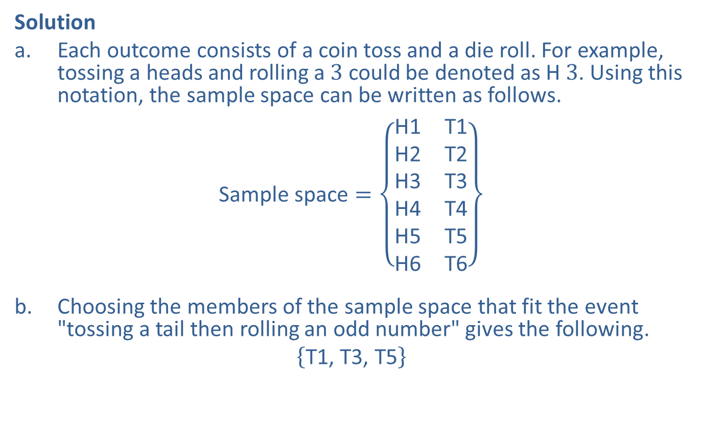
Example 4.1.1: Identifying Outcomes in a Sample Space or Event (cont.)
Solution
​Each outcome consists of a coin toss and a die roll. For example, tossing a heads and rolling a 3 could be denoted as H 3. Using this notation, the sample space can be written as follows.
​$\text{Sample} \text{space}=\left\{\begin{matrix}\text{H}\text{1} & \text{T}\text{1} \\ \text{H}\text{2} & \text{T}\text{2} \\ \text{H}\text{3} & \text{T}\text{3} \\ \text{H}\text{4} & \text{T}\text{4} \\ \text{H}\text{5} & \text{T}\text{5} \\ \text{H}\text{6} & \text{T}\text{6}\end{matrix}\right\}$
​Choosing the members of the sample space that fit the event "tossing a tail then rolling an odd number" gives the following.
​$\left\{\text{T}\text{1, }\text{T}\text{3, }\text{T}\text{5}\right\}$

Slide 6
Example 4.1.2: Using a Pattern to List All Outcomes in a Sample Space
Consider the experiment in which a red six-sided die and a blue six-sided die are rolled together.
​Use a pattern to help list the outcomes in the sample space.
​List the outcomes in the event "the sum of the numbers rolled on the two dice equals 6."

Slide 7
Example 4.1.2: Using a Pattern to List All Outcomes in a Sample Space (cont.)
Solution
​Although there are many patterns that could help us list all outcomes in the sample space, our pattern will be to start with keeping the red die at 1 and allowing the blue die to vary from 1 to 6.

Slide 8






Example 4.1.2: Using a Pattern to List All Outcomes in a Sample Space (cont.)
​There are six of these outcomes: , , , ,
, and . Next, we list all outcomes in which a 2 is rolled on the red die. Again, there are six outcomes of this form. The pattern continues until all 36 outcomes are listed.

Slide 9
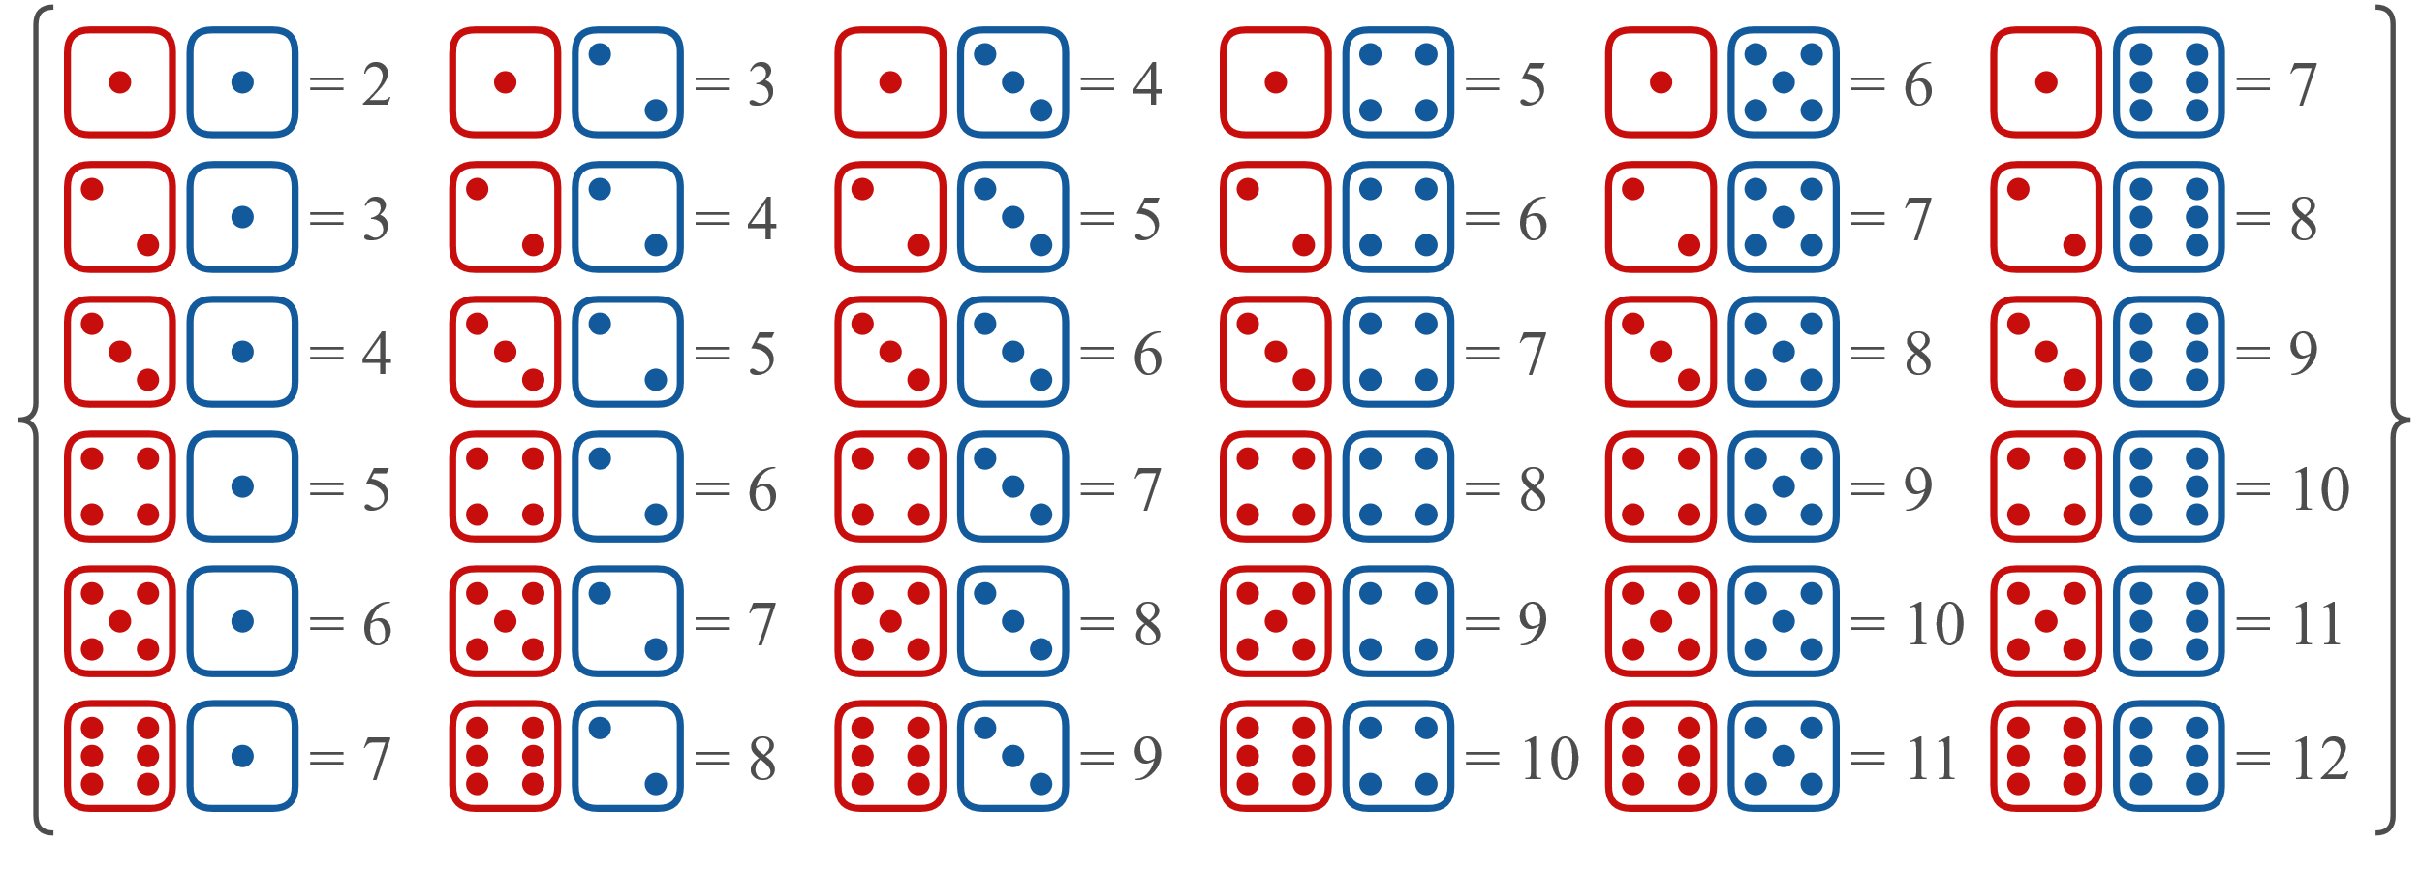
Example 4.1.2: Using a Pattern to List All Outcomes in a Sample Space (cont.)
​Sample space =
​

Slide 10

Example 4.1.2: Using a Pattern to List All Outcomes in a Sample Space (cont.)
​Note that rolling a 1 on the red die and a 2 on the blue die, denoted , is a different outcome than rolling a 2 on the red die and a 1 on the blue die, denoted .

Slide 11
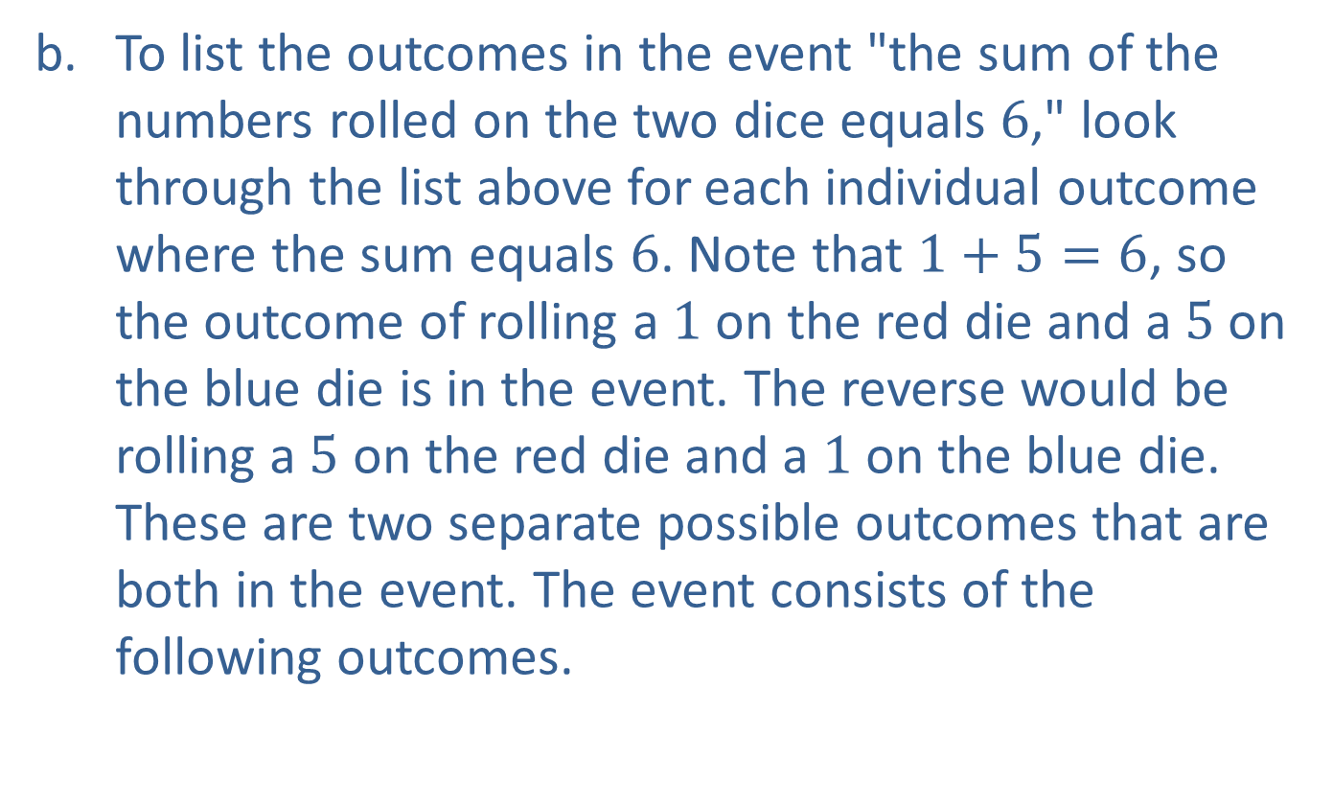
Example 4.1.2: Using a Pattern to List All Outcomes in a Sample Space (cont.)
​To list the outcomes in the event "the sum of the numbers rolled on the two dice equals 6," look through the list above for each individual outcome where the sum equals 6. Note that $1+5=6$, so the outcome of rolling a 1 on the red die and a 5 on the blue die is in the event. The reverse would be rolling a 5 on the red die and a 1 on the blue die. These are two separate possible outcomes that are both in the event. The event consists of the following outcomes.
​

Slide 12
Example 4.1.2: Using a Pattern to List All Outcomes in a Sample Space (cont.)

Slide 13
Caution
The sample space is the set of outcomes for an experiment, not the number of outcomes.

Slide 14
Example 4.1.3: Using a Tree Diagram to List All Outcomes in a Sample Space
Consider a litter of 3 puppies that are known to be only solid brown or spotted at birth. Use a tree diagram to list all the outcomes in the sample space for each puppy's coloring in regard to birth order.

Slide 15
Example 4.1.3: Using a Tree Diagram to List All Outcomes in a Sample Space (cont.)
Solution
The tree begins with the two possibilities for the first puppy—solid brown or spotted. It then branches for each of the other two births in the litter as shown.

Slide 16
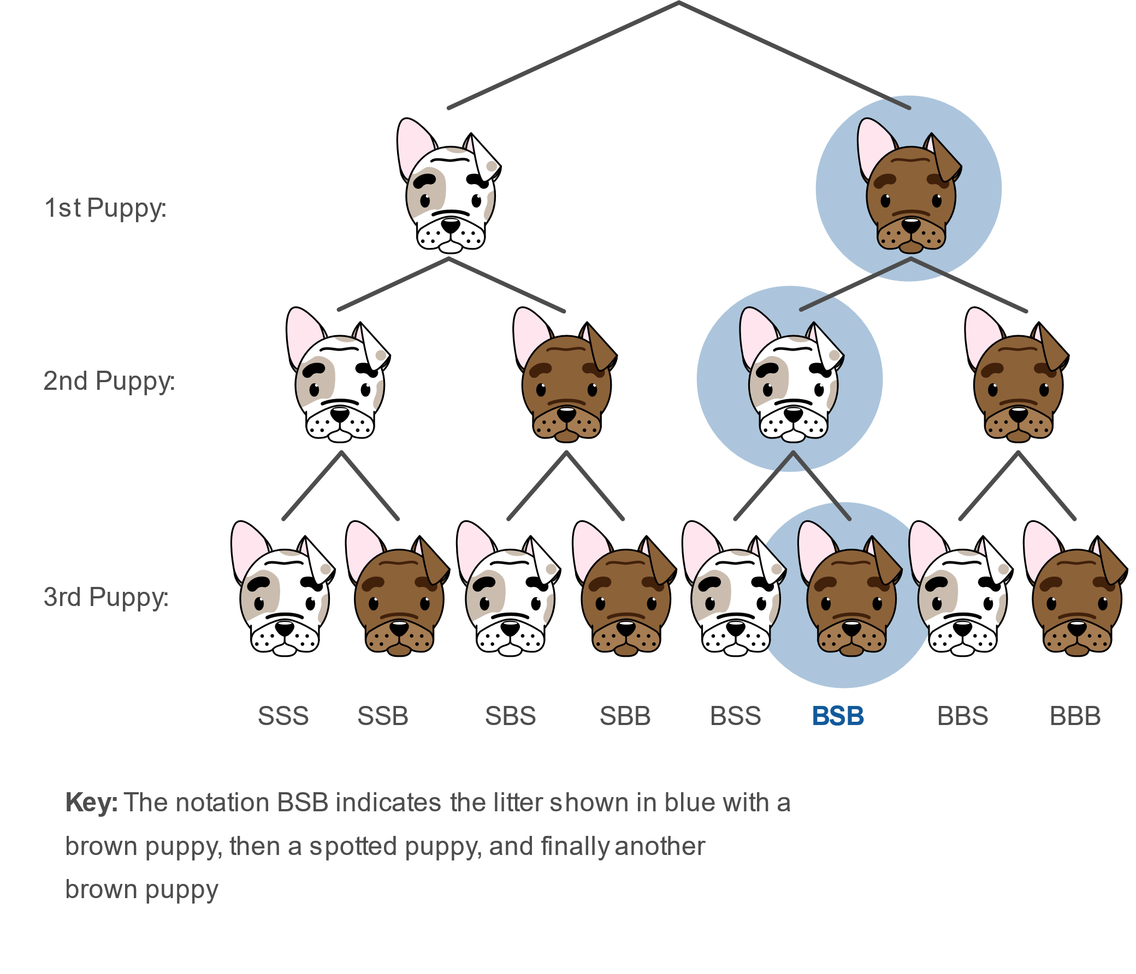
Example 4.1.3: Using a Tree Diagram to List All Outcomes in a Sample Space (cont.)

Slide 17

Example 4.1.3: Using a Tree Diagram to List All Outcomes in a Sample Space (cont.)
Using the tree diagram as a guide, the sample space can be written as follows.
$$\text{Sample} \text{space}=\left\{\begin{matrix}\text{SSS} & \text{SSB} & \text{SBS} & \text{SBB} \\ \text{BSS} & \text{BSB} & \text{BBS} & \text{BBB}\end{matrix}\right\}$$

Slide 18
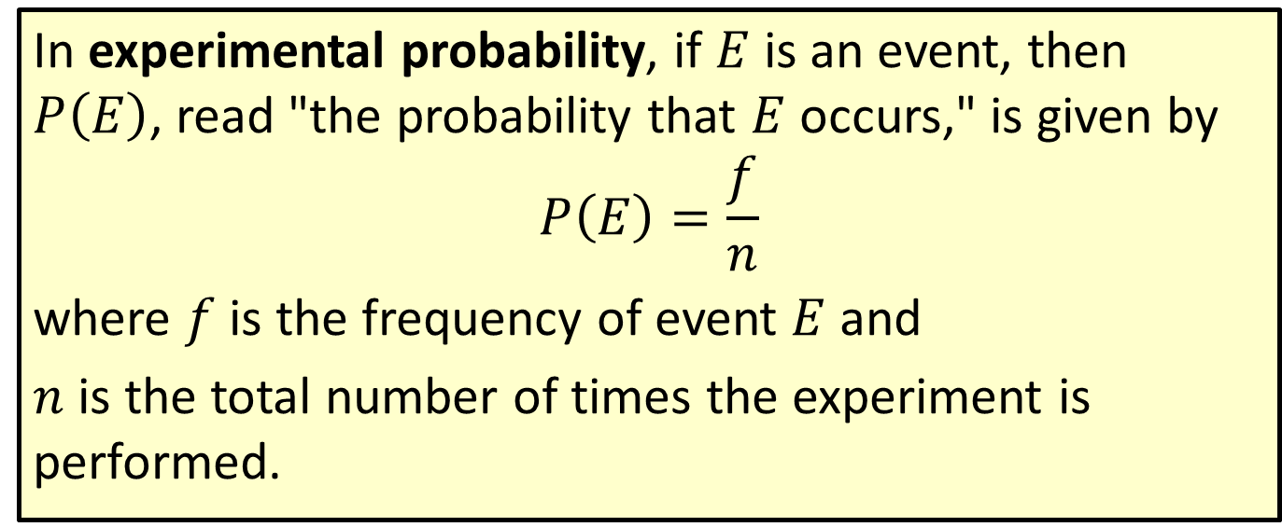
Formula: Experimental Probability
In experimental probability, if $E$ is an event, then $P⁡\left(E\right)$, read "the probability that $E$ occurs," is given by
$$P\left(E\right)=\frac{f}{n}$$
where $f$ is the frequency of event $E$ and
$n$ is the total number of times the experiment is performed.

Slide 19
Rounding Rule
When calculating probability, either give the exact fraction or a decimal rounded to four decimal places. If the probability is extremely small, it is permissible to round the decimal to the first nonzero digit.

Slide 20
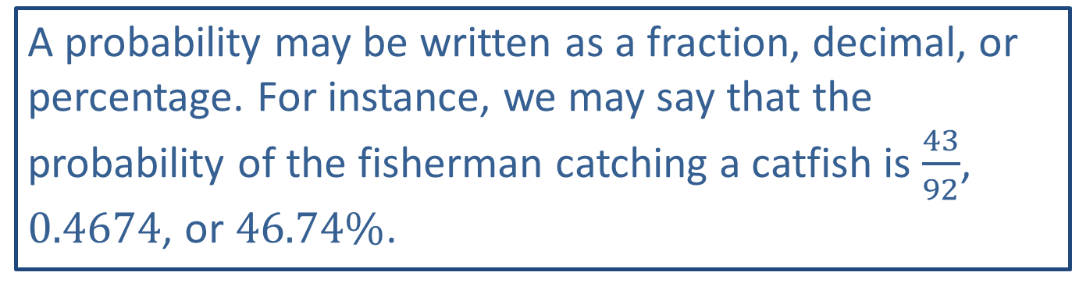
Side Note: Expressing Probability
A probability may be written as a fraction, decimal, or percentage. For instance, we may say that the probability of the fisherman catching a catfish is $\frac{43}{92}$, 0.4674, or $46.74\%$.

Slide 21
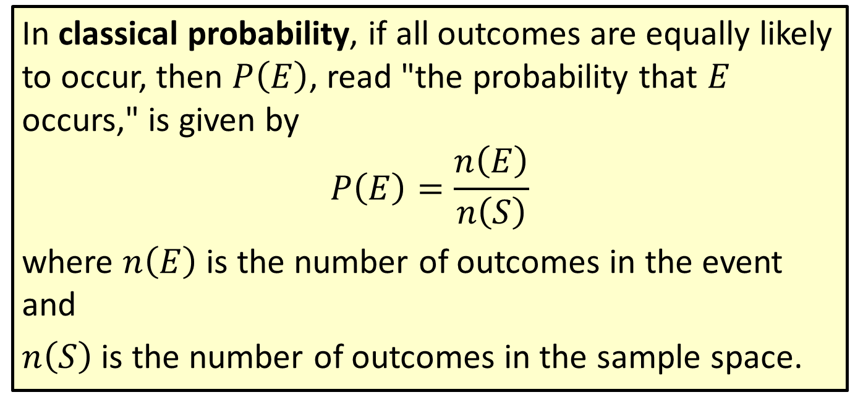
Formula: Classical Probability
In classical probability, if all outcomes are equally likely to occur, then $P⁡\left(E\right)$, read "the probability that $E$ occurs," is given by
$$P\left(E\right)=\frac{n\left(E\right)}{n\left(S\right)}$$
where $n⁡\left(E\right)$ is the number of outcomes in the event and
$n⁡\left(S\right)$ is the number of outcomes in the sample space.

Slide 22
Struck by Lightning
Many people have a greater chance of meeting someone who survived a lightning strike than someone who won the lottery. There are an estimated 1800 new thunderstorms being created around the world every minute and the odds against someone being struck by lightning is 606,944 to one. Unless you are Roy C. Sullivan. Mr. Sullivan was a former U.S. park ranger who was struck by lightning seven times in less than 36 years.

Slide 23
Subjective Probability, Experimental Probability, Classical Probability & Law Of Large Numbers
Definition
Subjective probability is an educated guess regarding the chance that an event will occur.
Experimental probability (or empirical probability) uses the outcomes obtained by repeatedly performing an experiment to calculate the probability.
Classical probability (or theoretical probability) is the most precise type of probability and can only be calculated when all possible outcomes in the sample space are known and equally likely to occur.
The Law of Large Numbers states that the greater the number of trials, the closer the experimental probability will be to the true probability.

Slide 24
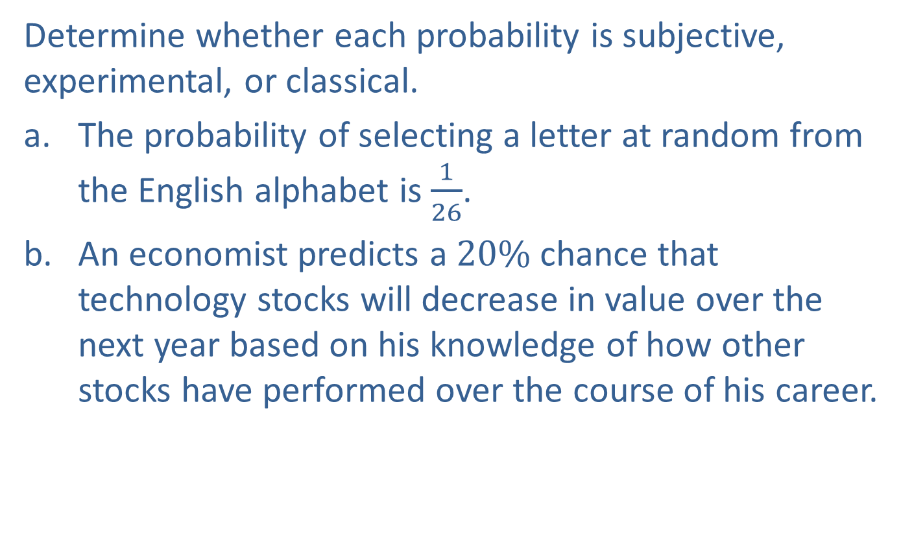
Example 4.1.4: Identifying Types of Probability
Determine whether each probability is subjective, experimental, or classical.
​The probability of selecting a letter at random from the English alphabet is $\frac{1}{26}$.
​An economist predicts a $20\%$ chance that technology stocks will decrease in value over the next year based on his knowledge of how other stocks have performed over the course of his career.

Slide 25
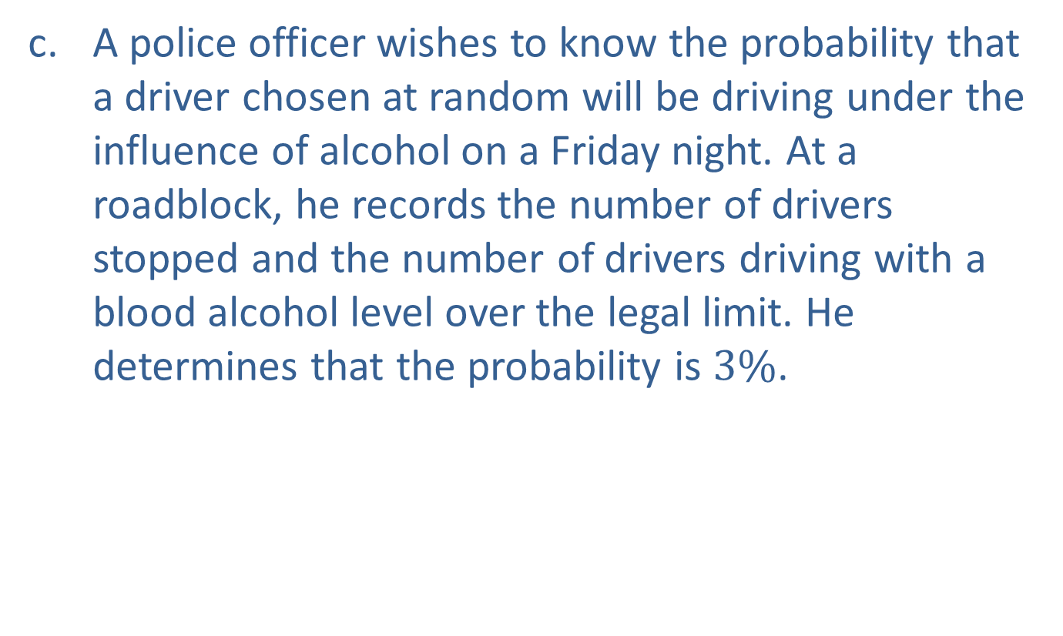
Example 4.1.4: Identifying Types of Probability (cont.)
​A police officer wishes to know the probability that a driver chosen at random will be driving under the influence of alcohol on a Friday night. At a roadblock, he records the number of drivers stopped and the number of drivers driving with a blood alcohol level over the legal limit. He determines that the probability is $3\%$.

Slide 26
Example 4.1.4: Identifying Types of Probability (cont.)
Solution
​All 26 outcomes are known and are equally likely to occur, so this is an example of classical probability.
​The economist is giving an educated guess; therefore, this is an example of subjective probability.
​The police officer's probability is based on the evidence gathered from the roadblock. Because not all drivers were evaluated at that roadblock, the probability is experimental.

Slide 27
Example 4.1.5: Calculating Classical Probability
Beck is allergic to peanuts. At a large dinner party one evening, he notices that the cheesecake options on the dessert table contain the following flavors: 10 slices of chocolate, 12 slices of caramel, 12 slices of chocolate peanut butter, and 8 slices of strawberry. Assume that the desserts are served to guests at random.
​What is the probability that Beck's cheesecake contains peanuts?
​What is the probability that Beck's dessert does not contain chocolate?

Slide 28
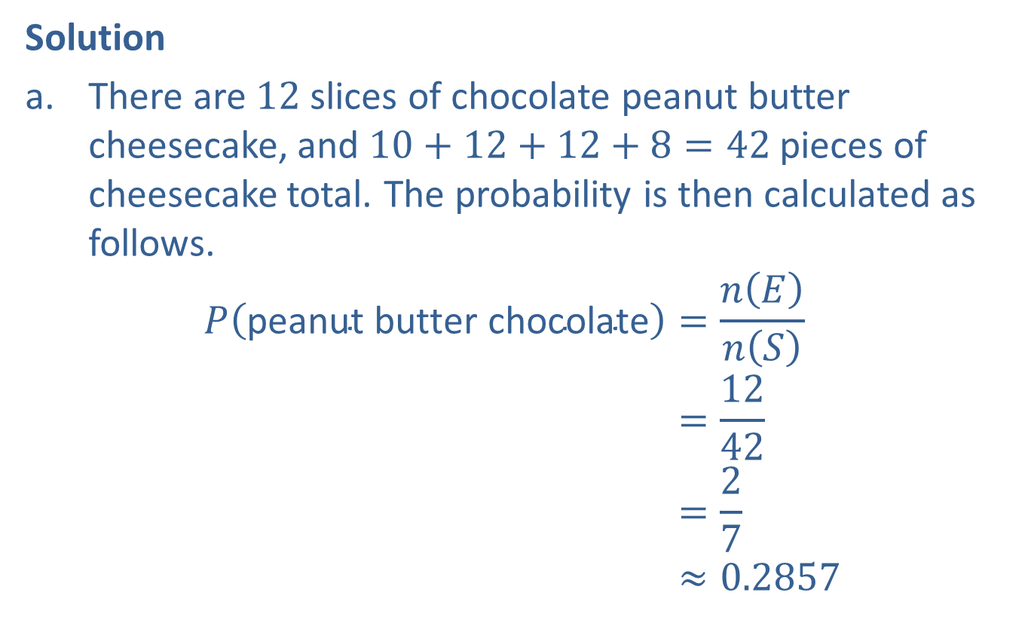
Example 4.1.5: Calculating Classical Probability (cont.)
Solution
​There are 12 slices of chocolate peanut butter cheesecake, and $10+12+12+8=42$ pieces of cheesecake total. The probability is then calculated as follows.
𝑃peanut butter chocolate=𝑛𝐸𝑛𝑆𝑃⁡peanut butter chocolate=1242𝑃⁡peanut butter chocolate=27𝑃⁡peanut butter chocolate≈0.2857

Slide 29
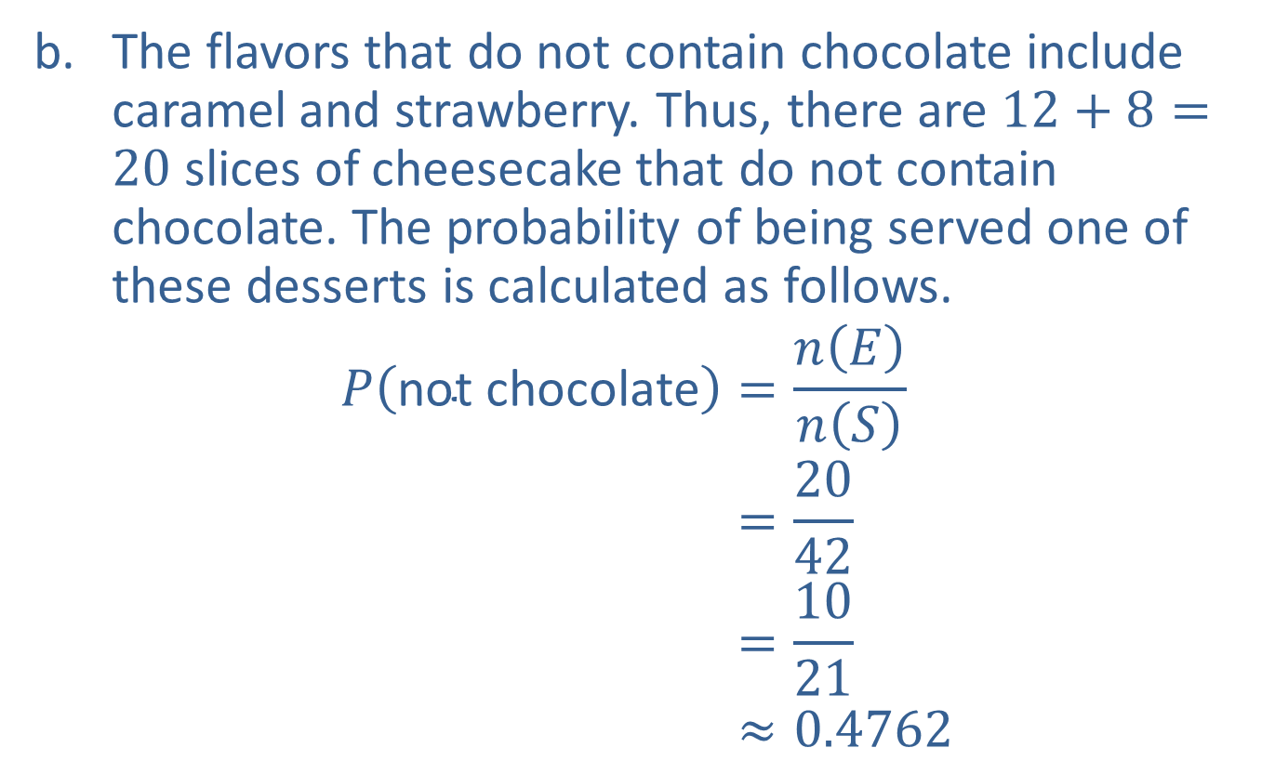
Example 4.1.5: Calculating Classical Probability (cont.)
​The flavors that do not contain chocolate include caramel and strawberry. Thus, there are $12+8=20$ slices of cheesecake that do not contain chocolate. The probability of being served one of these desserts is calculated as follows.
𝑃not chocolate=𝑛𝐸𝑛𝑆𝑃⁡not chocolate=2042𝑃⁡not chocolate=1021𝑃⁡not chocolate≈0.4762

Slide 30

Example 4.1.6: Calculating Classical Probability
Consider a beginning archer who only manages to hit the target $50\%$ of the time. What is the probability that in three shots, the archer will hit the target all three times?

Slide 31
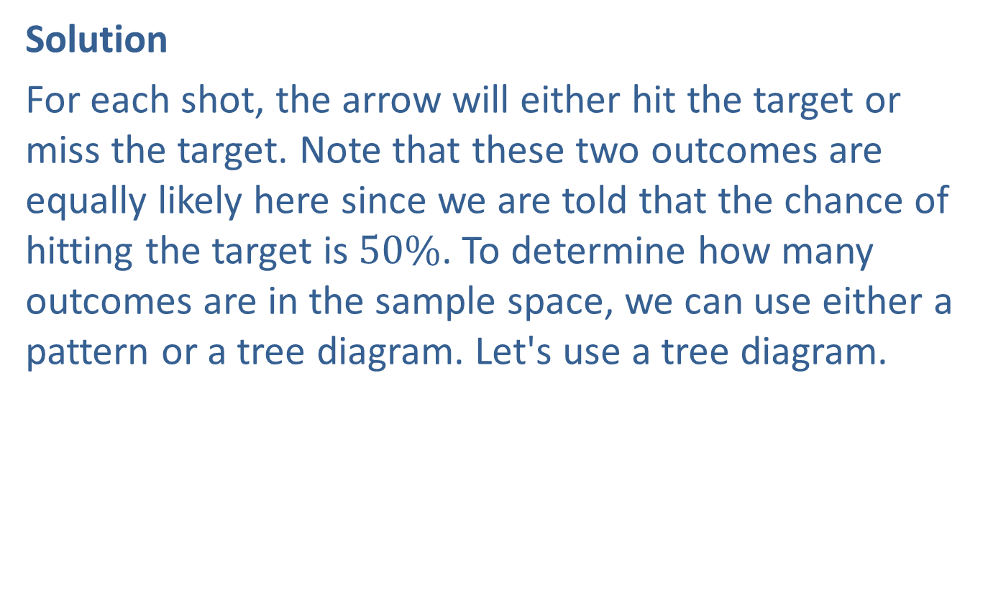
Example 4.1.6: Calculating Classical Probability (cont.)
Solution
For each shot, the arrow will either hit the target or miss the target. Note that these two outcomes are equally likely here since we are told that the chance of hitting the target is $50\%$. To determine how many outcomes are in the sample space, we can use either a pattern or a tree diagram. Let's use a tree diagram.

Slide 32
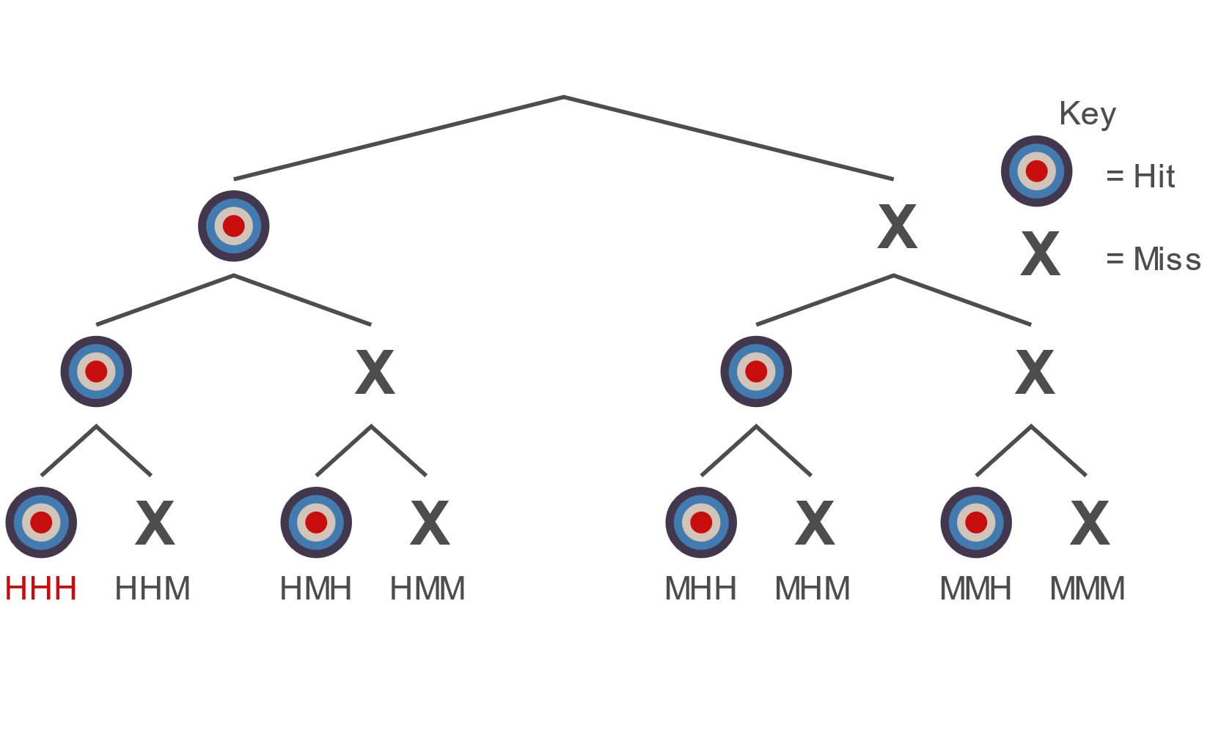
Example 4.1.6: Calculating Classical Probability (cont.)

Slide 33
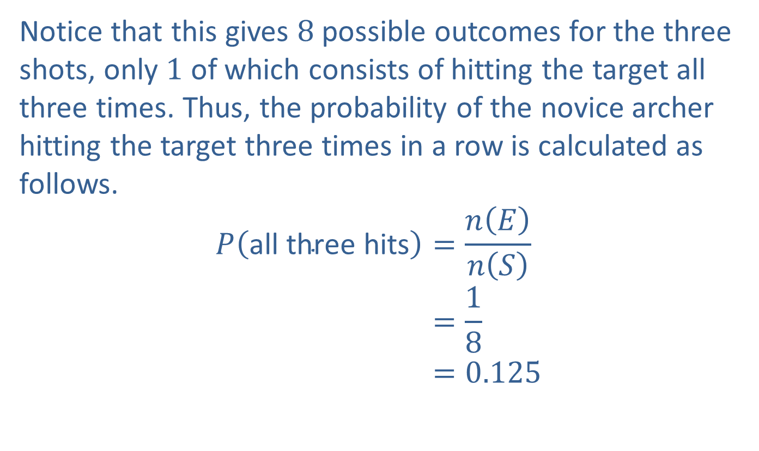
Example 4.1.6: Calculating Classical Probability (cont.)
Notice that this gives 8 possible outcomes for the three shots, only 1 of which consists of hitting the target all three times. Thus, the probability of the novice archer hitting the target three times in a row is calculated as follows.
𝑃all three hits=𝑛𝐸𝑛𝑆𝑃⁡all three hits=18𝑃⁡all three hits=0.125

Slide 34

Example 4.1.7: Calculating Classical Probability
Consider the novice archer again who hits the target $50\%$ of the time. Assume that six shots have been taken and each time the target was hit. What is the probability that the next shot taken will also hit the target?

Slide 35
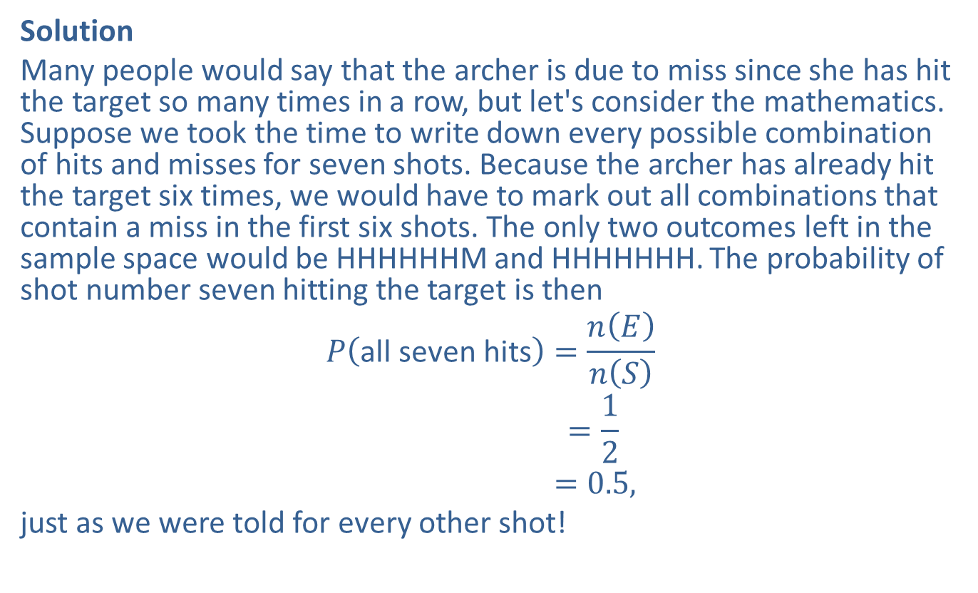
Example 4.1.7: Calculating Classical Probability (cont.)
Solution
Many people would say that the archer is due to miss since she has hit the target so many times in a row, but let's consider the mathematics. Suppose we took the time to write down every possible combination of hits and misses for seven shots. Because the archer has already hit the target six times, we would have to mark out all combinations that contain a miss in the first six shots. The only two outcomes left in the sample space would be HHHHHHM and HHHHHHH. The probability of shot number seven hitting the target is then
𝑃all seven hits=𝑛𝐸𝑛𝑆𝑃⁡all seven boys=12𝑃⁡all seven hits=0.5,
just as we were told for every other shot!

Slide 36
Example 4.1.8: Calculating Classical Probability
In biology, we learn that many diseases are genetic. One example of such a disease is Huntington's disease, which causes neurological disorders as a person ages. Each person has two huntingtin genes–one inherited from each parent. If an individual inherits a mutated huntingtin gene from either of his or her parents, he or she will develop the disease. On the TV show House, the character whom Dr. House calls " 13 " inherited this disease from her mother. Assume for a moment that " 13 " has a child with a person who has two healthy huntingtin genes. What is the probability that her child will develop Huntington's disease?

Slide 37
Example 4.1.8: Calculating Classical Probability (cont.)
Solution
So far, we have listed the outcomes of an experiment in an orderly fashion and by using a tree diagram. In biology, a Punnett square is commonly used to help list the outcomes of a genetic experiment. The mother's two alleles of a specific gene are listed along one side of a square, and the father's two alleles of the gene are listed along an adjacent side. We then fill in the square by writing in the four possible combinations of alleles inherited–one from each parent.
For this experiment, we know that each person has two huntingtin genes. We will label a mutated huntingtin gene with an uppercase "H" and an unaffected huntingtin gene with a lowercase "h." For this experiment, the mother has at least one mutated gene. Let's assume it is just one, so her genetic makeup would be written as Hh. She has a child with someone who has no affected huntingtin genes, so his genetic makeup can be written as hh. Let's write these gene combinations on the sides of a Punnett square.

Slide 38

Example 4.1.8: Calculating Classical Probability (cont.)

Slide 39
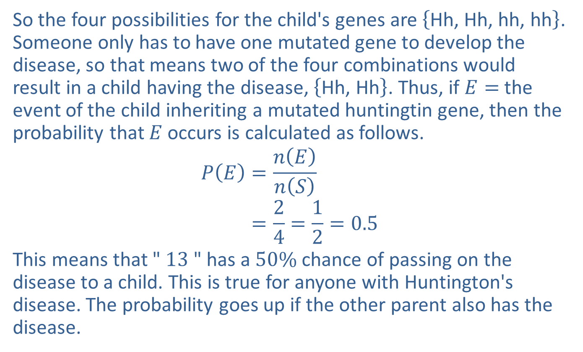
Example 4.1.8: Calculating Classical Probability (cont.)
So the four possibilities for the child's genes are $\left\{\text{Hh}\text{, }\text{Hh}\text{, }\text{hh}\text{, }\text{hh}\right\}$. Someone only has to have one mutated gene to develop the disease, so that means two of the four combinations would result in a child having the disease, $\left\{\text{Hh}\text{, }\text{Hh}\right\}$. Thus, if $E=$ the event of the child inheriting a mutated huntingtin gene, then the probability that $E$ occurs is calculated as follows.
𝑃𝐸=𝑛𝐸𝑛𝑆𝑃⁡𝐸=24=12=0.5
This means that " 13 " has a $50\%$ chance of passing on the disease to a child. This is true for anyone with Huntington's disease. The probability goes up if the other parent also has the disease.

Slide 40
Side Note:
The gene name (huntingtin) and the disease (Huntington's) are spelled differently.

Slide 41
Side Note: Punnett Square
Reginald Punnett (1875-1967) was a British geneticist who developed the method discussed in Example 4.1.8, which is named after him, called the Punnett square. He is also known for cofounding the Journal of Genetics and writing one of the first textbooks on genetics.

