Slide 1
Section 4.2
Addition Rules for Probability

Slide 2
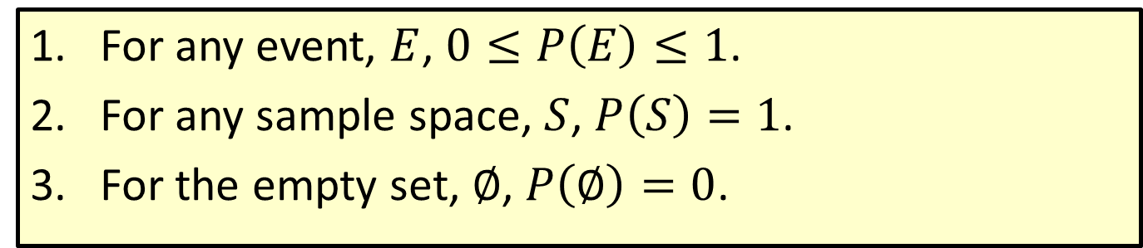
Properties: Properties of Probability
​For any event, $E$, $0≤P\left(E\right)≤1$.
​For any sample space, $S$, $P\left(S\right)=1$.
​For the empty set, ∅, $P\left(∅\right)=0$.

Slide 3
Memory Booster
When an event includes the entire sample space, the probability is equal to 1.

Slide 4
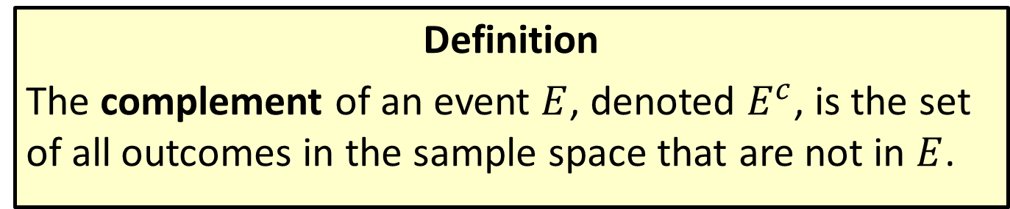
Definition
Definition
The complement of an event $E$, denoted $E^{c}$, is the set of all outcomes in the sample space that are not in $E$.

Slide 5
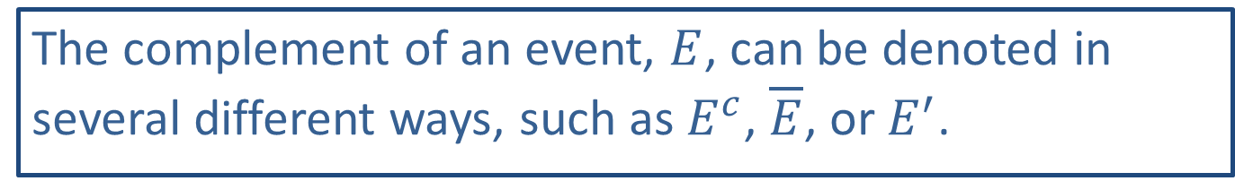
Math Symbols
The complement of an event, $E$, can be denoted in several different ways, such as $E^{c}$, $\overline{E}$, or $E^{′}$.

Slide 6
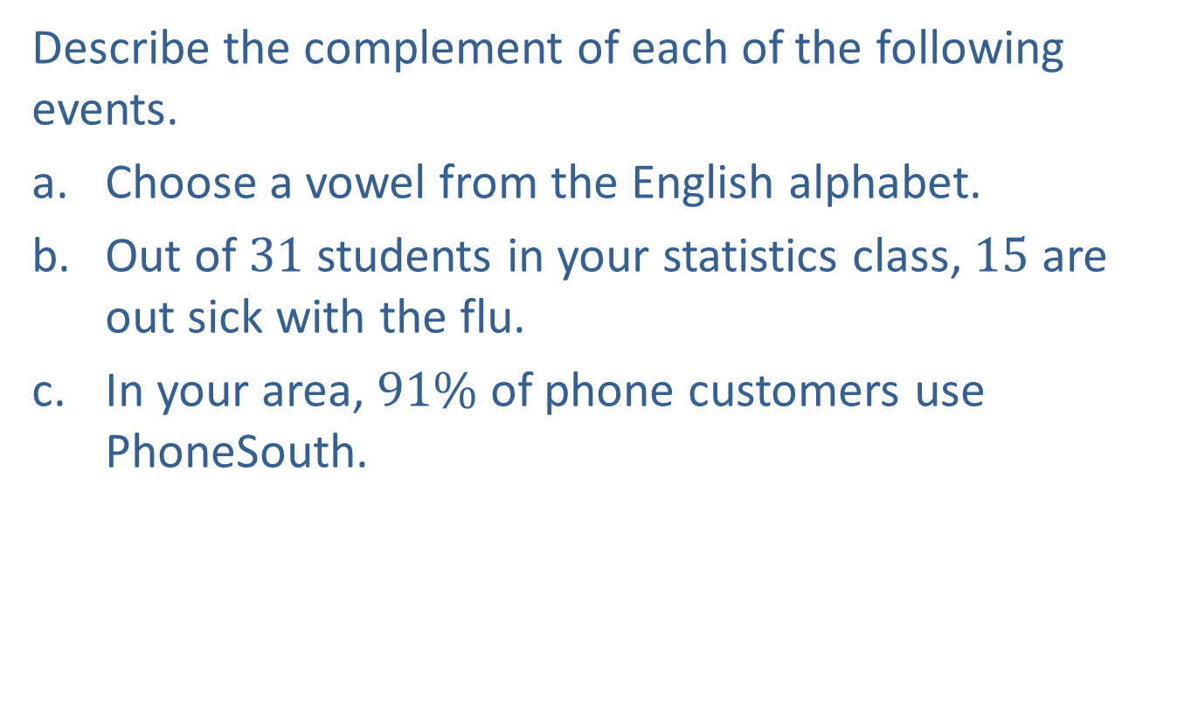
Example 4.2.1: Describing the Complement of an Event
Describe the complement of each of the following events.
​Choose a vowel from the English alphabet.
​Out of 31 students in your statistics class, 15 are out sick with the flu.
​In your area, $91\%$ of phone customers use PhoneSouth.

Slide 7
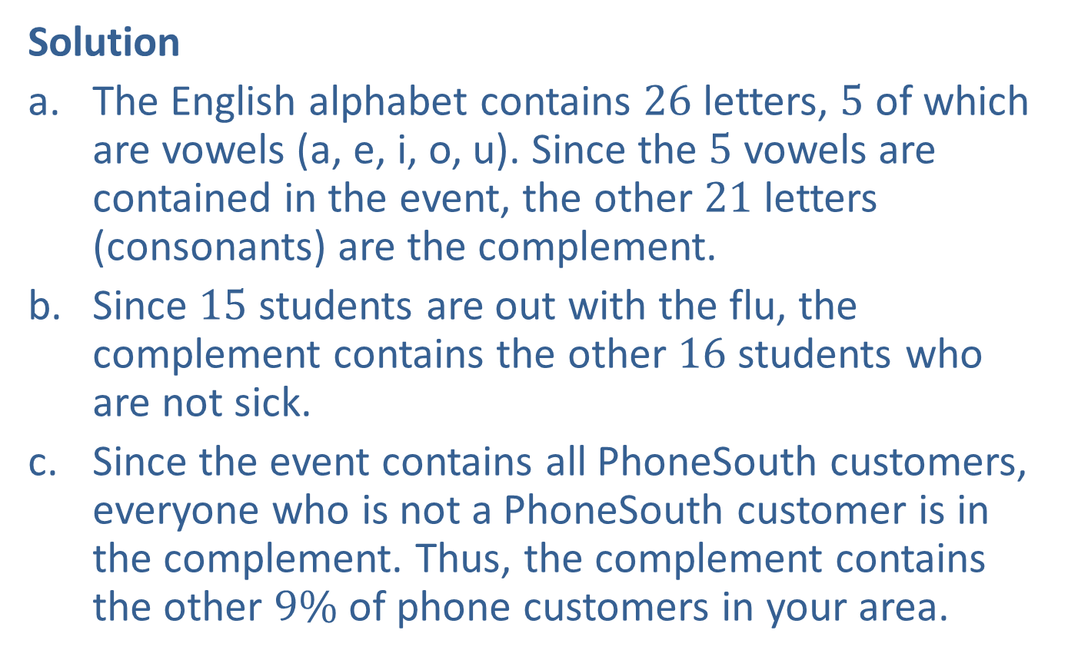
Example 4.2.1: Describing the Complement of an Event (cont.)
Solution
​The English alphabet contains 26 letters, 5 of which are vowels (a, e, i, o, u). Since the 5 vowels are contained in the event, the other 21 letters (consonants) are the complement.
​Since 15 students are out with the flu, the complement contains the other 16 students who are not sick.
​Since the event contains all PhoneSouth customers, everyone who is not a PhoneSouth customer is in the complement. Thus, the complement contains the other $9\%$ of phone customers in your area.

Slide 8
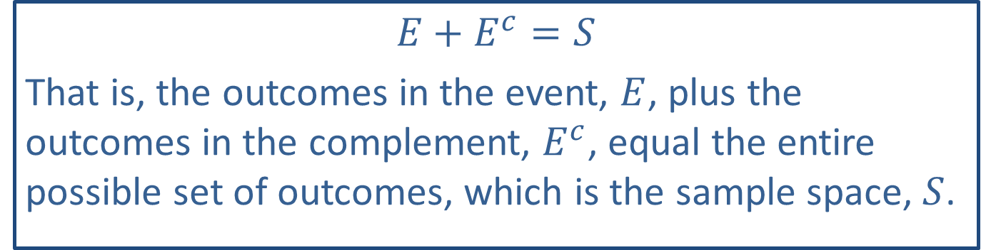
Memory Booster
$$E+E^{c}=S$$
That is, the outcomes in the event, $E$, plus the outcomes in the complement, $E^{c}$, equal the entire possible set of outcomes, which is the sample space, $S$.

Slide 9
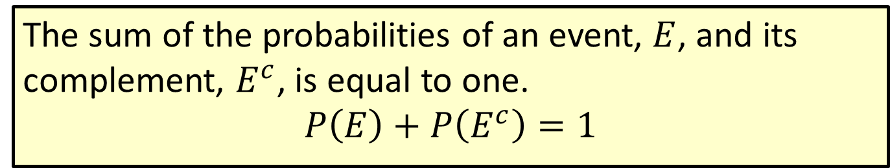
Formula: Complement Rule for Probability
The sum of the probabilities of an event, $E$, and its complement, $E^{c}$, is equal to one.
$$P\left(E\right)+P\left(E^{c}\right)=1$$

Slide 10
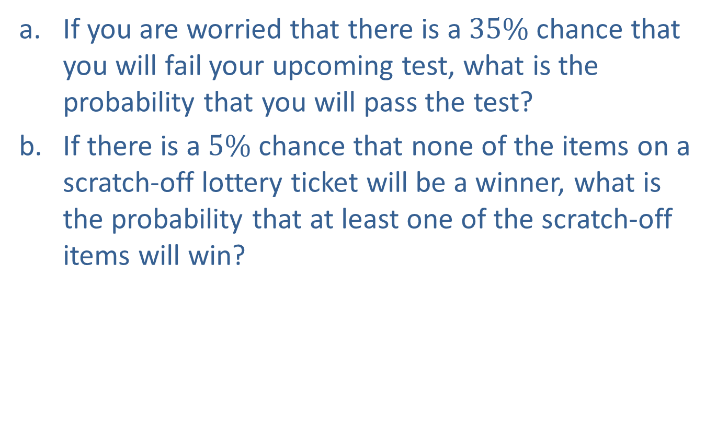
Example 4.2.2: Using the Complement Rule for Probability
​If you are worried that there is a $35\%$ chance that you will fail your upcoming test, what is the probability that you will pass the test?
​If there is a $5\%$ chance that none of the items on a scratch-off lottery ticket will be a winner, what is the probability that at least one of the scratch-off items will win?

Slide 11
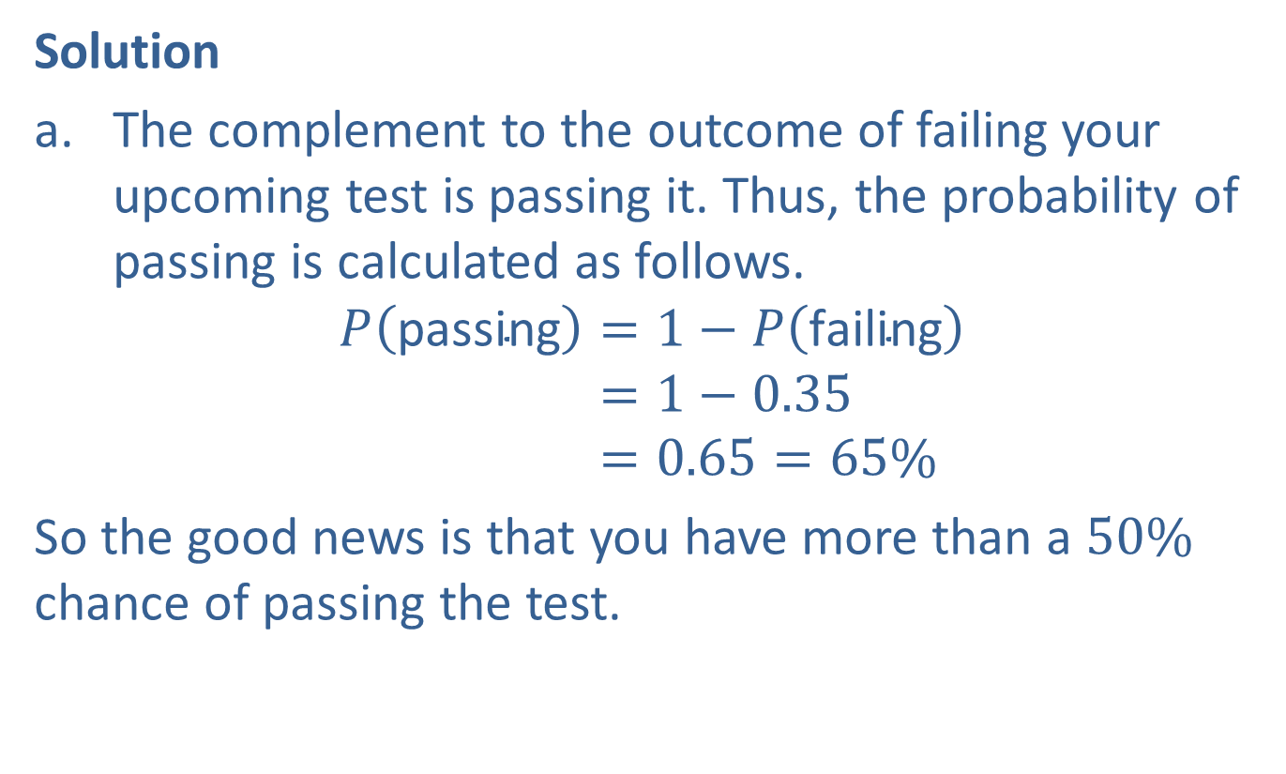
Example 4.2.2: Using the Complement Rule for Probability (cont.)
Solution
​The complement to the outcome of failing your upcoming test is passing it. Thus, the probability of passing is calculated as follows.
𝑃passing=1−𝑃failing𝑃⁡passing=1−0.35𝑃⁡passing=0.65=65%
​So the good news is that you have more than a $50\%$ chance of passing the test.

Slide 12
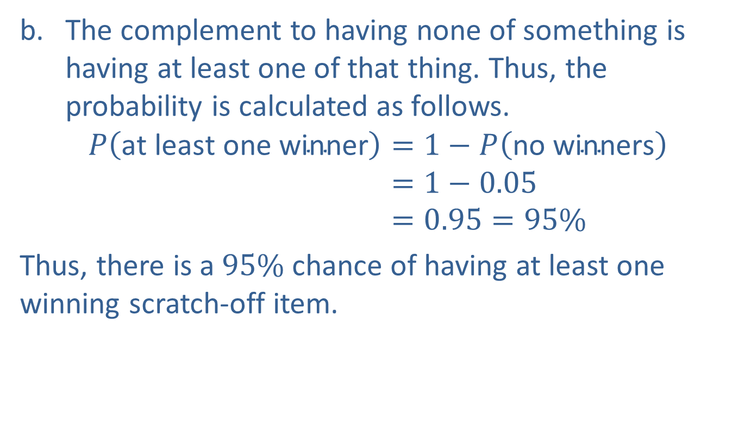
Example 4.2.2: Using the Complement Rule for Probability (cont.)
​The complement to having none of something is having at least one of that thing. Thus, the probability is calculated as follows.
𝑃at least one winner=1−𝑃no winners𝑃⁡at least one winner=1−0.05𝑃⁡at least one winner=0.95=95%
​Thus, there is a $95\%$ chance of having at least one winning scratch-off item.

Slide 13
Example 4.2.3: Using the Complement Rule for Probability
Roll a pair of standard six-sided dice. What is the probability that neither die is a three?

Slide 14
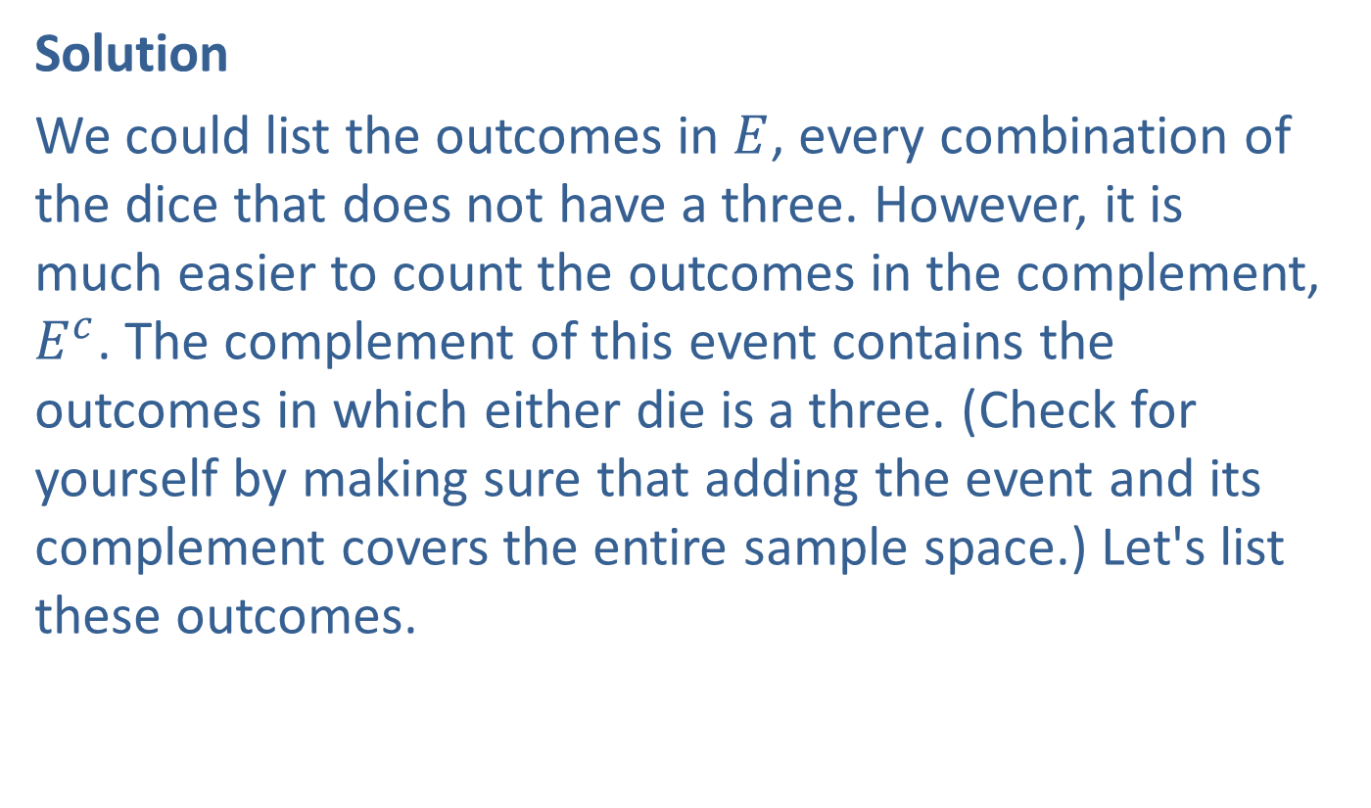
Example 4.2.3: Using the Complement Rule for Probability (cont.)
Solution
We could list the outcomes in $E$, every combination of the dice that does not have a three. However, it is much easier to count the outcomes in the complement, $E^{c}$. The complement of this event contains the outcomes in which either die is a three. (Check for yourself by making sure that adding the event and its complement covers the entire sample space.) Let's list these outcomes.

Slide 15
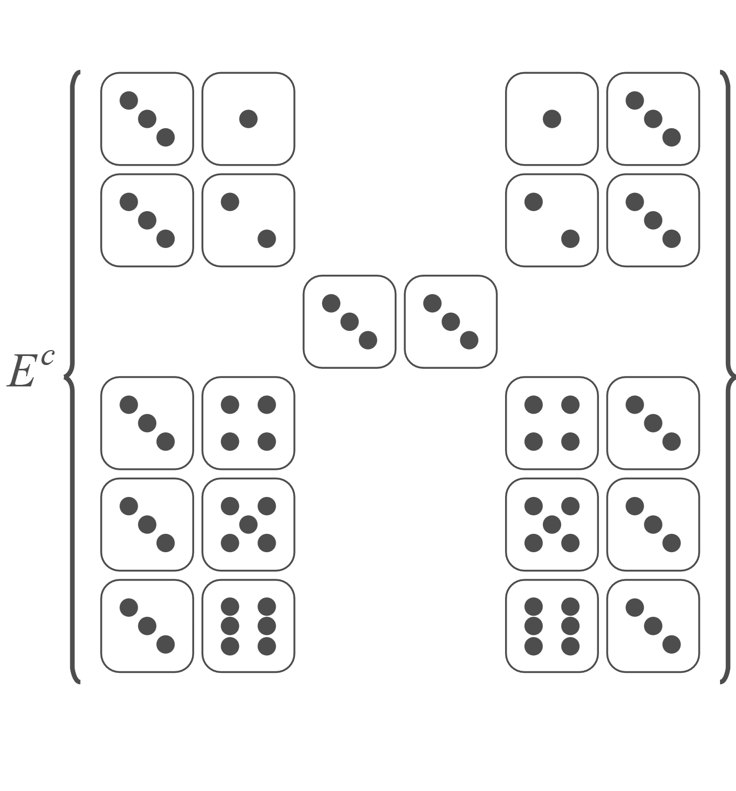
Example 4.2.3: Using the Complement Rule for Probability (cont.)

Slide 16
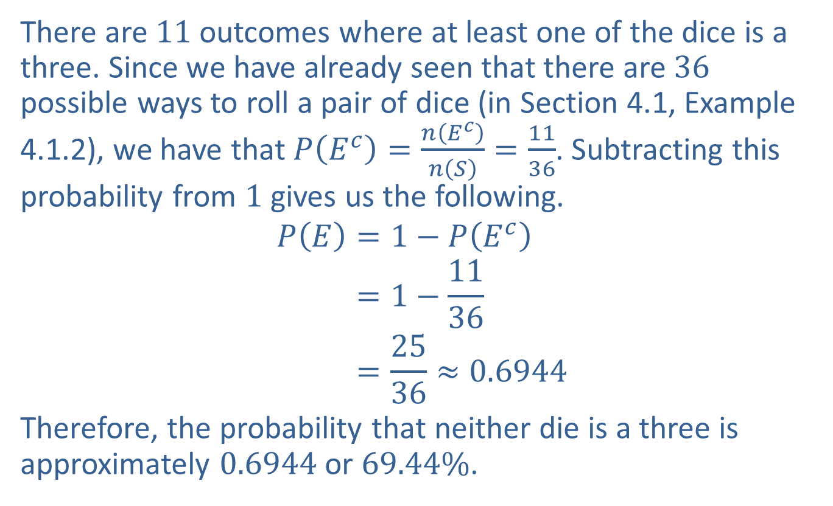
Example 4.2.3: Using the Complement Rule for Probability (cont.)
There are 11 outcomes where at least one of the dice is a three. Since we have already seen that there are 36 possible ways to roll a pair of dice (in Section 4.1, Example 4.1.2), we have that $P\left(E^{c}\right)=\frac{n\left(E^{c}\right)}{n\left(S\right)}=\frac{11}{36}$. Subtracting this probability from 1 gives us the following.
𝑃𝐸=1−𝑃𝐸𝑐𝑃⁡𝐸=1−1136𝑃⁡𝐸=2536≈0.6944
Therefore, the probability that neither die is a three is approximately 0.6944 or $69.44\%$.

Slide 17
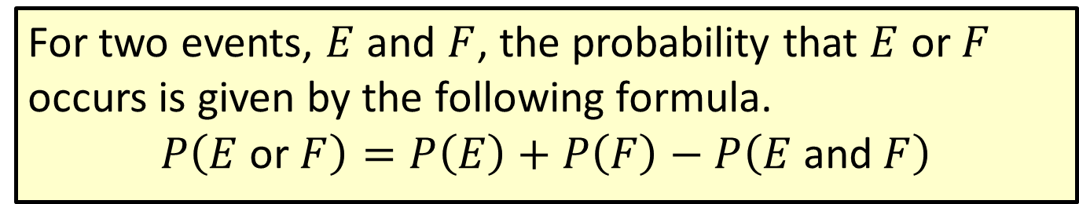
Formula: Addition Rule for Probability
For two events, $E$ and $F$, the probability that $E$ or $F$ occurs is given by the following formula.
$$P\left(E \text{or} F\right)=P\left(E\right)+P\left(F\right)−P\left(E \text{and} F\right)$$

Slide 18
Example 4.2.4: Using the Addition Rule for Probability
Ceresa is looking for a new condo to rent. Ceresa's realtor has provided her with the following list of amenities for 17 available properties. The list contains the following.
​Close to the subway: 6 properties
​Low maintenance fee: 7 properties
​Green space: 5 properties
​Newly renovated: 2 properties
​Close to the subway and low maintenance fee: 2 properties
​Green space and newly renovated: 1 property
If Ceresa's realtor selects the first condo they visit at random, what is the probability that the property is either close to the subway or has a low maintenance fee?

Slide 19
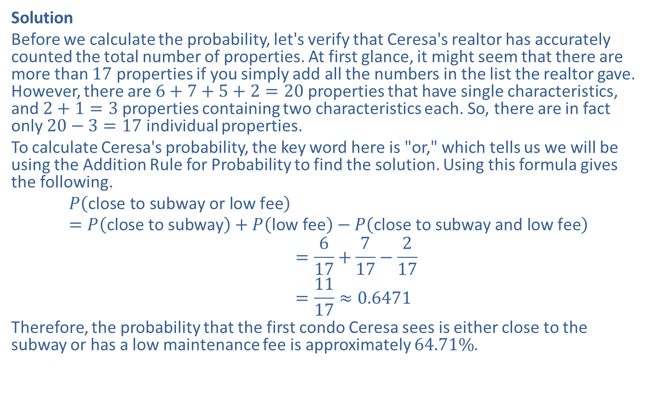
Example 4.2.4: Using the Addition Rule for Probability (cont.)
Solution
Before we calculate the probability, let's verify that Ceresa's realtor has accurately counted the total number of properties. At first glance, it might seem that there are more than 17 properties if you simply add all the numbers in the list the realtor gave. However, there are $6+7+5+2=20$ properties that have single characteristics, and $2+1=3$ properties containing two characteristics each. So, there are in fact only $20−3=17$ individual properties.
To calculate Ceresa's probability, the key word here is "or," which tells us we will be using the Addition Rule for Probability to find the solution. Using this formula gives the following.
𝑃close to subway or low fee=𝑃close to subway+𝑃low fee−𝑃close to subway and low fee𝑃⁡close to subway or low fee=617+717−217𝑃⁡close to subway or low fee=1117≈0.6471
Therefore, the probability that the first condo Ceresa sees is either close to the subway or has a low maintenance fee is approximately $64.71\%$.

Slide 20
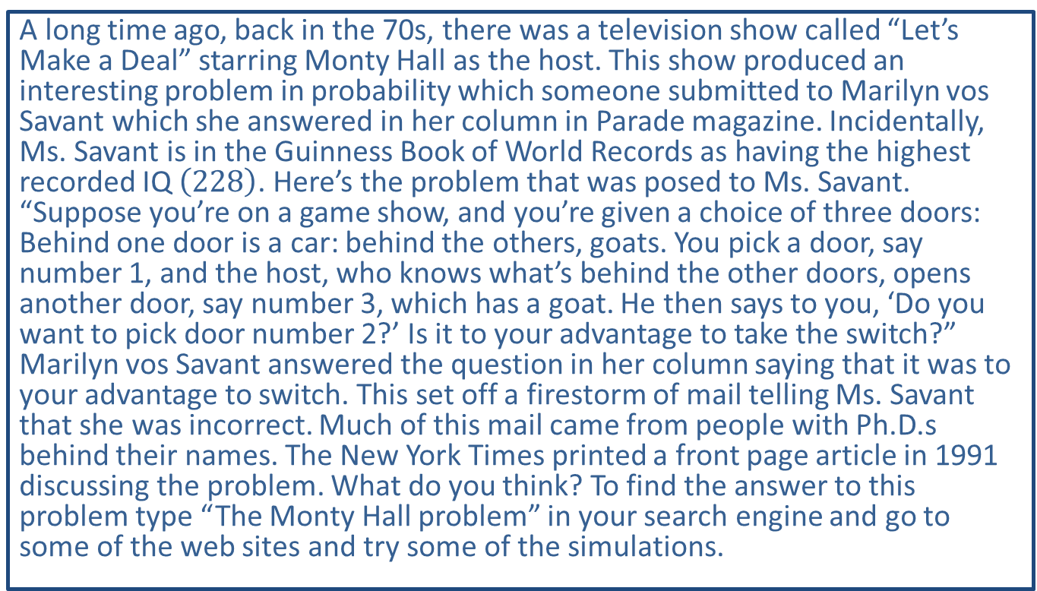
Let's make a Deal
A long time ago, back in the 70s, there was a television show called “Let’s Make a Deal” starring Monty Hall as the host. This show produced an interesting problem in probability which someone submitted to Marilyn vos Savant which she answered in her column in Parade magazine. Incidentally, Ms. Savant is in the Guinness Book of World Records as having the highest recorded IQ $\left(228\right)$. Here’s the problem that was posed to Ms. Savant. “Suppose you’re on a game show, and you’re given a choice of three doors: Behind one door is a car: behind the others, goats. You pick a door, say number 1, and the host, who knows what’s behind the other doors, opens another door, say number 3, which has a goat. He then says to you, ‘Do you want to pick door number 2?’ Is it to your advantage to take the switch?” Marilyn vos Savant answered the question in her column saying that it was to your advantage to switch. This set off a firestorm of mail telling Ms. Savant that she was incorrect. Much of this mail came from people with Ph.D.s behind their names. The New York Times printed a front page article in 1991 discussing the problem. What do you think? To find the answer to this problem type “The Monty Hall problem” in your search engine and go to some of the web sites and try some of the simulations.

Slide 21
Example 4.2.5: Using the Addition Rule for Probability
Suppose that after a vote in the US Senate on a proposed health care bill, the following table shows the breakdown of the votes by party.
Votes on Health Care Bill
 | Voted in Favor | Voted Against
Democrat | 23 | 21
Republican | 43 | 7
Independent | 2 | 4
If a lobbyist stops a random senator after the vote, what is the probability that this senator will either be a Republican or have voted against the bill?

Slide 22
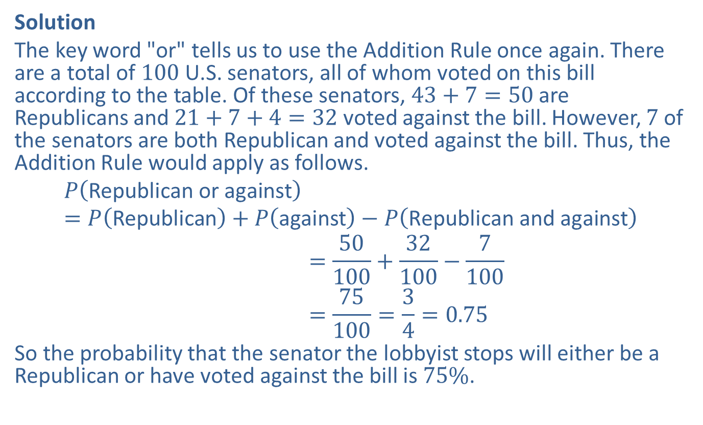
Example 4.2.5: Using the Addition Rule for Probability (cont.)
Solution
The key word "or" tells us to use the Addition Rule once again. There are a total of 100 U.S. senators, all of whom voted on this bill according to the table. Of these senators, $43+7=50$ are Republicans and $21+7+4=32$ voted against the bill. However, 7 of the senators are both Republican and voted against the bill. Thus, the Addition Rule would apply as follows.
𝑃Republican or against=𝑃Republican+𝑃against−𝑃Republican and against𝑃⁡Republican or against=50100+32100−7100𝑃⁡Republican or against=75100=34=0.75
So the probability that the senator the lobbyist stops will either be a Republican or have voted against the bill is $75\%$.

Slide 23
Example 4.2.6: Using the Addition Rule for Probability
Roll a pair of dice. What is the probability of rolling either a total less than four or a total equal to ten?

Slide 24
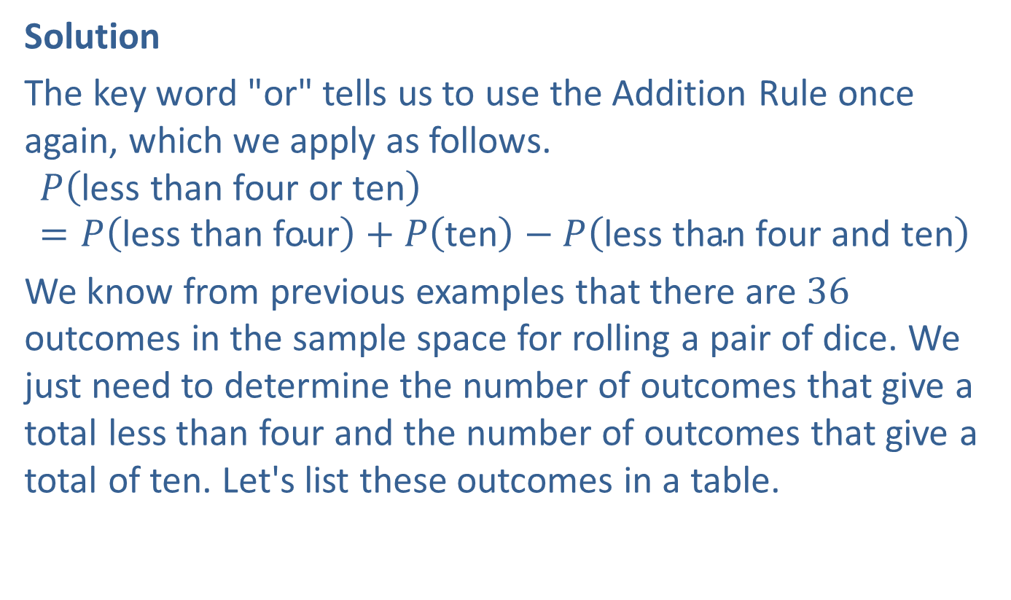
Example 4.2.6: Using the Addition Rule for Probability (cont.)
Solution
The key word "or" tells us to use the Addition Rule once again, which we apply as follows.
$$P\left(\text{less} \text{than} \text{four} \text{or} \text{ten}\right)=P\left(\text{less} \text{than} \text{four}\right)+P\left(\text{ten}\right)−P\left(\text{less} \text{than} \text{four} \text{and} \text{ten}\right)$$
We know from previous examples that there are 36 outcomes in the sample space for rolling a pair of dice. We just need to determine the number of outcomes that give a total less than four and the number of outcomes that give a total of ten. Let's list these outcomes in a table.

Slide 25
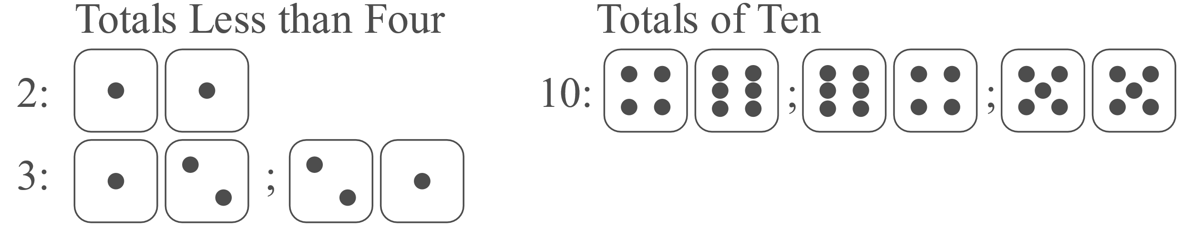
Example 4.2.6: Using the Addition Rule for Probability (cont.)

Slide 26
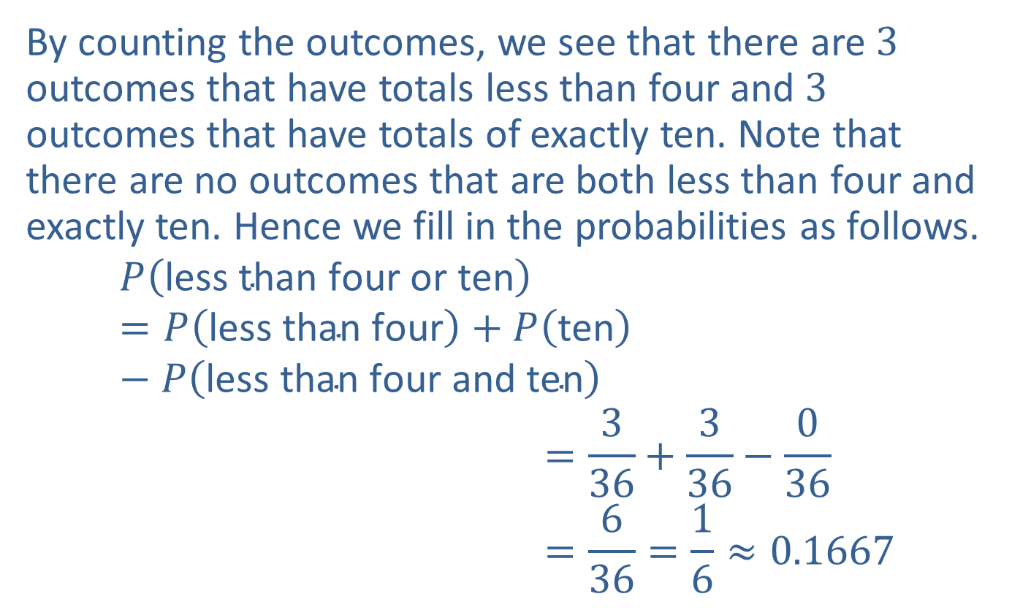
Example 4.2.6: Using the Addition Rule for Probability (cont.)
By counting the outcomes, we see that there are 3 outcomes that have totals less than four and 3 outcomes that have totals of exactly ten. Note that there are no outcomes that are both less than four and exactly ten. Hence we fill in the probabilities as follows.
𝑃less than four or ten=𝑃less than four+𝑃ten−𝑃less than four and ten𝑃⁡less than four or ten=336+336−036𝑃⁡less than four or ten=636=16≈0.1667

Slide 27
Mutually Exclusive
Definition
Mutually exclusive events have no outcomes in common.

Slide 28
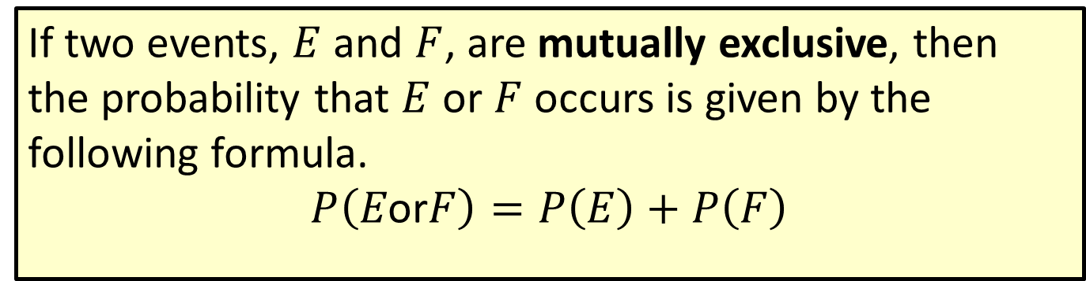
Formula: Addition Rule for Probability of Mutually Exclusive Events
If two events, $E$ and $F$, are mutually exclusive, then the probability that $E$ or $F$ occurs is given by the following formula.
$$P\left(E\text{or}F\right)=P\left(E\right)+P\left(F\right)$$

Slide 29
Example 4.2.7: Using the Addition Rule for Probability of Mutually Exclusive Events
Caleb is very excited that it's finally time to purchase his first new car. After much thought, he has narrowed his choices down to four. Because it has taken him so long to make up his mind, his friends have started to bet on which car he will choose. They have given each car a probability based on how likely they think Caleb is to choose that car. Devin is betting that Caleb will choose either the Toyota or the Jeep. Find the probability that Devin is right.
Toyota: 0.40
Honda: 0.10
Ford: 0.10
Jeep: 0.35
Other Car: 0.05

Slide 30
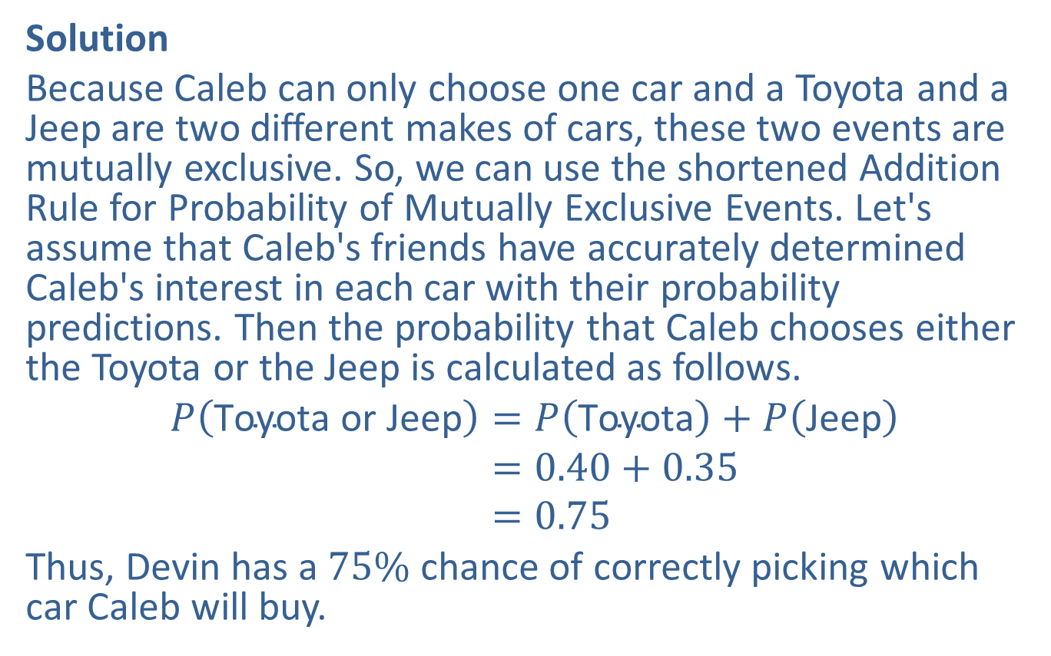
Example 4.2.7: Using the Addition Rule for Probability of Mutually Exclusive Events (cont.)
Solution
Because Caleb can only choose one car and a Toyota and a Jeep are two different makes of cars, these two events are mutually exclusive. So, we can use the shortened Addition Rule for Probability of Mutually Exclusive Events. Let's assume that Caleb's friends have accurately determined Caleb's interest in each car with their probability predictions. Then the probability that Caleb chooses either the Toyota or the Jeep is calculated as follows.
𝑃Toyota or Jeep=𝑃Toyota+𝑃Jeep𝑃⁡Toyota or Jeep=0.40+0.35𝑃⁡Toyota or Jeep=0.75
Thus, Devin has a $75\%$ chance of correctly picking which car Caleb will buy.

Slide 31
Example 4.2.8: Using the Extended Addition Rule for Probability of Mutually Exclusive Events
At a certain major exit on the interstate, past experience tells us that the probabilities of a truck driver refueling at each of the five possible gas stations are given in the following table. Assuming that the truck driver will refuel at only one of the gas stations (thus making the events mutually exclusive), what is the probability that the driver will refuel at Shell, Exxon, or Chevron?

Slide 32
Example 4.2.8: Using the Extended Addition Rule for Probability of Mutually Exclusive Events (cont.)
Probabilities of Refueling
Gas Station | Probability
BP | 0.0351
Chevron | 0.1539
Exxon | 0.2793
Shell | 0.3207
Texaco | 0.2110

Slide 33
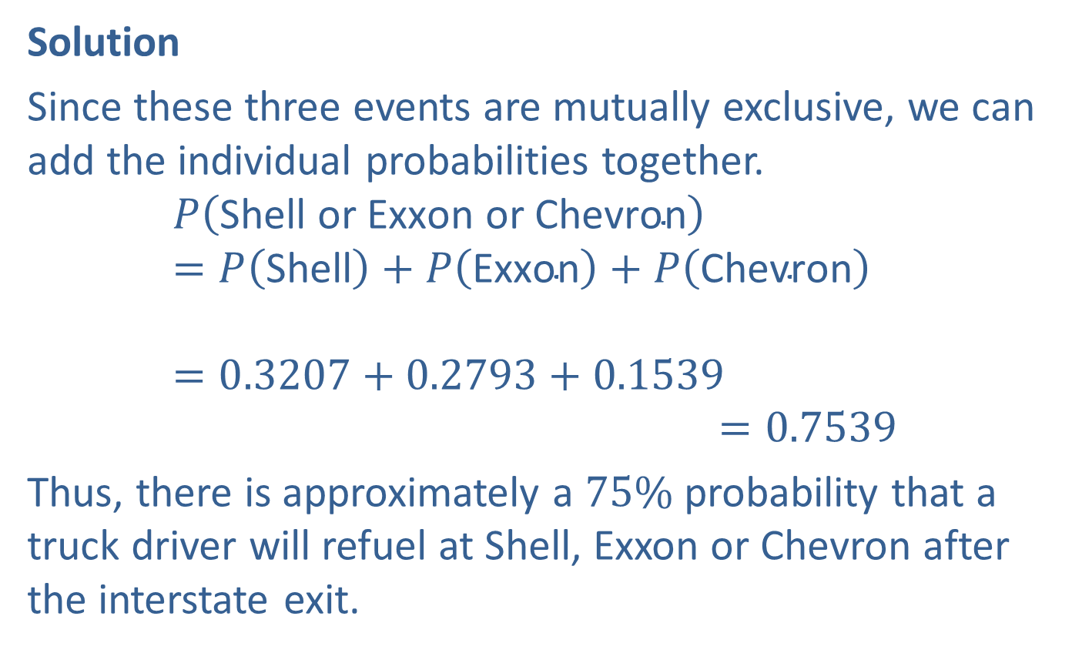
Example 4.2.8: Using the Extended Addition Rule for Probability of Mutually Exclusive Events (cont.)
Solution
Since these three events are mutually exclusive, we can add the individual probabilities together.
𝑃Shell or Exxon or Chevron=𝑃Shell+𝑃Exxon+𝑃Chevron𝑃⁡Shell or Exxon or Chevron=0.3207+0.2793+0.1539𝑃⁡Shell or Exxon or Chevron=0.7539
Thus, there is approximately a $75\%$ probability that a truck driver will refuel at Shell, Exxon or Chevron after the interstate exit.

