Slide 1
Section 4.3
Multiplication Rules for Probability

Slide 2
Multistage Experiment, With Replacement & Independent
Definition
A multistage experiment is an experiment with more than one step.
When objects are placed back into consideration before performing the next stage of a multistage experiment, we say the experiment is performed with replacement.
Two events are independent if one event happening does not influence the probability of the other event happening.

Slide 3
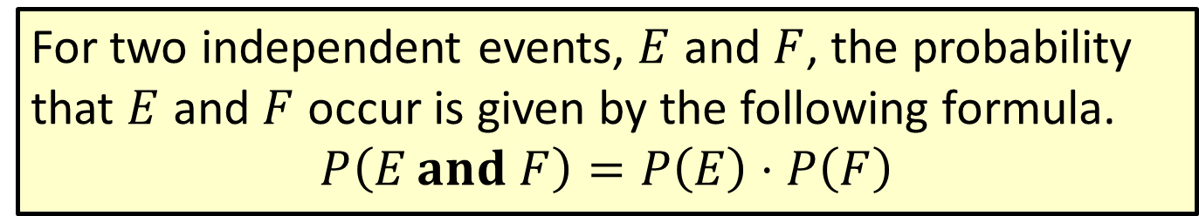
Formula: Multiplication Rule for Probability of Independent Events
For two independent events, $E$ and $F$, the probability that $E$ and $F$ occur is given by the following formula.
$$P\left(E and F\right)=P⁡\left(E\right)⋅P⁡\left(F\right)$$

Slide 4
Memory Booster
Mutually Exclusive
Consider whether the events can happen at the same time.
Independent
Consider whether one event occurring affects the probability of the other event occurring.

Slide 5
Example 4.3.1: Using the Multiplication Rule for Probability of Independent Events
A booth at the state fair has rubber ducks floating in water. For each ticket, you get two chances to pick a duck from those floating by. In order to win a small stuffed animal, you must pick a duck that has a star drawn on the bottom. If you manage to choose two ducks that both have stars drawn on them, you win the extra-large stuffed animal. After your first pick, the rubber duck is placed back in the water for your second pick. If there are 50 floating ducks and 3 that have stars drawn on them, what is the probability of choosing 2 ducks that both have stars on them?

Slide 6
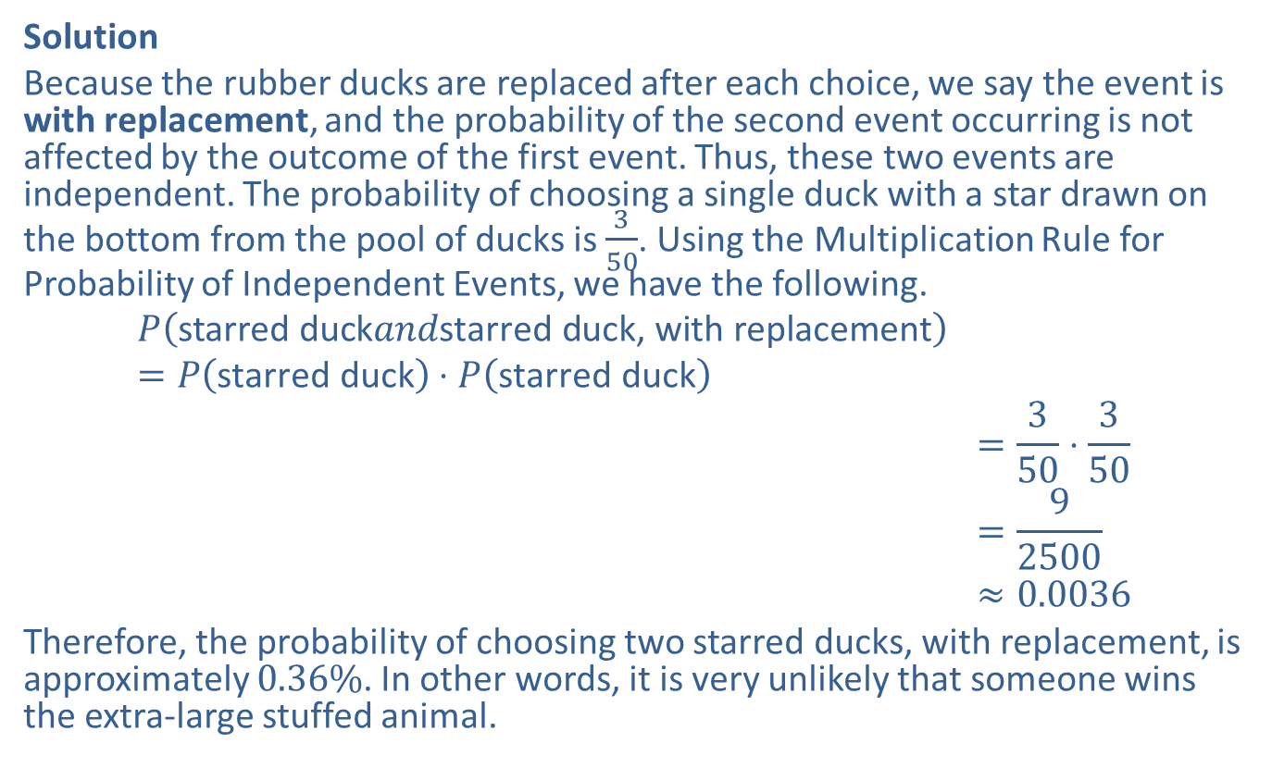
Example 4.3.1: Using the Multiplication Rule for Probability of Independent Events (cont.)
Solution
Because the rubber ducks are replaced after each choice, we say the event is with replacement, and the probability of the second event occurring is not affected by the outcome of the first event. Thus, these two events are independent. The probability of choosing a single duck with a star drawn on the bottom from the pool of ducks is $\frac{3}{50}$. Using the Multiplication Rule for Probability of Independent Events, we have the following.
𝑃starred duck𝑎𝑛𝑑starred duck, with replacement=𝑃starred duck⋅𝑃starred duck𝑃starred duck 𝑎𝑛𝑑 starred duck, with replacement=350⋅350𝑃starred duck 𝑎𝑛𝑑 starred duck, with replacement=92500𝑃starred duck 𝑎𝑛𝑑 starred duck, with replacement≈0.0036
Therefore, the probability of choosing two starred ducks, with replacement, is approximately $0.36\%$. In other words, it is very unlikely that someone wins the extra-large stuffed animal.

Slide 7
Example 4.3.2: Using the Extended Multiplication Rule for Probability of Independent Events
Assume that a study by Human Resources has found that the probabilities of an employee being written up for certain infractions are the values shown in the following table. Assume that each infraction is independent of the others. What is the probability that a given employee will be written up for being late for work, taking unauthorized breaks, and leaving early?

Slide 8
Example 4.3.2: Using the Extended Multiplication Rule for Probability of Independent Events (cont.)
Probabilities of Being Written Up at Work
Infraction | Probability
Insubordination | 0.1356
Late for work | 0.2478
Failure to show up for work | 0.1026
Leaving early | 0.1954
Taking unauthorized breaks | 0.3186

Slide 9
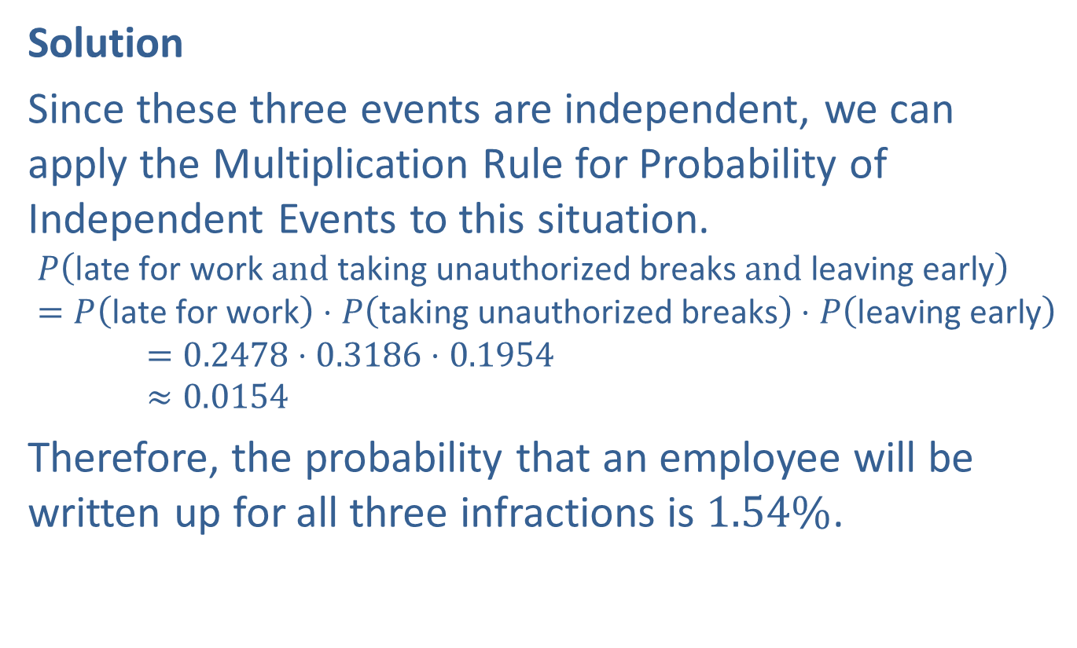
Example 4.3.2: Using the Extended Multiplication Rule for Probability of Independent Events (cont.)
Solution
Since these three events are independent, we can apply the Multiplication Rule for Probability of Independent Events to this situation.
𝑃⁡late for work and taking unauthorized breaks and leaving early=𝑃late for work⋅𝑃taking unauthorized breaks⋅𝑃leaving early00000=0.2478⋅0.3186⋅0.195400000≈0.0154
Therefore, the probability that an employee will be written up for all three infractions is $1.54\%$.

Slide 10
Without Replacement & Dependent
Definition
When objects are not placed back into consideration before performing the next stage of a multistage experiment, we say the experiment is performed without replacement.
Two events are dependent if one event happening influences the probability of the other event happening.

Slide 11
Example 4.3.3: Calculating Probability of Dependent Events
Consider the rubber duck booth at the state fair once again. You are choosing 2 ducks from 50 and 3 have stars drawn on the bottom. This time, you choose two of the floating ducks without replacement. What is the probability that both ducks you choose have stars on them?

Slide 12
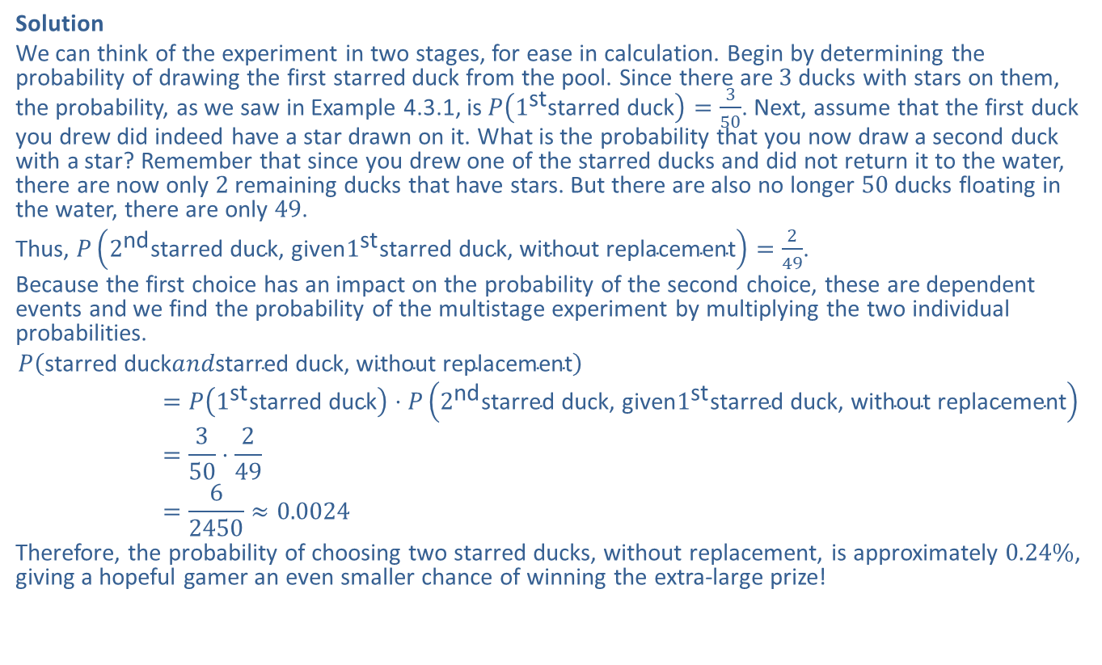
Example 4.3.3: Calculating Probability of Dependent Events (cont.)
Solution
We can think of the experiment in two stages, for ease in calculation. Begin by determining the probability of drawing the first starred duck from the pool. Since there are 3 ducks with stars on them, the probability, as we saw in Example 4.3.1, is $P\left(1^{\text{st}}\text{starred} \text{duck}\right)=\frac{3}{50}$. Next, assume that the first duck you drew did indeed have a star drawn on it. What is the probability that you now draw a second duck with a star? Remember that since you drew one of the starred ducks and did not return it to the water, there are now only 2 remaining ducks that have stars. But there are also no longer 50 ducks floating in the water, there are only 49.
Thus, $P\left(2^{\text{nd}}\text{starred} \text{duck}\text{, }\text{given}1^{\text{st}}\text{starred} \text{duck}\text{, }\text{without} \text{replacement}\right)=\frac{2}{49}$.
Because the first choice has an impact on the probability of the second choice, these are dependent events and we find the probability of the multistage experiment by multiplying the two individual probabilities.
𝑃starred duck𝑎𝑛𝑑starred duck, without replacementstarred duck=𝑃1ststarred duck⋅𝑃2ndstarred duck, given1ststarred duck, without replacementstarred duck=350⋅249starred duck=62450≈0.0024
Therefore, the probability of choosing two starred ducks, without replacement, is approximately $0.24\%$, giving a hopeful gamer an even smaller chance of winning the extra-large prize!

Slide 13
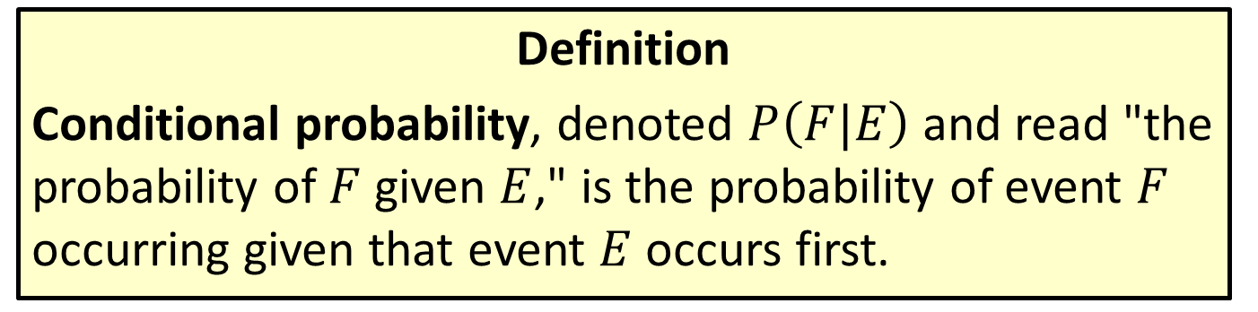
Conditional Probability
Definition
Conditional probability, denoted $P⁡\left(F|E\right)$ and read "the probability of $F$ given $E$," is the probability of event $F$ occurring given that event $E$ occurs first.

Slide 14
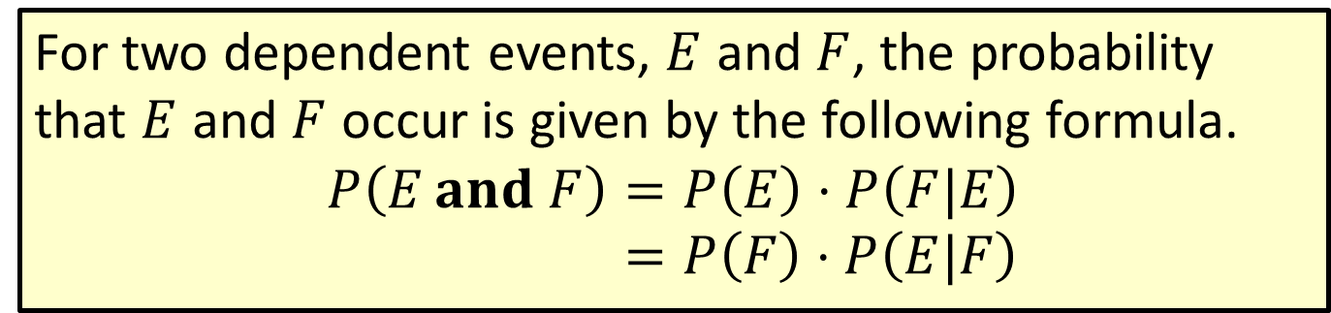
Formula: Multiplication Rule for Probability of Dependent Events
For two dependent events, $E$ and $F$, the probability that $E$ and $F$ occur is given by the following formula.
𝑃𝐸 𝐚𝐧𝐝 𝐹=𝑃𝐸⋅𝑃𝐹|𝐸𝑃⁡𝐸 𝐚𝐧𝐝 𝐹=𝑃𝐹⋅𝑃𝐸|𝐹

Slide 15
Example 4.3.4: Using the Multiplication Rule for Probability of Dependent Events
What is the probability of choosing two aces in a row from a standard deck of 52 cards? Assume that there are four aces in a standard deck and that the cards are chosen without replacement.

Slide 16
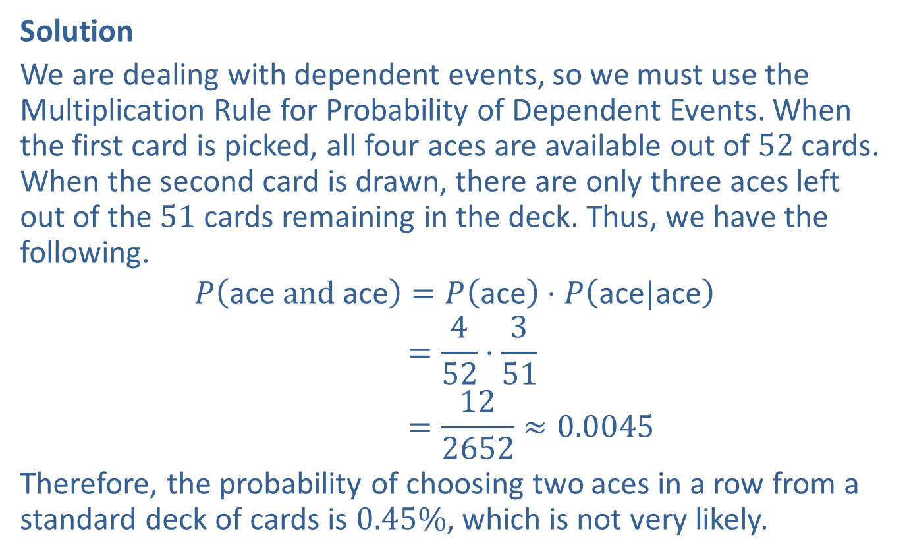
Example 4.3.4: Using the Multiplication Rule for Probability of Dependent Events (cont.)
Solution
We are dealing with dependent events, so we must use the Multiplication Rule for Probability of Dependent Events. When the first card is picked, all four aces are available out of 52 cards. When the second card is drawn, there are only three aces left out of the 51 cards remaining in the deck. Thus, we have the following.
𝑃ace and ace=𝑃ace⋅𝑃ace|ace𝑃ace𝑎𝑛𝑑ace =452⋅351𝑃ace𝑎𝑛𝑑ace =122652≈0.0045
Therefore, the probability of choosing two aces in a row from a standard deck of cards is $0.45\%$, which is not very likely.

Slide 17
Example 4.3.5: Using the Multiplication Rule for Probability of Dependent Events
Assume that there are 17 newcomers and 24 long-term members in the Rotary Club. Two members are chosen at random each year to serve on the scholarship committee. What is the probability of choosing two members at random and the first being a newcomer and the second being a long-term member?

Slide 18
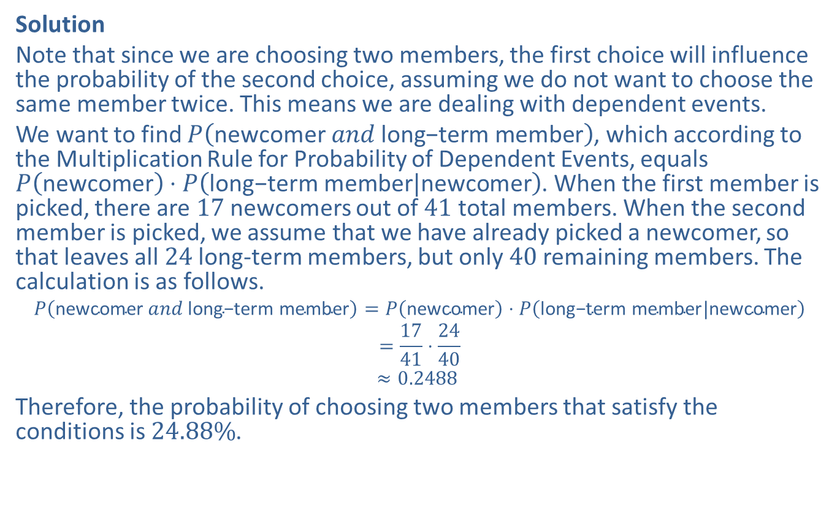
Example 4.3.5: Using the Multiplication Rule for Probability of Dependent Events (cont.)
Solution
Note that since we are choosing two members, the first choice will influence the probability of the second choice, assuming we do not want to choose the same member twice. This means we are dealing with dependent events.
We want to find $P⁡\left(\text{newcomer} and \text{long}\text{−}\text{term} \text{member}\right)$, which according to the Multiplication Rule for Probability of Dependent Events, equals $P⁡\left(\text{newcomer}\right)⋅P⁡\left(\text{long}\text{−}\text{term} \text{member}|\text{newcomer}\right)$. When the first member is picked, there are 17 newcomers out of 41 total members. When the second member is picked, we assume that we have already picked a newcomer, so that leaves all 24 long-term members, but only 40 remaining members. The calculation is as follows.
𝑃newcomer 𝑎𝑛𝑑 long−term member=𝑃newcomer⋅𝑃long−term member|newcomer𝑃⁡newcomer, 𝑎𝑛𝑑 , long−term member=1741⋅2440𝑃⁡newcomer, 𝑎𝑛𝑑 , long−term member≈0.2488
Therefore, the probability of choosing two members that satisfy the conditions is $24.88\%$.

Slide 19
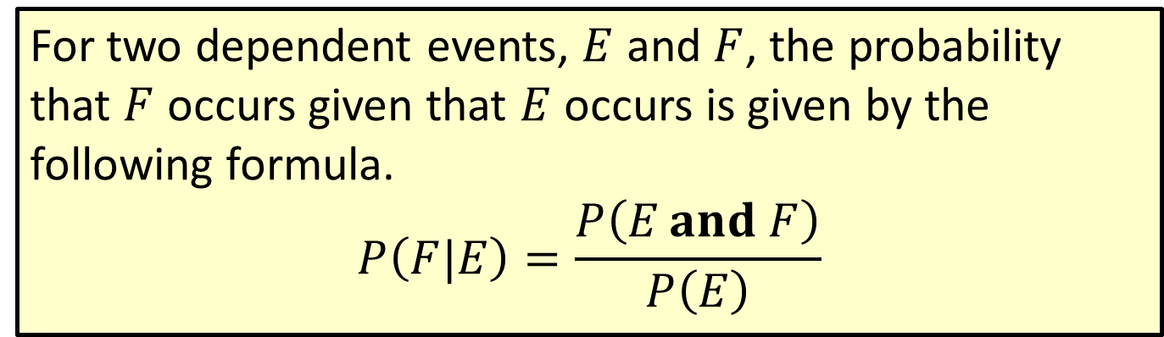
Formula: Conditional Probability
For two dependent events, $E$ and $F$, the probability that $F$ occurs given that $E$ occurs is given by the following formula.
$$P\left(F|E\right)=\frac{P\left(E and F\right)}{P\left(E\right)}$$

Slide 20
Example 4.3.6: Using the Rule for Conditional Probability
Out of 300 applicants for a job, 212 are female and 110 are females who hold a graduate degree.
​What is the probability that a randomly chosen applicant has a graduate degree, given that she is female?
​If 152 of the applicants have graduate degrees, what is the probability that a randomly chosen applicant is female, given that the applicant has a graduate degree?

Slide 21
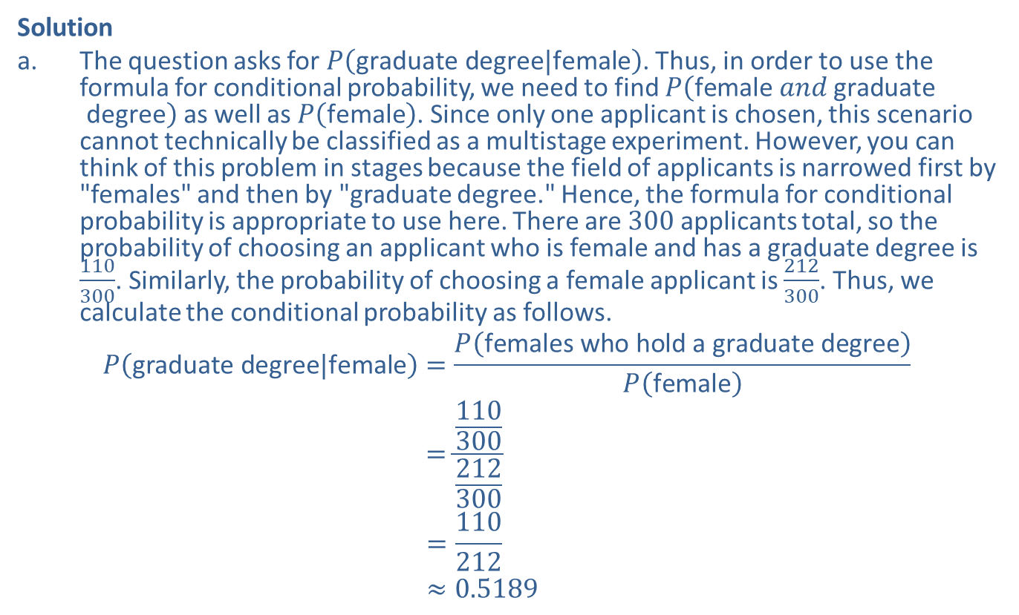
Example 4.3.6: Using the Rule for Conditional Probability (cont.)
Solution
​The question asks for $P⁡\left(\text{graduate} \text{degree}|\text{female}\right)$. Thus, in order to use the formula for conditional probability, we need to find $P⁡\left(\text{female} and \text{graduate} \text{degree}\right)$ as well as $P⁡\left(\text{female}\right)$. Since only one applicant is chosen, this scenario cannot technically be classified as a multistage experiment. However, you can think of this problem in stages because the field of applicants is narrowed first by "females" and then by "graduate degree." Hence, the formula for conditional probability is appropriate to use here. There are 300 applicants total, so the probability of choosing an applicant who is female and has a graduate degree is $\frac{110}{300}$. Similarly, the probability of choosing a female applicant is $\frac{212}{300}$. Thus, we calculate the conditional probability as follows.
𝑃graduate degree|female=𝑃females who hold a graduate degree𝑃female𝑃⁡graduate degree|female=110300212300𝑃⁡graduate degree|female=110212𝑃⁡graduate degree|female≈0.5189

Slide 22
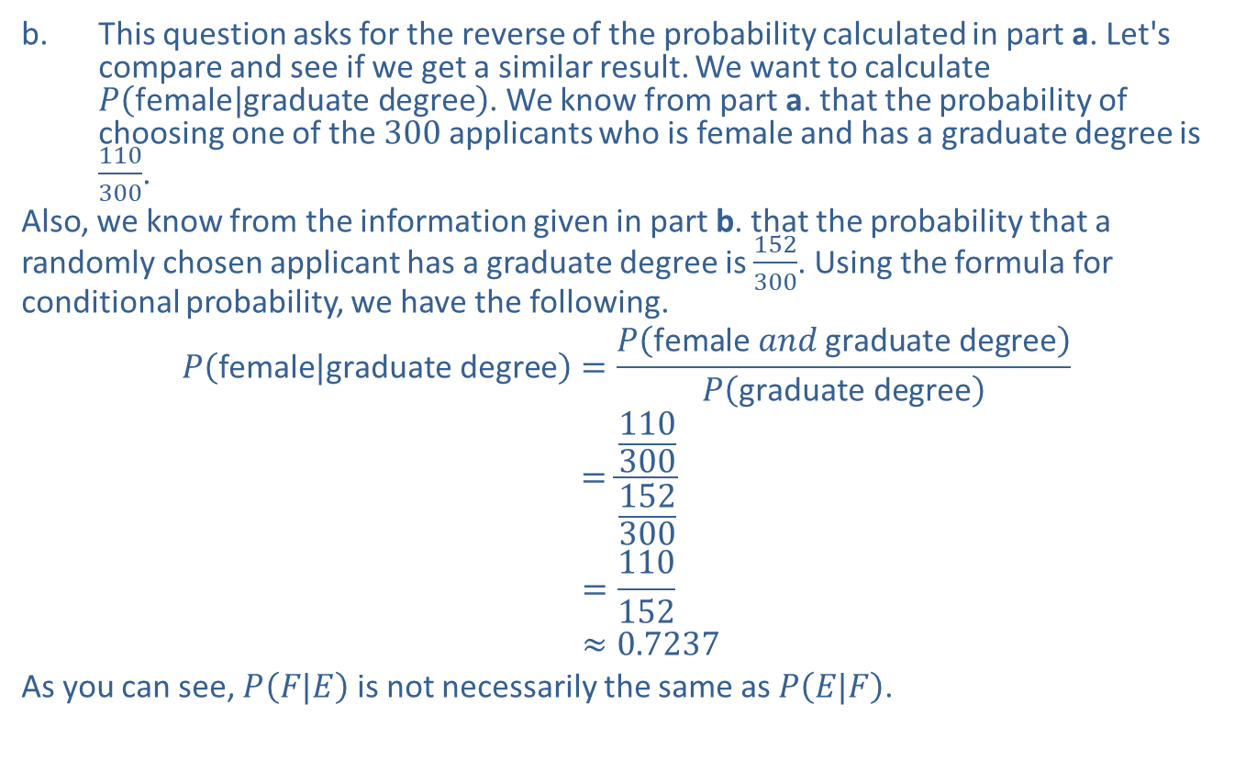
Example 4.3.6: Using the Rule for Conditional Probability (cont.)
​This question asks for the reverse of the probability calculated in part a. Let's compare and see if we get a similar result. We want to calculate $P⁡\left(\text{female}|\text{graduate} \text{degree}\right)$. We know from part a. that the probability of choosing one of the 300 applicants who is female and has a graduate degree is $\frac{110}{300}$.
​Also, we know from the information given in part b. that the probability that a randomly chosen applicant has a graduate degree is $\frac{152}{300}$. Using the formula for conditional probability, we have the following.
𝑃female|graduate degree=𝑃female 𝑎𝑛𝑑 graduate degree𝑃graduate degree𝑃⁡female|graduate degree=110300152300𝑃⁡female|graduate degree=110152𝑃⁡female|graduate degree≈0.7237
​As you can see, $P⁡\left(F|E\right)$ is not necessarily the same as $P⁡\left(E|F\right)$.

Slide 23
Winning the Lottery Twice!
In 1986 a woman won the N.J. State lottery twice and in 1988 a man in Pennsylvania also won the State lottery twice for a total of 5.4 and 6.8 million dollars respectively. The New York Times reported the odds to be 1 in 17 trillion? How is this to be explained? When millions of people play a lottery daily it can be shown that the odds of winning twice are about 1 in 30 in a 4-month period and the odds are better than even in a 7-year period. Thus what appeared to be an almost theoretical impossibility, turns out to be quite a probable event. What one can say is that even when the probability of an event is very small, if there are millions of possibilities, then the rare event rarely remains rare. This is what has been called “The Law of Real Large Numbers” by Diaconis and Mosteller.
Source: Diaconis, P. and Mosteller, F. (1989). Methods for Studying Coincidences,” Journal of the American Statistical Association, 84, 853-861.

Slide 24
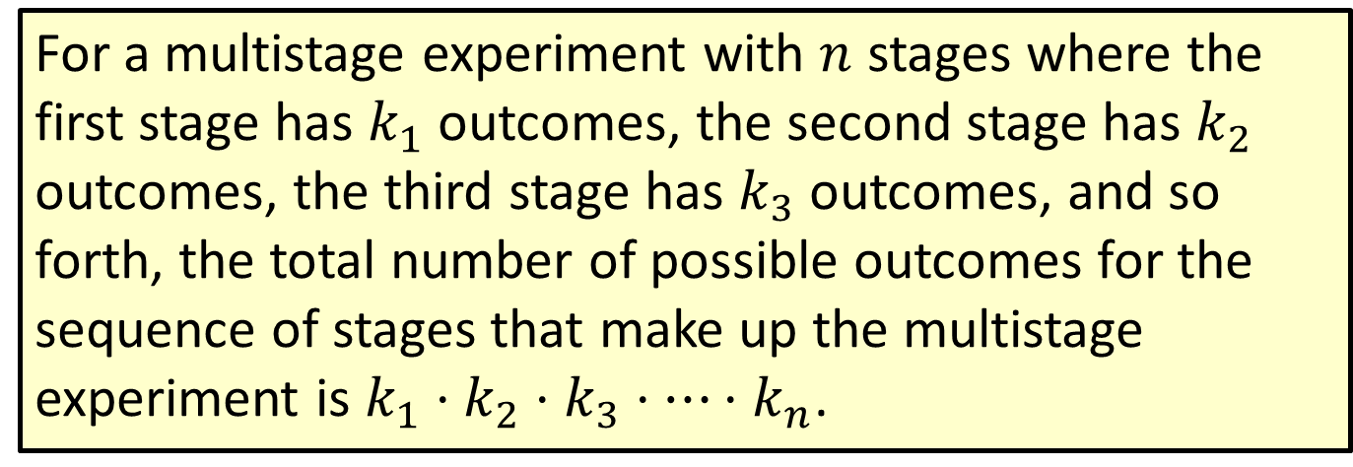
Theorem: Fundamental Counting Principle
For a multistage experiment with $n$ stages where the first stage has $k_{1}$ outcomes, the second stage has $k_{2}$ outcomes, the third stage has $k_{3}$ outcomes, and so forth, the total number of possible outcomes for the sequence of stages that make up the multistage experiment is $k_{1}⋅k_{2}⋅k_{3}⋅⋯⋅k_{n}$.

Slide 25
Example 4.3.7: Using the Fundamental Counting Principle
Kilby begins her first year in an online degree program in July. The first semester she will randomly be assigned to one section for each of four different core courses. If there are 8 English I sections, 12 College Algebra sections, 11 American History sections, and 5 Physical Science sections, how many different options are there for Kilby's schedule for her first semester?

Slide 26
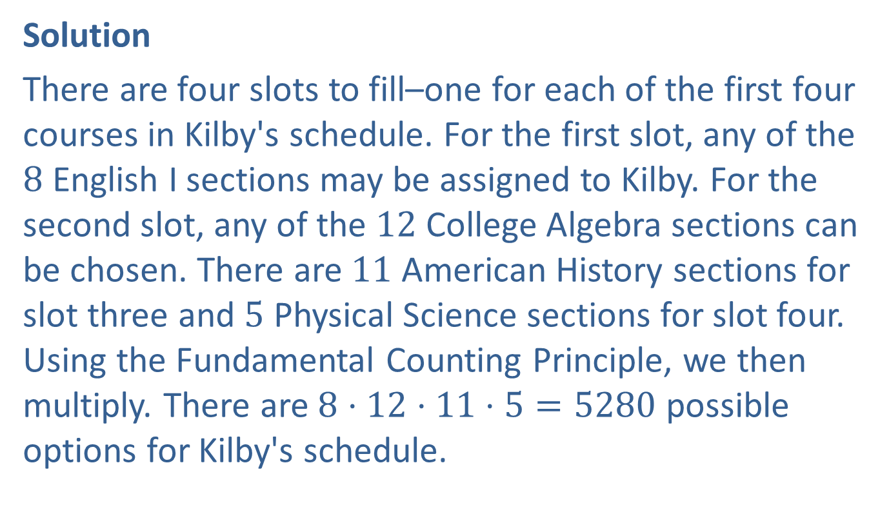
Example 4.3.7: Using the Fundamental Counting Principle (cont.)
Solution
There are four slots to fill–one for each of the first four courses in Kilby's schedule. For the first slot, any of the 8 English I sections may be assigned to Kilby. For the second slot, any of the 12 College Algebra sections can be chosen. There are 11 American History sections for slot three and 5 Physical Science sections for slot four. Using the Fundamental Counting Principle, we then multiply. There are $8⋅12⋅11⋅5=5280$ possible options for Kilby's schedule.

Slide 27
Example 4.3.8: Using the Fundamental Counting Principle (Without Replacement)
The governing board of the local charity, Mission Stateville, is electing a new vice president and secretary to replace outgoing board members. If the board consists of 11 members who don't already hold an office, in how many different ways can the two positions be filled if no one may hold more than one office?

Slide 28
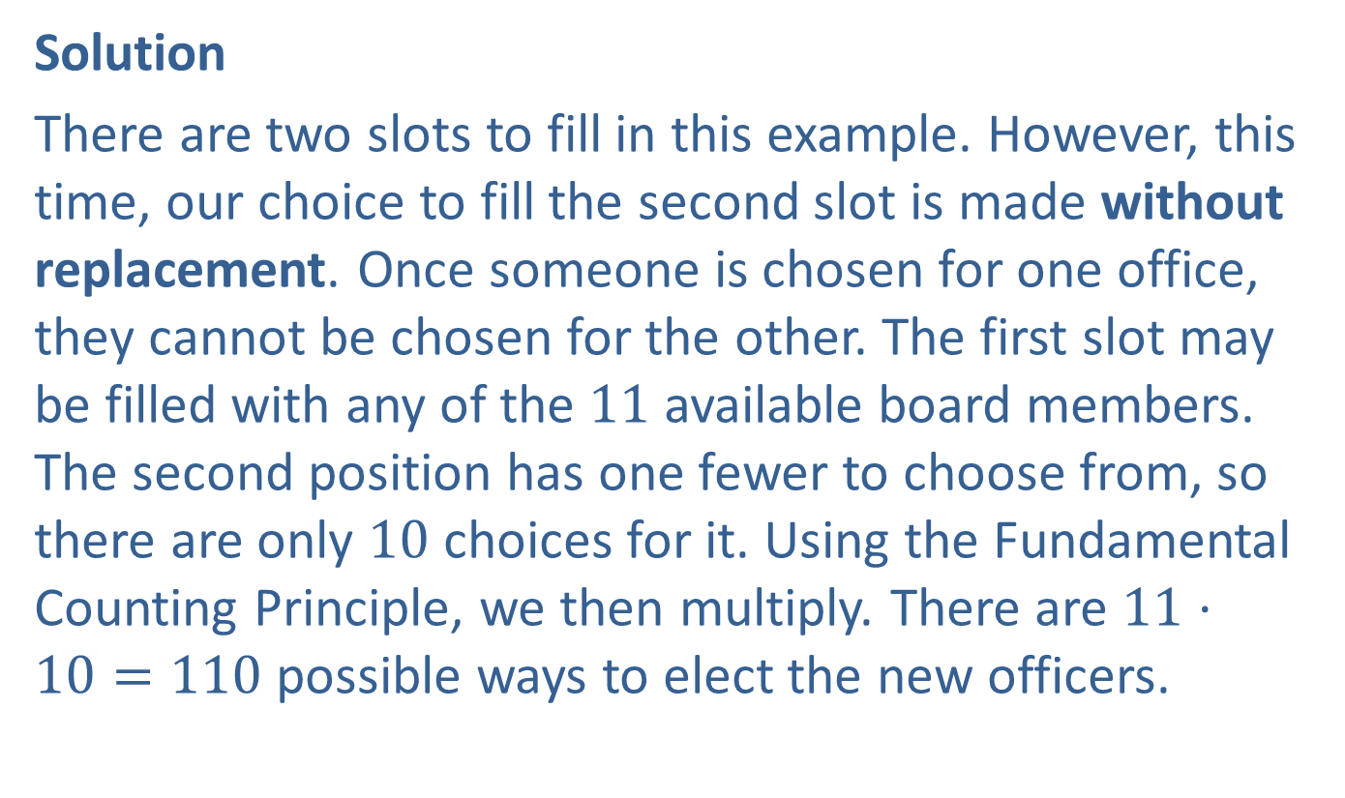
Example 4.3.8: Using the Fundamental Counting Principle (Without Replacement) (cont.)
Solution
There are two slots to fill in this example. However, this time, our choice to fill the second slot is made without replacement. Once someone is chosen for one office, they cannot be chosen for the other. The first slot may be filled with any of the 11 available board members. The second position has one fewer to choose from, so there are only 10 choices for it. Using the Fundamental Counting Principle, we then multiply. There are $11⋅10=110$ possible ways to elect the new officers.

Slide 29
Example 4.3.9: Using the Fundamental Counting Principle to Calculate Probability
Robin is preparing an afternoon snack for her twins, Matthew and Lainey. She wants to give each child one item. She has the following snacks on hand: carrots, raisins, crackers, grapes, apples, yogurt, and granola bars. If she randomly chooses one snack for Matthew and one snack for Lainey, what is the probability that each child gets the same snack as yesterday?

Slide 30
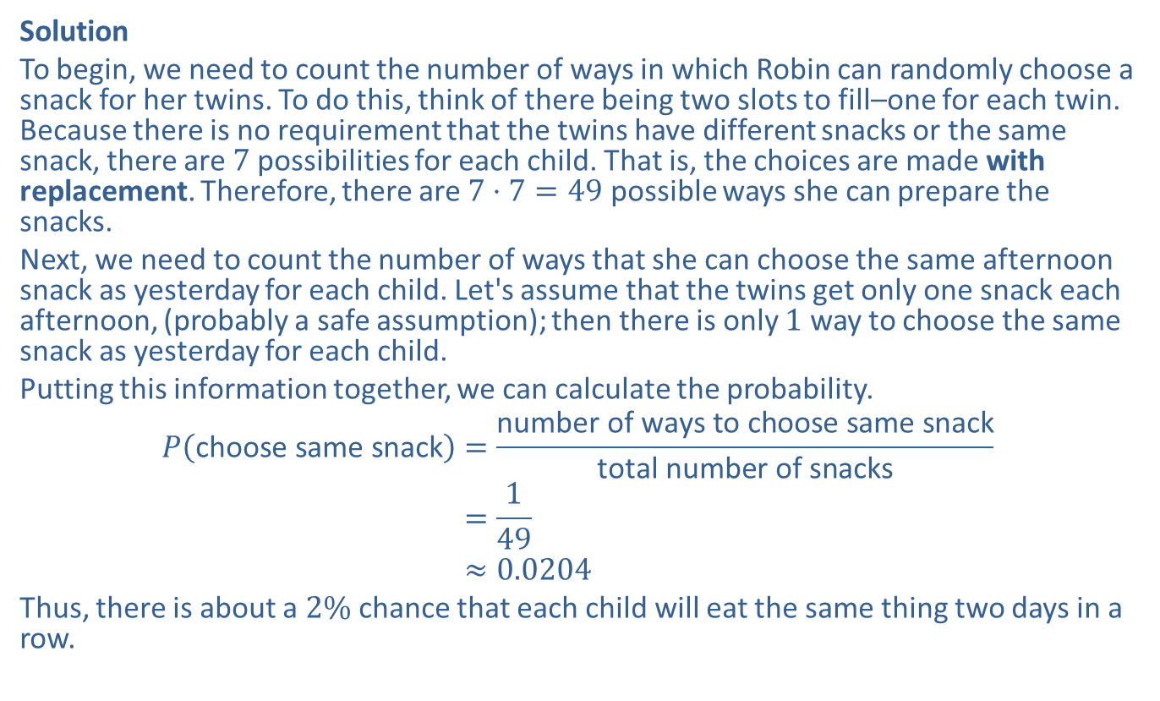
Example 4.3.9: Using the Fundamental Counting Principle to Calculate Probability (cont.)
Solution
To begin, we need to count the number of ways in which Robin can randomly choose a snack for her twins. To do this, think of there being two slots to fill–one for each twin. Because there is no requirement that the twins have different snacks or the same snack, there are 7 possibilities for each child. That is, the choices are made with replacement. Therefore, there are $7⋅7=49$ possible ways she can prepare the snacks.
Next, we need to count the number of ways that she can choose the same afternoon snack as yesterday for each child. Let's assume that the twins get only one snack each afternoon, (probably a safe assumption); then there is only 1 way to choose the same snack as yesterday for each child.
Putting this information together, we can calculate the probability.
𝑃choose same snack=number of ways to choose same snacktotal number of snacks𝑃⁡choose same snack=149𝑃⁡choose same snack≈0.0204
Thus, there is about a $2\%$ chance that each child will eat the same thing two days in a row.

