Slide 1
Section 4.4
Combinations and Permutations

Slide 2
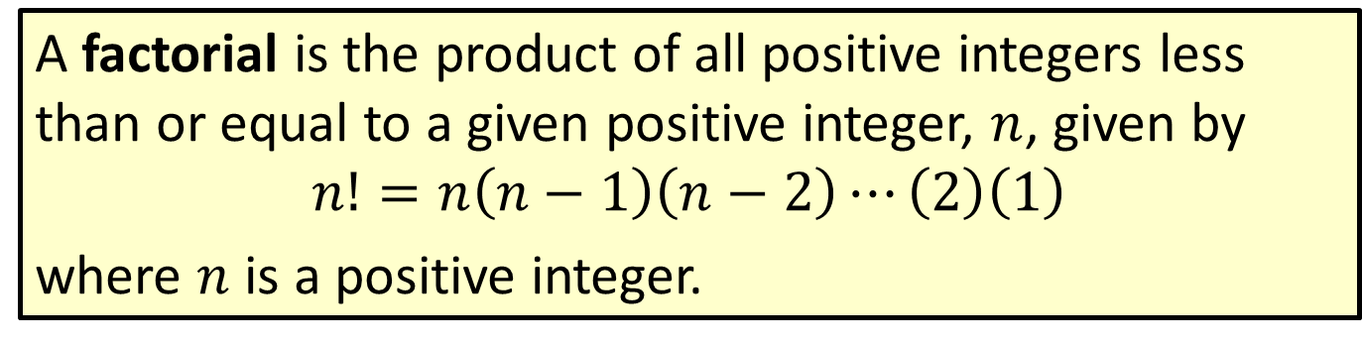
Formula: Factorial
A factorial is the product of all positive integers less than or equal to a given positive integer, $n$, given by
$$n!=n\left(n−1\right)\left(n−2\right)⋯\left(2\right)\left(1\right)$$
where $n$ is a positive integer.

Slide 3
Math Symbols
$$0!=1$$

Slide 4

Example 4.4.1: Calculating Factorial Expressions
Calculate the following factorial expressions.
​$7!$
​$\frac{4!}{0!}$
​$\frac{65!}{63!}$
​$\frac{5!}{\left(5−3\right)!}$
​$\frac{6!}{2!\left(6−2\right)!}$

Slide 5

Example 4.4.1: Calculating Factorial Expressions (cont.)
Solution
​$7!$ indicates that we need to multiply each positive integer less than or equal to 7.
​By Hand:
​$7!=7⋅6⋅5⋅4⋅3⋅2⋅1=5040$
​

Slide 6

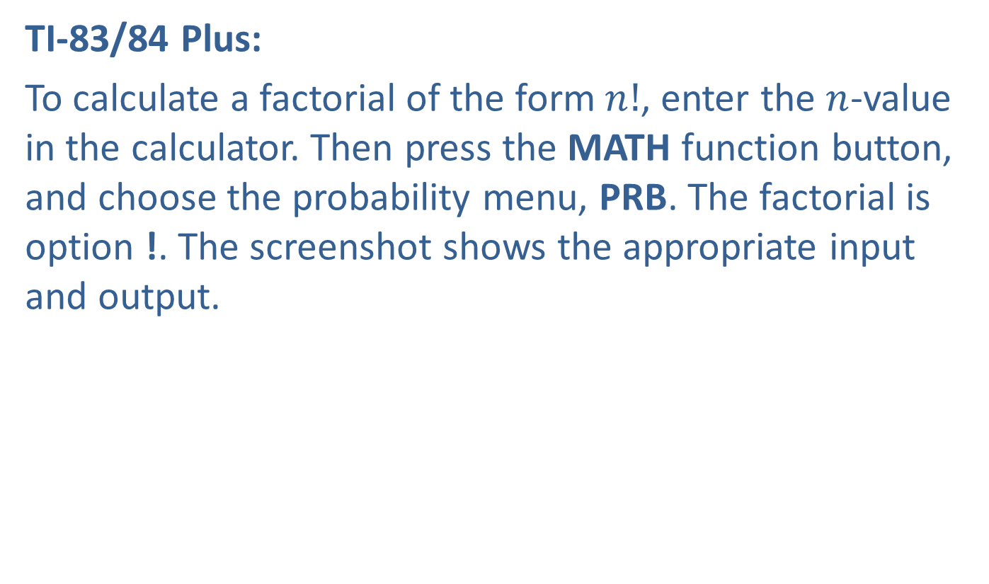
Example 4.4.1: Calculating Factorial Expressions (cont.)
​TI-83/84 Plus:
​To calculate a factorial of the form $n!$, enter the $n$-value in the calculator. Then press the MATH function button, and choose the probability menu, PRB. The factorial is option !. The screenshot shows the appropriate input and output.
​

Slide 7

Example 4.4.1: Calculating Factorial Expressions (cont.)
​$\frac{4!}{0!}$
​By Hand:
​Calculate each factorial and then divide. Remember that $0!=1$.
​$\frac{4!}{0!}=\frac{4⋅3⋅2⋅1}{1}=24$
​

Slide 8
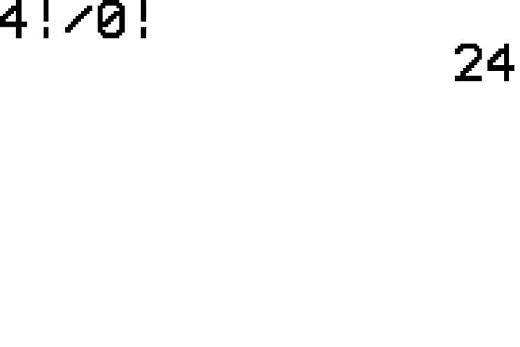

Example 4.4.1: Calculating Factorial Expressions (cont.)
​TI-83/84:
​We can do the calculation in one step with the calculator by typing in 4!/0!. Note that we are not dividing by 0, but by $0!$. Thus, the solution is 24 as shown in the screenshot.
​

Slide 9
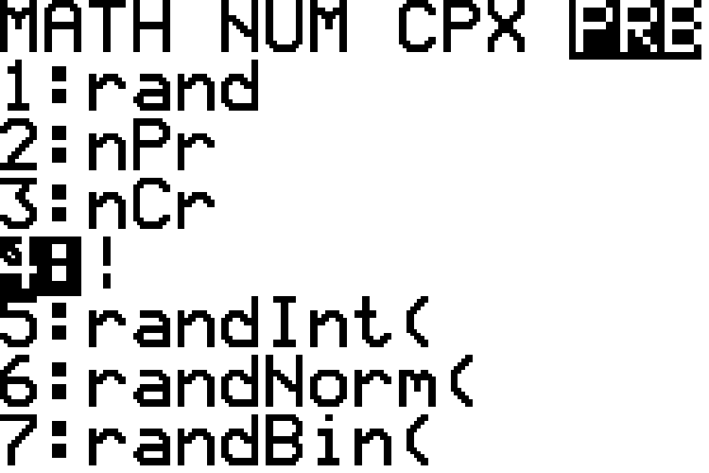
Example 4.4.1: Calculating Factorial Expressions (cont.)

Slide 10
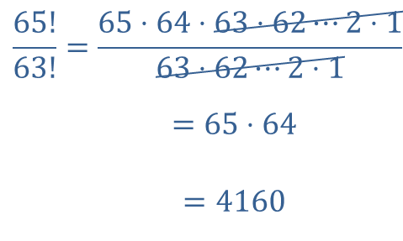
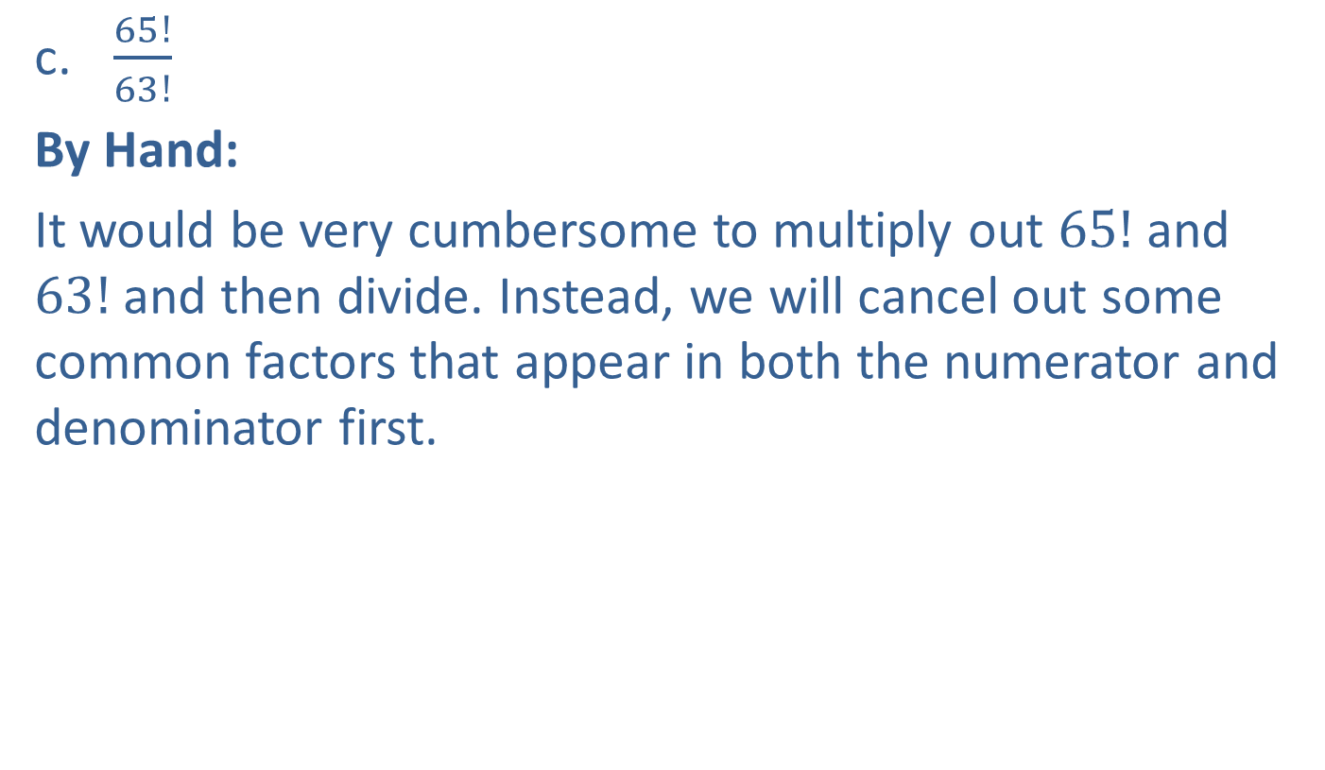
Example 4.4.1: Calculating Factorial Expressions (cont.)
​$\frac{65!}{63!}$
​By Hand:
​It would be very cumbersome to multiply out $65!$ and $63!$ and then divide. Instead, we will cancel out some common factors that appear in both the numerator and denominator first.
​
65!63!=65⋅64⋅63⋅62⋯2⋅163⋅62⋯2⋅165!63!=65⋅6465!63!=4160

Slide 11
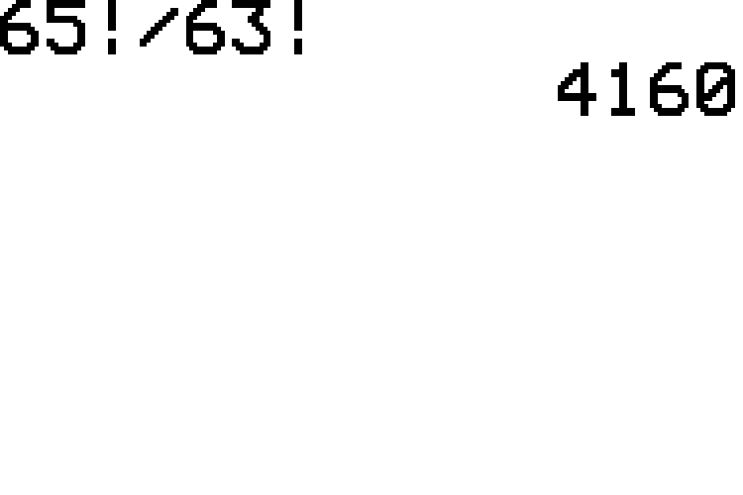
Example 4.4.1: Calculating Factorial Expressions (cont.)
​TI-83/84 Plus:
​Notice that we do not need to simplify first when using the calculator. We simply enter 65!/63! and obtain 4160 as shown in the screenshot.
​

Slide 12
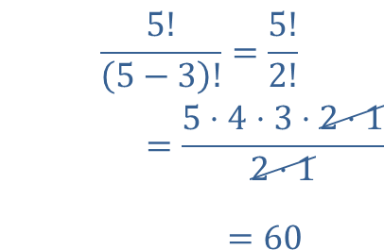
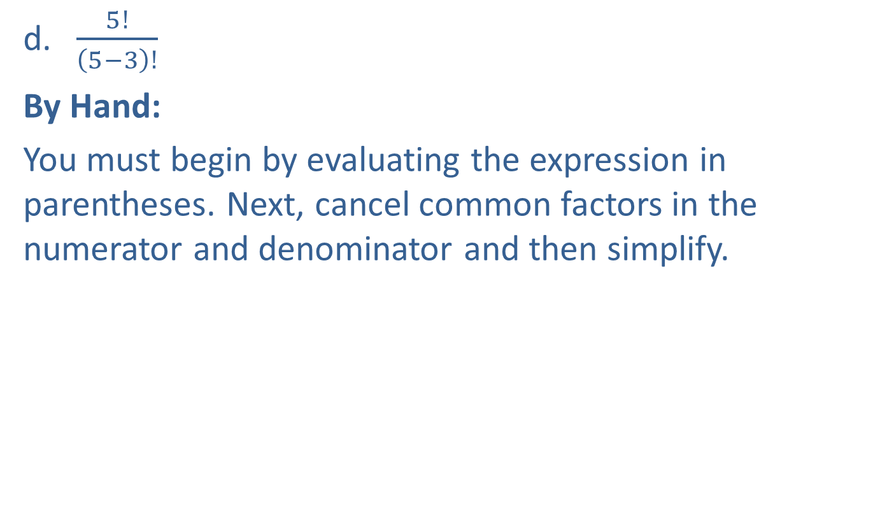
Example 4.4.1: Calculating Factorial Expressions (cont.)
​$\frac{5!}{\left(5−3\right)!}$
​By Hand:
​You must begin by evaluating the expression in parentheses. Next, cancel common factors in the numerator and denominator and then simplify.
​
5!5−3!=5!2!5!5−3!=5⋅4⋅3⋅2⋅12⋅15!5−3!=60

Slide 13
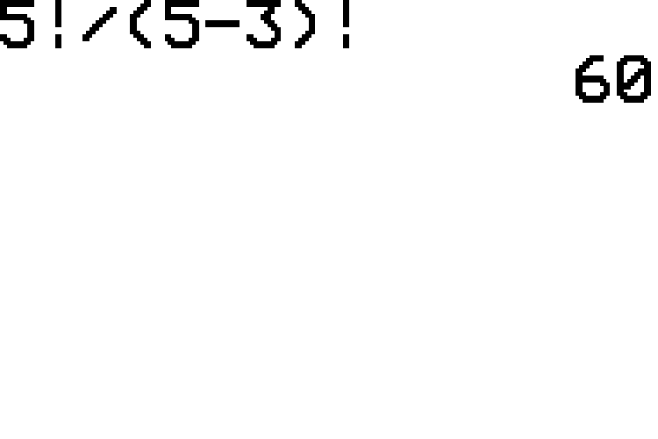
Example 4.4.1: Calculating Factorial Expressions (cont.)
​TI-83/84 Plus:
​Notice that we can type the entire expression in without simplifying first. Be sure to place the parentheses in the denominator. The input and solution are shown in the screenshot.
​

Slide 14
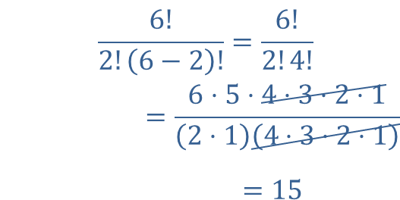

Example 4.4.1: Calculating Factorial Expressions (cont.)
​$\frac{6!}{2!\left(6−2\right)!}$
​By Hand:
​Make sure that you begin by subtracting to simplify the expression in parentheses.
​
6!2!6−2!=6!2!4!6!2!6−2!=6⋅5⋅4⋅3⋅2⋅12⋅14⋅3⋅2⋅16!2!6−2!=15

Slide 15
Example 4.4.1: Calculating Factorial Expressions (cont.)
​TI-83/84 Plus:
​Once again, we can enter the entire original expression in one line. However, we must place parentheses around the entire expression in the denominator, as shown in the screenshot, which produces the correct solution of 15. Since calculators follow the rules for order of operations, what answers are produced if you remove the parenthesis in the denominator? Try this for yourself.
​

Slide 16
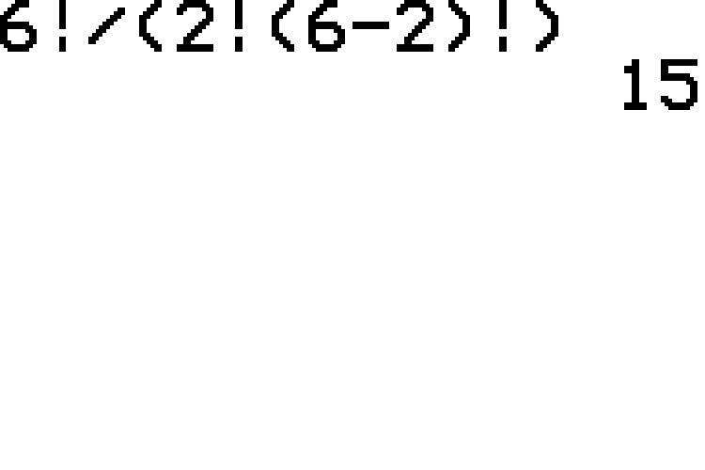
Example 4.4.1: Calculating Factorial Expressions (cont.)

Slide 17
Combination & Permutation
Definition
A combination is a selection of objects from a group without regard to their arrangement.
A permutation is a selection of objects from a group where the arrangement is specific.

Slide 18
Memory Booster
Combinations
order does not matter
Permutations
order matters

Slide 19
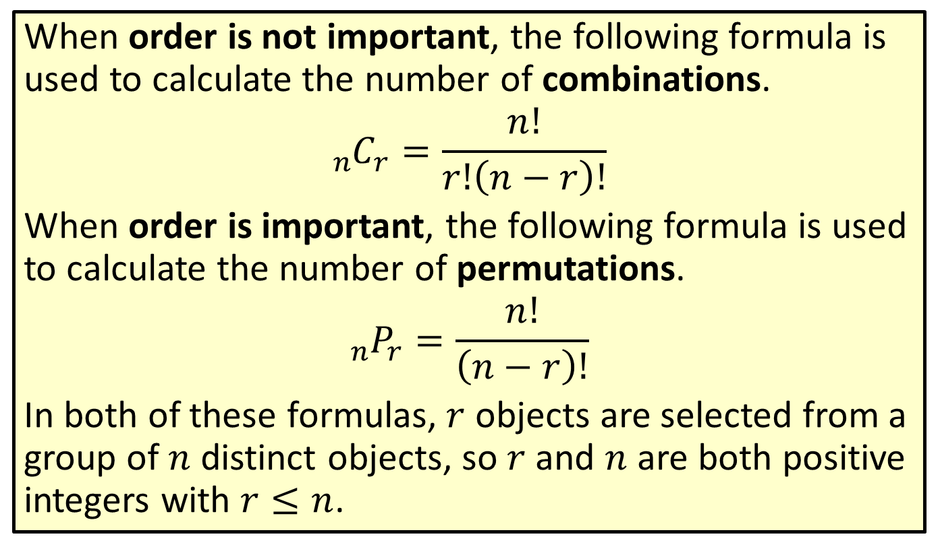
Formula: Combinations and Permutations
When order is not important, the following formula is used to calculate the number of combinations.
$${}_{n}^{ }{C_{r}}=\frac{n!}{r!\left(n−r\right)!}$$
When order is important, the following formula is used to calculate the number of permutations.
$${}_{n}^{ }{P_{r}}=\frac{n!}{\left(n−r\right)!}$$
In both of these formulas, $r$ objects are selected from a group of $n$ distinct objects, so $r$ and $n$ are both positive integers with $r≤n$.

Slide 20
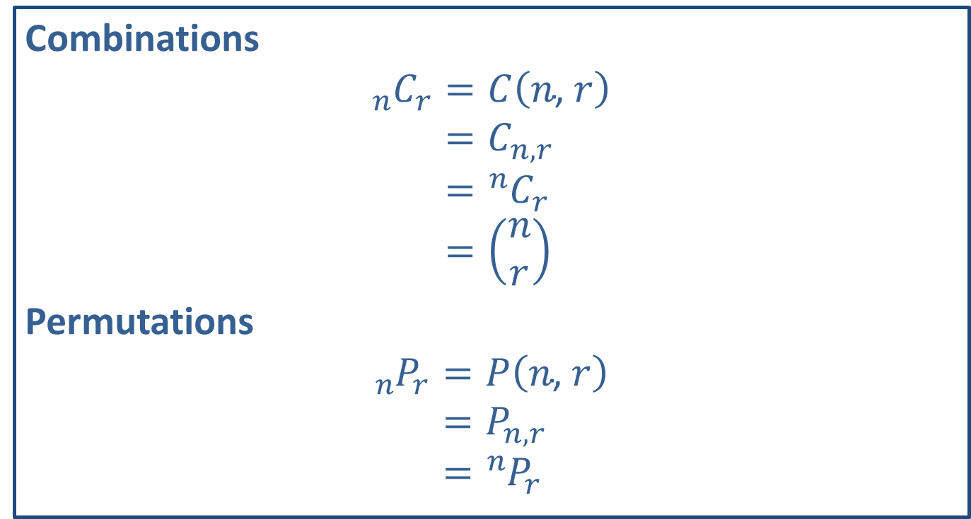
Math Symbols
Combinations
𝑛 𝐶𝑟=𝐶𝑛, 𝑟𝑛 𝐶𝑟=𝐶𝑛,𝑟𝑛 𝐶𝑟= 𝑛𝐶𝑟𝑛 𝐶𝑟=𝑛𝑟
Permutations
𝑛 𝑃𝑟=𝑃𝑛, 𝑟𝑛 𝑃𝑟=𝑃𝑛,𝑟𝑛 𝑃𝑟= 𝑛𝑃𝑟

Slide 21
Example 4.4.2: Calculating Numbers of Combinations and Permutations
Given a group of three friends, Emre, Heather, and Sheena:
​How many ways can you arrange the way they stand in line for the movies?
​How many ways can you choose two of them to ride in a car together?

Slide 22
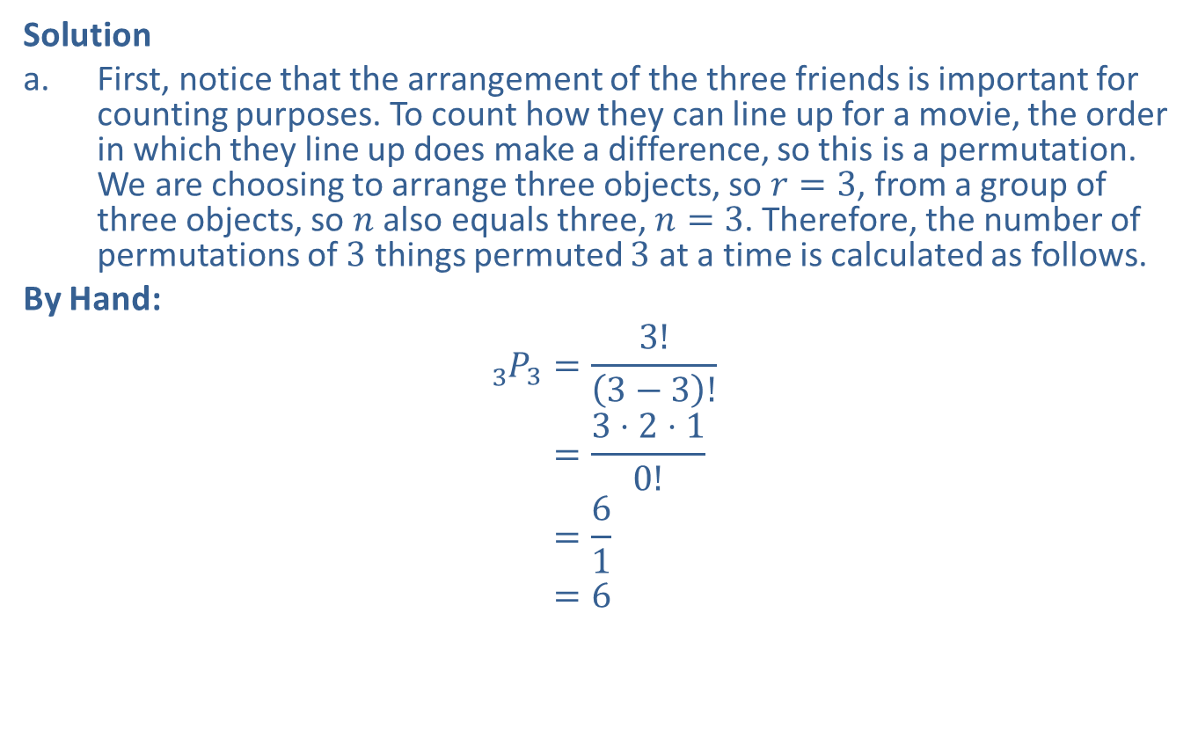
Example 4.4.2: Calculating Numbers of Combinations and Permutations (cont.)
Solution
​First, notice that the arrangement of the three friends is important for counting purposes. To count how they can line up for a movie, the order in which they line up does make a difference, so this is a permutation. We are choosing to arrange three objects, so $r=3$, from a group of three objects, so $n$ also equals three, $n=3$. Therefore, the number of permutations of 3 things permuted 3 at a time is calculated as follows.
​By Hand:
3 𝑃3=3!3−3!3 𝑃3=3⋅2⋅10!3 𝑃3=613 𝑃3=6
​

Slide 23
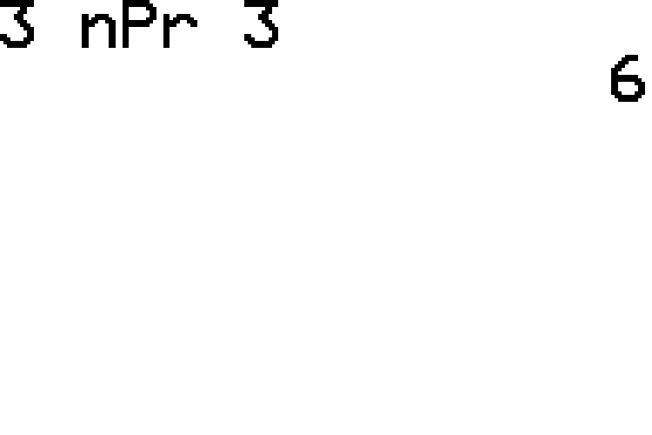
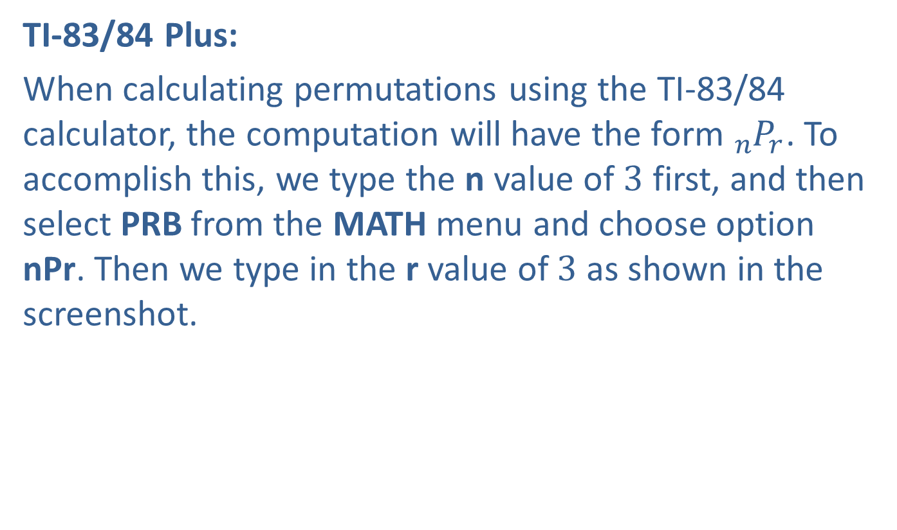
Example 4.4.2: Calculating Numbers of Combinations and Permutations (cont.)
​TI-83/84 Plus:
​When calculating permutations using the TI-83/84 calculator, the computation will have the form ${}_{n}^{ }{P_{r}}$. To accomplish this, we type the n value of 3 first, and then select PRB from the MATH menu and choose option nPr. Then we type in the r value of 3 as shown in the screenshot.
​

Slide 24
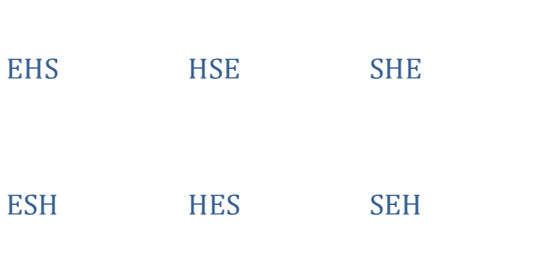
Example 4.4.2: Calculating Numbers of Combinations and Permutations (cont.)
​So, there are six unique ways for the friends to line up for the movie. Let's check this by listing out all the possible arrangements. We'll use a pattern to help us.
​
​$\text{EHS}$ | ​$\text{HSE}$ | ​$\text{SHE}$
​$\text{ESH}$ | ​$\text{HES}$ | ​$\text{SEH}$

Slide 25
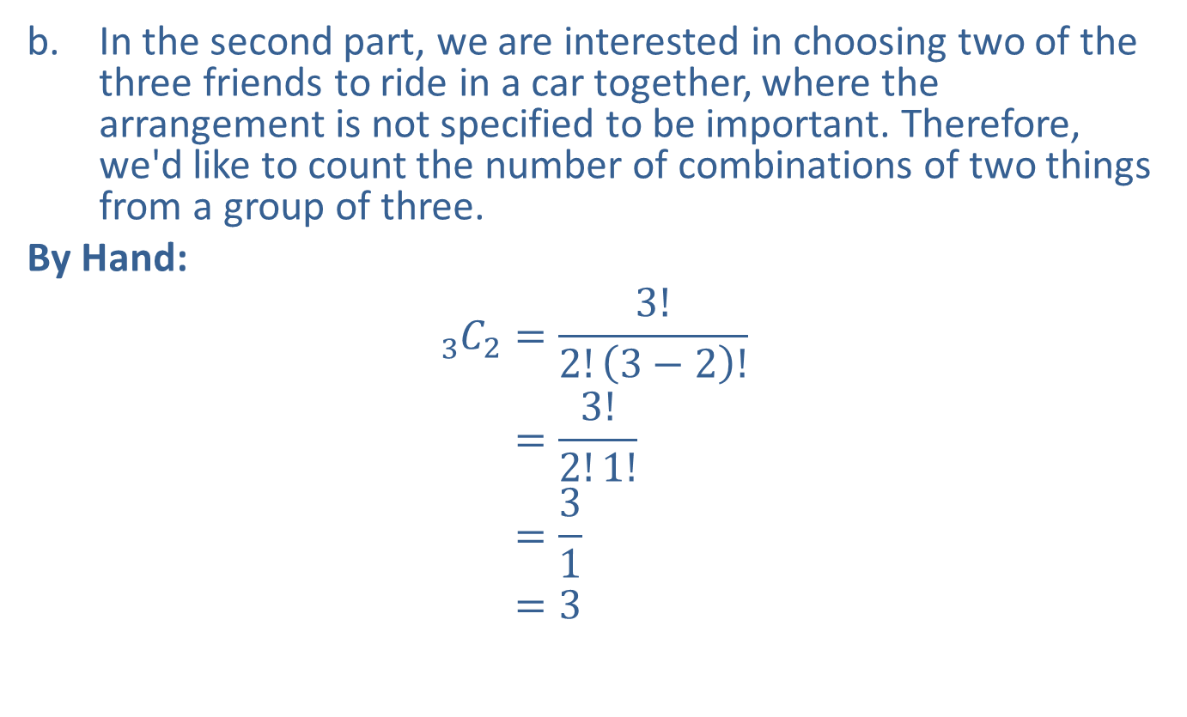
Example 4.4.2: Calculating Numbers of Combinations and Permutations (cont.)
​In the second part, we are interested in choosing two of the three friends to ride in a car together, where the arrangement is not specified to be important. Therefore, we'd like to count the number of combinations of two things from a group of three.
​By Hand:
3 𝐶2=3!2!3−2!3 𝐶2=3!2!1!3 𝐶2=313 𝐶2=3
​

Slide 26
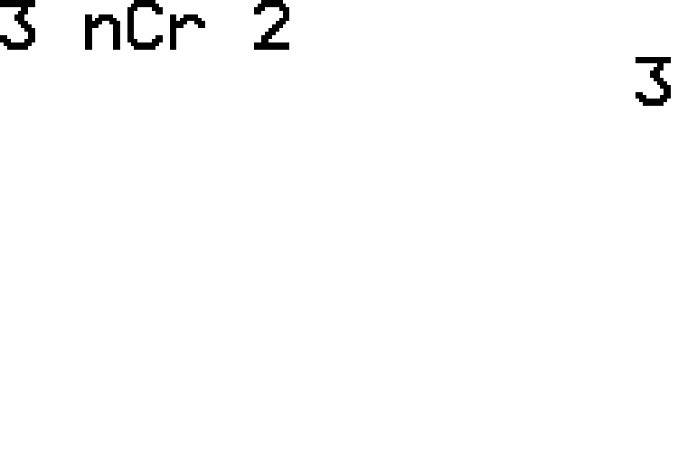

Example 4.4.2: Calculating Numbers of Combinations and Permutations (cont.)
​TI-83/84 Plus:
​The computation will have the form ${}_{n}^{ }{C_{r}}$. To accomplish this, we type the n value of 3 first, and then select PRB from the MATH menu and choose option nCr. Then we type in the r value of 2 as shown in the screenshot.
​

Slide 27

Example 4.4.2: Calculating Numbers of Combinations and Permutations (cont.)
​From this, we know there are three distinct ways that we can choose two of the friends to ride in the car. Let's list out all of the possibilities.
​
​$\text{EH}$ | ​$\text{ES}$ | ​$\text{HS}$

Slide 28
Technology
For further instruction on calculating combinations and permutations using a TI-83/84 Plus calculator or other technology, navigate to stat.hawkeslearning.com and see Technology Instructions > Counting.

Slide 29
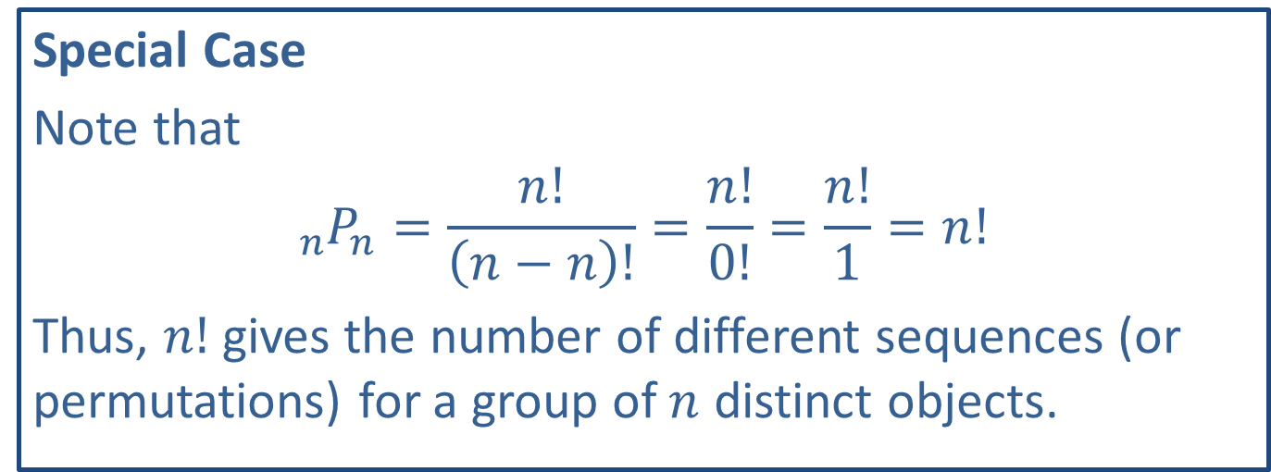
Side Note
Special Case
Note that
$${}_{n}^{ }{P_{n}}=\frac{n!}{\left(n−n\right)!}=\frac{n!}{0!}=\frac{n!}{1}=n!$$
Thus, $n!$ gives the number of different sequences (or permutations) for a group of $n$ distinct objects.

Slide 30
Example 4.4.3: Calculating the Number of Permutations
A class of 18 fifth graders is holding elections for class president, vice president, and secretary. In how many different ways can the officers be elected?

Slide 31
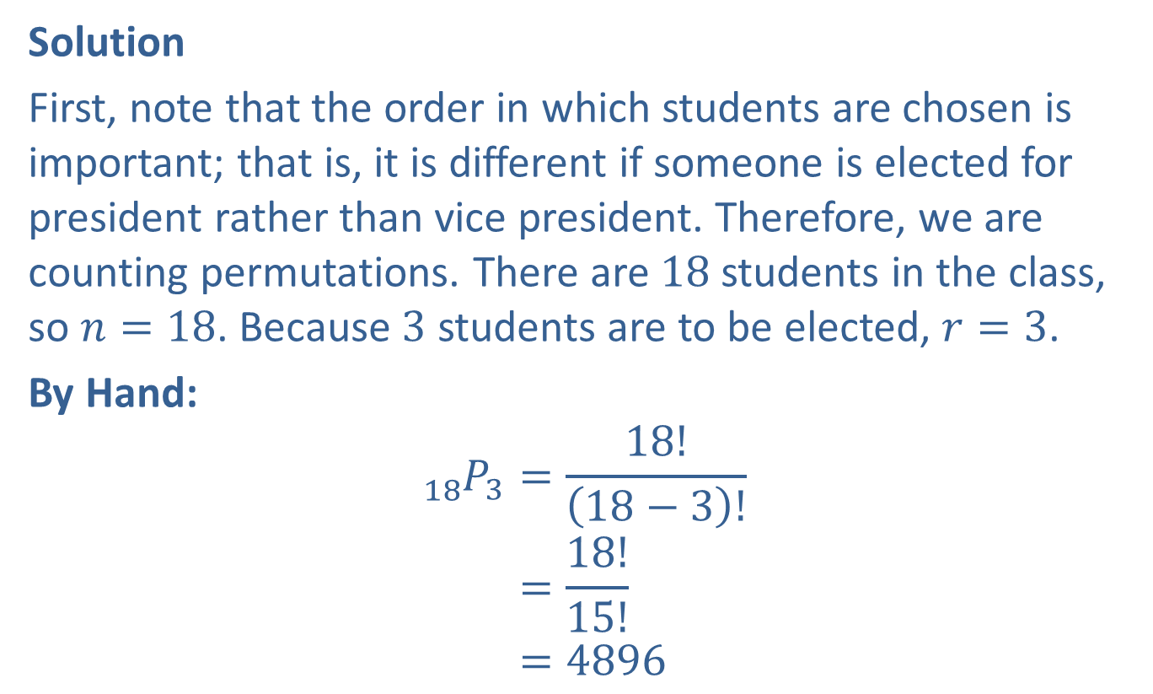
Example 4.4.3: Calculating the Number of Permutations (cont.)
Solution
First, note that the order in which students are chosen is important; that is, it is different if someone is elected for president rather than vice president. Therefore, we are counting permutations. There are 18 students in the class, so $n=18$. Because 3 students are to be elected, $r=3$.
By Hand:
18 𝑃3=18!18−3!18 𝑃3=18!15!18 𝑃3=4896

Slide 32
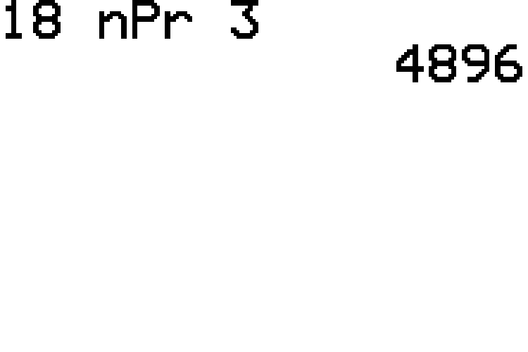

Example 4.4.3: Calculating the Number of Permutations (cont.)
TI-83/84 Plus:
The computation will have the form ${}_{n}^{ }{P_{r}}$ as shown in the screenshot.
So, there are 4896 ways the class officers can be elected.

Slide 33
Example 4.4.4: Calculating the Number of Combinations
Consider that a cafeteria is serving the following vegetables for lunch one weekday: carrots, green beans, lima beans, celery, corn, broccoli, and spinach. Suppose now that Bill wishes to order a vegetable plate with 3 different vegetables. How many ways can his plate be prepared?

Slide 34
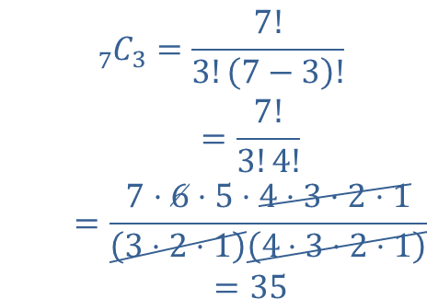
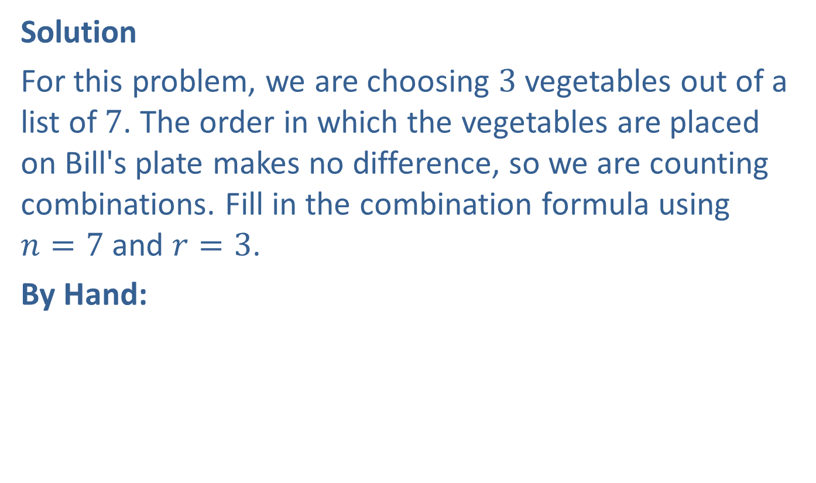
Example 4.4.4: Calculating the Number of Combinations (cont.)
Solution
For this problem, we are choosing 3 vegetables out of a list of 7. The order in which the vegetables are placed on Bill's plate makes no difference, so we are counting combinations. Fill in the combination formula using $n=7$ and $r=3$.
By Hand:
7 𝐶3=7!3!7−3!7 𝐶3=7!3!4!7 𝐶3=7⋅6⋅5⋅4⋅3⋅2⋅13⋅2⋅14⋅3⋅2⋅17 𝐶3=35

Slide 35
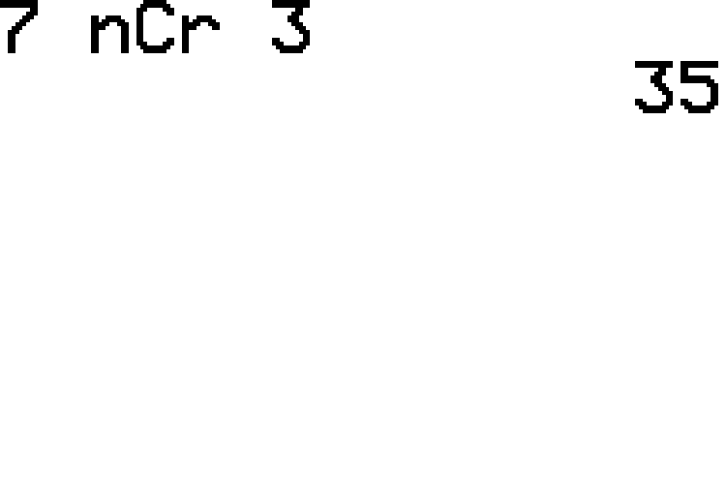

Example 4.4.4: Calculating the Number of Combinations (cont.)
TI-83/84 Plus:
The computation will have the form ${}_{n}^{ }{C_{r}}$ as shown in the screenshot.
Therefore, Bill has 35 different ways to order his vegetable plate. Let's hope he doesn't hold up the line making his choice!

Slide 36
Example 4.4.5: Calculating Probability Using Permutations
Suppose that a little league baseball coach is randomly listing the 9 starting baseball players in a batting order for their second game. At this level, the batting order is randomly chosen to give all players the opportunity to experience different batting positions. What is the probability that the order chosen for the second game is exactly the same as that of the first game?

Slide 37
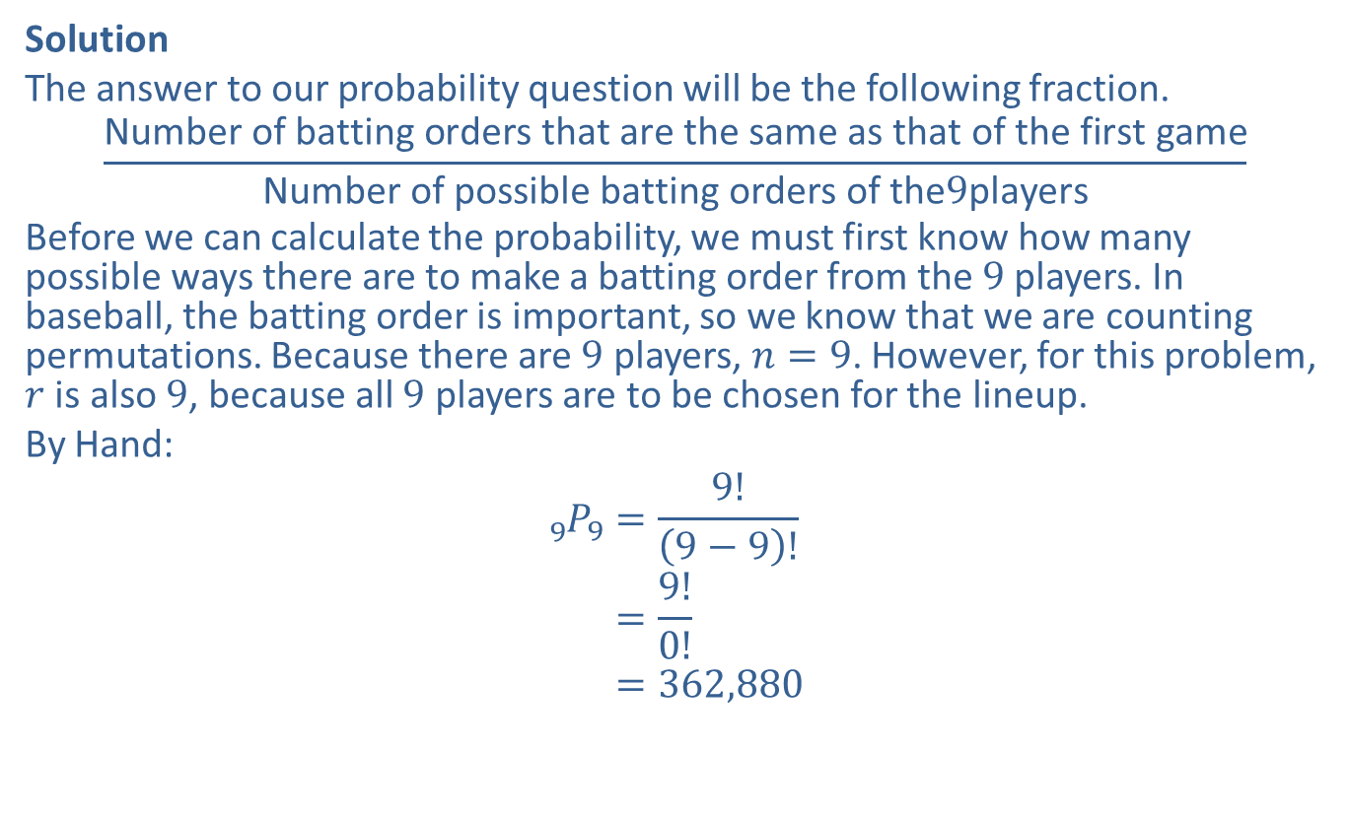
Example 4.4.5: Calculating Probability Using Permutations (cont.)
Solution
The answer to our probability question will be the following fraction.
$$\frac{\text{Number} \text{of} \text{batting} \text{orders} \text{that} \text{are} \text{the} \text{same} \text{as} \text{that} \text{of} \text{the} \text{first} \text{game}}{\text{Number} \text{of} \text{possible} \text{batting} \text{orders} \text{of} \text{the}9\text{players}}$$
Before we can calculate the probability, we must first know how many possible ways there are to make a batting order from the 9 players. In baseball, the batting order is important, so we know that we are counting permutations. Because there are 9 players, $n=9$. However, for this problem, $r$ is also 9, because all 9 players are to be chosen for the lineup.
By Hand:
9 𝑃9=9!9−9!9 𝑃9=9!0!9 𝑃9=362,880

Slide 38
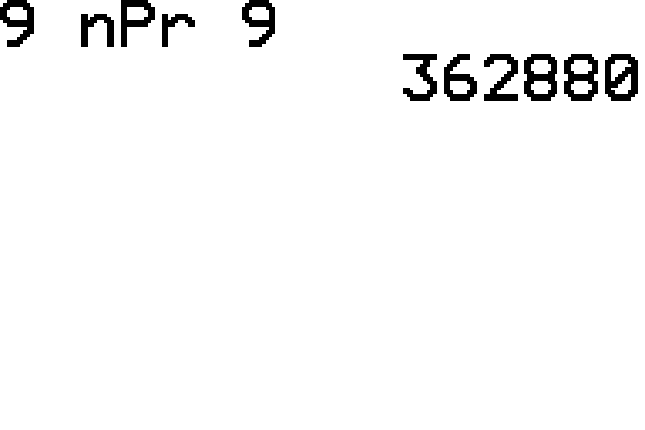
Example 4.4.5: Calculating Probability Using Permutations (cont.)
TI-83/84 Plus:
The computation will have the form ${}_{n}^{ }{P_{r}}$ as shown in the screenshot.

Slide 39
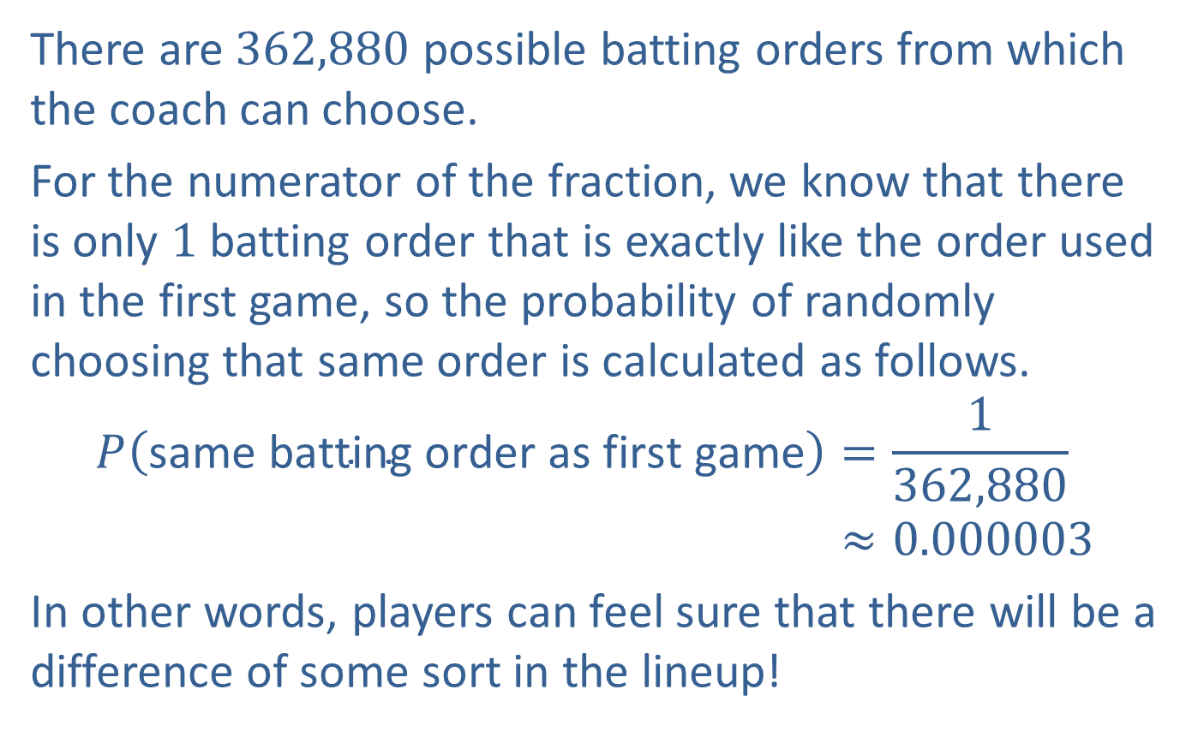
Example 4.4.5: Calculating Probability Using Permutations (cont.)
There are 362,880 possible batting orders from which the coach can choose.
For the numerator of the fraction, we know that there is only 1 batting order that is exactly like the order used in the first game, so the probability of randomly choosing that same order is calculated as follows.
𝑃same batting order as first game=1362,880𝑃⁡same batting order as first game≈0.000003
In other words, players can feel sure that there will be a difference of some sort in the lineup!

Slide 40
Example 4.4.6: Calculating Probability Using Combinations
Maya has a bag of 15 blocks, each of which is a different color including red, blue, and yellow. Maya reaches into the bag and pulls out 3 blocks. What is the probability that Maya has chosen one of each block color?

Slide 41
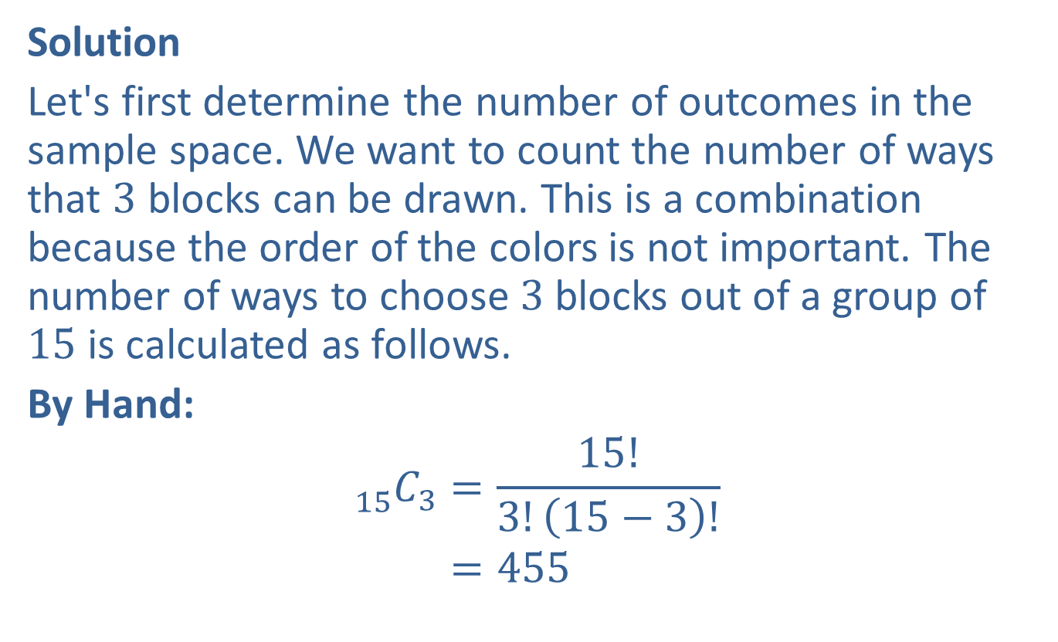
Example 4.4.6: Calculating Probability Using Combinations (cont.)
Solution
Let's first determine the number of outcomes in the sample space. We want to count the number of ways that 3 blocks can be drawn. This is a combination because the order of the colors is not important. The number of ways to choose 3 blocks out of a group of 15 is calculated as follows.
By Hand:
15 𝐶3=15!3!15−3!15 𝐶3=455

Slide 42
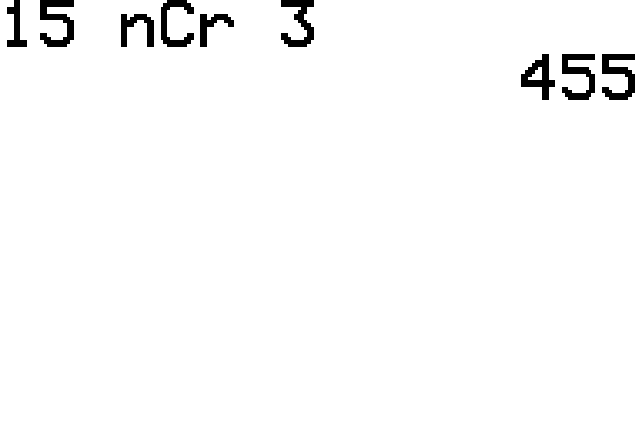
Example 4.4.6: Calculating Probability Using Combinations (cont.)
TI-83/84 Plus:
The computation will have the form ${}_{n}^{ }{C_{r}}$ as shown in the screenshot.

Slide 43
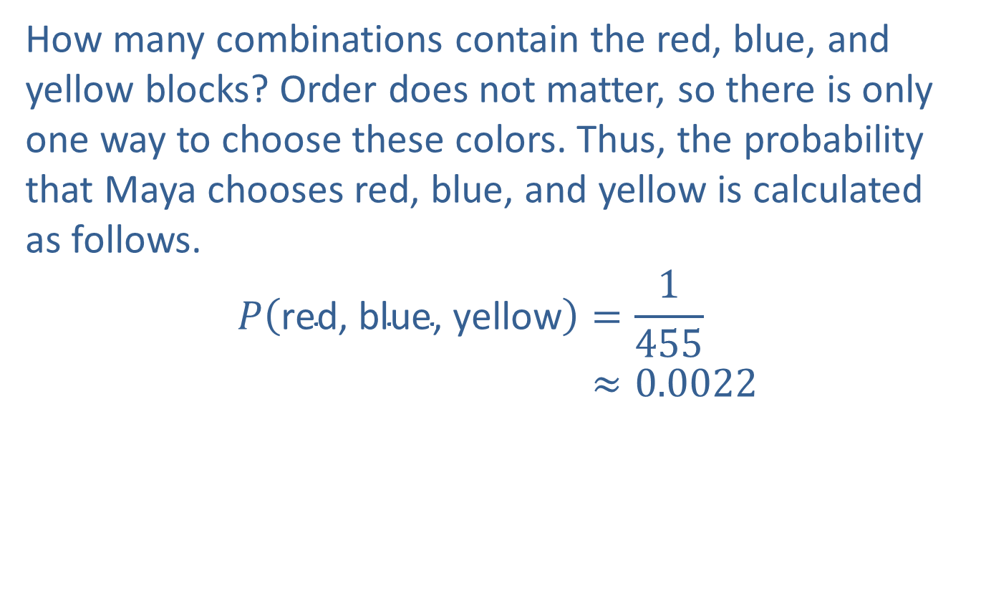
Example 4.4.6: Calculating Probability Using Combinations (cont.)
How many combinations contain the red, blue, and yellow blocks? Order does not matter, so there is only one way to choose these colors. Thus, the probability that Maya chooses red, blue, and yellow is calculated as follows.
𝑃red, blue, yellow=1455𝑃⁡red, blue, yellow≈0.0022

Slide 44
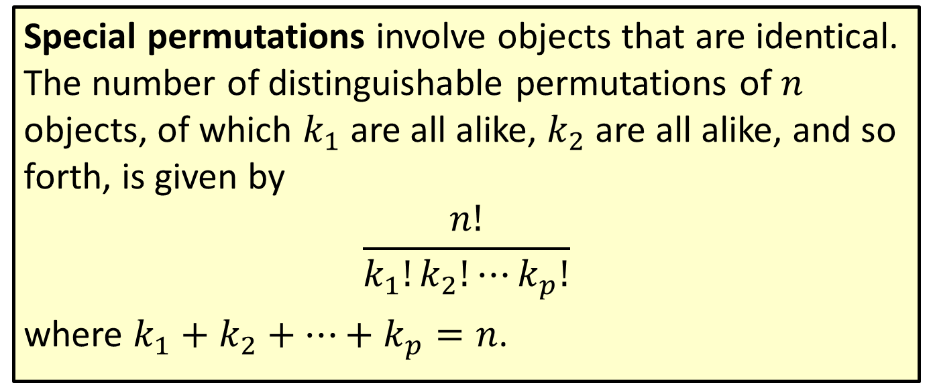
Formula: Special Permutations
Special permutations involve objects that are identical. The number of distinguishable permutations of $n$ objects, of which $k_{1}$ are all alike, $k_{2}$ are all alike, and so forth, is given by
$$\frac{n!}{k_{1}!k_{2}!⋯k_{p}!}$$
where $k_{1}+k_{2}+⋯+k_{p}=n$.

Slide 45
Example 4.4.7: Calculating the Number of Special Permutations
How many different ways can you arrange the letters in the word TENNESSEE?

Slide 46
Example 4.4.7: Calculating the Number of Special Permutations (cont.)
Solution
Because we can make no distinction between each E, N, or S in the word, we need to group the letters together. The letters in TENNESSEE are grouped as follows.
T: 1
E: 4
N: 2
S: 2
Since there are a total of 9 letters in TENNESSEE, substituting these values into the special permutation formula gives the following.

Slide 47
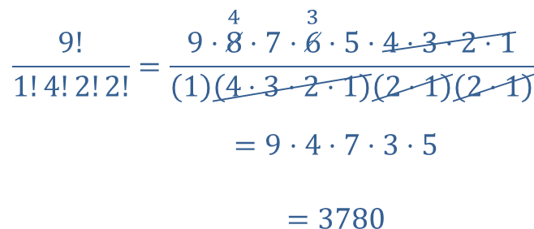
Example 4.4.7: Calculating the Number of Special Permutations (cont.)
By Hand:
9!1!4!2!2!=9⋅84⋅7⋅63⋅5⋅4⋅3⋅2⋅114⋅3⋅2⋅12⋅12⋅19!1!4!2!2!=9⋅4⋅7⋅3⋅59!1!4!2!2!=3780

Slide 48
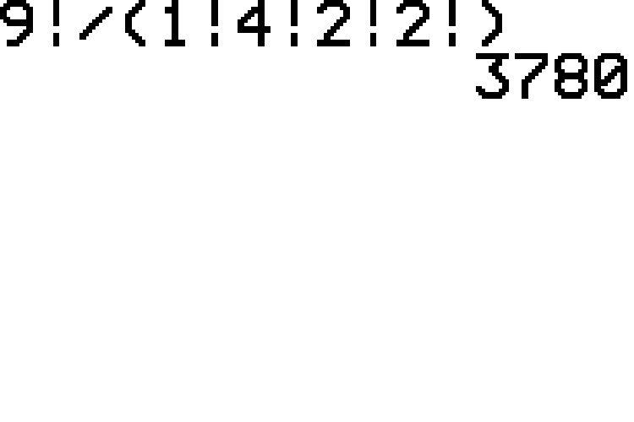
Example 4.4.7: Calculating the Number of Special Permutations (cont.)
TI-83/84 Plus:
Using the calculator we obtain the same result shown in the screenshot. Remember that you need parentheses around the calculation in the denominator.
Thus, there are 3780 ways to arrange the letters in the word TENNESSEE.

