Slide 1
Section 4.5
Combining Probability and Counting Techniques

Slide 2
Example 4.5.1: Calculating Probability Using Combinations
A group of 12 tourists are visiting London. At one particular museum, a discounted admission is given to groups of at least ten.
​How many combinations of tourists can be made for the museum visit so that the group receives the discounted rate?
​Suppose that a group of the tourists get the discount. What's the probability that it was made up of 11 of the tourists?

Slide 3
Example 4.5.1: Calculating Probability Using Combinations (cont.)
Solution
​The key words for this problem are at least. If at least 10 are required, then the group will get the discount rate if 10, 11 or 12 tourists go to the museum. We must then calculate the number of combinations for each of the three possibilities. Because the problem implies that the group will get the discount rate for any of these three numbers of tourists we must add the results together. Note that we are counting combinations, not permutations, because the order of tourists chosen to go to the museum is irrelevant.​

Slide 4
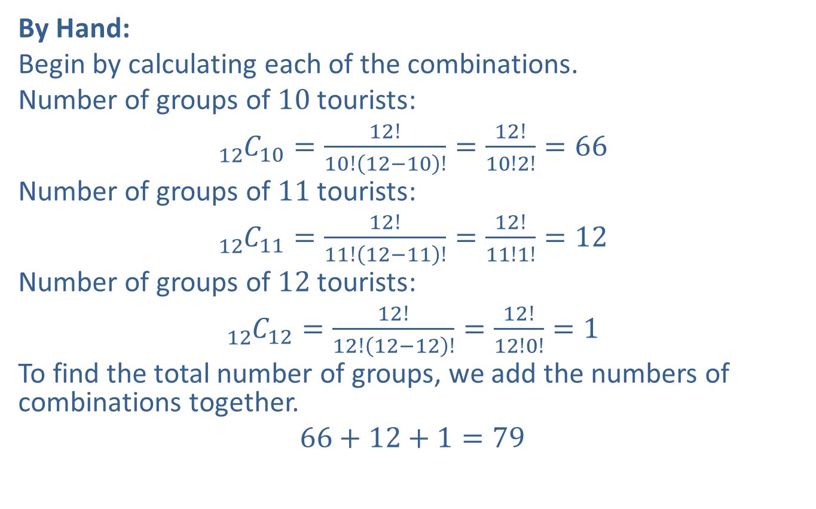
Example 4.5.1: Calculating Probability Using Combinations (cont.)
​By Hand:
​Begin by calculating each of the combinations.
​Number of groups of 10 tourists:
​${}_{12}^{ }{C_{10}}=\frac{12!}{10!\left(12−10\right)!}=\frac{12!}{10!2!}=66$
​Number of groups of 11 tourists:
​${}_{12}^{ }{C_{11}}=\frac{12!}{11!\left(12−11\right)!}=\frac{12!}{11!1!}=12$
​Number of groups of 12 tourists:
​${}_{12}^{ }{C_{12}}=\frac{12!}{12!\left(12−12\right)!}=\frac{12!}{12!0!}=1$
​To find the total number of groups, we add the numbers of combinations together.
​$66+12+1=79$
​

Slide 5
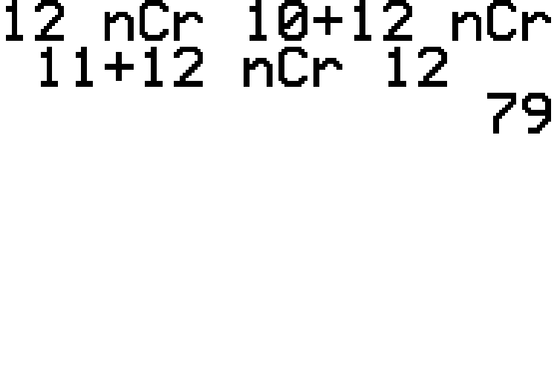
Example 4.5.1: Calculating Probability Using Combinations (cont.)
​TI-83/84 Plus:
​We can add the required three combination calculations at once using our calculators. Simply type the addition sign between each combination syntax as shown in the screenshot.
​

Slide 6
Example 4.5.1: Calculating Probability Using Combinations (cont.)
​Thus, there are 79 different groups that can be formed to tour the museum at the discounted rate.

Slide 7
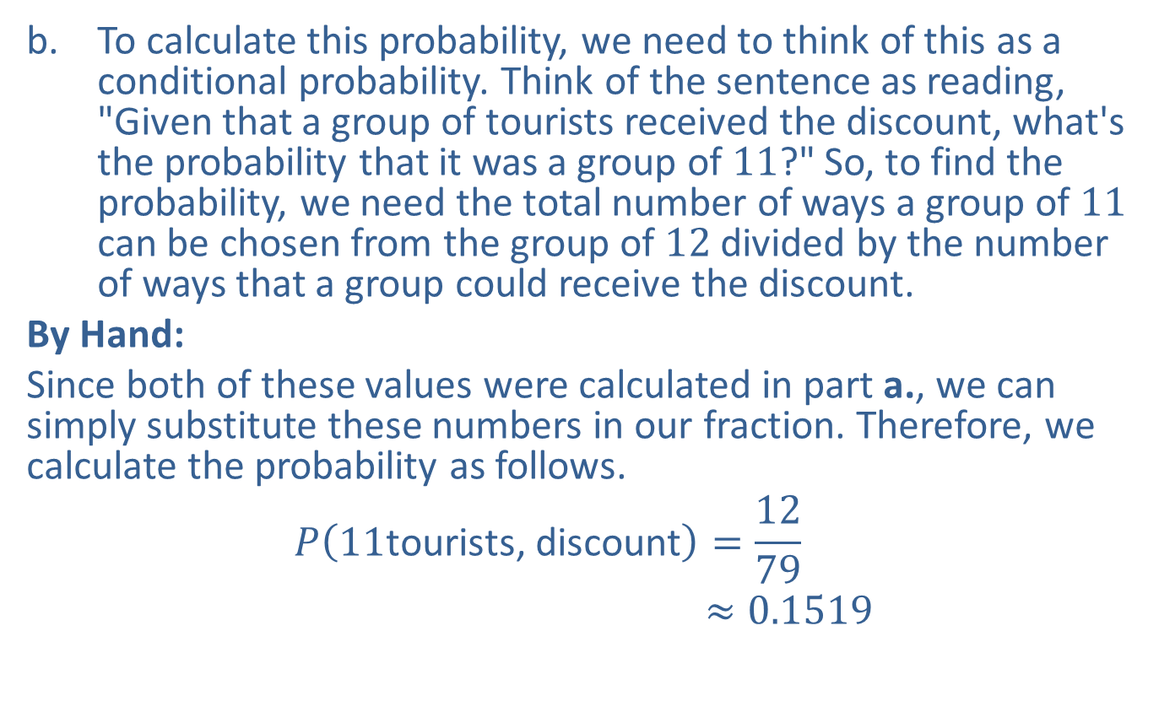
Example 4.5.1: Calculating Probability Using Combinations (cont.)
​To calculate this probability, we need to think of this as a conditional probability. Think of the sentence as reading, "Given that a group of tourists received the discount, what's the probability that it was a group of 11?" So, to find the probability, we need the total number of ways a group of 11 can be chosen from the group of 12 divided by the number of ways that a group could receive the discount.
​By Hand:
​Since both of these values were calculated in part a., we can simply substitute these numbers in our fraction. Therefore, we calculate the probability as follows.
𝑃11tourists, discount=1279𝑃⁡11tourists|discount≈0.1519
​

Slide 8
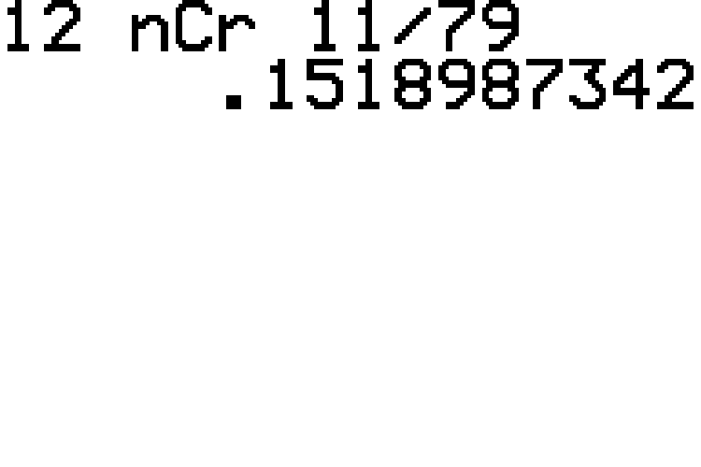

Example 4.5.1: Calculating Probability Using Combinations (cont.)
​TI-83/84 Plus:
​The numerator of the probability requires ${}_{12}^{ }{C_{11}}$ and the denominator is the total from part a. We can find the probability in one step as shown in the screenshot.
​

Slide 9

Example 4.5.1: Calculating Probability Using Combinations (cont.)
​Thus, the probability that the group which received the discount was comprised of 11 tourists is approximately $15.19\%$.

Slide 10
Technology
For further instruction on calculating combinations and permutations using a TI-83/84 Plus calculator or other technology, navigate to stat.hawkeslearning.com and see Technology Instructions > Counting > Permutation.

Slide 11
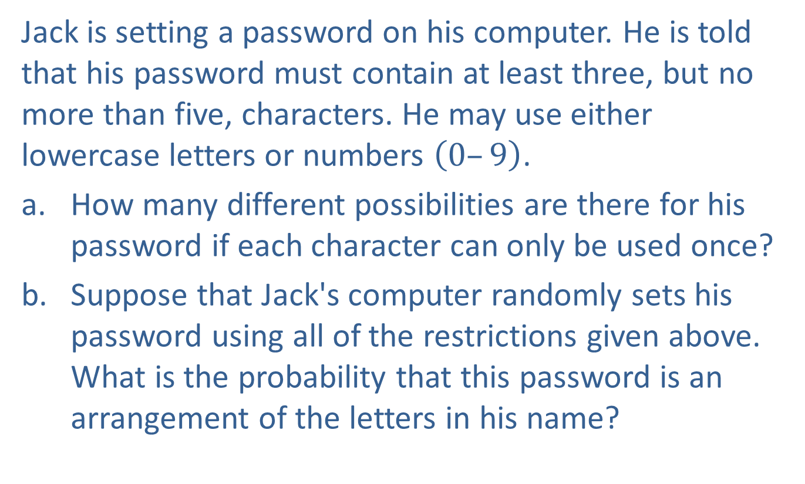
Example 4.5.2: Calculating Probability Using Permutations
Jack is setting a password on his computer. He is told that his password must contain at least three, but no more than five, characters. He may use either lowercase letters or numbers $\left(0–9\right)$.
​How many different possibilities are there for his password if each character can only be used once?
​Suppose that Jack's computer randomly sets his password using all of the restrictions given above. What is the probability that this password is an arrangement of the letters in his name?

Slide 12
Example 4.5.2: Calculating Probability Using Permutations (cont.)
Solution
​First, notice the key words at least and no more than. These words tell us that Jack's password can be 3, 4, or 5 characters in length. Also note that for a password, the order of characters is important, so we are counting permutations. There are 26 letters and 10 digits to choose from, so we must calculate the number of permutations possible from taking groups of 3, 4, or 5 characters out of 36 possibilities. To find the total number of possible passwords, once again we need to add all three of the numbers of permutations together since the solution contains an “or” statement.
​

Slide 13
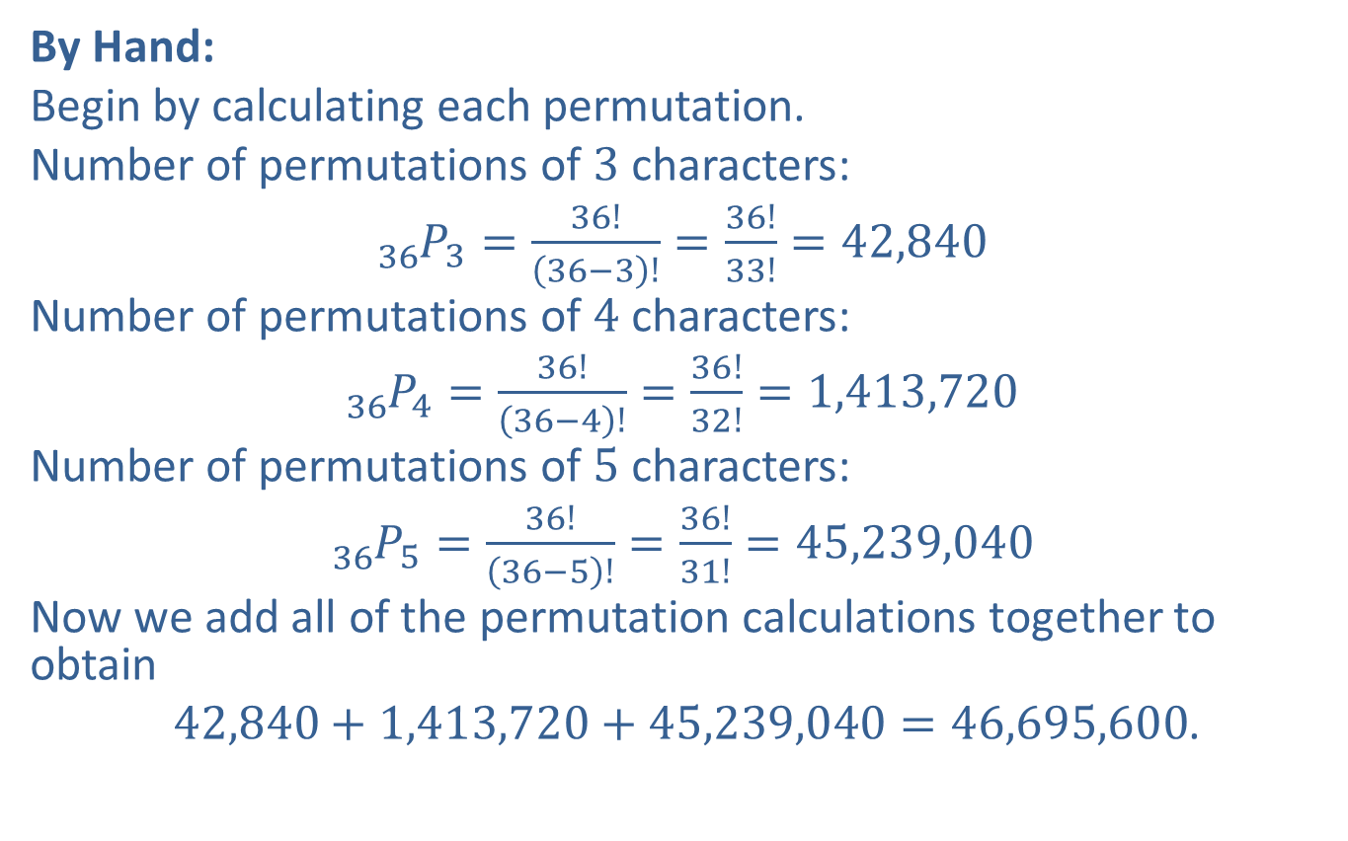
Example 4.5.2: Calculating Probability Using Permutations (cont.)
​By Hand:
​Begin by calculating each permutation.
​Number of permutations of 3 characters:
​${}_{36}^{ }{P_{3}}=\frac{36!}{\left(36−3\right)!}=\frac{36!}{33!}=42,840$
​Number of permutations of 4 characters:
​${}_{36}^{ }{P_{4}}=\frac{36!}{\left(36−4\right)!}=\frac{36!}{32!}=1,413,720$
​Number of permutations of 5 characters:
​${}_{36}^{ }{P_{5}}=\frac{36!}{\left(36−5\right)!}=\frac{36!}{31!}=45,239,040$
​Now we add all of the permutation calculations together to obtain
​ $42,840+1,413,720+45,239,040=46,695,600$.
​

Slide 14
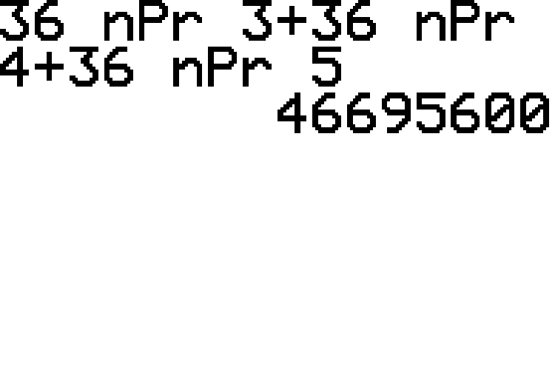
Example 4.5.2: Calculating Probability Using Permutations (cont.)
​TI-83/84 Plus:
​We can add the required three permutation calculations at once using our calculators. Simply type the addition sign between each permutation syntax as shown in the screenshot.
​

Slide 15
Example 4.5.2: Calculating Probability Using Permutations (cont.)
​Therefore, there are a total of 46,695,600 different possibilities for Jack's password if each character can only be used once. Imagine how many possibilities there would be if he could use up to eight or nine characters!

Slide 16
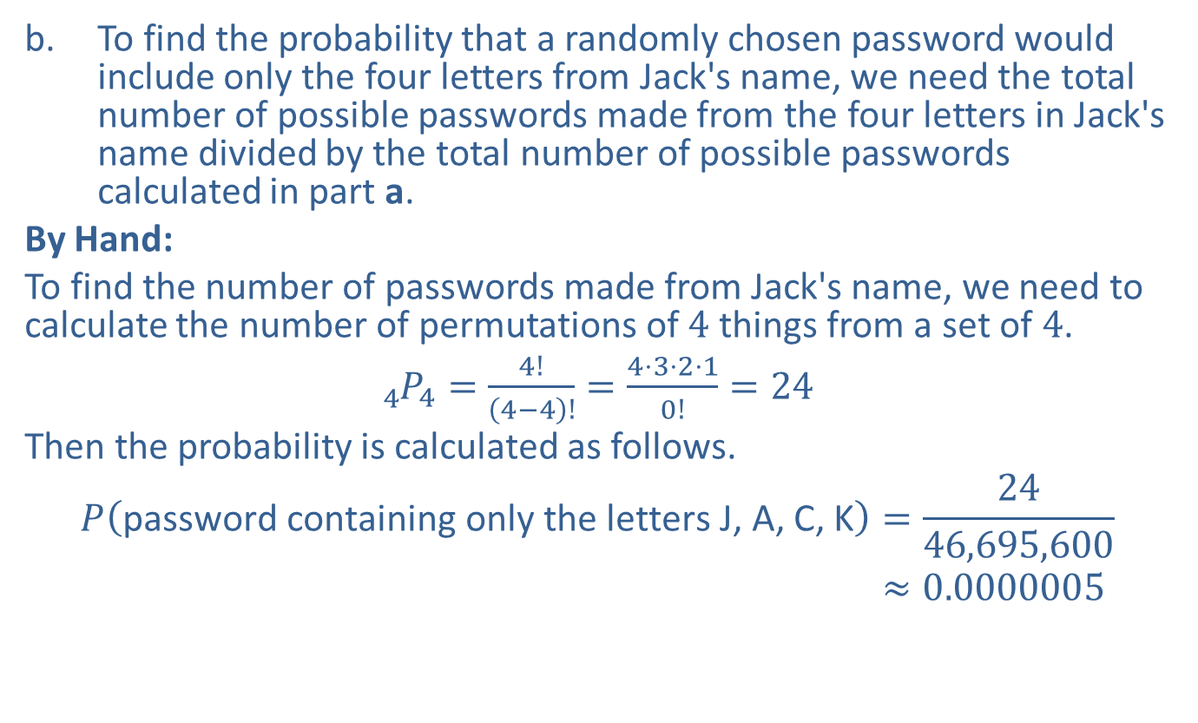
Example 4.5.2: Calculating Probability Using Permutations (cont.)
​To find the probability that a randomly chosen password would include only the four letters from Jack's name, we need the total number of possible passwords made from the four letters in Jack's name divided by the total number of possible passwords calculated in part a.
​By Hand:
​To find the number of passwords made from Jack's name, we need to calculate the number of permutations of 4 things from a set of 4.
​${}_{4}^{ }{P_{4}}=\frac{4!}{\left(4−4\right)!}=\frac{4⋅3⋅2⋅1}{0!}=24$
​Then the probability is calculated as follows.
𝑃password containing only the letters J, A, C, K=2446,695,600𝑃⁡password containing only the letters J, A, C, K≈0.0000005
​

Slide 17
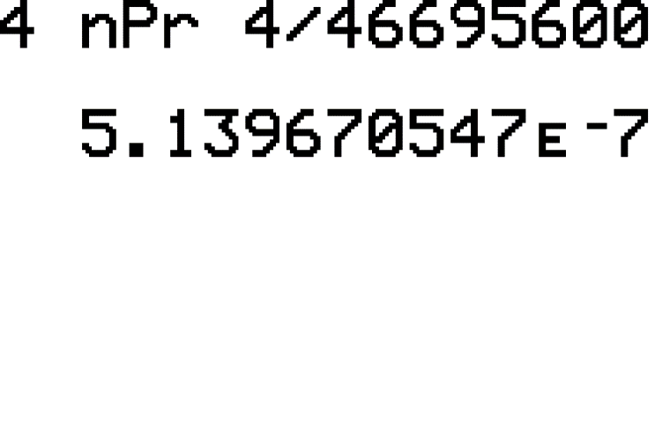

Example 4.5.2: Calculating Probability Using Permutations (cont.)
​TI-83/84 Plus:
​The probability fraction will include the permutation of the letters in Jack's name in the numerator (${}_{4}^{ }{P_{4}}$) divided by the answer from part a. as shown in the screenshot.
​

Slide 18

Example 4.5.2: Calculating Probability Using Permutations (cont.)
​Therefore, the probability that Jack's computer randomly sets his password to contain only the letters in his name is $0.00005\%$, an extremely rare possibility.

Slide 19
Example 4.5.3: Using Numbers of Combinations with the Fundamental Counting Principle
Tina is packing her suitcase to go on a weekend trip. She wants to pack 3 shirts, 2 pairs of pants, and 2 pairs of shoes. She has 9 shirts, 5 pairs of pants, and 4 pairs of shoes to choose from. How many ways can Tina pack her suitcase?

Slide 20
Example 4.5.3: Using Numbers of Combinations with the Fundamental Counting Principle (cont.)
Solution
Begin by thinking of this problem as a Fundamental Counting Principle problem. Consider the act of packing the suitcase to be a multistage experiment. There are three stages—packing the shirts, packing the pants, and packing the shoes. Thus, there are three suitcase "slots" for Tina to fill—a slot for shirts, a slot for pants, and a slot for shoes. To fill these slots, the combination formula must be used because we are choosing some items out of her closet, and the order of the choosing does not matter. The final step in this problem is different than the final step in the last two examples, because of the word “and.” The Fundamental Counting Principle tells us we have to multiply, rather than add, the numbers of combinations together to get the final result.

Slide 21
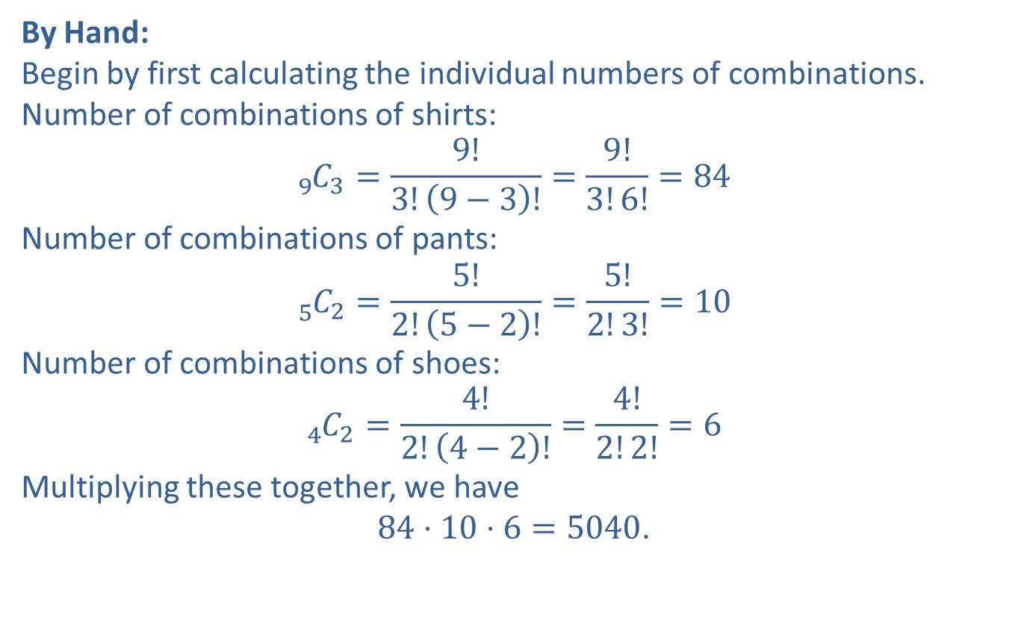
Example 4.5.3: Using Numbers of Combinations with the Fundamental Counting Principle (cont.)
By Hand:
Begin by first calculating the individual numbers of combinations.
Number of combinations of shirts:
$${}_{9}^{ }{C_{3}}=\frac{9!}{3!\left(9−3\right)!}=\frac{9!}{3!6!}=84$$
Number of combinations of pants:
$${}_{5}^{ }{C_{2}}=\frac{5!}{2!\left(5−2\right)!}=\frac{5!}{2!3!}=10$$
Number of combinations of shoes:
$${}_{4}^{ }{C_{2}}=\frac{4!}{2!\left(4−2\right)!}=\frac{4!}{2!2!}=6$$
Multiplying these together, we have
$84⋅10⋅6=5040$.

Slide 22
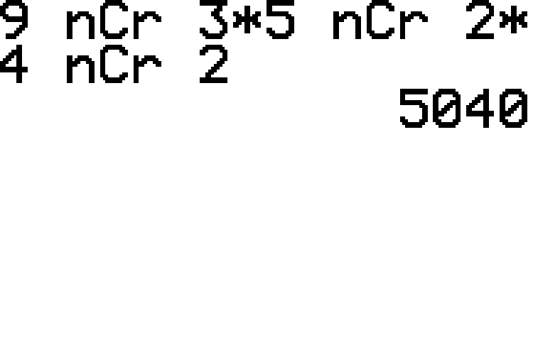
Example 4.5.3: Using Numbers of Combinations with the Fundamental Counting Principle (cont.)
TI-83/84 Plus:
We can multiply the required three combination calculations at once using our calculators. Simply type the multiplication sign between each combination syntax as shown in the screenshot.

Slide 23
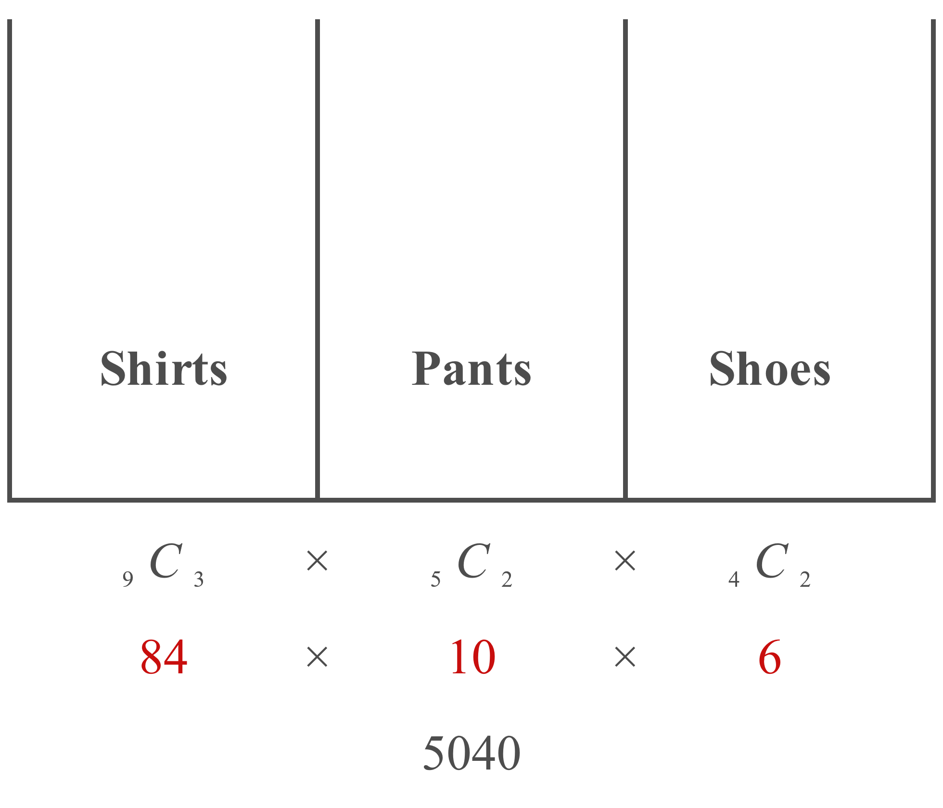
Example 4.5.3: Using Numbers of Combinations with the Fundamental Counting Principle (cont.)
Therefore, there are 5040 different ways that Tina can pack for the weekend.

Slide 24
Memory Booster
And vs. Or in Probability
"And" ⇔ Multiply
"Or" ⇔ Add

Slide 25
Example 4.5.4: Using Numbers of Combinations with the Fundamental Counting Principle
An elementary school principal is putting together a committee of 6 teachers to head up the spring festival. There are 8 first-grade, 9 second-grade, and 7 third-grade teachers at the school.
​In how many ways can the committee be formed?
​In how many ways can the committee be formed if there must be 2 teachers chosen from each grade?
​Suppose the committee is chosen at random and with no restrictions. What is the probability that 2 teachers from each grade are represented?

Slide 26
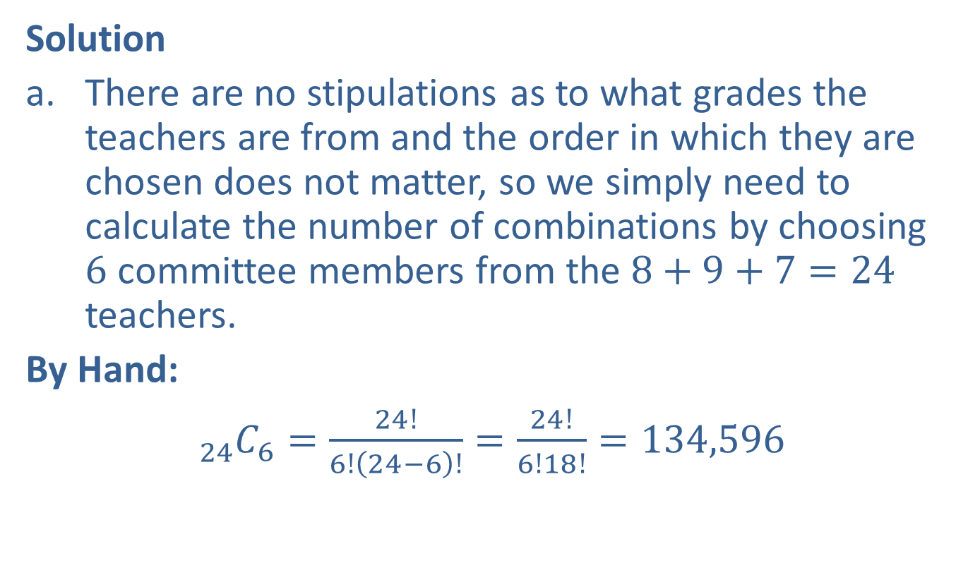
Example 4.5.4: Using Numbers of Combinations with the Fundamental Counting Principle (cont.)
Solution
​There are no stipulations as to what grades the teachers are from and the order in which they are chosen does not matter, so we simply need to calculate the number of combinations by choosing 6 committee members from the $8+9+7=24$ teachers.
​By Hand:
​${}_{24}^{ }{C_{6}}=\frac{24!}{6!\left(24−6\right)!}=\frac{24!}{6!18!}=134,596$
​

Slide 27
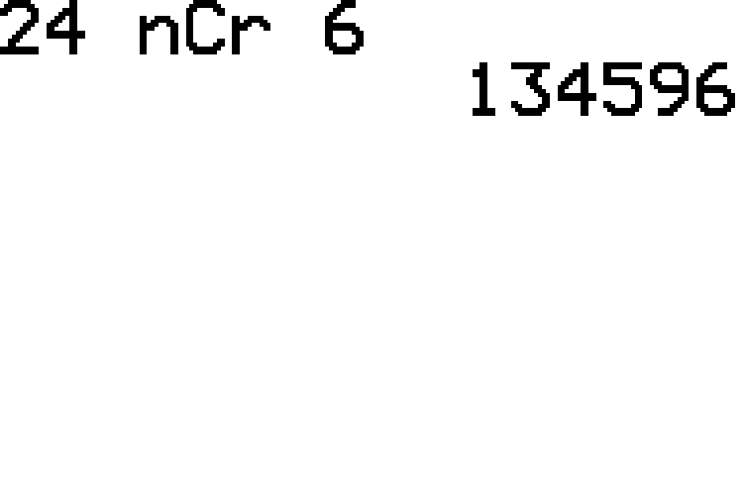

Example 4.5.4: Using Numbers of Combinations with the Fundamental Counting Principle (cont.)
​TI-83/84 Plus:
​The computation will have the form ${}_{n}^{ }{C_{r}}$ as shown in the screenshot. Thus there are 134,596 ways in which a committee of 6 teachers can be formed.
​

Slide 28
Example 4.5.4: Using Numbers of Combinations with the Fundamental Counting Principle (cont.)
​For this problem we need to combine the Fundamental Counting Principle and the combination formula. First, we see that there are three slots to fill: one first-grade slot, one second-grade slot, and one third-grade slot. Each slot is made up of 2 teachers, and we must use the combination formula to determine how many ways these slots can be filled. Finally, the Fundamental Counting Principle says that we have to multiply together the outcomes for all three slots in order to obtain the total number of ways to form the committee.

Slide 29
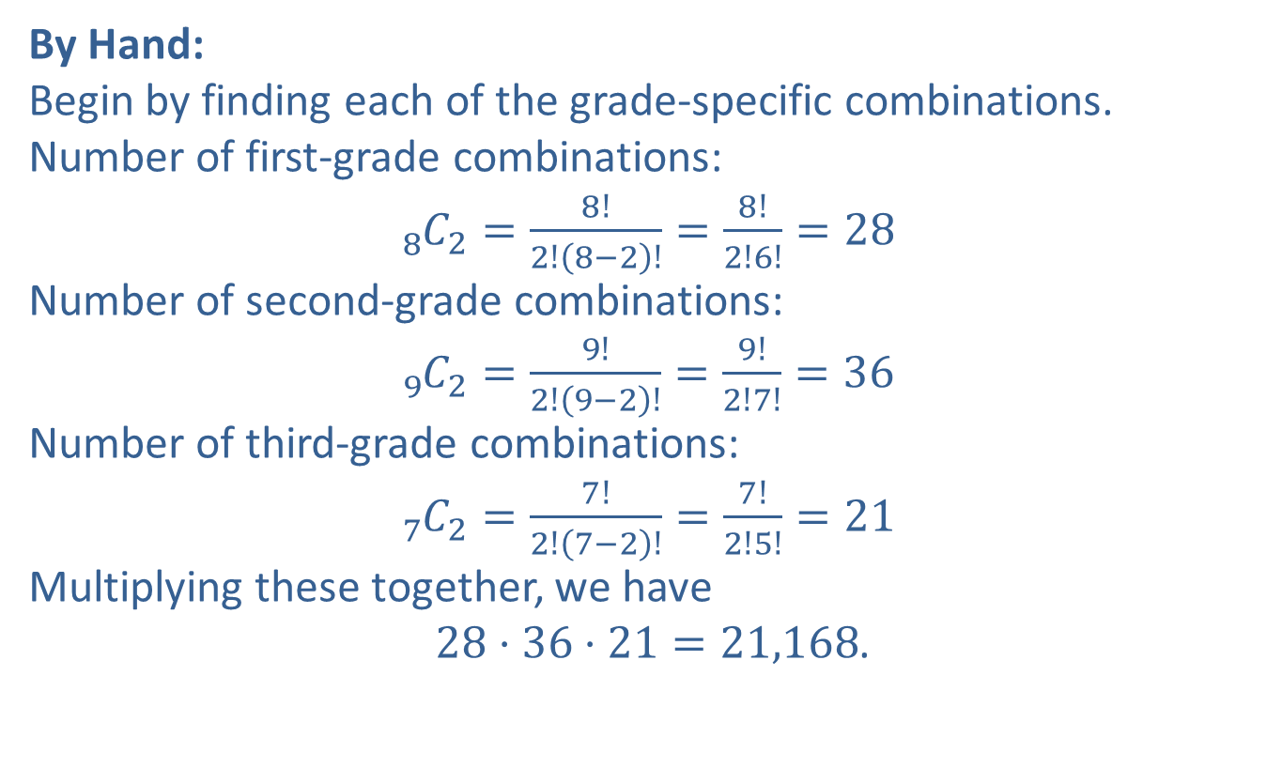
Example 4.5.4: Using Numbers of Combinations with the Fundamental Counting Principle (cont.)
​By Hand:
​Begin by finding each of the grade-specific combinations.
​Number of first-grade combinations:
​${}_{8}^{ }{C_{2}}=\frac{8!}{2!\left(8−2\right)!}=\frac{8!}{2!6!}=28$
​Number of second-grade combinations:
​${}_{9}^{ }{C_{2}}=\frac{9!}{2!\left(9−2\right)!}=\frac{9!}{2!7!}=36$
​Number of third-grade combinations:
​${}_{7}^{ }{C_{2}}=\frac{7!}{2!\left(7−2\right)!}=\frac{7!}{2!5!}=21$
​Multiplying these together, we have
​ $28⋅36⋅21=21,168$.
​

Slide 30
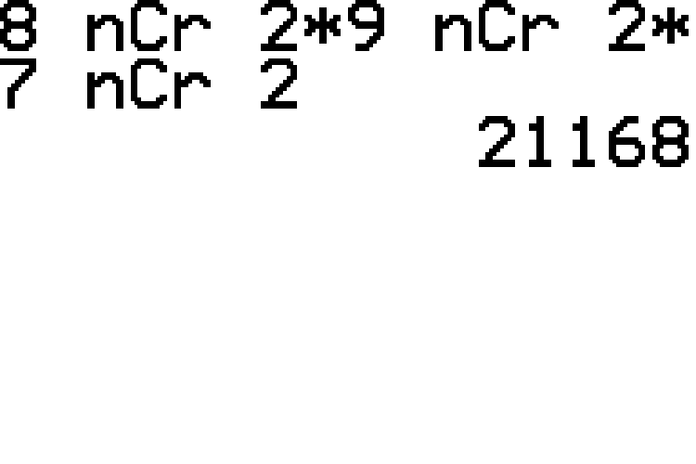
Example 4.5.4: Using Numbers of Combinations with the Fundamental Counting Principle (cont.)
​TI-83/84 Plus:
​We can multiply the required grade-specific combination calculations at once using our calculators. Simply type the multiplication sign between each combination syntax as shown in the screenshot.
​

Slide 31
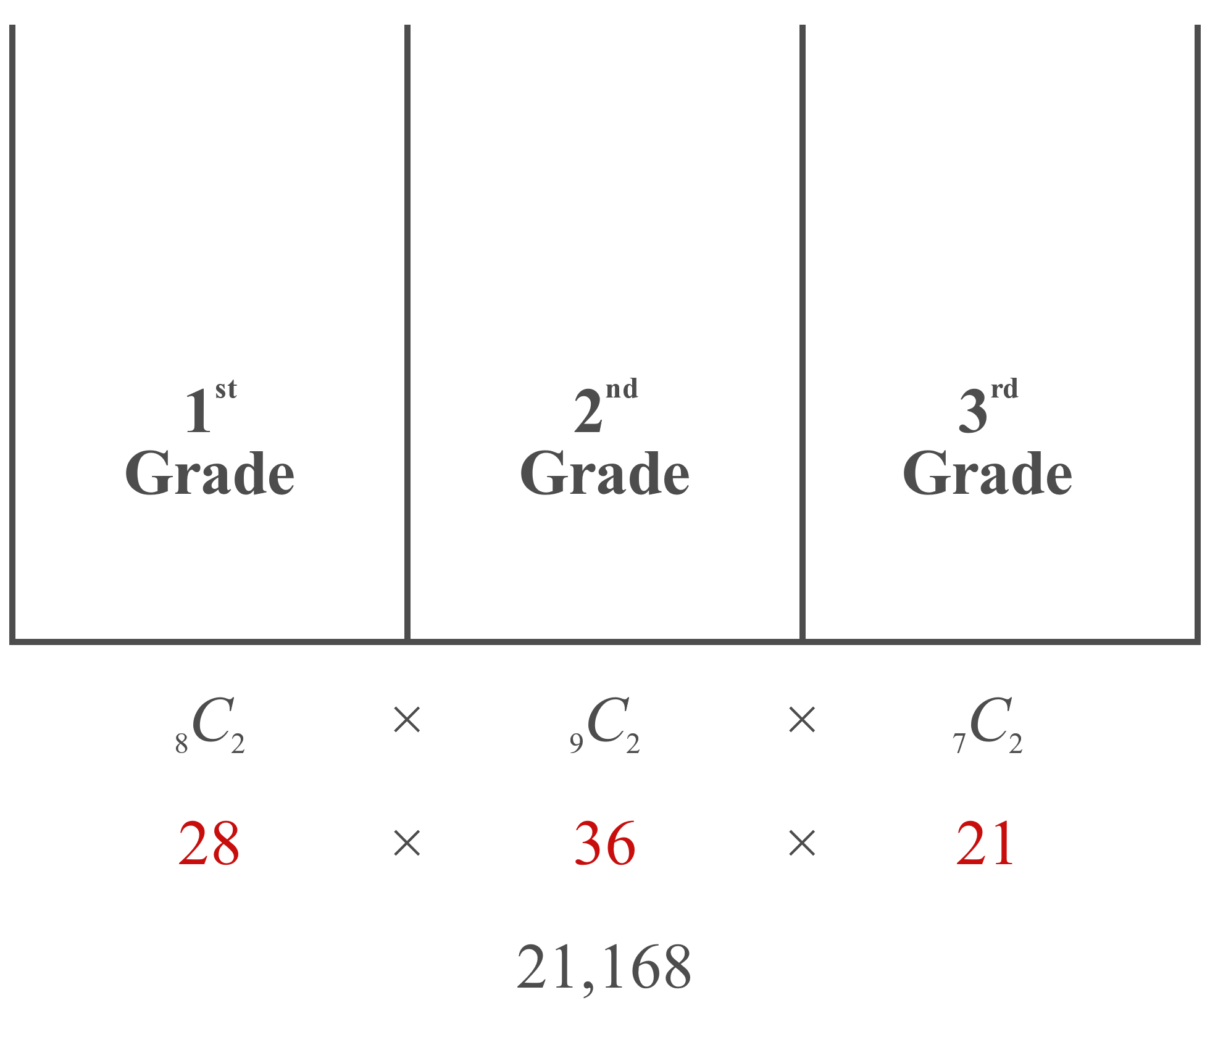
Example 4.5.4: Using Numbers of Combinations with the Fundamental Counting Principle (cont.)
​Thus, there are 21,168 ways to choose the committee if there must be 2 teachers chosen from each grade.

Slide 32
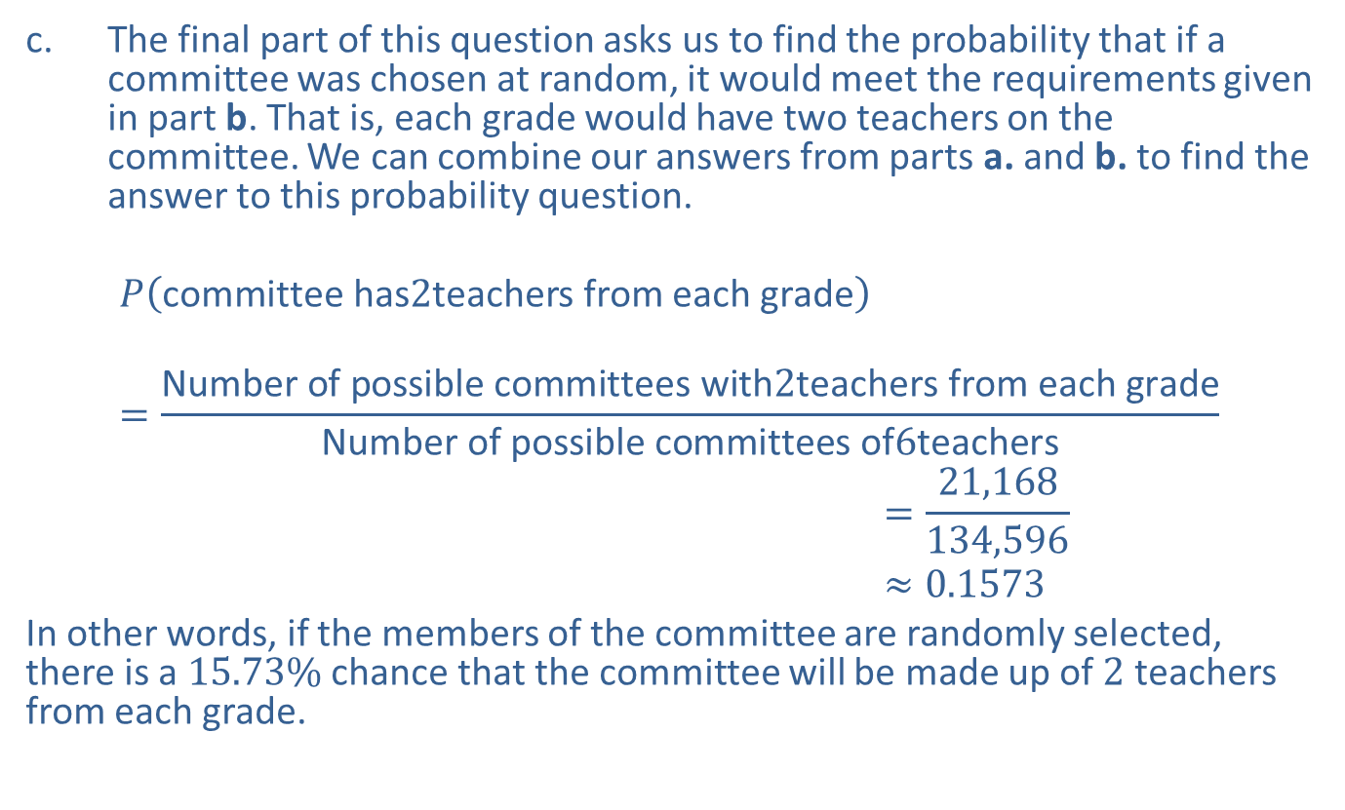
Example 4.5.4: Using Numbers of Combinations with the Fundamental Counting Principle (cont.)
​The final part of this question asks us to find the probability that if a committee was chosen at random, it would meet the requirements given in part b. That is, each grade would have two teachers on the committee. We can combine our answers from parts a. and b. to find the answer to this probability question.
𝑃⁡committee has2teachers from each grade𝑃committee has2teachers from each grade=Number of possible committees with2teachers from each gradeNumber of possible committees of6teachers𝑃⁡committee has2teachers from each grade=21,168134,596𝑃⁡committee has2teachers from each grade≈0.1573
​In other words, if the members of the committee are randomly selected, there is a $15.73\%$ chance that the committee will be made up of 2 teachers from each grade.

