Slide 1
Section 5.1
Discrete Random Variables

Slide 2
Random Variable
Definition
A random variable is a variable whose numeric value is determined by the outcome of a probability experiment.

Slide 3
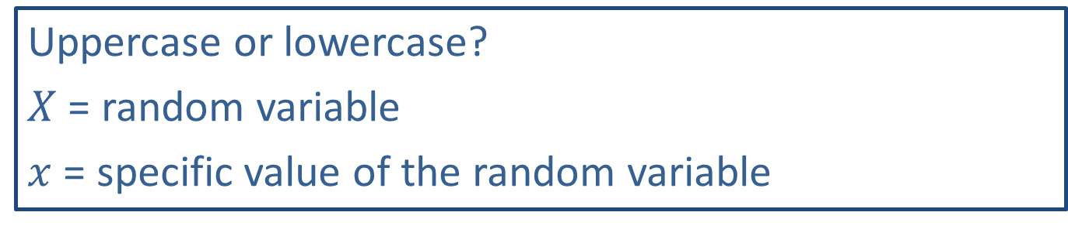
Memory Booster
Uppercase or lowercase?
$X$ = random variable
$x$ = specific value of the random variable

Slide 4
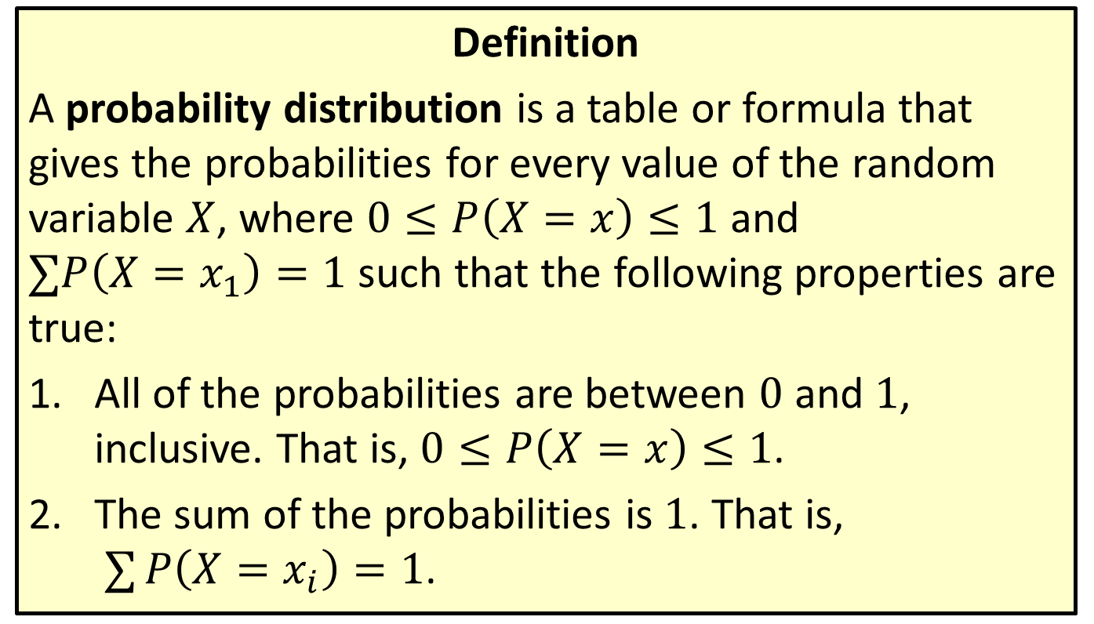
Distribution
Definition
A probability distribution is a table or formula that gives the probabilities for every value of the random variable $X$, where $0≤P\left(X=x\right)≤1$ and $∑P\left(X=x_{1}\right)=1$ such that the following properties are true:
​All of the probabilities are between 0 and 1, inclusive. That is, $0≤P\left(X=x\right)≤1$.
​The sum of the probabilities is 1. That is, $∑P\left(X=x_{i}\right)=1$.

Slide 5

Example 5.1.1: Creating a Discrete Probability Distribution
Create a discrete probability distribution for $X$, the sum of two rolled dice.

Slide 6
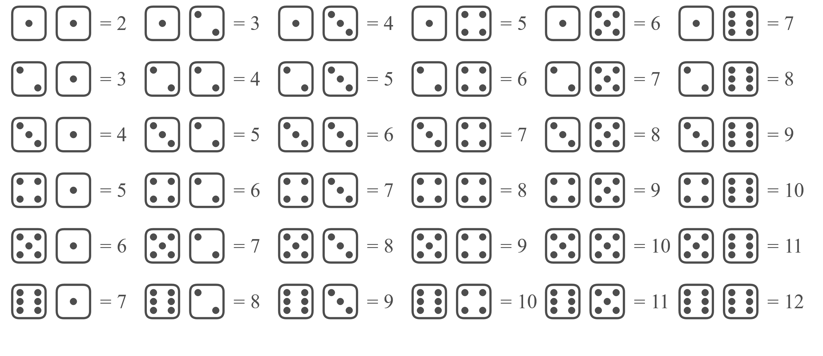

Example 5.1.1: Creating a Discrete Probability Distribution (cont.)
Solution
To begin, let's list all of the possible values for $X$.

Slide 7

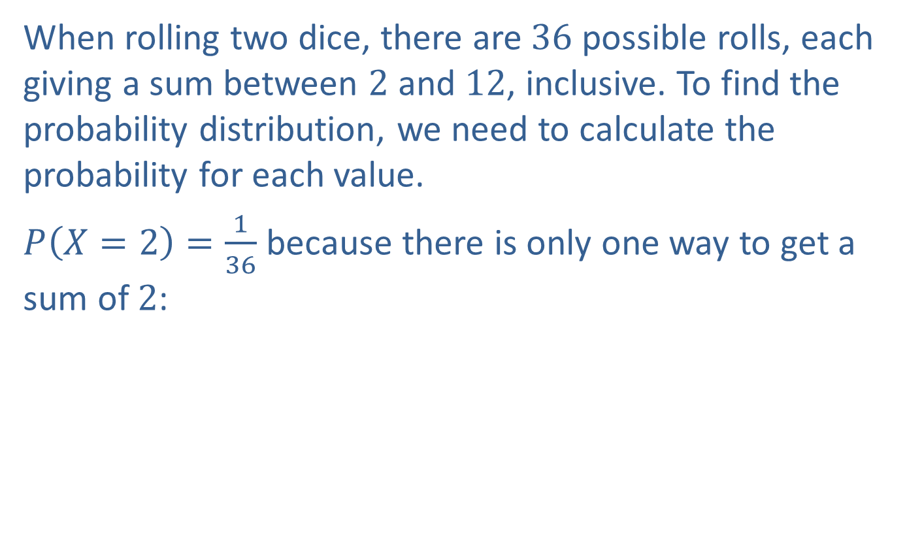
Example 5.1.1: Creating a Discrete Probability Distribution (cont.)
When rolling two dice, there are 36 possible rolls, each giving a sum between 2 and 12, inclusive. To find the probability distribution, we need to calculate the probability for each value.
$P\left(X=2\right)=\frac{1}{36}$ because there is only one way to get a sum of 2:

Slide 8


Example 5.1.1: Creating a Discrete Probability Distribution (cont.)
$P\left(X=3\right)=\frac{2}{36}$ because you may get the sum of 3 in two ways:
or

Slide 9
Example 5.1.1: Creating a Discrete Probability Distribution (cont.)
Continuing this process will give us the following probability distribution.

Slide 10
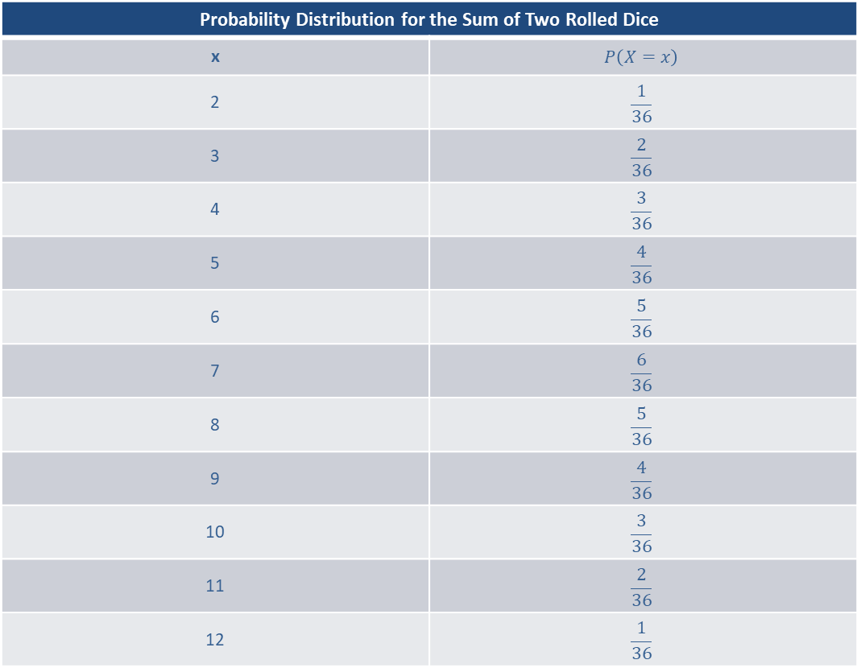
Example 5.1.1: Creating a Discrete Probability Distribution (cont.)
Probability Distribution for the Sum of Two Rolled Dice
x | $$P⁡\left(X=x\right)$$
2 | $$\frac{1}{36}$$
3 | $$\frac{2}{36}$$
4 | $$\frac{3}{36}$$
5 | $$\frac{4}{36}$$
6 | $$\frac{5}{36}$$
7 | $$\frac{6}{36}$$
8 | $$\frac{5}{36}$$
9 | $$\frac{4}{36}$$
10 | $$\frac{3}{36}$$
11 | $$\frac{2}{36}$$
12 | $$\frac{1}{36}$$

Slide 11
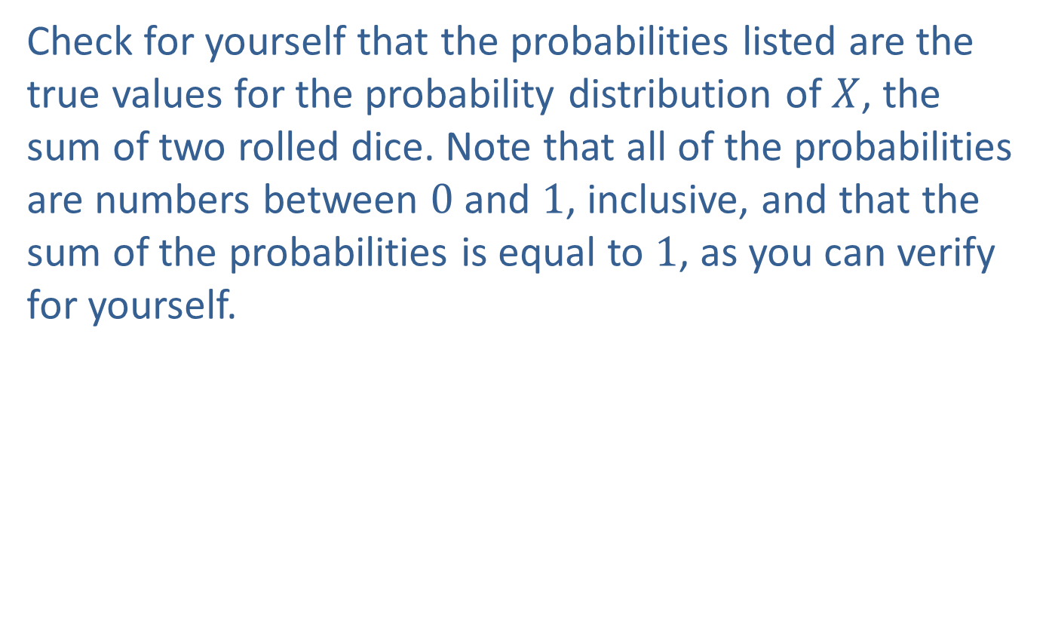
Example 5.1.1: Creating a Discrete Probability Distribution (cont.)
Check for yourself that the probabilities listed are the true values for the probability distribution of $X$, the sum of two rolled dice. Note that all of the probabilities are numbers between 0 and 1, inclusive, and that the sum of the probabilities is equal to 1, as you can verify for yourself.

Slide 12

Memory Booster
Properties of a Probability Distribution
$$0≤P\left(X=x\right)≤1$$
$$∑P\left(X=x_{i}\right)=1$$

Slide 13
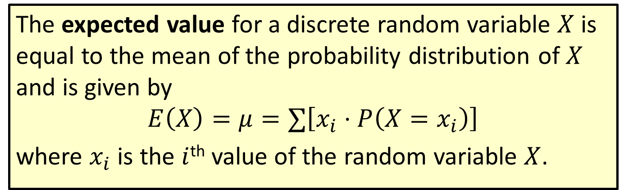
Formula: Expected Value
The expected value for a discrete random variable $X$ is equal to the mean of the probability distribution of $X$ and is given by
$$E\left(X\right)=μ=∑\left[x_{i}⋅P\left(X=x_{i}\right)\right]$$
where $x_{i}$ is the $i$^{th} value of the random variable $X$.

Slide 14
Rounding Rule
When calculating the expected value, round to one more decimal place than the largest number of decimal places given in the values of the random variable. Occasional exceptions to this rule can be made when the type of data lends itself to a more natural rounding scheme, such as rounding values of currency to two decimal places.

Slide 15
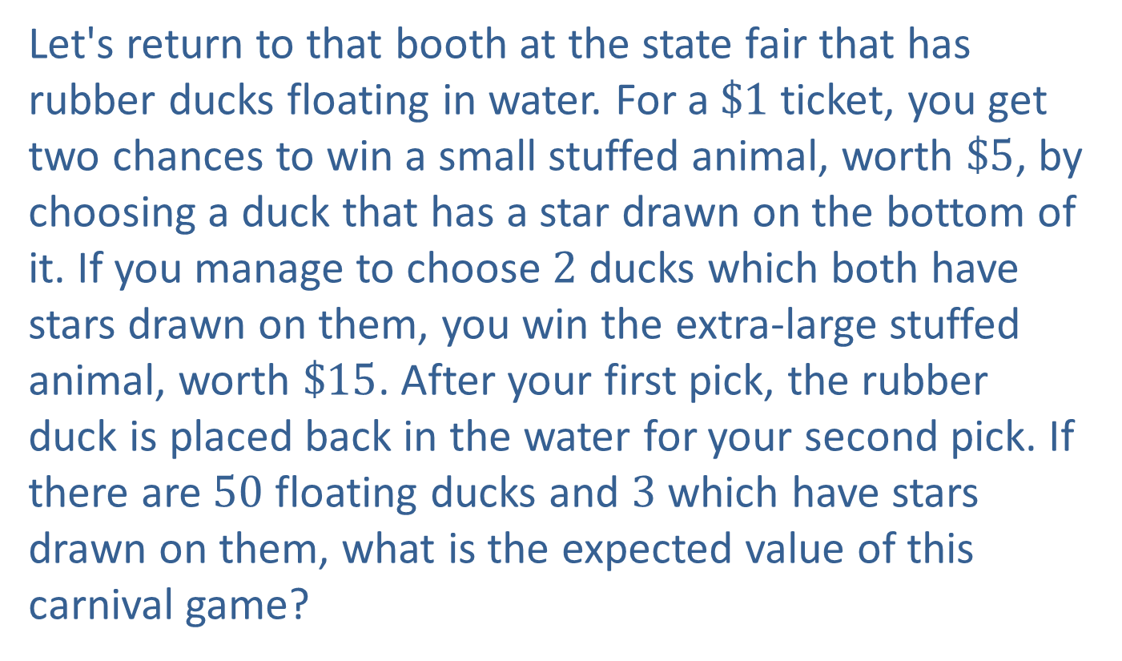
Example 5.1.2: Calculating Expected Values
Let's return to that booth at the state fair that has rubber ducks floating in water. For a $\$1$ ticket, you get two chances to win a small stuffed animal, worth $\$5$, by choosing a duck that has a star drawn on the bottom of it. If you manage to choose 2 ducks which both have stars drawn on them, you win the extra-large stuffed animal, worth $\$15$. After your first pick, the rubber duck is placed back in the water for your second pick. If there are 50 floating ducks and 3 which have stars drawn on them, what is the expected value of this carnival game?

Slide 16
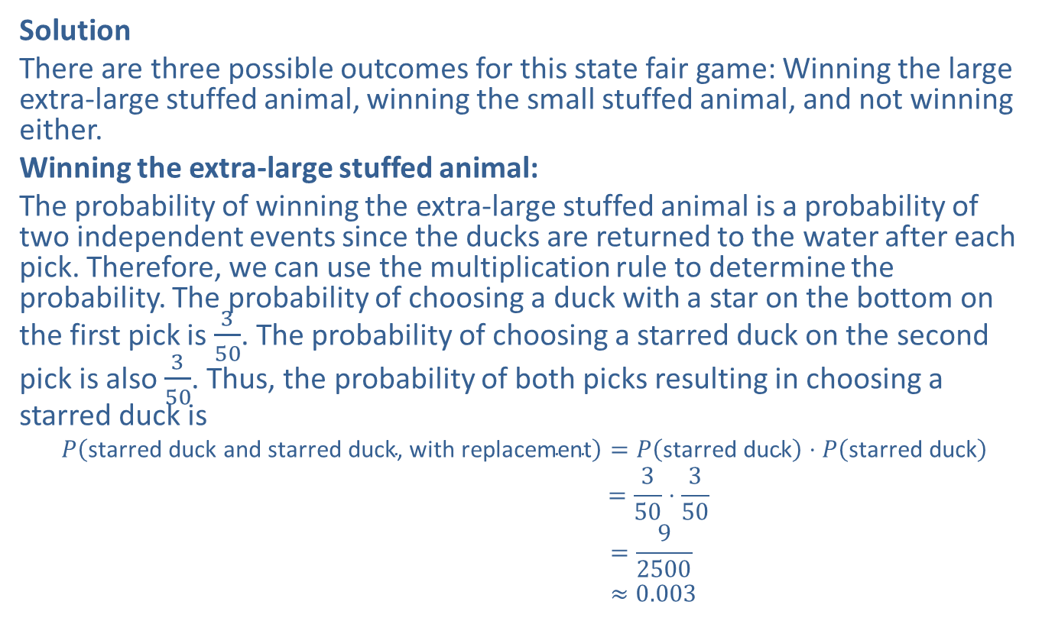
Example 5.1.2: Calculating Expected Values (cont.)
Solution
There are three possible outcomes for this state fair game: Winning the large extra-large stuffed animal, winning the small stuffed animal, and not winning either.
Winning the extra-large stuffed animal:
The probability of winning the extra-large stuffed animal is a probability of two independent events since the ducks are returned to the water after each pick. Therefore, we can use the multiplication rule to determine the probability. The probability of choosing a duck with a star on the bottom on the first pick is $\frac{3}{50}$. The probability of choosing a starred duck on the second pick is also $\frac{3}{50}$. Thus, the probability of both picks resulting in choosing a starred duck is
𝑃starred duck and starred duck, with replacement=𝑃starred duck⋅𝑃starred duck𝑃⁡starred duck and starred duck, with replacement=350⋅350𝑃⁡starred duck and starred duck, with replacement=92500𝑃⁡starred duck and starred duck, with replacement≈0.003

Slide 17
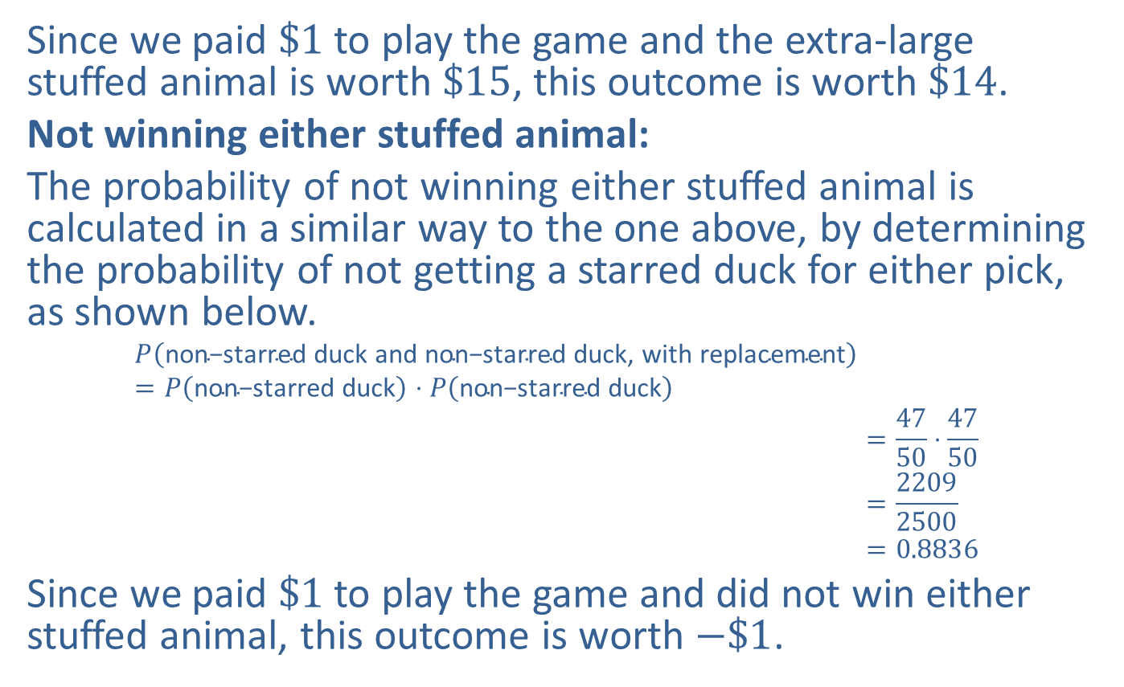
Example 5.1.2: Calculating Expected Values (cont.)
Since we paid $\$1$ to play the game and the extra-large stuffed animal is worth $\$15$, this outcome is worth $\$14$.
Not winning either stuffed animal:
The probability of not winning either stuffed animal is calculated in a similar way to the one above, by determining the probability of not getting a starred duck for either pick, as shown below.
𝑃non−starred duck and non−starred duck, with replacement=𝑃non−starred duck⋅𝑃non−starred duck𝑃⁡non−starred duck and non−starred duck, with replacement=4750⋅4750𝑃⁡non−starred duck and non−starred duck, with replacement=22092500𝑃⁡non−starred duck and non−starred duck, with replacement=0.8836
Since we paid $\$1$ to play the game and did not win either stuffed animal, this outcome is worth $−\$1$.

Slide 18
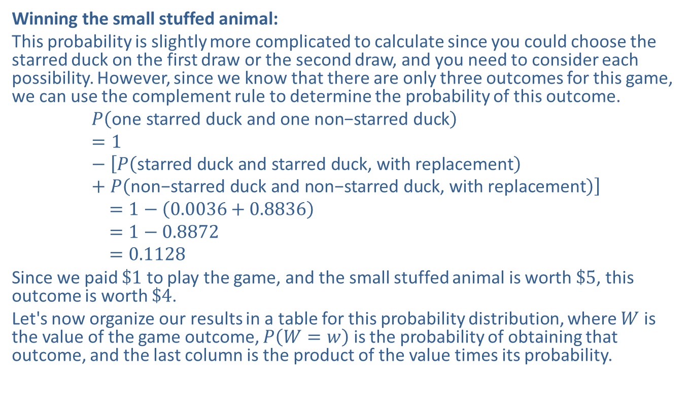
Example 5.1.2: Calculating Expected Values (cont.)
Winning the small stuffed animal:
This probability is slightly more complicated to calculate since you could choose the starred duck on the first draw or the second draw, and you need to consider each possibility. However, since we know that there are only three outcomes for this game, we can use the complement rule to determine the probability of this outcome.
𝑃one starred duck and one non−starred duck=1−𝑃starred duck and starred duck, with replacement+𝑃non−starred duck and non−starred duck, with replacement𝑃=1−0.0036+0.8836𝑃=1−0.8872𝑃=0.1128
Since we paid $\$1$ to play the game, and the small stuffed animal is worth $\$5$, this outcome is worth $\$4$.
Let's now organize our results in a table for this probability distribution, where $W$ is the value of the game outcome, $P⁡\left(W=w\right)$ is the probability of obtaining that outcome, and the last column is the product of the value times its probability.

Slide 19
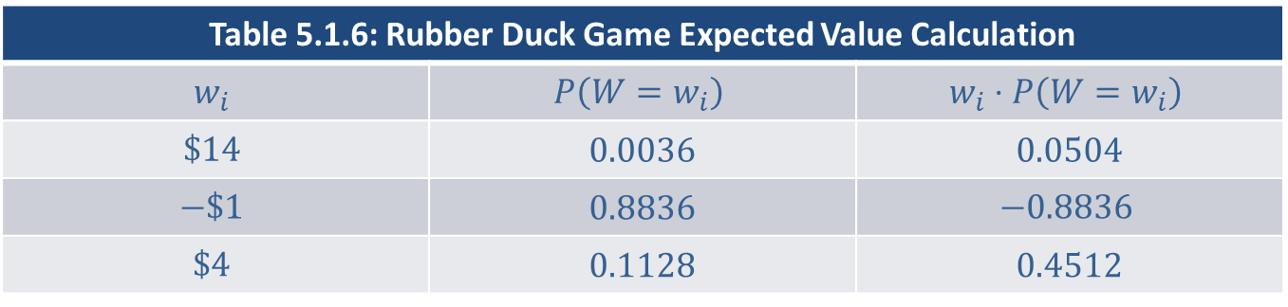
Example 5.1.2: Calculating Expected Values (cont.)
Table 5.1.6: Rubber Duck Game Expected Value Calculation
$$w_{i}$$ | $$P⁡\left(W=w_{i}\right)$$ | $$w_{i}⋅P\left(W=w_{i}\right)$$
$$\$14$$ | 0.0036 | 0.0504
$$−\$1$$ | 0.8836 | $$−0.8836$$
$$\$4$$ | 0.1128 | 0.4512

Slide 20
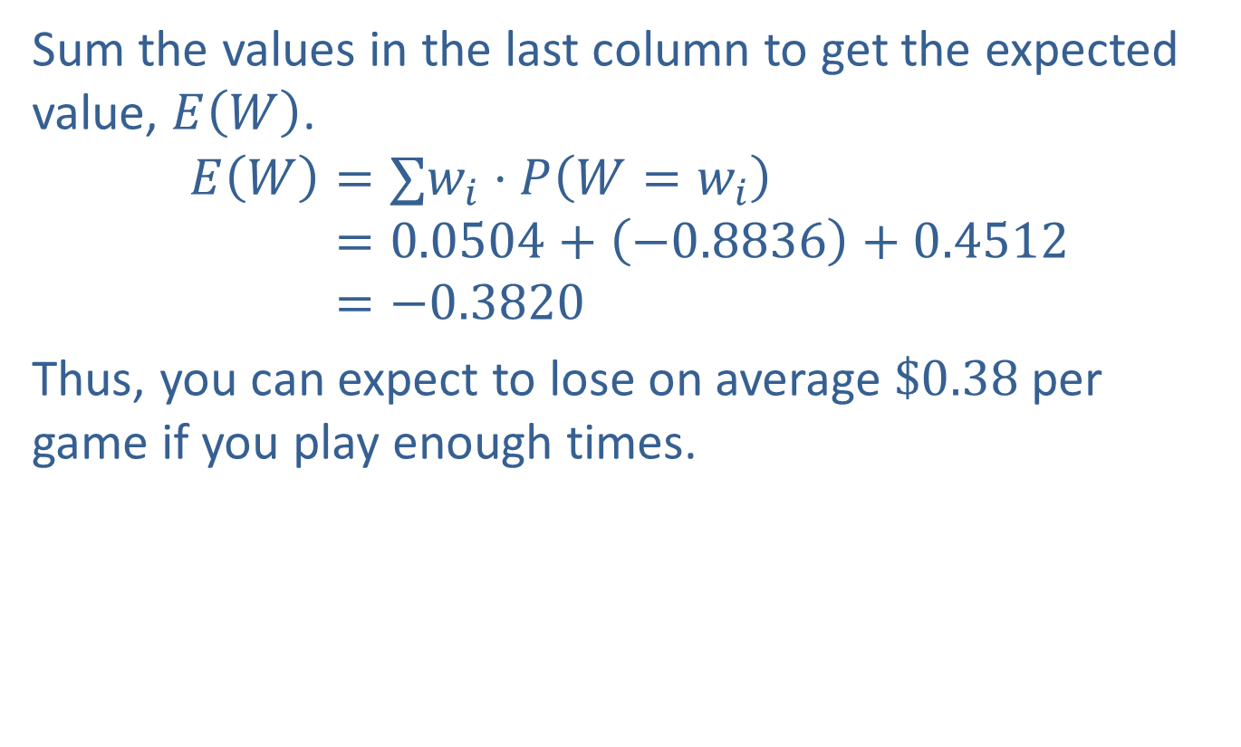
Example 5.1.2: Calculating Expected Values (cont.)
Sum the values in the last column to get the expected value, $E⁡\left(W\right)$.
𝐸𝑊=∑𝑤𝑖⋅𝑃𝑊=𝑤𝑖𝐸⁡𝑊=0.0504+−0.8836+0.4512𝐸⁡𝑊=−0.3820
Thus, you can expect to lose on average $\$0.38$ per game if you play enough times.

Slide 21
Example 5.1.3: Calculating Expected Values
Peyton is trying to decide between two different investment opportunities. The two plans are summarized in the following table. The left column for each plan gives the potential earnings, and the right columns give their respective probabilities. Which plan should he choose?

Slide 22
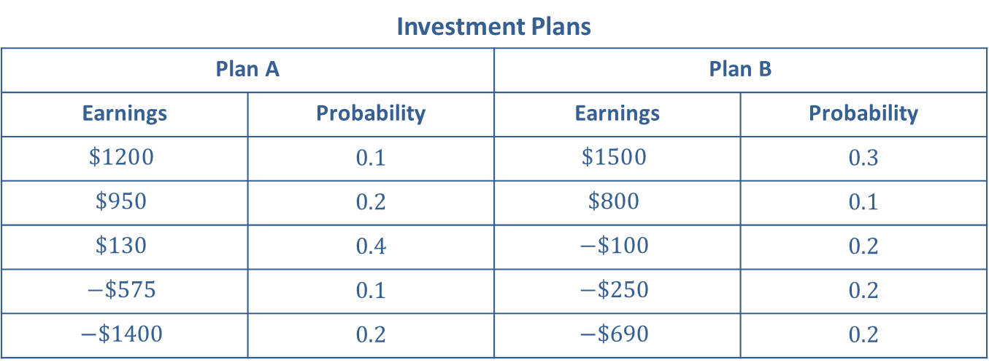
Example 5.1.3: Calculating Expected Values (cont.)
Investment Plans
Plan A |  | Plan B
Earnings | Probability | Earnings | Probability
$$\$1200$$ | 0.1 | $$\$1500$$ | 0.3
$$\$950$$ | 0.2 | $$\$800$$ | 0.1
$$\$130$$ | 0.4 | $$−\$100$$ | 0.2
$$−\$575$$ | 0.1 | $$−\$250$$ | 0.2
$$−\$1400$$ | 0.2 | $$−\$690$$ | 0.2

Slide 23
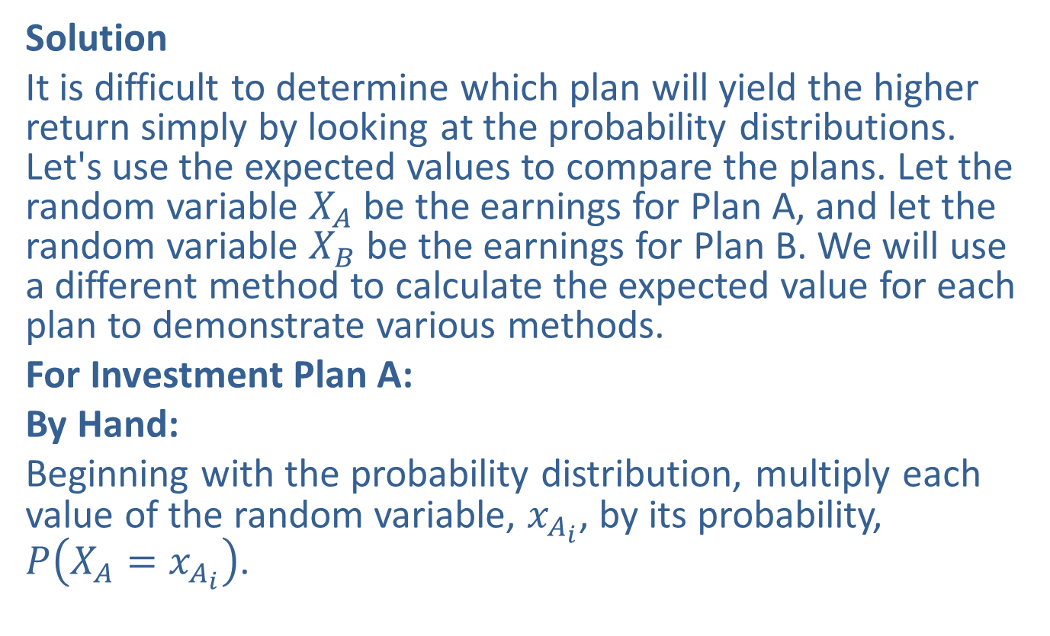
Example 5.1.3: Calculating Expected Values (cont.)
Solution
It is difficult to determine which plan will yield the higher return simply by looking at the probability distributions. Let's use the expected values to compare the plans. Let the random variable $X_{A}$ be the earnings for Plan A, and let the random variable $X_{B}$ be the earnings for Plan B. We will use a different method to calculate the expected value for each plan to demonstrate various methods.
For Investment Plan A:
By Hand:
Beginning with the probability distribution, multiply each value of the random variable, $x_{A_{i}}$, by its probability, $P⁡\left(X_{A}=x_{A_{i}}\right)$.

Slide 24
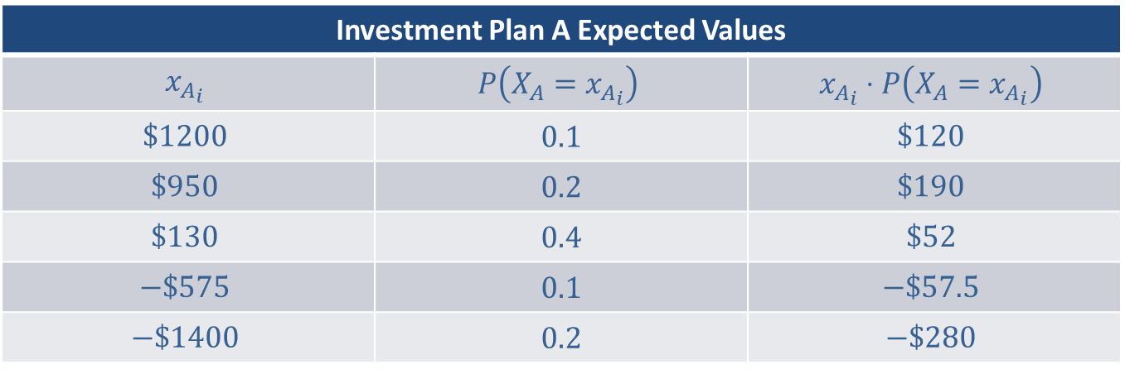
Example 5.1.3: Calculating Expected Values (cont.)
Investment Plan A Expected Values
$$x_{A_{i}}$$ | $$P⁡\left(X_{A}=x_{A_{i}}\right)$$ | $$x_{A_{i}}⋅P\left(X_{A}=x_{A_{i}}\right)$$
$$\$1200$$ | 0.1 | $$\$120$$
$$\$950$$ | 0.2 | $$\$190$$
$$\$130$$ | 0.4 | $$\$52$$
$$−\$575$$ | 0.1 | $$−\$57.5$$
$$−\$1400$$ | 0.2 | $$−\$280$$

Slide 25

Example 5.1.3: Calculating Expected Values (cont.)
Sum the values in the last column to get the expected value, for Plan A.
$$E\left(X_{A}\right)=\$120+\$190+\$52−\$57.50−\$280=\$24.50$$

Slide 26
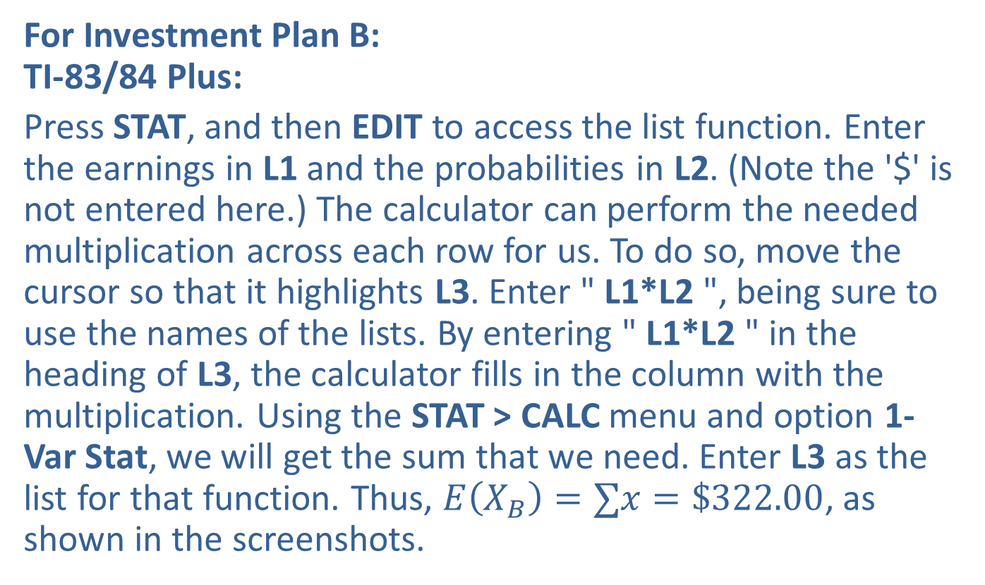
Example 5.1.3: Calculating Expected Values (cont.)
For Investment Plan B: TI-83/84 Plus:
Press STAT, and then EDIT to access the list function. Enter the earnings in L1 and the probabilities in L2. (Note the '$' is not entered here.) The calculator can perform the needed multiplication across each row for us. To do so, move the cursor so that it highlights L3. Enter " L1*L2 ", being sure to use the names of the lists. By entering " L1*L2 " in the heading of L3, the calculator fills in the column with the multiplication. Using the STAT > CALC menu and option 1-Var Stat, we will get the sum that we need. Enter L3 as the list for that function. Thus, $E\left(X_{B}\right)=∑x=\$322.00$, as shown in the screenshots.

Slide 27
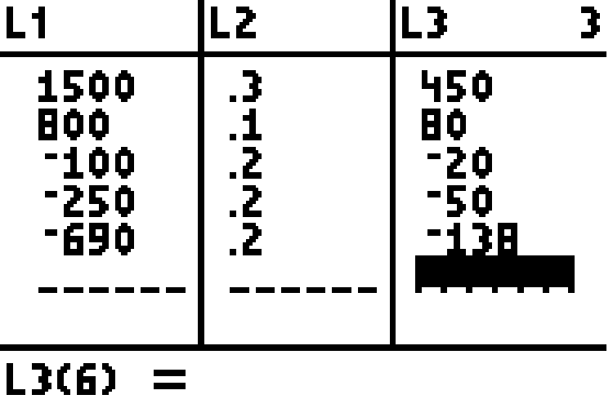
Example 5.1.3: Calculating Expected Values (cont.)

Slide 28
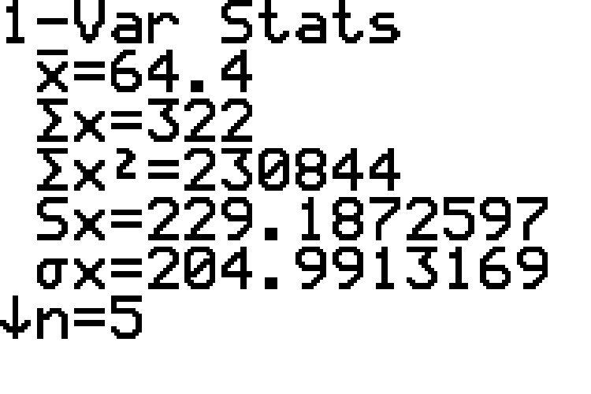
Example 5.1.3: Calculating Expected Values (cont.)

Slide 29

Example 5.1.3: Calculating Expected Values (cont.)
From these calculations, we see that the expected value of Plan A is $\$24.50$, and the expected value of Plan B is $\$322.00$. Therefore, Plan B appears to be the wiser investment option for Peyton.

Slide 30
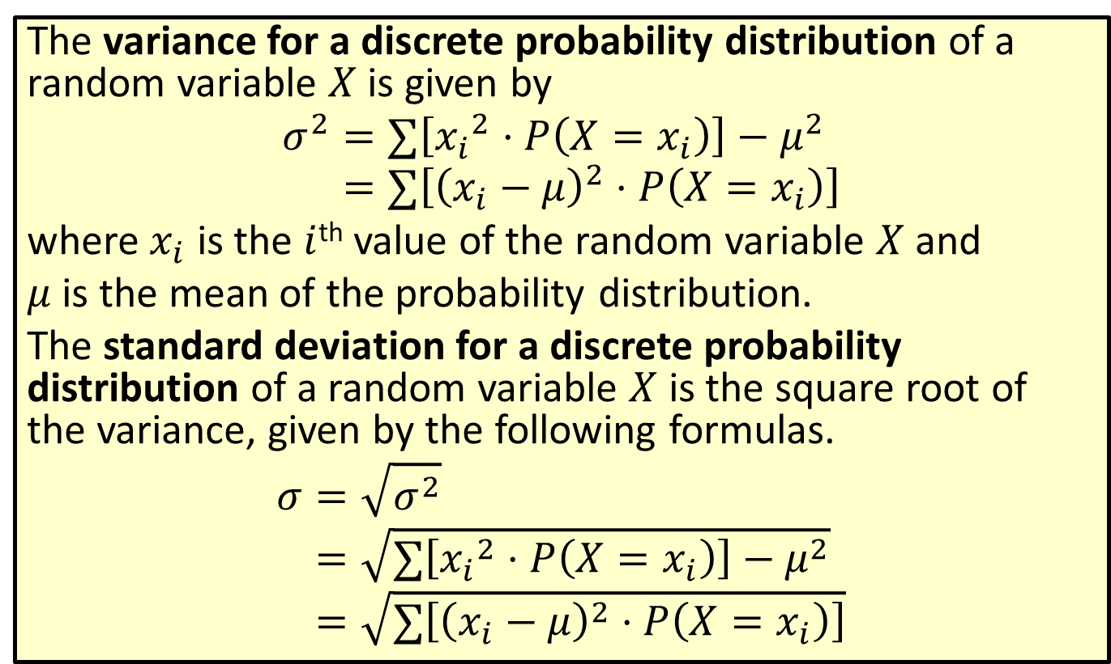
Formula: Variance and Standard Deviation for a Discrete Probability Distribution
The variance for a discrete probability distribution of a random variable $X$ is given by
𝜎2=∑𝑥𝑖2⋅𝑃𝑋=𝑥𝑖−𝜇2𝜎2=∑𝑥𝑖−𝜇2⋅𝑃𝑋=𝑥𝑖
where $x_{i}$ is the $i$^{th} value of the random variable $X$ and
$μ$ is the mean of the probability distribution.
The standard deviation for a discrete probability distribution of a random variable $X$ is the square root of the variance, given by the following formulas.
𝜎=𝜎2𝜎=∑𝑥𝑖2⋅𝑃𝑋=𝑥𝑖−𝜇2𝜎=∑𝑥𝑖−𝜇2⋅𝑃𝑋=𝑥𝑖

Slide 31
Rounding Rule
When calculating the variance or standard deviation for a discrete probability distribution, round to one more decimal place than the largest number of decimal places given in the values of the random variable. Occasional exceptions to this rule can be made when the type of data lends itself to a more natural rounding scheme, such as rounding values of currency to two decimal places.
When calculating the standard deviation, do not round the value of the variance before taking the square root.

Slide 32
Example 5.1.4: Calculating the Variances and Standard Deviations for Discrete Probability Distributions
Which of the investment plans in the previous example carries more risk, Plan A or Plan B?

Slide 33
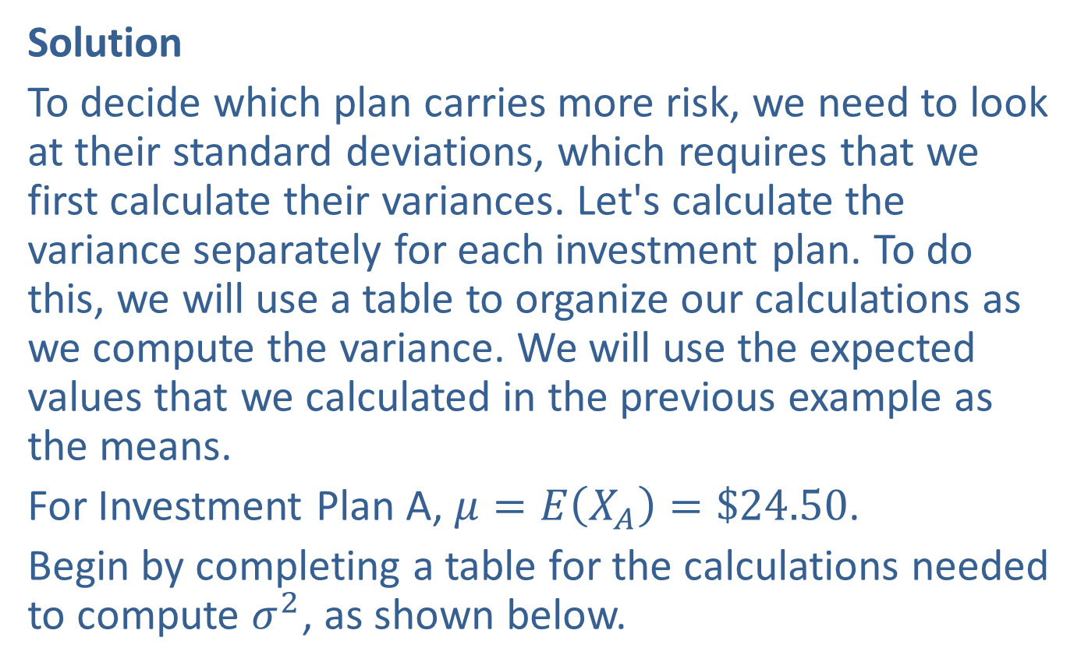
Example 5.1.4: Calculating the Variances and Standard Deviations for Discrete Probability Distributions (cont.)
Solution
To decide which plan carries more risk, we need to look at their standard deviations, which requires that we first calculate their variances. Let's calculate the variance separately for each investment plan. To do this, we will use a table to organize our calculations as we compute the variance. We will use the expected values that we calculated in the previous example as the means.
For Investment Plan A, $μ=E\left(X_{A}\right)=\$24.50$.
Begin by completing a table for the calculations needed to compute $σ^{2}$, as shown below.

Slide 34
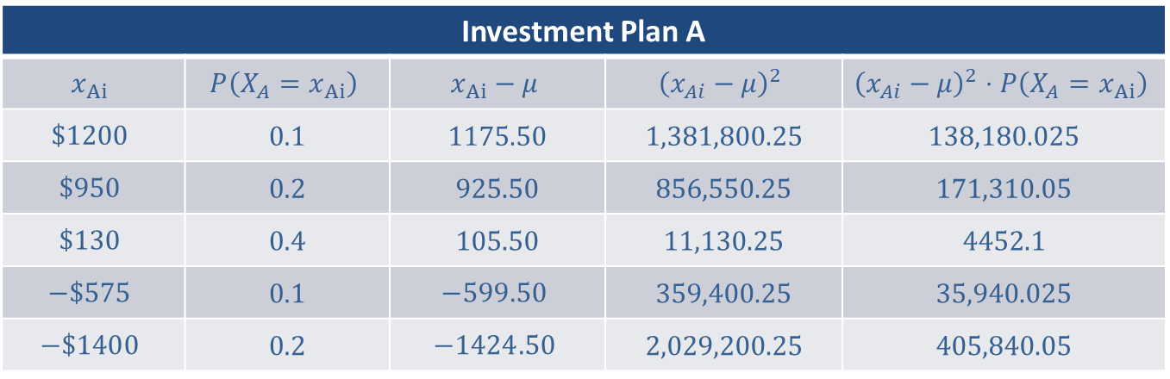
Example 5.1.4: Calculating the Variances and Standard Deviations for Discrete Probability Distributions (cont.)
By Hand:
Investment Plan A
$$x_{Ai}$$ | $$P⁡\left(X_{A}=x_{Ai}\right)$$ | $$x_{Ai}−μ$$ | $${\left(x_{Ai}−μ\right)}^{2}$$ | $${\left(x_{Ai}−μ\right)}^{2}⋅P\left(X_{A}=x_{Ai}\right)$$
$$\$1200$$ | 0.1 | 1175.50 | 1,381,800.25 | 138,180.025
$$\$950$$ | 0.2 | 925.50 | 856,550.25 | 171,310.05
$$\$130$$ | 0.4 | 105.50 | 11,130.25 | 4452.1
$$−\$575$$ | 0.1 | $$−599.50$$ | 359,400.25 | 35,940.025
$$−\$1400$$ | 0.2 | $$−1424.50$$ | 2,029,200.25 | 405,840.05

Slide 35
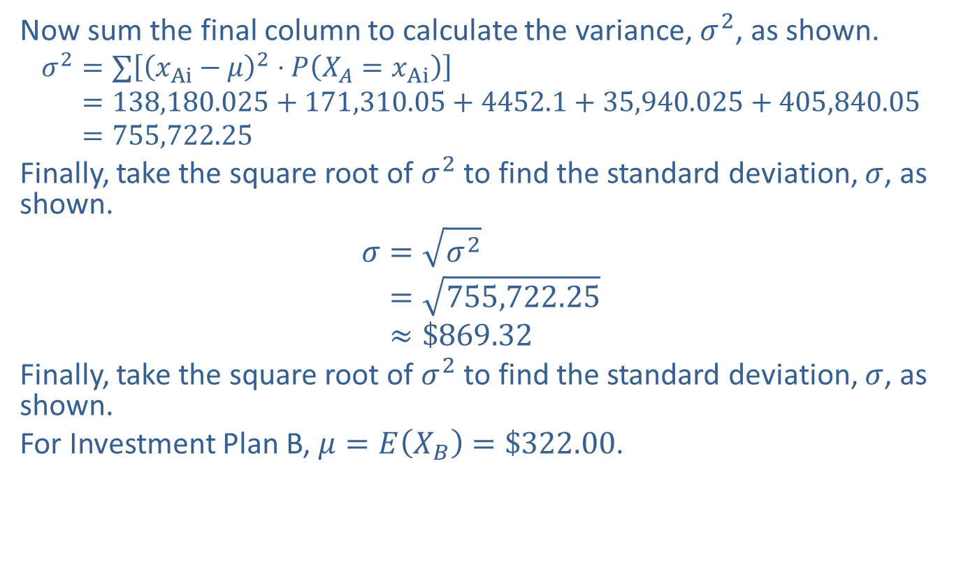
Example 5.1.4: Calculating the Variances and Standard Deviations for Discrete Probability Distributions (cont.)
Now sum the final column to calculate the variance, $σ^{2}$, as shown.
𝜎2=∑𝑥Ai−𝜇2⋅𝑃𝑋𝐴=𝑥Ai𝜎2=138,180.025+171,310.05+4452.1+35,940.025+405,840.05𝜎2=755,722.25
Finally, take the square root of $σ^{2}$ to find the standard deviation, $σ$, as shown.
𝜎=𝜎2𝜎=755,722.25𝜎≈$869.32
Finally, take the square root of $σ^{2}$ to find the standard deviation, $σ$, as shown.
For Investment Plan B, $μ=E\left(X_{B}\right)=\$322.00$.

Slide 36
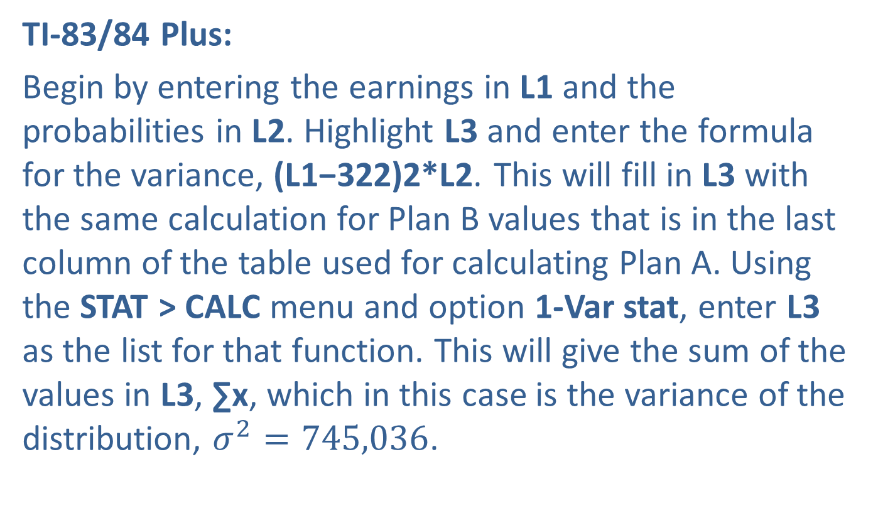
Example 5.1.4: Calculating the Variances and Standard Deviations for Discrete Probability Distributions (cont.)
TI-83/84 Plus:
Begin by entering the earnings in L1 and the probabilities in L2. Highlight L3 and enter the formula for the variance, (L1−322)2*L2. This will fill in L3 with the same calculation for Plan B values that is in the last column of the table used for calculating Plan A. Using the STAT > CALC menu and option 1-Var stat, enter L3 as the list for that function. This will give the sum of the values in L3, ∑x, which in this case is the variance of the distribution, $σ^{2}=745,036$.

Slide 37
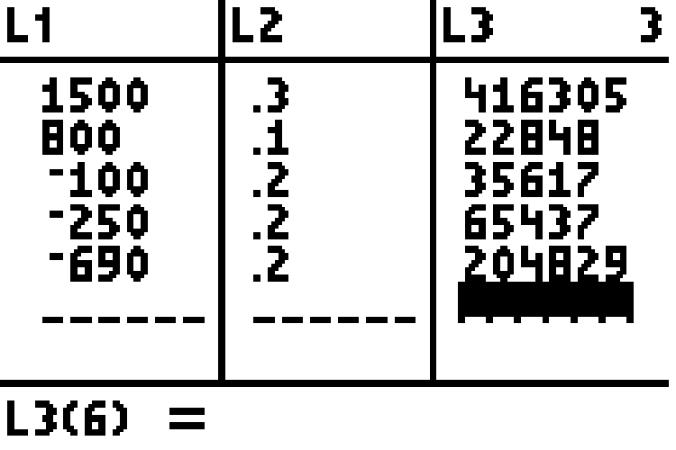
Example 5.1.4: Calculating the Variances and Standard Deviations for Discrete Probability Distributions (cont.)

Slide 38
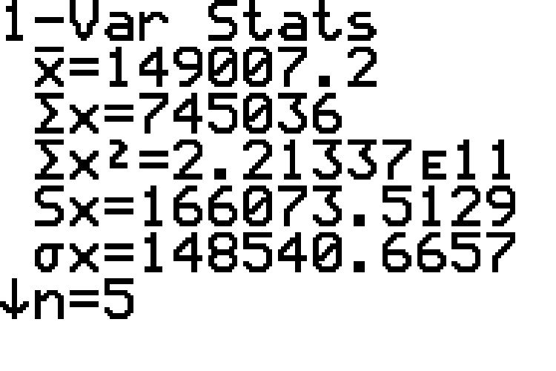
Example 5.1.4: Calculating the Variances and Standard Deviations for Discrete Probability Distributions (cont.)

Slide 39
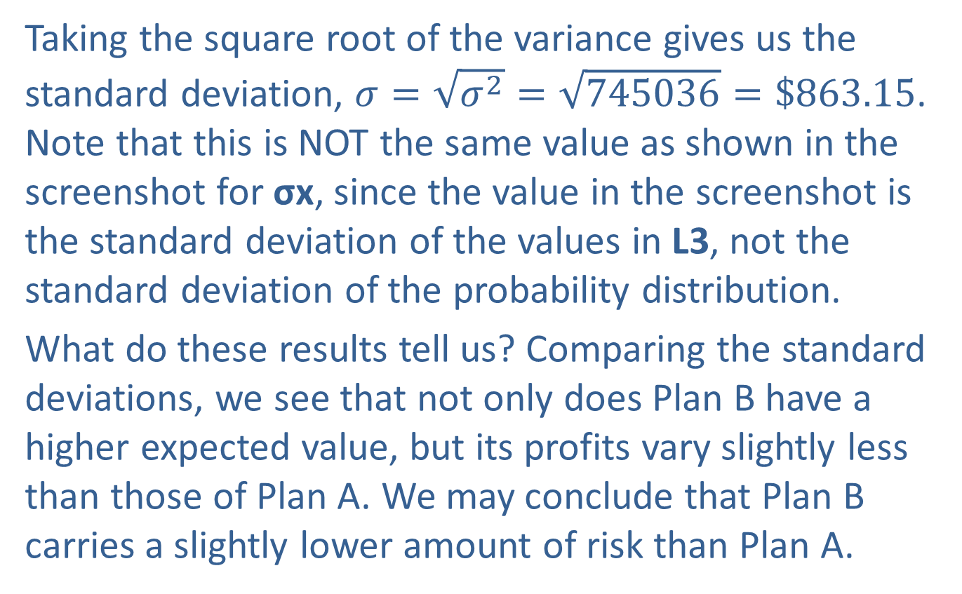
Example 5.1.4: Calculating the Variances and Standard Deviations for Discrete Probability Distributions (cont.)
Taking the square root of the variance gives us the standard deviation, $σ=\sqrt{σ^{2}}=\sqrt{745036}=\$863.15$. Note that this is NOT the same value as shown in the screenshot for σx, since the value in the screenshot is the standard deviation of the values in L3, not the standard deviation of the probability distribution.
What do these results tell us? Comparing the standard deviations, we see that not only does Plan B have a higher expected value, but its profits vary slightly less than those of Plan A. We may conclude that Plan B carries a slightly lower amount of risk than Plan A.

