Slide 1
Section 5.2
Binomial Distribution

Slide 2
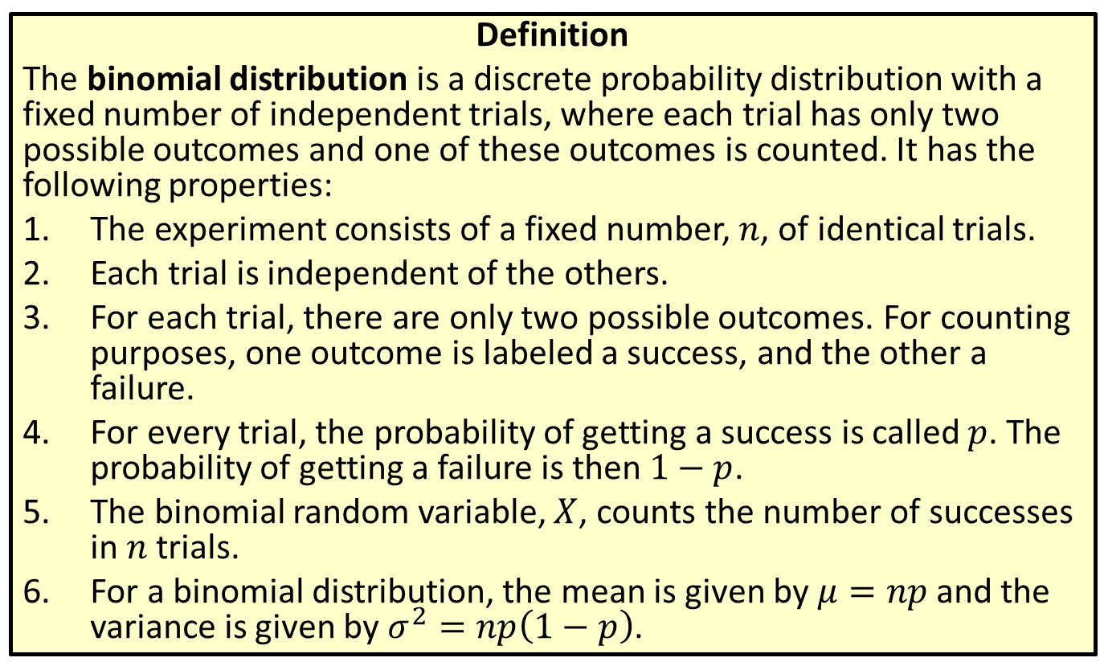
Distribution
Definition
The binomial distribution is a discrete probability distribution with a fixed number of independent trials, where each trial has only two possible outcomes and one of these outcomes is counted. It has the following properties:
​The experiment consists of a fixed number, $n$, of identical trials.
​Each trial is independent of the others.
​For each trial, there are only two possible outcomes. For counting purposes, one outcome is labeled a success, and the other a failure.
​For every trial, the probability of getting a success is called $p$. The probability of getting a failure is then $1−p$.
​The binomial random variable, $X$, counts the number of successes in $n$ trials.
​For a binomial distribution, the mean is given by $μ=np$ and the variance is given by $σ^{2}=np\left(1−p\right)$.

Slide 3
Memory Booster
$E\left(X\right)=μ$ for a random variable $X$.

Slide 4
Example 5.2.1: Finding the Mean and Standard Deviation of a Binomial Distribution
Consider the experiment of tossing a fair coin 58 times.
​How many times we can expect to get heads?
​Calculate the standard deviation for this distribution. What does it tell us?

Slide 5
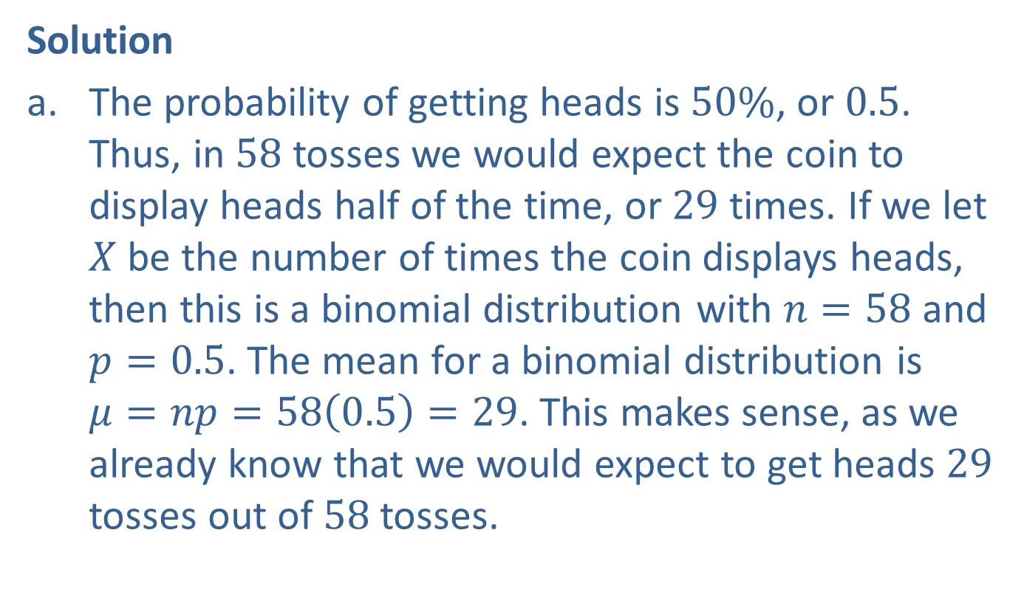
Example 5.2.1: Finding the Mean and Standard Deviation of a Binomial Distribution (cont.)
Solution
​The probability of getting heads is $50\%$, or 0.5. Thus, in 58 tosses we would expect the coin to display heads half of the time, or 29 times. If we let $X$ be the number of times the coin displays heads, then this is a binomial distribution with $n=58$ and $p=0.5$. The mean for a binomial distribution is $μ=np=58\left(0.5\right)=29$. This makes sense, as we already know that we would expect to get heads 29 tosses out of 58 tosses.

Slide 6
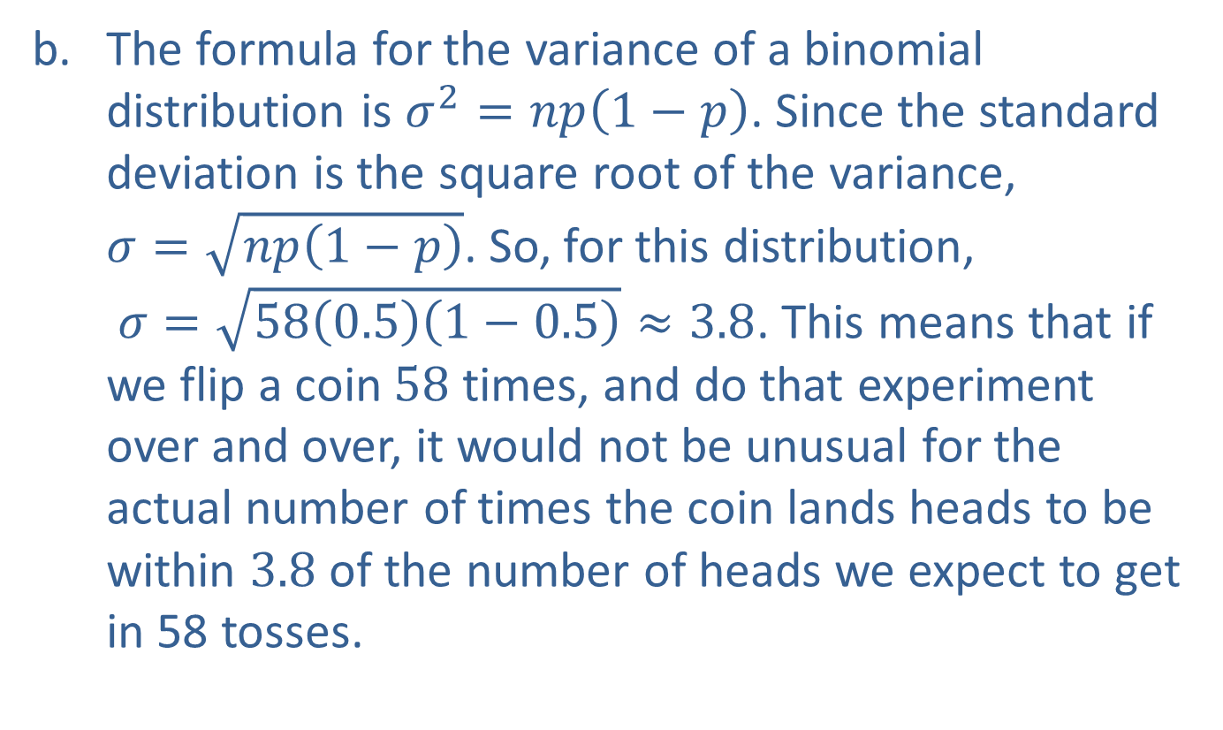
Example 5.2.1: Finding the Mean and Standard Deviation of a Binomial Distribution (cont.)
​The formula for the variance of a binomial distribution is $σ^{2}=np\left(1−p\right)$. Since the standard deviation is the square root of the variance, $σ=\sqrt{np\left(1−p\right)}$. So, for this distribution, $σ=\sqrt{58\left(0.5\right)\left(1−0.5\right)}≈3.8$. This means that if we flip a coin 58 times, and do that experiment over and over, it would not be unusual for the actual number of times the coin lands heads to be within 3.8 of the number of heads we expect to get in 58 tosses.

Slide 7
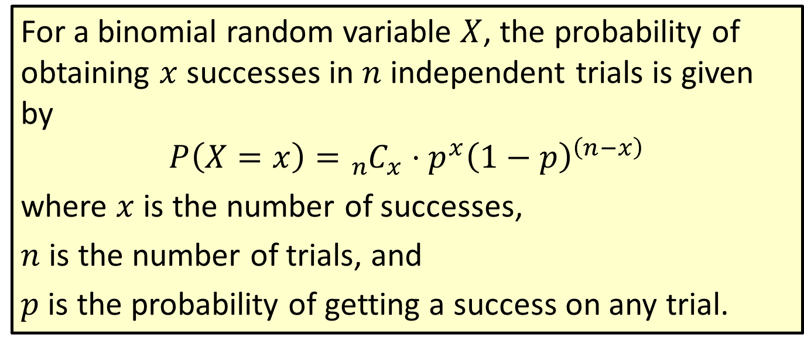
Formula: Probability for a Binomial Distribution
For a binomial random variable $X$, the probability of obtaining $x$ successes in $n$ independent trials is given by
$$P\left(X=x\right)={}_{n}^{ }{C_{x}}⋅p^{x}{\left(1−p\right)}^{\left(n−x\right)}$$
where $x$ is the number of successes,
$n$ is the number of trials, and
$p$ is the probability of getting a success on any trial.

Slide 8
Rounding Rule
When calculating probabilities for binomial distributions, round to four decimal places. This follows the convention used in the binomial probability distribution tables.

Slide 9
Example 5.2.2: Calculating a Binomial Probability Using the Formula
What is the probability of getting exactly six heads in ten coin tosses?

Slide 10
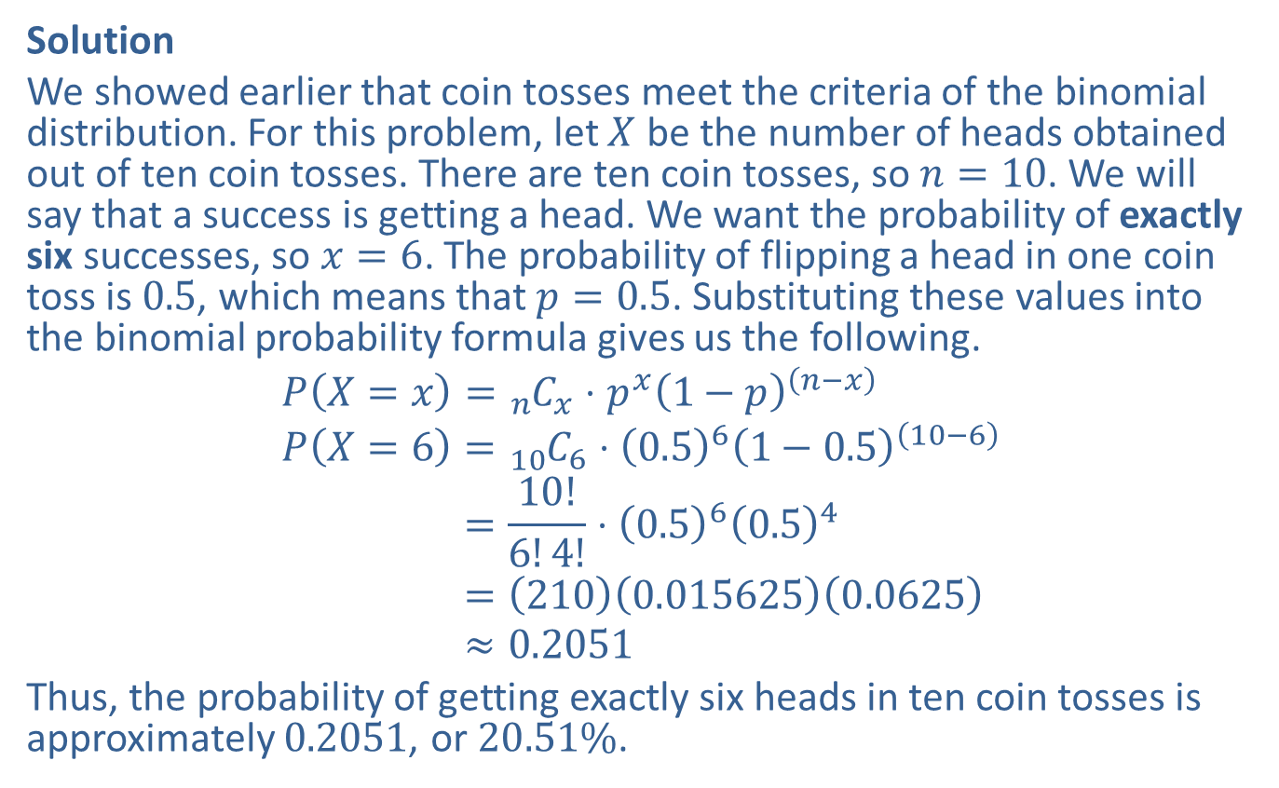
Example 5.2.2: Calculating a Binomial Probability Using the Formula (cont.)
Solution
We showed earlier that coin tosses meet the criteria of the binomial distribution. For this problem, let $X$ be the number of heads obtained out of ten coin tosses. There are ten coin tosses, so $n=10$. We will say that a success is getting a head. We want the probability of exactly six successes, so $x=6$. The probability of flipping a head in one coin toss is 0.5, which means that $p=0.5$. Substituting these values into the binomial probability formula gives us the following.
𝑃𝑋=𝑥=𝑛 𝐶𝑥⋅𝑝𝑥1−𝑝𝑛−𝑥𝑃𝑋=6=10 𝐶6⋅0.561−0.510−6𝑃⁡𝑋=6=10!6!4!⋅0.560.54𝑃⁡𝑋=6=2100.0156250.0625𝑃⁡𝑋=6≈0.2051
Thus, the probability of getting exactly six heads in ten coin tosses is approximately 0.2051, or $20.51\%$.

Slide 11
Example 5.2.3: Finding a Binomial Probability Using a Table
What is the probability of rolling a die ten times and obtaining odd digits on eight of the rolls?

Slide 12
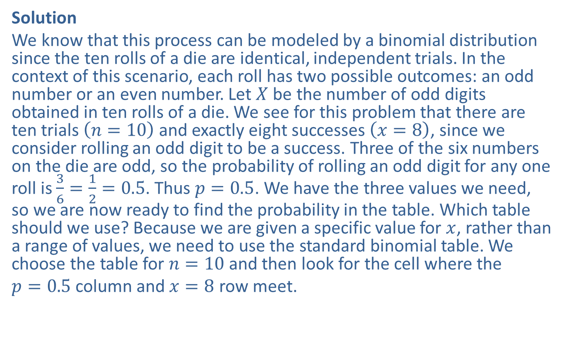
Example 5.2.3: Finding a Binomial Probability Using a Table (cont.)
Solution
We know that this process can be modeled by a binomial distribution since the ten rolls of a die are identical, independent trials. In the context of this scenario, each roll has two possible outcomes: an odd number or an even number. Let $X$ be the number of odd digits obtained in ten rolls of a die. We see for this problem that there are ten trials $\left(n=10\right)$ and exactly eight successes $\left(x=8\right)$, since we consider rolling an odd digit to be a success. Three of the six numbers on the die are odd, so the probability of rolling an odd digit for any one roll is $\frac{3}{6}=\frac{1}{2}=0.5$. Thus $p=0.5$. We have the three values we need, so we are now ready to find the probability in the table. Which table should we use? Because we are given a specific value for $x$, rather than a range of values, we need to use the standard binomial table. We choose the table for $n=10$ and then look for the cell where the
$p=0.5$ column and $x=8$ row meet.

Slide 13
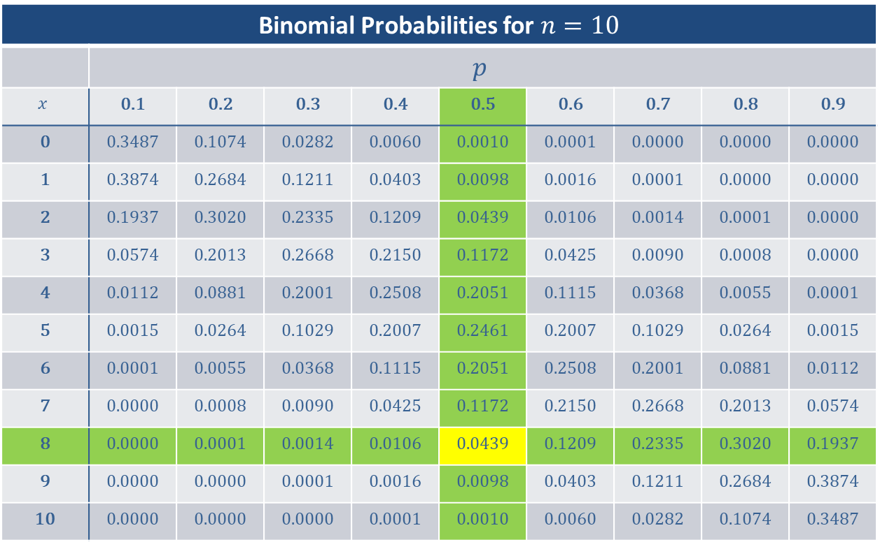
Example 5.2.3: Finding a Binomial Probability Using a Table (cont.)
Binomial Probabilities for $n=10$
 | $$p$$
$$x$$ | 0.1 | 0.2 | 0.3 | 0.4 | 0.5 | 0.6 | 0.7 | 0.8 | 0.9
0 | 0.3487 | 0.1074 | 0.0282 | 0.0060 | 0.0010 | 0.0001 | 0.0000 | 0.0000 | 0.0000
1 | 0.3874 | 0.2684 | 0.1211 | 0.0403 | 0.0098 | 0.0016 | 0.0001 | 0.0000 | 0.0000
2 | 0.1937 | 0.3020 | 0.2335 | 0.1209 | 0.0439 | 0.0106 | 0.0014 | 0.0001 | 0.0000
3 | 0.0574 | 0.2013 | 0.2668 | 0.2150 | 0.1172 | 0.0425 | 0.0090 | 0.0008 | 0.0000
4 | 0.0112 | 0.0881 | 0.2001 | 0.2508 | 0.2051 | 0.1115 | 0.0368 | 0.0055 | 0.0001
5 | 0.0015 | 0.0264 | 0.1029 | 0.2007 | 0.2461 | 0.2007 | 0.1029 | 0.0264 | 0.0015
6 | 0.0001 | 0.0055 | 0.0368 | 0.1115 | 0.2051 | 0.2508 | 0.2001 | 0.0881 | 0.0112
7 | 0.0000 | 0.0008 | 0.0090 | 0.0425 | 0.1172 | 0.2150 | 0.2668 | 0.2013 | 0.0574
8 | 0.0000 | 0.0001 | 0.0014 | 0.0106 | 0.0439 | 0.1209 | 0.2335 | 0.3020 | 0.1937
9 | 0.0000 | 0.0000 | 0.0001 | 0.0016 | 0.0098 | 0.0403 | 0.1211 | 0.2684 | 0.3874
10 | 0.0000 | 0.0000 | 0.0000 | 0.0001 | 0.0010 | 0.0060 | 0.0282 | 0.1074 | 0.3487

Slide 14

Example 5.2.3: Finding a Binomial Probability Using a Table (cont.)
We then see that the probability of getting eight odd numbers in ten rolls is 0.0439, or $4.39\%$.

Slide 15

Side Note
When using the binomial tables, precision is limited to the choices for the probability, $p$, given in the tables.

Slide 16


Example 5.2.4: Calculating a Binomial Probability, $P⁡\left(X=x\right)$
A quality control expert at a large factory estimates that $10\%$ of all batteries produced are defective. If he takes a random sample of fifteen batteries, what is the probability that exactly two are defective?

Slide 17
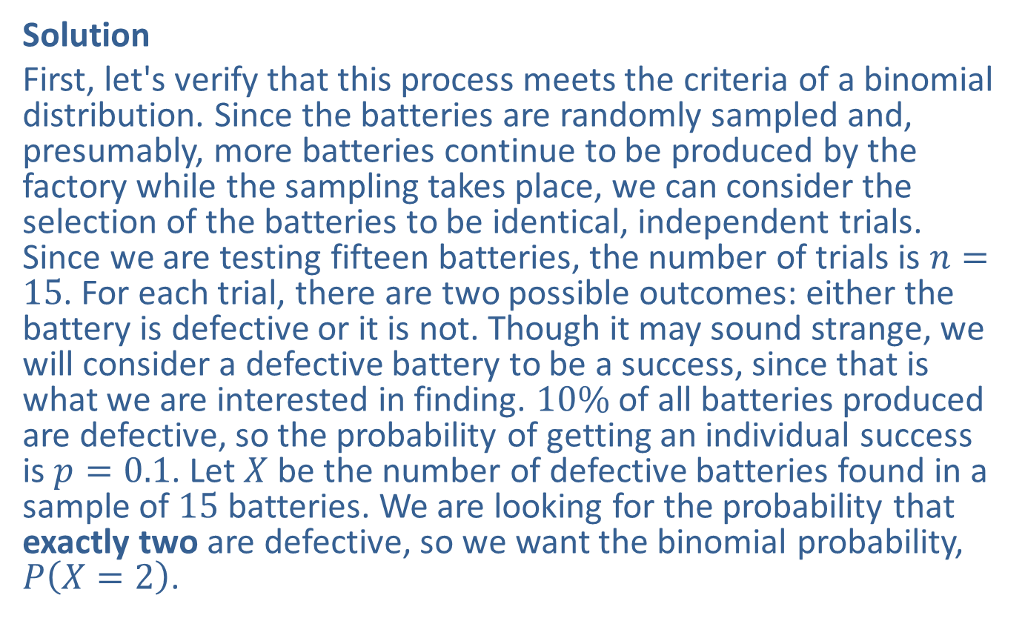

Example 5.2.4: Calculating a Binomial Probability, $P⁡\left(X=x\right)$ (cont.)
Solution
First, let's verify that this process meets the criteria of a binomial distribution. Since the batteries are randomly sampled and, presumably, more batteries continue to be produced by the factory while the sampling takes place, we can consider the selection of the batteries to be identical, independent trials. Since we are testing fifteen batteries, the number of trials is $n=15$. For each trial, there are two possible outcomes: either the battery is defective or it is not. Though it may sound strange, we will consider a defective battery to be a success, since that is what we are interested in finding. $10\%$ of all batteries produced are defective, so the probability of getting an individual success is $p=0.1$. Let $X$ be the number of defective batteries found in a sample of 15 batteries. We are looking for the probability that exactly two are defective, so we want the binomial probability, $P⁡\left(X=2\right)$.

Slide 18
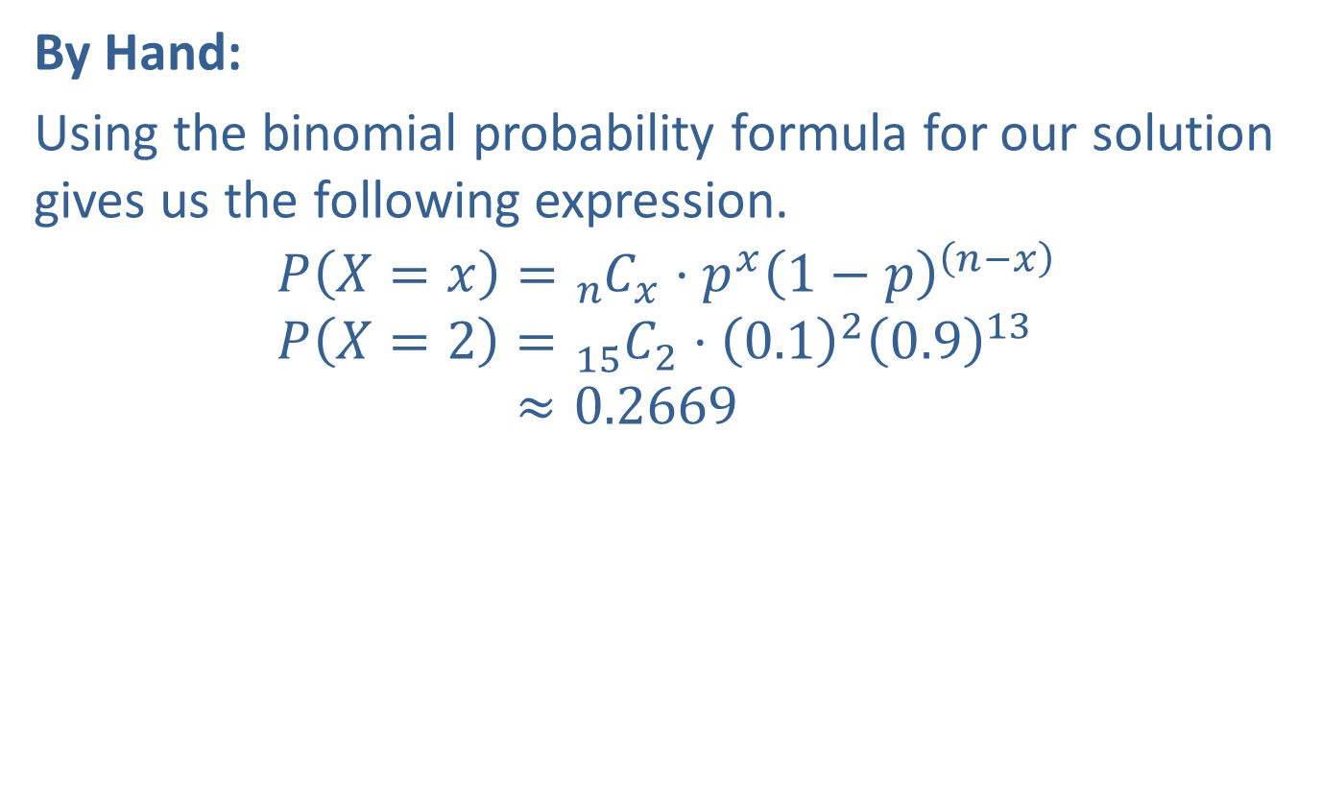
Example 5.2.4: Calculating a Binomial Probability, $P⁡\left(X=x\right)$ (cont.)
By Hand:
Using the binomial probability formula for our solution gives us the following expression.
𝑃𝑋=𝑥=𝑛 𝐶𝑥⋅𝑝𝑥1−𝑝𝑛−𝑥𝑃𝑋=2=15 𝐶2⋅0.120.913𝑃⁡𝑋=2≈0.2669

Slide 19
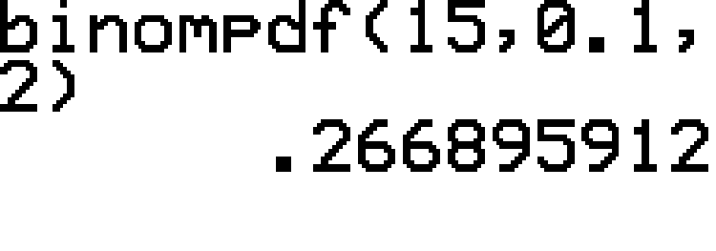
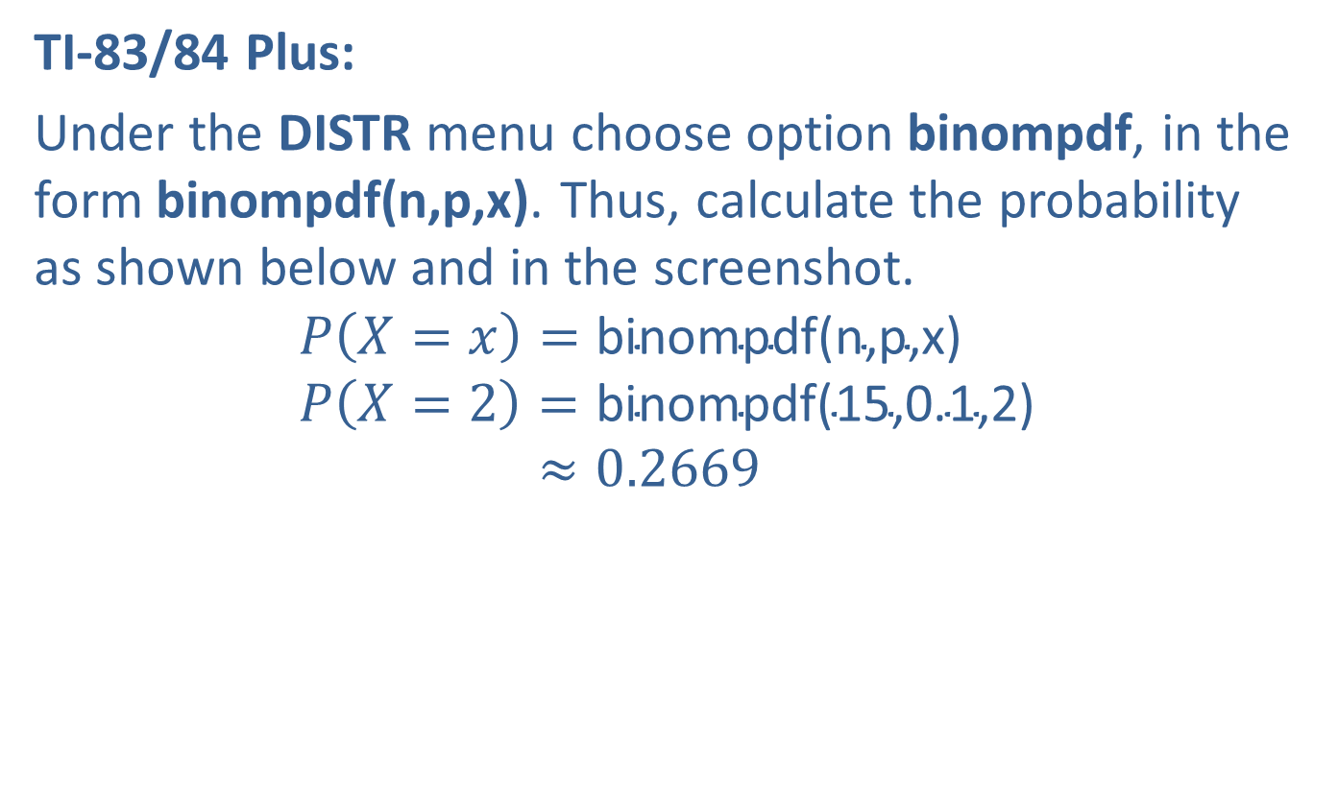
Example 5.2.4: Calculating a Binomial Probability, $P⁡\left(X=x\right)$ (cont.)
TI-83/84 Plus:
Under the DISTR menu choose option binompdf, in the form binompdf(n,p,x). Thus, calculate the probability as shown below and in the screenshot.
𝑃⁡𝑋=𝑥=binompdf(n,p,x)𝑃⁡𝑋=2=binompdf(15,0.1,2)𝑃⁡𝑋=2≈0.2669

Slide 20

Example 5.2.4: Calculating a Binomial Probability, $P⁡\left(X=x\right)$ (cont.)
Therefore, the probability that exactly two out of the fifteen batteries are defective is approximately 0.2669, or approximately $26.69\%$.

Slide 21
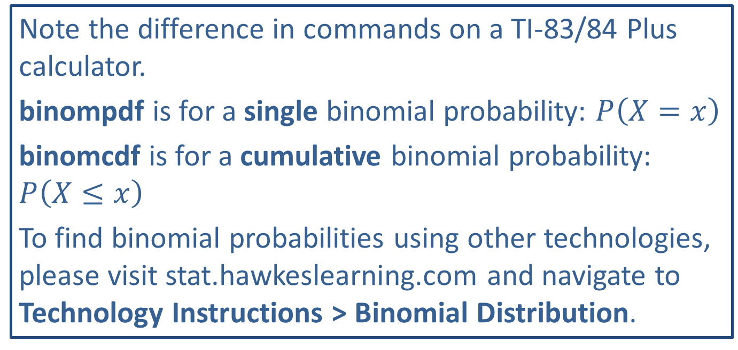
Technology
Note the difference in commands on a TI-83/84 Plus calculator.
binompdf is for a single binomial probability: $P⁡\left(X=x\right)$
binomcdf is for a cumulative binomial probability: $P⁡\left(X≤x\right)$
To find binomial probabilities using other technologies, please visit stat.hawkeslearning.com and navigate to Technology Instructions > Binomial Distribution.

Slide 22


Example 5.2.5: Calculating Binomial Probabilities, $P⁡\left(X≤x\right)$
A quality control expert at a large factory estimates that $10\%$ of all the batteries produced at the factory are defective. If he takes a random sample of fifteen batteries, what is the probability that no more than two are defective?

Slide 23
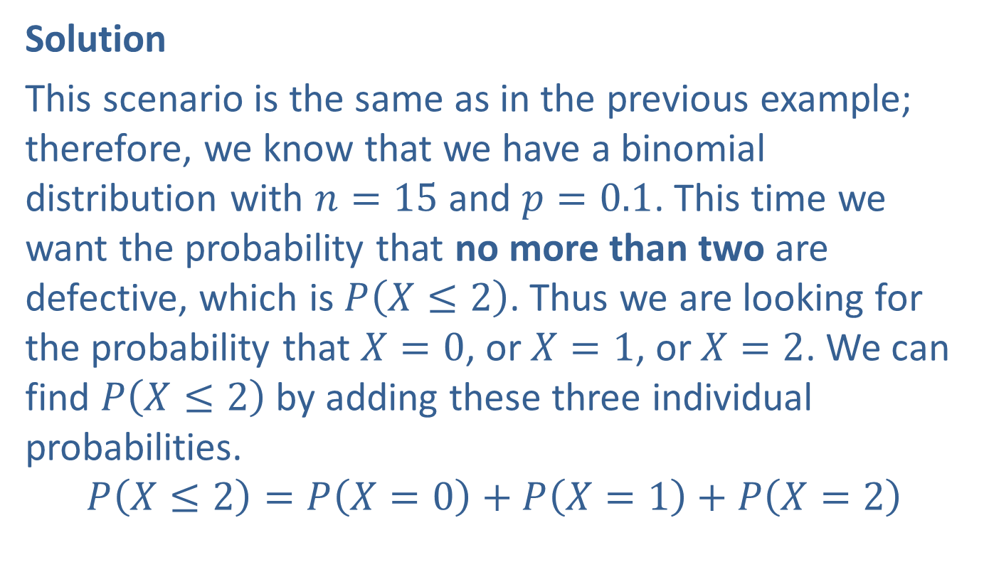

Example 5.2.5: Calculating Binomial Probabilities, $P⁡\left(X≤x\right)$ (cont.)
Solution
This scenario is the same as in the previous example; therefore, we know that we have a binomial distribution with $n=15$ and $p=0.1$. This time we want the probability that no more than two are defective, which is $P⁡\left(X≤2\right)$. Thus we are looking for the probability that $X=0$, or $X=1$, or $X=2$. We can find $P⁡\left(X≤2\right)$ by adding these three individual probabilities.
$$P\left(X≤2\right)=P⁡\left(X=0\right)+P\left(X=1\right)+P\left(X=2\right)$$

Slide 24
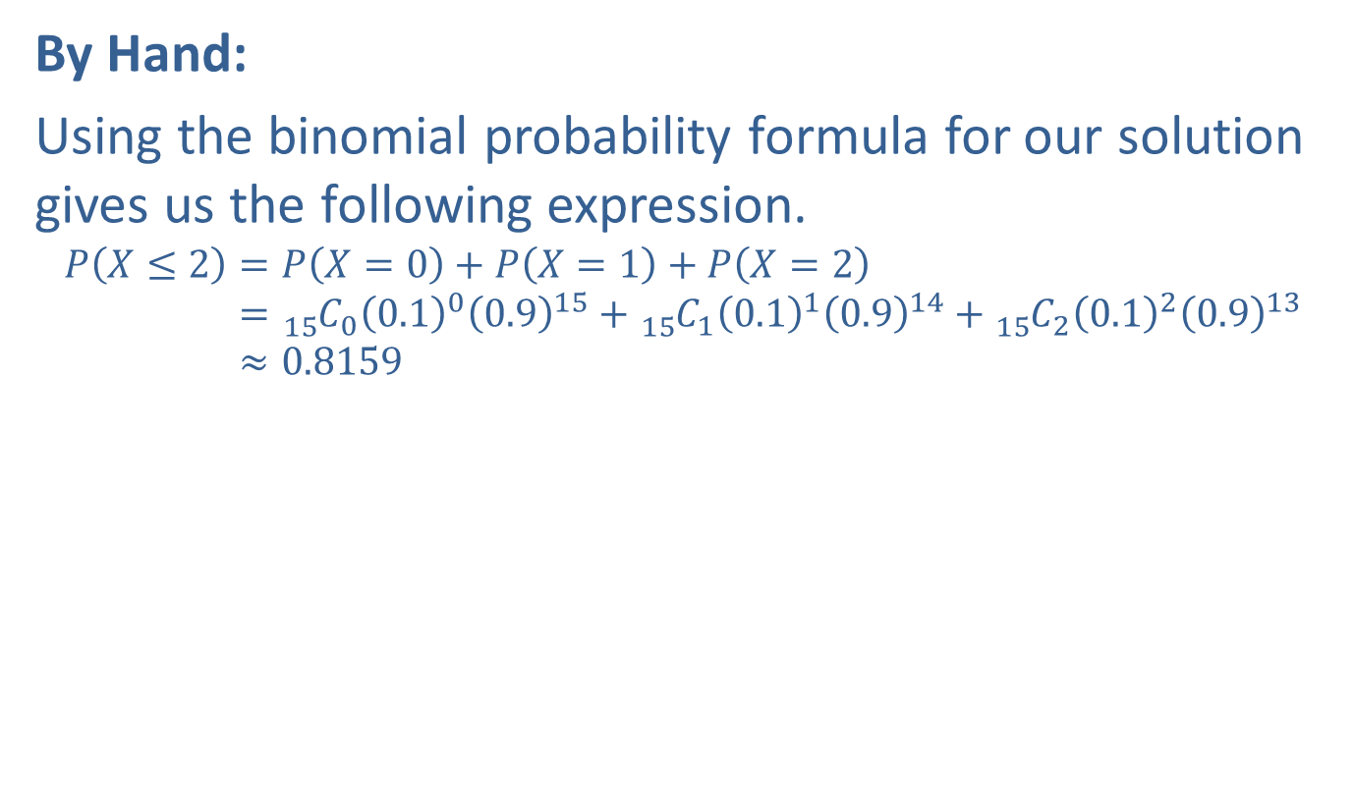
Example 5.2.5: Calculating Binomial Probabilities, $P⁡\left(X≤x\right)$ (cont.)
By Hand:
Using the binomial probability formula for our solution gives us the following expression.
𝑃𝑋≤2=𝑃𝑋=0+𝑃𝑋=1+𝑃𝑋=2𝑃⁡𝑋≤2=15 𝐶00.100.915+15 𝐶10.110.914+15 𝐶20.120.913𝑃⁡𝑋≤2≈0.8159

Slide 25
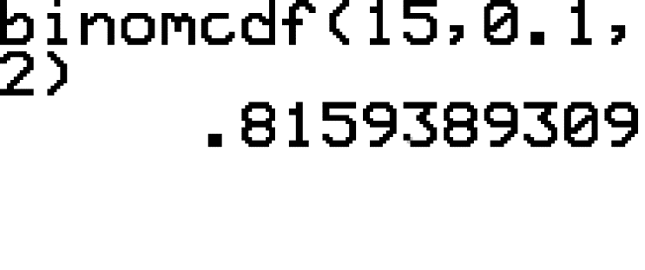
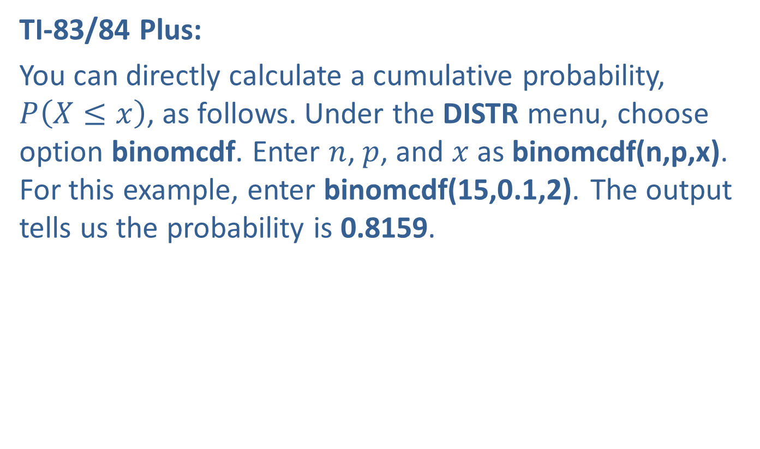
Example 5.2.5: Calculating Binomial Probabilities, $P⁡\left(X≤x\right)$ (cont.)
TI-83/84 Plus:
You can directly calculate a cumulative probability, $P⁡\left(X≤x\right)$, as follows. Under the DISTR menu, choose option binomcdf. Enter $n$, $p$, and $x$ as binomcdf(n,p,x). For this example, enter binomcdf(15,0.1,2). The output tells us the probability is 0.8159.

Slide 26

Example 5.2.5: Calculating Binomial Probabilities, $P⁡\left(X≤x\right)$ (cont.)
Therefore, the probability that no more than two out of the fifteen batteries are defective is approximately 0.8159, or $81.59\%$.

Slide 27


Example 5.2.6: Calculating a Cumulative Binomial Probability, $P⁡\left(X>x\right)$
What is the probability that a salesperson gets a sale more than two times in six sales calls if the probability that the salesperson gets a sale on any given call is only $50\%$? Assume that one call resulting in a sale is independent of another call resulting in a sale.

Slide 28
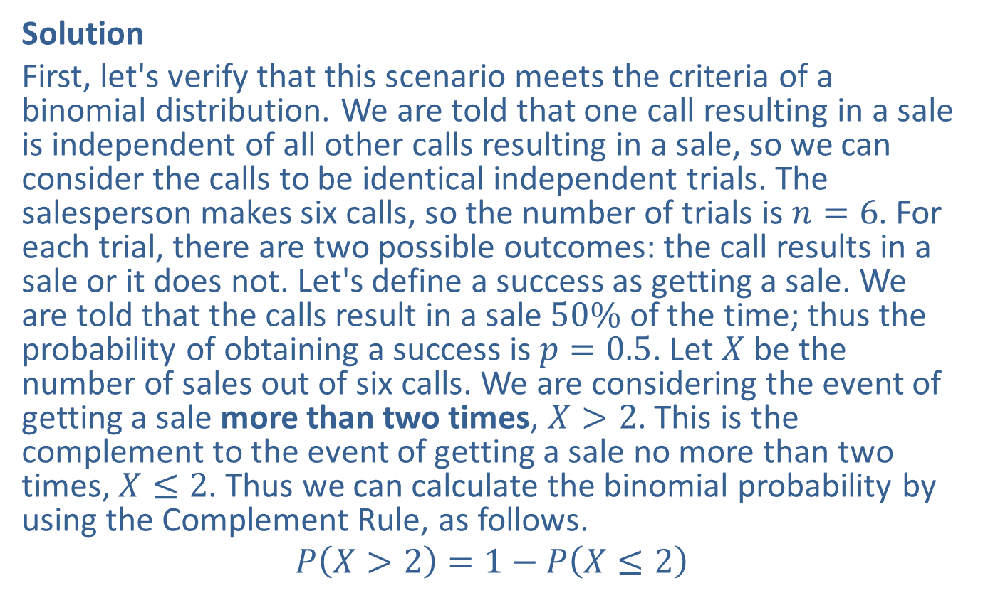

Example 5.2.6: Calculating a Cumulative Binomial Probability, $P⁡\left(X>x\right)$ (cont.)
Solution
First, let's verify that this scenario meets the criteria of a binomial distribution. We are told that one call resulting in a sale is independent of all other calls resulting in a sale, so we can consider the calls to be identical independent trials. The salesperson makes six calls, so the number of trials is $n=6$. For each trial, there are two possible outcomes: the call results in a sale or it does not. Let's define a success as getting a sale. We are told that the calls result in a sale $50\%$ of the time; thus the probability of obtaining a success is $p=0.5$. Let $X$ be the number of sales out of six calls. We are considering the event of getting a sale more than two times, $X>2$. This is the complement to the event of getting a sale no more than two times, $X≤2$. Thus we can calculate the binomial probability by using the Complement Rule, as follows.
$$P\left(X>2\right)=1−P\left(X≤2\right)$$

Slide 29
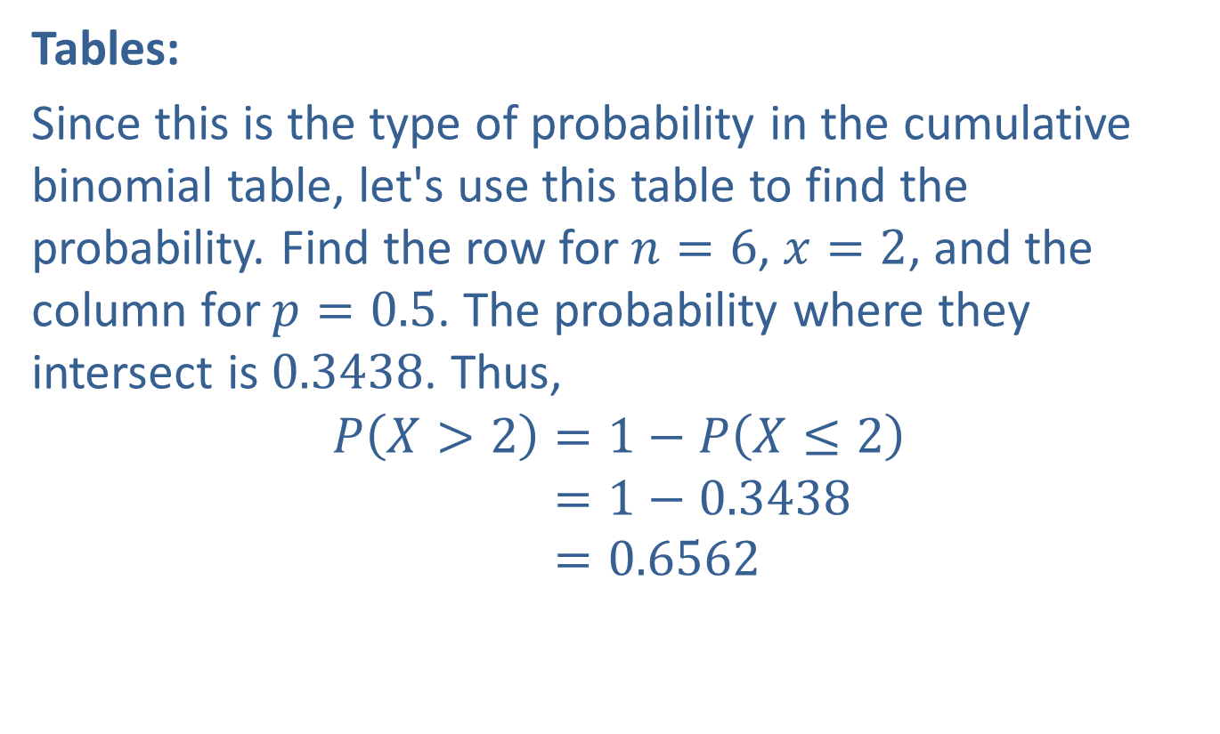
Example 5.2.6: Calculating a Cumulative Binomial Probability, $P⁡\left(X>x\right)$ (cont.)
Tables:
Since this is the type of probability in the cumulative binomial table, let's use this table to find the probability. Find the row for $n=6$, $x=2$, and the column for $p=0.5$. The probability where they intersect is 0.3438. Thus,
𝑃𝑋>2=1−𝑃𝑋≤2𝑃𝑋>2=1−0.3438𝑃𝑋>2=0.6562

Slide 30
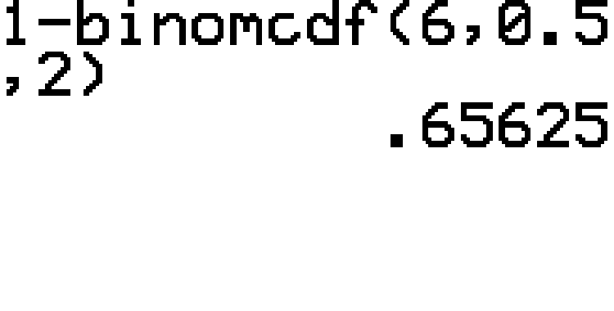
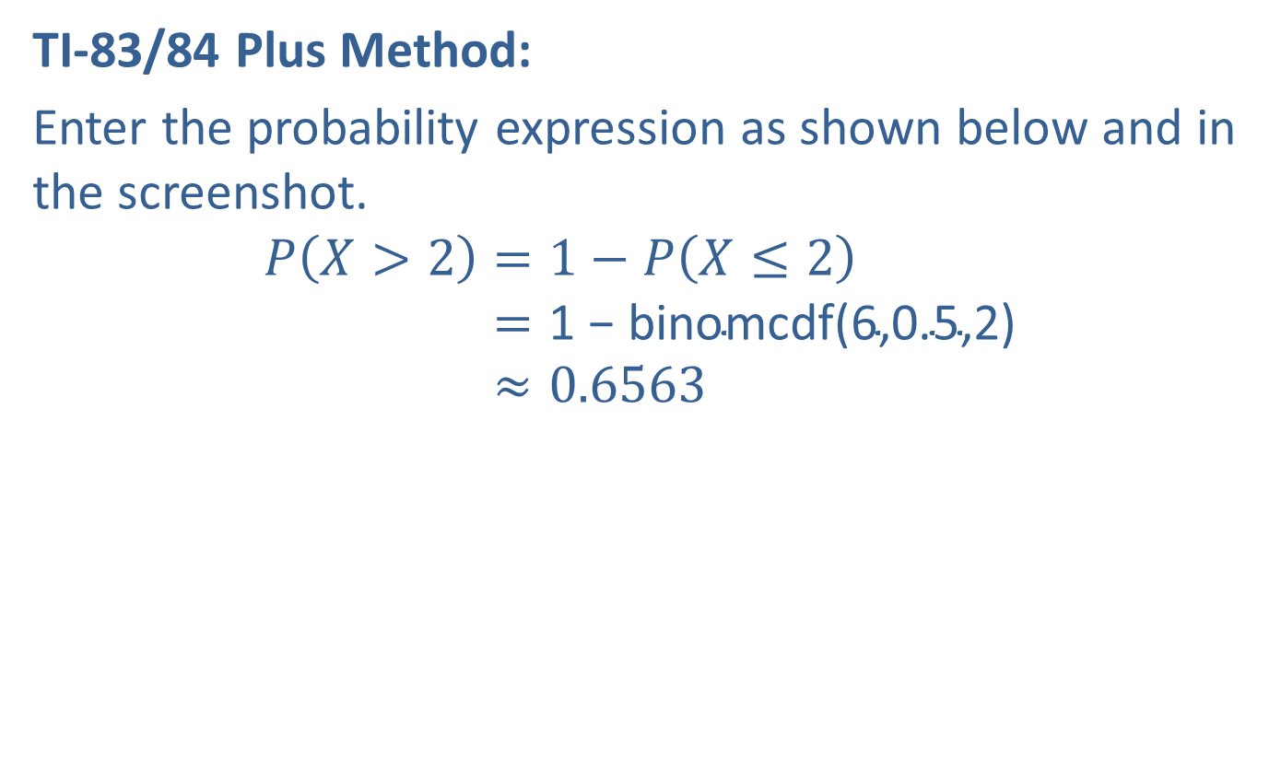
Example 5.2.6: Calculating a Cumulative Binomial Probability, $P⁡\left(X>x\right)$ (cont.)
TI-83/84 Plus Method:
Enter the probability expression as shown below and in the screenshot.
𝑃𝑋>2=1−𝑃𝑋≤2𝑃⁡𝑋>2=1 − binomcdf(6,0.5,2)𝑃⁡𝑋>2≈0.6563

Slide 31

Example 5.2.6: Calculating a Cumulative Binomial Probability, $P⁡\left(X>x\right)$ (cont.)
The probability would be reported as 0.6562 if using the tables and 0.6563 if using a calculator. Therefore, the probability salesperson gets more than two sales from six sales calls is approximately $65.6\%$.

Slide 32
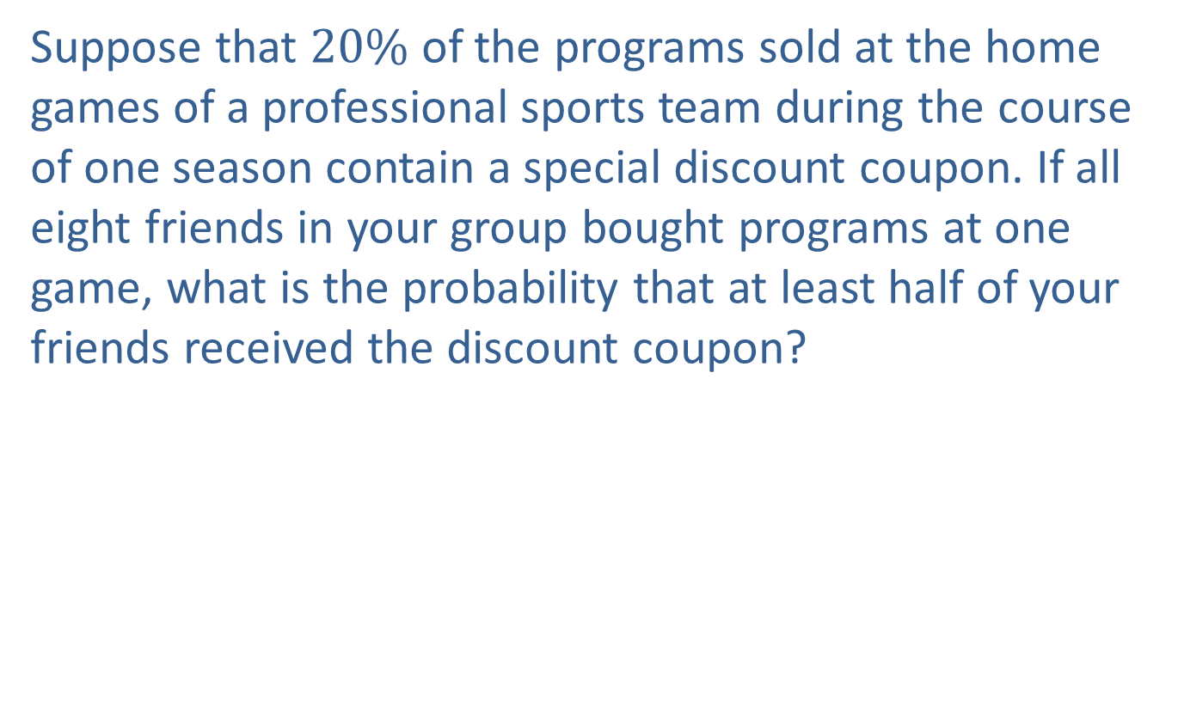

Example 5.2.7: Calculating a Cumulative Binomial Probability, $P⁡\left(X≥x\right)$
Suppose that $20\%$ of the programs sold at the home games of a professional sports team during the course of one season contain a special discount coupon. If all eight friends in your group bought programs at one game, what is the probability that at least half of your friends received the discount coupon?

Slide 33
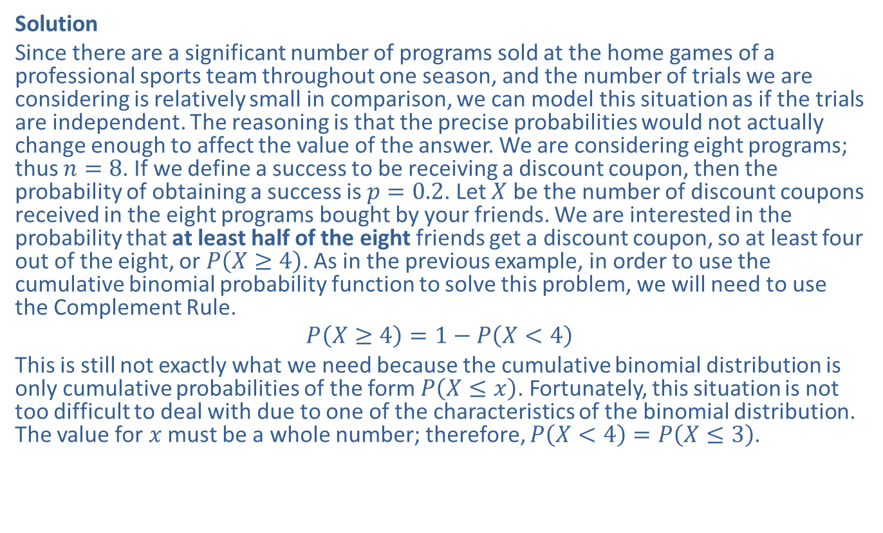

Example 5.2.7: Calculating a Cumulative Binomial Probability, $P⁡\left(X≥x\right)$ (cont.)
Solution
Since there are a significant number of programs sold at the home games of a professional sports team throughout one season, and the number of trials we are considering is relatively small in comparison, we can model this situation as if the trials are independent. The reasoning is that the precise probabilities would not actually change enough to affect the value of the answer. We are considering eight programs; thus $n=8$. If we define a success to be receiving a discount coupon, then the probability of obtaining a success is $p=0.2$. Let $X$ be the number of discount coupons received in the eight programs bought by your friends. We are interested in the probability that at least half of the eight friends get a discount coupon, so at least four out of the eight, or $P⁡\left(X≥4\right)$. As in the previous example, in order to use the cumulative binomial probability function to solve this problem, we will need to use the Complement Rule.
$$P\left(X≥4\right)=1−P\left(X<4\right)$$
This is still not exactly what we need because the cumulative binomial distribution is only cumulative probabilities of the form $P⁡\left(X≤x\right)$. Fortunately, this situation is not too difficult to deal with due to one of the characteristics of the binomial distribution. The value for $x$ must be a whole number; therefore, $P\left(X<4\right)=P\left(X≤3\right)$.

Slide 34
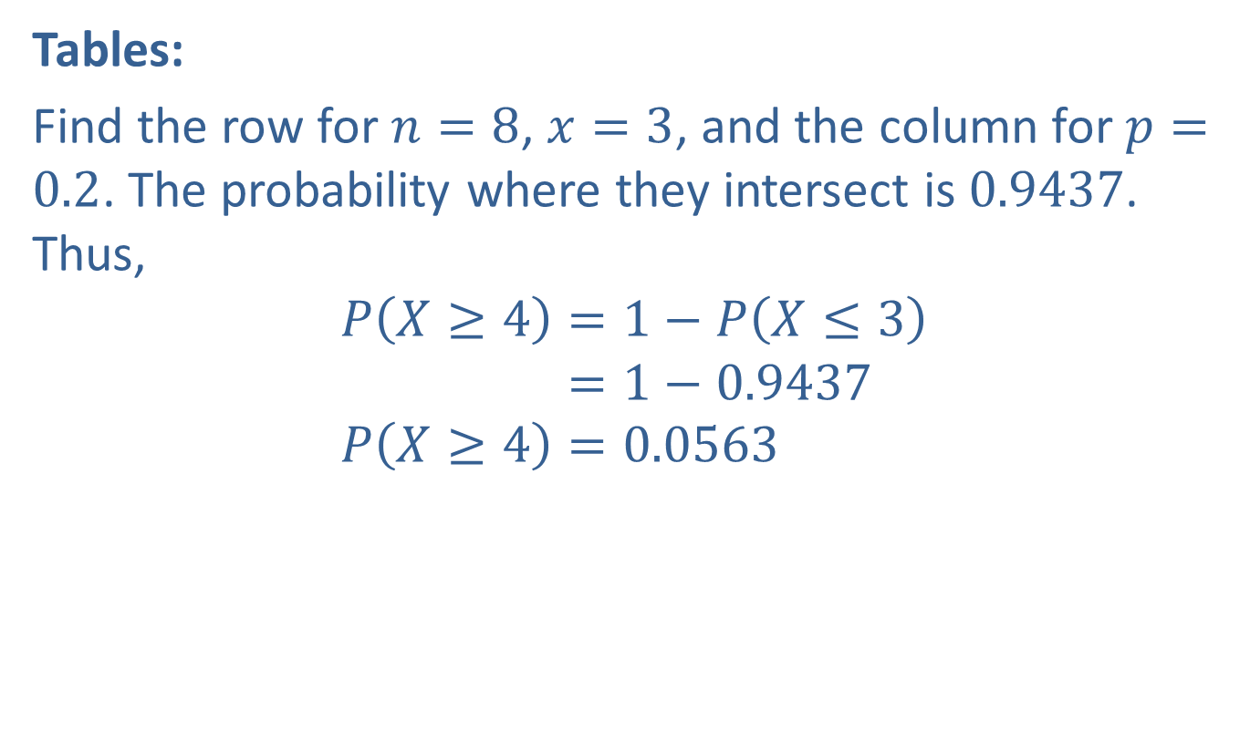
Example 5.2.7: Calculating a Cumulative Binomial Probability, $P⁡\left(X≥x\right)$ (cont.)
Tables:
Find the row for $n=8$, $x=3$, and the column for $p=0.2$. The probability where they intersect is 0.9437. Thus,
𝑃𝑋≥4=1−𝑃𝑋≤3𝑃⁡𝑋≥4=1−0.9437𝑃𝑋≥4=0.0563

Slide 35
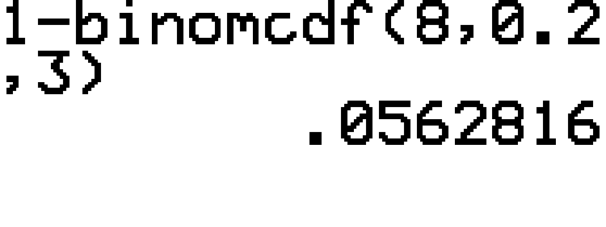
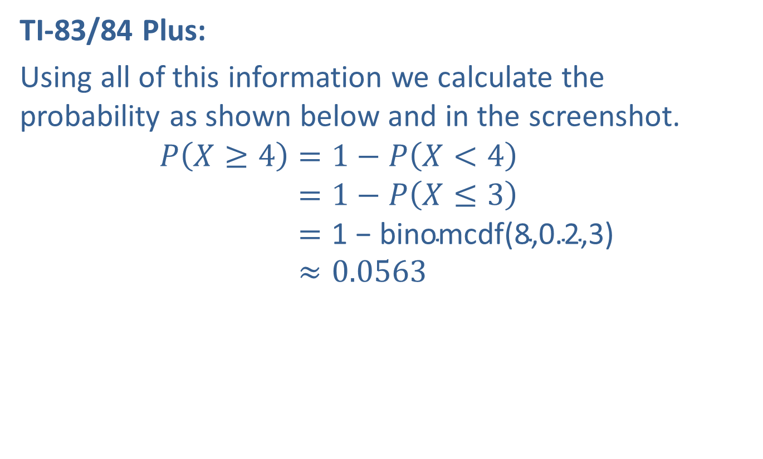
Example 5.2.7: Calculating a Cumulative Binomial Probability, $P⁡\left(X≥x\right)$ (cont.)
TI-83/84 Plus:
Using all of this information we calculate the probability as shown below and in the screenshot.
𝑃𝑋≥4=1−𝑃𝑋<4𝑃⁡𝑋≥4=1−𝑃𝑋≤3𝑃⁡𝑋≥4=1 − binomcdf(8,0.2,3)𝑃⁡𝑋≥4≈0.0563

Slide 36

Example 5.2.7: Calculating a Cumulative Binomial Probability, $P⁡\left(X≥x\right)$ (cont.)
Therefore, the probability that at least half of the eight friends find discount coupons in their programs is approximately 0.0563, or $5.63\%$ which indicates that it is not very likely.

