Slide 1
Section 5.3
Poisson Distribution

Slide 2
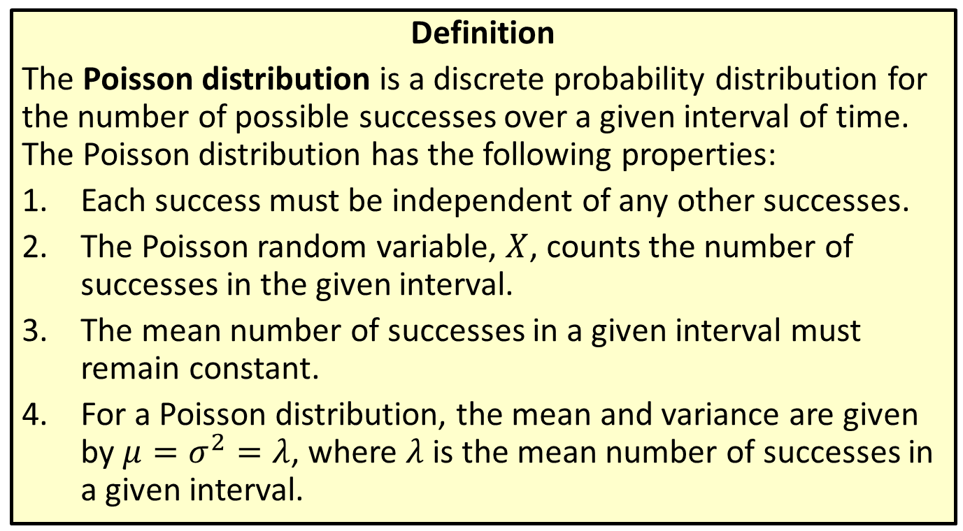
Distribution
Definition
The Poisson distribution is a discrete probability distribution for the number of possible successes over a given interval of time. The Poisson distribution has the following properties:
​Each success must be independent of any other successes.
​The Poisson random variable, $X$, counts the number of successes in the given interval.
​The mean number of successes in a given interval must remain constant.
​For a Poisson distribution, the mean and variance are given by $μ=σ^{2}=λ$, where $λ$ is the mean number of successes in a given interval.

Slide 3
Memory Booster
$E\left(X\right)=μ$ for a random variable $X$.

Slide 4

Math Symbols
$λ$: mean number of successes in one interval; Greek letter lambda

Slide 5
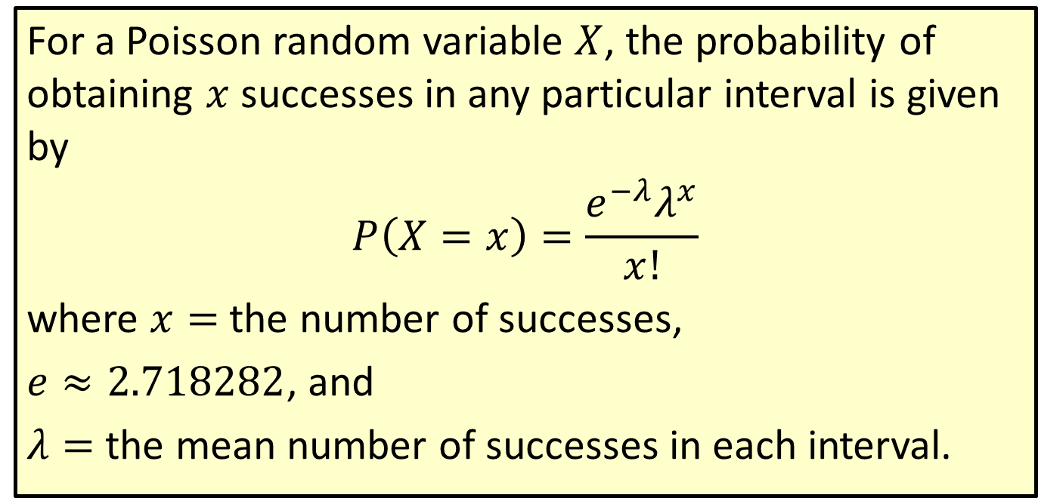
Formula: Probability for a Poisson Distribution
For a Poisson random variable $X$, the probability of obtaining $x$ successes in any particular interval is given by
$$P\left(X=x\right)=\frac{e^{−λ}λ^{x}}{x!}$$
where $x=$ the number of successes,
$e≈2.718282$, and
$λ=$ the mean number of successes in each interval.

Slide 6
Rounding Rule
When calculating probabilities for Poisson distributions, round to four decimal places. This follows the convention used in the Poisson probability distribution tables.

Slide 7

Memory Booster
Make sure that your calculation for $λ$ is in the same unit of measurement as the interval in the question.

Slide 8
Example 5.3.1: Calculating a Poisson Probability Using the Formula
Calculate the probability that our barber is feeling extra-speedy one day and finishes six haircuts in one hour. Recall that he usually finishes one haircut every fifteen minutes.

Slide 9
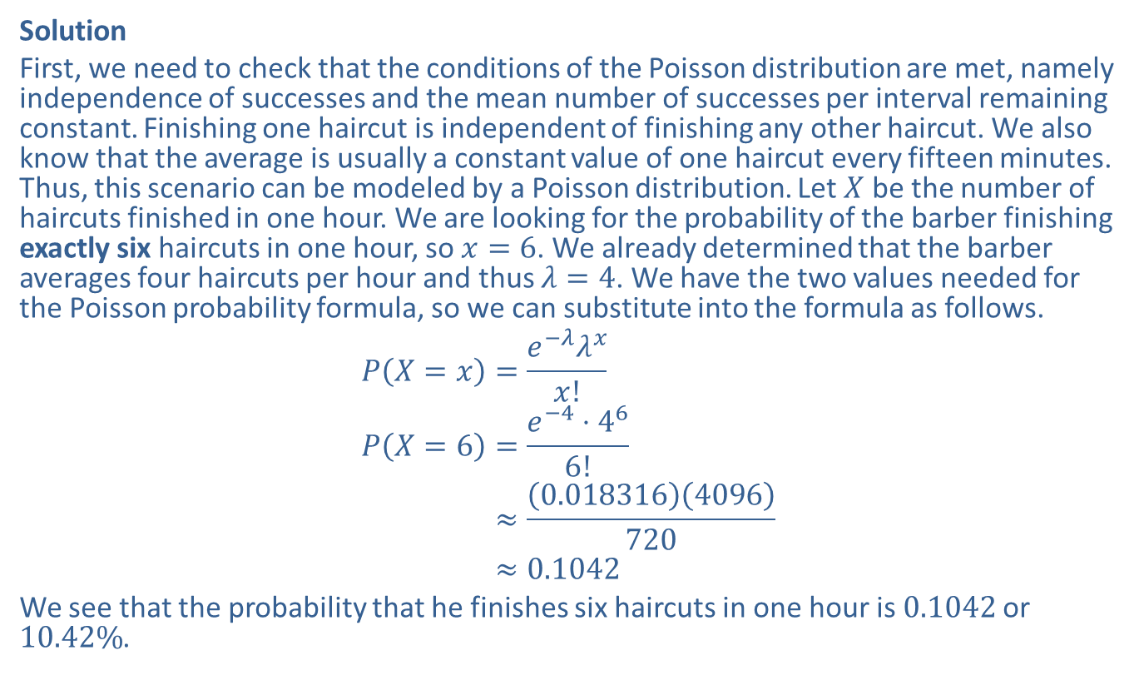
Example 5.3.1: Calculating a Poisson Probability Using the Formula (cont.)
Solution
First, we need to check that the conditions of the Poisson distribution are met, namely independence of successes and the mean number of successes per interval remaining constant. Finishing one haircut is independent of finishing any other haircut. We also know that the average is usually a constant value of one haircut every fifteen minutes. Thus, this scenario can be modeled by a Poisson distribution. Let $X$ be the number of haircuts finished in one hour. We are looking for the probability of the barber finishing exactly six haircuts in one hour, so $x=6$. We already determined that the barber averages four haircuts per hour and thus $λ=4$. We have the two values needed for the Poisson probability formula, so we can substitute into the formula as follows.
𝑃𝑋=𝑥=𝑒−𝜆𝜆𝑥𝑥!𝑃𝑋=6=𝑒−4⋅466!𝑃⁡𝑋=6≈0.0183164096720𝑃⁡𝑋=6≈0.1042
We see that the probability that he finishes six haircuts in one hour is 0.1042 or $10.42\%$.

Slide 10
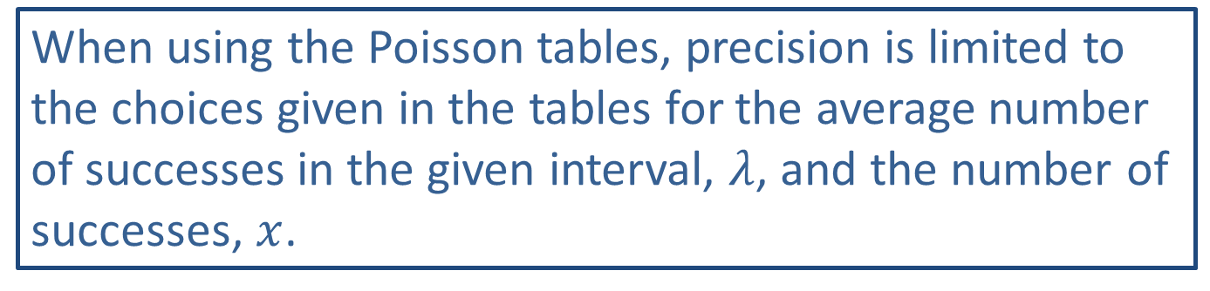
Side Note
When using the Poisson tables, precision is limited to the choices given in the tables for the average number of successes in the given interval, $λ$, and the number of successes, $x$.

Slide 11
Example 5.3.2: Finding a Poisson Probability Using a Table
Suppose that a length of copper wiring averages one defect every 200 feet. What is the probability that a 300-foot stretch will have no defects?

Slide 12
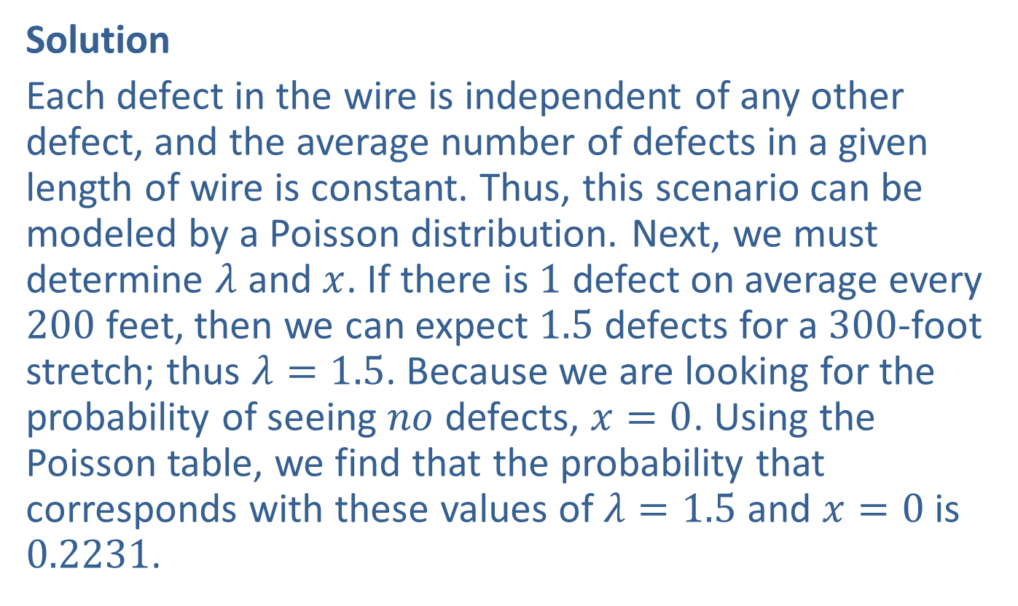
Example 5.3.2: Finding a Poisson Probability Using a Table (cont.)
Solution
Each defect in the wire is independent of any other defect, and the average number of defects in a given length of wire is constant. Thus, this scenario can be modeled by a Poisson distribution. Next, we must determine $λ$ and $x$. If there is 1 defect on average every 200 feet, then we can expect 1.5 defects for a 300-foot stretch; thus $λ=1.5$. Because we are looking for the probability of seeing $no$ defects, $x=0$. Using the Poisson table, we find that the probability that corresponds with these values of $λ=1.5$ and $x=0$ is 0.2231.

Slide 13
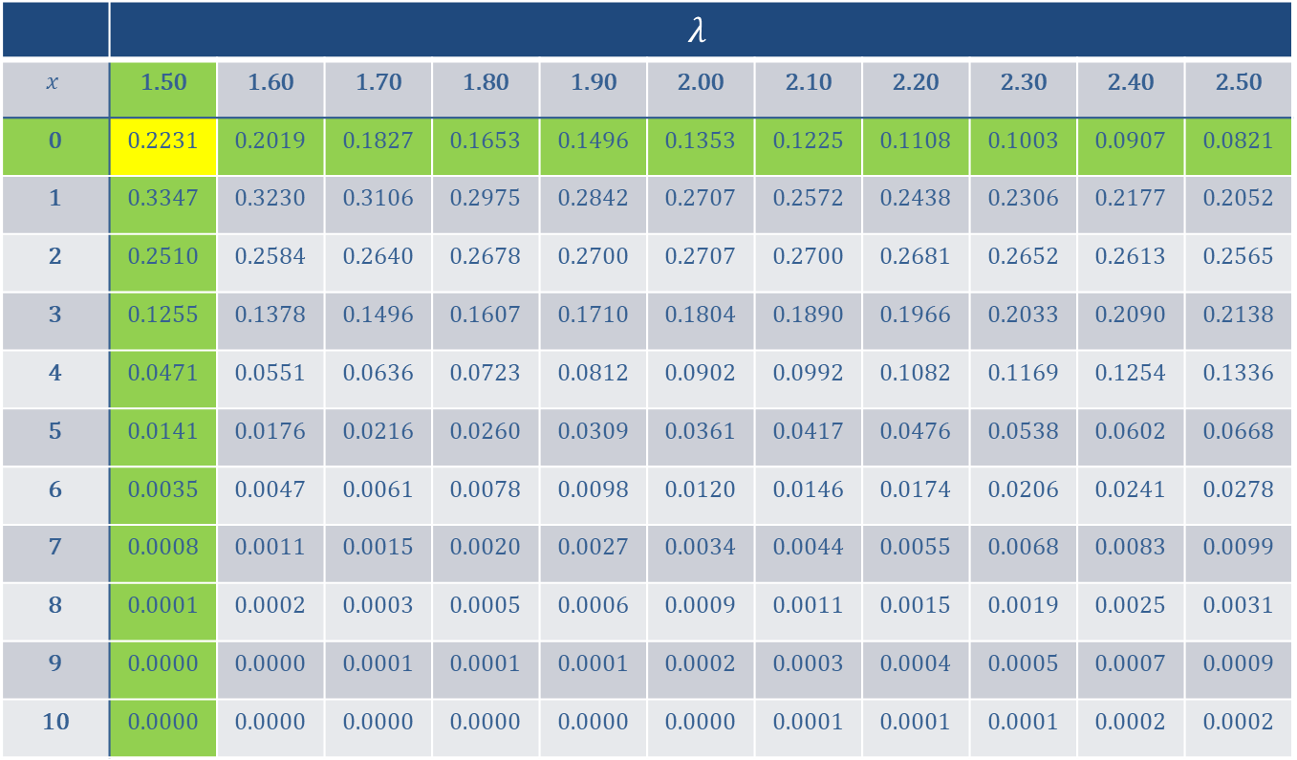
Example 5.3.2: Finding a Poisson Probability Using a Table (cont.)
 | $$λ$$
$$x$$ | 1.50 | 1.60 | 1.70 | 1.80 | 1.90 | 2.00 | 2.10 | 2.20 | 2.30 | 2.40 | 2.50
0 | 0.2231 | 0.2019 | 0.1827 | 0.1653 | 0.1496 | 0.1353 | 0.1225 | 0.1108 | 0.1003 | 0.0907 | 0.0821
1 | 0.3347 | 0.3230 | 0.3106 | 0.2975 | 0.2842 | 0.2707 | 0.2572 | 0.2438 | 0.2306 | 0.2177 | 0.2052
2 | 0.2510 | 0.2584 | 0.2640 | 0.2678 | 0.2700 | 0.2707 | 0.2700 | 0.2681 | 0.2652 | 0.2613 | 0.2565
3 | 0.1255 | 0.1378 | 0.1496 | 0.1607 | 0.1710 | 0.1804 | 0.1890 | 0.1966 | 0.2033 | 0.2090 | 0.2138
4 | 0.0471 | 0.0551 | 0.0636 | 0.0723 | 0.0812 | 0.0902 | 0.0992 | 0.1082 | 0.1169 | 0.1254 | 0.1336
5 | 0.0141 | 0.0176 | 0.0216 | 0.0260 | 0.0309 | 0.0361 | 0.0417 | 0.0476 | 0.0538 | 0.0602 | 0.0668
6 | 0.0035 | 0.0047 | 0.0061 | 0.0078 | 0.0098 | 0.0120 | 0.0146 | 0.0174 | 0.0206 | 0.0241 | 0.0278
7 | 0.0008 | 0.0011 | 0.0015 | 0.0020 | 0.0027 | 0.0034 | 0.0044 | 0.0055 | 0.0068 | 0.0083 | 0.0099
8 | 0.0001 | 0.0002 | 0.0003 | 0.0005 | 0.0006 | 0.0009 | 0.0011 | 0.0015 | 0.0019 | 0.0025 | 0.0031
9 | 0.0000 | 0.0000 | 0.0001 | 0.0001 | 0.0001 | 0.0002 | 0.0003 | 0.0004 | 0.0005 | 0.0007 | 0.0009
10 | 0.0000 | 0.0000 | 0.0000 | 0.0000 | 0.0000 | 0.0000 | 0.0001 | 0.0001 | 0.0001 | 0.0002 | 0.0002

Slide 14

Example 5.3.2: Finding a Poisson Probability Using a Table (cont.)
We can say that there is a $22.31\%$ chance of finding no defects in a 300-foot section of wire.

Slide 15

Example 5.3.3: Calculating a Poisson Probability, $P⁡\left(X=x\right)$
A popular accounting office takes in an average of three new tax returns per day during tax season. What is the probability that on a given day during tax season the firm will take in just one new tax return?

Slide 16
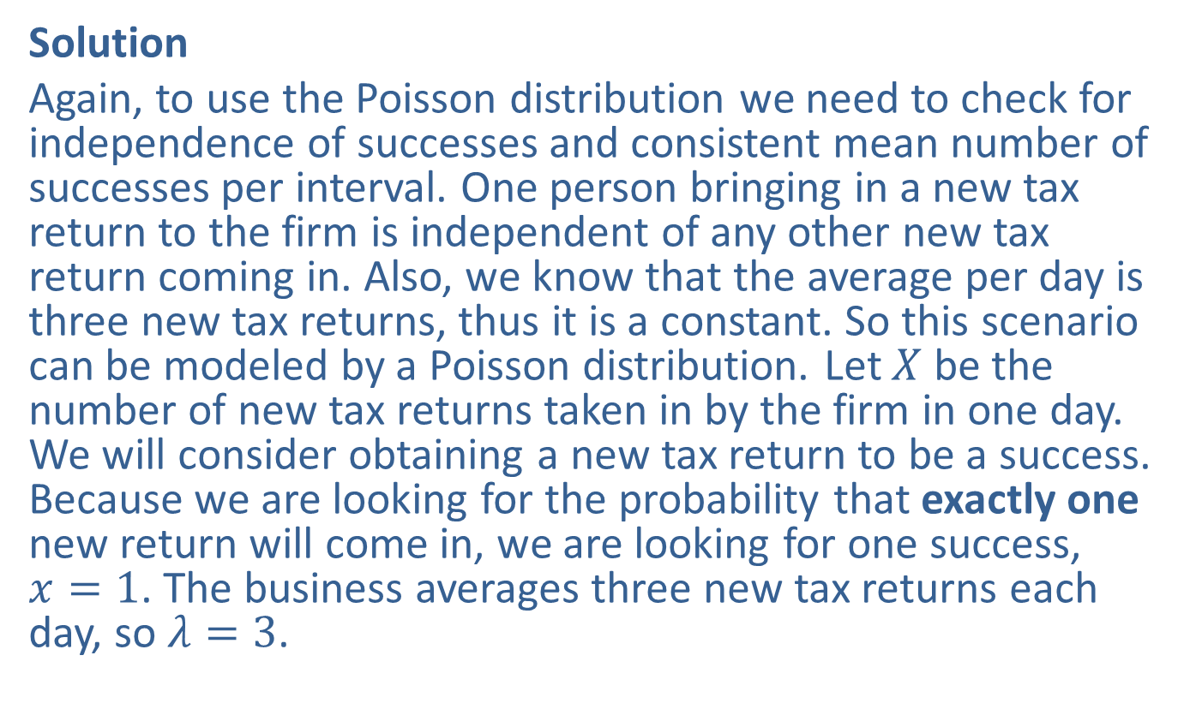

Example 5.3.3: Calculating a Poisson Probability, $P⁡\left(X=x\right)$ (cont.)
Solution
Again, to use the Poisson distribution we need to check for independence of successes and consistent mean number of successes per interval. One person bringing in a new tax return to the firm is independent of any other new tax return coming in. Also, we know that the average per day is three new tax returns, thus it is a constant. So this scenario can be modeled by a Poisson distribution. Let $X$ be the number of new tax returns taken in by the firm in one day. We will consider obtaining a new tax return to be a success. Because we are looking for the probability that exactly one new return will come in, we are looking for one success, $x=1$. The business averages three new tax returns each day, so $λ=3$.

Slide 17
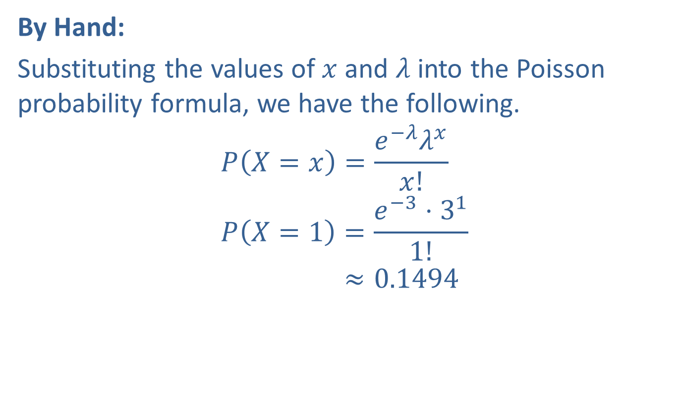
Example 5.3.3: Calculating a Poisson Probability, $P⁡\left(X=x\right)$ (cont.)
By Hand:
Substituting the values of $x$ and $λ$ into the Poisson probability formula, we have the following.
𝑃𝑋=𝑥=𝑒−𝜆𝜆𝑥𝑥!𝑃𝑋=1=𝑒−3⋅311!𝑃⁡𝑋=1≈0.1494

Slide 18
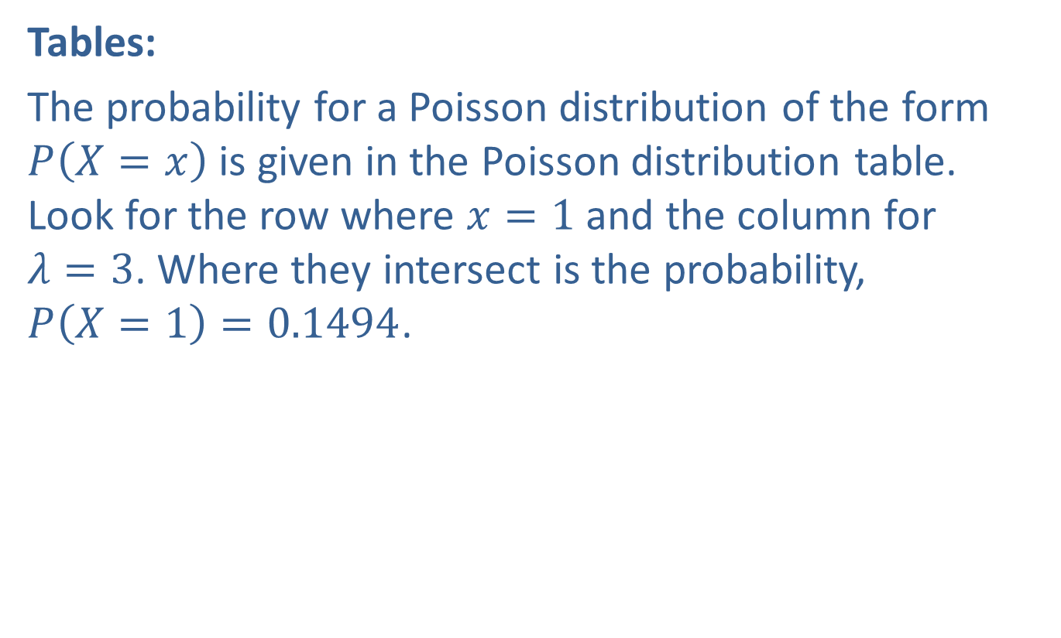
Example 5.3.3: Calculating a Poisson Probability, $P⁡\left(X=x\right)$ (cont.)
Tables:
The probability for a Poisson distribution of the form $P⁡\left(X=x\right)$ is given in the Poisson distribution table. Look for the row where $x=1$ and the column for
$λ=3$. Where they intersect is the probability, $P\left(X=1\right)=0.1494$.

Slide 19
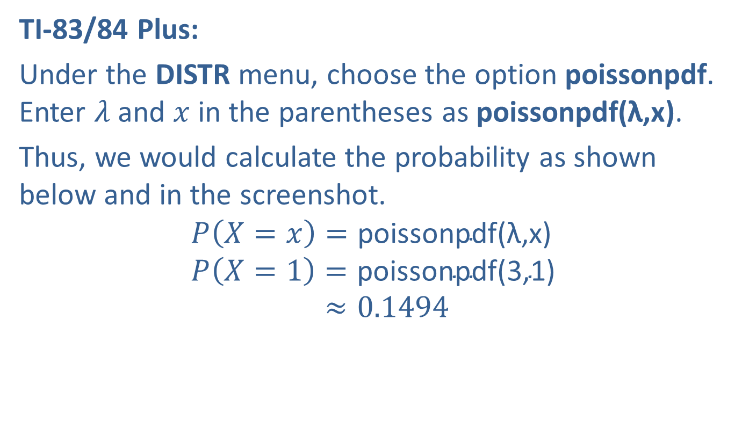
Example 5.3.3: Calculating a Poisson Probability, $P⁡\left(X=x\right)$ (cont.)
TI-83/84 Plus:
Under the DISTR menu, choose the option poissonpdf. Enter $λ$ and $x$ in the parentheses as poissonpdf(λ,x).
Thus, we would calculate the probability as shown below and in the screenshot.
𝑃𝑋=𝑥=poissonpdf(λ,x)𝑃𝑋=1=poissonpdf(3,1)𝑃⁡𝑋=1≈0.1494

Slide 20
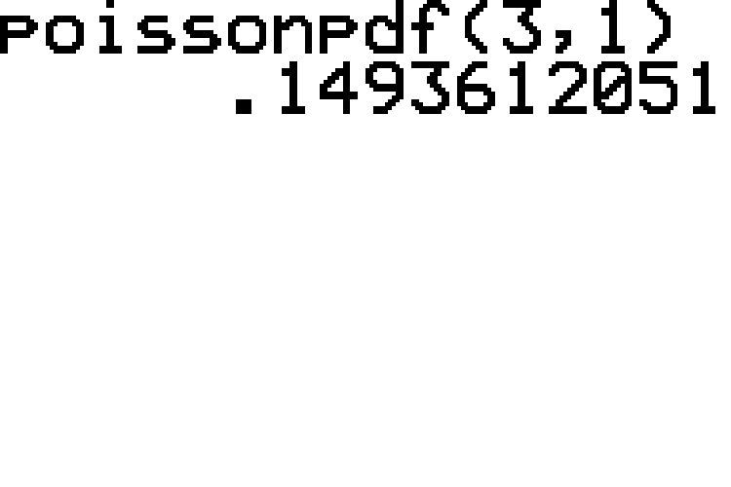
Example 5.3.3: Calculating a Poisson Probability, $P⁡\left(X=x\right)$ (cont.)

Slide 21

Example 5.3.3: Calculating a Poisson Probability, $P⁡\left(X=x\right)$ (cont.)
Therefore, the probability of the business getting just one new tax return on a given day during tax season is 0.1494, or $14.94\%$.

Slide 22

Example 5.3.4: Calculating a Poisson Probability, $P⁡\left(X=x\right)$
Suppose that in a rural area, the internet connection at Olivia's house goes out an average of 0.9 times every hour. If she plans to be connected to the internet for three hours one afternoon, what is the probability that she will stay connected the entire time?

Slide 23
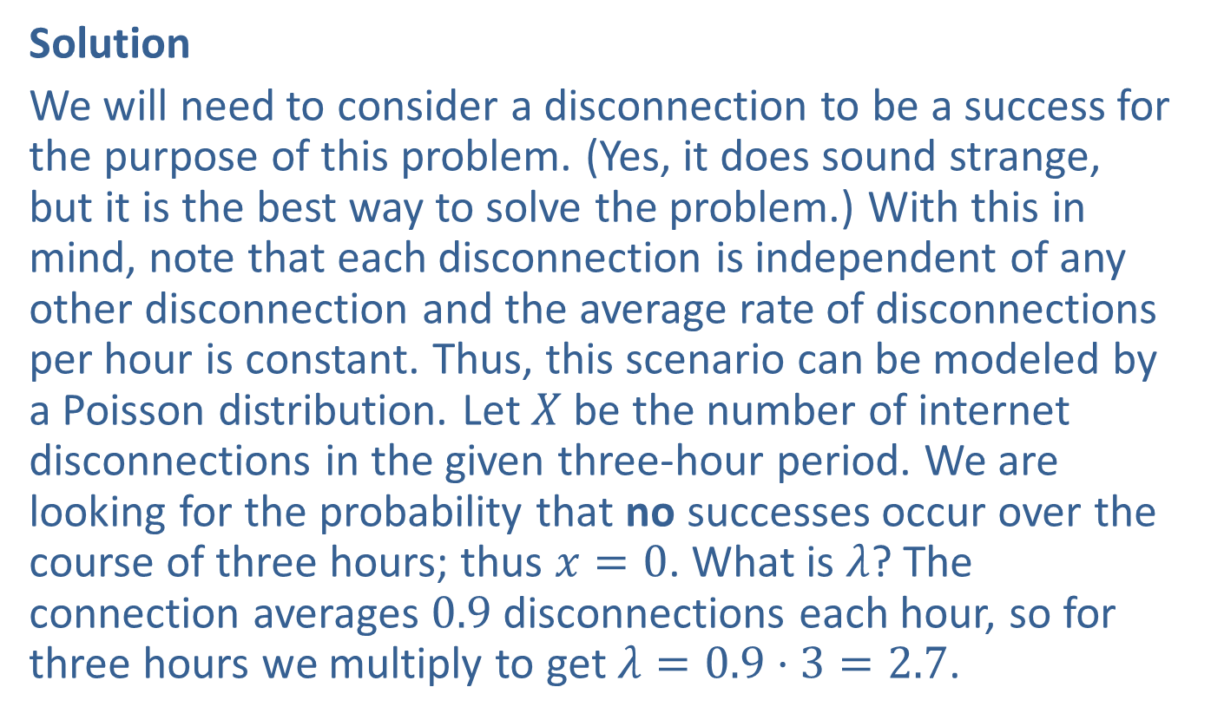

Example 5.3.4: Calculating a Poisson Probability, $P⁡\left(X=x\right)$ (cont.)
Solution
We will need to consider a disconnection to be a success for the purpose of this problem. (Yes, it does sound strange, but it is the best way to solve the problem.) With this in mind, note that each disconnection is independent of any other disconnection and the average rate of disconnections per hour is constant. Thus, this scenario can be modeled by a Poisson distribution. Let $X$ be the number of internet disconnections in the given three-hour period. We are looking for the probability that no successes occur over the course of three hours; thus $x=0$. What is $λ$? The connection averages 0.9 disconnections each hour, so for three hours we multiply to get $λ=0.9⋅3=2.7$.

Slide 24
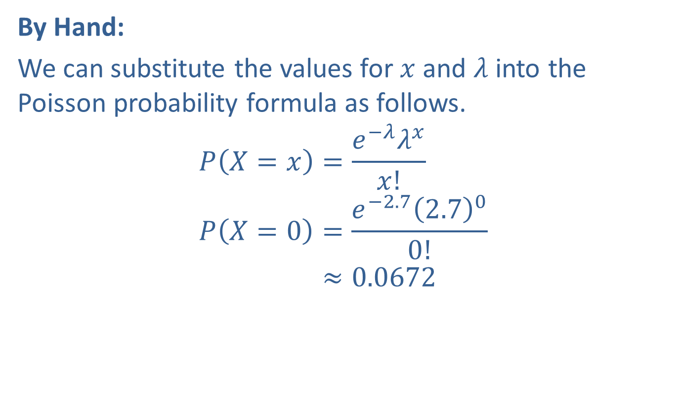
Example 5.3.4: Calculating a Poisson Probability, $P⁡\left(X=x\right)$ (cont.)
By Hand:
We can substitute the values for $x$ and $λ$ into the Poisson probability formula as follows.
𝑃𝑋=𝑥=𝑒−𝜆𝜆𝑥𝑥!𝑃𝑋=0=𝑒−2.72.700!𝑃⁡𝑋=0≈0.0672

Slide 25

Example 5.3.4: Calculating a Poisson Probability, $P⁡\left(X=x\right)$ (cont.)
Tables:
Since this is a probability of the form $P⁡\left(X=x\right)$, we can use the Poisson distribution table. Look for the row where $x=0$ and the column for $λ=2.7$. Where they intersect is the probability, $P\left(X=0\right)=0.0672$.

Slide 26
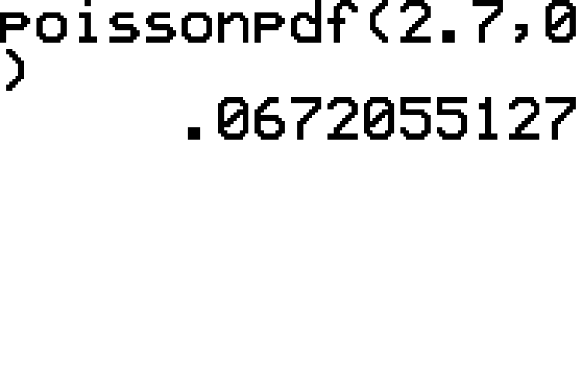
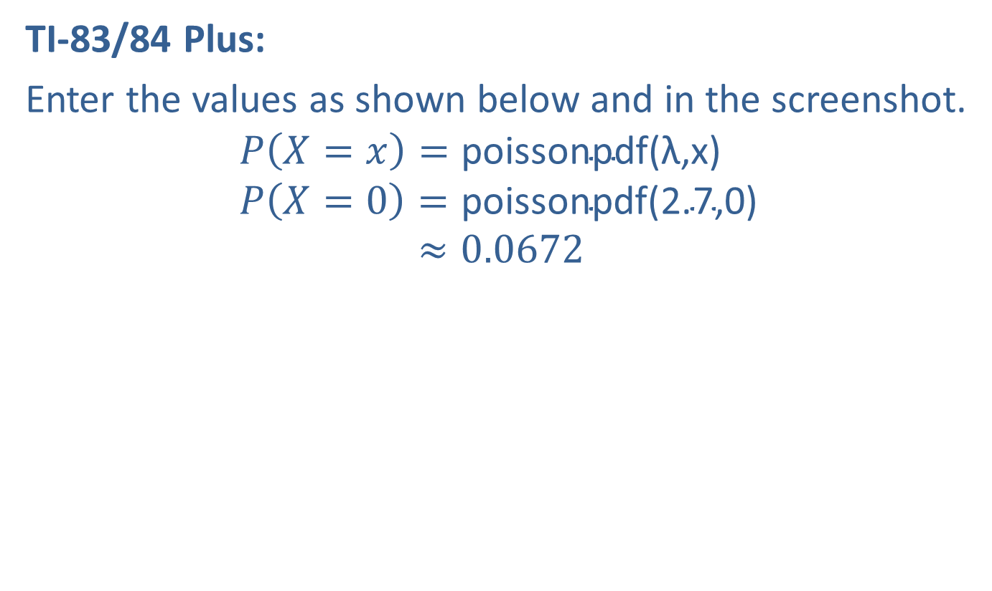
Example 5.3.4: Calculating a Poisson Probability, $P⁡\left(X=x\right)$ (cont.)
TI-83/84 Plus:
Enter the values as shown below and in the screenshot.
𝑃𝑋=𝑥=poissonpdf(λ,x)𝑃𝑋=0=poissonpdf(2.7,0)𝑃⁡𝑋=0≈0.0672

Slide 27

Example 5.3.4: Calculating a Poisson Probability, $P⁡\left(X=x\right)$ (cont.)
Thus, the probability of staying connected for all three hours is 0.0672 or $6.72\%$.

Slide 28

Example 5.3.5: Calculating Poisson Probabilities, $P⁡\left(X≤x\right)$
A fast-food restaurant averages one incorrect order every three hours. What is the probability that the restaurant will get no more than three orders wrong on any given day between 5 p.m. and 11 p.m.? Assume that the number of incorrect orders follows a Poisson distribution.

Slide 29
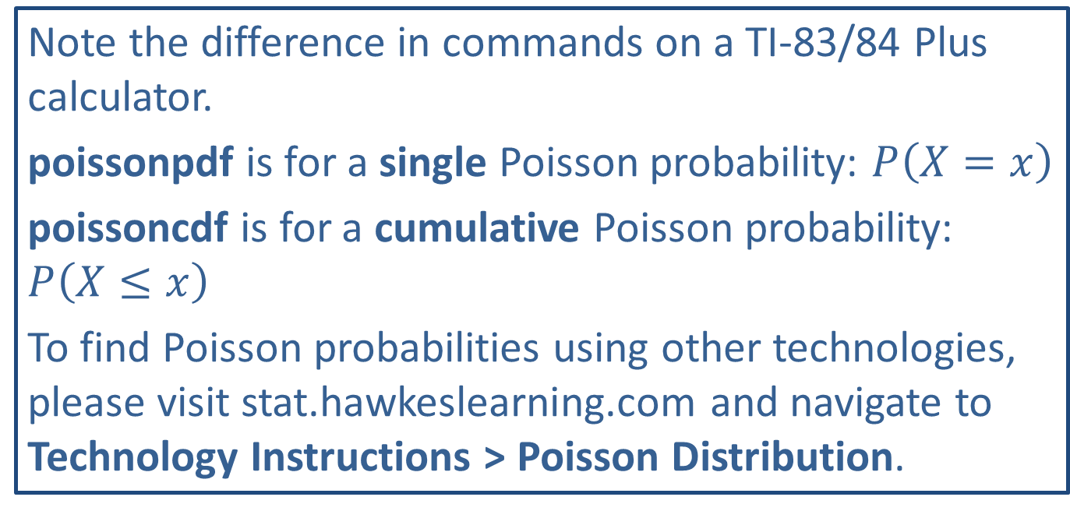
Technology
Note the difference in commands on a TI-83/84 Plus calculator.
poissonpdf is for a single Poisson probability: $P⁡\left(X=x\right)$
poissoncdf is for a cumulative Poisson probability: $P⁡\left(X≤x\right)$
To find Poisson probabilities using other technologies, please visit stat.hawkeslearning.com and navigate to Technology Instructions > Poisson Distribution.

Slide 30
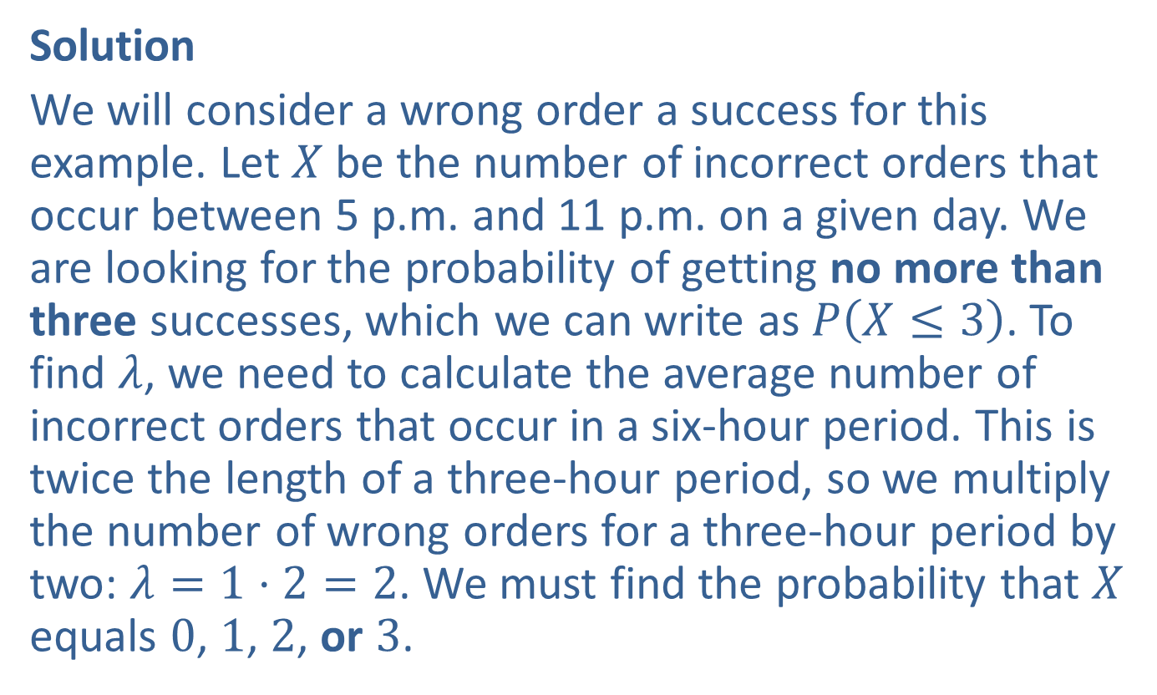

Example 5.3.5: Calculating Poisson Probabilities, $P⁡\left(X≤x\right)$ (cont.)
Solution
We will consider a wrong order a success for this example. Let $X$ be the number of incorrect orders that occur between 5 p.m. and 11 p.m. on a given day. We are looking for the probability of getting no more than three successes, which we can write as $P⁡\left(X≤3\right)$. To find $λ$, we need to calculate the average number of incorrect orders that occur in a six-hour period. This is twice the length of a three-hour period, so we multiply the number of wrong orders for a three-hour period by two: $λ=1⋅2=2$. We must find the probability that $X$ equals 0, 1, 2, or 3.

Slide 31
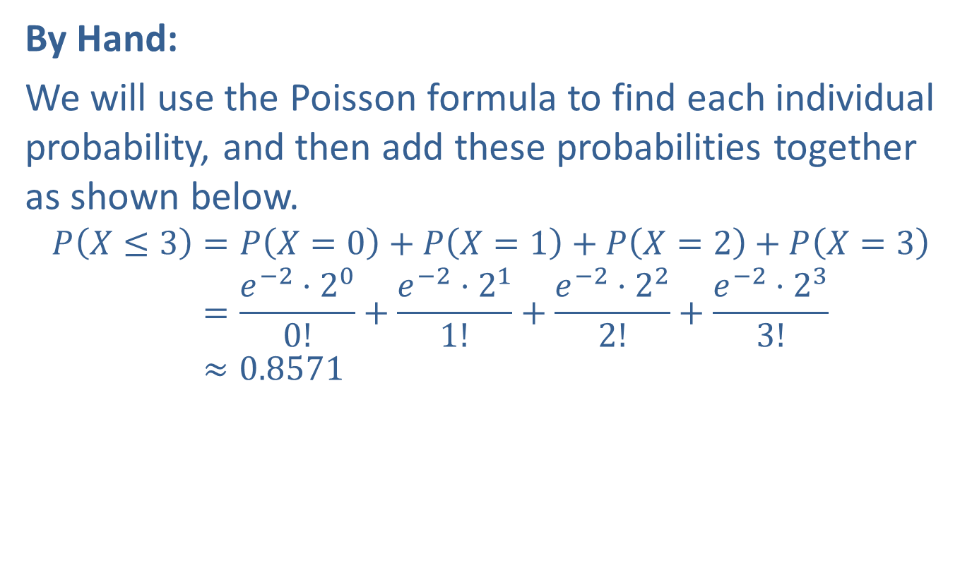
Example 5.3.5: Calculating Poisson Probabilities, $P⁡\left(X≤x\right)$ (cont.)
By Hand:
We will use the Poisson formula to find each individual probability, and then add these probabilities together as shown below.
𝑃𝑋≤3=𝑃𝑋=0+𝑃𝑋=1+𝑃𝑋=2+𝑃𝑋=3𝑃⁡𝑋≤3=𝑒−2⋅200!+𝑒−2⋅211!+𝑒−2⋅222!+𝑒−2⋅233!𝑃⁡𝑋≤3≈0.8571

Slide 32
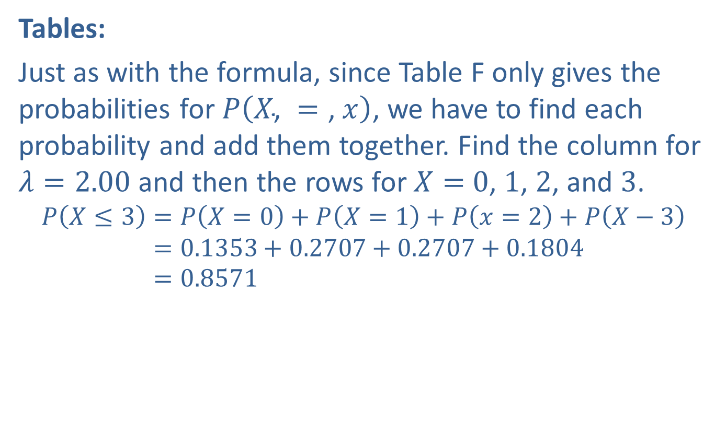
Example 5.3.5: Calculating Poisson Probabilities, $P⁡\left(X≤x\right)$ (cont.)
Tables:
Just as with the formula, since Table F only gives the probabilities for $P⁡\left(X\text{, }=\text{, }x\right)$, we have to find each probability and add them together. Find the column for $λ=2.00$ and then the rows for $X=$ 0, 1, 2, and 3.
𝑃𝑋≤3=𝑃⁡𝑋=0+𝑃𝑋=1+𝑃𝑥=2+𝑃𝑋−3𝑃𝑋≤3=0.1353+0.2707+0.2707+0.1804𝑃𝑋≤3=0.8571

Slide 33
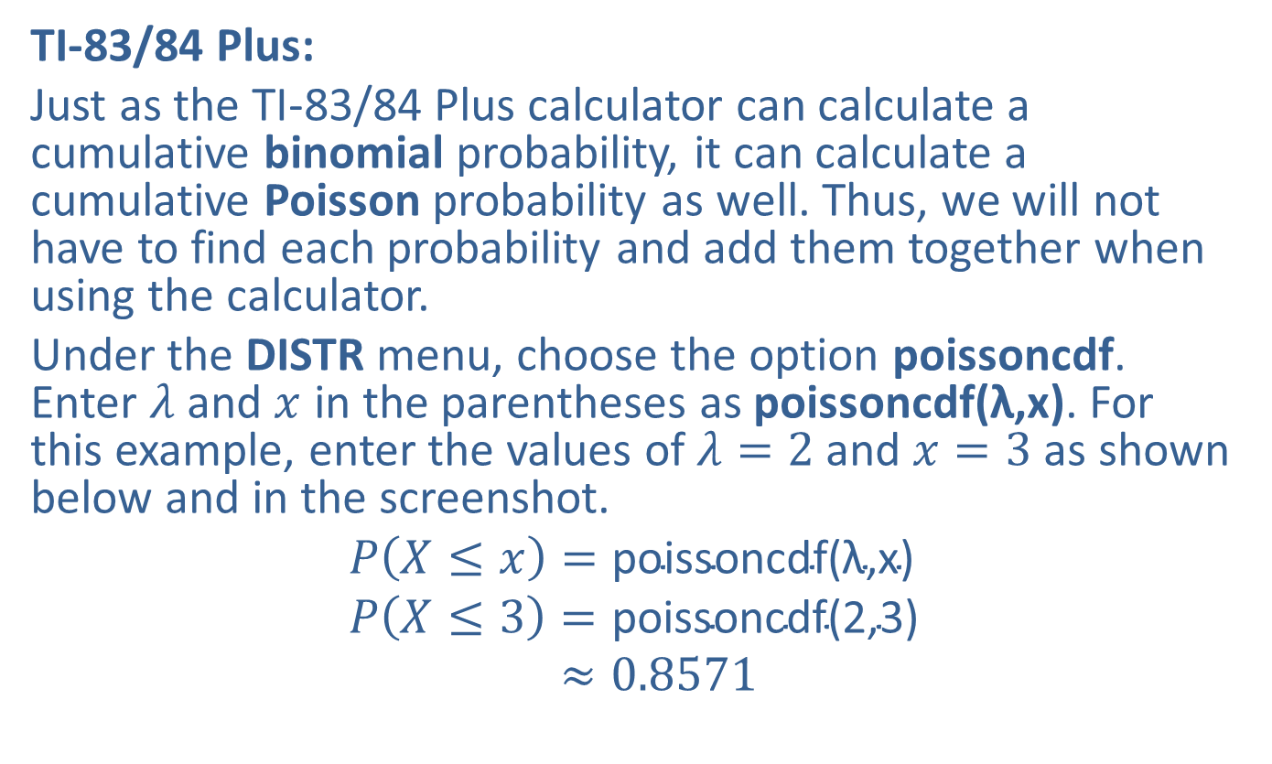
Example 5.3.5: Calculating Poisson Probabilities, $P⁡\left(X≤x\right)$ (cont.)
TI-83/84 Plus:
Just as the TI-83/84 Plus calculator can calculate a cumulative binomial probability, it can calculate a cumulative Poisson probability as well. Thus, we will not have to find each probability and add them together when using the calculator.
Under the DISTR menu, choose the option poissoncdf. Enter $λ$ and $x$ in the parentheses as poissoncdf(λ,x). For this example, enter the values of $λ=2$ and $x=3$ as shown below and in the screenshot.
𝑃𝑋≤𝑥=poissoncdf(λ,x)𝑃𝑋≤3=poissoncdf(2,3)𝑃⁡𝑋≤3≈0.8571

Slide 34
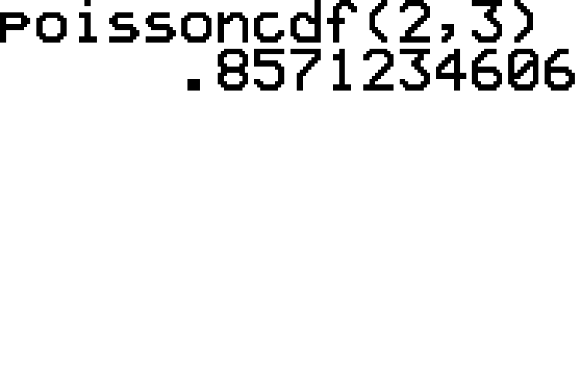
Example 5.3.5: Calculating Poisson Probabilities, $P⁡\left(X≤x\right)$ (cont.)

Slide 35

Example 5.3.5: Calculating Poisson Probabilities, $P⁡\left(X≤x\right)$ (cont.)
Thus, the fast-food restaurant has an $85.71\%$ chance of getting no more than three orders wrong on any given day between 5 p.m. and 11 p.m.

Slide 36

Example 5.3.6: Calculating a Cumulative Poisson Probability, $P⁡\left(X>x\right)$
A math professor averages grading 20 exams per hour. What is the probability that she grades more than 35 of her 60 statistics exams during her uninterrupted hour and a half between classes? Assume that the number of exams graded follows a Poisson distribution.

Slide 37
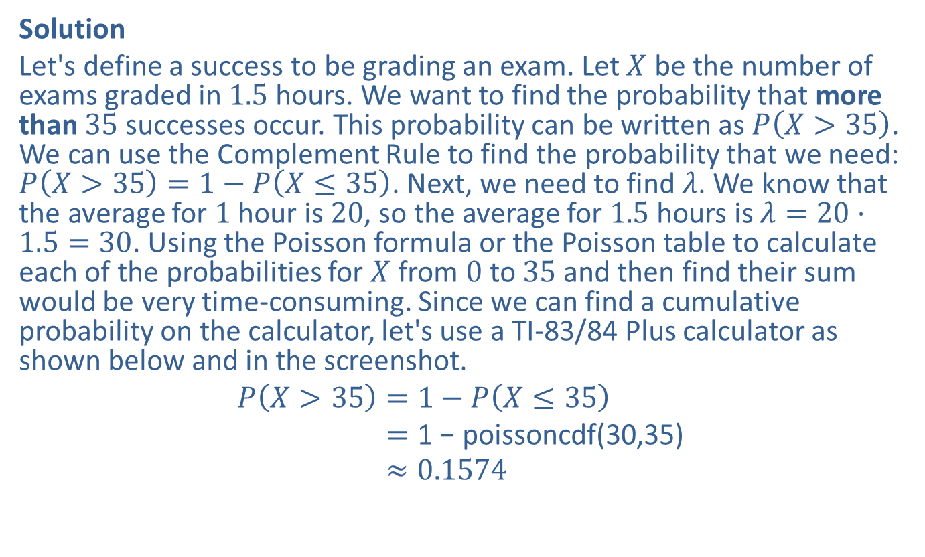

Example 5.3.6: Calculating a Cumulative Poisson Probability, $P⁡\left(X>x\right)$ (cont.)
Solution
Let's define a success to be grading an exam. Let $X$ be the number of exams graded in 1.5 hours. We want to find the probability that more than 35 successes occur. This probability can be written as $P⁡\left(X>35\right)$. We can use the Complement Rule to find the probability that we need: $P\left(X>35\right)=1−P\left(X≤35\right)$. Next, we need to find $λ$. We know that the average for 1 hour is 20, so the average for 1.5 hours is $λ=20⋅1.5=30$. Using the Poisson formula or the Poisson table to calculate each of the probabilities for $X$ from 0 to 35 and then find their sum would be very time-consuming. Since we can find a cumulative probability on the calculator, let's use a TI-83/84 Plus calculator as shown below and in the screenshot.
𝑃𝑋>35=1−𝑃𝑋≤35𝑃⁡𝑋>35=1 − poissoncdf(30,35)𝑃⁡𝑋>35≈0.1574

Slide 38
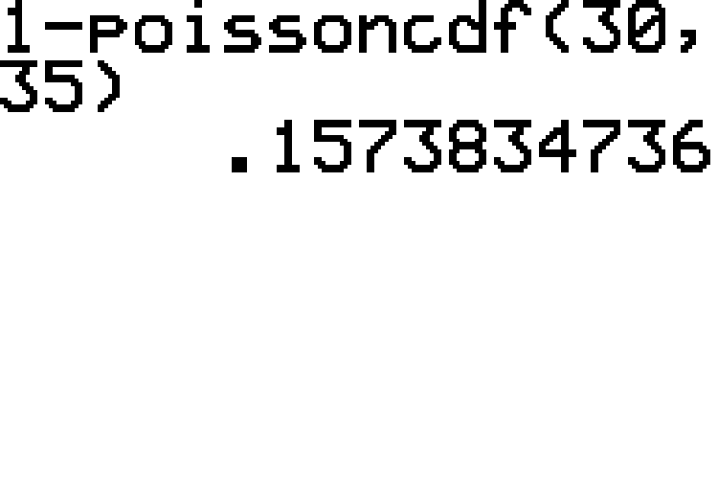
Example 5.3.6: Calculating a Cumulative Poisson Probability, $P⁡\left(X>x\right)$ (cont.)

Slide 39

Example 5.3.6: Calculating a Cumulative Poisson Probability, $P⁡\left(X>x\right)$ (cont.)
Thus, the math professor has a $15.74\%$ chance of getting more than 35 statistics exams graded between classes.

Slide 40

Example 5.3.7: Calculating a Cumulative Poisson Probability, $P⁡\left(X<x\right)$
A typist averages four typographical errors per paragraph. If he is typing a five-paragraph document, what is the probability that he will make fewer than ten mistakes? Assume that the number of errors follows a Poisson distribution.

Slide 41
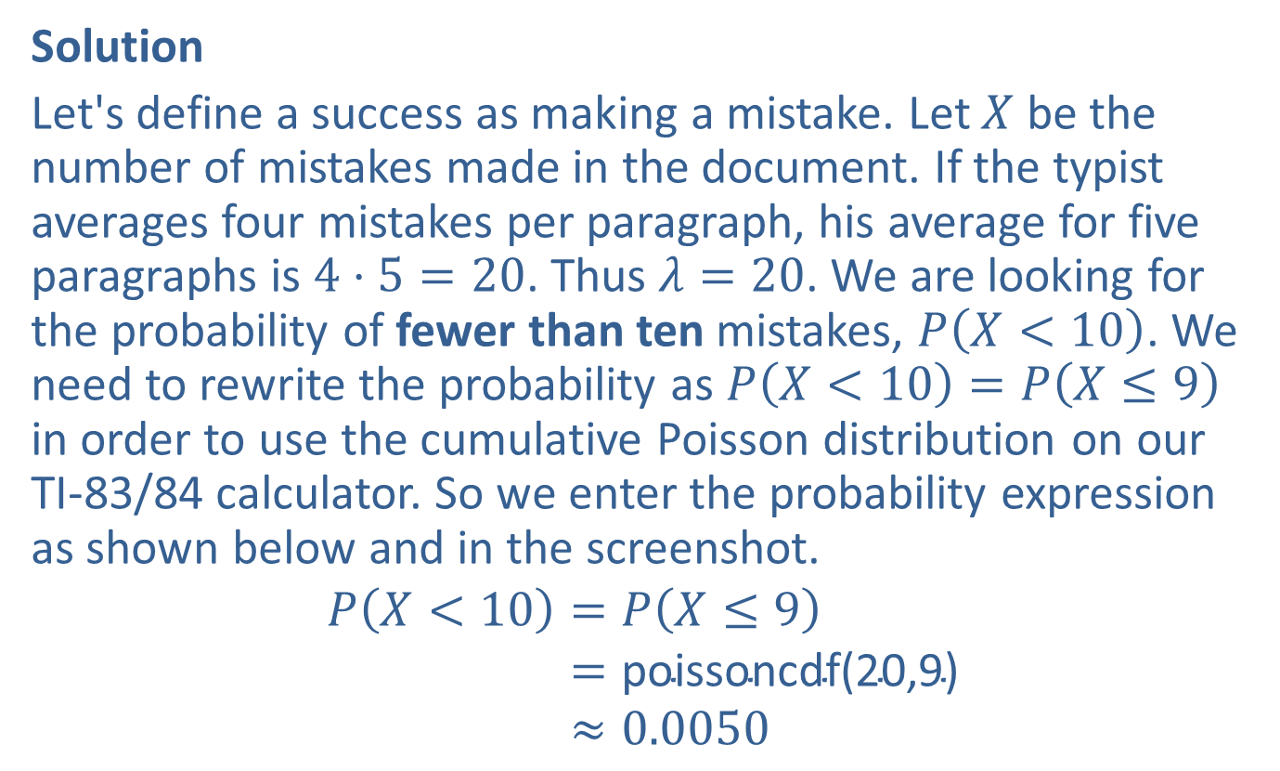

Example 5.3.7: Calculating a Cumulative Poisson Probability, $P⁡\left(X<x\right)$ (cont.)
Solution
Let's define a success as making a mistake. Let $X$ be the number of mistakes made in the document. If the typist averages four mistakes per paragraph, his average for five paragraphs is $4⋅5=20$. Thus $λ=20$. We are looking for the probability of fewer than ten mistakes, $P⁡\left(X<10\right)$. We need to rewrite the probability as $P\left(X<10\right)=P\left(X≤9\right)$ in order to use the cumulative Poisson distribution on our TI-83/84 calculator. So we enter the probability expression as shown below and in the screenshot.
𝑃𝑋<10=𝑃𝑋≤9𝑃⁡𝑋<10=poissoncdf(20,9)𝑃⁡𝑋<10≈0.0050

Slide 42
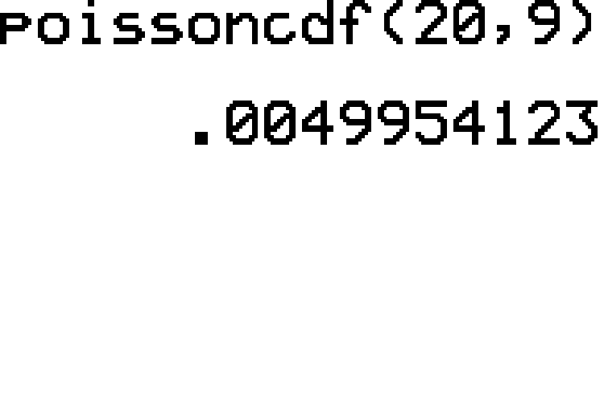
Example 5.3.7: Calculating a Cumulative Poisson Probability, $P⁡\left(X<x\right)$ (cont.)

Slide 43

Example 5.3.7: Calculating a Cumulative Poisson Probability, $P⁡\left(X<x\right)$ (cont.)
Thus the typist has a 0.0050, or $0.50\%$ probability of making fewer than ten mistakes.

