Slide 1
Section 5.4
Hypergeometric Distribution

Slide 2
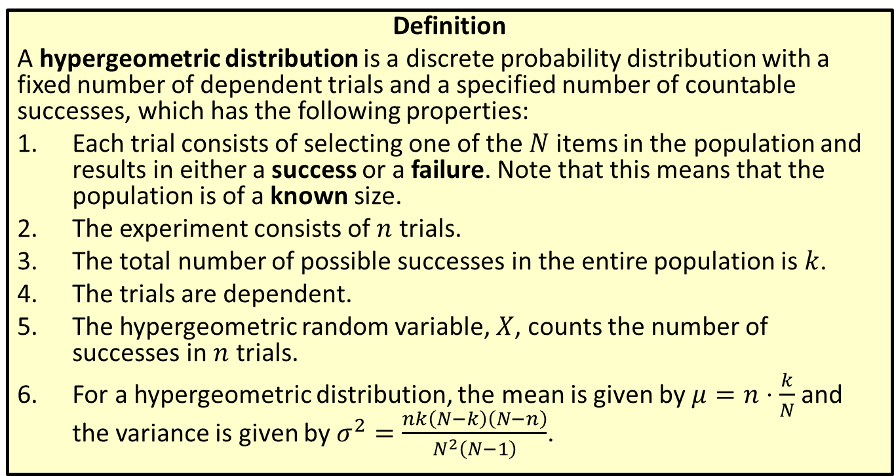
Distribution
Definition
A hypergeometric distribution is a discrete probability distribution with a fixed number of dependent trials and a specified number of countable successes, which has the following properties:
​Each trial consists of selecting one of the $N$ items in the population and results in either a success or a failure. Note that this means that the population is of a known size.
​The experiment consists of $n$ trials.
​The total number of possible successes in the entire population is $k$.
​The trials are dependent.
​The hypergeometric random variable, $X$, counts the number of successes in $n$ trials.
​For a hypergeometric distribution, the mean is given by $μ=n⋅\frac{k}{N}$ and the variance is given by $σ^{2}=\frac{nk\left(N−k\right)\left(N−n\right)}{N^{2}\left(N−1\right)}$.

Slide 3
Memory Booster
$E\left(X\right)=μ$ for a random variable $X$.

Slide 4
Example 5.4.1: Finding the Mean and Variance of a Hypergeometric Distribution
You bring a cooler full of soft drinks to a football tailgate party. You have packed 12 cans of regular soda and 6 cans of diet soda scattered randomly throughout the cooler. Suppose you grab 3 drinks for your friends without looking.
​What is the average number of diet sodas that you would grab?
​What is the variance of this hypergeometric distribution?

Slide 5
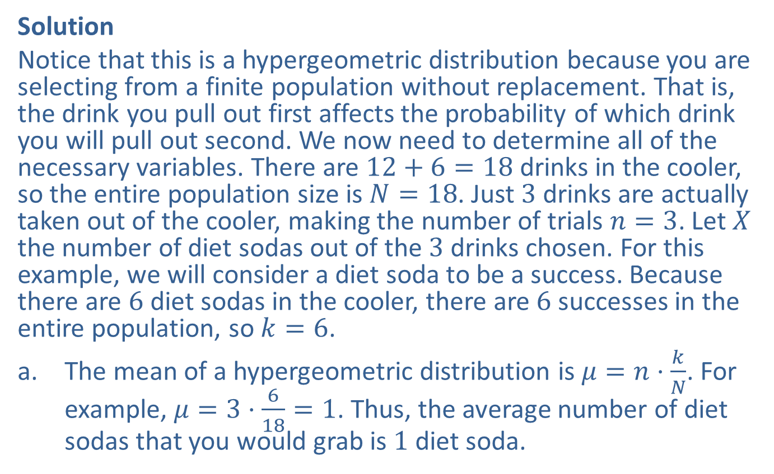
Example 5.4.1: Finding the Mean and Variance of a Hypergeometric Distribution (cont.)
Solution
Notice that this is a hypergeometric distribution because you are selecting from a finite population without replacement. That is, the drink you pull out first affects the probability of which drink you will pull out second. We now need to determine all of the necessary variables. There are $12+6=18$ drinks in the cooler, so the entire population size is $N=18$. Just 3 drinks are actually taken out of the cooler, making the number of trials $n=3$. Let $X$ the number of diet sodas out of the 3 drinks chosen. For this example, we will consider a diet soda to be a success. Because there are 6 diet sodas in the cooler, there are 6 successes in the entire population, so $k=6$.
​The mean of a hypergeometric distribution is $μ=n⋅\frac{k}{N}$. For example, $μ=3⋅\frac{6}{18}=1$. Thus, the average number of diet sodas that you would grab is 1 diet soda.

Slide 6

Example 5.4.1: Finding the Mean and Variance of a Hypergeometric Distribution (cont.)
​The variance of a hypergeometric distribution is
$σ^{2}=\frac{nk\left(N−k\right)\left(N−n\right)}{N^{2}\left(N−1\right)}$. So for this example,
$σ^{2}=\frac{3⋅6\left(18−6\right)\left(18−3\right)}{{18}^{2}\left(18−1\right)}≈0.6$.

Slide 7
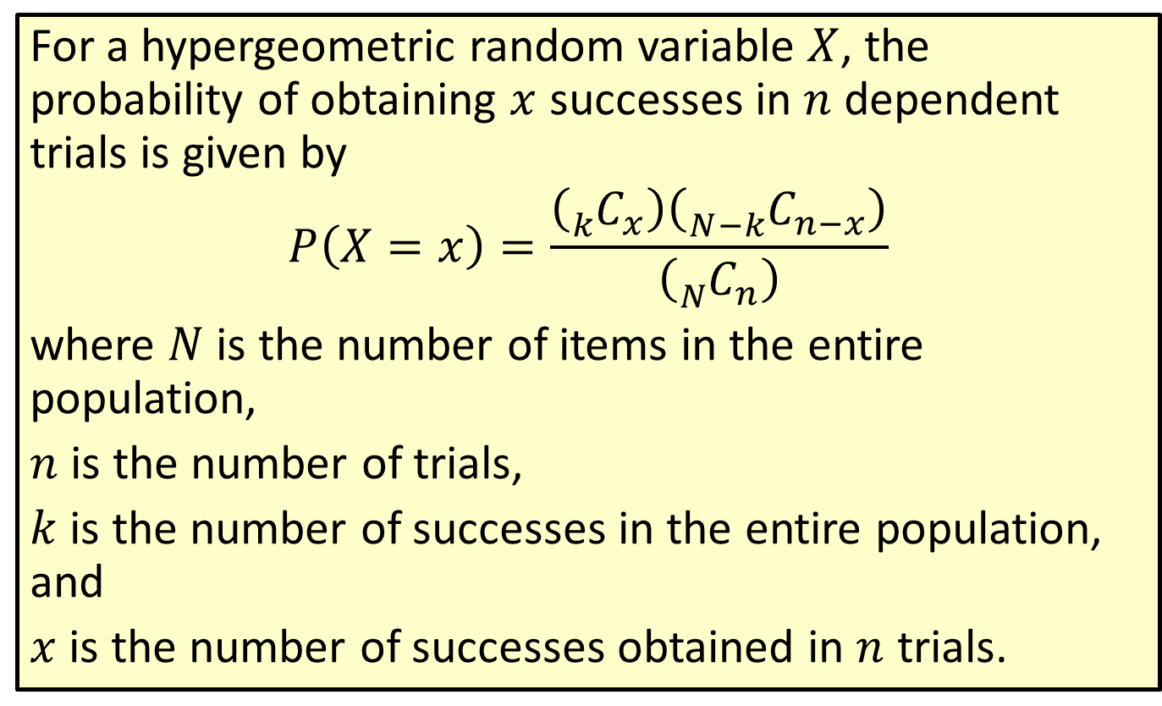
Formula: Probability for a Hypergeometric Distribution
For a hypergeometric random variable $X$, the probability of obtaining $x$ successes in $n$ dependent trials is given by
$$P\left(X=x\right)=\frac{\left({}_{k}^{ }{C_{x}}\right)\left({}_{N−k}^{ }{C_{n−x}}\right)}{\left({}_{N}^{ }{C_{n}}\right)}$$
where $N$ is the number of items in the entire population,
$n$ is the number of trials,
$k$ is the number of successes in the entire population, and
$x$ is the number of successes obtained in $n$ trials.

Slide 8
Rounding Rule
When calculating probabilities for hypergeometric distributions, round to four decimal places.

Slide 9
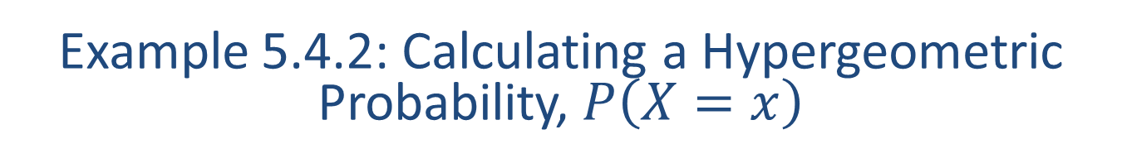
Example 5.4.2: Calculating a Hypergeometric Probability, $P⁡\left(X=x\right)$
At the local grocery store there are twenty boxes of cereal on one shelf, half of which contain a prize. Suppose that you buy three boxes of cereal. What is the probability that all three boxes contain a prize?

Slide 10
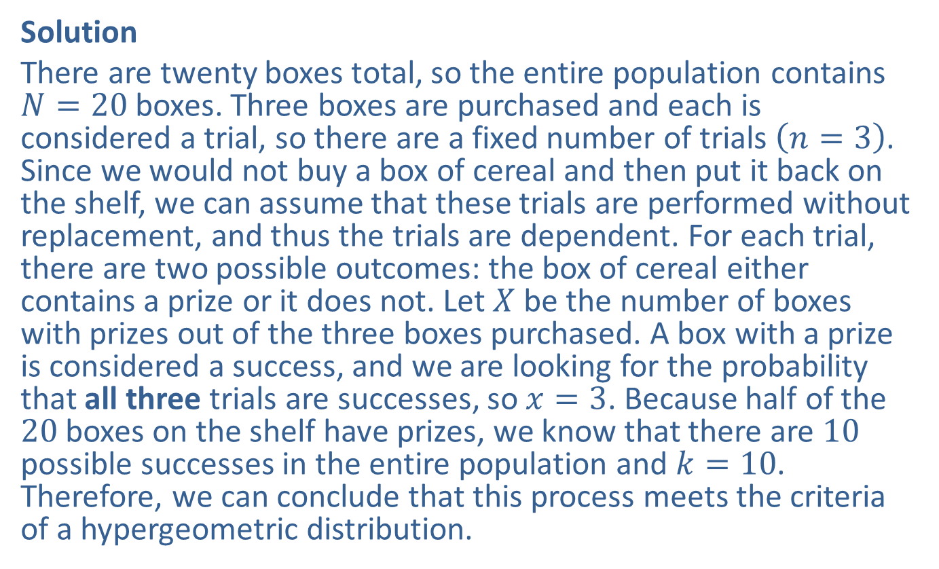
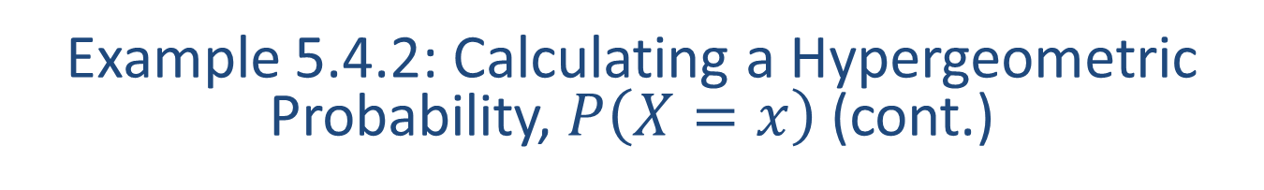
Example 5.4.2: Calculating a Hypergeometric Probability, $P⁡\left(X=x\right)$ (cont.)
Solution
There are twenty boxes total, so the entire population contains $N=20$ boxes. Three boxes are purchased and each is considered a trial, so there are a fixed number of trials $\left(n=3\right)$. Since we would not buy a box of cereal and then put it back on the shelf, we can assume that these trials are performed without replacement, and thus the trials are dependent. For each trial, there are two possible outcomes: the box of cereal either contains a prize or it does not. Let $X$ be the number of boxes with prizes out of the three boxes purchased. A box with a prize is considered a success, and we are looking for the probability that all three trials are successes, so $x=3$. Because half of the 20 boxes on the shelf have prizes, we know that there are 10 possible successes in the entire population and $k=10$. Therefore, we can conclude that this process meets the criteria of a hypergeometric distribution.

Slide 11
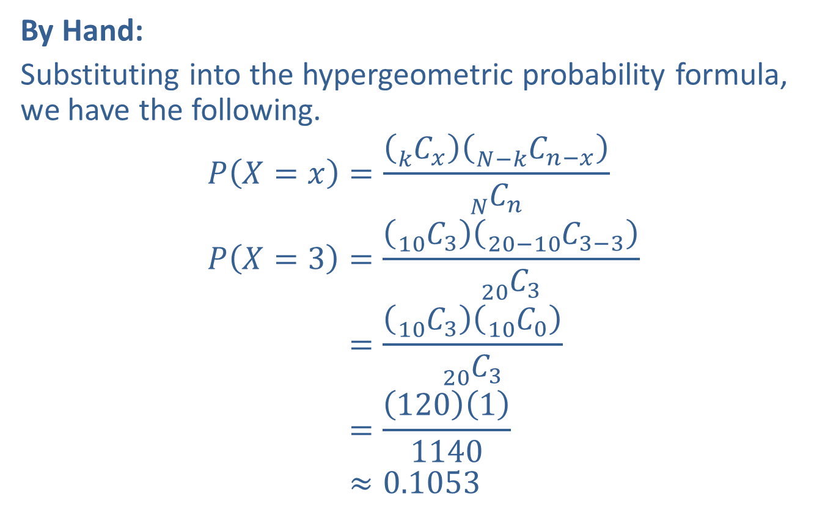
Example 5.4.2: Calculating a Hypergeometric Probability, $P⁡\left(X=x\right)$ (cont.)
By Hand:
Substituting into the hypergeometric probability formula, we have the following.
𝑃𝑋=𝑥=𝑘 𝐶𝑥𝑁−𝑘 𝐶𝑛−𝑥𝑁 𝐶𝑛𝑃𝑋=3=10 𝐶320−10 𝐶3−320 𝐶3𝑃⁡𝑋=3=10 𝐶310 𝐶020 𝐶3𝑃⁡𝑋=3=12011140𝑃⁡𝑋=3≈0.1053

Slide 12
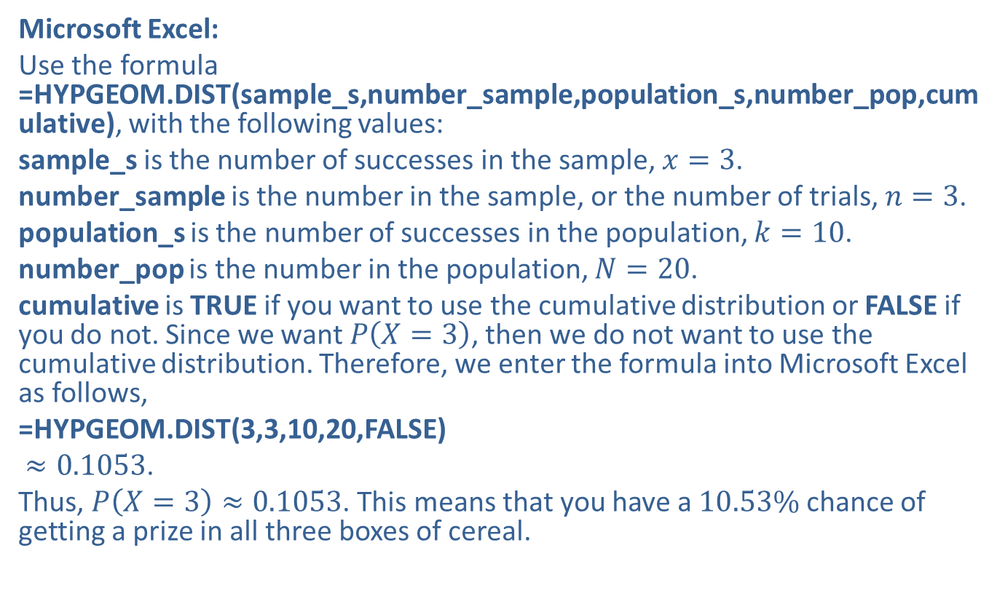
Example 5.4.2: Calculating a Hypergeometric Probability, $P⁡\left(X=x\right)$ (cont.)
Microsoft Excel:
Use the formula =HYPGEOM.DIST(sample_s,number_sample,population_s,number_pop,cumulative), with the following values:
sample_s is the number of successes in the sample, $x=3$.
number_sample is the number in the sample, or the number of trials, $n=3$.
population_s is the number of successes in the population, $k=10$.
number_pop is the number in the population, $N=20$.
cumulative is TRUE if you want to use the cumulative distribution or FALSE if you do not. Since we want $P⁡\left(X=3\right)$, then we do not want to use the cumulative distribution. Therefore, we enter the formula into Microsoft Excel as follows,
=HYPGEOM.DIST(3,3,10,20,FALSE)
$≈0.1053$.
Thus, $P\left(X=3\right)≈0.1053$. This means that you have a $10.53\%$ chance of getting a prize in all three boxes of cereal.

Slide 13
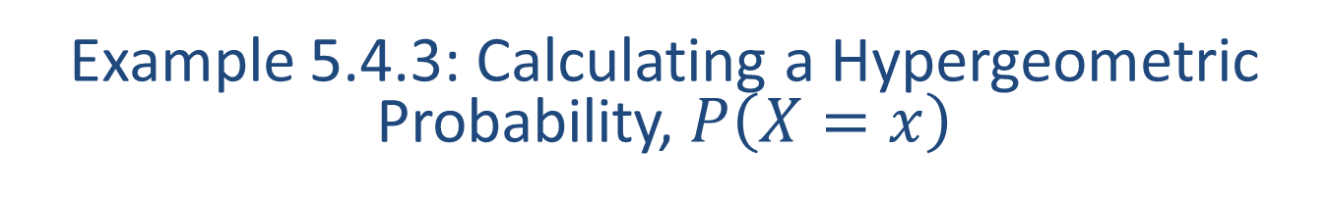
Example 5.4.3: Calculating a Hypergeometric Probability, $P⁡\left(X=x\right)$
There are seven yellow and nine green marbles in a bag. If five marbles are chosen at random without replacement, what is the probability that exactly three of the marbles chosen will be yellow?

Slide 14
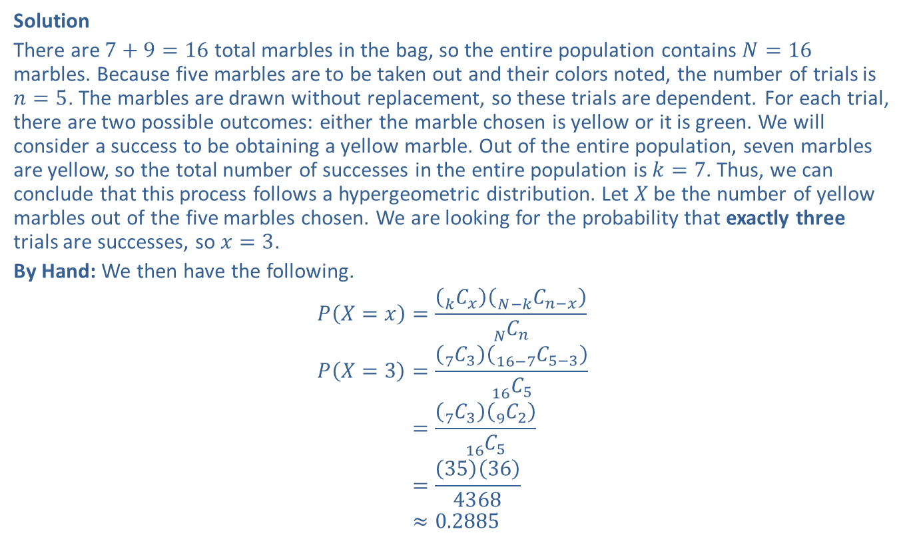

Example 5.4.3: Calculating a Hypergeometric Probability, $P⁡\left(X=x\right)$ (cont.)
Solution
There are $7+9=16$ total marbles in the bag, so the entire population contains $N=16$ marbles. Because five marbles are to be taken out and their colors noted, the number of trials is $n=5$. The marbles are drawn without replacement, so these trials are dependent. For each trial, there are two possible outcomes: either the marble chosen is yellow or it is green. We will consider a success to be obtaining a yellow marble. Out of the entire population, seven marbles are yellow, so the total number of successes in the entire population is $k=7$. Thus, we can conclude that this process follows a hypergeometric distribution. Let $X$ be the number of yellow marbles out of the five marbles chosen. We are looking for the probability that exactly three trials are successes, so $x=3$.
By Hand: We then have the following.
𝑃𝑋=𝑥=𝑘 𝐶𝑥𝑁−𝑘 𝐶𝑛−𝑥𝑁 𝐶𝑛𝑃𝑋=3=7 𝐶316−7 𝐶5−316 𝐶5𝑃⁡𝑋=3=7 𝐶39 𝐶216 𝐶5𝑃⁡𝑋=3=35364368𝑃⁡𝑋=3≈0.2885

Slide 15
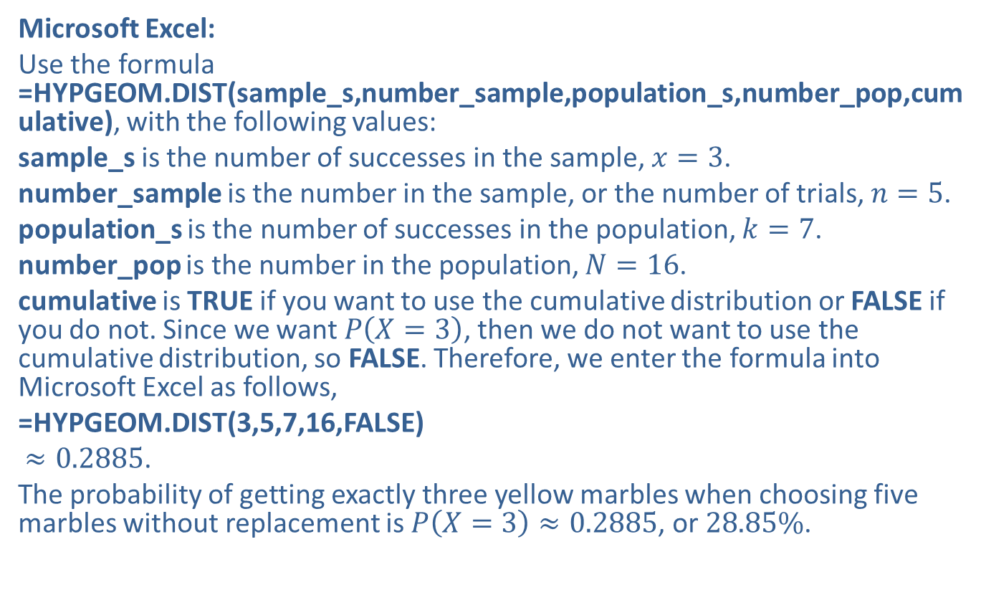
Example 5.4.3: Calculating a Hypergeometric Probability, $P⁡\left(X=x\right)$ (cont.)
Microsoft Excel:
Use the formula =HYPGEOM.DIST(sample_s,number_sample,population_s,number_pop,cumulative), with the following values:
sample_s is the number of successes in the sample, $x=3$.
number_sample is the number in the sample, or the number of trials, $n=5$.
population_s is the number of successes in the population, $k=7$.
number_pop is the number in the population, $N=16$.
cumulative is TRUE if you want to use the cumulative distribution or FALSE if you do not. Since we want $P⁡\left(X=3\right)$, then we do not want to use the cumulative distribution, so FALSE. Therefore, we enter the formula into Microsoft Excel as follows,
=HYPGEOM.DIST(3,5,7,16,FALSE)
$≈0.2885$.
The probability of getting exactly three yellow marbles when choosing five marbles without replacement is $P\left(X=3\right)≈0.2885$, or $28.85\%$.

Slide 16

Example 5.4.4: Calculating a Cumulative Hypergeometric Probability, $P⁡\left(X<x\right)$
A shipment of 25 light bulbs contains 3 defective bulbs. If 5 bulbs are selected randomly without replacement, what is the probability that fewer than 2 of the bulbs chosen are defective?

Slide 17
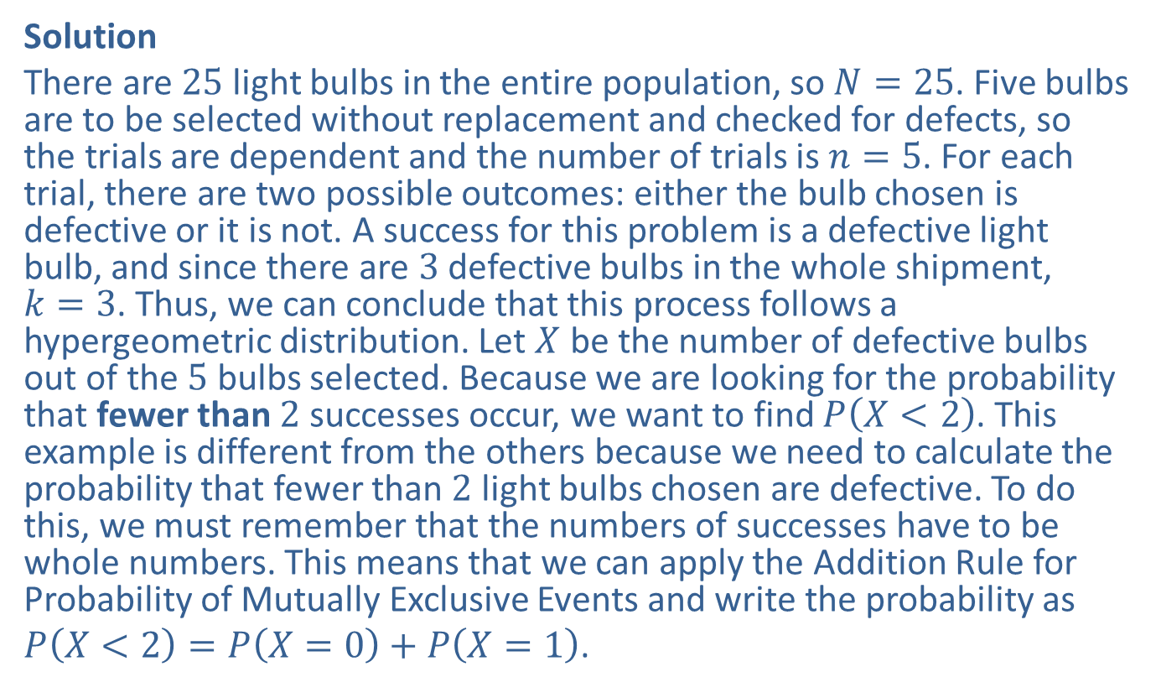

Example 5.4.4: Calculating a Cumulative Hypergeometric Probability, $P⁡\left(X<x\right)$ (cont.)
Solution
There are 25 light bulbs in the entire population, so $N=25$. Five bulbs are to be selected without replacement and checked for defects, so the trials are dependent and the number of trials is $n=5$. For each trial, there are two possible outcomes: either the bulb chosen is defective or it is not. A success for this problem is a defective light bulb, and since there are 3 defective bulbs in the whole shipment,
$k=3$. Thus, we can conclude that this process follows a hypergeometric distribution. Let $X$ be the number of defective bulbs out of the 5 bulbs selected. Because we are looking for the probability that fewer than 2 successes occur, we want to find $P⁡\left(X<2\right)$. This example is different from the others because we need to calculate the probability that fewer than 2 light bulbs chosen are defective. To do this, we must remember that the numbers of successes have to be whole numbers. This means that we can apply the Addition Rule for Probability of Mutually Exclusive Events and write the probability as
$P\left(X<2\right)=P\left(X=0\right)+P\left(X=1\right)$.

Slide 18
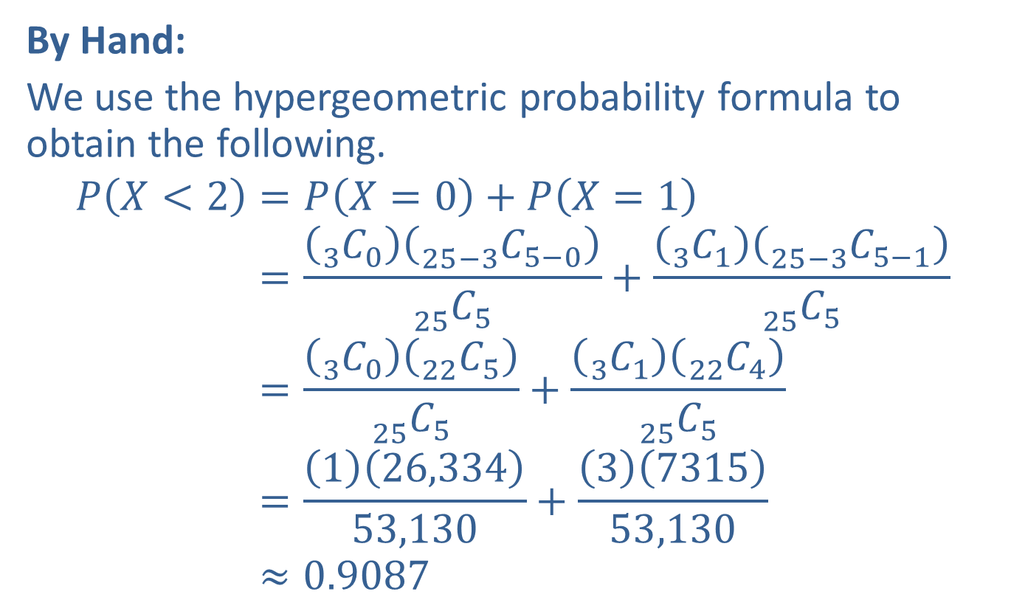
Example 5.4.4: Calculating a Cumulative Hypergeometric Probability, $P⁡\left(X<x\right)$ (cont.)
By Hand:
We use the hypergeometric probability formula to obtain the following.
𝑃𝑋<2=𝑃𝑋=0+𝑃𝑋=1𝑃⁡𝑋<2=3 𝐶025−3 𝐶5−025 𝐶5+3 𝐶125−3 𝐶5−125 𝐶5𝑃⁡𝑋<2=3 𝐶022 𝐶525 𝐶5+3 𝐶122 𝐶425 𝐶5𝑃⁡𝑋<2=126,33453,130+3731553,130𝑃⁡𝑋<2≈0.9087

Slide 19
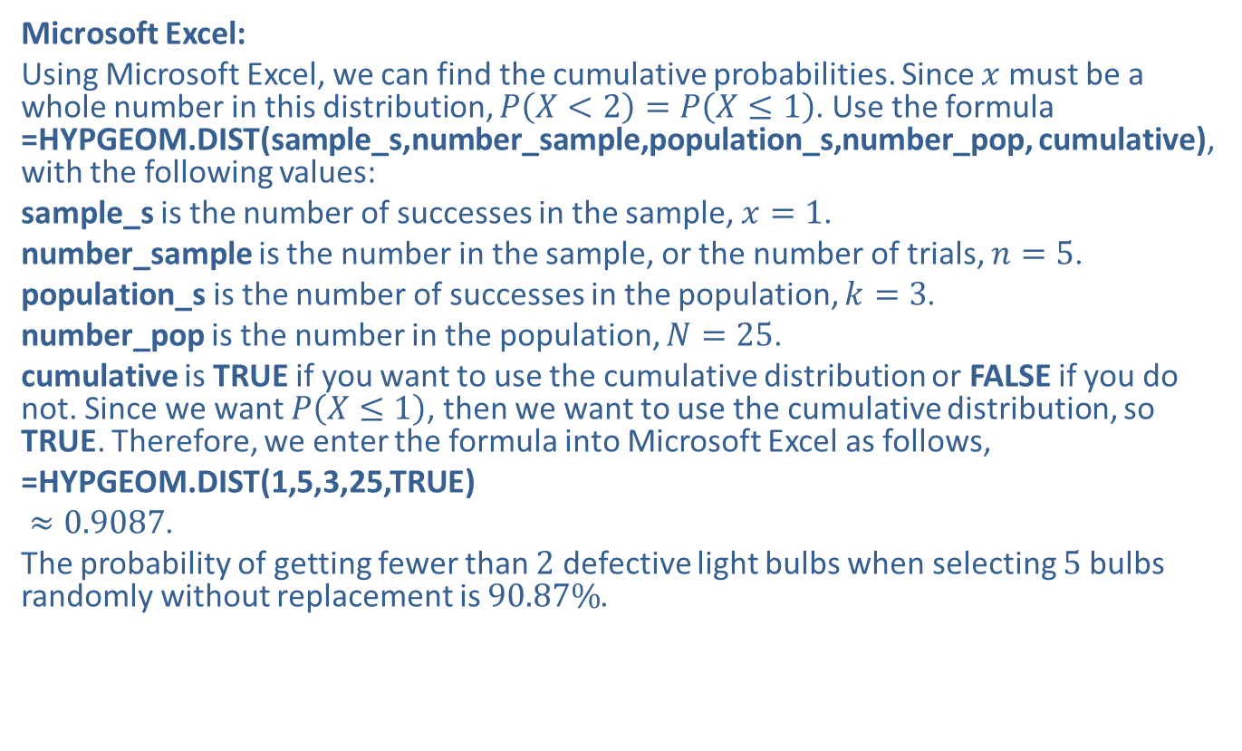
Example 5.4.4: Calculating a Cumulative Hypergeometric Probability, $P⁡\left(X<x\right)$ (cont.)
Microsoft Excel:
Using Microsoft Excel, we can find the cumulative probabilities. Since $x$ must be a whole number in this distribution, $P\left(X<2\right)=P\left(X≤1\right)$. Use the formula =HYPGEOM.DIST(sample_s,number_sample,population_s,number_pop, cumulative), with the following values:
sample_s is the number of successes in the sample, $x=1$.
number_sample is the number in the sample, or the number of trials, $n=5$.
population_s is the number of successes in the population, $k=3$.
number_pop is the number in the population, $N=25$.
cumulative is TRUE if you want to use the cumulative distribution or FALSE if you do not. Since we want $P⁡\left(X≤1\right)$, then we want to use the cumulative distribution, so TRUE. Therefore, we enter the formula into Microsoft Excel as follows,
=HYPGEOM.DIST(1,5,3,25,TRUE)
$≈0.9087$.
The probability of getting fewer than 2 defective light bulbs when selecting 5 bulbs randomly without replacement is $90.87\%$.

Slide 20

Example 5.4.5: Calculating Hypergeometric Probabilities, $P⁡\left(X≥x\right)$
A produce distributor is carrying nine boxes of Granny Smith apples and eight boxes of Golden Delicious apples. If four boxes are randomly delivered to a local market, what is the probability that at least three of the boxes delivered contain Golden Delicious apples?

Slide 21
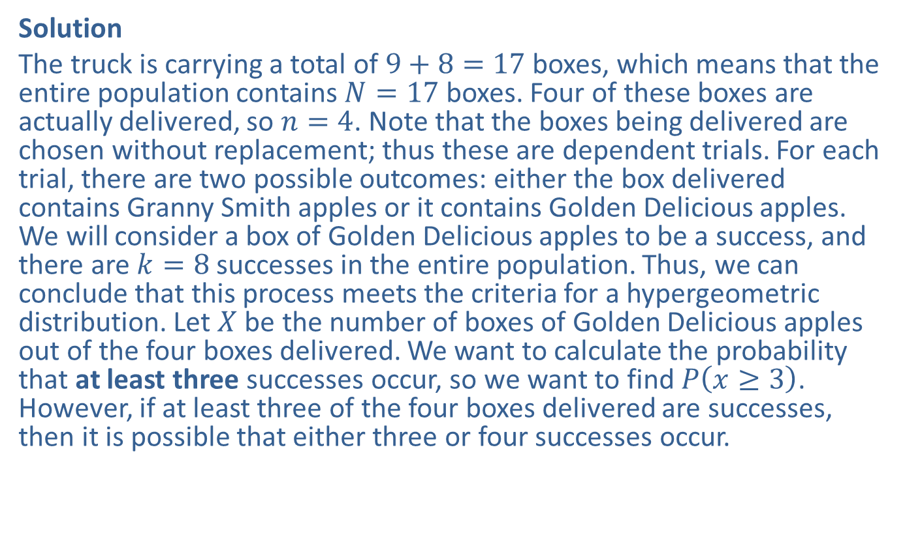

Example 5.4.5: Calculating Hypergeometric Probabilities, $P⁡\left(X≥x\right)$ (cont.)
Solution
The truck is carrying a total of $9+8=17$ boxes, which means that the entire population contains $N=17$ boxes. Four of these boxes are actually delivered, so $n=4$. Note that the boxes being delivered are chosen without replacement; thus these are dependent trials. For each trial, there are two possible outcomes: either the box delivered contains Granny Smith apples or it contains Golden Delicious apples. We will consider a box of Golden Delicious apples to be a success, and there are $k=8$ successes in the entire population. Thus, we can conclude that this process meets the criteria for a hypergeometric distribution. Let $X$ be the number of boxes of Golden Delicious apples out of the four boxes delivered. We want to calculate the probability that at least three successes occur, so we want to find $P⁡\left(x≥3\right)$. However, if at least three of the four boxes delivered are successes, then it is possible that either three or four successes occur.

Slide 22
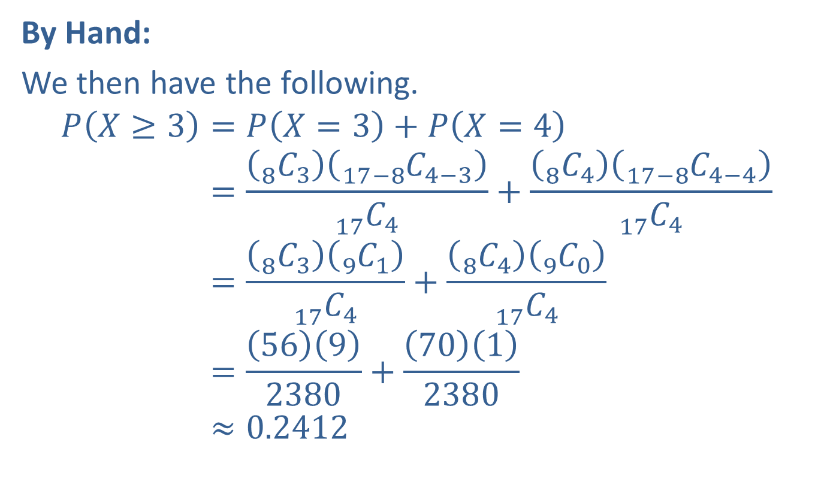
Example 5.4.5: Calculating Hypergeometric Probabilities, $P⁡\left(X≥x\right)$ (cont.)
By Hand:
We then have the following.
𝑃𝑋≥3=𝑃𝑋=3+𝑃𝑋=4𝑃⁡𝑋≥3=8 𝐶317−8 𝐶4−317 𝐶4+8 𝐶417−8 𝐶4−417 𝐶4𝑃⁡𝑋≥3=8 𝐶39 𝐶117 𝐶4+8 𝐶49 𝐶017 𝐶4𝑃⁡𝑋≥3=5692380+7012380𝑃⁡𝑋≥3≈0.2412

Slide 23
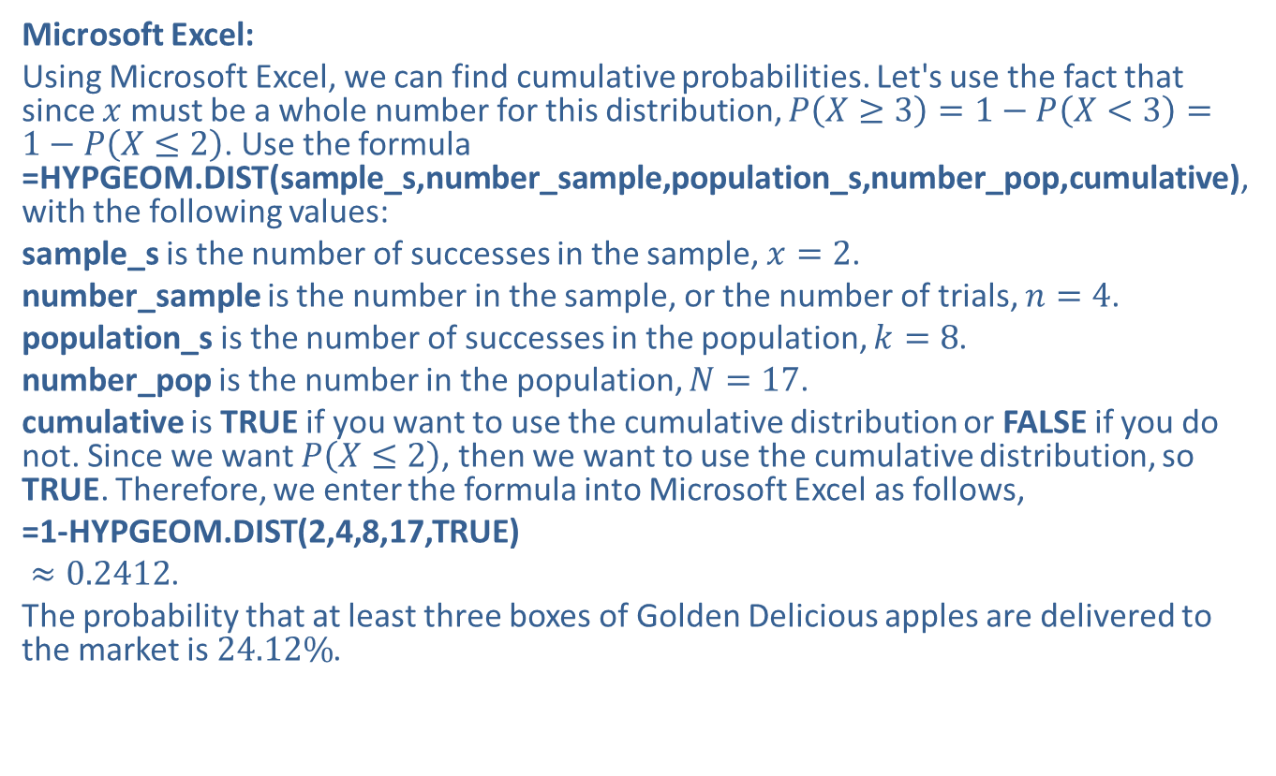
Example 5.4.5: Calculating Hypergeometric Probabilities, $P⁡\left(X≥x\right)$ (cont.)
Microsoft Excel:
Using Microsoft Excel, we can find cumulative probabilities. Let's use the fact that since $x$ must be a whole number for this distribution, $P\left(X≥3\right)=1−P\left(X<3\right)=1−P\left(X≤2\right)$. Use the formula =HYPGEOM.DIST(sample_s,number_sample,population_s,number_pop,cumulative), with the following values:
sample_s is the number of successes in the sample, $x=2$.
number_sample is the number in the sample, or the number of trials, $n=4$.
population_s is the number of successes in the population, $k=8$.
number_pop is the number in the population, $N=17$.
cumulative is TRUE if you want to use the cumulative distribution or FALSE if you do not. Since we want $P⁡\left(X≤2\right)$, then we want to use the cumulative distribution, so TRUE. Therefore, we enter the formula into Microsoft Excel as follows,
=1-HYPGEOM.DIST(2,4,8,17,TRUE)
$≈0.2412$.
The probability that at least three boxes of Golden Delicious apples are delivered to the market is $24.12\%$.

Slide 24
Example 5.4.6: Determining Which Discrete Probability Distribution to Use
For each scenario, determine the discrete probability distribution that should be used.
​Based on data from an online search provider, a new company believes that its website is viewed 1500 times a week. What is the probability that in the next four weeks, the company's website will be viewed more than 5000 times?

Slide 25
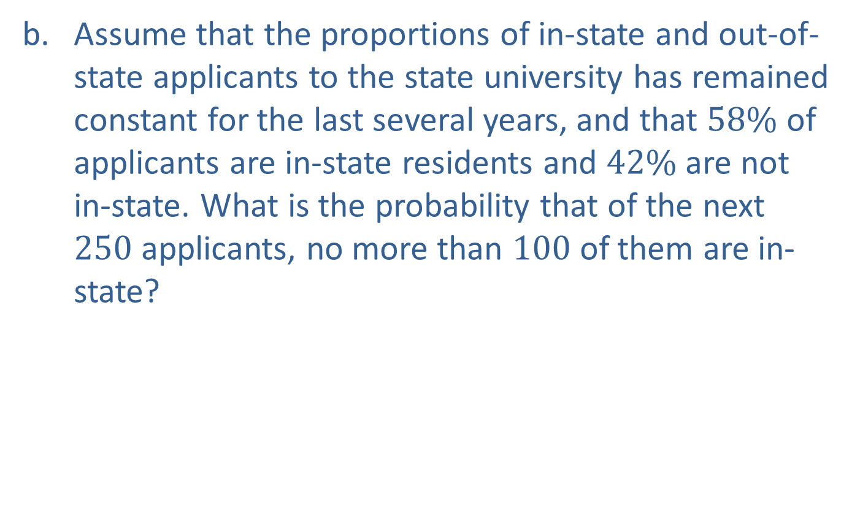
Example 5.4.6: Determining Which Discrete Probability Distribution to Use (cont.)
​Assume that the proportions of in-state and out-of-state applicants to the state university has remained constant for the last several years, and that $58\%$ of applicants are in-state residents and $42\%$ are not in-state. What is the probability that of the next 250 applicants, no more than 100 of them are in-state?

Slide 26
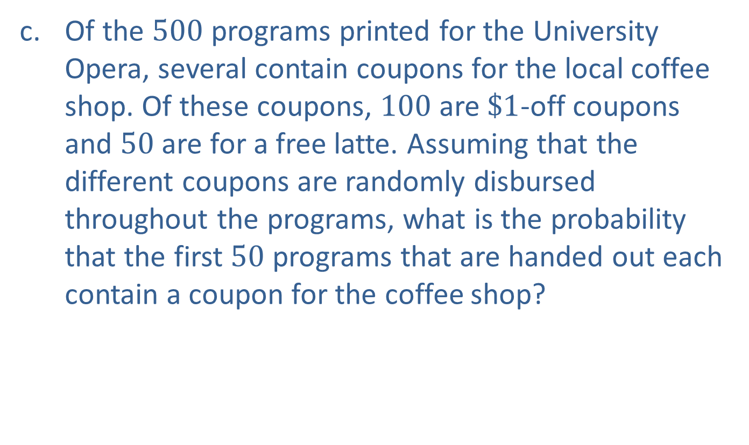
Example 5.4.6: Determining Which Discrete Probability Distribution to Use (cont.)
​Of the 500 programs printed for the University Opera, several contain coupons for the local coffee shop. Of these coupons, 100 are $\$1$-off coupons and 50 are for a free latte. Assuming that the different coupons are randomly disbursed throughout the programs, what is the probability that the first 50 programs that are handed out each contain a coupon for the coffee shop?

Slide 27
Example 5.4.6: Determining Which Discrete Probability Distribution to Use (cont.)
Solution
​In this scenario, there is not a fixed number of trials. We are counting the number of times the website is viewed in a given period of time. In a fixed number of trials, a precise number of people would report either looking at the website or not looking at the website. Furthermore, the fact that one person chooses to access the website does not affect the probability of another person accessing the website. Therefore, this is a scenario with an unknown number of independent trials where successes occur in a given interval. A Poisson distribution should be used.

Slide 28
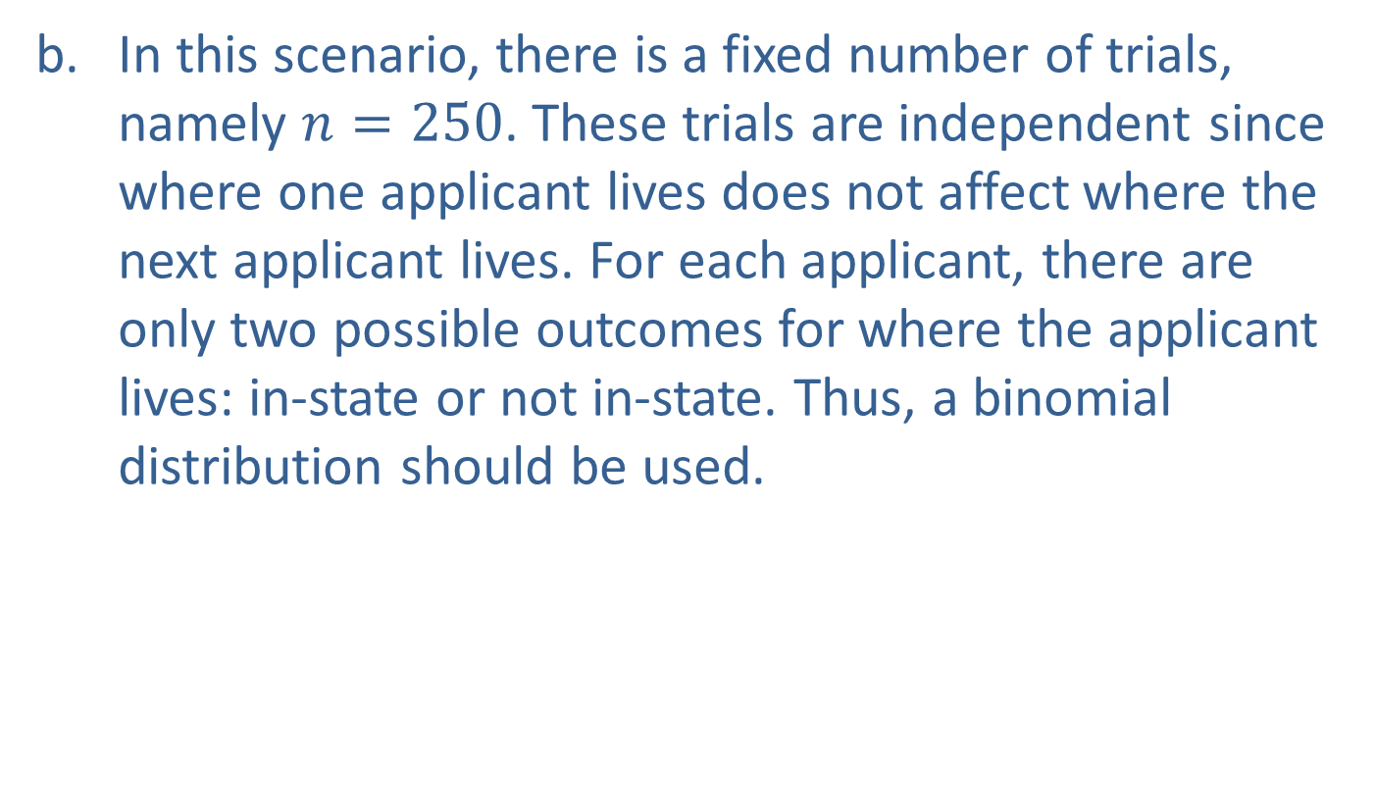
Example 5.4.6: Determining Which Discrete Probability Distribution to Use (cont.)
​In this scenario, there is a fixed number of trials, namely $n=250$. These trials are independent since where one applicant lives does not affect where the next applicant lives. For each applicant, there are only two possible outcomes for where the applicant lives: in-state or not in-state. Thus, a binomial distribution should be used.

Slide 29
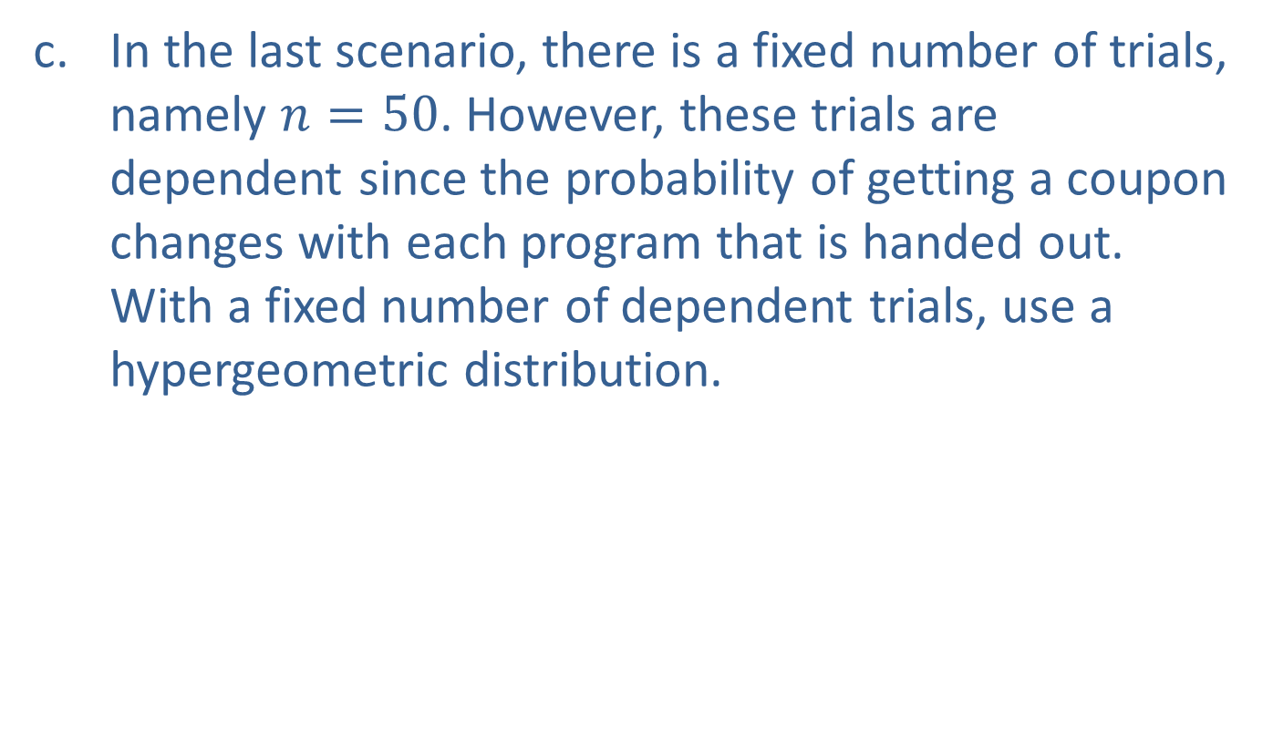
Example 5.4.6: Determining Which Discrete Probability Distribution to Use (cont.)
​In the last scenario, there is a fixed number of trials, namely $n=50$. However, these trials are dependent since the probability of getting a coupon changes with each program that is handed out. With a fixed number of dependent trials, use a hypergeometric distribution.

