Slide 1
Section 6.1
Introduction to the Normal Distribution

Slide 2
Continuous Random Variable
Definition
A continuous random variable is a continuous variable whose numeric value is determined by the outcome of a probability experiment.

Slide 3
Side Note
The exponential function for the normal distribution, also sometimes referred to as the Gaussian normal distribution, was first developed by German mathematician Carl Friedrich Gauss (1777–1855). He is generally regarded as one of the greatest mathematicians of all time and is sometimes called "the prince of mathematics." As a child he often surprised both his parents and his teachers with the complicated arithmetic he could do in his head.

Slide 4
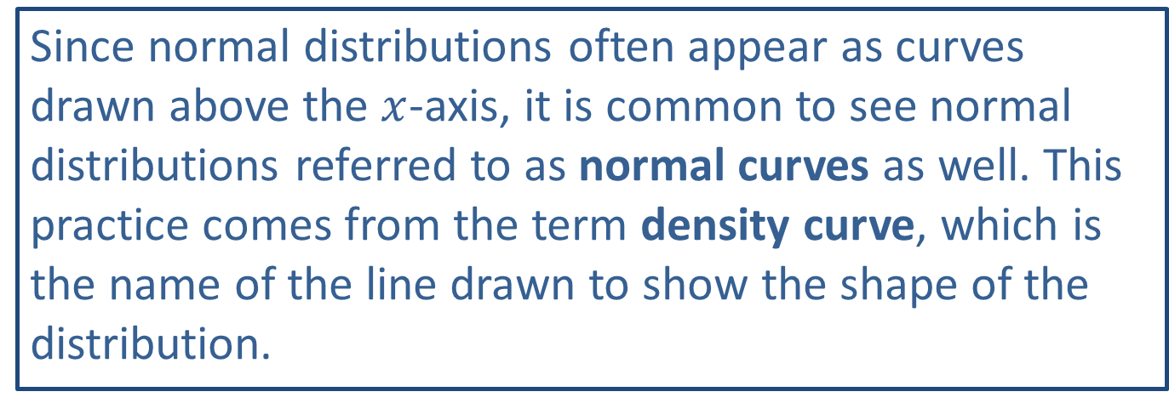
Side Note
Since normal distributions often appear as curves drawn above the $x$-axis, it is common to see normal distributions referred to as normal curves as well. This practice comes from the term density curve, which is the name of the line drawn to show the shape of the distribution.

Slide 5
Memory Booster:
For any probability distribution, the sum of the probabilities is 1.

Slide 6
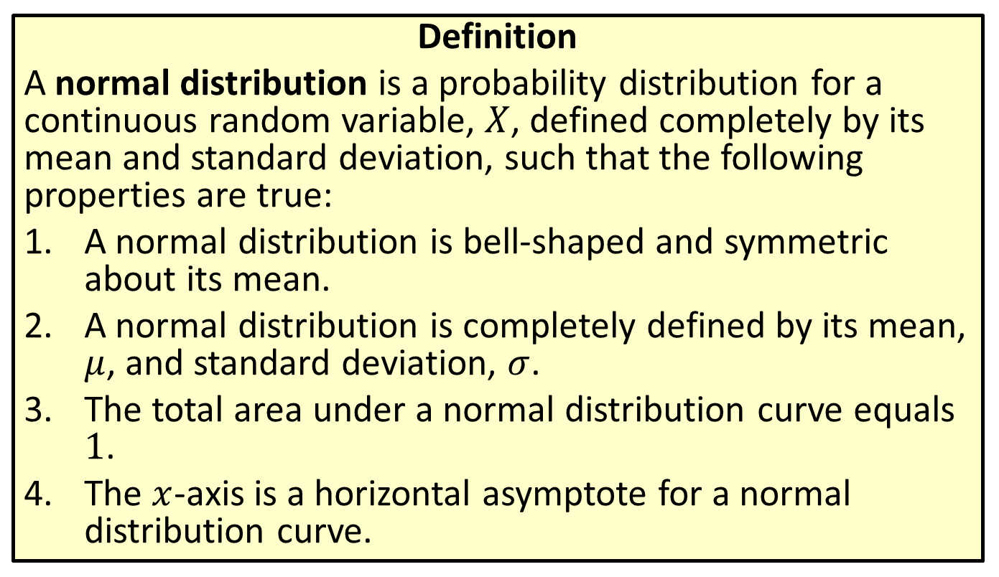
Distribution
Definition
A normal distribution is a probability distribution for a continuous random variable, $X$, defined completely by its mean and standard deviation, such that the following properties are true:
​A normal distribution is bell-shaped and symmetric about its mean.
​A normal distribution is completely defined by its mean, $μ$, and standard deviation, $σ$.
​The total area under a normal distribution curve equals 1.
​The $x$-axis is a horizontal asymptote for a normal distribution curve.

Slide 7
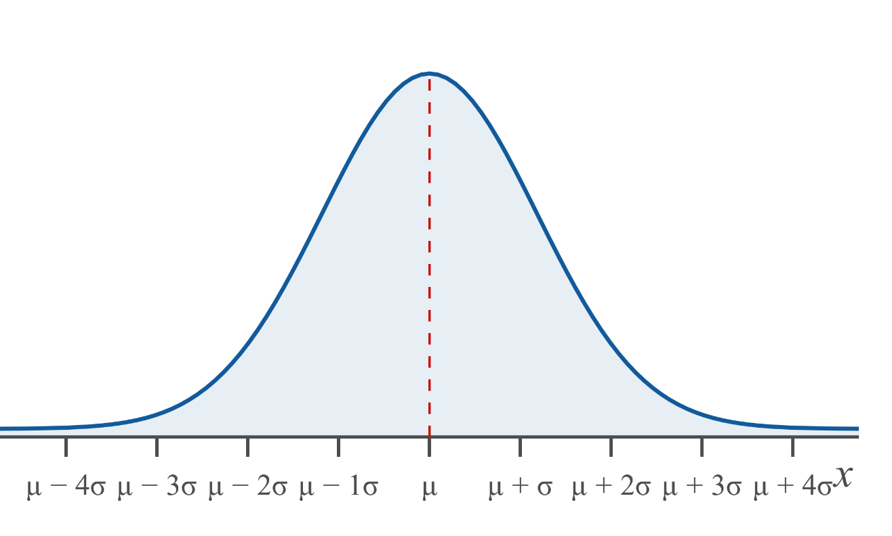
Distribution (cont.)

Slide 8
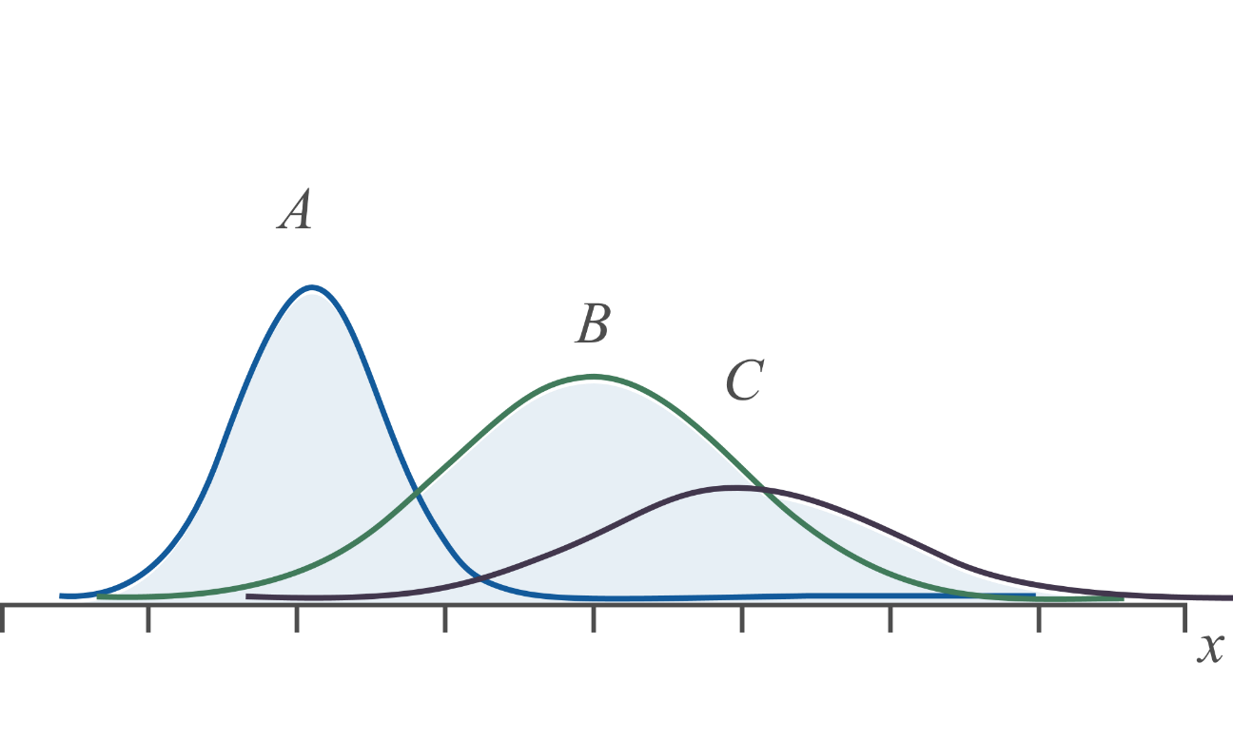
Example 6.1.1: Identifying Properties of Normal Curves
Use the following graphs of three normal distributions to answer the following questions

Slide 9
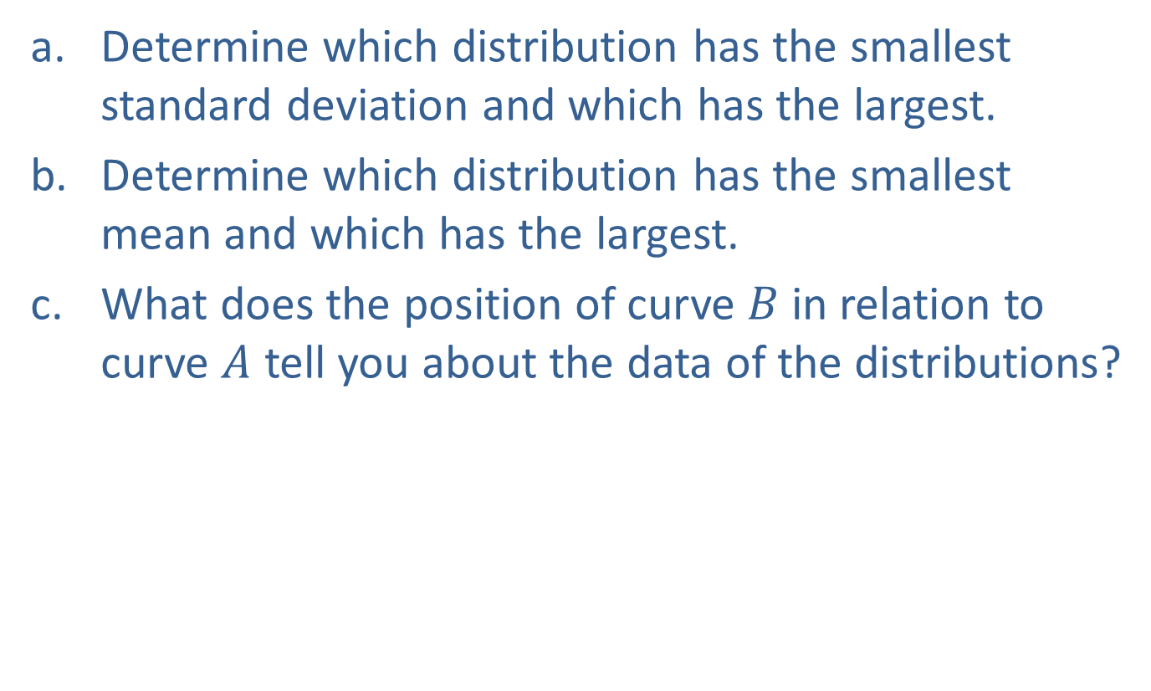
Example 6.1.1: Identifying Properties of Normal Curves (cont.)
​Determine which distribution has the smallest standard deviation and which has the largest.
​Determine which distribution has the smallest mean and which has the largest.
​What does the position of curve $B$ in relation to curve $A$ tell you about the data of the distributions?

Slide 10
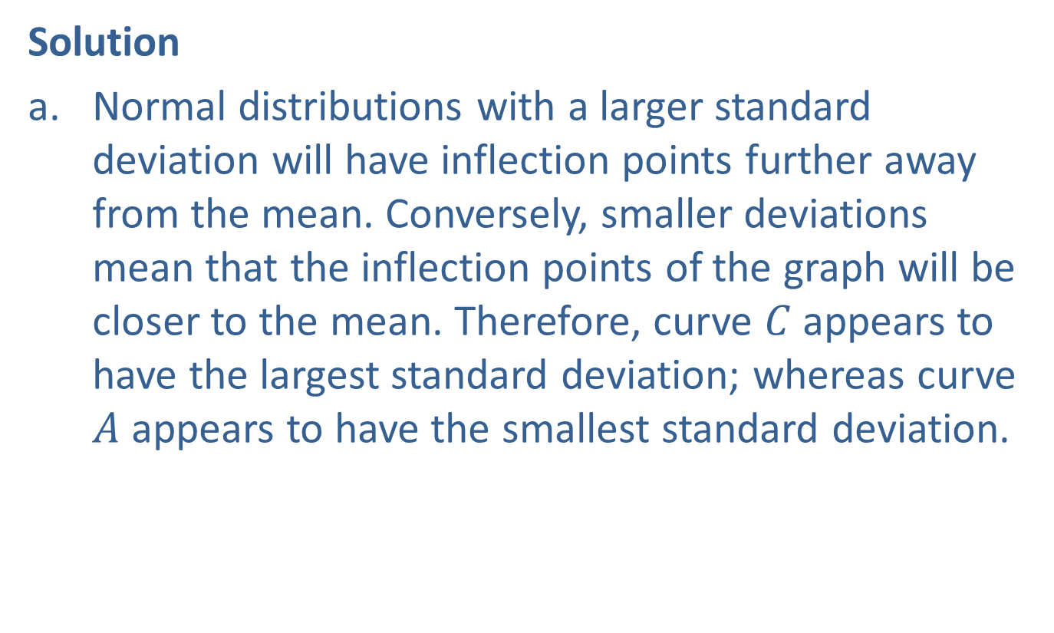
Example 6.1.1: Identifying Properties of Normal Curves (cont.)
Solution
​Normal distributions with a larger standard deviation will have inflection points further away from the mean. Conversely, smaller deviations mean that the inflection points of the graph will be closer to the mean. Therefore, curve $C$ appears to have the largest standard deviation; whereas curve $A$ appears to have the smallest standard deviation.

Slide 11
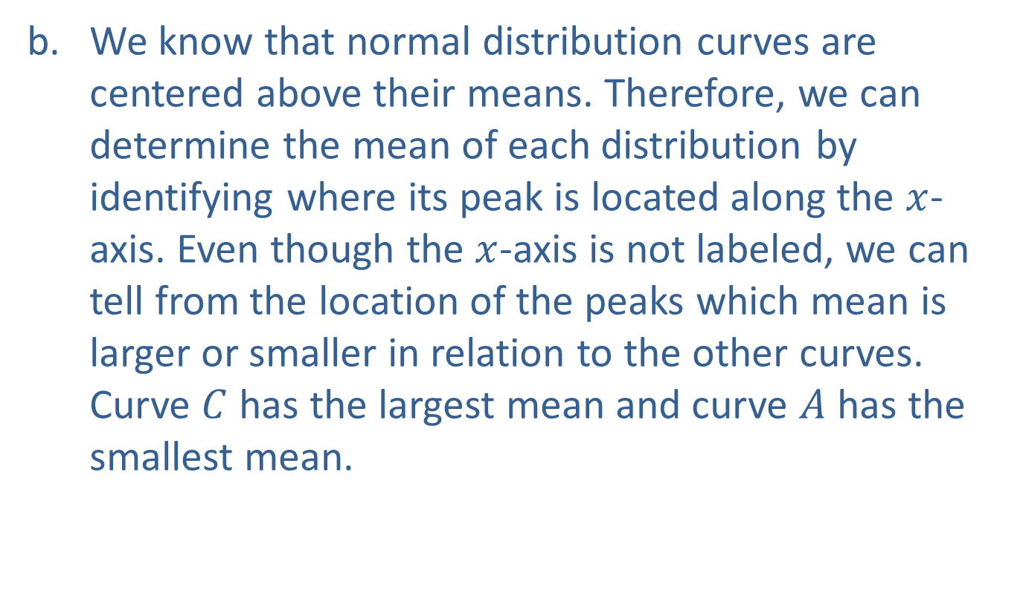
Example 6.1.1: Identifying Properties of Normal Curves (cont.)
​We know that normal distribution curves are centered above their means. Therefore, we can determine the mean of each distribution by identifying where its peak is located along the $x$-axis. Even though the $x$-axis is not labeled, we can tell from the location of the peaks which mean is larger or smaller in relation to the other curves. Curve $C$ has the largest mean and curve $A$ has the smallest mean.

Slide 12

Example 6.1.1: Identifying Properties of Normal Curves (cont.)
​Because most of curve $B$ is to the right of curve $A$ along the $x$-axis, curve $B$ appears to have larger data values than that of curve $A$.

Slide 13
Example 6.1.2: Determining if a Distribution is Normal
Determine if the following distributions could be classified as normal distributions based on the information given.
​Ratings for customer service taken from an online survey based on a scale from 1 – 10.
​Finishing times (in minutes) for runners in the Labor Day 5K race.

Slide 14
Example 6.1.2: Determining if a Distribution is Normal (cont.)
Solution
​Ratings on a scale of 1 to 10 are classified as discrete data, and therefore cannot be considered a normal distribution.
​To begin with, time meets the requirement that normal distributions consist of continuous data. Secondly, times of runners in a 5K are likely to have some times that are considered very fast and some that are considered very slow. However, most of the runners will likely come in somewhere near the middle of the pack. So, the shape of the distribution is likely to be bell-shaped about the mean. Based on this, this distribution might be classified as a normal distribution.

Slide 15
Memory Booster:
For any probability distribution, all of the probabilities lie between 0 and 1, inclusive.

