Slide 1
Section 6.3
Finding Probability Using a Normal Distribution

Slide 2
Example 6.3.1: Finding the Probability that a Normally Distributed Random Variable Will Be Less Than a Given Value
Dairy Delight Farms has been milking cows for many generations. They have calculated that on average, the milk production per dairy cow over a month’s time is 1931 lbs with a standard deviation of 67.1 lbs. The manager has noticed that the milk production from their cows seems to have been slowly decreasing in the past couple of years. However, their sales remain steady. Determine the probability that a random cow chosen from the farm produces less than 1831 pounds of milk per month. Assume that the milk production from the cows is normally distributed.

Slide 3
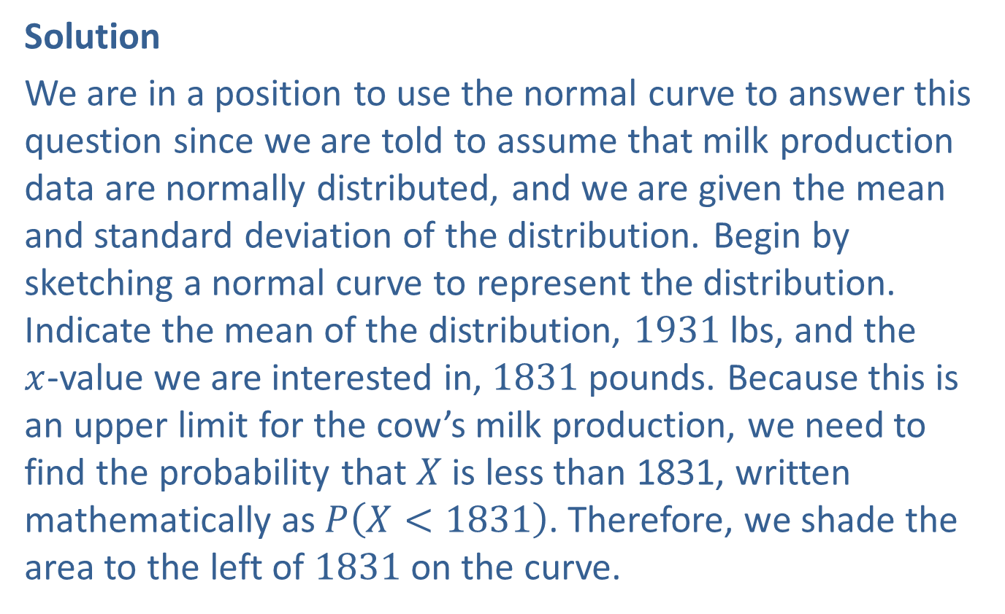
Example 6.3.1: Finding the Probability that a Normally Distributed Random Variable Will Be Less Than a Given Value (cont.)
Solution
We are in a position to use the normal curve to answer this question since we are told to assume that milk production data are normally distributed, and we are given the mean and standard deviation of the distribution. Begin by sketching a normal curve to represent the distribution. Indicate the mean of the distribution, 1931 lbs, and the
$x$-value we are interested in, 1831 pounds. Because this is an upper limit for the cow’s milk production, we need to find the probability that $X$ is less than 1831, written mathematically as $P⁡\left(X<1831\right)$. Therefore, we shade the area to the left of 1831 on the curve.

Slide 4
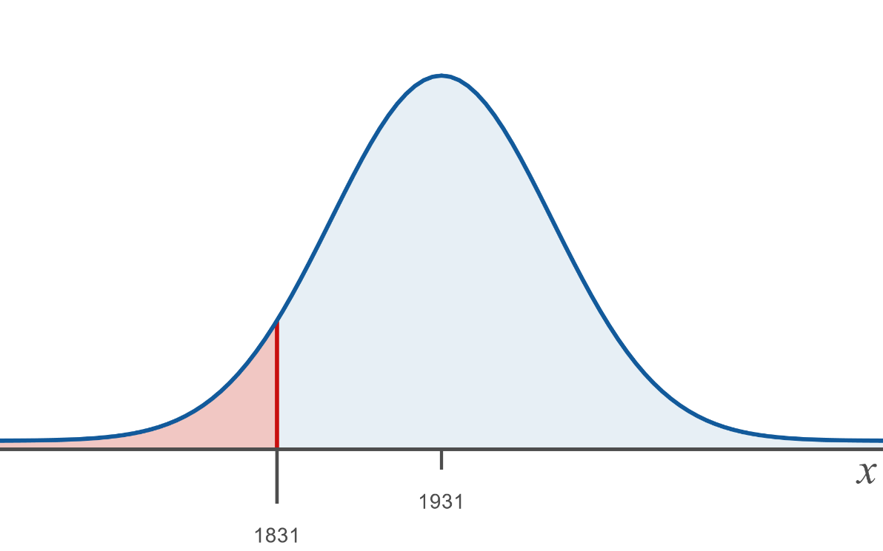
Example 6.3.1: Finding the Probability that a Normally Distributed Random Variable Will Be Less Than a Given Value (cont.)
Notice that the area shaded is less than half of the area under the curve, so we can expect the value we find to be smaller than 0.5. Now use either tables or available technology to find the value of the shaded area.

Slide 5
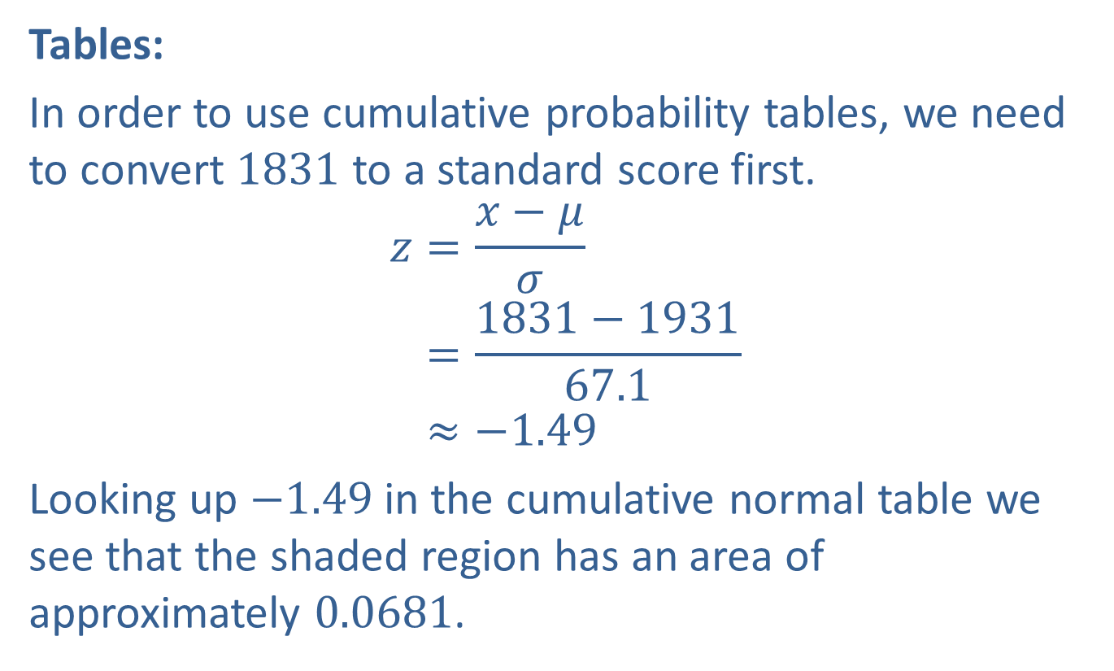
Example 6.3.1: Finding the Probability that a Normally Distributed Random Variable Will Be Less Than a Given Value (cont.)
Tables:
In order to use cumulative probability tables, we need to convert 1831 to a standard score first.
𝑧=𝑥−𝜇𝜎𝑧=1831−193167.1𝑧≈−1.49
Looking up $−1.49$ in the cumulative normal table we see that the shaded region has an area of approximately 0.0681.

Slide 6
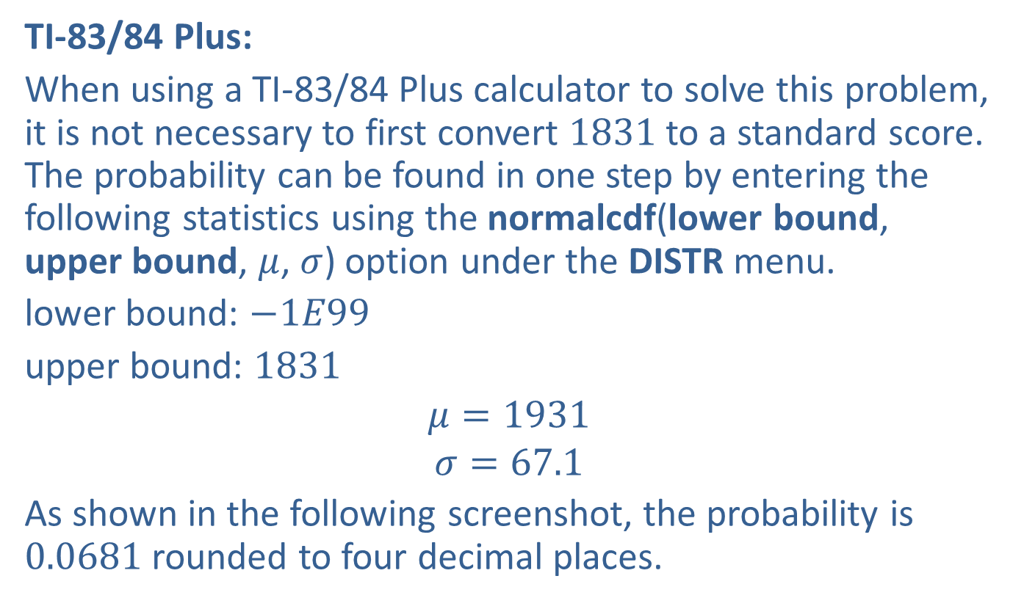
Example 6.3.1: Finding the Probability that a Normally Distributed Random Variable Will Be Less Than a Given Value (cont.)
TI-83/84 Plus:
When using a TI-83/84 Plus calculator to solve this problem, it is not necessary to first convert 1831 to a standard score. The probability can be found in one step by entering the following statistics using the normalcdf(lower bound, upper bound, $μ$, $σ$) option under the DISTR menu.
lower bound: $−1E99$
upper bound: 1831
$$μ=1931$$
$$σ=67.1$$
As shown in the following screenshot, the probability is 0.0681 rounded to four decimal places.

Slide 7
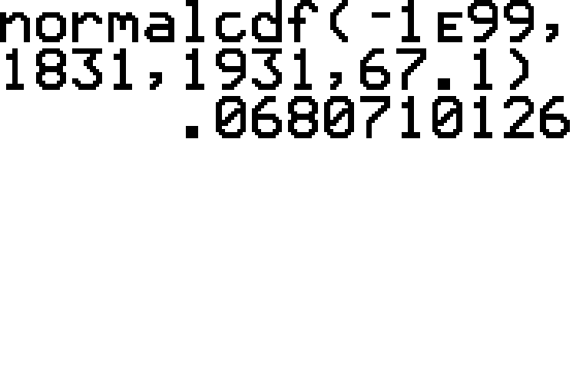
Example 6.3.1: Finding the Probability that a Normally Distributed Random Variable Will Be Less Than a Given Value (cont.)

Slide 8
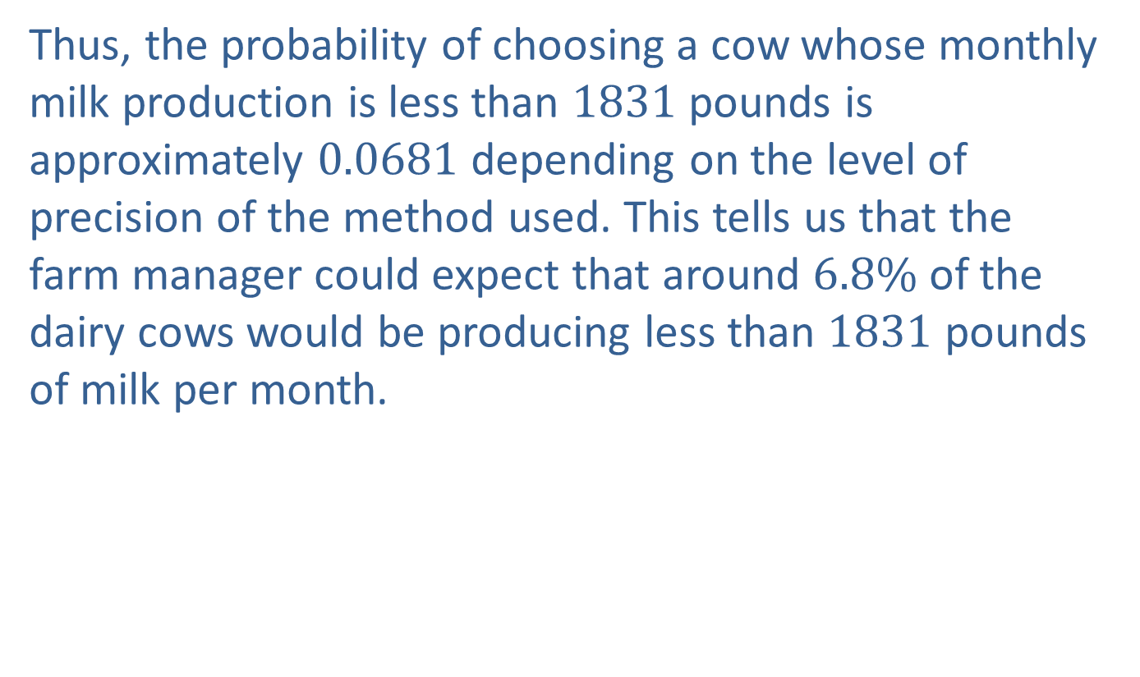
Example 6.3.1: Finding the Probability that a Normally Distributed Random Variable Will Be Less Than a Given Value (cont.)
Thus, the probability of choosing a cow whose monthly milk production is less than 1831 pounds is approximately 0.0681 depending on the level of precision of the method used. This tells us that the farm manager could expect that around $6.8\%$ of the dairy cows would be producing less than 1831 pounds of milk per month.

Slide 9
Technology
For further instructions on finding normal probabilities using a TI-83/84 Plus calculator or other technology, please visit stat.hawkeslearning.com and see Technology Instructions > Normal Distribution > Normal Probability (cdf).

Slide 10
Example 6.3.2: Finding the Probability that a Normal Distributed Random Variable Will Be Greater Than a Given Value
Disney World is a dream for lots of children around the world. Full days of talking with live characters from the movies, wearing funny hats with ears, and riding rides of all types will wear out even the heartiest of souls at the end of the day. However, not everyone gets to ride every attraction. There are height restrictions on some of the rides. For instance, guests must be at least 40 inches tall to ride Splash Mountain. If heights for 6 year-olds are normally distributed with a mean of 3 ft 9 inches and a standard deviation of 2 inches, what percentage of 6-year-olds are allowed to ride Splash Mountain?

Slide 11
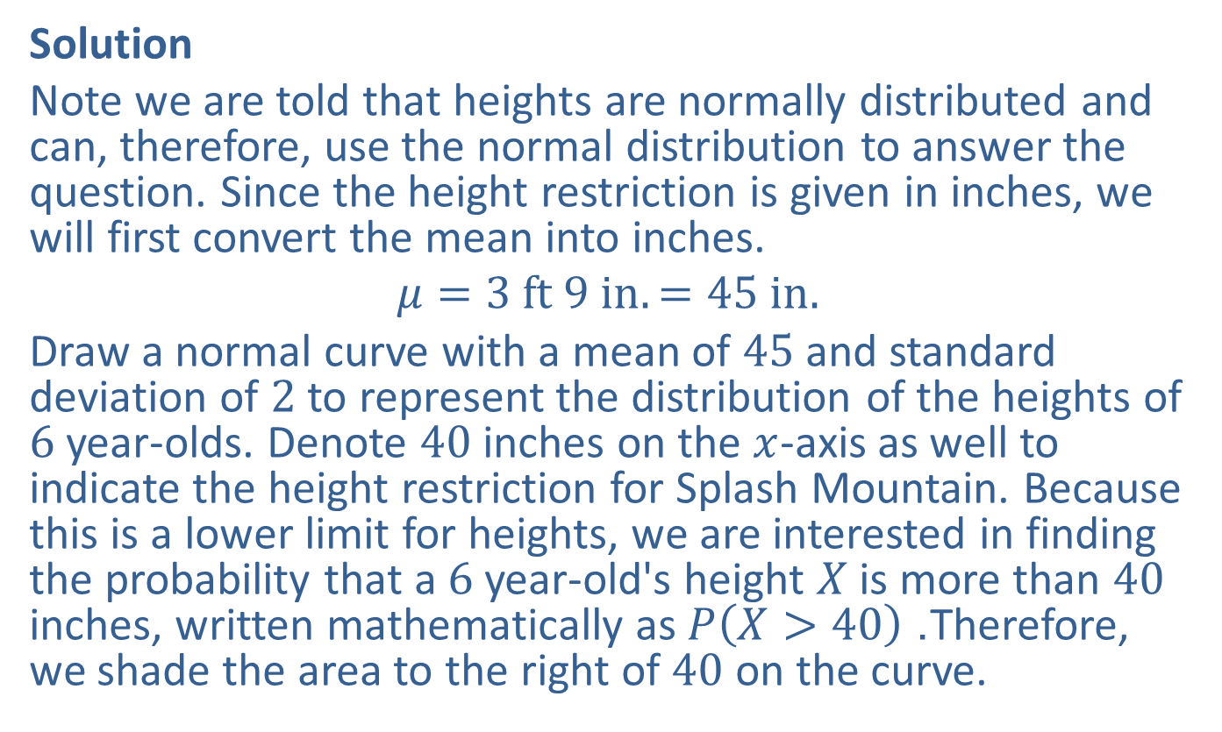
Example 6.3.2: Finding the Probability that a Normal Distributed Random Variable Will Be Greater Than a Given Value (cont.)
Solution
Note we are told that heights are normally distributed and can, therefore, use the normal distribution to answer the question. Since the height restriction is given in inches, we will first convert the mean into inches.
$$μ=3 ft 9 in.=45 in.$$
Draw a normal curve with a mean of 45 and standard deviation of 2 to represent the distribution of the heights of 6 year-olds. Denote 40 inches on the $x$-axis as well to indicate the height restriction for Splash Mountain. Because this is a lower limit for heights, we are interested in finding the probability that a 6 year-old's height $X$ is more than 40 inches, written mathematically as $P⁡\left(X>40\right)$. Therefore, we shade the area to the right of 40 on the curve.

Slide 12
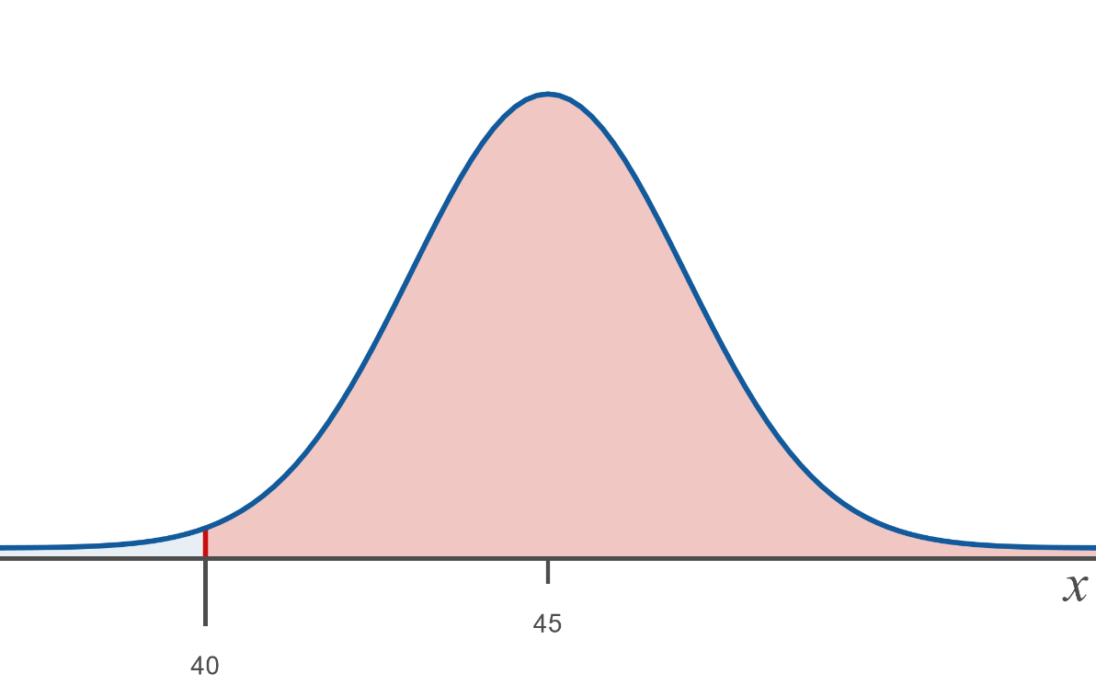
Example 6.3.2: Finding the Probability that a Normal Distributed Random Variable Will Be Greater Than a Given Value (cont.)
Notice that the area shaded is more than half of the area under the curve, so we can expect the value we find to be larger than 0.5. Now, using either tables or available technology find the value of the shaded area.

Slide 13
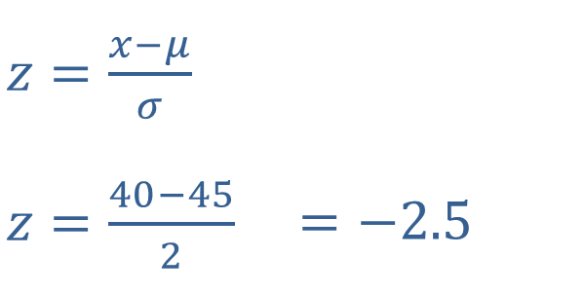
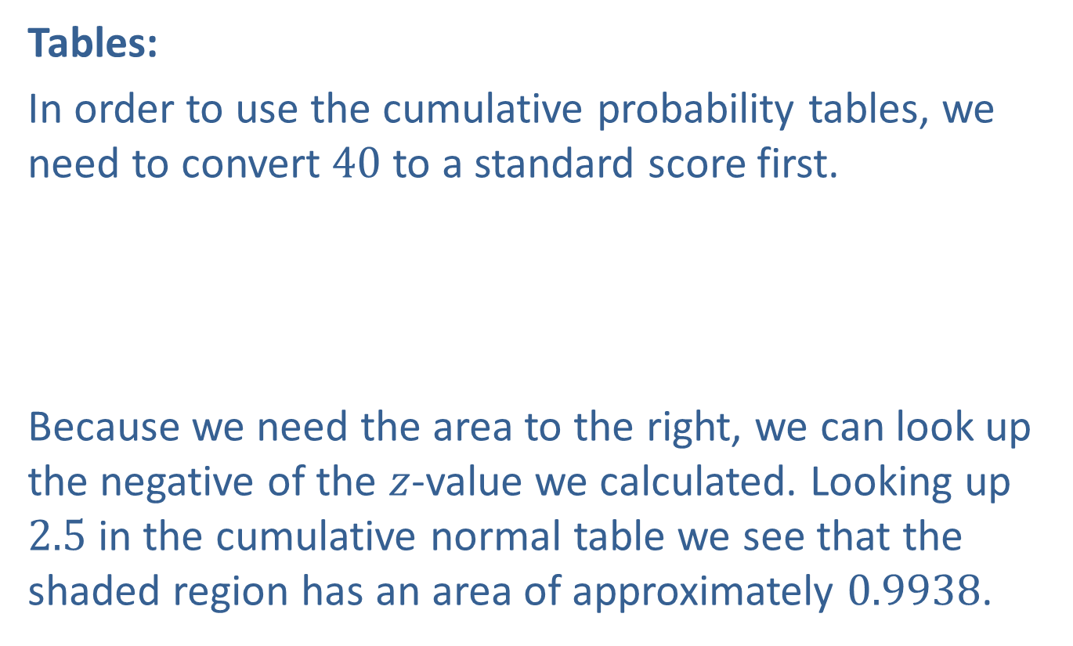
Example 6.3.2: Finding the Probability that a Normal Distributed Random Variable Will Be Greater Than a Given Value (cont.)
Tables:
In order to use the cumulative probability tables, we need to convert 40 to a standard score first.
​
Because we need the area to the right, we can look up the negative of the $z$-value we calculated. Looking up 2.5 in the cumulative normal table we see that the shaded region has an area of approximately 0.9938.
​$z=\frac{x−μ}{σ}$ | ​
​$z=\frac{40−45}{2}$ | ​$=−2.5$

Slide 14
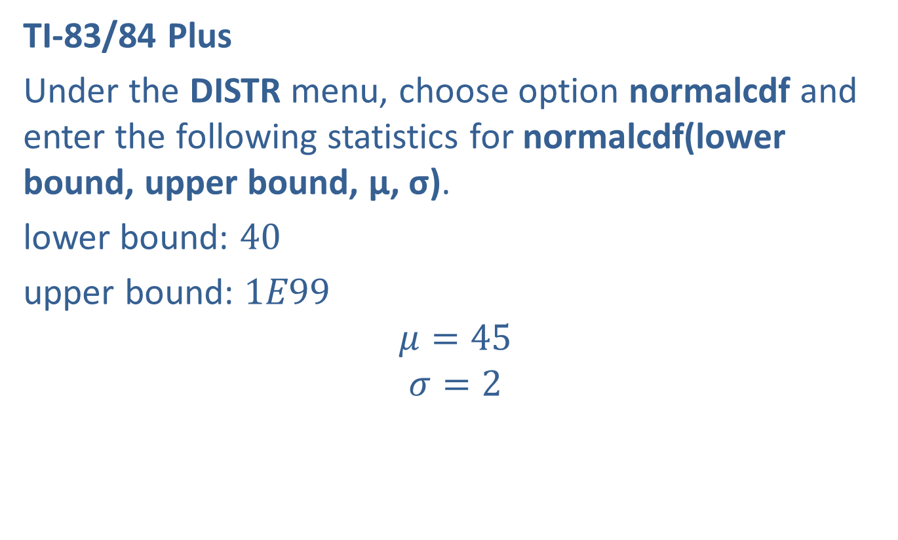
Example 6.3.2: Finding the Probability that a Normal Distributed Random Variable Will Be Greater Than a Given Value (cont.)
TI-83/84 Plus
Under the DISTR menu, choose option normalcdf and enter the following statistics for normalcdf(lower bound, upper bound, μ, σ).
lower bound: 40
upper bound: $1E99$
$$μ=45$$
$$σ=2$$

Slide 15
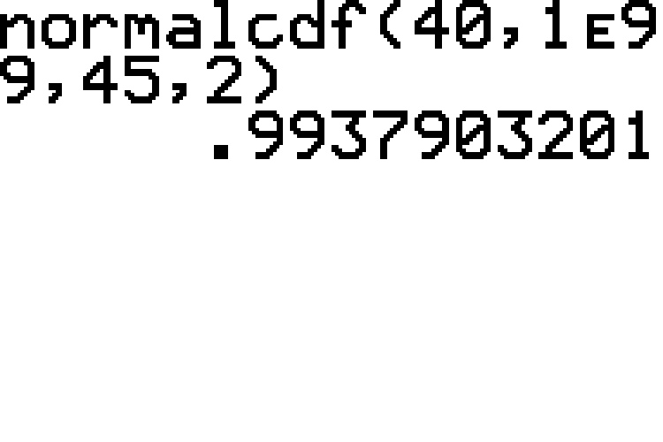
Example 6.3.2: Finding the Probability that a Normal Distributed Random Variable Will Be Greater Than a Given Value (cont.)

Slide 16
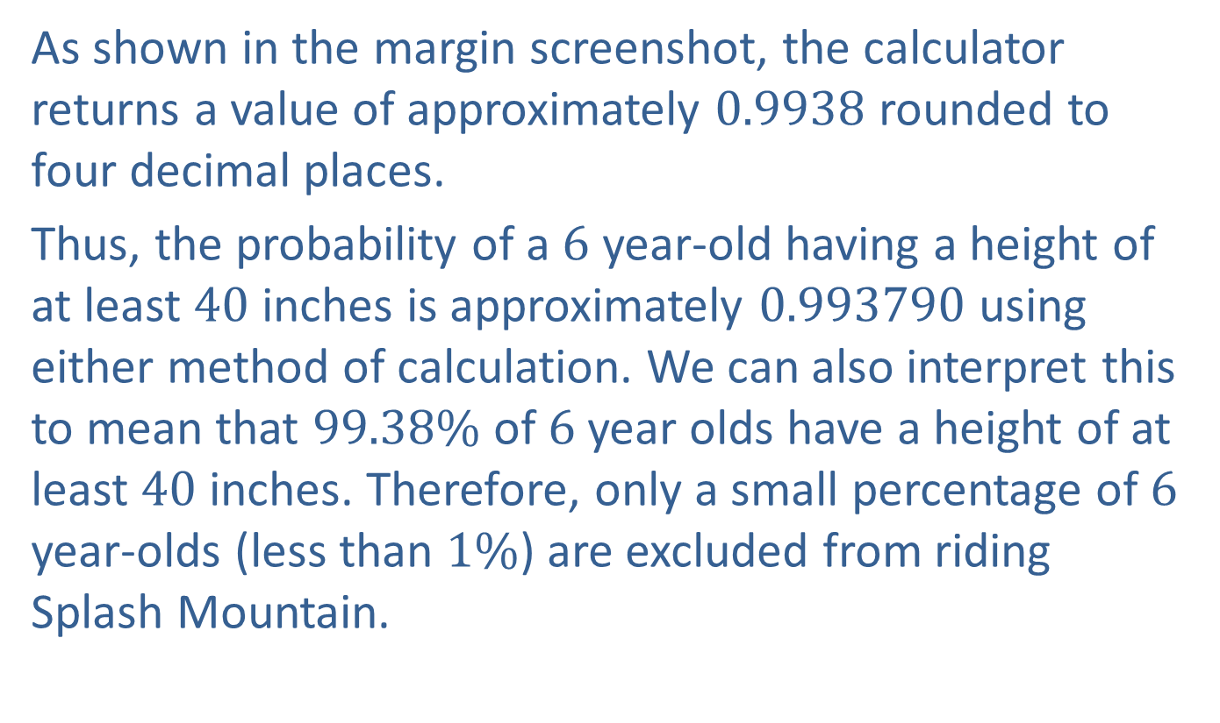
Example 6.3.2: Finding the Probability that a Normal Distributed Random Variable Will Be Greater Than a Given Value (cont.)
As shown in the margin screenshot, the calculator returns a value of approximately 0.9938 rounded to four decimal places.
Thus, the probability of a 6 year-old having a height of at least 40 inches is approximately 0.993790 using either method of calculation. We can also interpret this to mean that $99.38\%$ of 6 year olds have a height of at least 40 inches. Therefore, only a small percentage of 6 year-olds (less than $1\%$) are excluded from riding Splash Mountain.

Slide 17
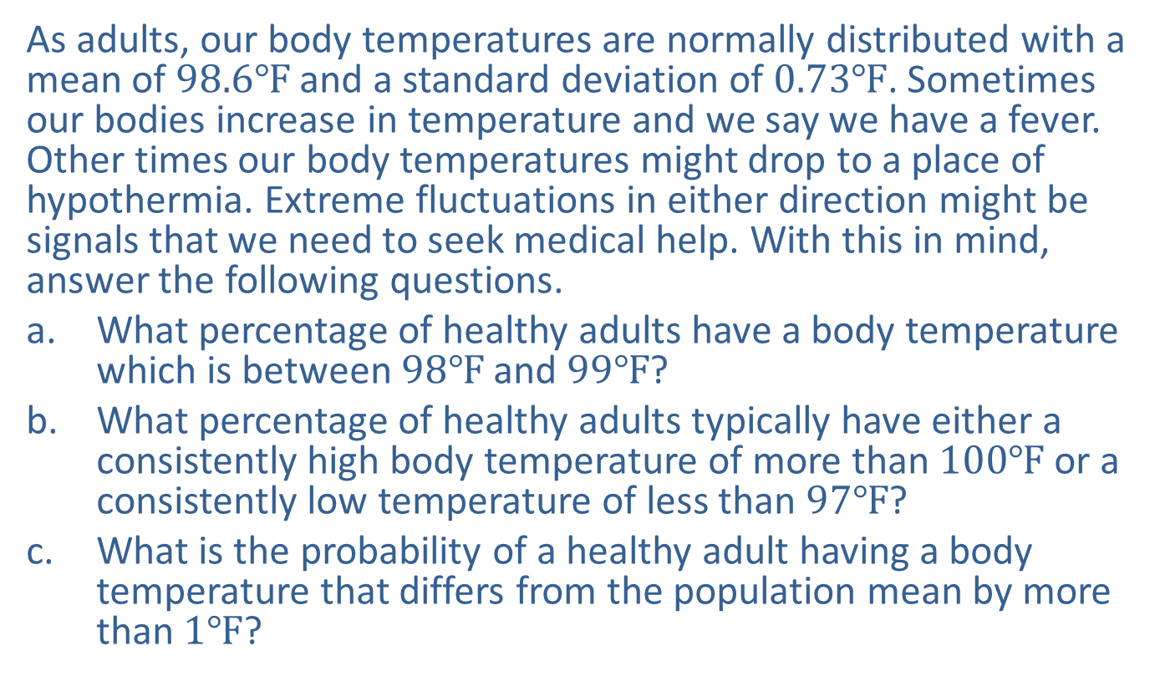
Example 6.3.3: Finding the Probability that a Normally Distributed Random Variable Will Be between Two Given Values Or in the Tails Defined by Two Given Values
As adults, our body temperatures are normally distributed with a mean of $98.6℉$ and a standard deviation of $0.73℉$. Sometimes our bodies increase in temperature and we say we have a fever. Other times our body temperatures might drop to a place of hypothermia. Extreme fluctuations in either direction might be signals that we need to seek medical help. With this in mind, answer the following questions.
​What percentage of healthy adults have a body temperature which is between $98℉$ and $99℉$?
​What percentage of healthy adults typically have either a consistently high body temperature of more than $100℉$ or a consistently low temperature of less than $97℉$?
​What is the probability of a healthy adult having a body temperature that differs from the population mean by more than $1℉$?

Slide 18
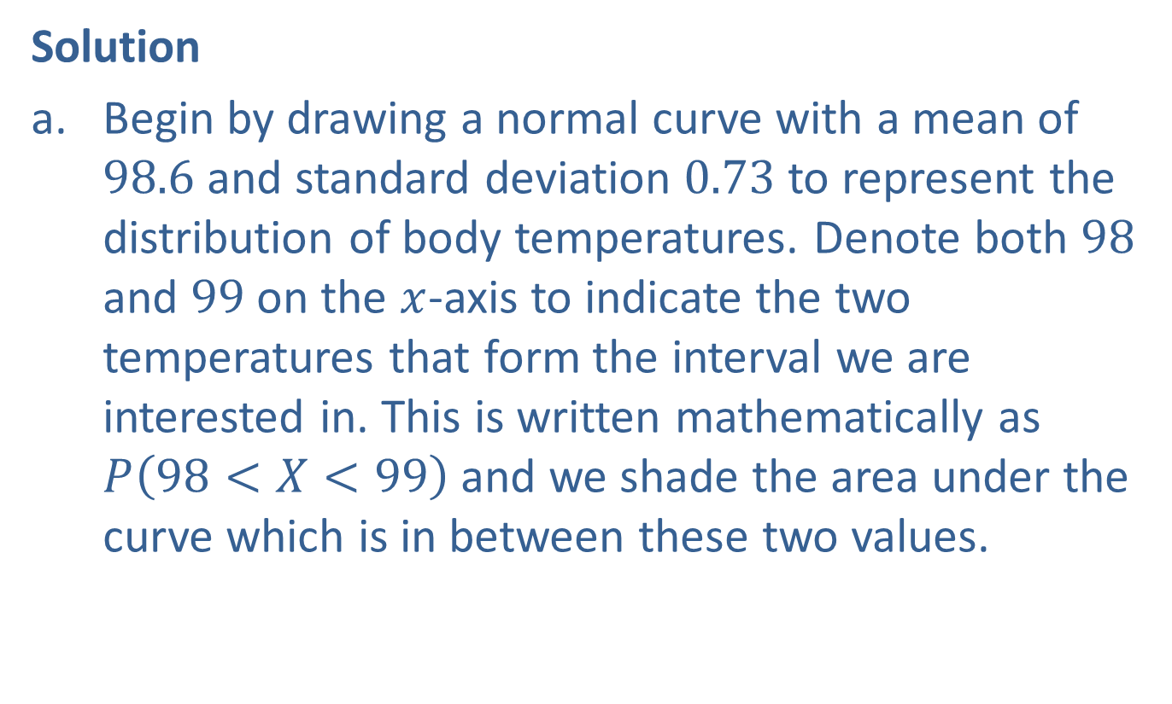
Example 6.3.3: Finding the Probability that a Normally Distributed Random Variable Will Be between Two Given Values Or in the Tails Defined by Two Given Values (cont.)
Solution
​Begin by drawing a normal curve with a mean of 98.6 and standard deviation 0.73 to represent the distribution of body temperatures. Denote both 98 and 99 on the $x$-axis to indicate the two temperatures that form the interval we are interested in. This is written mathematically as $P⁡\left(98<X<99\right)$ and we shade the area under the curve which is in between these two values.
​

Slide 19
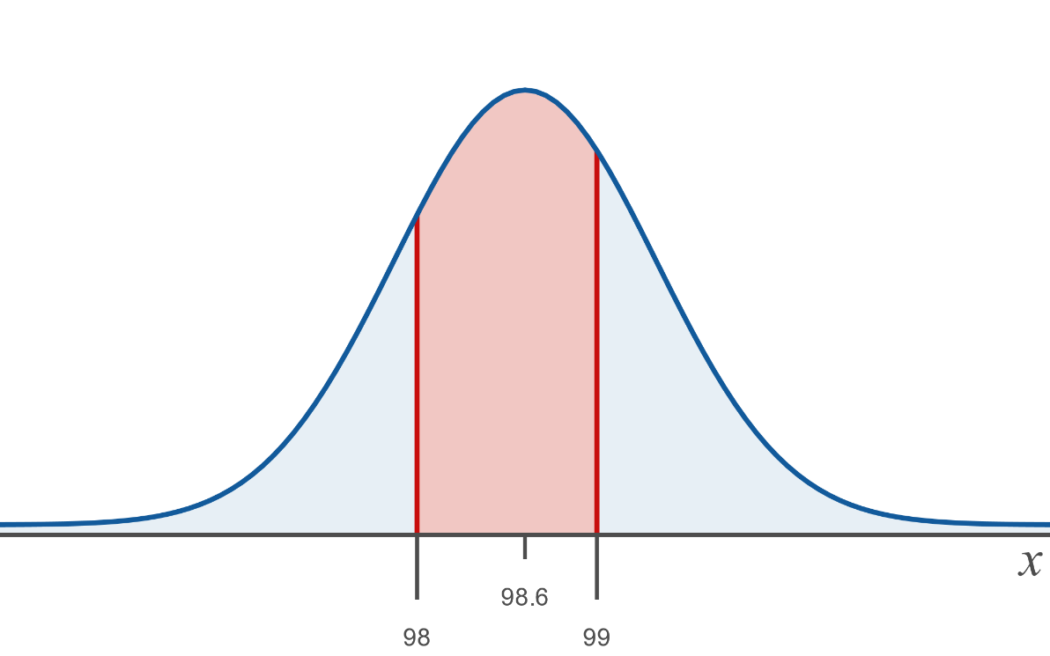
Example 6.3.3: Finding the Probability that a Normally Distributed Random Variable Will Be between Two Given Values Or in the Tails Defined by Two Given Values (cont.)
​Now, using either tables or available technology find the value of the shaded area.

Slide 20
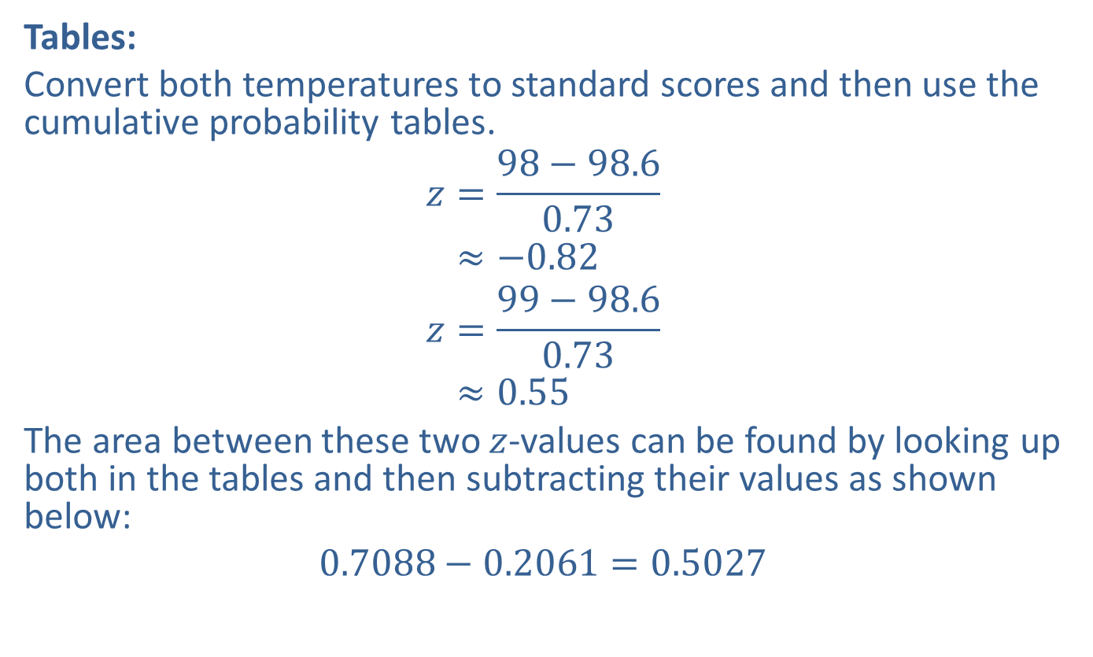
Example 6.3.3: Finding the Probability that a Normally Distributed Random Variable Will Be between Two Given Values Or in the Tails Defined by Two Given Values (cont.)
​Tables:
​Convert both temperatures to standard scores and then use the cumulative probability tables.
𝑧=98−98.60.73𝑧≈−0.82
𝑧=99−98.60.73𝑧≈0.55
​The area between these two $z$-values can be found by looking up both in the tables and then subtracting their values as shown below:
​$0.7088−0.2061=0.5027$
​
For 98°F:
For 99°F:

Slide 21
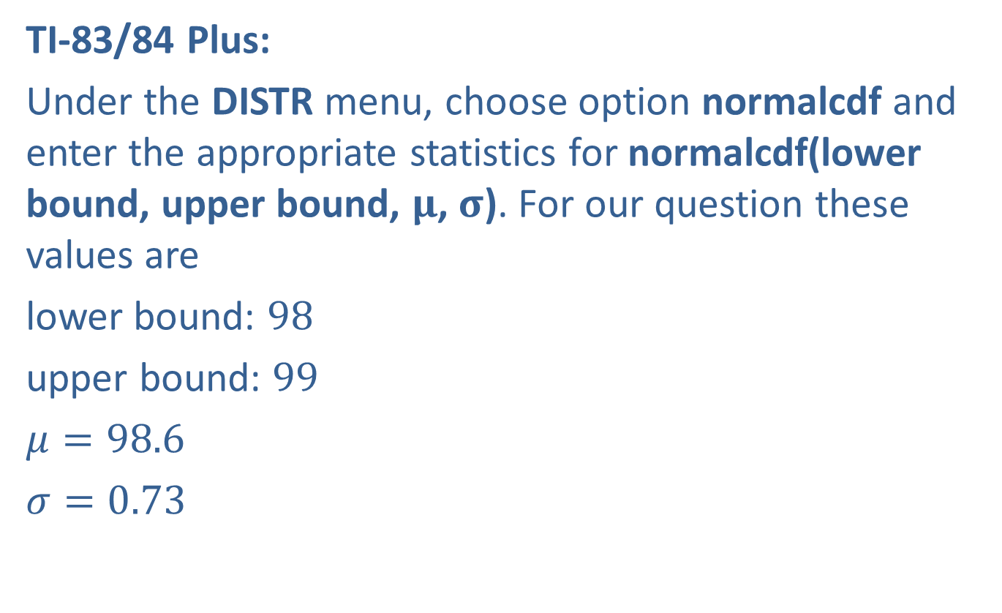
Example 6.3.3: Finding the Probability that a Normally Distributed Random Variable Will Be between Two Given Values Or in the Tails Defined by Two Given Values (cont.)
​TI-83/84 Plus:
​Under the DISTR menu, choose option normalcdf and enter the appropriate statistics for normalcdf(lower bound, upper bound, $μ$, $σ$). For our question these values are
​lower bound: 98
​upper bound: 99
​$μ=98.6$
​$σ=0.73$
​

Slide 22
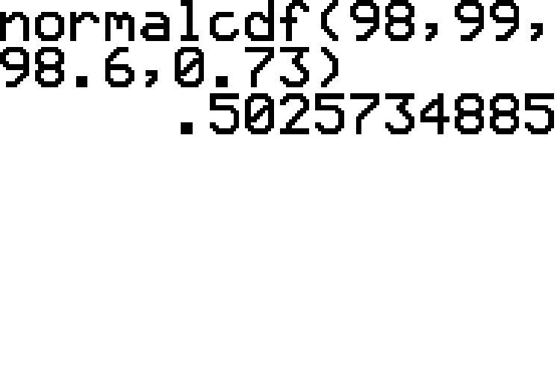
Example 6.3.3: Finding the Probability that a Normally Distributed Random Variable Will Be between Two Given Values Or in the Tails Defined by Two Given Values (cont.)

Slide 23
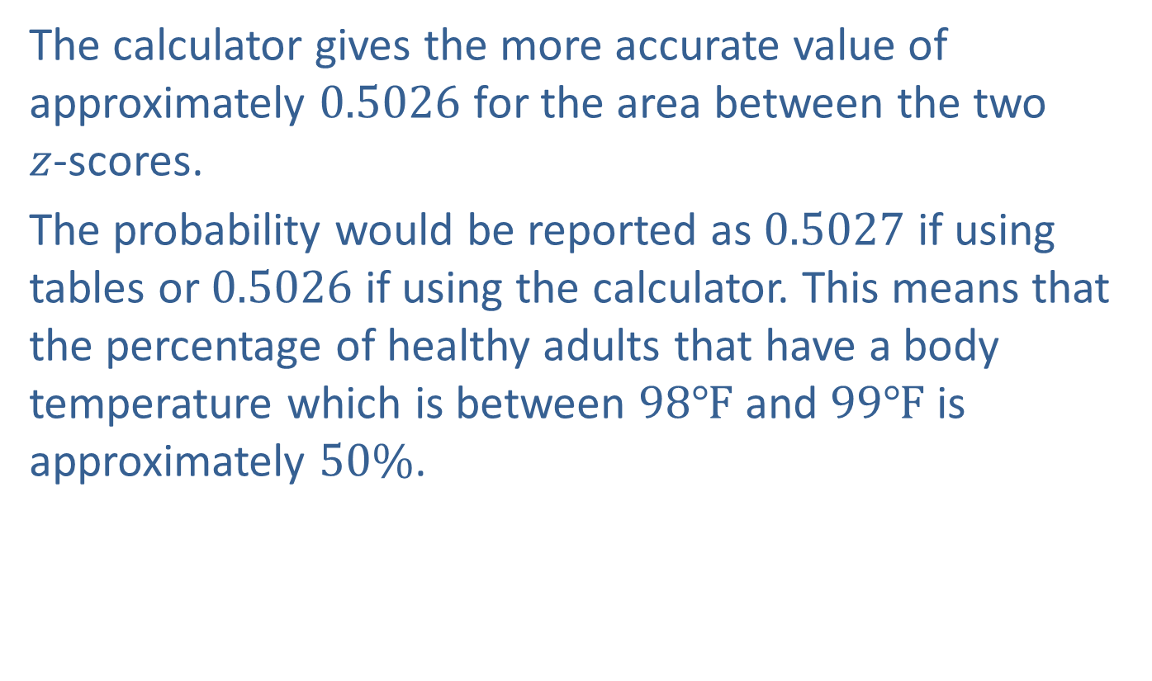
Example 6.3.3: Finding the Probability that a Normally Distributed Random Variable Will Be between Two Given Values Or in the Tails Defined by Two Given Values (cont.)
​The calculator gives the more accurate value of approximately 0.5026 for the area between the two
$z$-scores.
​The probability would be reported as 0.5027 if using tables or 0.5026 if using the calculator. This means that the percentage of healthy adults that have a body temperature which is between $98℉$ and $99℉$ is approximately $50\%$.

Slide 24
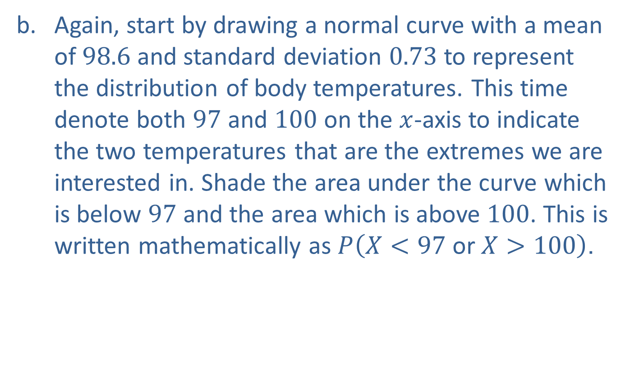
Example 6.3.3: Finding the Probability that a Normally Distributed Random Variable Will Be between Two Given Values Or in the Tails Defined by Two Given Values (cont.)
​Again, start by drawing a normal curve with a mean of 98.6 and standard deviation 0.73 to represent the distribution of body temperatures. This time denote both 97 and 100 on the $x$-axis to indicate the two temperatures that are the extremes we are interested in. Shade the area under the curve which is below 97 and the area which is above 100. This is written mathematically as $P⁡\left(X<97 \text{or} X>100\right)$.
​

Slide 25
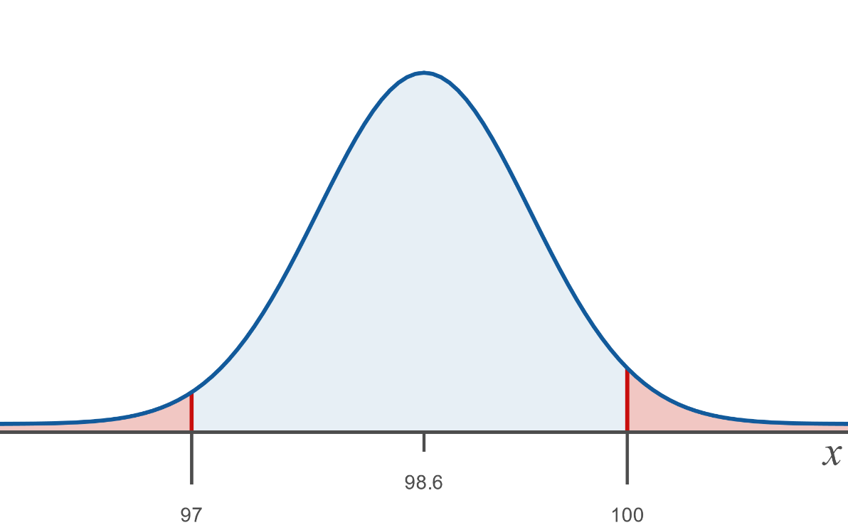
Example 6.3.3: Finding the Probability that a Normally Distributed Random Variable Will Be between Two Given Values Or in the Tails Defined by Two Given Values (cont.)
Now, using either tables or available technology find the value of the shaded area.

Slide 26
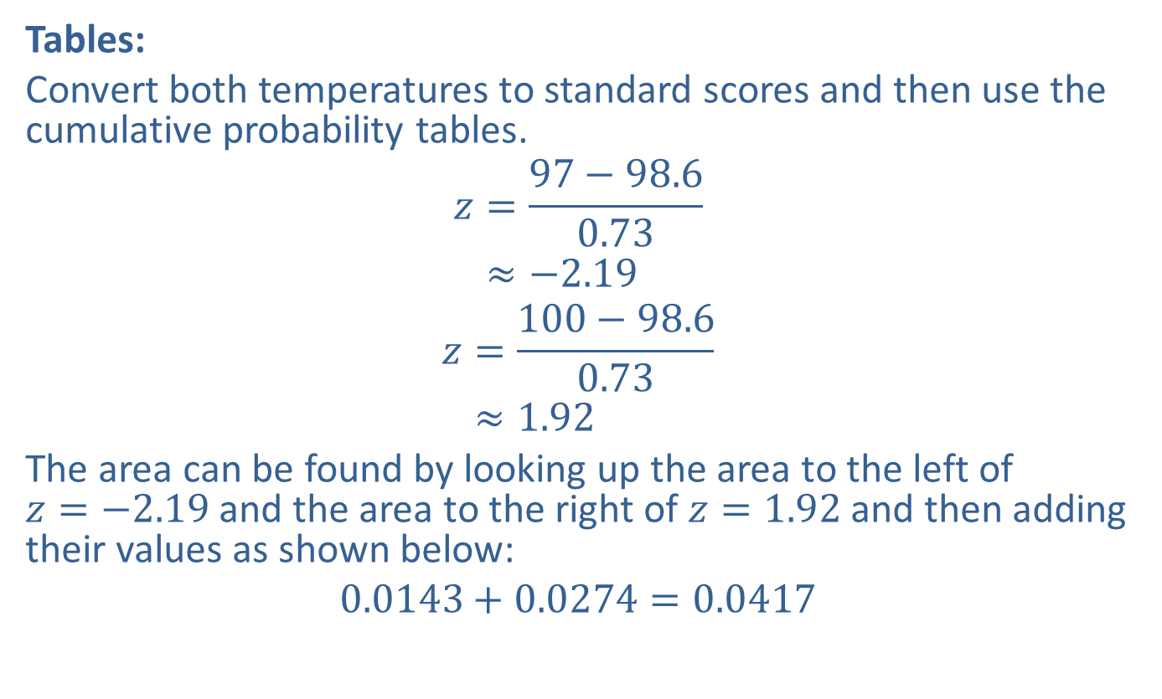
Example 6.3.3: Finding the Probability that a Normally Distributed Random Variable Will Be between Two Given Values Or in the Tails Defined by Two Given Values (cont.)
​Tables:
​Convert both temperatures to standard scores and then use the cumulative probability tables.
𝑧=97−98.60.73𝑧≈−2.19
𝑧=100−98.60.73𝑧≈1.92
​The area can be found by looking up the area to the left of
$z=−2.19$ and the area to the right of $z=1.92$ and then adding their values as shown below:
​$0.0143+0.0274=0.0417$
​
For 97°F:
For 100°F:

Slide 27
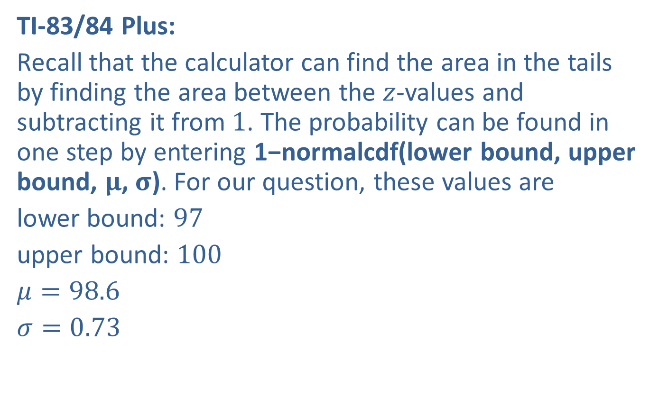
Example 6.3.3: Finding the Probability that a Normally Distributed Random Variable Will Be between Two Given Values Or in the Tails Defined by Two Given Values (cont.)
​TI-83/84 Plus:
​Recall that the calculator can find the area in the tails by finding the area between the $z$-values and subtracting it from 1. The probability can be found in one step by entering 1−normalcdf(lower bound, upper bound, $μ$, $σ$). For our question, these values are
​lower bound: 97
​upper bound: 100
​$μ=98.6$
​$σ=0.73$
​

Slide 28
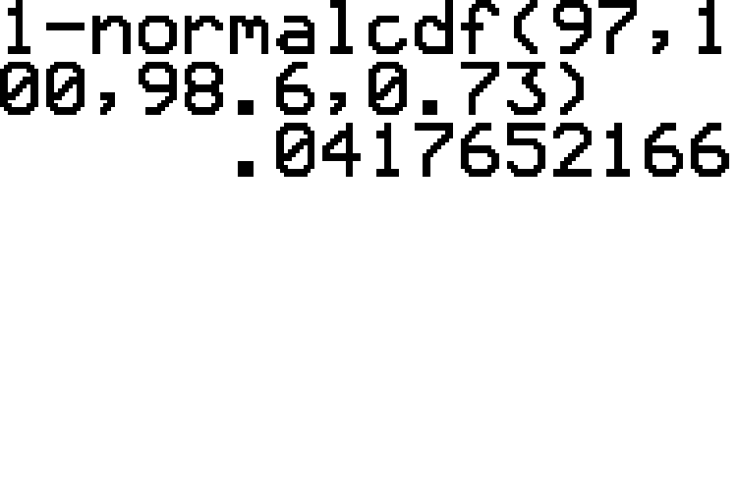
Example 6.3.3: Finding the Probability that a Normally Distributed Random Variable Will Be between Two Given Values Or in the Tails Defined by Two Given Values (cont.)

Slide 29
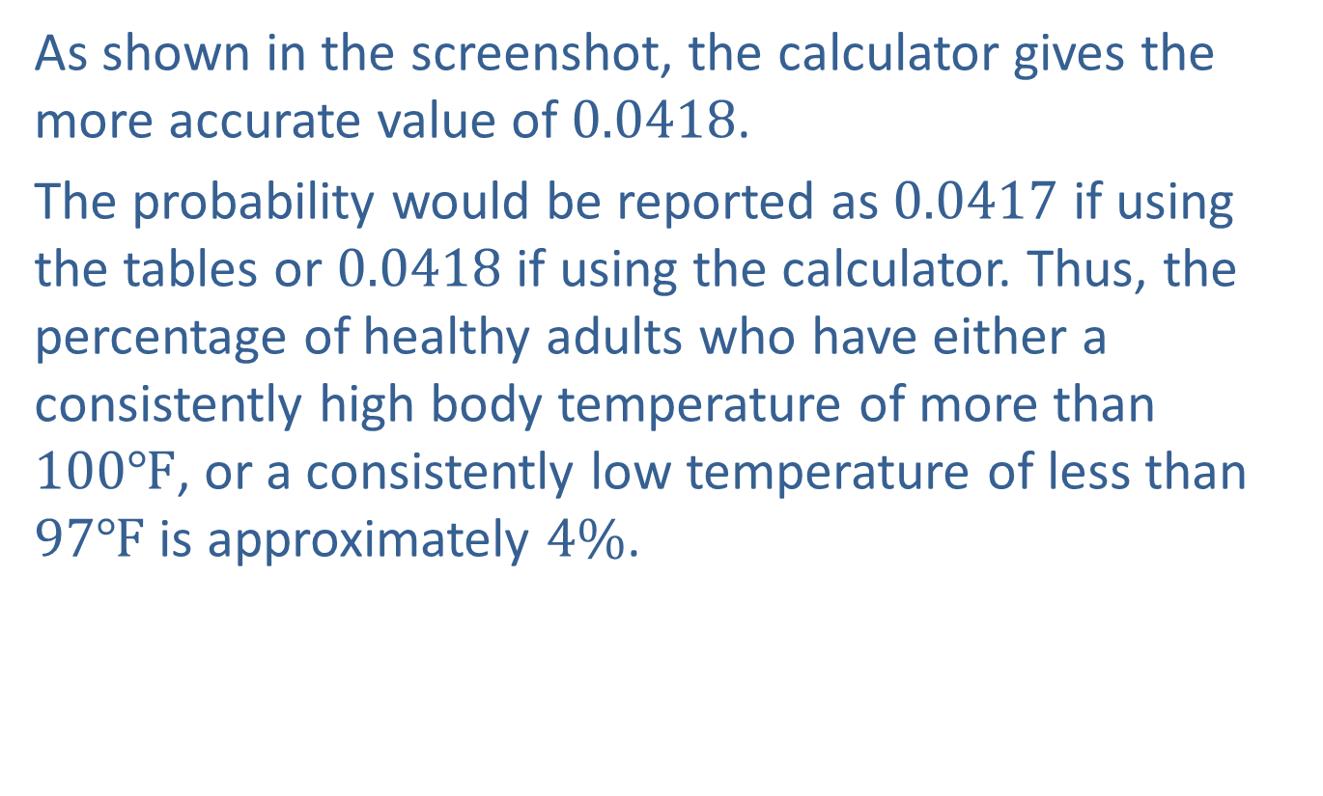
Example 6.3.3: Finding the Probability that a Normally Distributed Random Variable Will Be between Two Given Values Or in the Tails Defined by Two Given Values (cont.)
​As shown in the screenshot, the calculator gives the more accurate value of 0.0418.
​The probability would be reported as 0.0417 if using the tables or 0.0418 if using the calculator. Thus, the percentage of healthy adults who have either a consistently high body temperature of more than $100℉$, or a consistently low temperature of less than $97℉$ is approximately $4\%$.

Slide 30
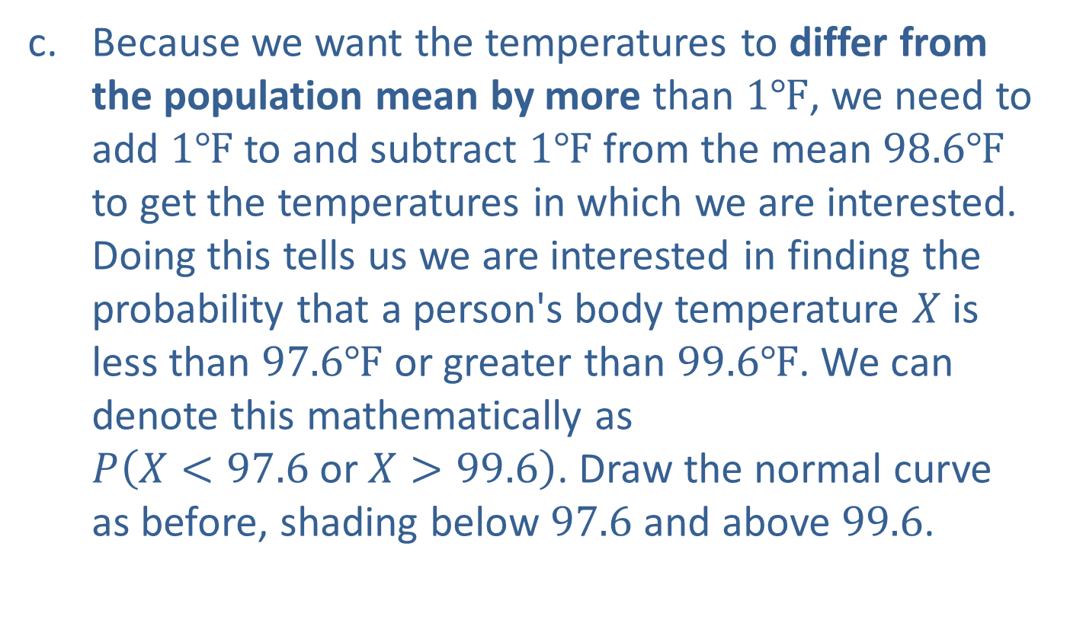
Example 6.3.3: Finding the Probability that a Normally Distributed Random Variable Will Be between Two Given Values Or in the Tails Defined by Two Given Values (cont.)
​Because we want the temperatures to differ from the population mean by more than $1℉$, we need to add $1℉$ to and subtract $1℉$ from the mean $98.6℉$ to get the temperatures in which we are interested. Doing this tells us we are interested in finding the probability that a person's body temperature $X$ is less than $97.6℉$ or greater than $99.6℉$. We can denote this mathematically as
$P⁡\left(X<97.6 \text{or} X>99.6\right)$. Draw the normal curve as before, shading below 97.6 and above 99.6.
​

Slide 31
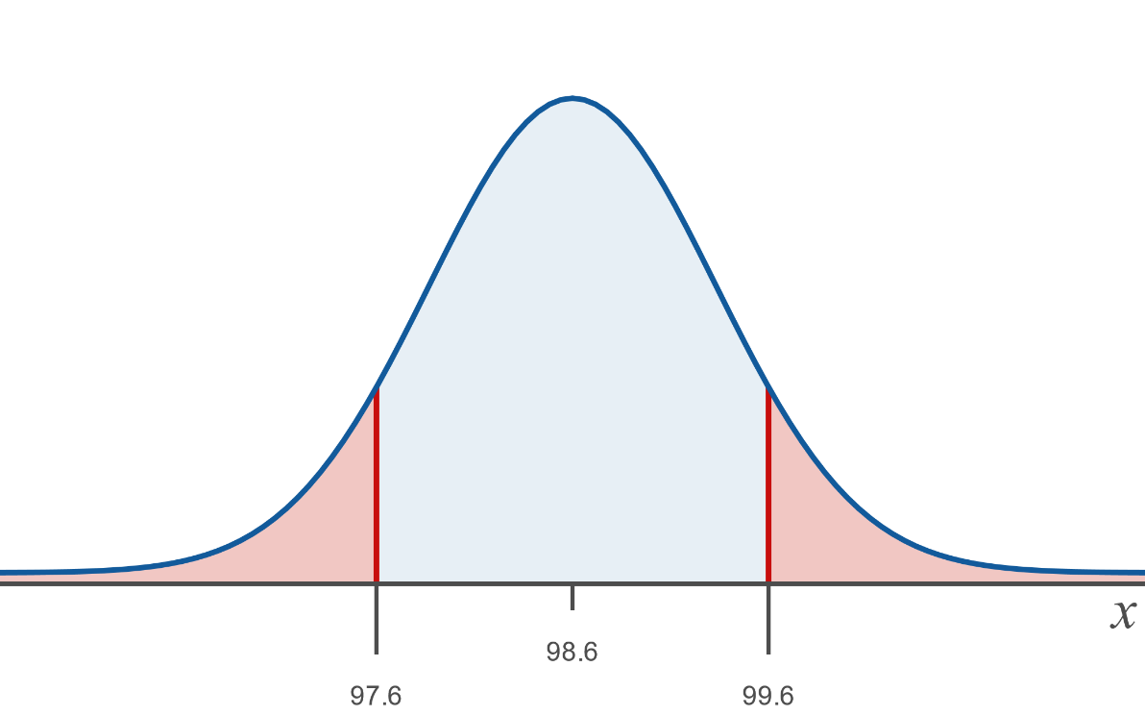
Example 6.3.3: Finding the Probability that a Normally Distributed Random Variable Will Be between Two Given Values Or in the Tails Defined by Two Given Values (cont.)
​Now, using either tables or available technology find the value of the shaded area.

Slide 32
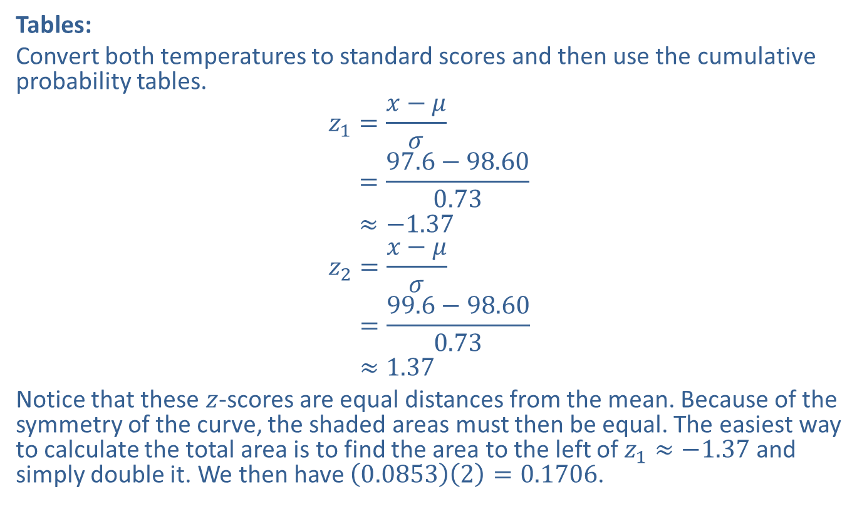
Example 6.3.3: Finding the Probability that a Normally Distributed Random Variable Will Be between Two Given Values Or in the Tails Defined by Two Given Values (cont.)
​Tables:
​Convert both temperatures to standard scores and then use the cumulative probability tables.
𝑧1=𝑥−𝜇𝜎𝑧1=97.6−98.600.73𝑧1≈−1.37
𝑧2=𝑥−𝜇𝜎𝑧2=99.6−98.600.73𝑧2≈1.37
​Notice that these $z$-scores are equal distances from the mean. Because of the symmetry of the curve, the shaded areas must then be equal. The easiest way to calculate the total area is to find the area to the left of $z_{1}≈−1.37$ and simply double it. We then have $\left(0.0853\right)\left(2\right)=0.1706$.
For 97.6°F:
For 99.6°F:

Slide 33
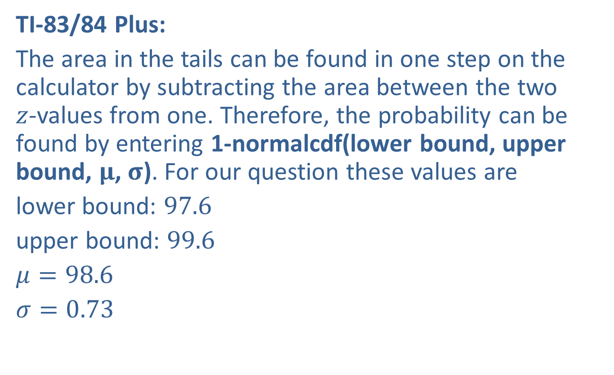
Example 6.3.3: Finding the Probability that a Normally Distributed Random Variable Will Be between Two Given Values Or in the Tails Defined by Two Given Values (cont.)
​TI-83/84 Plus:
​The area in the tails can be found in one step on the calculator by subtracting the area between the two
$z$-values from one. Therefore, the probability can be found by entering 1-normalcdf(lower bound, upper bound, $μ$, $σ$). For our question these values are
​lower bound: 97.6
​upper bound: 99.6
​$μ=98.6$
​$σ=0.73$
​

Slide 34
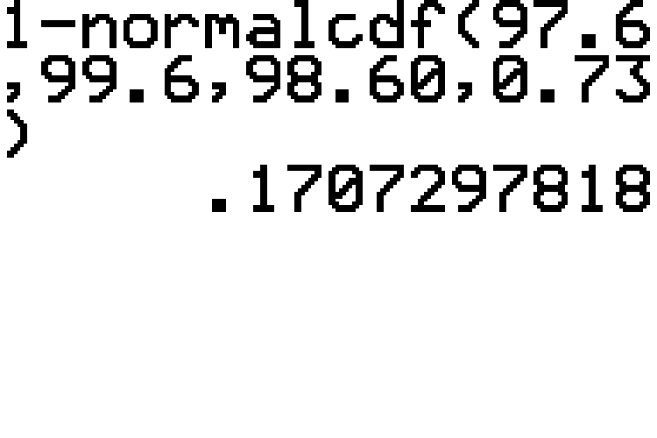
Example 6.3.3: Finding the Probability that a Normally Distributed Random Variable Will Be between Two Given Values Or in the Tails Defined by Two Given Values (cont.)

Slide 35
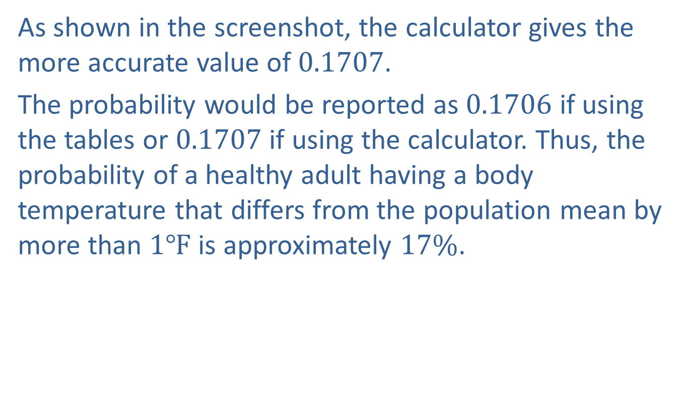
Example 6.3.3: Finding the Probability that a Normally Distributed Random Variable Will Be between Two Given Values Or in the Tails Defined by Two Given Values (cont.)
​As shown in the screenshot, the calculator gives the more accurate value of 0.1707.
​The probability would be reported as 0.1706 if using the tables or 0.1707 if using the calculator. Thus, the probability of a healthy adult having a body temperature that differs from the population mean by more than $1℉$ is approximately $17\%$.

Slide 36
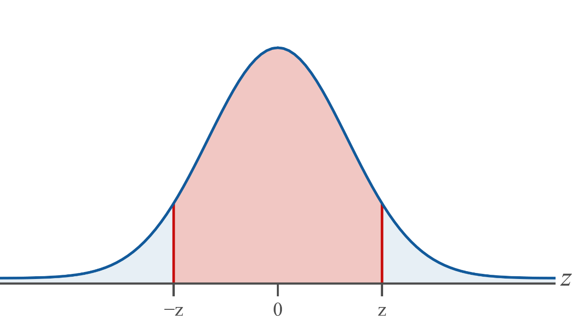
Memory Booster
"Differs by less": between

Slide 37
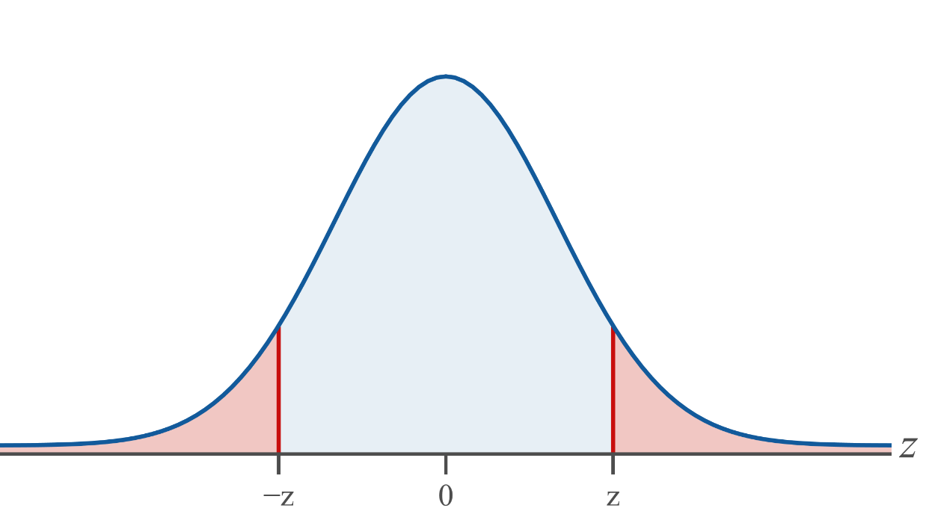
Memory Booster (cont.)
"Differs by more": two tails

