Slide 1
Section 6.4
Finding Values of a Normally Distributed Random Variable

Slide 2
Memory Booster
Not sure about your answer? Draw a sketch to make sure your answer makes sense.

Slide 3
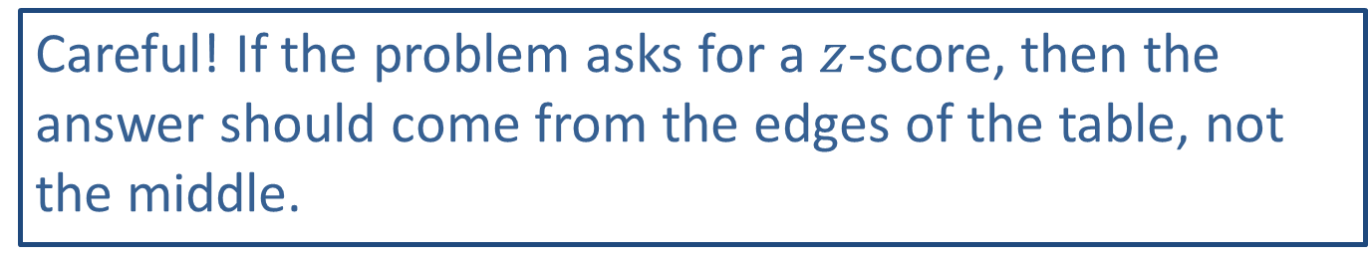
Caution
Careful! If the problem asks for a $z$-score, then the answer should come from the edges of the table, not the middle.

Slide 4

Example 6.4.1: Finding the z-value with a Given Area to Its Left
What $z$-value has an area of 0.7357 to its left? Round to 2 decimal places.

Slide 5

Example 6.4.1: Finding the z-value with a Given Area to Its Left (cont.)
Solution
In order to sketch a graph of where the area under the curve lies, we need to shade under more than half of the curve because $0.7357>0.5$. Therefore, we know that the $z$-value will be a positive number.

Slide 6
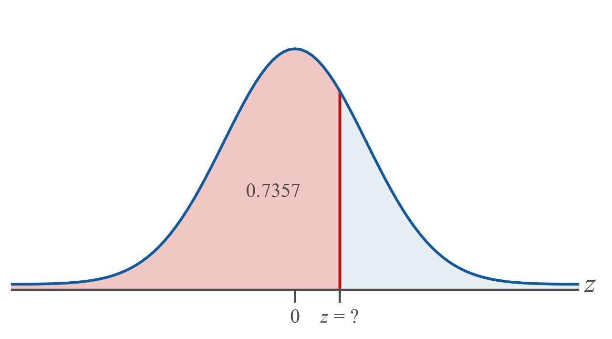
Example 6.4.1: Finding the z-value with a Given Area to Its Left (cont.)

Slide 7

Example 6.4.1: Finding the z-value with a Given Area to Its Left (cont.)
Tables:
Scan through the interior of the standard normal table for area $−∞$ to $z$ for an area of 0.7357. Look to the left and up to find the corresponding $z$-value. Looking at the row and column titles, you will see that $z=0.63$.

Slide 8
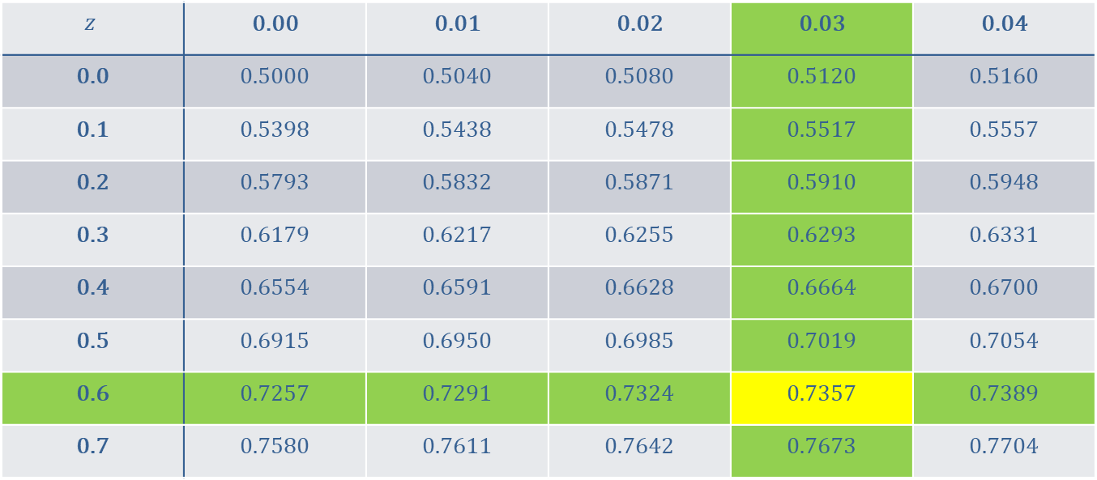
Example 6.4.1: Finding the z-value with a Given Area to Its Left (cont.)
$$z$$ | 0.00 | 0.01 | 0.02 | 0.03 | 0.04
0.0 | 0.5000 | 0.5040 | 0.5080 | 0.5120 | 0.5160
0.1 | 0.5398 | 0.5438 | 0.5478 | 0.5517 | 0.5557
0.2 | 0.5793 | 0.5832 | 0.5871 | 0.5910 | 0.5948
0.3 | 0.6179 | 0.6217 | 0.6255 | 0.6293 | 0.6331
0.4 | 0.6554 | 0.6591 | 0.6628 | 0.6664 | 0.6700
0.5 | 0.6915 | 0.6950 | 0.6985 | 0.7019 | 0.7054
0.6 | 0.7257 | 0.7291 | 0.7324 | 0.7357 | 0.7389
0.7 | 0.7580 | 0.7611 | 0.7642 | 0.7673 | 0.7704

Slide 9
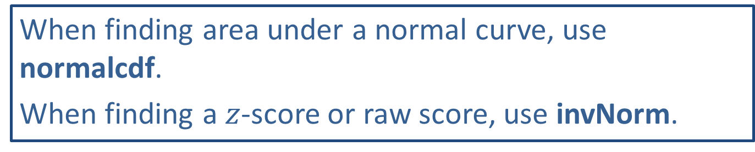
Technology Tip
When finding area under a normal curve, use normalcdf.
When finding a $z$-score or raw score, use invNorm.

Slide 10
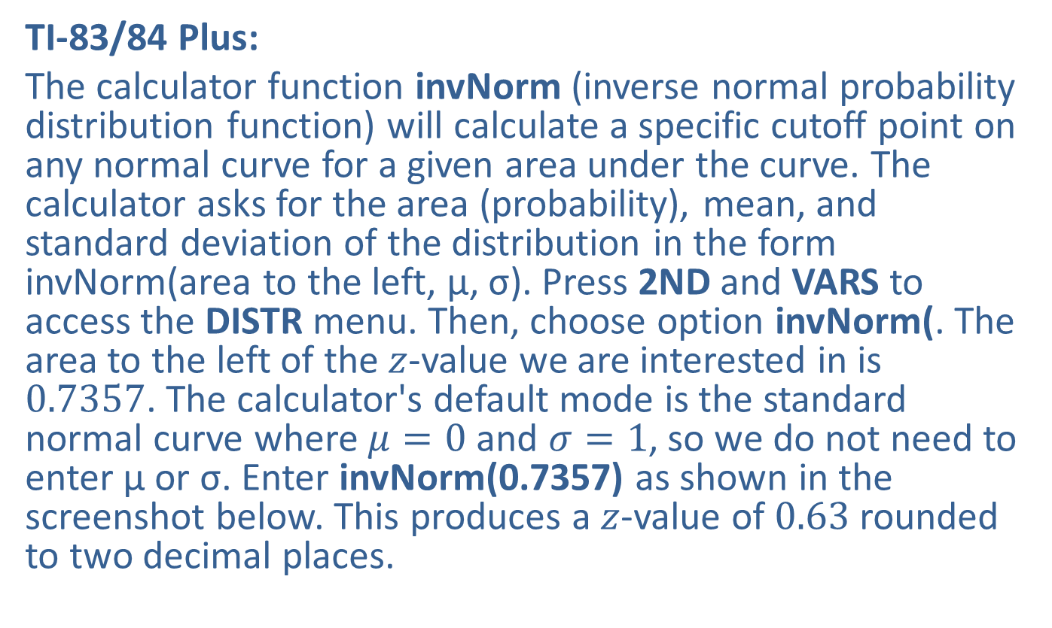
Example 6.4.1: Finding the z-value with a Given Area to Its Left (cont.)
TI-83/84 Plus:
The calculator function invNorm (inverse normal probability distribution function) will calculate a specific cutoff point on any normal curve for a given area under the curve. The calculator asks for the area (probability), mean, and standard deviation of the distribution in the form invNorm(area to the left, μ, σ). Press 2ND and VARS to access the DISTR menu. Then, choose option invNorm(. The area to the left of the $z$-value we are interested in is 0.7357. The calculator's default mode is the standard normal curve where $μ=0$ and $σ=1$, so we do not need to enter μ or σ. Enter invNorm(0.7357) as shown in the screenshot below. This produces a $z$-value of 0.63 rounded to two decimal places.

Slide 11
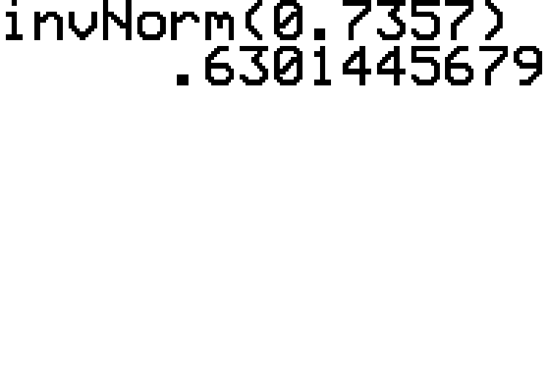
Example 6.4.1: Finding the z-value with a Given Area to Its Left (cont.)

Slide 12

Example 6.4.1: Finding the z-value with a Given Area to Its Left (cont.)
Therefore, an area of 0.7357 to the left corresponds to a $z$-value of approximately 0.63.

Slide 13
Technology Tip
For further instructions on finding values from a normal distribution with a TI-83/84 Plus calculator or other technology, please visit stat.hawkeslearning.com and see Technology Instructions > Normal Distribution > Inverse Normal.

Slide 14

Example 6.4.2: Finding the z-value That Represents a Given Percentile
What $z$-value represents the 90th percentile? Round to 2 decimal places.

Slide 15
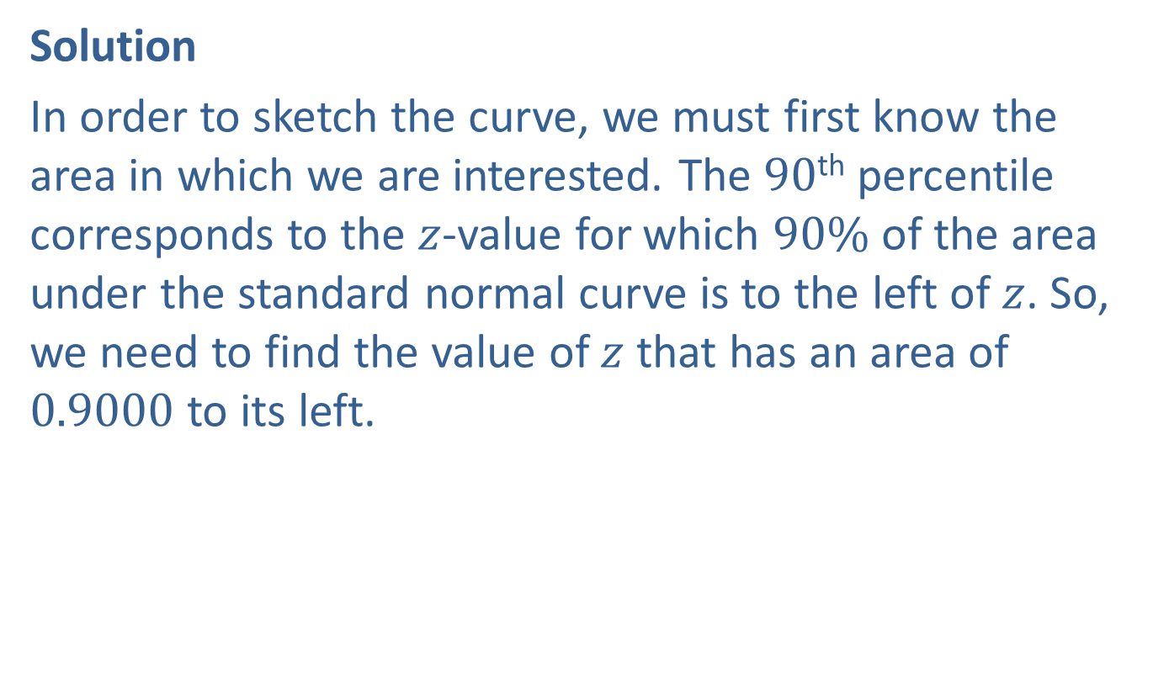
Example 6.4.2: Finding the z-value That Represents a Given Percentile (cont.)
Solution
In order to sketch the curve, we must first know the area in which we are interested. The 90th percentile corresponds to the $z$-value for which $90\%$ of the area under the standard normal curve is to the left of $z$. So, we need to find the value of $z$ that has an area of 0.9000 to its left.

Slide 16
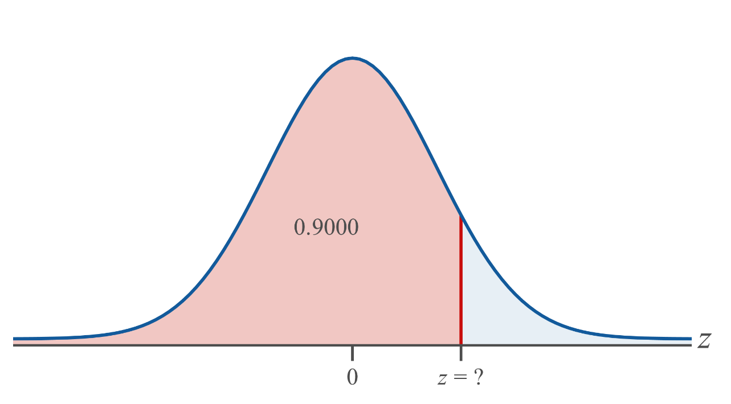
Example 6.4.2: Finding the z-value That Represents a Given Percentile (cont.)

Slide 17
Side Note
If an exact area is not listed in the cumulative table, we will use the area closest in value.

Slide 18

Example 6.4.2: Finding the z-value That Represents a Given Percentile (cont.)
Tables:
Looking for 0.9000 (or the closest area) in the interior of the cumulative normal tables, we find 0.8997, which corresponds to a $z$-value of 1.28. Thus we will use $z=1.28$ to represent the 90th percentile.

Slide 19
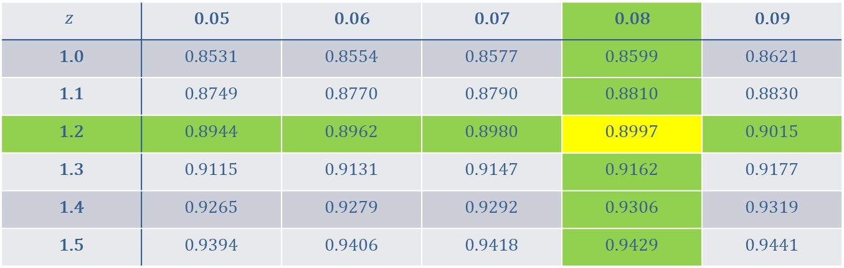
Example 6.4.2: Finding the z-value That Represents a Given Percentile (cont.)
$$z$$ | 0.05 | 0.06 | 0.07 | 0.08 | 0.09
1.0 | 0.8531 | 0.8554 | 0.8577 | 0.8599 | 0.8621
1.1 | 0.8749 | 0.8770 | 0.8790 | 0.8810 | 0.8830
1.2 | 0.8944 | 0.8962 | 0.8980 | 0.8997 | 0.9015
1.3 | 0.9115 | 0.9131 | 0.9147 | 0.9162 | 0.9177
1.4 | 0.9265 | 0.9279 | 0.9292 | 0.9306 | 0.9319
1.5 | 0.9394 | 0.9406 | 0.9418 | 0.9429 | 0.9441

Slide 20
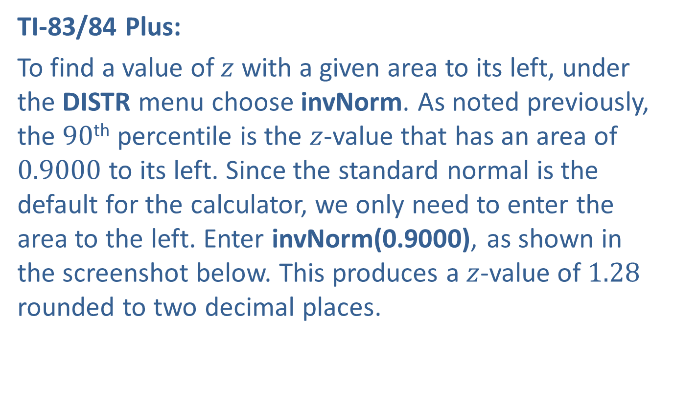
Example 6.4.2: Finding the z-value That Represents a Given Percentile (cont.)
TI-83/84 Plus:
To find a value of $z$ with a given area to its left, under the DISTR menu choose invNorm. As noted previously, the 90th percentile is the $z$-value that has an area of 0.9000 to its left. Since the standard normal is the default for the calculator, we only need to enter the area to the left. Enter invNorm(0.9000), as shown in the screenshot below. This produces a $z$-value of 1.28 rounded to two decimal places.

Slide 21
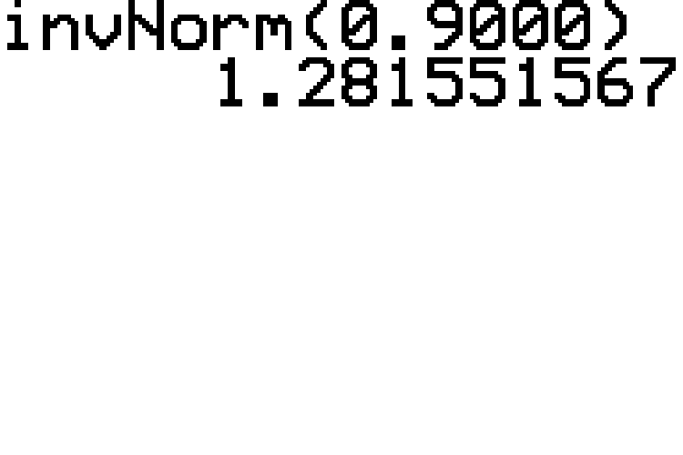
Example 6.4.2: Finding the z-value That Represents a Given Percentile (cont.)

Slide 22

Example 6.4.2: Finding the z-value That Represents a Given Percentile (cont.)
Thus, the $z$-value representing the 90th percentile is approximately 1.28.

Slide 23

Example 6.4.3: Finding the z-value with a Given Area to Its Right
What $z$-value has an area of 0.0096 to its right? Round to 2 decimal places.

Slide 24
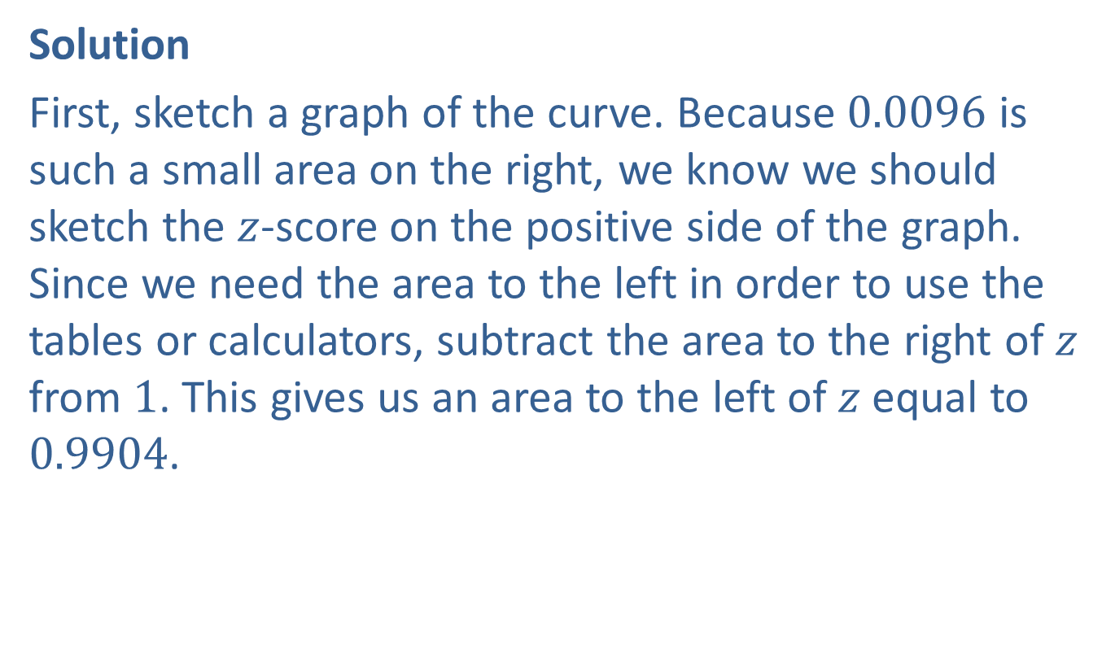
Example 6.4.3: Finding the z-value with a Given Area to Its Right (cont.)
Solution
First, sketch a graph of the curve. Because 0.0096 is such a small area on the right, we know we should sketch the $z$-score on the positive side of the graph. Since we need the area to the left in order to use the tables or calculators, subtract the area to the right of $z$ from 1. This gives us an area to the left of $z$ equal to 0.9904.

Slide 25
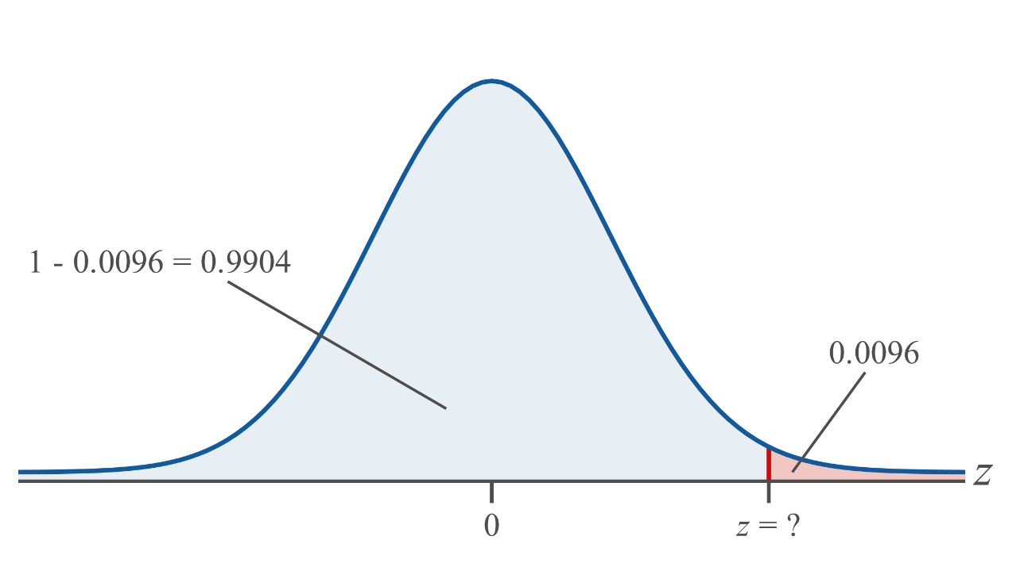
Example 6.4.3: Finding the z-value with a Given Area to Its Right (cont.)

Slide 26

Example 6.4.3: Finding the z-value with a Given Area to Its Right (cont.)
Tables:
Scan through the interior of the table for an area of 0.9904. Look to the left and above to find the corresponding $z$-value. What we find is that $z=2.34$.

Slide 27
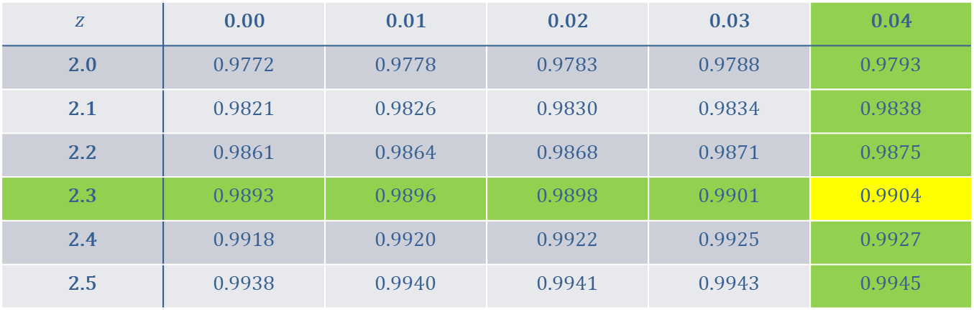
Example 6.4.3: Finding the z-value with a Given Area to Its Right (cont.)
$$z$$ | 0.00 | 0.01 | 0.02 | 0.03 | 0.04
2.0 | 0.9772 | 0.9778 | 0.9783 | 0.9788 | 0.9793
2.1 | 0.9821 | 0.9826 | 0.9830 | 0.9834 | 0.9838
2.2 | 0.9861 | 0.9864 | 0.9868 | 0.9871 | 0.9875
2.3 | 0.9893 | 0.9896 | 0.9898 | 0.9901 | 0.9904
2.4 | 0.9918 | 0.9920 | 0.9922 | 0.9925 | 0.9927
2.5 | 0.9938 | 0.9940 | 0.9941 | 0.9943 | 0.9945

Slide 28
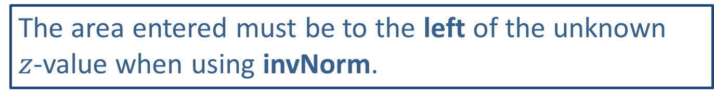
Technology Tip
The area entered must be to the left of the unknown $z$-value when using invNorm.

Slide 29
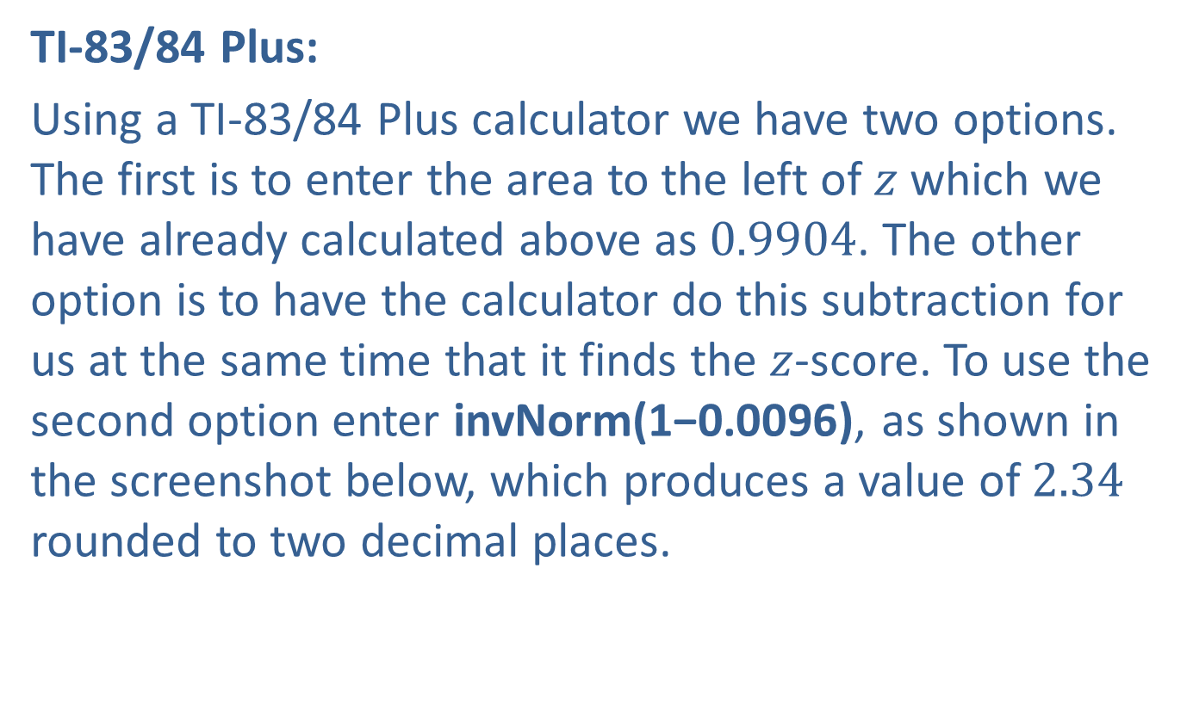
Example 6.4.3: Finding the z-value with a Given Area to Its Right (cont.)
TI-83/84 Plus:
Using a TI-83/84 Plus calculator we have two options. The first is to enter the area to the left of $z$ which we have already calculated above as 0.9904. The other option is to have the calculator do this subtraction for us at the same time that it finds the $z$-score. To use the second option enter invNorm(1−0.0096), as shown in the screenshot below, which produces a value of 2.34 rounded to two decimal places.

Slide 30
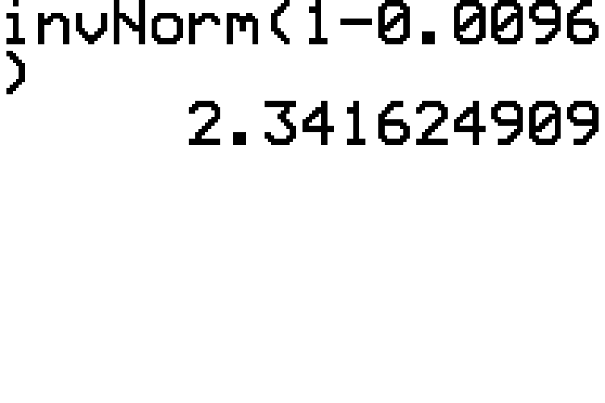
Example 6.4.3: Finding the z-value with a Given Area to Its Right (cont.)

Slide 31

Example 6.4.3: Finding the z-value with a Given Area to Its Right (cont.)
Therefore, the $z$-value which has an area of 0.0096 to its right is approximately 2.34.

Slide 32

Example 6.4.4: Finding the z-value with a Given Area between −z and z
Find the value of $z$ such that the area between $−z$ and $z$ is 0.90. Round to 3 decimal places.

Slide 33
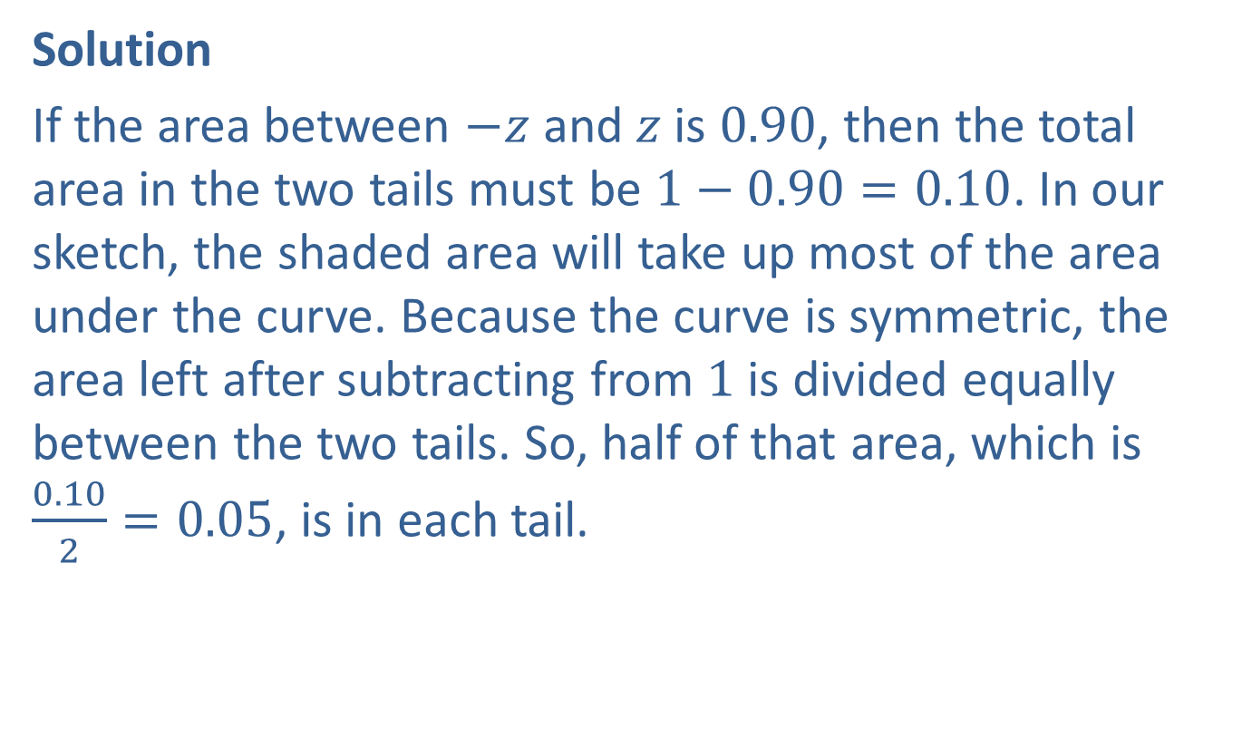
Example 6.4.4: Finding the z-value with a Given Area between −z and z (cont.)
Solution
If the area between $−z$ and $z$ is 0.90, then the total area in the two tails must be $1−0.90=0.10$. In our sketch, the shaded area will take up most of the area under the curve. Because the curve is symmetric, the area left after subtracting from 1 is divided equally between the two tails. So, half of that area, which is $\frac{0.10}{2}=0.05$, is in each tail.

Slide 34
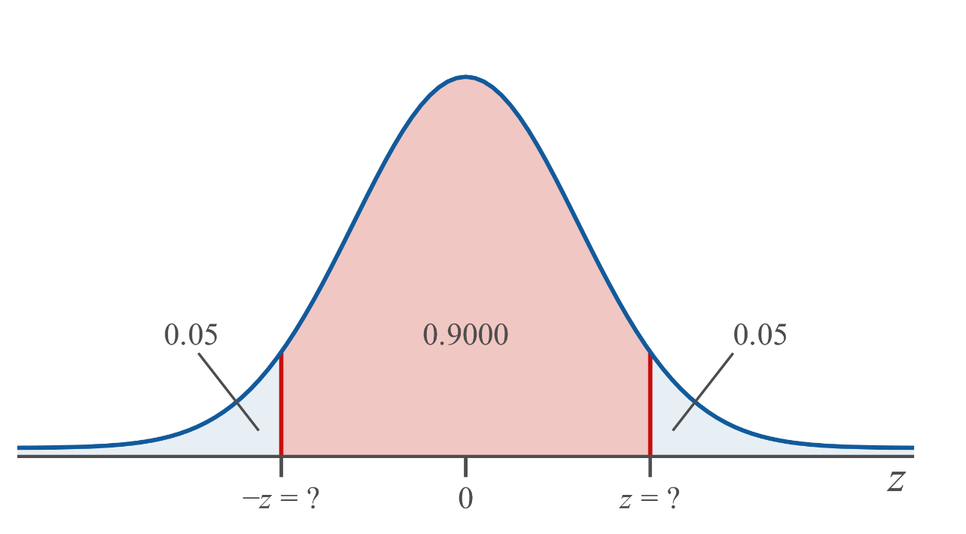
Example 6.4.4: Finding the z-value with a Given Area between −z and z (cont.)

Slide 35
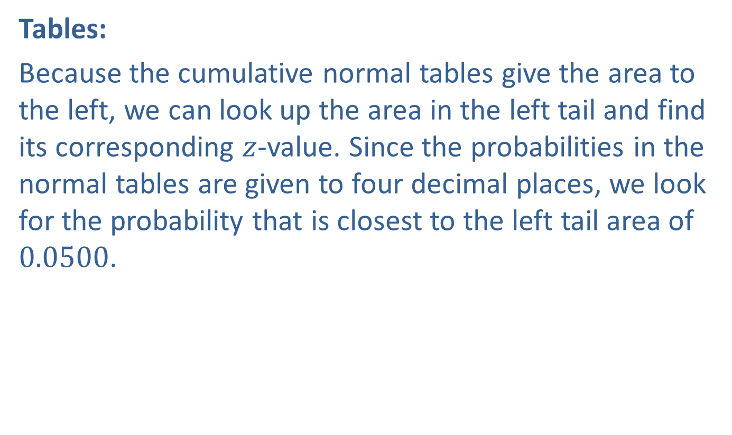
Example 6.4.4: Finding the z-value with a Given Area between −z and z (cont.)
Tables:
Because the cumulative normal tables give the area to the left, we can look up the area in the left tail and find its corresponding $z$-value. Since the probabilities in the normal tables are given to four decimal places, we look for the probability that is closest to the left tail area of 0.0500.

Slide 36
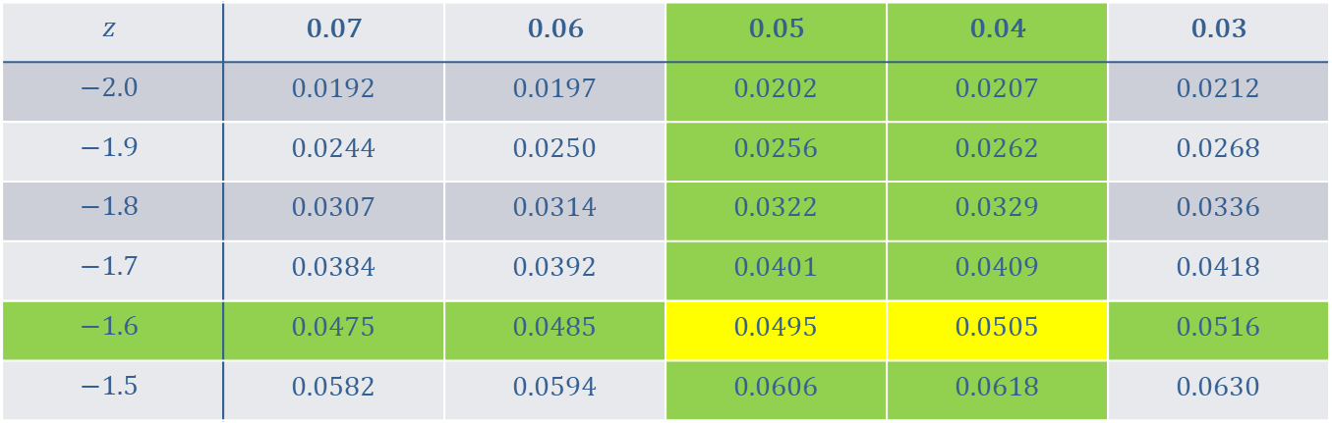
Example 6.4.4: Finding the z-value with a Given Area between −z and z (cont.)
$$z$$ | 0.07 | 0.06 | 0.05 | 0.04 | 0.03
$$−2.0$$ | 0.0192 | 0.0197 | 0.0202 | 0.0207 | 0.0212
$$−1.9$$ | 0.0244 | 0.0250 | 0.0256 | 0.0262 | 0.0268
$$−1.8$$ | 0.0307 | 0.0314 | 0.0322 | 0.0329 | 0.0336
$$−1.7$$ | 0.0384 | 0.0392 | 0.0401 | 0.0409 | 0.0418
$$−1.6$$ | 0.0475 | 0.0485 | 0.0495 | 0.0505 | 0.0516
$$−1.5$$ | 0.0582 | 0.0594 | 0.0606 | 0.0618 | 0.0630

Slide 37
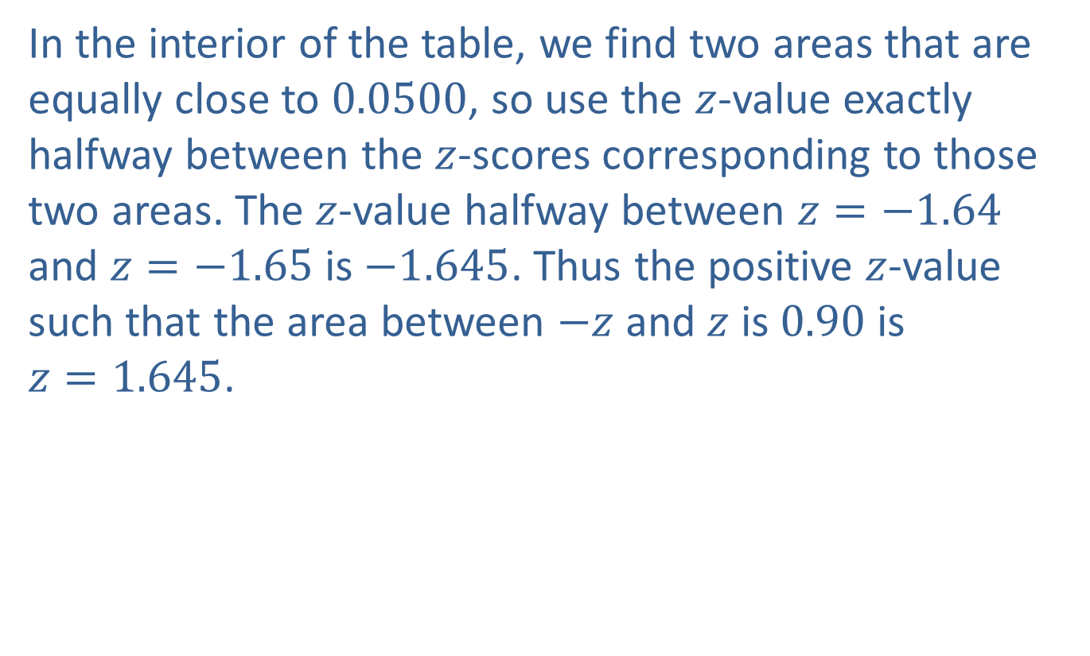
Example 6.4.4: Finding the z-value with a Given Area between −z and z (cont.)
In the interior of the table, we find two areas that are equally close to 0.0500, so use the $z$-value exactly halfway between the $z$-scores corresponding to those two areas. The $z$-value halfway between $z=−1.64$ and $z=−1.65$ is $−1.645$. Thus the positive $z$-value such that the area between $−z$ and $z$ is 0.90 is $z=1.645$.

Slide 38

Example 6.4.4: Finding the z-value with a Given Area between −z and z (cont.)
TI-83/84 Plus:
Using a TI-83/84 Plus calculator requires that we enter the area to the left of $−z$. Enter invNorm(0.05), as shown in the screenshot below. This gives a value of $−1.645$ rounded to three decimal places.

Slide 39
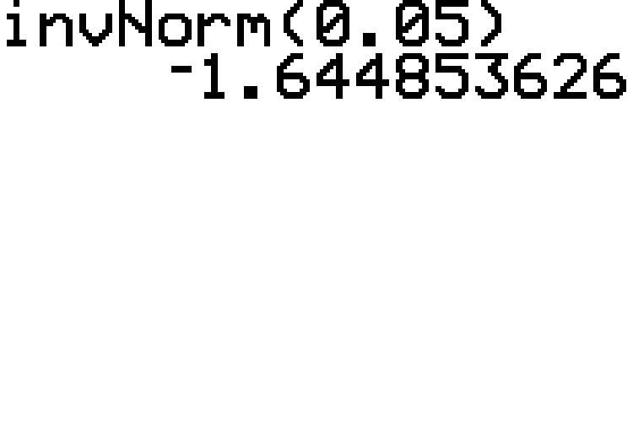
Example 6.4.4: Finding the z-value with a Given Area between −z and z (cont.)

Slide 40

Example 6.4.4: Finding the z-value with a Given Area between −z and z (cont.)
Therefore, the positive $z$-value such that the area between $−z$ and $z$ is 0.90 is approximately 1.645.

Slide 41

Example 6.4.5: Finding the z-value with a Given Area in the Tails to the Left of −z and to the Right of z
Find the value of $z$ such that the area to the left of $−z$ plus the area to the right of $z$ is 0.1616. Round to 2 decimal places.

Slide 42

Example 6.4.5: Finding the z-value with a Given Area in the Tails to the Left of −z and to the Right of z (cont.)
Solution
If the total area in both tails is 0.1616, then the area in one of the tails must be half of that or $\frac{0.1616}{2}=0.0808$.

Slide 43
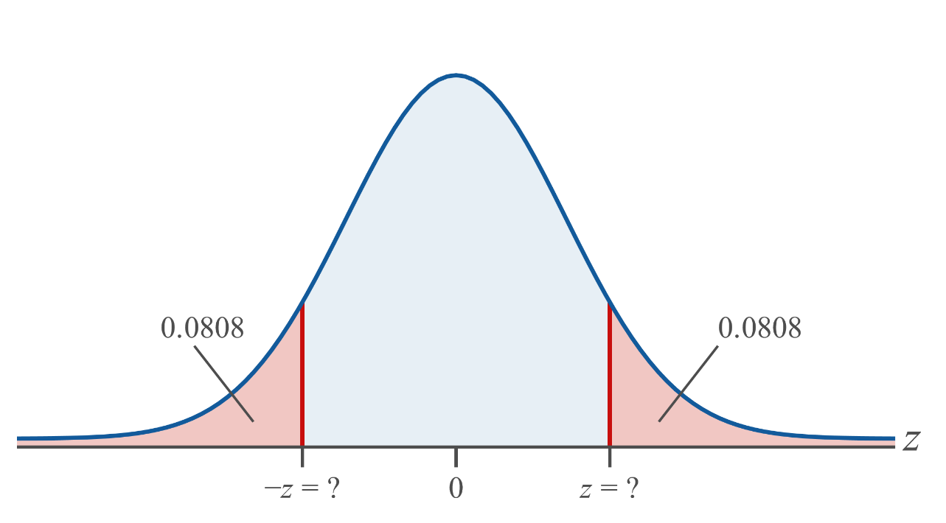
Example 6.4.5: Finding the z-value with a Given Area in the Tails to the Left of −z and to the Right of z (cont.)

Slide 44

Example 6.4.5: Finding the z-value with a Given Area in the Tails to the Left of −z and to the Right of z (cont.)
Tables:
Scan through the interior of the cumulative normal table for an area of 0.0808. The corresponding $z$-value is $−z=−1.40$.

Slide 45
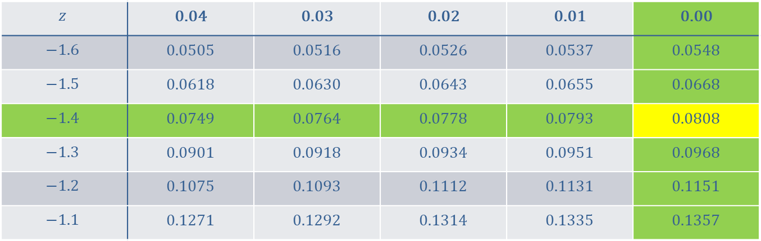
Example 6.4.5: Finding the z-value with a Given Area in the Tails to the Left of −z and to the Right of z (cont.)
$$z$$ | 0.04 | 0.03 | 0.02 | 0.01 | 0.00
$$−1.6$$ | 0.0505 | 0.0516 | 0.0526 | 0.0537 | 0.0548
$$−1.5$$ | 0.0618 | 0.0630 | 0.0643 | 0.0655 | 0.0668
$$−1.4$$ | 0.0749 | 0.0764 | 0.0778 | 0.0793 | 0.0808
$$−1.3$$ | 0.0901 | 0.0918 | 0.0934 | 0.0951 | 0.0968
$$−1.2$$ | 0.1075 | 0.1093 | 0.1112 | 0.1131 | 0.1151
$$−1.1$$ | 0.1271 | 0.1292 | 0.1314 | 0.1335 | 0.1357

Slide 46
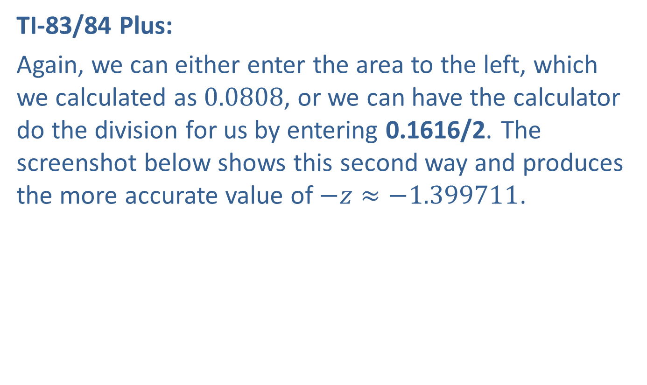
Example 6.4.5: Finding the z-value with a Given Area in the Tails to the Left of −z and to the Right of z (cont.)
TI-83/84 Plus:
Again, we can either enter the area to the left, which we calculated as 0.0808, or we can have the calculator do the division for us by entering 0.1616/2. The screenshot below shows this second way and produces the more accurate value of $−z≈−1.399711$.

Slide 47
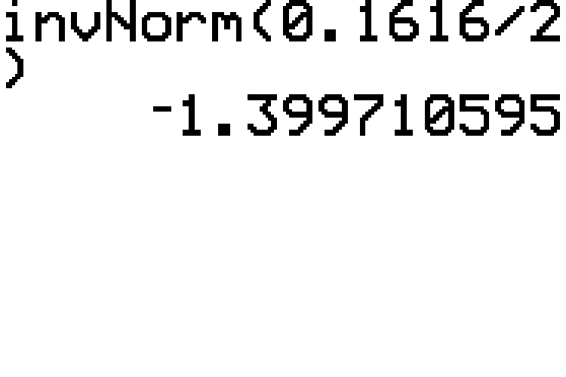
Example 6.4.5: Finding the z-value with a Given Area in the Tails to the Left of −z and to the Right of z (cont.)

Slide 48

Example 6.4.5: Finding the z-value with a Given Area in the Tails to the Left of −z and to the Right of z (cont.)
Thus, the $z$-value such that the area to the left of $−z$ plus the area to the right of $z$ amounts to 0.1616 is approximately 1.40.

Slide 49
Example 6.4.6: Finding the Value of a Normally Distributed Random Variable That Represents a Given Percentile
At his most recent well-being checkup, Ethan’s doctor told him that for his age, his cholesterol level was in a good range at the 60th percentile. Assume cholesterol levels are approximately normally distributed with a mean of 189.1 mg/dL and a standard deviation of 37.8 mg/dL for Ethan’s age group. What was Ethan’s cholesterol level at his last checkup? Round to two decimal places.

Slide 50
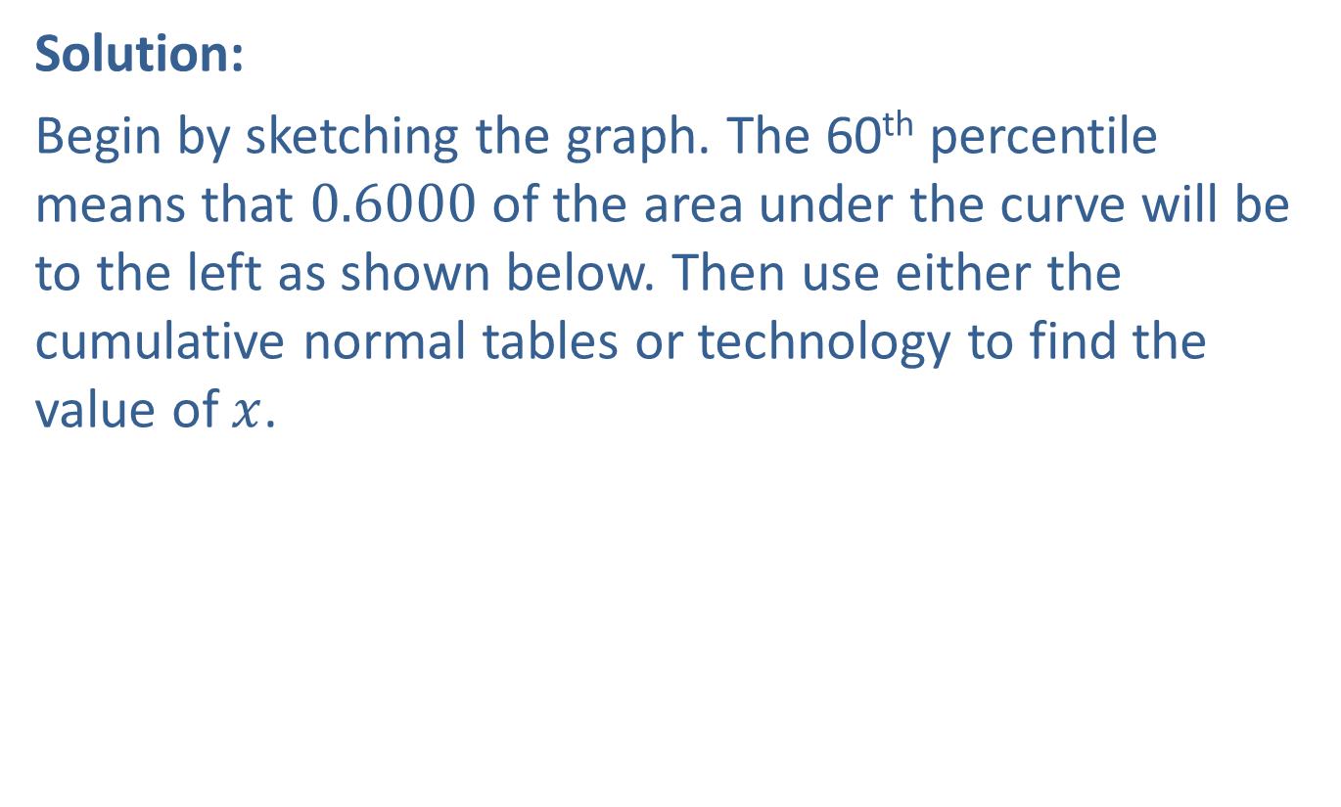
Example 6.4.6: Finding the Value of a Normally Distributed Random Variable That Represents a Given Percentile (cont.)
Solution:
Begin by sketching the graph. The 60th percentile means that 0.6000 of the area under the curve will be to the left as shown below. Then use either the cumulative normal tables or technology to find the value of $x$.

Slide 51
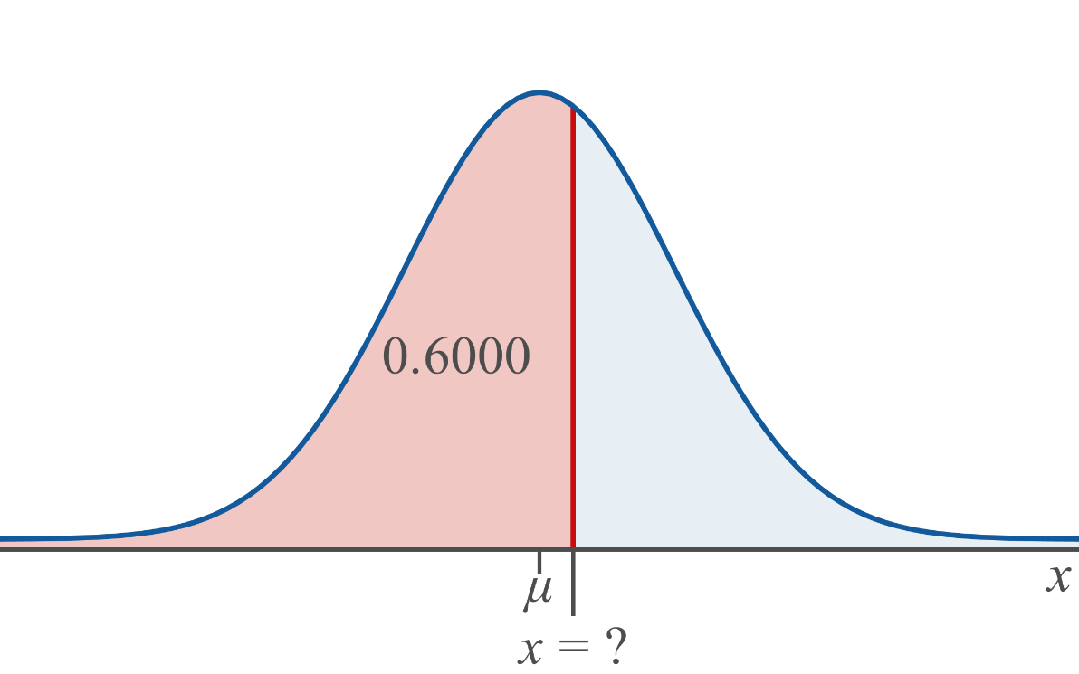
Example 6.4.6: Finding the Value of a Normally Distributed Random Variable That Represents a Given Percentile (cont.)

Slide 52
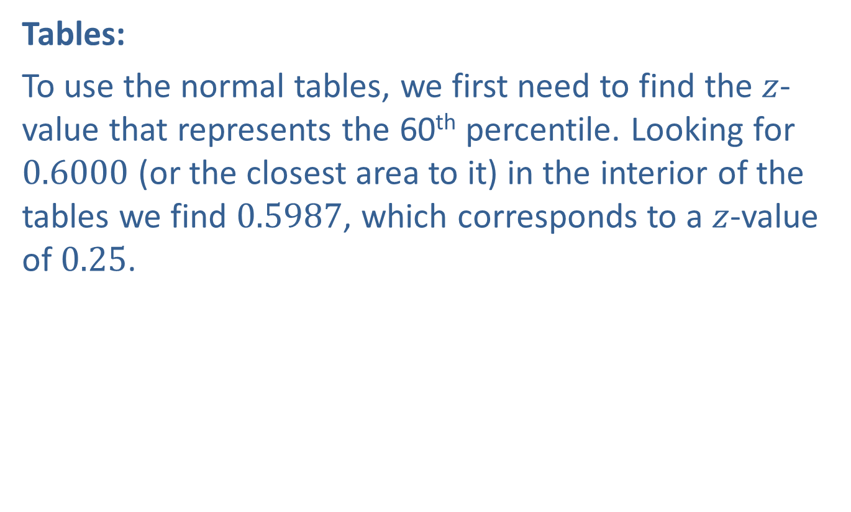
Example 6.4.6: Finding the Value of a Normally Distributed Random Variable That Represents a Given Percentile (cont.)
Tables:
To use the normal tables, we first need to find the $z$-value that represents the 60th percentile. Looking for 0.6000 (or the closest area to it) in the interior of the tables we find 0.5987, which corresponds to a $z$-value of 0.25.

Slide 53
Example 6.4.6: Finding the Value of a Normally Distributed Random Variable That Represents a Given Percentile (cont.)
z | 0.02 | 0.03 | 0.04 | 0.05 | 0.06
0.0 | 0.5080 | 0.5120 | 0.5160 | 0.5199 | 0.5239
0.1 | 0.5478 | 0.5517 | 0.5557 | 0.5596 | 0.5636
0.2 | 0.5871 | 0.5910 | 0.5948 | 0.5987 | 0.6026
0.3 | 0.6255 | 0.6293 | 0.6331 | 0.6368 | 0.6406
0.4 | 0.6628 | 0.6664 | 0.6700 | 0.6736 | 0.6772
0.5 | 0.6985 | 0.7019 | 0.7054 | 0.7088 | 0.7123

Slide 54
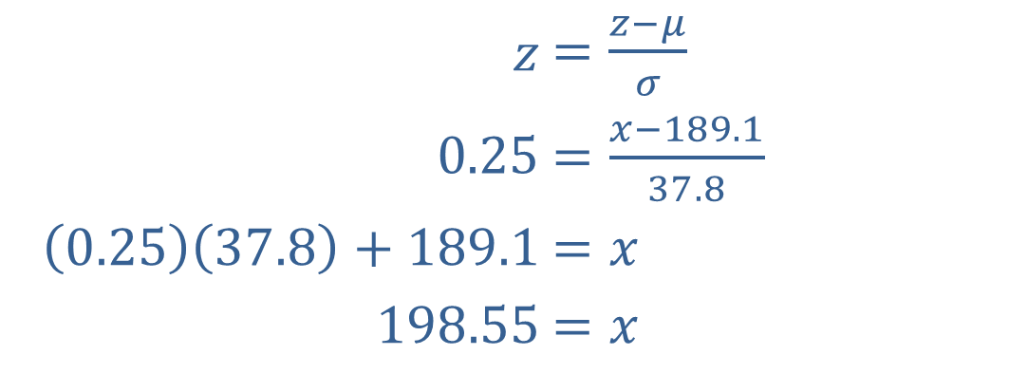

Example 6.4.6: Finding the Value of a Normally Distributed Random Variable That Represents a Given Percentile (cont.)
We can now substitute this value, along with the mean and standard deviation, in the formula for standard scores and use algebra to find the $x$ value.
​$z$ | ​$=\frac{z−μ}{σ}$
​$0.25$ | ​$=\frac{x−189.1}{37.8}$
​$\left(0.25\right)\left(37.8\right)+189.1$ | ​$=x$
​$198.55$ | ​$=x$

Slide 55
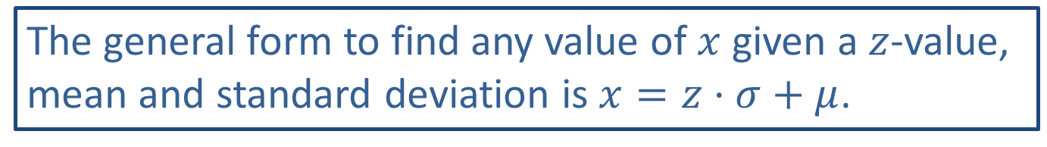
Memory Booster
The general form to find any value of $x$ given a $z$-value, mean and standard deviation is $x=z⋅σ+μ$.

Slide 56

Example 6.4.6: Finding the Value of a Normally Distributed Random Variable That Represents a Given Percentile (cont.)
Notice that by rearranging the $z$-score formula in general, we can use it to find any value of $x$, given the $z$-value, mean, and standard deviation. The general form is then $x=z⋅σ+μ$.

Slide 57

Example 6.4.6: Finding the Value of a Normally Distributed Random Variable That Represents a Given Percentile (cont.)
TI-83/84 Plus:
We can find the value of the normally distributed variable in one step using the calculator. The function syntax is invNorm(area, $μ$, $σ$), where area is the area to the left of $x$.
Here we have
$$area=0.6000$$
$$μ=189.1$$
$$σ=37.8$$
Enter invNorm(0.6000, 189.1, 37.8), as shown in the screenshot below. The calculator gives the more accurate value of 198.67.

Slide 58

Example 6.4.6: Finding the Value of a Normally Distributed Random Variable That Represents a Given Percentile (cont.)

Slide 59

Example 6.4.6: Finding the Value of a Normally Distributed Random Variable That Represents a Given Percentile (cont.)
The answer would be reported as 198.55 if using the tables and 198.67 if using the calculator. Therefore, Ethan had a cholesterol level of approximately $199\frac{mg}{dl}$.

Slide 60

Example 6.4.7: Finding the Value of a Normally Distributed Random Variable That Represents a Given Quartile
Let's assume that the lengths of newborn full-term babies in the United States are normally distributed with a mean length of 20.0 inches and a standard deviation of 1.2 inches. What is the minimum length that a baby could be and still have a length that is amongst the top $25\%$ of baby lengths? Round to one decimal place.

Slide 61

Example 6.4.7: Finding the Value of a Normally Distributed Random Variable That Represents a Given Quartile (cont.)
Solution
If we want to find the minimum length for the top $25\%$ of baby lengths, we can simply find the value of the 75th percentile, or $Q_{3}$. A percentage of $75\%$ is the same as an area of 0.75 under the normal distribution.

Slide 62

Example 6.4.7: Finding the Value of a Normally Distributed Random Variable That Represents a Given Quartile (cont.)

Slide 63

Example 6.4.7: Finding the Value of a Normally Distributed Random Variable That Represents a Given Quartile (cont.)
Tables:
We will begin by finding the $z$-score that has an area of 0.75 to its left. Scan through the interior of the cumulative normal table for an area of 0.7500. The closest corresponding $z$-value is $z=0.67$.

Slide 64
Example 6.4.7: Finding the Value of a Normally Distributed Random Variable That Represents a Given Quartile (cont.)
z | 0.05 | 0.06 | 0.07 | 0.08 | 0.09
0.4 | 0.6736 | 0.6722 | 0.6808 | 0.6844 | 0.6879
0.5 | 0.7088 | 0.7123 | 0.7157 | 0.7190 | 0.7224
0.6 | 0.7422 | 0.7454 | 0.7486 | 0.7517 | 0.7549
0.7 | 0.7734 | 0.7764 | 0.7794 | 0.7823 | 0.7852
0.8 | 0.8023 | 0.8051 | 0.8078 | 0.8106 | 0.8133
0.9 | 0.8289 | 0.8315 | 0.8340 | 0.8365 | 0.8389

Slide 65

Example 6.4.7: Finding the Value of a Normally Distributed Random Variable That Represents a Given Quartile (cont.)
Now that we know the value of $z$, we will use it along with the mean and standard deviation to calculate the corresponding value of the random variable $X$ that represents the length of the baby. We can use the formula for $x$ that we saw previously.
𝑥=𝑧⋅𝜎+𝜇𝑥=0.671.2+20𝑥≈20.8

Slide 66

Example 6.4.7: Finding the Value of a Normally Distributed Random Variable That Represents a Given Quartile (cont.)
TI-83/84 Plus:
We can find the value of the normally distributed variable in one step using the function syntax invNorm(area, μ, σ), where area is the area to the left.
Here we have
$$area=0.7500$$
$$μ=20.0$$
$$σ=1.2$$
Enter invNorm(0.7500, 20, 1.2), as shown in the screenshot below. This gives a value of 20.8 rounded to one decimal place.

Slide 67

Example 6.4.7: Finding the Value of a Normally Distributed Random Variable That Represents a Given Quartile (cont.)

Slide 68

Example 6.4.7: Finding the Value of a Normally Distributed Random Variable That Represents a Given Quartile (cont.)
Therefore the minimum length a baby can be and still be in the top $25\%$ of lengths of full-term newborn babies is approximately 20.8 inches.

