Slide 1
Section 6.5
Approximating a Binomial Distribution Using a Normal Distribution

Slide 2
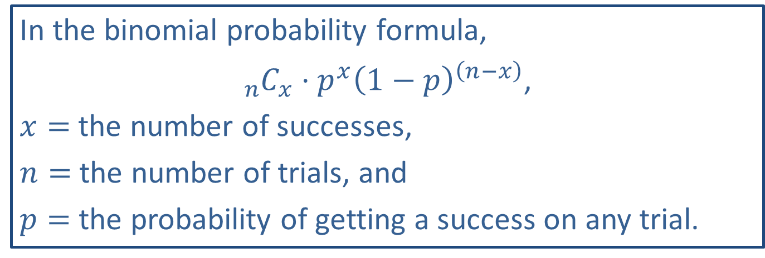
Memory Booster:
In the binomial probability formula,
${}_{n}^{ }{C_{x}}⋅p^{x}{\left(1−p\right)}^{\left(n−x\right)}$,
$x=$ the number of successes,
$n=$ the number of trials, and
$p=$ the probability of getting a success on any trial.

Slide 3
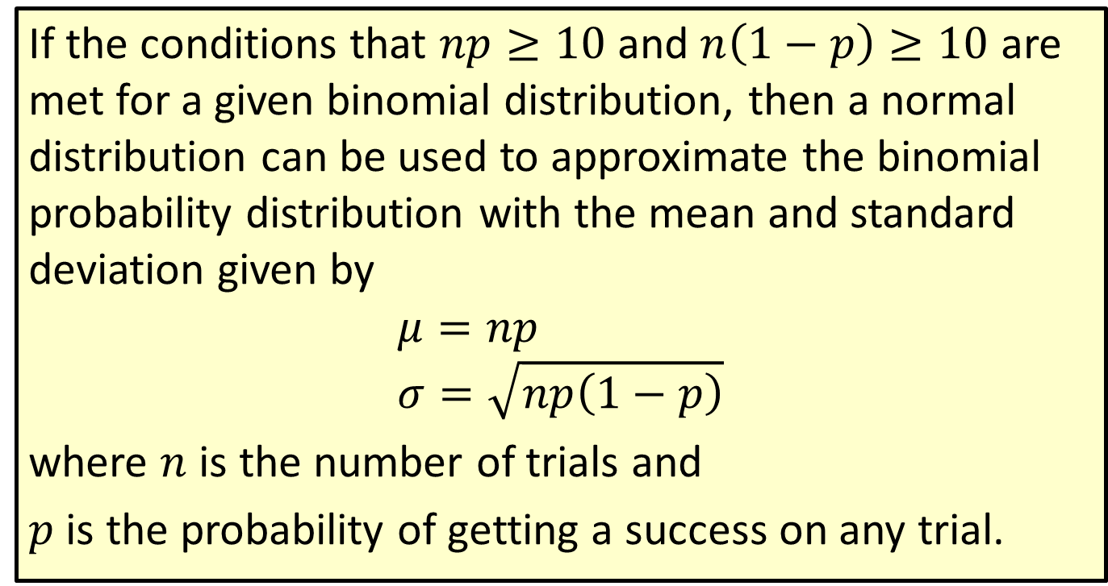
Formula: Normal Distribution Approximation of a Binomial Distribution
If the conditions that $np≥10$ and $n\left(1−p\right)≥10$ are met for a given binomial distribution, then a normal distribution can be used to approximate the binomial probability distribution with the mean and standard deviation given by
$$μ=np \\ σ=\sqrt{np\left(1−p\right)}$$
where $n$ is the number of trials and
$p$ is the probability of getting a success on any trial.

Slide 4
Continuity Correction
Definition
A continuity correction is a correction factor used to convert a value of a discrete random variable to an interval range of a continuous random variable when using a continuous distribution to approximate a discrete distribution.

Slide 5
Example 6.5.1: Using the Continuity Correction Factor with a Normal Distribution to Approximate a Binomial Probability
Use the continuity correction factor to describe the area under the normal curve that approximates the probability that at least 2 people in a statistics class of 50 students regularly cheat on their math tests. Assume that the number of people in a statistics class of 50 students who consistently cheat on their math tests has a binomial distribution with a mean of 5.00 and a standard deviation of approximately 2.12.

Slide 6
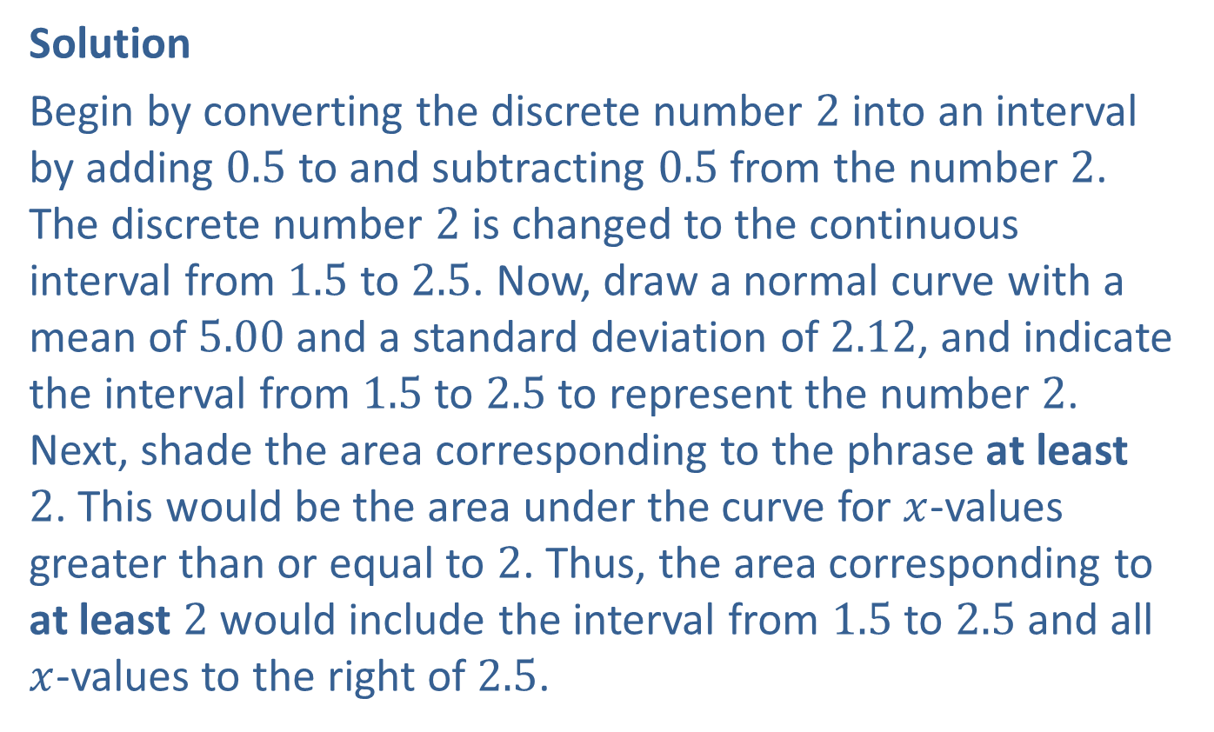
Example 6.5.1: Using the Continuity Correction Factor with a Normal Distribution to Approximate a Binomial Probability (cont.)
Solution
Begin by converting the discrete number 2 into an interval by adding 0.5 to and subtracting 0.5 from the number 2. The discrete number 2 is changed to the continuous interval from 1.5 to 2.5. Now, draw a normal curve with a mean of 5.00 and a standard deviation of 2.12, and indicate the interval from 1.5 to 2.5 to represent the number 2. Next, shade the area corresponding to the phrase at least 2. This would be the area under the curve for $x$-values greater than or equal to 2. Thus, the area corresponding to at least 2 would include the interval from 1.5 to 2.5 and all $x$-values to the right of 2.5.

Slide 7
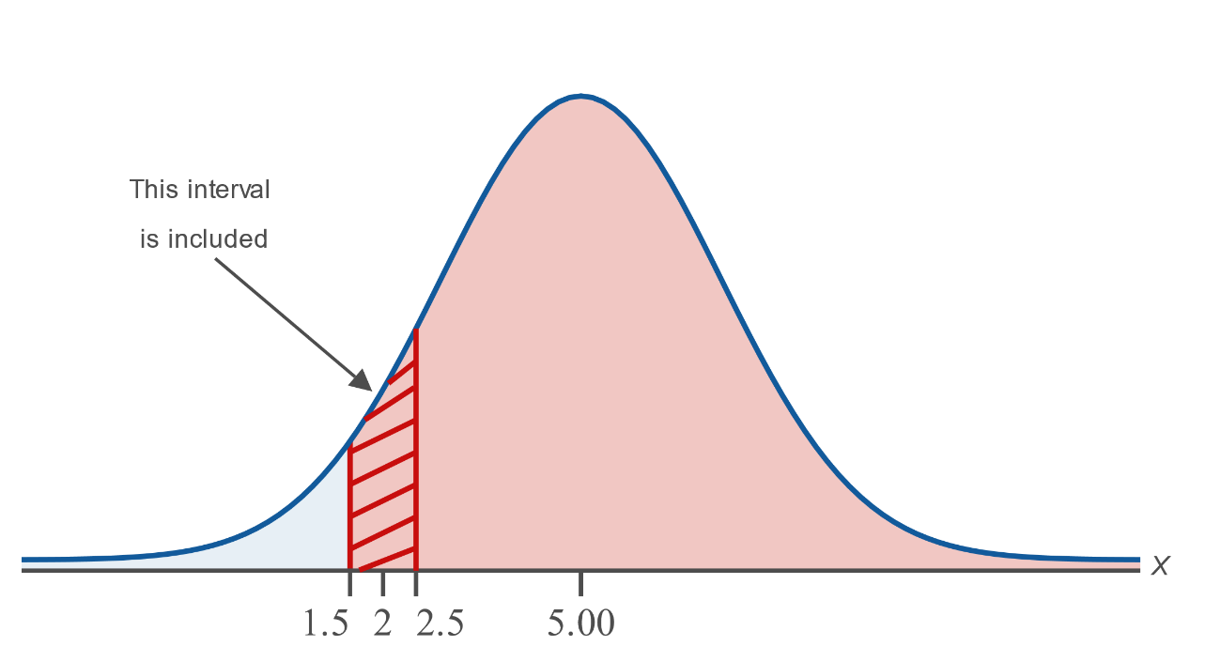
Example 6.5.1: Using the Continuity Correction Factor with a Normal Distribution to Approximate a Binomial Probability (cont.)
Thus, the area under the normal curve with a mean of 5.00 and a standard deviation of 2.12 that approximates the probability that at least 2 people in the statistics class regularly cheat on their math tests is the area to the right of 1.5.

Slide 8
Example 6.5.2: Using the Continuity Correction Factor with a Normal Distribution to Approximate a Binomial Probability
Use the continuity correction factor to describe the area under the normal curve that approximates the probability that fewer than 5 out of the 25 students on the 4th floor of a dorm went to high school within a 30 mile radius of the campus. Assume that the number of students who went to high school within a 30 mile radius of the campus on any given dorm floor with 25 residents has a binomial distribution with a mean of 7.00 and a standard deviation of approximately 2.16.

Slide 9
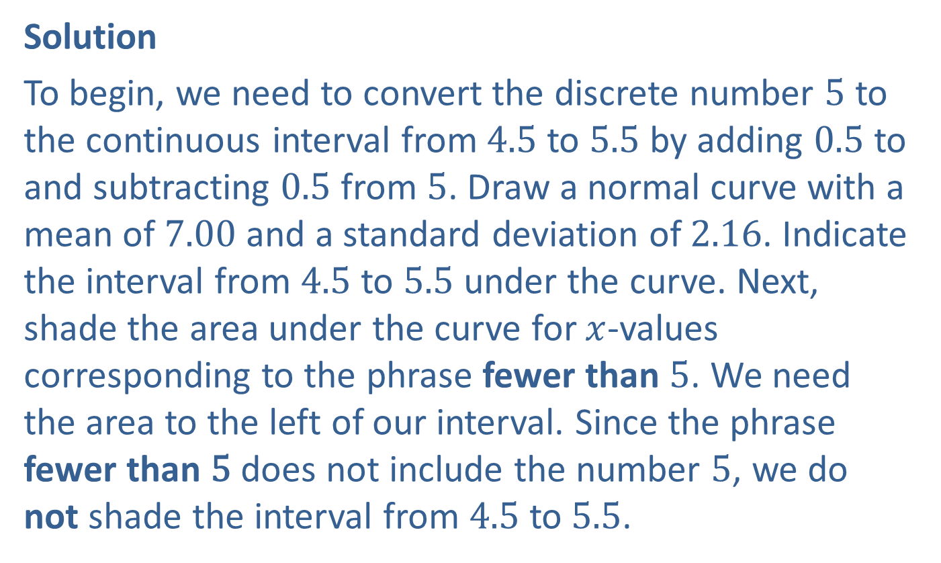
Example 6.5.2: Using the Continuity Correction Factor with a Normal Distribution to Approximate a Binomial Probability (cont.)
Solution
To begin, we need to convert the discrete number 5 to the continuous interval from 4.5 to 5.5 by adding 0.5 to and subtracting 0.5 from 5. Draw a normal curve with a mean of 7.00 and a standard deviation of 2.16. Indicate the interval from 4.5 to 5.5 under the curve. Next, shade the area under the curve for $x$-values corresponding to the phrase fewer than 5. We need the area to the left of our interval. Since the phrase fewer than 5 does not include the number 5, we do not shade the interval from 4.5 to 5.5.

Slide 10
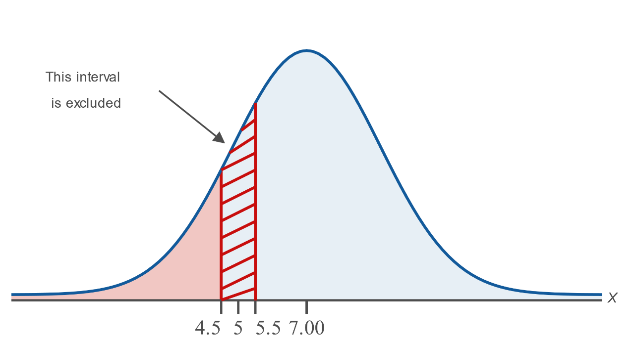
Example 6.5.2: Using the Continuity Correction Factor with a Normal Distribution to Approximate a Binomial Probability (cont.)

Slide 11
Example 6.5.2: Using the Continuity Correction Factor with a Normal Distribution to Approximate a Binomial Probability (cont.)
Thus, the area under the normal curve with a mean of 7.00 and a standard deviation of 2.16 that approximates the probability that fewer than 5 students on the 4th floor of the dorm went to high school within a 30 mile radius of the campus is the area to the left of 4.5.

Slide 12
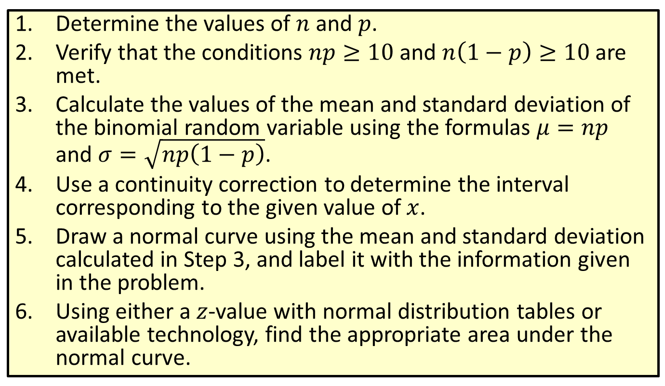
Procedure: Using a Normal Distribution to Approximate a Binomial Distribution
​Determine the values of $n$ and $p$.
​Verify that the conditions $np≥10$ and $n\left(1−p\right)≥10$ are met.
​Calculate the values of the mean and standard deviation of the binomial random variable using the formulas $μ=np$ and $σ=\sqrt{np\left(1−p\right)}$.
​Use a continuity correction to determine the interval corresponding to the given value of $x$.
​Draw a normal curve using the mean and standard deviation calculated in Step 3, and label it with the information given in the problem.
​Using either a $z$-value with normal distribution tables or available technology, find the appropriate area under the normal curve.

Slide 13
Example 6.5.3: Using a Normal Distribution to Approximate a Binomial Probability of the Form P(X > x)
Antibiotic therapy for acute maxillary sinusitis (inflamed sinuses) has a clinical cure rate of 90 percent in patients. Use a normal distribution to estimate the probability that the antibiotic therapy will be successful in more than 100 patients out of the 112 diagnosed with acute maxillary sinusitis at a hospital over one year.

Slide 14
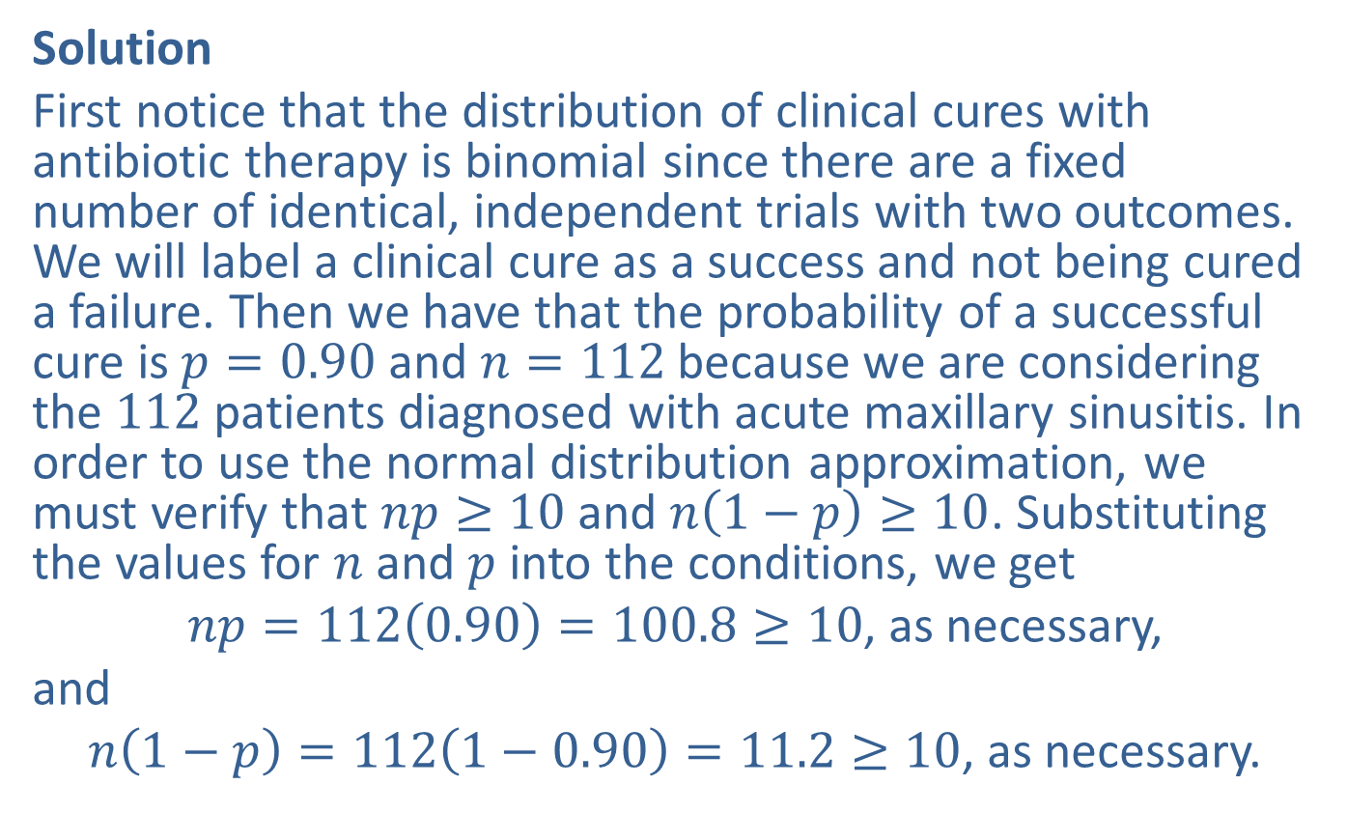
Example 6.5.3: Using a Normal Distribution to Approximate a Binomial Probability of the Form P(X > x) (cont.)
Solution
First notice that the distribution of clinical cures with antibiotic therapy is binomial since there are a fixed number of identical, independent trials with two outcomes. We will label a clinical cure as a success and not being cured a failure. Then we have that the probability of a successful cure is $p=0.90$ and $n=112$ because we are considering the 112 patients diagnosed with acute maxillary sinusitis. In order to use the normal distribution approximation, we must verify that $np≥10$ and $n\left(1−p\right)≥10$. Substituting the values for $n$ and $p$ into the conditions, we get
$np=112\left(0.90\right)=100.8≥10$, as necessary,
and
$n\left(1−p\right)=112\left(1−0.90\right)=11.2≥10$, as necessary.

Slide 15
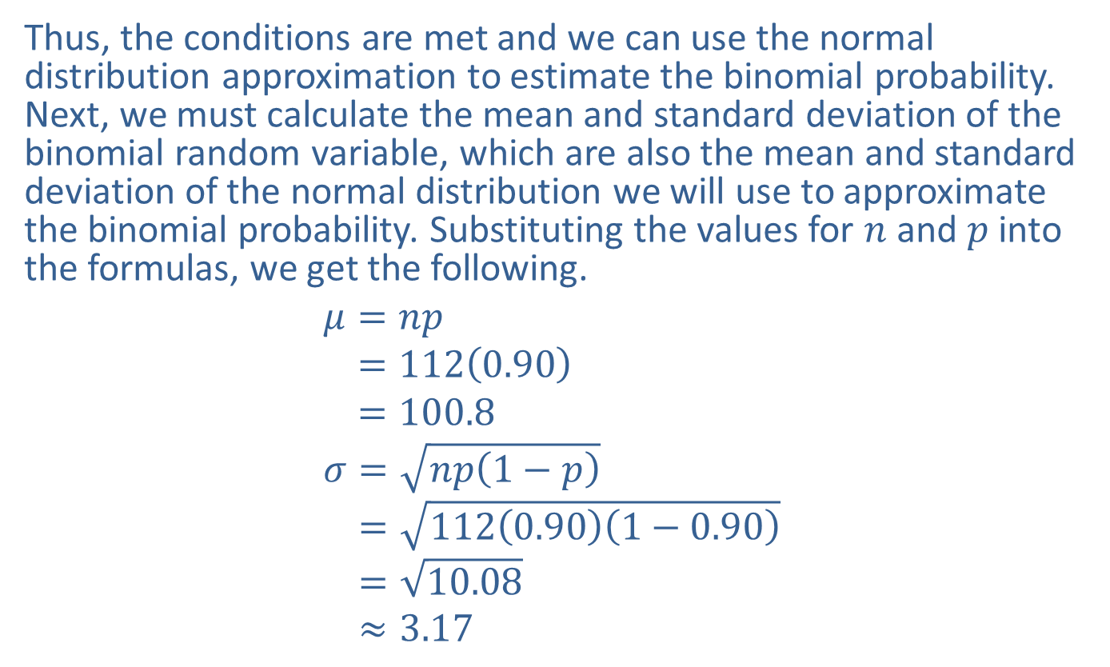
Example 6.5.3: Using a Normal Distribution to Approximate a Binomial Probability of the Form P(X > x) (cont.)
Thus, the conditions are met and we can use the normal distribution approximation to estimate the binomial probability. Next, we must calculate the mean and standard deviation of the binomial random variable, which are also the mean and standard deviation of the normal distribution we will use to approximate the binomial probability. Substituting the values for $n$ and $p$ into the formulas, we get the following.
𝜇=𝑛𝑝𝜇=1120.90𝜇=100.8𝜎=𝑛𝑝1−𝑝𝜎=1120.901−0.90𝜎=10.08𝜎≈3.17

Slide 16
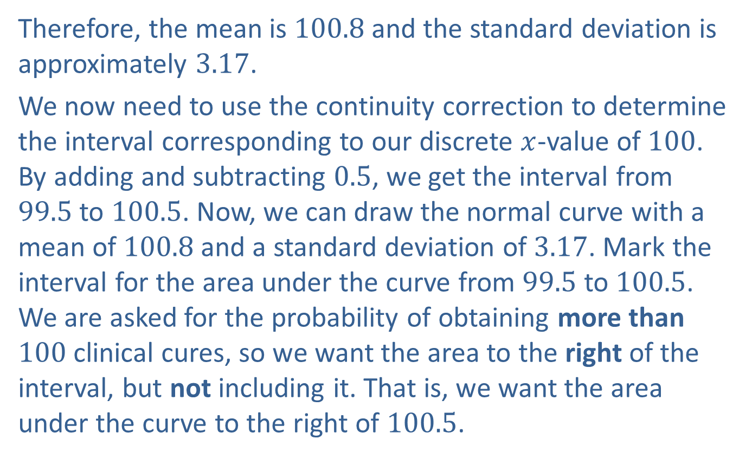
Example 6.5.3: Using a Normal Distribution to Approximate a Binomial Probability of the Form P(X > x) (cont.)
Therefore, the mean is 100.8 and the standard deviation is approximately 3.17.
We now need to use the continuity correction to determine the interval corresponding to our discrete $x$-value of 100. By adding and subtracting 0.5, we get the interval from 99.5 to 100.5. Now, we can draw the normal curve with a mean of 100.8 and a standard deviation of 3.17. Mark the interval for the area under the curve from 99.5 to 100.5. We are asked for the probability of obtaining more than 100 clinical cures, so we want the area to the right of the interval, but not including it. That is, we want the area under the curve to the right of 100.5.

Slide 17
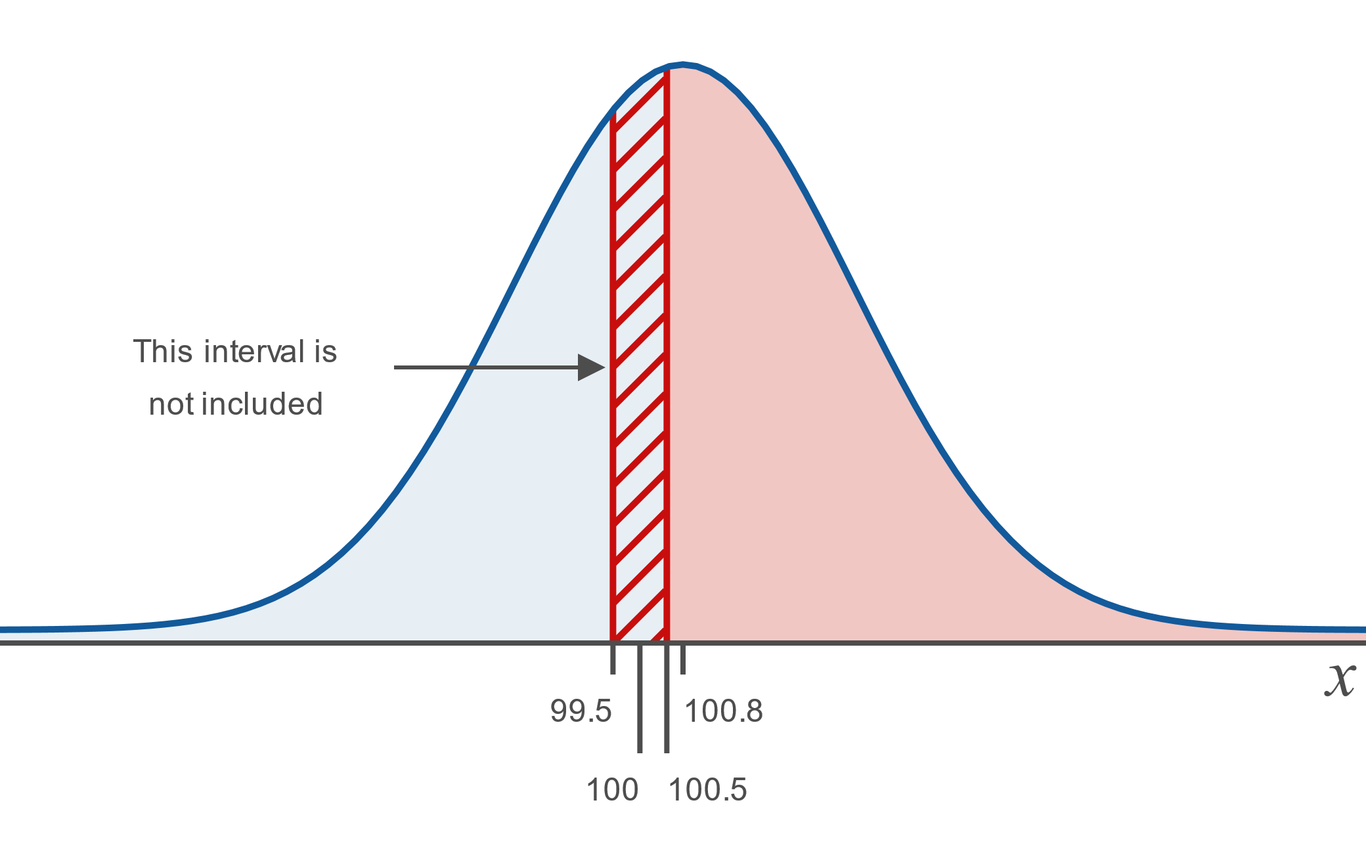
Example 6.5.3: Using a Normal Distribution to Approximate a Binomial Probability of the Form P(X > x) (cont.)

Slide 18
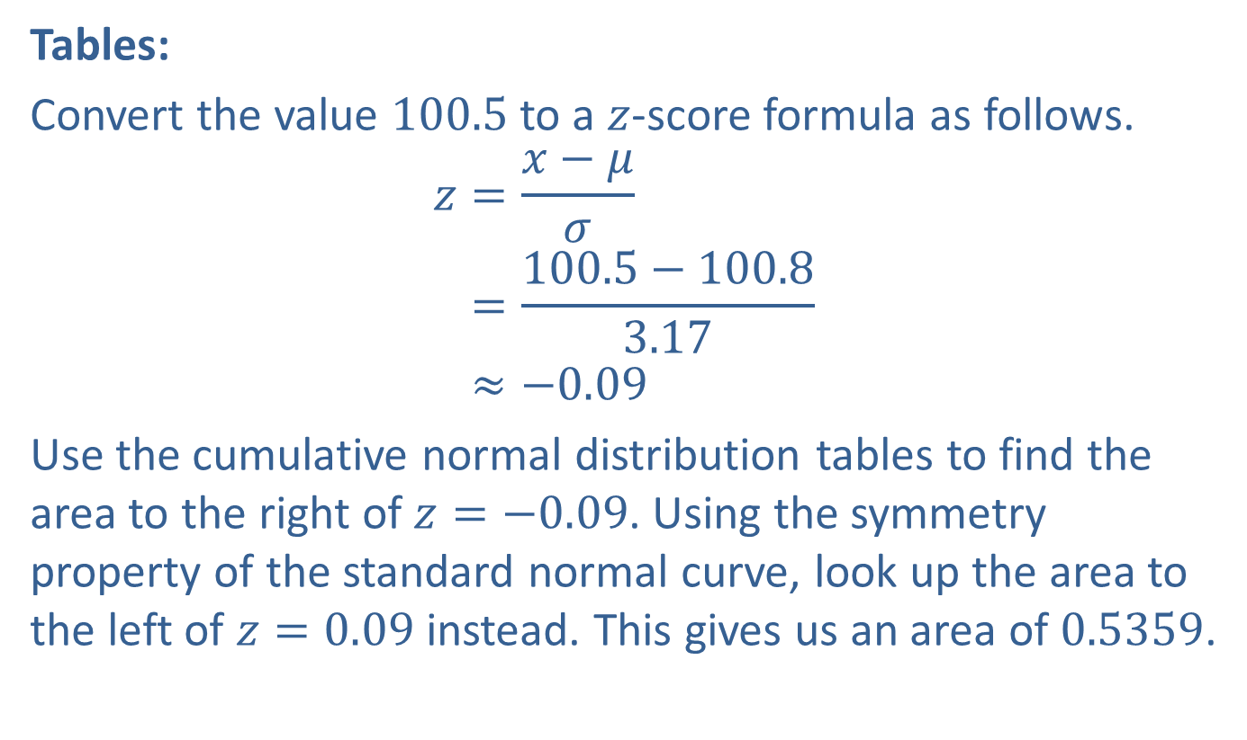
Example 6.5.3: Using a Normal Distribution to Approximate a Binomial Probability of the Form P(X > x) (cont.)
Tables:
Convert the value 100.5 to a $z$-score formula as follows.
𝑧=𝑥−𝜇𝜎𝑧=100.5−100.83.17𝑧≈−0.09
Use the cumulative normal distribution tables to find the area to the right of $z=−0.09$. Using the symmetry property of the standard normal curve, look up the area to the left of $z=0.09$ instead. This gives us an area of 0.5359.

Slide 19
Memory Booster
Using a normal distribution to approximate a binomial probability results in an approximate answer.

Slide 20
Technology Tip
To enter very large (or small) numbers on the TI-83/84 calculator, press 1 (or − 1) 2ND, 9 9.

Slide 21
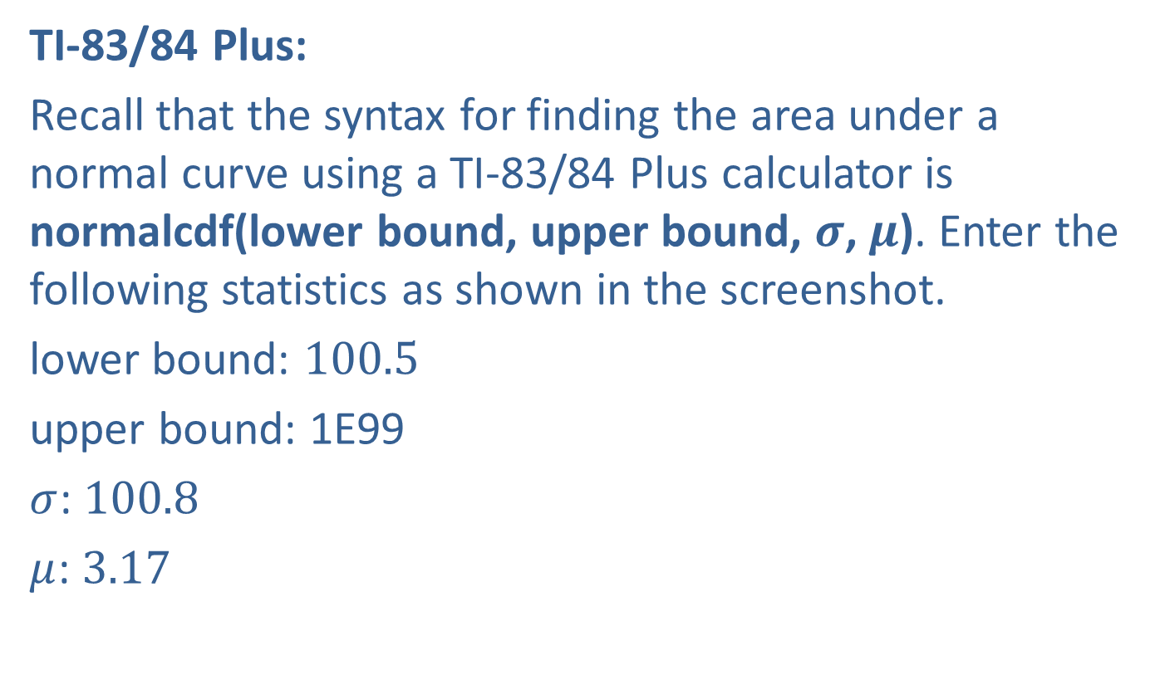
Example 6.5.3: Using a Normal Distribution to Approximate a Binomial Probability of the Form P(X > x) (cont.)
TI-83/84 Plus:
Recall that the syntax for finding the area under a normal curve using a TI-83/84 Plus calculator is normalcdf(lower bound, upper bound, $σ$, $μ$). Enter the following statistics as shown in the screenshot.
lower bound: 100.5
upper bound: 1E99
$σ$: 100.8
$μ$: 3.17

Slide 22
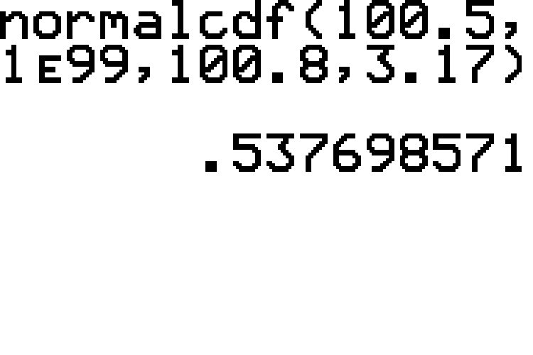
Example 6.5.3: Using a Normal Distribution to Approximate a Binomial Probability of the Form P(X > x) (cont.)

Slide 23
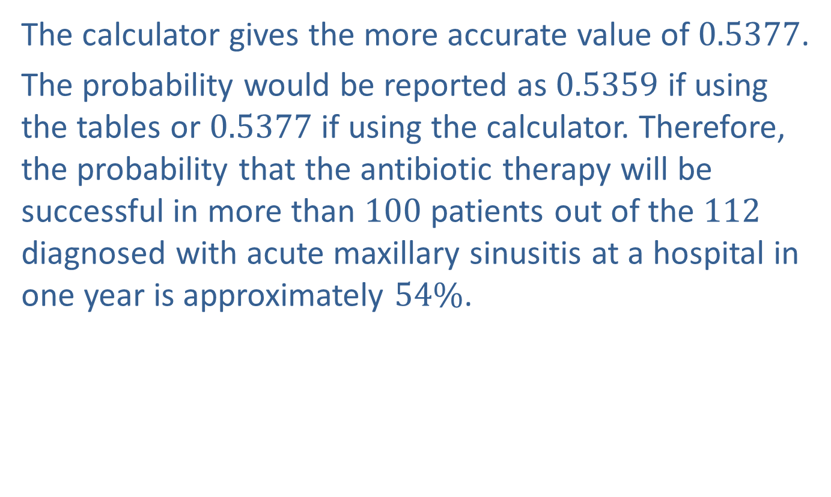
Example 6.5.3: Using a Normal Distribution to Approximate a Binomial Probability of the Form P(X > x) (cont.)
The calculator gives the more accurate value of 0.5377.
The probability would be reported as 0.5359 if using the tables or 0.5377 if using the calculator. Therefore, the probability that the antibiotic therapy will be successful in more than 100 patients out of the 112 diagnosed with acute maxillary sinusitis at a hospital in one year is approximately $54\%$.

Slide 24
Technology
For further instructions on finding normal probabilities using a TI-83/84 Plus calculator or other technology, please visit stat.hawkeslearning.com and see Technology Instructions > Normal Distribution > Normal Probability (cdf).

Slide 25
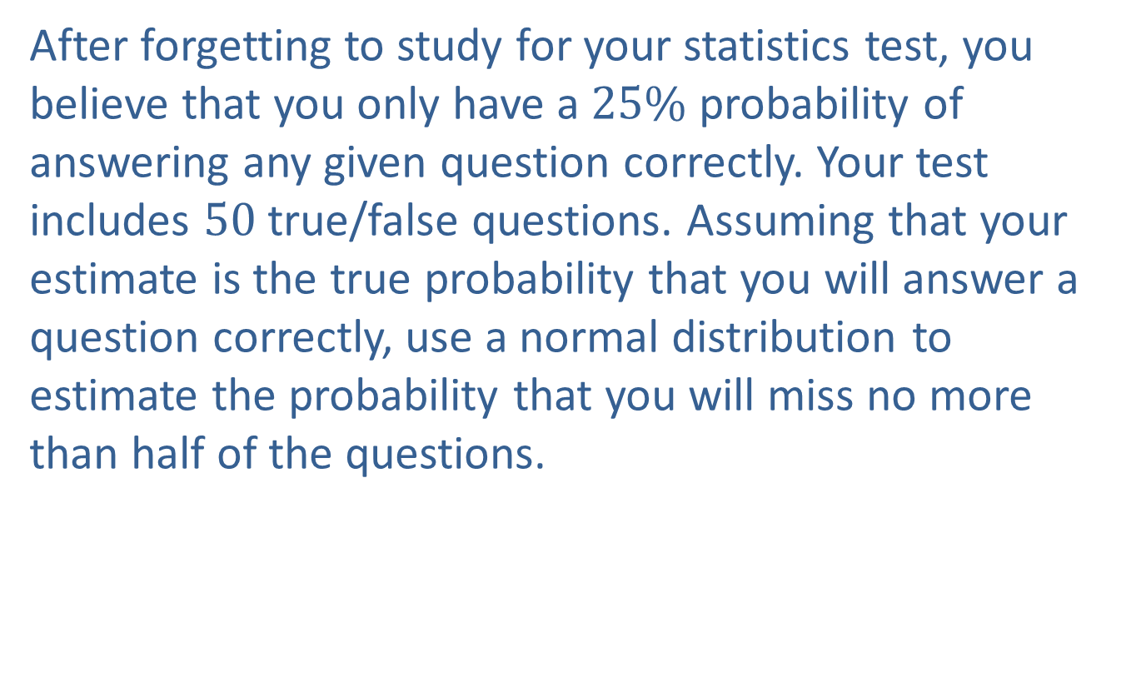
Example 6.5.4: Using a Normal Distribution to Approximate a Binomial Probability of the Form P(X ≤ x)
After forgetting to study for your statistics test, you believe that you only have a $25\%$ probability of answering any given question correctly. Your test includes 50 true/false questions. Assuming that your estimate is the true probability that you will answer a question correctly, use a normal distribution to estimate the probability that you will miss no more than half of the questions.

Slide 26
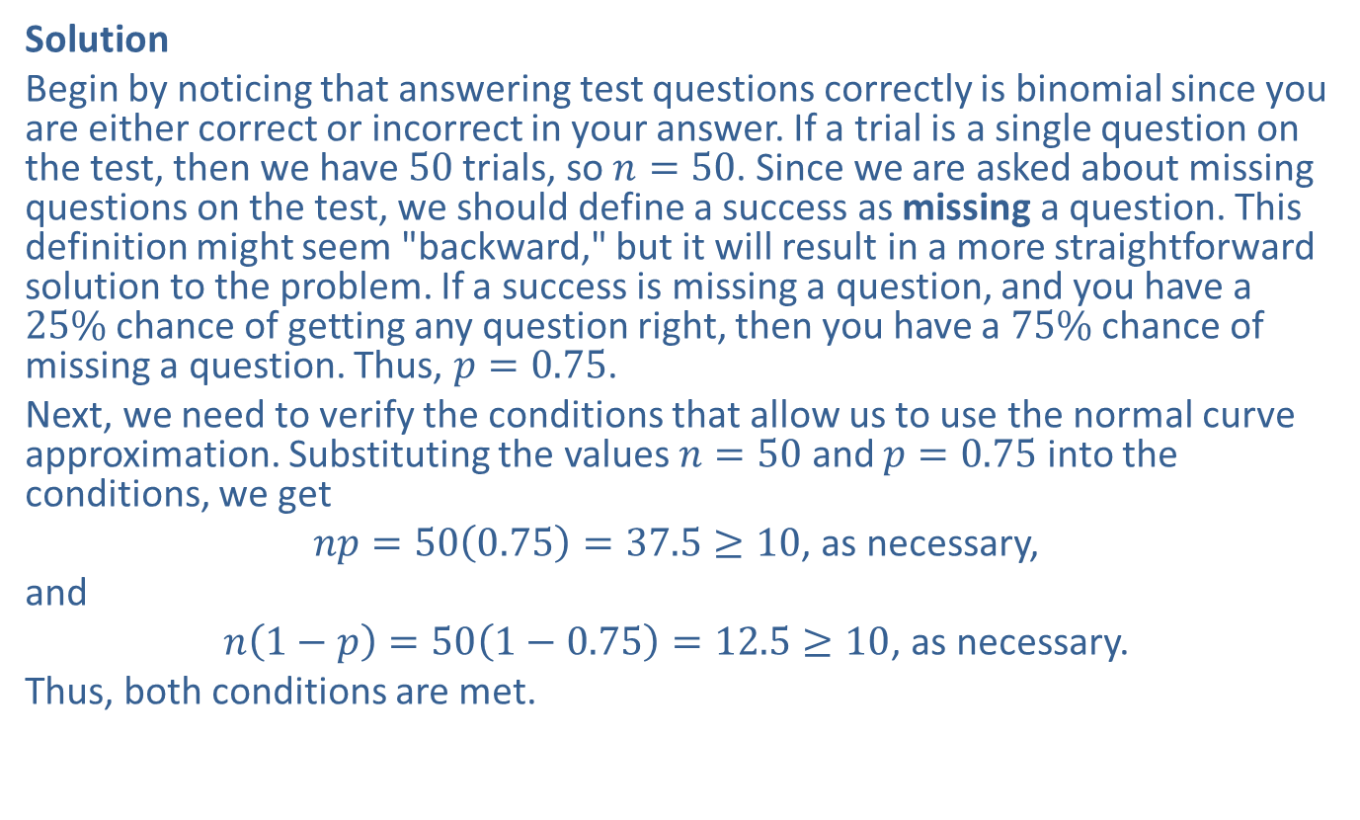
Example 6.5.4: Using a Normal Distribution to Approximate a Binomial Probability of the Form P(X ≤ x) (cont.)
Solution
Begin by noticing that answering test questions correctly is binomial since you are either correct or incorrect in your answer. If a trial is a single question on the test, then we have 50 trials, so $n=50$. Since we are asked about missing questions on the test, we should define a success as missing a question. This definition might seem "backward," but it will result in a more straightforward solution to the problem. If a success is missing a question, and you have a $25\%$ chance of getting any question right, then you have a $75\%$ chance of missing a question. Thus, $p=0.75$.
Next, we need to verify the conditions that allow us to use the normal curve approximation. Substituting the values $n=50$ and $p=0.75$ into the conditions, we get
$np=50\left(0.75\right)=37.5≥10$, as necessary,
and
$n\left(1−p\right)=50\left(1−0.75\right)=12.5≥10$, as necessary.
Thus, both conditions are met.

Slide 27
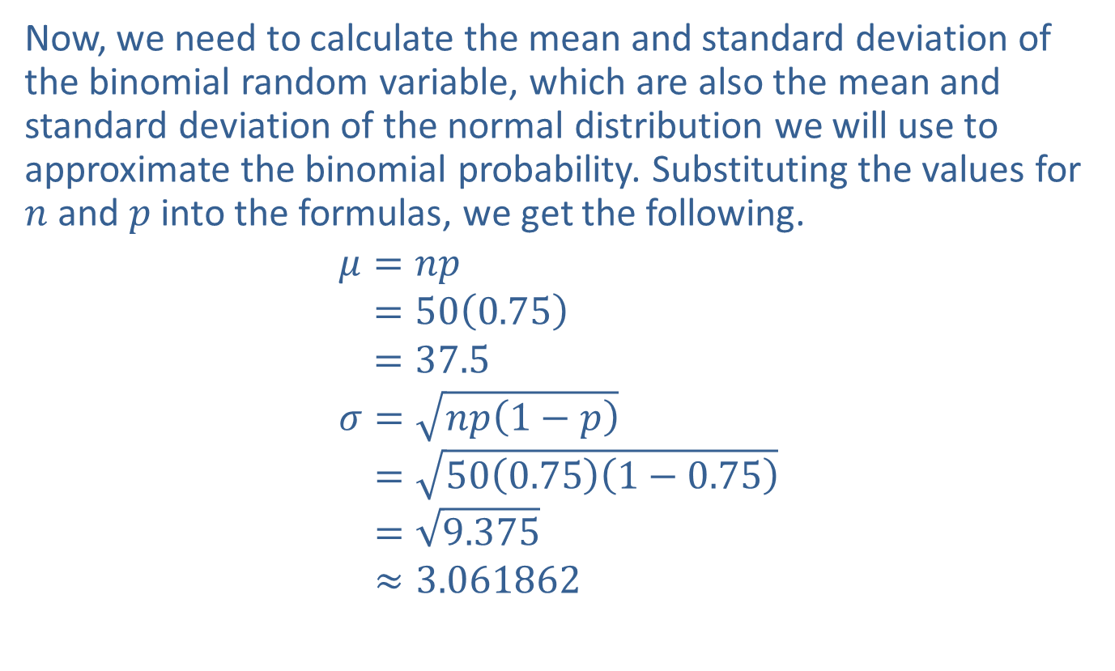
Example 6.5.4: Using a Normal Distribution to Approximate a Binomial Probability of the Form P(X ≤ x) (cont.)
Now, we need to calculate the mean and standard deviation of the binomial random variable, which are also the mean and standard deviation of the normal distribution we will use to approximate the binomial probability. Substituting the values for $n$ and $p$ into the formulas, we get the following.
𝜇=𝑛𝑝𝜇=500.75𝜇=37.5𝜎=𝑛𝑝1−𝑝𝜎=500.751−0.75𝜎=9.375𝜎≈3.061862

Slide 28
Memory Booster
Remember to leave intermediate calculations to at least six decimal places so as to reduce rounding errors.

Slide 29
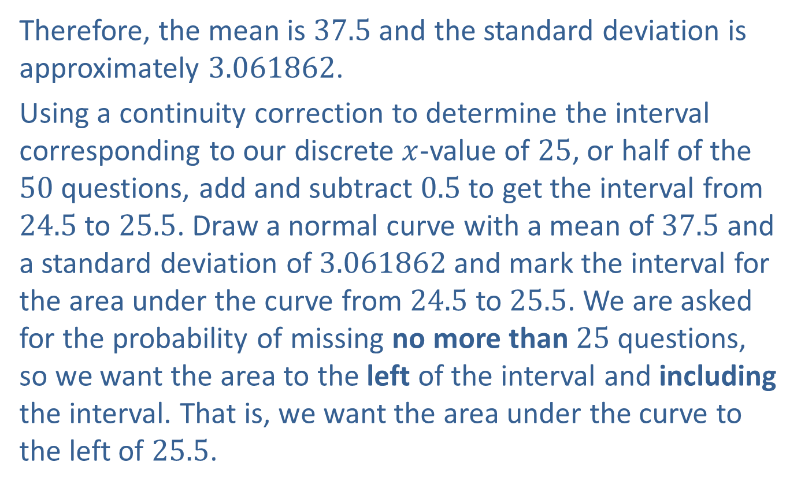
Example 6.5.4: Using a Normal Distribution to Approximate a Binomial Probability of the Form P(X ≤ x) (cont.)
Therefore, the mean is 37.5 and the standard deviation is approximately 3.061862.
Using a continuity correction to determine the interval corresponding to our discrete $x$-value of 25, or half of the 50 questions, add and subtract 0.5 to get the interval from 24.5 to 25.5. Draw a normal curve with a mean of 37.5 and a standard deviation of 3.061862 and mark the interval for the area under the curve from 24.5 to 25.5. We are asked for the probability of missing no more than 25 questions, so we want the area to the left of the interval and including the interval. That is, we want the area under the curve to the left of 25.5.

Slide 30
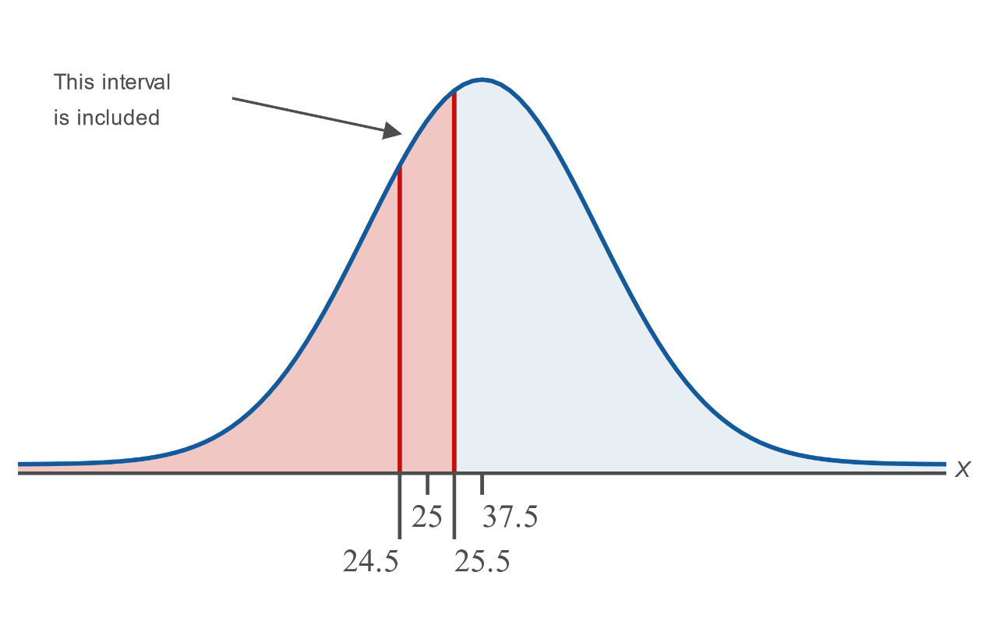
Example 6.5.4: Using a Normal Distribution to Approximate a Binomial Probability of the Form P(X ≤ x) (cont.)

Slide 31
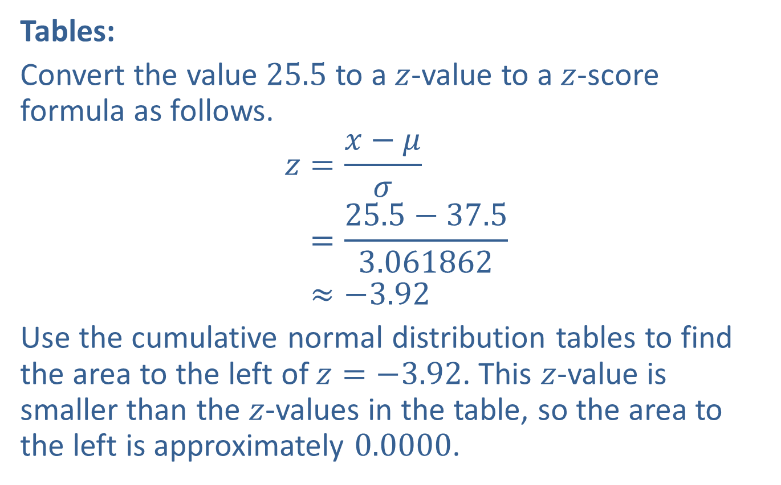
Example 6.5.4: Using a Normal Distribution to Approximate a Binomial Probability of the Form P(X ≤ x) (cont.)
Tables:
Convert the value 25.5 to a $z$-value to a $z$-score formula as follows.
𝑧=𝑥−𝜇𝜎𝑧=25.5−37.53.061862𝑧≈−3.92
Use the cumulative normal distribution tables to find the area to the left of $z=−3.92$. This $z$-value is smaller than the $z$-values in the table, so the area to the left is approximately 0.0000.

Slide 32
Example 6.5.4: Using a Normal Distribution to Approximate a Binomial Probability of the Form P(X ≤ x) (cont.)
TI-83/84 Plus:
Find the area under the normal curve to the left of 25.5 by entering the mean and standard deviation of the distribution. The probability can be found by entering normalcdf(−1E99,25.5,37.5,3.061862), as shown in the screenshot below.

Slide 33
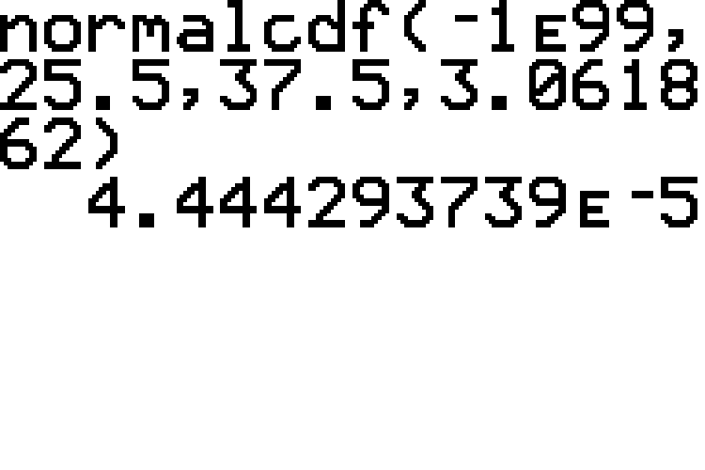
Example 6.5.4: Using a Normal Distribution to Approximate a Binomial Probability of the Form P(X ≤ x) (cont.)

Slide 34
Example 6.5.4: Using a Normal Distribution to Approximate a Binomial Probability of the Form P(X ≤ x) (cont.)
Therefore, the probability of missing no more than 25 questions out of 50 on your statistics test is approximately 0.0000.

Slide 35
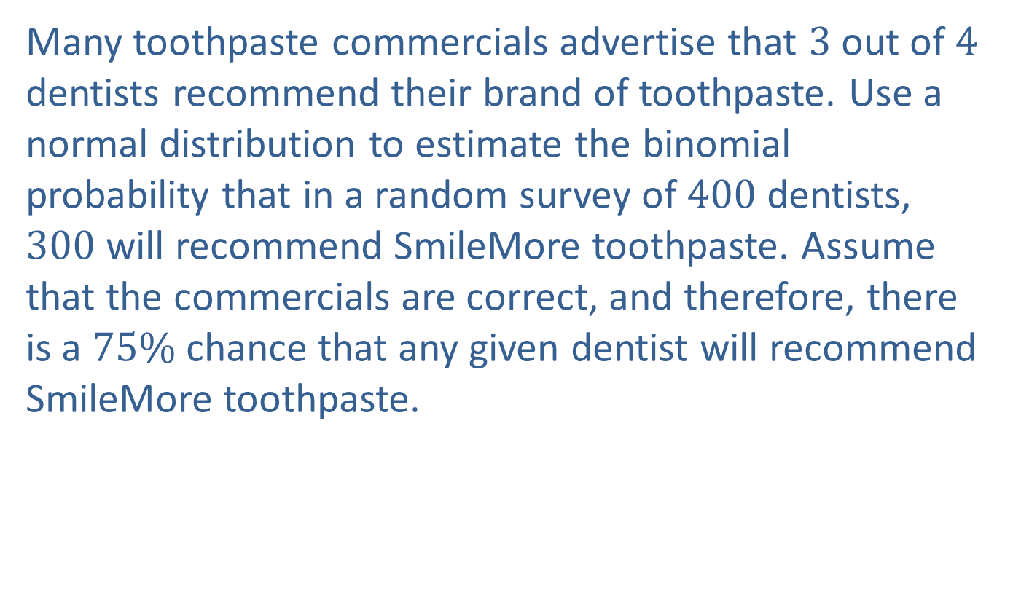
Example 6.5.5: Using a Normal Distribution to Approximate a Binomial Probability of the Form P(X = x)
Many toothpaste commercials advertise that 3 out of 4 dentists recommend their brand of toothpaste. Use a normal distribution to estimate the binomial probability that in a random survey of 400 dentists, 300 will recommend SmileMore toothpaste. Assume that the commercials are correct, and therefore, there is a $75\%$ chance that any given dentist will recommend SmileMore toothpaste.

Slide 36
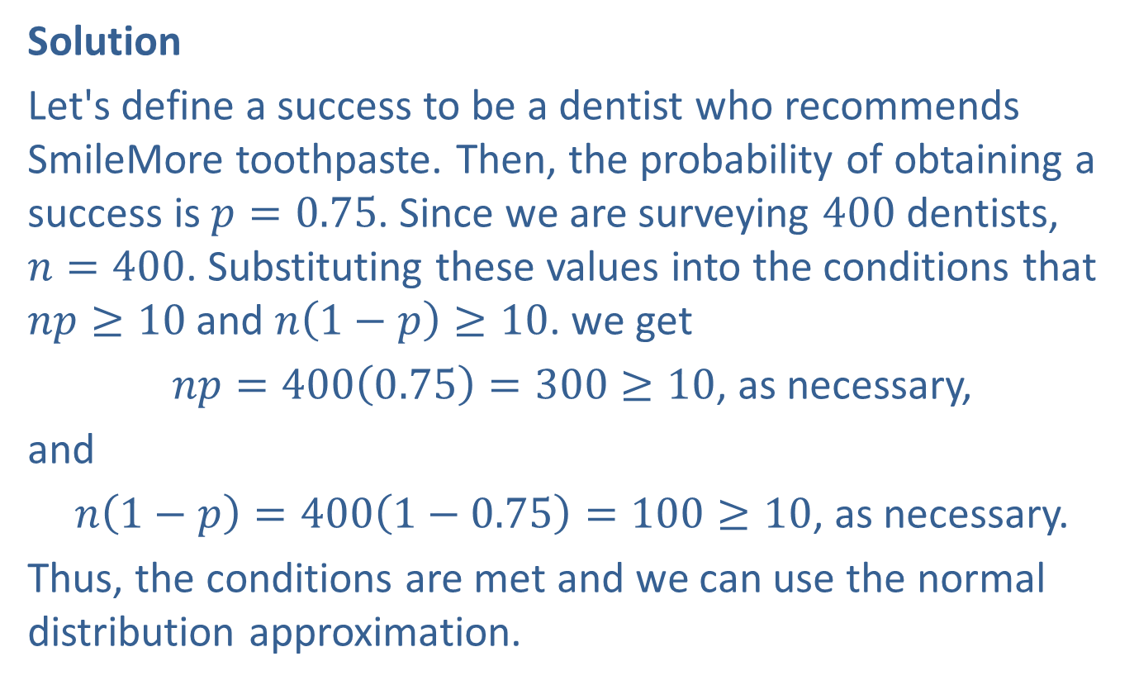
Example 6.5.5: Using a Normal Distribution to Approximate a Binomial Probability of the Form P(X = x) (cont.)
Solution
Let's define a success to be a dentist who recommends SmileMore toothpaste. Then, the probability of obtaining a success is $p=0.75$. Since we are surveying 400 dentists, $n=400$. Substituting these values into the conditions that $np≥10$ and $n\left(1−p\right)≥10$. we get
$np=400\left(0.75\right)=300≥10$, as necessary,
and
$n\left(1−p\right)=400\left(1−0.75\right)=100≥10$, as necessary.
Thus, the conditions are met and we can use the normal distribution approximation.

Slide 37
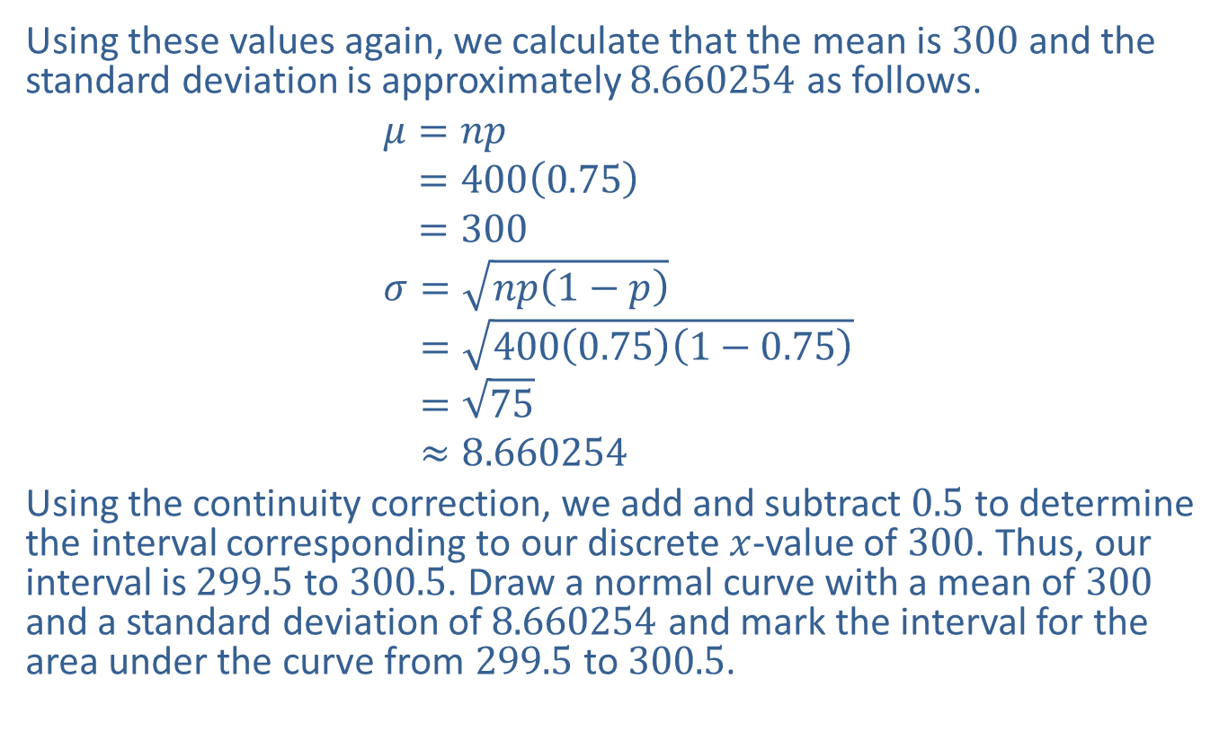
Example 6.5.5: Using a Normal Distribution to Approximate a Binomial Probability of the Form P(X = x) (cont.)
Using these values again, we calculate that the mean is 300 and the standard deviation is approximately 8.660254 as follows.
𝜇=𝑛𝑝𝜇=4000.75𝜇=300𝜎=𝑛𝑝1−𝑝𝜎=4000.751−0.75𝜎=75𝜎≈8.660254
Using the continuity correction, we add and subtract 0.5 to determine the interval corresponding to our discrete $x$-value of 300. Thus, our interval is 299.5 to 300.5. Draw a normal curve with a mean of 300 and a standard deviation of 8.660254 and mark the interval for the area under the curve from 299.5 to 300.5.

Slide 38
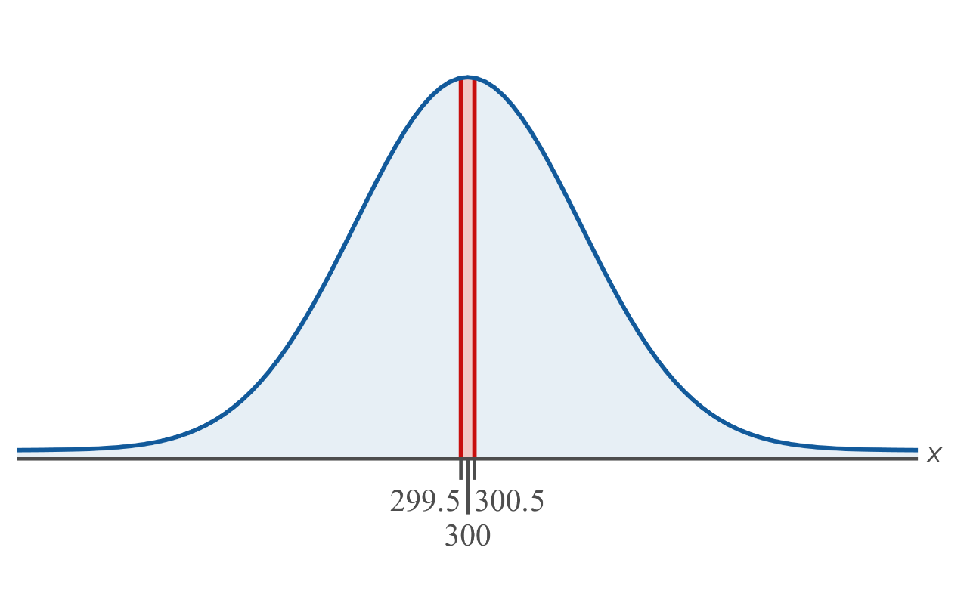
Example 6.5.5: Using a Normal Distribution to Approximate a Binomial Probability of the Form P(X = x) (cont.)

Slide 39
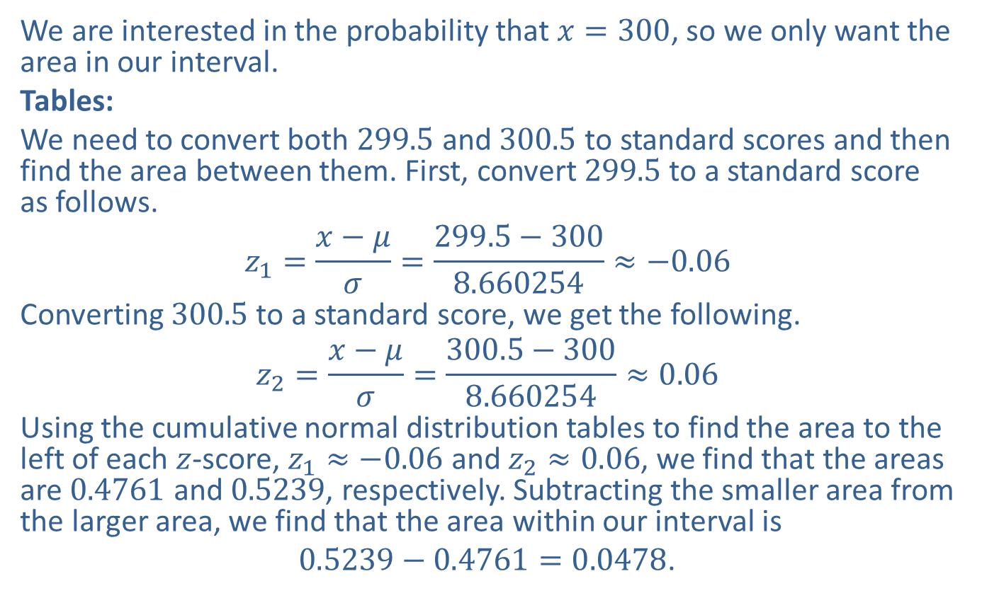
Example 6.5.5: Using a Normal Distribution to Approximate a Binomial Probability of the Form P(X = x) (cont.)
We are interested in the probability that $x=300$, so we only want the area in our interval.
Tables:
We need to convert both 299.5 and 300.5 to standard scores and then find the area between them. First, convert 299.5 to a standard score as follows.
$$z_{1}=\frac{x−μ}{σ}=\frac{299.5−300}{8.660254}≈−0.06$$
Converting 300.5 to a standard score, we get the following.
$$z_{2}=\frac{x−μ}{σ}=\frac{300.5−300}{8.660254}≈0.06$$
Using the cumulative normal distribution tables to find the area to the left of each $z$-score, $z_{1}≈−0.06$ and $z_{2}≈0.06$, we find that the areas are 0.4761 and 0.5239, respectively. Subtracting the smaller area from the larger area, we find that the area within our interval is
$0.5239−0.4761=0.0478$.

Slide 40
Example 6.5.5: Using a Normal Distribution to Approximate a Binomial Probability of the Form P(X = x) (cont.)
TI-83/84 Plus:
To find the area under the normal curve between 299.5 and 300.5 enter normalcdf(299.5,300.5,300,8.660254), which includes the mean and standard deviation of the distribution. As shown in the screenshot below, this method gives the more accurate estimate of approximately 0.0460 for the probability.

Slide 41
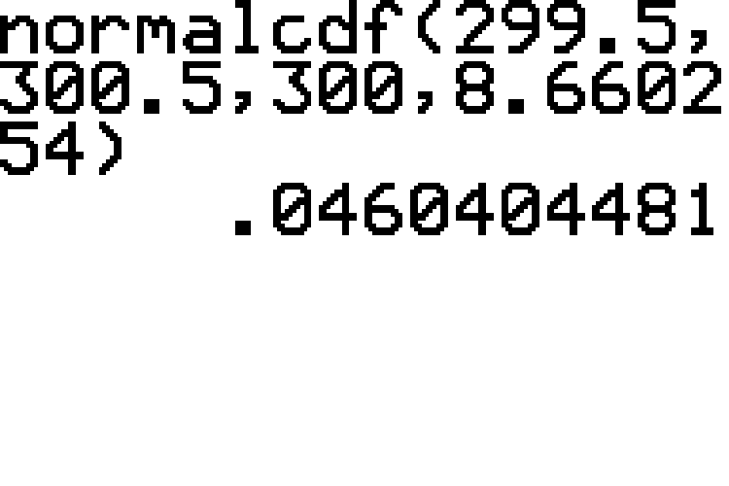
Example 6.5.5: Using a Normal Distribution to Approximate a Binomial Probability of the Form P(X = x) (cont.)

Slide 42

Example 6.5.5: Using a Normal Distribution to Approximate a Binomial Probability of the Form P(X = x) (cont.)
The probability would be reported as 0.0478 if using the tables or 0.0460 if using the calculator. Thus, the probability of exactly 300 out of a sample of 400 dentists recommending SmileMore toothpaste is approximately $5\%$.

