Slide 1
Section 7.1
Sampling Distributions and the Central Limit Theorem

Slide 2
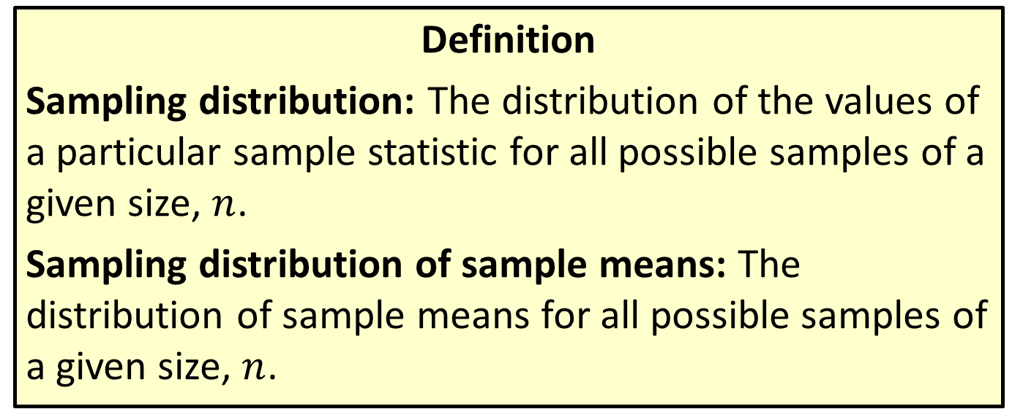
Sampling Distribution & Sampling Distribution Of Sample Means
Definition
Sampling distribution: The distribution of the values of a particular sample statistic for all possible samples of a given size, $n$.
Sampling distribution of sample means: The distribution of sample means for all possible samples of a given size, $n$.

Slide 3
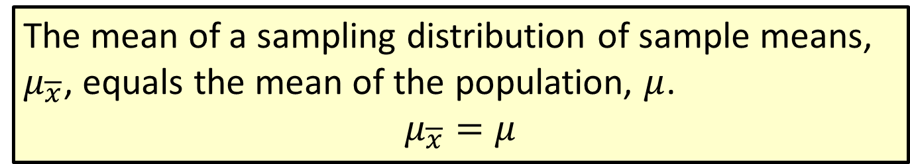
Formula: Mean of the Sampling Distribution of Sample Means
The mean of a sampling distribution of sample means, $μ_{\overline{x}}$, equals the mean of the population, $μ$.
$$μ_{\overline{x}}=μ$$

Slide 4
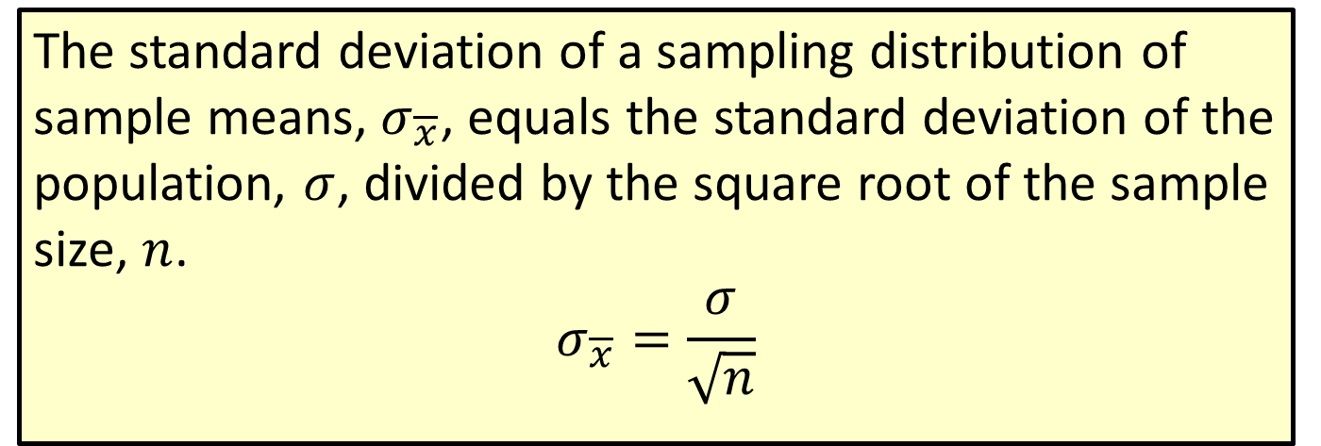
Formula: Standard Deviation of the Sampling Distribution of Sample Means (Standard Error of the Mean)
The standard deviation of a sampling distribution of sample means, $σ_{\overline{x}}$, equals the standard deviation of the population, $σ$, divided by the square root of the sample size, $n$.
$$σ_{\overline{x}}=\frac{σ}{\sqrt{n}}$$

Slide 5
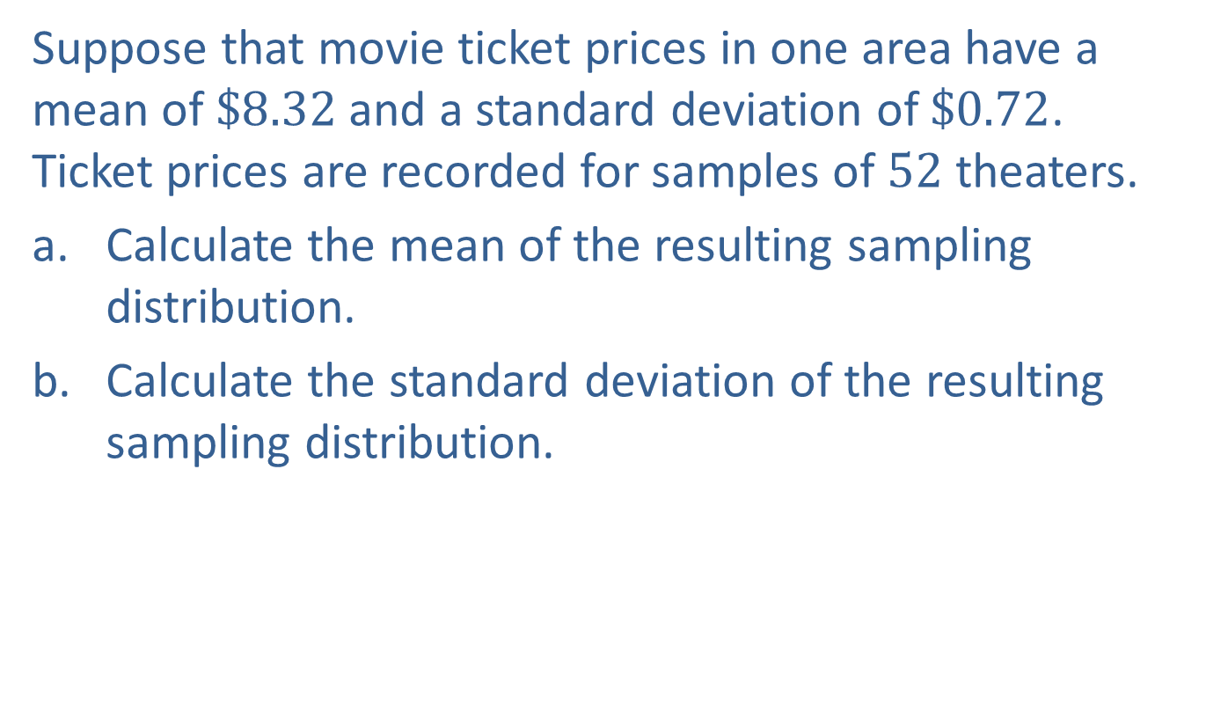
Example 7.1.1: Calculating the Mean and Standard Deviation of a Sampling Distribution of Sample Means
Suppose that movie ticket prices in one area have a mean of $\$8.32$ and a standard deviation of $\$0.72$. Ticket prices are recorded for samples of 52 theaters.
​Calculate the mean of the resulting sampling distribution.
​Calculate the standard deviation of the resulting sampling distribution.

Slide 6
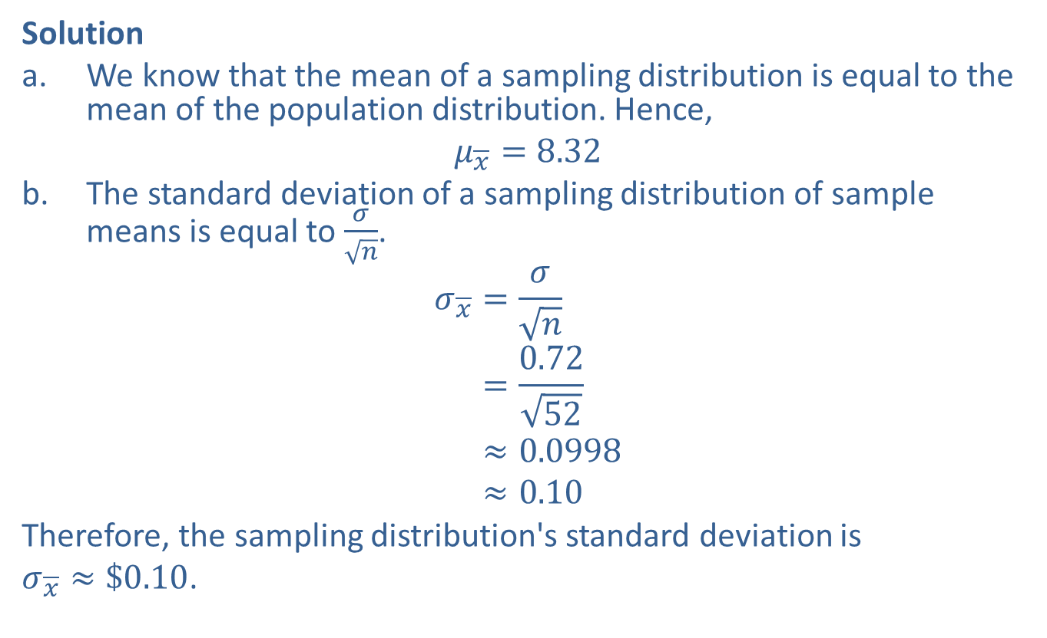
Example 7.1.1: Calculating the Mean and Standard Deviation of a Sampling Distribution of Sample Means (cont.)
Solution
​We know that the mean of a sampling distribution is equal to the mean of the population distribution. Hence,
​$μ_{\overline{x}}=8.32$
​The standard deviation of a sampling distribution of sample means is equal to $\frac{σ}{\sqrt{n}}$.
𝜎𝑥=𝜎𝑛𝜎𝑥=0.7252𝜎𝑥≈0.0998𝜎𝑥≈0.10
​Therefore, the sampling distribution's standard deviation is
$σ_{\overline{x}}≈\$0.10$.

Slide 7
The History of the Central Limit Theorem
Pierre-Simon Laplace is credited with the initial statement of the Central Limit Theorem in 1776. He developed the theorem while working on the probability distribution of the sum of meteor inclination angles.
Although the theorem is stated with respect to the sample mean, it is a more general theorem regarding the sum of random variables. If you add up a sufficiently large number of random variables the sum will be normally distributed.

Slide 8
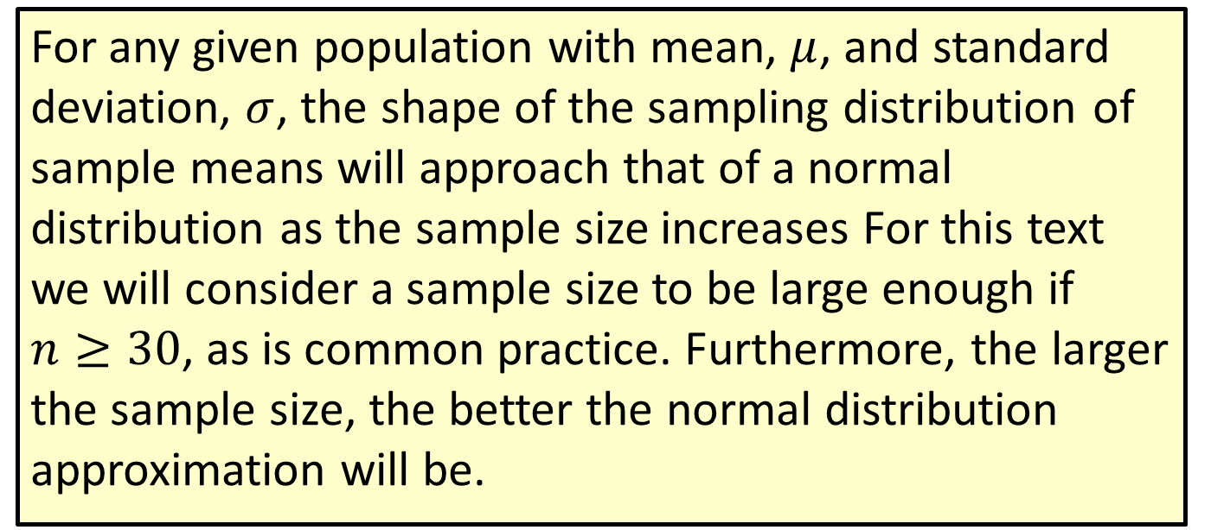
Theorem: The Central Limit Theorem (CLT)
For any given population with mean, $μ$, and standard deviation, $σ$, the shape of the sampling distribution of sample means will approach that of a normal distribution as the sample size increases For this text we will consider a sample size to be large enough if $n≥30$, as is common practice. Furthermore, the larger the sample size, the better the normal distribution approximation will be.

Slide 9
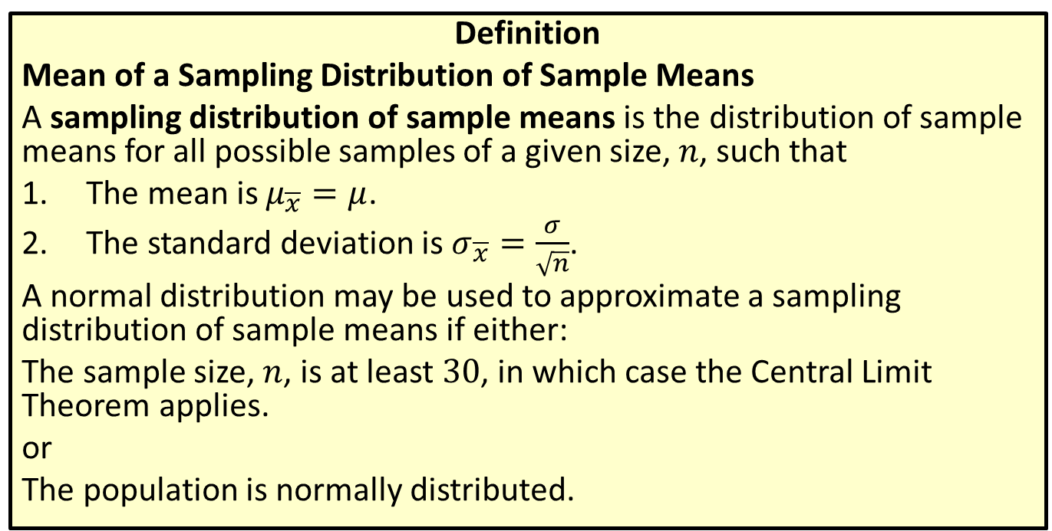
Distribution
Definition
Mean of a Sampling Distribution of Sample Means
A sampling distribution of sample means is the distribution of sample means for all possible samples of a given size, $n$, such that
​The mean is $μ_{\overline{x}}=μ$.
​The standard deviation is $σ_{\overline{x}}=\frac{σ}{\sqrt{n}}$.
A normal distribution may be used to approximate a sampling distribution of sample means if either:
The sample size, $n$, is at least 30, in which case the Central Limit Theorem applies.
or
The population is normally distributed.

Slide 10
Example 7.1.2: Applying the Central Limit Theorem
The following histogram represents the population distribution of the weights of 600 horse jockeys. The mean of the population is 116.2 pounds and the standard deviation is 3.9 pounds.

Slide 11
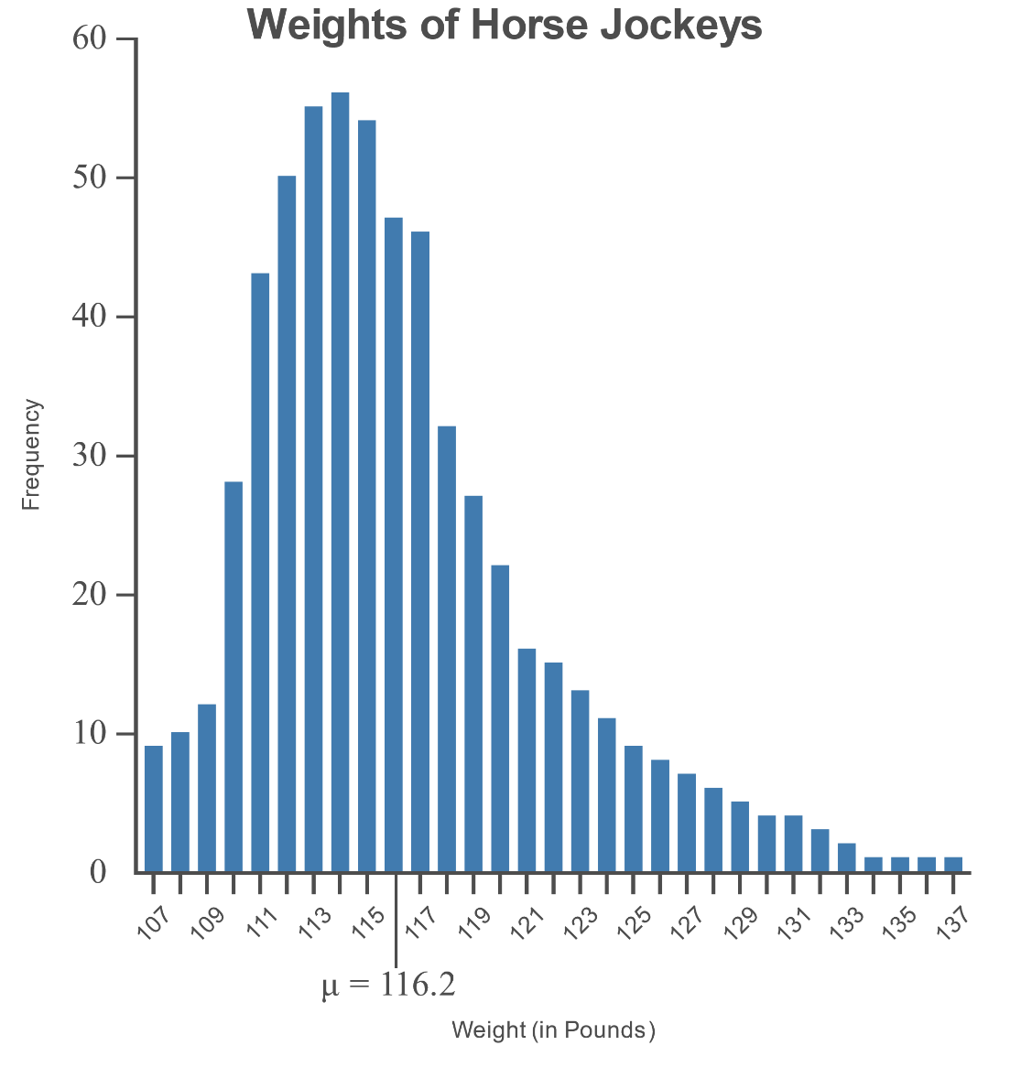
Example 7.1.2: Applying the Central Limit Theorem (cont.)

Slide 12
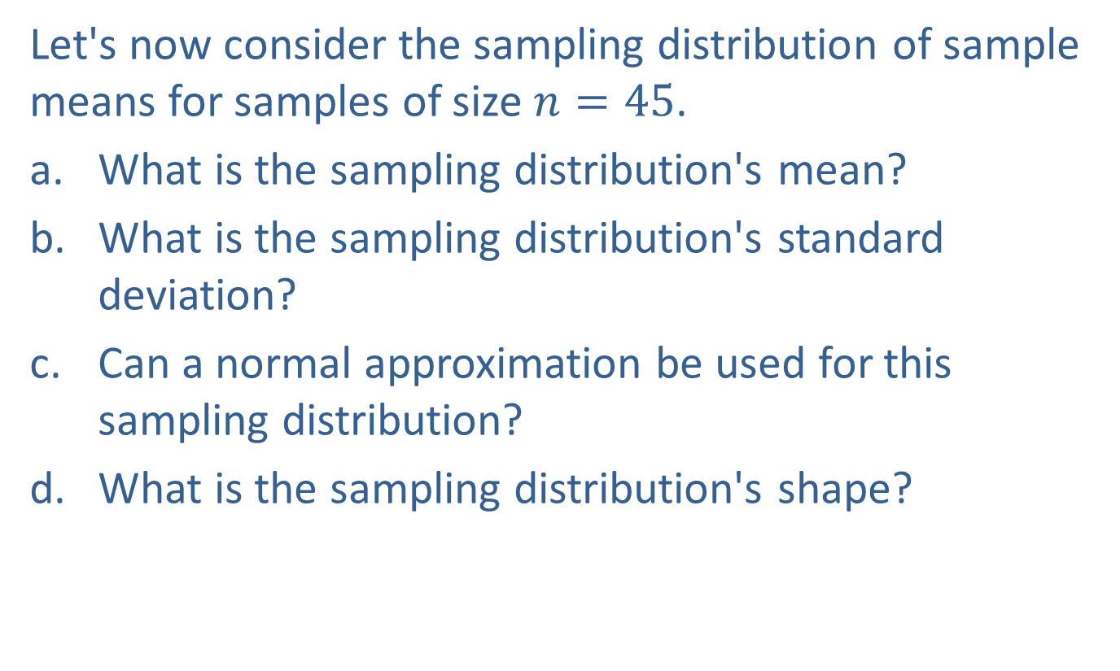
Example 7.1.2: Applying the Central Limit Theorem (cont.)
Let's now consider the sampling distribution of sample means for samples of size $n=45$.
​What is the sampling distribution's mean?
​What is the sampling distribution's standard deviation?
​Can a normal approximation be used for this sampling distribution?
​What is the sampling distribution's shape?

Slide 13
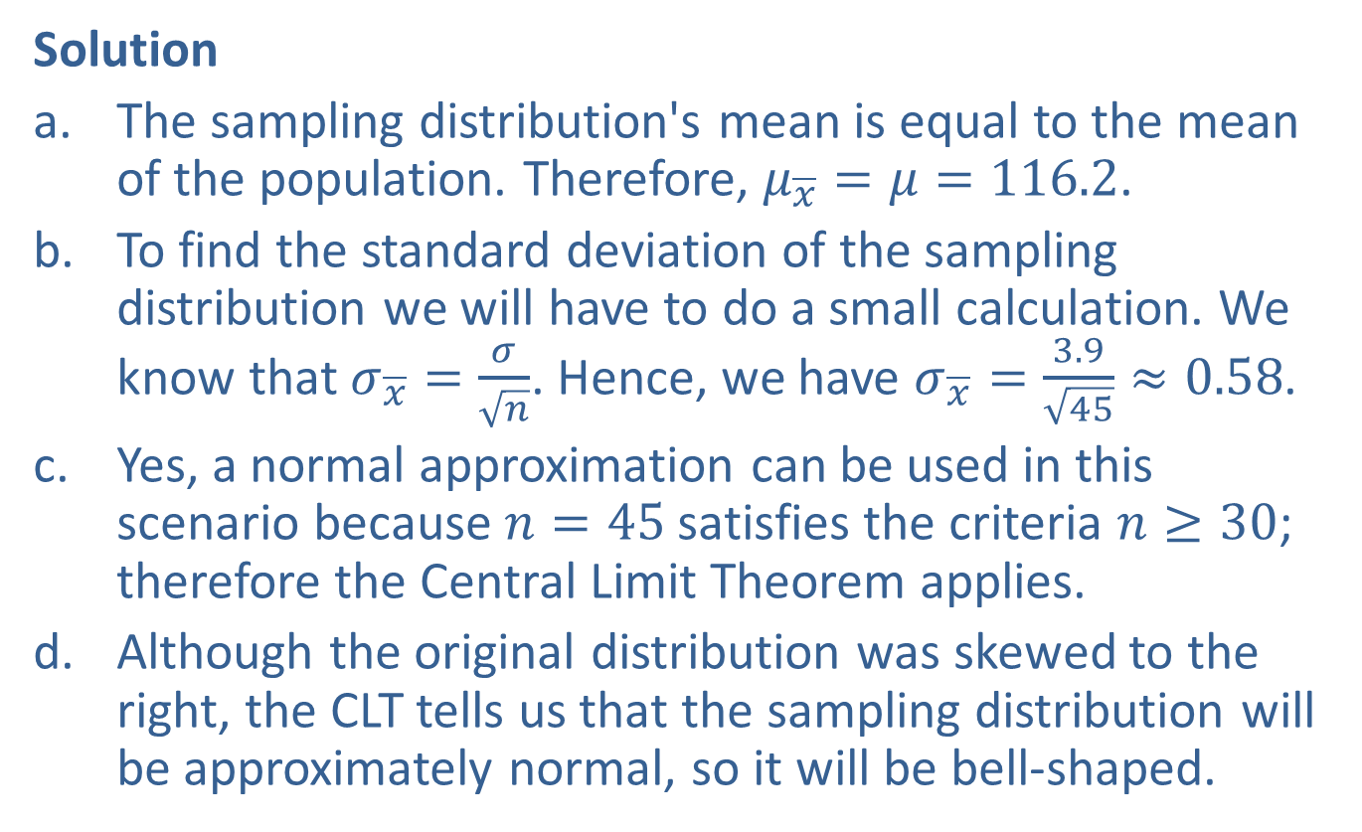
Example 7.1.2: Applying the Central Limit Theorem (cont.)
Solution
​The sampling distribution's mean is equal to the mean of the population. Therefore, $μ_{\overline{x}}=μ=116.2$.
​To find the standard deviation of the sampling distribution we will have to do a small calculation. We know that $σ_{\overline{x}}=\frac{σ}{\sqrt{n}}$. Hence, we have $σ_{\overline{x}}=\frac{3.9}{\sqrt{45}}≈0.58$.
​Yes, a normal approximation can be used in this scenario because $n=45$ satisfies the criteria $n≥30$; therefore the Central Limit Theorem applies.
​Although the original distribution was skewed to the right, the CLT tells us that the sampling distribution will be approximately normal, so it will be bell-shaped.

Slide 14
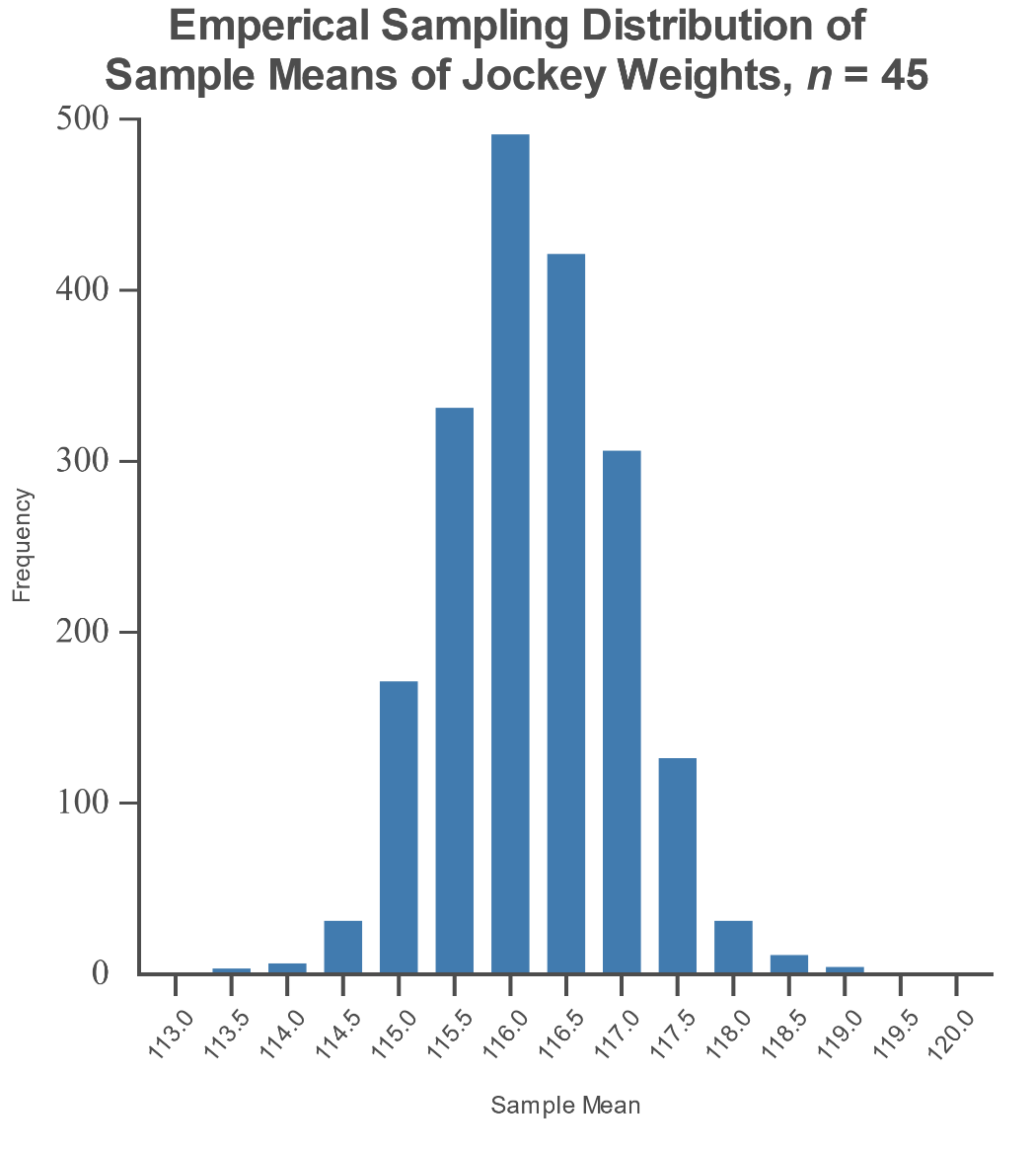
Example 7.1.2: Applying the Central Limit Theorem (cont.)

Slide 15
Example 7.1.3: Applying the Central Limit Theorem
The following graph displays the starting salaries for law school graduates entering the workforce in 2014.

Slide 16
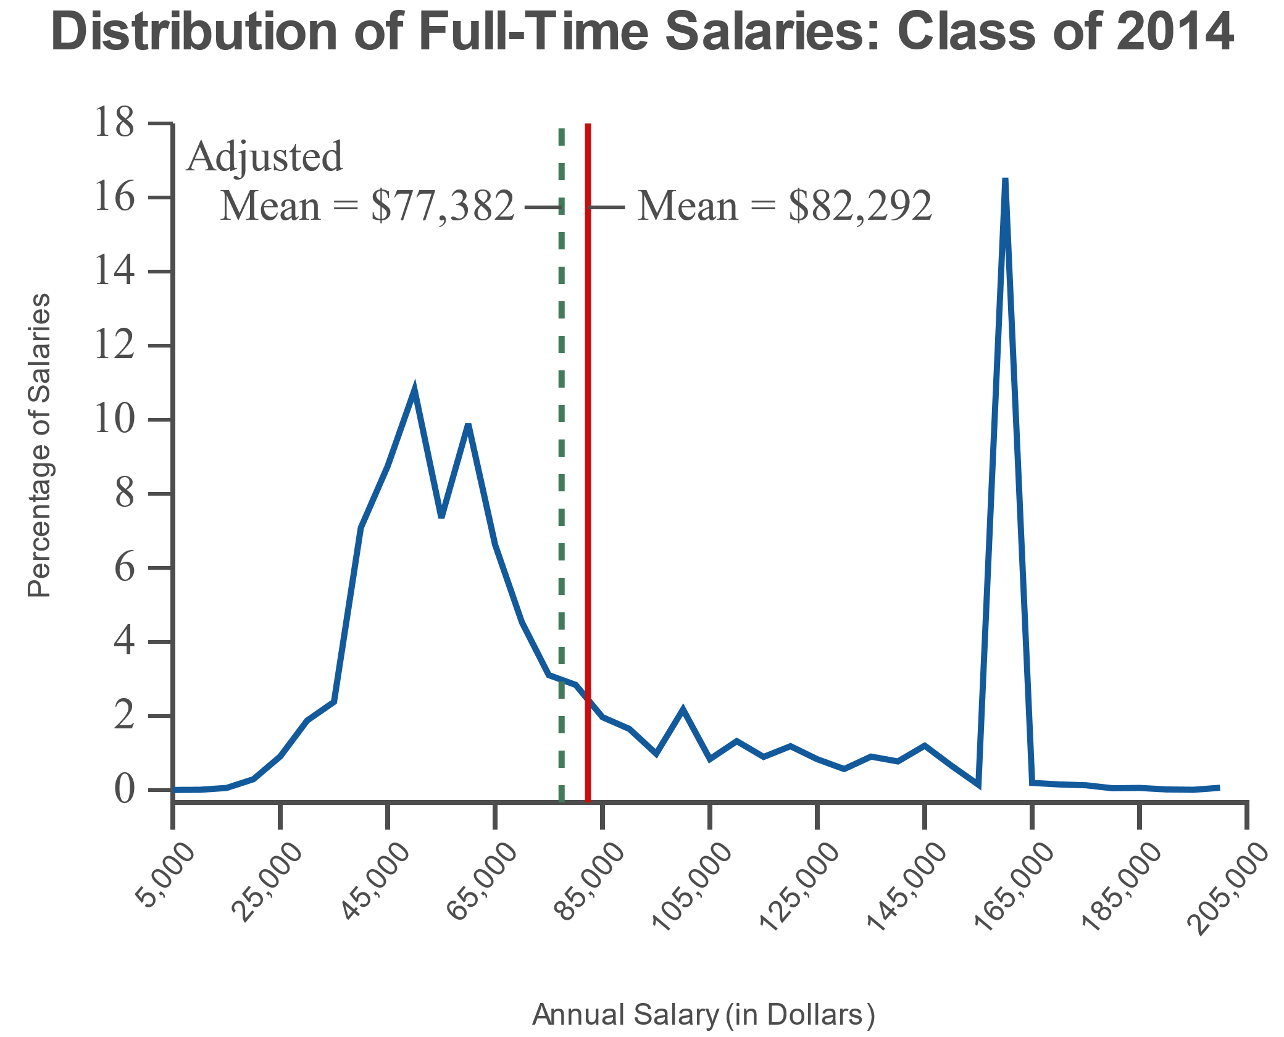
Example 7.1.3: Applying the Central Limit Theorem (cont.)
Note: The graph is based on 22,095 salaries. A few salaries above $205,000 are excluded for clarity.
Reproduced with permission of the National Association for Law Placement, Inc. (NALP).
Source: NALP: The Association for Legal Career Professionals. Salary Distribution Curves. Class of 2014. https://www.nalp.org/salarydistrib#2014(12 Aug. 2019).

Slide 17
Example 7.1.3: Applying the Central Limit Theorem (cont.)
​Describe the shape of this distribution.
​Consider the sampling distribution of the sample means created from this population for samples of size 25. Can a normal approximation be used for this sampling distribution?
​Consider the sampling distribution of the sample means created from this population for samples of size 50. Can the Central Limit Theorem be applied in this situation?

Slide 18
Example 7.1.3: Applying the Central Limit Theorem (cont.)
​Consider the sampling distribution of the sample means created from this population for samples of size 200. What would you expect the shape of this distribution to be? How would it compare to the sampling distribution described in part c.?

Slide 19
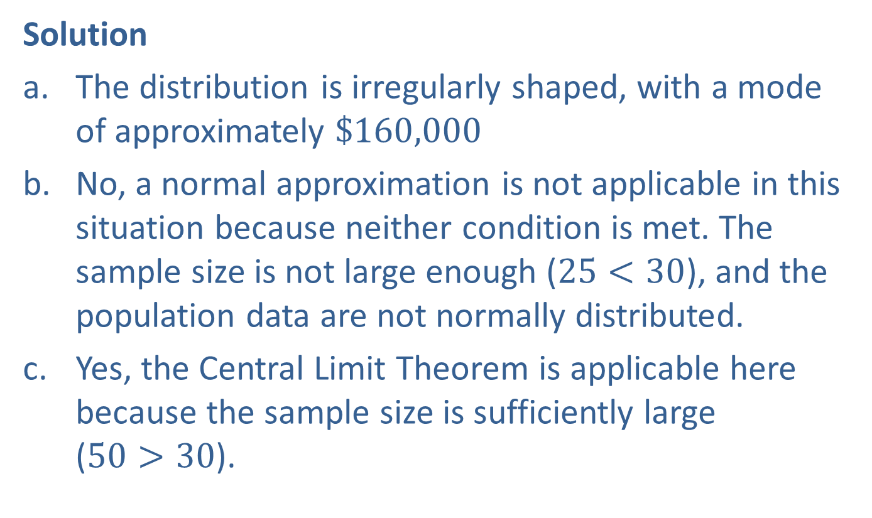
Example 7.1.3: Applying the Central Limit Theorem (cont.)
Solution
​The distribution is irregularly shaped, with a mode of approximately $\$160,000$
​No, a normal approximation is not applicable in this situation because neither condition is met. The sample size is not large enough ($25<30$), and the population data are not normally distributed.
​Yes, the Central Limit Theorem is applicable here because the sample size is sufficiently large ($50>30$).

Slide 20
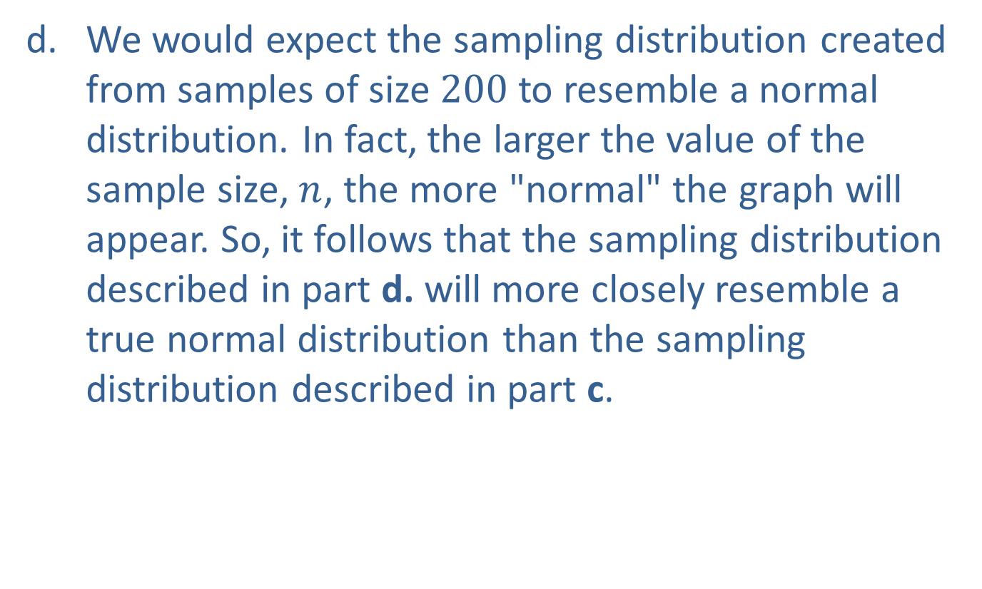
Example 7.1.3: Applying the Central Limit Theorem (cont.)
​We would expect the sampling distribution created from samples of size 200 to resemble a normal distribution. In fact, the larger the value of the sample size, $n$, the more "normal" the graph will appear. So, it follows that the sampling distribution described in part d. will more closely resemble a true normal distribution than the sampling distribution described in part c.

Slide 21
Note:
If you need help on setting up the sample sizes or determining what burst rate to use, select the Help button.

Slide 22
Note:
The default distribution type is Uniform.

