Slide 1
Section 7.2
Central Limit Theorem with Means

Slide 2
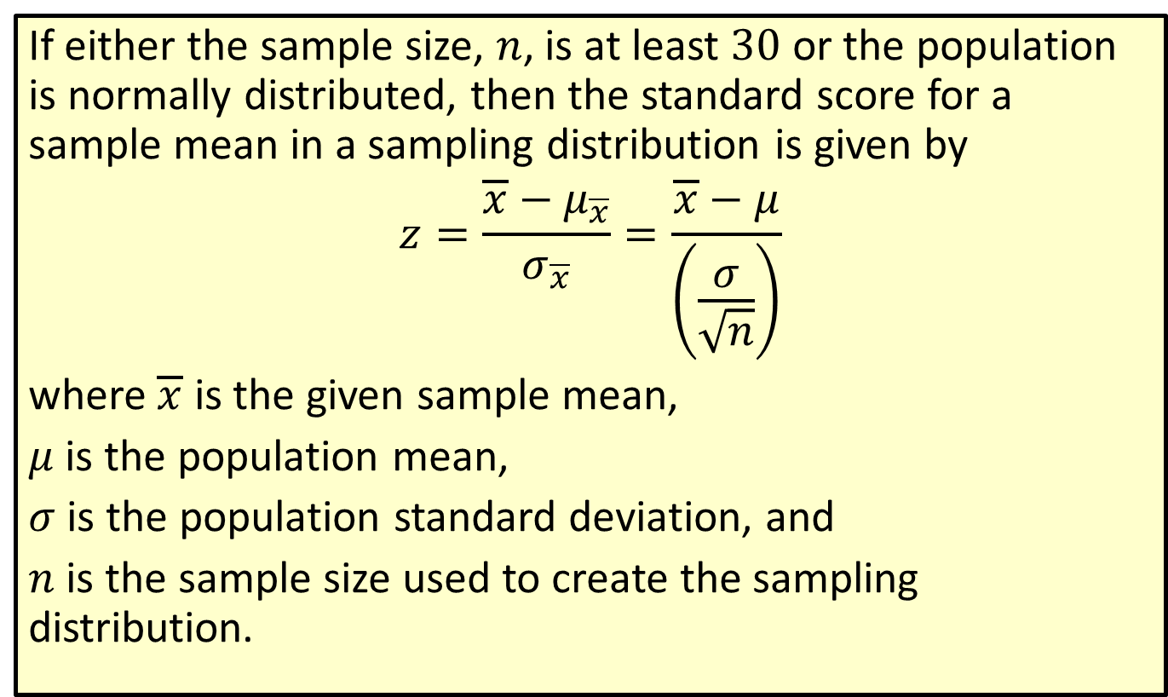
Formula: Standard Score for a Sample Mean
If either the sample size, $n$, is at least 30 or the population is normally distributed, then the standard score for a sample mean in a sampling distribution is given by
$$z=\frac{\overline{x}−μ_{\overline{x}}}{σ_{\overline{x}}}=\frac{\overline{x}−μ}{\left(\frac{σ}{\sqrt{n}}\right)}$$
where $\overline{x}$ is the given sample mean,
$μ$ is the population mean,
$σ$ is the population standard deviation, and
$n$ is the sample size used to create the sampling distribution.

Slide 3
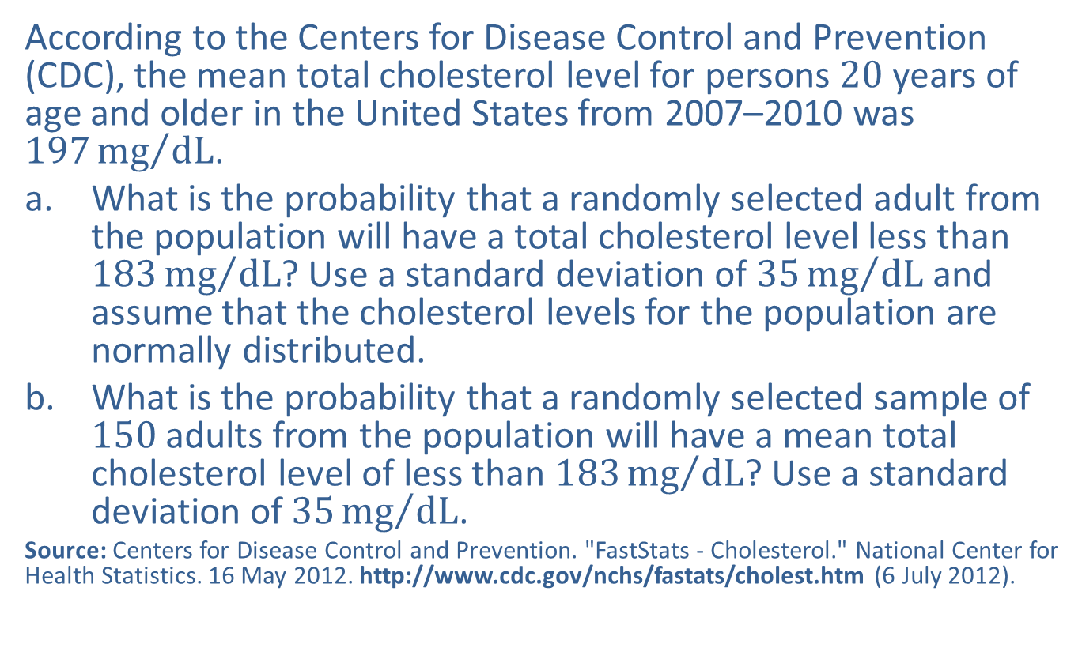
Example 7.2.1: Finding the Probability that a Sample Mean Will Be Less Than a Given Value
According to the Centers for Disease Control and Prevention (CDC), the mean total cholesterol level for persons 20 years of age and older in the United States from 2007–2010 was $197{mg}/{dL}$.
​What is the probability that a randomly selected adult from the population will have a total cholesterol level less than $183{mg}/{dL}$? Use a standard deviation of $35{mg}/{dL}$ and assume that the cholesterol levels for the population are normally distributed.
​What is the probability that a randomly selected sample of 150 adults from the population will have a mean total cholesterol level of less than $183{mg}/{dL}$? Use a standard deviation of $35{mg}/{dL}$.
Source: Centers for Disease Control and Prevention. "FastStats - Cholesterol." National Center for Health Statistics. 16 May 2012. http://www.cdc.gov/nchs/fastats/cholest.htm (6 July 2012).

Slide 4
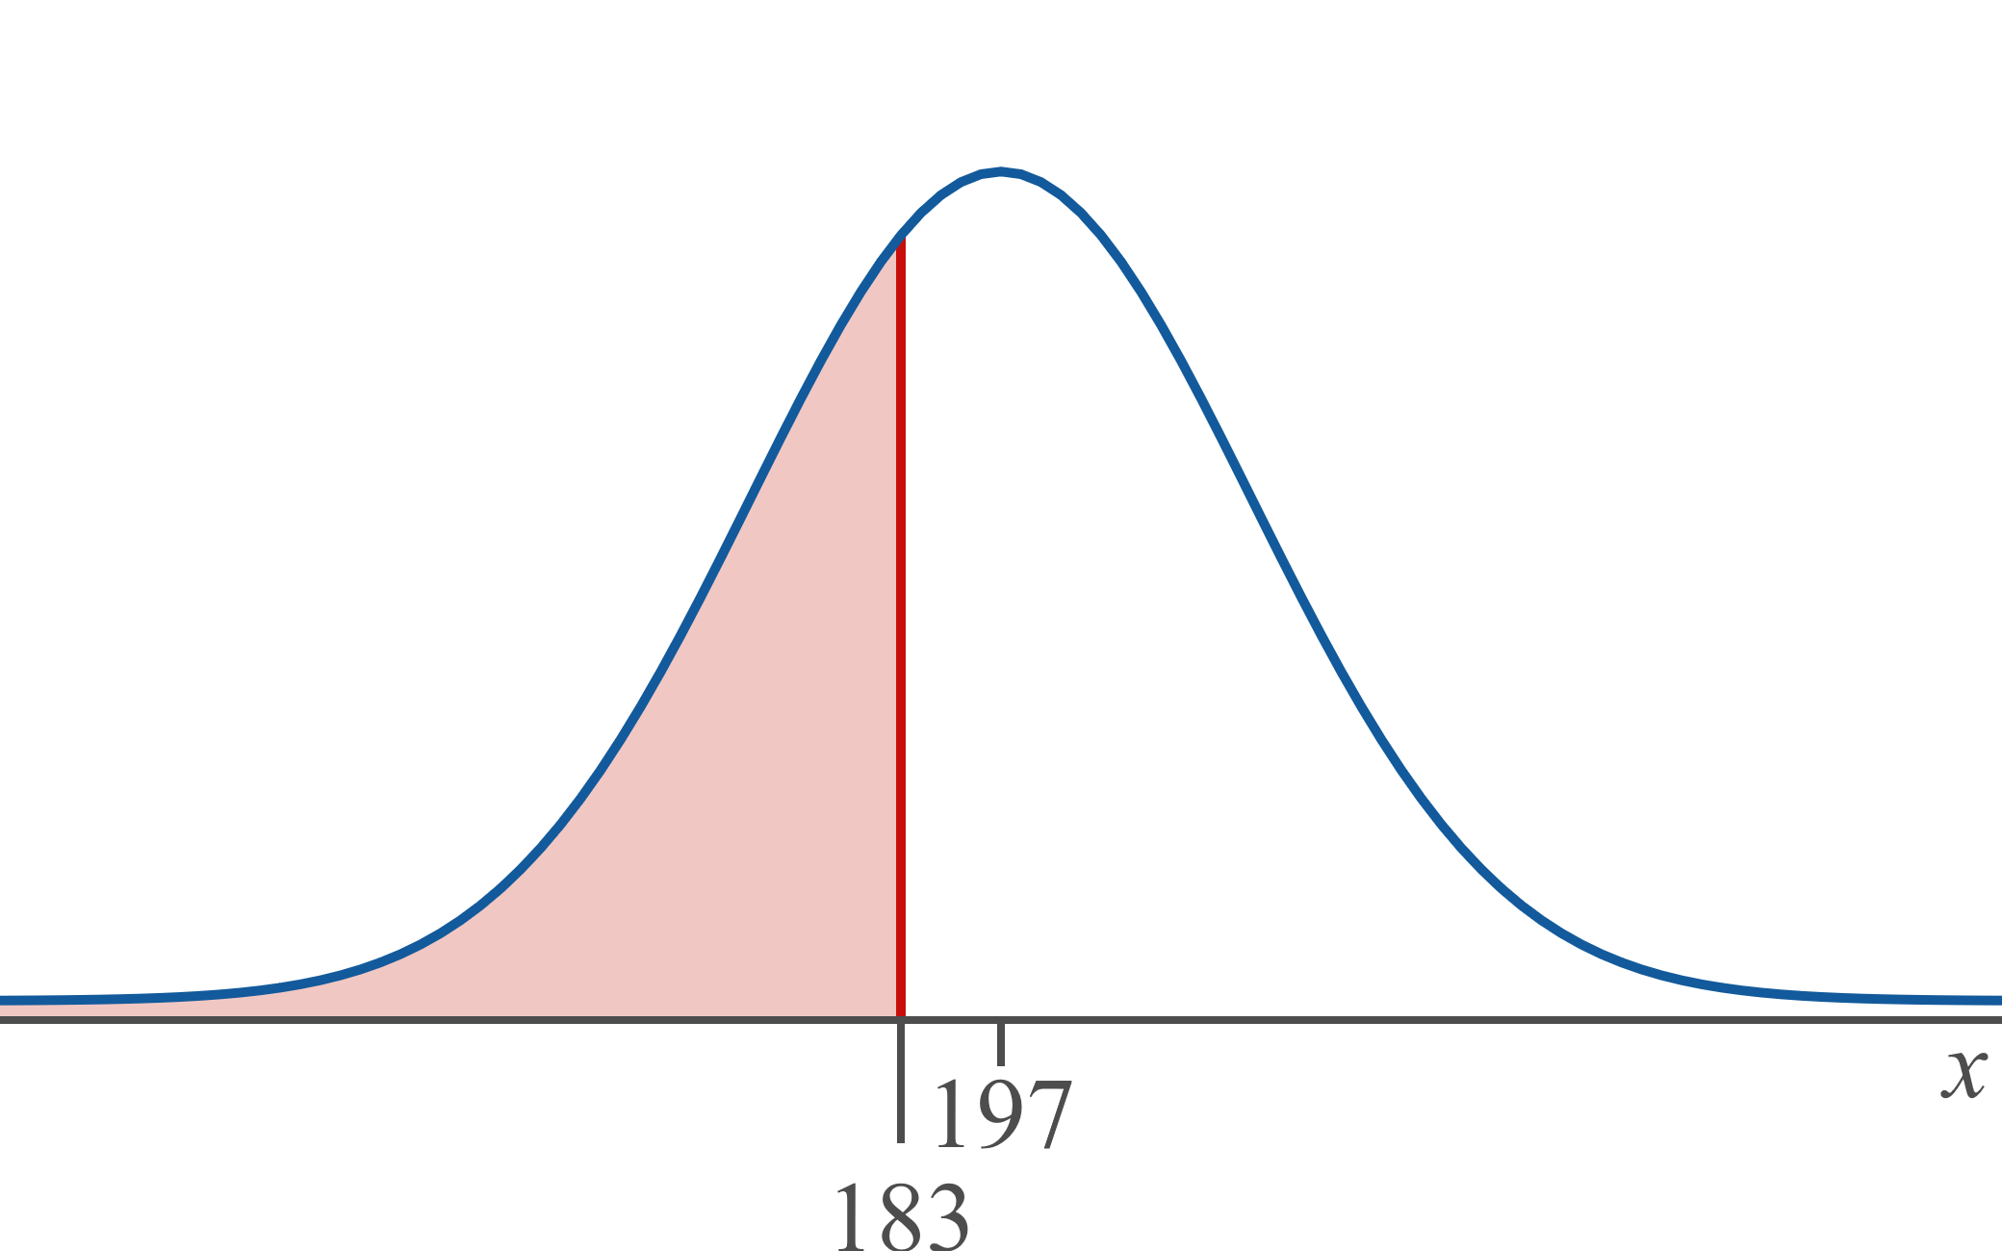

Example 7.2.1: Finding the Probability that a Sample Mean Will Be Less Than a Given Value (cont.)
Solution
​We are looking to find the probability that an individual person selected at random has a cholesterol level less than 183, i.e., $P⁡\left(x<183\right)$. The graph of this area is shown below.
​

Slide 5
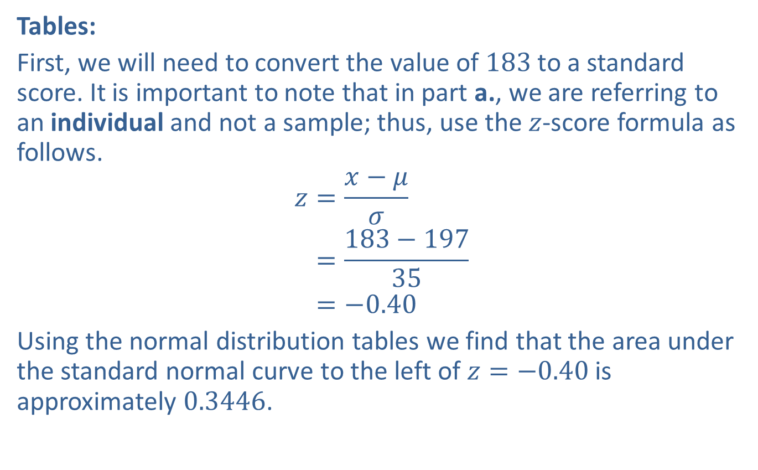
Example 7.2.1: Finding the Probability that a Sample Mean Will Be Less Than a Given Value (cont.)
​Tables:
​First, we will need to convert the value of 183 to a standard score. It is important to note that in part a., we are referring to an individual and not a sample; thus, use the $z$-score formula as follows.
𝑧=𝑥−𝜇𝜎𝑧=183−19735𝑧=−0.40
​Using the normal distribution tables we find that the area under the standard normal curve to the left of $z=−0.40$ is approximately 0.3446.
​

Slide 6
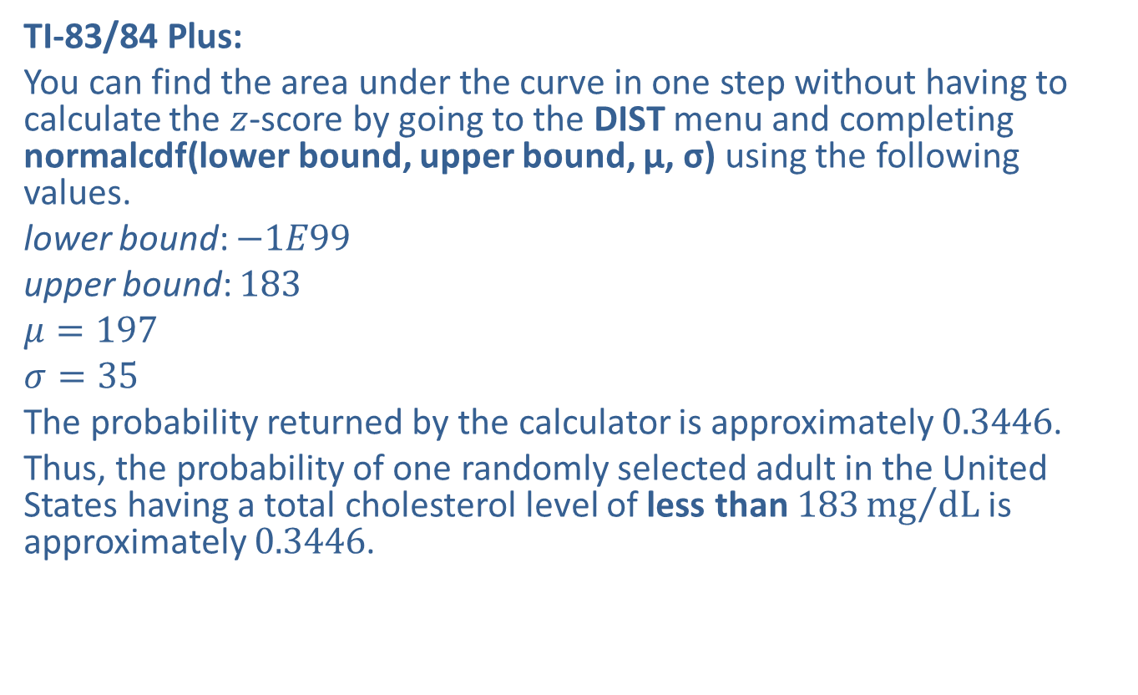
Example 7.2.1: Finding the Probability that a Sample Mean Will Be Less Than a Given Value (cont.)
​TI-83/84 Plus:
​You can find the area under the curve in one step without having to calculate the $z$-score by going to the DIST menu and completing normalcdf(lower bound, upper bound, μ, σ) using the following values.
​lower bound: $−1E99$
​upper bound: 183
​$μ=197$
​$σ=35$
​The probability returned by the calculator is approximately 0.3446.
​Thus, the probability of one randomly selected adult in the United States having a total cholesterol level of less than $183{mg}/{dL}$ is approximately 0.3446.
​

Slide 7
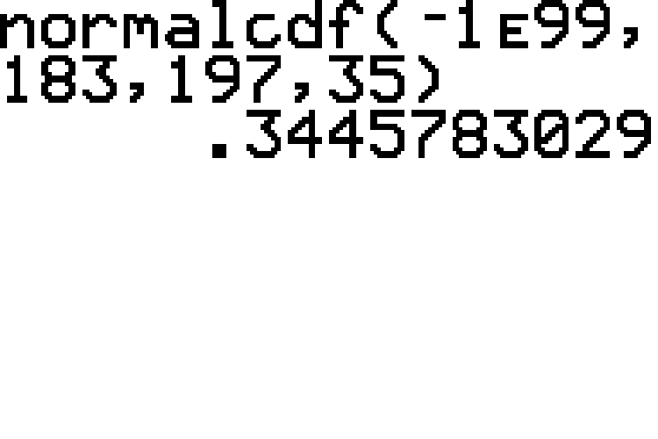
Example 7.2.1: Finding the Probability that a Sample Mean Will Be Less Than a Given Value (cont.)

Slide 8
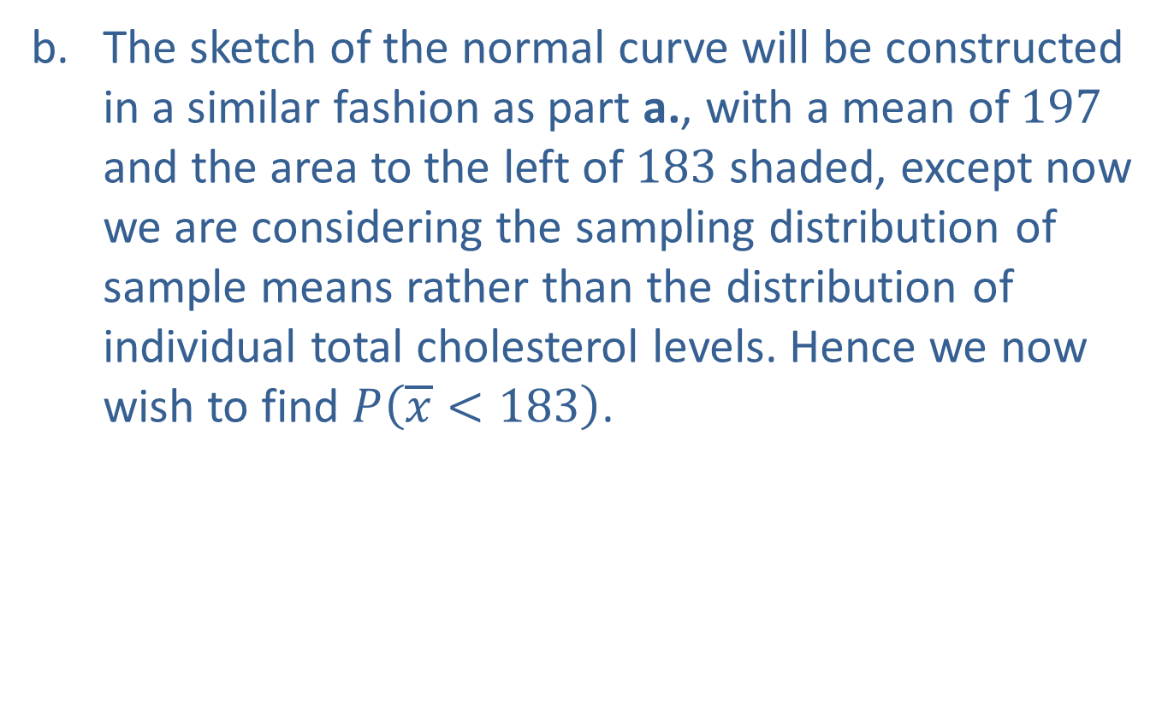
Example 7.2.1: Finding the Probability that a Sample Mean Will Be Less Than a Given Value (cont.)
​The sketch of the normal curve will be constructed in a similar fashion as part a., with a mean of 197 and the area to the left of 183 shaded, except now we are considering the sampling distribution of sample means rather than the distribution of individual total cholesterol levels. Hence we now wish to find $P⁡\left(\overline{x}<183\right)$.
​

Slide 9
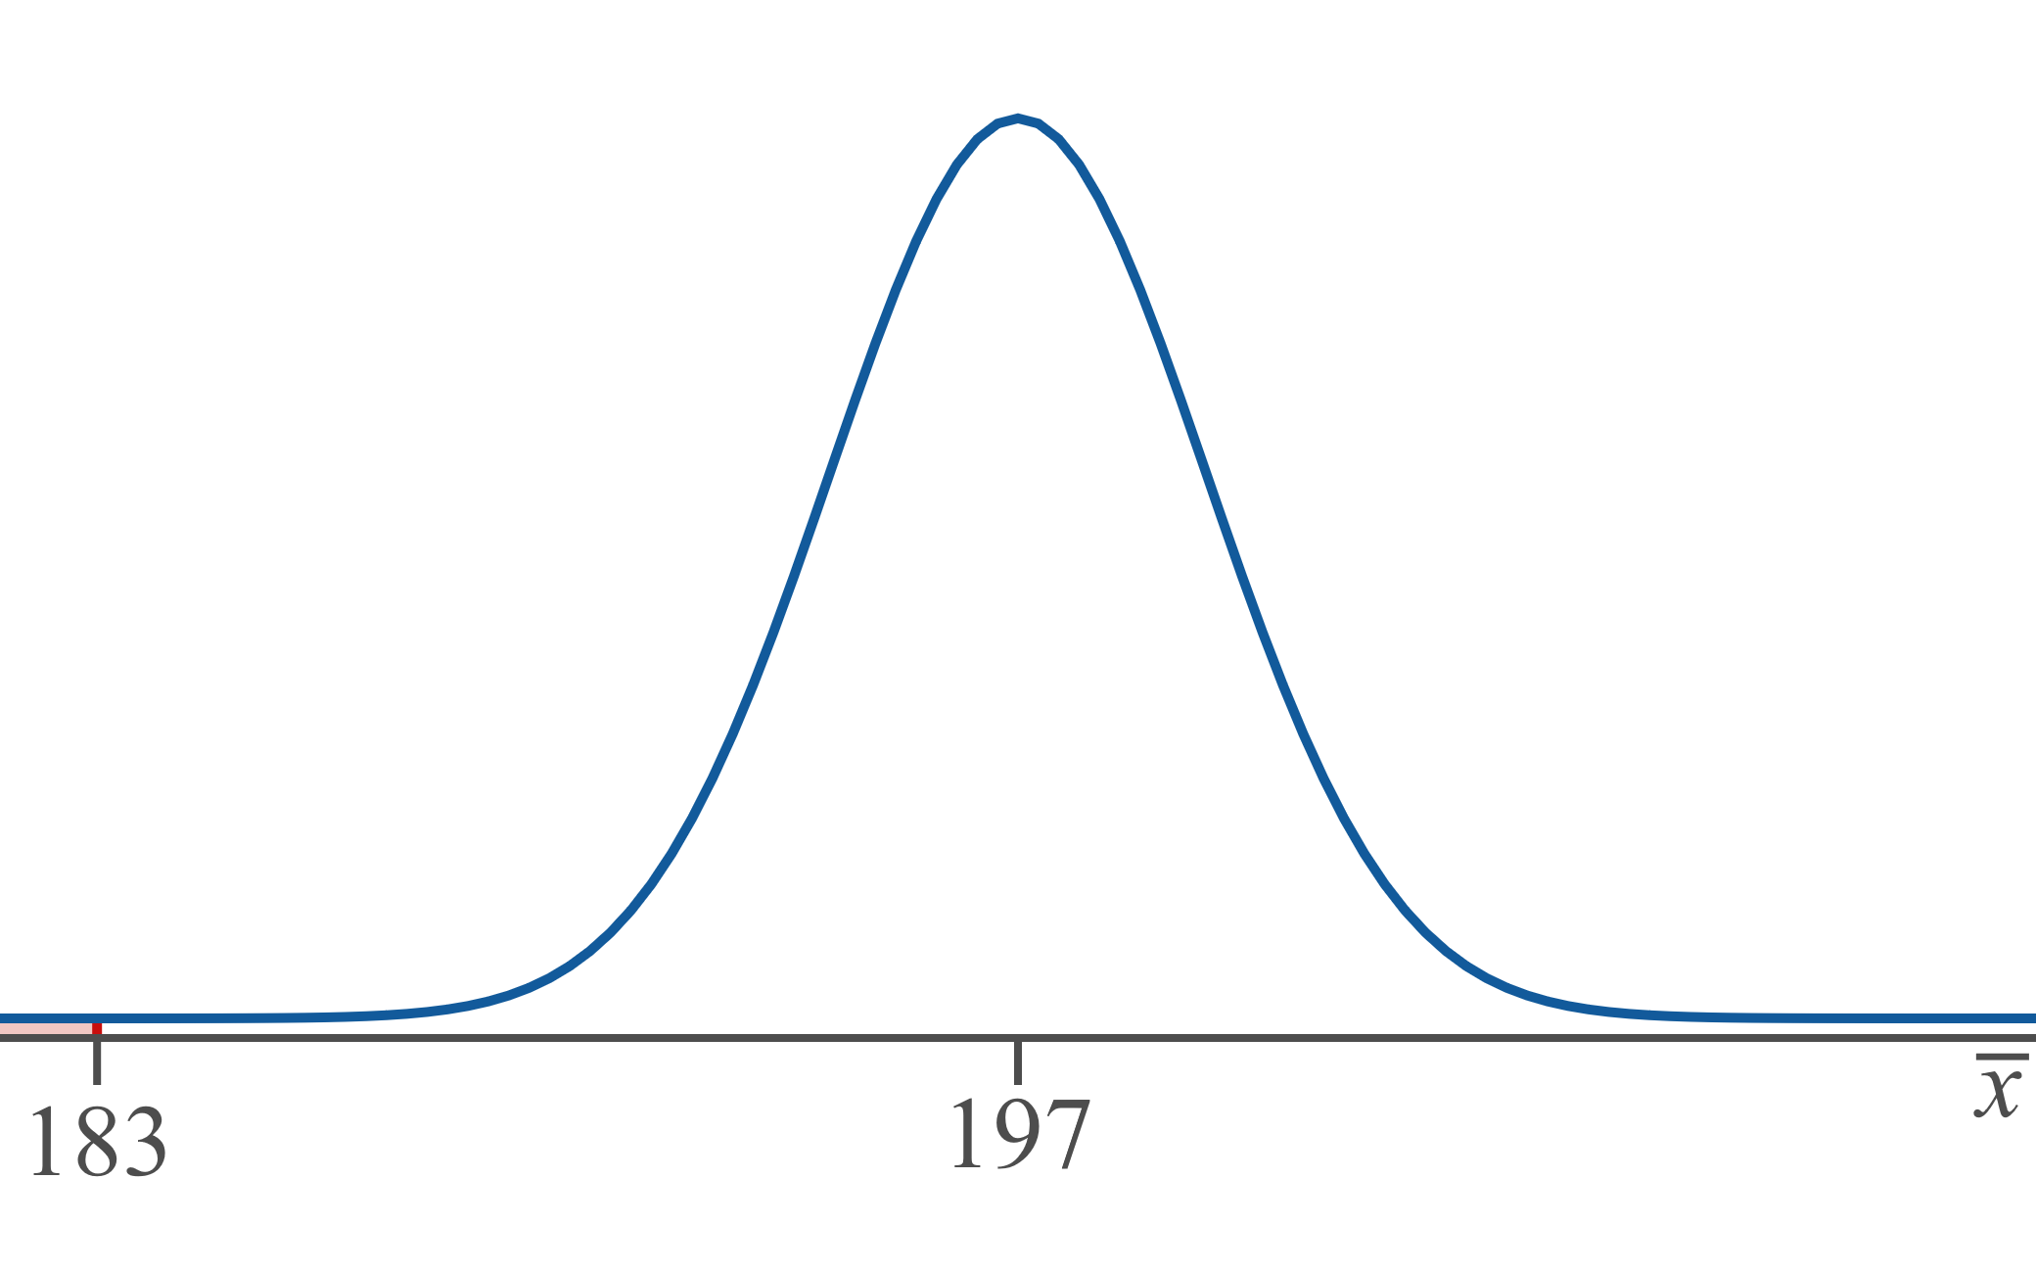
Example 7.2.1: Finding the Probability that a Sample Mean Will Be Less Than a Given Value (cont.)

Slide 10
Discussion Question
Note that the value of 183 is marked much farther to the left in this graph of the sampling distribution than it was in the graph of the population distribution. Why is that?

Slide 11
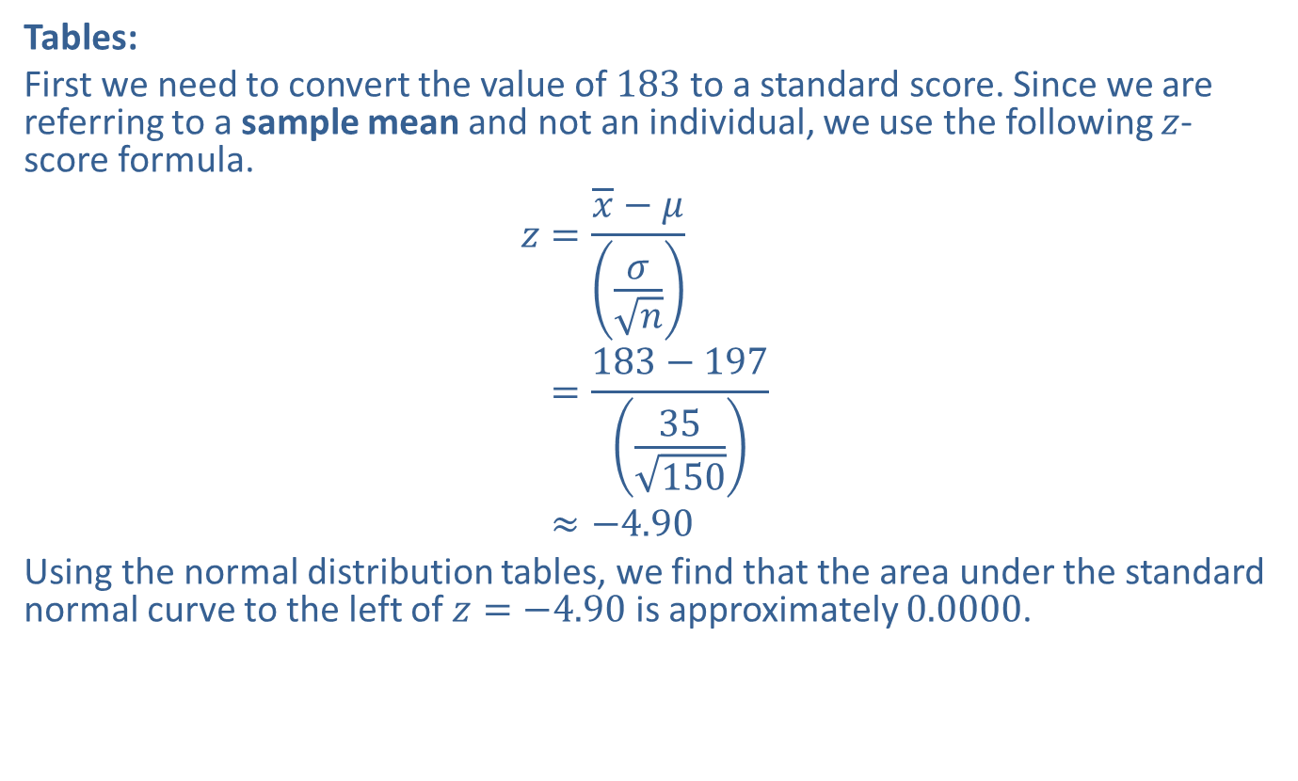
Example 7.2.1: Finding the Probability that a Sample Mean Will Be Less Than a Given Value (cont.)
​Tables:
​First we need to convert the value of 183 to a standard score. Since we are referring to a sample mean and not an individual, we use the following $z$-score formula.
𝑧=𝑥−𝜇𝜎𝑛𝑧=183−19735150𝑧≈−4.90
​Using the normal distribution tables, we find that the area under the standard normal curve to the left of $z=−4.90$ is approximately 0.0000.
​

Slide 12
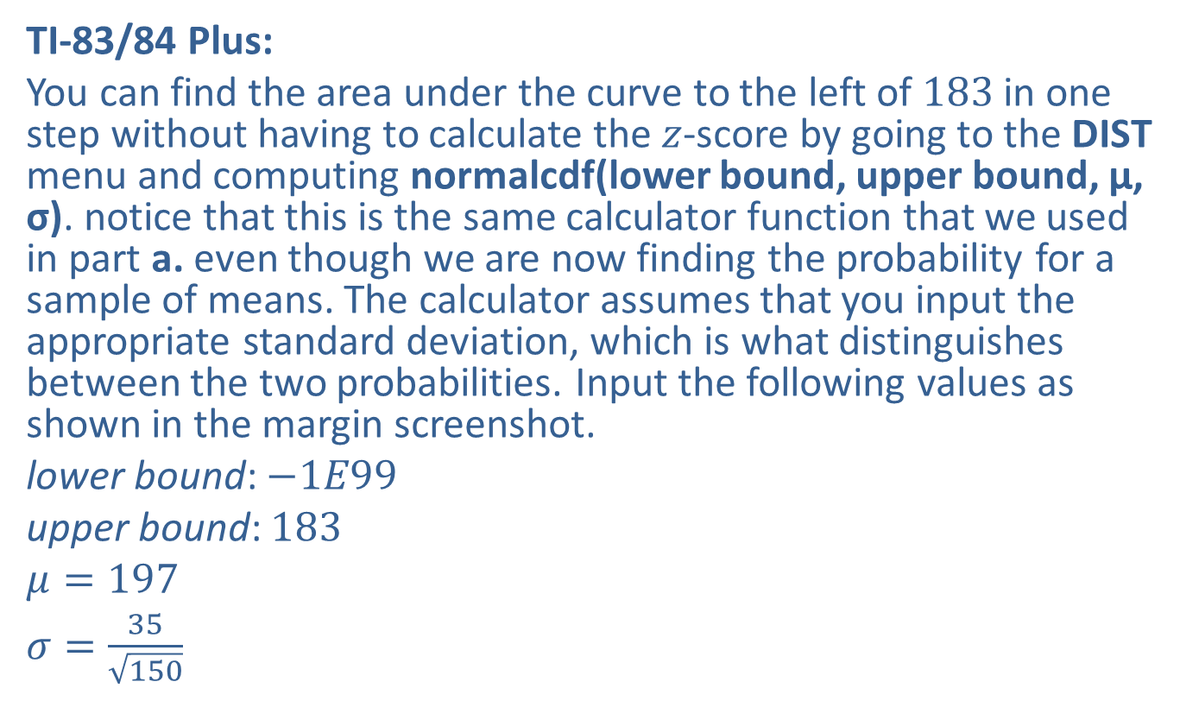
Example 7.2.1: Finding the Probability that a Sample Mean Will Be Less Than a Given Value (cont.)
​TI-83/84 Plus:
​You can find the area under the curve to the left of 183 in one step without having to calculate the $z$-score by going to the DIST menu and computing normalcdf(lower bound, upper bound, μ, σ). notice that this is the same calculator function that we used in part a. even though we are now finding the probability for a sample of means. The calculator assumes that you input the appropriate standard deviation, which is what distinguishes between the two probabilities. Input the following values as shown in the margin screenshot.
​lower bound: $−1E99$
​upper bound: 183
​$μ=197$
​$σ=\frac{35}{\sqrt{150}}$

Slide 13
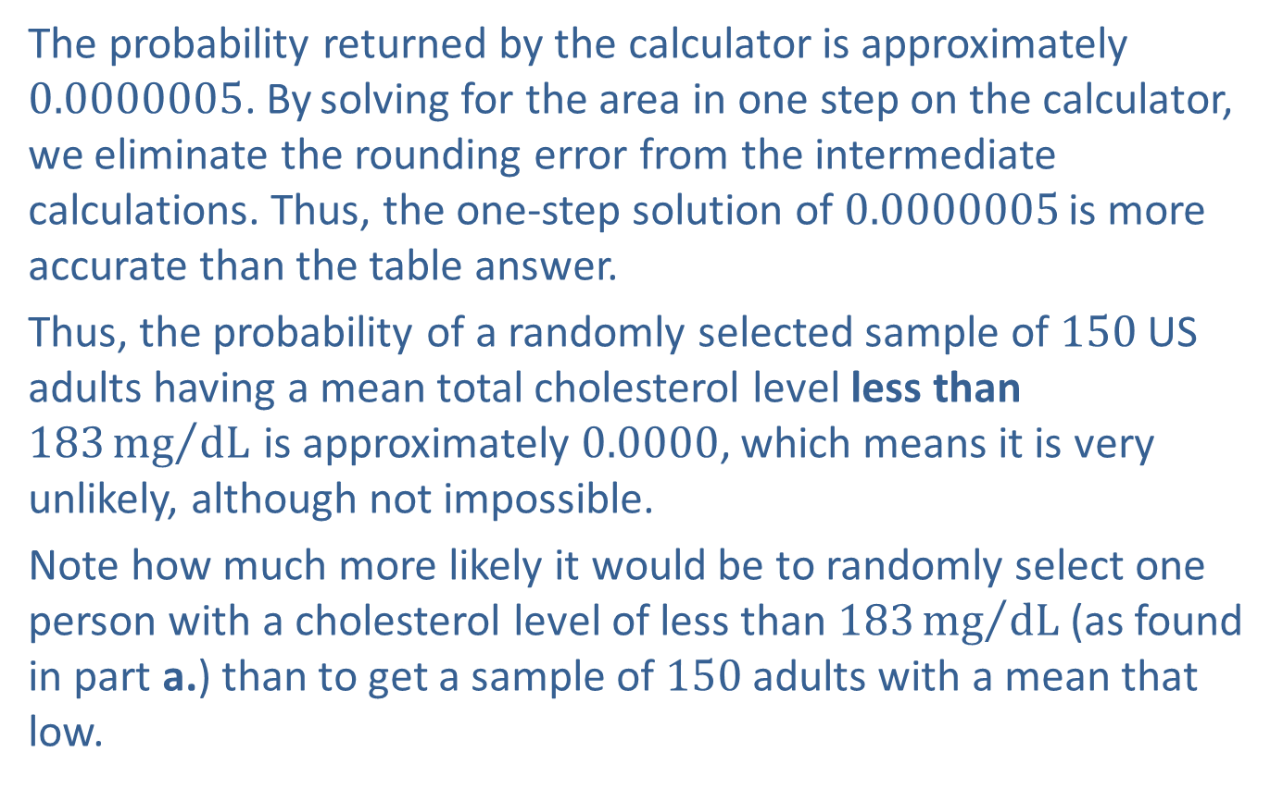
Example 7.2.1: Finding the Probability that a Sample Mean Will Be Less Than a Given Value (cont.)
The probability returned by the calculator is approximately 0.0000005. By solving for the area in one step on the calculator, we eliminate the rounding error from the intermediate calculations. Thus, the one-step solution of 0.0000005 is more accurate than the table answer.
​Thus, the probability of a randomly selected sample of 150 US adults having a mean total cholesterol level less than $183{mg}/{dL}$ is approximately 0.0000, which means it is very unlikely, although not impossible.
​Note how much more likely it would be to randomly select one person with a cholesterol level of less than $183{mg}/{dL}$(as found in part a.) than to get a sample of 150 adults with a mean that low.

Slide 14
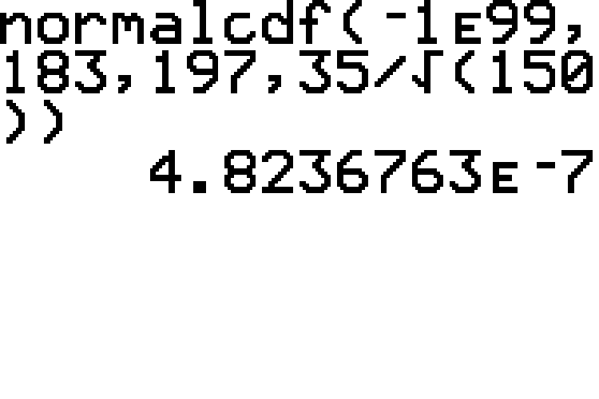
Example 7.2.1: Finding the Probability that a Sample Mean Will Be Less Than a Given Value (cont.)

Slide 15
Technology
For further instructions on finding normal probabilities using a TI-83/84 Plus calculator or other technology, please visit stat.hawkeslearning.com and see Technology Instructions > Normal Distribution > Normal Probability (cdf).

Slide 16
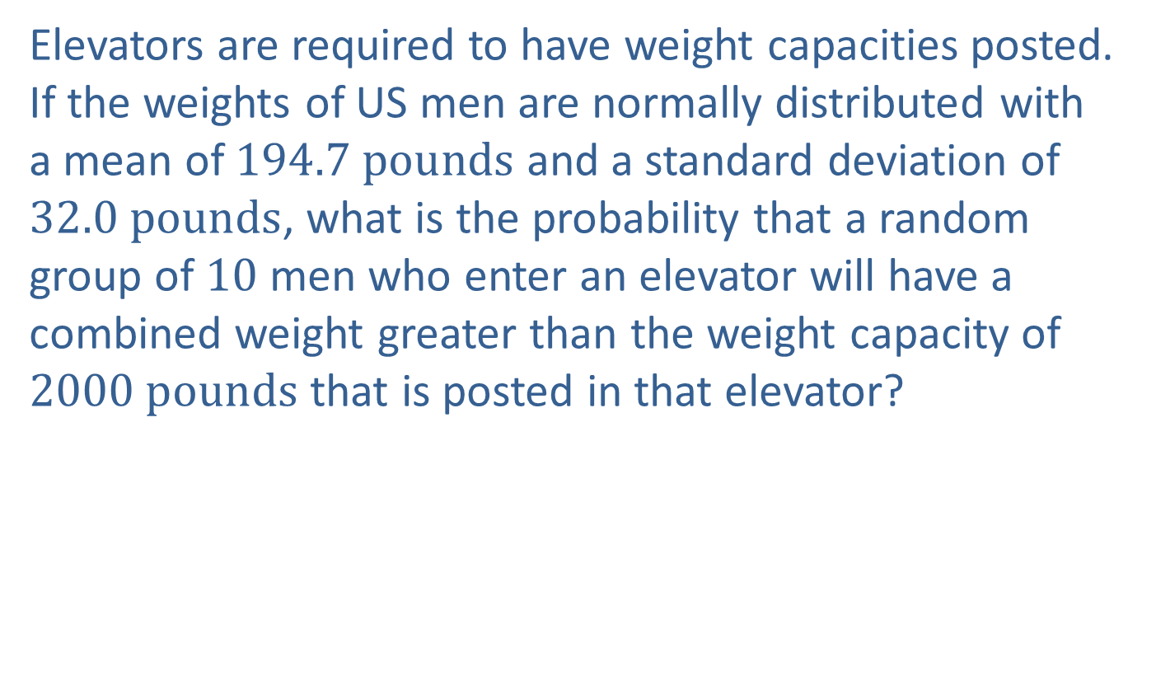
Example 7.2.2: Finding the Probability that a Sample Mean Will Be Greater Than a Given Value
Elevators are required to have weight capacities posted. If the weights of US men are normally distributed with a mean of $194.7 pounds$ and a standard deviation of $32.0 pounds$, what is the probability that a random group of 10 men who enter an elevator will have a combined weight greater than the weight capacity of $2000 pounds$ that is posted in that elevator?

Slide 17
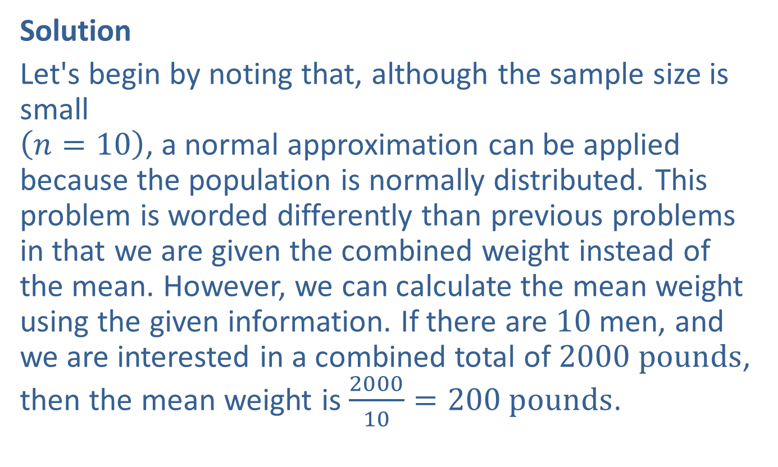
Example 7.2.2: Finding the Probability that a Sample Mean Will Be Greater Than a Given Value (cont.)
Solution
Let's begin by noting that, although the sample size is small $\left(n=10\right)$, a normal approximation can be applied because the population is normally distributed. This problem is worded differently than previous problems in that we are given the combined weight instead of the mean. However, we can calculate the mean weight using the given information. If there are 10 men, and we are interested in a combined total of $2000 pounds$, then the mean weight is $\frac{2000}{10}=200 pounds$.

Slide 18
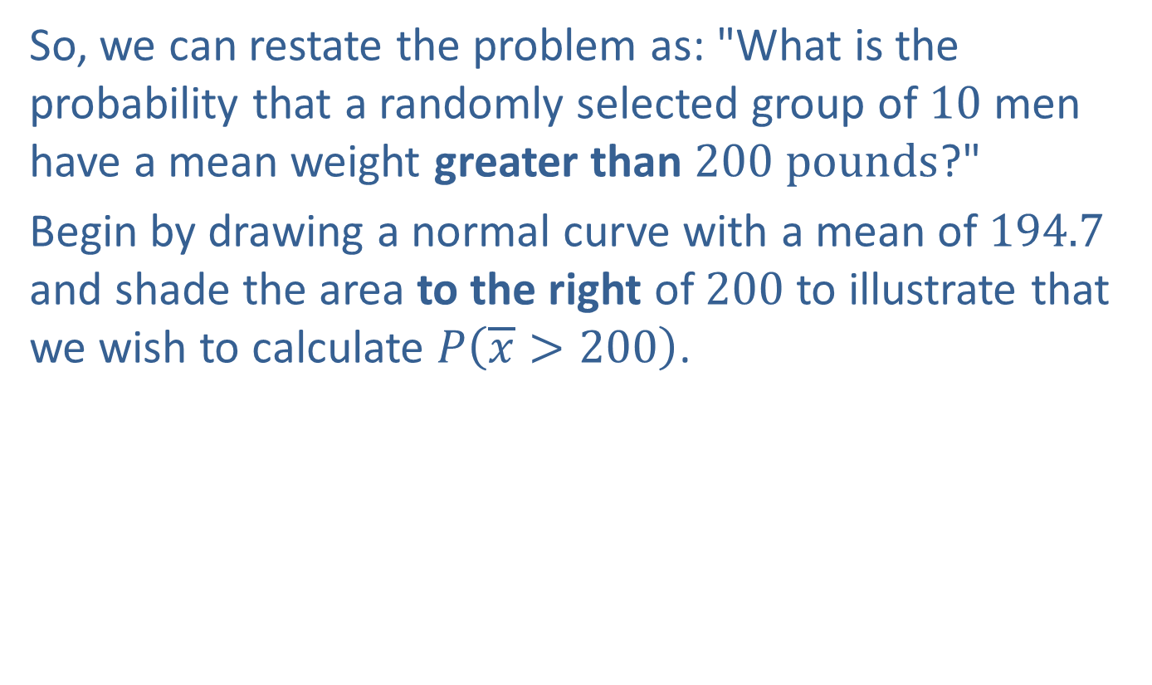
Example 7.2.2: Finding the Probability that a Sample Mean Will Be Greater Than a Given Value (cont.)
So, we can restate the problem as: "What is the probability that a randomly selected group of 10 men have a mean weight greater than $200 pounds$?"
Begin by drawing a normal curve with a mean of 194.7 and shade the area to the right of 200 to illustrate that we wish to calculate $P⁡\left(\overline{x}>200\right)$.

Slide 19
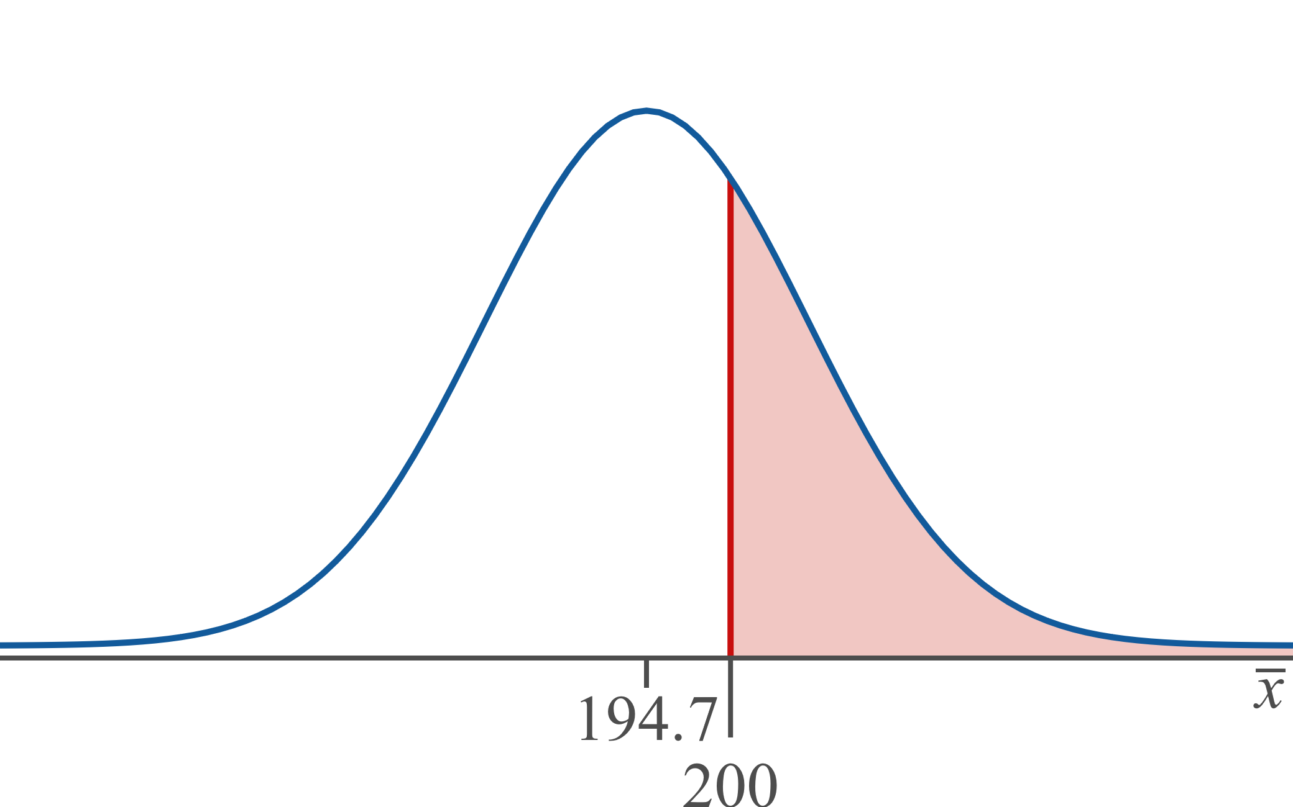
Example 7.2.2: Finding the Probability that a Sample Mean Will Be Greater Than a Given Value (cont.)

Slide 20
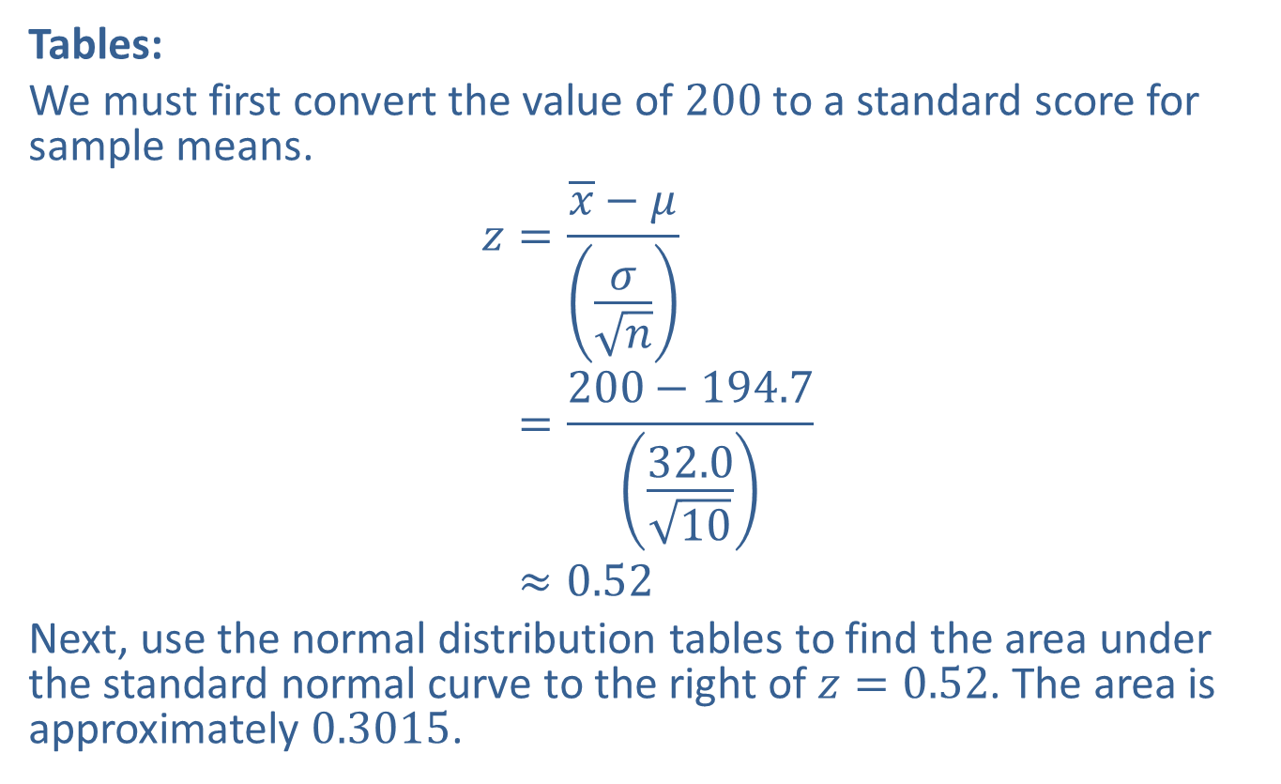
Example 7.2.2: Finding the Probability that a Sample Mean Will Be Greater Than a Given Value (cont.)
Tables:
We must first convert the value of 200 to a standard score for sample means.
𝑧=𝑥−𝜇𝜎𝑛𝑧=200−194.732.010𝑧≈0.52
Next, use the normal distribution tables to find the area under the standard normal curve to the right of $z=0.52$. The area is approximately 0.3015.

Slide 21
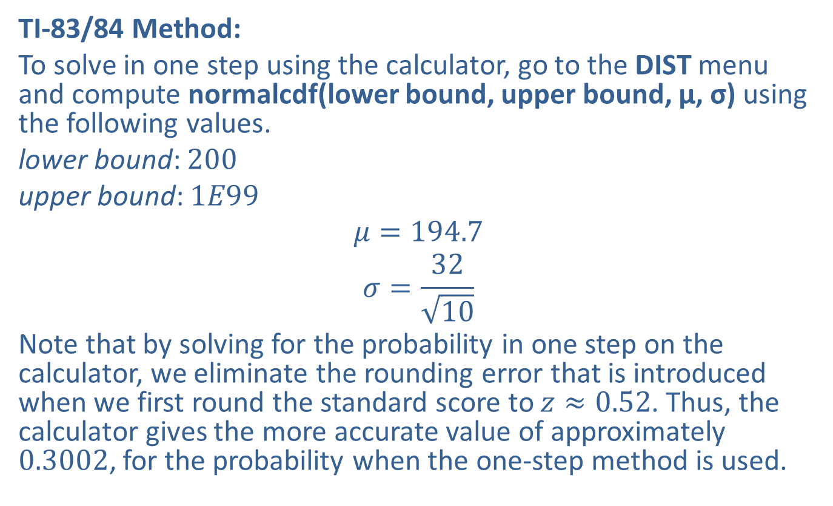
Example 7.2.2: Finding the Probability that a Sample Mean Will Be Greater Than a Given Value (cont.)
TI-83/84 Method:
To solve in one step using the calculator, go to the DIST menu and compute normalcdf(lower bound, upper bound, μ, σ) using the following values.
lower bound: 200
upper bound: $1E99$
$$μ=194.7$$
$$σ=\frac{32}{\sqrt{10}}$$
Note that by solving for the probability in one step on the calculator, we eliminate the rounding error that is introduced when we first round the standard score to $z≈0.52$. Thus, the calculator gives the more accurate value of approximately 0.3002, for the probability when the one-step method is used.

Slide 22
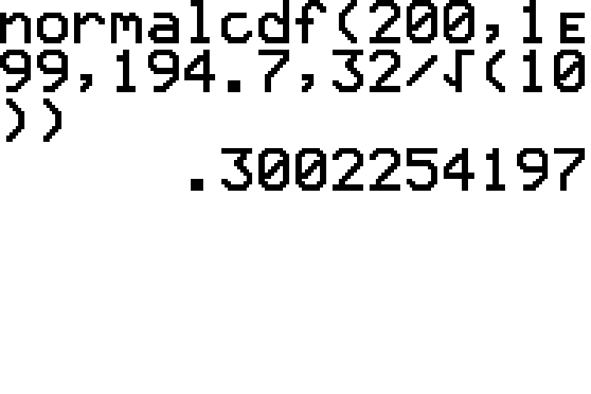
Example 7.2.2: Finding the Probability that a Sample Mean Will Be Greater Than a Given Value (cont.)

Slide 23

Example 7.2.2: Finding the Probability that a Sample Mean Will Be Greater Than a Given Value (cont.)
Hence, the probability would be reported as 0.3015 if using tables or 0.3002 if using the calculator. This means that the probability that a random group of 10 men who enter the elevator will exceed the posted weight capacity is approximately $30\%$.

Slide 24
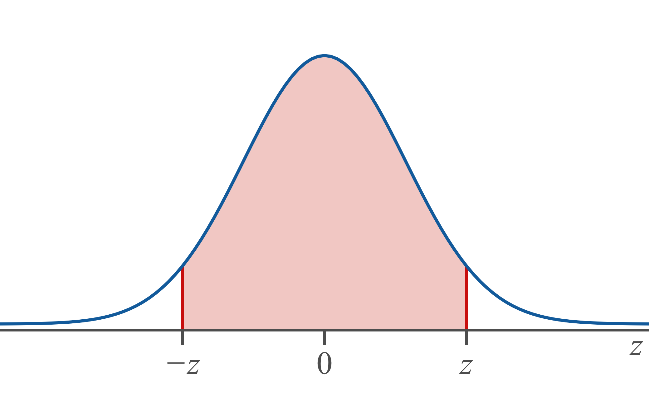
Memory Boost
"Differs by less": between

Slide 25
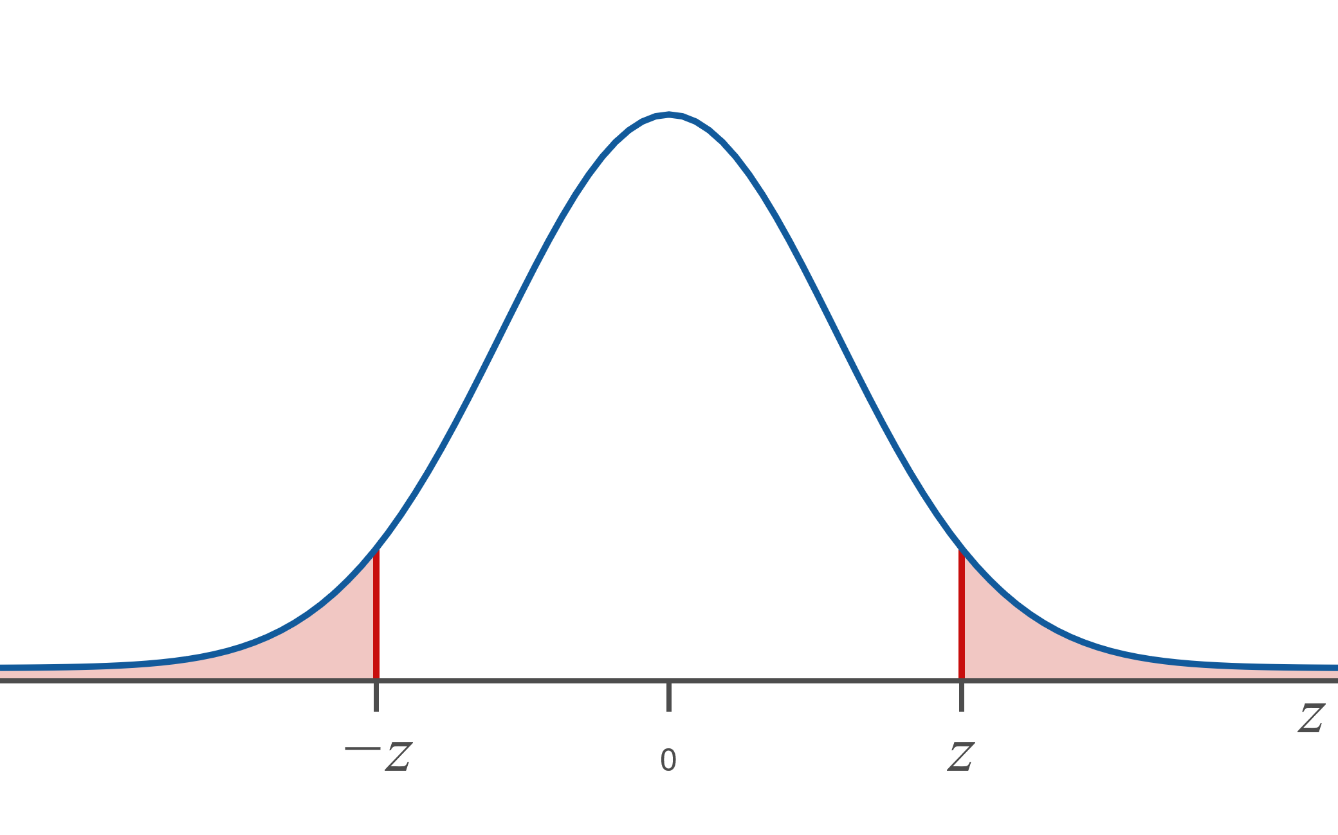
Memory Booster (cont.)
"Differs by more": two tails

Slide 26

Example 7.2.3: Finding the Probability that a Sample Mean Will Differ from the Population Mean by Less Than a Given Amount
Suppose that prices of athletic shoes have a mean of $\$75.15$ and a standard deviation of $\$17.89$. What is the probability that the mean price of a random sample of 50 pairs of athletic shoes will differ from the population mean by less than $\$5.00$?

Slide 27
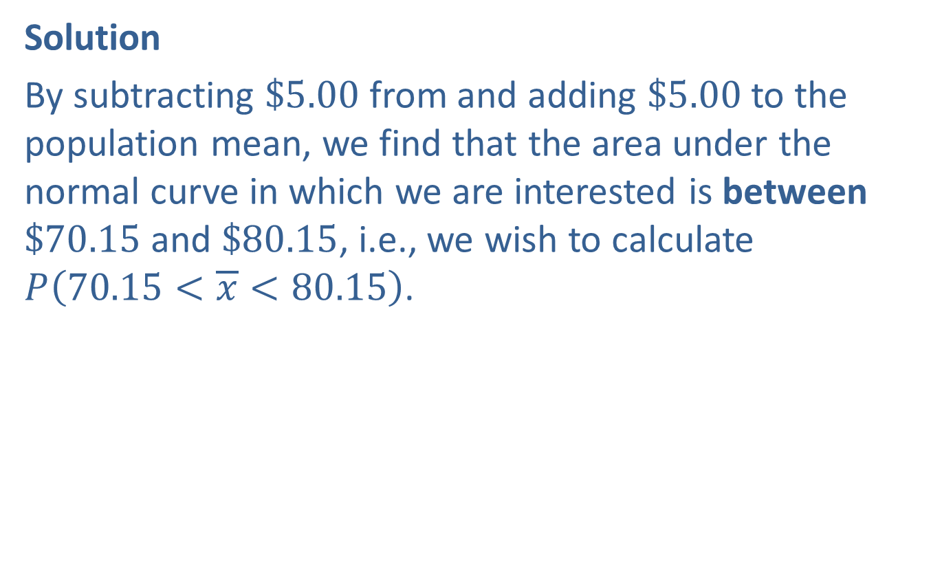
Example 7.2.3: Finding the Probability that a Sample Mean Will Differ from the Population Mean by Less Than a Given Amount (cont.)
Solution
By subtracting $\$5.00$ from and adding $\$5.00$ to the population mean, we find that the area under the normal curve in which we are interested is between $\$70.15$ and $\$80.15$, i.e., we wish to calculate $P⁡\left(70.15<\overline{x}<80.15\right)$.

Slide 28
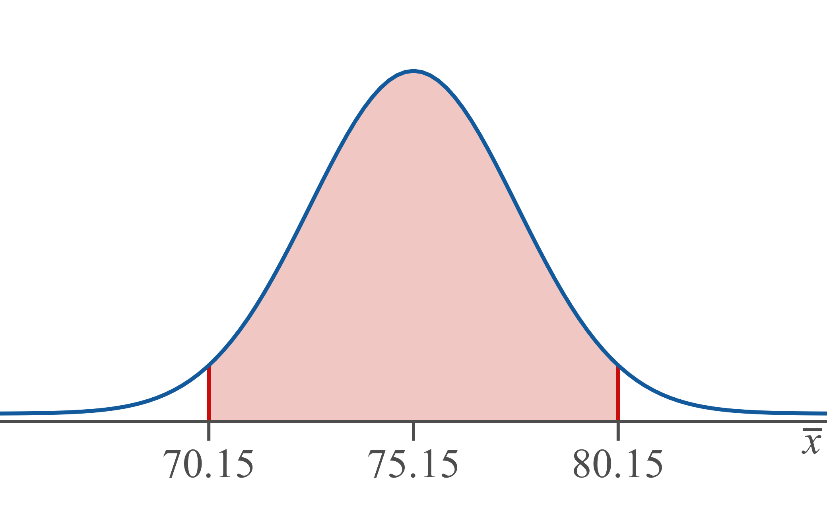
Example 7.2.3: Finding the Probability that a Sample Mean Will Differ from the Population Mean by Less Than a Given Amount (cont.)

Slide 29
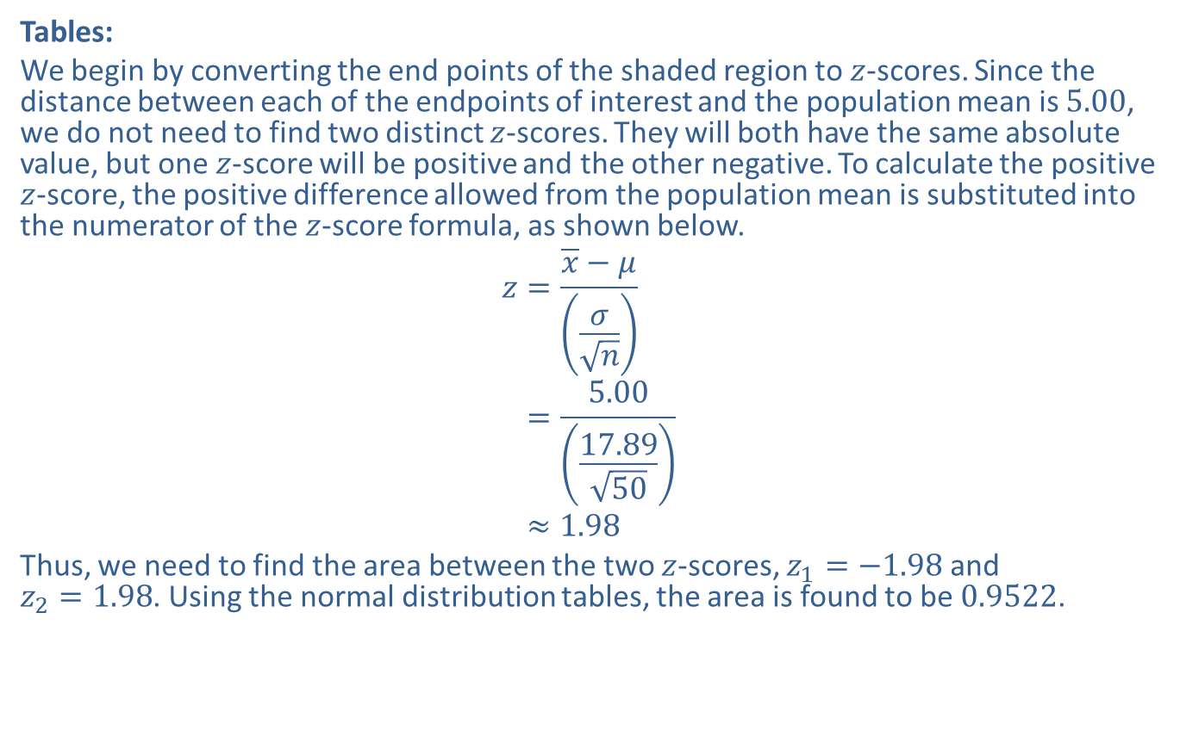
Example 7.2.3: Finding the Probability that a Sample Mean Will Differ from the Population Mean by Less Than a Given Amount (cont.)
Tables:
We begin by converting the end points of the shaded region to $z$-scores. Since the distance between each of the endpoints of interest and the population mean is 5.00, we do not need to find two distinct $z$-scores. They will both have the same absolute value, but one $z$-score will be positive and the other negative. To calculate the positive $z$-score, the positive difference allowed from the population mean is substituted into the numerator of the $z$-score formula, as shown below.
𝑧=𝑥−𝜇𝜎𝑛𝑧=5.0017.8950𝑧≈1.98
Thus, we need to find the area between the two $z$-scores, $z_{1}=−1.98$ and $z_{2}=1.98$. Using the normal distribution tables, the area is found to be 0.9522.

Slide 30
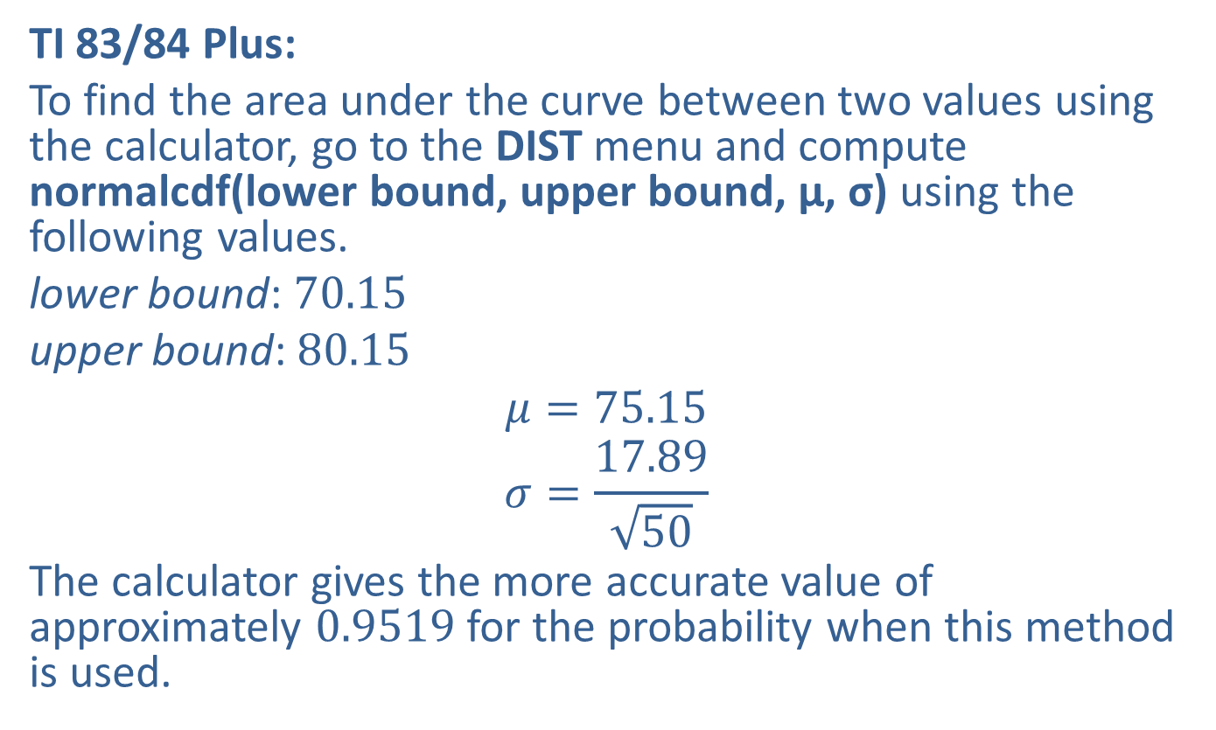
Example 7.2.3: Finding the Probability that a Sample Mean Will Differ from the Population Mean by Less Than a Given Amount (cont.)
TI 83/84 Plus:
To find the area under the curve between two values using the calculator, go to the DIST menu and compute normalcdf(lower bound, upper bound, μ, σ) using the following values.
lower bound: 70.15
upper bound: 80.15
$$μ=75.15$$
$$σ=\frac{17.89}{\sqrt{50}}$$
The calculator gives the more accurate value of approximately 0.9519 for the probability when this method is used.

Slide 31
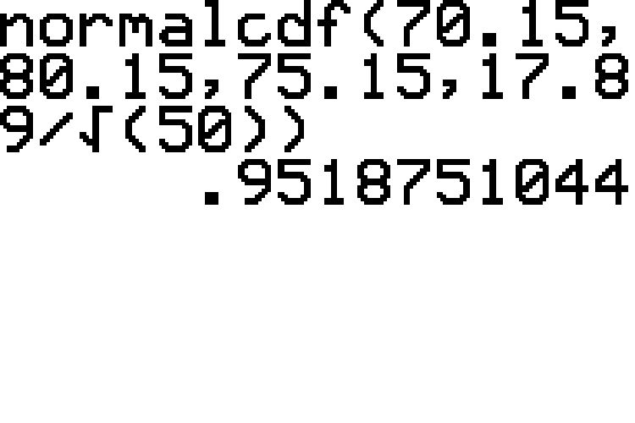
Example 7.2.3: Finding the Probability that a Sample Mean Will Differ from the Population Mean by Less Than a Given Amount (cont.)

Slide 32
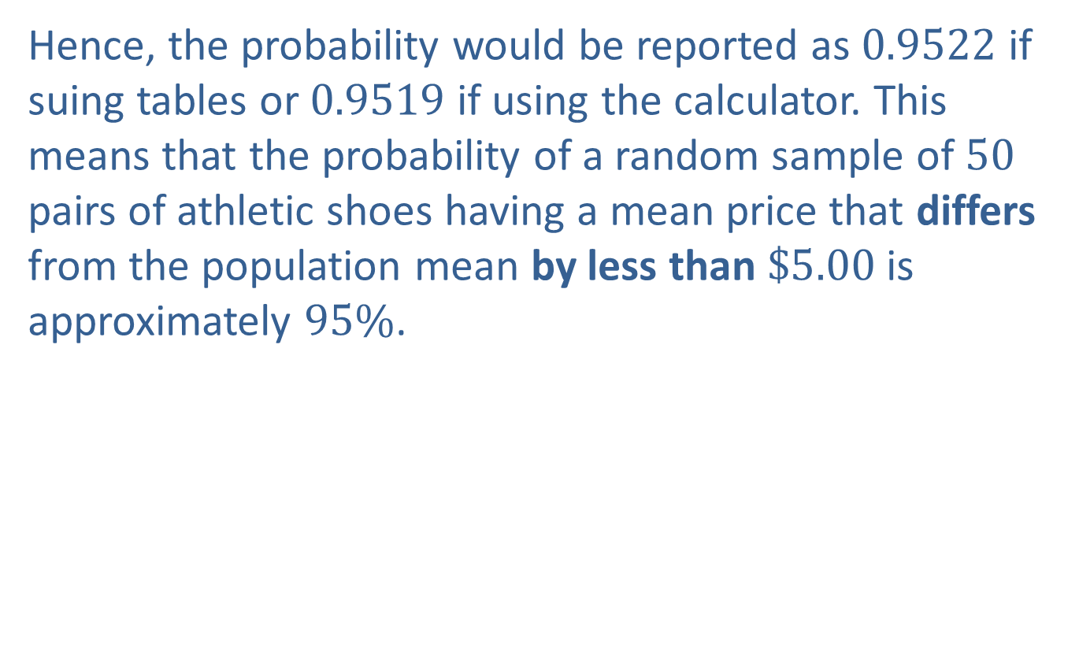
Example 7.2.3: Finding the Probability that a Sample Mean Will Differ from the Population Mean by Less Than a Given Amount (cont.)
Hence, the probability would be reported as 0.9522 if suing tables or 0.9519 if using the calculator. This means that the probability of a random sample of 50 pairs of athletic shoes having a mean price that differs from the population mean by less than $\$5.00$ is approximately $95\%$.

Slide 33
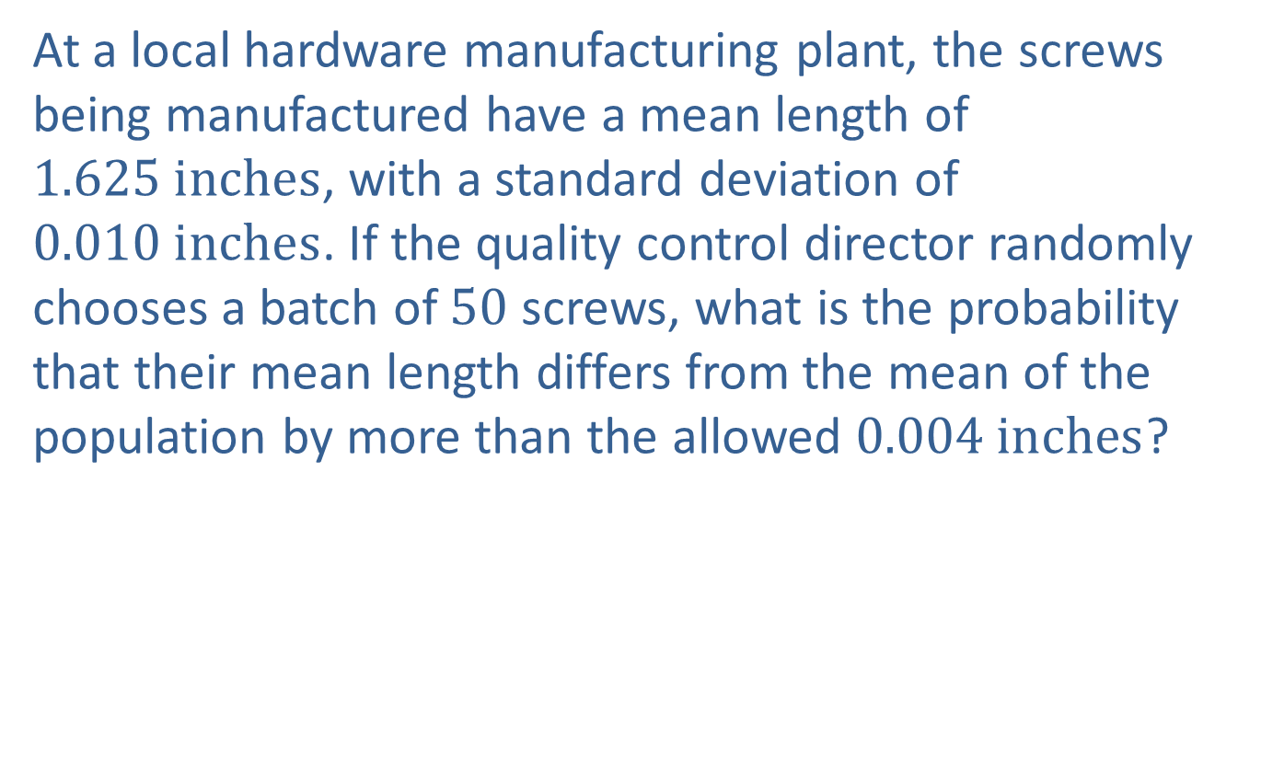
Example 7.2.4: Finding the Probability that a Sample Mean Will Differ from the Population Mean by More Than a Given Amount
At a local hardware manufacturing plant, the screws being manufactured have a mean length of $1.625 inches$, with a standard deviation of $0.010 inches$. If the quality control director randomly chooses a batch of 50 screws, what is the probability that their mean length differs from the mean of the population by more than the allowed $0.004 inches$?

Slide 34
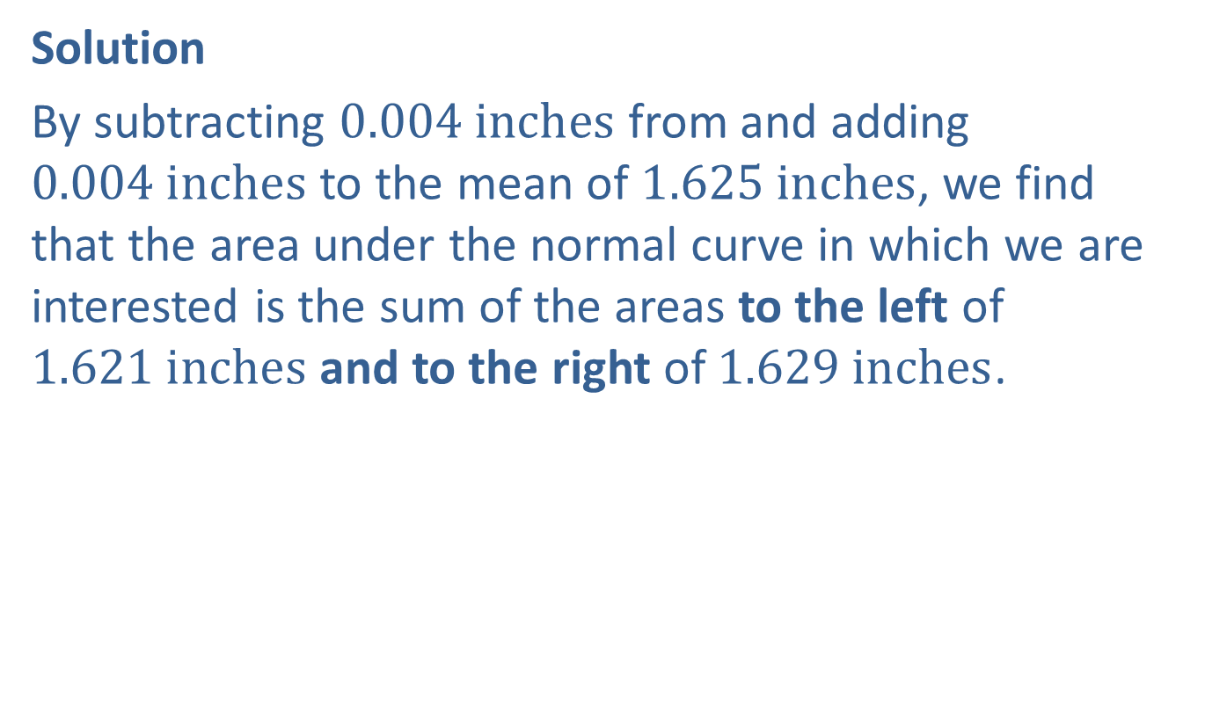
Example 7.2.4: Finding the Probability that a Sample Mean Will Differ from the Population Mean by More Than a Given Amount (cont.)
Solution
By subtracting $0.004 inches$ from and adding $0.004 inches$ to the mean of $1.625 inches$, we find that the area under the normal curve in which we are interested is the sum of the areas to the left of $1.621 inches$ and to the right of $1.629 inches$.

Slide 35
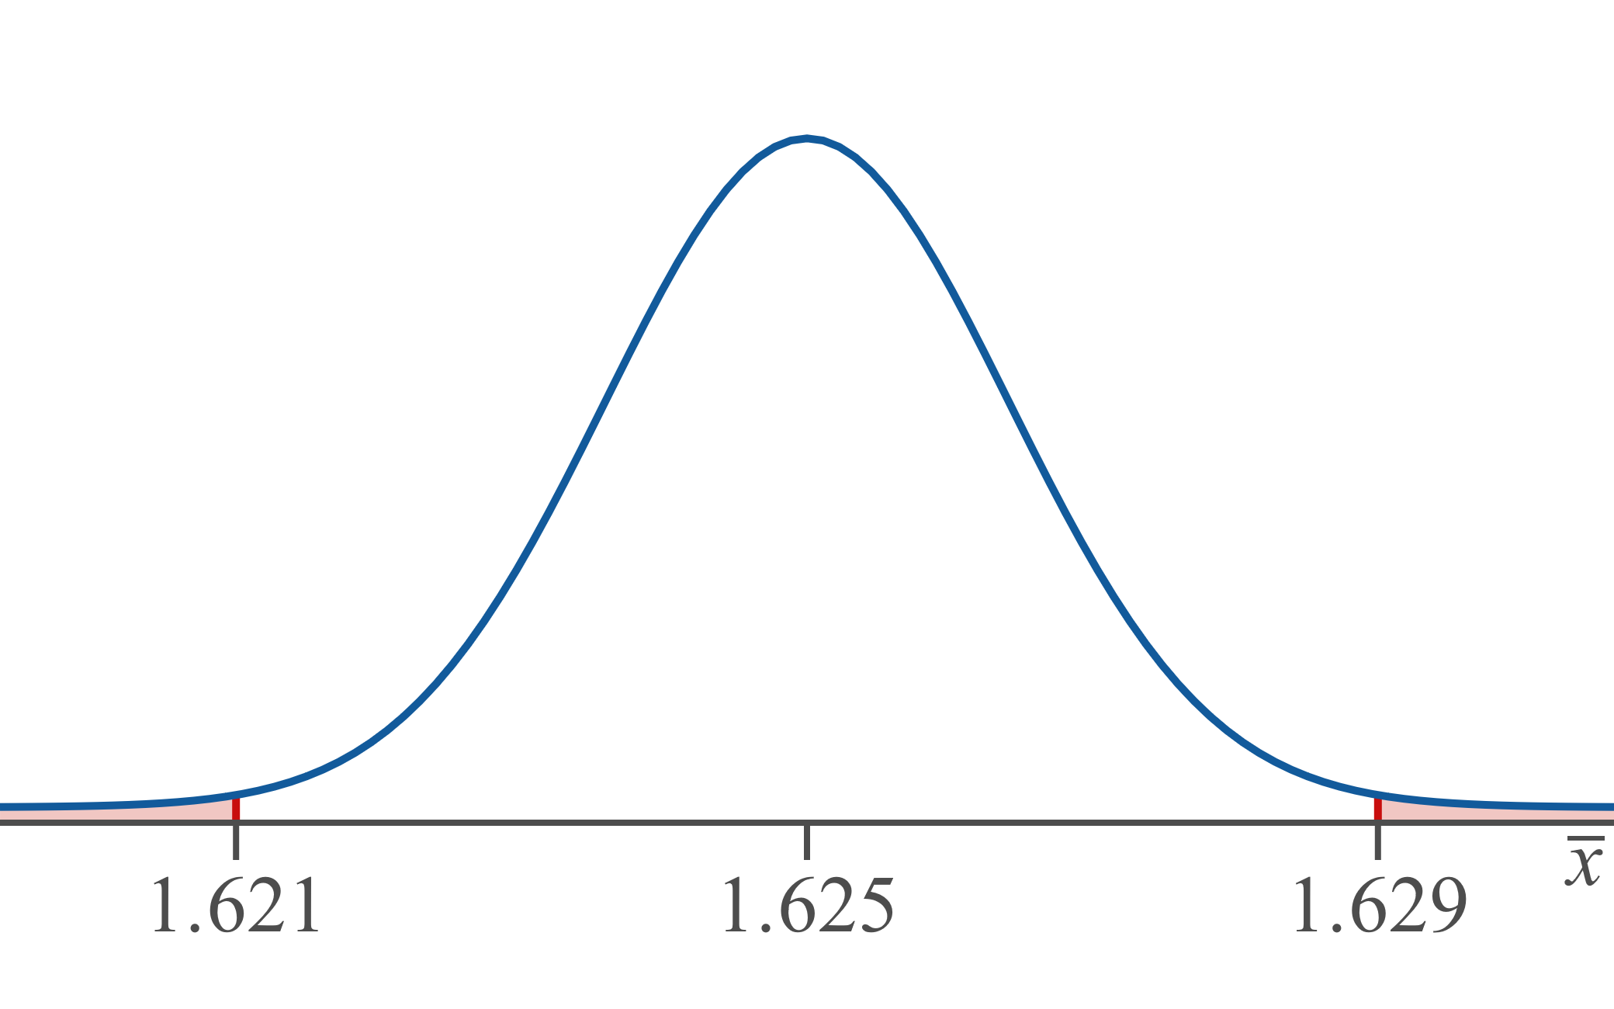
Example 7.2.4: Finding the Probability that a Sample Mean Will Differ from the Population Mean by More Than a Given Amount (cont.)

Slide 36
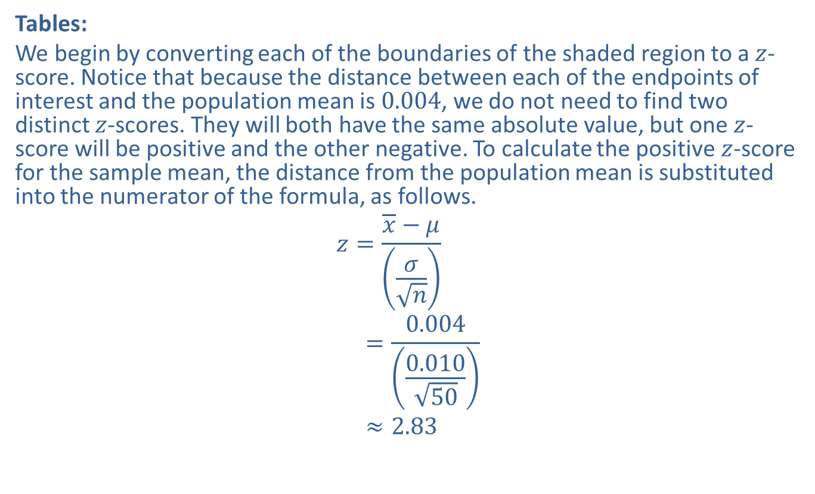
Example 7.2.4: Finding the Probability that a Sample Mean Will Differ from the Population Mean by More Than a Given Amount (cont.)
Tables:
We begin by converting each of the boundaries of the shaded region to a $z$-score. Notice that because the distance between each of the endpoints of interest and the population mean is 0.004, we do not need to find two distinct $z$-scores. They will both have the same absolute value, but one $z$-score will be positive and the other negative. To calculate the positive $z$-score for the sample mean, the distance from the population mean is substituted into the numerator of the formula, as follows.
𝑧=𝑥−𝜇𝜎𝑛𝑧1=0.0040.01050𝑧1≈2.83

Slide 37
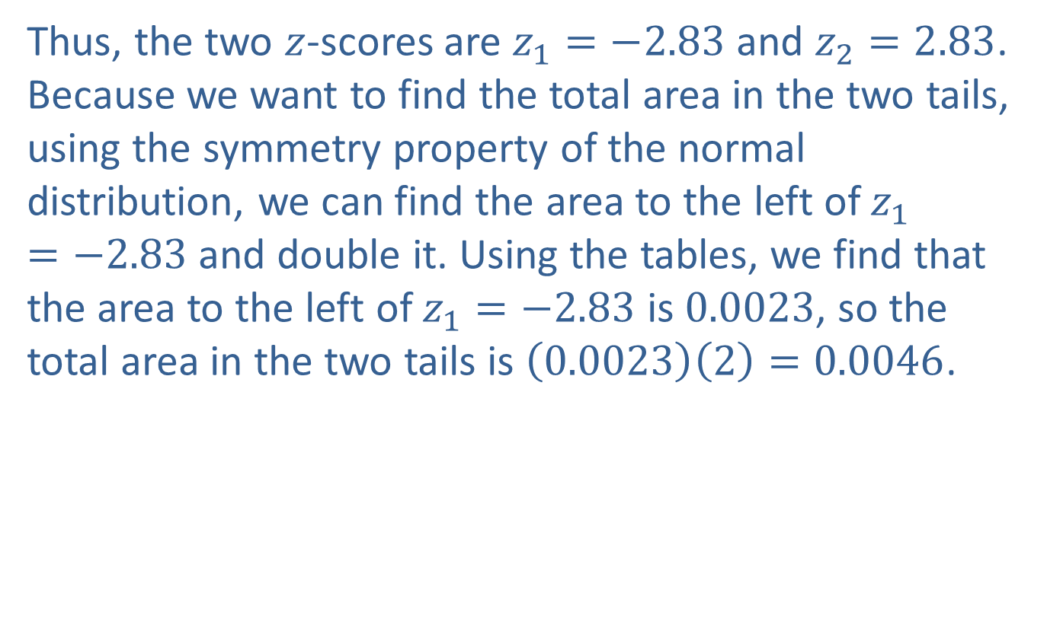
Example 7.2.4: Finding the Probability that a Sample Mean Will Differ from the Population Mean by More Than a Given Amount (cont.)
Thus, the two $z$-scores are $z_{1}=−2.83$ and $z_{2}=2.83$. Because we want to find the total area in the two tails, using the symmetry property of the normal distribution, we can find the area to the left of $z_{1}=−2.83$ and double it. Using the tables, we find that the area to the left of $z_{1}=−2.83$ is 0.0023, so the total area in the two tails is $\left(0.0023\right)\left(2\right)=0.0046$.

Slide 38
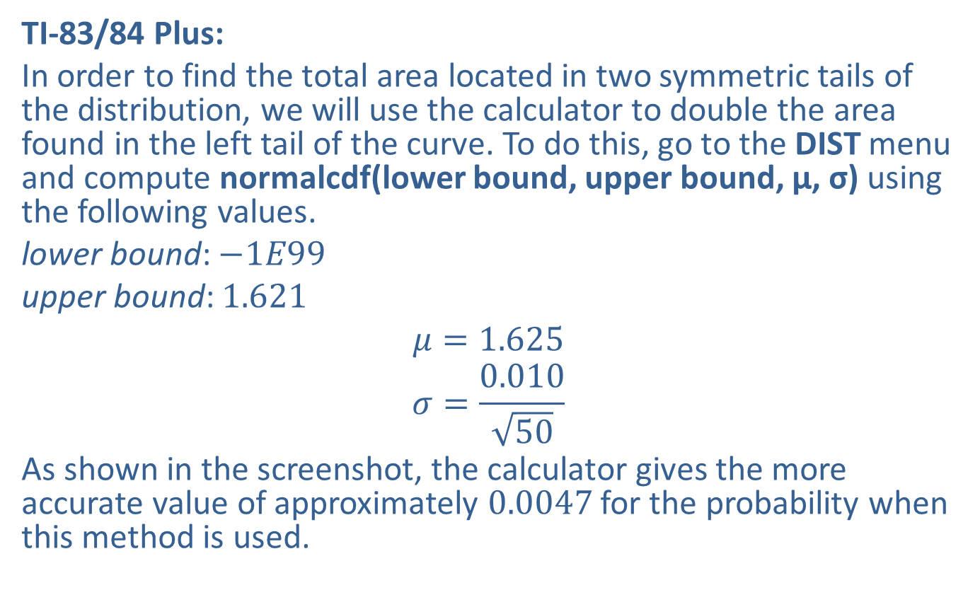
Example 7.2.4: Finding the Probability that a Sample Mean Will Differ from the Population Mean by More Than a Given Amount (cont.)
TI-83/84 Plus:
In order to find the total area located in two symmetric tails of the distribution, we will use the calculator to double the area found in the left tail of the curve. To do this, go to the DIST menu and compute normalcdf(lower bound, upper bound, μ, σ) using the following values.
lower bound: $−1E99$
upper bound: 1.621
$$μ=1.625$$
$$σ=\frac{0.010}{\sqrt{50}}$$
As shown in the screenshot, the calculator gives the more accurate value of approximately 0.0047 for the probability when this method is used.

Slide 39
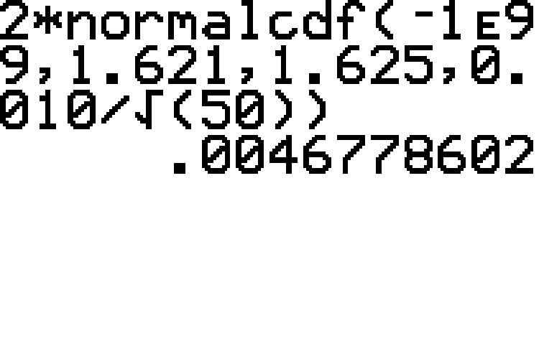
Example 7.2.4: Finding the Probability that a Sample Mean Will Differ from the Population Mean by More Than a Given Amount (cont.)

Slide 40

Example 7.2.4: Finding the Probability that a Sample Mean Will Differ from the Population Mean by More Than a Given Amount (cont.)
Hence, the probability would be reported as 0.0046 if using tables or 0.0047 if using the calculator. This means that the probability of the sample batch not meeting the requirements is very small, approximately $0.5\%$.

