Slide 1
Section 7.3
Central Limit Theorem with Proportions

Slide 2
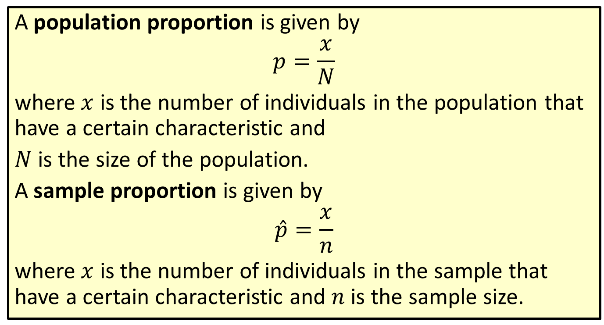
Formula: Proportion
A population proportion is given by
$$p=\frac{x}{N}$$
where $x$ is the number of individuals in the population that have a certain characteristic and
$N$ is the size of the population.
A sample proportion is given by
$$\hat{p}=\frac{x}{n}$$
where $x$ is the number of individuals in the sample that have a certain characteristic and $n$ is the sample size.

Slide 3
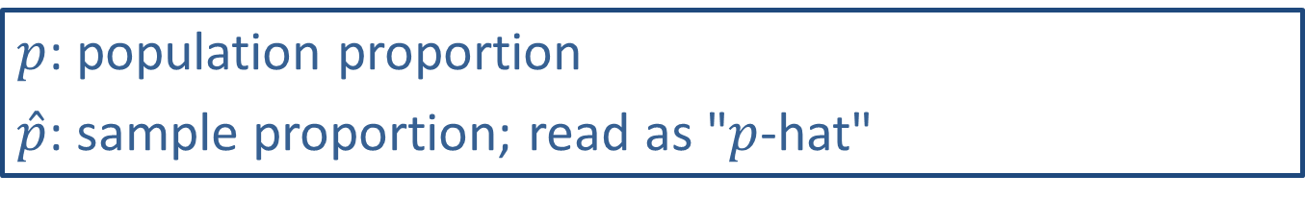
Math Symbols
$p$: population proportion
$\hat{p}$: sample proportion; read as "$p$-hat"

Slide 4
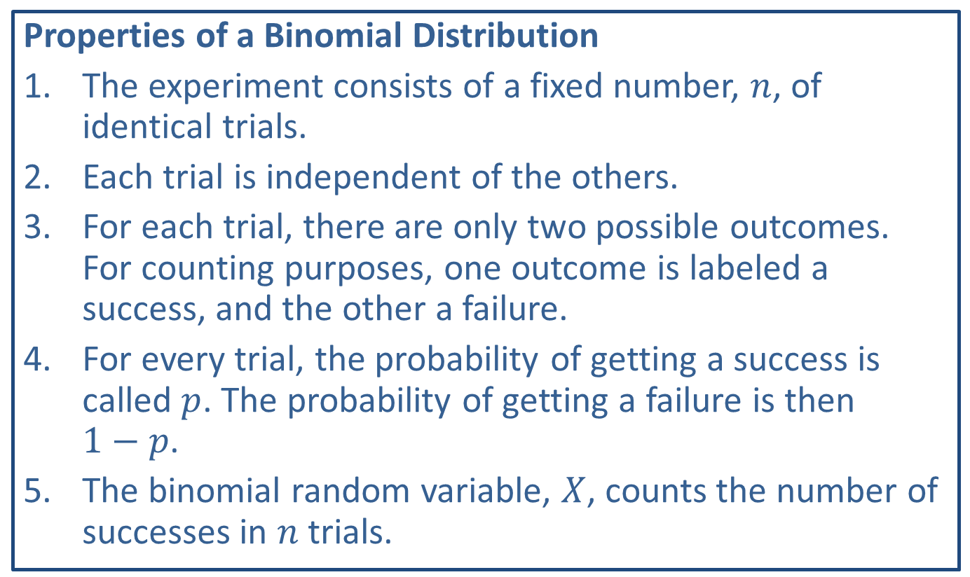
Memory Booster
Properties of a Binomial Distribution
​The experiment consists of a fixed number, $n$, of identical trials.
​Each trial is independent of the others.
​For each trial, there are only two possible outcomes. For counting purposes, one outcome is labeled a success, and the other a failure.
​For every trial, the probability of getting a success is called $p$. The probability of getting a failure is then $1−p$.
​The binomial random variable, $X$, counts the number of successes in $n$ trials.

Slide 5
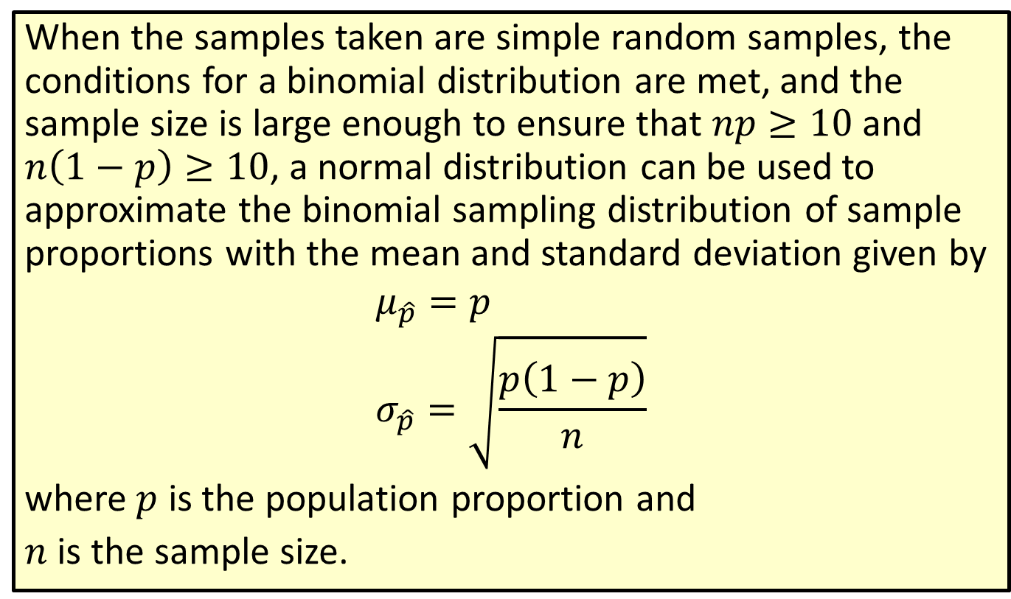
Formula: Mean and Standard Deviation of a Sampling Distribution of Sample Proportions
When the samples taken are simple random samples, the conditions for a binomial distribution are met, and the sample size is large enough to ensure that $np≥10$ and $n\left(1−p\right)≥10$, a normal distribution can be used to approximate the binomial sampling distribution of sample proportions with the mean and standard deviation given by
$$μ_{\hat{p}}=p \\ σ_{\hat{p}}=\sqrt{\frac{p\left(1−p\right)}{n}}$$
where $p$ is the population proportion and
$n$ is the sample size.

Slide 6
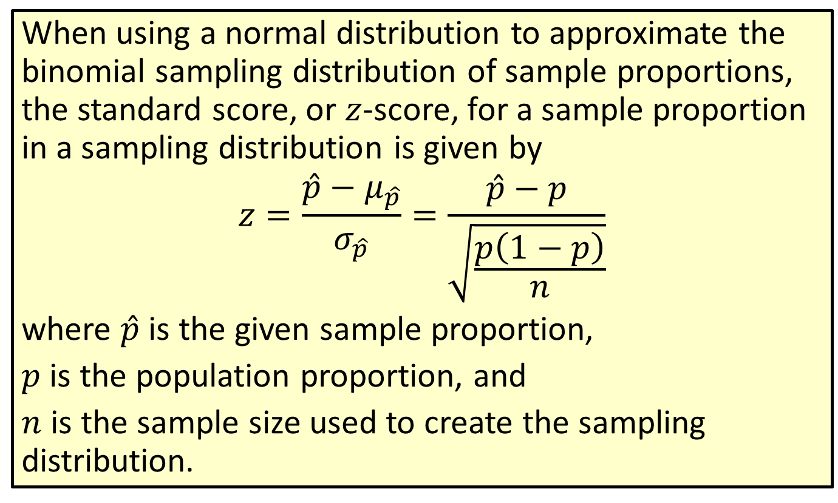
Formula: Standard Score for a Sample Proportion
When using a normal distribution to approximate the binomial sampling distribution of sample proportions, the standard score, or $z$-score, for a sample proportion in a sampling distribution is given by
$$z=\frac{\hat{p}−μ_{\hat{p}}}{σ_{\hat{p}}}=\frac{\hat{p}−p}{\sqrt{\frac{p\left(1−p\right)}{n}}}$$
where $\hat{p}$ is the given sample proportion,
$p$ is the population proportion, and
$n$ is the sample size used to create the sampling distribution.

Slide 7

Example 7.3.1: Finding the Probability that a Sample Proportion Will Be At Least a Given Value
In a certain conservative precinct, $79\%$ of the voters are registered Republicans. What is the probability that in a random sample of 100 voters from this precinct, at least 68 of the voters would be registered Republicans?

Slide 8
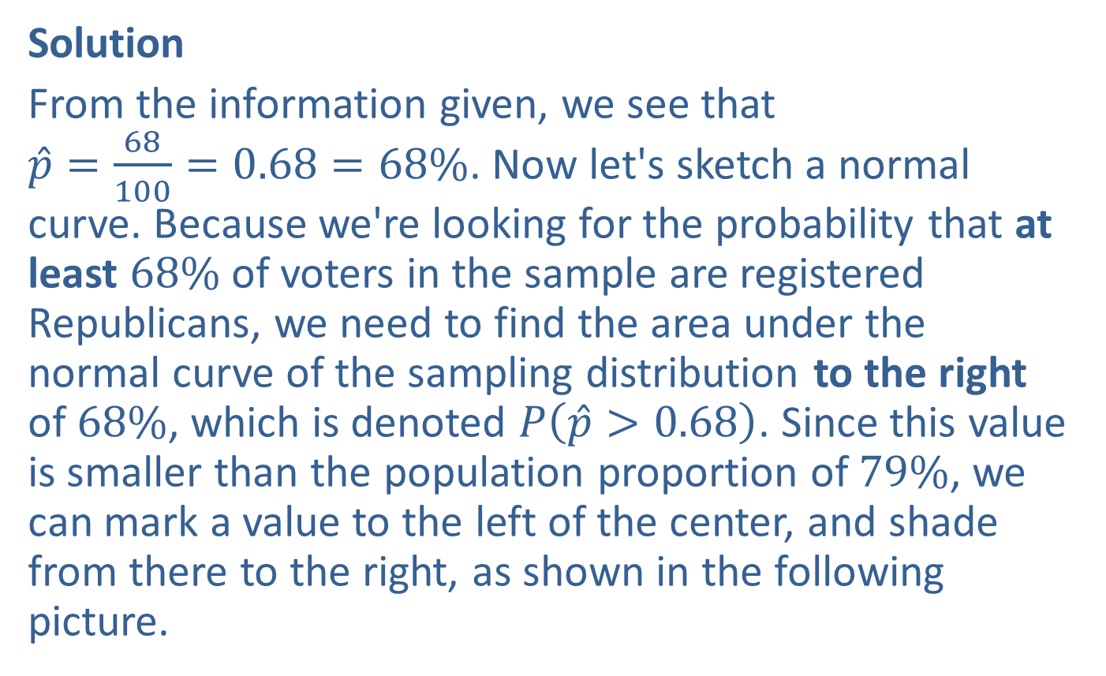
Example 7.3.1: Finding the Probability that a Sample Proportion Will Be At Least a Given Value (cont.)
Solution
From the information given, we see that $\hat{p}=\frac{68}{100}=0.68=68\%$. Now let's sketch a normal curve. Because we're looking for the probability that at least $68\%$ of voters in the sample are registered Republicans, we need to find the area under the normal curve of the sampling distribution to the right of $68\%$, which is denoted $P⁡\left(\hat{p}>0.68\right)$. Since this value is smaller than the population proportion of $79\%$, we can mark a value to the left of the center, and shade from there to the right, as shown in the following picture.

Slide 9
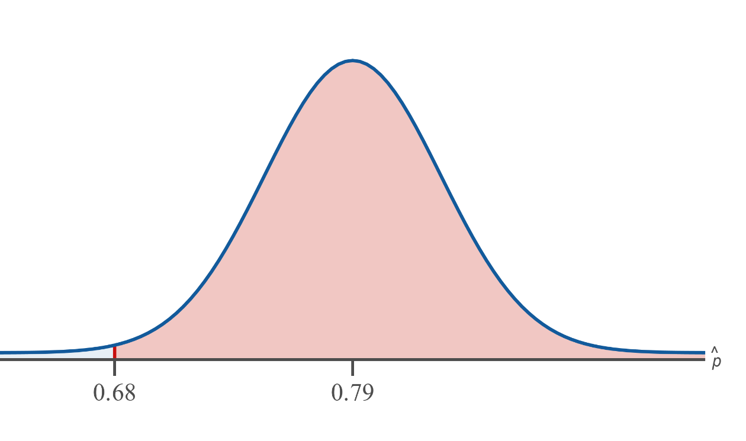
Example 7.3.1: Finding the Probability that a Sample Proportion Will Be At Least a Given Value (cont.)

Slide 10
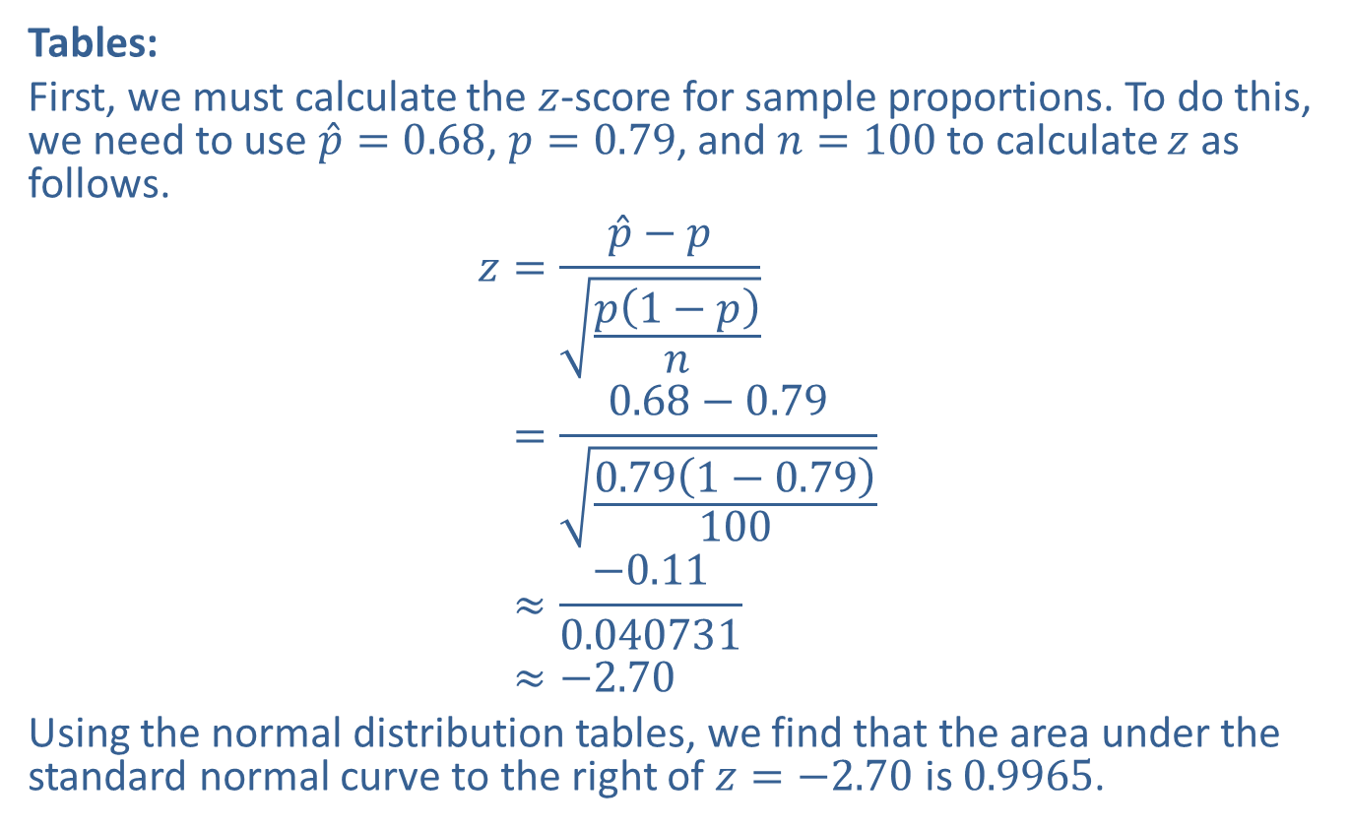
Example 7.3.1: Finding the Probability that a Sample Proportion Will Be At Least a Given Value (cont.)
Tables:
First, we must calculate the $z$-score for sample proportions. To do this, we need to use $\hat{p}=0.68$, $p=0.79$, and $n=100$ to calculate $z$ as follows.
𝑧=𝑝−𝑝𝑝1−𝑝𝑛𝑧=0.68−0.790.791−0.79100𝑧≈−0.110.040731𝑧≈−2.70
Using the normal distribution tables, we find that the area under the standard normal curve to the right of $z=−2.70$ is 0.9965.

Slide 11
Rounding Rule
When calculations involve several steps, avoid rounding at intermediate calculations. If necessary, round intermediate calculations to at least six decimal places to avoid additional rounding errors in subsequent calculations.

Slide 12
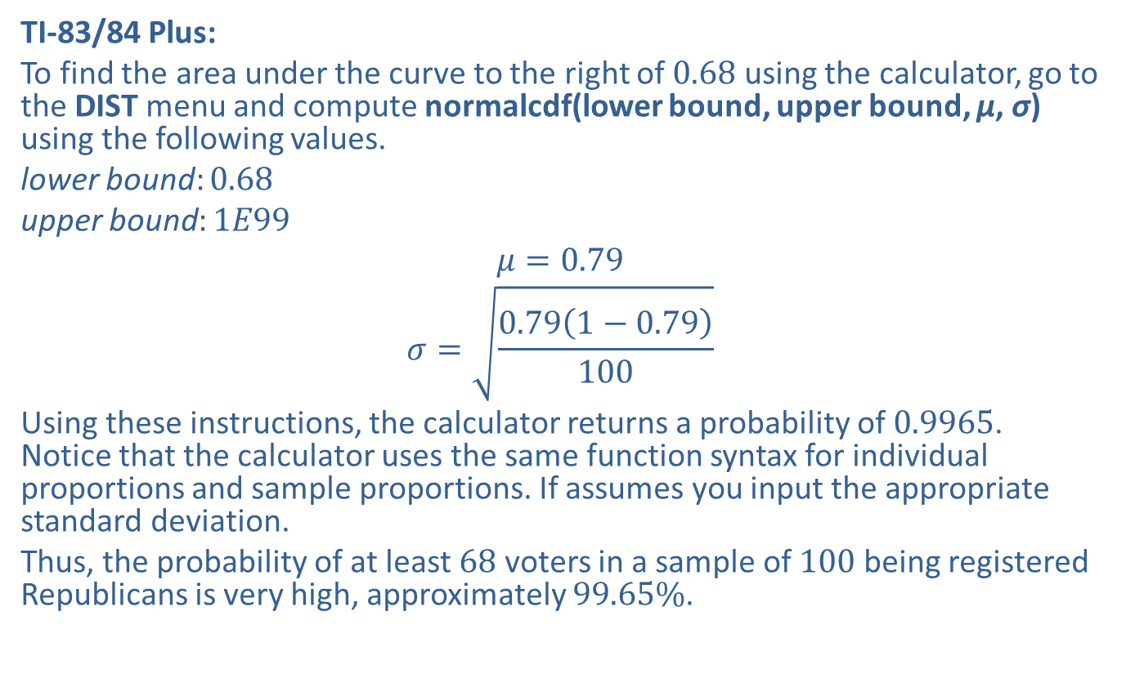
Example 7.3.1: Finding the Probability that a Sample Proportion Will Be At Least a Given Value (cont.)
TI-83/84 Plus:
To find the area under the curve to the right of 0.68 using the calculator, go to the DIST menu and compute normalcdf(lower bound, upper bound, μ, σ) using the following values.
lower bound: 0.68
upper bound: $1E99$
$$μ=0.79$$
$$σ=\sqrt{\frac{0.79\left(1−0.79\right)}{100}}$$
Using these instructions, the calculator returns a probability of 0.9965. Notice that the calculator uses the same function syntax for individual proportions and sample proportions. If assumes you input the appropriate standard deviation.
Thus, the probability of at least 68 voters in a sample of 100 being registered Republicans is very high, approximately $99.65\%$.

Slide 13
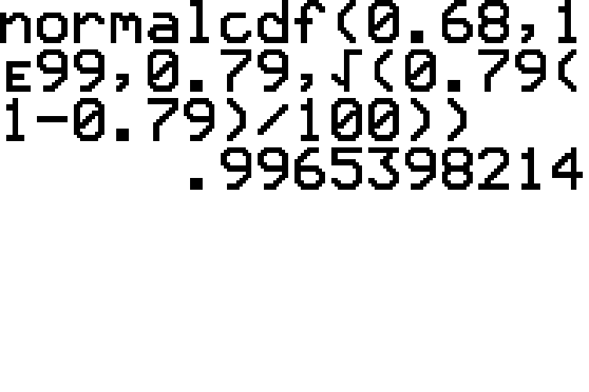
Example 7.3.1: Finding the Probability that a Sample Proportion Will Be At Least a Given Value (cont.)

Slide 14
Technology
To find normal probabilities using other technologies, please visit stat.hawkeslearning.com and navigate to Technology Instructions > Normal Distribution > Normal Probability (cdf).

Slide 15
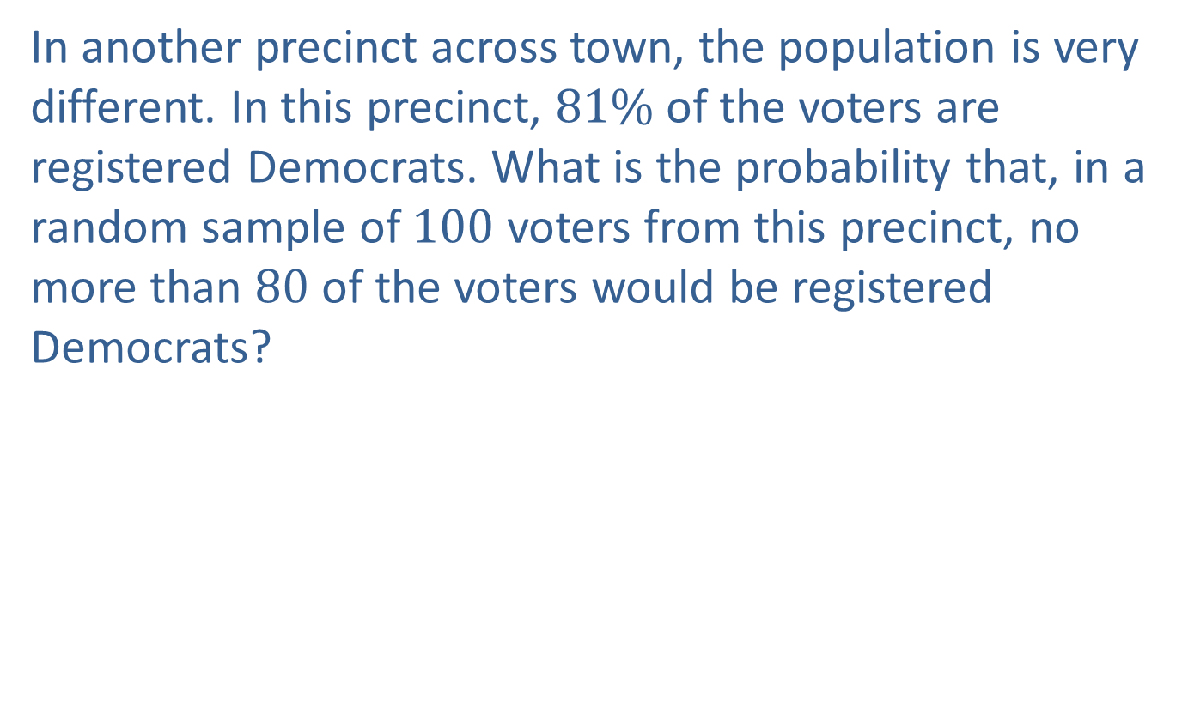
Example 7.3.2: Finding the Probability that a Sample Proportion Will Be No More Than a Given Value
In another precinct across town, the population is very different. In this precinct, $81\%$ of the voters are registered Democrats. What is the probability that, in a random sample of 100 voters from this precinct, no more than 80 of the voters would be registered Democrats?

Slide 16
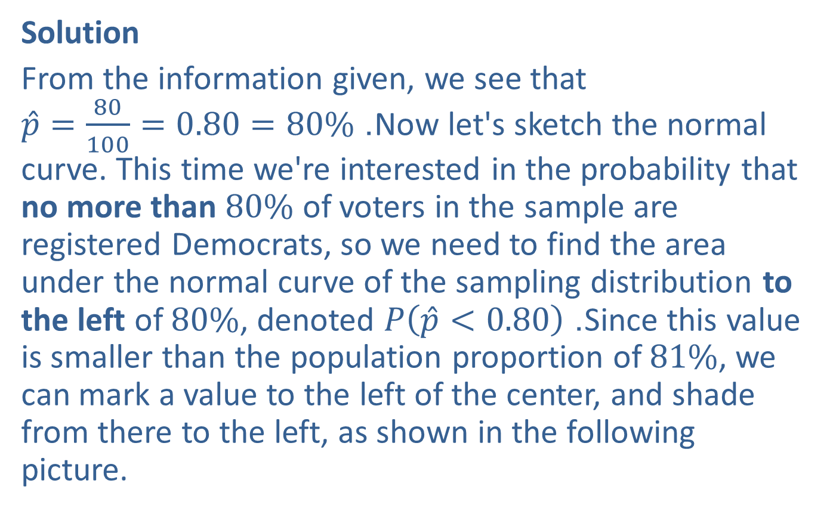
Example 7.3.2: Finding the Probability that a Sample Proportion Will Be No More Than a Given Value (cont.)
Solution
From the information given, we see that $\hat{p}=\frac{80}{100}=0.80=80\%$. Now let's sketch the normal curve. This time we're interested in the probability that no more than $80\%$ of voters in the sample are registered Democrats, so we need to find the area under the normal curve of the sampling distribution to the left of $80\%$, denoted $P⁡\left(\hat{p}<0.80\right)$. Since this value is smaller than the population proportion of $81\%$, we can mark a value to the left of the center, and shade from there to the left, as shown in the following picture.

Slide 17
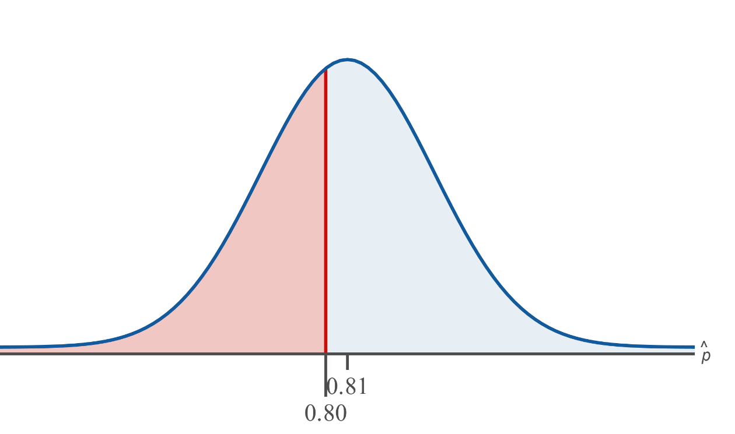
Example 7.3.2: Finding the Probability that a Sample Proportion Will Be No More Than a Given Value (cont.)

Slide 18
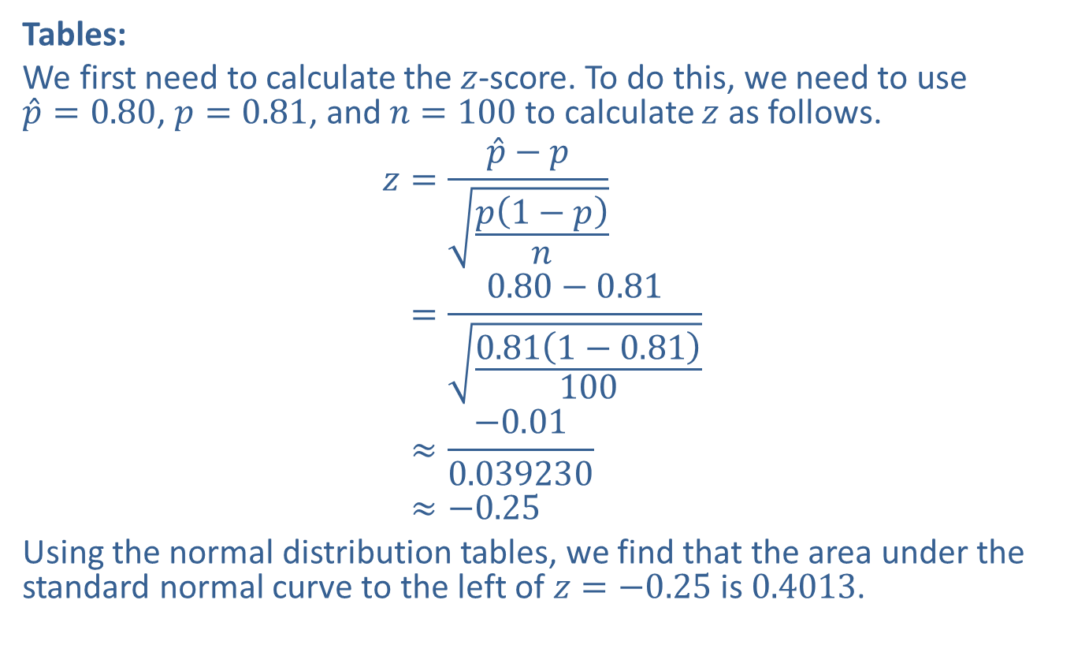
Example 7.3.2: Finding the Probability that a Sample Proportion Will Be No More Than a Given Value (cont.)
Tables:
We first need to calculate the $z$-score. To do this, we need to use $\hat{p}=0.80$, $p=0.81$, and $n=100$ to calculate $z$ as follows.
𝑧=𝑝−𝑝𝑝1−𝑝𝑛𝑧=0.80−0.810.811−0.81100𝑧≈−0.010.039230𝑧≈−0.25
Using the normal distribution tables, we find that the area under the standard normal curve to the left of $z=−0.25$ is 0.4013.

Slide 19
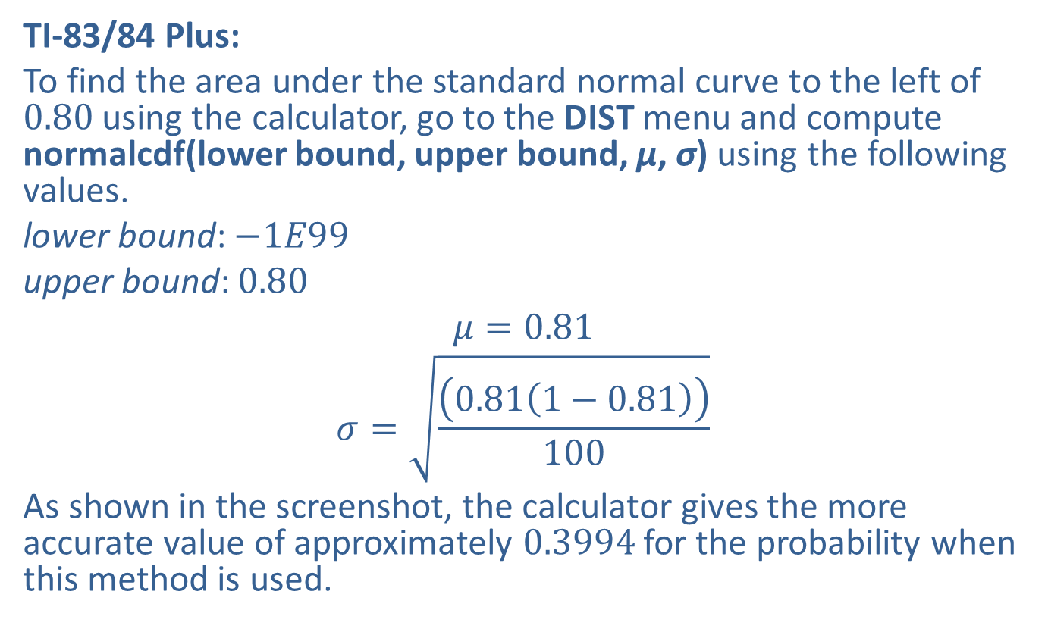
Example 7.3.2: Finding the Probability that a Sample Proportion Will Be No More Than a Given Value (cont.)
TI-83/84 Plus:
To find the area under the standard normal curve to the left of 0.80 using the calculator, go to the DIST menu and compute normalcdf(lower bound, upper bound, μ, σ) using the following values.
lower bound: $−1E99$
upper bound: 0.80
$$μ=0.81$$
$$σ=\sqrt{\frac{\left(0.81\left(1−0.81\right)\right)}{100}}$$
As shown in the screenshot, the calculator gives the more accurate value of approximately 0.3994 for the probability when this method is used.

Slide 20
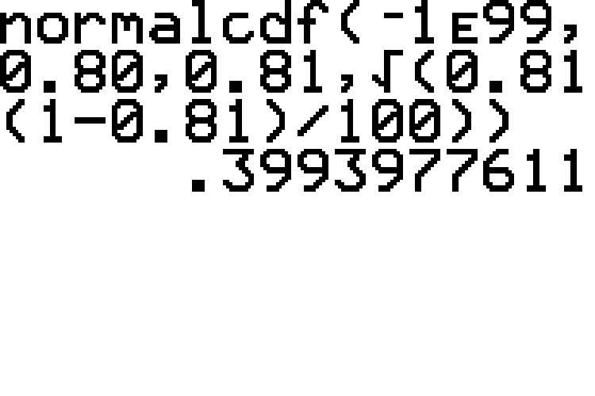
Example 7.3.2: Finding the Probability that a Sample Proportion Will Be No More Than a Given Value (cont.)

Slide 21

Example 7.3.2: Finding the Probability that a Sample Proportion Will Be No More Than a Given Value (cont.)
Hence, the probability would be reported as 0.4013 if using tables or 0.3994 if using the calculator. This means that the probability of no more than 80 voters in a randomly selected sample of 100 voters being registered Democrats is approximately $40\%$.

Slide 22
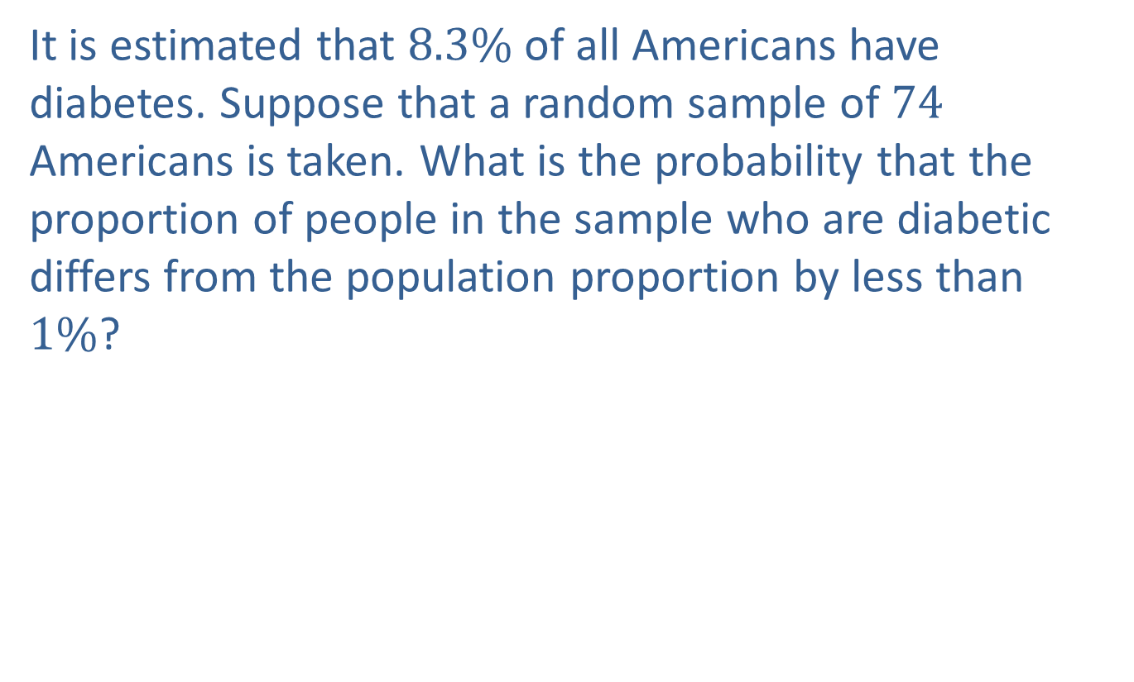
Example 7.3.3: Finding the Probability that a Sample Proportion Will Differ from the Population Proportion by Less Than a Given Amount
It is estimated that $8.3\%$ of all Americans have diabetes. Suppose that a random sample of 74 Americans is taken. What is the probability that the proportion of people in the sample who are diabetic differs from the population proportion by less than $1\%$?

Slide 23
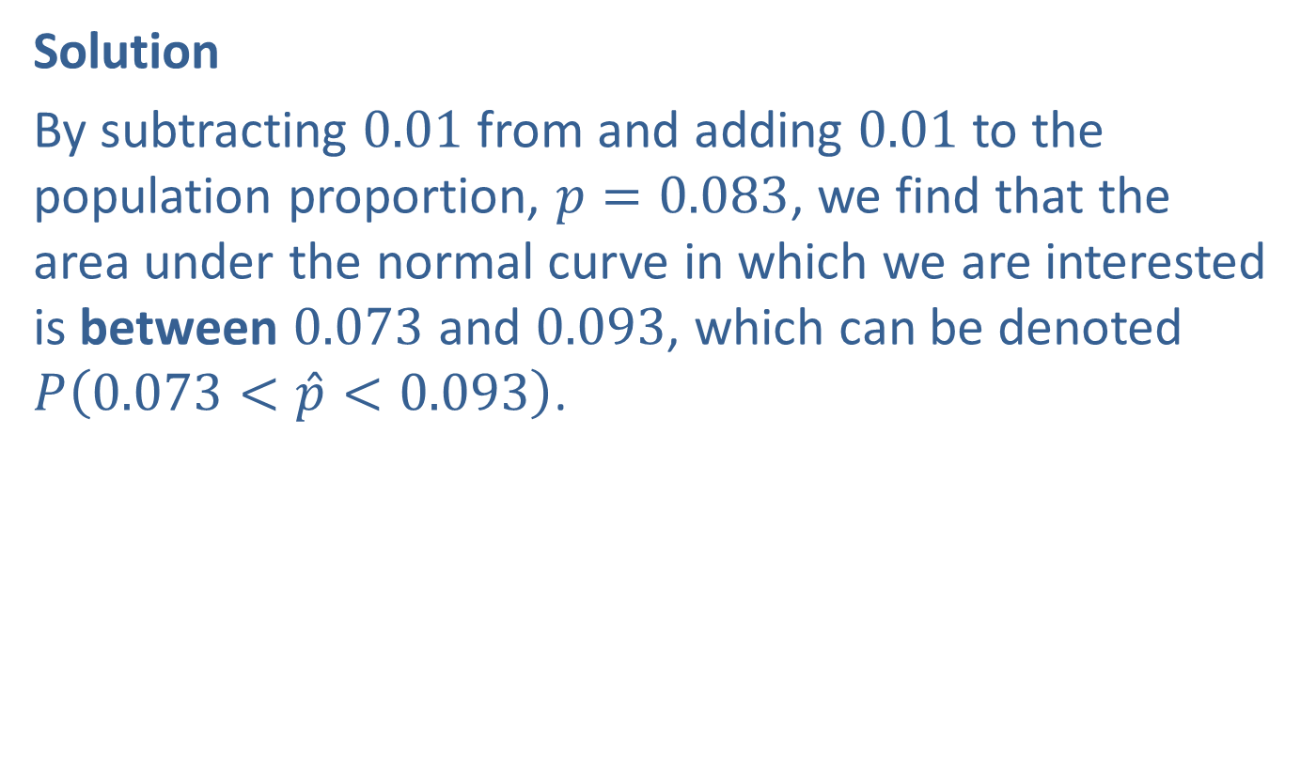
Example 7.3.3: Finding the Probability that a Sample Proportion Will Differ from the Population Proportion by Less Than a Given Amount (cont.)
Solution
By subtracting 0.01 from and adding 0.01 to the population proportion, $p=0.083$, we find that the area under the normal curve in which we are interested is between 0.073 and 0.093, which can be denoted $P⁡\left(0.073<\hat{p}<0.093\right)$.

Slide 24
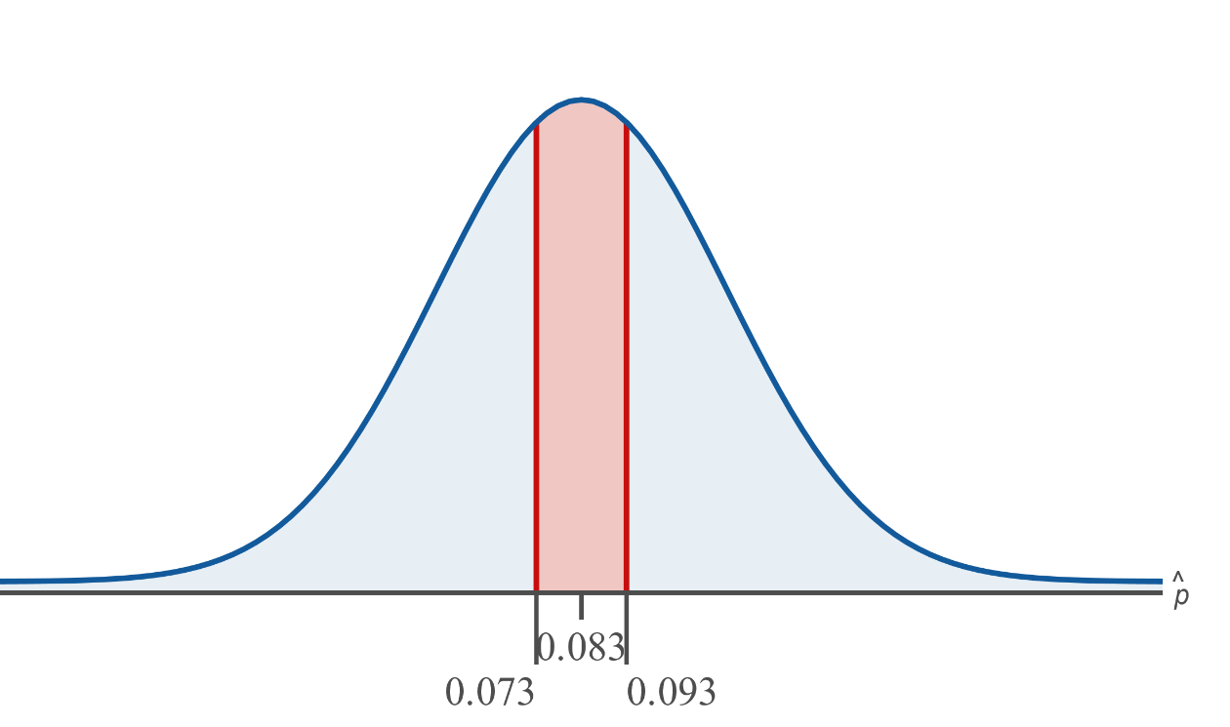
Example 7.3.3: Finding the Probability that a Sample Proportion Will Differ from the Population Proportion by Less Than a Given Amount (cont.)

Slide 25
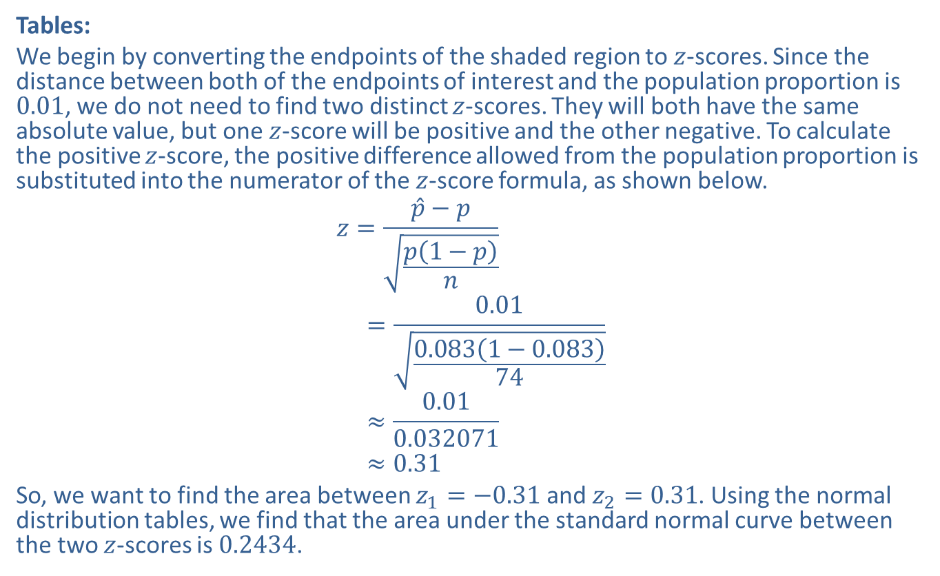
Example 7.3.3: Finding the Probability that a Sample Proportion Will Differ from the Population Proportion by Less Than a Given Amount (cont.)
Tables:
We begin by converting the endpoints of the shaded region to $z$-scores. Since the distance between both of the endpoints of interest and the population proportion is 0.01, we do not need to find two distinct $z$-scores. They will both have the same absolute value, but one $z$-score will be positive and the other negative. To calculate the positive $z$-score, the positive difference allowed from the population proportion is substituted into the numerator of the $z$-score formula, as shown below.
𝑧=𝑝−𝑝𝑝1−𝑝𝑛𝑧1=0.010.0831−0.08374𝑧1≈0.010.032071𝑧1≈0.31
So, we want to find the area between $z_{1}=−0.31$ and $z_{2}=0.31$. Using the normal distribution tables, we find that the area under the standard normal curve between the two $z$-scores is 0.2434.

Slide 26
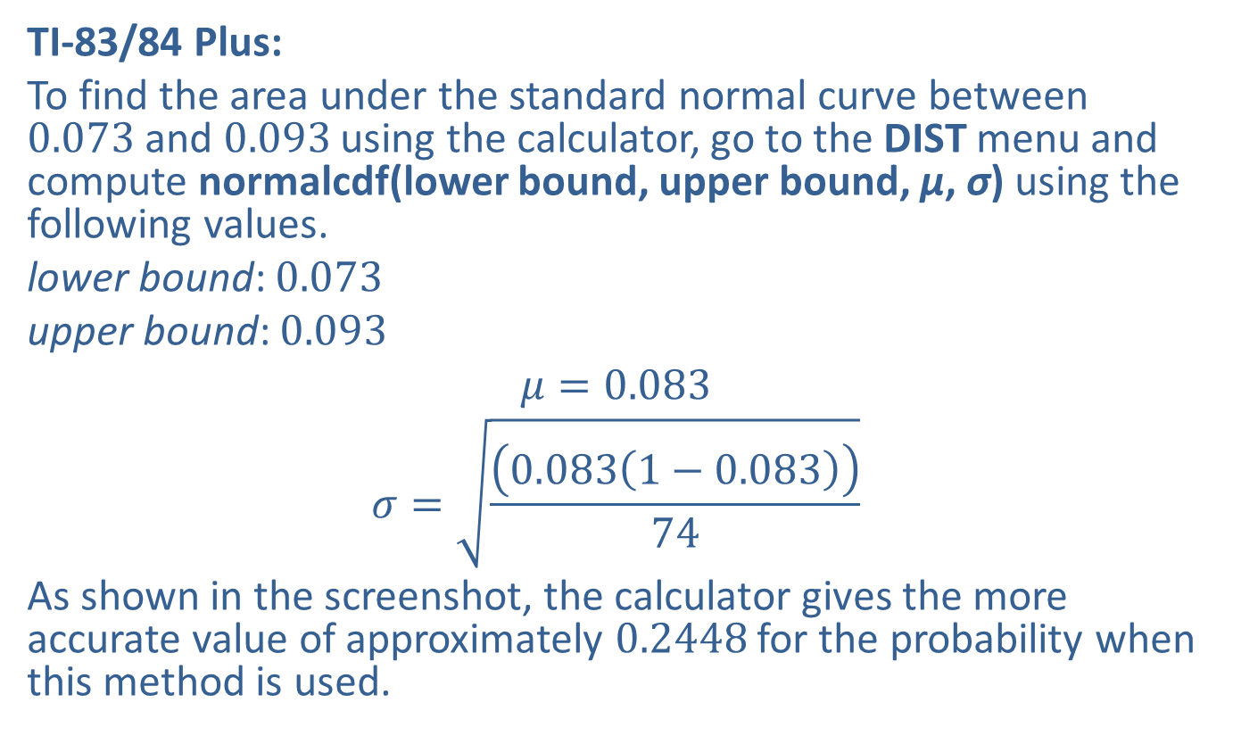
Example 7.3.3: Finding the Probability that a Sample Proportion Will Differ from the Population Proportion by Less Than a Given Amount (cont.)
TI-83/84 Plus:
To find the area under the standard normal curve between 0.073 and 0.093 using the calculator, go to the DIST menu and compute normalcdf(lower bound, upper bound, μ, σ) using the following values.
lower bound: 0.073
upper bound: 0.093
$$μ=0.083$$
$$σ=\sqrt{\frac{\left(0.083\left(1−0.083\right)\right)}{74}}$$
As shown in the screenshot, the calculator gives the more accurate value of approximately 0.2448 for the probability when this method is used.

Slide 27
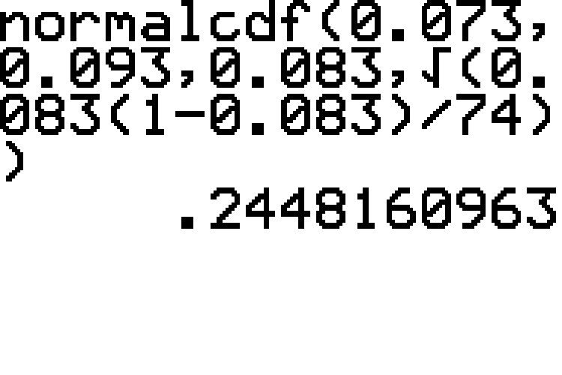
Example 7.3.3: Finding the Probability that a Sample Proportion Will Differ from the Population Proportion by Less Than a Given Amount (cont.)

Slide 28
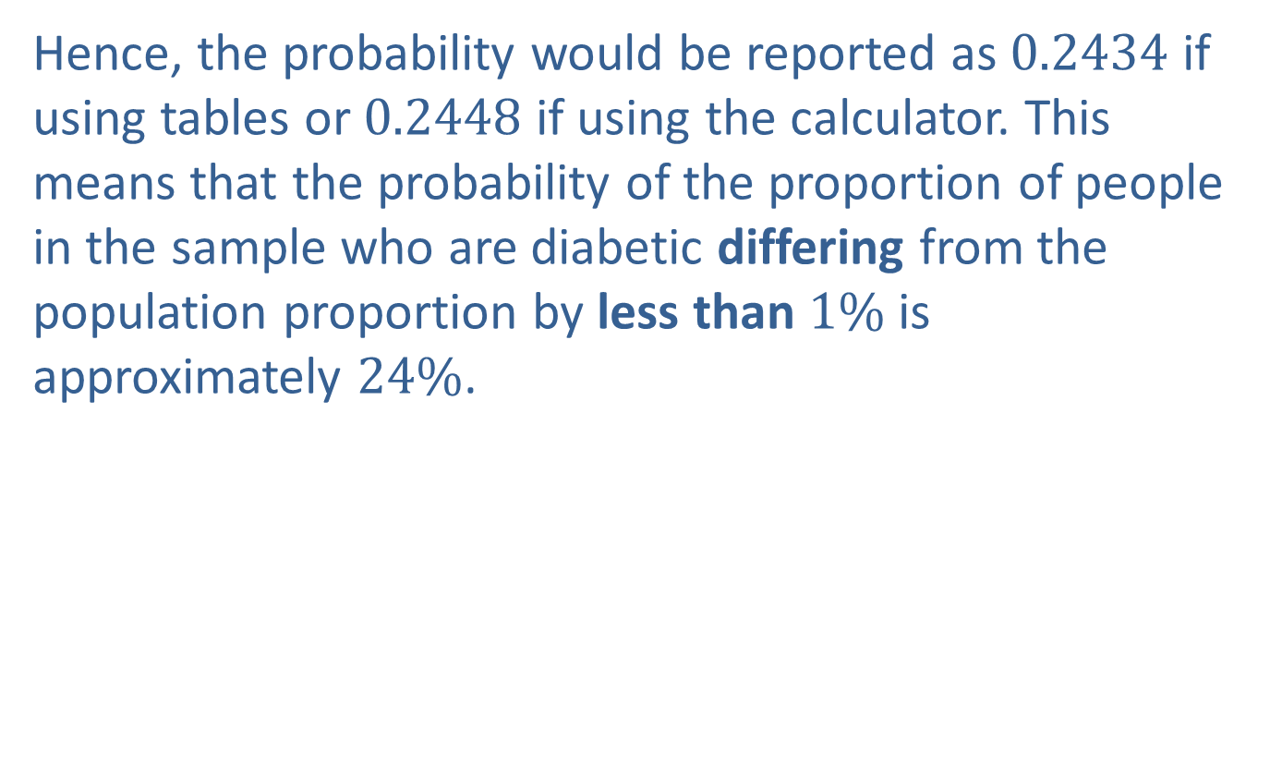
Example 7.3.3: Finding the Probability that a Sample Proportion Will Differ from the Population Proportion by Less Than a Given Amount (cont.)
Hence, the probability would be reported as 0.2434 if using tables or 0.2448 if using the calculator. This means that the probability of the proportion of people in the sample who are diabetic differing from the population proportion by less than $1\%$ is approximately $24\%$.

Slide 29
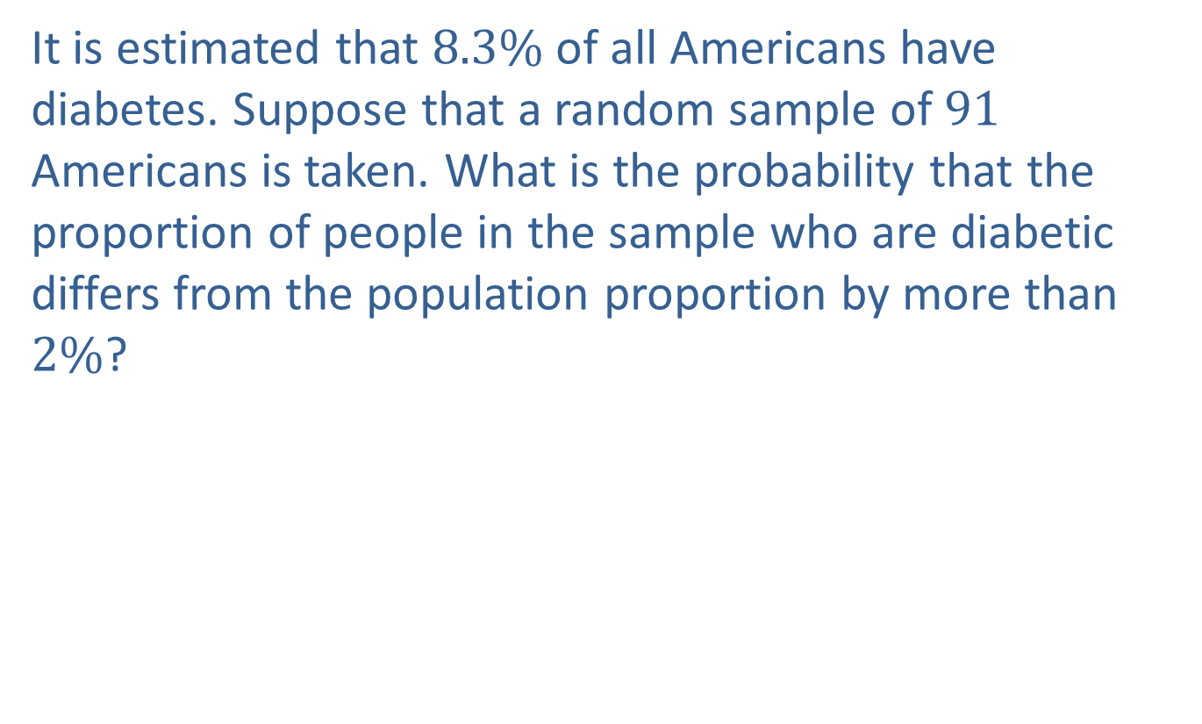
Example 7.3.4: Finding the Probability that a Sample Proportion Will Differ from the Population Proportion by More Than a Given Amount
It is estimated that $8.3\%$ of all Americans have diabetes. Suppose that a random sample of 91 Americans is taken. What is the probability that the proportion of people in the sample who are diabetic differs from the population proportion by more than $2\%$?

Slide 30
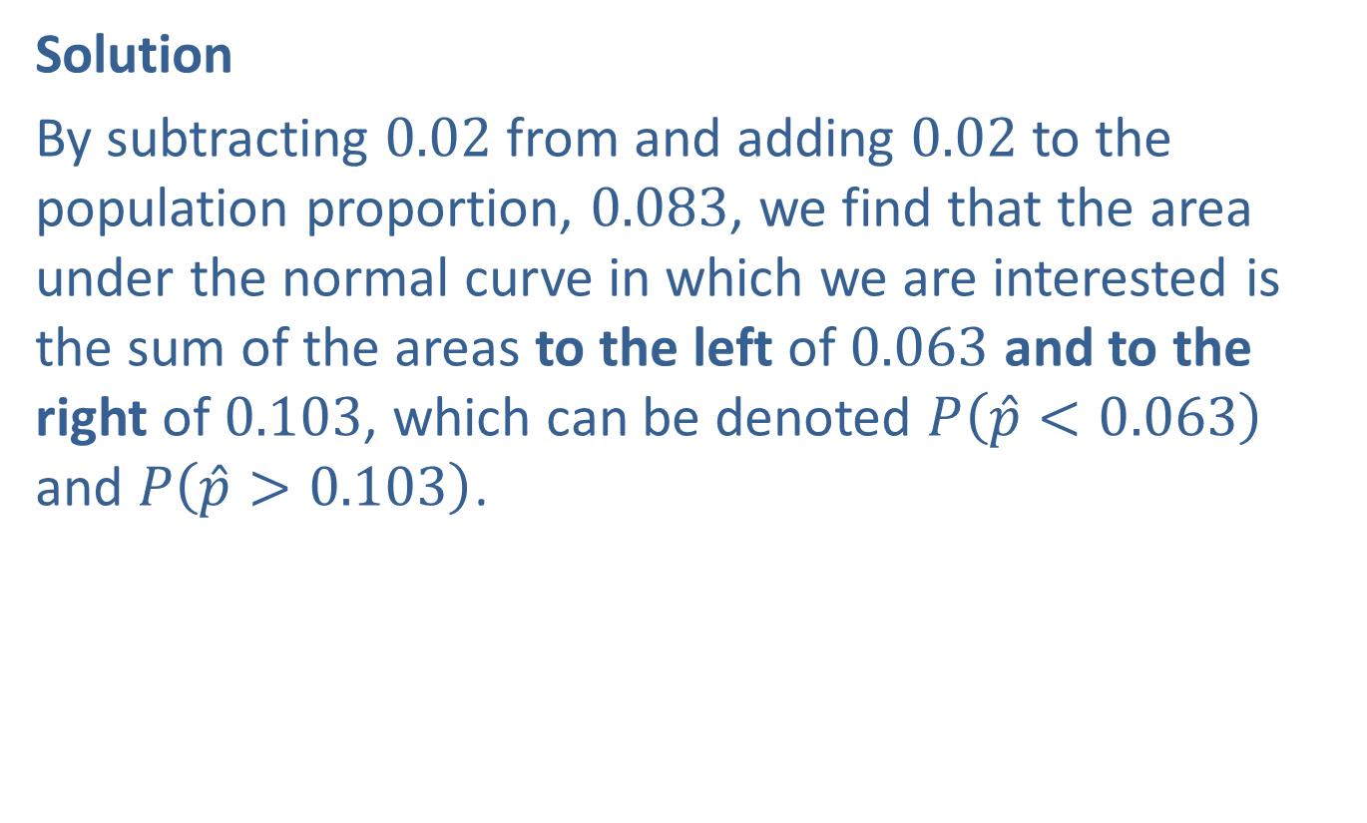
Example 7.3.4: Finding the Probability that a Sample Proportion Will Differ from the Population Proportion by More Than a Given Amount (cont.)
Solution
By subtracting 0.02 from and adding 0.02 to the population proportion, 0.083, we find that the area under the normal curve in which we are interested is the sum of the areas to the left of 0.063 and to the right of 0.103, which can be denoted $P⁡\left(\hat{p}<0.063\right)$ and $P⁡\left(\hat{p}>0.103\right)$.

Slide 31
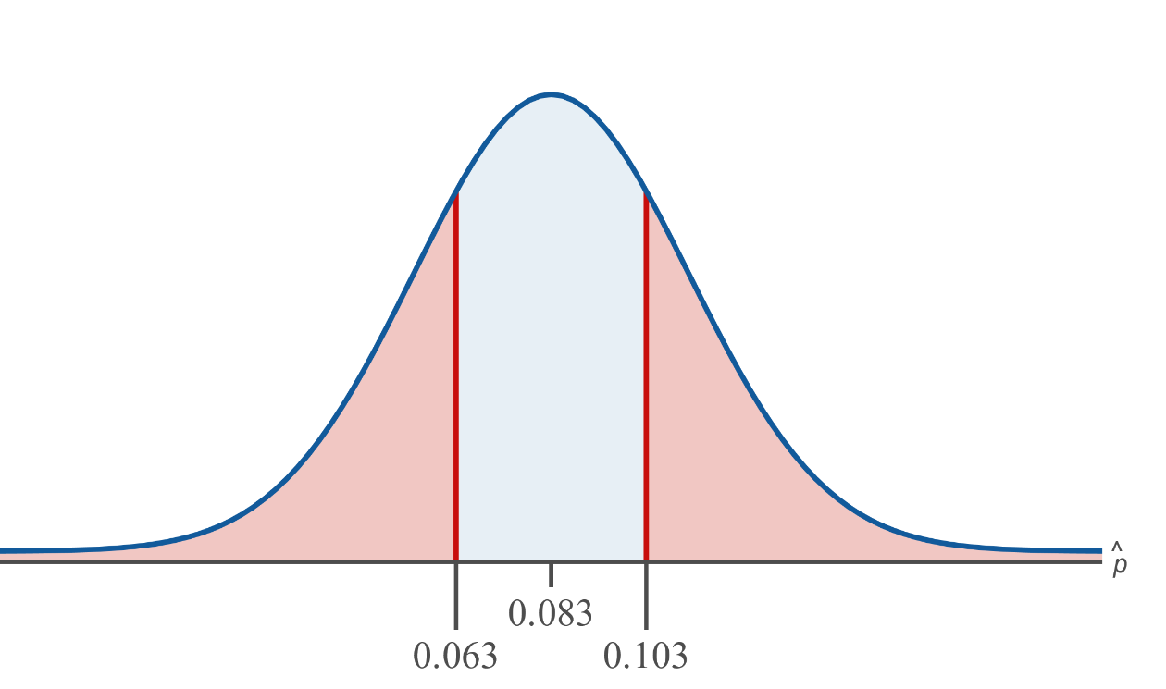
Example 7.3.4: Finding the Probability that a Sample Proportion Will Differ from the Population Proportion by More Than a Given Amount (cont.)

Slide 32
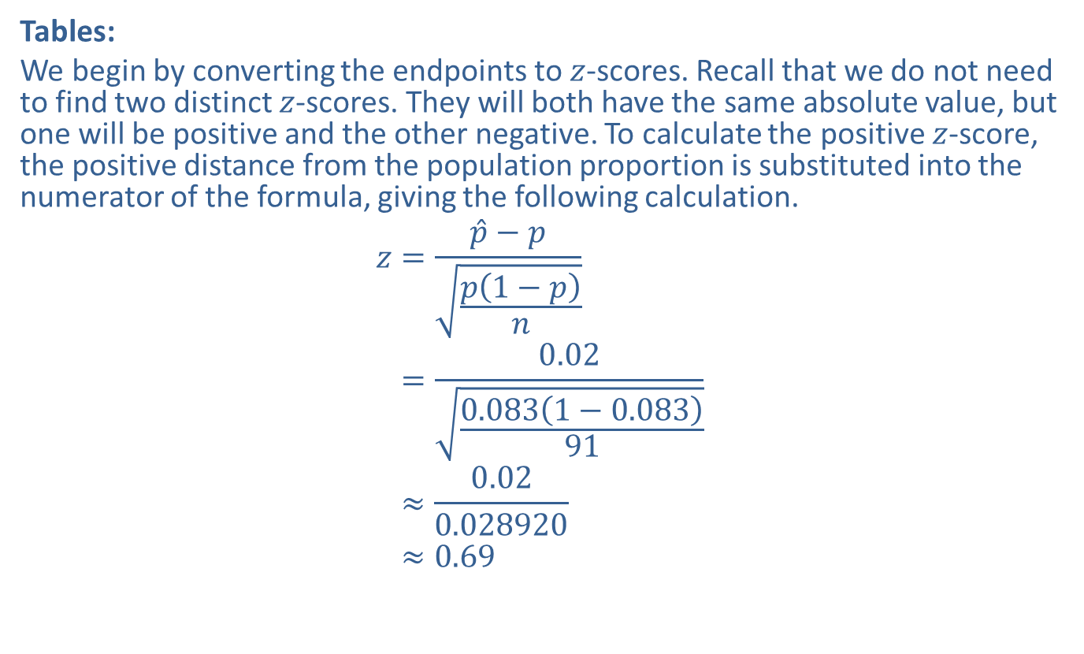
Example 7.3.4: Finding the Probability that a Sample Proportion Will Differ from the Population Proportion by More Than a Given Amount (cont.)
Tables:
We begin by converting the endpoints to $z$-scores. Recall that we do not need to find two distinct $z$-scores. They will both have the same absolute value, but one will be positive and the other negative. To calculate the positive $z$-score, the positive distance from the population proportion is substituted into the numerator of the formula, giving the following calculation.
𝑧=𝑝−𝑝𝑝1−𝑝𝑛𝑧=0.020.0831−0.08391𝑧≈0.020.028920𝑧≈0.69

Slide 33
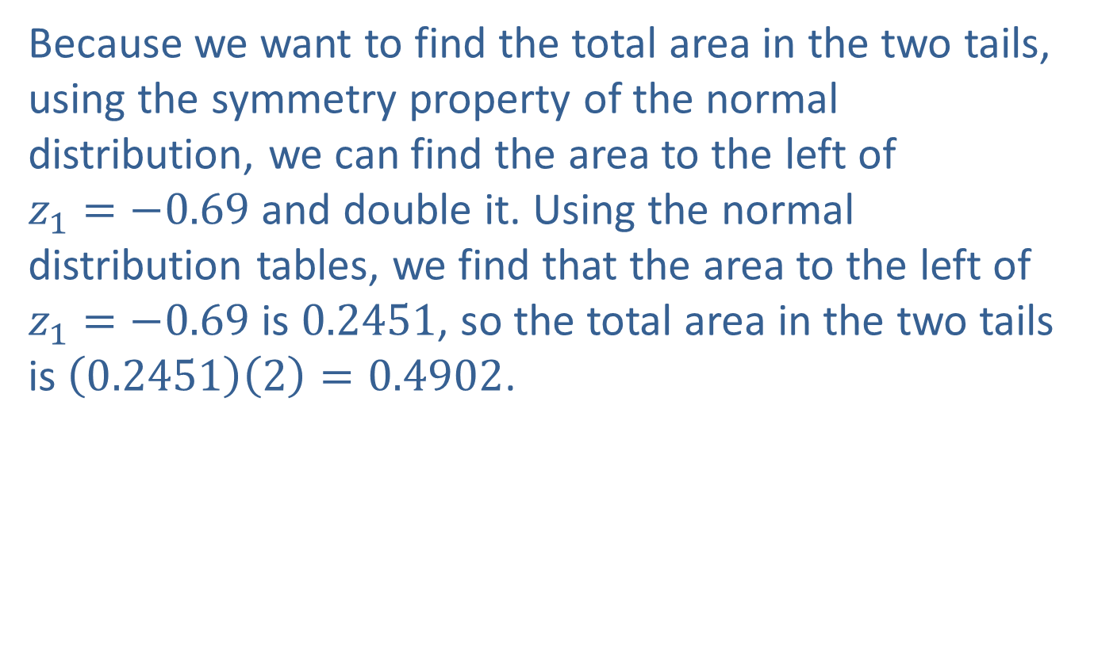
Example 7.3.4: Finding the Probability that a Sample Proportion Will Differ from the Population Proportion by More Than a Given Amount (cont.)
Because we want to find the total area in the two tails, using the symmetry property of the normal distribution, we can find the area to the left of $z_{1}=−0.69$ and double it. Using the normal distribution tables, we find that the area to the left of $z_{1}=−0.69$ is 0.2451, so the total area in the two tails is $\left(0.2451\right)\left(2\right)=0.4902$.

Slide 34
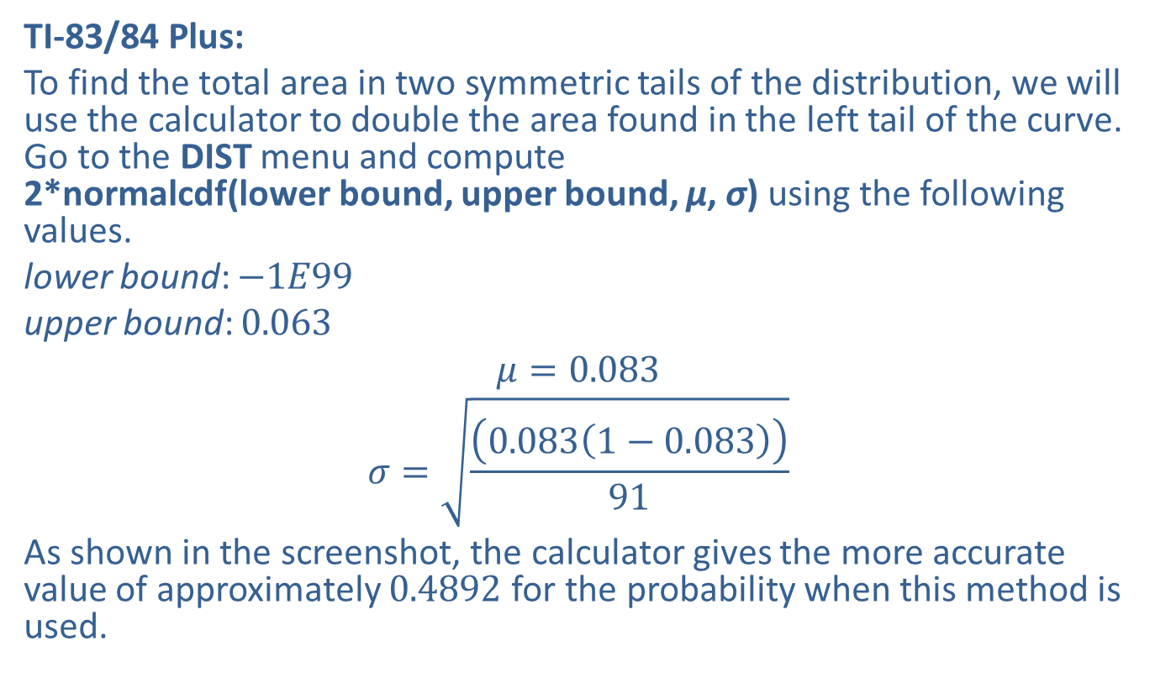
Example 7.3.4: Finding the Probability that a Sample Proportion Will Differ from the Population Proportion by More Than a Given Amount (cont.)
TI-83/84 Plus:
To find the total area in two symmetric tails of the distribution, we will use the calculator to double the area found in the left tail of the curve. Go to the DIST menu and compute 2*normalcdf(lower bound, upper bound, μ, σ) using the following values.
lower bound: $−1E99$
upper bound: 0.063
$$μ=0.083$$
$$σ=\sqrt{\frac{\left(0.083\left(1−0.083\right)\right)}{91}}$$
As shown in the screenshot, the calculator gives the more accurate value of approximately 0.4892 for the probability when this method is used.

Slide 35
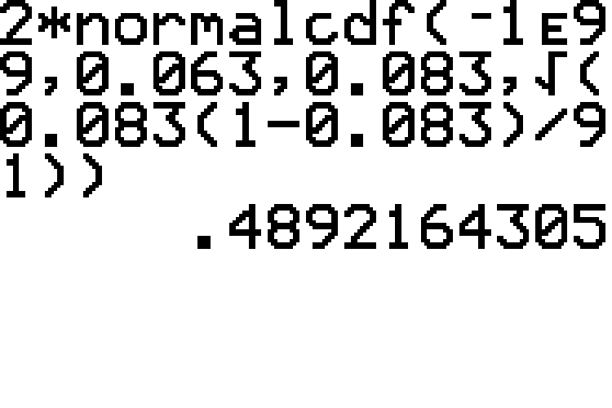
Example 7.3.4: Finding the Probability that a Sample Proportion Will Differ from the Population Proportion by More Than a Given Amount (cont.)

Slide 36

Example 7.3.4: Finding the Probability that a Sample Proportion Will Differ from the Population Proportion by More Than a Given Amount (cont.)
Hence, the probability would be reported as 0.4902 if using the tables or 0.4892 if using the calculator. This means that the probability that the sample proportion differs from the population proportion by more than $2\%$ is approximately $49\%$.

