Slide 1
Section 8.2
Student's t-Distribution

Slide 2
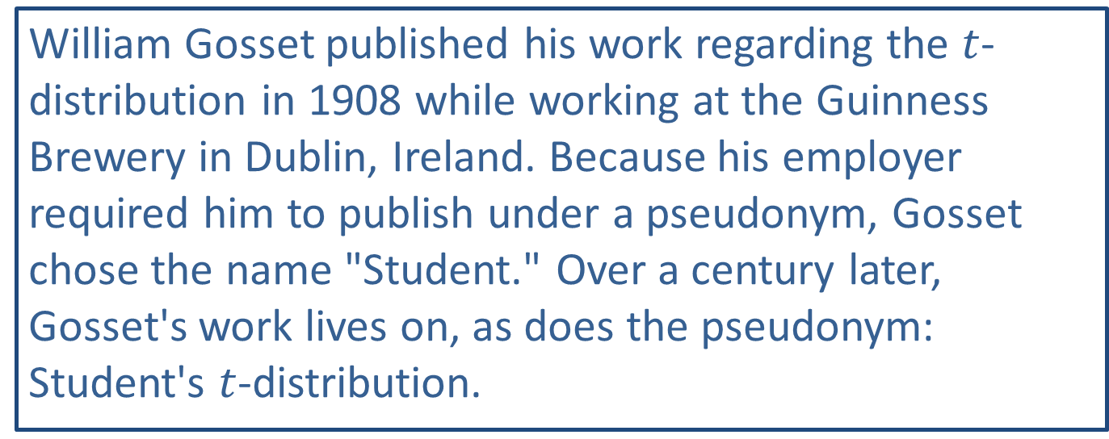
Side Note
William Gosset published his work regarding the $t$-distribution in 1908 while working at the Guinness Brewery in Dublin, Ireland. Because his employer required him to publish under a pseudonym, Gosset chose the name "Student." Over a century later, Gosset's work lives on, as does the pseudonym: Student's $t$-distribution.

Slide 3
Memory Booster
$$df=degrees of freedom$$

Slide 4
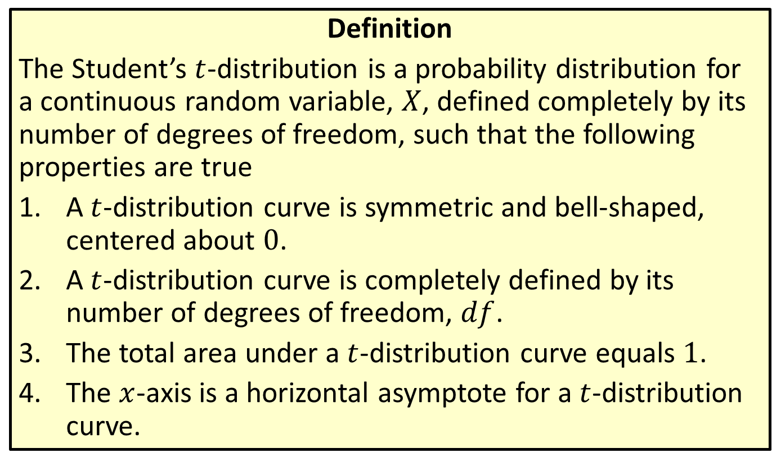
Distribution
Definition
The Student’s $t$-distribution is a probability distribution for a continuous random variable, $X$, defined completely by its number of degrees of freedom, such that the following properties are true
​A $t$-distribution curve is symmetric and bell-shaped, centered about 0.
​A $t$-distribution curve is completely defined by its number of degrees of freedom, $df$.
​The total area under a $t$-distribution curve equals 1.
​The $x$-axis is a horizontal asymptote for a $t$-distribution curve.

Slide 5
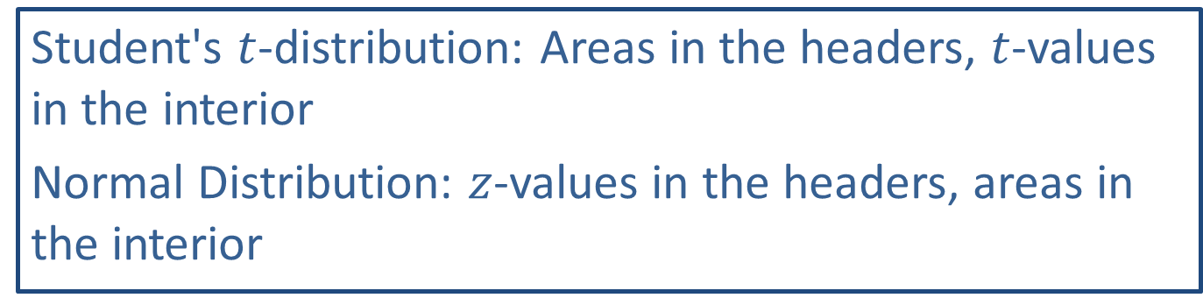
Memory Booster
Student's $t$-distribution: Areas in the headers, $t$-values in the interior
Normal Distribution: $z$-values in the headers, areas in the interior

Slide 6


Example 8.2.1 Finding the Value of $t_{a}$ Using a Table
Find the value of $t_{0.025}$ for the $t$-distribution with 25 degrees of freedom.

Slide 7
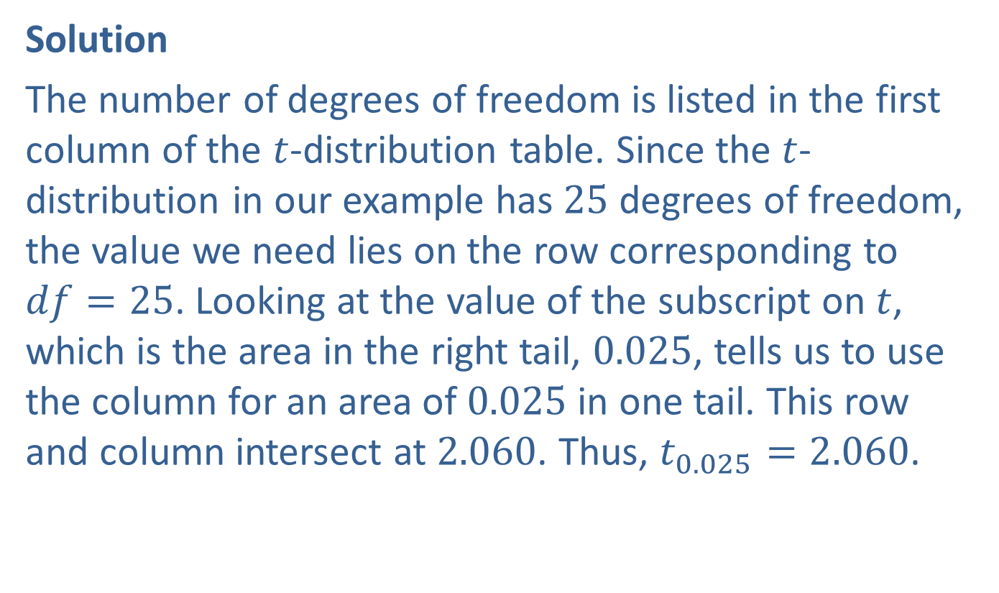

Example 8.2.1 Finding the Value of $t_{a}$ Using a Table (cont.)
Solution
The number of degrees of freedom is listed in the first column of the $t$-distribution table. Since the $t$-distribution in our example has 25 degrees of freedom, the value we need lies on the row corresponding to $df=25$. Looking at the value of the subscript on $t$, which is the area in the right tail, 0.025, tells us to use the column for an area of 0.025 in one tail. This row and column intersect at 2.060. Thus, $t_{0.025}=2.060$.

Slide 8
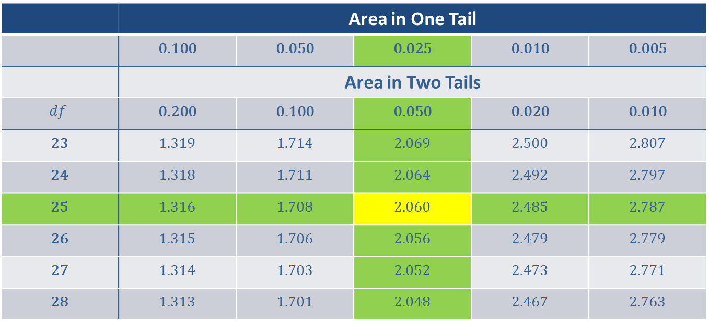
Example 8.2.1 Finding the Value of $t_{a}$ Using a Table (cont.)
 | Area in One Tail
 | 0.100 | 0.050 | 0.025 | 0.010 | 0.005
 | Area in Two Tails
$$df$$ | 0.200 | 0.100 | 0.050 | 0.020 | 0.010
23 | 1.319 | 1.714 | 2.069 | 2.500 | 2.807
24 | 1.318 | 1.711 | 2.064 | 2.492 | 2.797
25 | 1.316 | 1.708 | 2.060 | 2.485 | 2.787
26 | 1.315 | 1.706 | 2.056 | 2.479 | 2.779
27 | 1.314 | 1.703 | 2.052 | 2.473 | 2.771
28 | 1.313 | 1.701 | 2.048 | 2.467 | 2.763

Slide 9
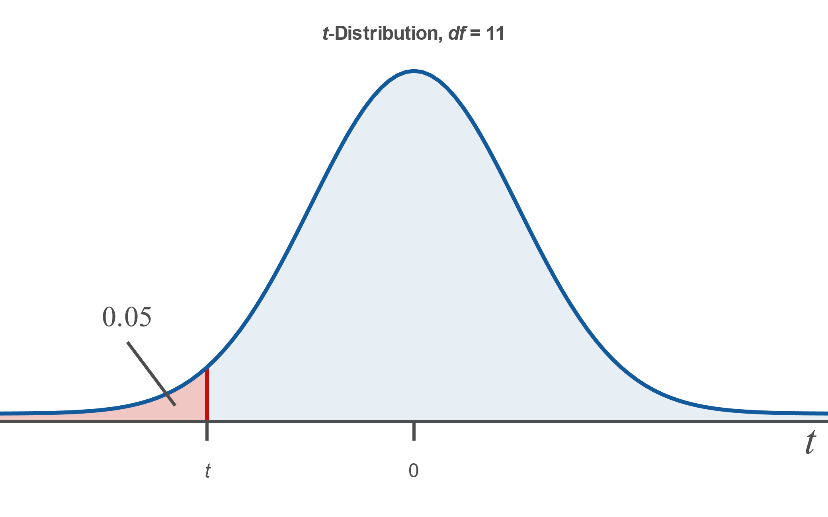

Example 8.2.2 Finding the Value of t Given the Area to the Left
Find the value of $t$ for a $t$-distribution with 11 degrees of freedom such that the area under the curve to the left of $t$ is 0.05.

Slide 10
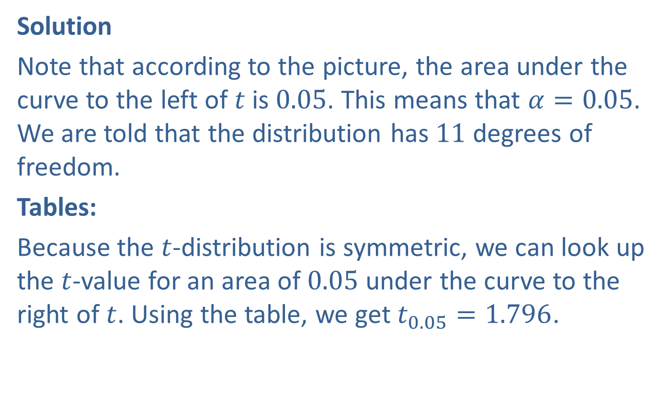
Example 8.2.2 Finding the Value of t Given the Area to the Left (cont.)
Solution
Note that according to the picture, the area under the curve to the left of $t$ is 0.05. This means that $α=0.05$. We are told that the distribution has 11 degrees of freedom.
Tables:
Because the $t$-distribution is symmetric, we can look up the $t$-value for an area of 0.05 under the curve to the right of $t$. Using the table, we get $t_{0.05}=1.796$.

Slide 11
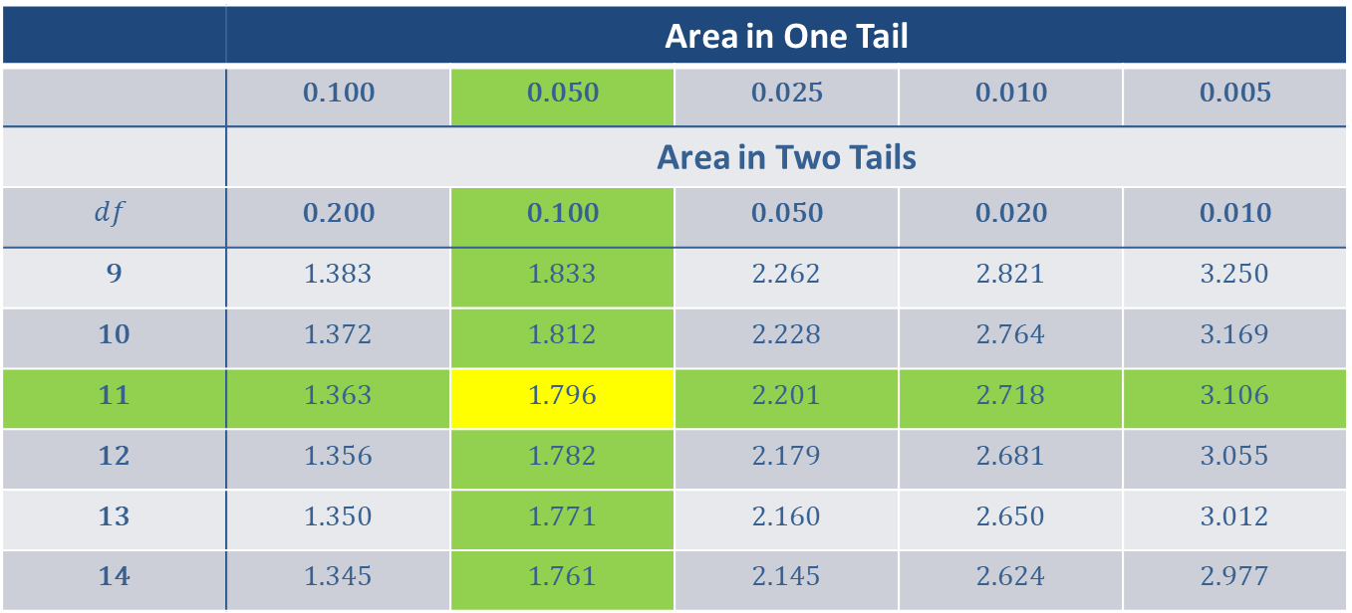
Example 8.2.2 Finding the Value of t Given the Area to the Left (cont.)
 | Area in One Tail
 | 0.100 | 0.050 | 0.025 | 0.010 | 0.005
 | Area in Two Tails
$$df$$ | 0.200 | 0.100 | 0.050 | 0.020 | 0.010
9 | 1.383 | 1.833 | 2.262 | 2.821 | 3.250
10 | 1.372 | 1.812 | 2.228 | 2.764 | 3.169
11 | 1.363 | 1.796 | 2.201 | 2.718 | 3.106
12 | 1.356 | 1.782 | 2.179 | 2.681 | 3.055
13 | 1.350 | 1.771 | 2.160 | 2.650 | 3.012
14 | 1.345 | 1.761 | 2.145 | 2.624 | 2.977

Slide 12

Example 8.2.2 Finding the Value of t Given the Area to the Left (cont.)
However, since the given area is to the left of $t$, the $t$-value needs to be negative. So, for this example, $−t_{0.05}=−1.796$.

Slide 13
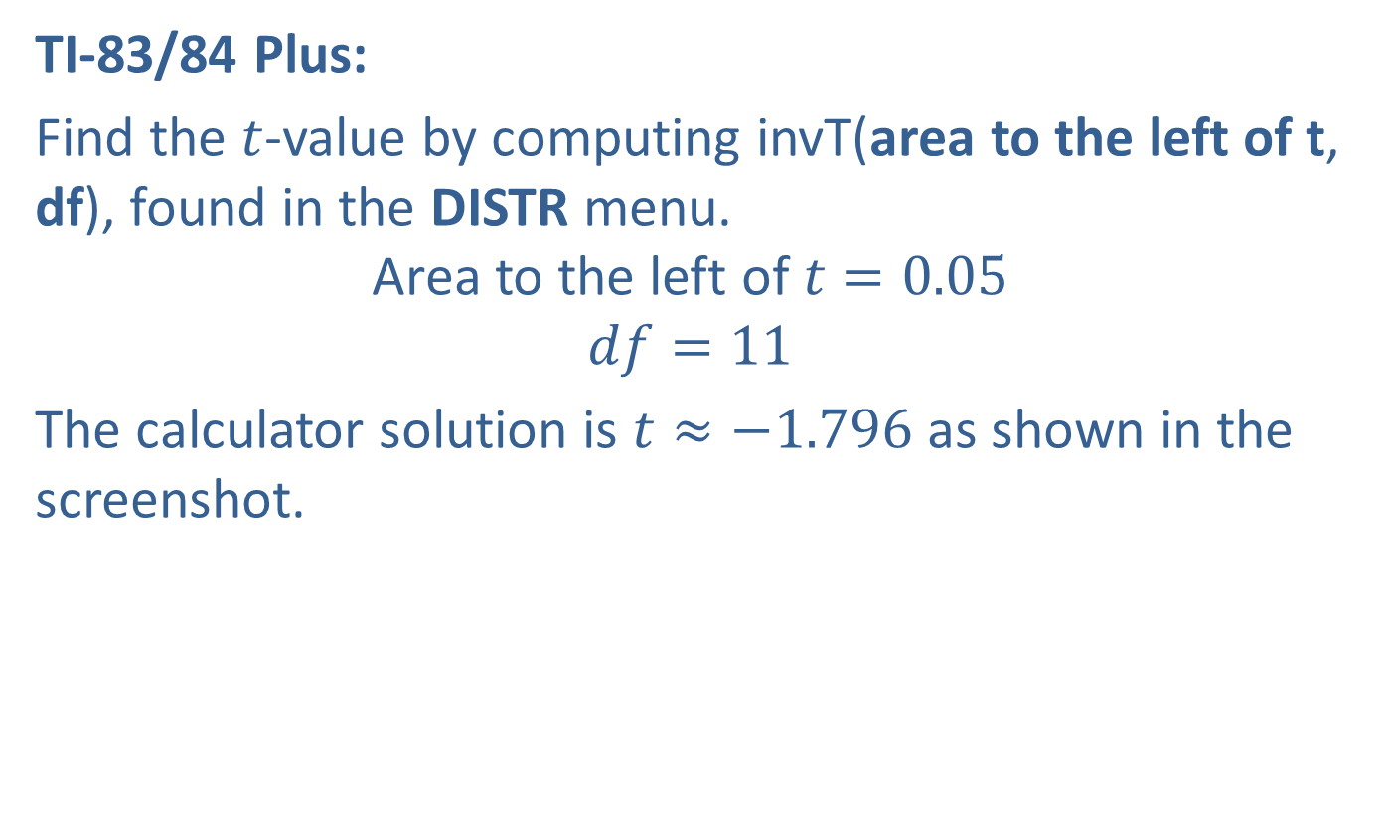
Example 8.2.2 Finding the Value of t Given the Area to the Left (cont.)
TI-83/84 Plus:
Find the $t$-value by computing invT(area to the left of t, df), found in the DISTR menu.
$$\text{Area} \text{to} \text{the} \text{left} \text{of} t=0.05$$
$$df=11$$
The calculator solution is $t≈−1.796$ as shown in the screenshot.

Slide 14
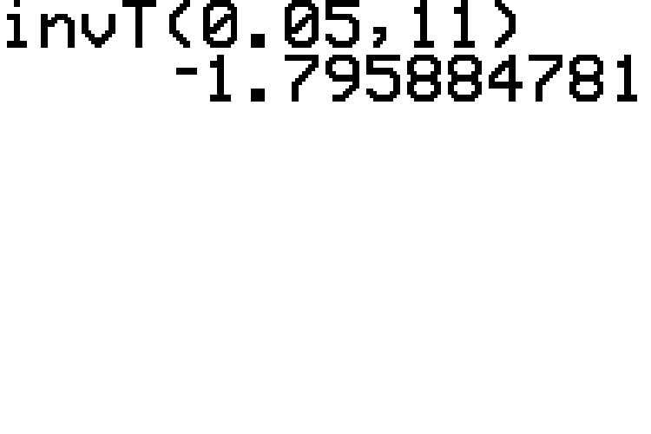
Example 8.2.2 Finding the Value of t Given the Area to the Left (cont.)

Slide 15
Technology
Note that the invT function is not available on some TI-83/84 Plus calculators.

Slide 16
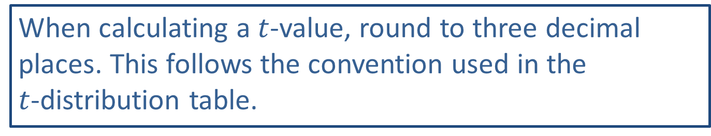
Rounding Rule
When calculating a $t$-value, round to three decimal places. This follows the convention used in the $t$-distribution table.

Slide 17
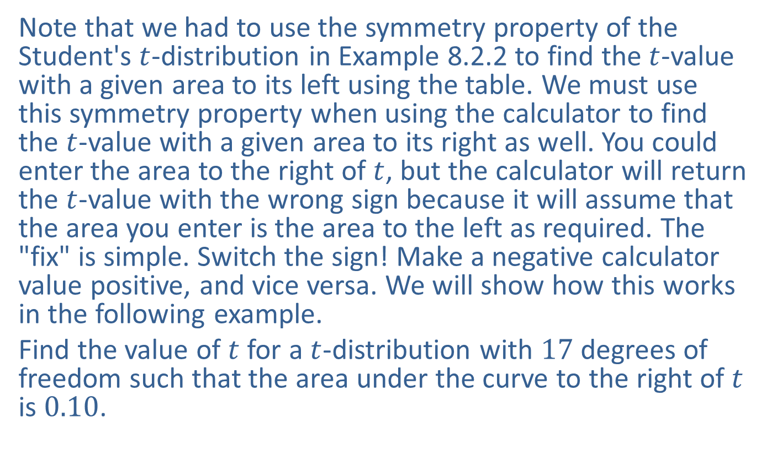
Example 8.2.3 Finding the Value of t Given the Area to the Right
Note that we had to use the symmetry property of the Student's $t$-distribution in Example 8.2.2 to find the $t$-value with a given area to its left using the table. We must use this symmetry property when using the calculator to find the $t$-value with a given area to its right as well. You could enter the area to the right of $t$, but the calculator will return the $t$-value with the wrong sign because it will assume that the area you enter is the area to the left as required. The "fix" is simple. Switch the sign! Make a negative calculator value positive, and vice versa. We will show how this works in the following example.
Find the value of $t$ for a $t$-distribution with 17 degrees of freedom such that the area under the curve to the right of $t$ is 0.10.

Slide 18
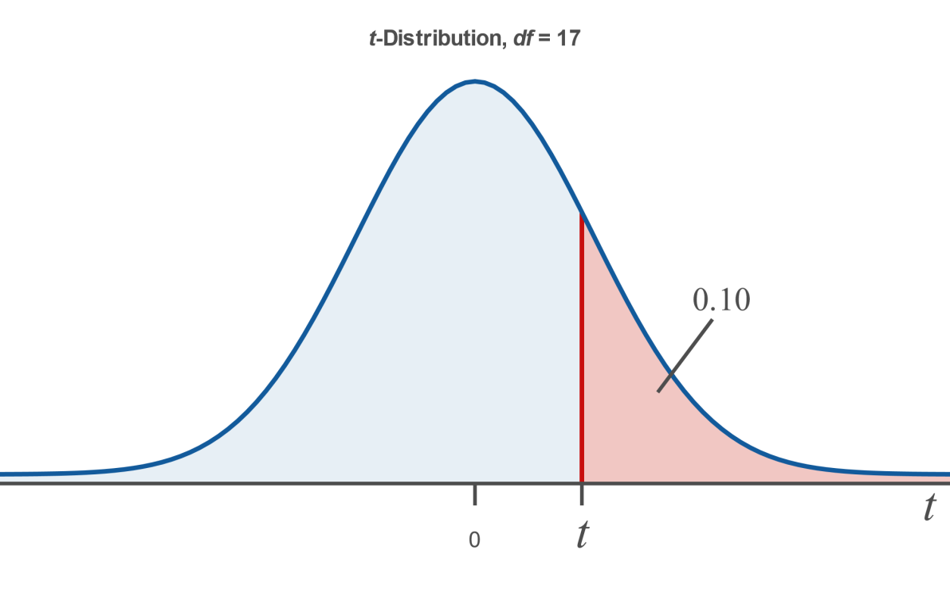
Example 8.2.3 Finding the Value of t Given the Area to the Right (cont.)

Slide 19
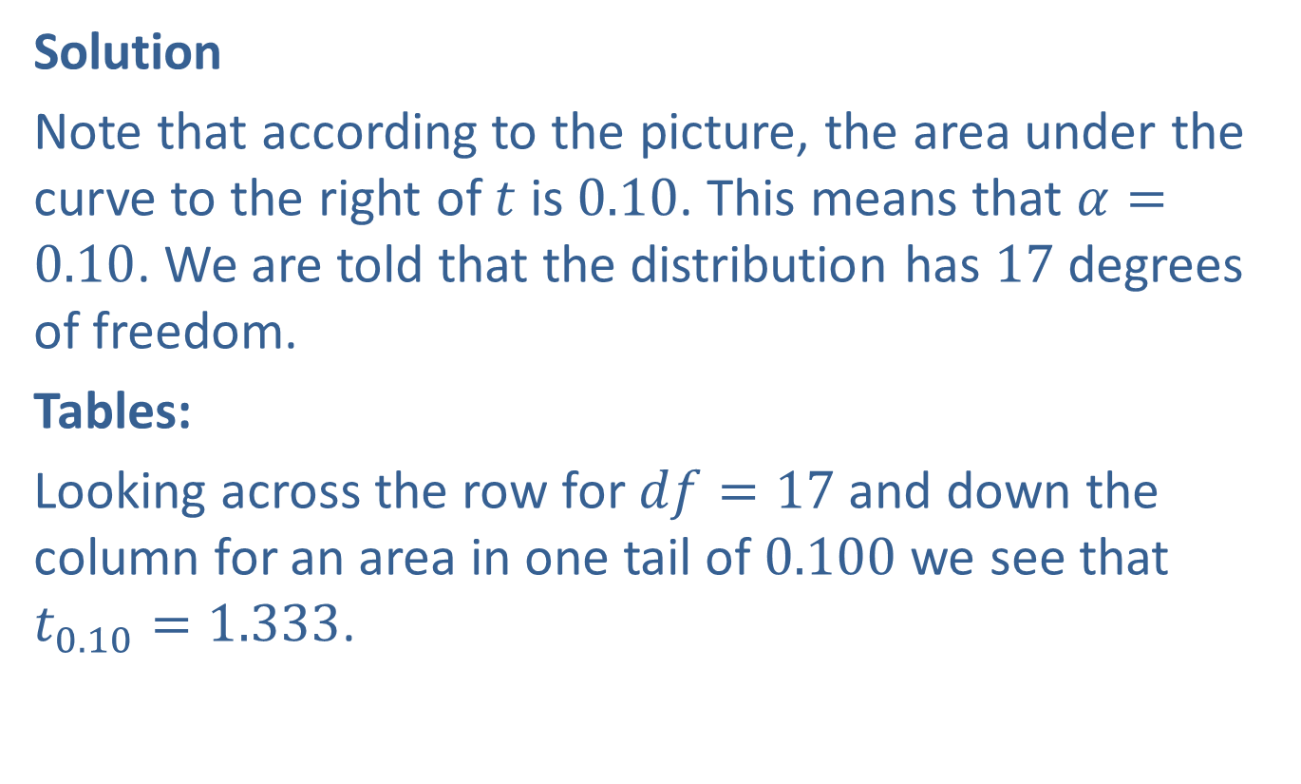
Example 8.2.3 Finding the Value of t Given the Area to the Right (cont.)
Solution
Note that according to the picture, the area under the curve to the right of $t$ is 0.10. This means that $α=0.10$. We are told that the distribution has 17 degrees of freedom.
Tables:
Looking across the row for $df=17$ and down the column for an area in one tail of 0.100 we see that $t_{0.10}=1.333$.

Slide 20
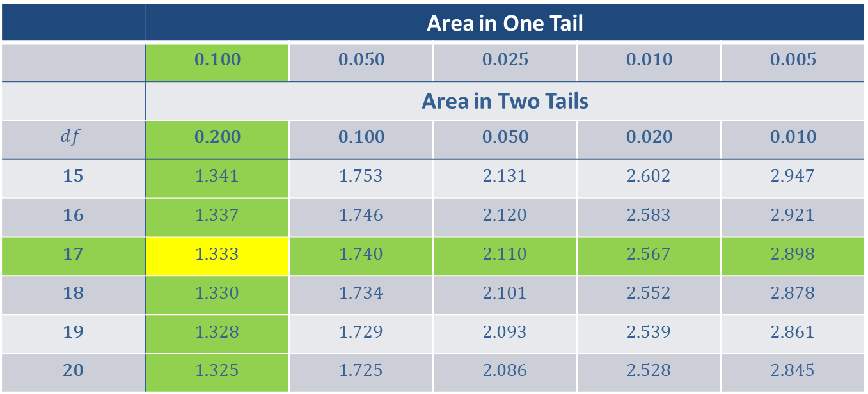
Example 8.2.3 Finding the Value of t Given the Area to the Right (cont.)
 | Area in One Tail
 | 0.100 | 0.050 | 0.025 | 0.010 | 0.005
 | Area in Two Tails
$$df$$ | 0.200 | 0.100 | 0.050 | 0.020 | 0.010
15 | 1.341 | 1.753 | 2.131 | 2.602 | 2.947
16 | 1.337 | 1.746 | 2.120 | 2.583 | 2.921
17 | 1.333 | 1.740 | 2.110 | 2.567 | 2.898
18 | 1.330 | 1.734 | 2.101 | 2.552 | 2.878
19 | 1.328 | 1.729 | 2.093 | 2.539 | 2.861
20 | 1.325 | 1.725 | 2.086 | 2.528 | 2.845

Slide 21
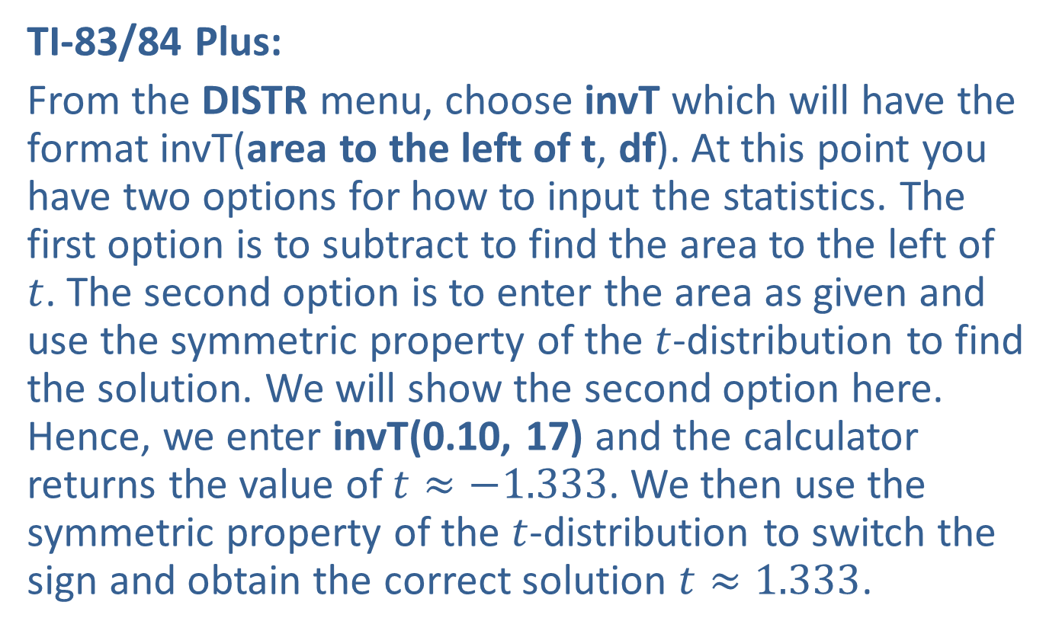
Example 8.2.3 Finding the Value of t Given the Area to the Right (cont.)
TI-83/84 Plus:
From the DISTR menu, choose invT which will have the format invT(area to the left of t, df). At this point you have two options for how to input the statistics. The first option is to subtract to find the area to the left of $t$. The second option is to enter the area as given and use the symmetric property of the $t$-distribution to find the solution. We will show the second option here. Hence, we enter invT(0.10, 17) and the calculator returns the value of $t≈−1.333$. We then use the symmetric property of the $t$-distribution to switch the sign and obtain the correct solution $t≈1.333$.

Slide 22
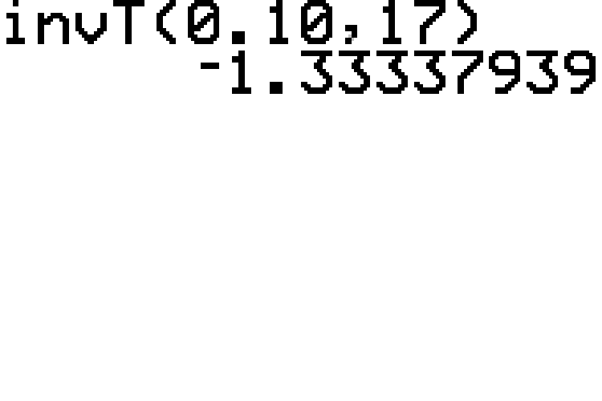
Example 8.2.3 Finding the Value of t Given the Area to the Right (cont.)

Slide 23
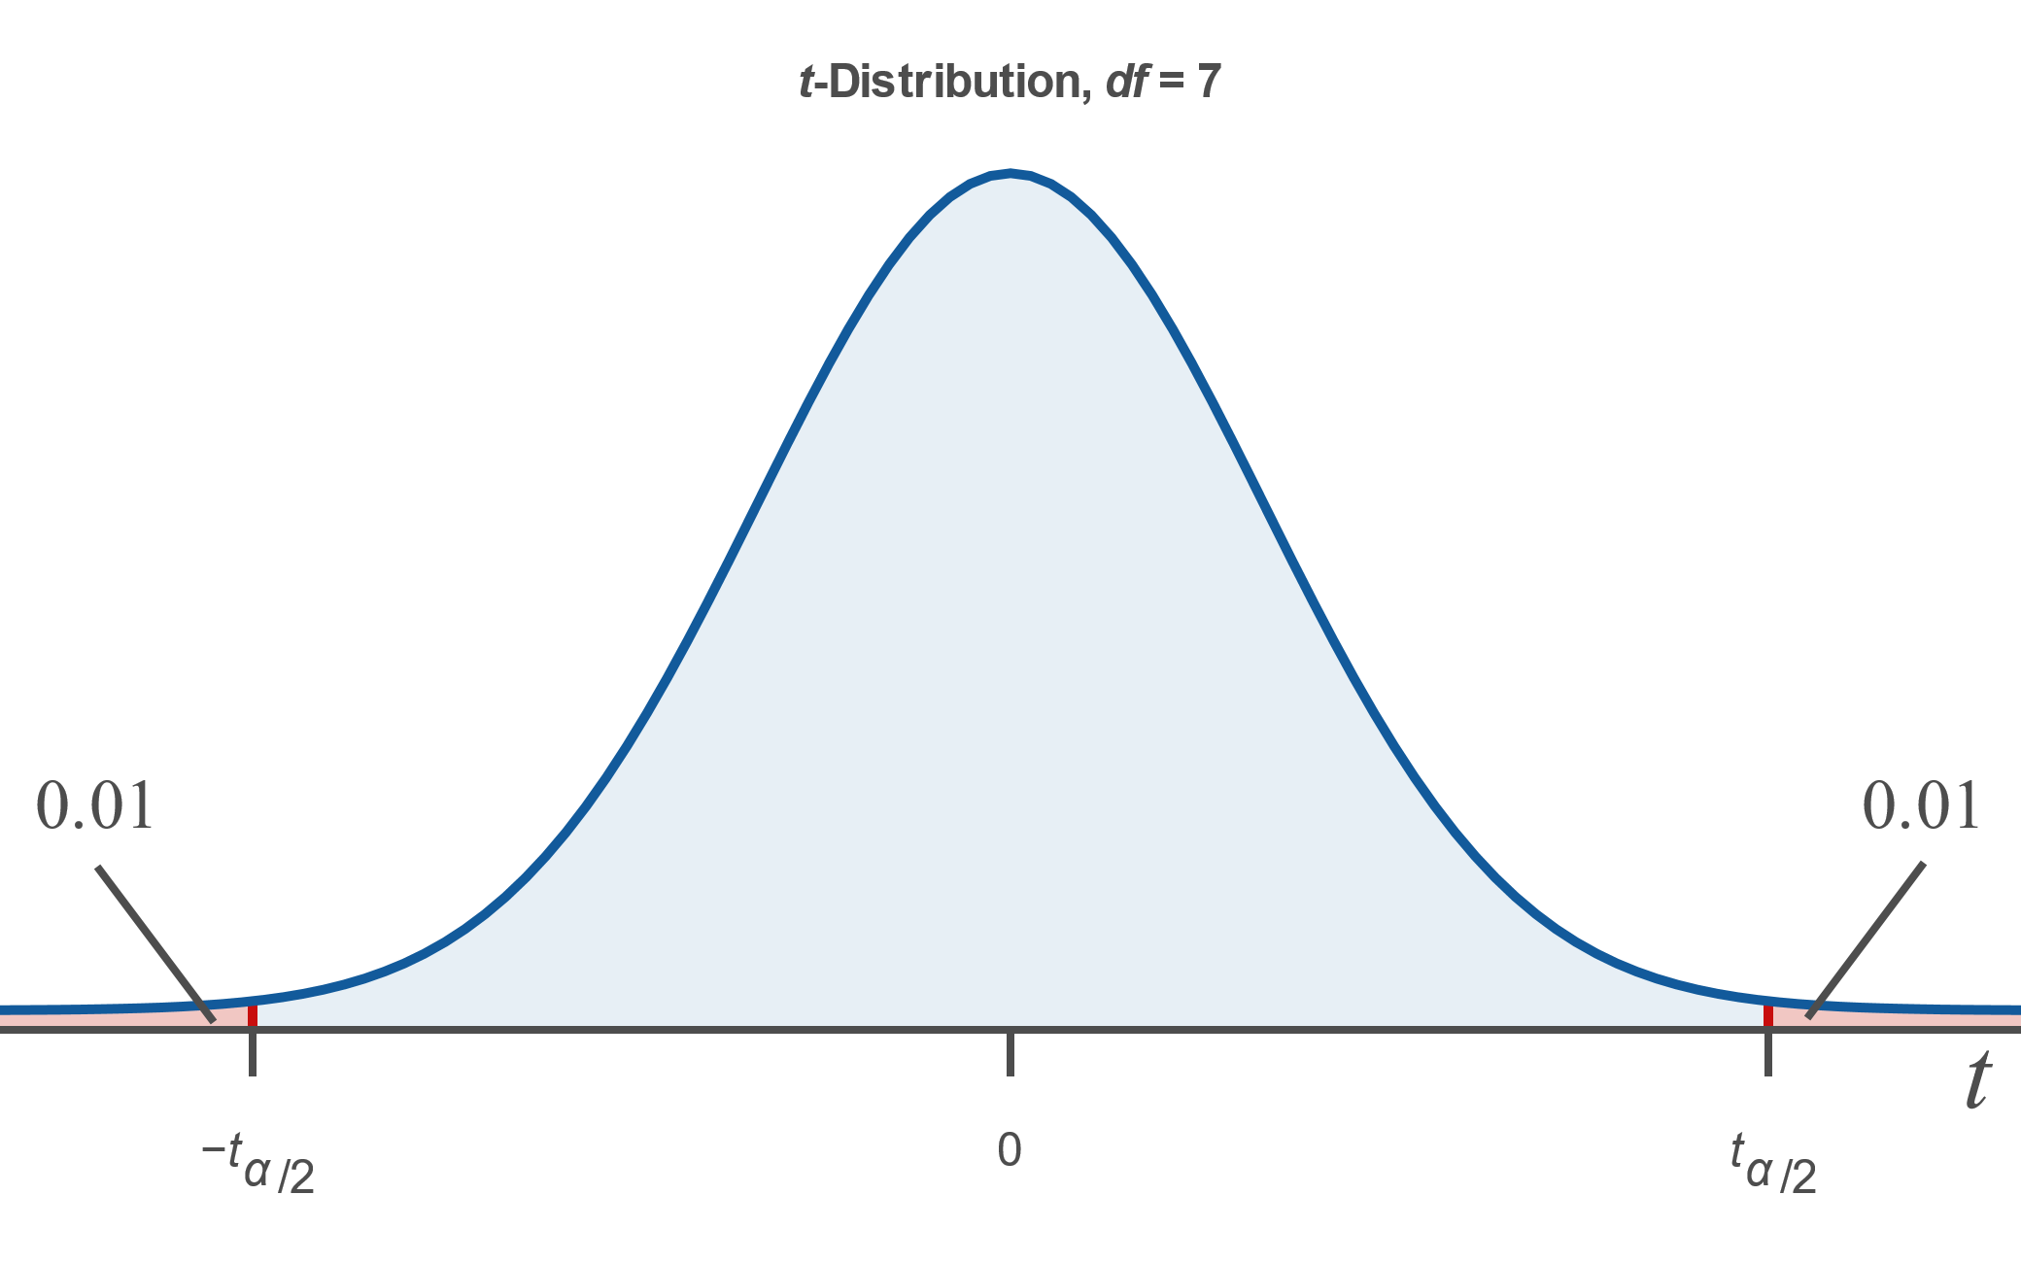

Example 8.2.4: Finding the Value of t Given the Area in Two Tails
Find the value of $t$ for a $t$-distribution with 7 degrees of freedom such that the area to the left of ${−t}_{α/2}$ plus the area to the right of $t_{α/2}$ is 0.02, as shown in the picture.

Slide 24
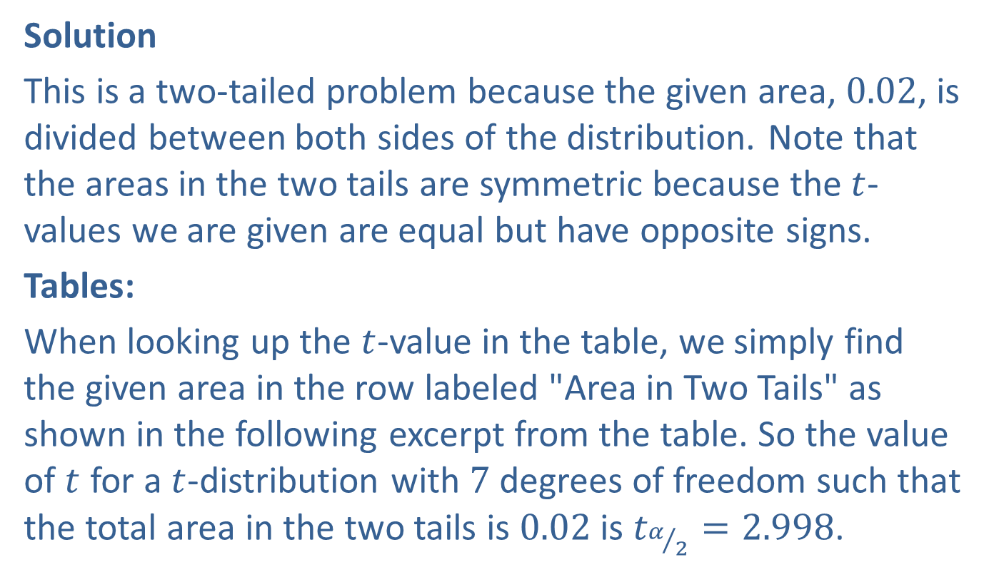
Example 8.2.4: Finding the Value of t Given the Area in Two Tails (cont.)
Solution
This is a two-tailed problem because the given area, 0.02, is divided between both sides of the distribution. Note that the areas in the two tails are symmetric because the $t$-values we are given are equal but have opposite signs.
Tables:
When looking up the $t$-value in the table, we simply find the given area in the row labeled "Area in Two Tails" as shown in the following excerpt from the table. So the value of $t$ for a $t$-distribution with 7 degrees of freedom such that the total area in the two tails is 0.02 is $t_{α/2}=2.998$.

Slide 25
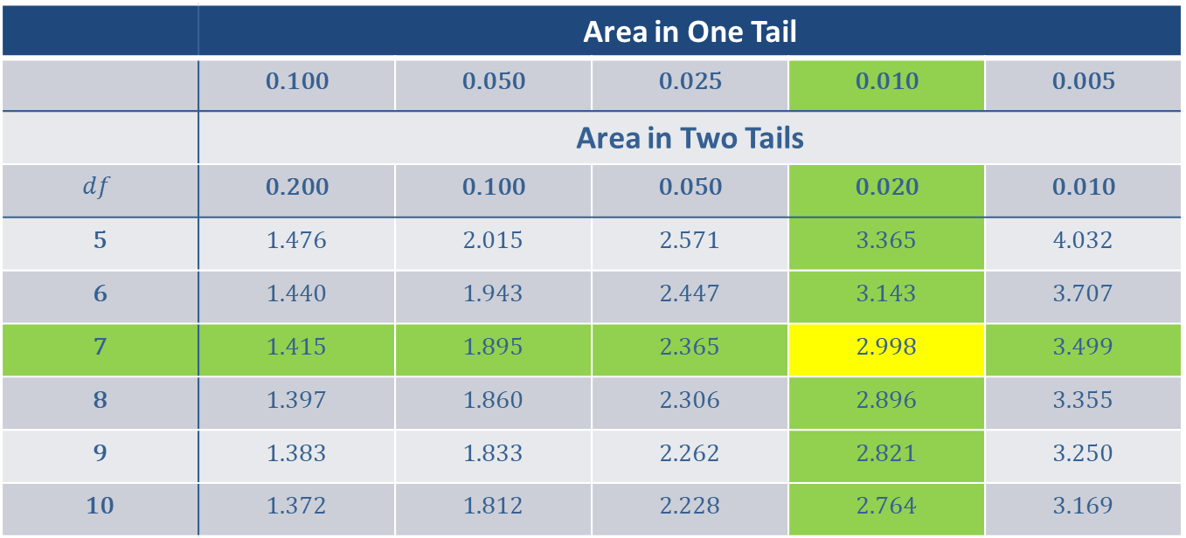
Example 8.2.4: Finding the Value of t Given the Area in Two Tails (cont.)
 | Area in One Tail
 | 0.100 | 0.050 | 0.025 | 0.010 | 0.005
 | Area in Two Tails
$$df$$ | 0.200 | 0.100 | 0.050 | 0.020 | 0.010
5 | 1.476 | 2.015 | 2.571 | 3.365 | 4.032
6 | 1.440 | 1.943 | 2.447 | 3.143 | 3.707
7 | 1.415 | 1.895 | 2.365 | 2.998 | 3.499
8 | 1.397 | 1.860 | 2.306 | 2.896 | 3.355
9 | 1.383 | 1.833 | 2.262 | 2.821 | 3.250
10 | 1.372 | 1.812 | 2.228 | 2.764 | 3.169

Slide 26
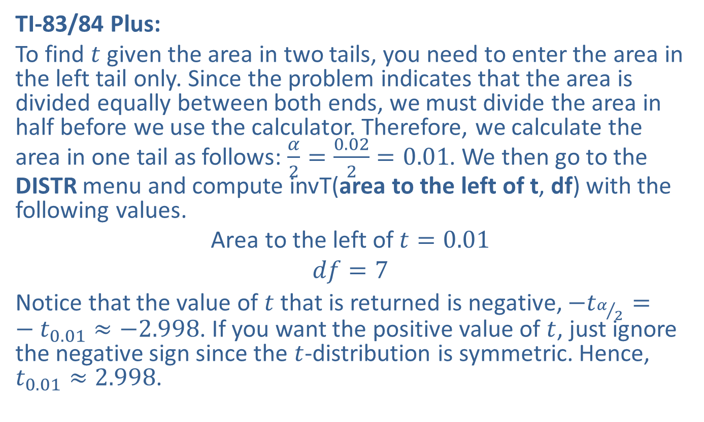
Example 8.2.4: Finding the Value of t Given the Area in Two Tails (cont.)
TI-83/84 Plus:
To find $t$ given the area in two tails, you need to enter the area in the left tail only. Since the problem indicates that the area is divided equally between both ends, we must divide the area in half before we use the calculator. Therefore, we calculate the area in one tail as follows: $\frac{α}{2}=\frac{0.02}{2}=0.01$. We then go to the DISTR menu and compute invT(area to the left of t, df) with the following values.
$$\text{Area} \text{to} \text{the} \text{left} \text{of} t=0.01$$
$$df=7$$
Notice that the value of $t$ that is returned is negative, $−t_{α/2}=−t_{0.01}≈−2.998$. If you want the positive value of $t$, just ignore the negative sign since the $t$-distribution is symmetric. Hence, $t_{0.01}≈2.998$.

Slide 27
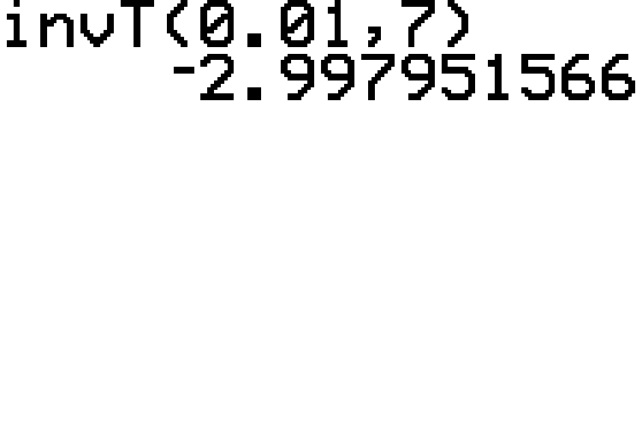
Example 8.2.4: Finding the Value of t Given the Area in Two Tails (cont.)

Slide 28
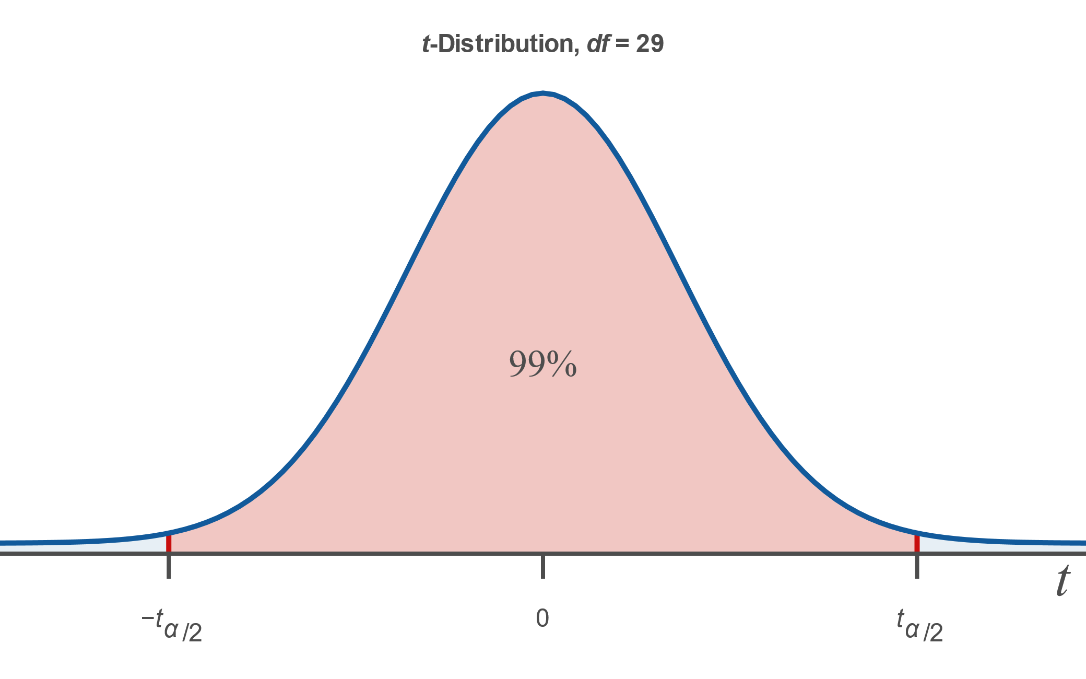


Example 8.2.5: Finding the Value of t Given Area between ${−t}_{α/2}$ and $t_{α/2}$
Find the critical value of $t$ for a $t$-distribution with 29 degrees of freedom such that the area between ${−t}_{α/2}$ and $t_{α/2}$ is $99\%$.

Slide 29
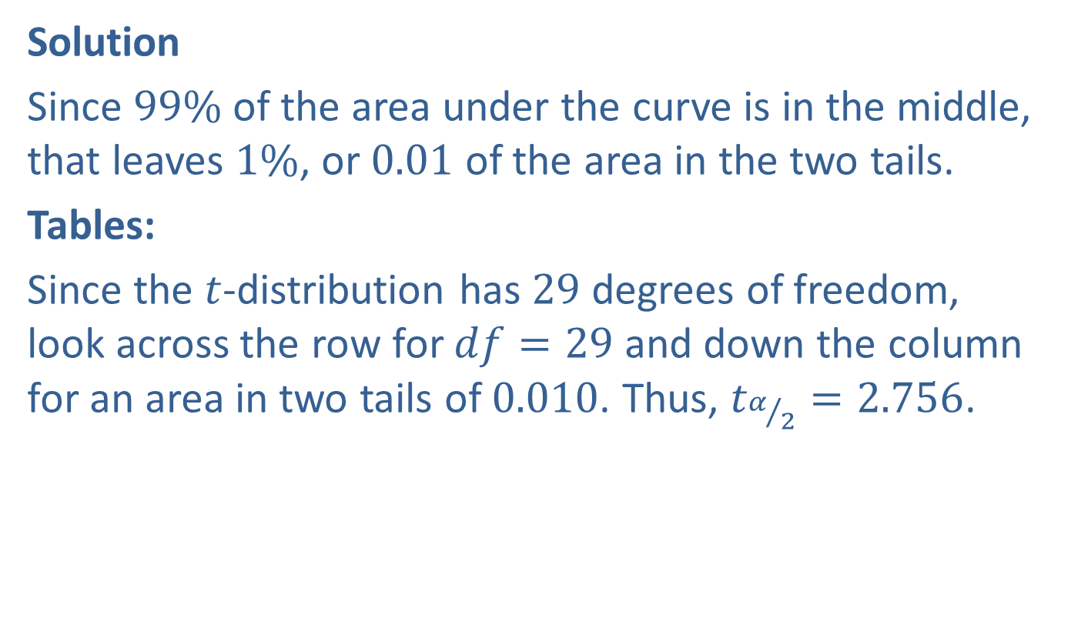

Example 8.2.5: Finding the Value of t Given Area between ${−t}_{α/2}$ and $t_{α/2}$ (cont.)
Solution
Since $99\%$ of the area under the curve is in the middle, that leaves $1\%$, or 0.01 of the area in the two tails.
Tables:
Since the $t$-distribution has 29 degrees of freedom, look across the row for $df=29$ and down the column for an area in two tails of 0.010. Thus, $t_{α/2}=2.756$.

Slide 30
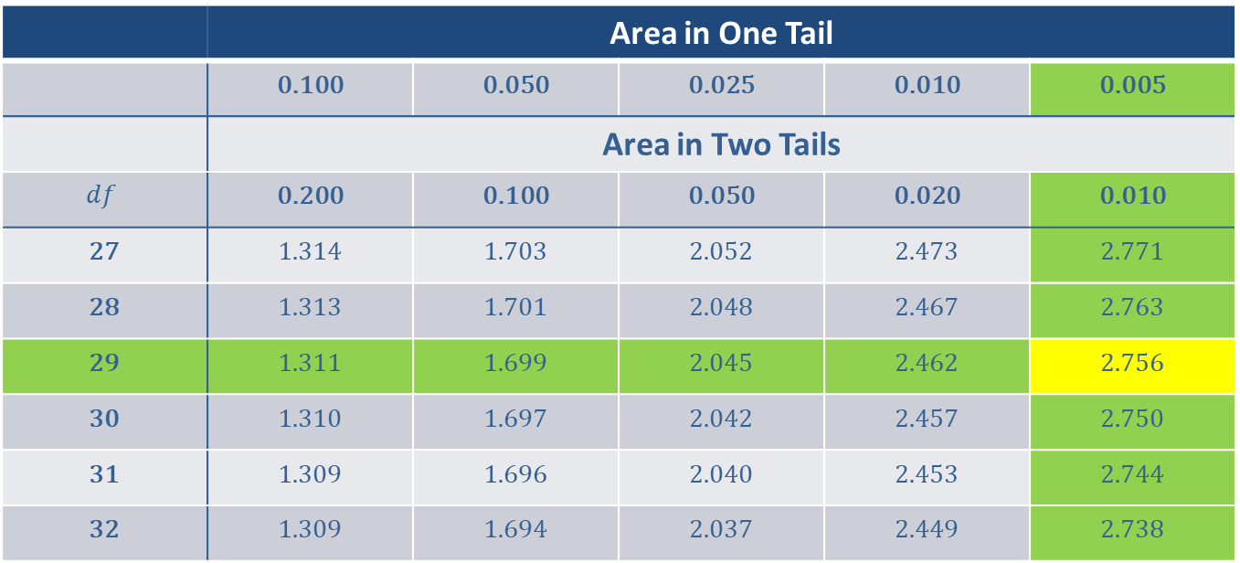
Example 8.2.5: Finding the Value of t Given Area between ${−t}_{α/2}$ and $t_{α/2}$ (cont.)
 | Area in One Tail
 | 0.100 | 0.050 | 0.025 | 0.010 | 0.005
 | Area in Two Tails
$$df$$ | 0.200 | 0.100 | 0.050 | 0.020 | 0.010
27 | 1.314 | 1.703 | 2.052 | 2.473 | 2.771
28 | 1.313 | 1.701 | 2.048 | 2.467 | 2.763
29 | 1.311 | 1.699 | 2.045 | 2.462 | 2.756
30 | 1.310 | 1.697 | 2.042 | 2.457 | 2.750
31 | 1.309 | 1.696 | 2.040 | 2.453 | 2.744
32 | 1.309 | 1.694 | 2.037 | 2.449 | 2.738

Slide 31
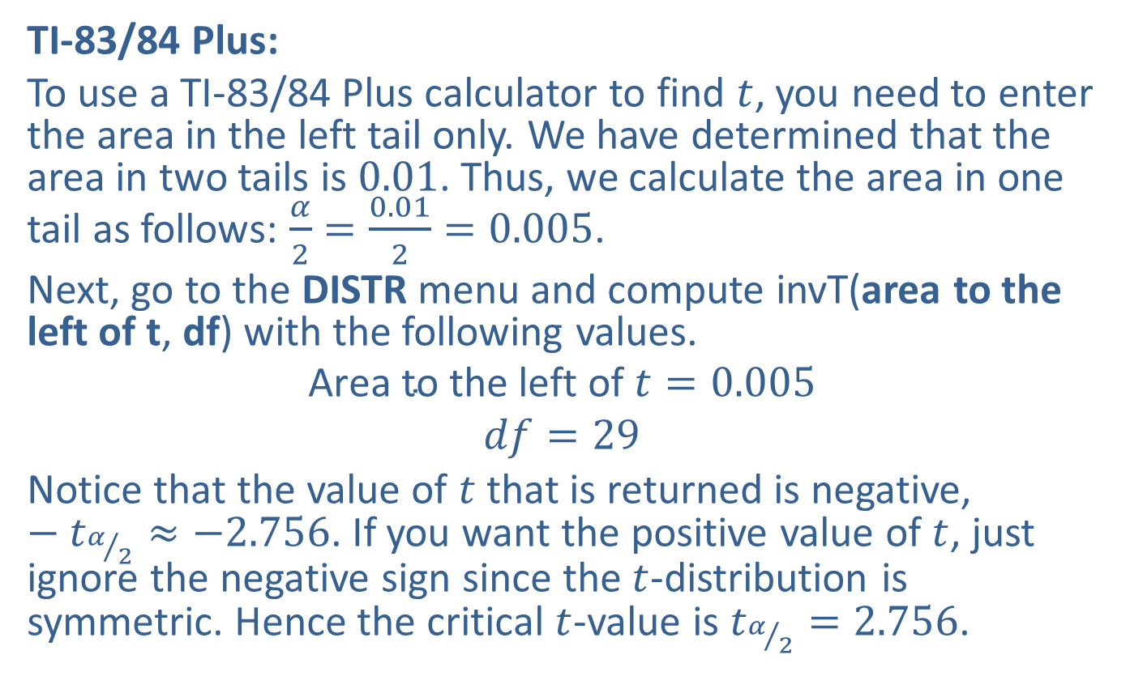
Example 8.2.5: Finding the Value of t Given Area between ${−t}_{α/2}$ and $t_{α/2}$ (cont.)
TI-83/84 Plus:
To use a TI-83/84 Plus calculator to find $t$, you need to enter the area in the left tail only. We have determined that the area in two tails is 0.01. Thus, we calculate the area in one tail as follows: $\frac{α}{2}=\frac{0.01}{2}=0.005$.
Next, go to the DISTR menu and compute invT(area to the left of t, df) with the following values.
$$\text{Area} \text{to} \text{the} \text{left} \text{of} t=0.005$$
$$df=29$$
Notice that the value of $t$ that is returned is negative, $−t_{α/2}≈−2.756$. If you want the positive value of $t$, just ignore the negative sign since the $t$-distribution is symmetric. Hence the critical $t$-value is $t_{α/2}=2.756$.

Slide 32
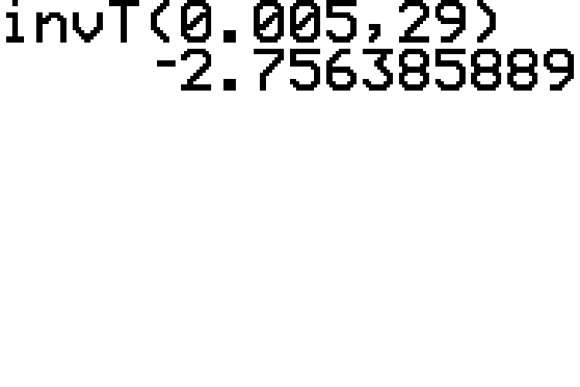
Example 8.2.5: Finding the Value of t Given Area between ${−t}_{α/2}$ and $t_{α/2}$ (cont.)

Slide 33

Memory Booster
Unlike critical $z$-values, to find critical $t$-values you must know the number of degrees of freedom in addition to the level of confidence.

Slide 34

Example 8.2.6: Finding the Critical t-value for a Confidence Interval
Find the critical $t$-value for a $95\%$ confidence interval using a $t$-distribution with 24 degrees of freedom.

Slide 35
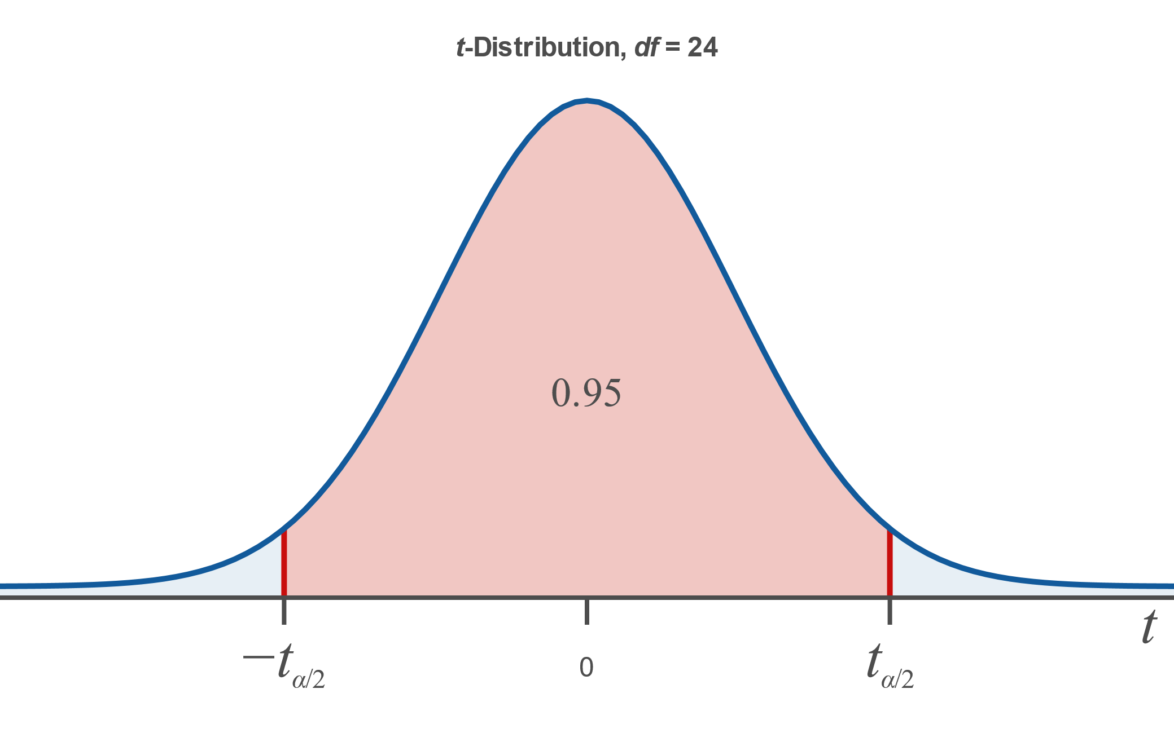
Example 8.2.6: Finding the Critical t-value for a Confidence Interval (cont.)
Solution

Slide 36
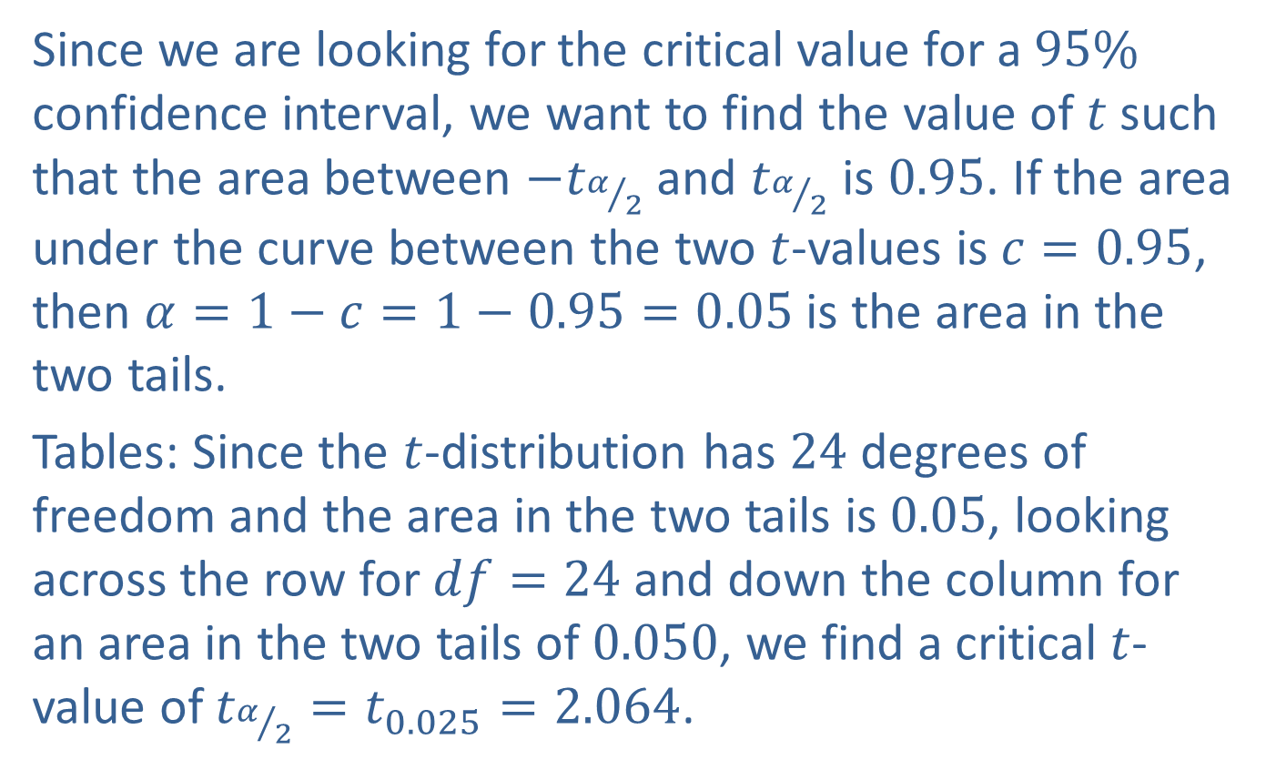
Example 8.2.6: Finding the Critical t-value for a Confidence Interval (cont.)
Since we are looking for the critical value for a $95\%$ confidence interval, we want to find the value of $t$ such that the area between $−t_{α/2}$ and $t_{α/2}$ is 0.95. If the area under the curve between the two $t$-values is $c=0.95$, then $α=1−c=1−0.95=0.05$ is the area in the two tails.
Tables: Since the $t$-distribution has 24 degrees of freedom and the area in the two tails is 0.05, looking across the row for $df=24$ and down the column for an area in the two tails of 0.050, we find a critical $t$-value of $t_{α/2}=t_{0.025}=2.064$.

Slide 37
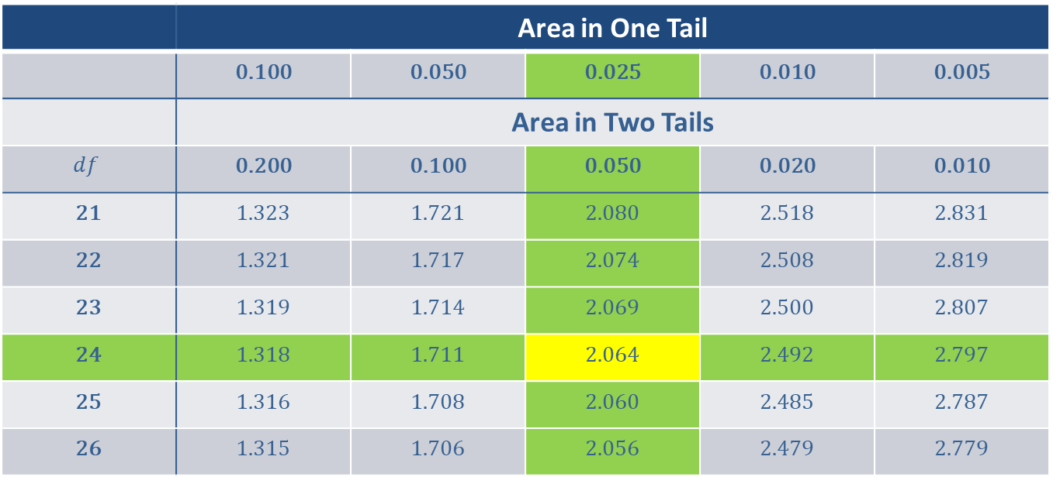
Example 8.2.6: Finding the Critical t-value for a Confidence Interval (cont.)
 | Area in One Tail
 | 0.100 | 0.050 | 0.025 | 0.010 | 0.005
 | Area in Two Tails
$$df$$ | 0.200 | 0.100 | 0.050 | 0.020 | 0.010
21 | 1.323 | 1.721 | 2.080 | 2.518 | 2.831
22 | 1.321 | 1.717 | 2.074 | 2.508 | 2.819
23 | 1.319 | 1.714 | 2.069 | 2.500 | 2.807
24 | 1.318 | 1.711 | 2.064 | 2.492 | 2.797
25 | 1.316 | 1.708 | 2.060 | 2.485 | 2.787
26 | 1.315 | 1.706 | 2.056 | 2.479 | 2.779

Slide 38
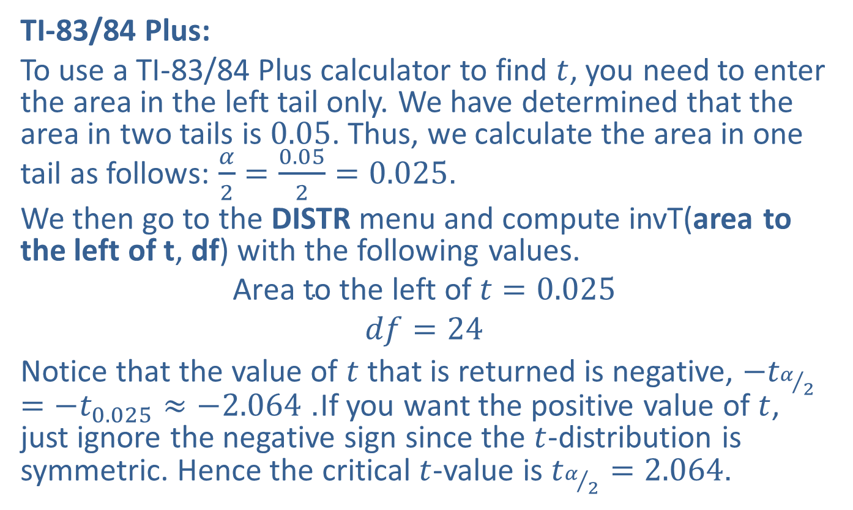
Example 8.2.6: Finding the Critical t-value for a Confidence Interval (cont.)
TI-83/84 Plus:
To use a TI-83/84 Plus calculator to find $t$, you need to enter the area in the left tail only. We have determined that the area in two tails is 0.05. Thus, we calculate the area in one tail as follows: $\frac{α}{2}=\frac{0.05}{2}=0.025$.
We then go to the DISTR menu and compute invT(area to the left of t, df) with the following values.
$$\text{Area} \text{to} \text{the} \text{left} \text{of} t=0.025$$
$$df=24$$
Notice that the value of $t$ that is returned is negative, $−t_{α/2}=−t_{0.025}≈−2.064$. If you want the positive value of $t$, just ignore the negative sign since the $t$-distribution is symmetric. Hence the critical $t$-value is $t_{α/2}=2.064$.

Slide 39
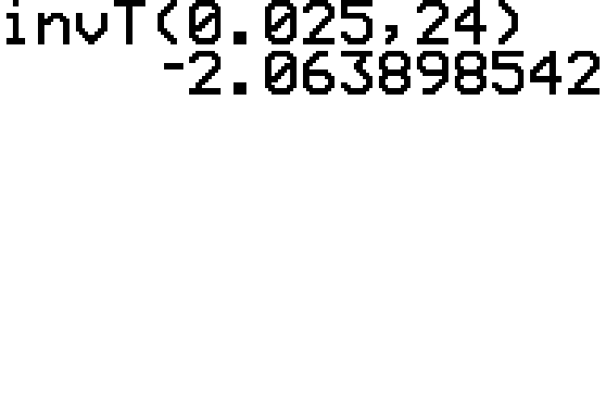
Example 8.2.6: Finding the Critical t-value for a Confidence Interval (cont.)

