Slide 1
Section 8.3
Estimating Population Means (Sigma Unknown)

Slide 2
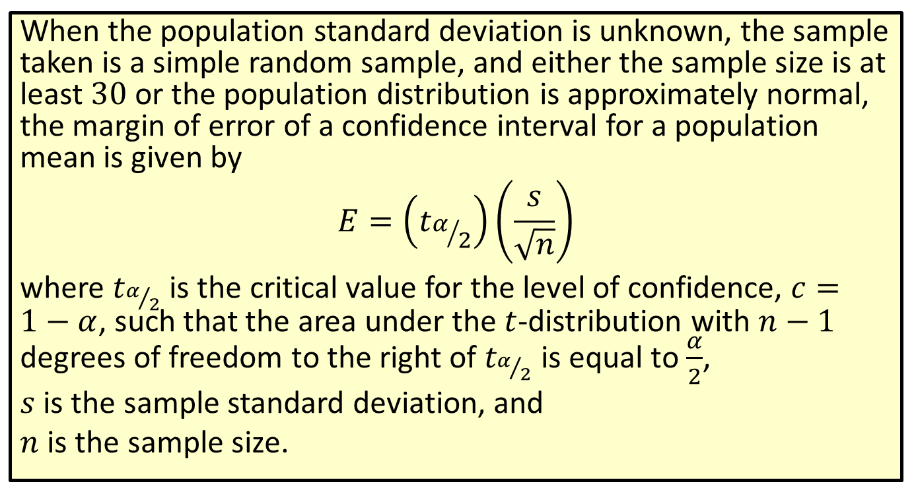

Formula: Margin of Error of a Confidence Interval for a Population Mean ($σ$ Unknown)
When the population standard deviation is unknown, the sample taken is a simple random sample, and either the sample size is at least 30 or the population distribution is approximately normal, the margin of error of a confidence interval for a population mean is given by
$$E=\left(t_{α/2}\right)\left(\frac{s}{\sqrt{n}}\right)$$
where $t_{α/2}$ is the critical value for the level of confidence, $c=1−α$, such that the area under the $t$-distribution with $n−1$ degrees of freedom to the right of $t_{α/2}$ is equal to $\frac{α}{2}$,
$s$ is the sample standard deviation, and
$n$ is the sample size.

Slide 3
Rounding Rule
When calculating a margin of error for a confidence interval, round to at least six decimal places to avoid additional rounding errors in the subsequent calculations of the endpoints of the confidence interval.

Slide 4
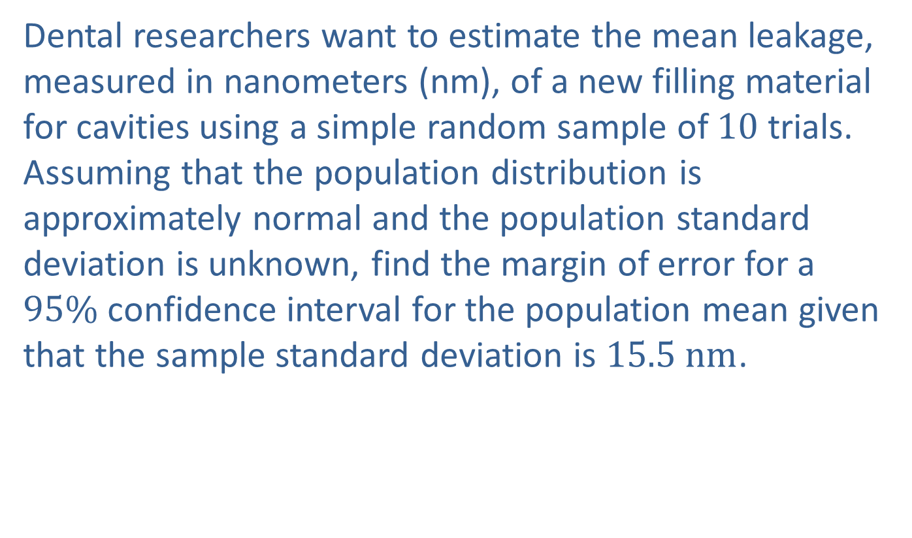
Example 8.3.1: Finding the Margin of Error of a Confidence Interval for a Population Mean (σ Unknown)
Dental researchers want to estimate the mean leakage, measured in nanometers (nm), of a new filling material for cavities using a simple random sample of 10 trials. Assuming that the population distribution is approximately normal and the population standard deviation is unknown, find the margin of error for a $95\%$ confidence interval for the population mean given that the sample standard deviation is $15.5 nm$.

Slide 5
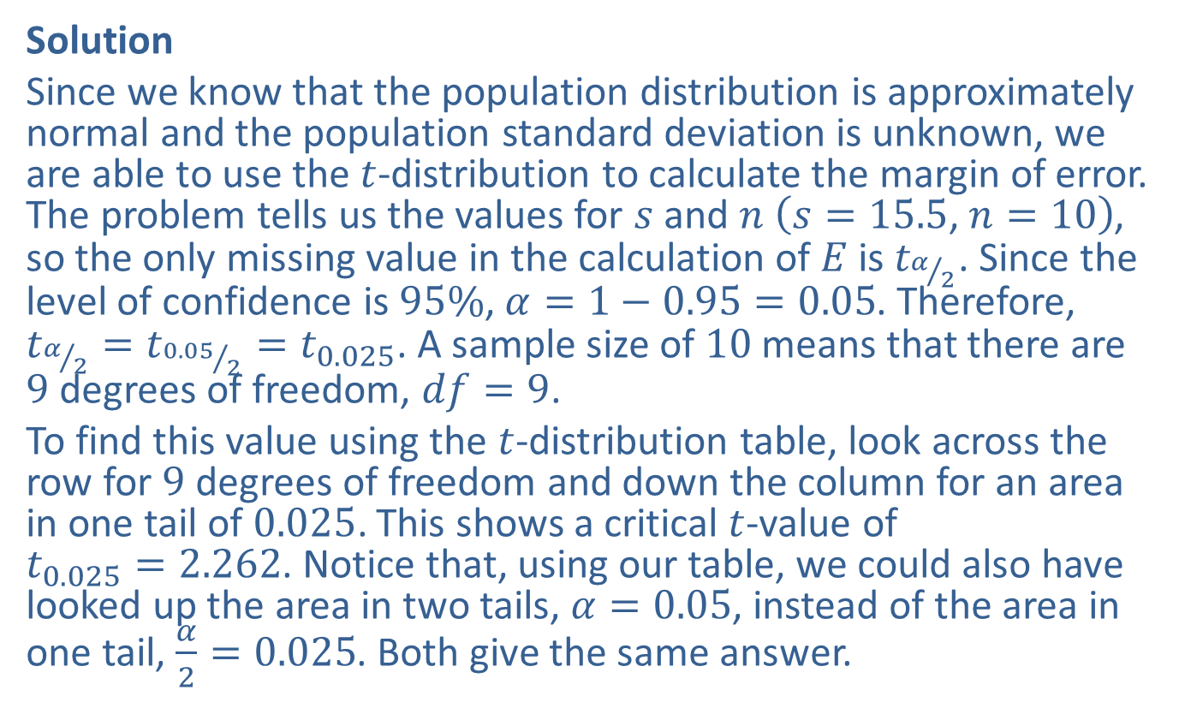
Example 8.3.1: Finding the Margin of Error of a Confidence Interval for a Population Mean (σ Unknown) (cont.)
Solution
Since we know that the population distribution is approximately normal and the population standard deviation is unknown, we are able to use the $t$-distribution to calculate the margin of error. The problem tells us the values for $s$ and $n$ $\left(s=15.5\text{, }n=10\right)$, so the only missing value in the calculation of $E$ is $t_{α/2}$. Since the level of confidence is $95\%$, $α=1−0.95=0.05$. Therefore, $t_{α/2}=t_{{0.05}/2}=t_{0.025}$. A sample size of 10 means that there are 9 degrees of freedom, $df=9$.
To find this value using the $t$-distribution table, look across the row for 9 degrees of freedom and down the column for an area in one tail of 0.025. This shows a critical $t$-value of $t_{0.025}=2.262$. Notice that, using our table, we could also have looked up the area in two tails, $α=0.05$, instead of the area in one tail, $\frac{α}{2}=0.025$. Both give the same answer.

Slide 6
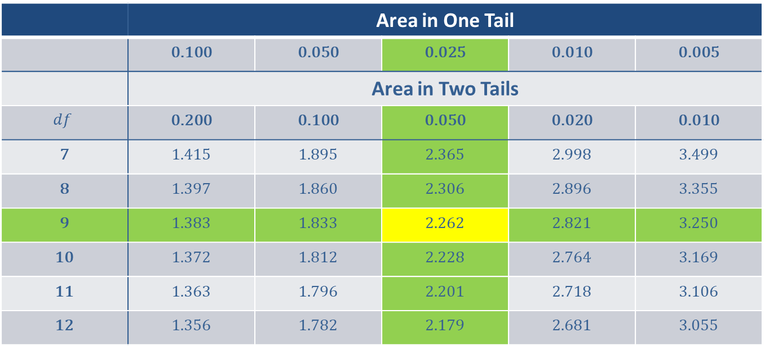
Example 8.3.1: Finding the Margin of Error of a Confidence Interval for a Population Mean (σ Unknown) (cont.)
 | Area in One Tail
 | 0.100 | 0.050 | 0.025 | 0.010 | 0.005
 | Area in Two Tails
$$df$$ | 0.200 | 0.100 | 0.050 | 0.020 | 0.010
7 | 1.415 | 1.895 | 2.365 | 2.998 | 3.499
8 | 1.397 | 1.860 | 2.306 | 2.896 | 3.355
9 | 1.383 | 1.833 | 2.262 | 2.821 | 3.250
10 | 1.372 | 1.812 | 2.228 | 2.764 | 3.169
11 | 1.363 | 1.796 | 2.201 | 2.718 | 3.106
12 | 1.356 | 1.782 | 2.179 | 2.681 | 3.055

Slide 7
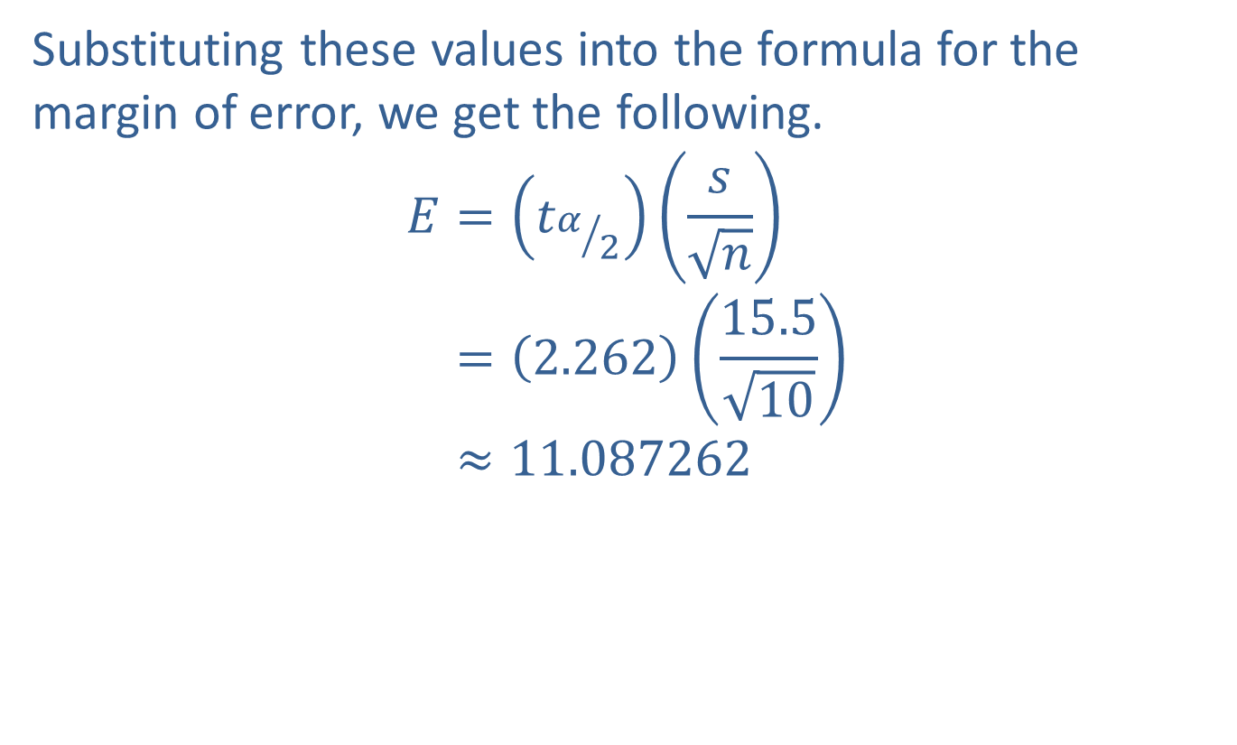
Example 8.3.1: Finding the Margin of Error of a Confidence Interval for a Population Mean (σ Unknown) (cont.)
Substituting these values into the formula for the margin of error, we get the following.
𝐸=𝑡𝛼2𝑠𝑛𝐸=2.26215.510𝐸≈11.087262

Slide 8
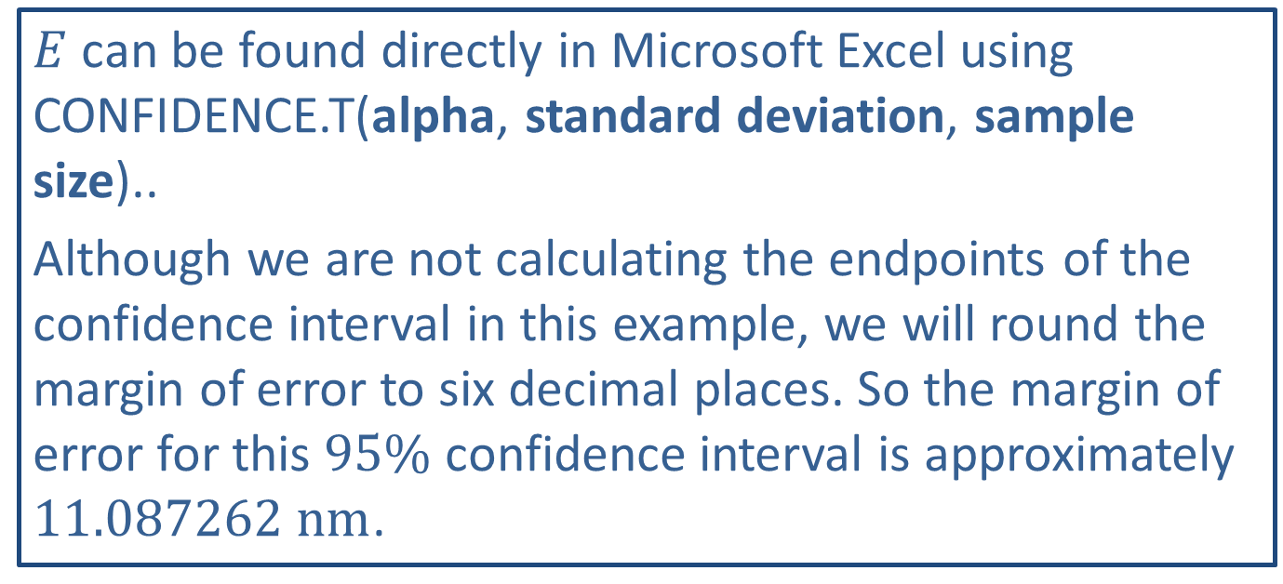
Technology Tip
$E$ can be found directly in Microsoft Excel using CONFIDENCE.T(alpha, standard deviation, sample size)..
Although we are not calculating the endpoints of the confidence interval in this example, we will round the margin of error to six decimal places. So the margin of error for this $95\%$ confidence interval is approximately $11.087262 nm$.

Slide 9
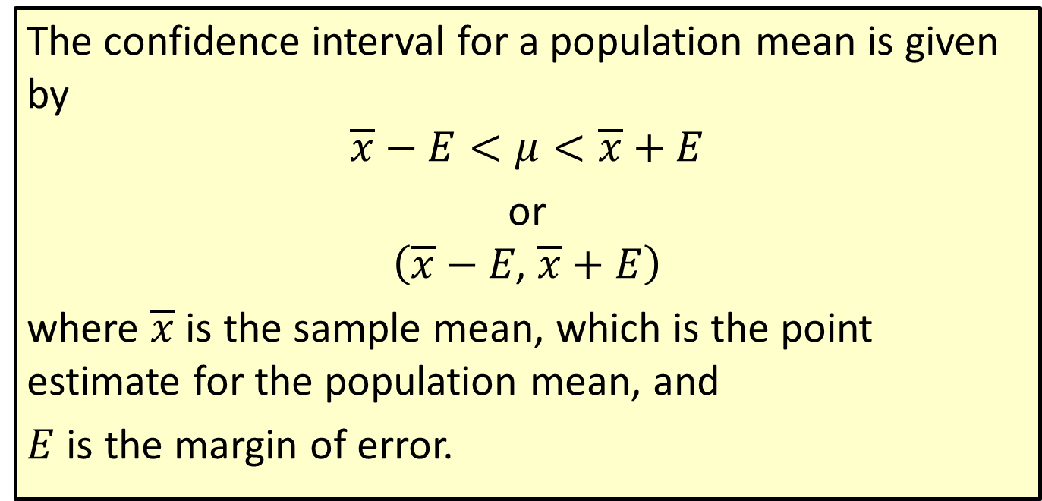
Formula: Confidence Interval for a Population Mean
The confidence interval for a population mean is given by
$$\overline{x}−E<μ<\overline{x}+E$$
or
$$\left(\overline{x}−E\text{, }\overline{x}+E\right)$$
where $\overline{x}$ is the sample mean, which is the point estimate for the population mean, and
$E$ is the margin of error.

Slide 10
Rounding Rule
Round the endpoints of a confidence interval for a population mean as follows:
​If sample data are given, round to one more decimal place than the largest number of decimal places in the given data.
​If statistics are given, round to the same number of decimal places as given in the standard deviation or variance.

Slide 11
Example 8.3.2: Constructing a Confidence Interval for a Population Mean (σ Unknown)
A marketing company wants to know the mean price of new vehicles sold in an up-and-coming area of town. Marketing strategists collected data over the past two years from all of the dealerships in the new area of town. From previous studies about new car sales, they believe that the population distribution looks somewhat like the following graph.

Slide 12
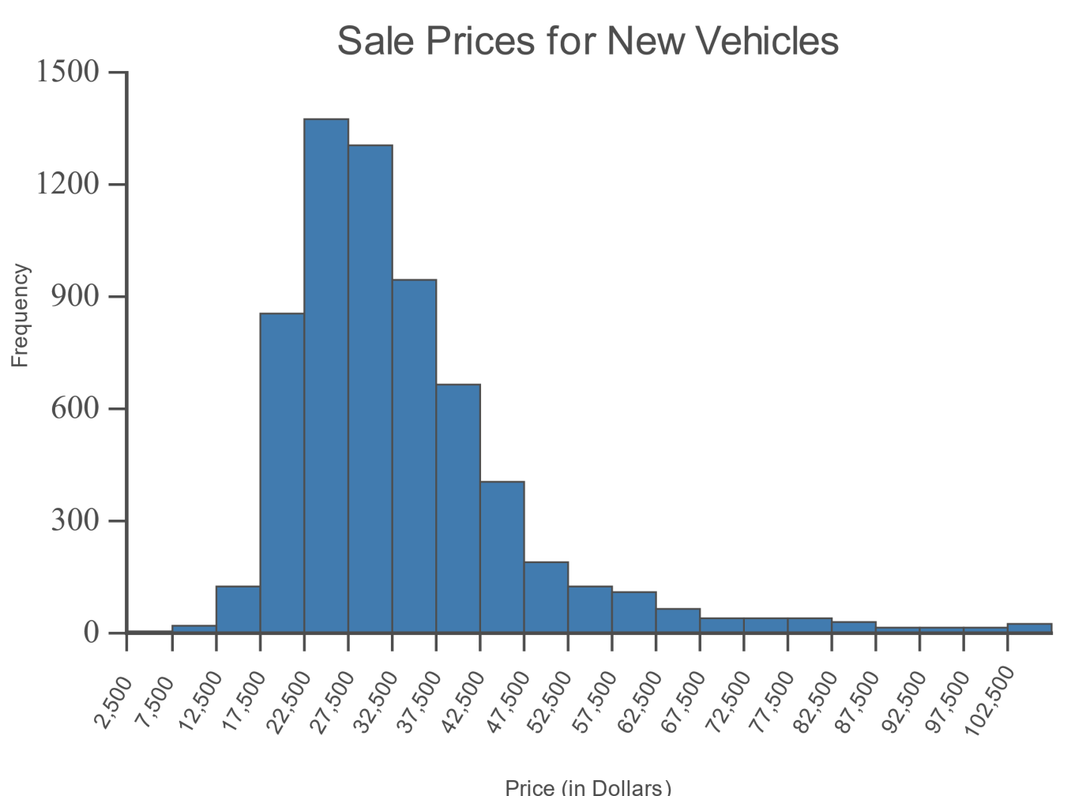
Example 8.3.2: Constructing a Confidence Interval for a Population Mean (σ Unknown) (cont.)

Slide 13

Example 8.3.2: Constructing a Confidence Interval for a Population Mean (σ Unknown) (cont.)
The simple random sample of 756 cars has a mean of $\$27,400$ with a standard deviation of $\$1300$. Construct a $95\%$ confidence interval for the mean price of new cars sold in this area.

Slide 14

Example 8.3.2: Constructing a Confidence Interval for a Population Mean (σ Unknown) (cont.)
Solution
Step 1: Find the point estimate.
The point estimate for the population mean is the sample mean, which we are told is $\$27,400$.

Slide 15
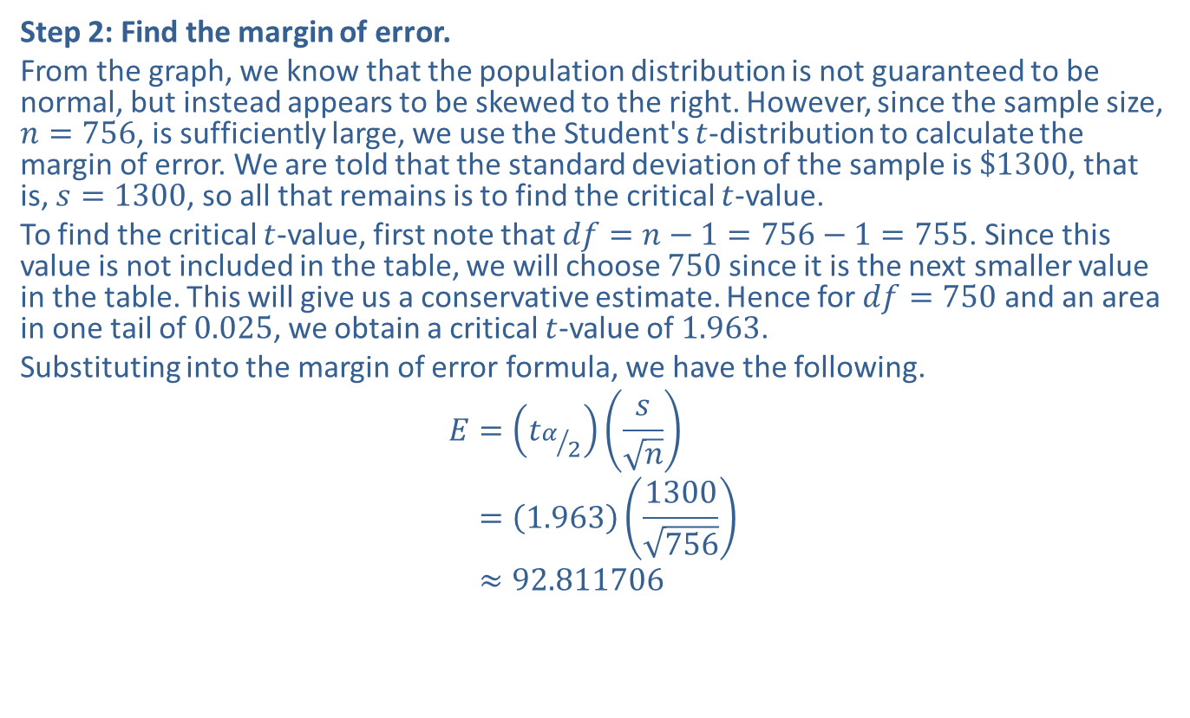
Example 8.3.2: Constructing a Confidence Interval for a Population Mean (σ Unknown) (cont.)
Step 2: Find the margin of error.
From the graph, we know that the population distribution is not guaranteed to be normal, but instead appears to be skewed to the right. However, since the sample size, $n=756$, is sufficiently large, we use the Student's $t$-distribution to calculate the margin of error. We are told that the standard deviation of the sample is $\$1300$, that is, $s=1300$, so all that remains is to find the critical $t$-value.
To find the critical $t$-value, first note that $df=n−1=756−1=755$. Since this value is not included in the table, we will choose 750 since it is the next smaller value in the table. This will give us a conservative estimate. Hence for $df=750$ and an area in one tail of 0.025, we obtain a critical $t$-value of 1.963.
Substituting into the margin of error formula, we have the following.
𝐸=𝑡𝛼2𝑠𝑛𝐸=1.9631300756𝐸≈92.811706

Slide 16
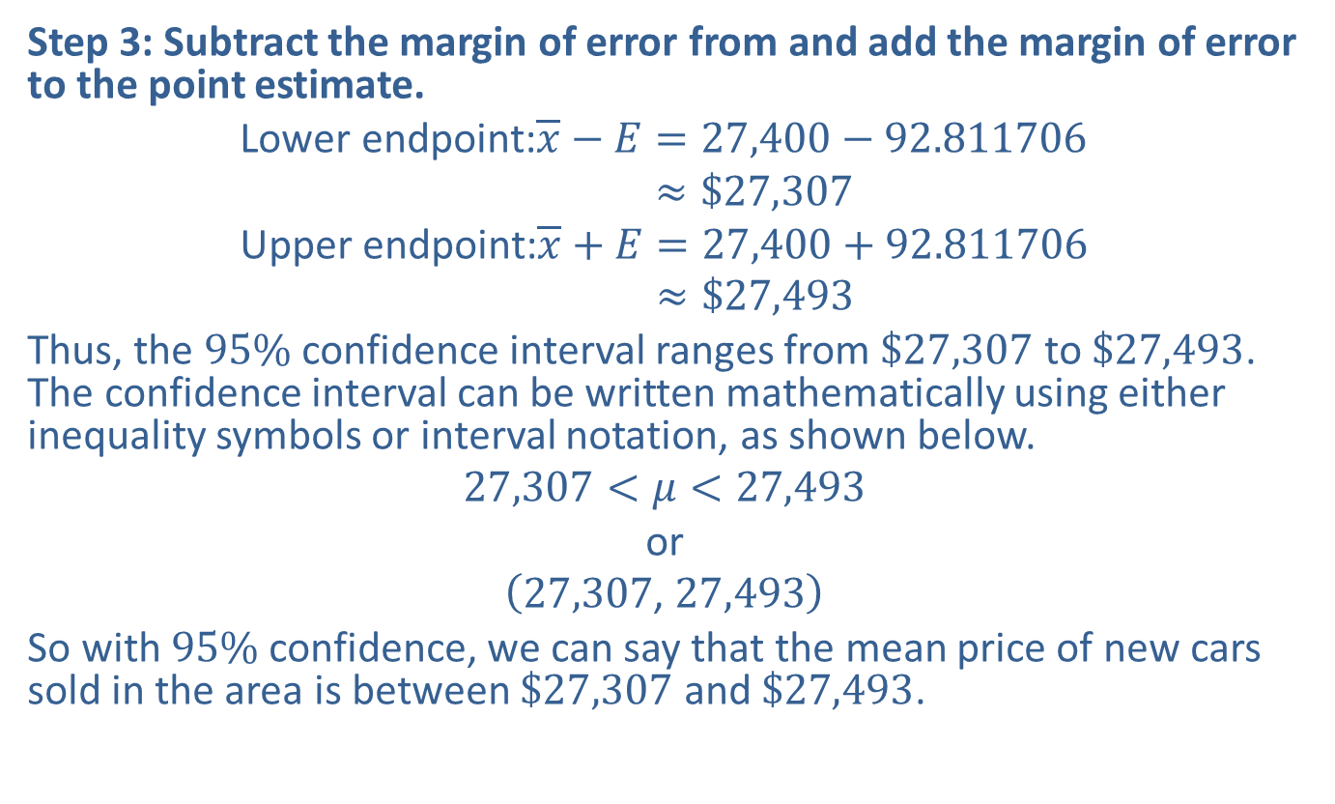
Example 8.3.2: Constructing a Confidence Interval for a Population Mean (σ Unknown) (cont.)
Step 3: Subtract the margin of error from and add the margin of error to the point estimate.
Lower endpoint:𝑥−𝐸=27,400−92.811706Lower endpoint:𝑥−𝐸≈$27,307Upper endpoint:𝑥+𝐸=27,400+92.811706Upper endpoint:𝑥+𝐸≈$27,493
Thus, the $95\%$ confidence interval ranges from $\$27,307$ to $\$27,493$. The confidence interval can be written mathematically using either inequality symbols or interval notation, as shown below.
$$27,307<μ<27,493$$
or
$$\left(27,307\text{, }27,493\right)$$
So with $95\%$ confidence, we can say that the mean price of new cars sold in the area is between $\$27,307$ and $\$27,493$.

Slide 17
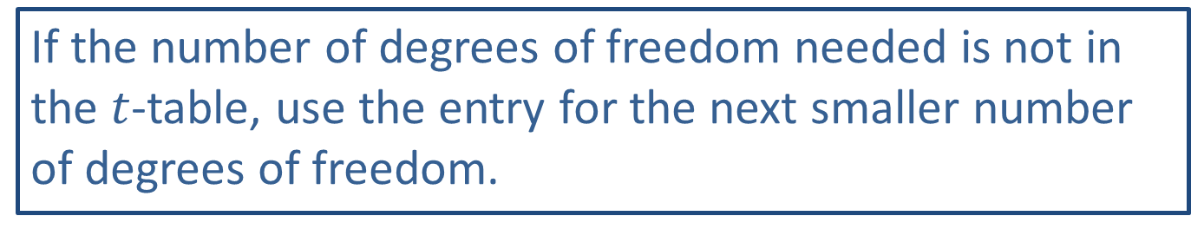
Memory Booster
If the number of degrees of freedom needed is not in the $t$-table, use the entry for the next smaller number of degrees of freedom.

Slide 18
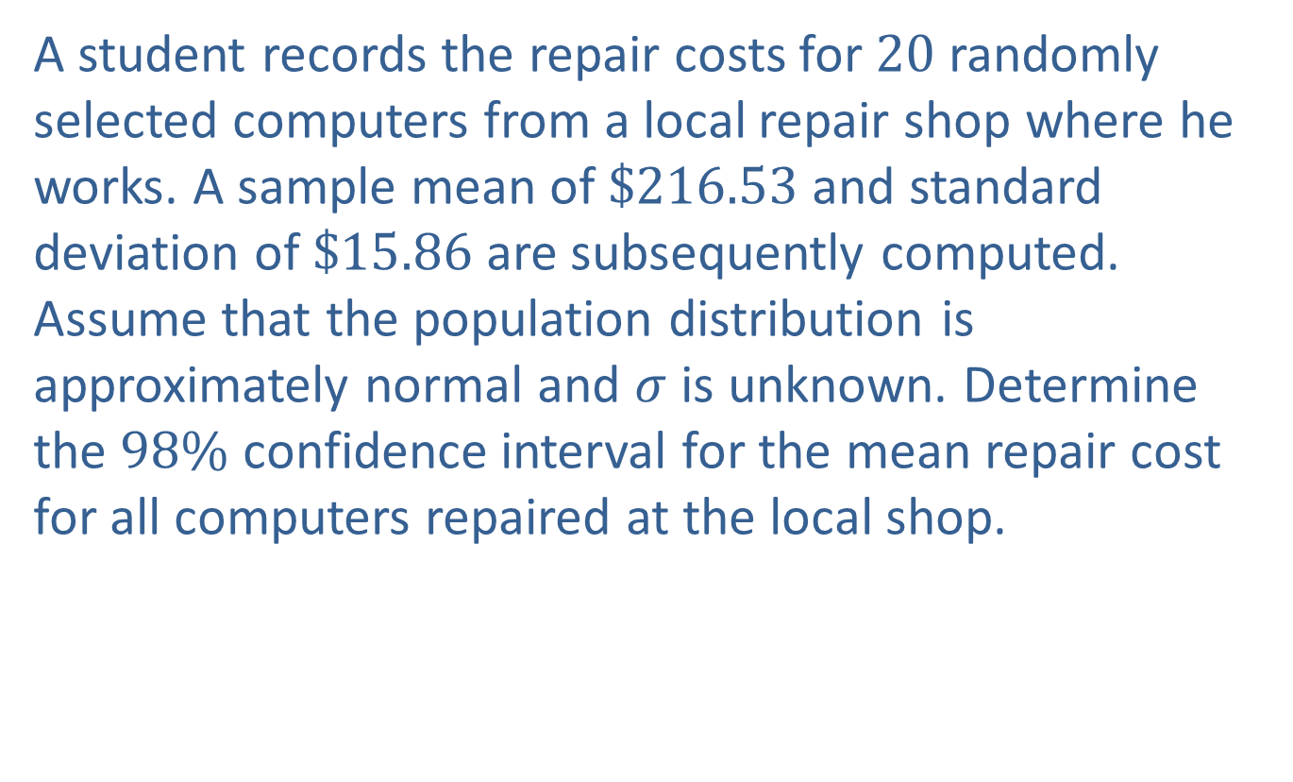
Example 8.3.3: Constructing a Confidence Interval for a Population Mean (σ Unknown)
A student records the repair costs for 20 randomly selected computers from a local repair shop where he works. A sample mean of $\$216.53$ and standard deviation of $\$15.86$ are subsequently computed. Assume that the population distribution is approximately normal and $σ$ is unknown. Determine the $98\%$ confidence interval for the mean repair cost for all computers repaired at the local shop.

Slide 19
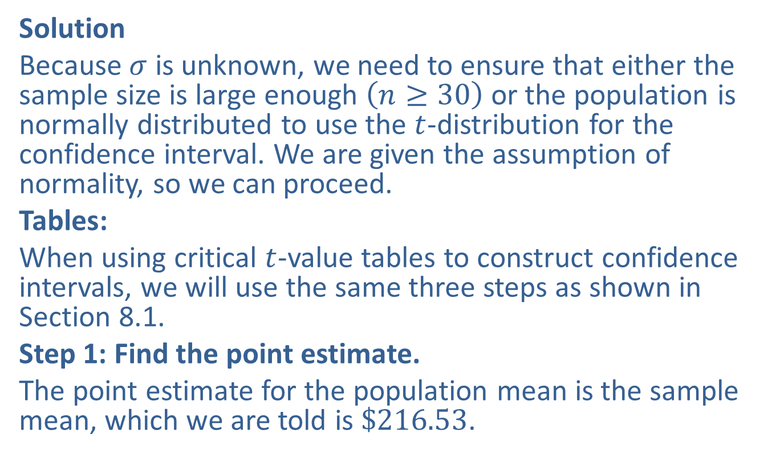
Example 8.3.3: Constructing a Confidence Interval for a Population Mean (σ Unknown) (cont.)
Solution
Because $σ$ is unknown, we need to ensure that either the sample size is large enough $\left(n≥30\right)$ or the population is normally distributed to use the $t$-distribution for the confidence interval. We are given the assumption of normality, so we can proceed.
Tables:
When using critical $t$-value tables to construct confidence intervals, we will use the same three steps as shown in Section 8.1.
Step 1: Find the point estimate.
The point estimate for the population mean is the sample mean, which we are told is $\$216.53$.

Slide 20
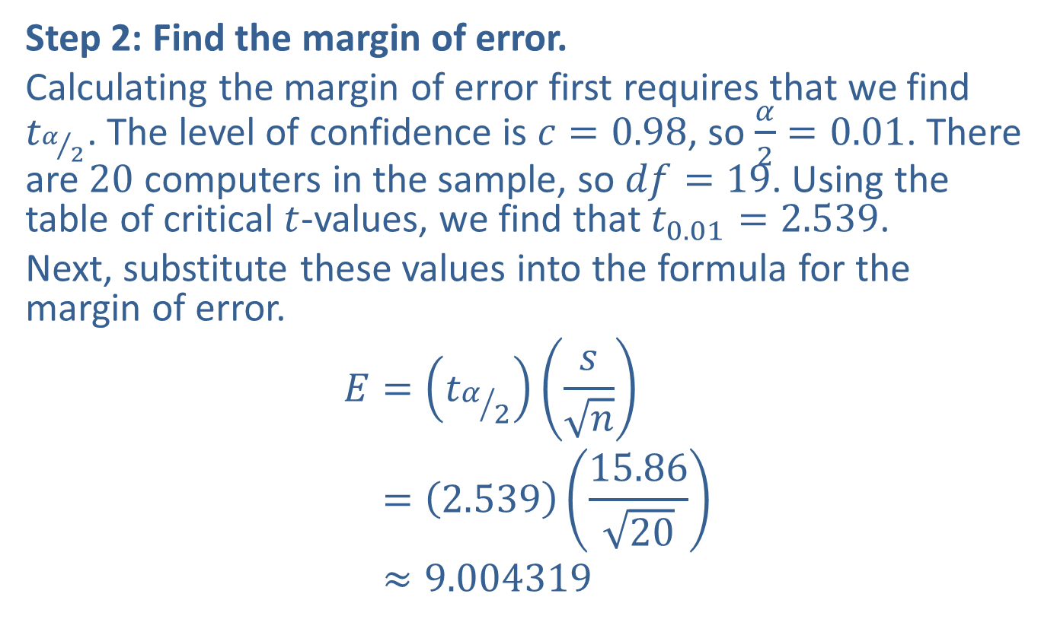
Example 8.3.3: Constructing a Confidence Interval for a Population Mean (σ Unknown) (cont.)
Step 2: Find the margin of error.
Calculating the margin of error first requires that we find $t_{α/2}$. The level of confidence is $c=0.98$, so $\frac{α}{2}=0.01$. There are 20 computers in the sample, so $df=19$. Using the table of critical $t$-values, we find that $t_{0.01}=2.539$.
Next, substitute these values into the formula for the margin of error.
𝐸=𝑡𝛼2𝑠𝑛𝐸=2.53915.8620𝐸≈9.004319

Slide 21
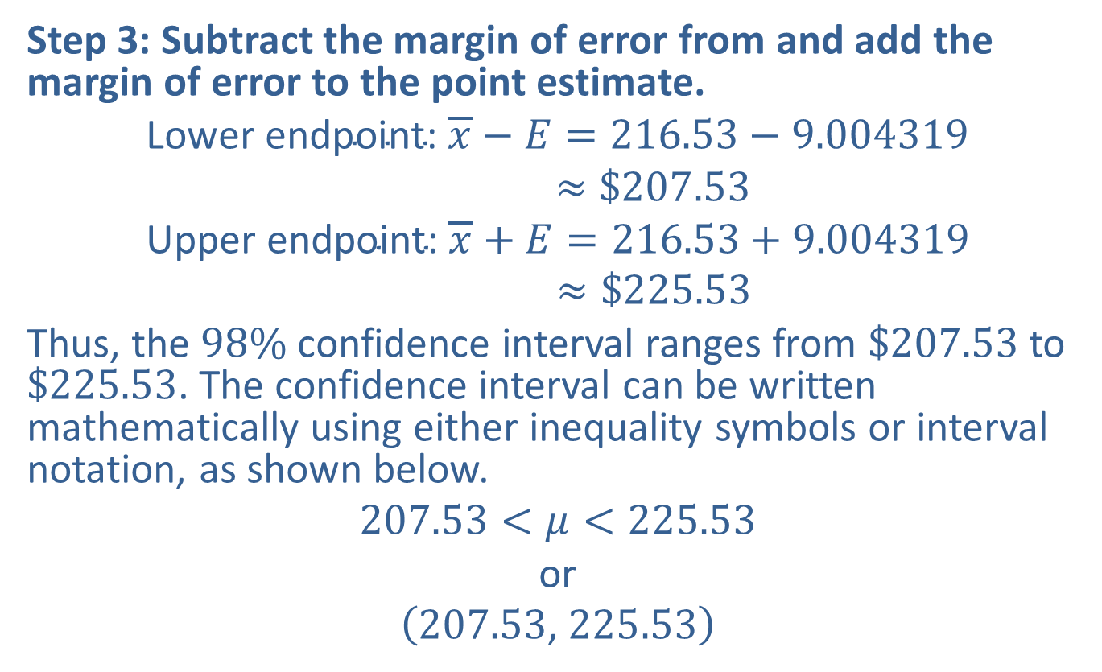
Example 8.3.3: Constructing a Confidence Interval for a Population Mean (σ Unknown) (cont.)
Step 3: Subtract the margin of error from and add the margin of error to the point estimate.
Lower endpoint: 𝑥−𝐸=216.53−9.004319Lower endpoint:𝑥−𝐸≈$207.53Upper endpoint: 𝑥+𝐸=216.53+9.004319Upper endpoint:𝑥+𝐸≈$225.53
Thus, the $98\%$ confidence interval ranges from $\$207.53$ to $\$225.53$. The confidence interval can be written mathematically using either inequality symbols or interval notation, as shown below.
$$207.53<μ<225.53$$
or
$$\left(207.53\text{, }225.53\right)$$

Slide 22
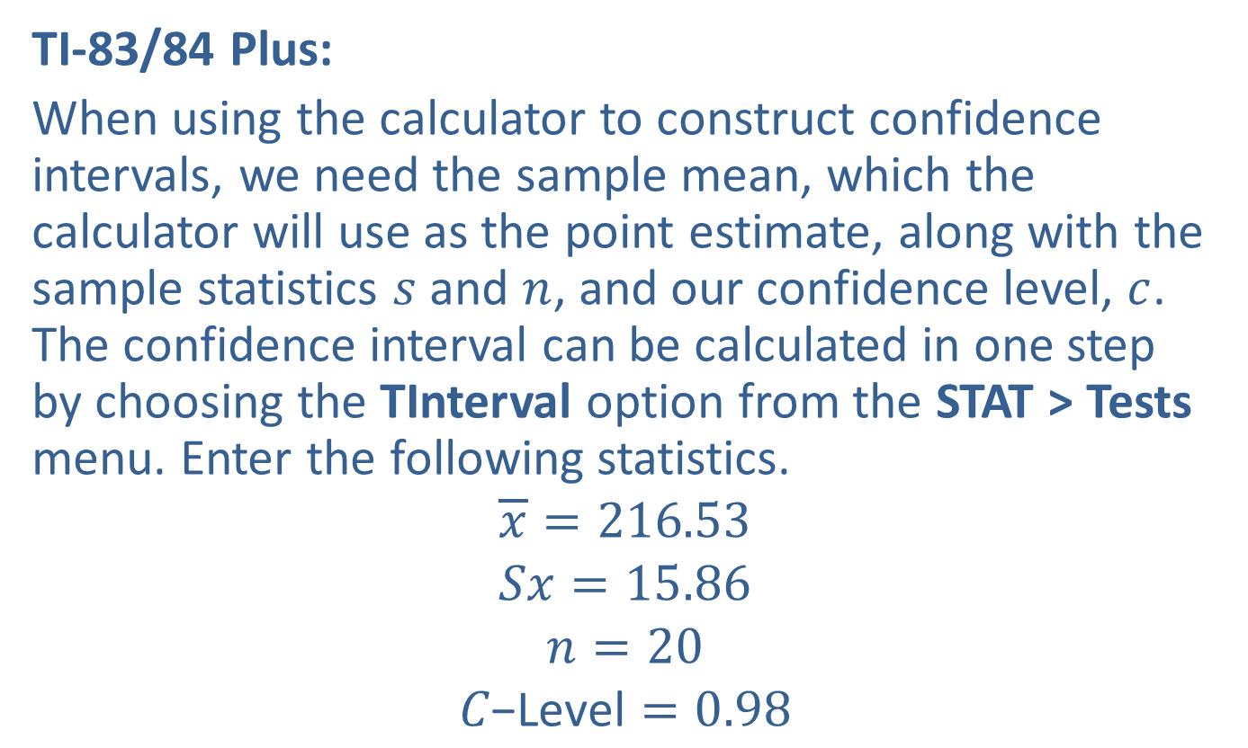
Example 8.3.3: Constructing a Confidence Interval for a Population Mean (σ Unknown) (cont.)
TI-83/84 Plus:
When using the calculator to construct confidence intervals, we need the sample mean, which the calculator will use as the point estimate, along with the sample statistics $s$ and $n$, and our confidence level, $c$. The confidence interval can be calculated in one step by choosing the TInterval option from the STAT > Tests menu. Enter the following statistics.
$$\overline{x}=216.53$$
$$Sx=15.86$$
$$n=20$$
$$C\text{−}\text{Level}=0.98$$

Slide 23
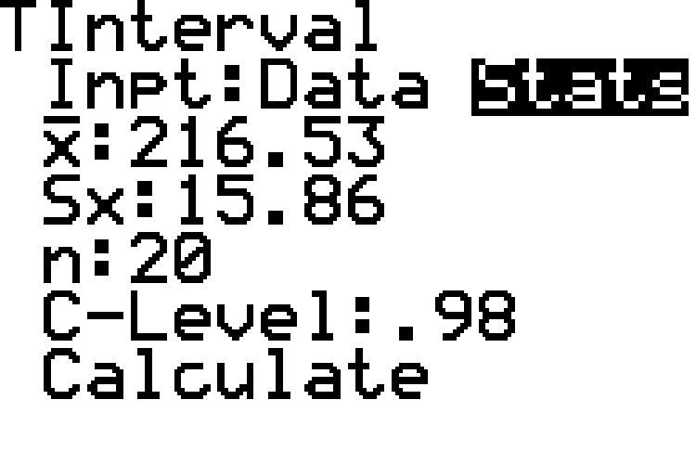
Example 8.3.3: Constructing a Confidence Interval for a Population Mean (σ Unknown) (cont.)

Slide 24
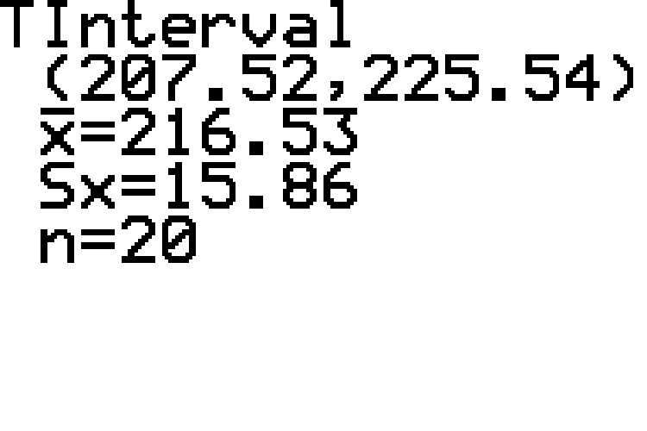
Example 8.3.3: Constructing a Confidence Interval for a Population Mean (σ Unknown) (cont.)

Slide 25
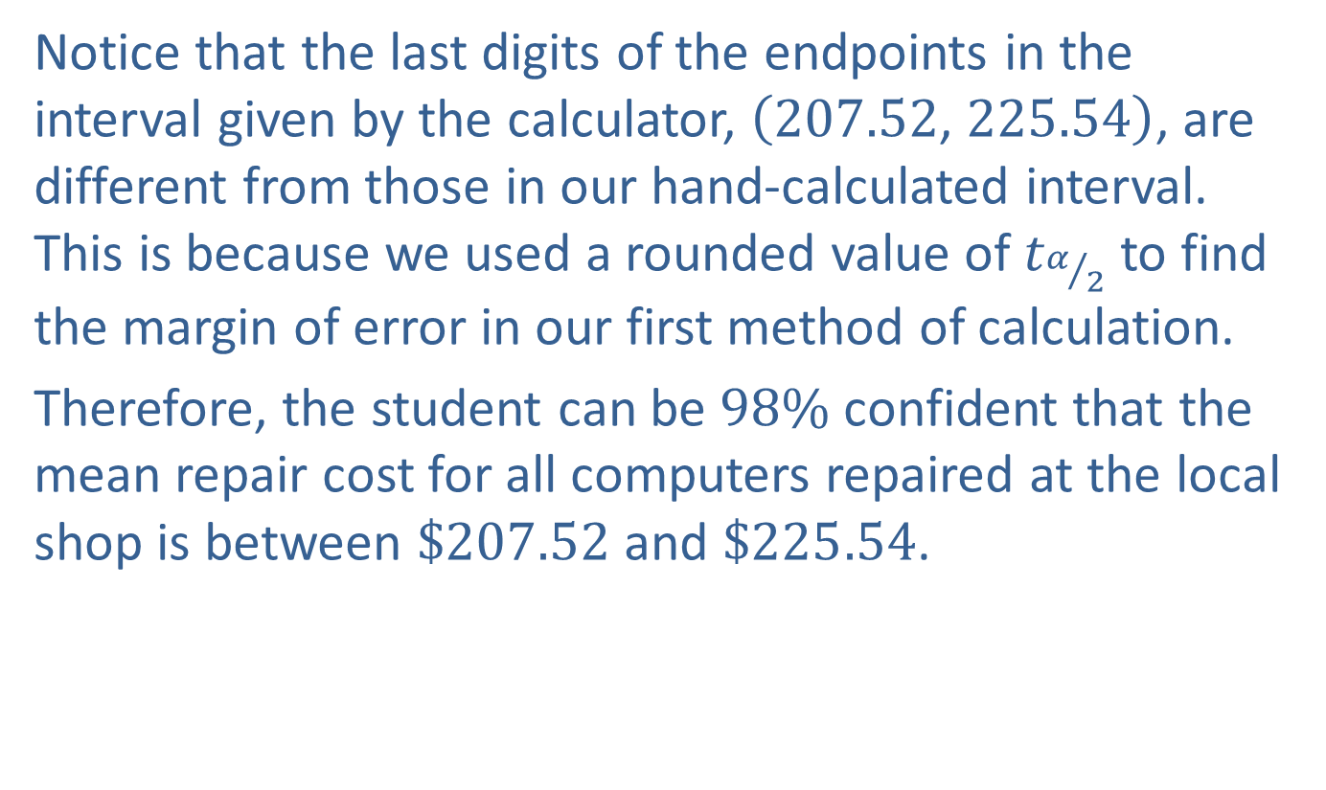
Example 8.3.3: Constructing a Confidence Interval for a Population Mean (σ Unknown) (cont.)
Notice that the last digits of the endpoints in the interval given by the calculator, $\left(207.52\text{, }225.54\right)$, are different from those in our hand-calculated interval. This is because we used a rounded value of $t_{α/2}$ to find the margin of error in our first method of calculation.
Therefore, the student can be $98\%$ confident that the mean repair cost for all computers repaired at the local shop is between $\$207.52$ and $\$225.54$.

Slide 26
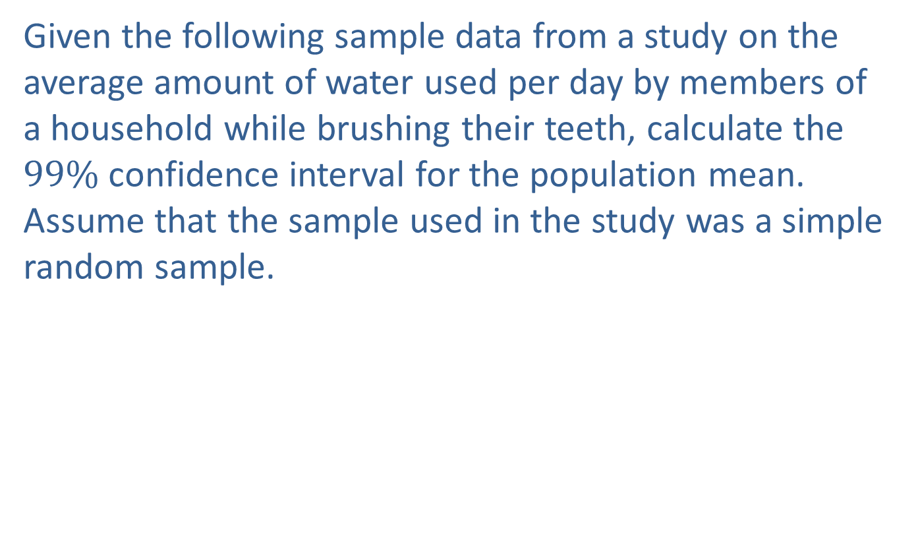
Example 8.3.4: Constructing a Confidence Interval for a Population Mean (σ Unknown) from Original Data
Given the following sample data from a study on the average amount of water used per day by members of a household while brushing their teeth, calculate the $99\%$ confidence interval for the population mean. Assume that the sample used in the study was a simple random sample.

Slide 27
Example 8.3.4: Constructing a Confidence Interval for a Population Mean (σ Unknown) from Original Data (cont.)
Household Water Used for Brushing Teeth (in Gallons per Day)
0.485 | 0.428 | 0.390 | 0.308 | 0.231
0.587 | 0.516 | 0.465 | 0.370 | 0.282
0.412 | 0.367 | 0.336 | 0.269 | 0.198
0.942 | 0.943 | 0.940 | 0.941 | 0.946
0.868 | 0.898 | 0.889 | 0.910 | 0.927
0.925 | 0.950 | 0.959 | 0.948 | 0.956
0.805 | 0.810 | 0.839 | 0.860 | 0.861
0.515 | 0.463 | 0.420 | 0.326 | 0.243

Slide 28
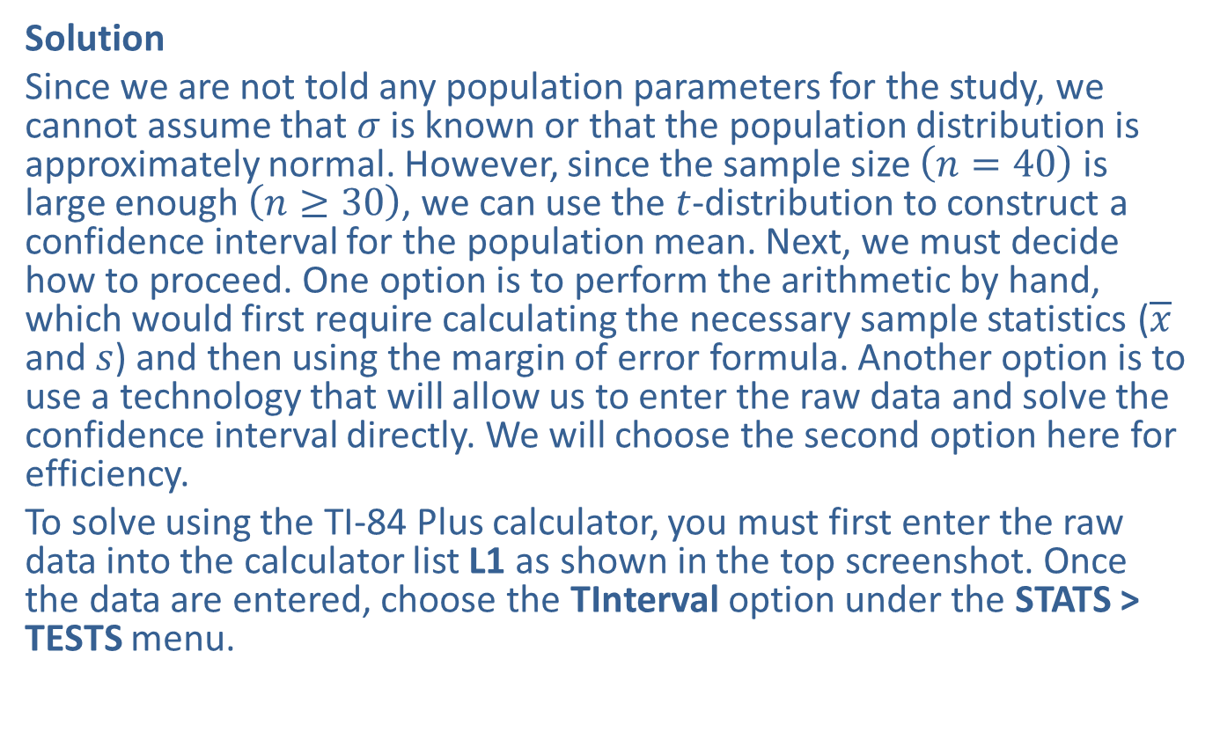
Example 8.3.4: Constructing a Confidence Interval for a Population Mean (σ Unknown) from Original Data (cont.)
Solution
Since we are not told any population parameters for the study, we cannot assume that $σ$ is known or that the population distribution is approximately normal. However, since the sample size $\left(n=40\right)$ is large enough $\left(n≥30\right)$, we can use the $t$-distribution to construct a confidence interval for the population mean. Next, we must decide how to proceed. One option is to perform the arithmetic by hand, which would first require calculating the necessary sample statistics ($\overline{x}$ and $s$) and then using the margin of error formula. Another option is to use a technology that will allow us to enter the raw data and solve the confidence interval directly. We will choose the second option here for efficiency.
To solve using the TI-84 Plus calculator, you must first enter the raw data into the calculator list L1 as shown in the top screenshot. Once the data are entered, choose the TInterval option under the STATS > TESTS menu.

Slide 29
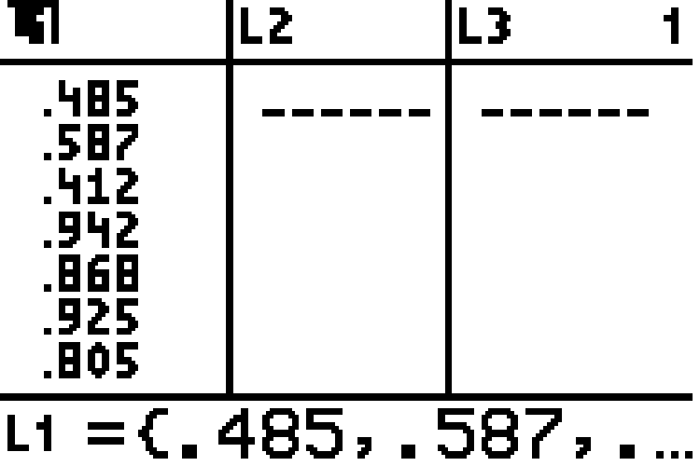
Example 8.3.4: Constructing a Confidence Interval for a Population Mean (σ Unknown) from Original Data (cont.)

Slide 30
Example 8.3.4: Constructing a Confidence Interval for a Population Mean (σ Unknown) from Original Data (cont.)
This time, however, choose the Data option. You'll need to specify which list your data are in, which is L1, and the confidence level (C-Level), which is 0.99 in this example. The value of Freq should be left as the default value of 1. The results are shown in the bottom screenshot.

Slide 31
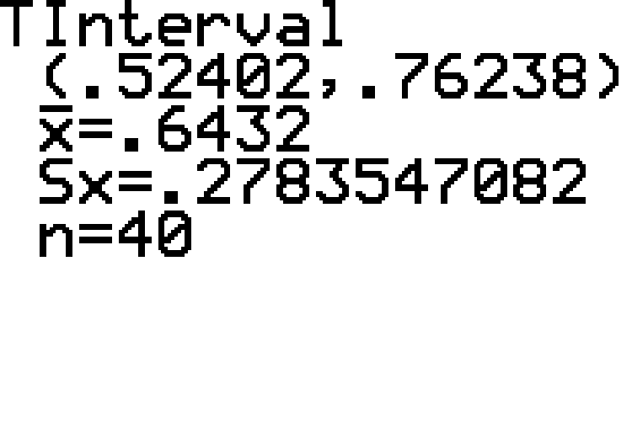
Example 8.3.4: Constructing a Confidence Interval for a Population Mean (σ Unknown) from Original Data (cont.)

Slide 32
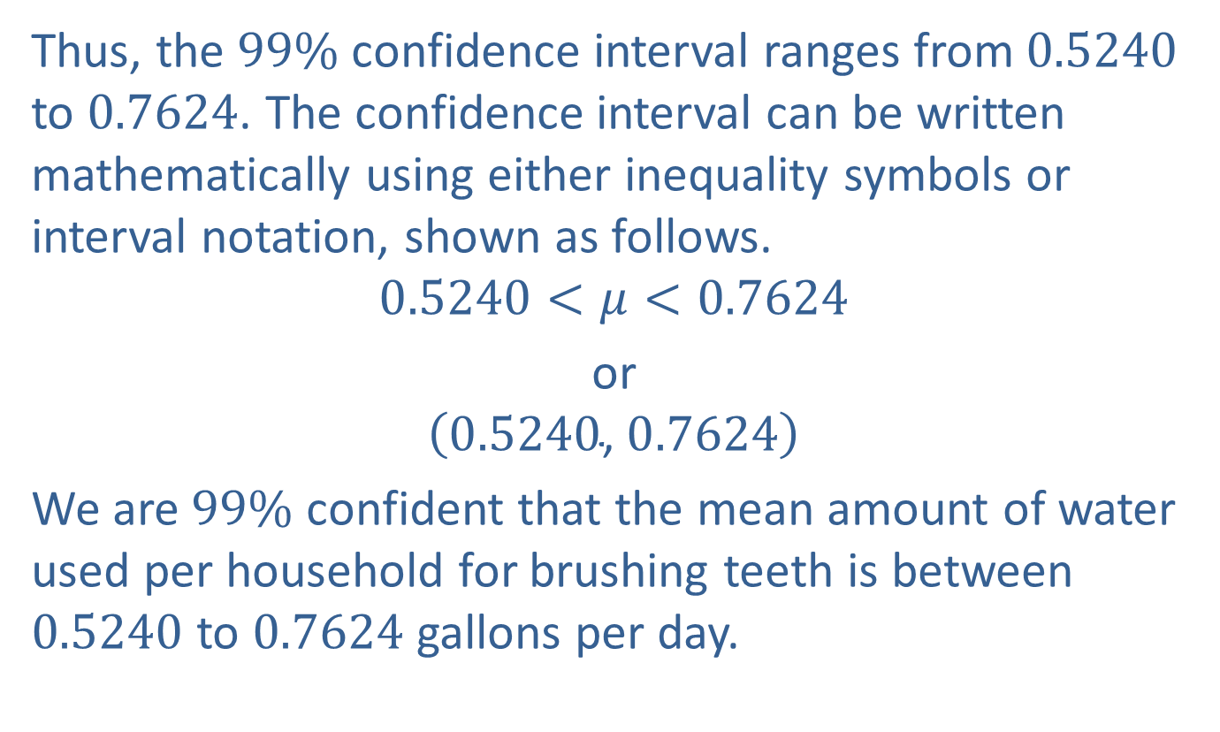
Example 8.3.4: Constructing a Confidence Interval for a Population Mean (σ Unknown) from Original Data (cont.)
Thus, the $99\%$ confidence interval ranges from 0.5240 to 0.7624. The confidence interval can be written mathematically using either inequality symbols or interval notation, shown as follows.
$$0.5240<μ<0.7624$$
or
$$\left(0.5240\text{, }0.7624\right)$$
We are $99\%$ confident that the mean amount of water used per household for brushing teeth is between 0.5240 to 0.7624 gallons per day.

