Slide 1
Section 8.4
Estimating Population Proportions

Slide 2
Example 8.4.1: Finding a Point Estimate for a Population Proportion
A graduate student wishes to know the proportion of American adults who speak two or more languages. He surveys 565 randomly selected American adults and finds that 226 speak two or more languages. Estimate the proportion of all American adults who speak two or more languages.

Slide 3
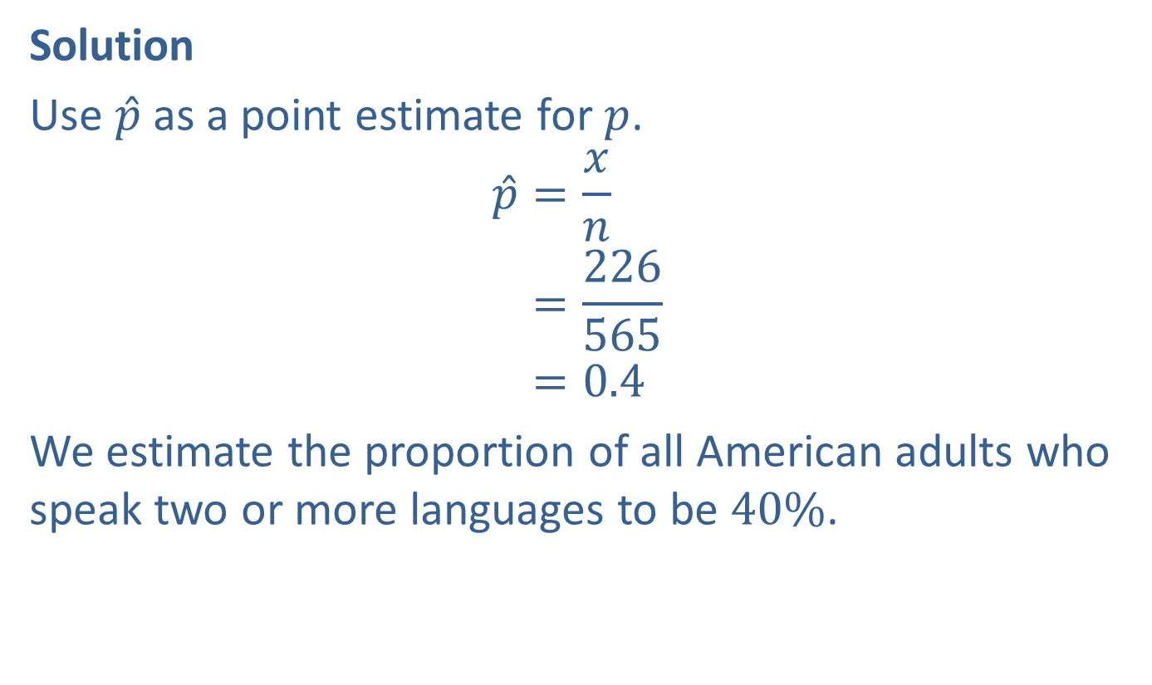
Example 8.4.1: Finding a Point Estimate for a Population Proportion (cont.)
Solution
Use $\hat{p}$ as a point estimate for $p$.
𝑝=𝑥𝑛𝑝=226565𝑝=0.4
We estimate the proportion of all American adults who speak two or more languages to be $40\%$.

Slide 4
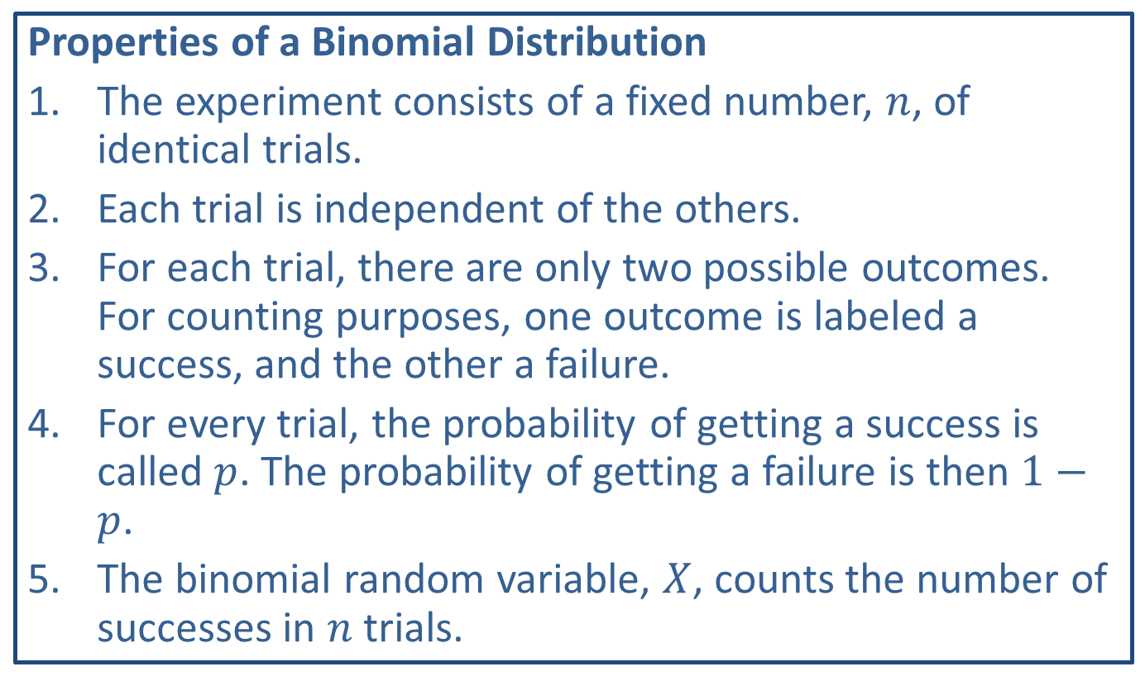
Memory Booster
Properties of a Binomial Distribution
​The experiment consists of a fixed number, $n$, of identical trials.
​Each trial is independent of the others.
​For each trial, there are only two possible outcomes. For counting purposes, one outcome is labeled a success, and the other a failure.
​For every trial, the probability of getting a success is called $p$. The probability of getting a failure is then $1−p$.
​The binomial random variable, $X$, counts the number of successes in $n$ trials.

Slide 5

Example 8.4.2: Determining Whether the Sample Size Conditions are Met
Determine if the conditions $n{\hat{p}}≥10$ and
$n\left(1−\hat{p}\right)≥10$ are met for the following scenarios.
​$n=45$, $\hat{p}=0.18$
​For a randomly selected group of 90 adults, 34 had been administered the shingles vaccine.

Slide 6
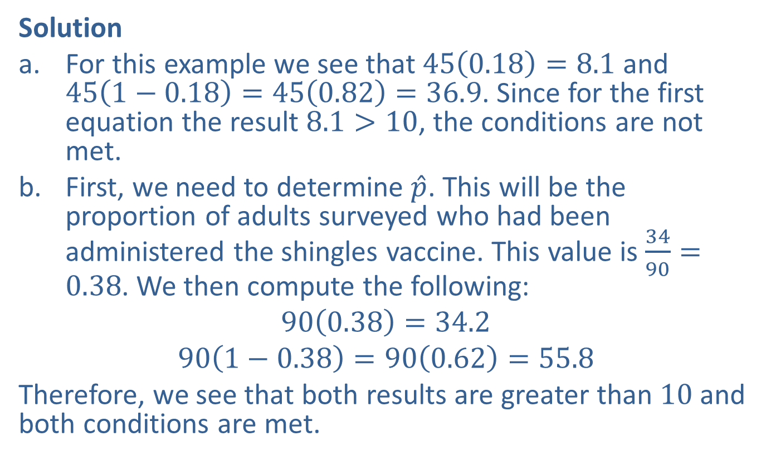
Example 8.4.2: Determining Whether the Sample Size Conditions are Met (cont.)
Solution
​For this example we see that $45\left(0.18\right)=8.1$ and $45\left(1−0.18\right)=45\left(0.82\right)=36.9$. Since for the first equation the result $8.1>10$, the conditions are not met.
​First, we need to determine $\hat{p}$. This will be the proportion of adults surveyed who had been administered the shingles vaccine. This value is $\frac{34}{90}=0.38$. We then compute the following:
​$90\left(0.38\right)=34.2$
​$90\left(1−0.38\right)=90\left(0.62\right)=55.8$
​Therefore, we see that both results are greater than 10 and both conditions are met.

Slide 7
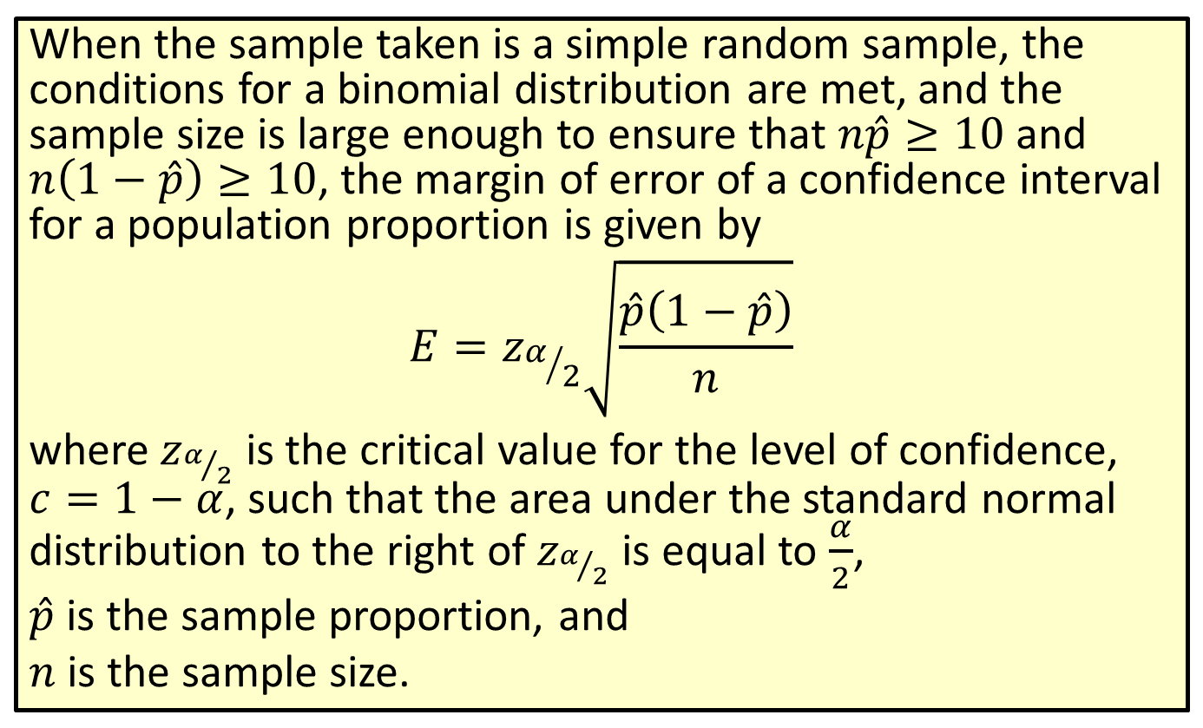
Formula: Margin of Error of a Confidence Interval for a Population Proportion
When the sample taken is a simple random sample, the conditions for a binomial distribution are met, and the sample size is large enough to ensure that $n\hat{p}≥10$ and $n\left(1−\hat{p}\right)≥10$, the margin of error of a confidence interval for a population proportion is given by
$$E=z_{α/2}\sqrt{\frac{\hat{p}\left(1−\hat{p}\right)}{n}}$$
where $z_{α/2}$ is the critical value for the level of confidence, $c=1−α$, such that the area under the standard normal distribution to the right of $z_{α/2}$ is equal to $\frac{α}{2}$,
$\hat{p}$ is the sample proportion, and
$n$ is the sample size.

Slide 8
Rounding Rule
When calculating a margin of error for a confidence interval, round to at least six decimal places to avoid additional rounding errors in the subsequent calculations of the endpoints of the confidence interval.

Slide 9
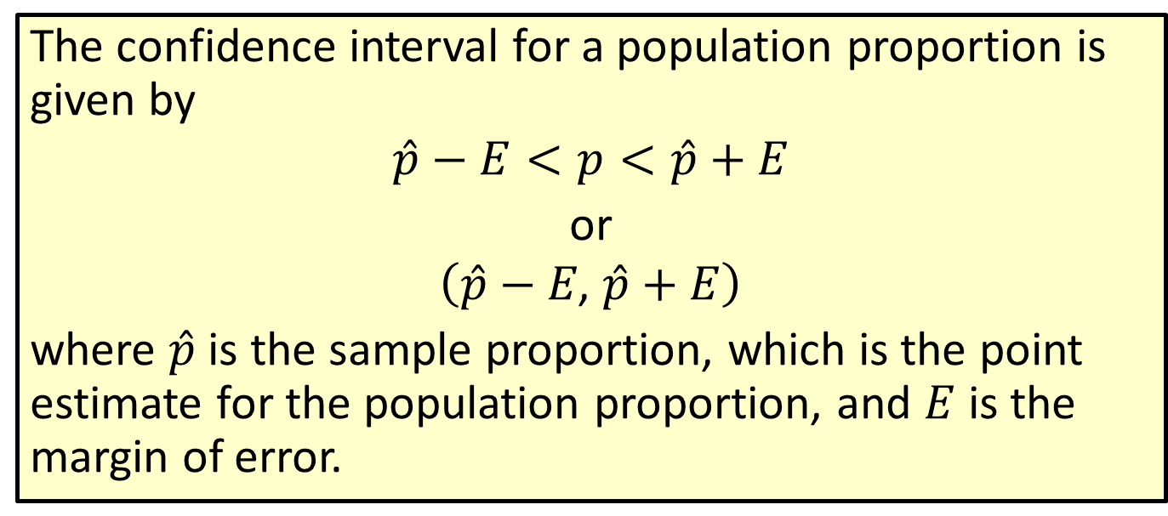
Formula: Confidence Interval for a Population Proportion
The confidence interval for a population proportion is given by
$$\hat{p}−E<p<\hat{p}+E$$
or
$$\left(\hat{p}−E\text{, }\hat{p}+E\right)$$
where $\hat{p}$ is the sample proportion, which is the point estimate for the population proportion, and $E$ is the margin of error.

Slide 10
Rounding Rule
Round the endpoints of a confidence interval for a population proportion to three decimal places.

Slide 11
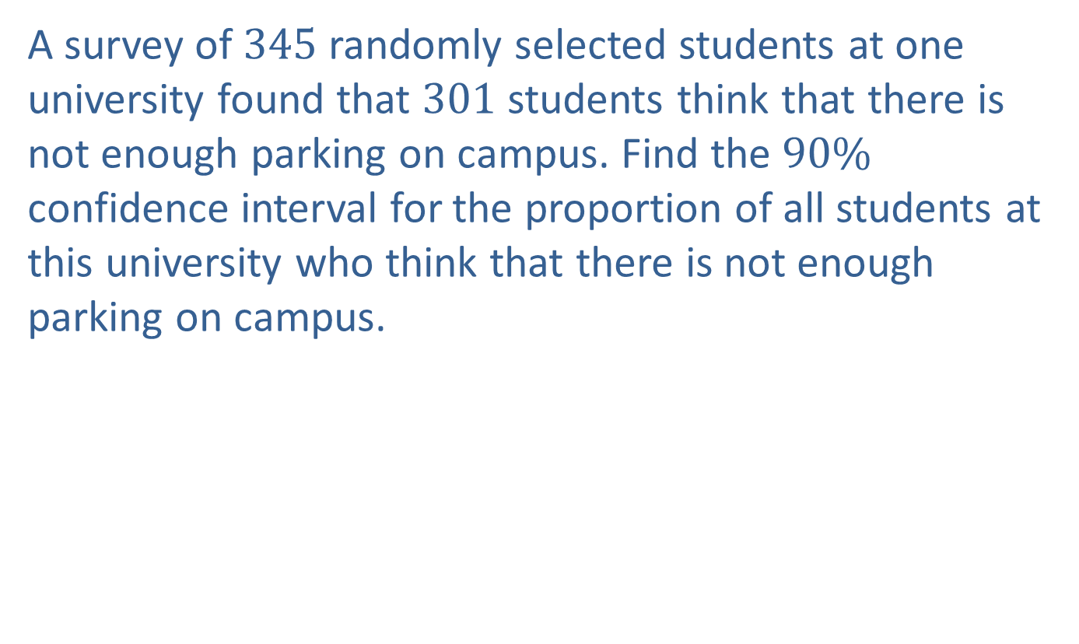
Example 8.4.3: Constructing a Confidence Interval for a Population Proportion
A survey of 345 randomly selected students at one university found that 301 students think that there is not enough parking on campus. Find the $90\%$ confidence interval for the proportion of all students at this university who think that there is not enough parking on campus.

Slide 12
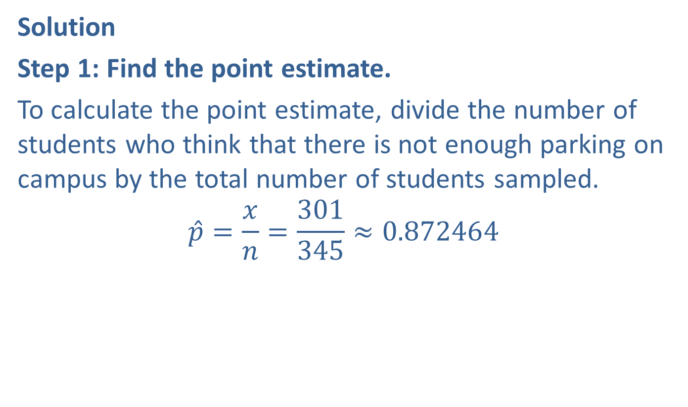
Example 8.4.3: Constructing a Confidence Interval for a Population Proportion (cont.)
Solution
Step 1: Find the point estimate.
To calculate the point estimate, divide the number of students who think that there is not enough parking on campus by the total number of students sampled.
$$\hat{p}=\frac{x}{n}=\frac{301}{345}≈0.872464$$

Slide 13
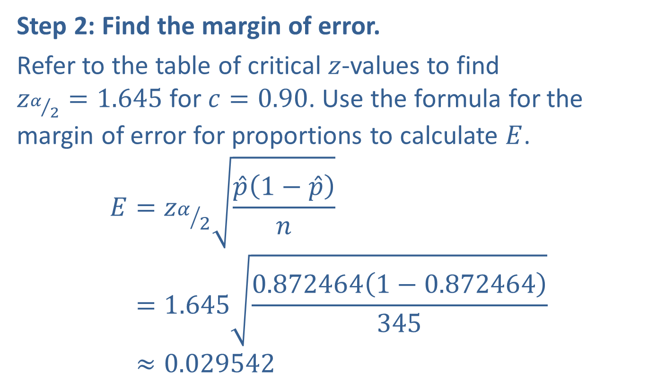
Example 8.4.3: Constructing a Confidence Interval for a Population Proportion (cont.)
Step 2: Find the margin of error.
Refer to the table of critical $z$-values to find
$z_{α/2}=1.645$ for $c=0.90$. Use the formula for the margin of error for proportions to calculate $E$.
𝐸=𝑧𝛼2𝑝1−𝑝𝑛𝐸=1.6450.8724641−0.872464345𝐸≈0.029542

Slide 14
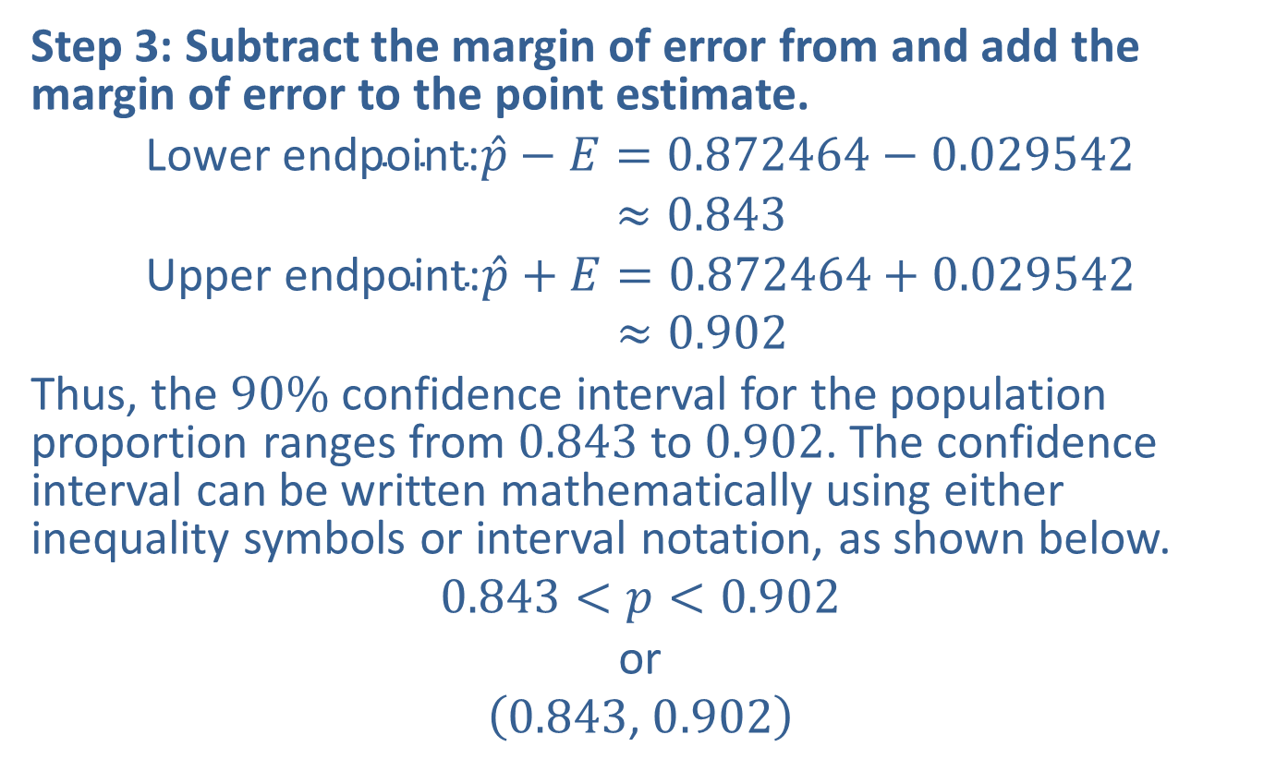
Example 8.4.3: Constructing a Confidence Interval for a Population Proportion (cont.)
Step 3: Subtract the margin of error from and add the margin of error to the point estimate.
Lower endpoint:𝑝−𝐸=0.872464−0.029542Lower endpoint:𝑝−𝐸≈0.843Upper endpoint:𝑝+𝐸=0.872464+0.029542Upper endpoint:𝑝+𝐸≈0.902
Thus, the $90\%$ confidence interval for the population proportion ranges from 0.843 to 0.902. The confidence interval can be written mathematically using either inequality symbols or interval notation, as shown below.
$$0.843<p<0.902$$
or
$$\left(0.843\text{, }0.902\right)$$

Slide 15
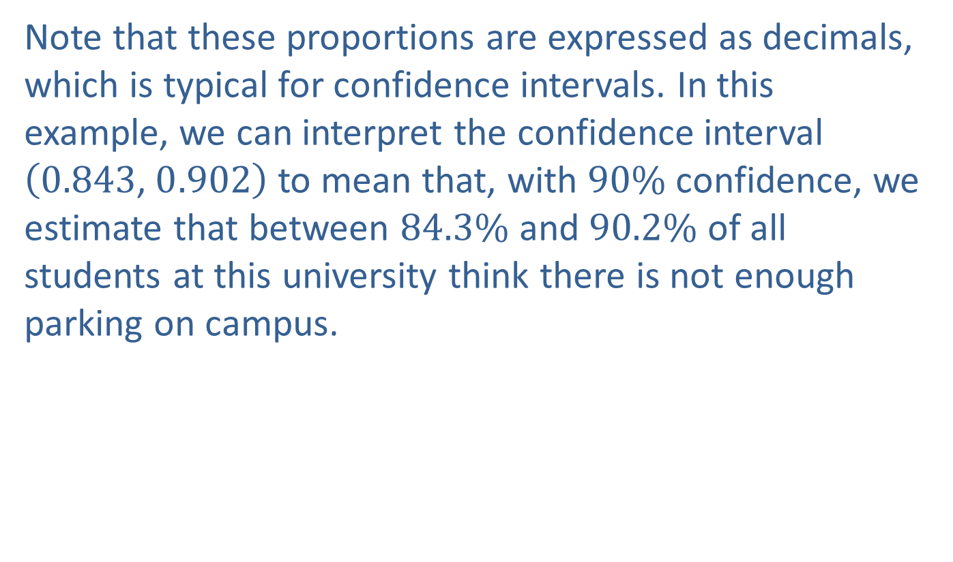
Example 8.4.3: Constructing a Confidence Interval for a Population Proportion (cont.)
Note that these proportions are expressed as decimals, which is typical for confidence intervals. In this example, we can interpret the confidence interval $\left(0.843\text{, }0.902\right)$ to mean that, with $90\%$ confidence, we estimate that between $84.3\%$ and $90.2\%$ of all students at this university think there is not enough parking on campus.

Slide 16
Rounding Rule
When calculations involve several steps, avoid rounding at intermediate calculations. If necessary, round intermediate calculations to at least six decimal places to avoid additional rounding errors in subsequent calculations.

Slide 17
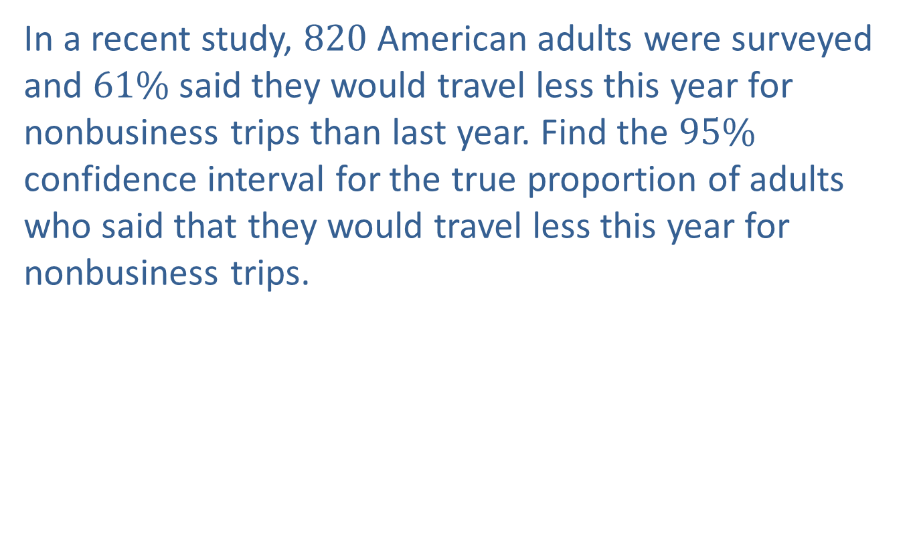
Example 8.4.4: Using a TI-83/84 Plus Calculator to Find a Confidence Interval for a Population Proportion
In a recent study, 820 American adults were surveyed and $61\%$ said they would travel less this year for nonbusiness trips than last year. Find the $95\%$ confidence interval for the true proportion of adults who said that they would travel less this year for nonbusiness trips.

Slide 18
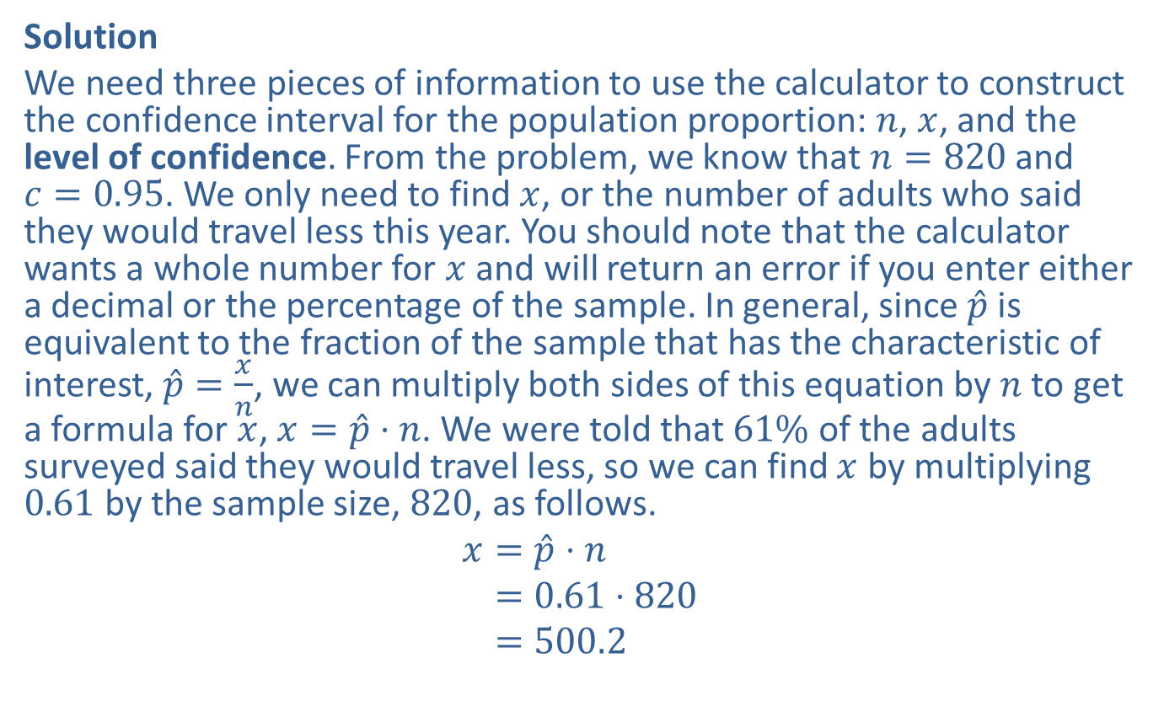
Example 8.4.4: Using a TI-83/84 Plus Calculator to Find a Confidence Interval for a Population Proportion (cont.)
Solution
We need three pieces of information to use the calculator to construct the confidence interval for the population proportion: $n$, $x$, and the level of confidence. From the problem, we know that $n=820$ and $c=0.95$. We only need to find $x$, or the number of adults who said they would travel less this year. You should note that the calculator wants a whole number for $x$ and will return an error if you enter either a decimal or the percentage of the sample. In general, since $\hat{p}$ is equivalent to the fraction of the sample that has the characteristic of interest, $\hat{p}=\frac{x}{n}$, we can multiply both sides of this equation by $n$ to get a formula for $x$, $x=\hat{p}⋅n$. We were told that $61\%$ of the adults surveyed said they would travel less, so we can find $x$ by multiplying 0.61 by the sample size, 820, as follows.
𝑥=𝑝⋅𝑛𝑥=0.61⋅820𝑥=500.2

Slide 19
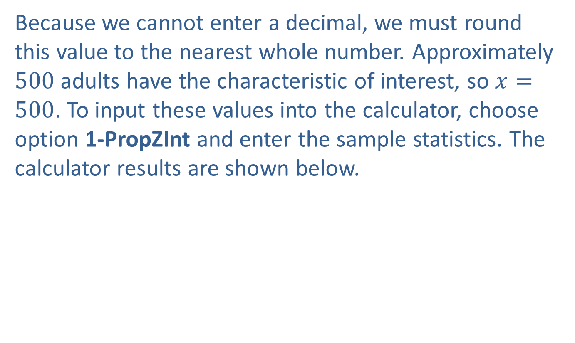
Example 8.4.4: Using a TI-83/84 Plus Calculator to Find a Confidence Interval for a Population Proportion (cont.)
Because we cannot enter a decimal, we must round this value to the nearest whole number. Approximately 500 adults have the characteristic of interest, so $x=500$. To input these values into the calculator, choose option 1-PropZInt and enter the sample statistics. The calculator results are shown below.

Slide 20
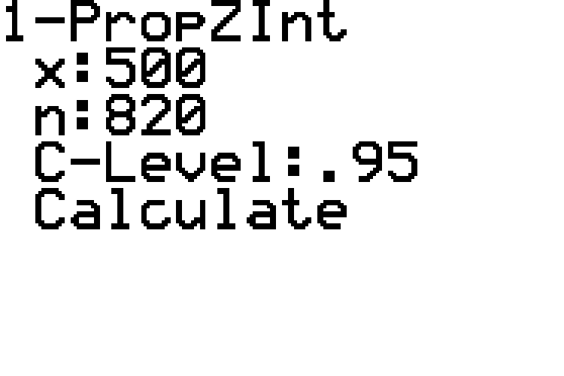
Example 8.4.4: Using a TI-83/84 Plus Calculator to Find a Confidence Interval for a Population Proportion (cont.)

Slide 21
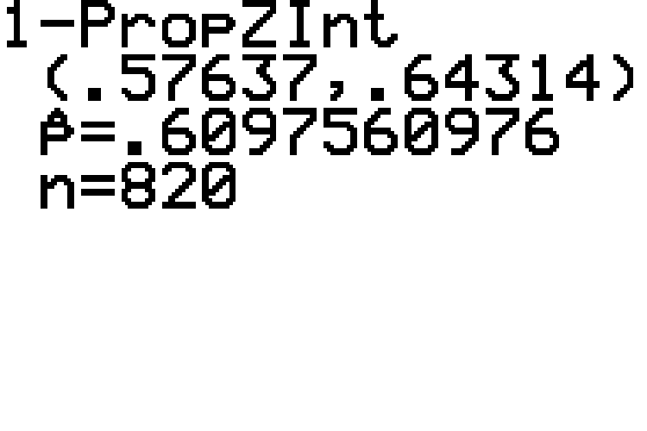
Example 8.4.4: Using a TI-83/84 Plus Calculator to Find a Confidence Interval for a Population Proportion (cont.)

Slide 22
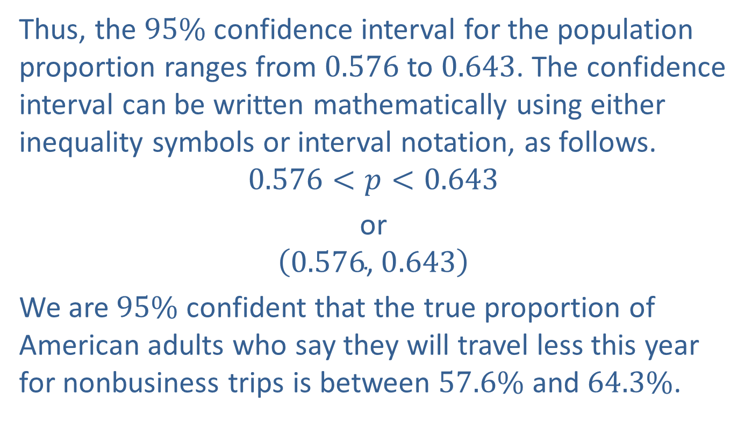
Example 8.4.4: Using a TI-83/84 Plus Calculator to Find a Confidence Interval for a Population Proportion (cont.)
Thus, the $95\%$ confidence interval for the population proportion ranges from 0.576 to 0.643. The confidence interval can be written mathematically using either inequality symbols or interval notation, as follows.
$$0.576<p<0.643$$
or
$$\left(0.576\text{, }0.643\right)$$
We are $95\%$ confident that the true proportion of American adults who say they will travel less this year for nonbusiness trips is between $57.6\%$ and $64.3\%$.

Slide 23
Technology Tip
For further instructions on constructing the confidence interval using a TI-83/84 Plus calculator or other technology, please visit stat.hawkeslearning.com and navigate to Technology Instructions > Confidence Intervals > Proportion.

Slide 24
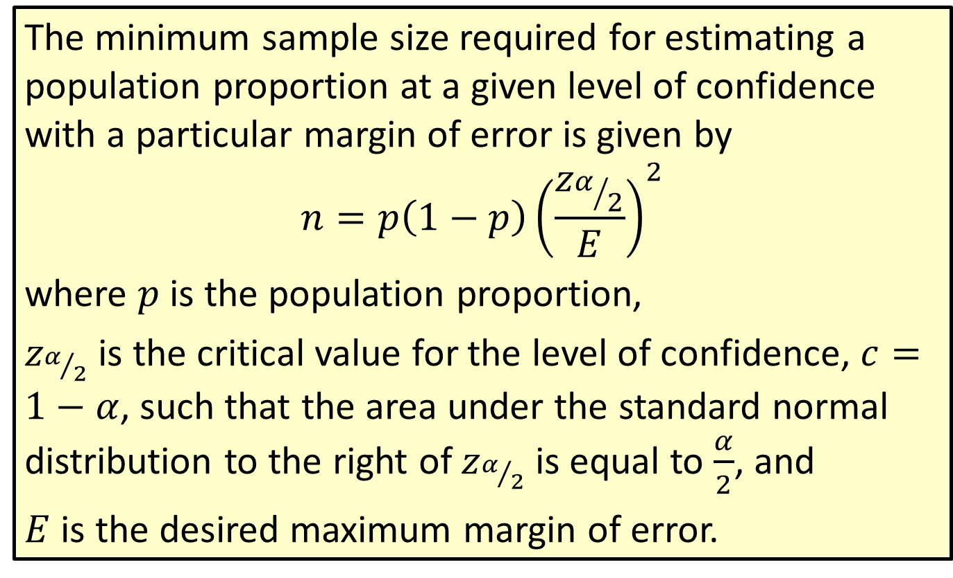
Formula: Minimum Sample Size for Estimating a Population Proportion
The minimum sample size required for estimating a population proportion at a given level of confidence with a particular margin of error is given by
$$n=p\left(1−p\right){\left(\frac{z_{α/2}}{E}\right)}^{2}$$
where $p$ is the population proportion,
$z_{α/2}$ is the critical value for the level of confidence, $c=1−α$, such that the area under the standard normal distribution to the right of $z_{α/2}$ is equal to $\frac{α}{2}$, and
$E$ is the desired maximum margin of error.

Slide 25

Rounding Rule
When calculating $n$, always round up to the next larger whole number.

Slide 26

Example 8.4.5: Finding the Minimum Sample Size Needed for a Confidence Interval for a Population Proportion
What is the minimum sample size needed for a $99\%$ confidence interval for the population proportion if previous studies indicated $p≈0.54$ and we desire no more than a $2\%$ margin of error?

Slide 27
Technology Tip
The TI-83/84 Plus does not directly calculate minimum sample size for a population proportion.

Slide 28
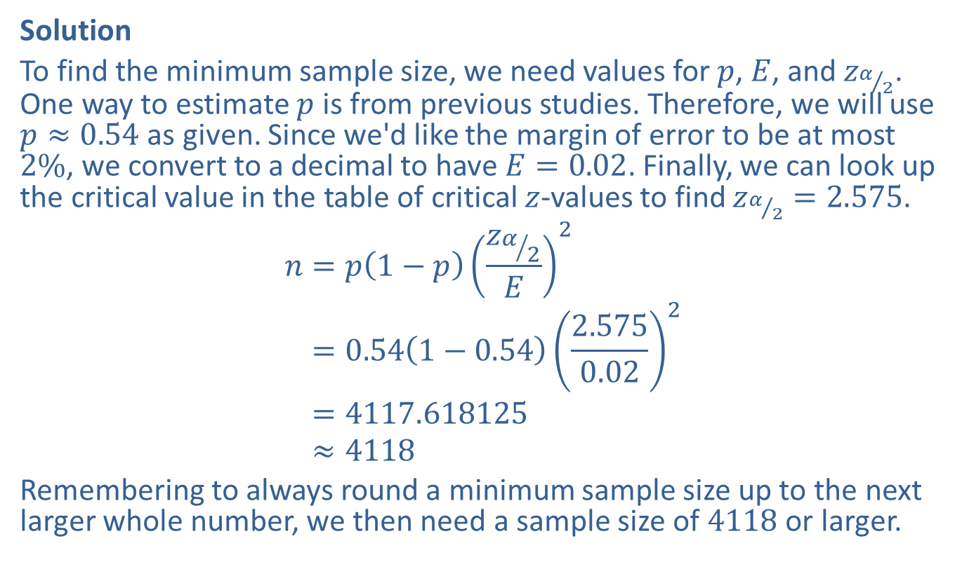
Example 8.4.5: Finding the Minimum Sample Size Needed for a Confidence Interval for a Population Proportion (cont.)
Solution
To find the minimum sample size, we need values for $p$, $E$, and $z_{α/2}$. One way to estimate $p$ is from previous studies. Therefore, we will use $p≈0.54$ as given. Since we'd like the margin of error to be at most $2\%$, we convert to a decimal to have $E=0.02$. Finally, we can look up the critical value in the table of critical $z$-values to find $z_{α/2}=2.575$.
𝑛=𝑝1−𝑝𝑧𝛼2𝐸2𝑛=0.541−0.542.5750.022𝑛=4117.618125𝑛≈4118
Remembering to always round a minimum sample size up to the next larger whole number, we then need a sample size of 4118 or larger.

Slide 29
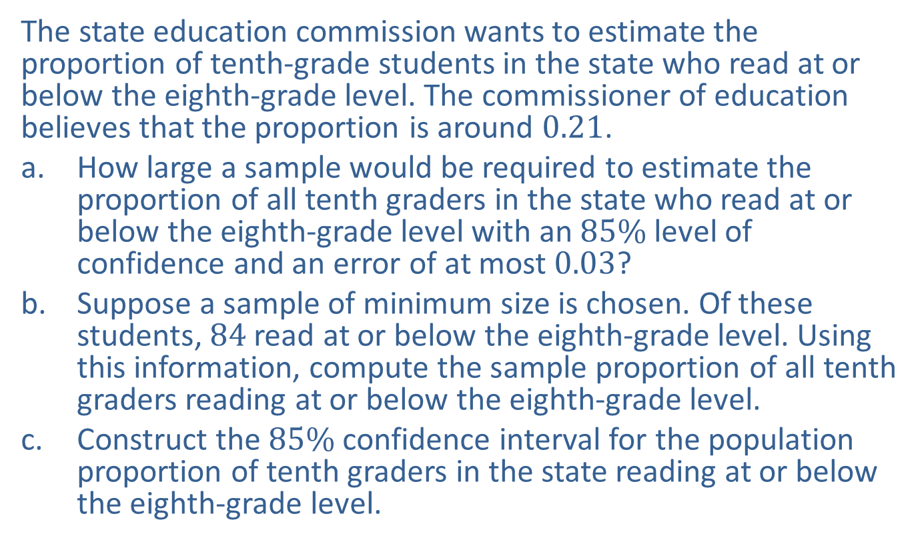
Example 8.4.6: Finding the Minimum Sample Size, Point Estimate, and Confidence Interval for a Population Proportion
The state education commission wants to estimate the proportion of tenth-grade students in the state who read at or below the eighth-grade level. The commissioner of education believes that the proportion is around 0.21.
​How large a sample would be required to estimate the proportion of all tenth graders in the state who read at or below the eighth-grade level with an $85\%$ level of confidence and an error of at most 0.03?
​Suppose a sample of minimum size is chosen. Of these students, 84 read at or below the eighth-grade level. Using this information, compute the sample proportion of all tenth graders reading at or below the eighth-grade level.
​Construct the $85\%$ confidence interval for the population proportion of tenth graders in the state reading at or below the eighth-grade level.

Slide 30
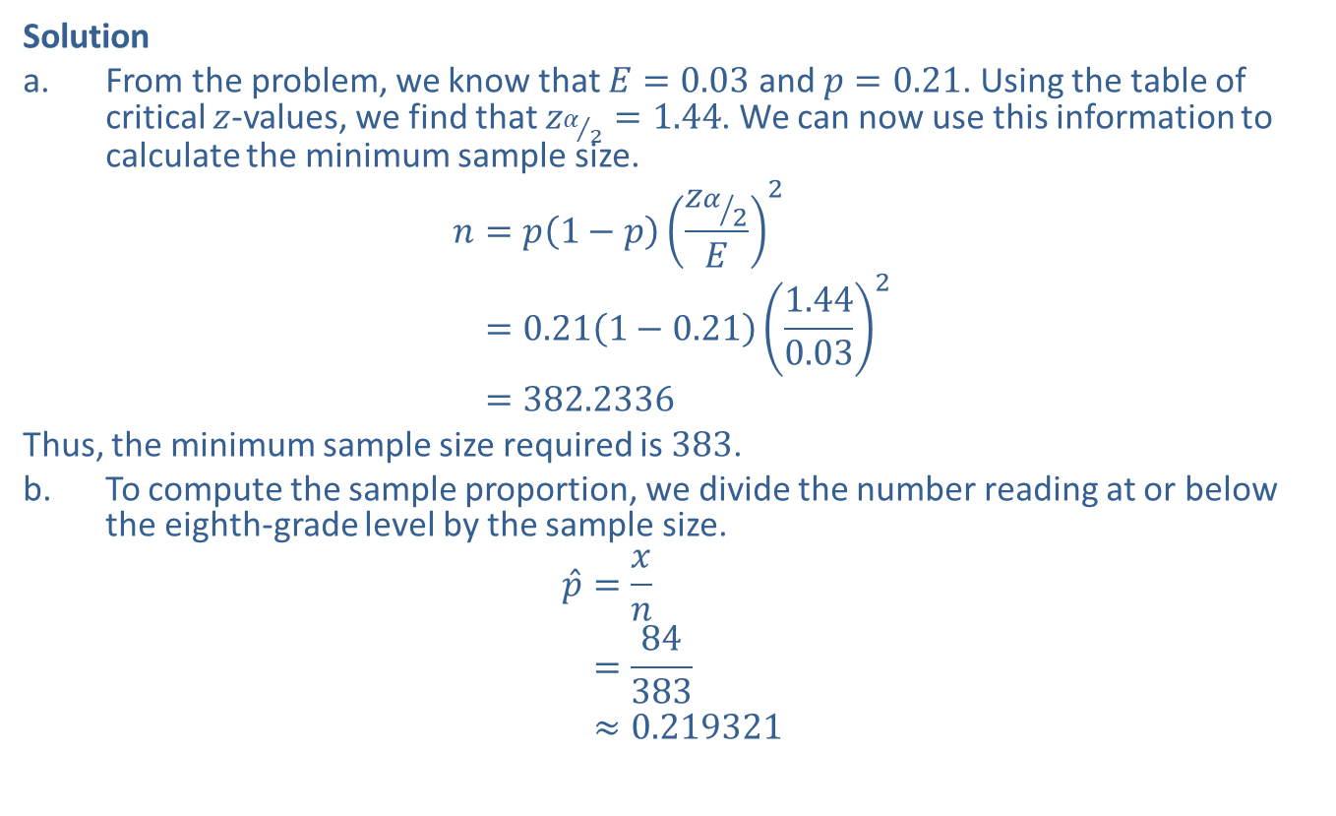
Example 8.4.6: Finding the Minimum Sample Size, Point Estimate, and Confidence Interval for a Population Proportion (cont.)
Solution
​From the problem, we know that $E=0.03$ and $p=0.21$. Using the table of critical $z$-values, we find that $z_{α/2}=1.44$. We can now use this information to calculate the minimum sample size.
𝑛=𝑝1−𝑝𝑧𝛼2𝐸2𝑛=0.211−0.211.440.032𝑛=382.2336
​Thus, the minimum sample size required is 383.
​To compute the sample proportion, we divide the number reading at or below the eighth-grade level by the sample size.
𝑝=𝑥𝑛𝑝=84383𝑝≈0.219321

Slide 31
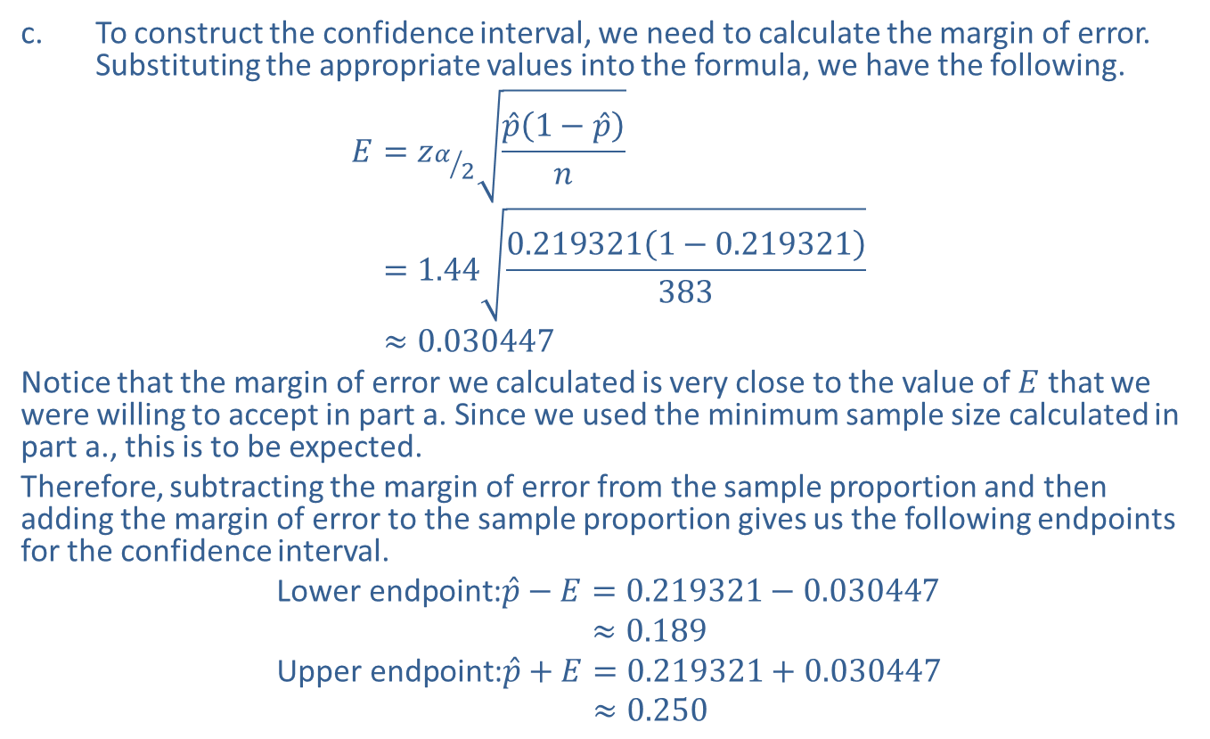
Example 8.4.6: Finding the Minimum Sample Size, Point Estimate, and Confidence Interval for a Population Proportion (cont.)
​To construct the confidence interval, we need to calculate the margin of error. Substituting the appropriate values into the formula, we have the following.
𝐸=𝑧𝛼2𝑝1−𝑝𝑛𝐸=1.440.2193211−0.219321383𝐸≈0.030447
​Notice that the margin of error we calculated is very close to the value of $E$ that we were willing to accept in part a. Since we used the minimum sample size calculated in part a., this is to be expected.
​Therefore, subtracting the margin of error from the sample proportion and then adding the margin of error to the sample proportion gives us the following endpoints for the confidence interval.
Lower endpoint:𝑝−𝐸=0.219321−0.030447Lower endpoint:𝑝−𝐸≈0.189Upper endpoint:𝑝+𝐸=0.219321+0.030447Upper endpoint:𝑝+𝐸≈0.250

Slide 32
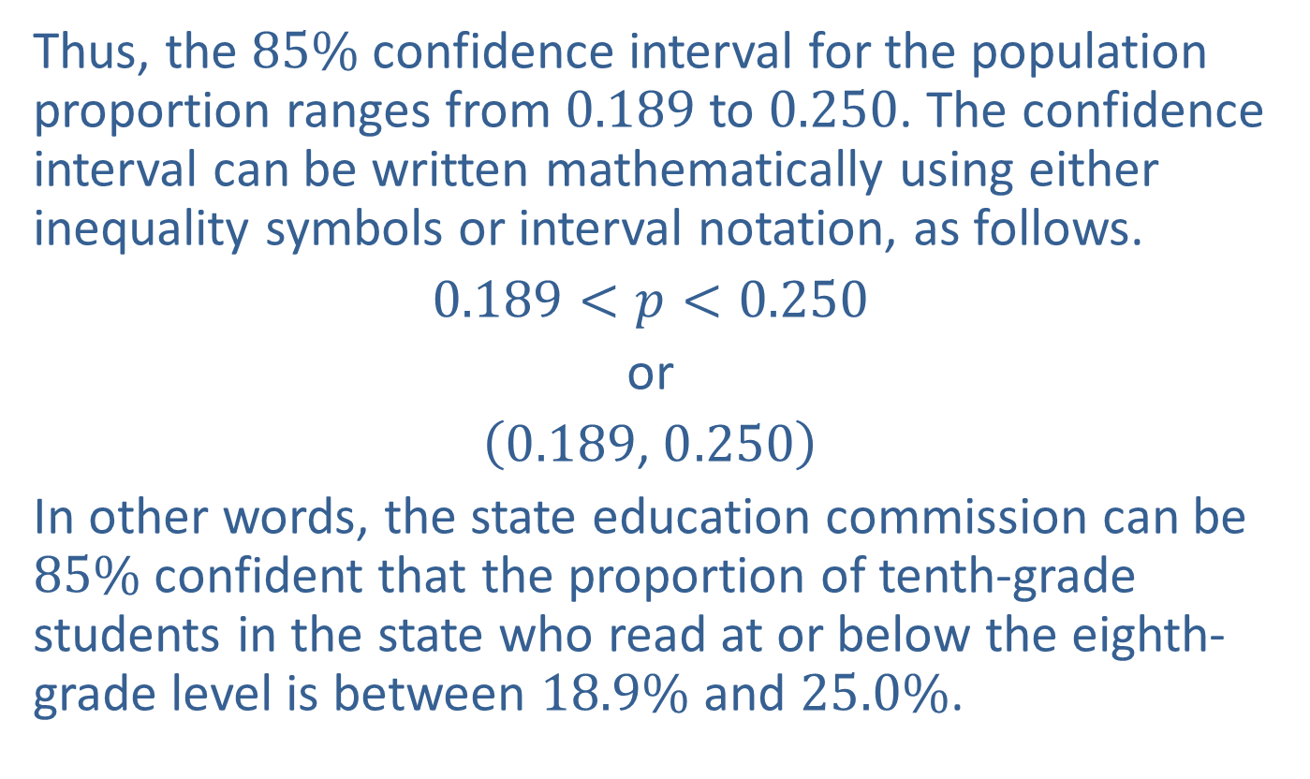
Example 8.4.6: Finding the Minimum Sample Size, Point Estimate, and Confidence Interval for a Population Proportion (cont.)
​Thus, the $85\%$ confidence interval for the population proportion ranges from 0.189 to 0.250. The confidence interval can be written mathematically using either inequality symbols or interval notation, as follows.
​$0.189<p<0.250$
​or
​$\left(0.189\text{, }0.250\right)$
​In other words, the state education commission can be $85\%$ confident that the proportion of tenth-grade students in the state who read at or below the eighth-grade level is between $18.9\%$ and $25.0\%$.

