Slide 1
Section 8.5
Estimating Population Variances

Slide 2
Example 8.5.1: Finding Point Estimates for the Population Standard Deviation and Variance
General Auto is testing the variance in the lengths of its windshield wiper blades. A sample of 12 windshield wiper blades is randomly selected, and the following lengths are measured in inches.
22.1 | 22.0 | 22.1 | 22.4 | 22.3 | 22.5
22.3 | 22.1 | 22.2 | 22.6 | 22.5 | 22.7

Slide 3
Example 8.5.1: Finding Point Estimates for the Population Standard Deviation and Variance (cont.)
​Find a point estimate for the population standard deviation.
​Find a point estimate for the population variance.

Slide 4
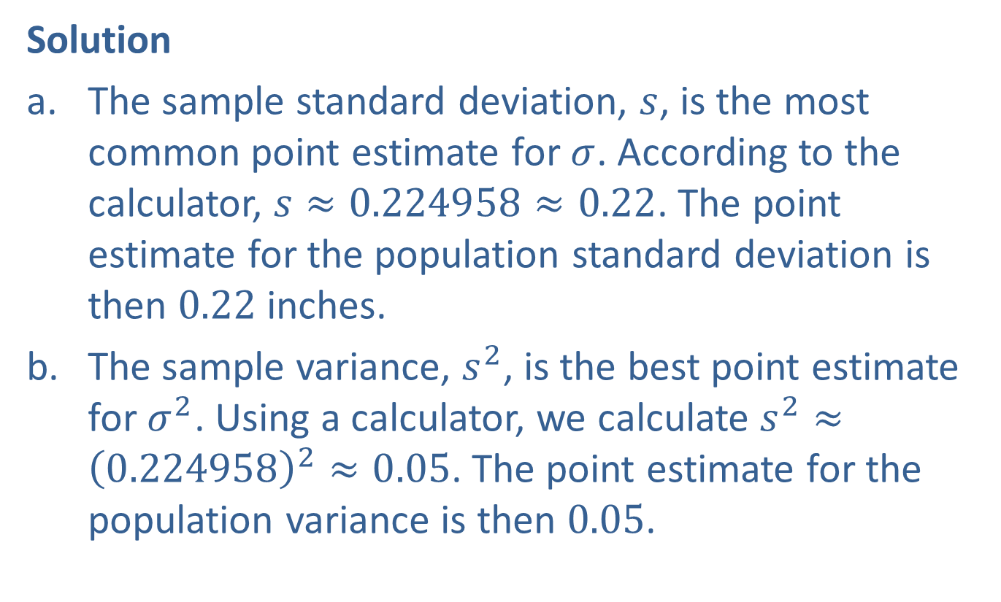
Example 8.5.1: Finding Point Estimates for the Population Standard Deviation and Variance (cont.)
Solution
​The sample standard deviation, $s$, is the most common point estimate for $σ$. According to the calculator, $s≈0.224958≈0.22$. The point estimate for the population standard deviation is then 0.22 inches.
​The sample variance, $s^{2}$, is the best point estimate for $σ^{2}$. Using a calculator, we calculate $s^{2}≈{\left(0.224958\right)}^{2}≈0.05$. The point estimate for the population variance is then 0.05.

Slide 5
Rounding Rule
Recall that standard deviation and variance are rounded to one more decimal place than the largest number of decimal places given in the data.

Slide 6
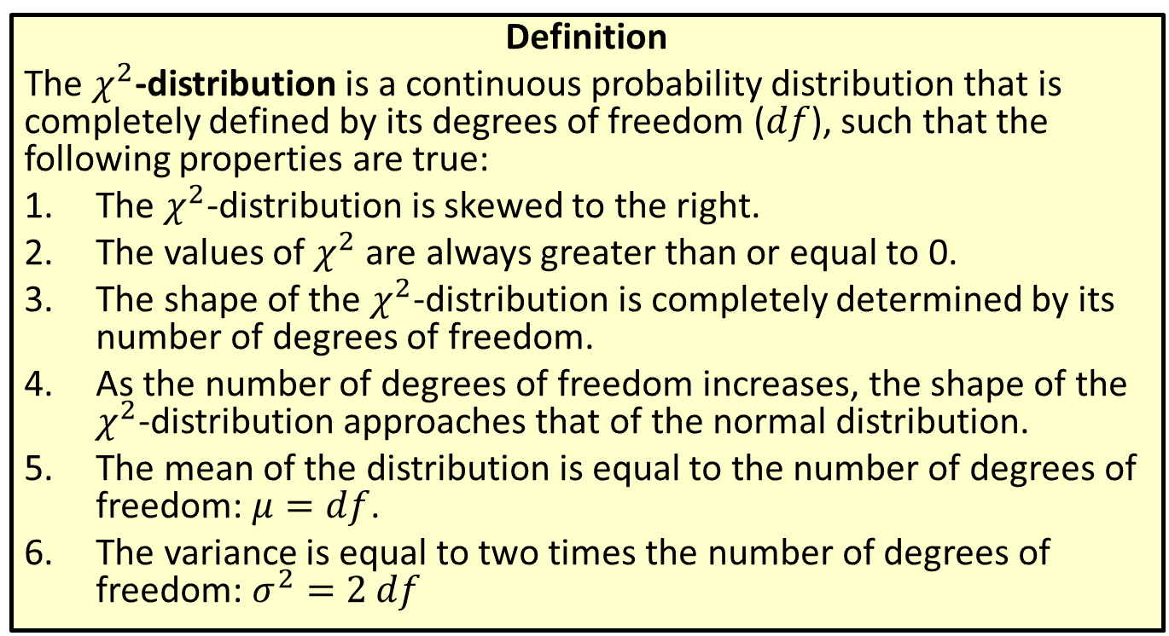

Distribution: $χ^{2}$-distribution
Definition
The $χ^{2}$-distribution is a continuous probability distribution that is completely defined by its degrees of freedom ($df$), such that the following properties are true:
​The $χ^{2}$-distribution is skewed to the right.
​The values of $χ^{2}$ are always greater than or equal to 0.
​The shape of the $χ^{2}$-distribution is completely determined by its number of degrees of freedom.
​As the number of degrees of freedom increases, the shape of the $χ^{2}$-distribution approaches that of the normal distribution.
​The mean of the distribution is equal to the number of degrees of freedom: $μ=df$.
​The variance is equal to two times the number of degrees of freedom: $σ^{2}=2 df$

Slide 7
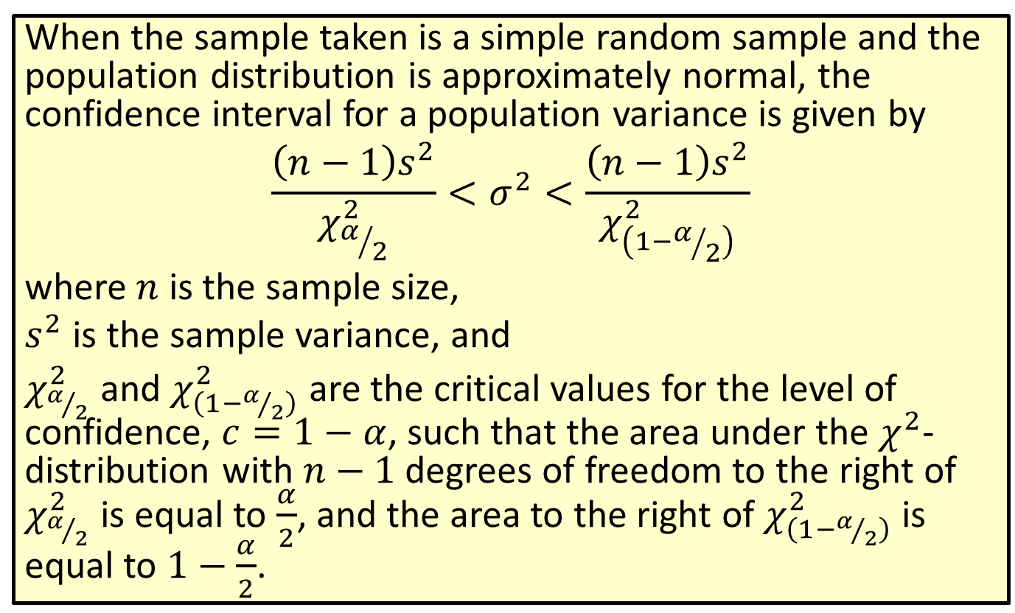
Formula: Confidence Interval for a Population Variance
When the sample taken is a simple random sample and the population distribution is approximately normal, the confidence interval for a population variance is given by
$$\frac{\left(n−1\right)s^{2}}{χ_{α/2}^{2}}<σ^{2}<\frac{\left(n−1\right)s^{2}}{χ_{\left(1−α/2\right)}^{2}}$$
where $n$ is the sample size,
$s^{2}$ is the sample variance, and
$χ_{α/2}^{2}$ and $χ_{\left(1−α/2\right)}^{2}$ are the critical values for the level of confidence, $c=1−α$, such that the area under the $χ^{2}$-distribution with $n−1$ degrees of freedom to the right of $χ_{α/2}^{2}$ is equal to $\frac{α}{2}$, and the area to the right of $χ_{\left(1−α/2\right)}^{2}$ is equal to $1−\frac{α}{2}$.

Slide 8
Rounding Rule
Round the endpoints of a confidence interval for a population variance or standard deviation as follows:
​If sample data are given, round to one more decimal place than the largest number of decimal places in the given data.
​If statistics are given, round to the same number of decimal places as given in the point estimate for the standard deviation or variance.

Slide 9
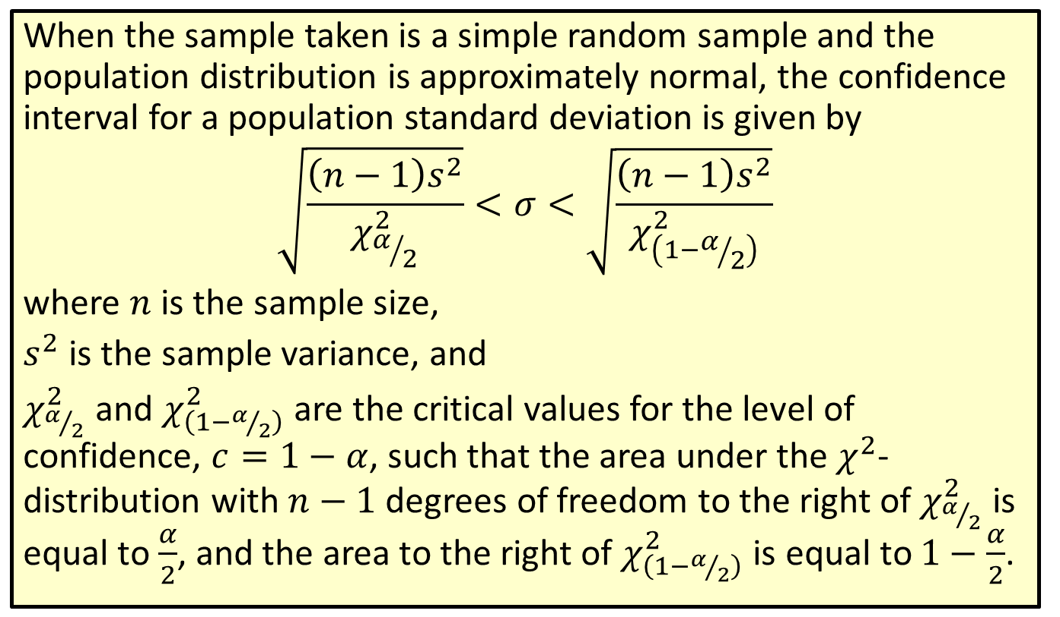
Formula: Confidence Interval for a Population Standard Deviation
When the sample taken is a simple random sample and the population distribution is approximately normal, the confidence interval for a population standard deviation is given by
$$\sqrt{\frac{\left(n−1\right)s^{2}}{χ_{α/2}^{2}}}<σ<\sqrt{\frac{\left(n−1\right)s^{2}}{χ_{\left(1−α/2\right)}^{2}}}$$
where $n$ is the sample size,
$s^{2}$ is the sample variance, and
$χ_{α/2}^{2}$ and $χ_{\left(1−α/2\right)}^{2}$ are the critical values for the level of confidence, $c=1−α$, such that the area under the $χ^{2}$-distribution with $n−1$ degrees of freedom to the right of $χ_{α/2}^{2}$ is equal to $\frac{α}{2}$, and the area to the right of $χ_{\left(1−α/2\right)}^{2}$ is equal to $1−\frac{α}{2}$.

Slide 10
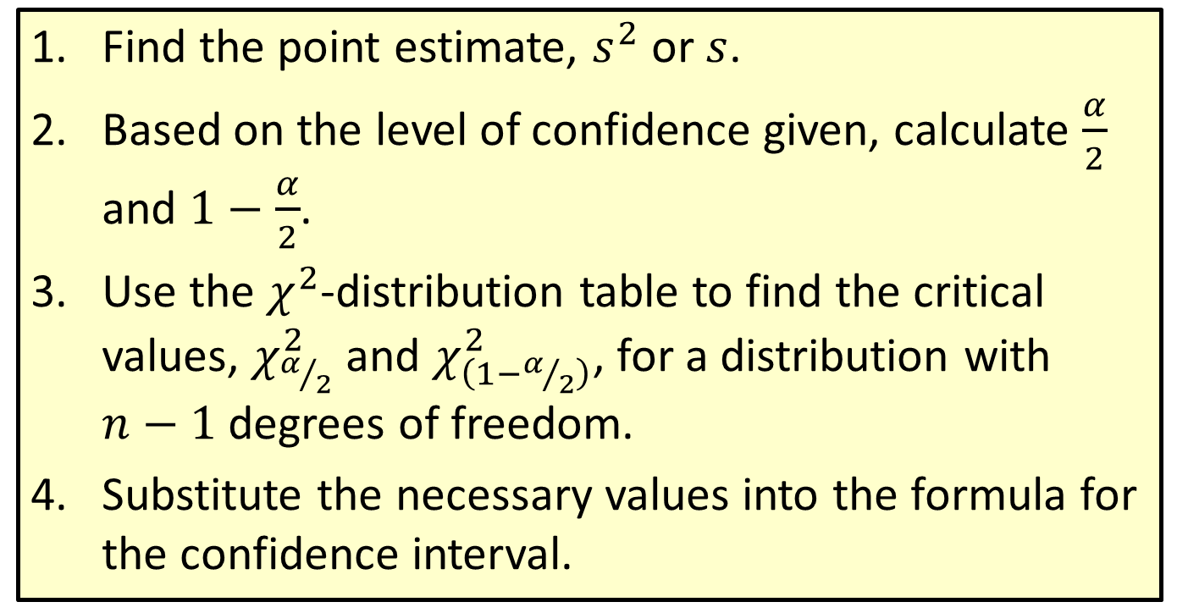
Procedure: Constructing a Confidence Interval for a Population Variance or Standard Deviation
​Find the point estimate, $s^{2}$ or $s$.
​Based on the level of confidence given, calculate $\frac{α}{2}$ and $1−\frac{α}{2}$.
​Use the $χ^{2}$-distribution table to find the critical values, $χ_{α/2}^{2}$ and $χ_{\left(1−α/2\right)}^{2}$, for a distribution with
$n−1$ degrees of freedom.
​Substitute the necessary values into the formula for the confidence interval.

Slide 11
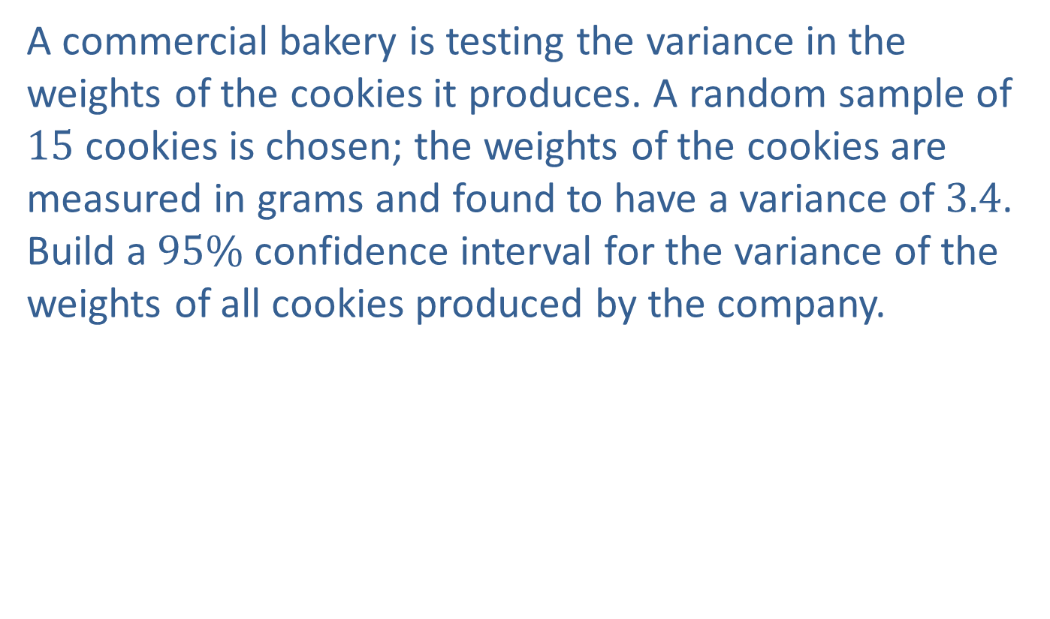
Example 8.5.2: Constructing a Confidence Interval for a Population Variance
A commercial bakery is testing the variance in the weights of the cookies it produces. A random sample of 15 cookies is chosen; the weights of the cookies are measured in grams and found to have a variance of 3.4. Build a $95\%$ confidence interval for the variance of the weights of all cookies produced by the company.

Slide 12

Example 8.5.2: Constructing a Confidence Interval for a Population Variance (cont.)
Solution
Step 1: Find the point estimate, $s^{2}$.
We are given the sample variance in the problem:
$s^{2}=3.4$.

Slide 13
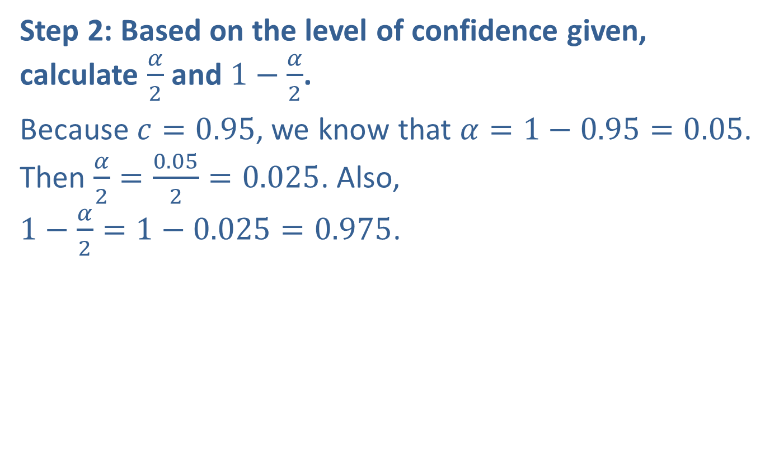
Example 8.5.2: Constructing a Confidence Interval for a Population Variance (cont.)
Step 2: Based on the level of confidence given, calculate $\frac{α}{2}$ and $1−\frac{α}{2}$.
Because $c=0.95$, we know that $α=1−0.95=0.05$. Then $\frac{α}{2}=\frac{0.05}{2}=0.025$. Also,
$1−\frac{α}{2}=1−0.025=0.975$.

Slide 14
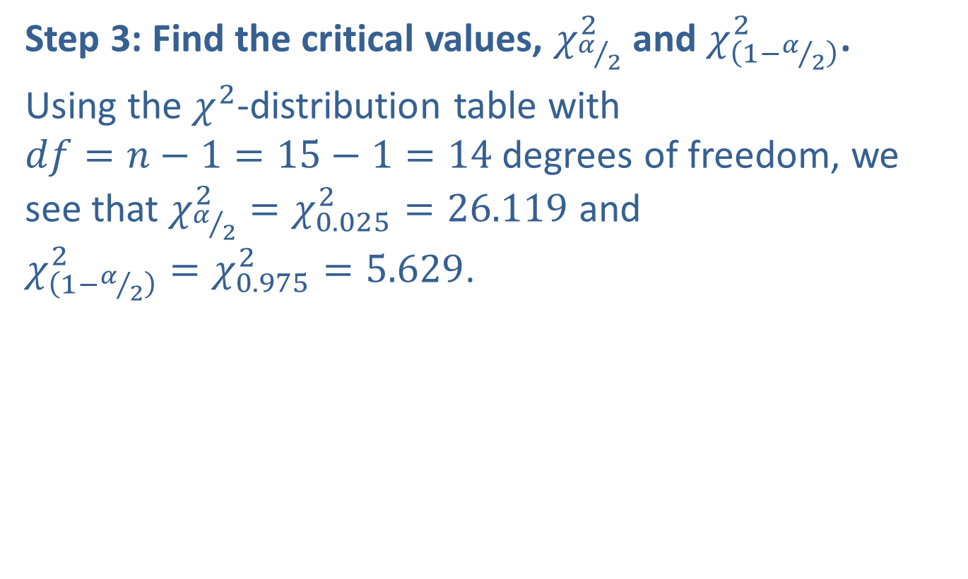
Example 8.5.2: Constructing a Confidence Interval for a Population Variance (cont.)
Step 3: Find the critical values, $χ_{α/2}^{2}$ and $χ_{\left(1−α/2\right)}^{2}$.
Using the $χ^{2}$-distribution table with
$df=n−1=15−1=14$ degrees of freedom, we see that $χ_{α/2}^{2}=χ_{0.025}^{2}=26.119$ and
$χ_{\left(1−α/2\right)}^{2}=χ_{0.975}^{2}=5.629$.

Slide 15
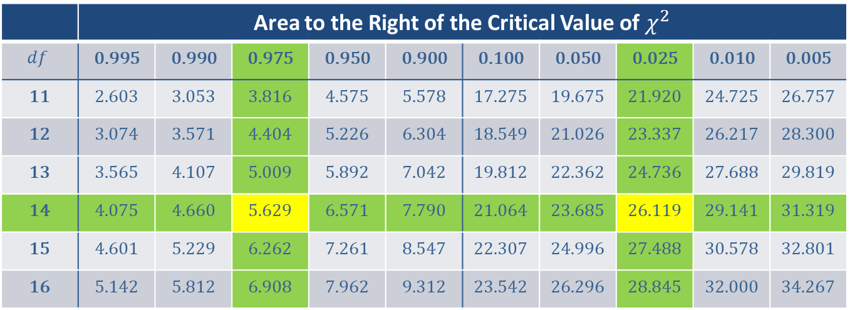
Example 8.5.2: Constructing a Confidence Interval for a Population Variance (cont.)
 | Area to the Right of the Critical Value of $χ^{2}$
$$df$$ | 0.995 | 0.990 | 0.975 | 0.950 | 0.900 | 0.100 | 0.050 | 0.025 | 0.010 | 0.005
11 | 2.603 | 3.053 | 3.816 | 4.575 | 5.578 | 17.275 | 19.675 | 21.920 | 24.725 | 26.757
12 | 3.074 | 3.571 | 4.404 | 5.226 | 6.304 | 18.549 | 21.026 | 23.337 | 26.217 | 28.300
13 | 3.565 | 4.107 | 5.009 | 5.892 | 7.042 | 19.812 | 22.362 | 24.736 | 27.688 | 29.819
14 | 4.075 | 4.660 | 5.629 | 6.571 | 7.790 | 21.064 | 23.685 | 26.119 | 29.141 | 31.319
15 | 4.601 | 5.229 | 6.262 | 7.261 | 8.547 | 22.307 | 24.996 | 27.488 | 30.578 | 32.801
16 | 5.142 | 5.812 | 6.908 | 7.962 | 9.312 | 23.542 | 26.296 | 28.845 | 32.000 | 34.267

Slide 16
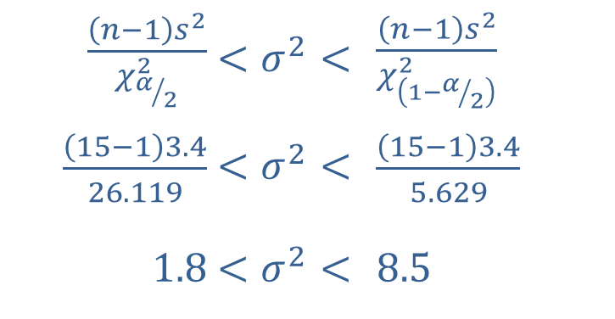
Example 8.5.2: Constructing a Confidence Interval for a Population Variance (cont.)
Step 4: Substitute the necessary values into the formula for the confidence interval.
Substituting into the formula for a confidence interval for a population variance gives us the following.
​
​$\frac{\left(n−1\right)s^{2}}{χ_{α/2}^{2}}$ | ​$<σ^{2}<$ | ​$\frac{\left(n−1\right)s^{2}}{χ_{\left(1−α/2\right)}^{2}}$
​$\frac{\left(15−1\right)3.4}{26.119}$ | ​$<σ^{2}<$ | ​$\frac{\left(15−1\right)3.4}{5.629}$
​$1.8$ | ​$<σ^{2}<$ | ​$8.5$

Slide 17

Example 8.5.2: Constructing a Confidence Interval for a Population Variance (cont.)
​Using interval notation, the confidence interval can also be written as $\left(1.8\text{, }8.5\right)$.
The bakery estimates with $95\%$ confidence that the variance in the weights of their cookies is between 1.8 and 8.5.

Slide 18

Memory Booster
Since the $χ^{2}$-distribution is not symmetric, the left and right critical values must be determined separately.

Slide 19
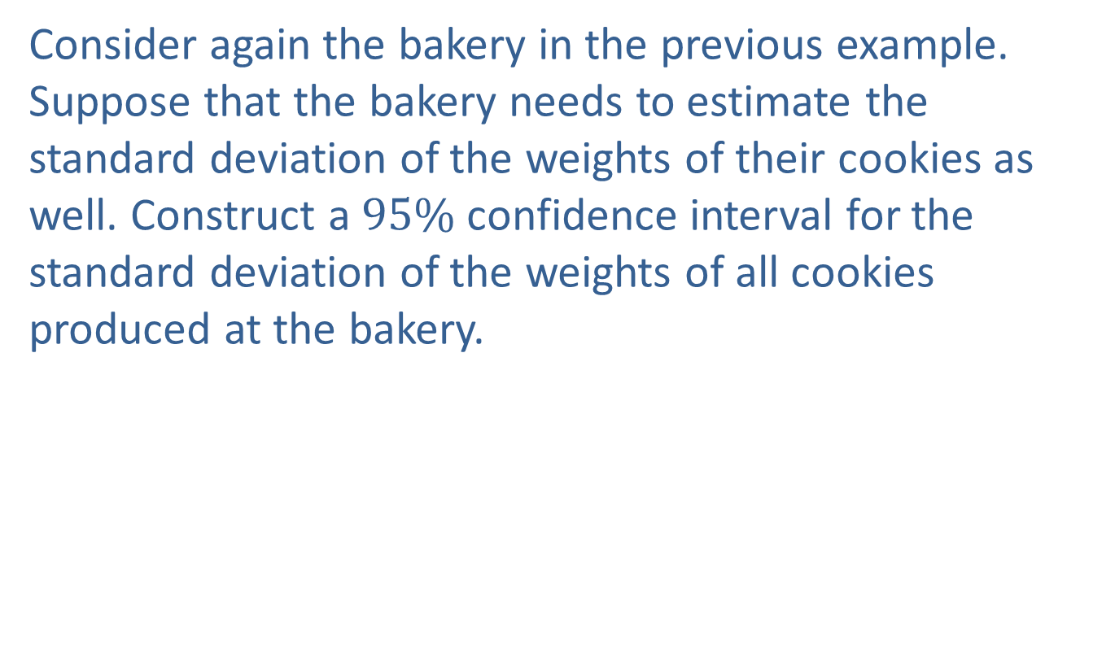
Example 8.5.3: Constructing a Confidence Interval for a Population Standard Deviation
Consider again the bakery in the previous example. Suppose that the bakery needs to estimate the standard deviation of the weights of their cookies as well. Construct a $95\%$ confidence interval for the standard deviation of the weights of all cookies produced at the bakery.

Slide 20
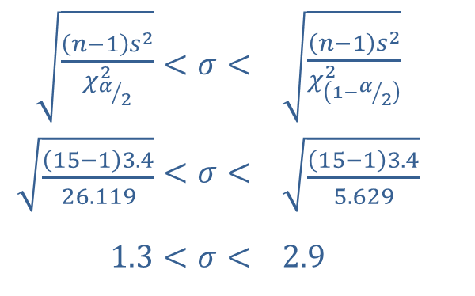
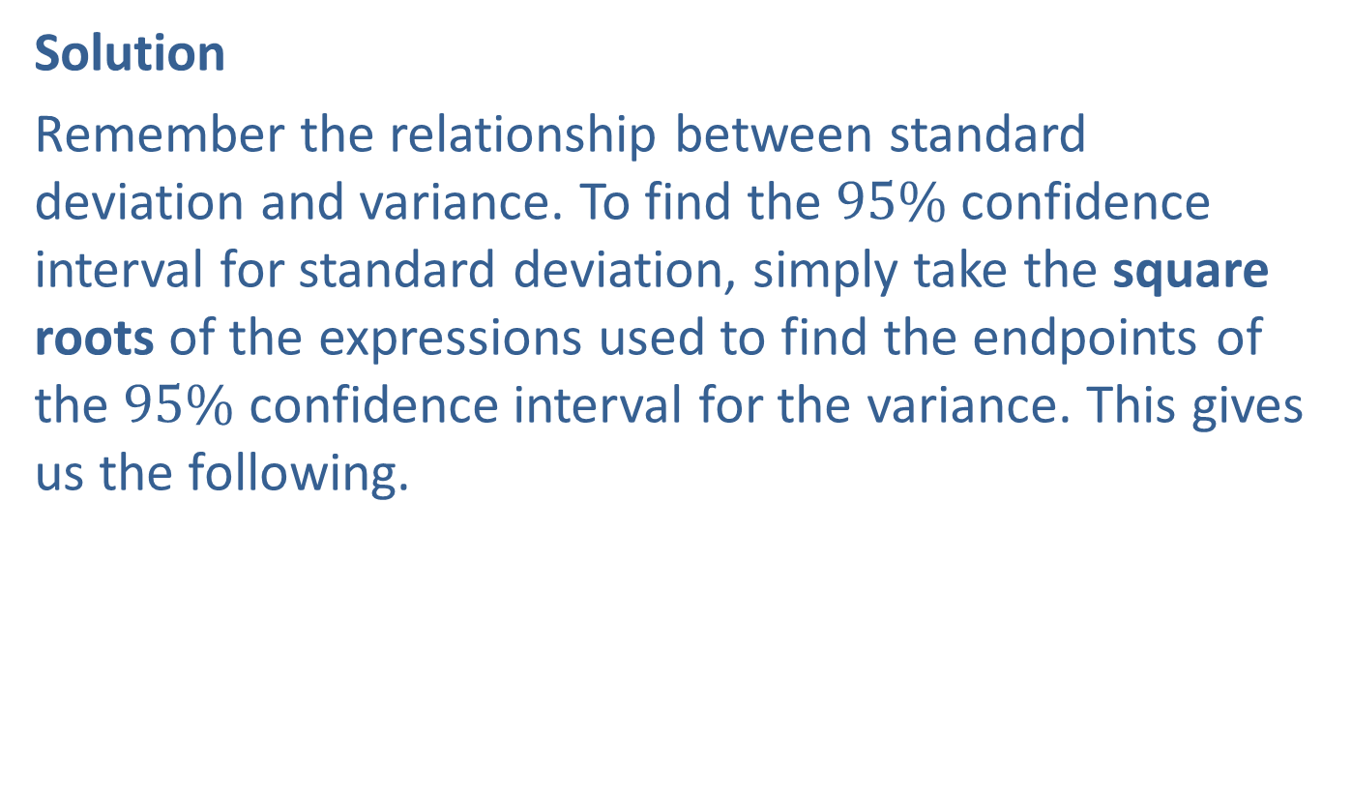
Example 8.5.3: Constructing a Confidence Interval for a Population Standard Deviation (cont.)
Solution
Remember the relationship between standard deviation and variance. To find the $95\%$ confidence interval for standard deviation, simply take the square roots of the expressions used to find the endpoints of the $95\%$ confidence interval for the variance. This gives us the following.
​$\sqrt{\frac{\left(n−1\right)s^{2}}{χ_{α/2}^{2}}}$ | ​$<σ<$ | ​$\sqrt{\frac{\left(n−1\right)s^{2}}{χ_{\left(1−α/2\right)}^{2}}}$
​$\sqrt{\frac{\left(15−1\right)3.4}{26.119}}$ | ​$<σ<$ | ​$\sqrt{\frac{\left(15−1\right)3.4}{5.629}}$
​$1.3$ | ​$<σ<$ | ​$2.9$

Slide 21

Example 8.5.3: Constructing a Confidence Interval for a Population Standard Deviation (cont.)
​Using interval notation, the confidence interval can also be written as $\left(1.3\text{, }2.9\right)$.
The bakery can be $95\%$ confident that the standard deviation of the weights of all cookies produced is between 1.3 and 2.9 grams.

Slide 22
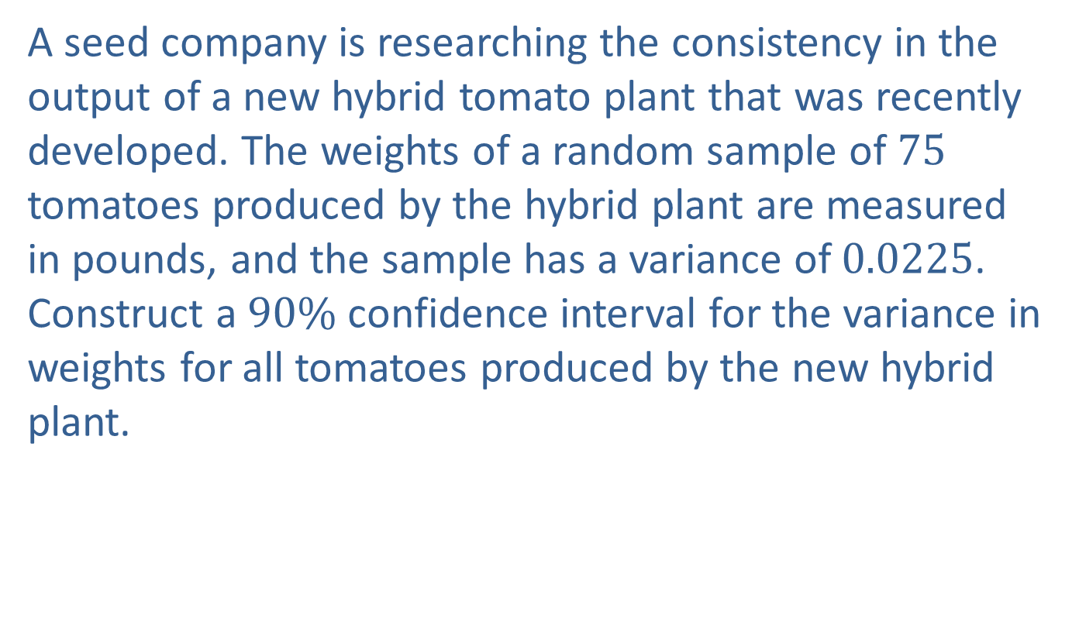
Example 8.5.4: Constructing a Confidence Interval for a Population Variance
A seed company is researching the consistency in the output of a new hybrid tomato plant that was recently developed. The weights of a random sample of 75 tomatoes produced by the hybrid plant are measured in pounds, and the sample has a variance of 0.0225. Construct a $90\%$ confidence interval for the variance in weights for all tomatoes produced by the new hybrid plant.

Slide 23

Example 8.5.4: Constructing a Confidence Interval for a Population Variance (cont.)
Solution
Step 1: Find the point estimate, $s^{2}$.
We are given the sample variance, $s^{2}=0.0225$.

Slide 24

Example 8.5.4: Constructing a Confidence Interval for a Population Variance (cont.)
Step 2: Based on the level of confidence given, calculate $\frac{α}{2}$ and $1−\frac{α}{2}$.
Because $c=0.90$, we know that $α=1−0.90=0.10$. Then $\frac{α}{2}=\frac{0.10}{2}=0.05$. Also, $1−\frac{α}{2}=1−0.05=0.95$.

Slide 25
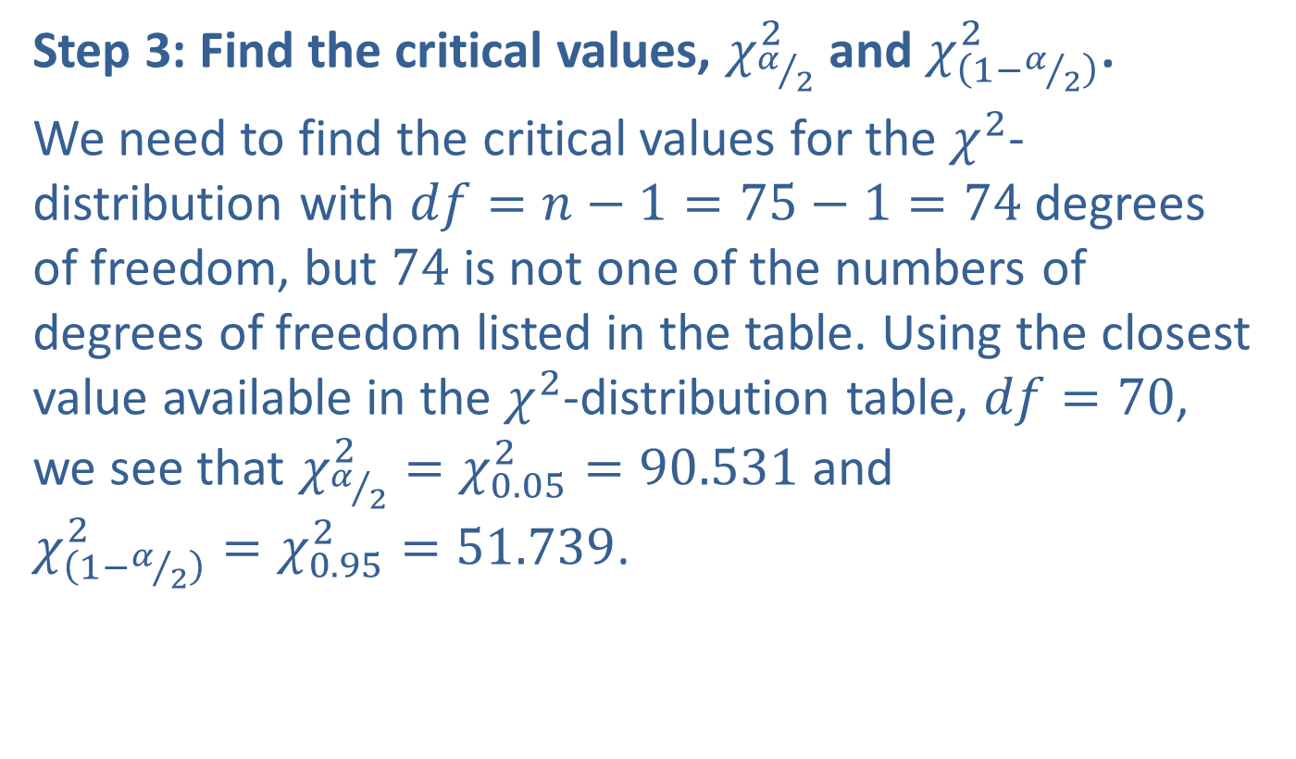
Example 8.5.4: Constructing a Confidence Interval for a Population Variance (cont.)
Step 3: Find the critical values, $χ_{α/2}^{2}$ and $χ_{\left(1−α/2\right)}^{2}$.
We need to find the critical values for the $χ^{2}$-distribution with $df=n−1=75−1=74$ degrees of freedom, but 74 is not one of the numbers of degrees of freedom listed in the table. Using the closest value available in the $χ^{2}$-distribution table, $df=70$, we see that $χ_{α/2}^{2}=χ_{0.05}^{2}=90.531$ and
$χ_{\left(1−α/2\right)}^{2}=χ_{0.95}^{2}=51.739$.

Slide 26
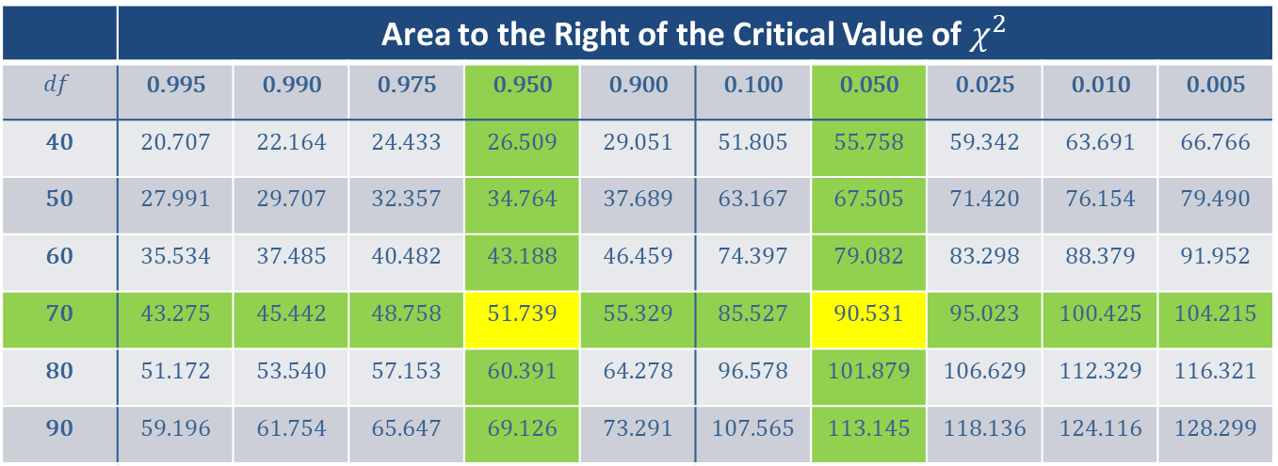
Example 8.5.4: Constructing a Confidence Interval for a Population Variance (cont.)
 | Area to the Right of the Critical Value of $χ^{2}$
$$df$$ | 0.995 | 0.990 | 0.975 | 0.950 | 0.900 | 0.100 | 0.050 | 0.025 | 0.010 | 0.005
40 | 20.707 | 22.164 | 24.433 | 26.509 | 29.051 | 51.805 | 55.758 | 59.342 | 63.691 | 66.766
50 | 27.991 | 29.707 | 32.357 | 34.764 | 37.689 | 63.167 | 67.505 | 71.420 | 76.154 | 79.490
60 | 35.534 | 37.485 | 40.482 | 43.188 | 46.459 | 74.397 | 79.082 | 83.298 | 88.379 | 91.952
70 | 43.275 | 45.442 | 48.758 | 51.739 | 55.329 | 85.527 | 90.531 | 95.023 | 100.425 | 104.215
80 | 51.172 | 53.540 | 57.153 | 60.391 | 64.278 | 96.578 | 101.879 | 106.629 | 112.329 | 116.321
90 | 59.196 | 61.754 | 65.647 | 69.126 | 73.291 | 107.565 | 113.145 | 118.136 | 124.116 | 128.299

Slide 27
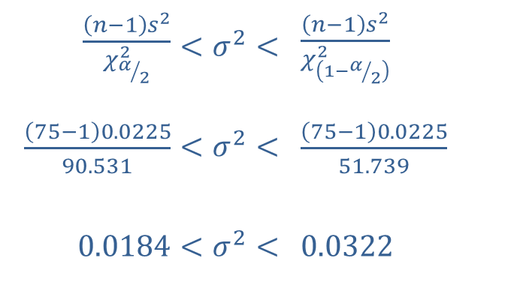
Example 8.5.4: Constructing a Confidence Interval for a Population Variance (cont.)
Step 4: Substitute the necessary values into the formula for the confidence interval.
Substituting into the formula for a confidence interval for a population variance gives us the following.
​
​$\frac{\left(n−1\right)s^{2}}{χ_{α/2}^{2}}$ | ​$<σ^{2}<$ | ​$\frac{\left(n−1\right)s^{2}}{χ_{\left(1−α/2\right)}^{2}}$
​$\frac{\left(75−1\right)0.0225}{90.531}$ | ​$<σ^{2}<$ | ​$\frac{\left(75−1\right)0.0225}{51.739}$
​$0.0184$ | ​$<σ^{2}<$ | ​$0.0322$

Slide 28
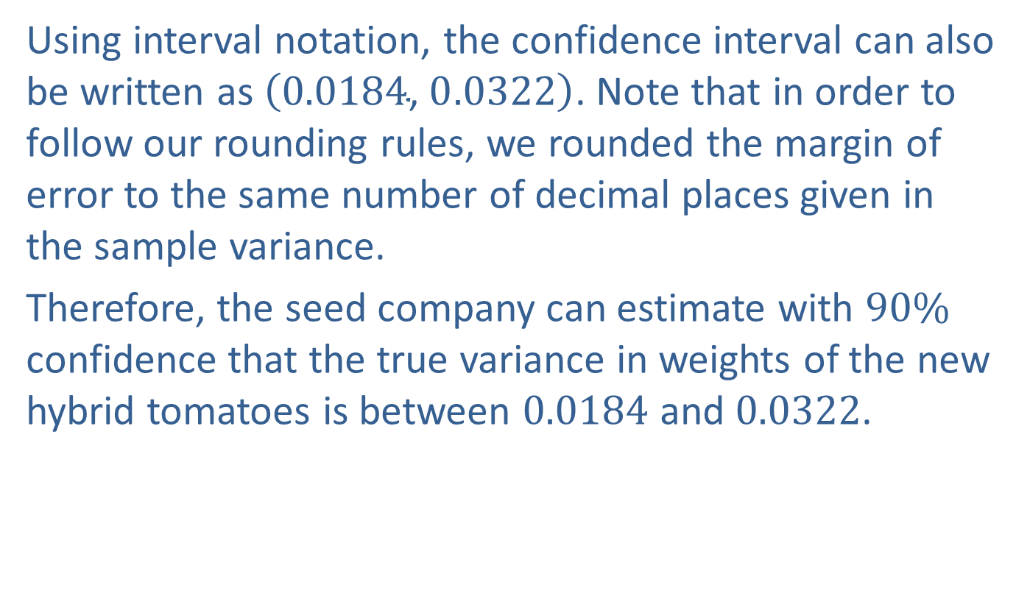
Example 8.5.4: Constructing a Confidence Interval for a Population Variance (cont.)
Using interval notation, the confidence interval can also be written as $\left(0.0184\text{, }0.0322\right)$. Note that in order to follow our rounding rules, we rounded the margin of error to the same number of decimal places given in the sample variance.
Therefore, the seed company can estimate with $90\%$ confidence that the true variance in weights of the new hybrid tomatoes is between 0.0184 and 0.0322.

Slide 29
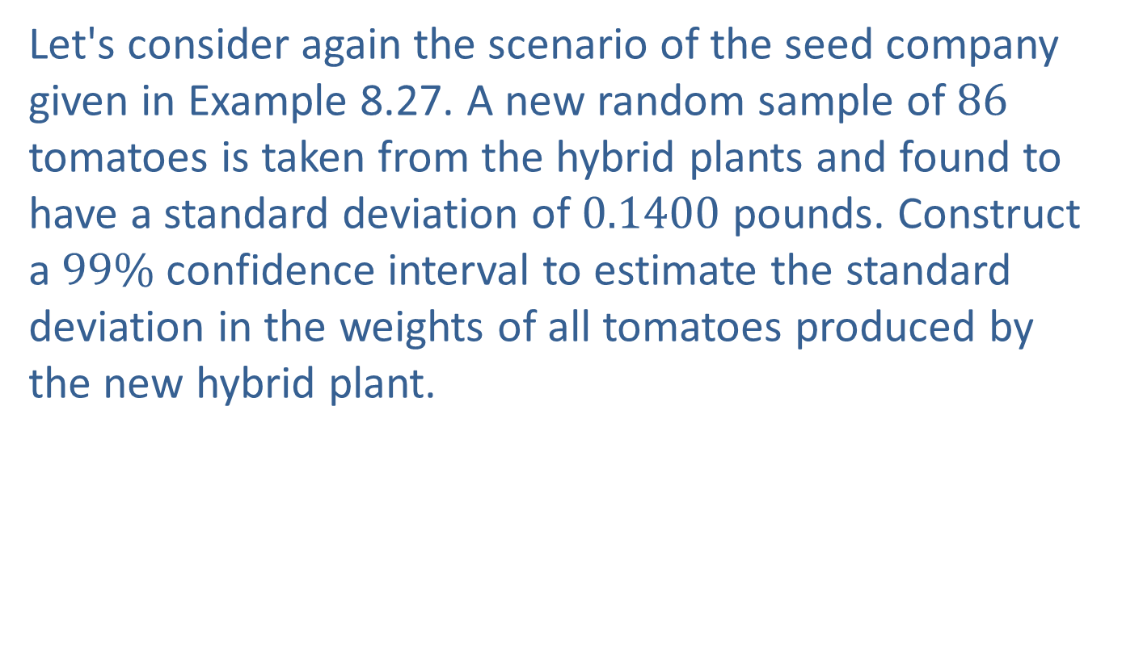
Example 8.5.5: Constructing a Confidence Interval for a Population Standard Deviation
Let's consider again the scenario of the seed company given in Example 8.27. A new random sample of 86 tomatoes is taken from the hybrid plants and found to have a standard deviation of 0.1400 pounds. Construct a $99\%$ confidence interval to estimate the standard deviation in the weights of all tomatoes produced by the new hybrid plant.

Slide 30

Example 8.5.5: Constructing a Confidence Interval for a Population Standard Deviation (cont.)
Solution
Step 1: Find the point estimate, $s$.
We are given the sample standard deviation,
$s=0.1400$.

Slide 31
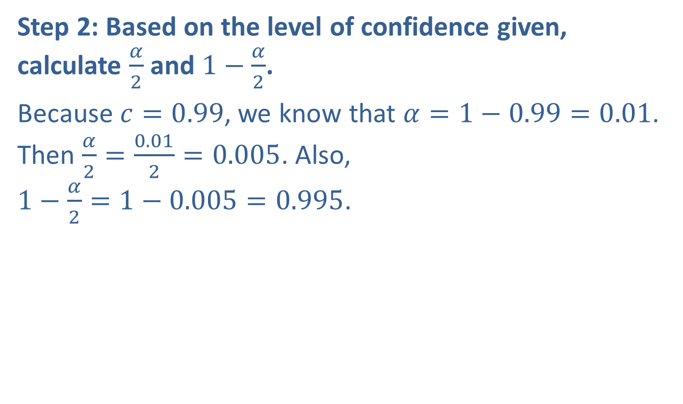
Example 8.5.5: Constructing a Confidence Interval for a Population Standard Deviation (cont.)
Step 2: Based on the level of confidence given, calculate $\frac{α}{2}$ and $1−\frac{α}{2}$.
Because $c=0.99$, we know that $α=1−0.99=0.01$. Then $\frac{α}{2}=\frac{0.01}{2}=0.005$. Also,
$1−\frac{α}{2}=1−0.005=0.995$.

Slide 32
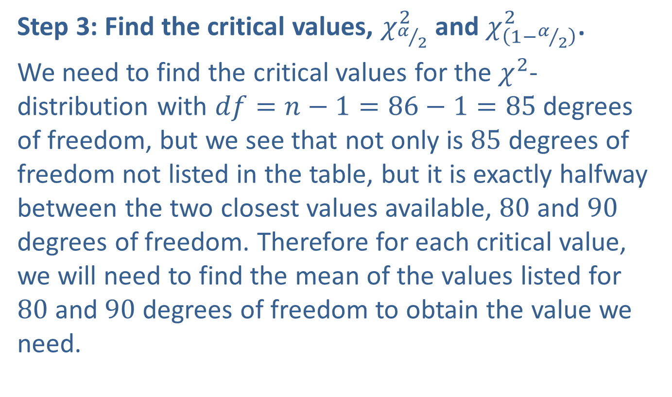
Example 8.5.5: Constructing a Confidence Interval for a Population Standard Deviation (cont.)
Step 3: Find the critical values, $χ_{α/2}^{2}$ and $χ_{\left(1−α/2\right)}^{2}$.
We need to find the critical values for the $χ^{2}$-distribution with $df=n−1=86−1=85$ degrees of freedom, but we see that not only is 85 degrees of freedom not listed in the table, but it is exactly halfway between the two closest values available, 80 and 90 degrees of freedom. Therefore for each critical value, we will need to find the mean of the values listed for 80 and 90 degrees of freedom to obtain the value we need.

Slide 33
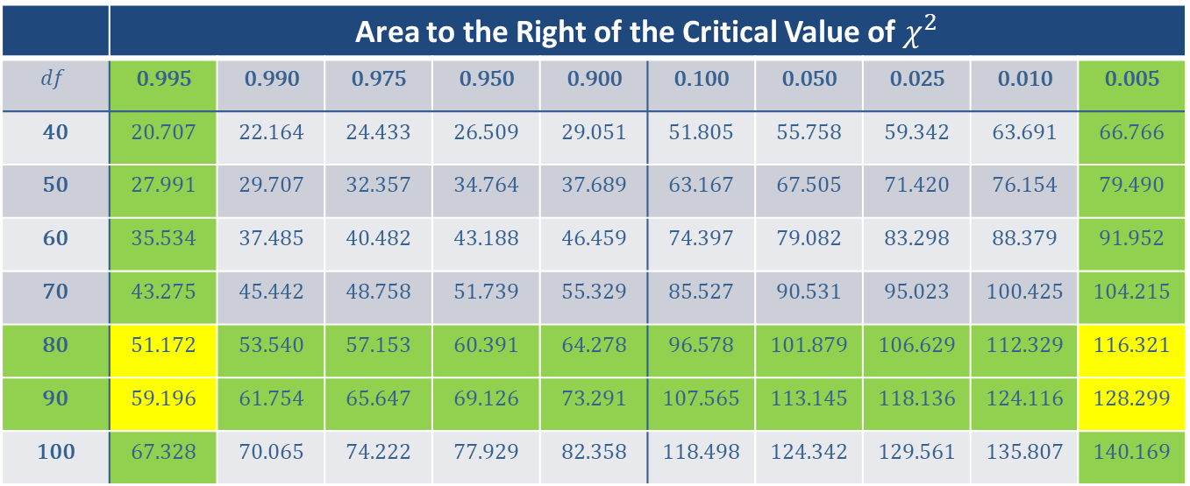
Example 8.5.5: Constructing a Confidence Interval for a Population Standard Deviation (cont.)
 | Area to the Right of the Critical Value of $χ^{2}$
$$df$$ | 0.995 | 0.990 | 0.975 | 0.950 | 0.900 | 0.100 | 0.050 | 0.025 | 0.010 | 0.005
40 | 20.707 | 22.164 | 24.433 | 26.509 | 29.051 | 51.805 | 55.758 | 59.342 | 63.691 | 66.766
50 | 27.991 | 29.707 | 32.357 | 34.764 | 37.689 | 63.167 | 67.505 | 71.420 | 76.154 | 79.490
60 | 35.534 | 37.485 | 40.482 | 43.188 | 46.459 | 74.397 | 79.082 | 83.298 | 88.379 | 91.952
70 | 43.275 | 45.442 | 48.758 | 51.739 | 55.329 | 85.527 | 90.531 | 95.023 | 100.425 | 104.215
80 | 51.172 | 53.540 | 57.153 | 60.391 | 64.278 | 96.578 | 101.879 | 106.629 | 112.329 | 116.321
90 | 59.196 | 61.754 | 65.647 | 69.126 | 73.291 | 107.565 | 113.145 | 118.136 | 124.116 | 128.299
100 | 67.328 | 70.065 | 74.222 | 77.929 | 82.358 | 118.498 | 124.342 | 129.561 | 135.807 | 140.169

Slide 34
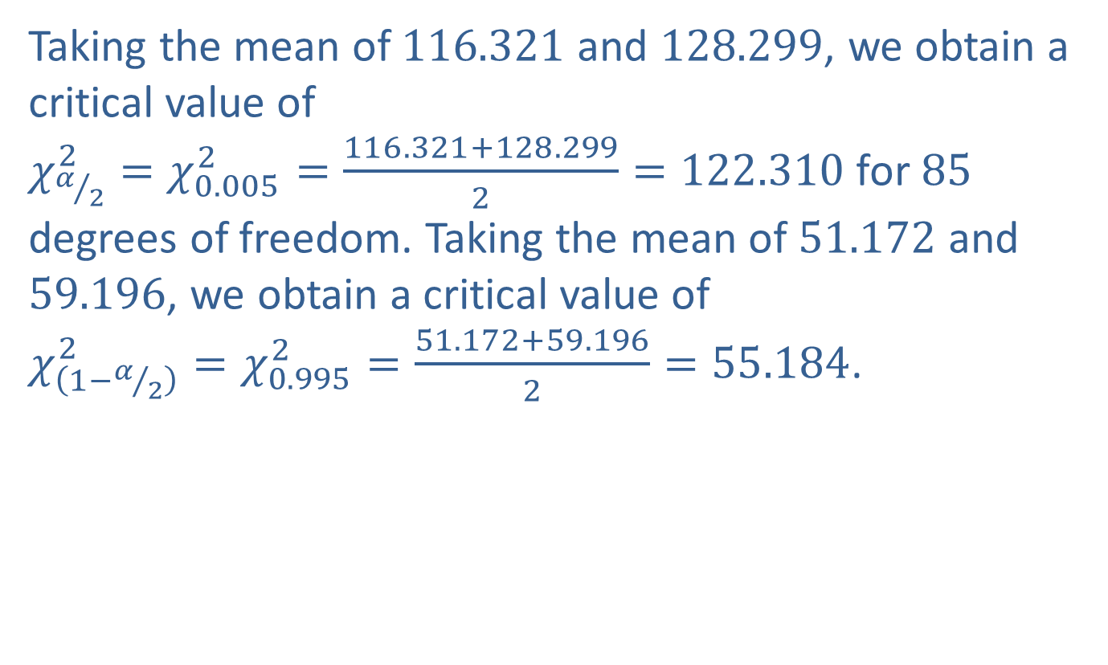
Example 8.5.5: Constructing a Confidence Interval for a Population Standard Deviation (cont.)
Taking the mean of 116.321 and 128.299, we obtain a critical value of
$χ_{α/2}^{2}=χ_{0.005}^{2}=\frac{116.321+128.299}{2}=122.310$ for 85 degrees of freedom. Taking the mean of 51.172 and 59.196, we obtain a critical value of
$χ_{\left(1−α/2\right)}^{2}=χ_{0.995}^{2}=\frac{51.172+59.196}{2}=55.184$.

Slide 35
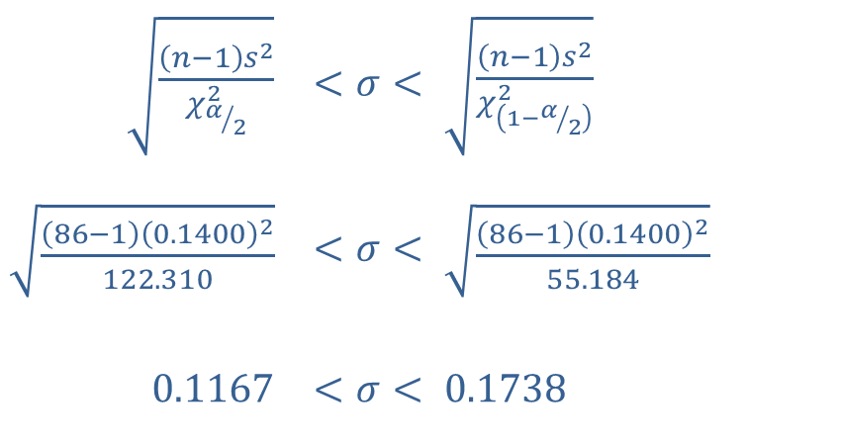
Example 8.5.5: Constructing a Confidence Interval for a Population Standard Deviation (cont.)
Step 4: Substitute the necessary values into the formula for the confidence interval.
Substituting into the formula for a confidence interval for a population standard deviation gives us the following.
​
​$\sqrt{\frac{\left(n−1\right)s^{2}}{χ_{α/2}^{2}}}$ | ​$<σ<$ | ​$\sqrt{\frac{\left(n−1\right)s^{2}}{χ_{\left(1−α/2\right)}^{2}}}$
​$\sqrt{\frac{\left(86−1\right){\left(0.1400\right)}^{2}}{122.310}}$ | ​$<σ<$ | ​$\sqrt{\frac{\left(86−1\right){\left(0.1400\right)}^{2}}{55.184}}$
​$0.1167$ | ​$<σ<$ | ​$0.1738$

Slide 36
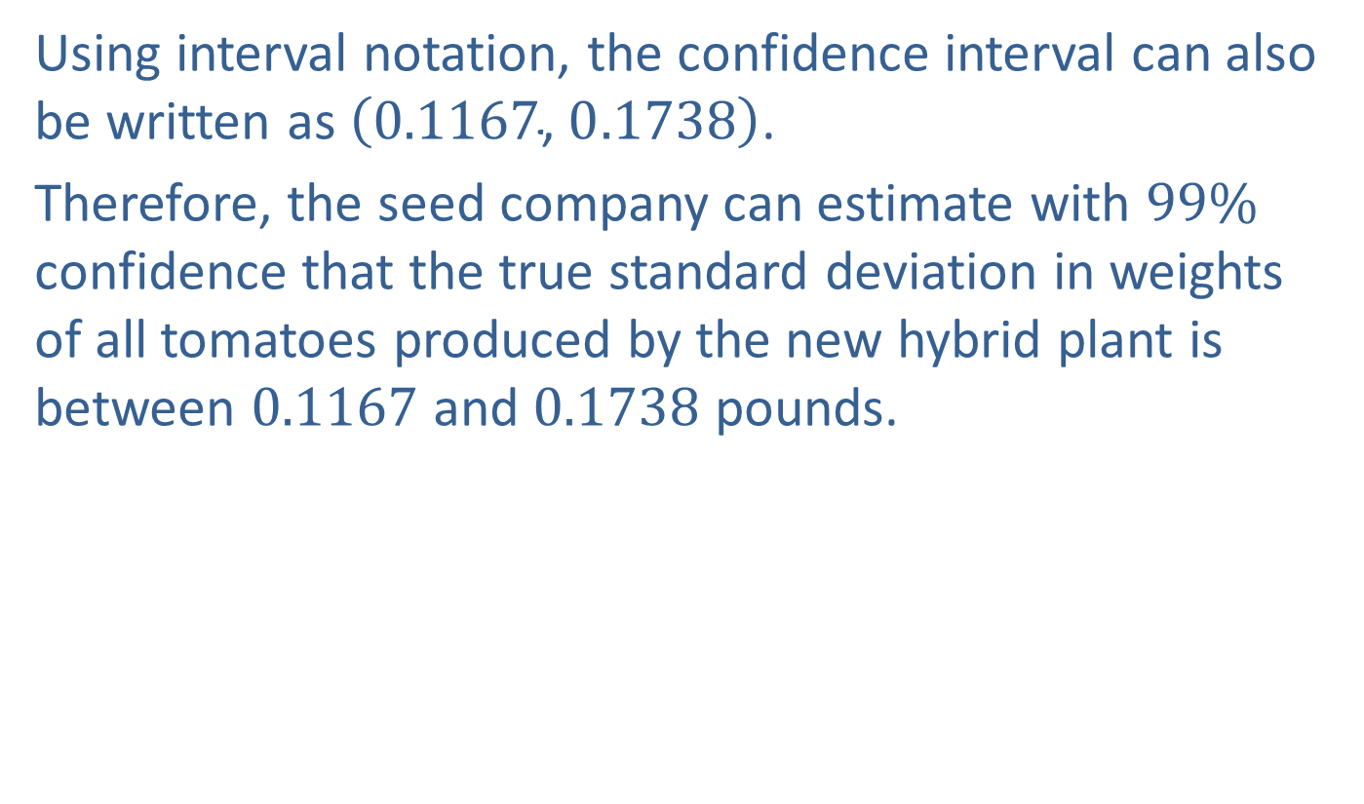
Example 8.5.5: Constructing a Confidence Interval for a Population Standard Deviation (cont.)
Using interval notation, the confidence interval can also be written as $\left(0.1167\text{, }0.1738\right)$.
Therefore, the seed company can estimate with $99\%$ confidence that the true standard deviation in weights of all tomatoes produced by the new hybrid plant is between 0.1167 and 0.1738 pounds.

Slide 37
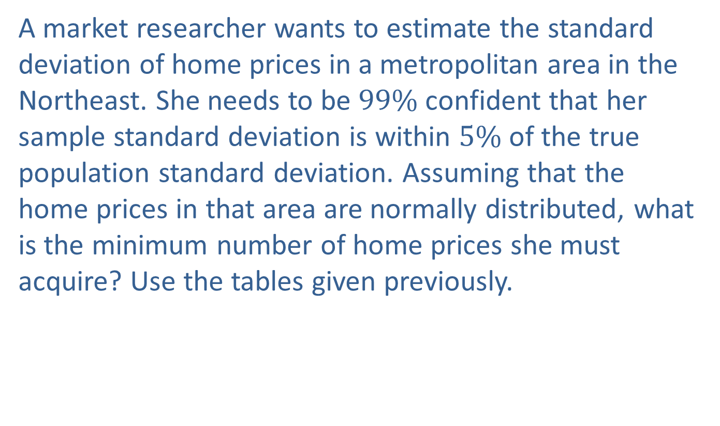
Example 8.5.6: Finding the Minimum Sample Size Needed for a Confidence Interval for a Population Standard Deviation
A market researcher wants to estimate the standard deviation of home prices in a metropolitan area in the Northeast. She needs to be $99\%$ confident that her sample standard deviation is within $5\%$ of the true population standard deviation. Assuming that the home prices in that area are normally distributed, what is the minimum number of home prices she must acquire? Use the tables given previously.

Slide 38

Example 8.5.6: Finding the Minimum Sample Size Needed for a Confidence Interval for a Population Standard Deviation (cont.)
Solution
According to the table, we see that to be $99\%$ confident that the sample standard deviation will be within $5\%$ of the true population standard deviation, the minimum sample size required is 1337.

Slide 39
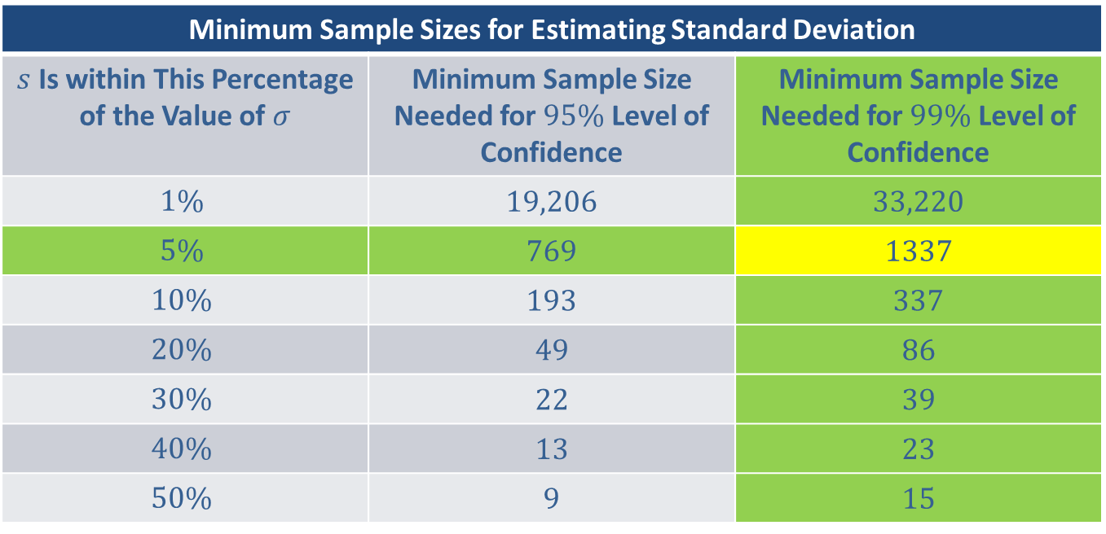
Example 8.5.6: Finding the Minimum Sample Size Needed for a Confidence Interval for a Population Standard Deviation (cont.)
Minimum Sample Sizes for Estimating Standard Deviation
$s$ Is within This Percentage of the Value of $σ$ | Minimum Sample Size Needed for $95\%$ Level of Confidence | Minimum Sample Size Needed for $99\%$ Level of Confidence
$$1\%$$ | 19,206 | 33,220
$$5\%$$ | 769 | 1337
$$10\%$$ | 193 | 337
$$20\%$$ | 49 | 86
$$30\%$$ | 22 | 39
$$40\%$$ | 13 | 23
$$50\%$$ | 9 | 15

Slide 40
Example 8.5.6: Finding the Minimum Sample Size Needed for a Confidence Interval for a Population Standard Deviation (cont.)
Therefore, the market researcher must include at least 1337 home prices for her study to have the level of precision that she needs.

