Slide 1
Section 9.1
Comparing Two Population Means (Sigma Known, Independent Samples)

Slide 2
Independent & Dependent
Definition
Two samples are independent if the data from the first sample are not connected to the data from the second sample.
Two samples are dependent if the data from both samples are systematically connected, or paired.

Slide 3

Memory Booster:
The best point estimate for the difference between two population means is ${\overline{x}}_{1}−{\overline{x}}_{2}$.

Slide 4
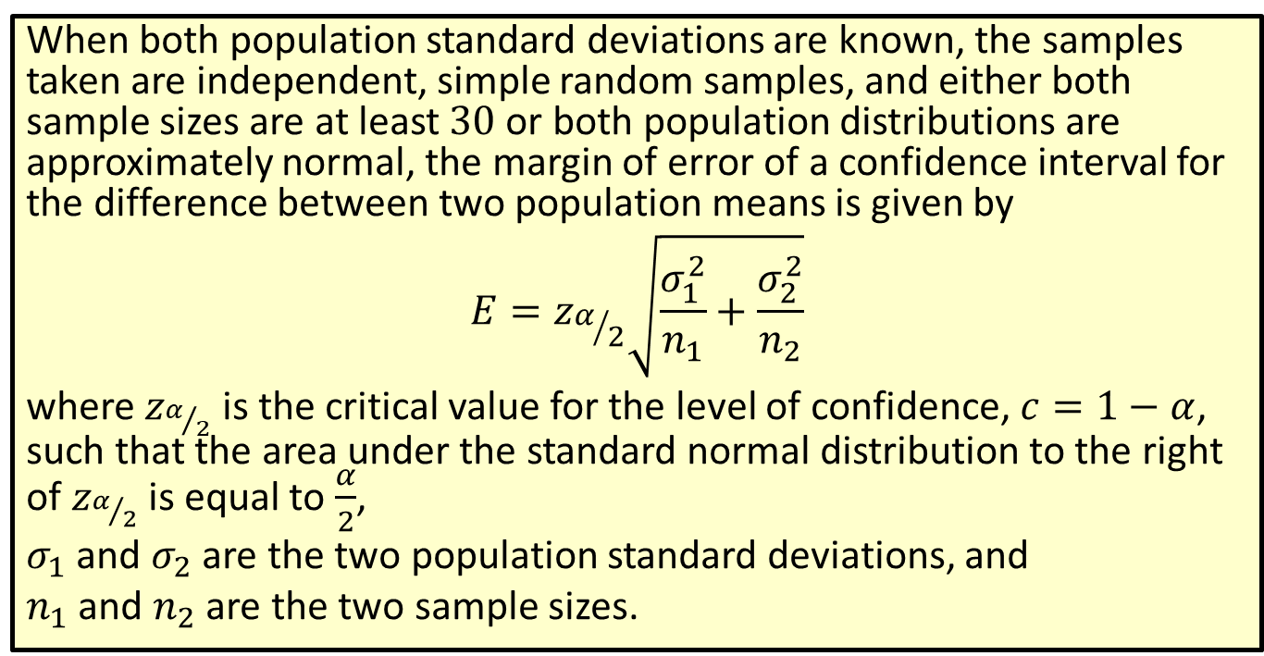
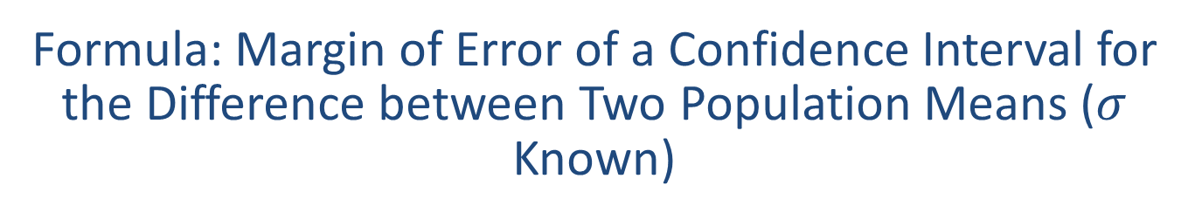
Formula: Margin of Error of a Confidence Interval for the Difference between Two Population Means ($σ$ Known)
When both population standard deviations are known, the samples taken are independent, simple random samples, and either both sample sizes are at least 30 or both population distributions are approximately normal, the margin of error of a confidence interval for the difference between two population means is given by
$$E=z_{α/2}\sqrt{\frac{σ_{1}^{2}}{n_{1}}+\frac{σ_{2}^{2}}{n_{2}}}$$
where $z_{α/2}$ is the critical value for the level of confidence, $c=1−α$, such that the area under the standard normal distribution to the right of $z_{α/2}$ is equal to $\frac{α}{2}$,
$σ_{1}$ and $σ_{2}$ are the two population standard deviations, and
$n_{1}$ and $n_{2}$ are the two sample sizes.

Slide 5
Rounding Rule
When calculating a margin of error for a confidence interval, round to at least six decimal places to avoid additional rounding errors in the subsequent calculations of the endpoints of the confidence interval.

Slide 6
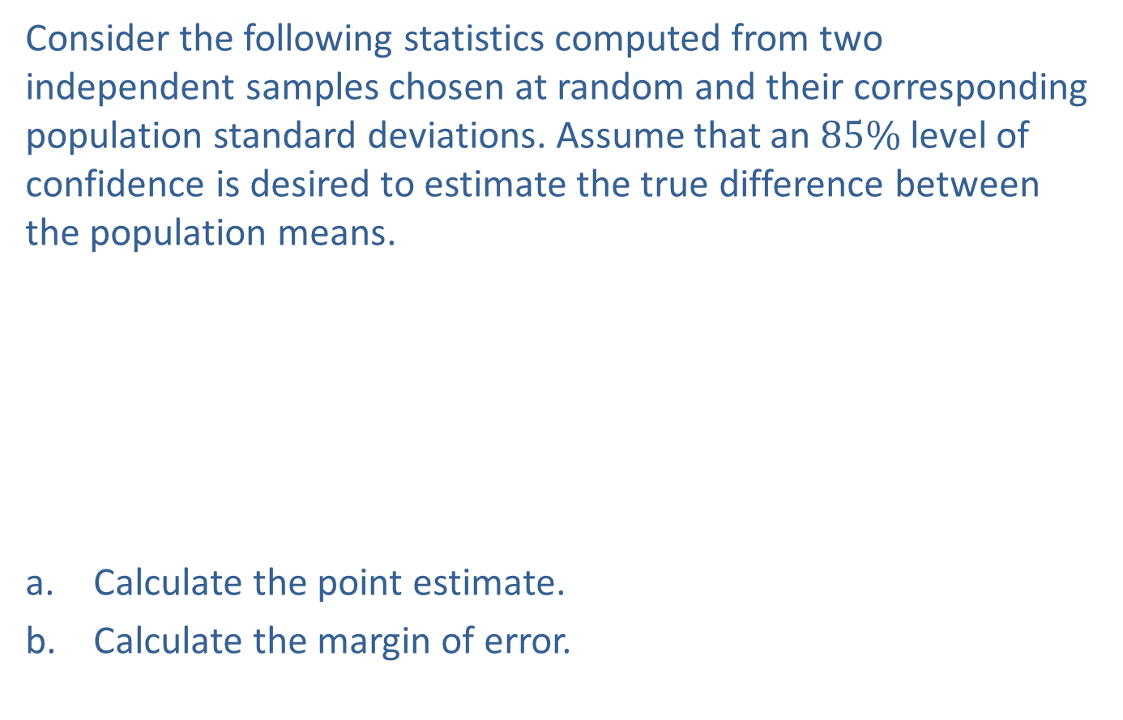
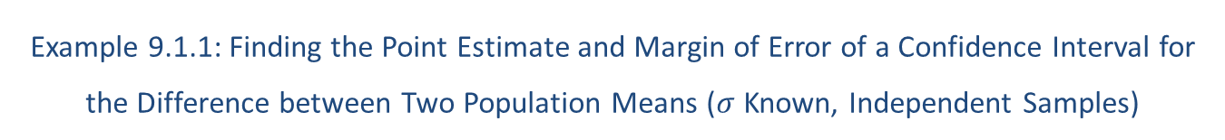
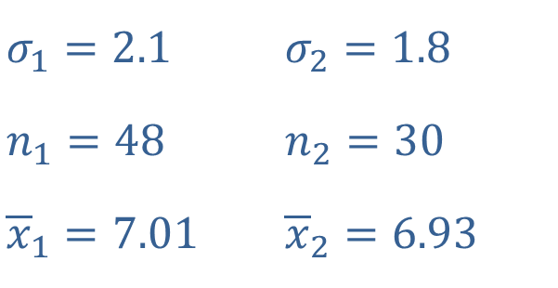
Example 9.1.1: Finding the Point Estimate and Margin of Error of a Confidence Interval for the Difference between Two Population Means ($σ$ Known, Independent Samples)
Consider the following statistics computed from two independent samples chosen at random and their corresponding population standard deviations. Assume that an $85\%$ level of confidence is desired to estimate the true difference between the population means.
​
​Calculate the point estimate.
​Calculate the margin of error.
​$σ_{1}=2.1$ | ​$σ_{2}=1.8$
​$n_{1}=48$ | ​$n_{2}=30$
​${\overline{x}}_{1}=7.01$ | ​${\overline{x}}_{2}=6.93$

Slide 7
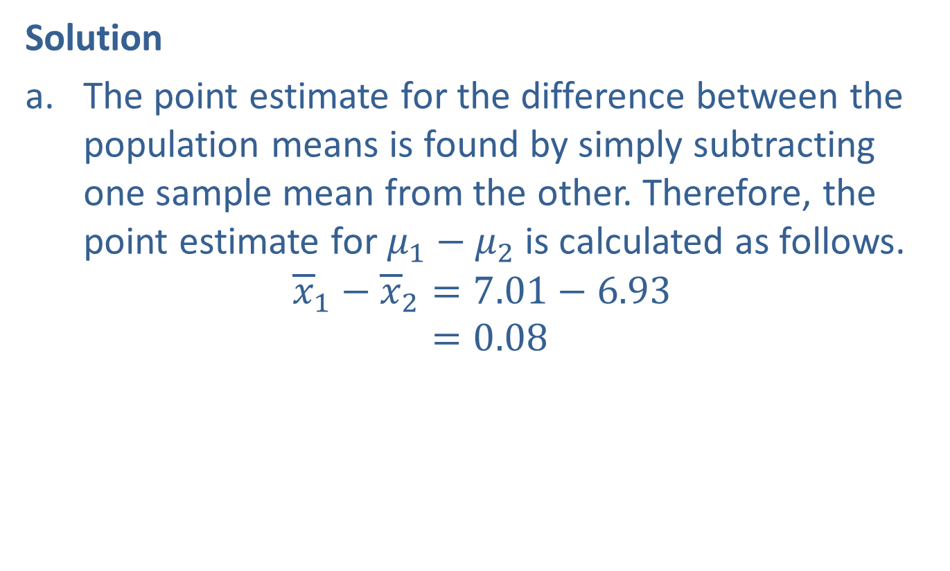
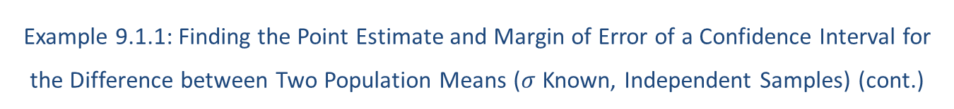
Example 9.1.1: Finding the Point Estimate and Margin of Error of a Confidence Interval for the Difference between Two Population Means ($σ$ Known, Independent Samples) (cont.)
Solution
​The point estimate for the difference between the population means is found by simply subtracting one sample mean from the other. Therefore, the point estimate for $μ_{1}−μ_{2}$ is calculated as follows.
𝑥1−𝑥2=7.01−6.93𝑥1−𝑥2=0.08

Slide 8
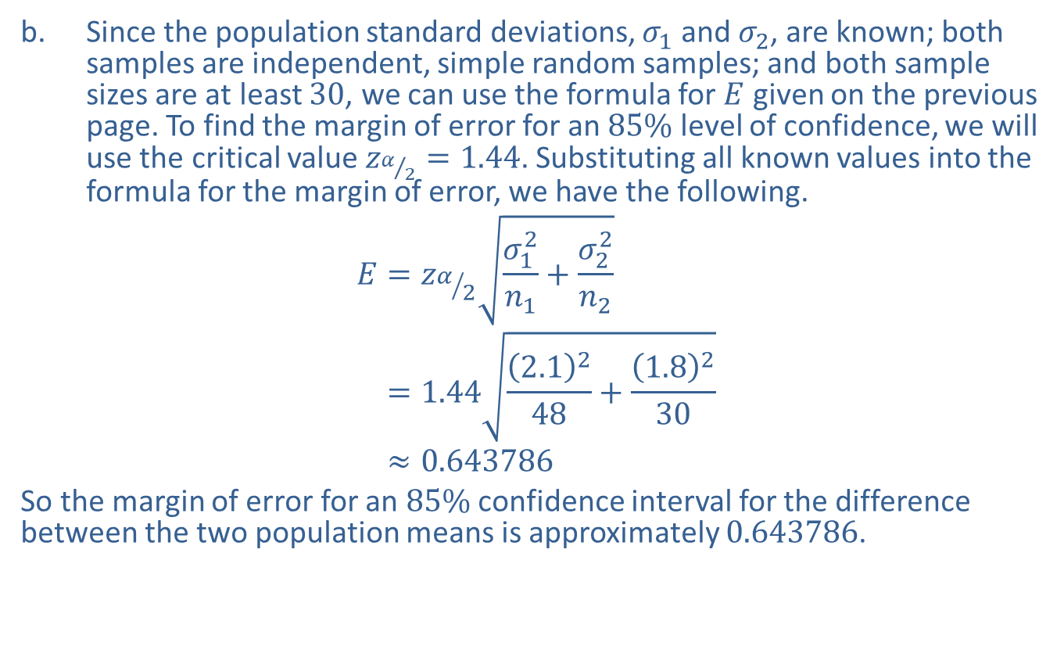
Example 9.1.1: Finding the Point Estimate and Margin of Error of a Confidence Interval for the Difference between Two Population Means ($σ$ Known, Independent Samples) (cont.)
​Since the population standard deviations, $σ_{1}$ and $σ_{2}$, are known; both samples are independent, simple random samples; and both sample sizes are at least 30, we can use the formula for $E$ given on the previous page. To find the margin of error for an $85\%$ level of confidence, we will use the critical value $z_{α/2}=1.44$. Substituting all known values into the formula for the margin of error, we have the following.
𝐸=𝑧𝛼2𝜎12𝑛1+𝜎22𝑛2𝐸=1.442.1248+1.8230𝐸≈0.643786
​So the margin of error for an $85\%$ confidence interval for the difference between the two population means is approximately 0.643786.

Slide 9
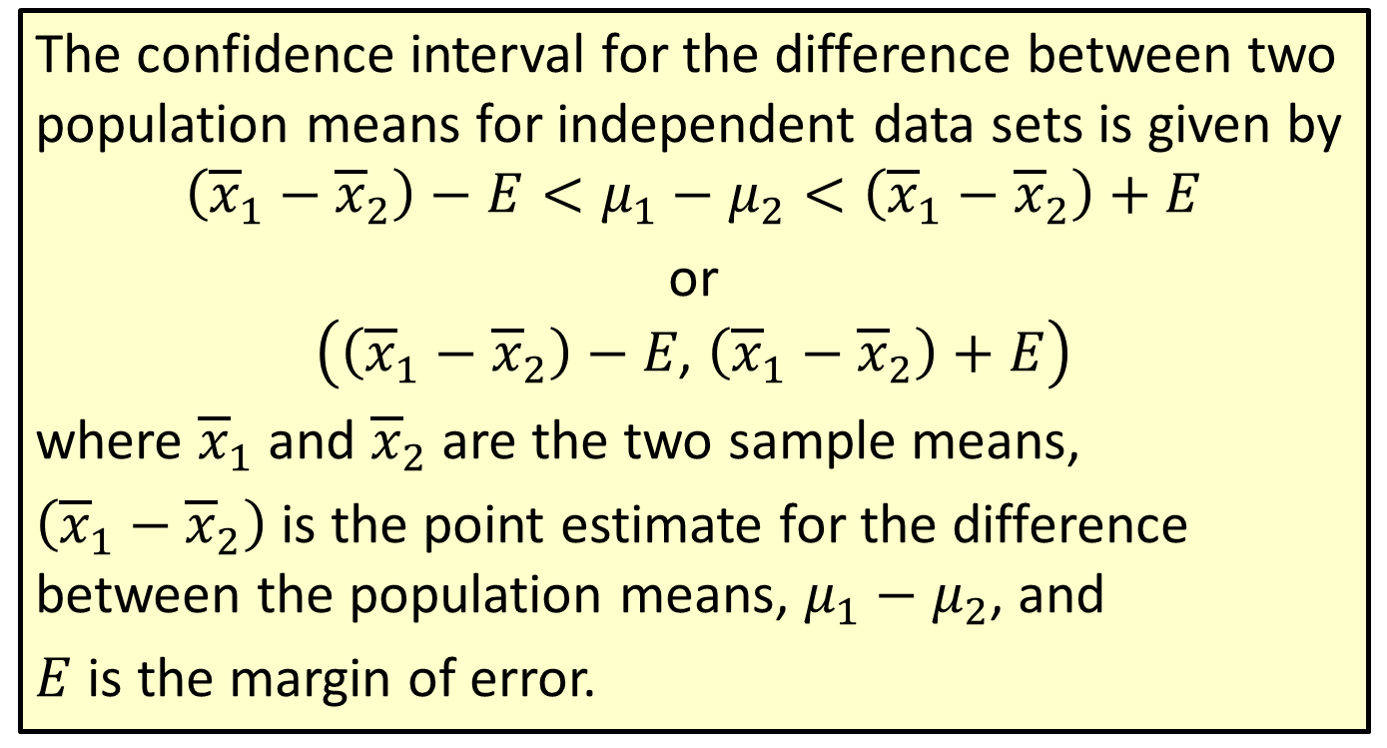
Formula: Confidence Interval for the Difference between Two Population Means (Independent Samples)
The confidence interval for the difference between two population means for independent data sets is given by
$$\left({\overline{x}}_{1}−{\overline{x}}_{2}\right)−E<μ_{1}−μ_{2}<\left({\overline{x}}_{1}−{\overline{x}}_{2}\right)+E$$
or
$$\left(\left({\overline{x}}_{1}−{\overline{x}}_{2}\right)−E\text{, }\left({\overline{x}}_{1}−{\overline{x}}_{2}\right)+E\right)$$
where ${\overline{x}}_{1}$ and ${\overline{x}}_{2}$ are the two sample means,
$\left({\overline{x}}_{1}−{\overline{x}}_{2}\right)$ is the point estimate for the difference between the population means, $μ_{1}−μ_{2}$, and
$E$ is the margin of error.

Slide 10
Rounding Rule
Round the endpoints of a confidence interval for the difference between two population means as follows:
​If sample data are given, round to one more decimal place than the largest number of decimal places in the given data.
​If statistics are given, round to the same number of decimal places as given in the standard deviation or variance.

Slide 11
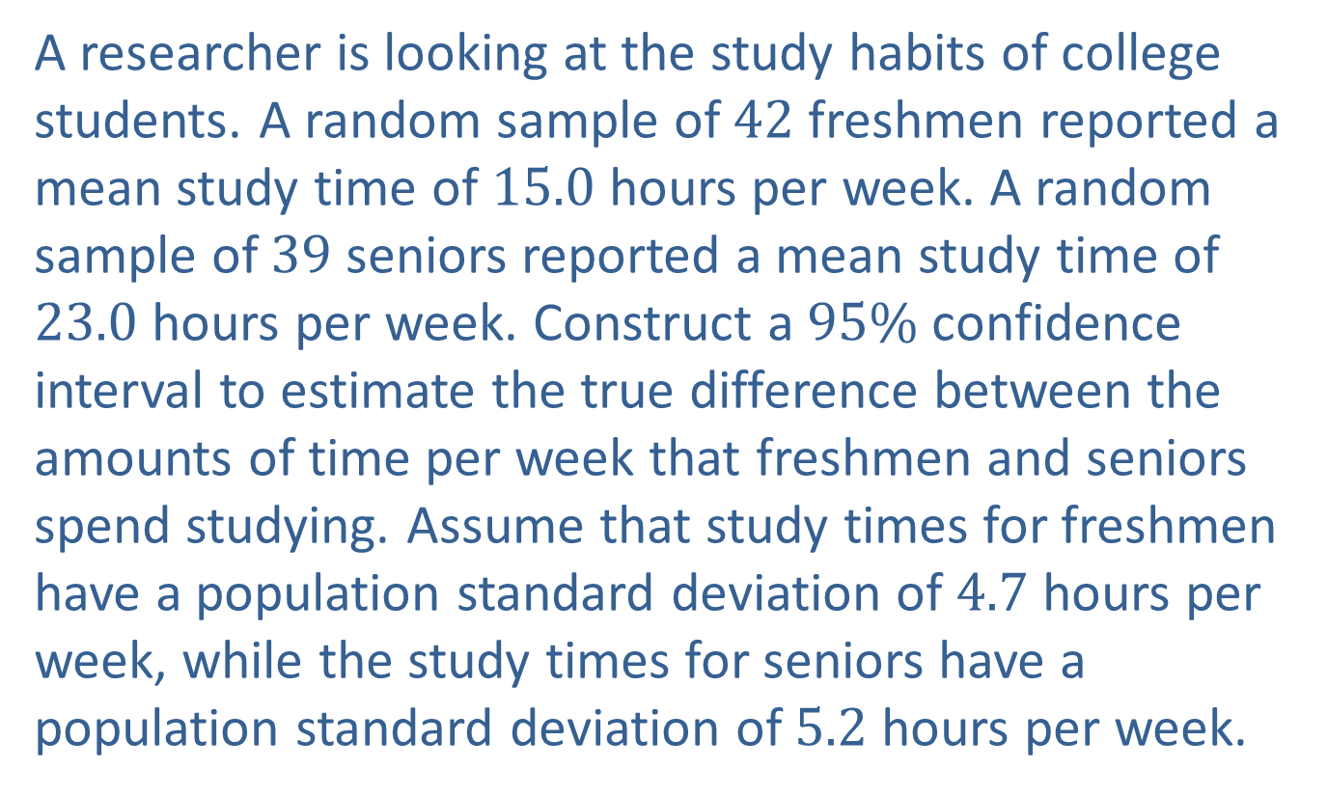
Example 9.1.2: Constructing a Confidence Interval for the Difference between Two Population Means (σ Known, Independent Samples)
A researcher is looking at the study habits of college students. A random sample of 42 freshmen reported a mean study time of 15.0 hours per week. A random sample of 39 seniors reported a mean study time of 23.0 hours per week. Construct a $95\%$ confidence interval to estimate the true difference between the amounts of time per week that freshmen and seniors spend studying. Assume that study times for freshmen have a population standard deviation of 4.7 hours per week, while the study times for seniors have a population standard deviation of 5.2 hours per week.

Slide 12
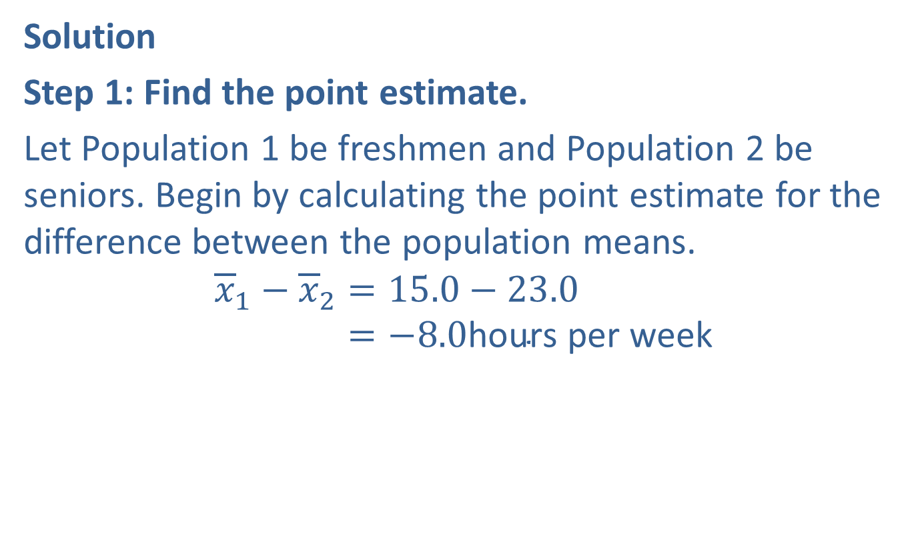
Example 9.1.2: Constructing a Confidence Interval for the Difference between Two Population Means (σ Known, Independent Samples) (cont.)
Solution
Step 1: Find the point estimate.
Let Population 1 be freshmen and Population 2 be seniors. Begin by calculating the point estimate for the difference between the population means.
𝑥1−𝑥2=15.0−23.0𝑥1−𝑥2=−8.0hours per week

Slide 13
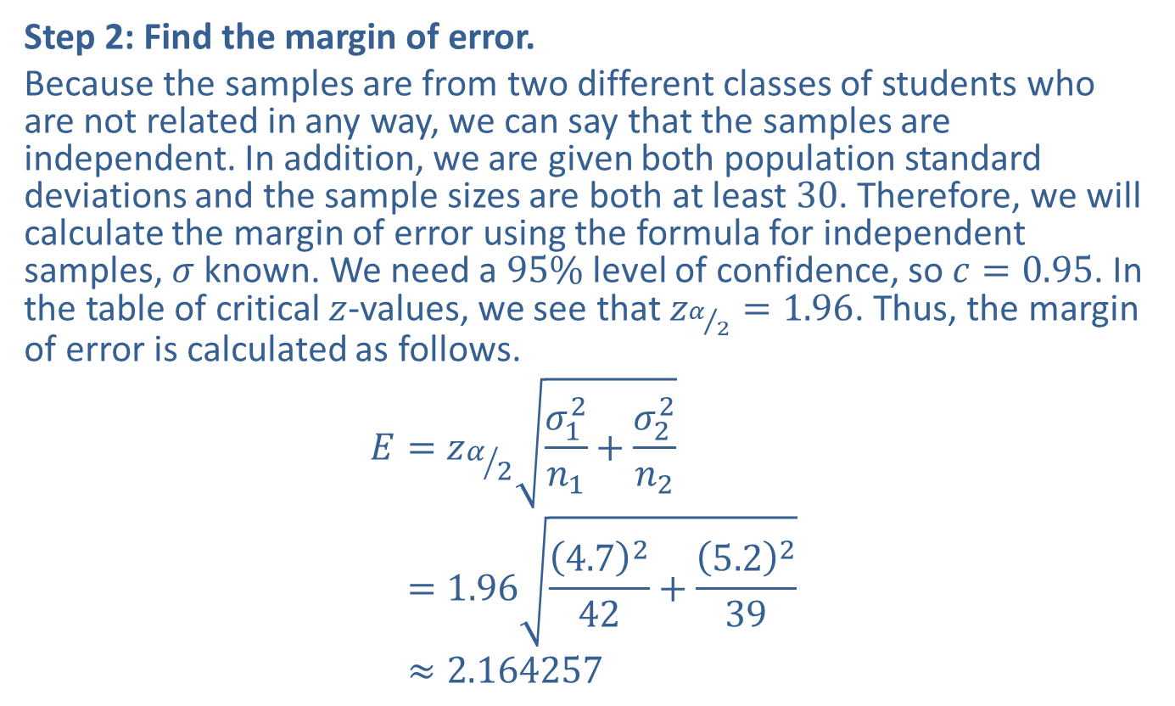
Example 9.1.2: Constructing a Confidence Interval for the Difference between Two Population Means (σ Known, Independent Samples) (cont.)
Step 2: Find the margin of error.
Because the samples are from two different classes of students who are not related in any way, we can say that the samples are independent. In addition, we are given both population standard deviations and the sample sizes are both at least 30. Therefore, we will calculate the margin of error using the formula for independent samples, $σ$ known. We need a $95\%$ level of confidence, so $c=0.95$. In the table of critical $z$-values, we see that $z_{α/2}=1.96$. Thus, the margin of error is calculated as follows.
𝐸=𝑧𝛼2𝜎12𝑛1+𝜎22𝑛2𝐸=1.964.7242+5.2239𝐸≈2.164257

Slide 14
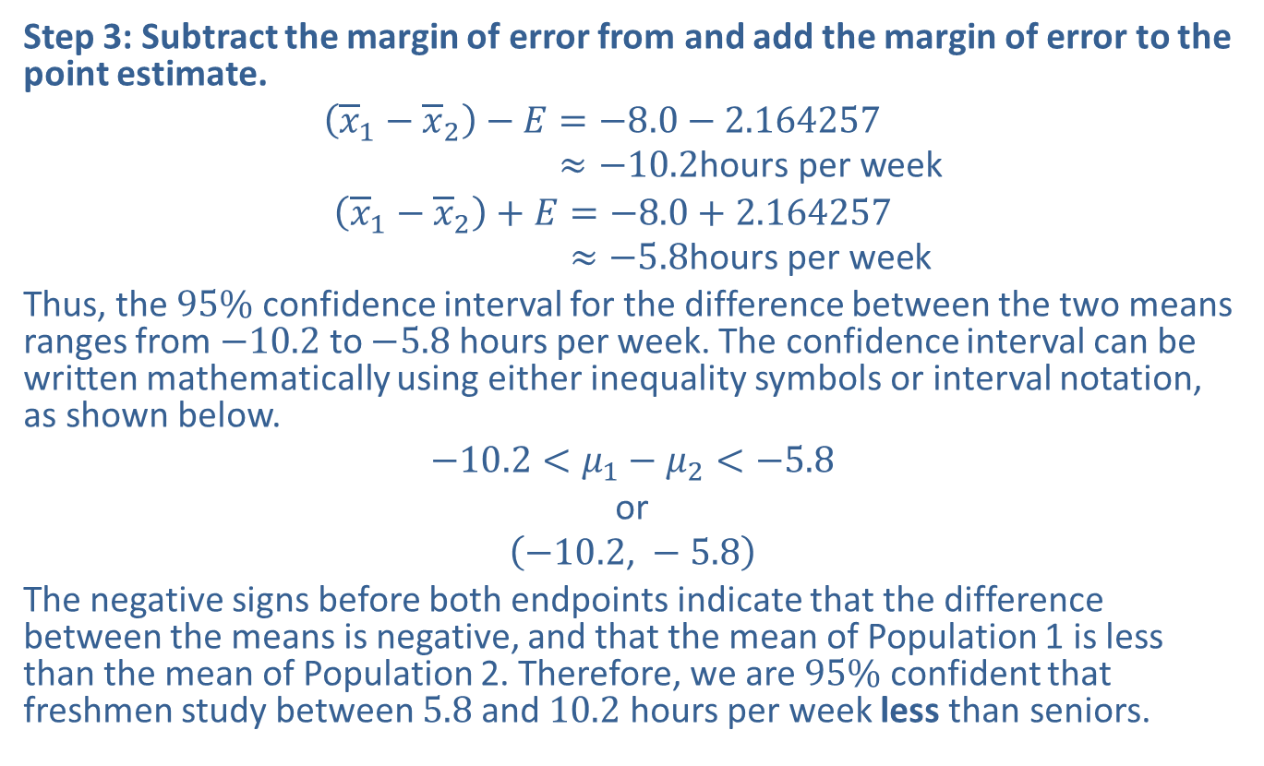
Example 9.1.2: Constructing a Confidence Interval for the Difference between Two Population Means (σ Known, Independent Samples) (cont.)
Step 3: Subtract the margin of error from and add the margin of error to the point estimate.
𝑥1−𝑥2−𝐸=−8.0−2.164257𝑥1−𝑥2−𝐸≈−10.2hours per week
𝑥1−𝑥2+𝐸=−8.0+2.164257𝑥1−𝑥2+𝐸≈−5.8hours per week
Thus, the $95\%$ confidence interval for the difference between the two means ranges from $−10.2$ to $−5.8$ hours per week. The confidence interval can be written mathematically using either inequality symbols or interval notation, as shown below.
$$−10.2<μ_{1}−μ_{2}<−5.8$$
or
$$\left(−10.2\text{, }−5.8\right)$$
The negative signs before both endpoints indicate that the difference between the means is negative, and that the mean of Population 1 is less than the mean of Population 2. Therefore, we are $95\%$ confident that freshmen study between 5.8 and 10.2 hours per week less than seniors.
Lower Endpoint:
Upper Endpoint:

Slide 15
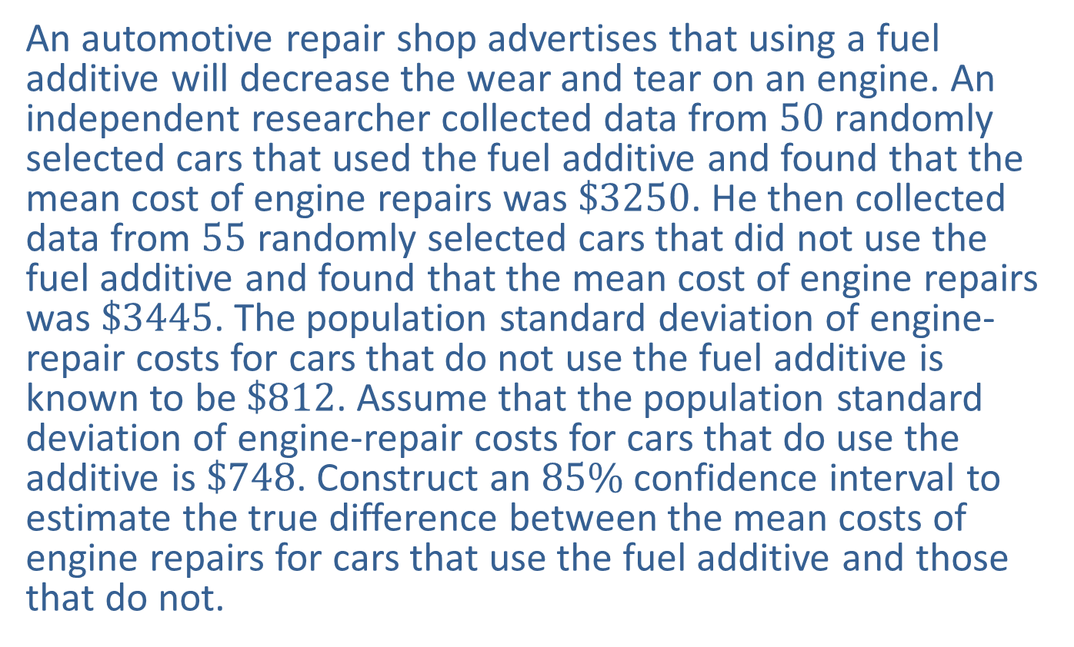
Example 9.1.3: Constructing a Confidence Interval for the Difference between Two Population Means (σ Known, Independent Samples)
An automotive repair shop advertises that using a fuel additive will decrease the wear and tear on an engine. An independent researcher collected data from 50 randomly selected cars that used the fuel additive and found that the mean cost of engine repairs was $\$3250$. He then collected data from 55 randomly selected cars that did not use the fuel additive and found that the mean cost of engine repairs was $\$3445$. The population standard deviation of engine-repair costs for cars that do not use the fuel additive is known to be $\$812$. Assume that the population standard deviation of engine-repair costs for cars that do use the additive is $\$748$. Construct an $85\%$ confidence interval to estimate the true difference between the mean costs of engine repairs for cars that use the fuel additive and those that do not.

Slide 16
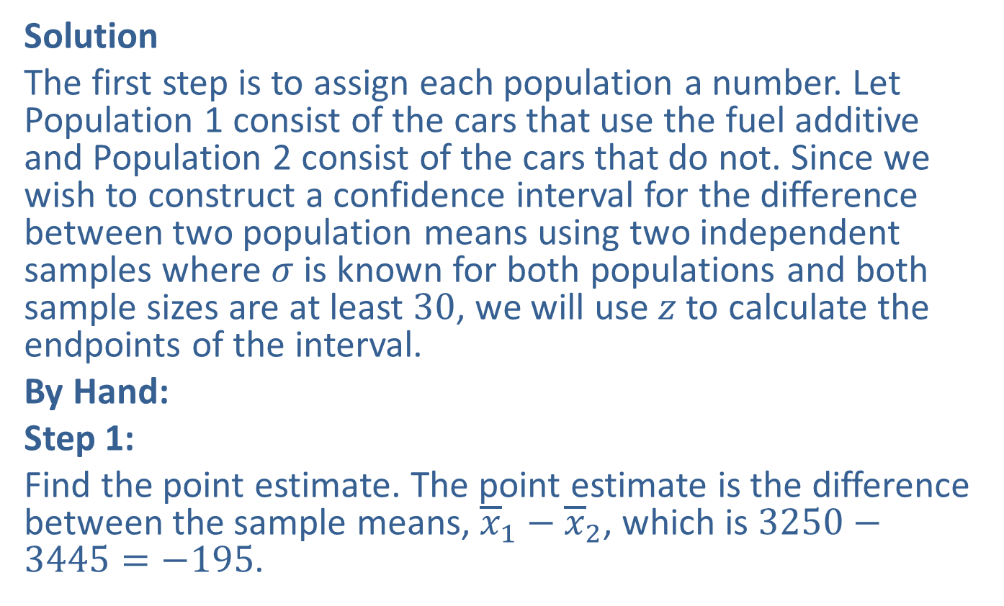
Example 9.1.3: Constructing a Confidence Interval for the Difference between Two Population Means (σ Known, Independent Samples) (cont.)
Solution
The first step is to assign each population a number. Let Population 1 consist of the cars that use the fuel additive and Population 2 consist of the cars that do not. Since we wish to construct a confidence interval for the difference between two population means using two independent samples where $σ$ is known for both populations and both sample sizes are at least 30, we will use $z$ to calculate the endpoints of the interval.
By Hand:
Step 1:
Find the point estimate. The point estimate is the difference between the sample means, ${\overline{x}}_{1}−{\overline{x}}_{2}$, which is $3250−3445=−195$.

Slide 17
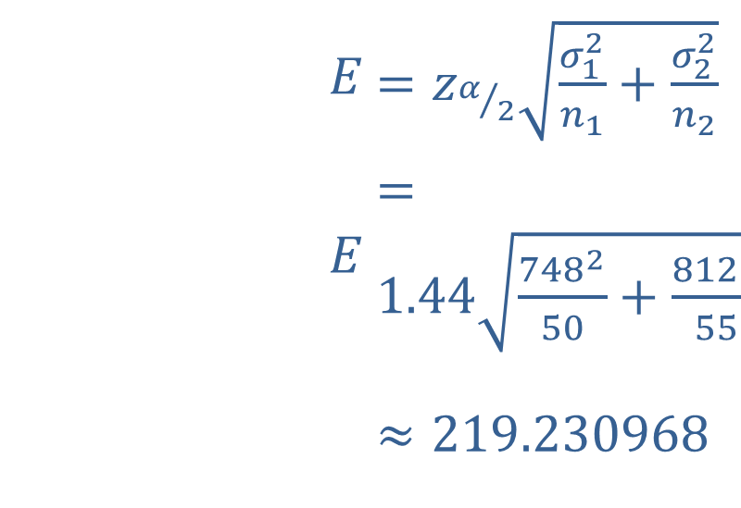

Example 9.1.3: Constructing a Confidence Interval for the Difference between Two Population Means (σ Known, Independent Samples) (cont.)
Step 2:
Find the margin of error. Note that because $c=0.85$, we will use $z_{α/2}=1.44$.
​
​$E$ | ​$=z_{α/2}\sqrt{\frac{σ_{1}^{2}}{n_{1}}+\frac{σ_{2}^{2}}{n_{2}}}$
​$E$ | ​$=1.44\sqrt{\frac{{748}^{2}}{50}+\frac{{812}^{2}}{55}}$
​ | ​$≈219.230968$

Slide 18
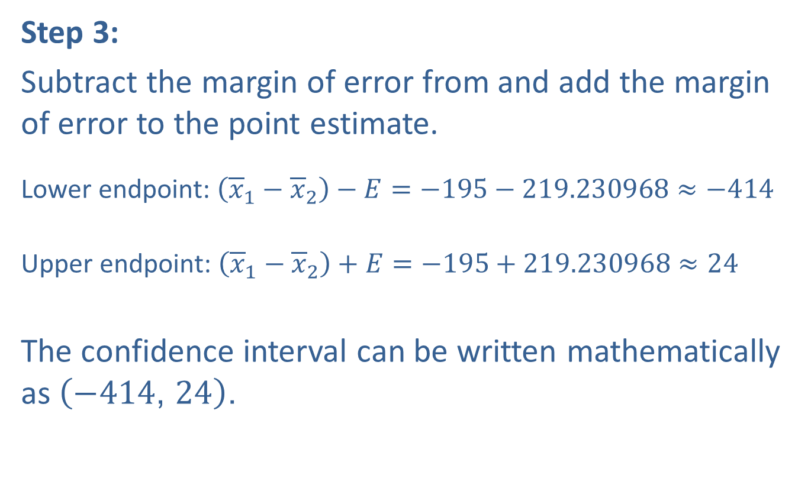
Example 9.1.3: Constructing a Confidence Interval for the Difference between Two Population Means (σ Known, Independent Samples) (cont.)
Step 3:
Subtract the margin of error from and add the margin of error to the point estimate.
Lower endpoint: $\left({\overline{x}}_{1}−{\overline{x}}_{2}\right)−E=−195−219.230968≈−414$
Upper endpoint: $\left({\overline{x}}_{1}−{\overline{x}}_{2}\right)+E=−195+219.230968≈24$
The confidence interval can be written mathematically as $\left(−414\text{, }24\right)$.

Slide 19
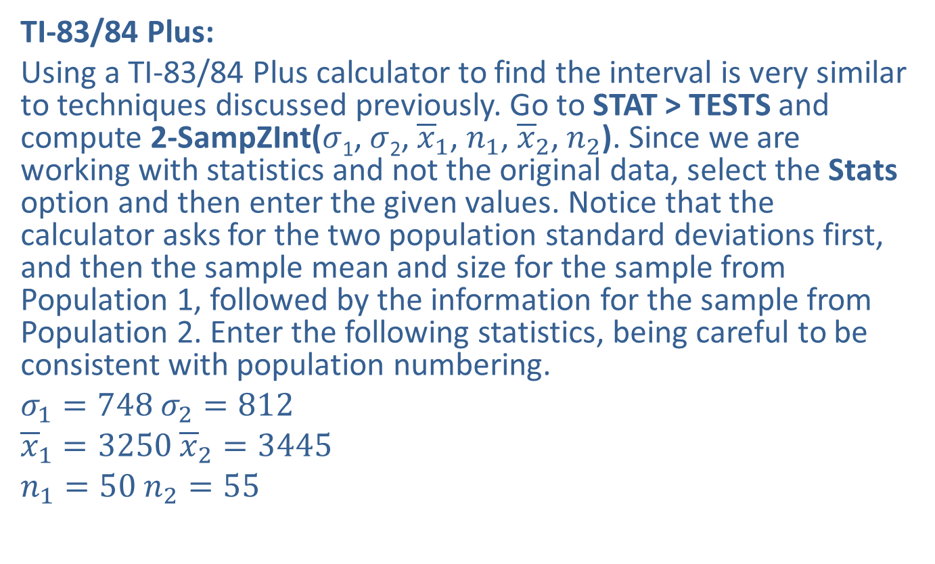
Example 9.1.3: Constructing a Confidence Interval for the Difference between Two Population Means (σ Known, Independent Samples) (cont.)
TI-83/84 Plus:
Using a TI-83/84 Plus calculator to find the interval is very similar to techniques discussed previously. Go to STAT > TESTS and compute 2-SampZInt($σ$₁, $σ$₂, ${\overline{x}}_{1}$, $n_{1}$, ${\overline{x}}_{2}$, $n_{2}$). Since we are working with statistics and not the original data, select the Stats option and then enter the given values. Notice that the calculator asks for the two population standard deviations first, and then the sample mean and size for the sample from Population 1, followed by the information for the sample from Population 2. Enter the following statistics, being careful to be consistent with population numbering.
$σ_{1}=748$ $σ_{2}=812$
${\overline{x}}_{1}=3250$ ${\overline{x}}_{2}=3445$
$n_{1}=50$ $n_{2}=55$

Slide 20
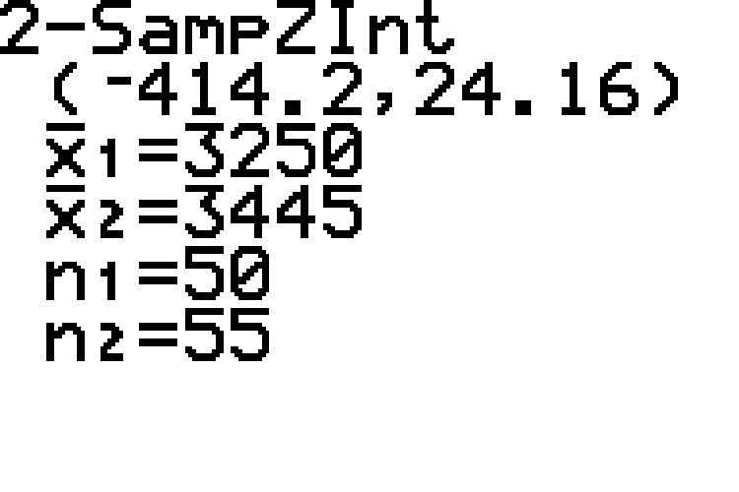
Example 9.1.3: Constructing a Confidence Interval for the Difference between Two Population Means (σ Known, Independent Samples) (cont.)

Slide 21
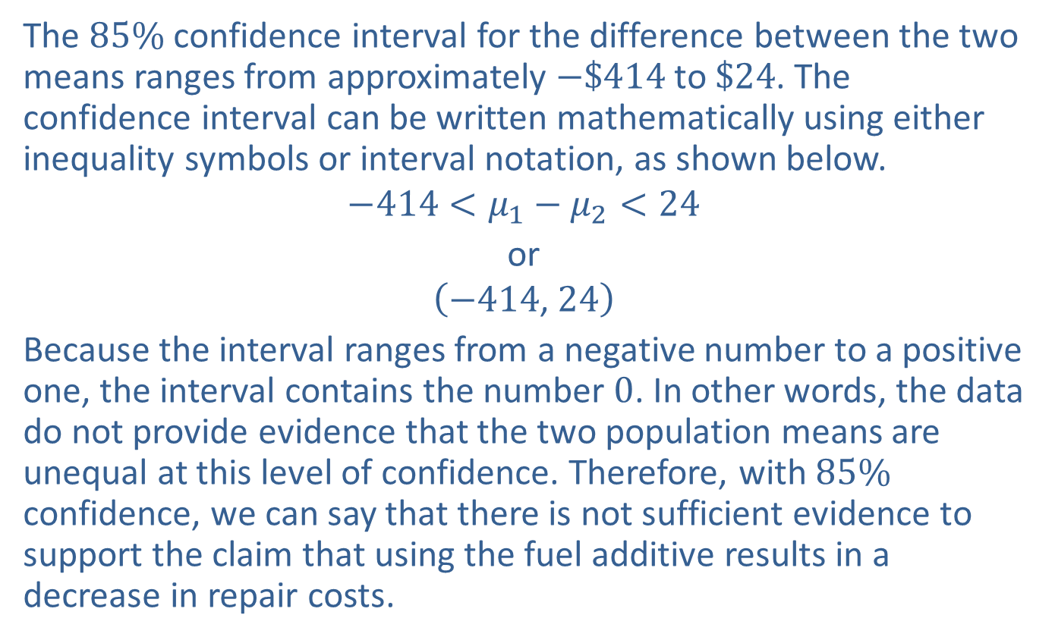
Example 9.1.3: Constructing a Confidence Interval for the Difference between Two Population Means (σ Known, Independent Samples) (cont.)
The $85\%$ confidence interval for the difference between the two means ranges from approximately $−\$414$ to $\$24$. The confidence interval can be written mathematically using either inequality symbols or interval notation, as shown below.
$$−414<μ_{1}−μ_{2}<24$$
or
$$\left(−414\text{, }24\right)$$
Because the interval ranges from a negative number to a positive one, the interval contains the number 0. In other words, the data do not provide evidence that the two population means are unequal at this level of confidence. Therefore, with $85\%$ confidence, we can say that there is not sufficient evidence to support the claim that using the fuel additive results in a decrease in repair costs.

Slide 22
Technology
For further instructions on calculating a two sample z-interval using a TI-83/84 Plus calculator or other technology, please visit stat.hawkeslearning.com and see Technology Instructions > Confidence Intervals > Two Sample z-interval

