Slide 1
Section 9.2
Comparing Two Population Means (Sigma Unknown, Independent Samples)

Slide 2
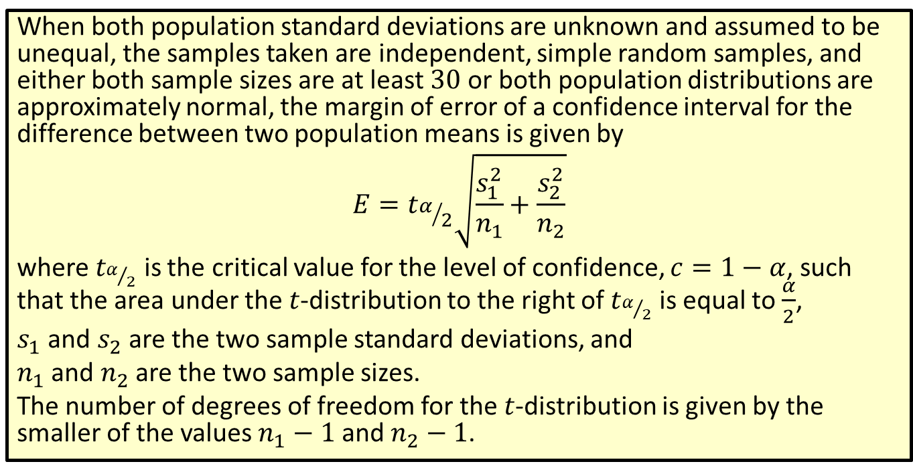
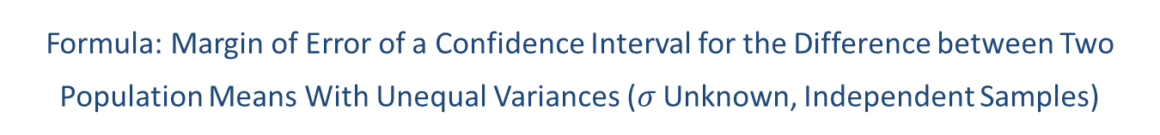
Formula: Margin of Error of a Confidence Interval for the Difference between Two Population Means With Unequal Variances ($σ$ Unknown, Independent Samples)
When both population standard deviations are unknown and assumed to be unequal, the samples taken are independent, simple random samples, and either both sample sizes are at least 30 or both population distributions are approximately normal, the margin of error of a confidence interval for the difference between two population means is given by
$$E=t_{α/2}\sqrt{\frac{s_{1}^{2}}{n_{1}}+\frac{s_{2}^{2}}{n_{2}}}$$
where $t_{α/2}$ is the critical value for the level of confidence, $c=1−α$, such that the area under the $t$-distribution to the right of $t_{α/2}$ is equal to $\frac{α}{2}$,
$s_{1}$ and $s_{2}$ are the two sample standard deviations, and
$n_{1}$ and $n_{2}$ are the two sample sizes.
The number of degrees of freedom for the $t$-distribution is given by the smaller of the values $n_{1}−1$ and $n_{2}−1$.

Slide 3
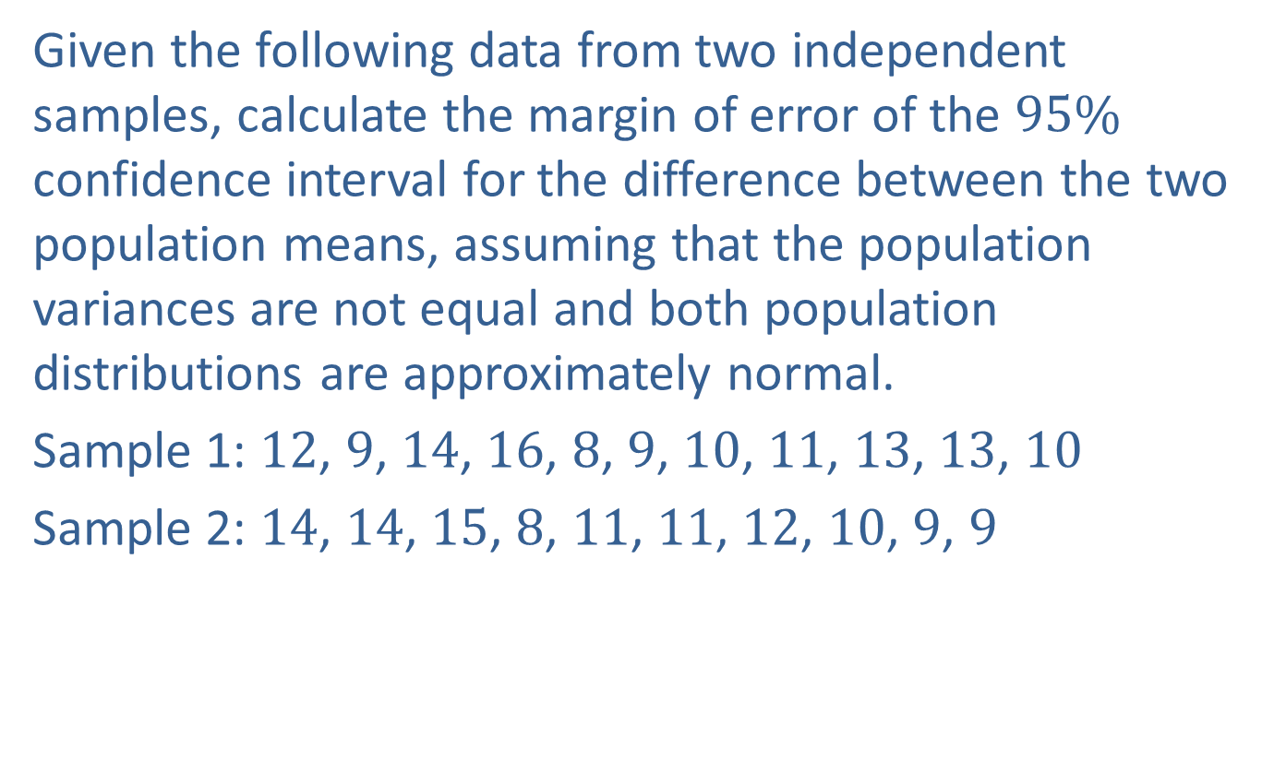
Example 9.2.1: Finding the Margin of Error of a Confidence Interval for the Difference between Two Population Means with Unequal Variances (σ Unknown, Independent Samples)
Given the following data from two independent samples, calculate the margin of error of the $95\%$ confidence interval for the difference between the two population means, assuming that the population variances are not equal and both population distributions are approximately normal.
Sample 1: 12, 9, 14, 16, 8, 9, 10, 11, 13, 13, 10
Sample 2: 14, 14, 15, 8, 11, 11, 12, 10, 9, 9

Slide 4
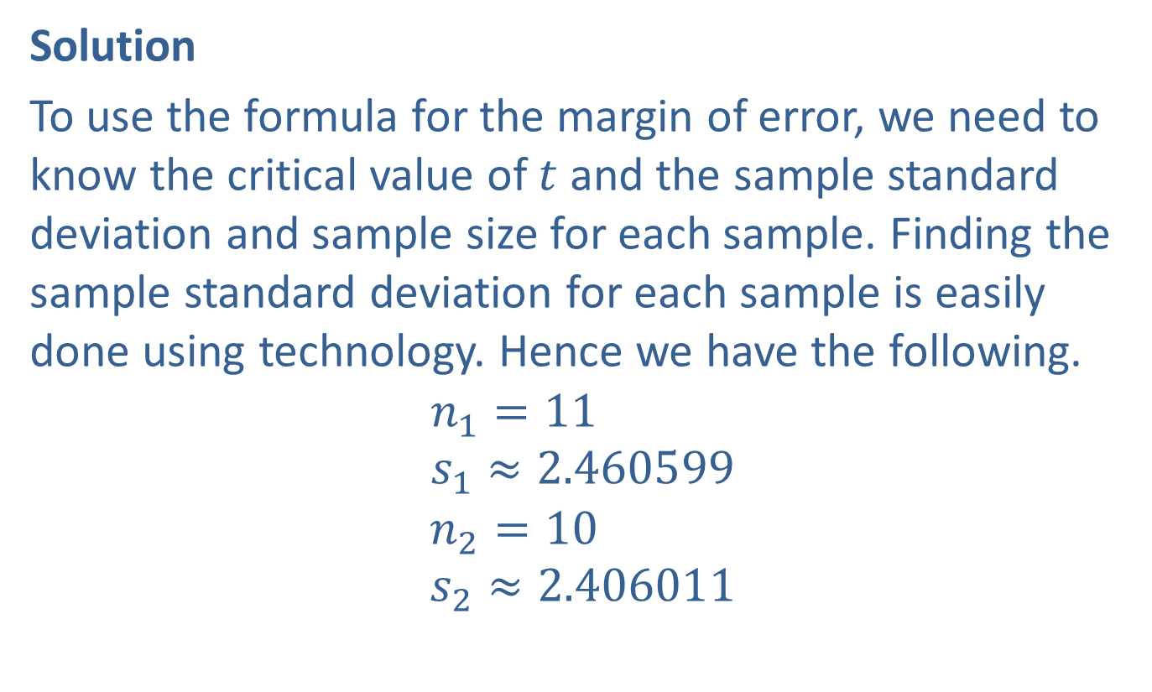
Example 9.2.1: Finding the Margin of Error of a Confidence Interval for the Difference between Two Population Means with Unequal Variances (σ Unknown, Independent Samples) (cont.)
Solution
To use the formula for the margin of error, we need to know the critical value of $t$ and the sample standard deviation and sample size for each sample. Finding the sample standard deviation for each sample is easily done using technology. Hence we have the following.
$$n_{1}=11 \\ s_{1}≈2.460599$$
$$n_{2}=10 \\ s_{2}≈2.406011$$

Slide 5
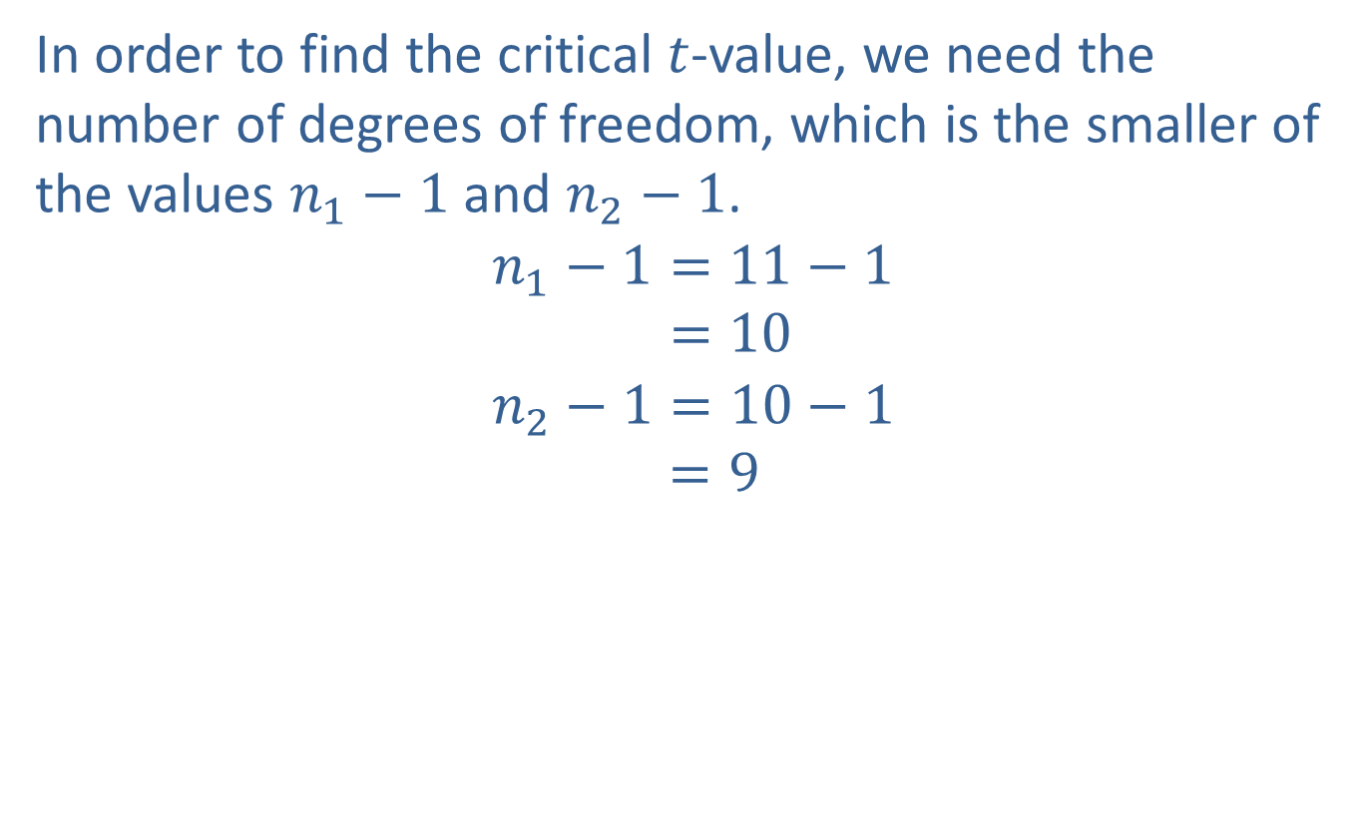
Example 9.2.1: Finding the Margin of Error of a Confidence Interval for the Difference between Two Population Means with Unequal Variances (σ Unknown, Independent Samples) (cont.)
In order to find the critical $t$-value, we need the number of degrees of freedom, which is the smaller of the values $n_{1}−1$ and $n_{2}−1$.
𝑛1−1=11−1𝑛1−1=10
𝑛2−1=10−1𝑛1−1=9

Slide 6
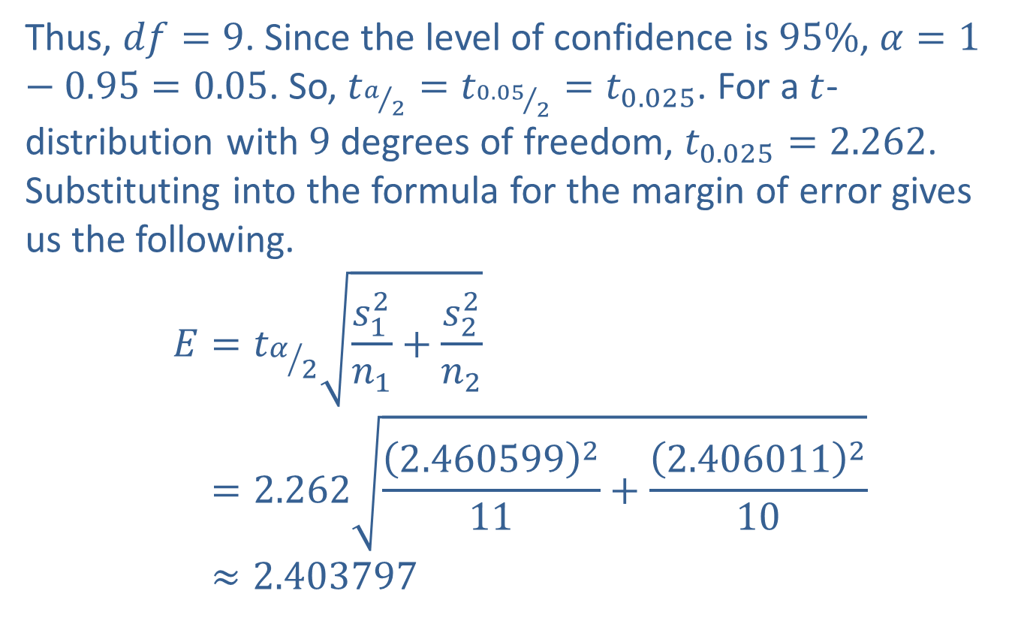
Example 9.2.1: Finding the Margin of Error of a Confidence Interval for the Difference between Two Population Means with Unequal Variances (σ Unknown, Independent Samples) (cont.)
Thus, $df=9$. Since the level of confidence is $95\%$, $α=1−0.95=0.05$. So, $t_{a/2}=t_{{0.05}/2}=t_{0.025}$. For a $t$-distribution with 9 degrees of freedom, $t_{0.025}=2.262$. Substituting into the formula for the margin of error gives us the following.
𝐸=𝑡𝛼2𝑠12𝑛1+𝑠22𝑛2𝐸=2.2622.460599211+2.406011210𝐸≈2.403797

Slide 7

Side Note
The table for Critical Values of $t$ can be accessed from the Tables button.

Slide 8
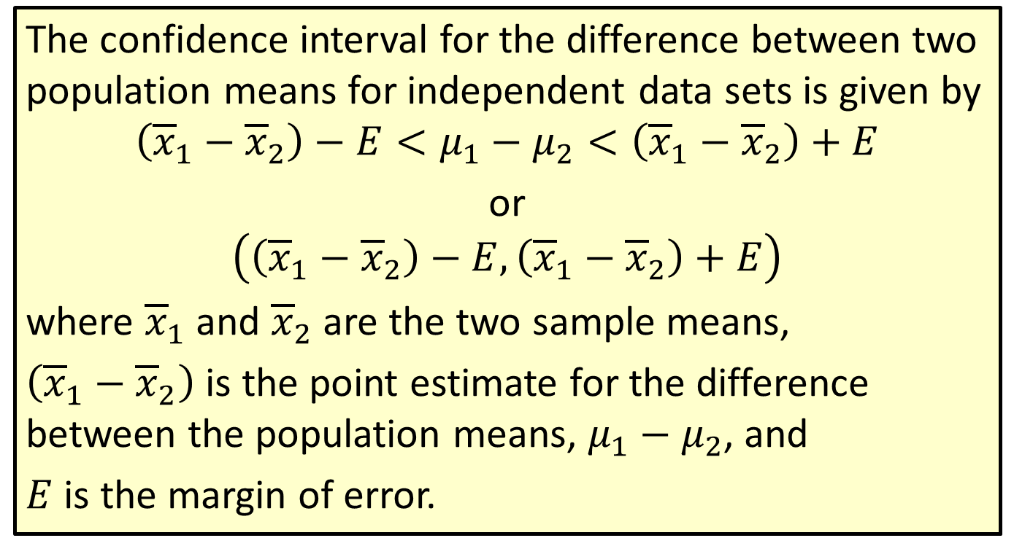
Formula: Confidence Interval for the Difference between Two Population Means (σ Unknown, Independent Samples)
The confidence interval for the difference between two population means for independent data sets is given by
$$\left({\overline{x}}_{1}−{\overline{x}}_{2}\right)−E<μ_{1}−μ_{2}<\left({\overline{x}}_{1}−{\overline{x}}_{2}\right)+E$$
or
$$\left(\left({\overline{x}}_{1}−{\overline{x}}_{2}\right)−E,\left({\overline{x}}_{1}−{\overline{x}}_{2}\right)+E\right)$$
where ${\overline{x}}_{1}$ and ${\overline{x}}_{2}$ are the two sample means,
$\left({\overline{x}}_{1}−{\overline{x}}_{2}\right)$ is the point estimate for the difference between the population means, $μ_{1}−μ_{2}$, and
$E$ is the margin of error.

Slide 9
Rounding Rule
Round the endpoints of a confidence interval for the difference between two population means as follows:
​If sample data are given, round to one more decimal place than the largest number of decimal places in the given data.
​If statistics are given, round to the same number of decimal places as given in the standard deviation or variance.

Slide 10
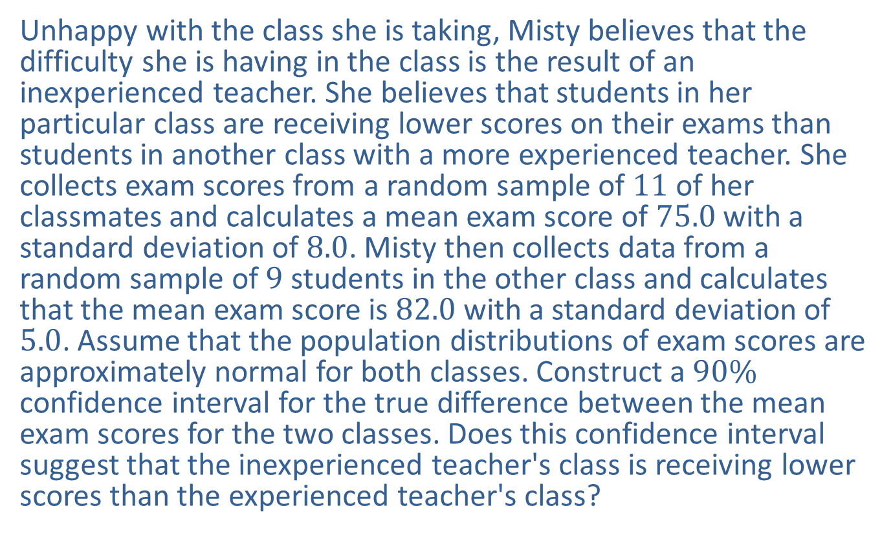
Example 9.2.2: Constructing a Confidence Interval for the Difference between Two Population Means with Unequal Variances (σ Unknown, Independent Samples)
Unhappy with the class she is taking, Misty believes that the difficulty she is having in the class is the result of an inexperienced teacher. She believes that students in her particular class are receiving lower scores on their exams than students in another class with a more experienced teacher. She collects exam scores from a random sample of 11 of her classmates and calculates a mean exam score of 75.0 with a standard deviation of 8.0. Misty then collects data from a random sample of 9 students in the other class and calculates that the mean exam score is 82.0 with a standard deviation of 5.0. Assume that the population distributions of exam scores are approximately normal for both classes. Construct a $90\%$ confidence interval for the true difference between the mean exam scores for the two classes. Does this confidence interval suggest that the inexperienced teacher's class is receiving lower scores than the experienced teacher's class?

Slide 11
Example 9.2.2: Constructing a Confidence Interval for the Difference between Two Population Means with Unequal Variances (σ Unknown, Independent Samples) (cont.)
Solution
First, let's let Population 1 be the class with the inexperienced teacher and Population 2 be the class with the experienced teacher. Next, consider the variances. Neither population variance is given, so we must consider the two populations to decide if it's reasonable to assume that the variances are equal. Since we are not given details about the two classes, that is, if they are the same course, if they have the same prerequisites, and so forth, we cannot assume the variances to be equal. Therefore, it is not appropriate to pool the data in this scenario.

Slide 12
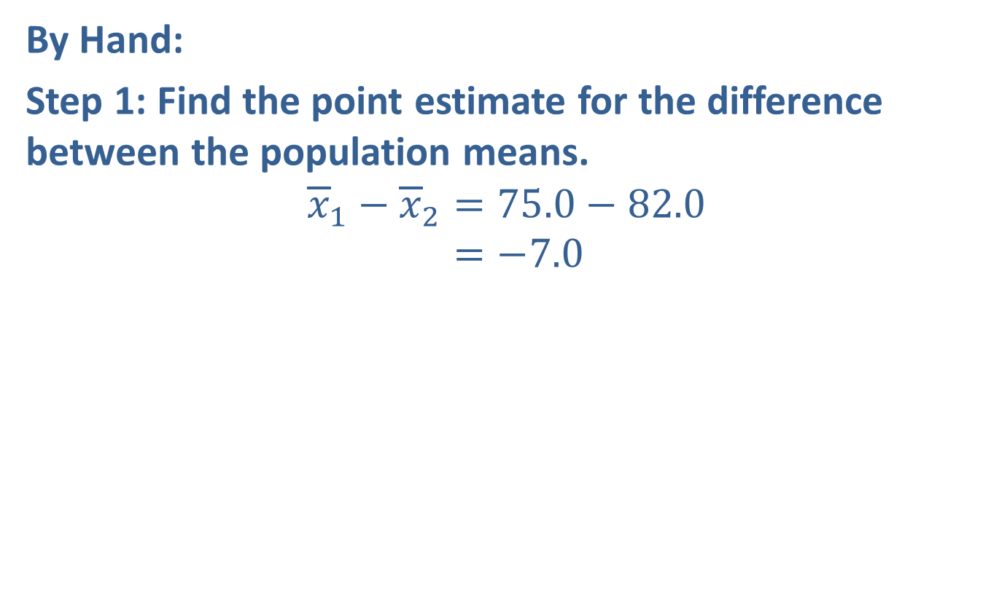
Example 9.2.2: Constructing a Confidence Interval for the Difference between Two Population Means with Unequal Variances (σ Unknown, Independent Samples) (cont.)
By Hand:
Step 1: Find the point estimate for the difference between the population means.
𝑥1−𝑥2=75.0−82.0𝑥1−𝑥2=−7.0

Slide 13
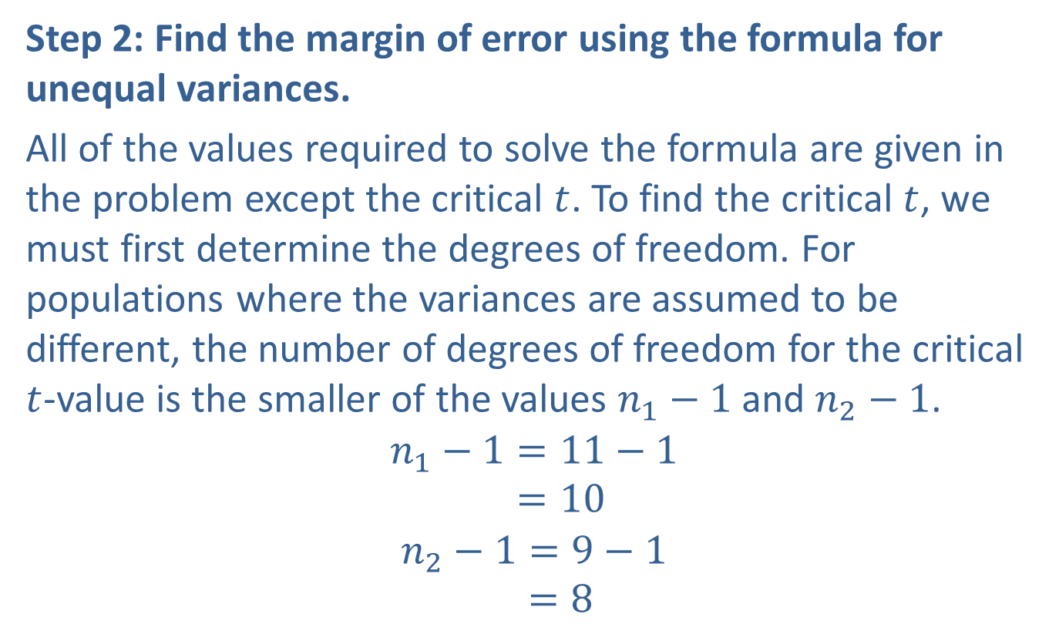
Example 9.2.2: Constructing a Confidence Interval for the Difference between Two Population Means with Unequal Variances (σ Unknown, Independent Samples) (cont.)
Step 2: Find the margin of error using the formula for unequal variances.
All of the values required to solve the formula are given in the problem except the critical $t$. To find the critical $t$, we must first determine the degrees of freedom. For populations where the variances are assumed to be different, the number of degrees of freedom for the critical $t$-value is the smaller of the values $n_{1}−1$ and $n_{2}−1$.
𝑛1−1=11−1𝑛1−1=10
𝑛2−1=9−1𝑛1−1=8

Slide 14
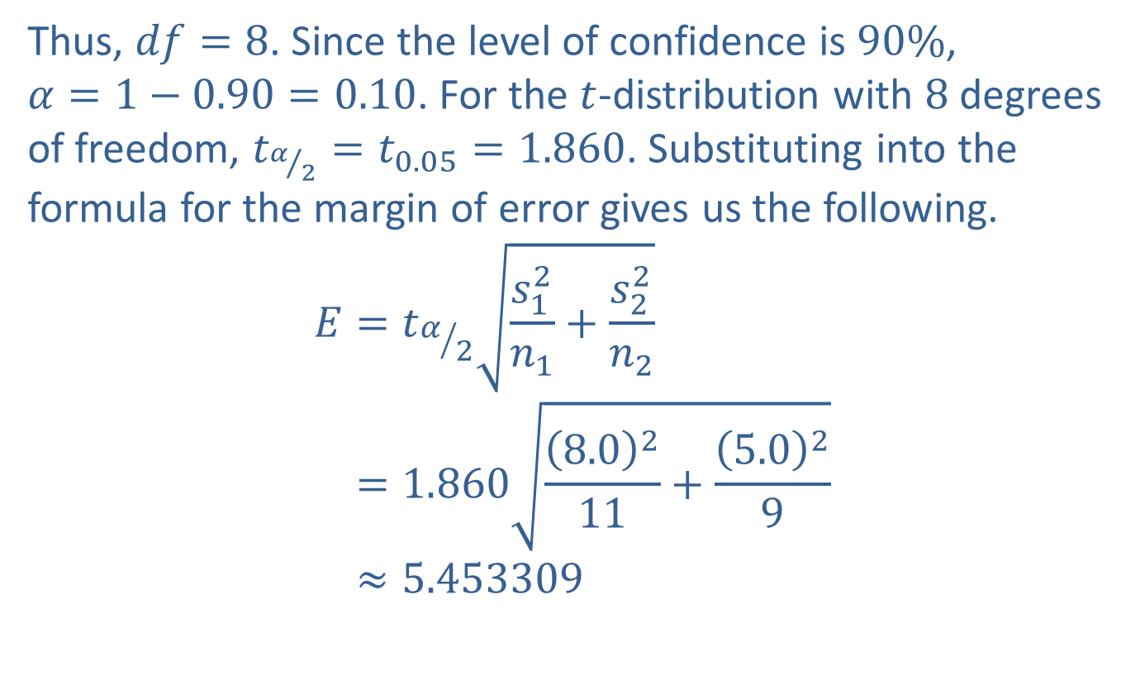
Example 9.2.2: Constructing a Confidence Interval for the Difference between Two Population Means with Unequal Variances (σ Unknown, Independent Samples) (cont.)
Thus, $df=8$. Since the level of confidence is $90\%$,
$α=1−0.90=0.10$. For the $t$-distribution with 8 degrees of freedom, $t_{α/2}=t_{0.05}=1.860$. Substituting into the formula for the margin of error gives us the following.
𝐸=𝑡𝛼2𝑠12𝑛1+𝑠22𝑛2𝐸=1.8608.0211+5.029𝐸≈5.453309

Slide 15
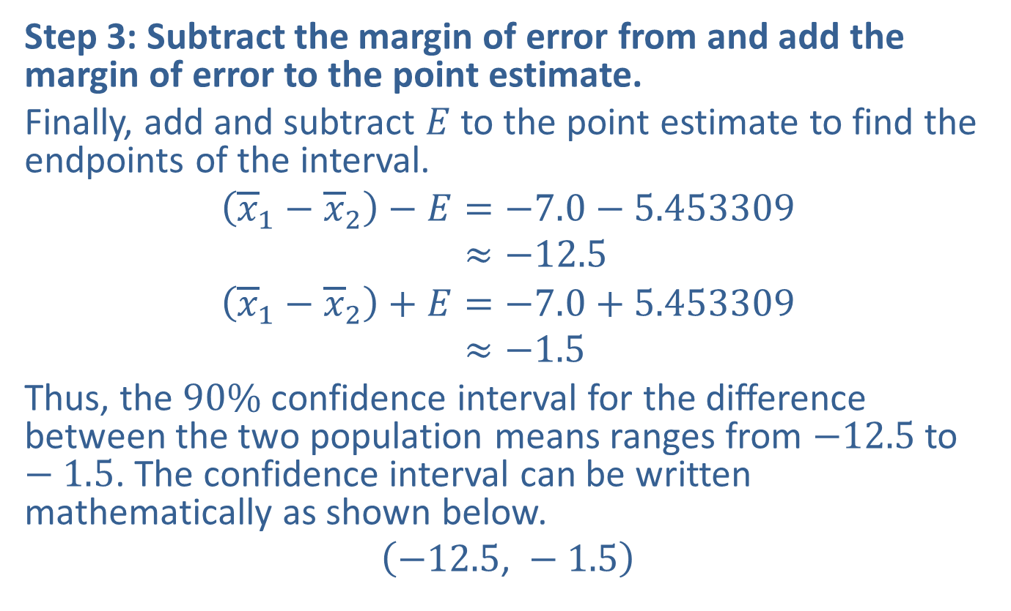
Example 9.2.2: Constructing a Confidence Interval for the Difference between Two Population Means with Unequal Variances (σ Unknown, Independent Samples) (cont.)
Step 3: Subtract the margin of error from and add the margin of error to the point estimate.
Finally, add and subtract $E$ to the point estimate to find the endpoints of the interval.
𝑥1−𝑥2−𝐸=−7.0−5.453309𝑥1−𝑥2−𝐸≈−12.5
𝑥1−𝑥2+𝐸=−7.0+5.453309𝑥1−𝑥2+𝐸≈−1.5
Thus, the $90\%$ confidence interval for the difference between the two population means ranges from $−12.5$ to $−1.5$. The confidence interval can be written mathematically as shown below.
$$\left(−12.5\text{, }−1.5\right)$$

Slide 16
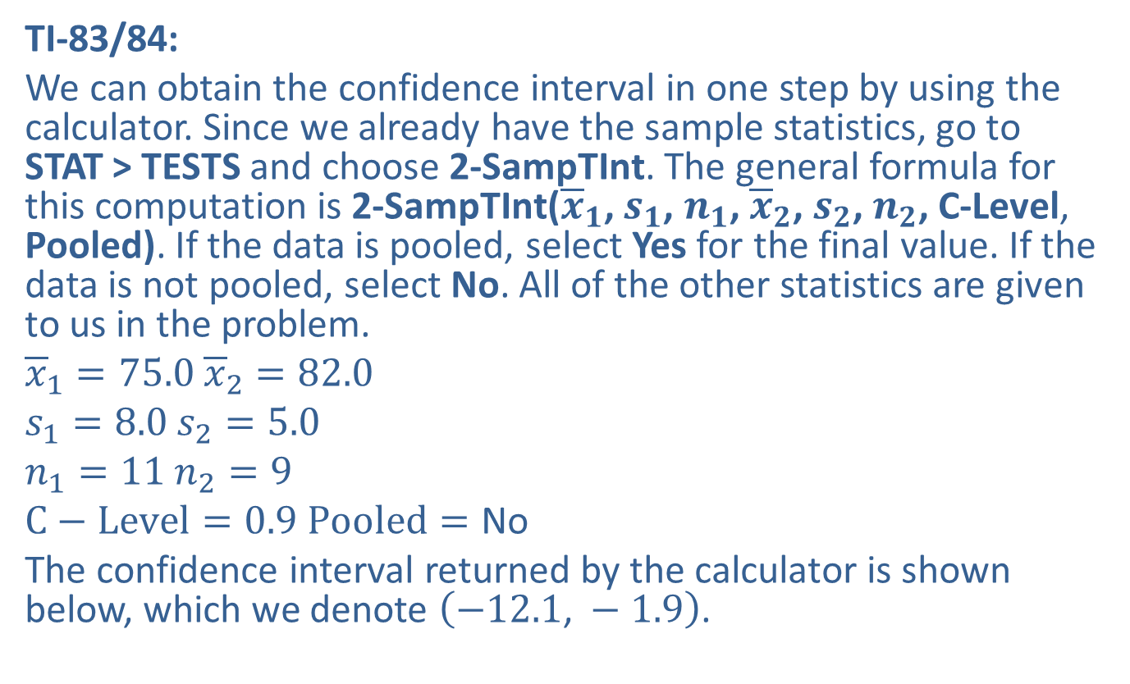
Example 9.2.2: Constructing a Confidence Interval for the Difference between Two Population Means with Unequal Variances (σ Unknown, Independent Samples) (cont.)
TI-83/84:
We can obtain the confidence interval in one step by using the calculator. Since we already have the sample statistics, go to
STAT > TESTS and choose 2-SampTInt. The general formula for this computation is 2-SampTInt(${\overline{x}}_{1}$, $s_{1}$, $n_{1}$, ${\overline{x}}_{2}$, $s_{2}$, $n_{2}$, C-Level, Pooled). If the data is pooled, select Yes for the final value. If the data is not pooled, select No. All of the other statistics are given to us in the problem.
${\overline{x}}_{1}=75.0$ ${\overline{x}}_{2}=82.0$
$s_{1}=8.0$ $s_{2}=5.0$
$n_{1}=11$ $n_{2}=9$
$C−Level=0.9$ $Pooled=\text{No}$
The confidence interval returned by the calculator is shown below, which we denote $\left(−12.1\text{, }−1.9\right)$.

Slide 17
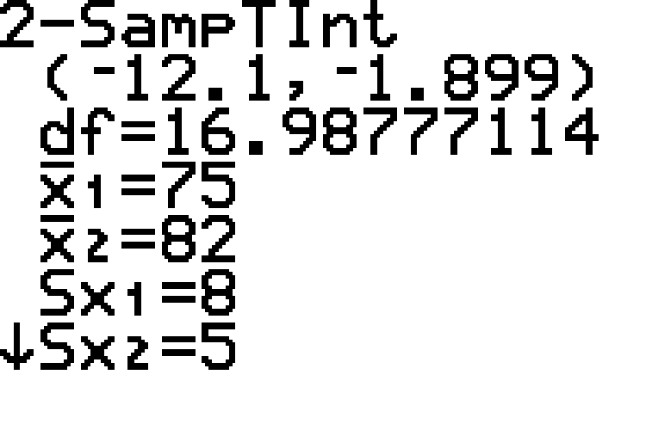
Example 9.2.2: Constructing a Confidence Interval for the Difference between Two Population Means with Unequal Variances (σ Unknown, Independent Samples) (cont.)

Slide 18
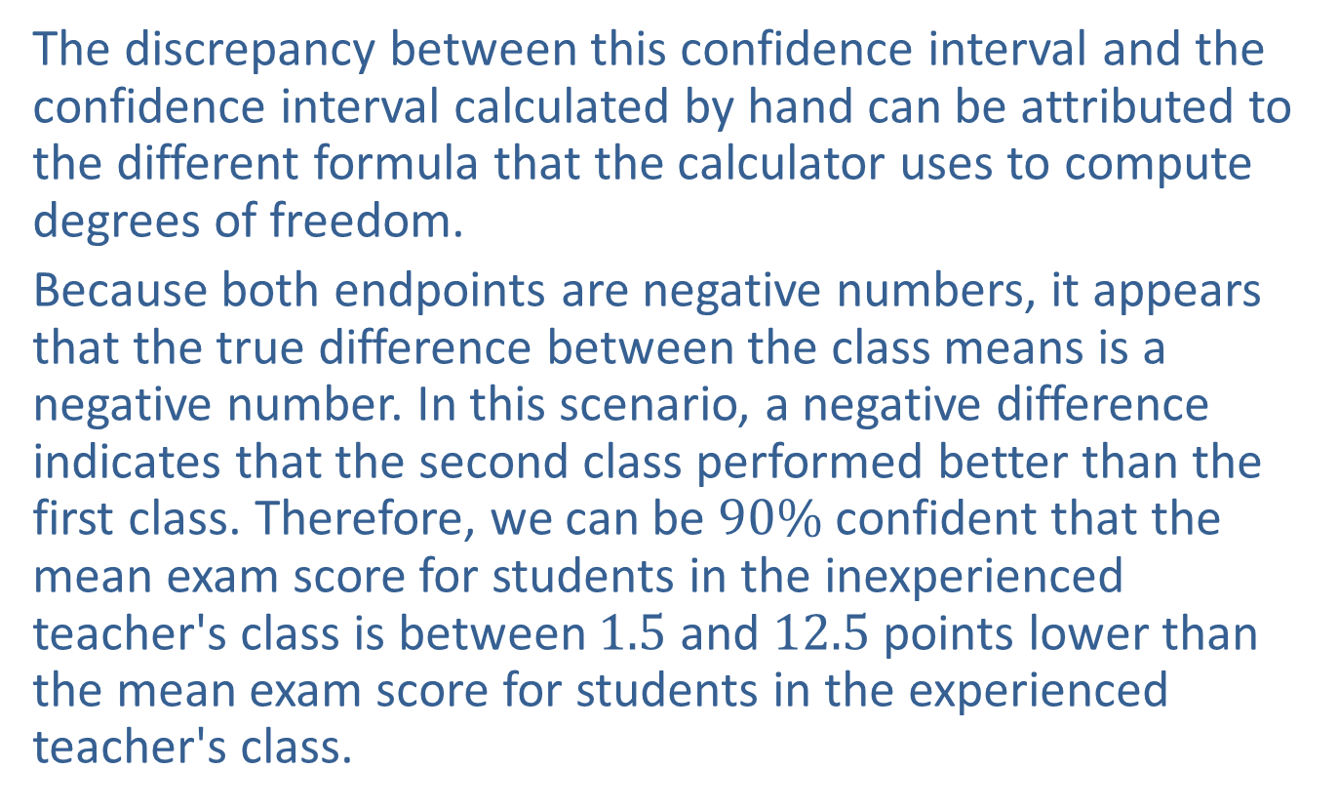
Example 9.2.2: Constructing a Confidence Interval for the Difference between Two Population Means with Unequal Variances (σ Unknown, Independent Samples) (cont.)
The discrepancy between this confidence interval and the confidence interval calculated by hand can be attributed to the different formula that the calculator uses to compute degrees of freedom.
Because both endpoints are negative numbers, it appears that the true difference between the class means is a negative number. In this scenario, a negative difference indicates that the second class performed better than the first class. Therefore, we can be $90\%$ confident that the mean exam score for students in the inexperienced teacher's class is between 1.5 and 12.5 points lower than the mean exam score for students in the experienced teacher's class.

Slide 19
Technology
For further instructions on calculating a two sample t-interval using a TI-83/84 Plus calculator or other technology, please visit stat.hawkeslearning.com and see Technology Instructions > Confidence Intervals > Two Sample t-interval.

Slide 20
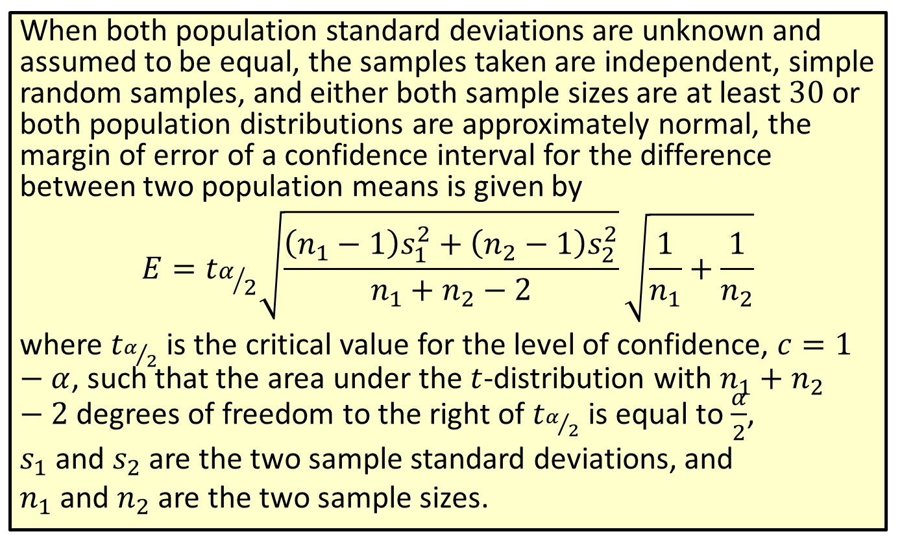
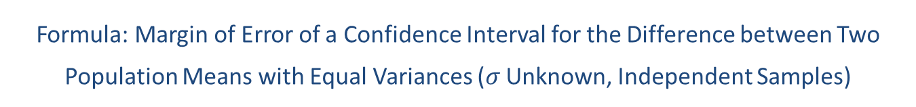
Formula: Margin of Error of a Confidence Interval for the Difference between Two Population Means with Equal Variances ($σ$ Unknown, Independent Samples)
When both population standard deviations are unknown and assumed to be equal, the samples taken are independent, simple random samples, and either both sample sizes are at least 30 or both population distributions are approximately normal, the margin of error of a confidence interval for the difference between two population means is given by
$$E=t_{α/2}\sqrt{\frac{\left(n_{1}−1\right)s_{1}^{2}+\left(n_{2}−1\right)s_{2}^{2}}{n_{1}+n_{2}−2}}\sqrt{\frac{1}{n_{1}}+\frac{1}{n_{2}}}$$
where $t_{α/2}$ is the critical value for the level of confidence, $c=1−α$, such that the area under the $t$-distribution with $n_{1}+n_{2}−2$ degrees of freedom to the right of $t_{α/2}$ is equal to $\frac{α}{2}$,
$s_{1}$ and $s_{2}$ are the two sample standard deviations, and
$n_{1}$ and $n_{2}$ are the two sample sizes.

Slide 21
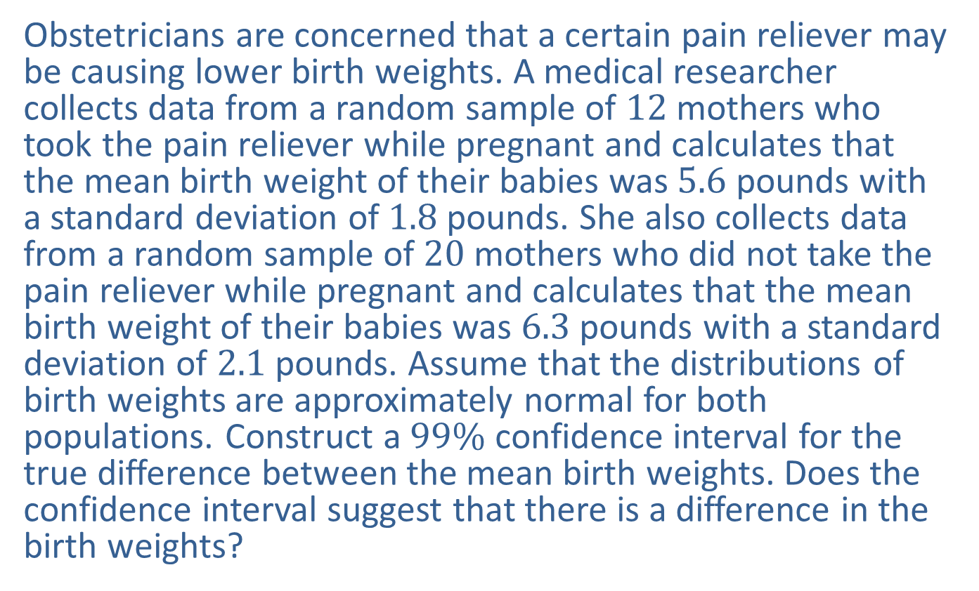
Example 9.2.3: Constructing a Confidence Interval for the Difference between Two Population Means with Equal Variances (σ Unknown, Independent Samples)
Obstetricians are concerned that a certain pain reliever may be causing lower birth weights. A medical researcher collects data from a random sample of 12 mothers who took the pain reliever while pregnant and calculates that the mean birth weight of their babies was 5.6 pounds with a standard deviation of 1.8 pounds. She also collects data from a random sample of 20 mothers who did not take the pain reliever while pregnant and calculates that the mean birth weight of their babies was 6.3 pounds with a standard deviation of 2.1 pounds. Assume that the distributions of birth weights are approximately normal for both populations. Construct a $99\%$ confidence interval for the true difference between the mean birth weights. Does the confidence interval suggest that there is a difference in the birth weights?

Slide 22
Example 9.2.3: Constructing a Confidence Interval for the Difference between Two Population Means with Equal Variances (σ Unknown, Independent Samples) (cont.)
Solution
Let's begin by assigning Population 1 as the birth weights of babies whose mothers took the pain reliever while pregnant, and Population 2 as the birth weights of babies whose mothers did not take the pain reliever while pregnant. Also note that because the only difference in the two populations was the administration of the pain reliever, it's reasonable to assume that the population variances are the same. For this reason, it is appropriate to use a pooled data approach to solving this problem.

Slide 23
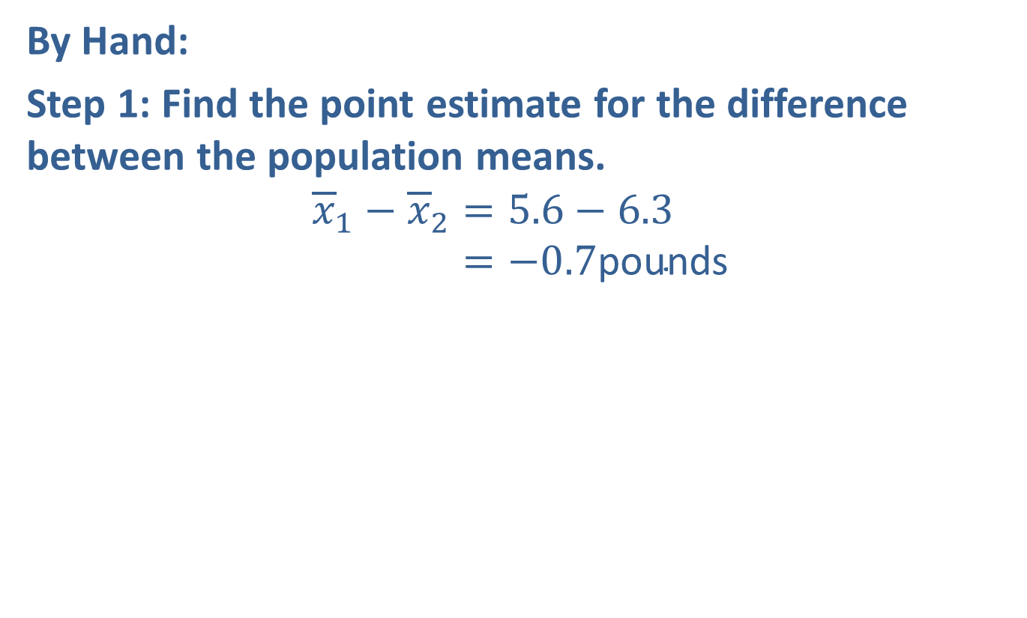
Example 9.2.3: Constructing a Confidence Interval for the Difference between Two Population Means with Equal Variances (σ Unknown, Independent Samples) (cont.)
By Hand:
Step 1: Find the point estimate for the difference between the population means.
𝑥1−𝑥2=5.6−6.3𝑥1−𝑥2=−0.7pounds

Slide 24
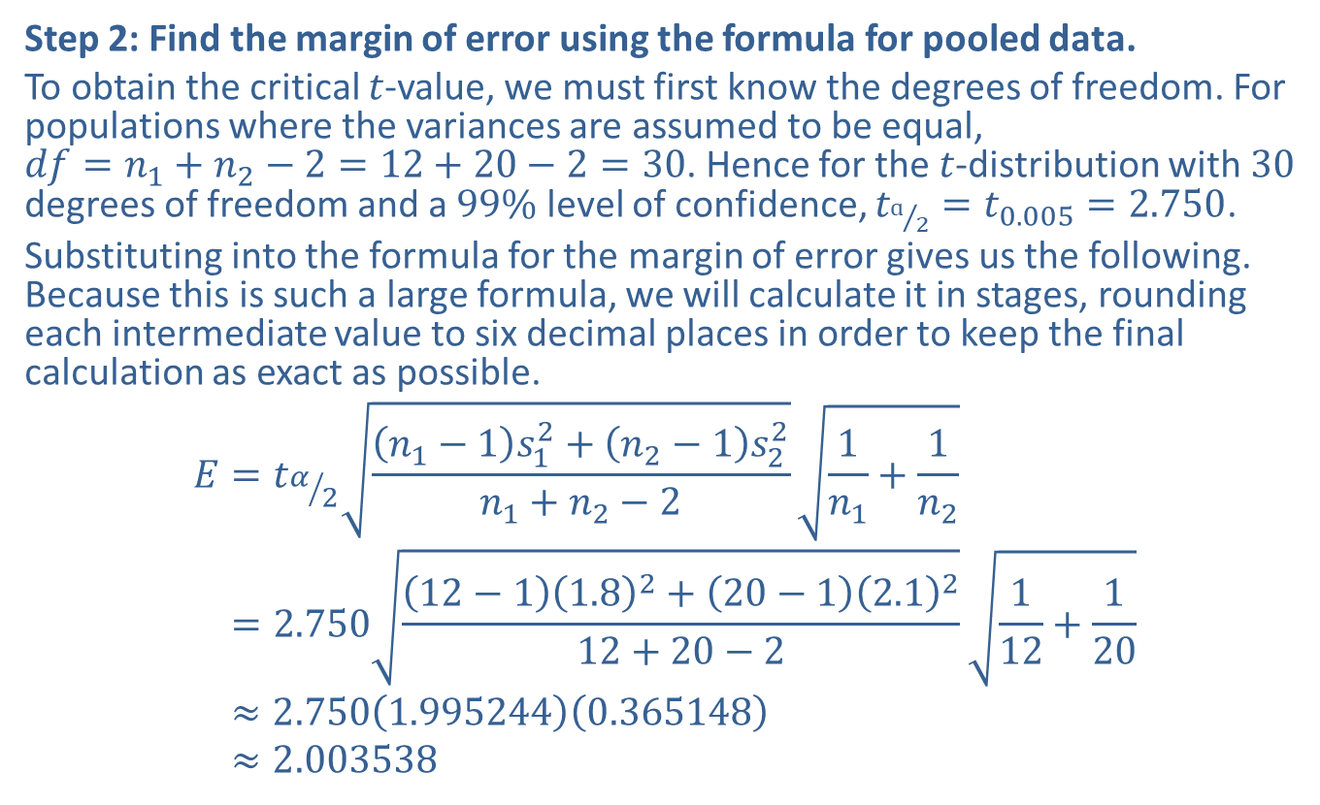
Example 9.2.3: Constructing a Confidence Interval for the Difference between Two Population Means with Equal Variances (σ Unknown, Independent Samples) (cont.)
Step 2: Find the margin of error using the formula for pooled data.
To obtain the critical $t$-value, we must first know the degrees of freedom. For populations where the variances are assumed to be equal,
$df=n_{1}+n_{2}−2=12+20−2=30$. Hence for the $t$-distribution with 30 degrees of freedom and a $99\%$ level of confidence, $t_{ɑ/2}=t_{0.005}=2.750$.
Substituting into the formula for the margin of error gives us the following. Because this is such a large formula, we will calculate it in stages, rounding each intermediate value to six decimal places in order to keep the final calculation as exact as possible.
𝐸=𝑡𝛼2𝑛1−1𝑠12+𝑛2−1𝑠22𝑛1+𝑛2−21𝑛1+1𝑛2𝐸=2.75012−11.82+20−12.1212+20−2112+120𝐸≈2.7501.9952440.365148𝐸≈2.003538

Slide 25
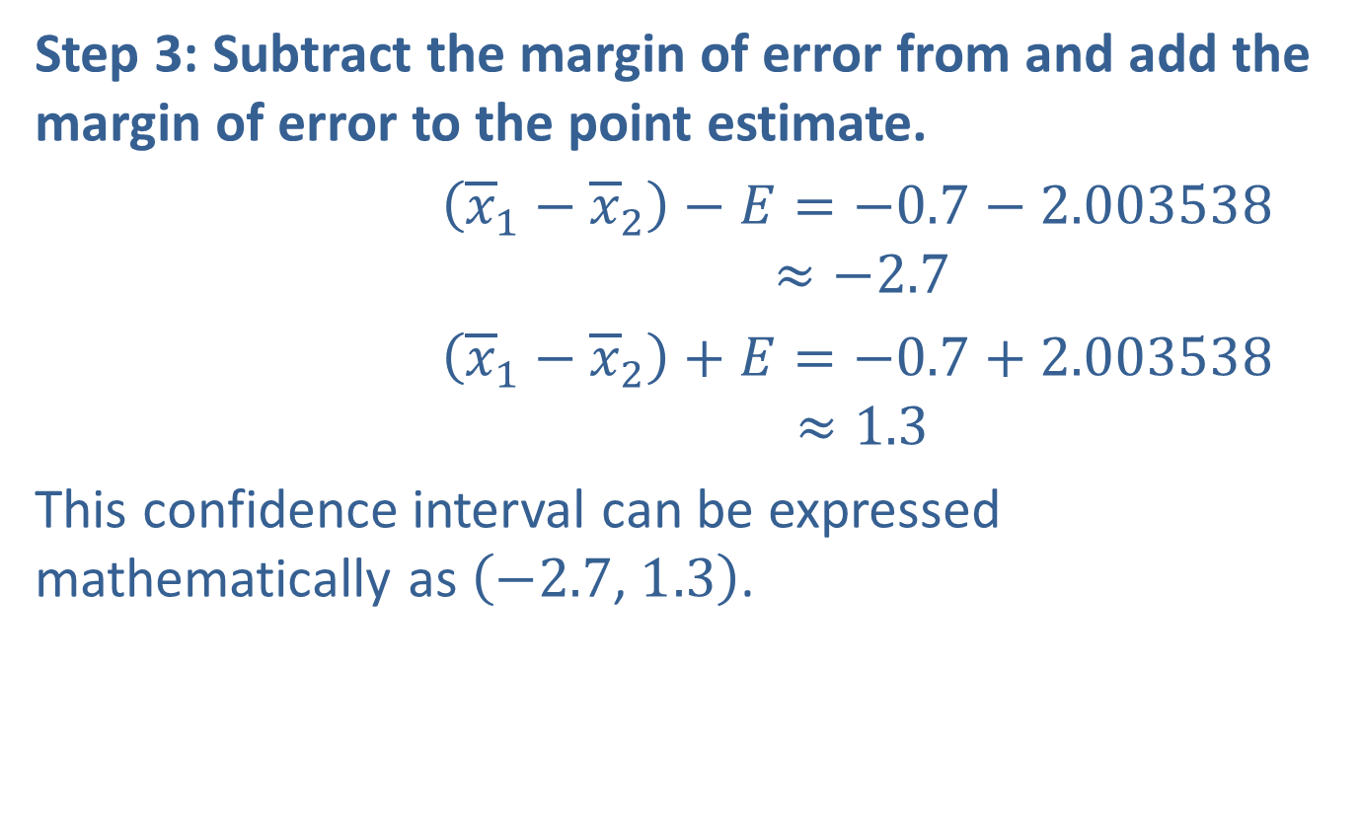
Example 9.2.3: Constructing a Confidence Interval for the Difference between Two Population Means with Equal Variances (σ Unknown, Independent Samples) (cont.)
Step 3: Subtract the margin of error from and add the margin of error to the point estimate.
$\left({\overline{x}}_{1}−{\overline{x}}_{2}\right)−E=−0.7−2.003538$
𝑥1−𝑥2−𝐸≈−2.7
$\left({\overline{x}}_{1}−{\overline{x}}_{2}\right)+E=−0.7+2.003538$
𝑥1−𝑥2+𝐸≈1.3
This confidence interval can be expressed mathematically as $\left(−2.7\text{, }1.3\right)$.
Lower endpoint:
Upper endpoint:

Slide 26
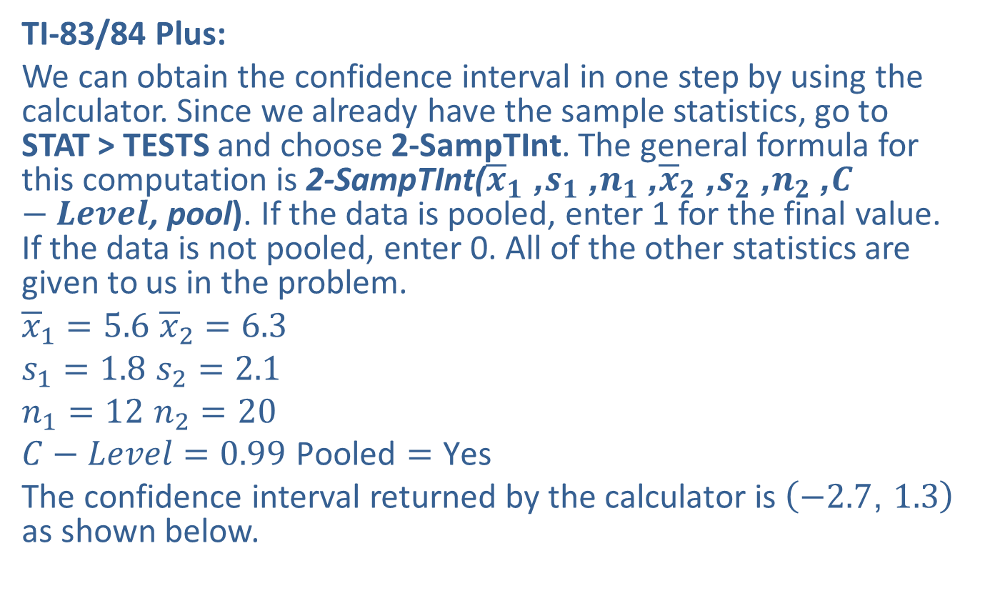
Example 9.2.3: Constructing a Confidence Interval for the Difference between Two Population Means with Equal Variances (σ Unknown, Independent Samples) (cont.)
TI-83/84 Plus:
We can obtain the confidence interval in one step by using the calculator. Since we already have the sample statistics, go to
STAT > TESTS and choose 2-SampTInt. The general formula for this computation is 2-SampTInt(${\overline{x}}_{1}$, $s_{1}$, $n_{1}$, ${\overline{x}}_{2}$, $s_{2}$, $n_{2}$, $C−Level$, pool). If the data is pooled, enter 1 for the final value. If the data is not pooled, enter 0. All of the other statistics are given to us in the problem.
${\overline{x}}_{1}=5.6$ ${\overline{x}}_{2}=6.3$
$s_{1}=1.8$ $s_{2}=2.1$
$n_{1}=12$ $n_{2}=20$
$C−Level=0.99$ $\text{Pooled}=\text{Y}\text{es}$
The confidence interval returned by the calculator is $\left(−2.7\text{, }1.3\right)$ as shown below.

Slide 27
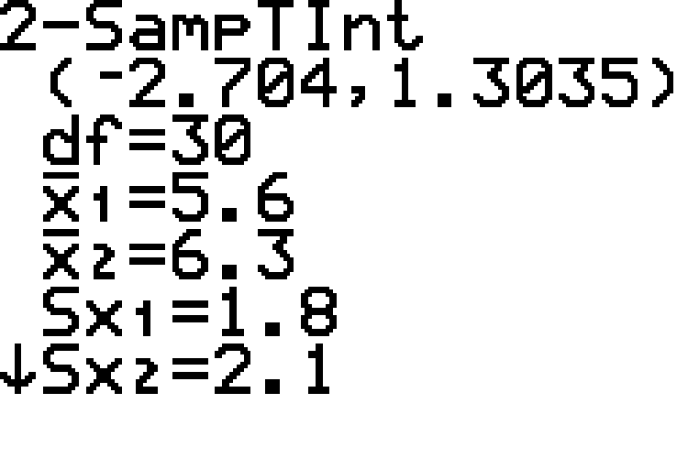
Example 9.2.3: Constructing a Confidence Interval for the Difference between Two Population Means with Equal Variances (σ Unknown, Independent Samples) (cont.)

Slide 28
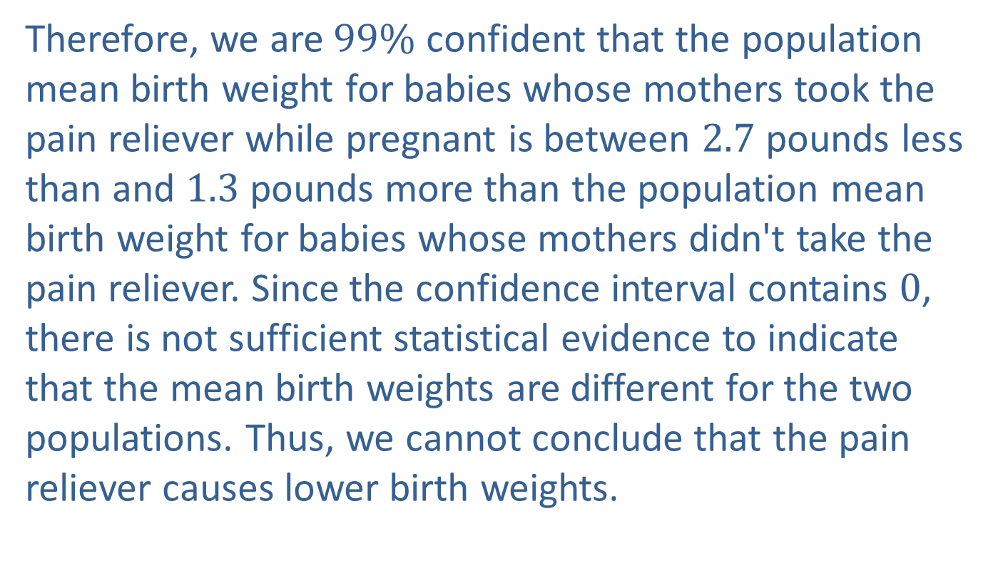
Example 9.2.3: Constructing a Confidence Interval for the Difference between Two Population Means with Equal Variances (σ Unknown, Independent Samples) (cont.)
Therefore, we are $99\%$ confident that the population mean birth weight for babies whose mothers took the pain reliever while pregnant is between 2.7 pounds less than and 1.3 pounds more than the population mean birth weight for babies whose mothers didn't take the pain reliever. Since the confidence interval contains 0, there is not sufficient statistical evidence to indicate that the mean birth weights are different for the two populations. Thus, we cannot conclude that the pain reliever causes lower birth weights.

