Slide 1
Section 9.3
Comparing Two Population Means (Sigma Unknown, Dependent Samples)

Slide 2
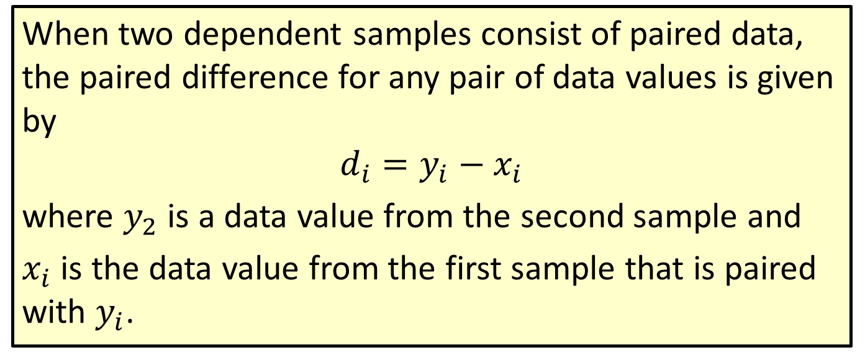
Formula: Paired Difference
When two dependent samples consist of paired data, the paired difference for any pair of data values is given by
$$d_{i}=y_{i}−x_{i}$$
where $y_{2}$ is a data value from the second sample and
$x_{i}$ is the data value from the first sample that is paired with $y_{i}$.

Slide 3
Example 9.3.1: Calculating Paired Differences
The amounts of home utility bills are given for two consecutive months for 5 different homes in a neighborhood. For each home in the sample, we can pair the billing amounts for March and April. Given the following data, calculate the paired differences for the five homes.

Slide 4
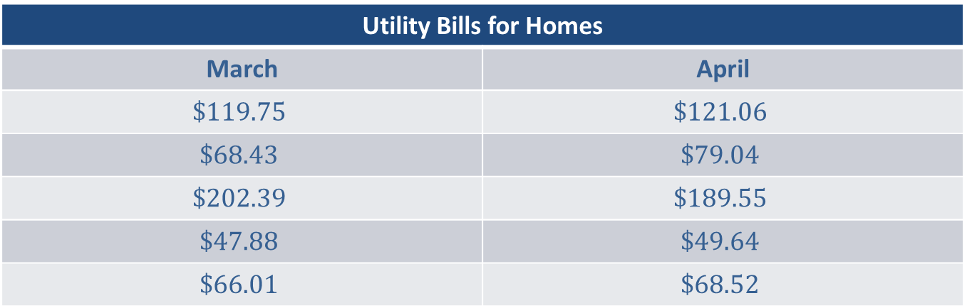
Example 9.3.1: Calculating Paired Differences (cont.)
Utility Bills for Homes
March | April
$$\$119.75$$ | $$\$121.06$$
$$\$68.43$$ | $$\$79.04$$
$$\$202.39$$ | $$\$189.55$$
$$\$47.88$$ | $$\$49.64$$
$$\$66.01$$ | $$\$68.52$$

Slide 5
Example 9.3.1: Calculating Paired Differences (cont.)
Solution
By Hand:
Calculate each paired difference by subtracting the value of the March bill from the value of the April bill. By subtracting in this manner, the paired difference will reflect the increase (or decrease) in the utility bill from March to April.

Slide 6
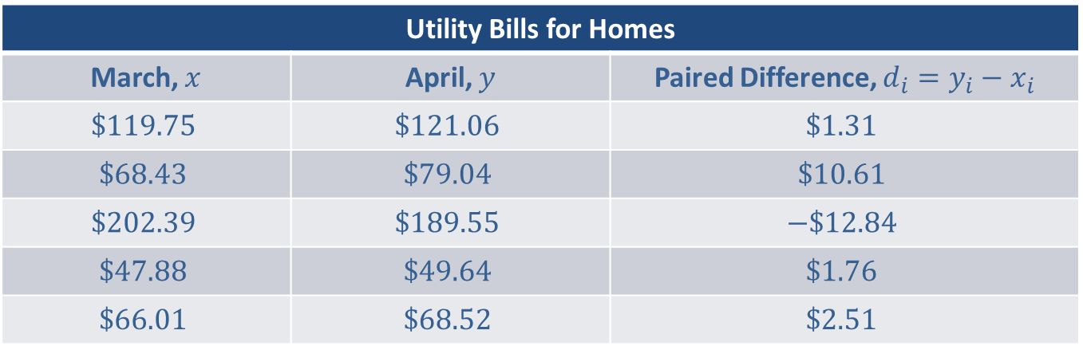
Example 9.3.1: Calculating Paired Differences (cont.)
Utility Bills for Homes
March, $x$ | April, $y$ | Paired Difference, $d_{i}=y_{i}−x_{i}$
$$\$119.75$$ | $$\$121.06$$ | $$\$1.31$$
$$\$68.43$$ | $$\$79.04$$ | $$\$10.61$$
$$\$202.39$$ | $$\$189.55$$ | $$−\$12.84$$
$$\$47.88$$ | $$\$49.64$$ | $$\$1.76$$
$$\$66.01$$ | $$\$68.52$$ | $$\$2.51$$

Slide 7
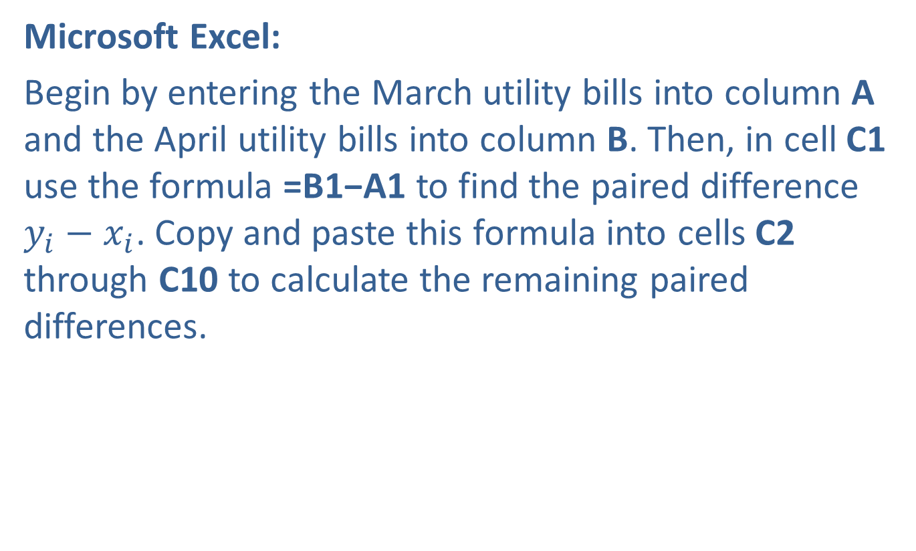
Example 9.3.1: Calculating Paired Differences (cont.)
Microsoft Excel:
Begin by entering the March utility bills into column A and the April utility bills into column B. Then, in cell C1 use the formula =B1−A1 to find the paired difference $y_{i}−x_{i}$. Copy and paste this formula into cells C2 through C10 to calculate the remaining paired differences.

Slide 8
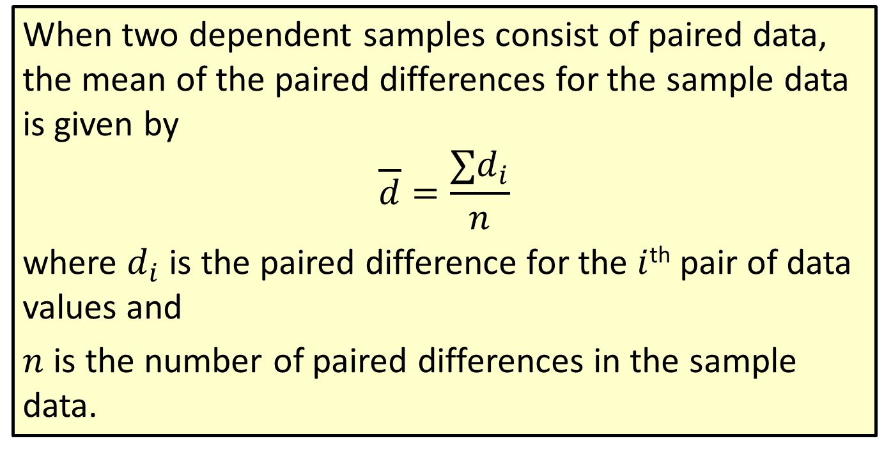
Formula: Mean of Paired Differences
When two dependent samples consist of paired data, the mean of the paired differences for the sample data is given by
$$\overline{d}=\frac{∑d_{i}}{n}$$
where $d_{i}$ is the paired difference for the $i$^{th} pair of data values and
$n$ is the number of paired differences in the sample data.

Slide 9
Example 9.3.2: Finding a Point Estimate for the Mean of the Paired Differences for Two Populations (σ Unknown, Dependent Samples)
Calculate the best point estimate for the mean of the paired differences for the two populations using the sample data given in Example 9.3.1.

Slide 10
Example 9.3.2: Finding a Point Estimate for the Mean of the Paired Differences for Two Populations (σ Unknown, Dependent Samples) (cont.)
Utility Bills for Homes
March | April
$$\$119.75$$ | $$\$121.06$$
$$\$68.43$$ | $$\$79.04$$
$$\$202.39$$ | $$\$189.55$$
$$\$47.88$$ | $$\$49.64$$
$$\$66.01$$ | $$\$68.52$$

Slide 11
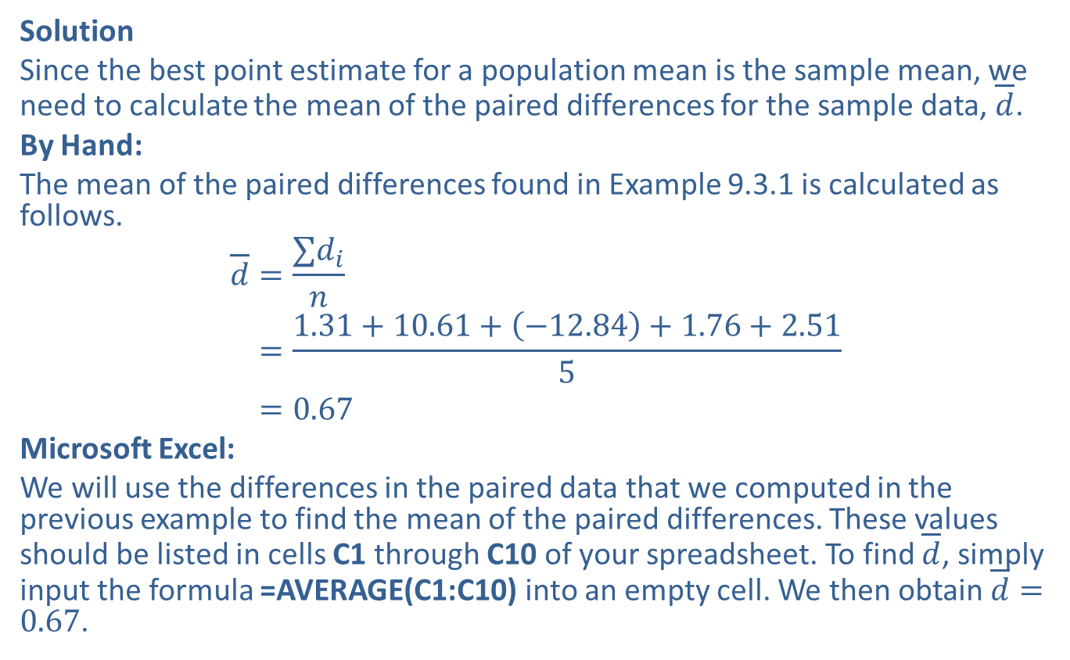
Example 9.3.2: Finding a Point Estimate for the Mean of the Paired Differences for Two Populations (σ Unknown, Dependent Samples) (cont.)
Solution
Since the best point estimate for a population mean is the sample mean, we need to calculate the mean of the paired differences for the sample data, $\overline{d}$.
By Hand:
The mean of the paired differences found in Example 9.3.1 is calculated as follows.
𝑑=∑𝑑𝑖𝑛𝑑=1.31+10.61+−12.84+1.76+2.515𝑑=0.67
Microsoft Excel:
We will use the differences in the paired data that we computed in the previous example to find the mean of the paired differences. These values should be listed in cells C1 through C10 of your spreadsheet. To find $\overline{d}$, simply input the formula =AVERAGE(C1:C10) into an empty cell. We then obtain $\overline{d}=0.67$.

Slide 12
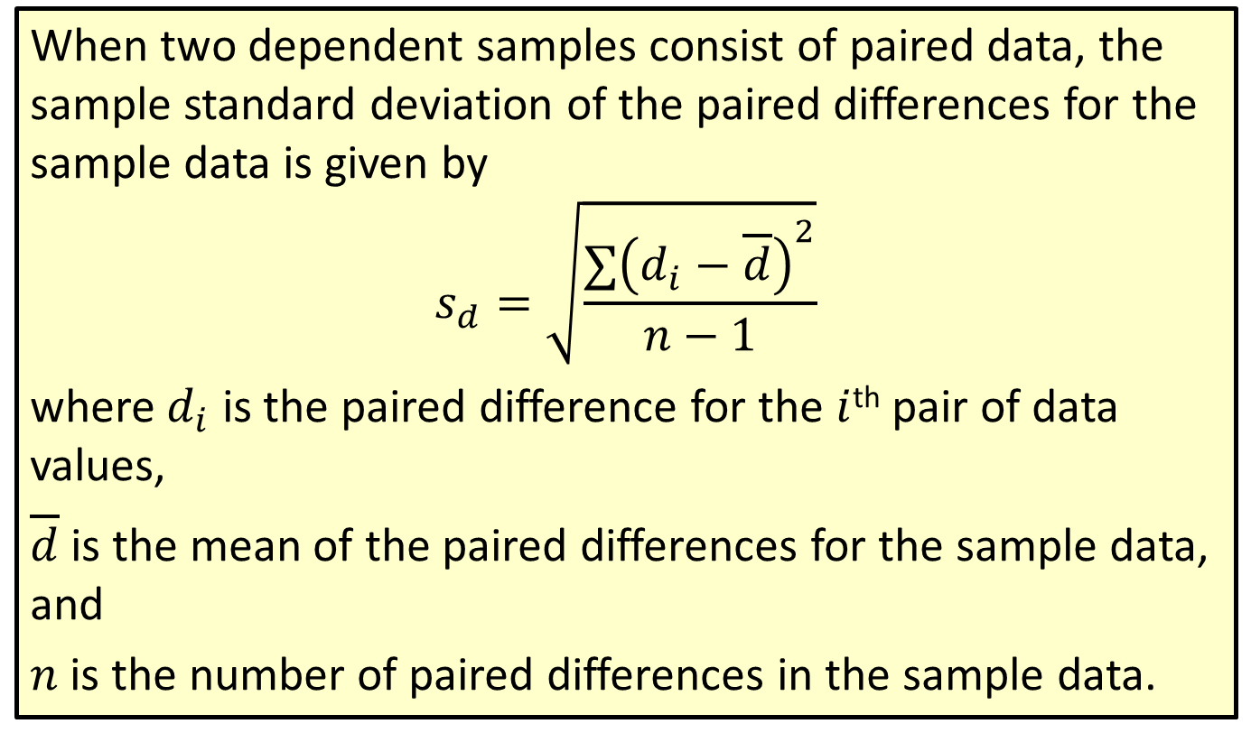
Formula: Sample Standard Deviation of Paired Differences
When two dependent samples consist of paired data, the sample standard deviation of the paired differences for the sample data is given by
$$s_{d}=\sqrt{\frac{∑{\left(d_{i}−\overline{d}\right)}^{2}}{n−1}}$$
where $d_{i}$ is the paired difference for the $i$^{th} pair of data values,
$\overline{d}$ is the mean of the paired differences for the sample data, and
$n$ is the number of paired differences in the sample data.

Slide 13
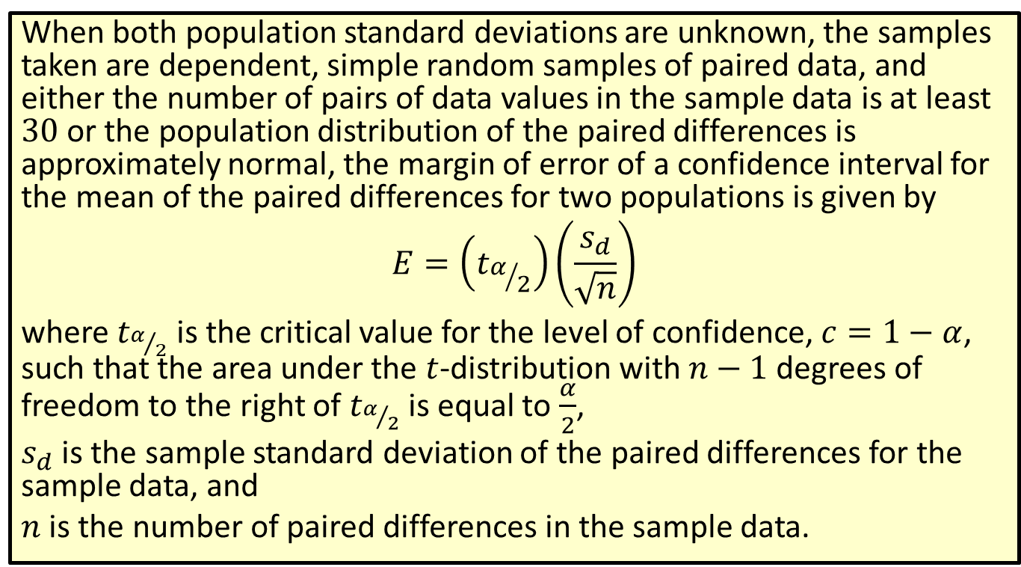
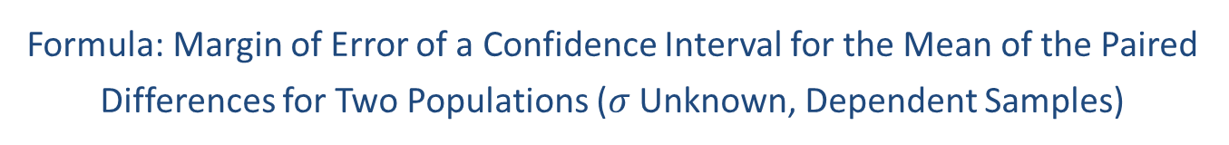
Formula: Margin of Error of a Confidence Interval for the Mean of the Paired Differences for Two Populations ($σ$ Unknown, Dependent Samples)
When both population standard deviations are unknown, the samples taken are dependent, simple random samples of paired data, and either the number of pairs of data values in the sample data is at least 30 or the population distribution of the paired differences is approximately normal, the margin of error of a confidence interval for the mean of the paired differences for two populations is given by
$$E=\left(t_{α/2}\right)\left(\frac{s_{d}}{\sqrt{n}}\right)$$
where $t_{α/2}$ is the critical value for the level of confidence, $c=1−α$, such that the area under the $t$-distribution with $n−1$ degrees of freedom to the right of $t_{α/2}$ is equal to $\frac{α}{2}$,
$s_{d}$ is the sample standard deviation of the paired differences for the sample data, and
$n$ is the number of paired differences in the sample data.

Slide 14
Rounding Rule
When calculating a margin of error for a confidence interval, round to at least six decimal places to avoid additional rounding errors in the subsequent calculations of the endpoints of the confidence interval.

Slide 15
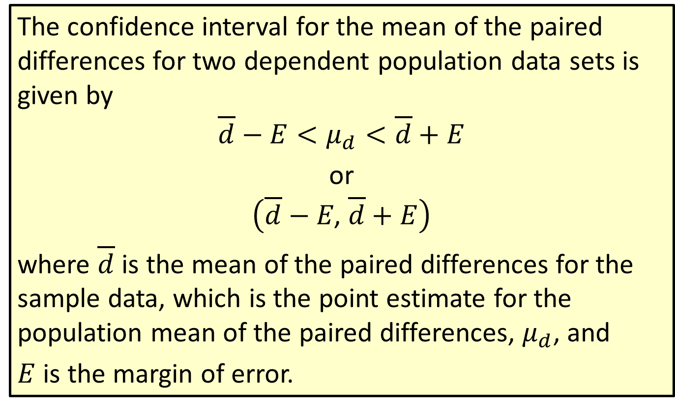

Formula: Confidence Interval for the Mean of the Paired Differences for Two Populations ($σ$ Unknown, Dependent Samples)
The confidence interval for the mean of the paired differences for two dependent population data sets is given by
$$\overline{d}−E<μ_{d}<\overline{d}+E$$
or
$$\left(\overline{d}−E\text{, }\overline{d}+E\right)$$
where $\overline{d}$ is the mean of the paired differences for the sample data, which is the point estimate for the population mean of the paired differences, $μ_{d}$, and
$E$ is the margin of error.

Slide 16
Rounding Rule
Round the endpoints of a confidence interval for the mean of the paired differences for two populations as follows:
​If sample data are given, round to one more decimal place than the largest number of decimal places in the given data
​If statistics are given, round to the same number of decimal places as given in the standard deviation or variance of the paired differences.

Slide 17
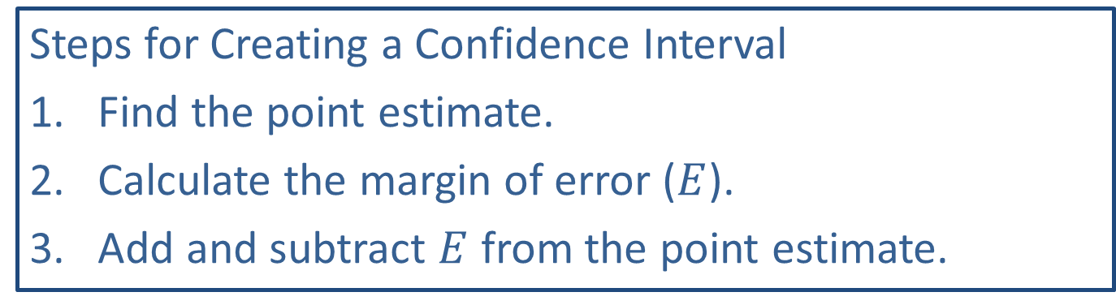
Memory Booster:
Steps for Creating a Confidence Interval
​Find the point estimate.
​Calculate the margin of error ($E$).
​Add and subtract $E$ from the point estimate.

Slide 18
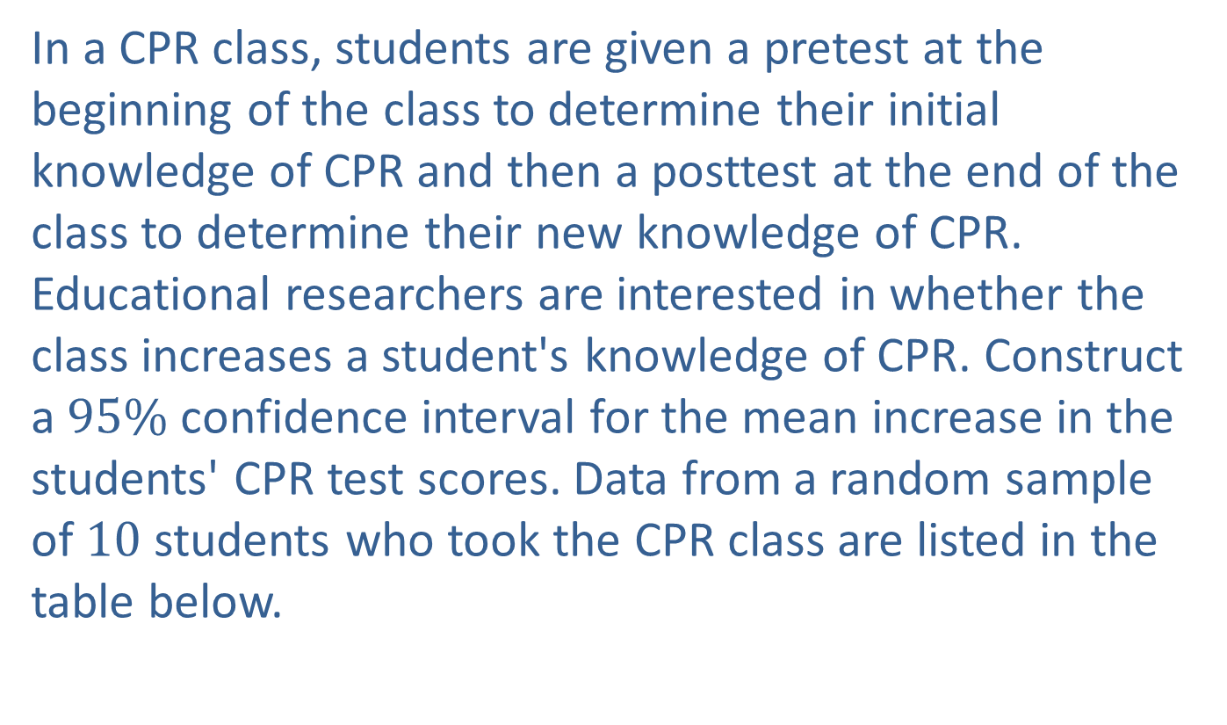
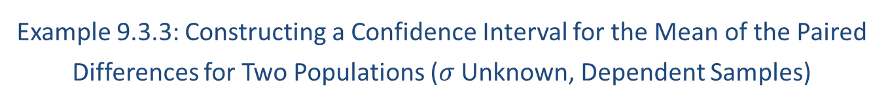
Example 9.3.3: Constructing a Confidence Interval for the Mean of the Paired Differences for Two Populations ($σ$ Unknown, Dependent Samples)
In a CPR class, students are given a pretest at the beginning of the class to determine their initial knowledge of CPR and then a posttest at the end of the class to determine their new knowledge of CPR. Educational researchers are interested in whether the class increases a student's knowledge of CPR. Construct a $95\%$ confidence interval for the mean increase in the students' CPR test scores. Data from a random sample of 10 students who took the CPR class are listed in the table below.

Slide 19
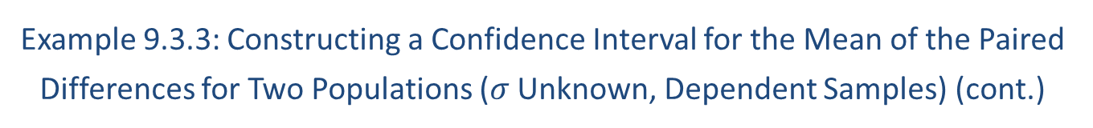
Example 9.3.3: Constructing a Confidence Interval for the Mean of the Paired Differences for Two Populations ($σ$ Unknown, Dependent Samples) (cont.)
Students' CPR Test Scores
Pretest Score | 60 | 63 | 68 | 70 | 71 | 68 | 72 | 80 | 83 | 79
Posttest Score | 80 | 79 | 83 | 90 | 83 | 89 | 94 | 95 | 96 | 93

Slide 20
Example 9.3.3: Constructing a Confidence Interval for the Mean of the Paired Differences for Two Populations ($σ$ Unknown, Dependent Samples) (cont.)
Solution
By Hand:
Step 1: Find the point estimate.
The point estimate for the population mean of the paired differences is the mean of the paired differences for the sample data. Because these are pretest and posttest scores, we can easily pair the data to determine if the mean test score either increased or decreased. The first step is to calculate the paired difference for each pair of data. Subtract each pretest score from its corresponding posttest score to obtain these values.

Slide 21
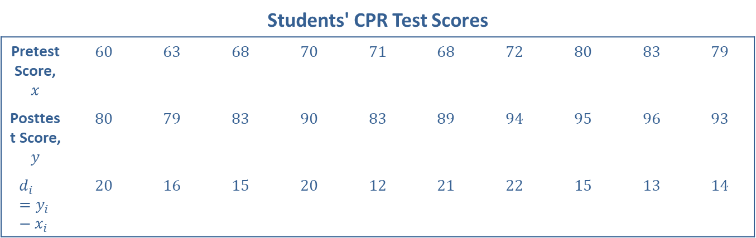
Example 9.3.3: Constructing a Confidence Interval for the Mean of the Paired Differences for Two Populations ($σ$ Unknown, Dependent Samples) (cont.)
Students' CPR Test Scores
Pretest Score, $x$ | 60 | 63 | 68 | 70 | 71 | 68 | 72 | 80 | 83 | 79
Posttest Score, $y$ | 80 | 79 | 83 | 90 | 83 | 89 | 94 | 95 | 96 | 93
$$d_{i}=y_{i}−x_{i}$$ | 20 | 16 | 15 | 20 | 12 | 21 | 22 | 15 | 13 | 14

Slide 22

Example 9.3.3: Constructing a Confidence Interval for the Mean of the Paired Differences for Two Populations ($σ$ Unknown, Dependent Samples) (cont.)
Next, calculate the mean and sample standard deviation of the paired differences. See Chapter 3 for a review of how to compute these values.
$$\overline{d}=16.8 \\ s_{d}≈3.614784$$

Slide 23
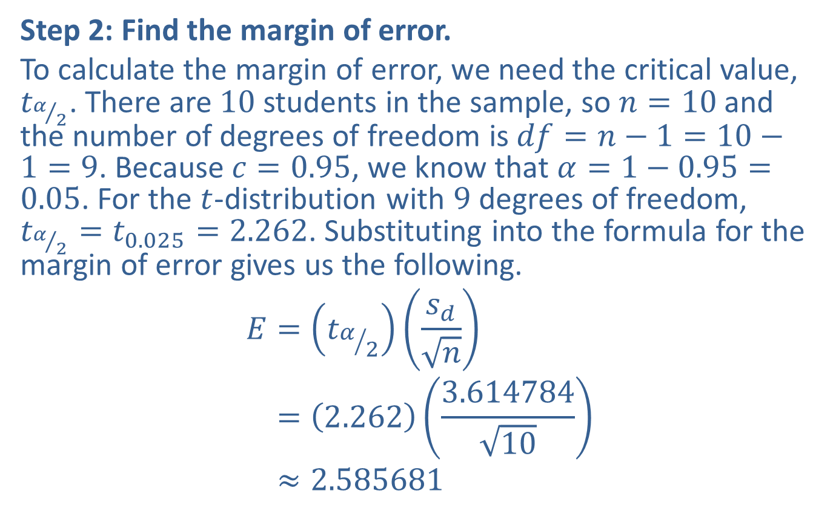
Example 9.3.3: Constructing a Confidence Interval for the Mean of the Paired Differences for Two Populations ($σ$ Unknown, Dependent Samples) (cont.)
Step 2: Find the margin of error.
To calculate the margin of error, we need the critical value, $t_{α/2}$. There are 10 students in the sample, so $n=10$ and the number of degrees of freedom is $df=n−1=10−1=9$. Because $c=0.95$, we know that $α=1−0.95=0.05$. For the $t$-distribution with 9 degrees of freedom, $t_{α/2}=t_{0.025}=2.262$. Substituting into the formula for the margin of error gives us the following.
𝐸=𝑡𝛼2𝑠𝑑𝑛𝐸=2.2623.61478410𝐸≈2.585681

Slide 24
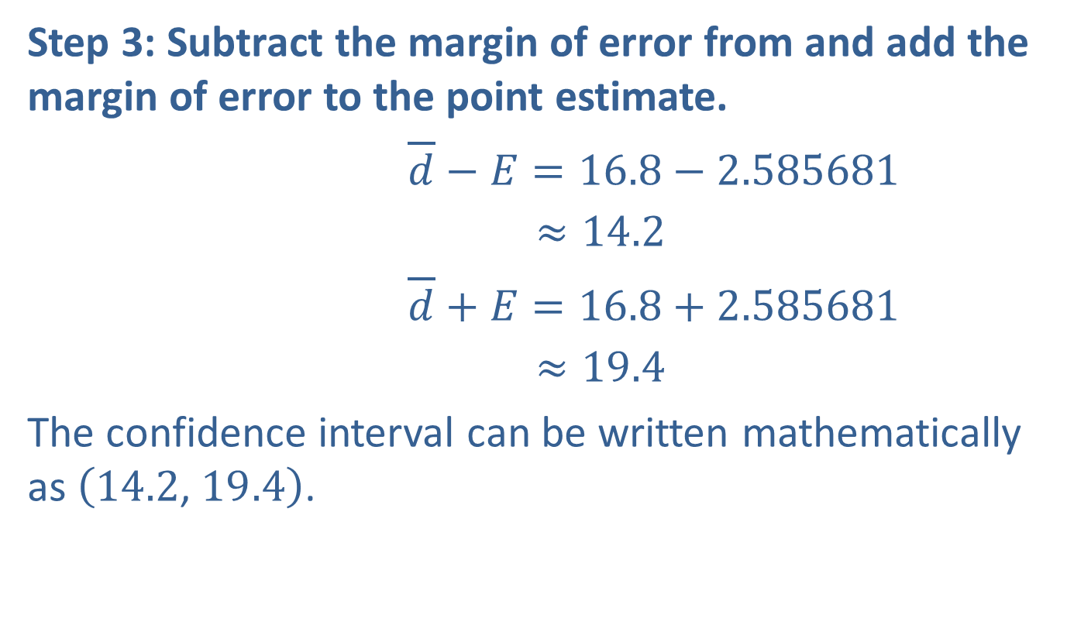
Example 9.3.3: Constructing a Confidence Interval for the Mean of the Paired Differences for Two Populations ($σ$ Unknown, Dependent Samples) (cont.)
Step 3: Subtract the margin of error from and add the margin of error to the point estimate.
$\overline{d}−E=16.8−2.585681$
𝑑−𝐸≈14.2
$\overline{d}+E=16.8+2.585681$
𝑑+𝐸≈19.4
The confidence interval can be written mathematically as $\left(14.2\text{, }19.4\right)$.
Lower endpoint:
Upper endpoint:

Slide 25
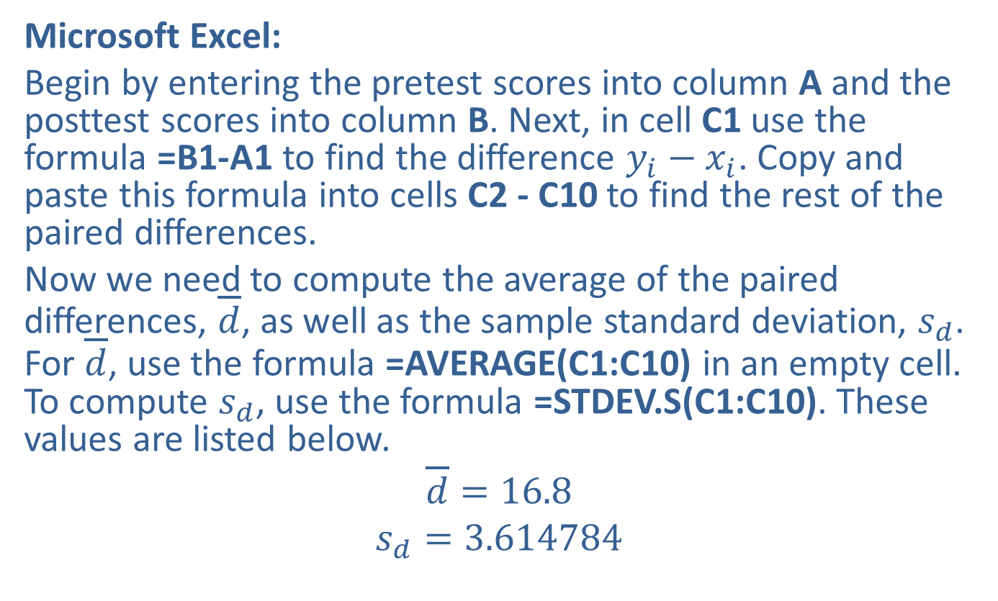
Example 9.3.3: Constructing a Confidence Interval for the Mean of the Paired Differences for Two Populations ($σ$ Unknown, Dependent Samples) (cont.)
Microsoft Excel:
Begin by entering the pretest scores into column A and the posttest scores into column B. Next, in cell C1 use the formula =B1-A1 to find the difference $y_{i}−x_{i}$. Copy and paste this formula into cells C2 - C10 to find the rest of the paired differences.
Now we need to compute the average of the paired differences, $\overline{d}$, as well as the sample standard deviation, $s_{d}$. For $\overline{d}$, use the formula =AVERAGE(C1:C10) in an empty cell. To compute $s_{d}$, use the formula =STDEV.S(C1:C10). These values are listed below.
$$\overline{d}=16.8$$
$$s_{d}=3.614784$$

Slide 26
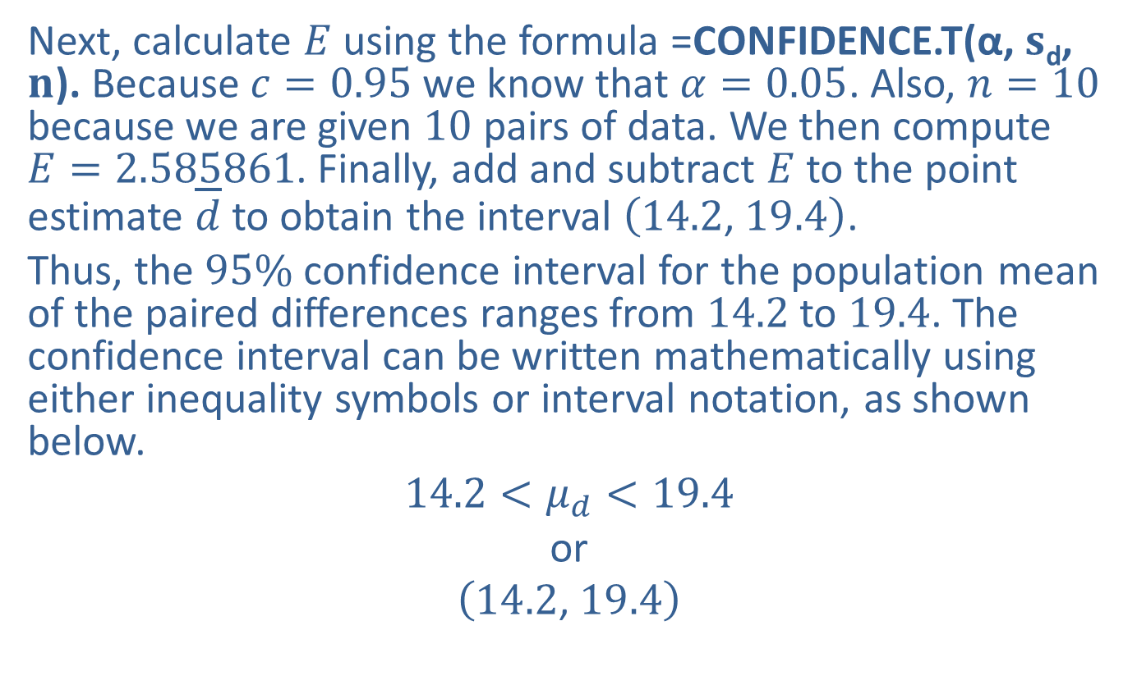
Example 9.3.3: Constructing a Confidence Interval for the Mean of the Paired Differences for Two Populations ($σ$ Unknown, Dependent Samples) (cont.)
Next, calculate $E$ using the formula =CONFIDENCE.T(α, $s$_{d}, $n$). Because $c=0.95$ we know that $α=0.05$. Also, $n=10$ because we are given 10 pairs of data. We then compute $E=2.585861$. Finally, add and subtract $E$ to the point estimate $\overline{d}$ to obtain the interval $\left(14.2\text{, }19.4\right)$.
Thus, the $95\%$ confidence interval for the population mean of the paired differences ranges from 14.2 to 19.4. The confidence interval can be written mathematically using either inequality symbols or interval notation, as shown below.
$$14.2<μ_{d}<19.4$$
or
$$\left(14.2\text{, }19.4\right)$$

Slide 27
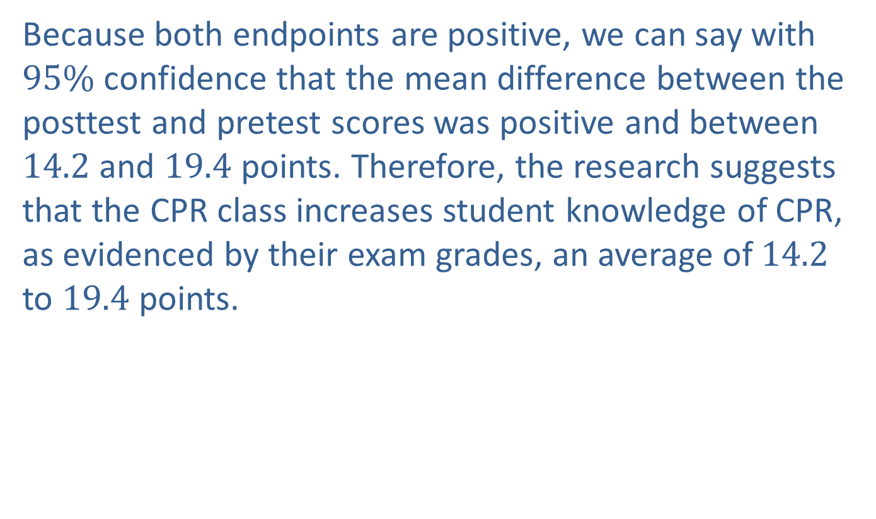
Example 9.3.3: Constructing a Confidence Interval for the Mean of the Paired Differences for Two Populations ($σ$ Unknown, Dependent Samples) (cont.)
Because both endpoints are positive, we can say with $95\%$ confidence that the mean difference between the posttest and pretest scores was positive and between 14.2 and 19.4 points. Therefore, the research suggests that the CPR class increases student knowledge of CPR, as evidenced by their exam grades, an average of 14.2 to 19.4 points.

Slide 28
Technology
For further instructions on calculating a t-interval using Excel or other technology, please visit stat.hawkeslearning.com and see Technology Instructions > Confidence Intervals > t-interval.

Slide 29
Example 9.3.4: Constructing a Confidence Interval for the Mean of the Paired Differences for Two Populations (σ Unknown, Dependent Samples)
In a recent study, cholesterol levels were measured before and after participants took a new drug designed to lower their total cholesterol for four weeks. The results are shown in the following table.

Slide 30
Example 9.3.4: Constructing a Confidence Interval for the Mean of the Paired Differences for Two Populations (σ Unknown, Dependent Samples) (cont.)
Total Cholesterol Levels (in mg/dL)
Before | After
238 | 235
240 | 241
220 | 219
246 | 235
202 | 198
222 | 208
210 | 202
233 | 211
204 | 188
229 | 201
244 | 235
220 | 211
219 | 207

Slide 31

Example 9.3.4: Constructing a Confidence Interval for the Mean of the Paired Differences for Two Populations (σ Unknown, Dependent Samples) (cont.)
Find the $99\%$ confidence interval for the true mean of the differences between the cholesterol levels for the population from which the participants were sampled.

Slide 32
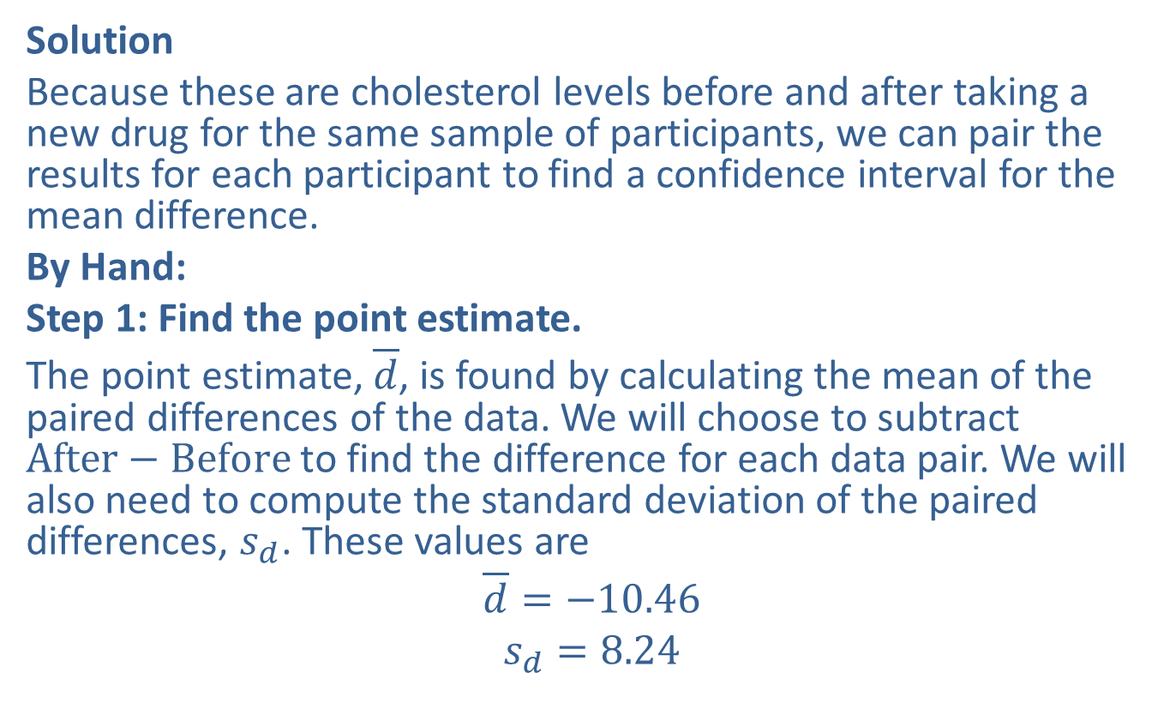
Example 9.3.4: Constructing a Confidence Interval for the Mean of the Paired Differences for Two Populations (σ Unknown, Dependent Samples) (cont.)
Solution
Because these are cholesterol levels before and after taking a new drug for the same sample of participants, we can pair the results for each participant to find a confidence interval for the mean difference.
By Hand:
Step 1: Find the point estimate.
The point estimate, $\overline{d}$, is found by calculating the mean of the paired differences of the data. We will choose to subtract $After−Before$ to find the difference for each data pair. We will also need to compute the standard deviation of the paired differences, $s_{d}$. These values are
$$\overline{d}=−10.46$$
$$s_{d}=8.24$$

Slide 33
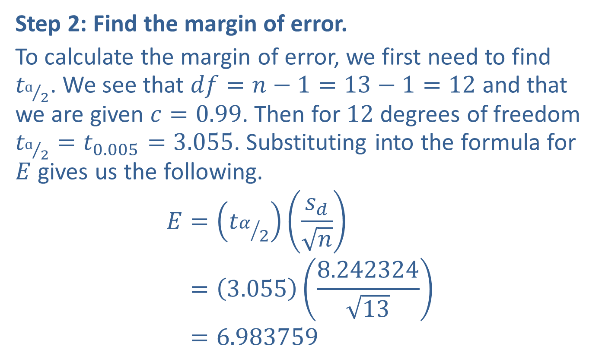
Example 9.3.4: Constructing a Confidence Interval for the Mean of the Paired Differences for Two Populations (σ Unknown, Dependent Samples) (cont.)
Step 2: Find the margin of error.
To calculate the margin of error, we first need to find $t_{ɑ/2}$. We see that $df=n−1=13−1=12$ and that we are given $c=0.99$. Then for 12 degrees of freedom $t_{ɑ/2}=t_{0.005}=3.055$. Substituting into the formula for $E$ gives us the following.
𝐸=𝑡𝛼2𝑠𝑑𝑛𝐸=3.0558.24232413𝐸=6.983759

Slide 34
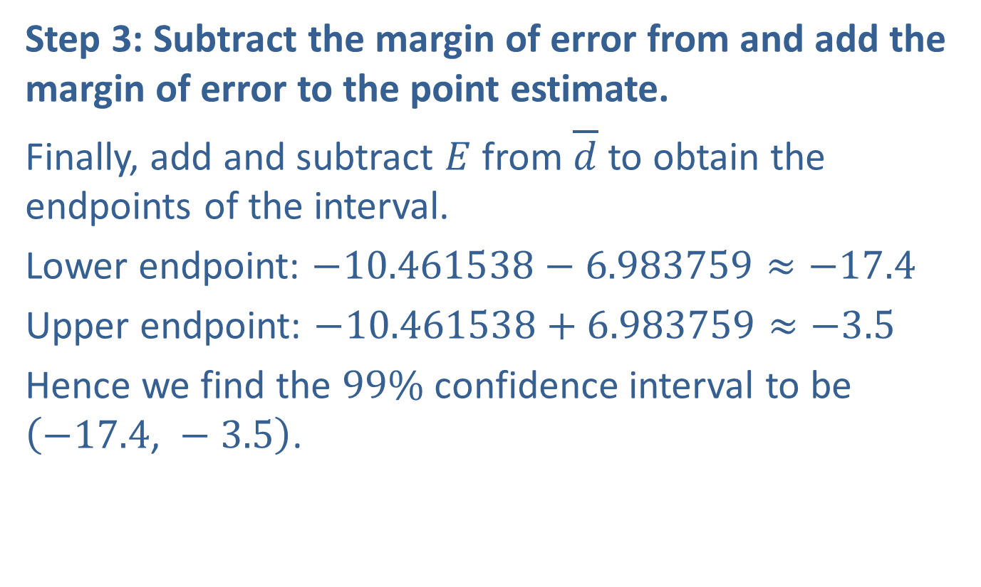
Example 9.3.4: Constructing a Confidence Interval for the Mean of the Paired Differences for Two Populations (σ Unknown, Dependent Samples) (cont.)
Step 3: Subtract the margin of error from and add the margin of error to the point estimate.
Finally, add and subtract $E$ from $\overline{d}$ to obtain the endpoints of the interval.
Lower endpoint: $−10.461538−6.983759≈−17.4$
Upper endpoint: $−10.461538+6.983759≈−3.5$
Hence we find the $99\%$ confidence interval to be $\left(−17.4\text{, }−3.5\right)$.

Slide 35
Example 9.3.4: Constructing a Confidence Interval for the Mean of the Paired Differences for Two Populations (σ Unknown, Dependent Samples) (cont.)
TI 83/84-Plus:
Begin by entering the data in the lists L1 and L2. Let L1 be the "before" levels and L2 be the "after" levels. Since we need the differences between the pairs of data, we use L3 to calculate those differences for us. To do so, highlight L3 and enter the formula to subtract the "before" levels from the "after" levels (L2-L1). The screenshot below shows how the data and the paired differences will appear in the calculator.

Slide 36
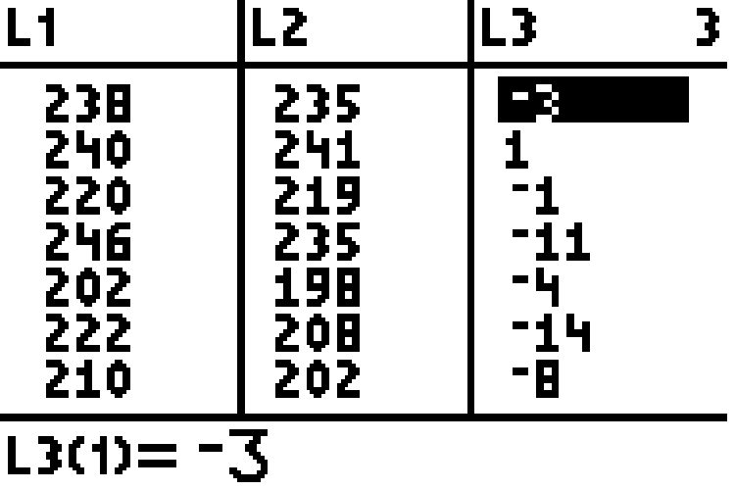
Example 9.3.4: Constructing a Confidence Interval for the Mean of the Paired Differences for Two Populations (σ Unknown, Dependent Samples) (cont.)

Slide 37
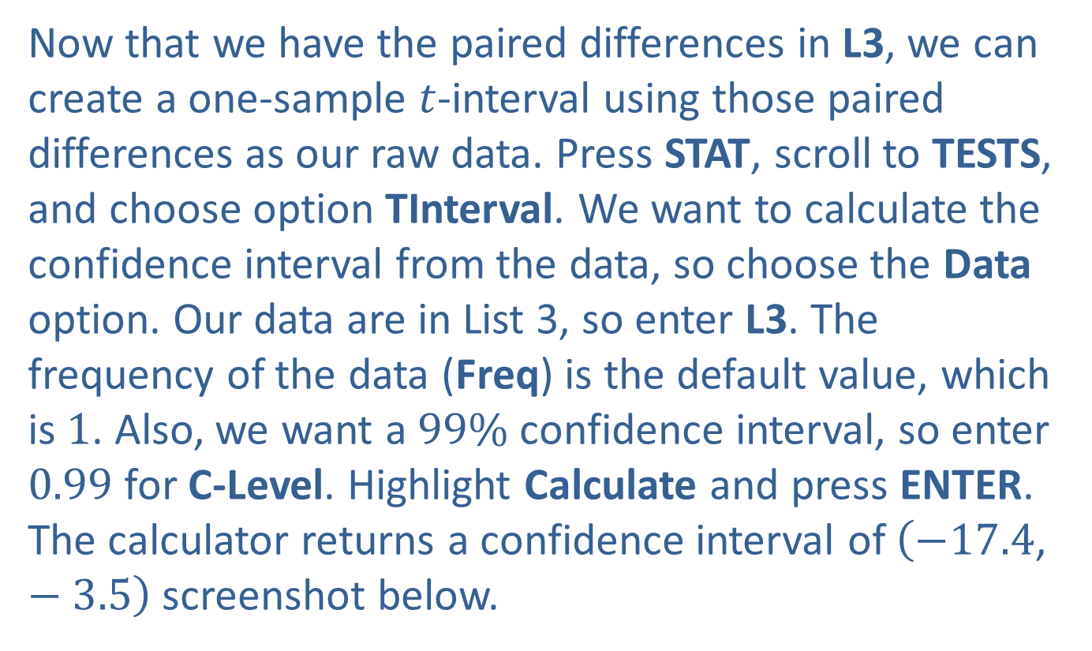
Example 9.3.4: Constructing a Confidence Interval for the Mean of the Paired Differences for Two Populations (σ Unknown, Dependent Samples) (cont.)
Now that we have the paired differences in L3, we can create a one-sample $t$-interval using those paired differences as our raw data. Press STAT, scroll to TESTS, and choose option TInterval. We want to calculate the confidence interval from the data, so choose the Data option. Our data are in List 3, so enter L3. The frequency of the data (Freq) is the default value, which is 1. Also, we want a $99\%$ confidence interval, so enter 0.99 for C-Level. Highlight Calculate and press ENTER. The calculator returns a confidence interval of $\left(−17.4\text{, }−3.5\right)$ screenshot below.

Slide 38
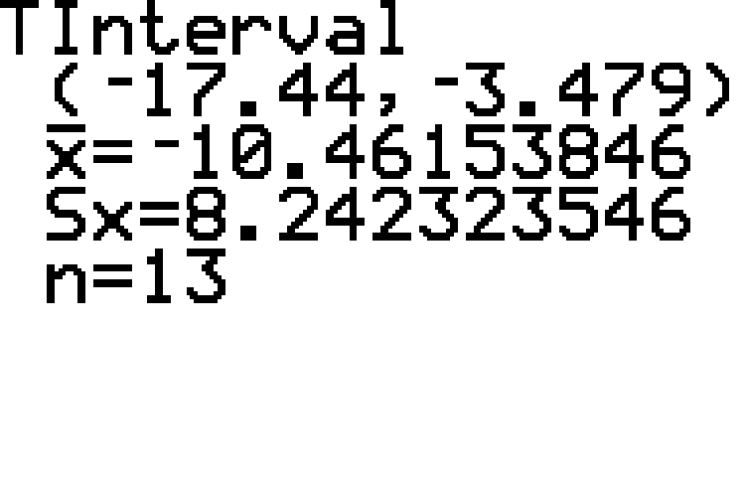
Example 9.3.4: Constructing a Confidence Interval for the Mean of the Paired Differences for Two Populations (σ Unknown, Dependent Samples) (cont.)

Slide 39
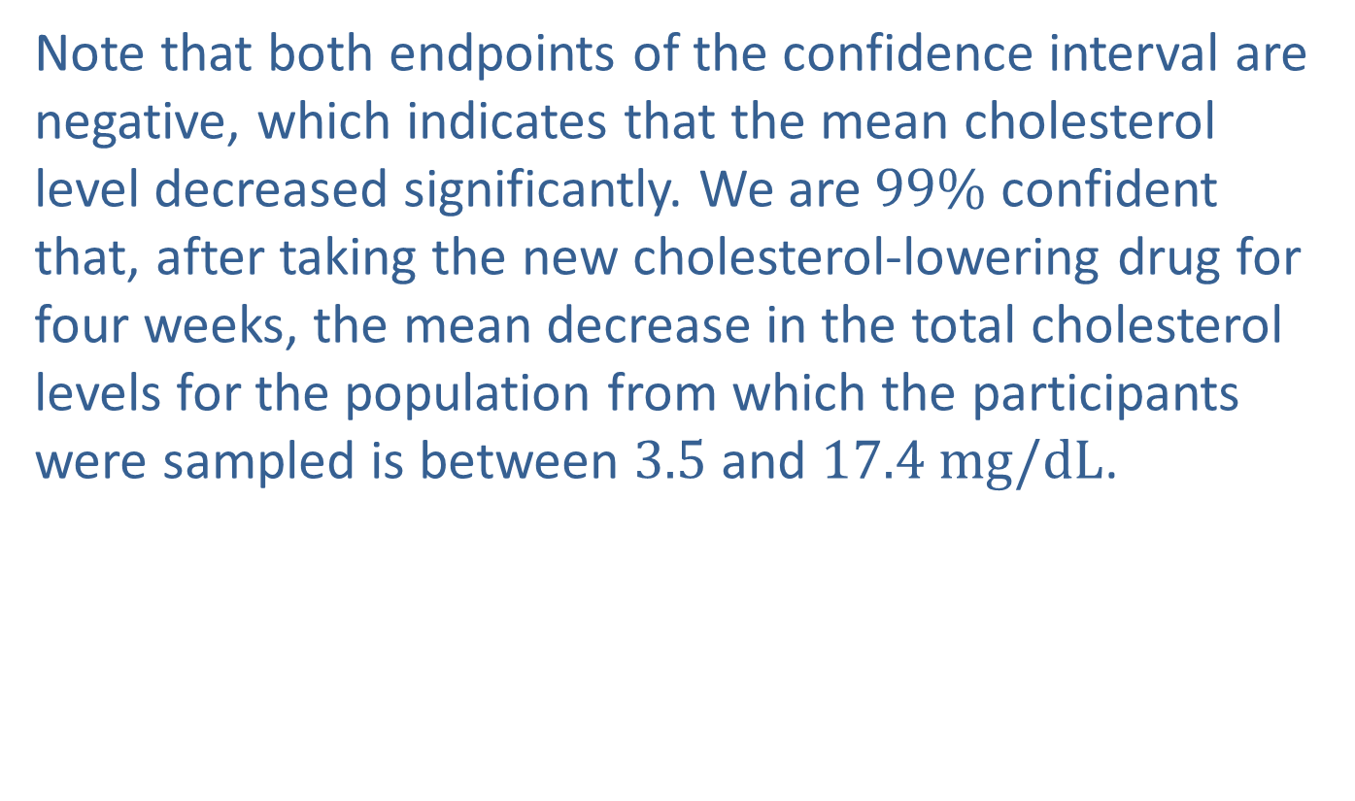
Example 9.3.4: Constructing a Confidence Interval for the Mean of the Paired Differences for Two Populations (σ Unknown, Dependent Samples) (cont.)
Note that both endpoints of the confidence interval are negative, which indicates that the mean cholesterol level decreased significantly. We are $99\%$ confident that, after taking the new cholesterol-lowering drug for four weeks, the mean decrease in the total cholesterol levels for the population from which the participants were sampled is between 3.5 and $17.4 mg/dL$.

Slide 40
Technology
For further instructions on calculating a t-interval using a TI-83/84 Plus calculator or other technology, please visit stat.hawkeslearning.com and see Technology Instructions > Confidence Intervals > t-interval.

