Slide 1
Section 9.4
Comparing Two Population Proportions

Slide 2
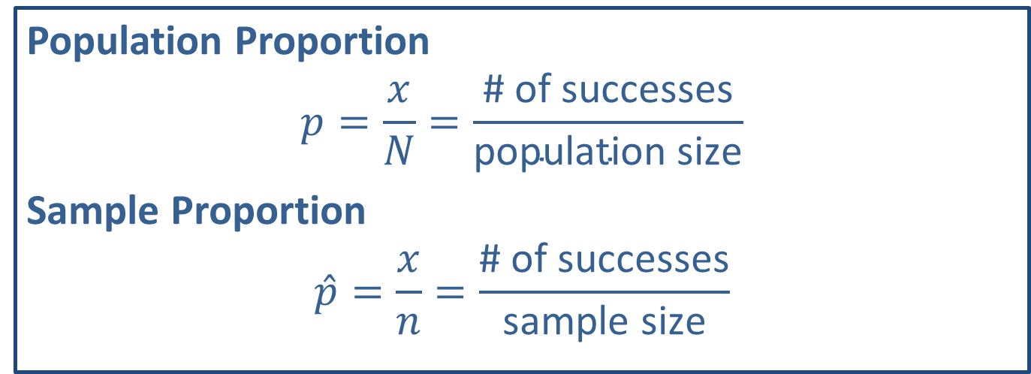
Memory Booster
Population Proportion
$$p=\frac{x}{N}=\frac{\text{\# }\text{of} \text{successes}}{\text{population} \text{size}}$$
Sample Proportion
$$\hat{p}=\frac{x}{n}=\frac{\text{\# }\text{of} \text{successes}}{\text{sample} \text{size}}$$

Slide 3
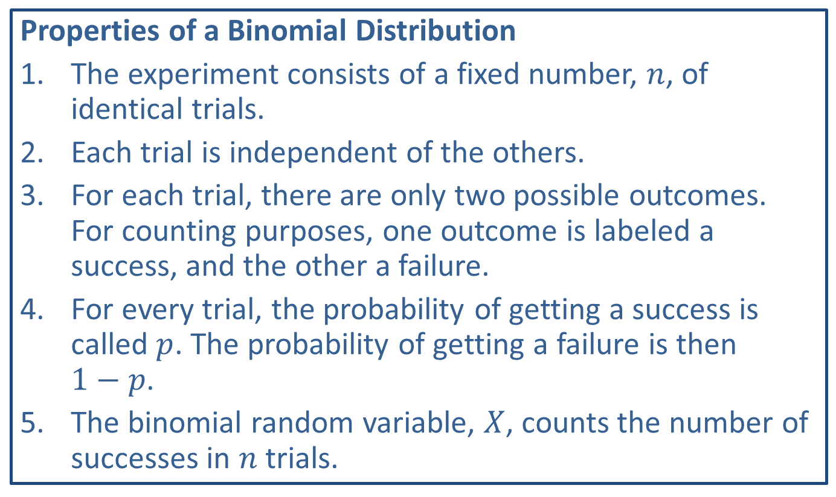
Memory Booster
Properties of a Binomial Distribution
​The experiment consists of a fixed number, $n$, of identical trials.
​Each trial is independent of the others.
​For each trial, there are only two possible outcomes. For counting purposes, one outcome is labeled a success, and the other a failure.
​For every trial, the probability of getting a success is called $p$. The probability of getting a failure is then
$1−p$.
​The binomial random variable, $X$, counts the number of successes in $n$ trials.

Slide 4
Example 9.4.1: Calculating Sample Proportions and Verifying Sample Size Conditions
Suppose that you wish to compare the proportions of registered voters who are college graduates in two different towns. You take a random sample of registered voters from each town and record the numbers of college graduates versus non-college graduates in each sample. The following table summarizes your results.
Voters
 | College Graduates | Not College Graduates
Jasper | 45 | 37
Marietta | 32 | 28

Slide 5
Example 9.4.1: Calculating Sample Proportions and Verifying Sample Size Conditions (cont.)
Calculate the sample proportion for each town and verify that the samples are large enough to use the normal distribution to compare the population proportions.

Slide 6
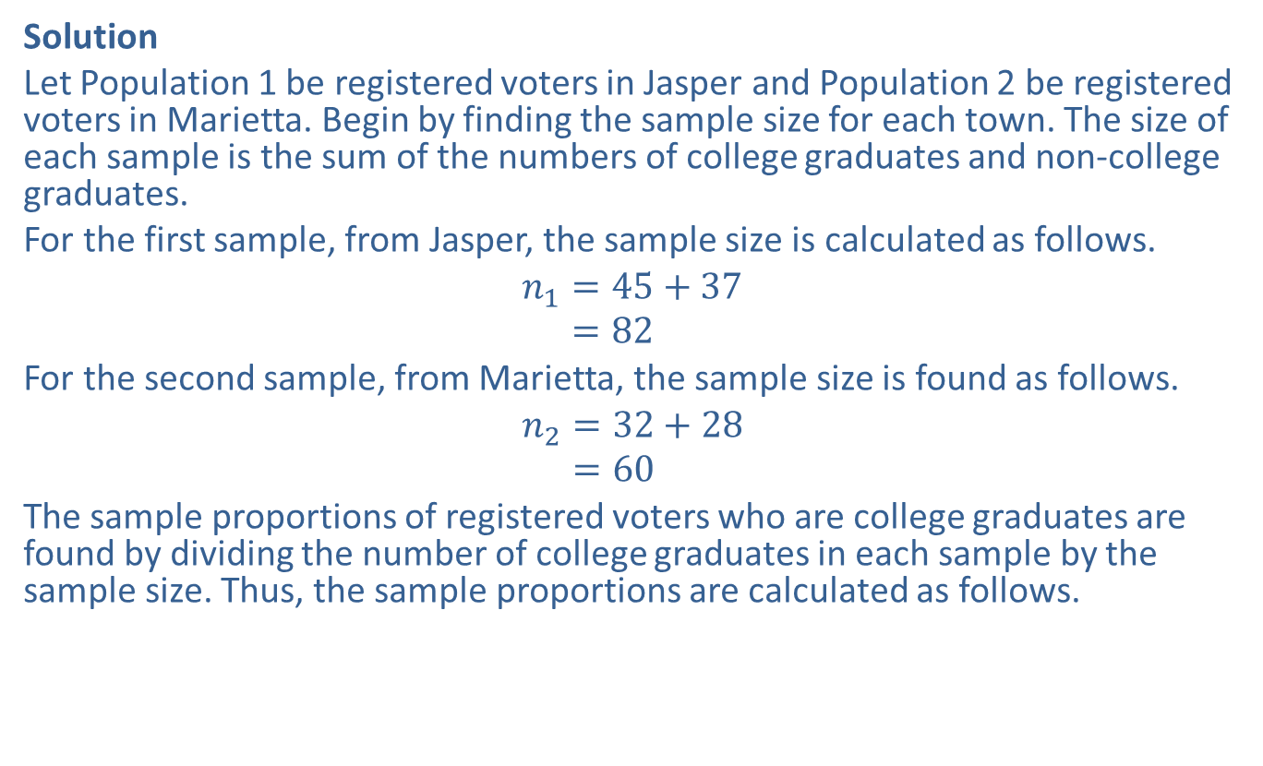
Example 9.4.1: Calculating Sample Proportions and Verifying Sample Size Conditions (cont.)
Solution
Let Population 1 be registered voters in Jasper and Population 2 be registered voters in Marietta. Begin by finding the sample size for each town. The size of each sample is the sum of the numbers of college graduates and non-college graduates.
For the first sample, from Jasper, the sample size is calculated as follows.
𝑛1=45+37𝑛1=82
For the second sample, from Marietta, the sample size is found as follows.
𝑛2=32+28𝑛2=60
The sample proportions of registered voters who are college graduates are found by dividing the number of college graduates in each sample by the sample size. Thus, the sample proportions are calculated as follows.

Slide 7
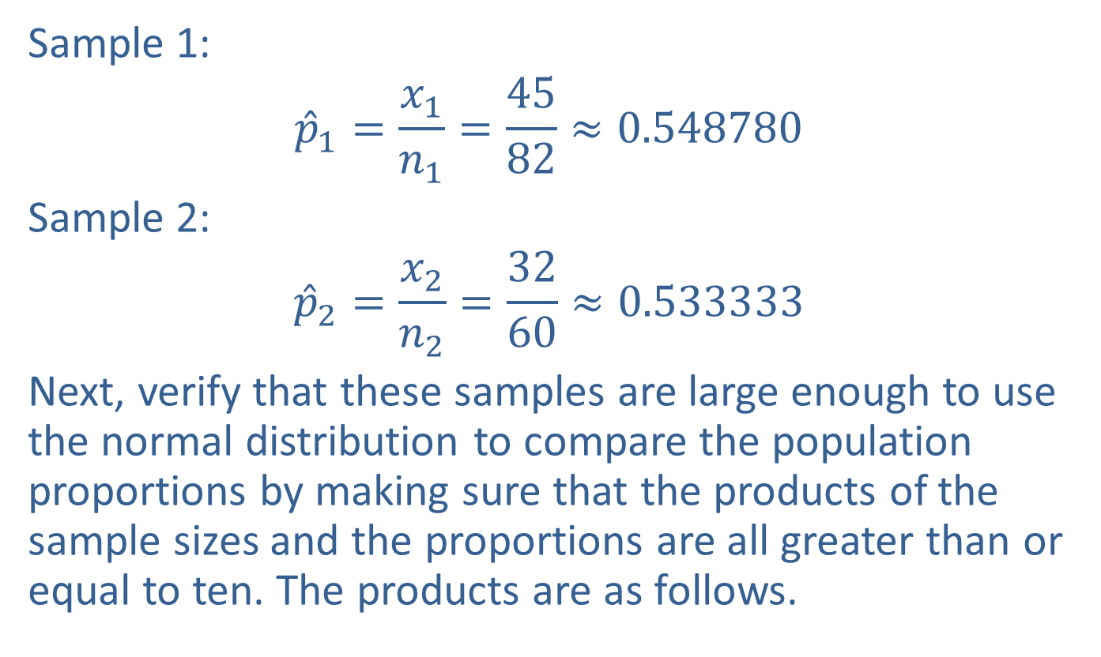
Example 9.4.1: Calculating Sample Proportions and Verifying Sample Size Conditions (cont.)
Sample 1:
$${\hat{p}}_{1}=\frac{x_{1}}{n_{1}}=\frac{45}{82}≈0.548780$$
Sample 2:
$${\hat{p}}_{2}=\frac{x_{2}}{n_{2}}=\frac{32}{60}≈0.533333$$
Next, verify that these samples are large enough to use the normal distribution to compare the population proportions by making sure that the products of the sample sizes and the proportions are all greater than or equal to ten. The products are as follows.

Slide 8
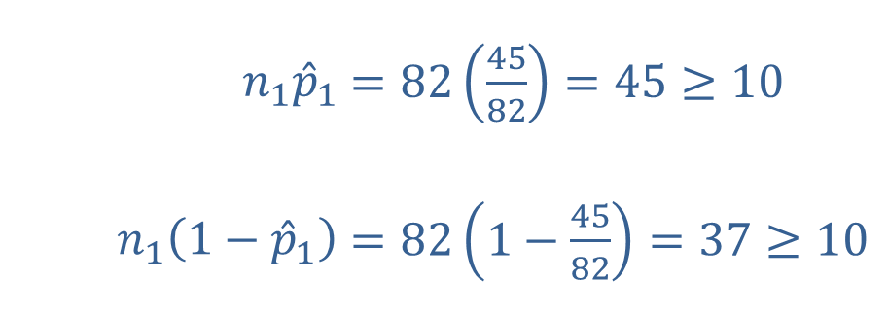
Example 9.4.1: Calculating Sample Proportions and Verifying Sample Size Conditions (cont.)
Next, verify that these samples are large enough to use the normal distribution to compare the population proportions by making sure that the products of the sample sizes and the proportions are all greater than or equal to ten. The products are as follows.
Sample 1:
​
​$n_{1}{\hat{p}}_{1}$ | ​$=82\left(\frac{45}{82}\right)=45≥10$
​$n_{1}\left(1−{\hat{p}}_{1}\right)$ | ​$=82\left(1−\frac{45}{82}\right)=37≥10$

Slide 9
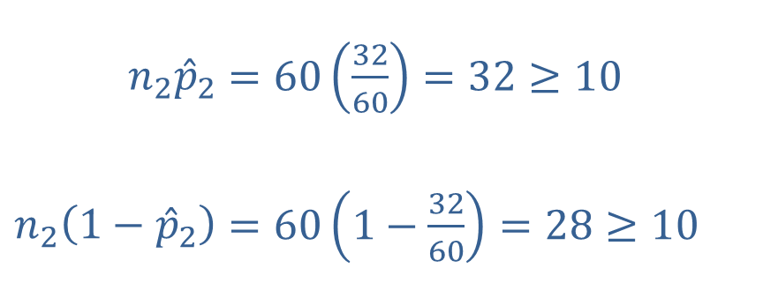
Example 9.4.1: Calculating Sample Proportions and Verifying Sample Size Conditions (cont.)
​Sample 2:
​
Because these are independent samples and all four products are greater than or equal to ten, the normal distribution can be used to compare the population proportions.
​$n_{2}{\hat{p}}_{2}$ | ​$=60\left(\frac{32}{60}\right)=32≥10$
​$n_{2}\left(1−{\hat{p}}_{2}\right)$ | ​$=60\left(1−\frac{32}{60}\right)=28≥10$

Slide 10

Memory Booster
The best point estimate for the difference between two population proportions is ${\hat{p}}_{1}−{\hat{p}}_{2}$.

Slide 11
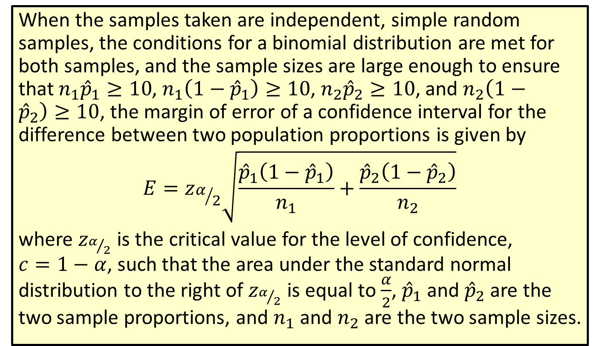
Formula: Margin of Error of a Confidence Interval for the Difference between Two Population Proportions
When the samples taken are independent, simple random samples, the conditions for a binomial distribution are met for both samples, and the sample sizes are large enough to ensure that $n_{1}{\hat{p}}_{1}≥10$, $n_{1}\left(1−{\hat{p}}_{1}\right)≥10$, $n_{2}{\hat{p}}_{2}≥10$, and $n_{2}\left(1−{\hat{p}}_{2}\right)≥10$, the margin of error of a confidence interval for the difference between two population proportions is given by
$$E=z_{α/2}\sqrt{\frac{{\hat{p}}_{1}\left(1−{\hat{p}}_{1}\right)}{n_{1}}+\frac{{\hat{p}}_{2}\left(1−{\hat{p}}_{2}\right)}{n_{2}}}$$
where $z_{α/2}$ is the critical value for the level of confidence,
$c=1−α$, such that the area under the standard normal distribution to the right of $z_{α/2}$ is equal to $\frac{α}{2}$, ${\hat{p}}_{1}$ and ${\hat{p}}_{2}$ are the two sample proportions, and $n_{1}$ and $n_{2}$ are the two sample sizes.

Slide 12
Rounding Rule
When calculating a margin of error for a confidence interval, round to at least six decimal places to avoid additional rounding errors in the subsequent calculations of the endpoints of the confidence interval.

Slide 13
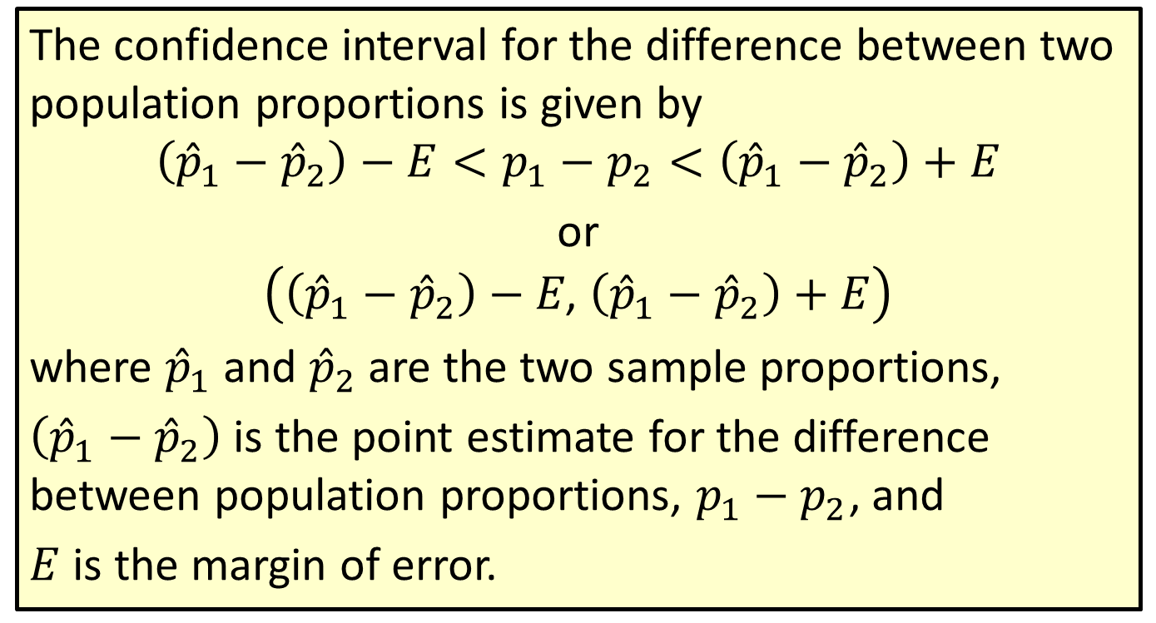
Formula: Confidence Interval for the Difference between Two Population Proportions
The confidence interval for the difference between two population proportions is given by
$$\left({\hat{p}}_{1}−{\hat{p}}_{2}\right)−E<p_{1}−p_{2}<\left({\hat{p}}_{1}−{\hat{p}}_{2}\right)+E$$
or
$$\left(\left({\hat{p}}_{1}−{\hat{p}}_{2}\right)−E\text{, }\left({\hat{p}}_{1}−{\hat{p}}_{2}\right)+E\right)$$
where ${\hat{p}}_{1}$ and ${\hat{p}}_{2}$ are the two sample proportions,
$\left({\hat{p}}_{1}−{\hat{p}}_{2}\right)$ is the point estimate for the difference between population proportions, $p_{1}−p_{2}$, and
$E$ is the margin of error.

Slide 14
Rounding Rule
Round the endpoints of a confidence interval for the difference between two population proportions to three decimal places.

Slide 15
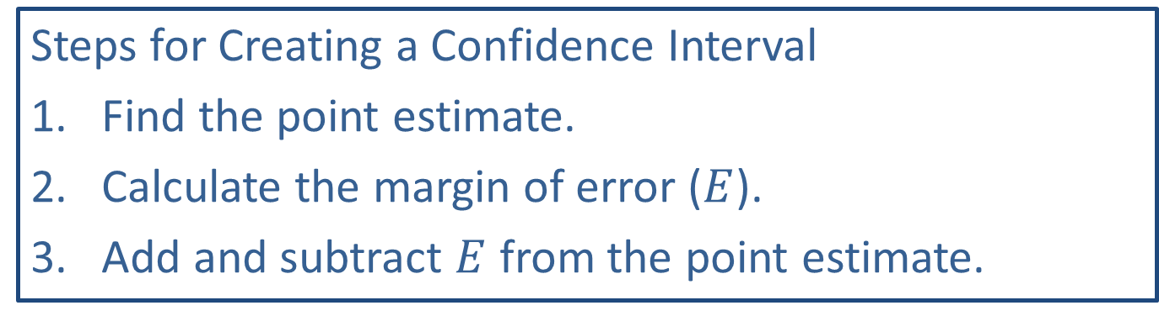
Memory Booster:
Steps for Creating a Confidence Interval
​Find the point estimate.
​Calculate the margin of error ($E$).
​Add and subtract $E$ from the point estimate.

Slide 16
Example 9.4.2: Constructing a Confidence Interval for the Difference between Two Population Proportions
School administrators want to know if there is a smaller percentage of students at a public middle school who carry cell phones than the percentage of students who carry cell phones at a private middle school. A survey of students is conducted at each school and the following results are tabulated.
Responses to Survey
 | Public School | Private School
Carry a Cell Phone | 45 | 53
Do Not Carry a Cell Phone | 31 | 25

Slide 17

Example 9.4.2: Constructing a Confidence Interval for the Difference between Two Population Proportions (cont.)
Construct a $90\%$ confidence interval for the true difference between the proportions of students who carry a cell phone at the two schools.

Slide 18
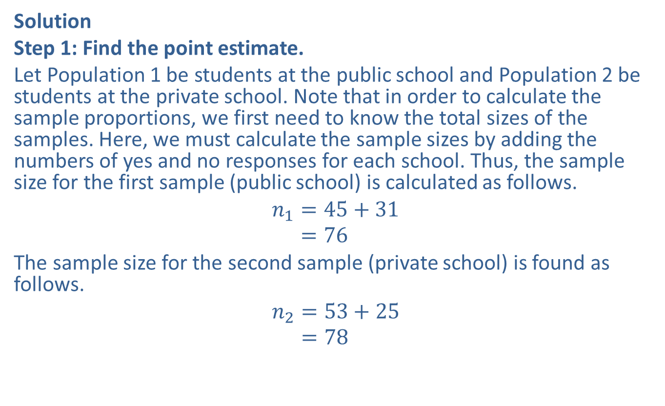
Example 9.4.2: Constructing a Confidence Interval for the Difference between Two Population Proportions (cont.)
Solution
Step 1: Find the point estimate.
Let Population 1 be students at the public school and Population 2 be students at the private school. Note that in order to calculate the sample proportions, we first need to know the total sizes of the samples. Here, we must calculate the sample sizes by adding the numbers of yes and no responses for each school. Thus, the sample size for the first sample (public school) is calculated as follows.
𝑛1=45+31𝑛1=76
The sample size for the second sample (private school) is found as follows.
𝑛2=53+25𝑛2=78

Slide 19
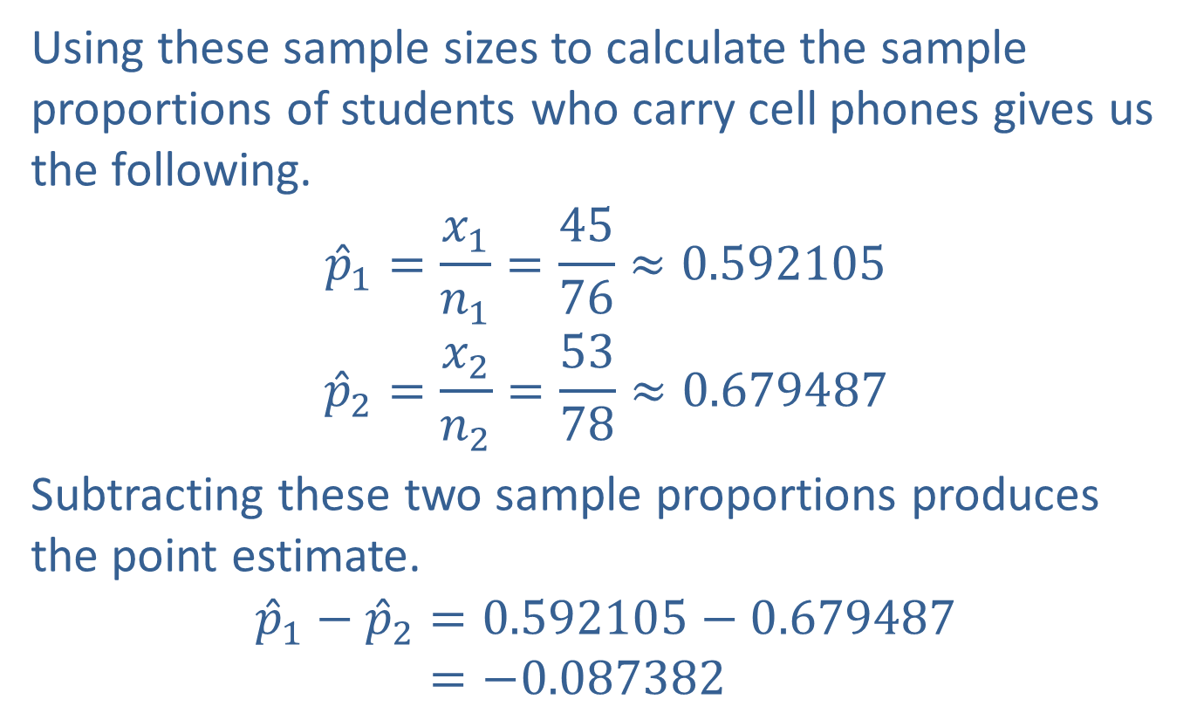
Example 9.4.2: Constructing a Confidence Interval for the Difference between Two Population Proportions (cont.)
Using these sample sizes to calculate the sample proportions of students who carry cell phones gives us the following.
$${\hat{p}}_{1}=\frac{x_{1}}{n_{1}}=\frac{45}{76}≈0.592105$$
$${\hat{p}}_{2}=\frac{x_{2}}{n_{2}}=\frac{53}{78}≈0.679487$$
Subtracting these two sample proportions produces the point estimate.
𝑝1−𝑝2=0.592105−0.679487𝑝1−𝑝2=−0.087382

Slide 20
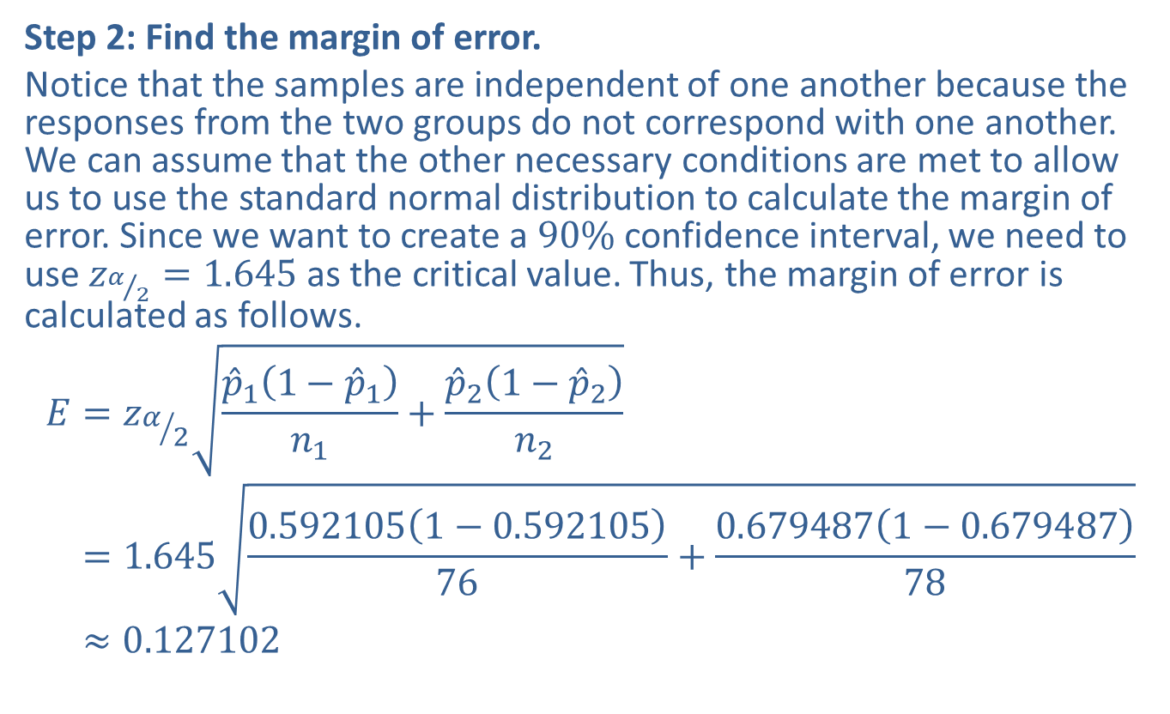
Example 9.4.2: Constructing a Confidence Interval for the Difference between Two Population Proportions (cont.)
Step 2: Find the margin of error.
Notice that the samples are independent of one another because the responses from the two groups do not correspond with one another. We can assume that the other necessary conditions are met to allow us to use the standard normal distribution to calculate the margin of error. Since we want to create a $90\%$ confidence interval, we need to use $z_{α/2}=1.645$ as the critical value. Thus, the margin of error is calculated as follows.
𝐸=𝑧𝛼2𝑝11−𝑝1𝑛1+𝑝21−𝑝2𝑛2𝐸=1.6450.5921051−0.59210576+0.6794871−0.67948778𝐸≈0.127102

Slide 21
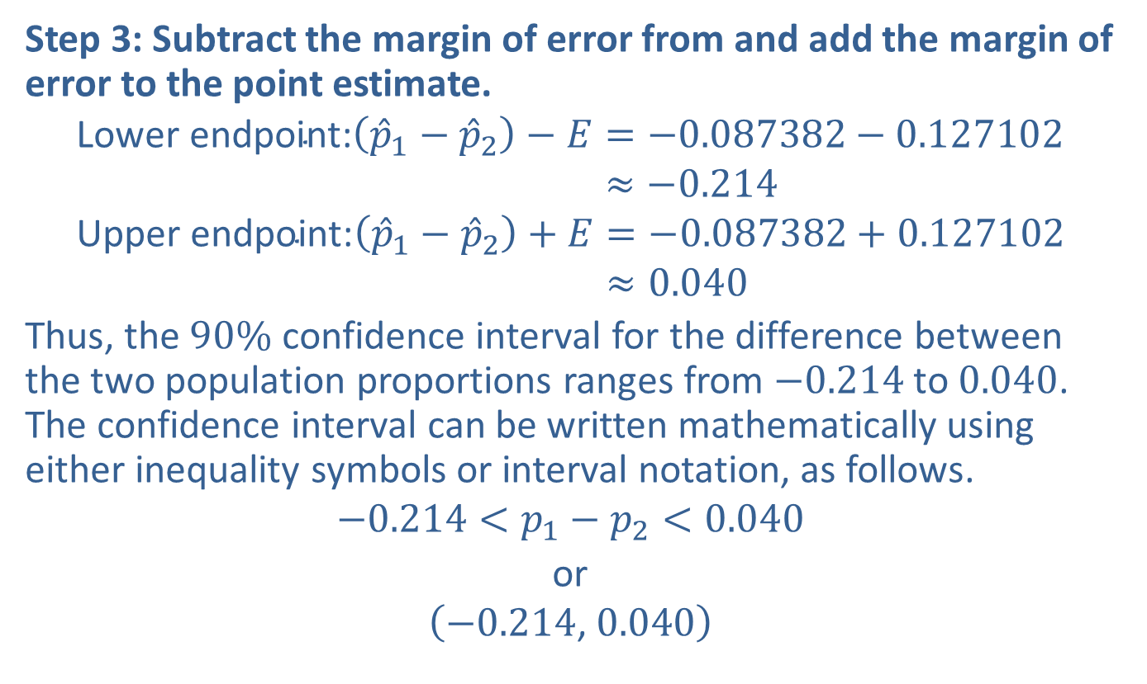
Example 9.4.2: Constructing a Confidence Interval for the Difference between Two Population Proportions (cont.)
Step 3: Subtract the margin of error from and add the margin of error to the point estimate.
Lower endpoint:𝑝1−𝑝2−𝐸=−0.087382−0.127102Lower endpoint:𝑝1−𝑝2−𝐸≈−0.214Upper endpoint:𝑝1−𝑝2+𝐸=−0.087382+0.127102Upper endpoint:𝑝1−𝑝2+𝐸≈0.040
Thus, the $90\%$ confidence interval for the difference between the two population proportions ranges from $−0.214$ to 0.040. The confidence interval can be written mathematically using either inequality symbols or interval notation, as follows.
$$−0.214<p_{1}−p_{2}<0.040$$
or
$$\left(−0.214\text{, }0.040\right)$$

Slide 22
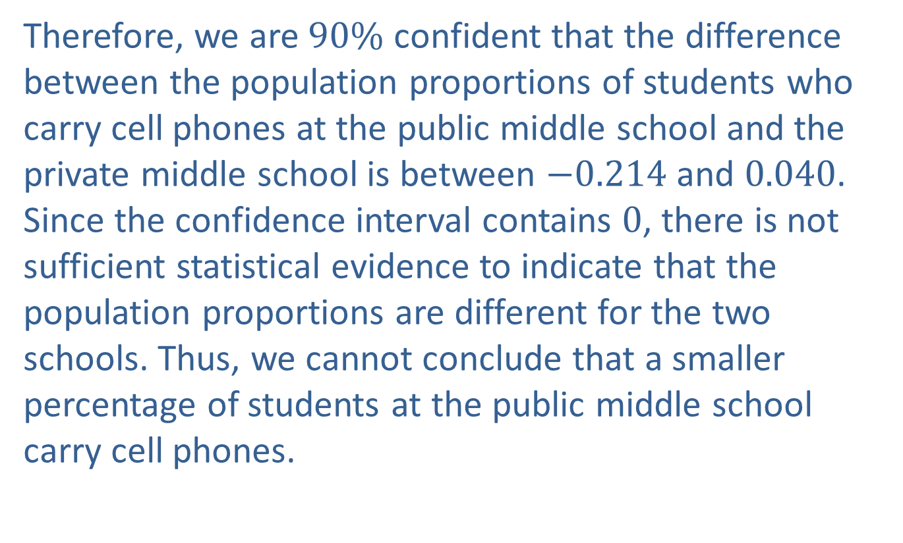
Example 9.4.2: Constructing a Confidence Interval for the Difference between Two Population Proportions (cont.)
Therefore, we are $90\%$ confident that the difference between the population proportions of students who carry cell phones at the public middle school and the private middle school is between $−0.214$ and 0.040. Since the confidence interval contains 0, there is not sufficient statistical evidence to indicate that the population proportions are different for the two schools. Thus, we cannot conclude that a smaller percentage of students at the public middle school carry cell phones.

Slide 23
Rounding Rule
When calculations involve several steps, avoid rounding at intermediate calculations. If necessary, round intermediate calculations to at least six decimal places to avoid additional rounding errors in subsequent calculations.

Slide 24
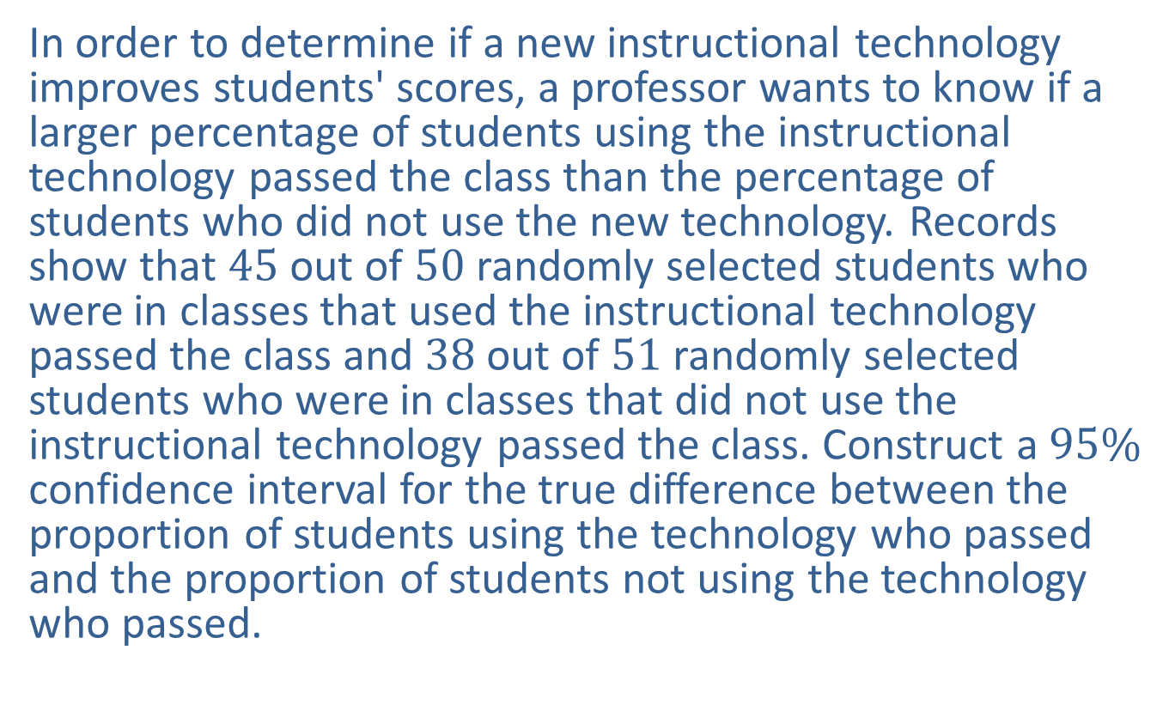
Example 9.4.3: Constructing a Confidence Interval for the Difference between Two Population Proportions
In order to determine if a new instructional technology improves students' scores, a professor wants to know if a larger percentage of students using the instructional technology passed the class than the percentage of students who did not use the new technology. Records show that 45 out of 50 randomly selected students who were in classes that used the instructional technology passed the class and 38 out of 51 randomly selected students who were in classes that did not use the instructional technology passed the class. Construct a $95\%$ confidence interval for the true difference between the proportion of students using the technology who passed and the proportion of students not using the technology who passed.

Slide 25
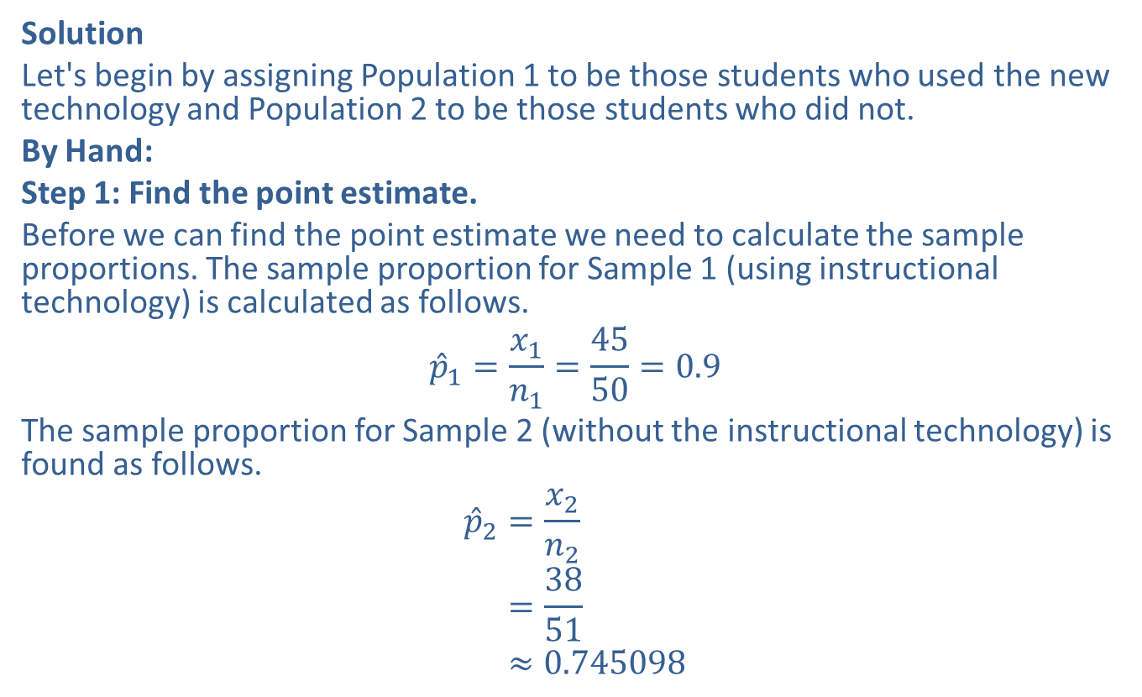
Example 9.4.3: Constructing a Confidence Interval for the Difference between Two Population Proportions (cont.)
Solution
Let's begin by assigning Population 1 to be those students who used the new technology and Population 2 to be those students who did not.
By Hand:
Step 1: Find the point estimate.
Before we can find the point estimate we need to calculate the sample proportions. The sample proportion for Sample 1 (using instructional technology) is calculated as follows.
$${\hat{p}}_{1}=\frac{x_{1}}{n_{1}}=\frac{45}{50}=0.9$$
The sample proportion for Sample 2 (without the instructional technology) is found as follows.
𝑝2=𝑥2𝑛2𝑝2=3851𝑝2≈0.745098

Slide 26
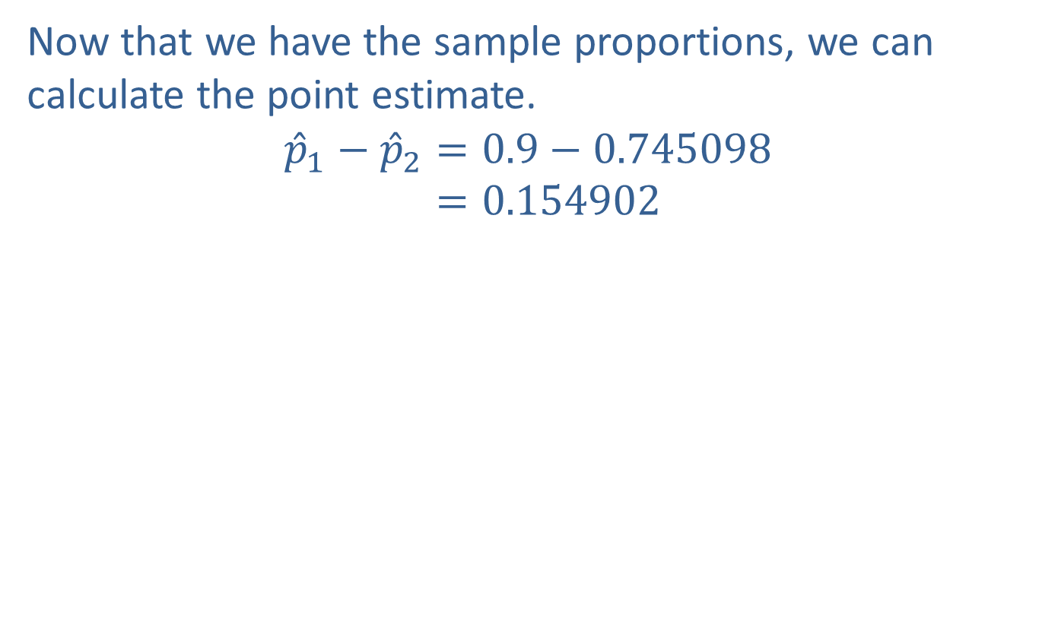
Example 9.4.3: Constructing a Confidence Interval for the Difference between Two Population Proportions (cont.)
Now that we have the sample proportions, we can calculate the point estimate.
𝑝1−𝑝2=0.9−0.745098𝑝1−𝑝2=0.154902

Slide 27
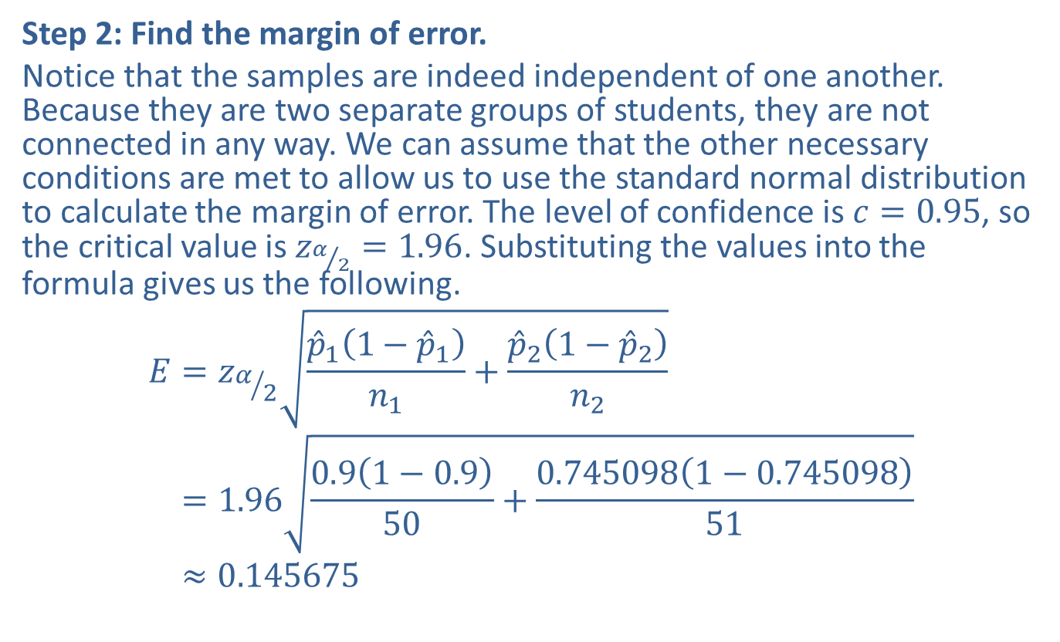
Example 9.4.3: Constructing a Confidence Interval for the Difference between Two Population Proportions (cont.)
Step 2: Find the margin of error.
Notice that the samples are indeed independent of one another. Because they are two separate groups of students, they are not connected in any way. We can assume that the other necessary conditions are met to allow us to use the standard normal distribution to calculate the margin of error. The level of confidence is $c=0.95$, so the critical value is $z_{α/2}=1.96$. Substituting the values into the formula gives us the following.
𝐸=𝑧𝛼2𝑝11−𝑝1𝑛1+𝑝21−𝑝2𝑛2𝐸=1.960.91−0.950+0.7450981−0.74509851𝐸≈0.145675

Slide 28
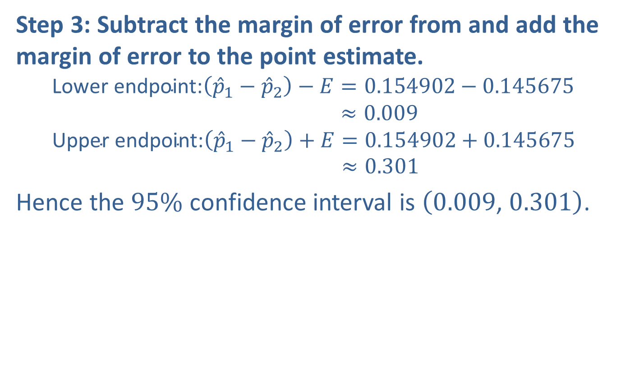
Example 9.4.3: Constructing a Confidence Interval for the Difference between Two Population Proportions (cont.)
Step 3: Subtract the margin of error from and add the margin of error to the point estimate.
Lower endpoint:𝑝1−𝑝2−𝐸=0.154902−0.145675Lower endpoint:𝑝1−𝑝2−𝐸≈0.009Upper endpoint:𝑝1−𝑝2+𝐸=0.154902+0.145675Upper endpoint:𝑝1−𝑝2+𝐸≈0.301
Hence the $95\%$ confidence interval is $\left(0.009\text{, }0.301\right)$.

Slide 29
Example 9.4.3: Constructing a Confidence Interval for the Difference between Two Population Proportions (cont.)
TI-83/84 Method:
To calculate the confidence interval for the difference between two proportions on the calculator, we don't need to find the individual sample proportions; we just need to enter the number of successes and the sample size for each sample, as well as the level of confidence. Press STAT, scroll to TESTS, and then choose option 2-PropZInt. x1 is the number of successes from the first sample and n1 is the first sample's size. Similarly, x2 is the number of successes from the second sample and n2 is the second sample's size. As usual, C-Level is the confidence level, which must be entered as a decimal. The data should be entered as shown in the first screenshot below. After you select Calculate and press ENTER, the results will be displayed on the screen as shown in the second screenshot below.

Slide 30
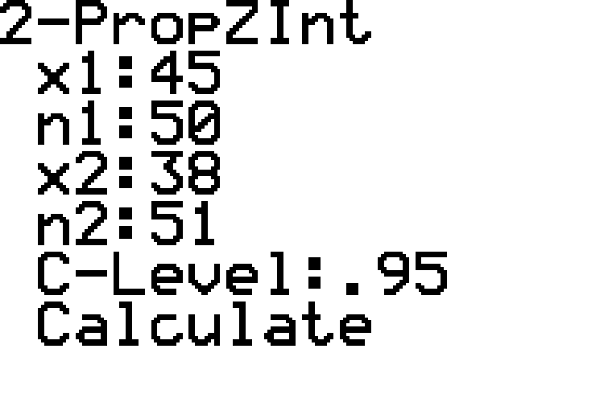
Example 9.4.3: Constructing a Confidence Interval for the Difference between Two Population Proportions (cont.)

Slide 31
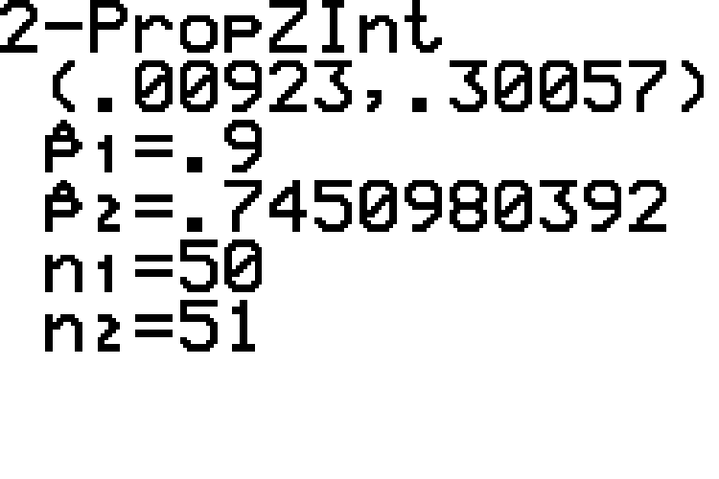
Example 9.4.3: Constructing a Confidence Interval for the Difference between Two Population Proportions (cont.)

Slide 32
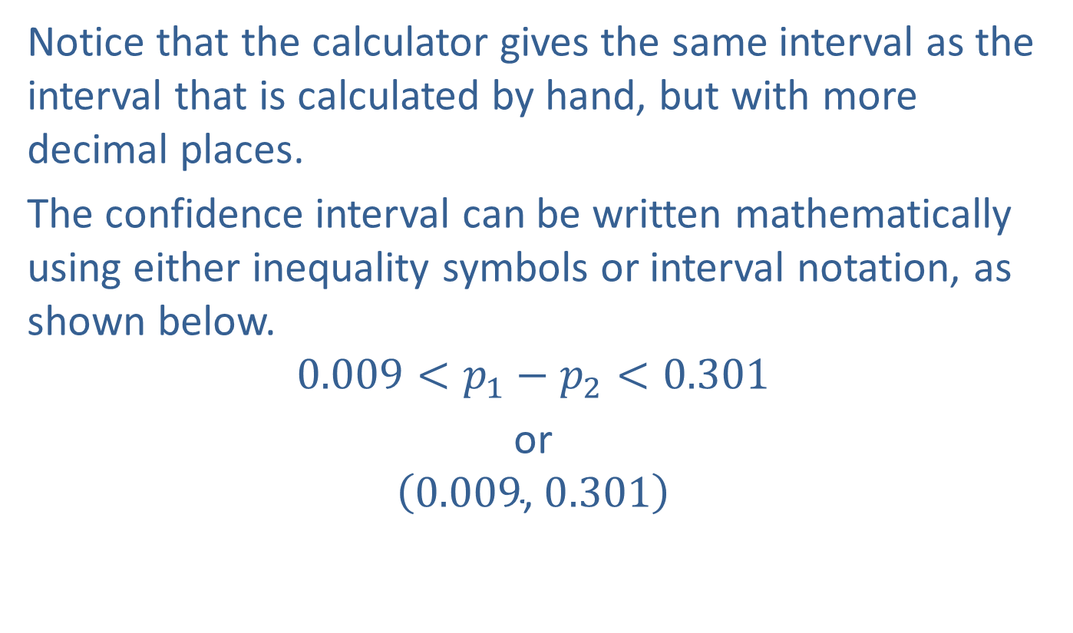
Example 9.4.3: Constructing a Confidence Interval for the Difference between Two Population Proportions (cont.)
Notice that the calculator gives the same interval as the interval that is calculated by hand, but with more decimal places.
The confidence interval can be written mathematically using either inequality symbols or interval notation, as shown below.
$$0.009<p_{1}−p_{2}<0.301$$
or
$$\left(0.009\text{, }0.301\right)$$

Slide 33
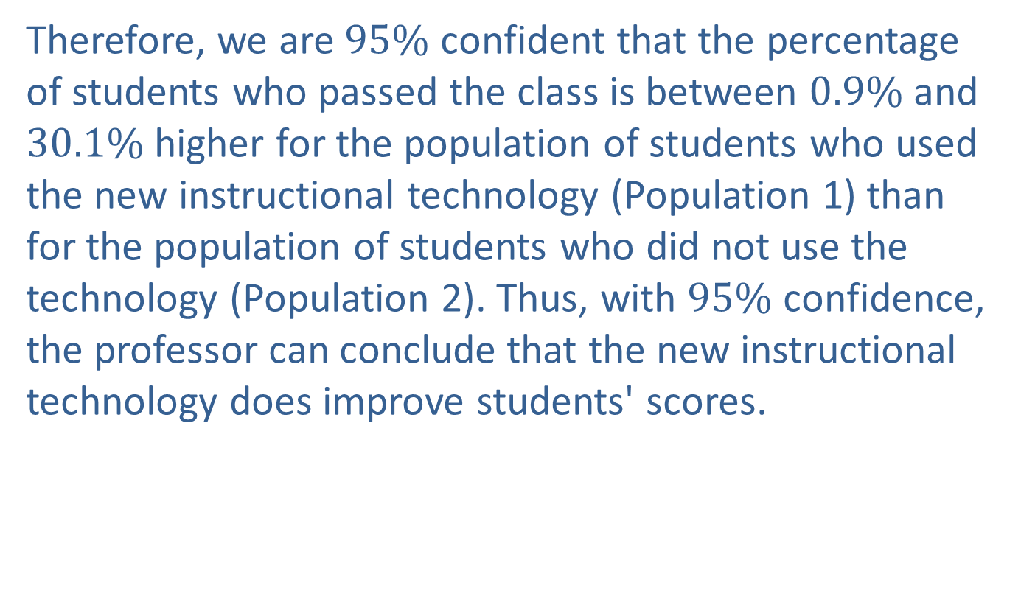
Example 9.4.3: Constructing a Confidence Interval for the Difference between Two Population Proportions (cont.)
Therefore, we are $95\%$ confident that the percentage of students who passed the class is between $0.9\%$ and $30.1\%$ higher for the population of students who used the new instructional technology (Population 1) than for the population of students who did not use the technology (Population 2). Thus, with $95\%$ confidence, the professor can conclude that the new instructional technology does improve students' scores.

Slide 34
Technology
For further instructions on computing a confidence interval using technology, visit stat.hawkeslearning.com and see Technology Instructions > Confidence Intervals > Two Sample Proportions z-Interval.

