Slide 1
Section 9.5
Comparing Two Population Variances

Slide 2

Memory Booster
Use the larger of the two sample variances as $s_{1}^{2}$ to simplify calculations.

Slide 3
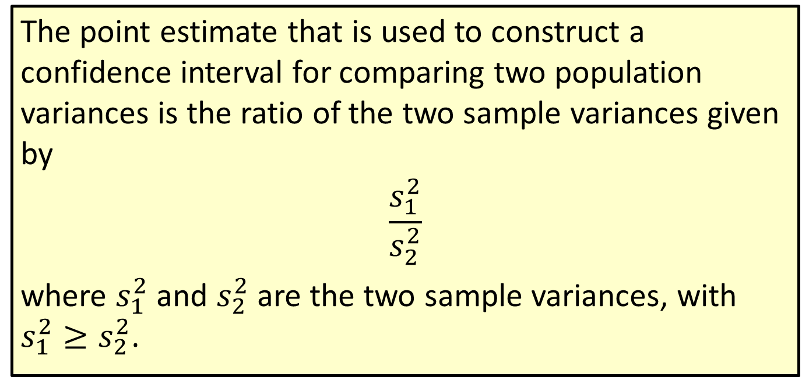
Formula: Point Estimate for Comparing Two Population Variances
The point estimate that is used to construct a confidence interval for comparing two population variances is the ratio of the two sample variances given by
$$\frac{s_{1}^{2}}{s_{2}^{2}}$$
where $s_{1}^{2}$ and $s_{2}^{2}$ are the two sample variances, with $s_{1}^{2}≥s_{2}^{2}$.

Slide 4
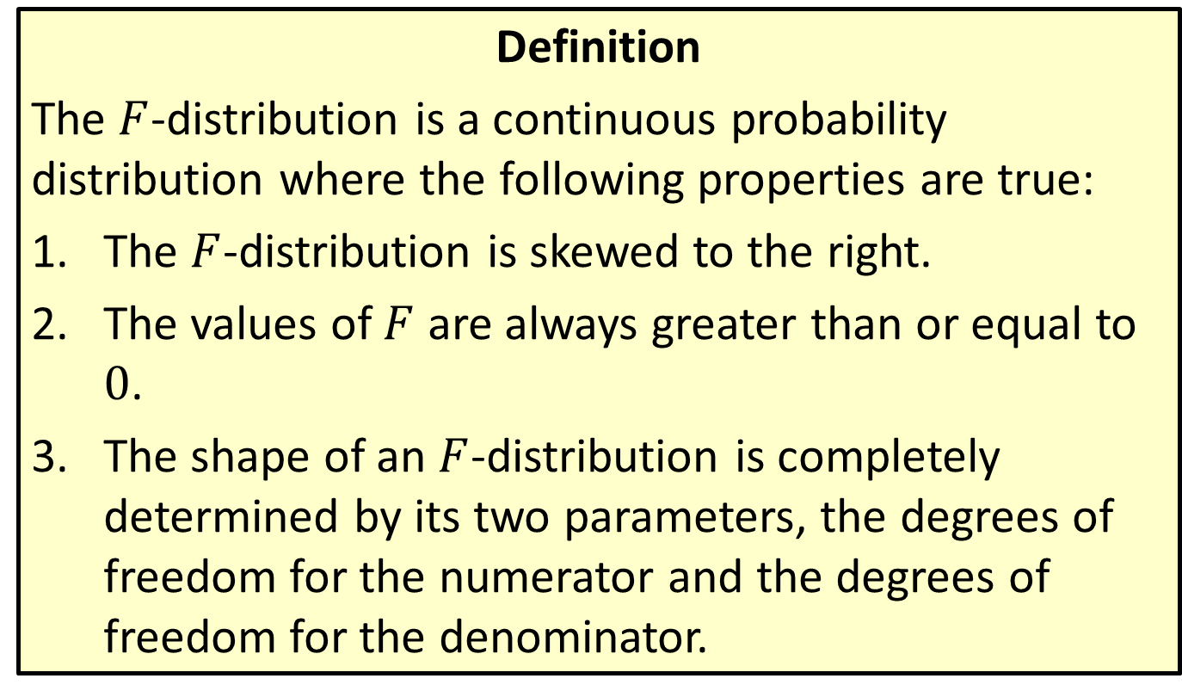

Distribution: $F$-Distribution
Definition
The $F$-distribution is a continuous probability distribution where the following properties are true:
​The $F$-distribution is skewed to the right.
​The values of $F$ are always greater than or equal to 0.
​The shape of an $F$-distribution is completely determined by its two parameters, the degrees of freedom for the numerator and the degrees of freedom for the denominator.

Slide 5
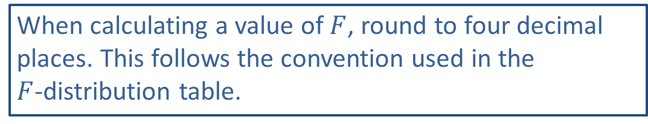
Rounding Rule
When calculating a value of $F$, round to four decimal places. This follows the convention used in the $F$-distribution table.

Slide 6
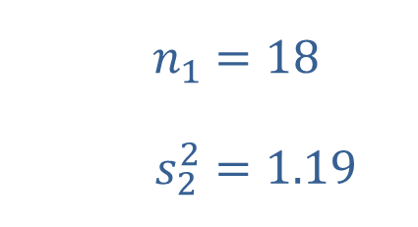
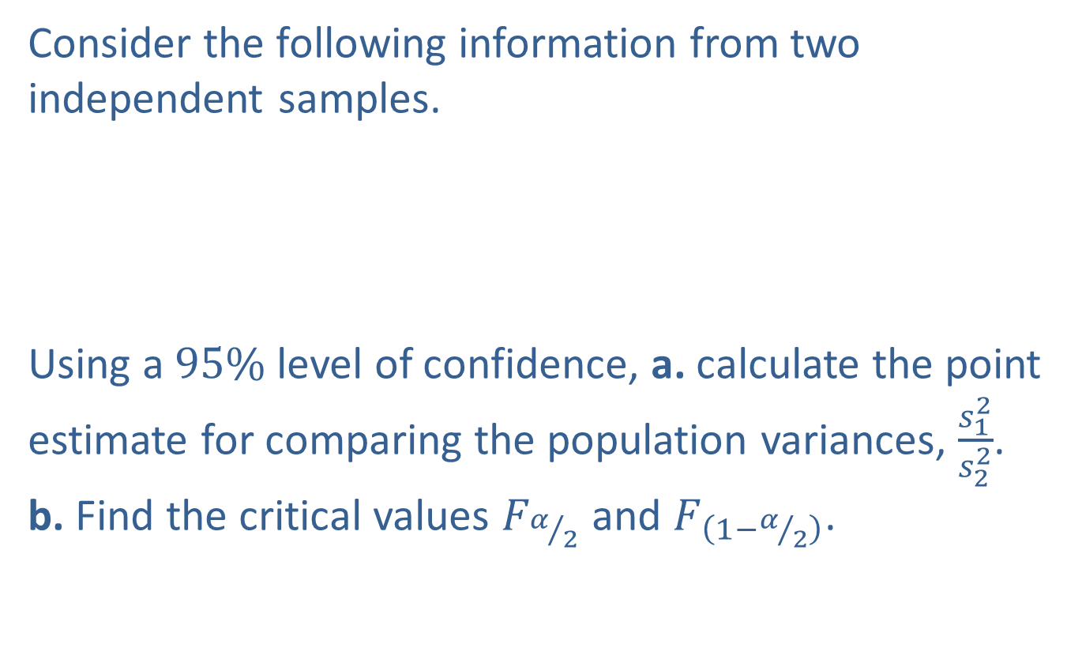
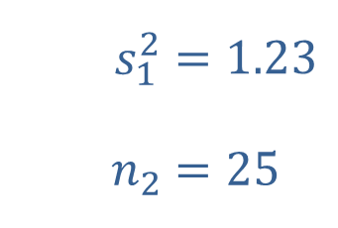
Example 9.5.1: Calculating the Point Estimate for Comparing Two Population Variances and Finding Critical F-Values
Consider the following information from two independent samples.
​
Using a $95\%$ level of confidence, a. calculate the point estimate for comparing the population variances, $\frac{s_{1}^{2}}{s_{2}^{2}}$. b. Find the critical values $F_{α/2}$ and $F_{\left(1−α/2\right)}$.
​$n_{1}$ | ​$=18$
​$s_{2}^{2}$ | ​$=1.19$
​$s_{1}^{2}$ | ​$=1.23$
​$n_{2}$ | ​$=25$

Slide 7
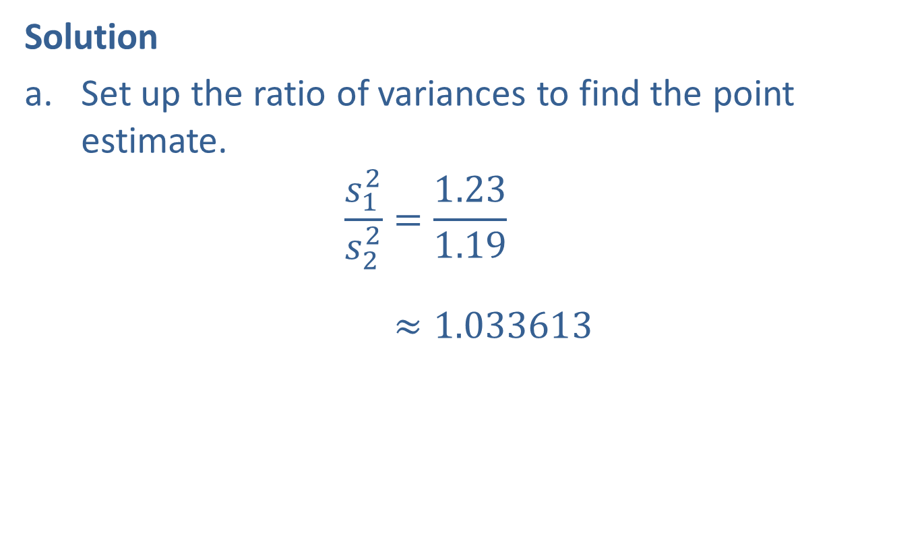
Example 9.5.1: Calculating the Point Estimate for Comparing Two Population Variances and Finding Critical F-Values (cont.)
Solution
​Set up the ratio of variances to find the point estimate.
𝑠12𝑠22=1.231.19𝑠12𝑠22≈1.033613

Slide 8
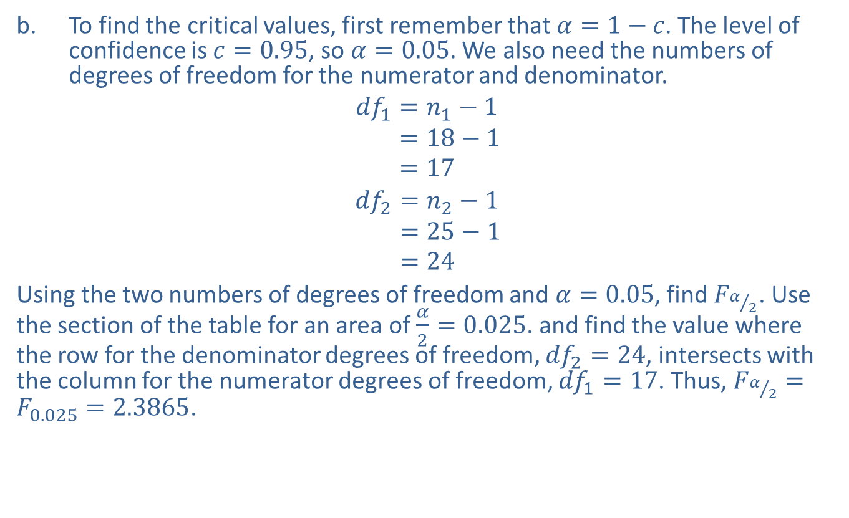
Example 9.5.1: Calculating the Point Estimate for Comparing Two Population Variances and Finding Critical F-Values (cont.)
​To find the critical values, first remember that $α=1−c$. The level of confidence is $c=0.95$, so $α=0.05$. We also need the numbers of degrees of freedom for the numerator and denominator.
𝑑𝑓1=𝑛1−1𝑑𝑓1=18−1𝑑𝑓1=17
𝑑𝑓2=𝑛2−1𝑑𝑓2=25−1𝑑𝑓2=24
​Using the two numbers of degrees of freedom and $α=0.05$, find $F_{α/2}$. Use the section of the table for an area of $\frac{α}{2}=0.025$. and find the value where the row for the denominator degrees of freedom, ${df}_{2}=24$, intersects with the column for the numerator degrees of freedom, ${df}_{1}=17$. Thus, $F_{α/2}=F_{0.025}=2.3865$.
​

Slide 9
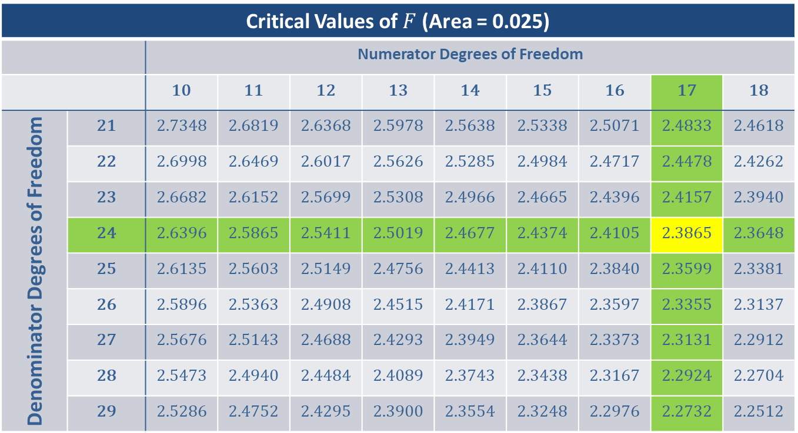
Example 9.5.1: Calculating the Point Estimate for Comparing Two Population Variances and Finding Critical F-Values (cont.)
Critical Values of $F$ (Area = 0.025)
 |  | Numerator Degrees of Freedom
 |  | 10 | 11 | 12 | 13 | 14 | 15 | 16 | 17 | 18
Denominator Degrees of Freedom | 21 | 2.7348 | 2.6819 | 2.6368 | 2.5978 | 2.5638 | 2.5338 | 2.5071 | 2.4833 | 2.4618
 | 22 | 2.6998 | 2.6469 | 2.6017 | 2.5626 | 2.5285 | 2.4984 | 2.4717 | 2.4478 | 2.4262
 | 23 | 2.6682 | 2.6152 | 2.5699 | 2.5308 | 2.4966 | 2.4665 | 2.4396 | 2.4157 | 2.3940
 | 24 | 2.6396 | 2.5865 | 2.5411 | 2.5019 | 2.4677 | 2.4374 | 2.4105 | 2.3865 | 2.3648
 | 25 | 2.6135 | 2.5603 | 2.5149 | 2.4756 | 2.4413 | 2.4110 | 2.3840 | 2.3599 | 2.3381
 | 26 | 2.5896 | 2.5363 | 2.4908 | 2.4515 | 2.4171 | 2.3867 | 2.3597 | 2.3355 | 2.3137
 | 27 | 2.5676 | 2.5143 | 2.4688 | 2.4293 | 2.3949 | 2.3644 | 2.3373 | 2.3131 | 2.2912
 | 28 | 2.5473 | 2.4940 | 2.4484 | 2.4089 | 2.3743 | 2.3438 | 2.3167 | 2.2924 | 2.2704
 | 29 | 2.5286 | 2.4752 | 2.4295 | 2.3900 | 2.3554 | 2.3248 | 2.2976 | 2.2732 | 2.2512

Slide 10

Example 9.5.1: Calculating the Point Estimate for Comparing Two Population Variances and Finding Critical F-Values (cont.)
​To find the critical value $F_{\left(1−α/2\right)}$ we use similar methods. Thus, $F_{\left(1−α/2\right)}=F_{0.975}=0.3907$.
​

Slide 11
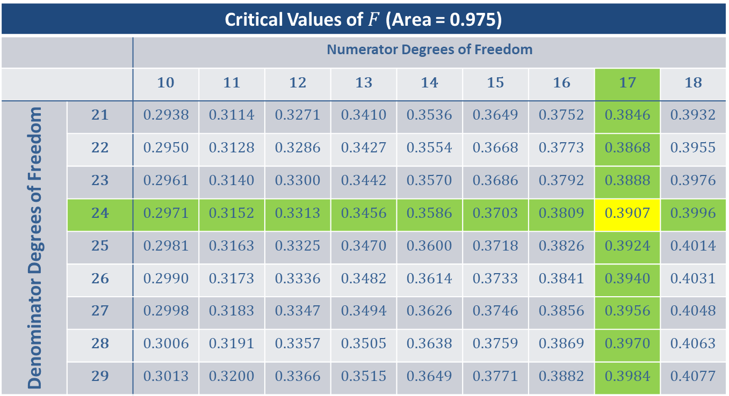
Example 9.5.1: Calculating the Point Estimate for Comparing Two Population Variances and Finding Critical F-Values (cont.)
Critical Values of $F$ (Area = 0.975)
 |  | Numerator Degrees of Freedom
 |  | 10 | 11 | 12 | 13 | 14 | 15 | 16 | 17 | 18
Denominator Degrees of Freedom | 21 | 0.2938 | 0.3114 | 0.3271 | 0.3410 | 0.3536 | 0.3649 | 0.3752 | 0.3846 | 0.3932
 | 22 | 0.2950 | 0.3128 | 0.3286 | 0.3427 | 0.3554 | 0.3668 | 0.3773 | 0.3868 | 0.3955
 | 23 | 0.2961 | 0.3140 | 0.3300 | 0.3442 | 0.3570 | 0.3686 | 0.3792 | 0.3888 | 0.3976
 | 24 | 0.2971 | 0.3152 | 0.3313 | 0.3456 | 0.3586 | 0.3703 | 0.3809 | 0.3907 | 0.3996
 | 25 | 0.2981 | 0.3163 | 0.3325 | 0.3470 | 0.3600 | 0.3718 | 0.3826 | 0.3924 | 0.4014
 | 26 | 0.2990 | 0.3173 | 0.3336 | 0.3482 | 0.3614 | 0.3733 | 0.3841 | 0.3940 | 0.4031
 | 27 | 0.2998 | 0.3183 | 0.3347 | 0.3494 | 0.3626 | 0.3746 | 0.3856 | 0.3956 | 0.4048
 | 28 | 0.3006 | 0.3191 | 0.3357 | 0.3505 | 0.3638 | 0.3759 | 0.3869 | 0.3970 | 0.4063
 | 29 | 0.3013 | 0.3200 | 0.3366 | 0.3515 | 0.3649 | 0.3771 | 0.3882 | 0.3984 | 0.4077

Slide 12
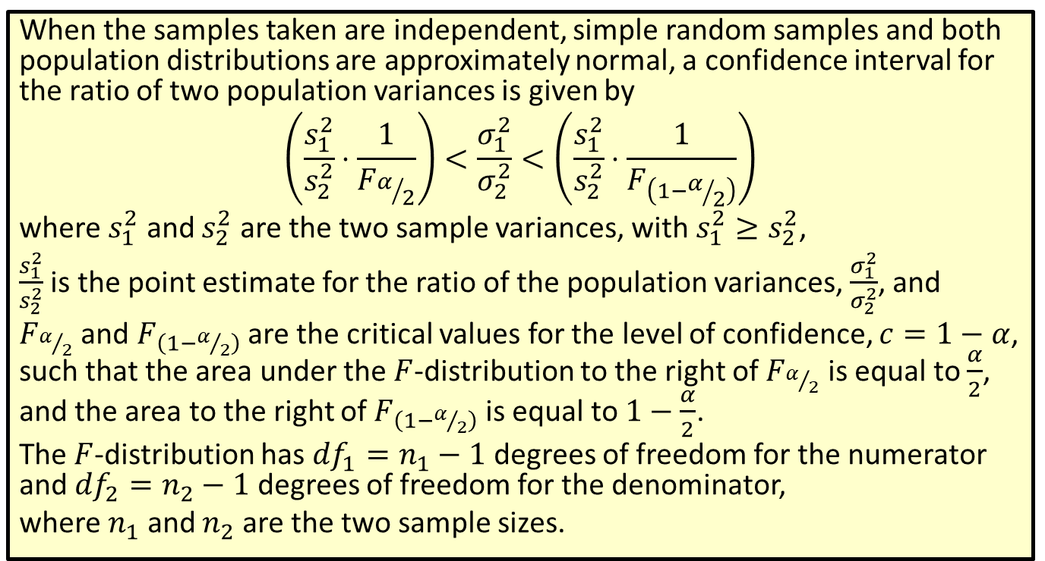
Formula: Confidence Interval for the Ratio of Two Population Variances
When the samples taken are independent, simple random samples and both population distributions are approximately normal, a confidence interval for the ratio of two population variances is given by
$$\left(\frac{s_{1}^{2}}{s_{2}^{2}}⋅\frac{1}{F_{α/2}}\right)<\frac{σ_{1}^{2}}{σ_{2}^{2}}<\left(\frac{s_{1}^{2}}{s_{2}^{2}}⋅\frac{1}{F_{\left(1−α/2\right)}}\right)$$
where $s_{1}^{2}$ and $s_{2}^{2}$ are the two sample variances, with $s_{1}^{2}≥s_{2}^{2}$,
$\frac{s_{1}^{2}}{s_{2}^{2}}$ is the point estimate for the ratio of the population variances, $\frac{σ_{1}^{2}}{σ_{2}^{2}}$, and
$F_{α/2}$ and $F_{\left(1−α/2\right)}$ are the critical values for the level of confidence, $c=1−α$, such that the area under the $F$-distribution to the right of $F_{α/2}$ is equal to $\frac{α}{2}$, and the area to the right of $F_{\left(1−α/2\right)}$ is equal to $1−\frac{α}{2}$.
The $F$-distribution has ${df}_{1}=n_{1}−1$ degrees of freedom for the numerator and ${df}_{2}=n_{2}−1$ degrees of freedom for the denominator,
where $n_{1}$ and $n_{2}$ are the two sample sizes.

Slide 13
Rounding Rule
Round the endpoints of a confidence interval for the ratio of two population variances or standard deviations to four decimal places.

Slide 14
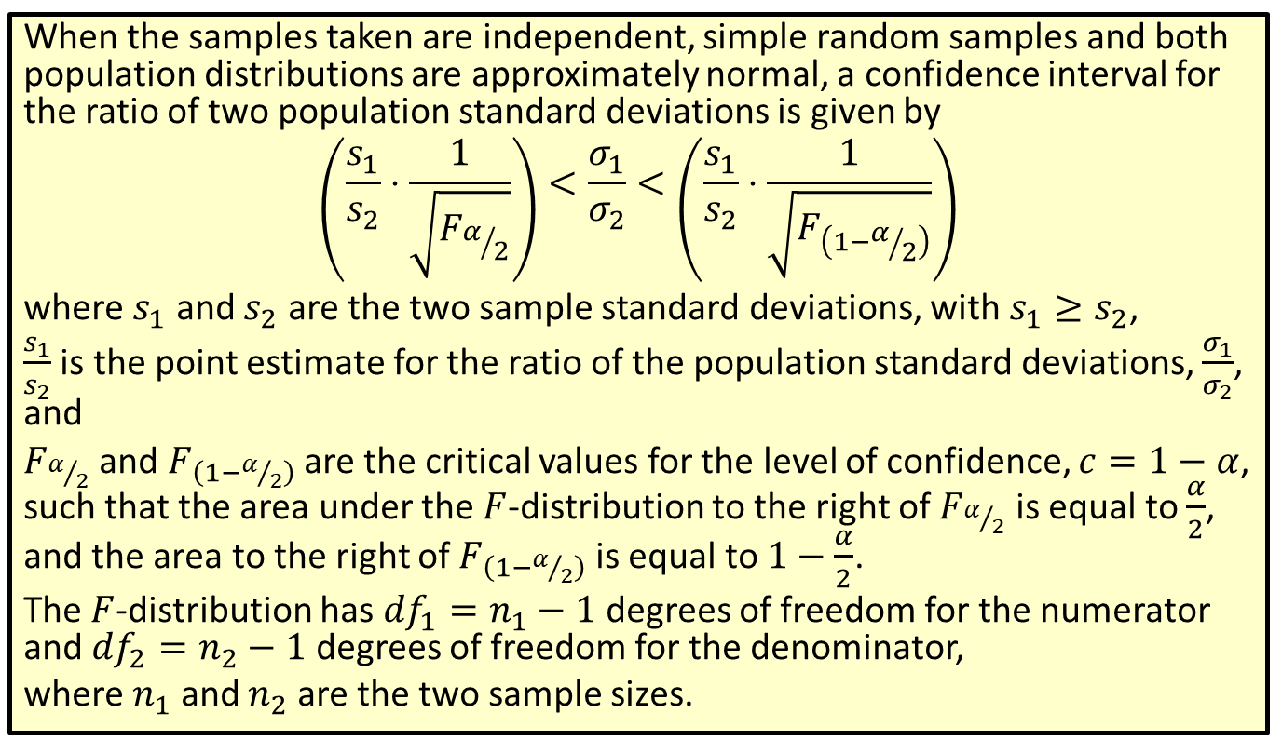
Formula: Confidence Interval for the Ratio of Two Population Standard Deviations
When the samples taken are independent, simple random samples and both population distributions are approximately normal, a confidence interval for the ratio of two population standard deviations is given by
$$\left(\frac{s_{1}}{s_{2}}⋅\frac{1}{\sqrt{F_{α/2}}}\right)<\frac{σ_{1}}{σ_{2}}<\left(\frac{s_{1}}{s_{2}}⋅\frac{1}{\sqrt{F_{\left(1−α/2\right)}}}\right)$$
where $s_{1}$ and $s_{2}$ are the two sample standard deviations, with $s_{1}≥s_{2}$,
$\frac{s_{1}}{s_{2}}$ is the point estimate for the ratio of the population standard deviations, $\frac{σ_{1}}{σ_{2}}$, and
$F_{α/2}$ and $F_{\left(1−α/2\right)}$ are the critical values for the level of confidence, $c=1−α$, such that the area under the $F$-distribution to the right of $F_{α/2}$ is equal to $\frac{α}{2}$, and the area to the right of $F_{\left(1−α/2\right)}$ is equal to $1−\frac{α}{2}$.
The $F$-distribution has ${df}_{1}=n_{1}−1$ degrees of freedom for the numerator and ${df}_{2}=n_{2}−1$ degrees of freedom for the denominator,
where $n_{1}$ and $n_{2}$ are the two sample sizes.

Slide 15
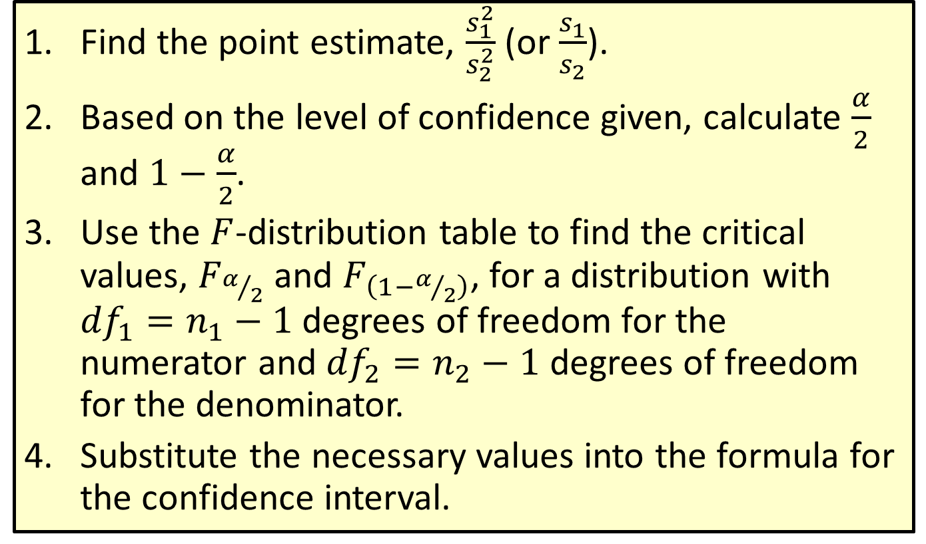
Procedure: Constructing a Confidence Interval for the Ratio of Two Population Variances (or Standard Deviations)
​Find the point estimate, $\frac{s_{1}^{2}}{s_{2}^{2}}$ (or $\frac{s_{1}}{s_{2}}$).
​Based on the level of confidence given, calculate $\frac{α}{2}$ and $1−\frac{α}{2}$.
​Use the $F$-distribution table to find the critical values, $F_{α/2}$ and $F_{\left(1−α/2\right)}$, for a distribution with ${df}_{1}=n_{1}−1$ degrees of freedom for the numerator and ${df}_{2}=n_{2}−1$ degrees of freedom for the denominator.
​Substitute the necessary values into the formula for the confidence interval.

Slide 16
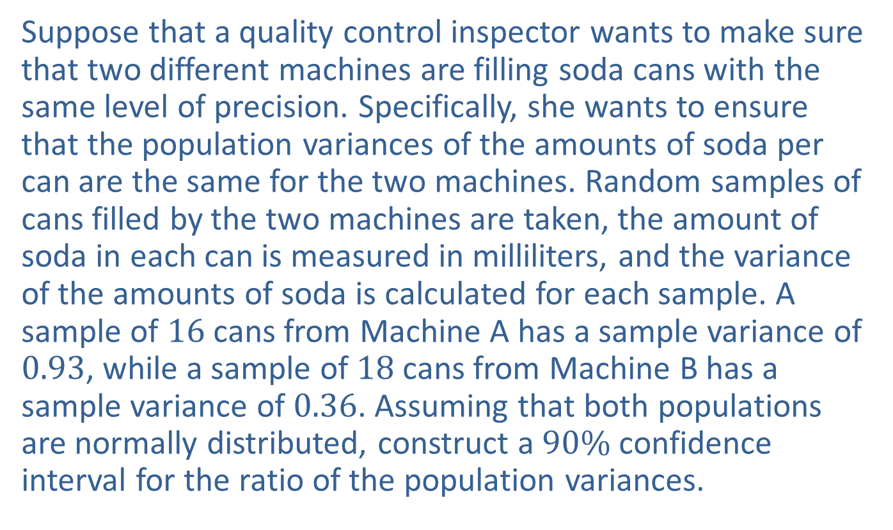
Example 9.5.2: Constructing a Confidence Interval for the Ratio of Two Population Variances
Suppose that a quality control inspector wants to make sure that two different machines are filling soda cans with the same level of precision. Specifically, she wants to ensure that the population variances of the amounts of soda per can are the same for the two machines. Random samples of cans filled by the two machines are taken, the amount of soda in each can is measured in milliliters, and the variance of the amounts of soda is calculated for each sample. A sample of 16 cans from Machine A has a sample variance of 0.93, while a sample of 18 cans from Machine B has a sample variance of 0.36. Assuming that both populations are normally distributed, construct a $90\%$ confidence interval for the ratio of the population variances.

Slide 17
Example 9.5.2: Constructing a Confidence Interval for the Ratio of Two Population Variances (cont.)
Solution
We first need to check that the three conditions are met in order to compare the variances. We are told that the samples are random samples and that the populations are normally distributed. The samples must also be independent of one another. Notice that this is the case in the experiment since the samples are drawn from two separate machines. We then begin by listing the information that was given in the problem. We will call the sample from Machine A Sample 1 since its variance is larger.

Slide 18


Example 9.5.2: Constructing a Confidence Interval for the Ratio of Two Population Variances (cont.)
Machine A: | Machine B:
​ | ​
​$n_{1}$ | ​$=16$
​$s_{1}^{2}$ | ​$=0.93$
​$n_{2}$ | ​$=18$
​$s_{2}^{2}$ | ​$=0.36$

Slide 19
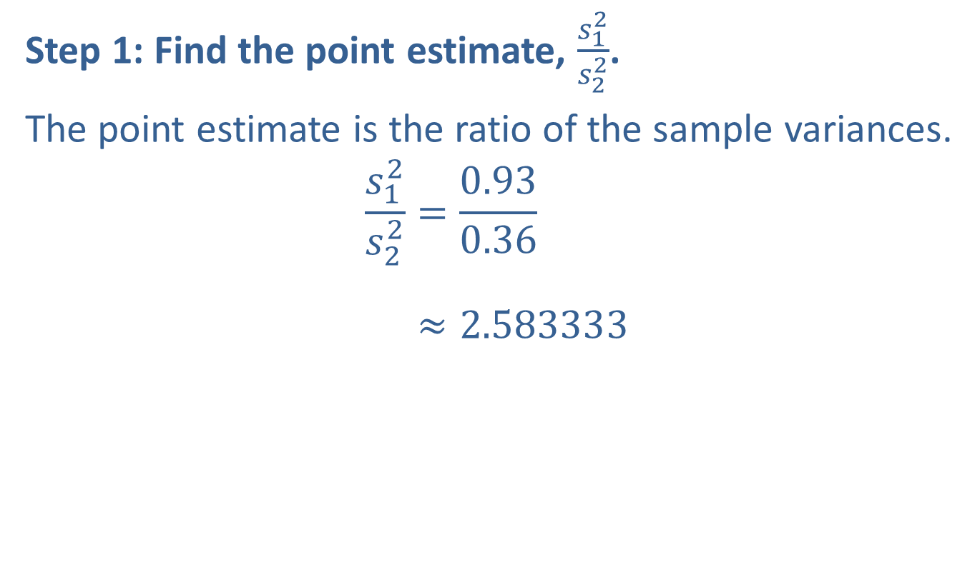
Example 9.5.2: Constructing a Confidence Interval for the Ratio of Two Population Variances (cont.)
Step 1: Find the point estimate, $\frac{s_{1}^{2}}{s_{2}^{2}}$.
The point estimate is the ratio of the sample variances.
𝑠12𝑠22=0.930.36𝑠12𝑠22≈2.583333

Slide 20
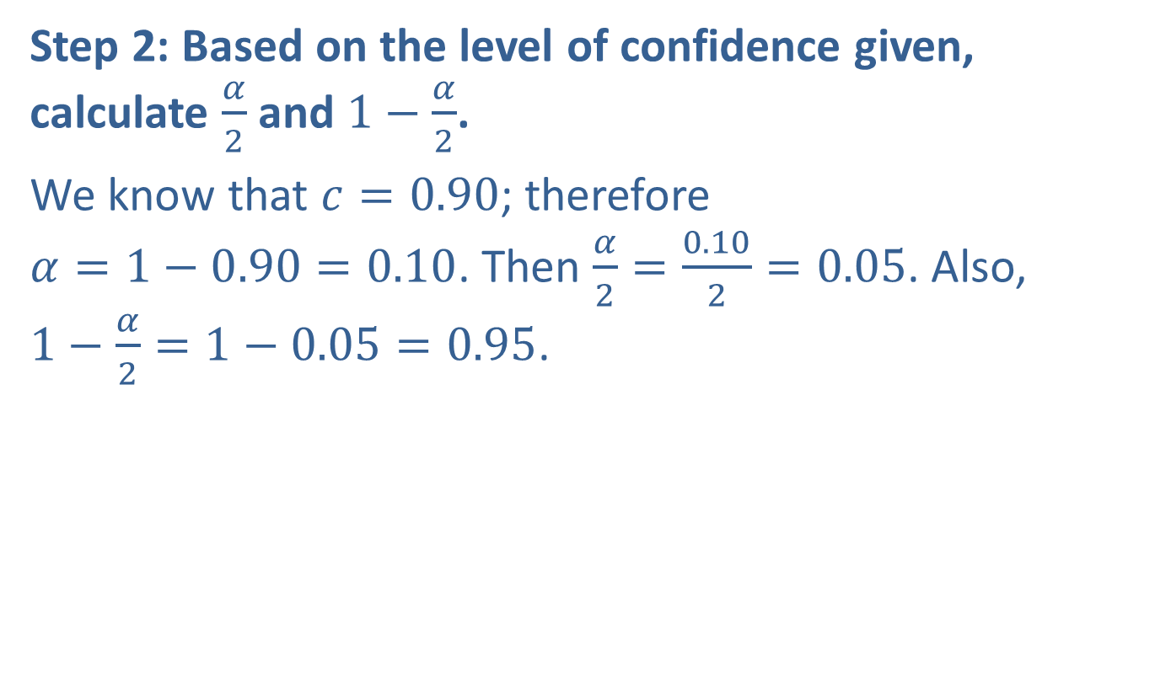
Example 9.5.2: Constructing a Confidence Interval for the Ratio of Two Population Variances (cont.)
Step 2: Based on the level of confidence given, calculate $\frac{α}{2}$ and $1−\frac{α}{2}$.
We know that $c=0.90$; therefore $α=1−0.90=0.10$. Then $\frac{α}{2}=\frac{0.10}{2}=0.05$. Also, $1−\frac{α}{2}=1−0.05=0.95$.

Slide 21
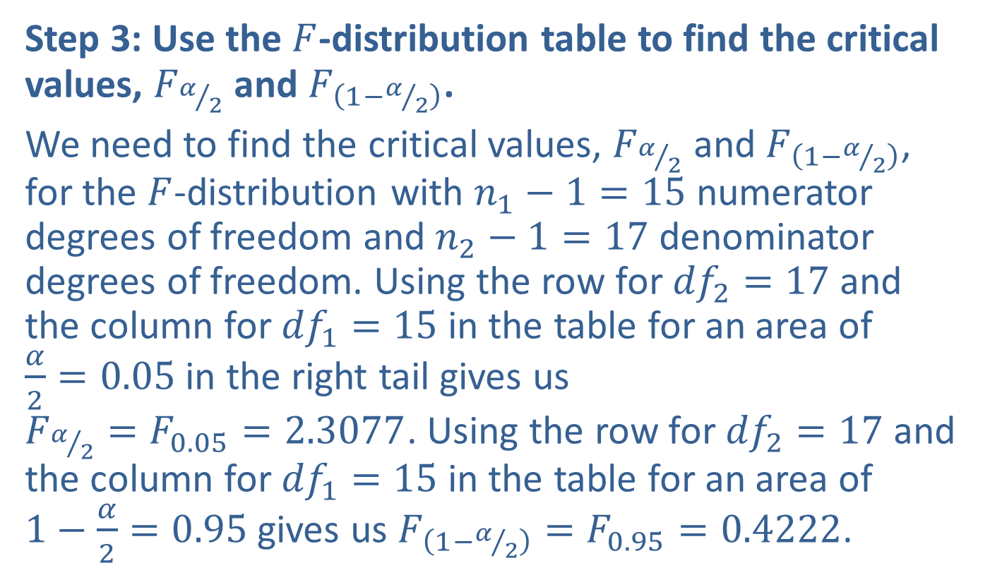
Example 9.5.2: Constructing a Confidence Interval for the Ratio of Two Population Variances (cont.)
Step 3: Use the $F$-distribution table to find the critical values, $F_{α/2}$ and $F_{\left(1−α/2\right)}$.
We need to find the critical values, $F_{α/2}$ and $F_{\left(1−α/2\right)}$, for the $F$-distribution with $n_{1}−1=15$ numerator degrees of freedom and $n_{2}−1=17$ denominator degrees of freedom. Using the row for ${df}_{2}=17$ and the column for ${df}_{1}=15$ in the table for an area of $\frac{α}{2}=0.05$ in the right tail gives us $F_{α/2}=F_{0.05}=2.3077$. Using the row for ${df}_{2}=17$ and the column for ${df}_{1}=15$ in the table for an area of $1−\frac{α}{2}=0.95$ gives us $F_{\left(1−α/2\right)}=F_{0.95}=0.4222$.

Slide 22
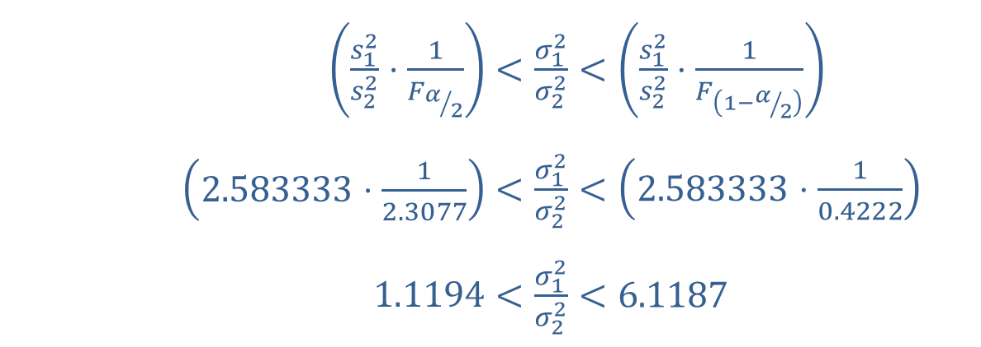
Example 9.5.2: Constructing a Confidence Interval for the Ratio of Two Population Variances (cont.)
Step 4: Substitute the necessary values into the formula for the confidence interval.
Substituting the values into the formula for a confidence interval for the ratio of two population variances gives us the following.
​
​$\left(\frac{s_{1}^{2}}{s_{2}^{2}}⋅\frac{1}{F_{α/2}}\right)$ | ​$<\frac{σ_{1}^{2}}{σ_{2}^{2}}<\left(\frac{s_{1}^{2}}{s_{2}^{2}}⋅\frac{1}{F_{\left(1−α/2\right)}}\right)$
​$\left(2.583333⋅\frac{1}{2.3077}\right)$ | ​$<\frac{σ_{1}^{2}}{σ_{2}^{2}}<\left(2.583333⋅\frac{1}{0.4222}\right)$
​$1.1194$ | ​$<\frac{σ_{1}^{2}}{σ_{2}^{2}}<6.1187$

Slide 23
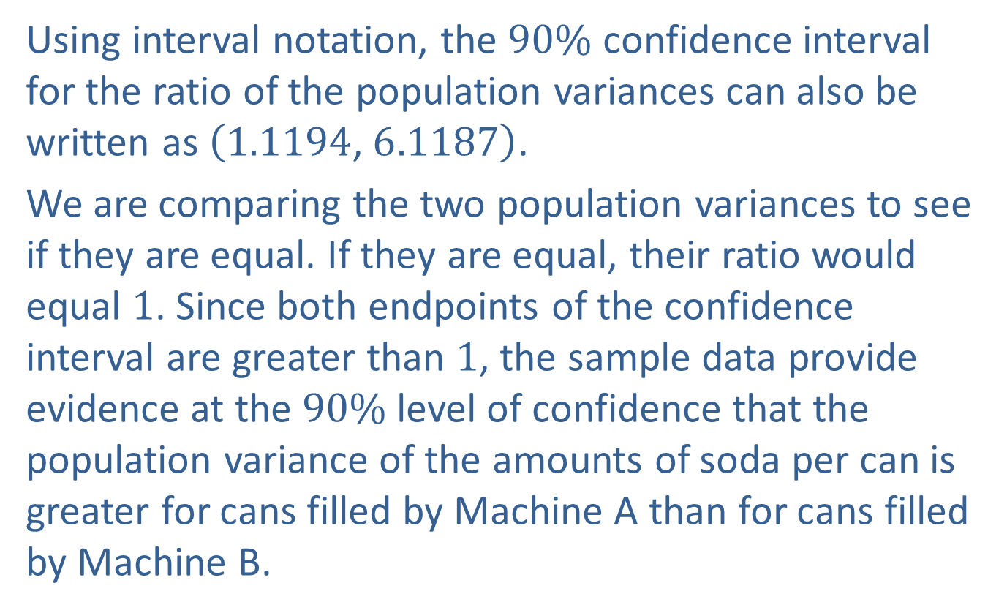
Example 9.5.2: Constructing a Confidence Interval for the Ratio of Two Population Variances (cont.)
Using interval notation, the $90\%$ confidence interval for the ratio of the population variances can also be written as $\left(1.1194\text{, }6.1187\right)$.
We are comparing the two population variances to see if they are equal. If they are equal, their ratio would equal 1. Since both endpoints of the confidence interval are greater than 1, the sample data provide evidence at the $90\%$ level of confidence that the population variance of the amounts of soda per can is greater for cans filled by Machine A than for cans filled by Machine B.

Slide 24
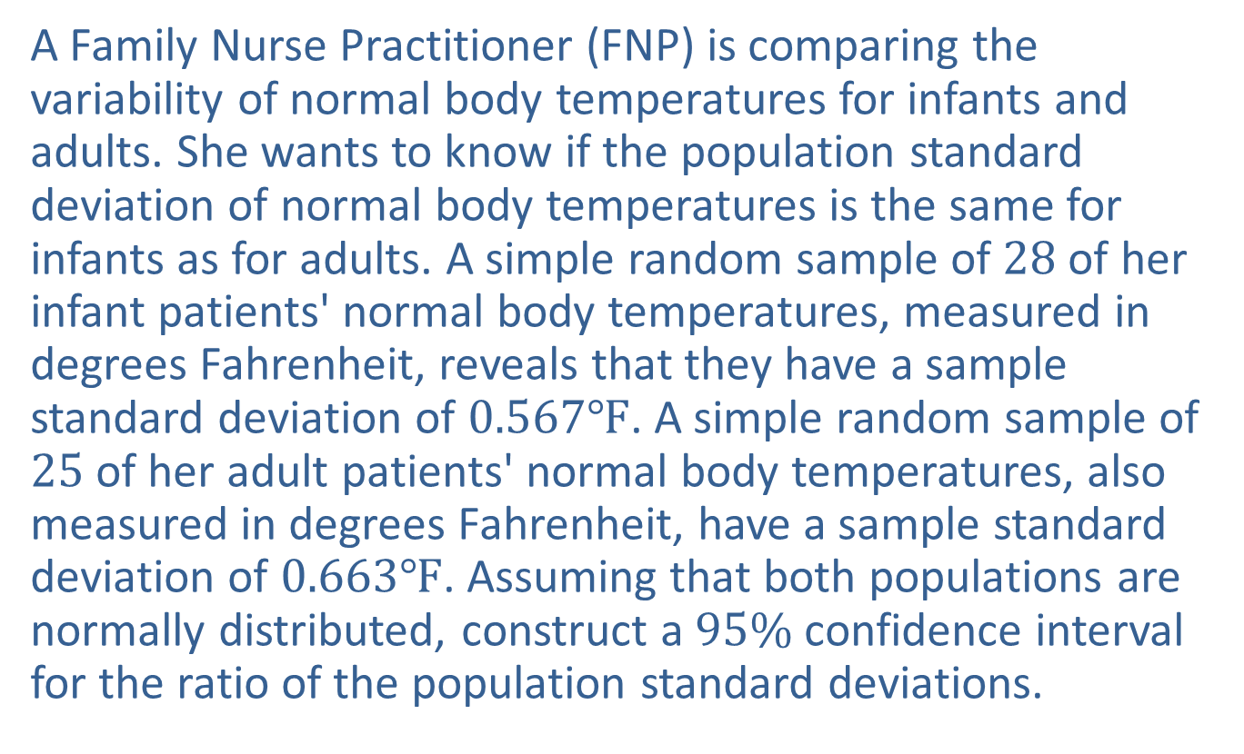
Example 9.5.3: Constructing a Confidence Interval for the Ratio of Two Population Standard Deviations
A Family Nurse Practitioner (FNP) is comparing the variability of normal body temperatures for infants and adults. She wants to know if the population standard deviation of normal body temperatures is the same for infants as for adults. A simple random sample of 28 of her infant patients' normal body temperatures, measured in degrees Fahrenheit, reveals that they have a sample standard deviation of $0.567℉$. A simple random sample of 25 of her adult patients' normal body temperatures, also measured in degrees Fahrenheit, have a sample standard deviation of $0.663℉$. Assuming that both populations are normally distributed, construct a $95\%$ confidence interval for the ratio of the population standard deviations.

Slide 25
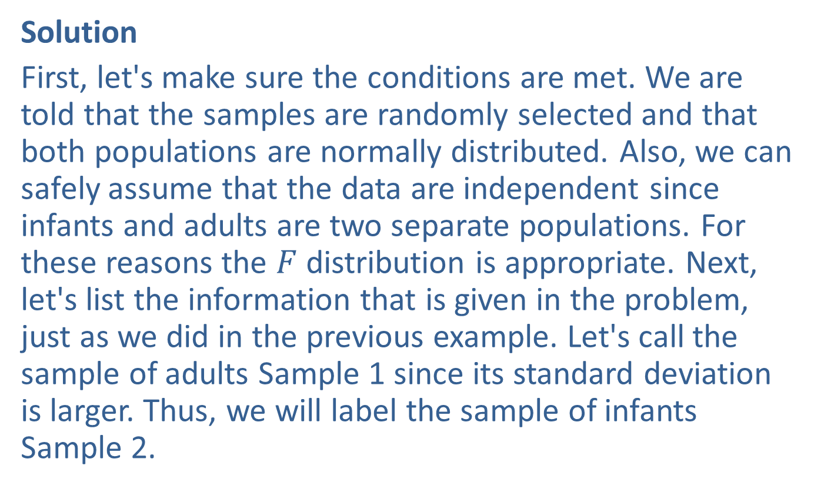
Example 9.5.3: Constructing a Confidence Interval for the Ratio of Two Population Standard Deviations (cont.)
Solution
First, let's make sure the conditions are met. We are told that the samples are randomly selected and that both populations are normally distributed. Also, we can safely assume that the data are independent since infants and adults are two separate populations. For these reasons the $F$ distribution is appropriate. Next, let's list the information that is given in the problem, just as we did in the previous example. Let's call the sample of adults Sample 1 since its standard deviation is larger. Thus, we will label the sample of infants Sample 2.

Slide 26


Example 9.5.3: Constructing a Confidence Interval for the Ratio of Two Population Standard Deviations (cont.)
Adults: | Infants:
​ | ​
​$n_{1}$ | ​$=25$
​$s_{1}$ | ​$=0.663$
​$n_{2}$ | ​$=28$
​$s_{2}$ | ​$=0.567$

Slide 27
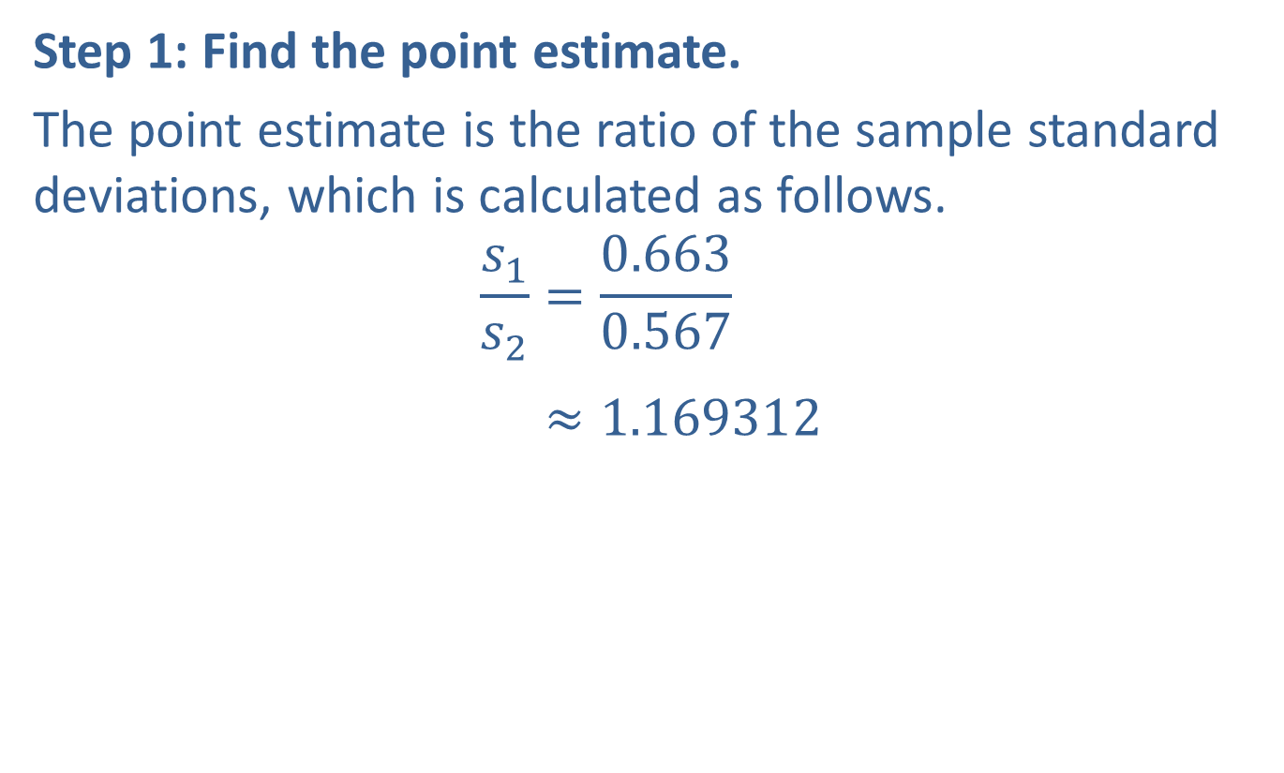
Example 9.5.3: Constructing a Confidence Interval for the Ratio of Two Population Standard Deviations (cont.)
Step 1: Find the point estimate.
The point estimate is the ratio of the sample standard deviations, which is calculated as follows.
𝑠1𝑠2=0.6630.567𝑠1𝑠2≈1.169312

Slide 28
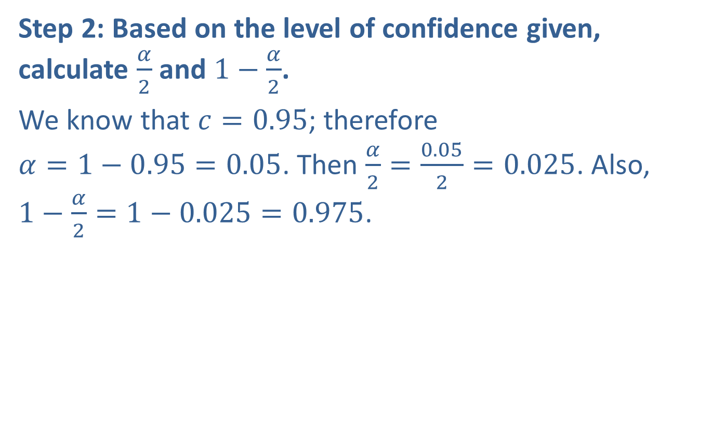
Example 9.5.3: Constructing a Confidence Interval for the Ratio of Two Population Standard Deviations (cont.)
Step 2: Based on the level of confidence given, calculate $\frac{α}{2}$ and $1−\frac{α}{2}$.
We know that $c=0.95$; therefore $α=1−0.95=0.05$. Then $\frac{α}{2}=\frac{0.05}{2}=0.025$. Also, $1−\frac{α}{2}=1−0.025=0.975$.

Slide 29
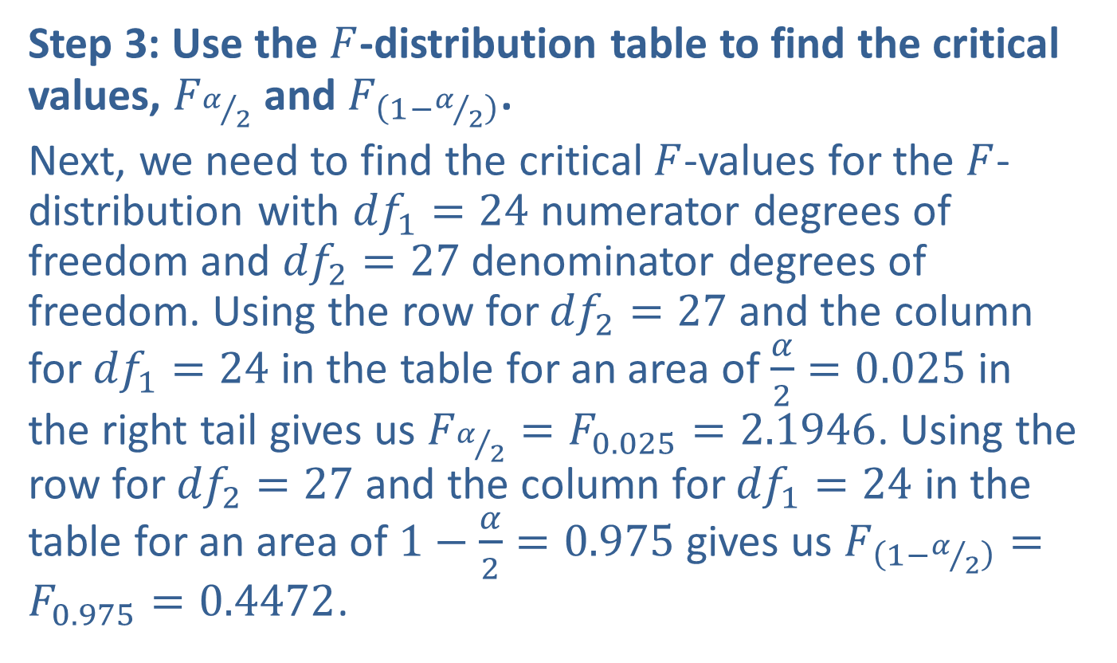
Example 9.5.3: Constructing a Confidence Interval for the Ratio of Two Population Standard Deviations (cont.)
Step 3: Use the $F$-distribution table to find the critical values, $F_{α/2}$ and $F_{\left(1−α/2\right)}$.
Next, we need to find the critical $F$-values for the $F$-distribution with ${df}_{1}=24$ numerator degrees of freedom and ${df}_{2}=27$ denominator degrees of freedom. Using the row for ${df}_{2}=27$ and the column for ${df}_{1}=24$ in the table for an area of $\frac{α}{2}=0.025$ in the right tail gives us $F_{α/2}=F_{0.025}=2.1946$. Using the row for ${df}_{2}=27$ and the column for ${df}_{1}=24$ in the table for an area of $1−\frac{α}{2}=0.975$ gives us $F_{\left(1−α/2\right)}=F_{0.975}=0.4472$.

Slide 30
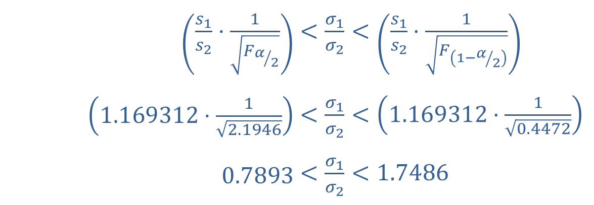
Example 9.5.3: Constructing a Confidence Interval for the Ratio of Two Population Standard Deviations (cont.)
Step 4: Substitute the necessary values into the formula for the confidence interval.
Substituting the values into the formula for a confidence interval for the ratio of two population standard deviations gives us the following.
​
​$\left(\frac{s_{1}}{s_{2}}⋅\frac{1}{\sqrt{F_{α/2}}}\right)$ | ​$<\frac{σ_{1}}{σ_{2}}<\left(\frac{s_{1}}{s_{2}}⋅\frac{1}{\sqrt{F_{\left(1−α/2\right)}}}\right)$
​$\left(1.169312⋅\frac{1}{\sqrt{2.1946}}\right)$ | ​$<\frac{σ_{1}}{σ_{2}}<\left(1.169312⋅\frac{1}{\sqrt{0.4472}}\right)$
​$0.7893$ | ​$<\frac{σ_{1}}{σ_{2}}<1.7486$

Slide 31
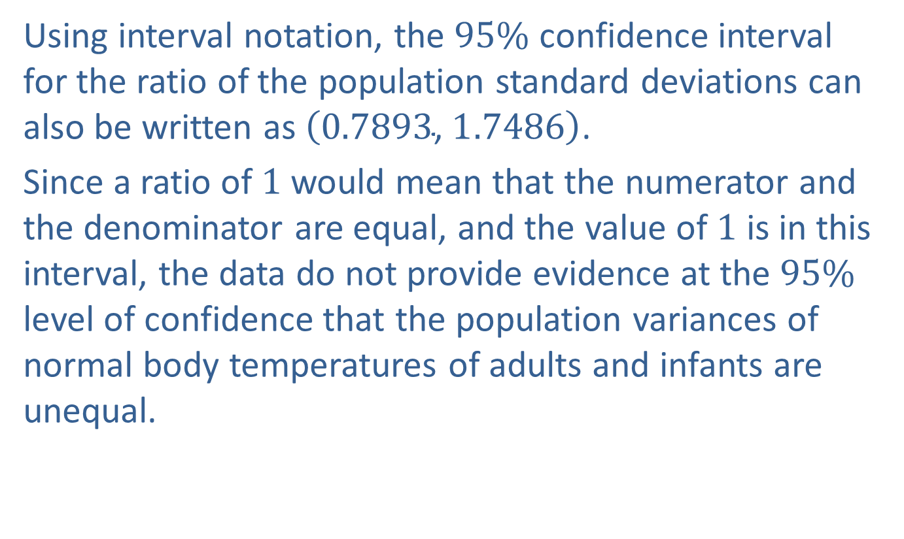
Example 9.5.3: Constructing a Confidence Interval for the Ratio of Two Population Standard Deviations (cont.)
Using interval notation, the $95\%$ confidence interval for the ratio of the population standard deviations can also be written as $\left(0.7893\text{, }1.7486\right)$.
Since a ratio of 1 would mean that the numerator and the denominator are equal, and the value of 1 is in this interval, the data do not provide evidence at the $95\%$ level of confidence that the population variances of normal body temperatures of adults and infants are unequal.

