Slide 1
Chapter 1
The Nature of Biology

Slide 2
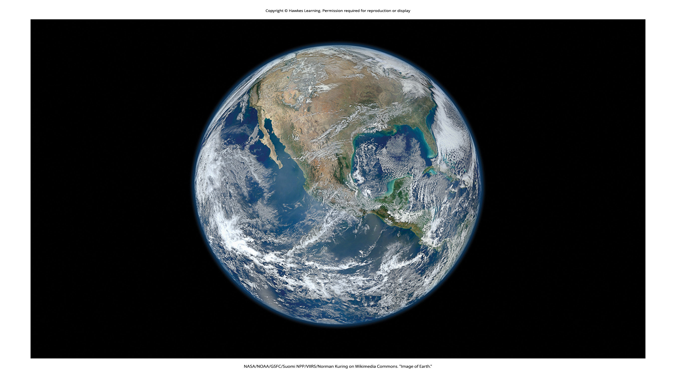
Lesson 1.1 Figure 1

Slide 3
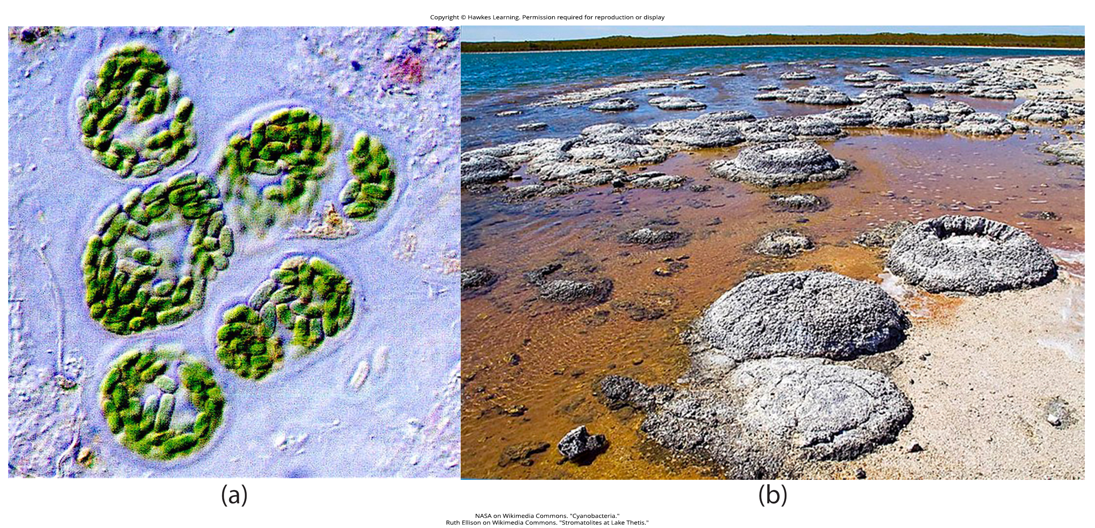
Lesson 1.1 Figure 2

Slide 4
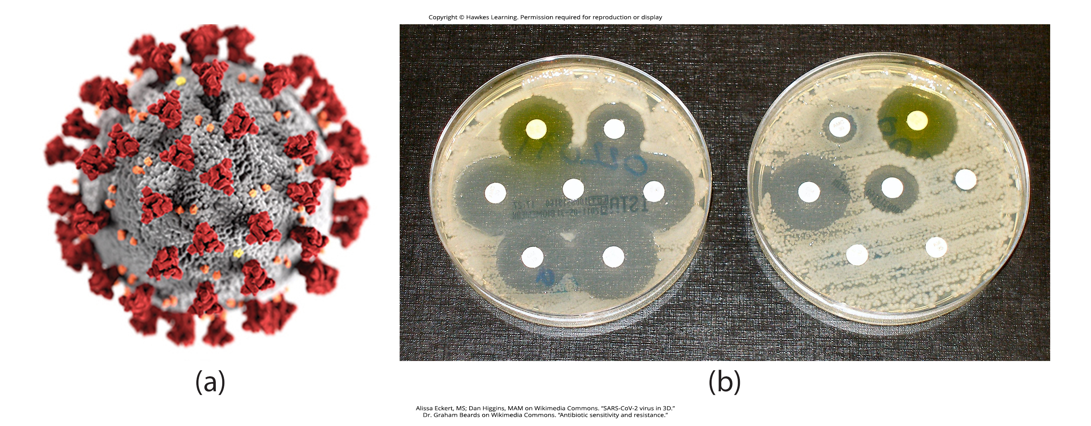
Lesson 1.1 Figure 3

Slide 5
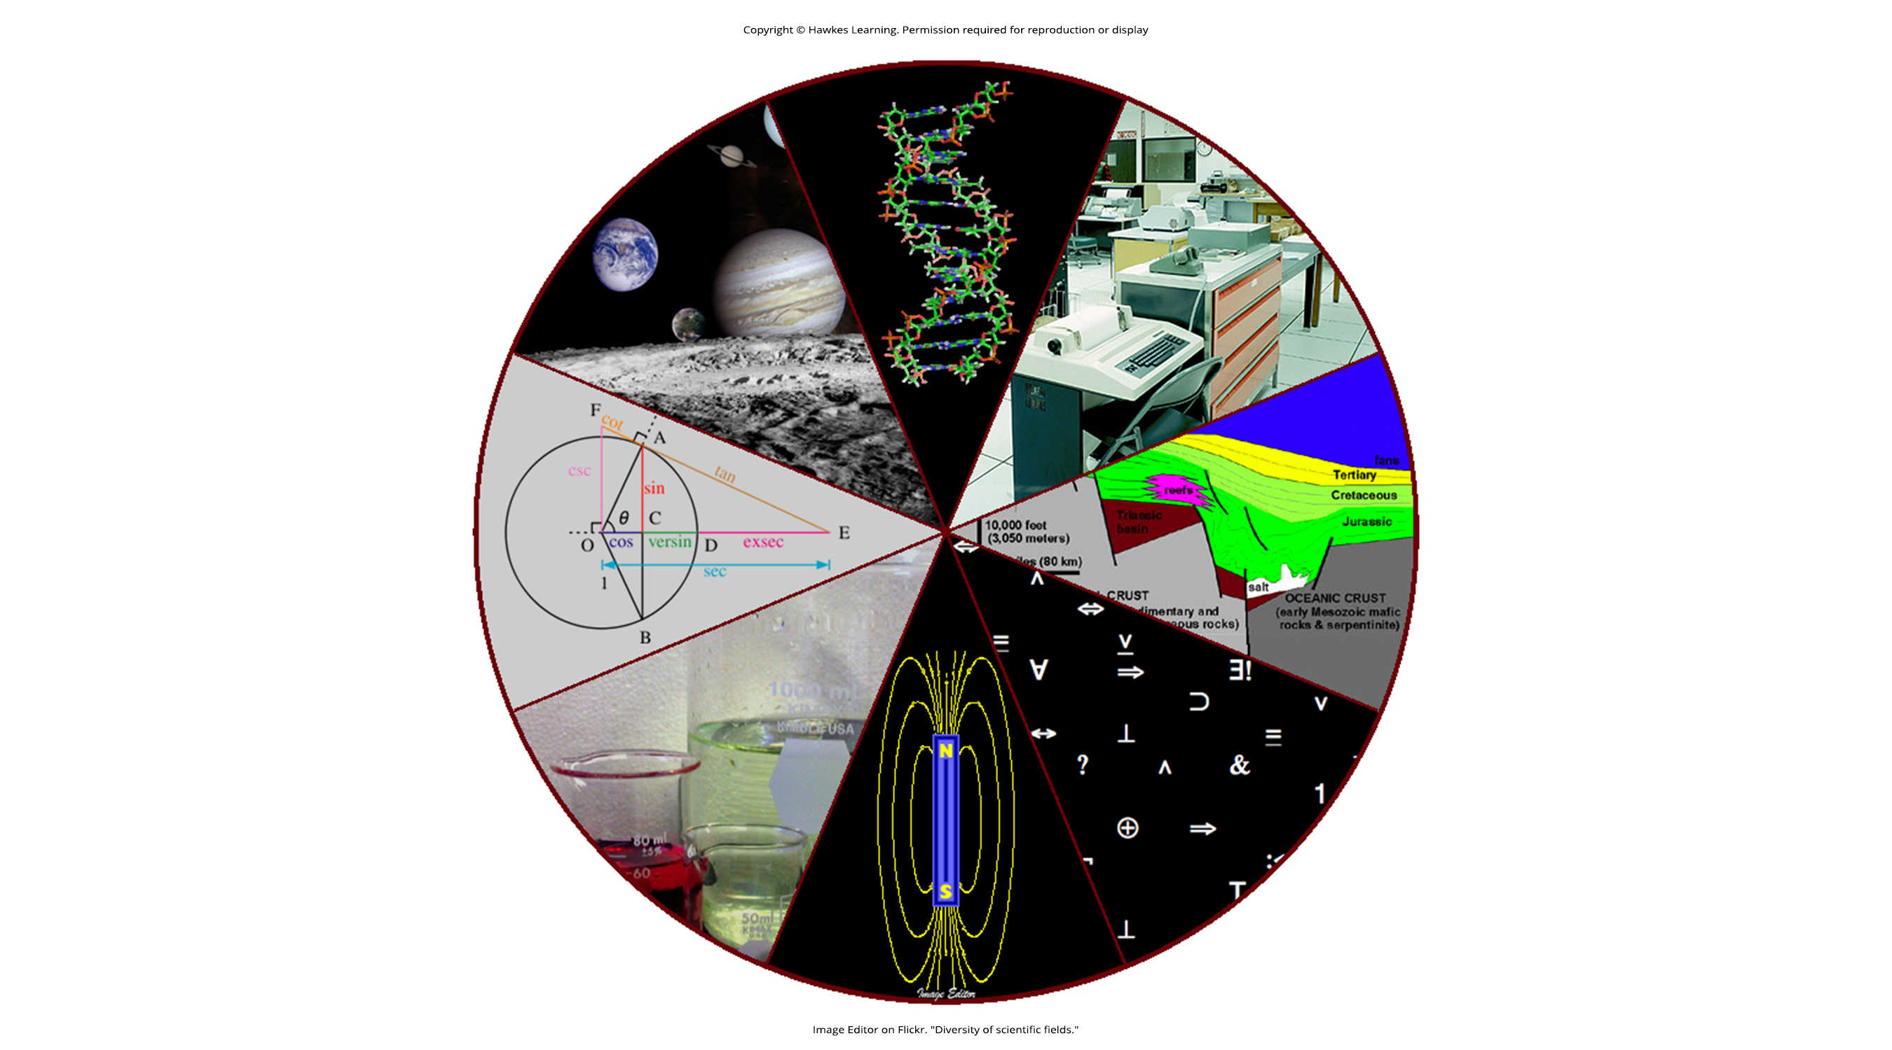
Lesson 1.1 Figure 4

Slide 6
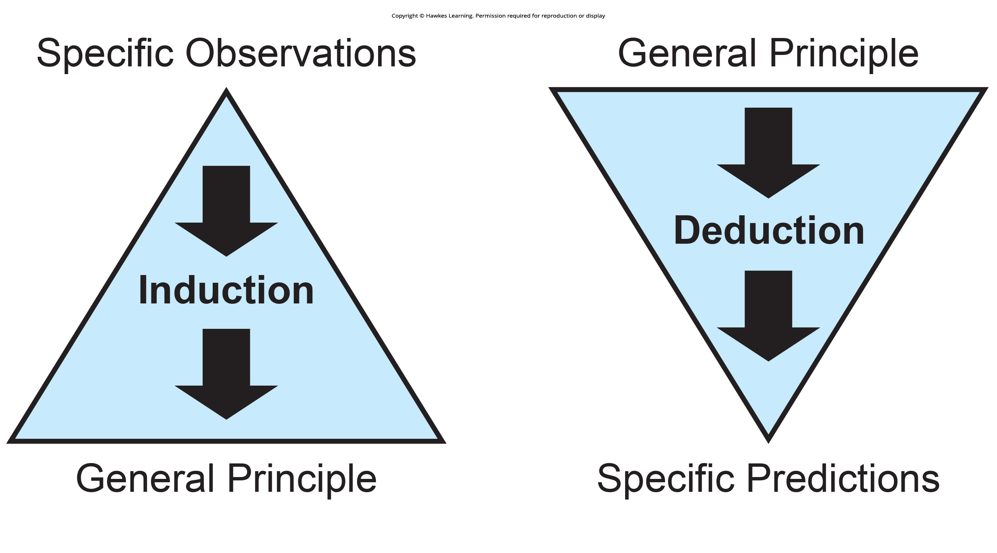
Lesson 1.1 Figure 5

Slide 7
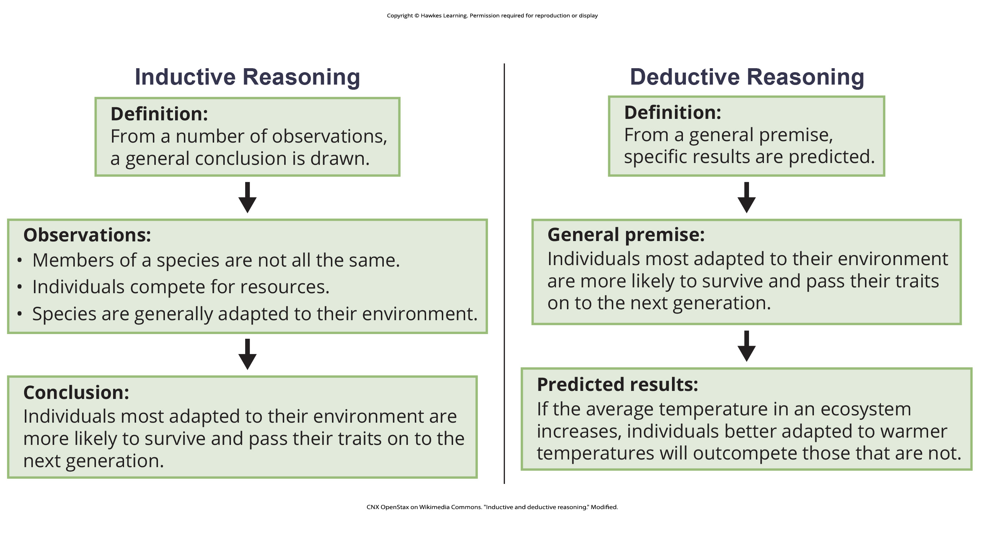
Lesson 1.1 Figure 6

Slide 8
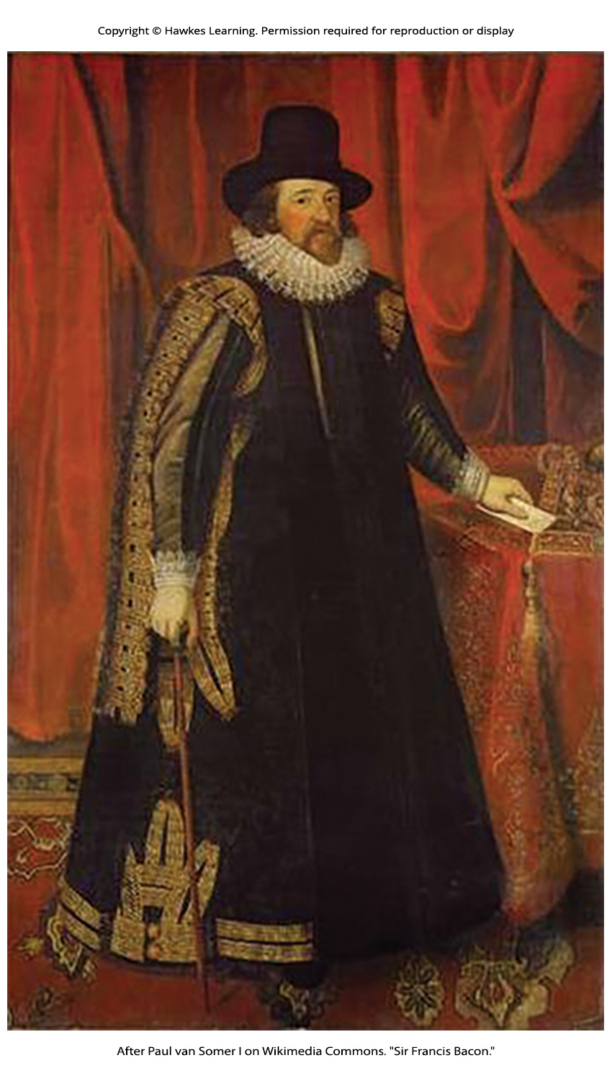
Lesson 1.1 Figure 7

Slide 9
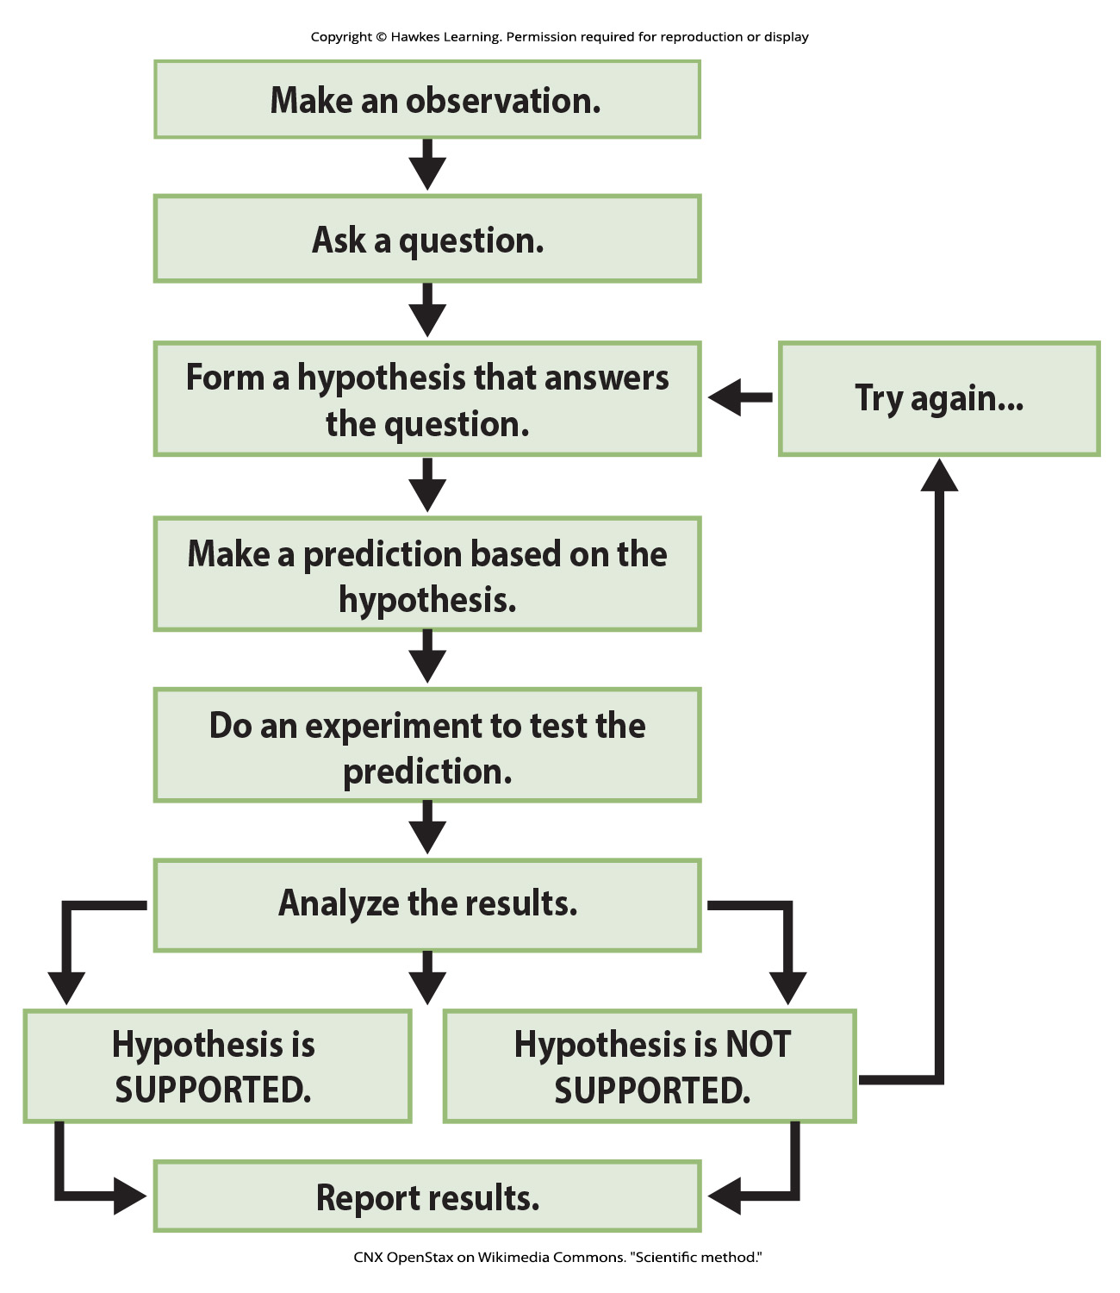
Lesson 1.1 Figure 8

Slide 10
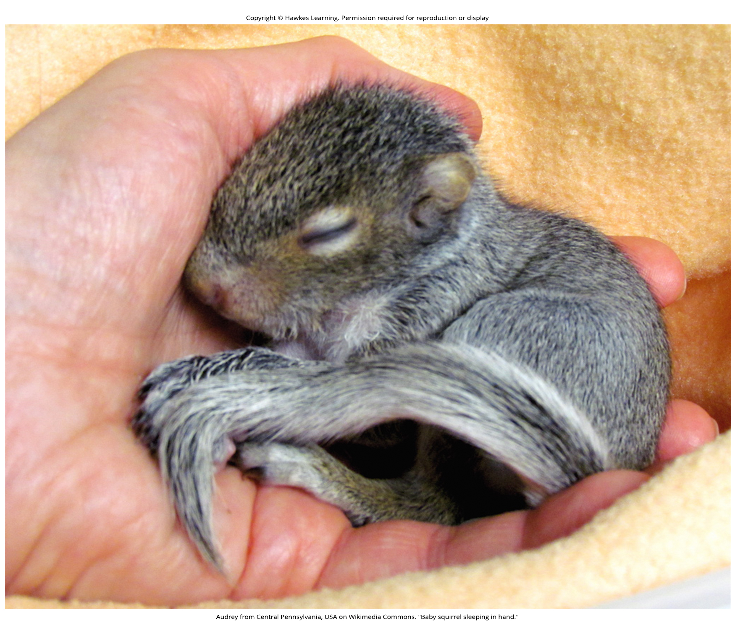
Lesson 1.1 Figure 9

Slide 11

Lesson 1.1 Figure 10a

Slide 12
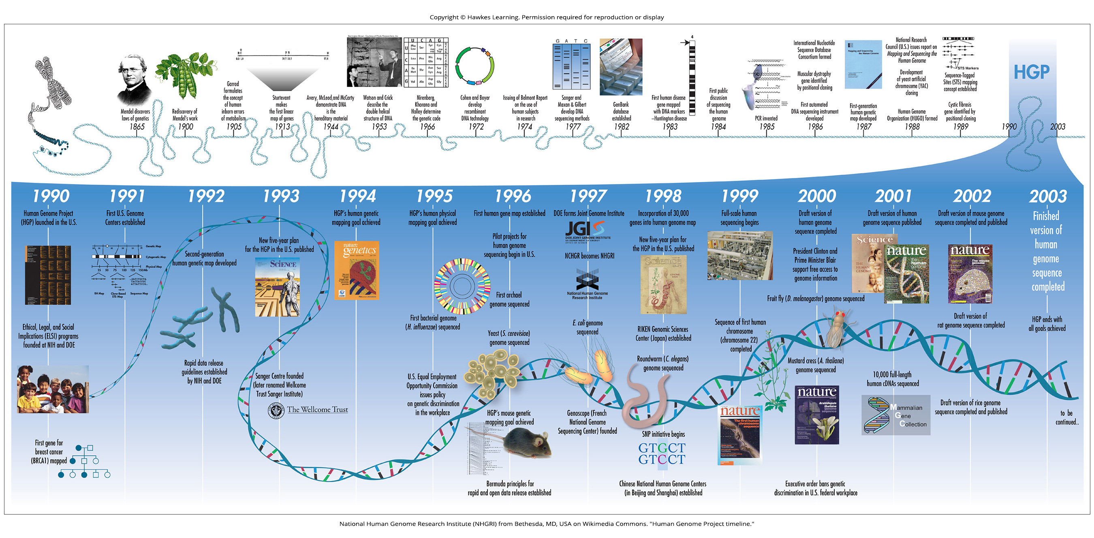
Lesson 1.1 Figure 10b

Slide 13
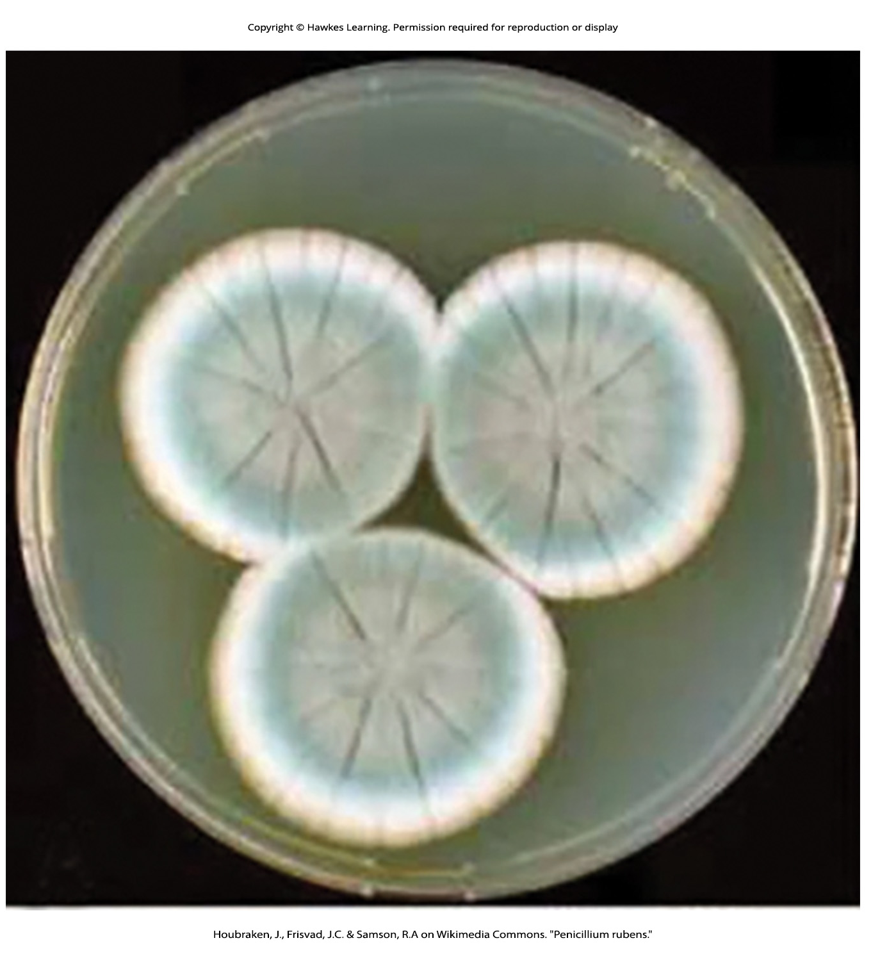
Lesson 1.1 Figure 11

Slide 14
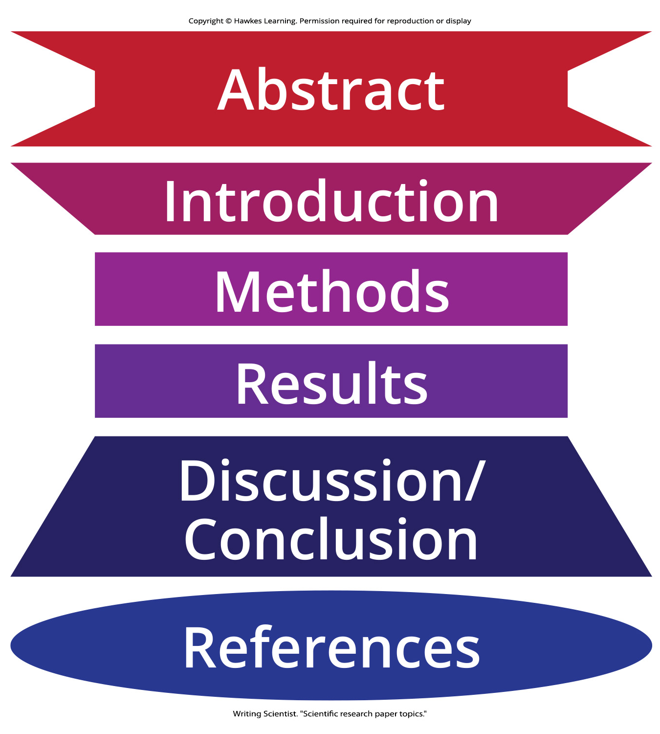
Lesson 1.1 Figure 12

Slide 15
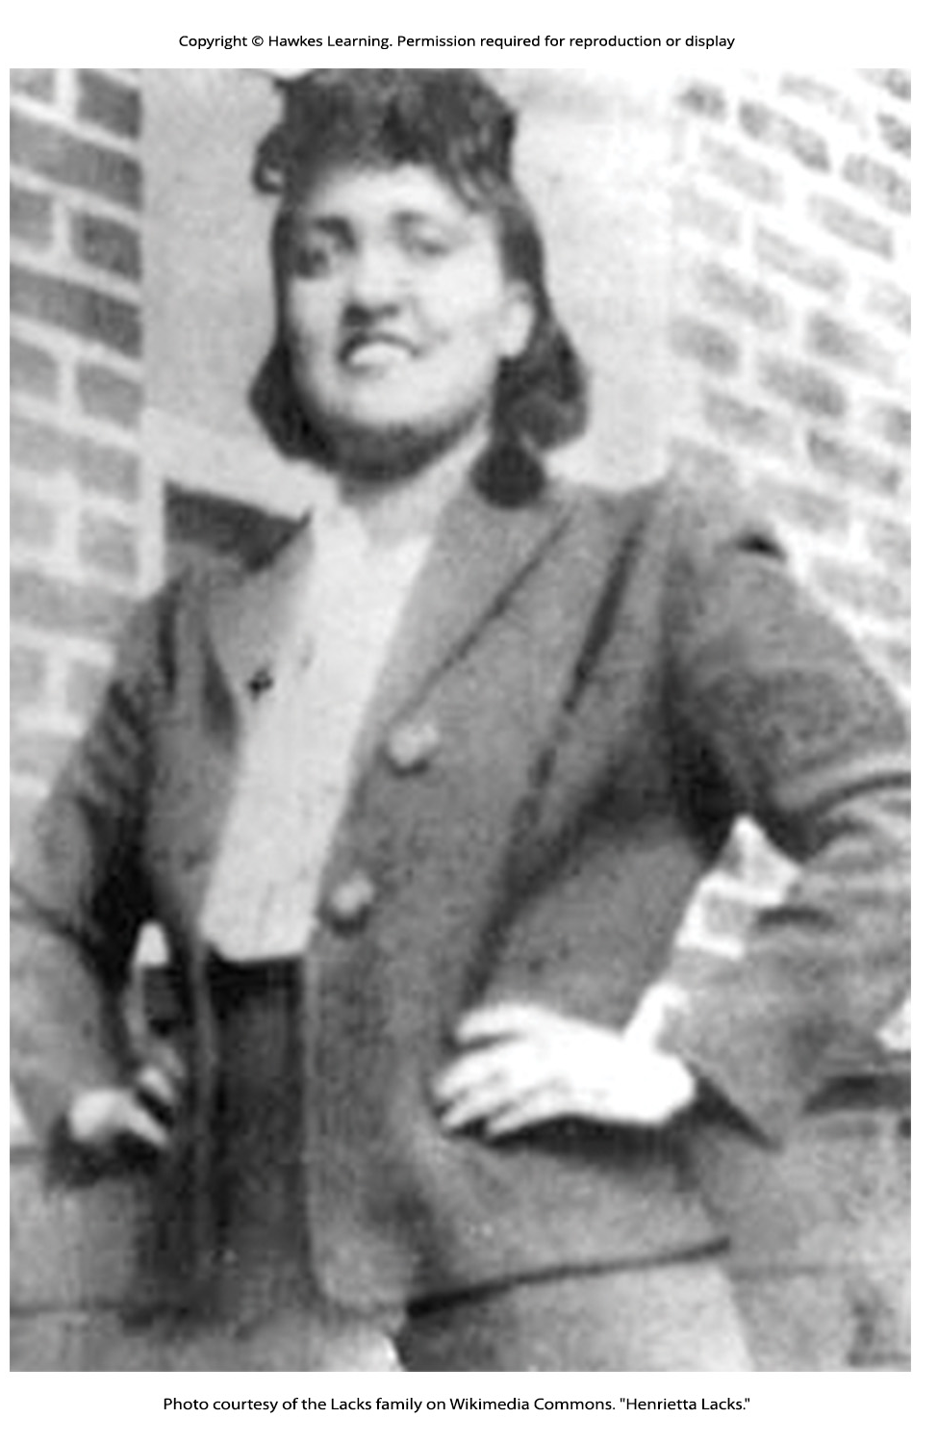
Lesson 1.1 Figure 13

Slide 16
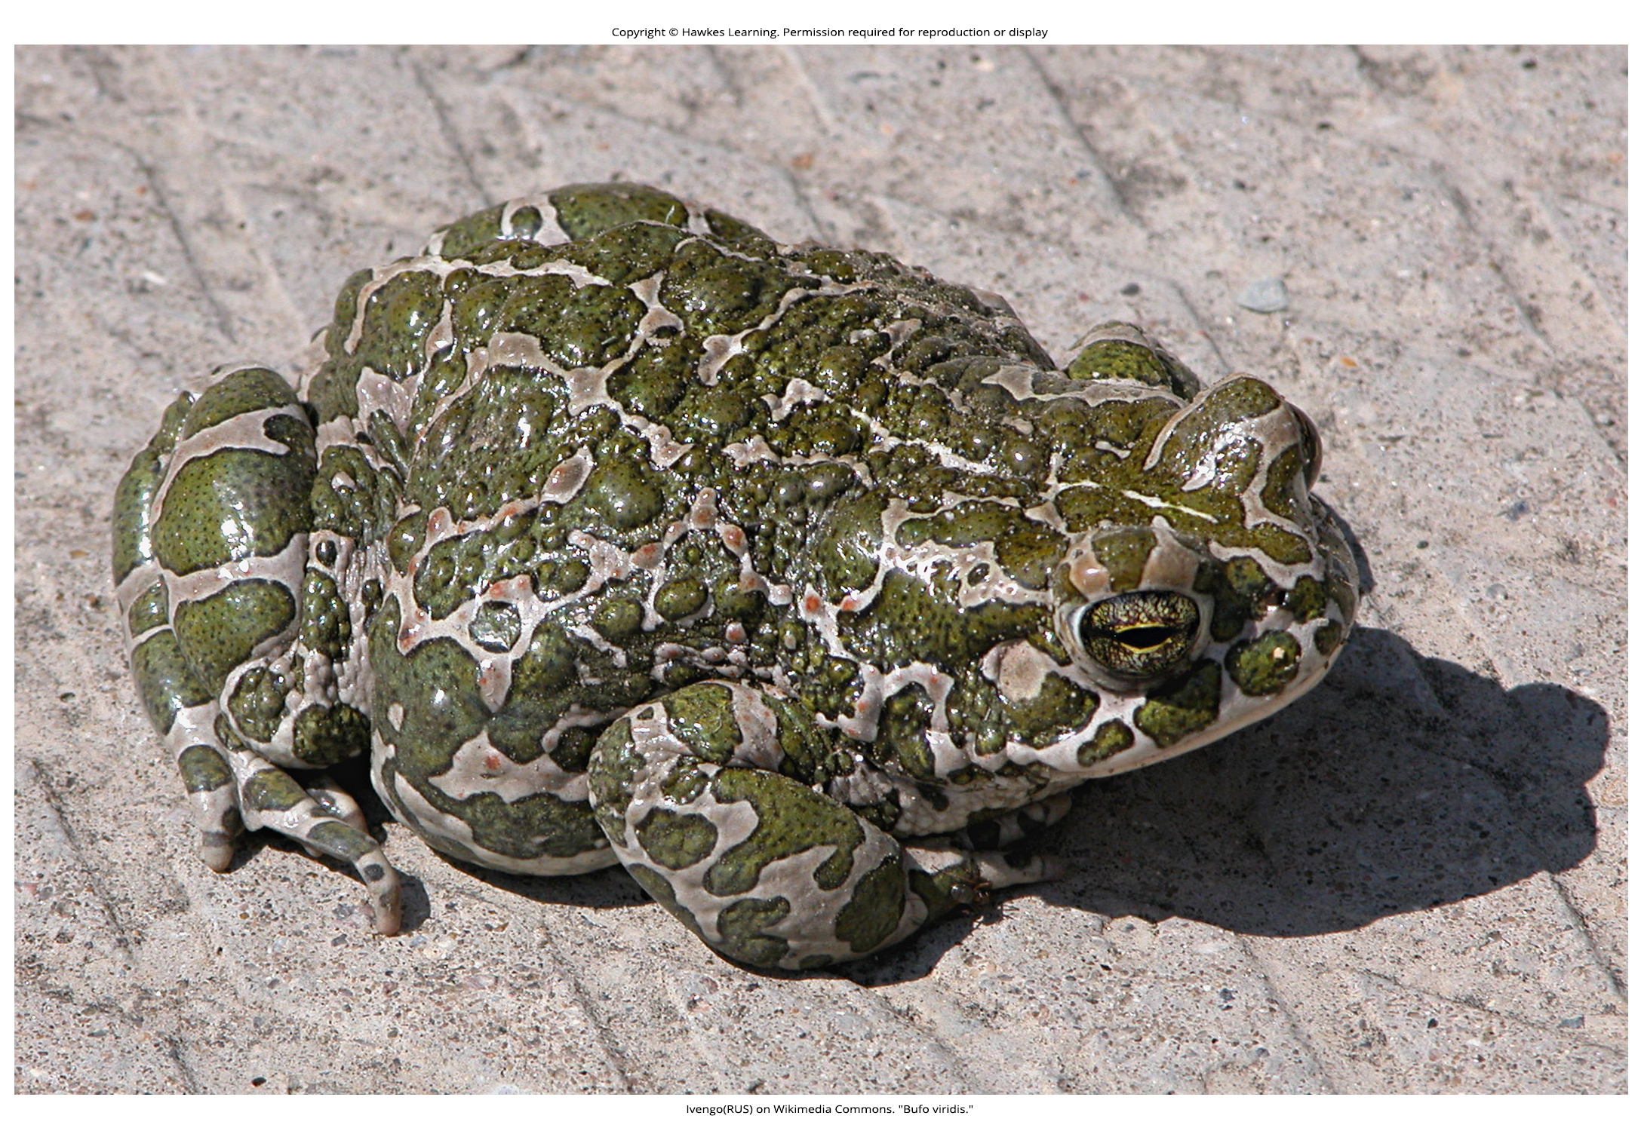
Lesson 1.2 Figure 1

Slide 17
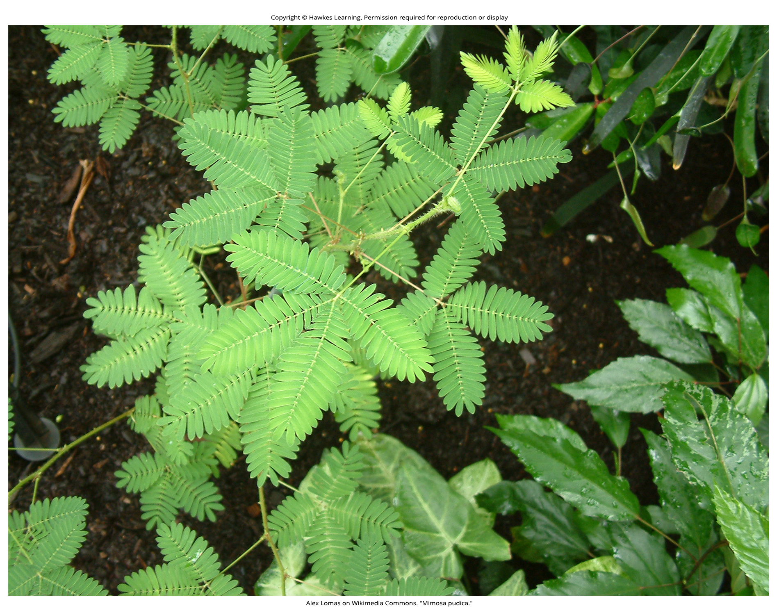
Lesson 1.2 Figure 2

Slide 18
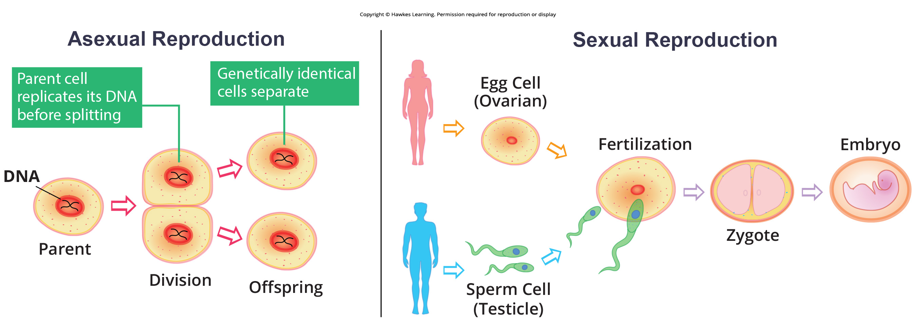
Lesson 1.2 Figure 3

Slide 19
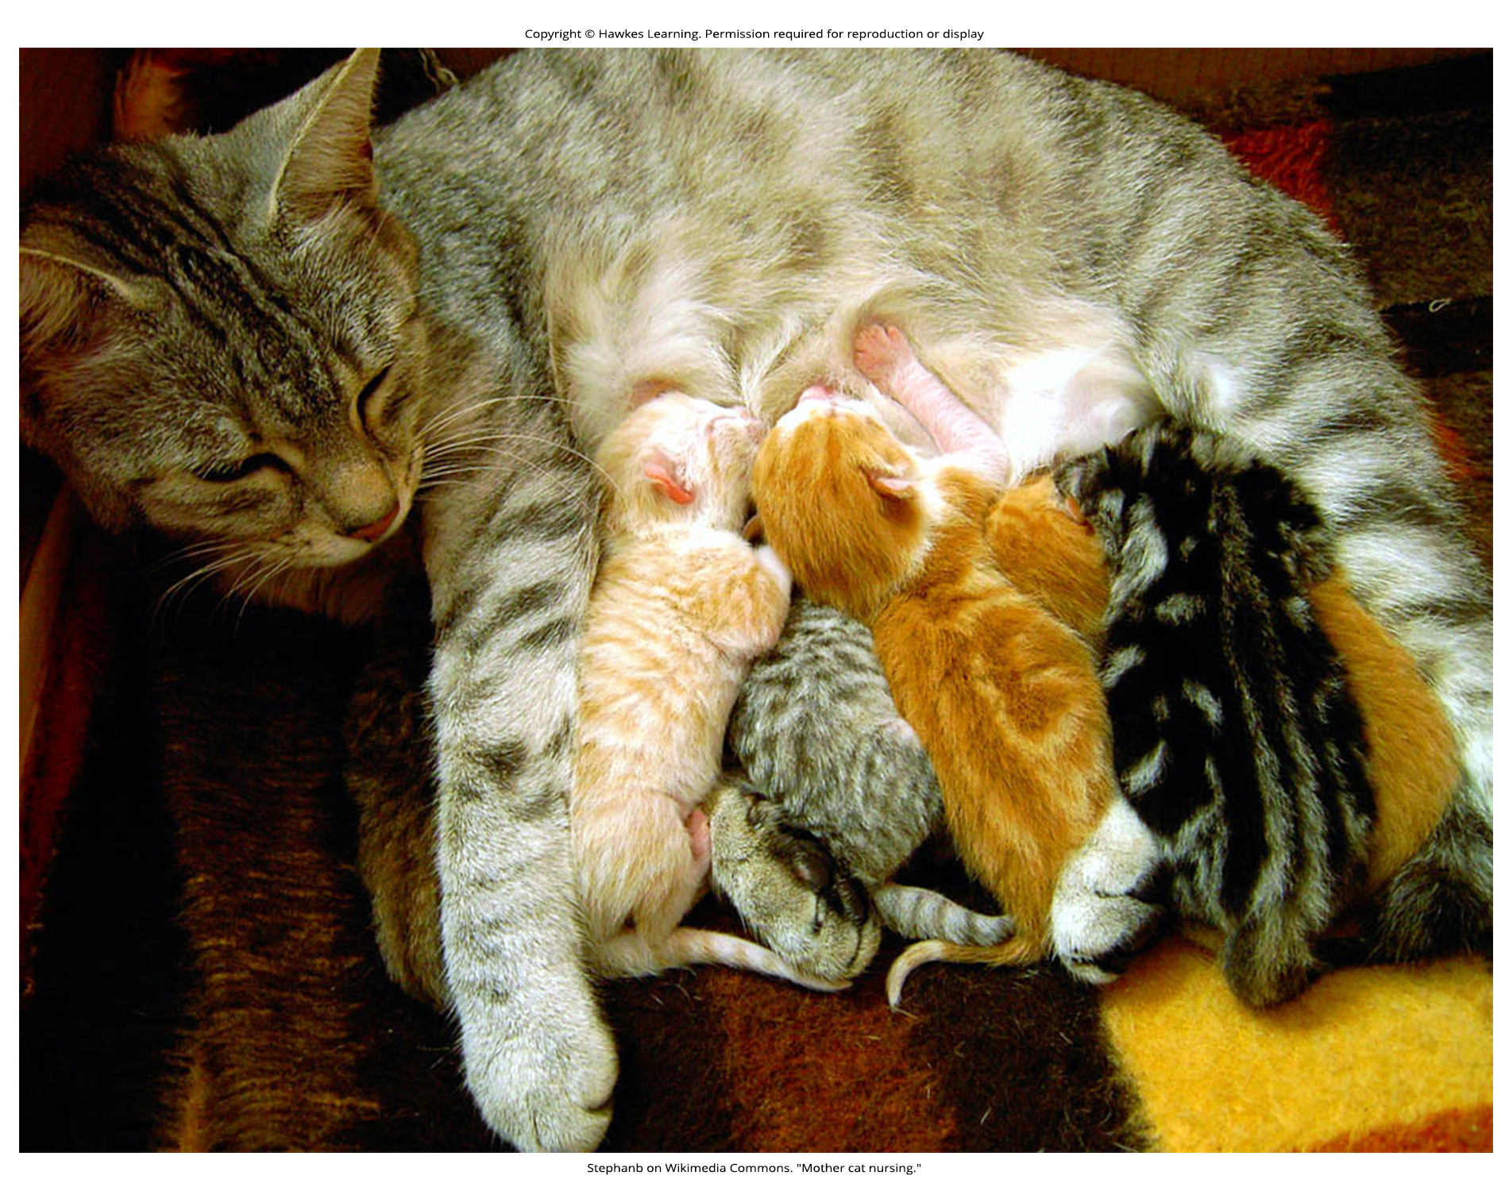
Lesson 1.2 Figure 4

Slide 20
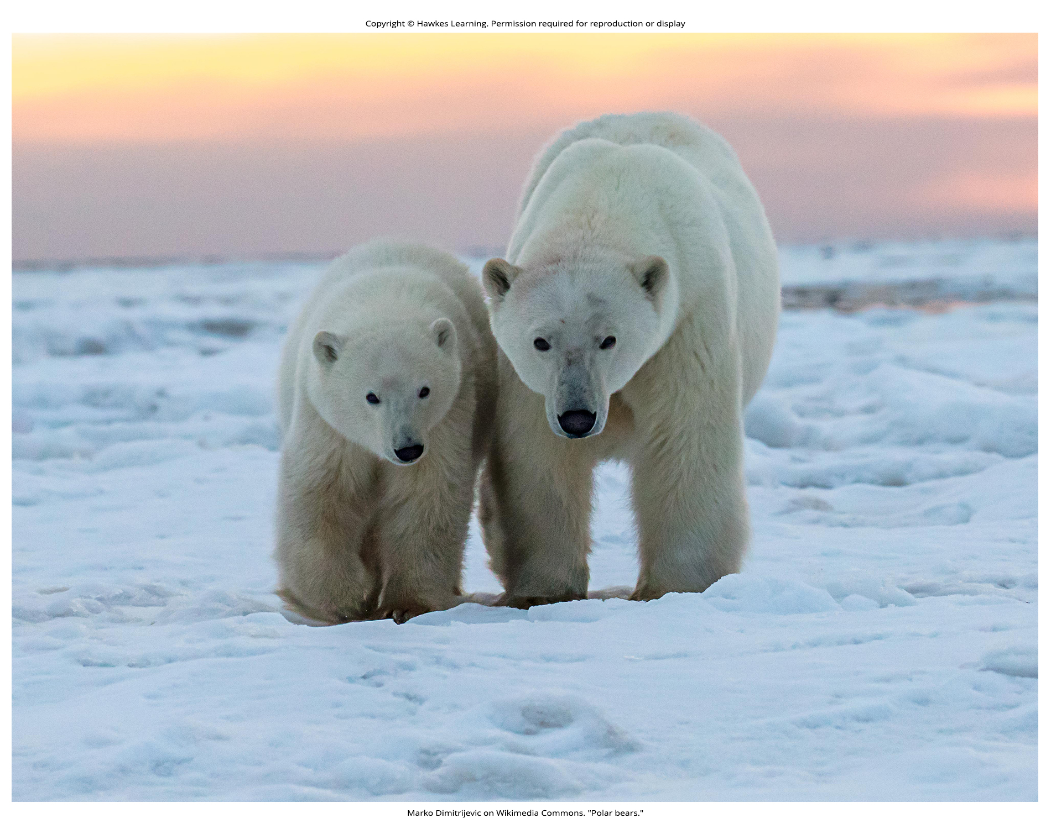
Lesson 1.2 Figure 5

Slide 21
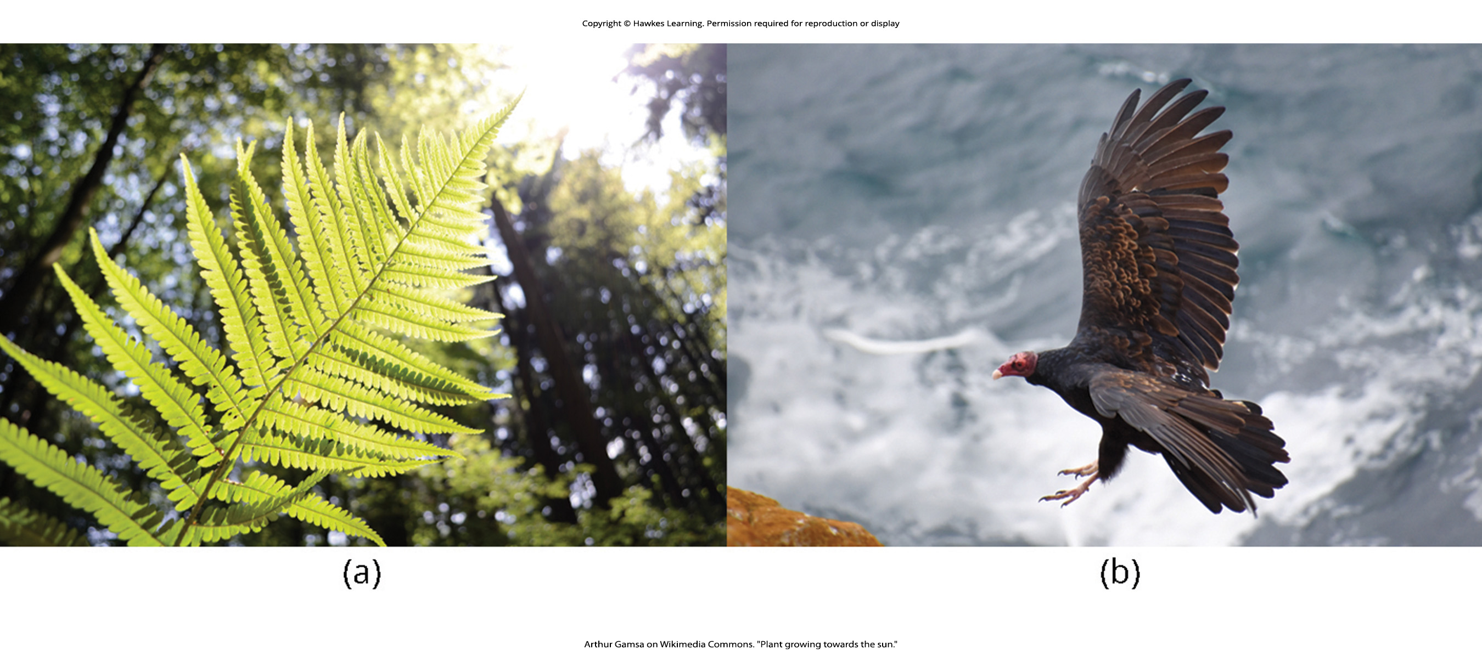
Lesson 1.2 Figure 6

Slide 22
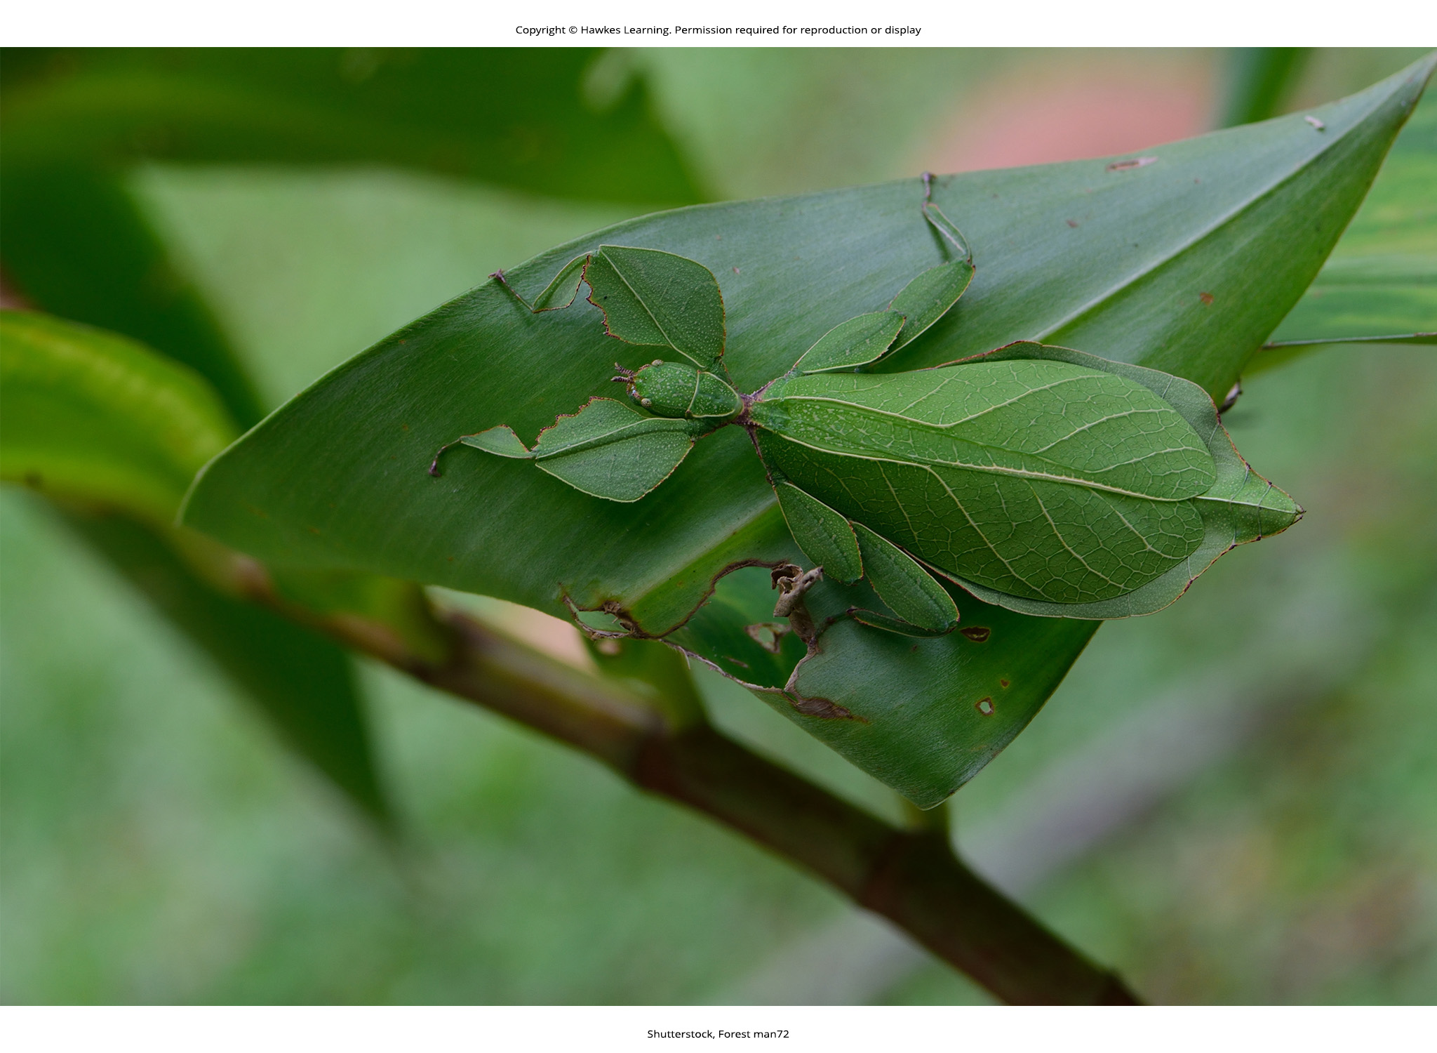
Lesson 1.2 Figure 7

Slide 23
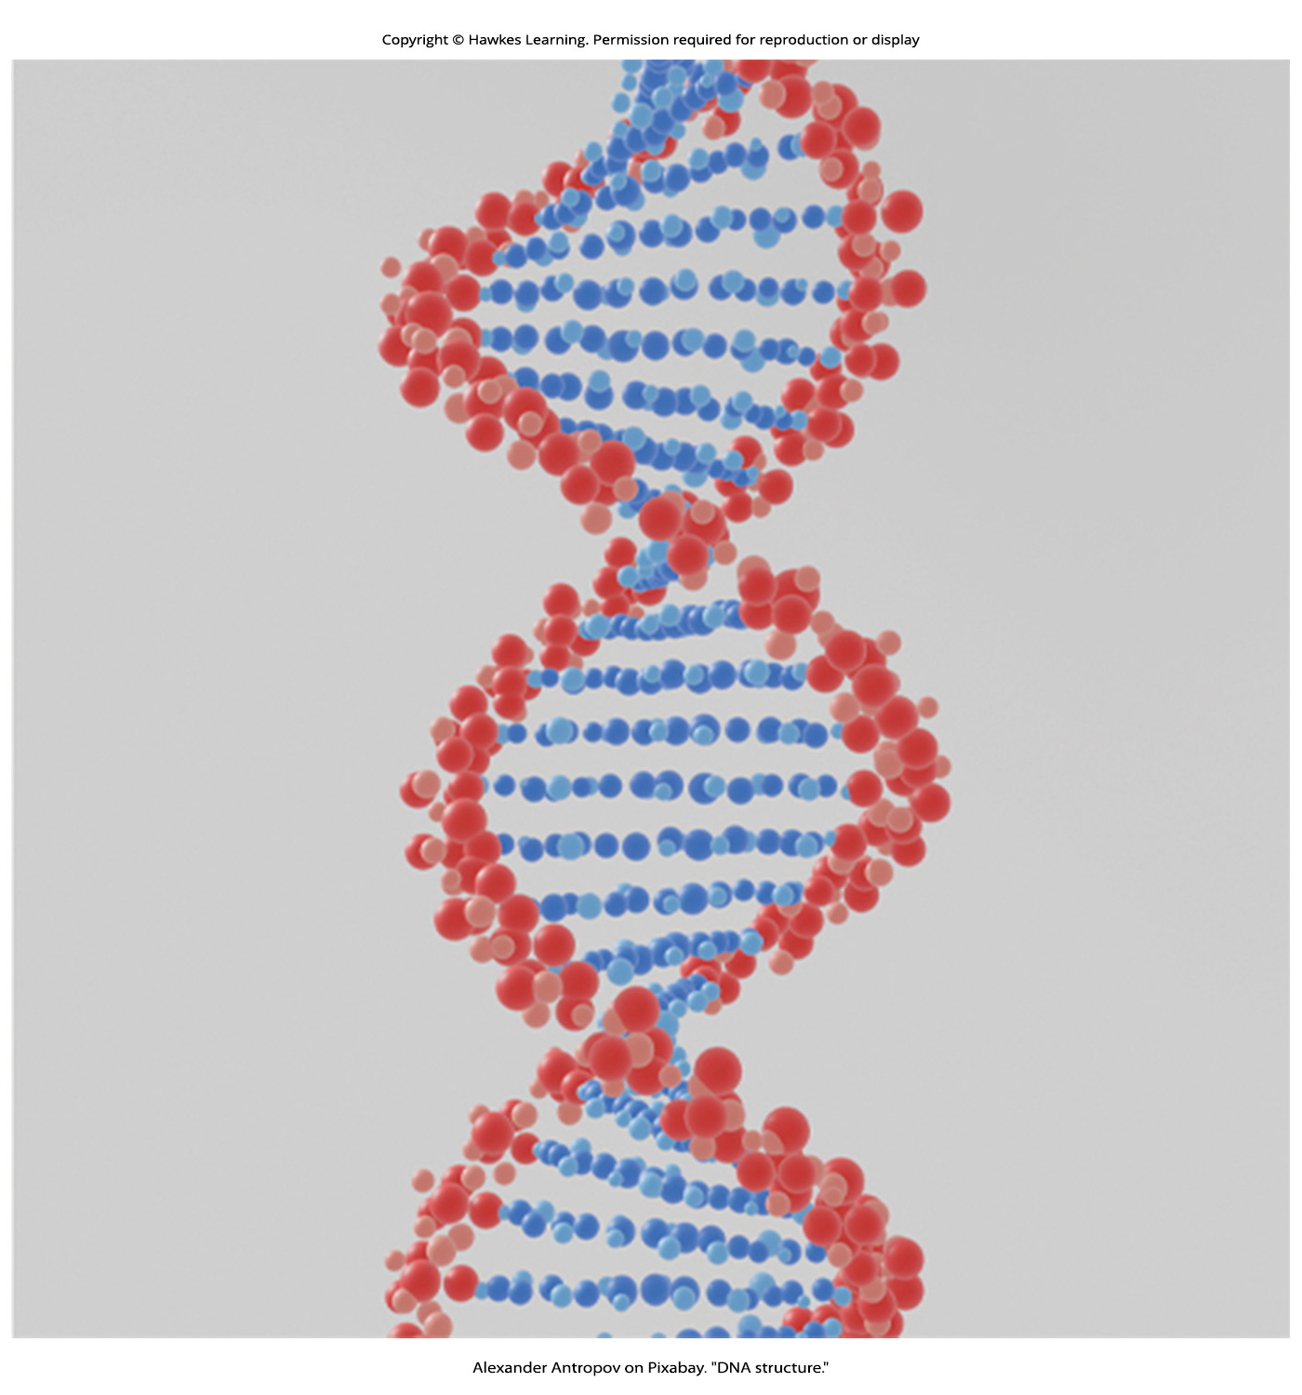
Lesson 1.2 Figure 8

Slide 24
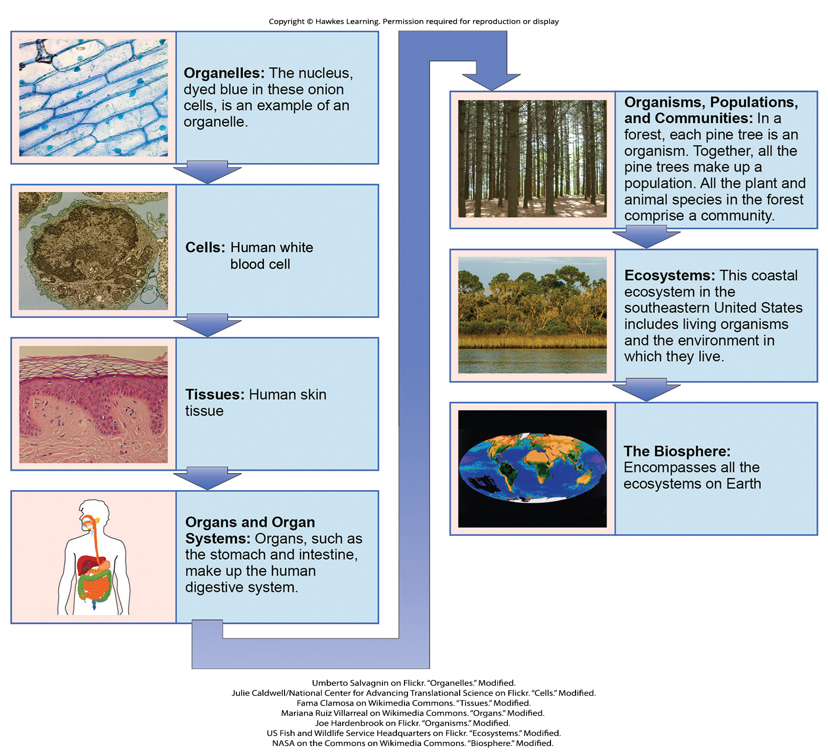
Lesson 1.2 Figure 9

Slide 25
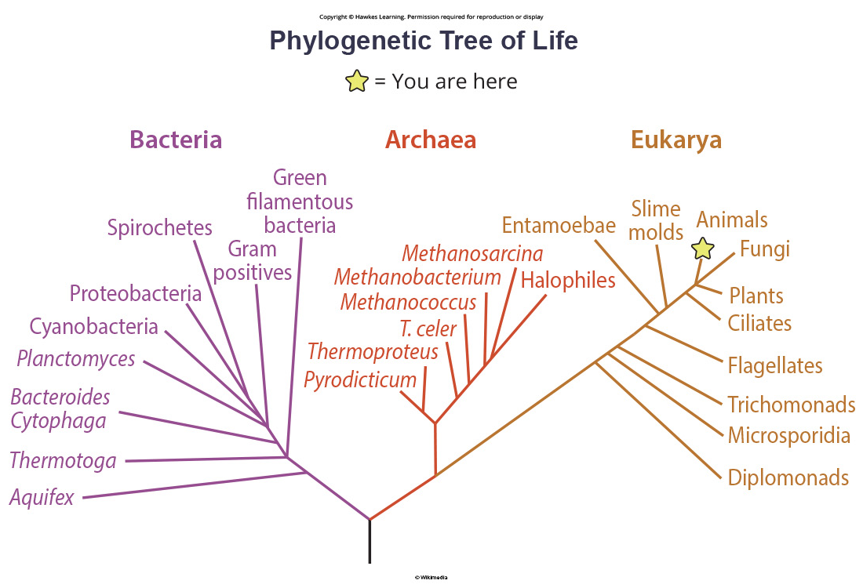
Lesson 1.2 Figure 10

Slide 26
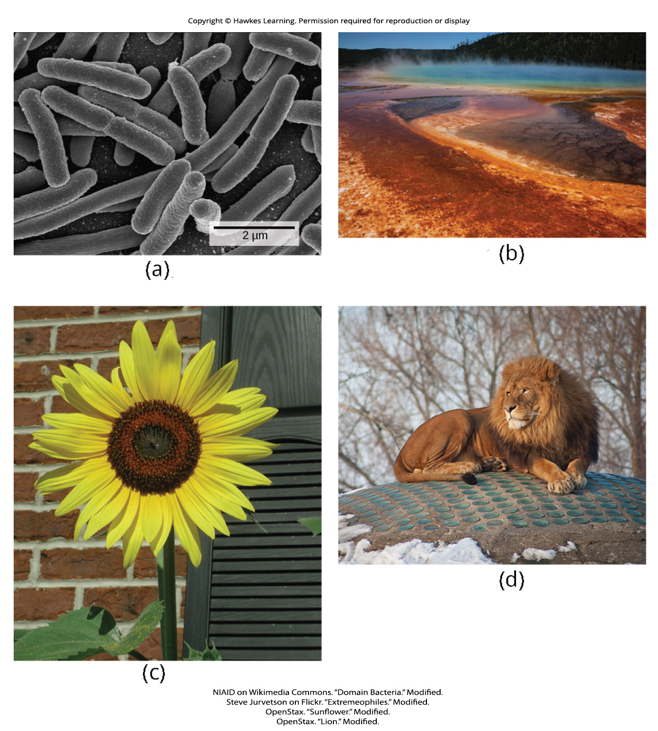
Lesson 1.2 Figure 11

Slide 27
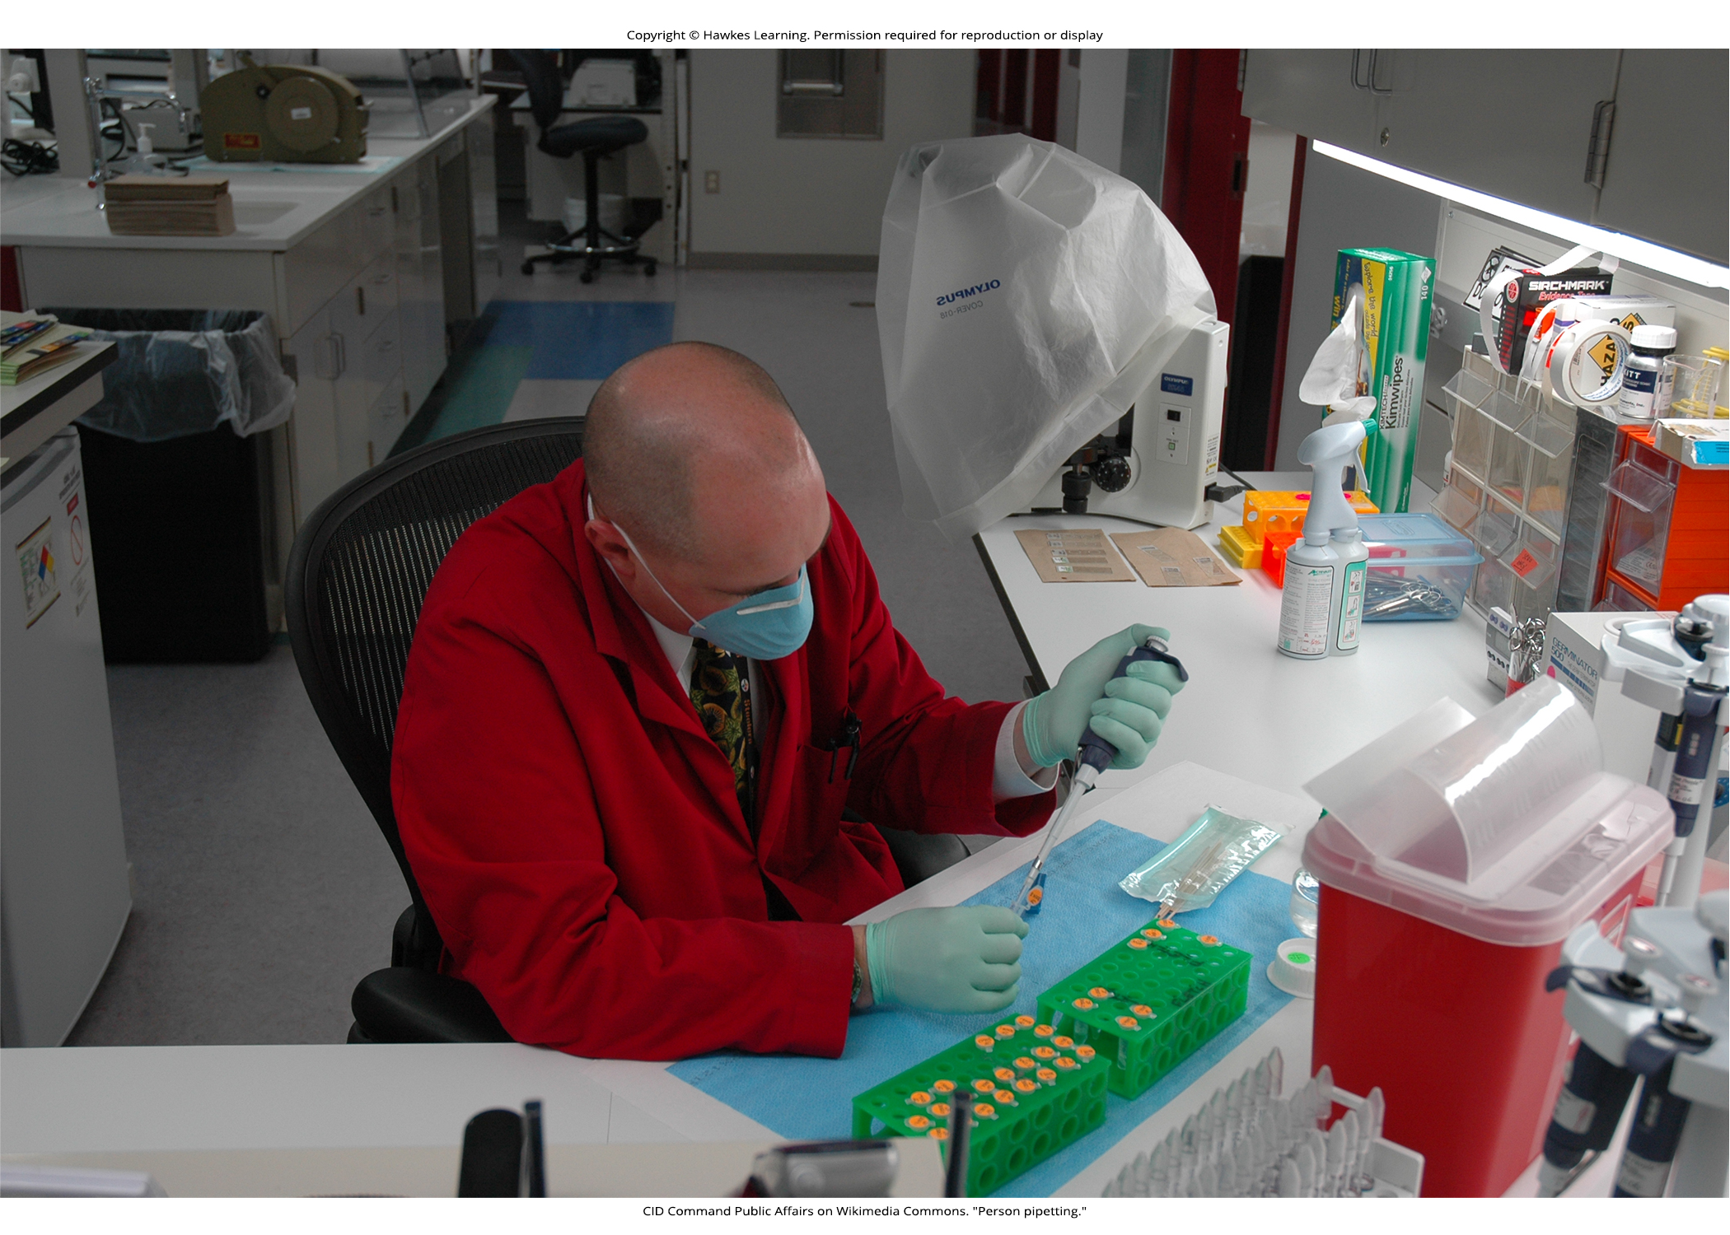
Lesson 1.2 Figure 12

Slide 28
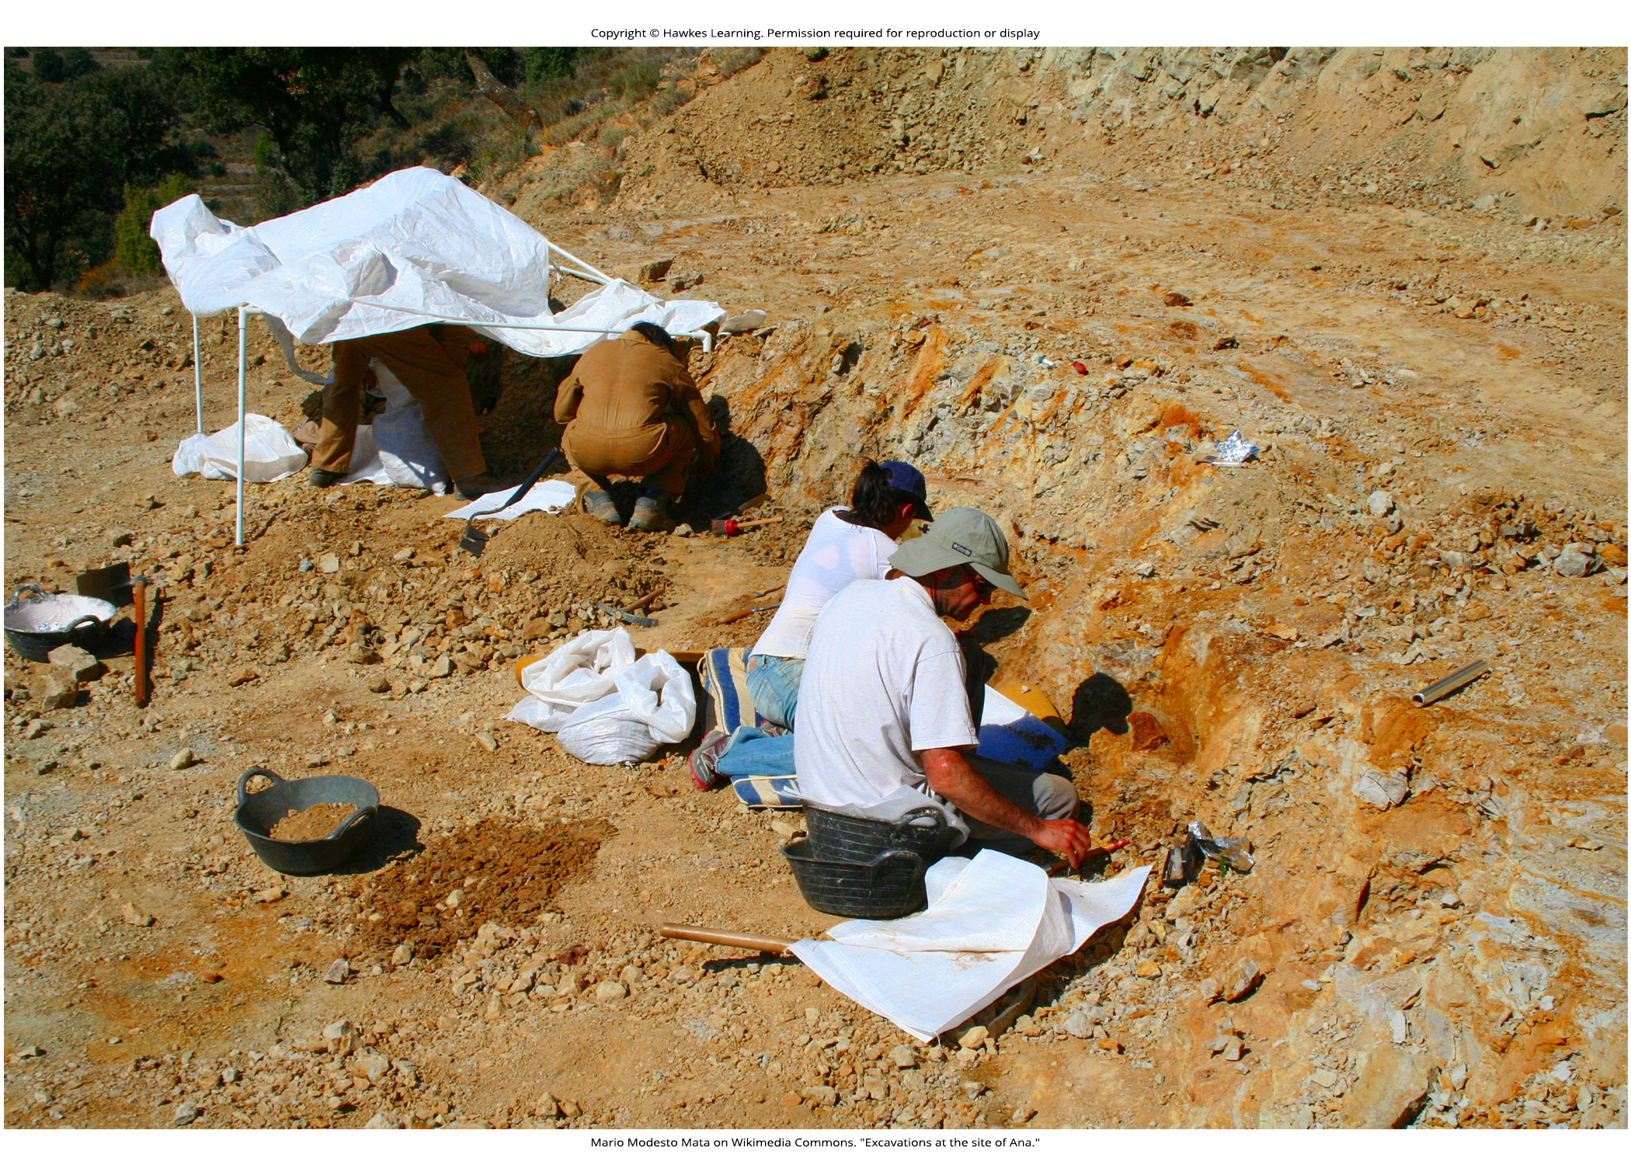
Lesson 1.2 Figure 13

Slide 29
Hawkes Learning – End of PowerPoint

