Slide 1
Chapter 11
Meiosis and Sexual Reproduction

Slide 2
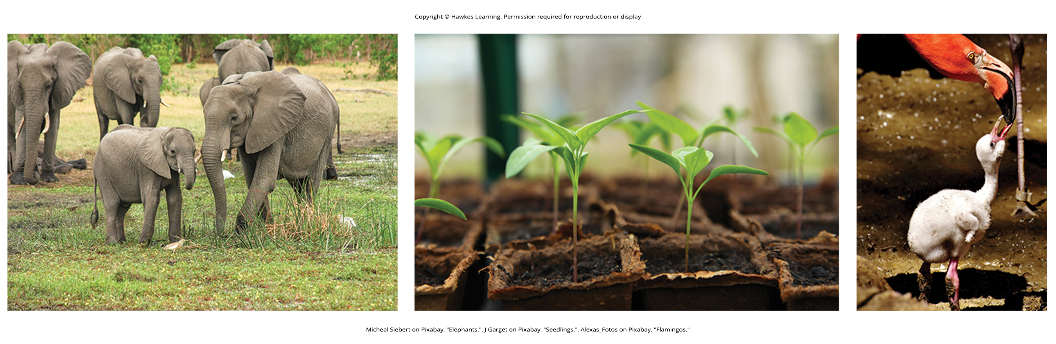
Lesson 11.1 Figure 1

Slide 3
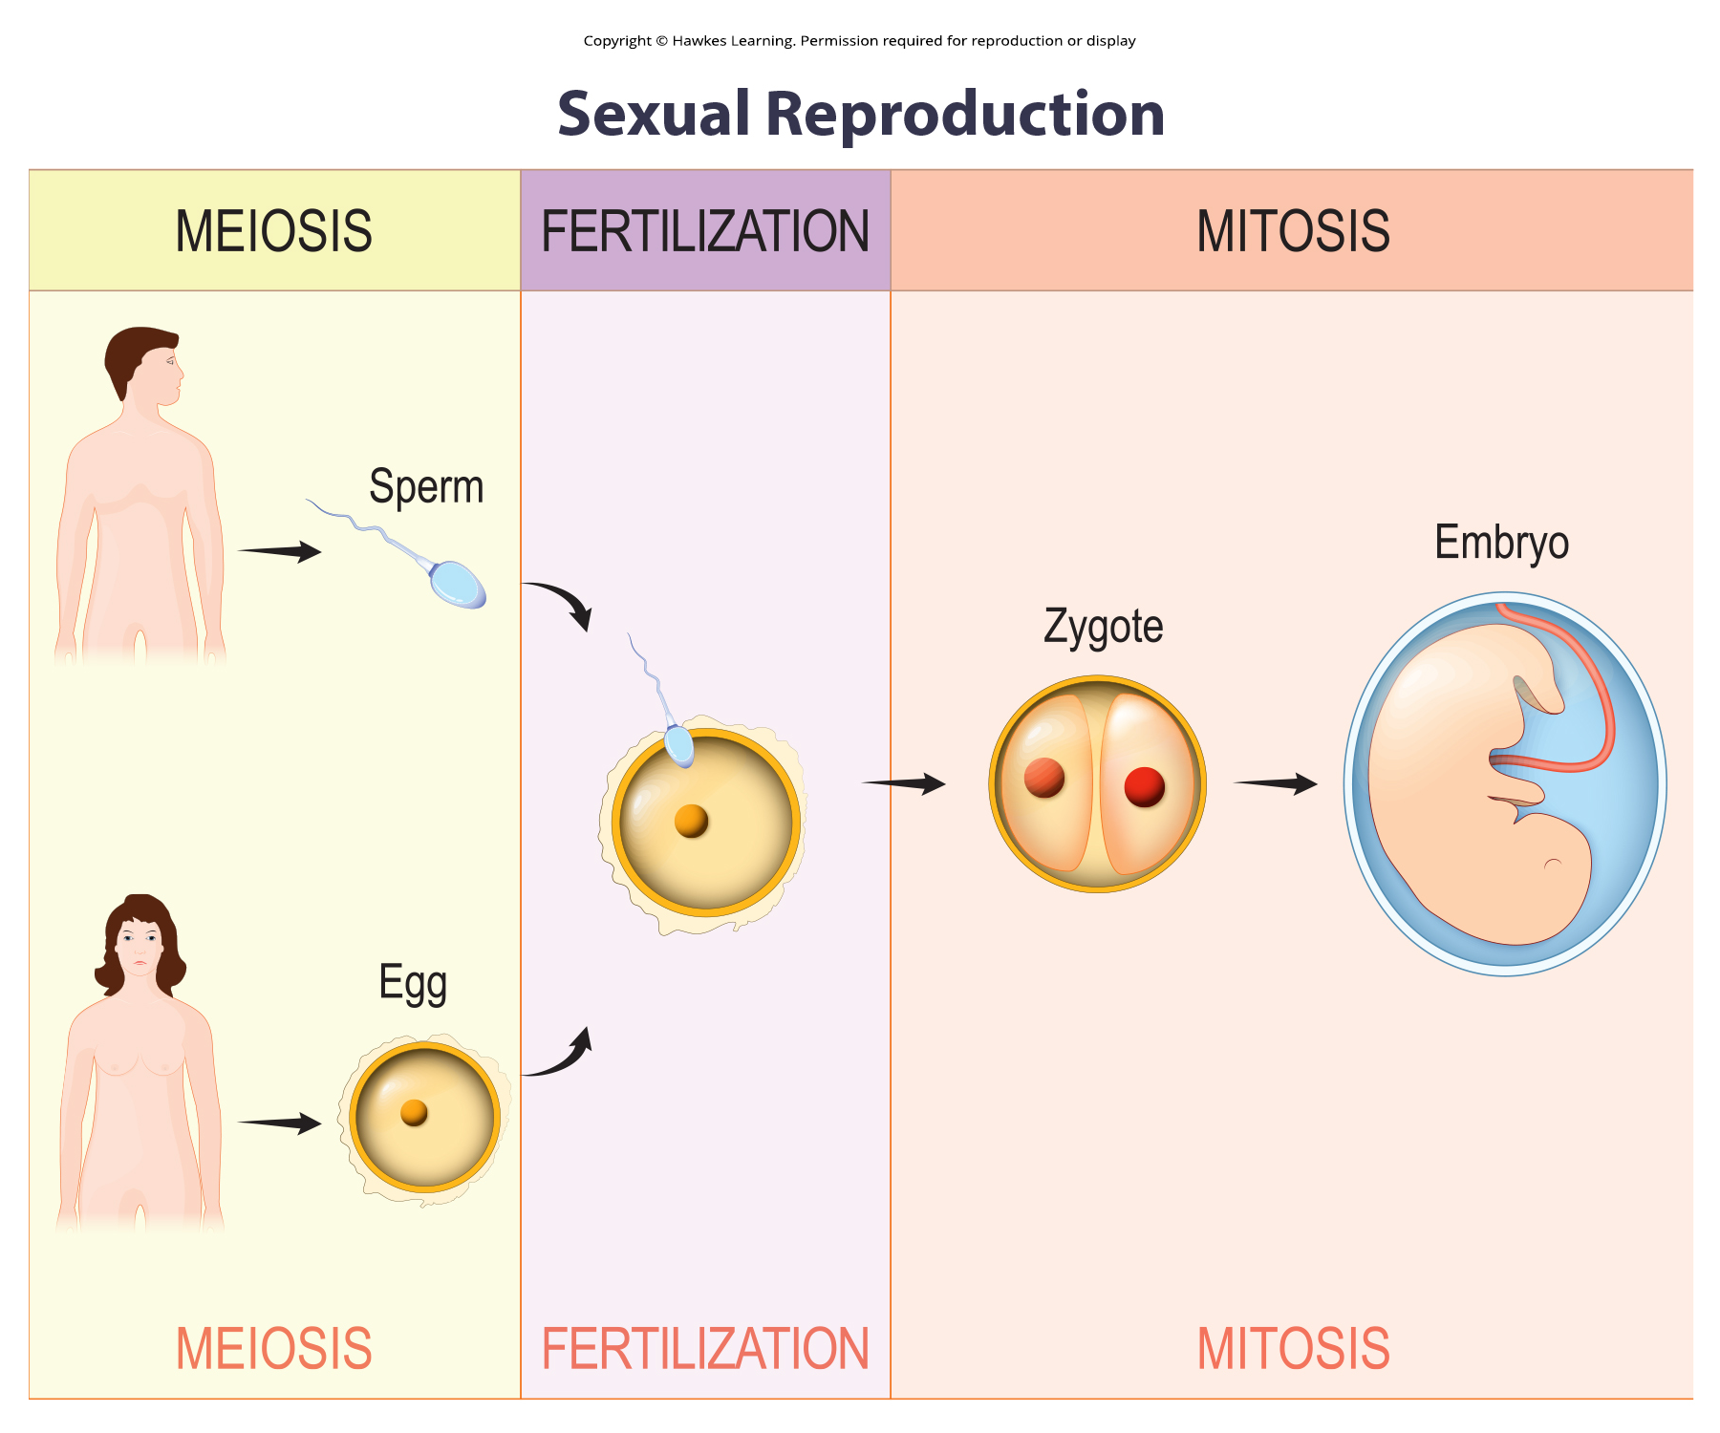
Lesson 11.1 Figure 2

Slide 4
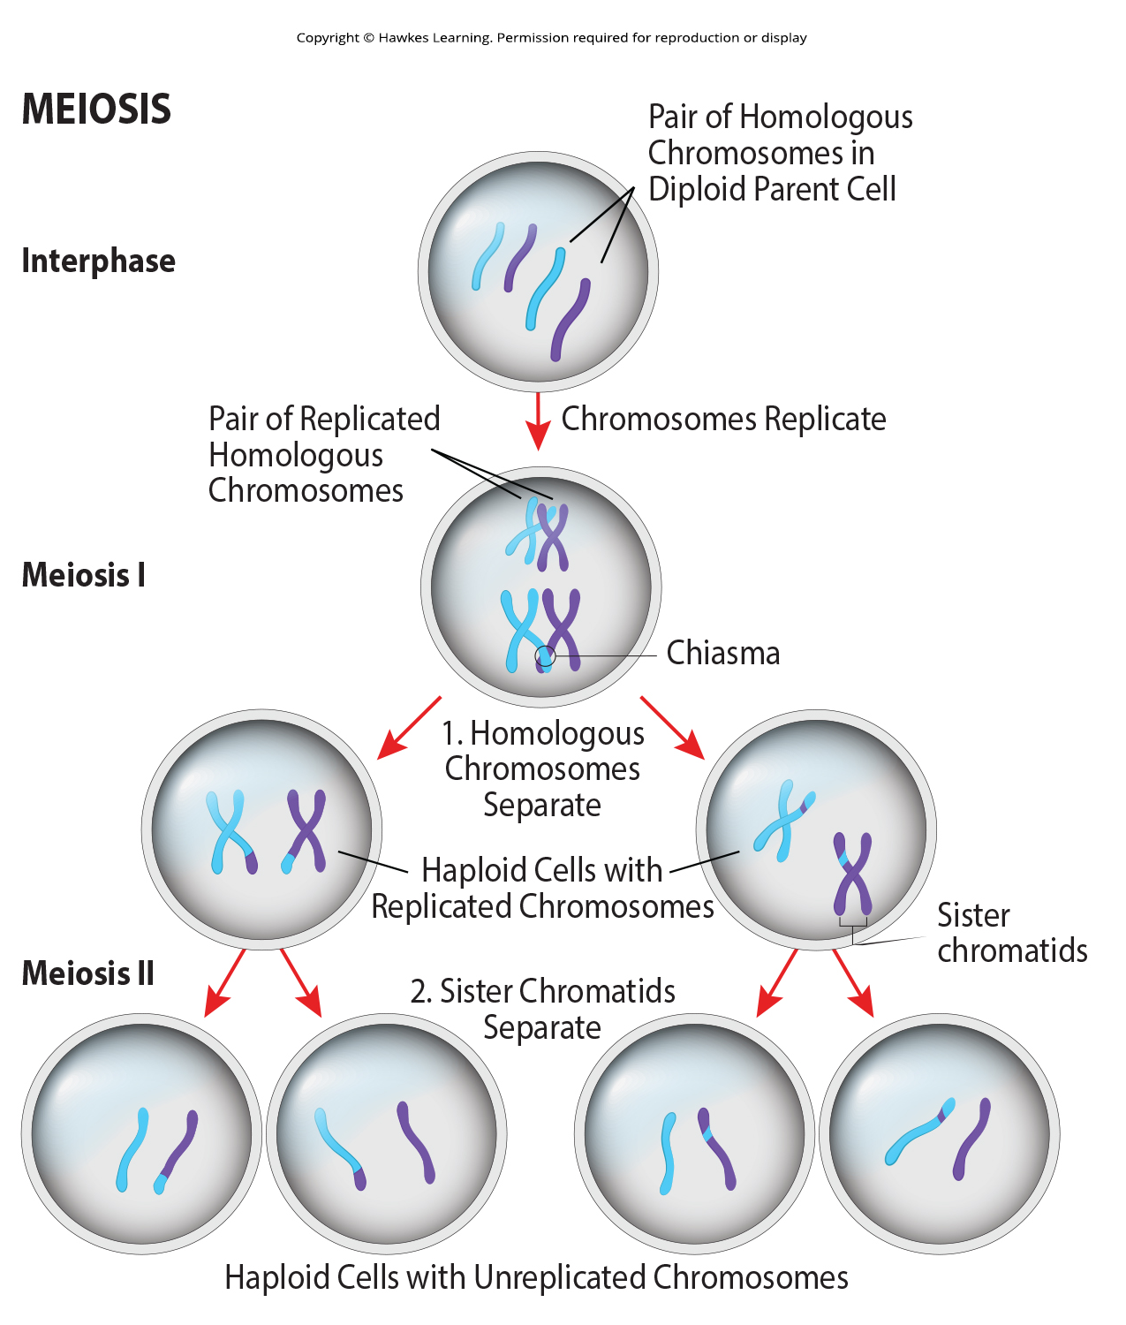
Lesson 11.1 Figure 3

Slide 5
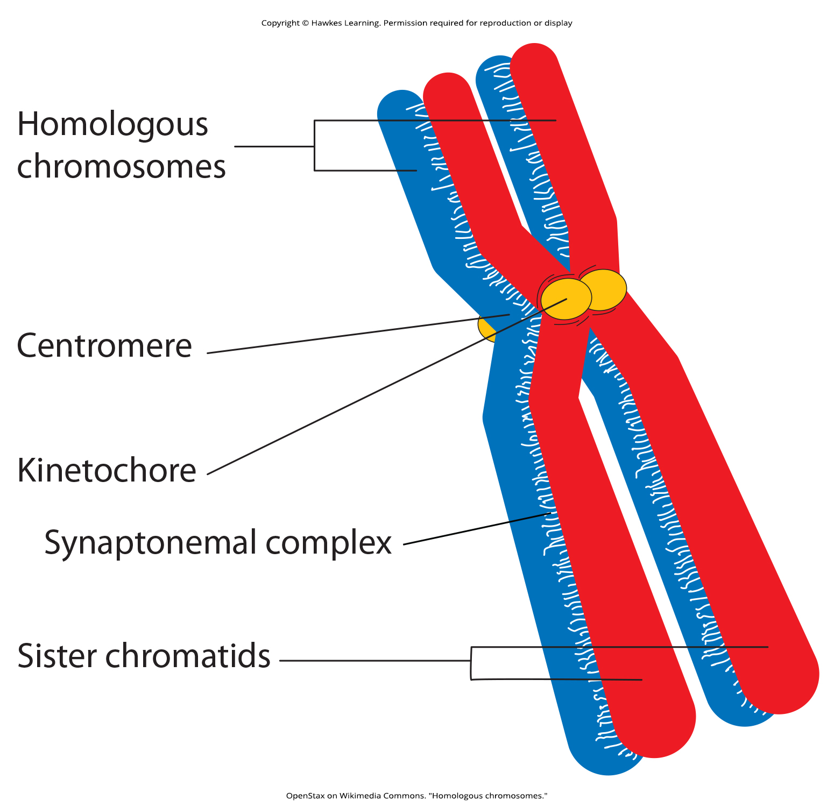
Lesson 11.1 Figure 4

Slide 6
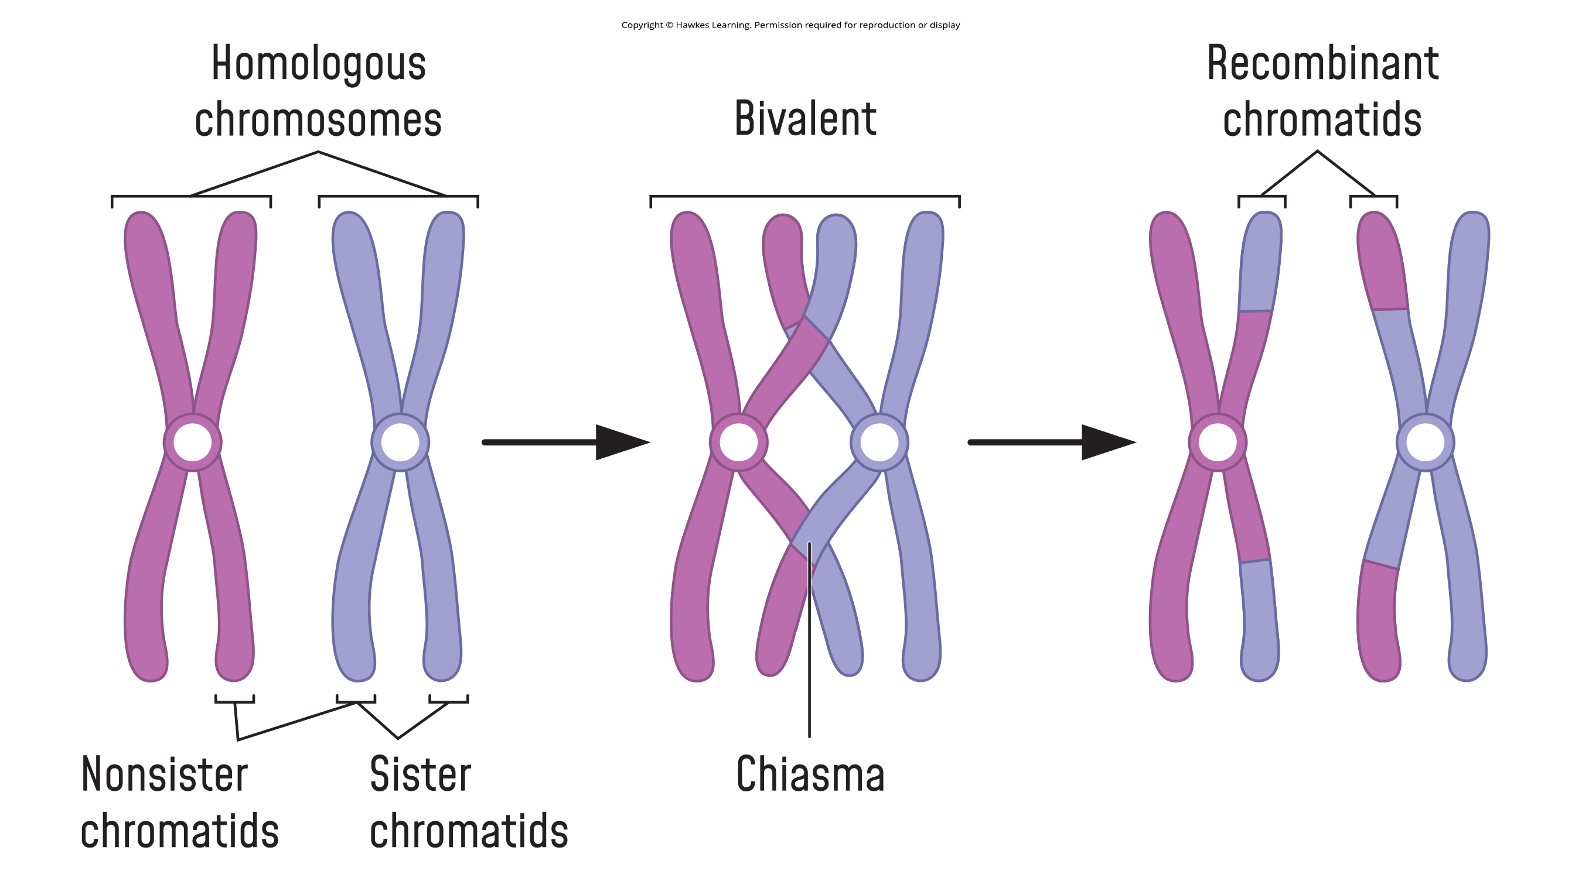
Lesson 11.1 Figure 5

Slide 7
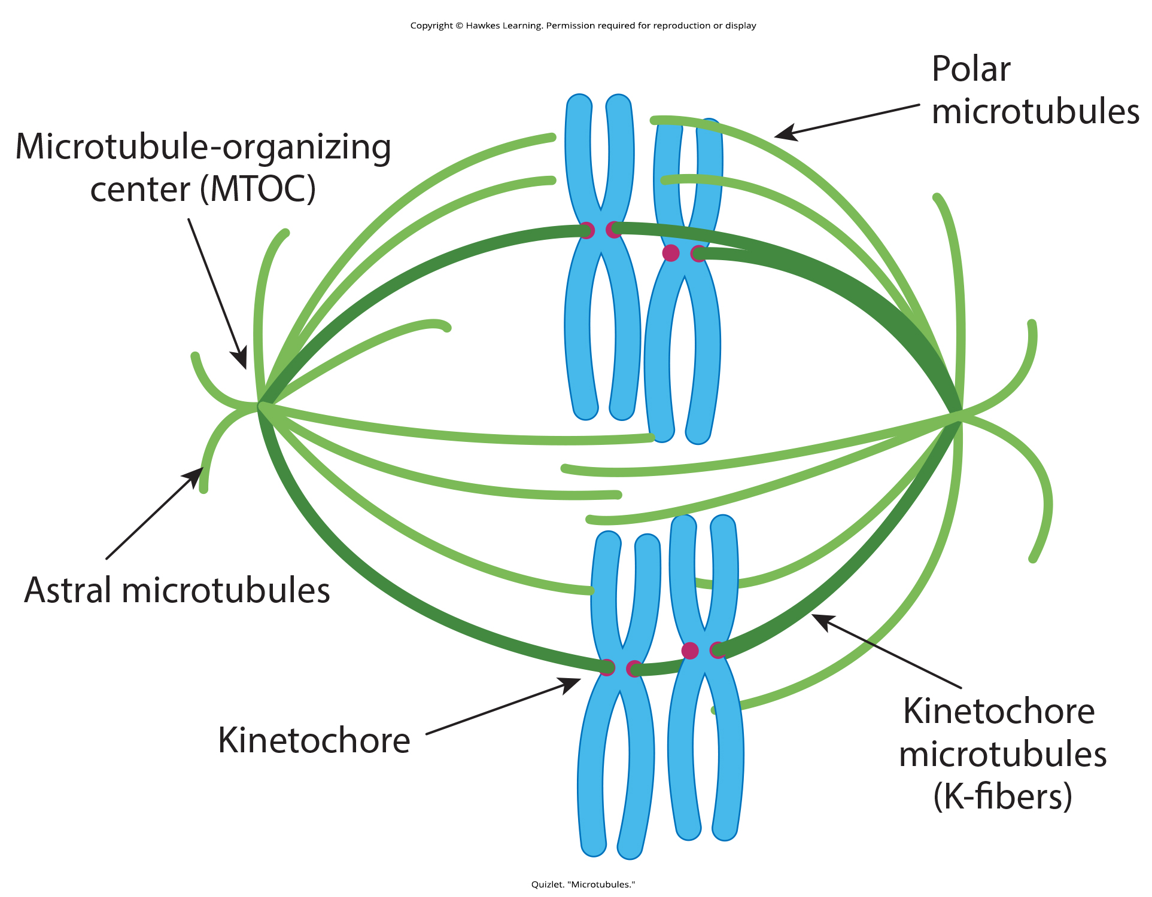
Lesson 11.1 Figure 6

Slide 8
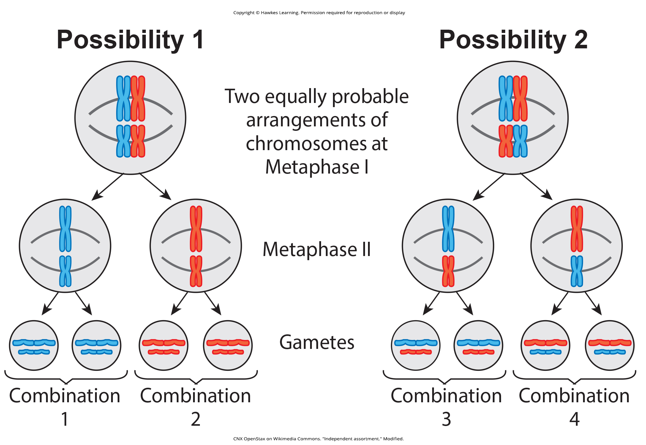
Lesson 11.1 Figure 7

Slide 9
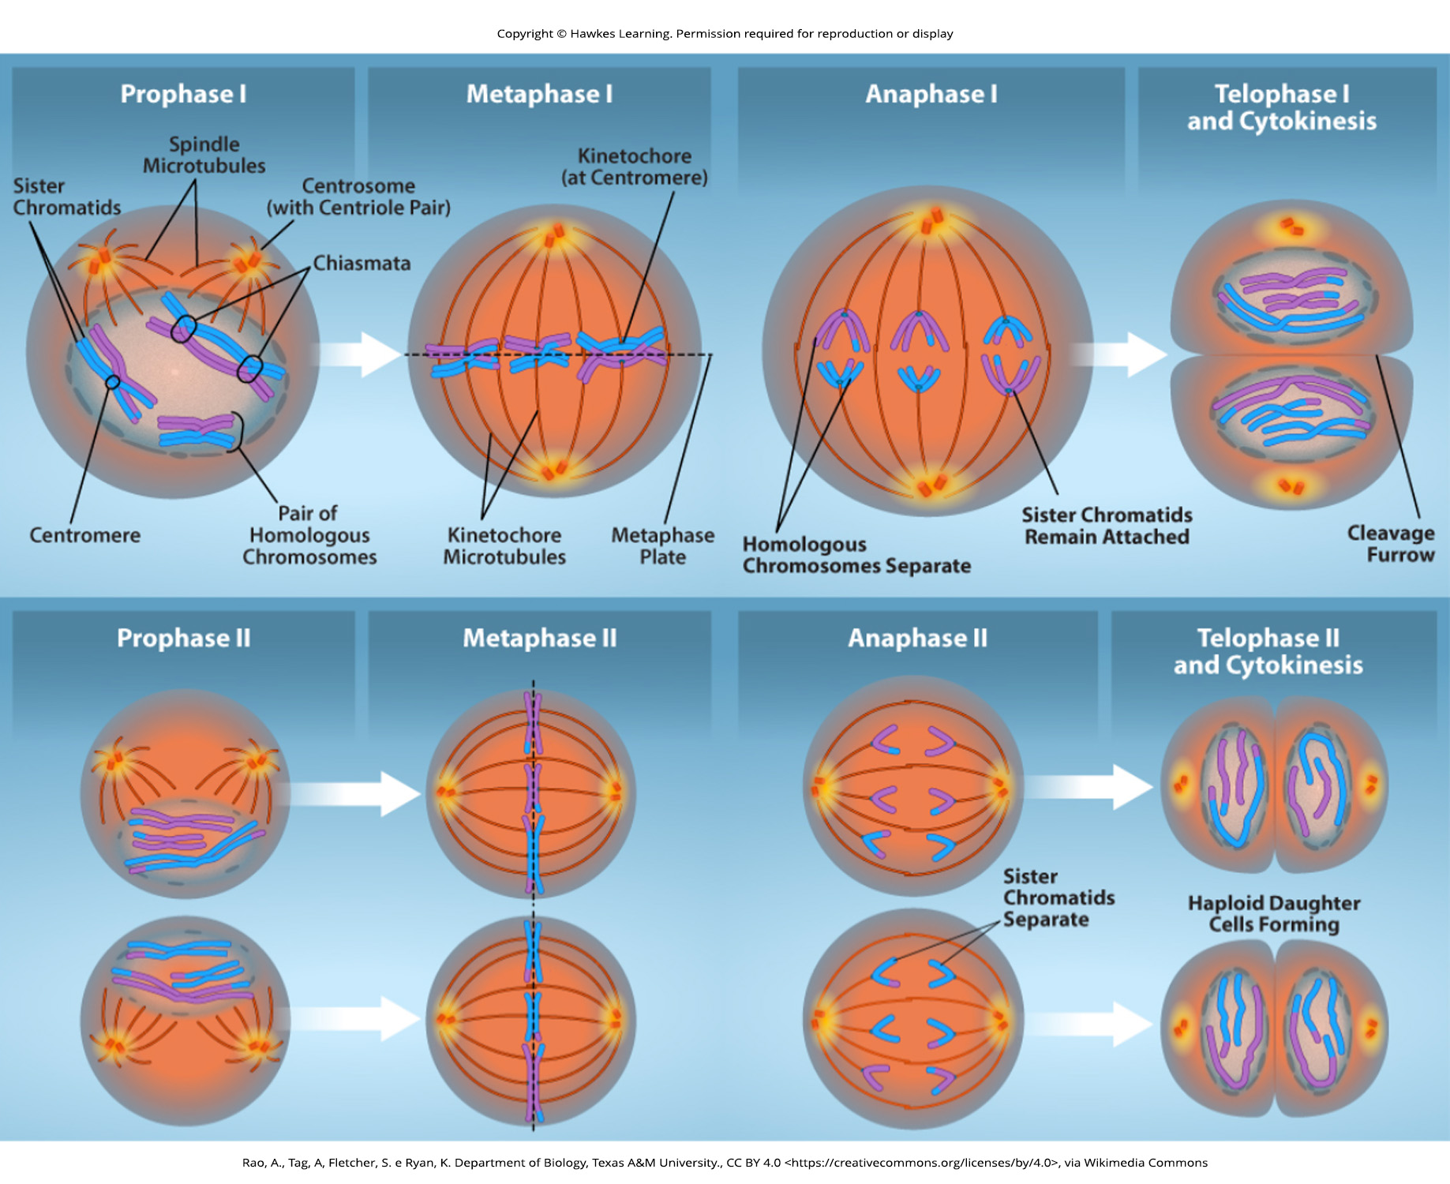
Lesson 11.1 Figure 8

Slide 10
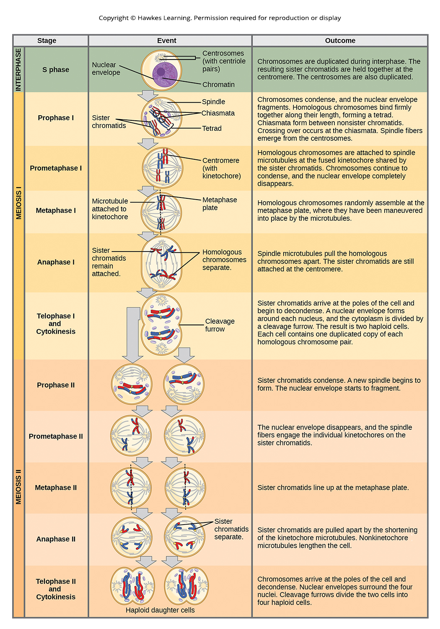
Lesson 11.1 Figure 9

Slide 11
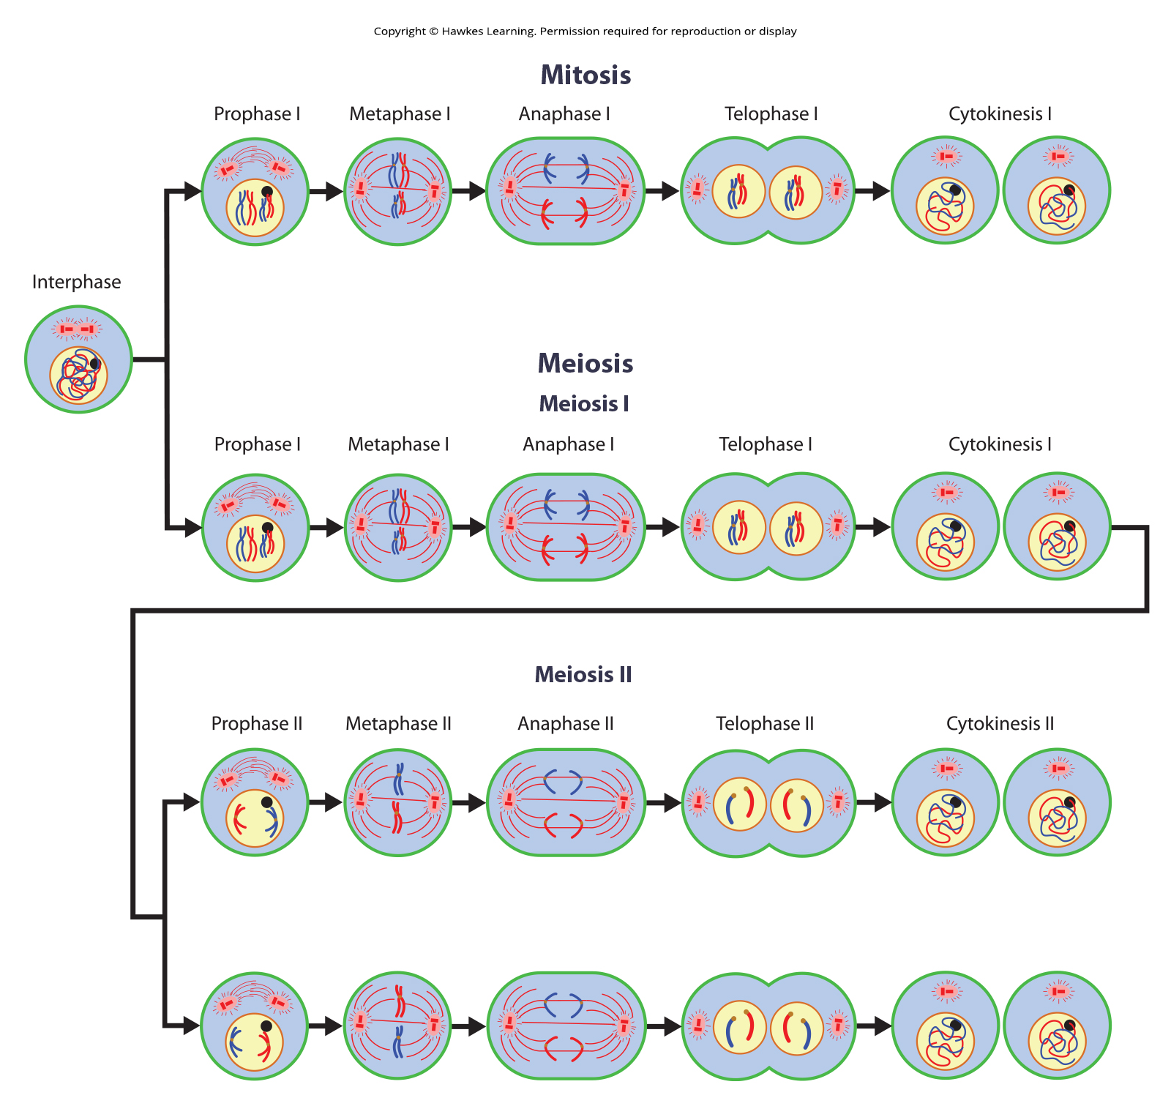
Lesson 11.1 Figure 10

Slide 12
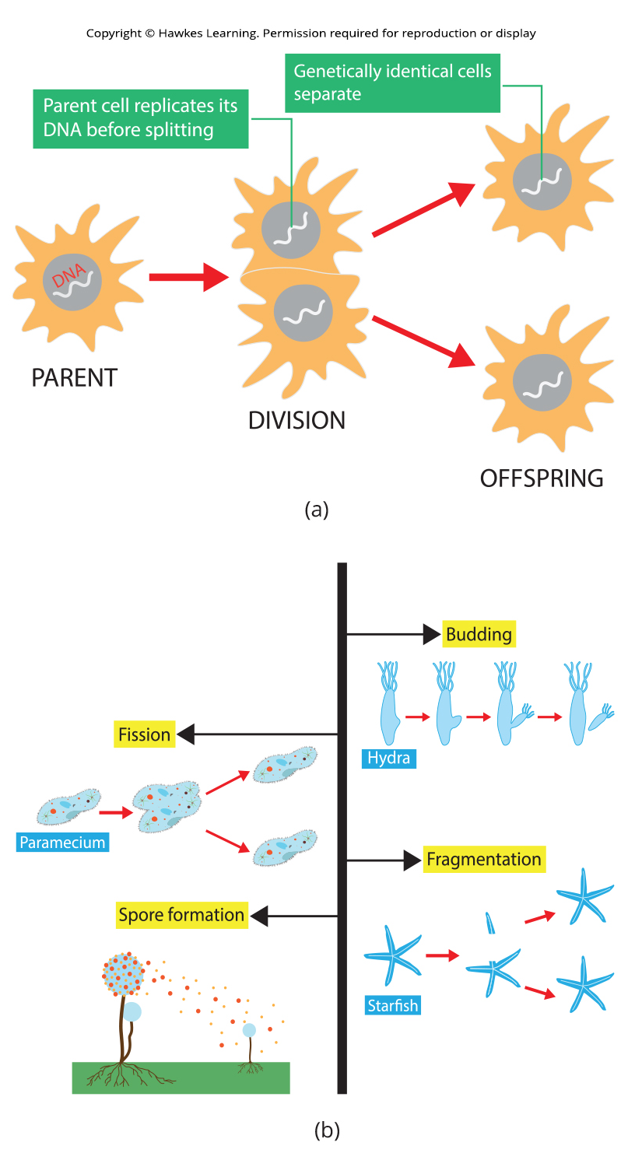
Lesson 11.2 Figure 1

Slide 13
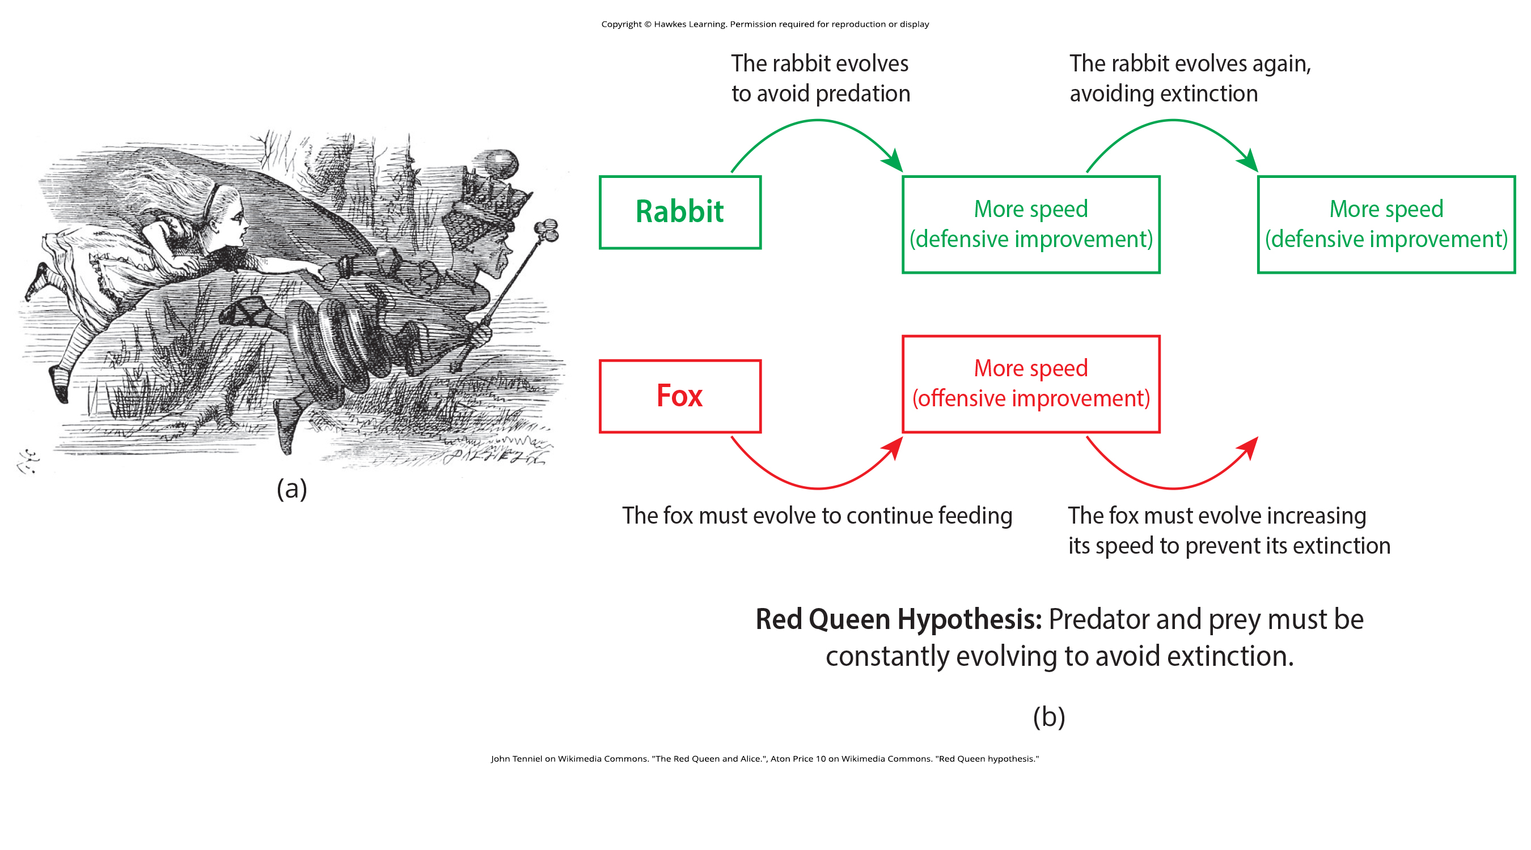
Lesson 11.2 Figure 2

Slide 14
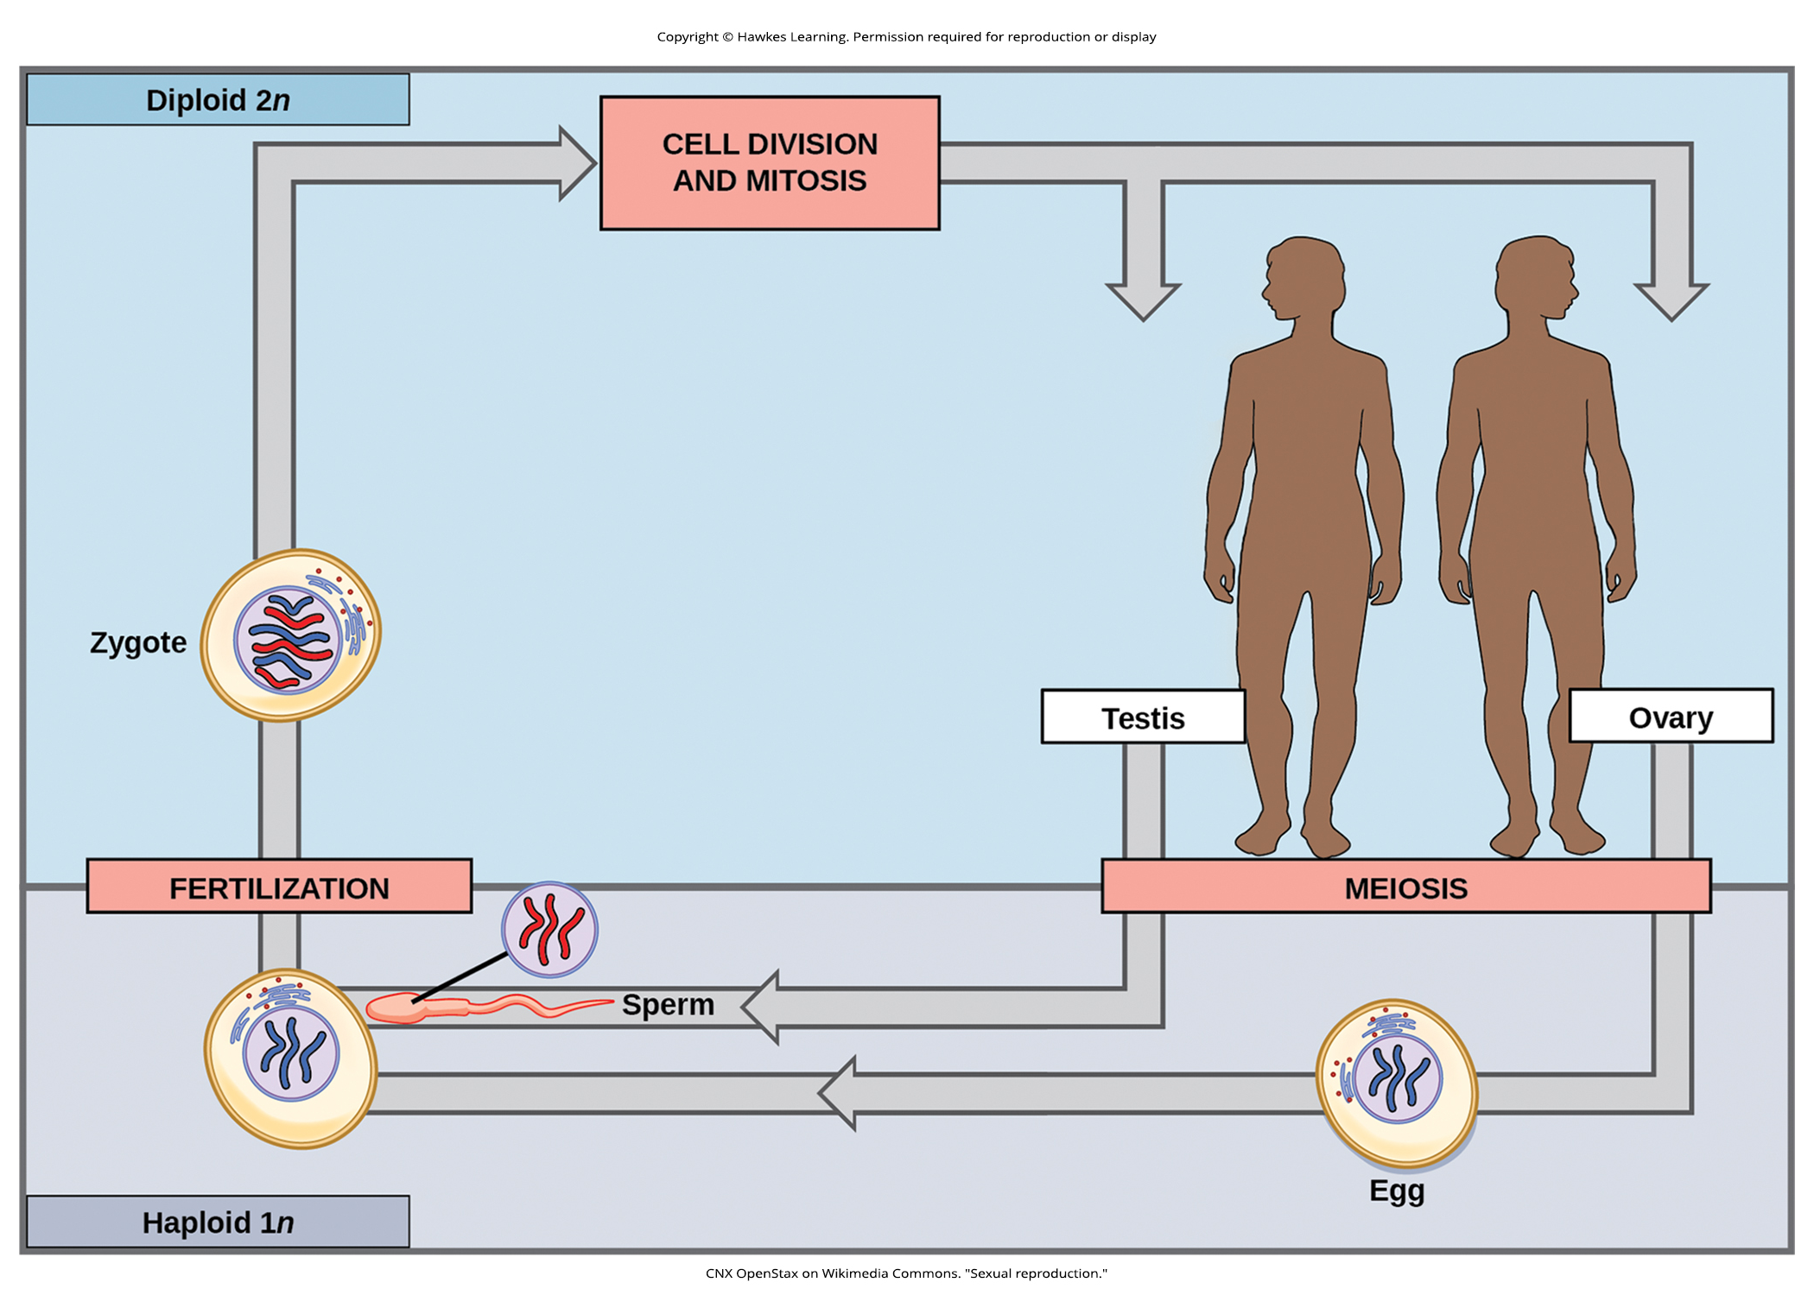
Lesson 11.2 Figure 3

Slide 15
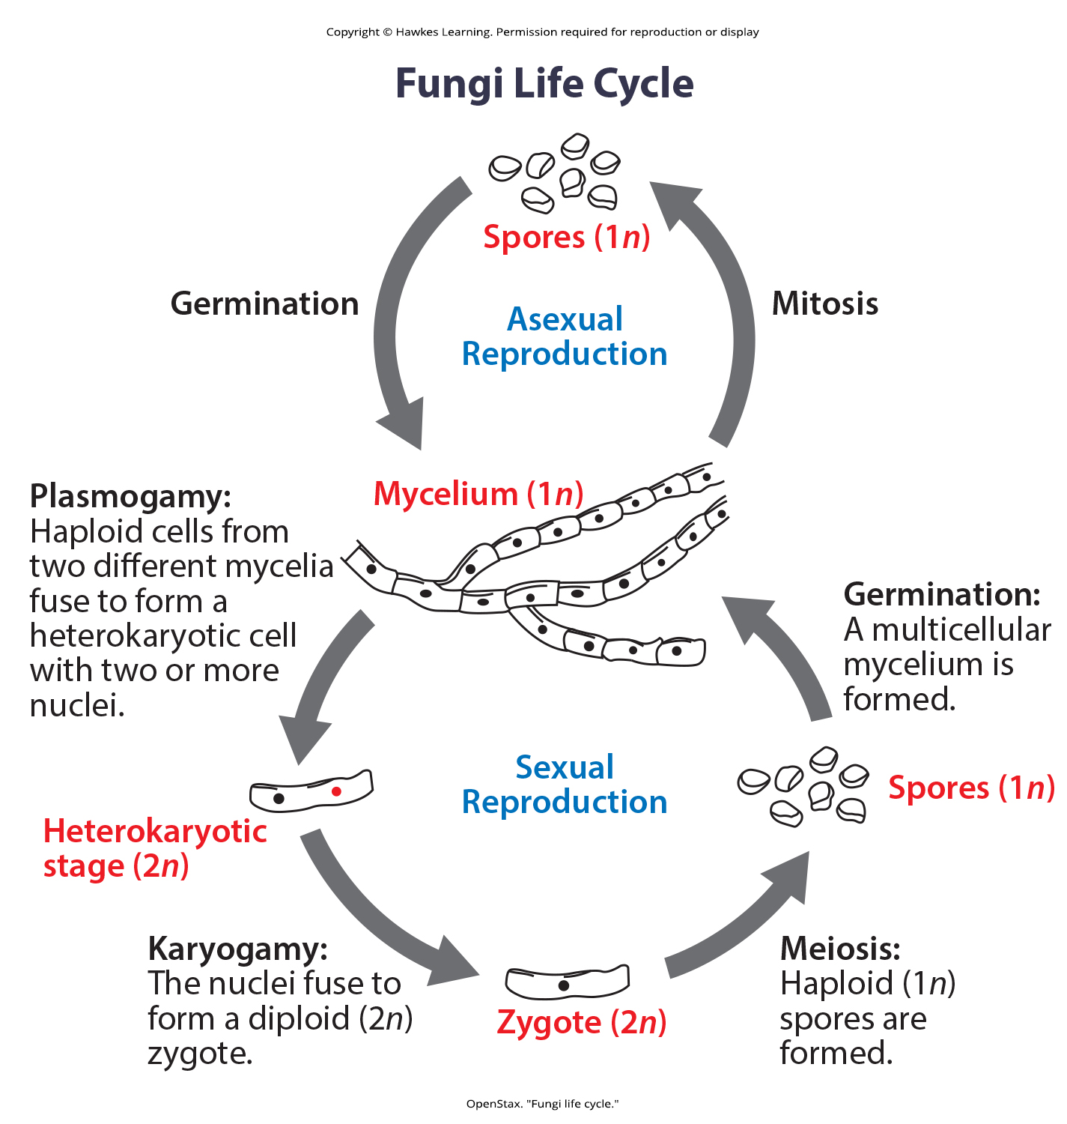
Lesson 11.2 Figure 4

Slide 16
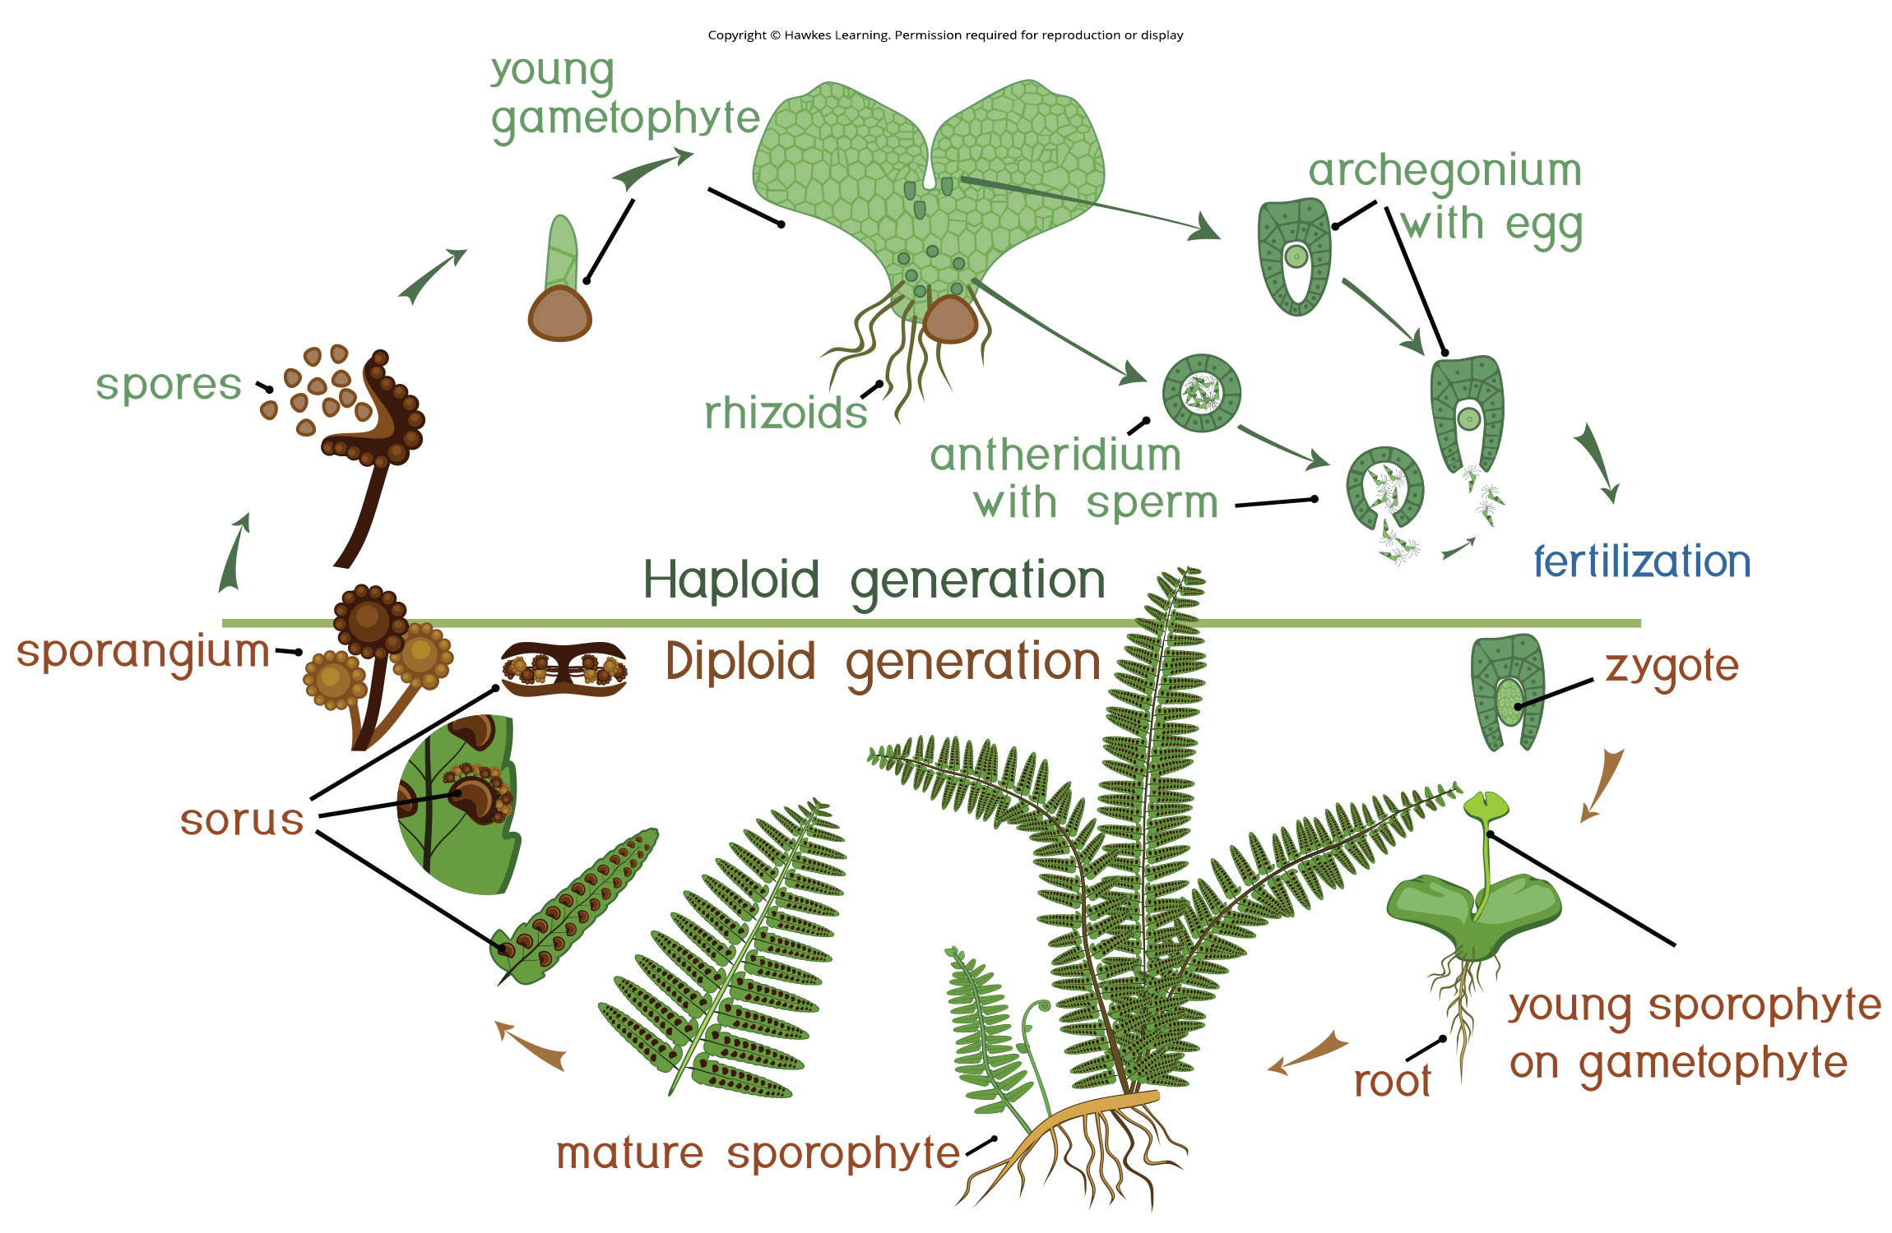
Lesson 11.2 Figure 5

Slide 17
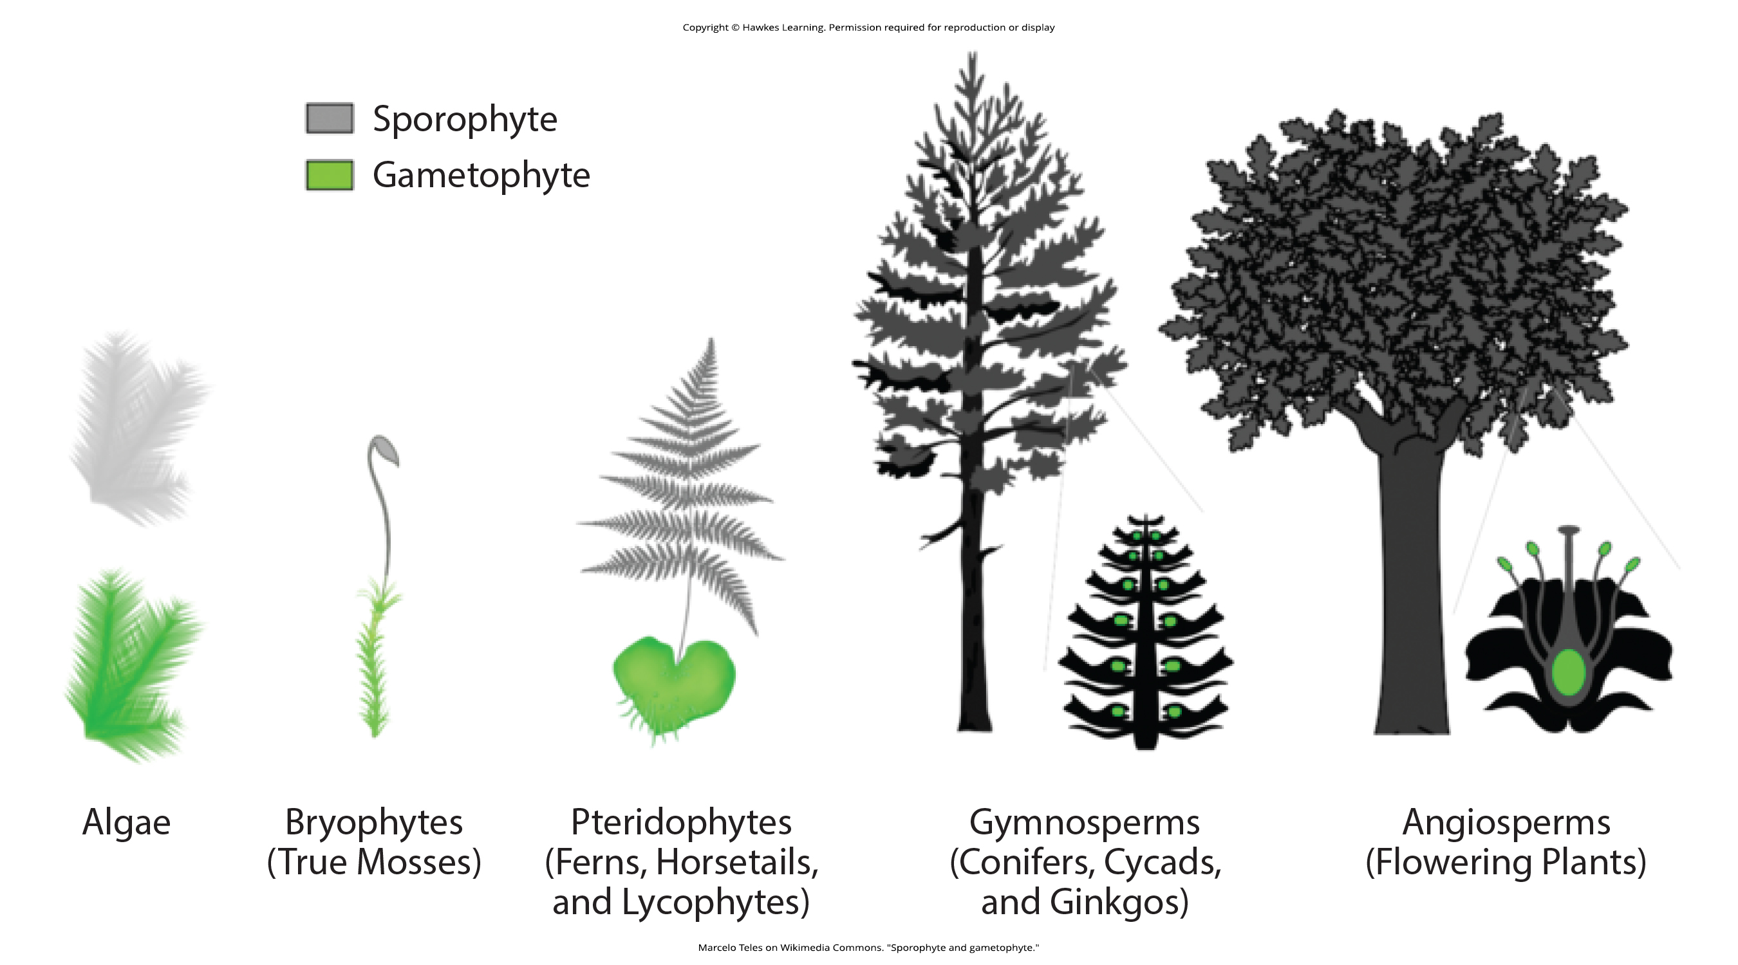
Lesson 11.2 Figure 6

Slide 18
Hawkes Learning – End of PowerPoint

