Slide 1
Chapter 12
Mendelian Genetics

Slide 2
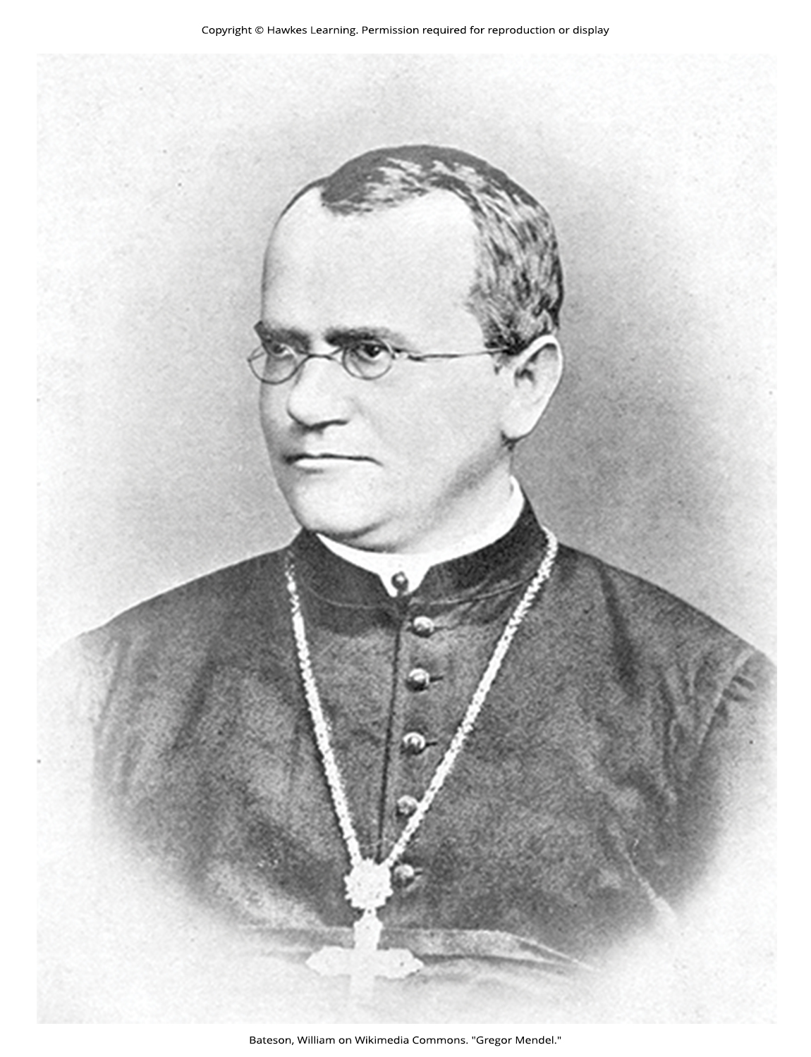
Lesson 12.1 Figure 1

Slide 3
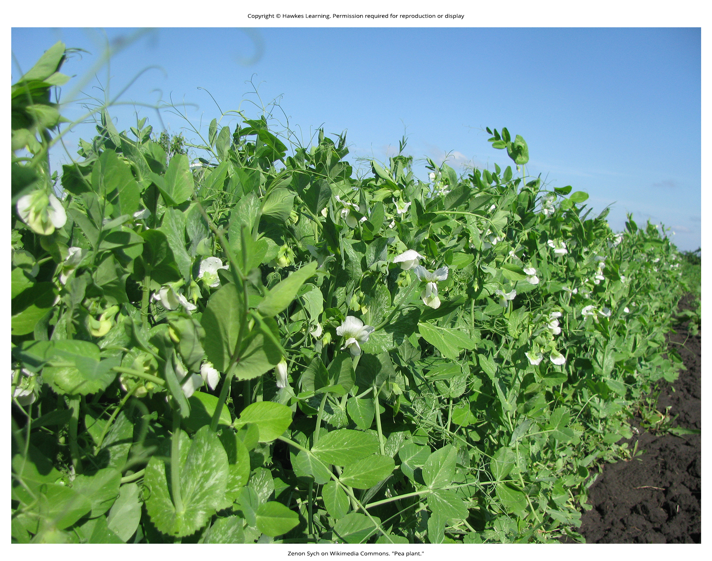
Lesson 12.1 Figure 2

Slide 4
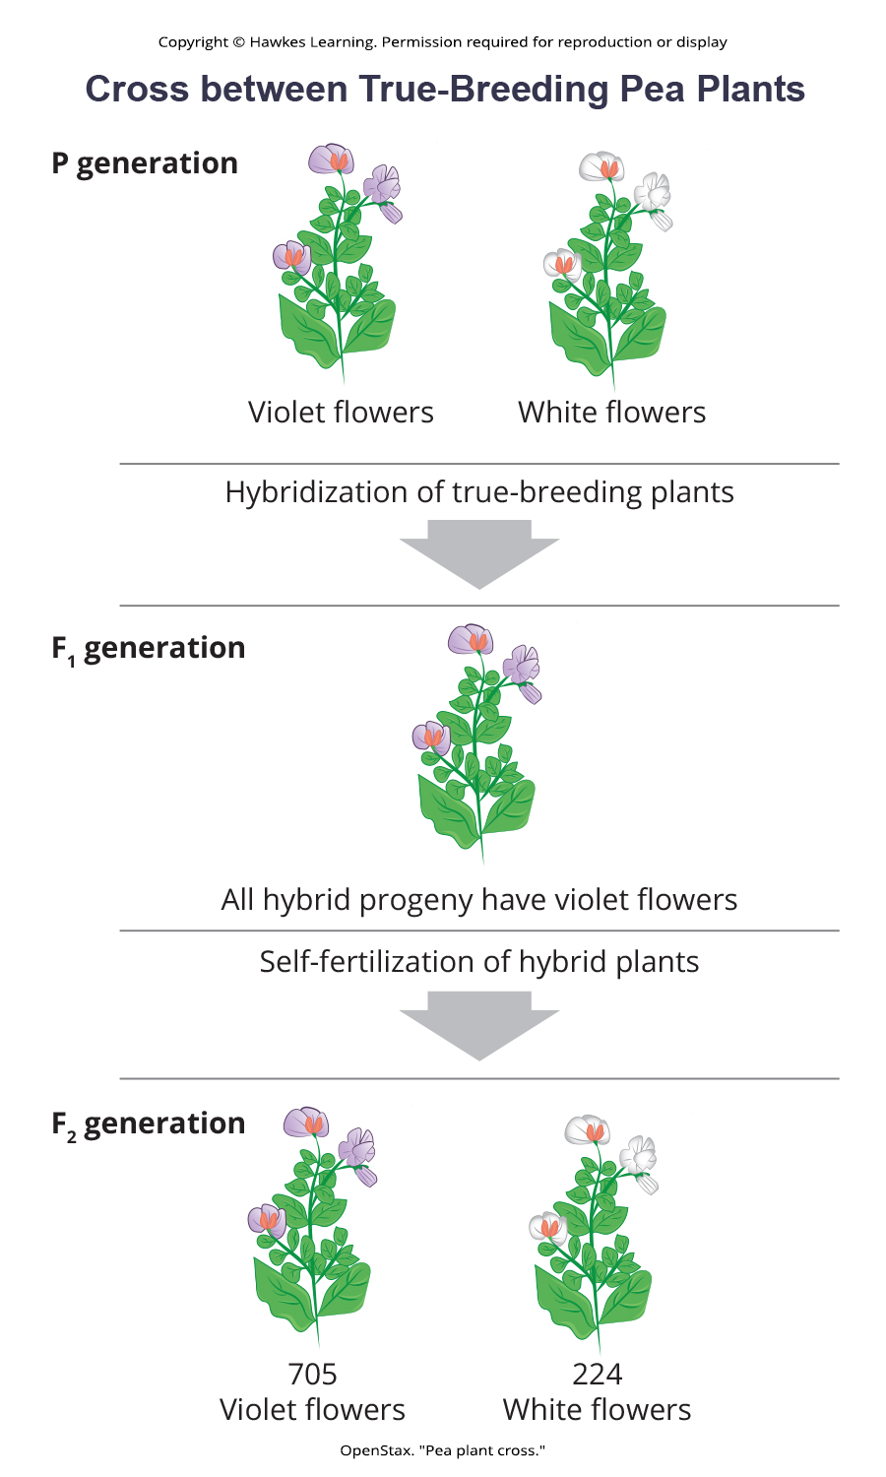
Lesson 12.1 Figure 3

Slide 5
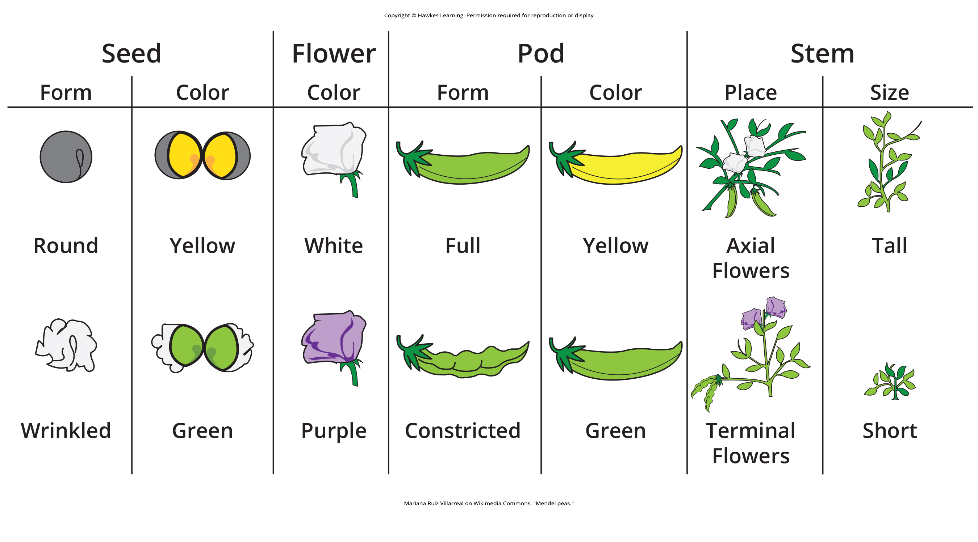
Lesson 12.1 Figure 4

Slide 6
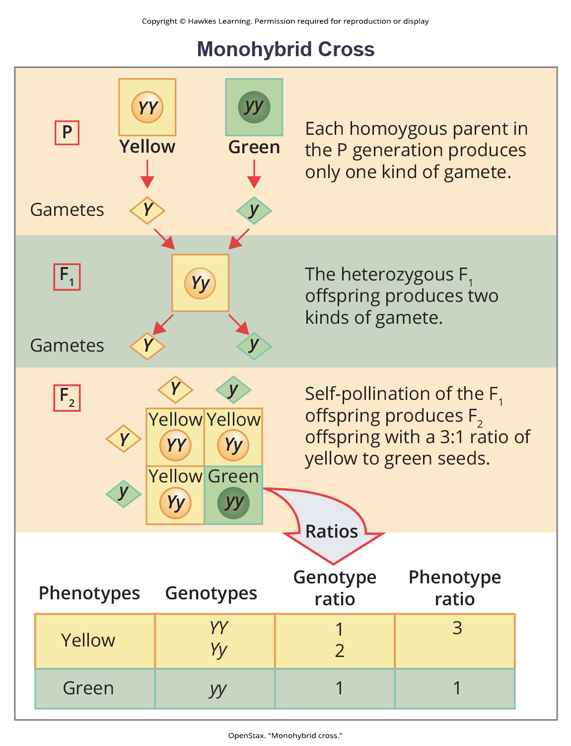
Lesson 12.2 Figure 1

Slide 7
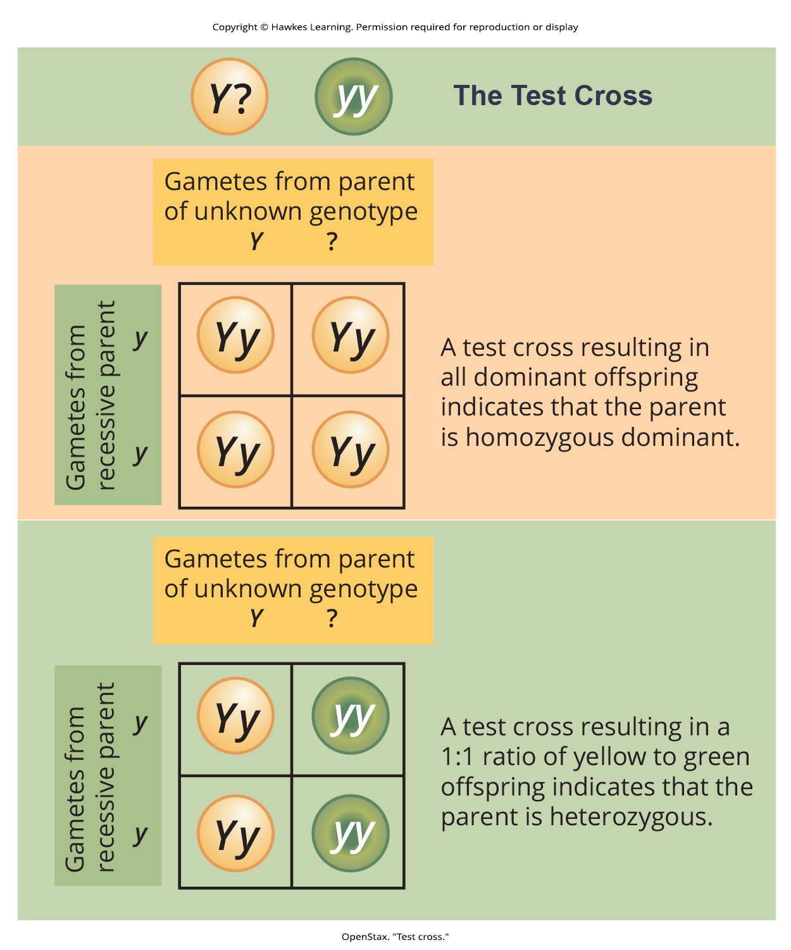
Lesson 12.2 Figure 2

Slide 8
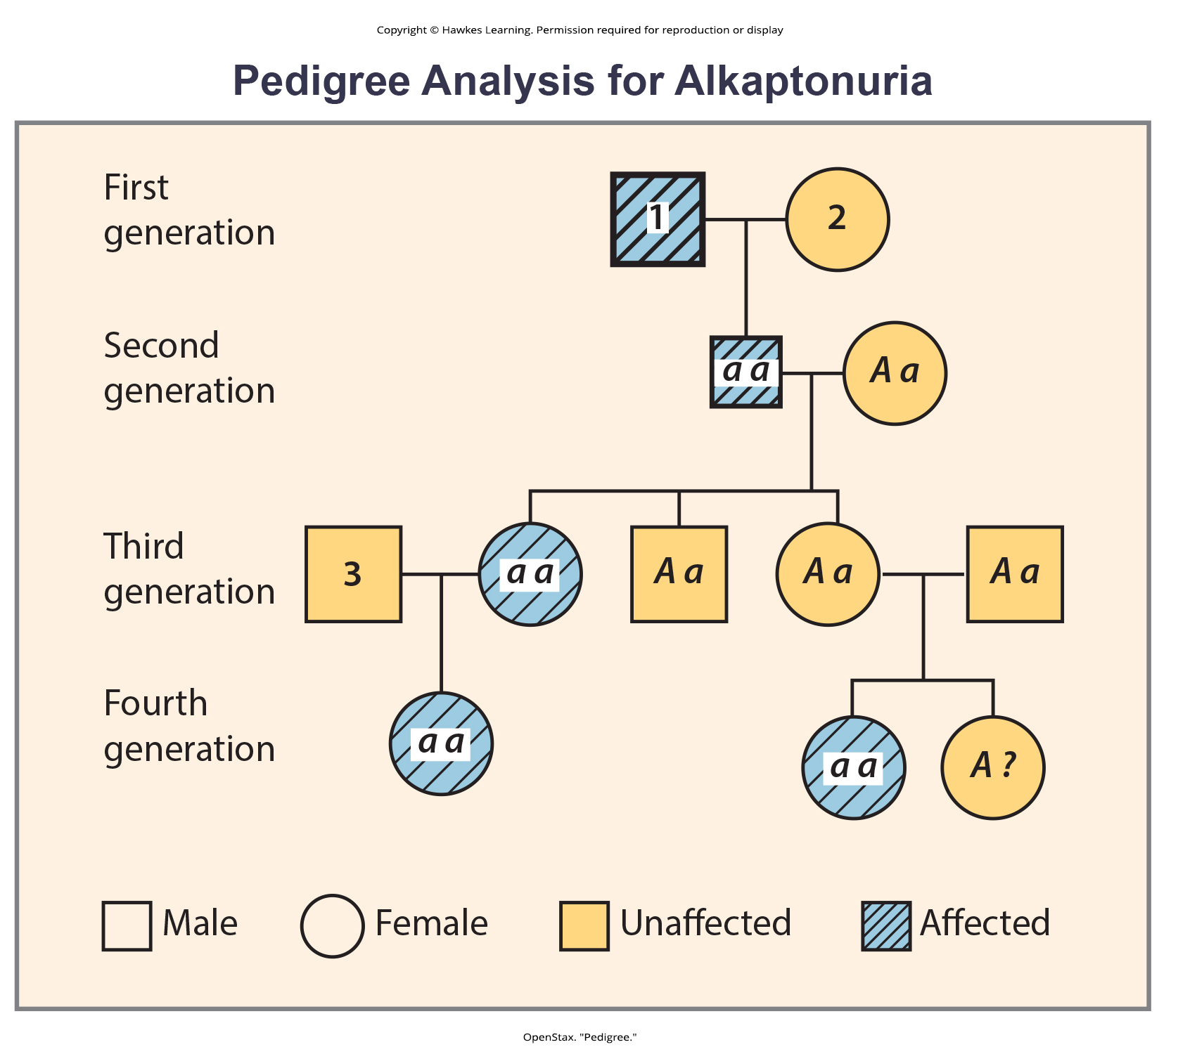
Lesson 12.2 Figure 3

Slide 9

Lesson 12.2 Figure 4

Slide 10
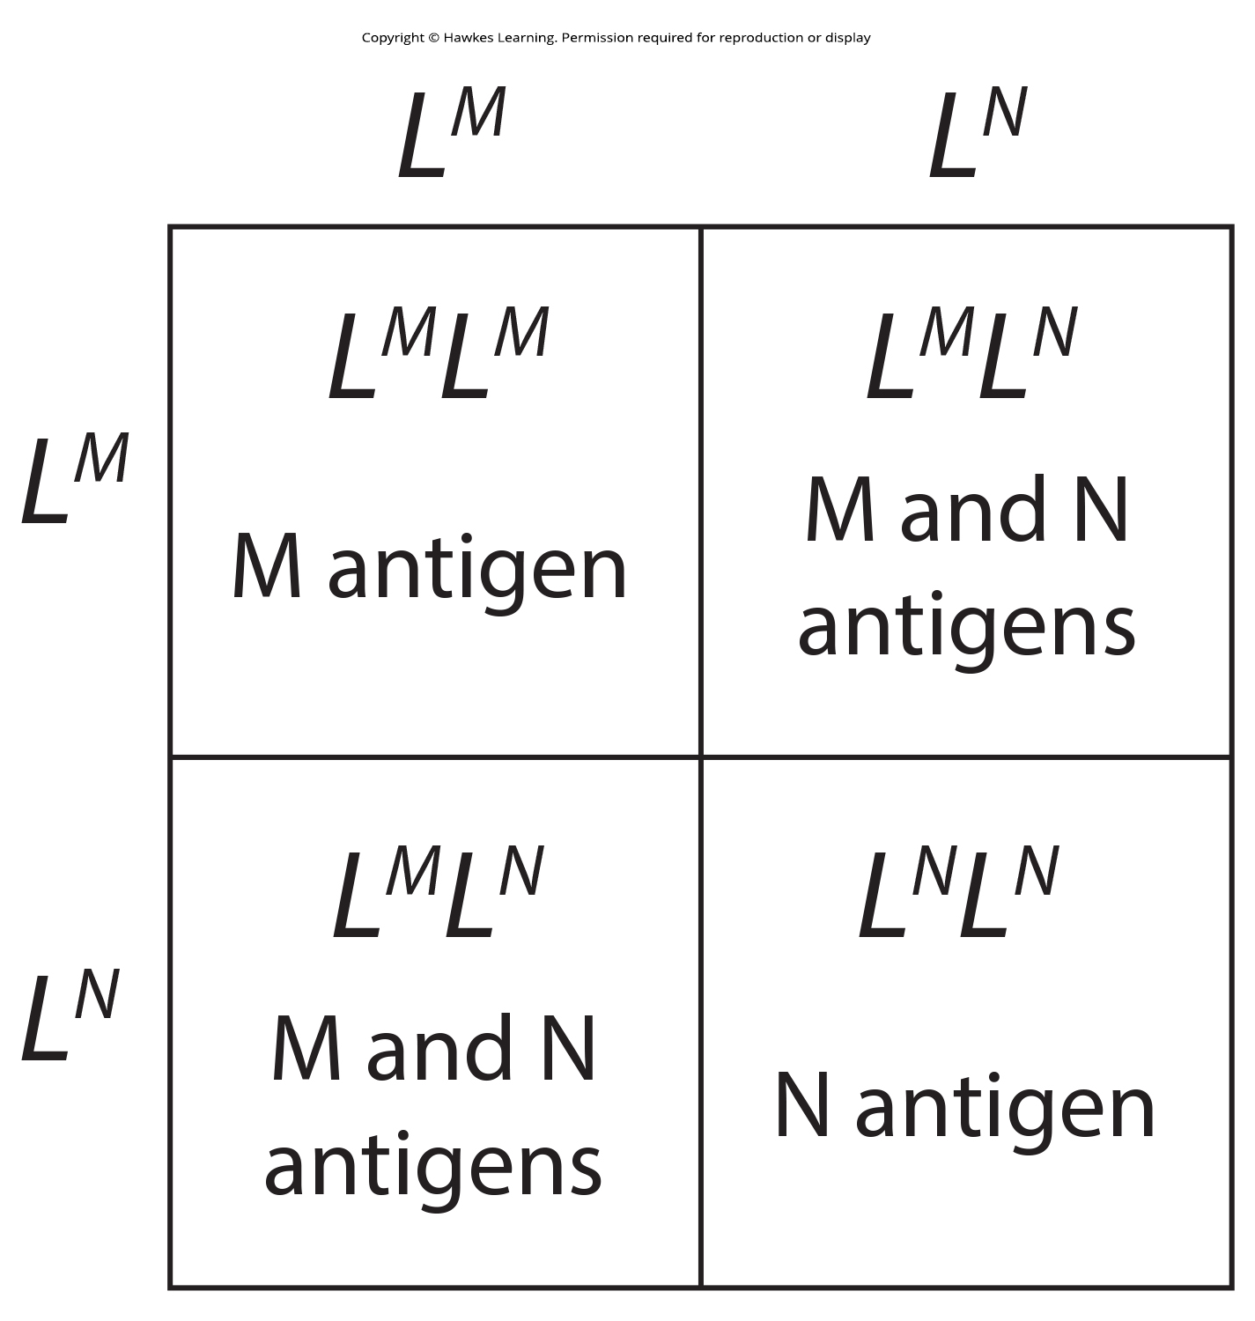
Lesson 12.2 Figure 5

Slide 11
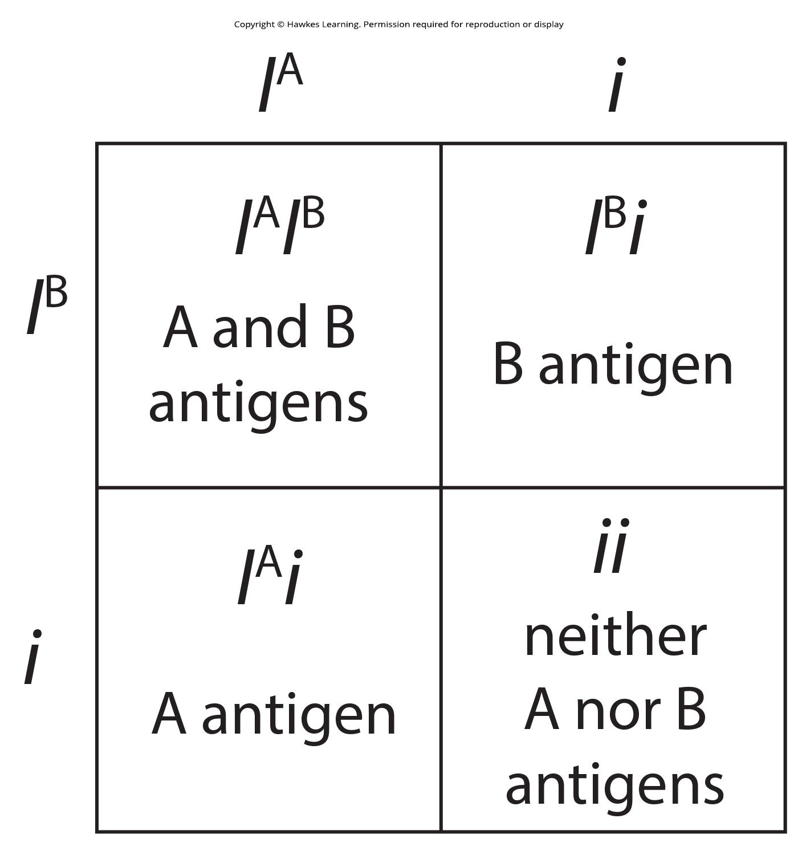
Lesson 12.2 Figure 6

Slide 12
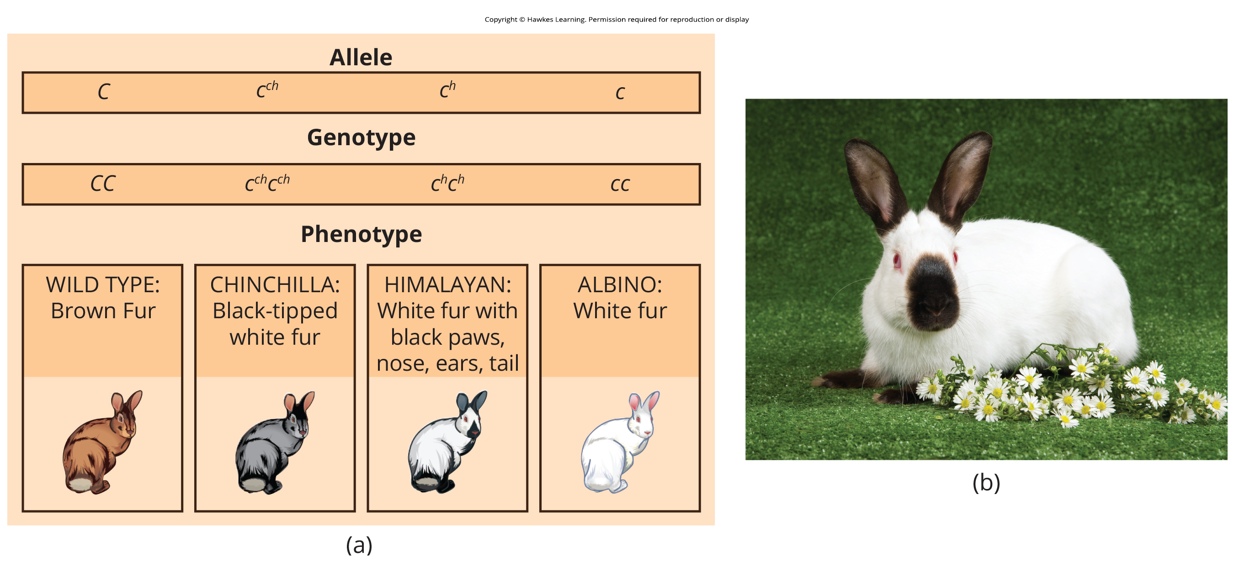
Lesson 12.2 Figure 7

Slide 13
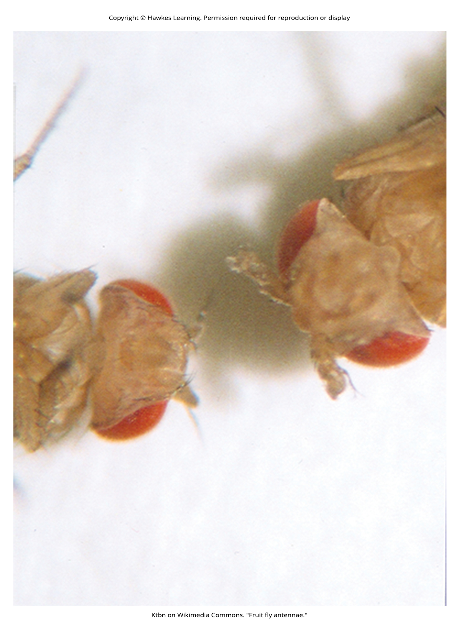
Lesson 12.2 Figure 8

Slide 14
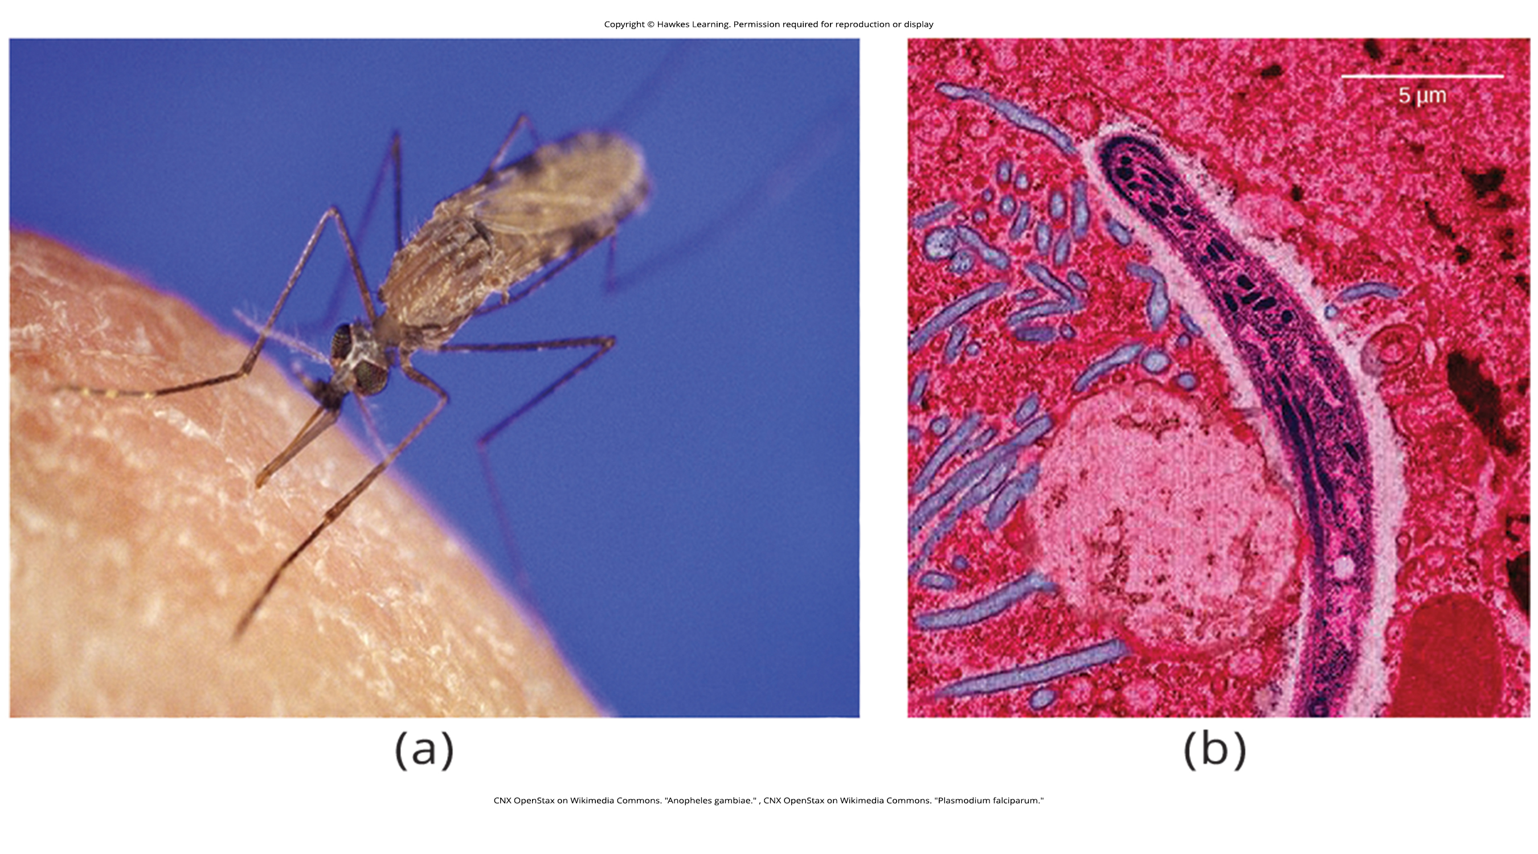
Lesson 12.2 Figure 9

Slide 15
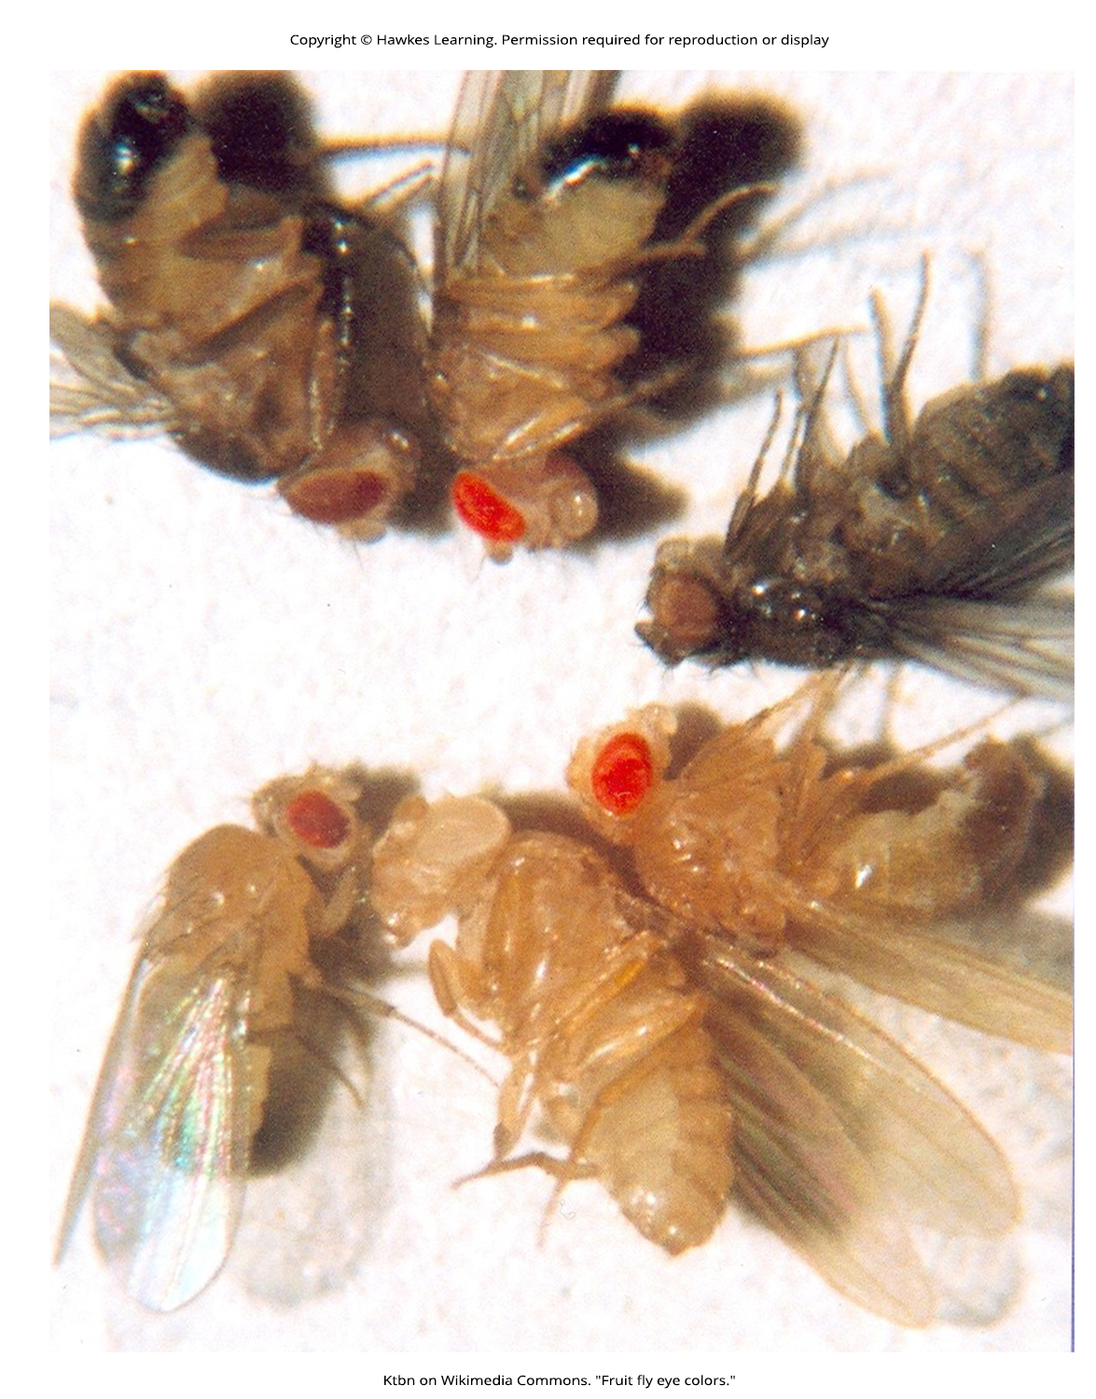
Lesson 12.2 Figure 10

Slide 16
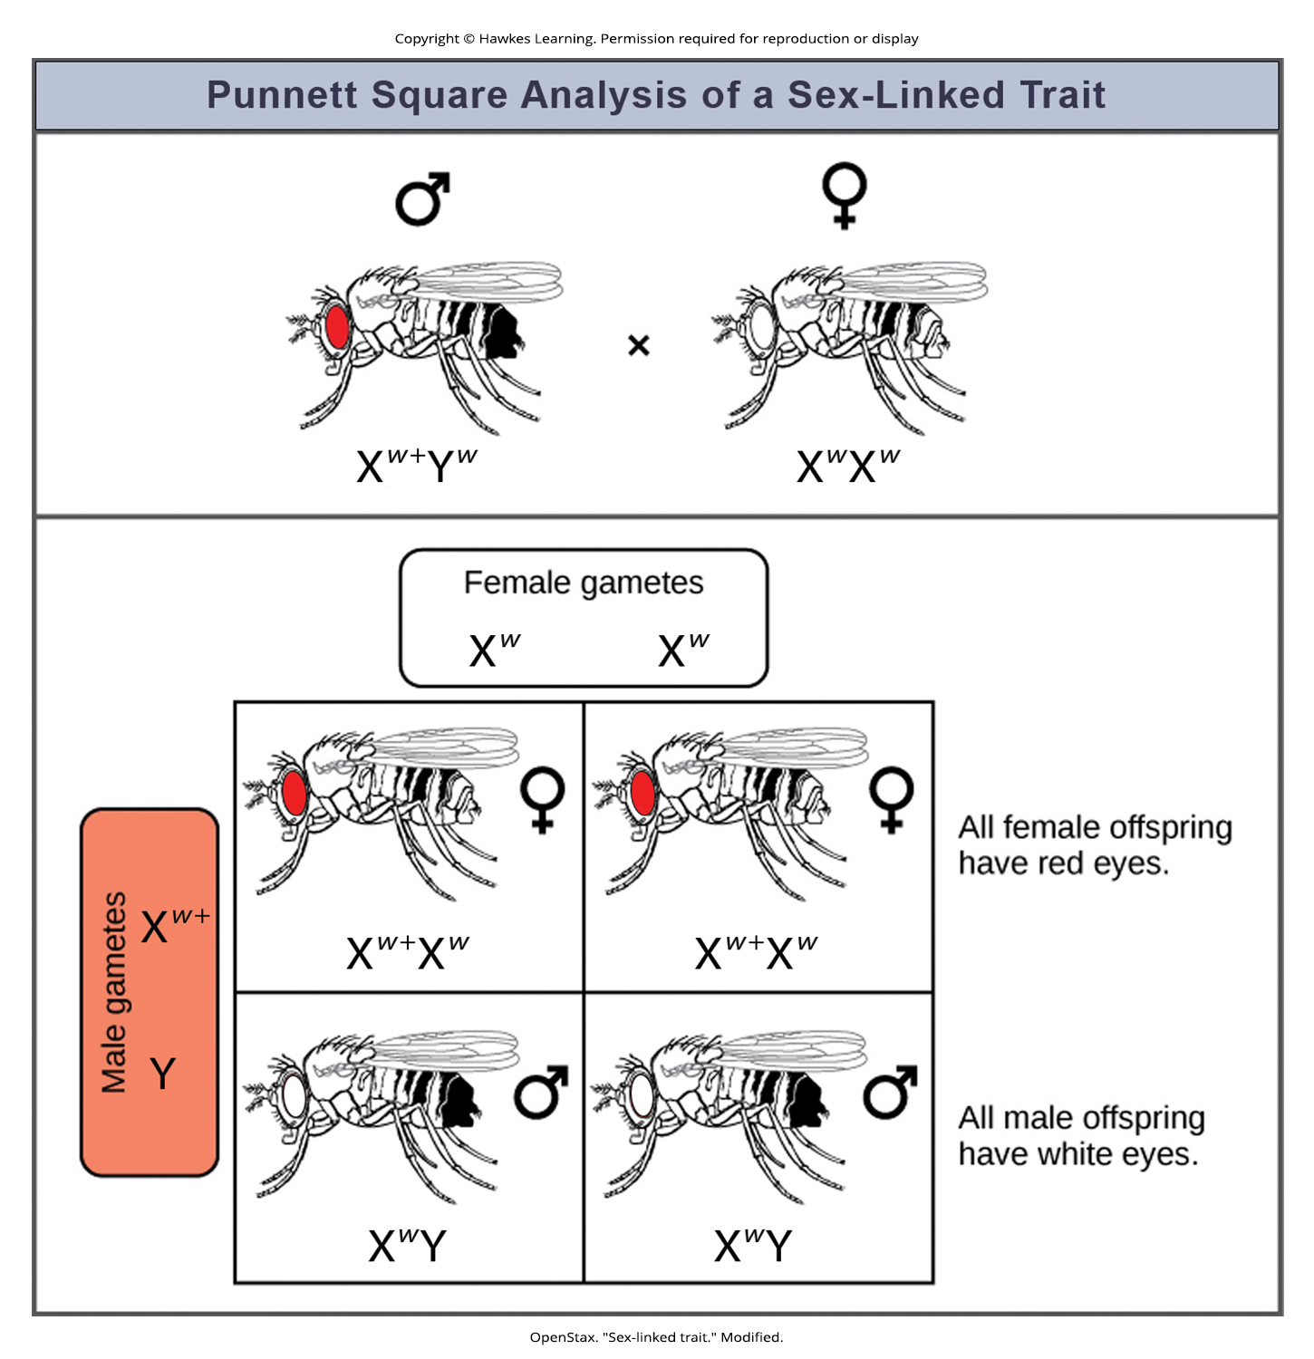
Lesson 12.2 Figure 11

Slide 17
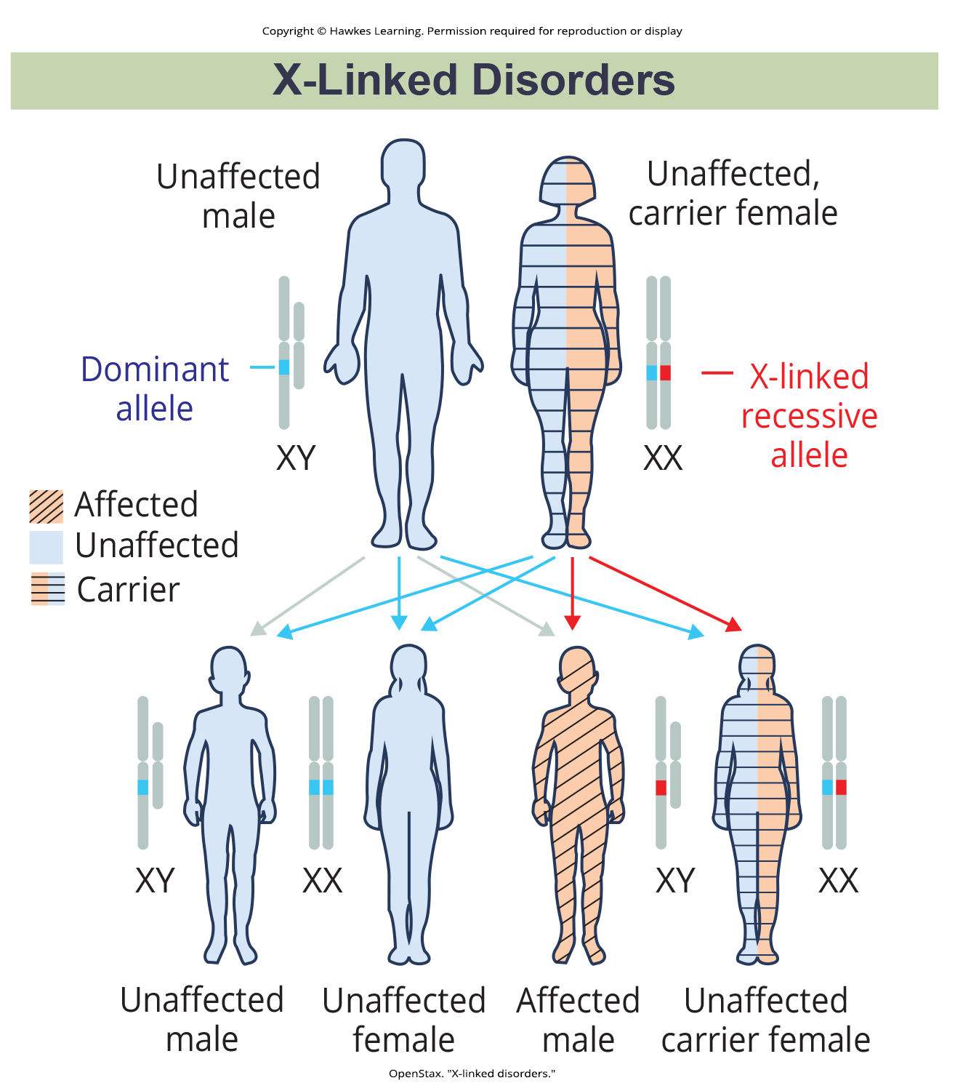
Lesson 12.2 Figure 12

Slide 18
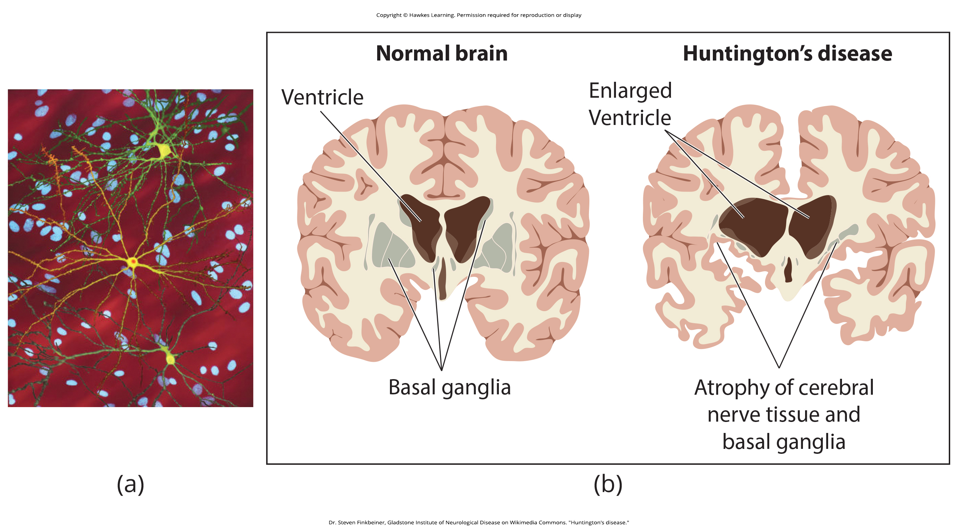
Lesson 12.2 Figure 13

Slide 19
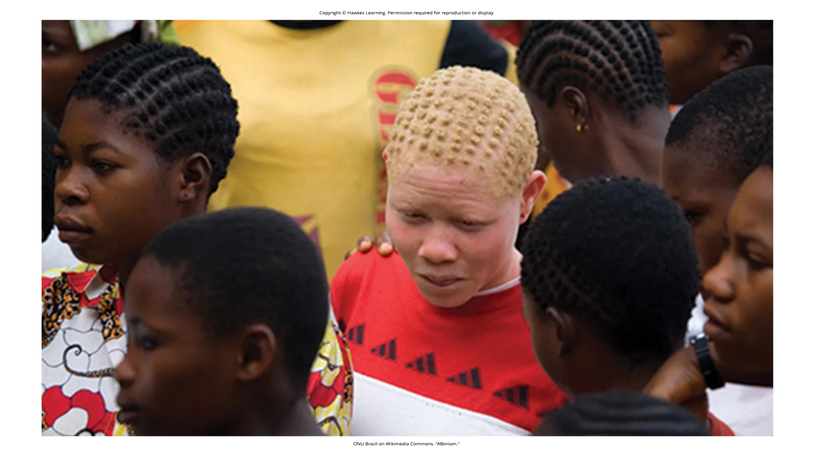
Lesson 12.3 Figure 1

Slide 20
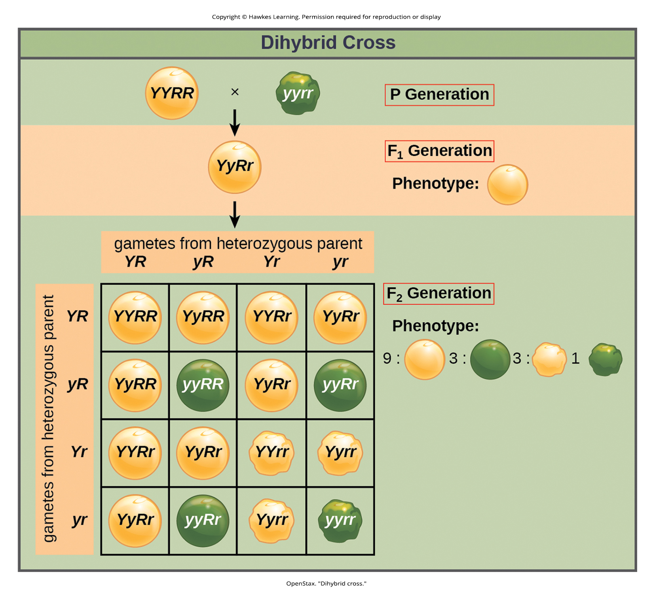
Lesson 12.3 Figure 2

Slide 21
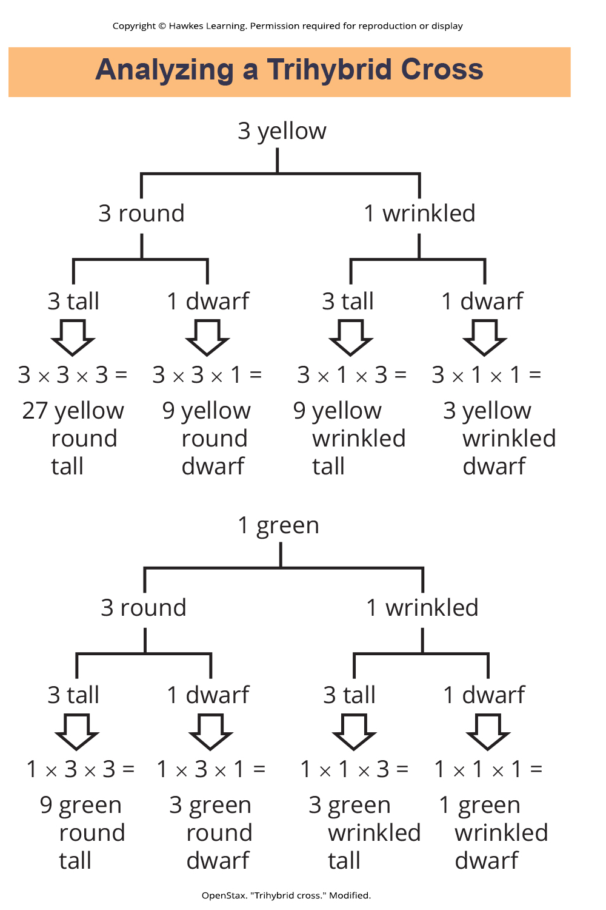
Lesson 12.3 Figure 3

Slide 22
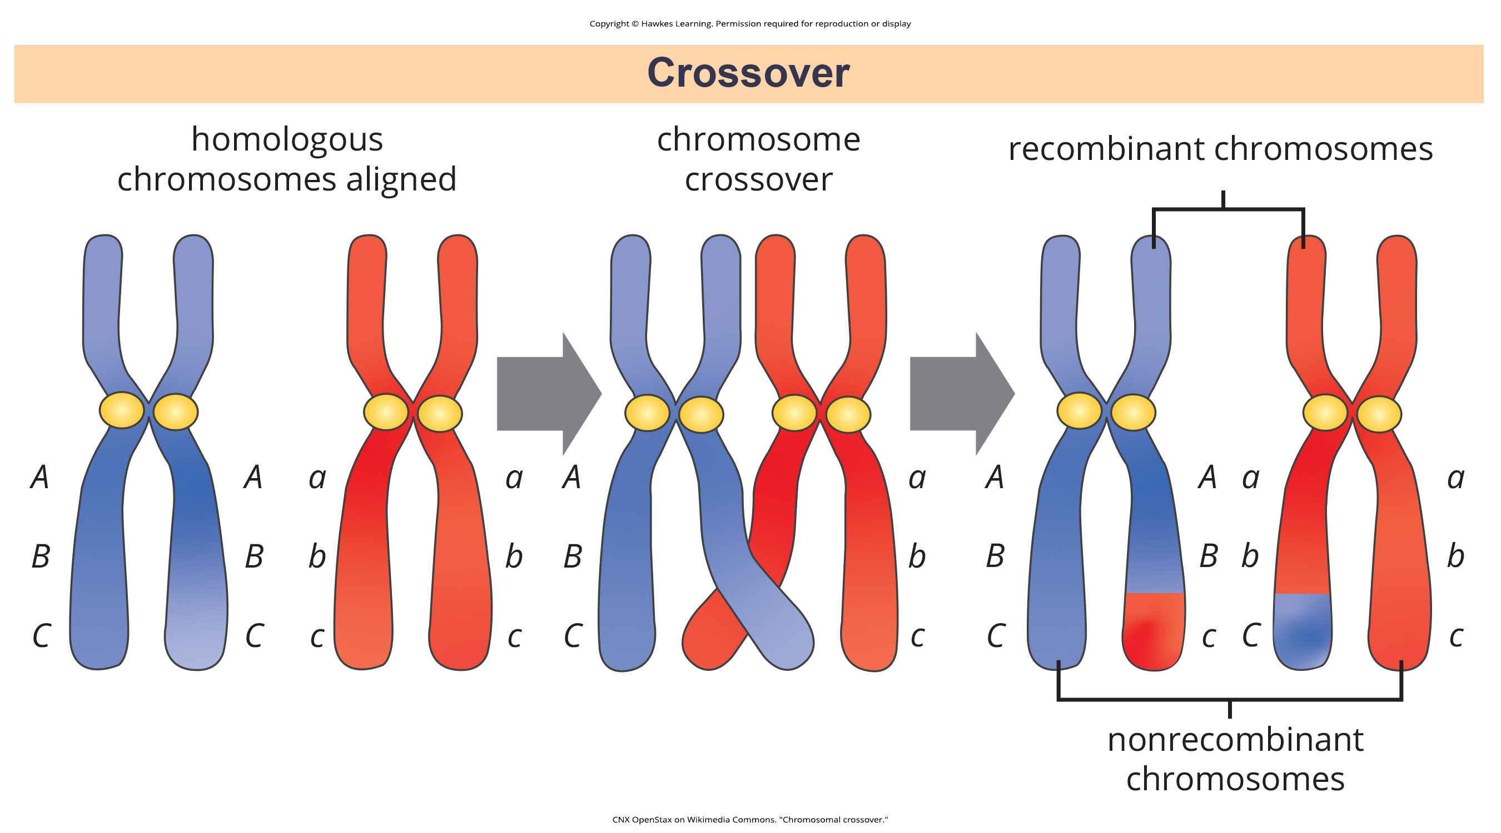
Lesson 12.3 Figure 4

Slide 23
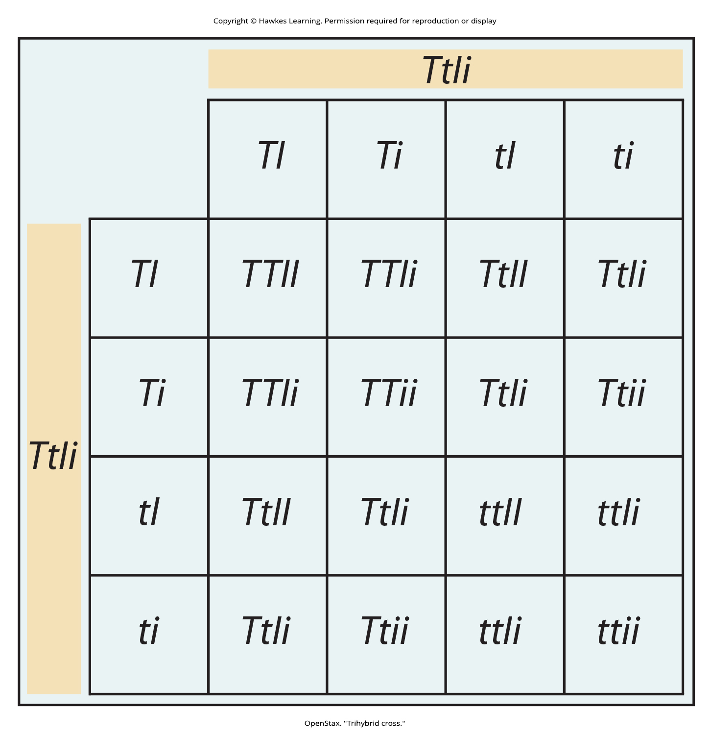
Lesson 12.3 Figure 5

Slide 24
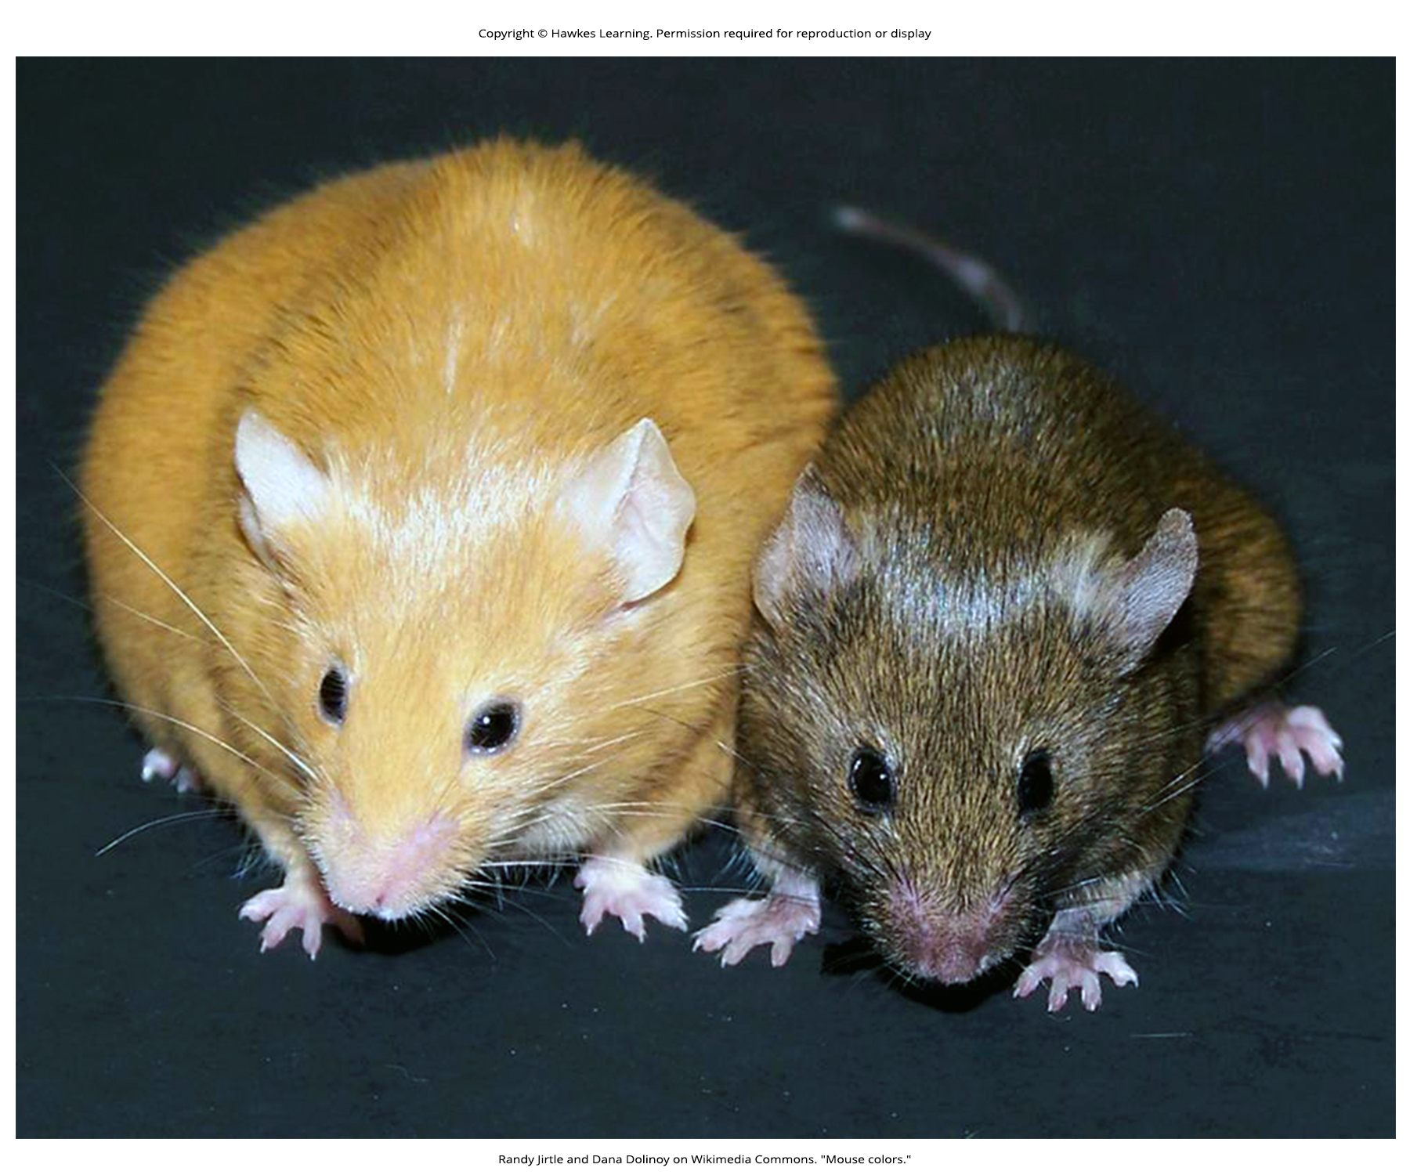
Lesson 12.3 Figure 6

Slide 25
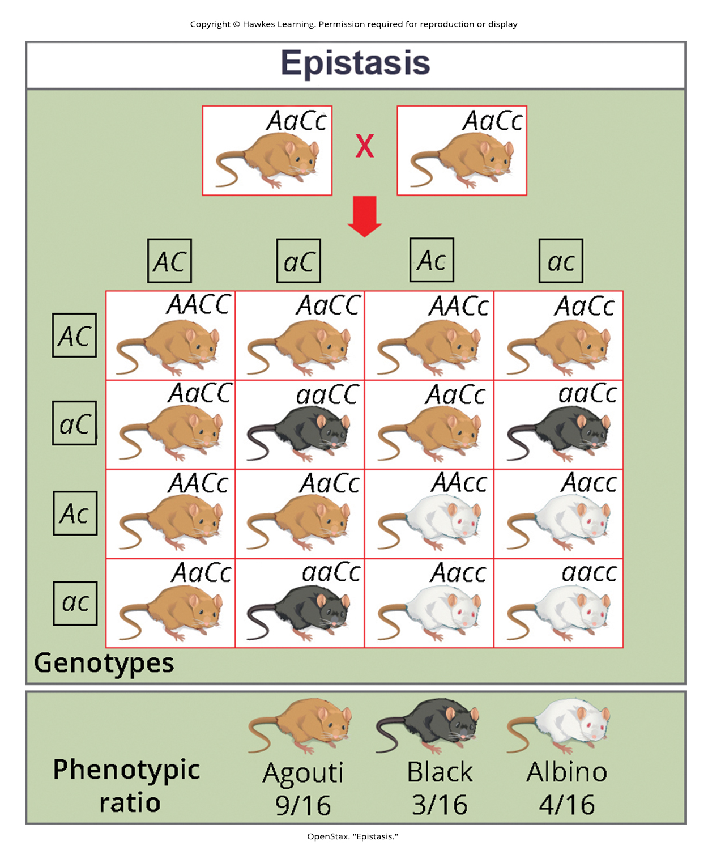
Lesson 12.3 Figure 7

Slide 26
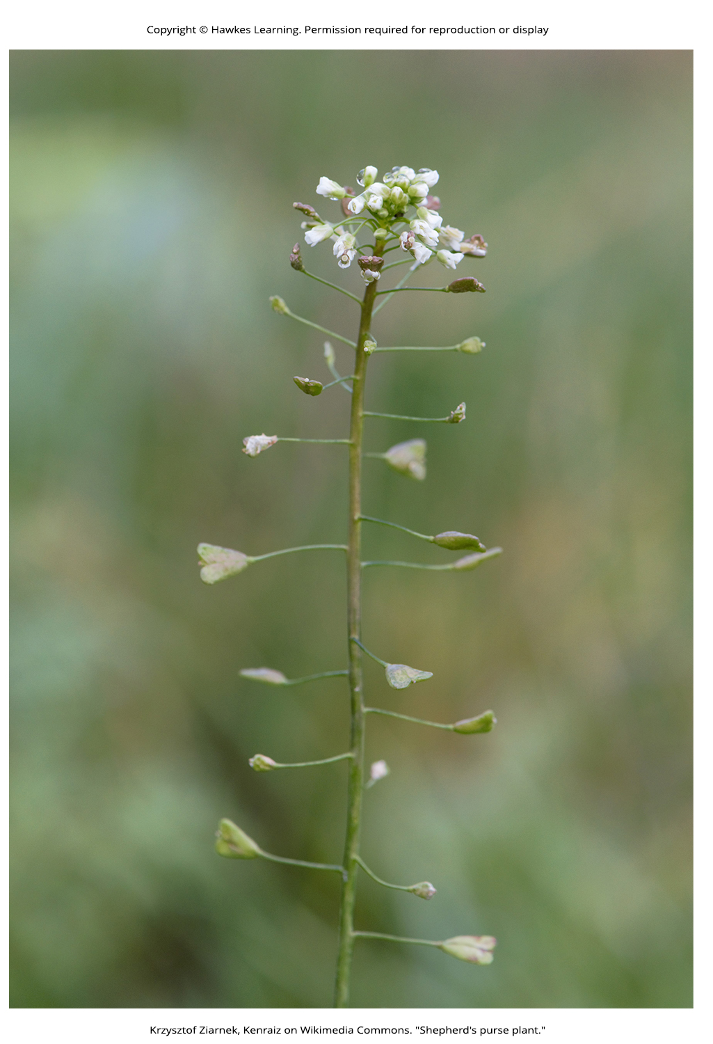
Lesson 12.3 Figure 8

Slide 27
Hawkes Learning – End of PowerPoint

