Slide 1
Chapter 13
Modern Genetics and Inheritance

Slide 2
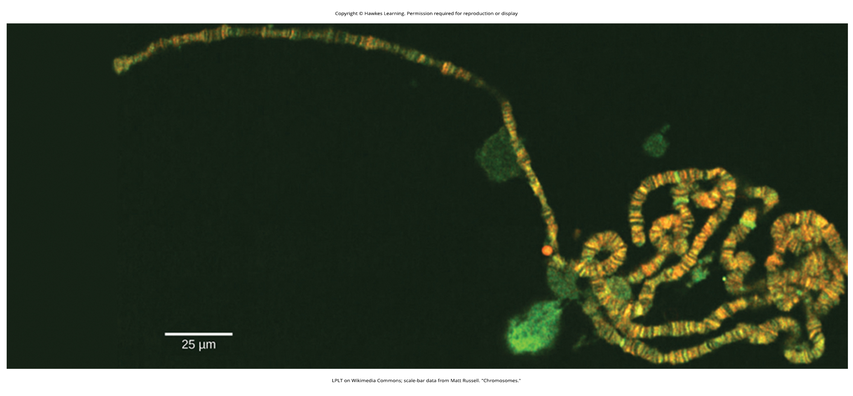
Lesson 13.1 Figure 1

Slide 3
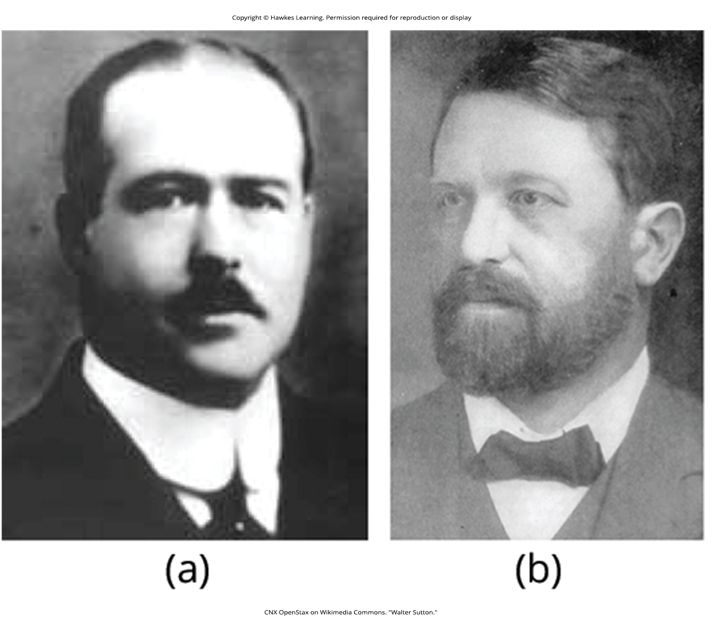
Lesson 13.1 Figure 2

Slide 4
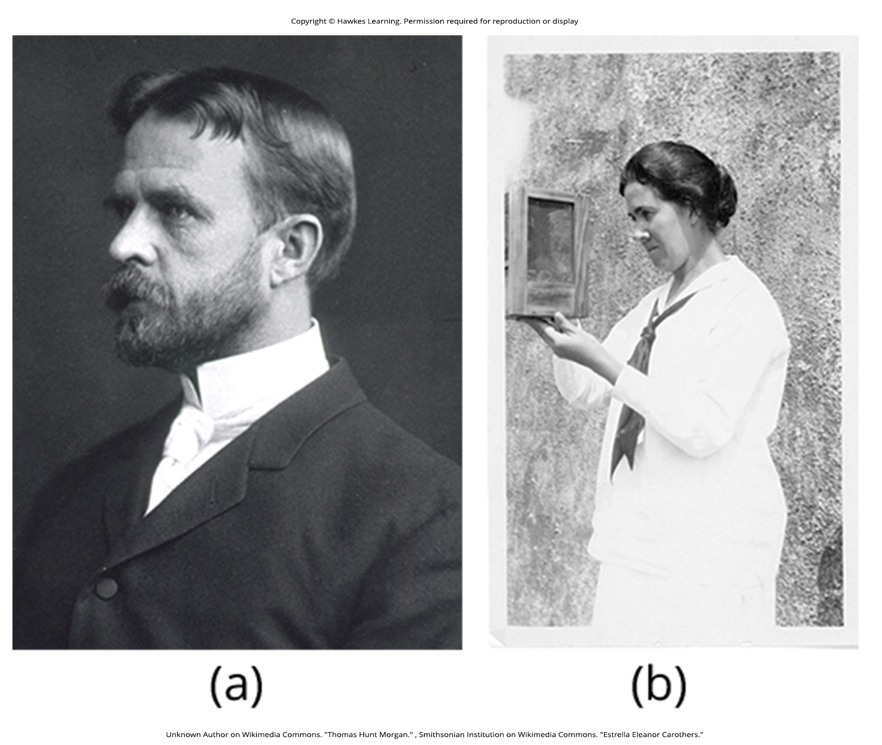
Lesson 13.1 Figure 3

Slide 5
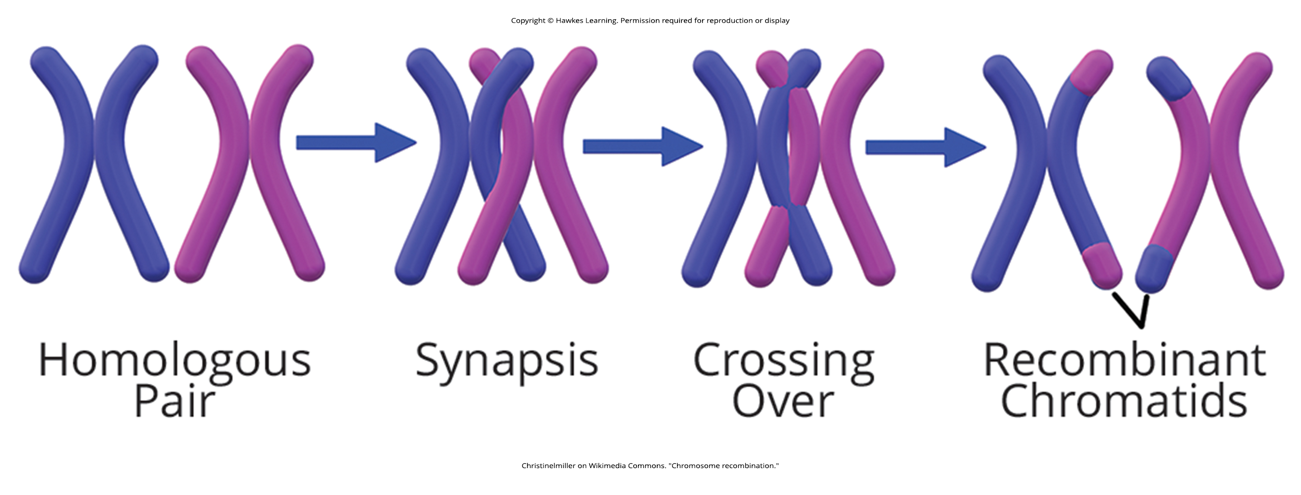
Lesson 13.1 Figure 4

Slide 6
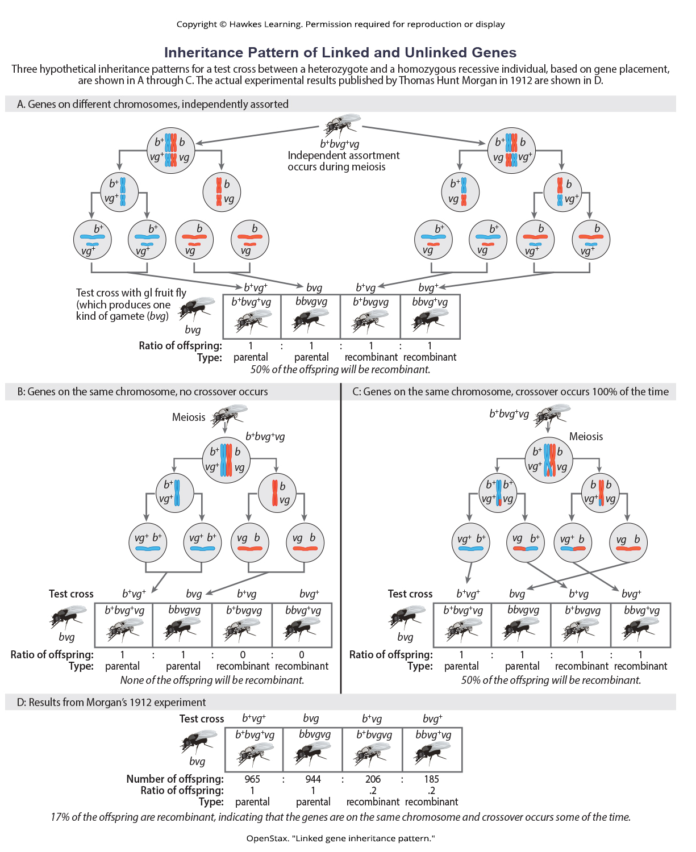
Lesson 13.1 Figure 5

Slide 7
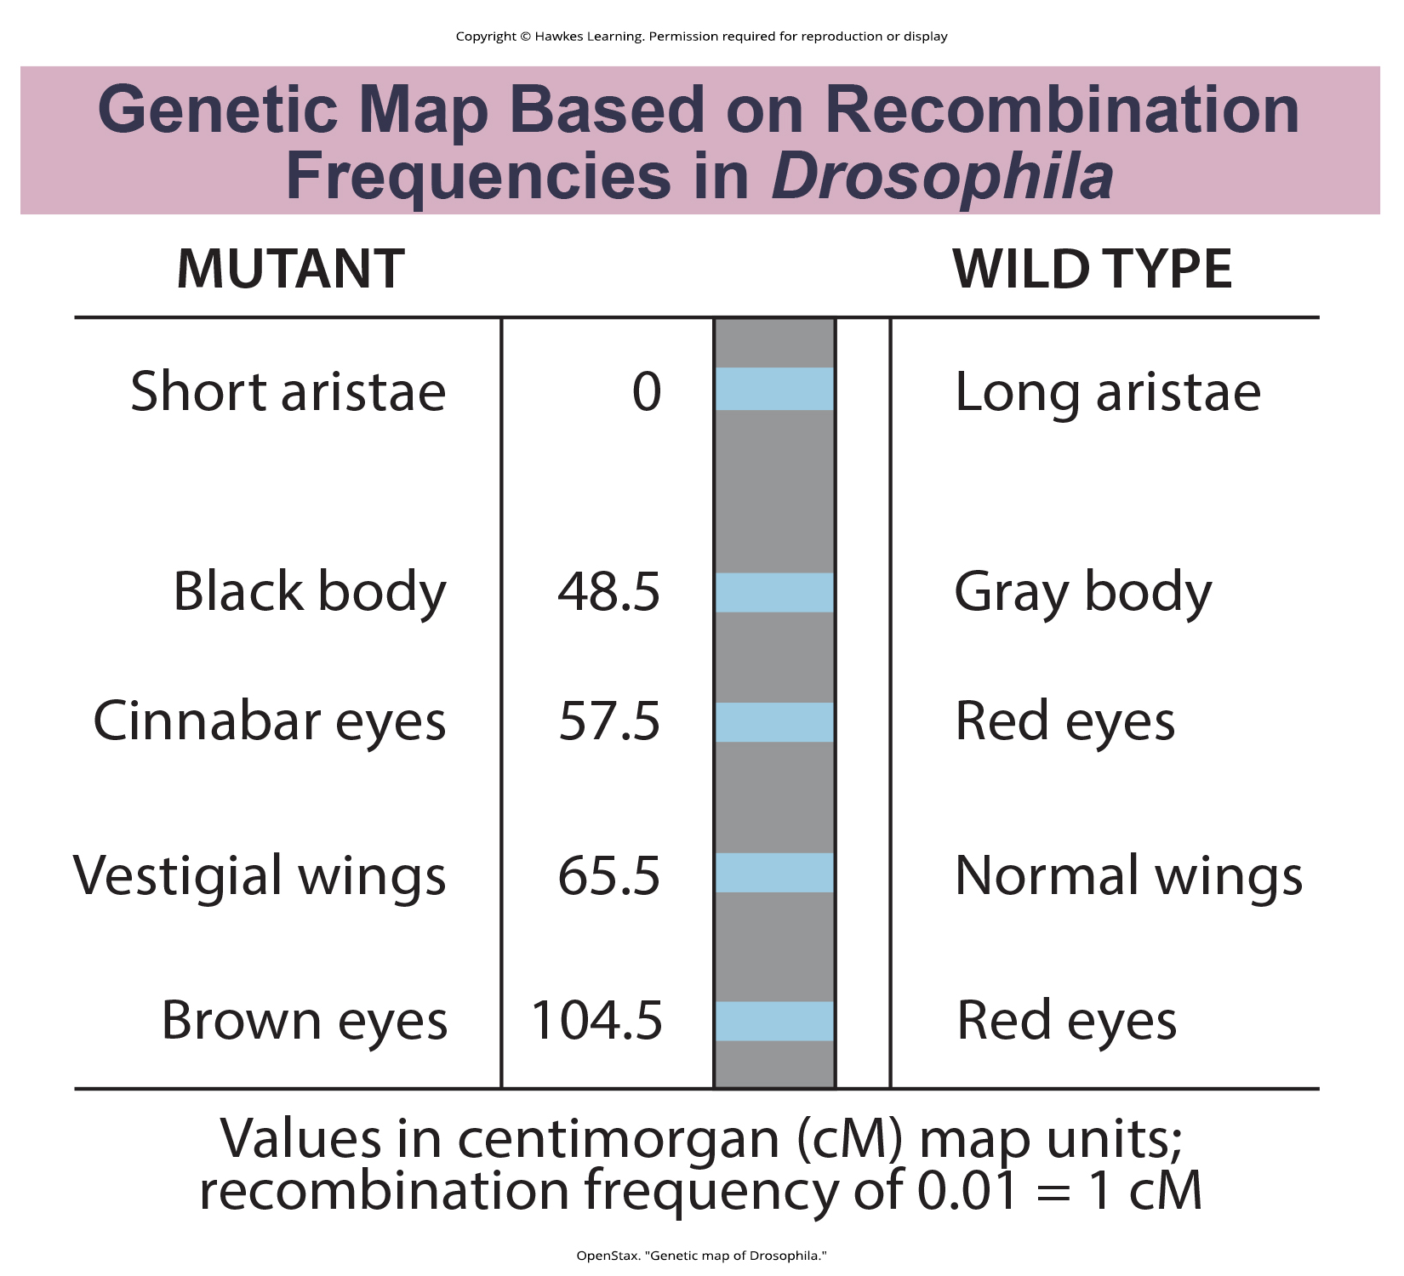
Lesson 13.1 Figure 6

Slide 8
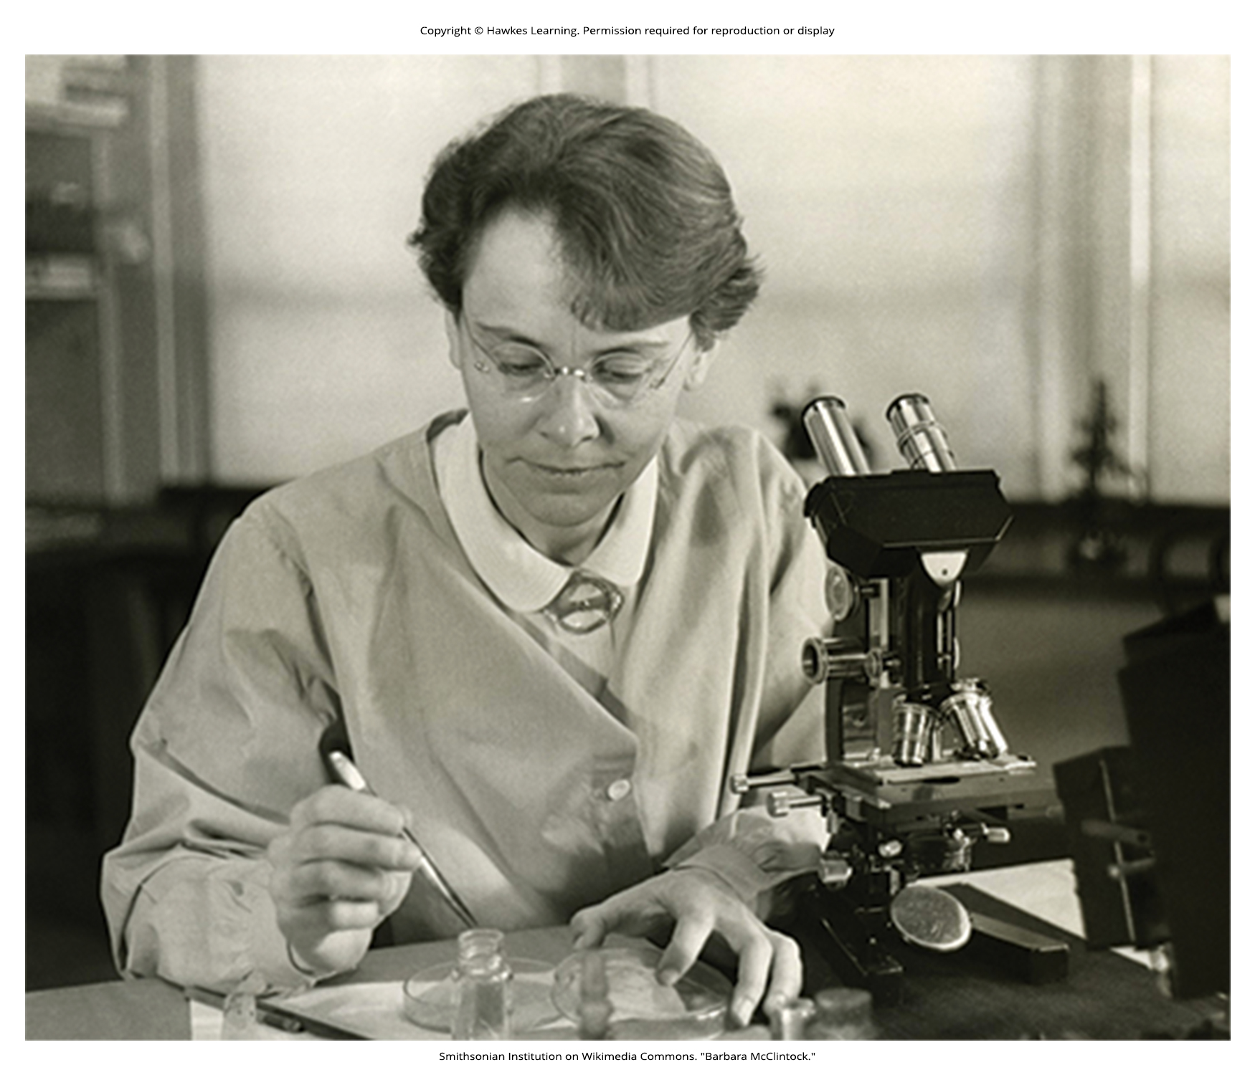
Lesson 13.1 Figure 7

Slide 9
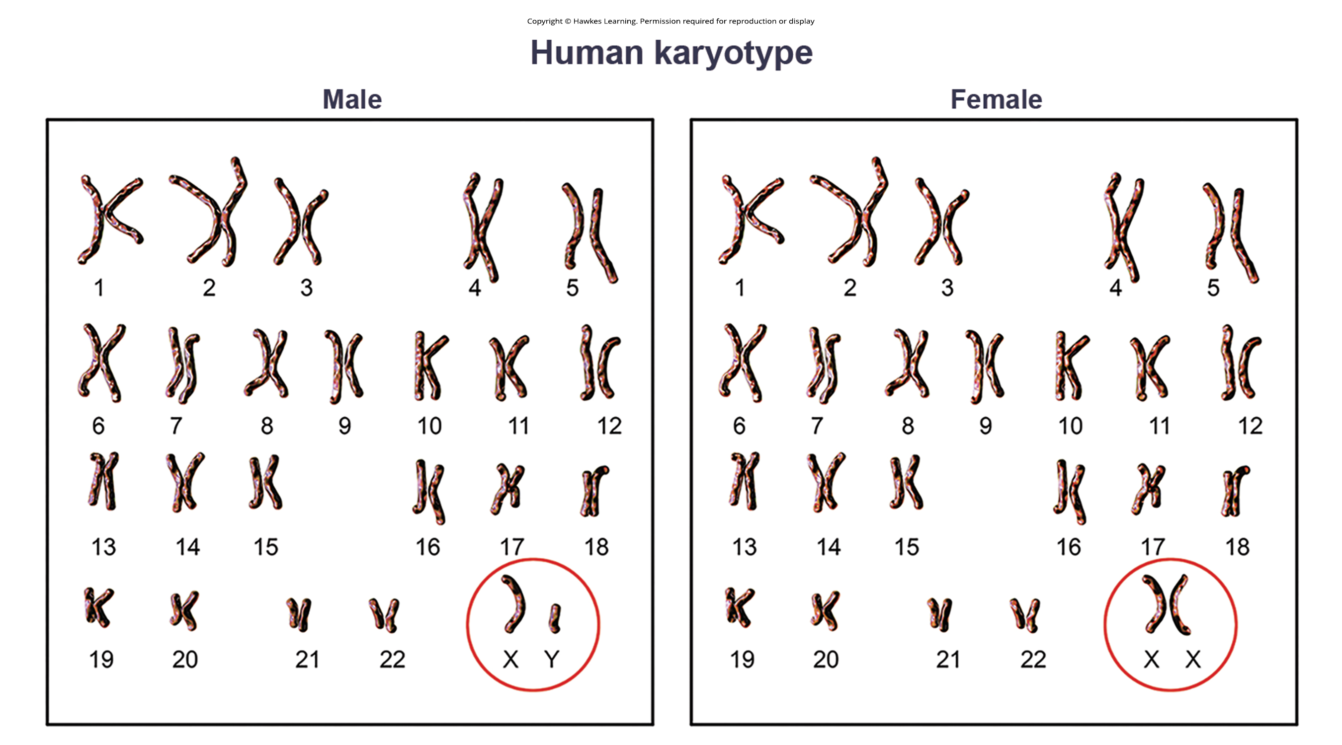
Lesson 13.2 Figure 1

Slide 10
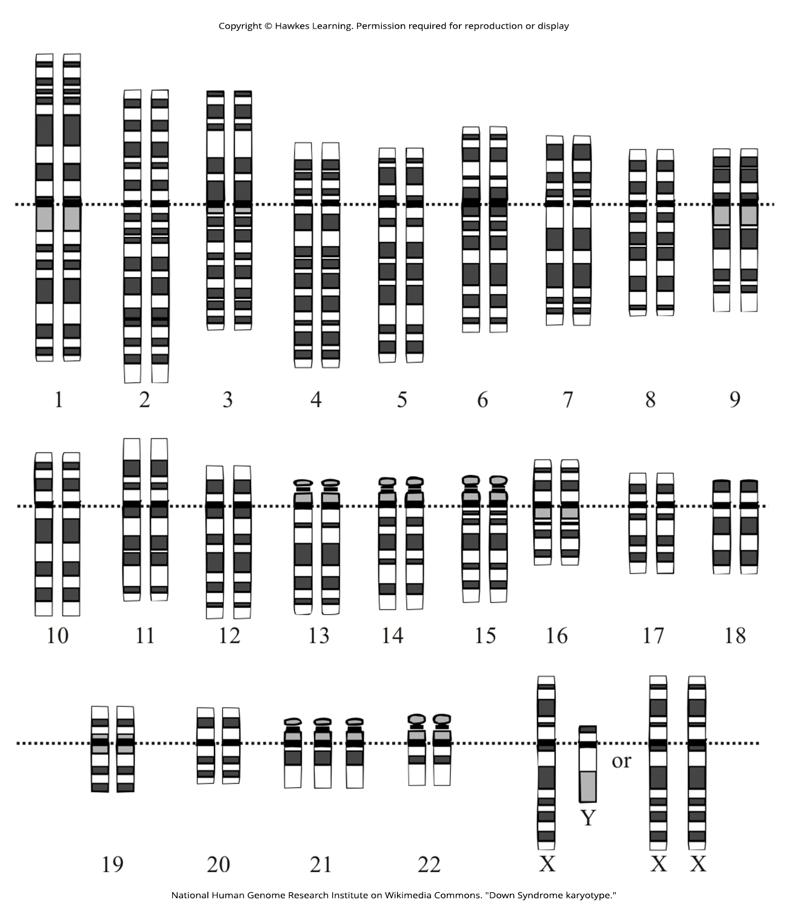
Lesson 13.2 Figure 2

Slide 11
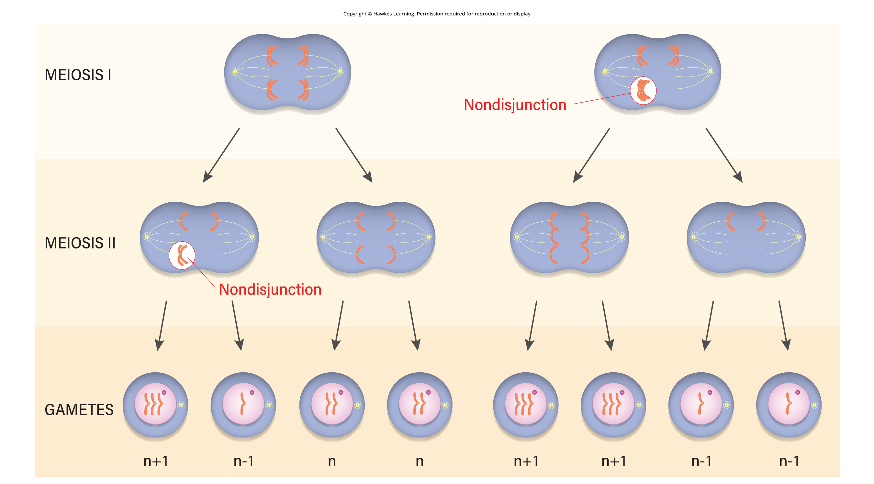
Lesson 13.2 Figure 3

Slide 12
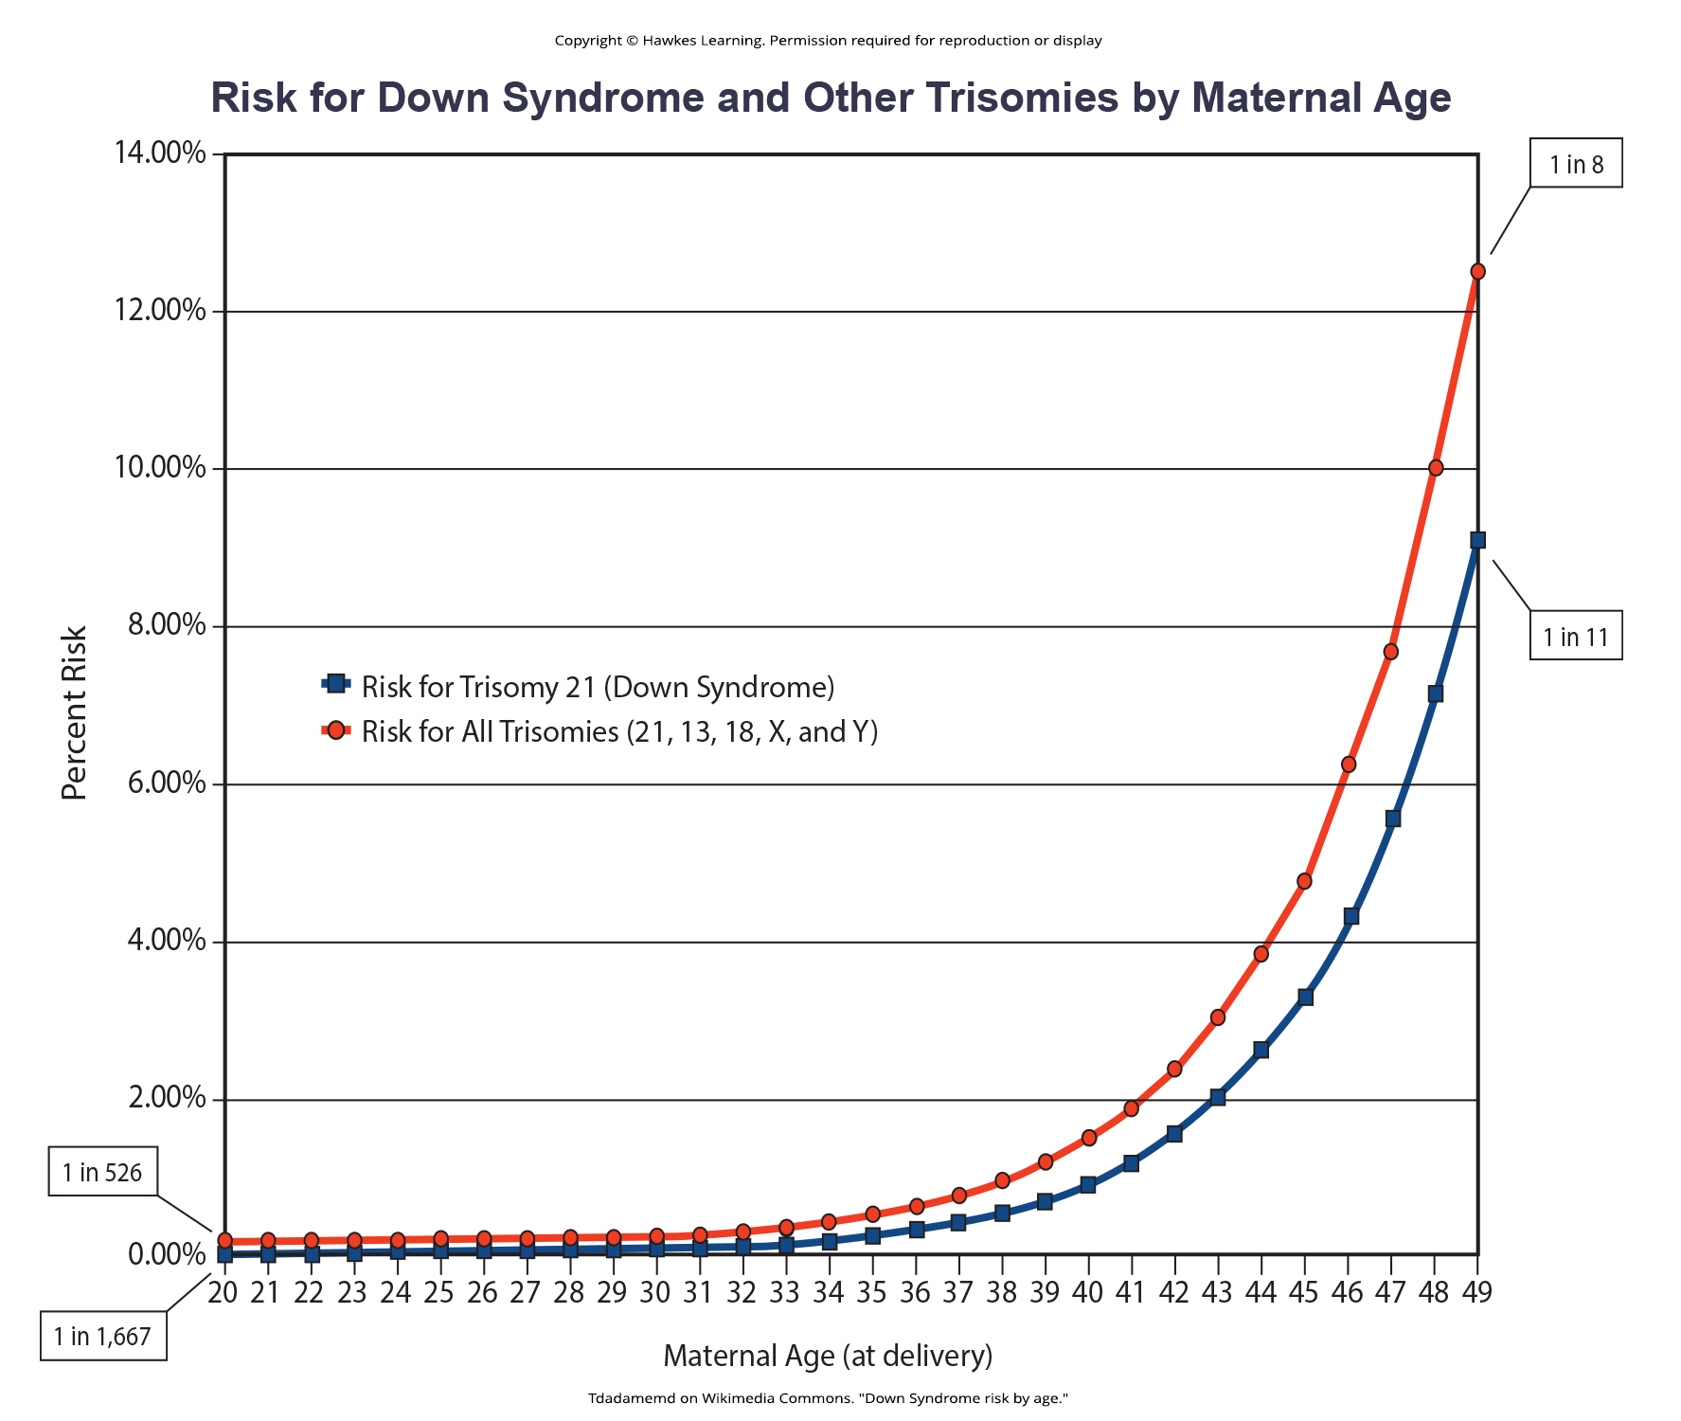
Lesson 13.2 Figure 4

Slide 13

Lesson 13.2 Figure 5

Slide 14
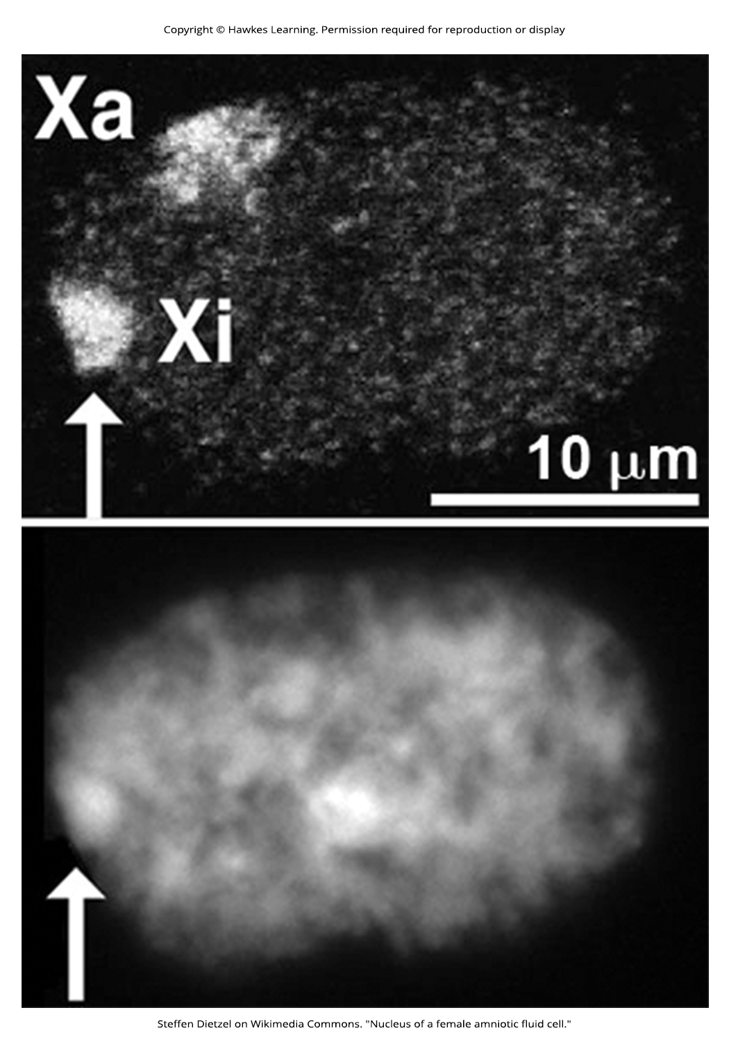
Lesson 13.2 Figure 6

Slide 15
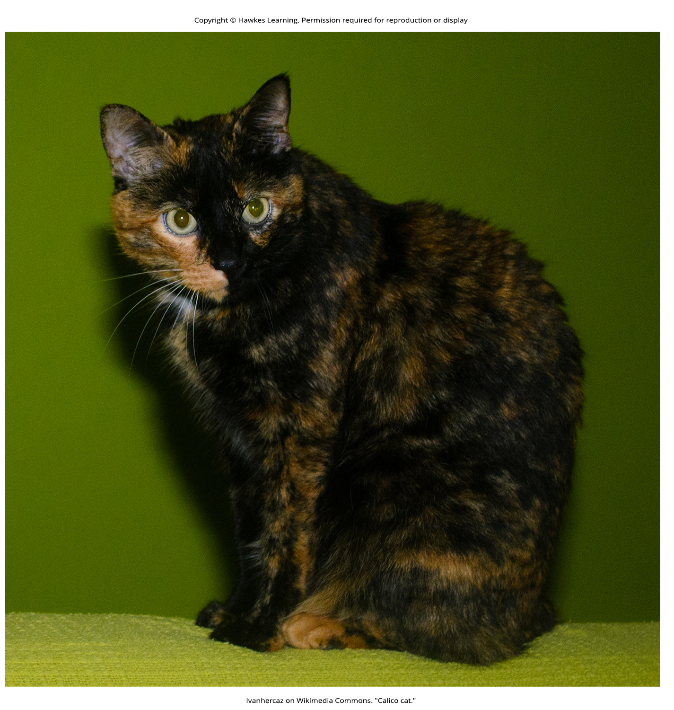
Lesson 13.2 Figure 7

Slide 16
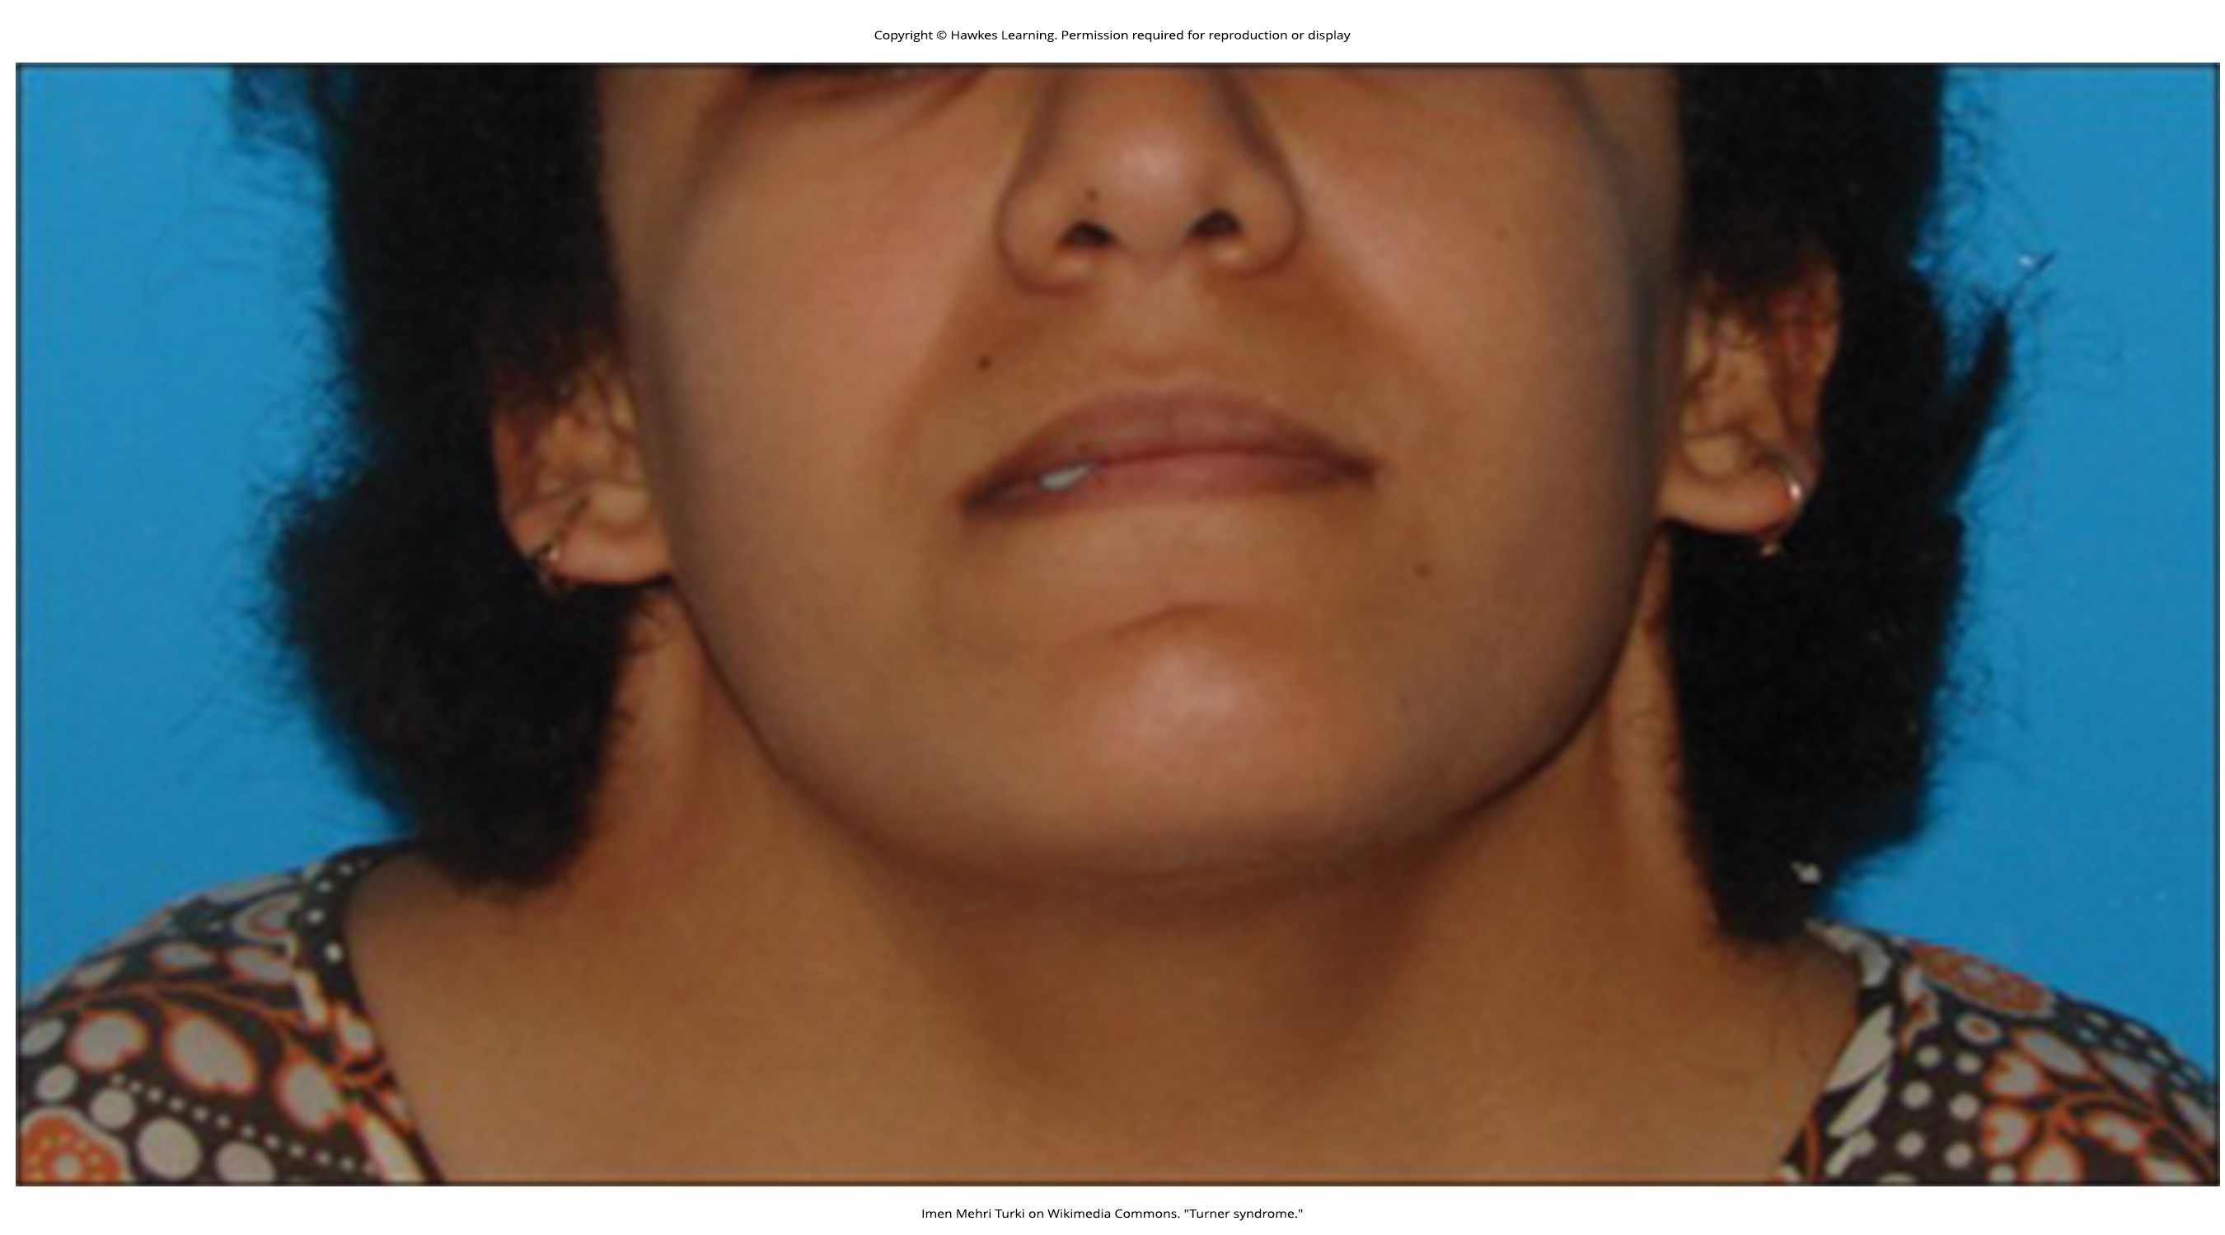
Lesson 13.2 Figure 8

Slide 17
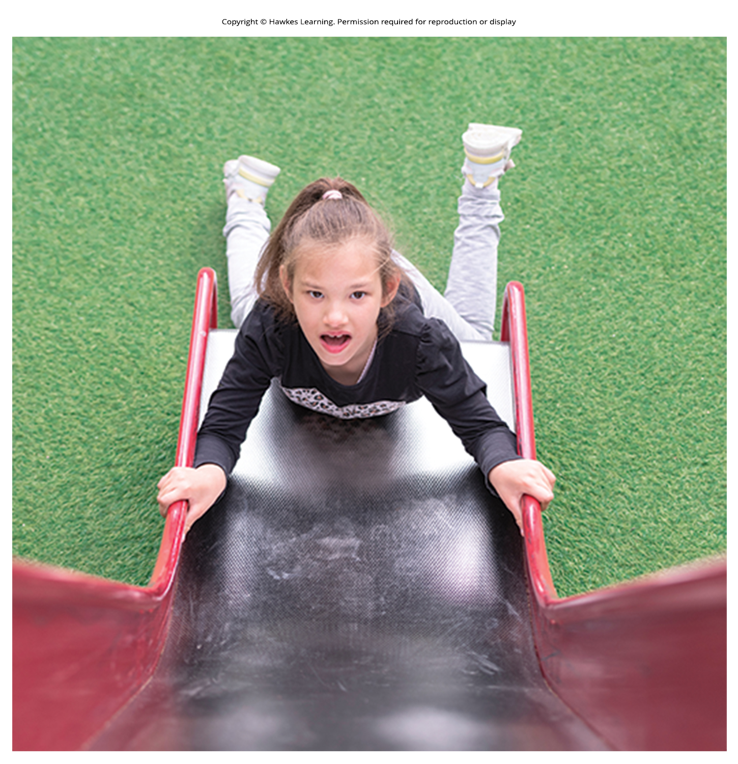
Lesson 13.2 Figure 9

Slide 18
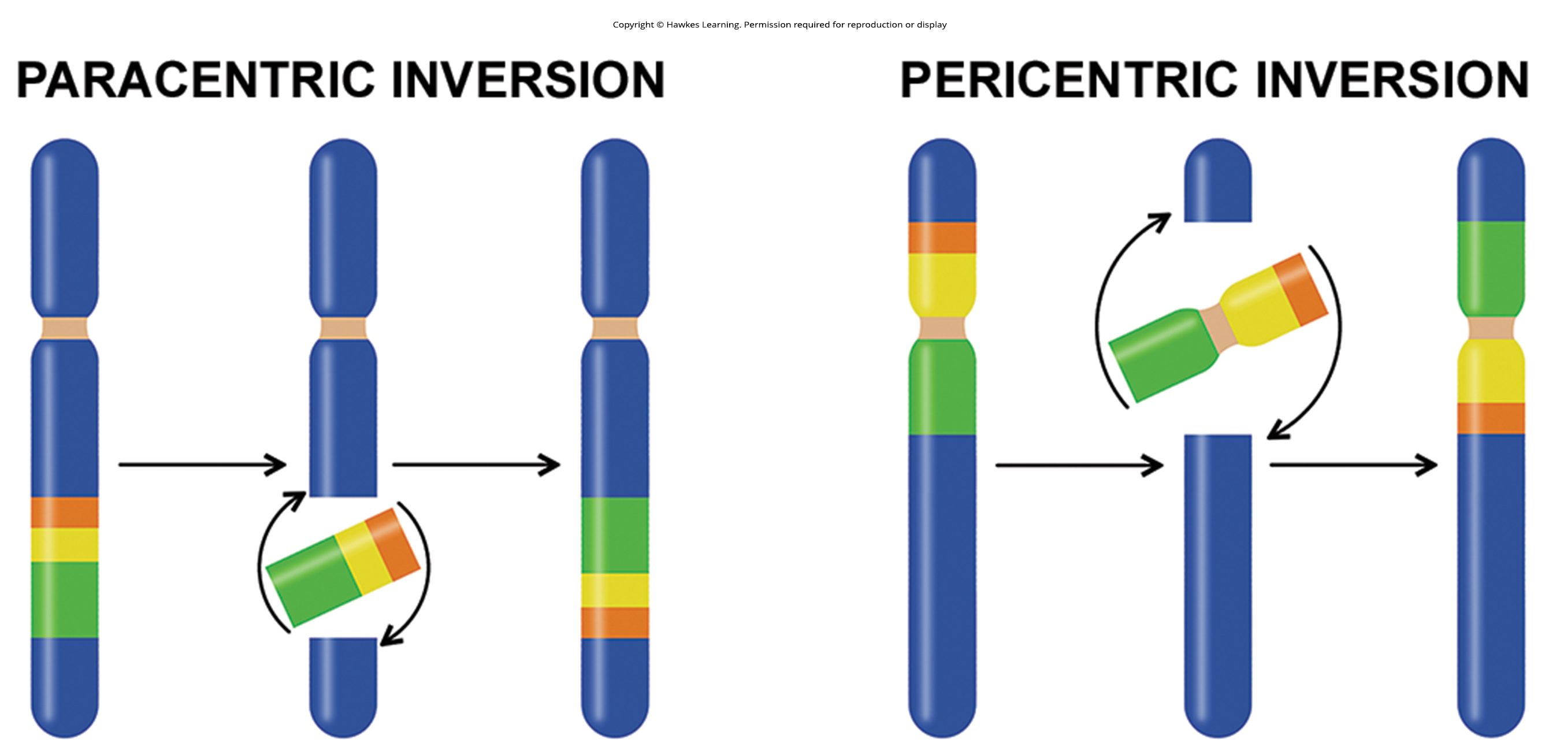
Lesson 13.2 Figure 10

Slide 19
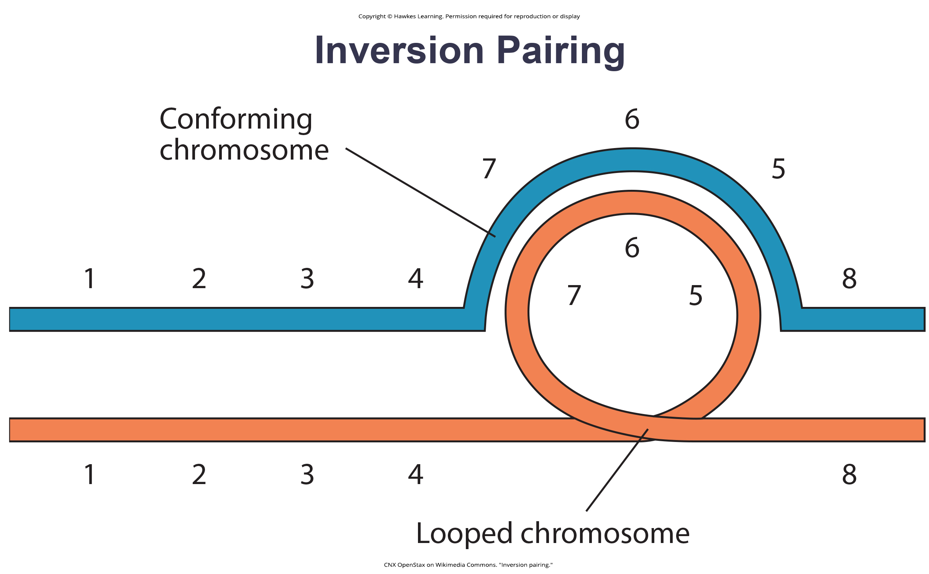
Lesson 13.2 Figure 11

Slide 20
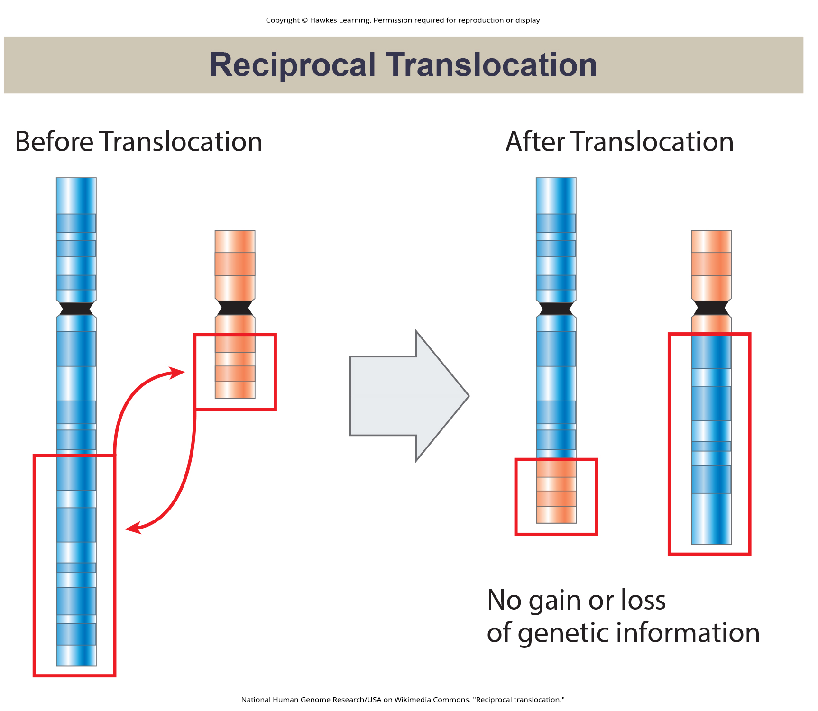
Lesson 13.2 Figure 12

Slide 21
Hawkes Learning – End of PowerPoint

