Slide 1
Chapter 17
Biotechnology and Genomics

Slide 2
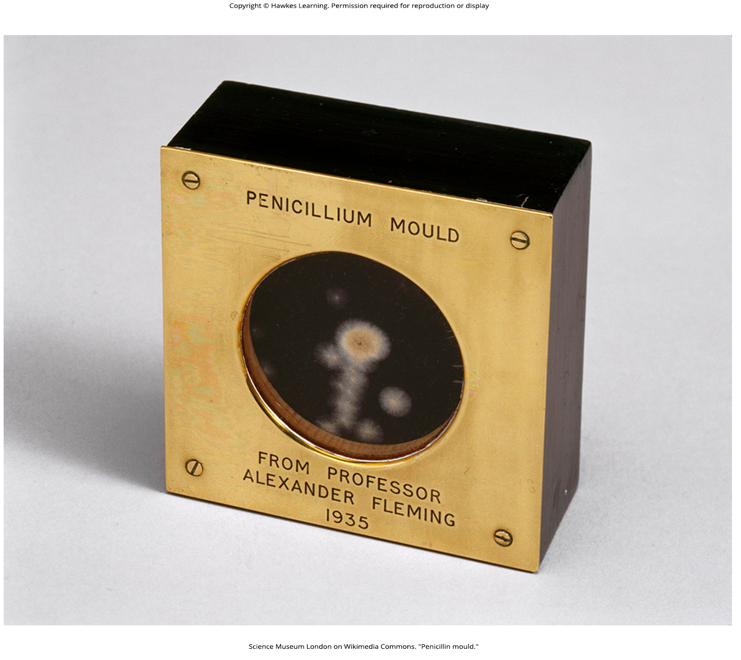
Lesson 17.1 Figure 1

Slide 3

Lesson 17.1 Figure 2

Slide 4
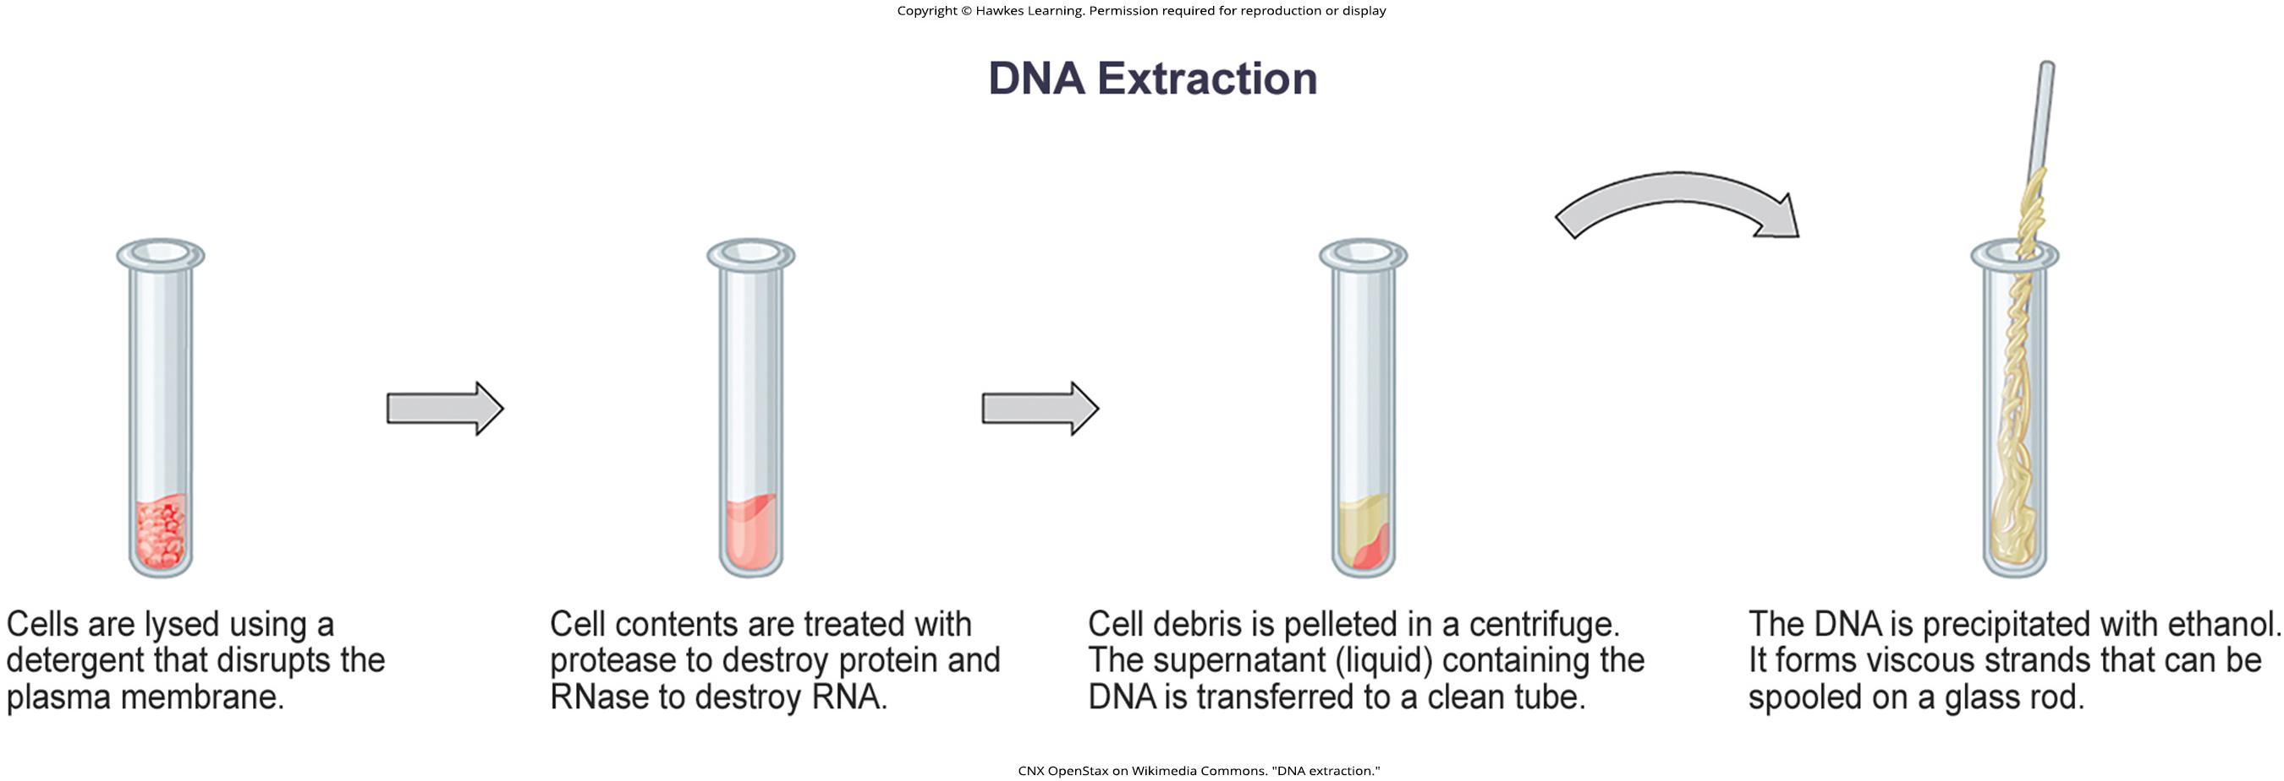
Lesson 17.1 Figure 3

Slide 5
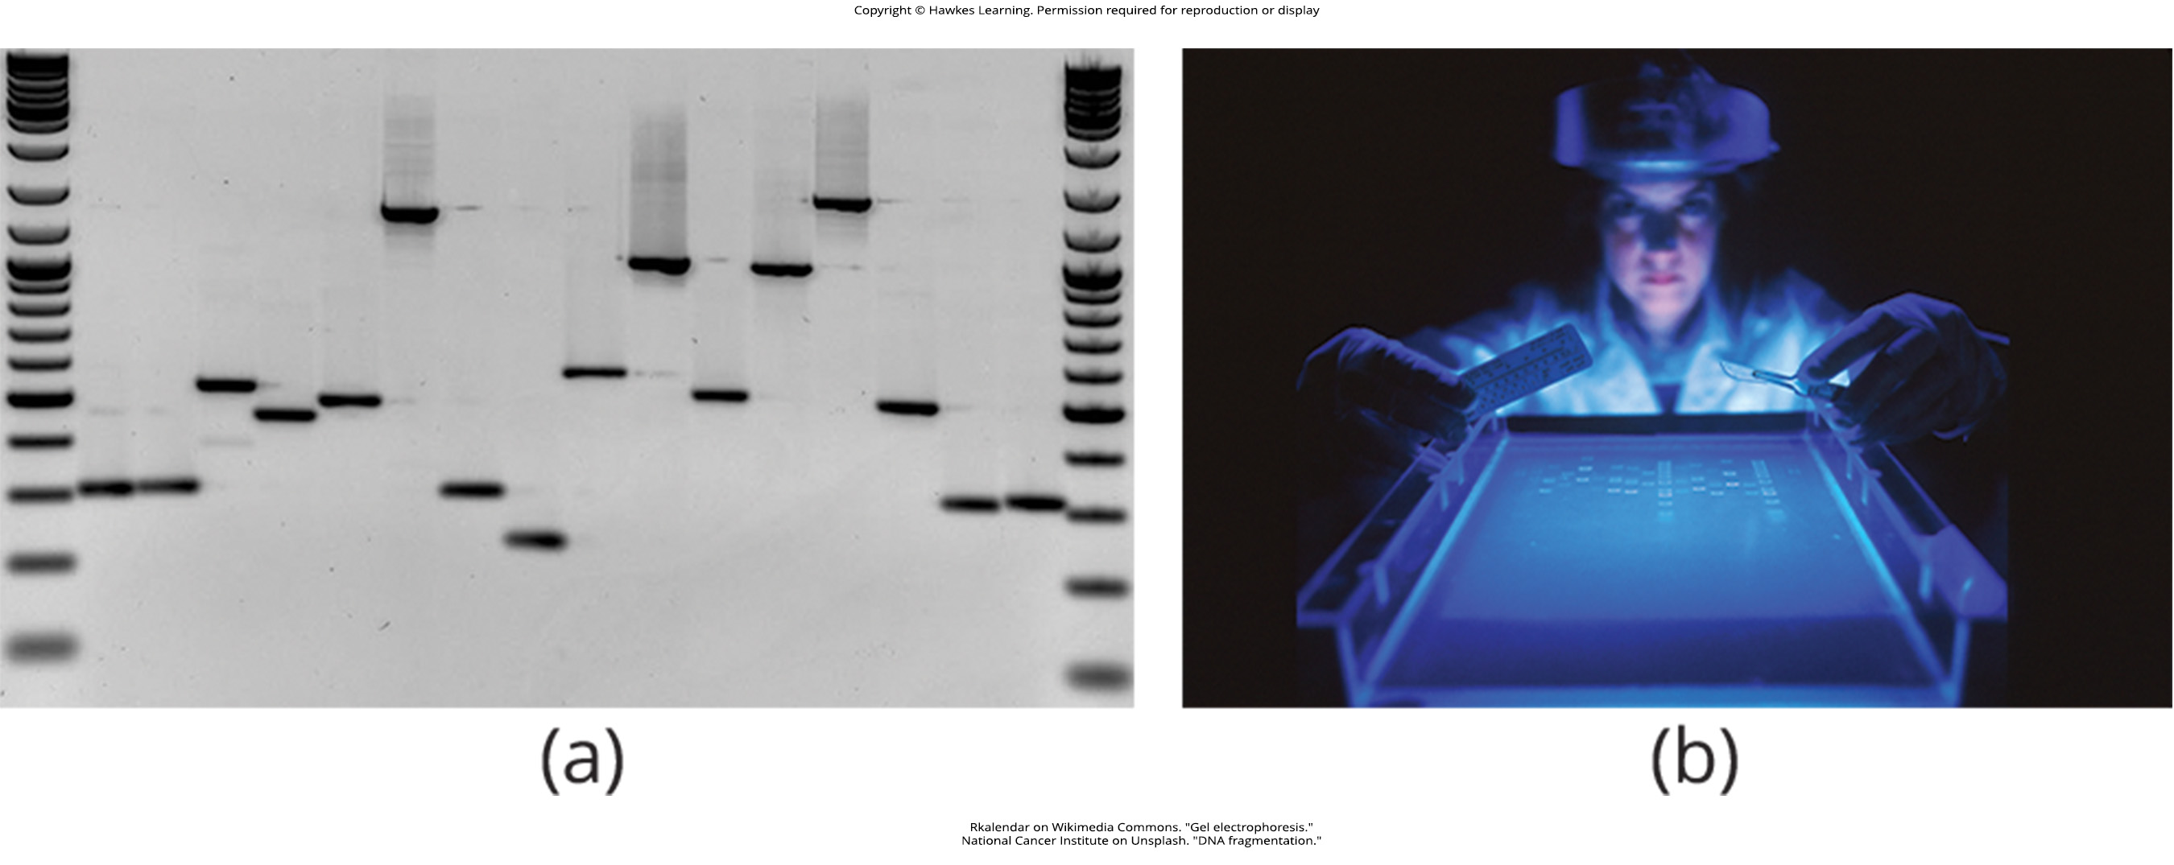
Lesson 17.1 Figure 4

Slide 6
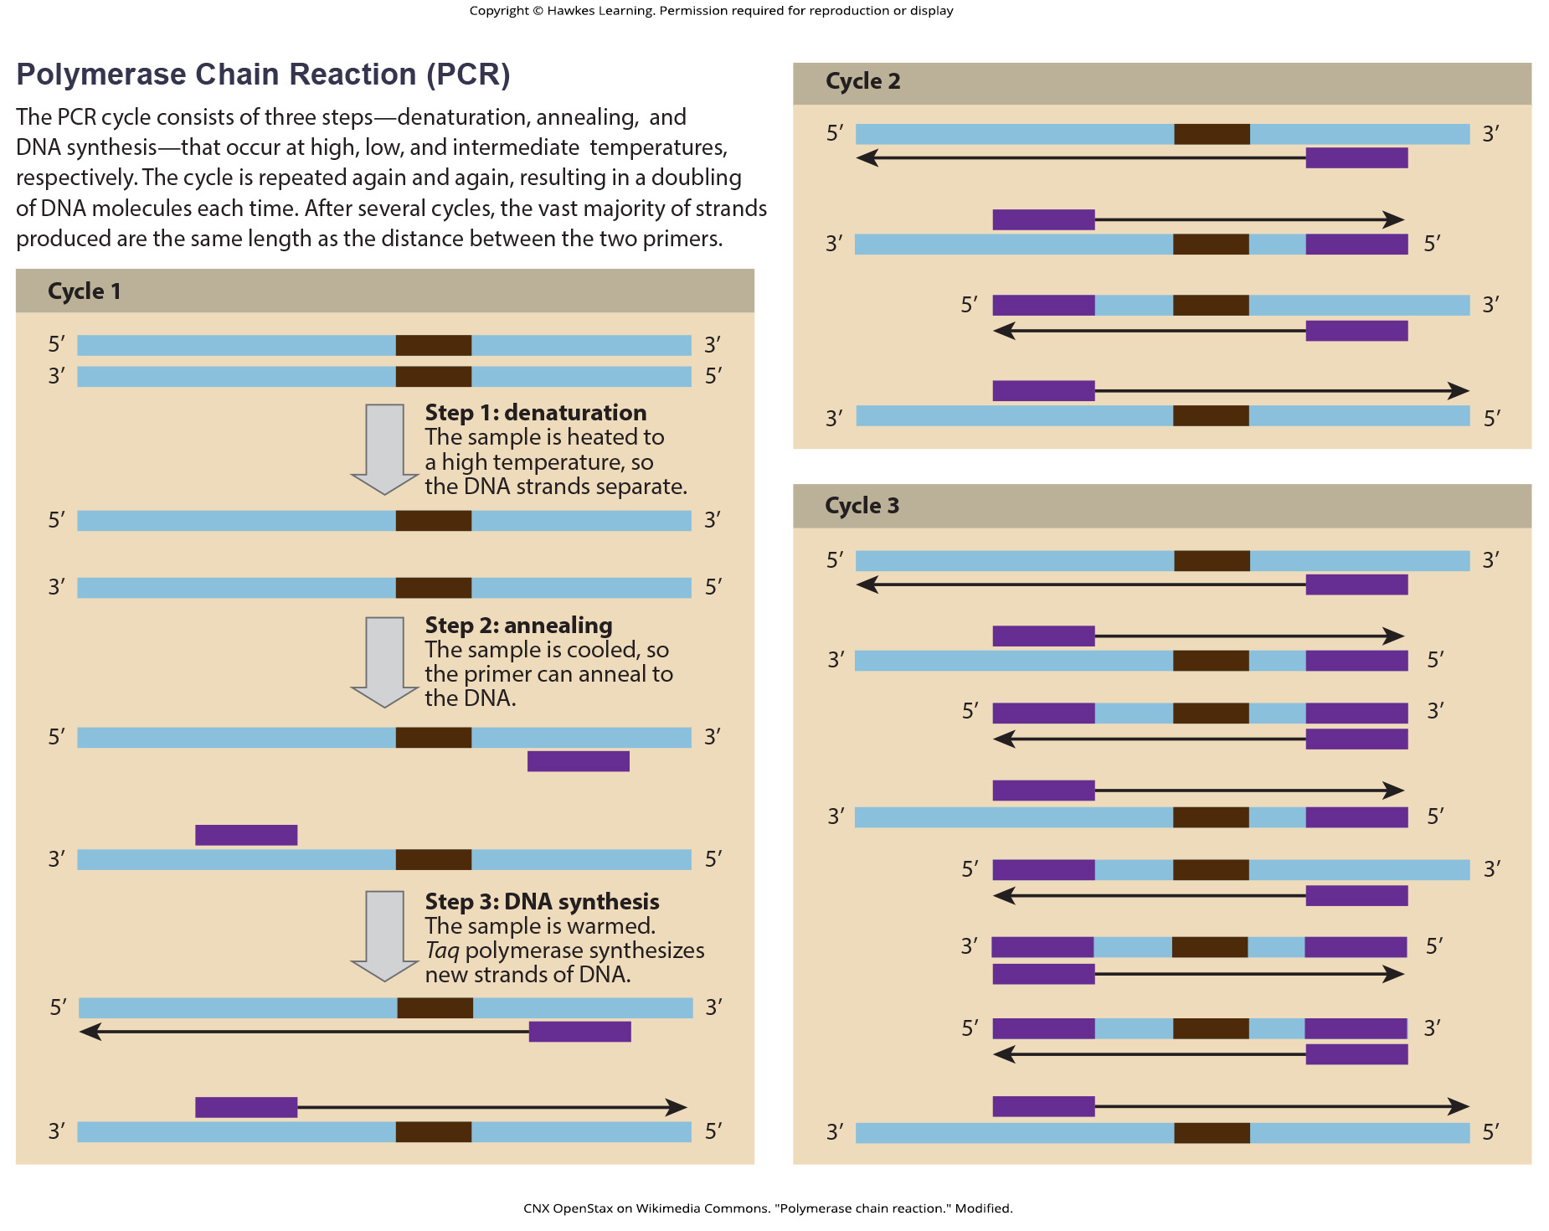
Lesson 17.1 Figure 5

Slide 7
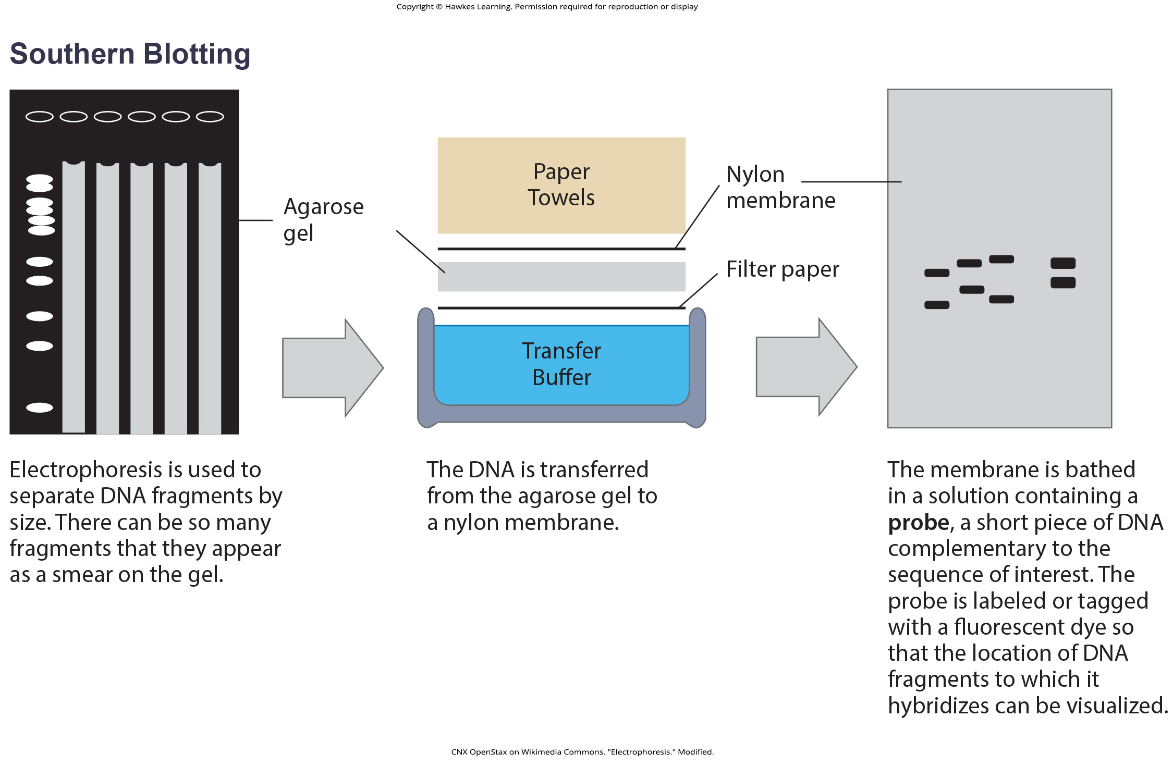
Lesson 17.1 Figure 6

Slide 8
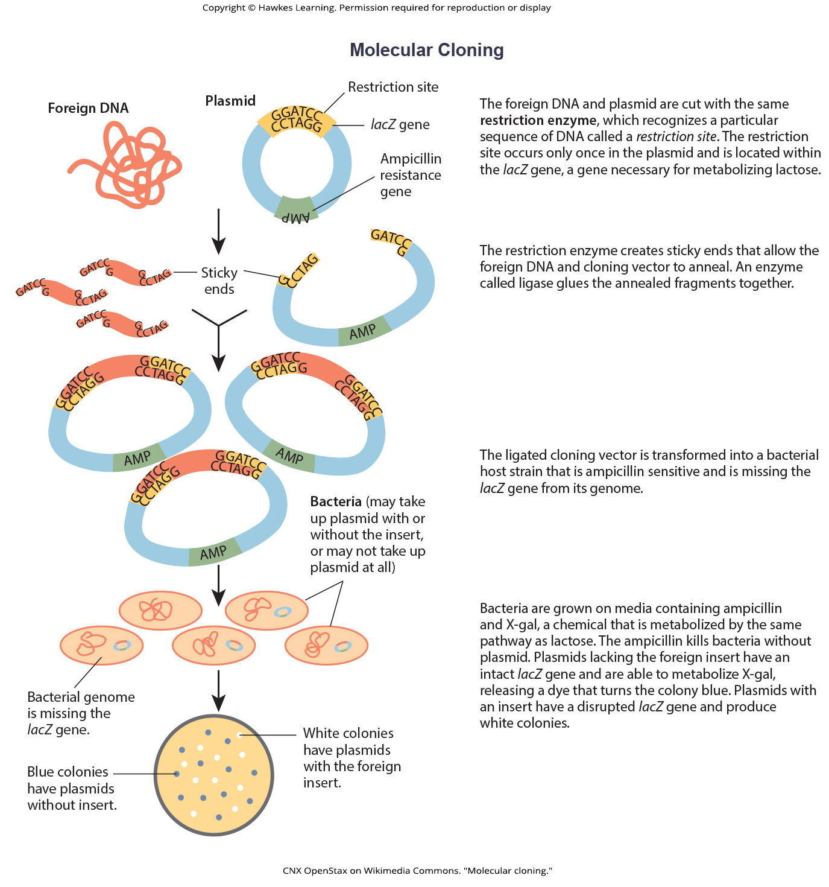
Lesson 17.1 Figure 7

Slide 9
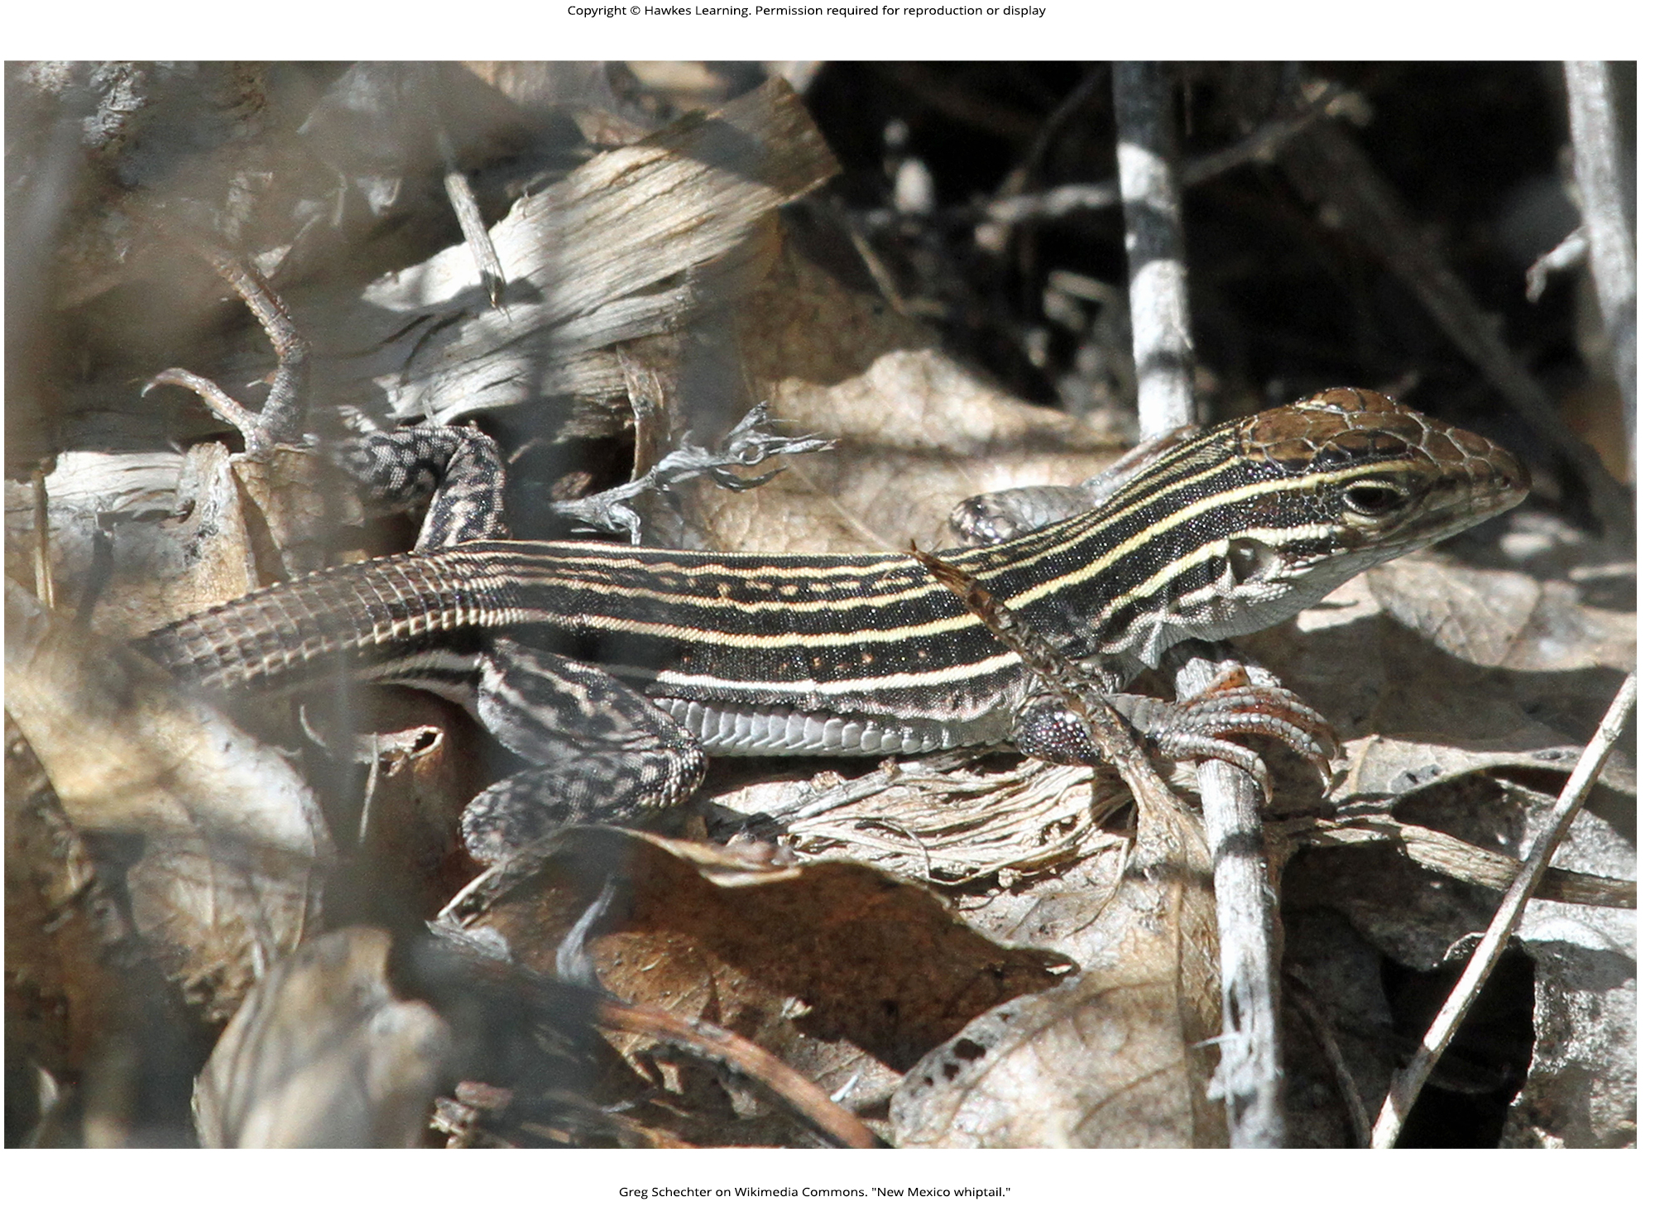
Lesson 17.1 Figure 8

Slide 10
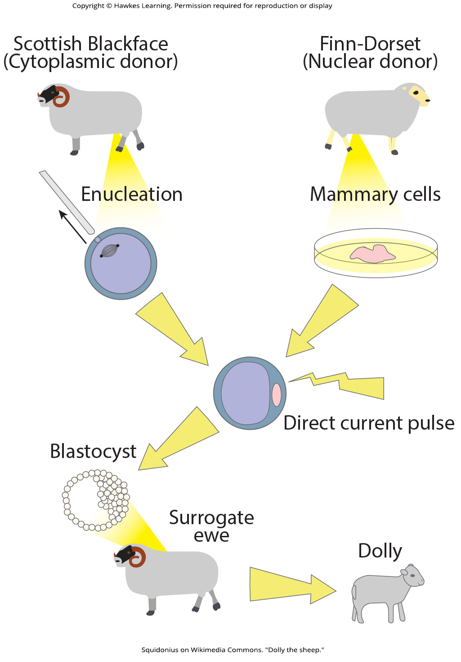
Lesson 17.1 Figure 9

Slide 11
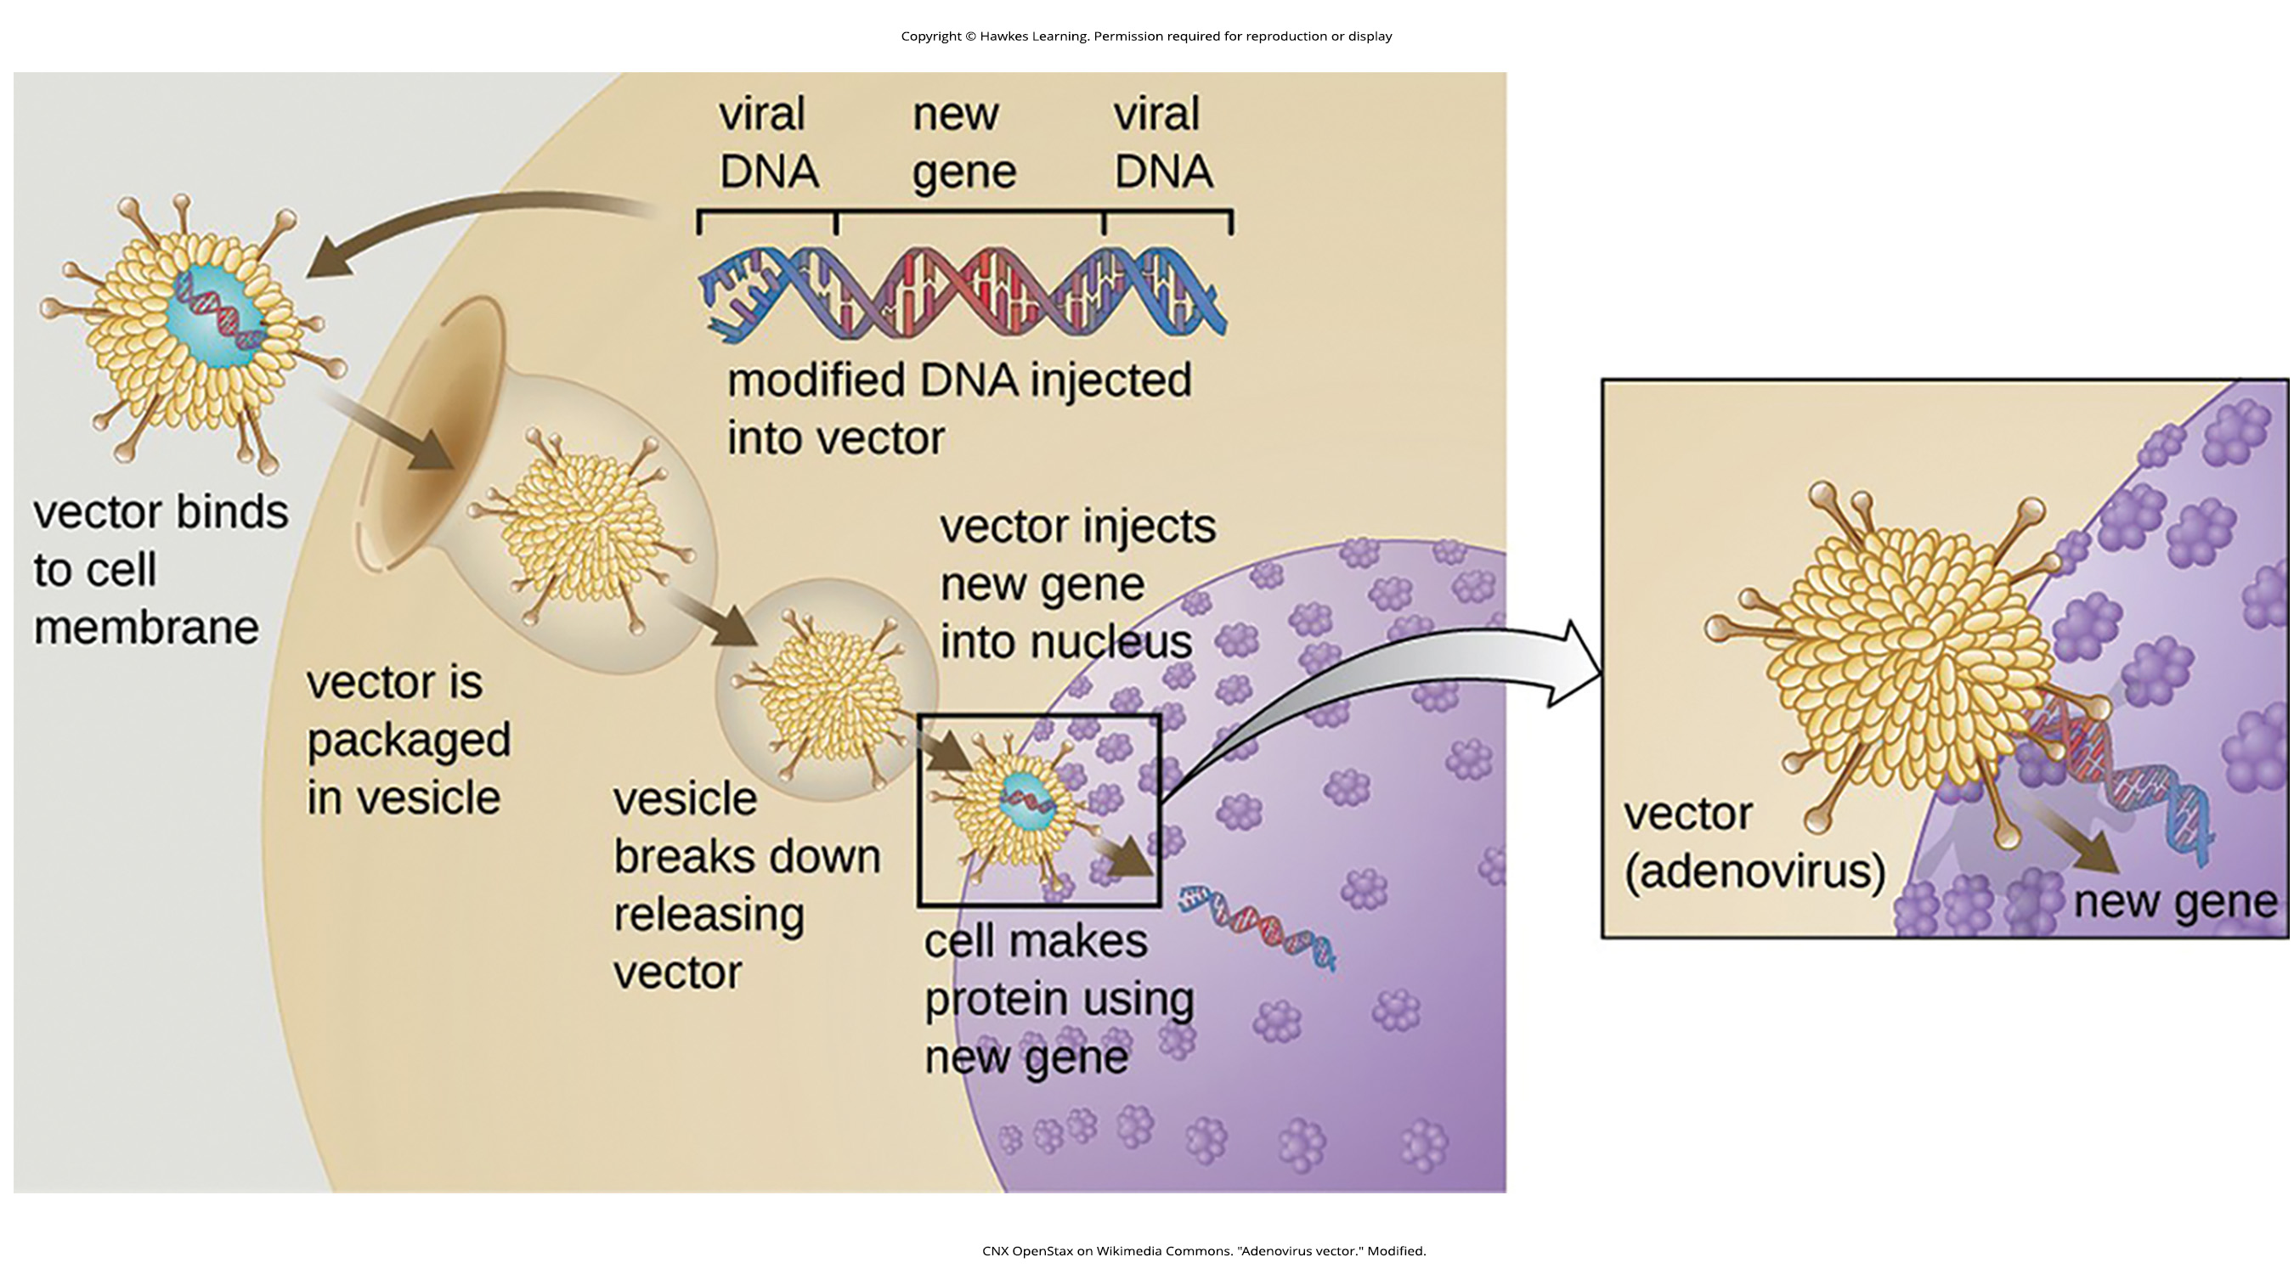
Lesson 17.1 Figure 10

Slide 12
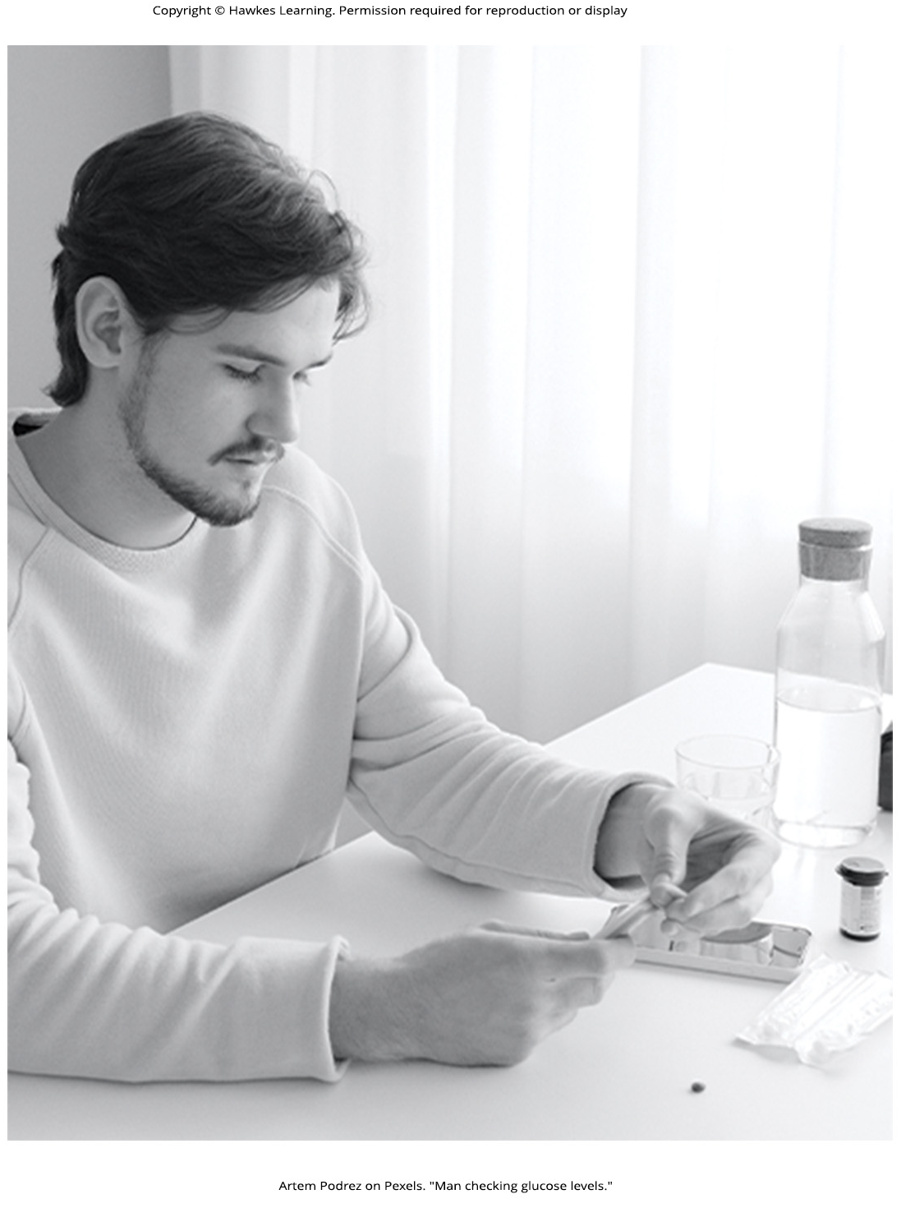
Lesson 17.1 Figure 11

Slide 13
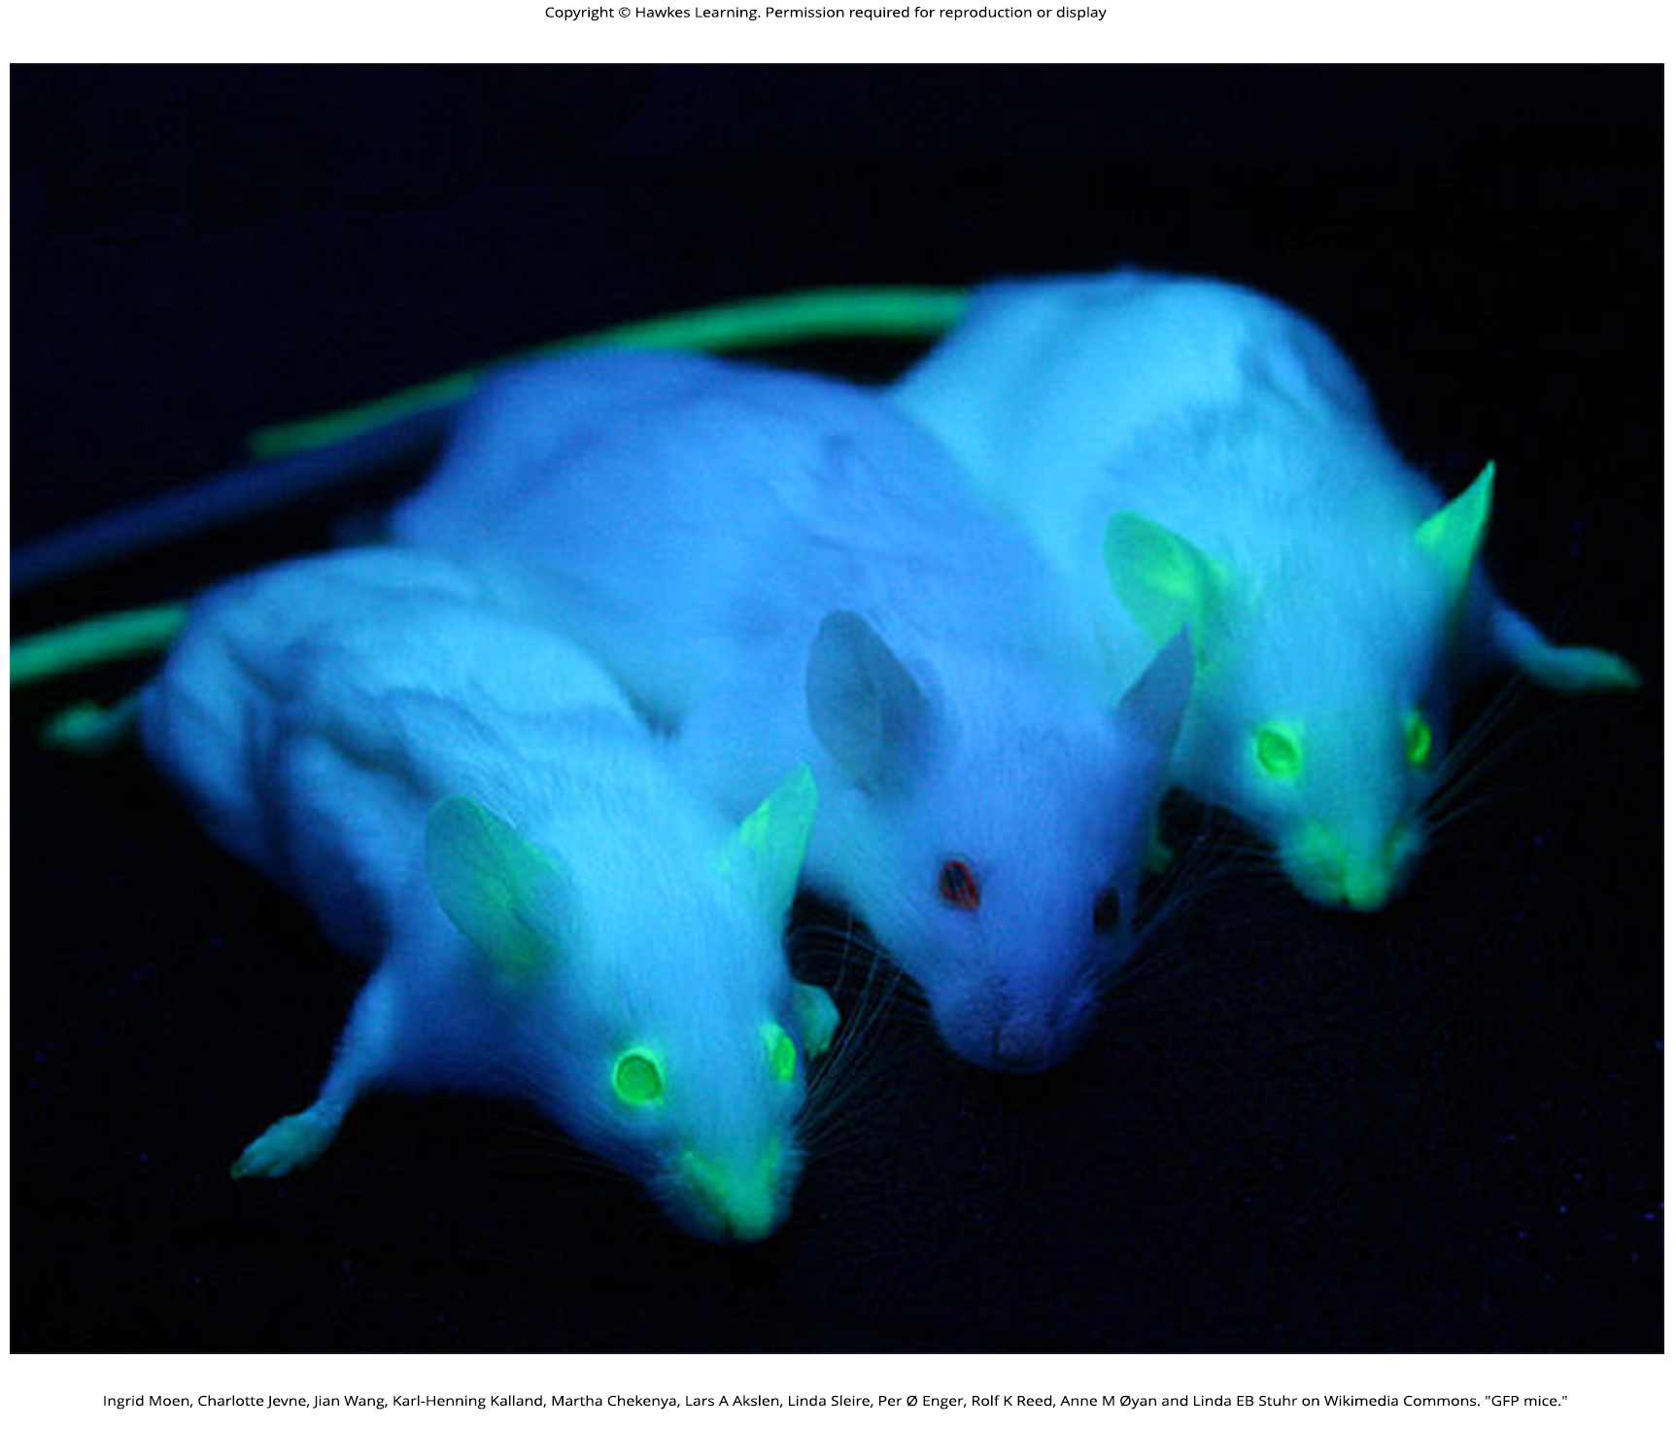
Lesson 17.1 Figure 12

Slide 14
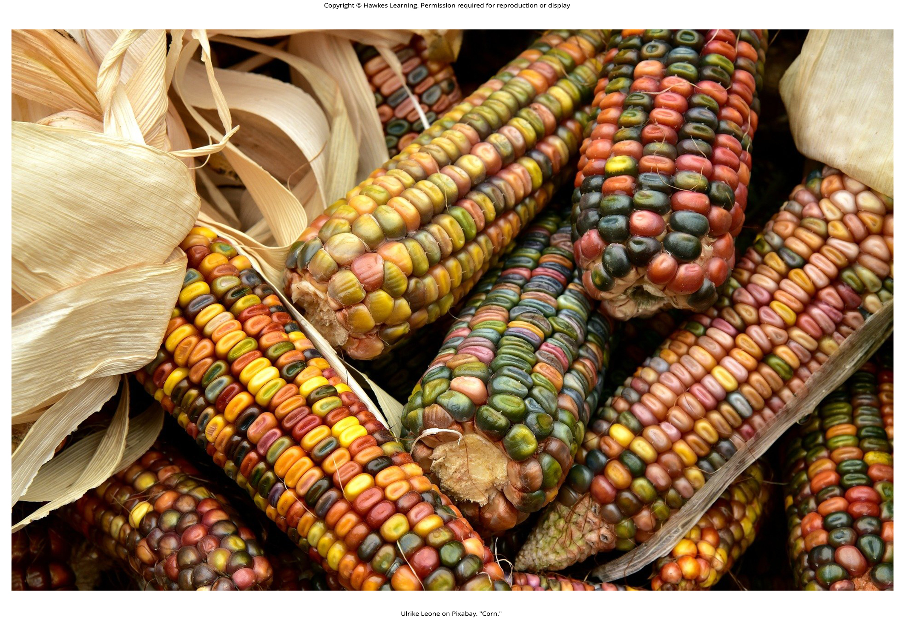
Lesson 17.1 Figure 13

Slide 15
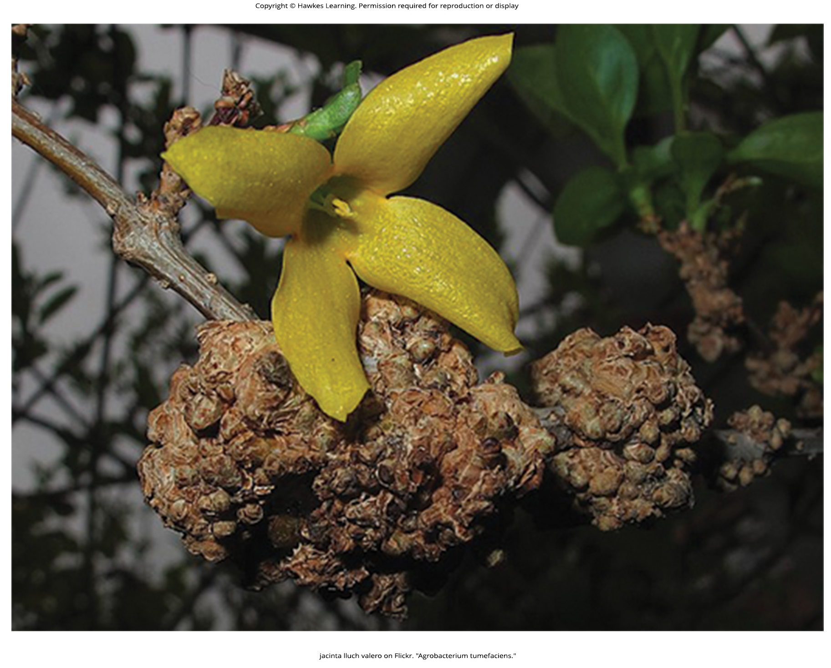
Lesson 17.1 Figure 14

Slide 16

Lesson 17.2 Figure 1

Slide 17
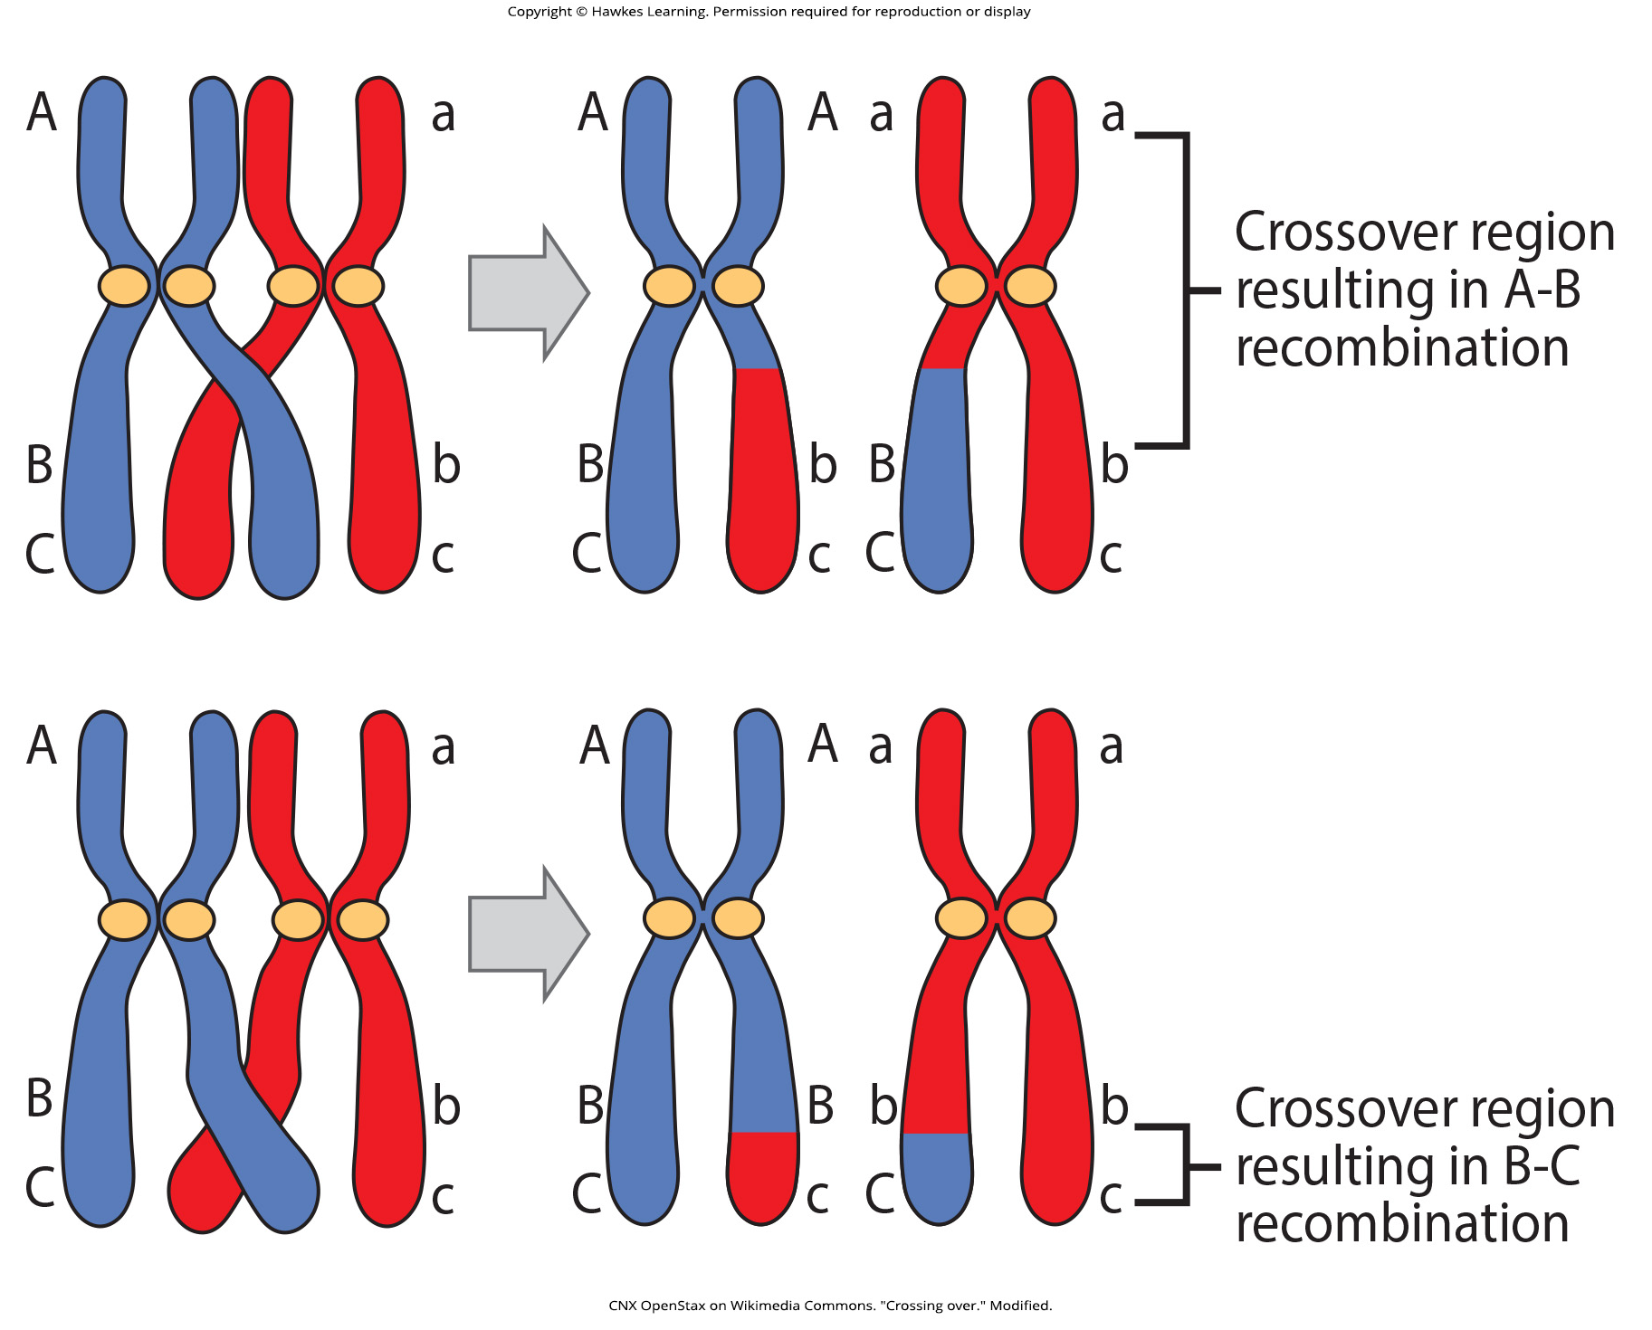
Lesson 17.2 Figure 2

Slide 18
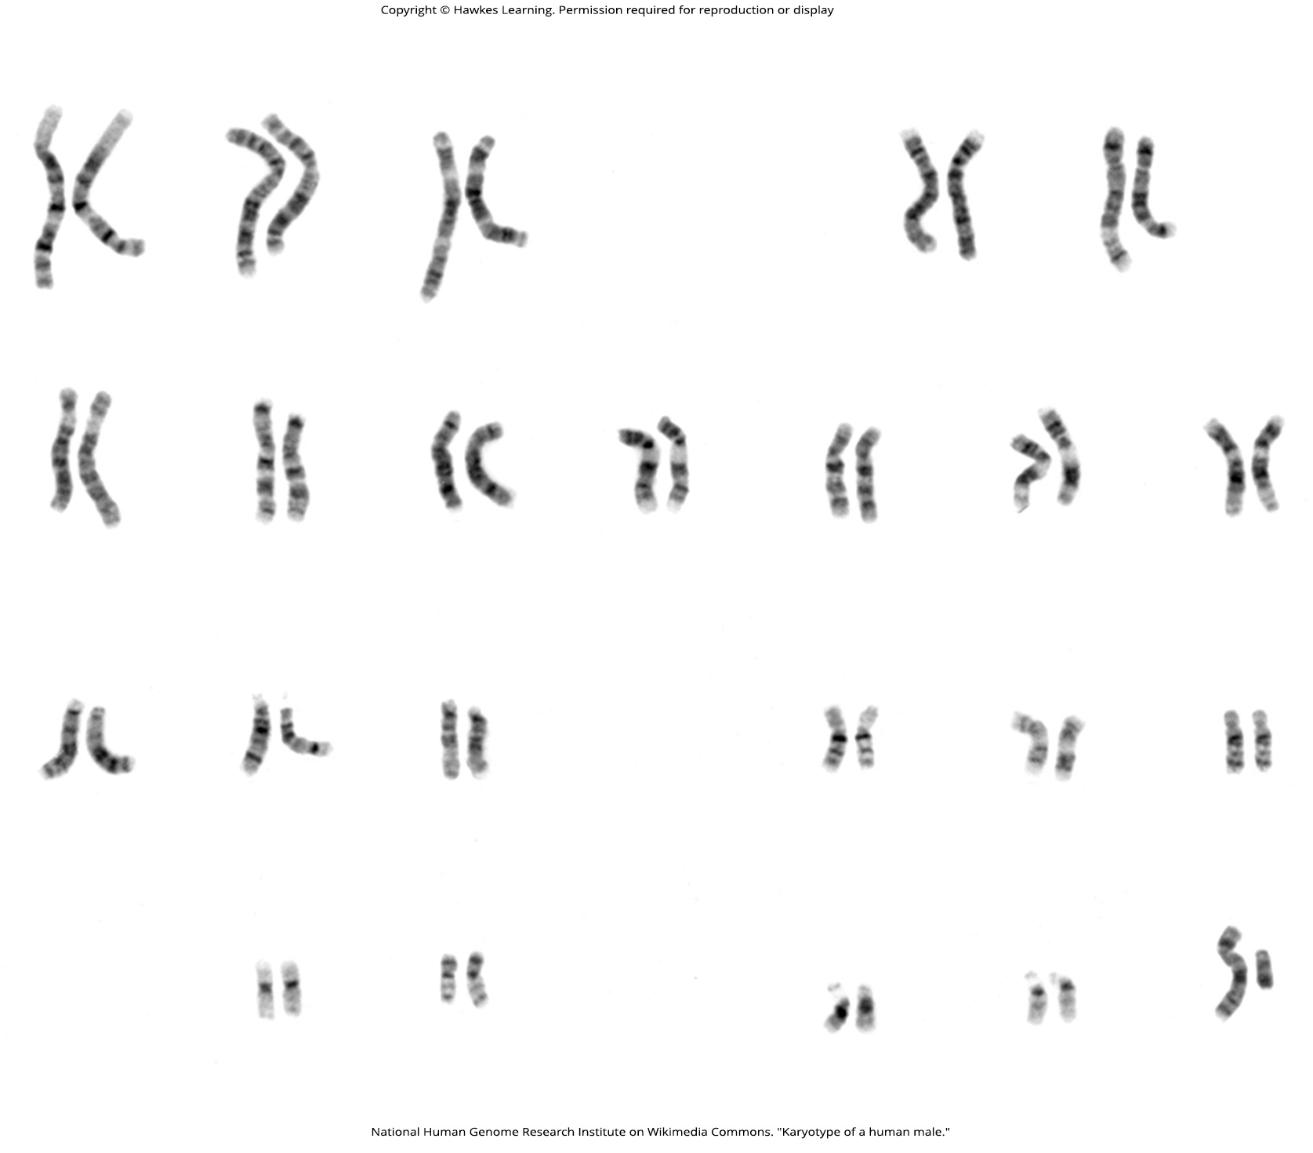
Lesson 17.2 Figure 3

Slide 19
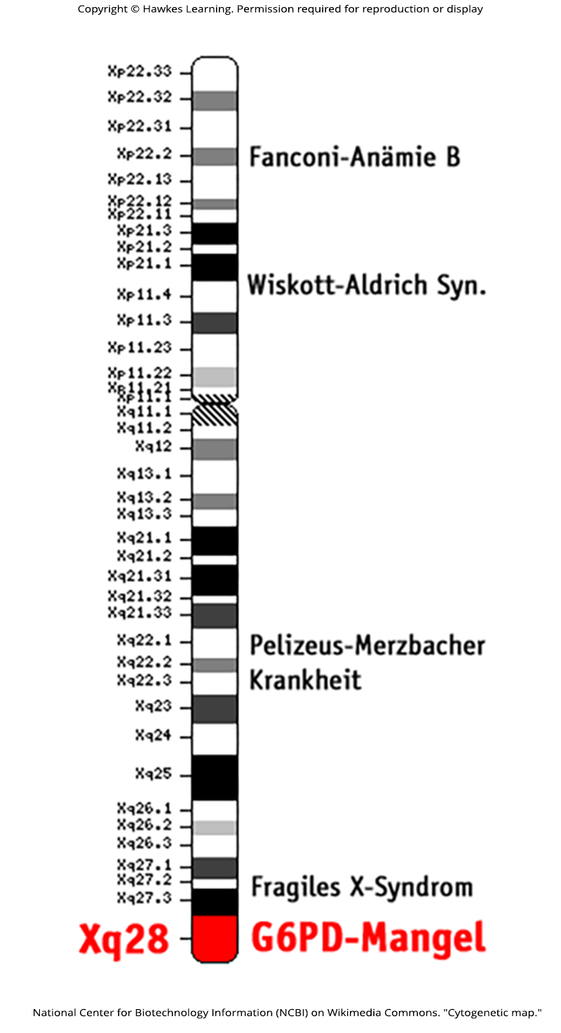
Lesson 17.2 Figure 4

Slide 20
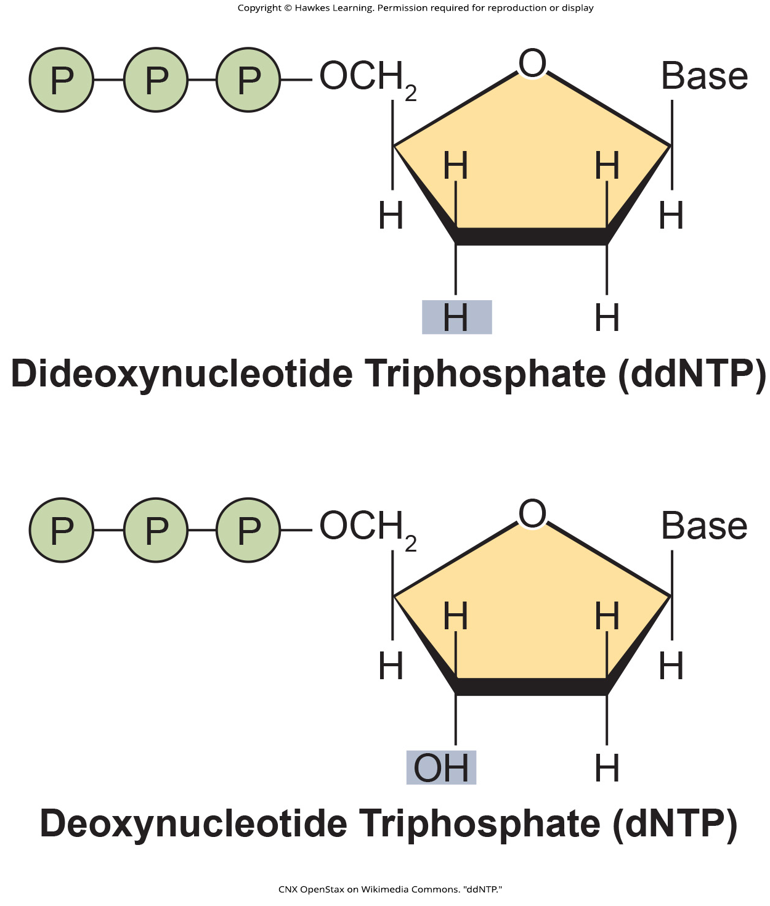
Lesson 17.2 Figure 5

Slide 21
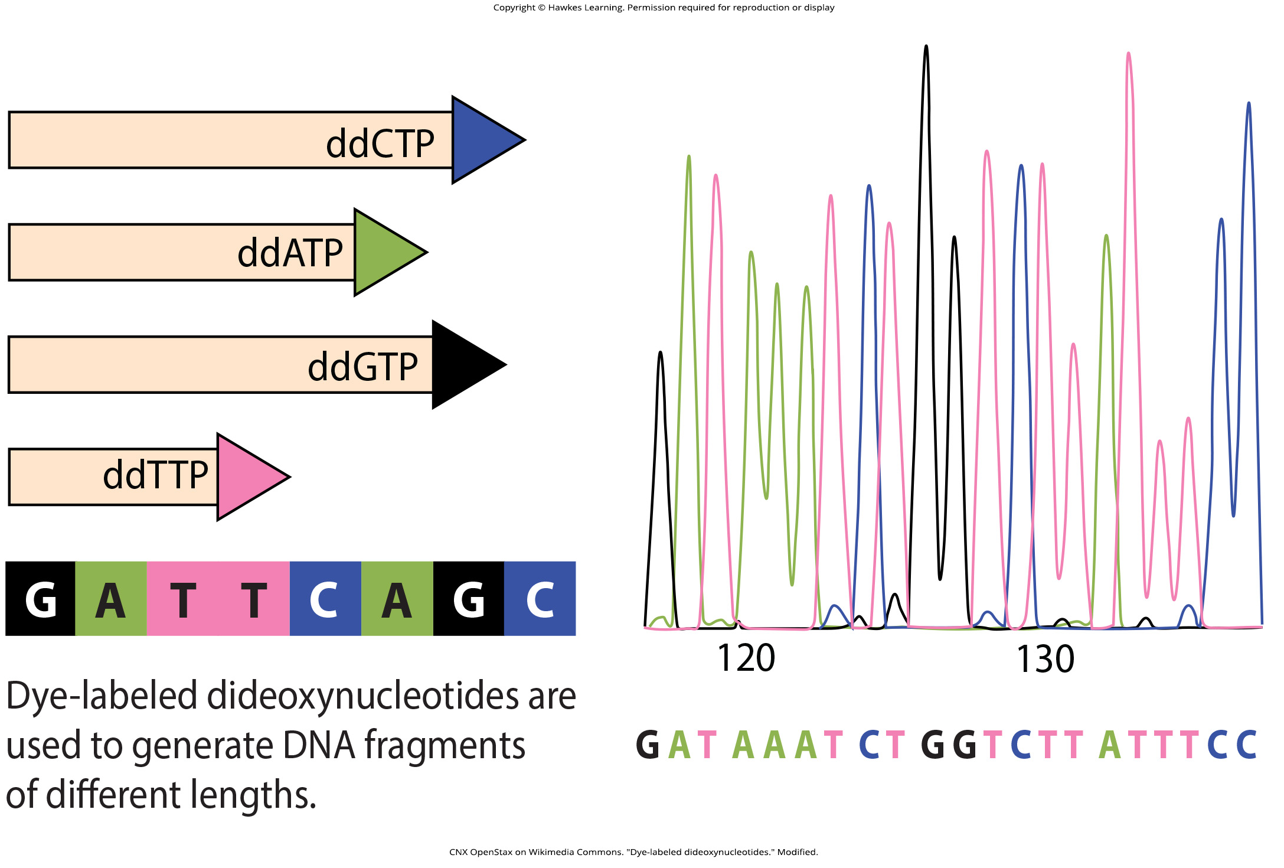
Lesson 17.2 Figure 6

Slide 22
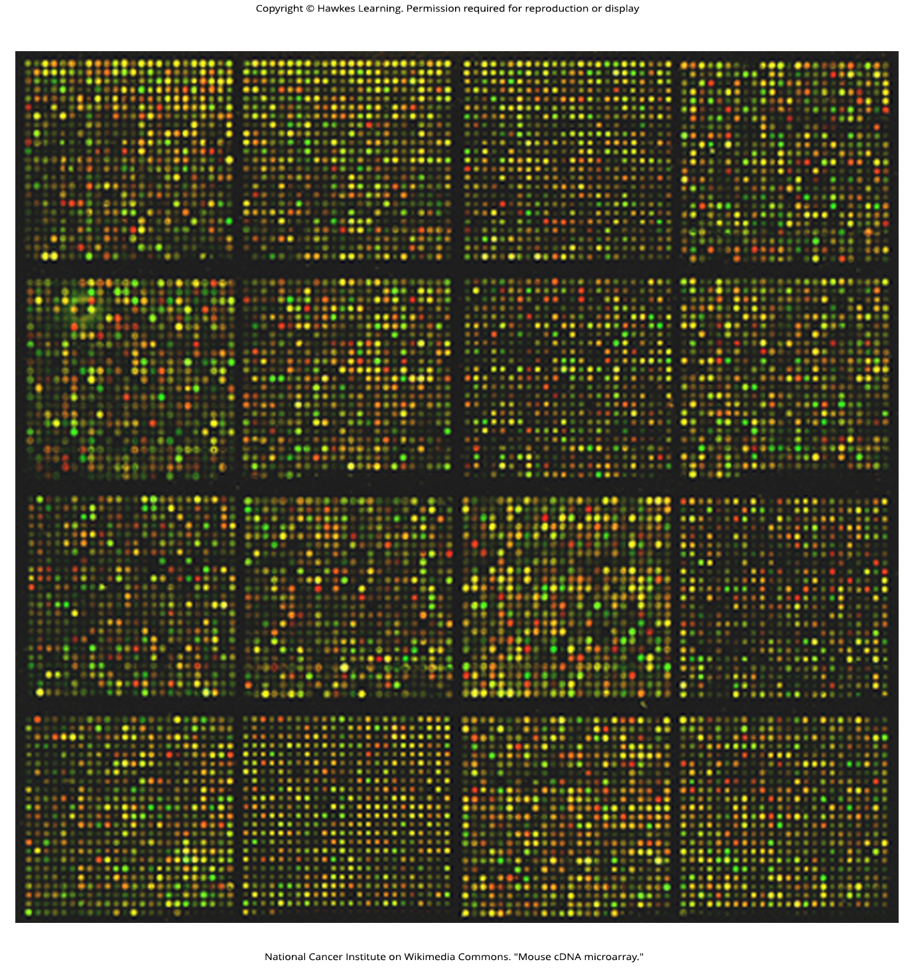
Lesson 17.2 Figure 7

Slide 23
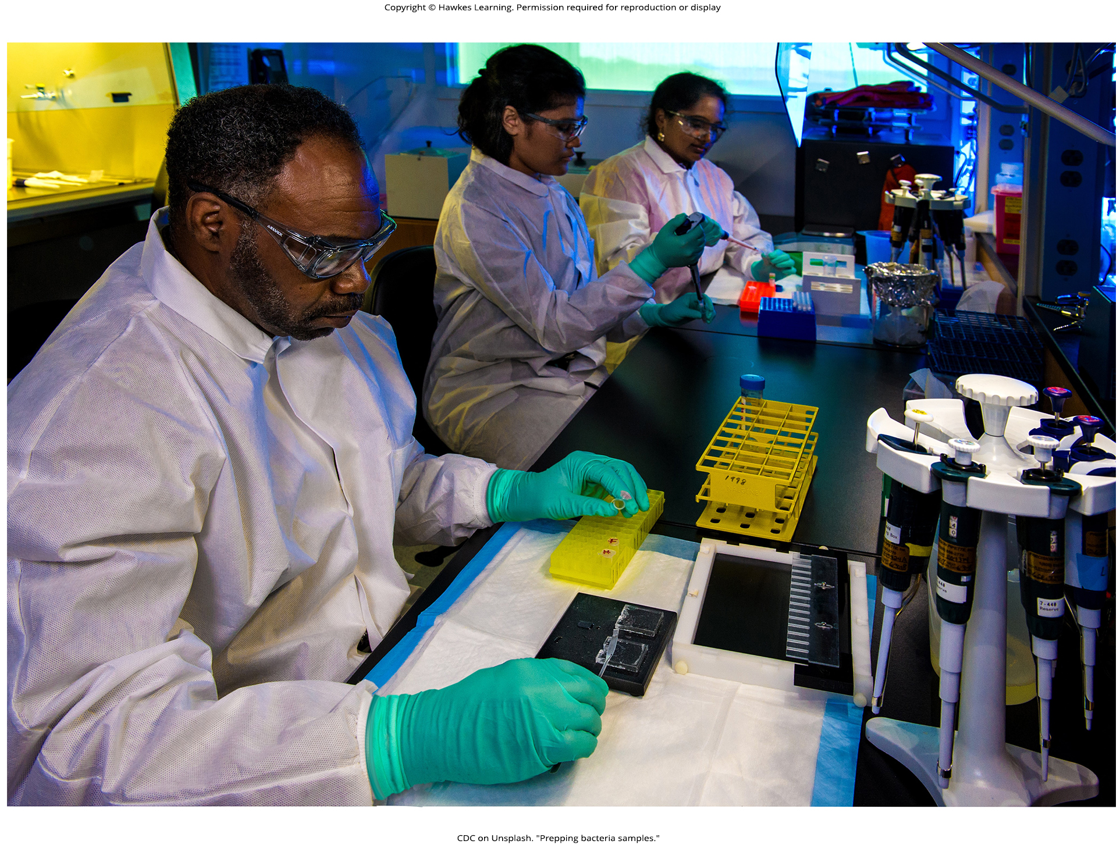
Lesson 17.3 Figure 1

Slide 24
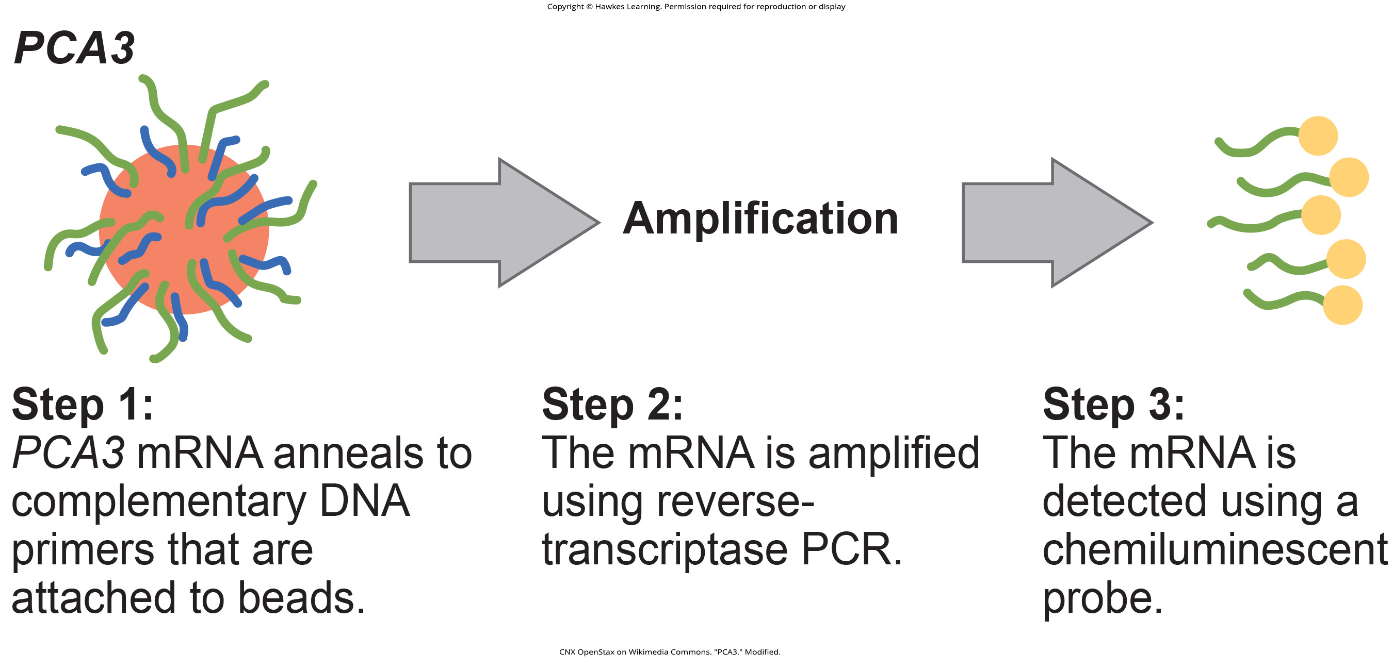
Lesson 17.3 Figure 2

Slide 25
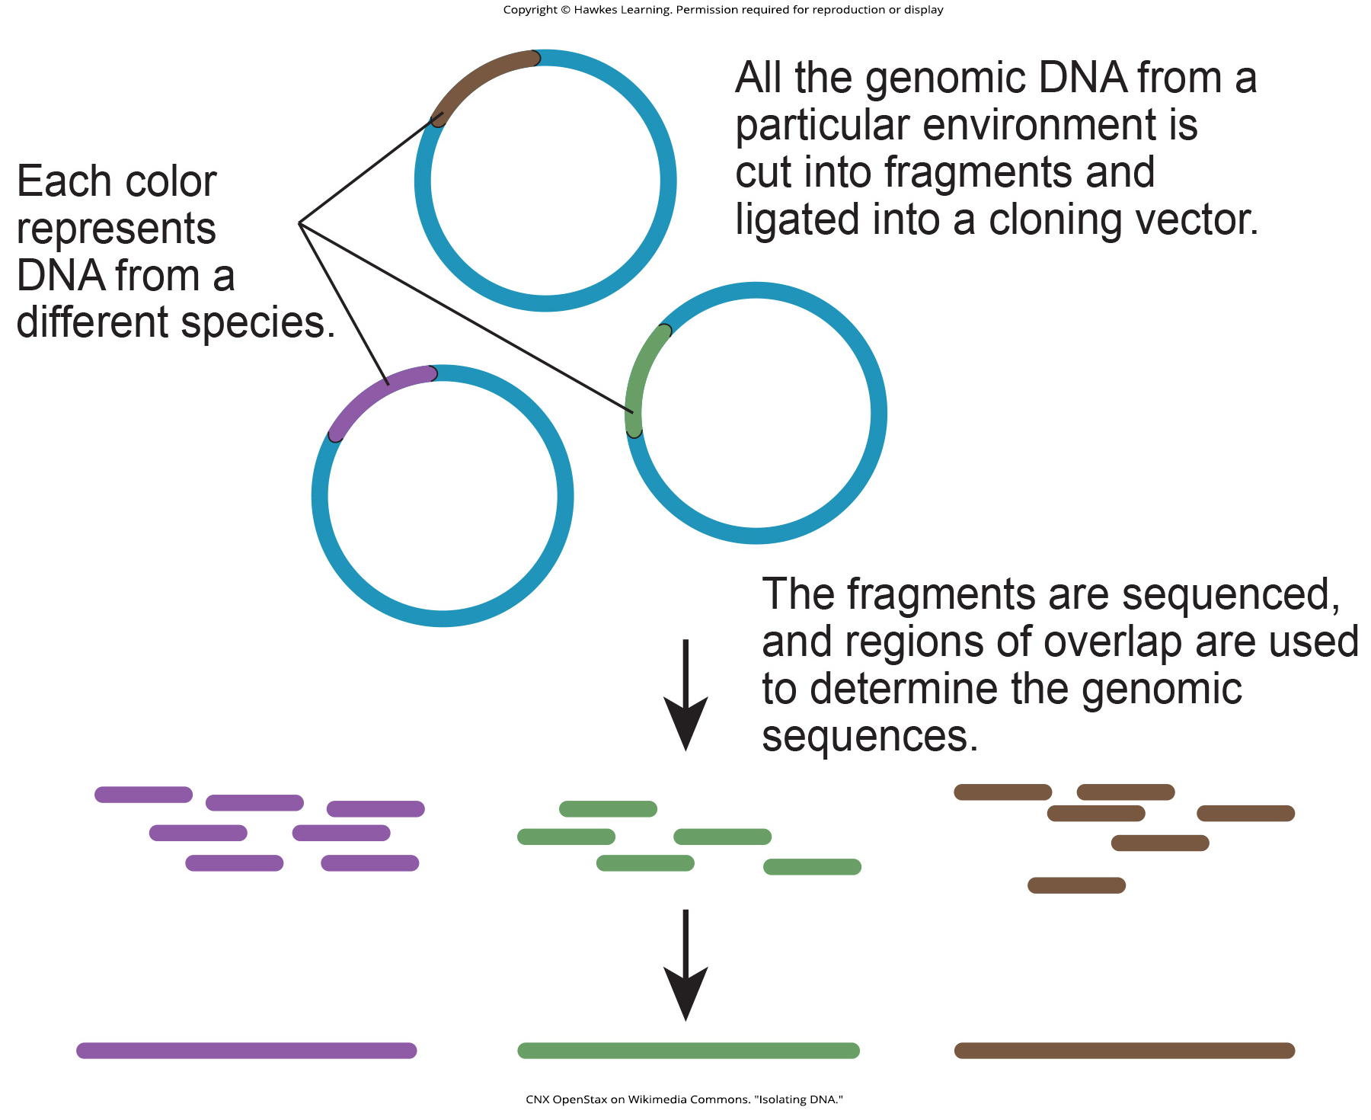
Lesson 17.3 Figure 3

Slide 26
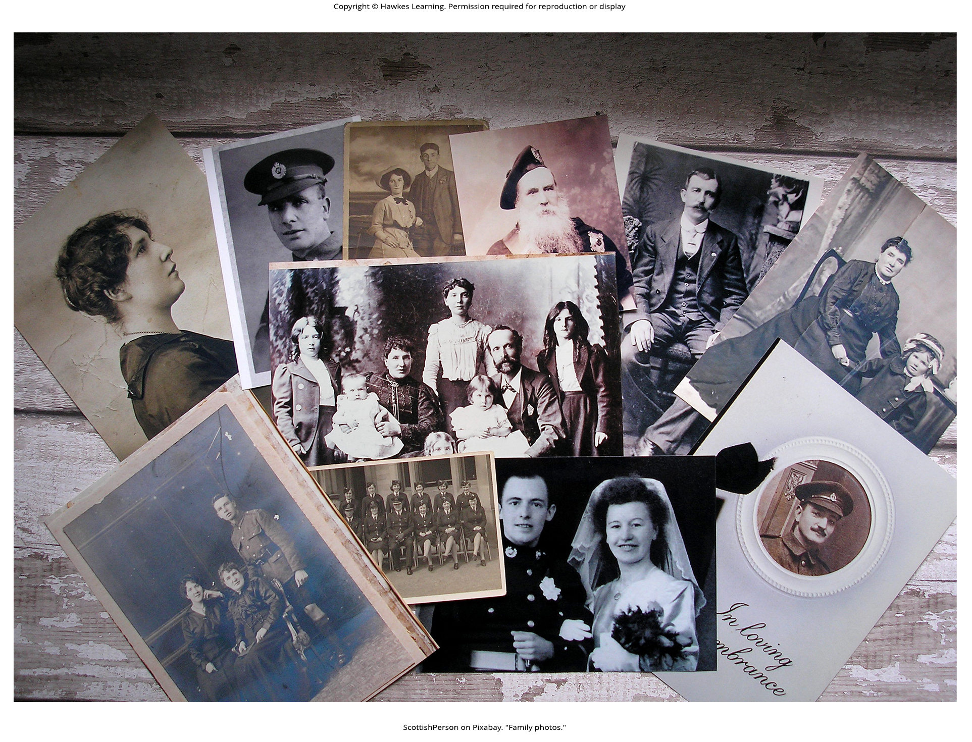
Lesson 17.3 Figure 4

Slide 27
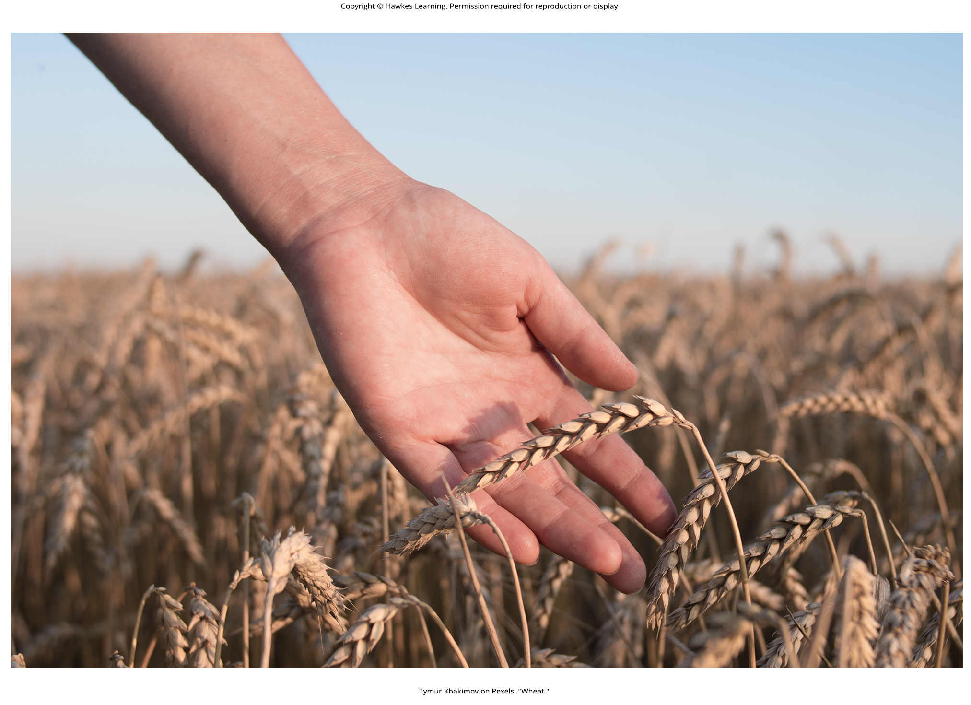
Lesson 17.3 Figure 5

Slide 28
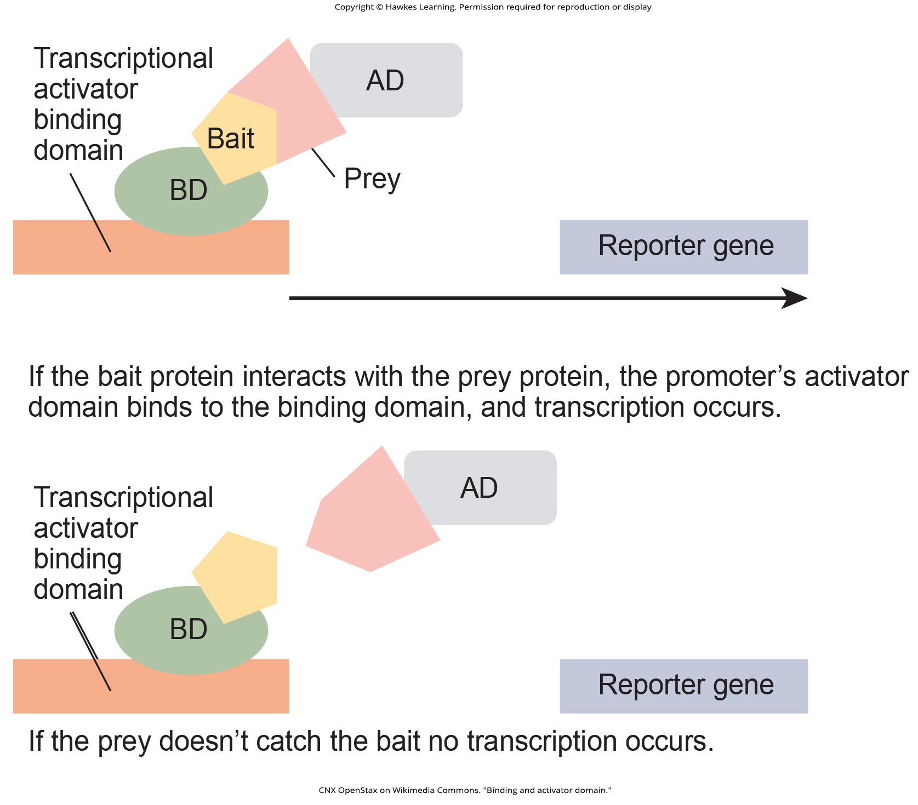
Lesson 17.3 Figure 6

Slide 29
Hawkes Learning – End of PowerPoint

