Slide 1
Chapter 18
Evolution and the Origin of the Species

Slide 2
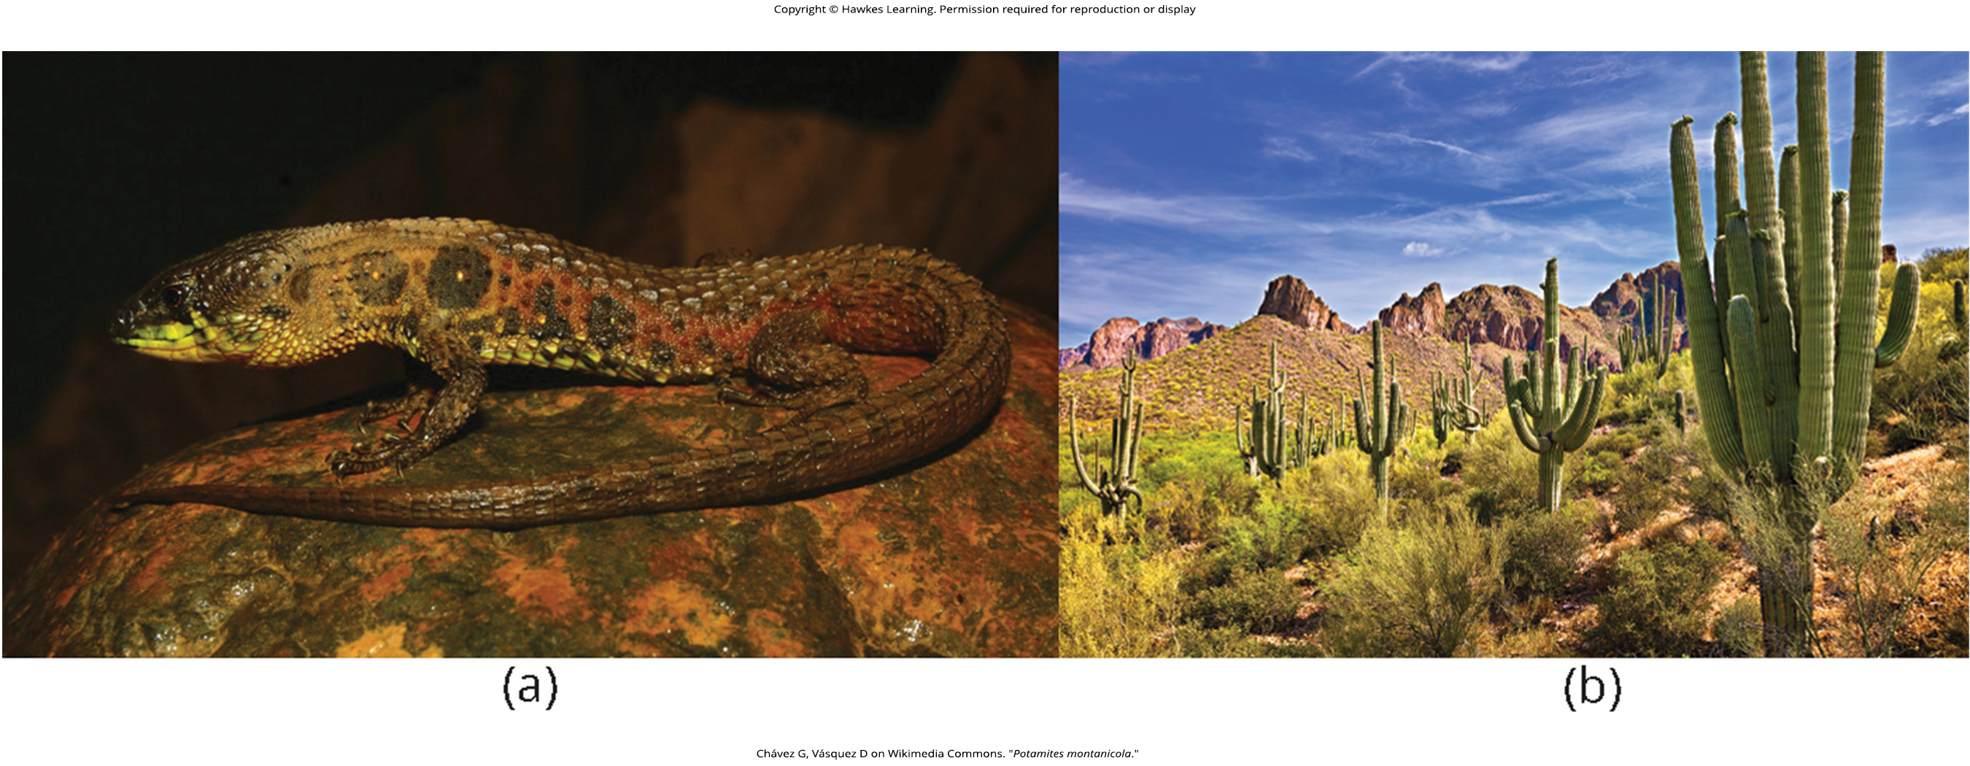
Lesson 18.1 Figure 1

Slide 3
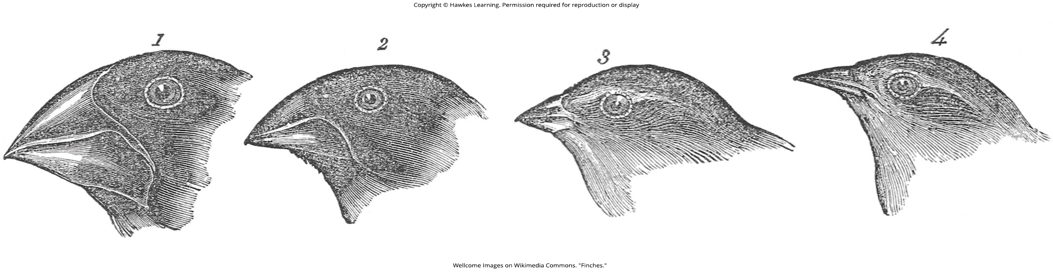
Lesson 18.1 Figure 2

Slide 4
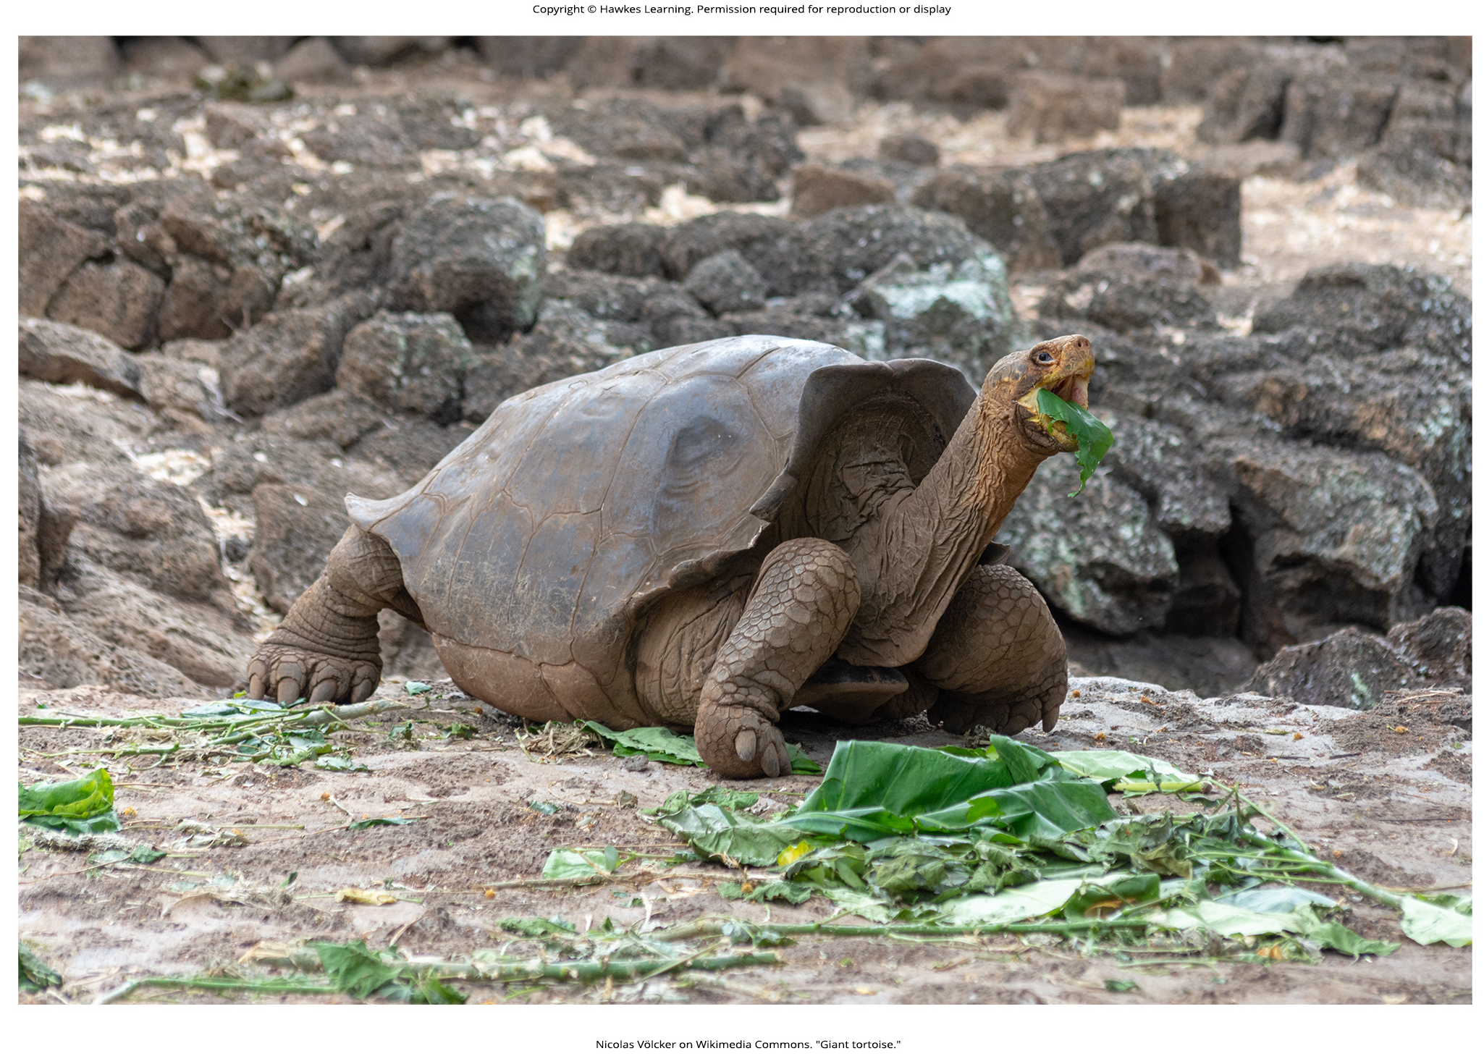
Lesson 18.1 Figure 3

Slide 5
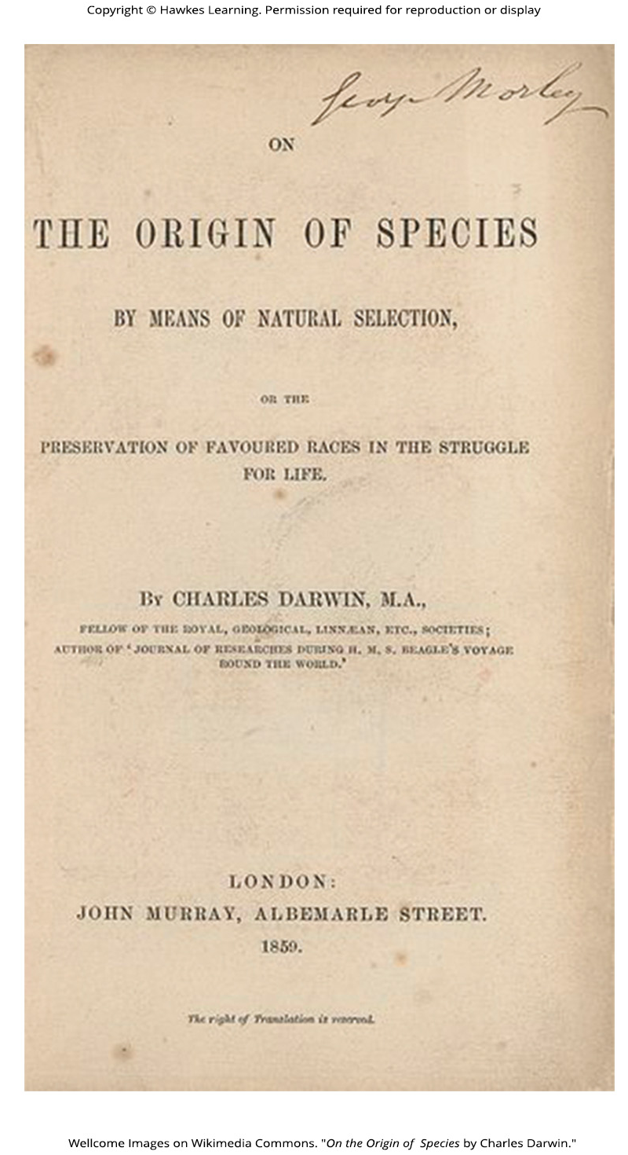
Lesson 18.1 Figure 4

Slide 6
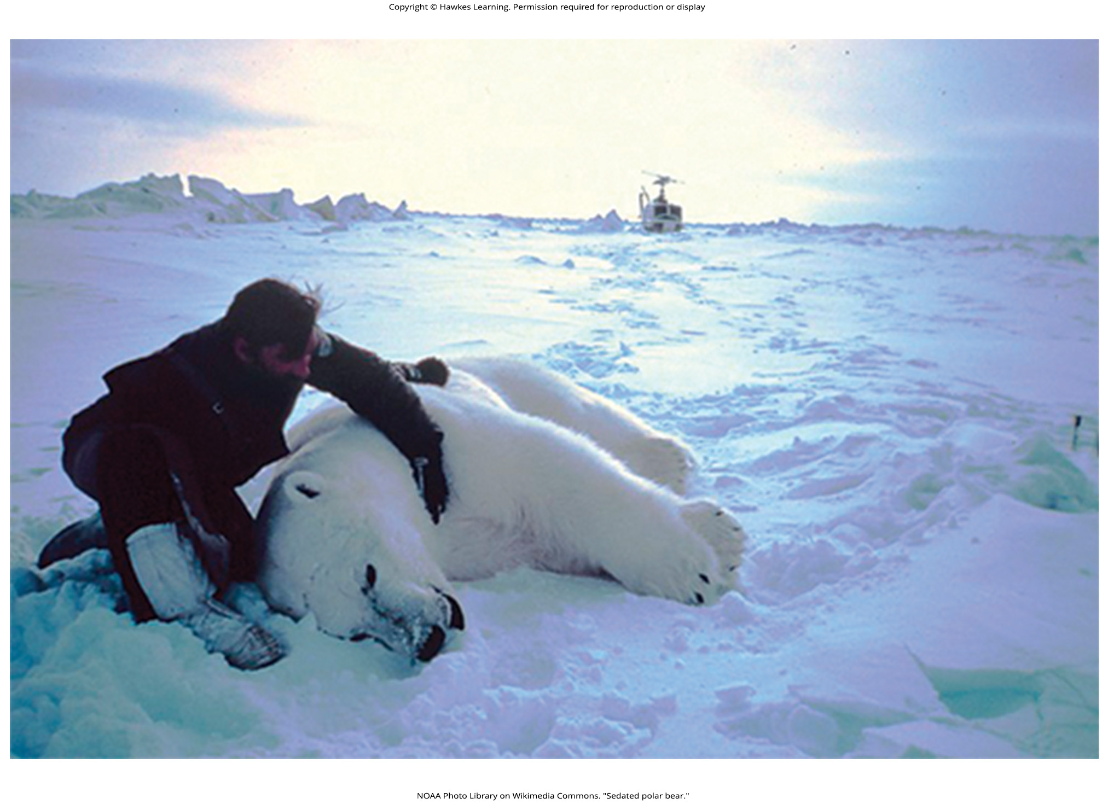
Lesson 18.1 Figure 5

Slide 7
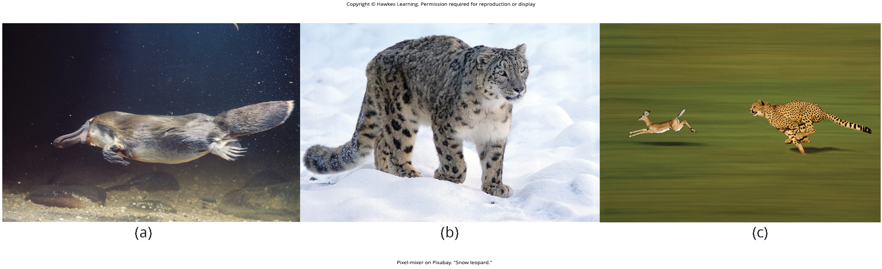
Lesson 18.1 Figure 6

Slide 8
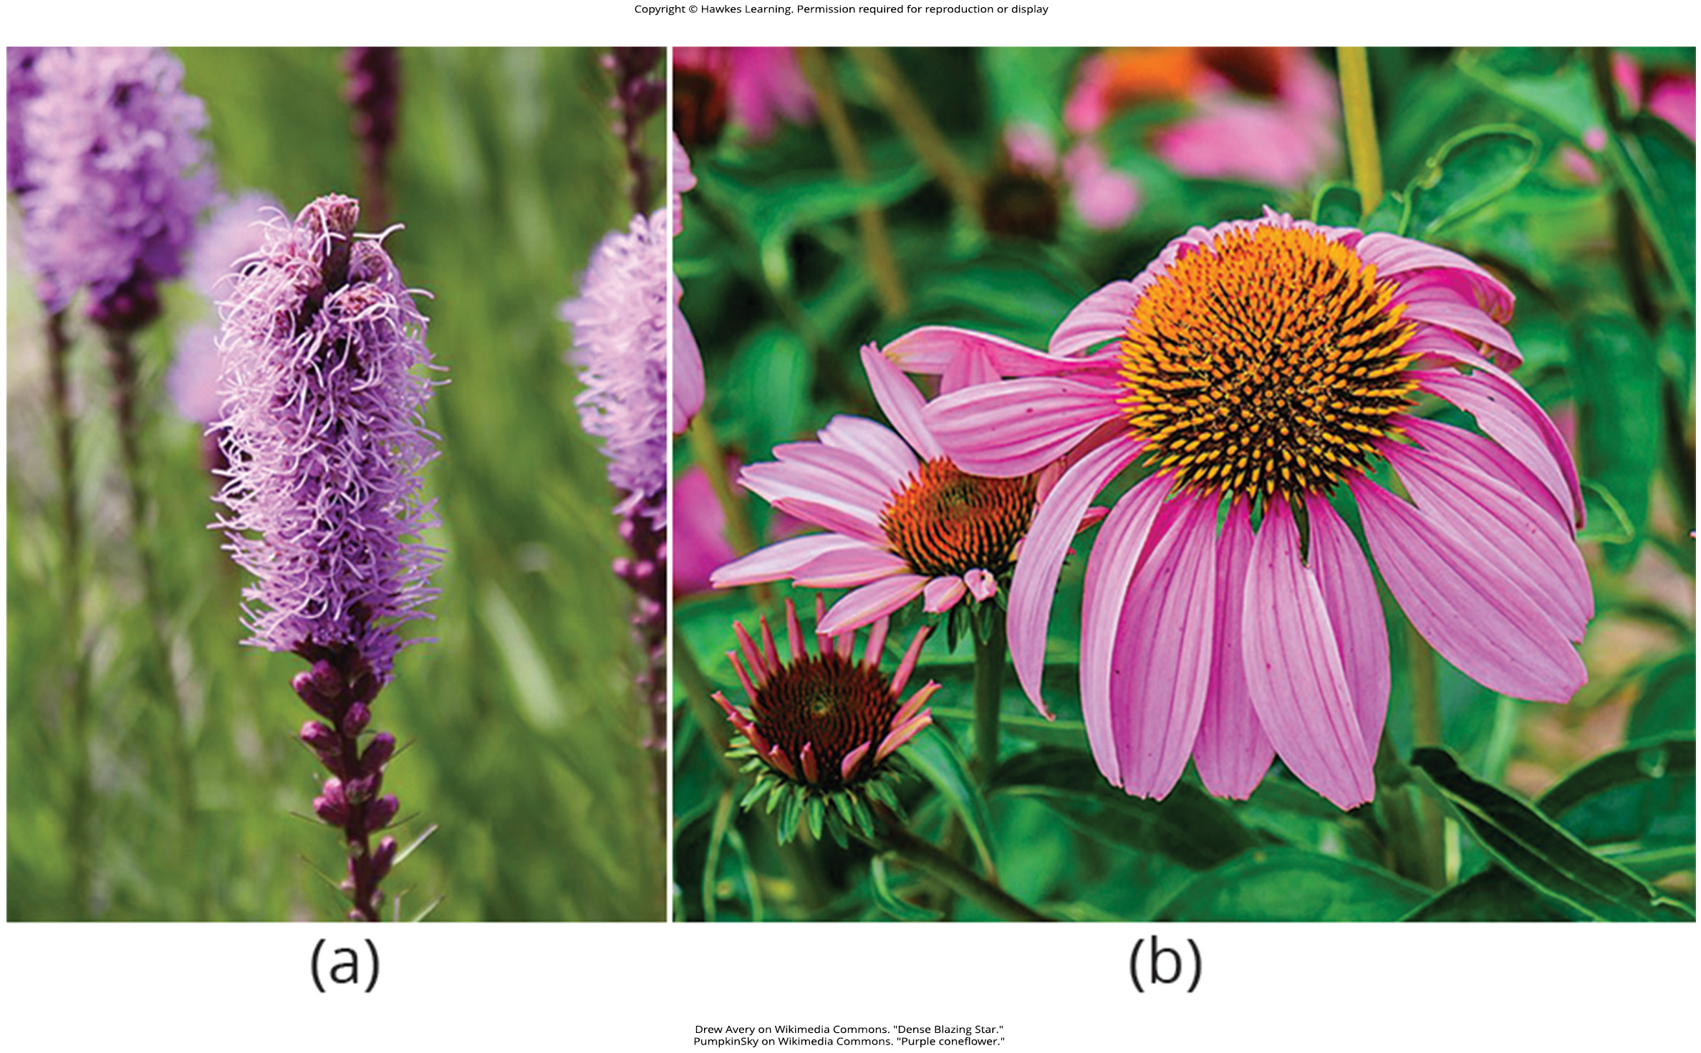
Lesson 18.1 Figure 7

Slide 9
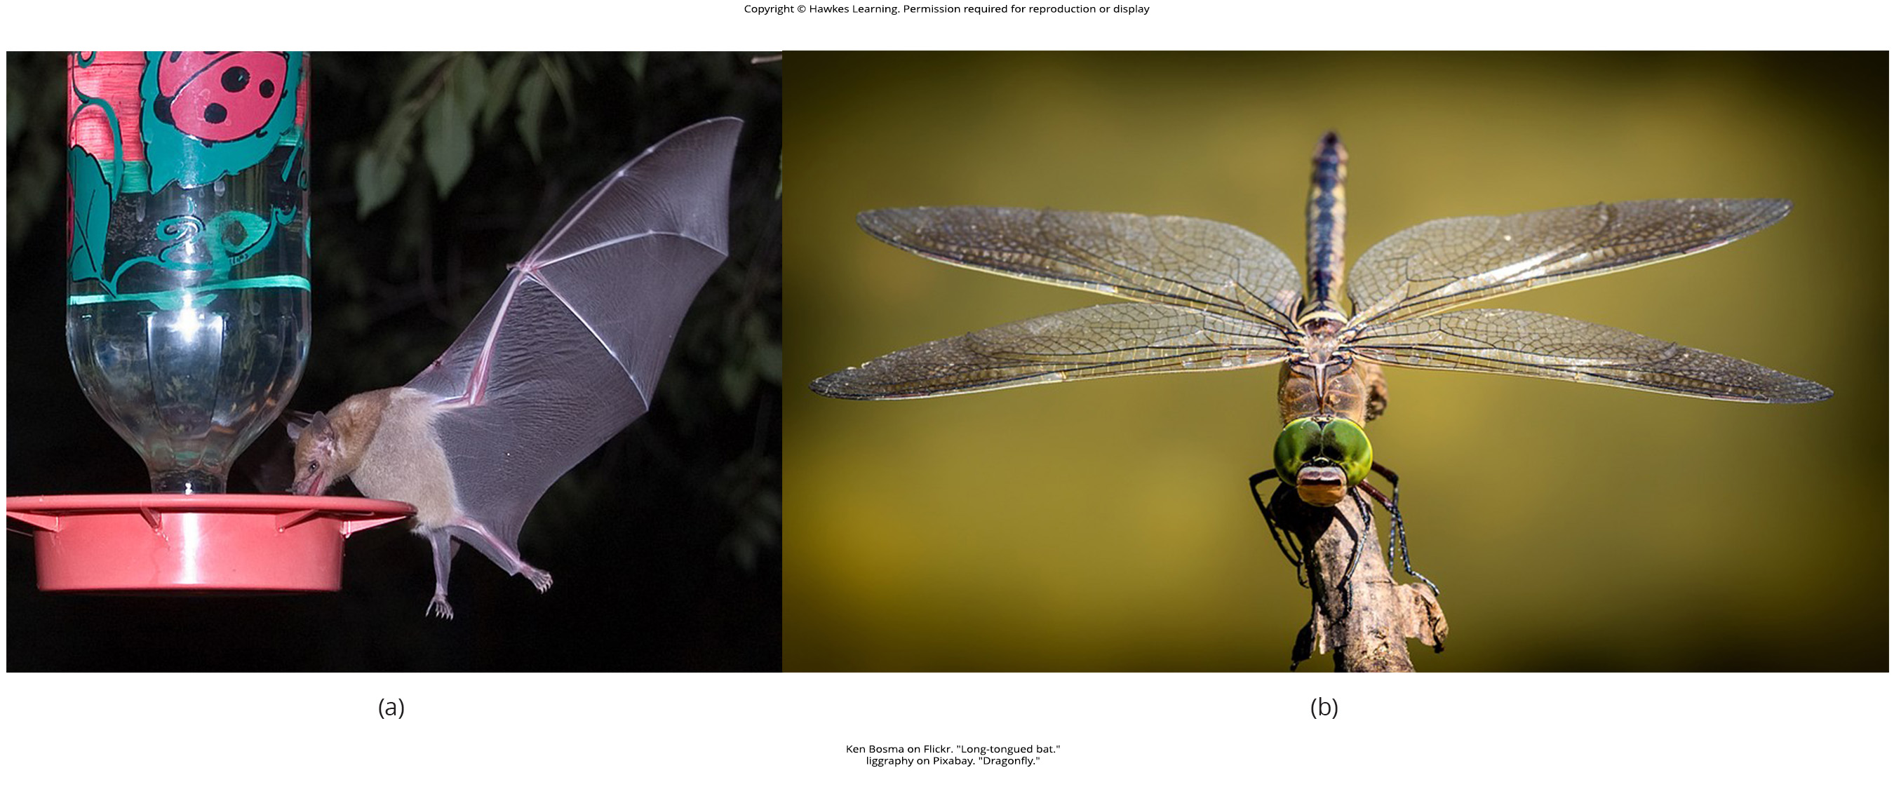
Lesson 18.1 Figure 8

Slide 10
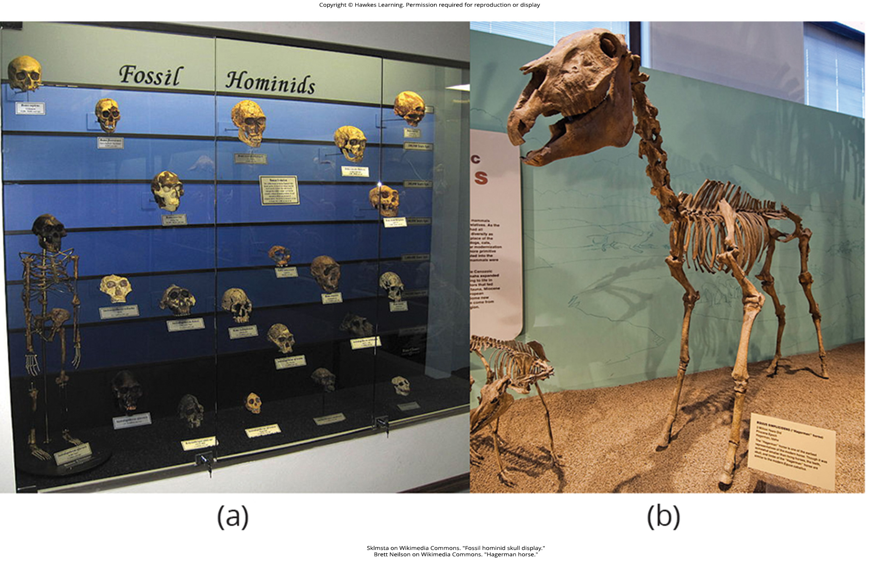
Lesson 18.1 Figure 9

Slide 11
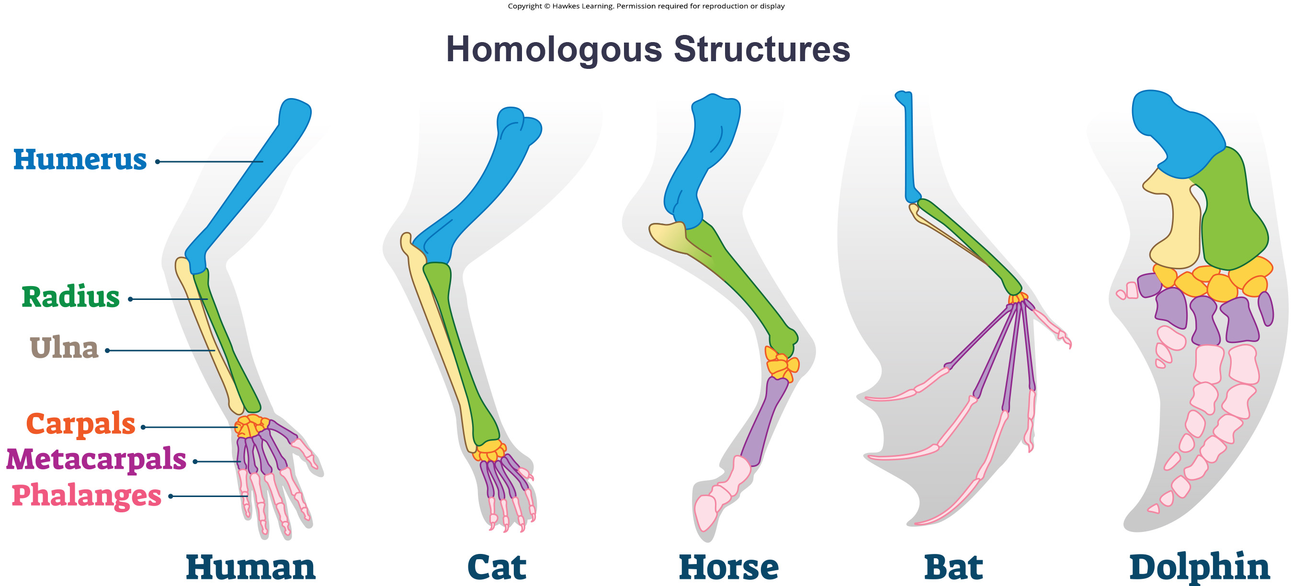
Lesson 18.1 Figure 10

Slide 12
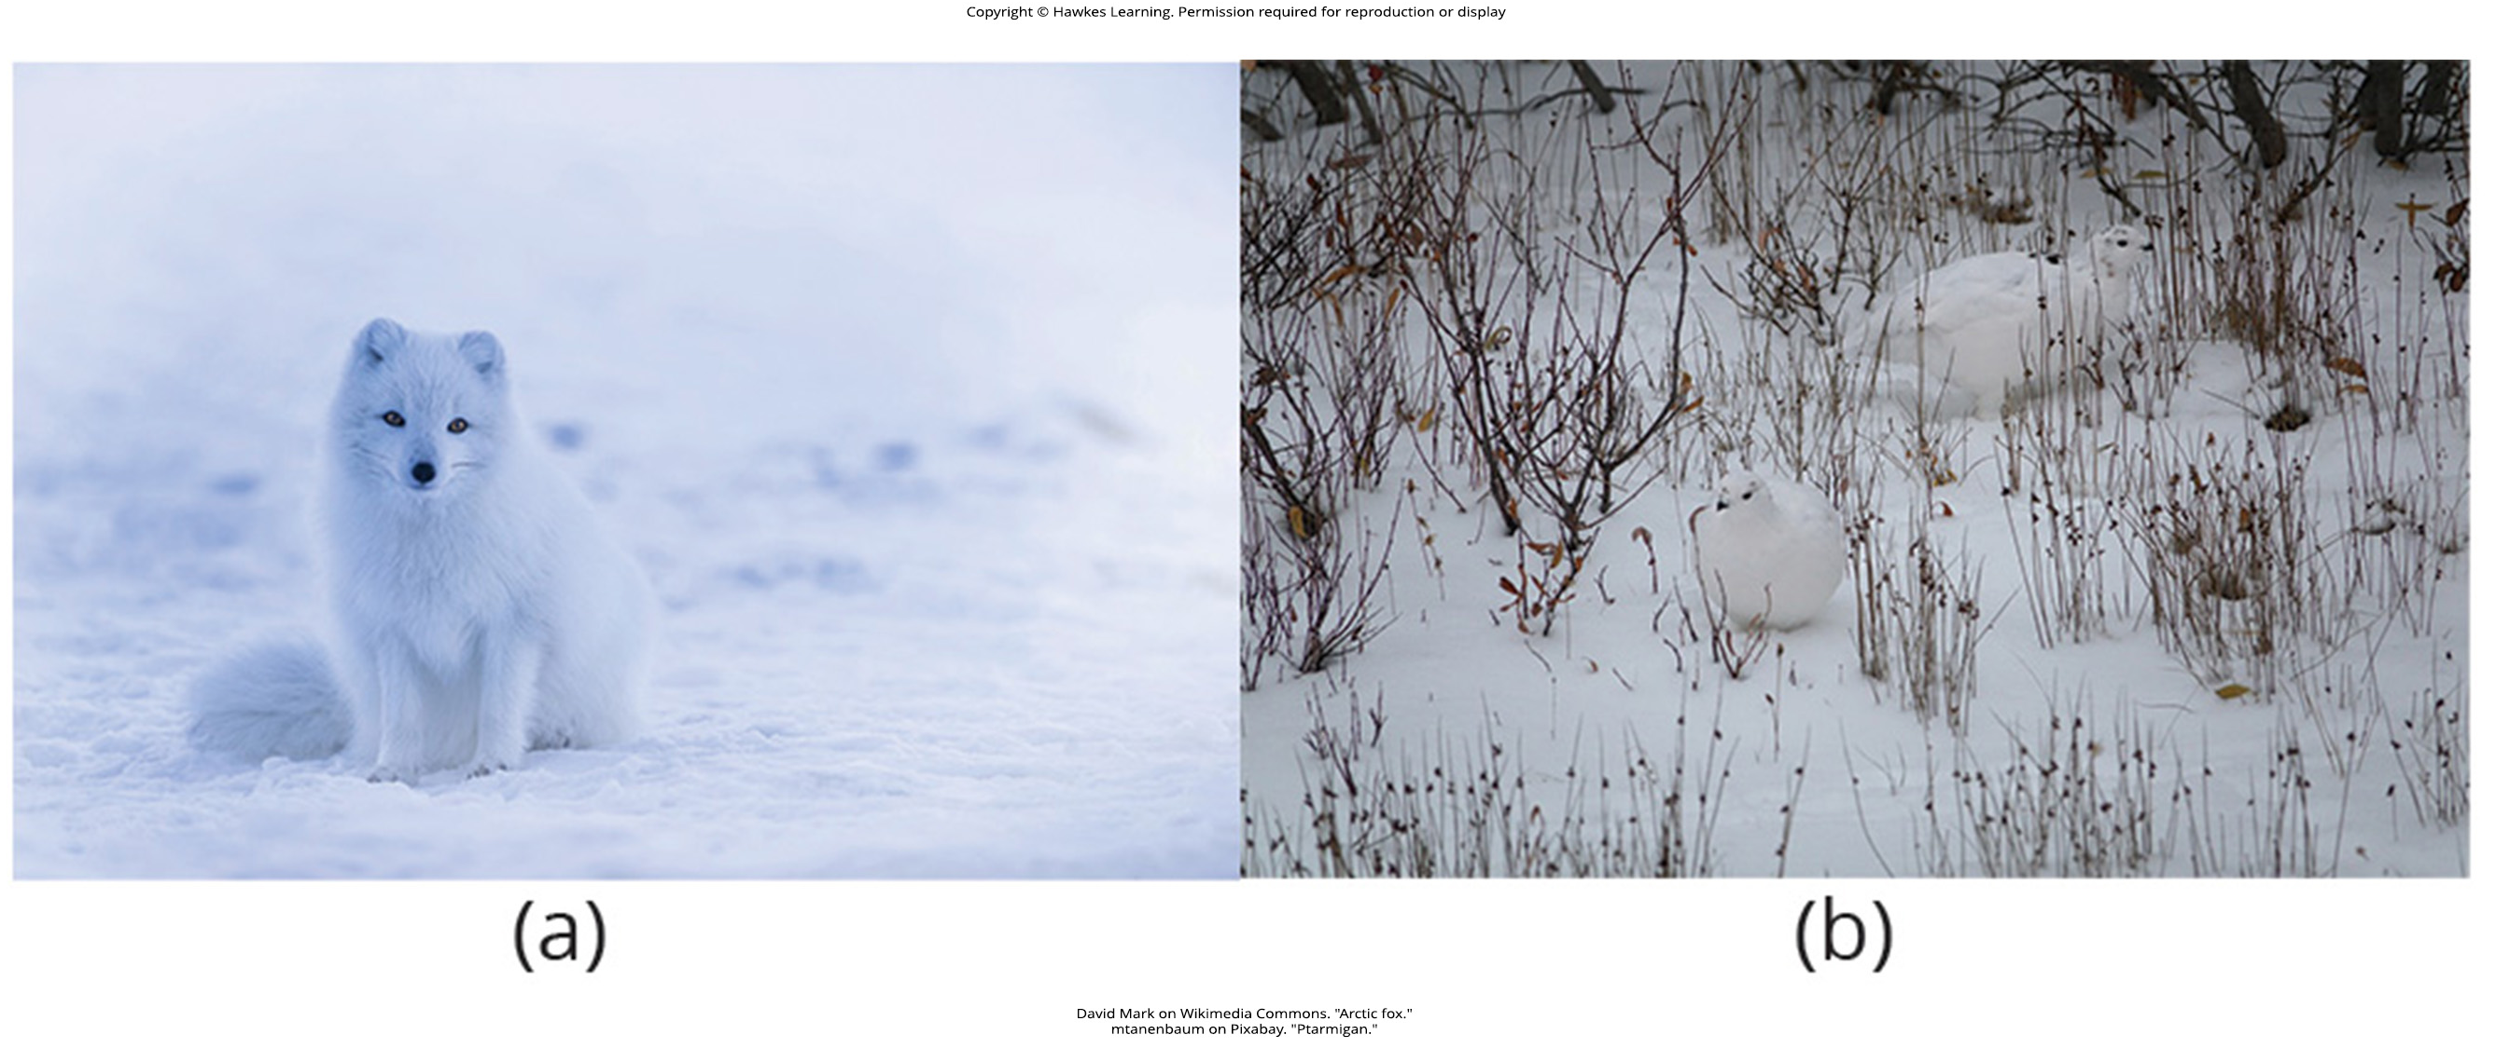
Lesson 18.1 Figure 11

Slide 13
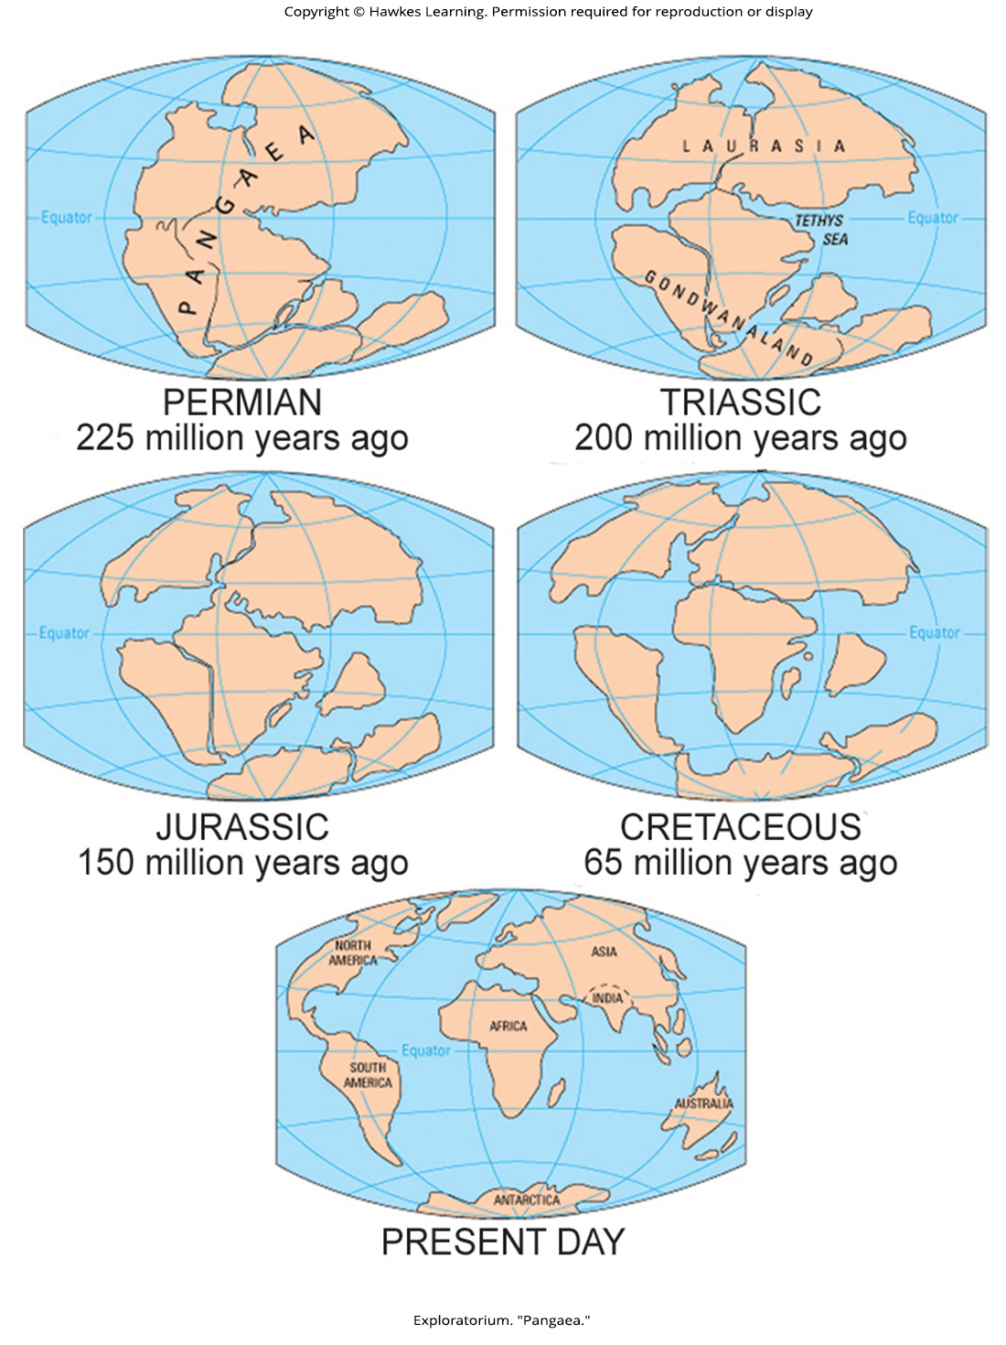
Lesson 18.1 Figure 12

Slide 14
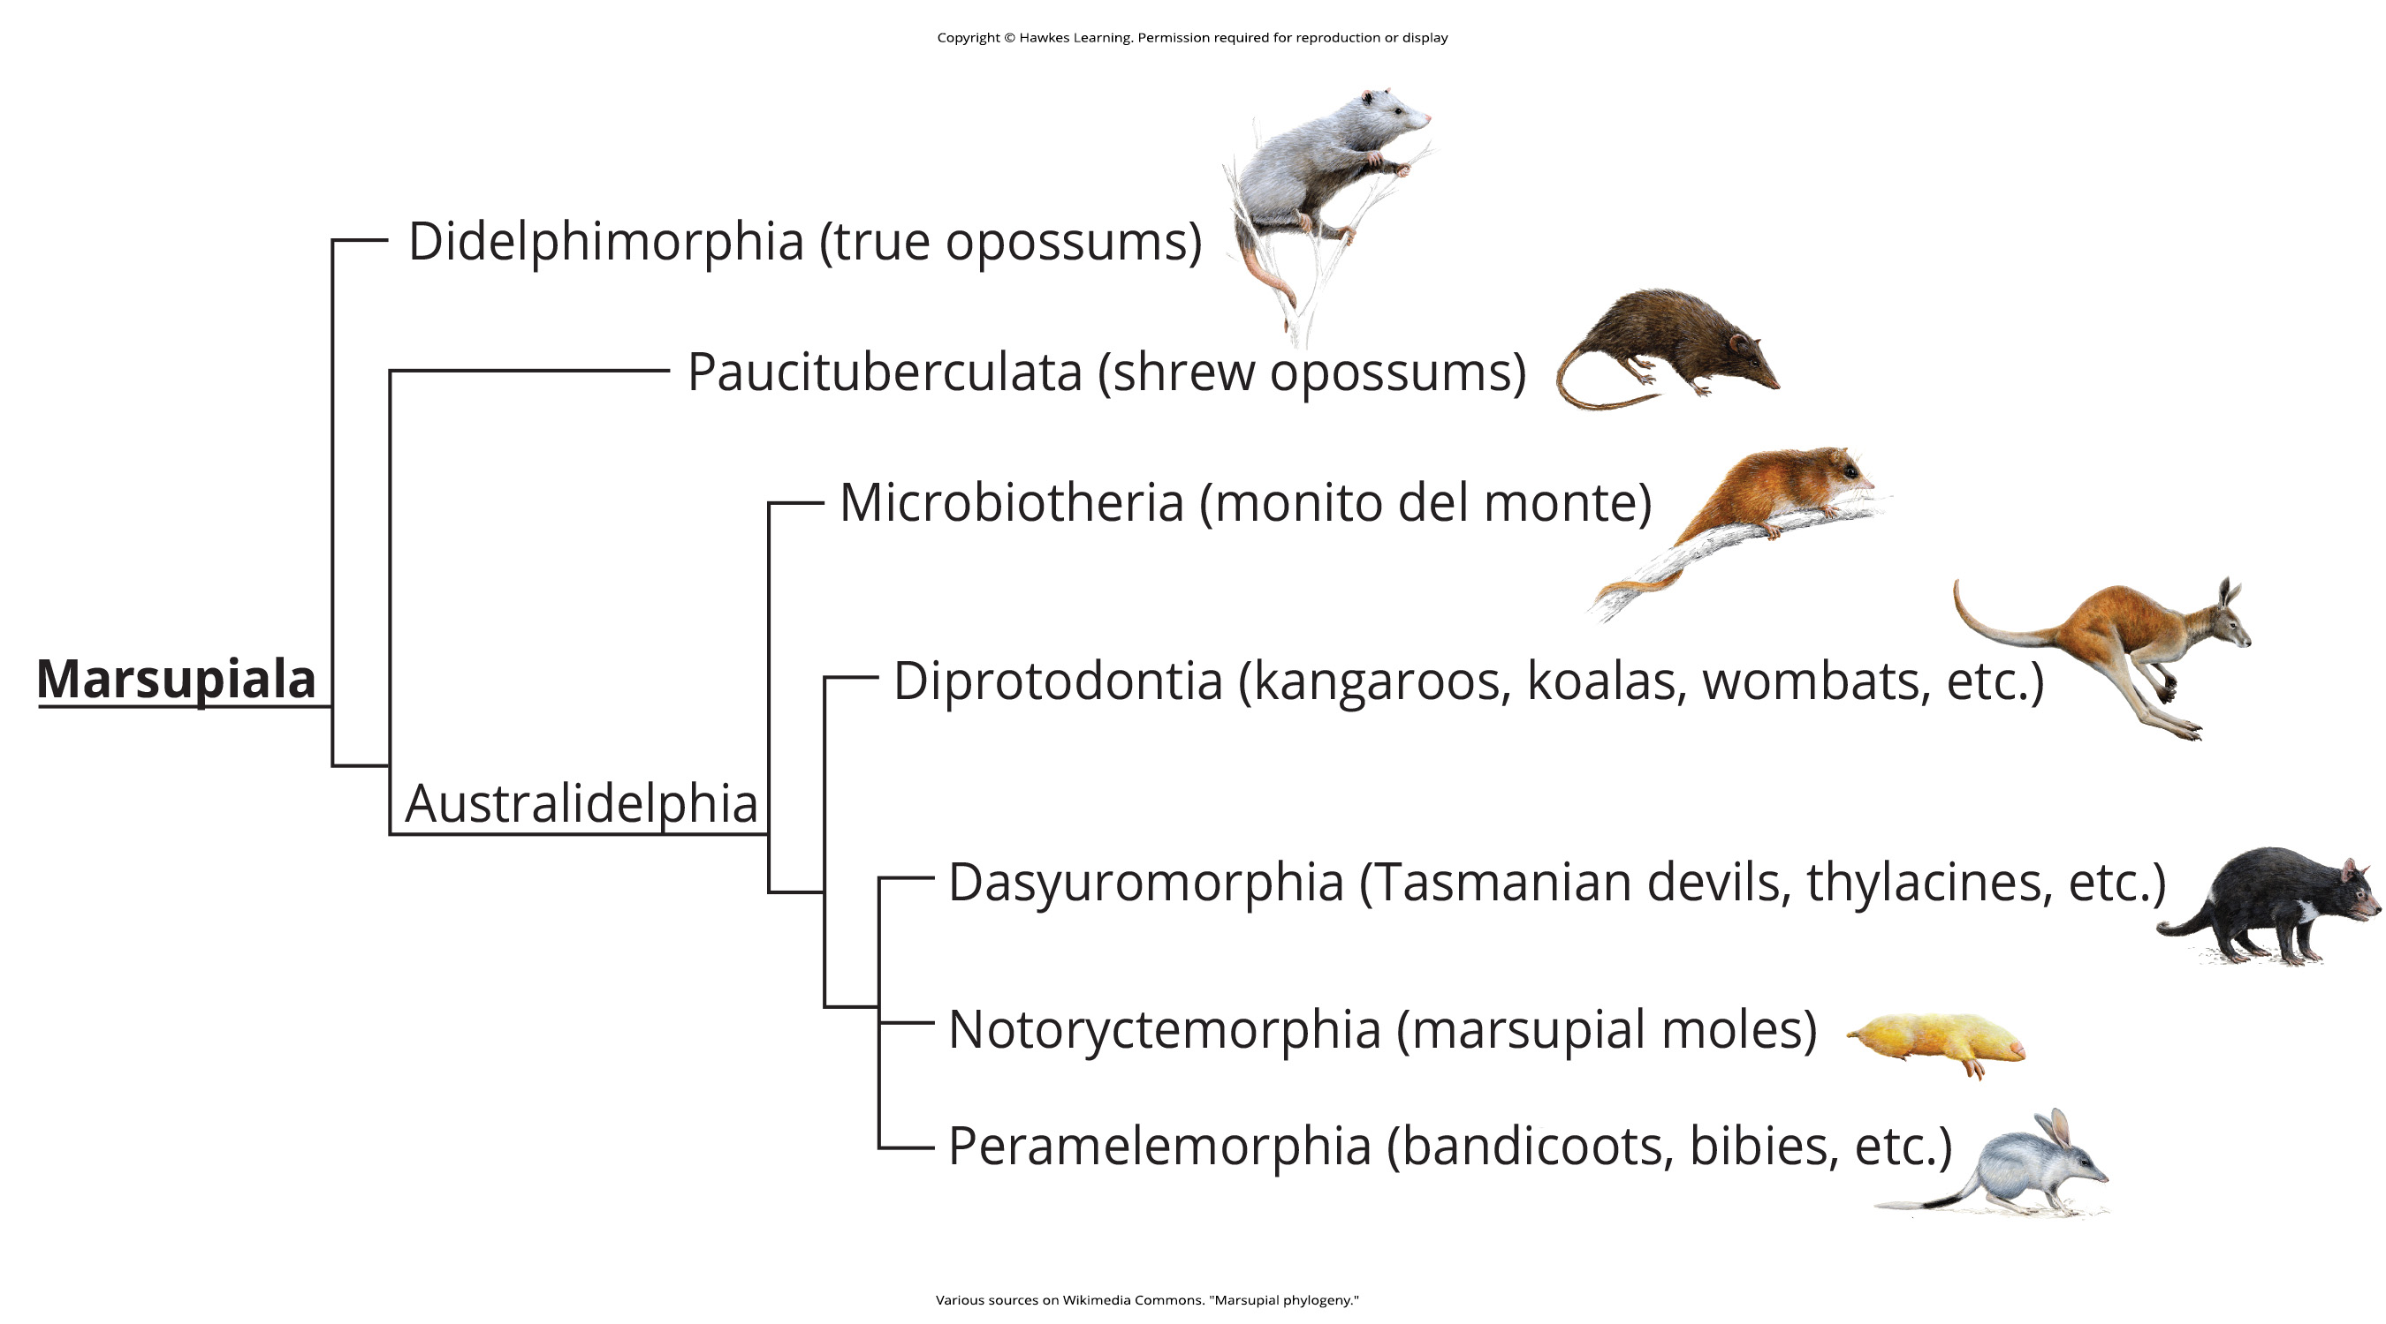
Lesson 18.1 Figure 13

Slide 15
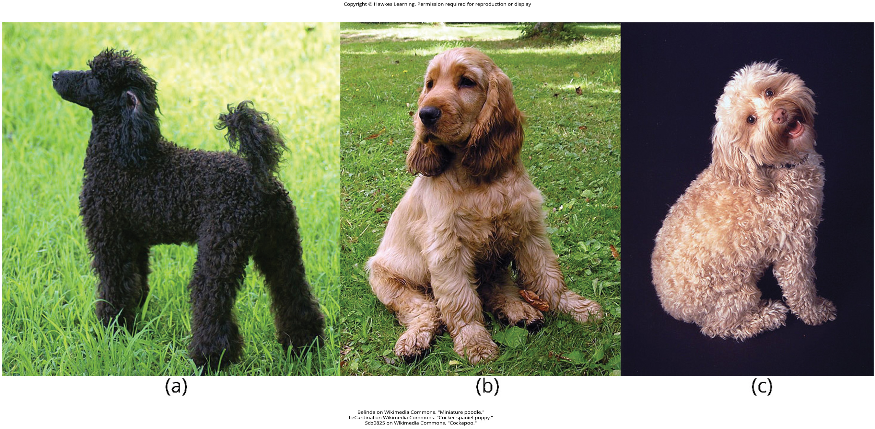
Lesson 18.2 Figure 1

Slide 16
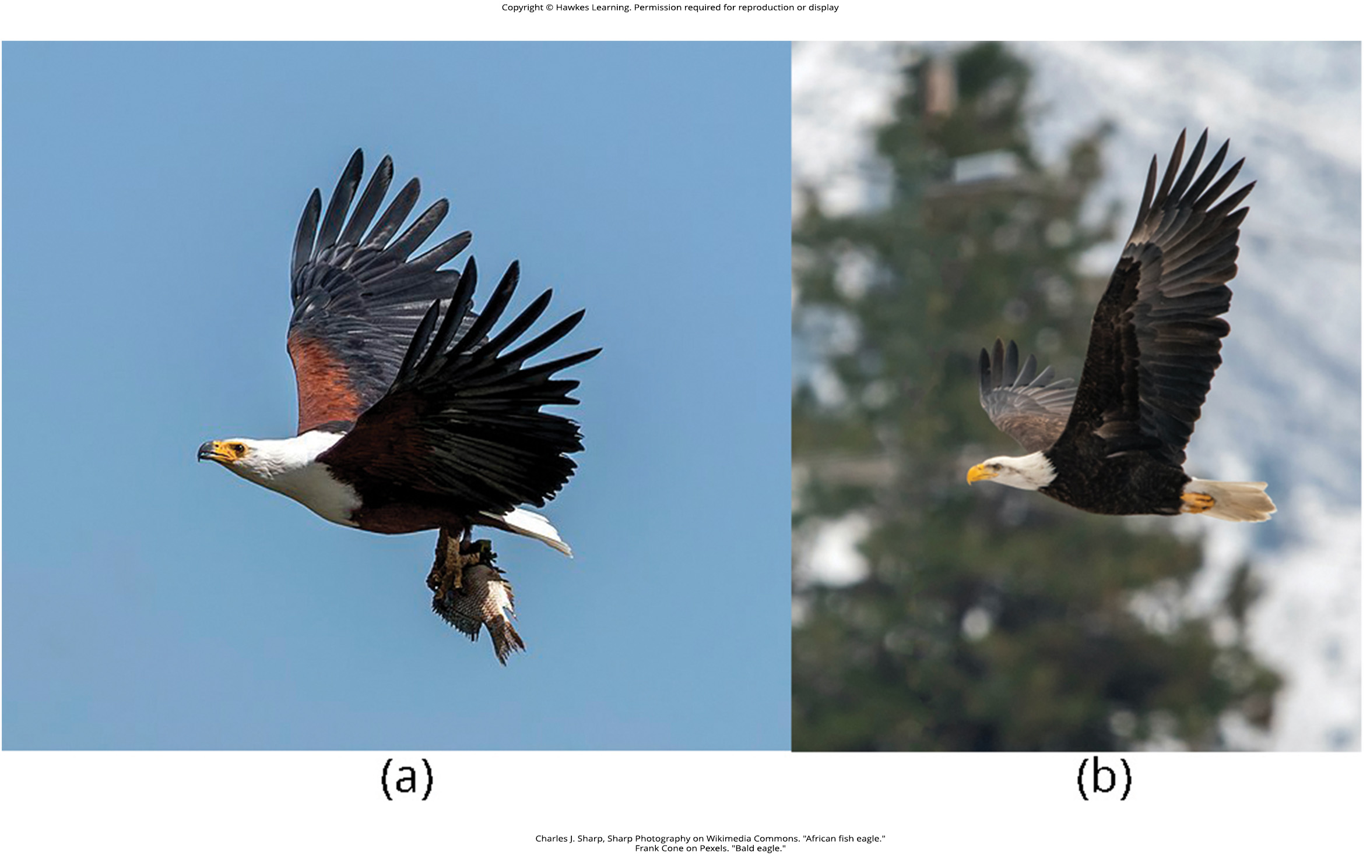
Lesson 18.2 Figure 2

Slide 17
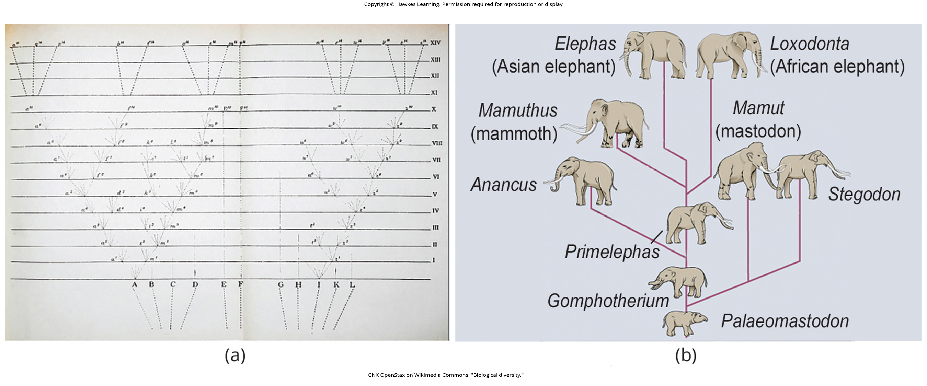
Lesson 18.2 Figure 3

Slide 18
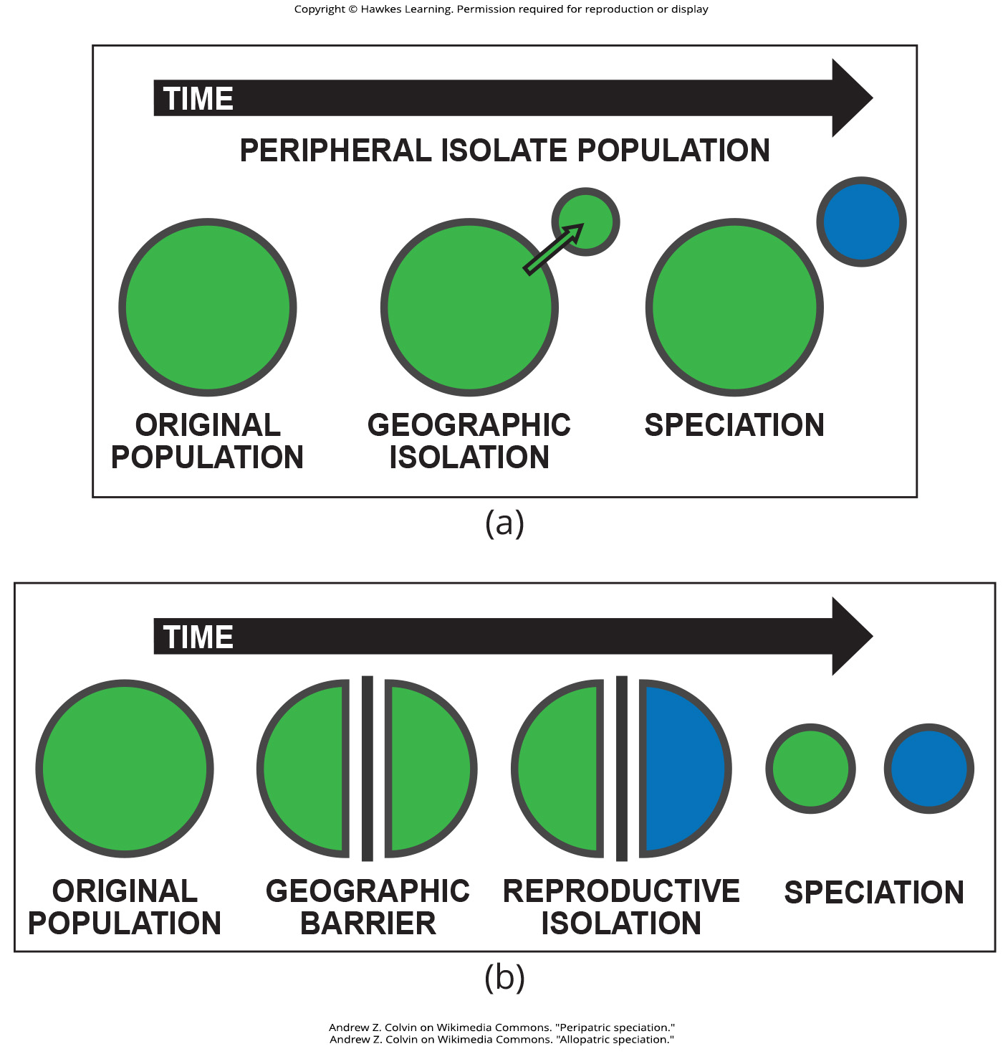
Lesson 18.2 Figure 4

Slide 19
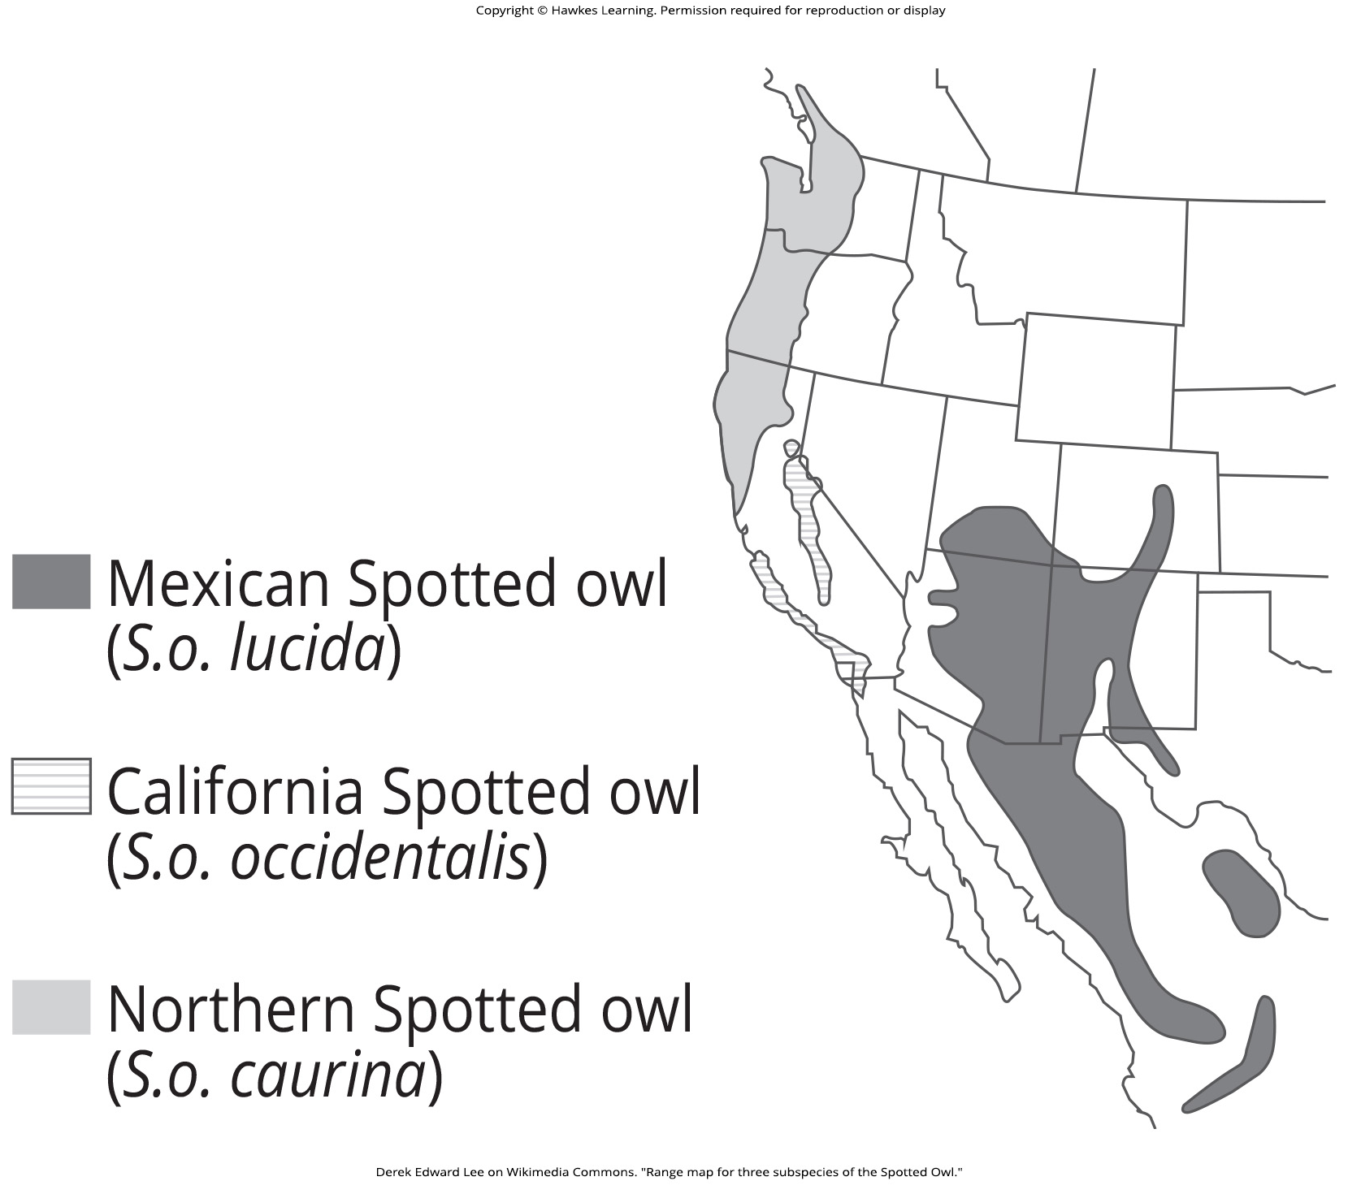
Lesson 18.2 Figure 5

Slide 20
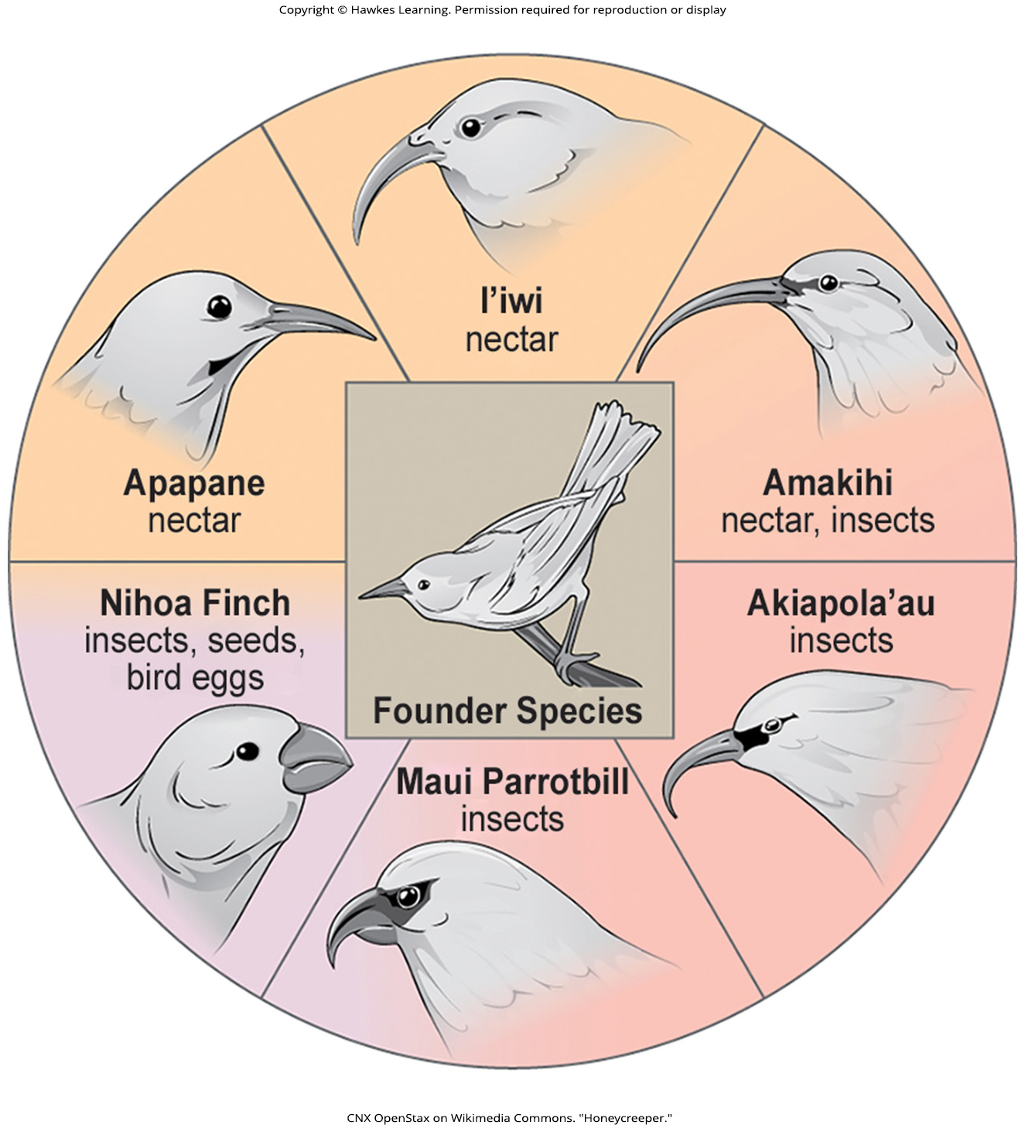
Lesson 18.2 Figure 6

Slide 21
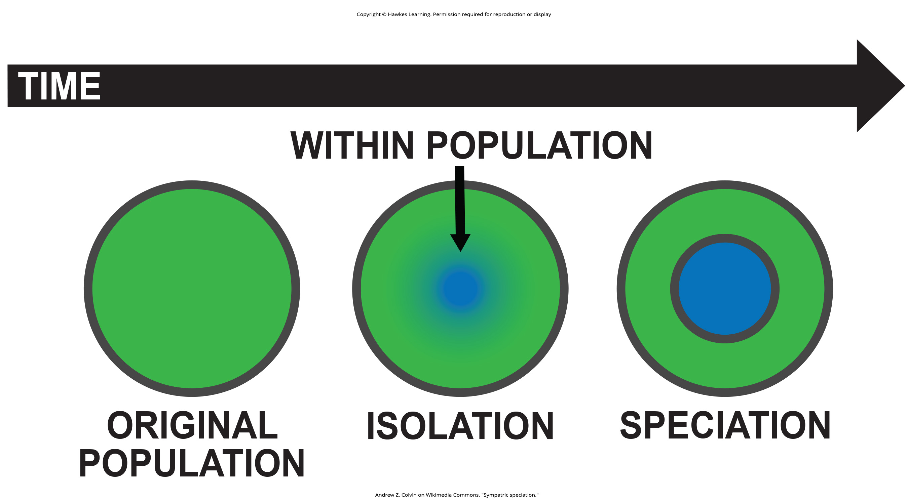
Lesson 18.2 Figure 7

Slide 22
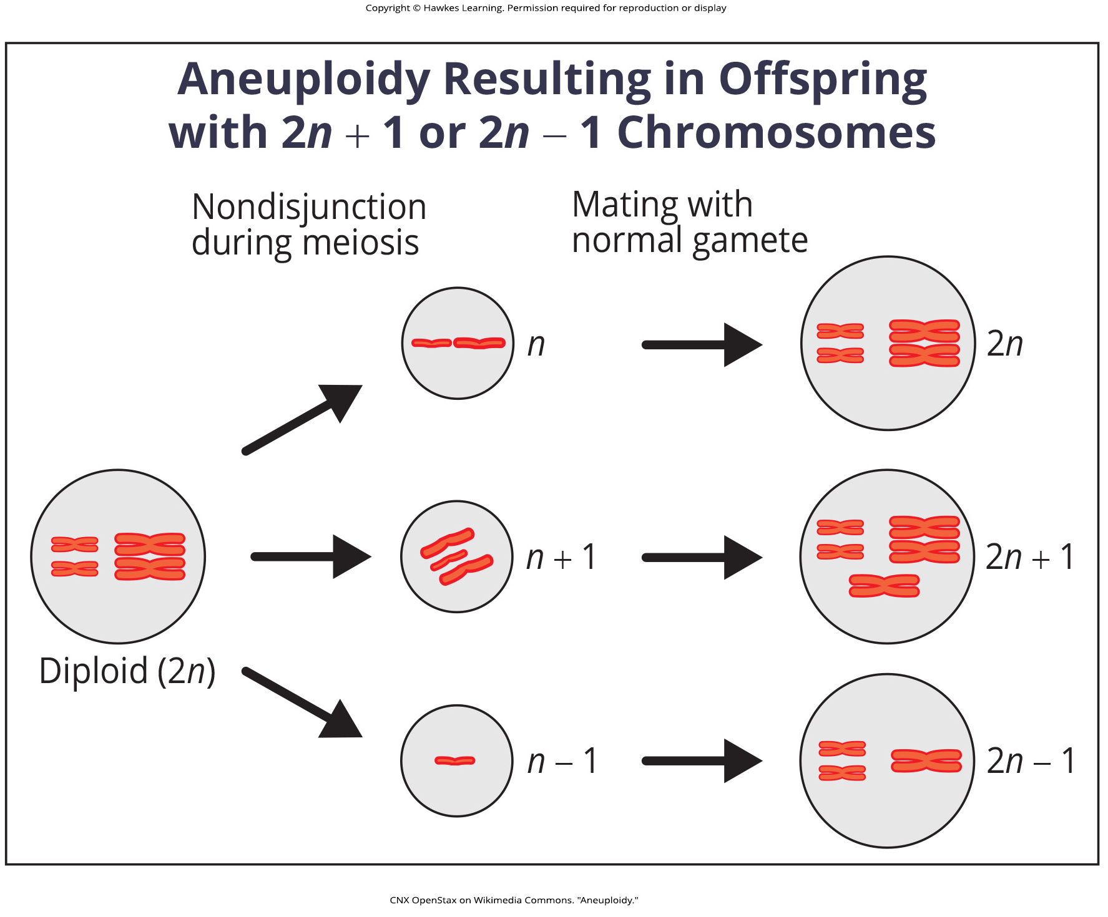
Lesson 18.2 Figure 8

Slide 23
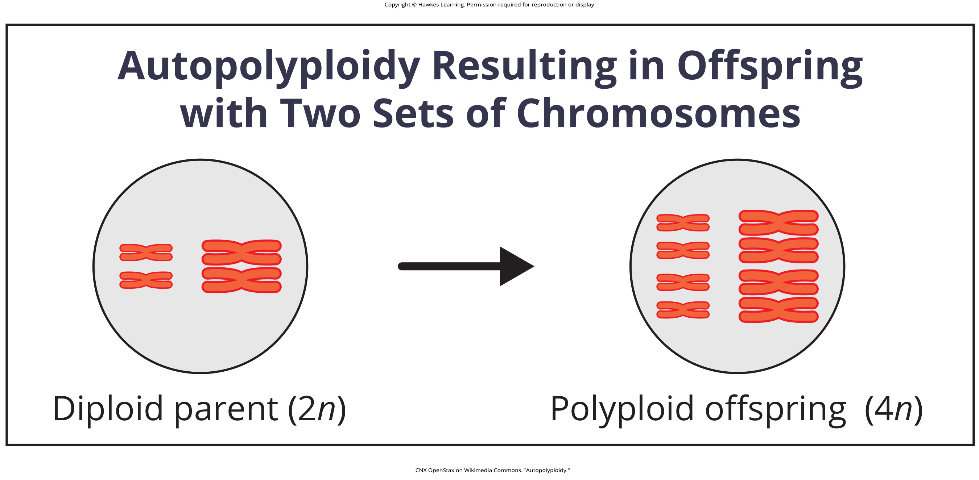
Lesson 18.2 Figure 9

Slide 24
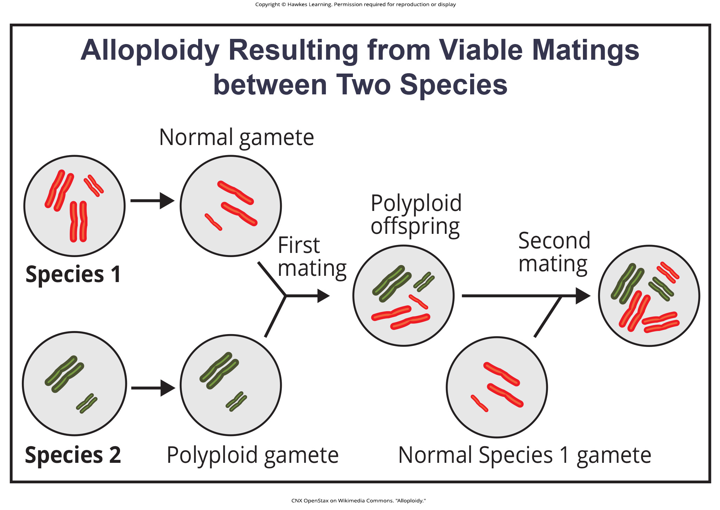
Lesson 18.2 Figure 10

Slide 25
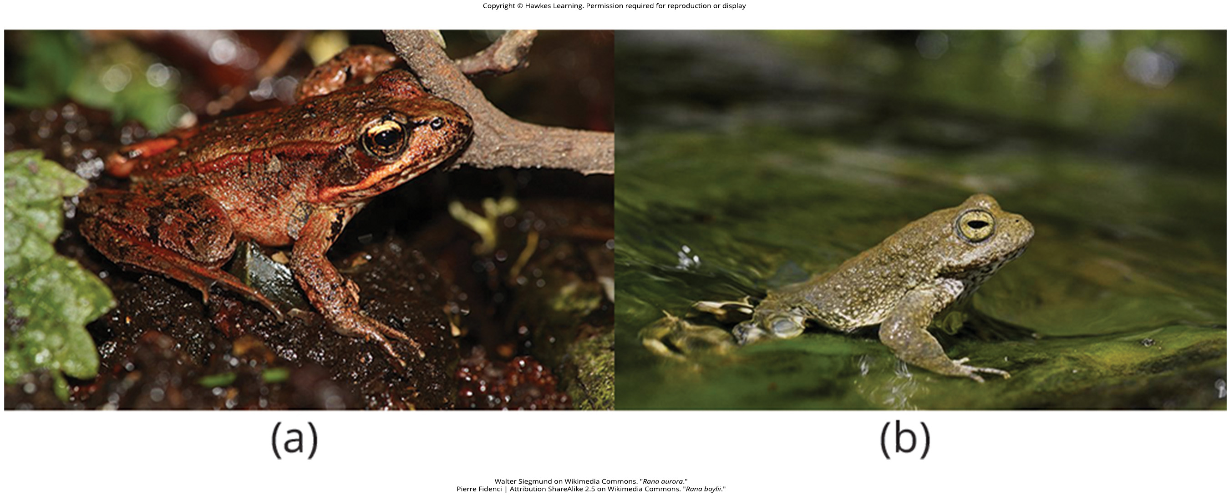
Lesson 18.2 Figure 11

Slide 26
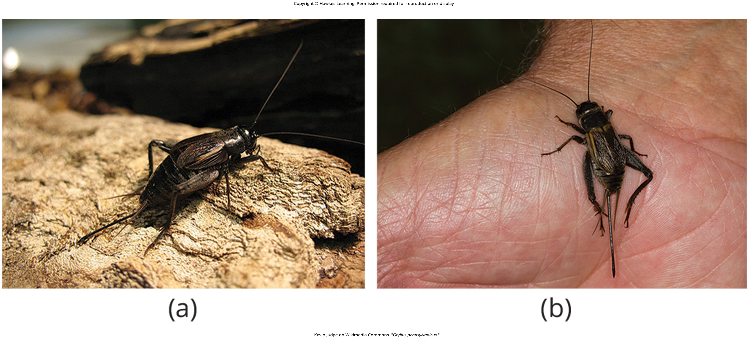
Lesson 18.2 Figure 12

Slide 27
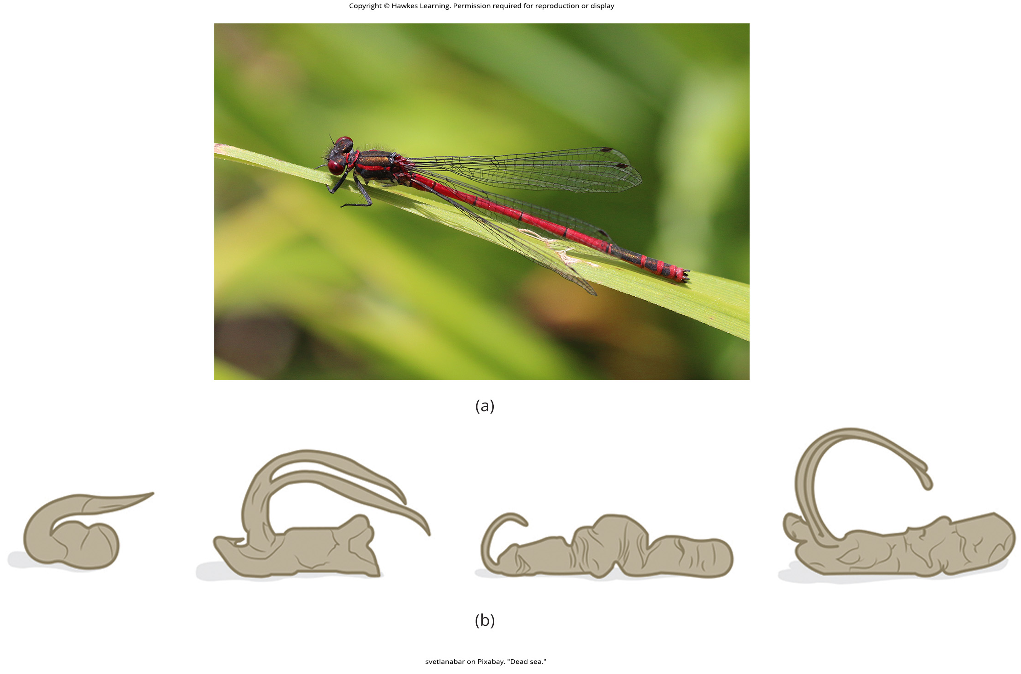
Lesson 18.2 Figure 13

Slide 28
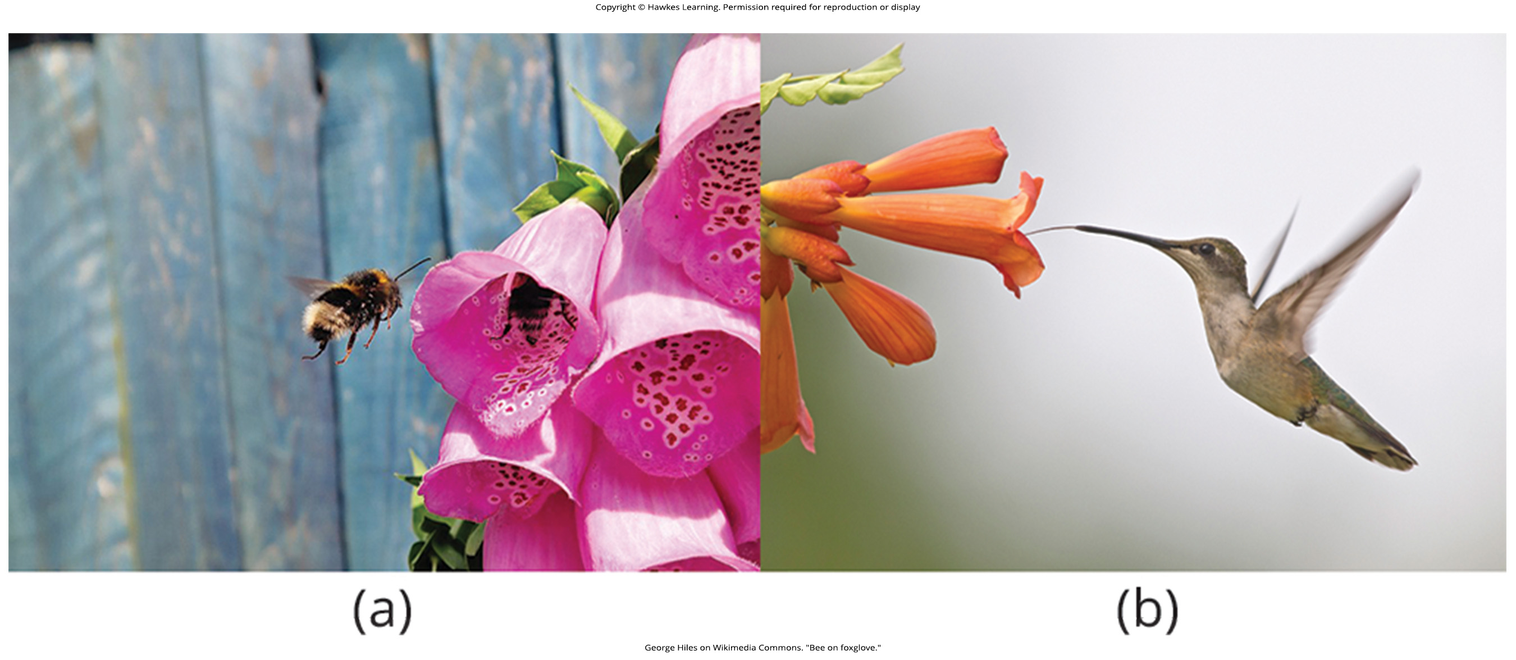
Lesson 18.2 Figure 14

Slide 29
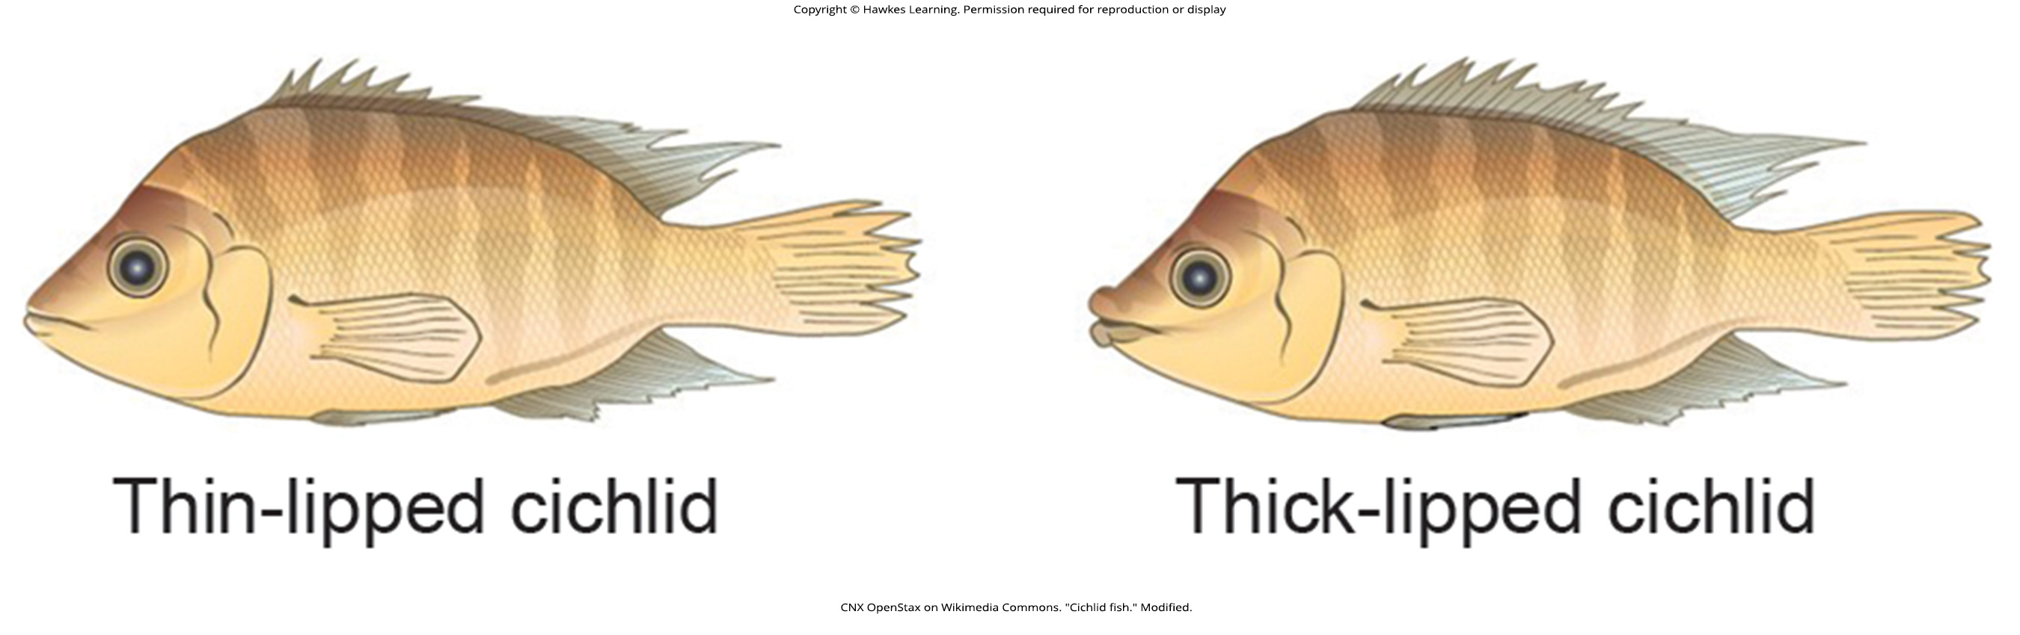
Lesson 18.2 Figure 15

Slide 30
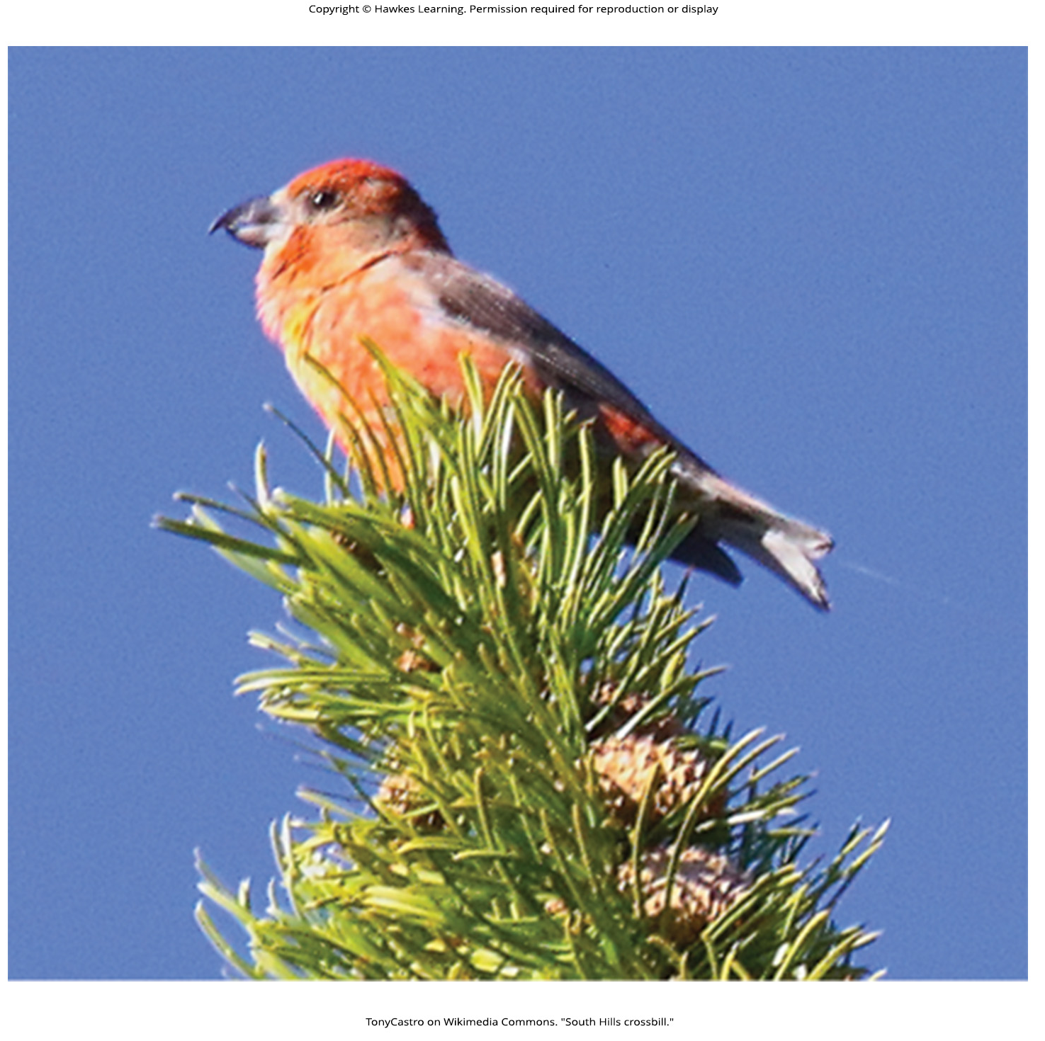
Lesson 18.2 Figure 16

Slide 31
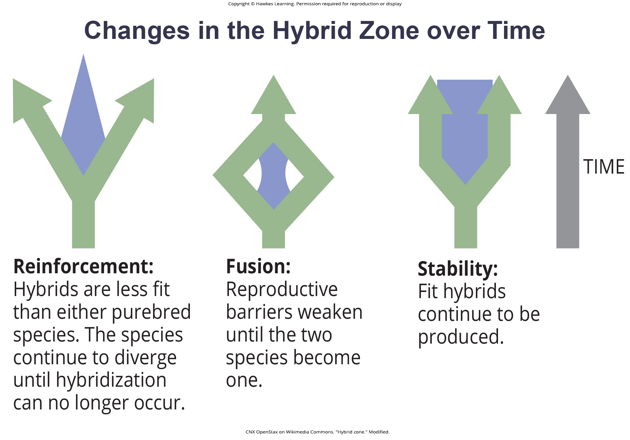
Lesson 18.3 Figure 1

Slide 32
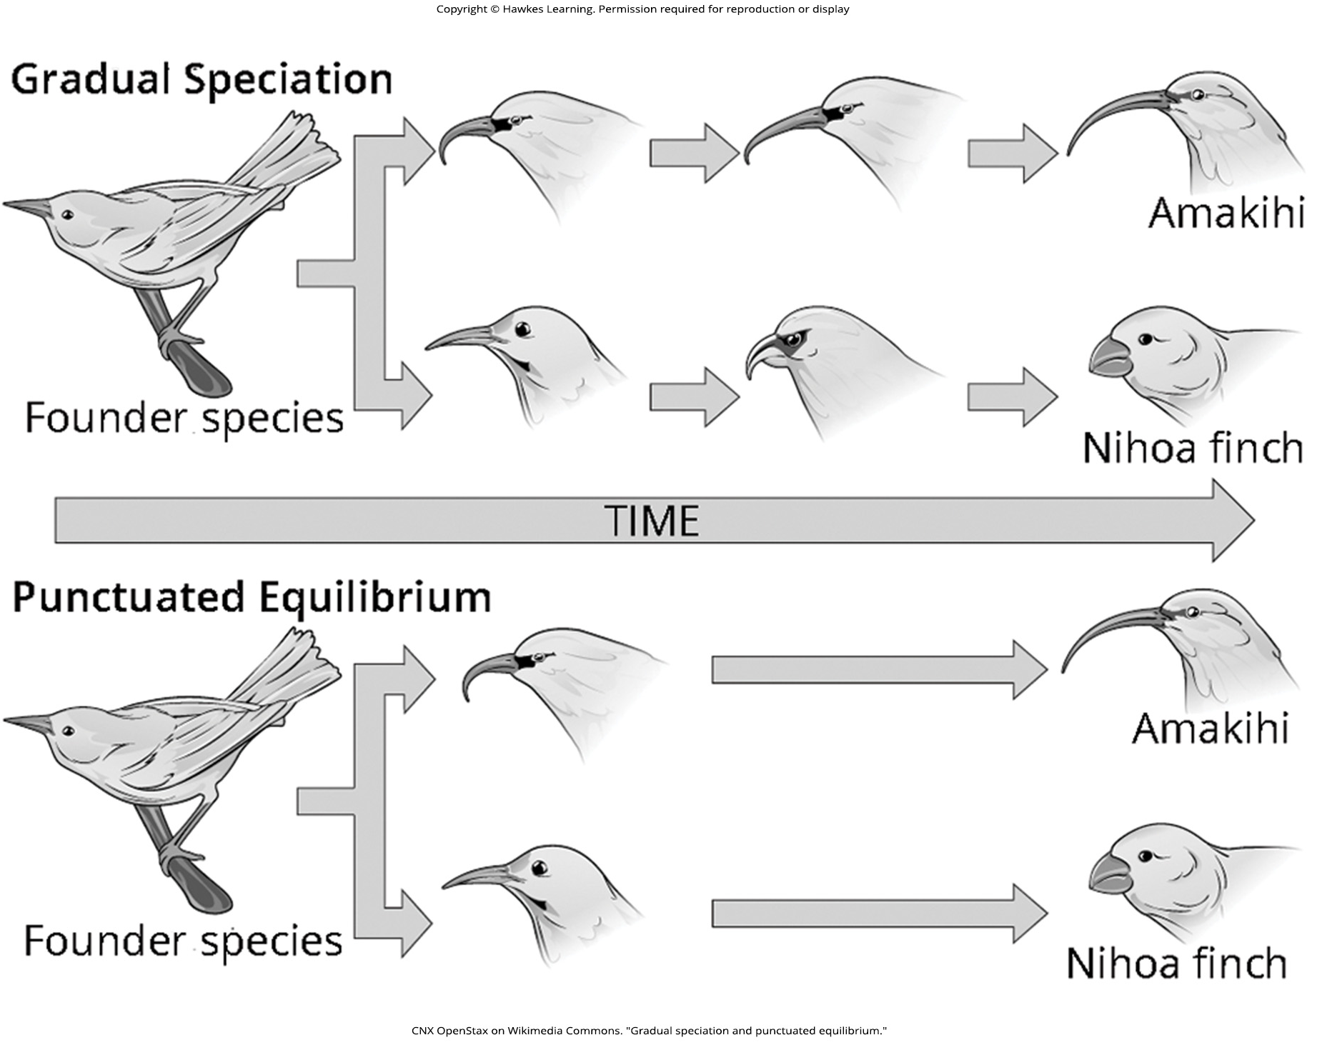
Lesson 18.3 Figure 2

Slide 33
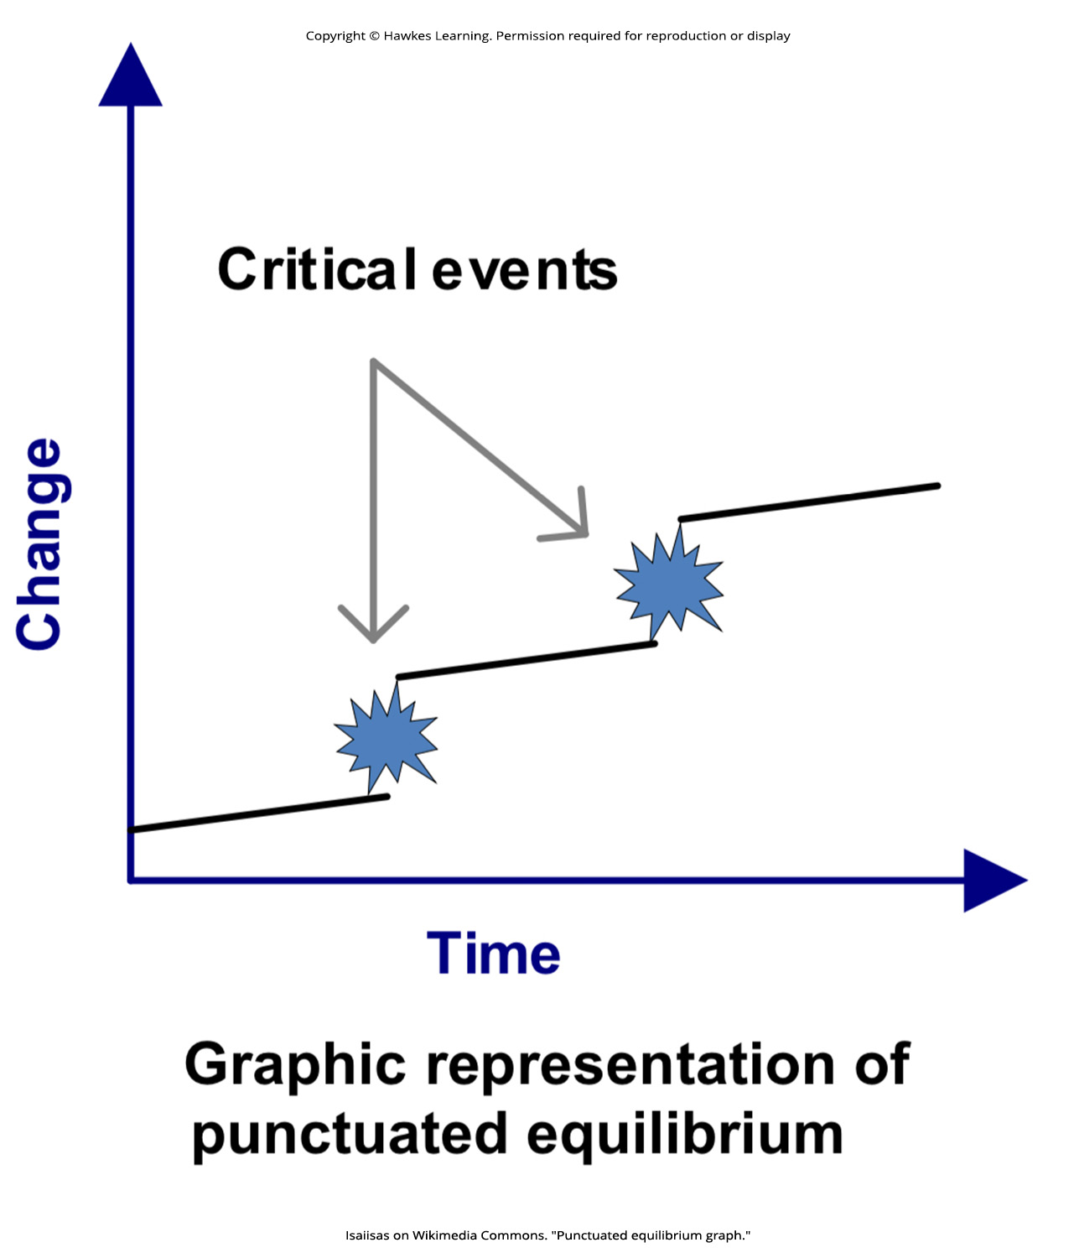
Lesson 18.3 Figure 3

Slide 34
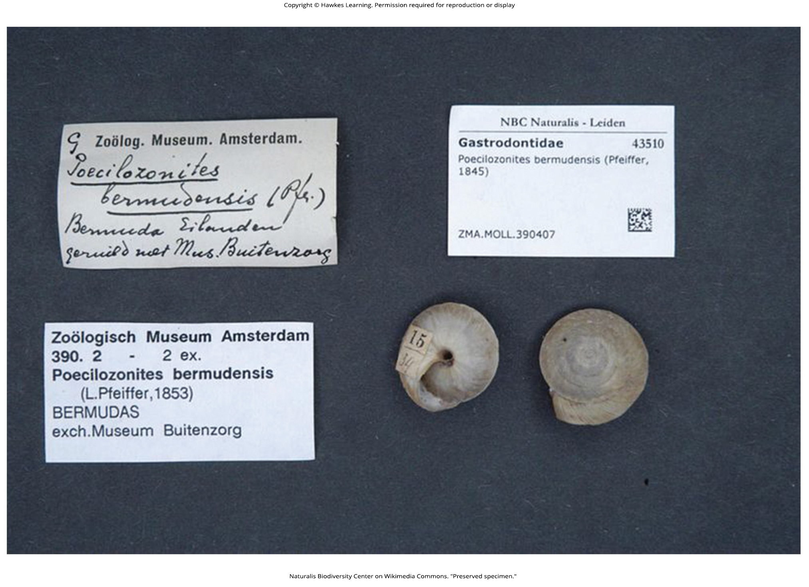
Lesson 18.3 Figure 4

Slide 35
Hawkes Learning – End of PowerPoint

