Slide 1
Chapter 19
The Evolution of Populations

Slide 2
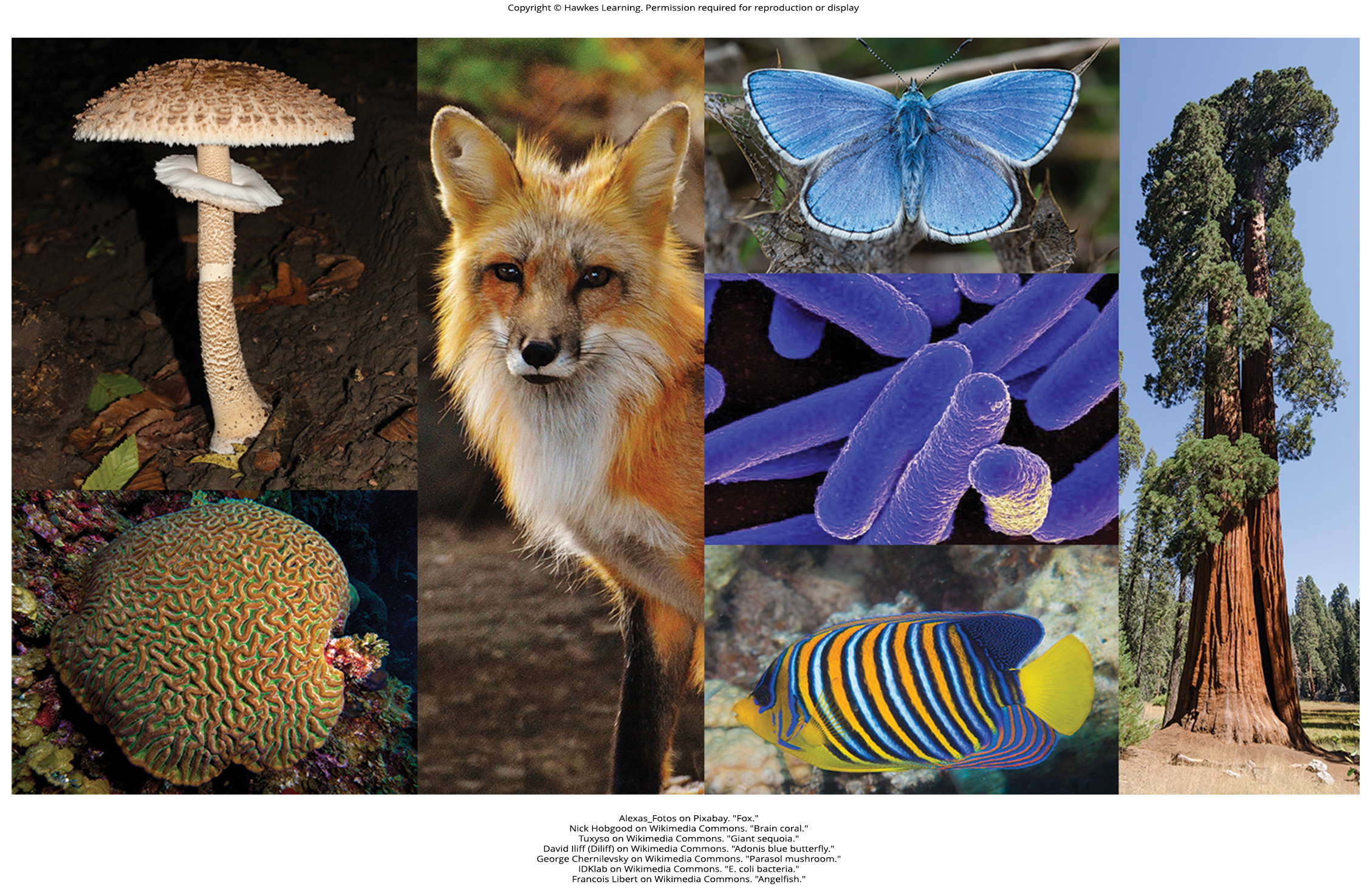
Lesson 19.1 Figure 1

Slide 3
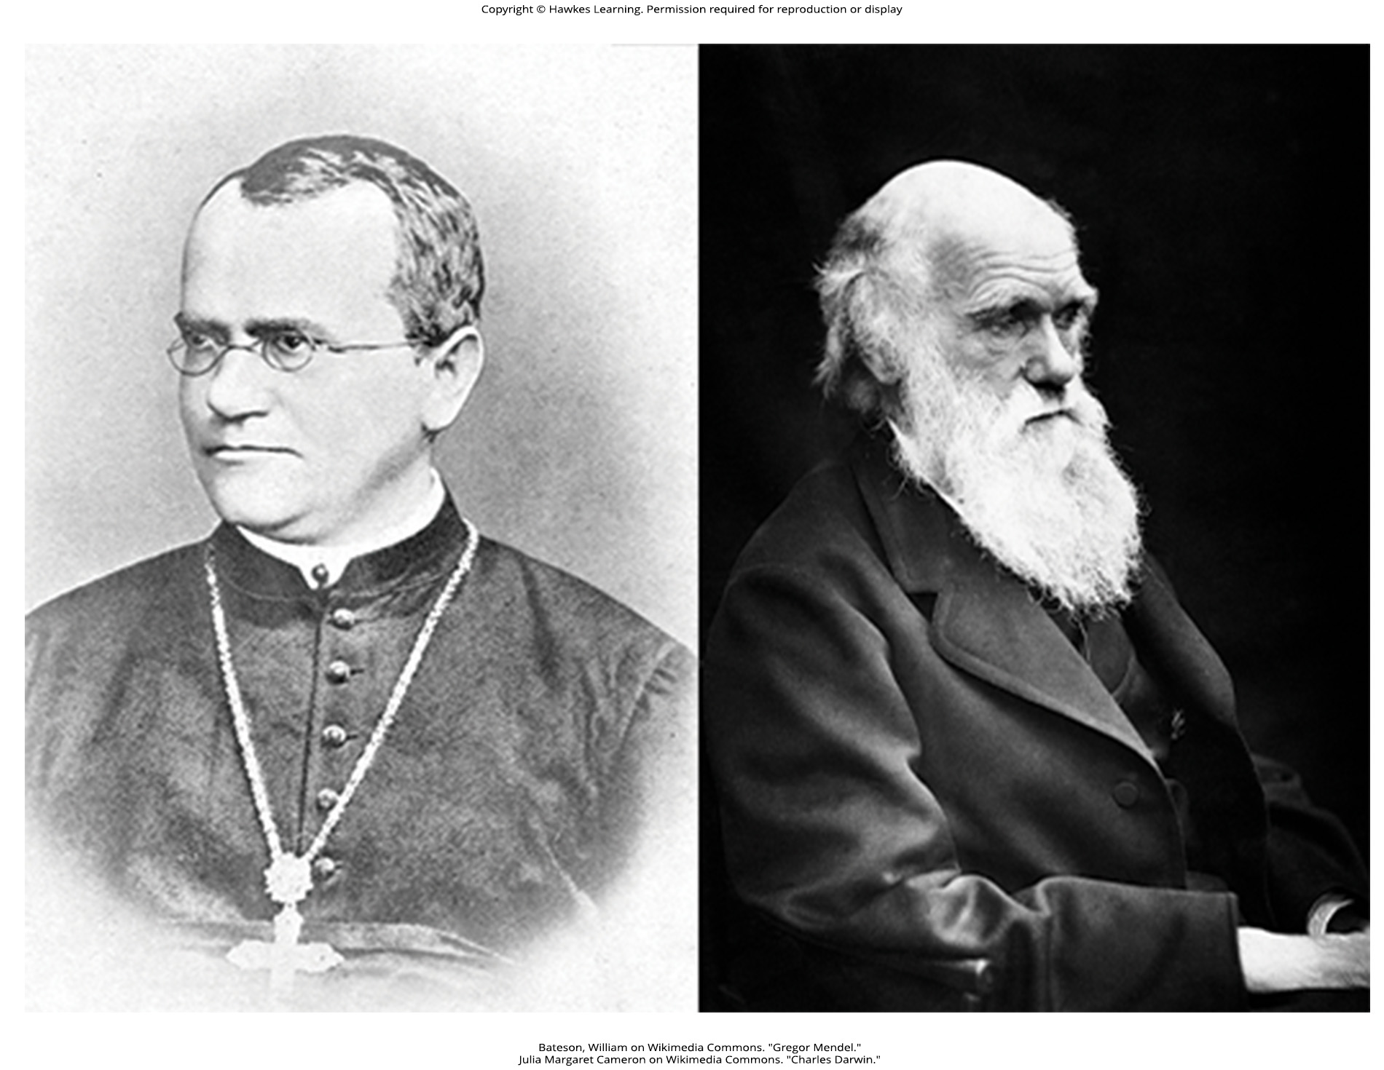
Lesson 19.1 Figure 2

Slide 4
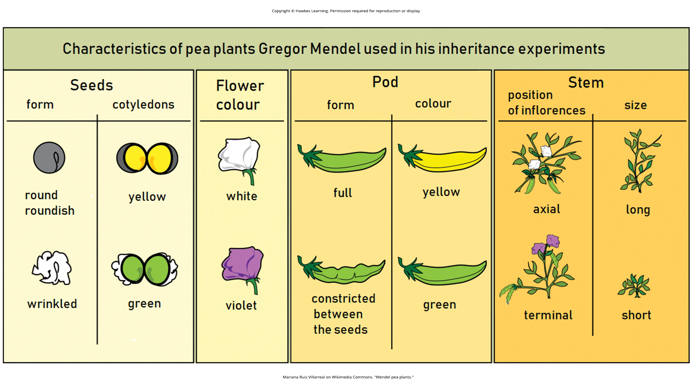
Lesson 19.1 Figure 3

Slide 5
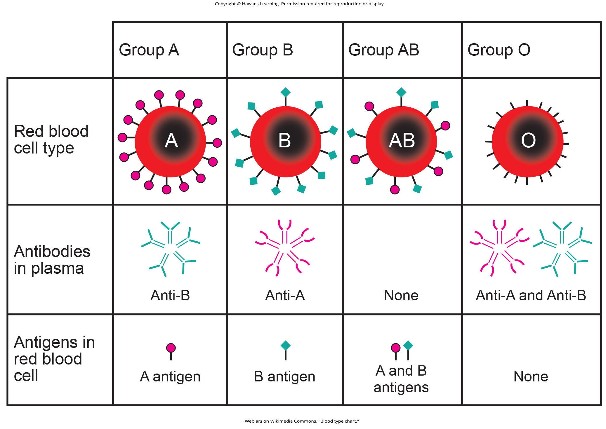
Lesson 19.1 Table 1

Slide 6
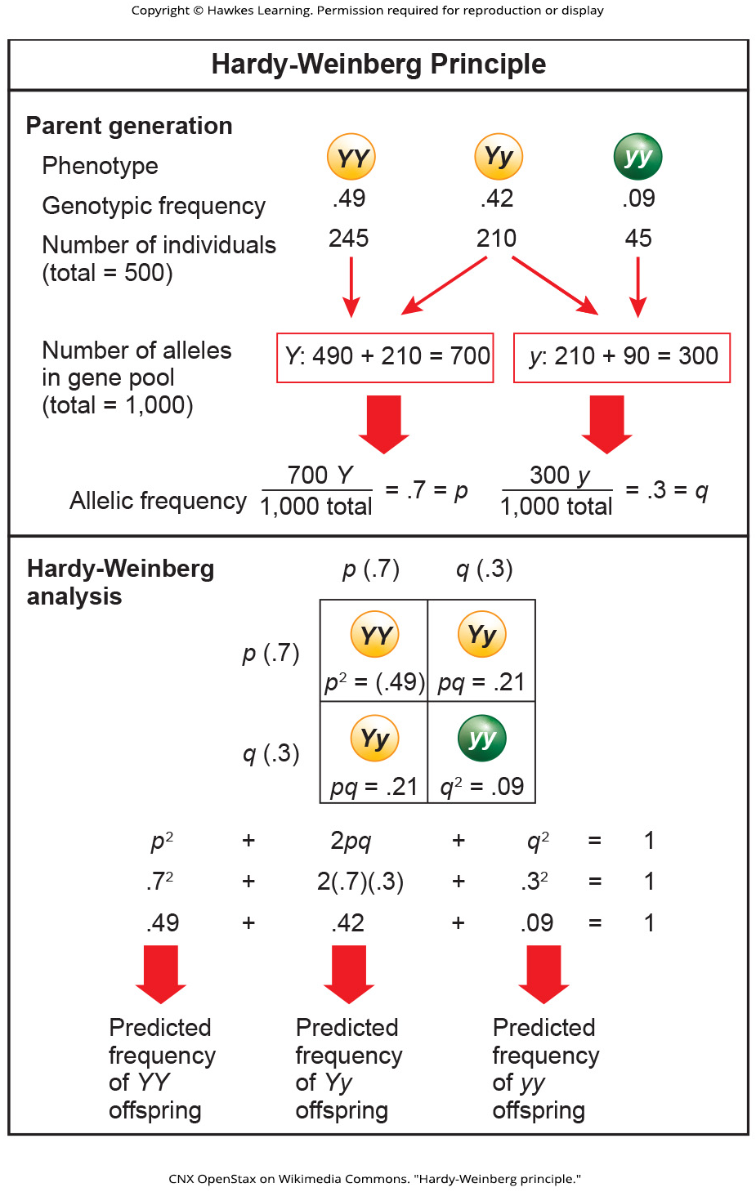
Lesson 19.1 Figure 4

Slide 7
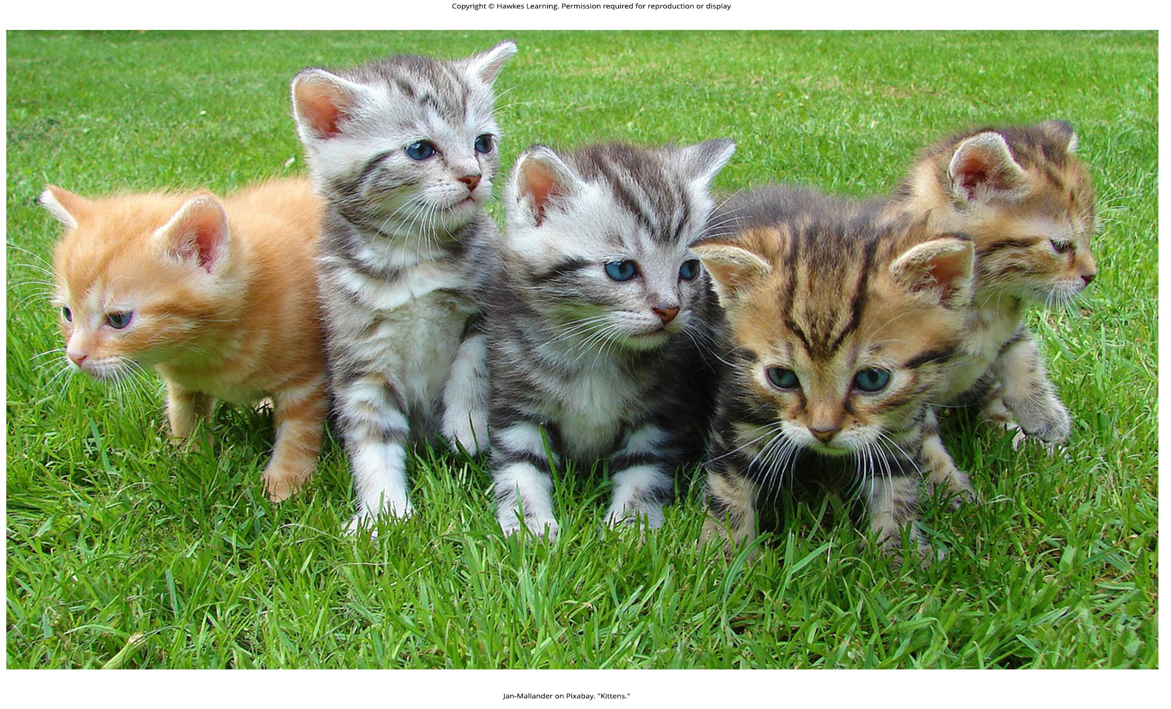
Lesson 19.2 Figure 1

Slide 8
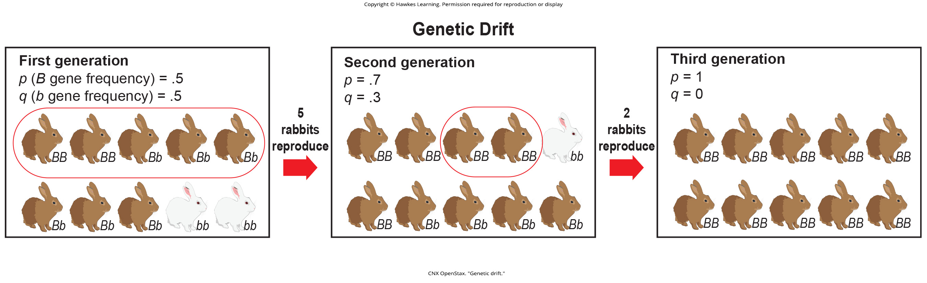
Lesson 19.2 Figure 2

Slide 9
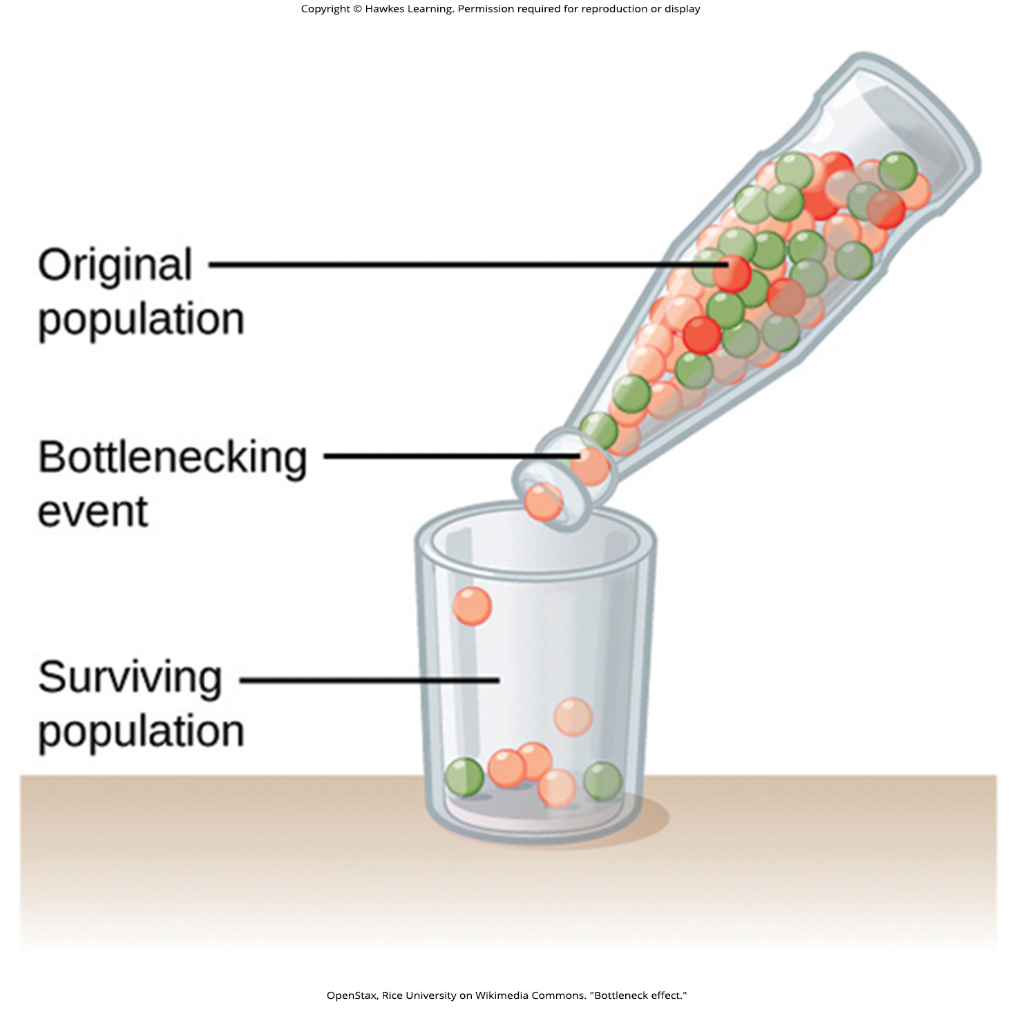
Lesson 19.2 Figure 3

Slide 10
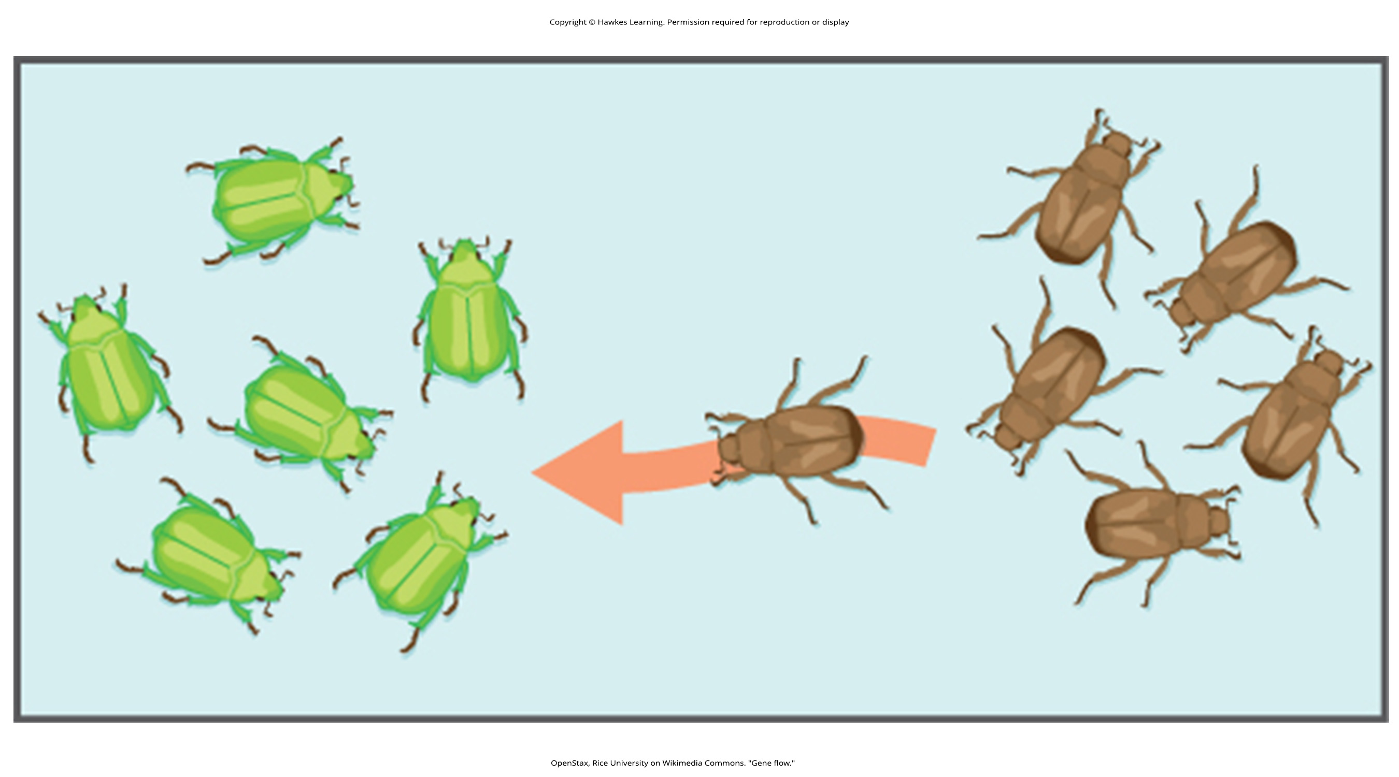
Lesson 19.2 Figure 4

Slide 11
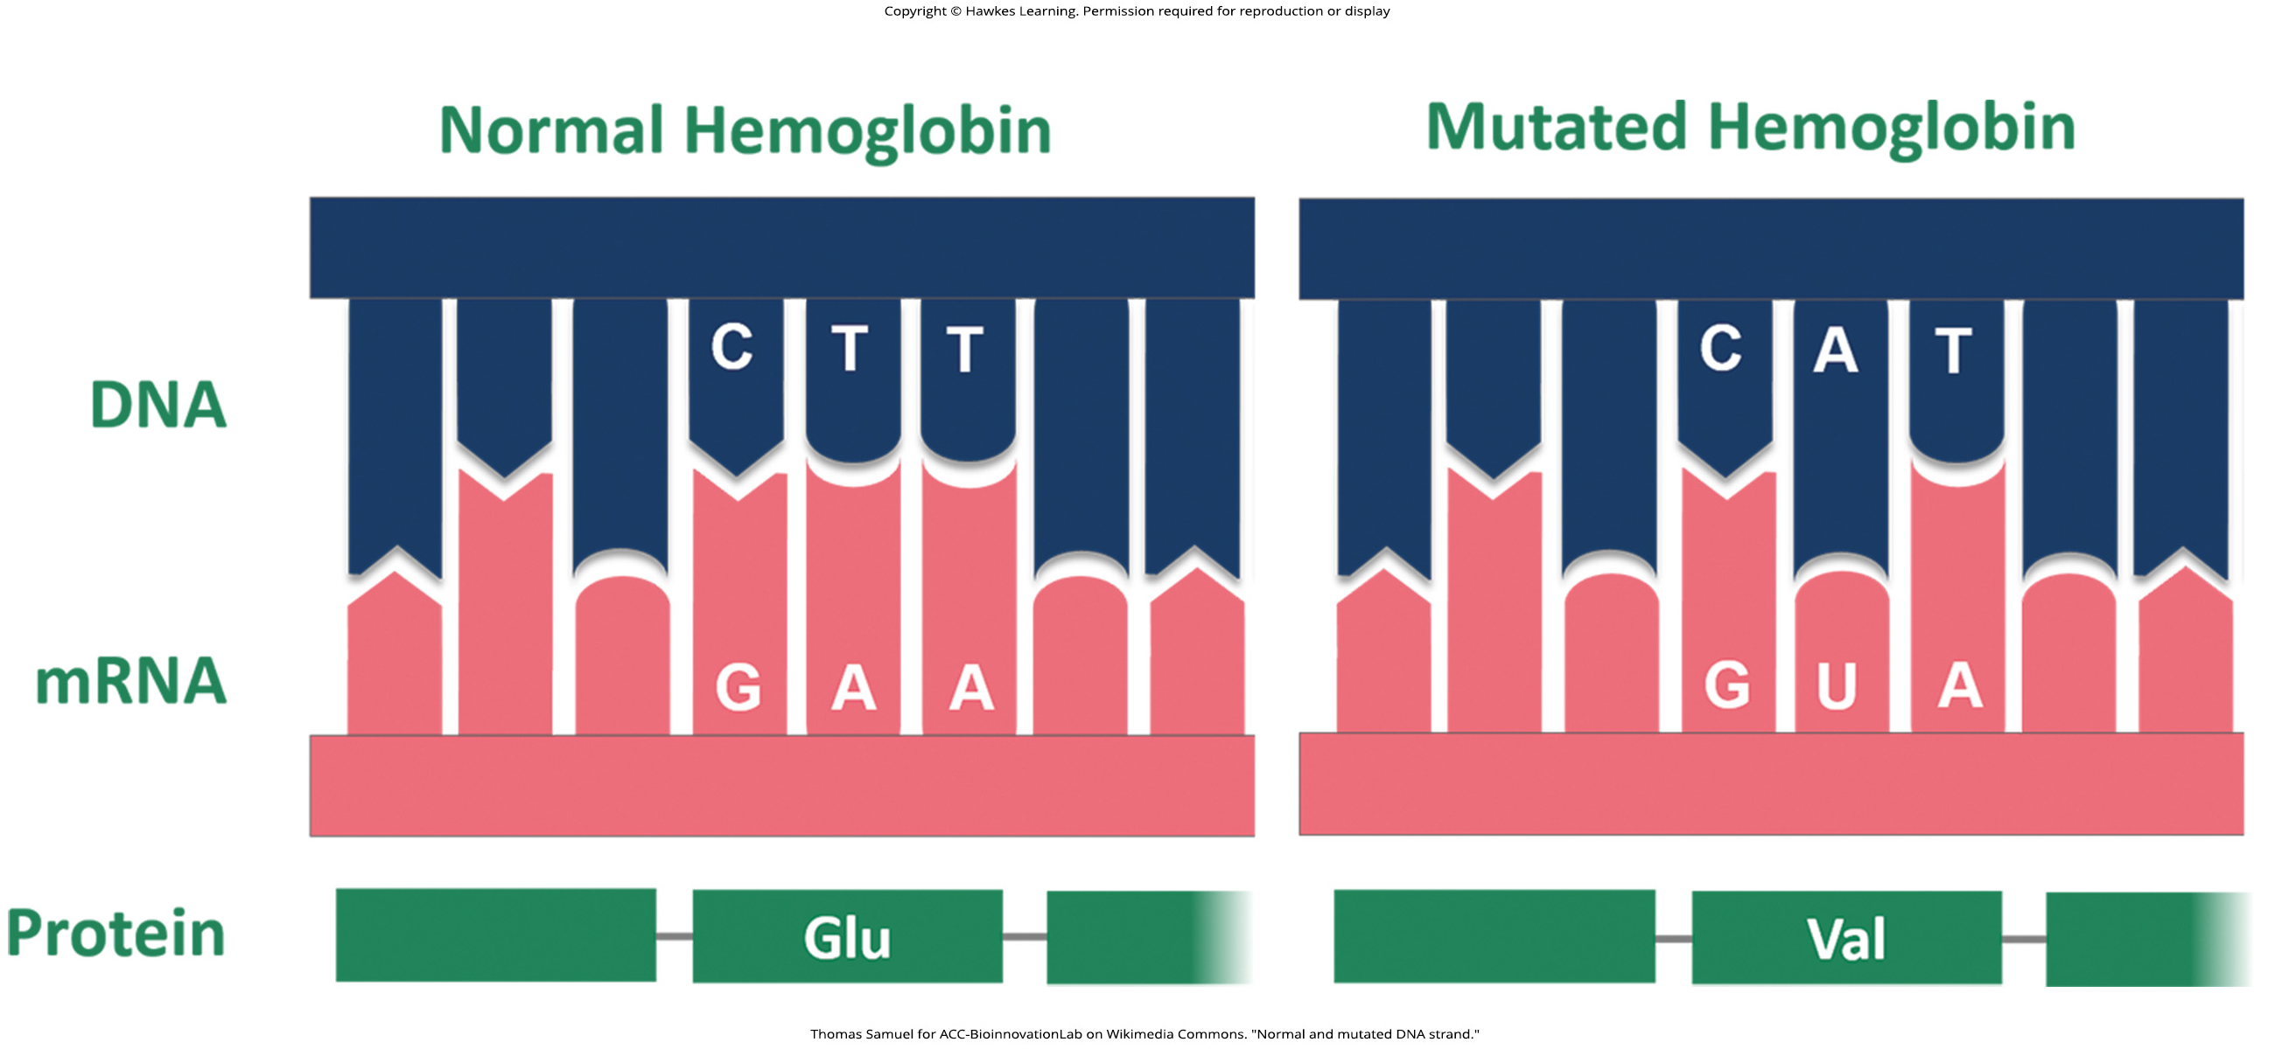
Lesson 19.2 Figure 5

Slide 12
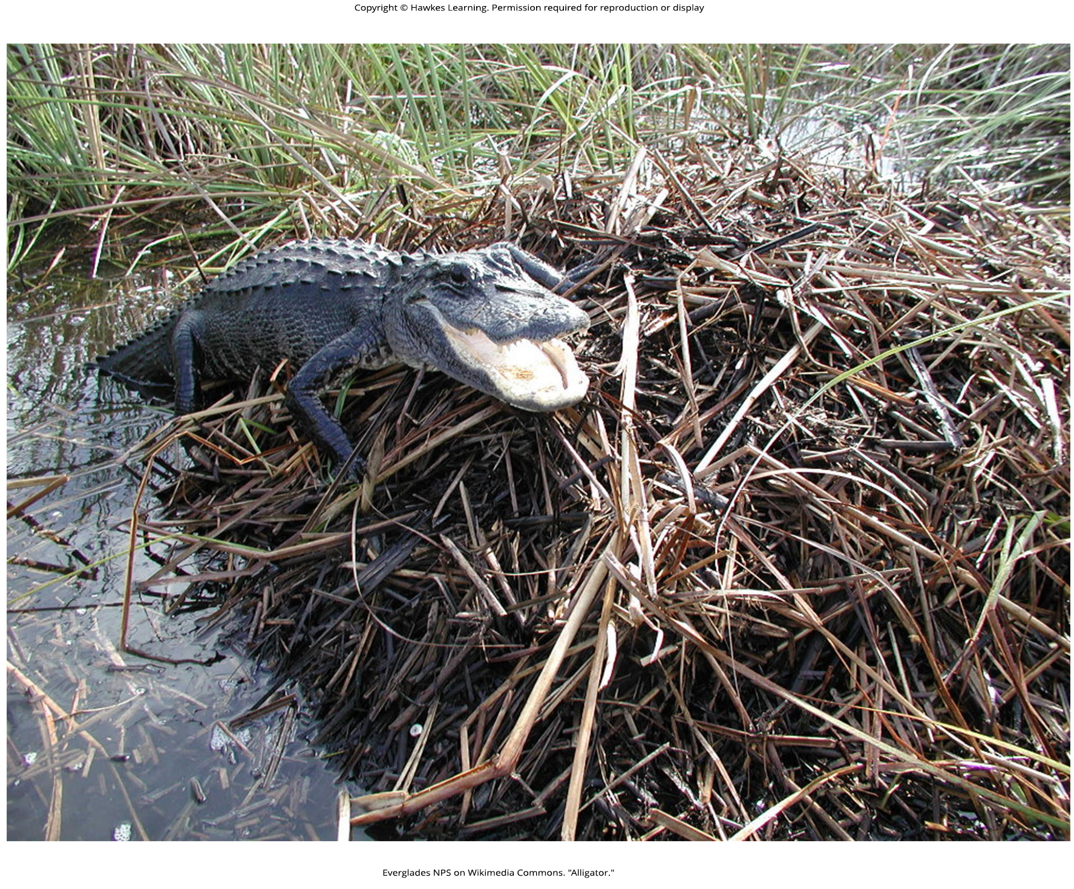
Lesson 19.2 Figure 6

Slide 13
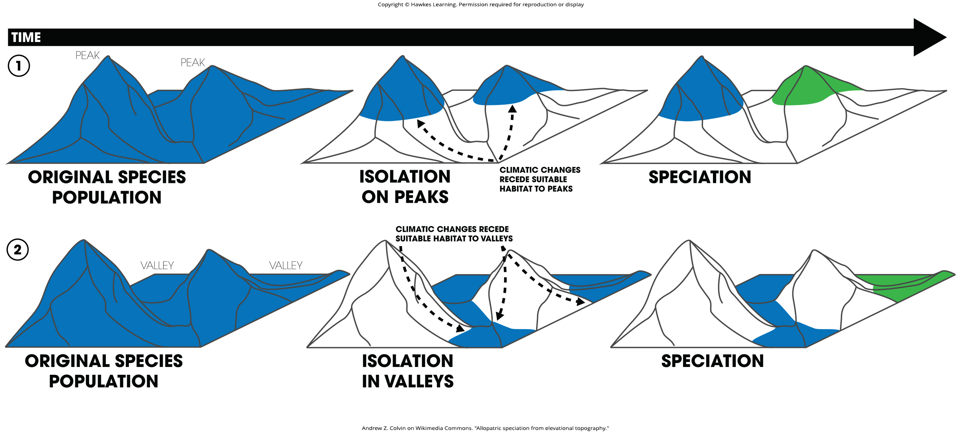
Lesson 19.2 Figure 7

Slide 14
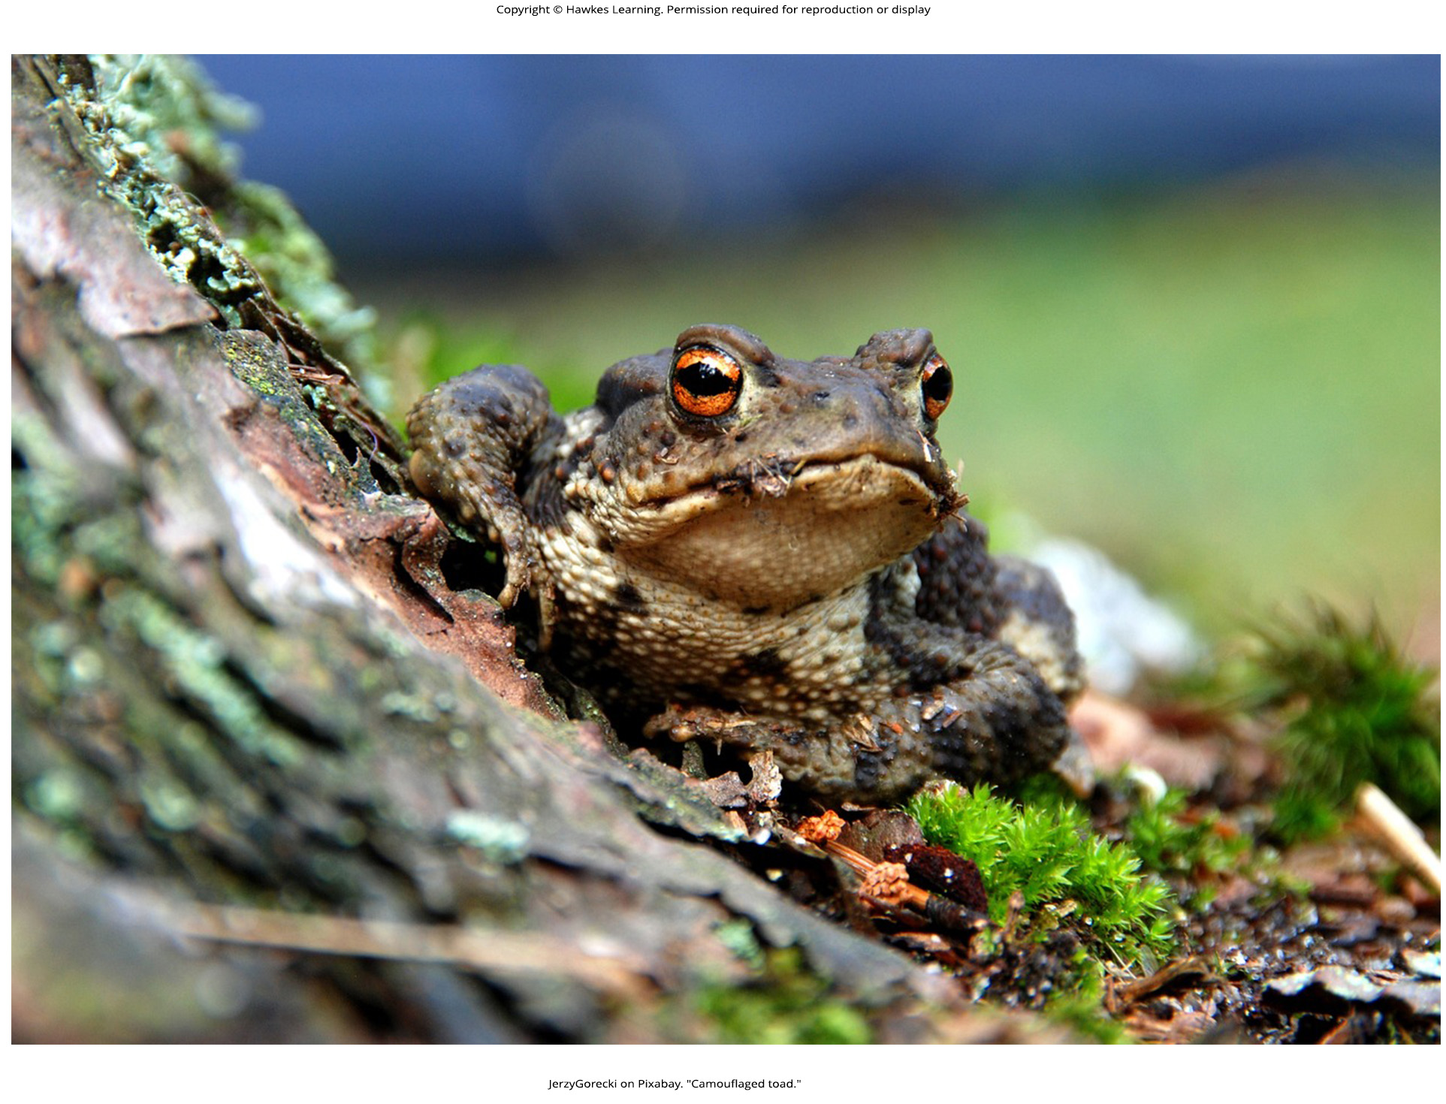
Lesson 19.3 Figure 1

Slide 15
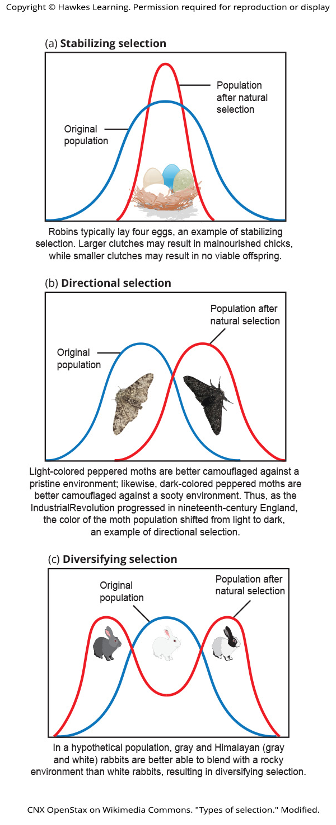
Lesson 19.3 Figure 2

Slide 16
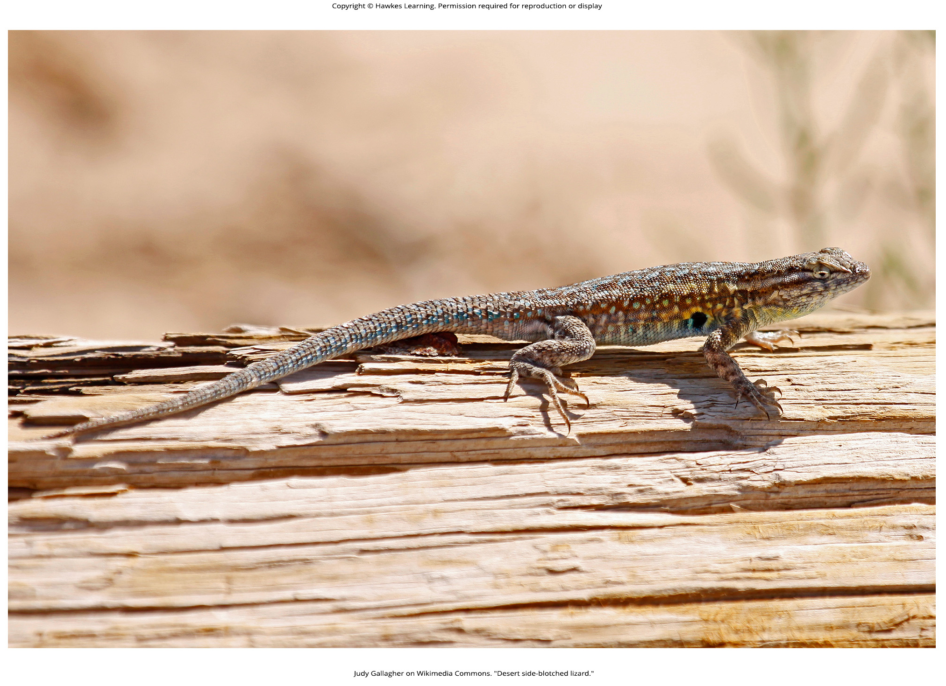
Lesson 19.3 Figure 3

Slide 17
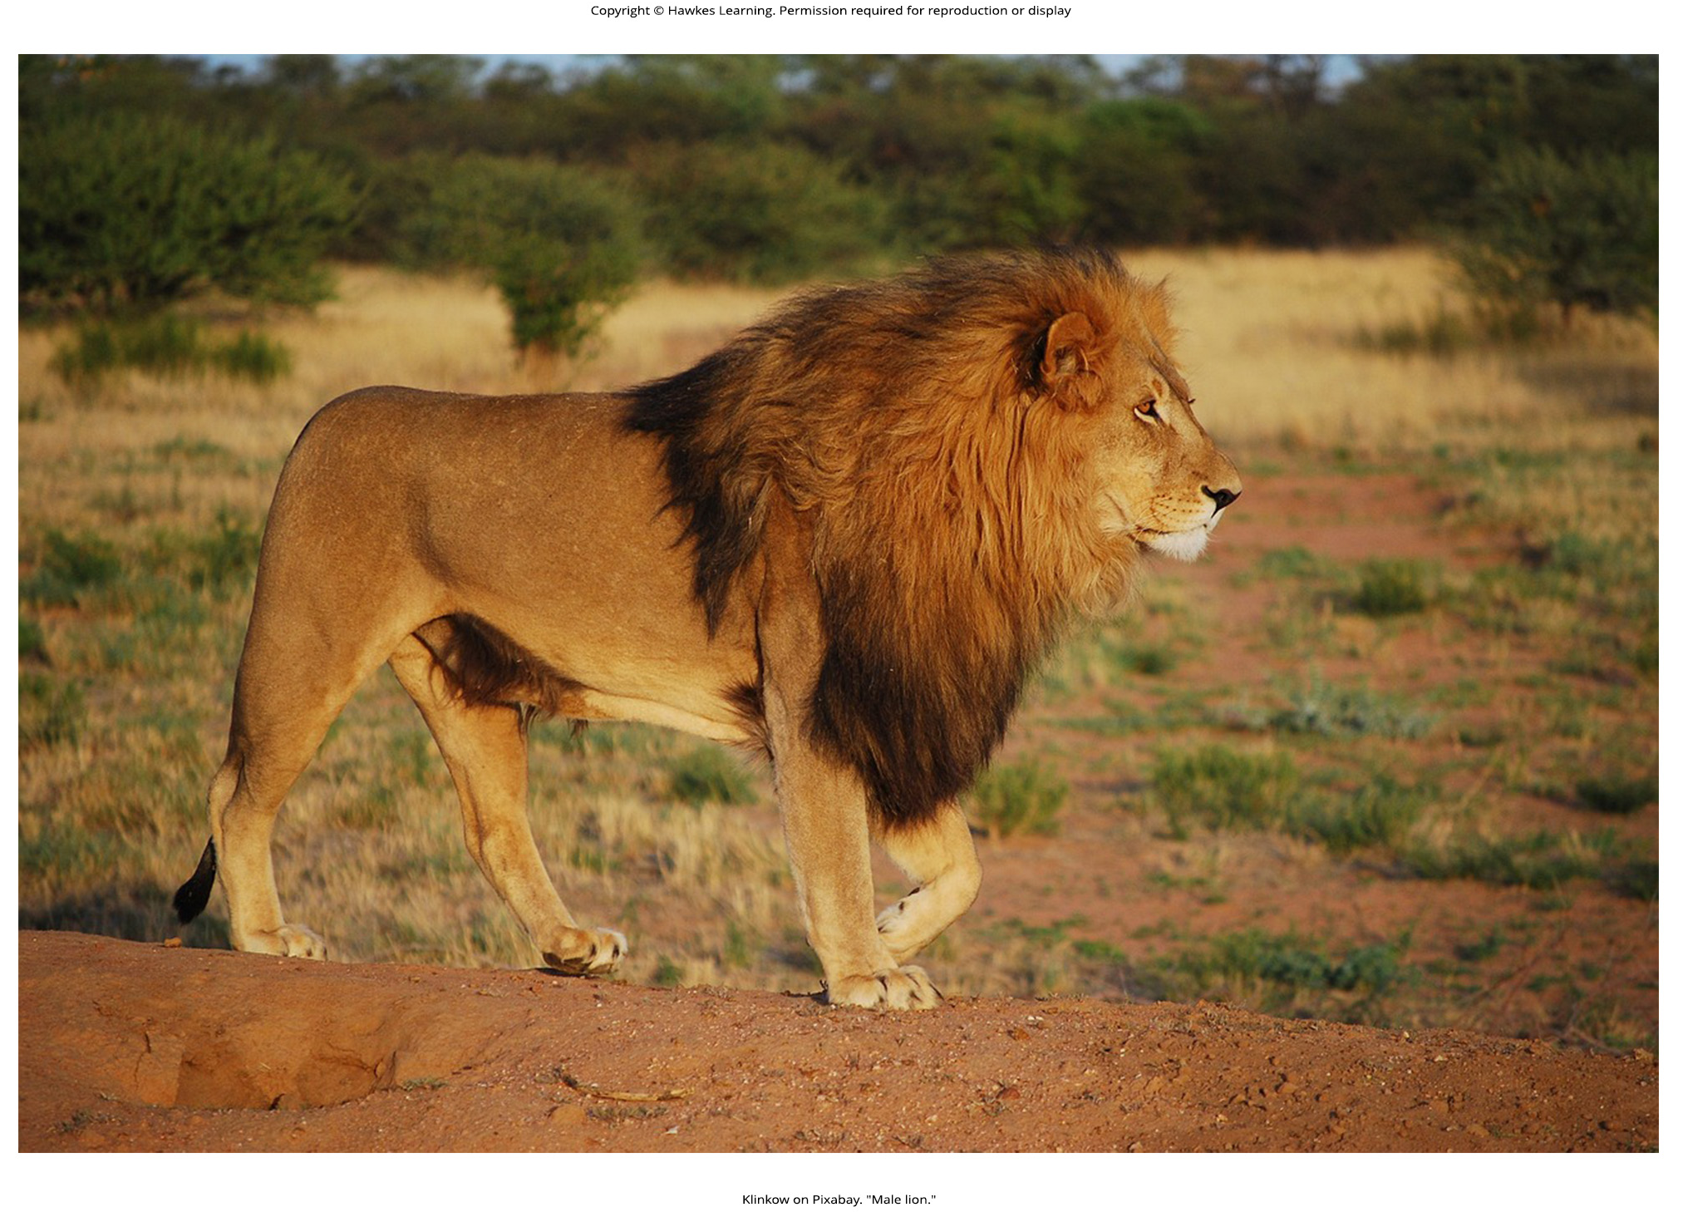
Lesson 19.3 Figure 4

Slide 18
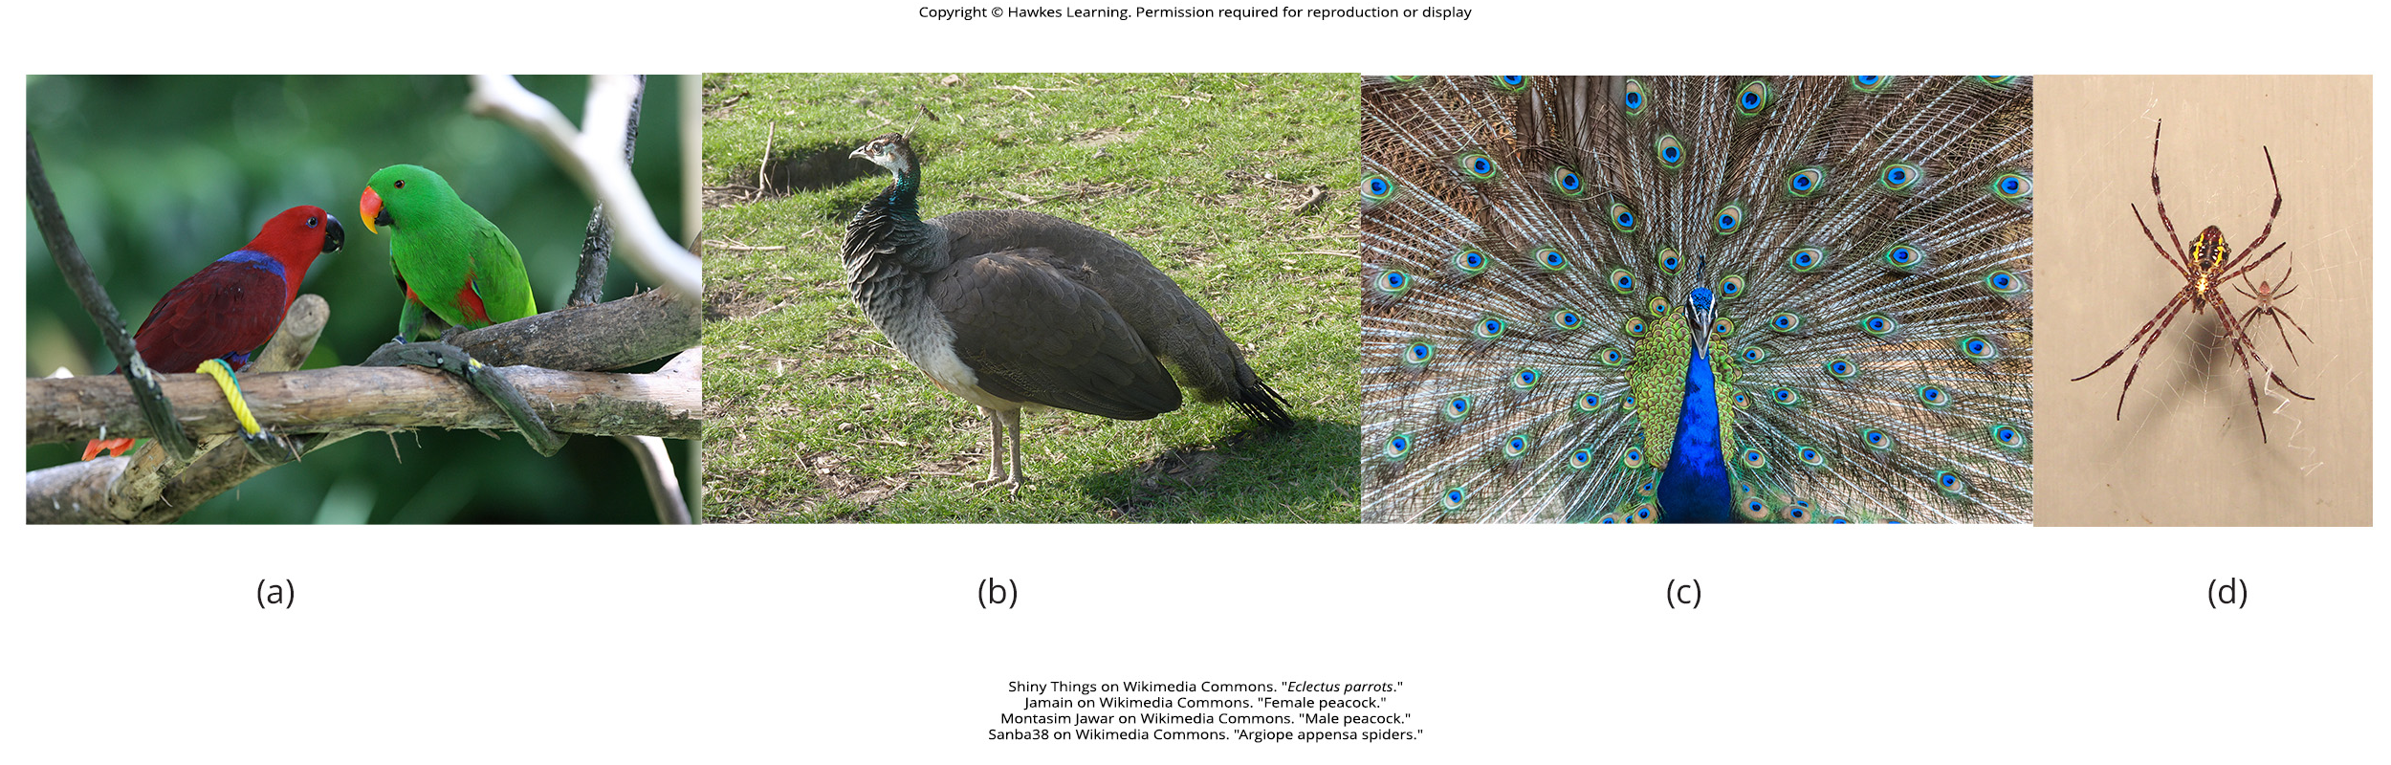
Lesson 19.3 Figure 5

Slide 19
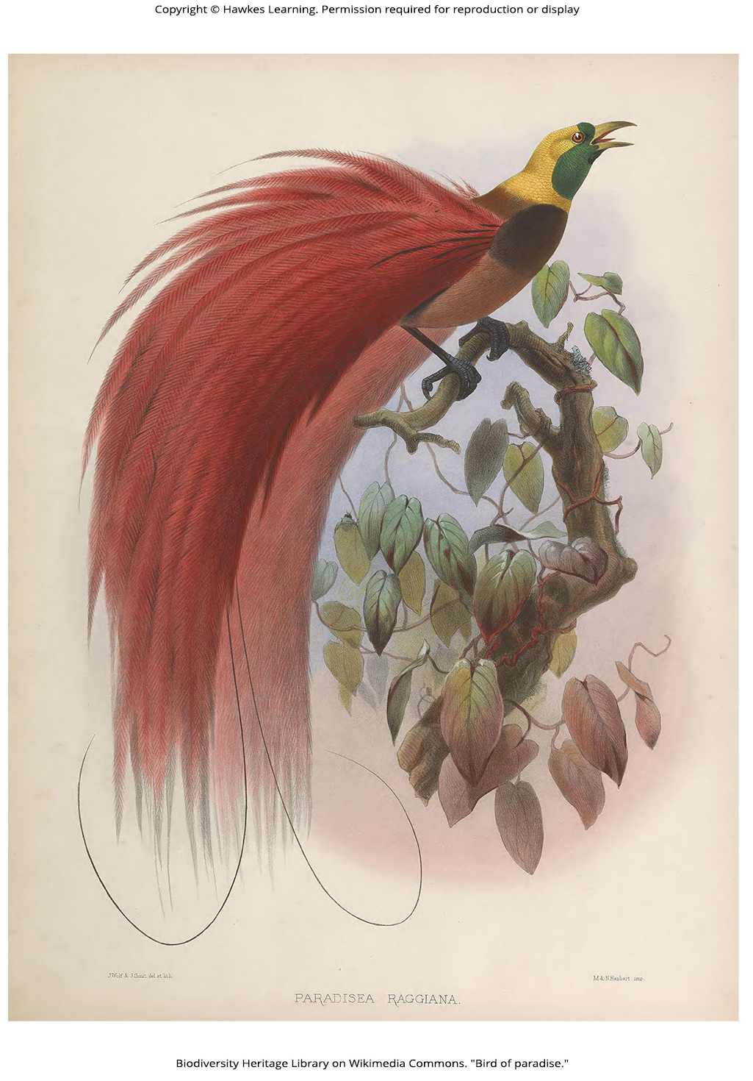
Lesson 19.3 Figure 6

Slide 20
Hawkes Learning – End of PowerPoint

