Slide 1
Chapter 2
Basic Chemistry for Biology

Slide 2
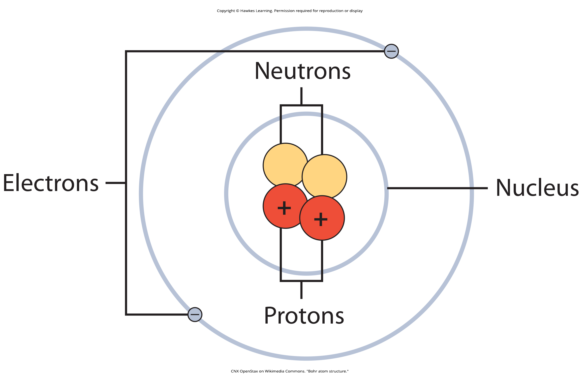
Lesson 2.1 Figure 1

Slide 3
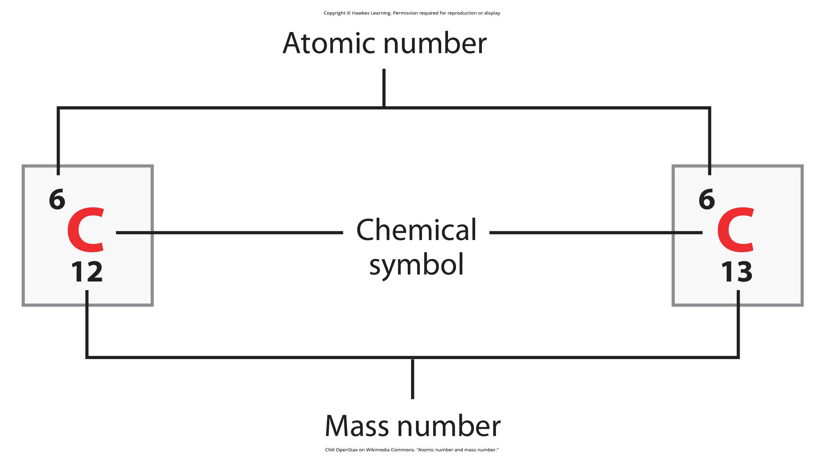
Lesson 2.1 Figure 2

Slide 4
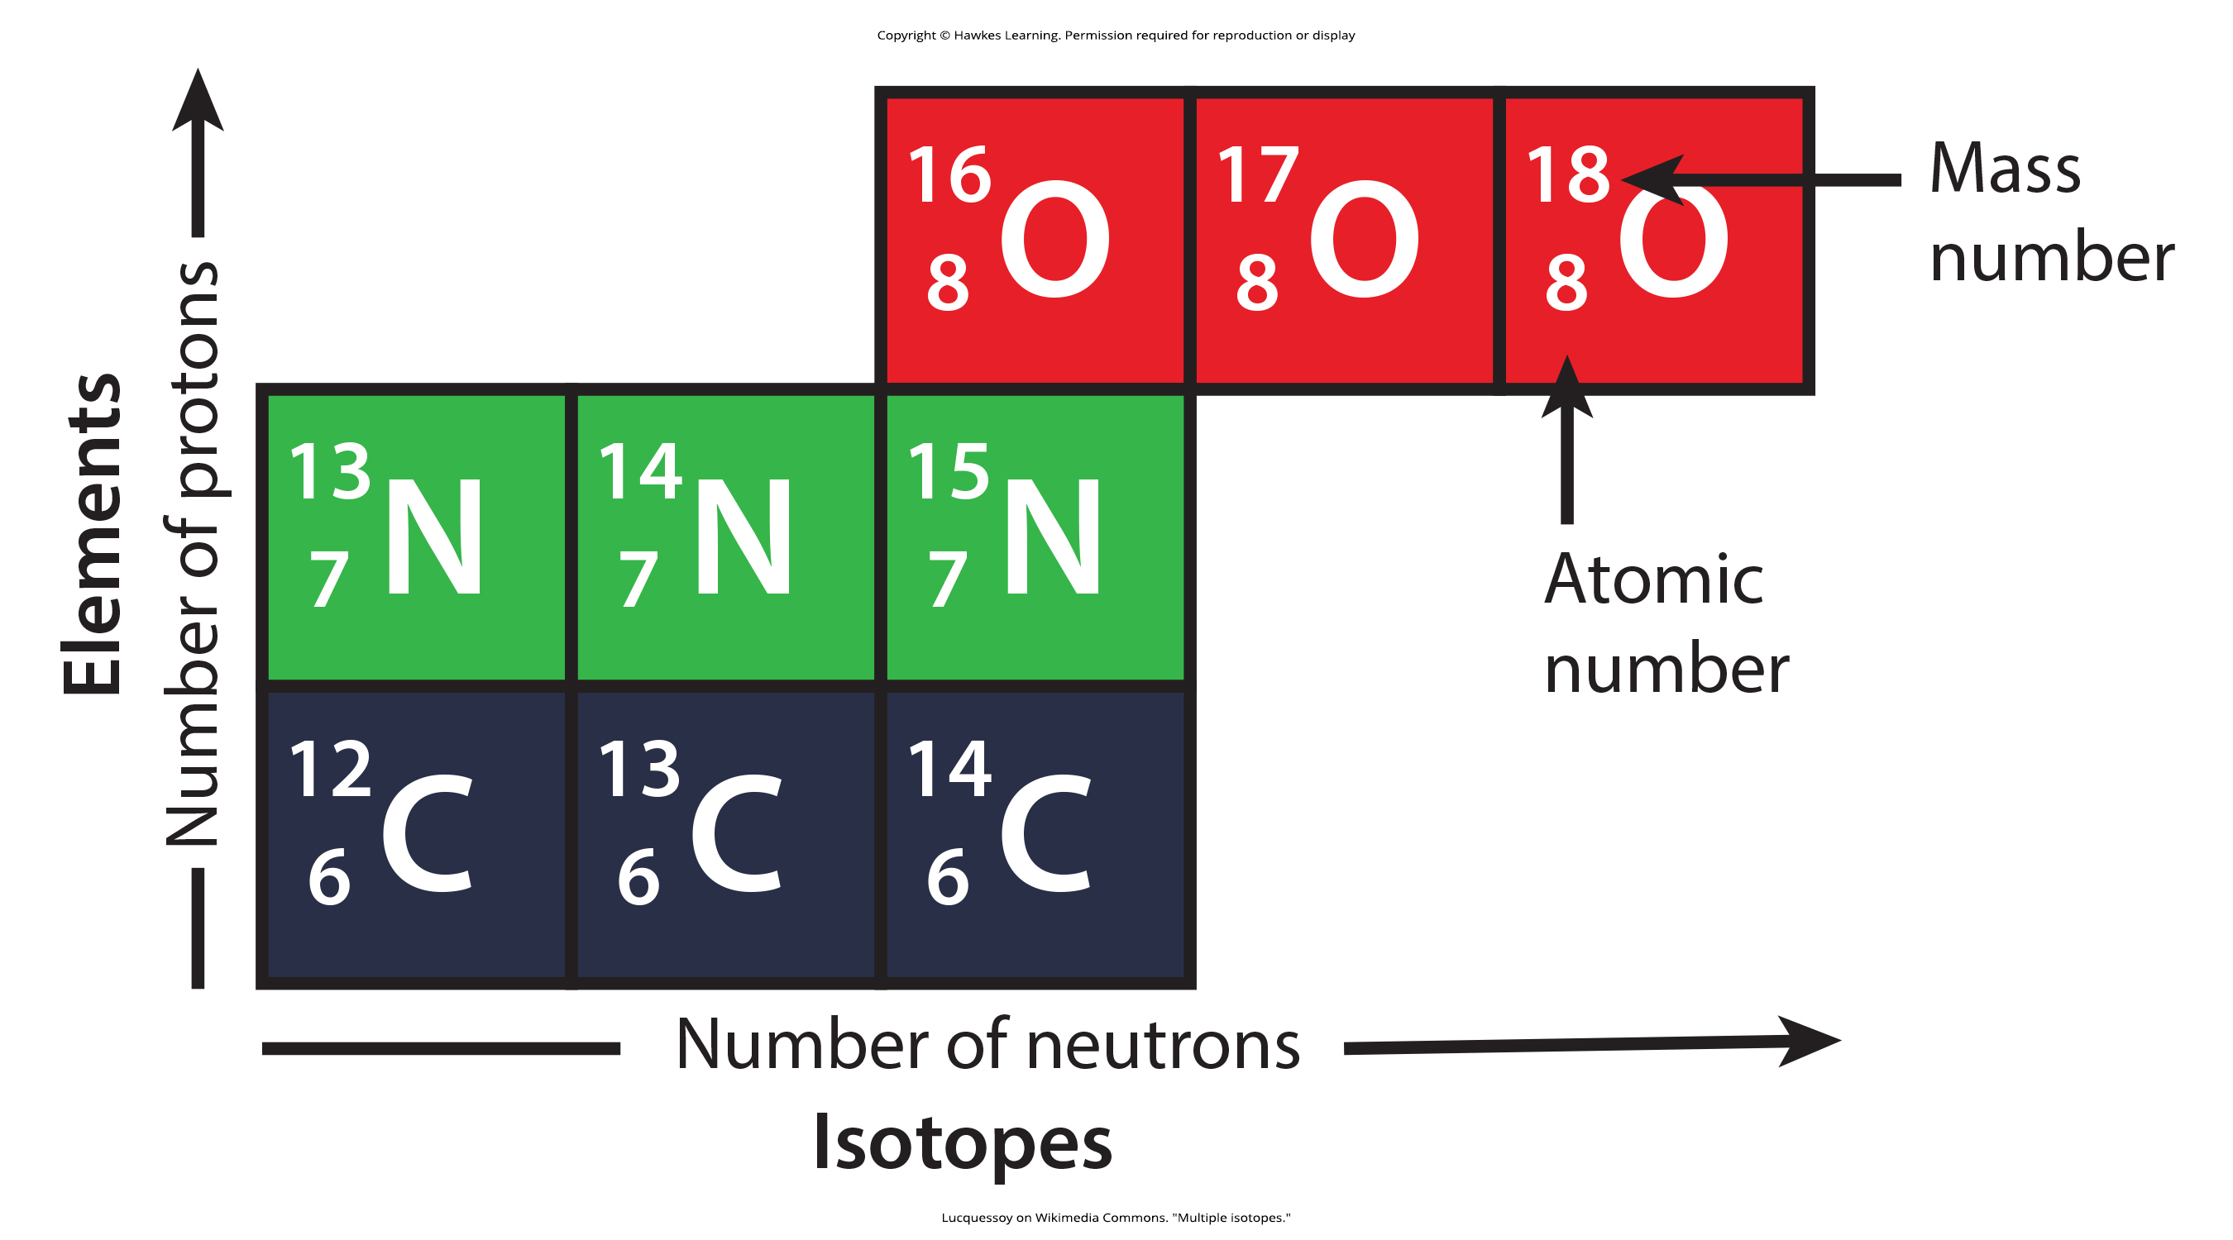
Lesson 2.1 Figure 3

Slide 5
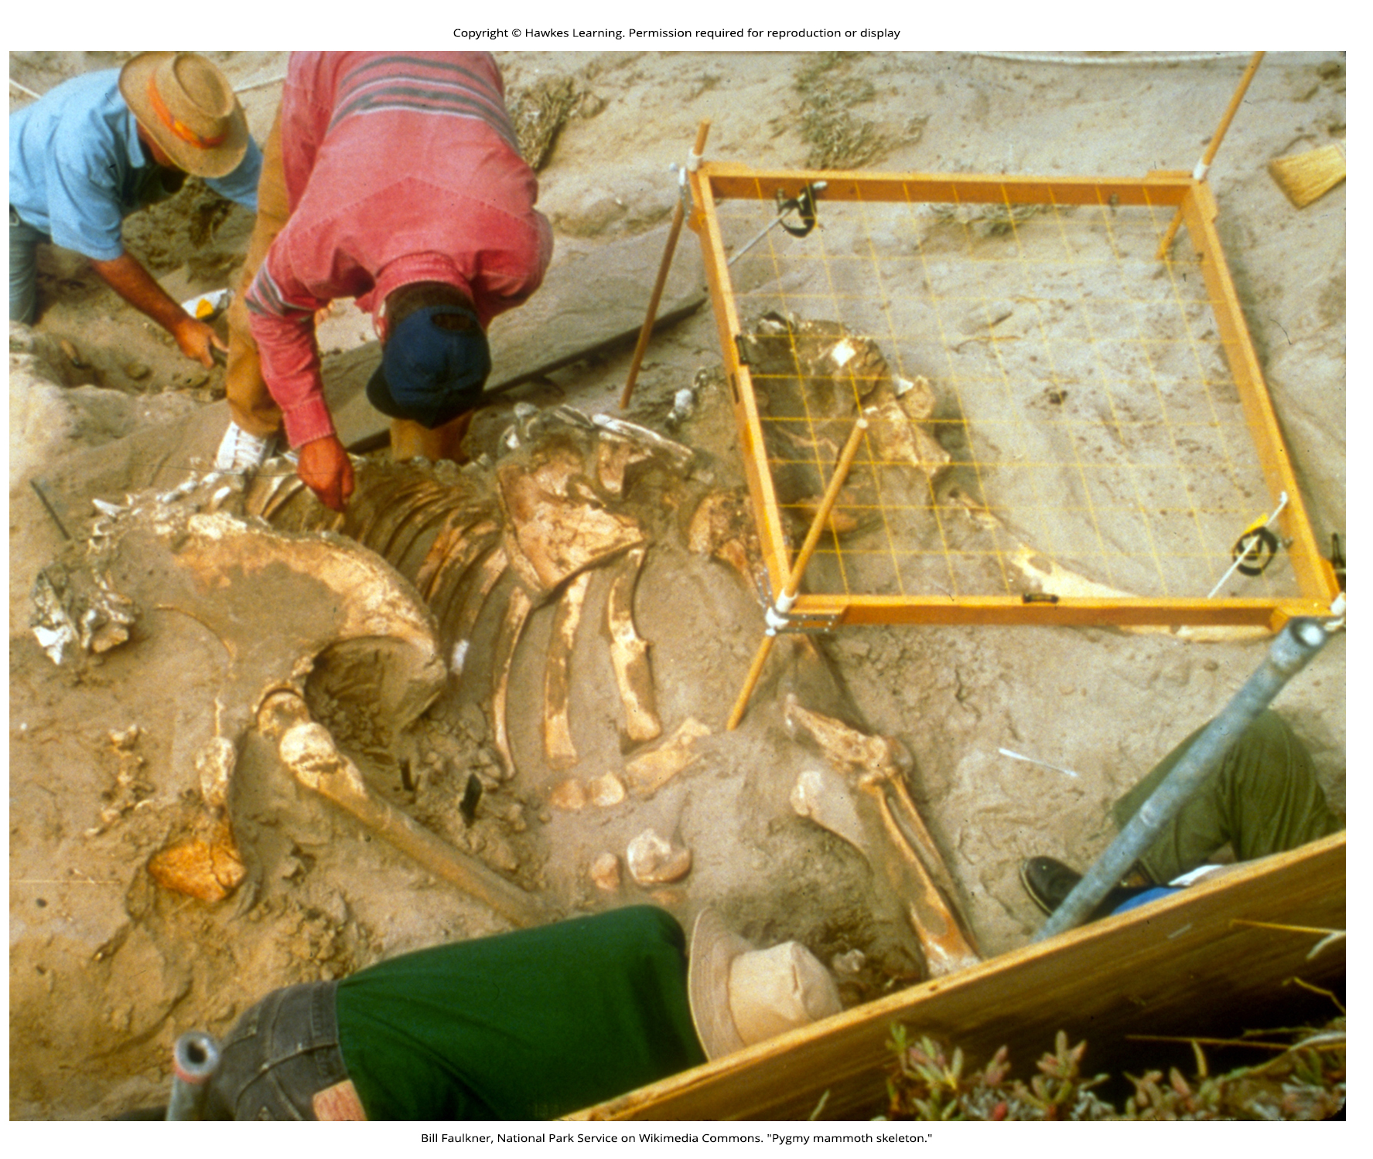
Lesson 2.1 Figure 4

Slide 6
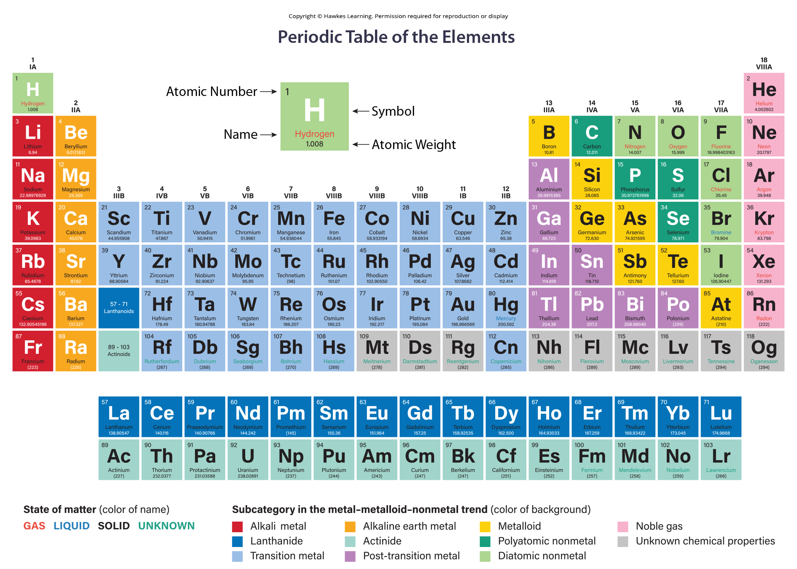
Lesson 2.1 Figure 5

Slide 7
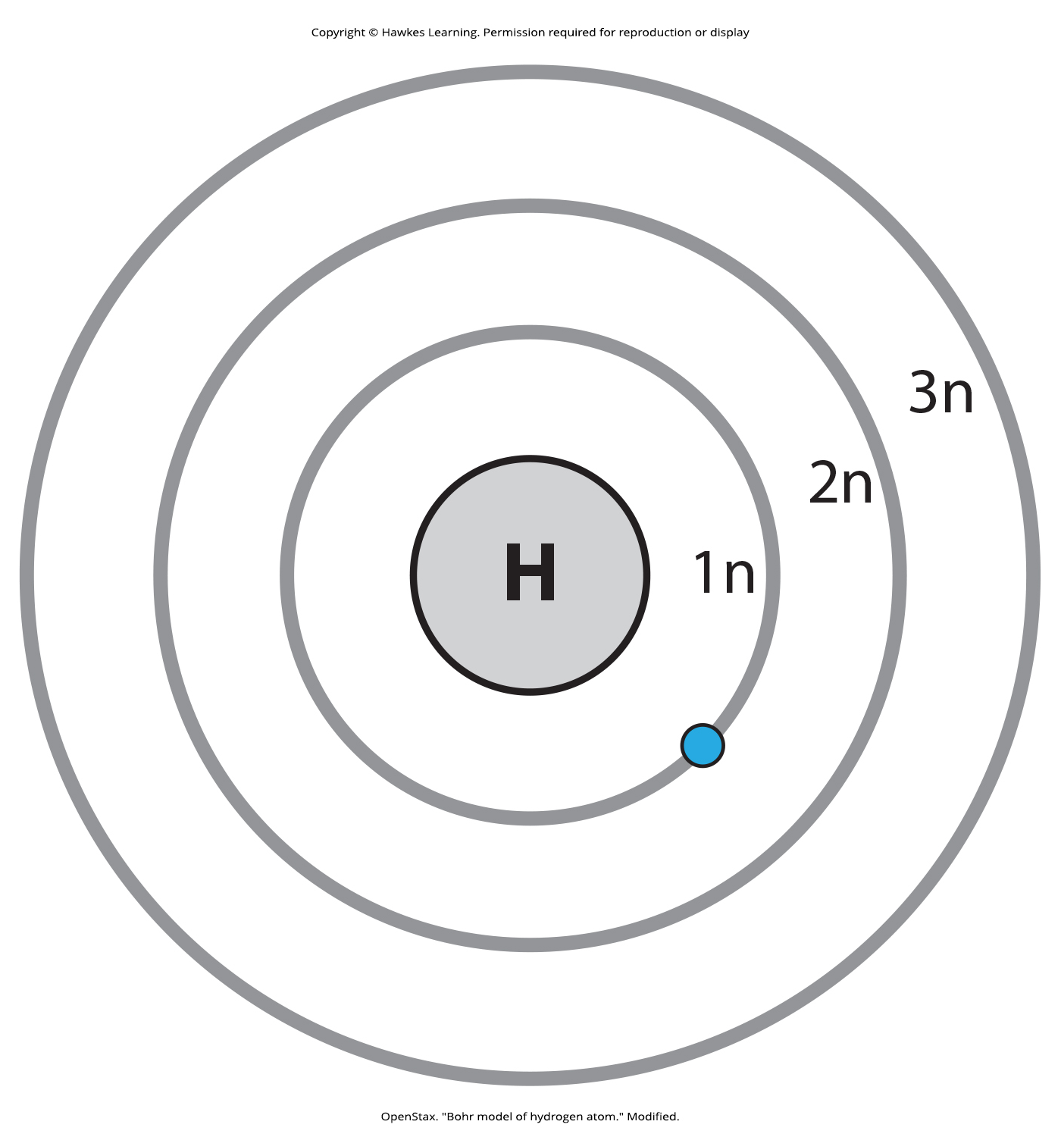
Lesson 2.1 Figure 6

Slide 8
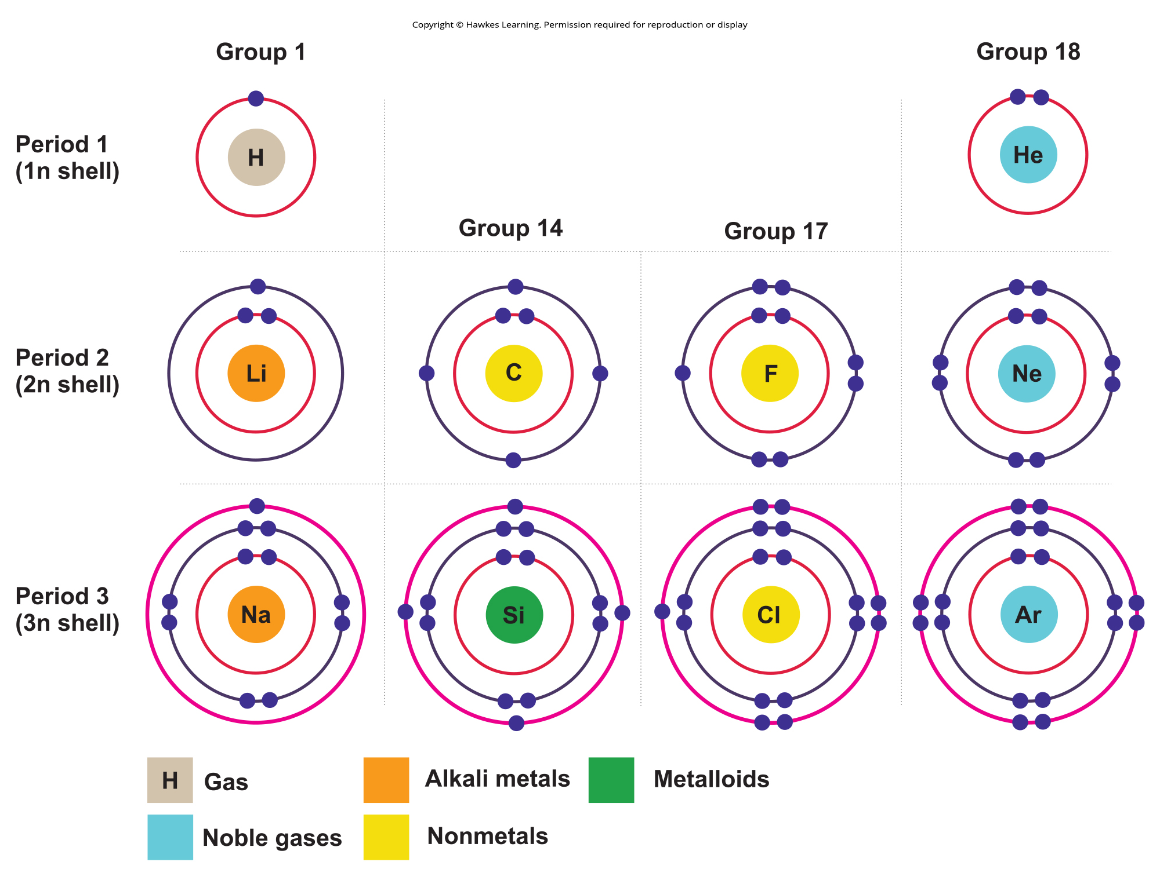
Lesson 2.1 Figure 7

Slide 9
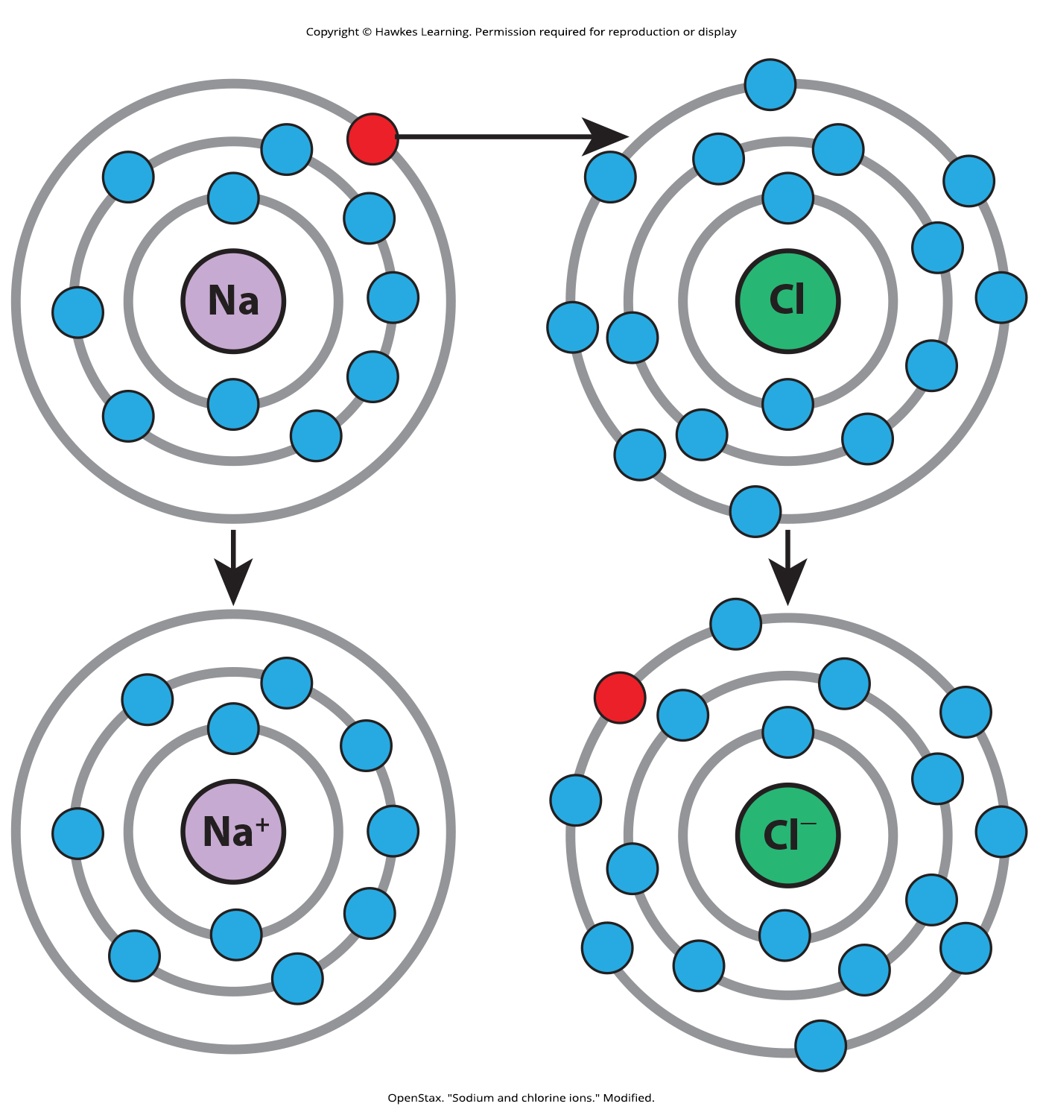
Lesson 2.1 Figure 8

Slide 10
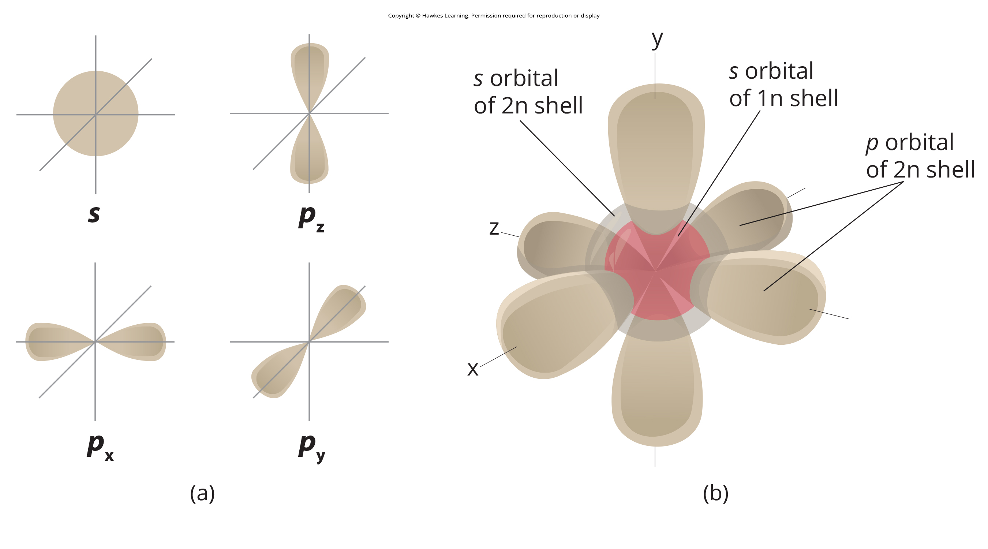
Lesson 2.1 Figure 9

Slide 11
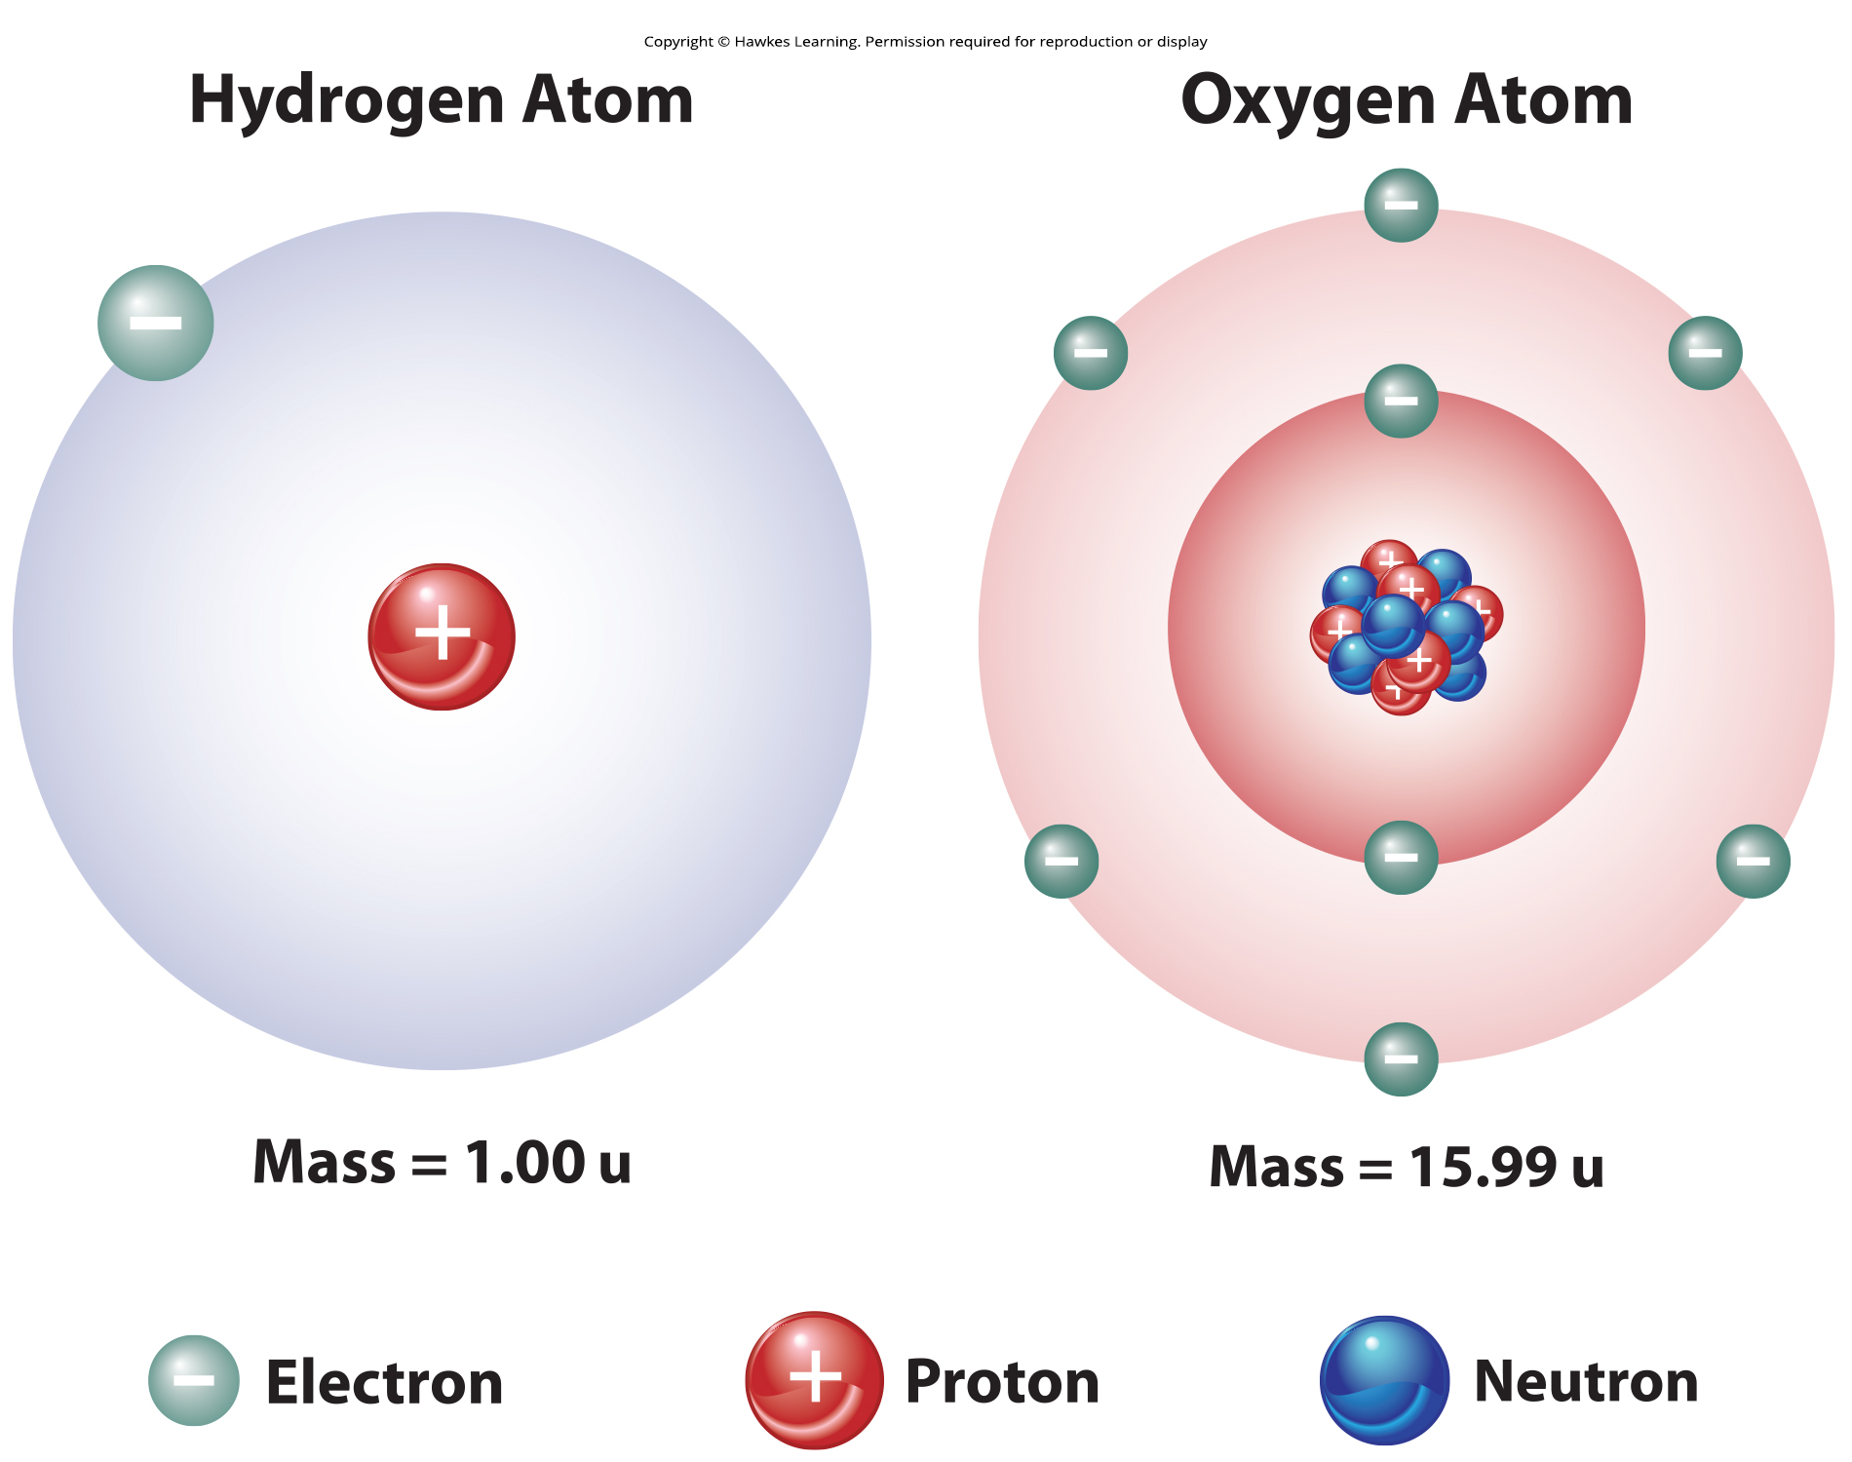
Lesson 2.1 Figure 10

Slide 12
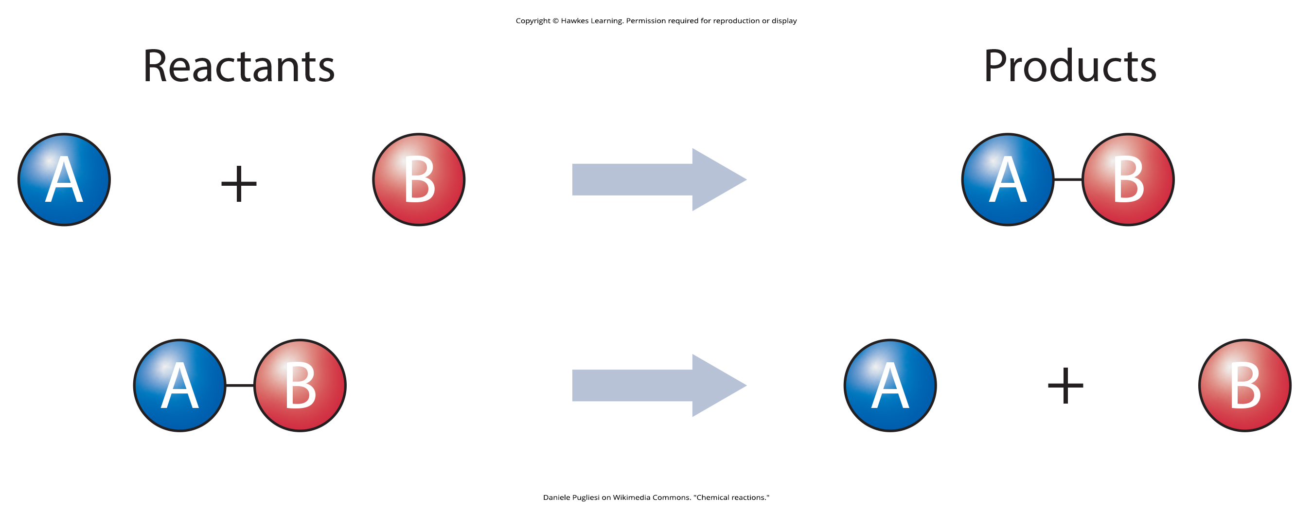
Lesson 2.1 Figure 11

Slide 13
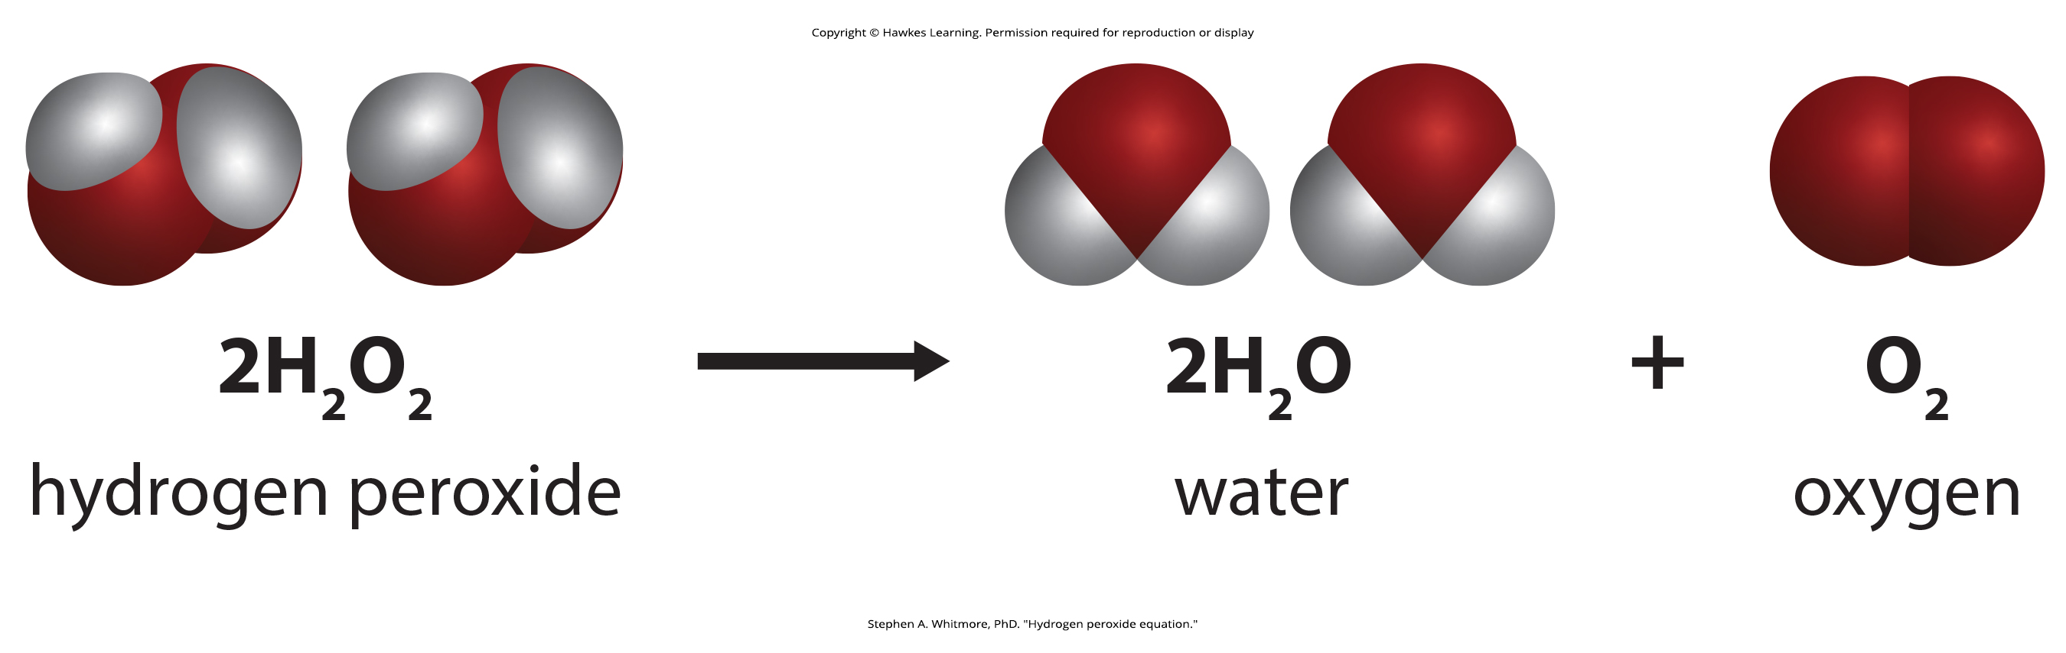
Lesson 2.1 Figure 12

Slide 14
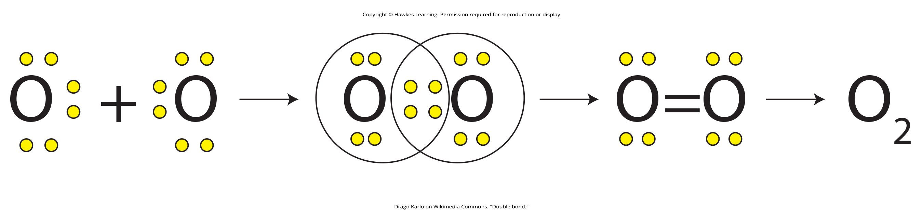
Lesson 2.1 Figure 13

Slide 15
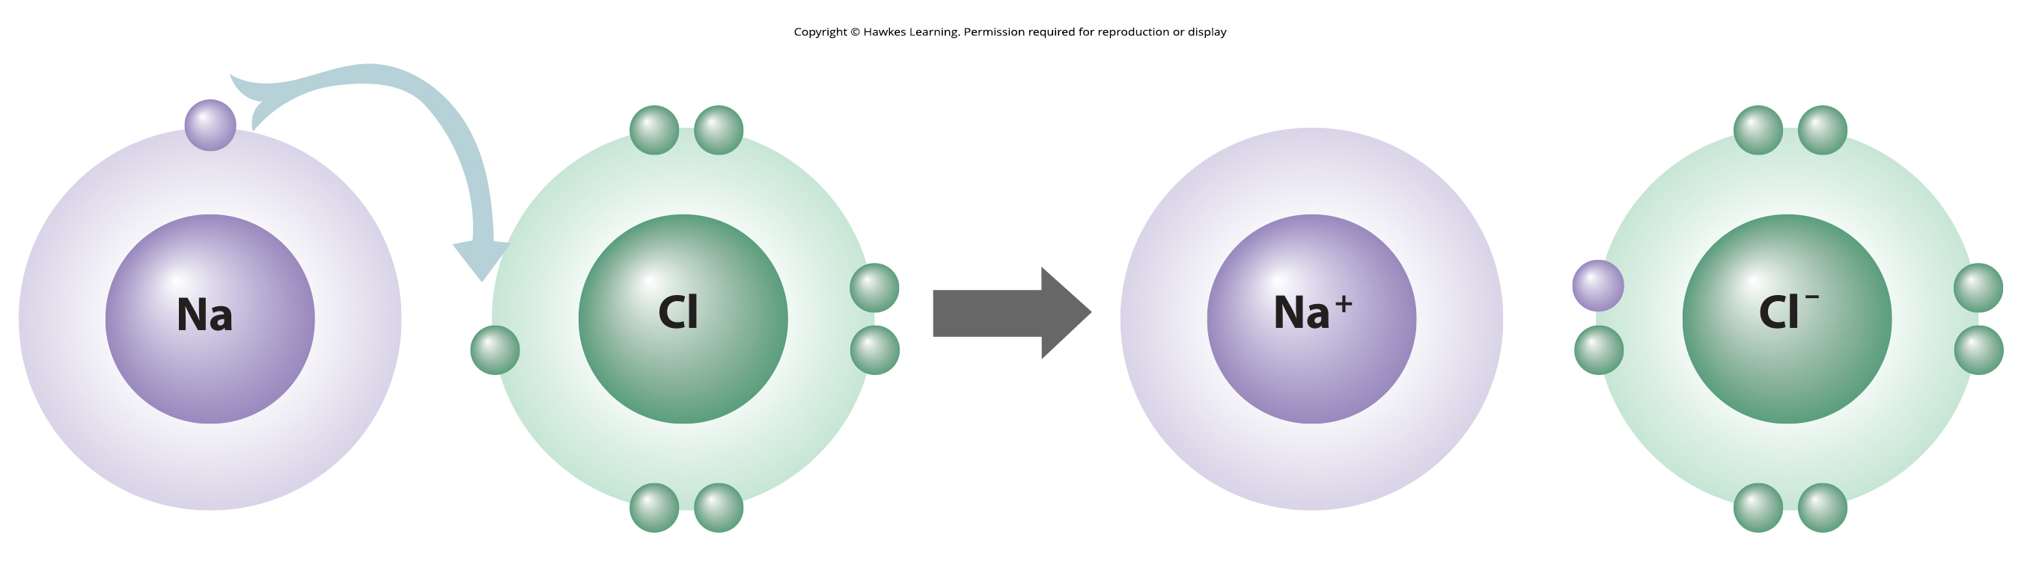
Lesson 2.1 Figure 14

Slide 16
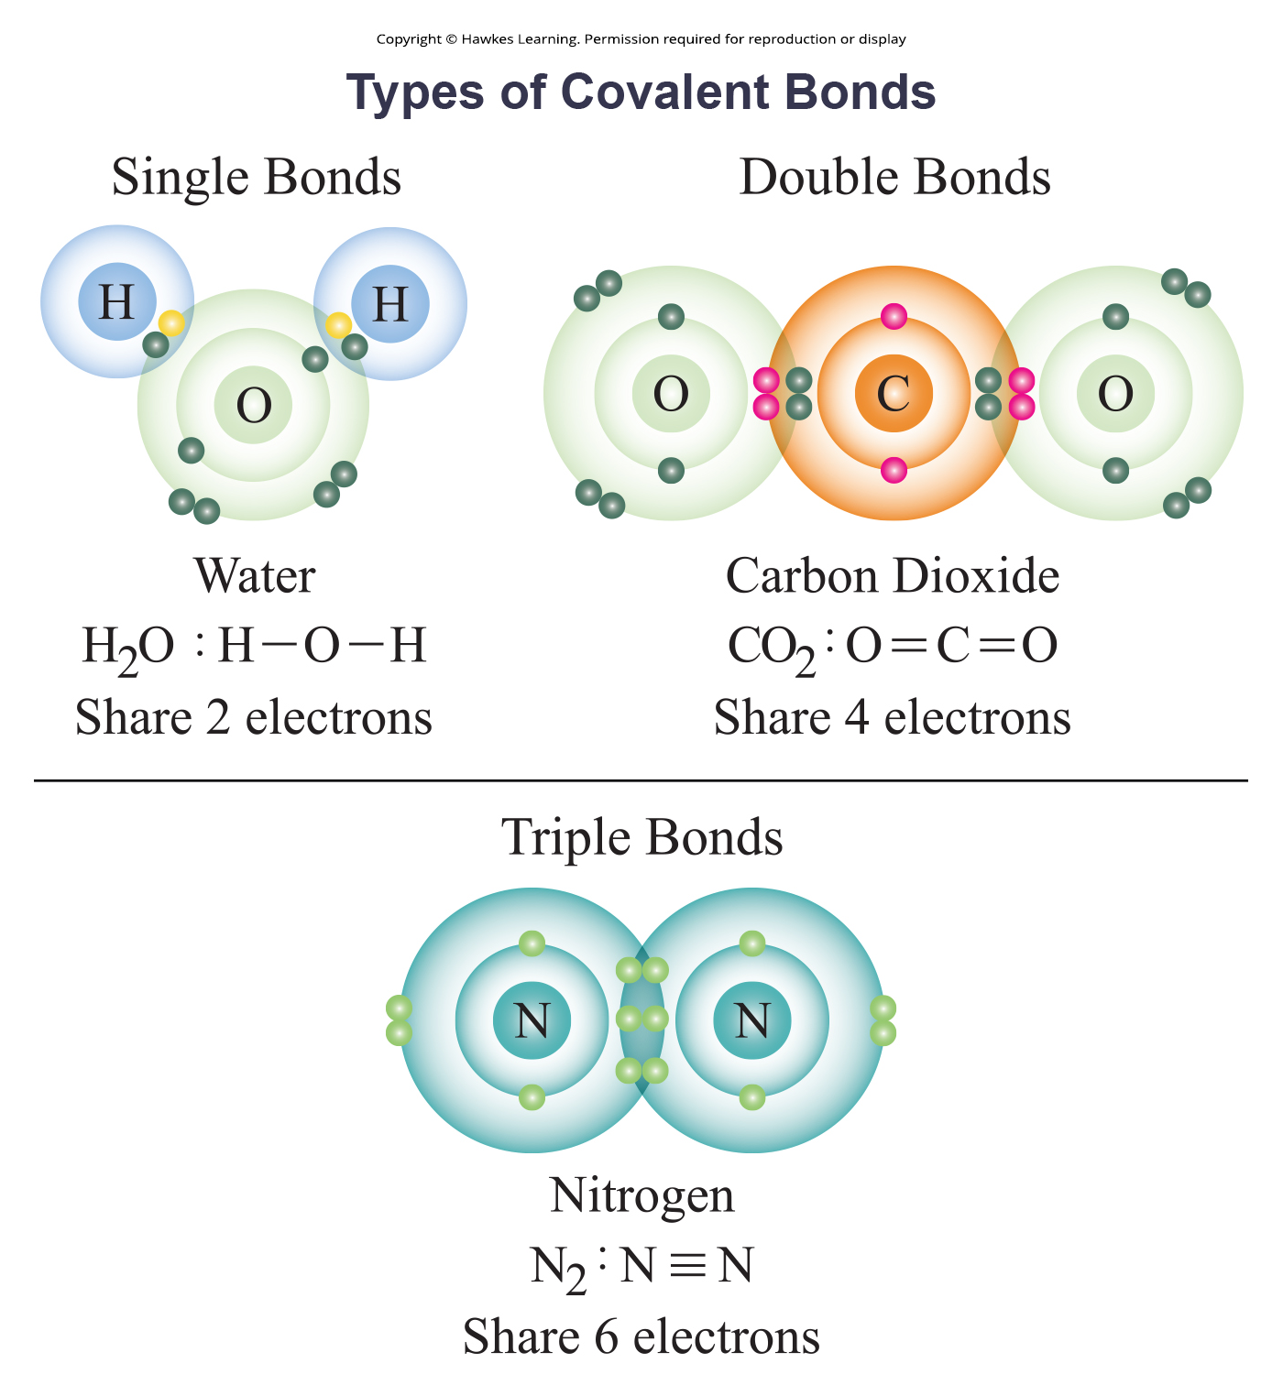
Lesson 2.1 Figure 15

Slide 17
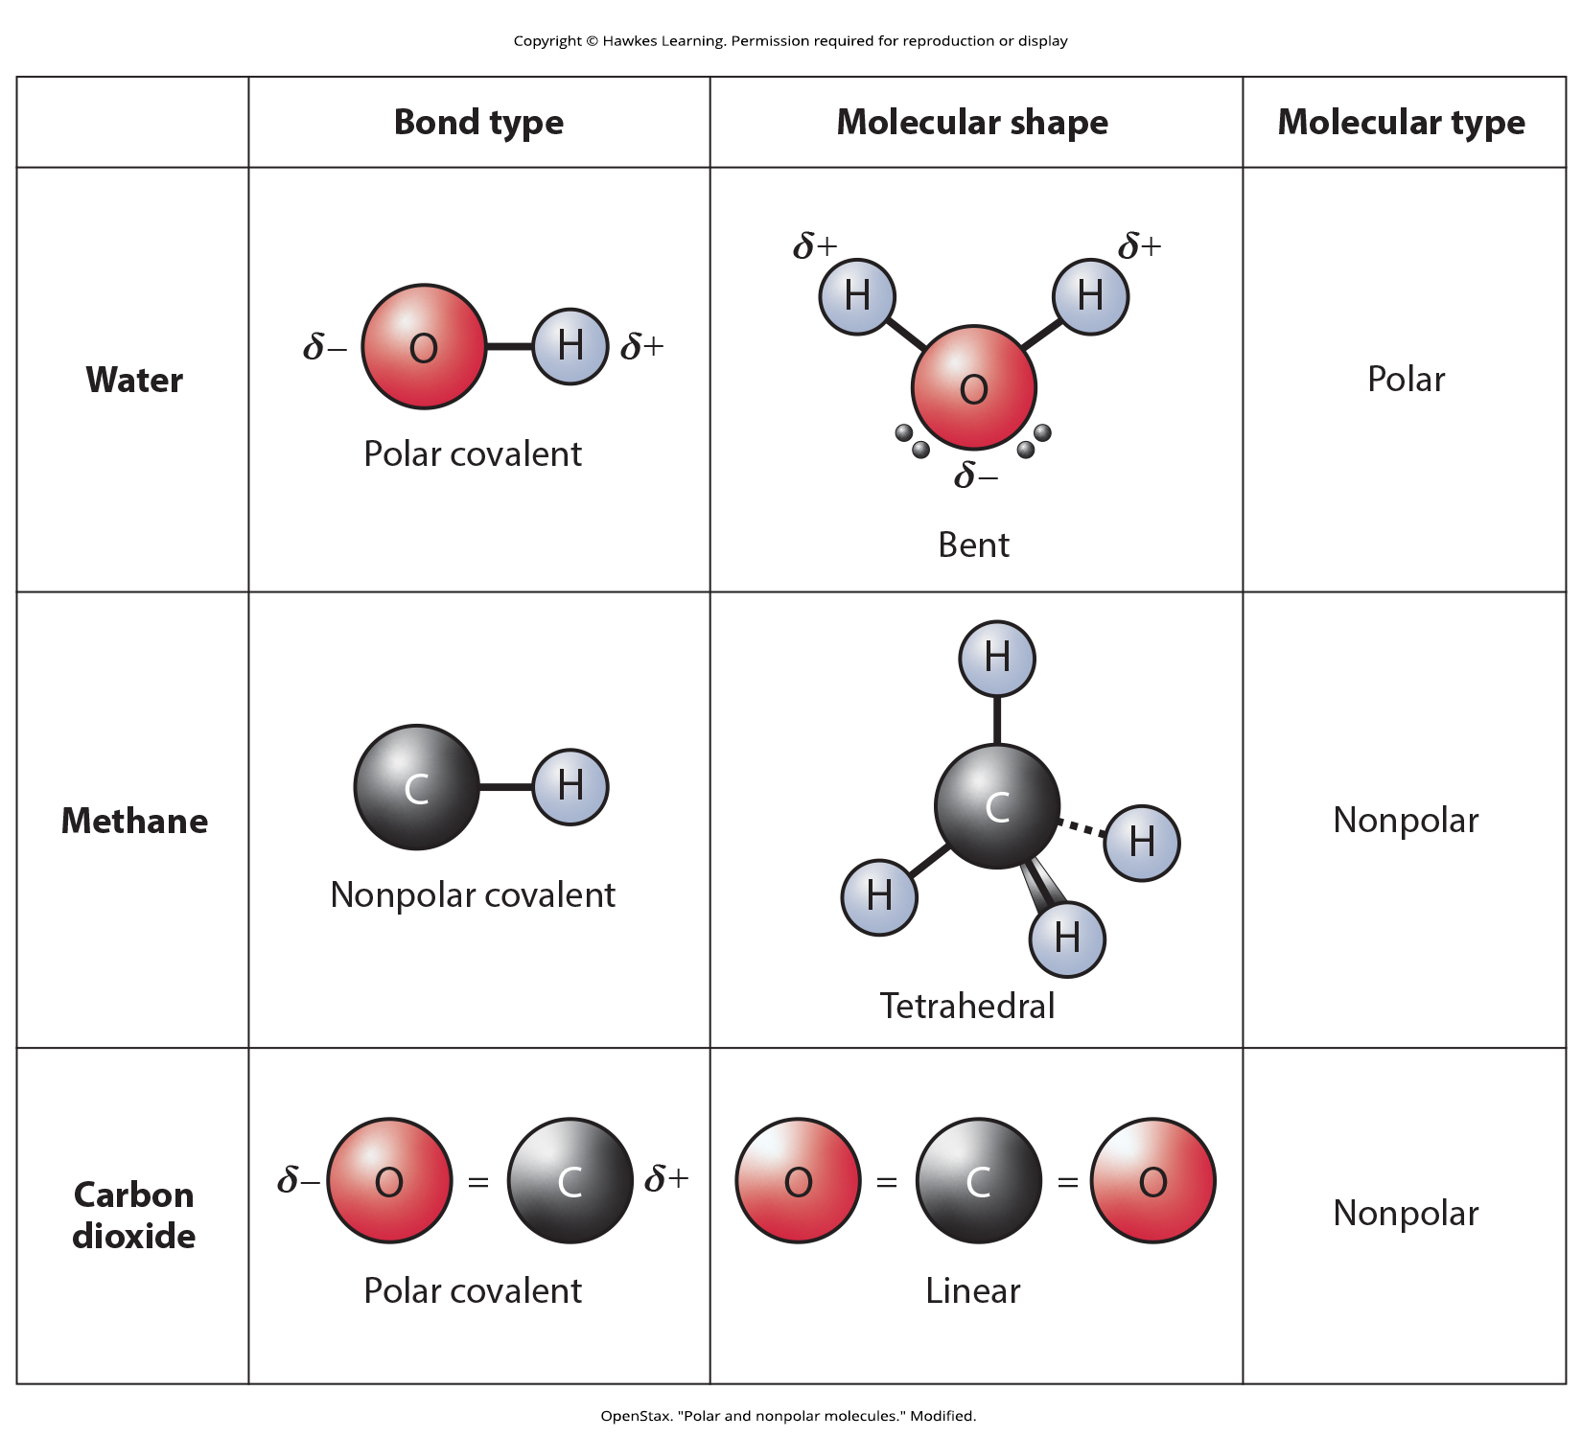
Lesson 2.1 Figure 16

Slide 18
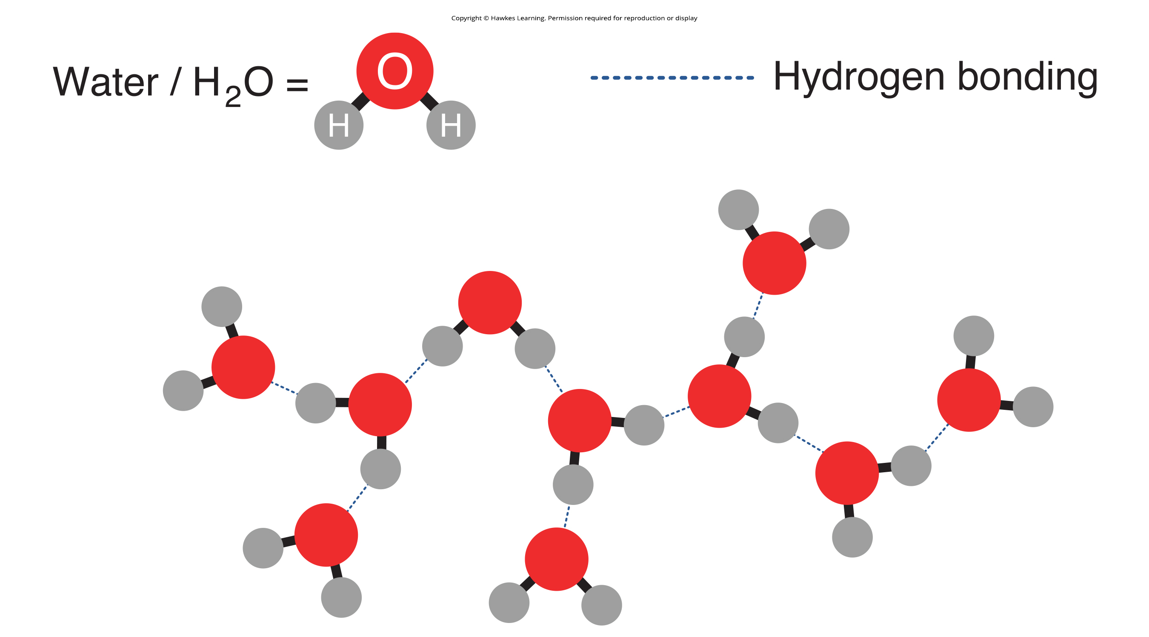
Lesson 2.1 Figure 17

Slide 19
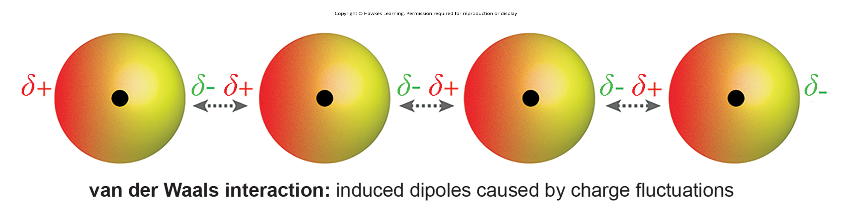
Lesson 2.1 Figure 18

Slide 20
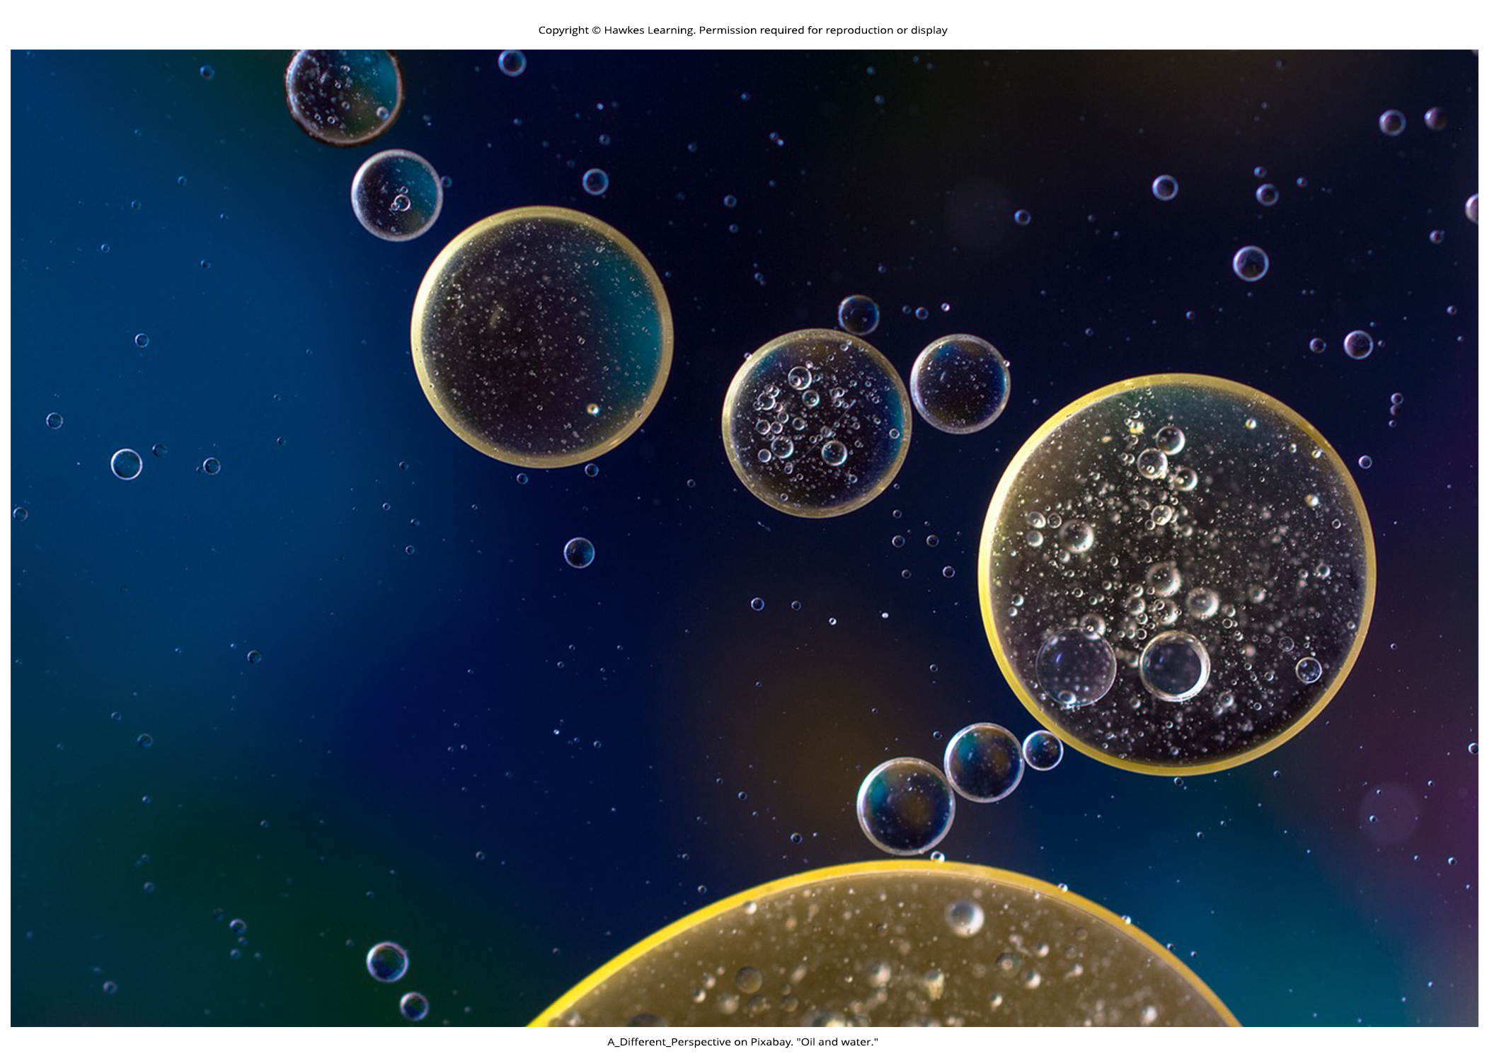
Lesson 2.2 Figure 1

Slide 21
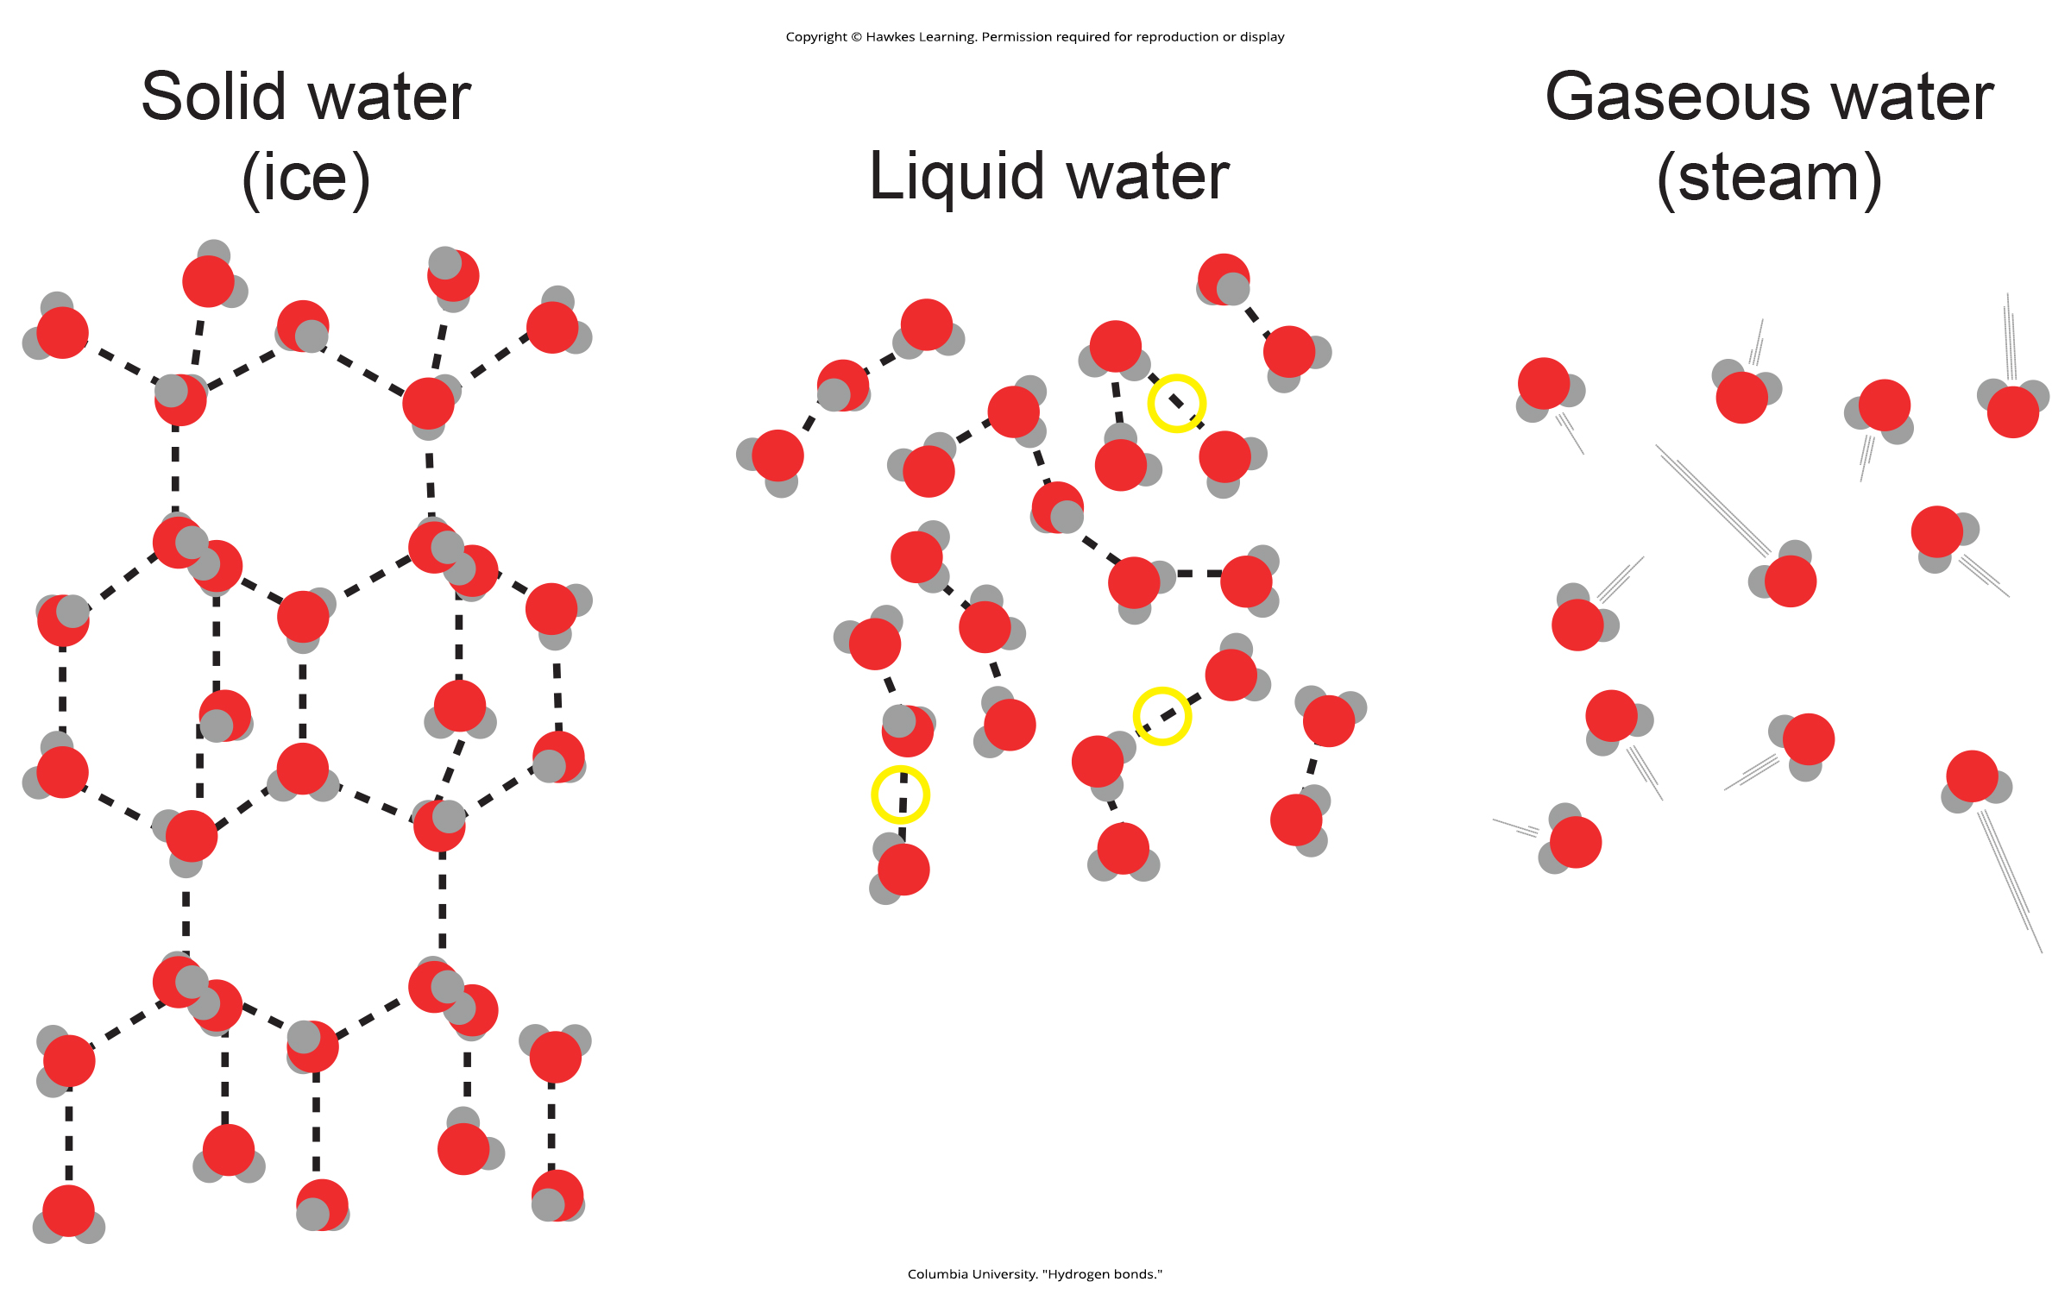
Lesson 2.2 Figure 2

Slide 22
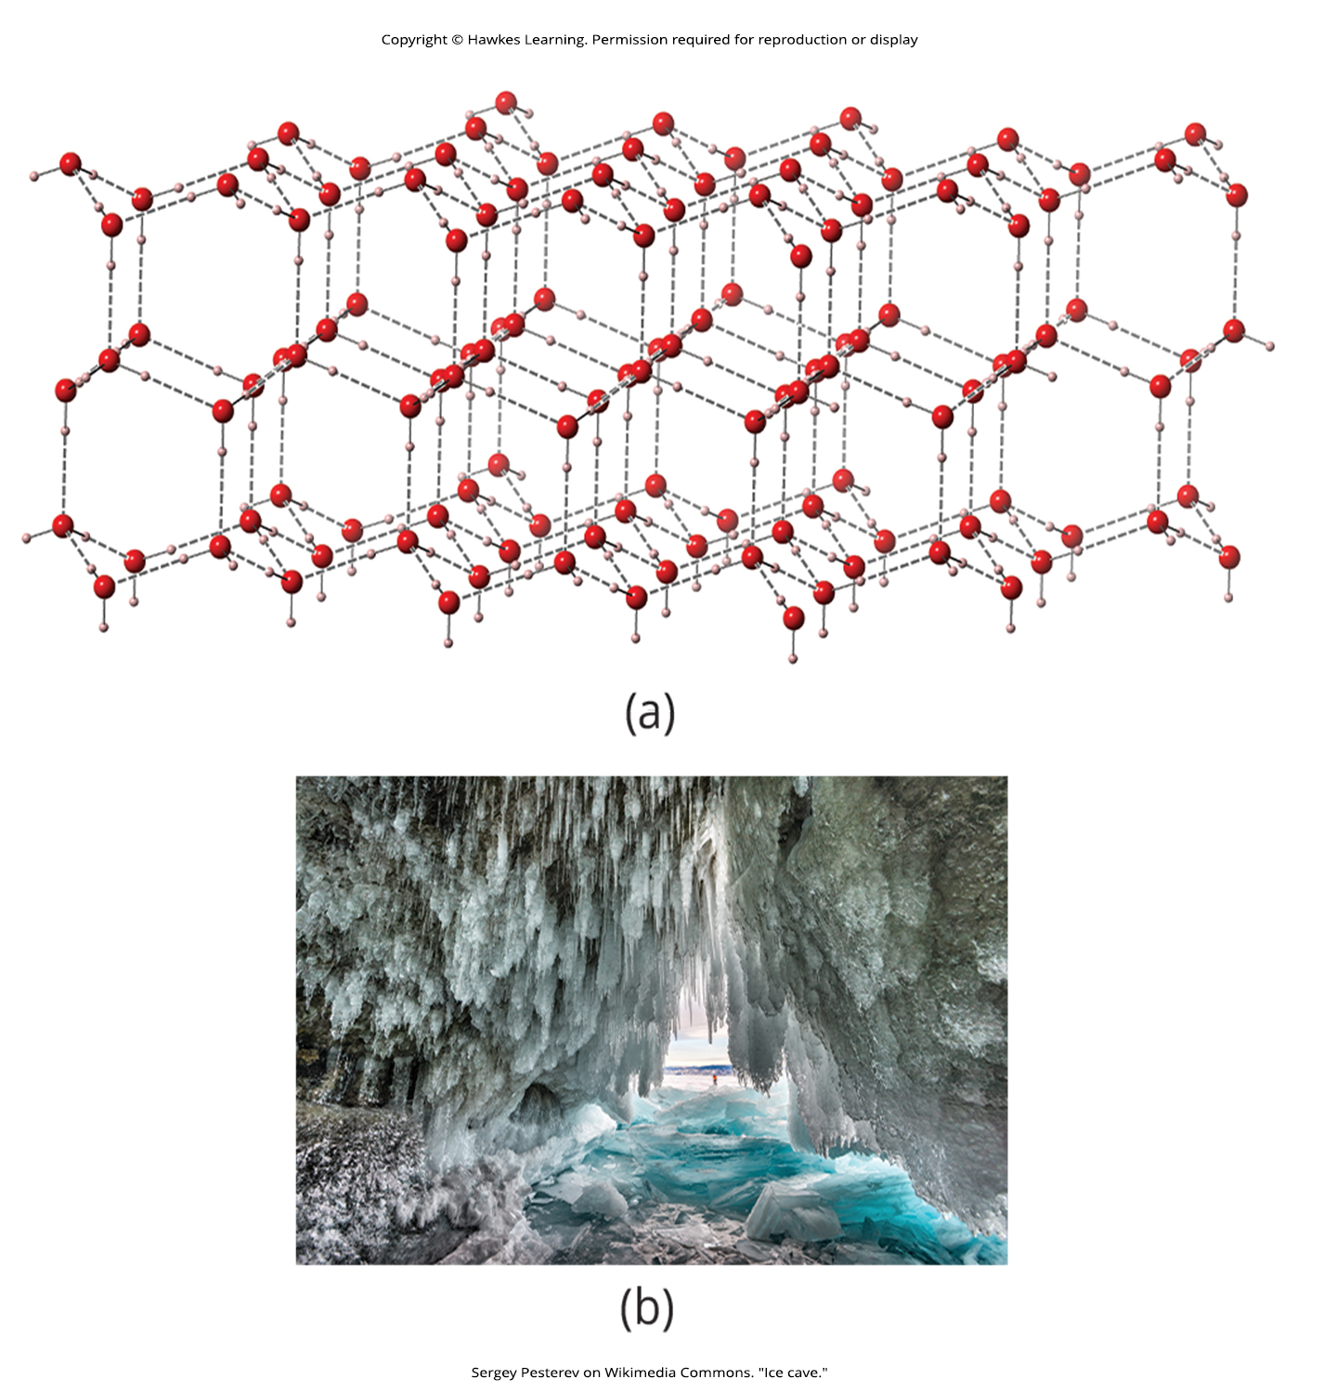
Lesson 2.2 Figure 3

Slide 23
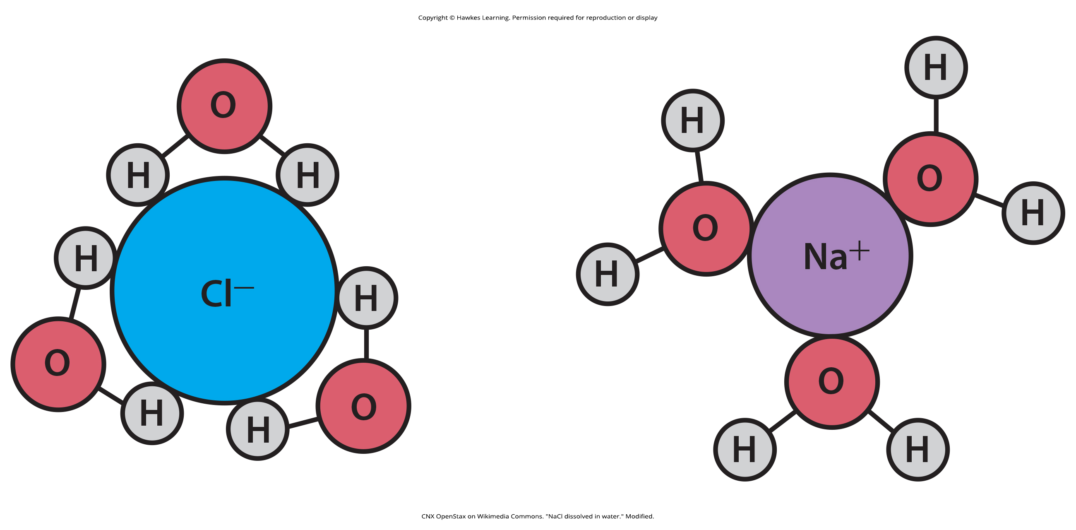
Lesson 2.2 Figure 4

Slide 24
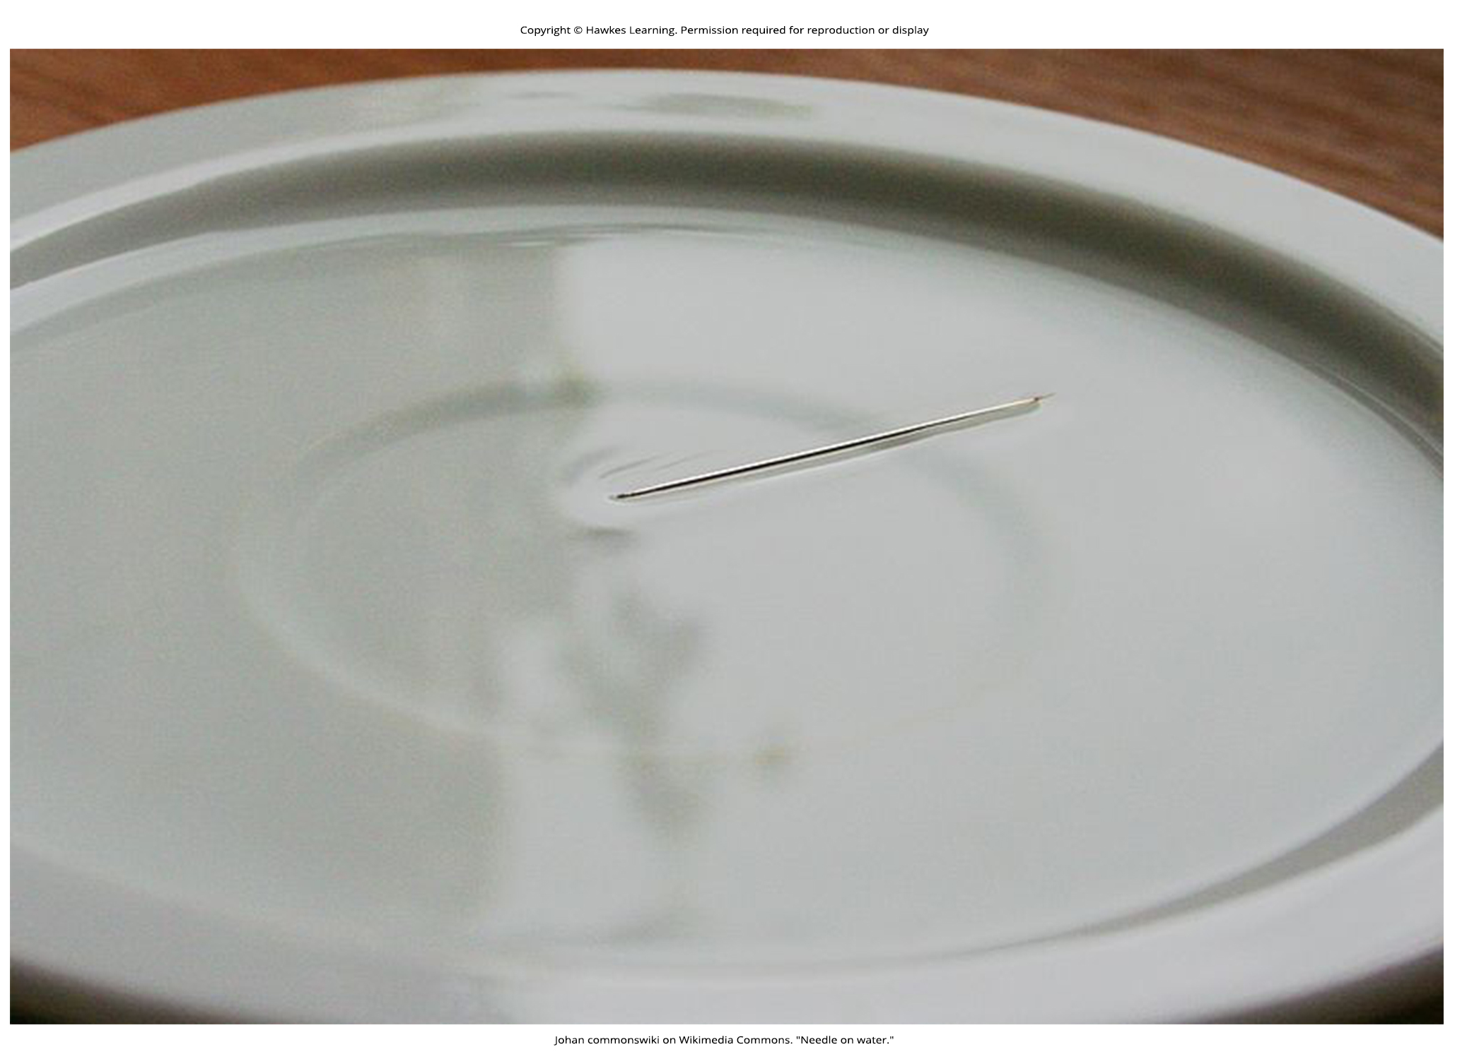
Lesson 2.2 Figure 5

Slide 25
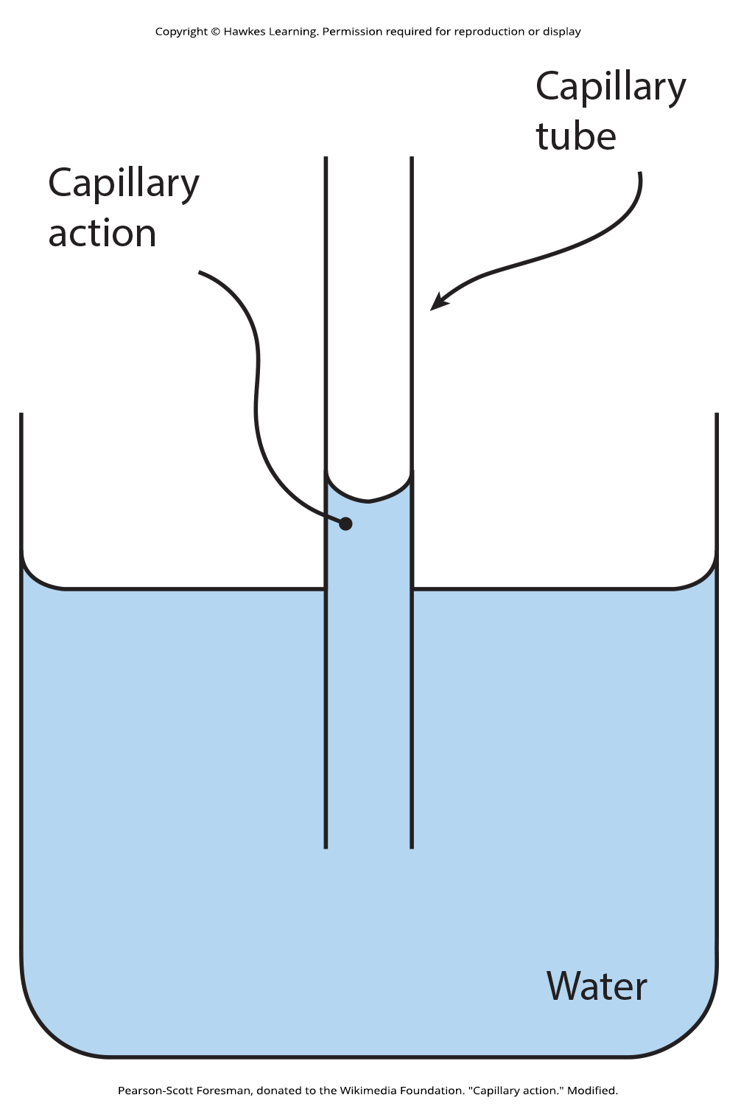
Lesson 2.2 Figure 6

Slide 26
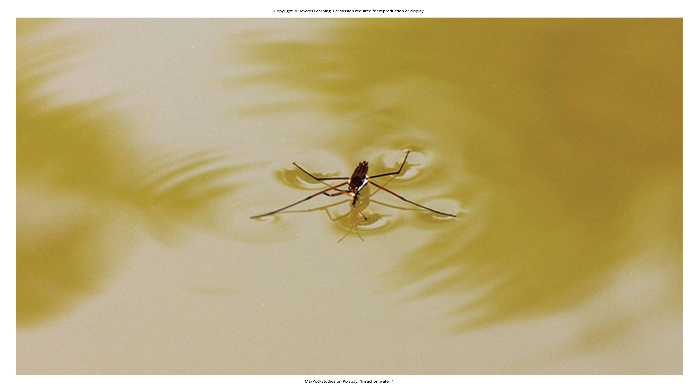
Lesson 2.2 Figure 7

Slide 27
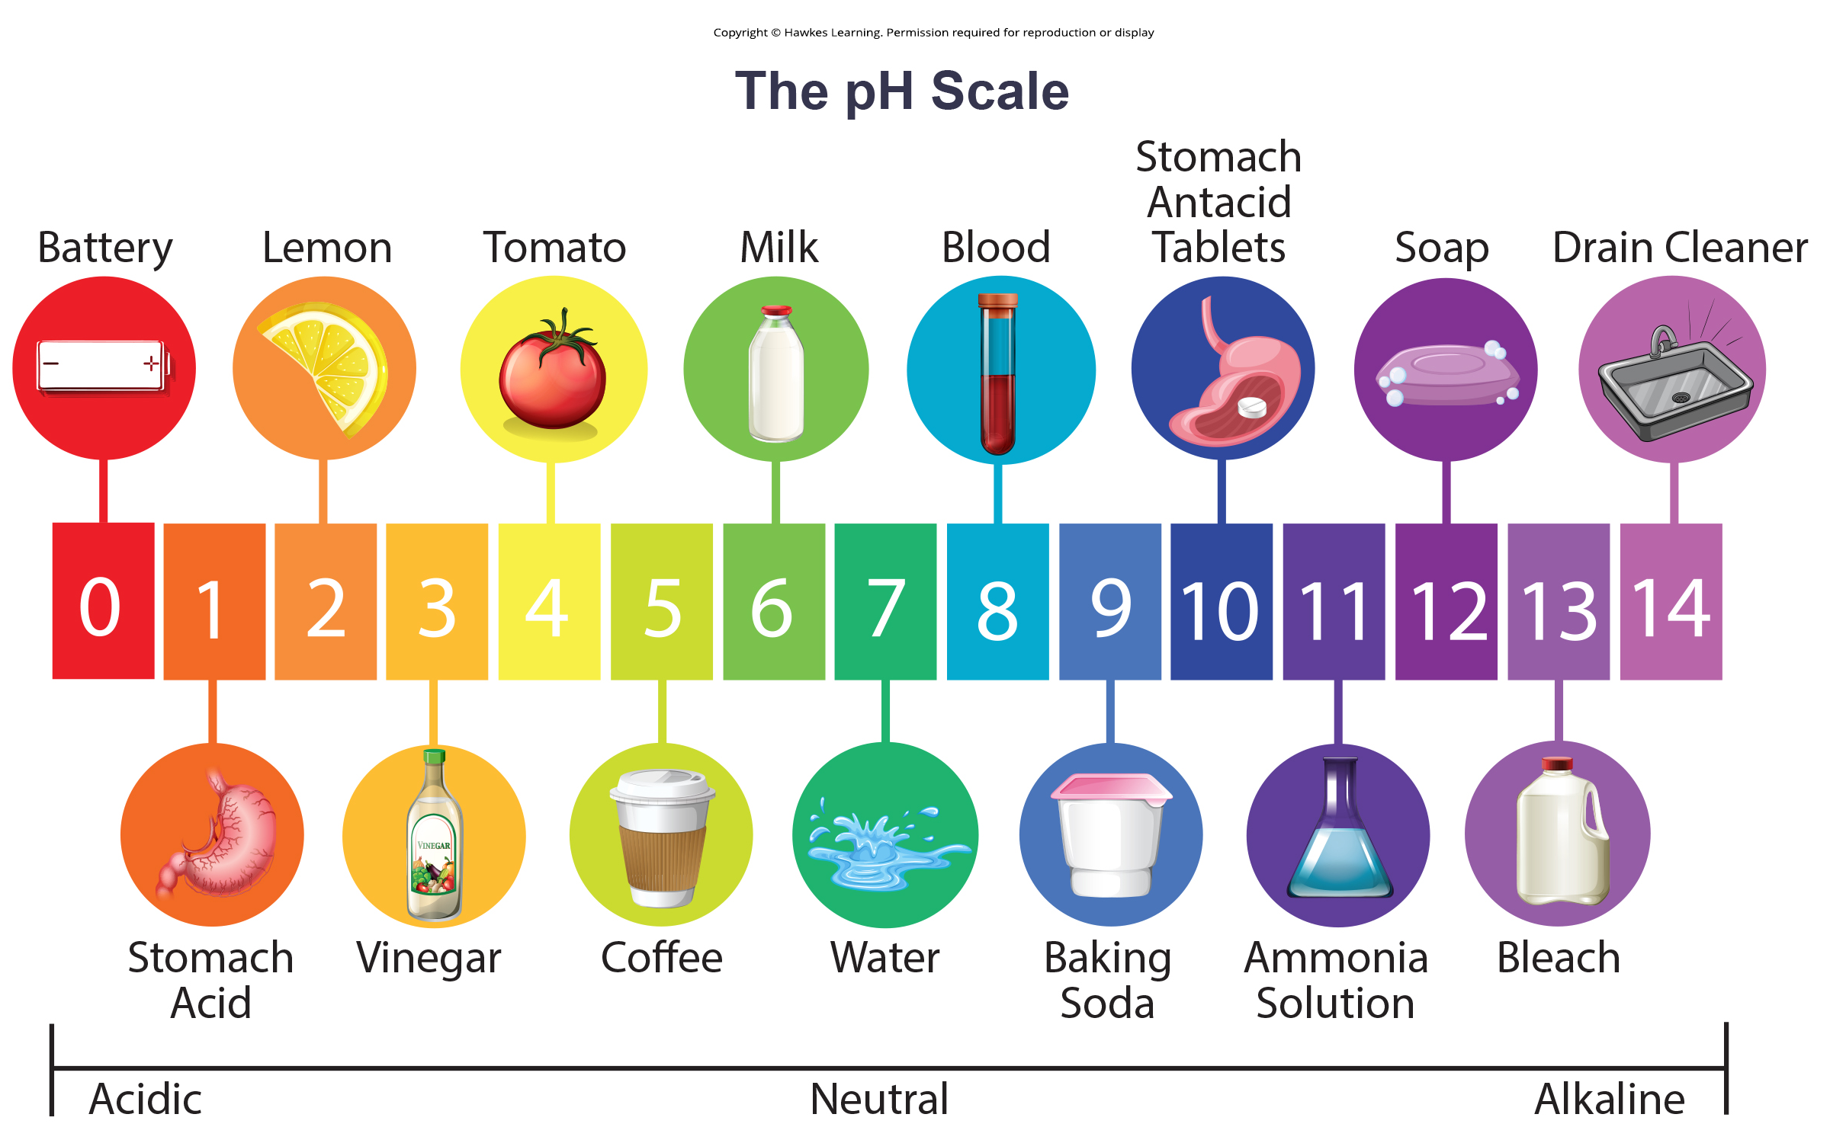
Lesson 2.2 Figure 8

Slide 28
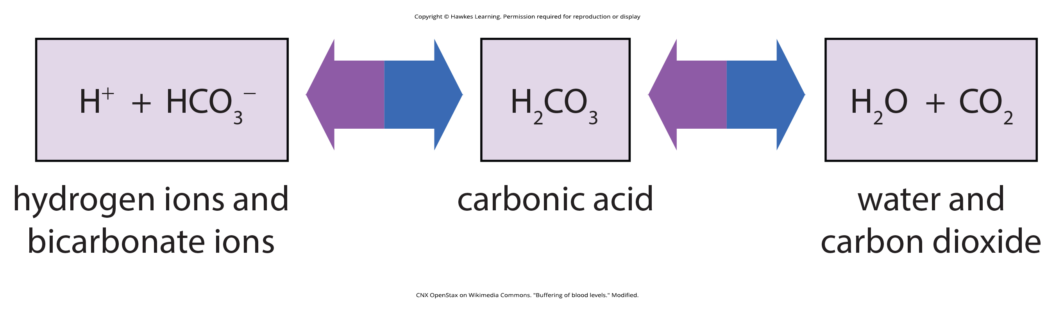
Lesson 2.2 Figure 9

Slide 29
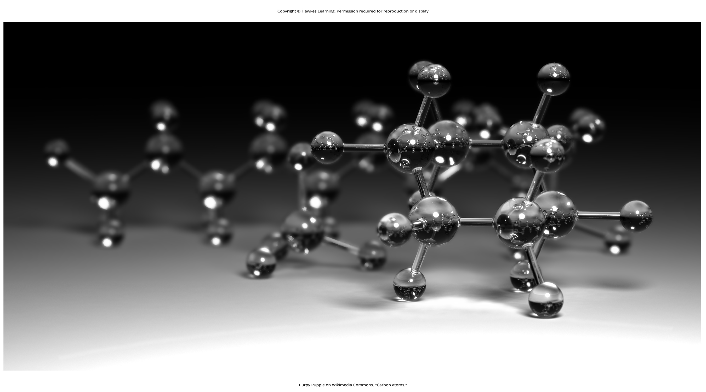
Lesson 2.3 Figure 1

Slide 30
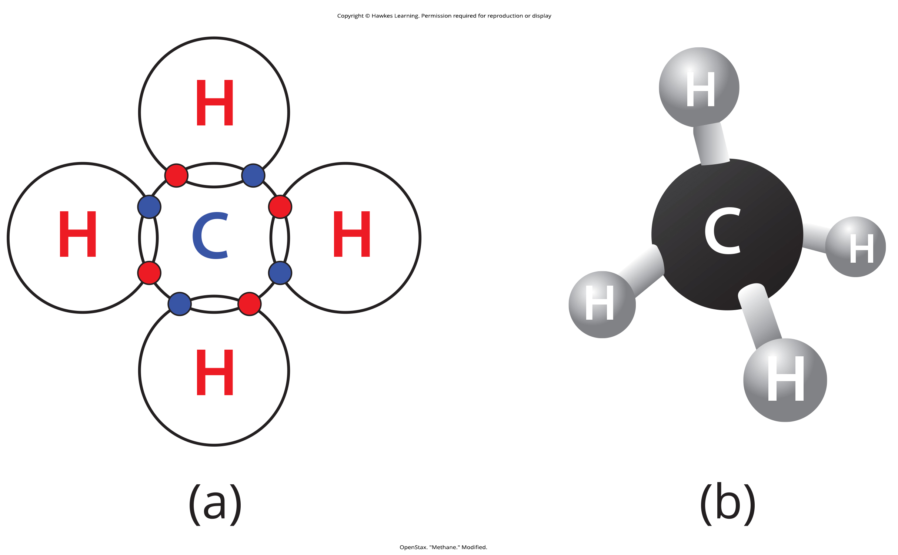
Lesson 2.3 Figure 2

Slide 31

Lesson 2.3 Figure 3

Slide 32
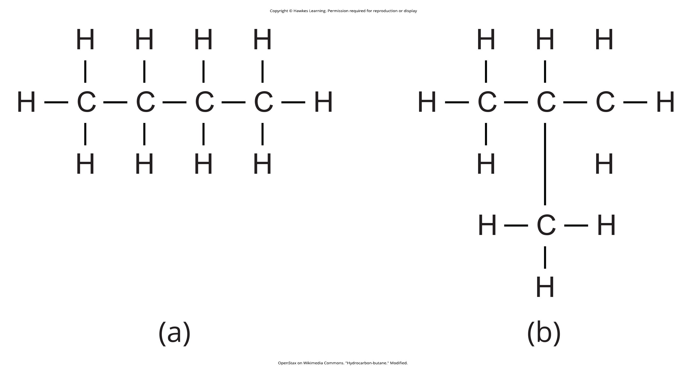
Lesson 2.3 Figure 4

Slide 33
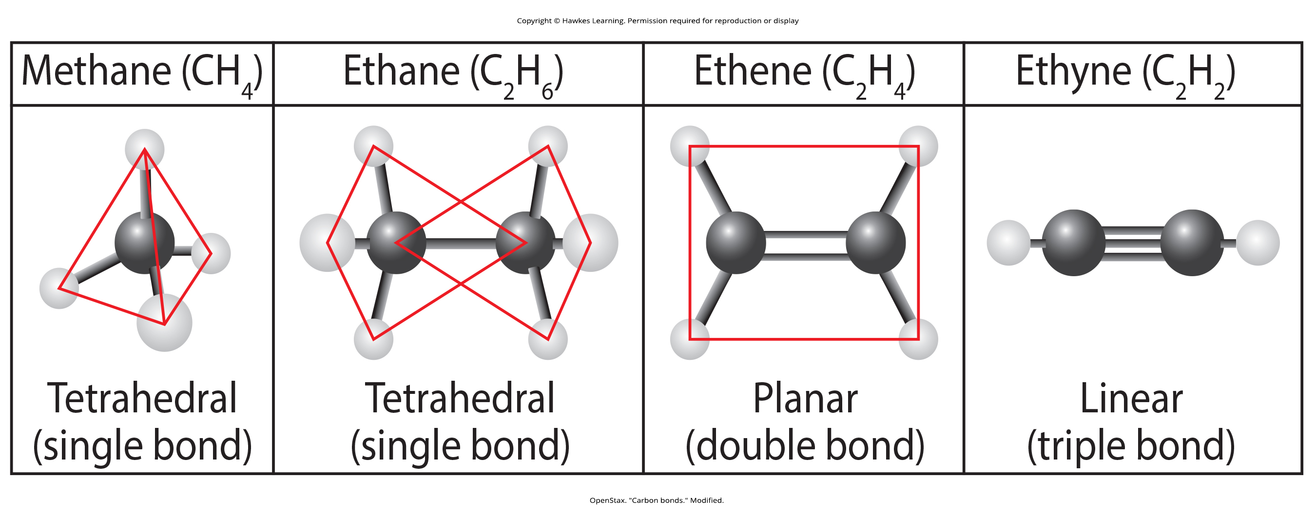
Lesson 2.3 Figure 5

Slide 34
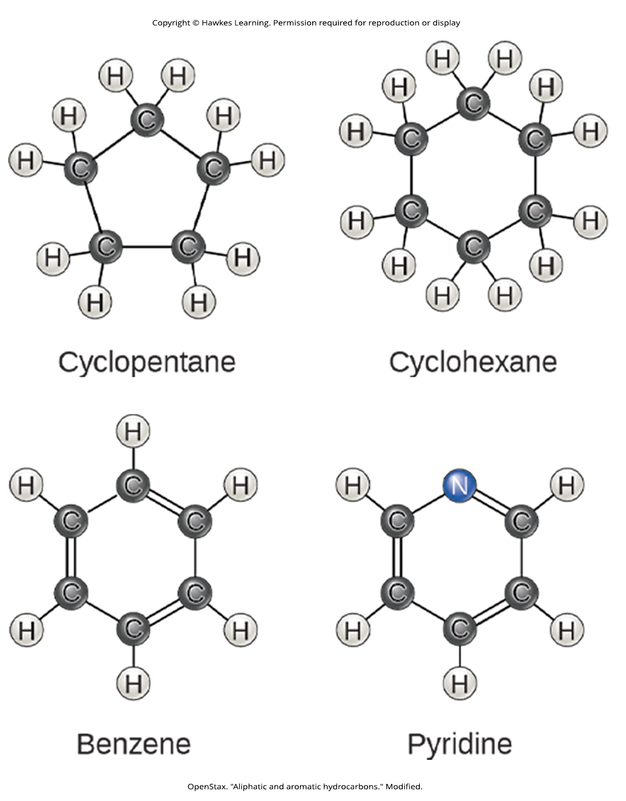
Lesson 2.3 Figure 6

Slide 35
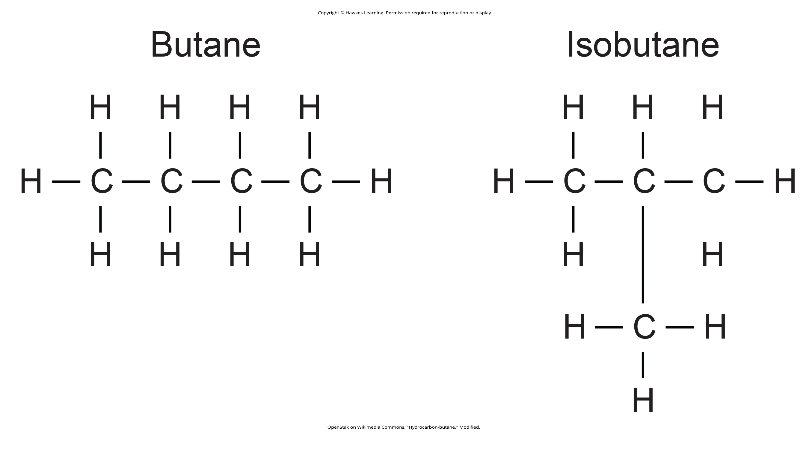
Lesson 2.3 Figure 7

Slide 36
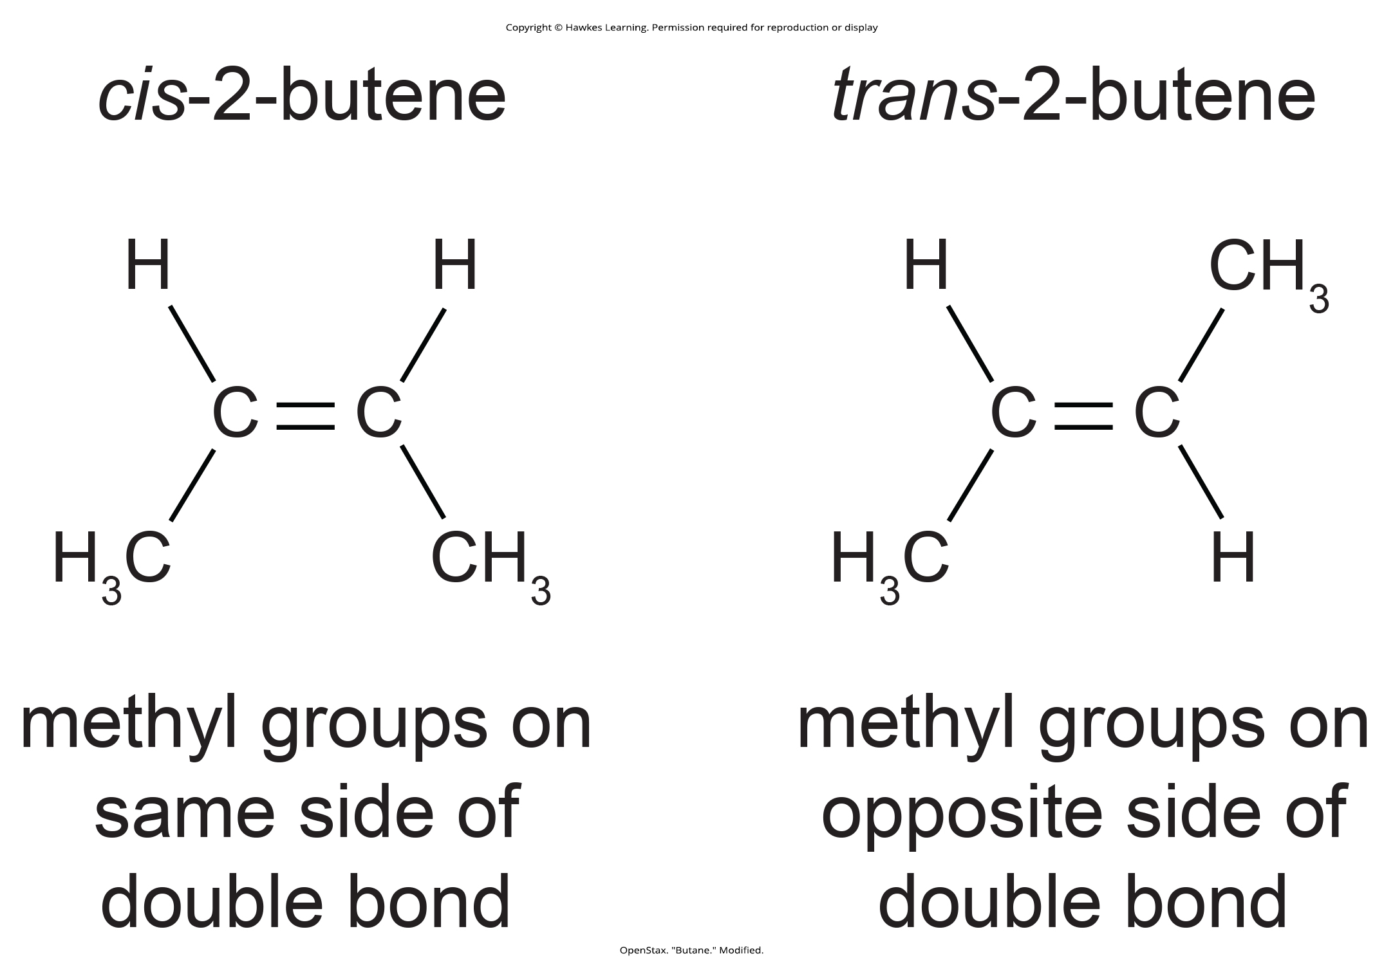
Lesson 2.3 Figure 8

Slide 37
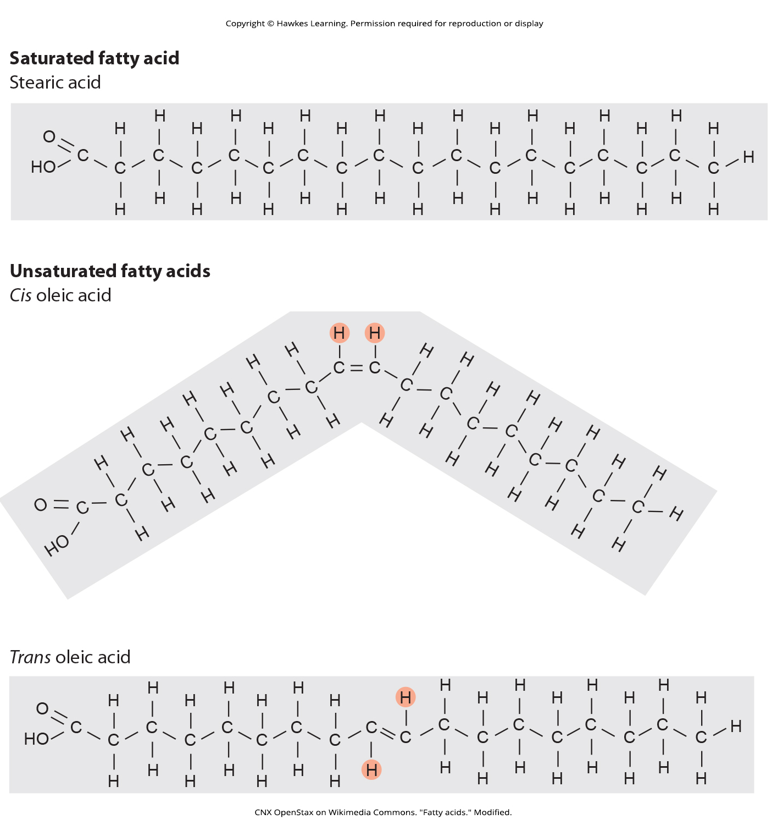
Lesson 2.3 Figure 9

Slide 38
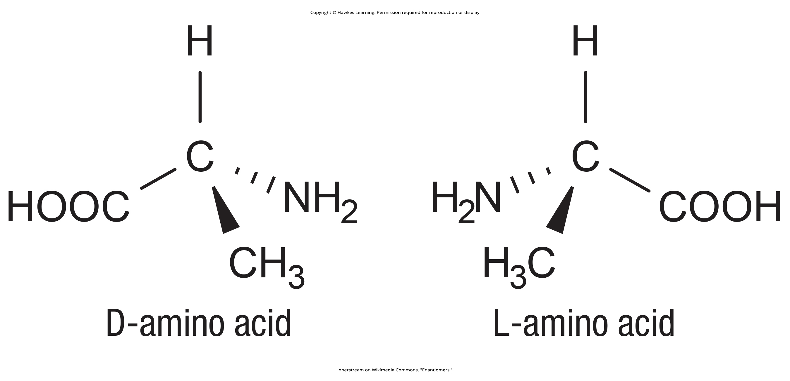
Lesson 2.3 Figure 10

Slide 39
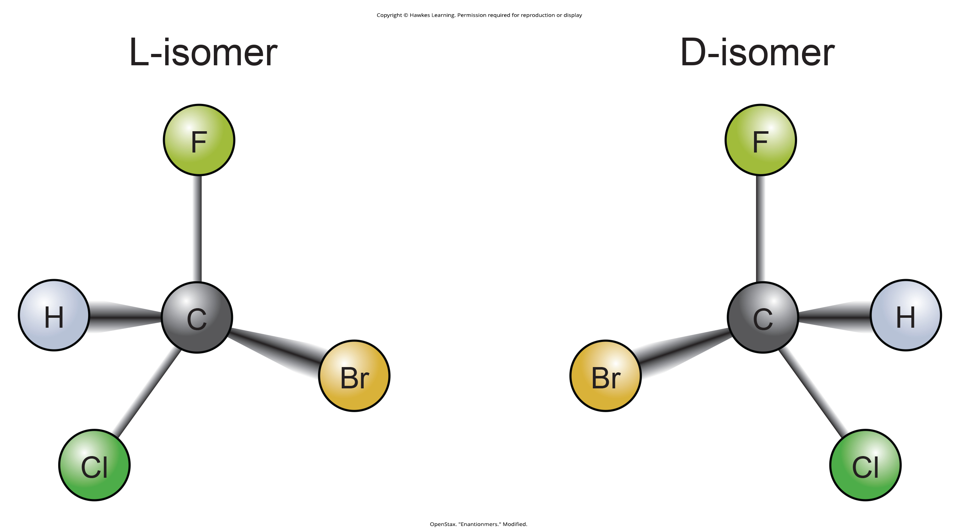
Lesson 2.3 Figure 11

Slide 40
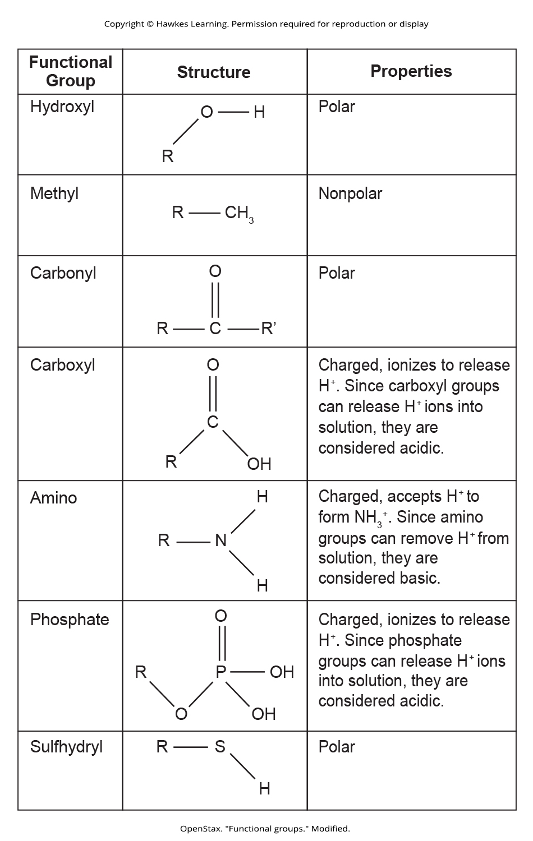
Lesson 2.3 Figure 12

Slide 41

Lesson 2.3 Figure 13

Slide 42
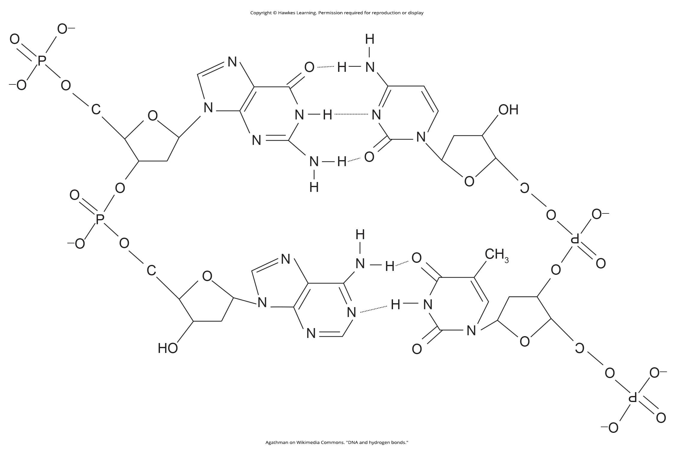
Lesson 2.3 Figure 14

Slide 43
Hawkes Learning – End of PowerPoint

