Slide 1
Chapter 20
The Tree of Life and Phylogenetics

Slide 2
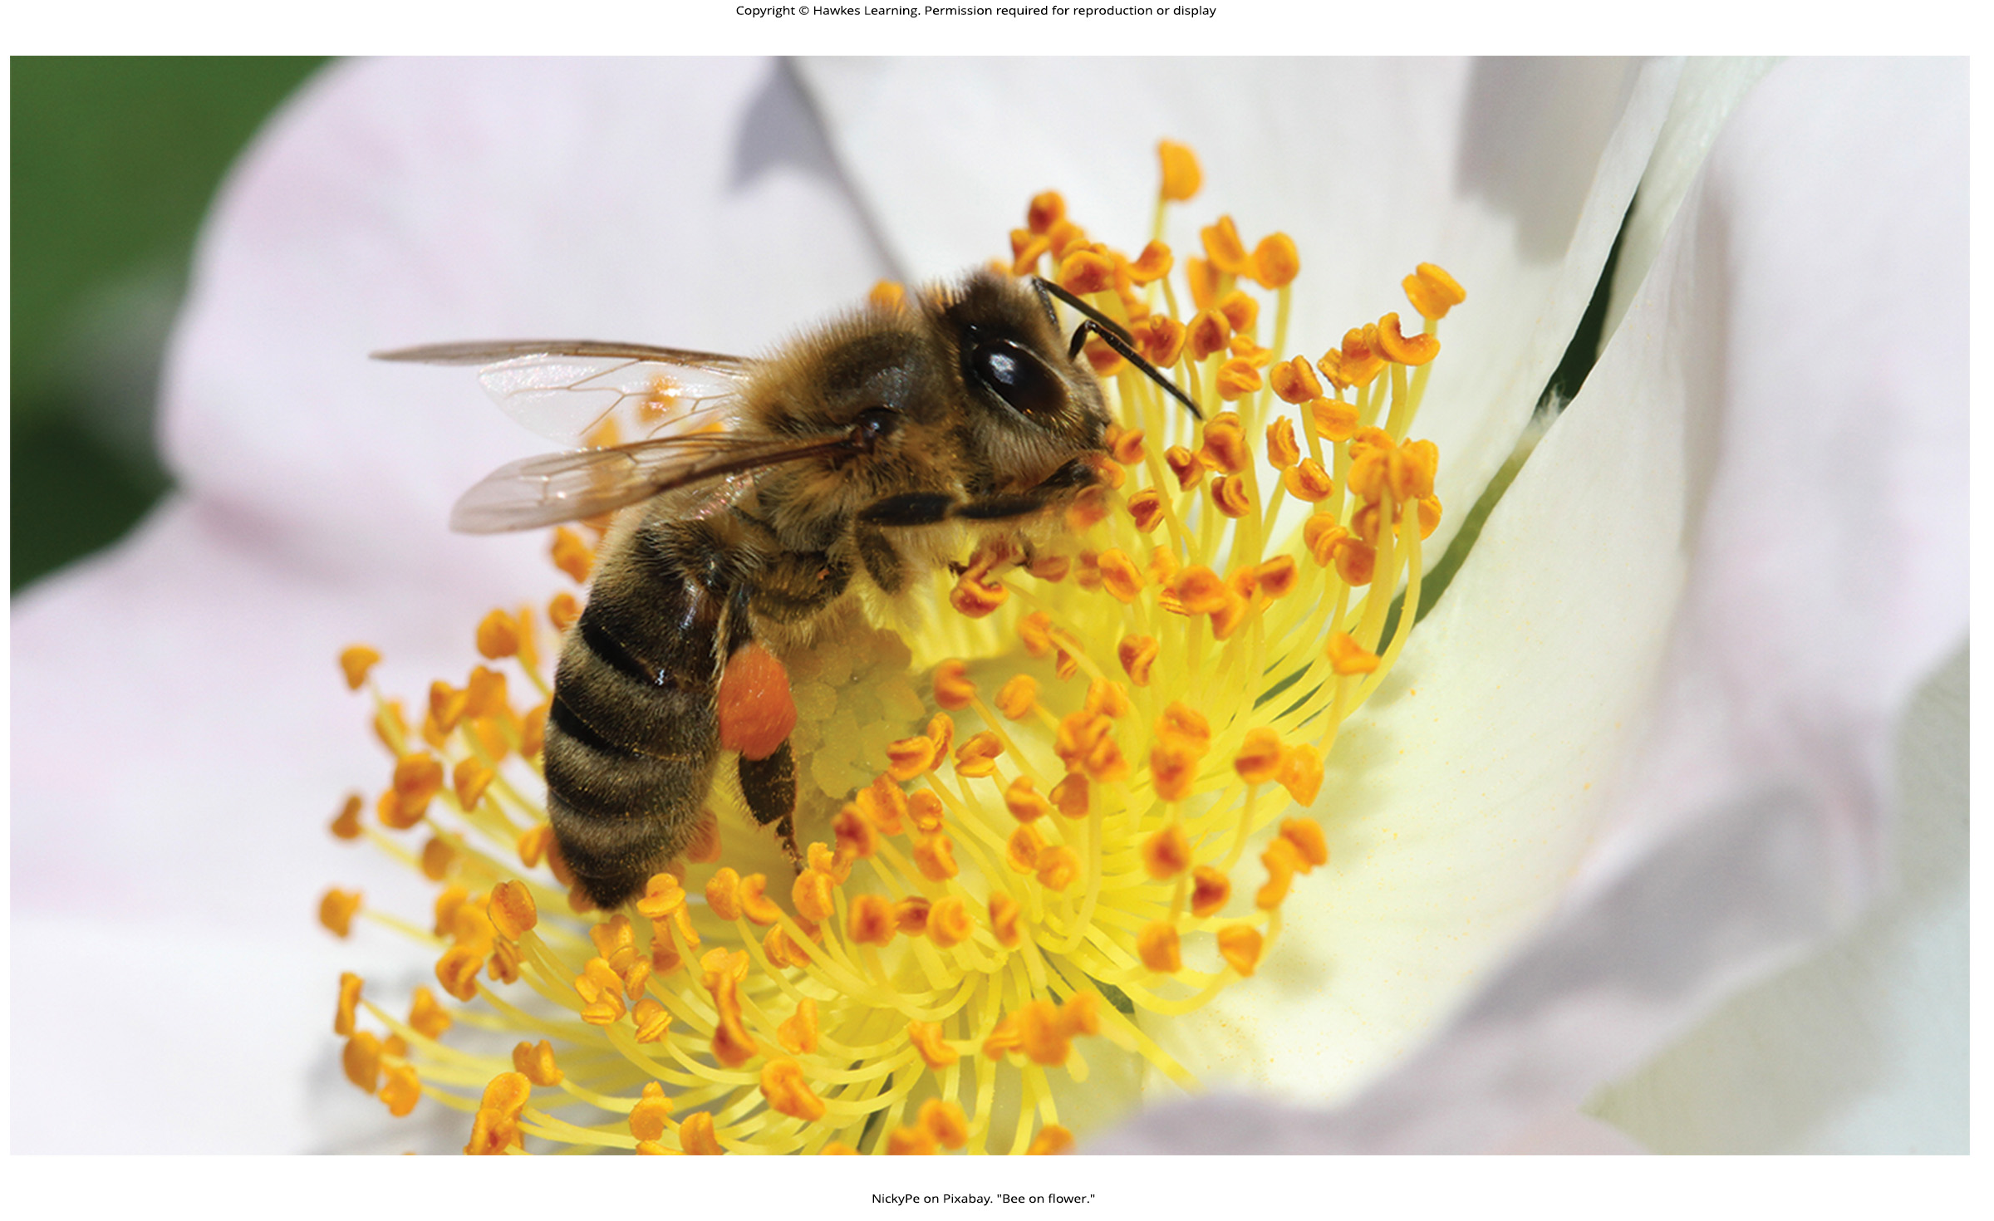
Lesson 20.1 Figure 1

Slide 3
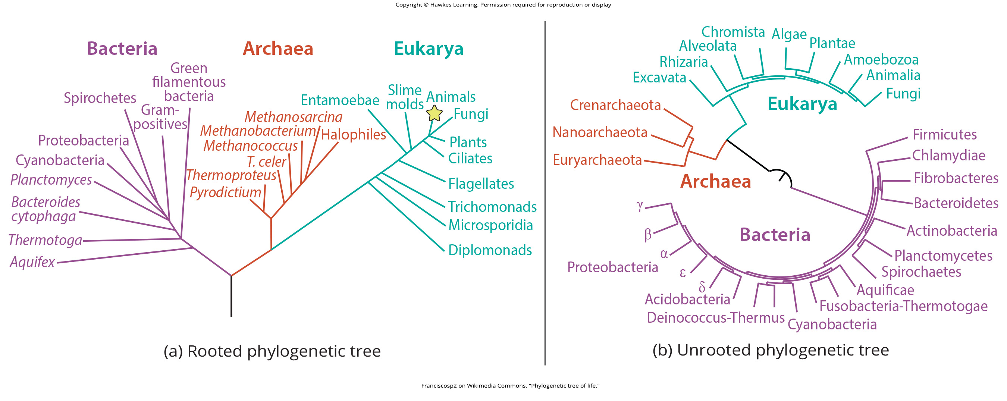
Lesson 20.1 Figure 2

Slide 4
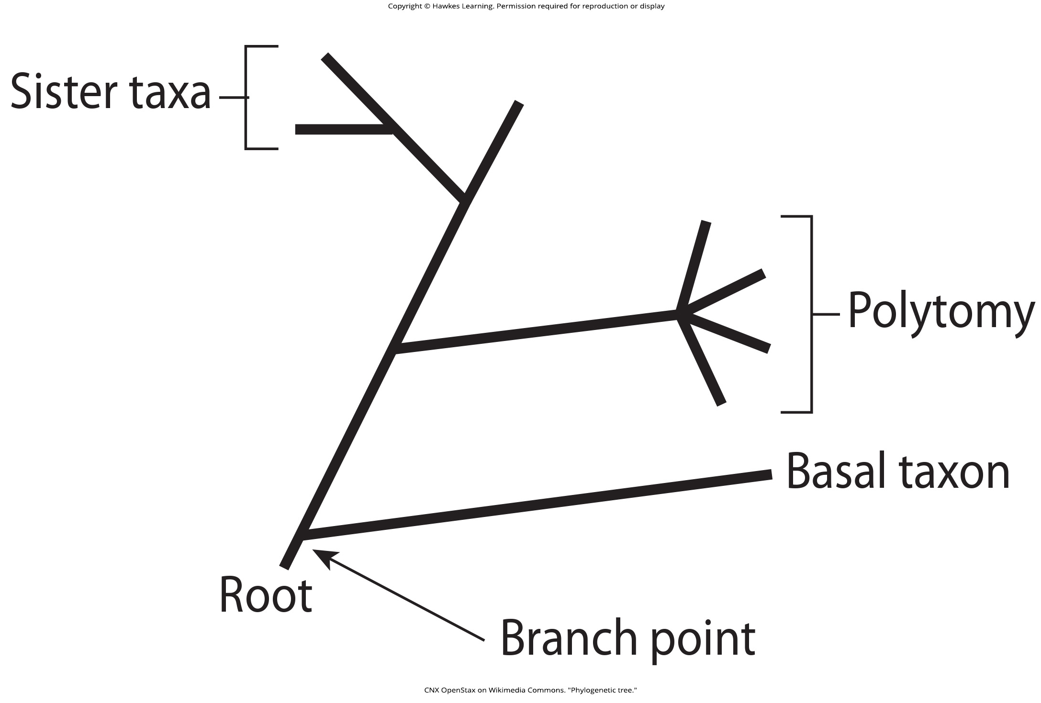
Lesson 20.1 Figure 3

Slide 5
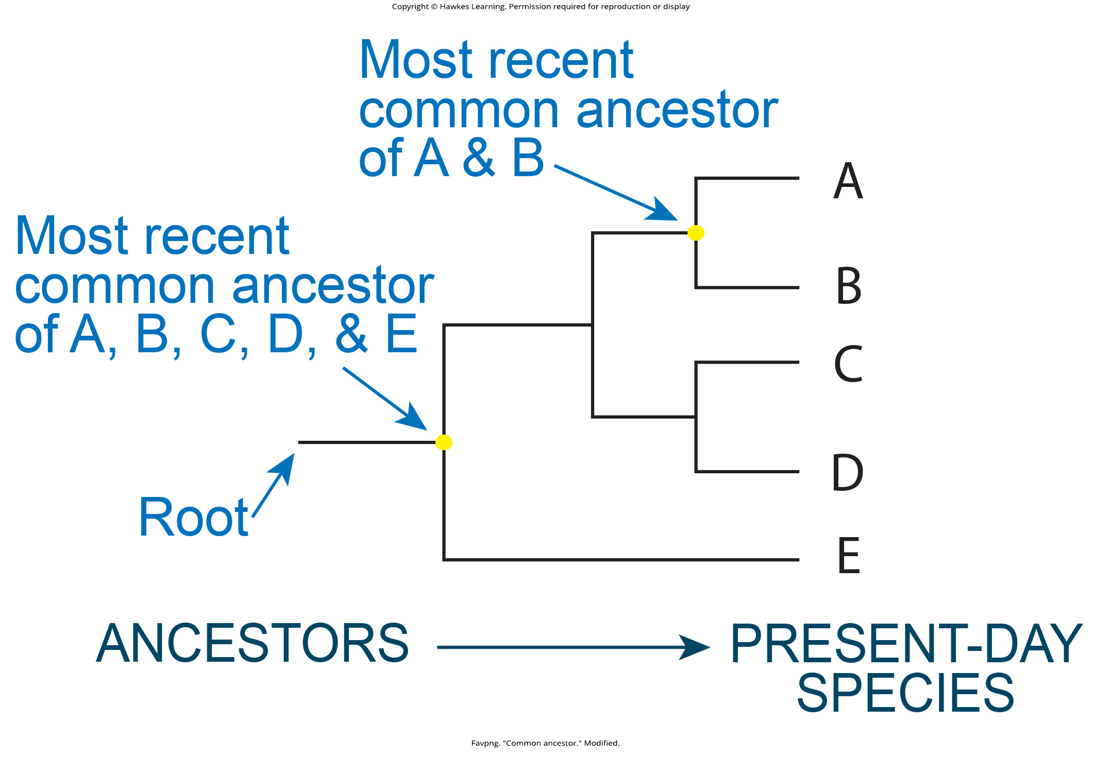
Lesson 20.1 Figure 4

Slide 6
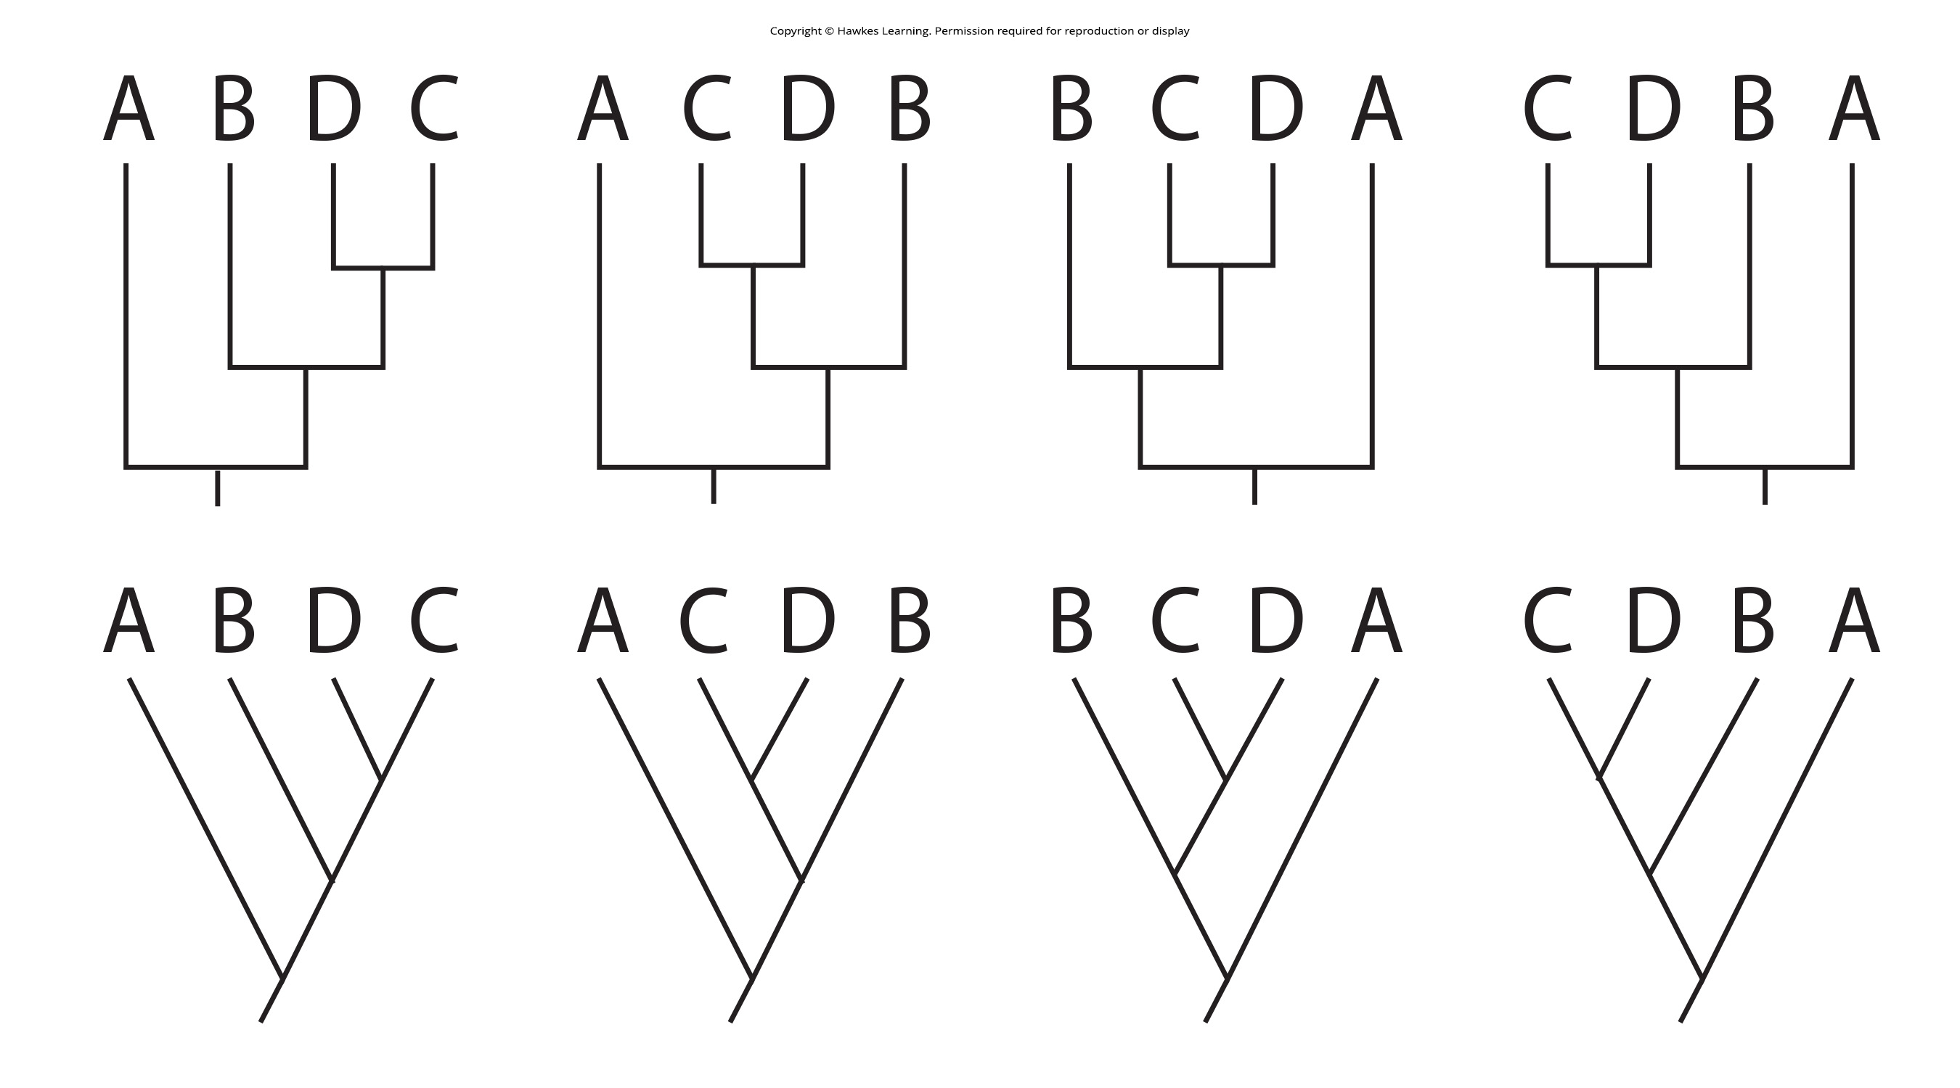
Lesson 20.1 Figure 5

Slide 7
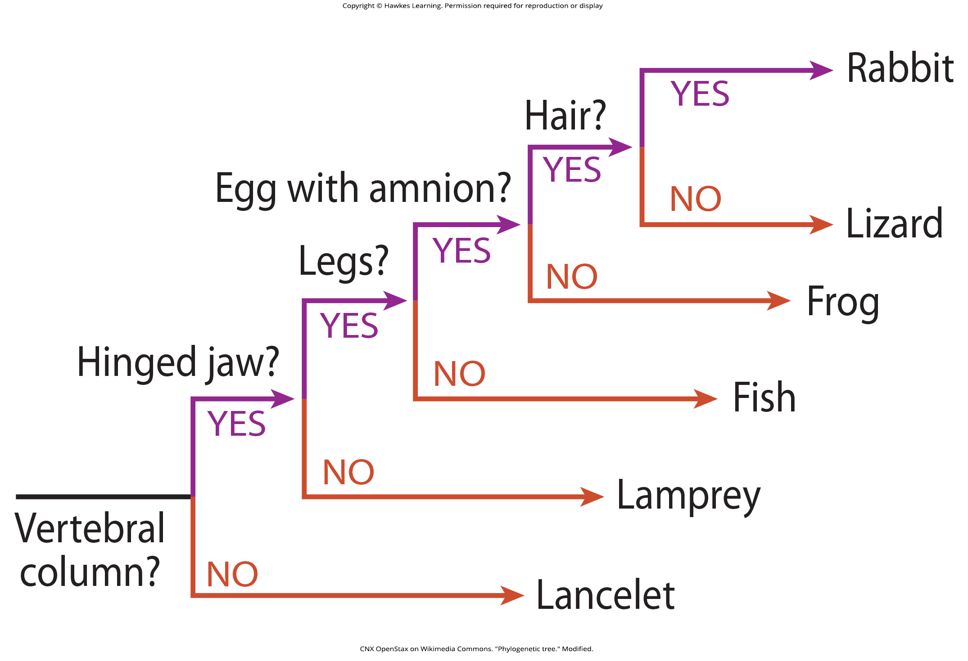
Lesson 20.1 Figure 6

Slide 8
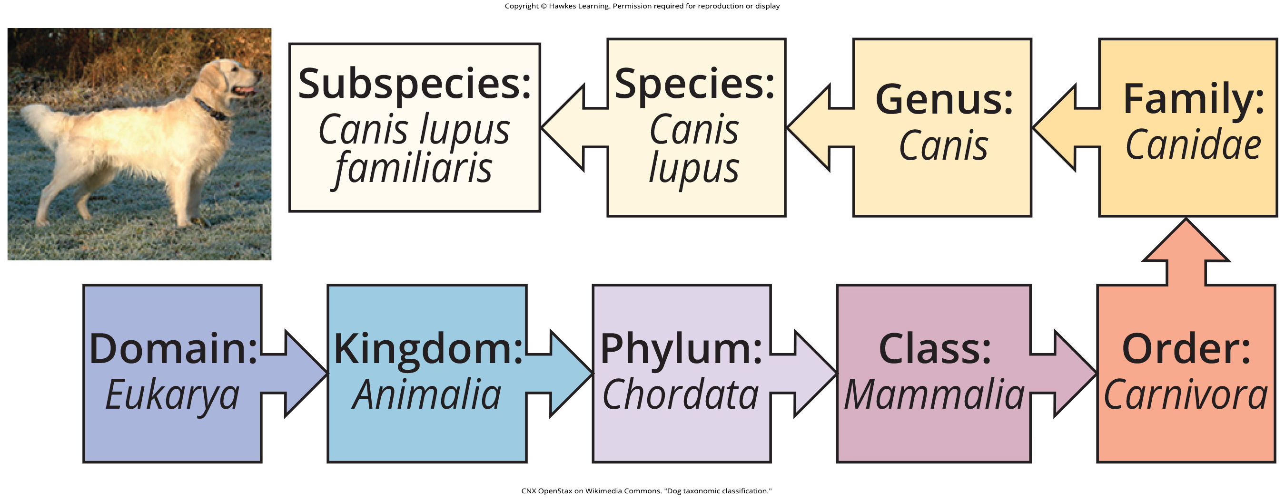
Lesson 20.1 Figure 7

Slide 9
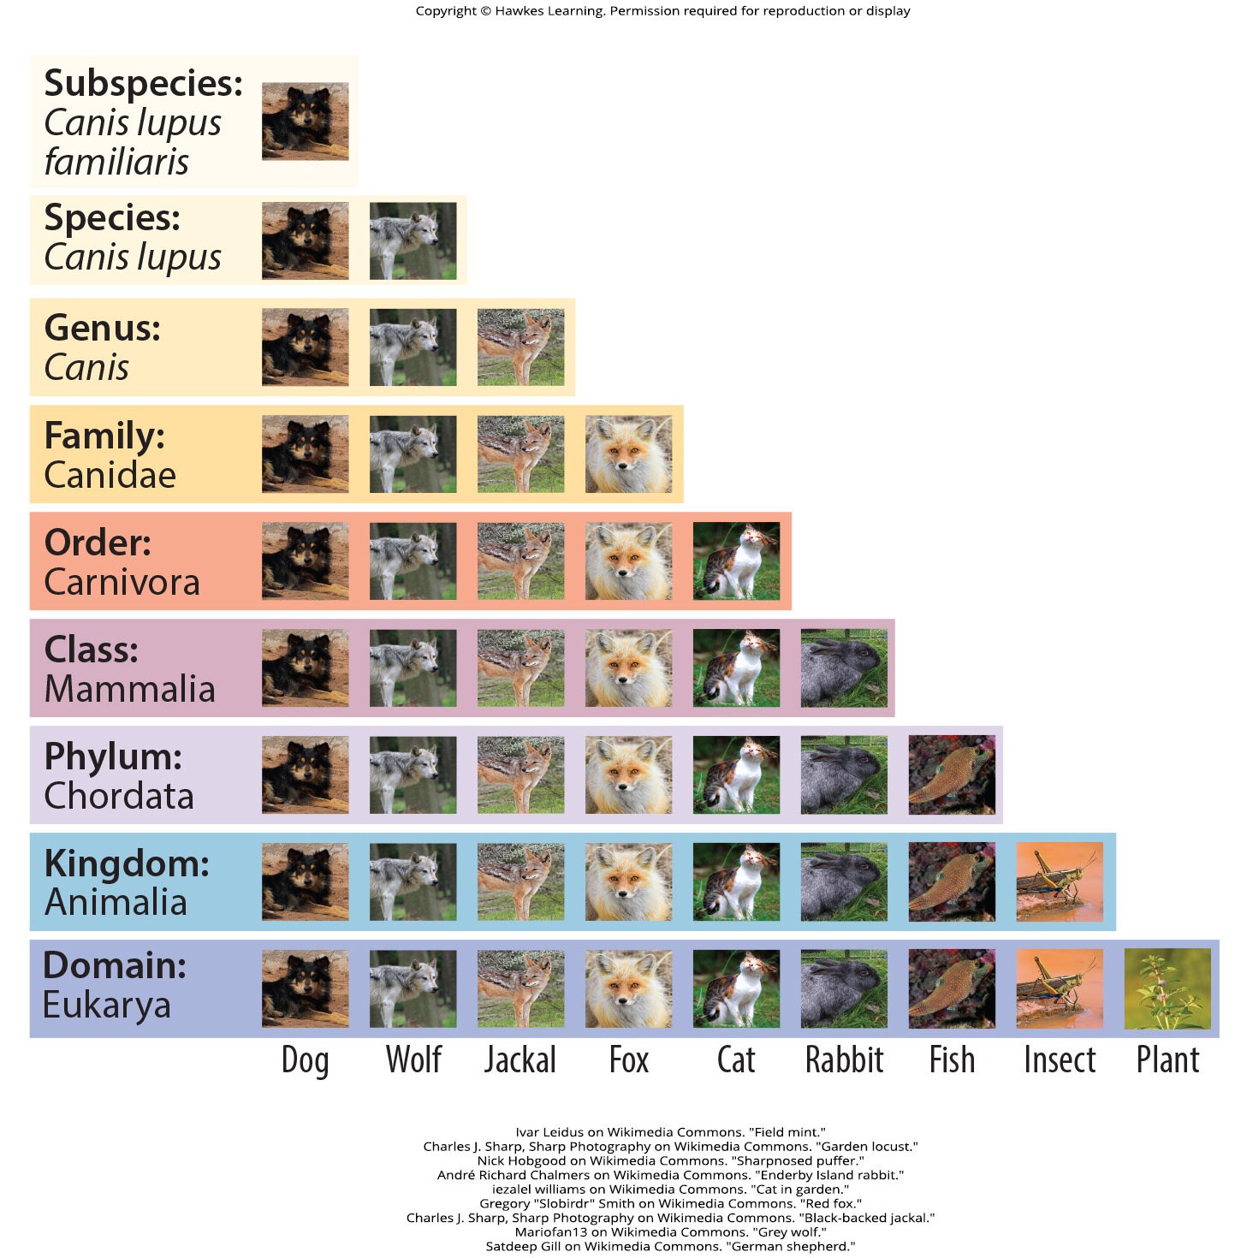
Lesson 20.1 Figure 8

Slide 10
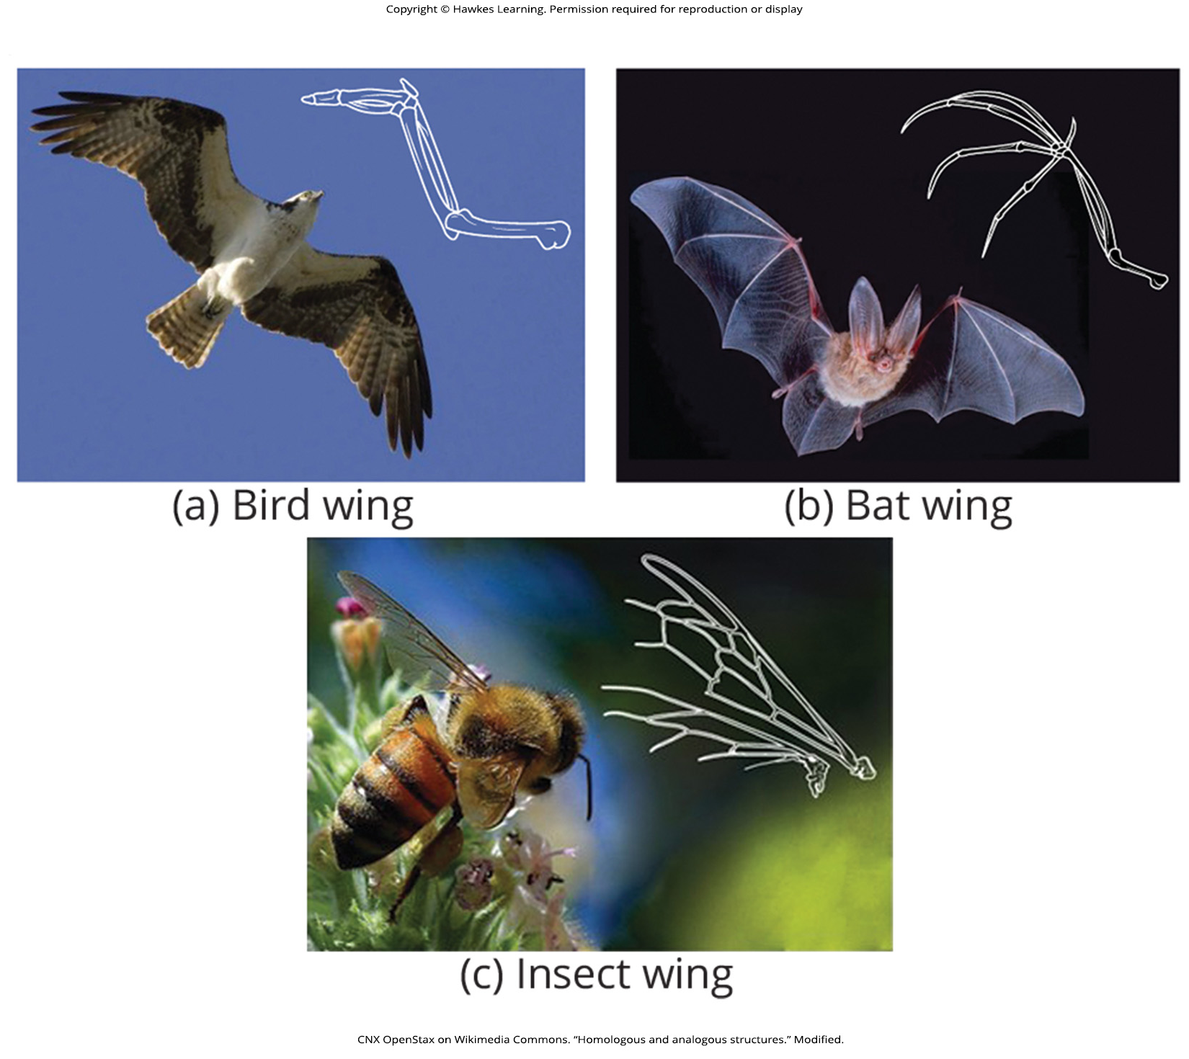
Lesson 20.2 Figure 1

Slide 11
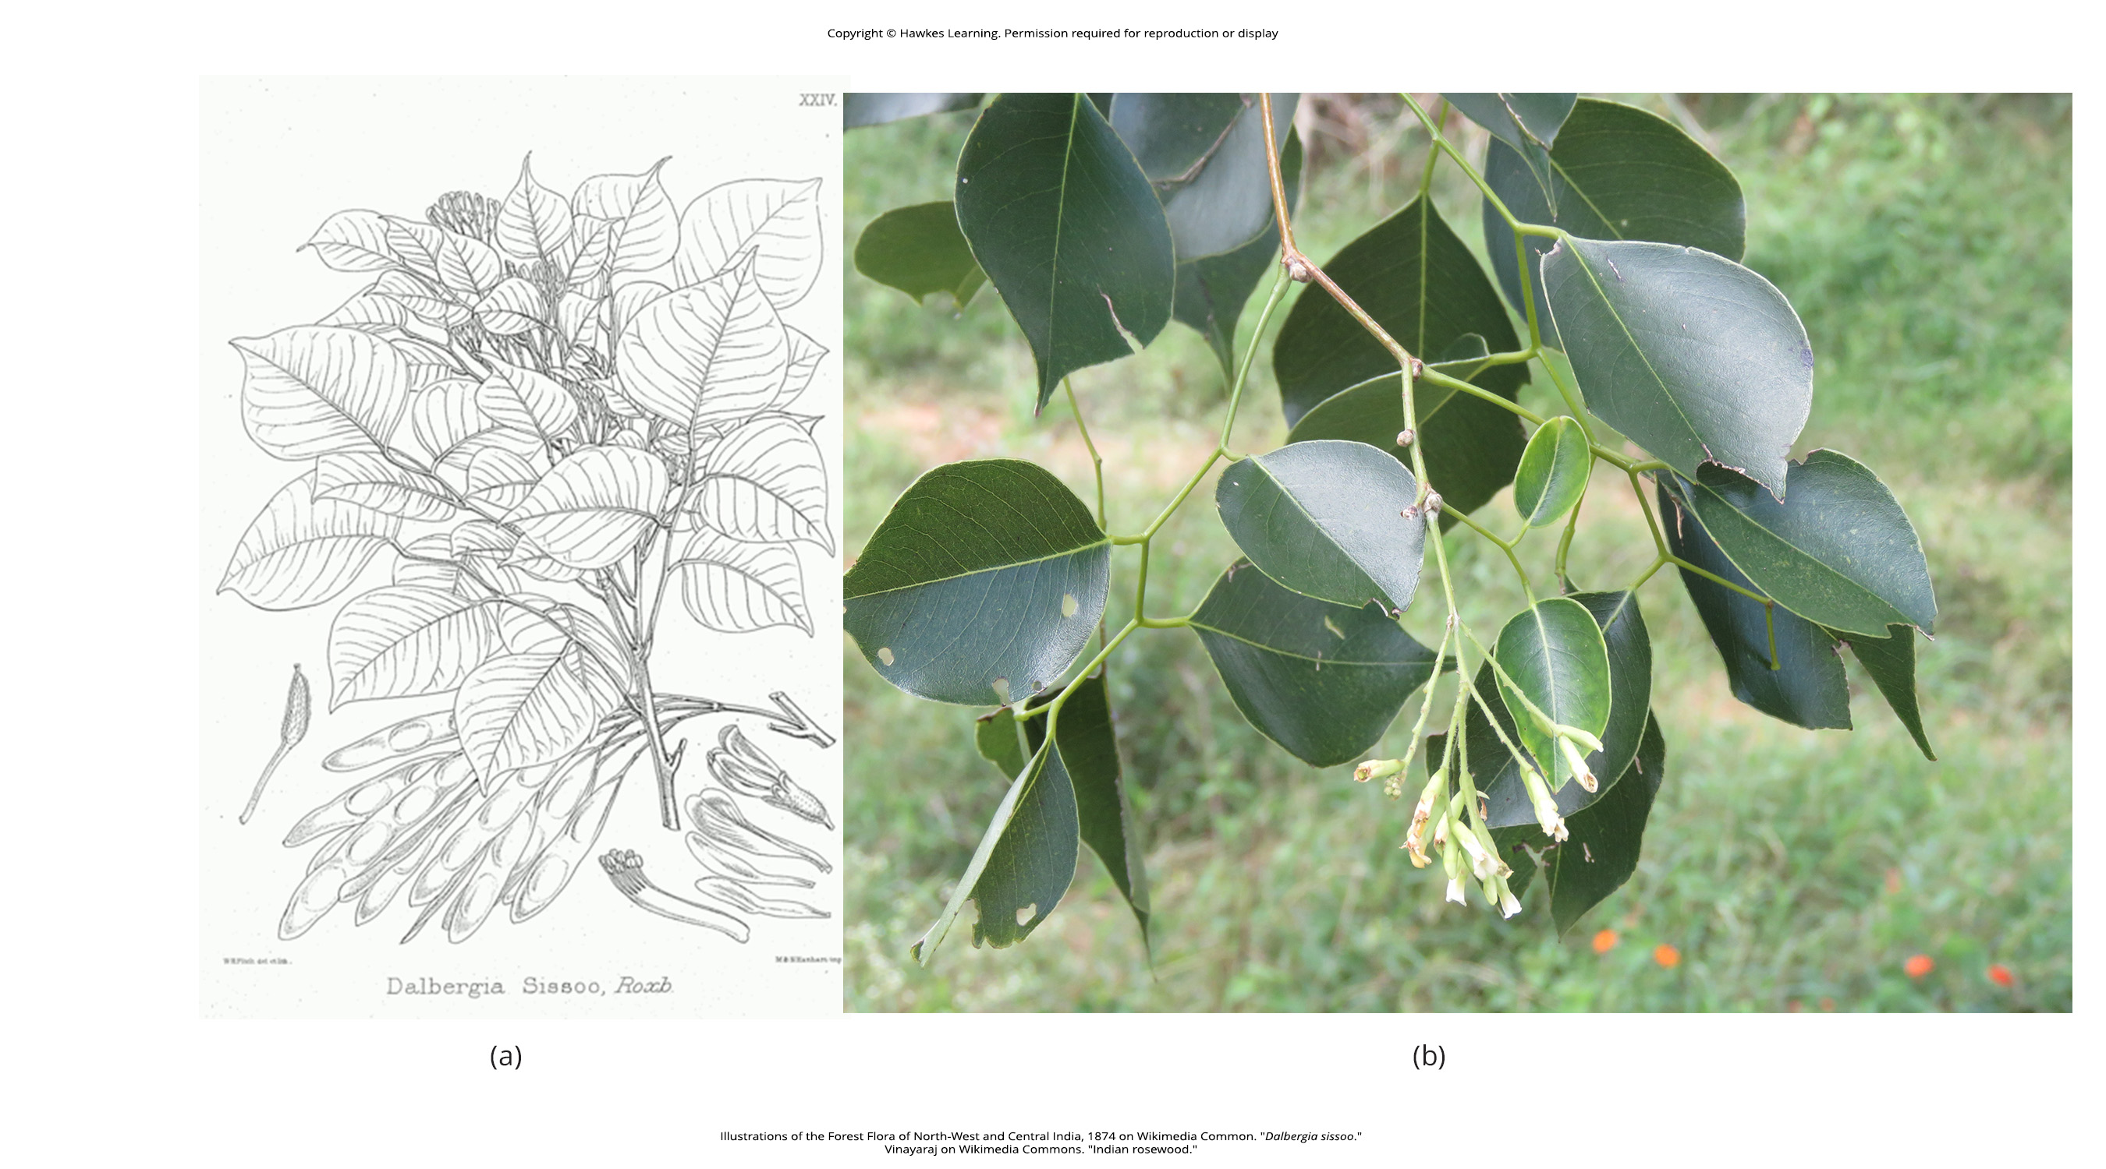
Lesson 20.2 Figure 2

Slide 12
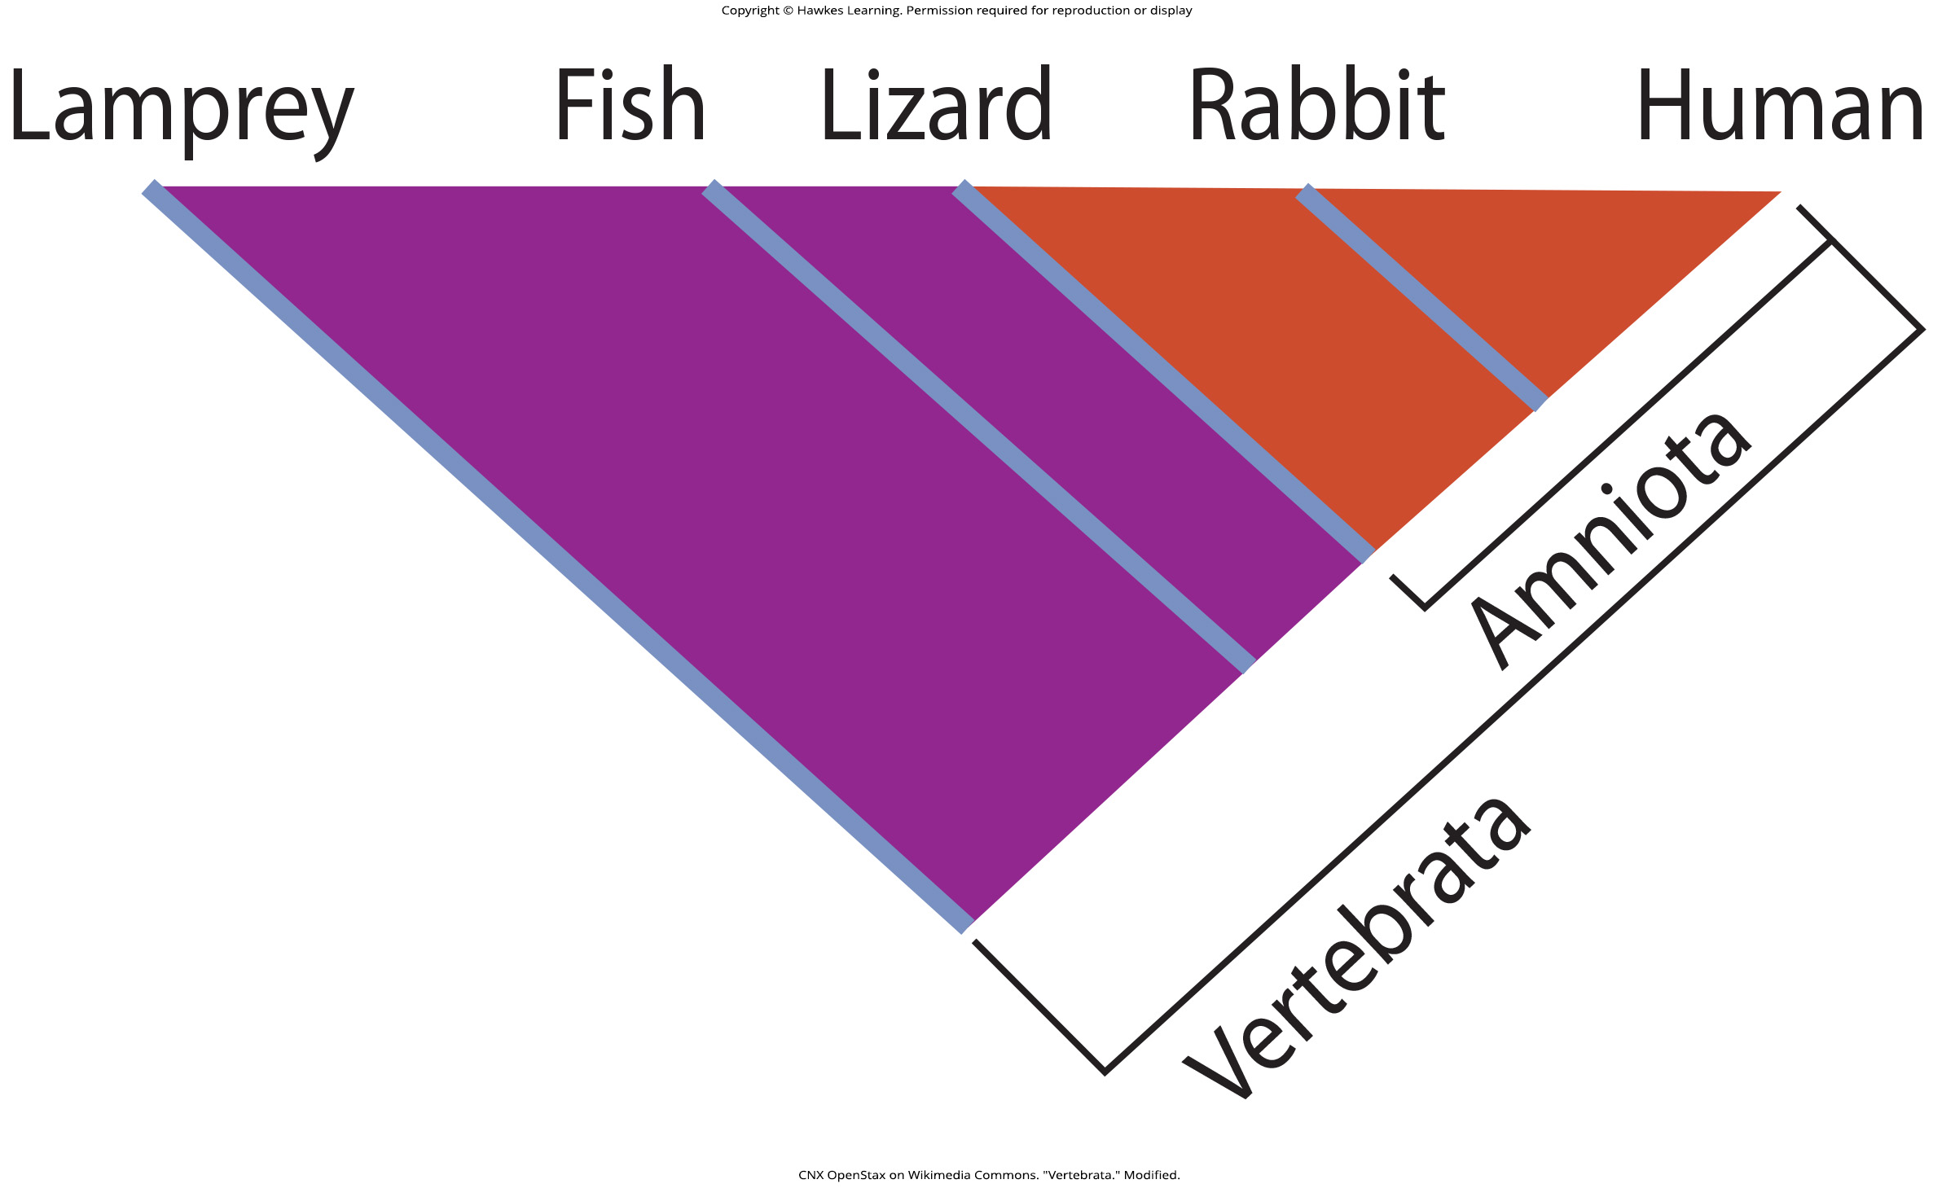
Lesson 20.2 Figure 3

Slide 13
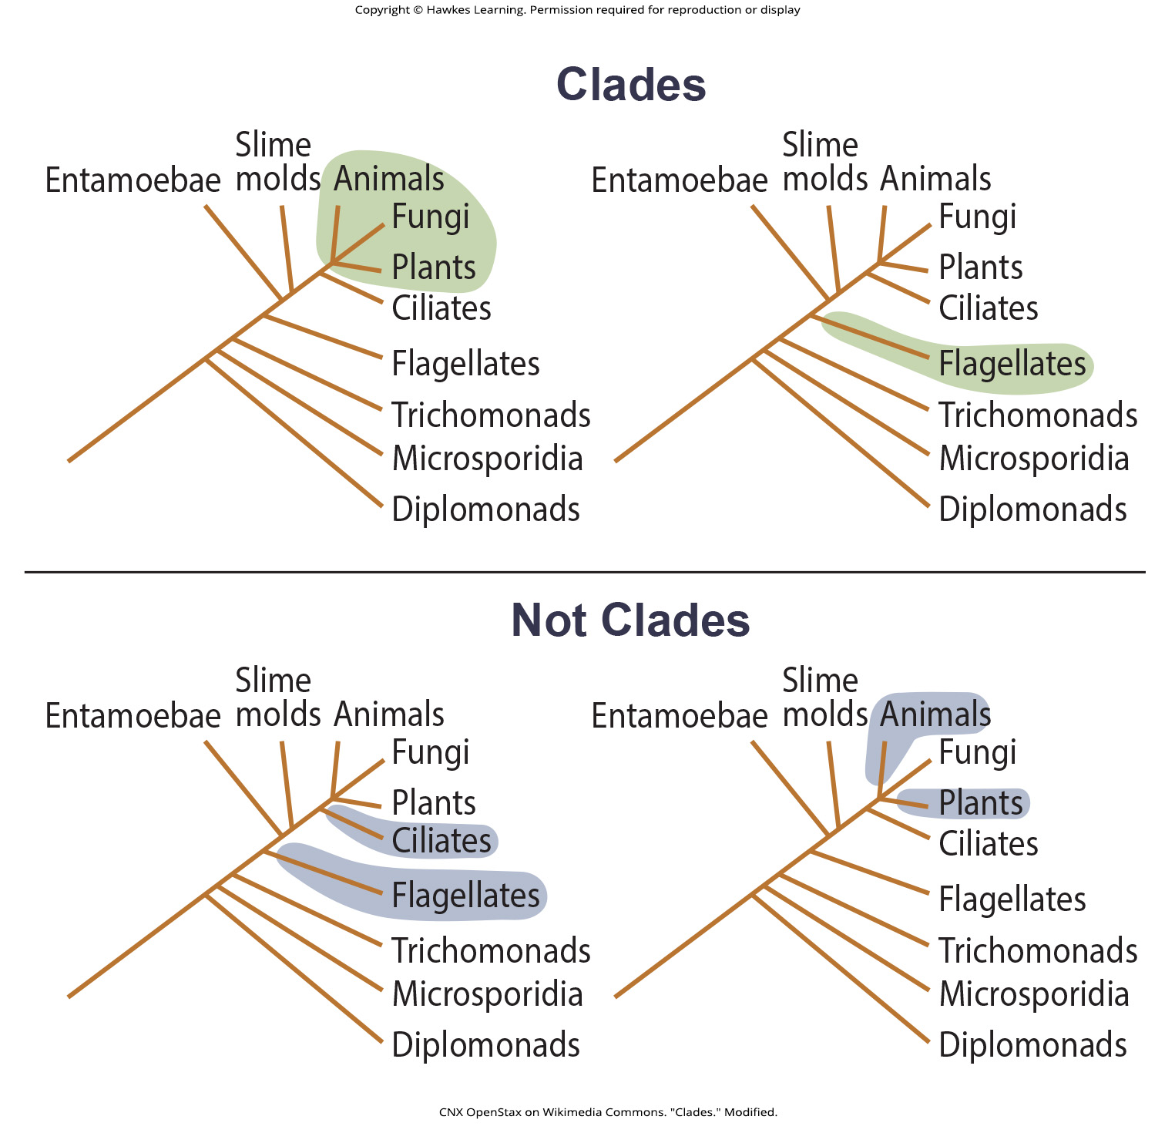
Lesson 20.4 Figure 4

Slide 14
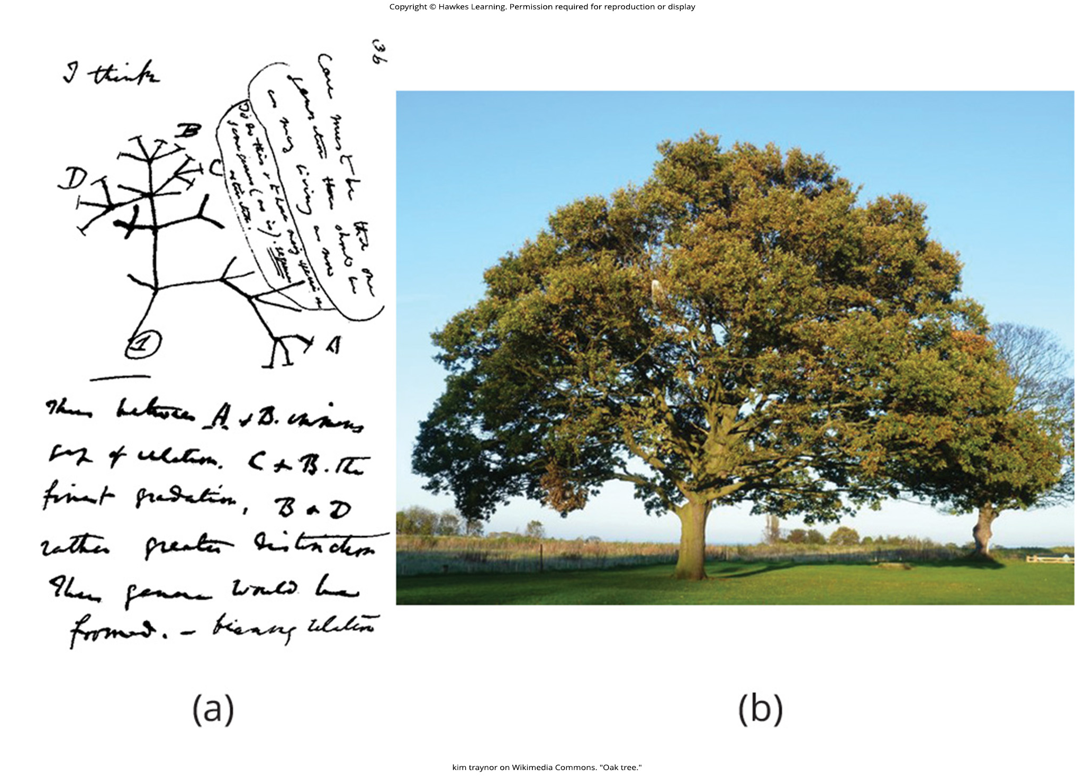
Lesson 20.3 Figure 1

Slide 15
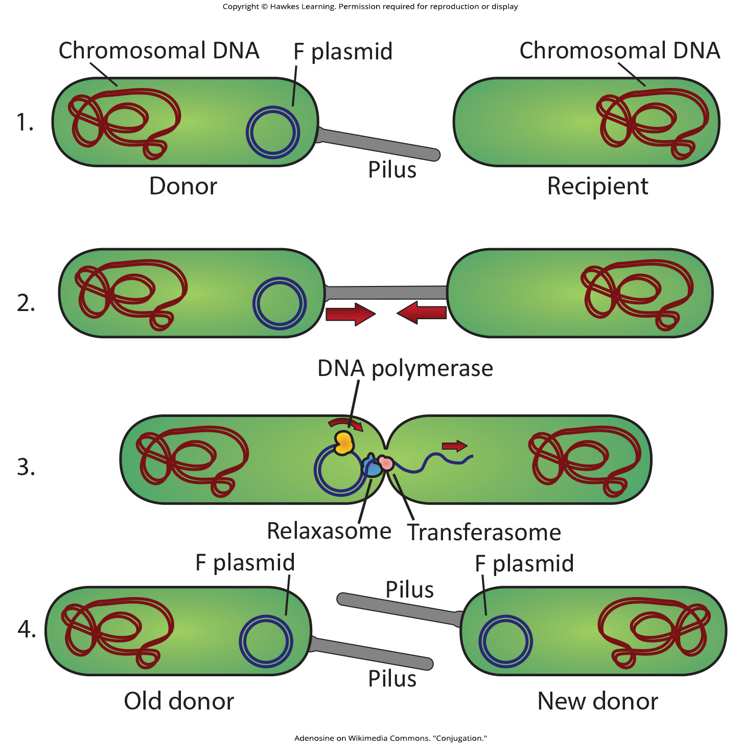
Lesson 20.3 Figure 2

Slide 16
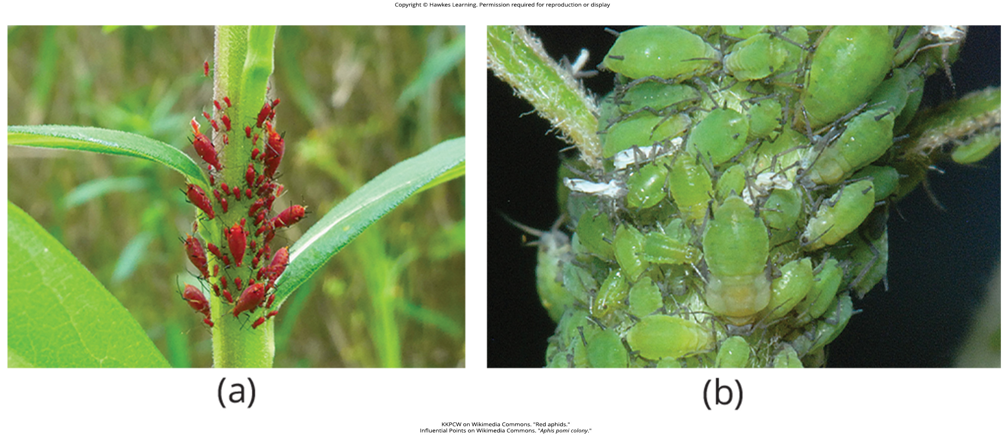
Lesson 20.3 Figure 3

Slide 17
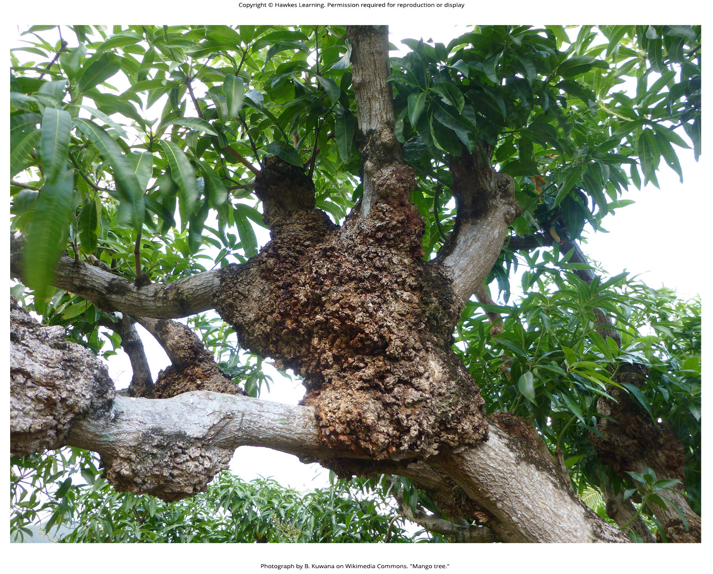
Lesson 20.3 Figure 4

Slide 18
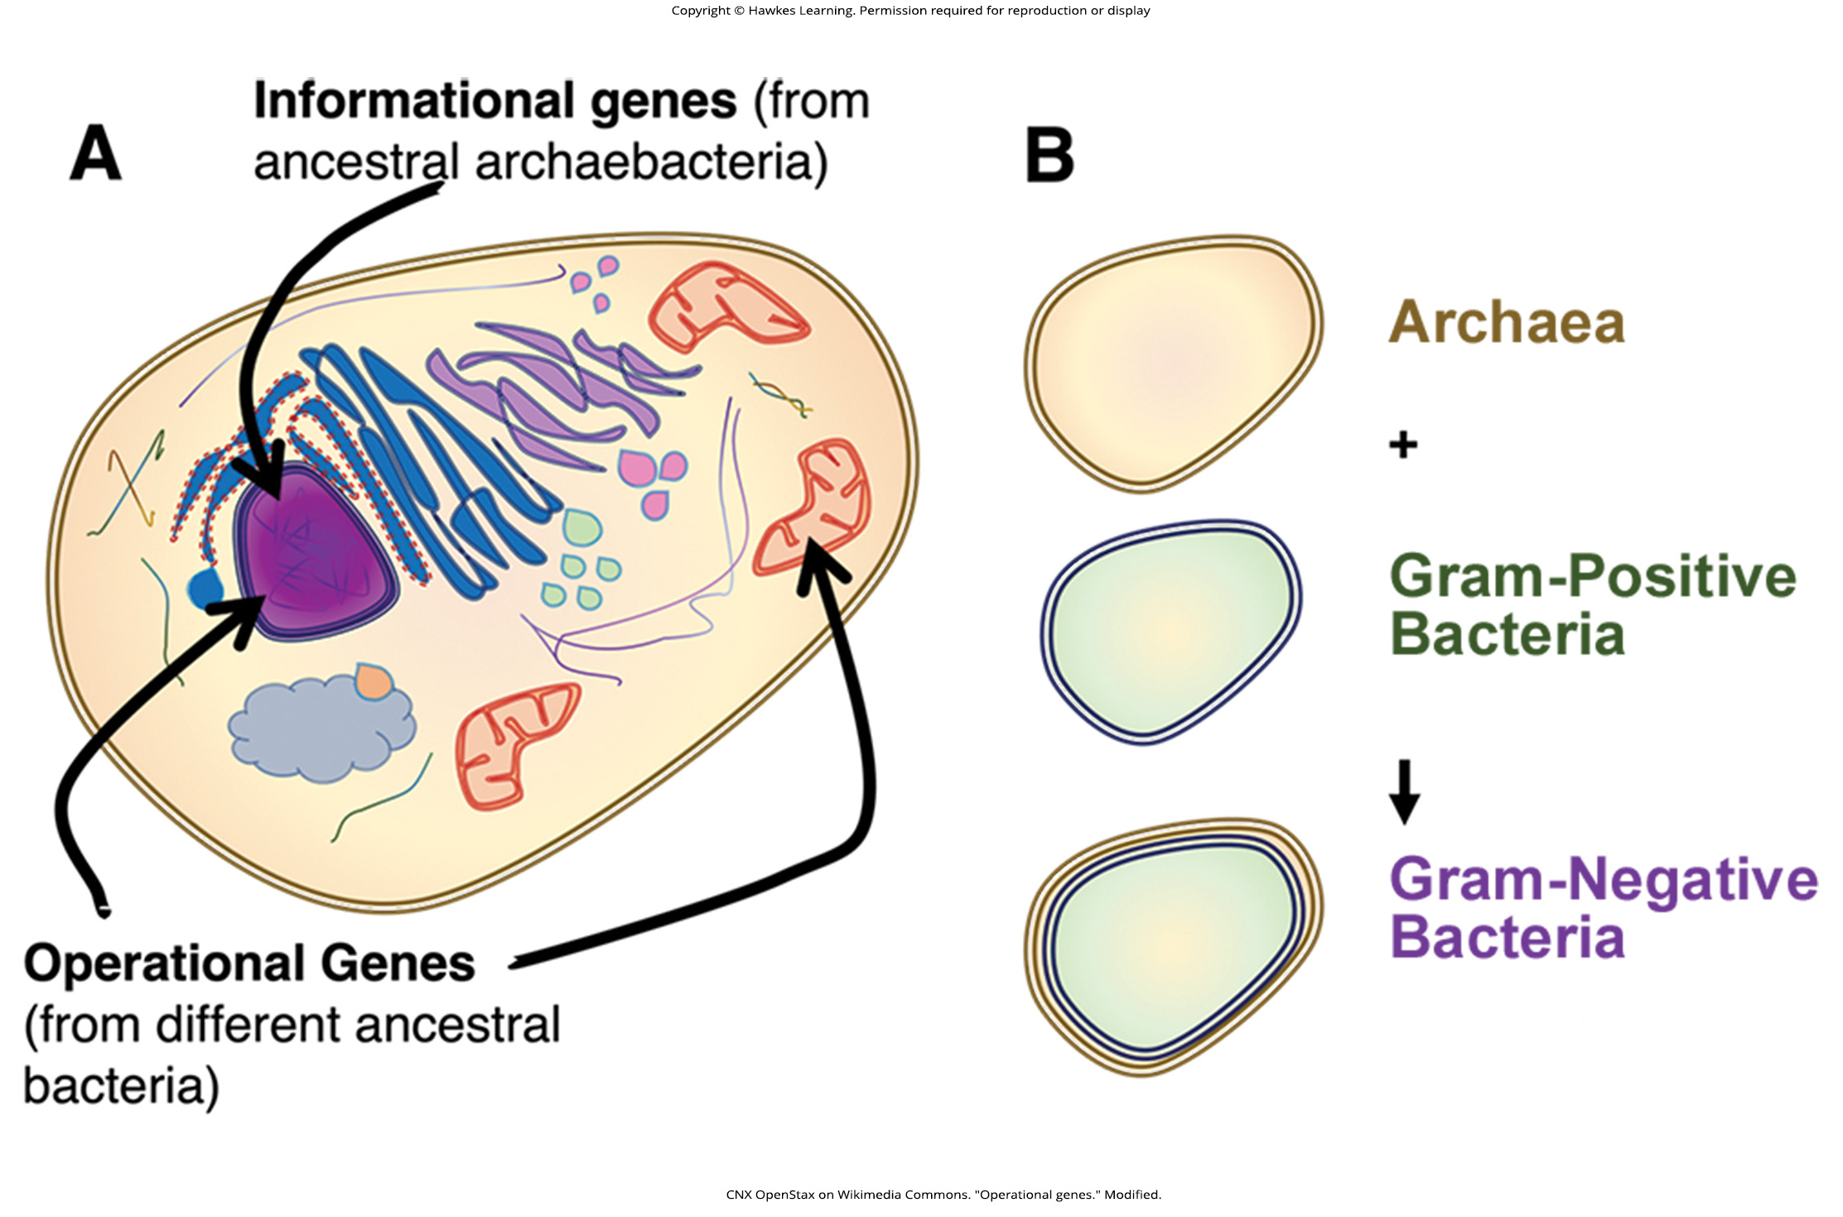
Lesson 20.3 Figure 5

Slide 19
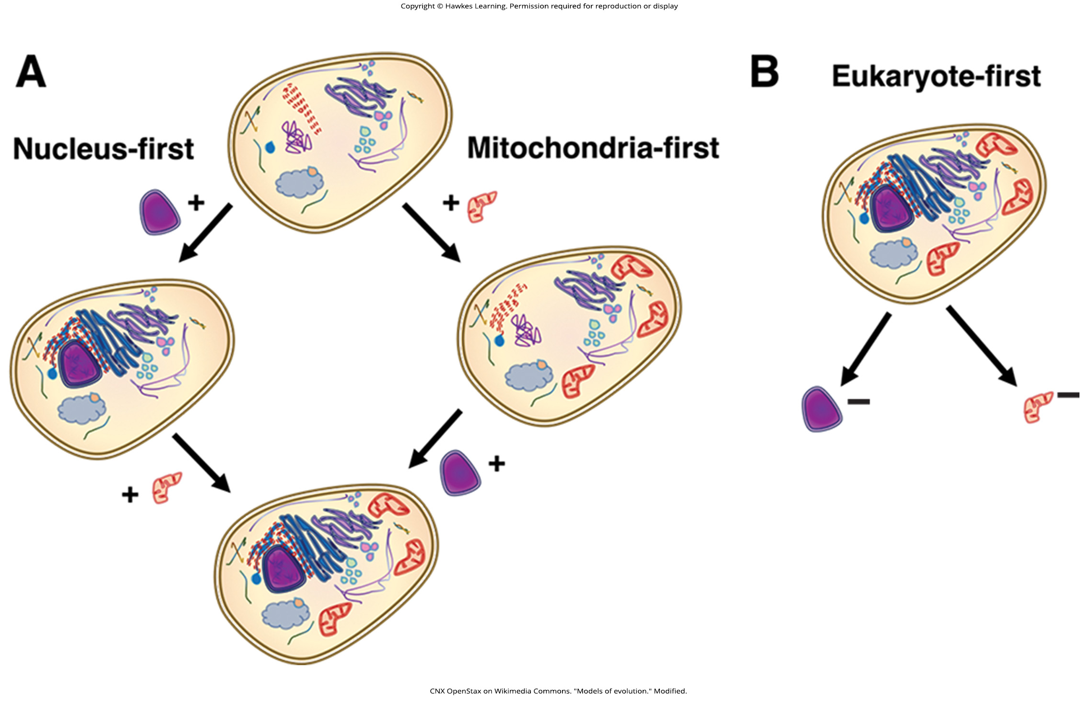
Lesson 20.3 Figure 6

Slide 20
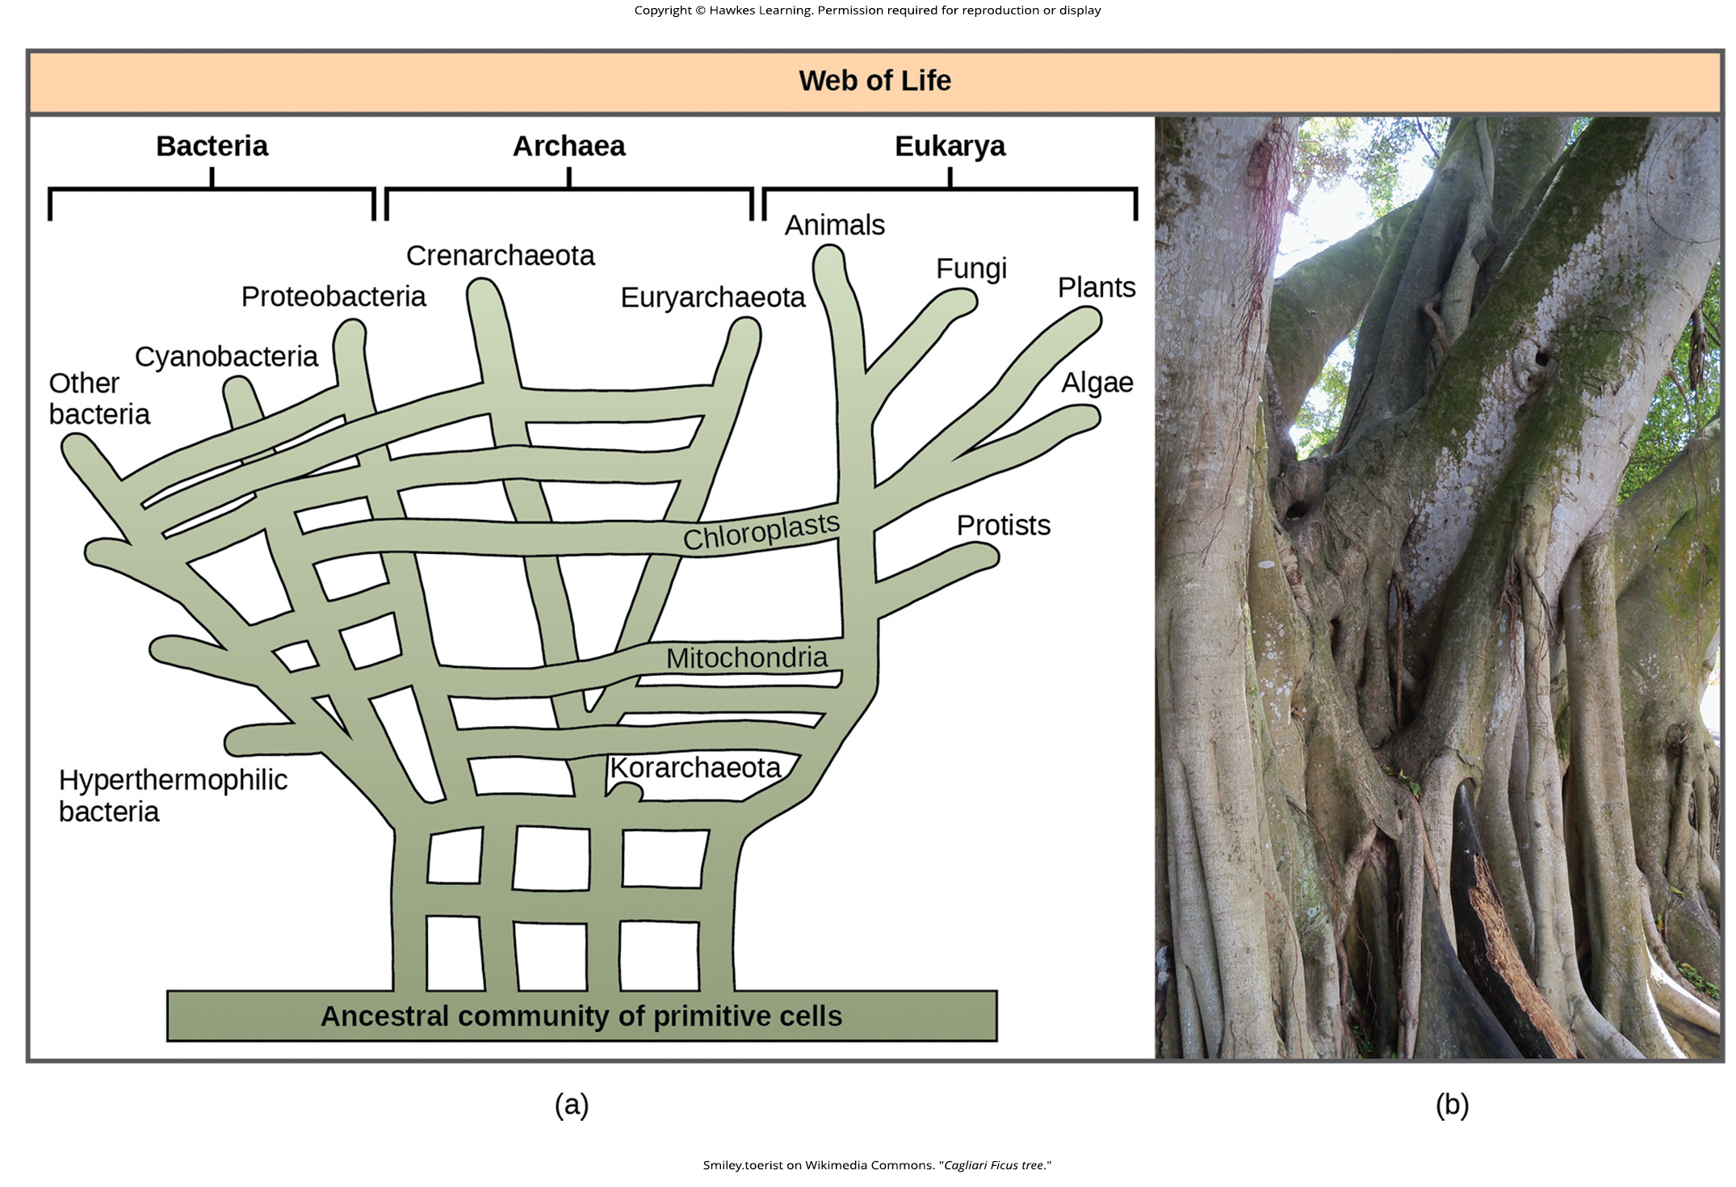
Lesson 20.3 Figure 7

Slide 21
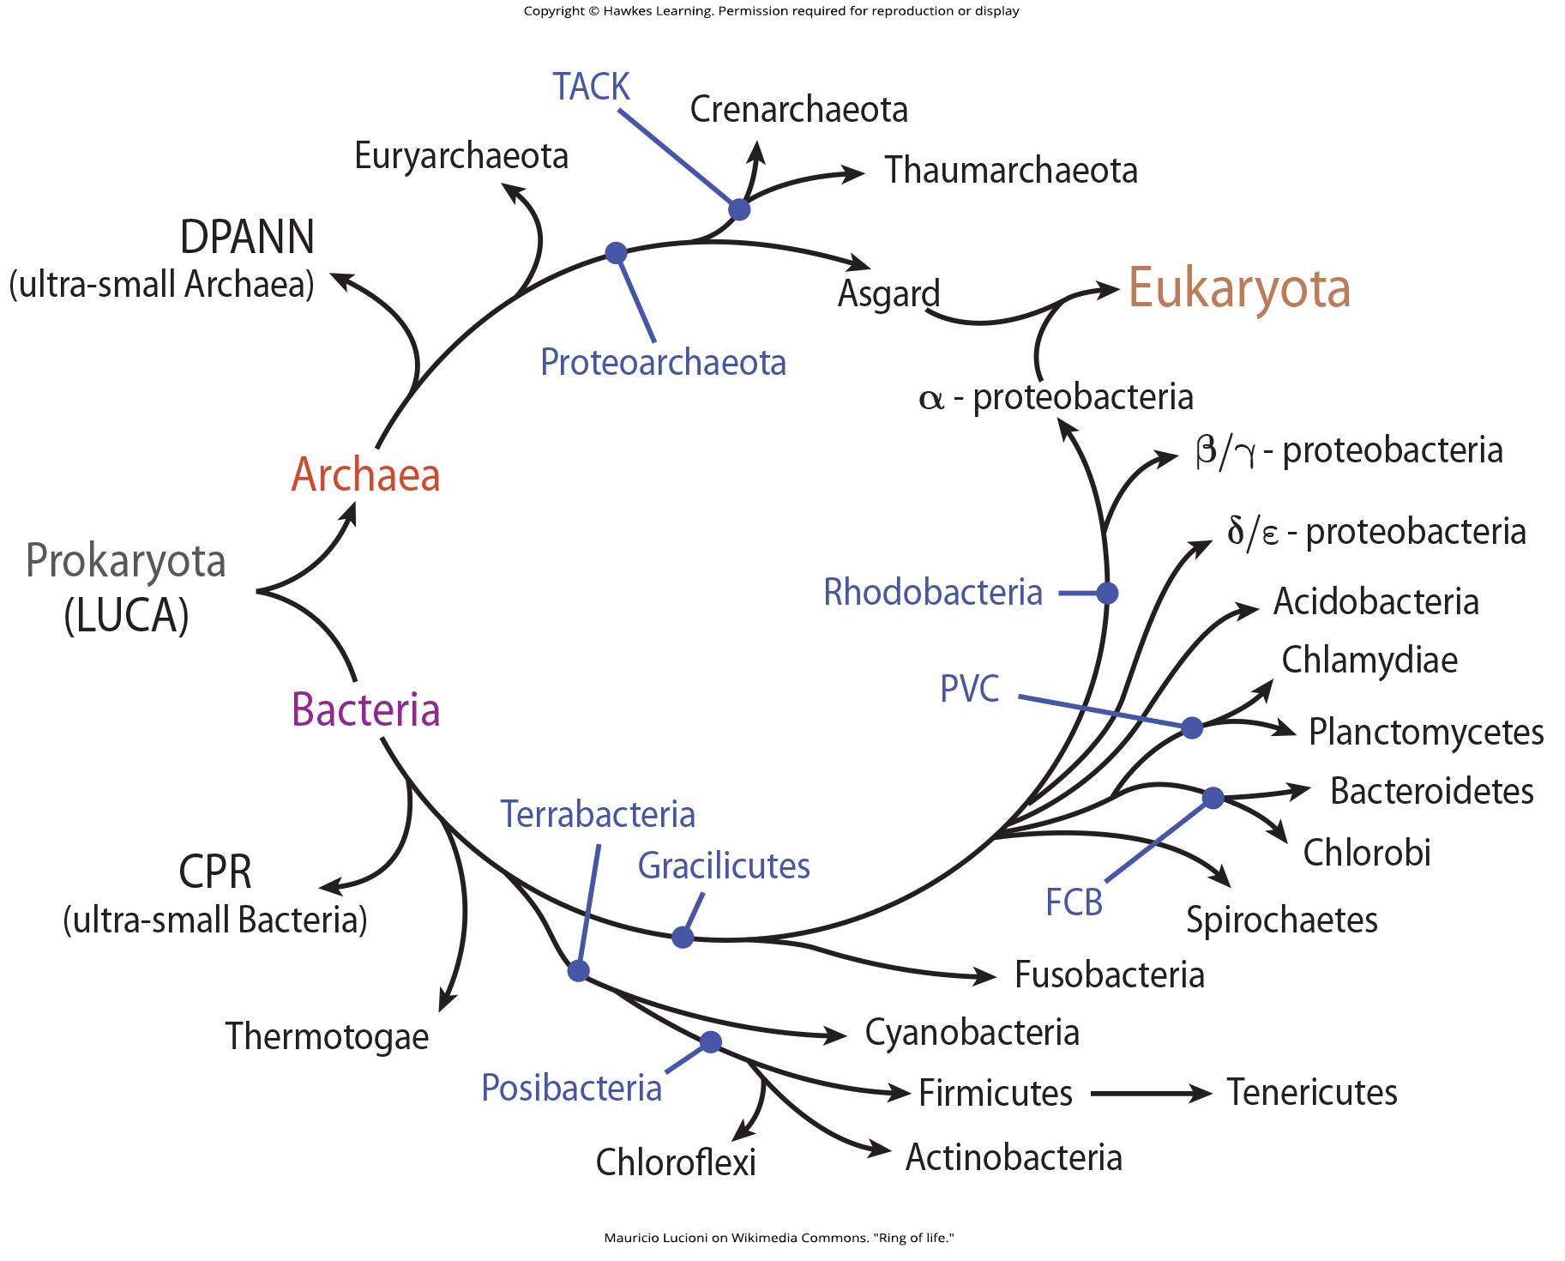
Lesson 20.3 Figure 8

Slide 22
Hawkes Learning – End of PowerPoint

