Slide 1
Chapter 21
Viruses

Slide 2
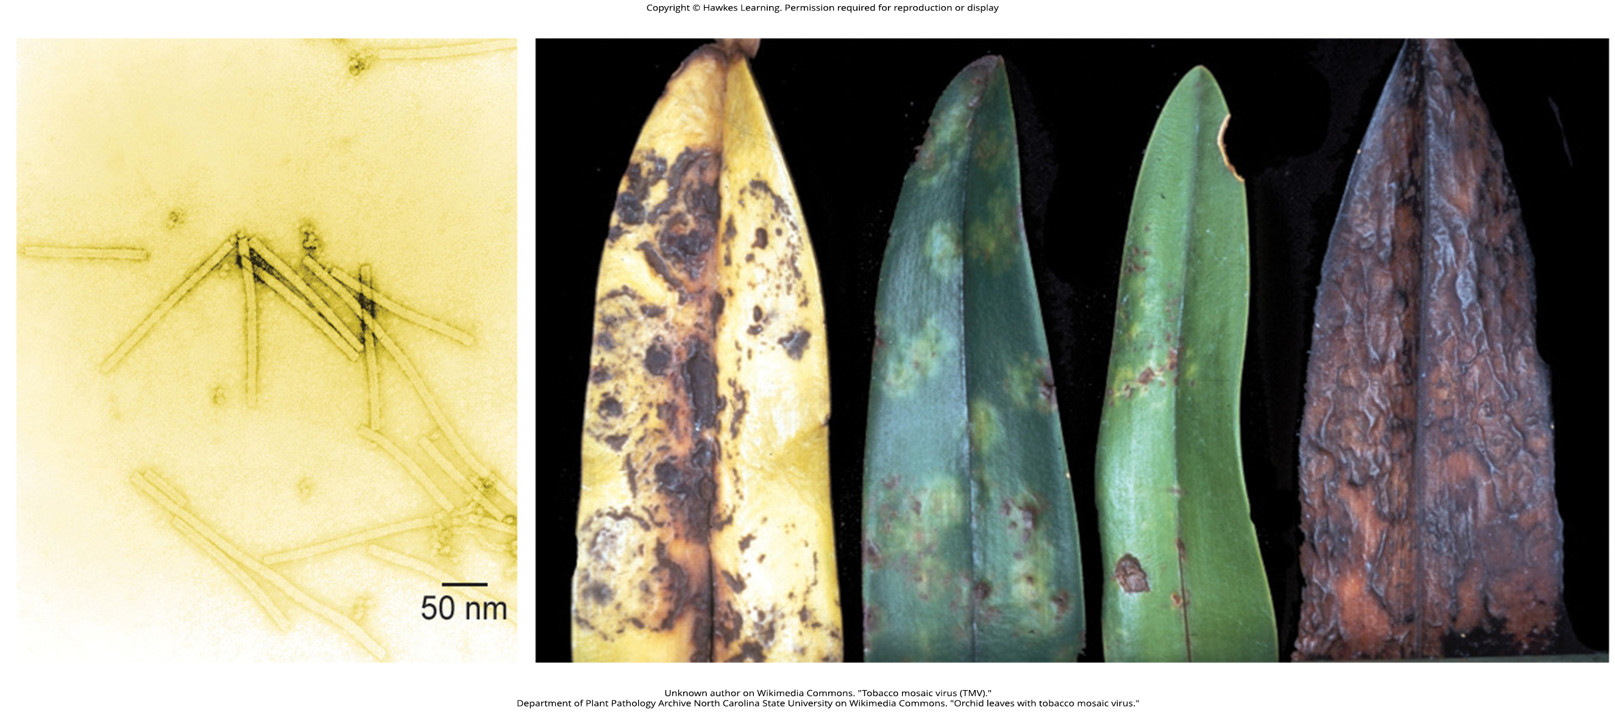
Lesson 21.1 Figure 1

Slide 3
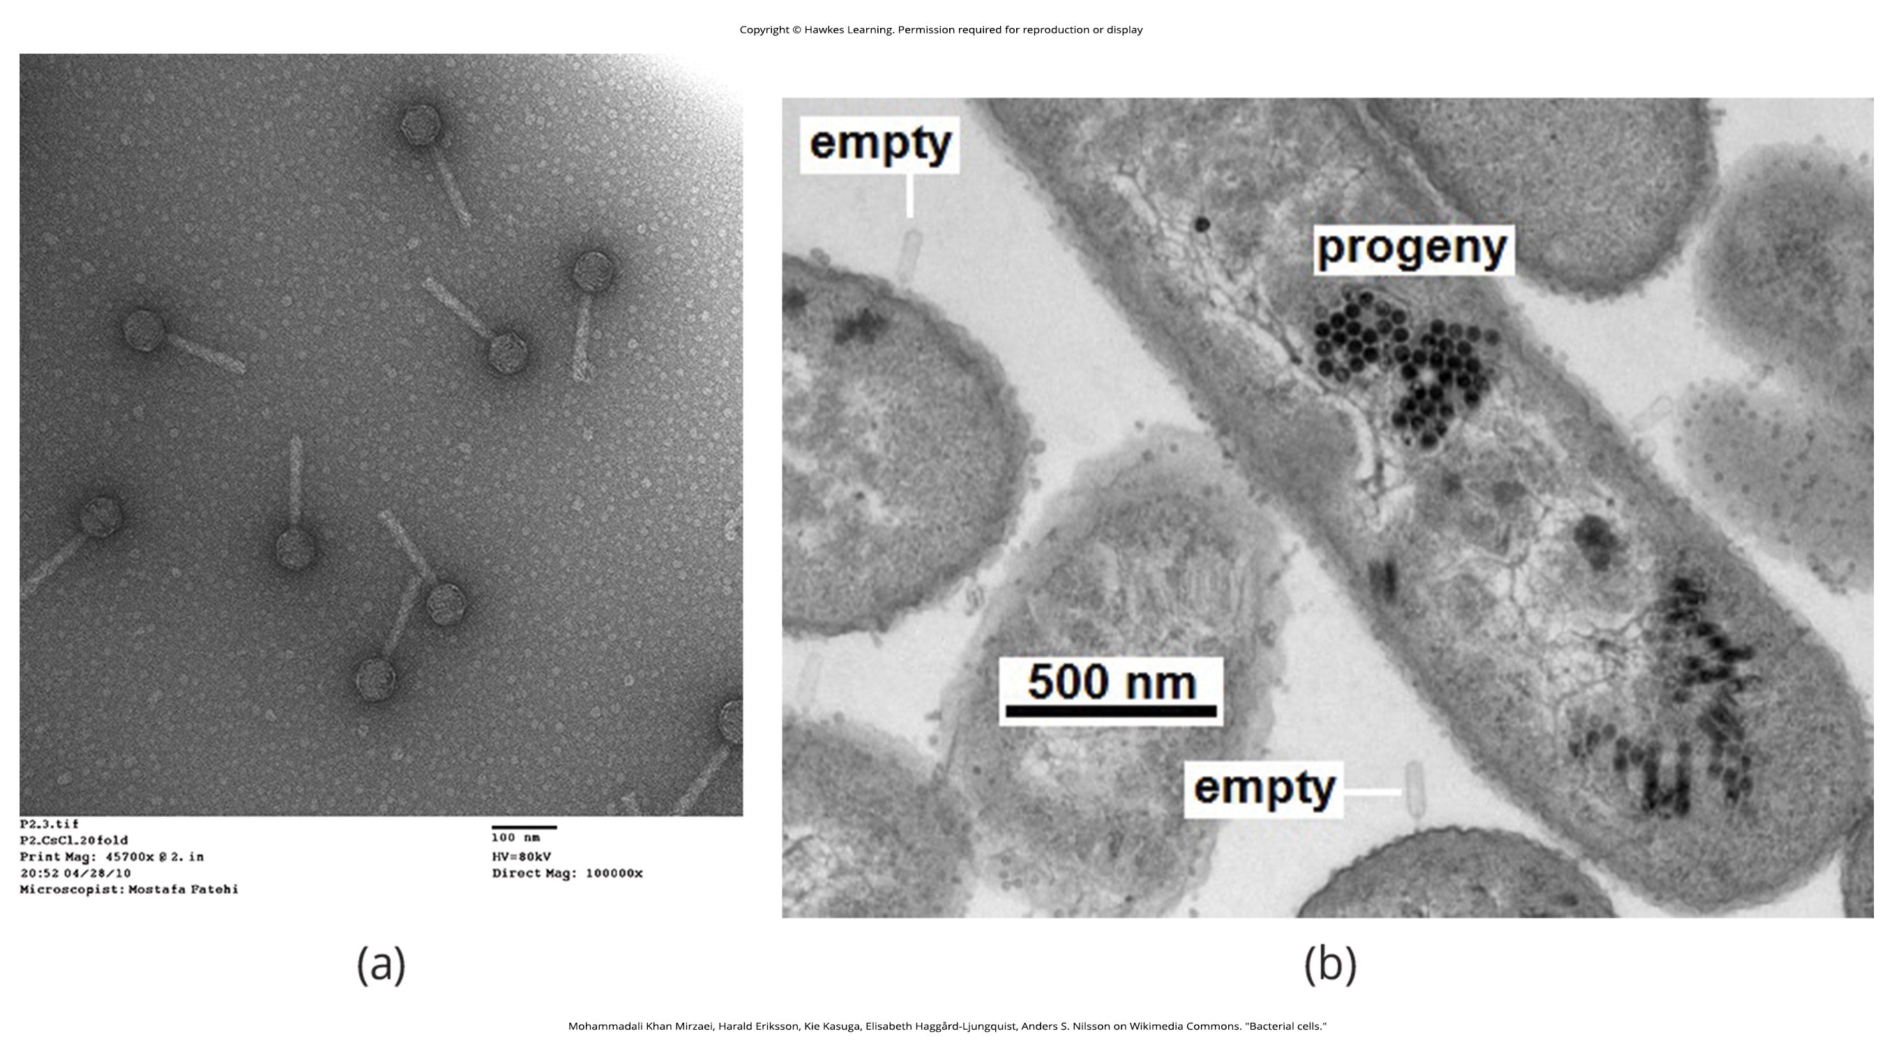
Lesson 21.1 Figure 2

Slide 4
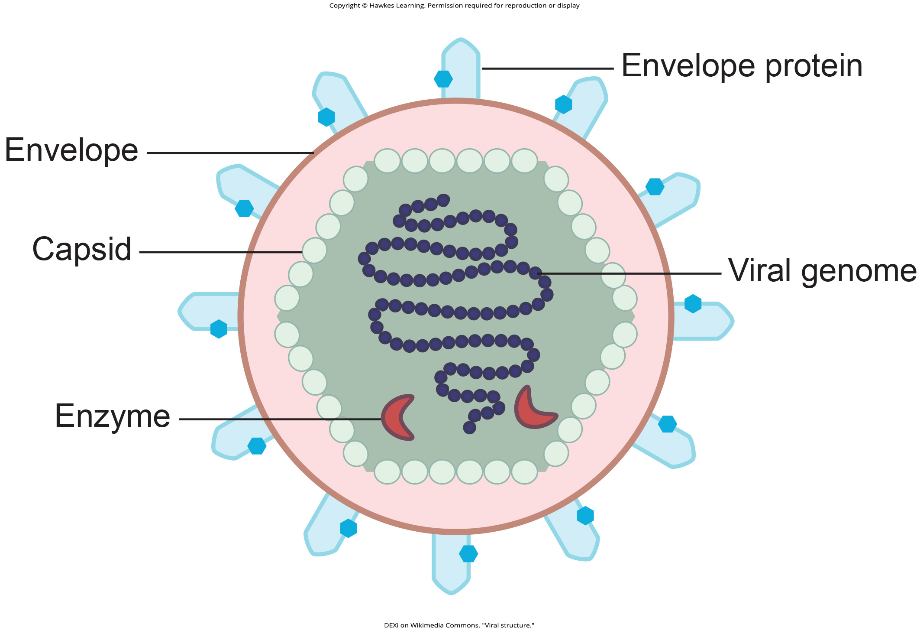
Lesson 21.1 Figure 3

Slide 5
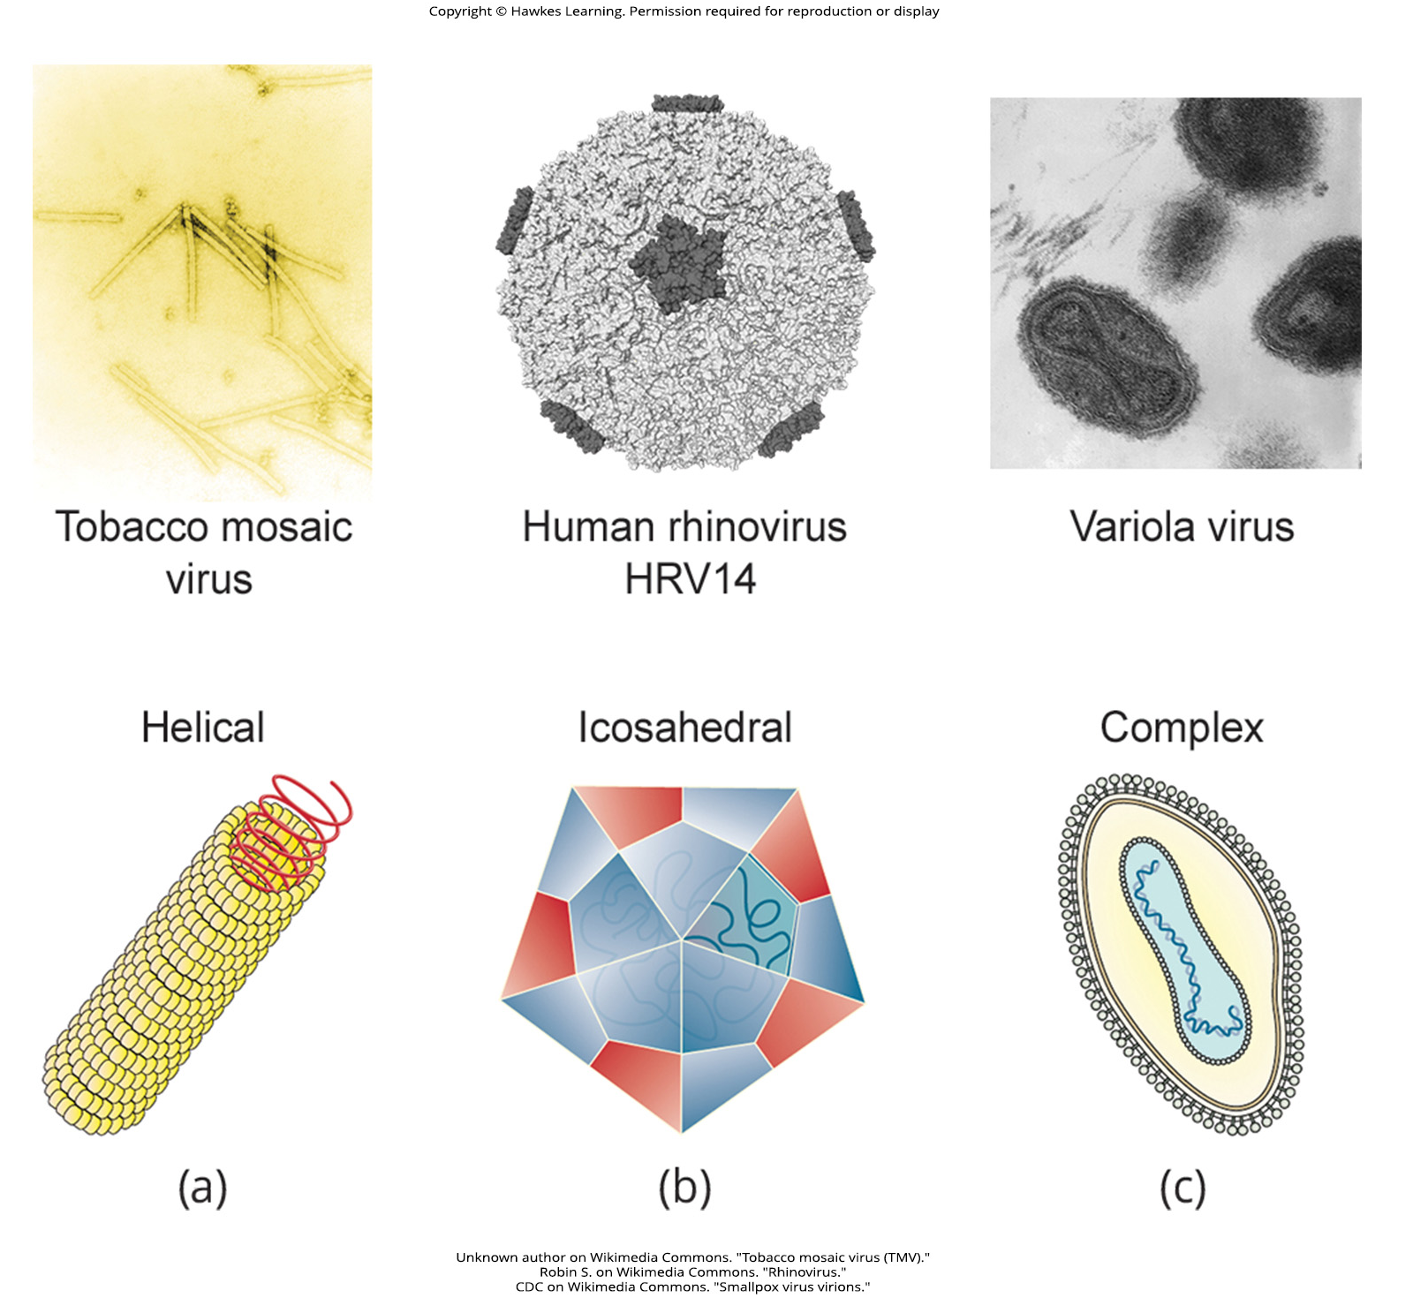
Lesson 21.1 Figure 4

Slide 6
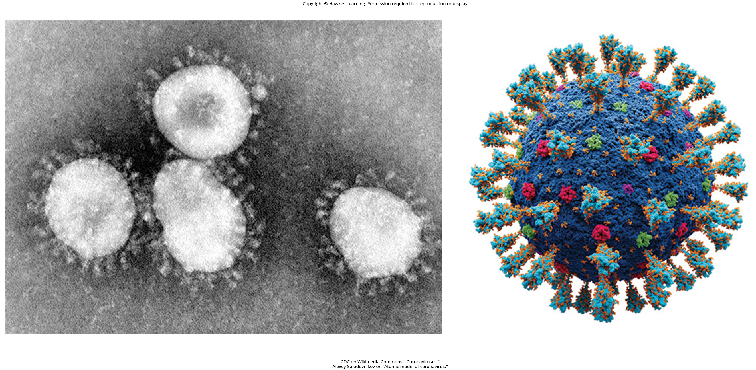
Lesson 21.1 Figure 5

Slide 7
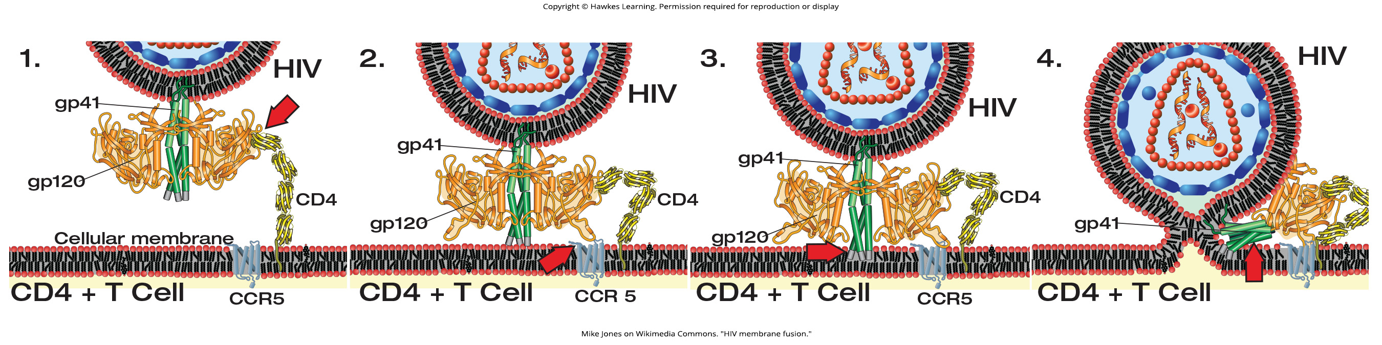
Lesson 21.1 Figure 6

Slide 8
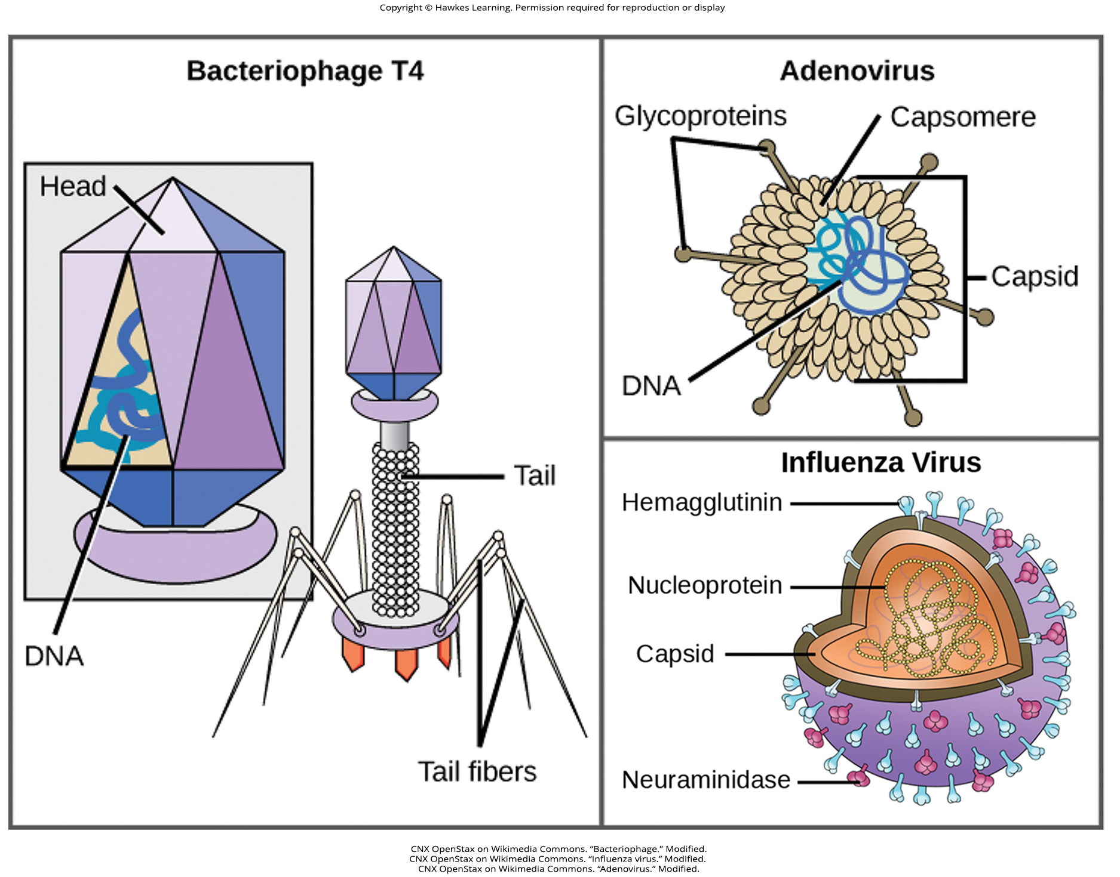
Lesson 21.1 Figure 7

Slide 9
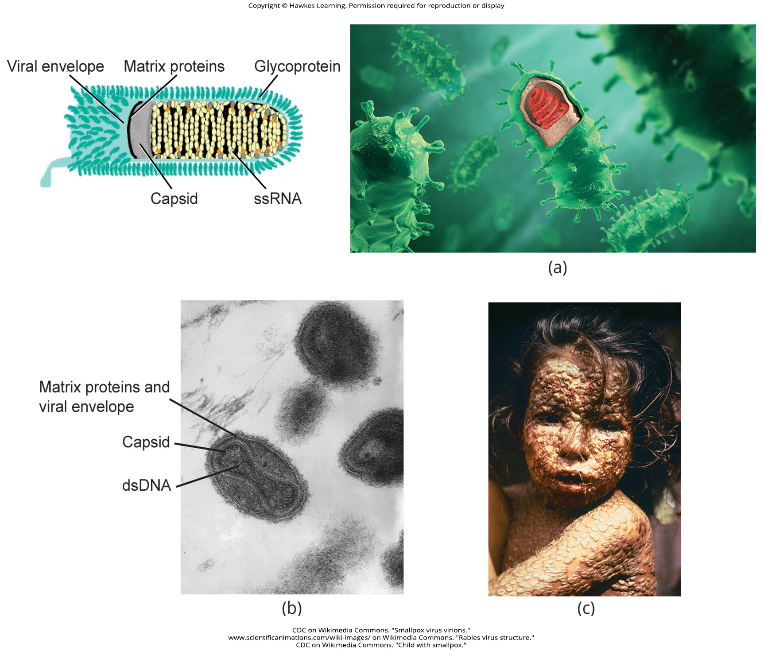
Lesson 21.1 Figure 8

Slide 10
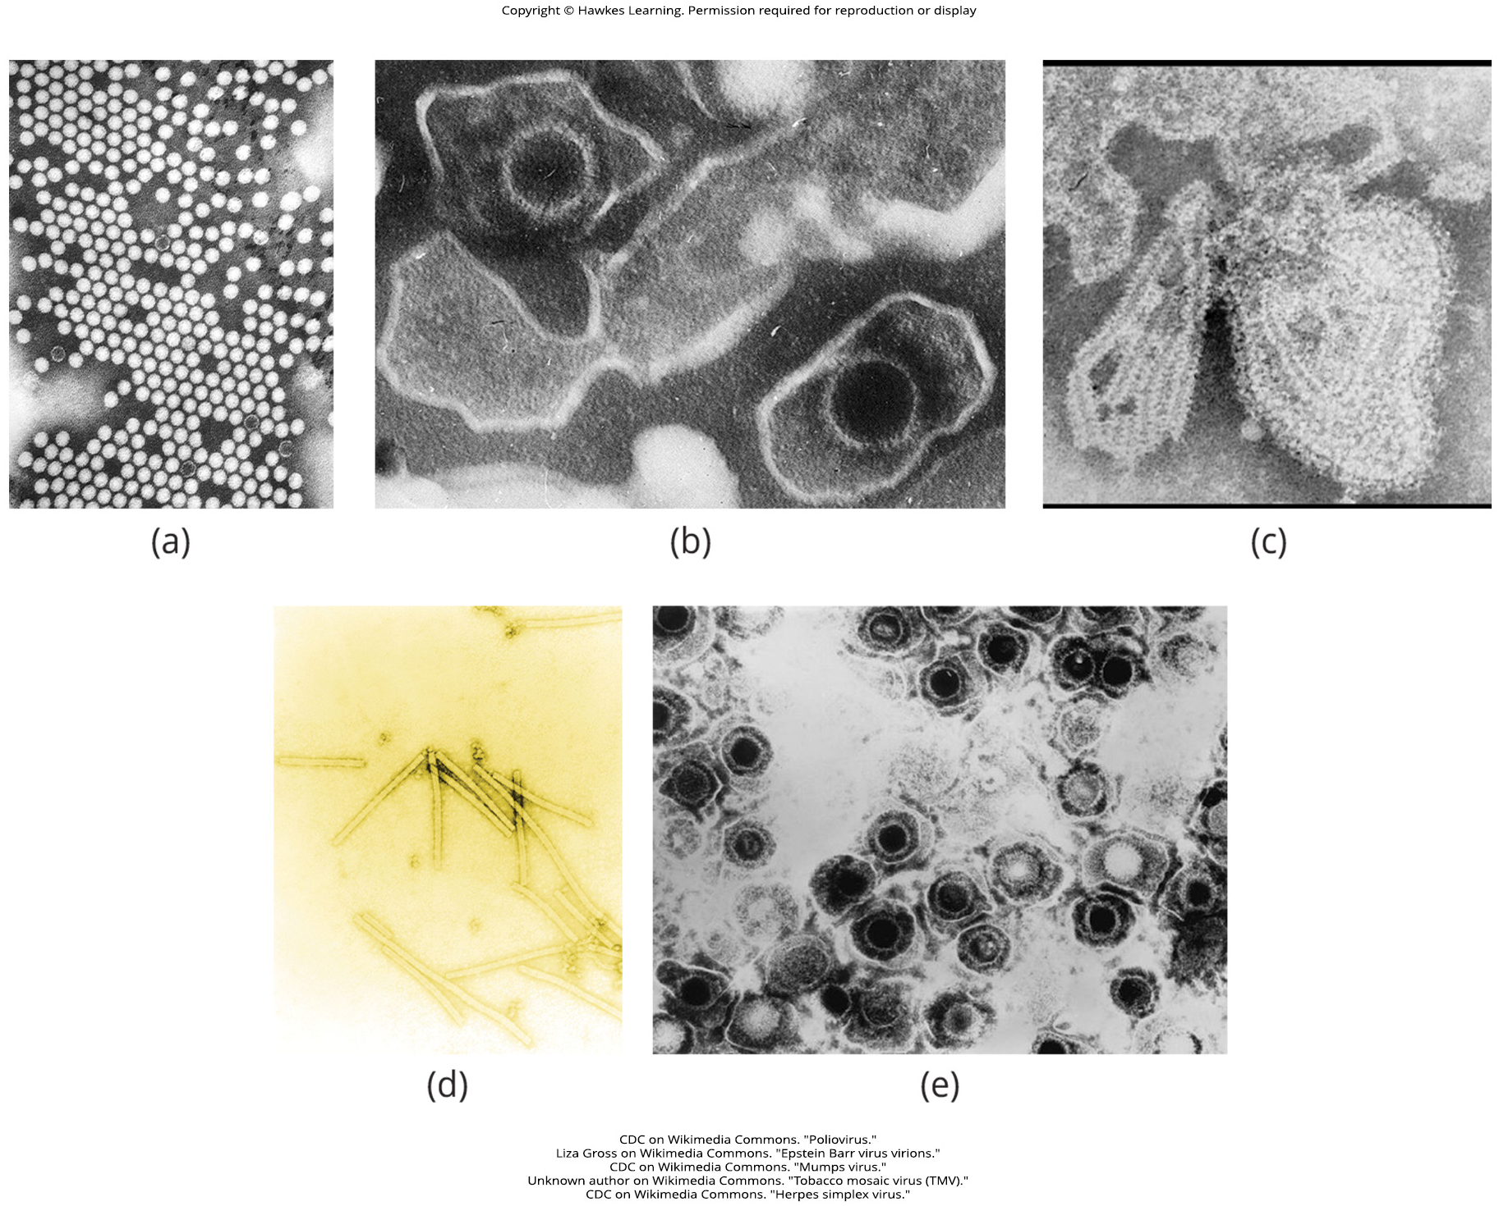
Lesson 21.1 Figure 9

Slide 11
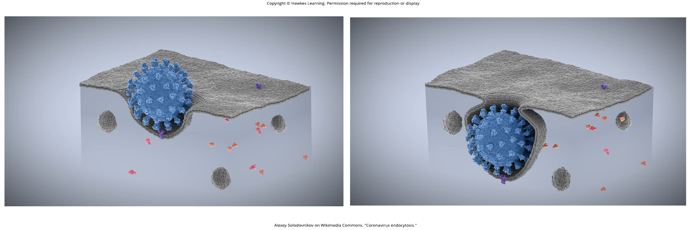
Lesson 21.2 Figure 1

Slide 12
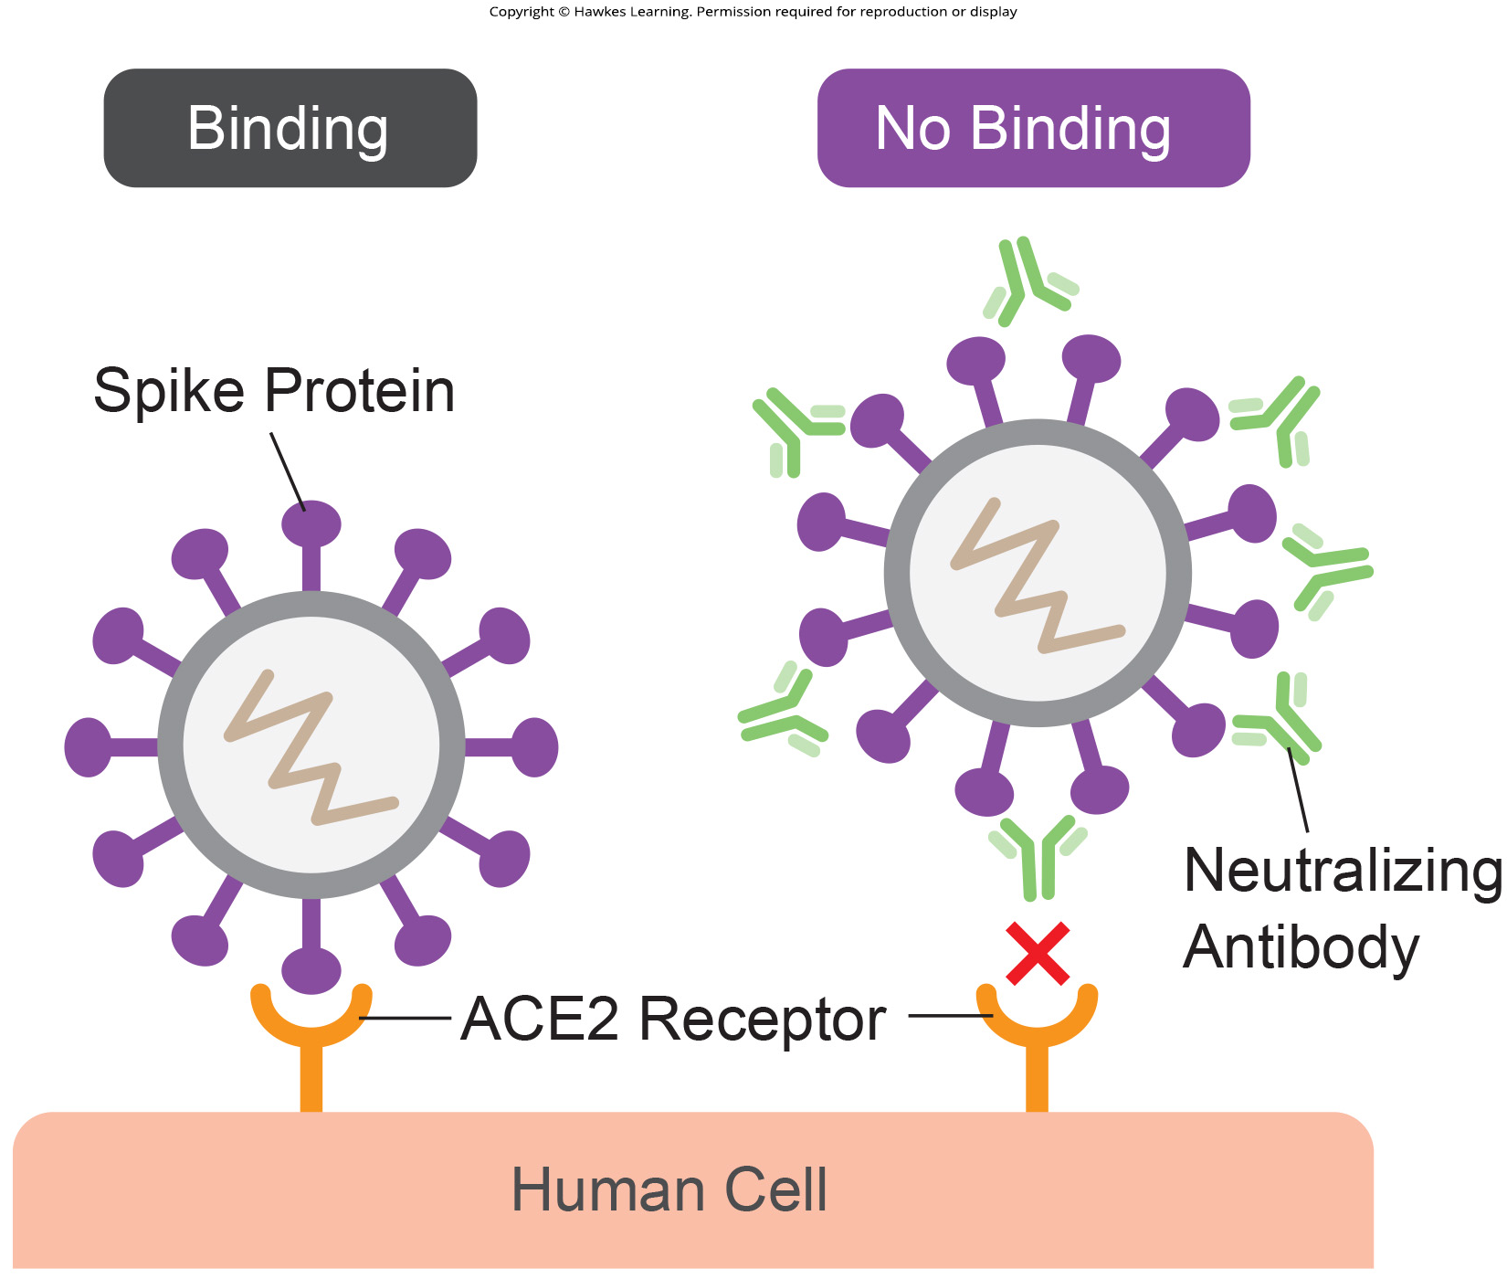
Lesson 21.2 Figure 2

Slide 13
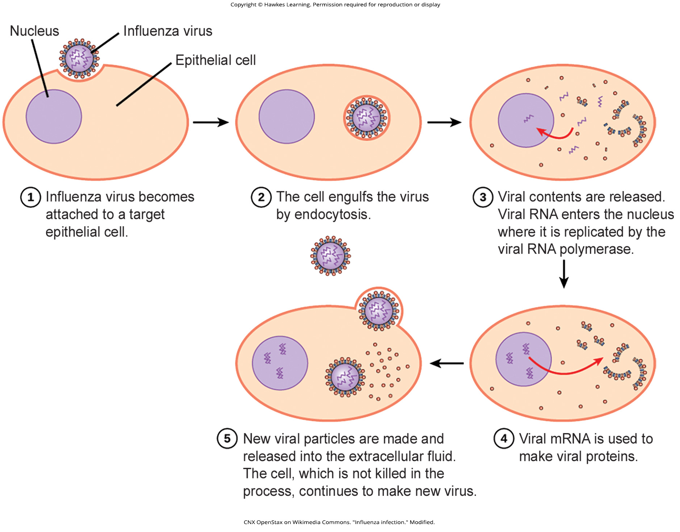
Lesson 21.2 Figure 3

Slide 14
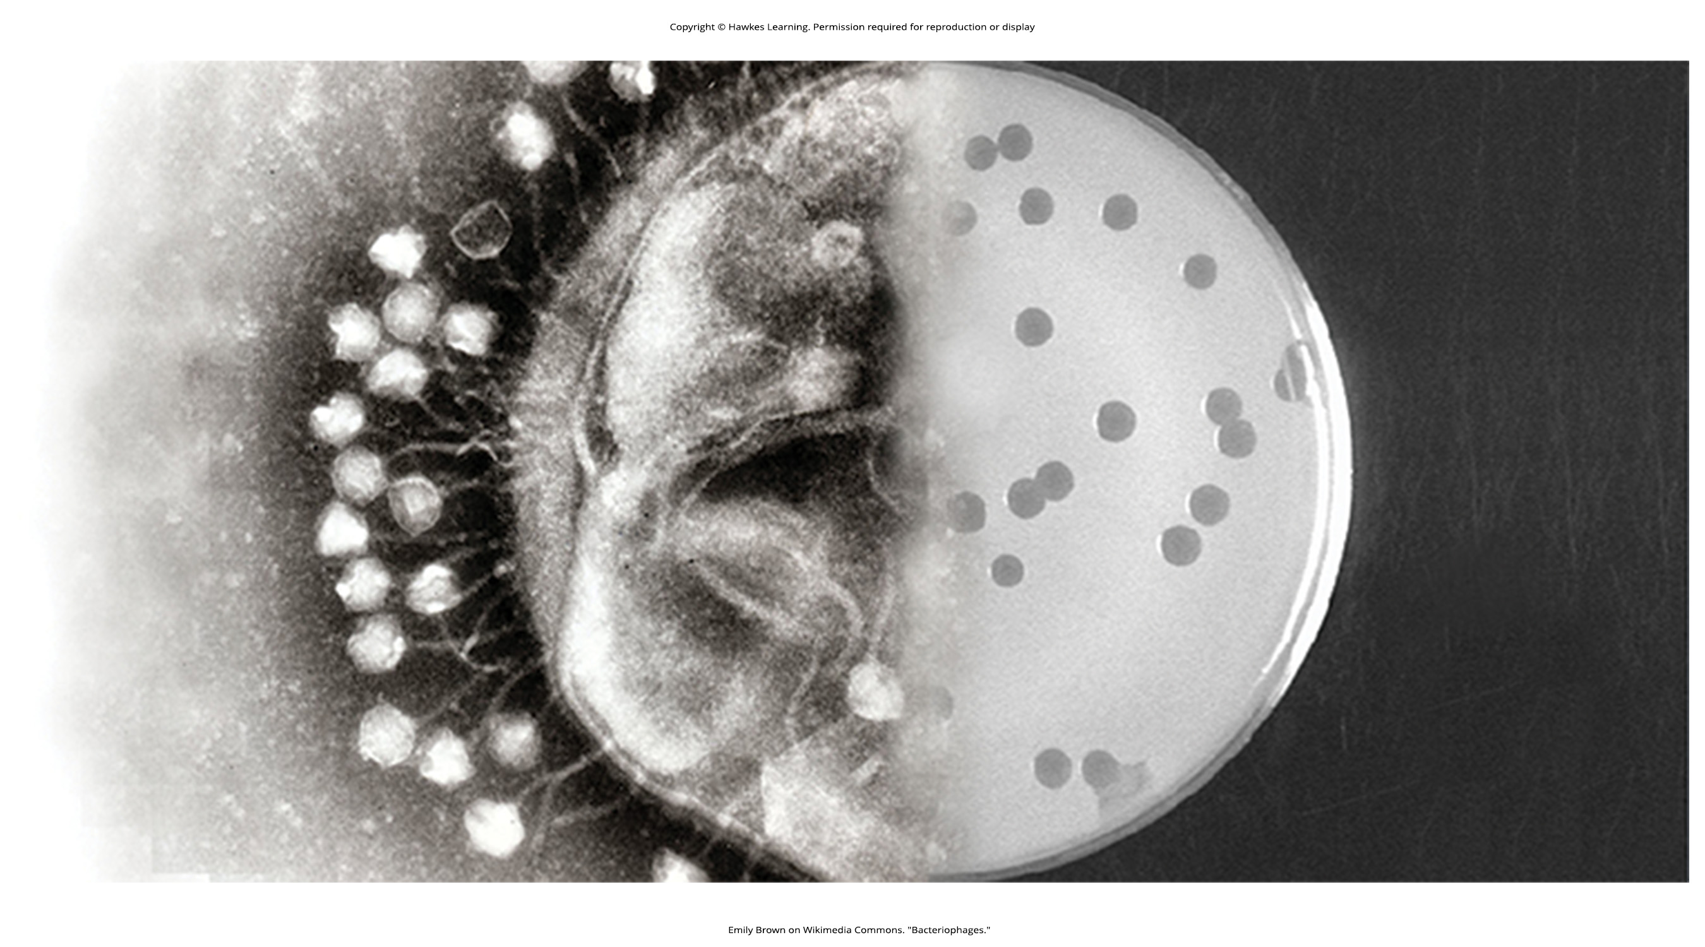
Lesson 21.2 Figure 4

Slide 15
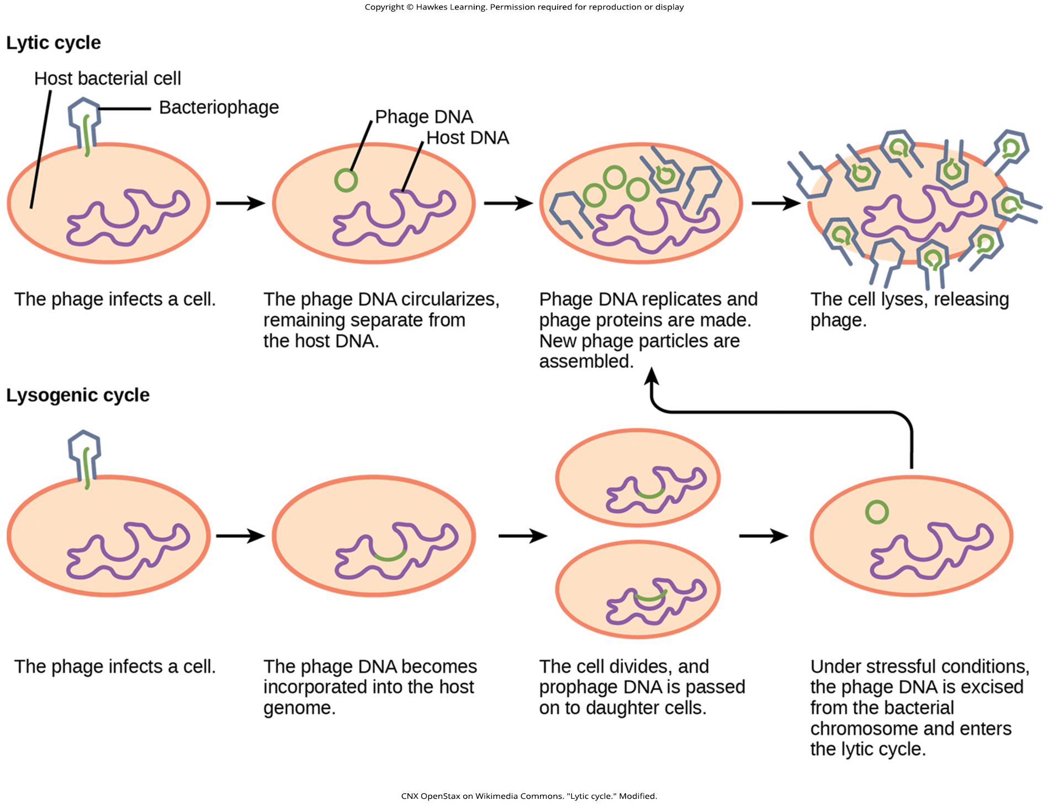
Lesson 21.2 Figure 5

Slide 16
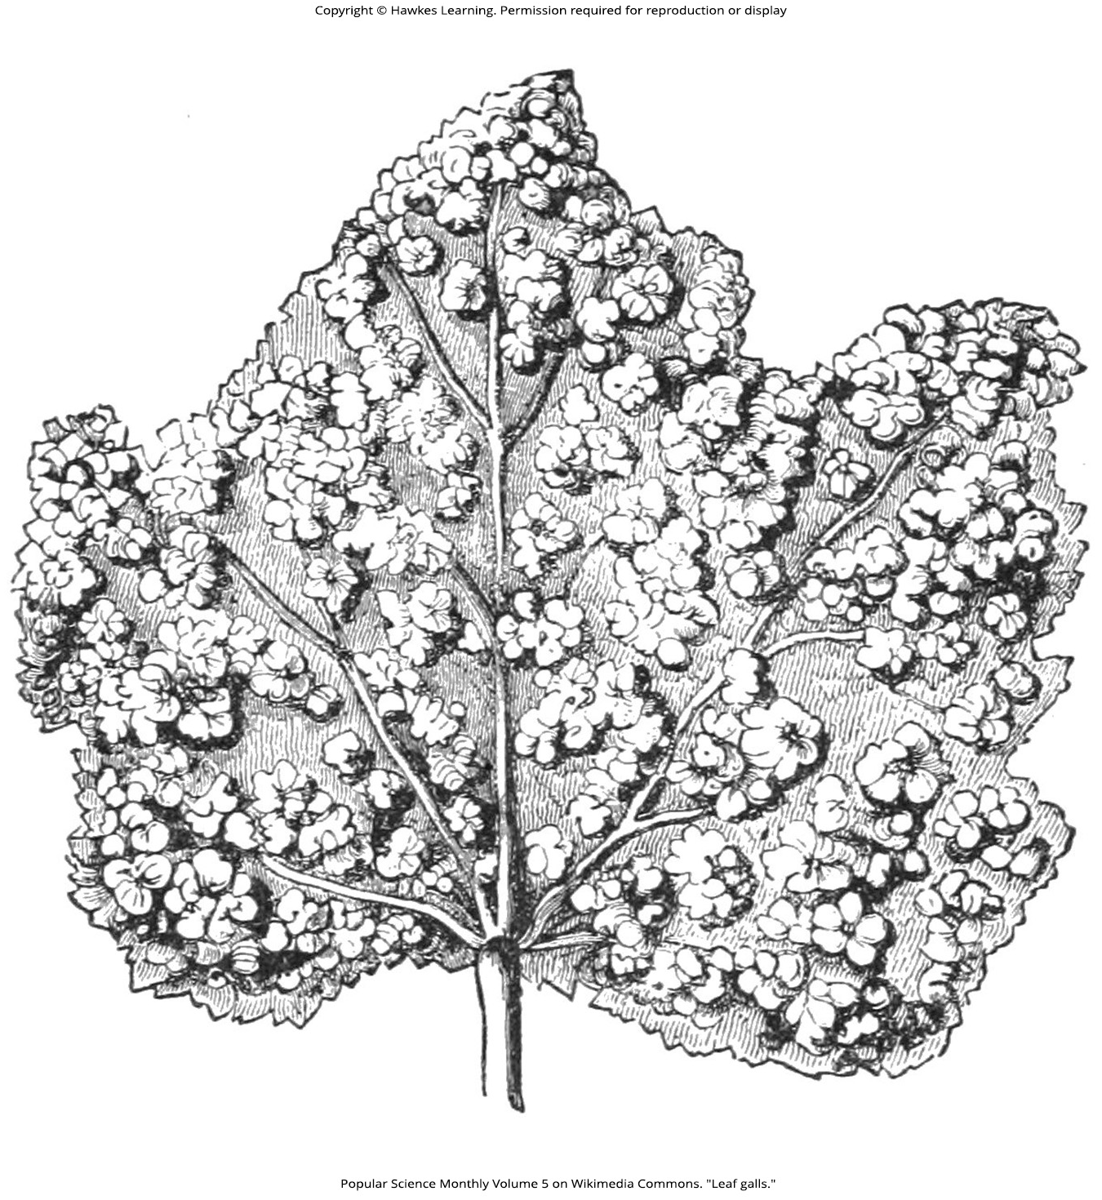
Lesson 21.2 Figure 6

Slide 17
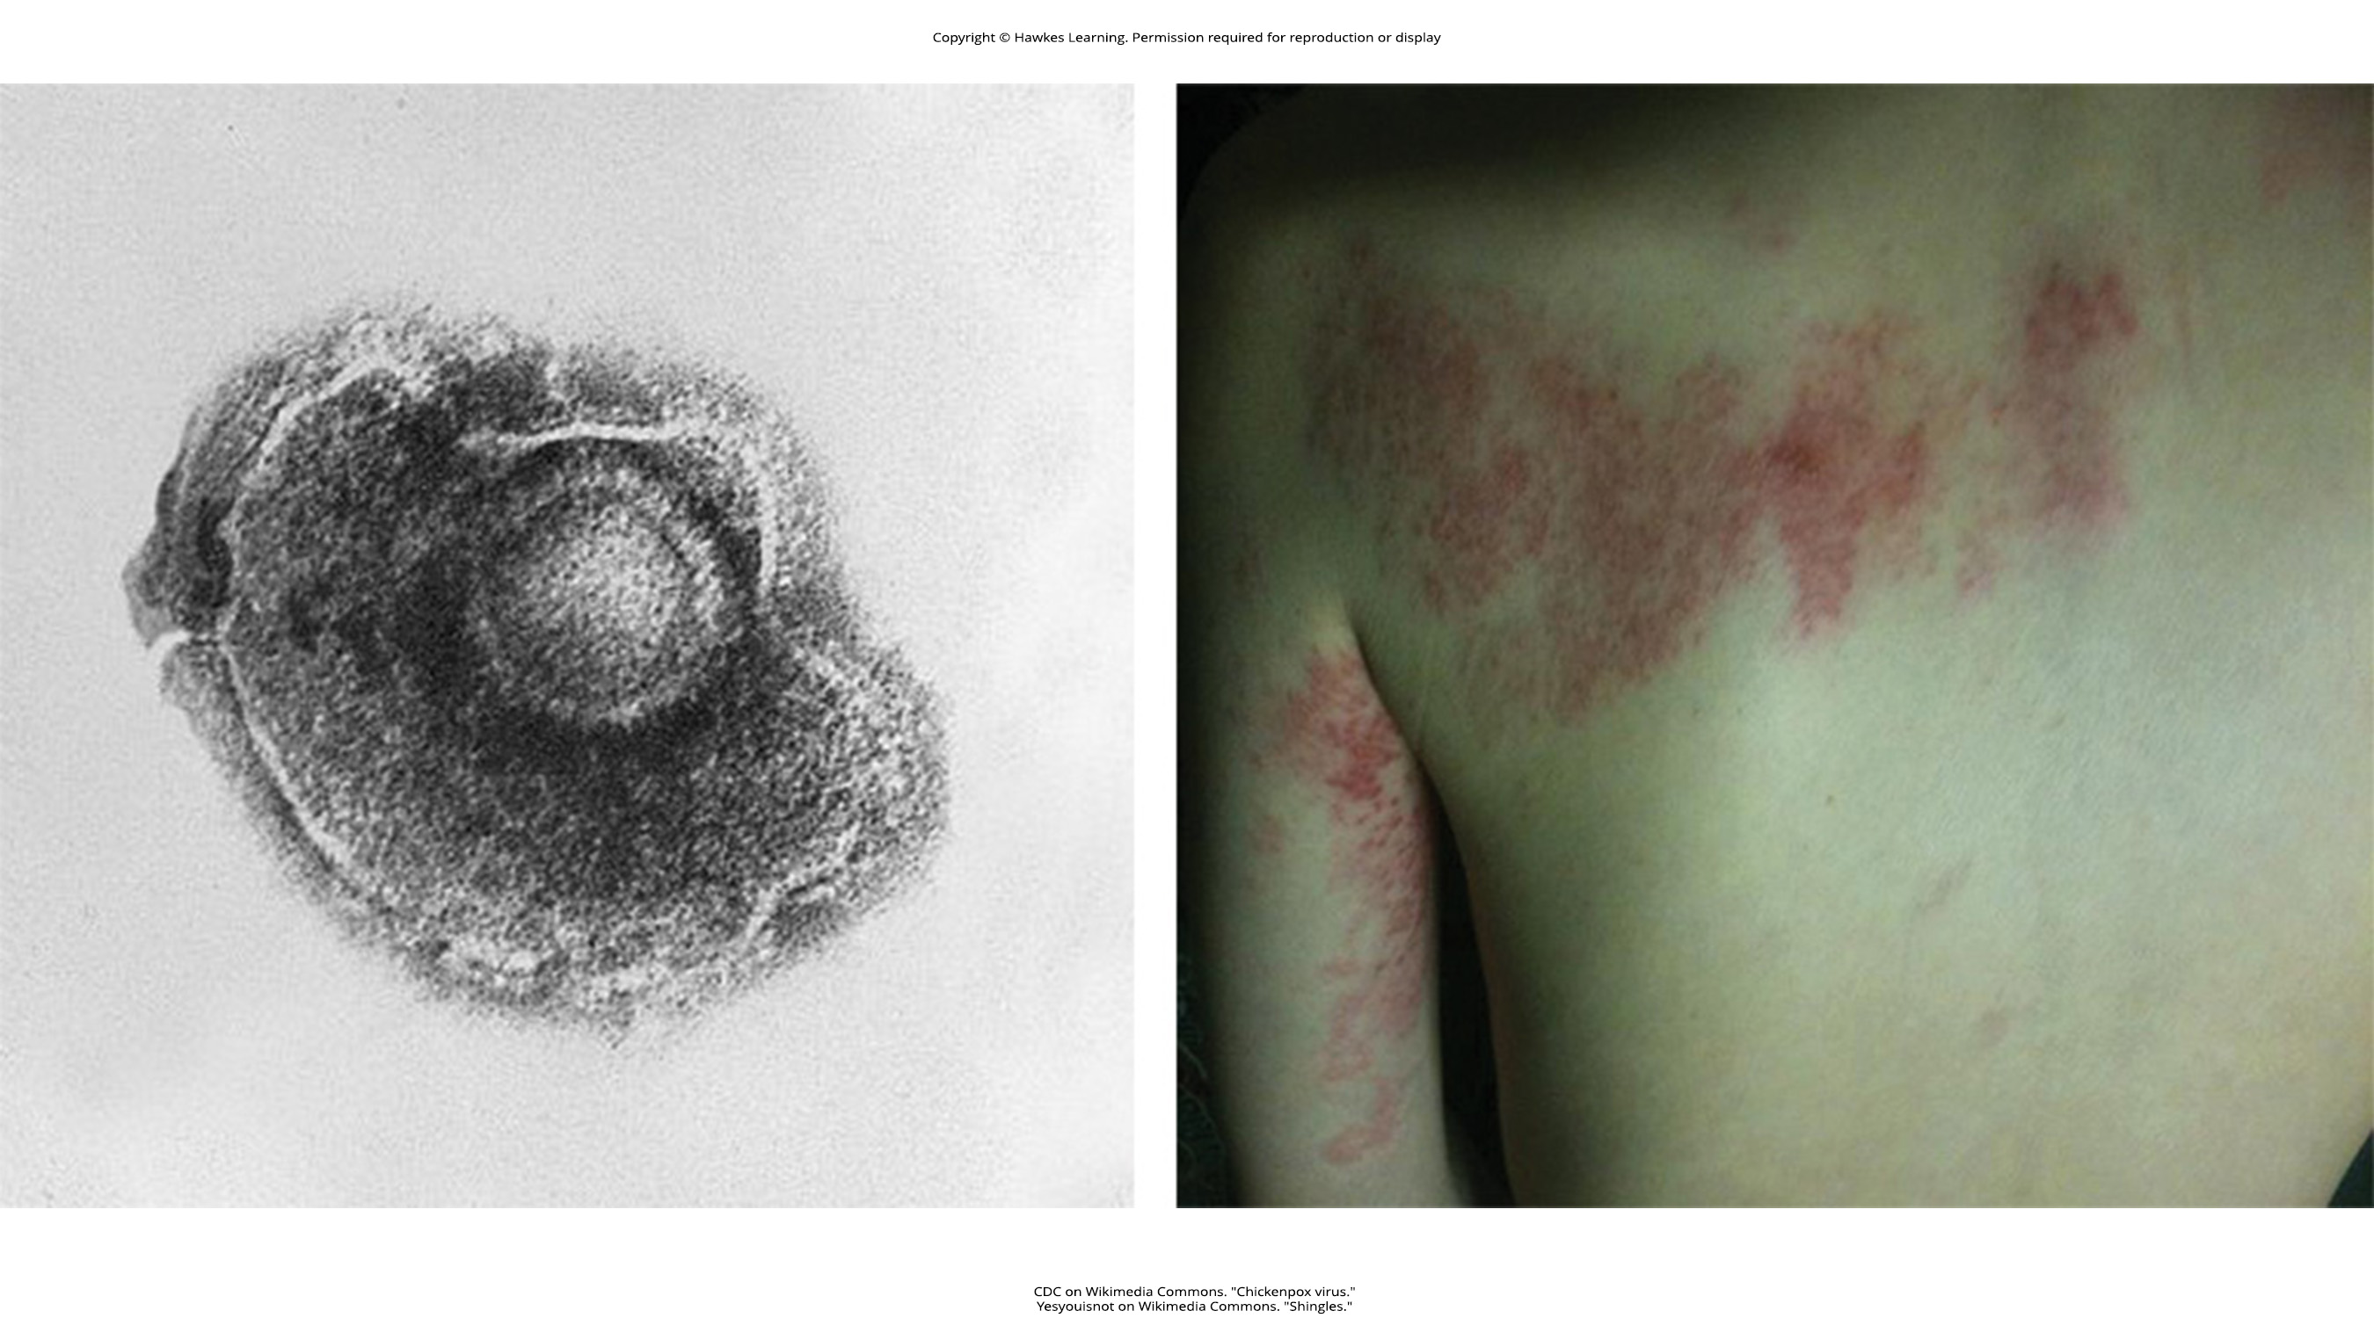
Lesson 21.2 Figure 7

Slide 18
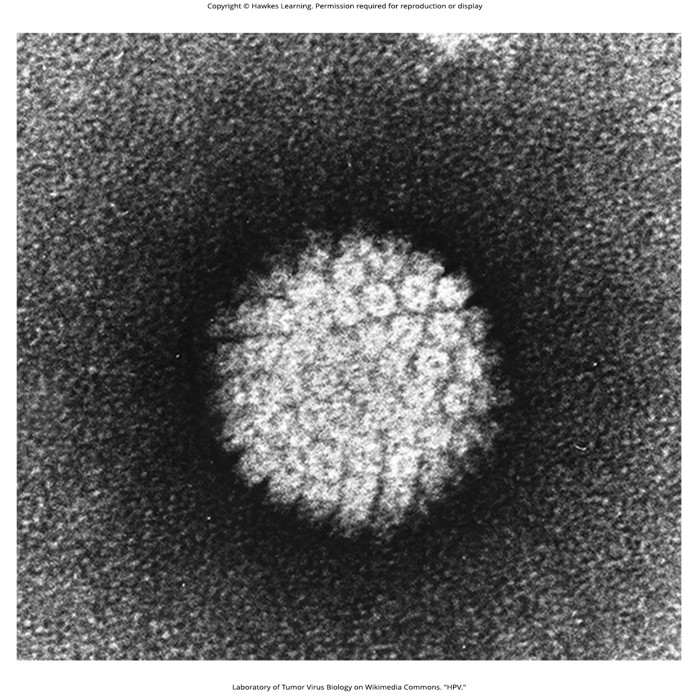
Lesson 21.2 Figure 8

Slide 19
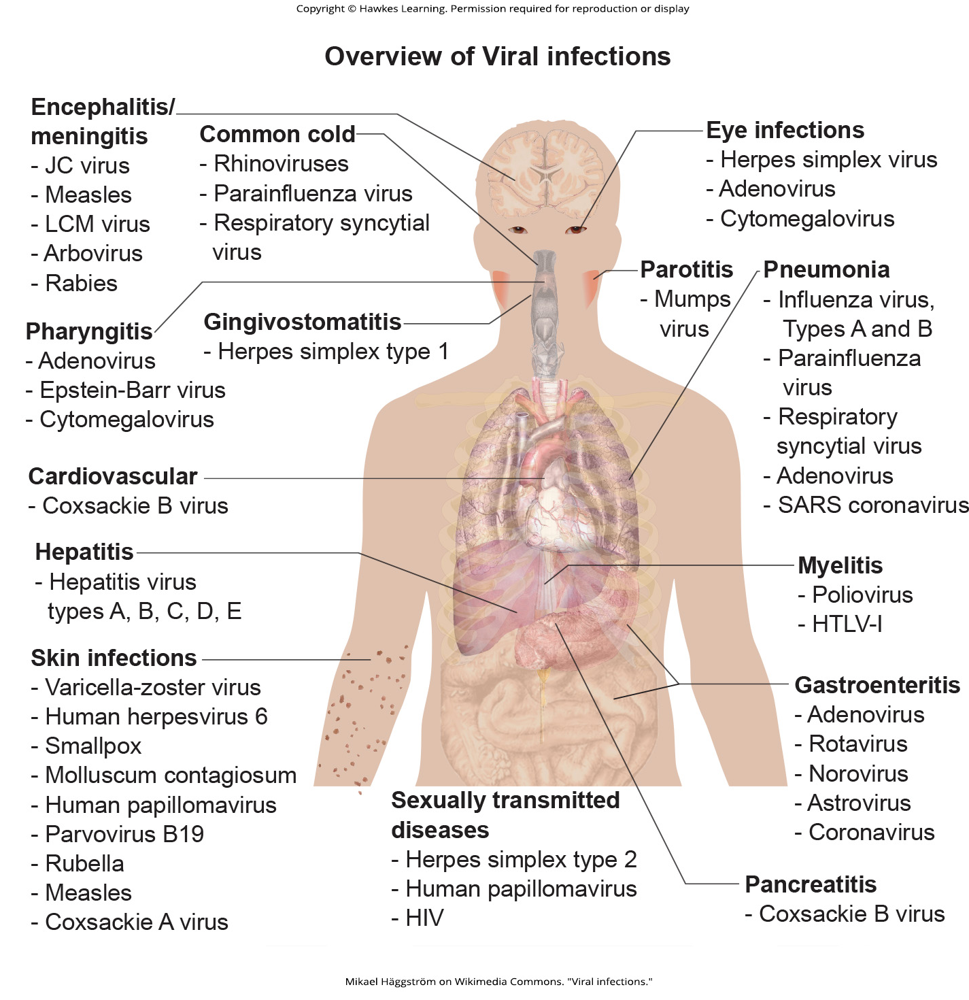
Lesson 21.3 Figure 1

Slide 20

Lesson 21.3 Figure 2

Slide 21
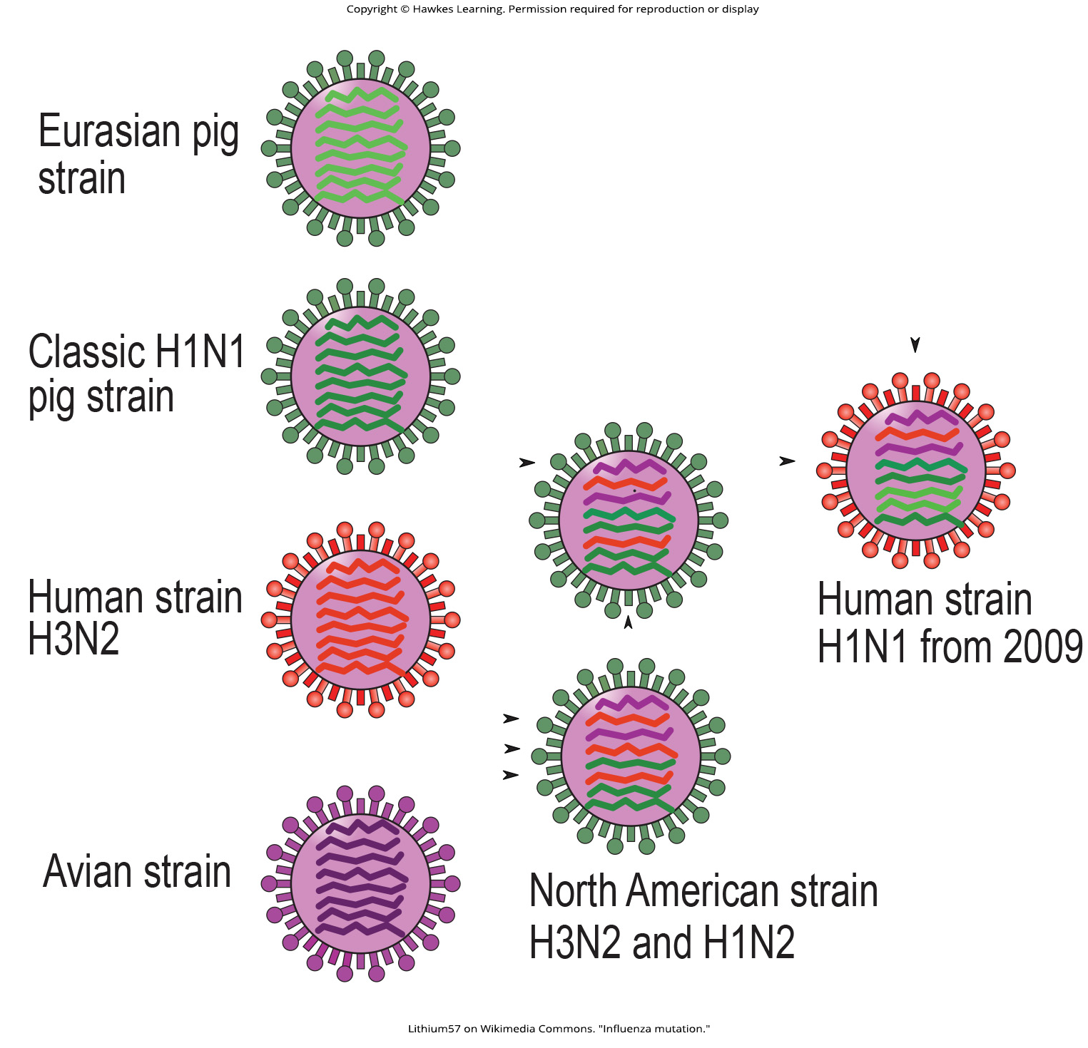
Lesson 21.3 Figure 3

Slide 22
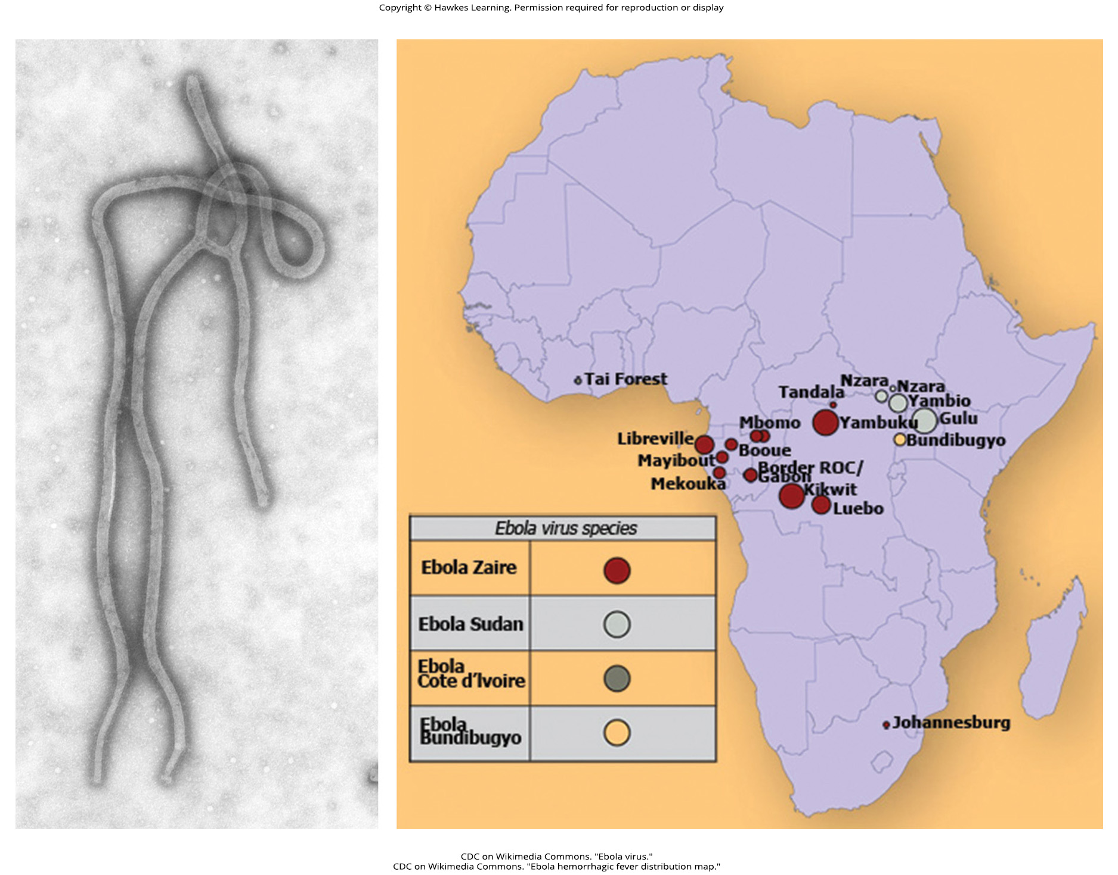
Lesson 21.3 Figure 4

Slide 23
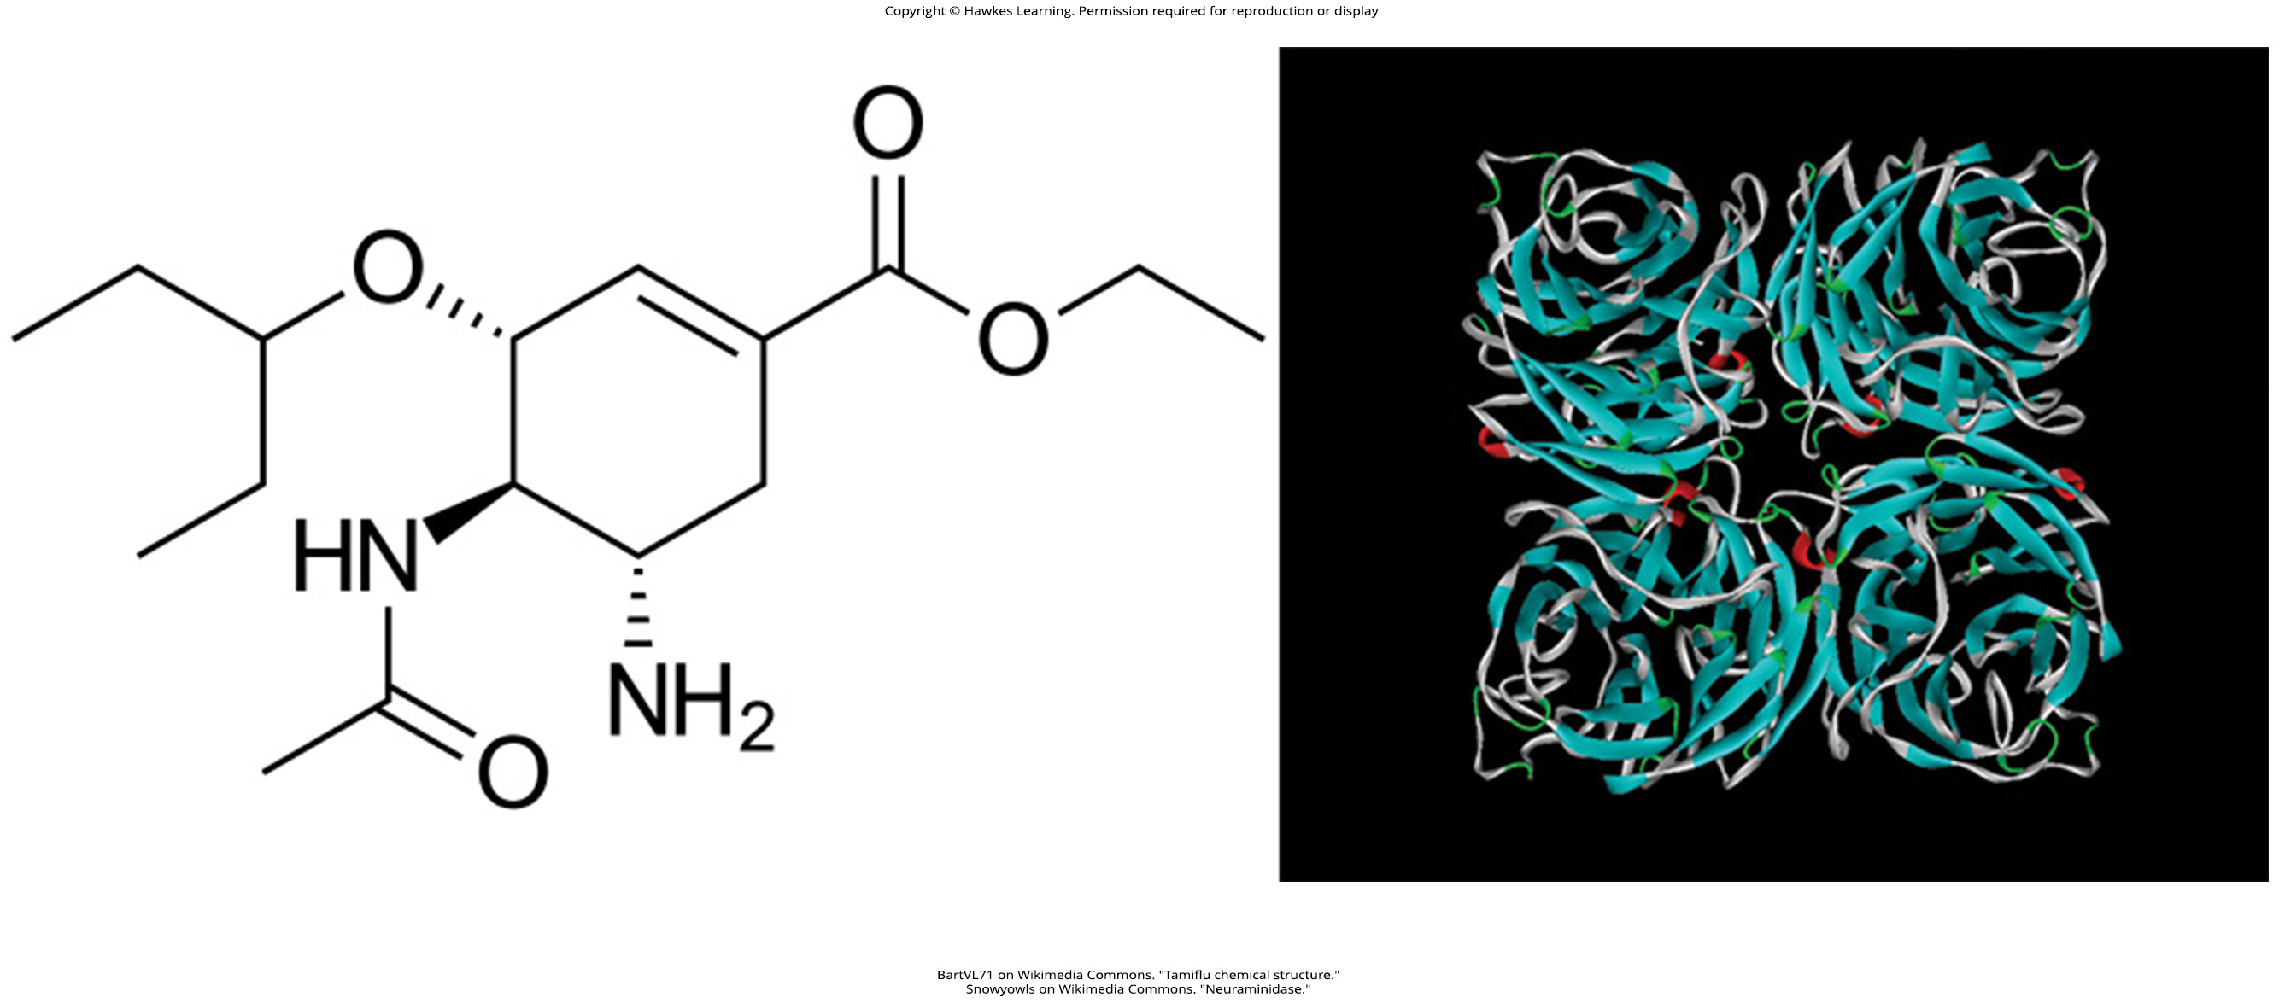
Lesson 21.3 Figure 5

Slide 24
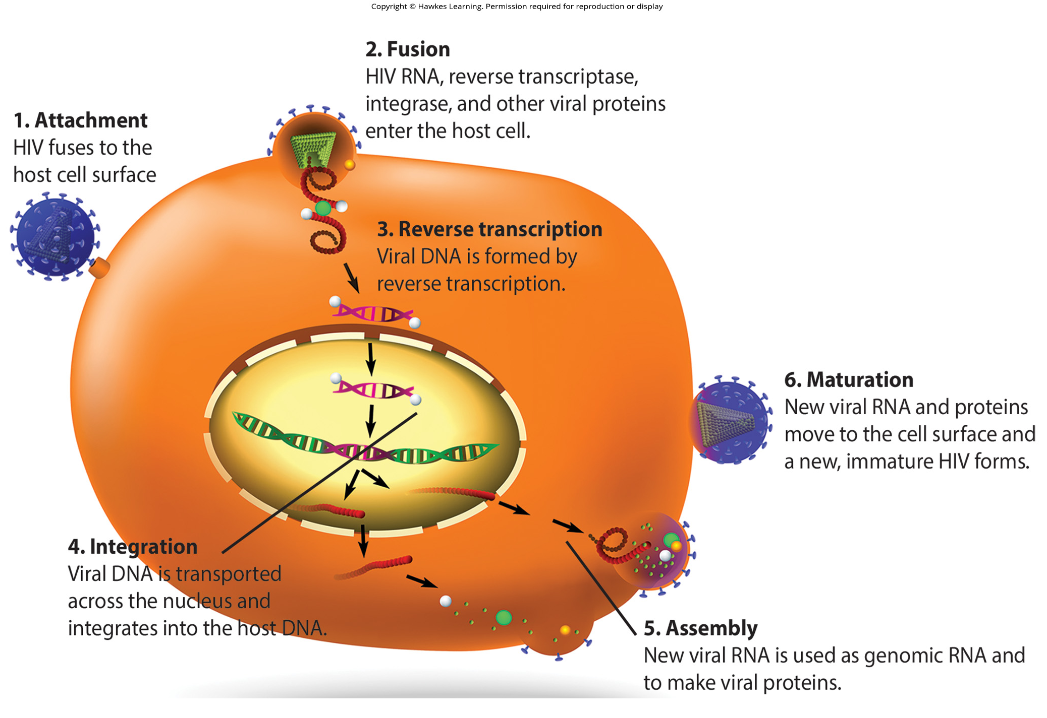
Lesson 21.3 Figure 6

Slide 25
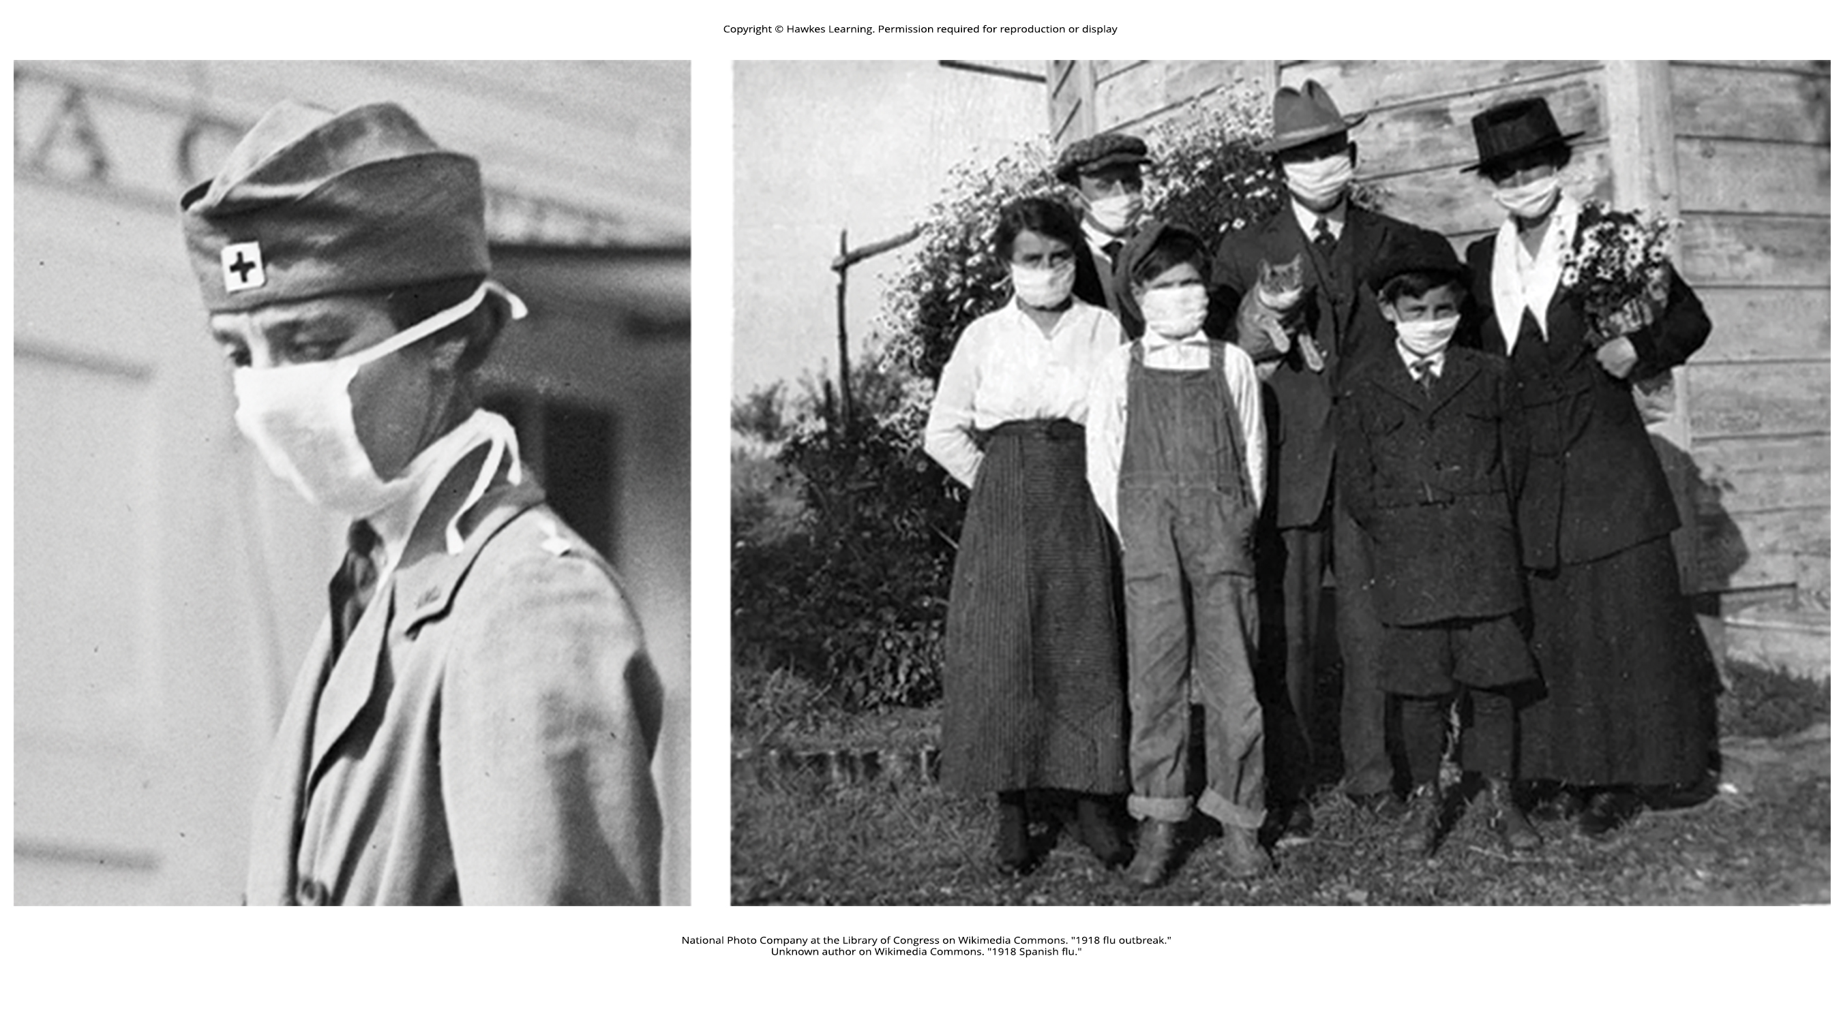
Lesson 21.3 Figure 7

Slide 26
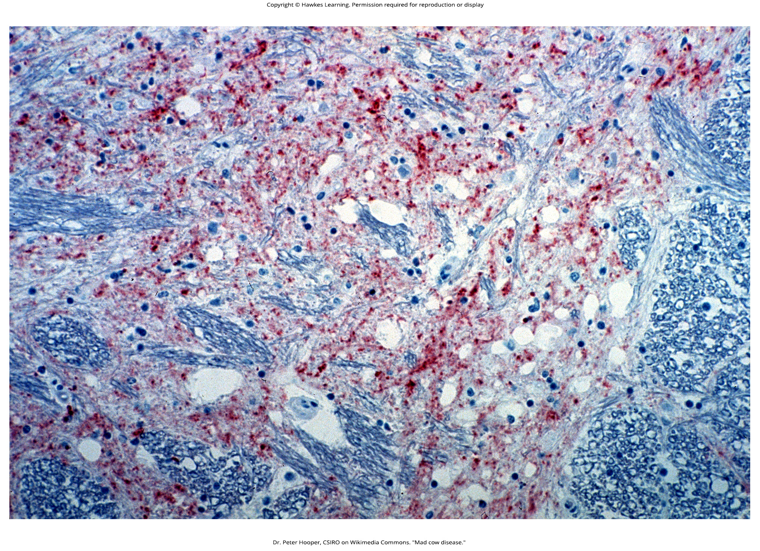
Lesson 21.4 Figure 1

Slide 27
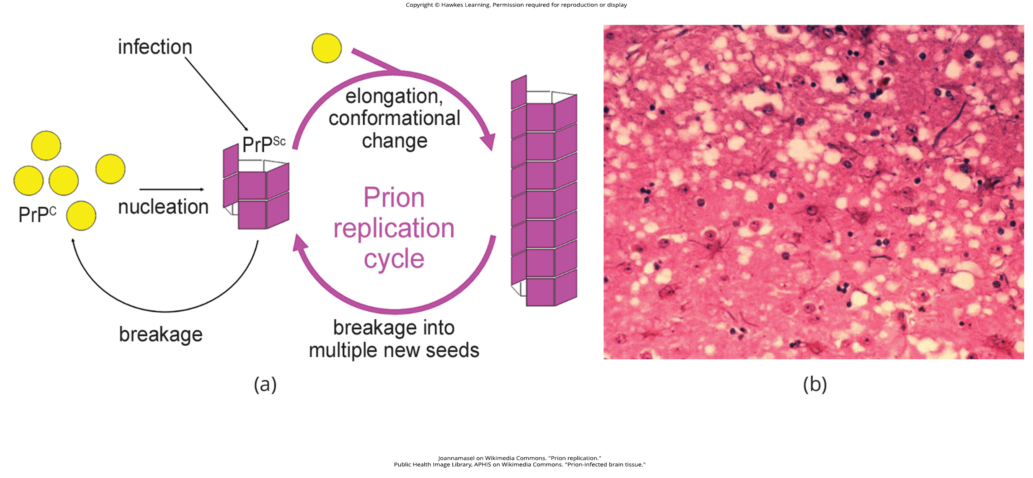
Lesson 21.4 Figure 2

Slide 28
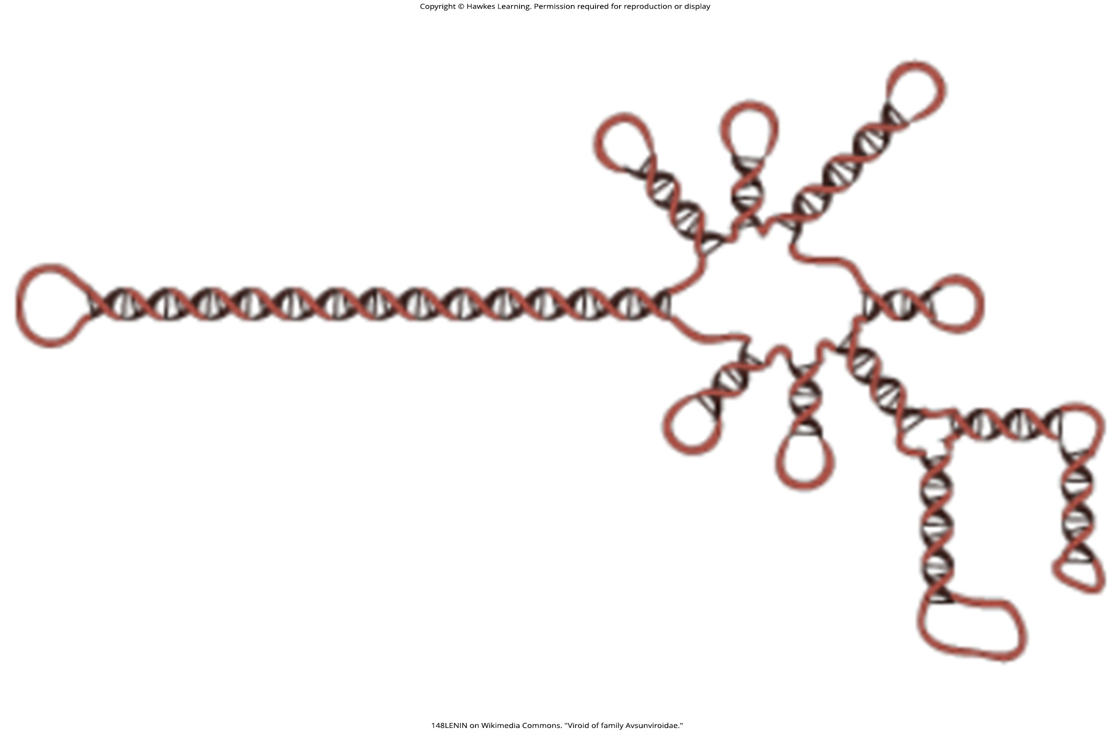
Lesson 21.4 Figure 3

Slide 29
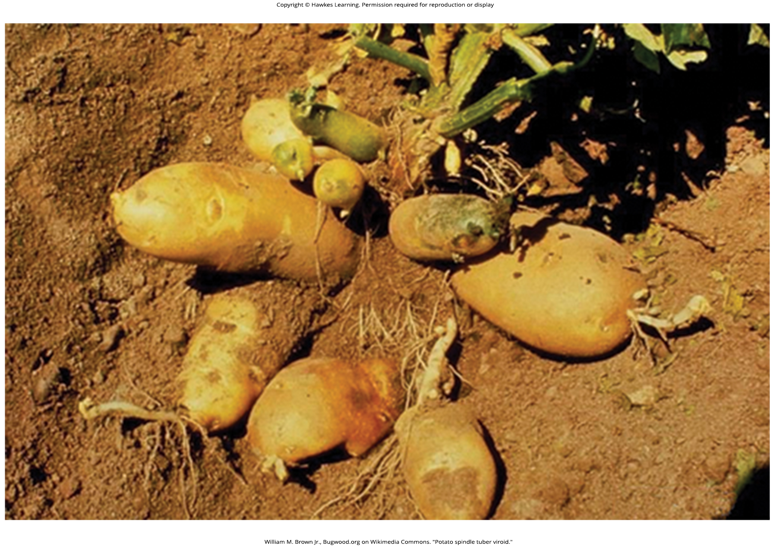
Lesson 21.4 Figure 4

Slide 30
Hawkes Learning – End of PowerPoint

