Slide 1
Chapter 22
Prokaryotes: Bacteria and Archaea

Slide 2
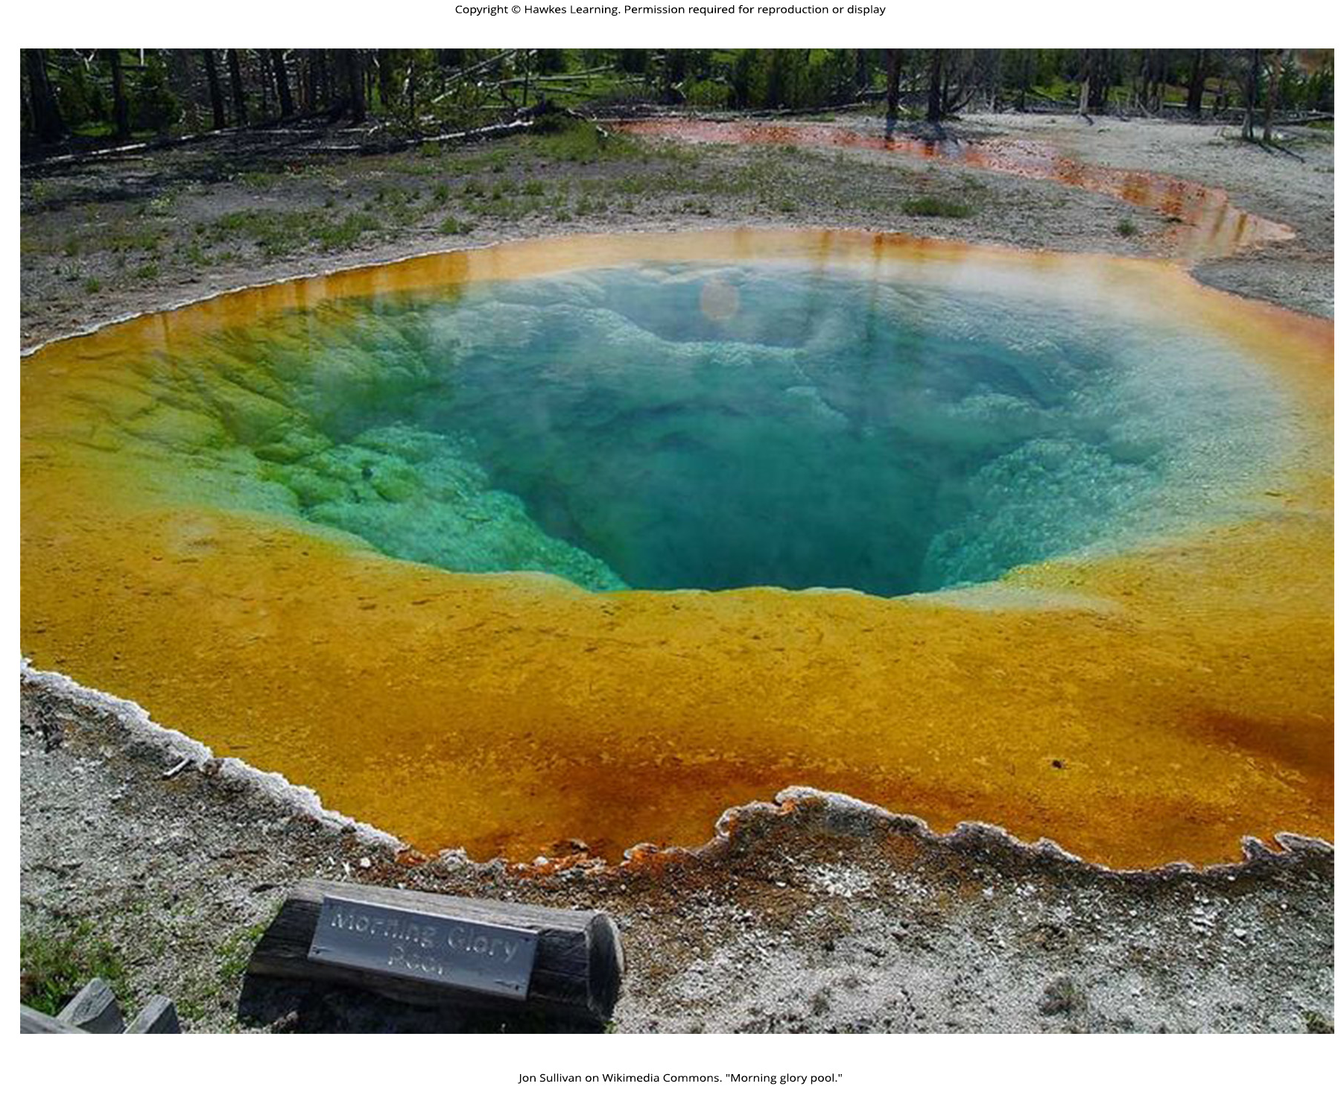
Lesson 22.1 Figure 1

Slide 3
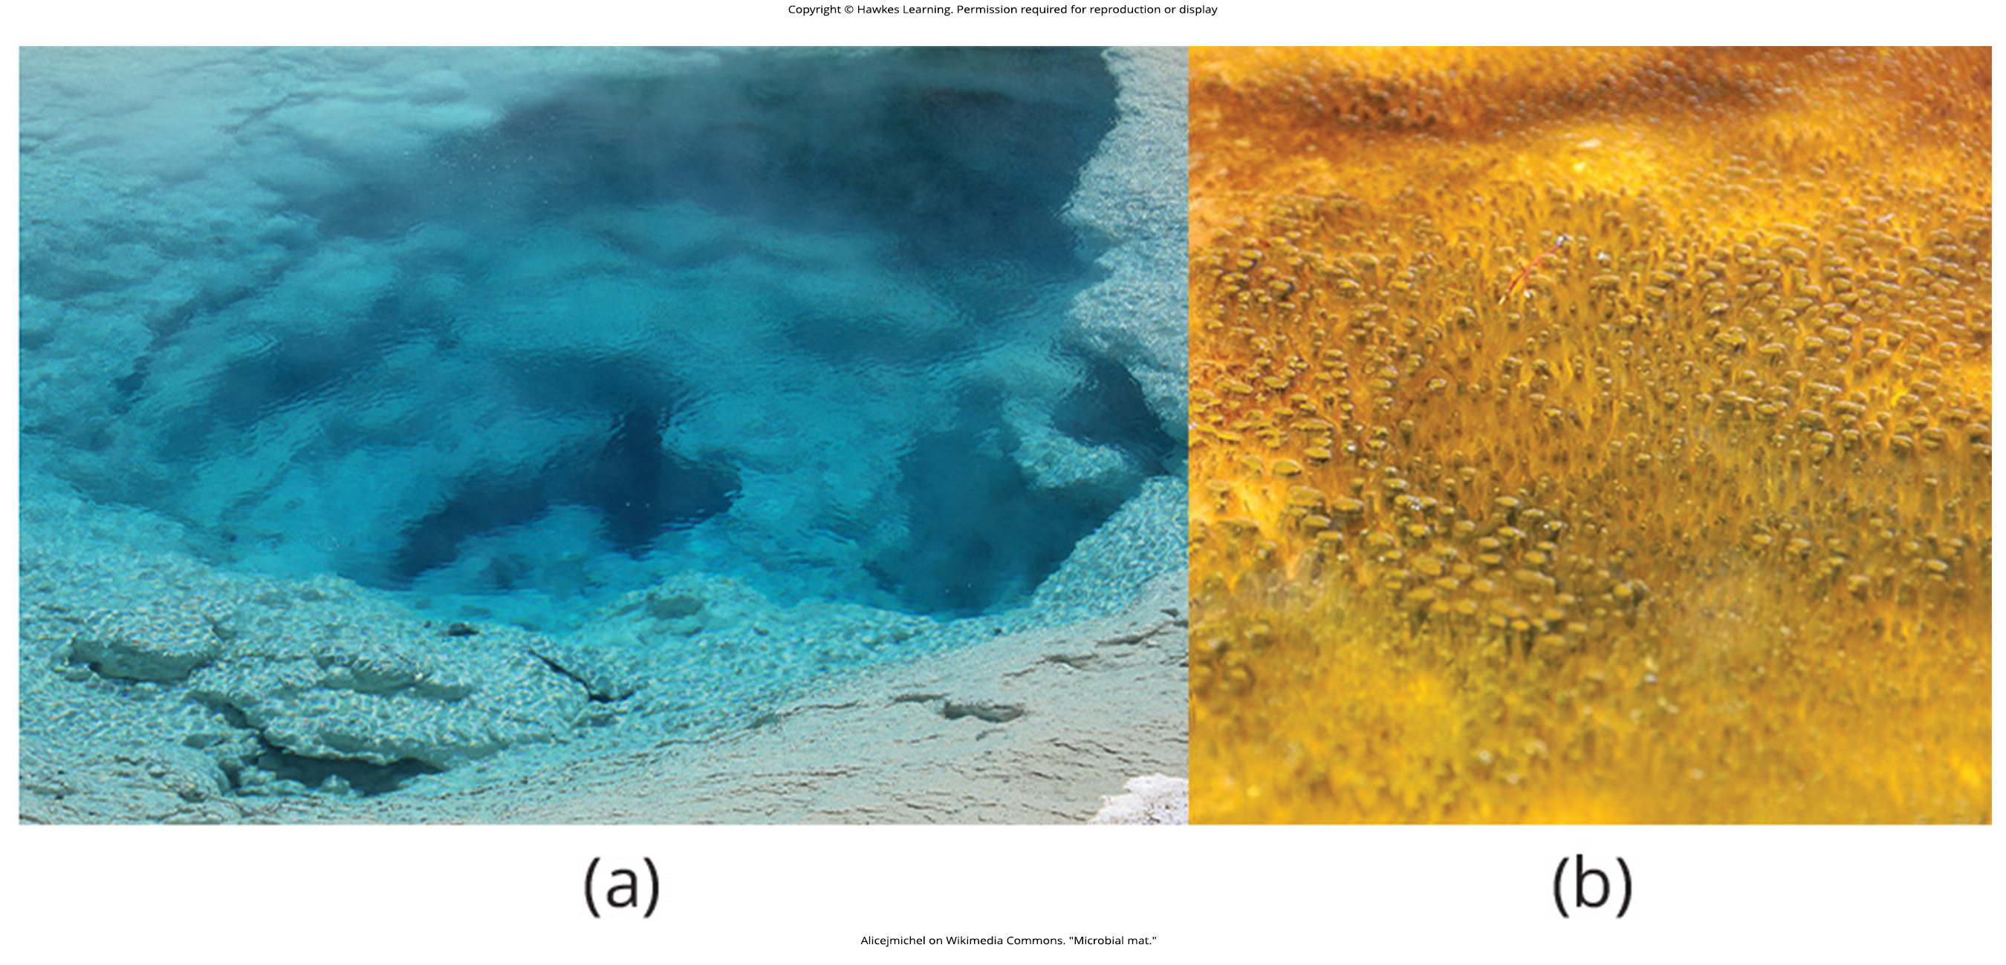
Lesson 22.1 Figure 2

Slide 4
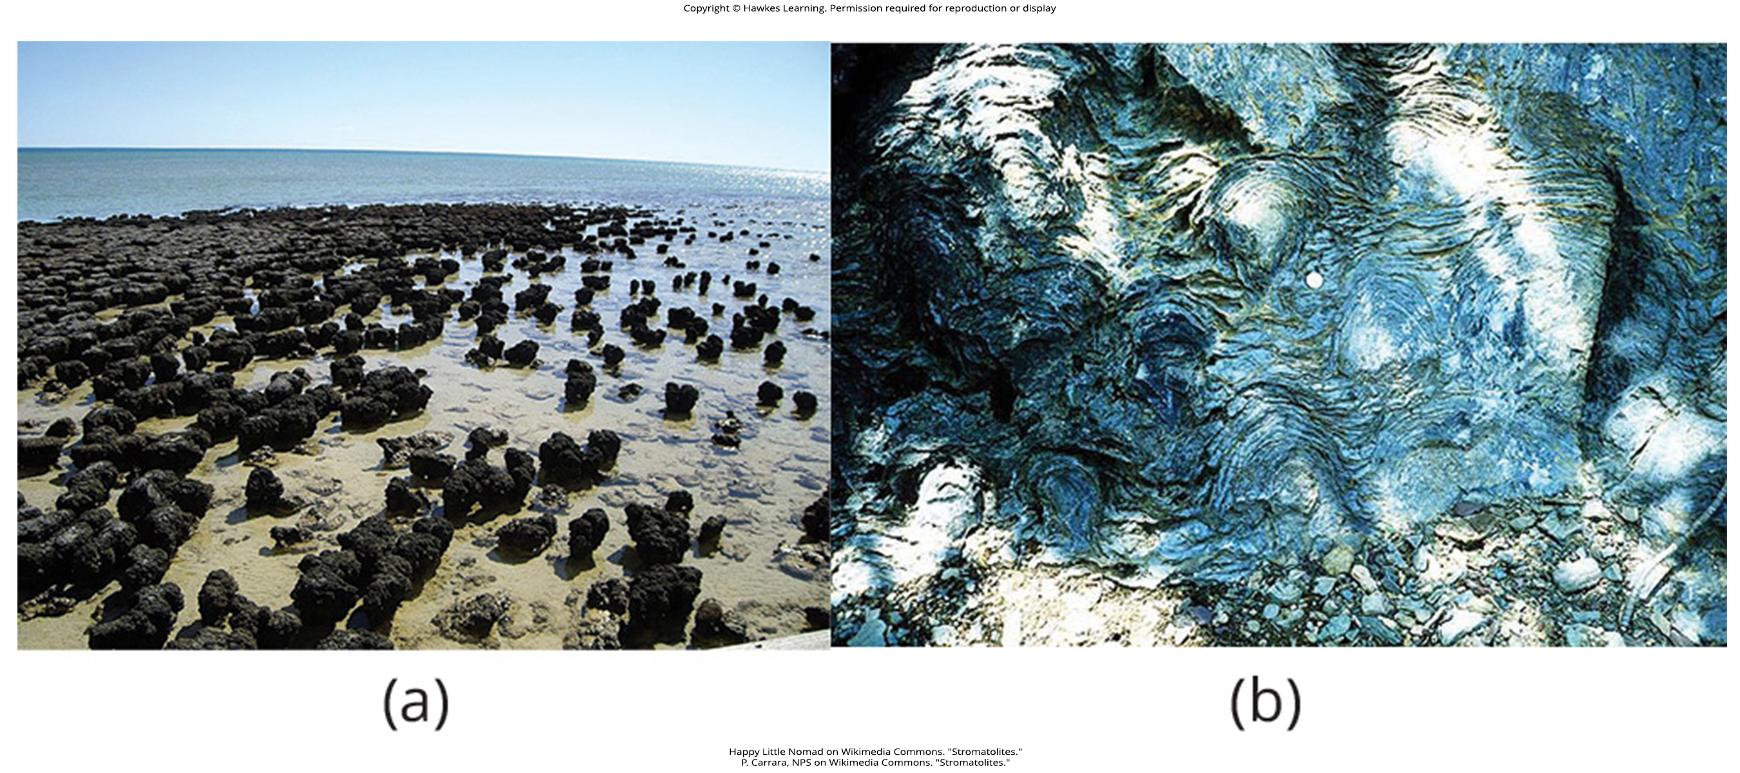
Lesson 22.1 Figure 3

Slide 5
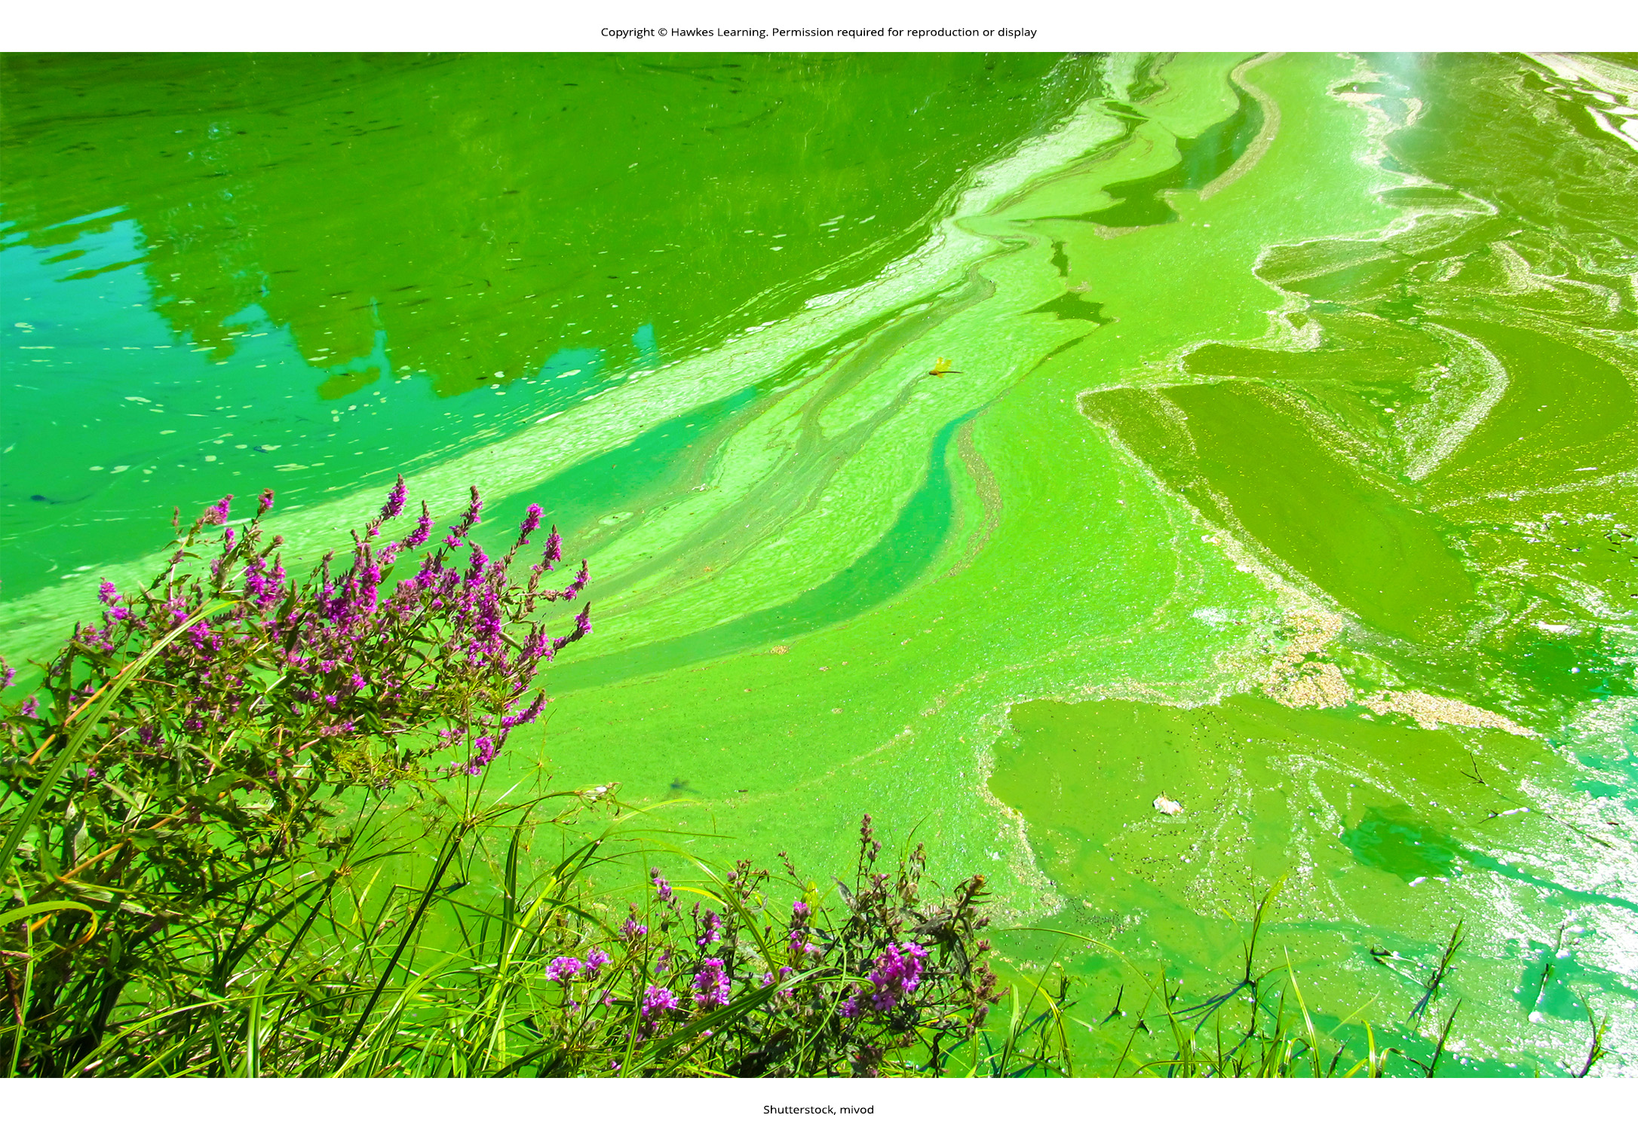
Lesson 22.1 Figure 4

Slide 6
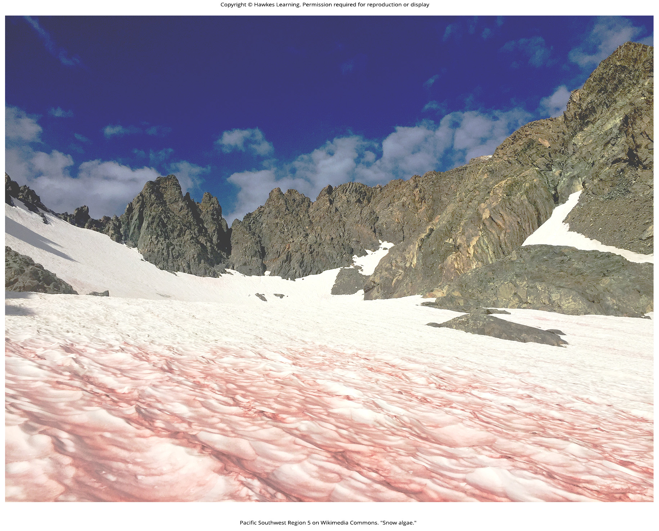
Lesson 22.1 Figure 5

Slide 7
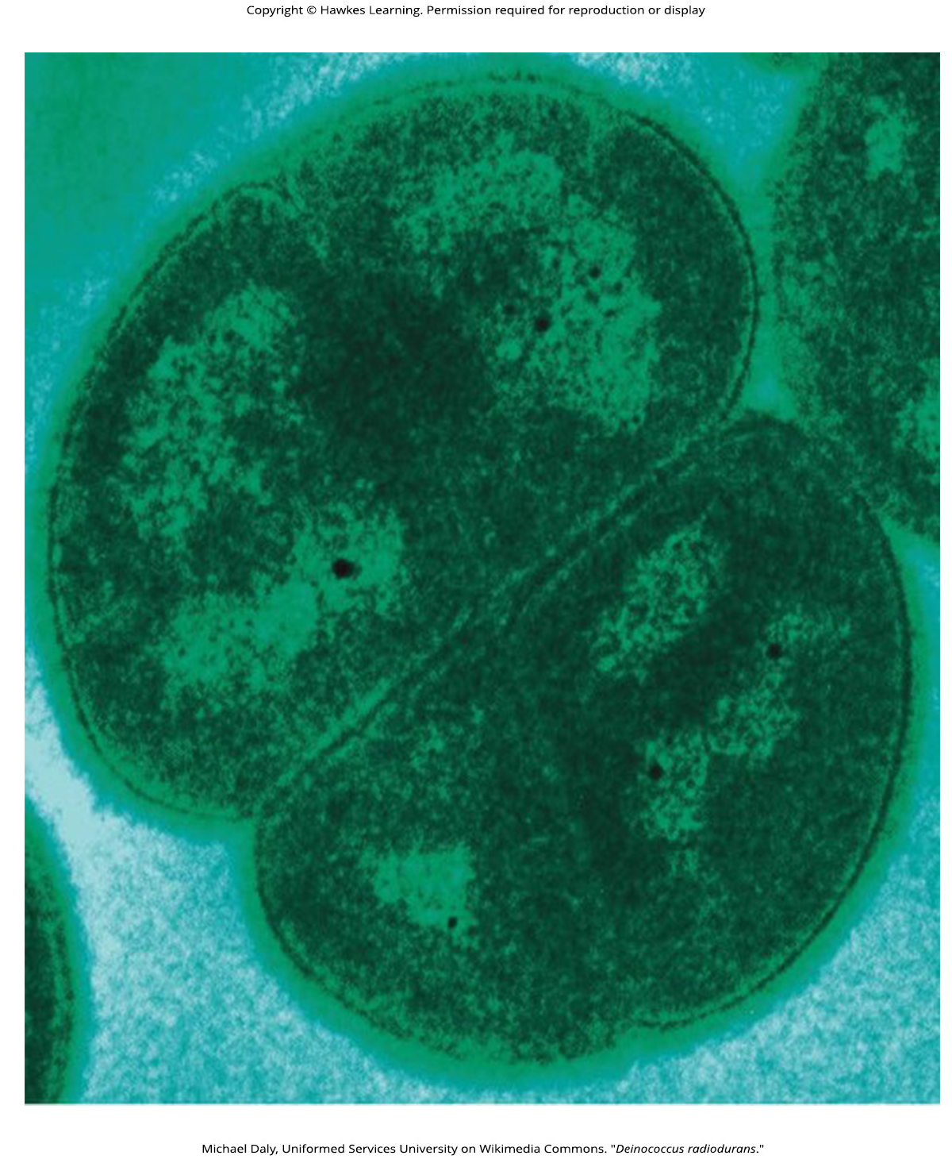
Lesson 22.1 Figure 6

Slide 8
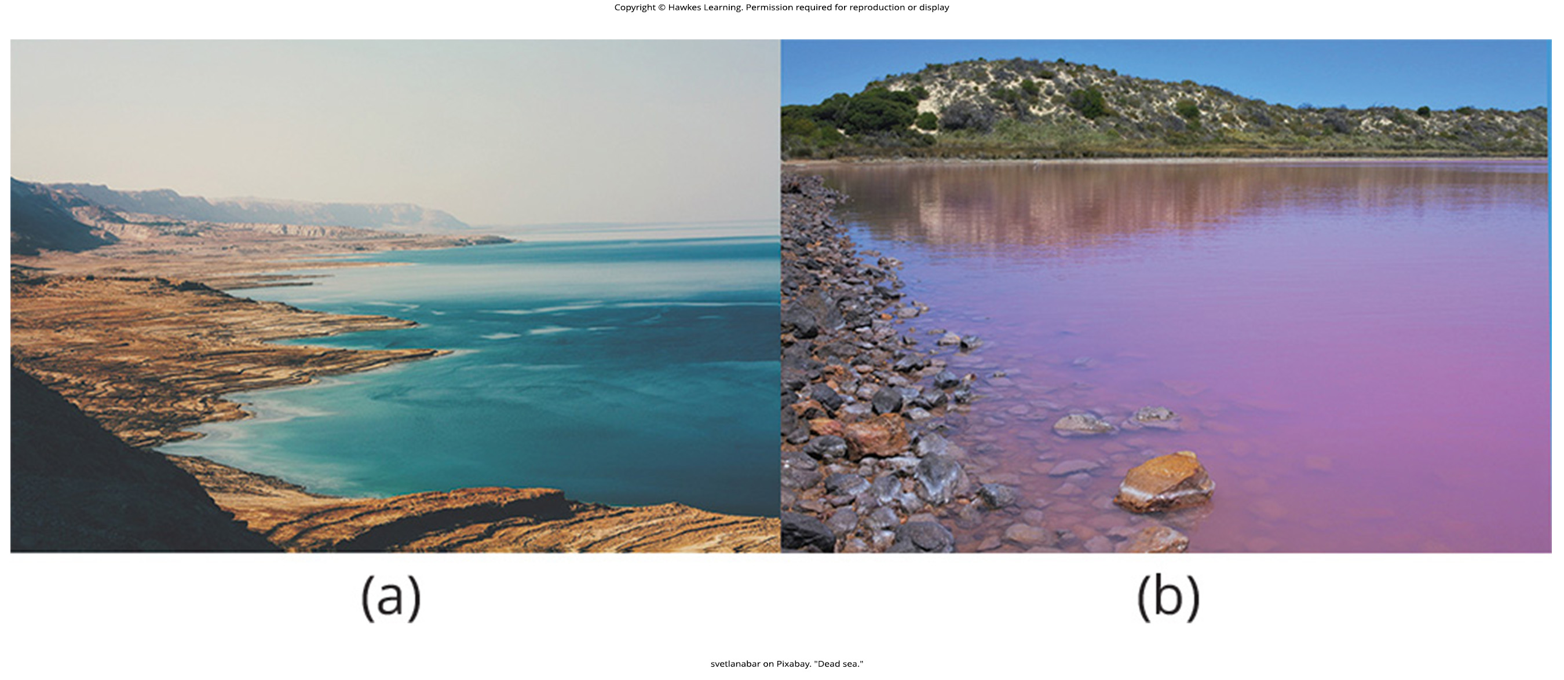
Lesson 22.1 Figure 7

Slide 9
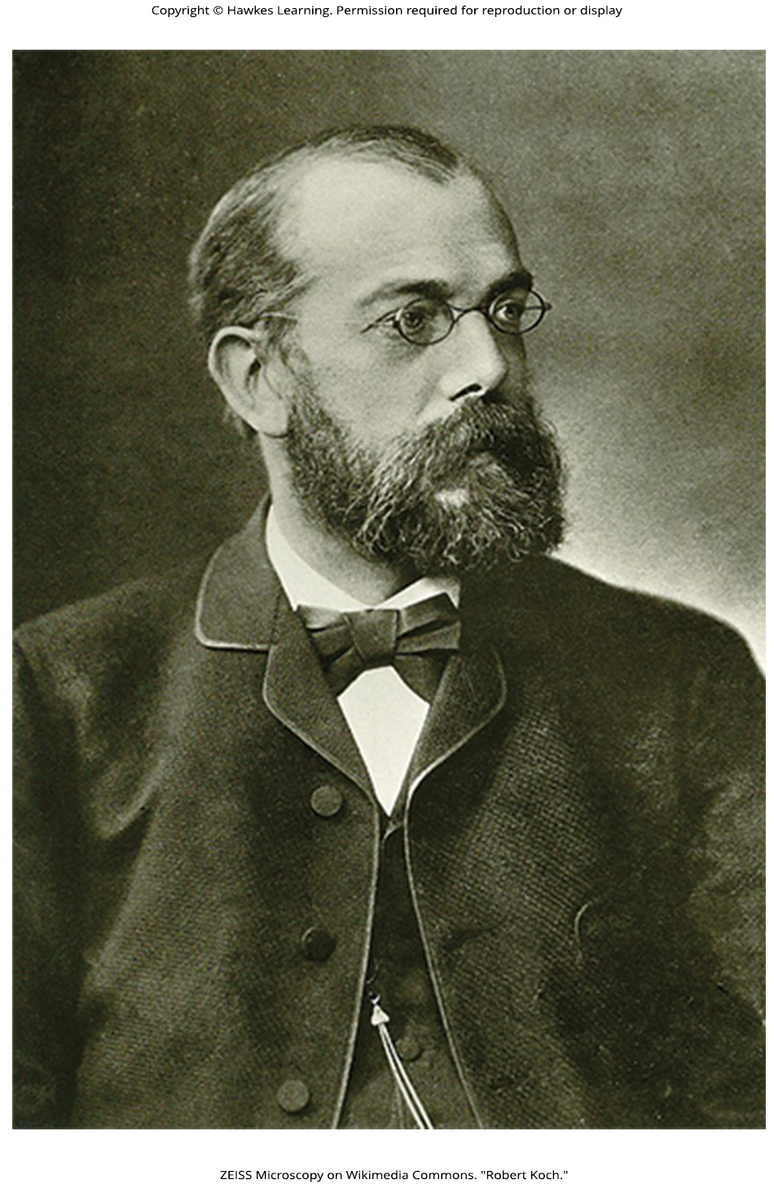
Lesson 22.1 Figure 8

Slide 10
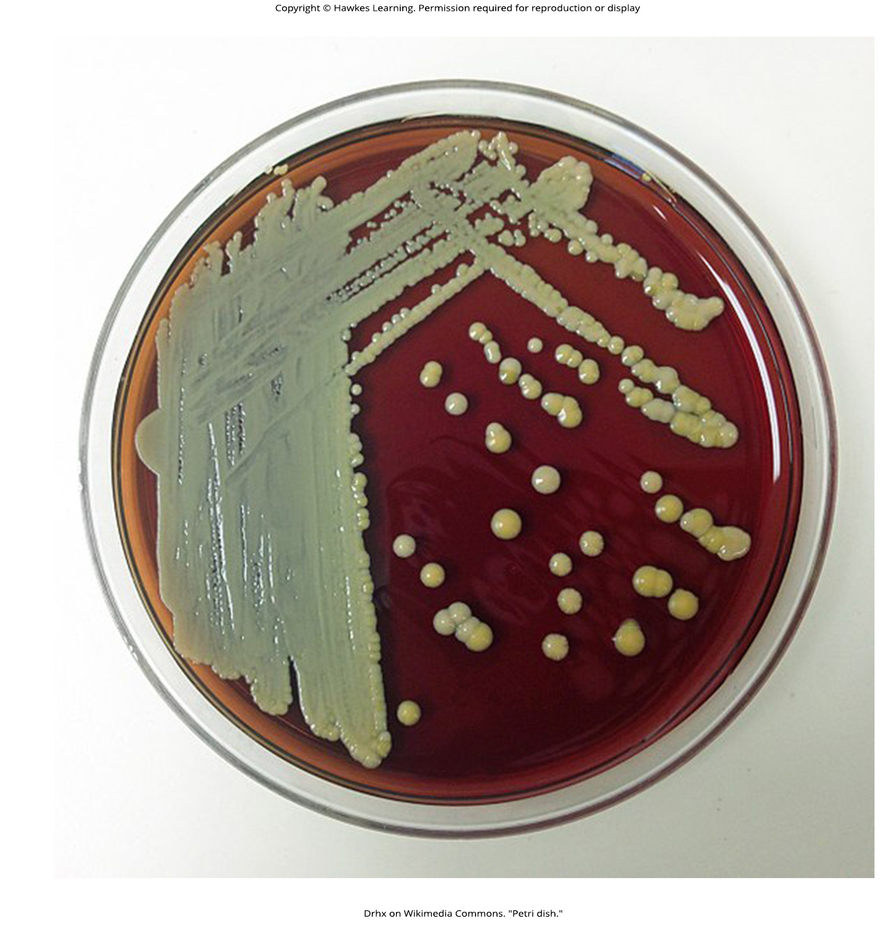
Lesson 22.1 Figure 9

Slide 11
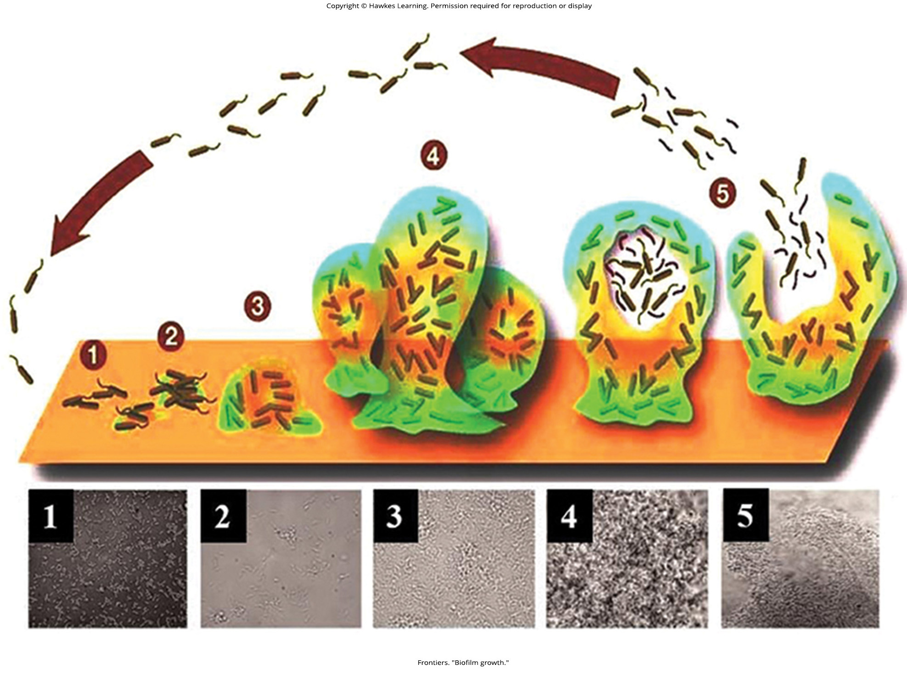
Lesson 22.1 Figure 10

Slide 12
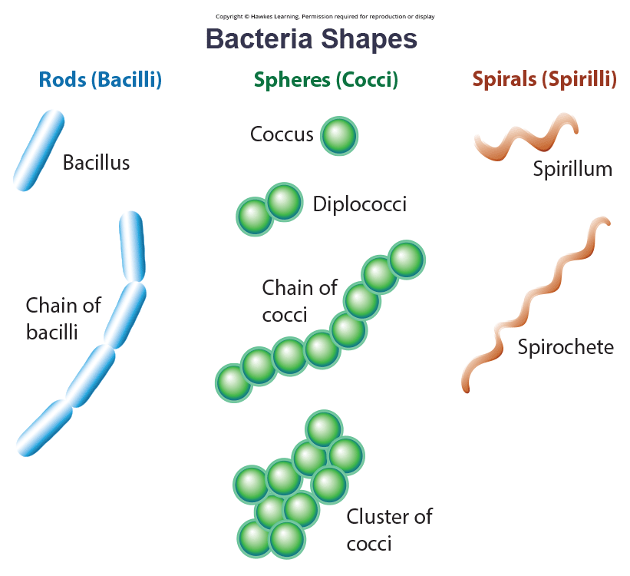
Lesson 22.2 Figure 1

Slide 13
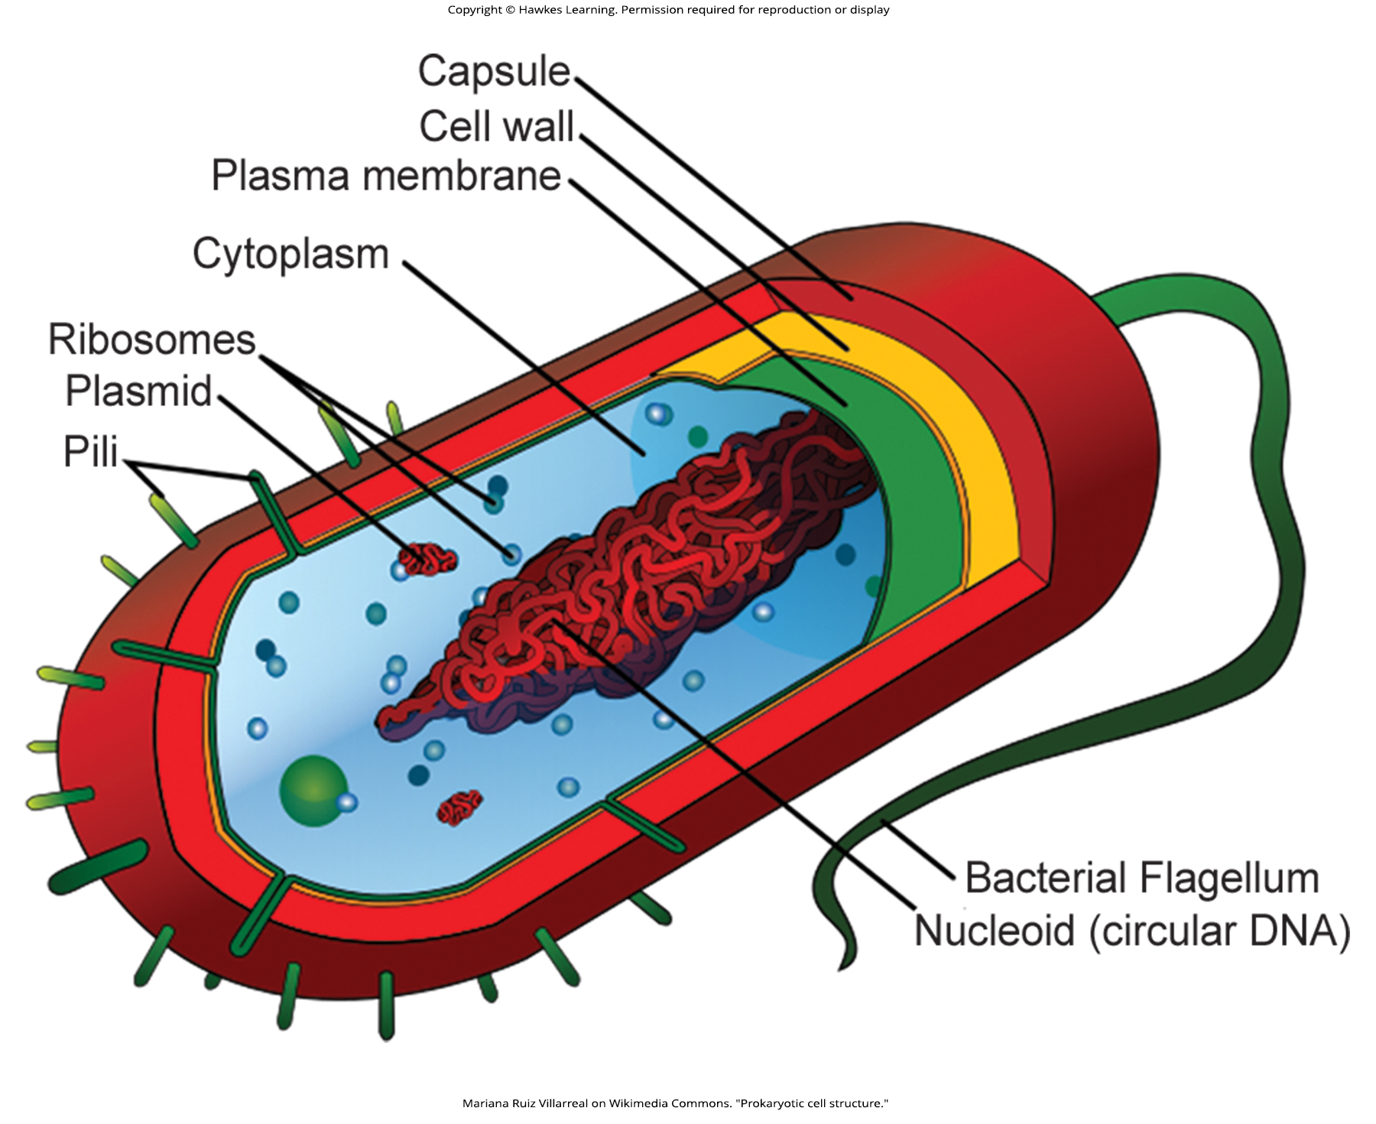
Lesson 22.2 Figure 2

Slide 14
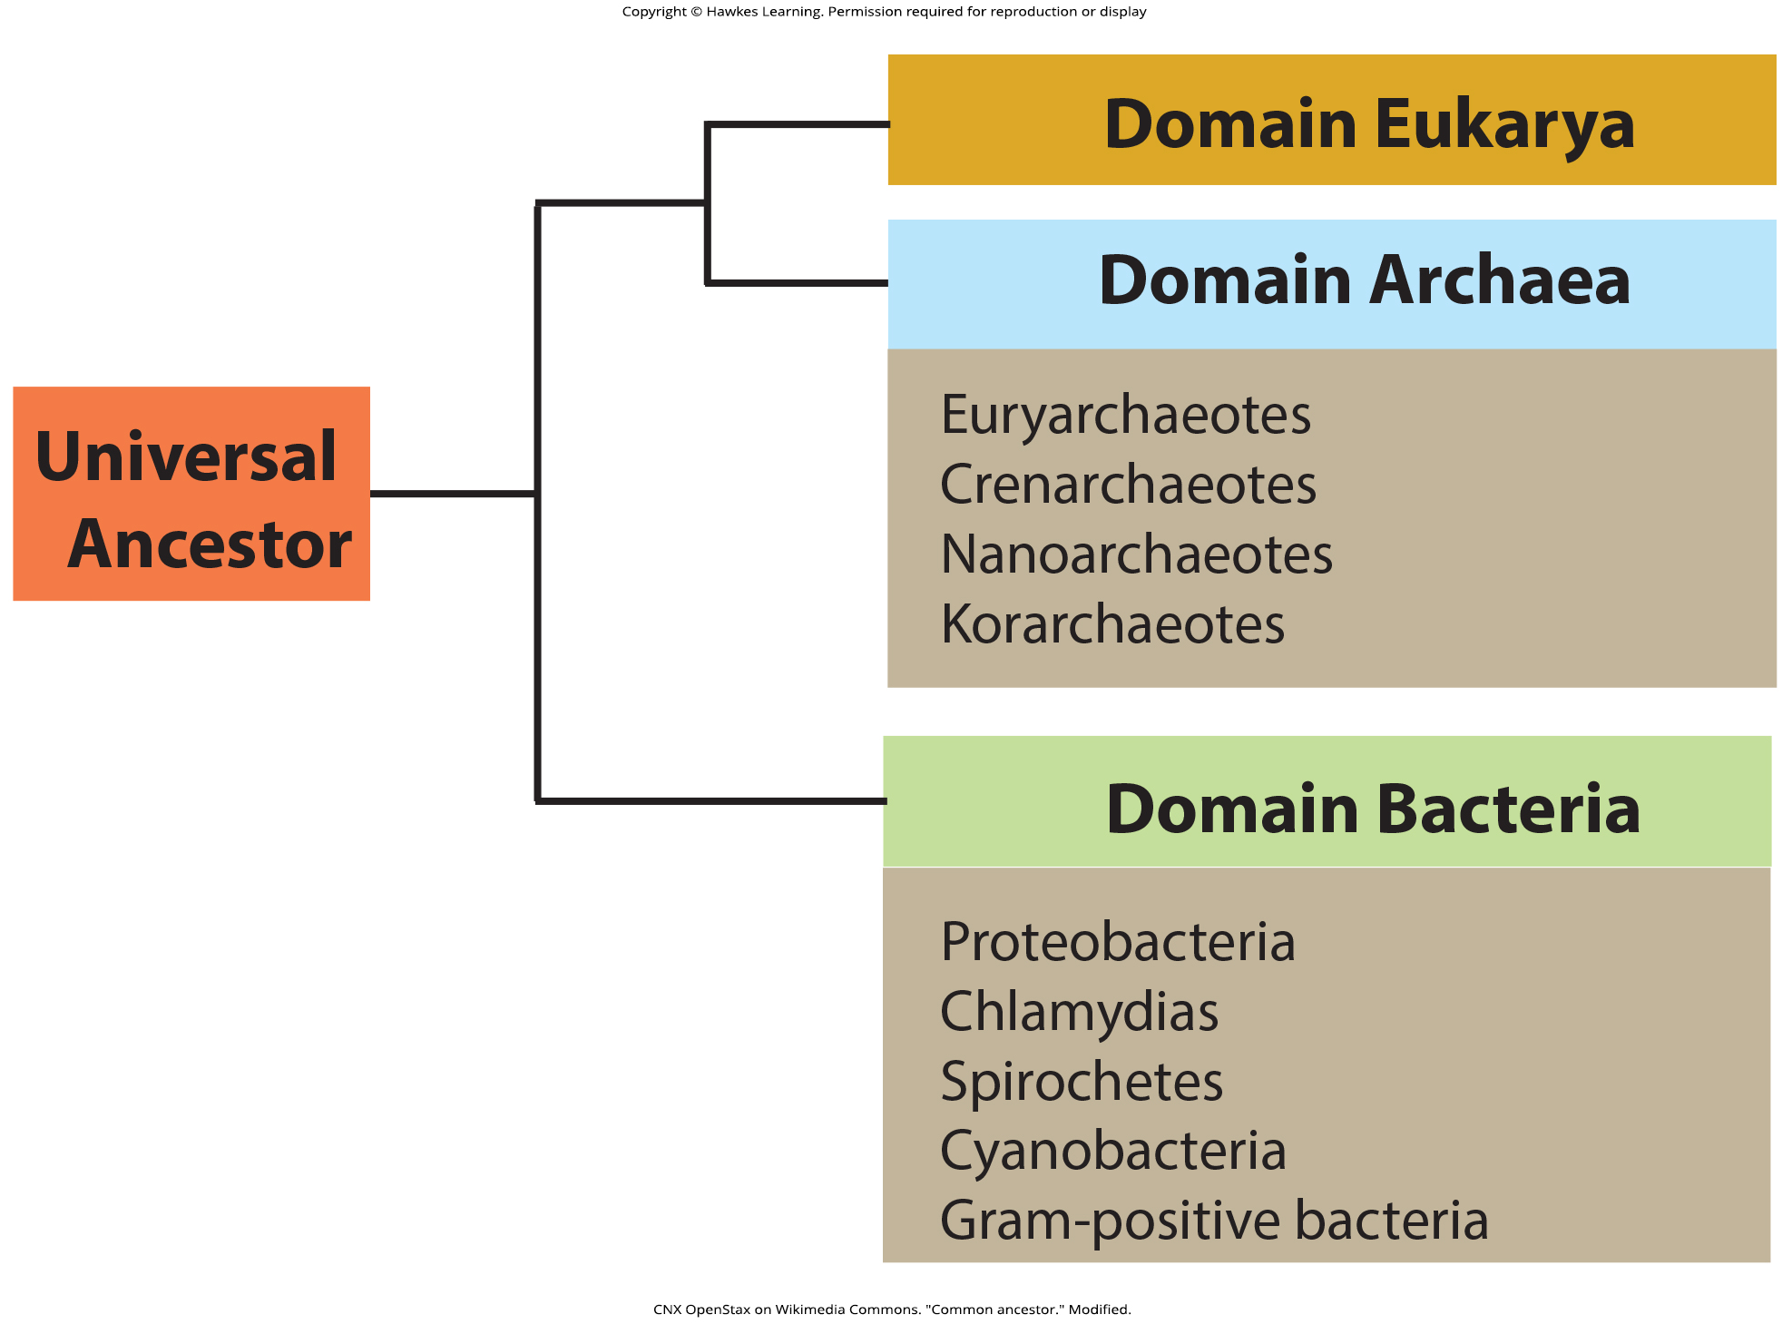
Lesson 22.2 Figure 3

Slide 15
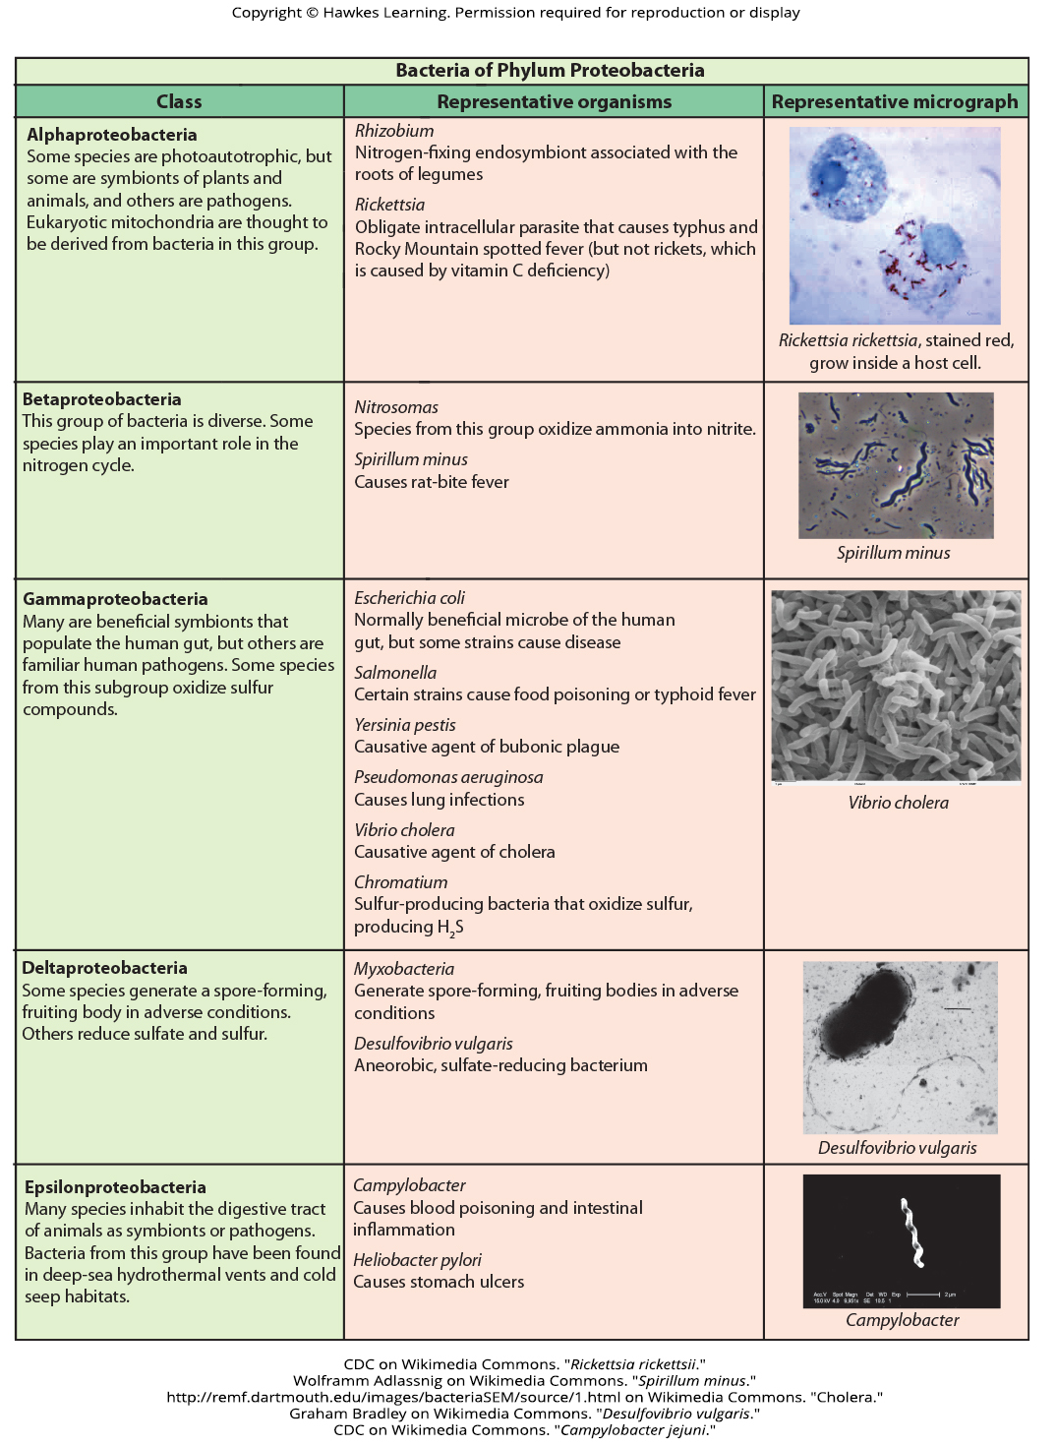
Lesson 22.2 Figure 4

Slide 16
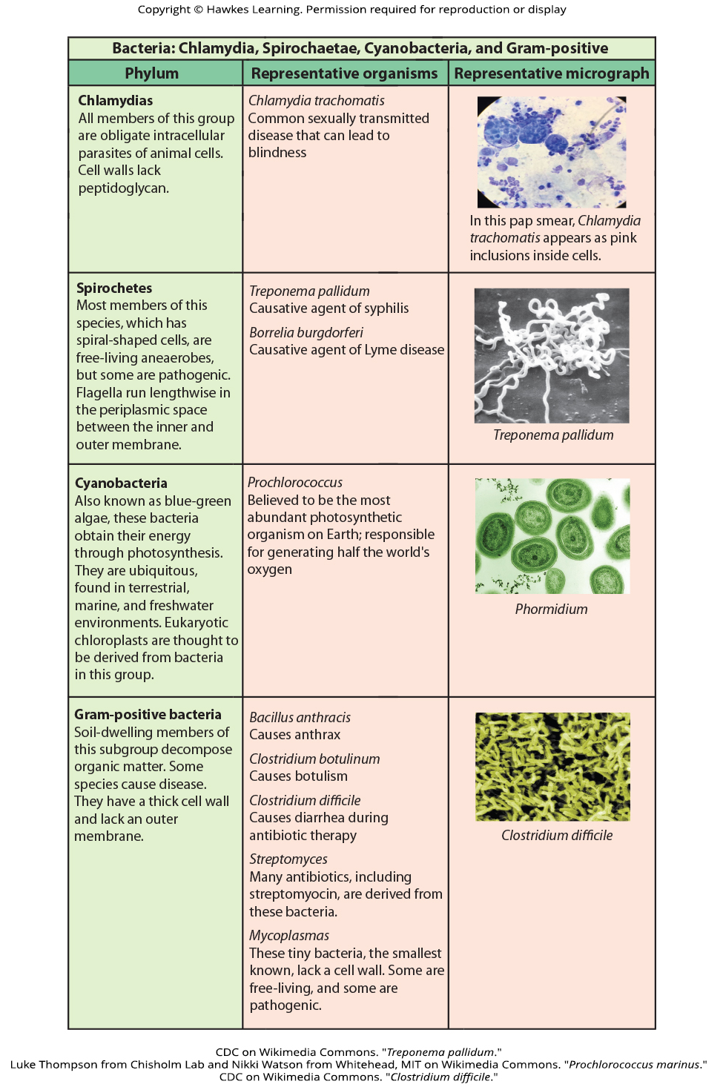
Lesson 22.2 Figure 5

Slide 17
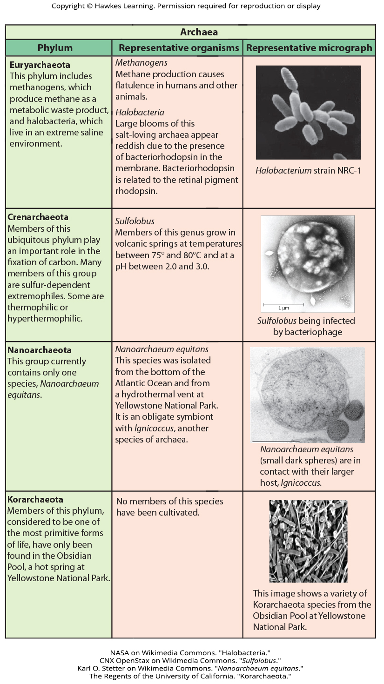
Lesson 22.2 Figure 6

Slide 18
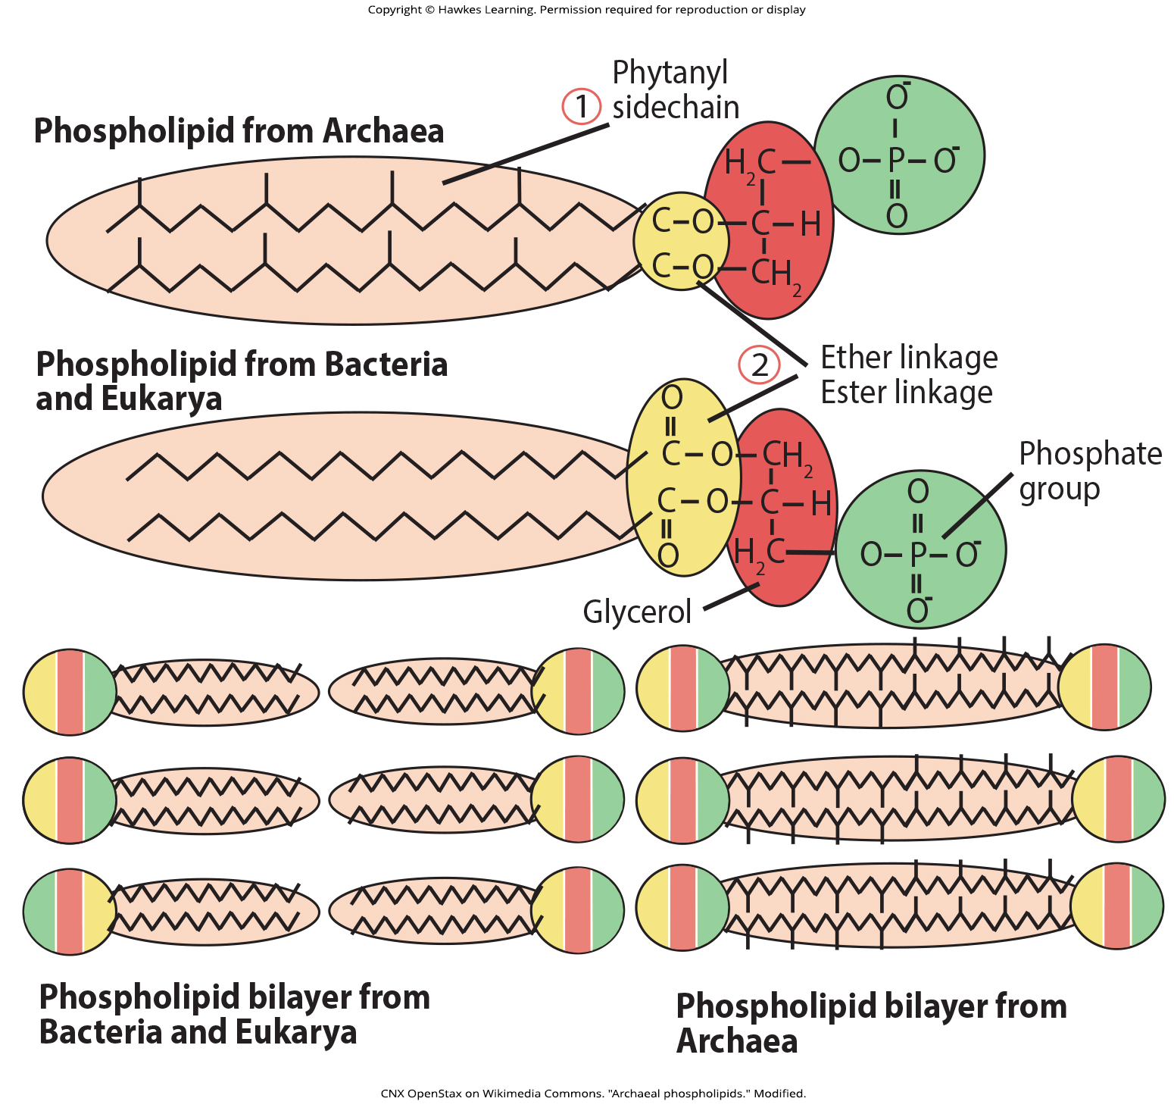
Lesson 22.2 Figure 7

Slide 19
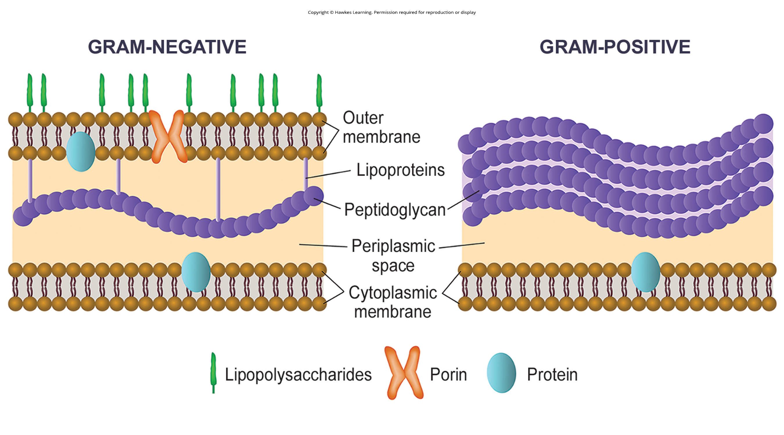
Lesson 22.2 Figure 8

Slide 20
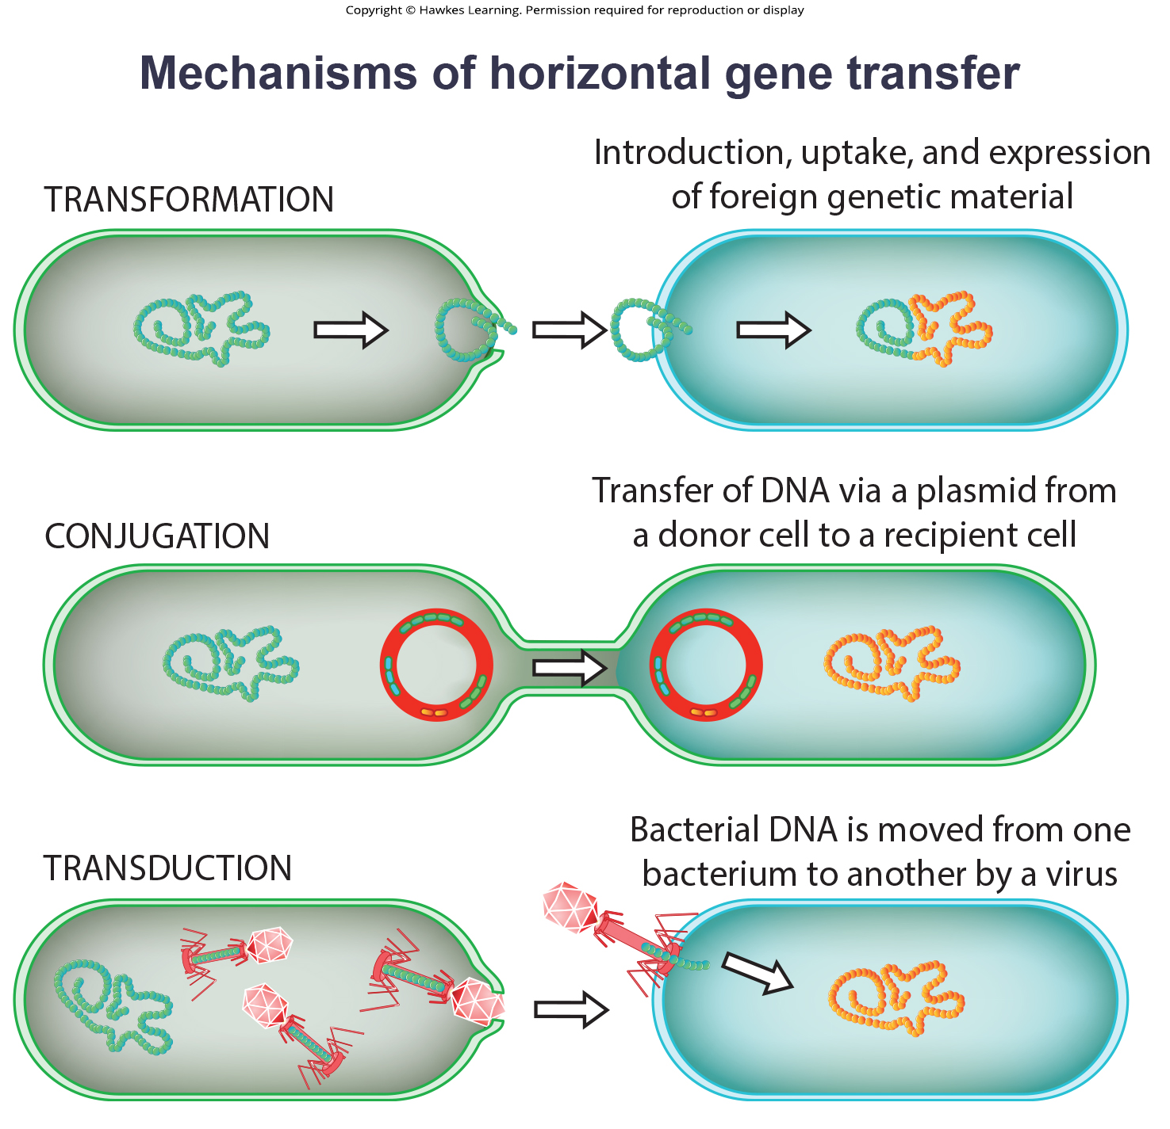
Lesson 22.2 Figure 9

Slide 21
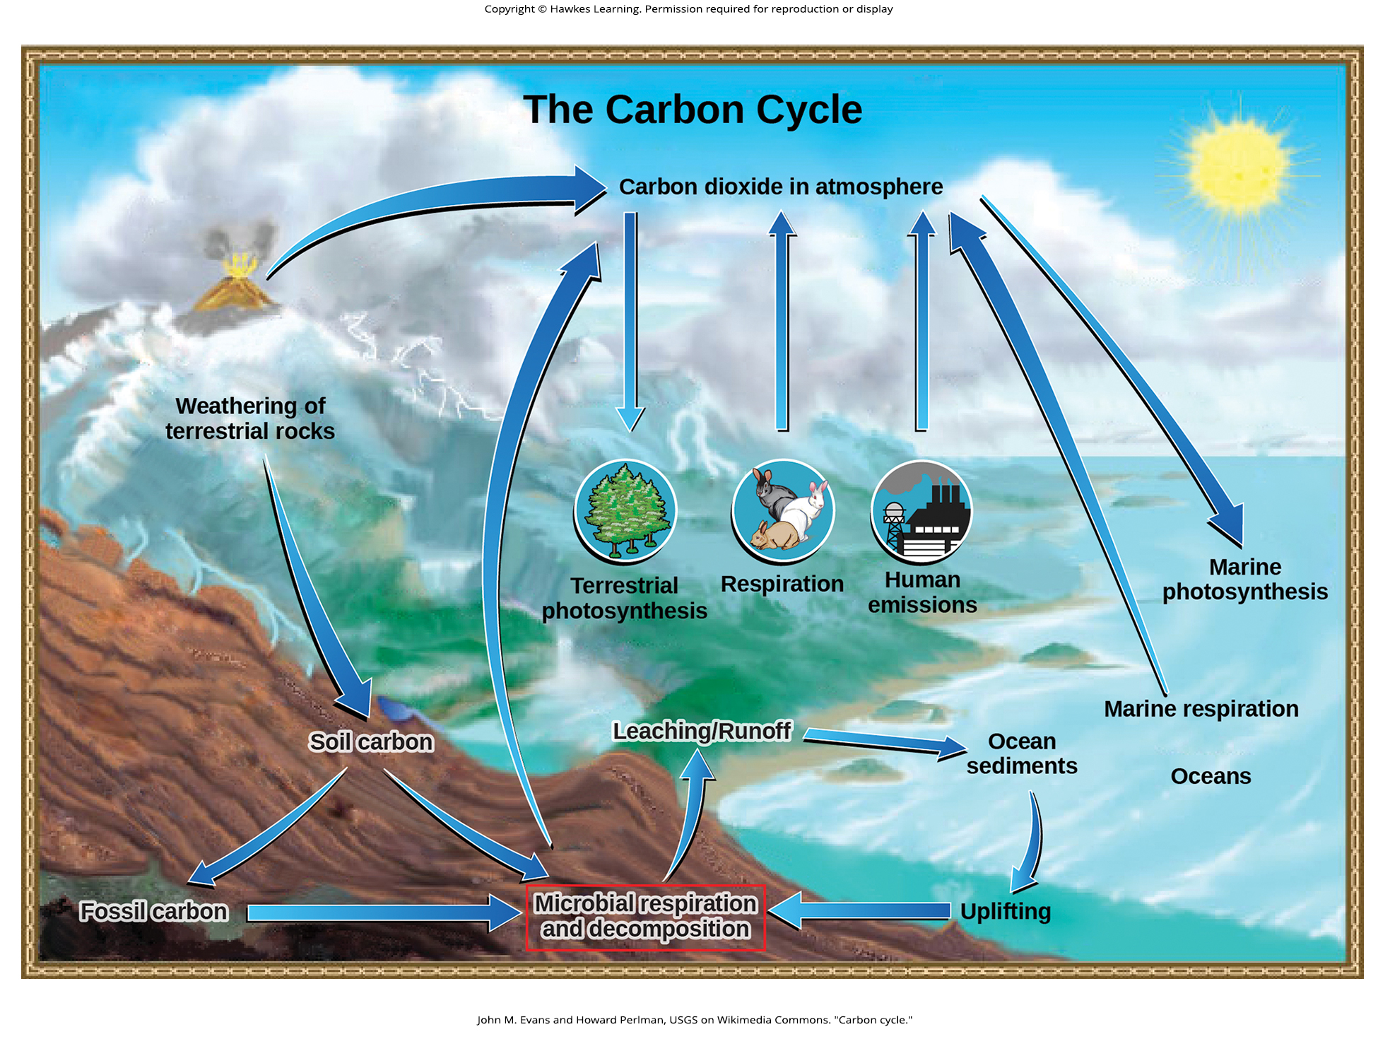
Lesson 22.3 Figure 1

Slide 22
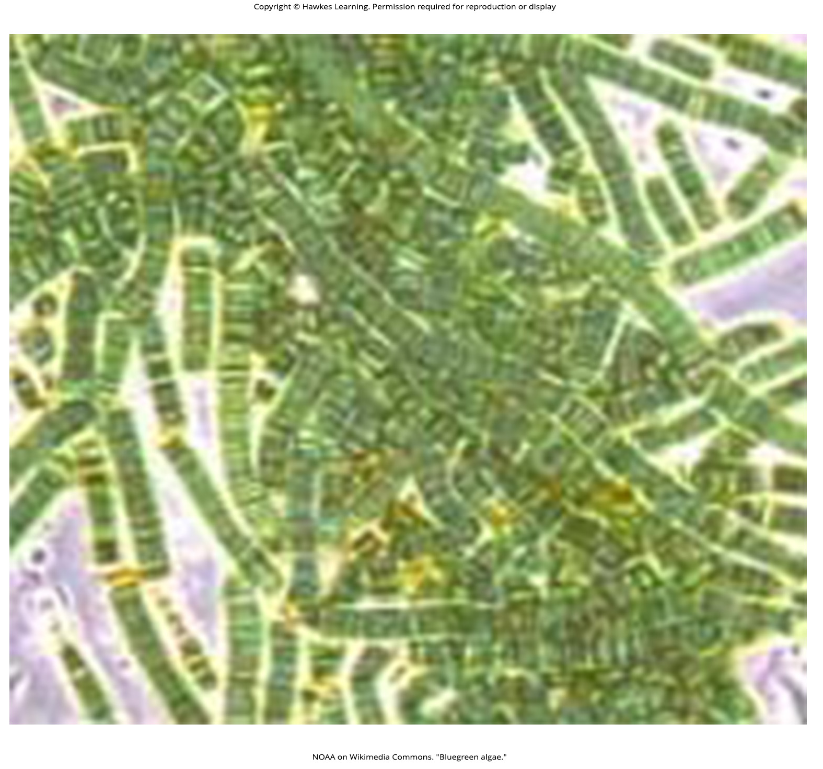
Lesson 22.3 Figure 2

Slide 23
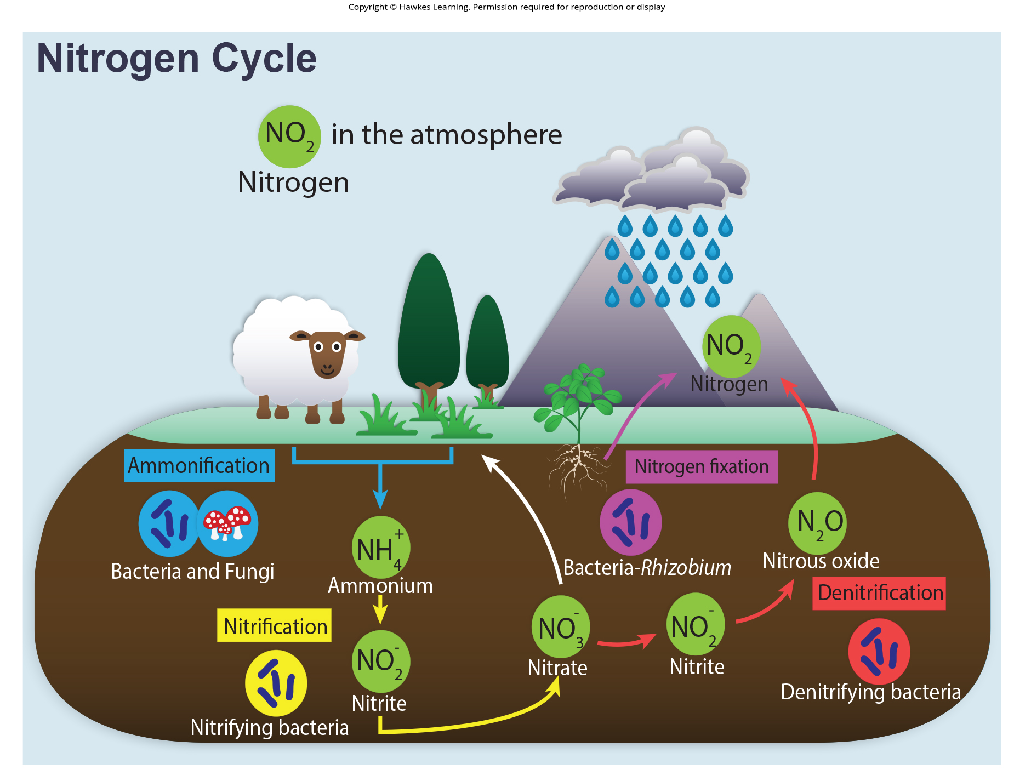
Lesson 22.3 Figure 3

Slide 24
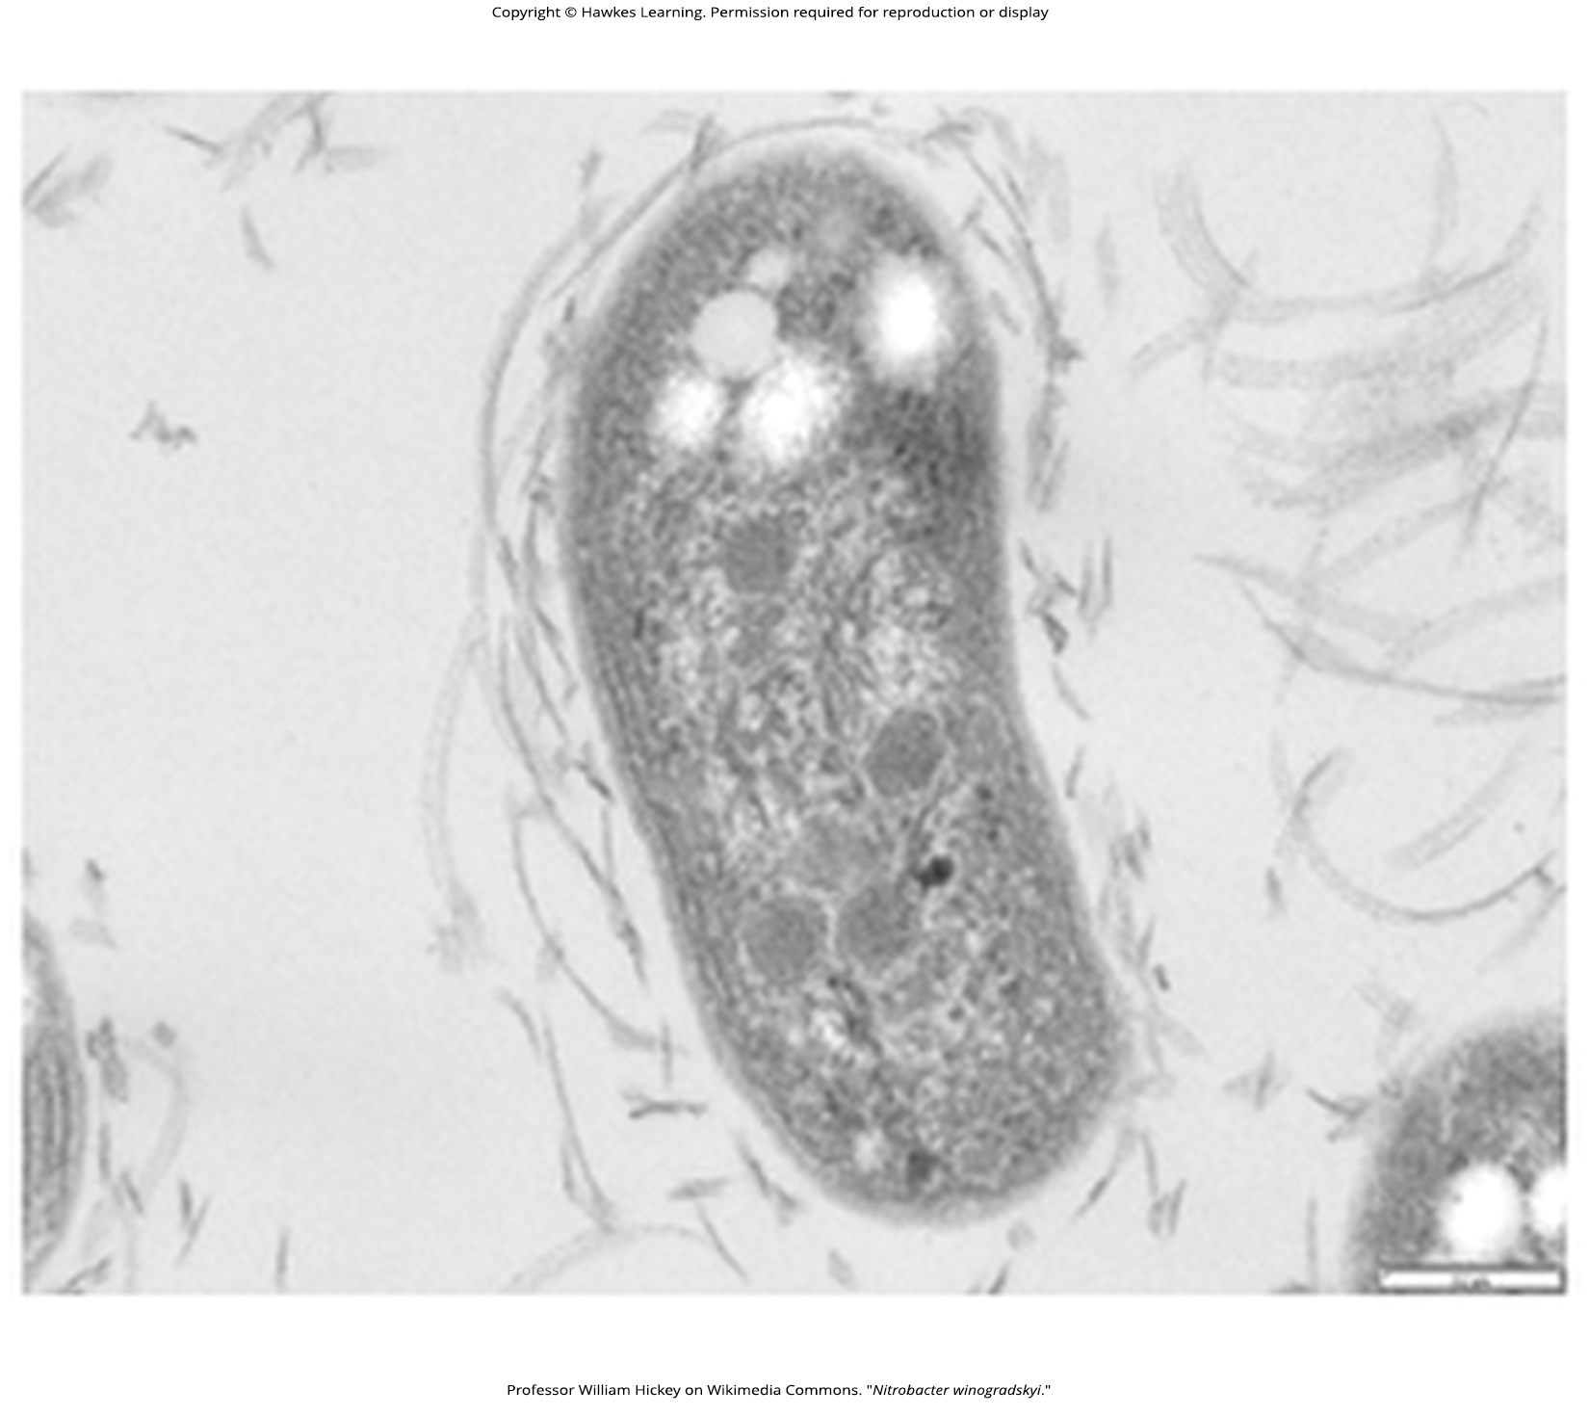
Lesson 22.3 Figure 4

Slide 25
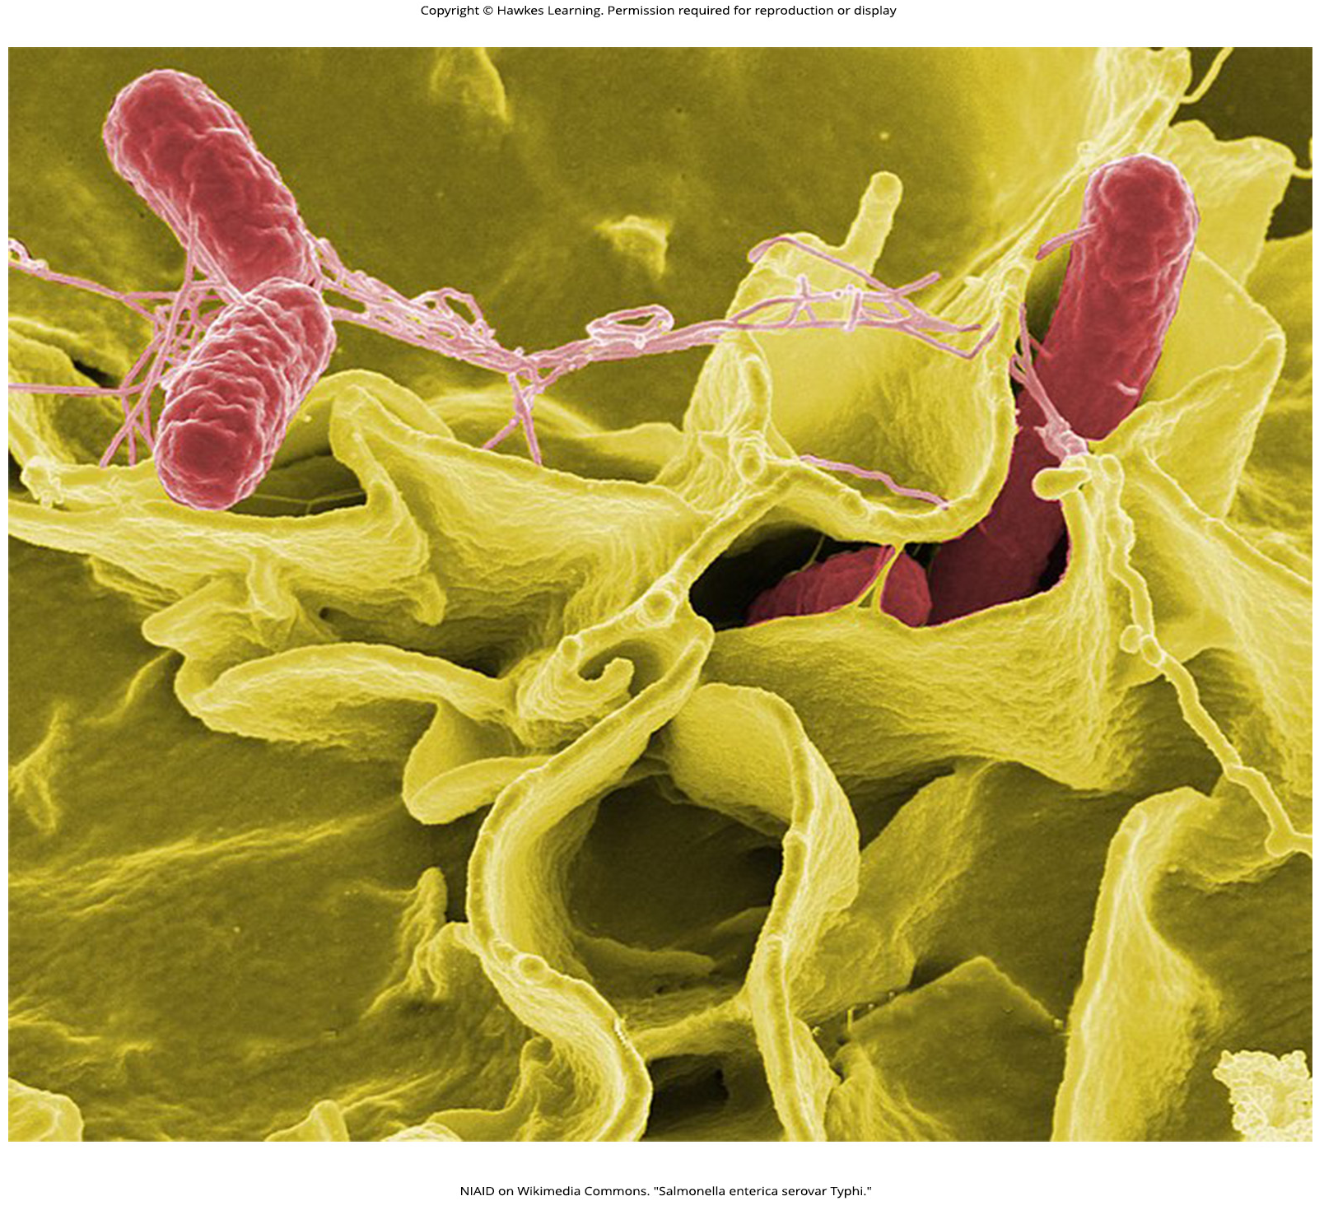
Lesson 22.4 Figure 1

Slide 26
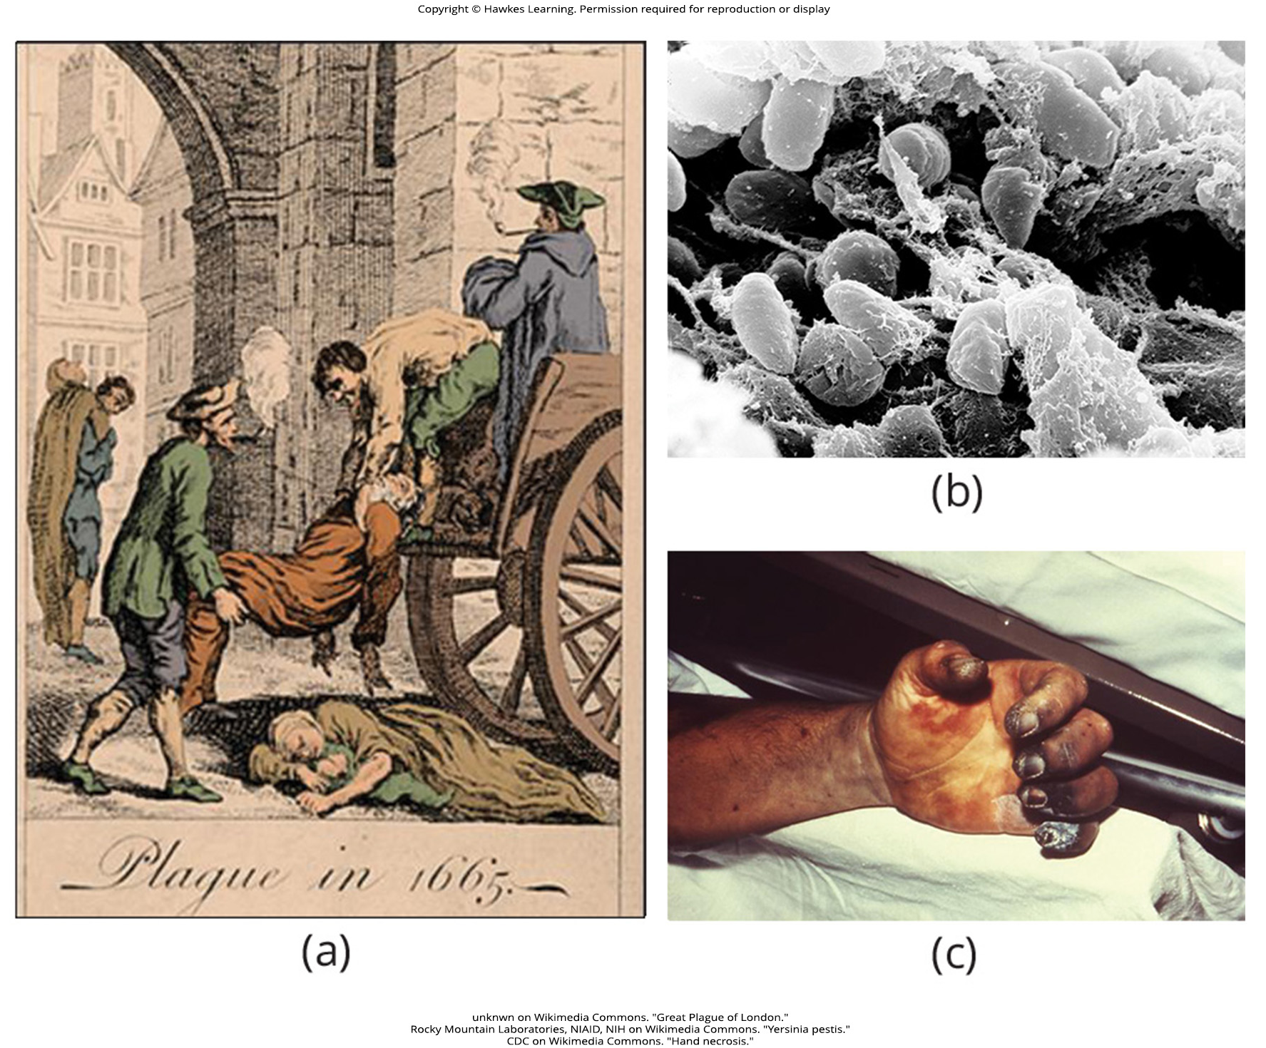
Lesson 22.4 Figure 2

Slide 27
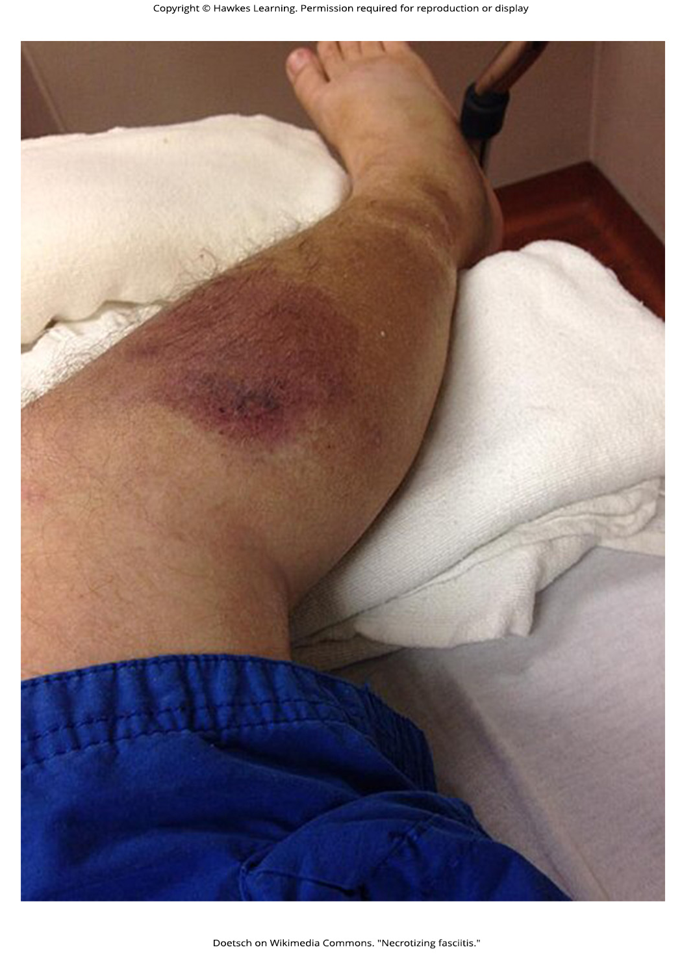
Lesson 22.4 Figure 3

Slide 28
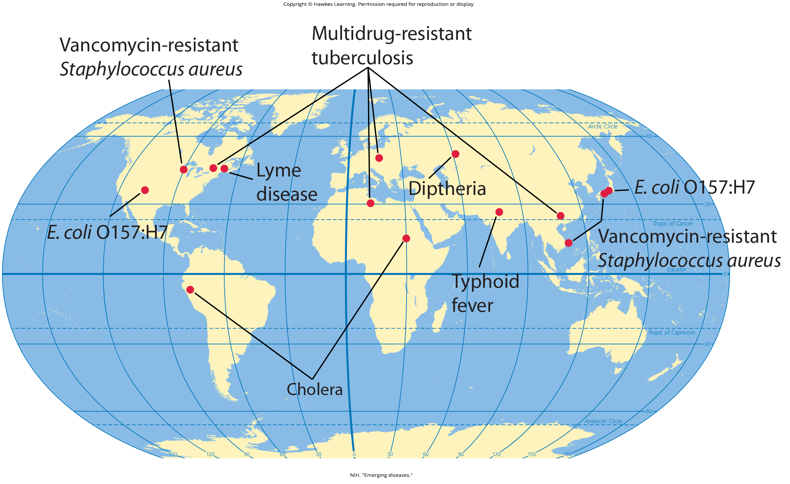
Lesson 22.4 Figure 4

Slide 29
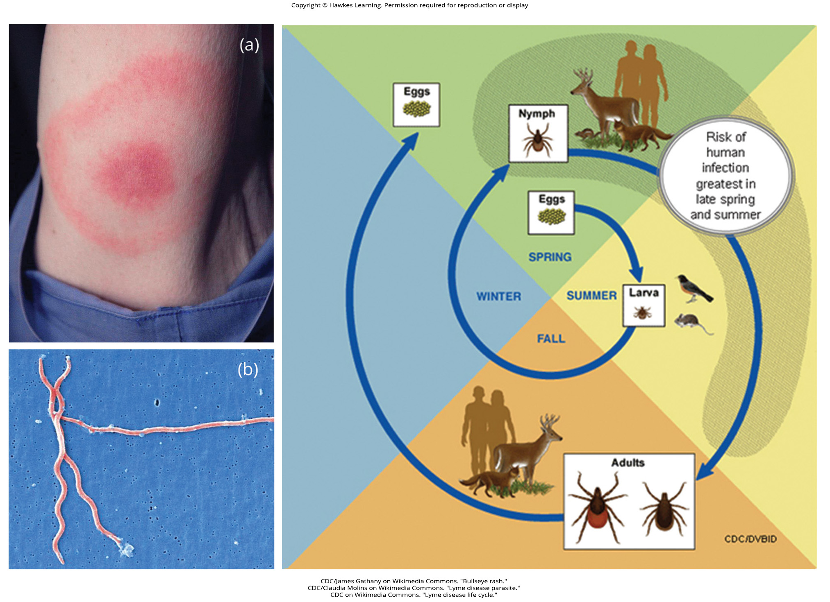
Lesson 22.4 Figure 5

Slide 30
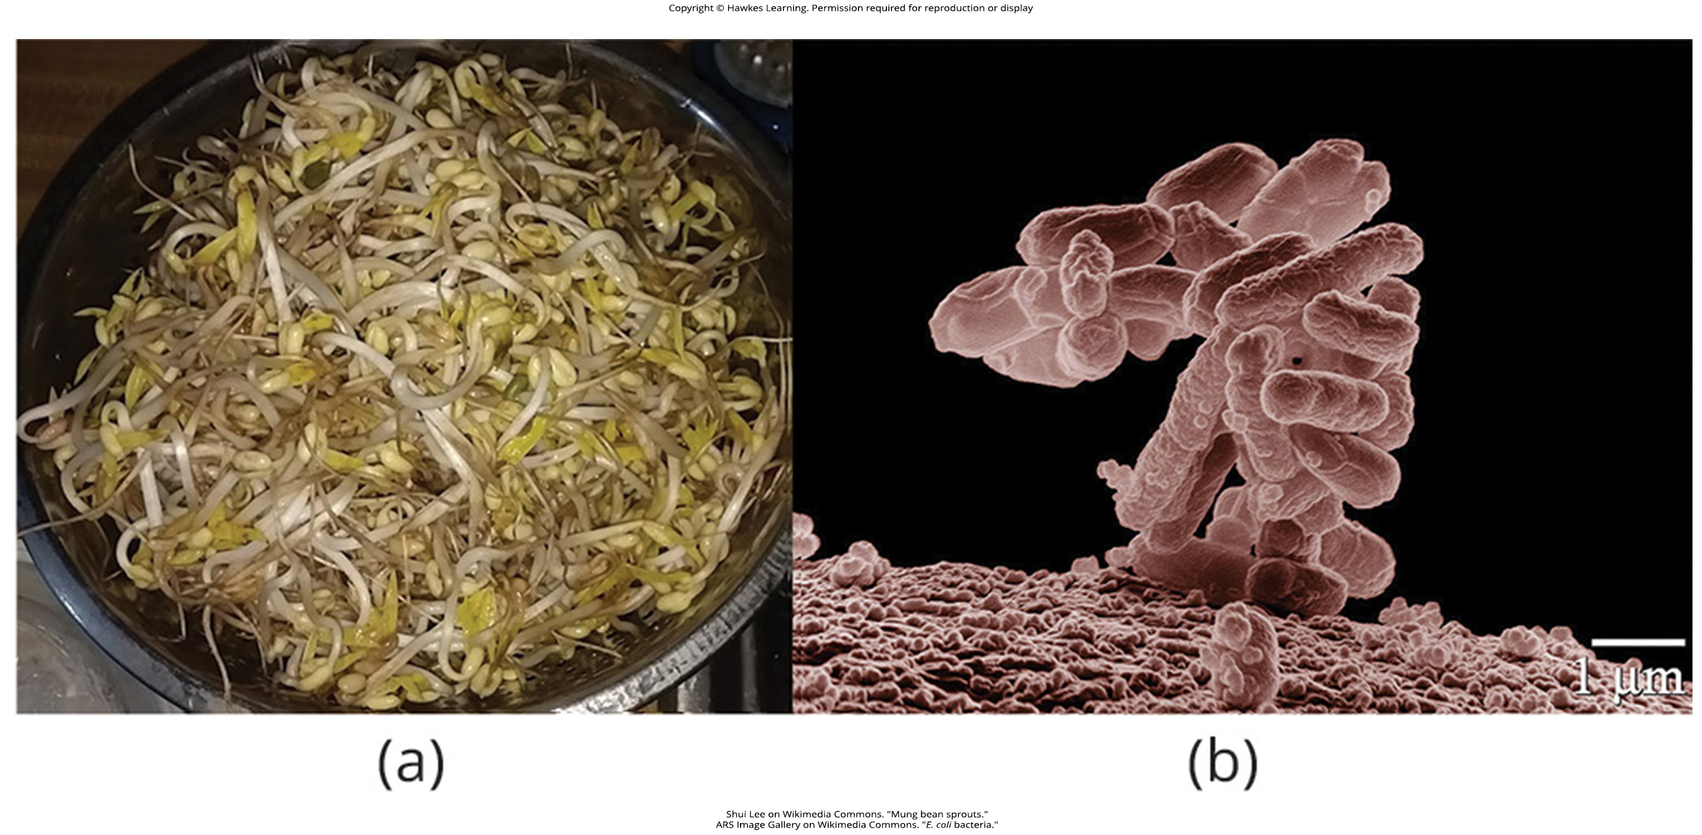
Lesson 22.4 Figure 6

Slide 31
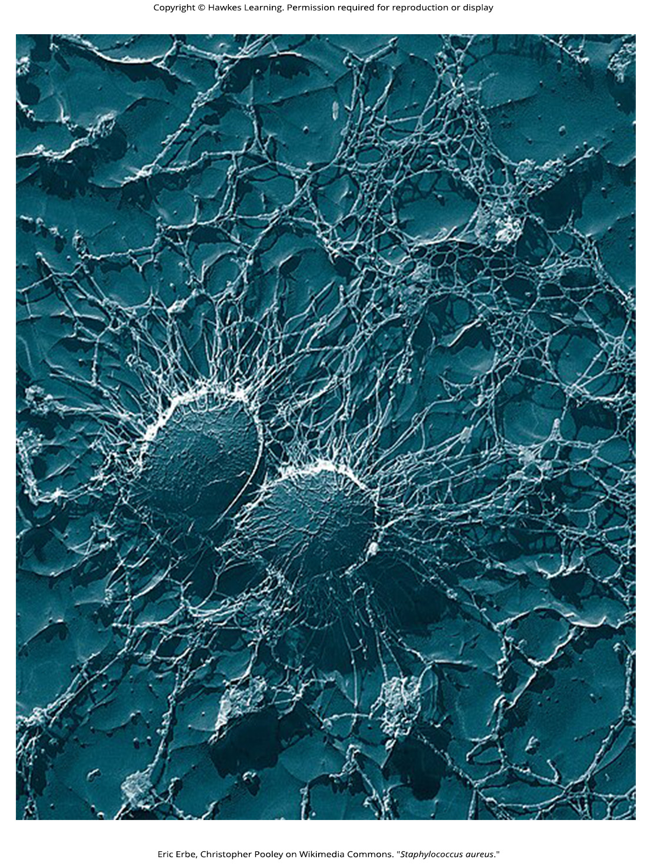
Lesson 22.4 Figure 7

Slide 32
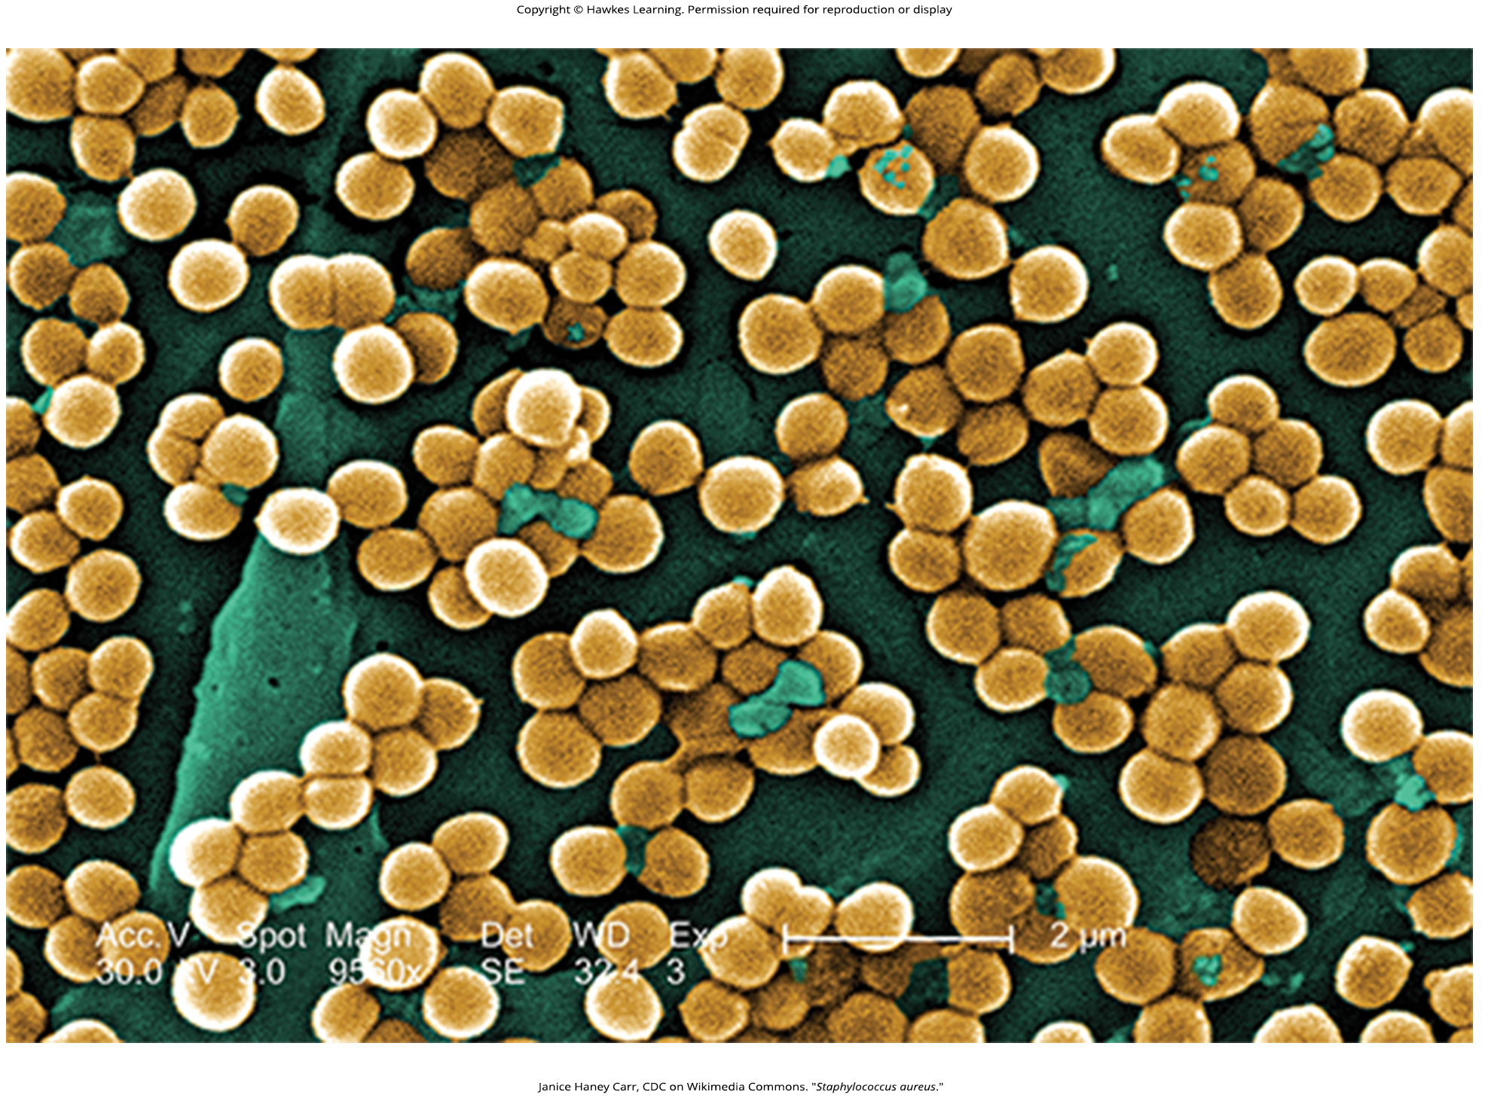
Lesson 22.4 Figure 8

Slide 33
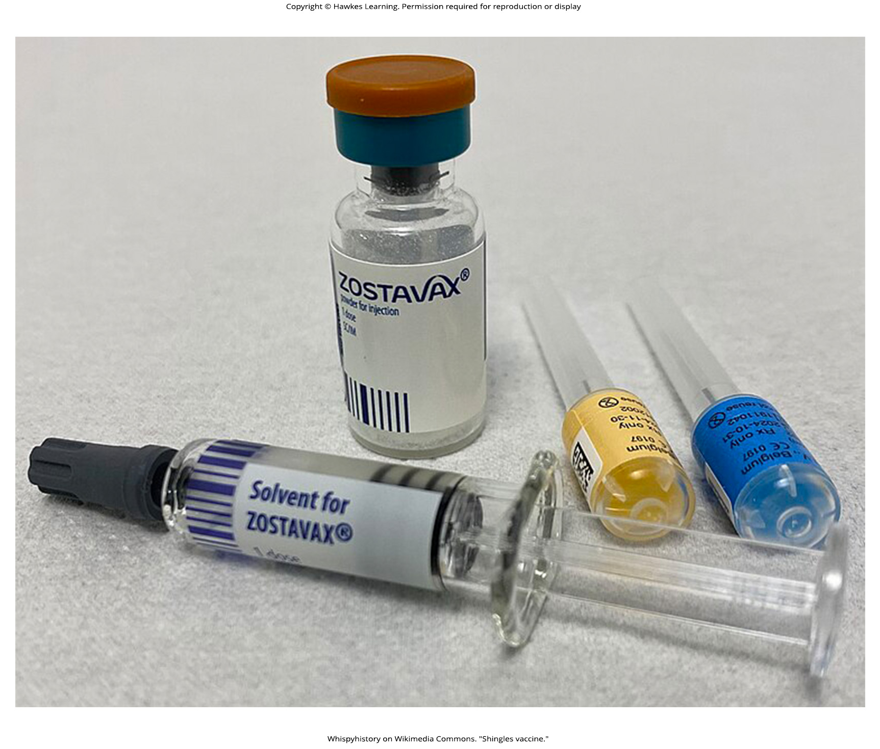
Lesson 22.4 Figure 9

Slide 34
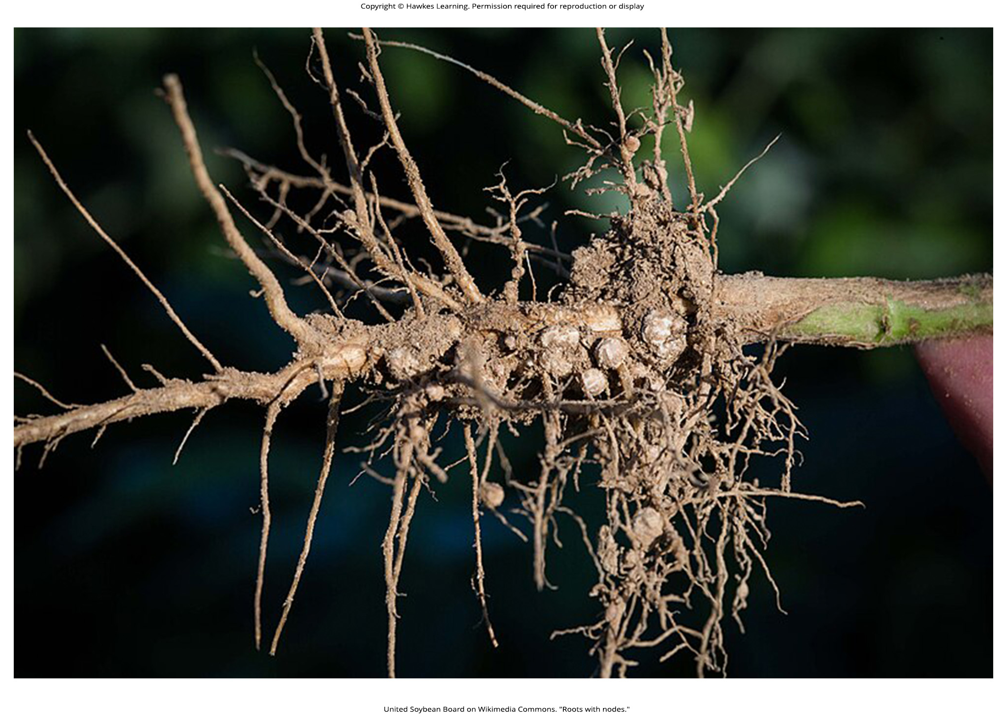
Lesson 22.5 Figure 1

Slide 35
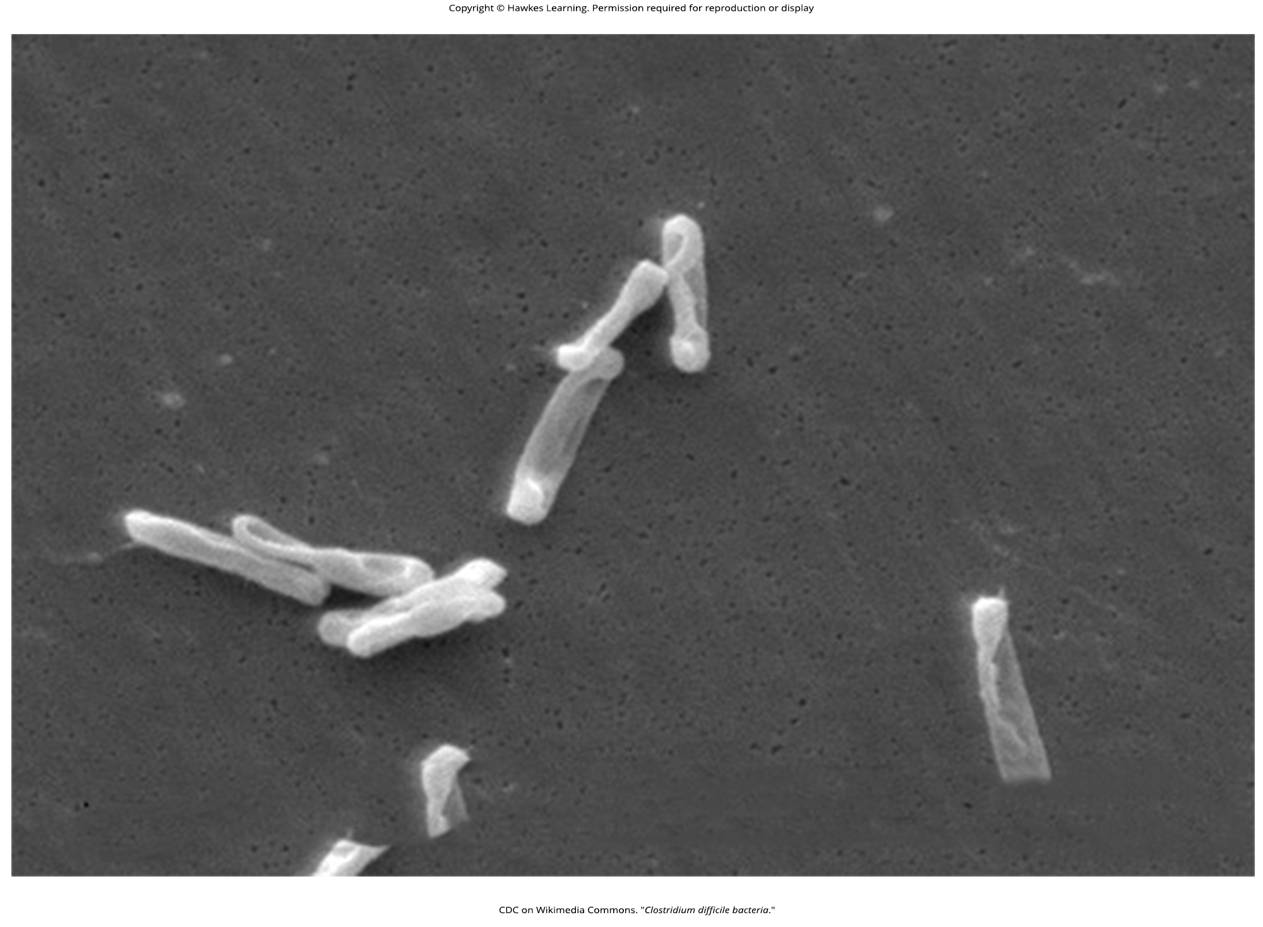
Lesson 22.5 Figure 2

Slide 36
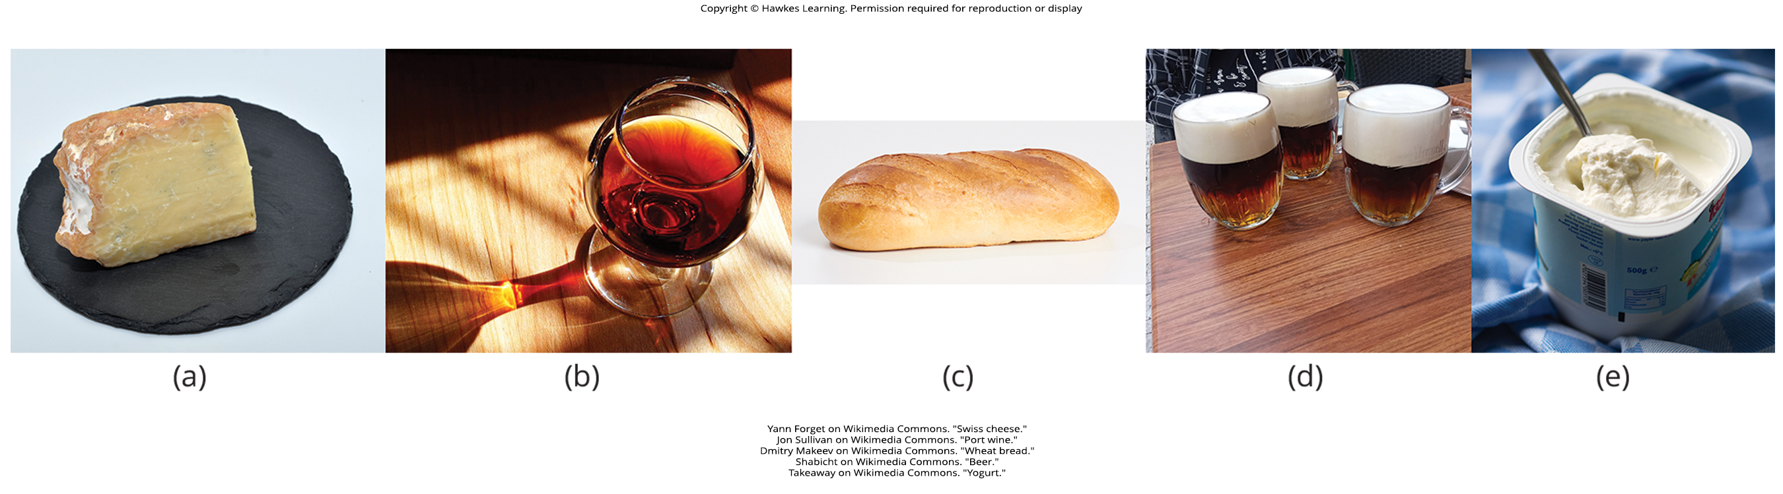
Lesson 22.5 Figure 3

Slide 37
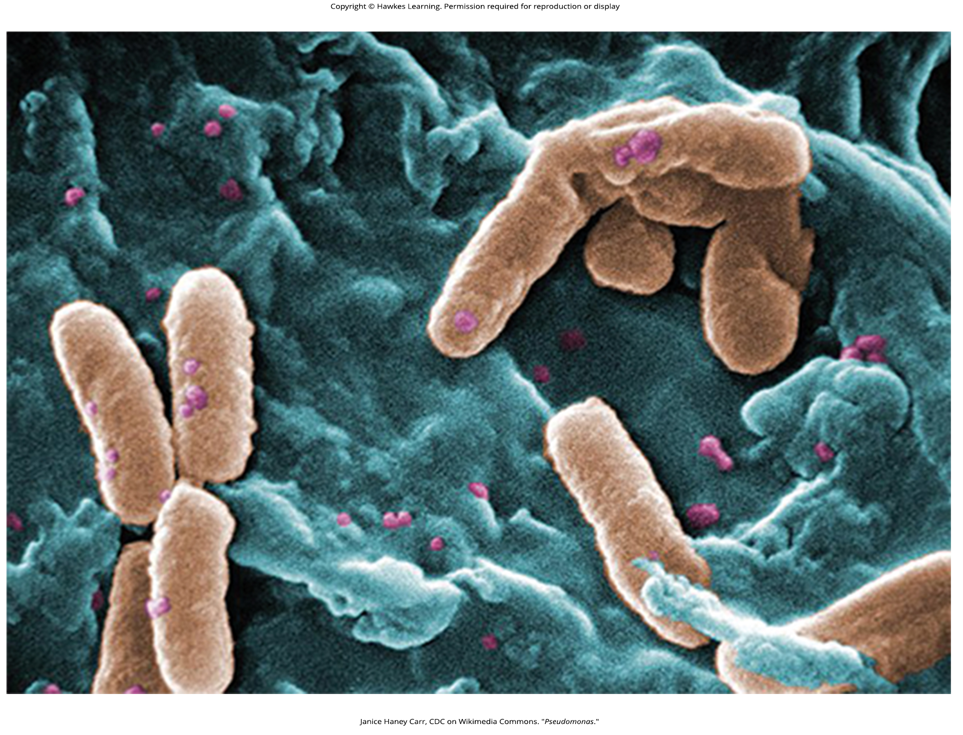
Lesson 22.5 Figure 4

Slide 38
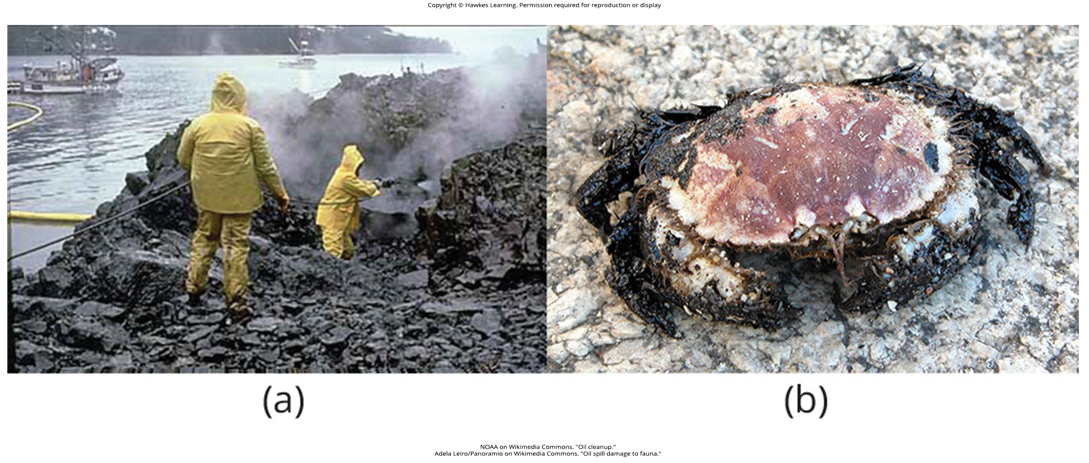
Lesson 22.5 Figure 5

Slide 39
Hawkes Learning – End of PowerPoint

