Slide 1
Chapter 23
Protists

Slide 2
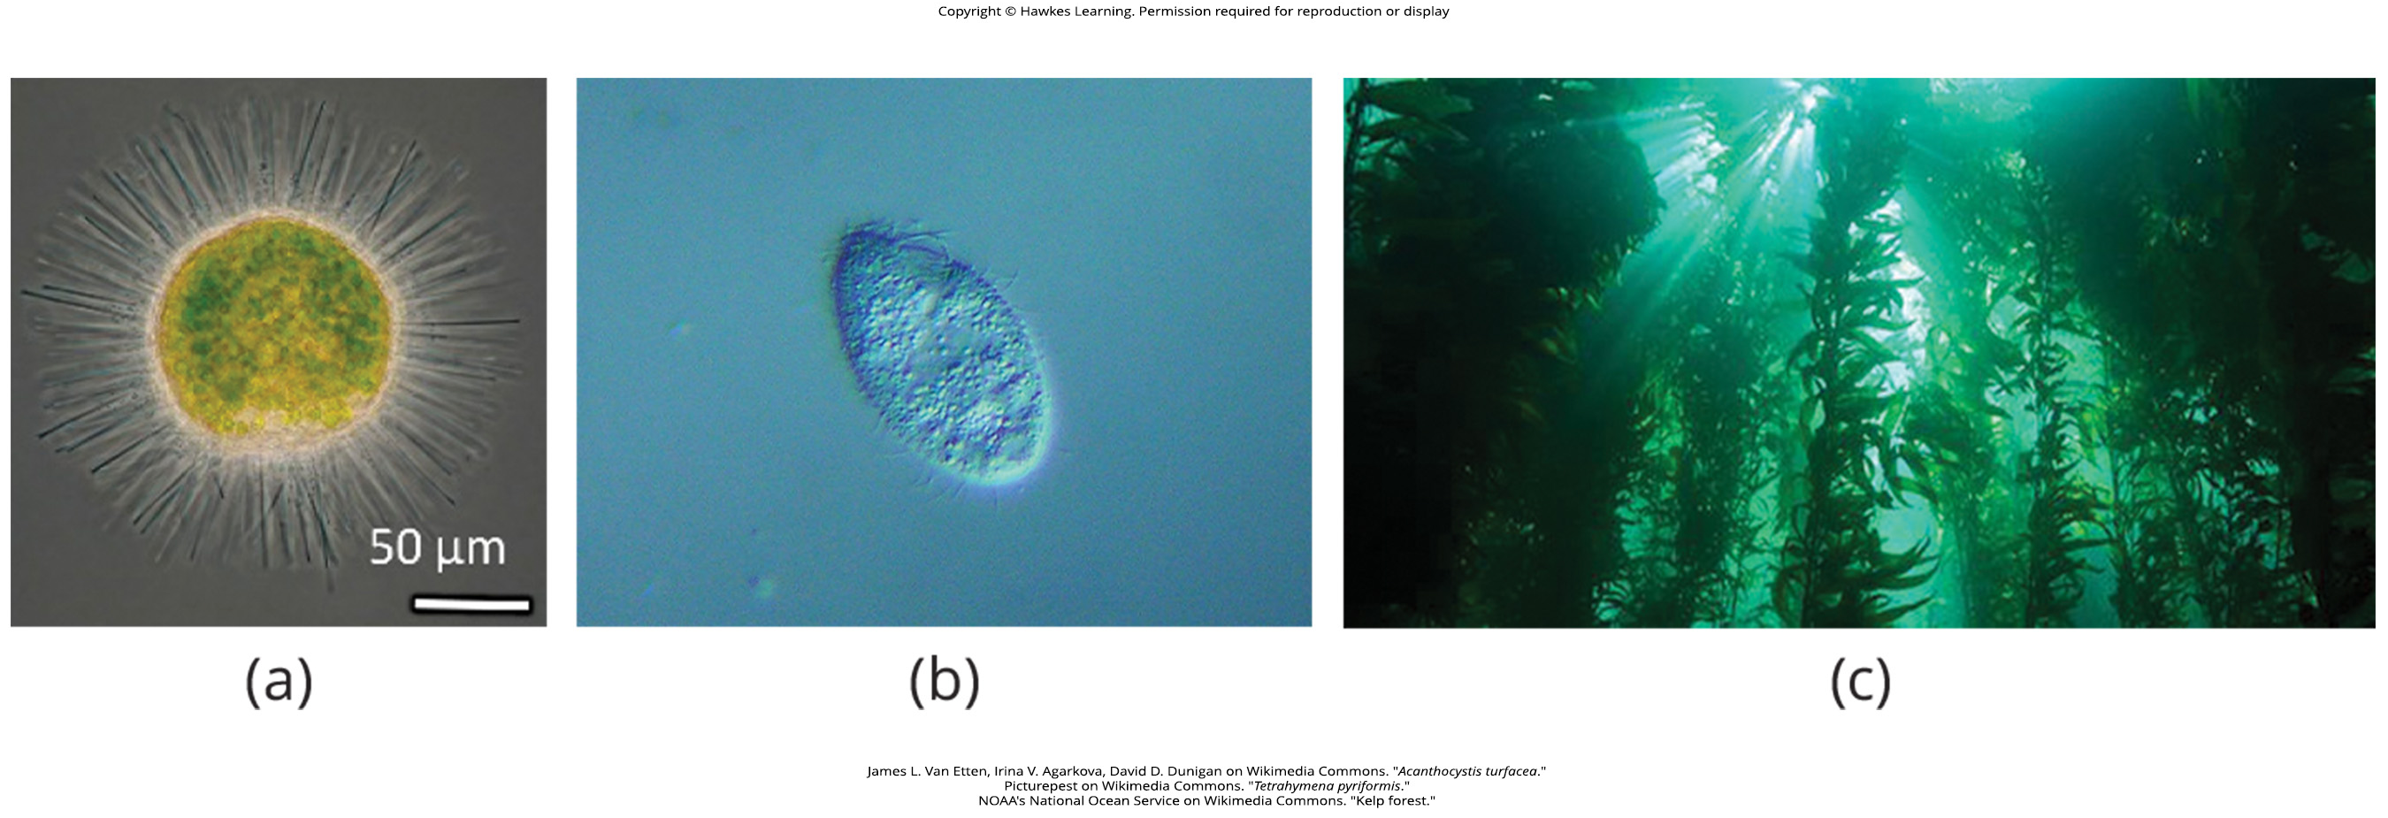
Lesson 23.1 Figure 1

Slide 3
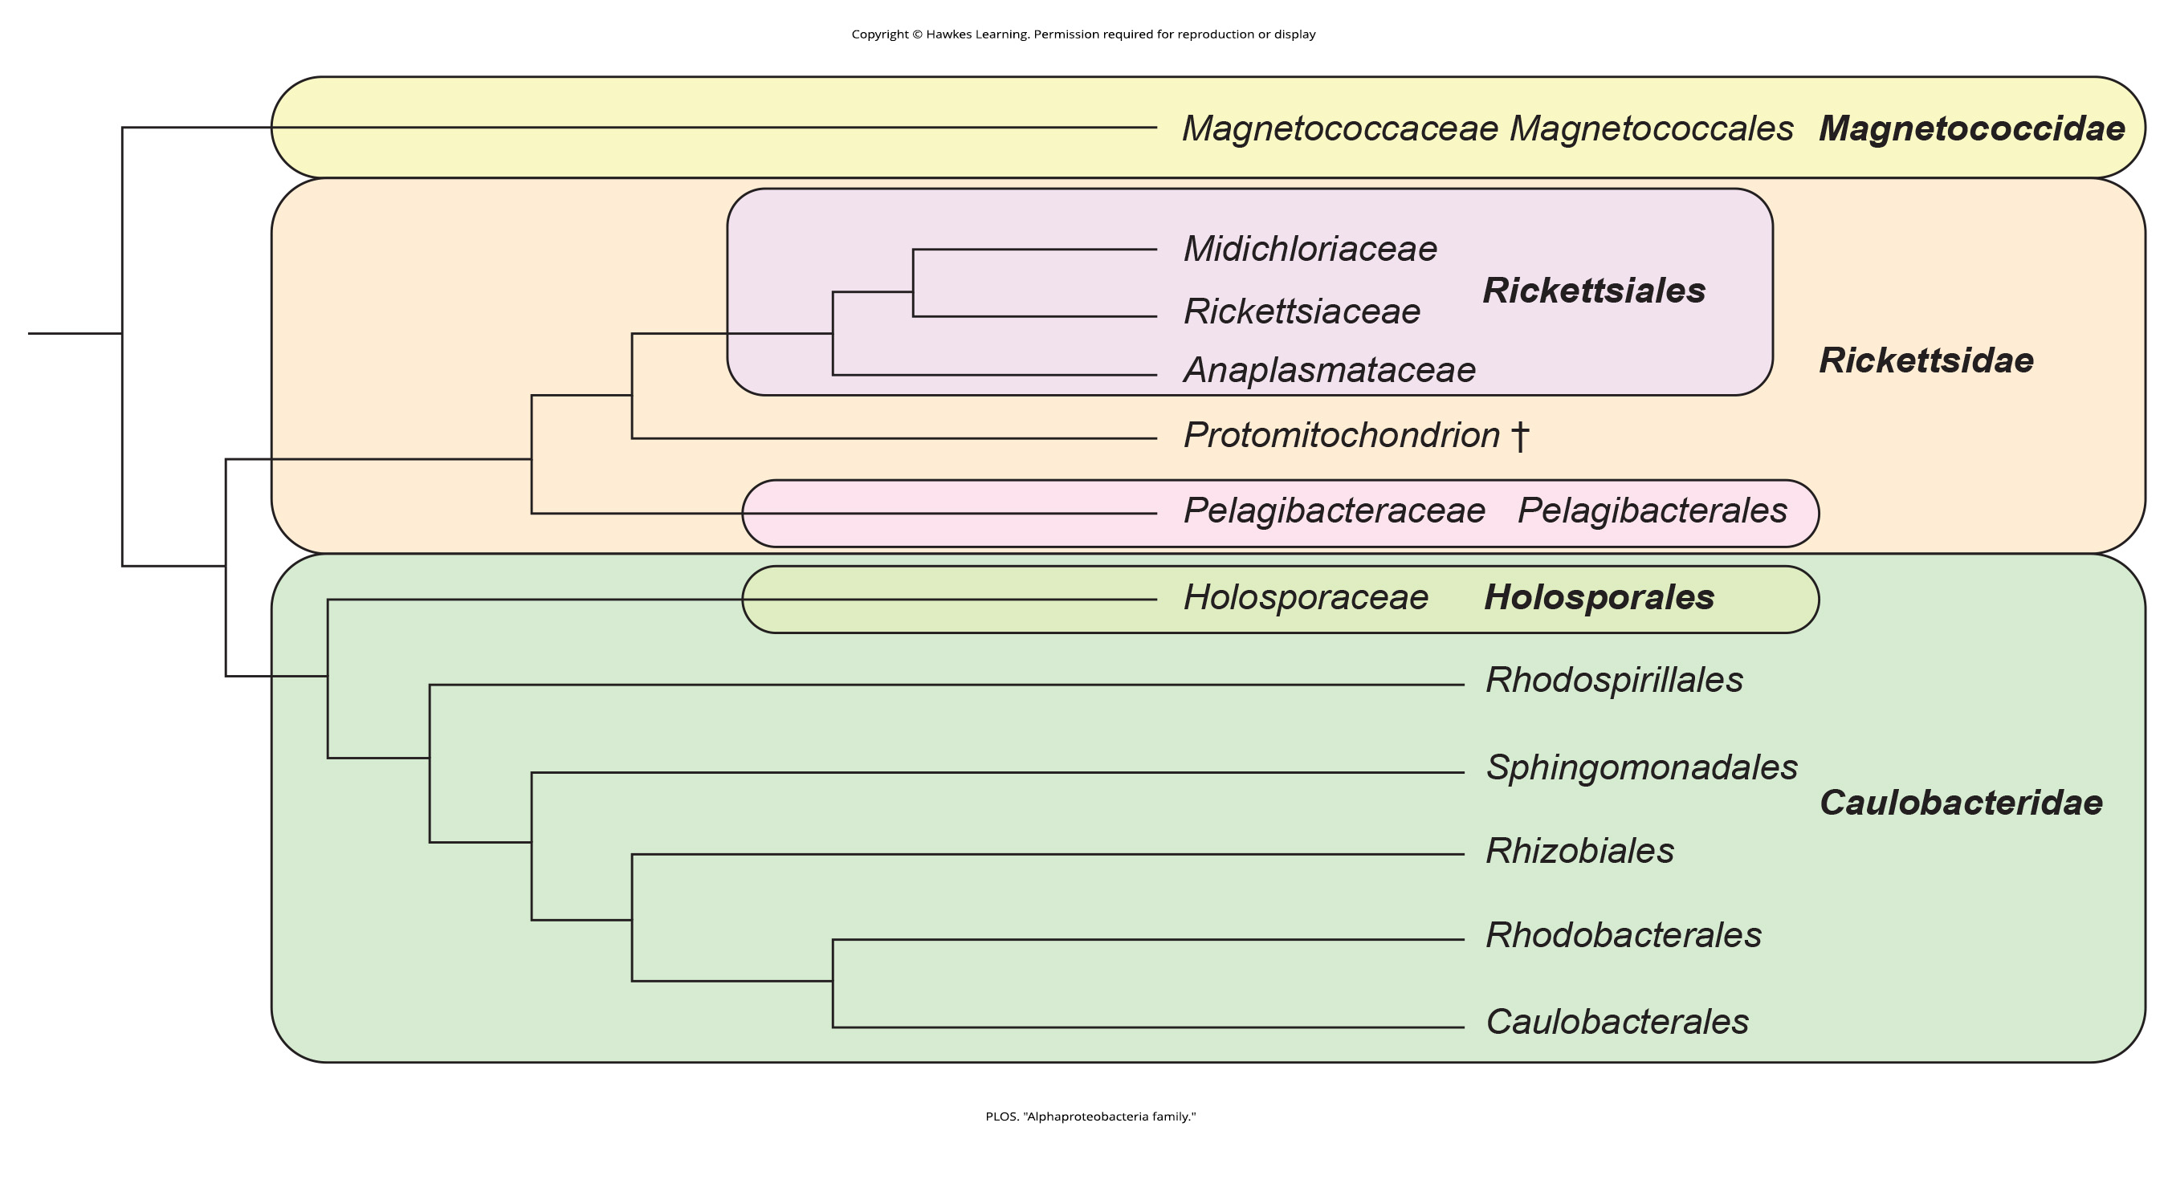
Lesson 23.1 Figure 2

Slide 4
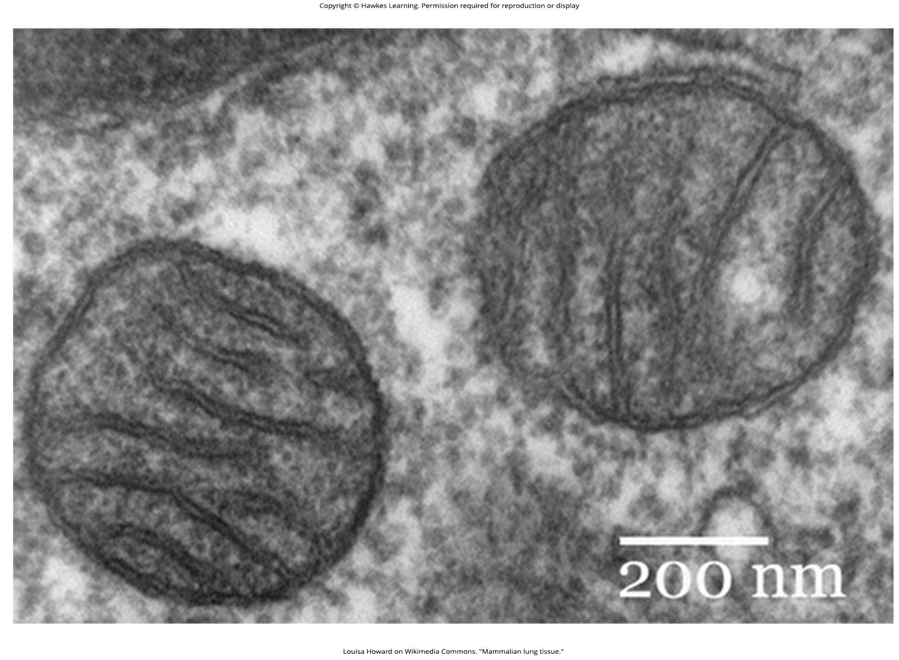
Lesson 23.1 Figure 3

Slide 5
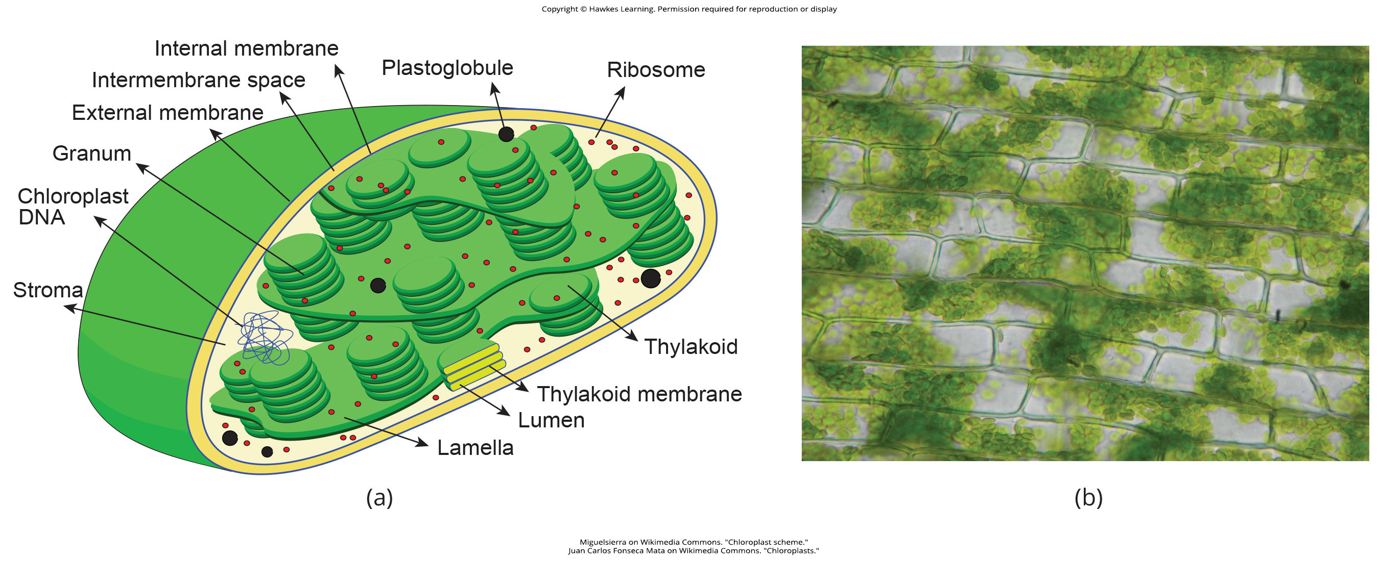
Lesson 23.1 Figure 4

Slide 6
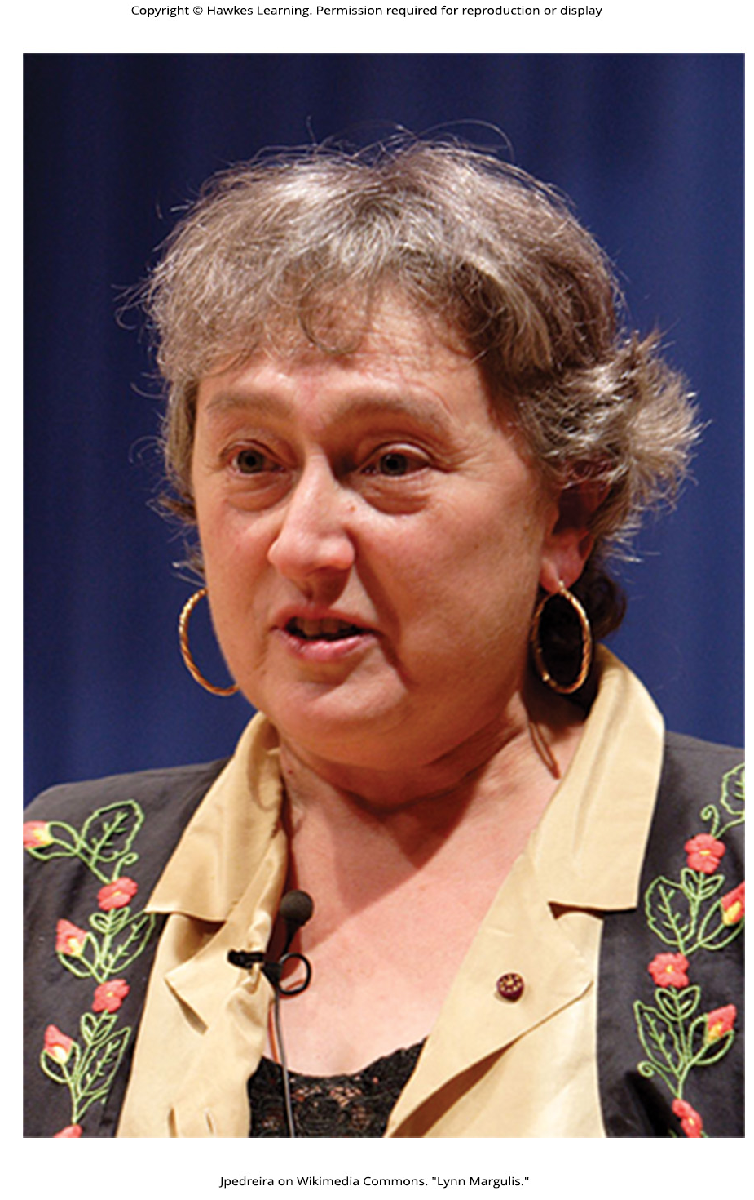
Lesson 23.1 Figure 5

Slide 7
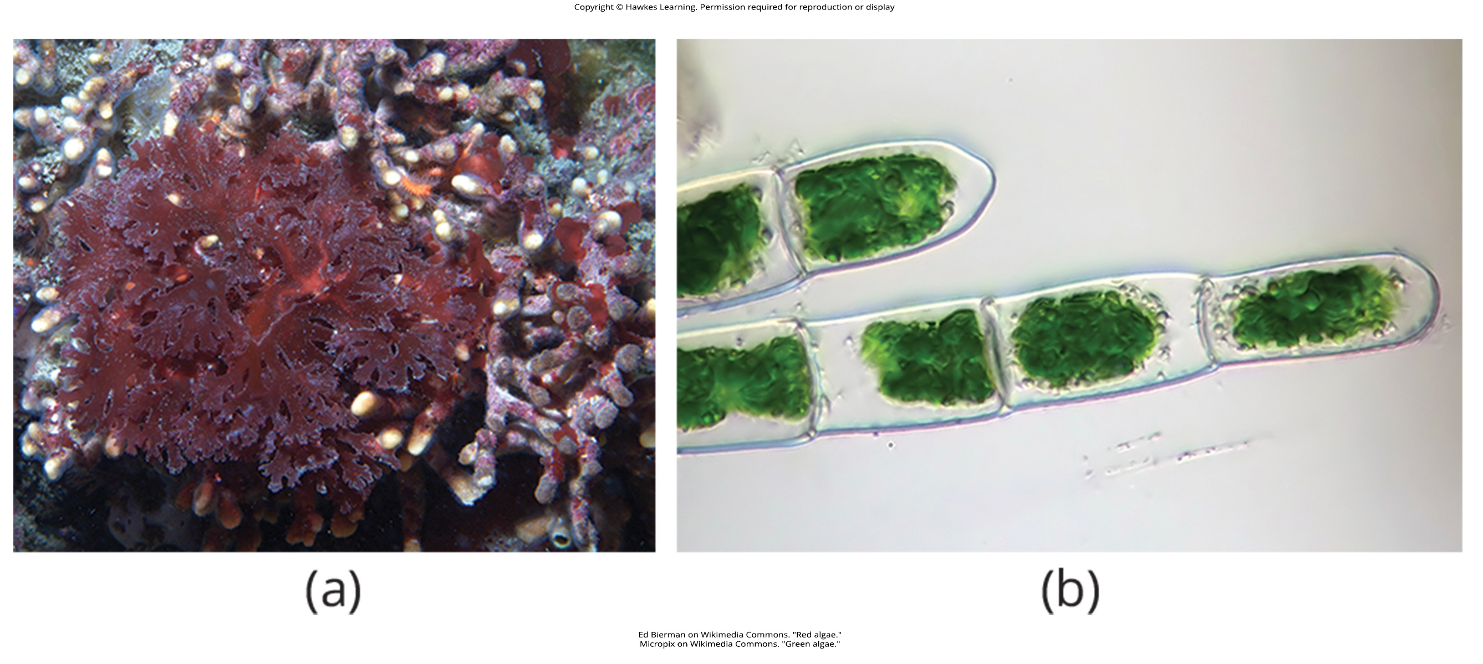
Lesson 23.1 Figure 6

Slide 8
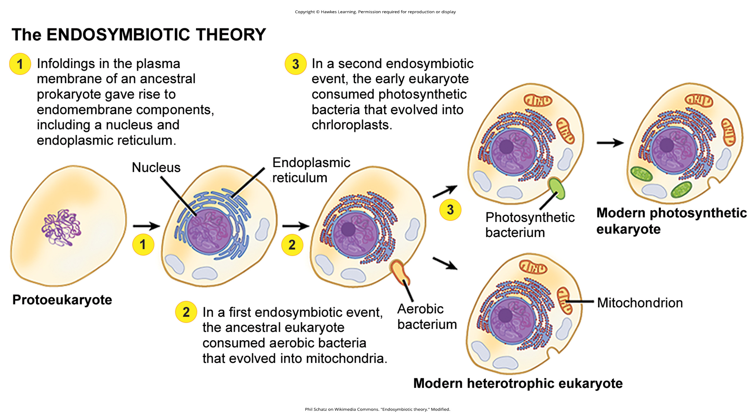
Lesson 23.1 Figure 7

Slide 9
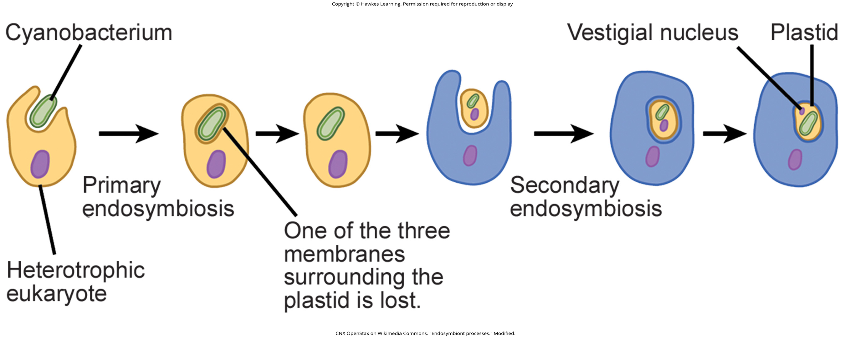
Lesson 23.1 Figure 8

Slide 10
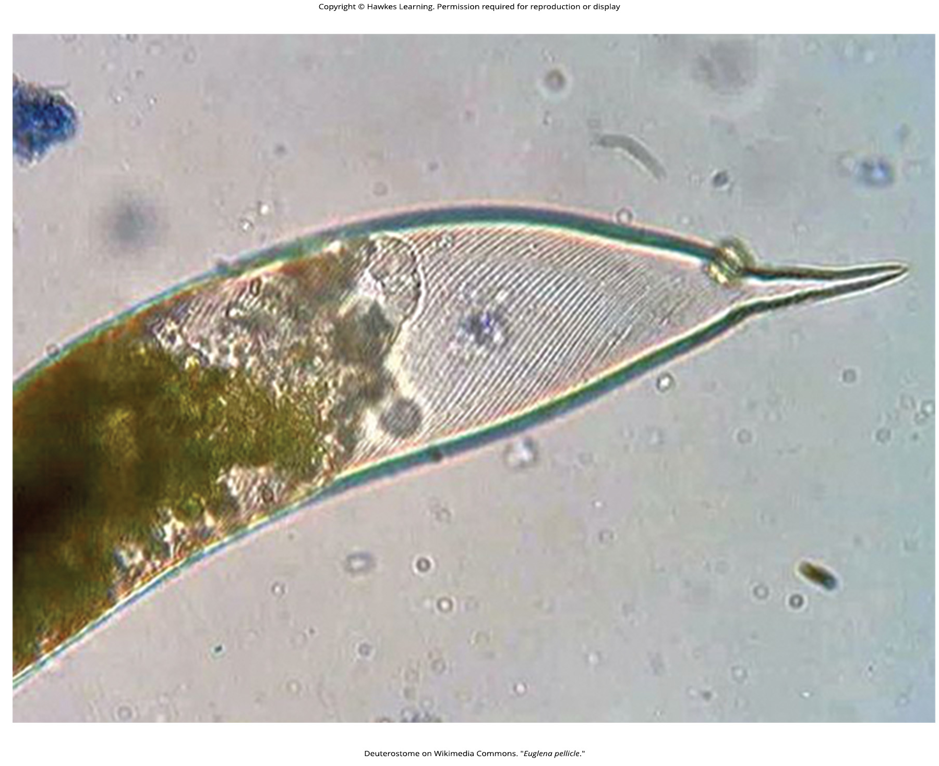
Lesson 23.2 Figure 1

Slide 11
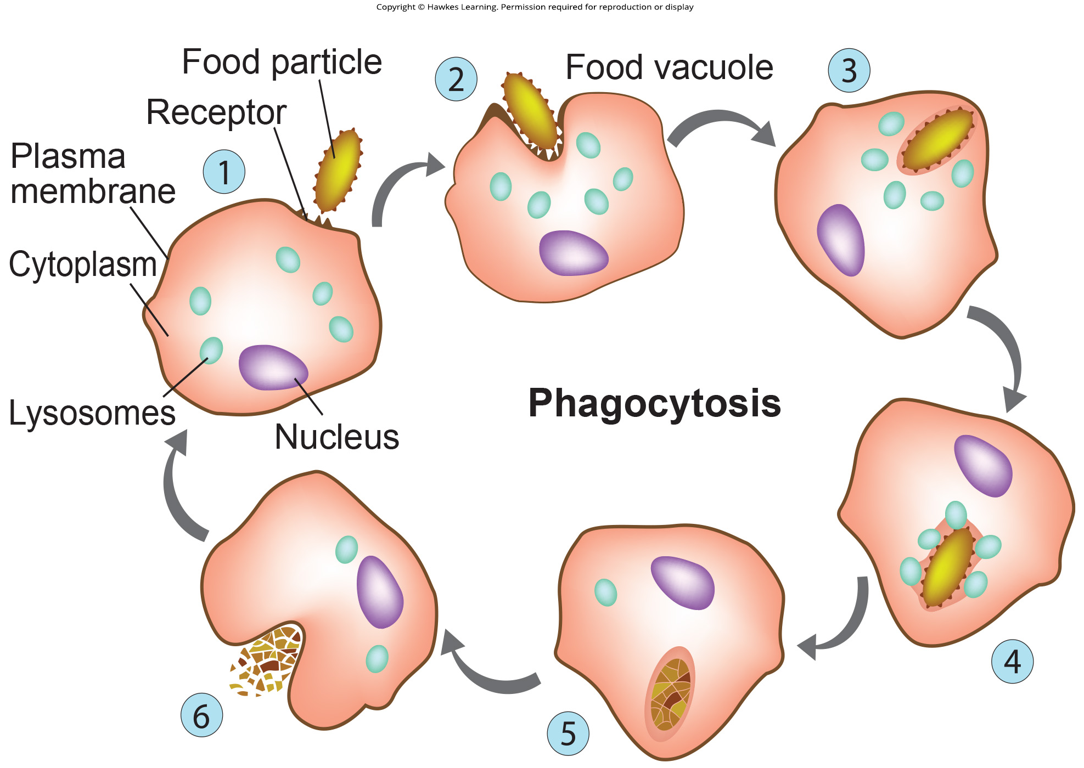
Lesson 23.2 Figure 2

Slide 12
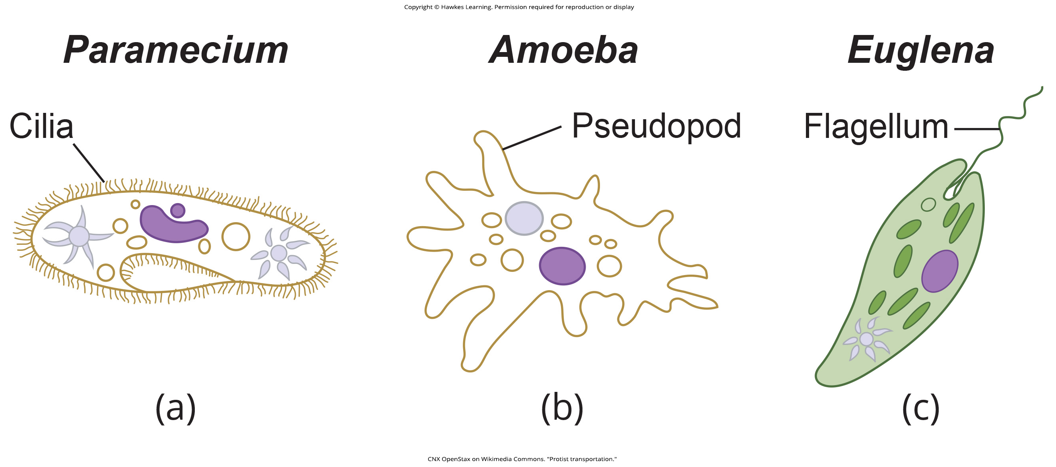
Lesson 23.2 Figure 3

Slide 13
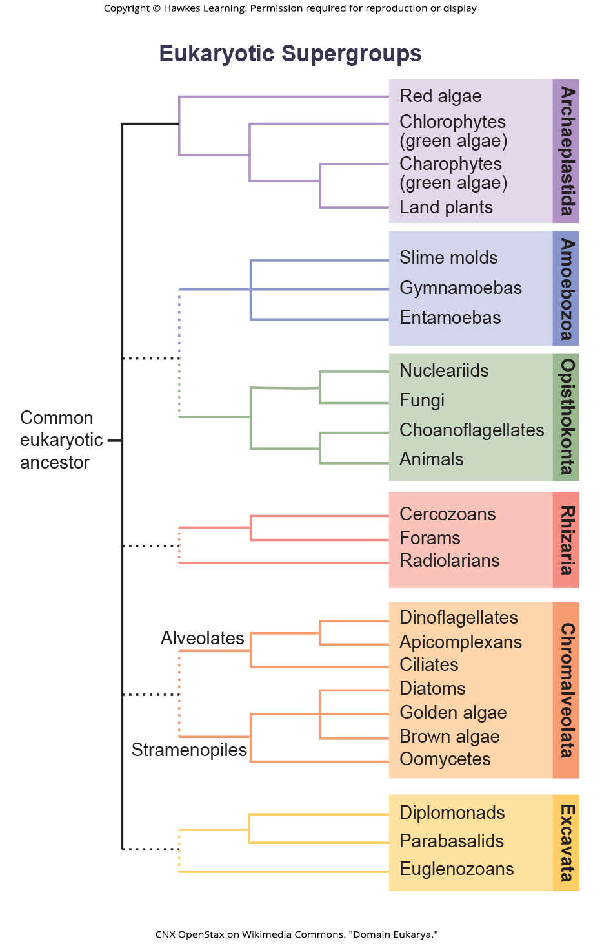
Lesson 23.2 Figure 4

Slide 14
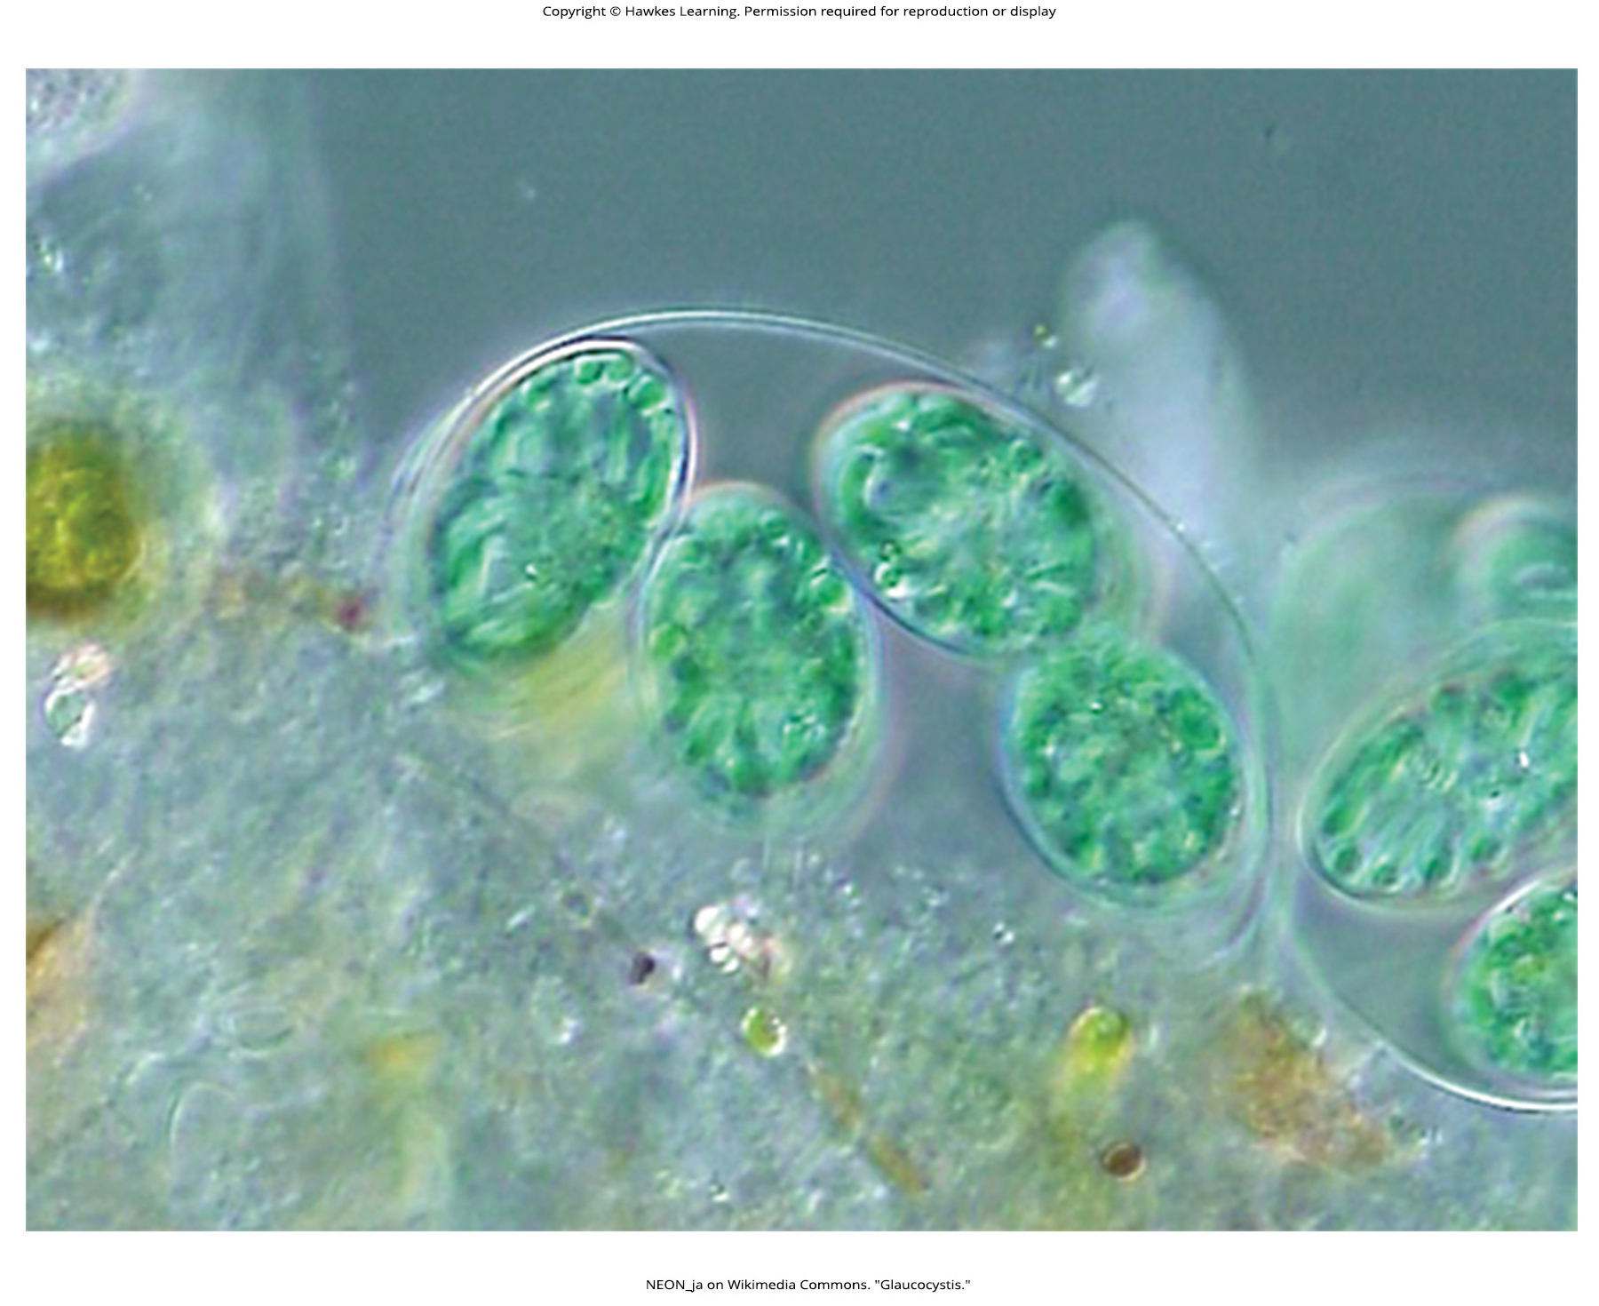
Lesson 23.2 Figure 5

Slide 15
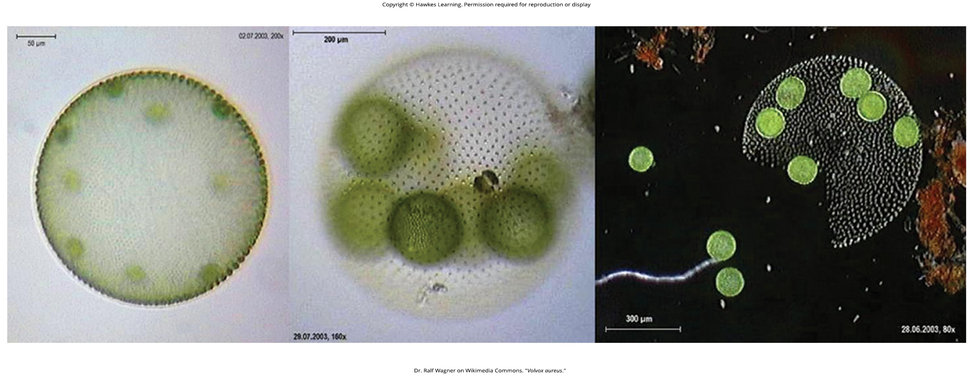
Lesson 23.2 Figure 6

Slide 16
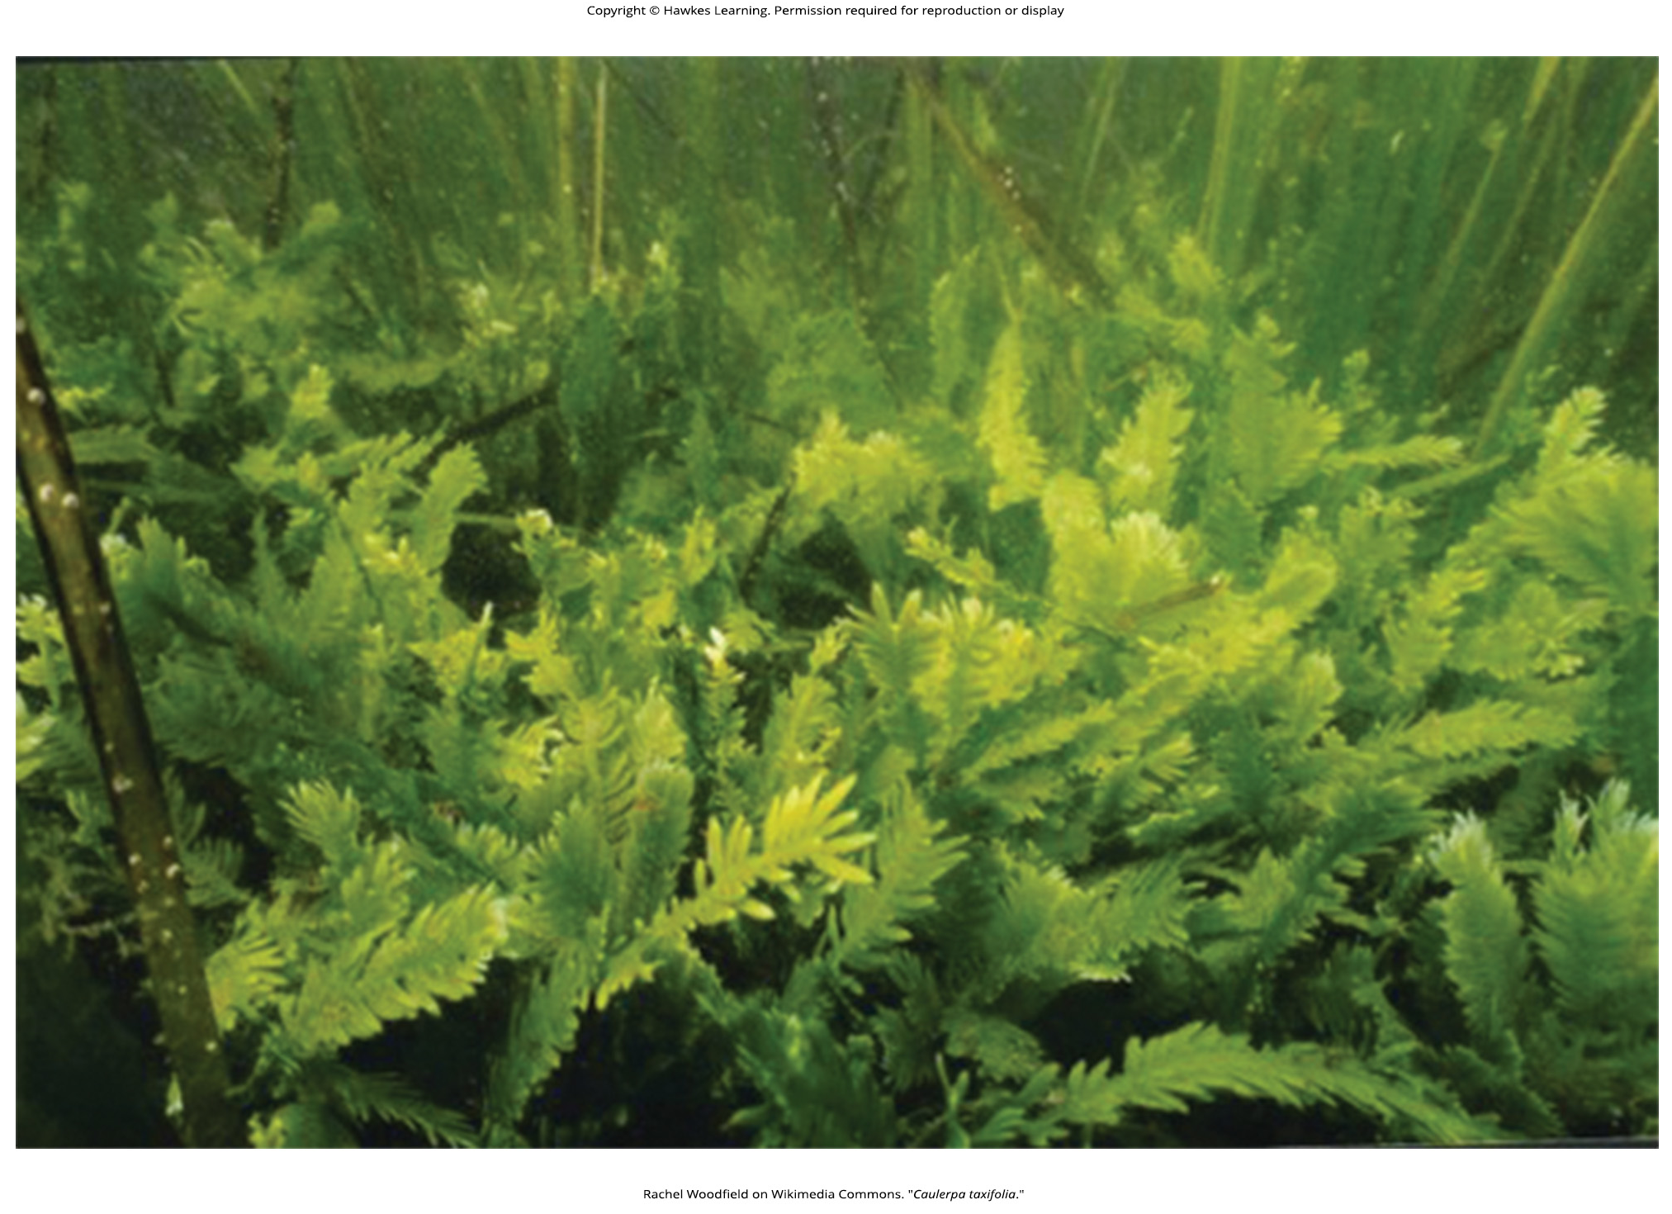
Lesson 23.2 Figure 7

Slide 17
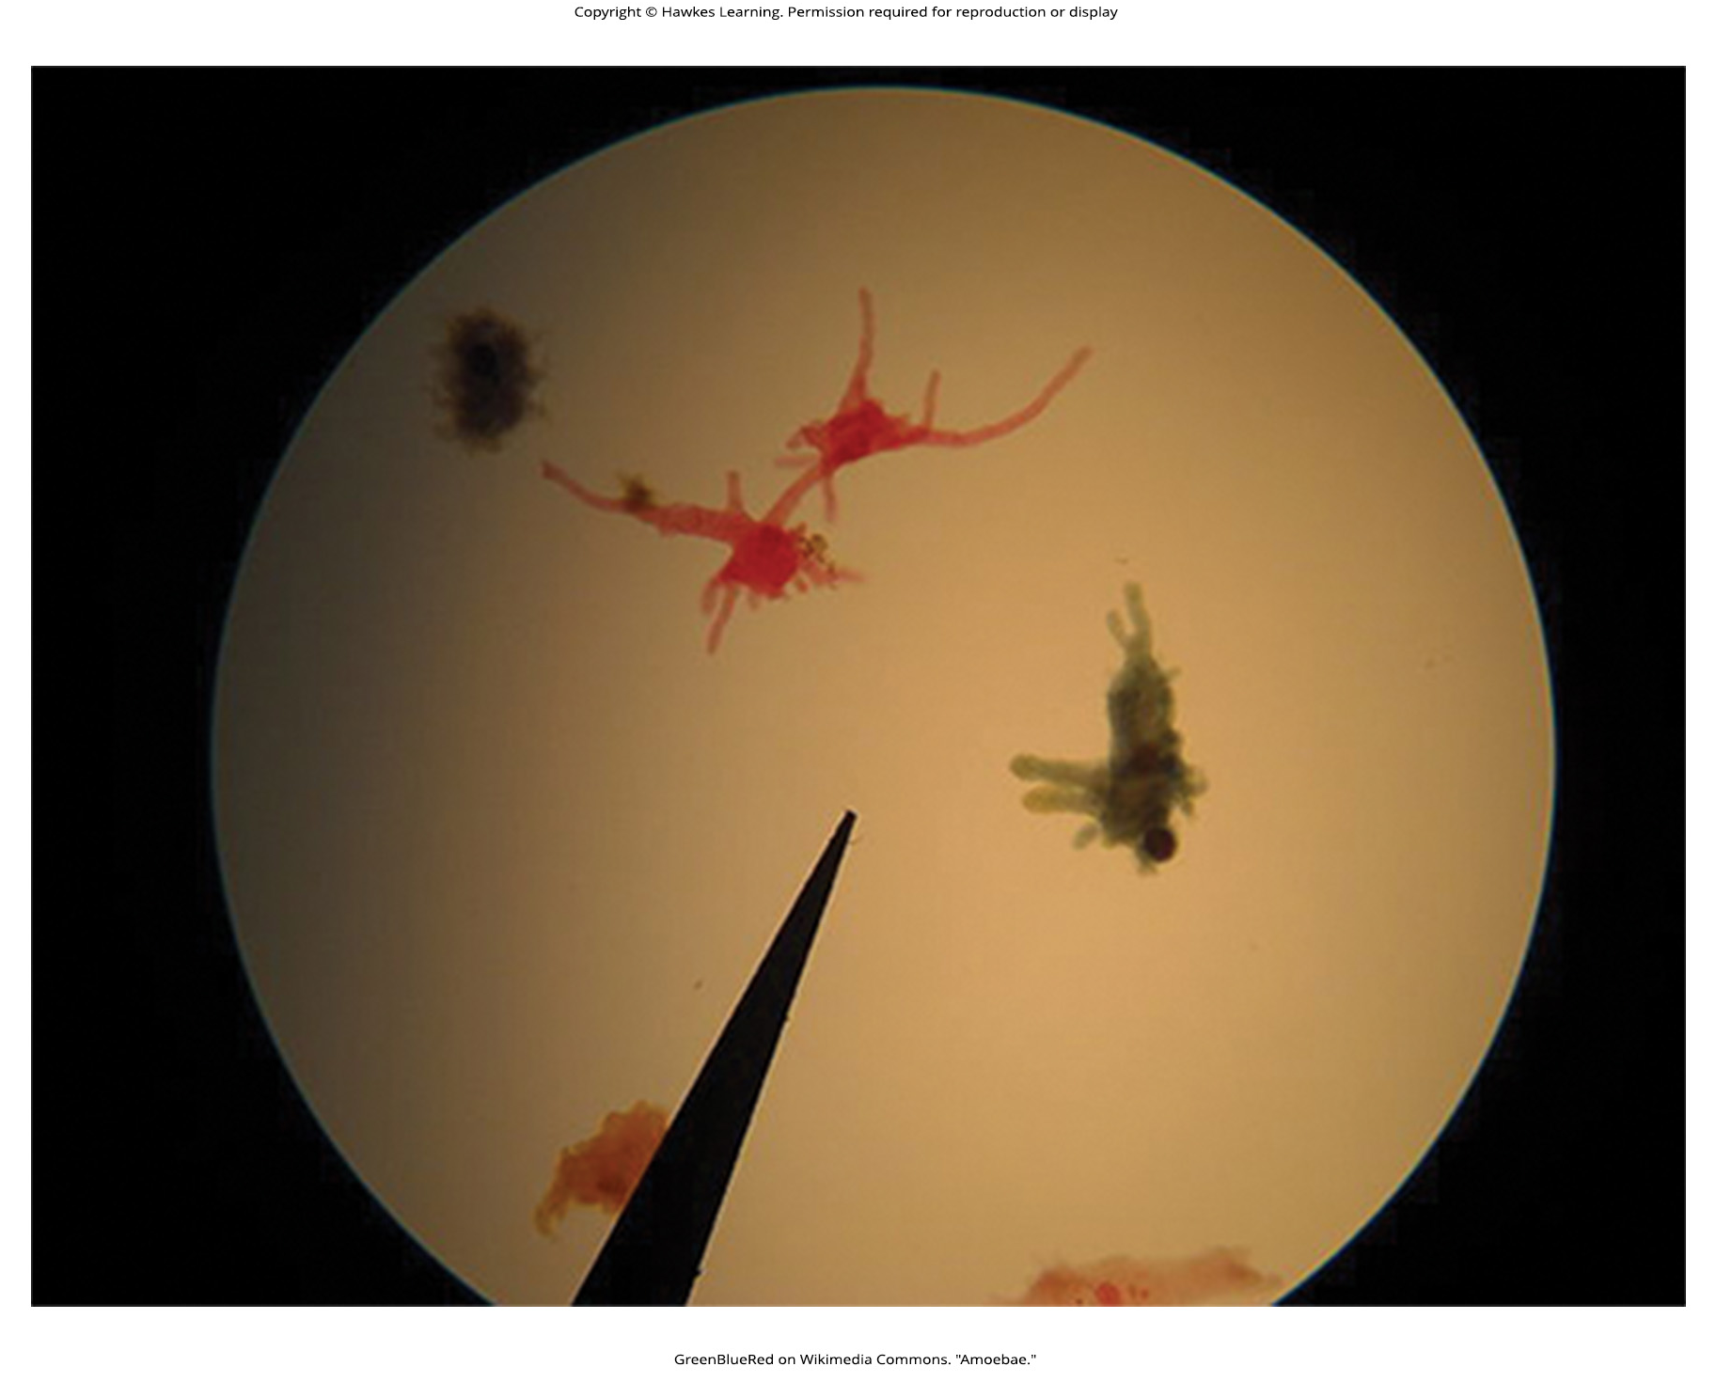
Lesson 23.2 Figure 8

Slide 18
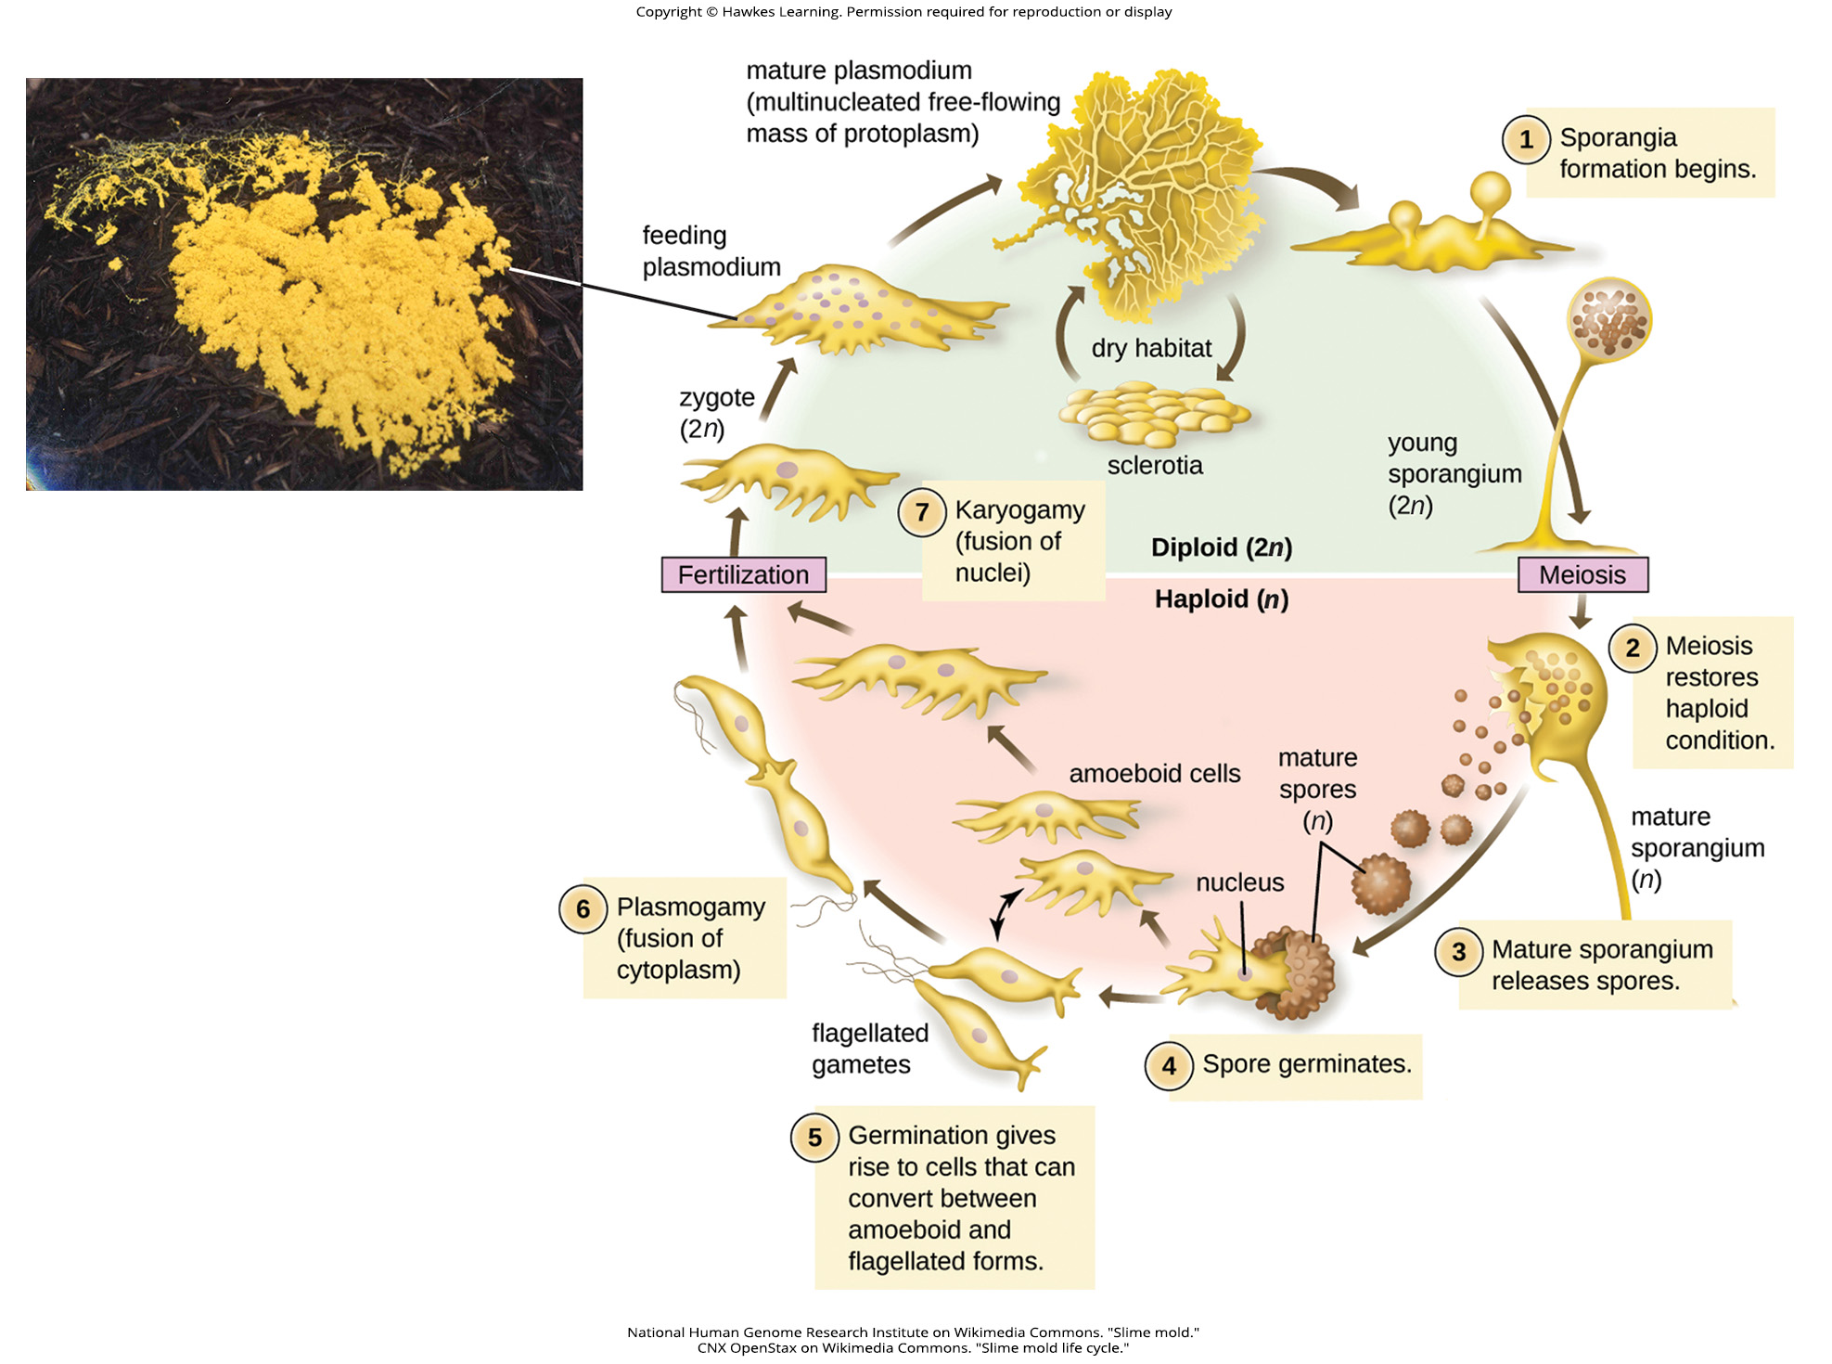
Lesson 23.2 Figure 9

Slide 19
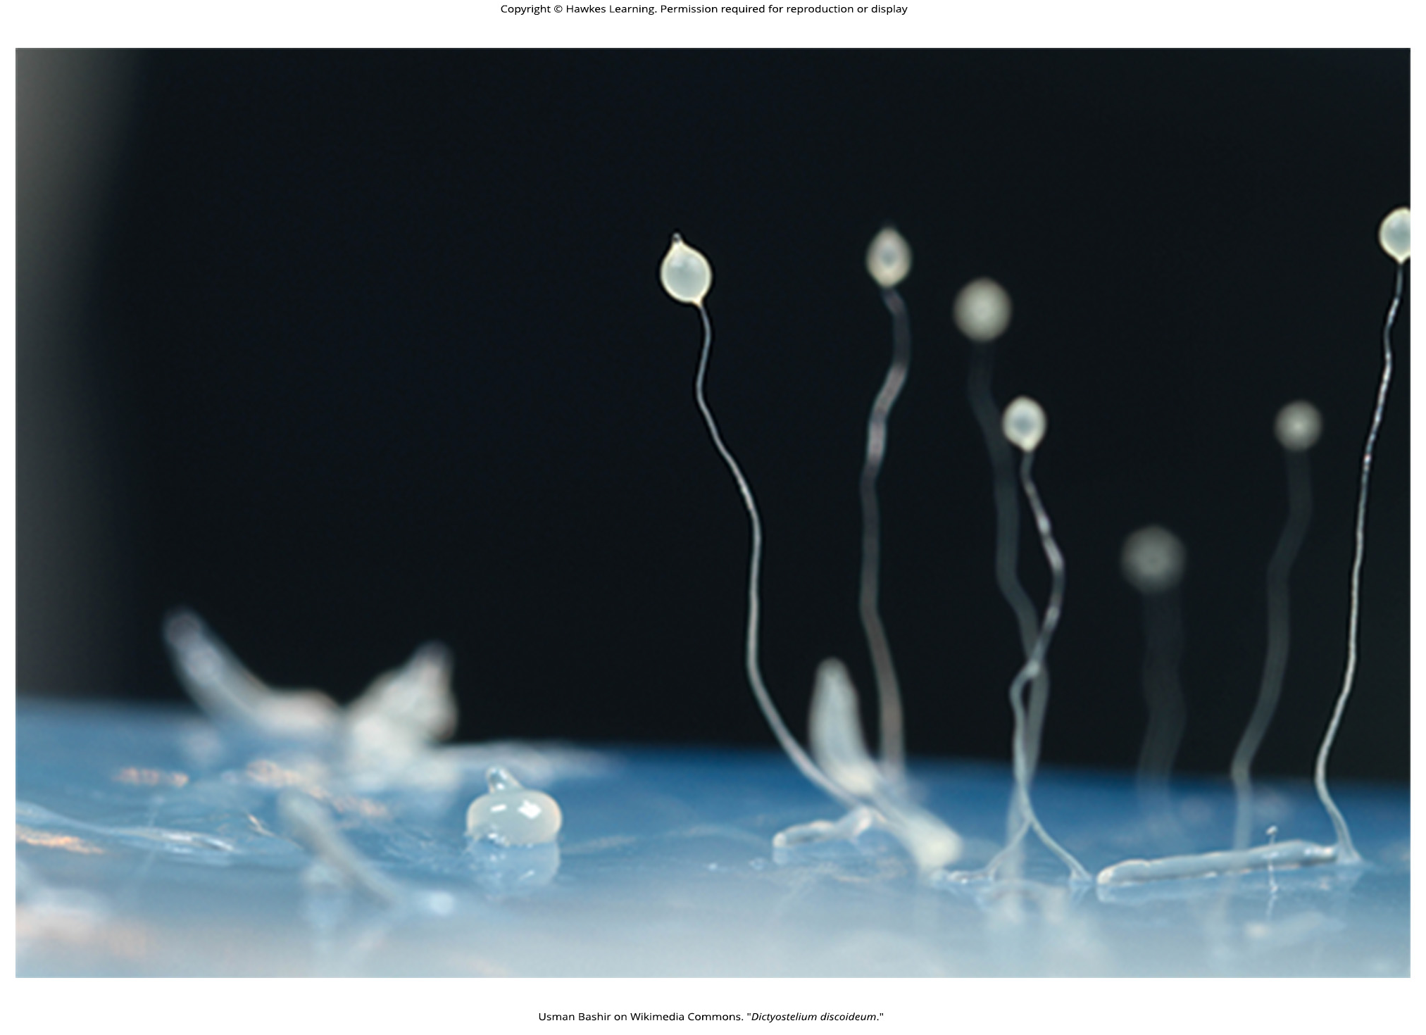
Lesson 23.2 Figure 10

Slide 20
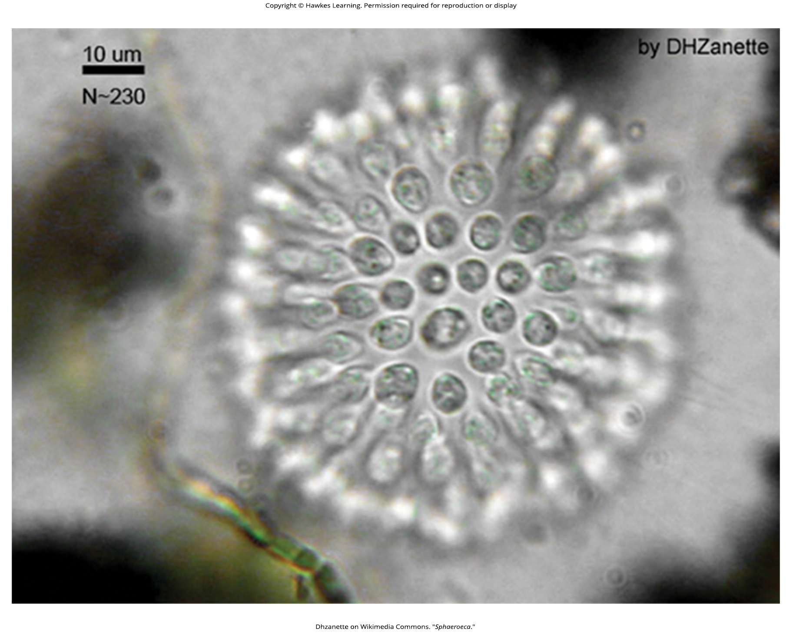
Lesson 23.2 Figure 11

Slide 21
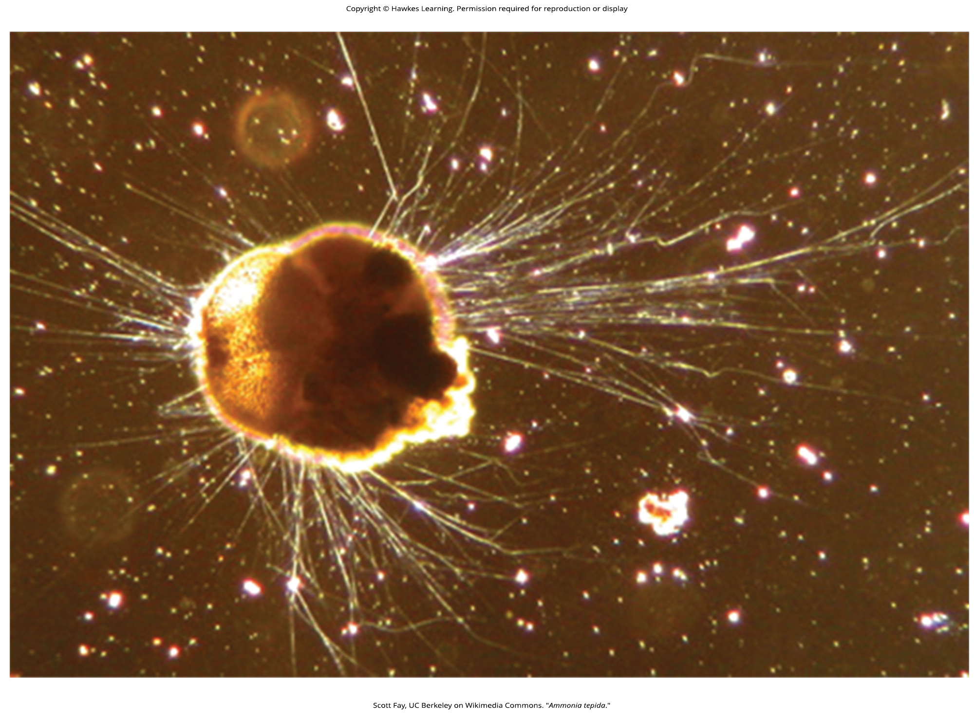
Lesson 23.2 Figure 12

Slide 22
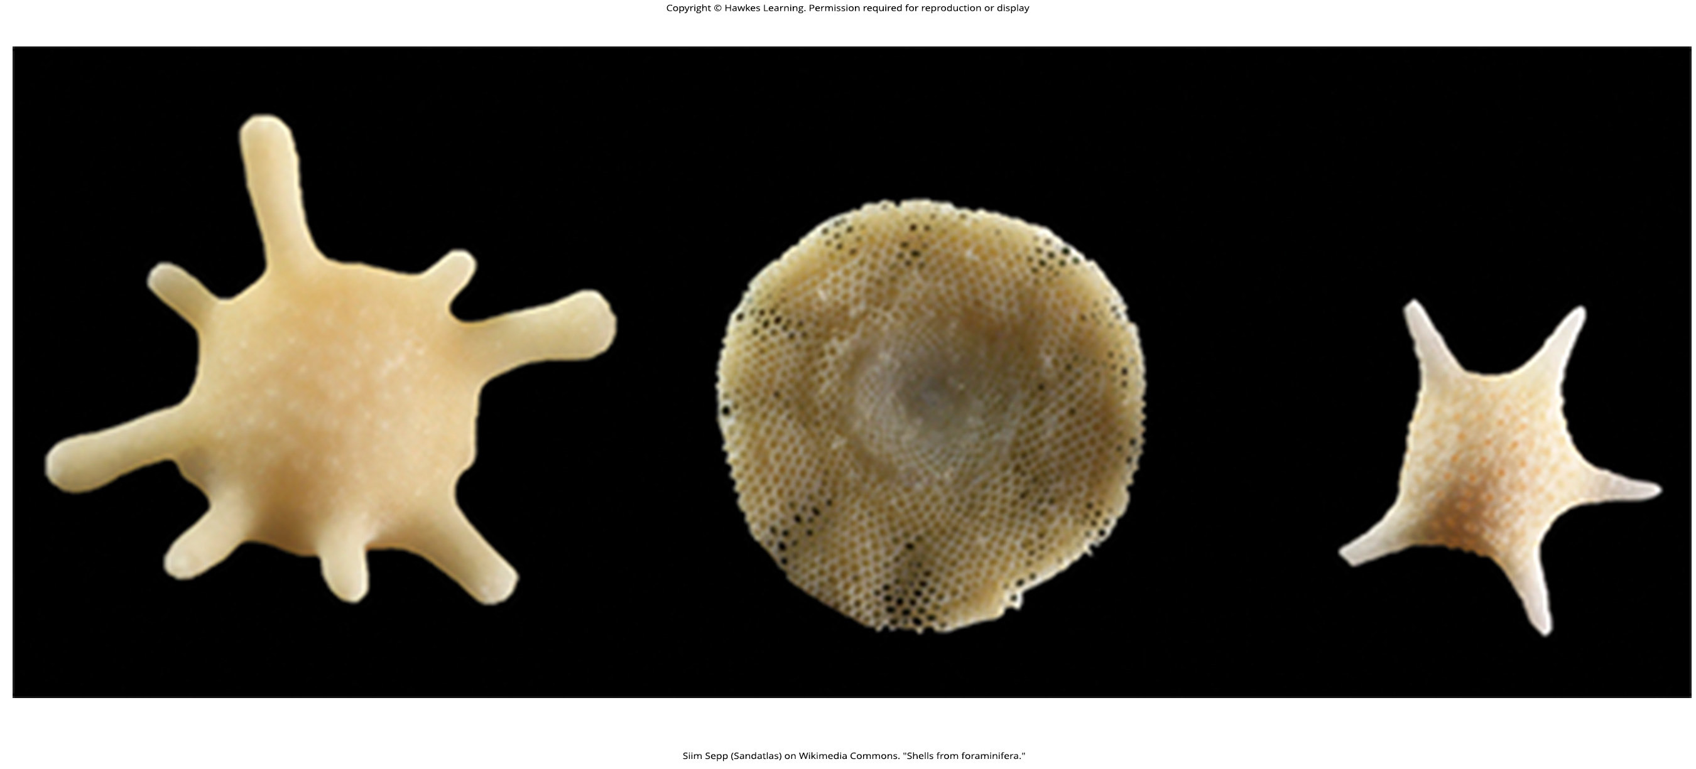
Lesson 23.2 Figure 13

Slide 23
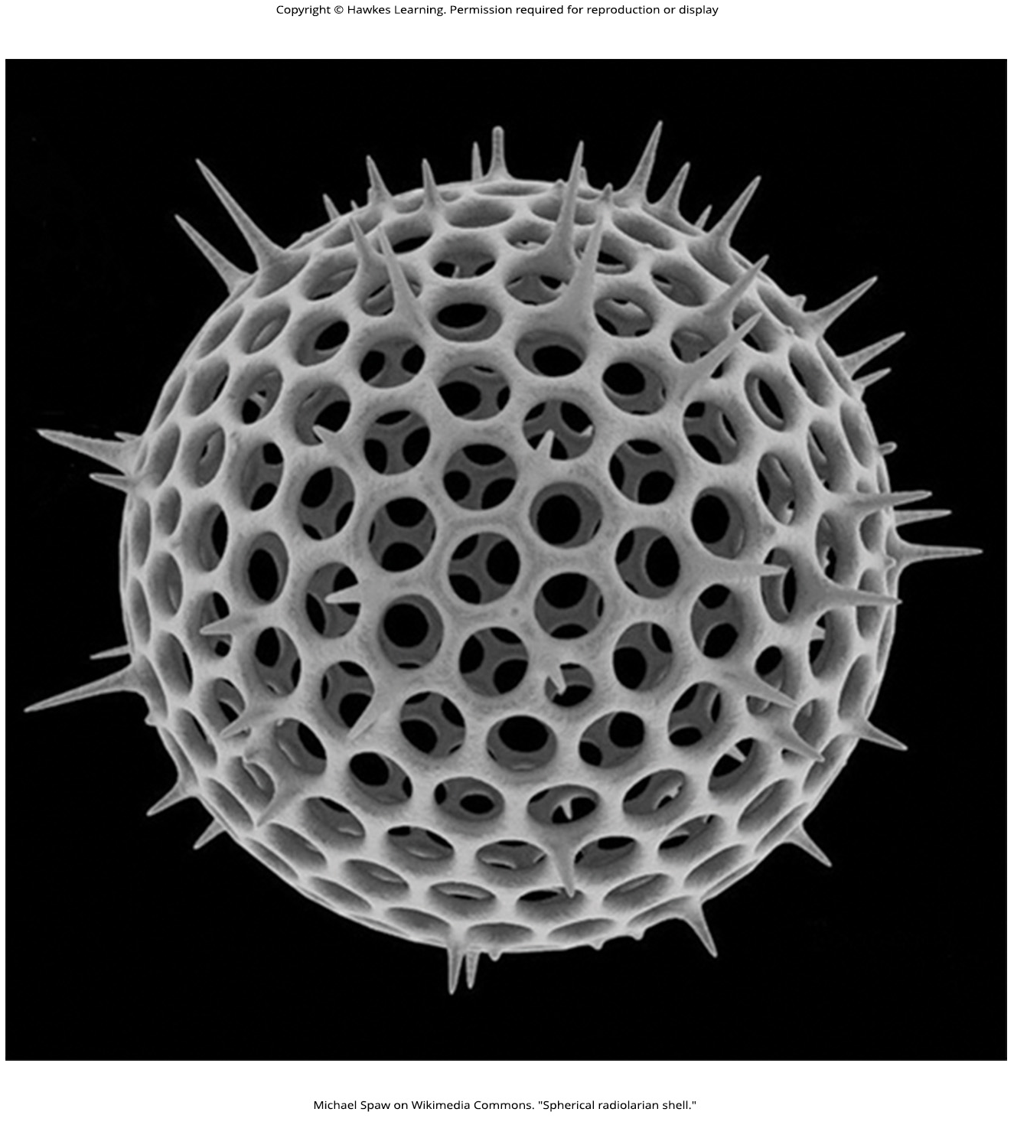
Lesson 23.2 Figure 14

Slide 24
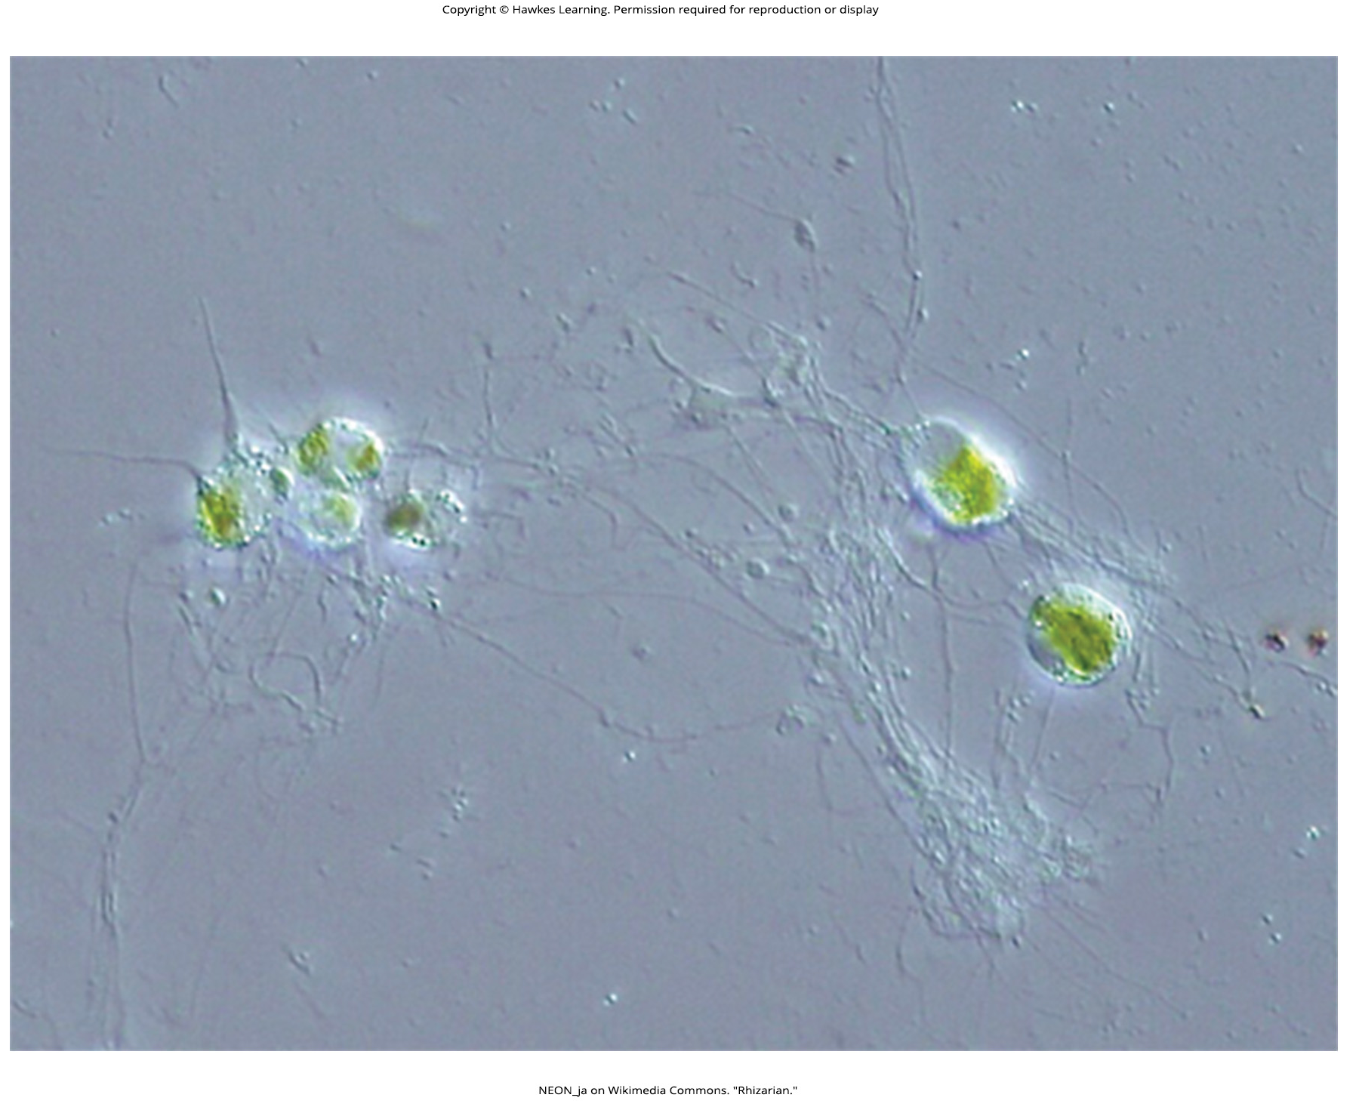
Lesson 23.2 Figure 15

Slide 25
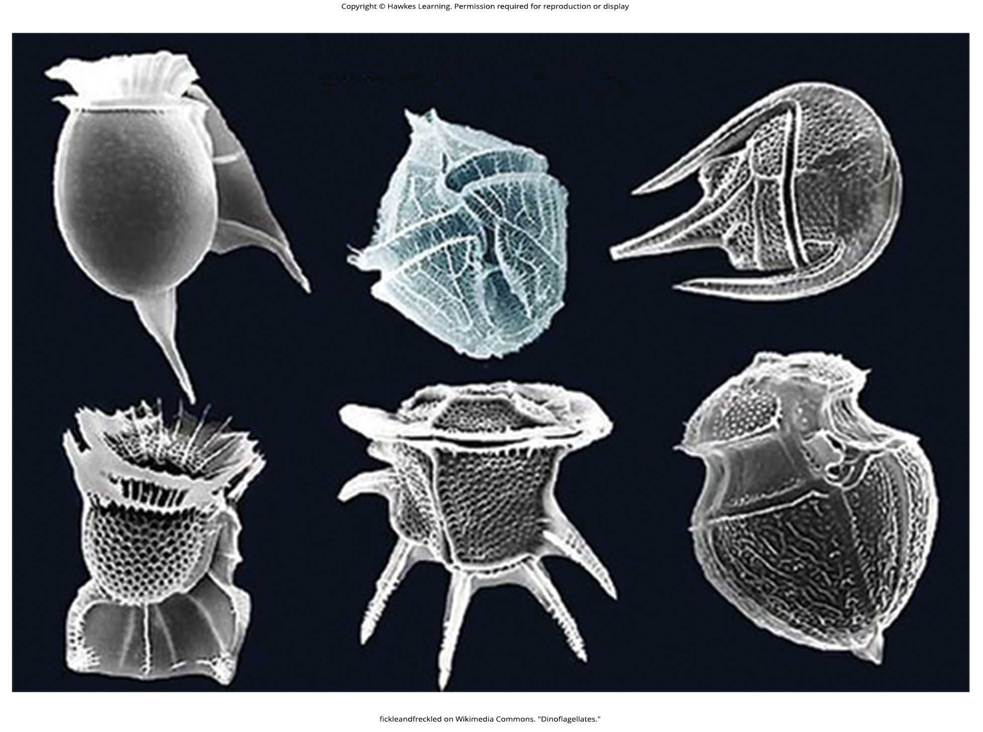
Lesson 23.2 Figure 16

Slide 26
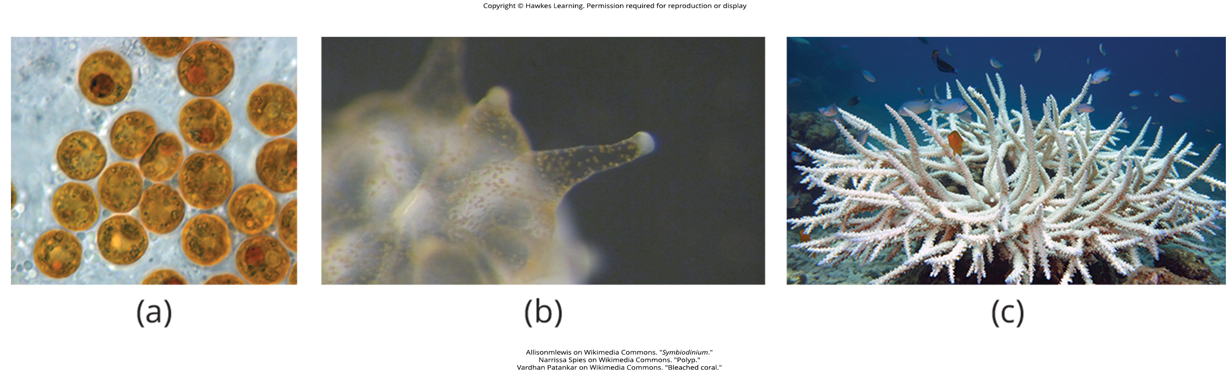
Lesson 23.2 Figure 17

Slide 27
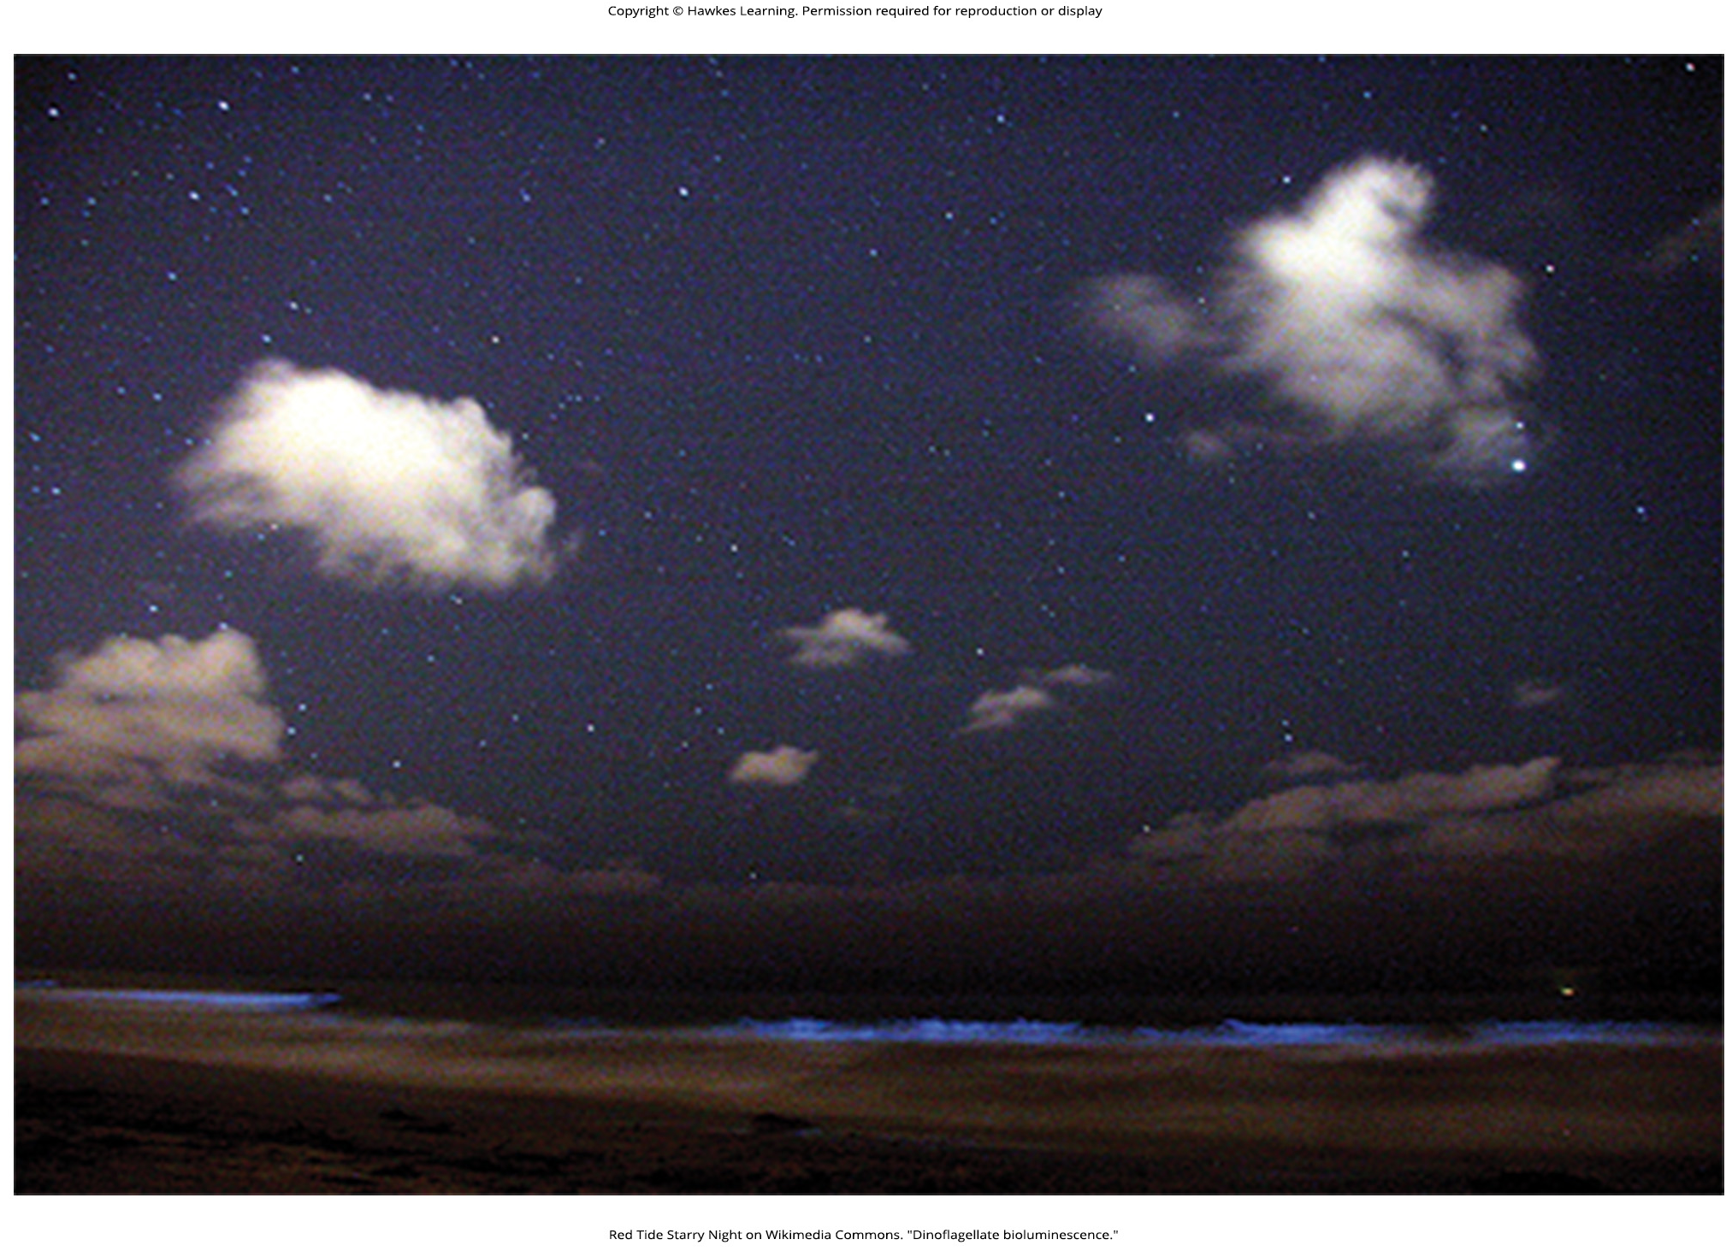
Lesson 23.2 Figure 18

Slide 28
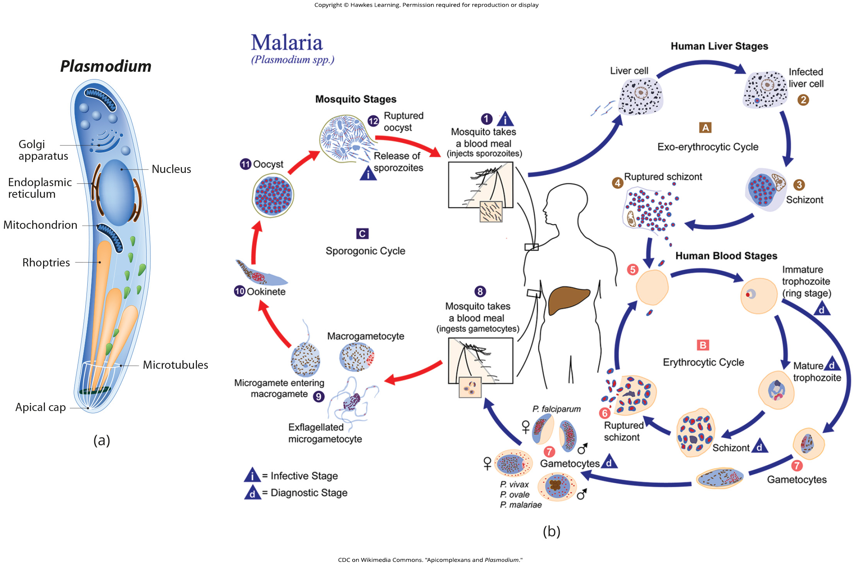
Lesson 23.2 Figure 19

Slide 29
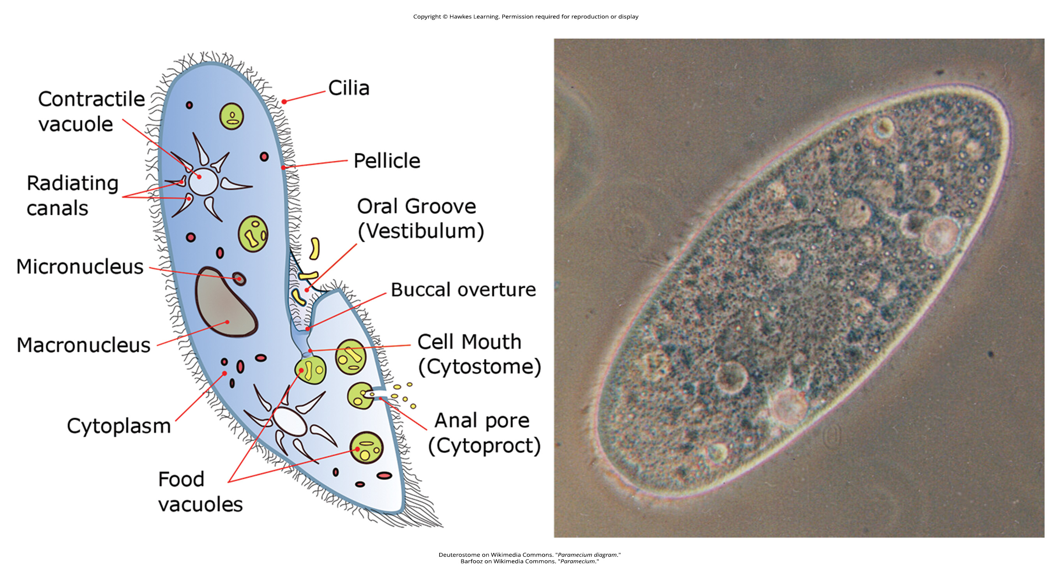
Lesson 23.2 Figure 20

Slide 30
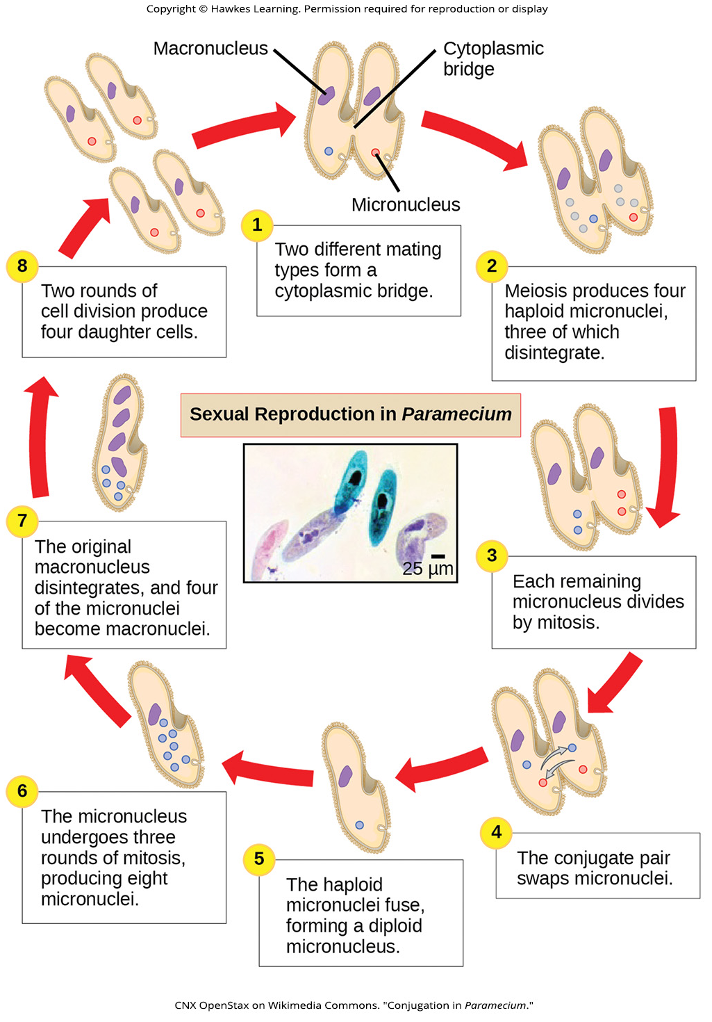
Lesson 23.2 Figure 21

Slide 31
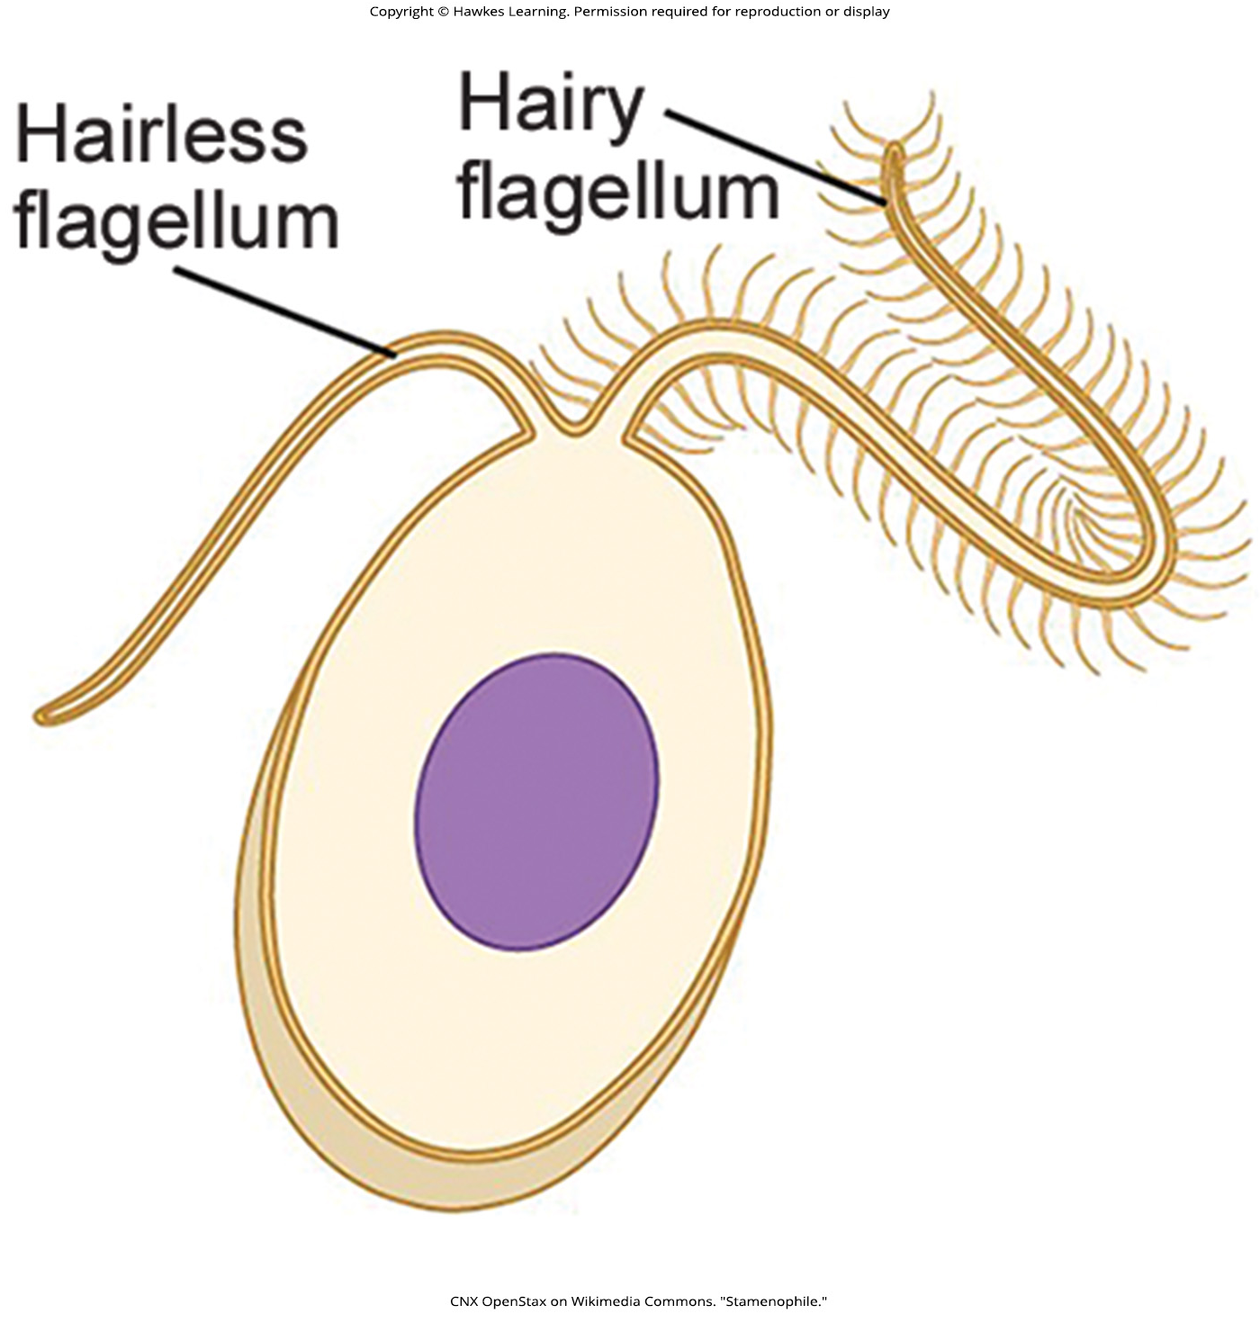
Lesson 23.2 Figure 22

Slide 32
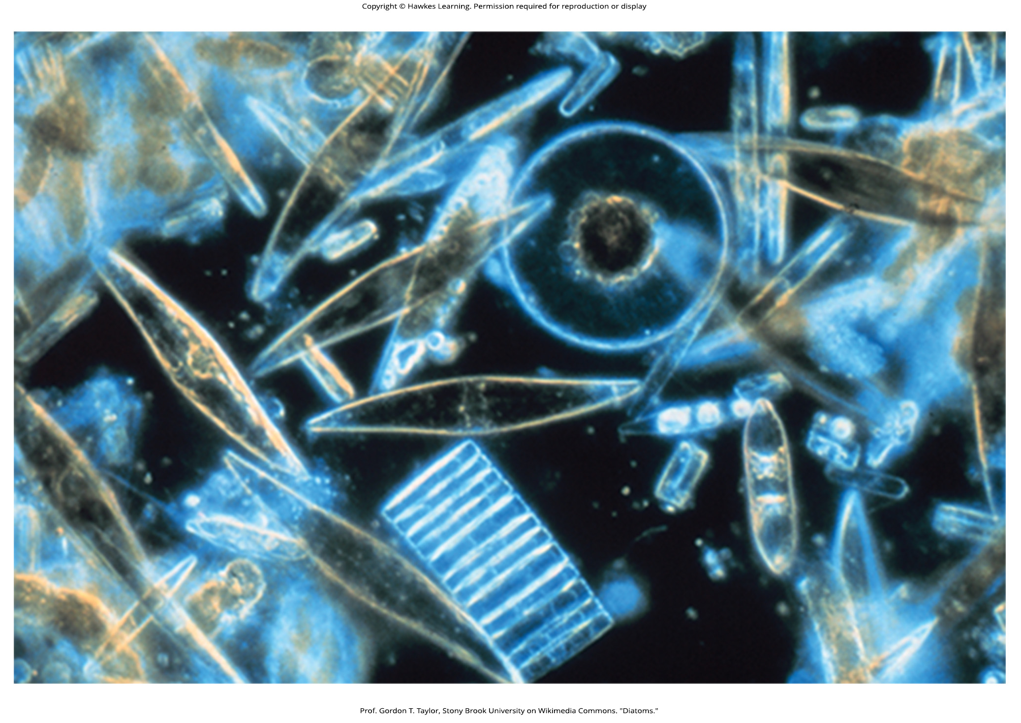
Lesson 23.2 Figure 23

Slide 33
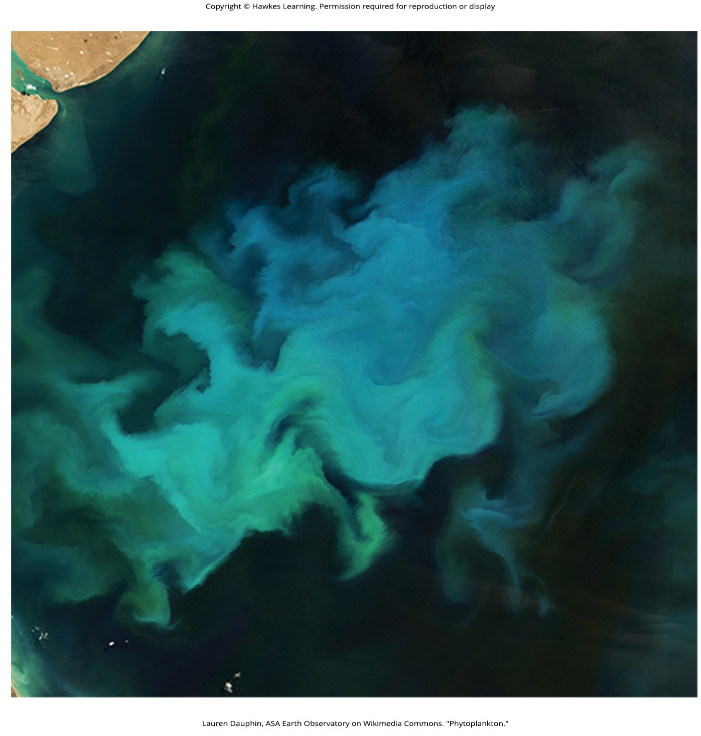
Lesson 23.2 Figure 24

Slide 34
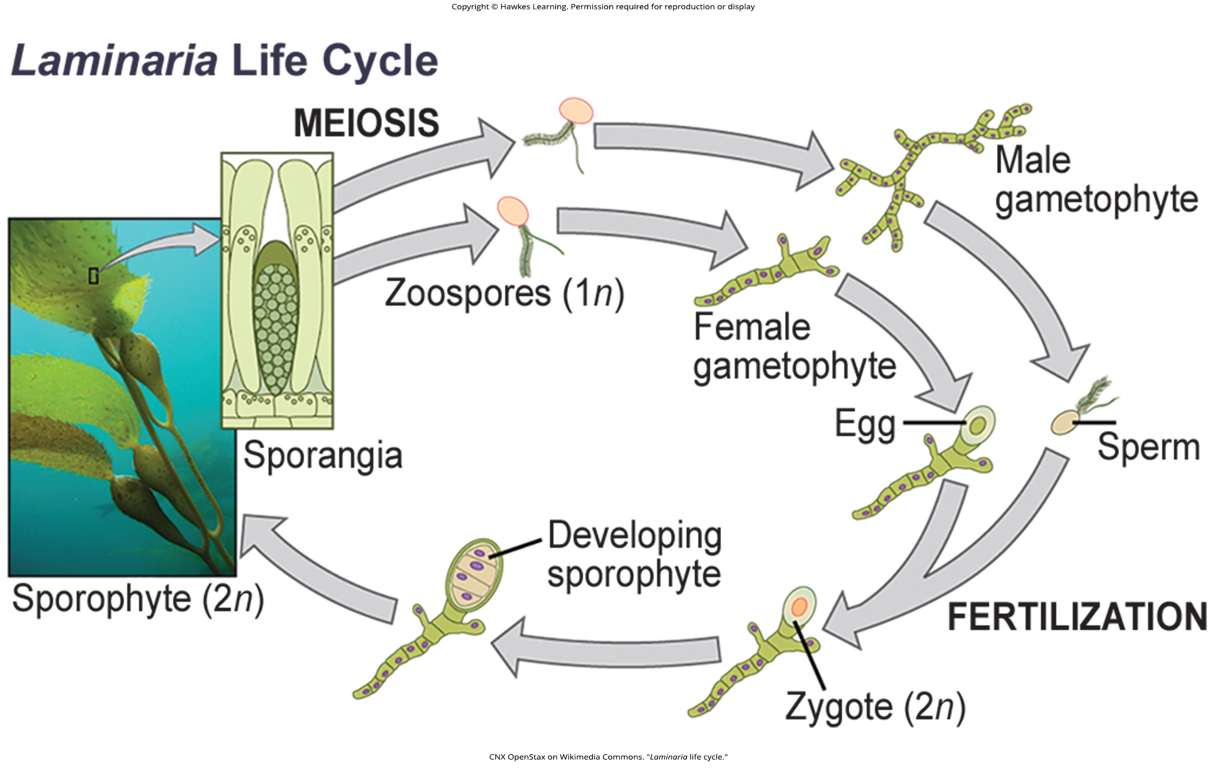
Lesson 23.2 Figure 25

Slide 35
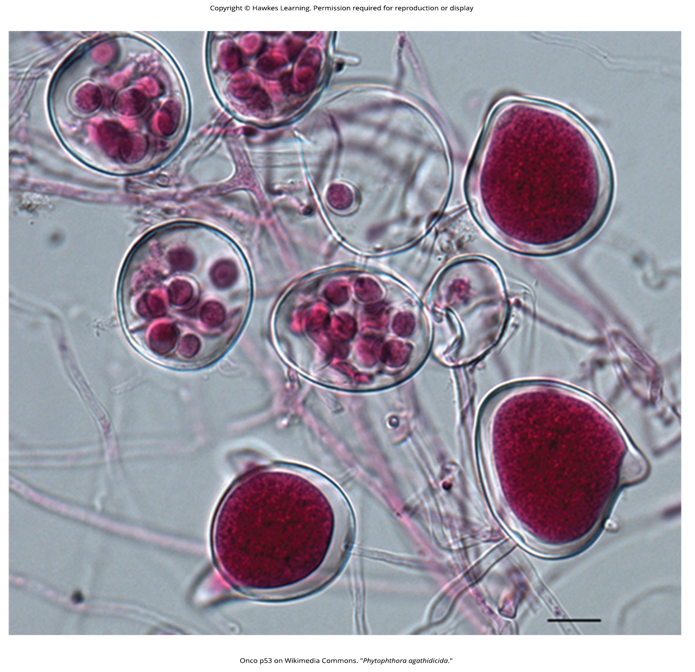
Lesson 23.2 Figure 26

Slide 36
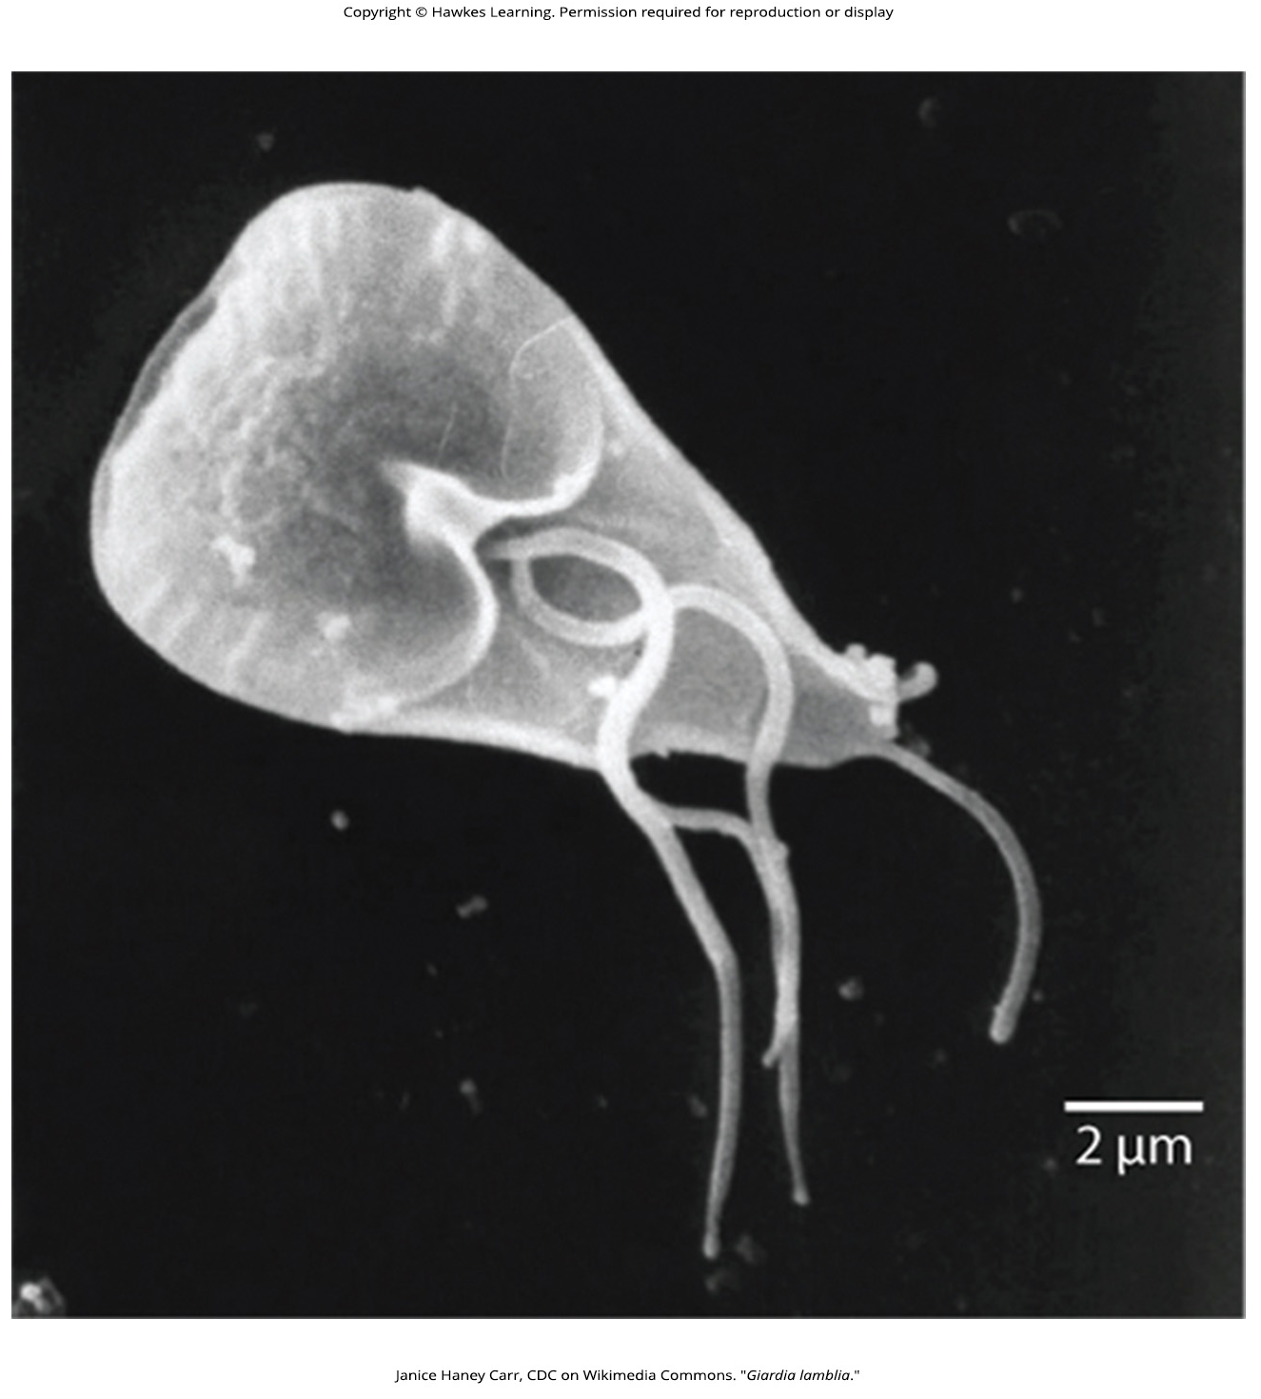
Lesson 23.2 Figure 27

Slide 37
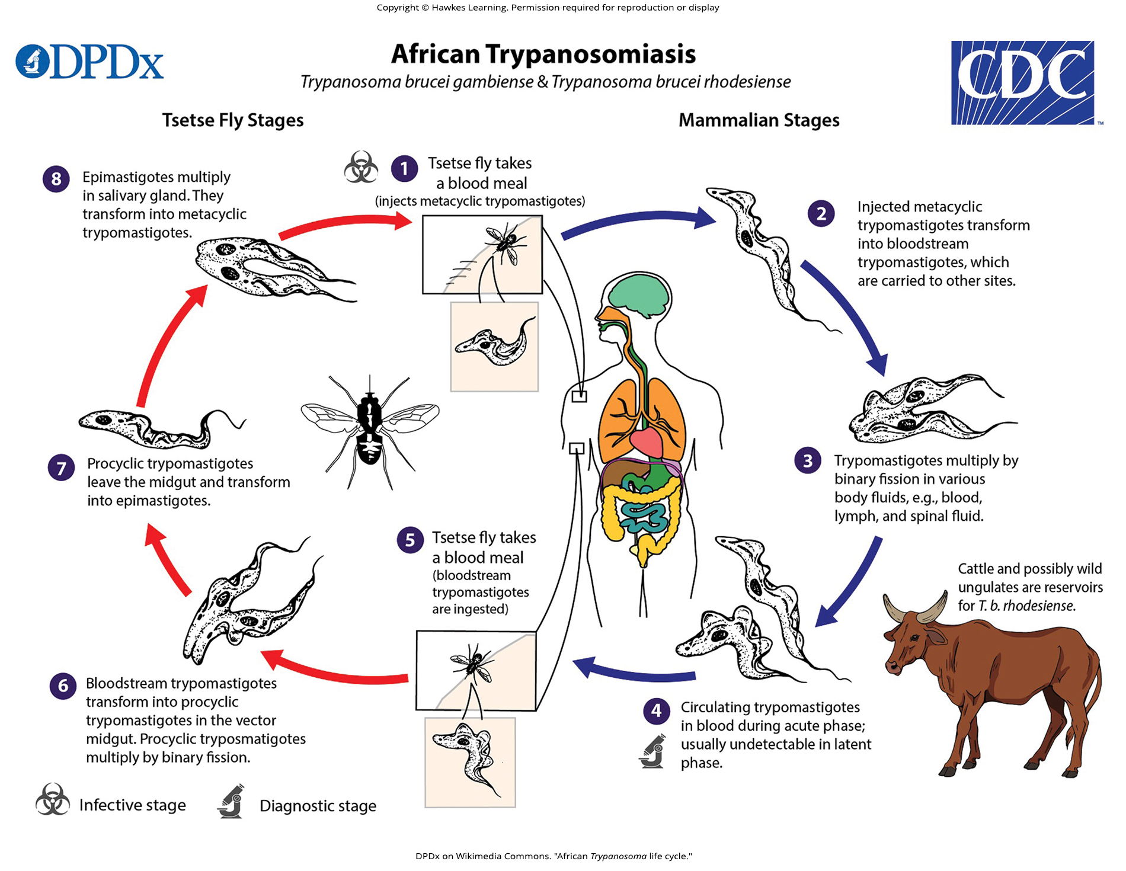
Lesson 23.2 Figure 28

Slide 38
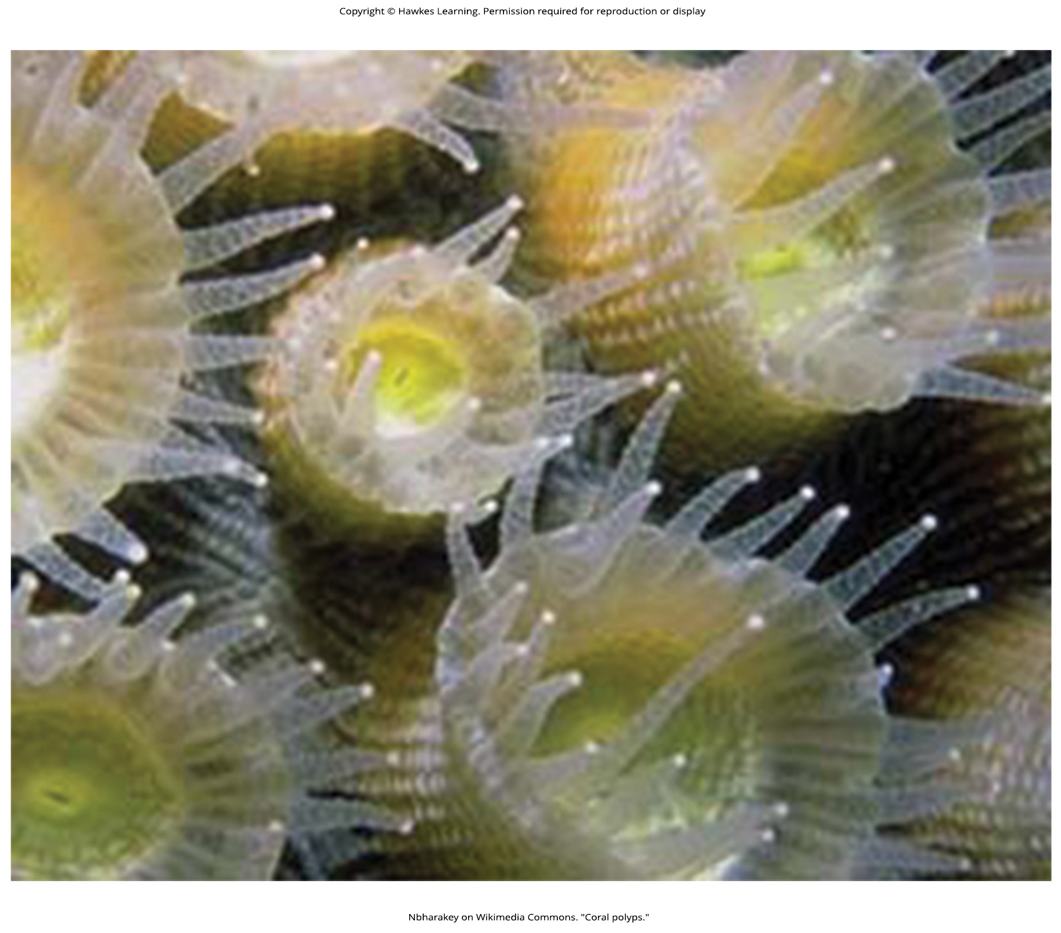
Lesson 23.3 Figure 1

Slide 39
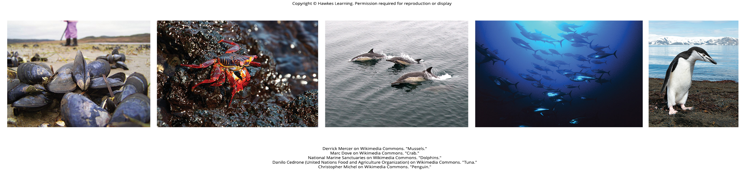
Lesson 23.3 Figure 2

Slide 40
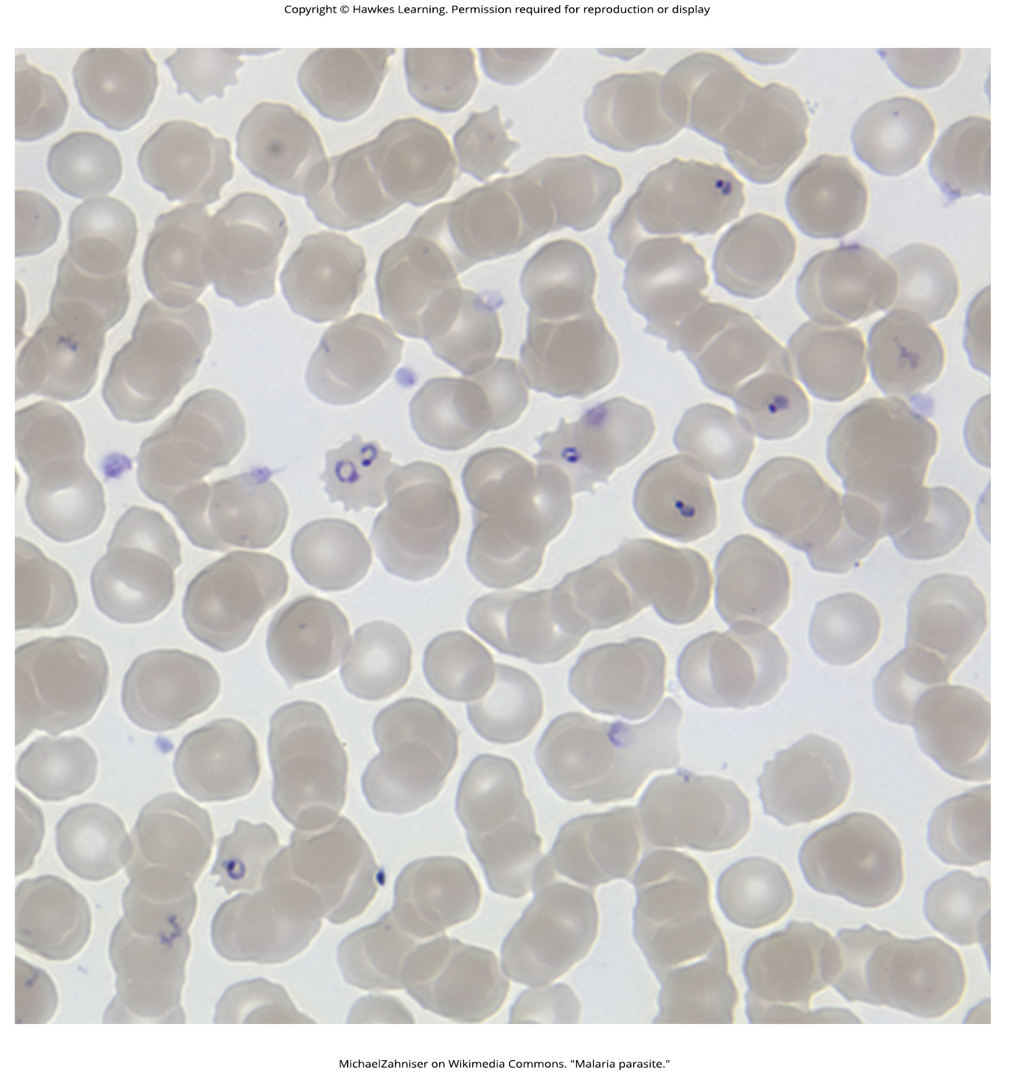
Lesson 23.3 Figure 3

Slide 41
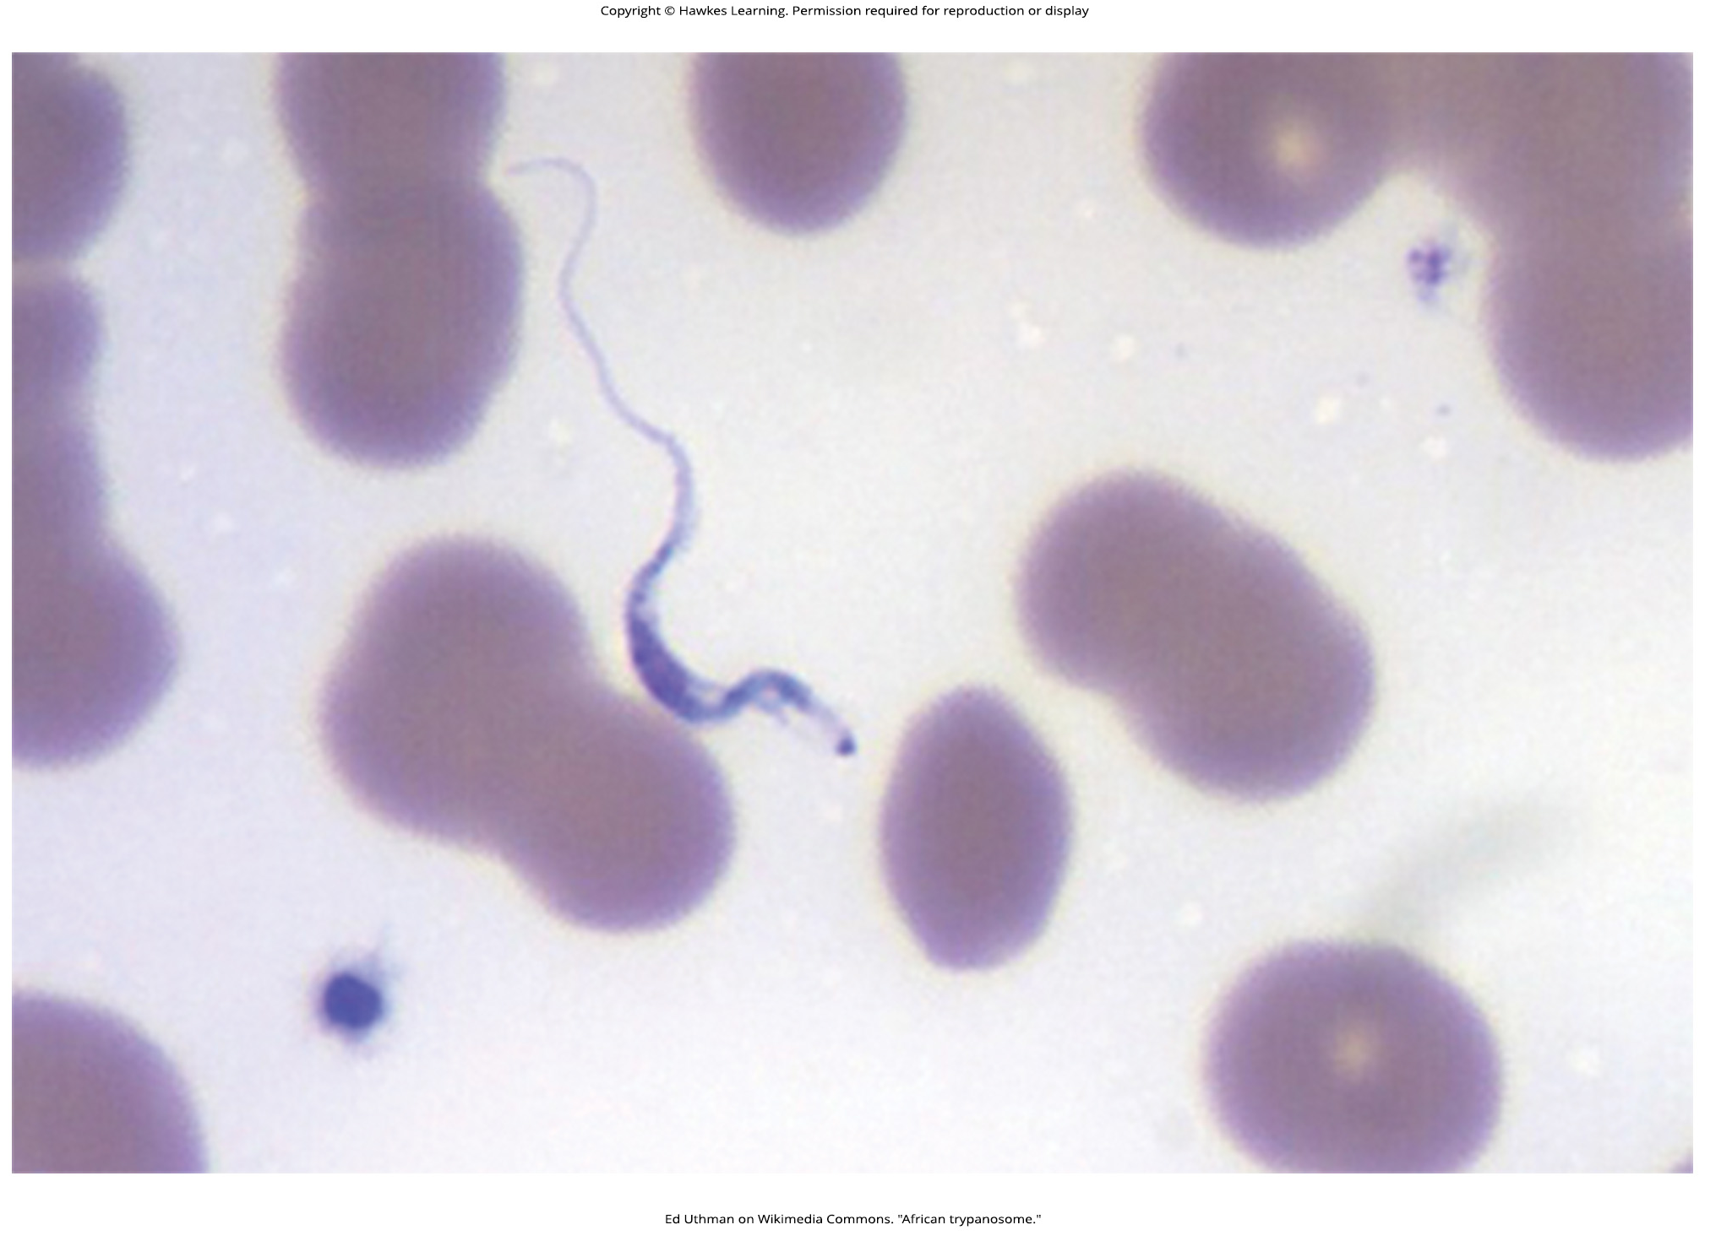
Lesson 23.3 Figure 4

Slide 42
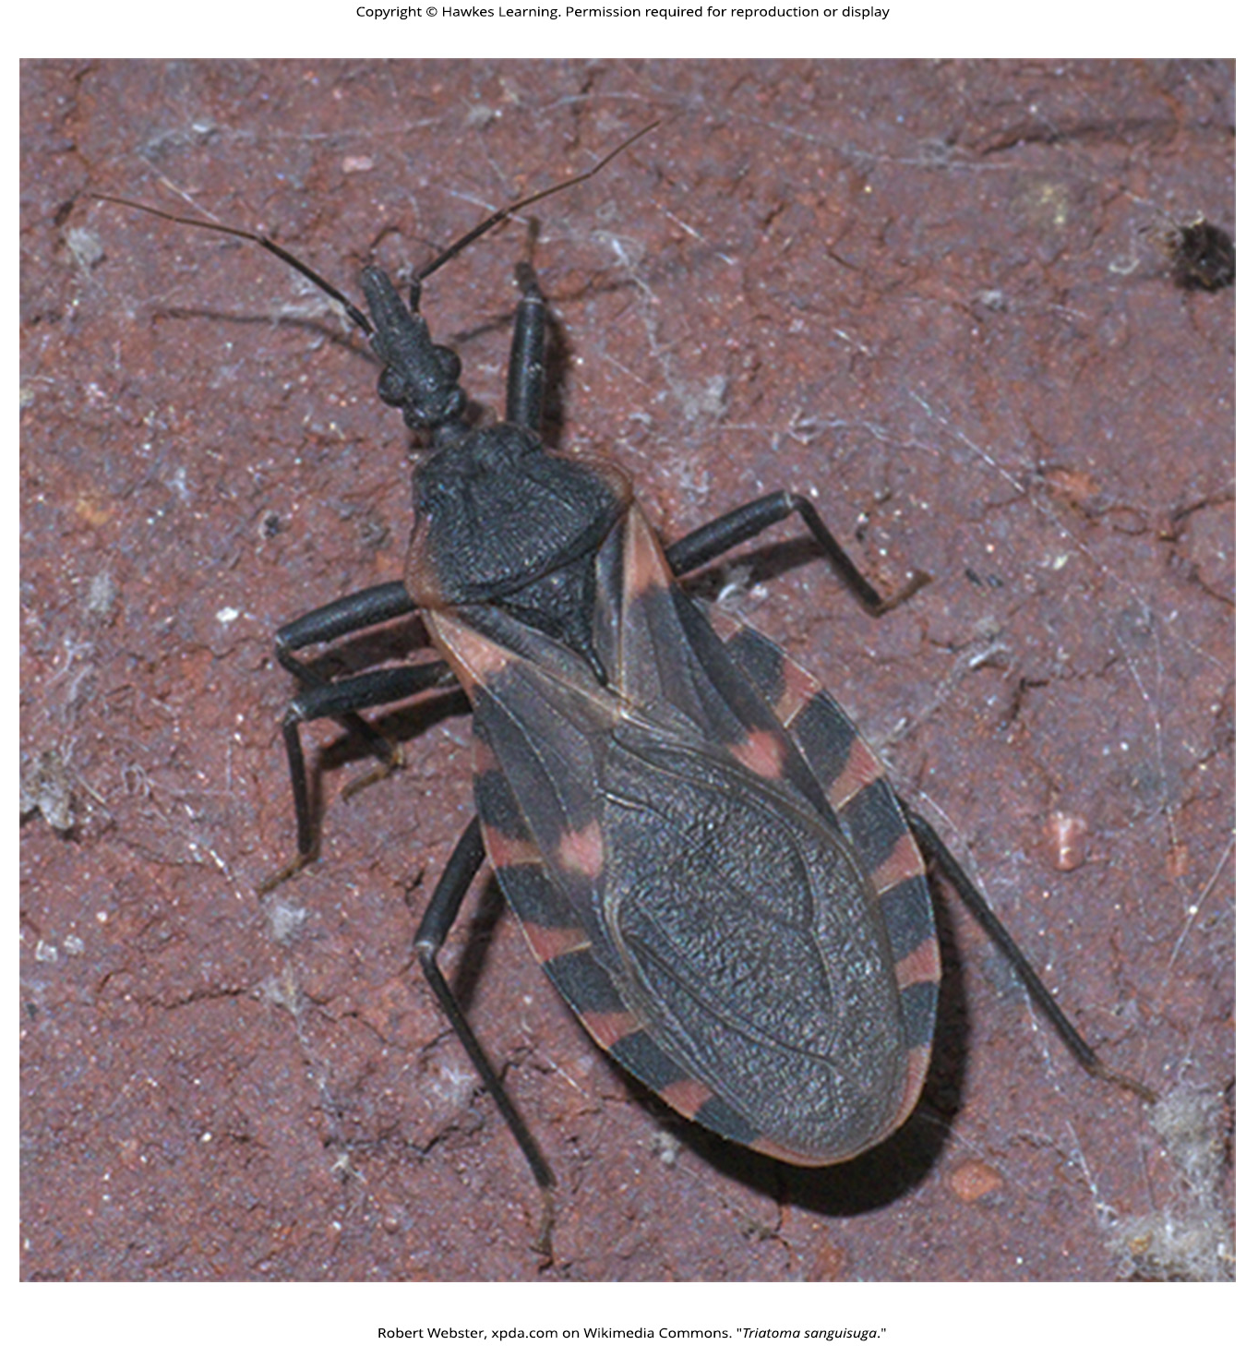
Lesson 23.3 Figure 5

Slide 43
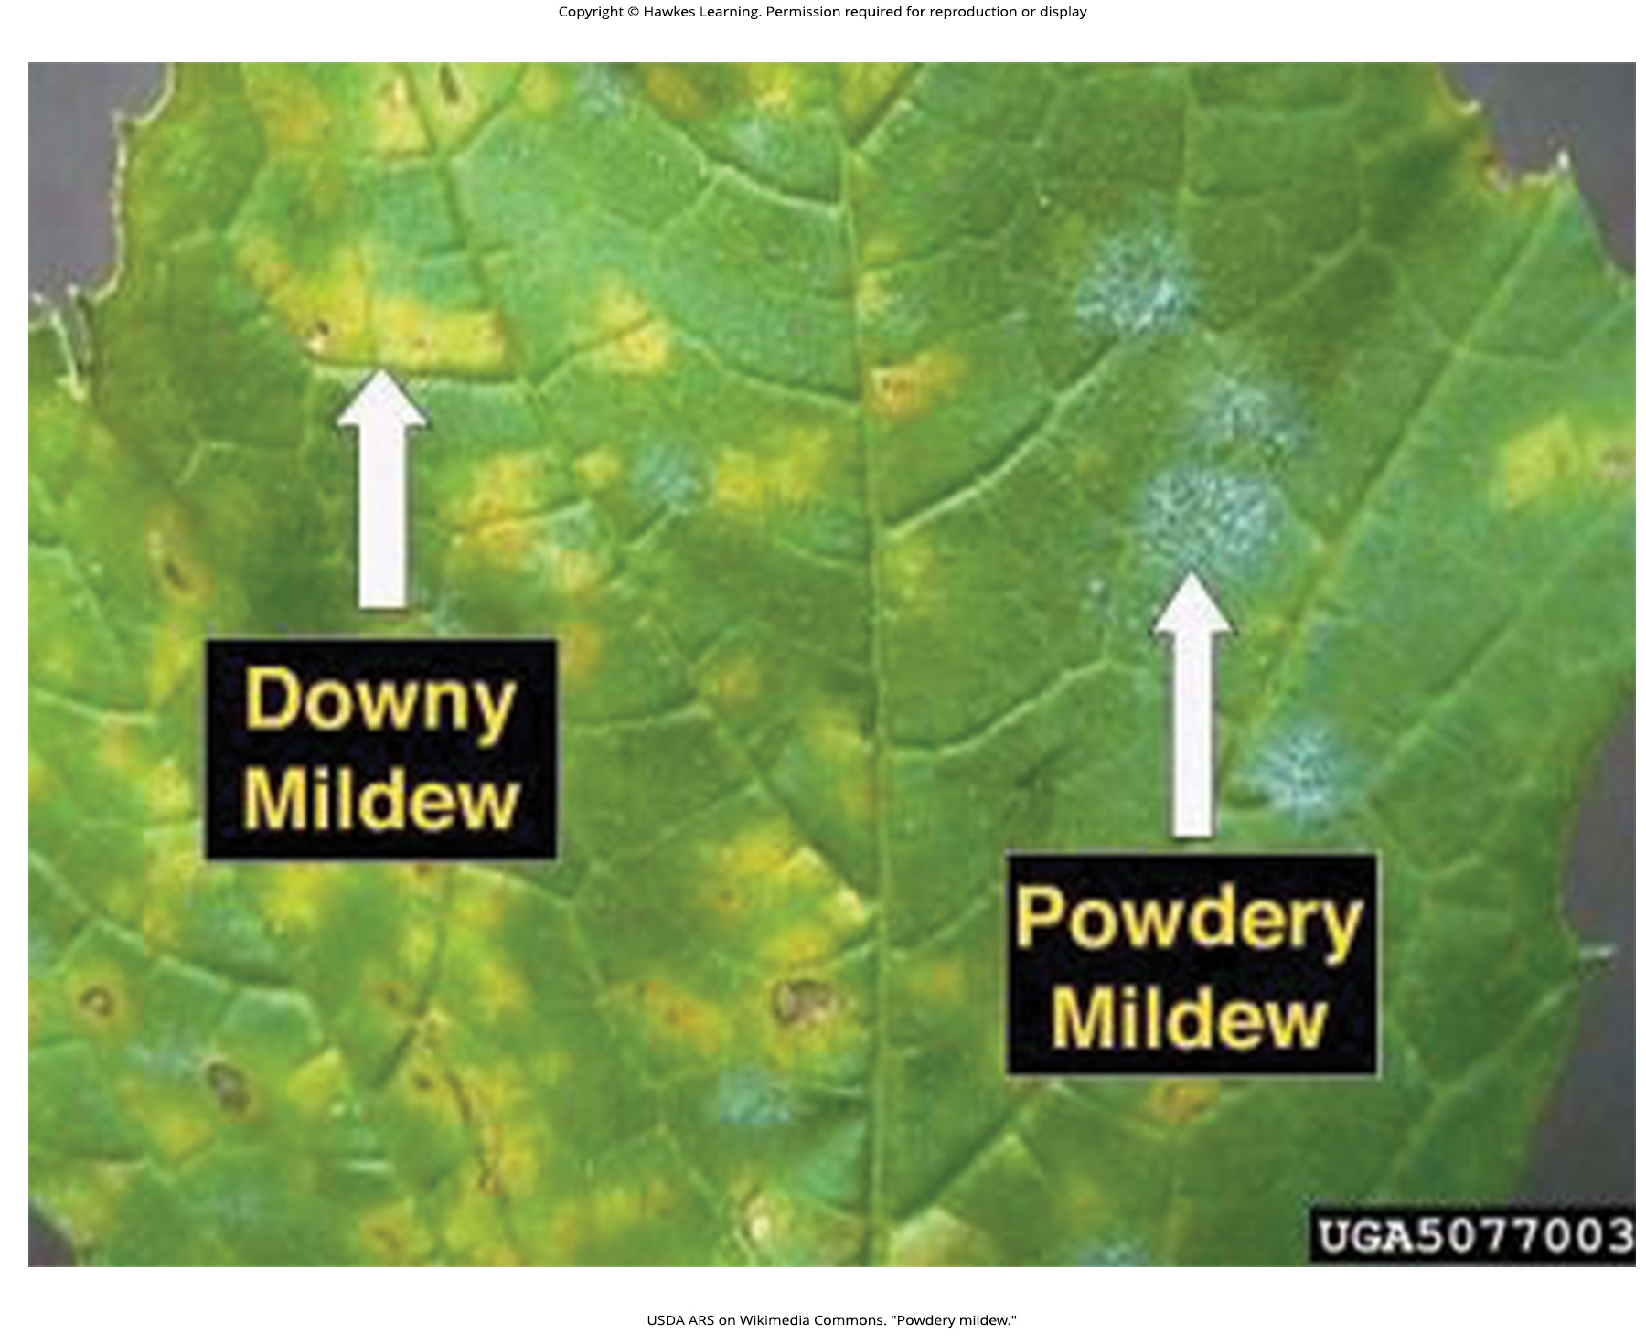
Lesson 23.3 Figure 6

Slide 44
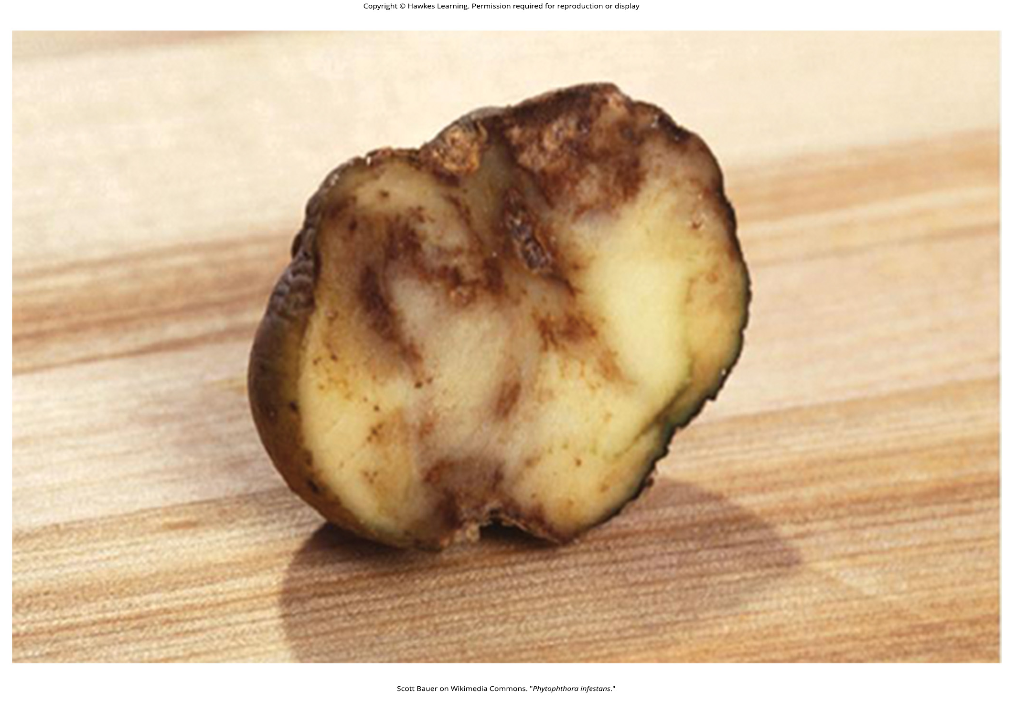
Lesson 23.3 Figure 7

Slide 45
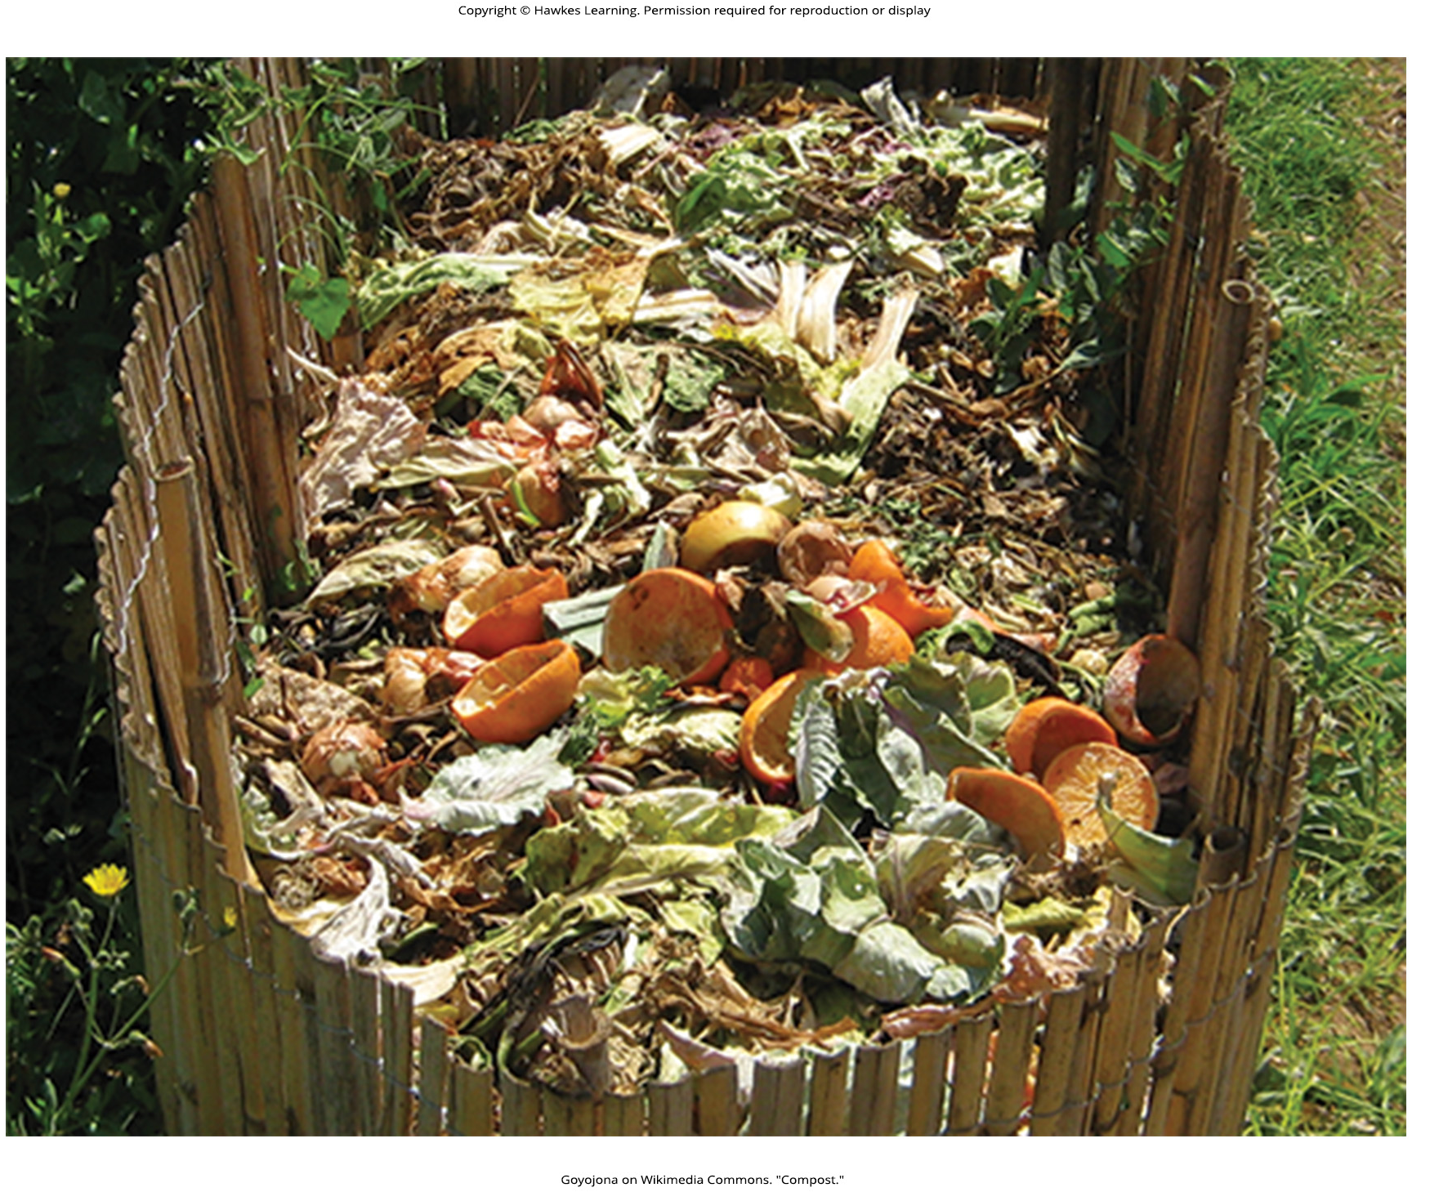
Lesson 23.3 Figure 8

Slide 46
Hawkes Learning – End of PowerPoint

