Slide 1
Chapter 24
Fungi

Slide 2
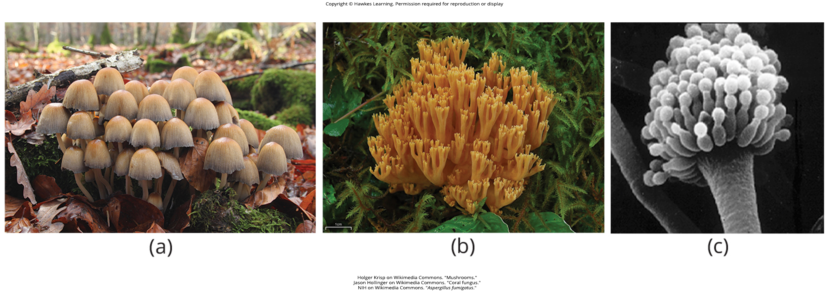
Lesson 24.1 Figure 1

Slide 3
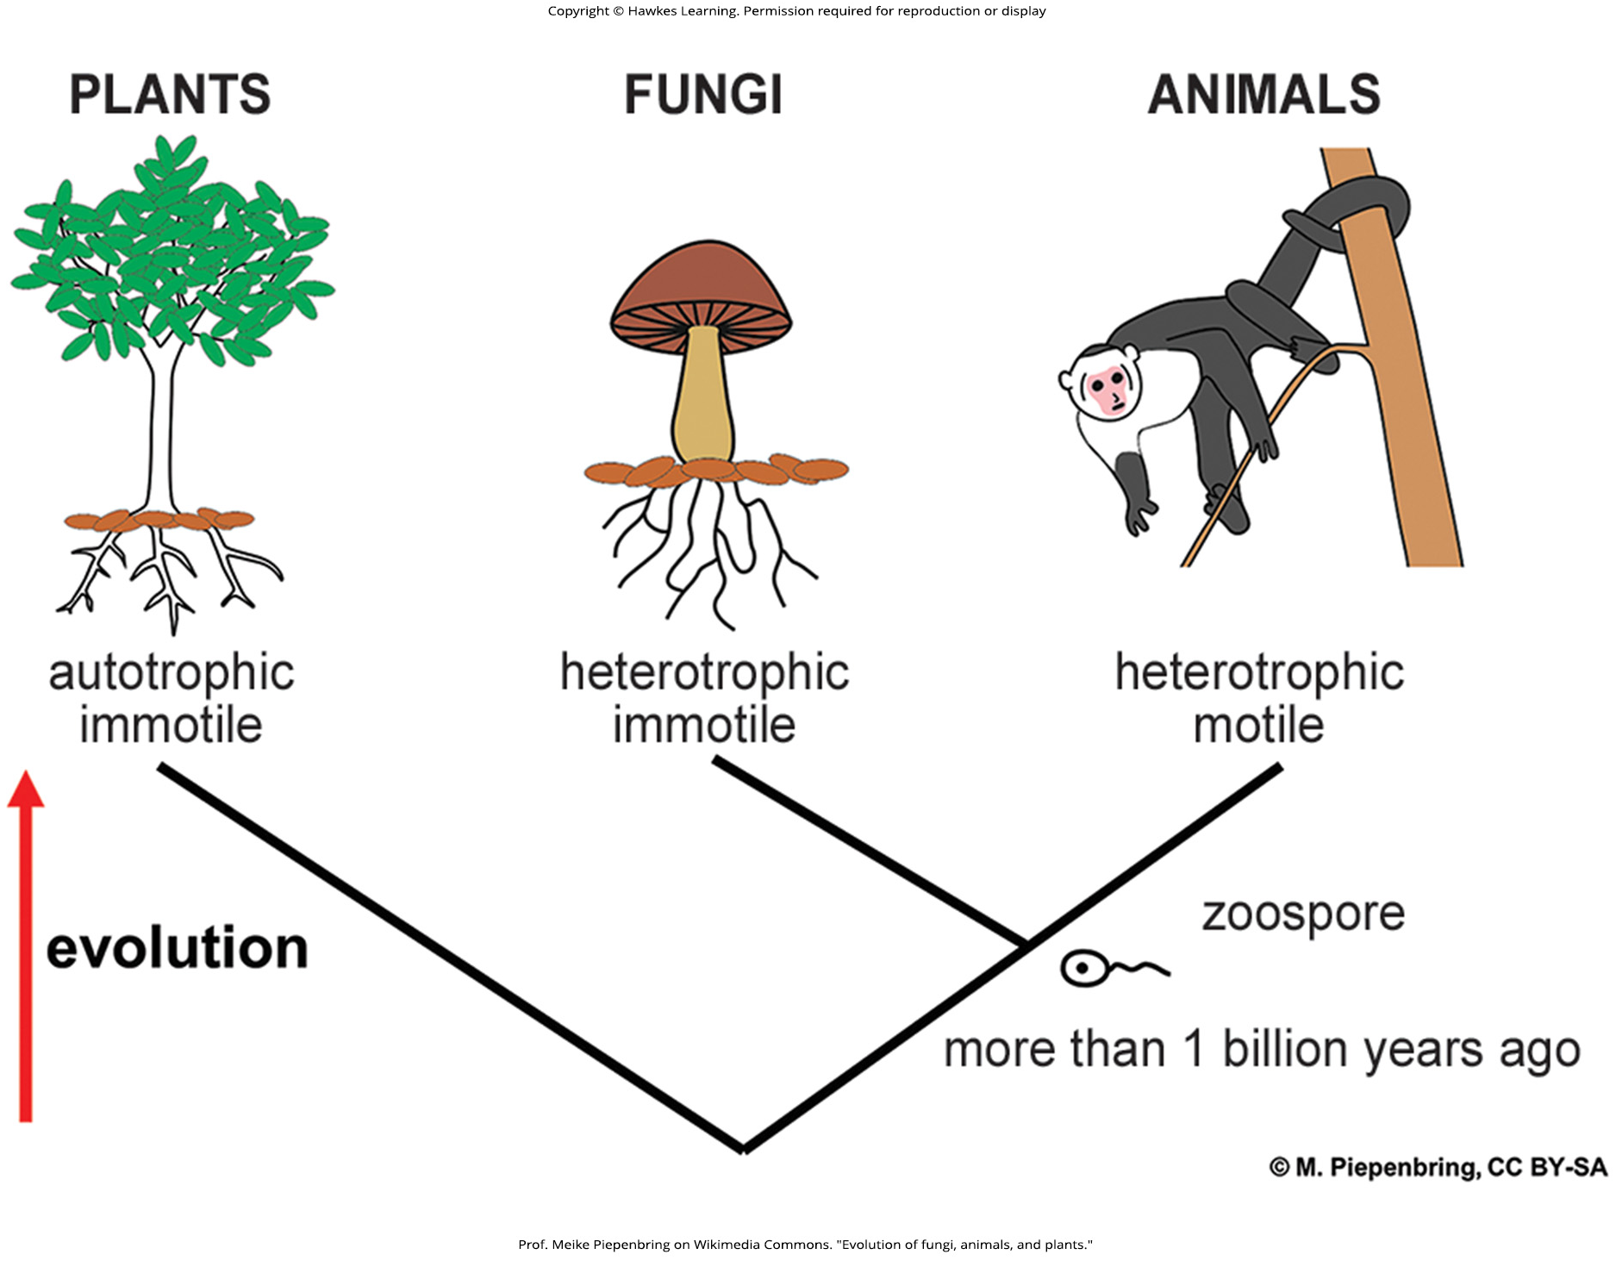
Lesson 24.1 Figure 2

Slide 4
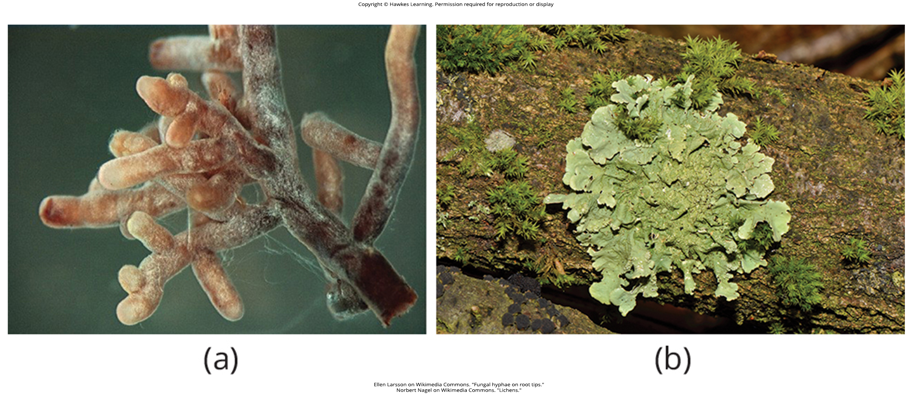
Lesson 24.1 Figure 3

Slide 5
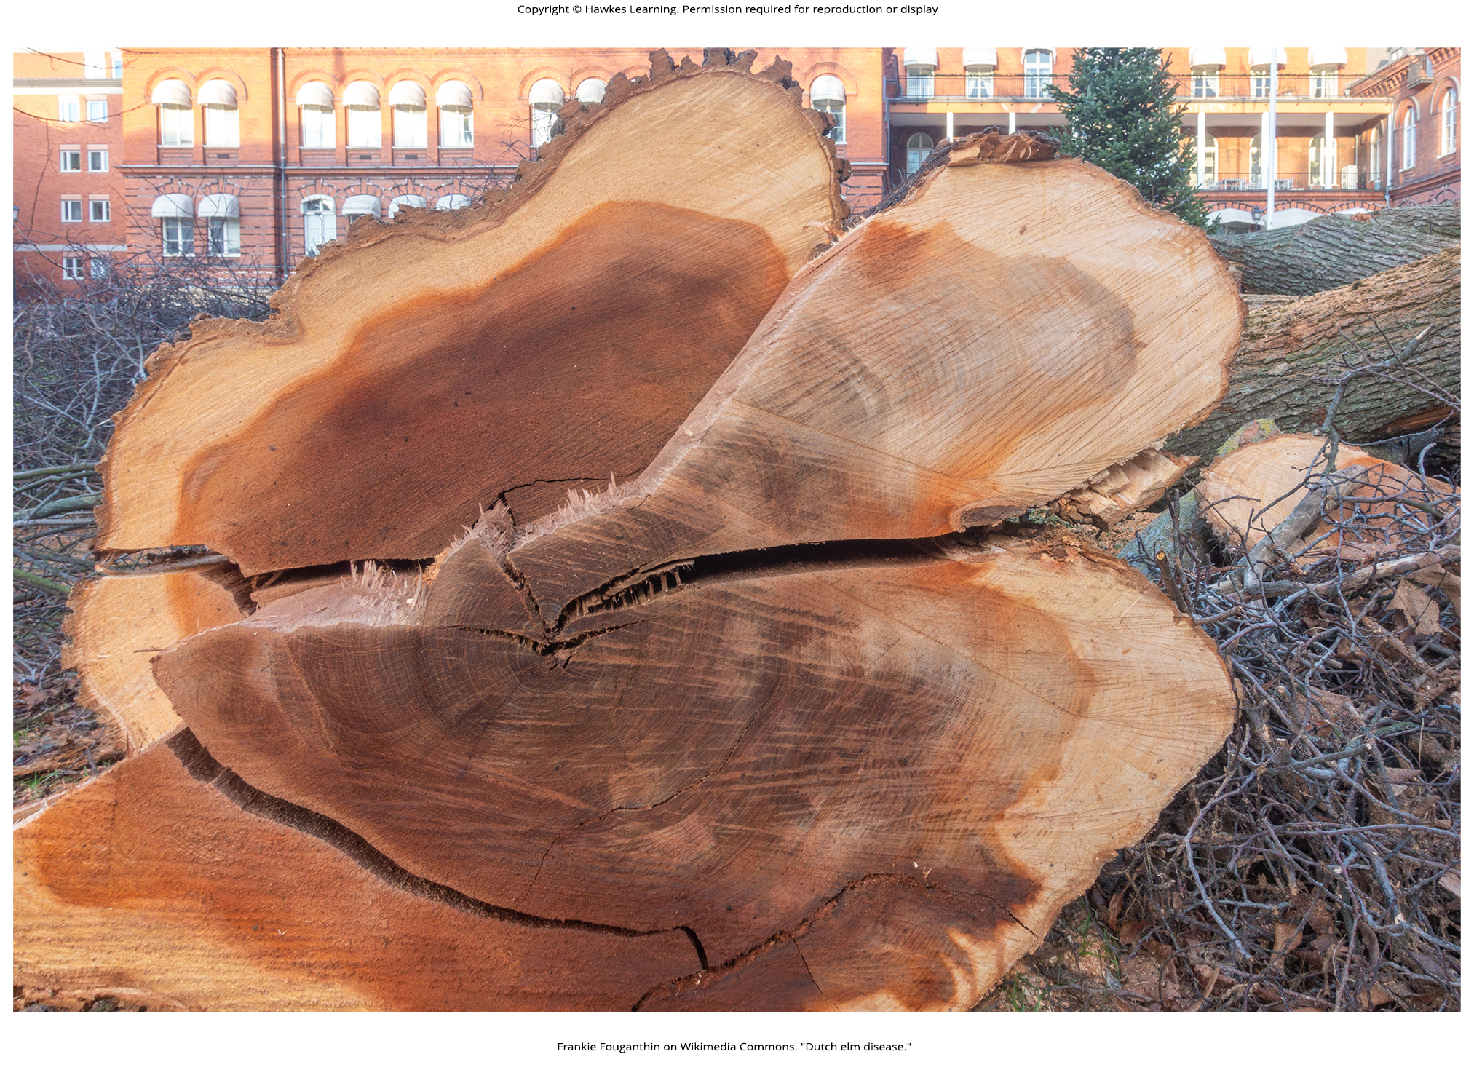
Lesson 24.1 Figure 4

Slide 6
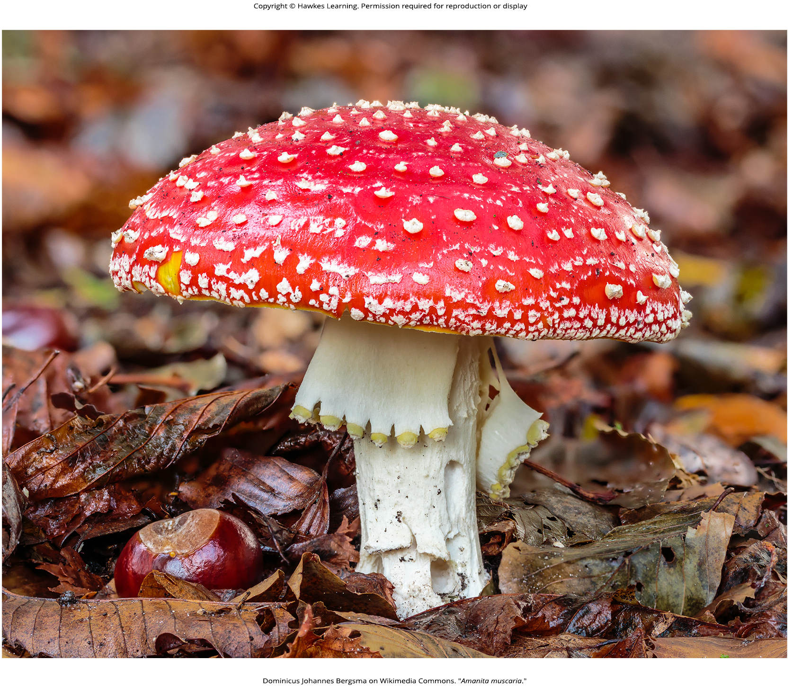
Lesson 24.1 Figure 5

Slide 7
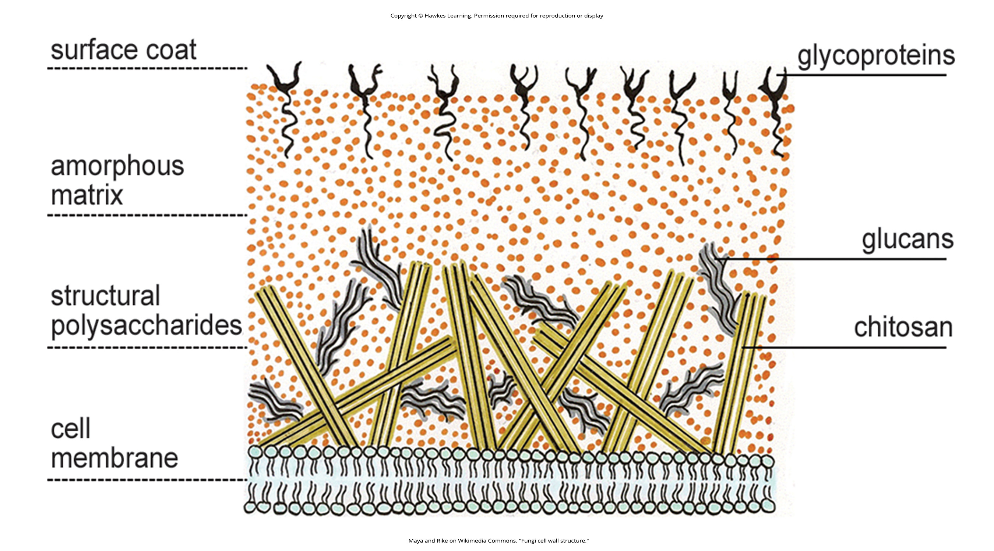
Lesson 24.1 Figure 6

Slide 8
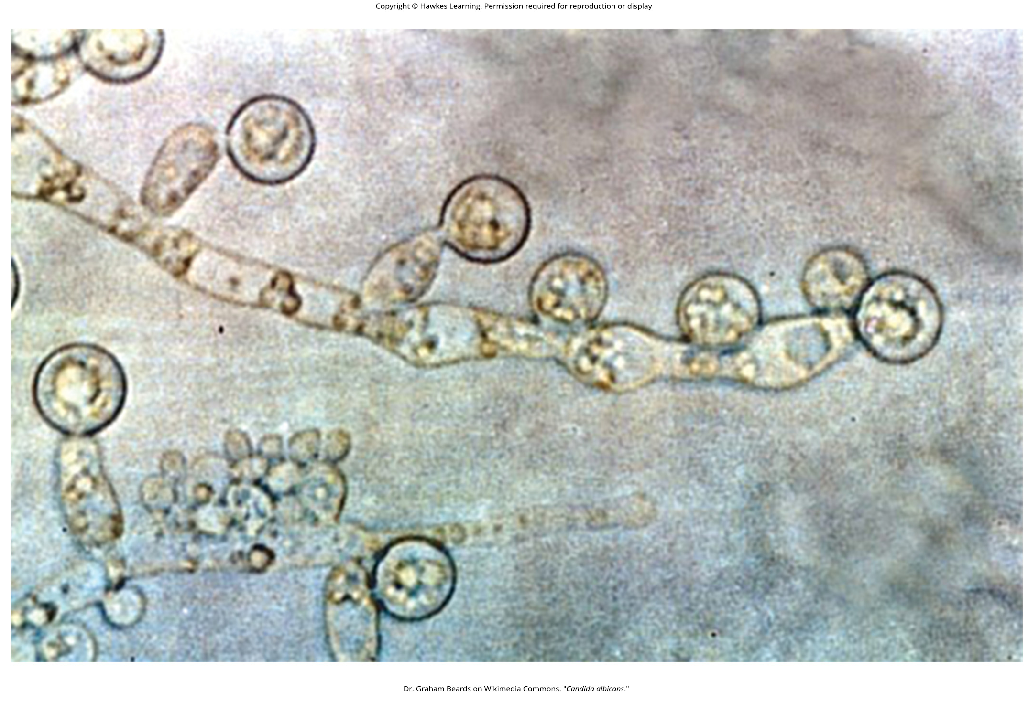
Lesson 24.1 Figure 7

Slide 9
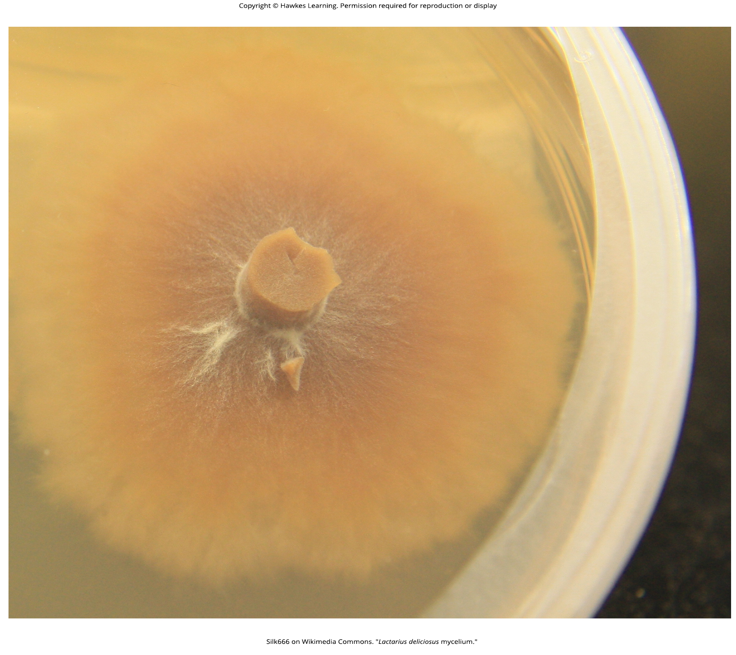
Lesson 24.1 Figure 8

Slide 10
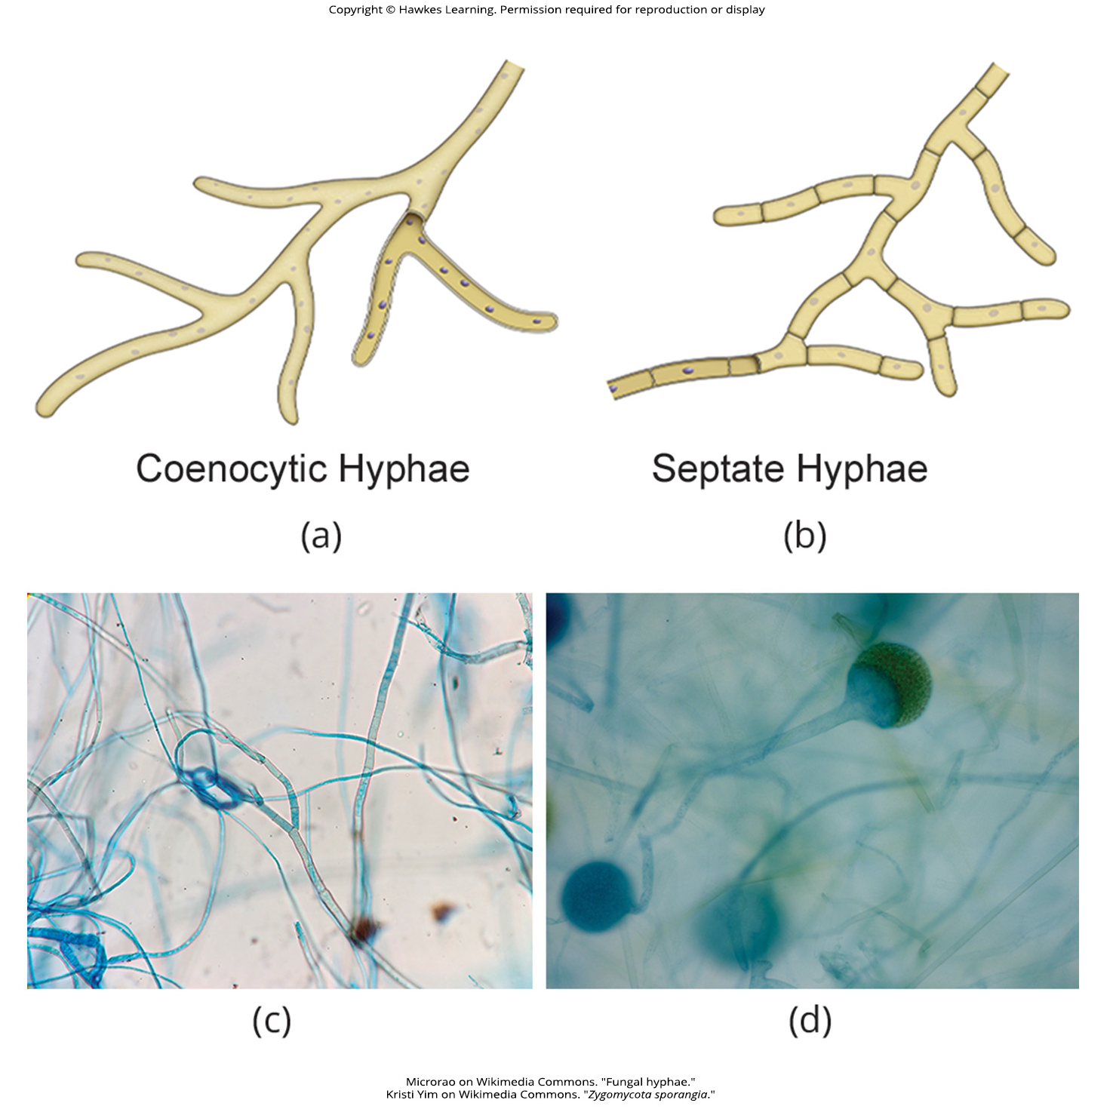
Lesson 24.1 Figure 9

Slide 11
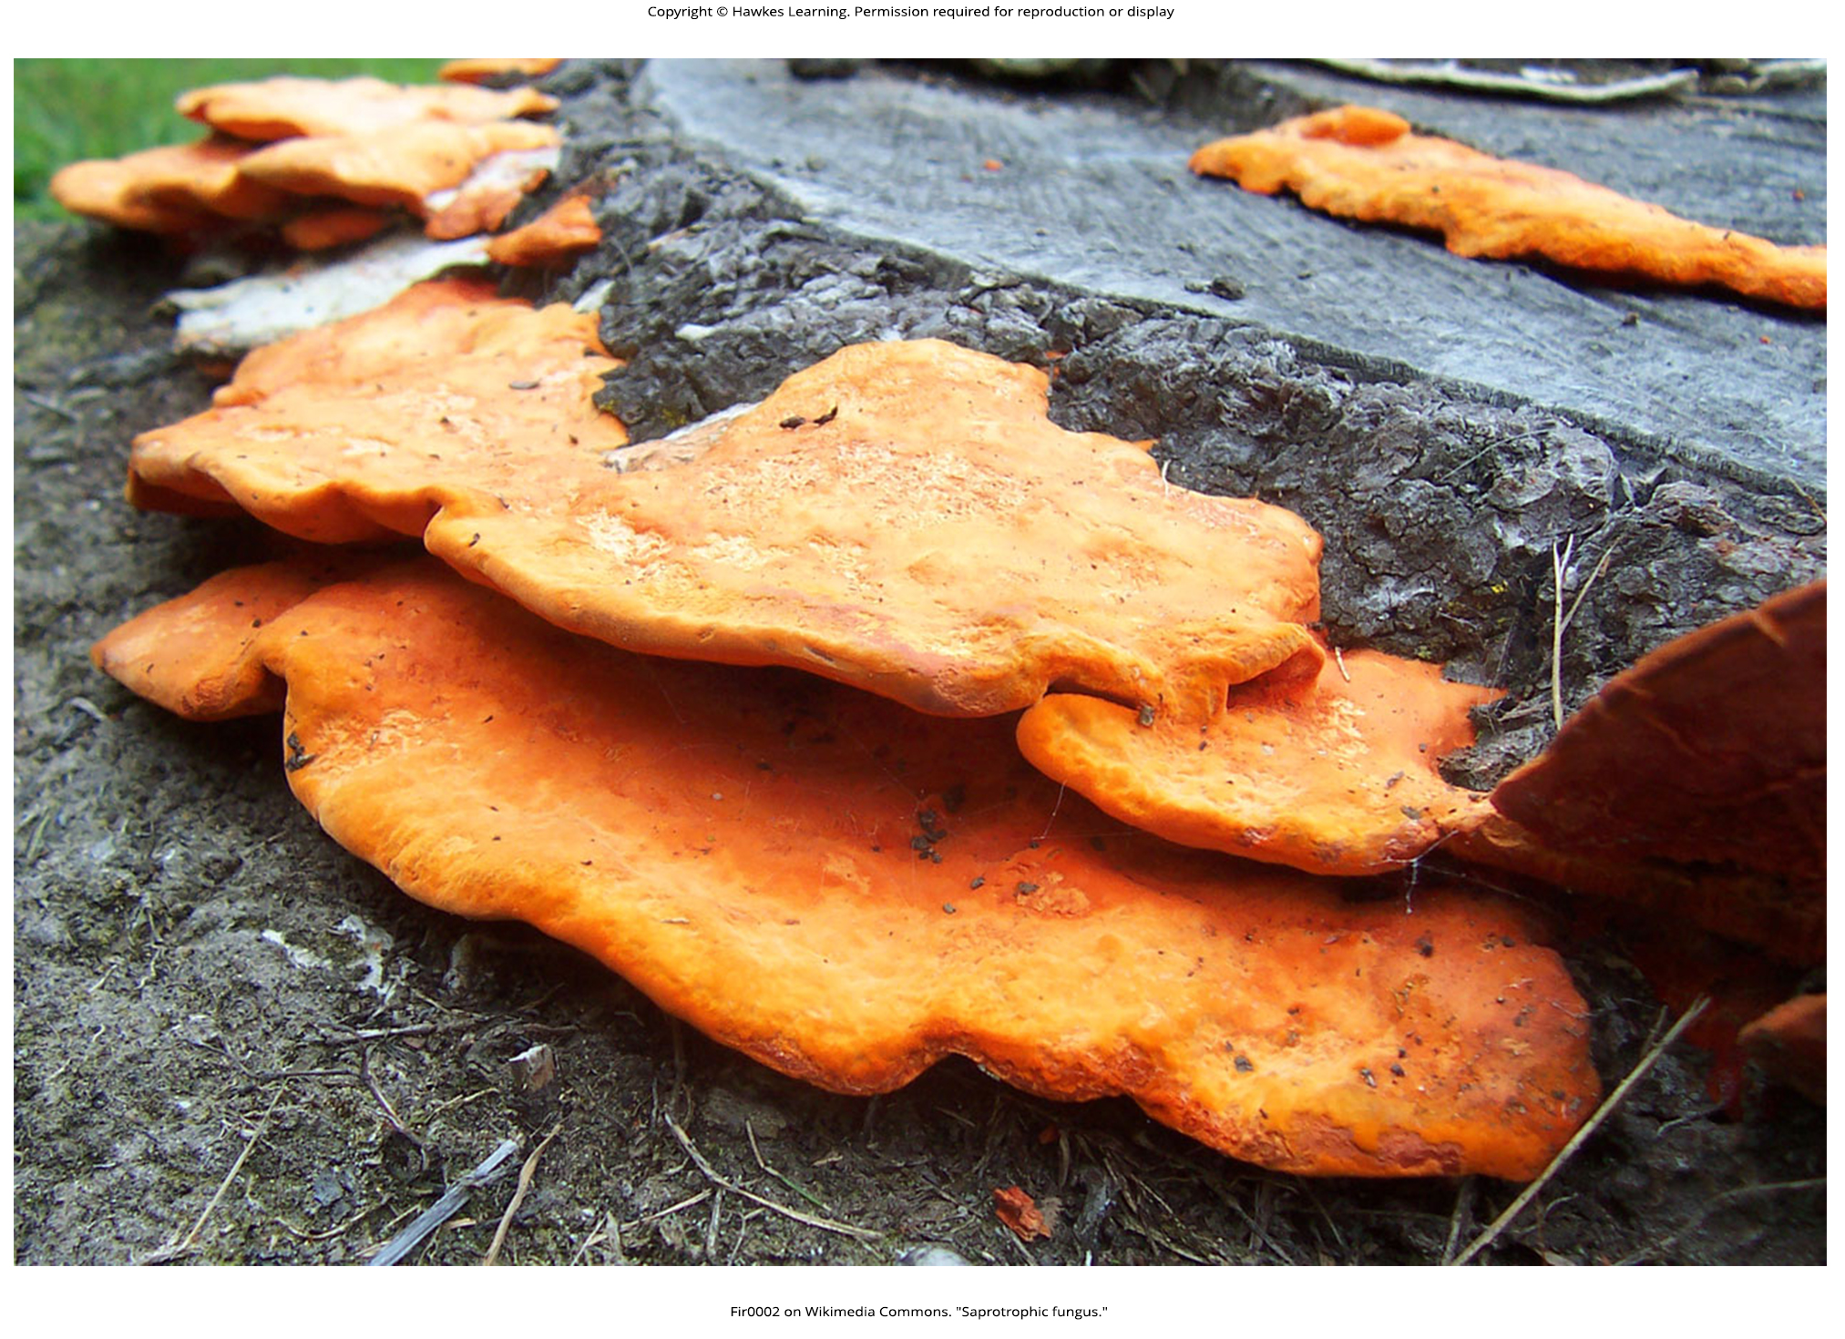
Lesson 24.1 Figure 10

Slide 12
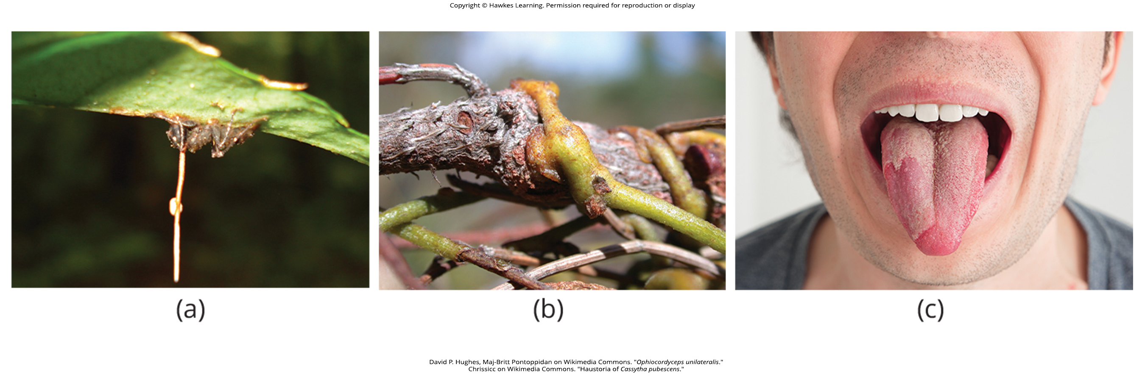
Lesson 24.1 Figure 11

Slide 13
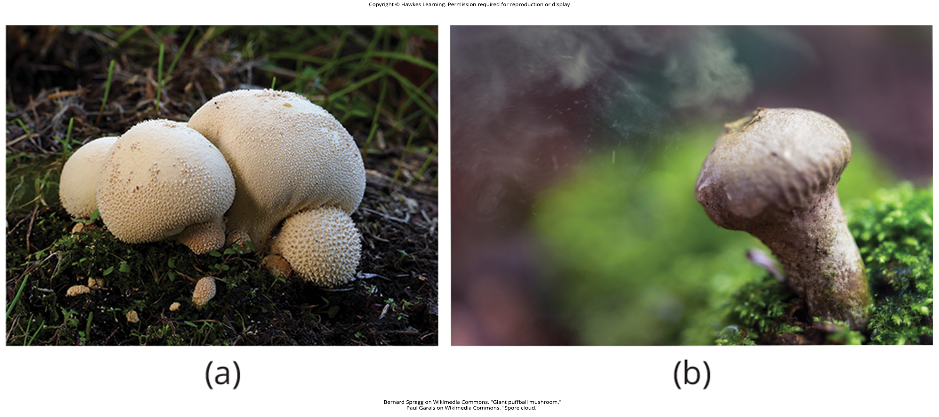
Lesson 24.1 Figure 12

Slide 14
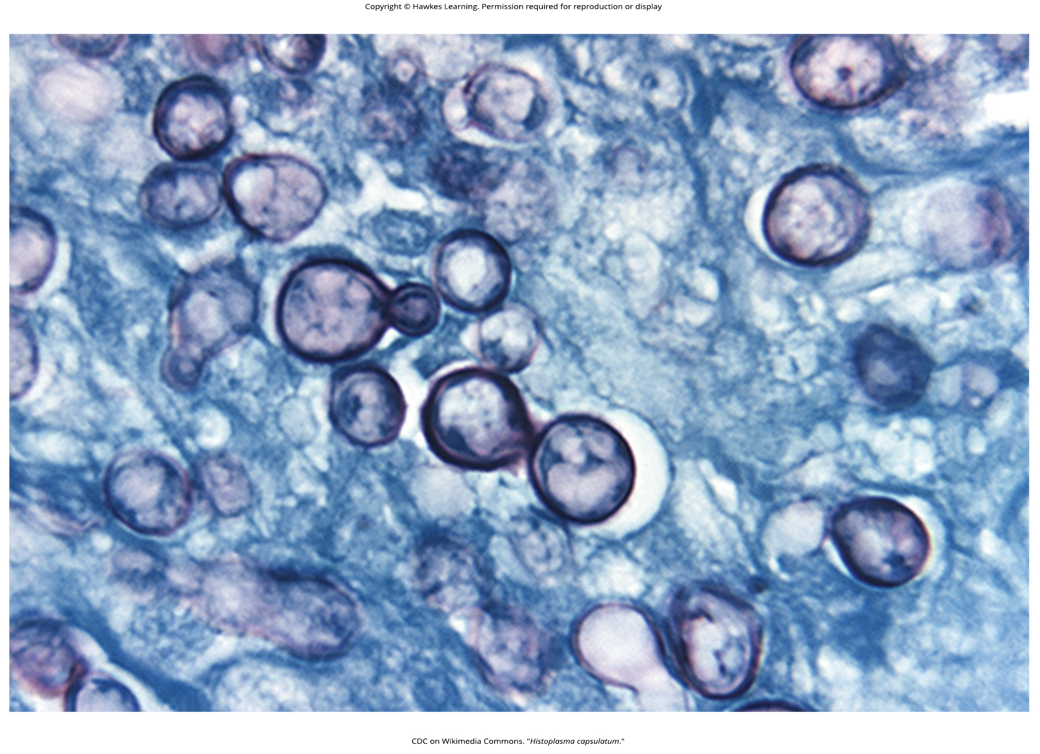
Lesson 24.1 Figure 13

Slide 15
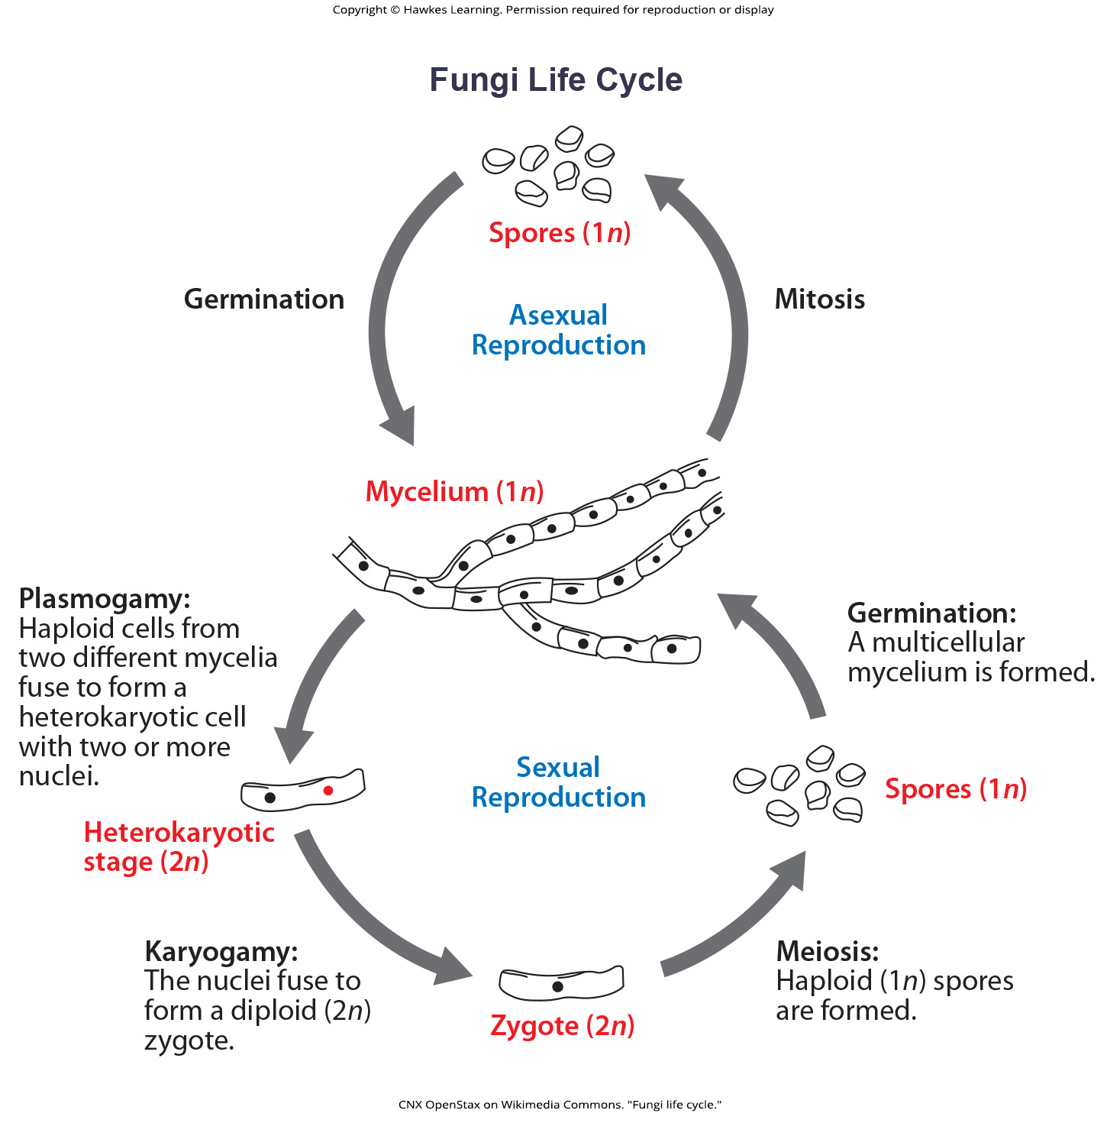
Lesson 24.1 Figure 14

Slide 16
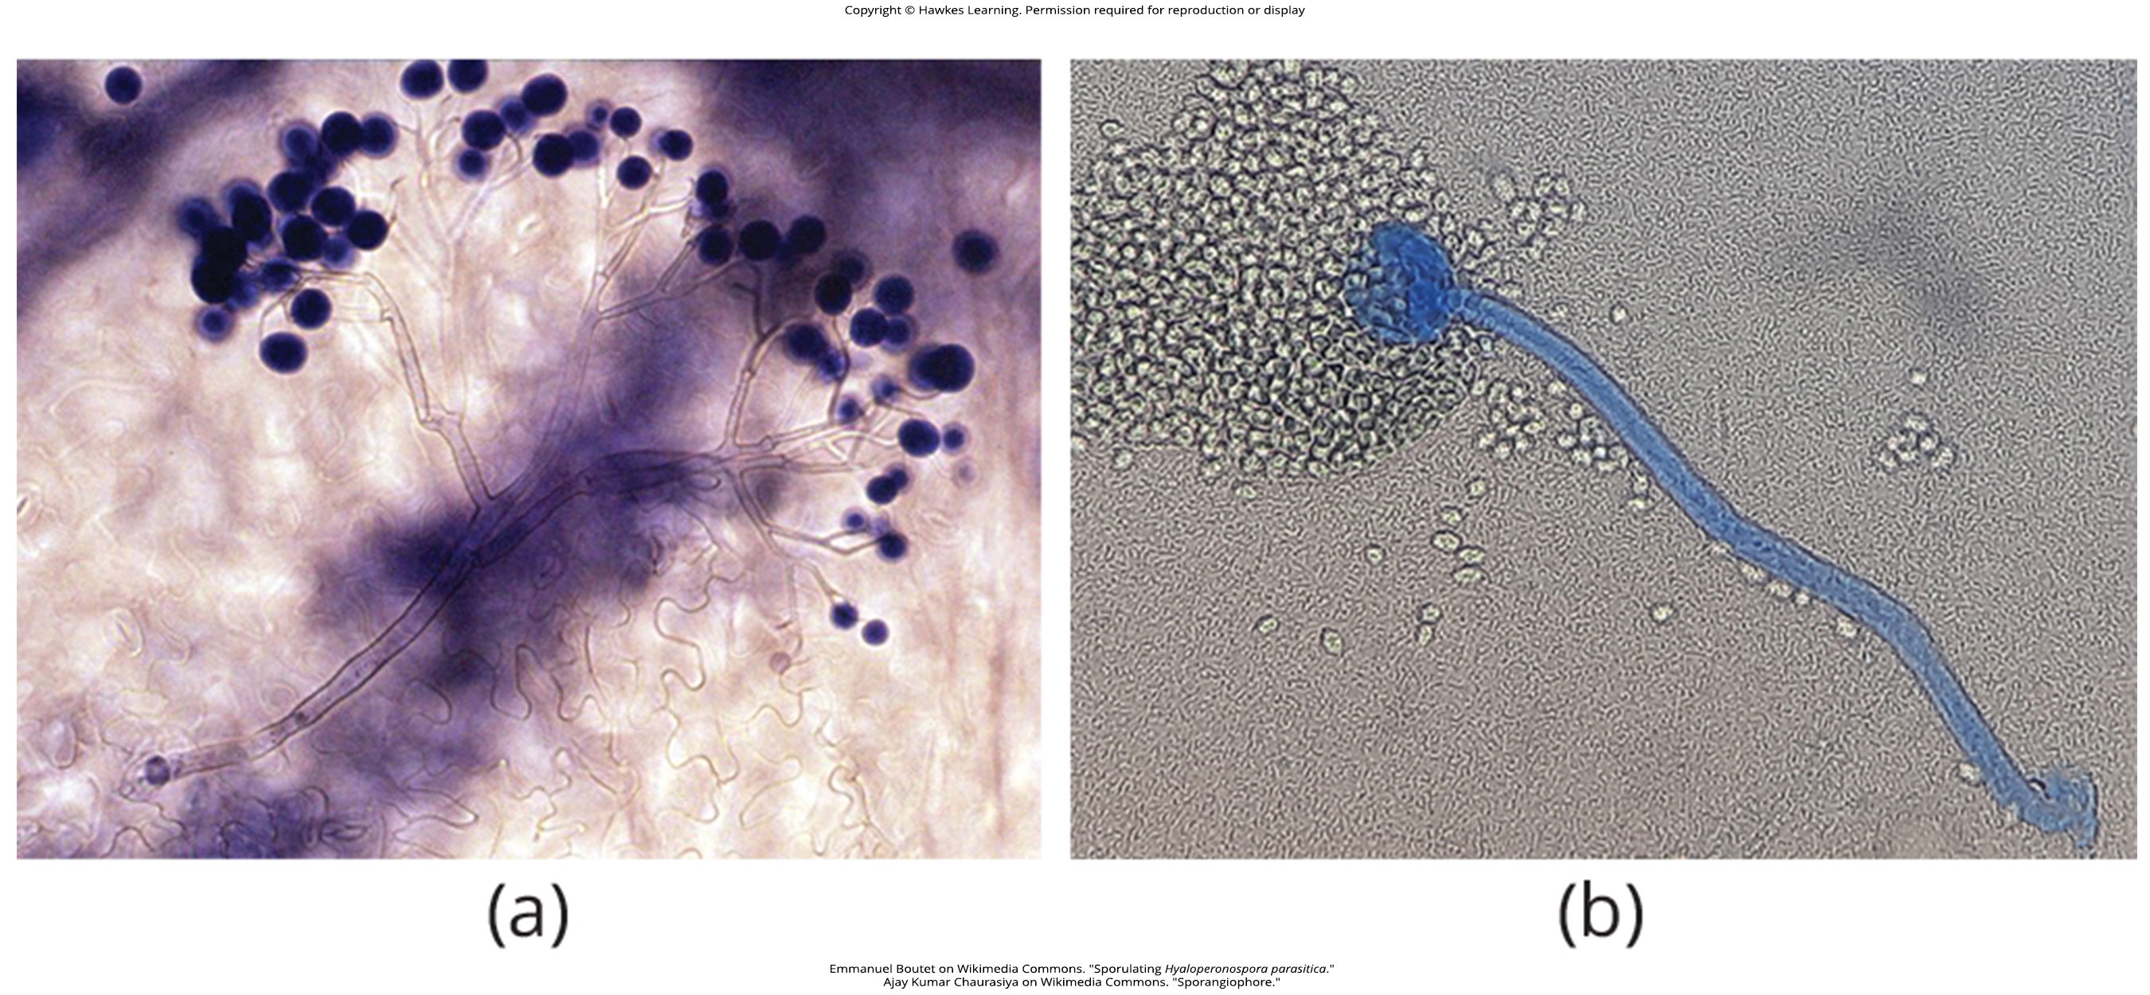
Lesson 24.1 Figure 15

Slide 17
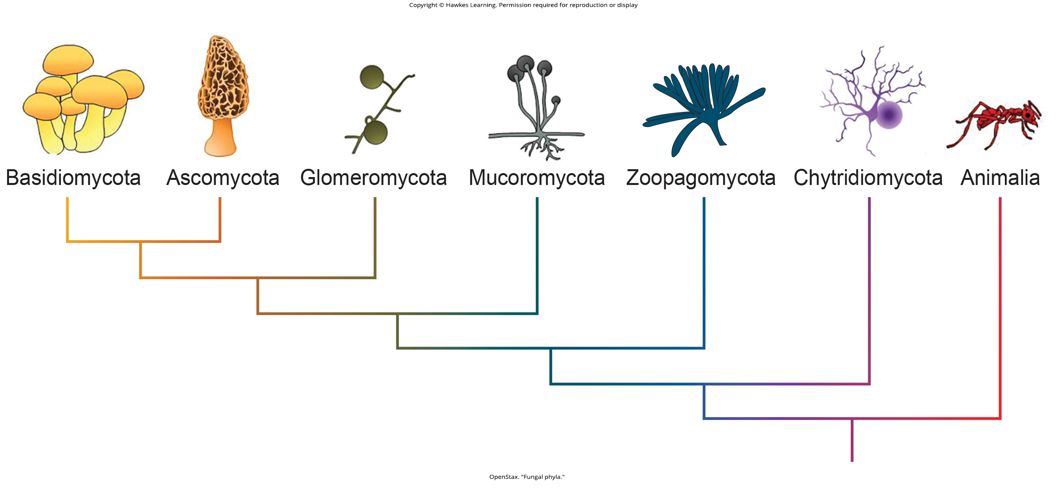
Lesson 24.2 Figure 1

Slide 18
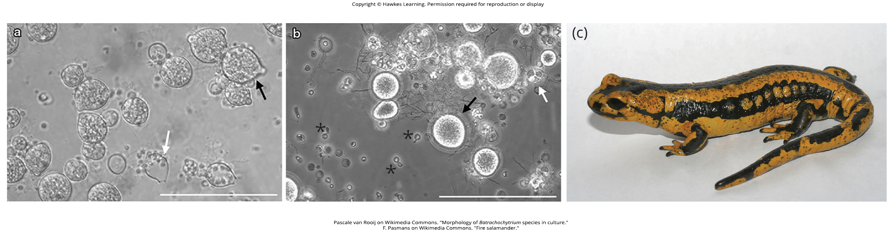
Lesson 24.2 Figure 2

Slide 19
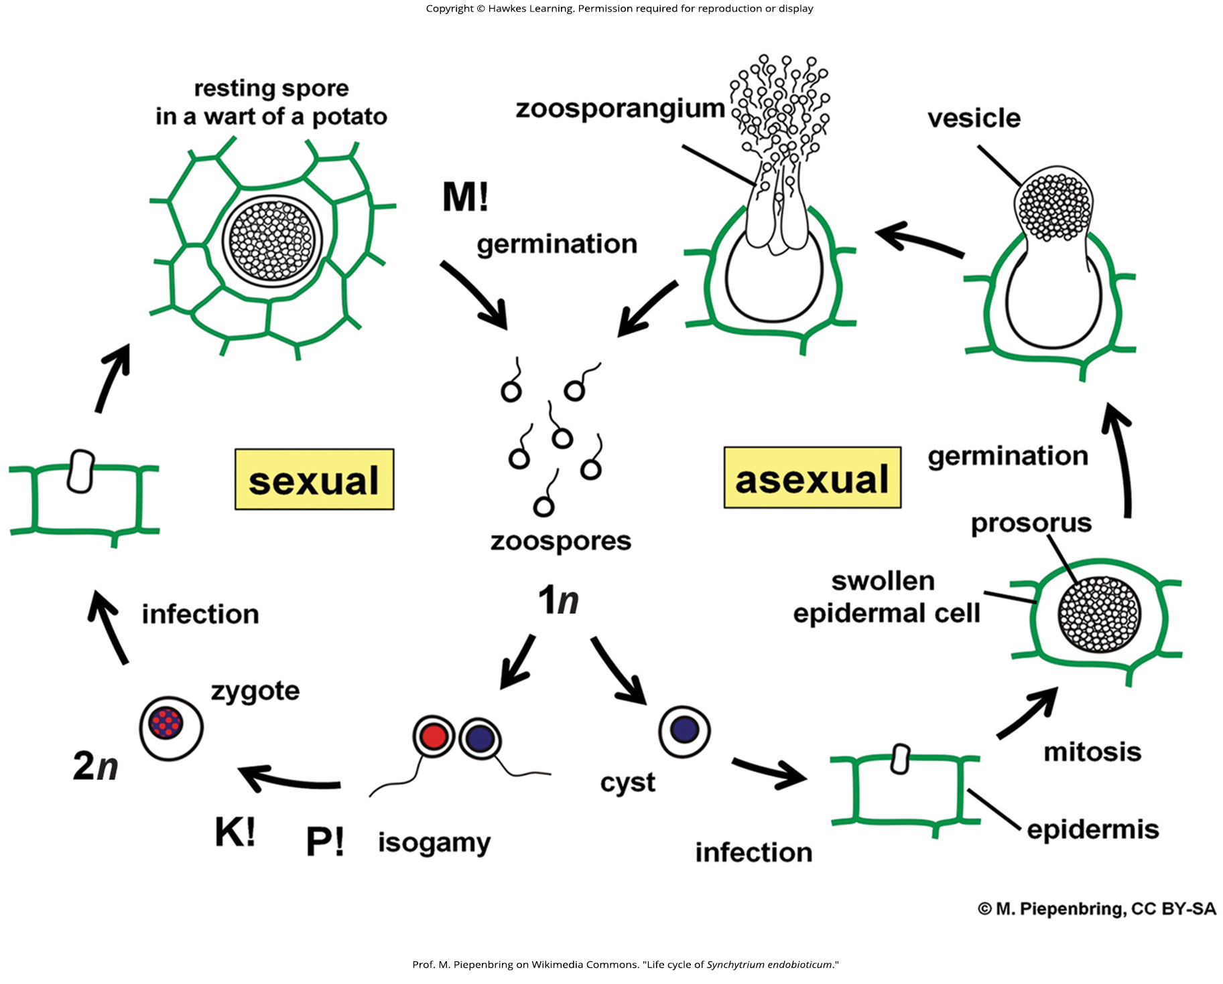
Lesson 24.2 Figure 3

Slide 20
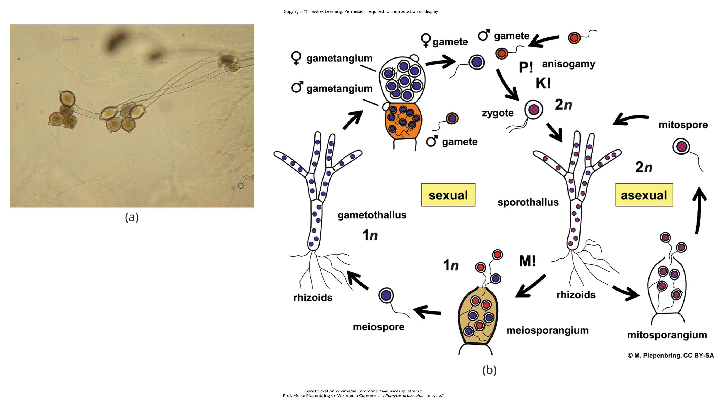
Lesson 24.2 Figure 4

Slide 21
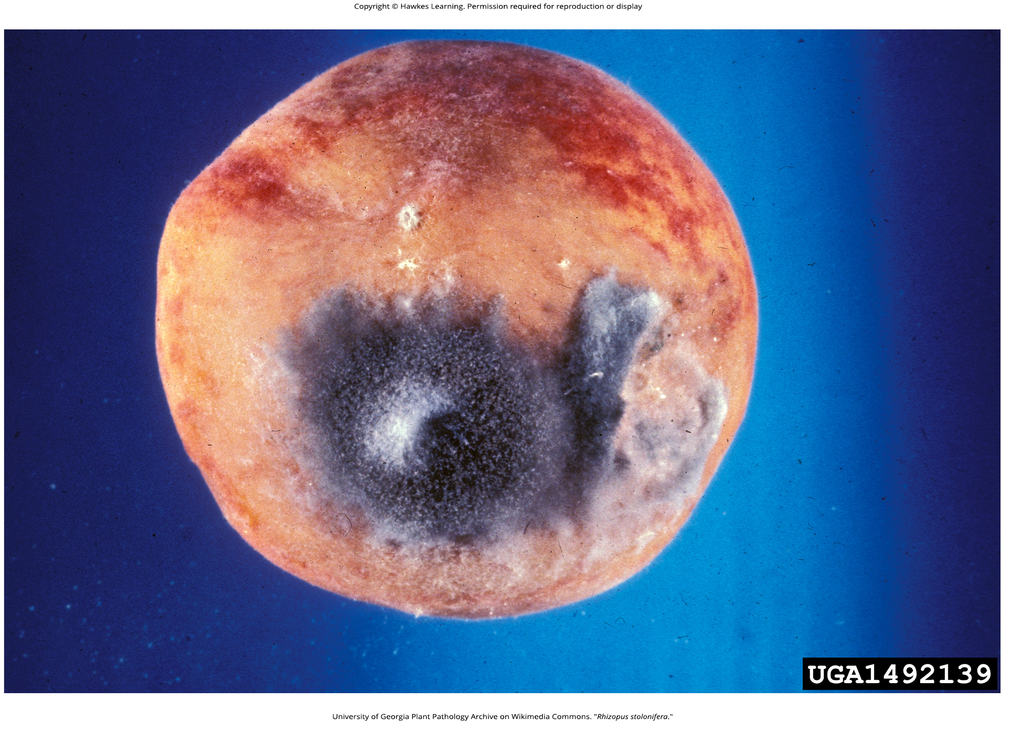
Lesson 24.2 Figure 5

Slide 22
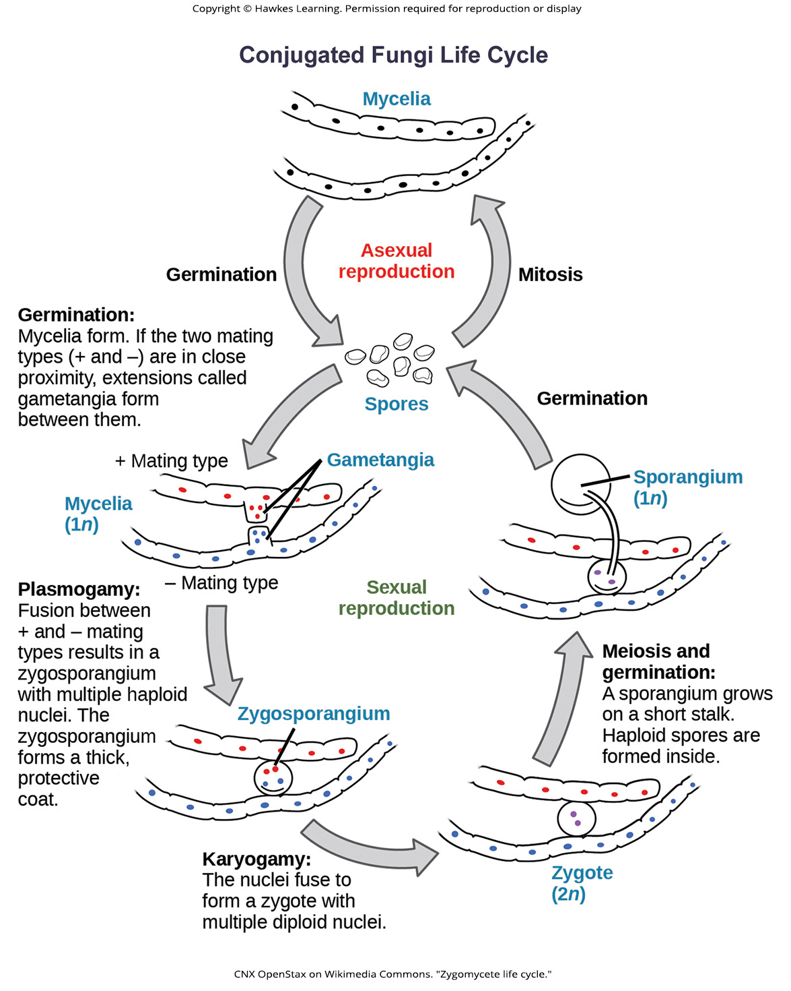
Lesson 24.2 Figure 6

Slide 23
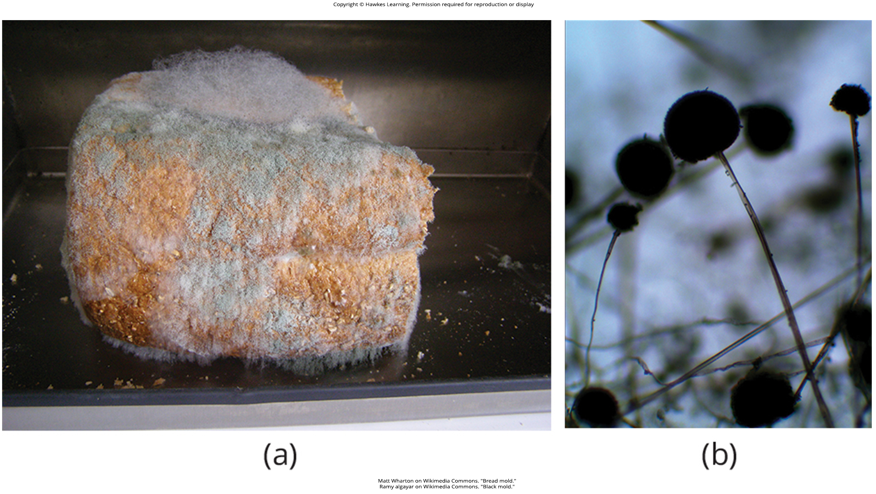
Lesson 24.2 Figure 7

Slide 24
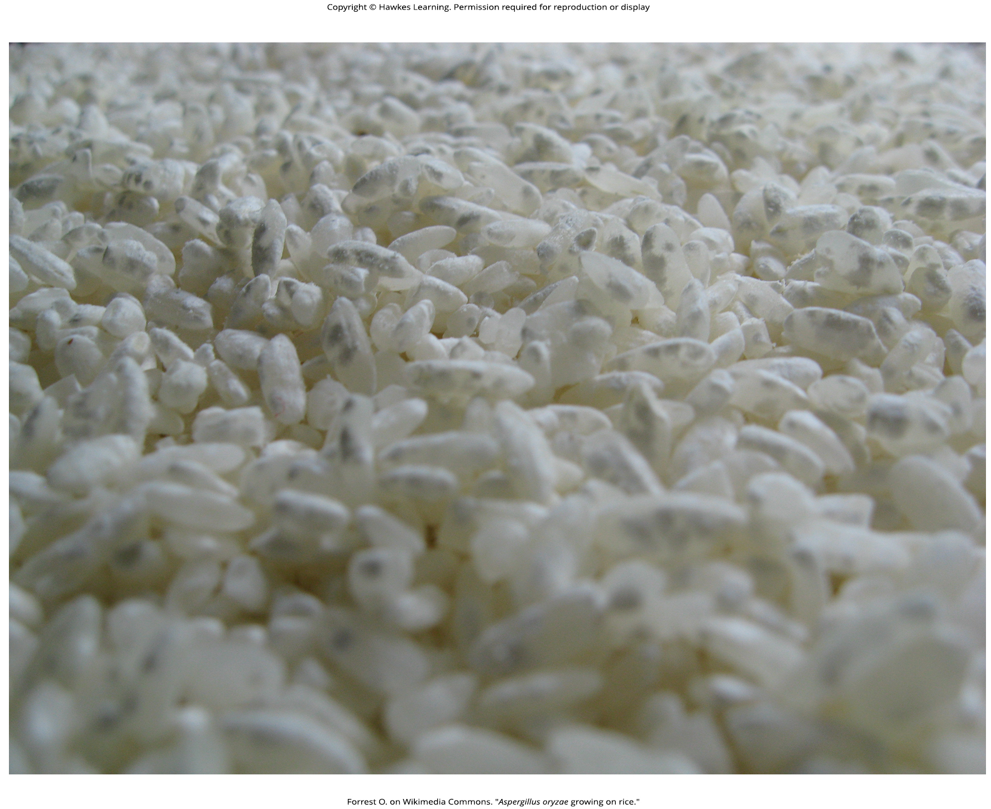
Lesson 24.2 Figure 8

Slide 25
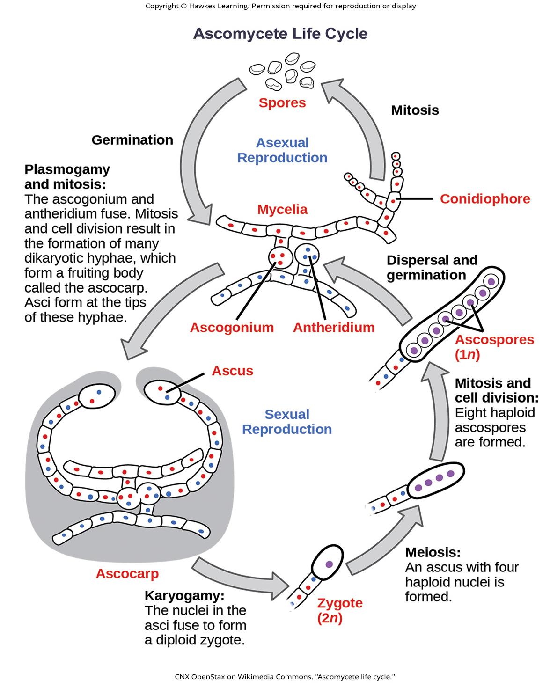
Lesson 24.2 Figure 9

Slide 26
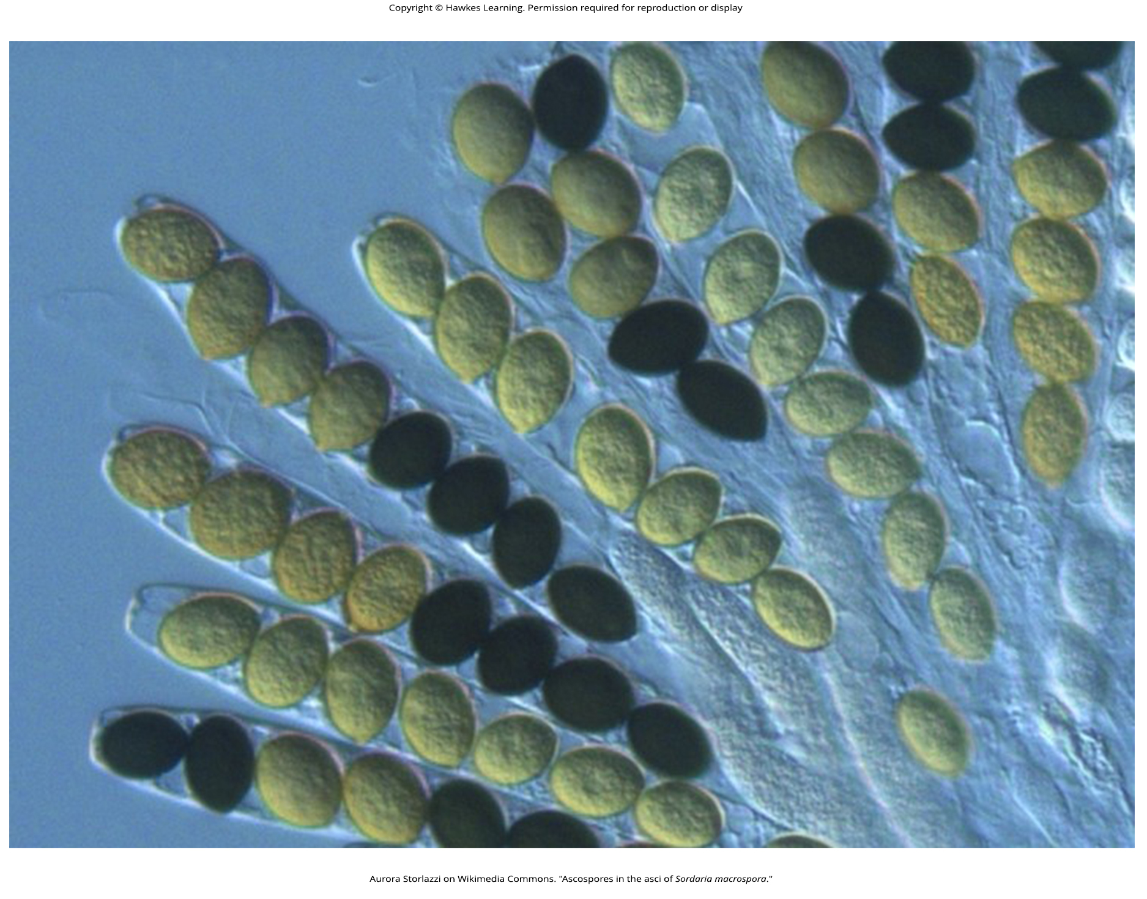
Lesson 24.2 Figure 10

Slide 27
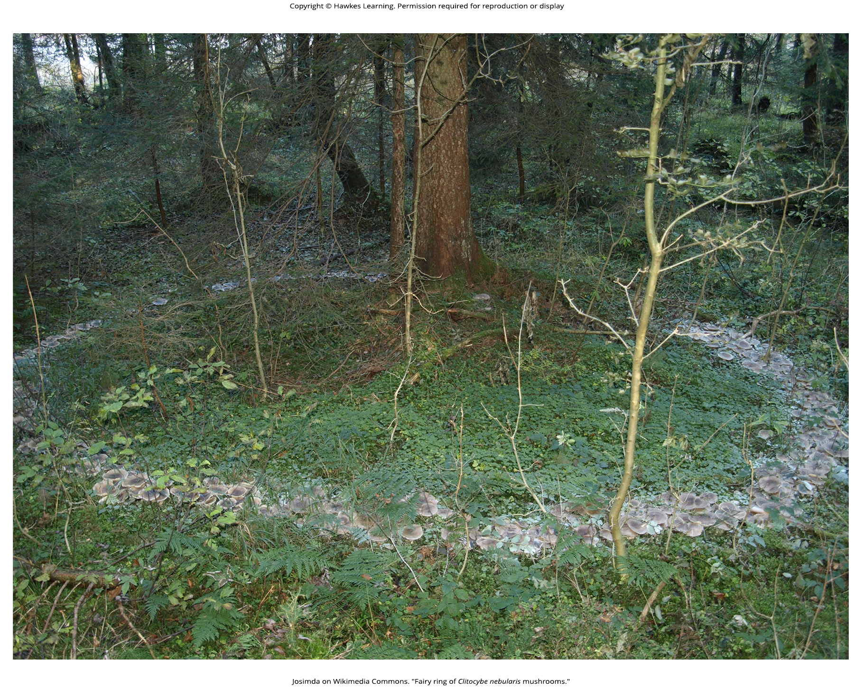
Lesson 24.2 Figure 11

Slide 28
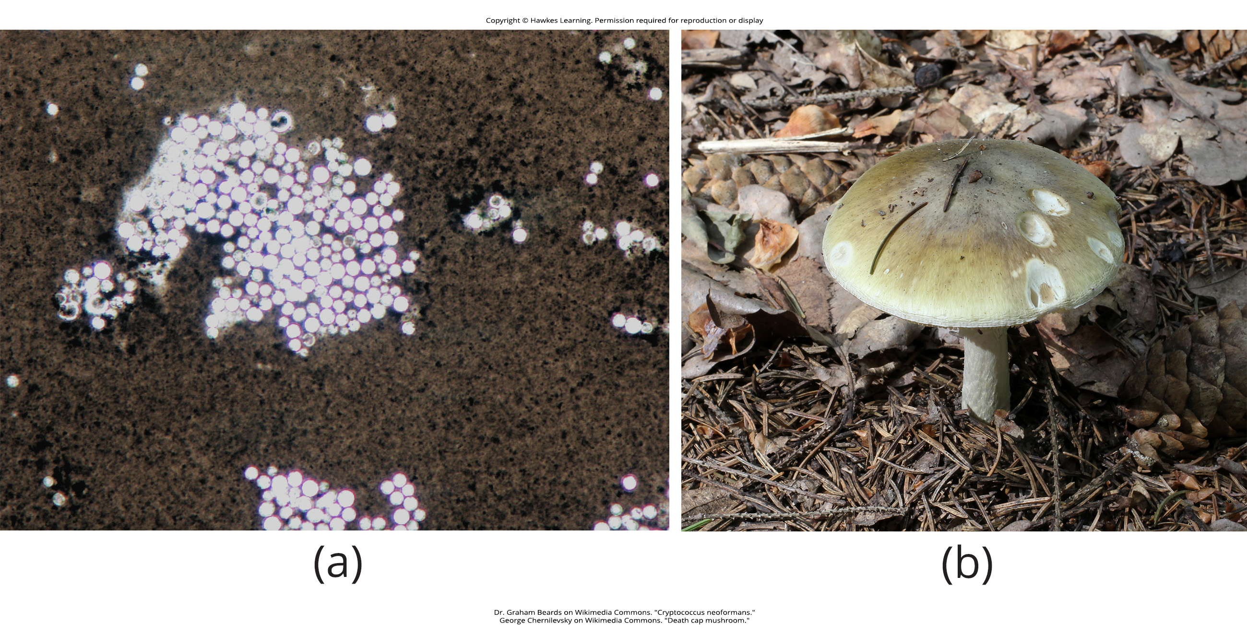
Lesson 24.2 Figure 12

Slide 29
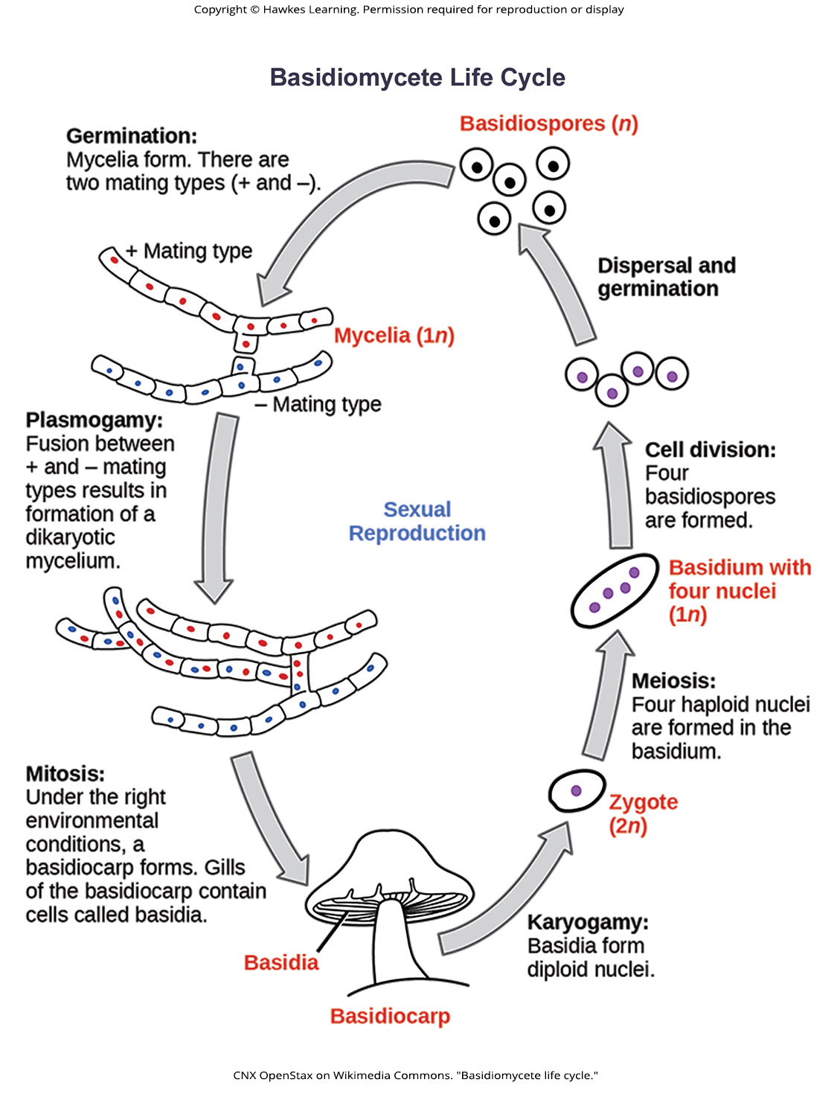
Lesson 24.2 Figure 13

Slide 30
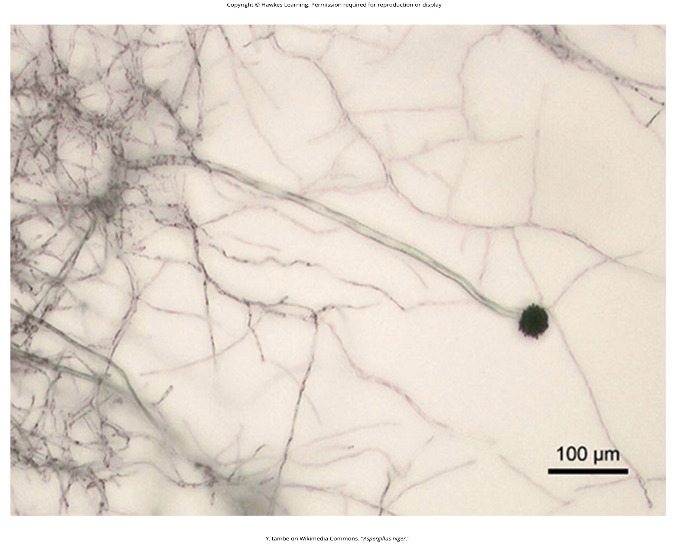
Lesson 24.2 Figure 14

Slide 31
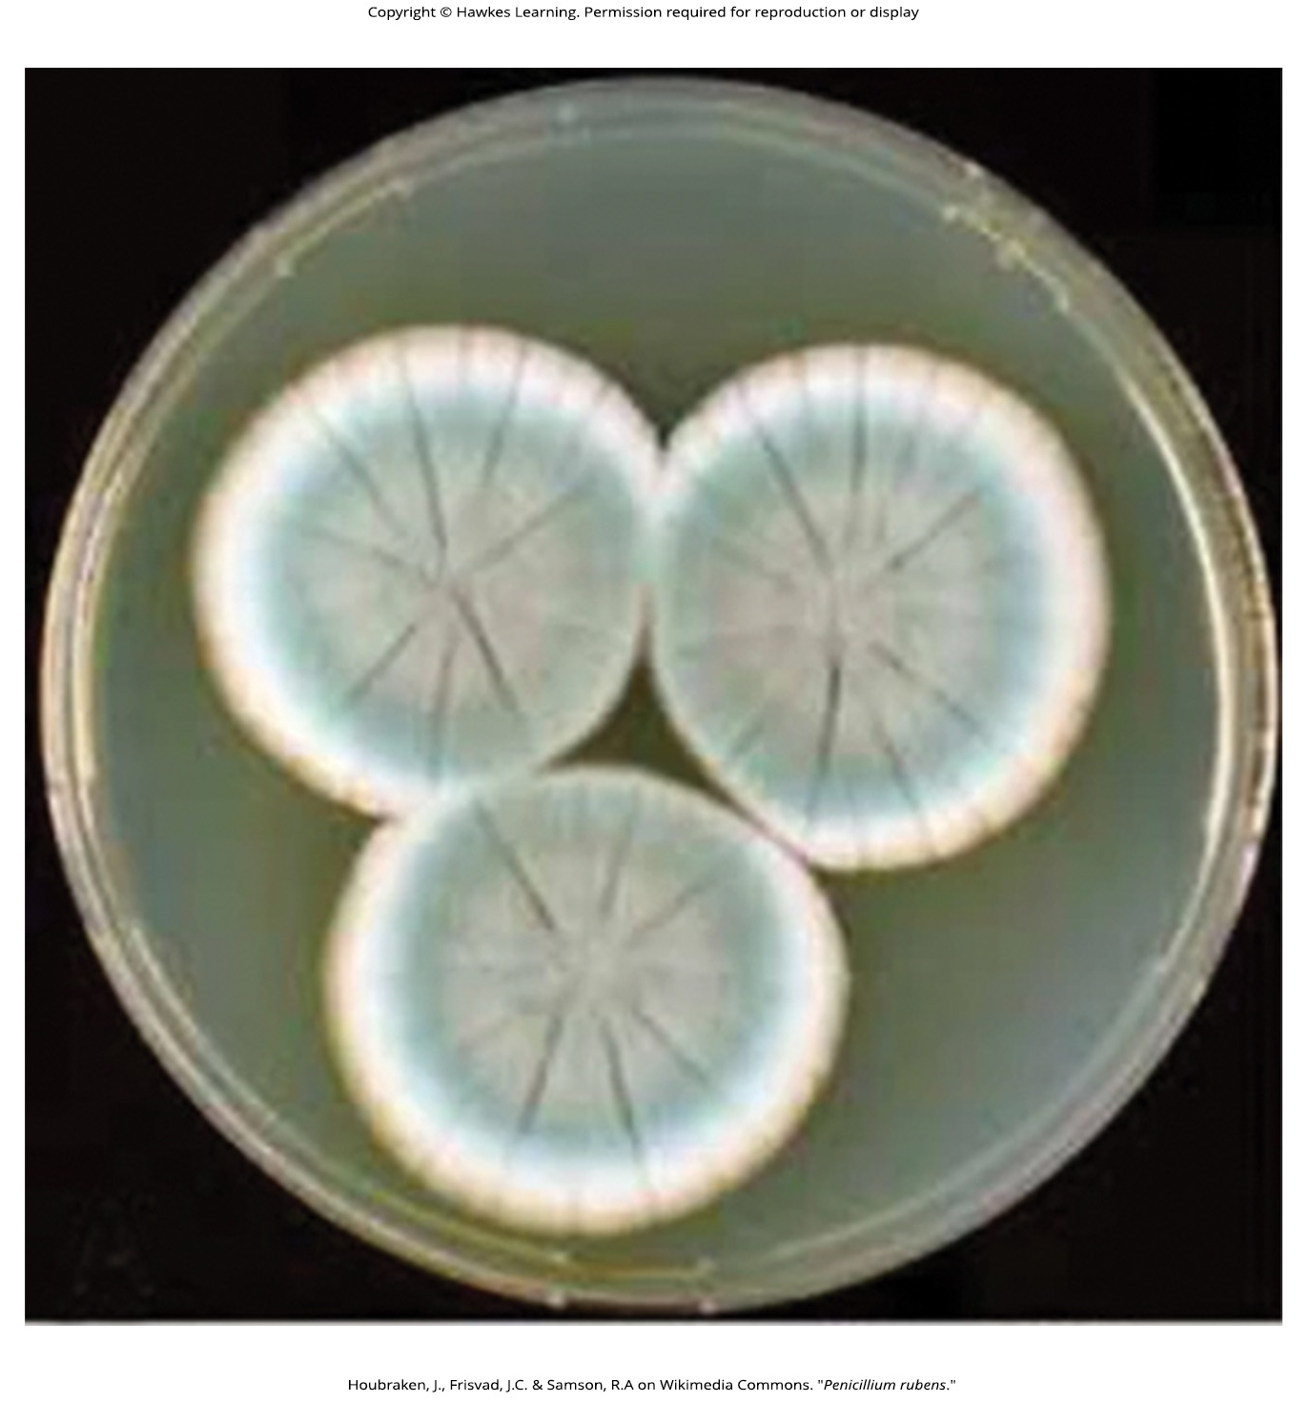
Lesson 24.2 Figure 15

Slide 32
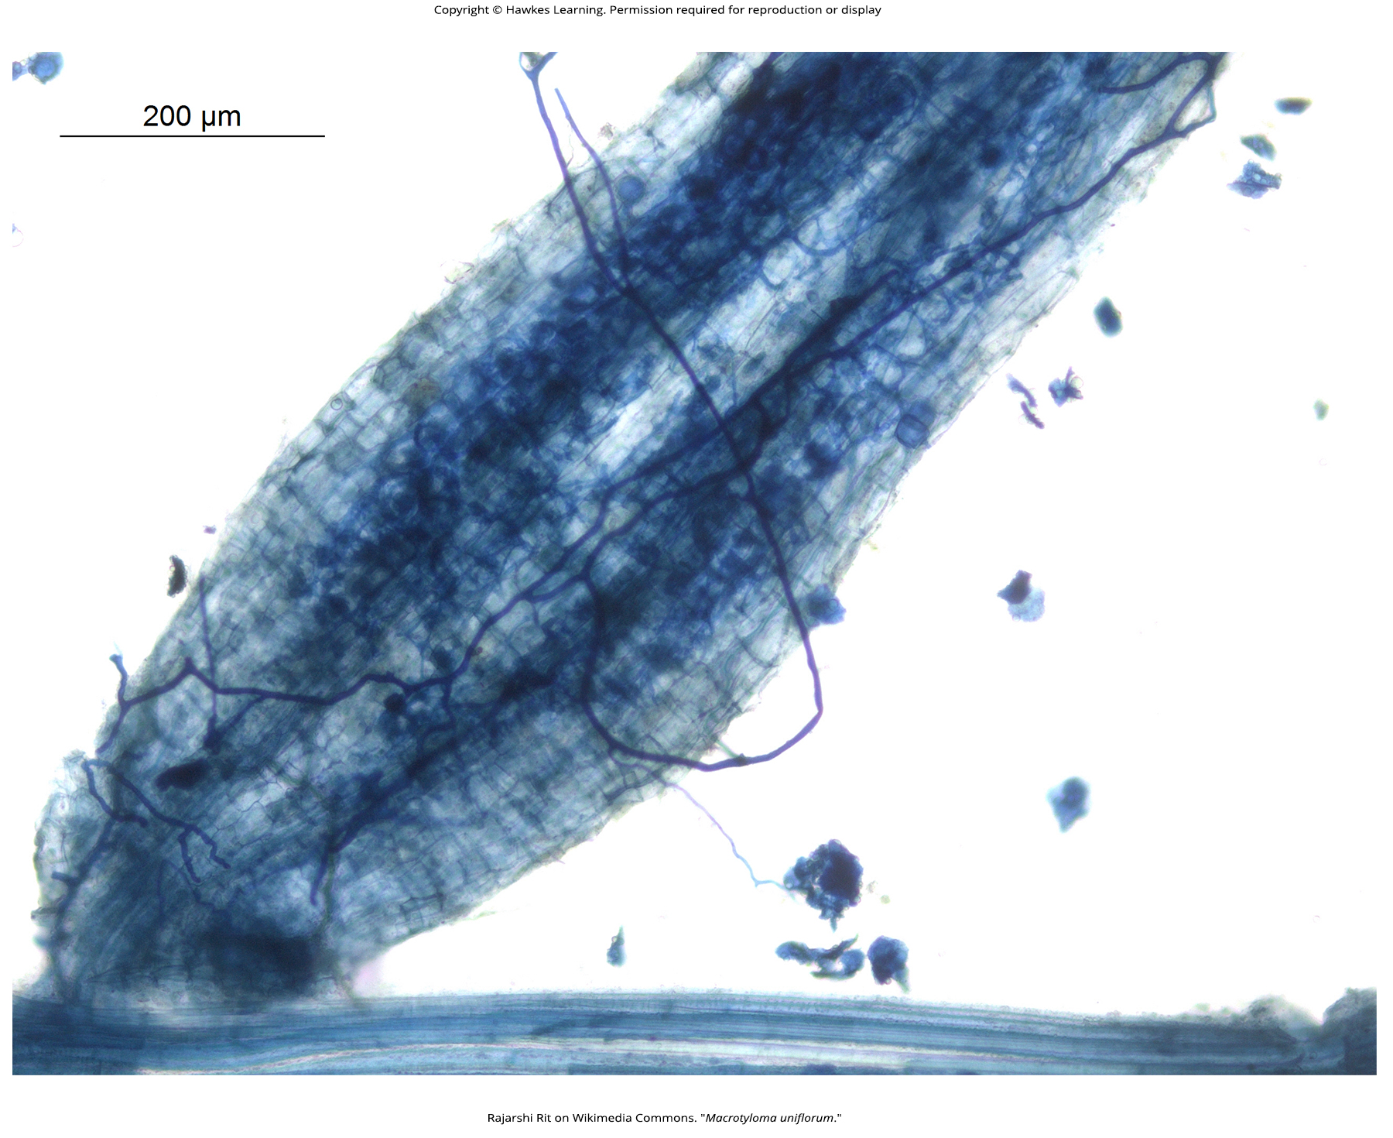
Lesson 24.2 Figure 16

Slide 33
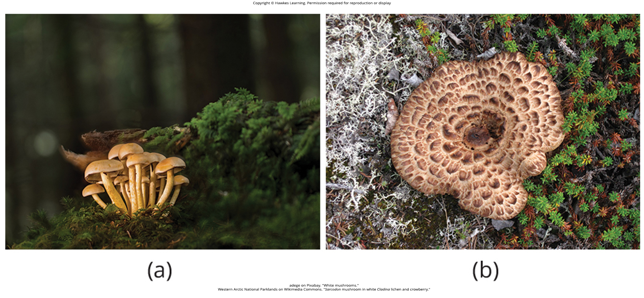
Lesson 24.3 Figure 1

Slide 34
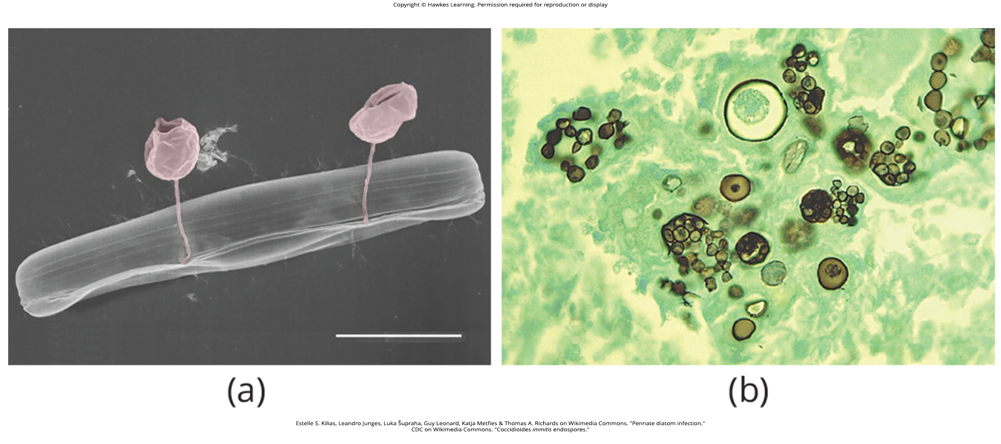
Lesson 24.3 Figure 2

Slide 35
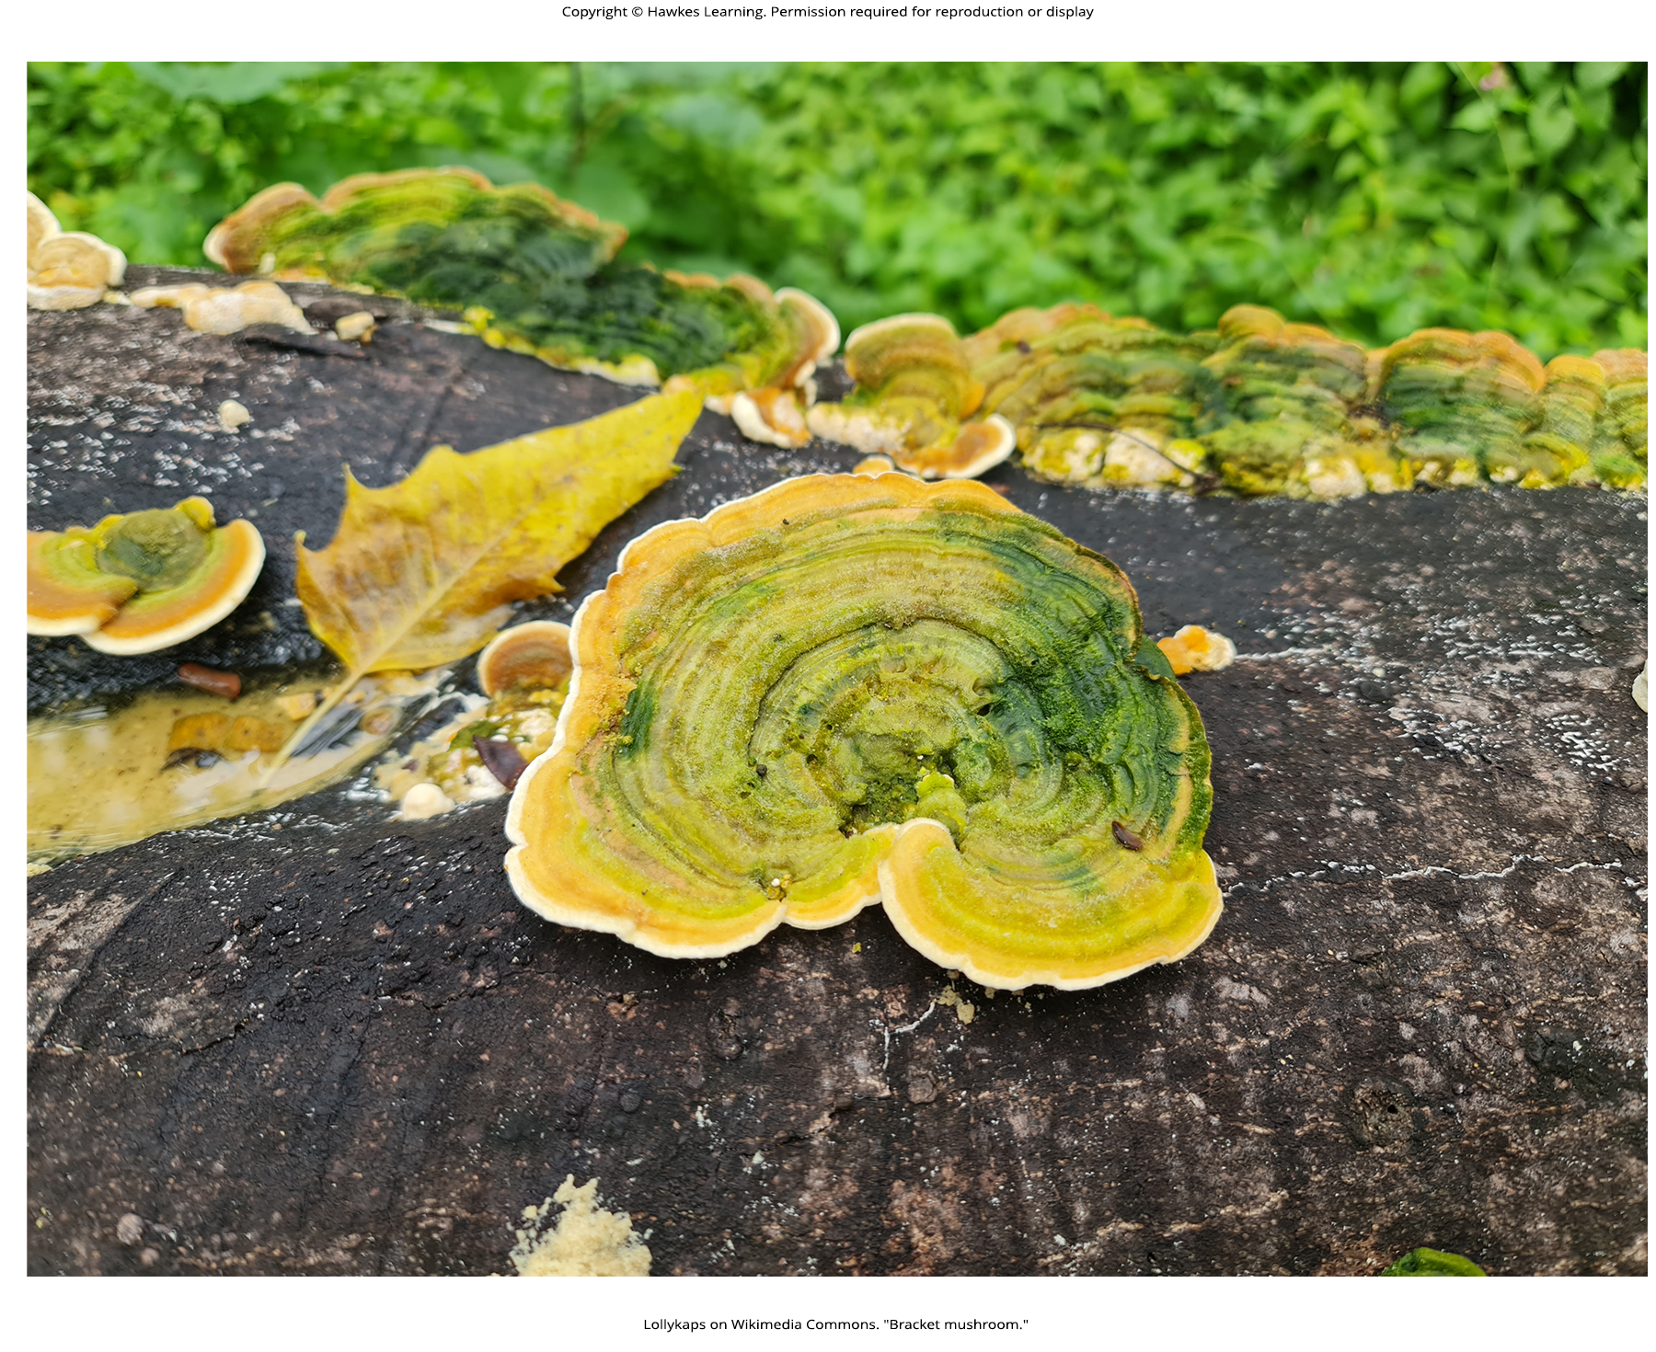
Lesson 24.3 Figure 3

Slide 36
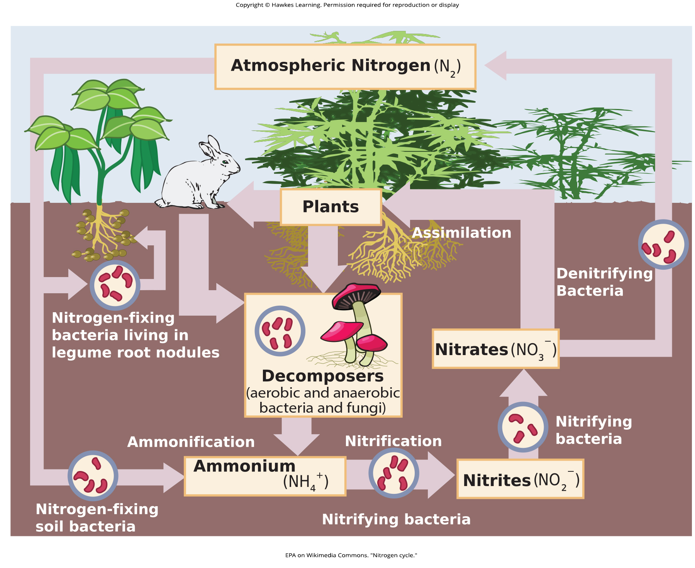
Lesson 24.3 Figure 4

Slide 37
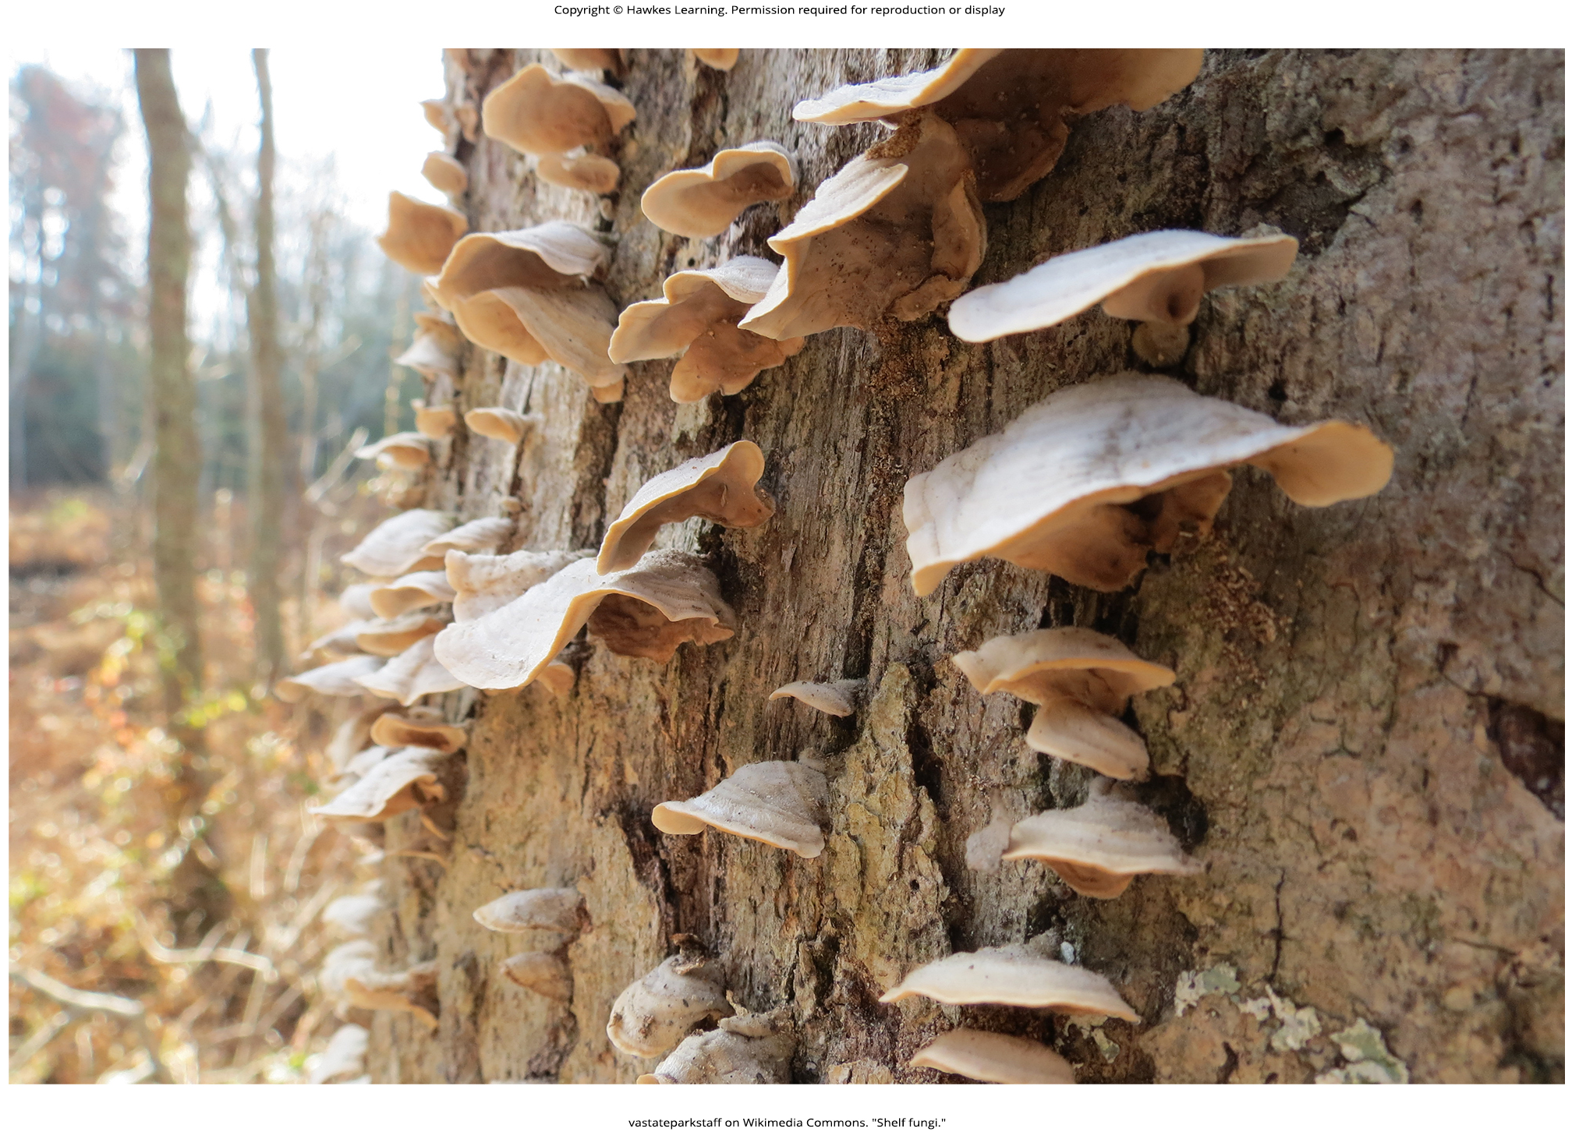
Lesson 24.3 Figure 5

Slide 38
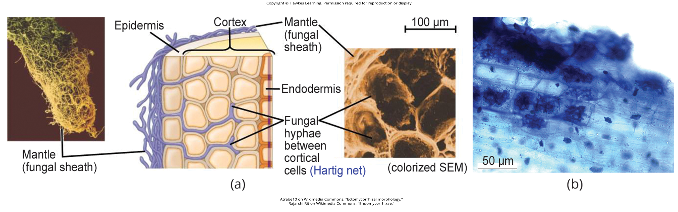
Lesson 24.3 Figure 6

Slide 39
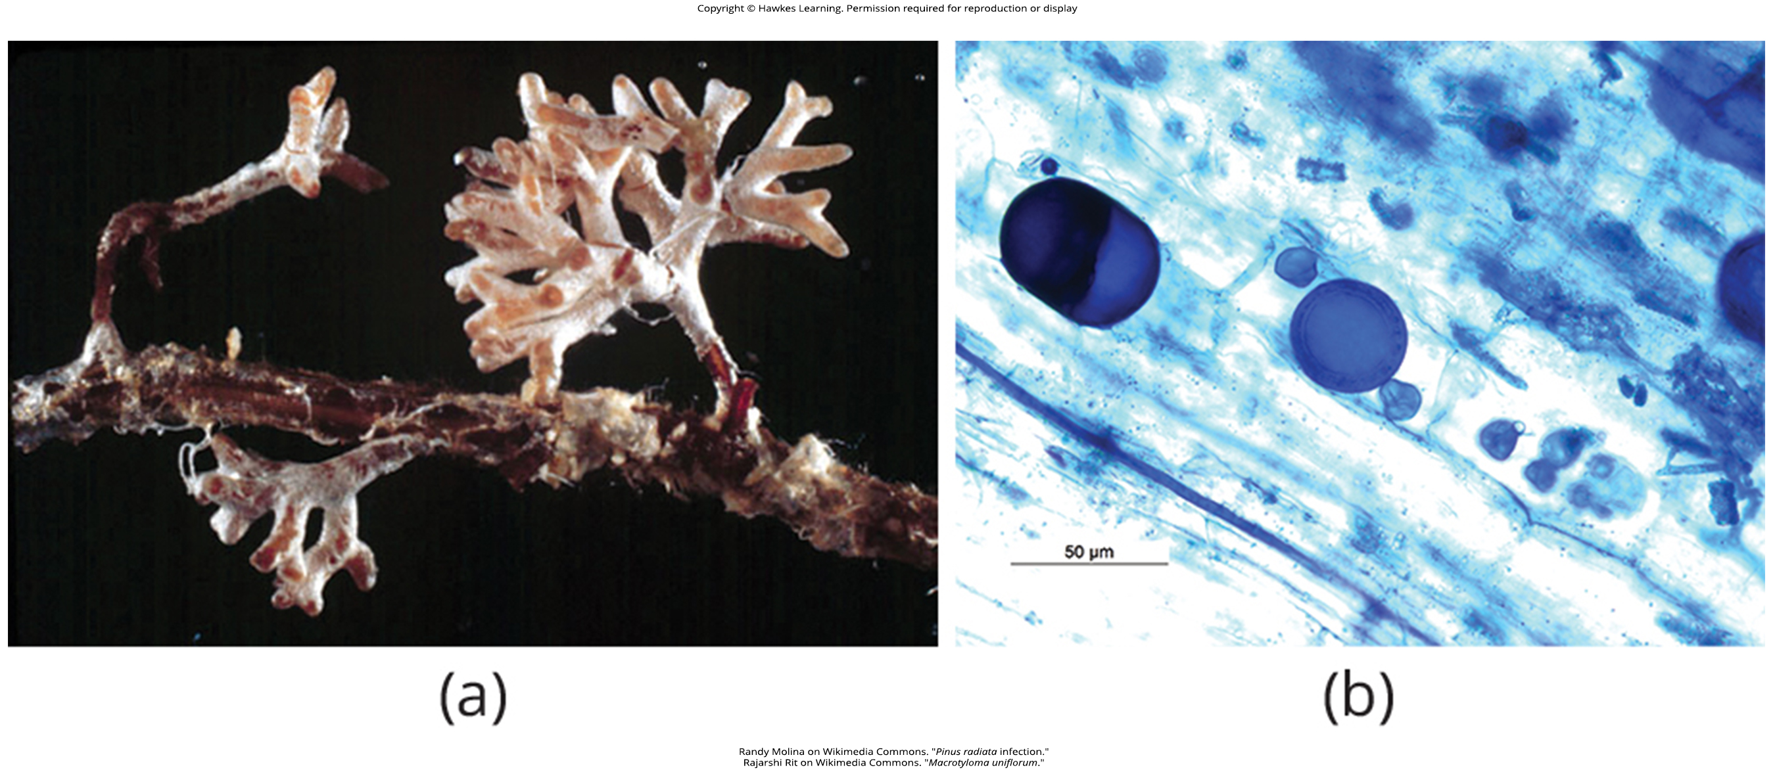
Lesson 24.3 Figure 7

Slide 40
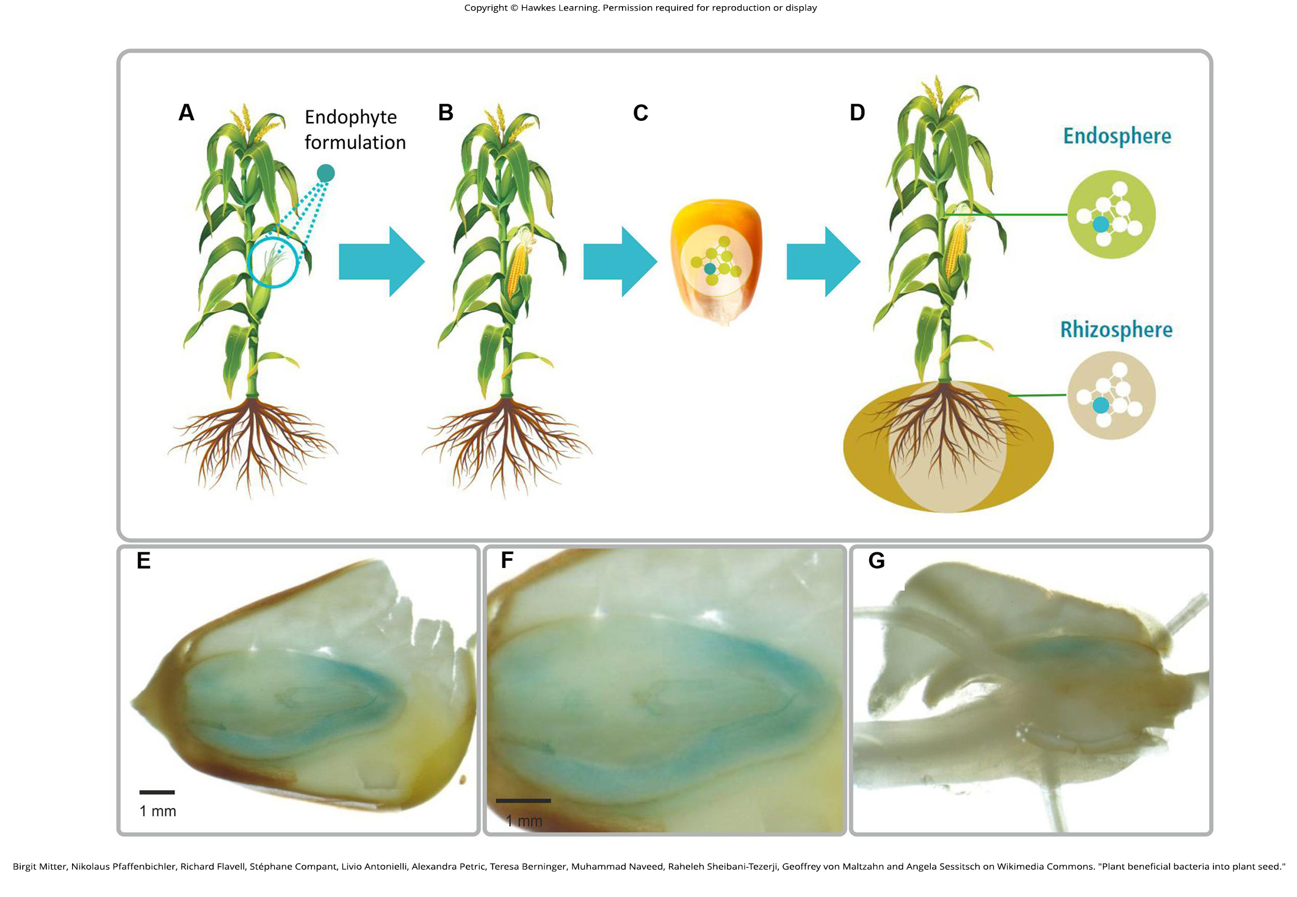
Lesson 24.3 Figure 8

Slide 41
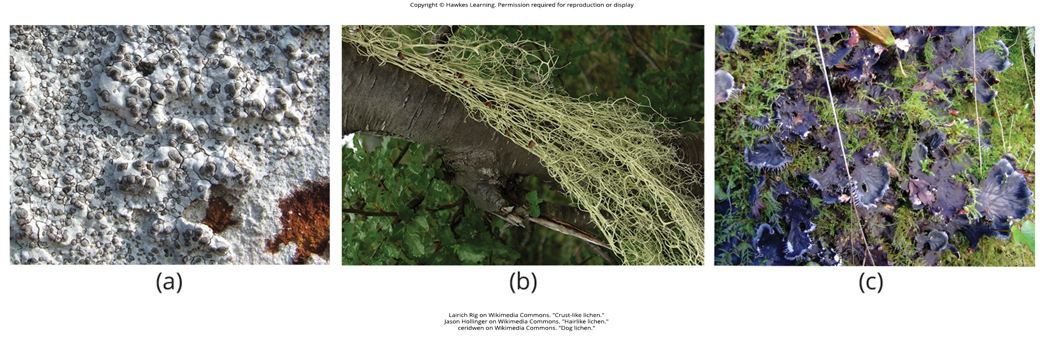
Lesson 24.3 Figure 9

Slide 42
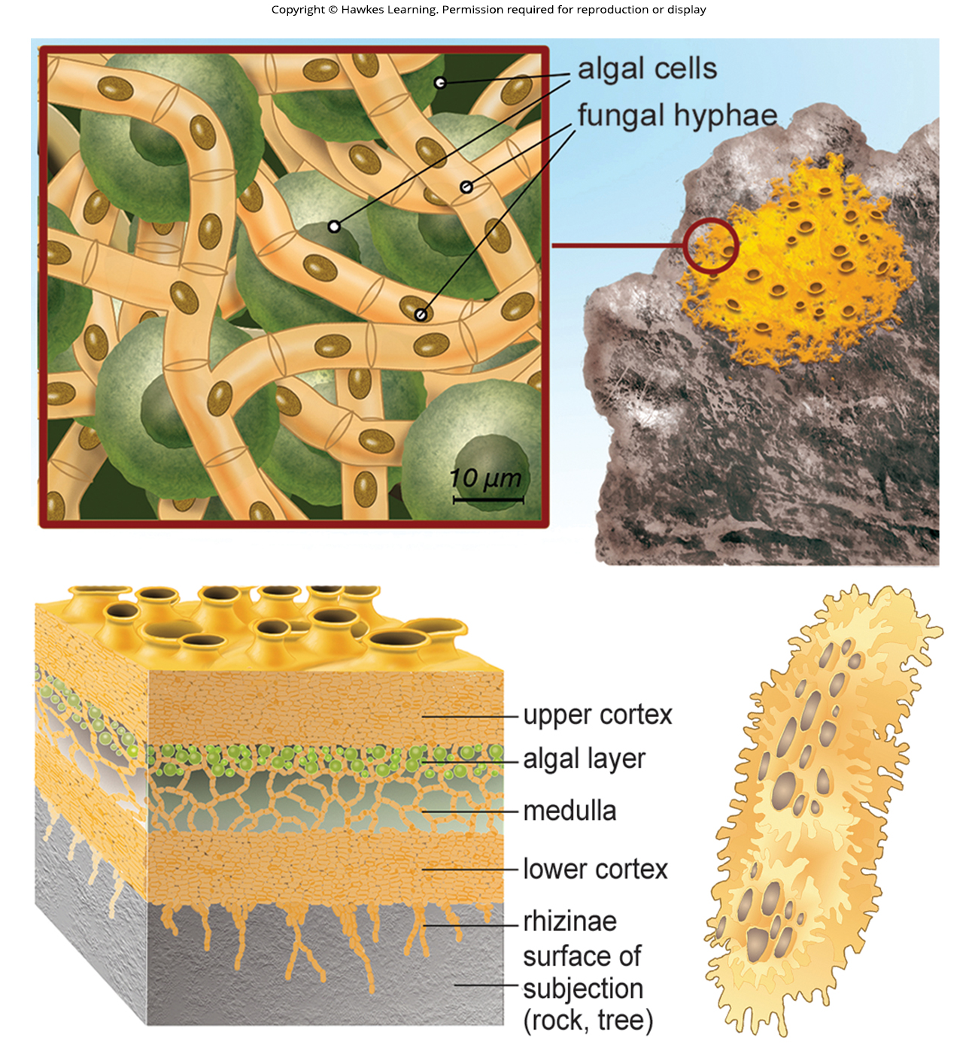
Lesson 24.3 Figure 10

Slide 43
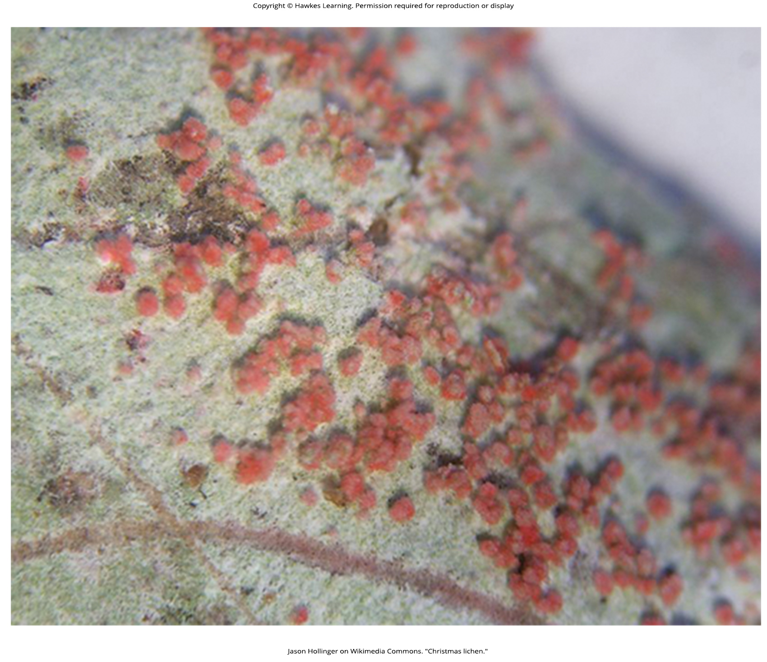
Lesson 24.3 Figure 11

Slide 44
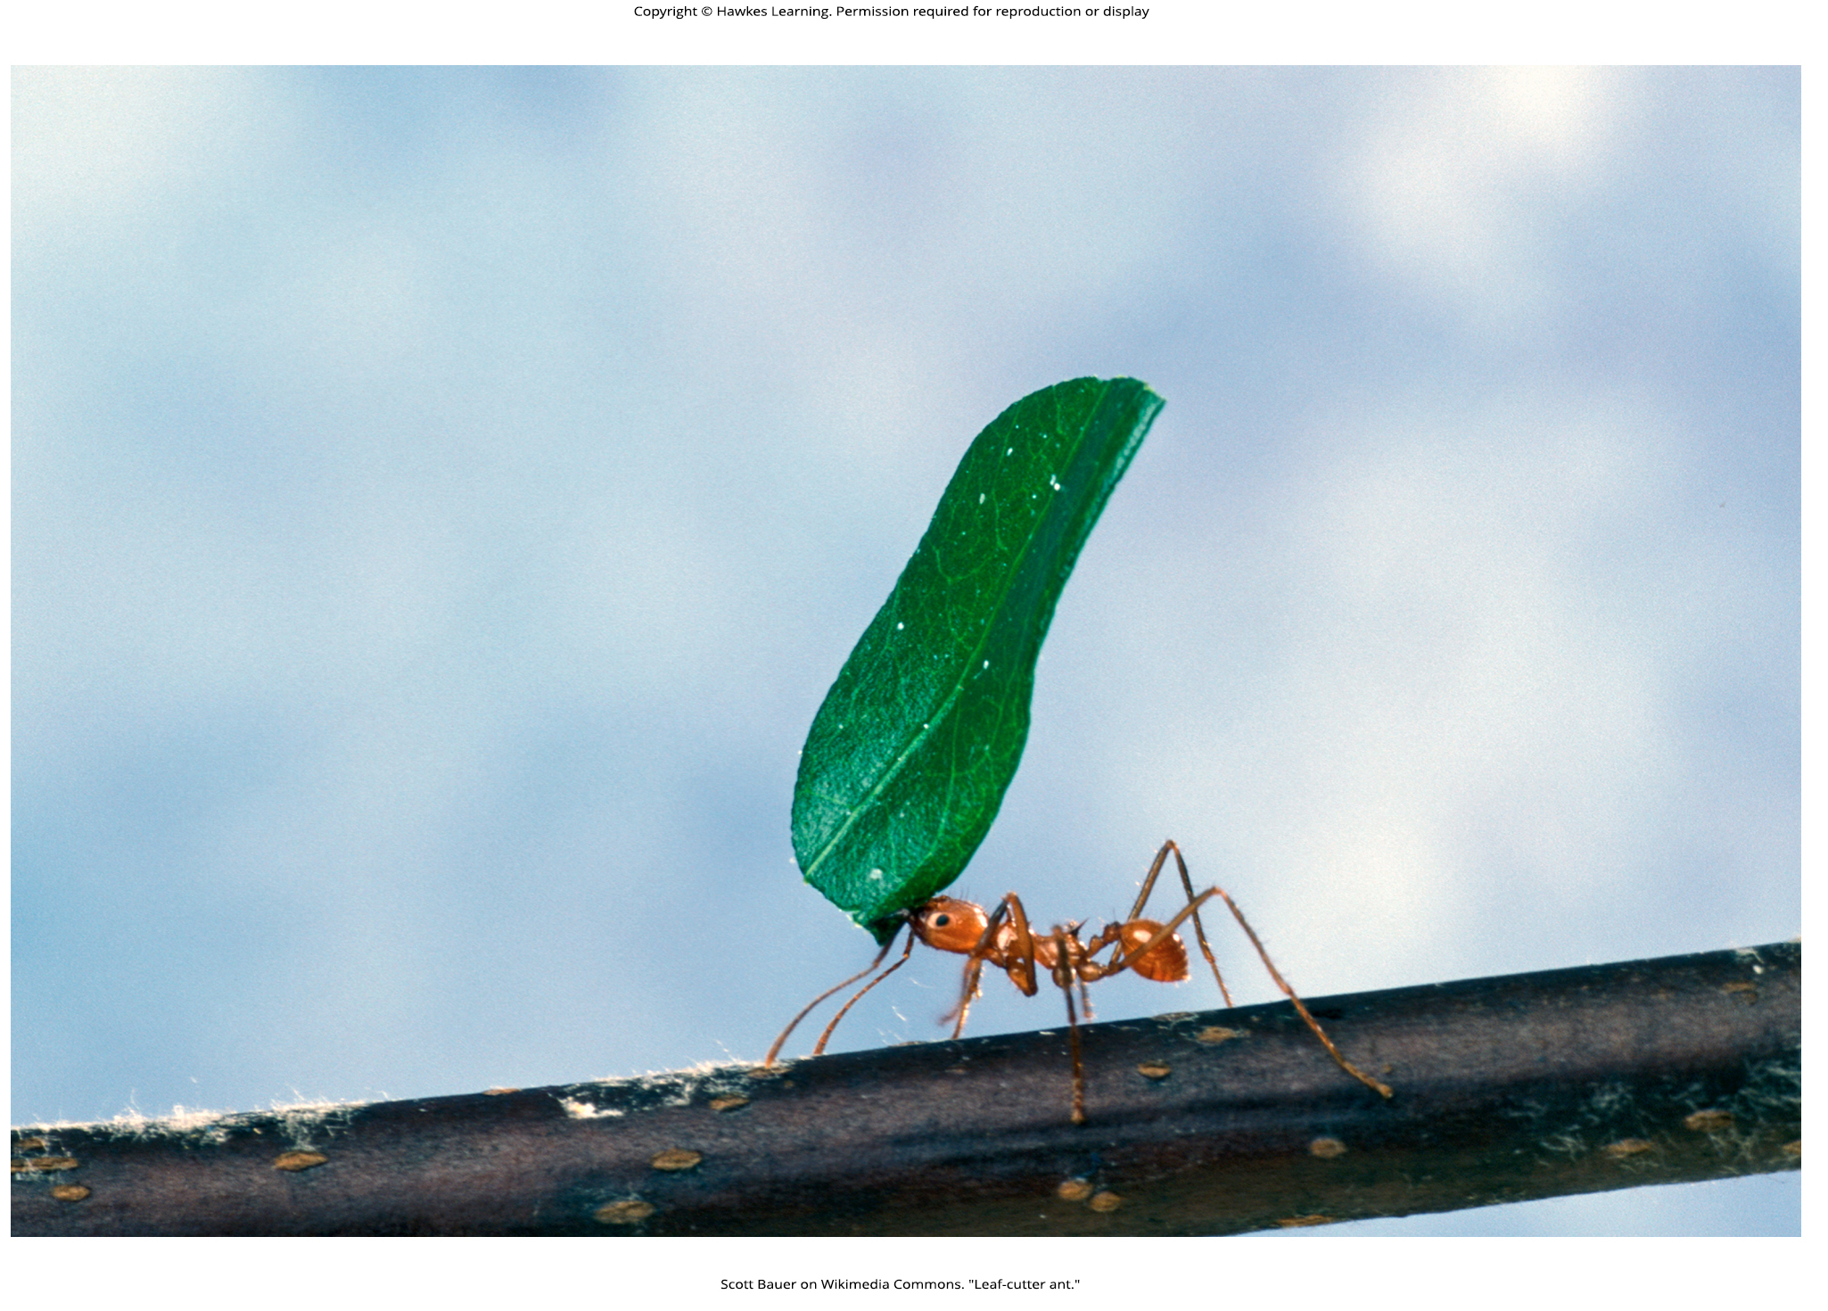
Lesson 24.3 Figure 12

Slide 45
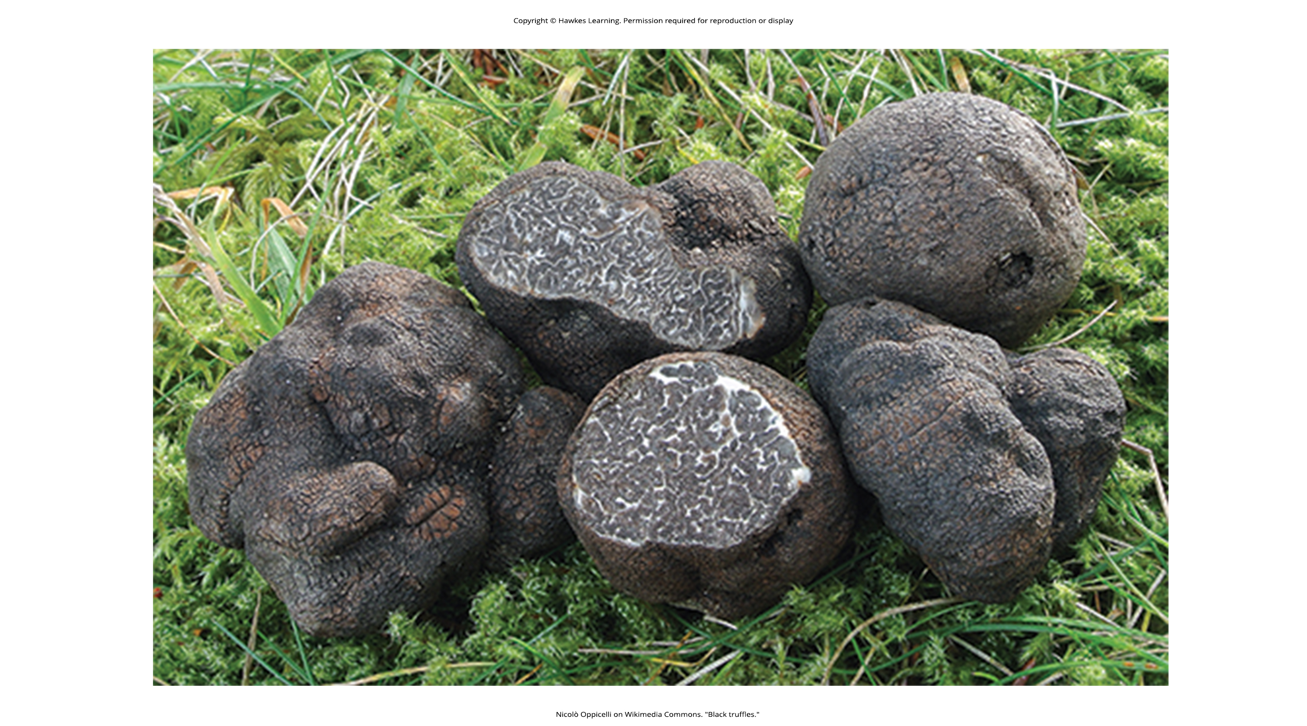
Lesson 24.3 Figure 13

Slide 46
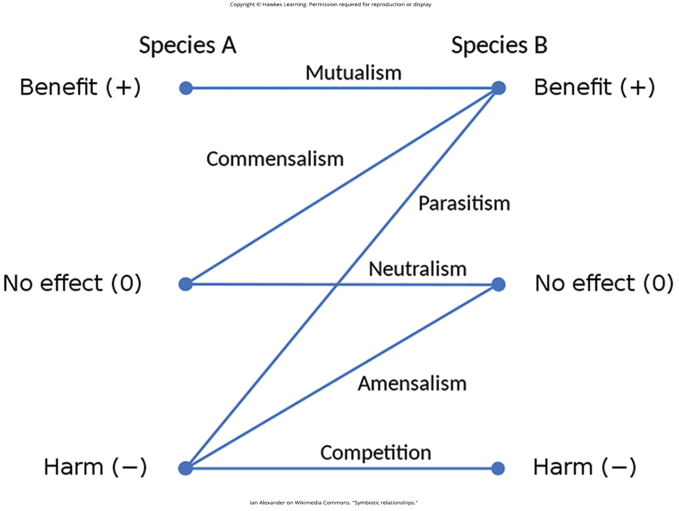
Lesson 24.3 Figure 14

Slide 47
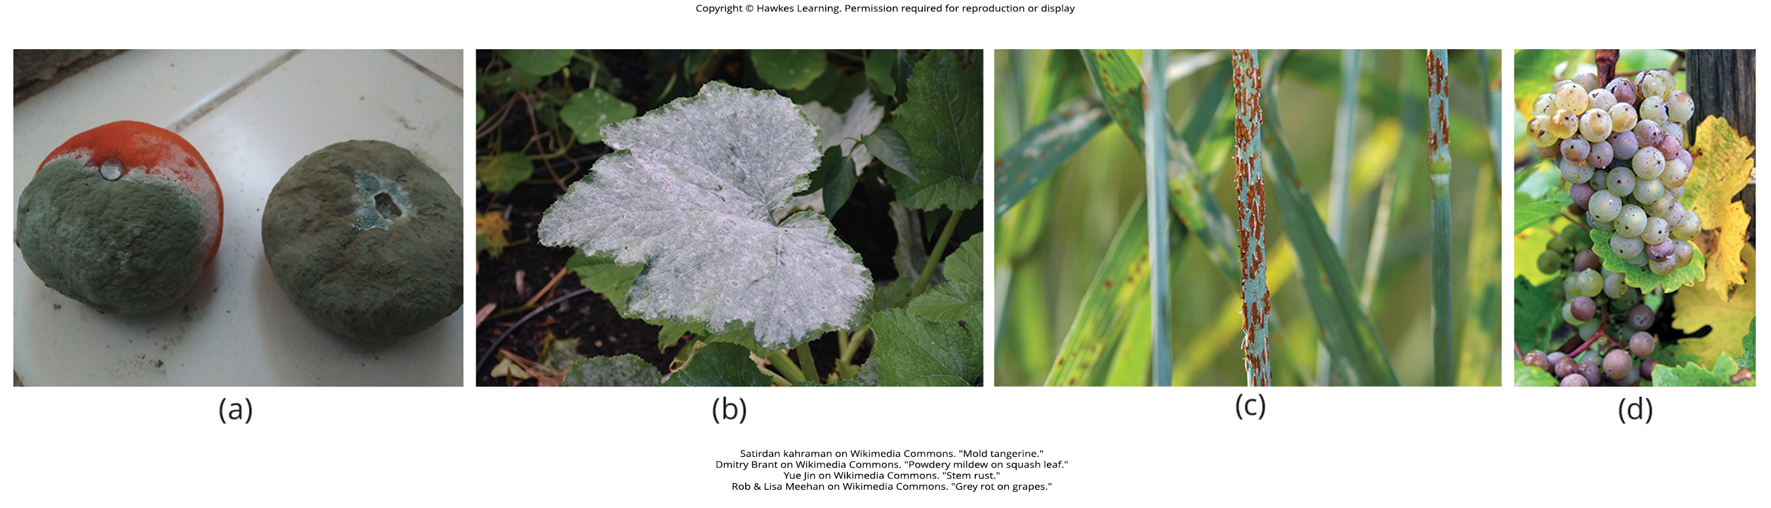
Lesson 24.3 Figure 15

Slide 48
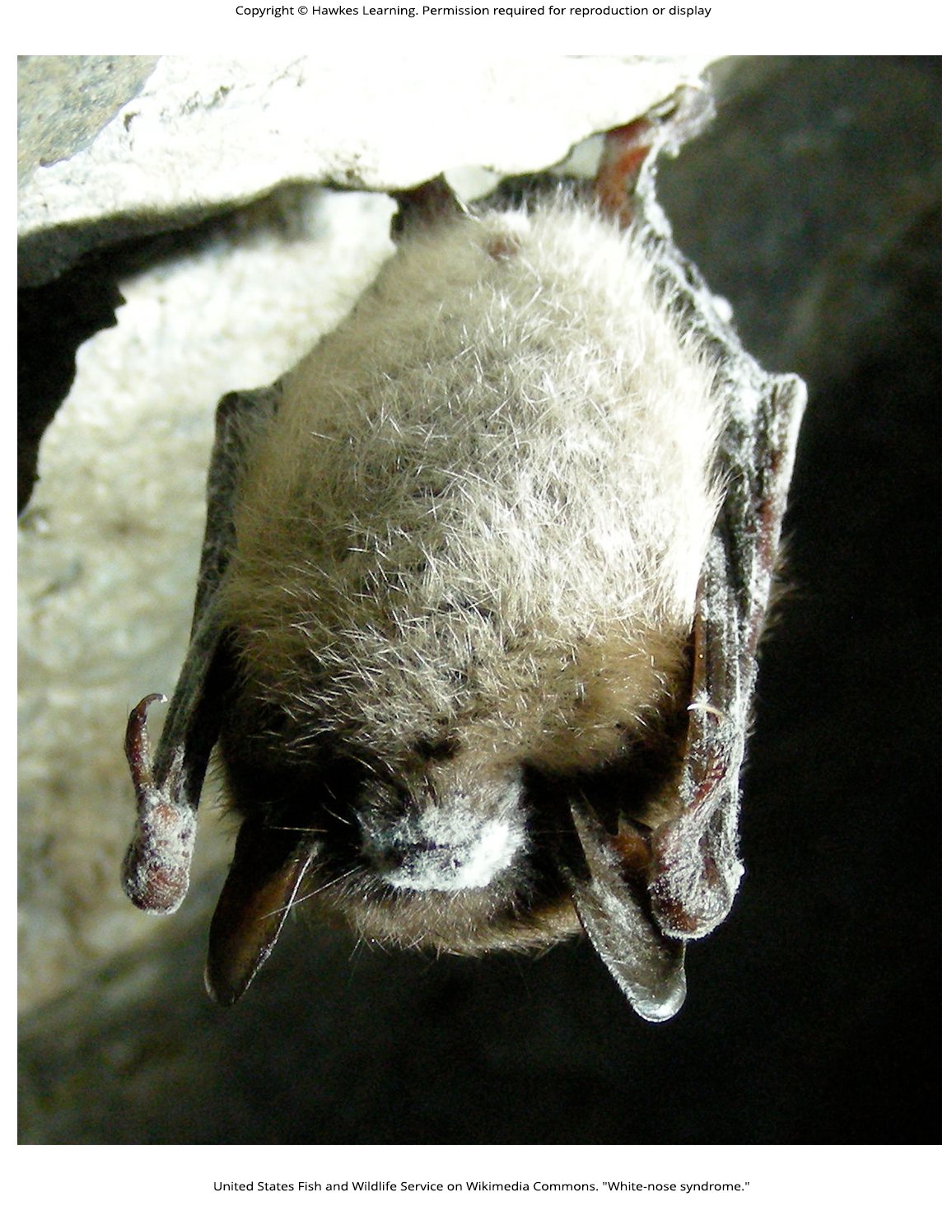
Lesson 24.3 Figure 16

Slide 49
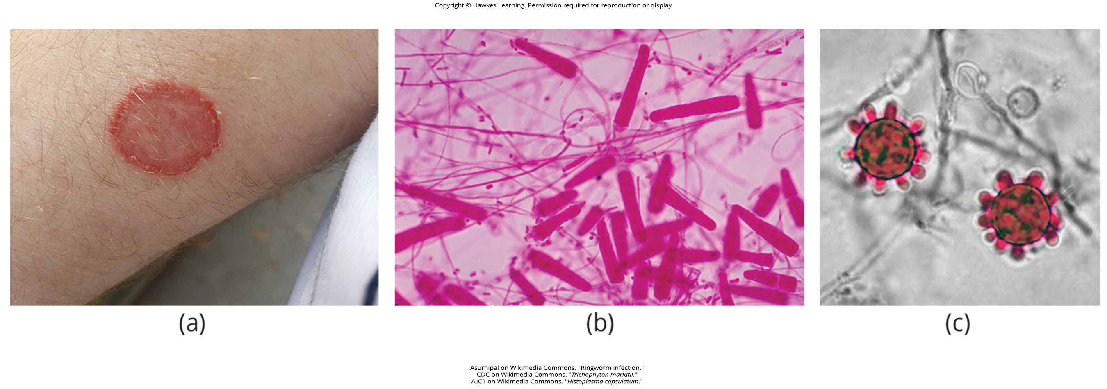
Lesson 24.3 Figure 17

Slide 50
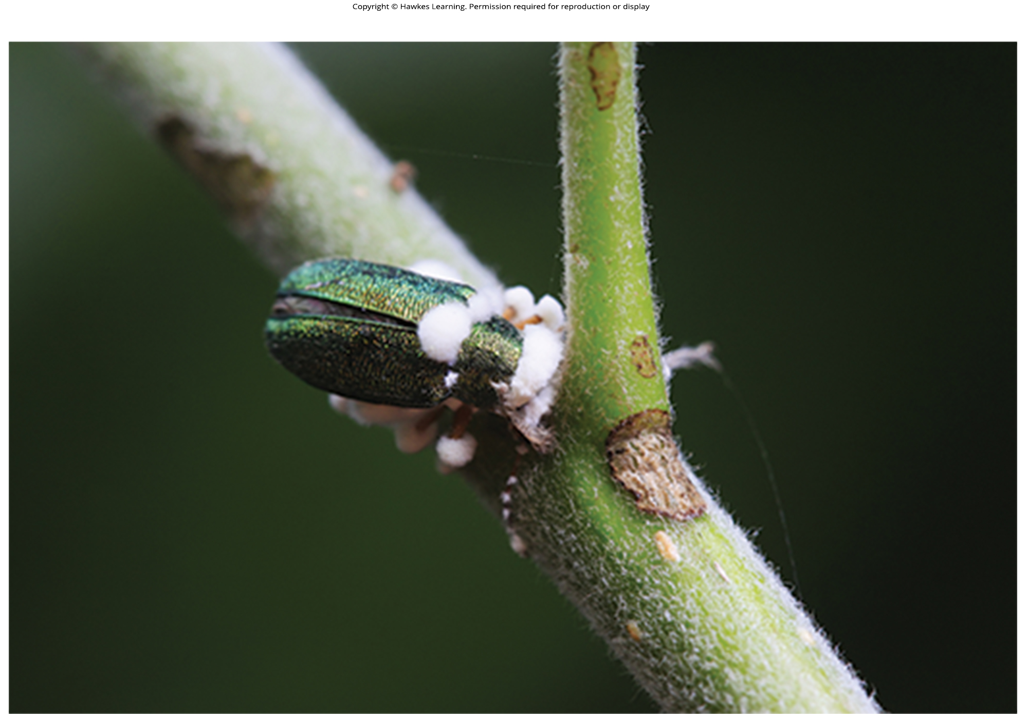
Lesson 24.3 Figure 18

Slide 51
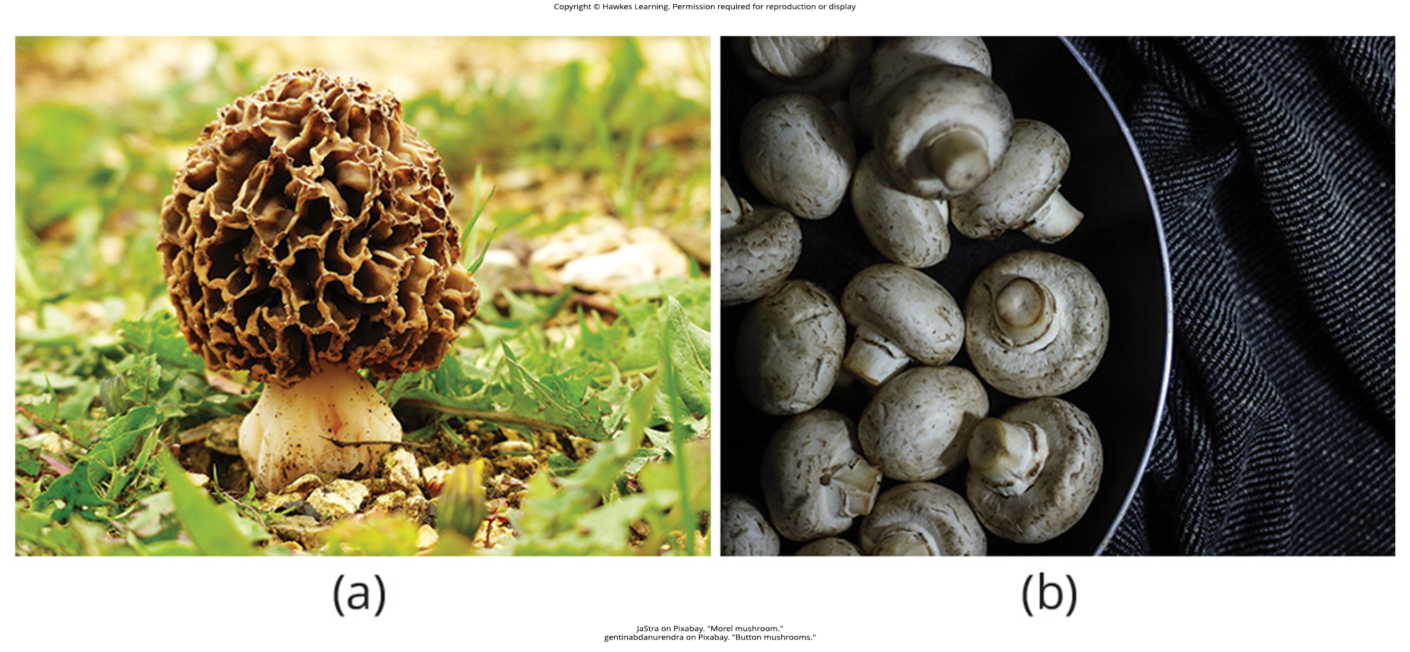
Lesson 24.3 Figure 19

Slide 52
Hawkes Learning – End of PowerPoint

