Slide 1
Chapter 25
Seedless Plants

Slide 2
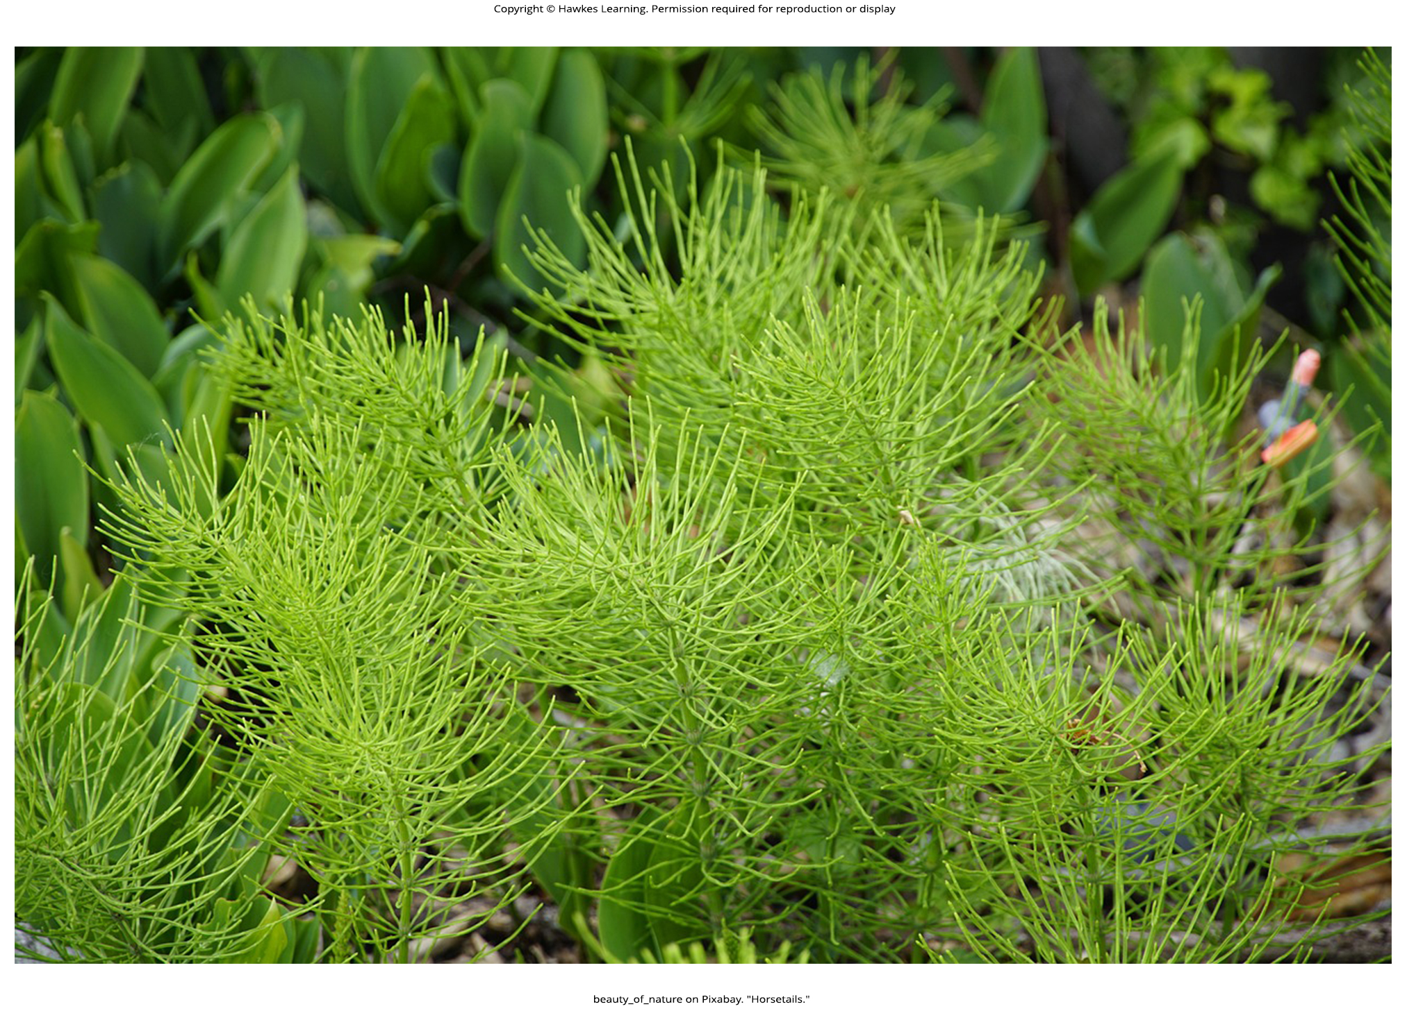
Lesson 25.1 Figure 1

Slide 3
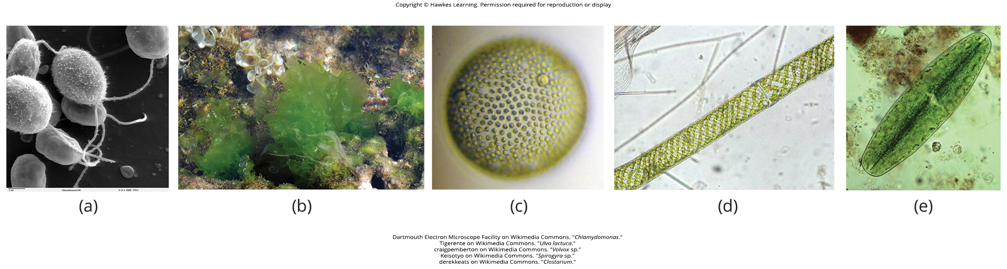
Lesson 25.1 Figure 2

Slide 4
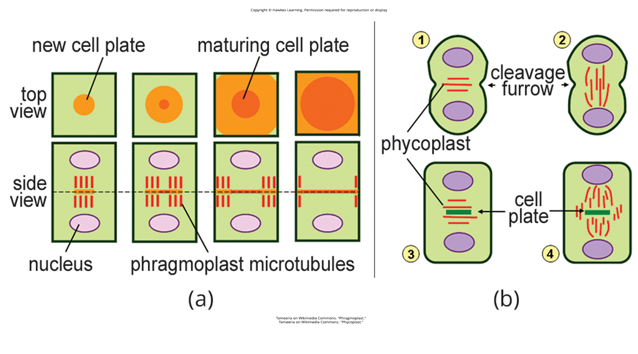
Lesson 25.1 Figure 3

Slide 5
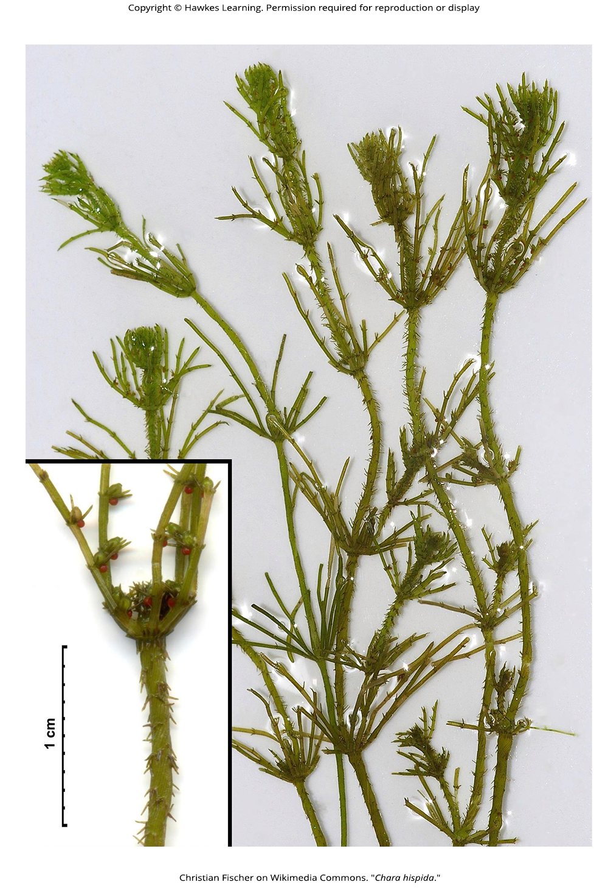
Lesson 25.1 Figure 4

Slide 6
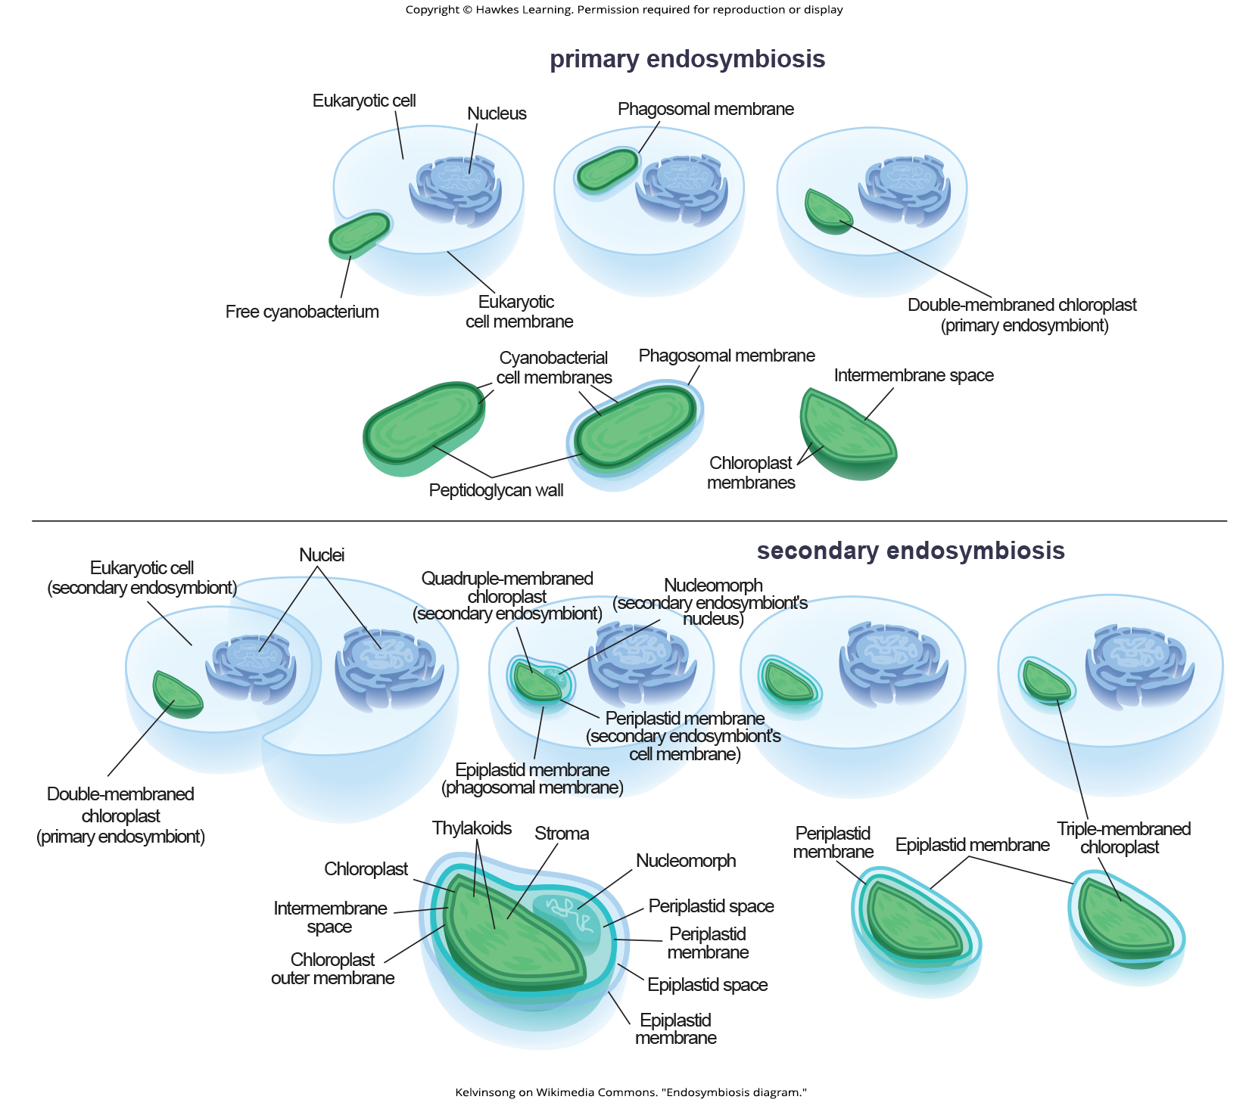
Lesson 25.1 Figure 5

Slide 7
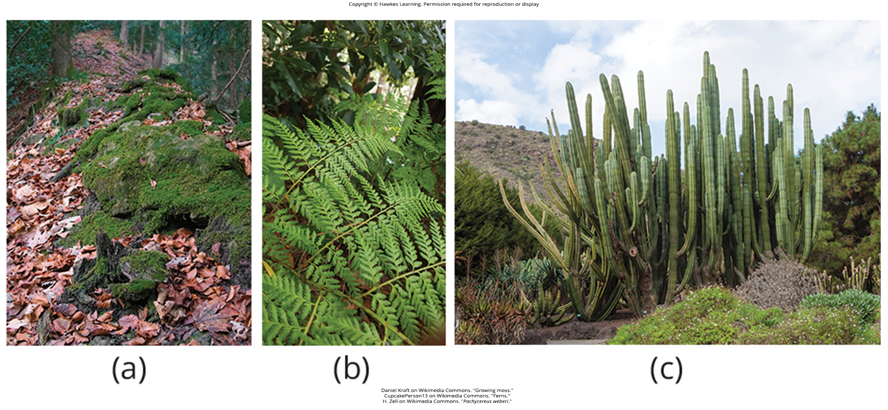
Lesson 25.1 Figure 6

Slide 8
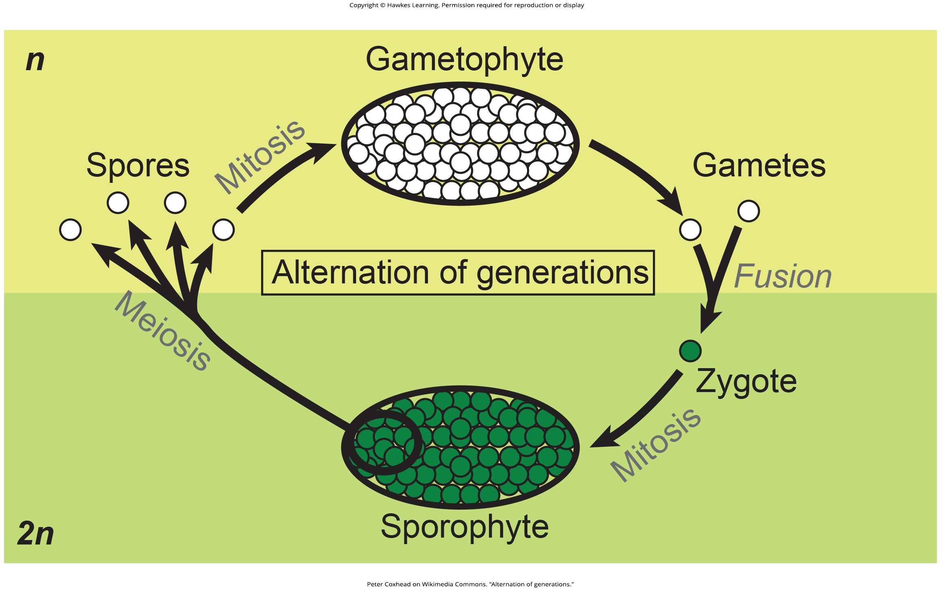
Lesson 25.1 Figure 7

Slide 9
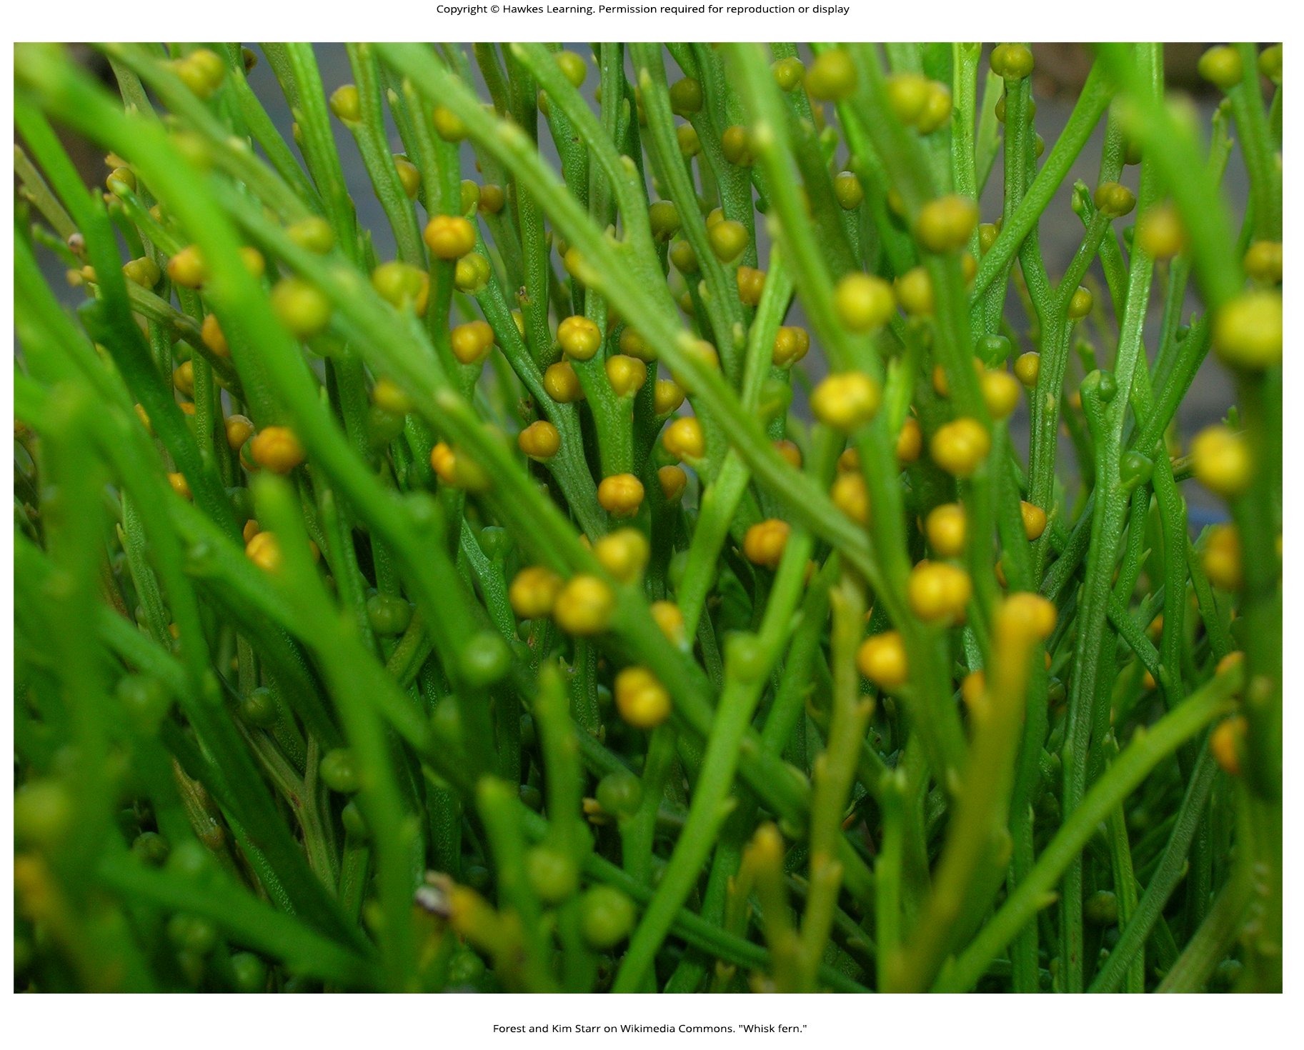
Lesson 25.1 Figure 8

Slide 10
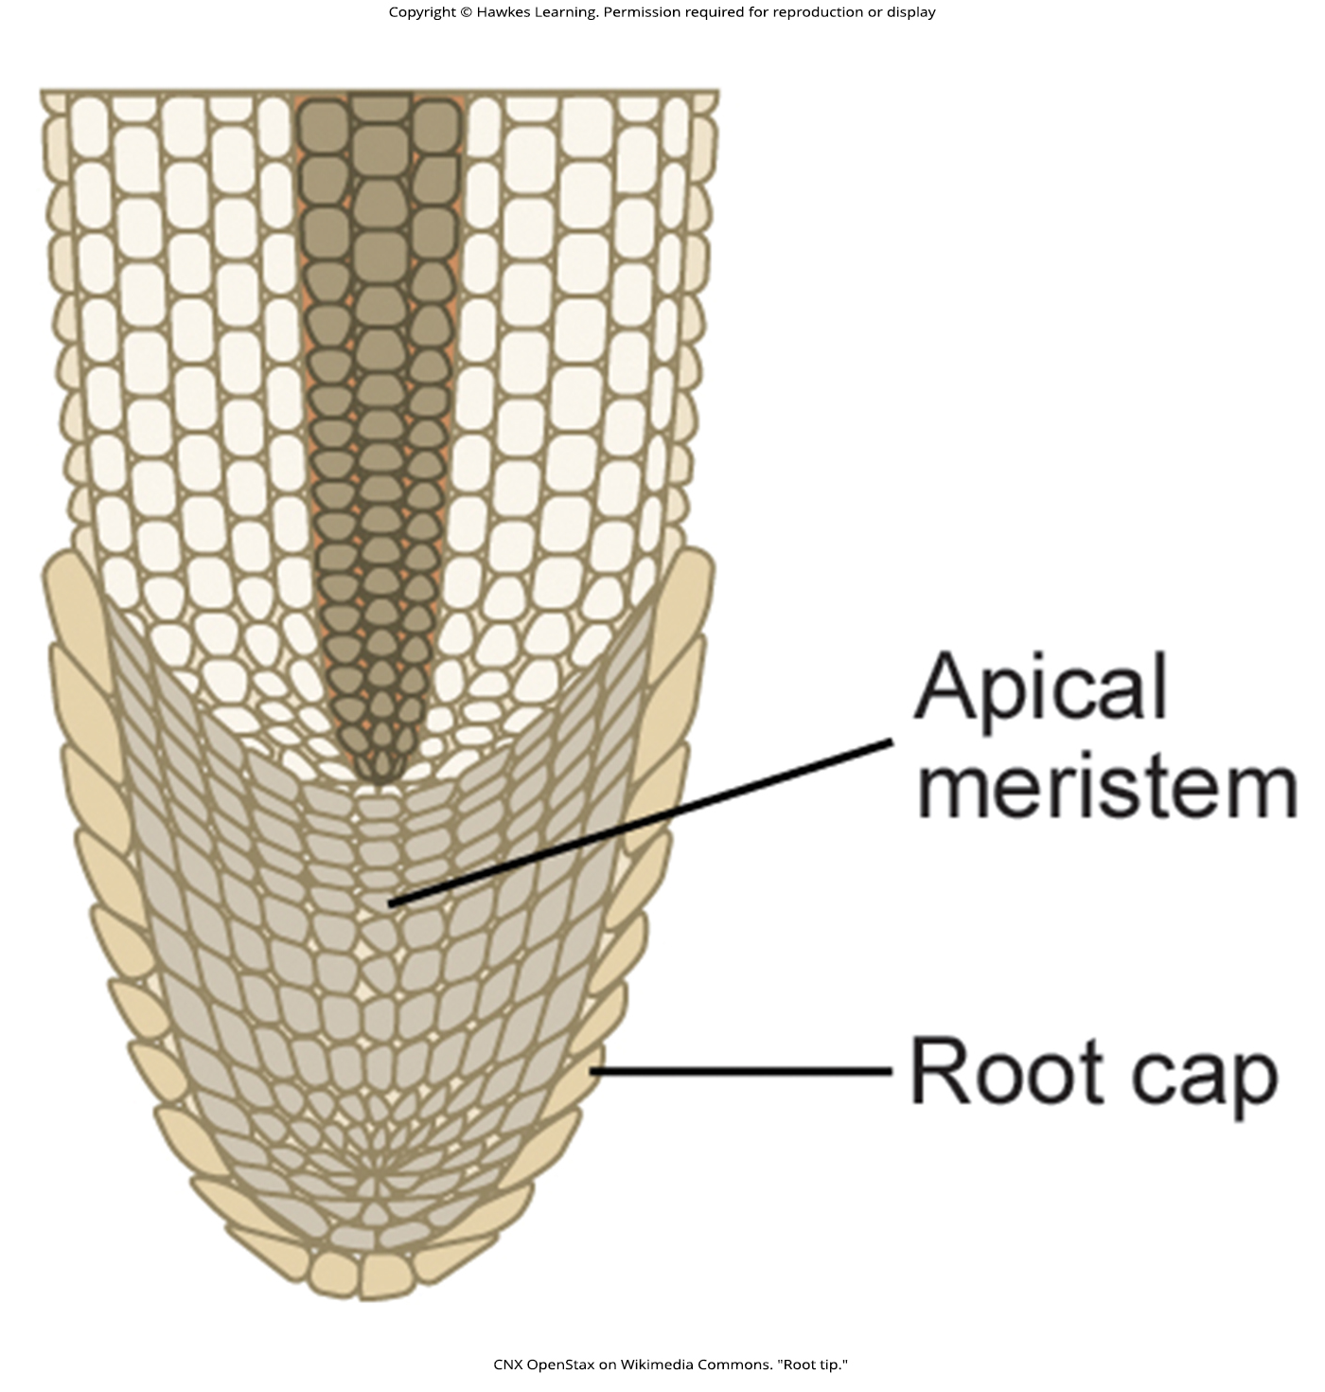
Lesson 25.1 Figure 9

Slide 11
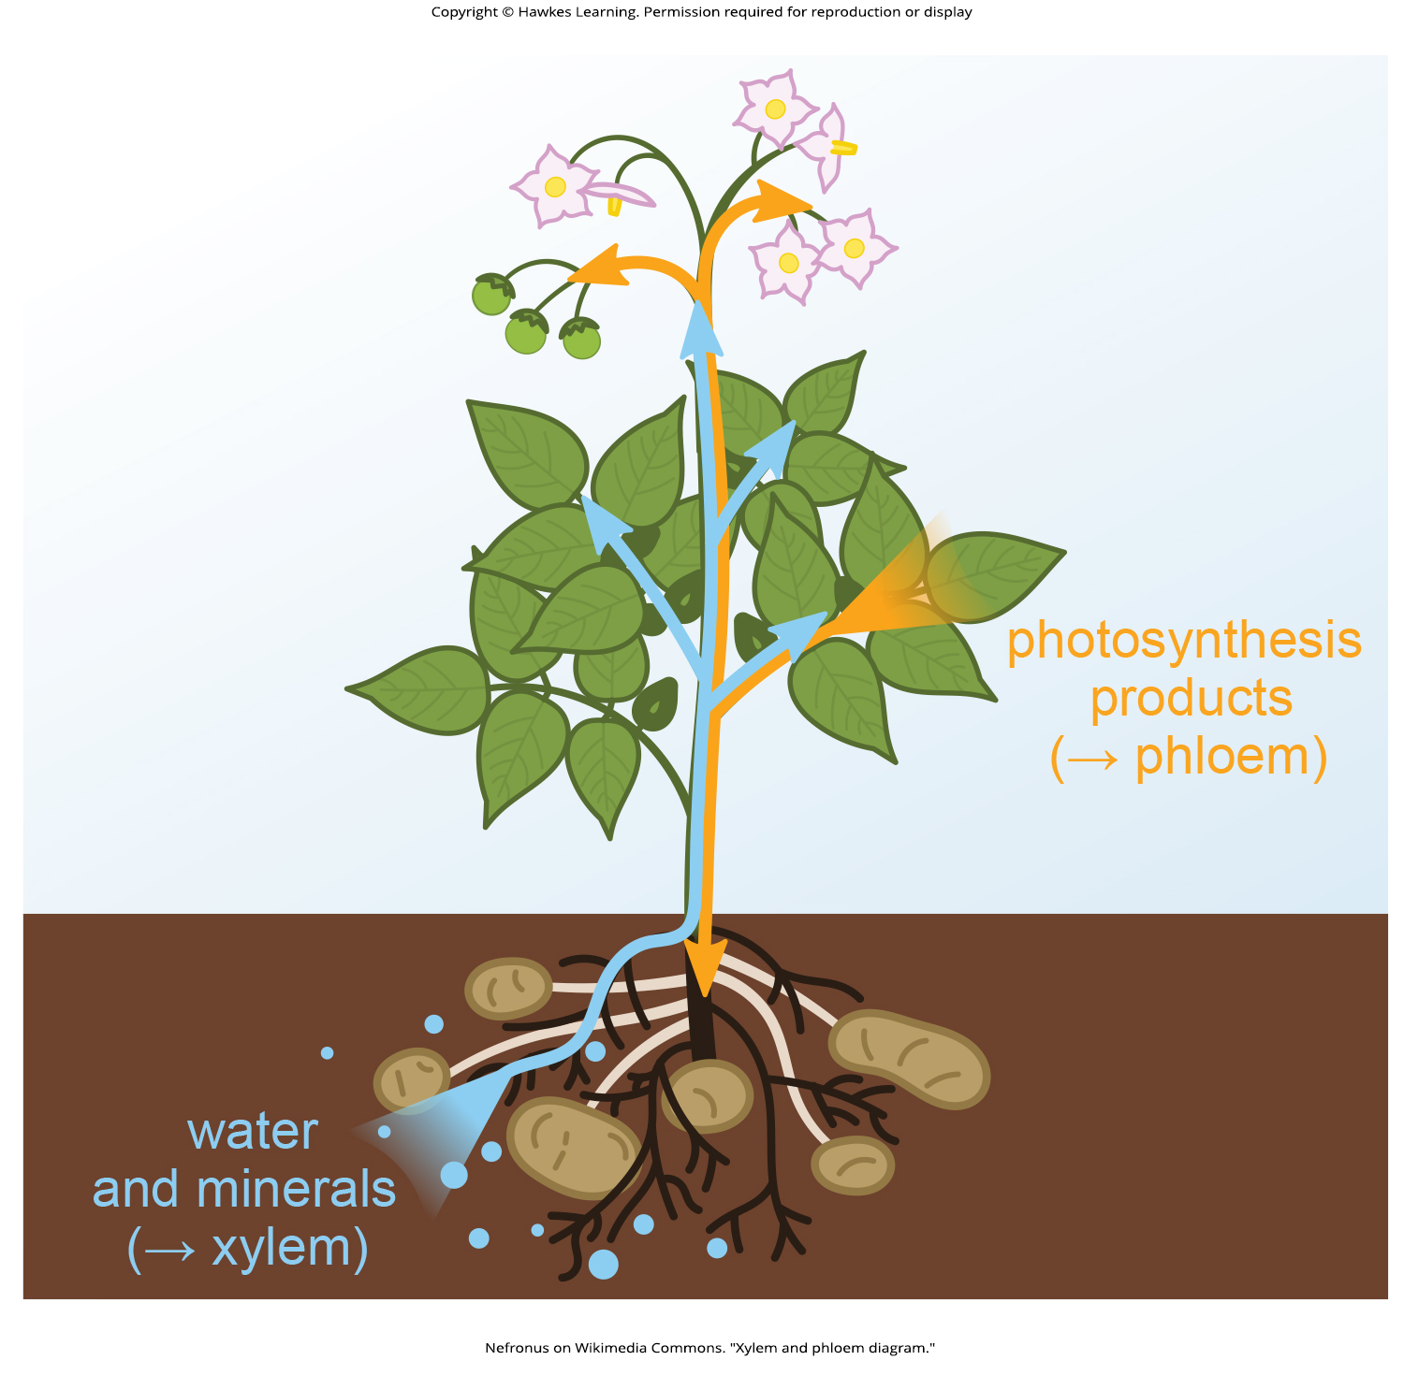
Lesson 25.1 Figure 10

Slide 12
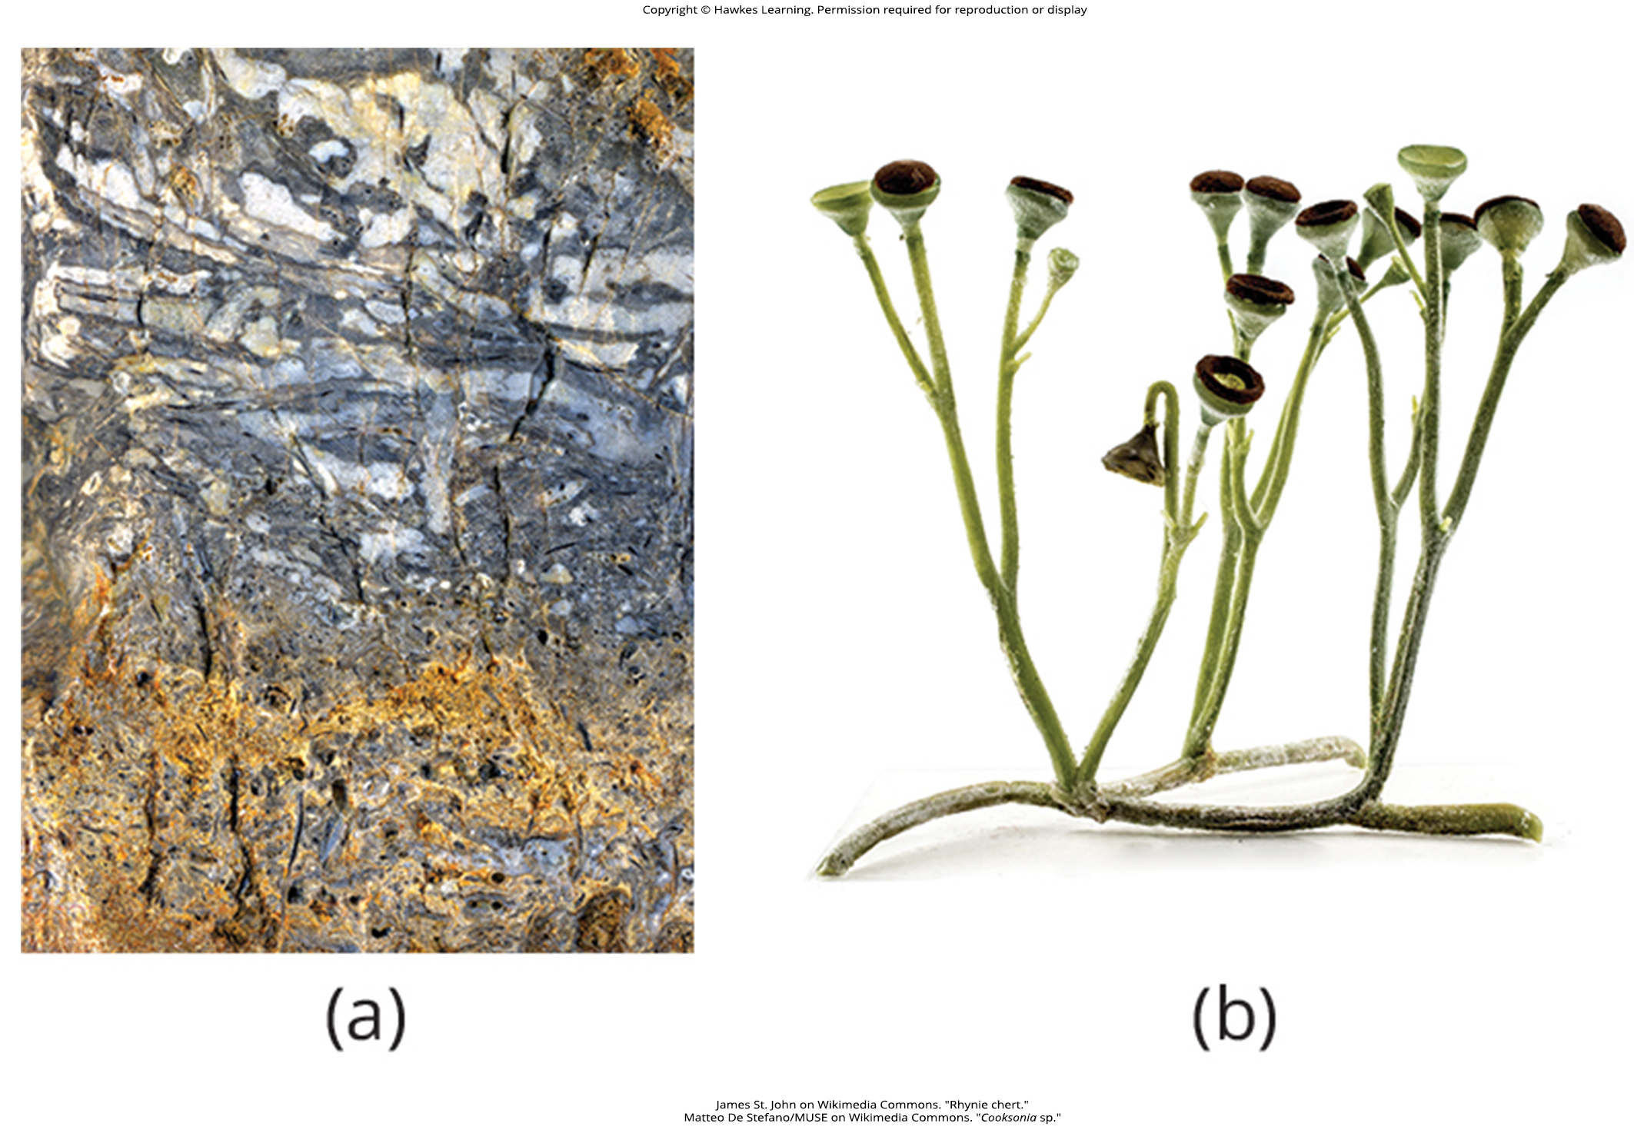
Lesson 25.1 Figure 11

Slide 13
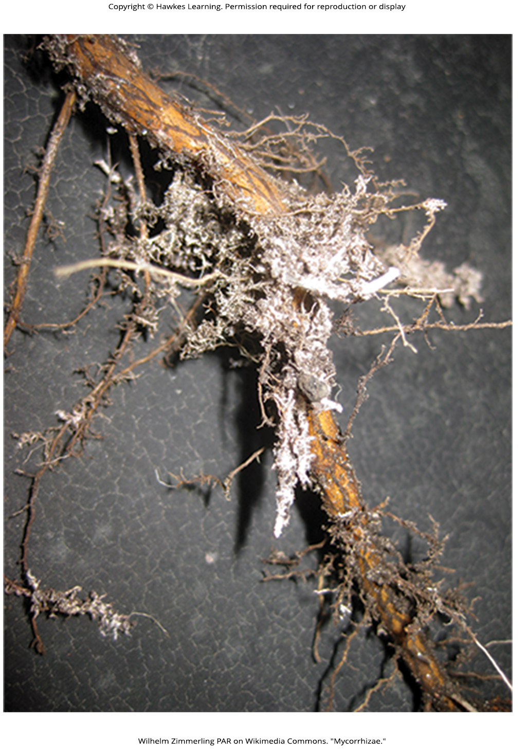
Lesson 25.1 Figure 12

Slide 14
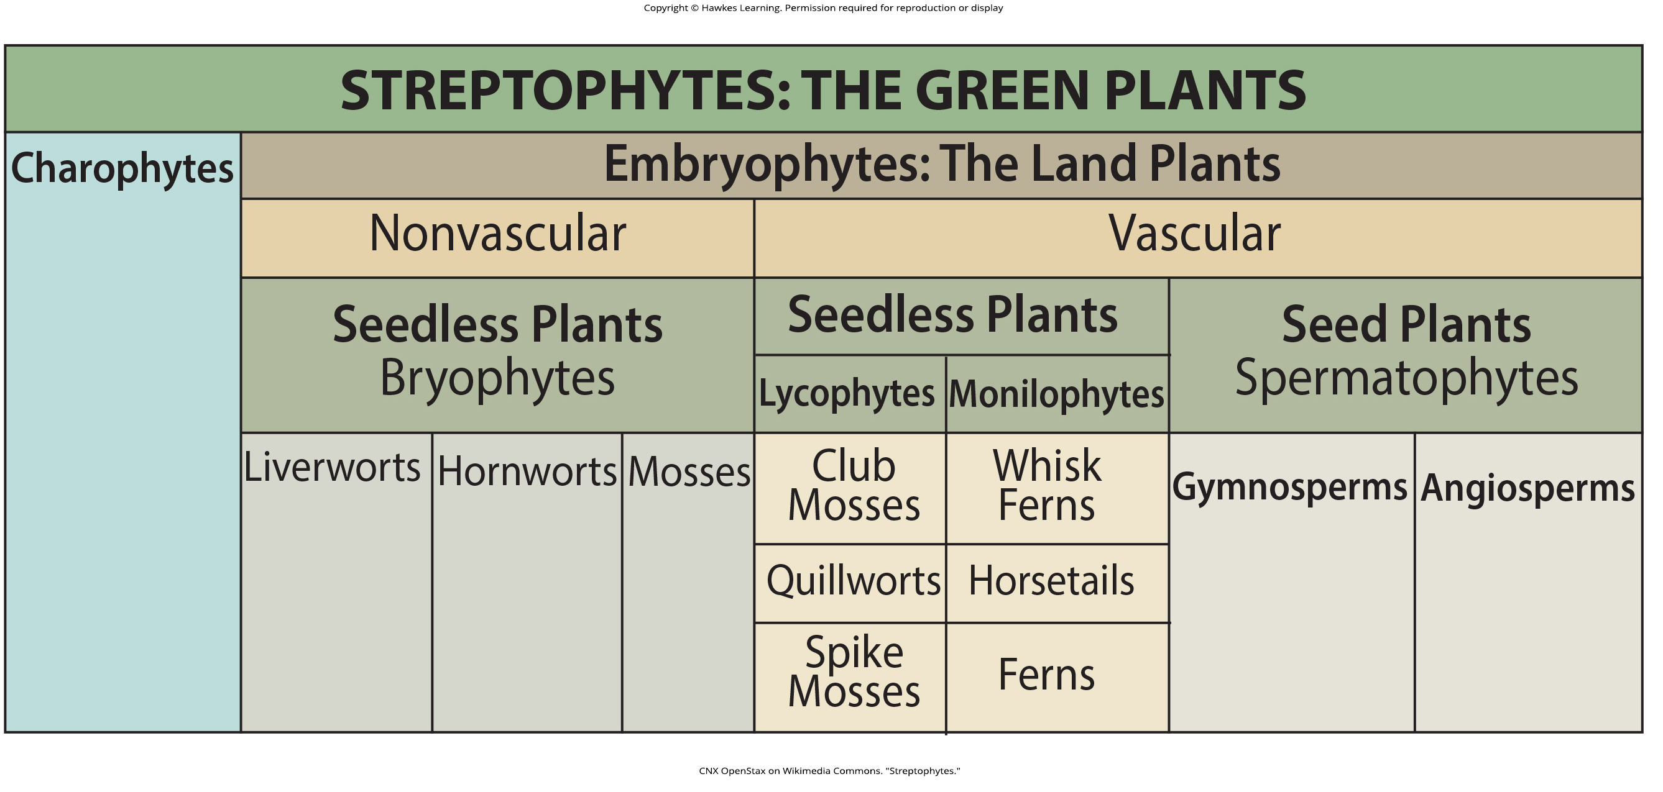
Lesson 25.1 Figure 13

Slide 15
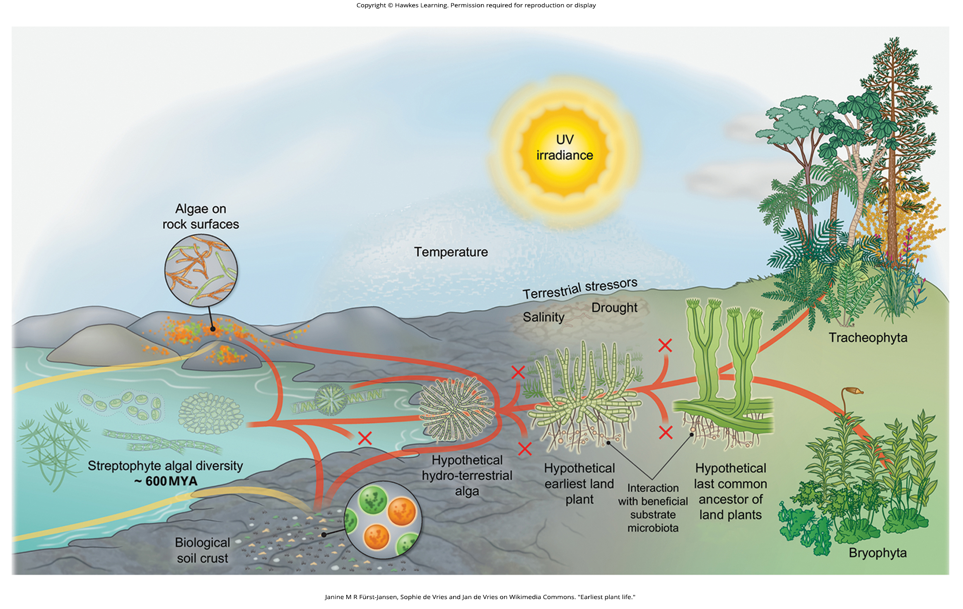
Lesson 25.2 Figure 1

Slide 16
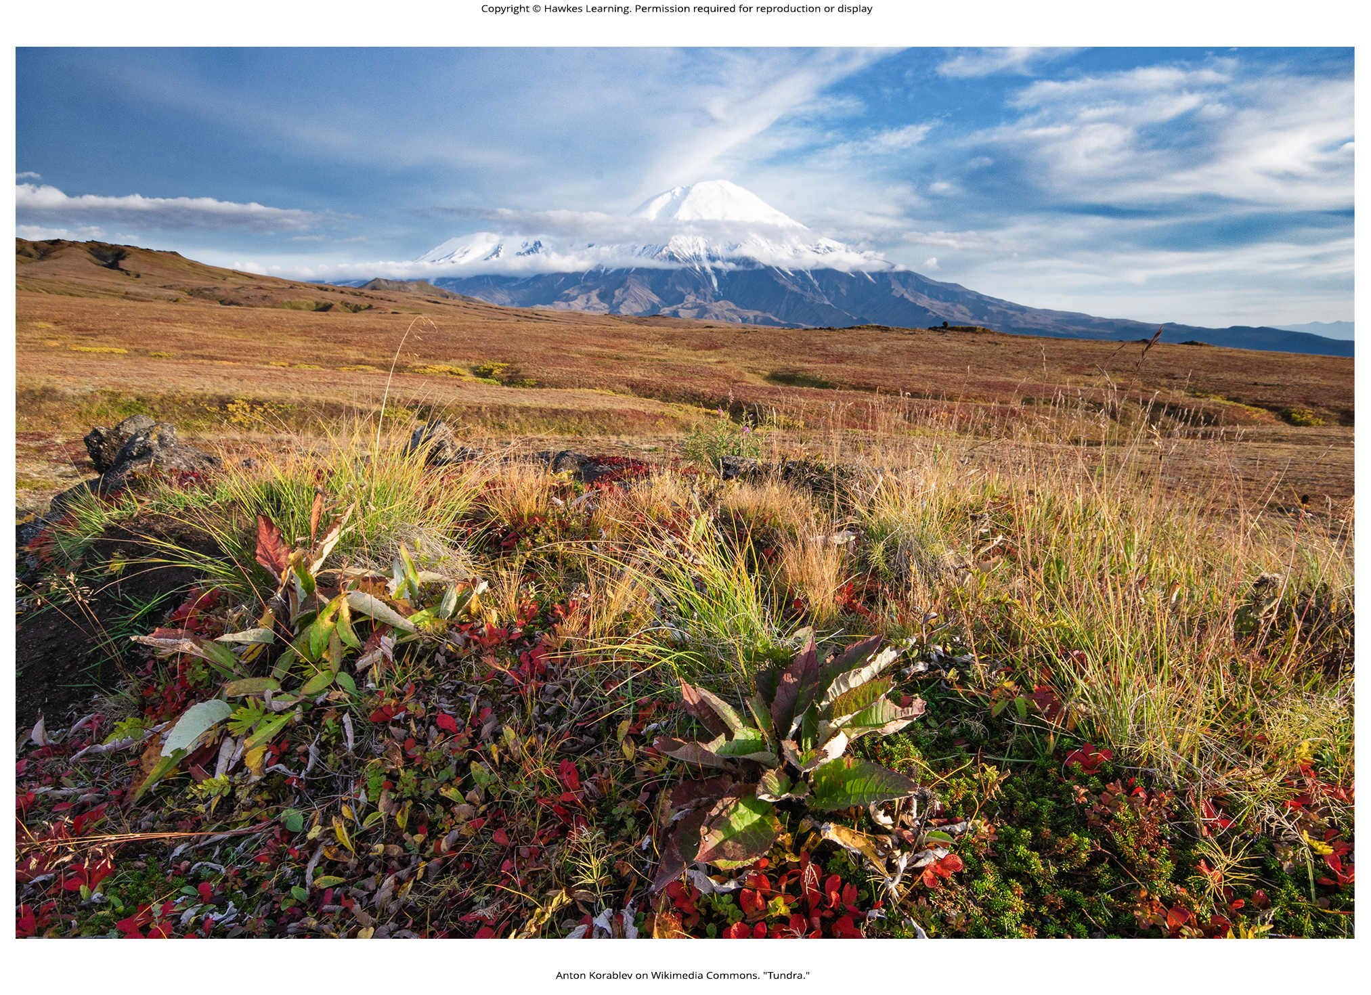
Lesson 25.2 Figure 2

Slide 17
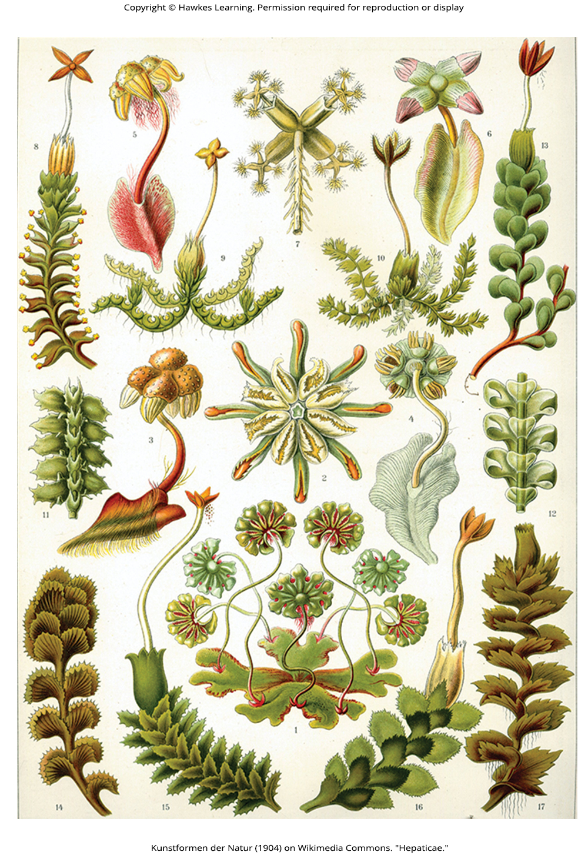
Lesson 25.2 Figure 3

Slide 18
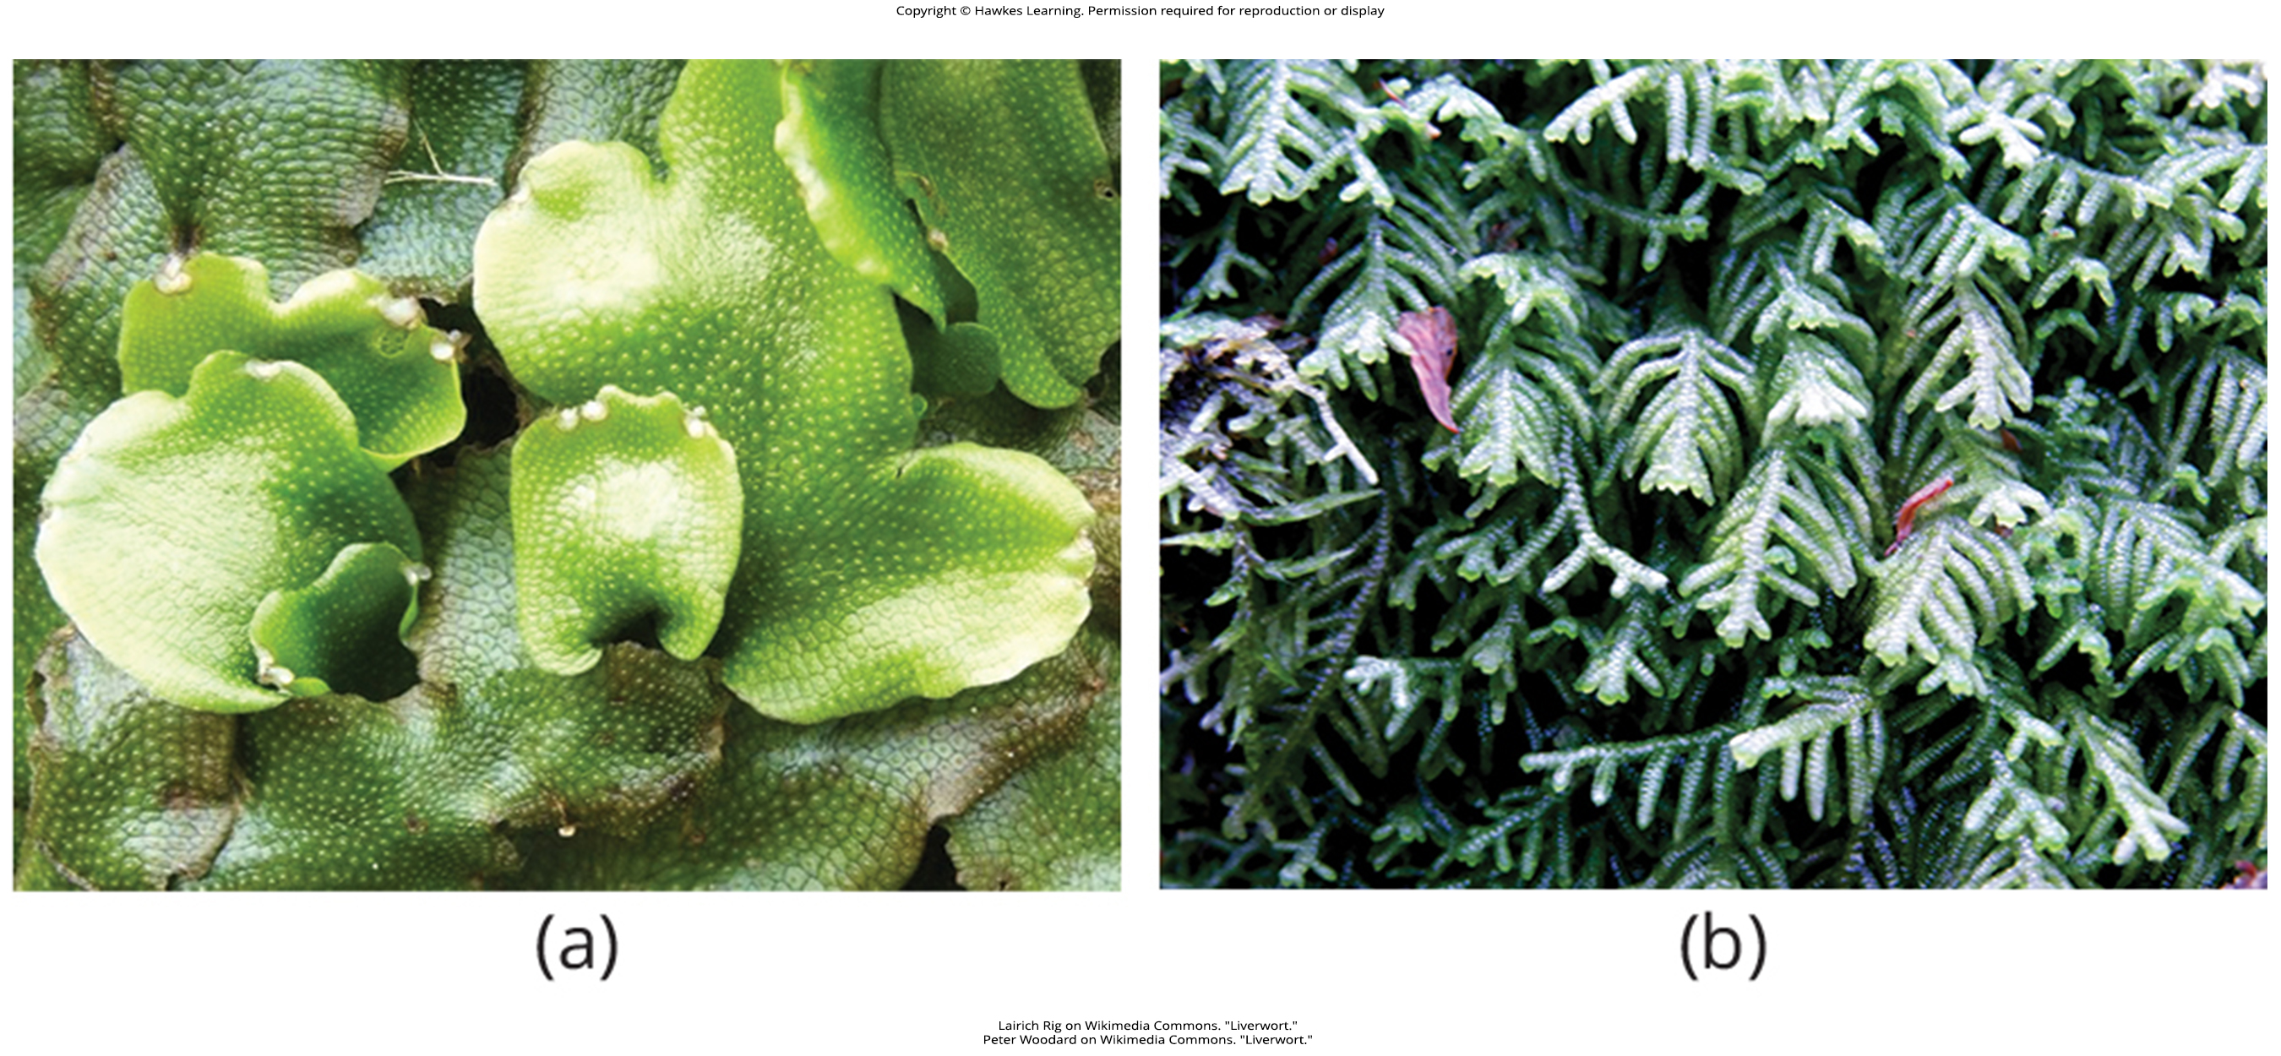
Lesson 25.2 Figure 4

Slide 19
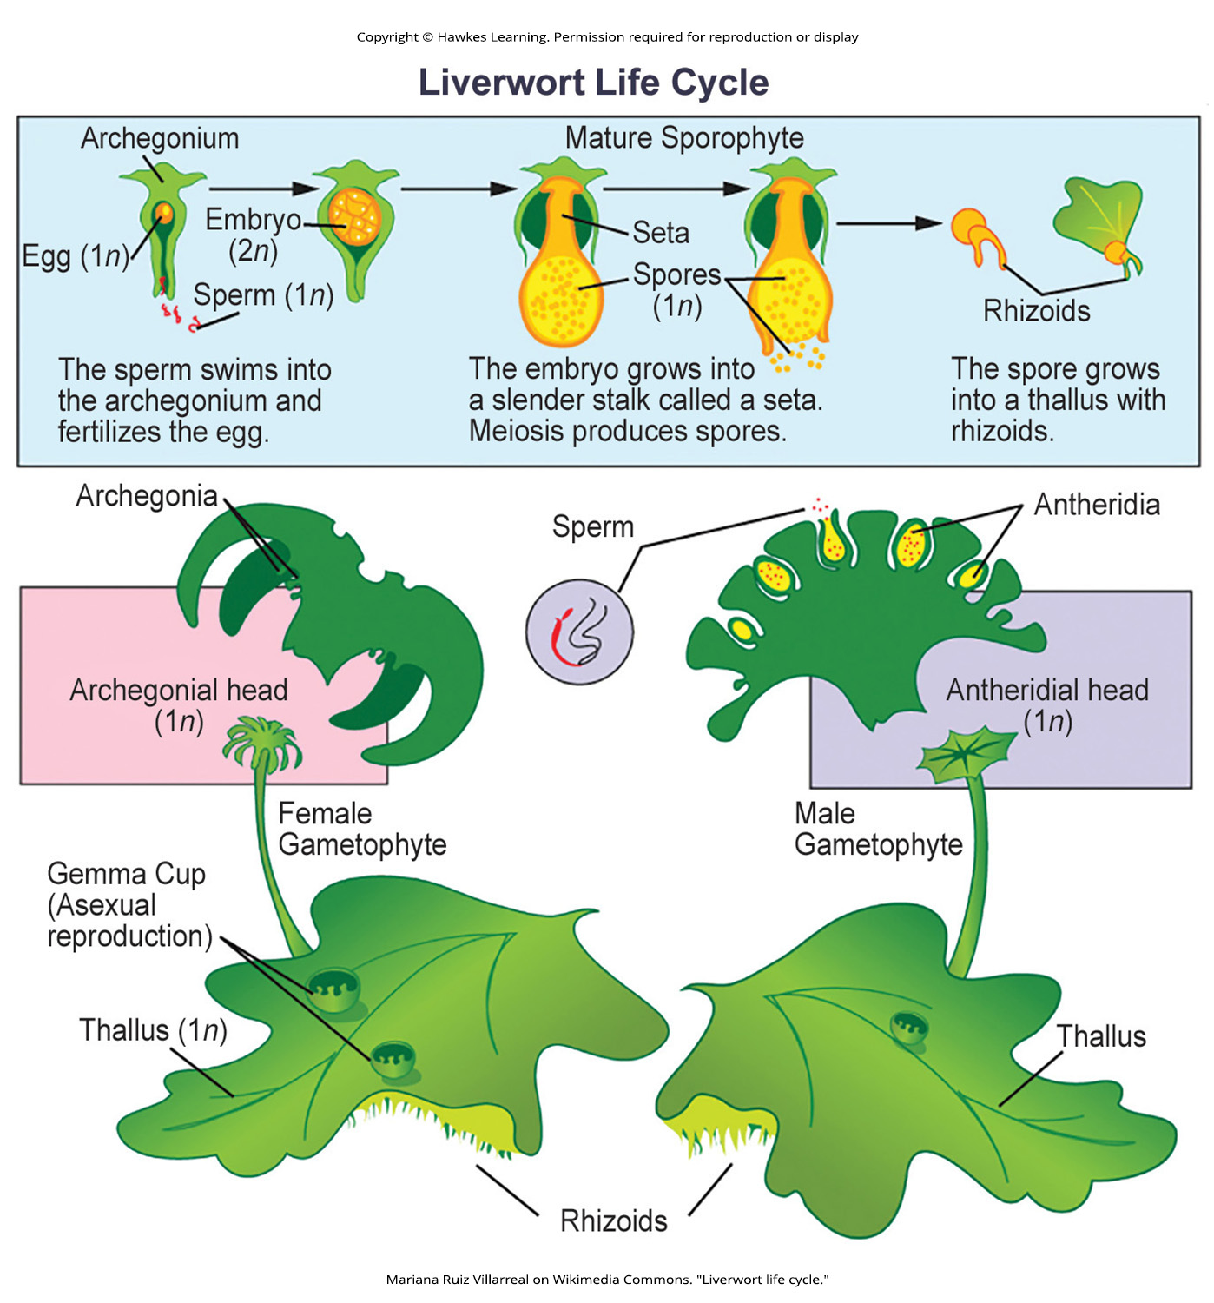
Lesson 25.2 Figure 5

Slide 20
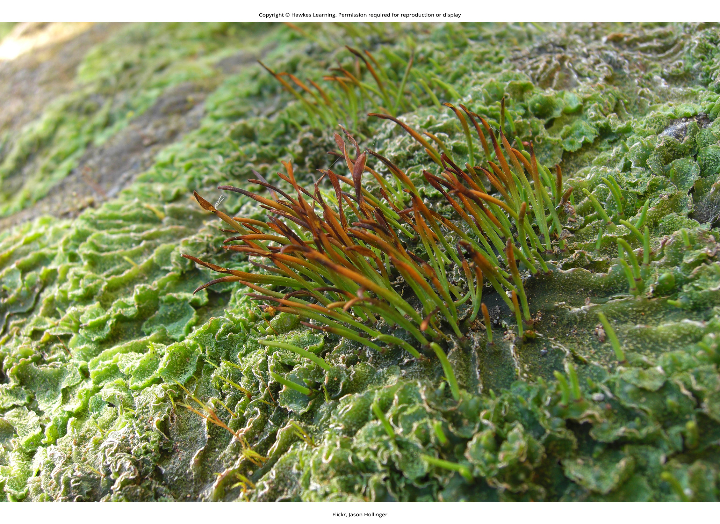
Lesson 25.2 Figure 6

Slide 21
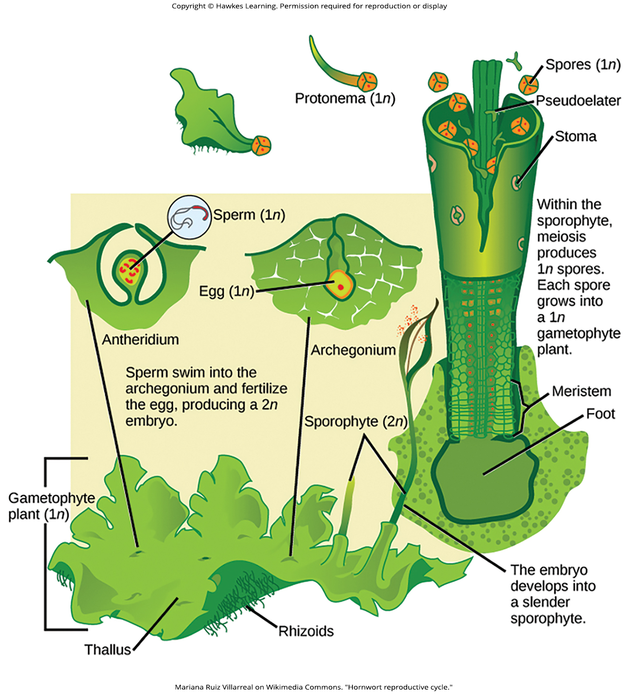
Lesson 25.2 Figure 7

Slide 22
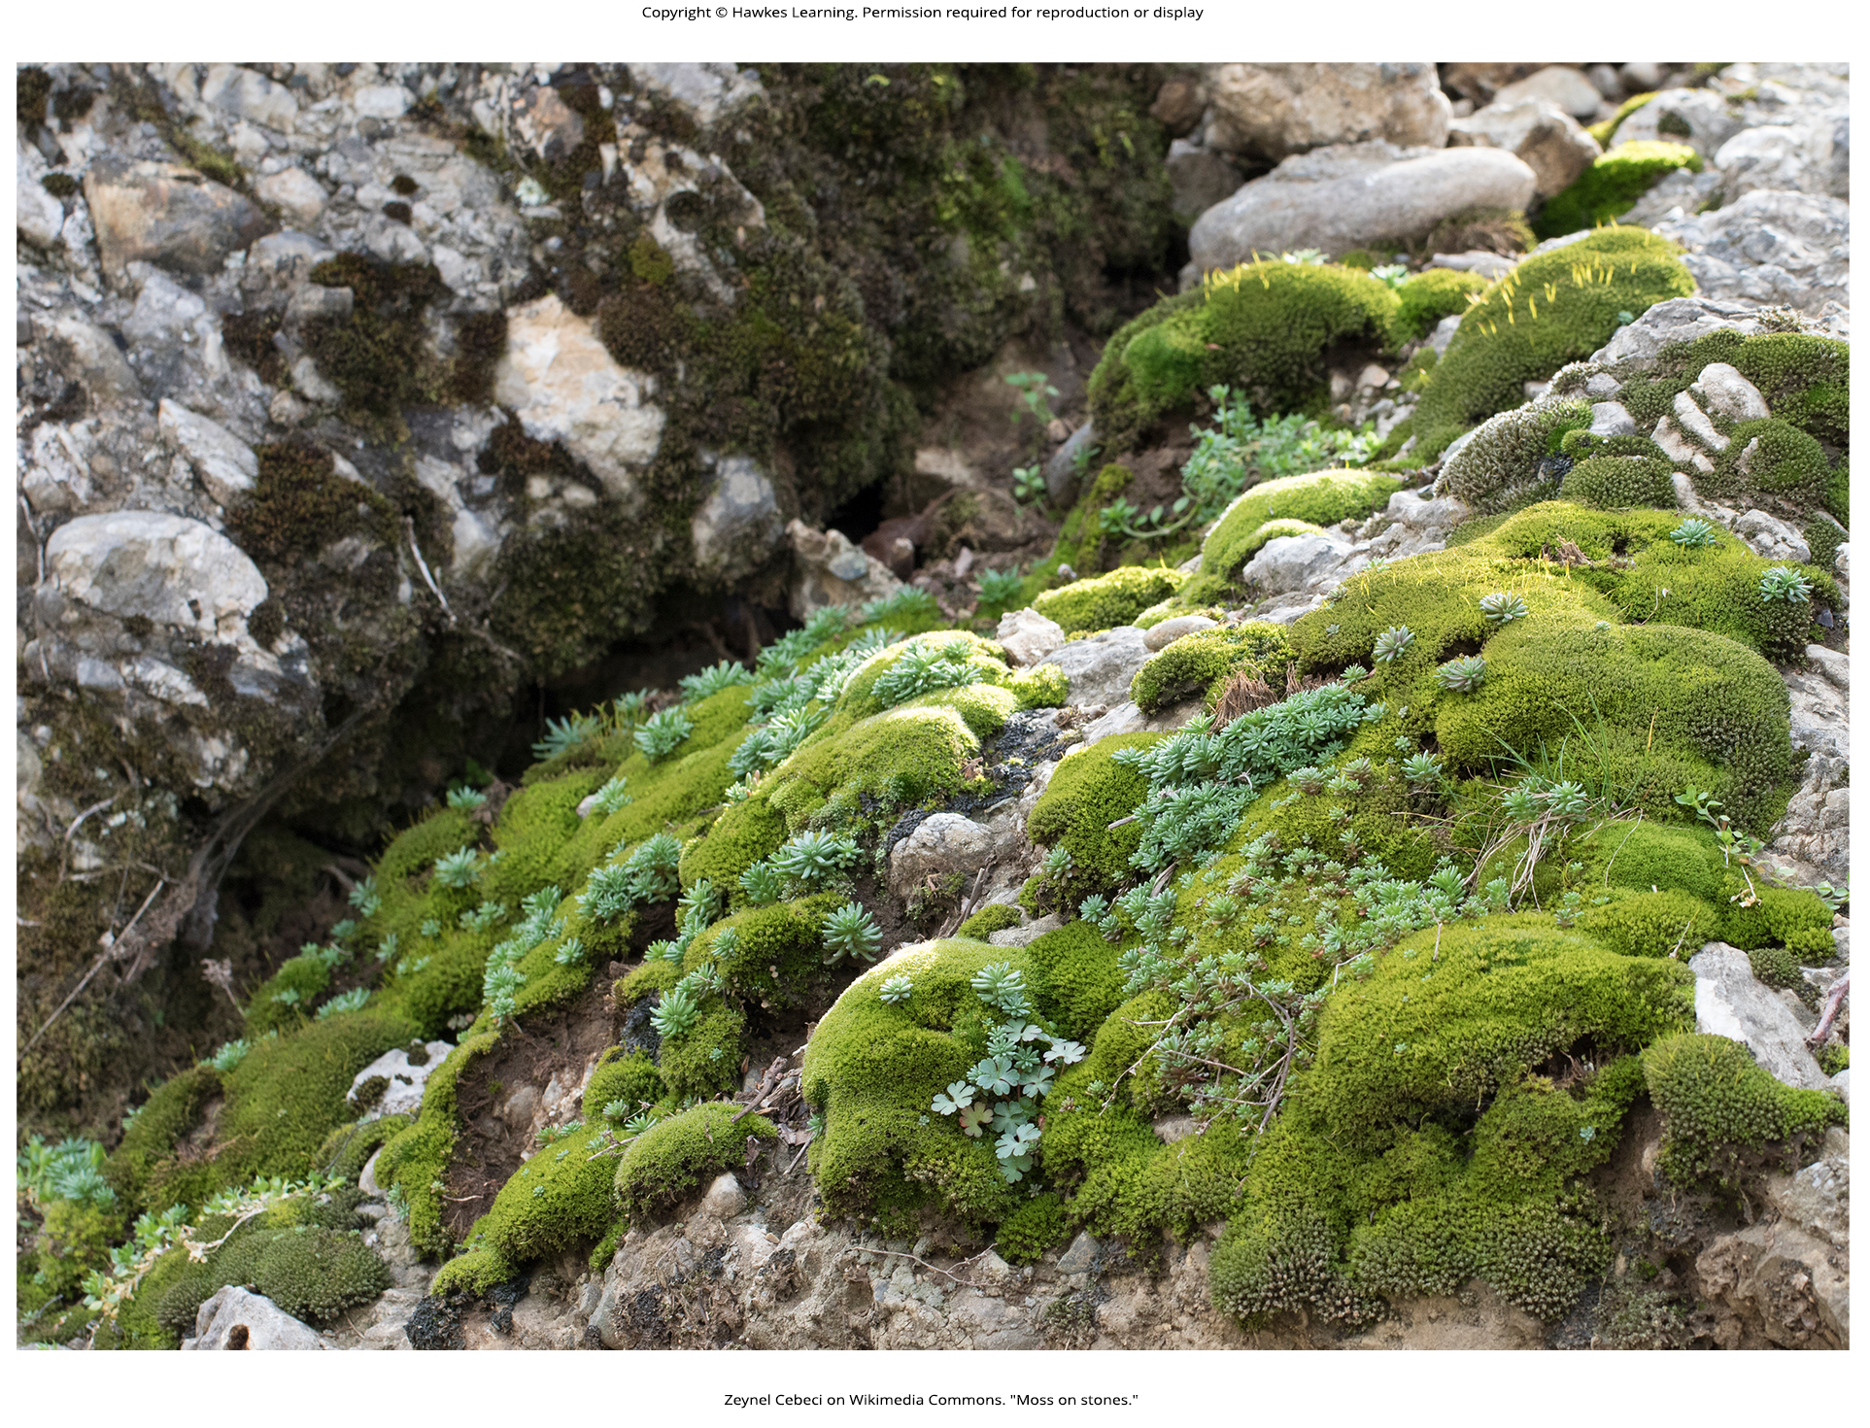
Lesson 25.2 Figure 8

Slide 23
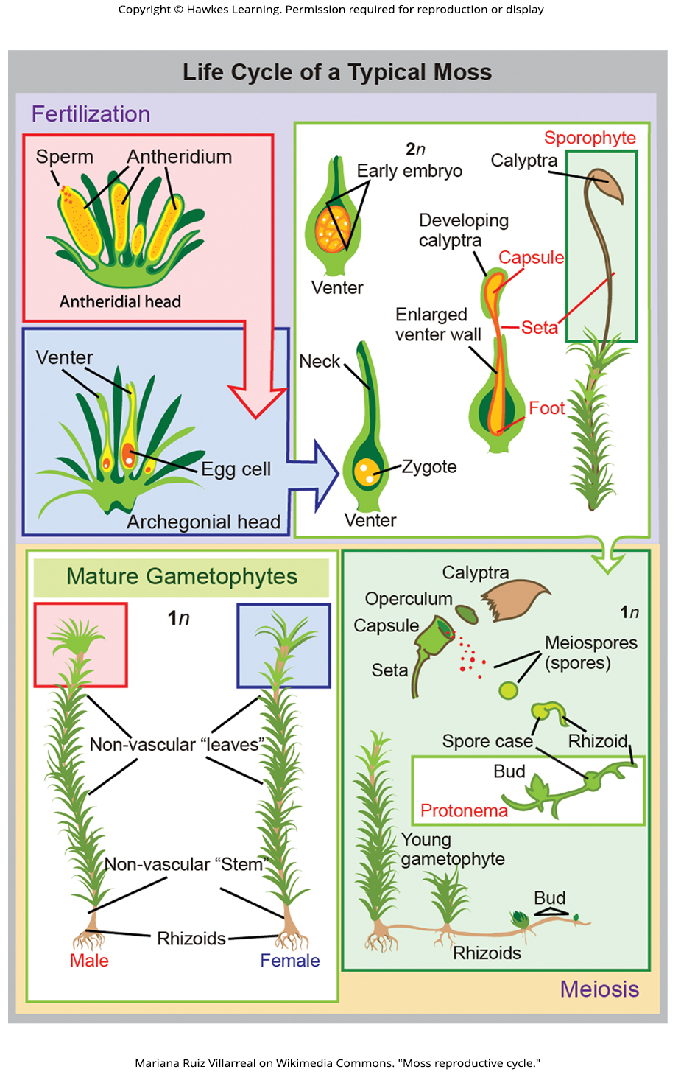
Lesson 25.2 Figure 9

Slide 24
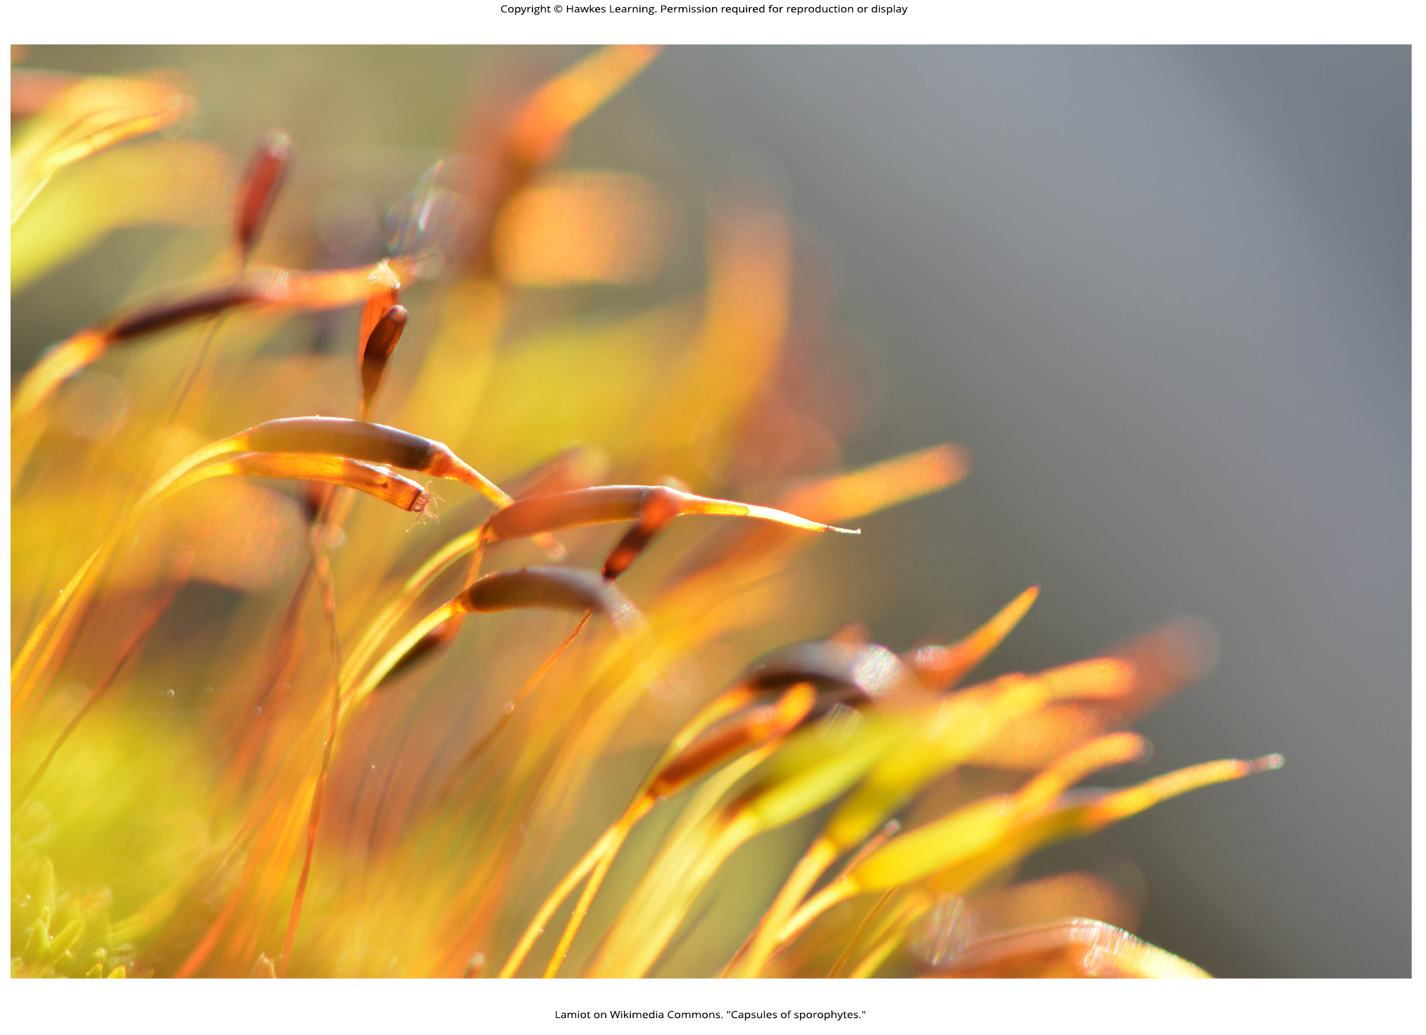
Lesson 25.2 Figure 10

Slide 25
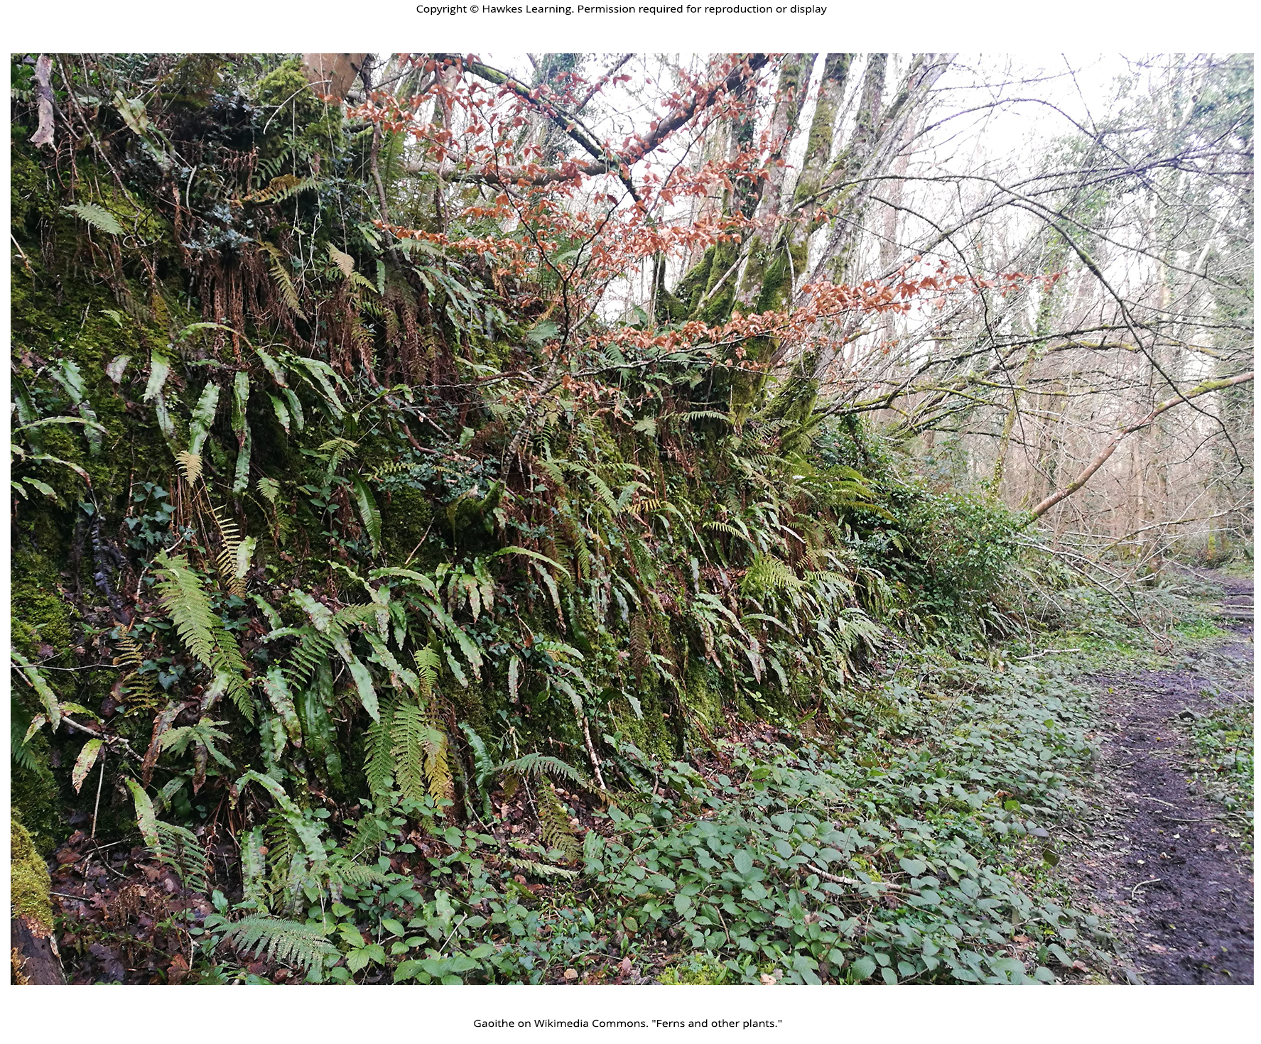
Lesson 25.3 Figure 1

Slide 26
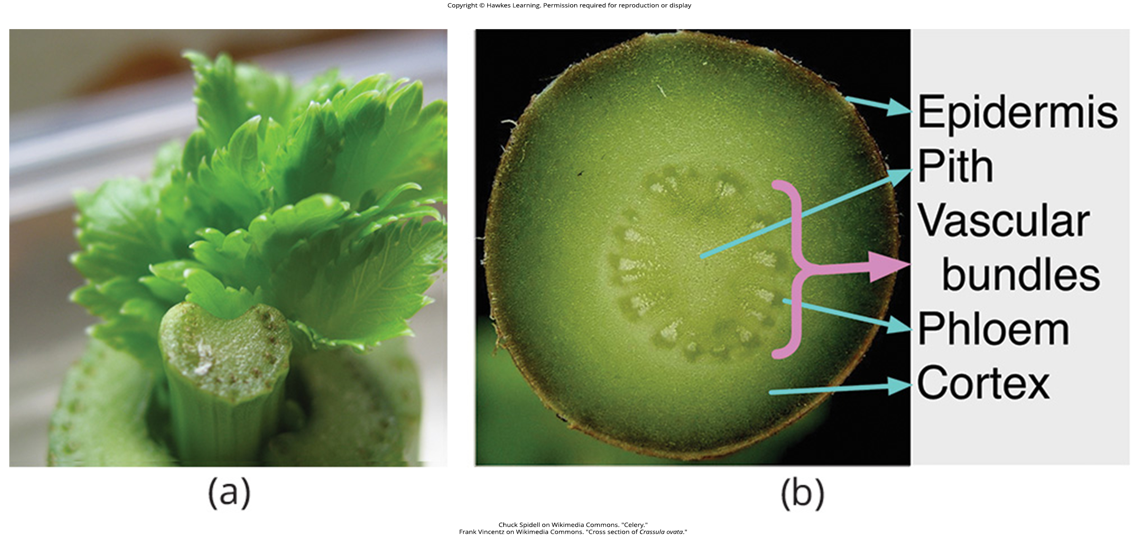
Lesson 25.3 Figure 2

Slide 27
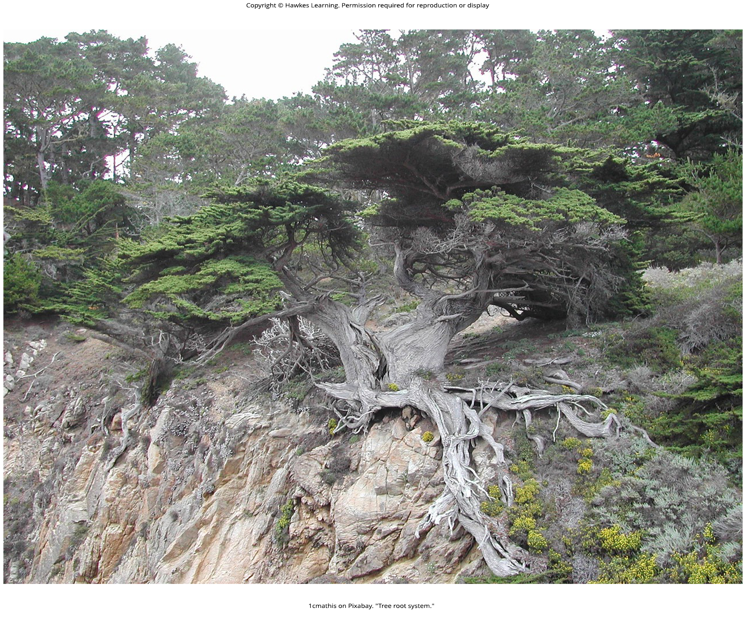
Lesson 25.3 Figure 3

Slide 28
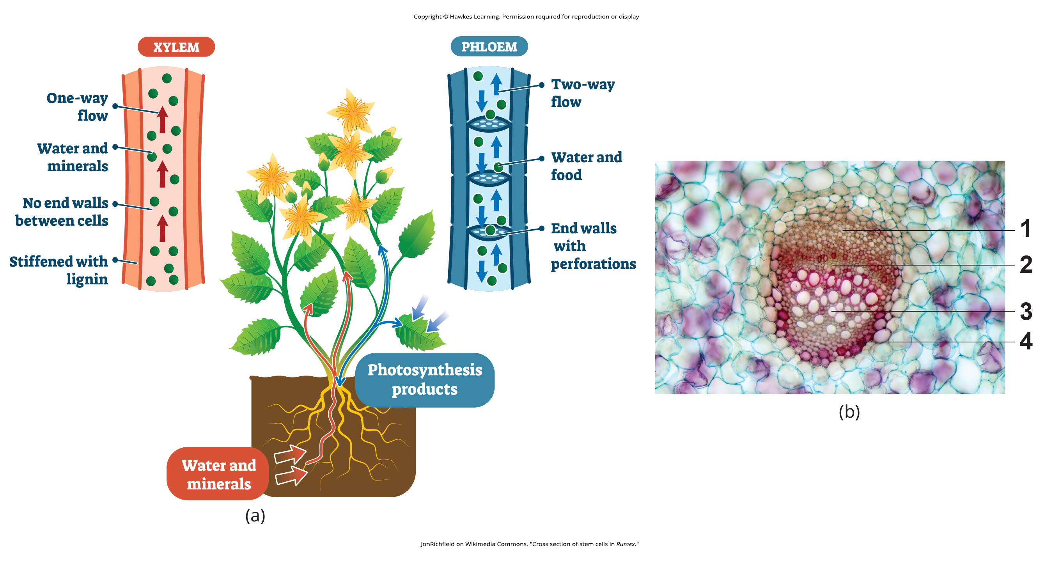
Lesson 25.3 Figure 4

Slide 29
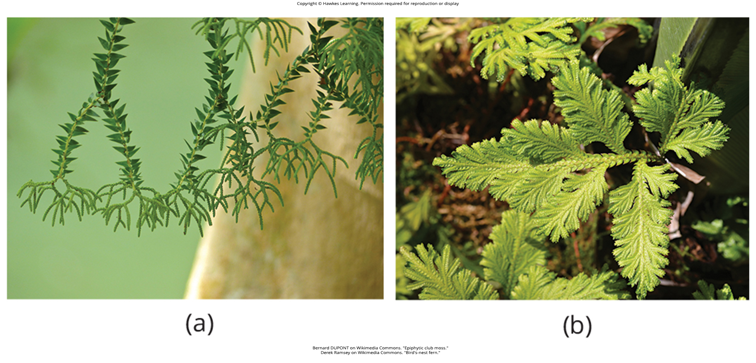
Lesson 25.3 Figure 5

Slide 30
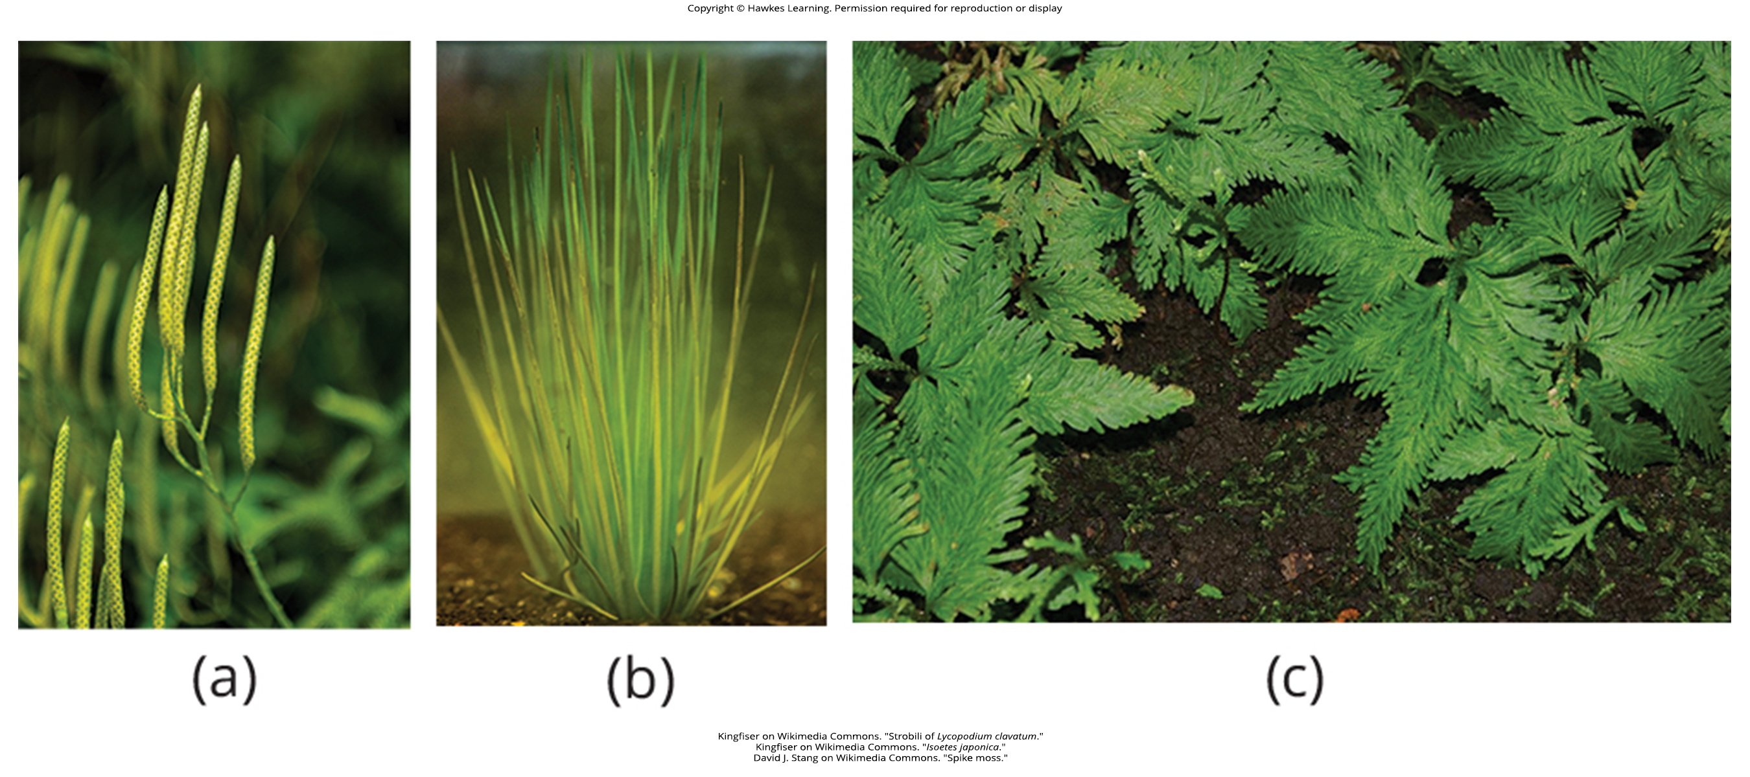
Lesson 25.3 Figure 6

Slide 31
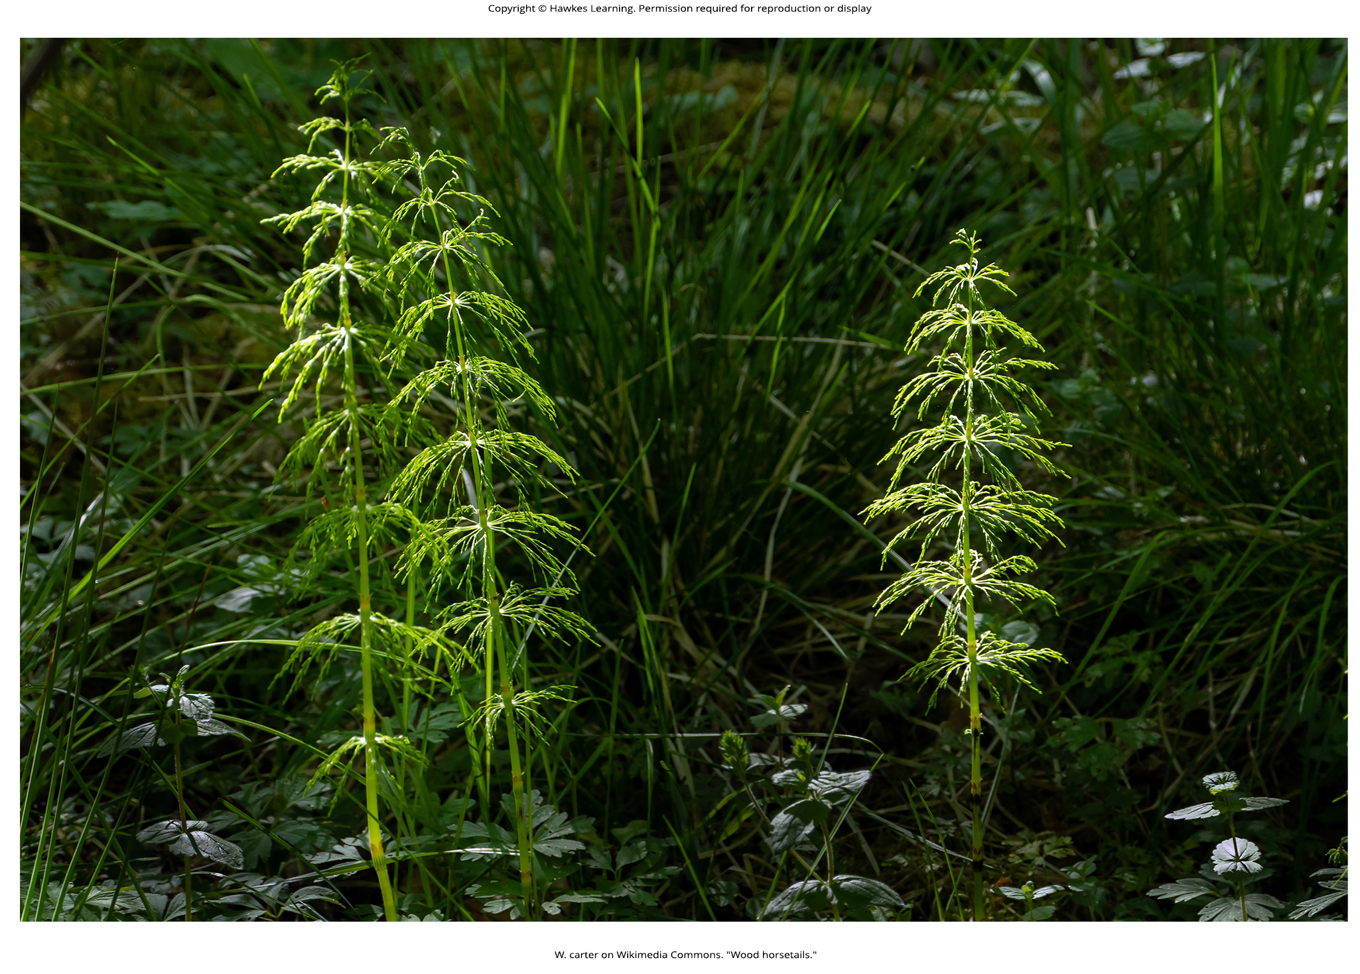
Lesson 25.3 Figure 7

Slide 32
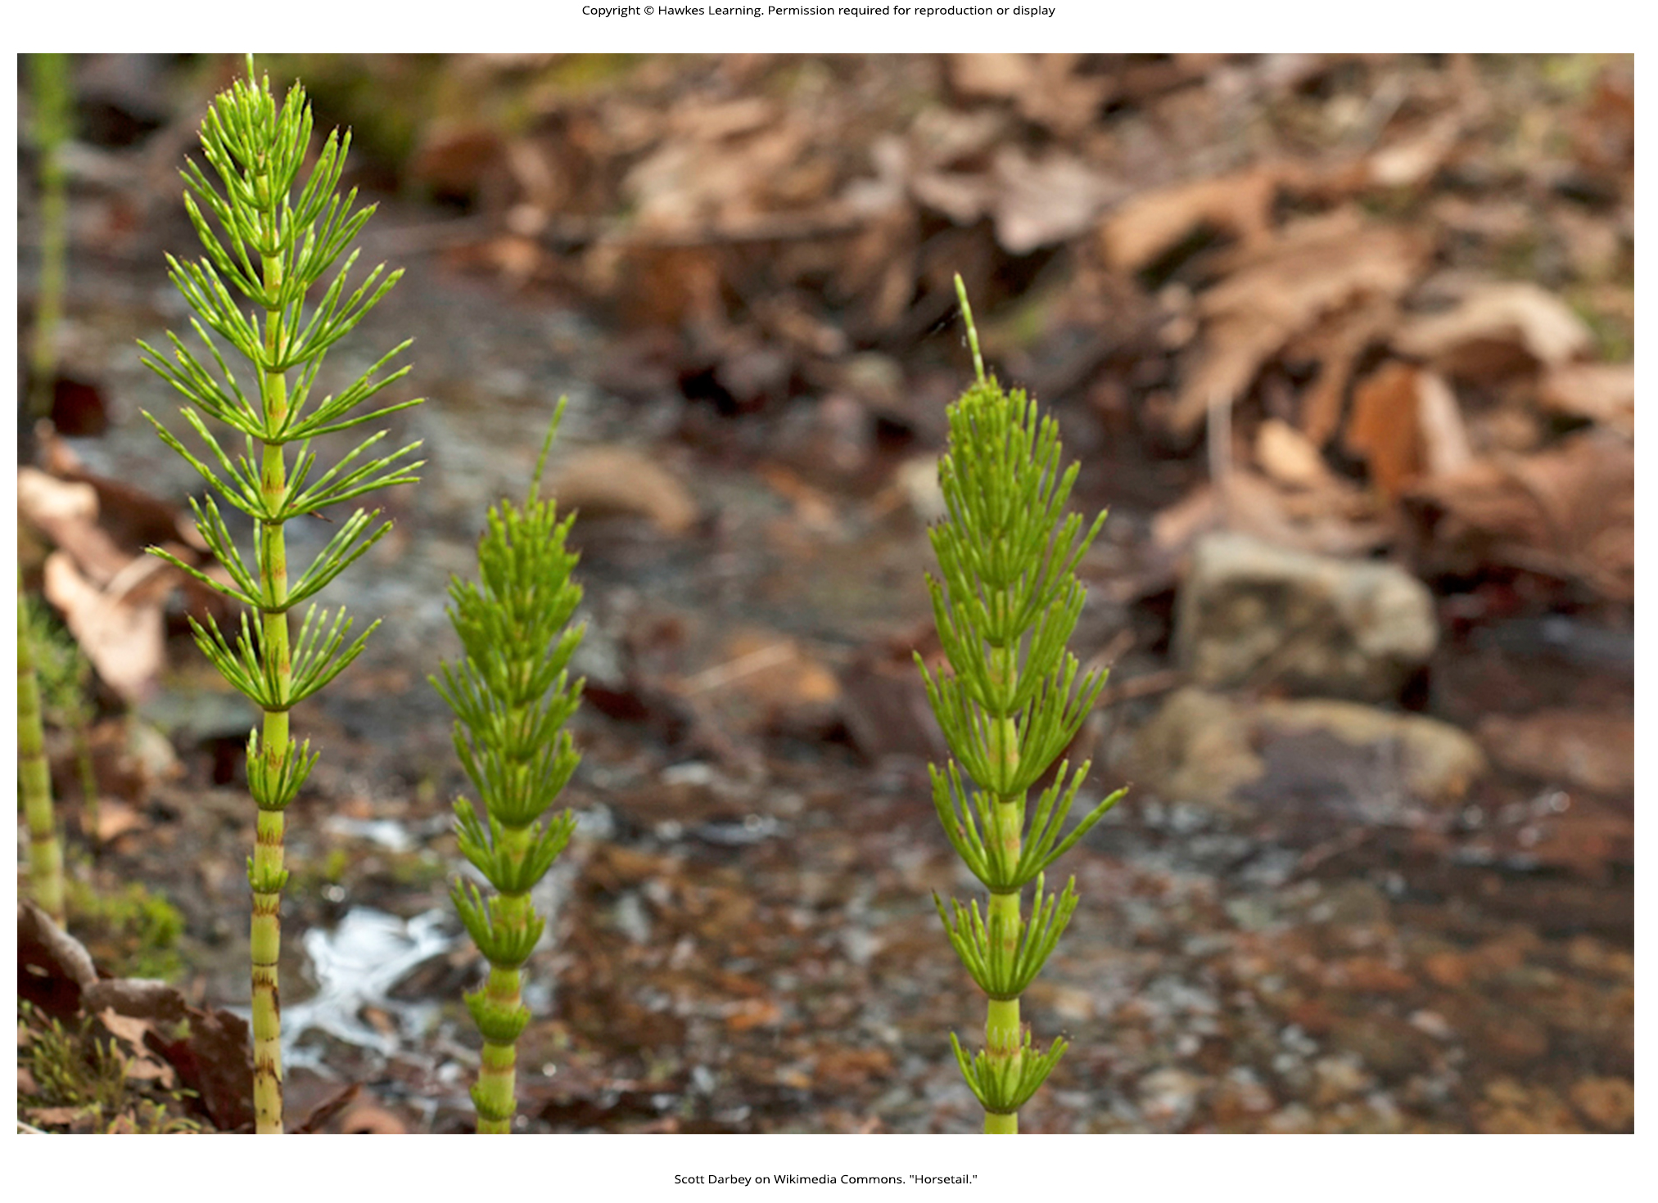
Lesson 25.3 Figure 8

Slide 33
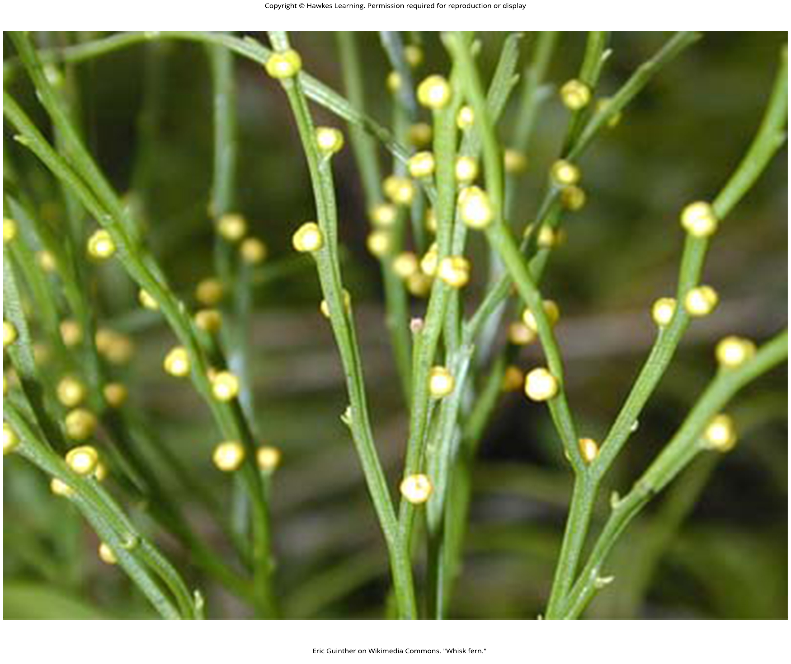
Lesson 25.3 Figure 9

Slide 34
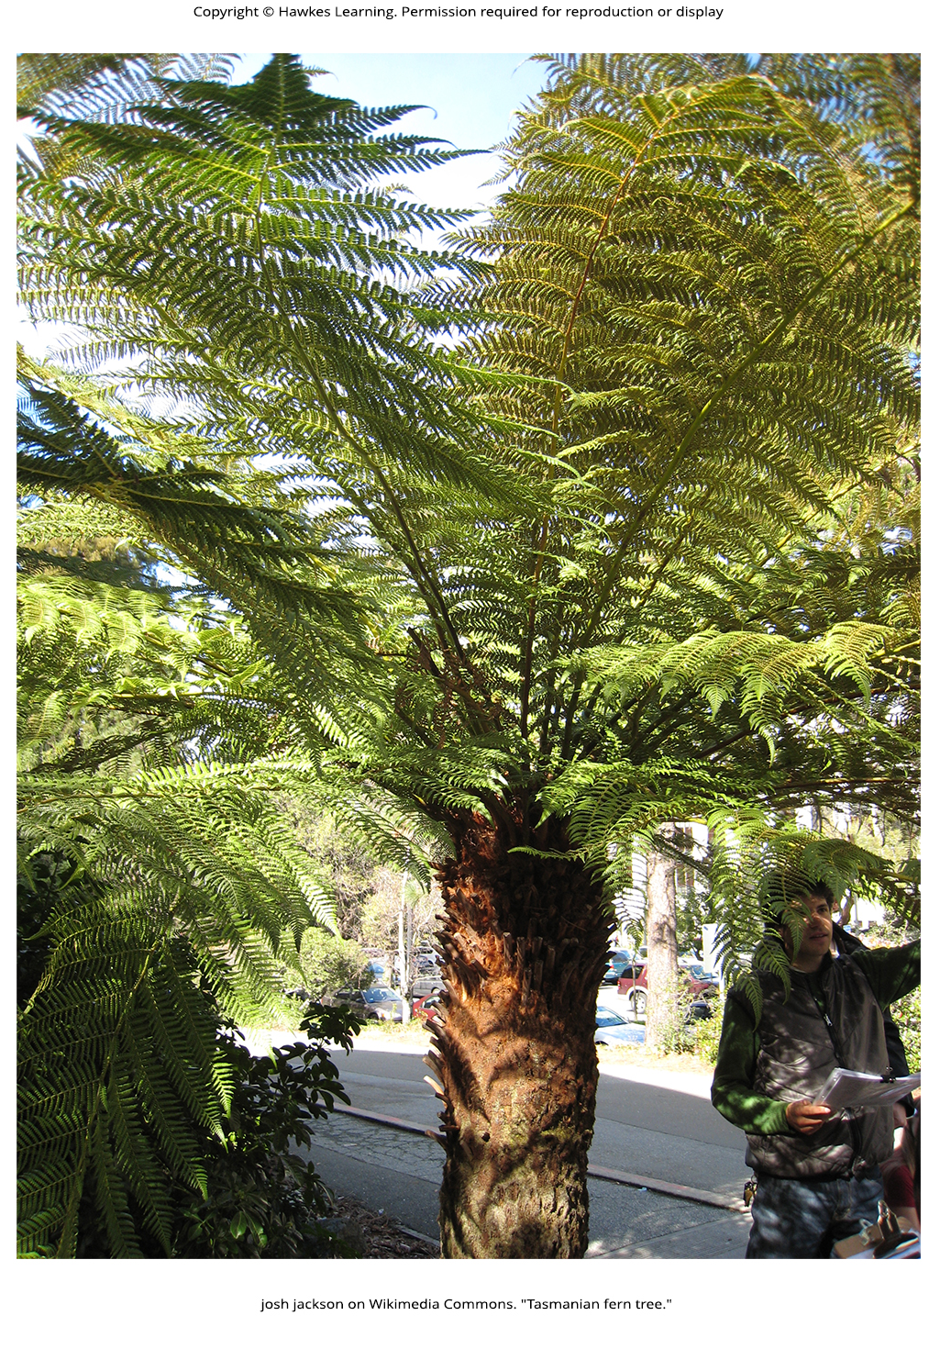
Lesson 25.3 Figure 10

Slide 35
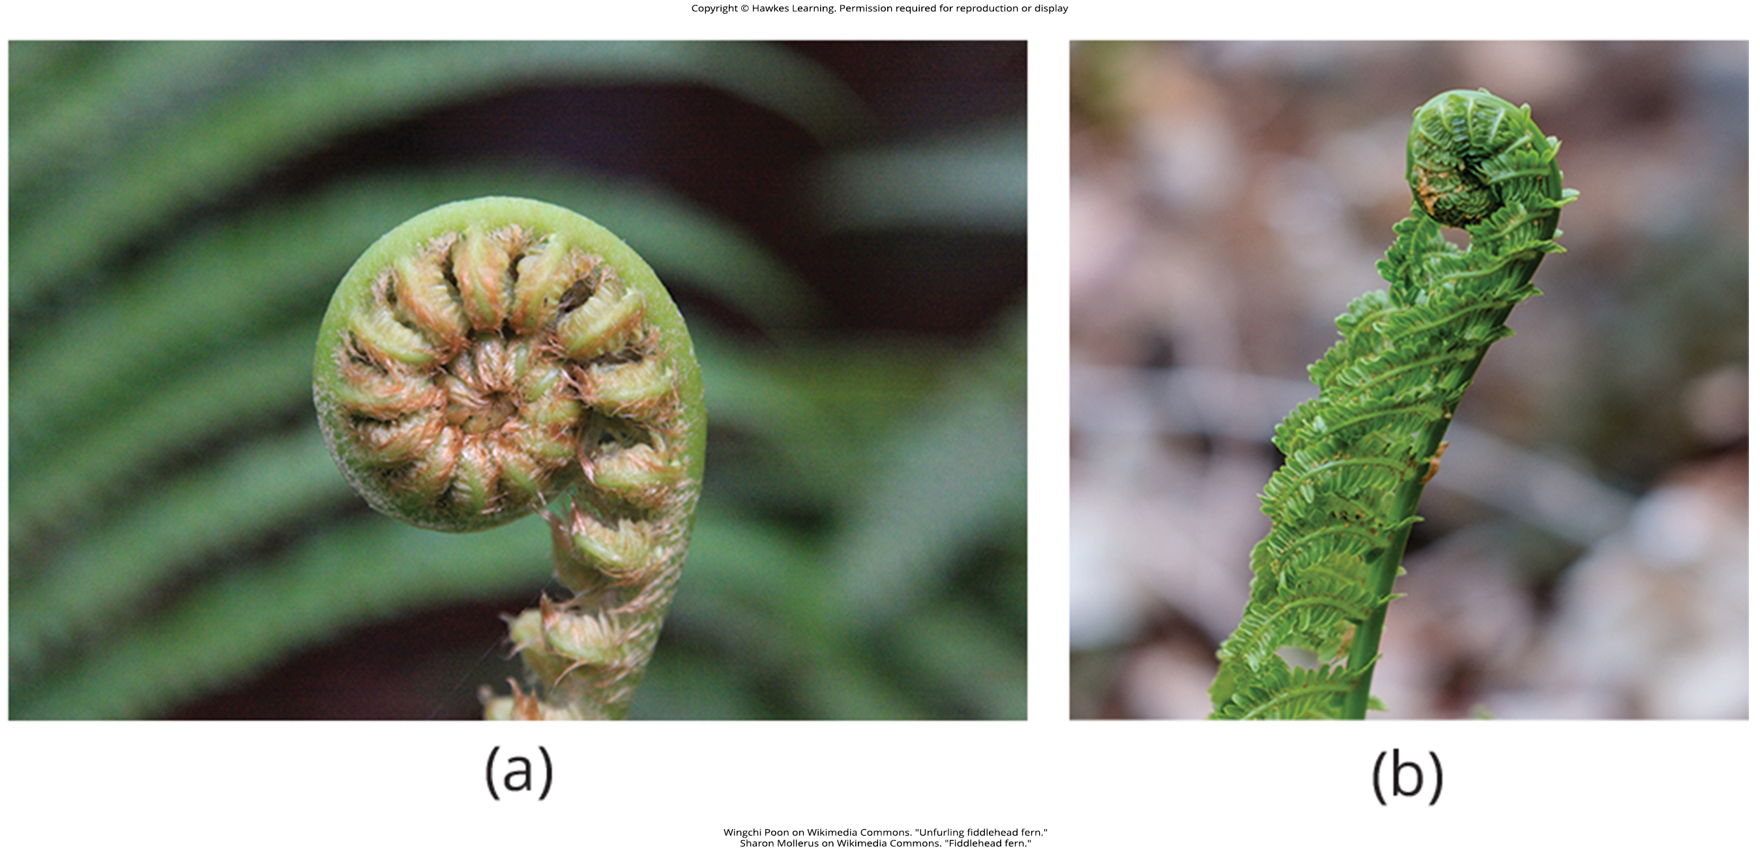
Lesson 25.3 Figure 11

Slide 36
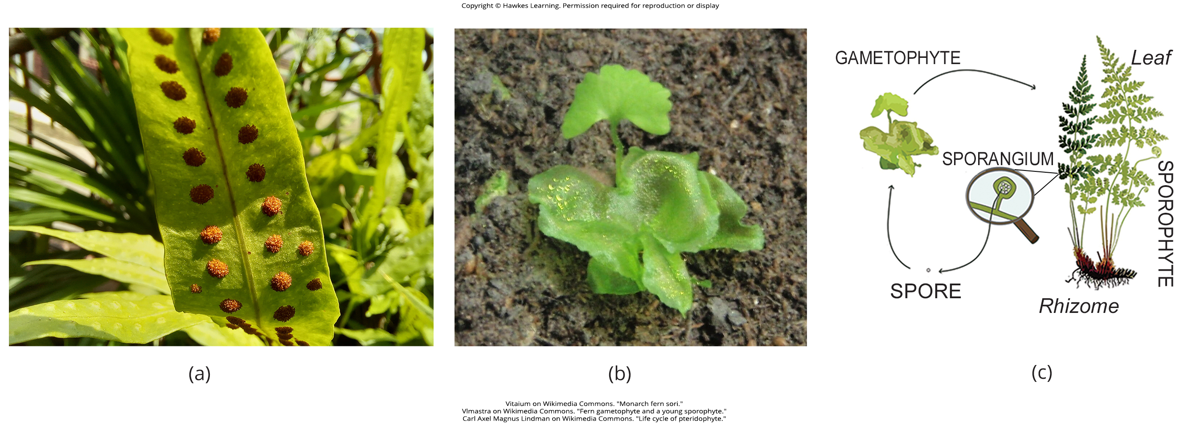
Lesson 25.3 Figure 12

Slide 37
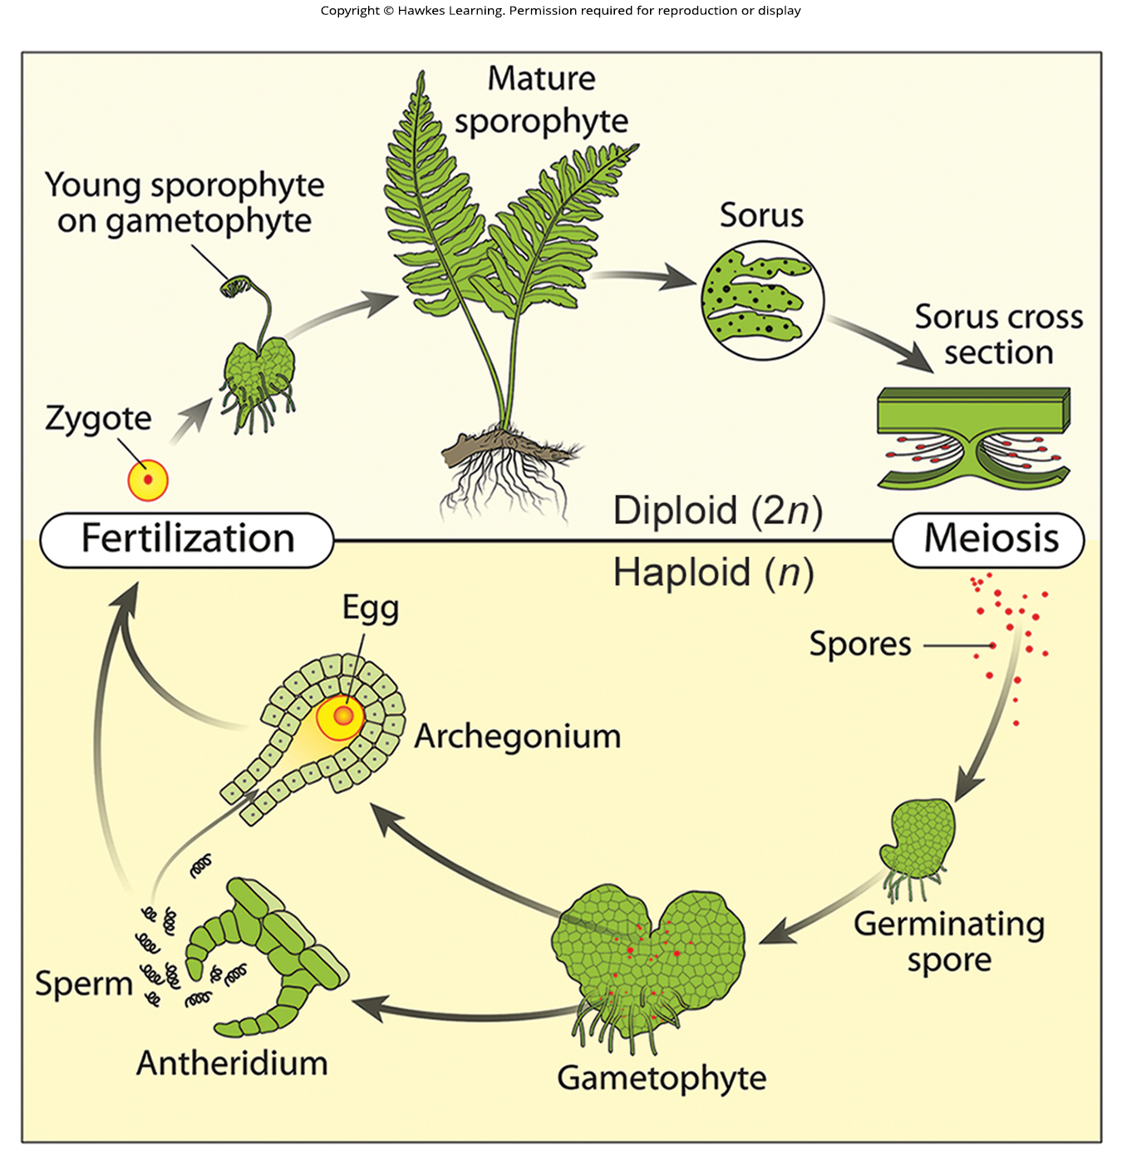
Lesson 25.3 Figure 13

Slide 38
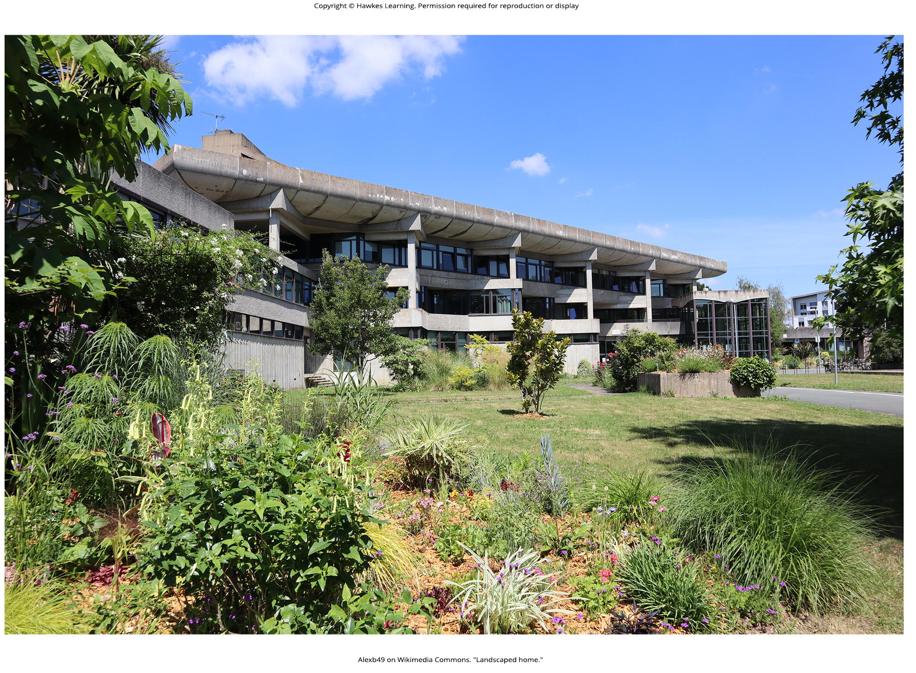
Lesson 25.3 Figure 14

Slide 39
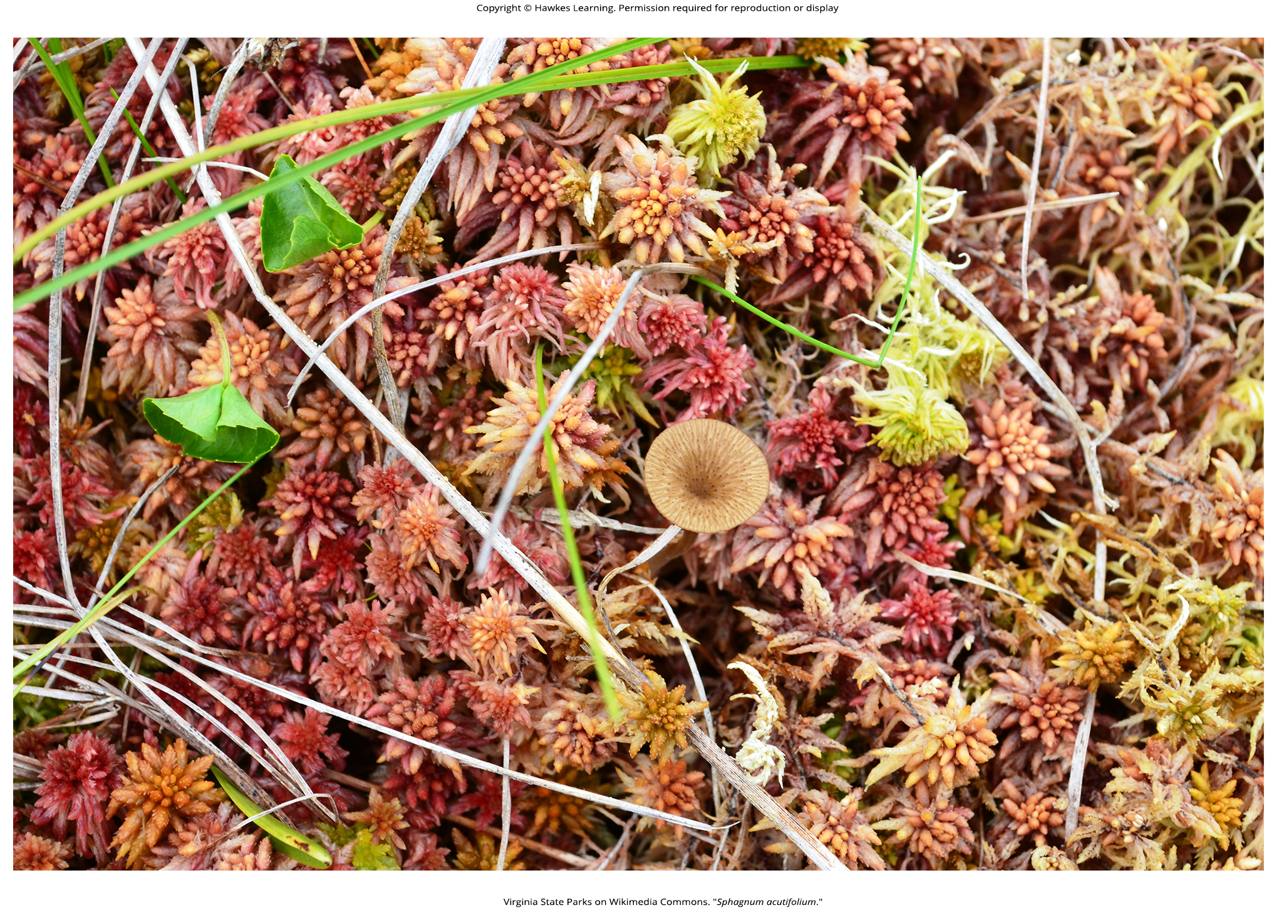
Lesson 25.3 Figure 15

Slide 40
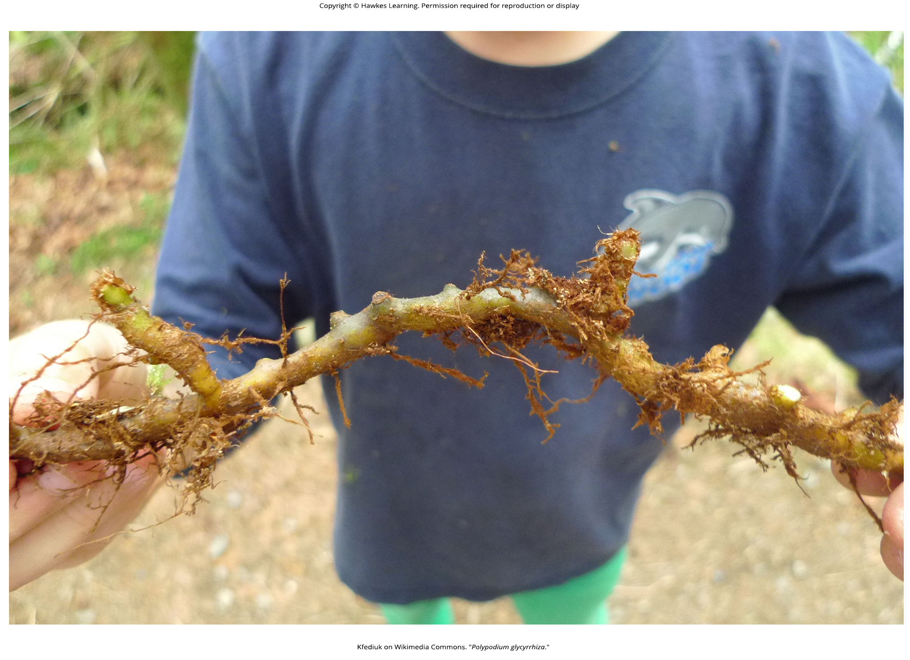
Lesson 25.3 Figure 16

Slide 41
Hawkes Learning – End of PowerPoint

