Slide 1
Chapter 27
Introduction to Animal Diversity

Slide 2
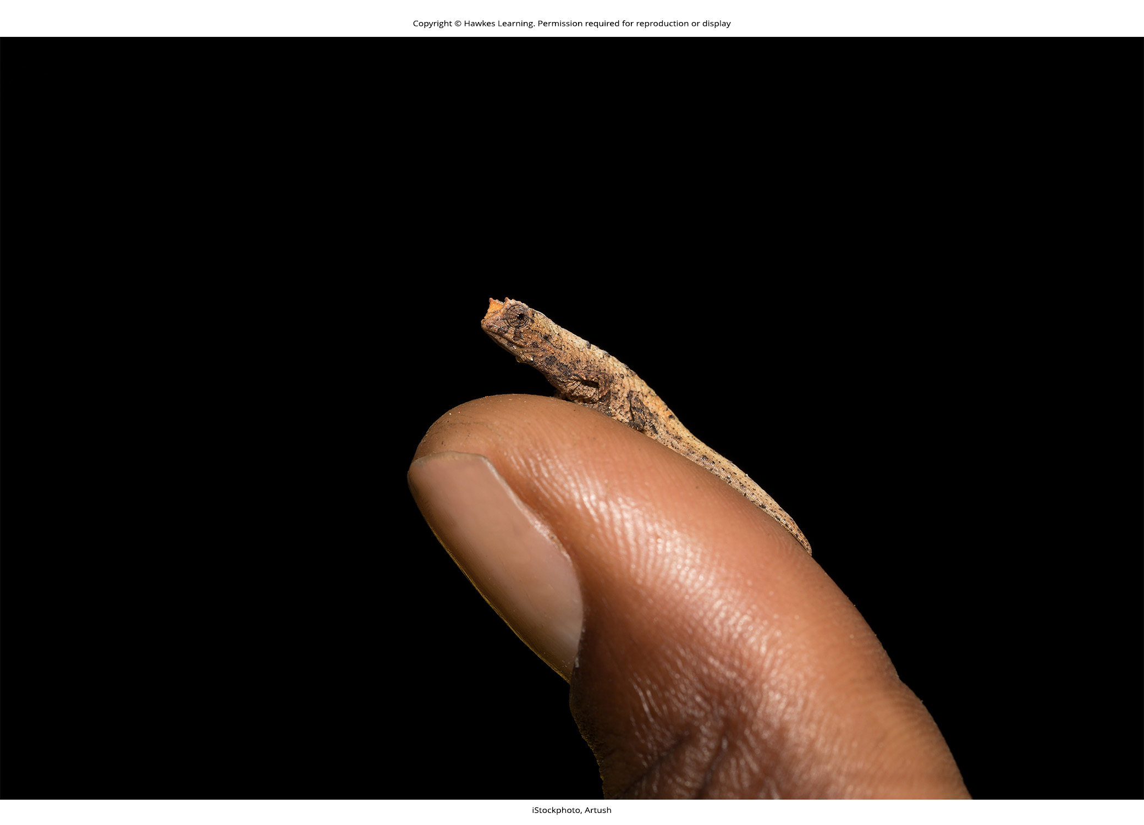
Lesson 27.1 Figure 1

Slide 3
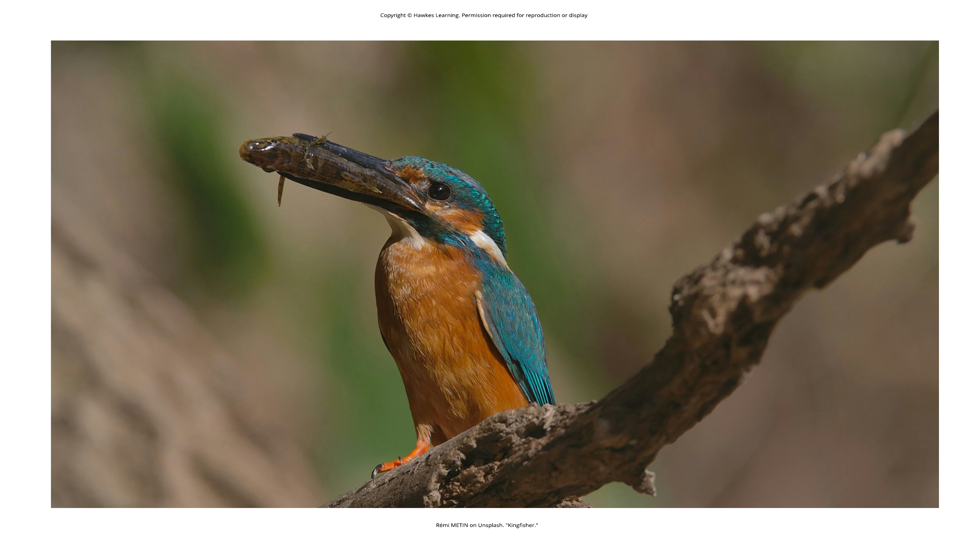
Lesson 27.1 Figure 2

Slide 4
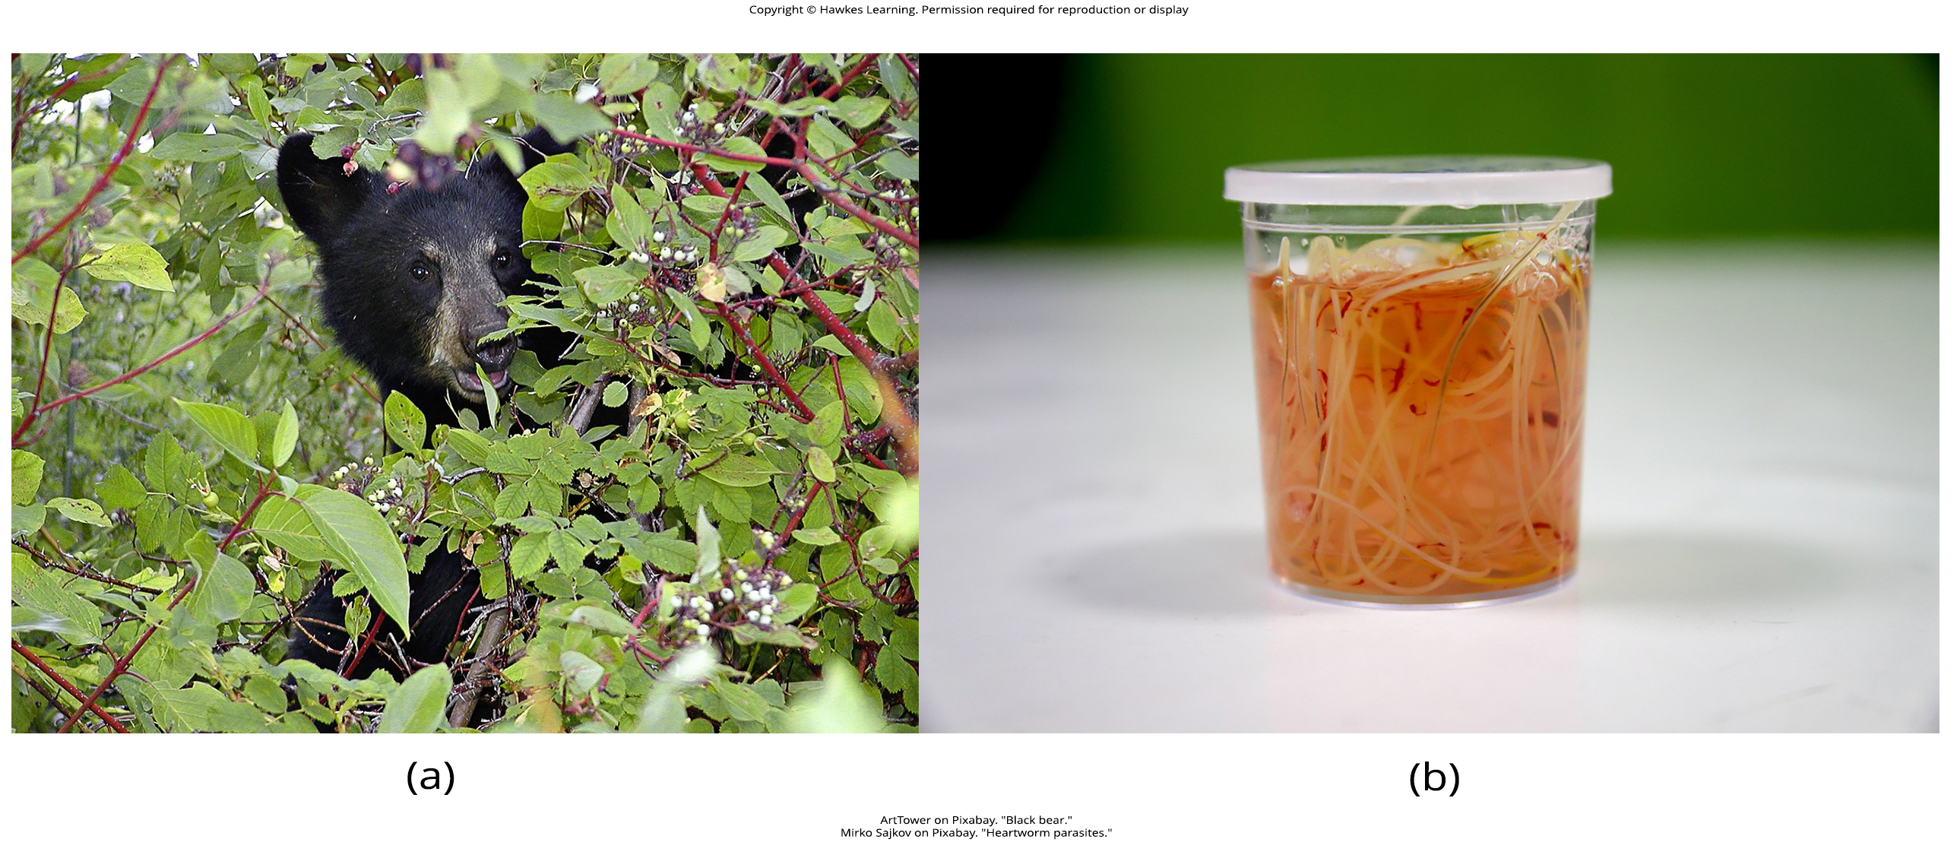
Lesson 27.1 Figure 3

Slide 5
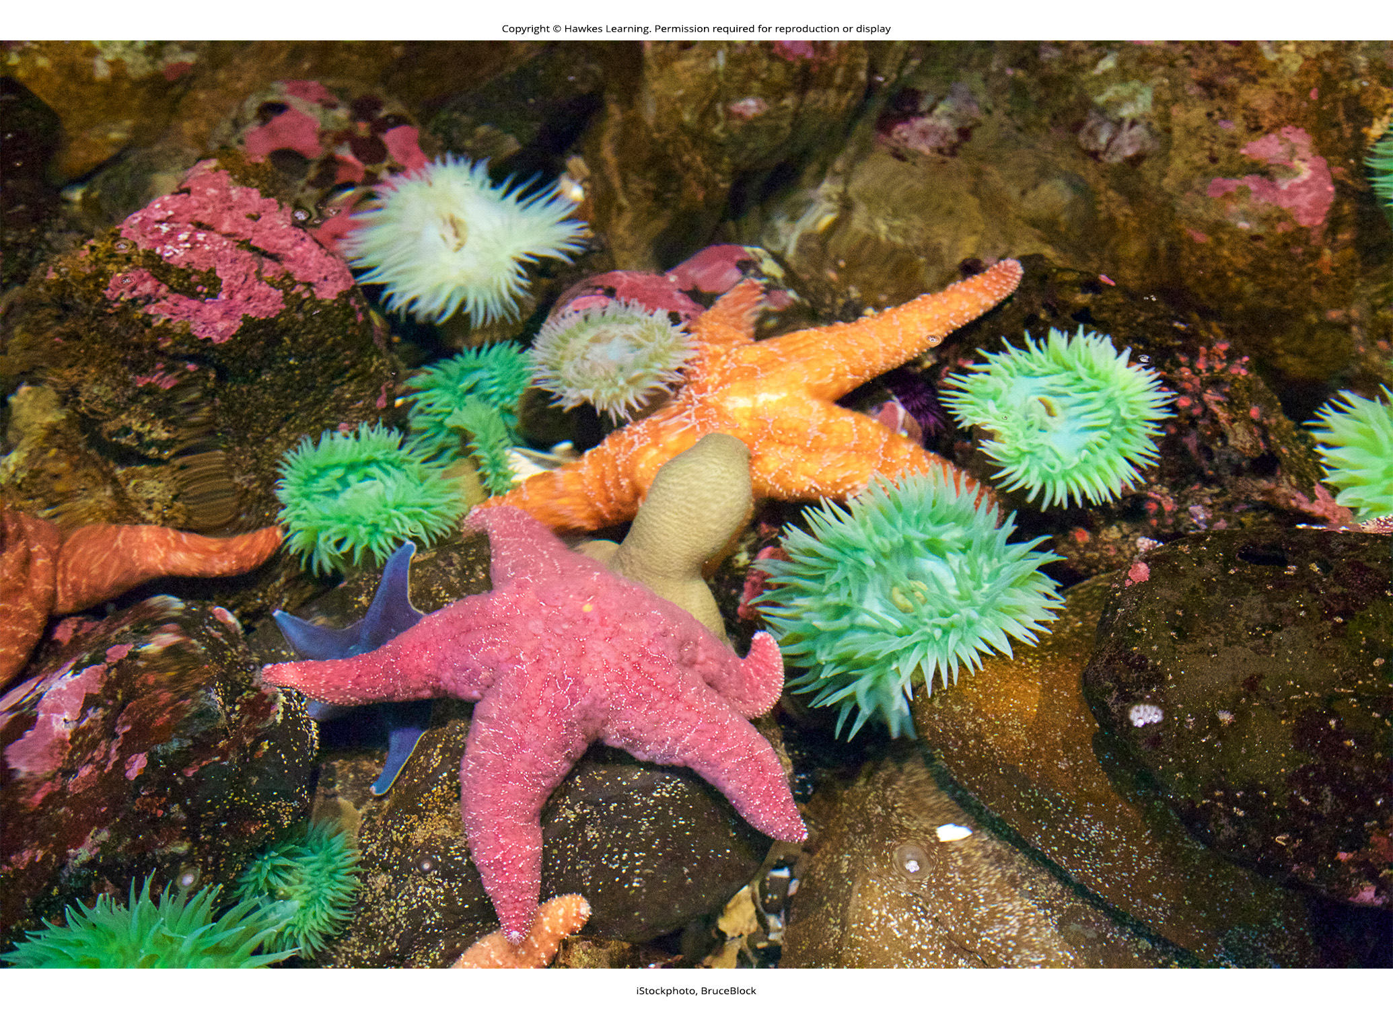
Lesson 27.1 Figure 4

Slide 6
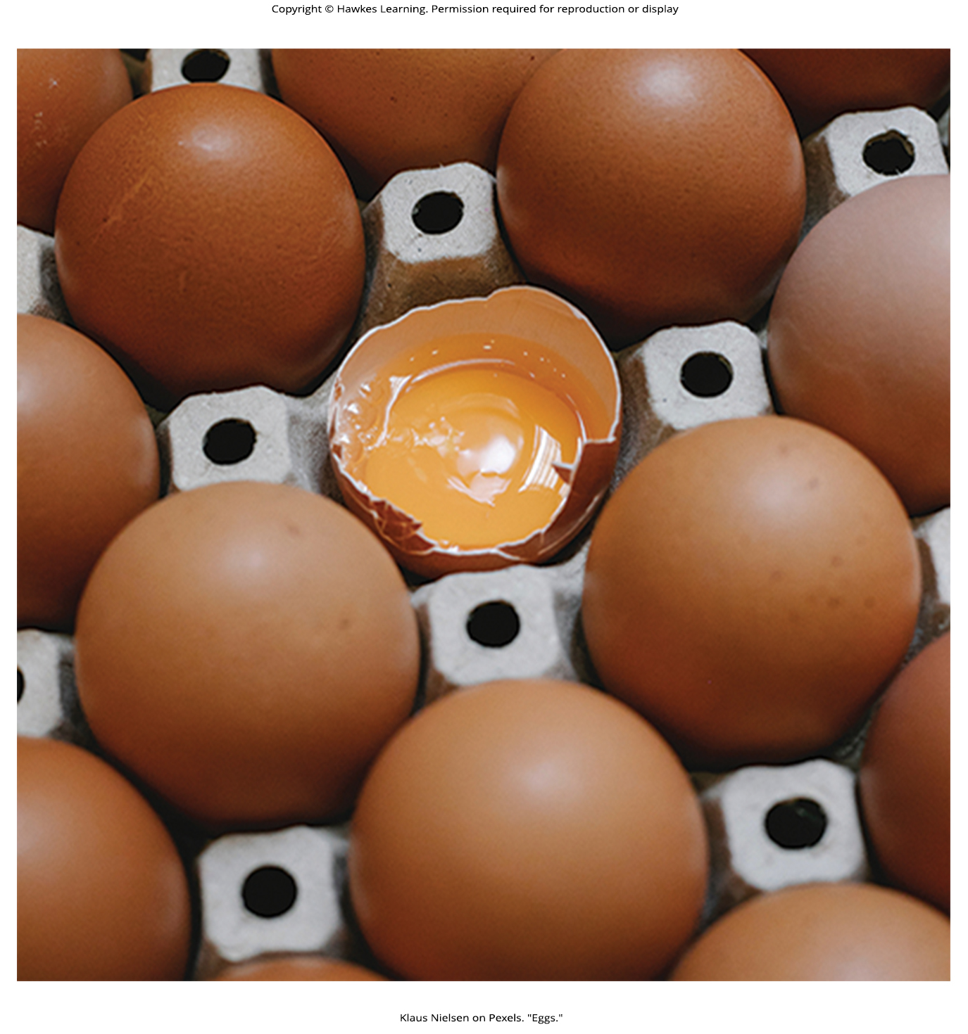
Lesson 27.1 Figure 5

Slide 7
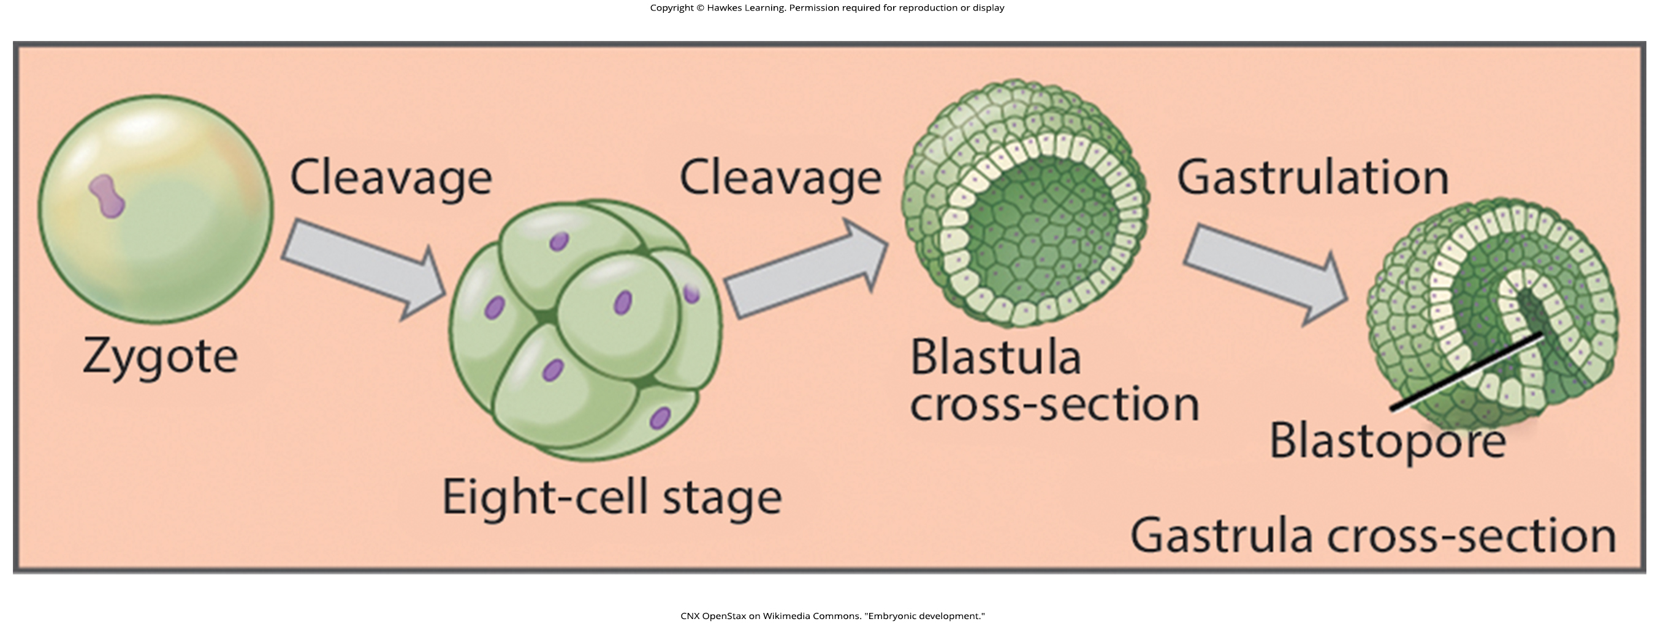
Lesson 27.1 Figure 6

Slide 8
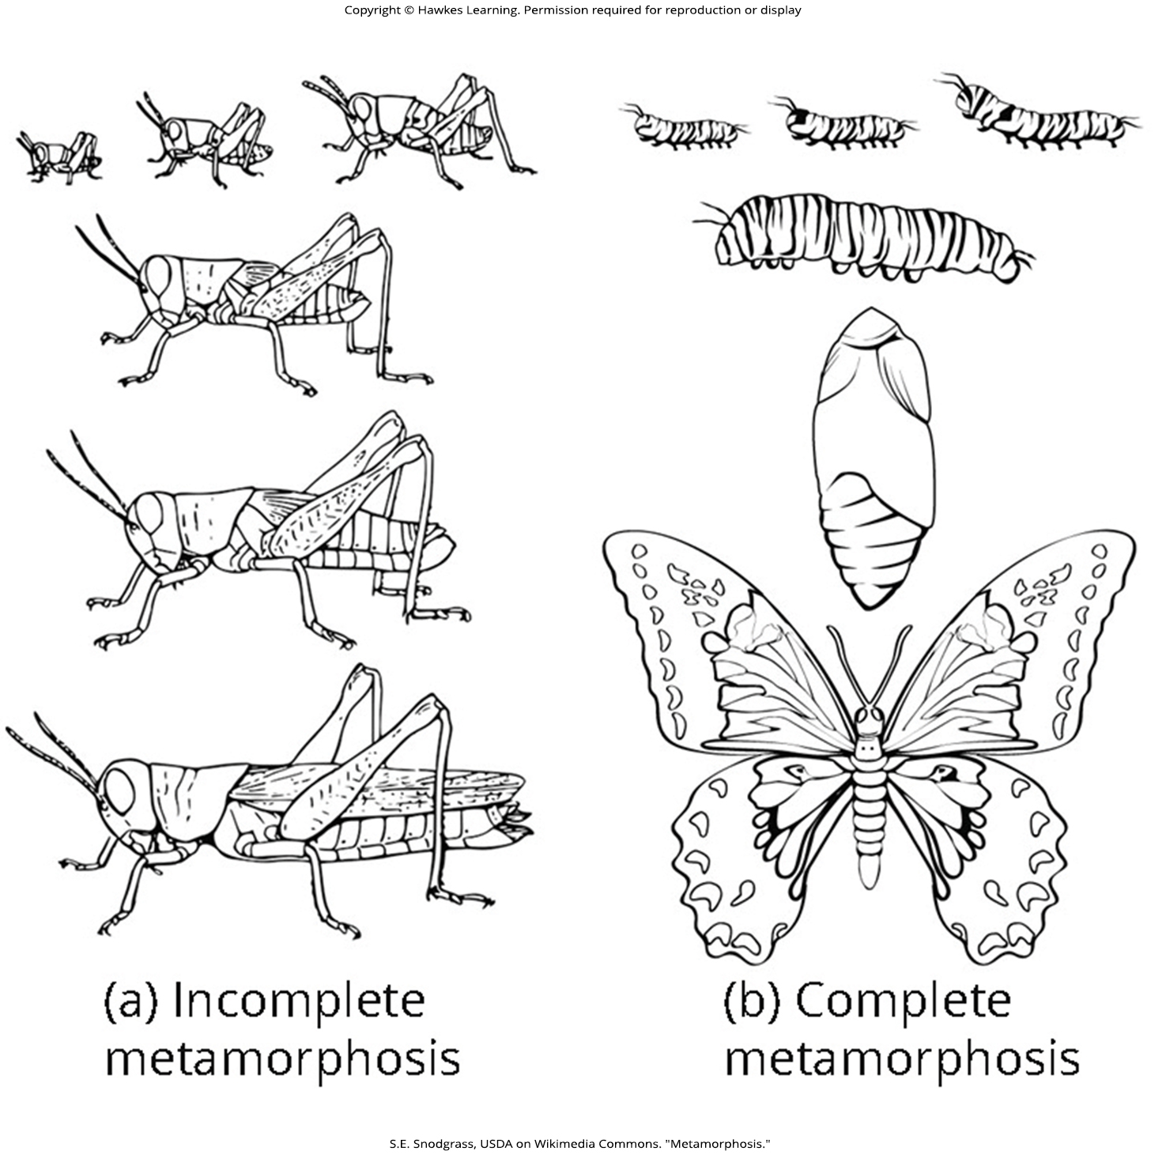
Lesson 27.1 Figure 7

Slide 9
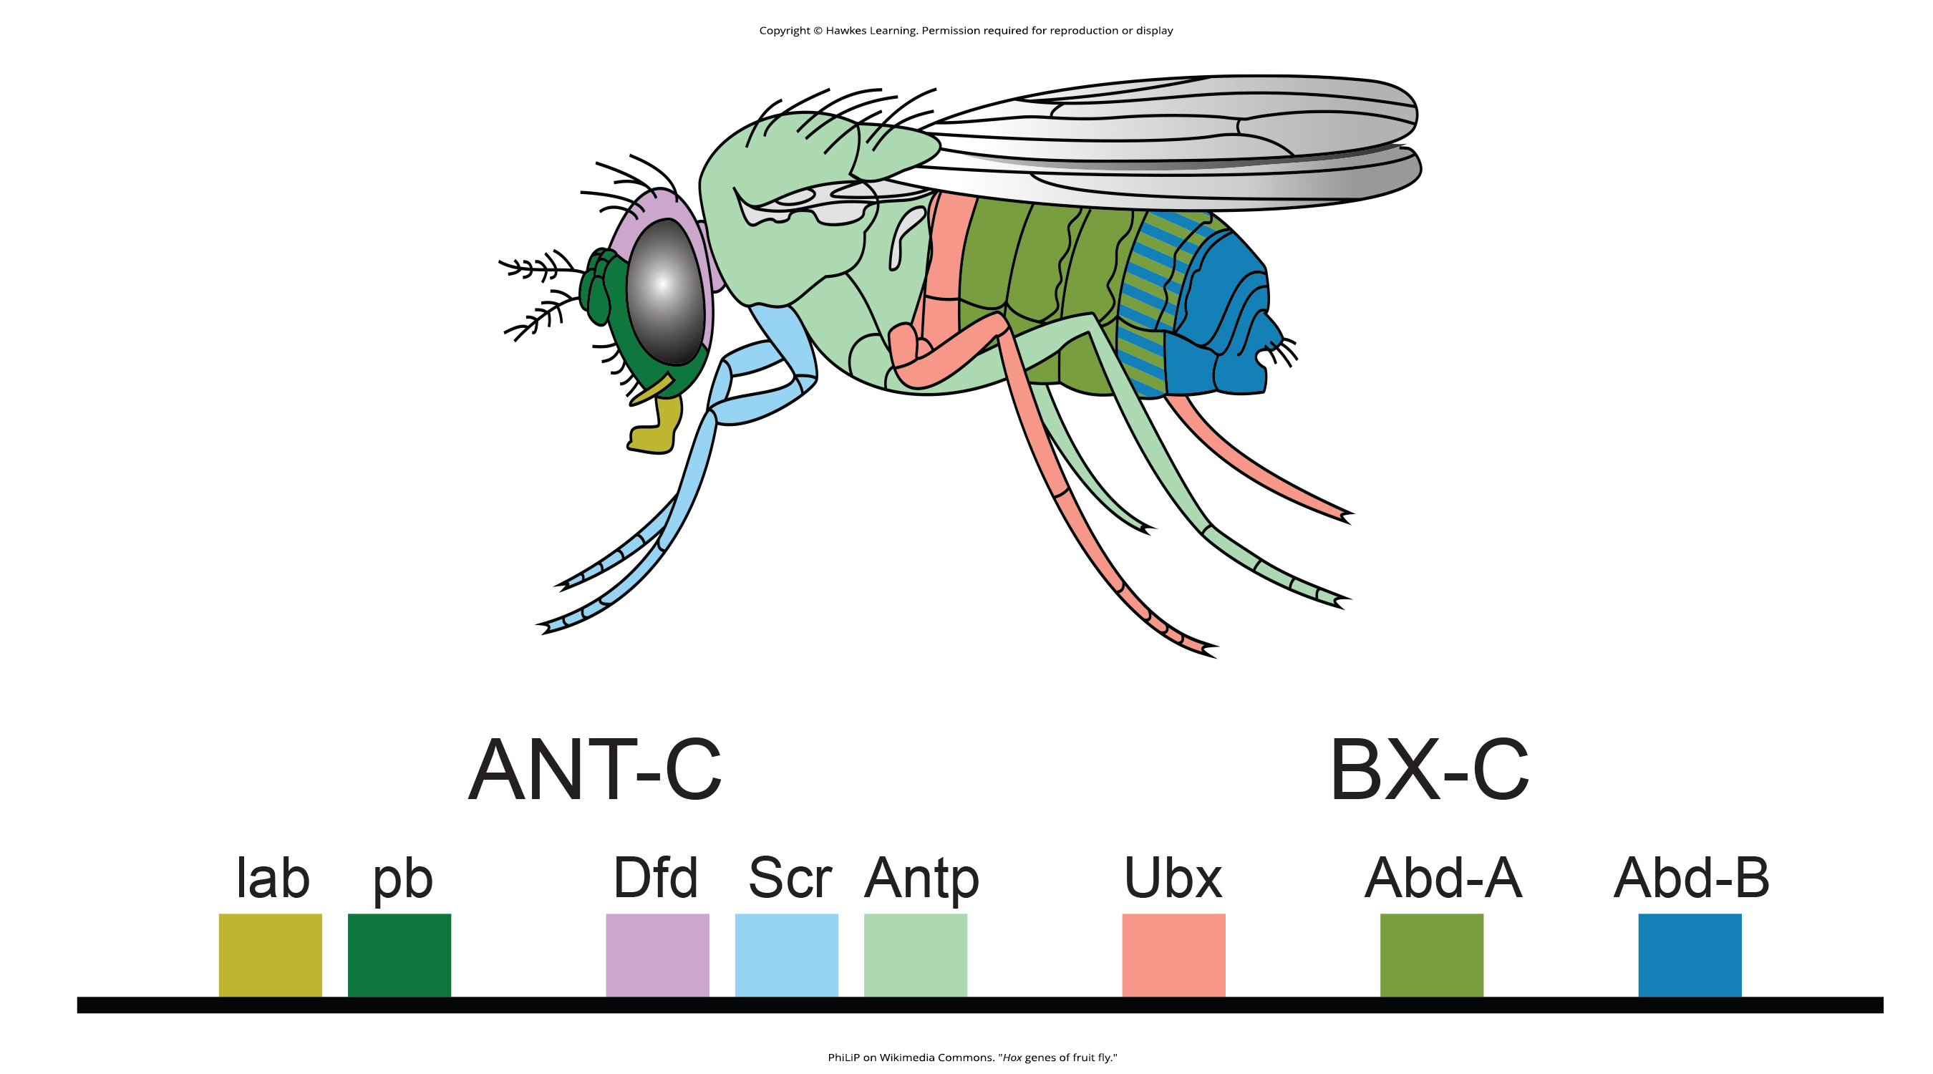
Lesson 27.1 Figure 8

Slide 10
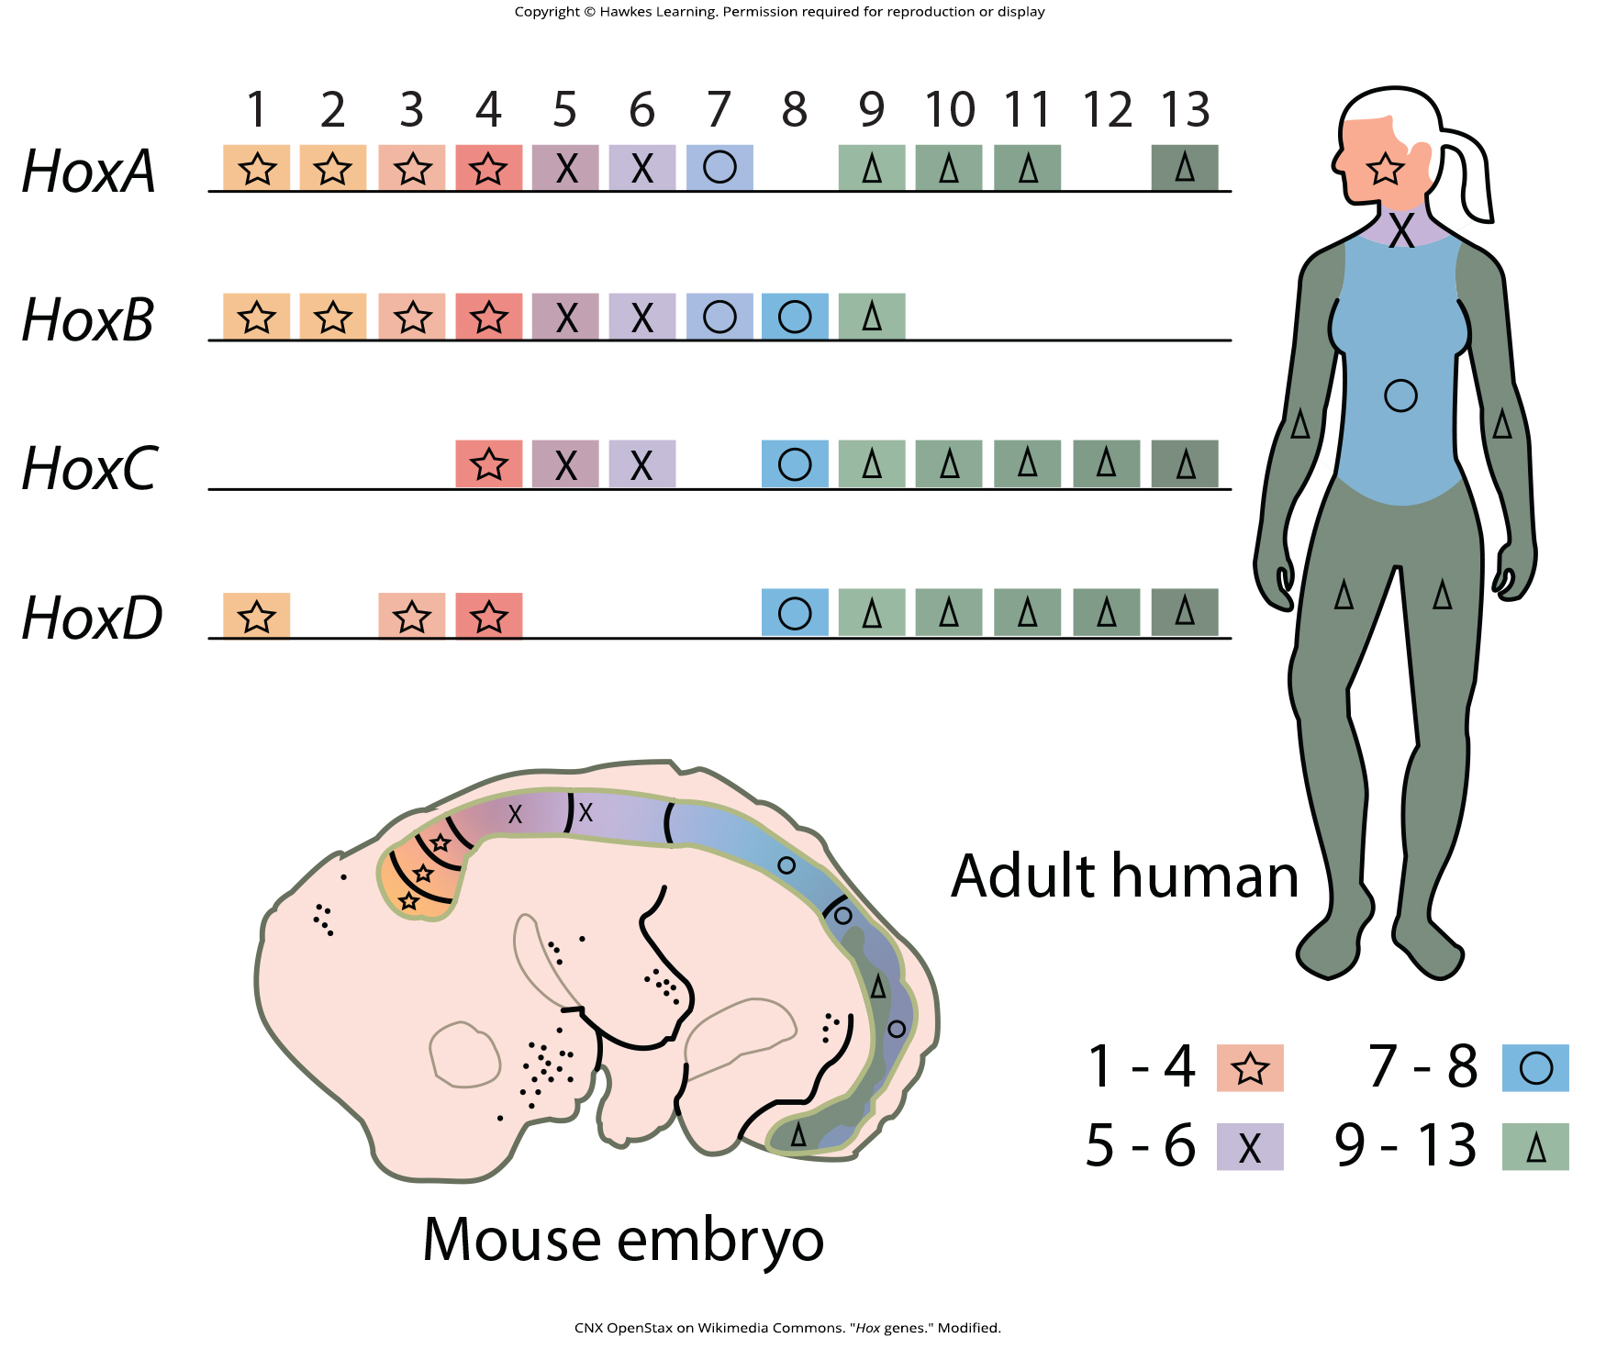
Lesson 27.1 Figure 9

Slide 11
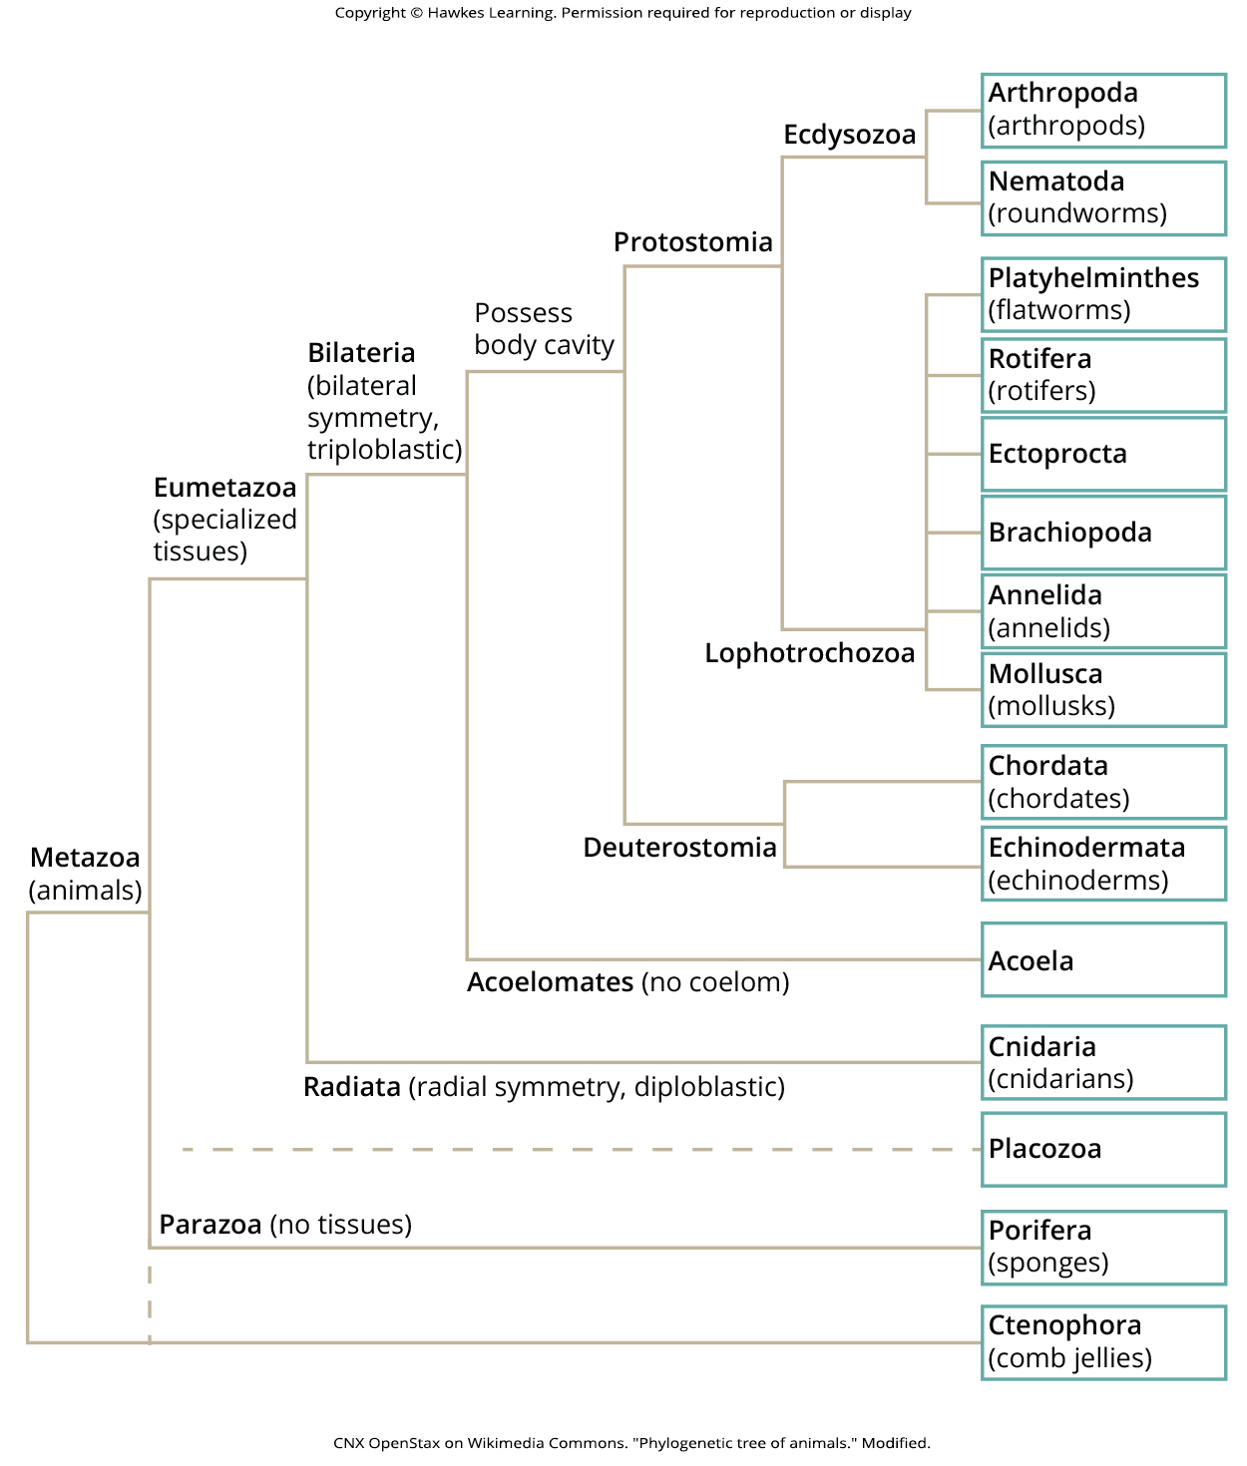
Lesson 27.2 Figure 1

Slide 12
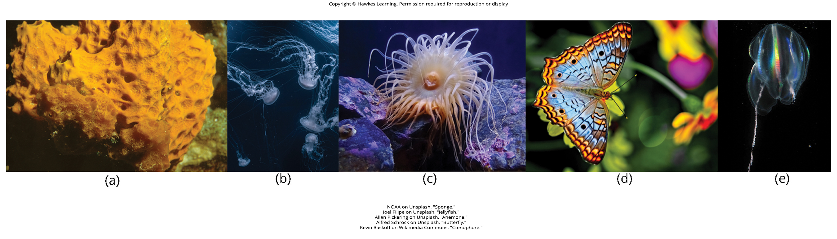
Lesson 27.2 Figure 2

Slide 13
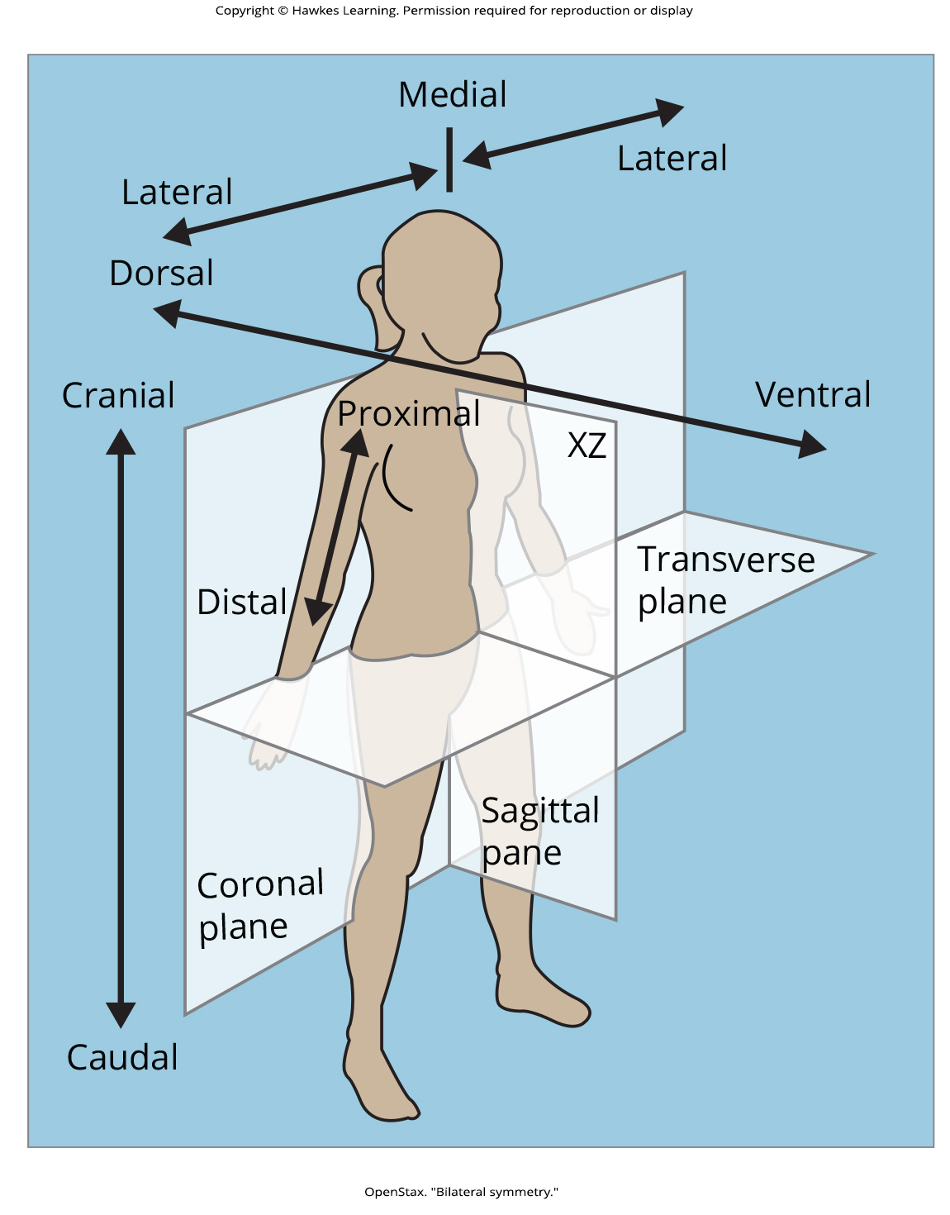
Lesson 27.2 Figure 3

Slide 14
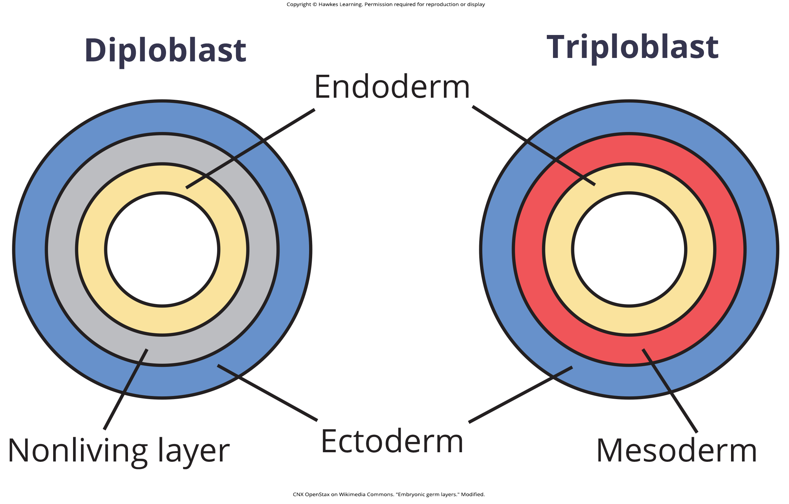
Lesson 27.2 Figure 4

Slide 15
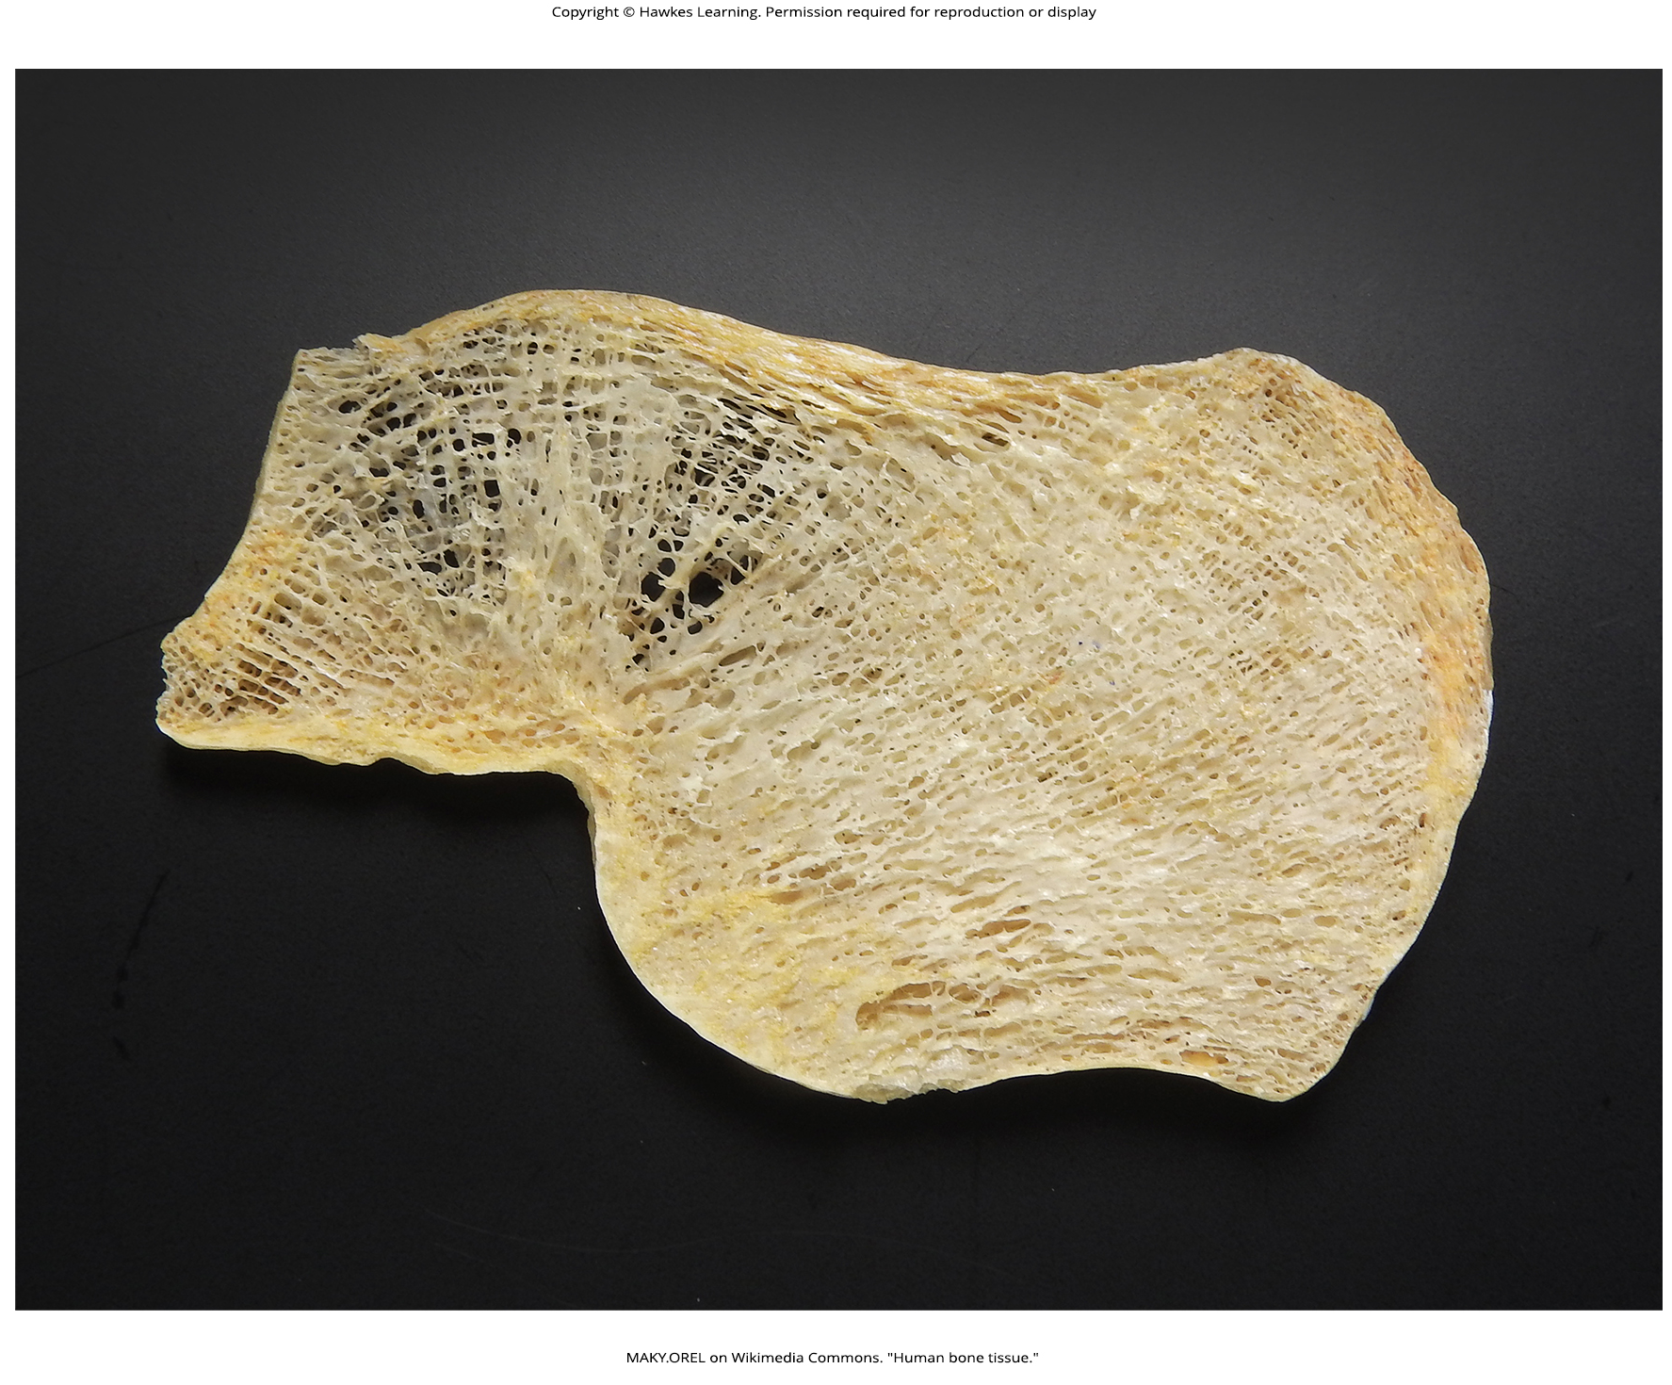
Lesson 27.2 Figure 5

Slide 16
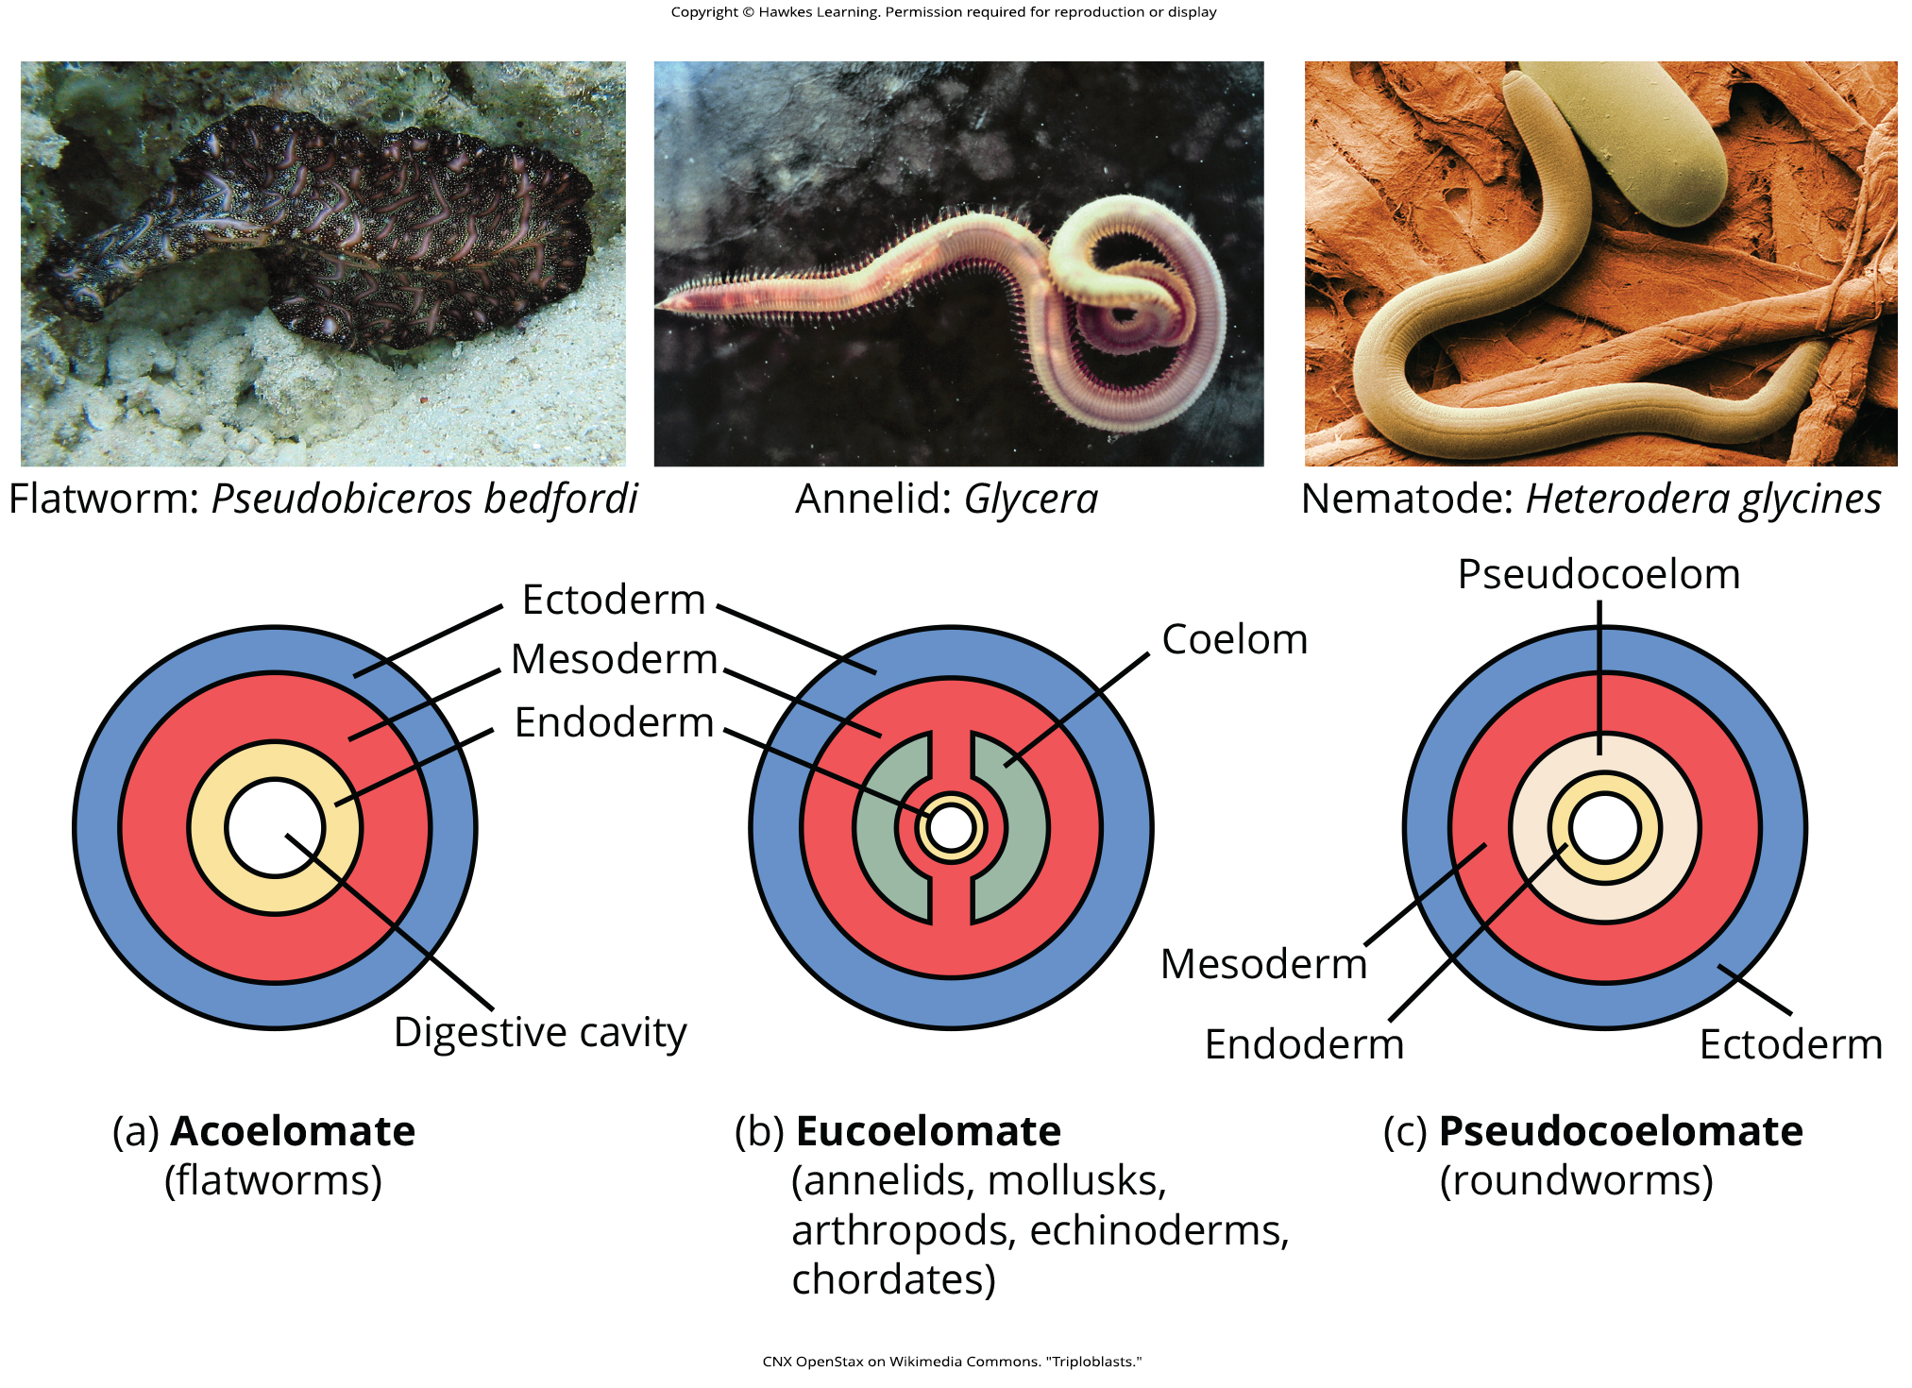
Lesson 27.2 Figure 6

Slide 17
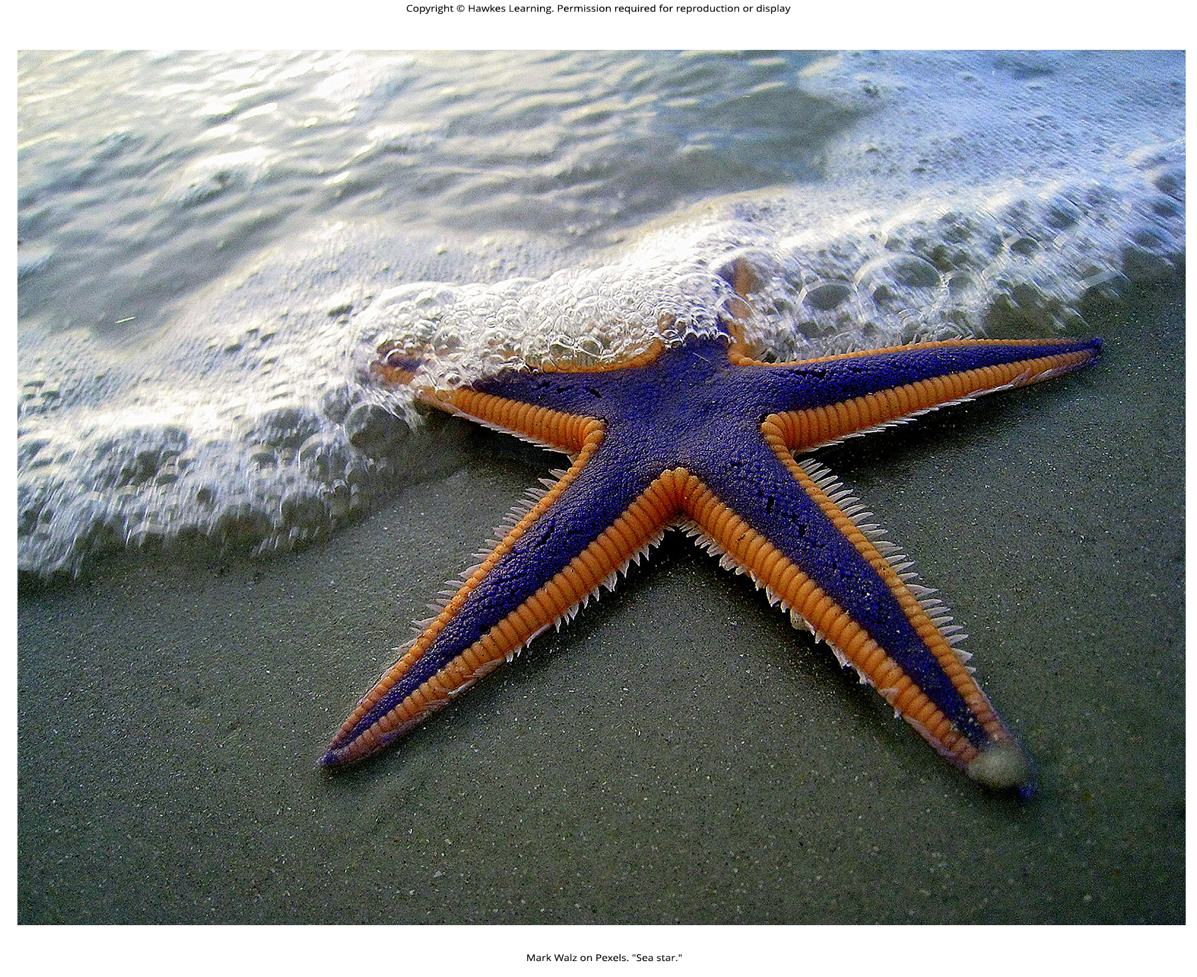
Lesson 27.2 Figure 7

Slide 18
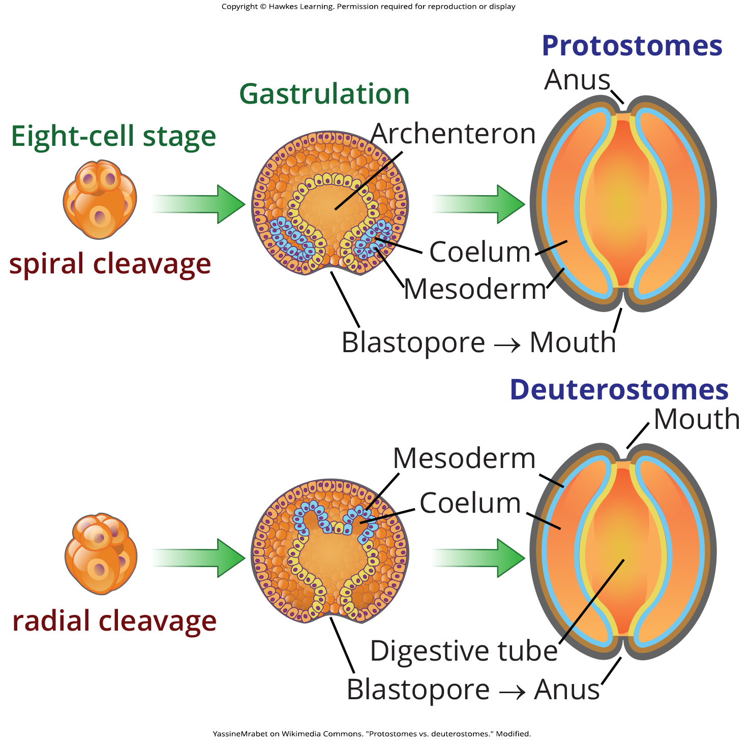
Lesson 27.2 Figure 8

Slide 19
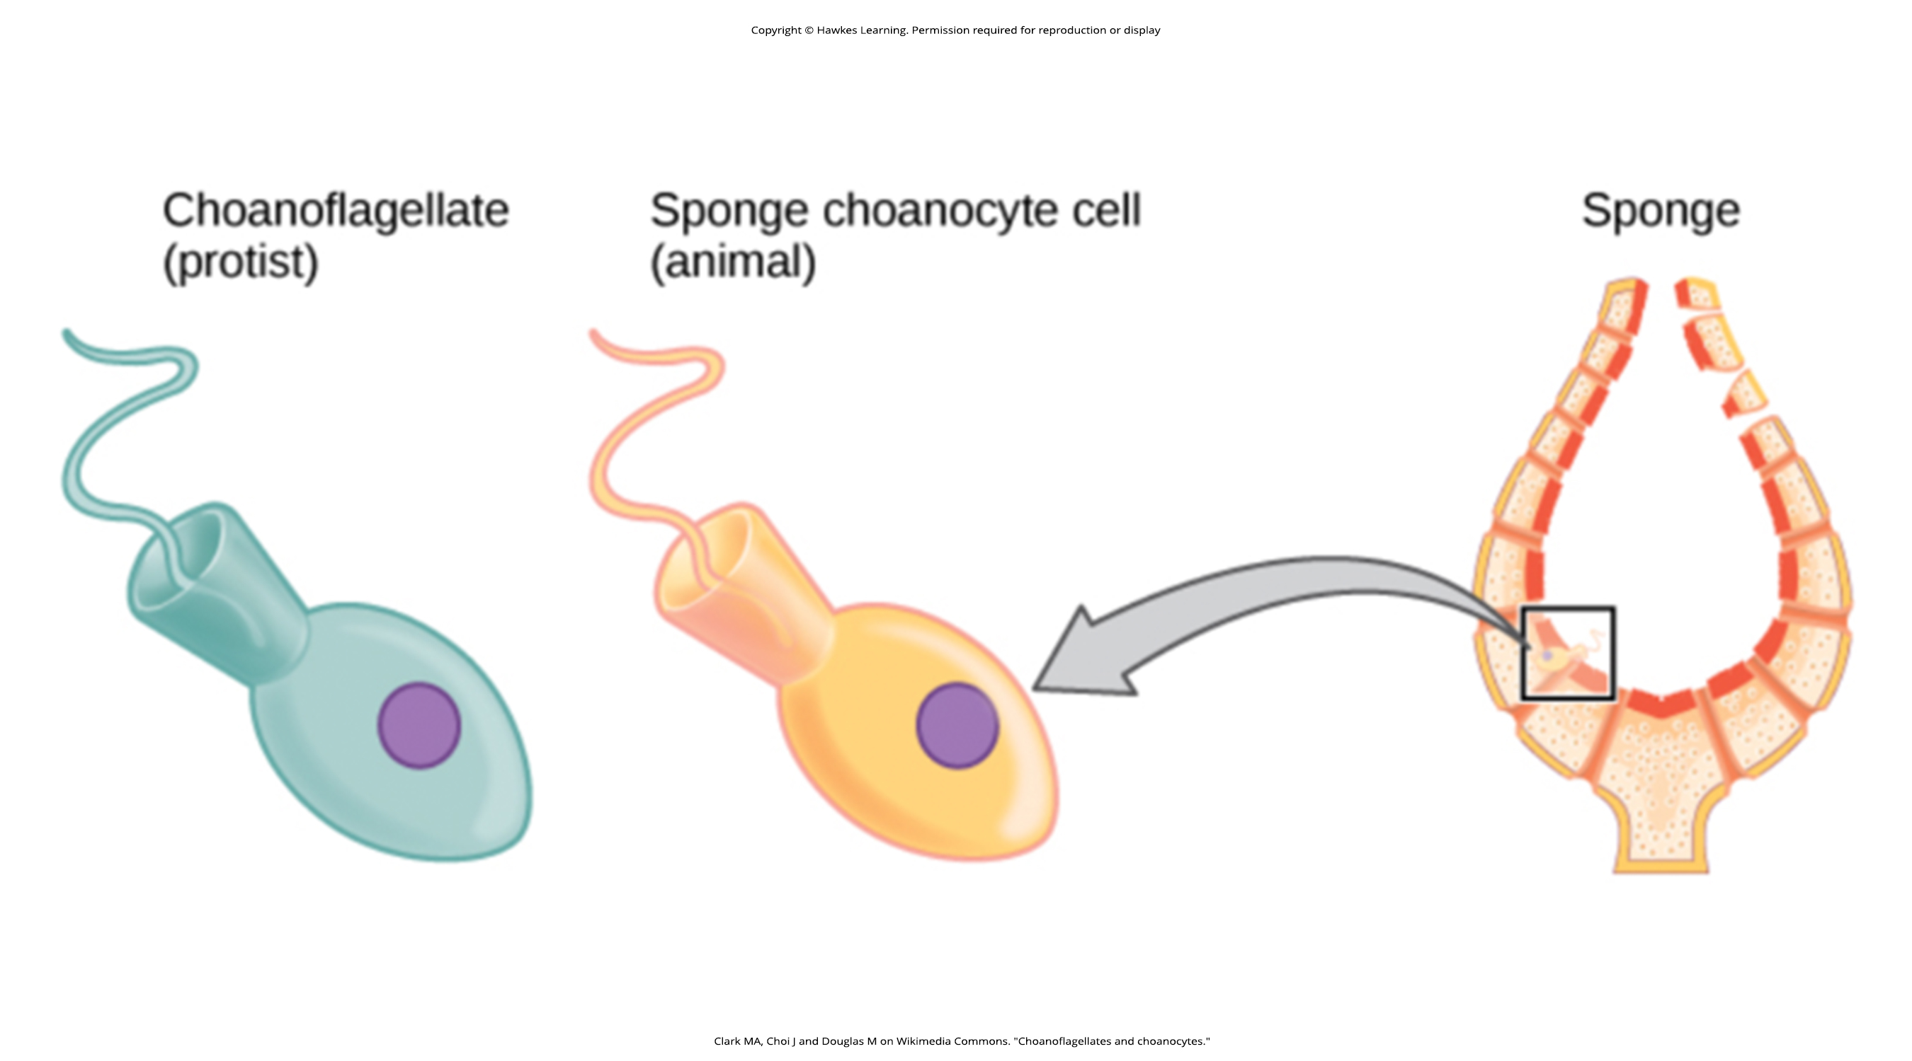
Lesson 27.3 Figure 1

Slide 20
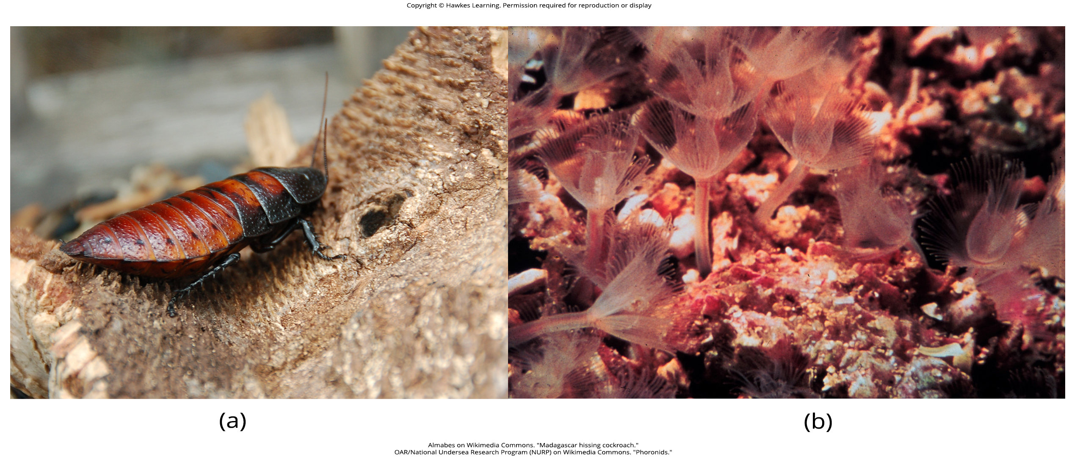
Lesson 27.3 Figure 2

Slide 21
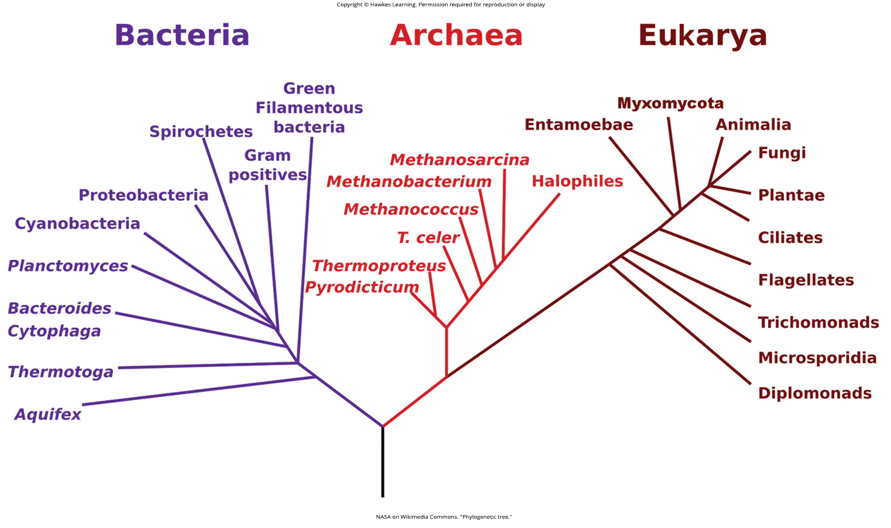
Lesson 27.3 Figure 3

Slide 22
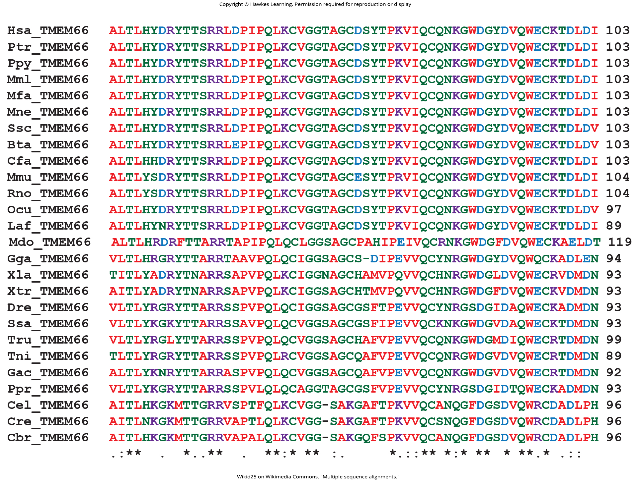
Lesson 27.3 Figure 4

Slide 23
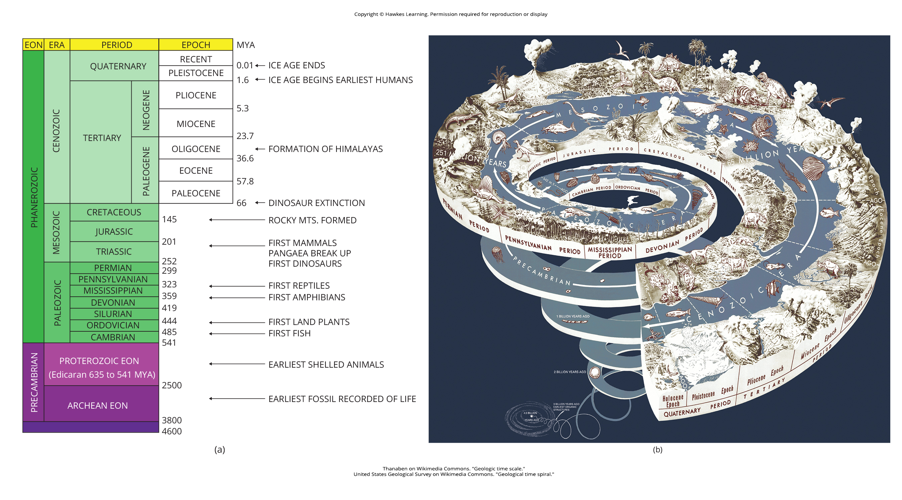
Lesson 27.3 Figure 5

Slide 24
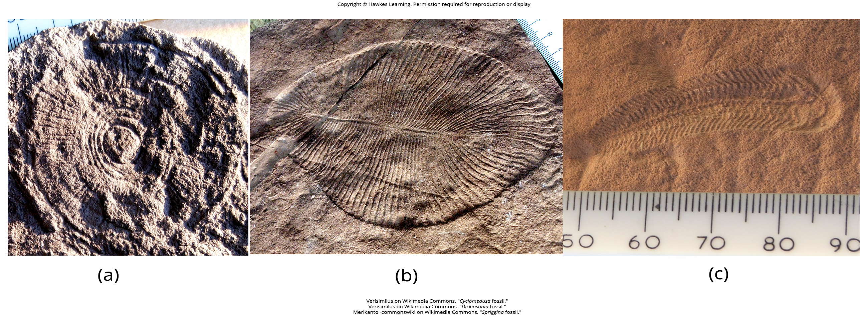
Lesson 27.3 Figure 6

Slide 25
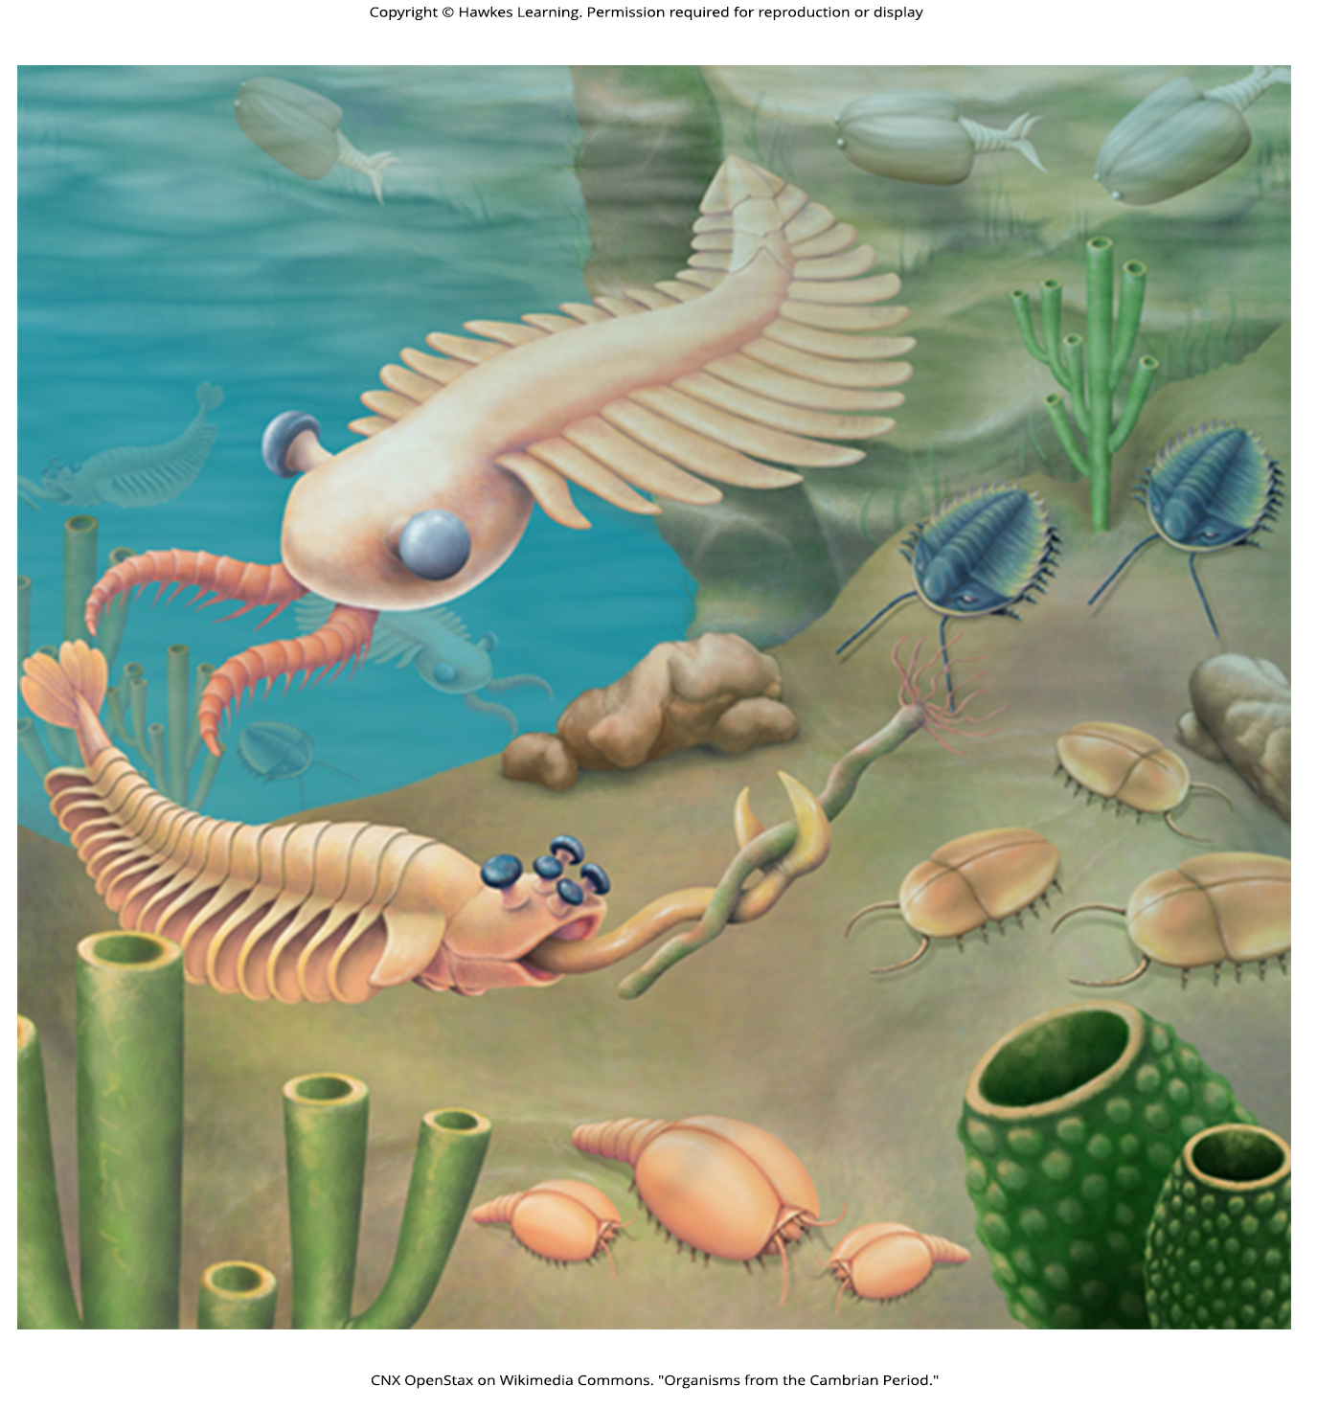
Lesson 27.3 Figure 7

Slide 26
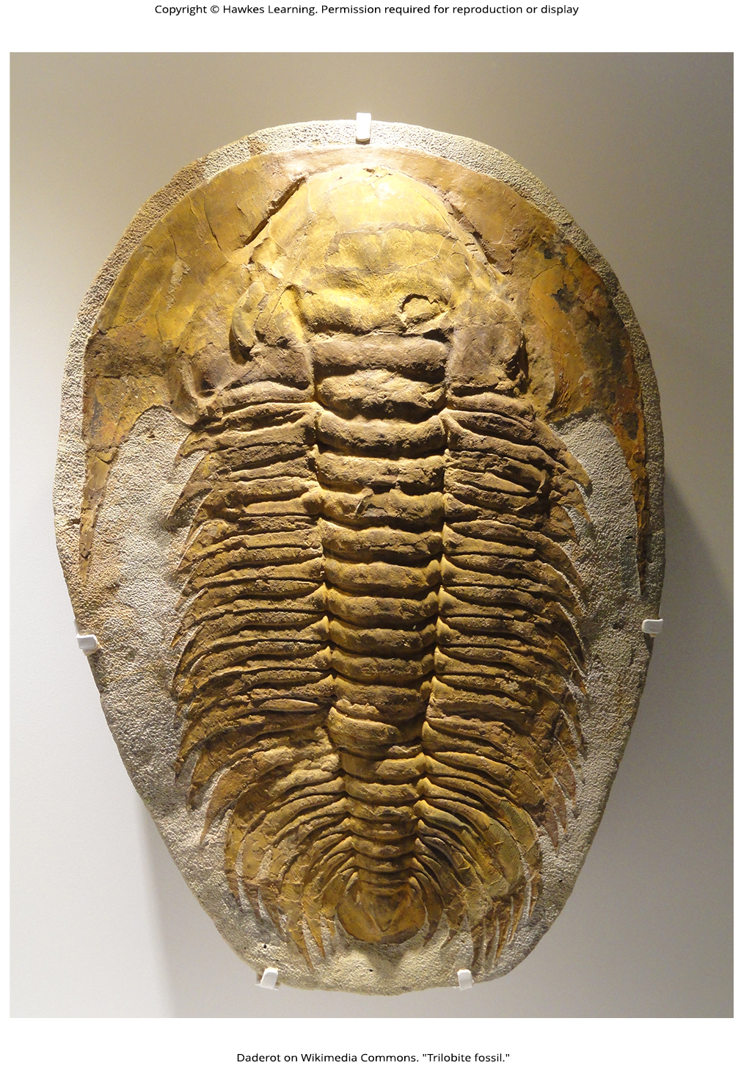
Lesson 27.3 Figure 8

Slide 27
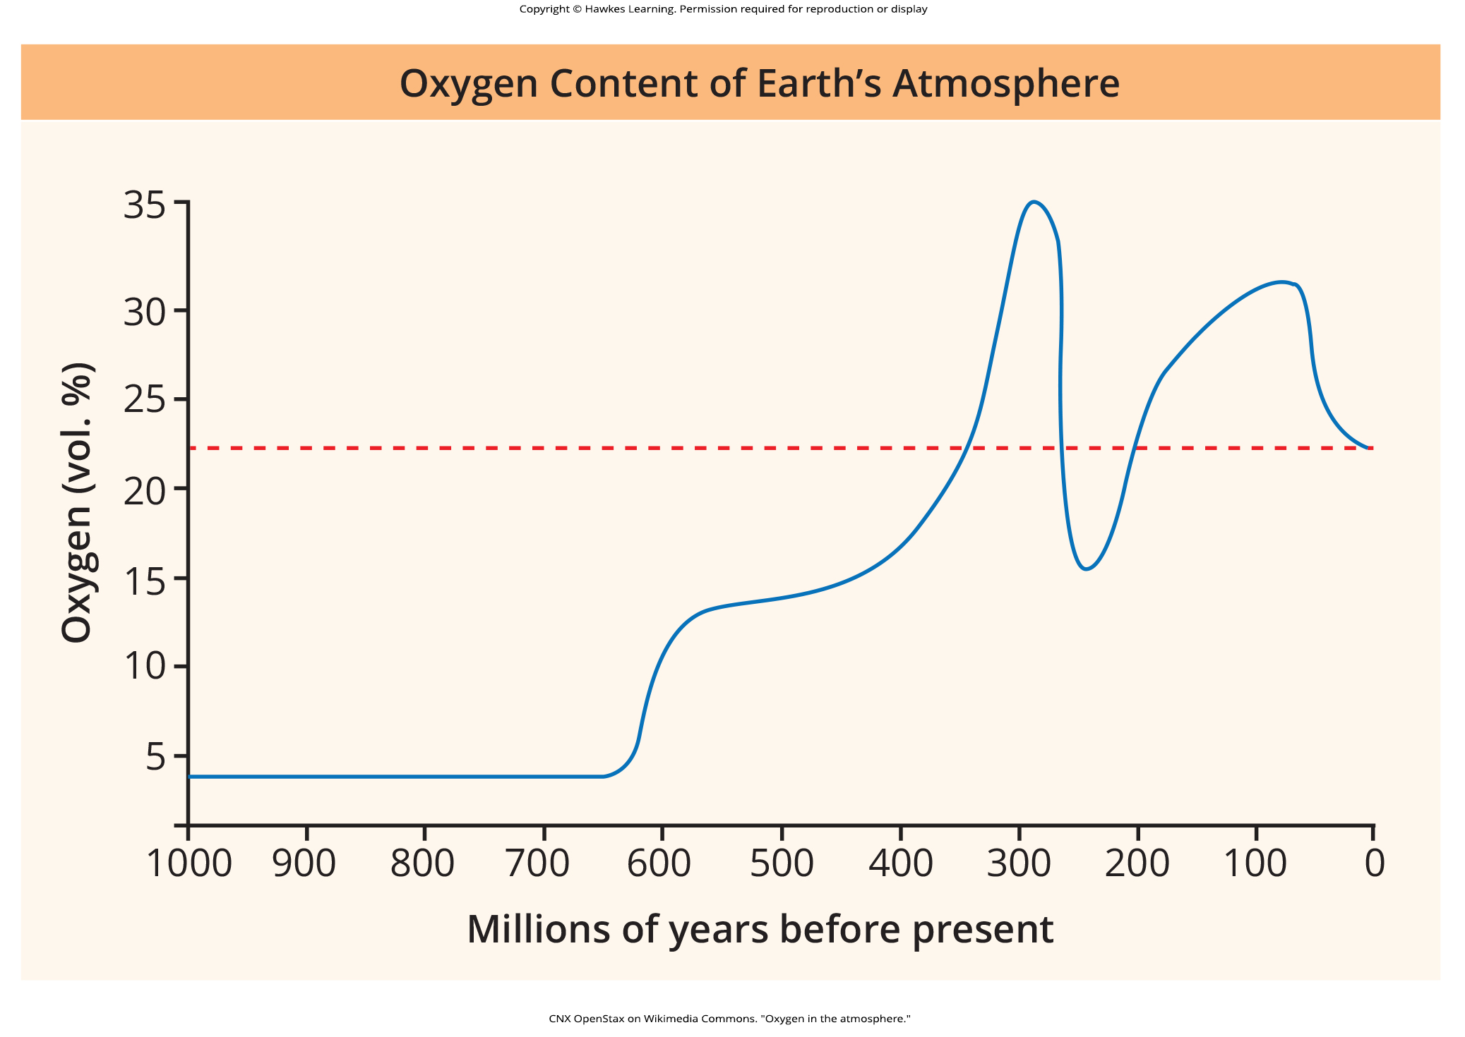
Lesson 27.3 Figure 9

Slide 28
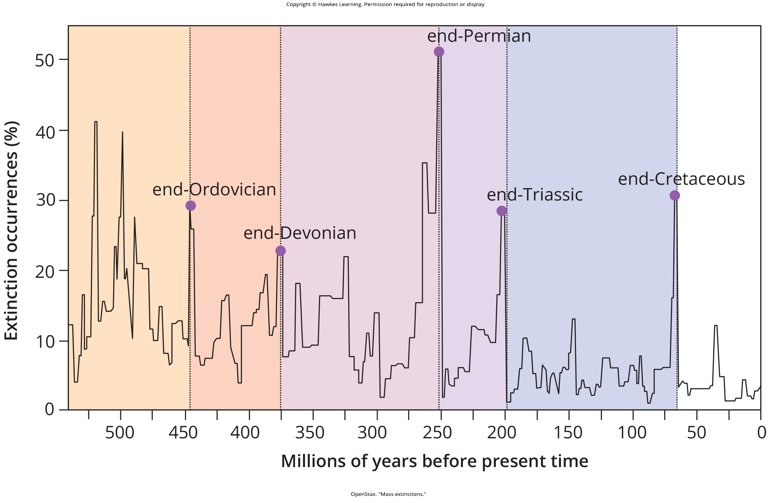
Lesson 27.3 Figure 10

Slide 29
Hawkes Learning – End of PowerPoint

