Slide 1
Chapter 28
Invertebrates

Slide 2
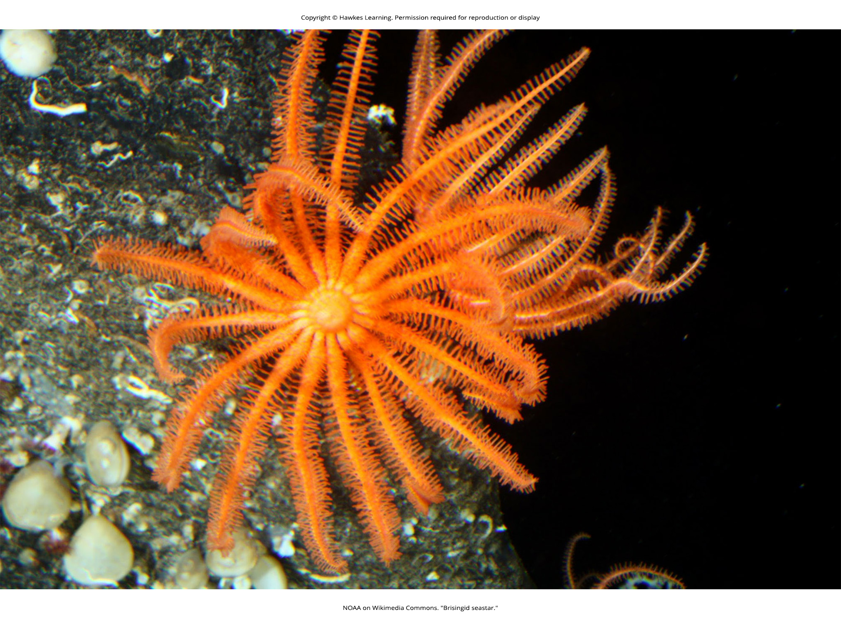
Lesson 28.1 Figure 1

Slide 3
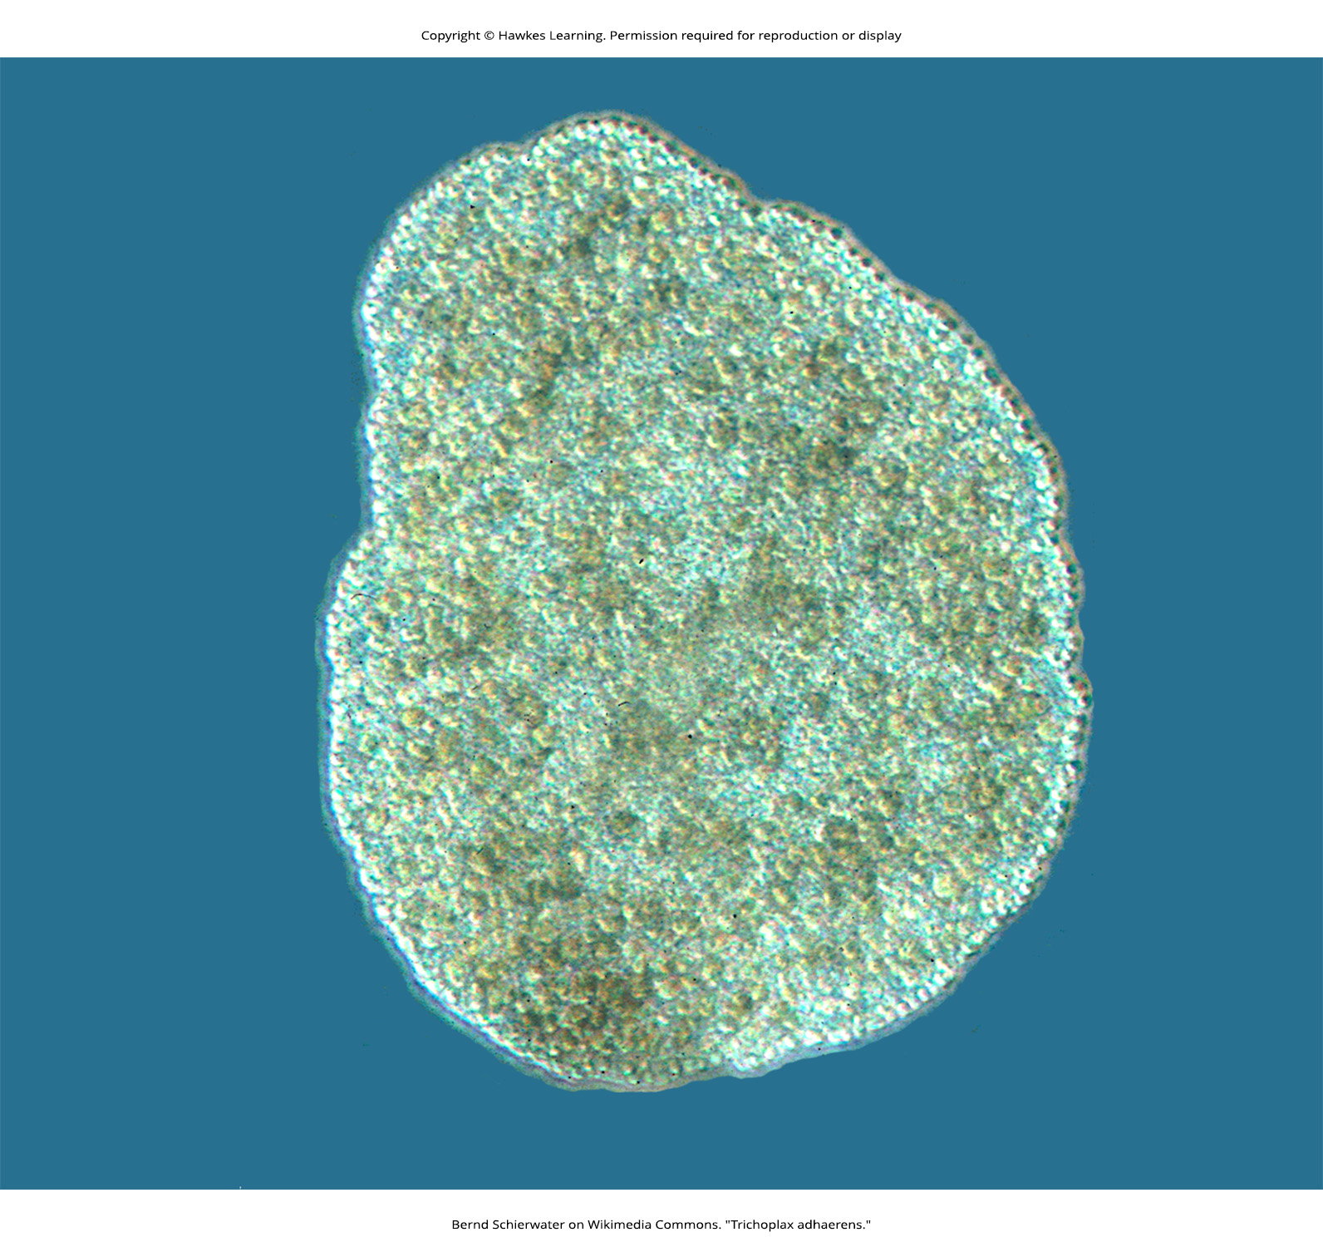
Lesson 28.1 Figure 2

Slide 4
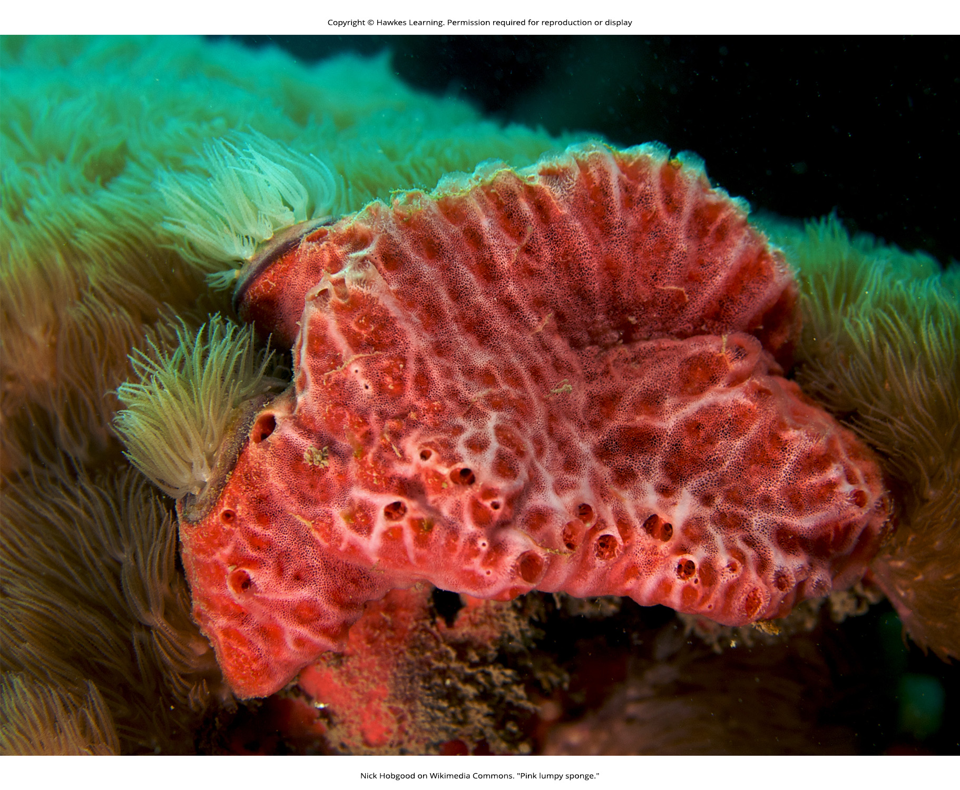
Lesson 28.1 Figure 3

Slide 5
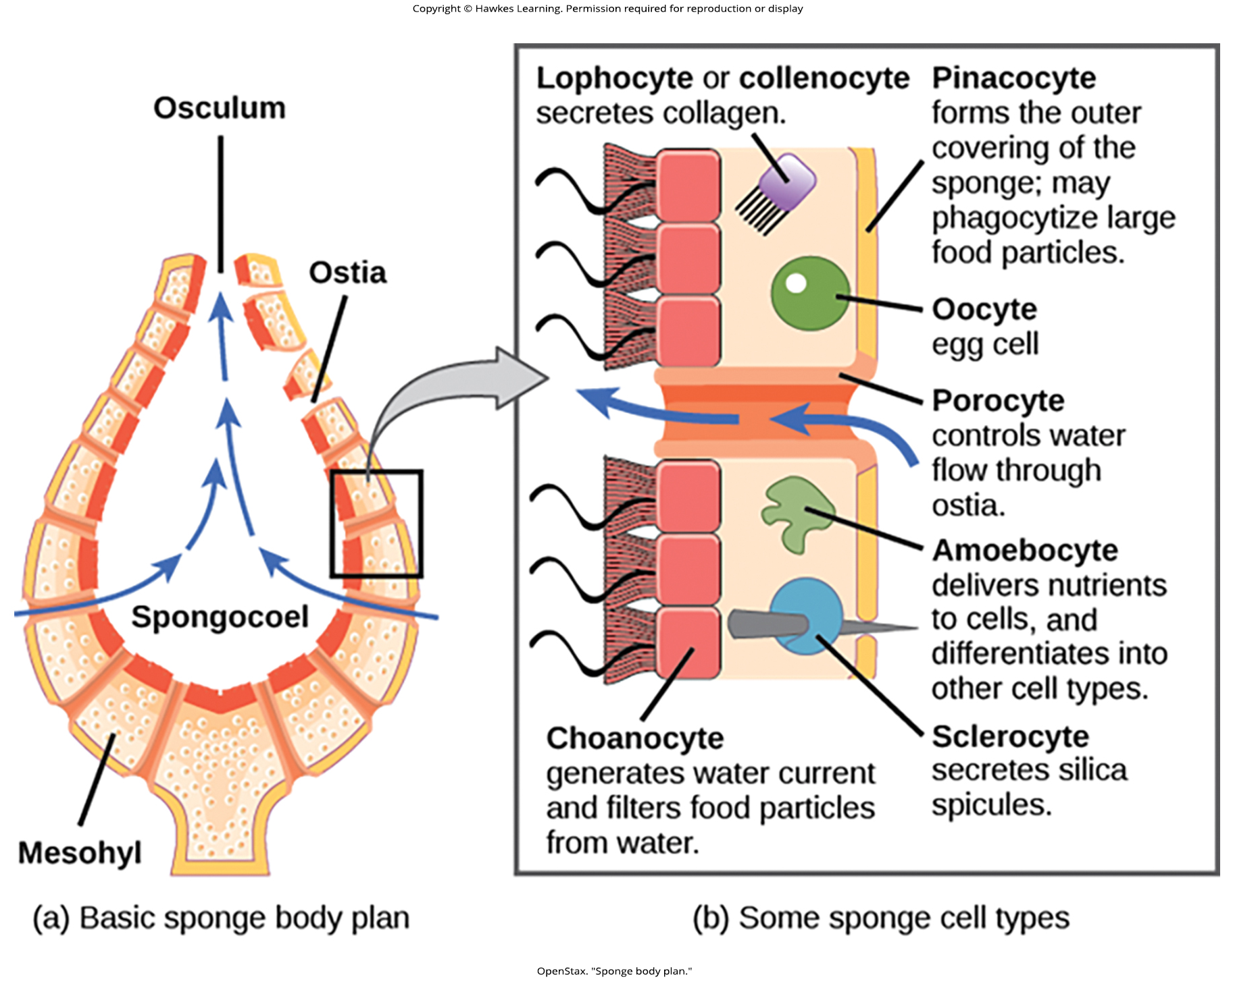
Lesson 28.1 Figure 4

Slide 6
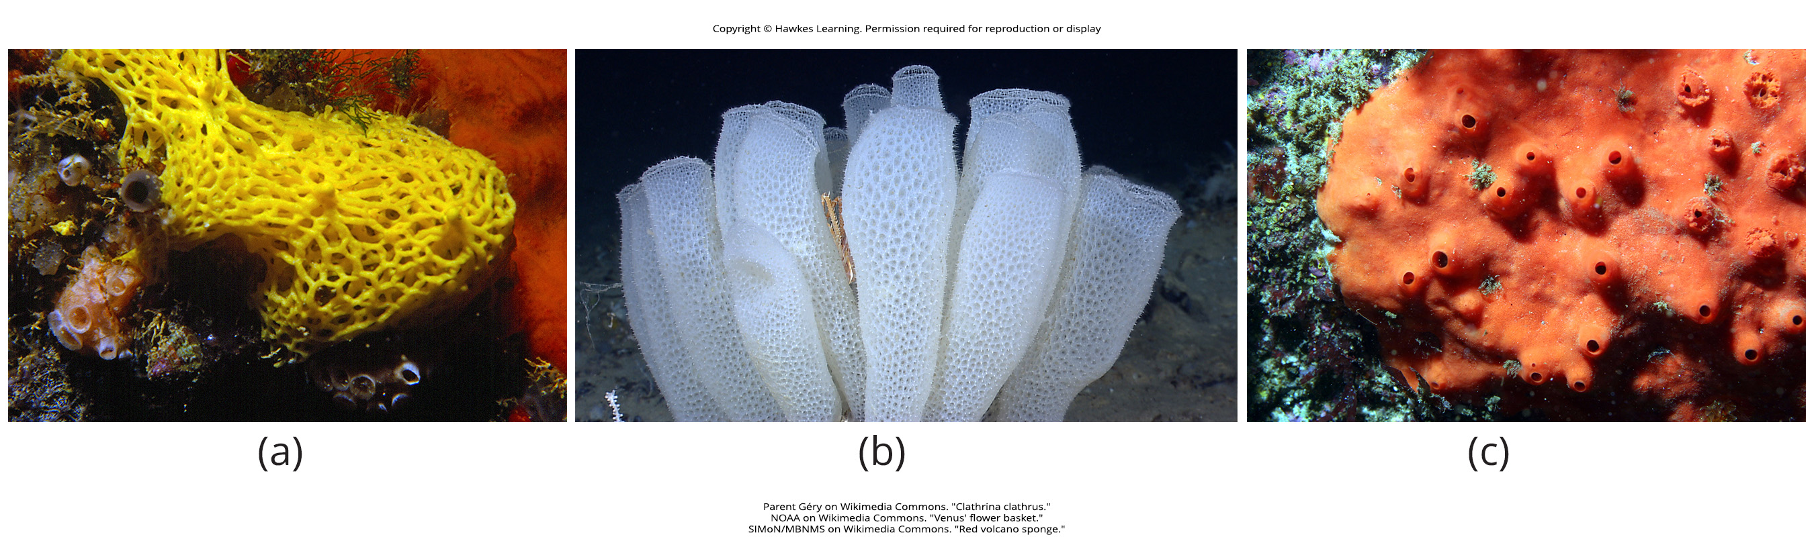
Lesson 28.1 Figure 5

Slide 7
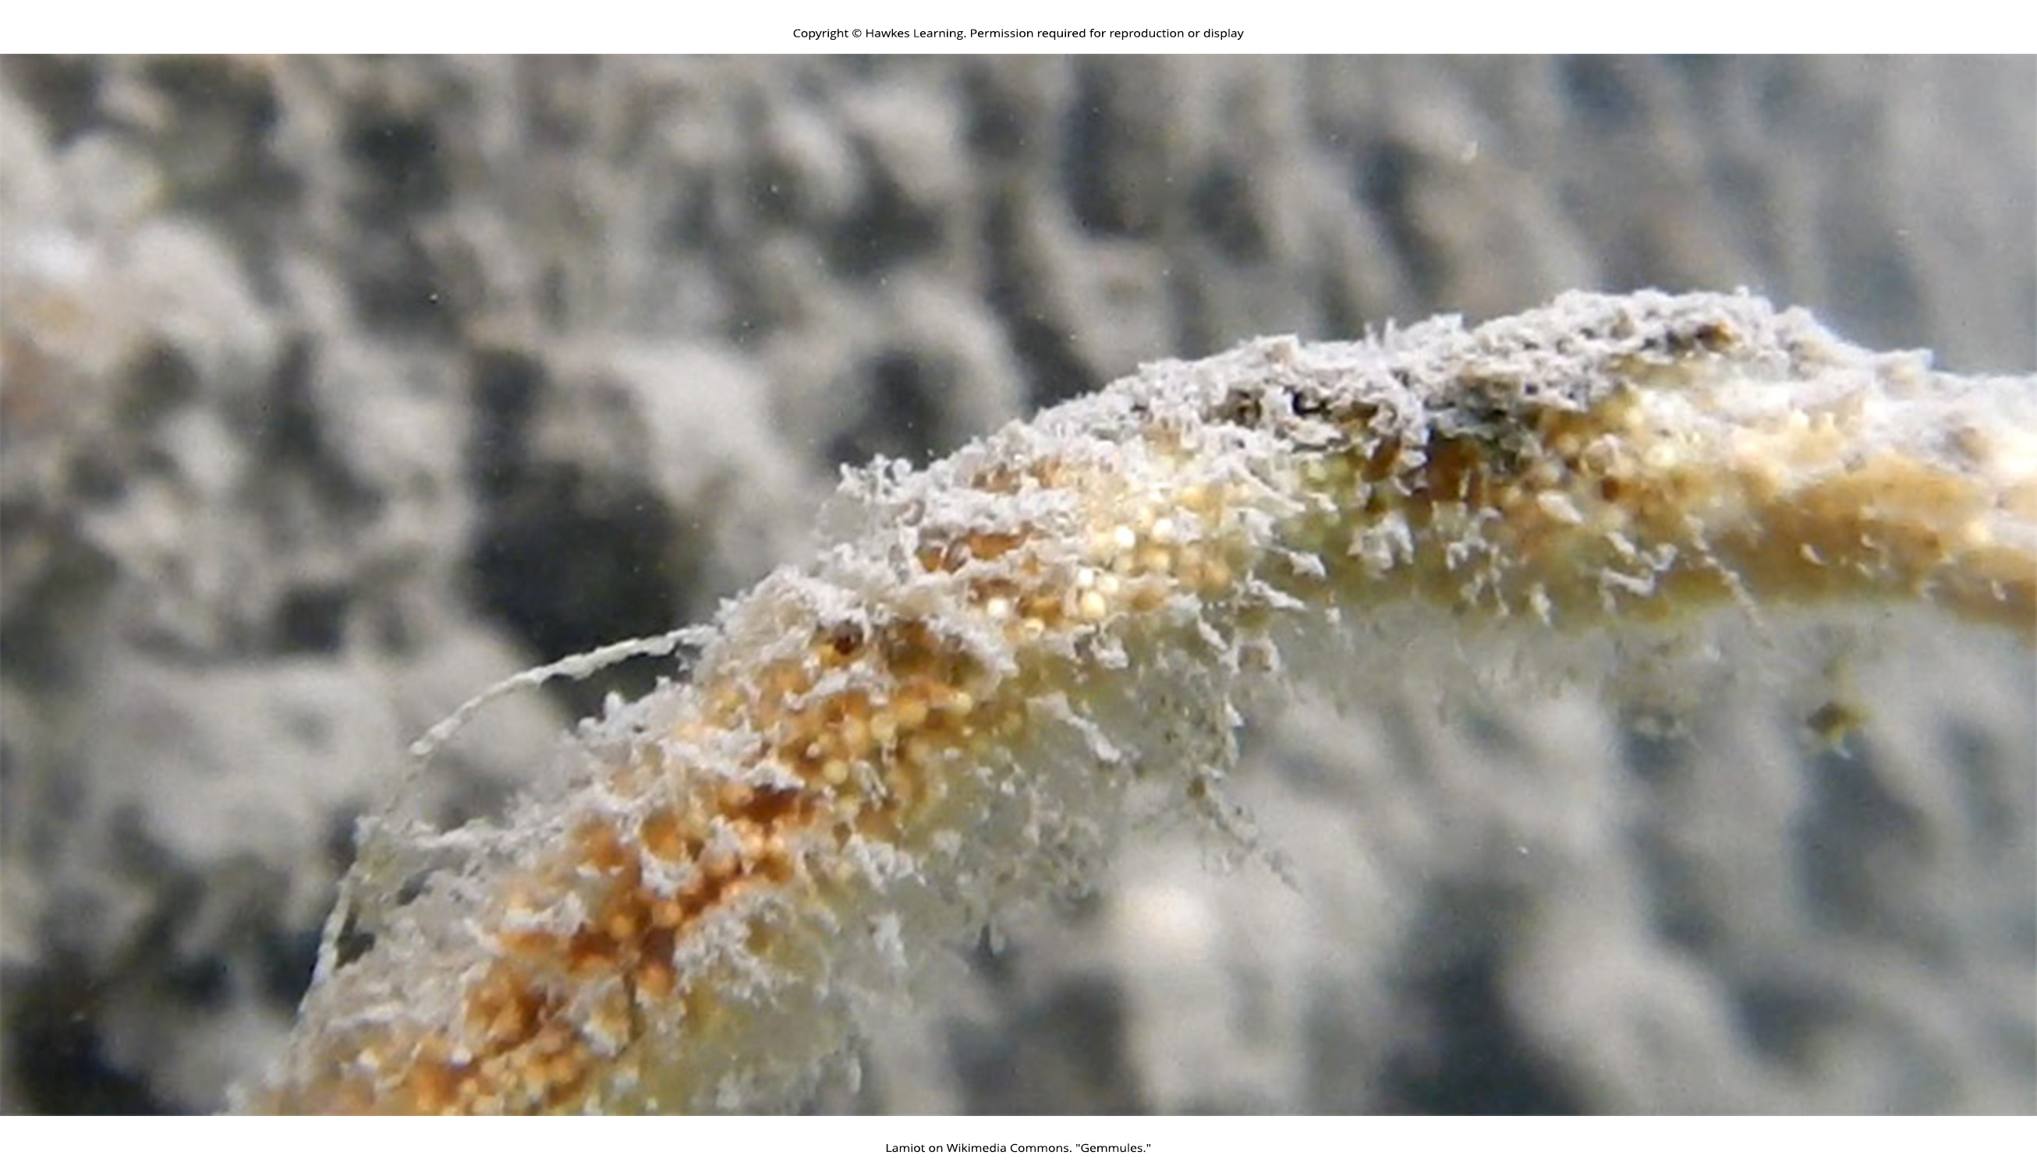
Lesson 28.1 Figure 6

Slide 8
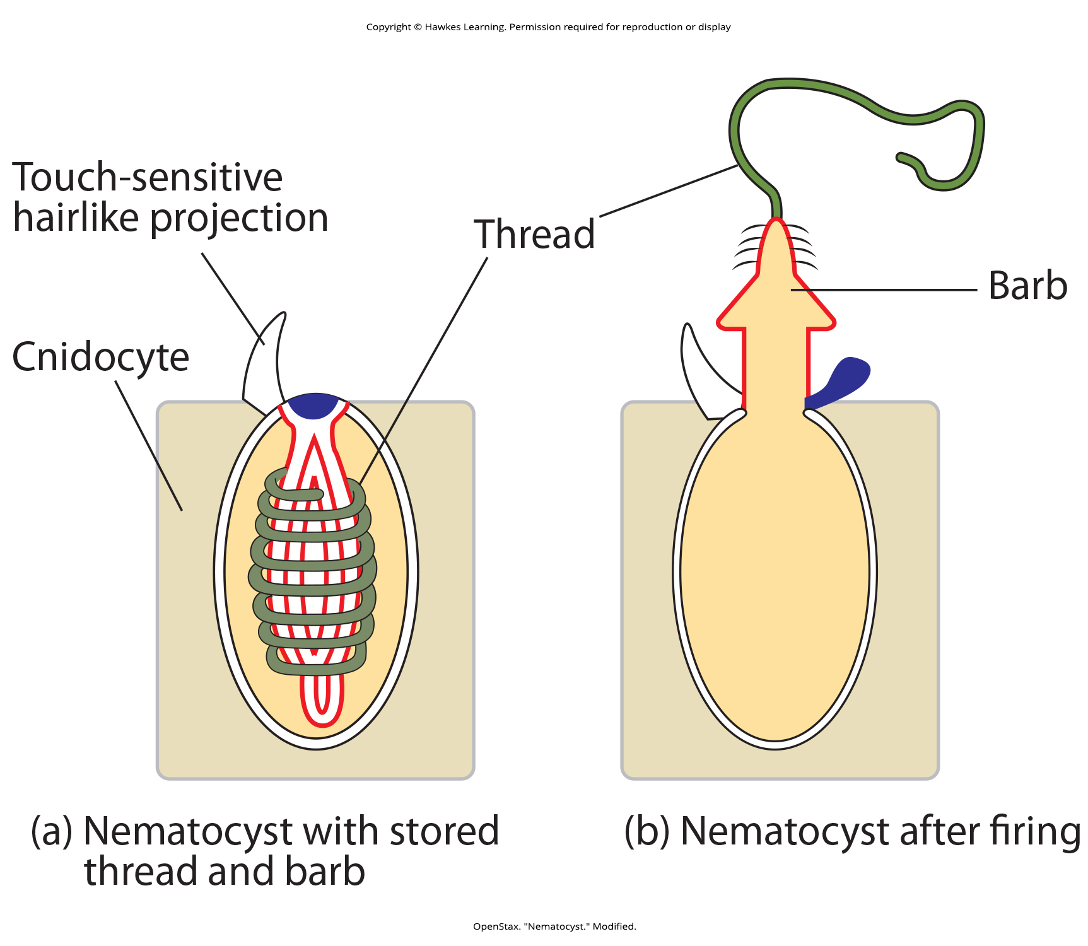
Lesson 28.2 Figure 1

Slide 9
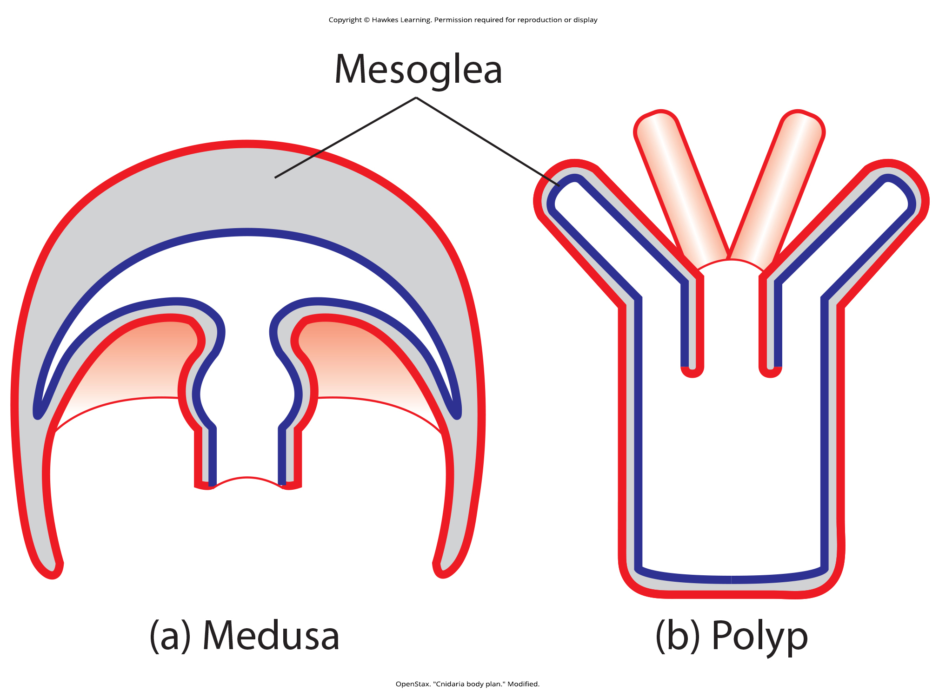
Lesson 28.2 Figure 2

Slide 10
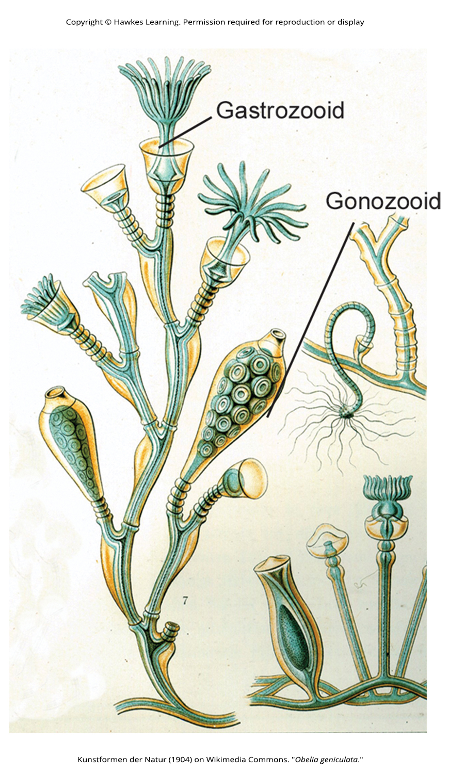
Lesson 28.2 Figure 3

Slide 11
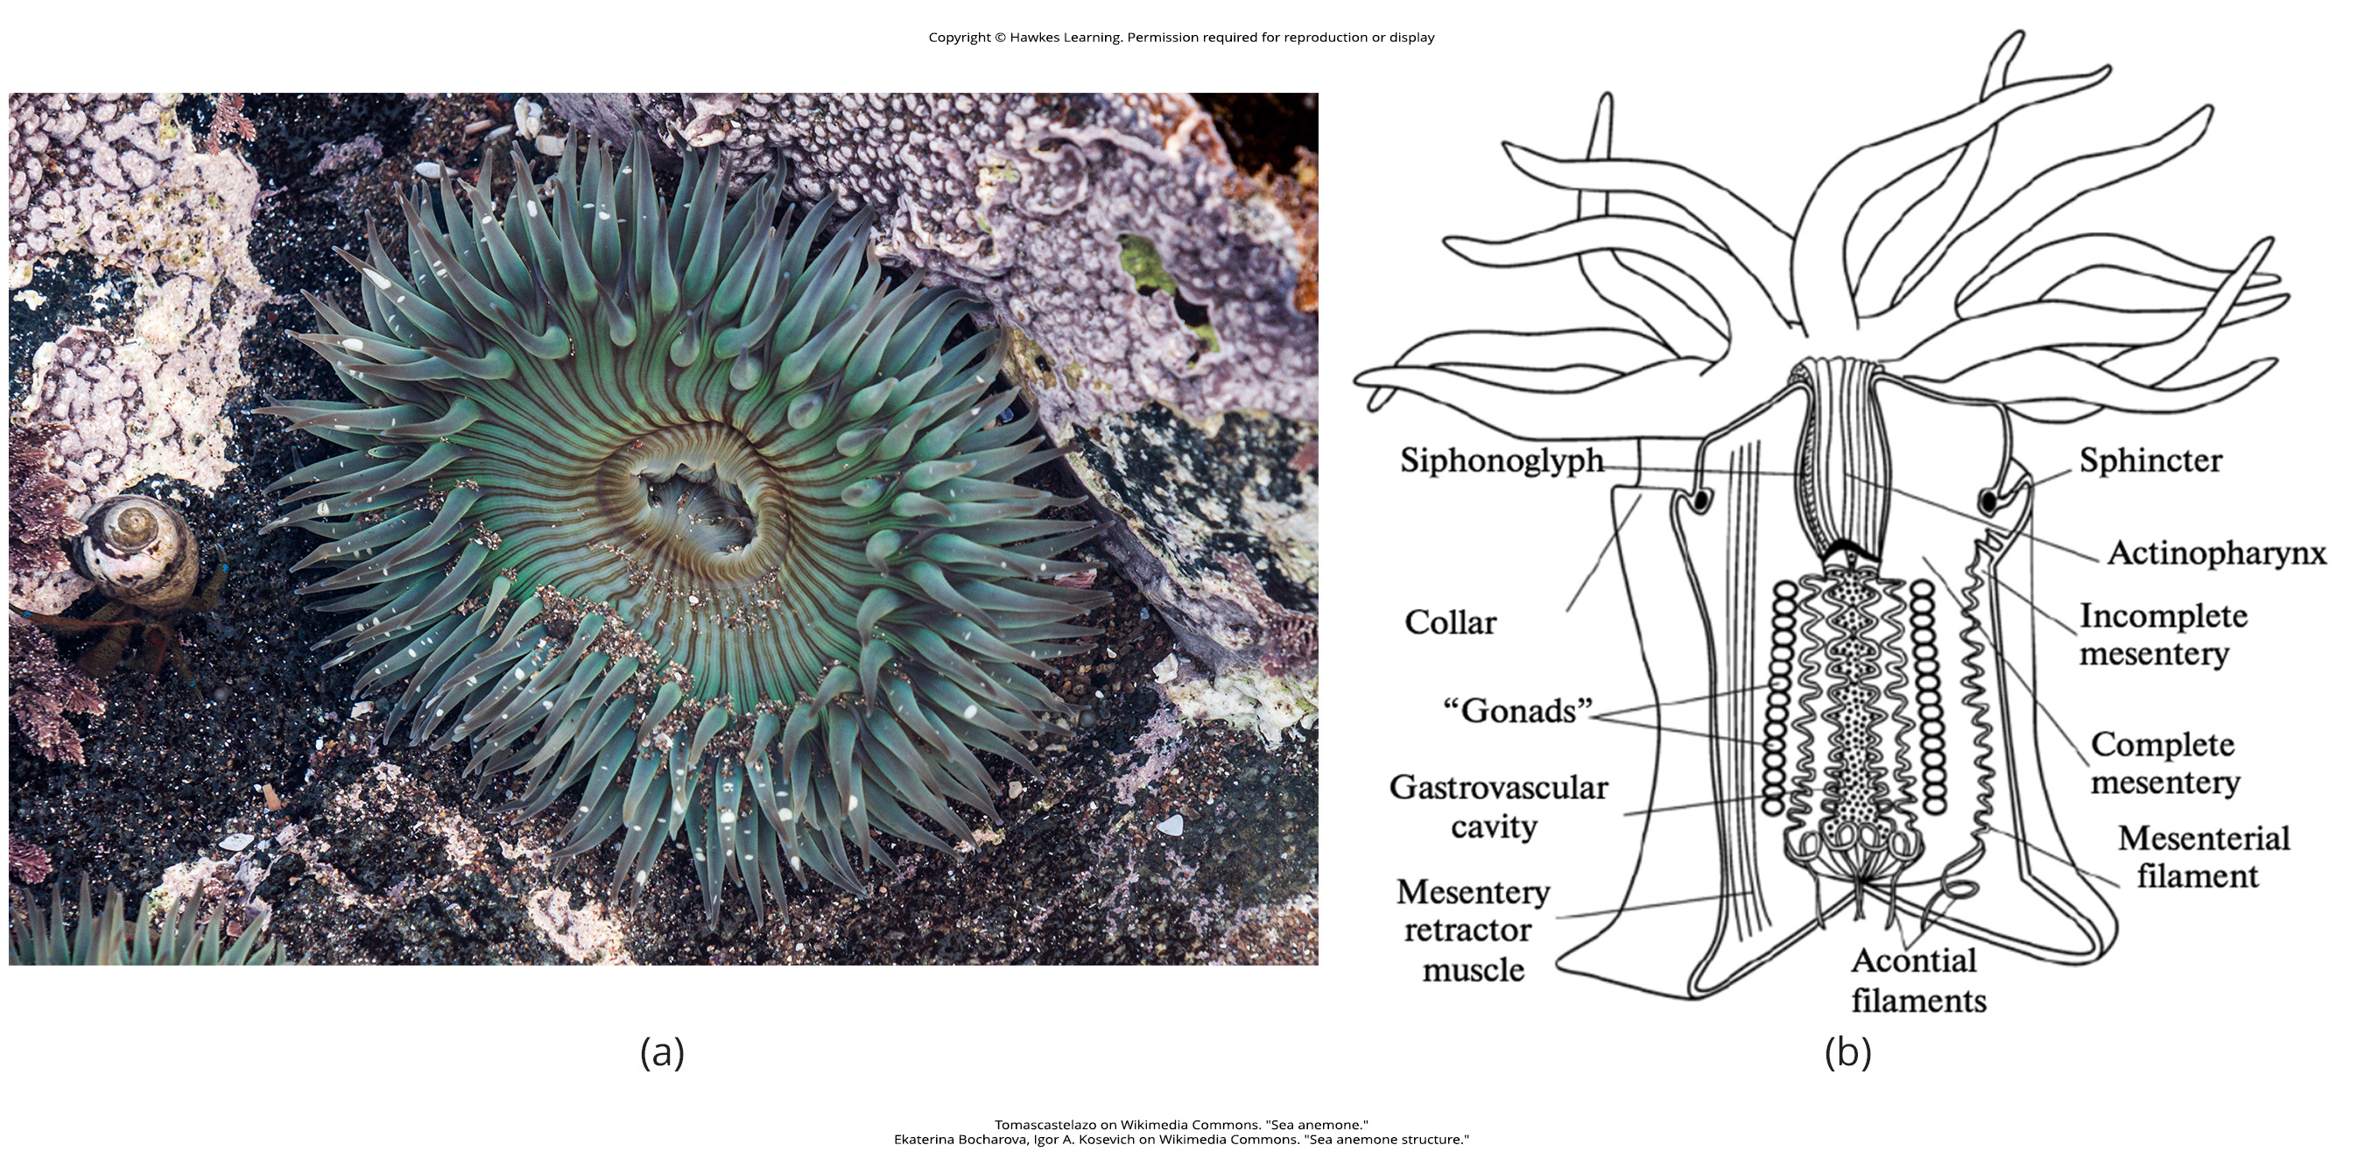
Lesson 28.2 Figure 4

Slide 12
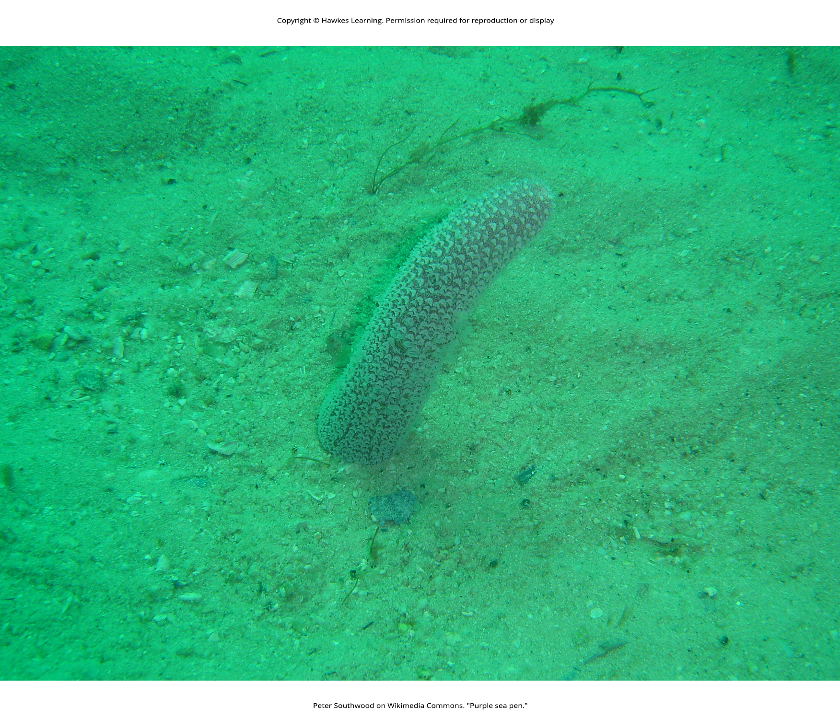
Lesson 28.2 Figure 5

Slide 13
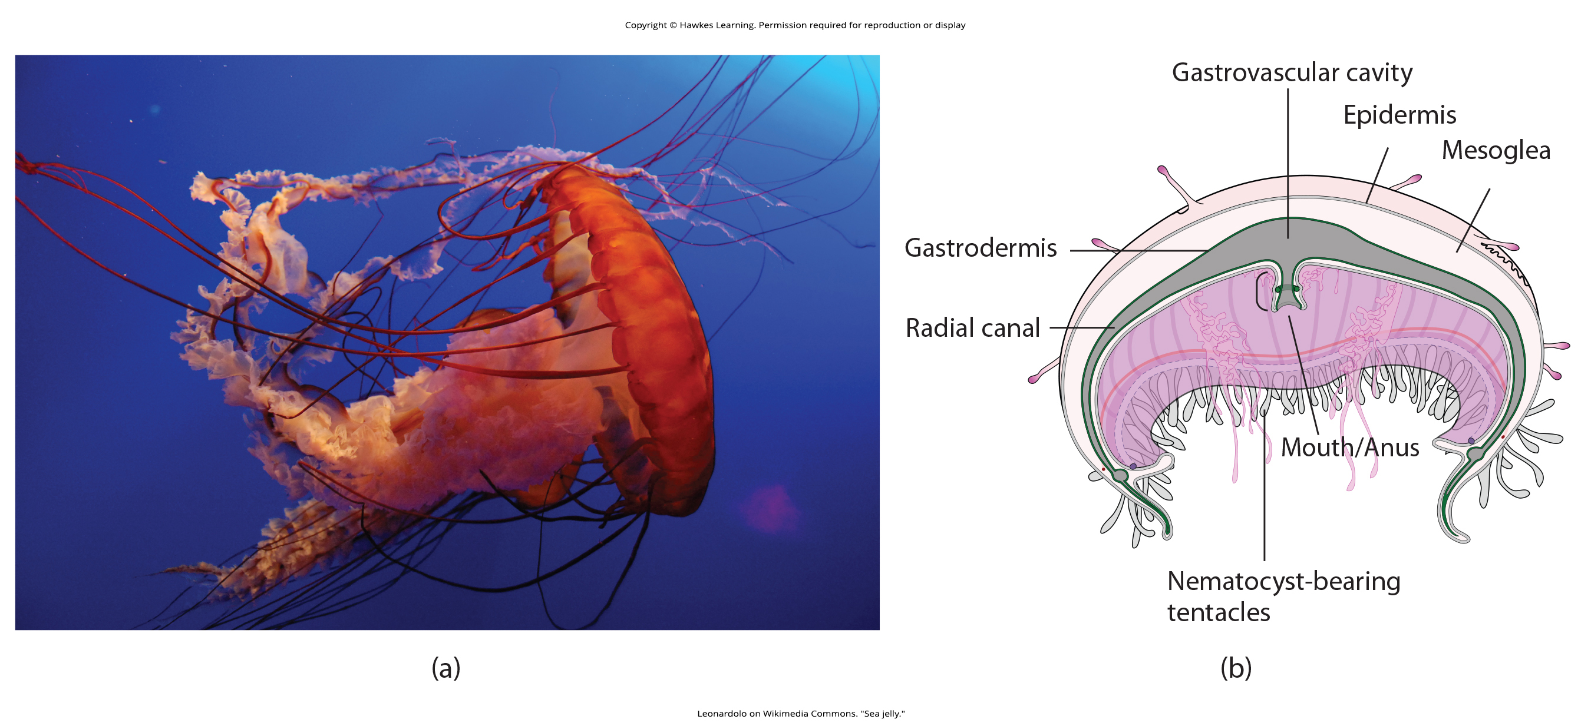
Lesson 28.2 Figure 6

Slide 14
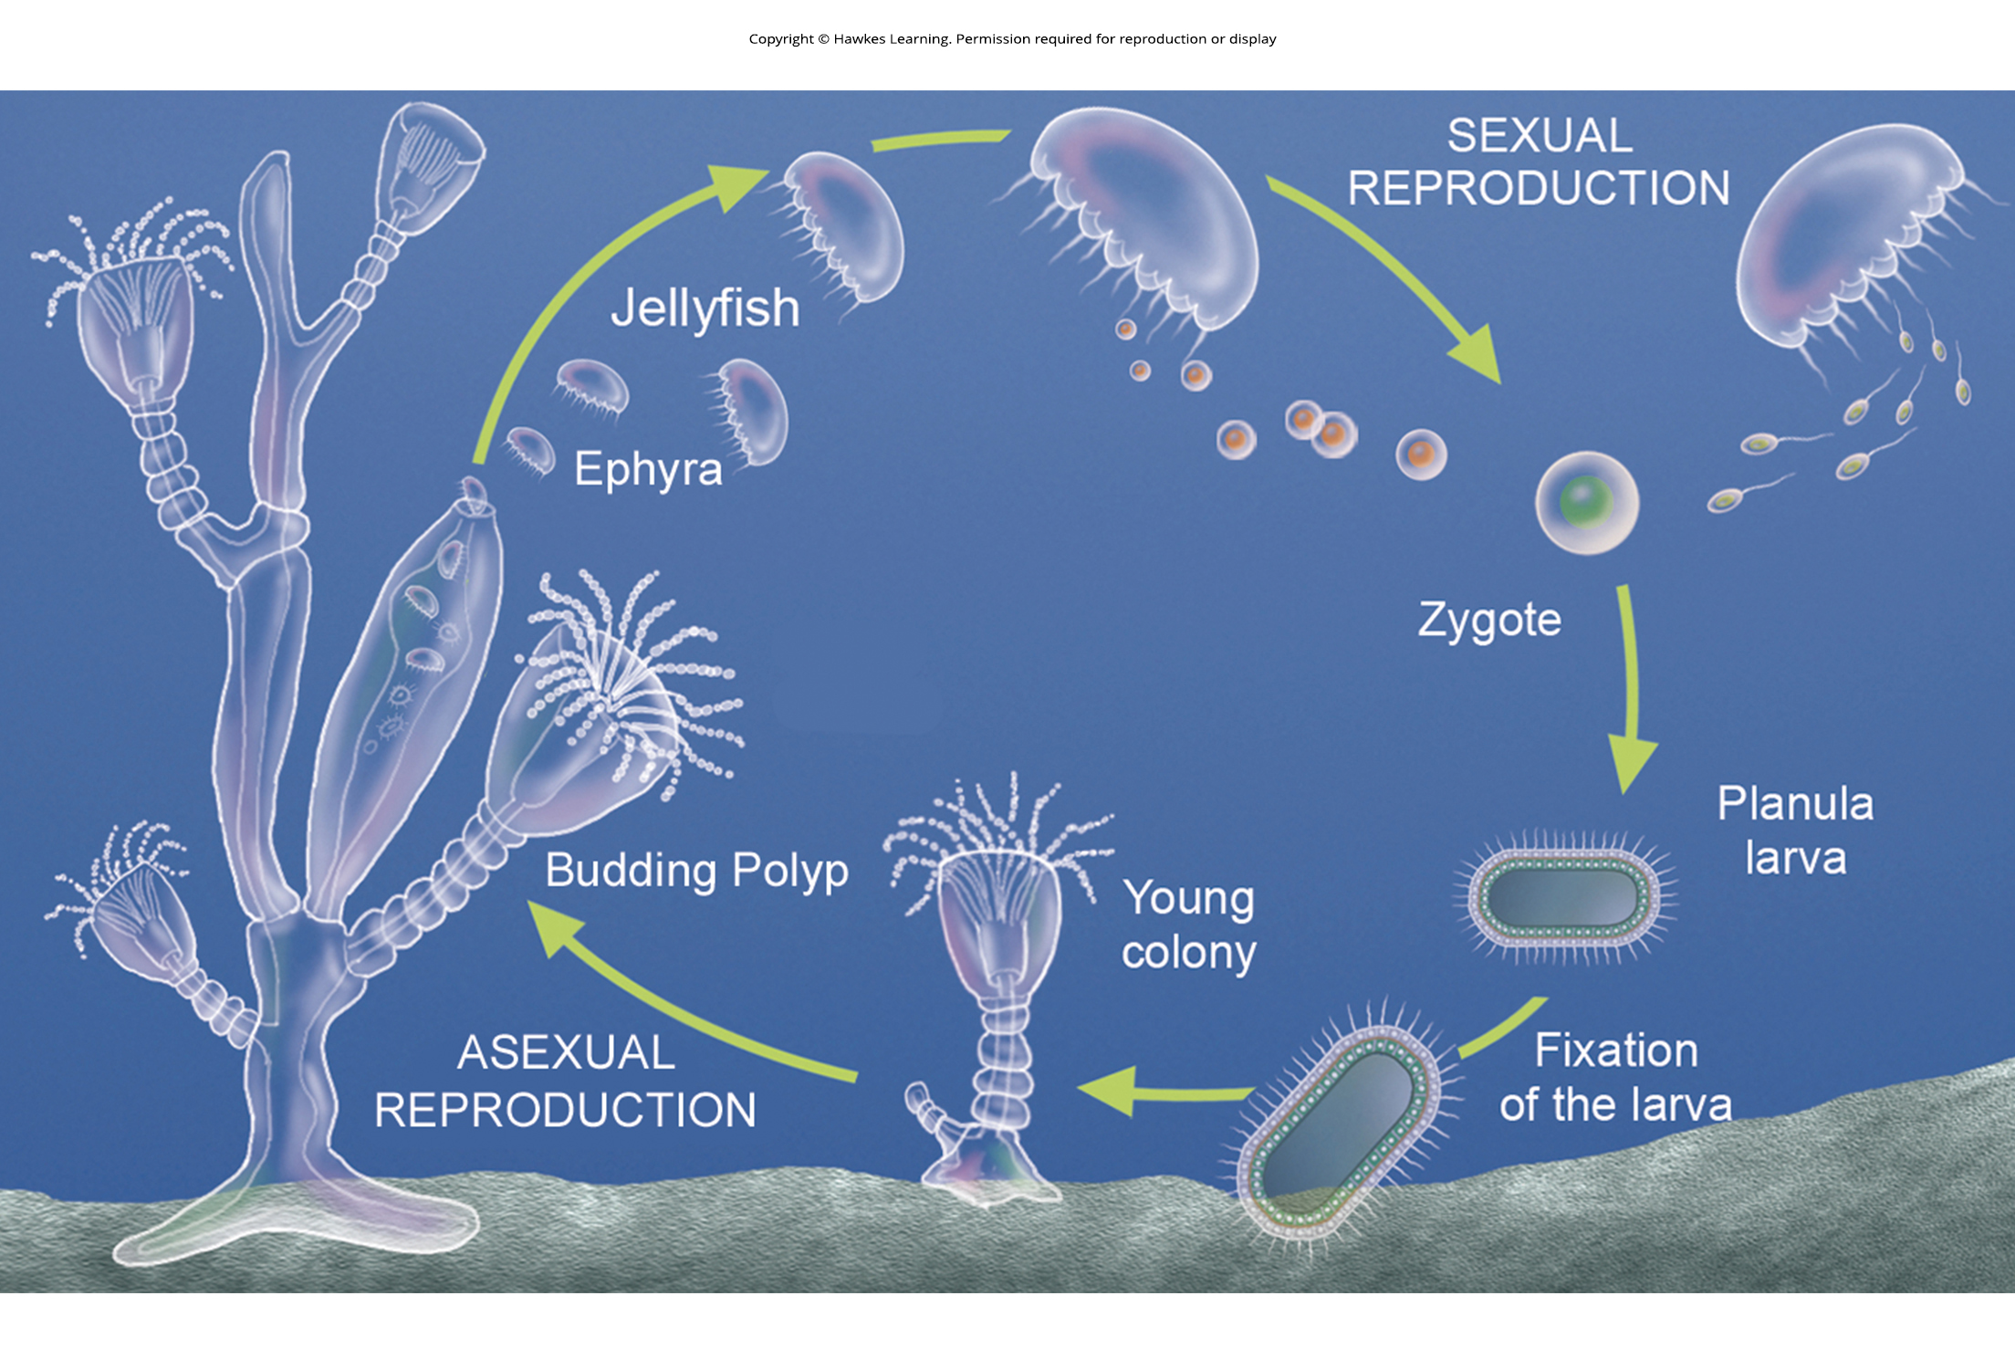
Lesson 28.2 Figure 7

Slide 15
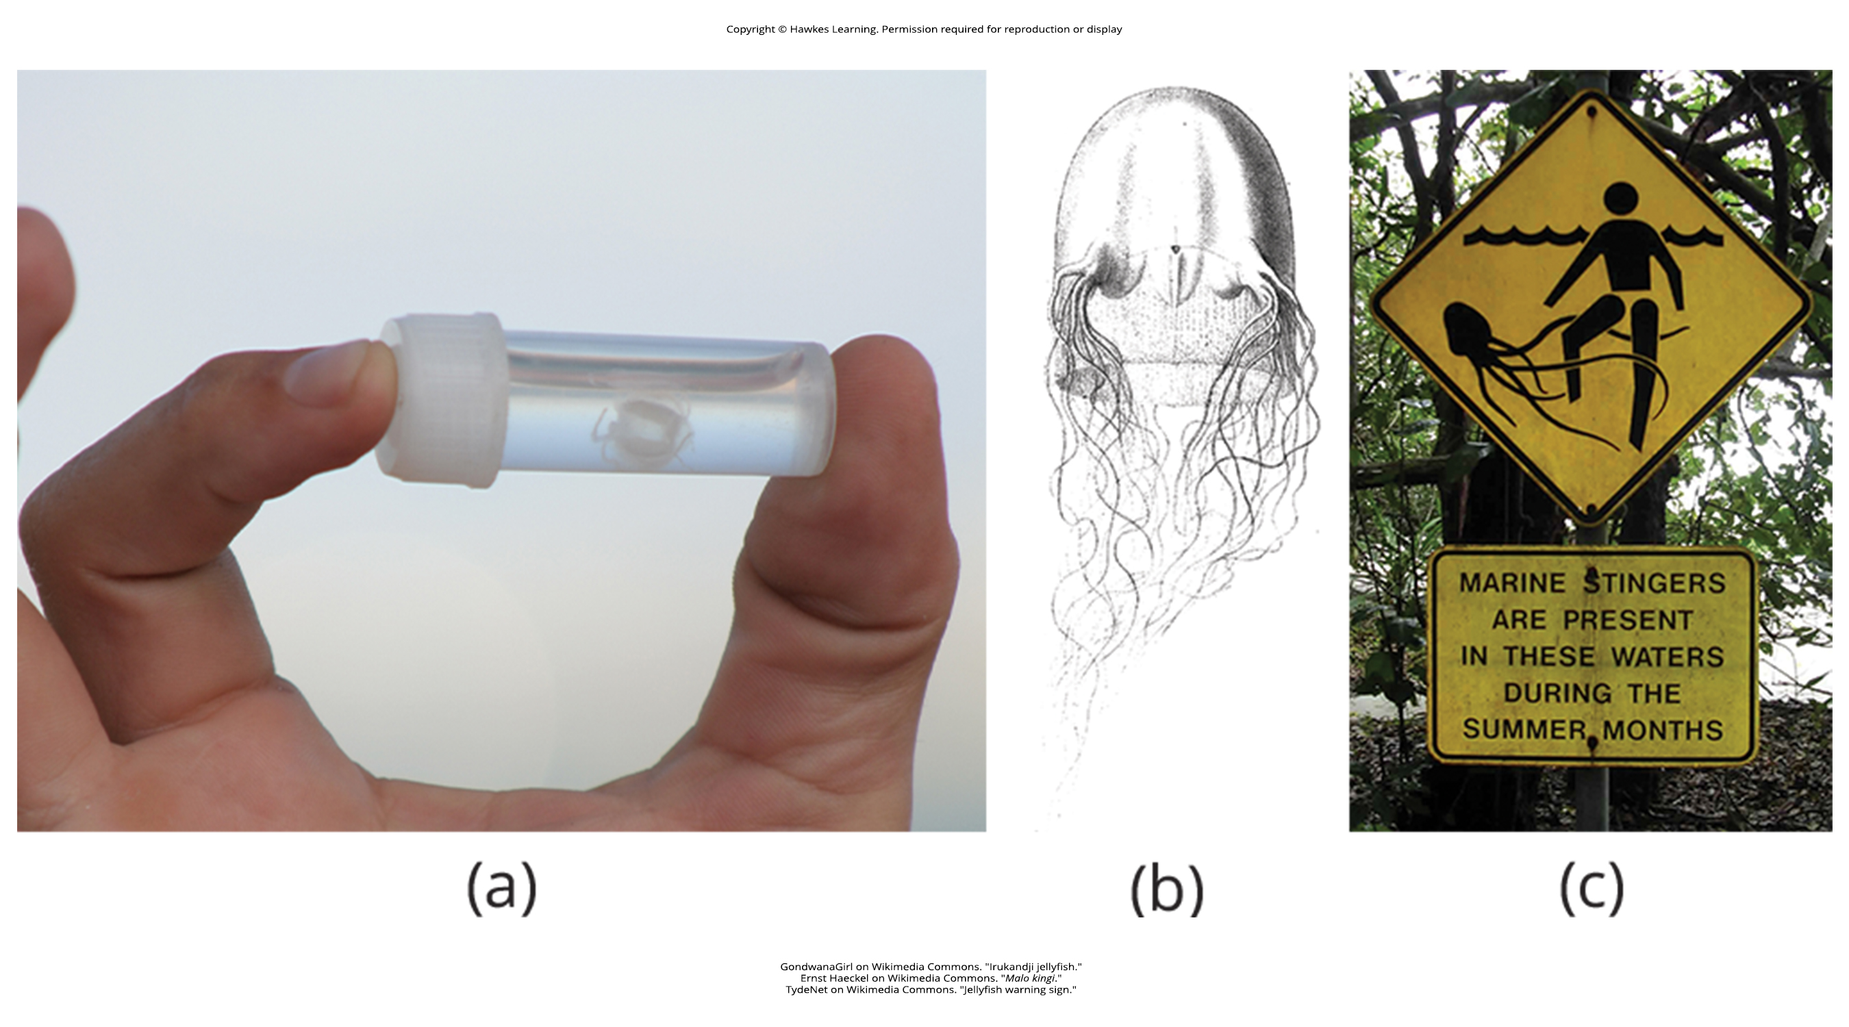
Lesson 28.2 Figure 8

Slide 16
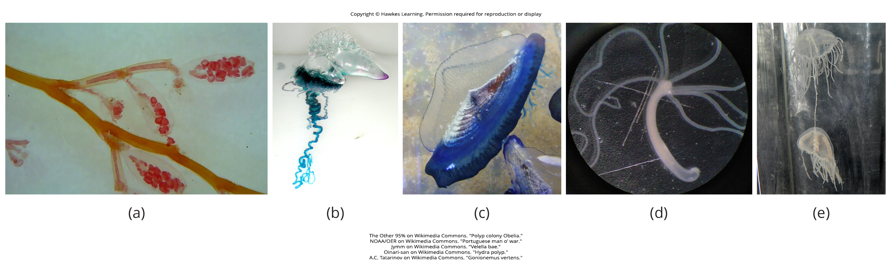
Lesson 28.2 Figure 9

Slide 17
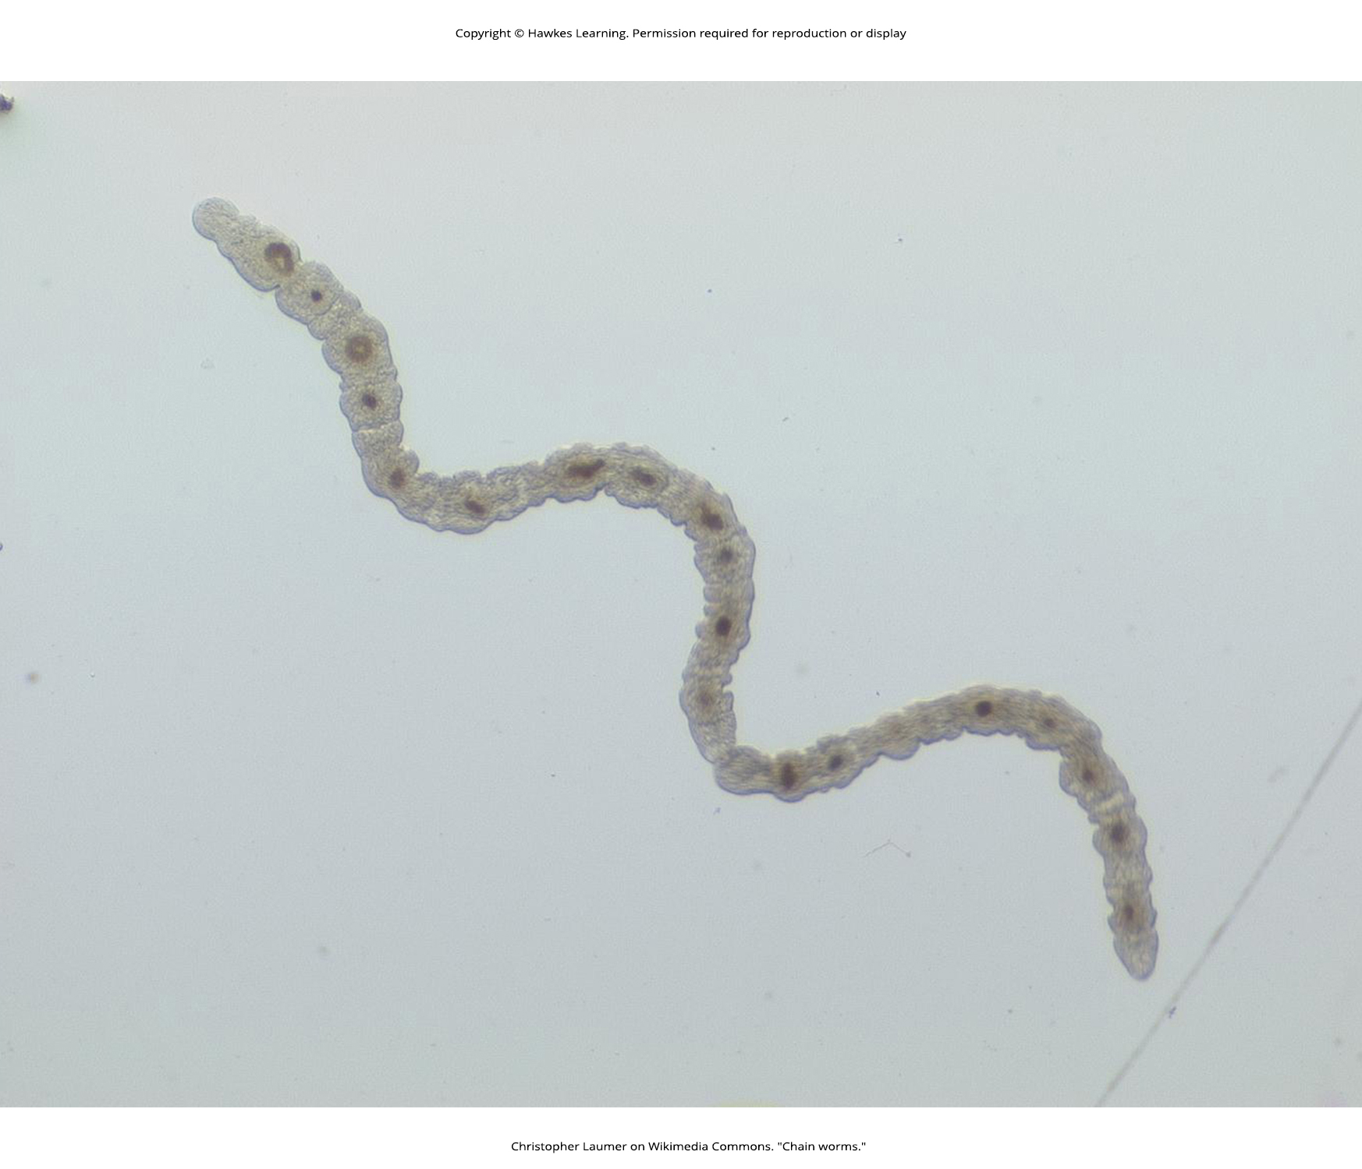
Lesson 28.3 Figure 1

Slide 18
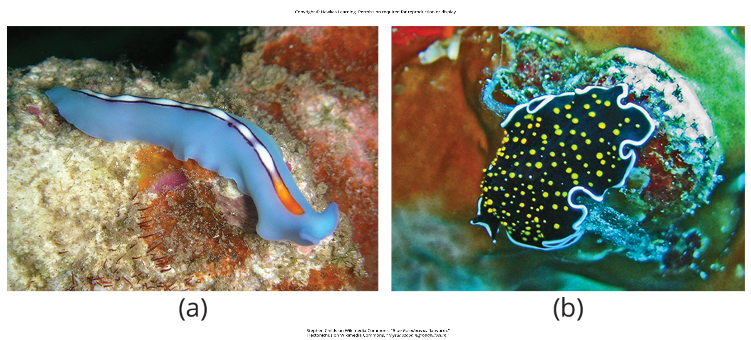
Lesson 28.3 Figure 2

Slide 19
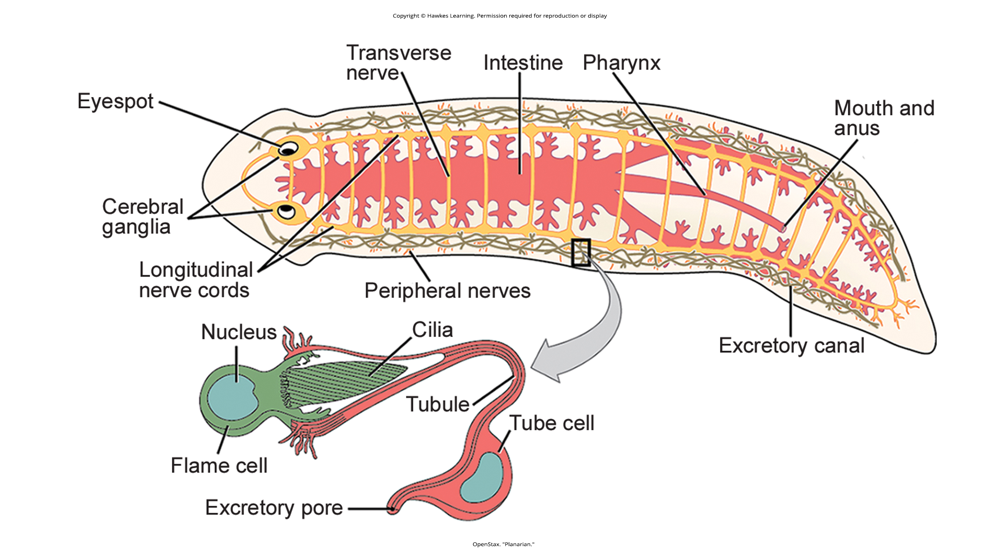
Lesson 28.3 Figure 3

Slide 20
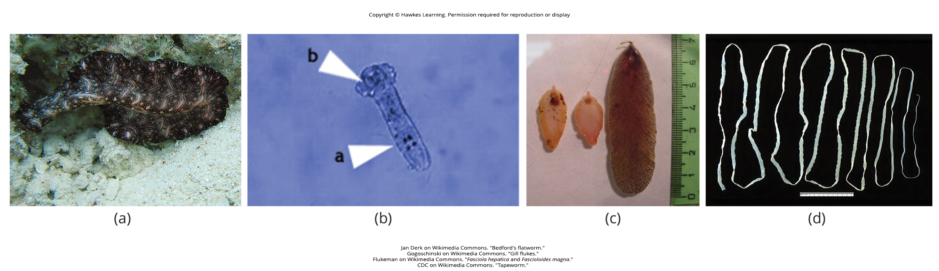
Lesson 28.3 Figure 4

Slide 21
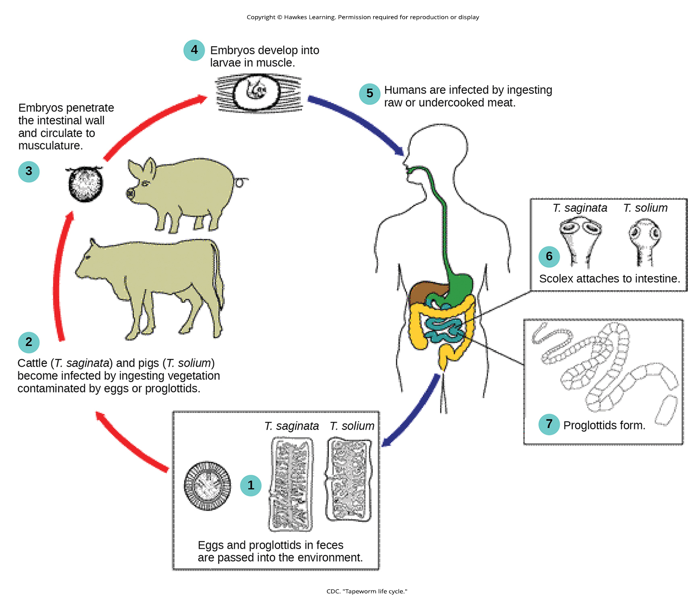
Lesson 28.3 Figure 5

Slide 22
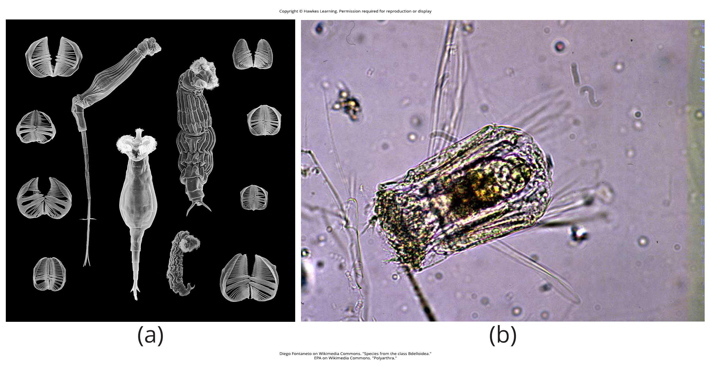
Lesson 28.3 Figure 6

Slide 23
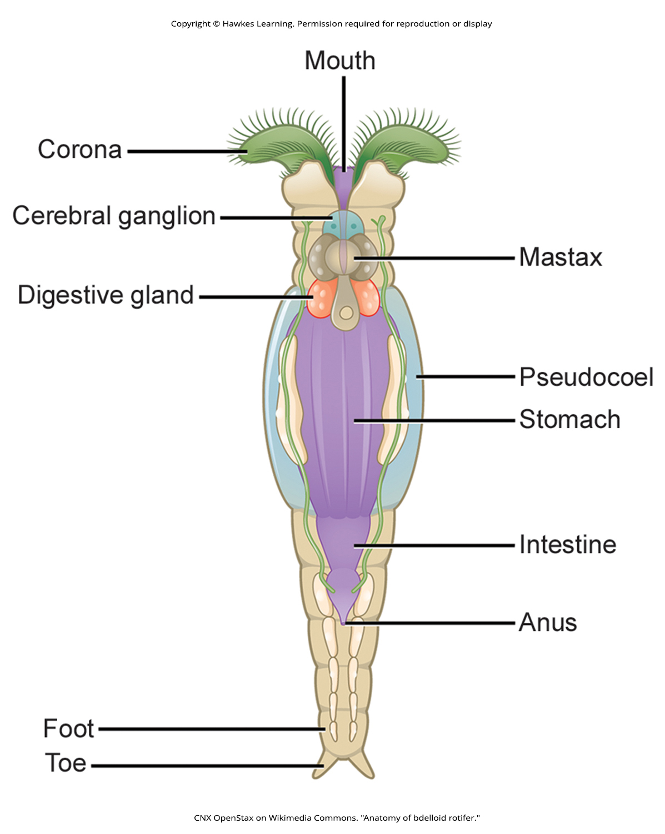
Lesson 28.3 Figure 7

Slide 24
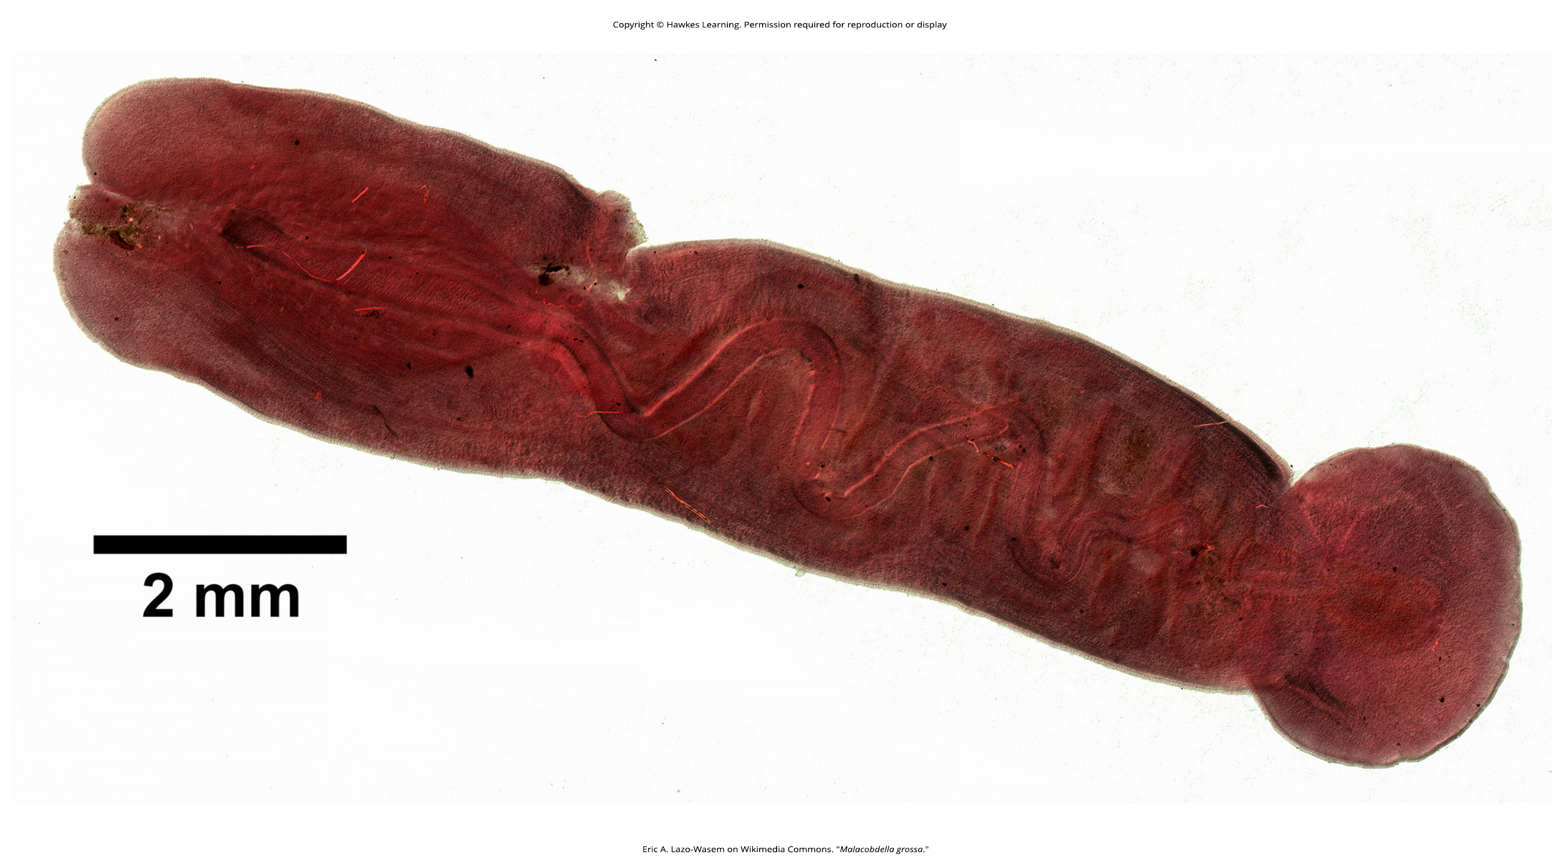
Lesson 28.3 Figure 8

Slide 25
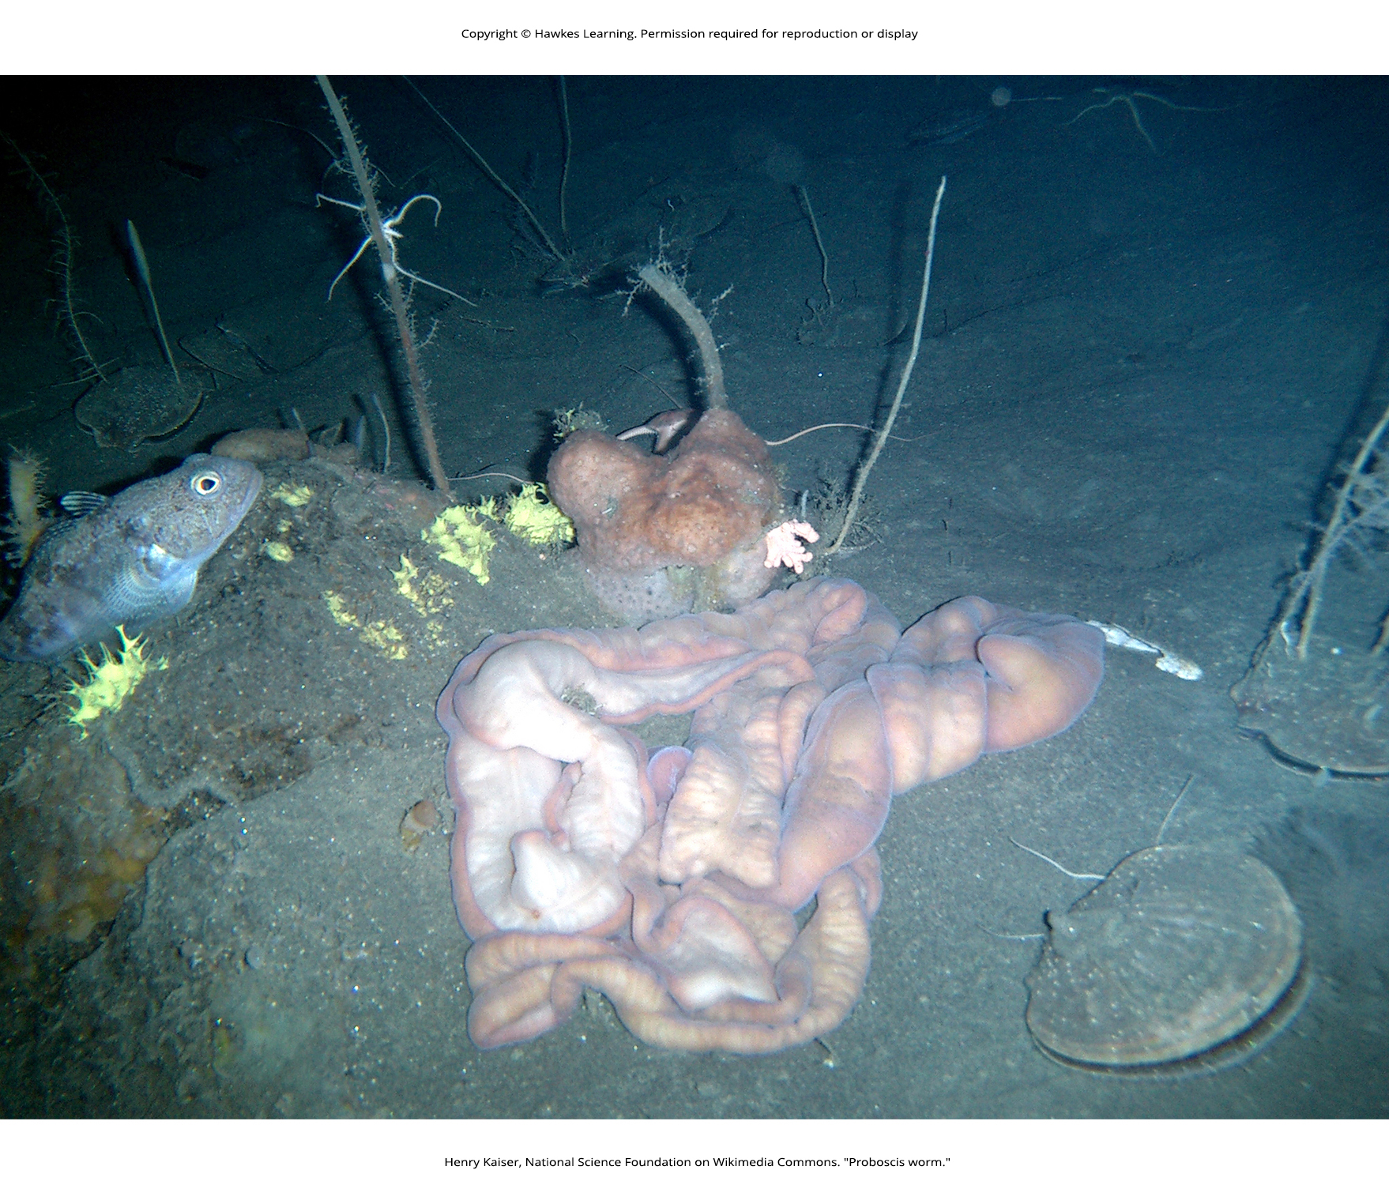
Lesson 28.3 Figure 9

Slide 26
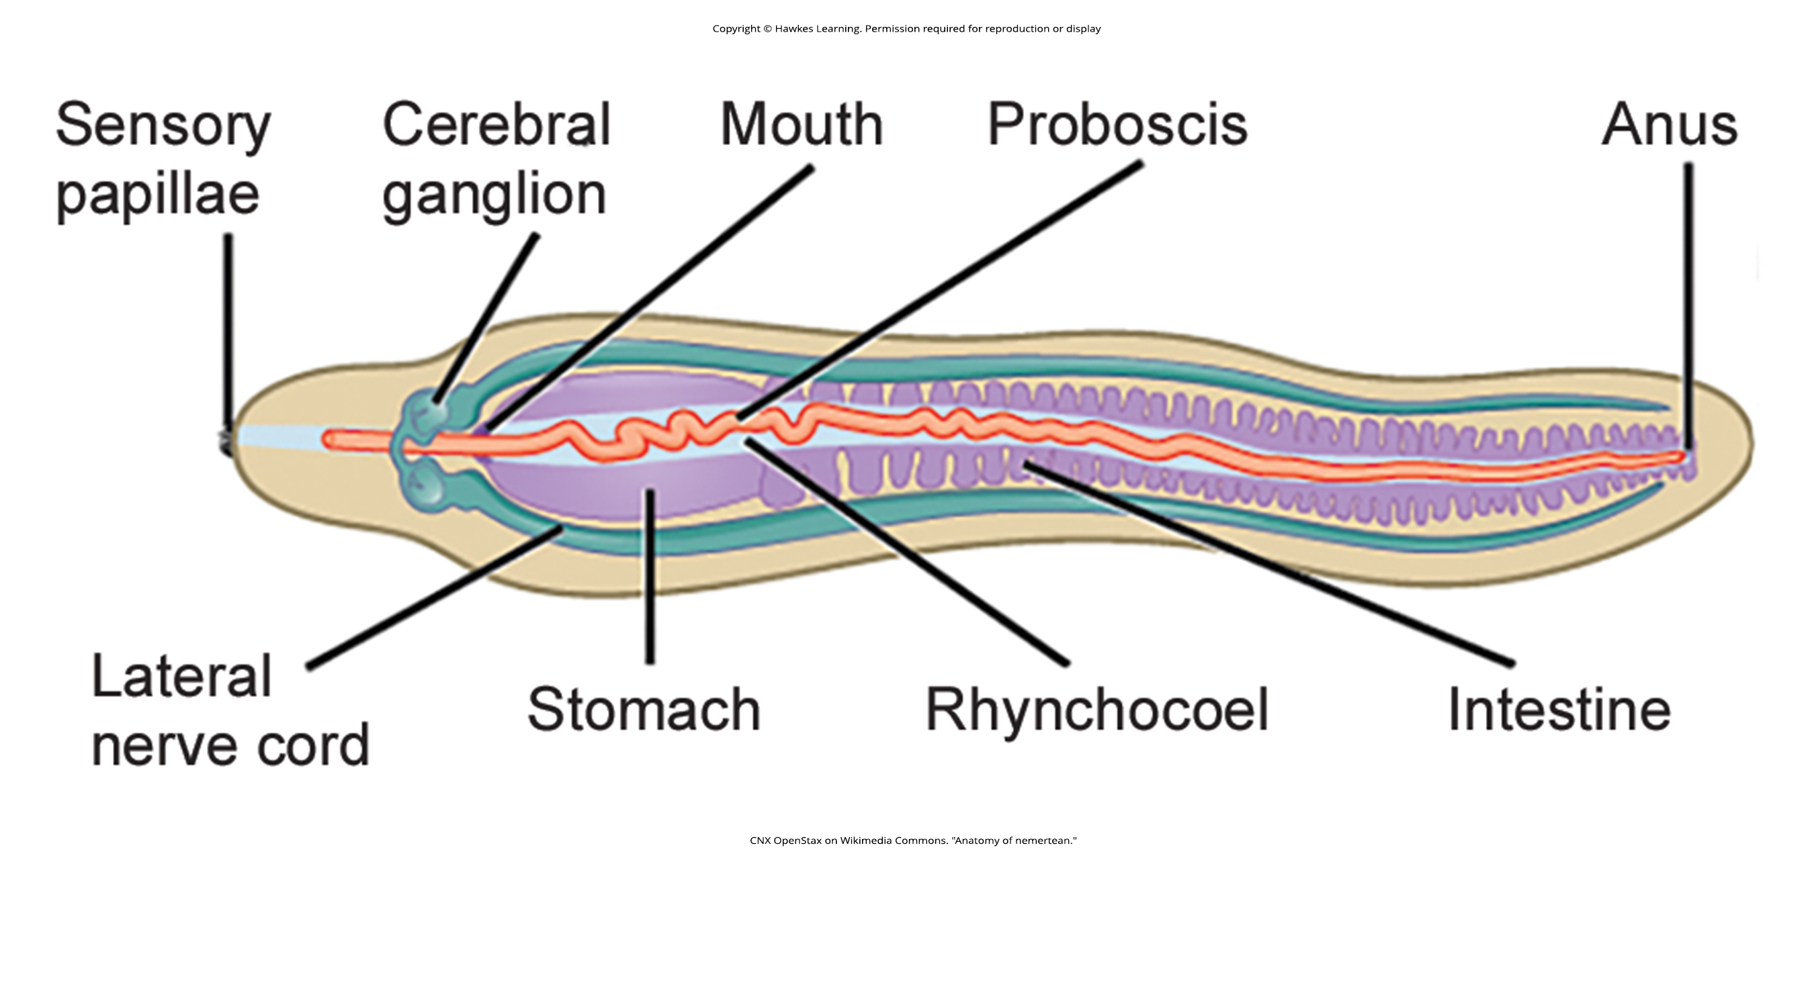
Lesson 28.3 Figure 10

Slide 27
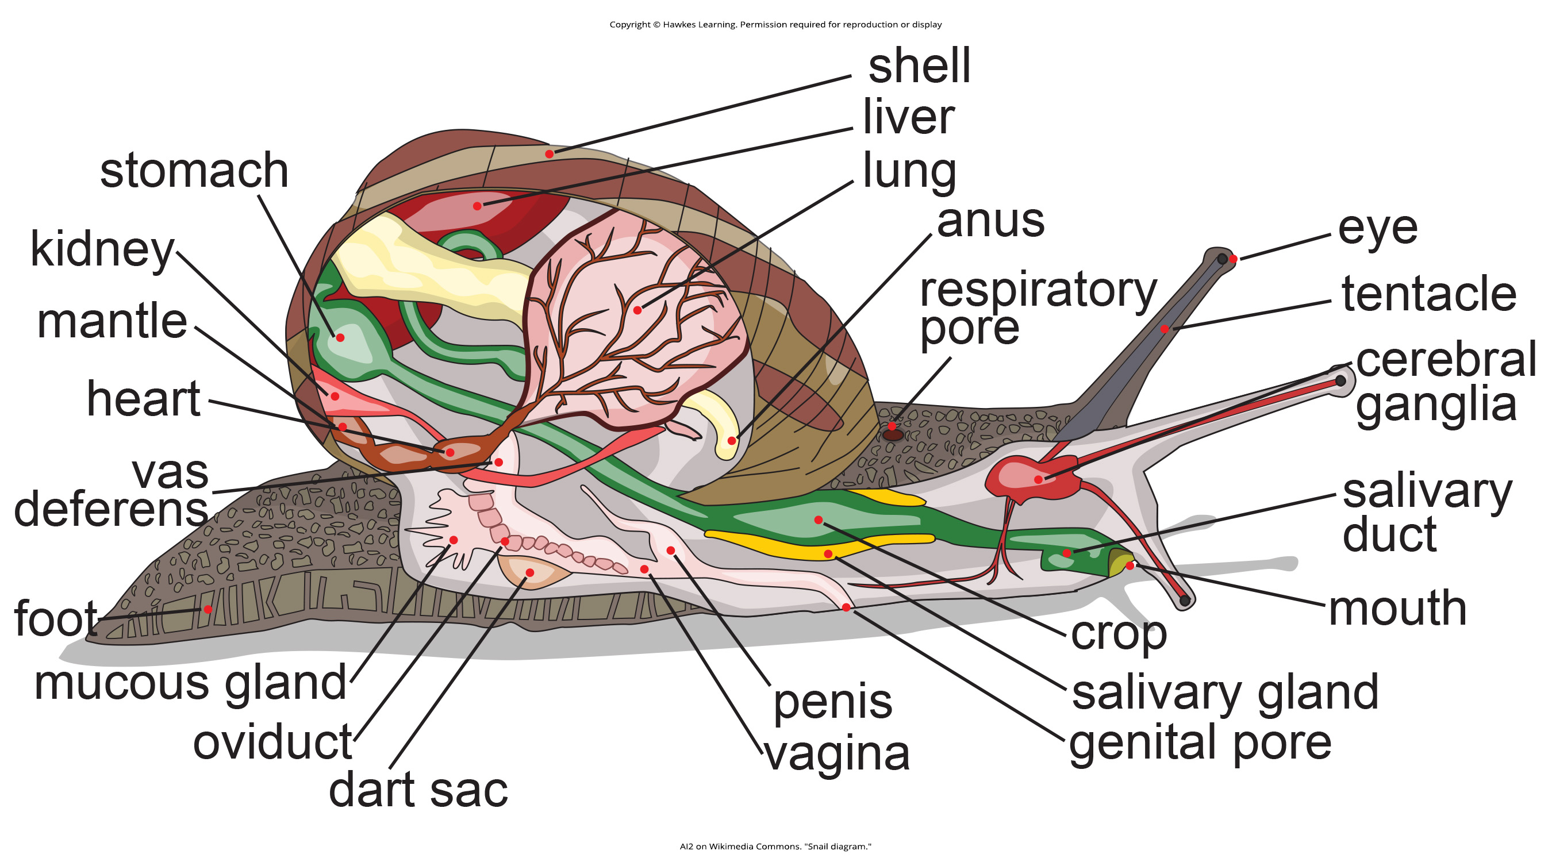
Lesson 28.4 Figure 1

Slide 28
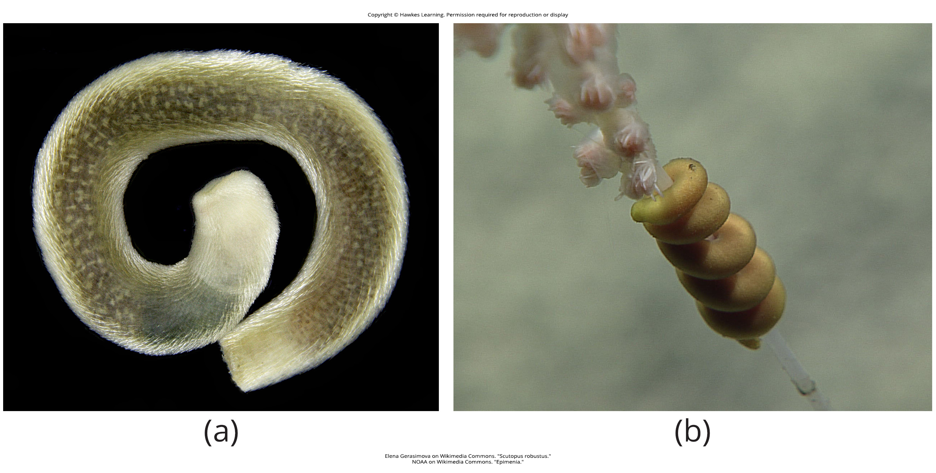
Lesson 28.4 Figure 2

Slide 29
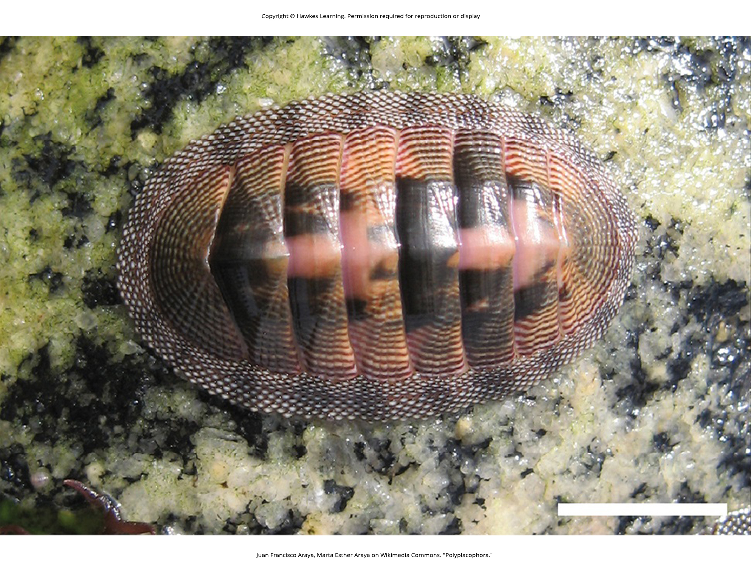
Lesson 28.4 Figure 3

Slide 30
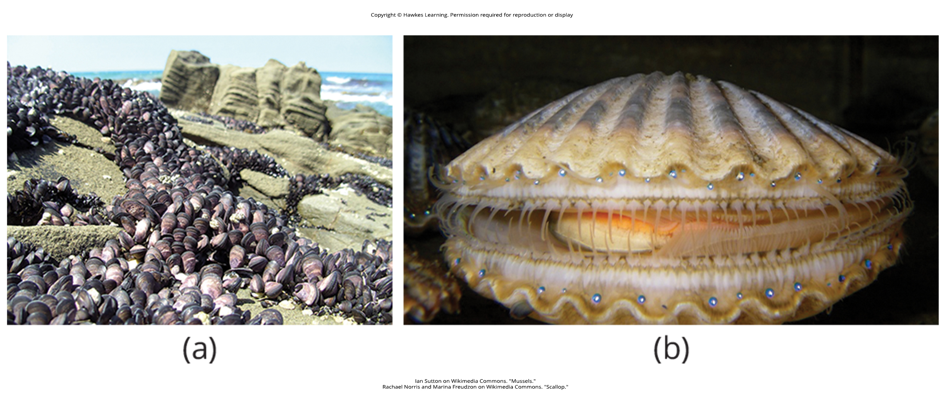
Lesson 28.4 Figure 4

Slide 31
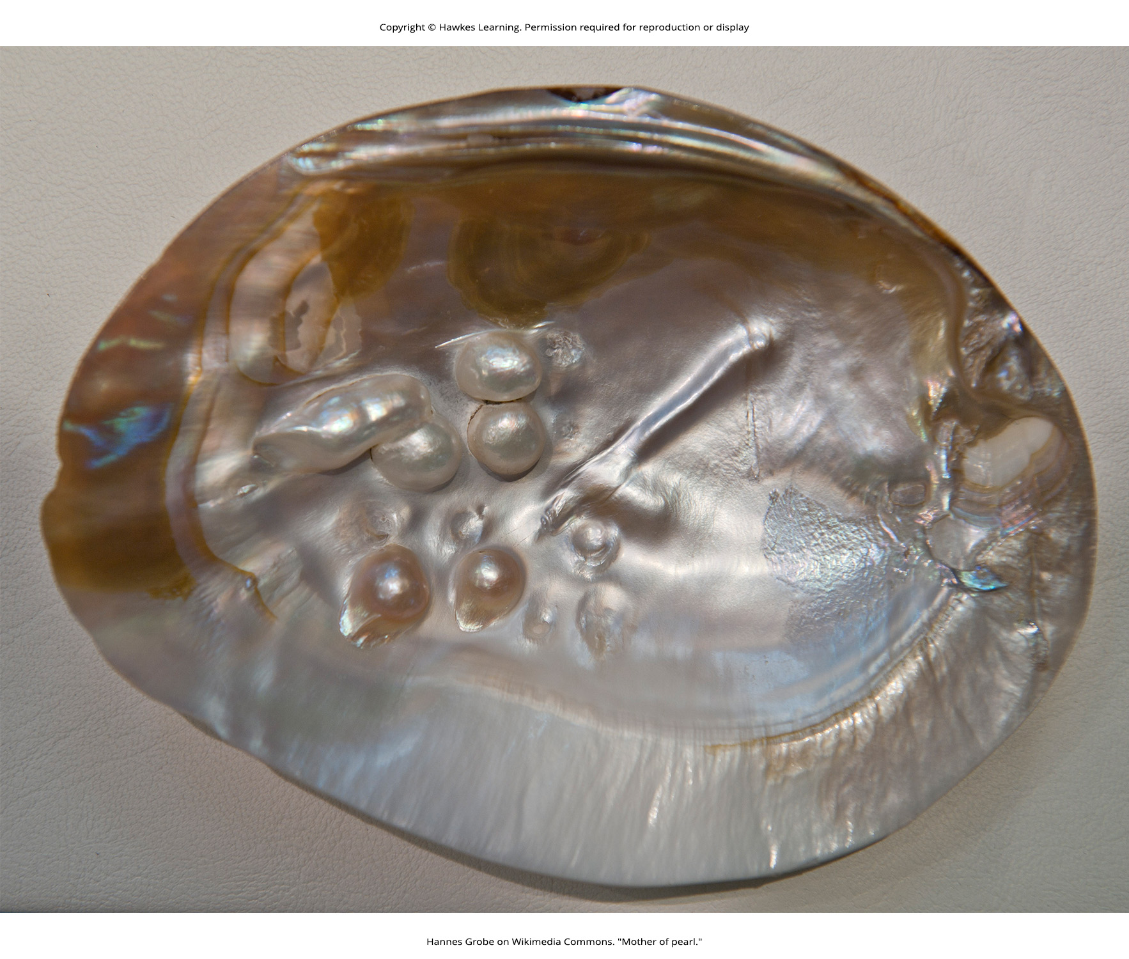
Lesson 28.4 Figure 5

Slide 32
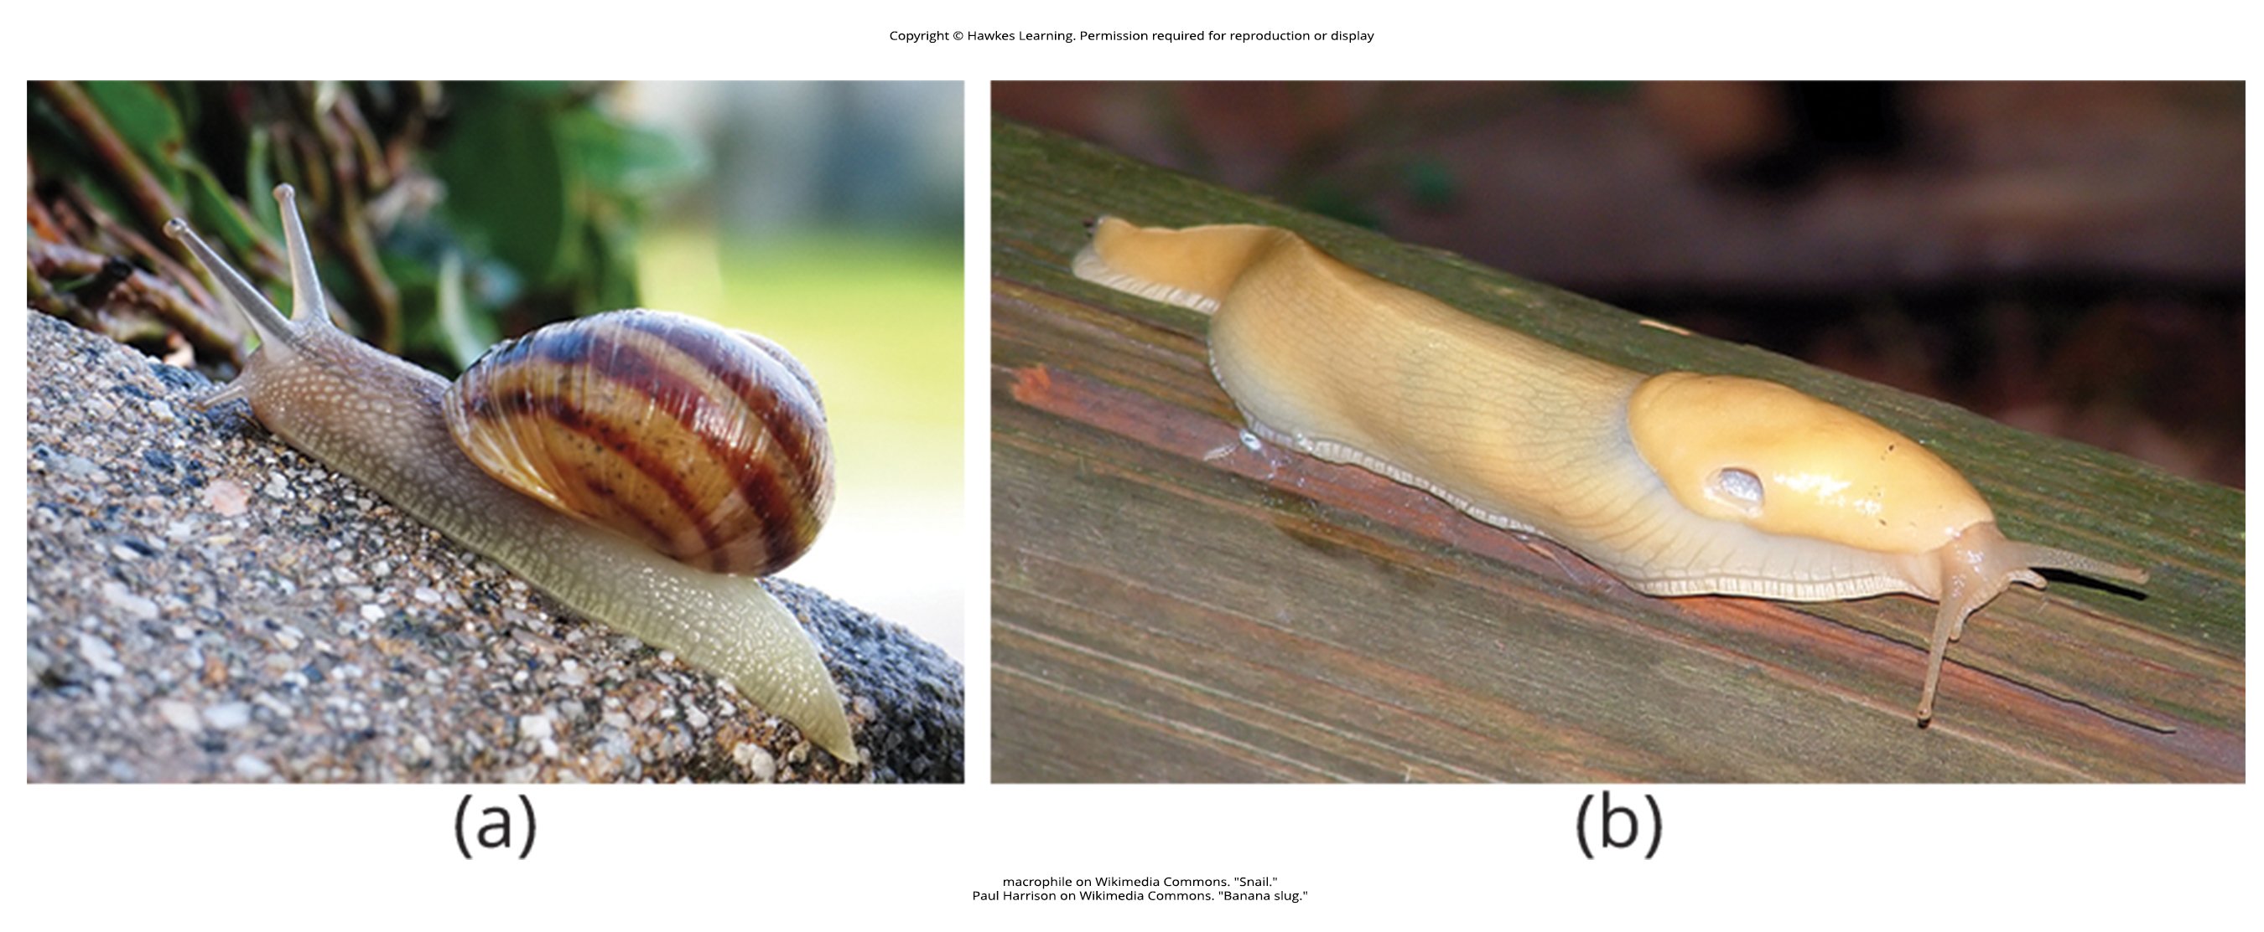
Lesson 28.4 Figure 6

Slide 33
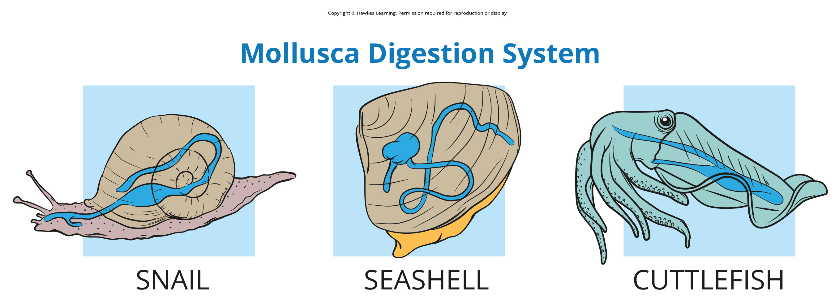
Lesson 28.4 Figure 7

Slide 34
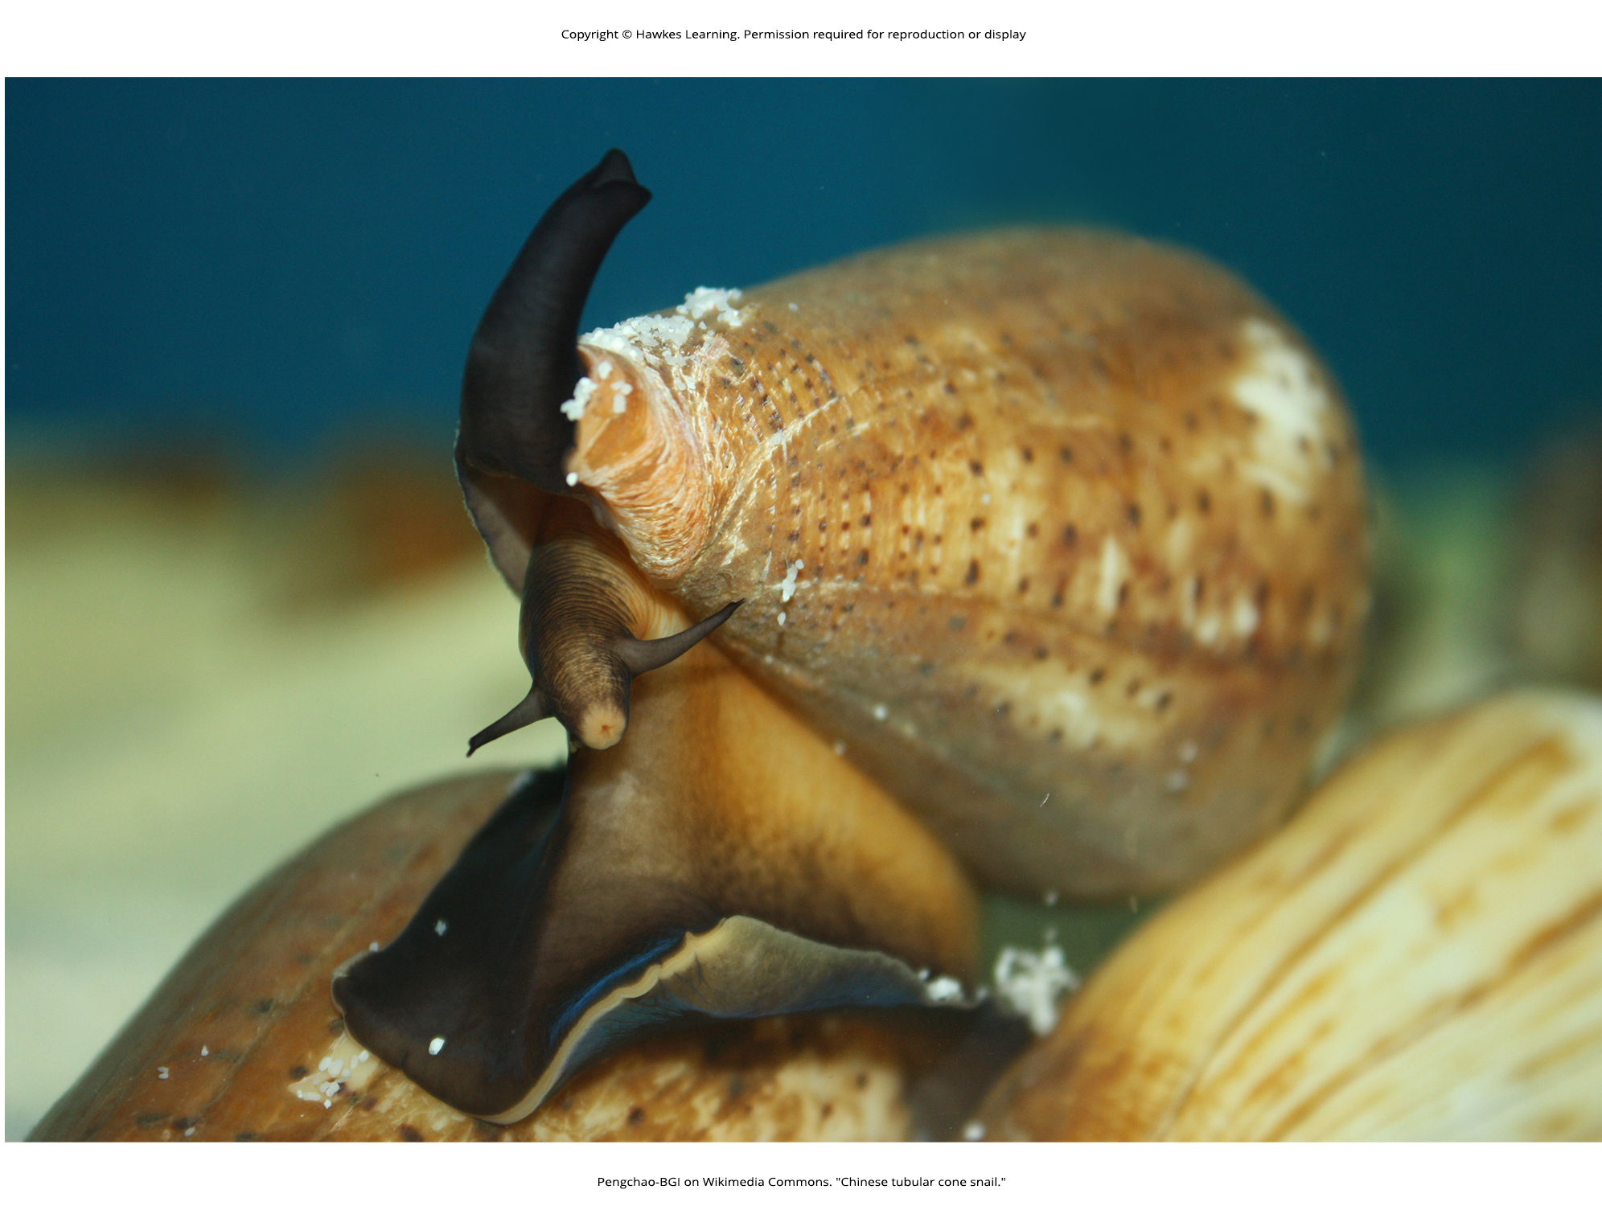
Lesson 28.4 Figure 8

Slide 35
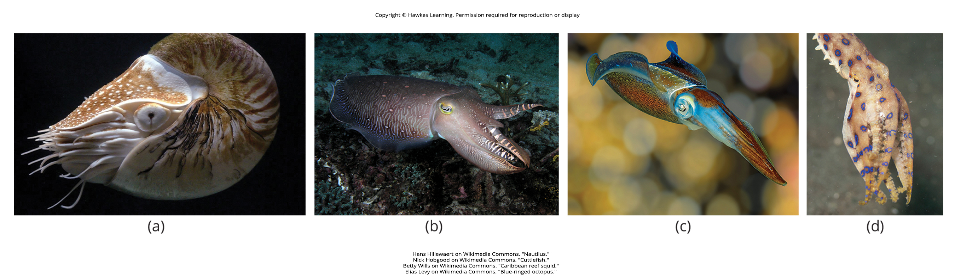
Lesson 28.4 Figure 9

Slide 36
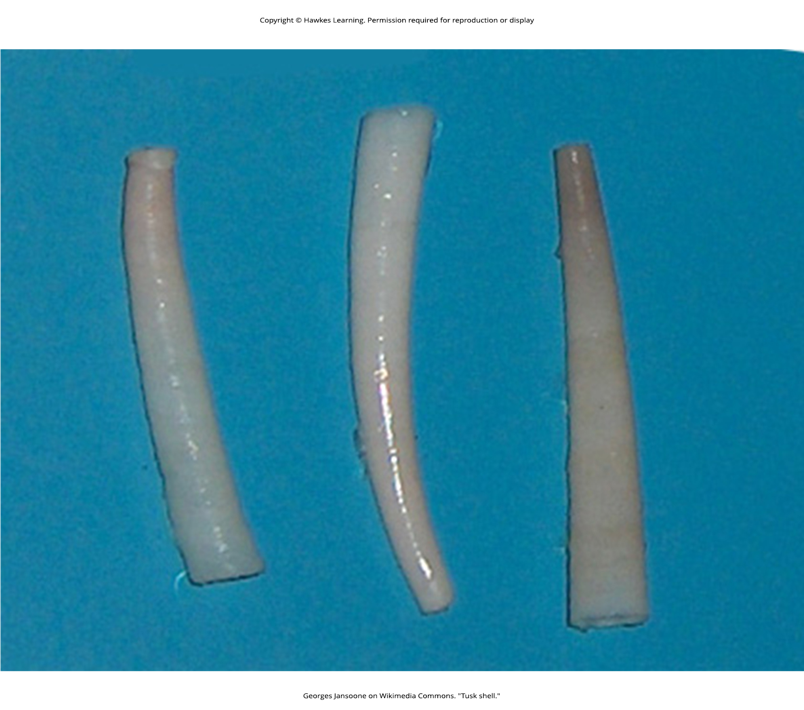
Lesson 28.4 Figure 10

Slide 37
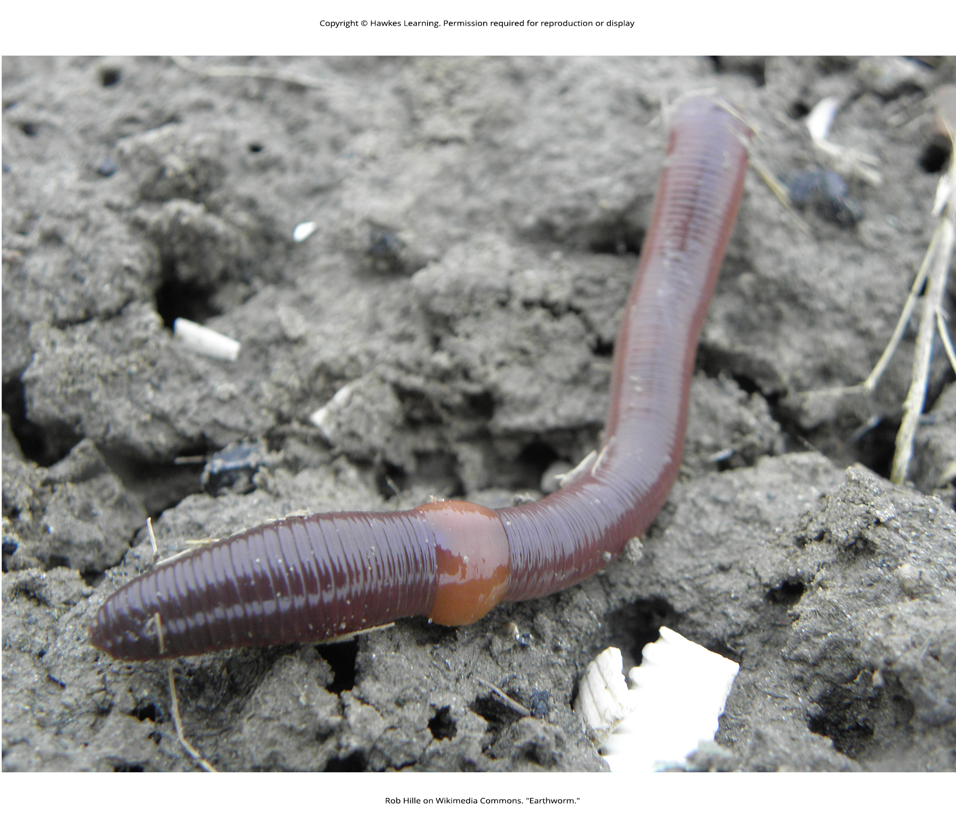
Lesson 28.4 Figure 11

Slide 38
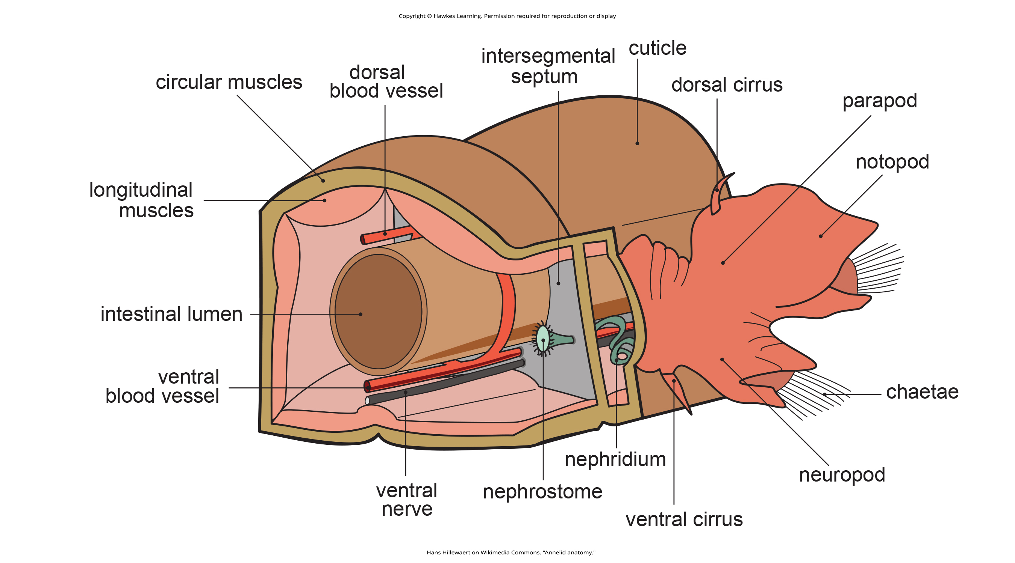
Lesson 28.4 Figure 12

Slide 39
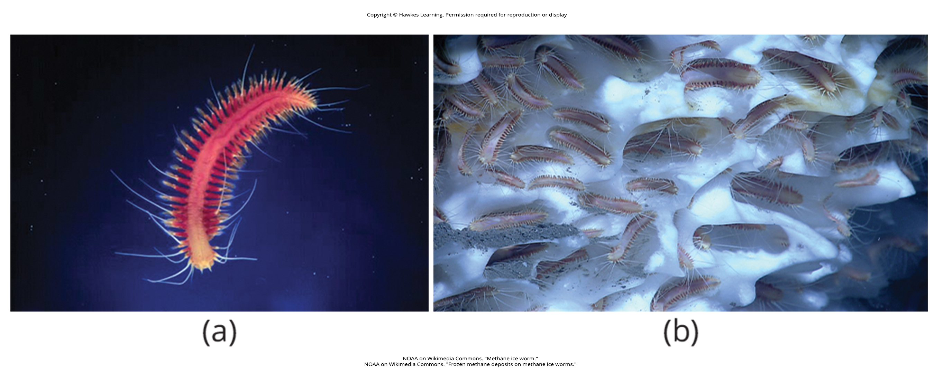
Lesson 28.4 Figure 13

Slide 40
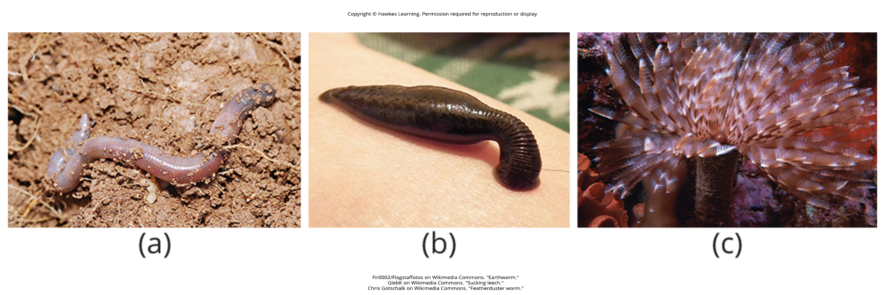
Lesson 28.4 Figure 14

Slide 41
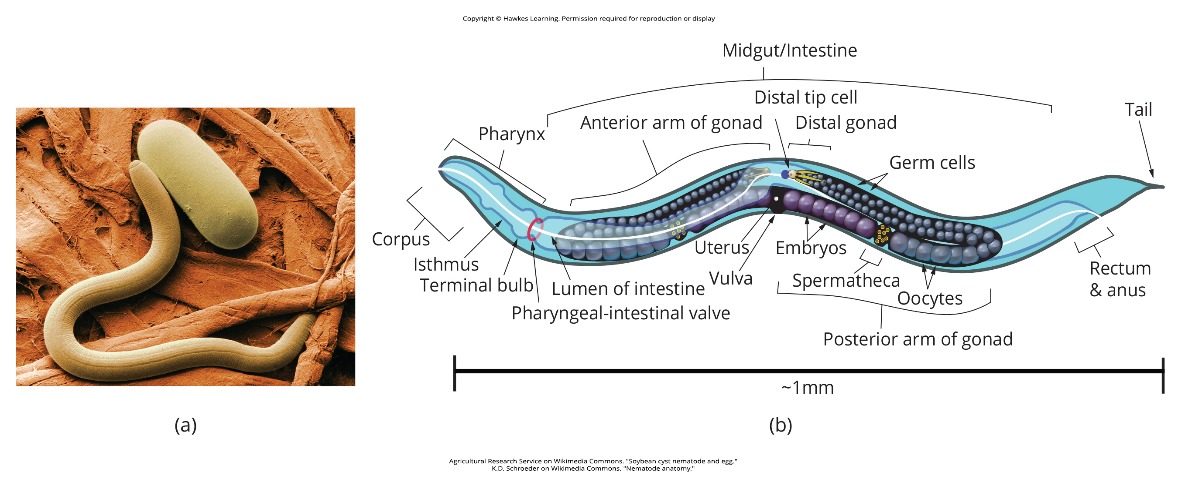
Lesson 28.5 Figure 1

Slide 42
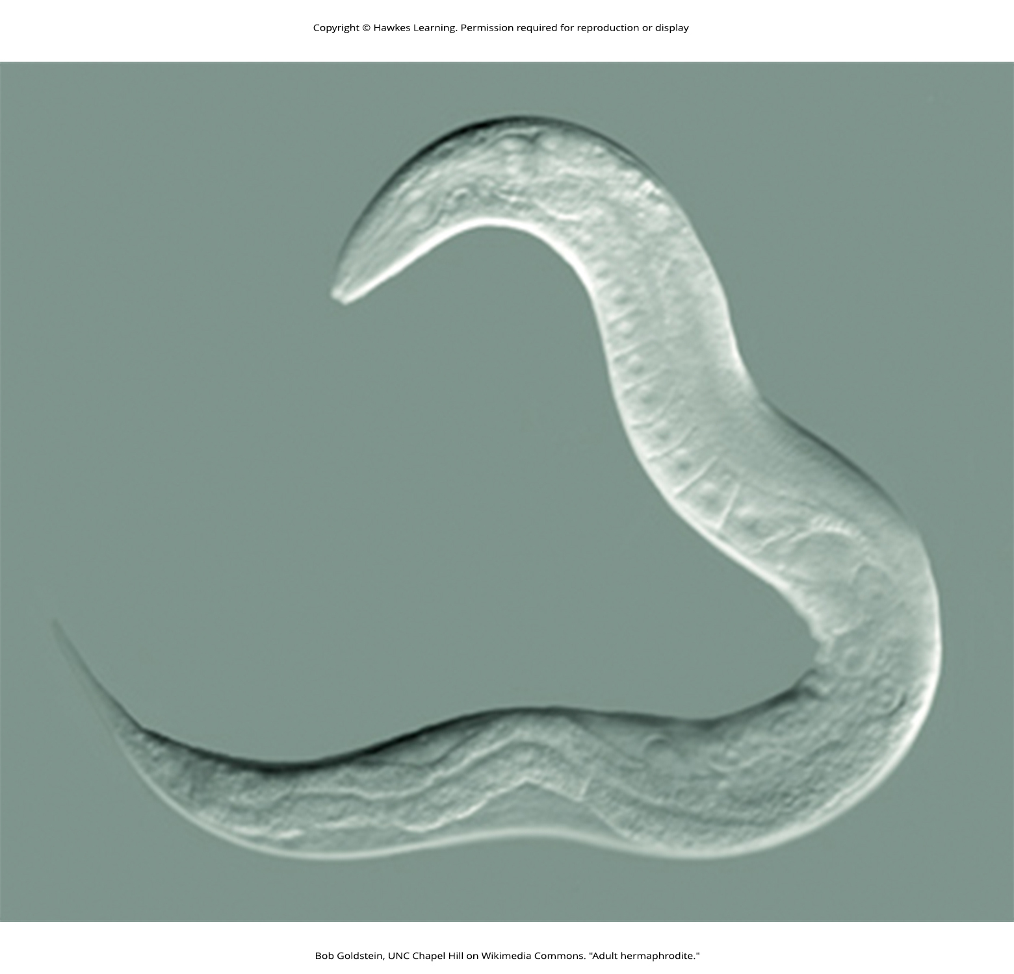
Lesson 28.5 Figure 2

Slide 43
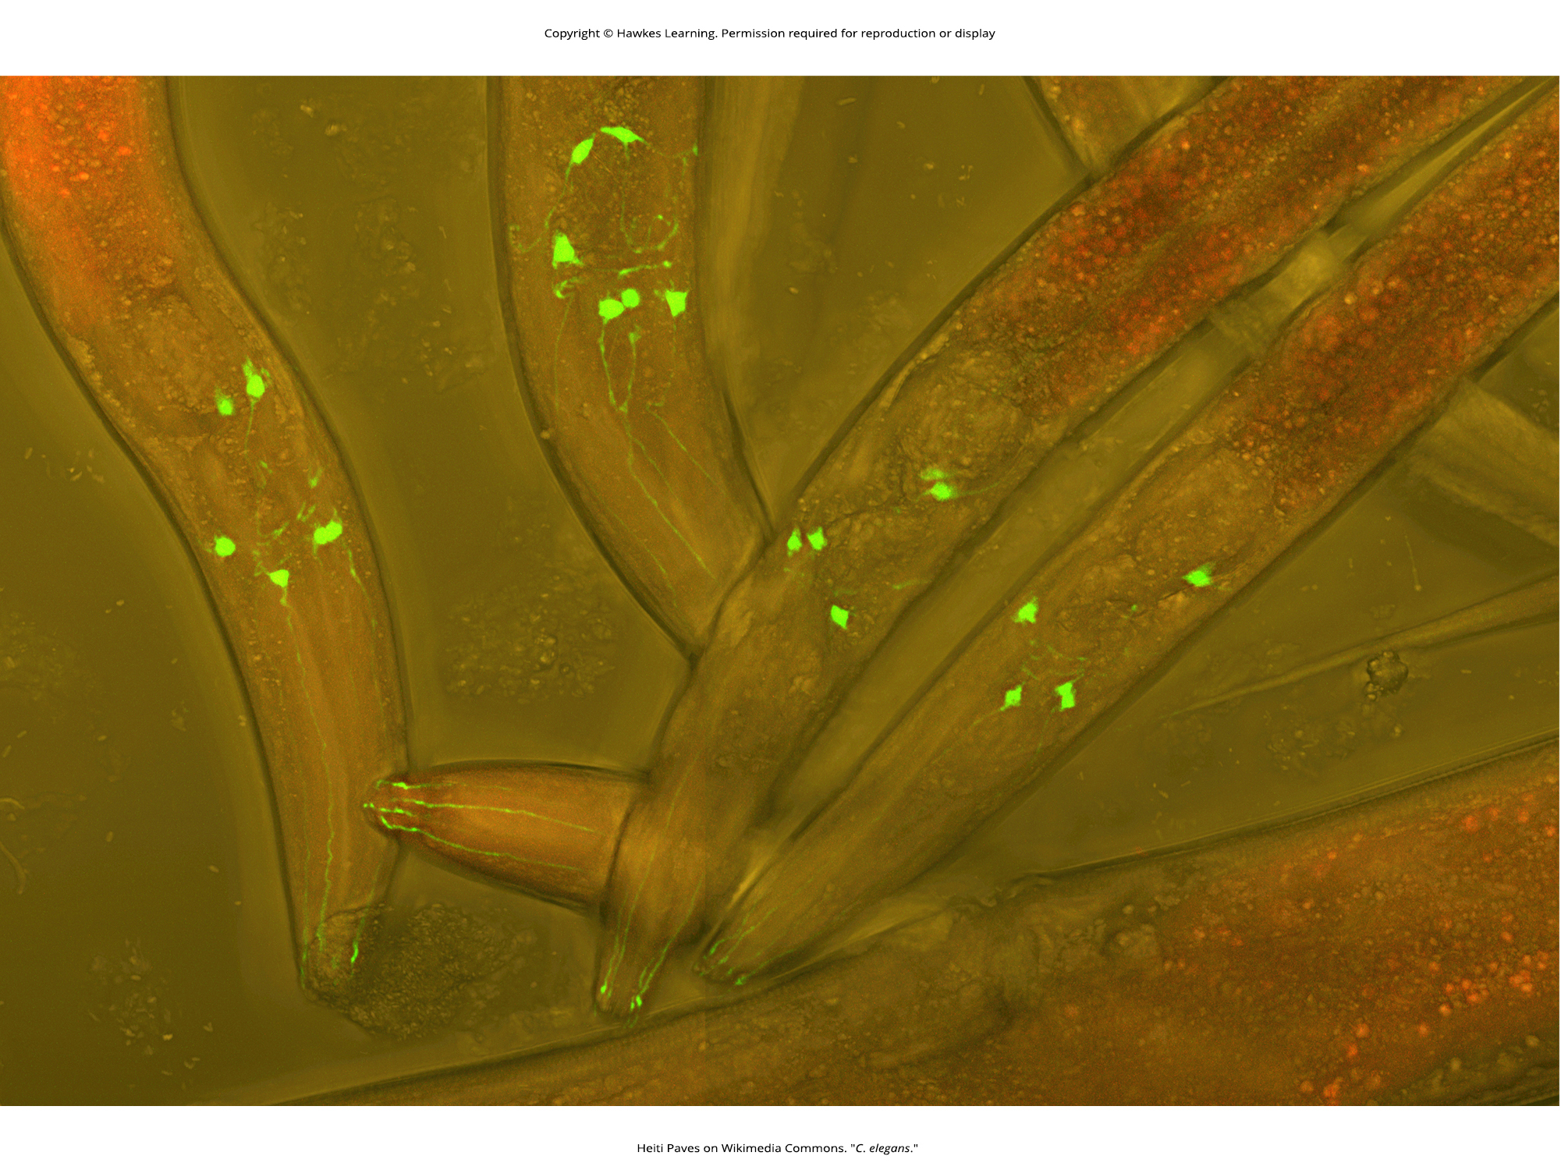
Lesson 28.5 Figure 3

Slide 44
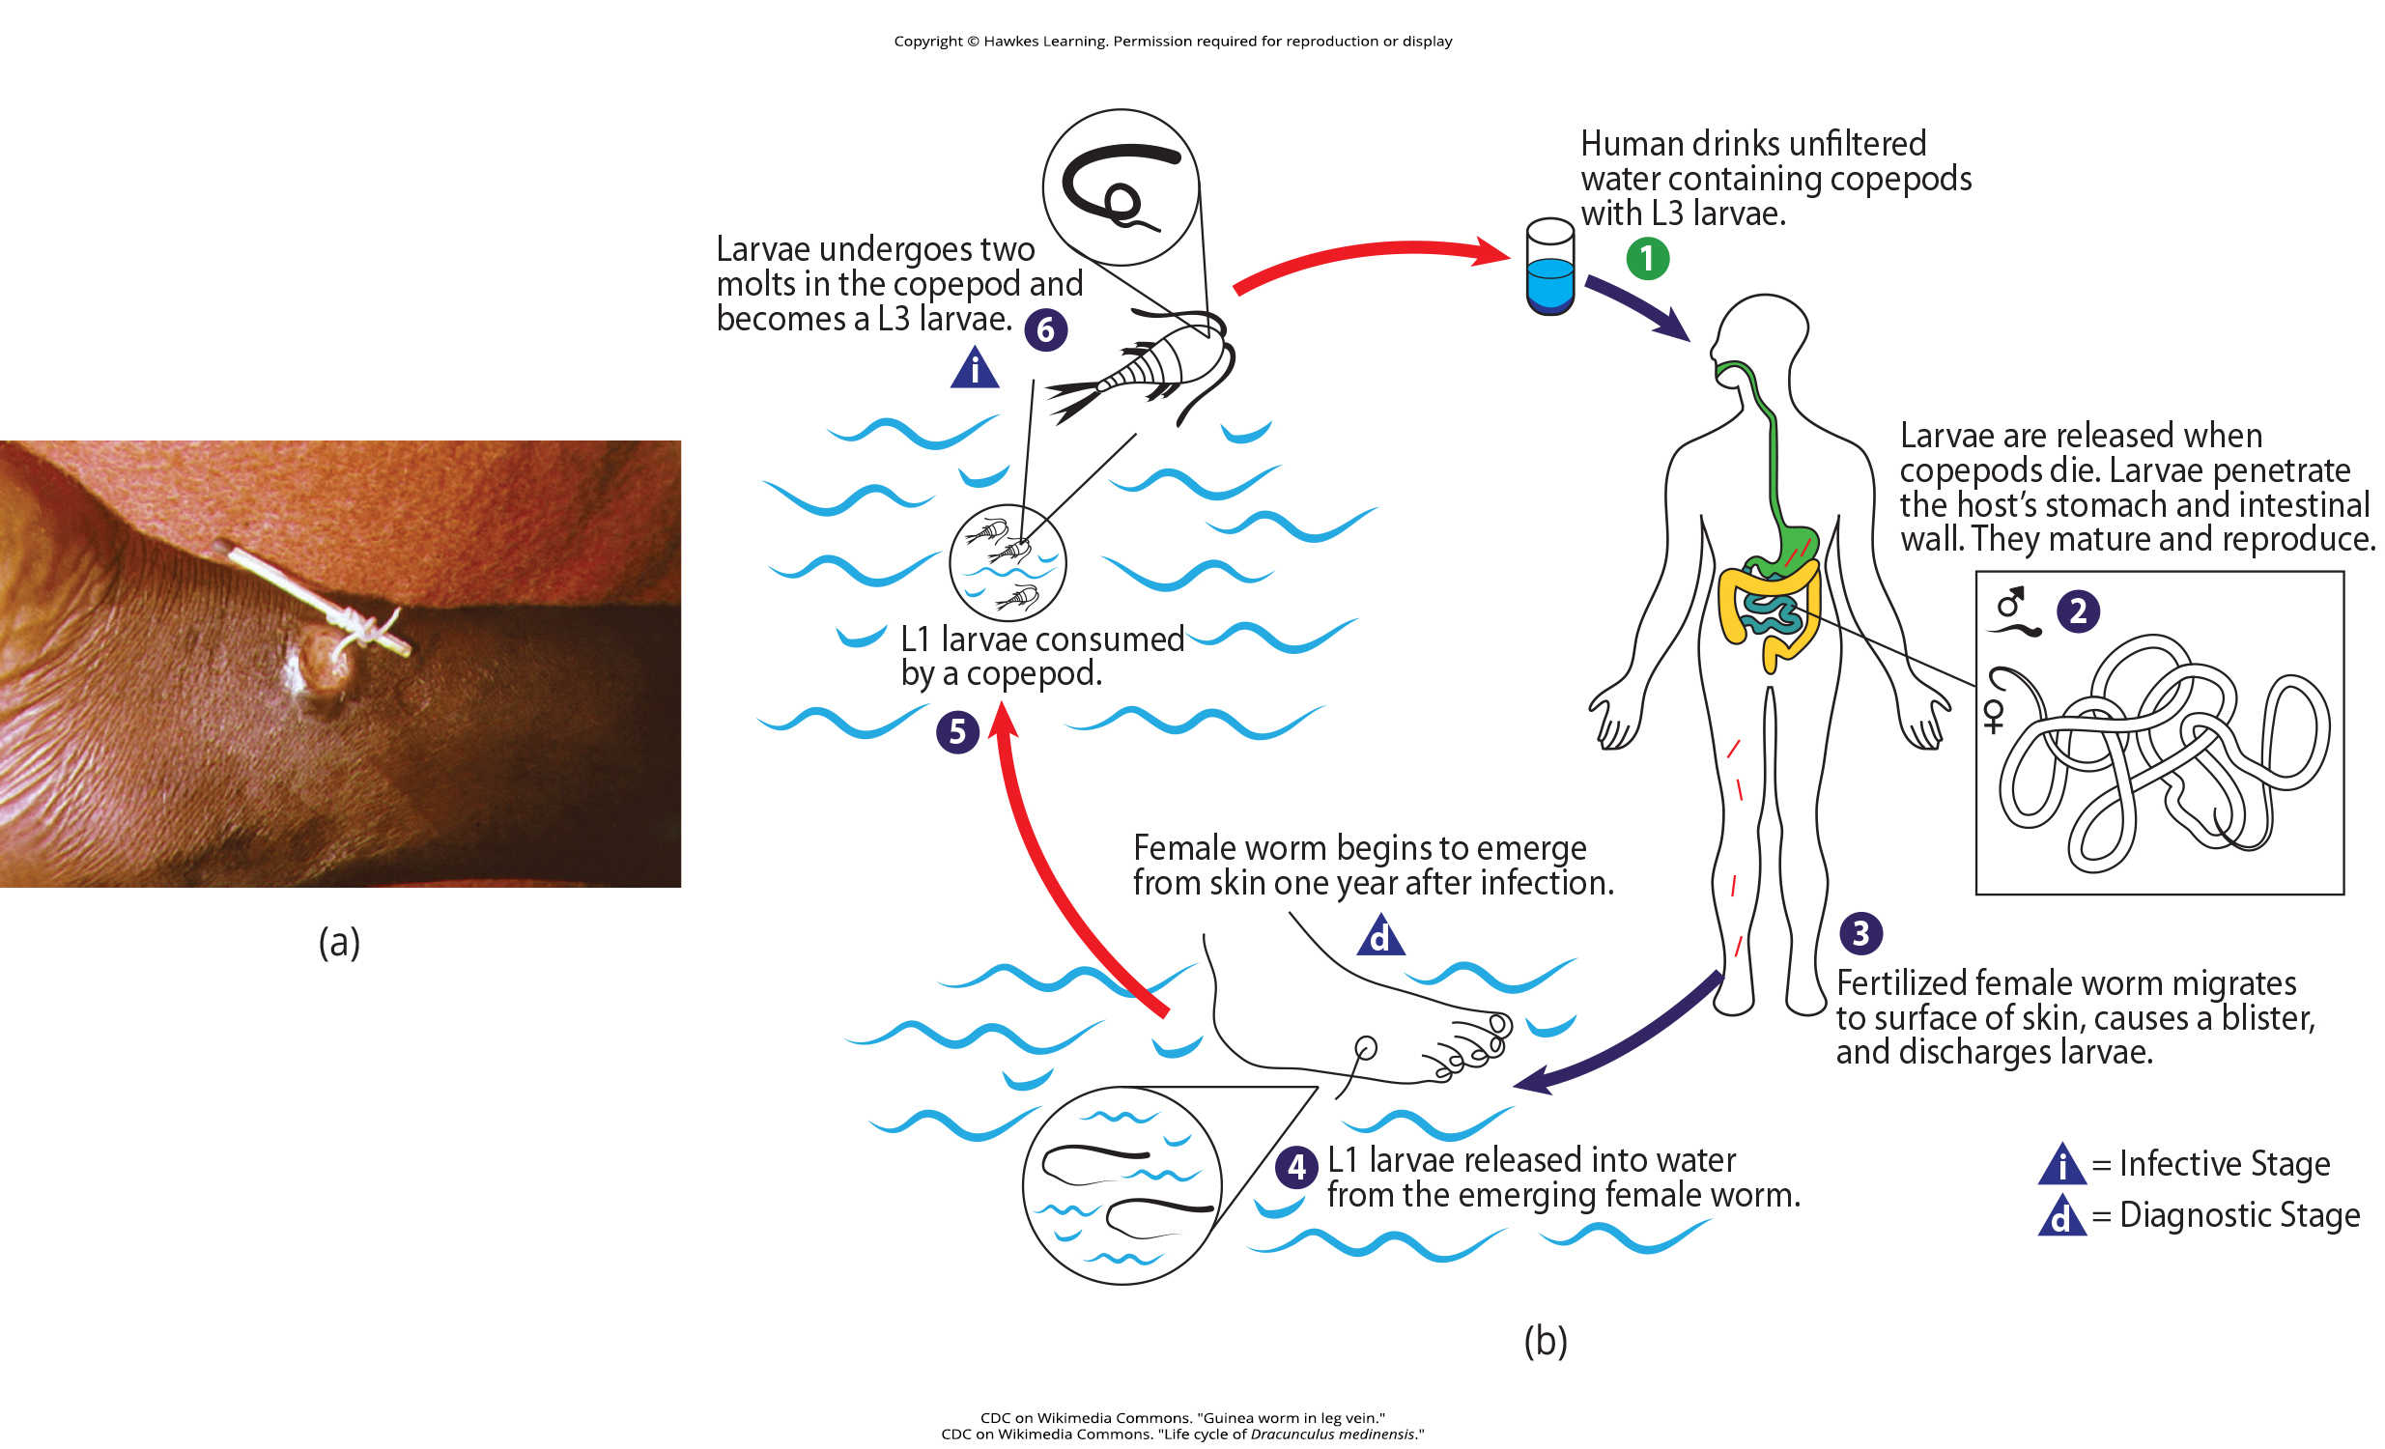
Lesson 28.5 Figure 4

Slide 45
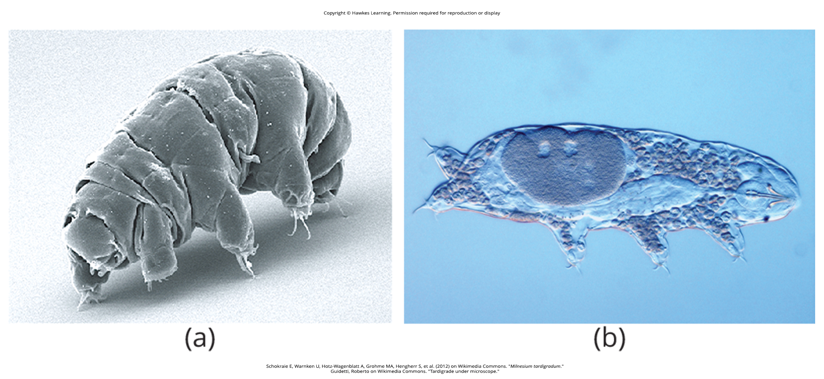
Lesson 28.5 Figure 5

Slide 46
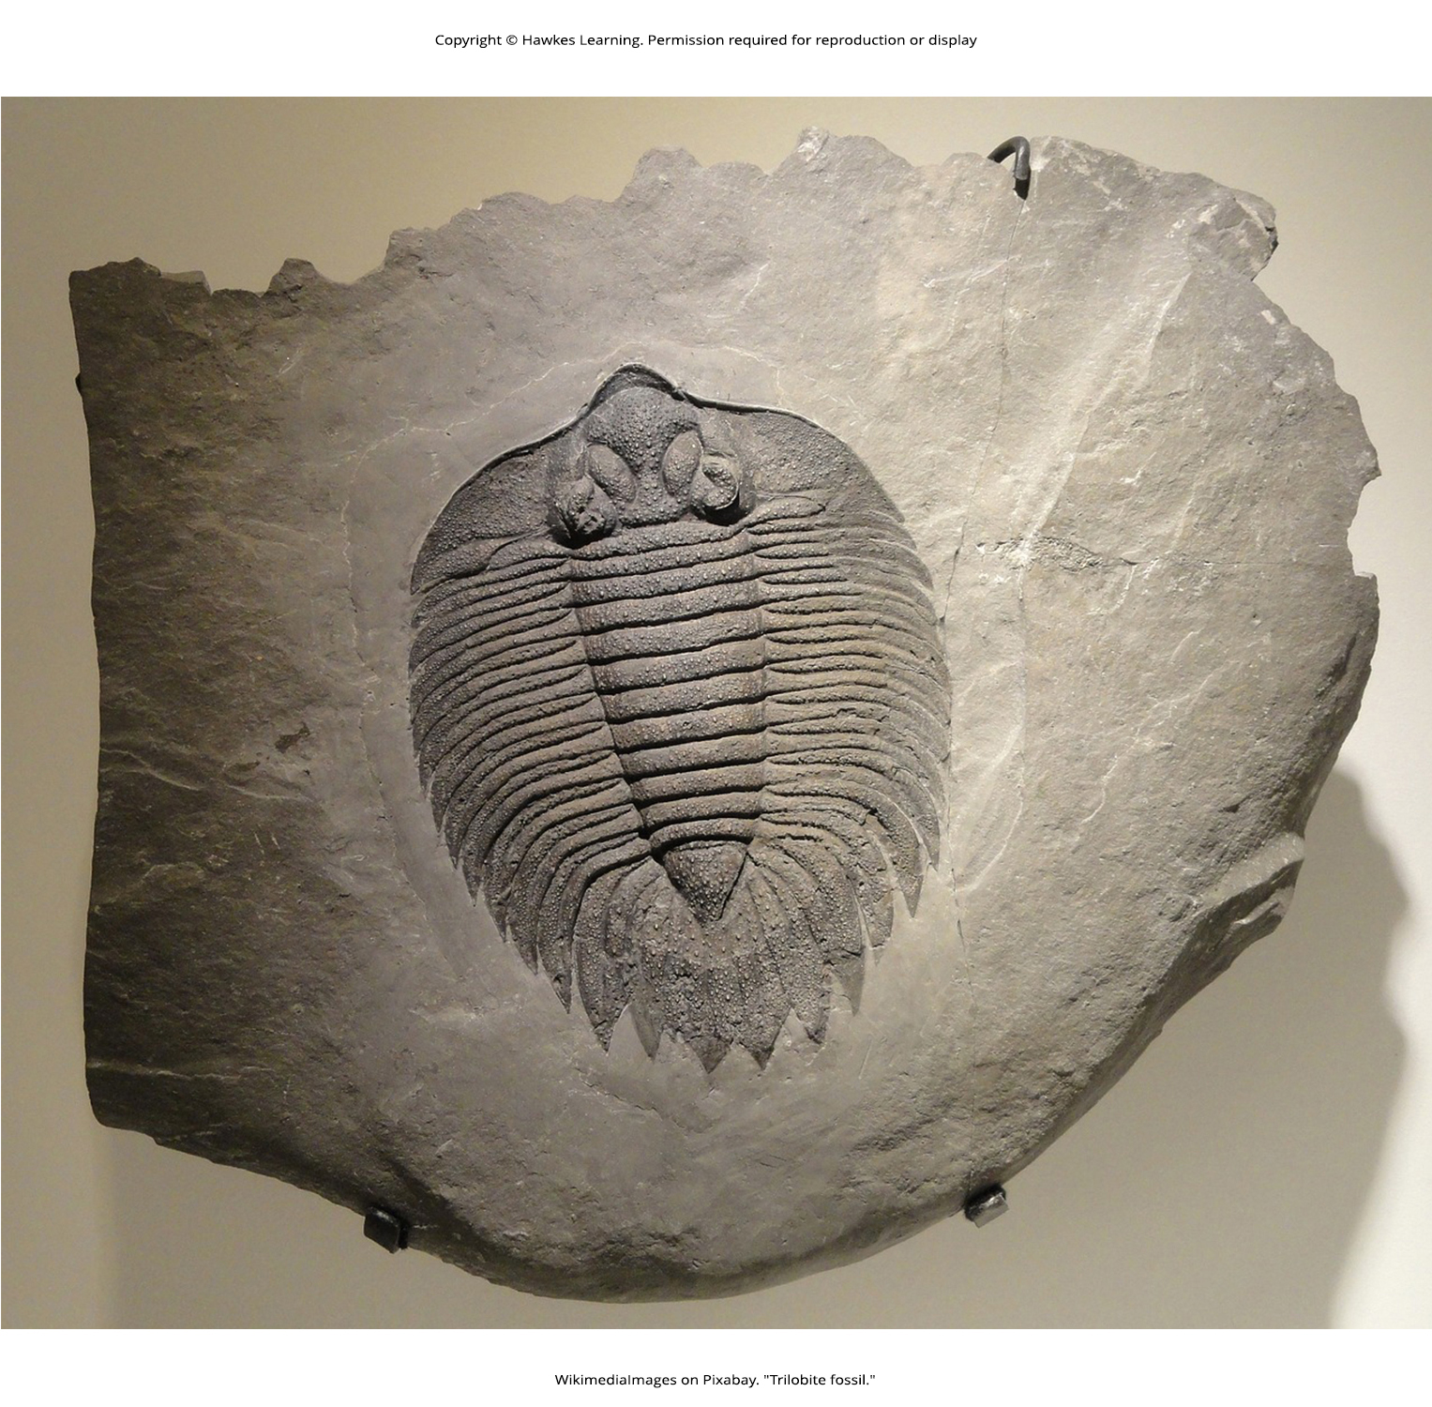
Lesson 28.6 Figure 1

Slide 47
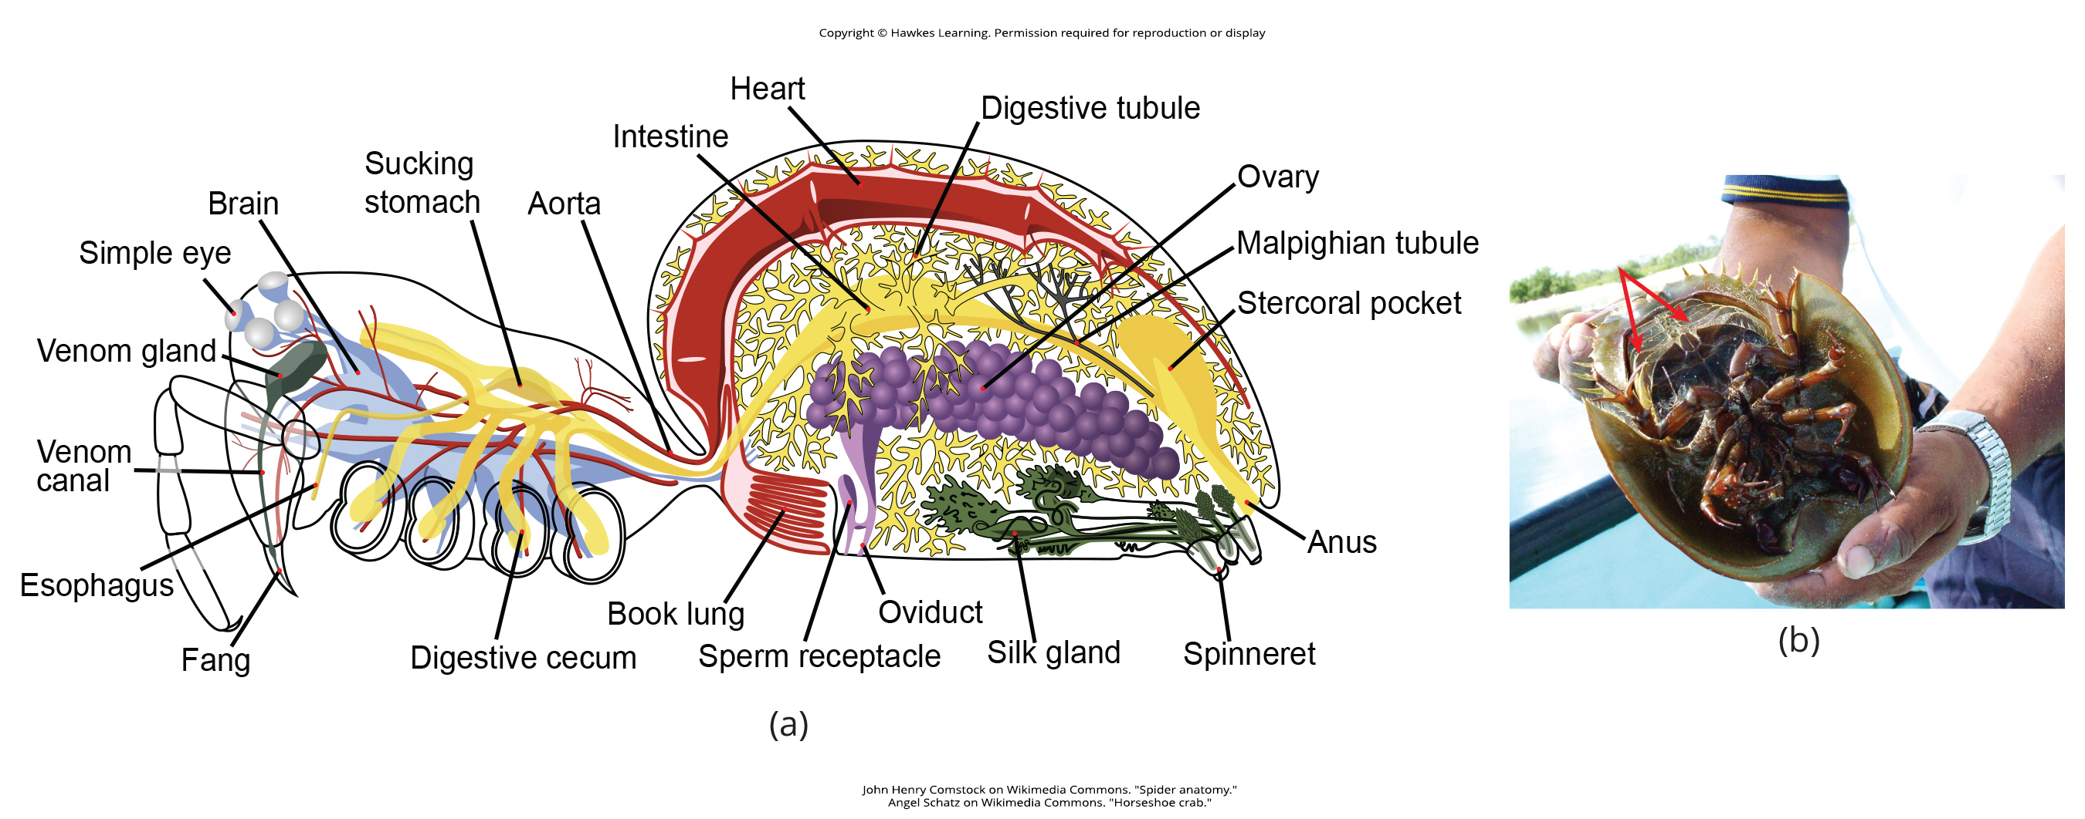
Lesson 28.6 Figure 2

Slide 48
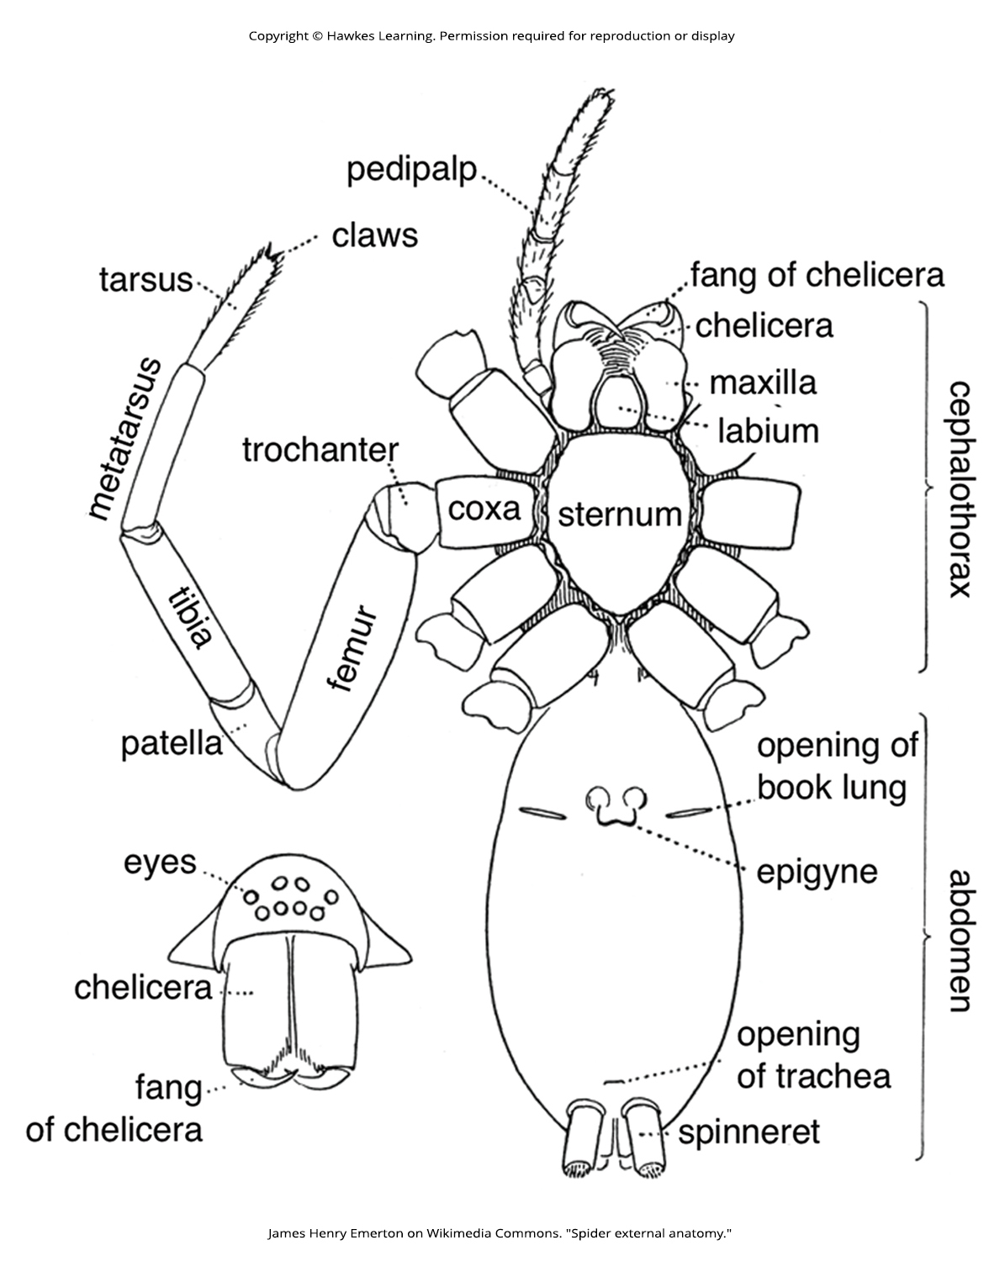
Lesson 28.6 Figure 3

Slide 49
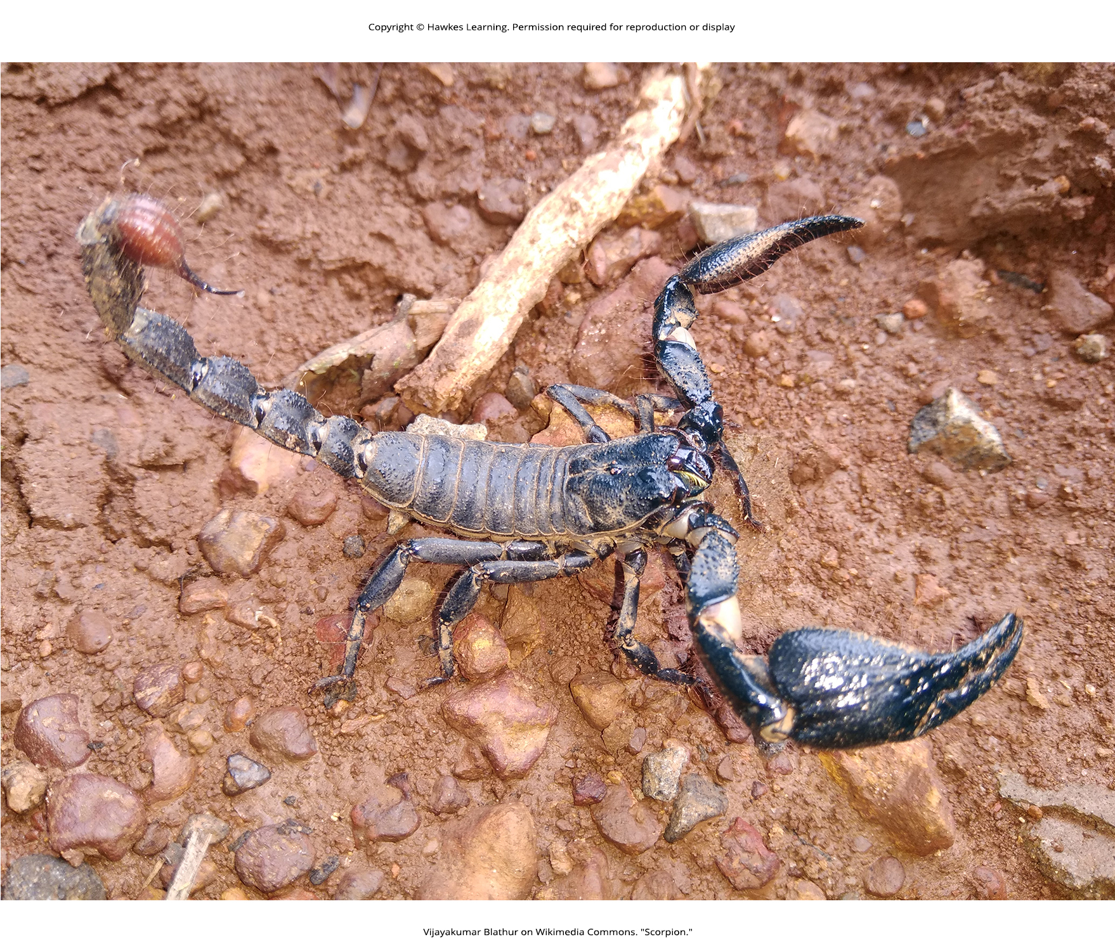
Lesson 28.6 Figure 4

Slide 50
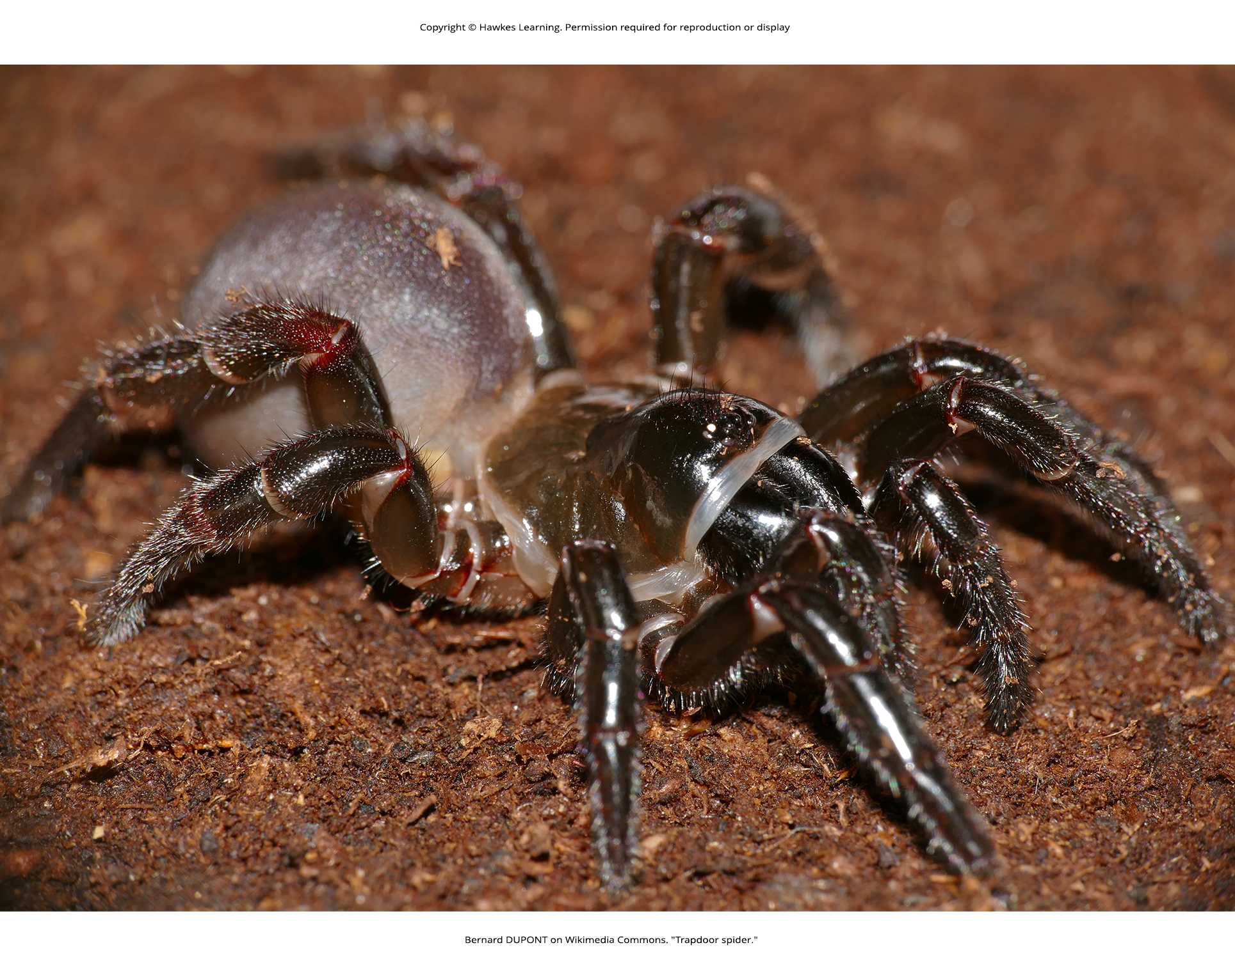
Lesson 28.6 Figure 5

Slide 51
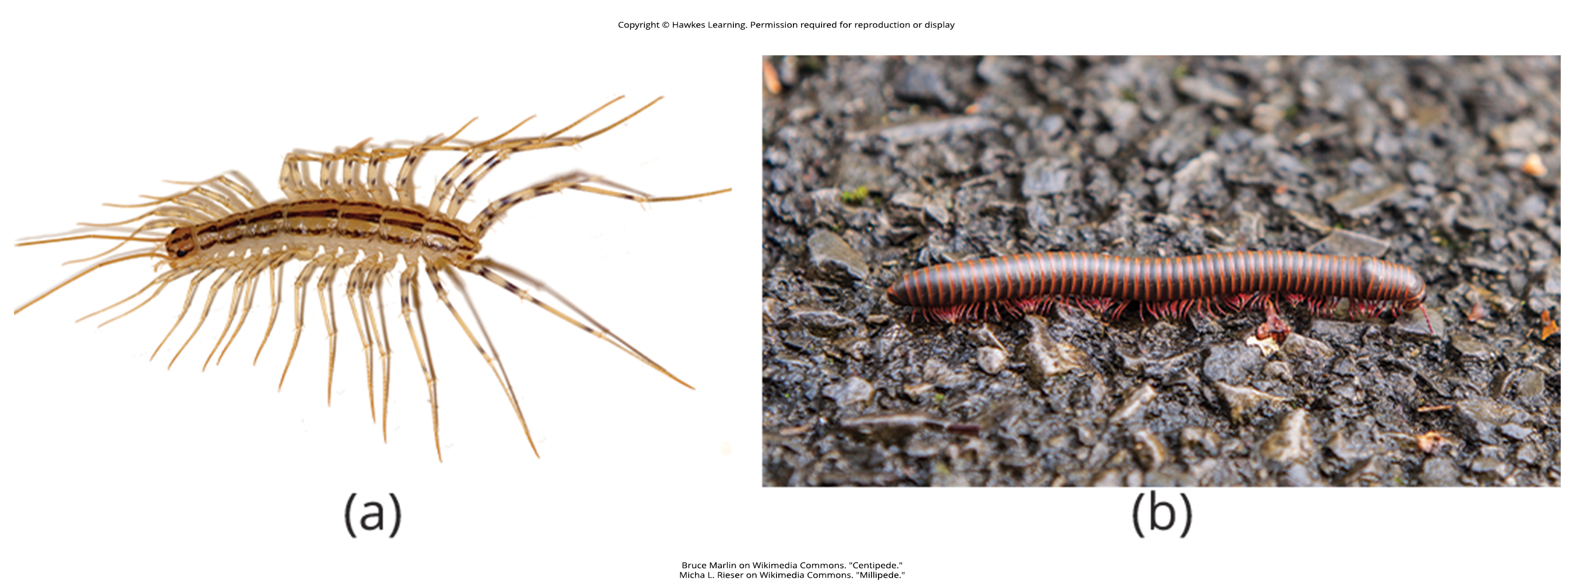
Lesson 28.6 Figure 6

Slide 52

Lesson 28.6 Figure 7

Slide 53

Lesson 28.6 Figure 8

Slide 54

Lesson 28.6 Figure 9

Slide 55

Lesson 28.6 Figure 10

Slide 56

Lesson 28.6 Figure 11

Slide 57

Lesson 28.6 Figure 12

Slide 58

Lesson 28.7 Figure 1

Slide 59

Lesson 28.7 Figure 2

Slide 60

Lesson 28.7 Figure 3

Slide 61

Lesson 28.7 Figure 4

Slide 62

Lesson 28.7 Figure 5

Slide 63
Hawkes Learning – End of PowerPoint

