Slide 1
Chapter 29
Vertebrates

Slide 2
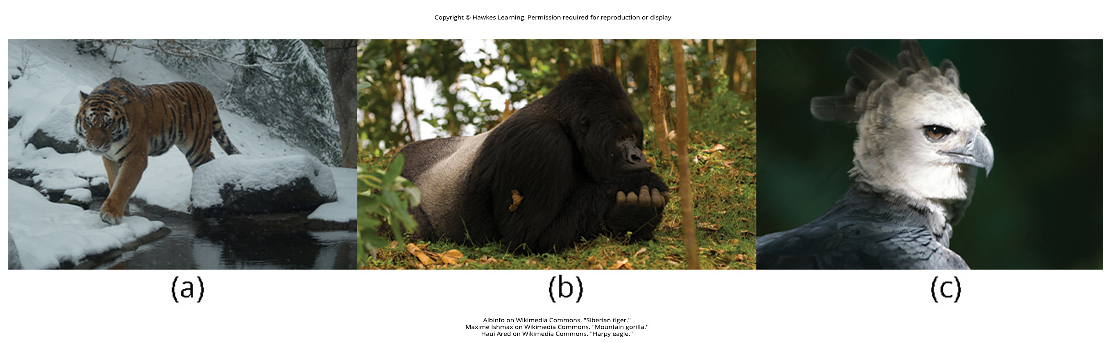
Lesson 29.1 Figure 1

Slide 3
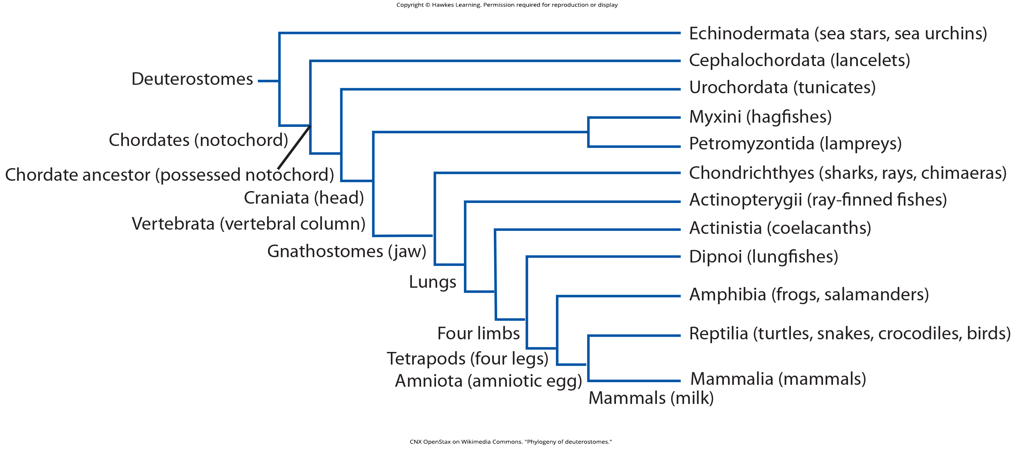
Lesson 29.1 Figure 2

Slide 4
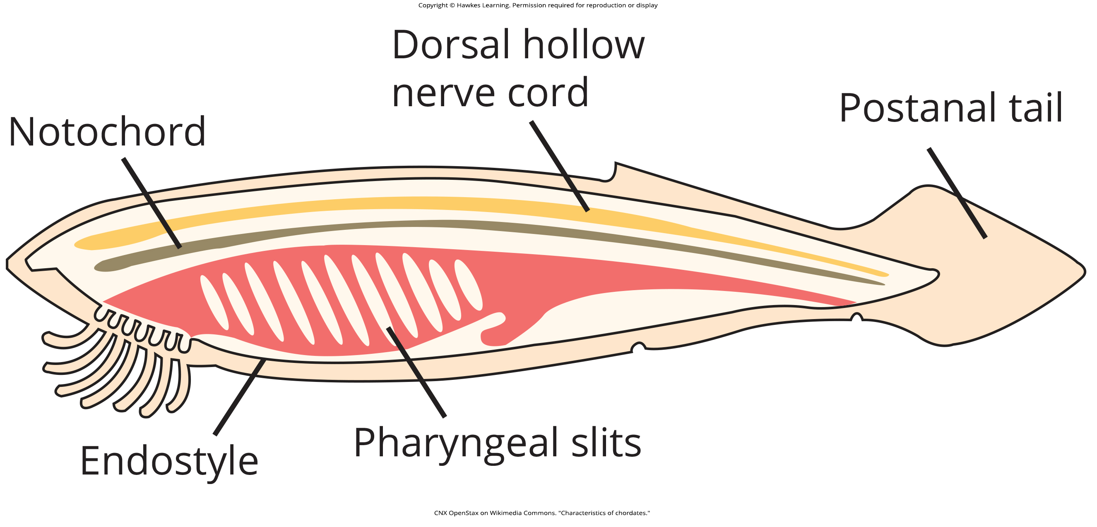
Lesson 29.1 Figure 3

Slide 5
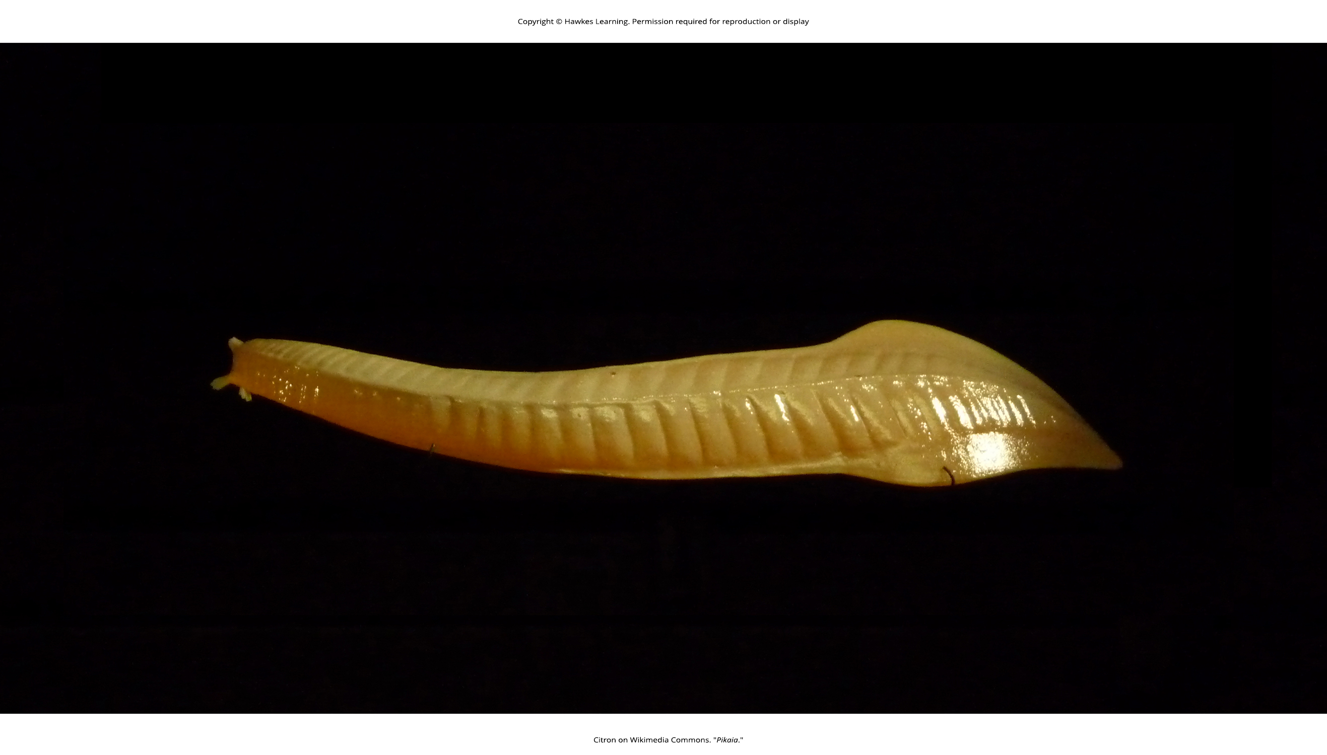
Lesson 29.1 Figure 4

Slide 6
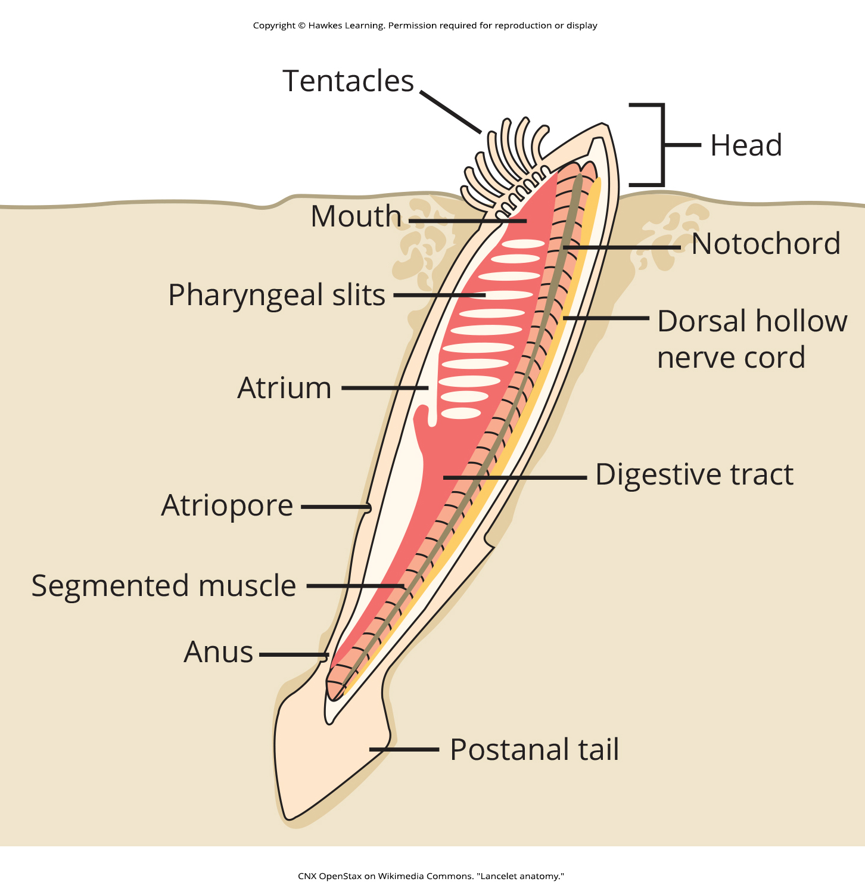
Lesson 29.1 Figure 5

Slide 7
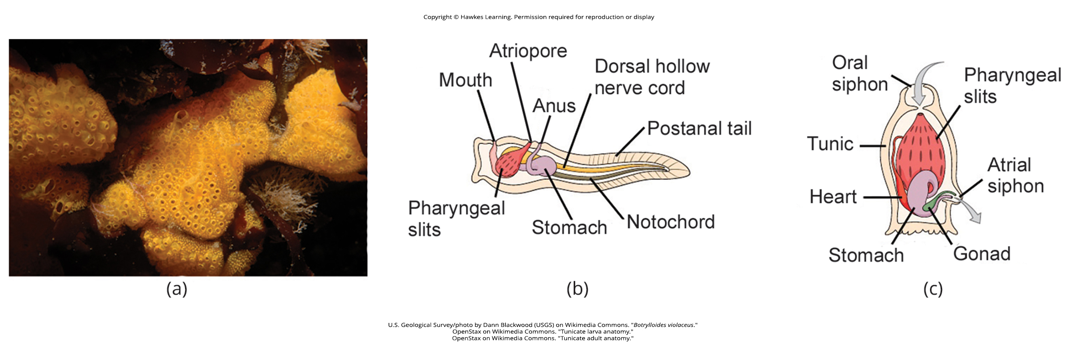
Lesson 29.1 Figure 6

Slide 8
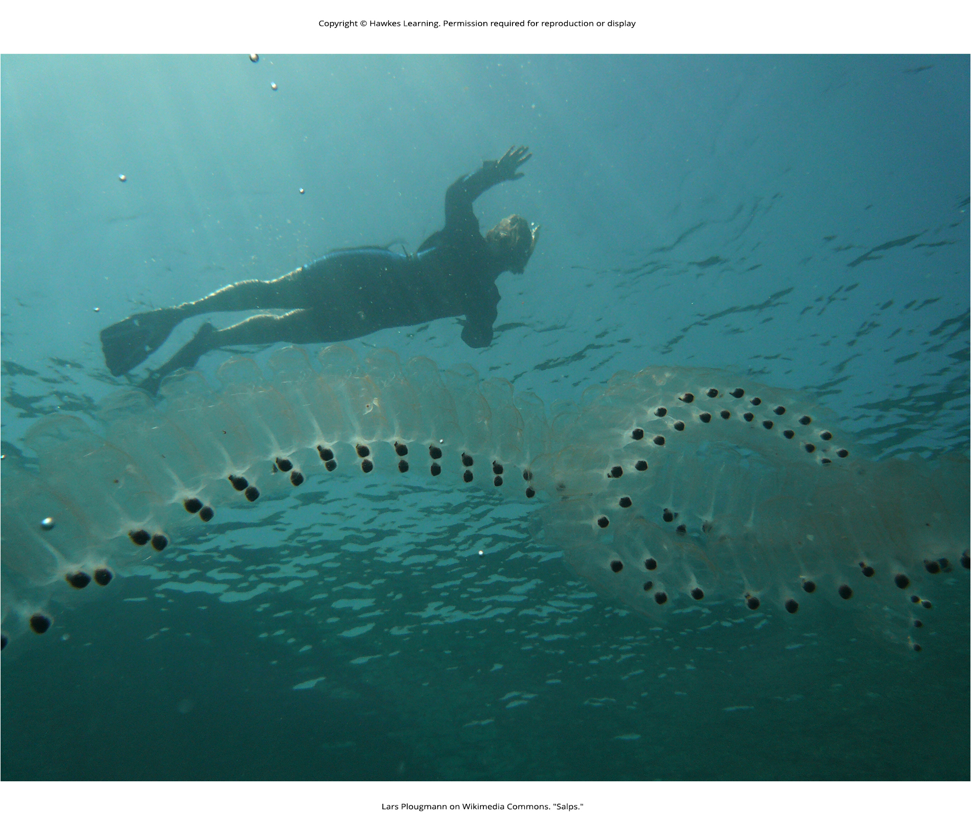
Lesson 29.1 Figure 7

Slide 9
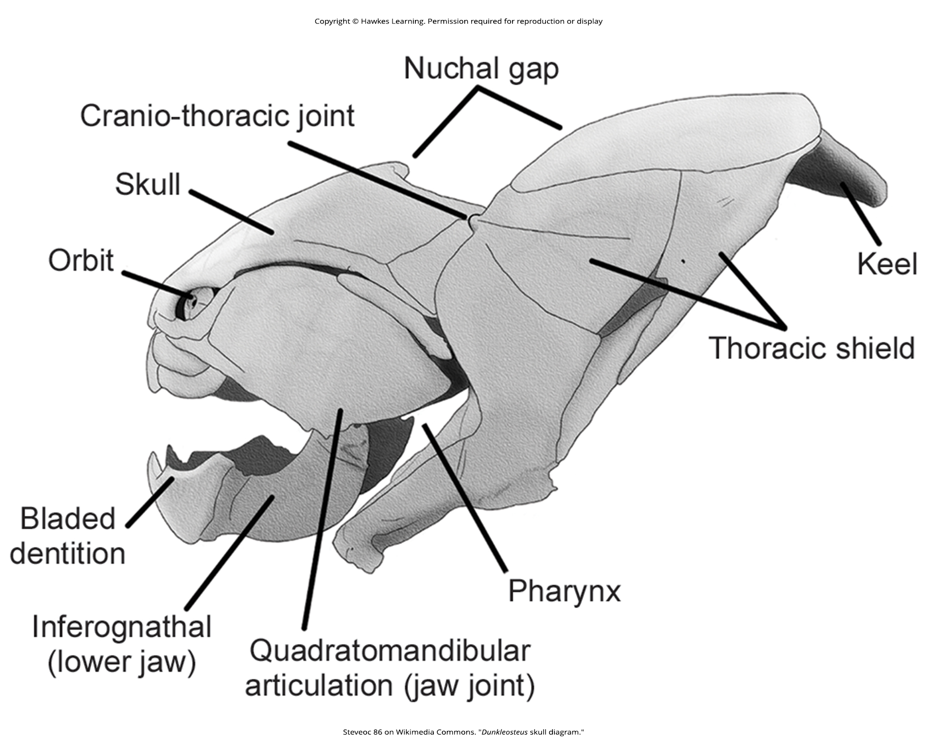
Lesson 29.1 Figure 8

Slide 10
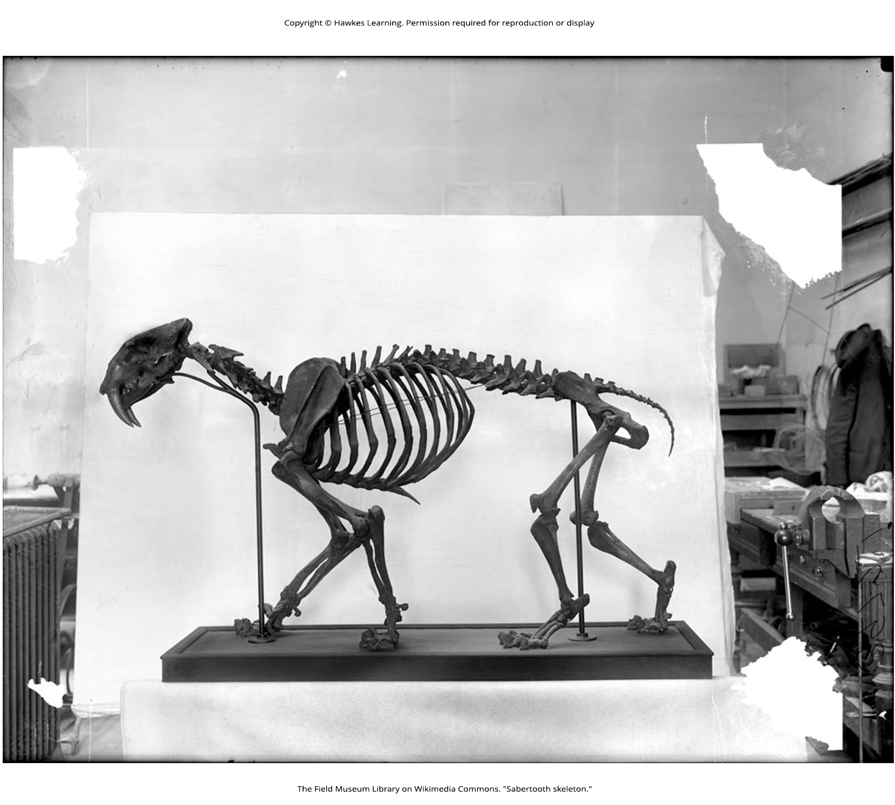
Lesson 29.1 Figure 9

Slide 11
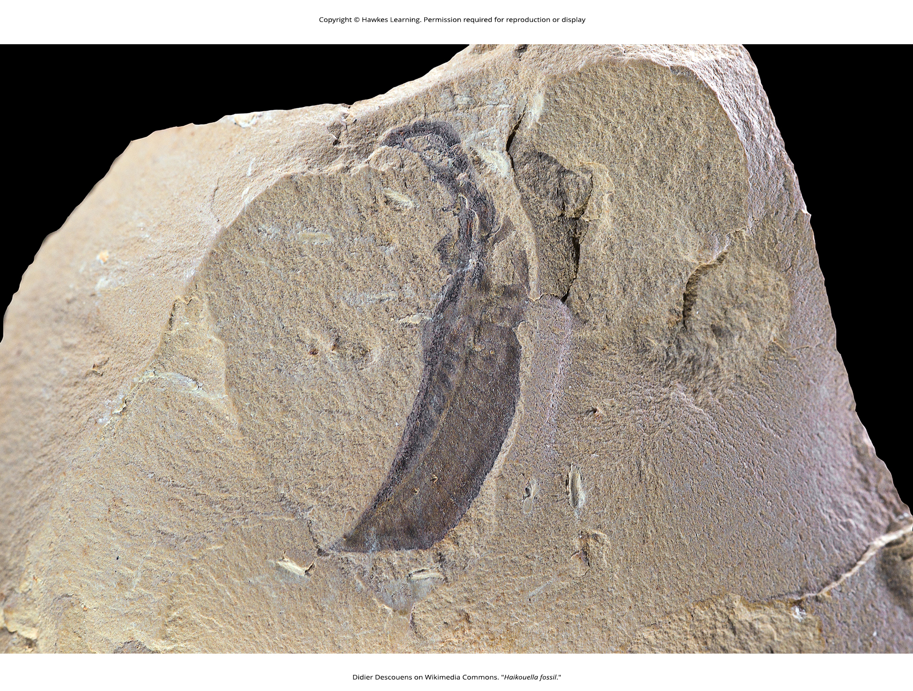
Lesson 29.1 Figure 10

Slide 12
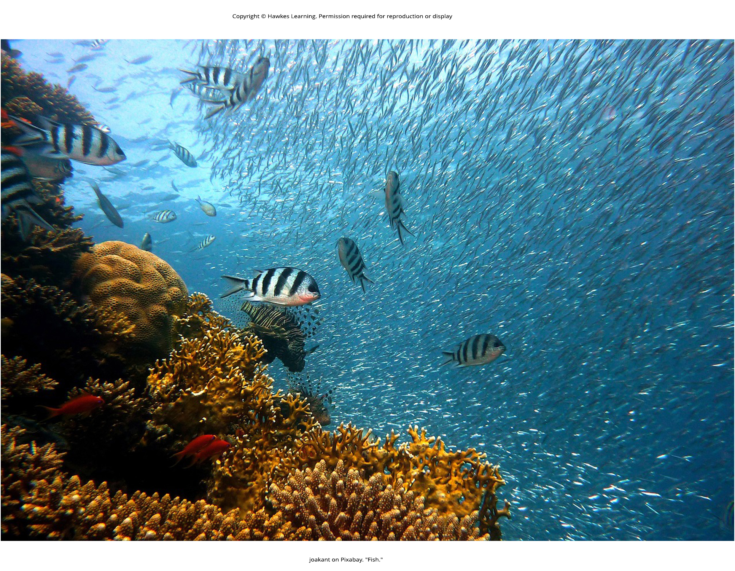
Lesson 29.2 Figure 1

Slide 13
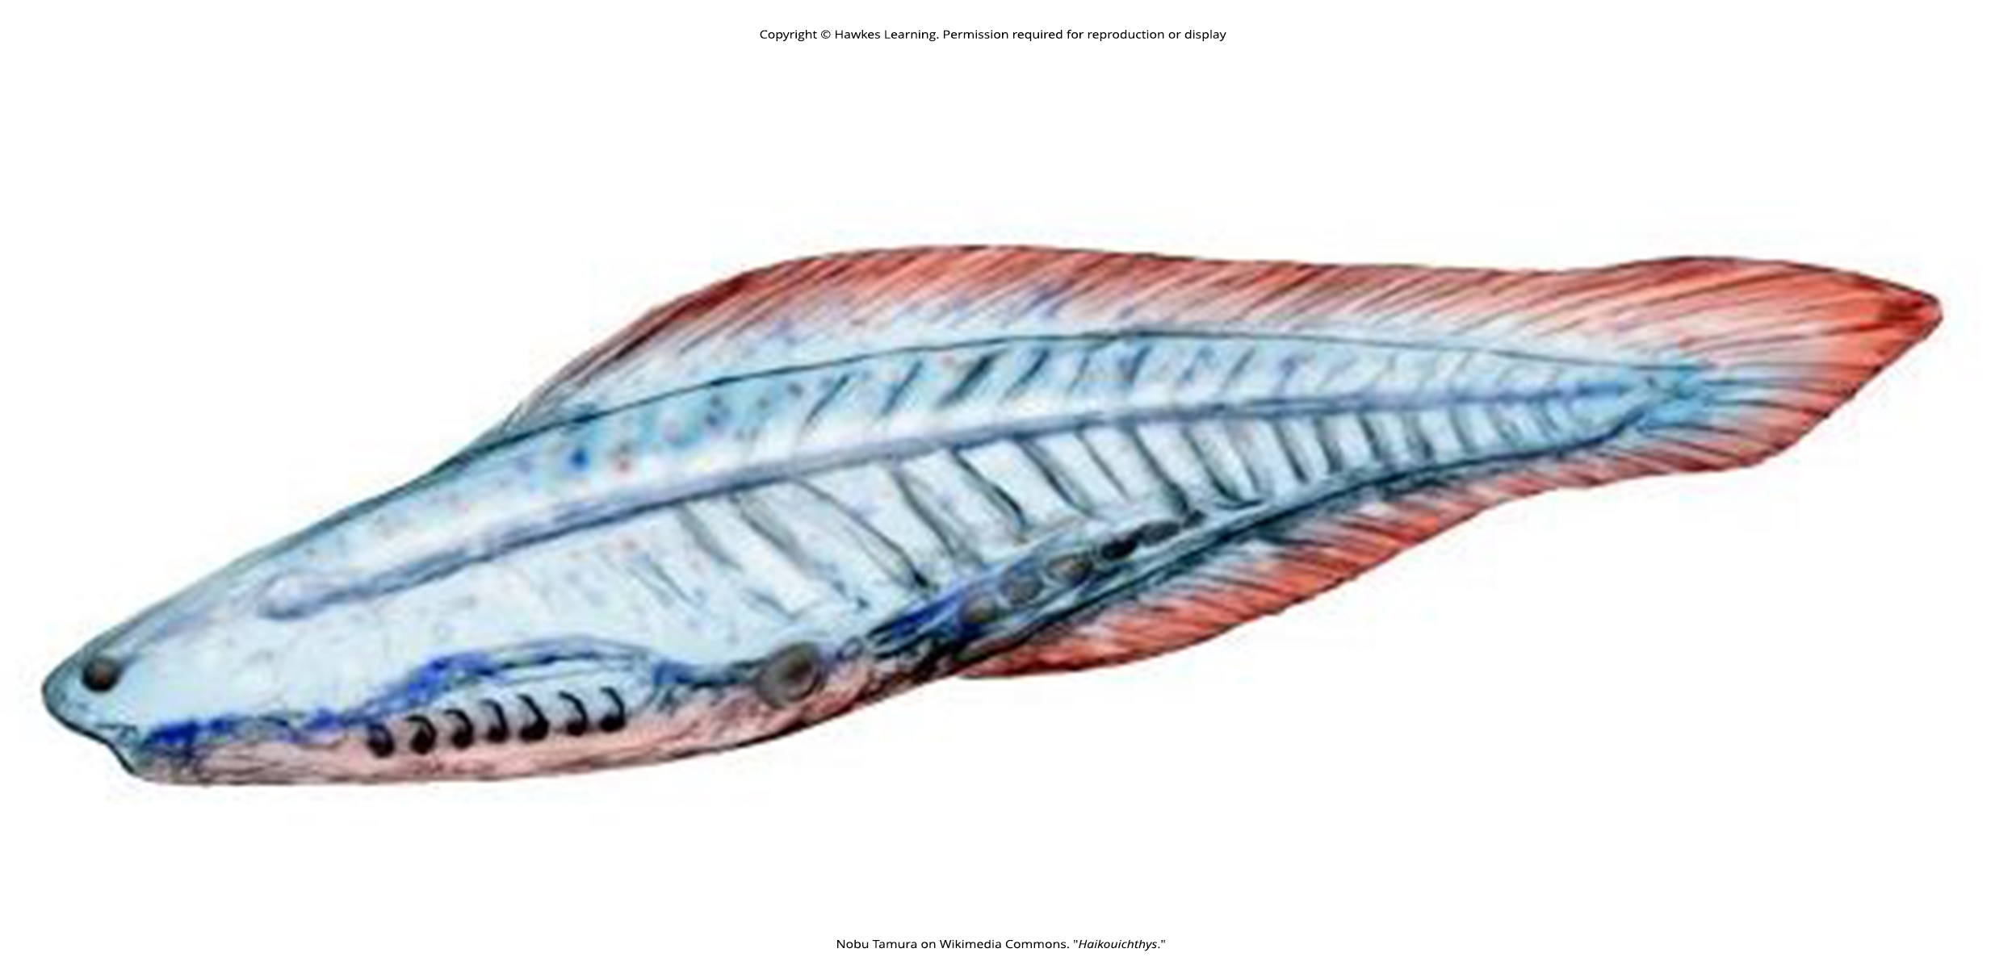
Lesson 29.2 Figure 2

Slide 14
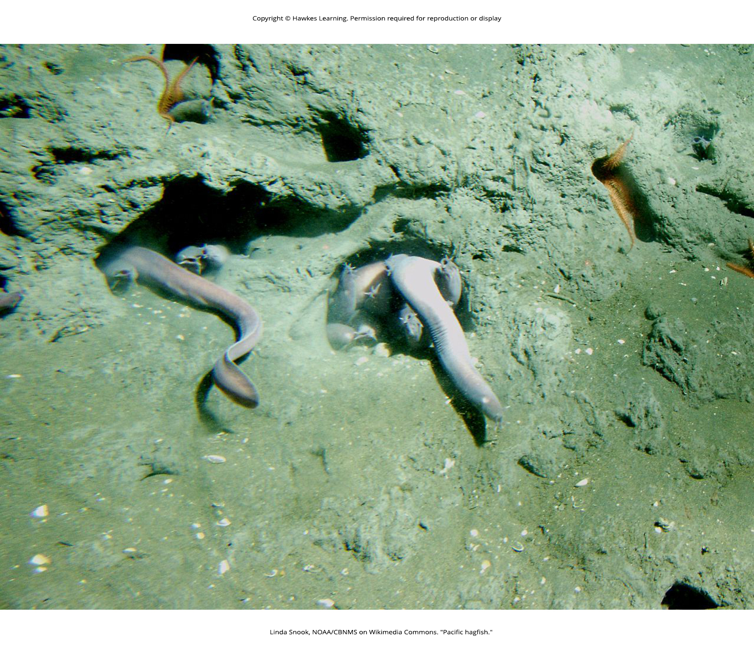
Lesson 29.2 Figure 3

Slide 15
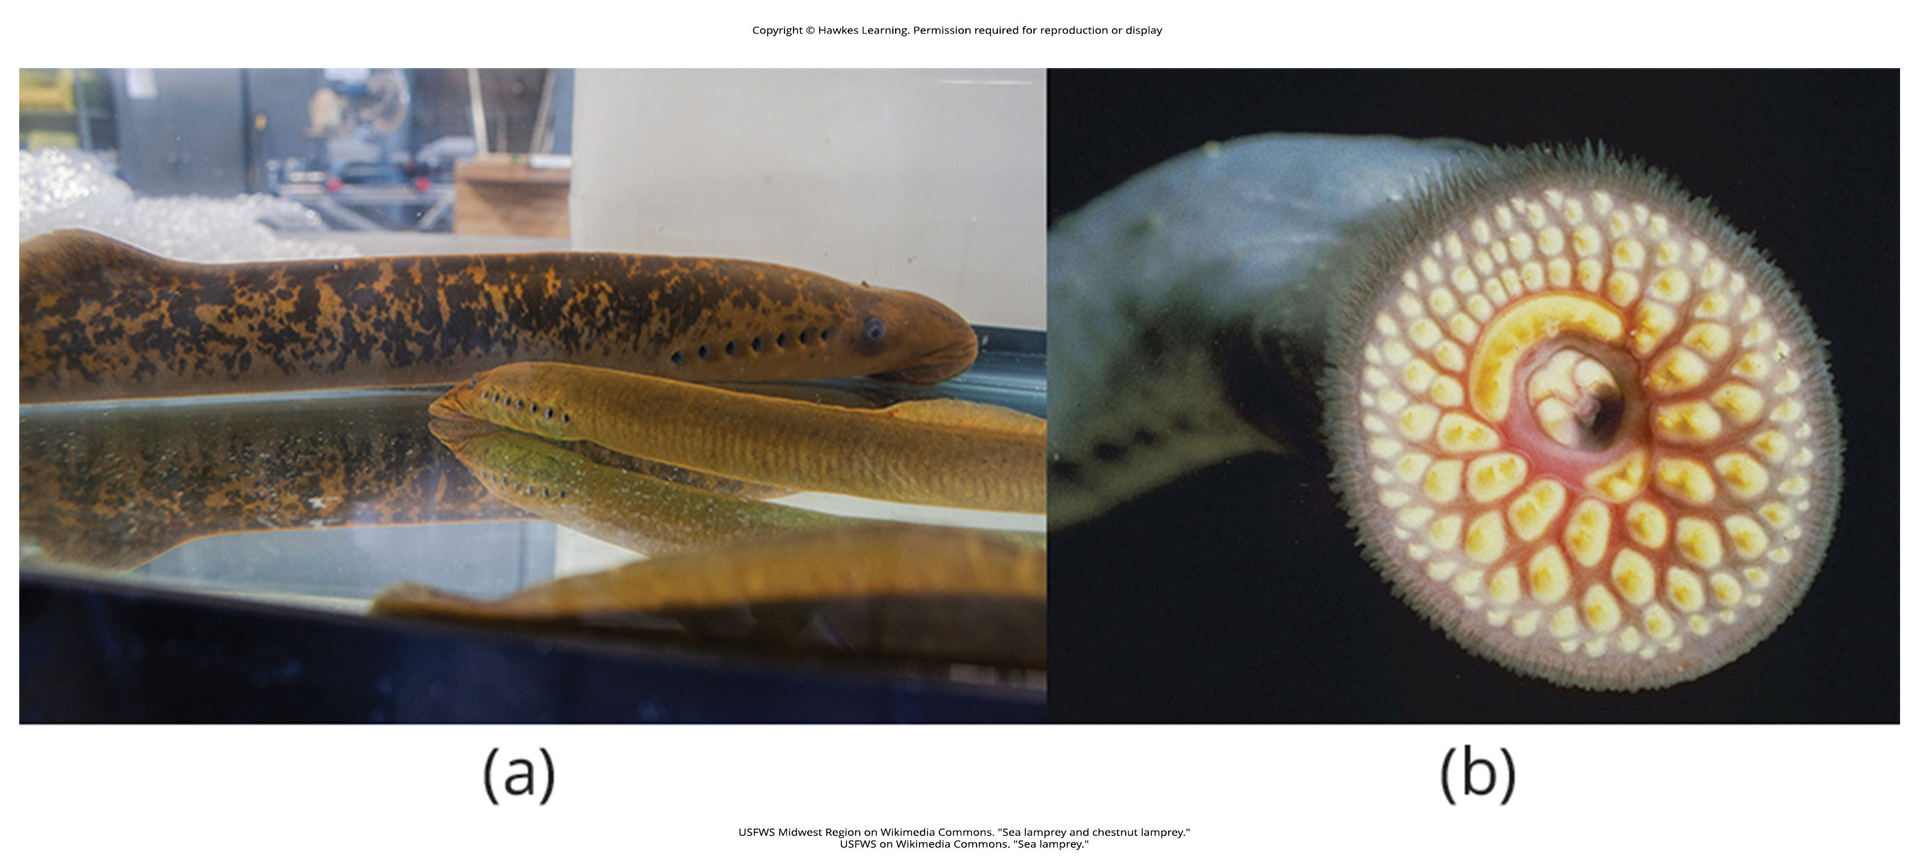
Lesson 29.2 Figure 4

Slide 16
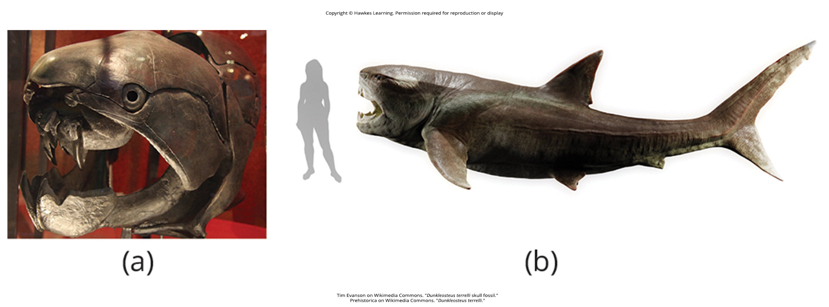
Lesson 29.2 Figure 5

Slide 17
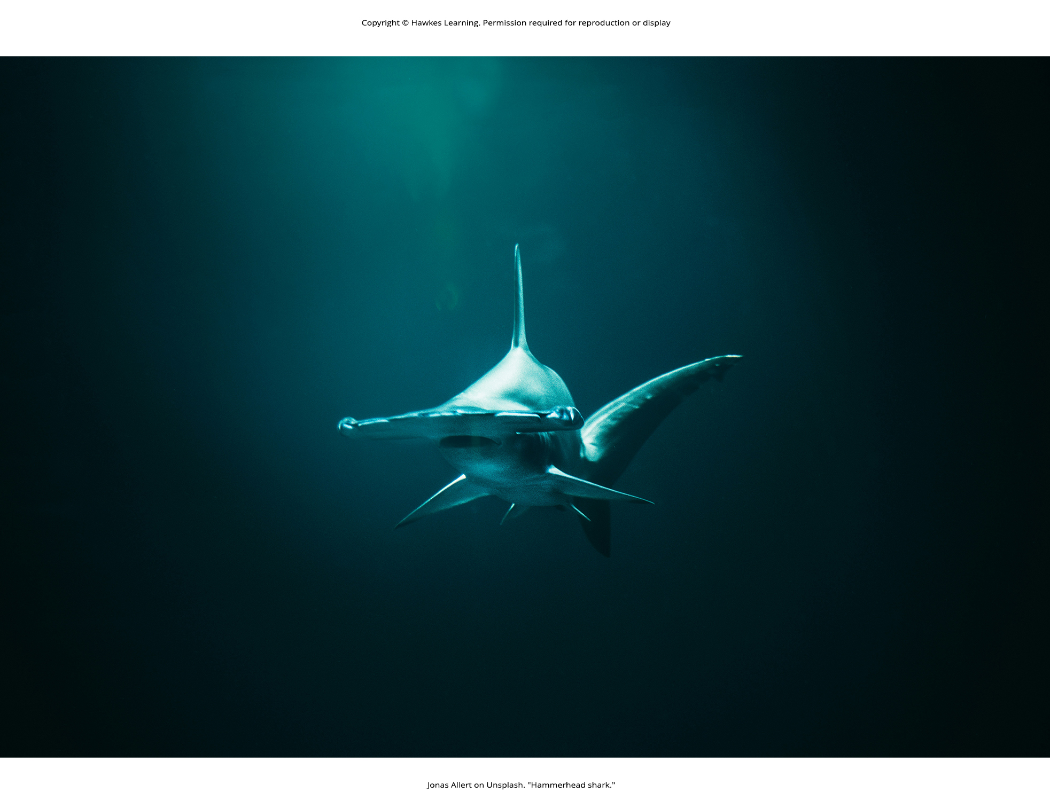
Lesson 29.2 Figure 6

Slide 18
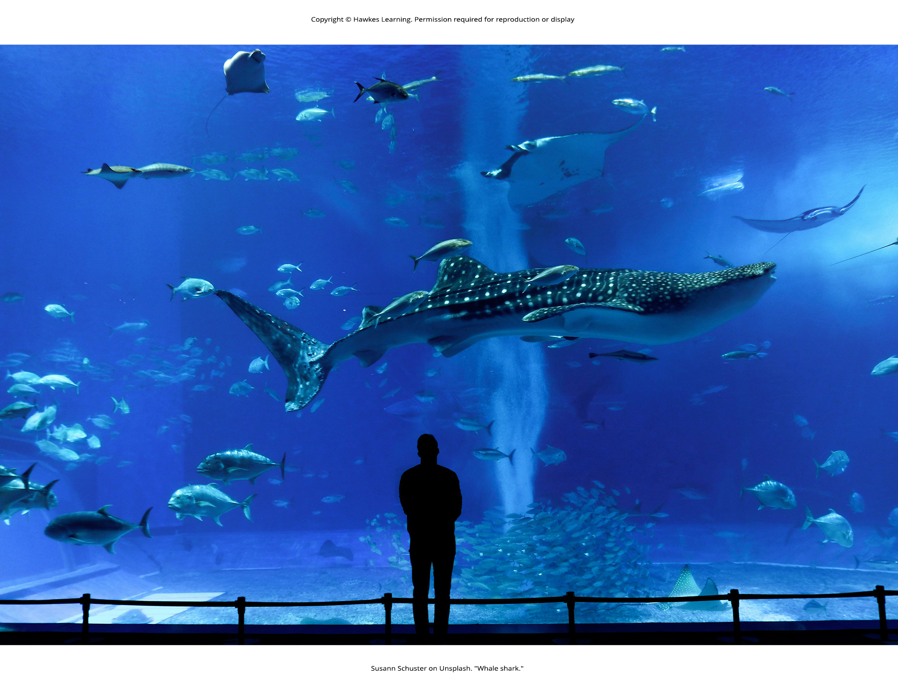
Lesson 29.2 Figure 7

Slide 19
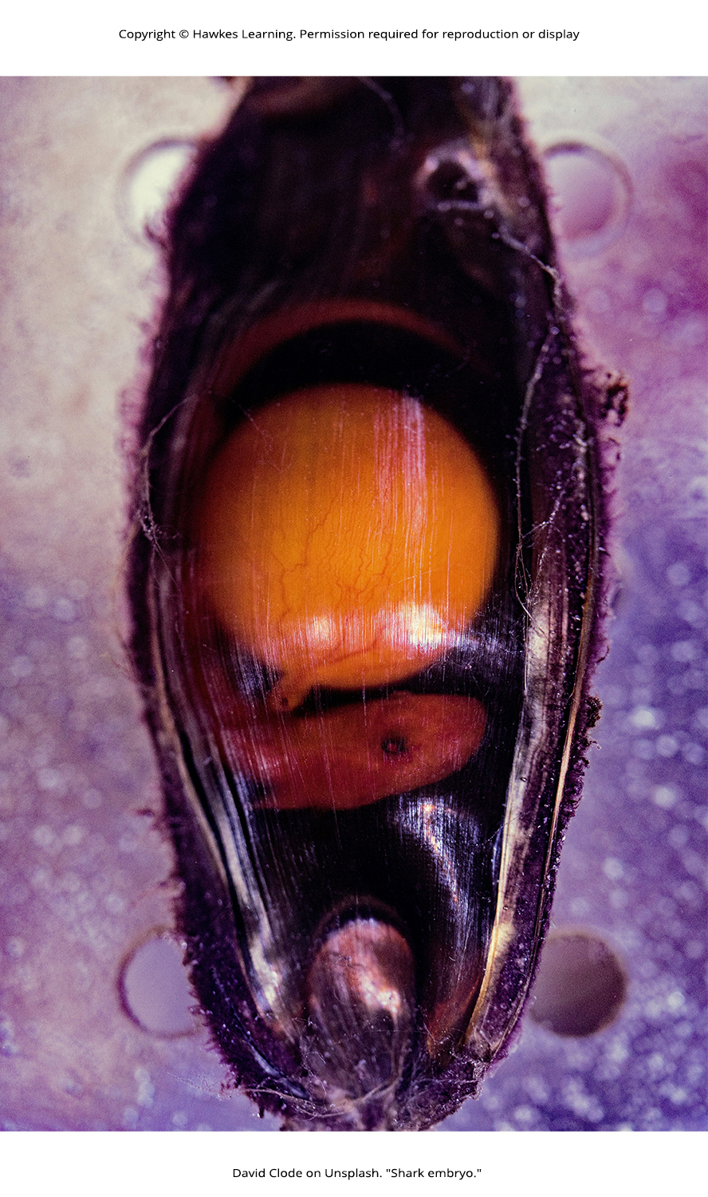
Lesson 29.2 Figure 8

Slide 20
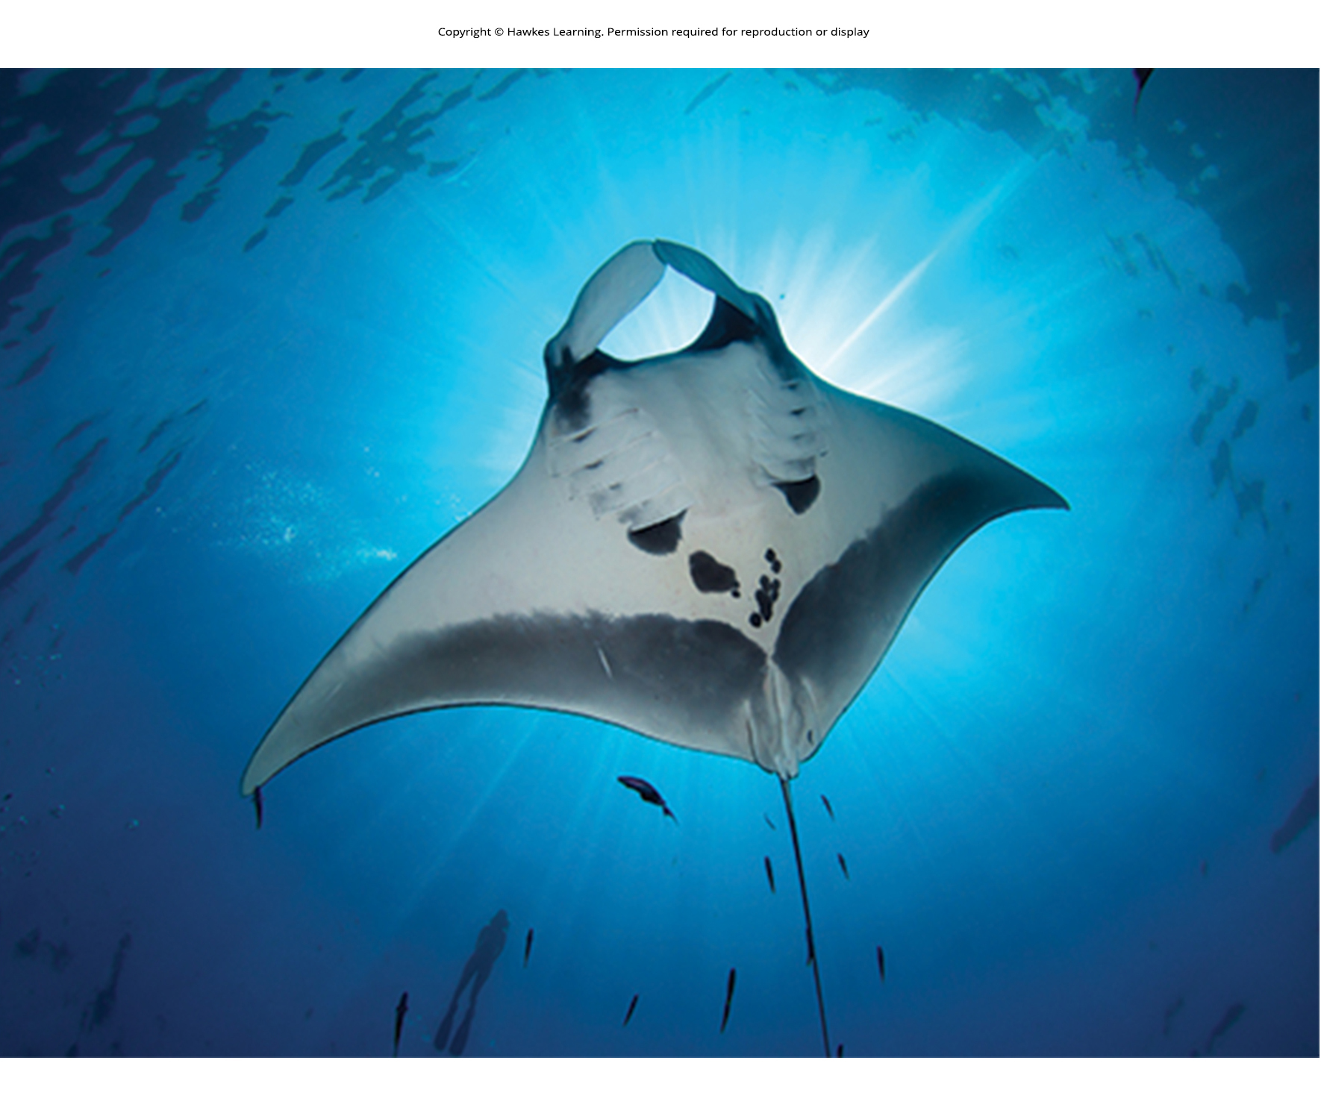
Lesson 29.2 Figure 9

Slide 21
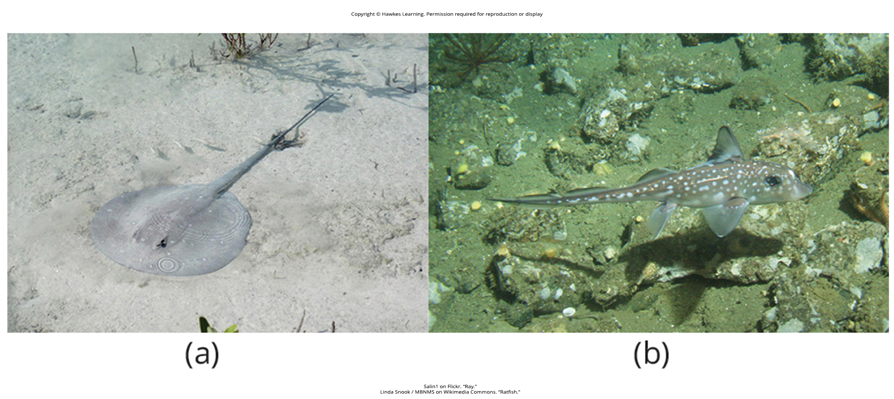
Lesson 29.2 Figure 10

Slide 22
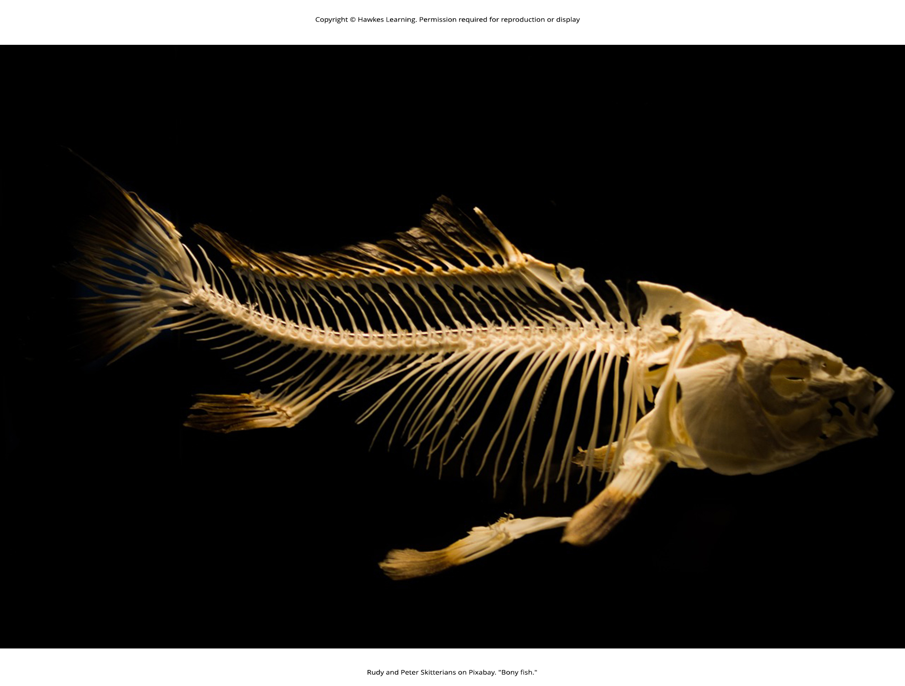
Lesson 29.2 Figure 11

Slide 23
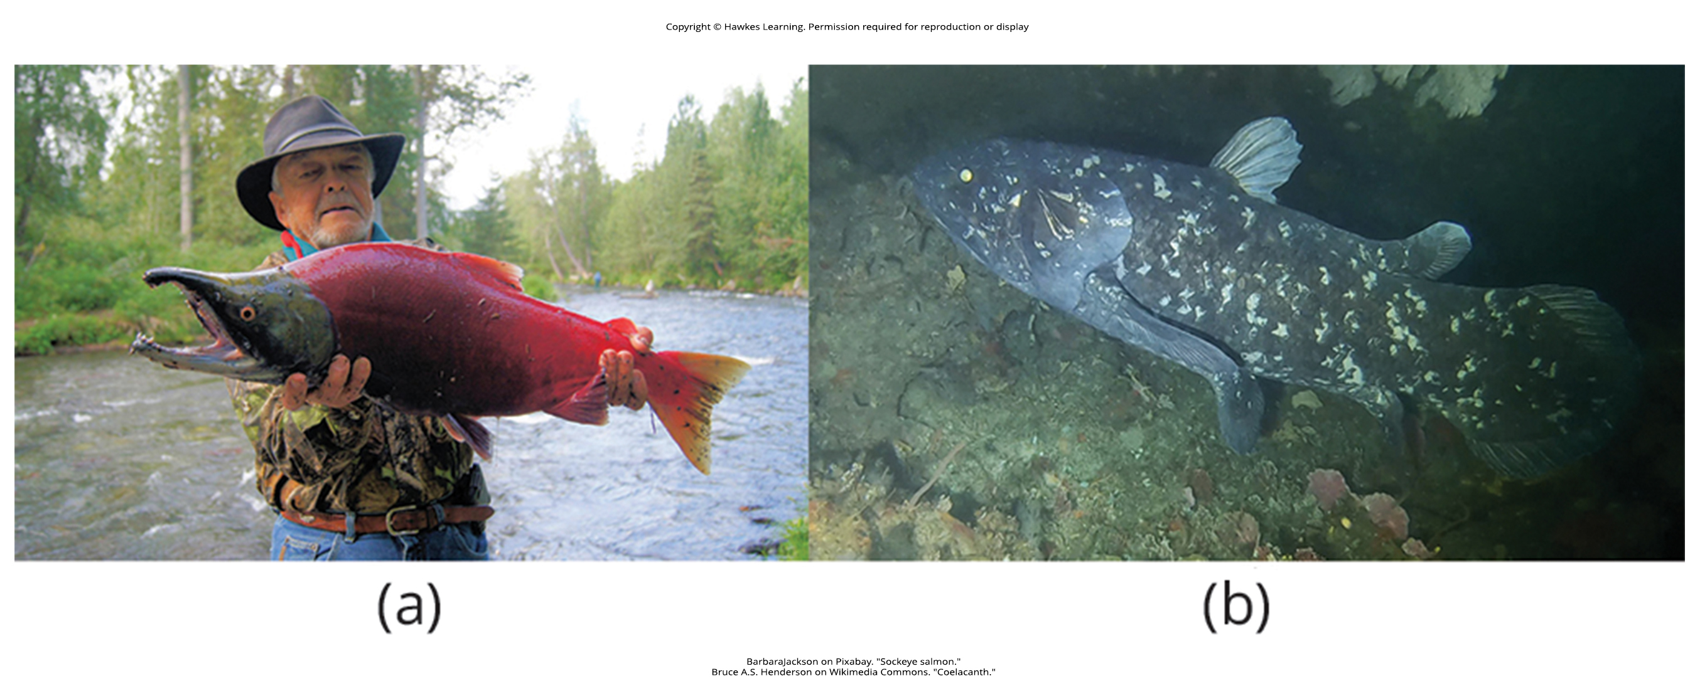
Lesson 29.2 Figure 12

Slide 24
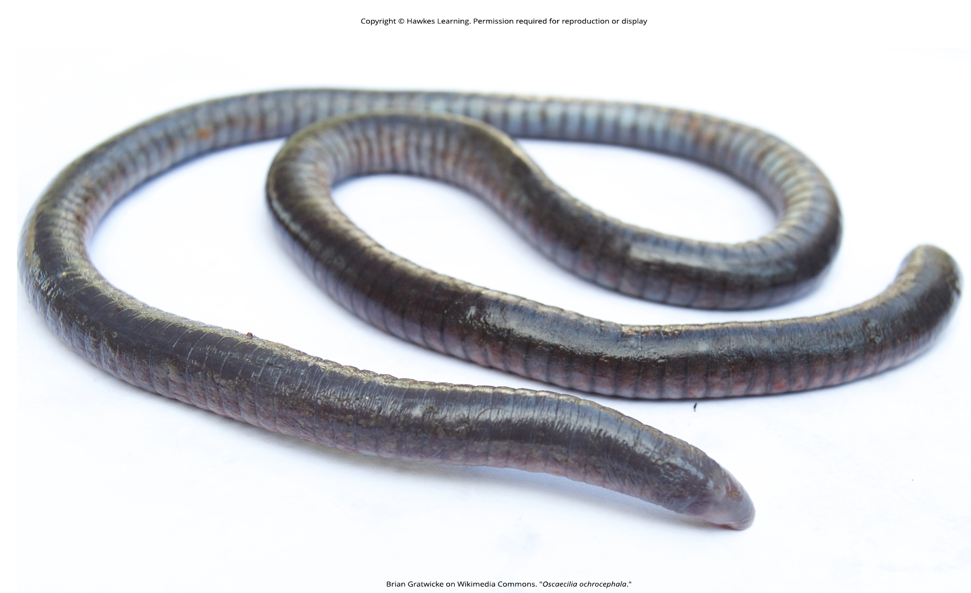
Lesson 29.3 Figure 1

Slide 25
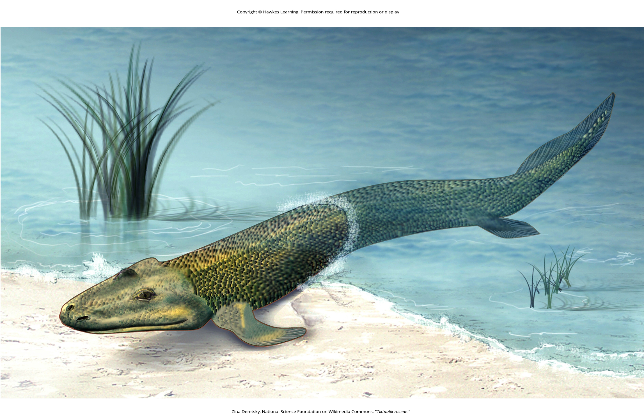
Lesson 29.3 Figure 2

Slide 26
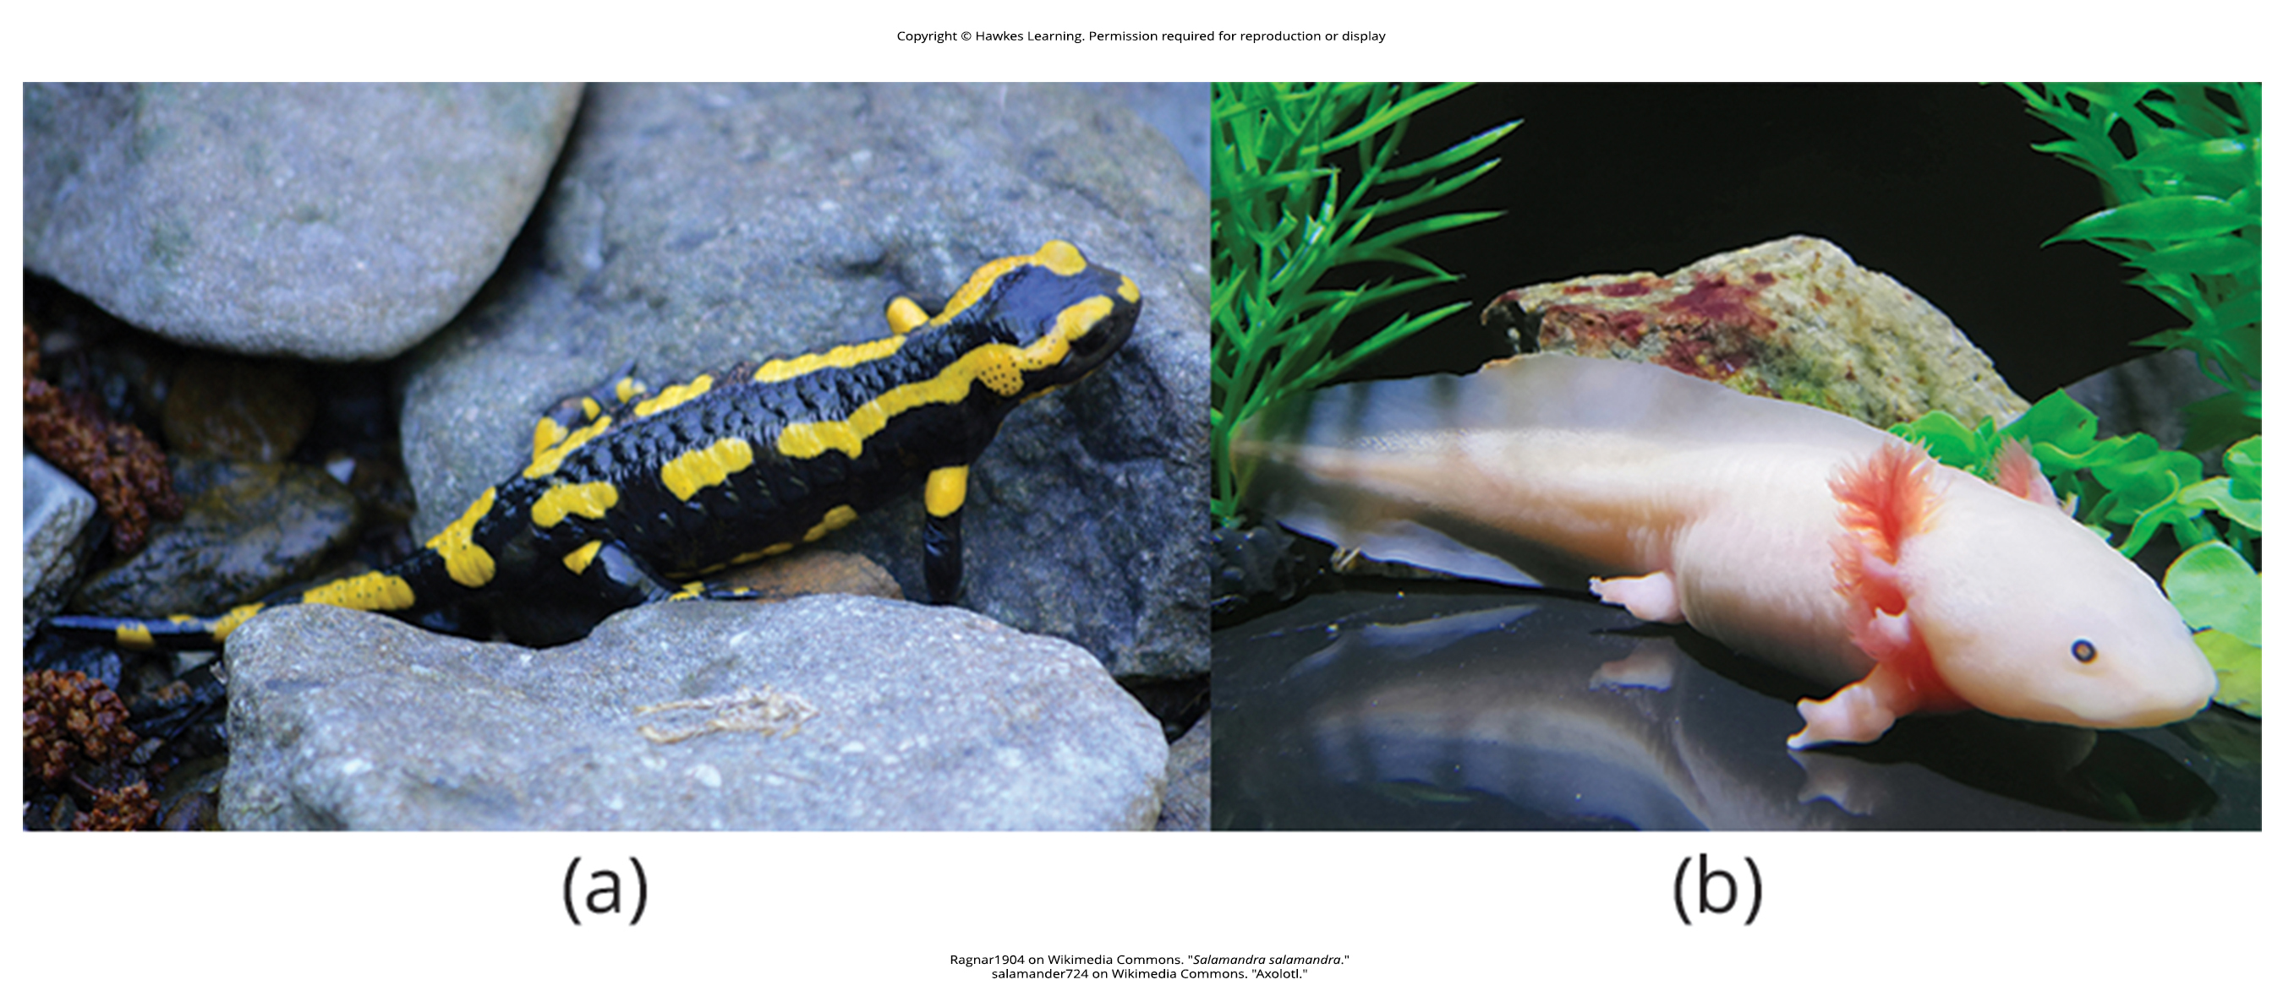
Lesson 29.3 Figure 3

Slide 27
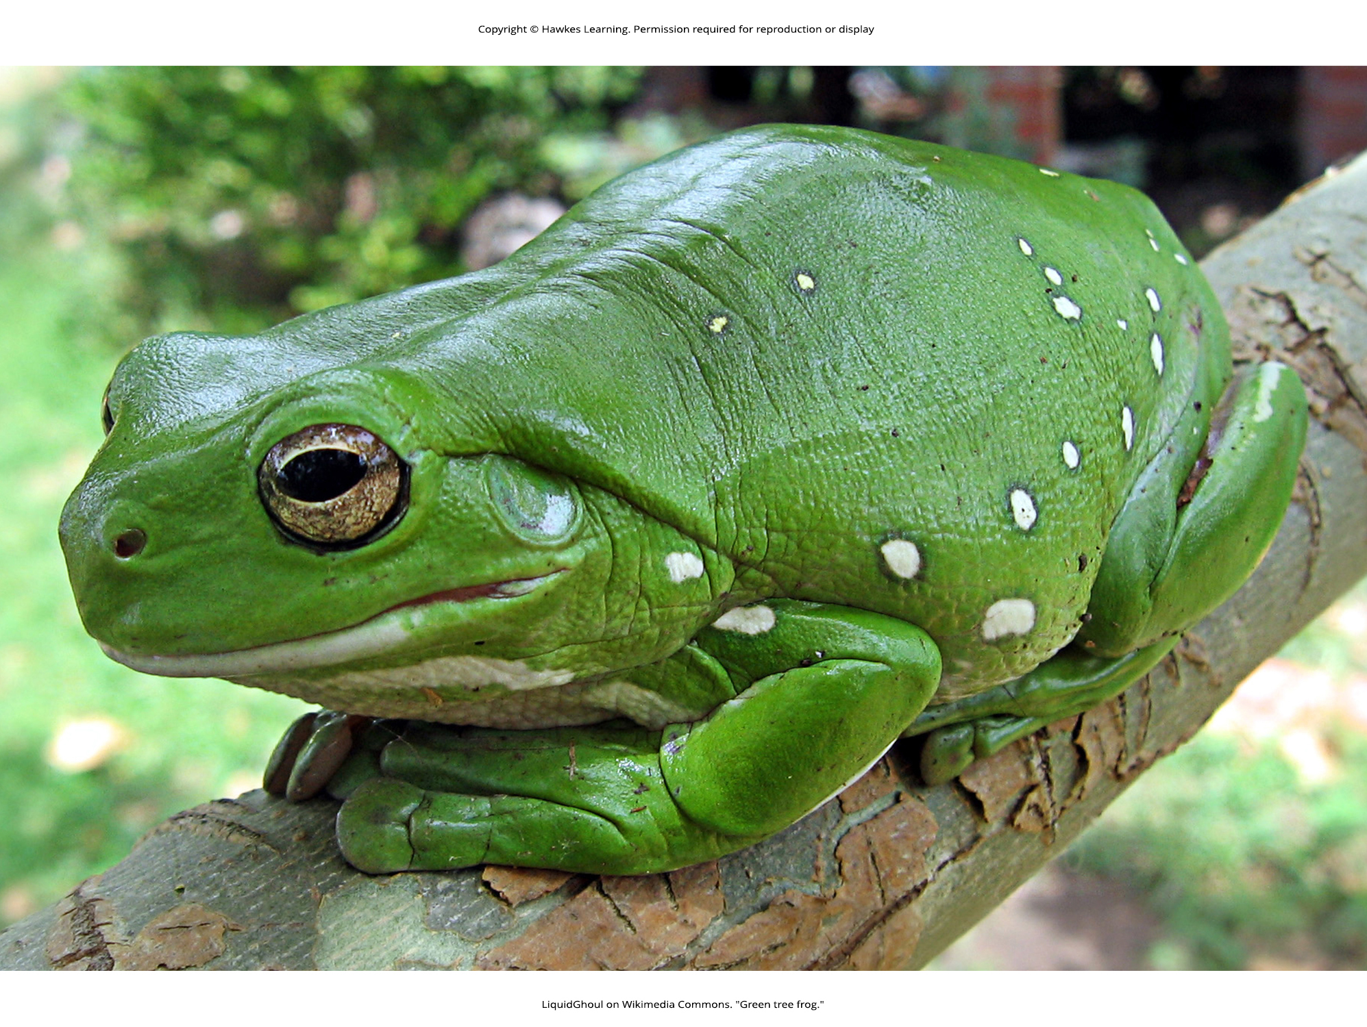
Lesson 29.3 Figure 4

Slide 28
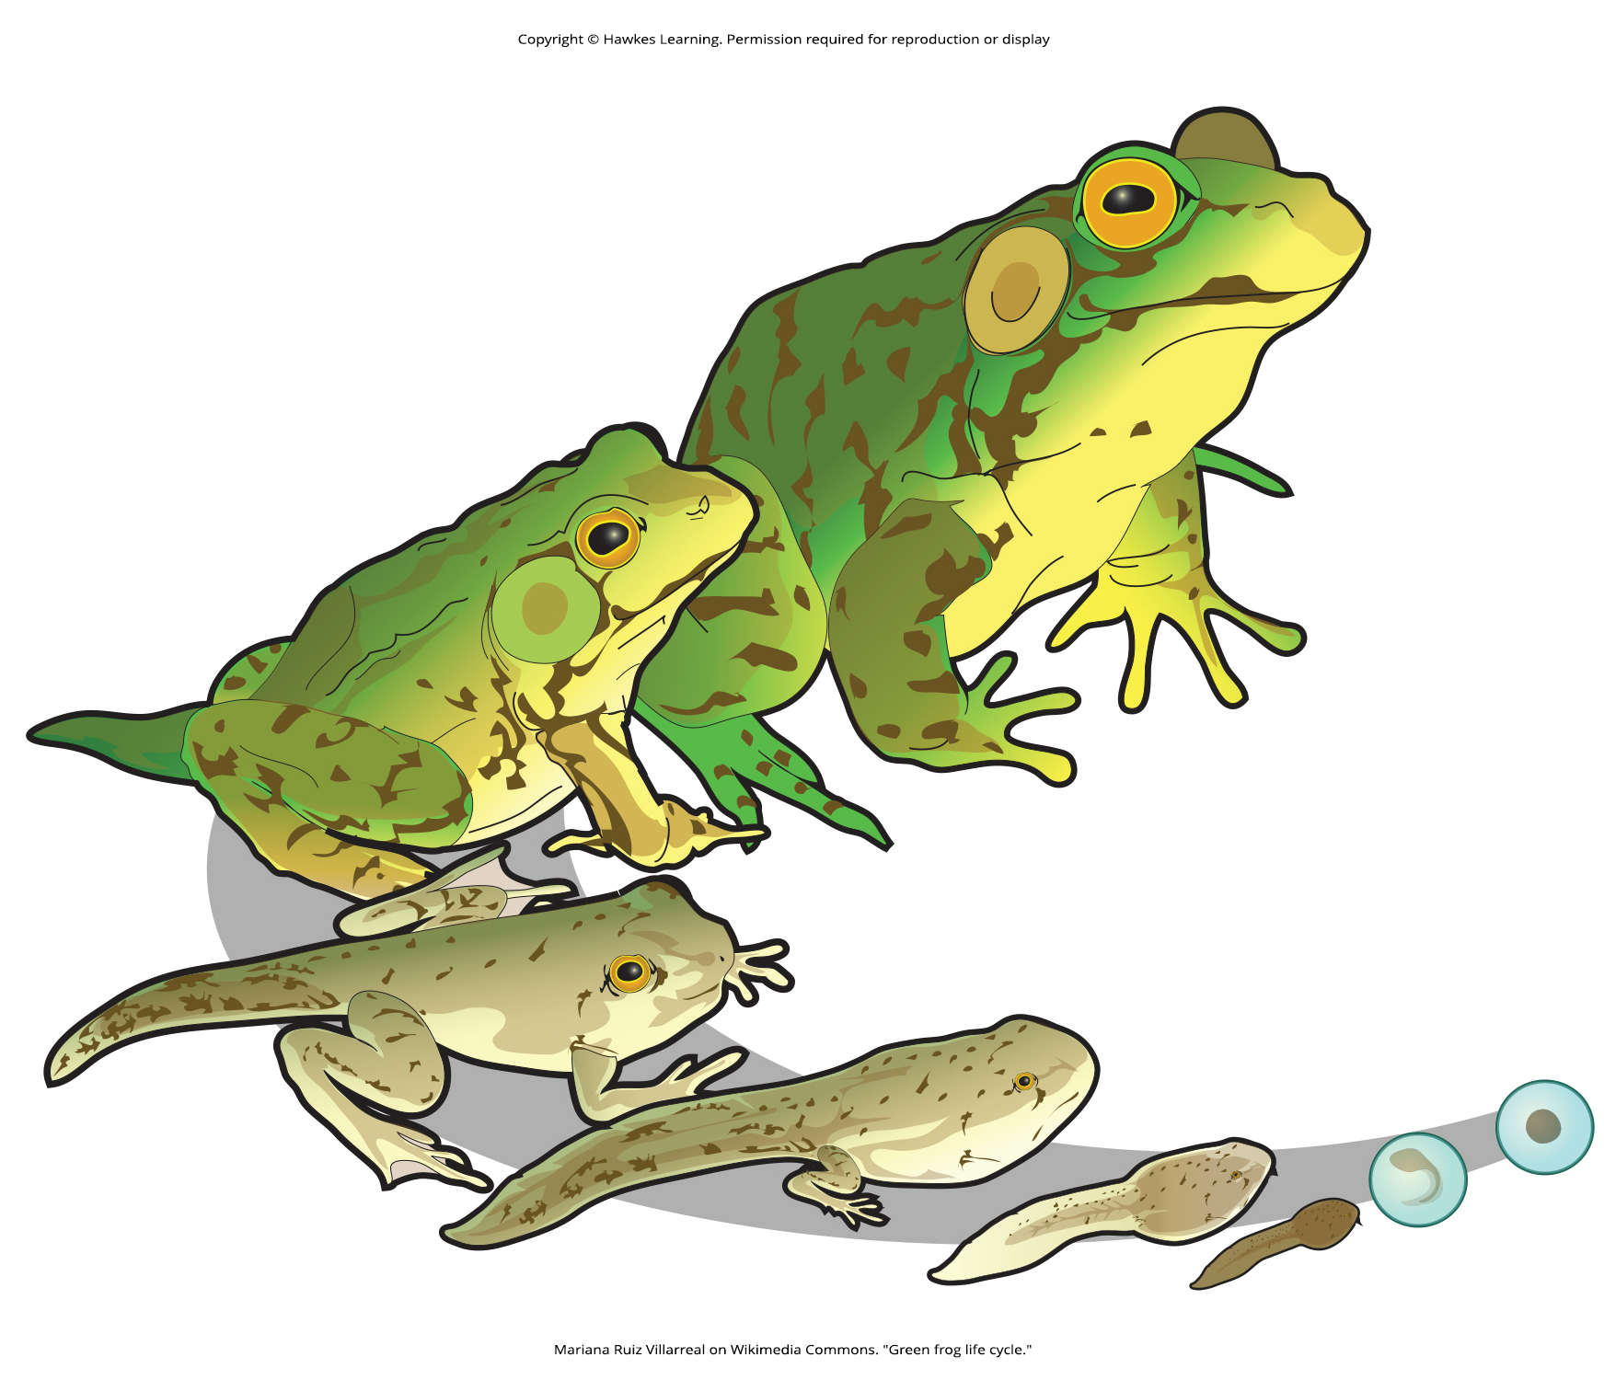
Lesson 29.3 Figure 5

Slide 29
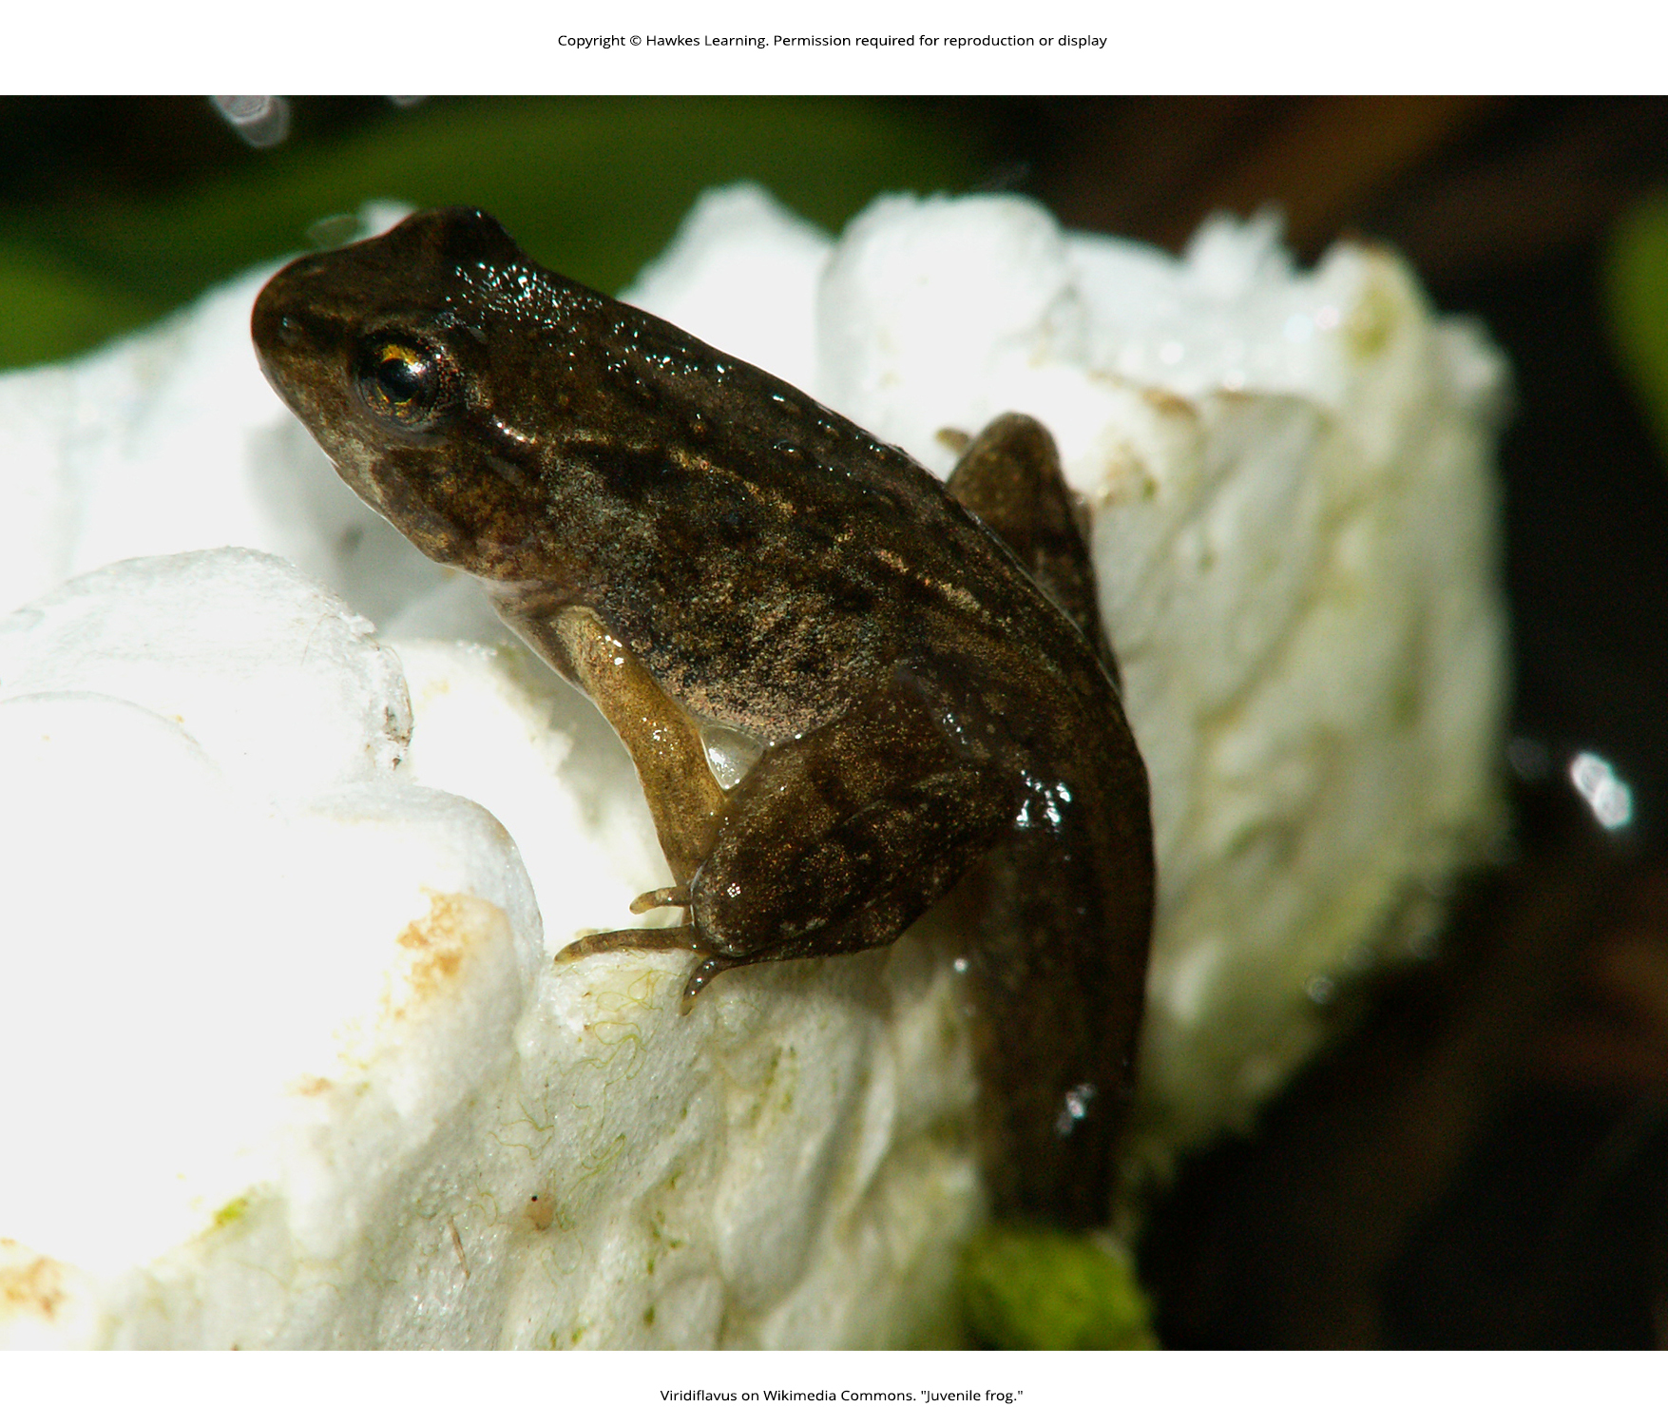
Lesson 29.3 Figure 6

Slide 30
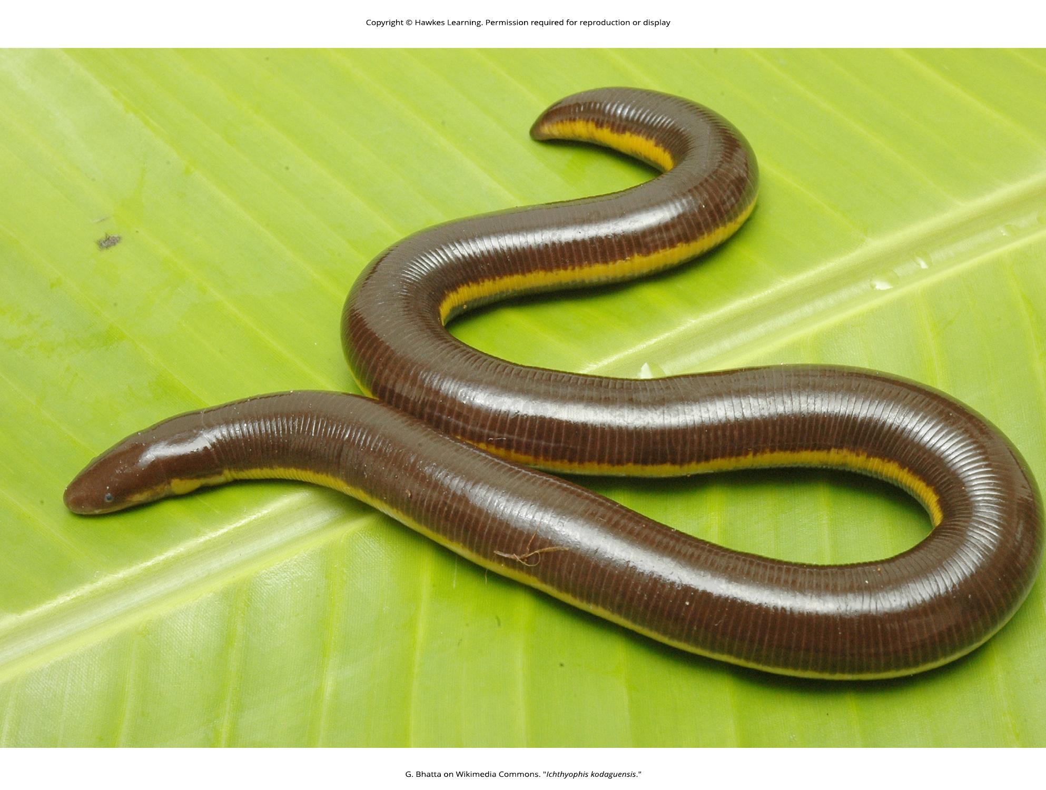
Lesson 29.3 Figure 7

Slide 31
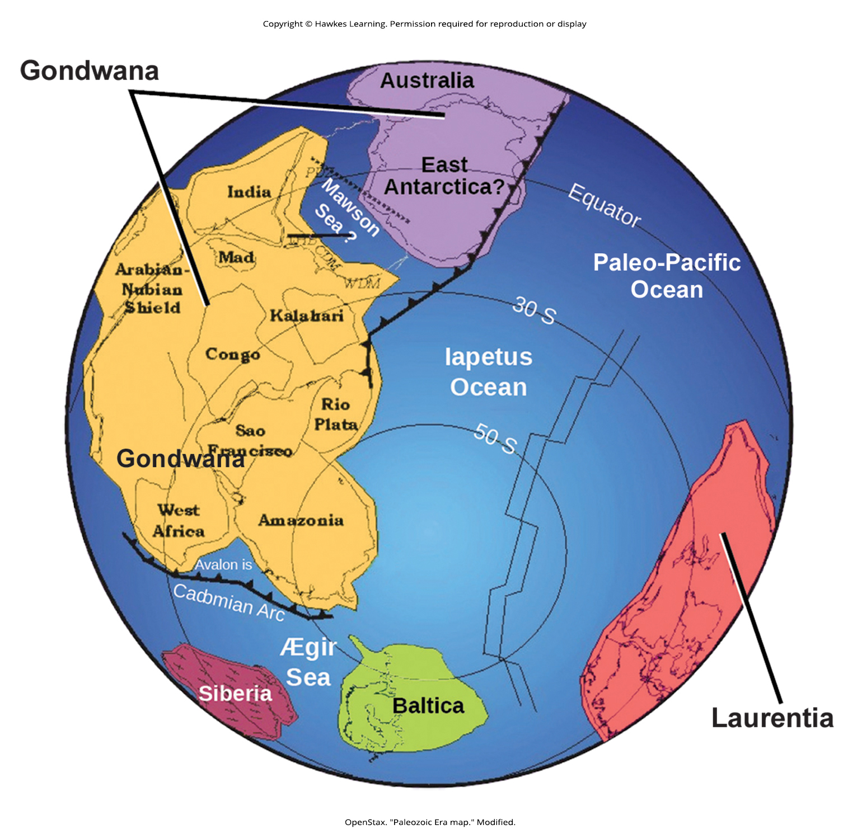
Lesson 29.3 Figure 8

Slide 32
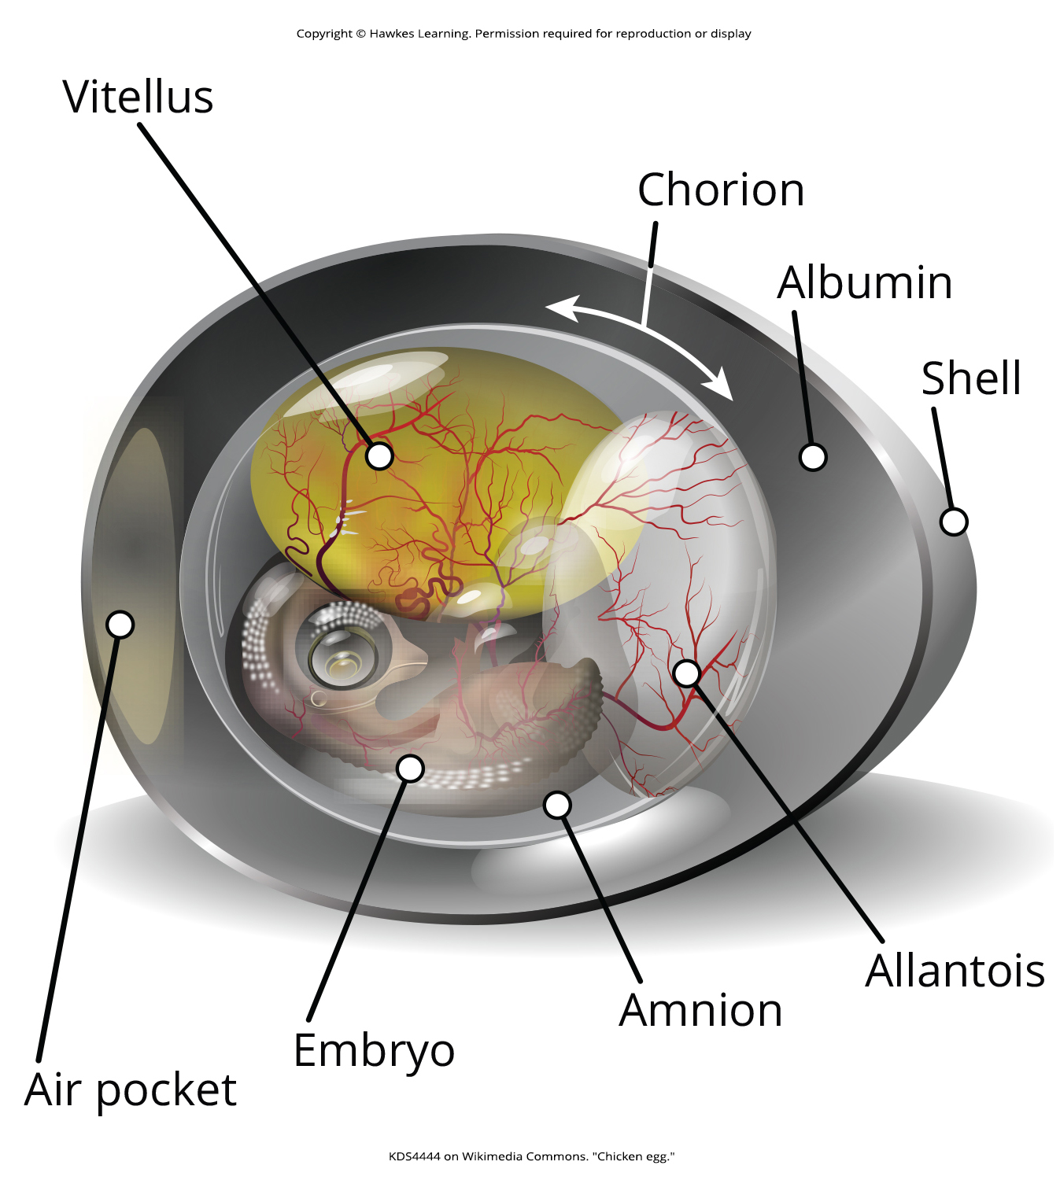
Lesson 29.4 Figure 1

Slide 33
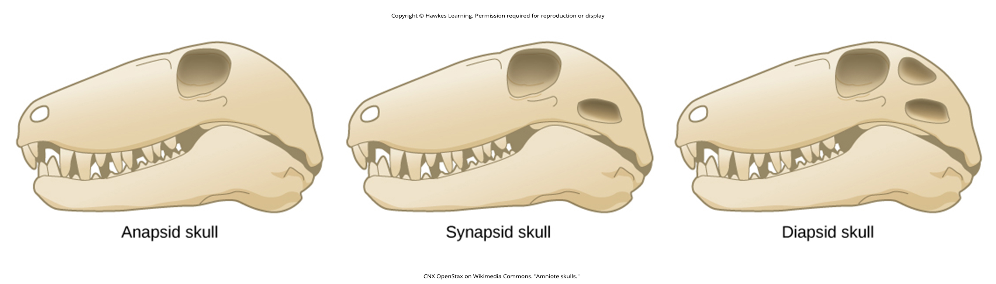
Lesson 29.4 Figure 2

Slide 34
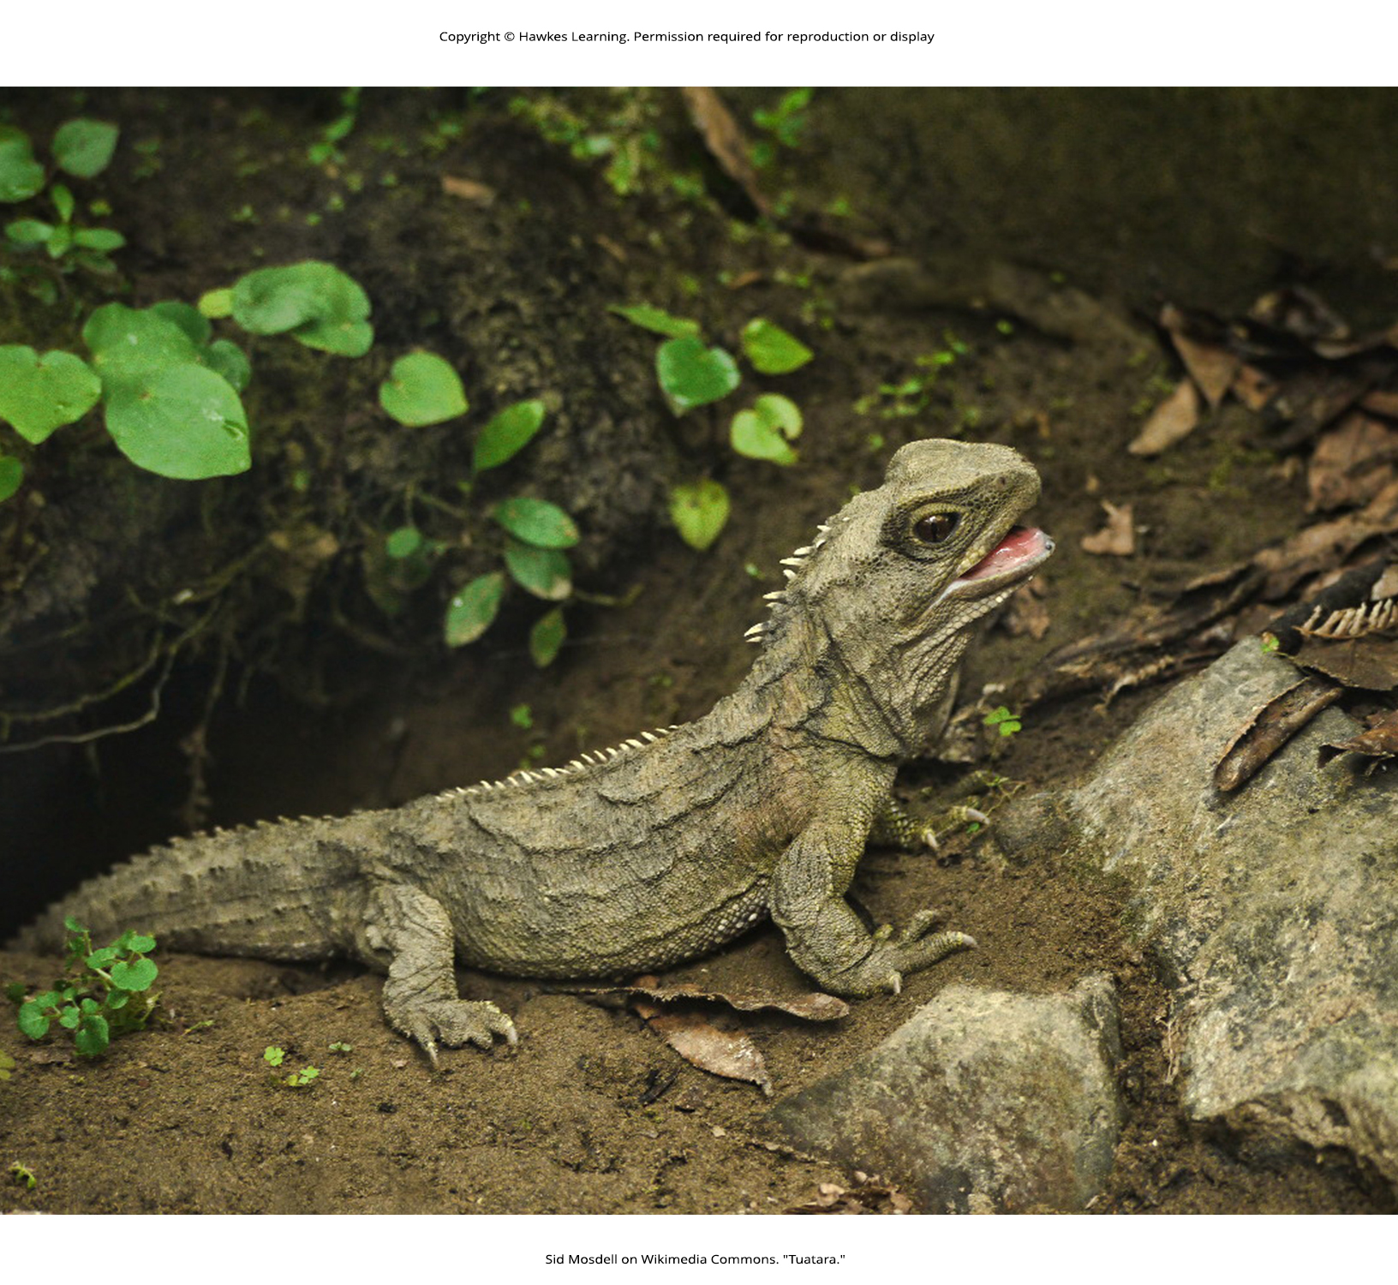
Lesson 29.4 Figure 3

Slide 35
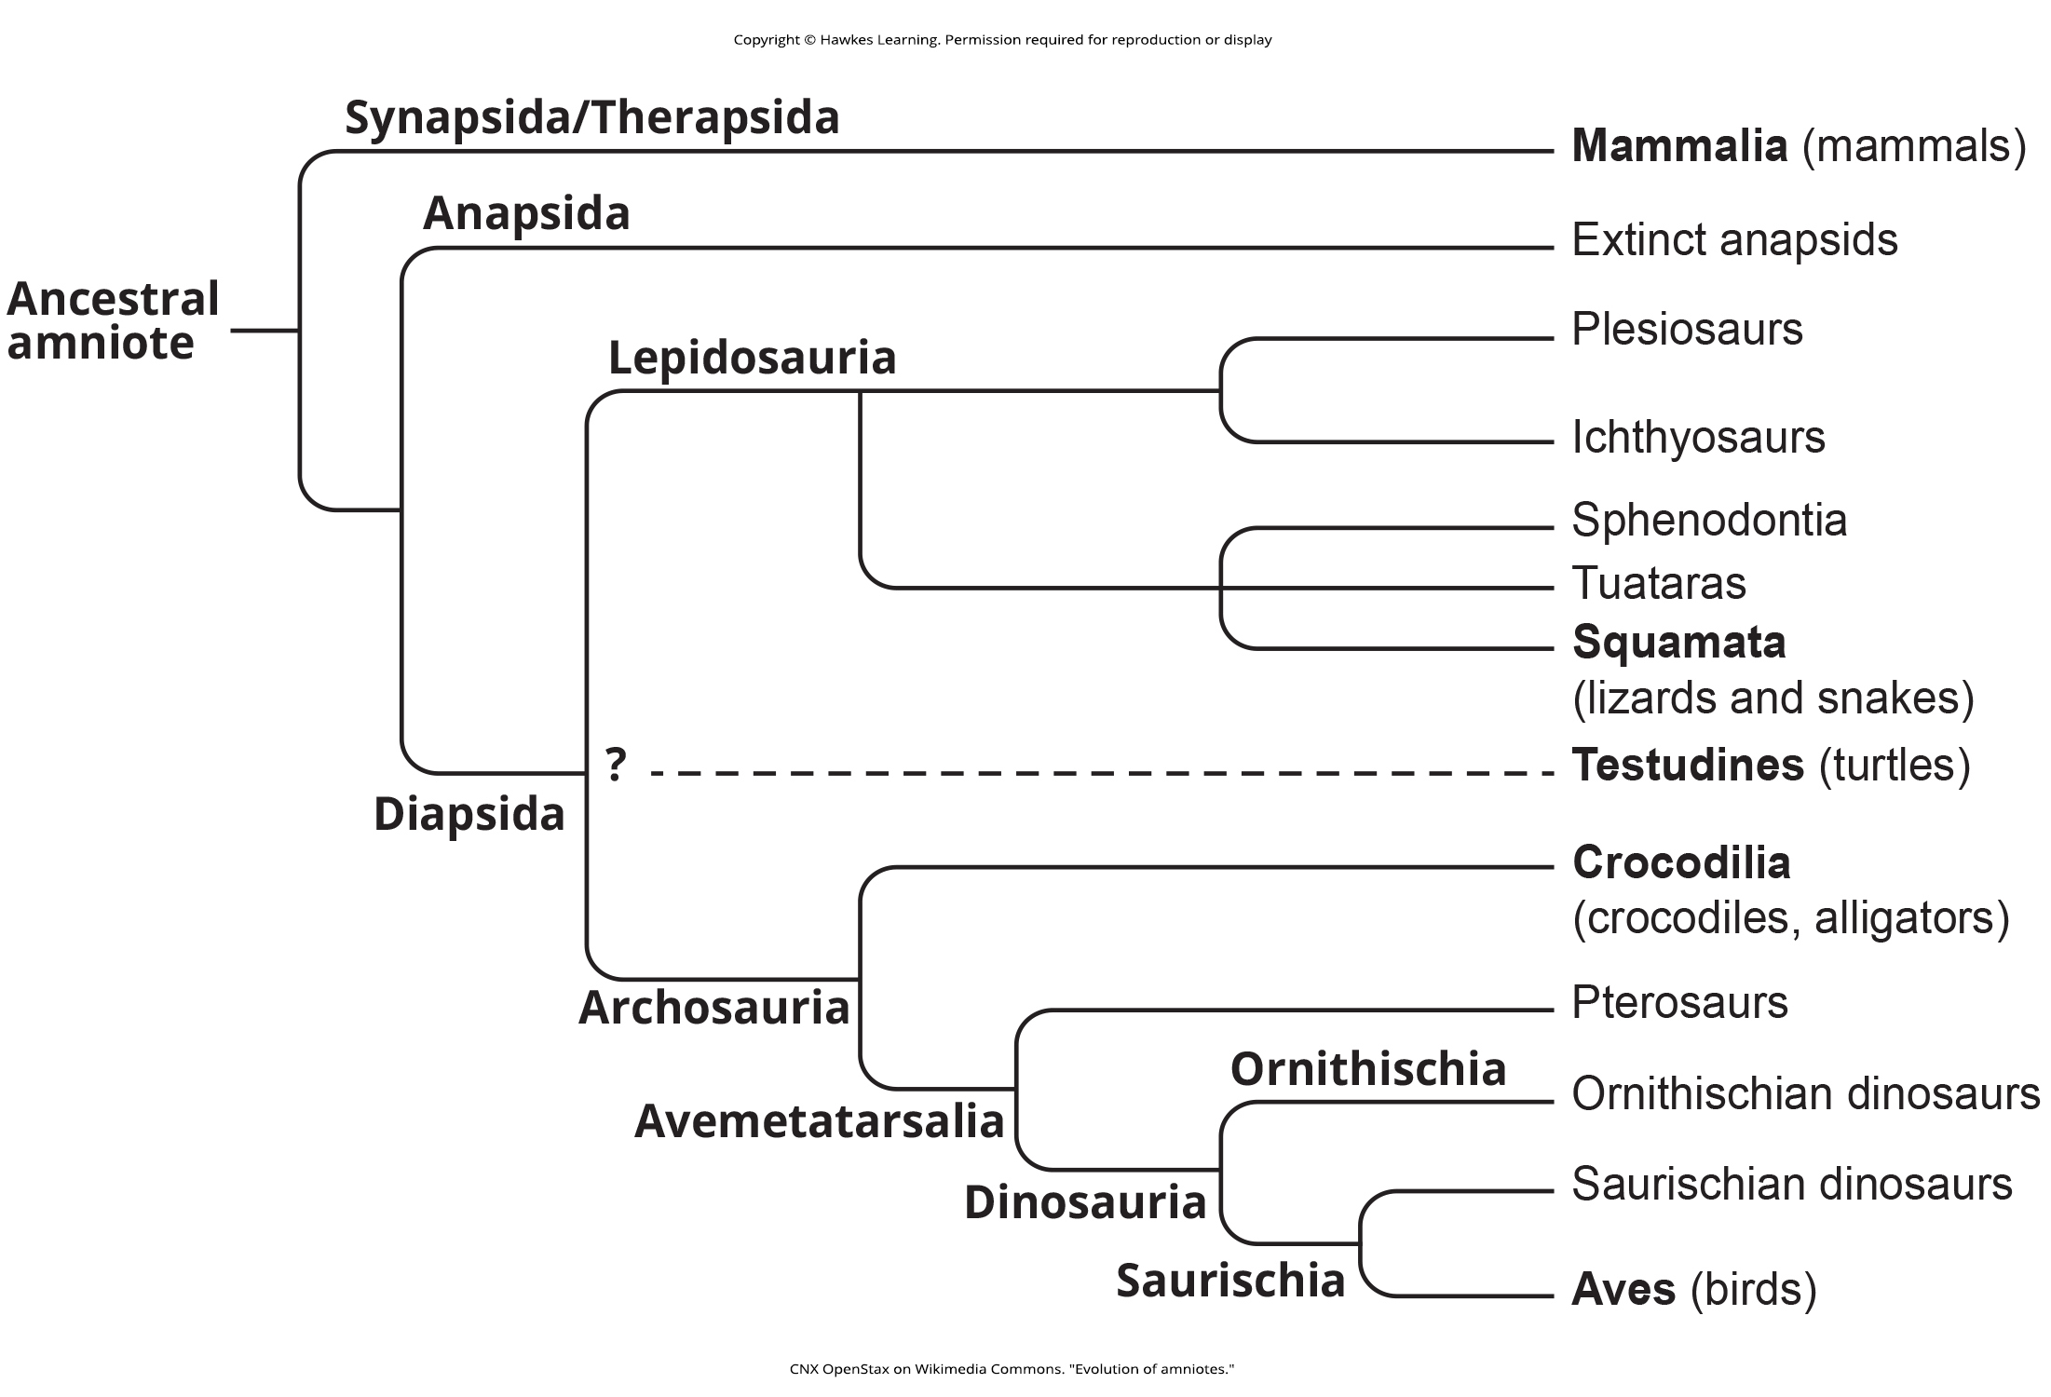
Lesson 29.4 Figure 4

Slide 36
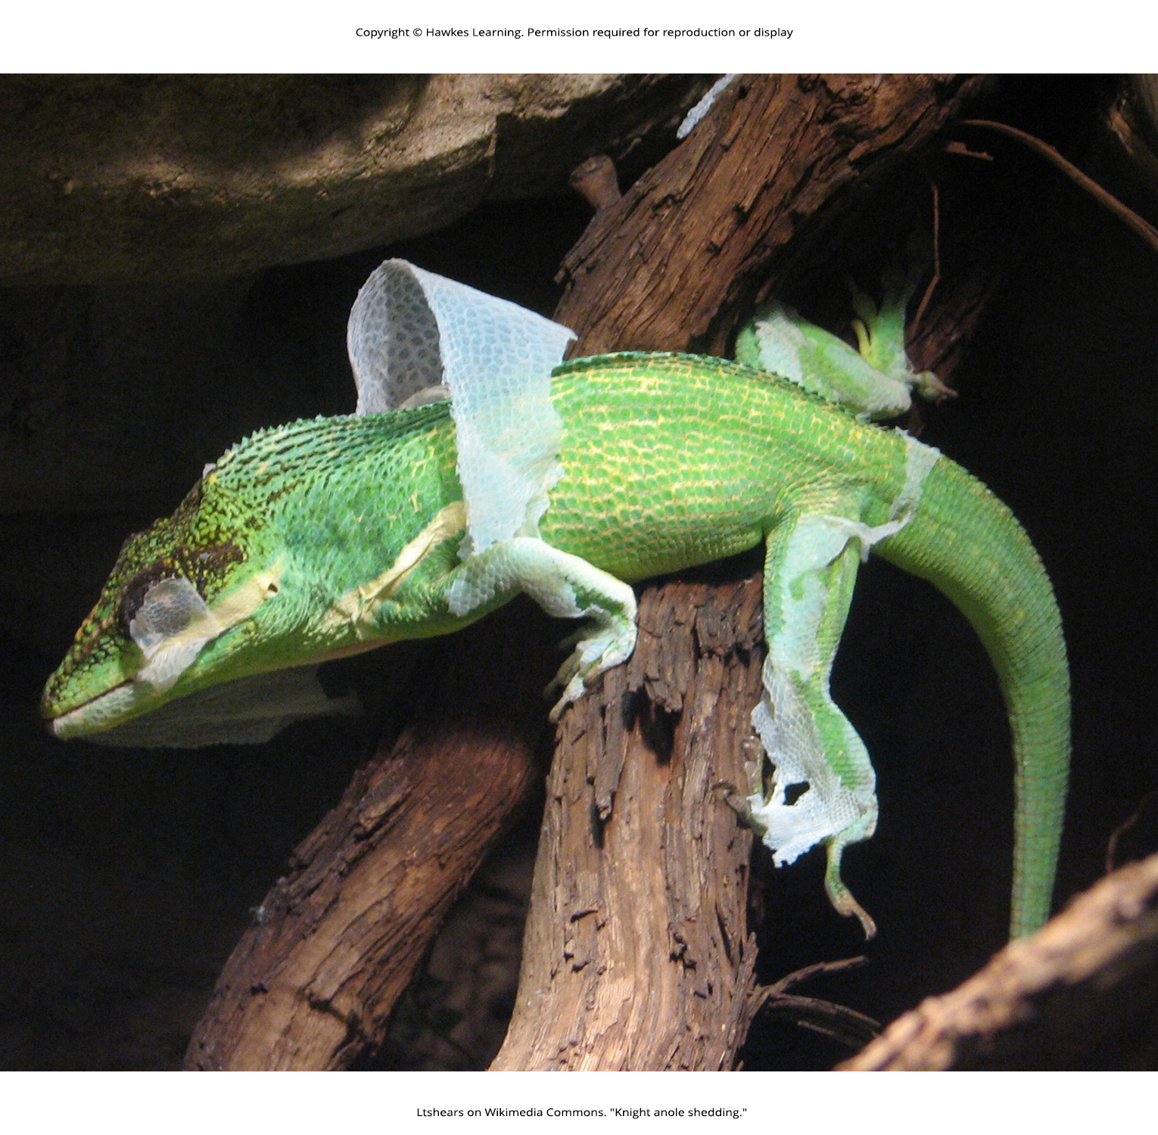
Lesson 29.4 Figure 5

Slide 37
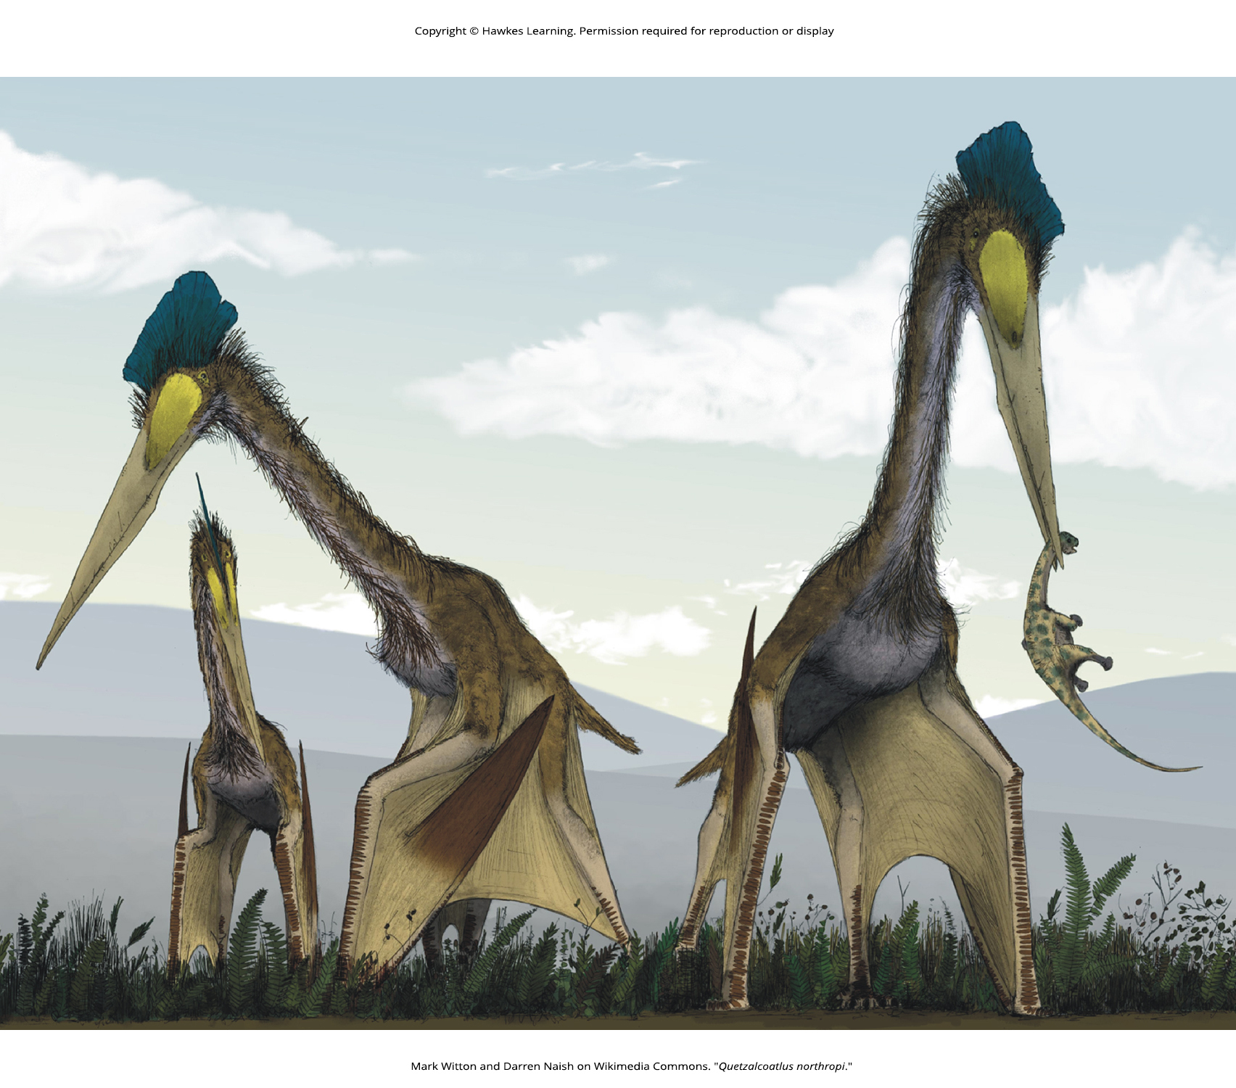
Lesson 29.4 Figure 6

Slide 38
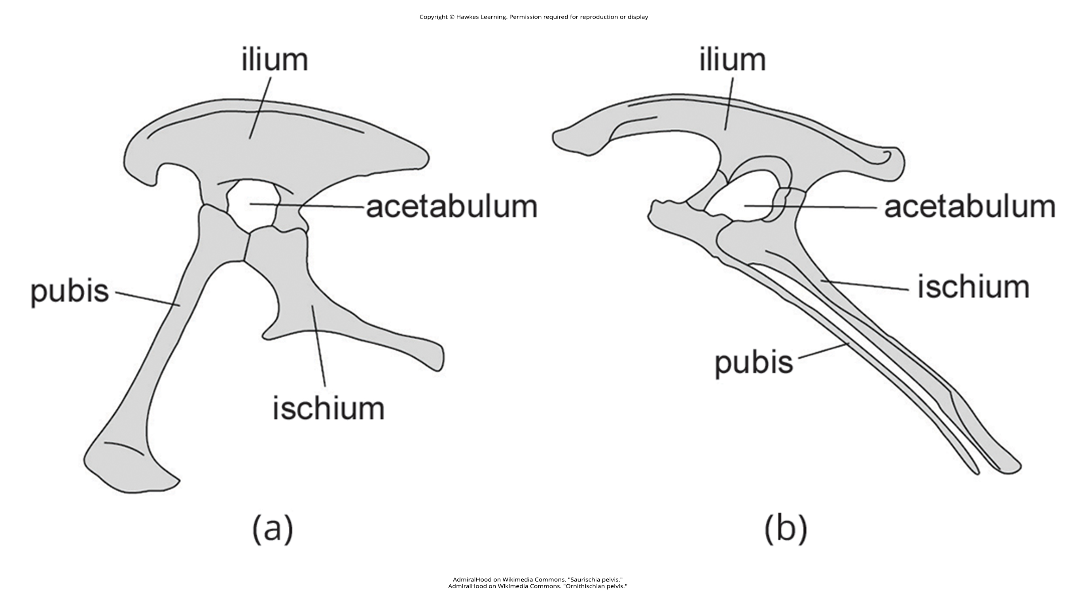
Lesson 29.4 Figure 7

Slide 39
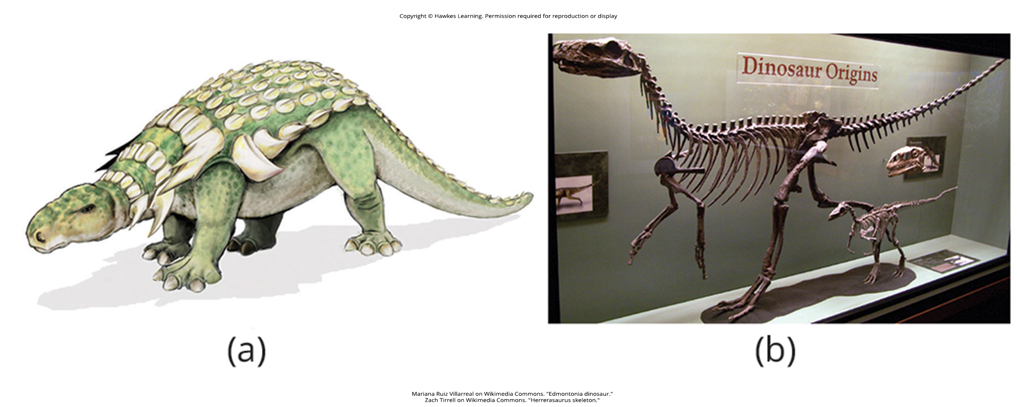
Lesson 29.4 Figure 8

Slide 40
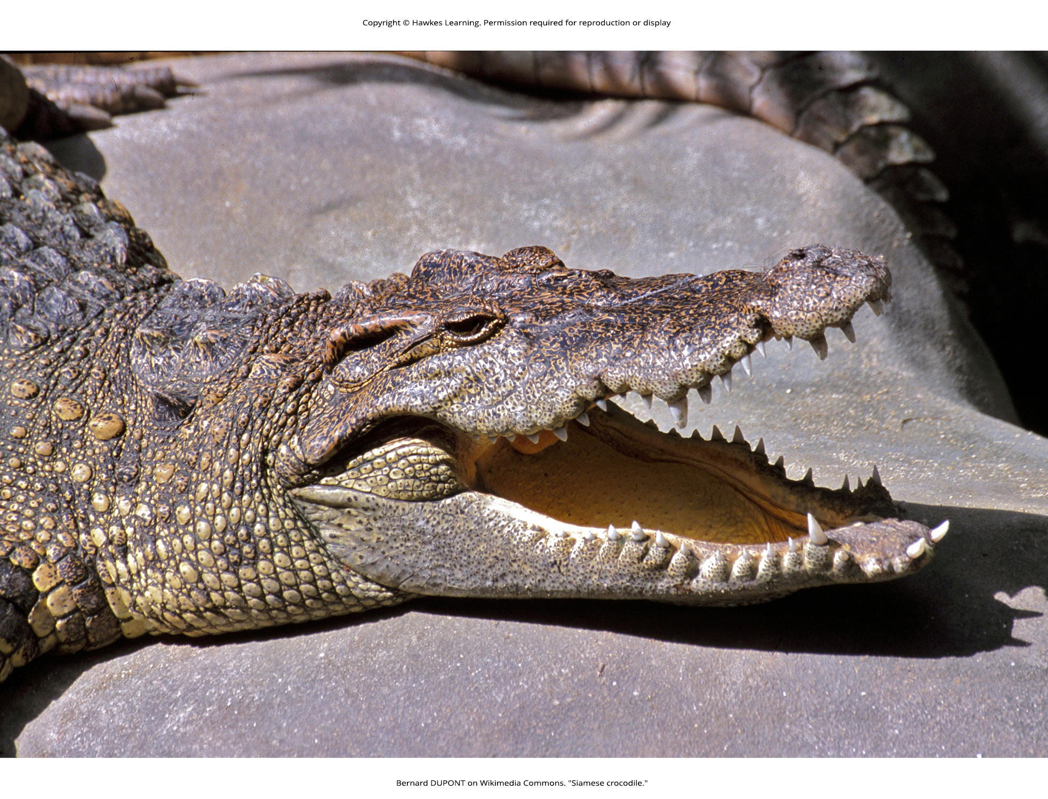
Lesson 29.4 Figure 9

Slide 41
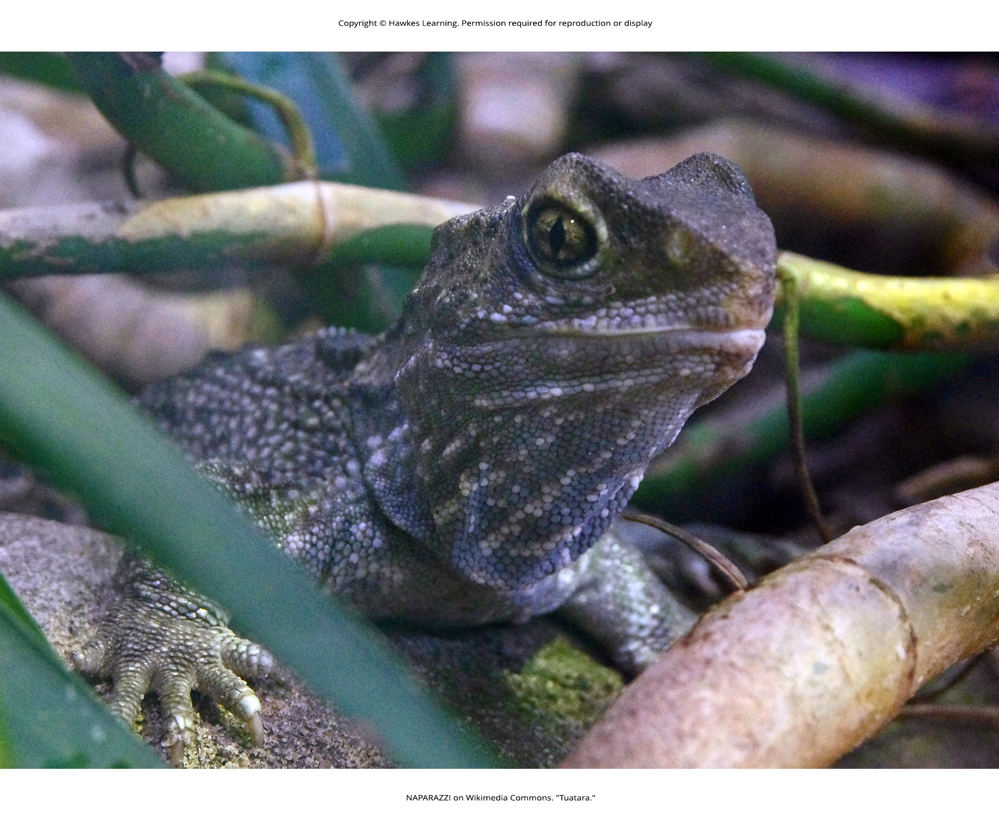
Lesson 29.4 Figure 10

Slide 42
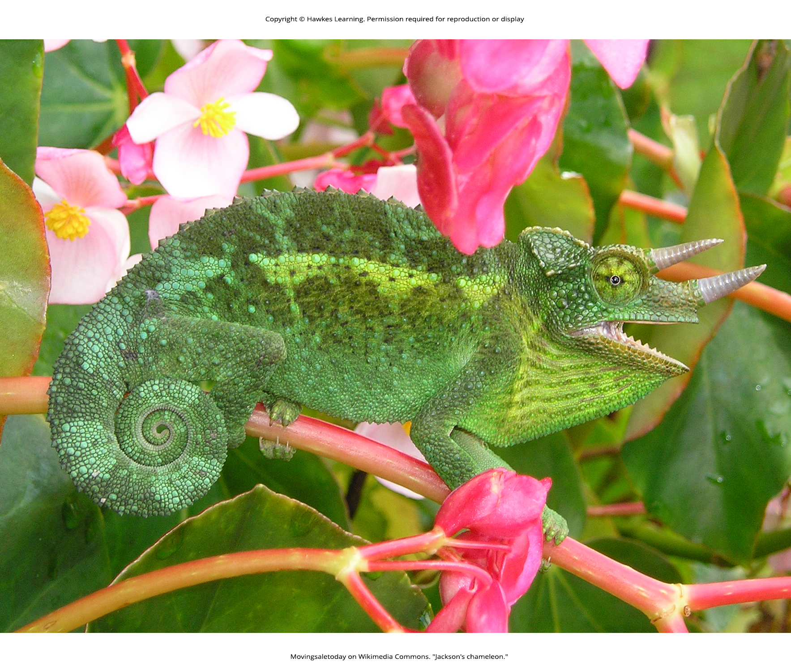
Lesson 29.4 Figure 11

Slide 43
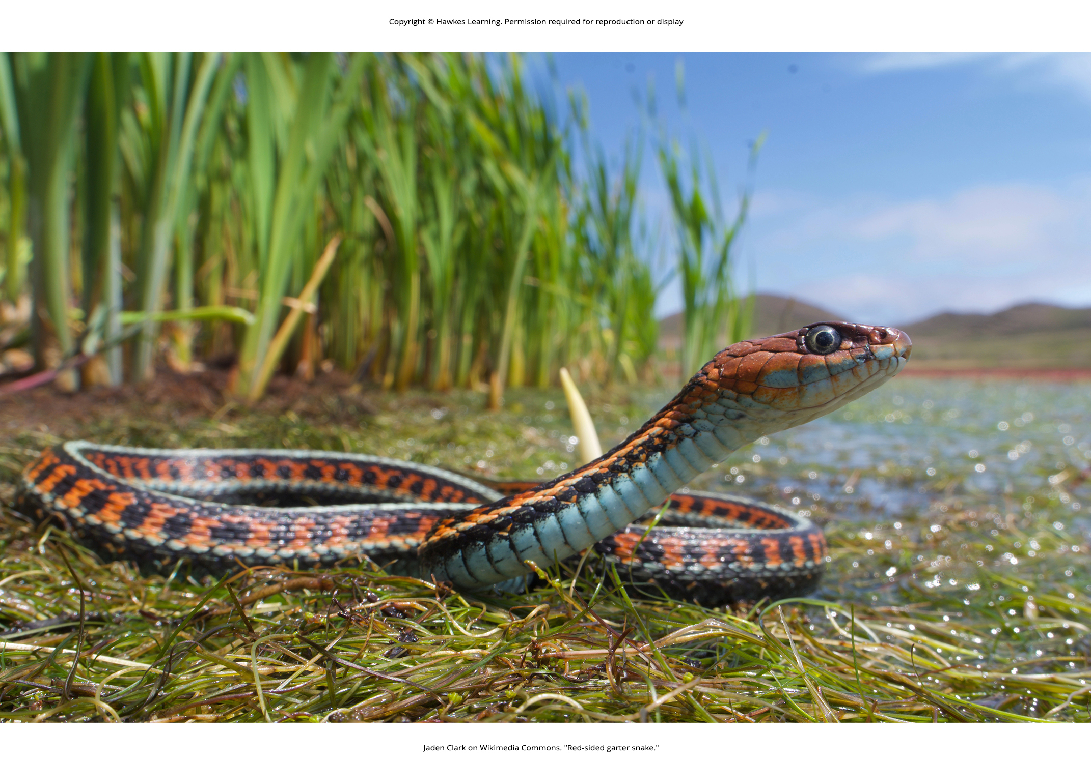
Lesson 29.4 Figure 12

Slide 44
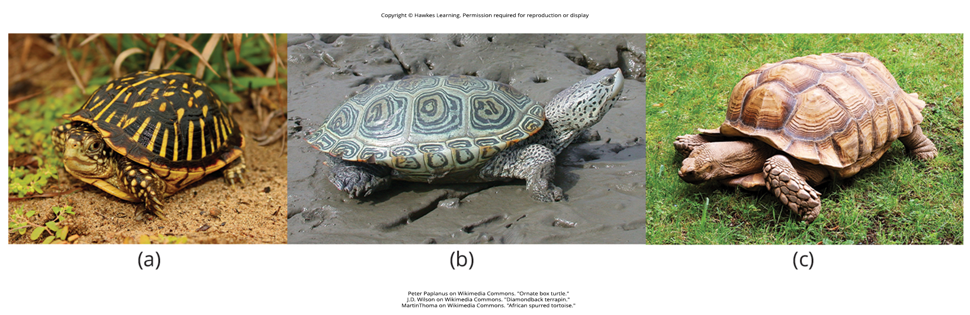
Lesson 29.4 Figure 13

Slide 45
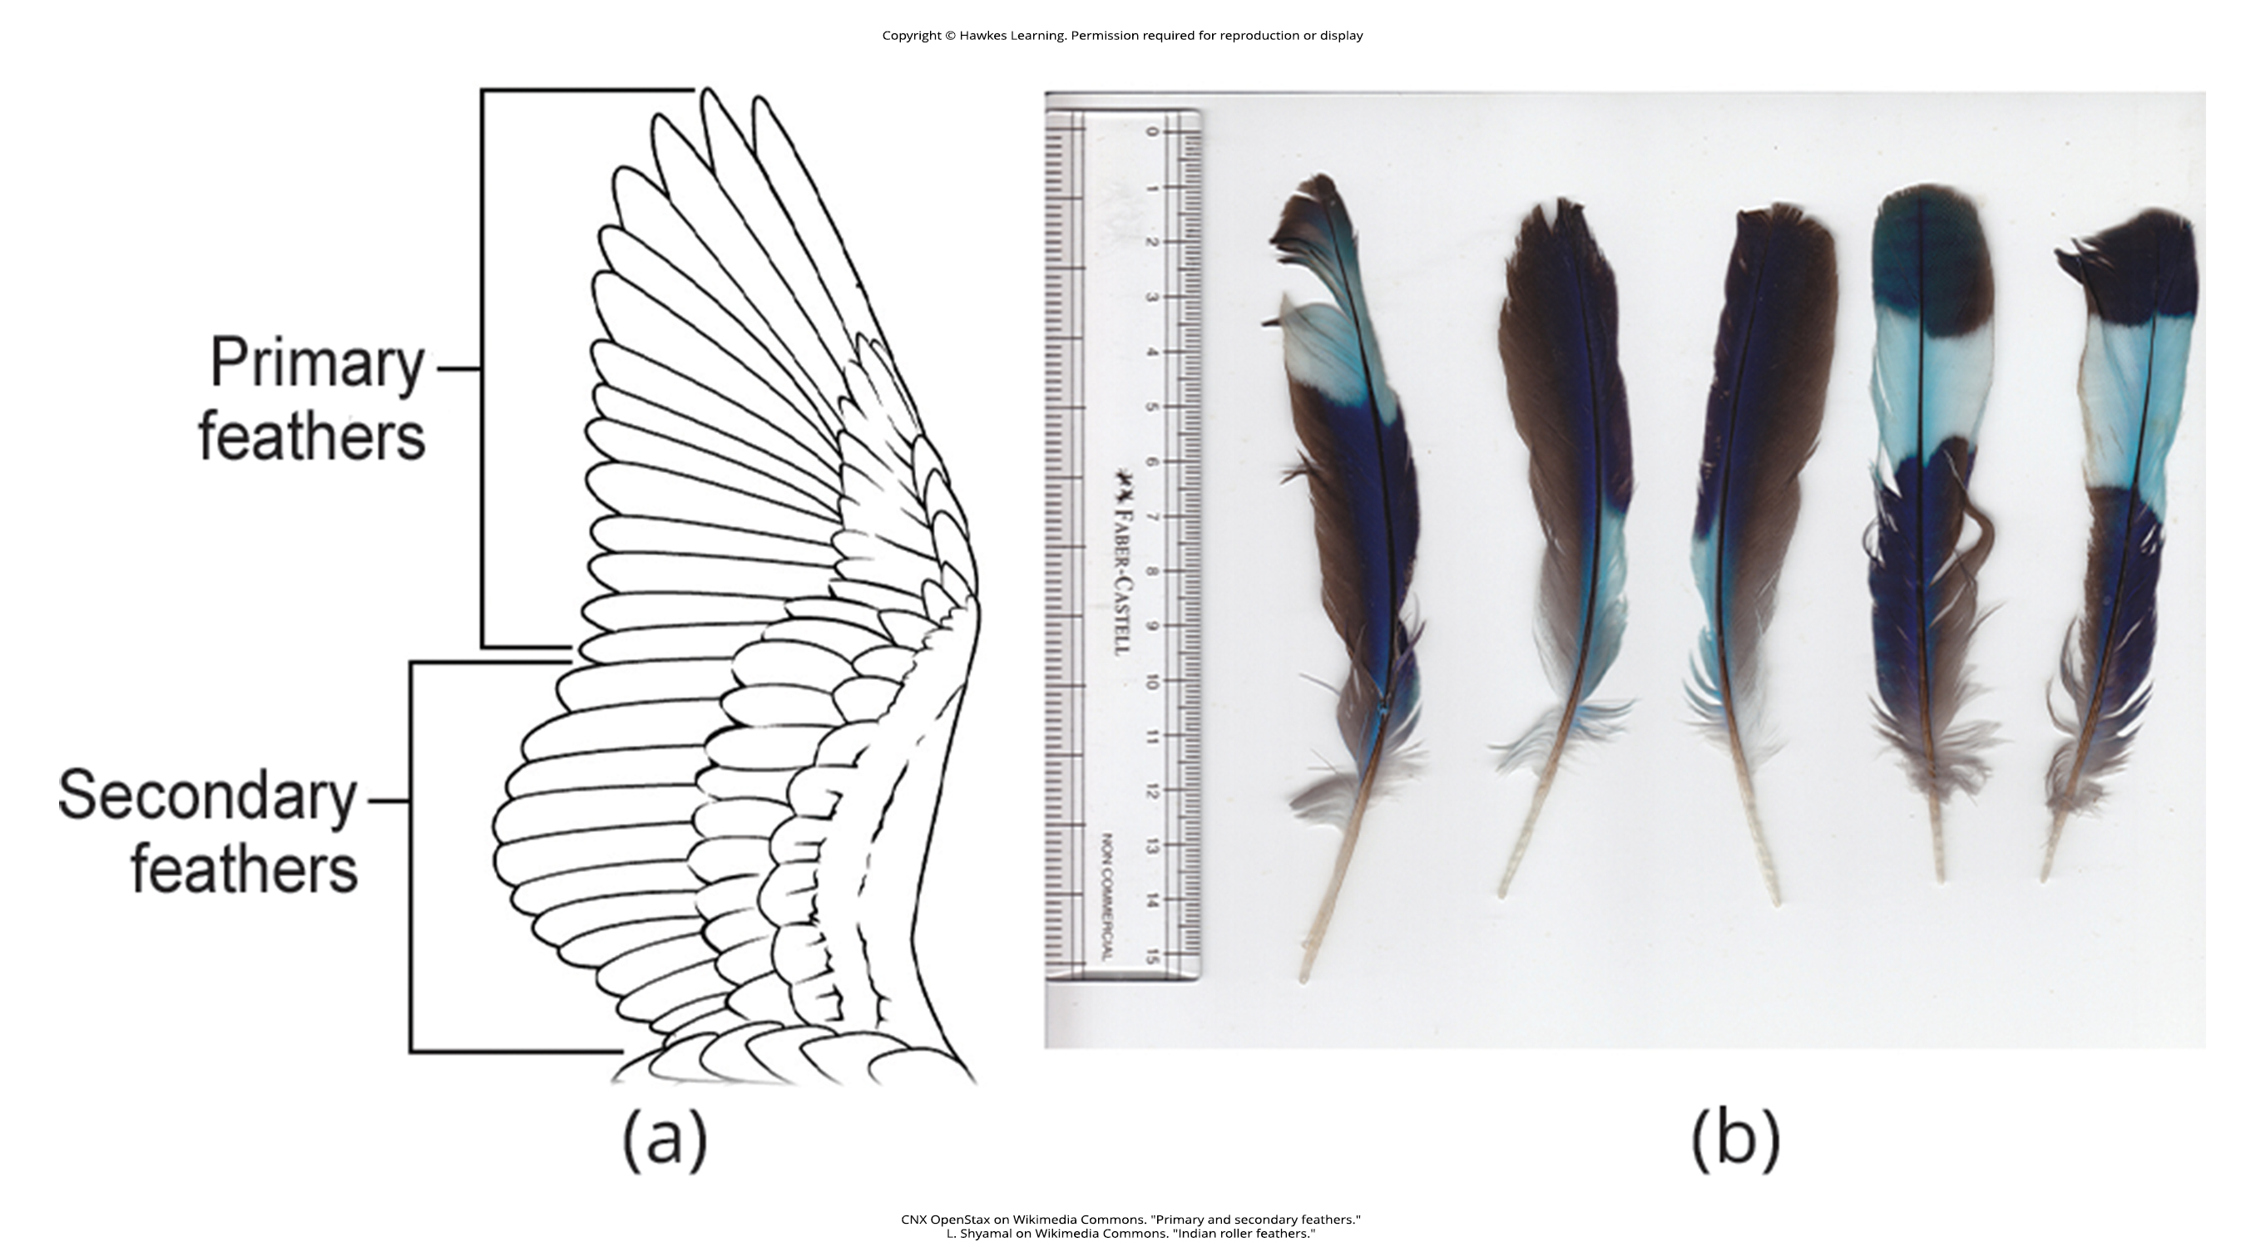
Lesson 29.4 Figure 14

Slide 46
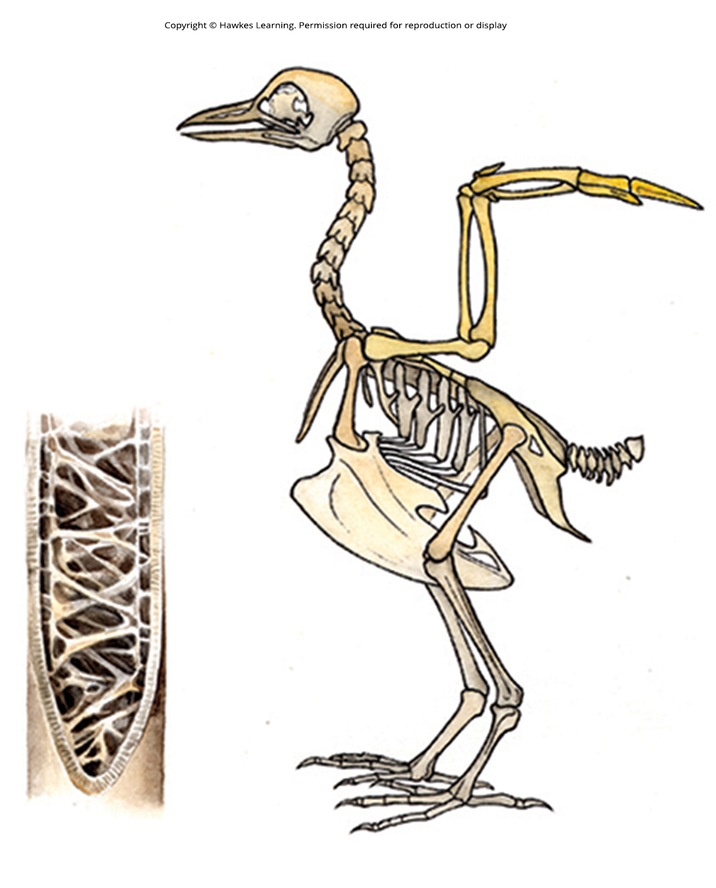
Lesson 29.4 Figure 15

Slide 47
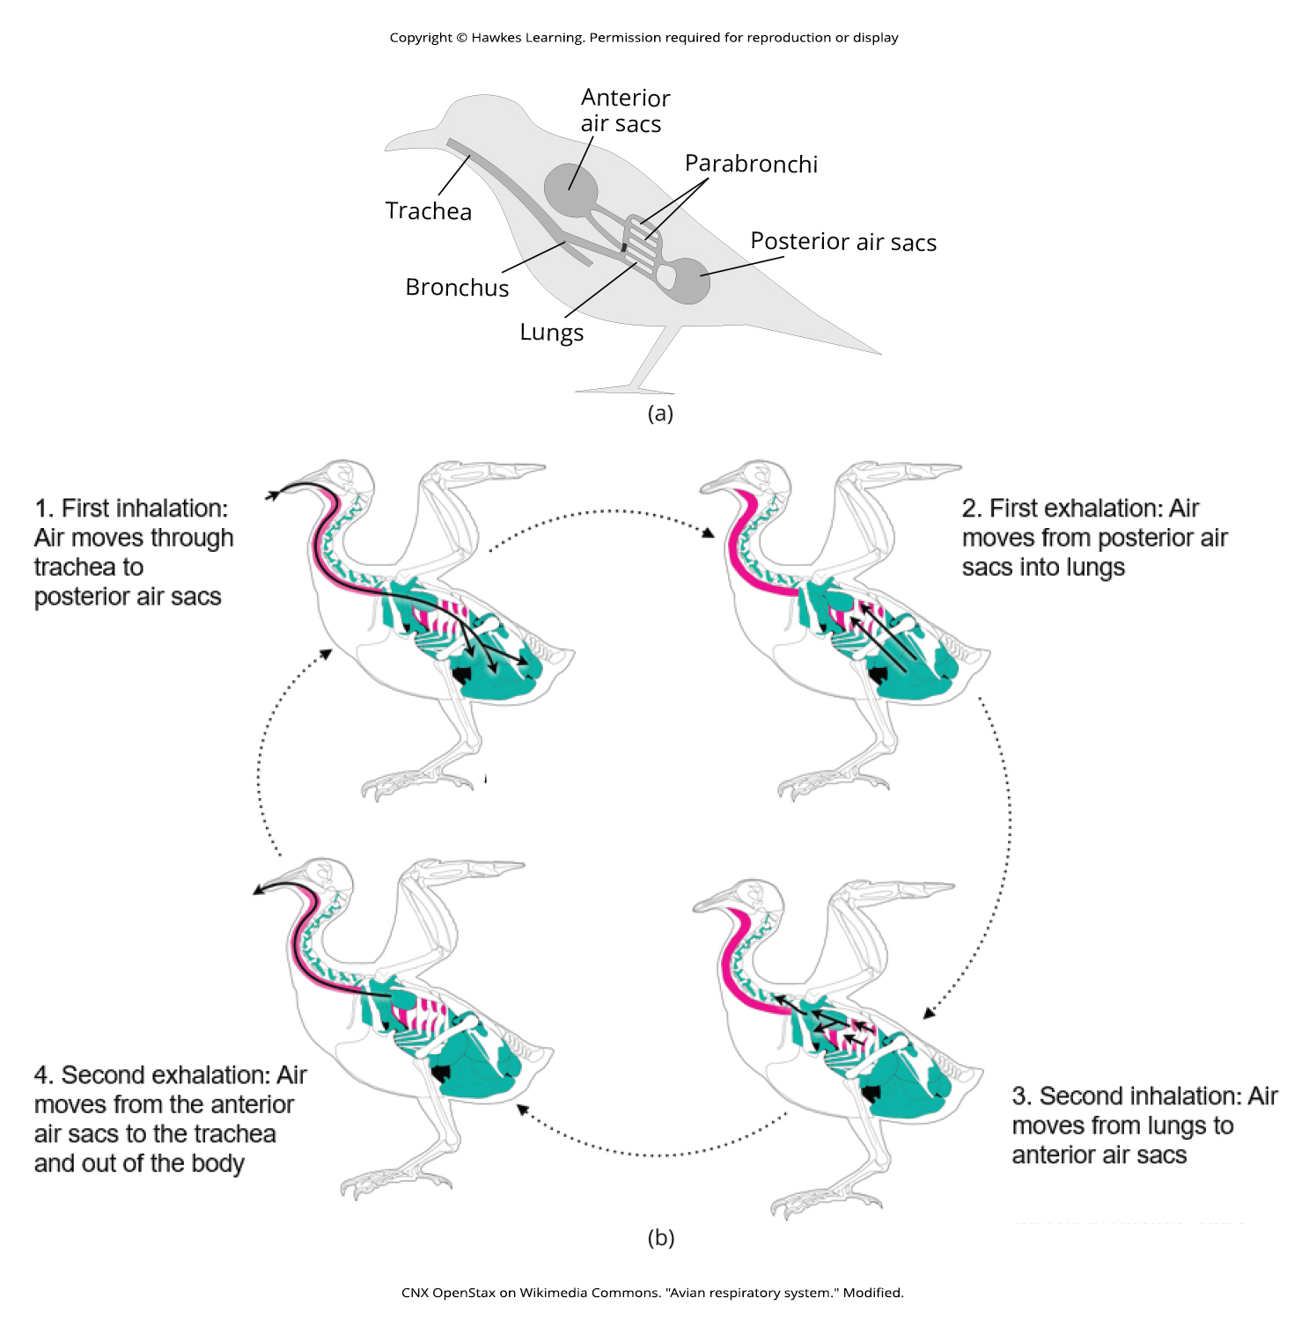
Lesson 29.4 Figure 16

Slide 48
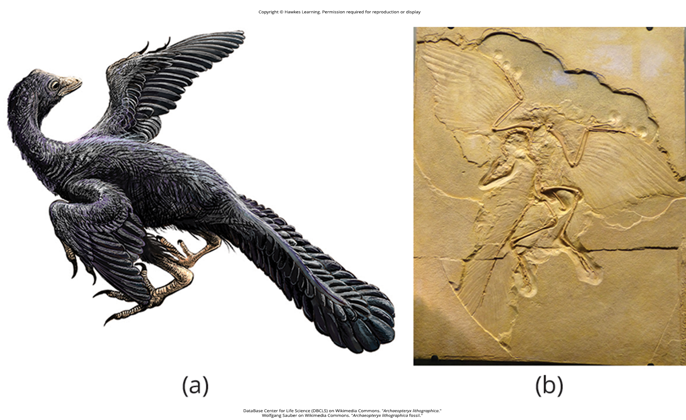
Lesson 29.4 Figure 17

Slide 49
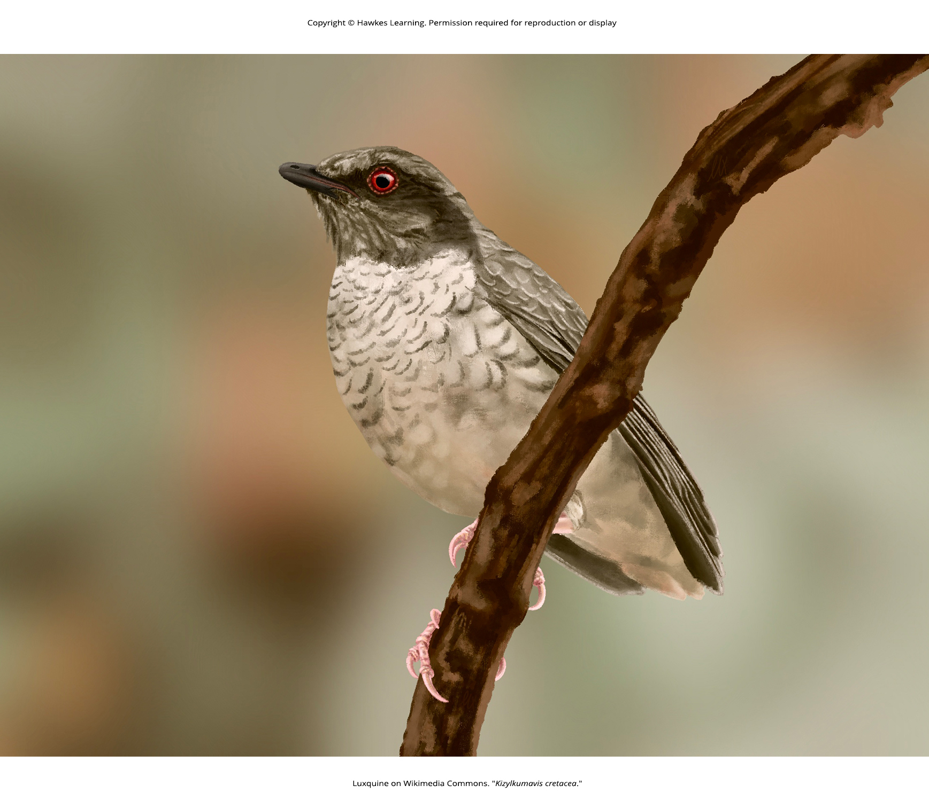
Lesson 29.4 Figure 18

Slide 50
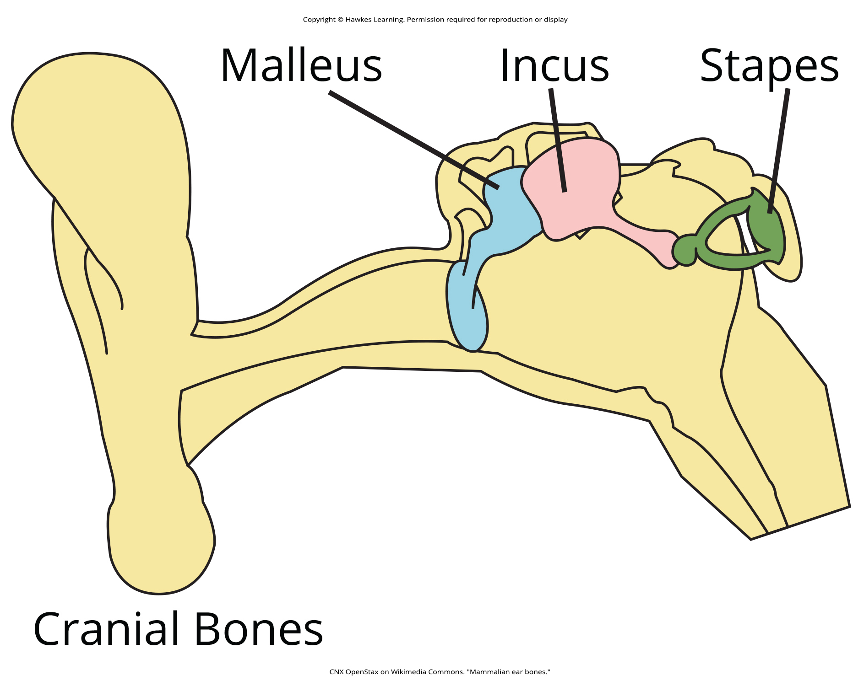
Lesson 29.5 Figure 1

Slide 51
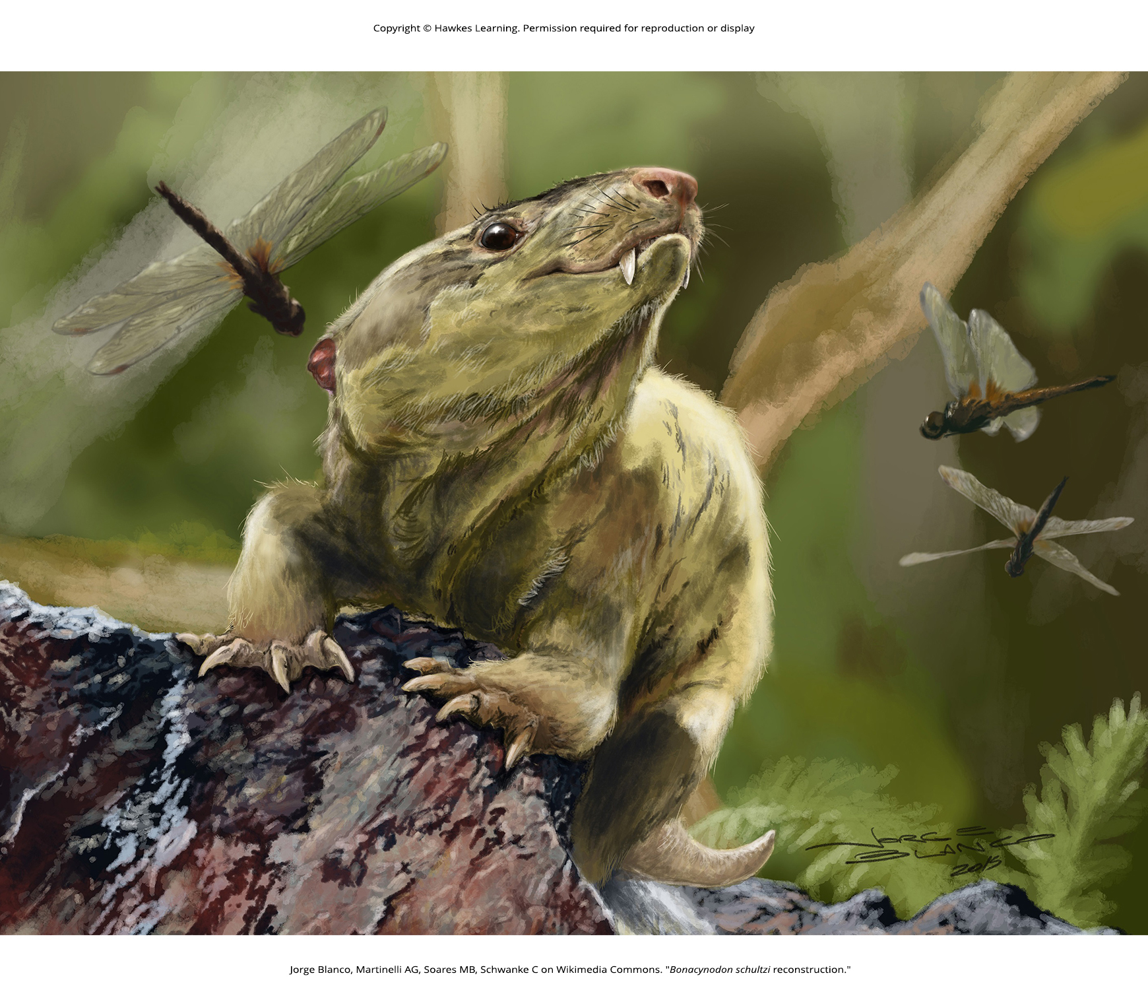
Lesson 29.5 Figure 2

Slide 52

Lesson 29.5 Figure 3

Slide 53

Lesson 29.5 Figure 4

Slide 54

Lesson 29.5 Figure 5

Slide 55

Lesson 29.5 Figure 6

Slide 56

Lesson 29.6 Figure 1

Slide 57

Lesson 29.6 Figure 2

Slide 58

Lesson 29.6 Figure 3

Slide 59

Lesson 29.6 Figure 4

Slide 60

Lesson 29.6 Figure 5

Slide 61

Lesson 29.6 Figure 6

Slide 62

Lesson 29.6 Figure 7

Slide 63

Lesson 29.6 Figure 8

Slide 64

Lesson 29.6 Figure 9

Slide 65

Lesson 29.6 Figure 10

Slide 66
Hawkes Learning – End of PowerPoint

