Slide 1
Chapter 30
Plant Physiology

Slide 2
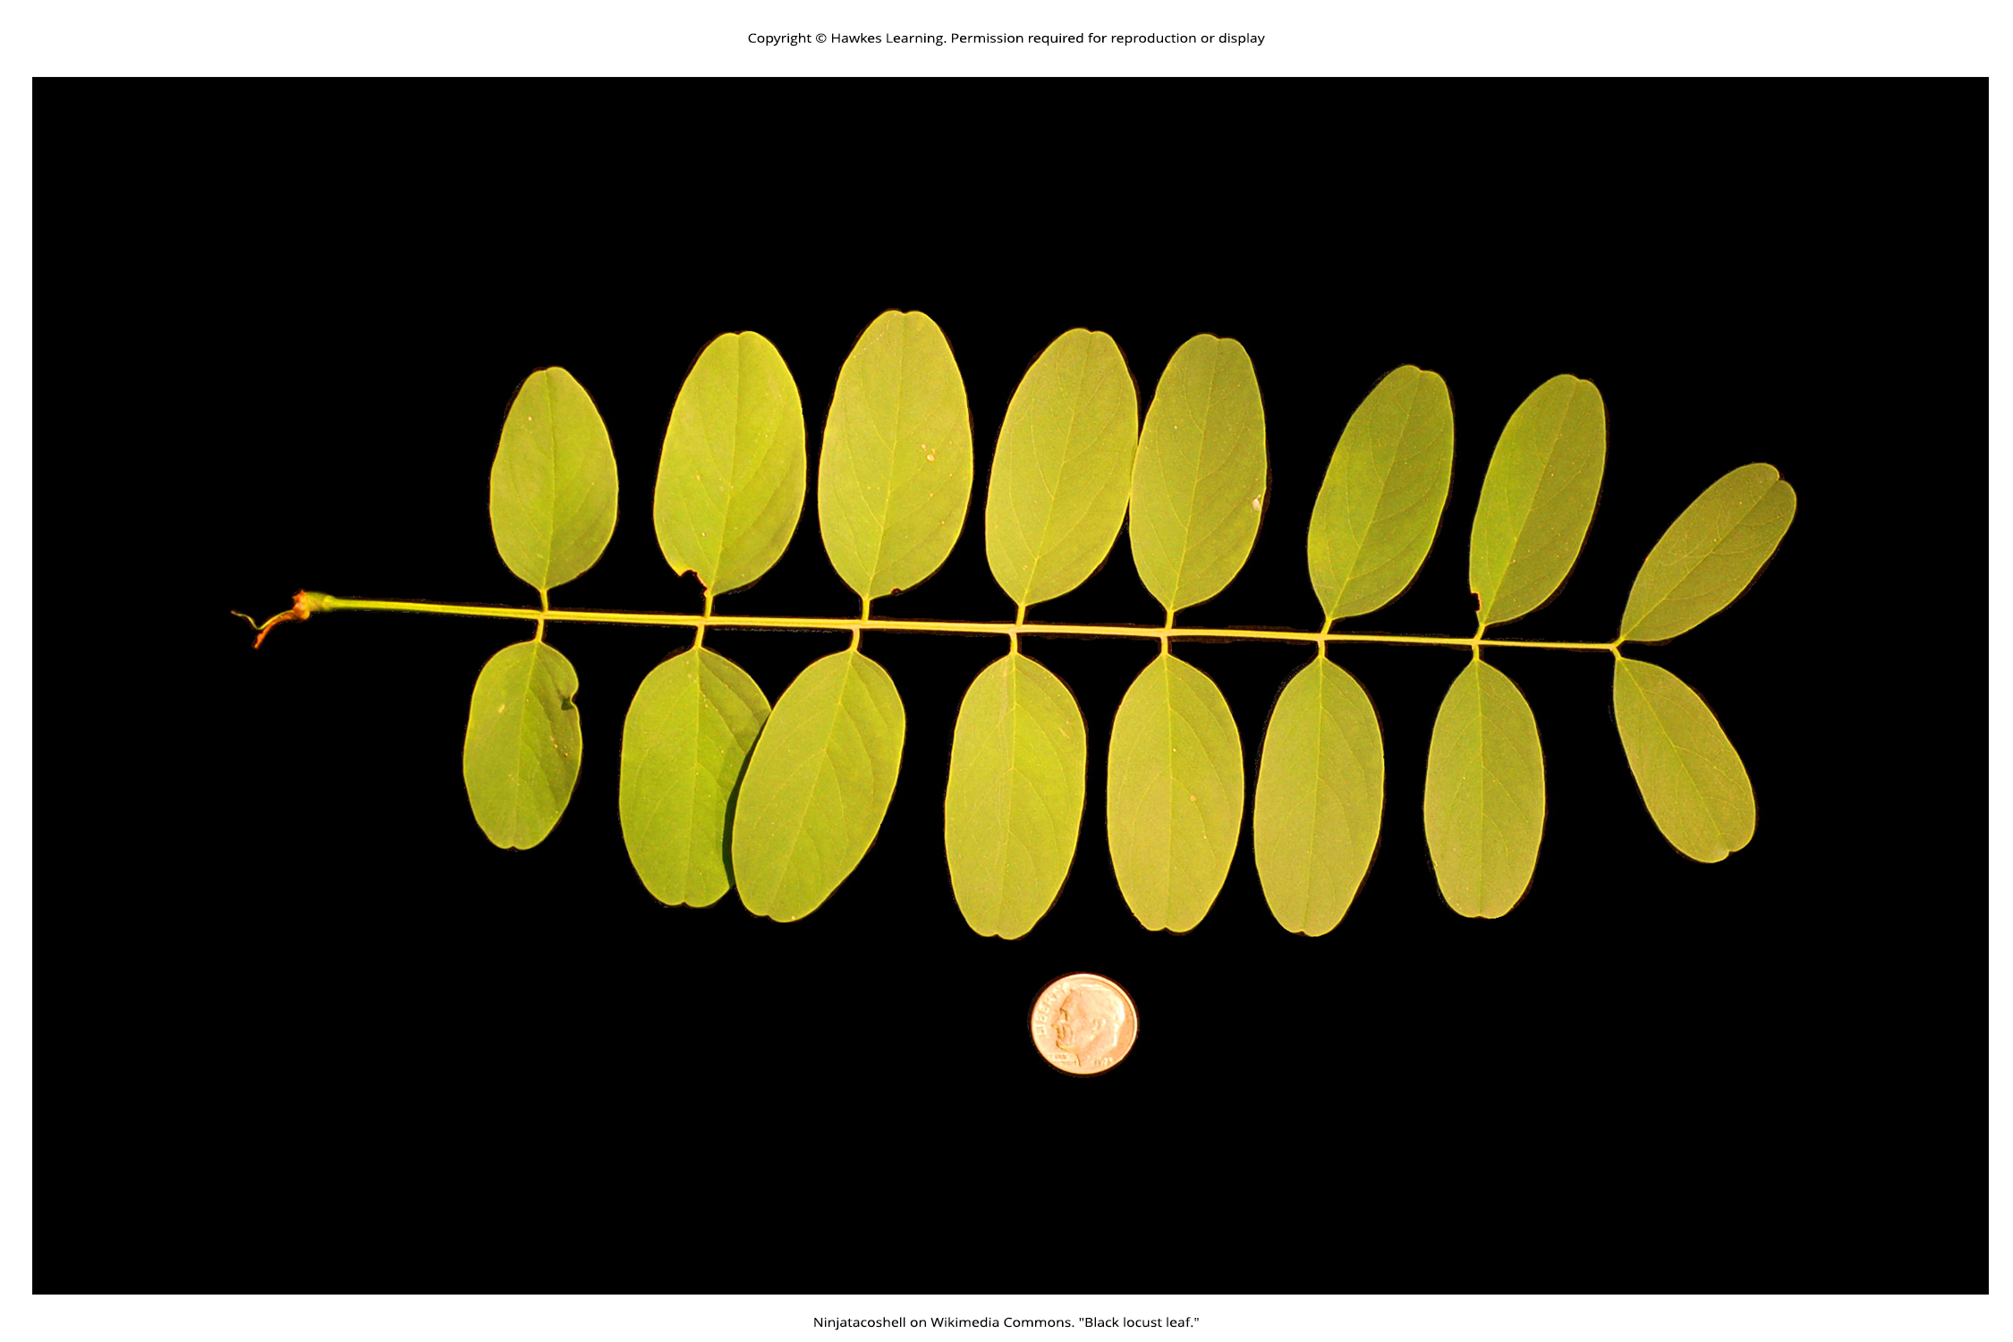
Lesson 30.1 Figure 1

Slide 3
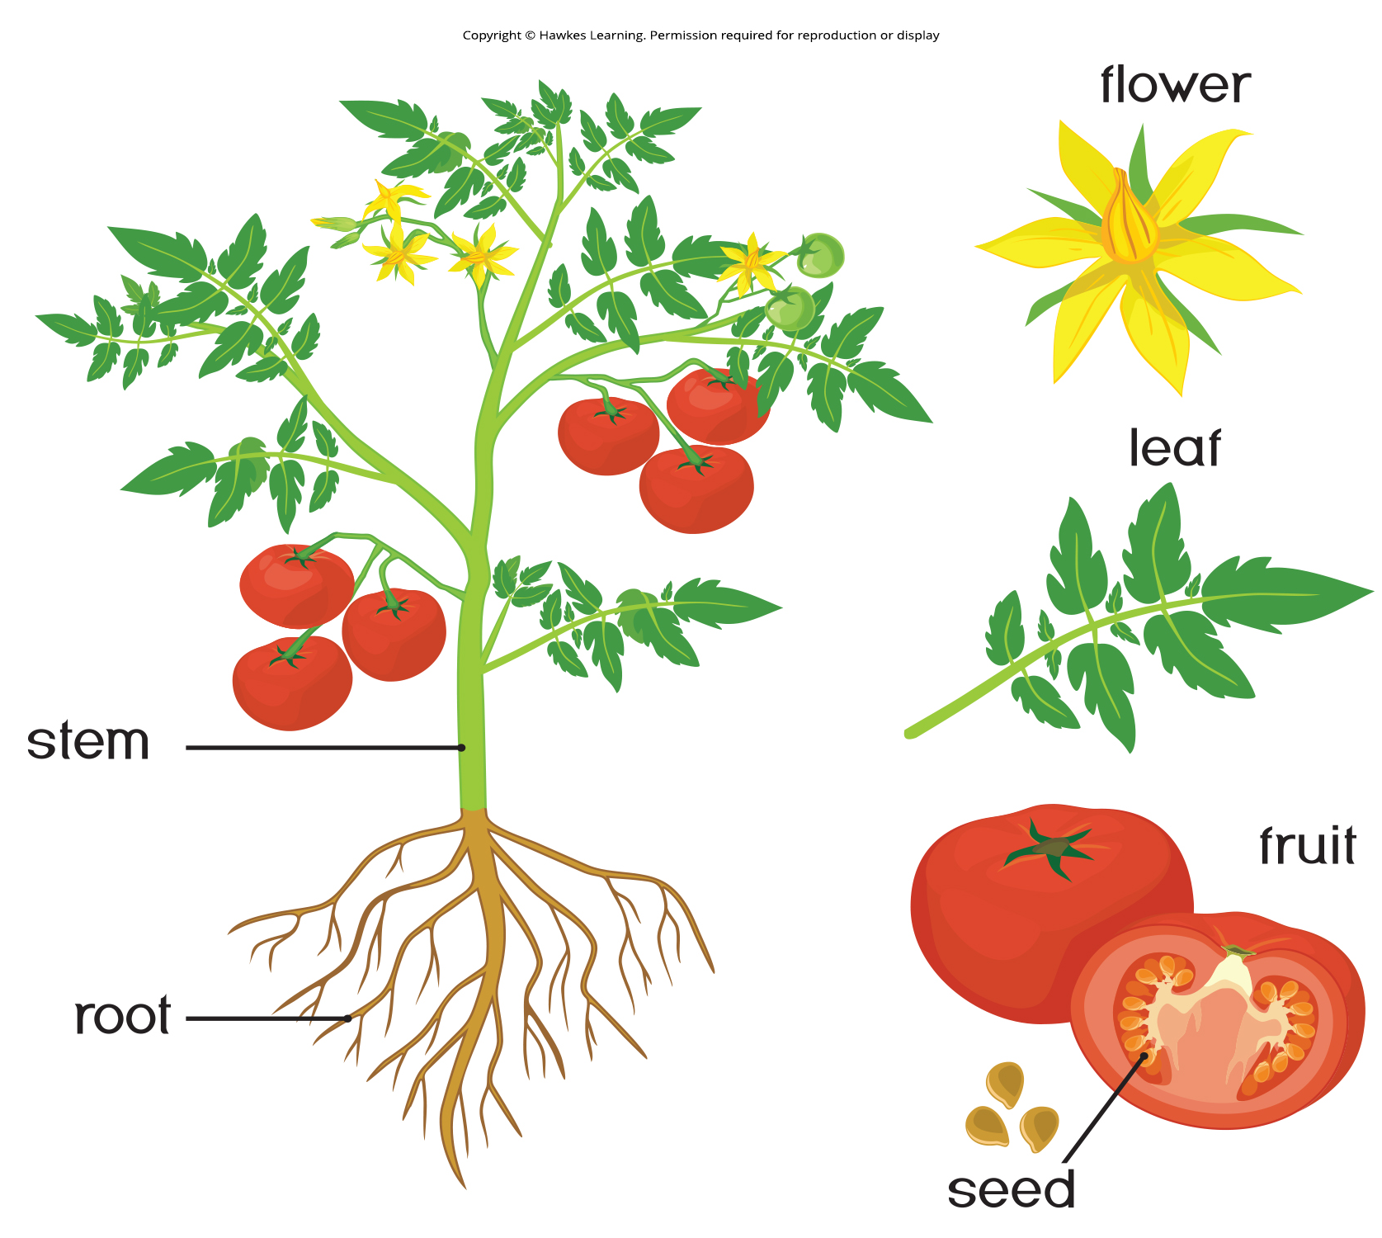
Lesson 30.1 Figure 2

Slide 4
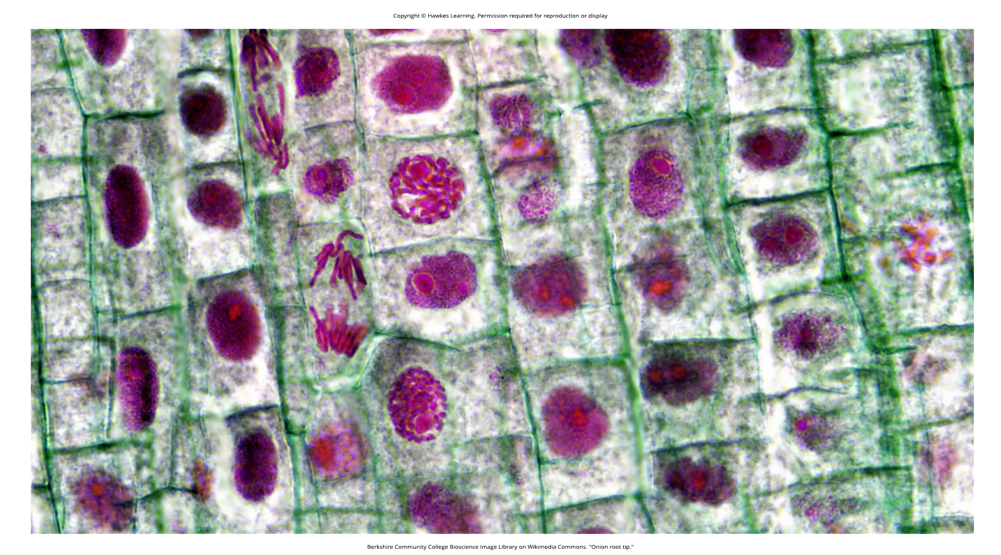
Lesson 30.1 Figure 3

Slide 5
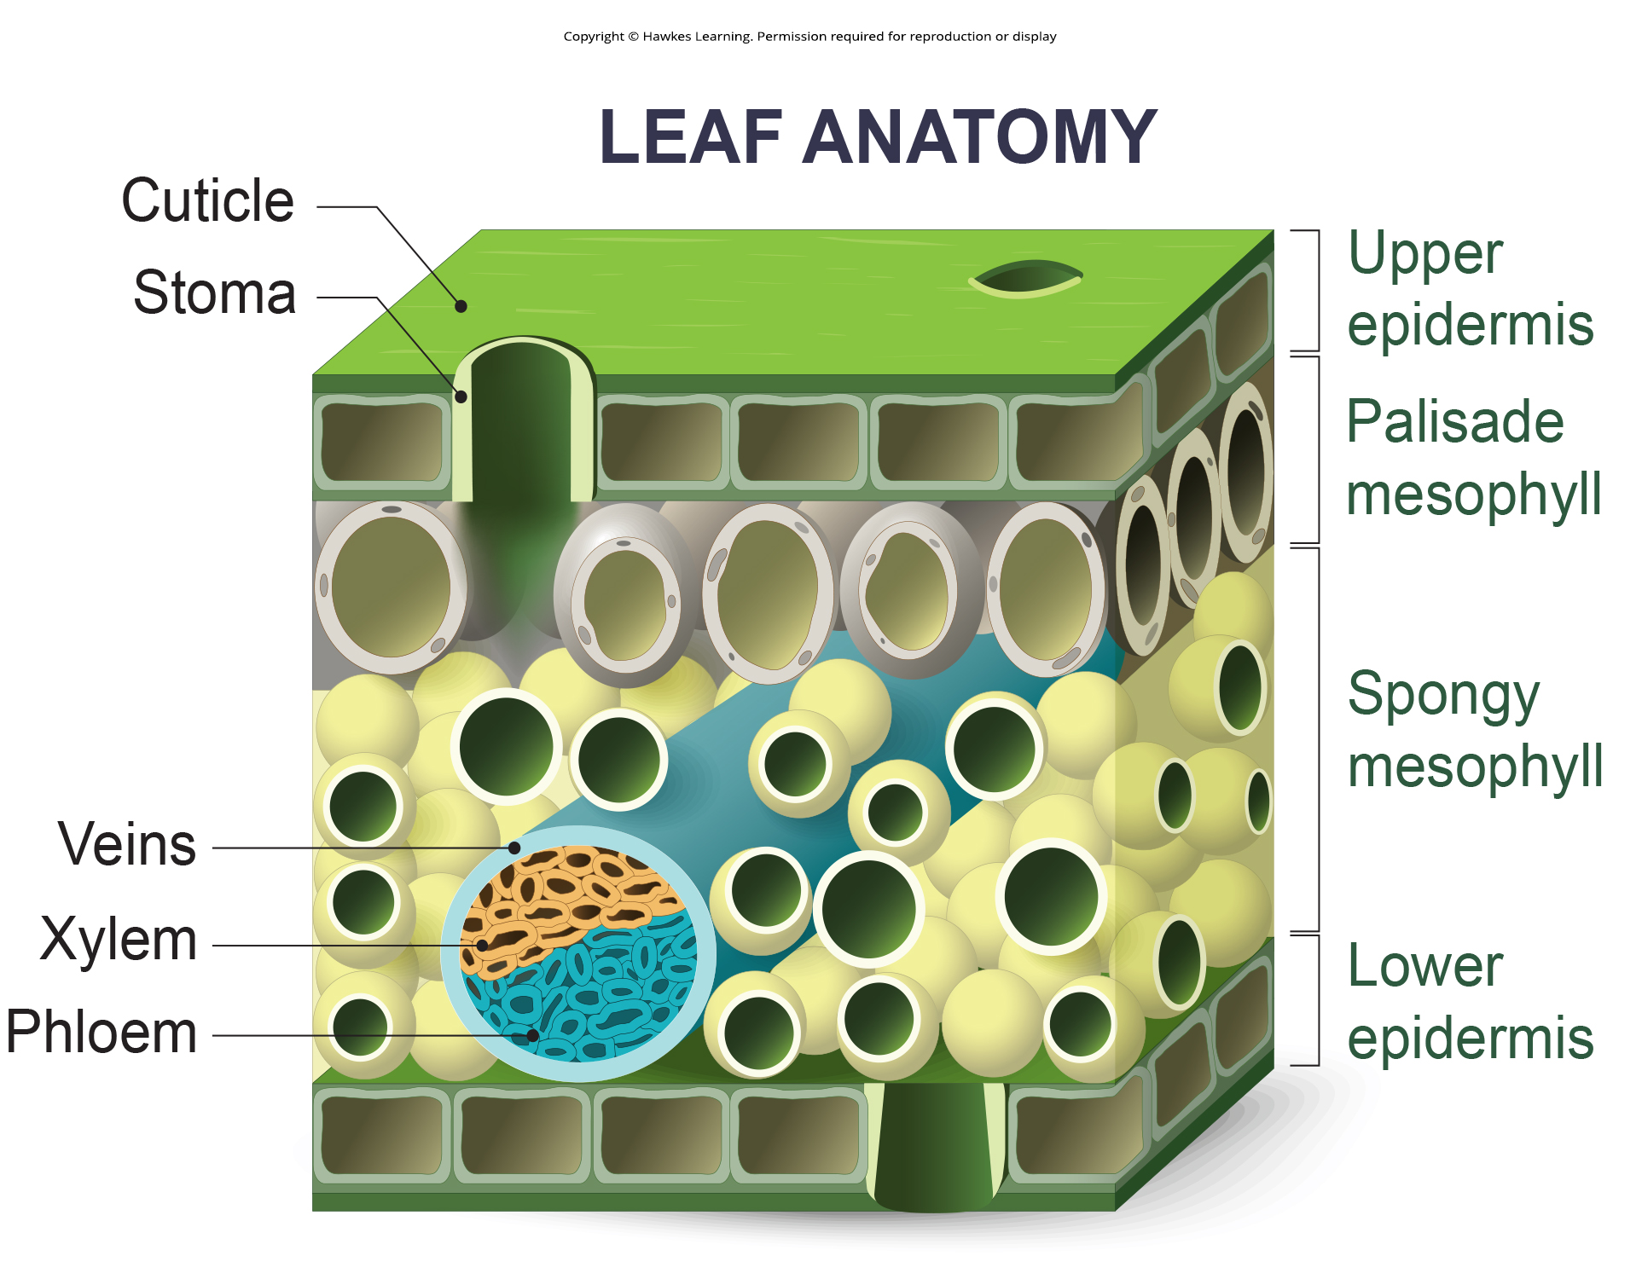
Lesson 30.1 Figure 4

Slide 6
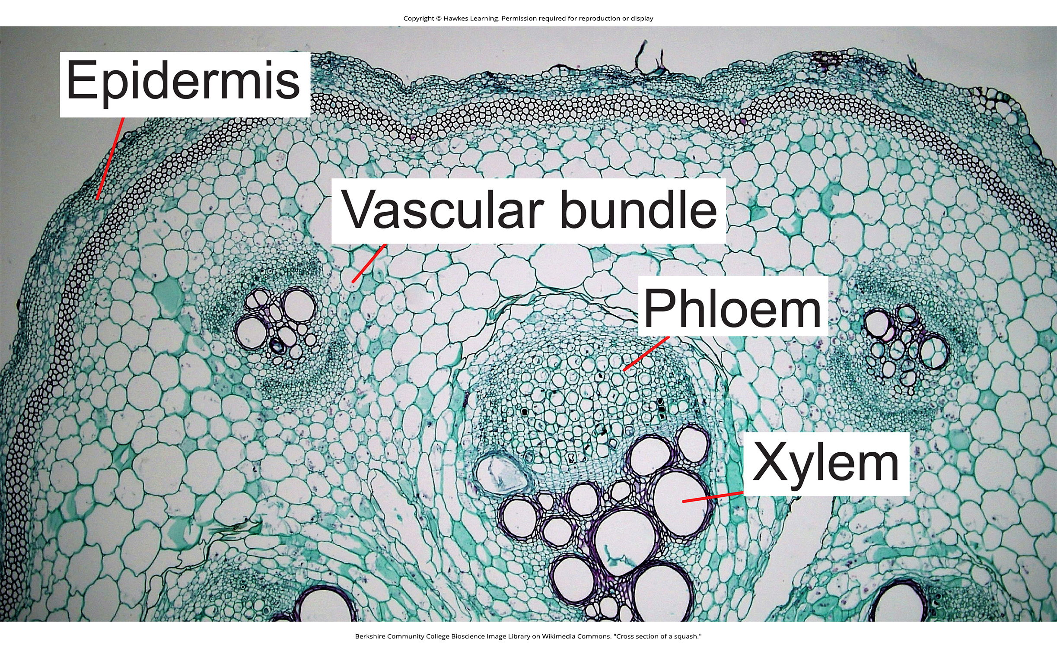
Lesson 30.1 Figure 5

Slide 7
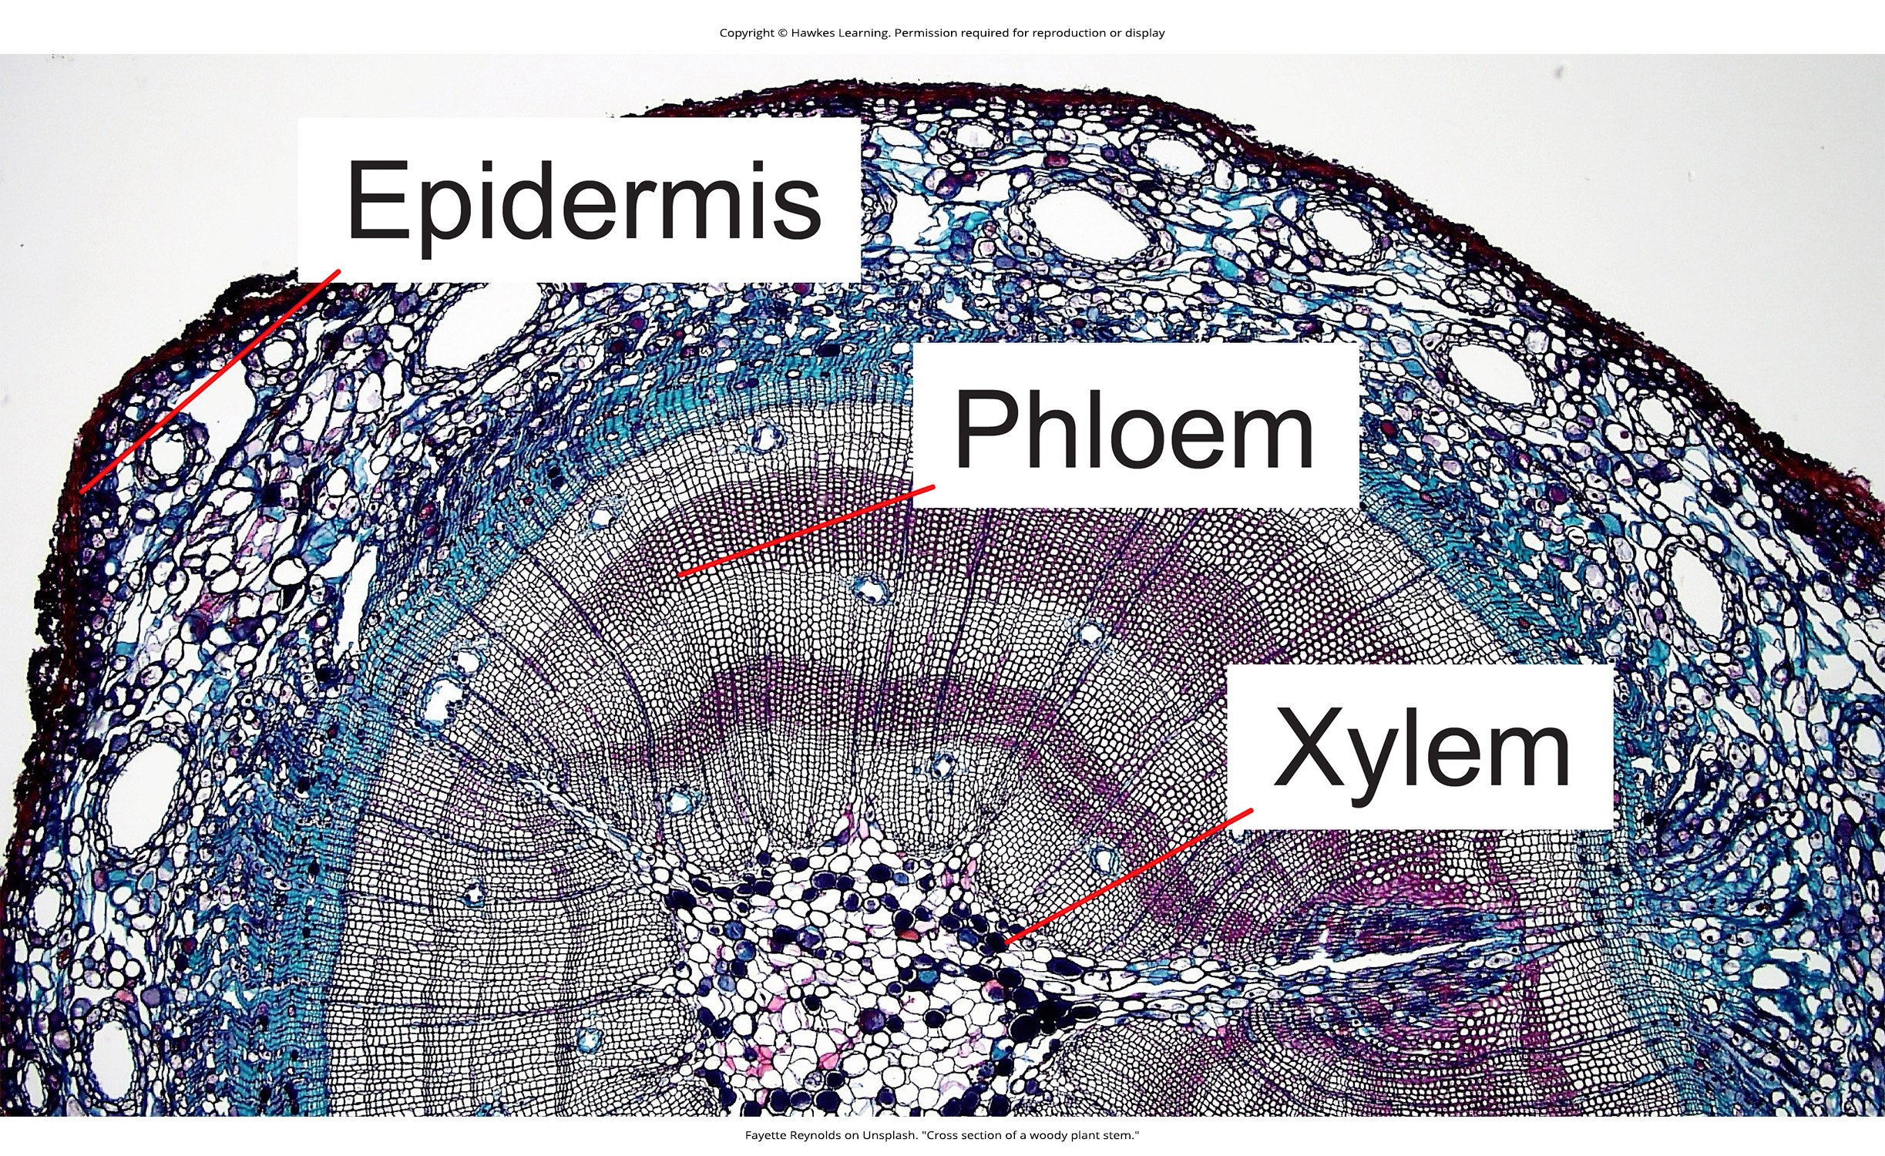
Lesson 30.1 Figure 6

Slide 8
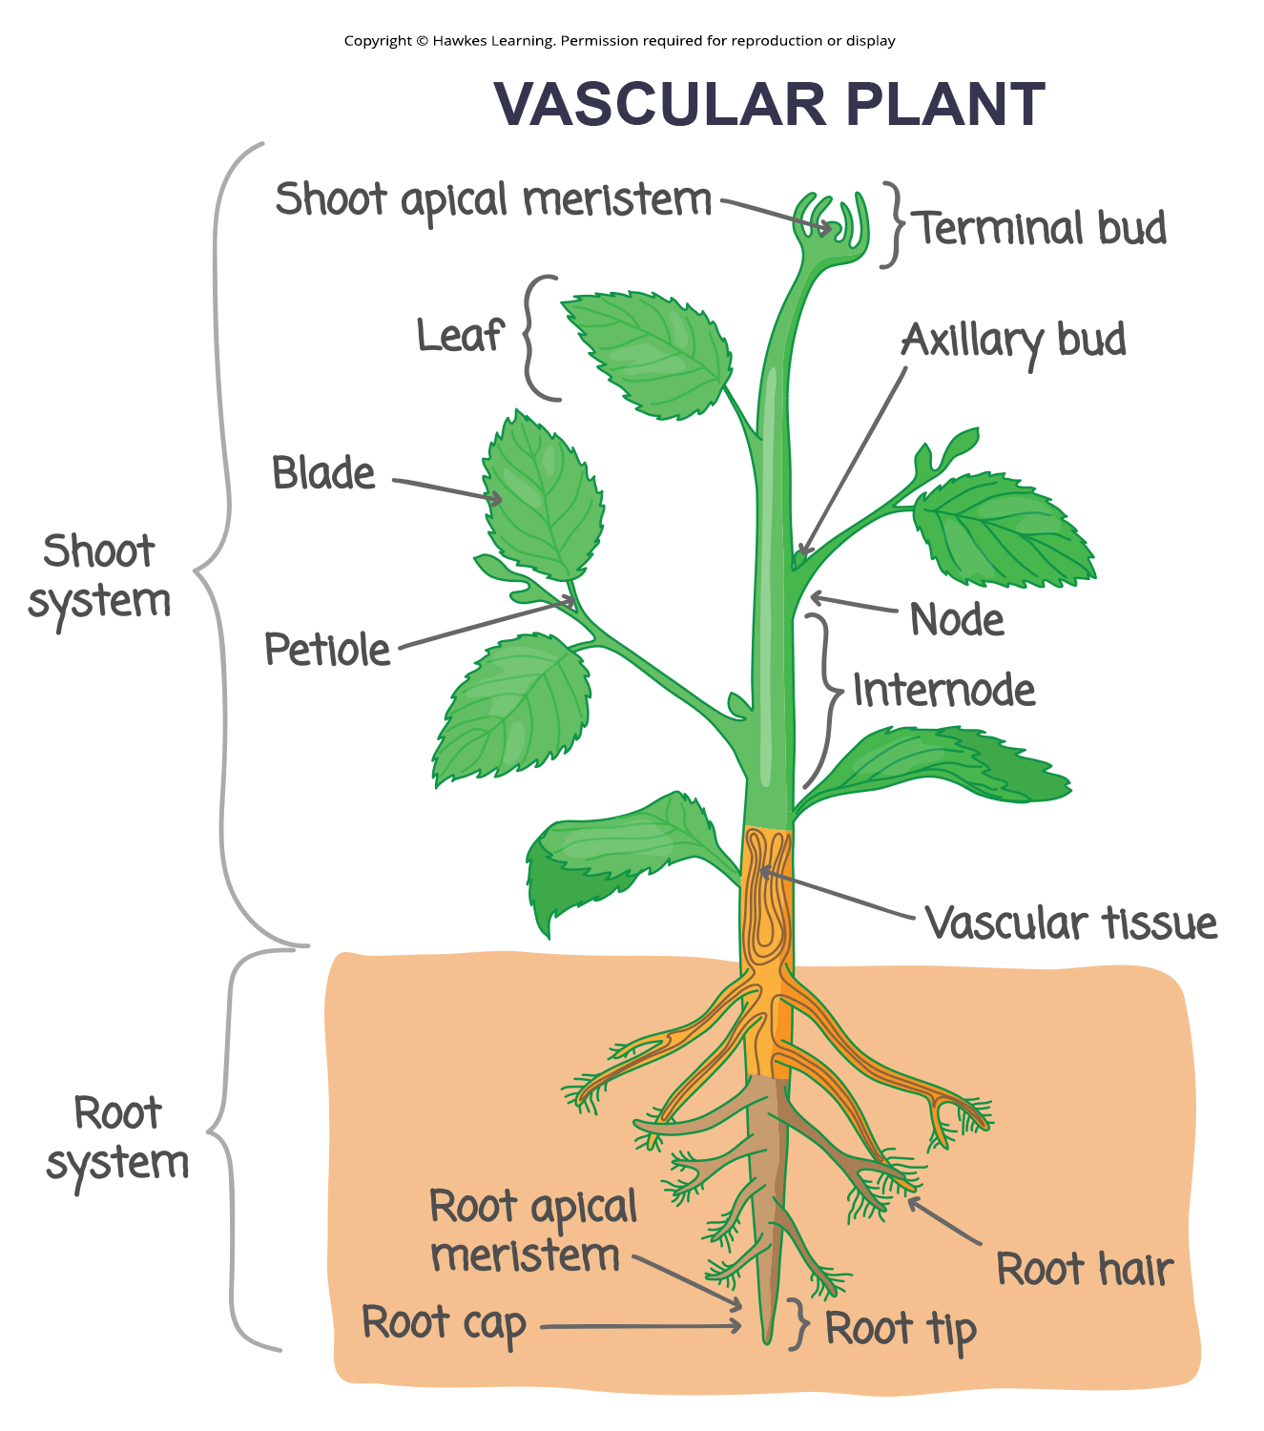
Lesson 30.2 Figure 1

Slide 9
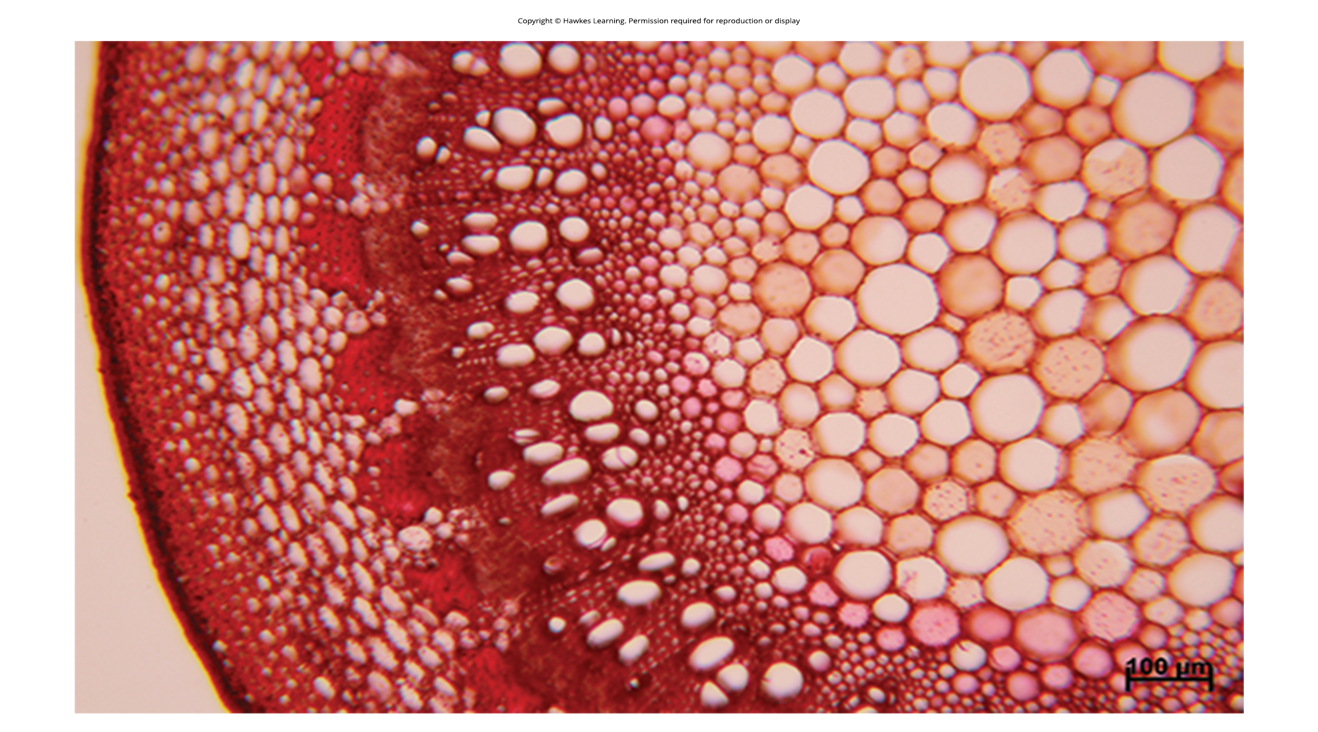
Lesson 30.2 Figure 2

Slide 10
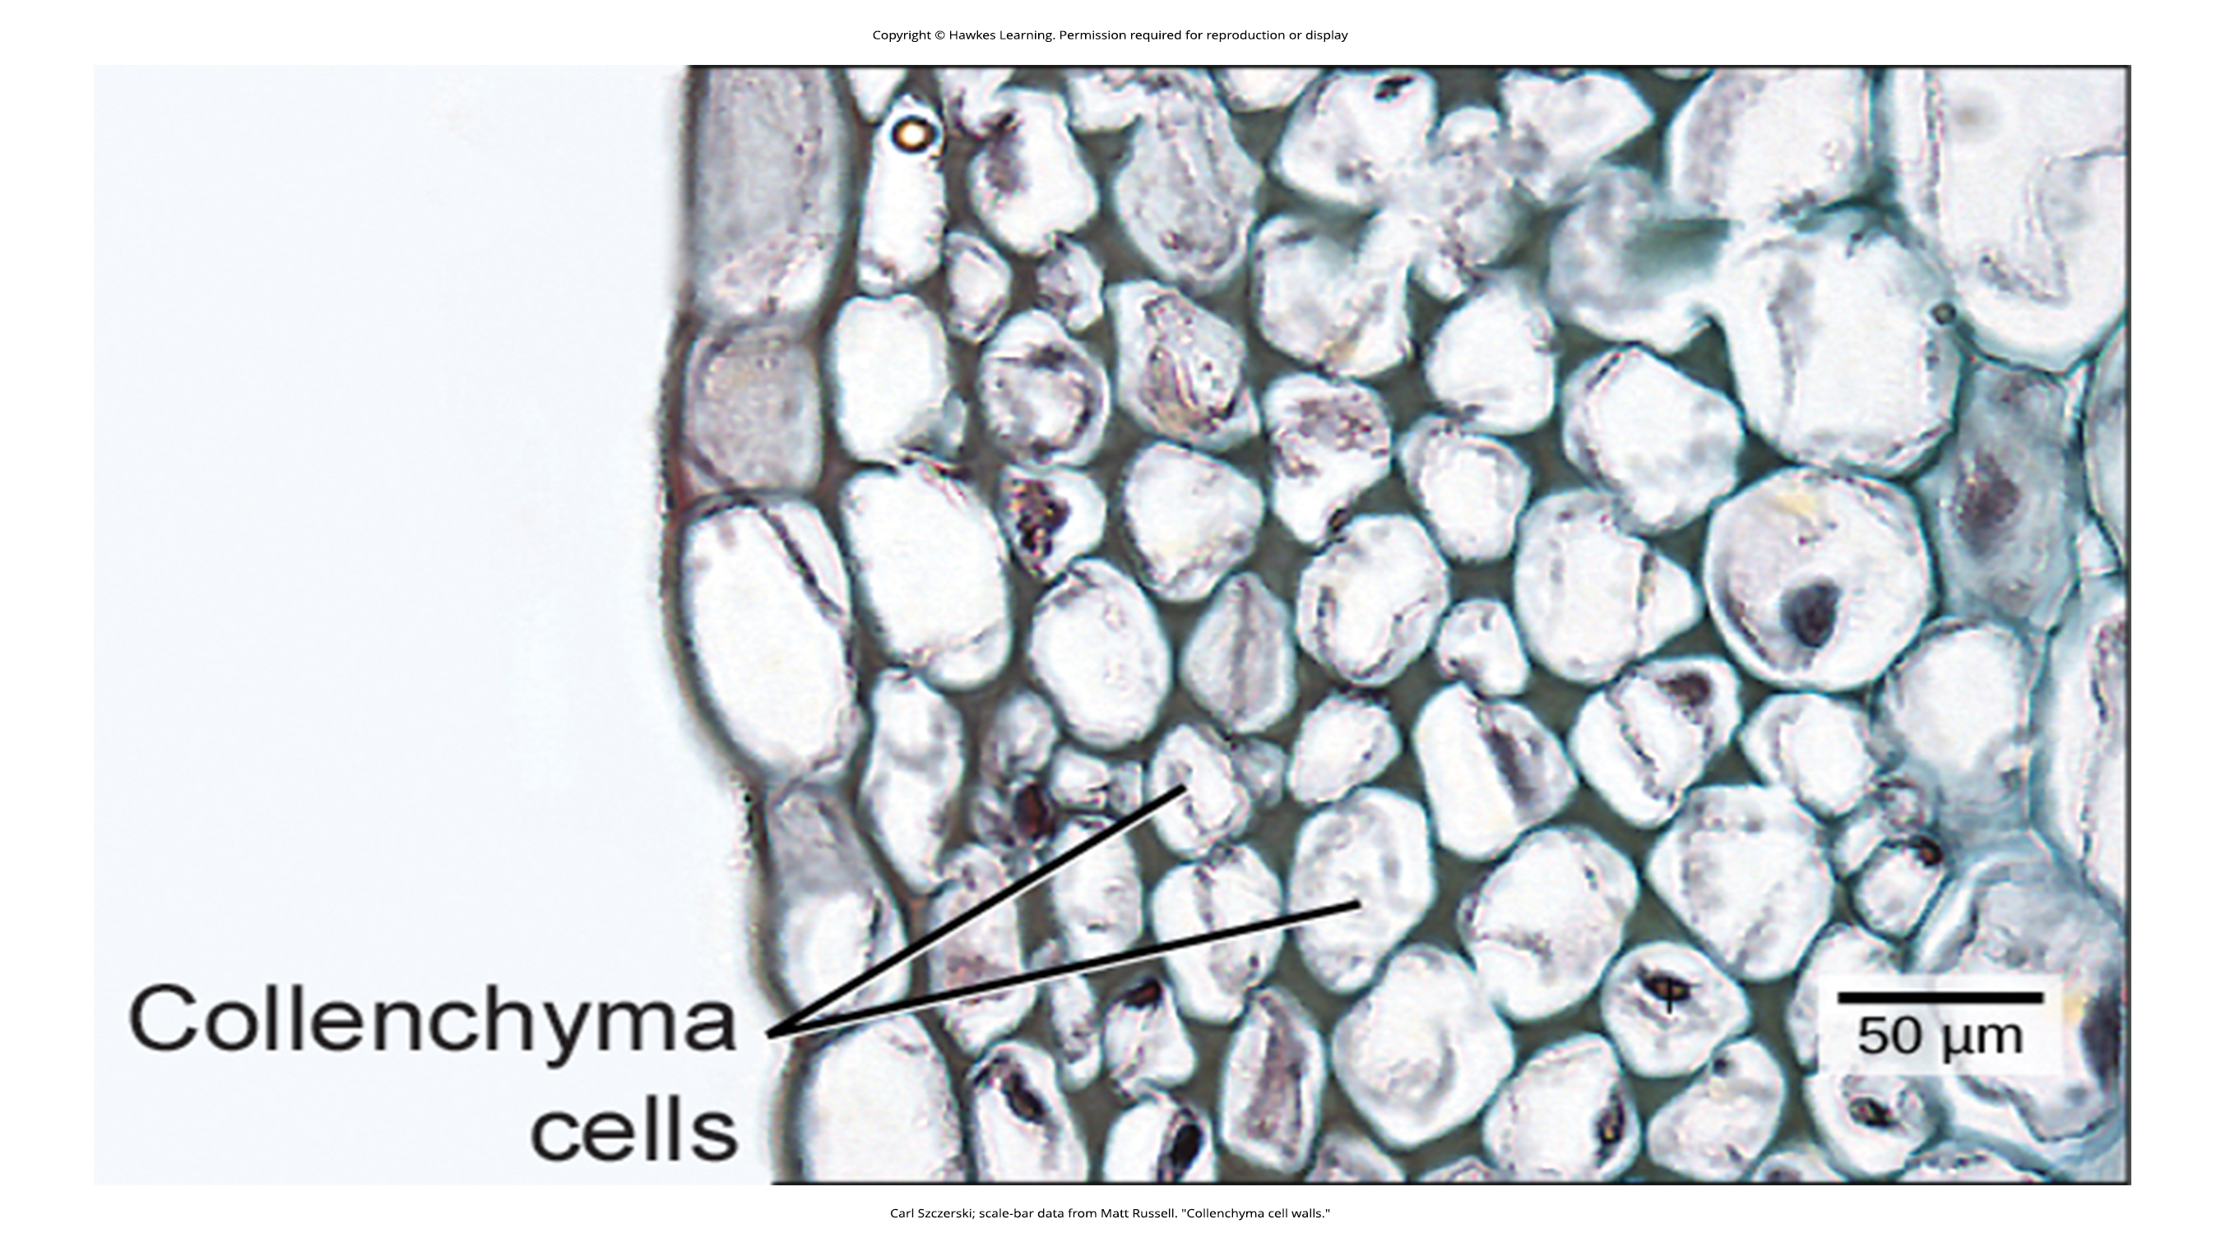
Lesson 30.2 Figure 3

Slide 11
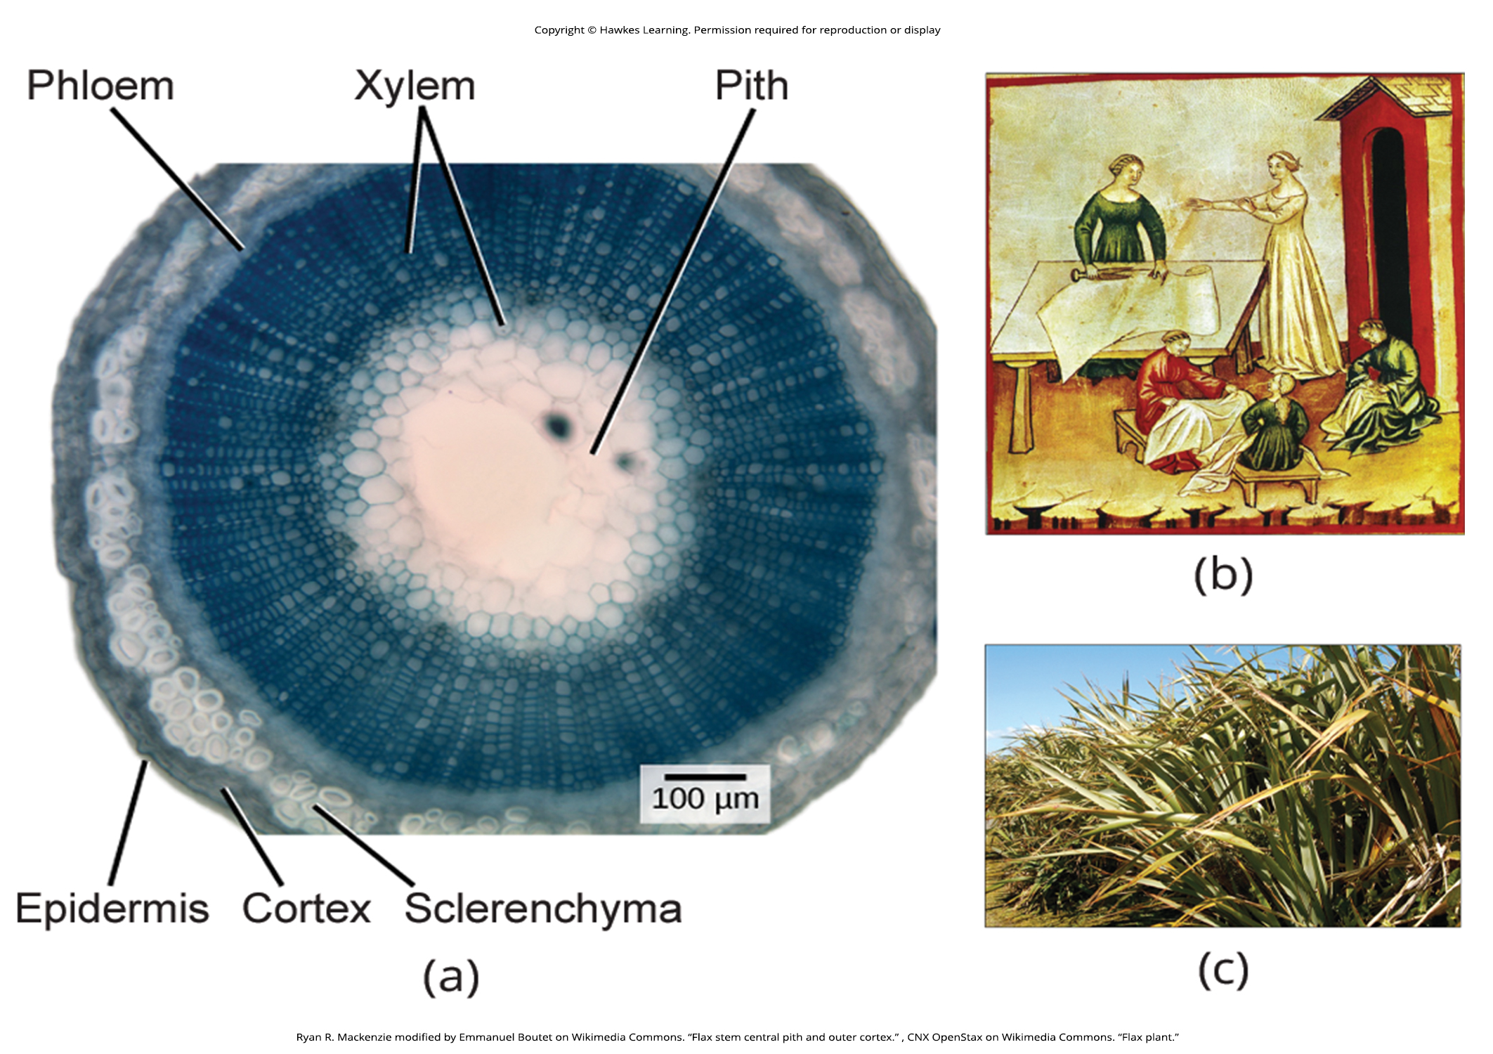
Lesson 30.2 Figure 4

Slide 12
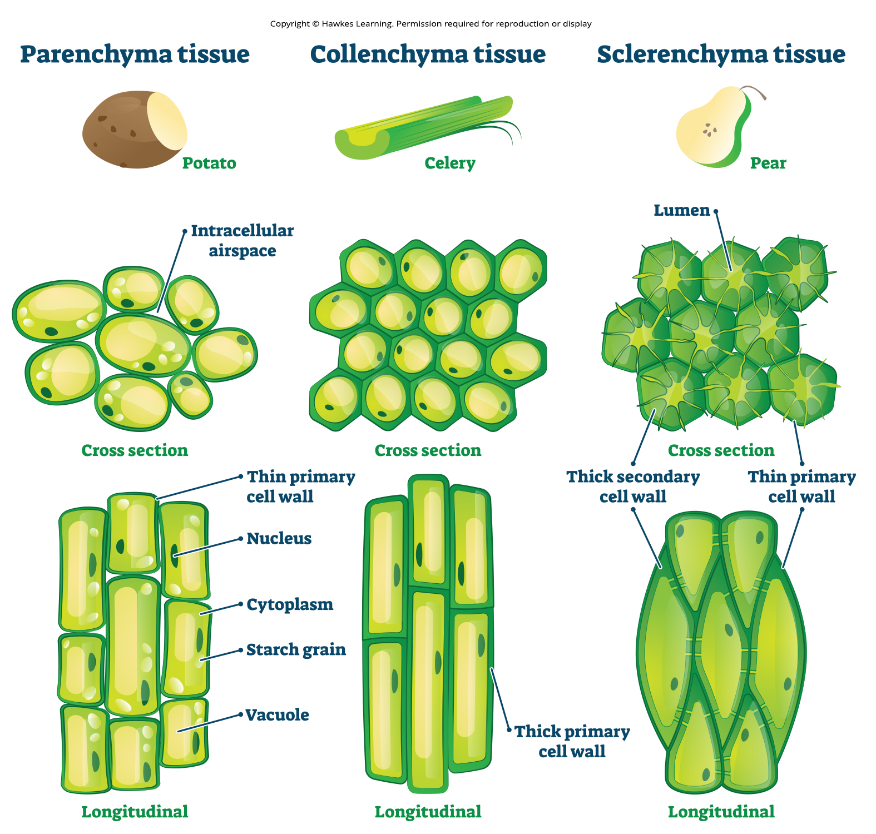
Lesson 30.2 Figure 5

Slide 13
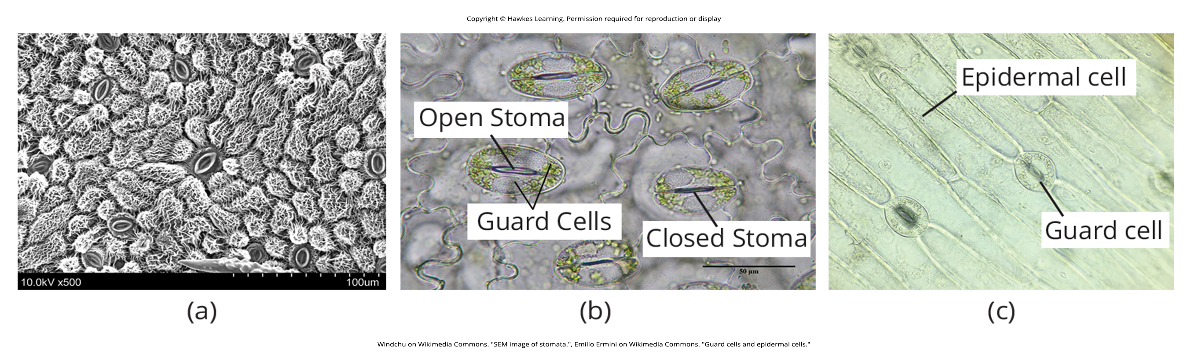
Lesson 30.2 Figure 6

Slide 14
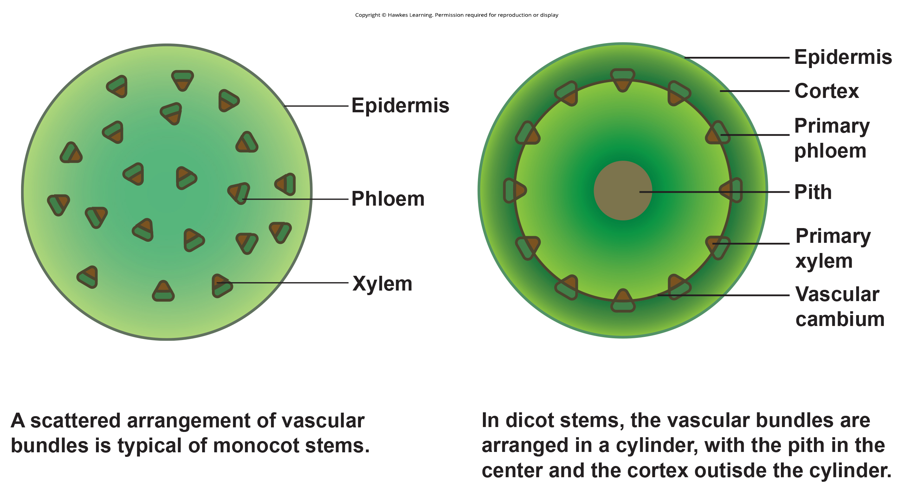
Lesson 30.2 Figure 7

Slide 15
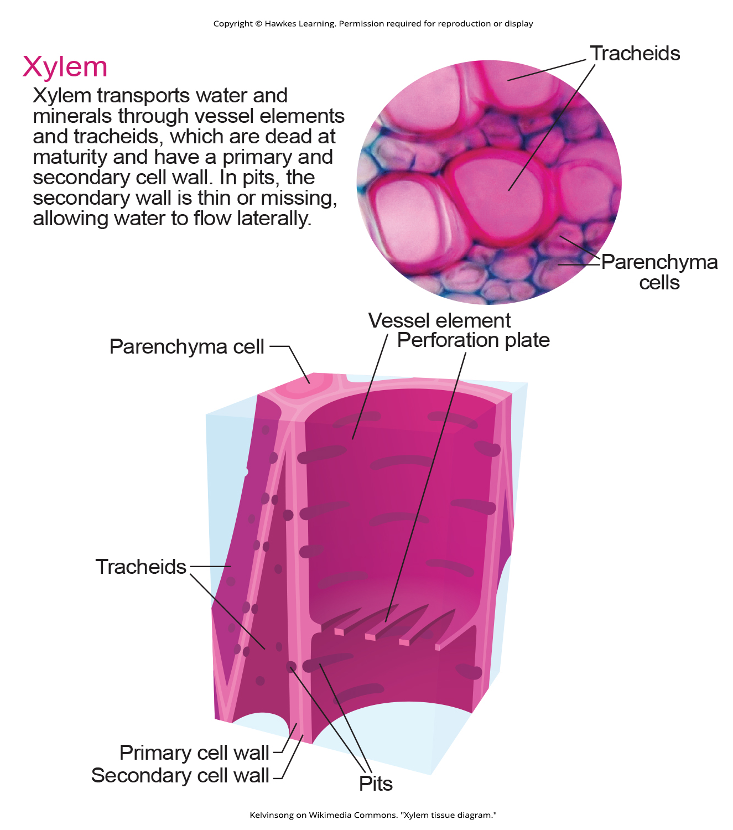
Lesson 30.2 Figure 8

Slide 16
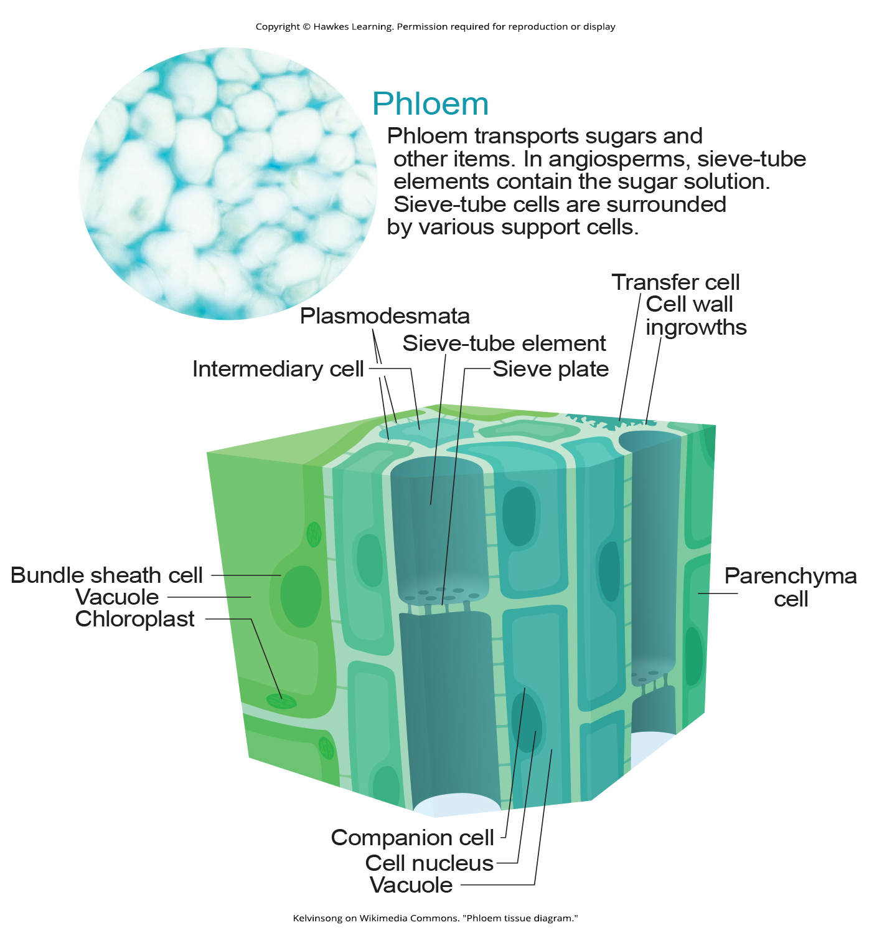
Lesson 30.2 Figure 9

Slide 17
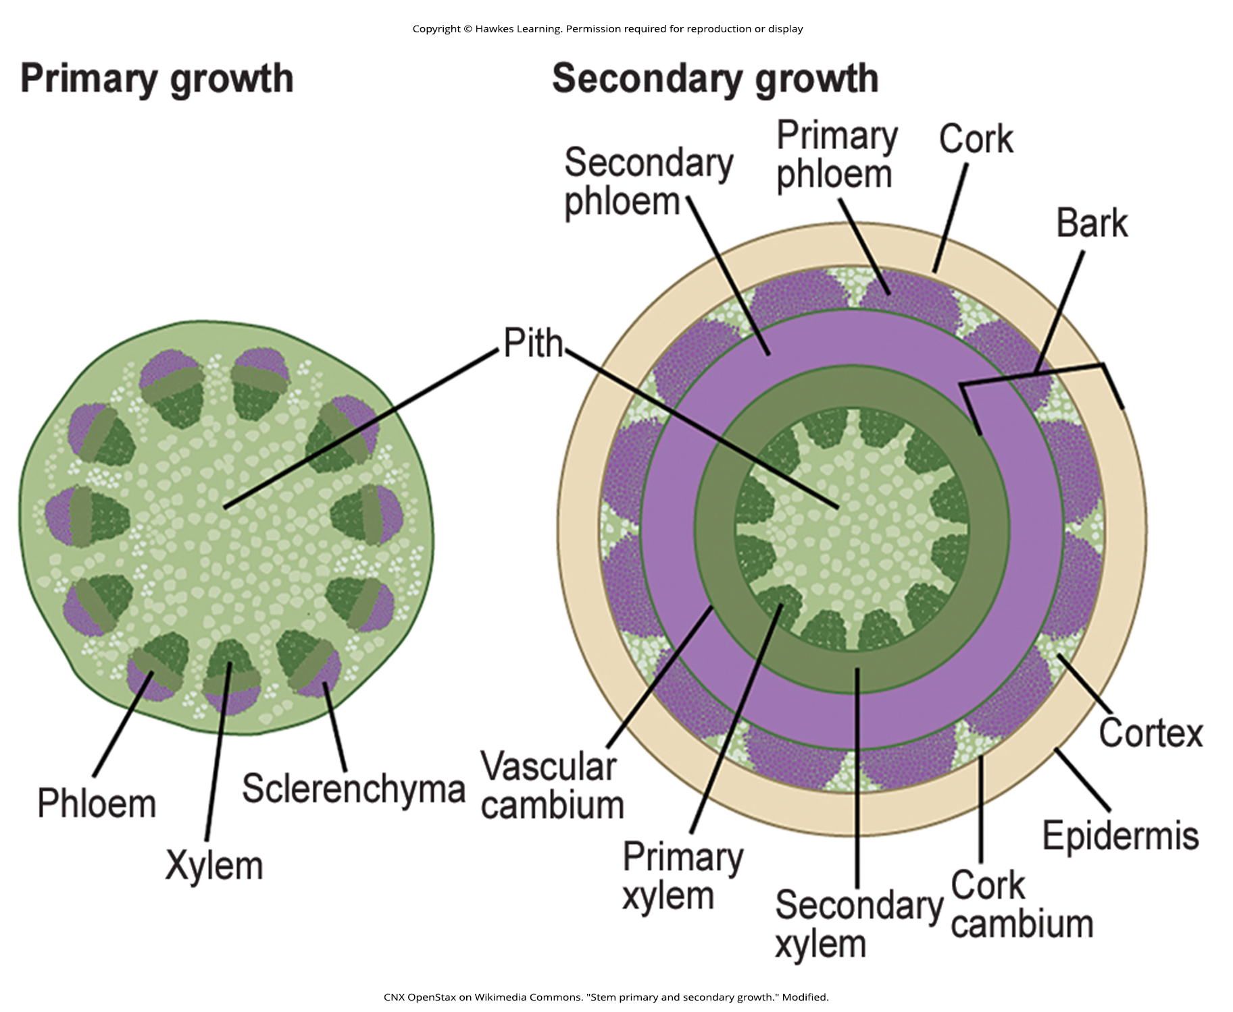
Lesson 30.2 Figure 10

Slide 18
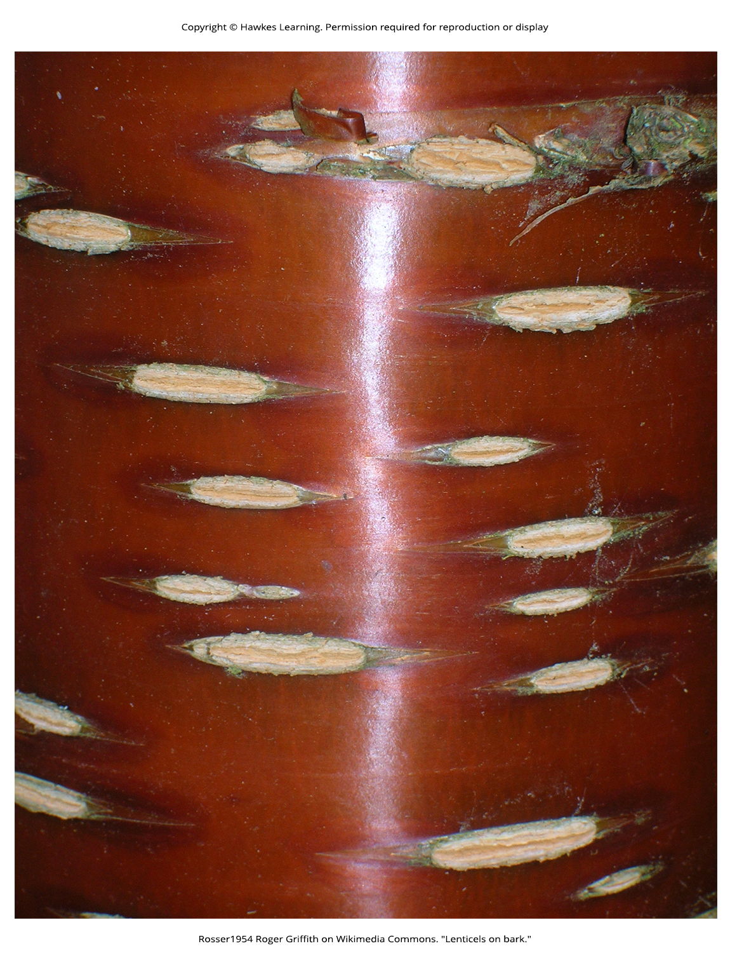
Lesson 30.2 Figure 11

Slide 19
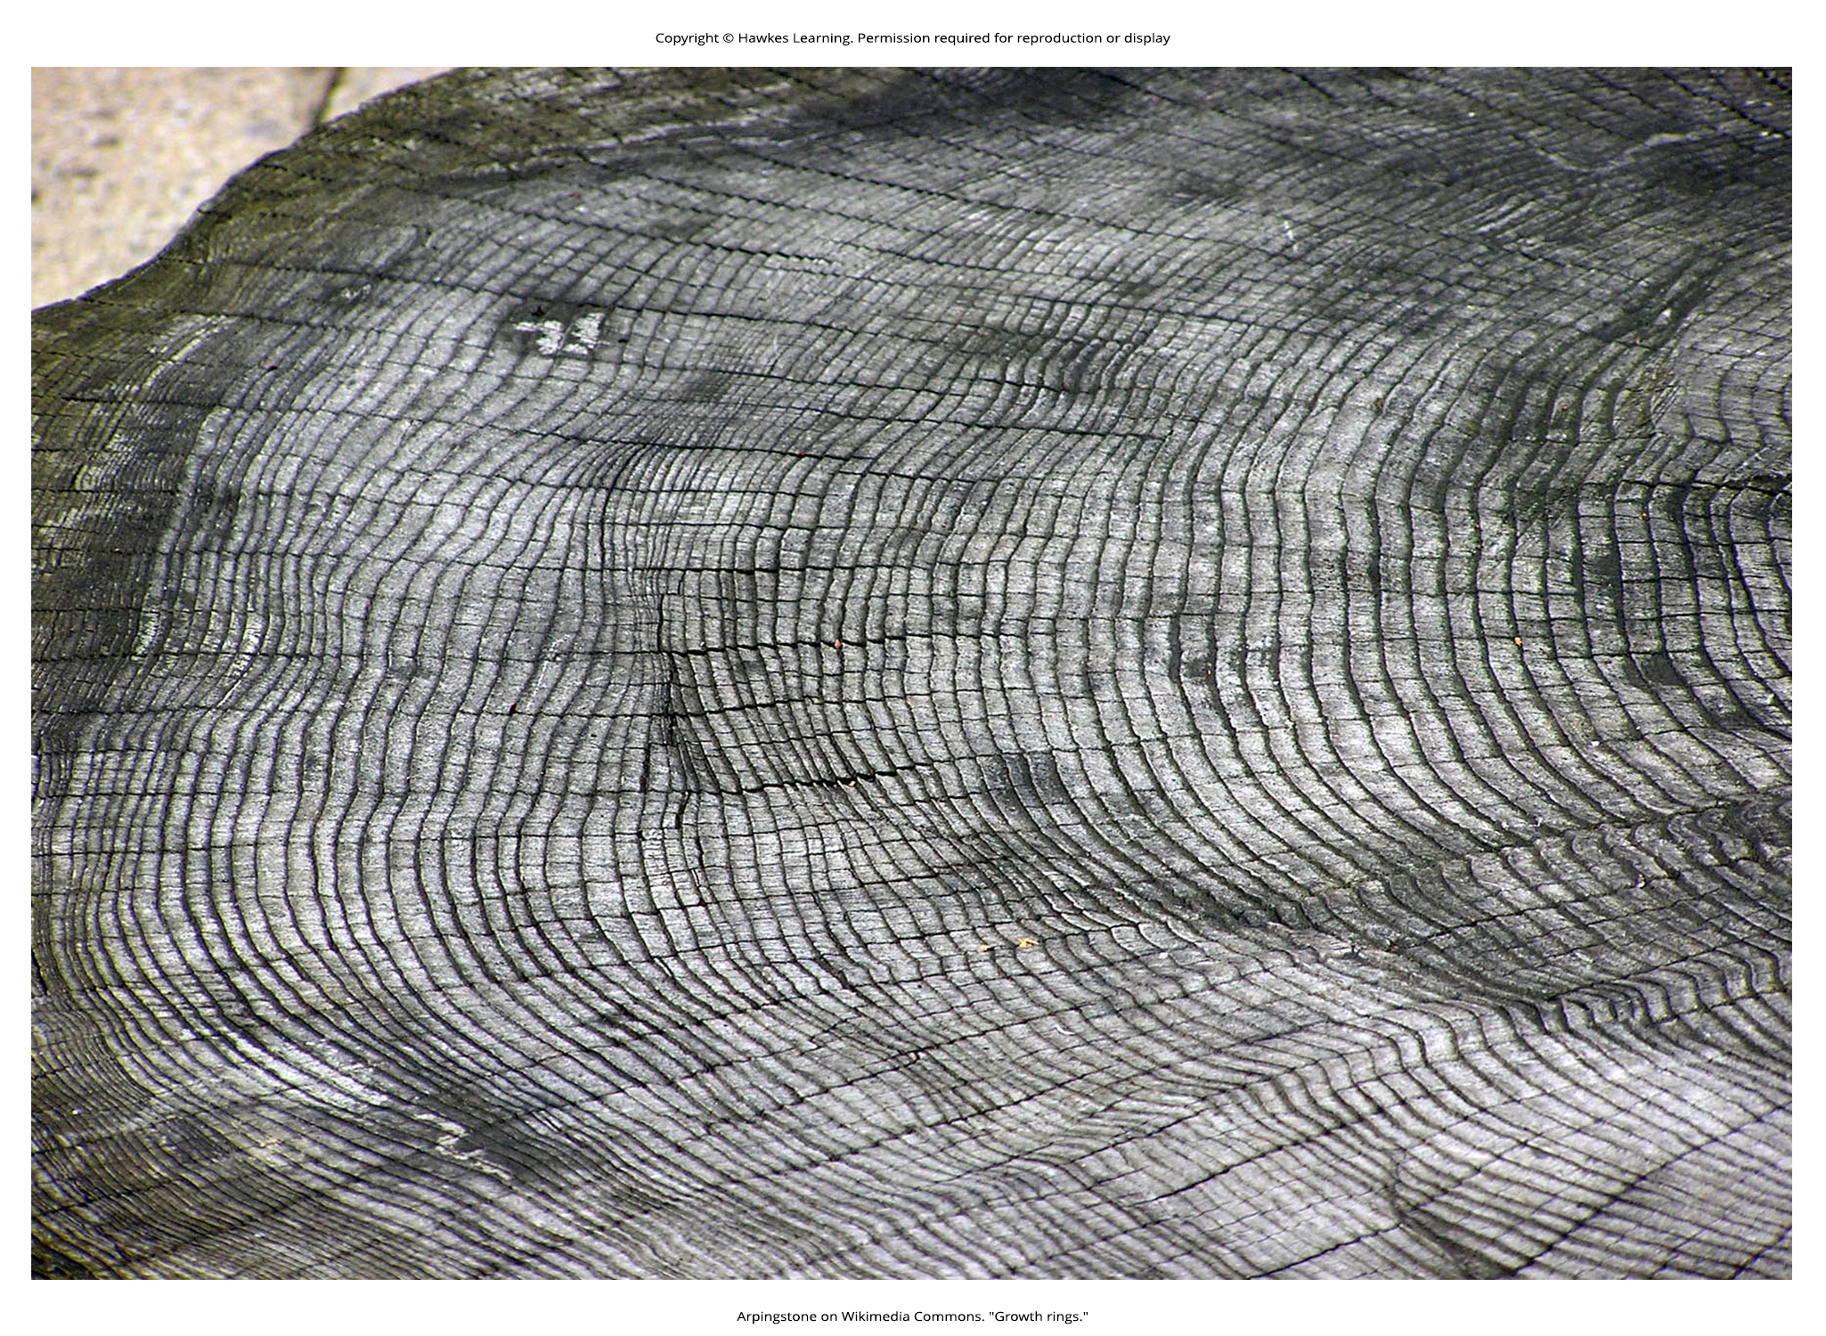
Lesson 30.2 Figure 12

Slide 20
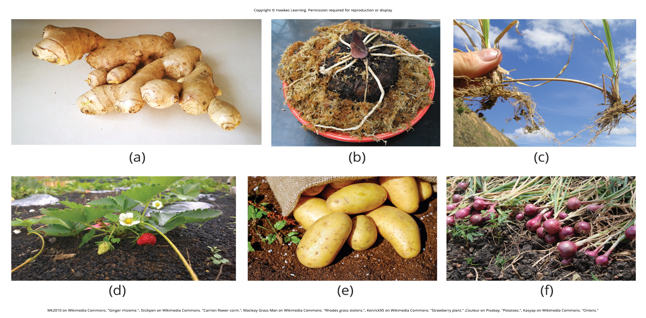
Lesson 30.2 Figure 13

Slide 21
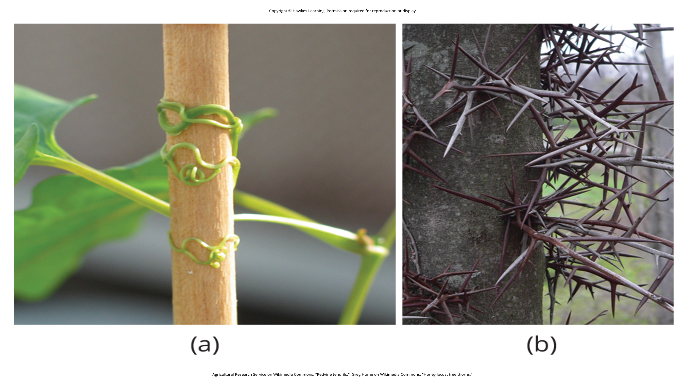
Lesson 30.2 Figure 14

Slide 22
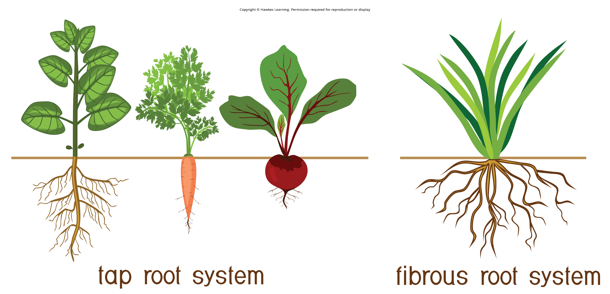
Lesson 30.3 Figure 1

Slide 23
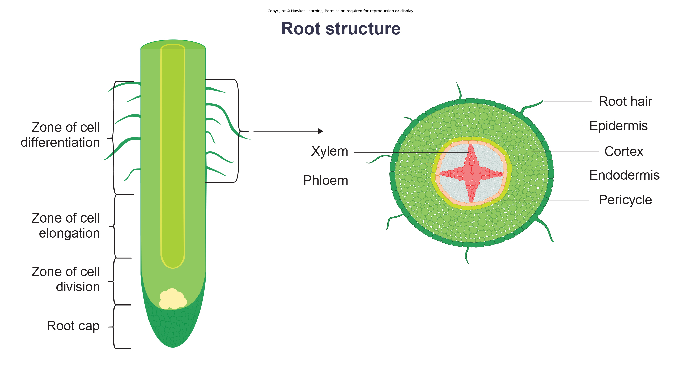
Lesson 30.3 Figure 2

Slide 24
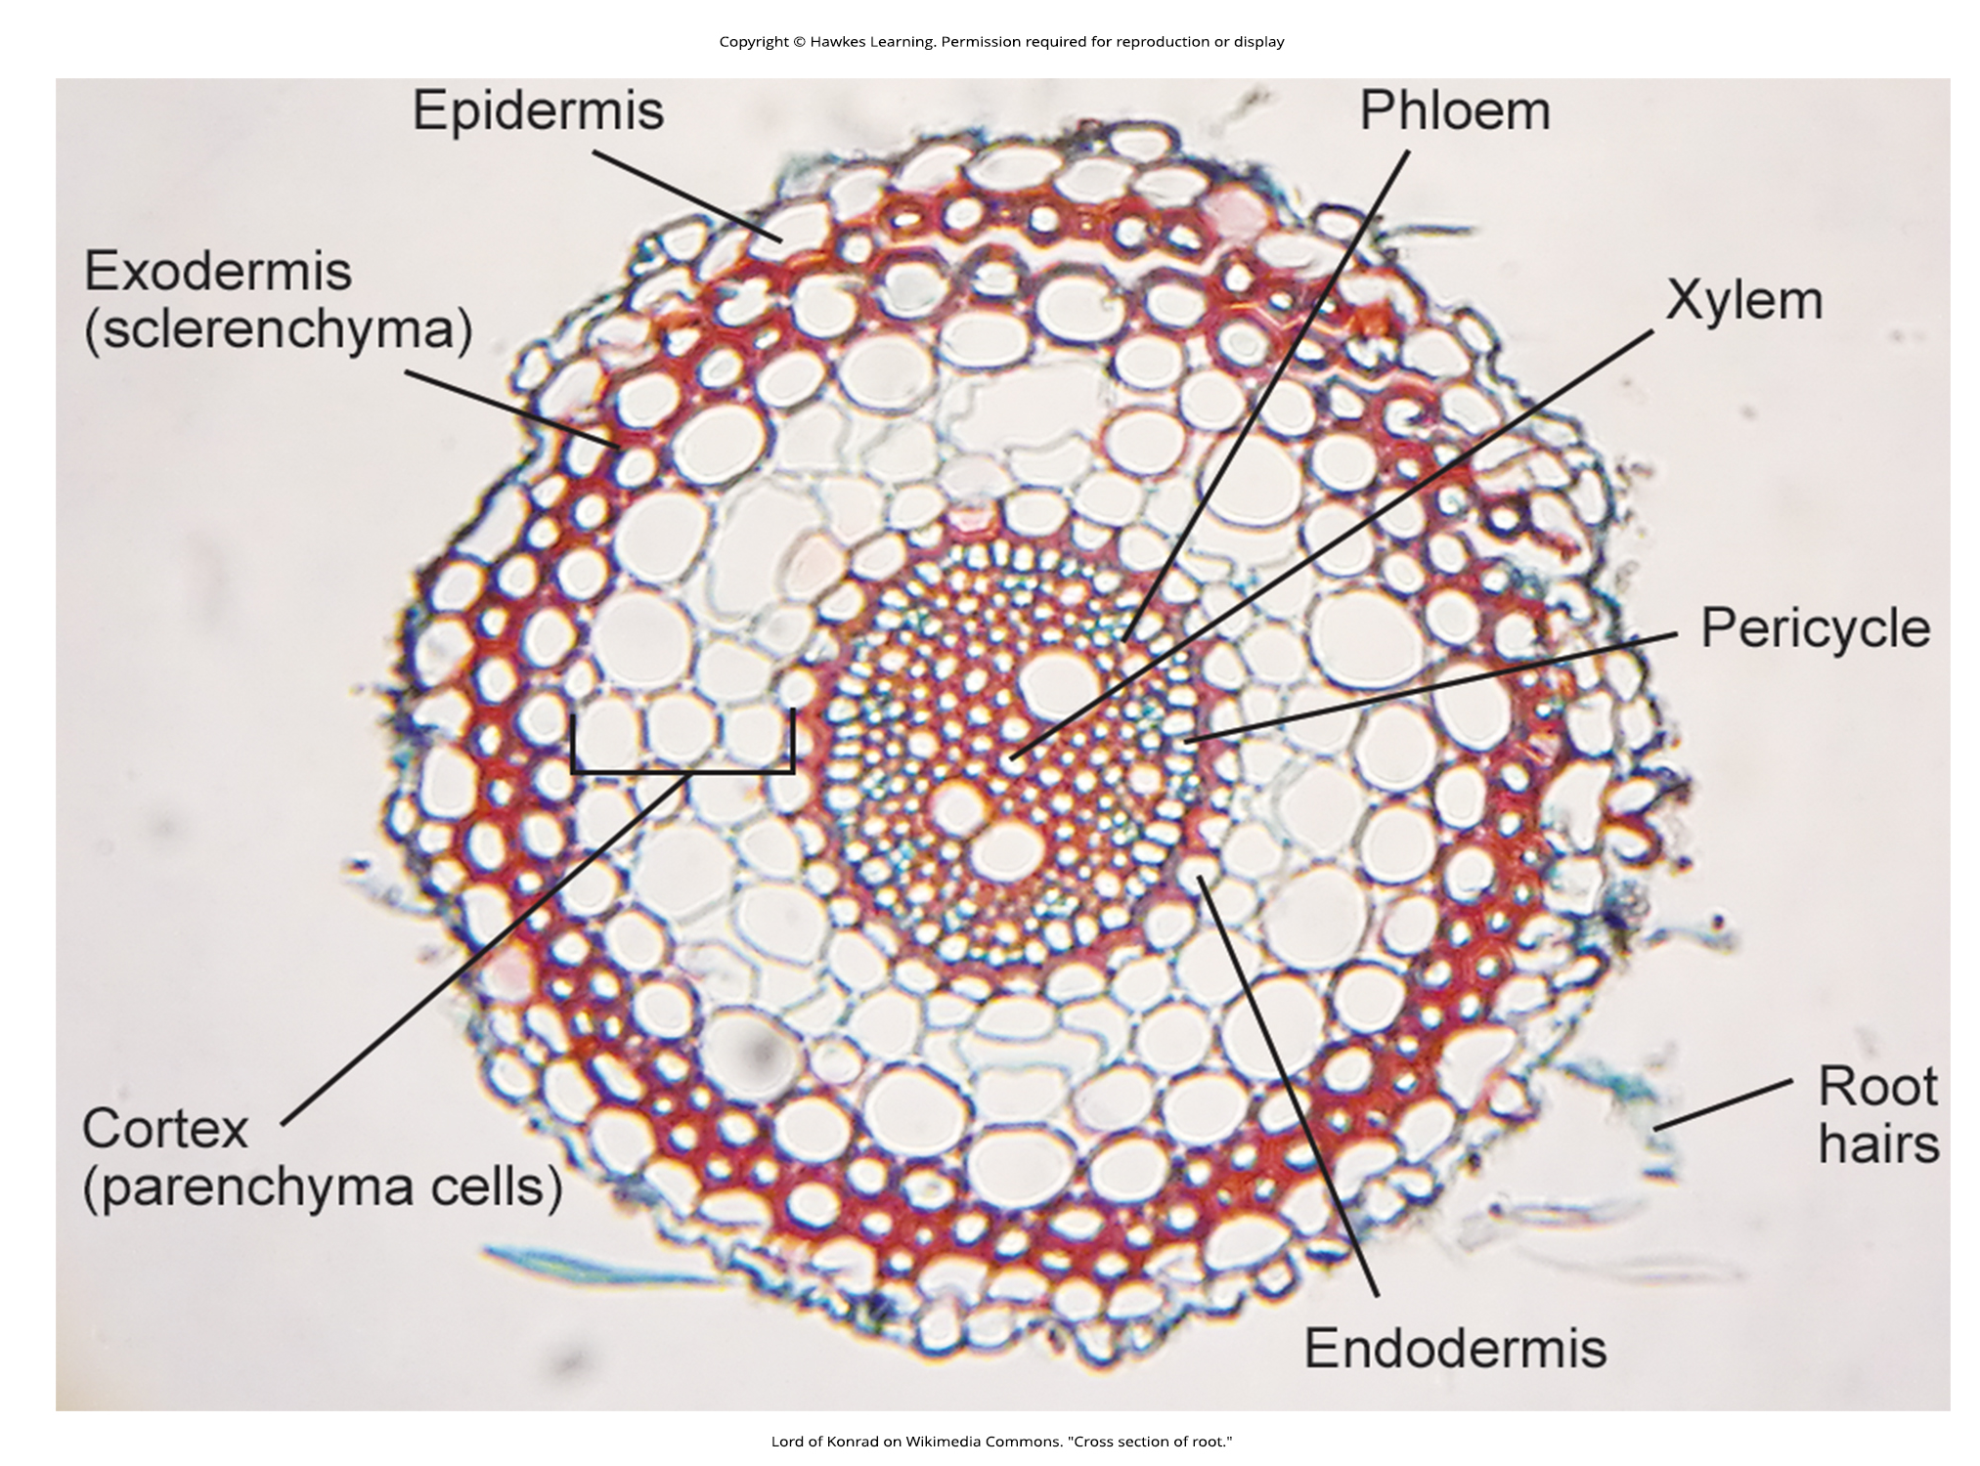
Lesson 30.3 Figure 3

Slide 25
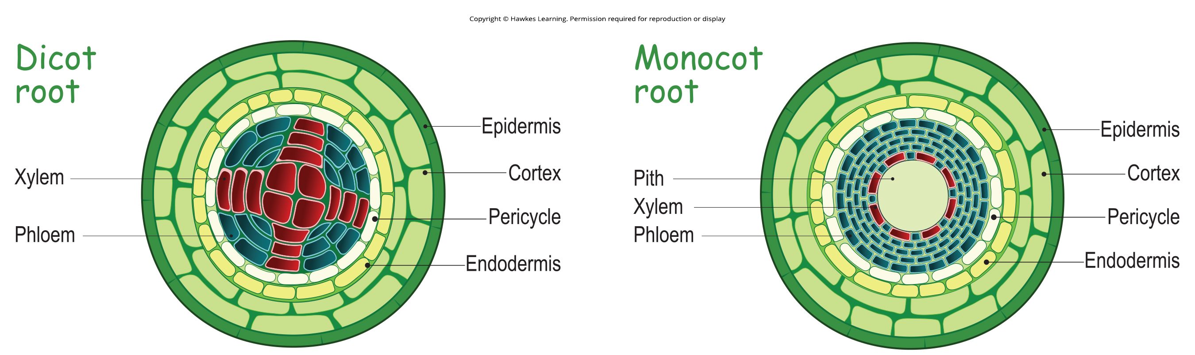
Lesson 30.3 Figure 4

Slide 26
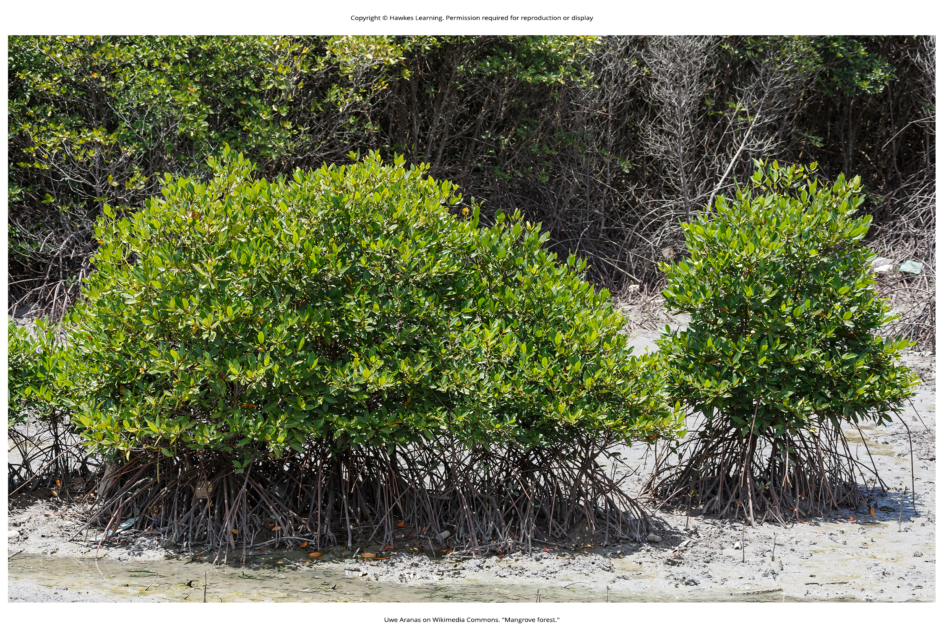
Lesson 30.3 Figure 5

Slide 27
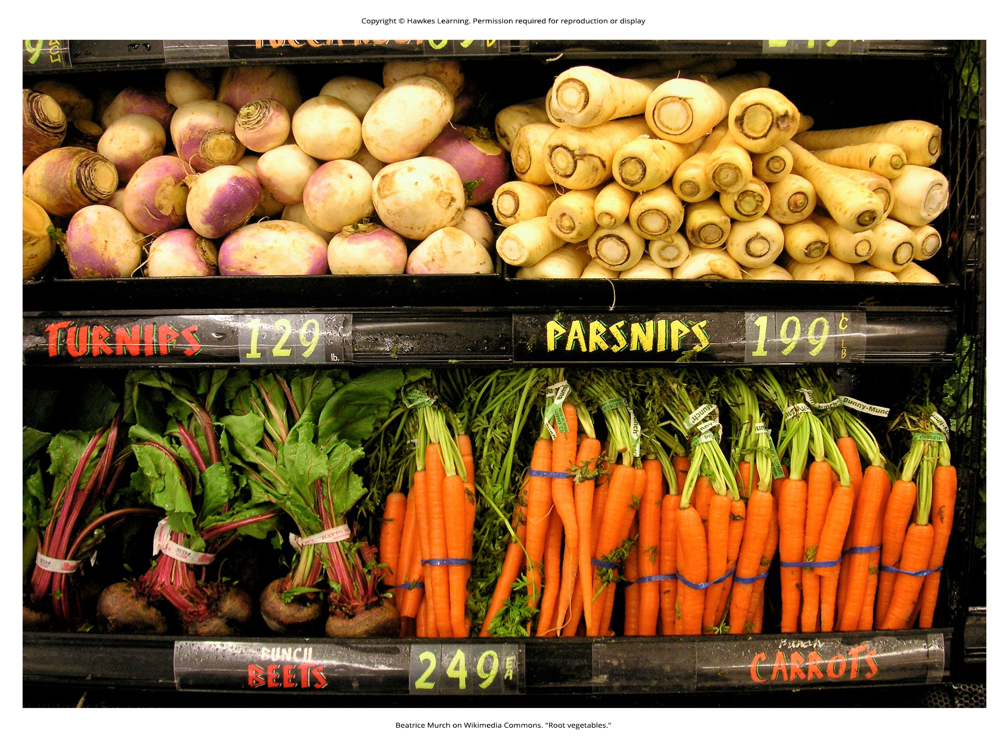
Lesson 30.3 Figure 6

Slide 28
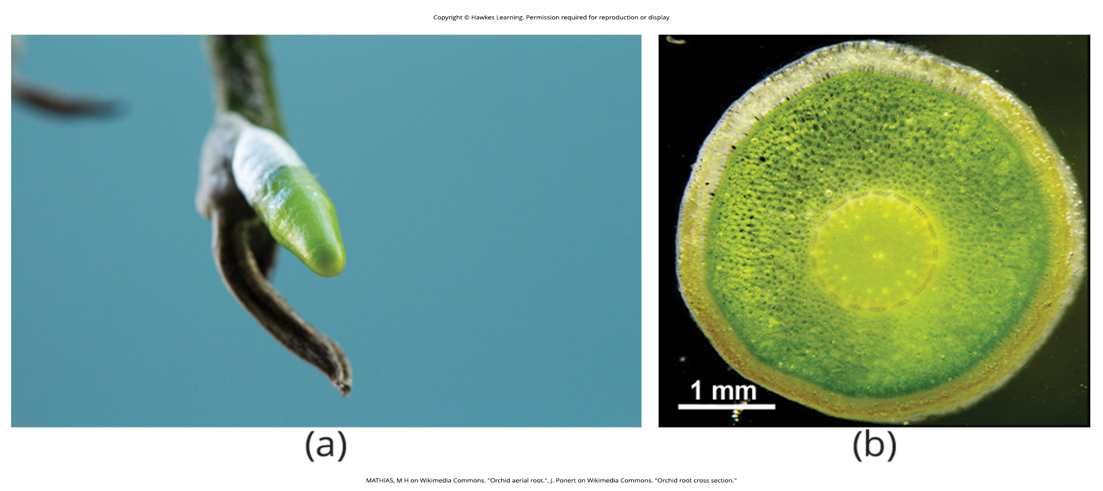
Lesson 30.3 Figure 7

Slide 29
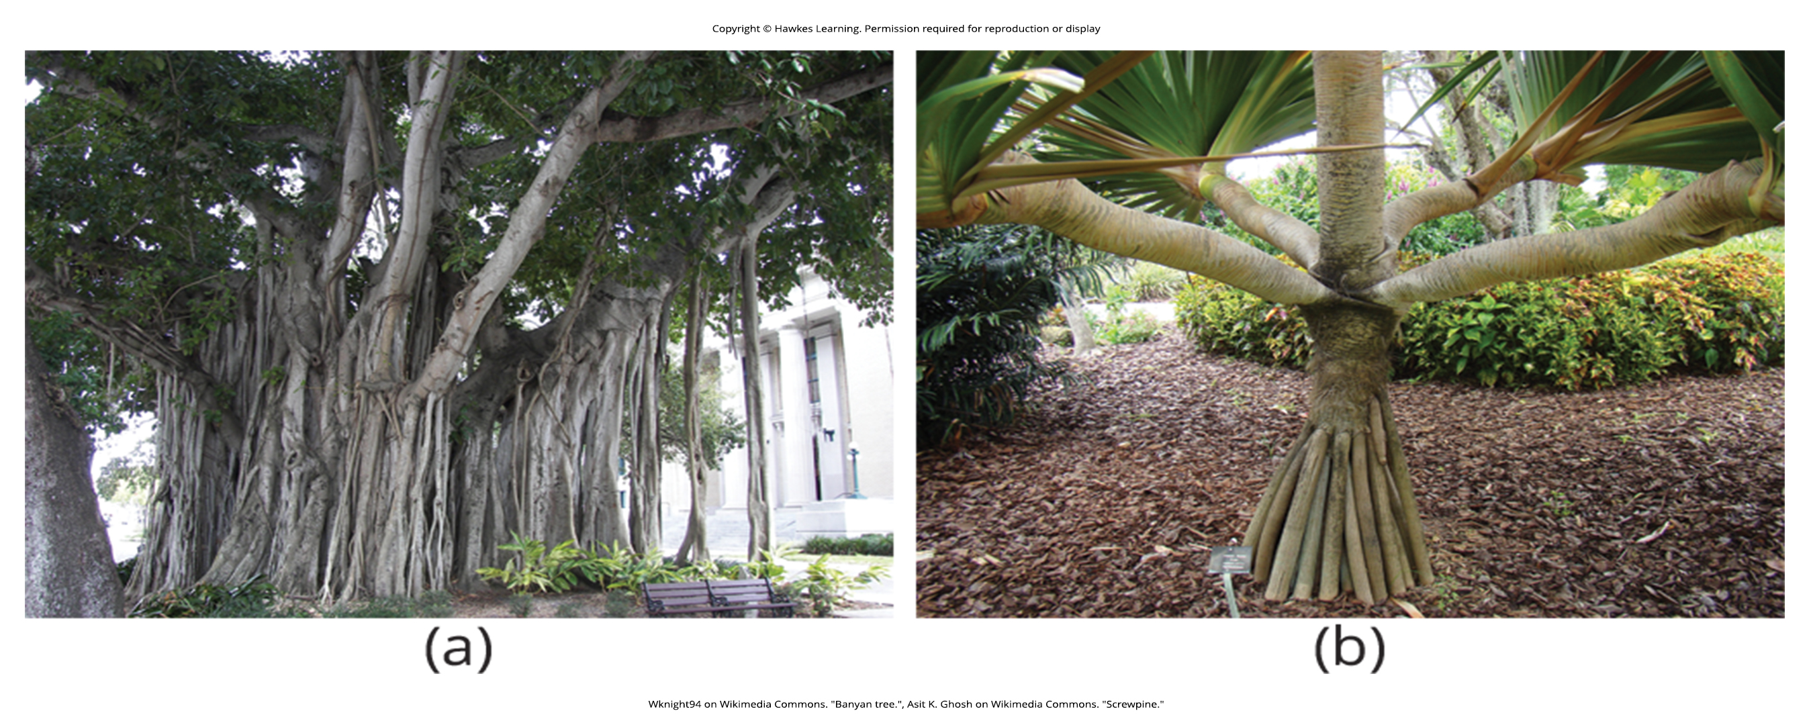
Lesson 30.3 Figure 8

Slide 30
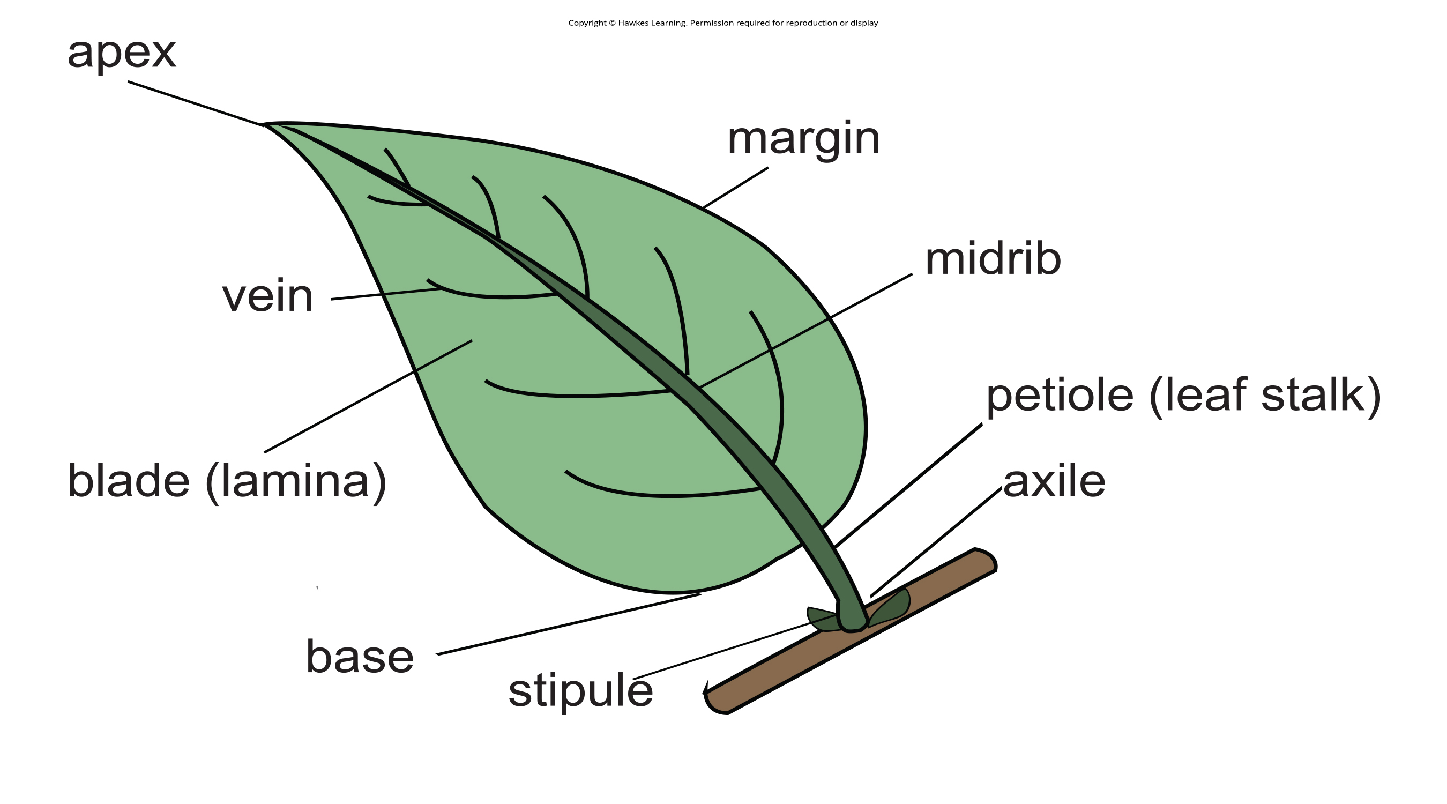
Lesson 30.4 Figure 1

Slide 31
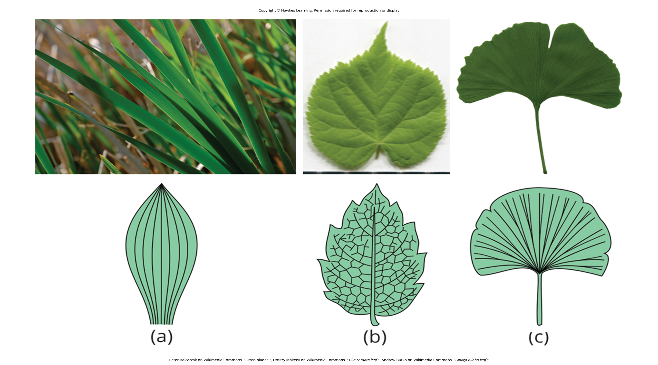
Lesson 30.4 Figure 2

Slide 32
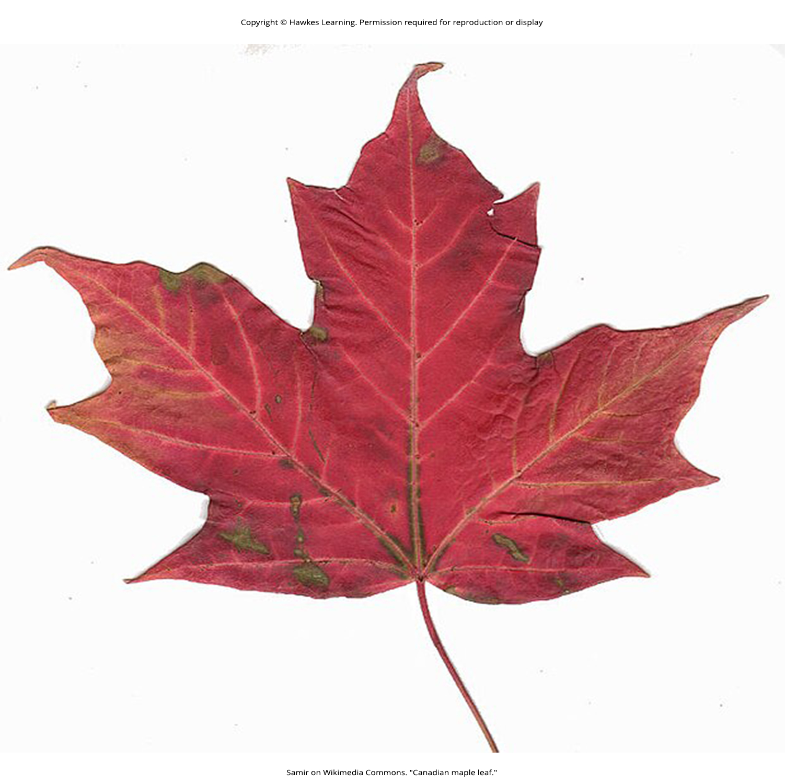
Lesson 30.4 Figure 3

Slide 33
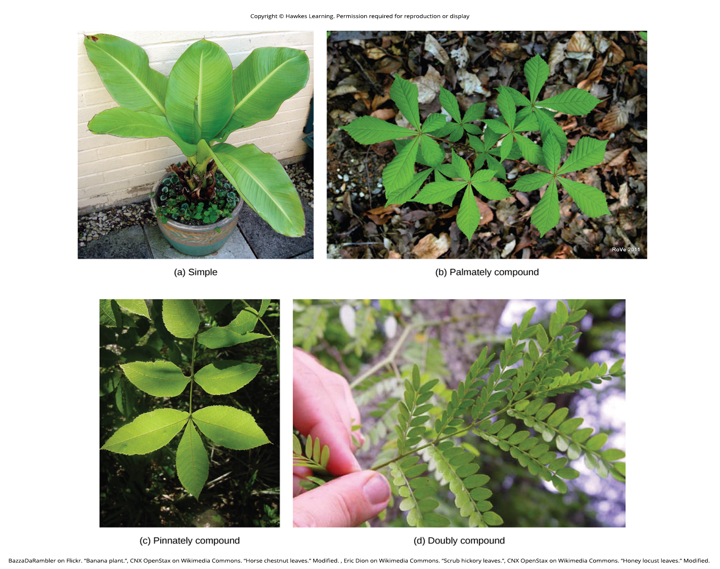
Lesson 30.4 Figure 4

Slide 34
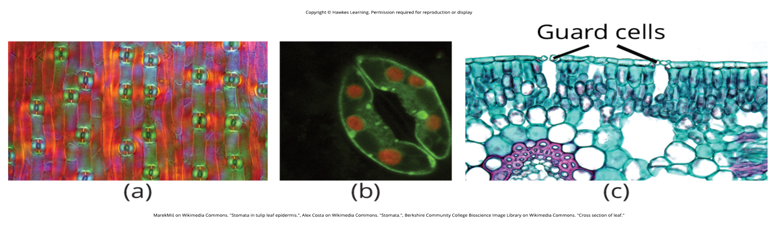
Lesson 30.4 Figure 5

Slide 35
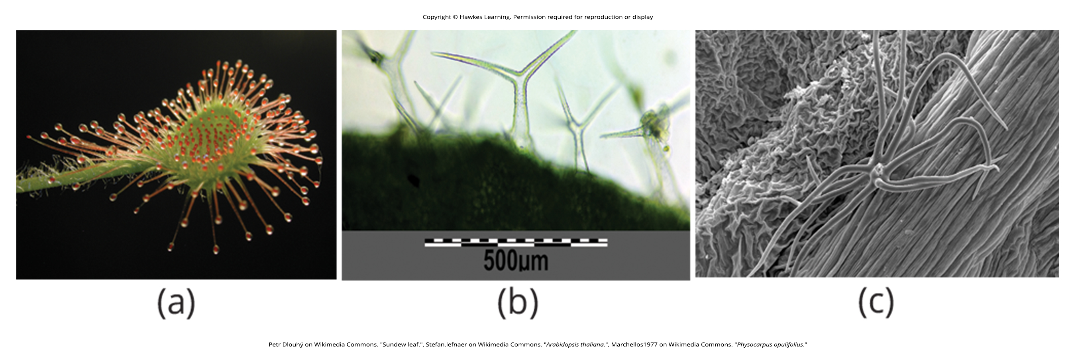
Lesson 30.4 Figure 6

Slide 36
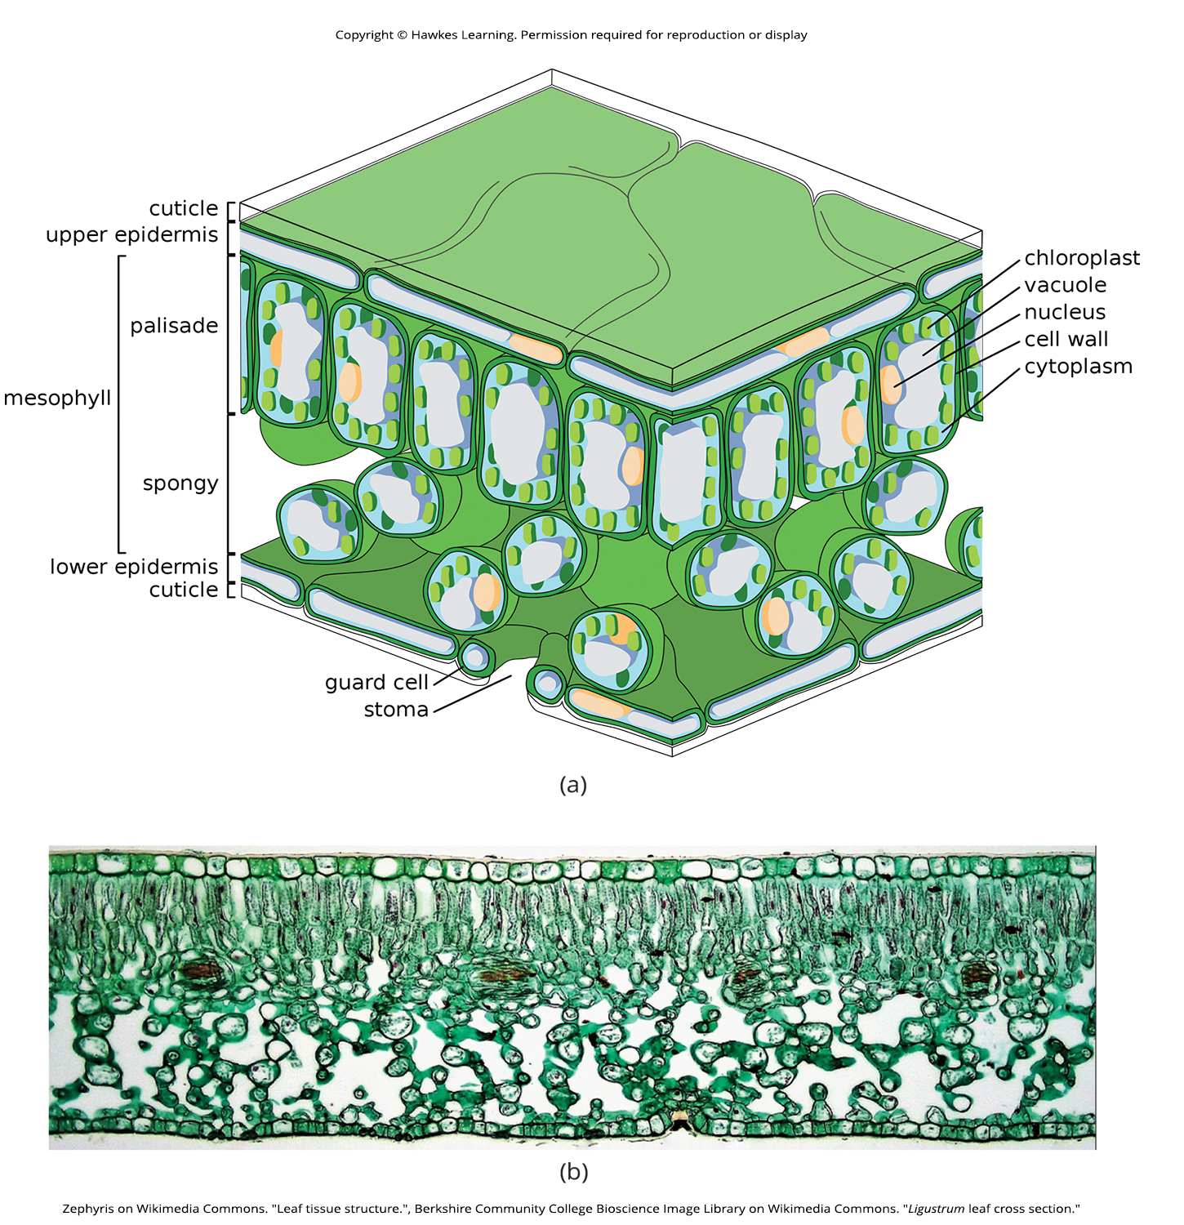
Lesson 30.4 Figure 7

Slide 37
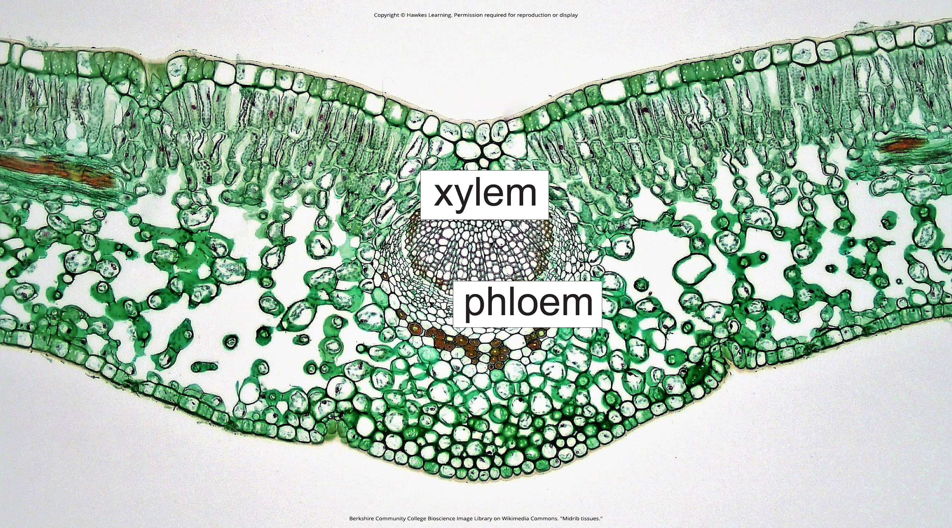
Lesson 30.4 Figure 8

Slide 38
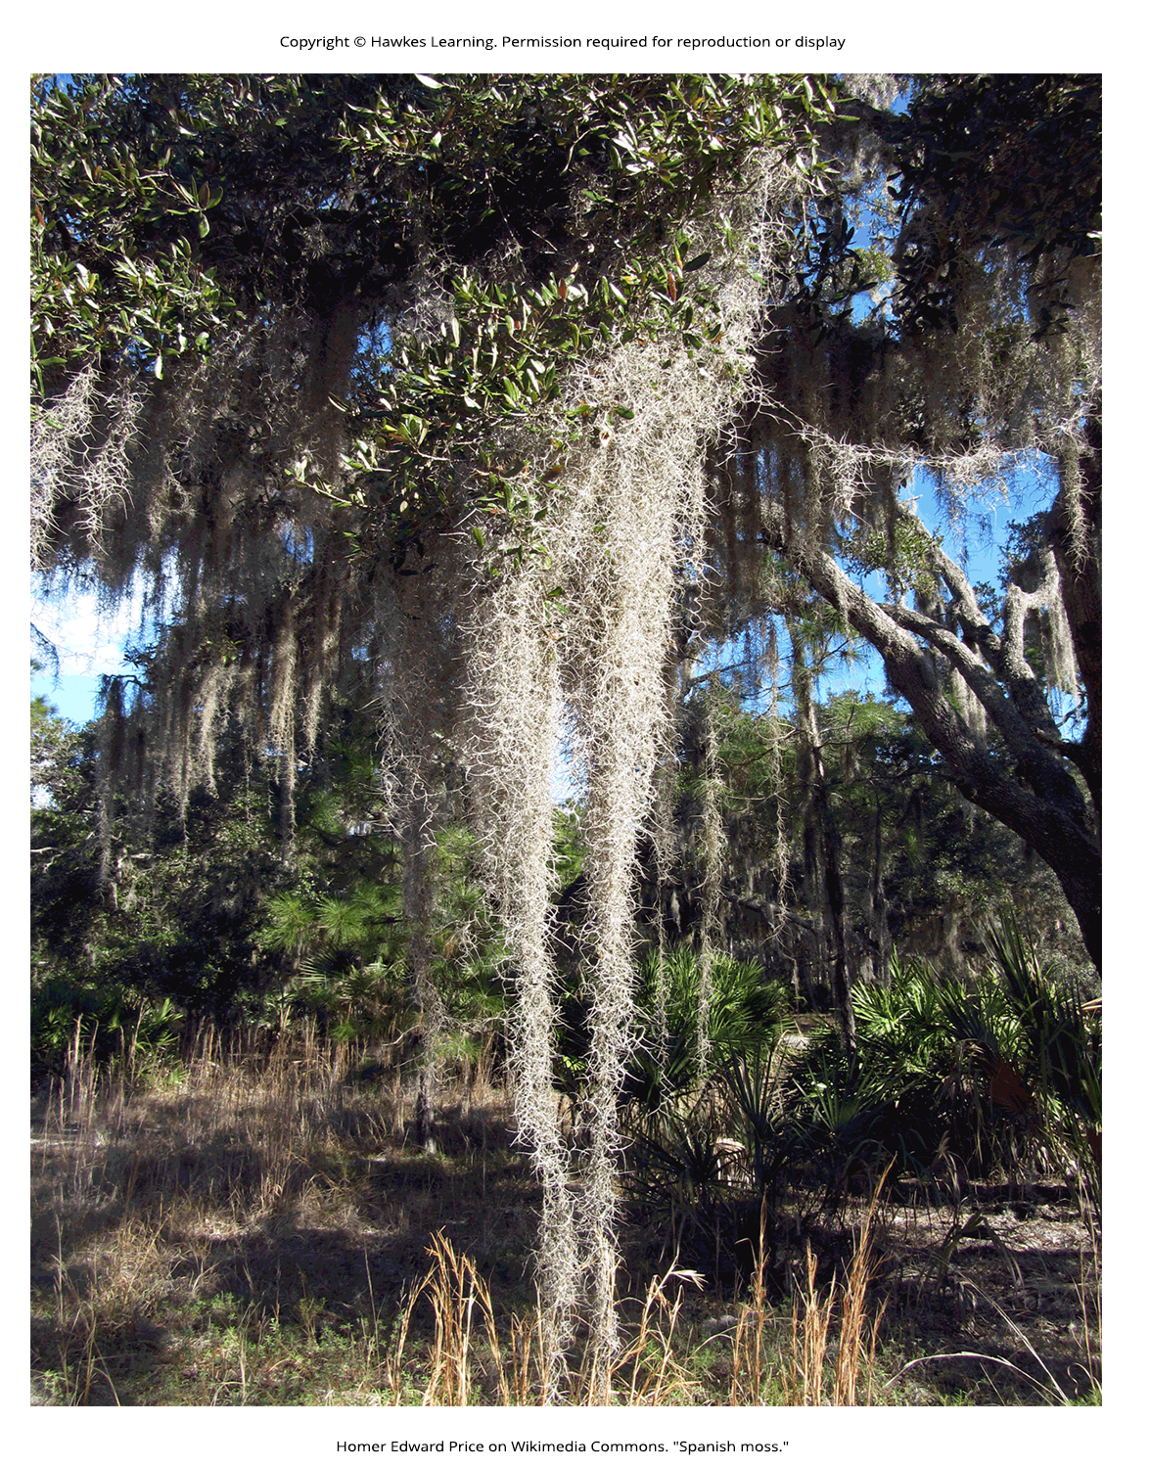
Lesson 30.4 Figure 9

Slide 39
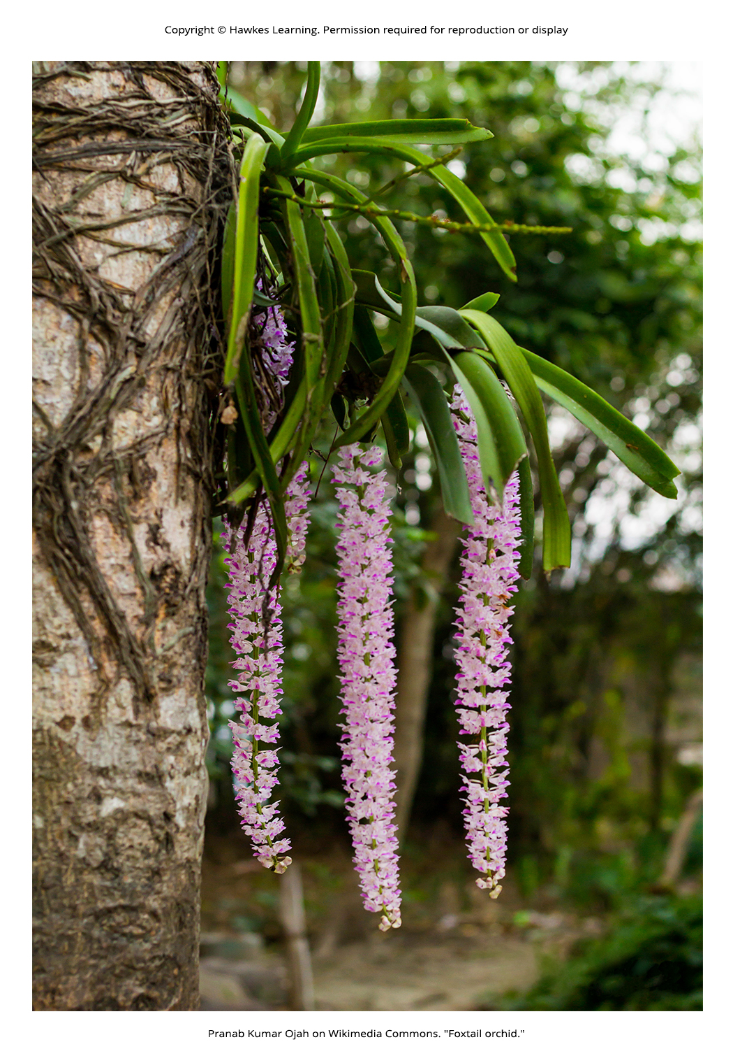
Lesson 30.4 Figure 10

Slide 40
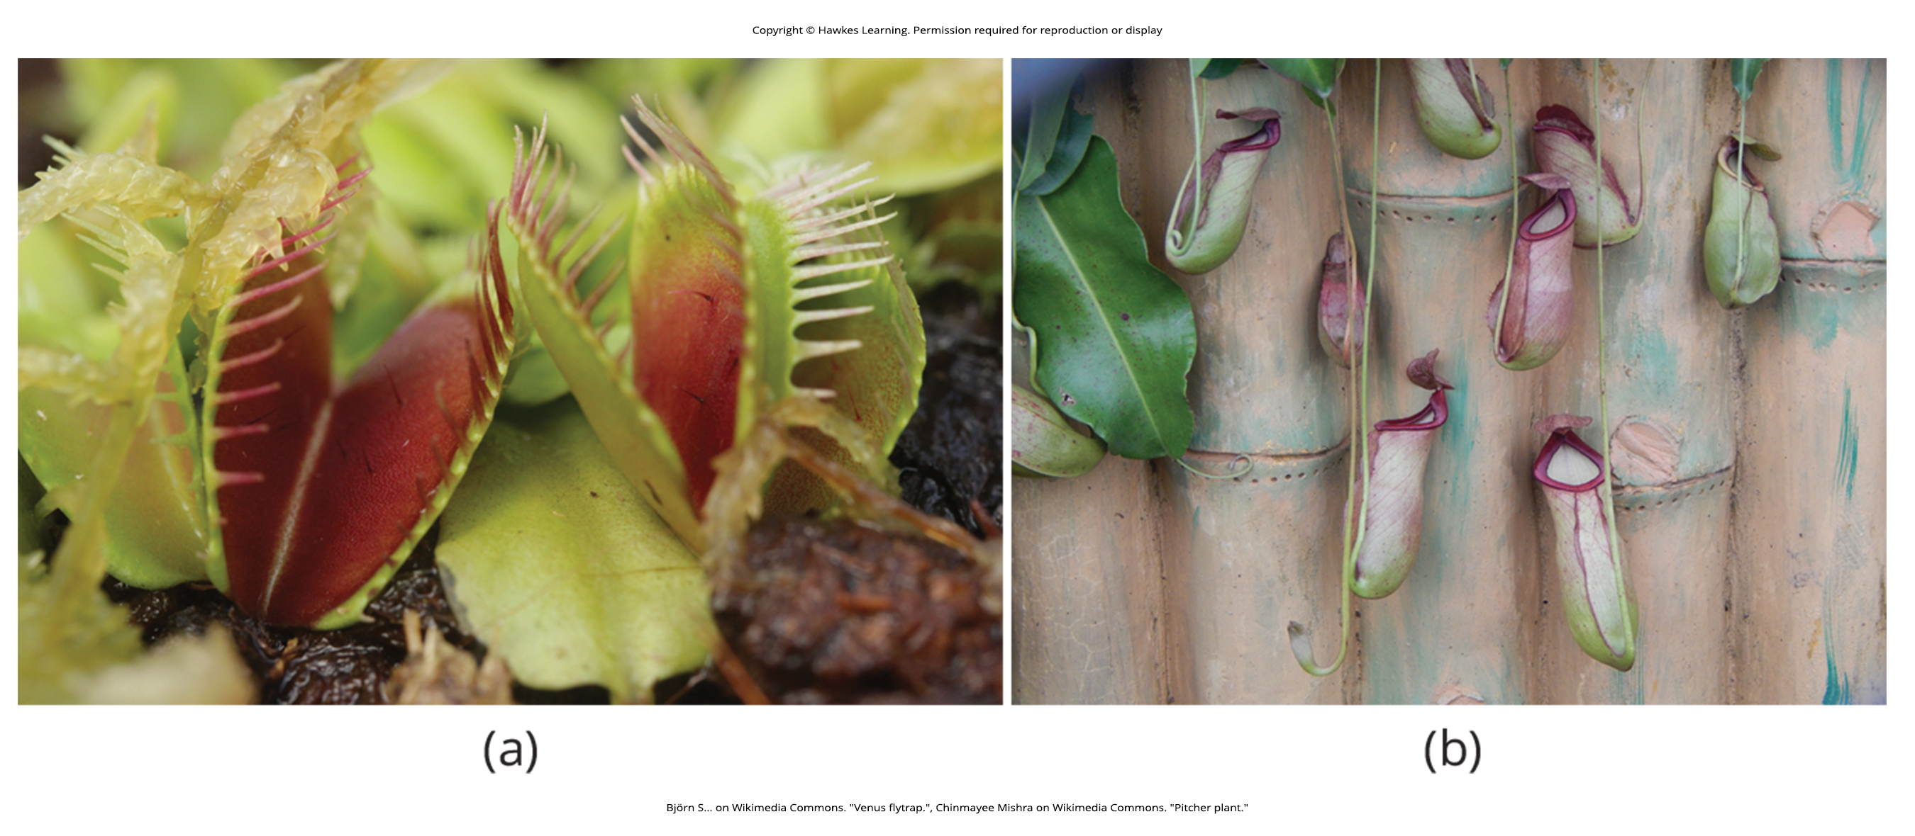
Lesson 30.4 Figure 11

Slide 41
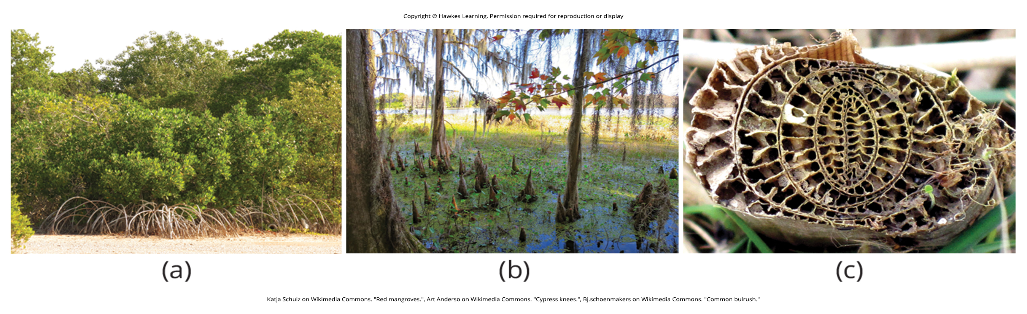
Lesson 30.4 Figure 12

Slide 42
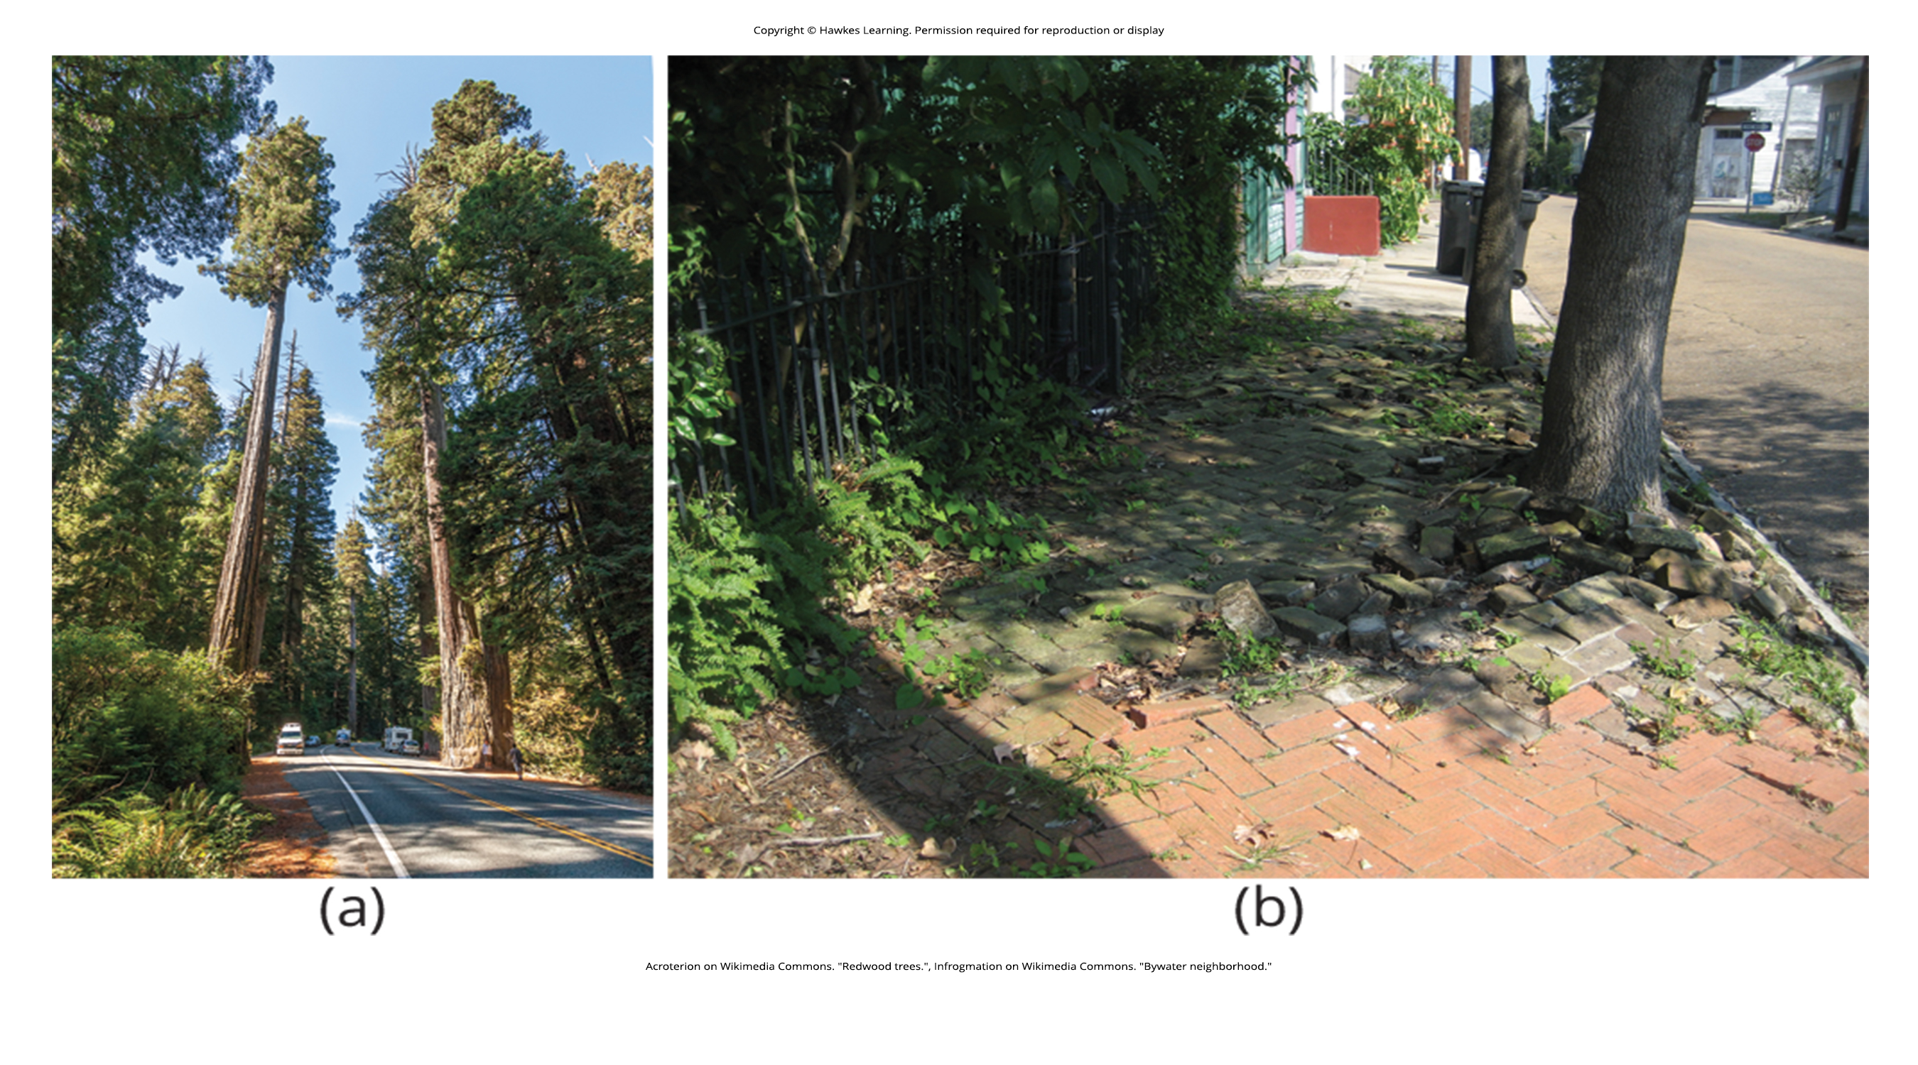
Lesson 30.5 Figure 1

Slide 43
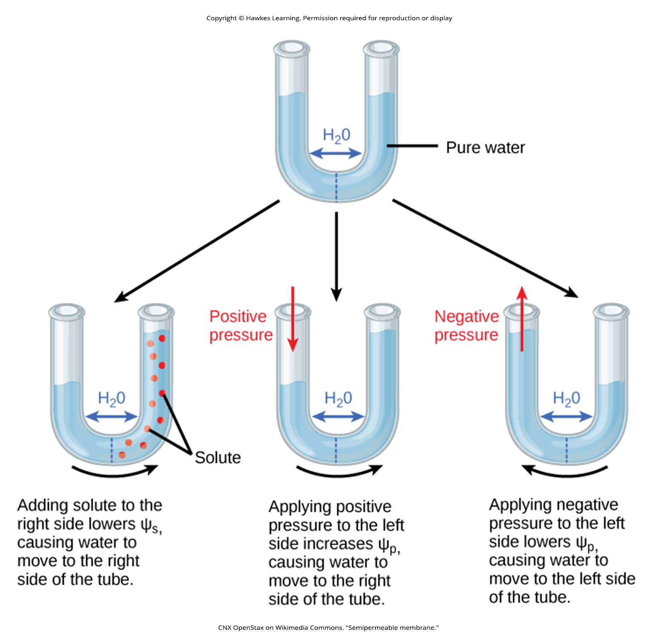
Lesson 30.5 Figure 2

Slide 44
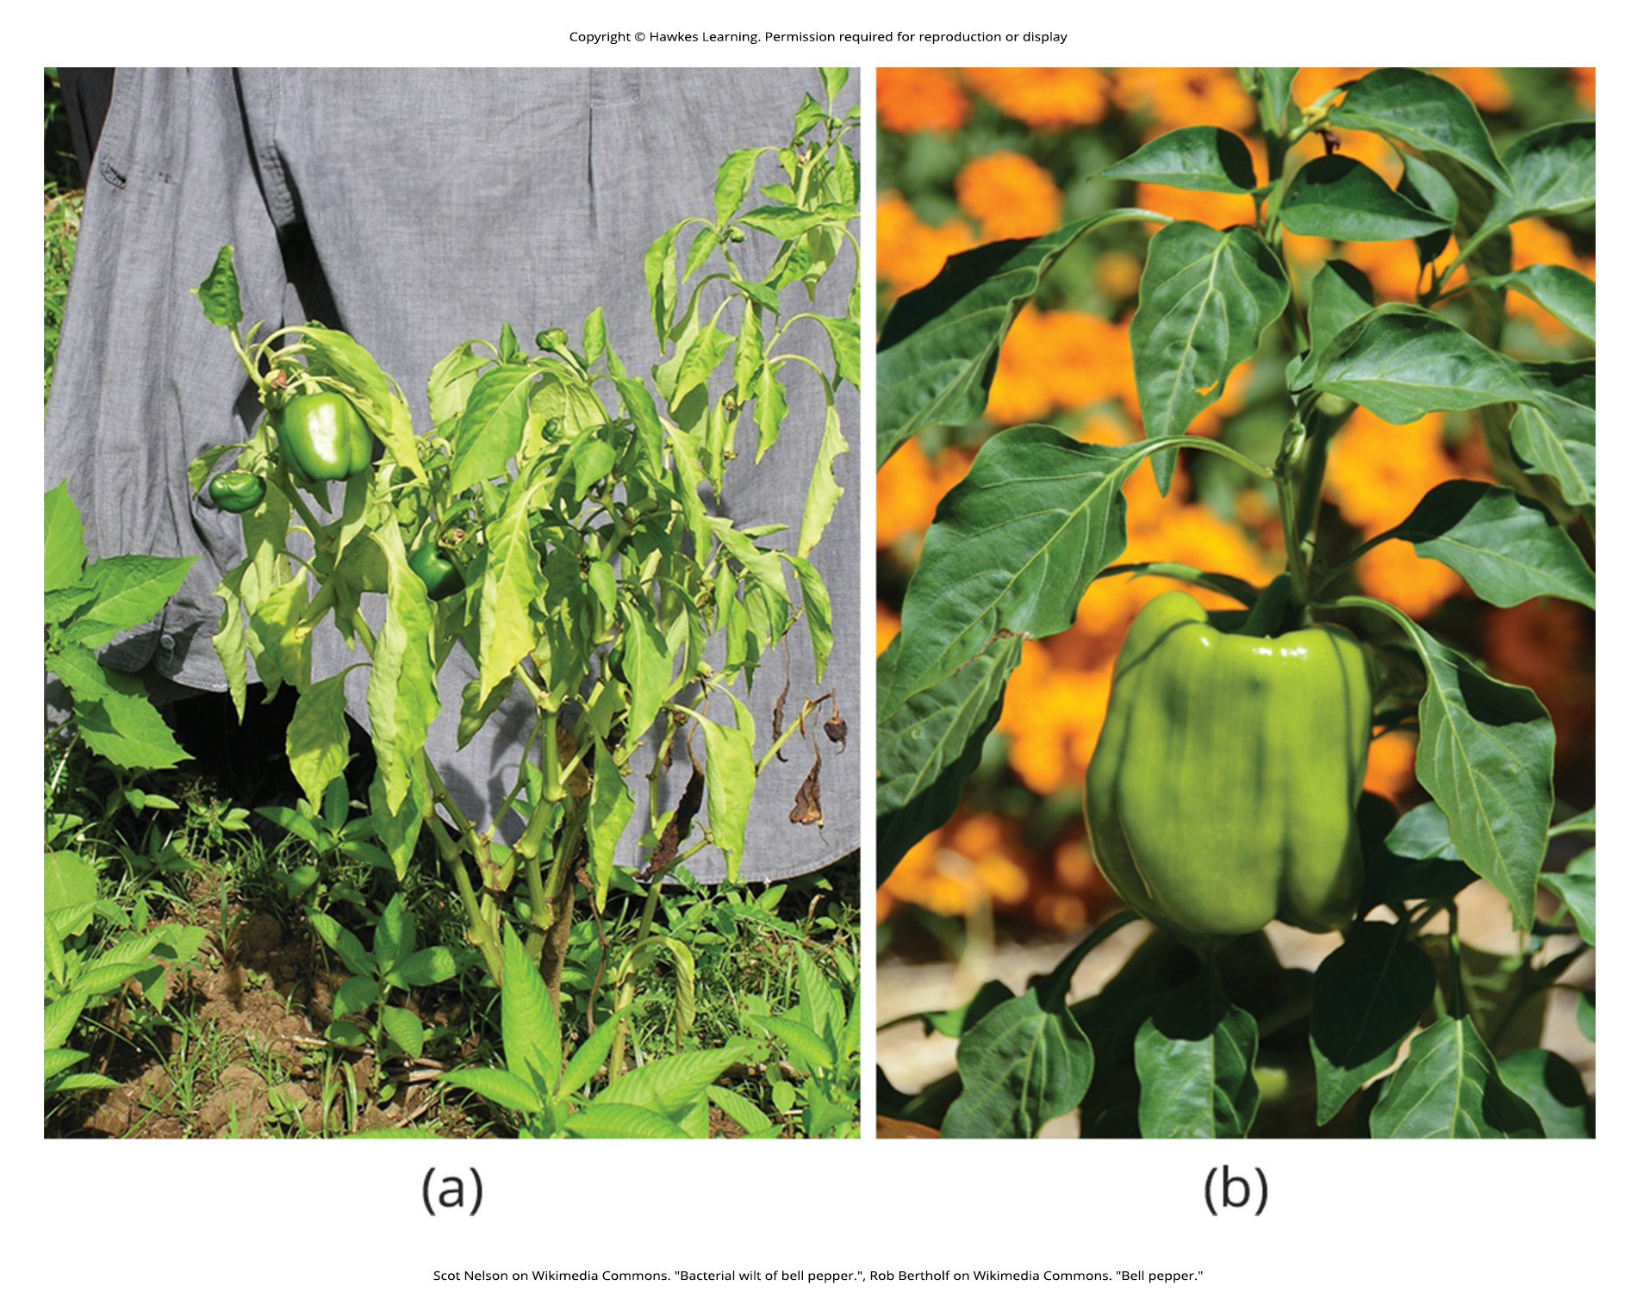
Lesson 30.5 Figure 3

Slide 45
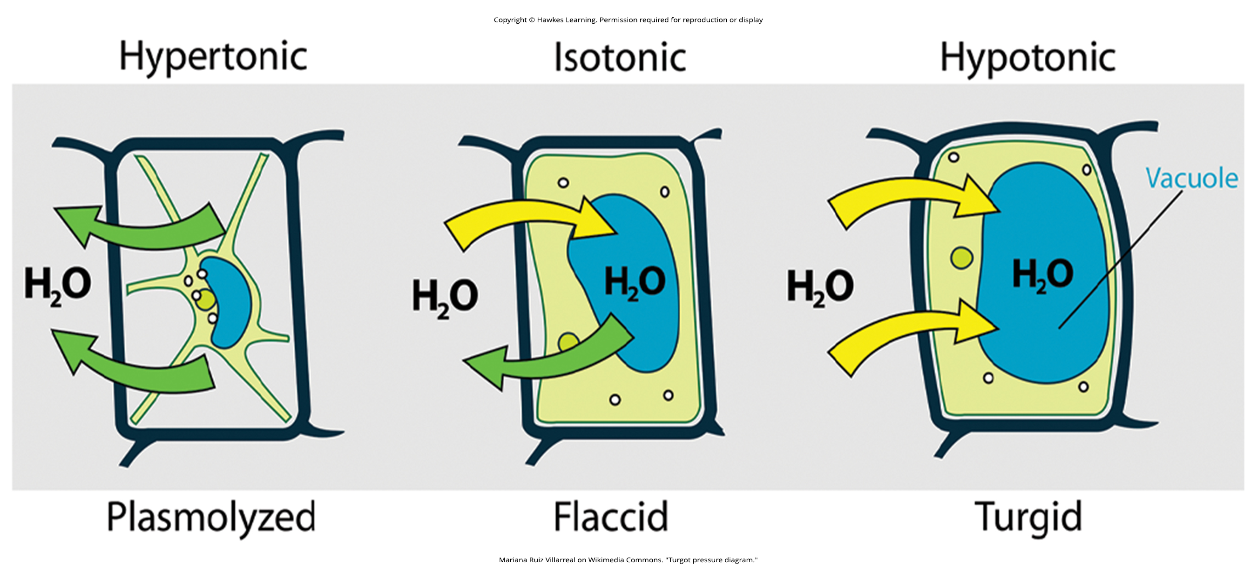
Lesson 30.5 Figure 4

Slide 46
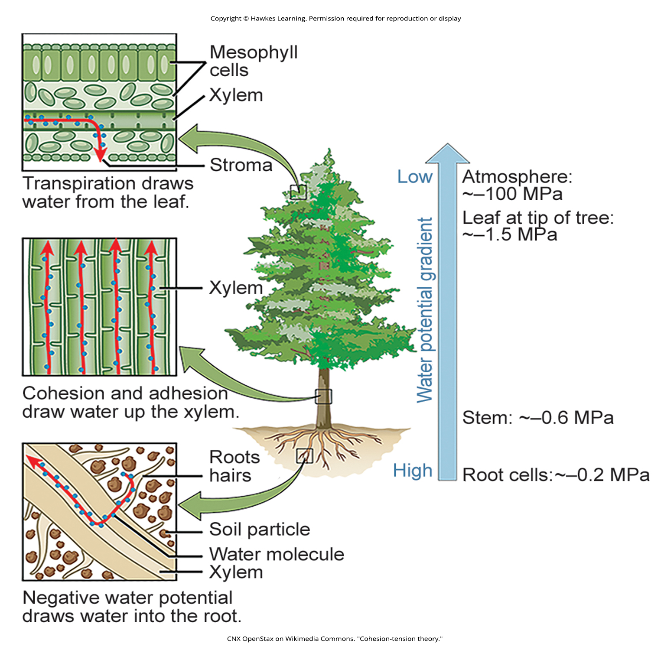
Lesson 30.5 Figure 5

Slide 47
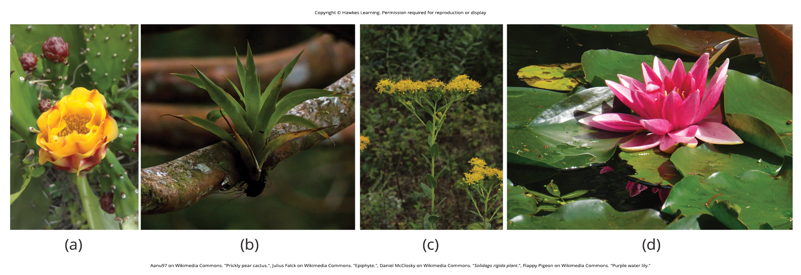
Lesson 30.5 Figure 6

Slide 48
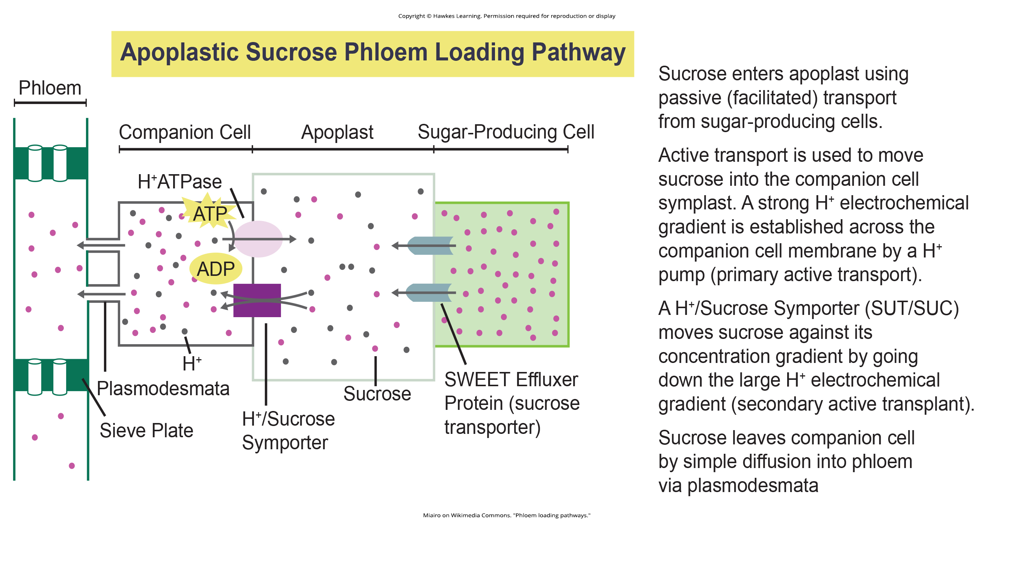
Lesson 30.5 Figure 7

Slide 49
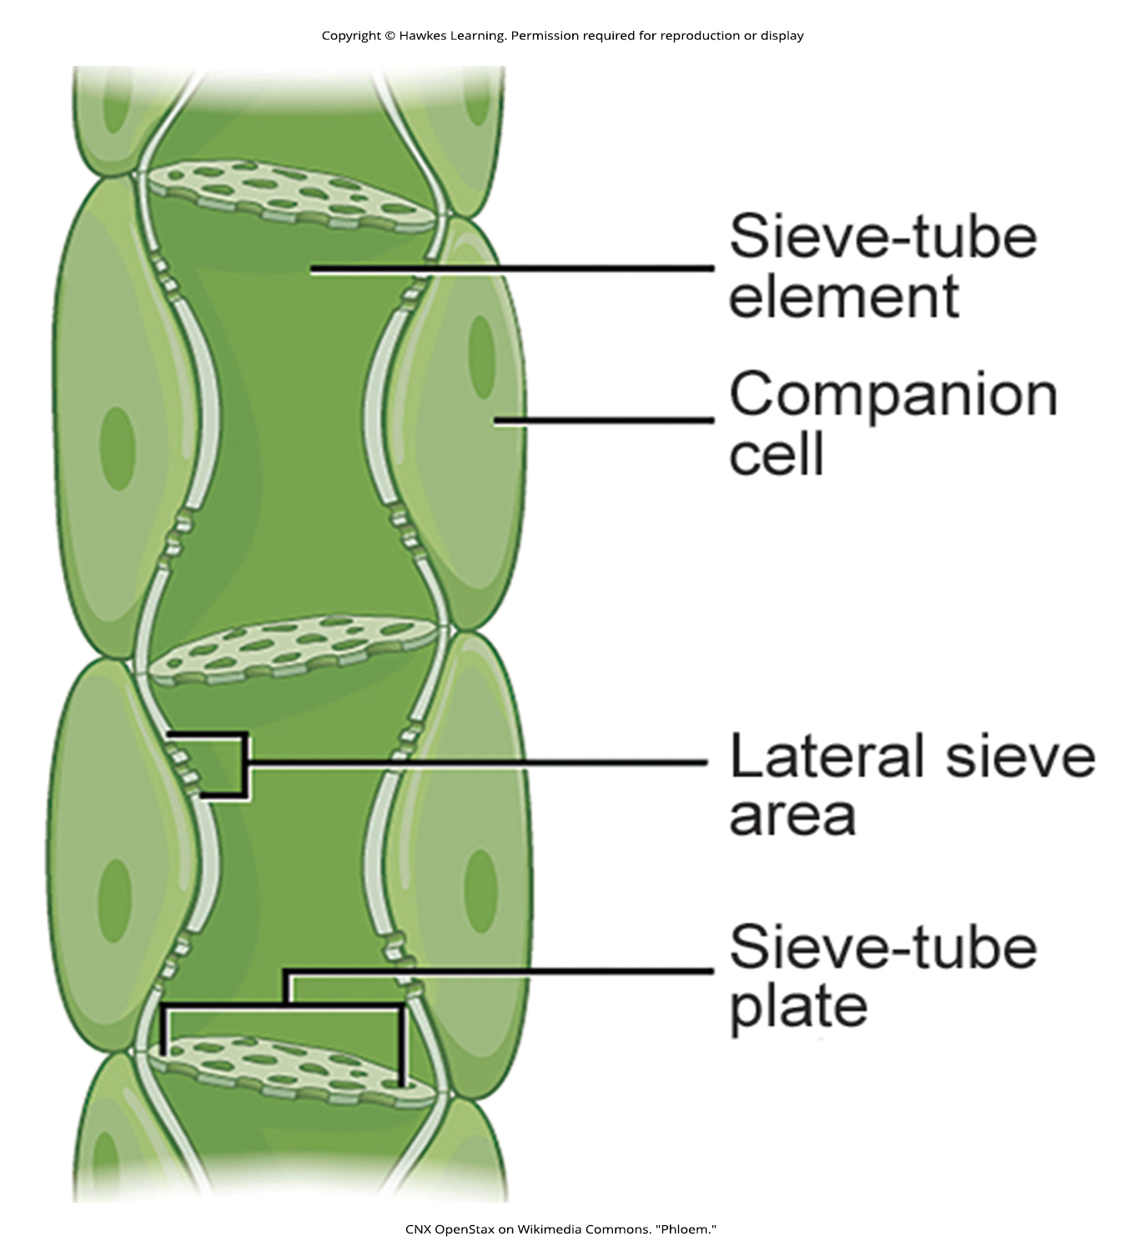
Lesson 30.5 Figure 8

Slide 50
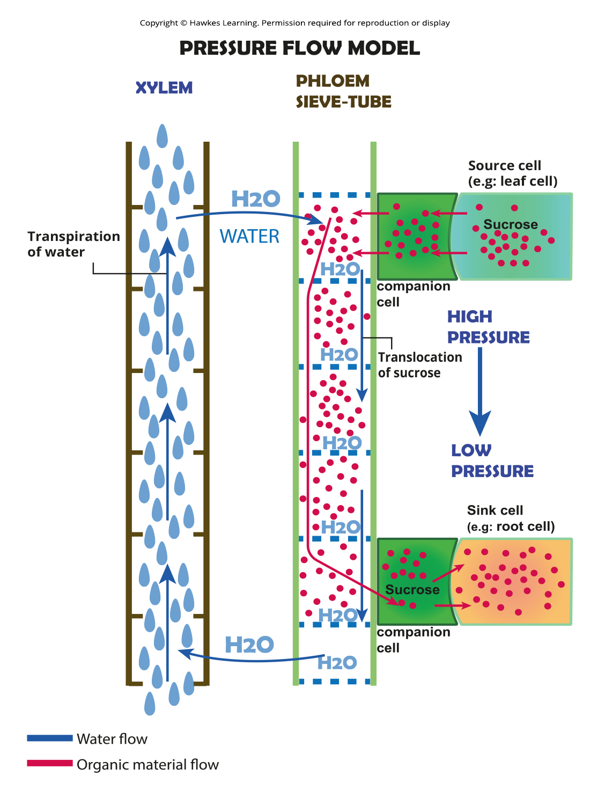
Lesson 30.5 Figure 9

Slide 51
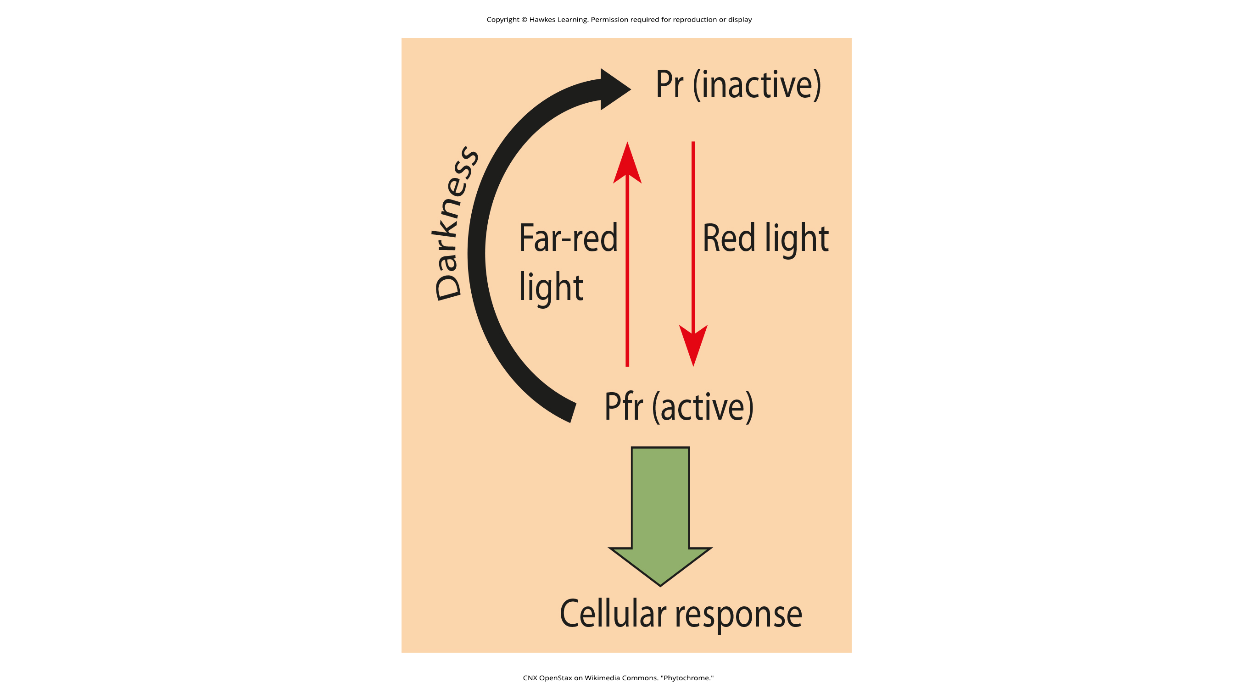
Lesson 30.6 Figure 1

Slide 52

Lesson 30.6 Figure 2

Slide 53

Lesson 30.6 Figure 3

Slide 54

Lesson 30.6 Figure 4

Slide 55

Lesson 30.6 Figure 5

Slide 56

Lesson 30.6 Figure 6

Slide 57

Lesson 30.6 Figure 7

Slide 58
Hawkes Learning – End of PowerPoint

