Slide 1
Chapter 31
Soil and Plant Nutrition

Slide 2
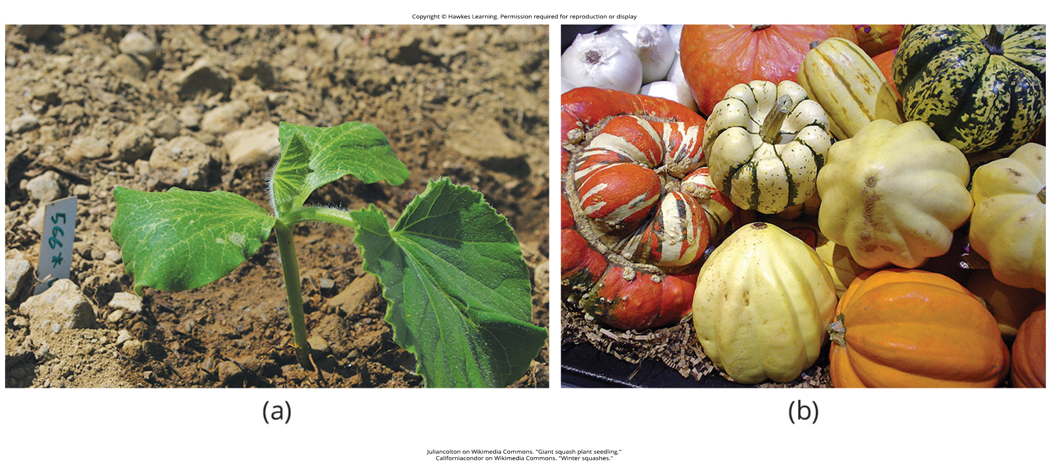
Lesson 31.1 Figure 1

Slide 3
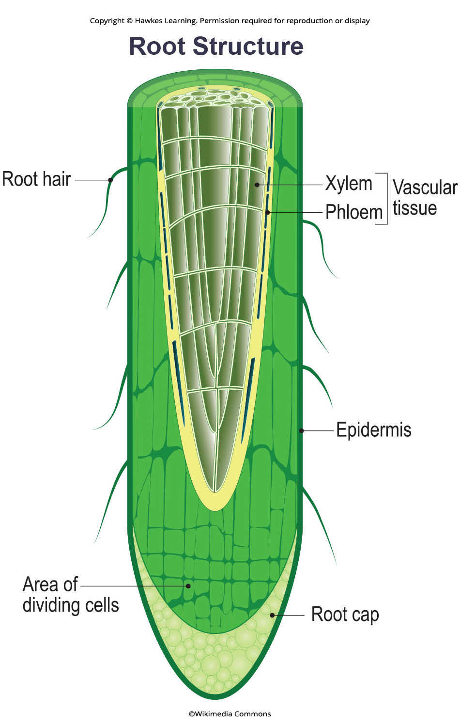
Lesson 31.1 Figure 2

Slide 4
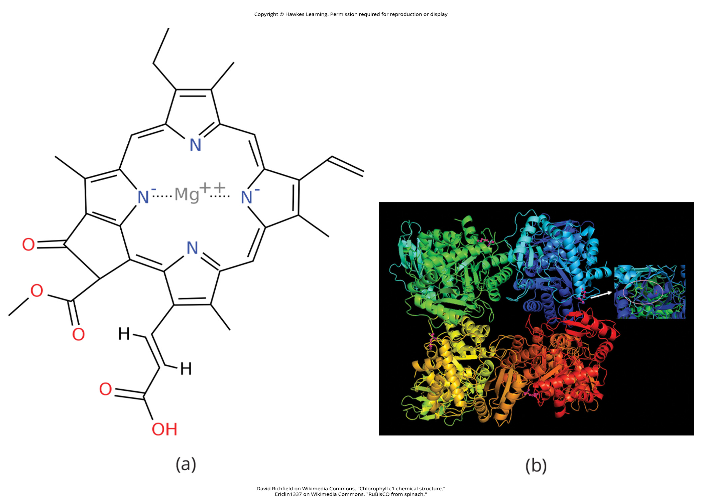
Lesson 31.1 Figure 3

Slide 5
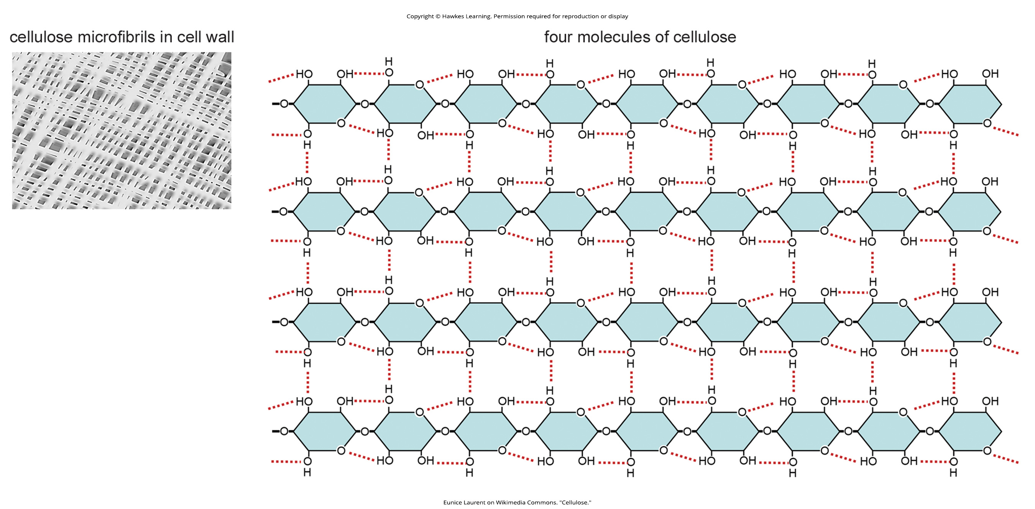
Lesson 31.1 Figure 4

Slide 6
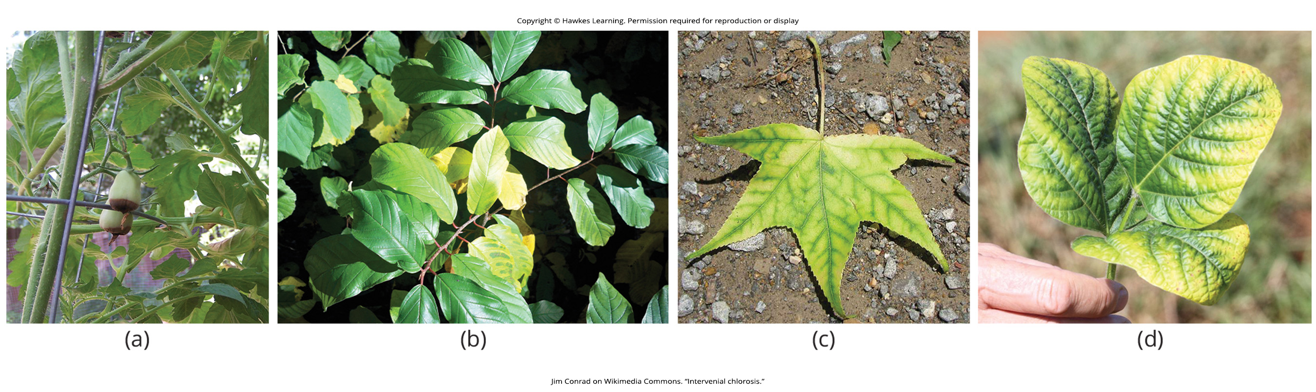
Lesson 31.1 Figure 5

Slide 7
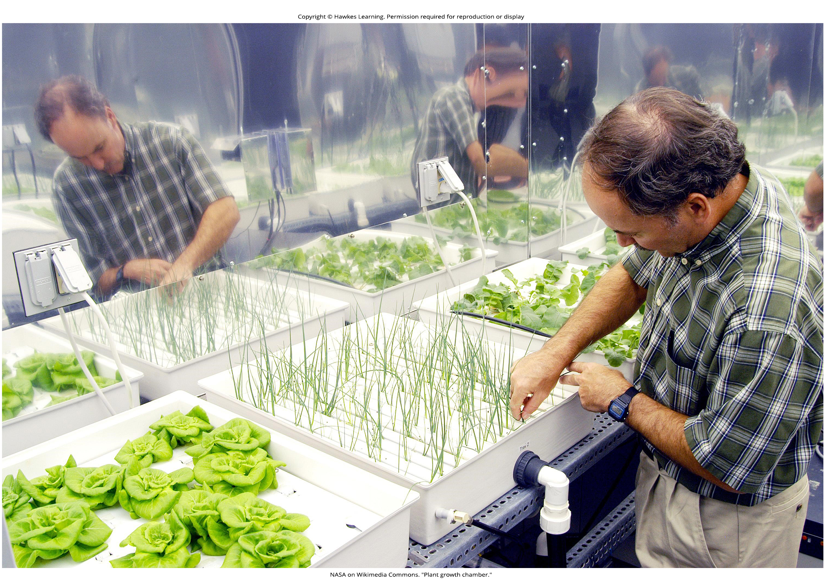
Lesson 31.1 Figure 6

Slide 8
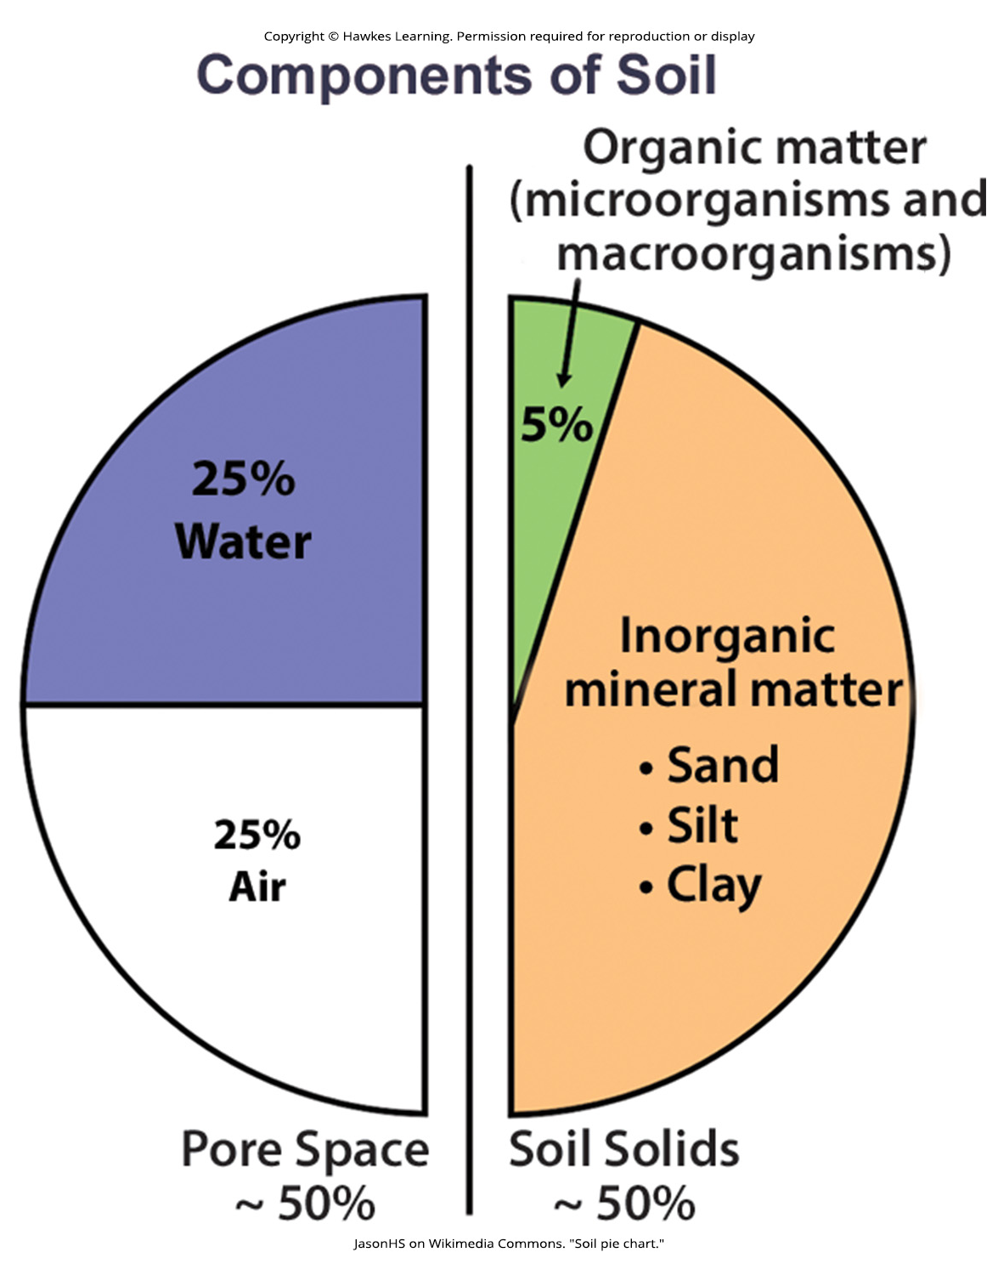
Lesson 31.1 Figure 7

Slide 9
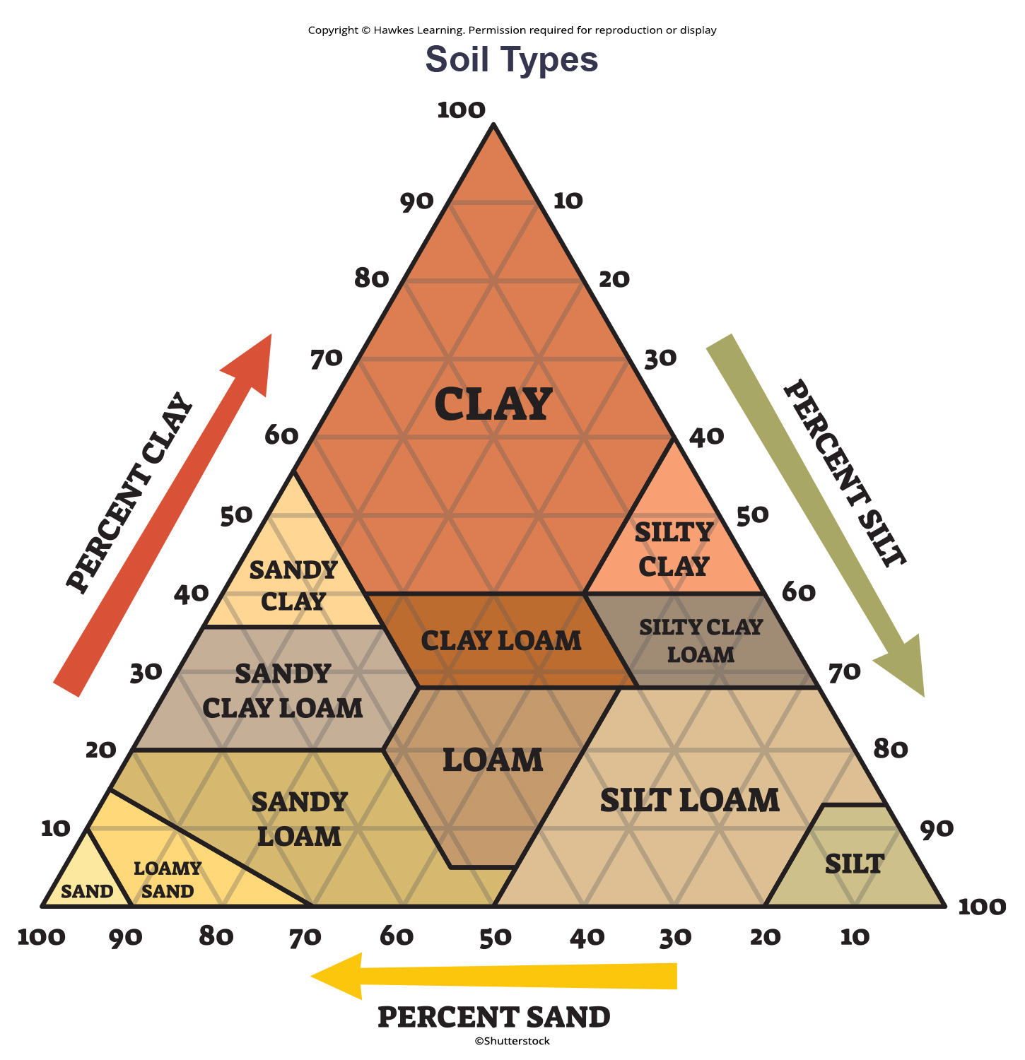
Lesson 31.1 Figure 8

Slide 10
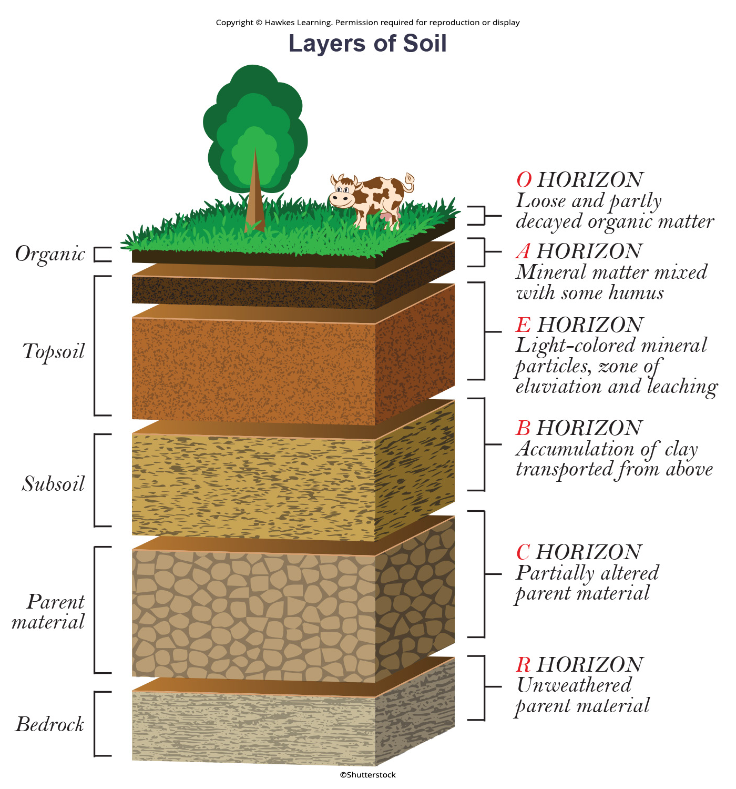
Lesson 31.1 Figure 9

Slide 11
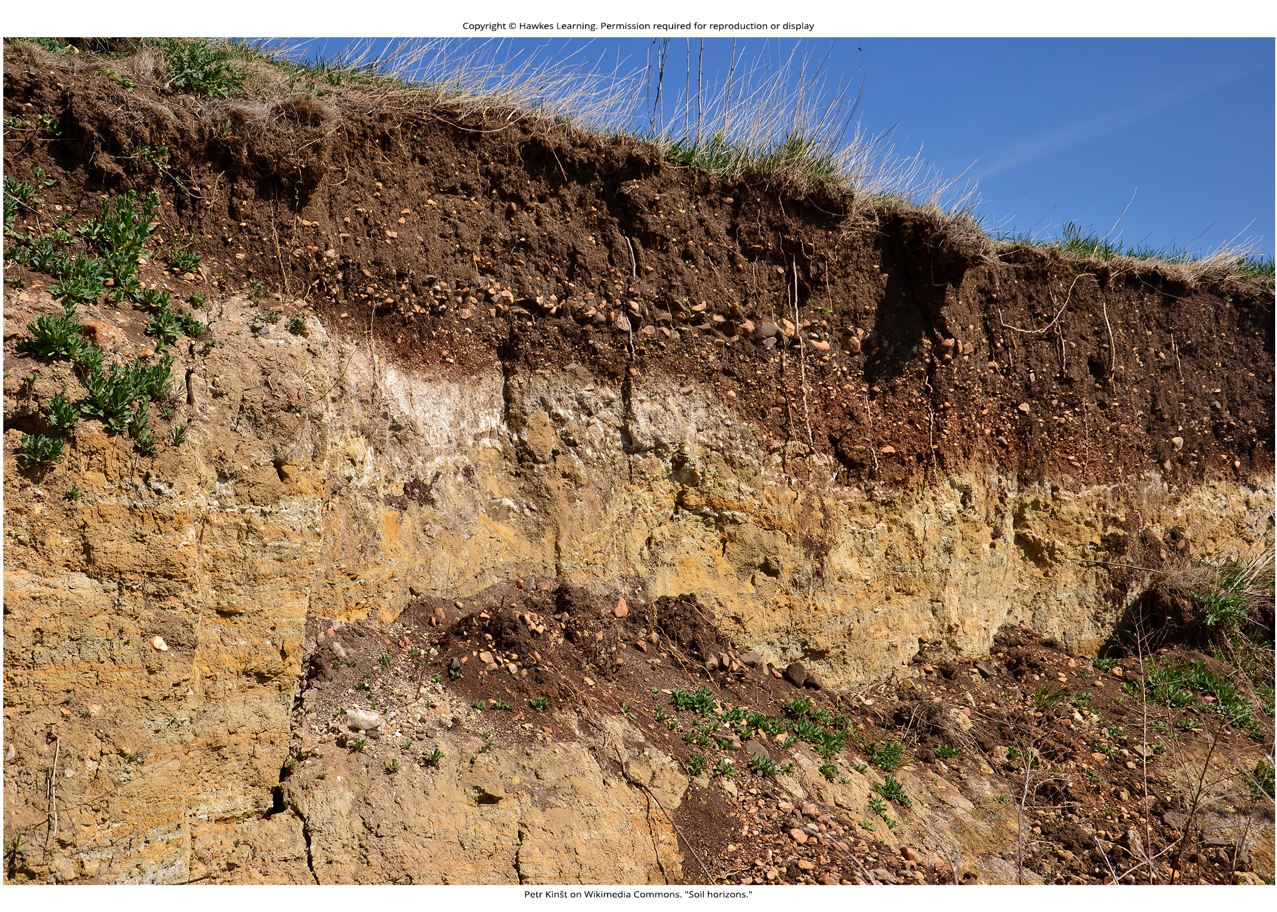
Lesson 31.1 Figure 10

Slide 12
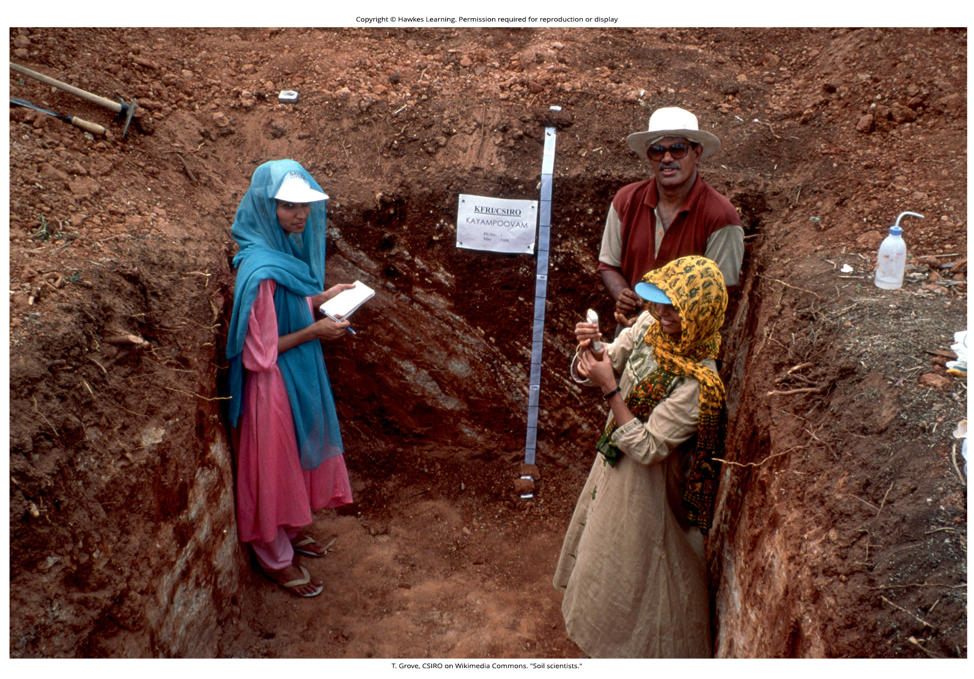
Lesson 31.1 Figure 11

Slide 13
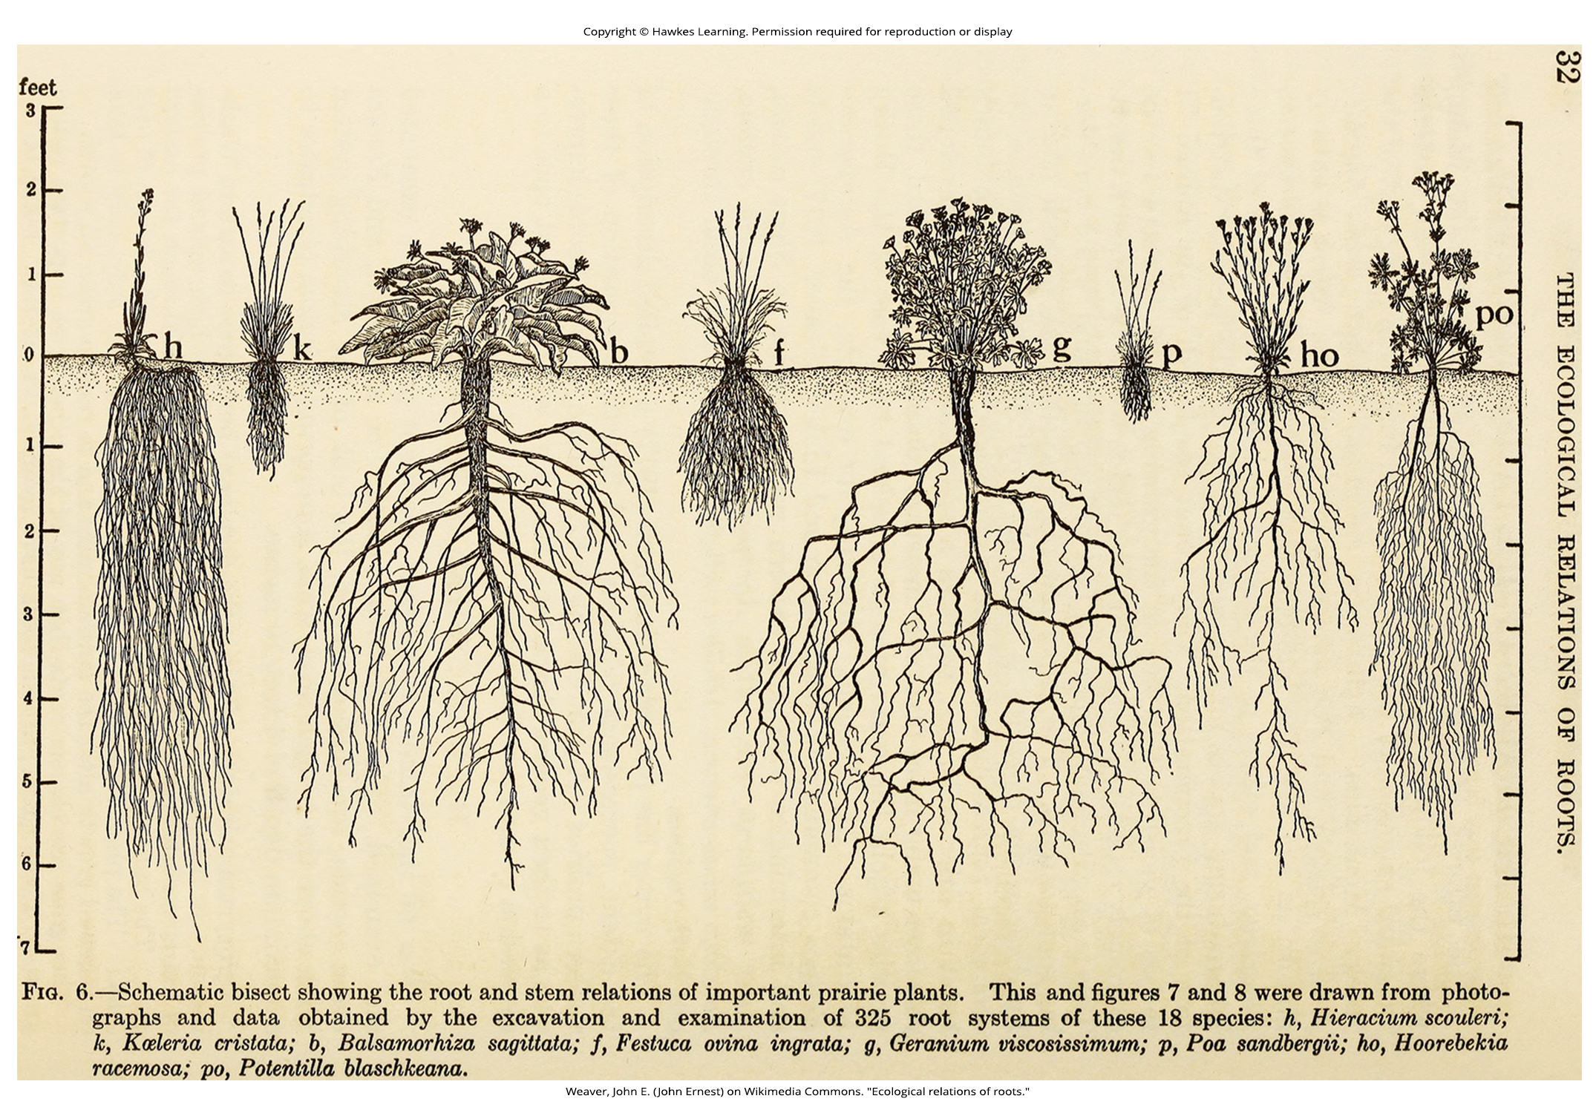
Lesson 31.1 Figure 12

Slide 14
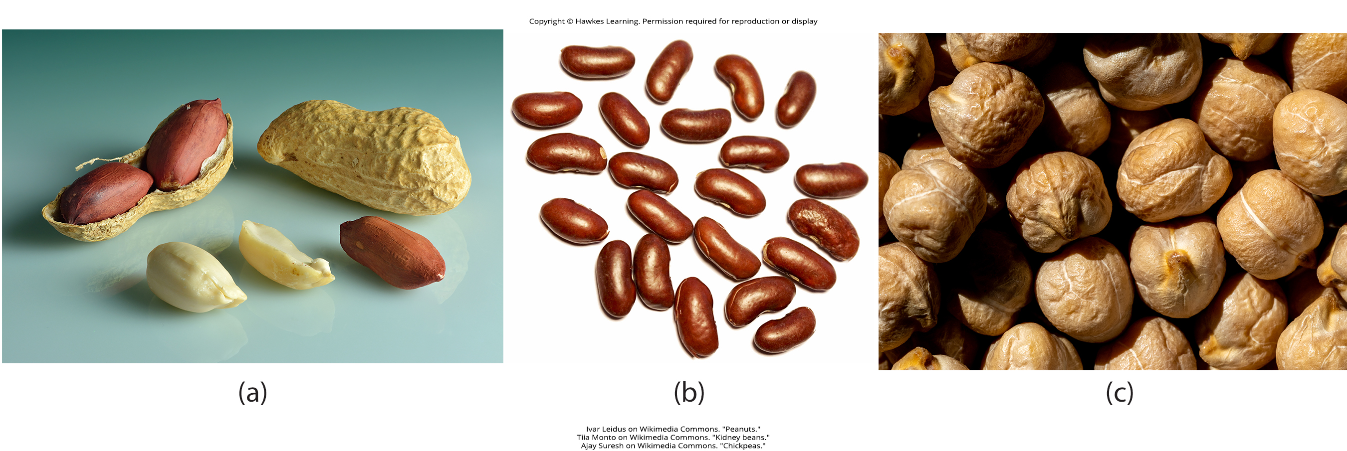
Lesson 31.2 Figure 1

Slide 15
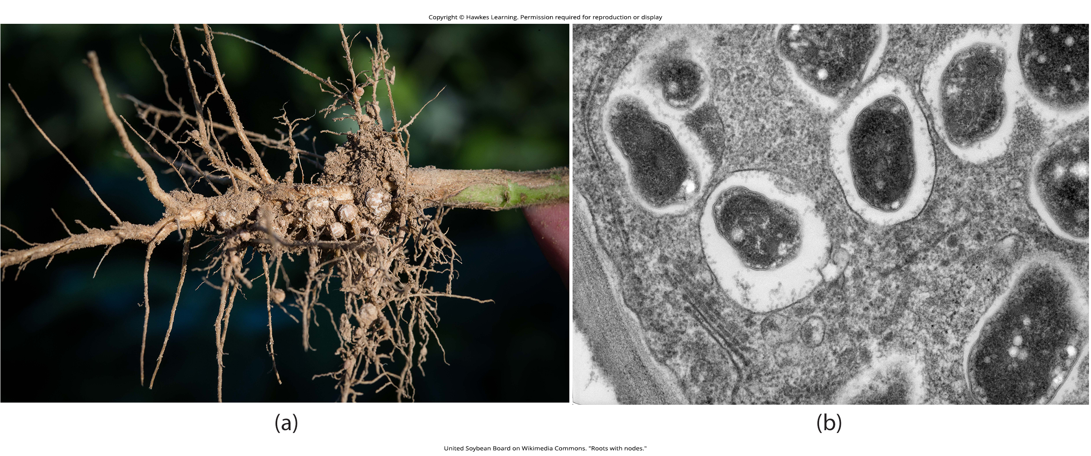
Lesson 31.2 Figure 2

Slide 16
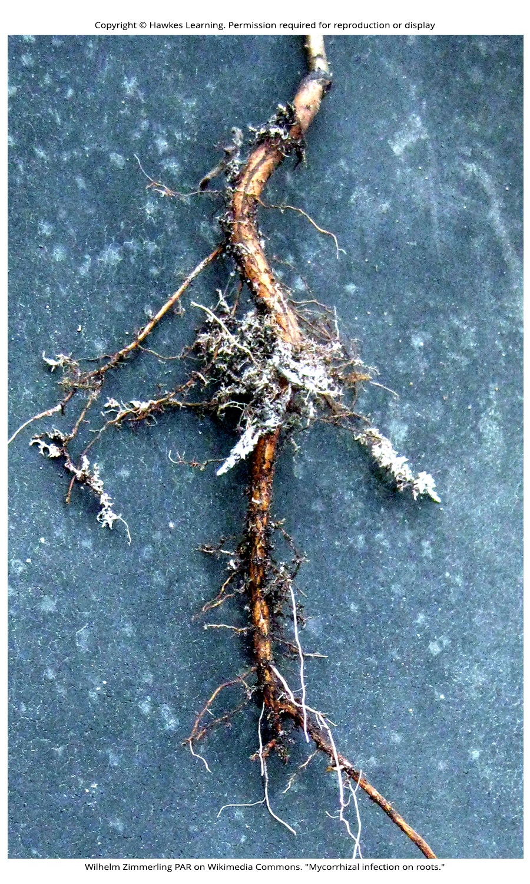
Lesson 31.2 Figure 3

Slide 17
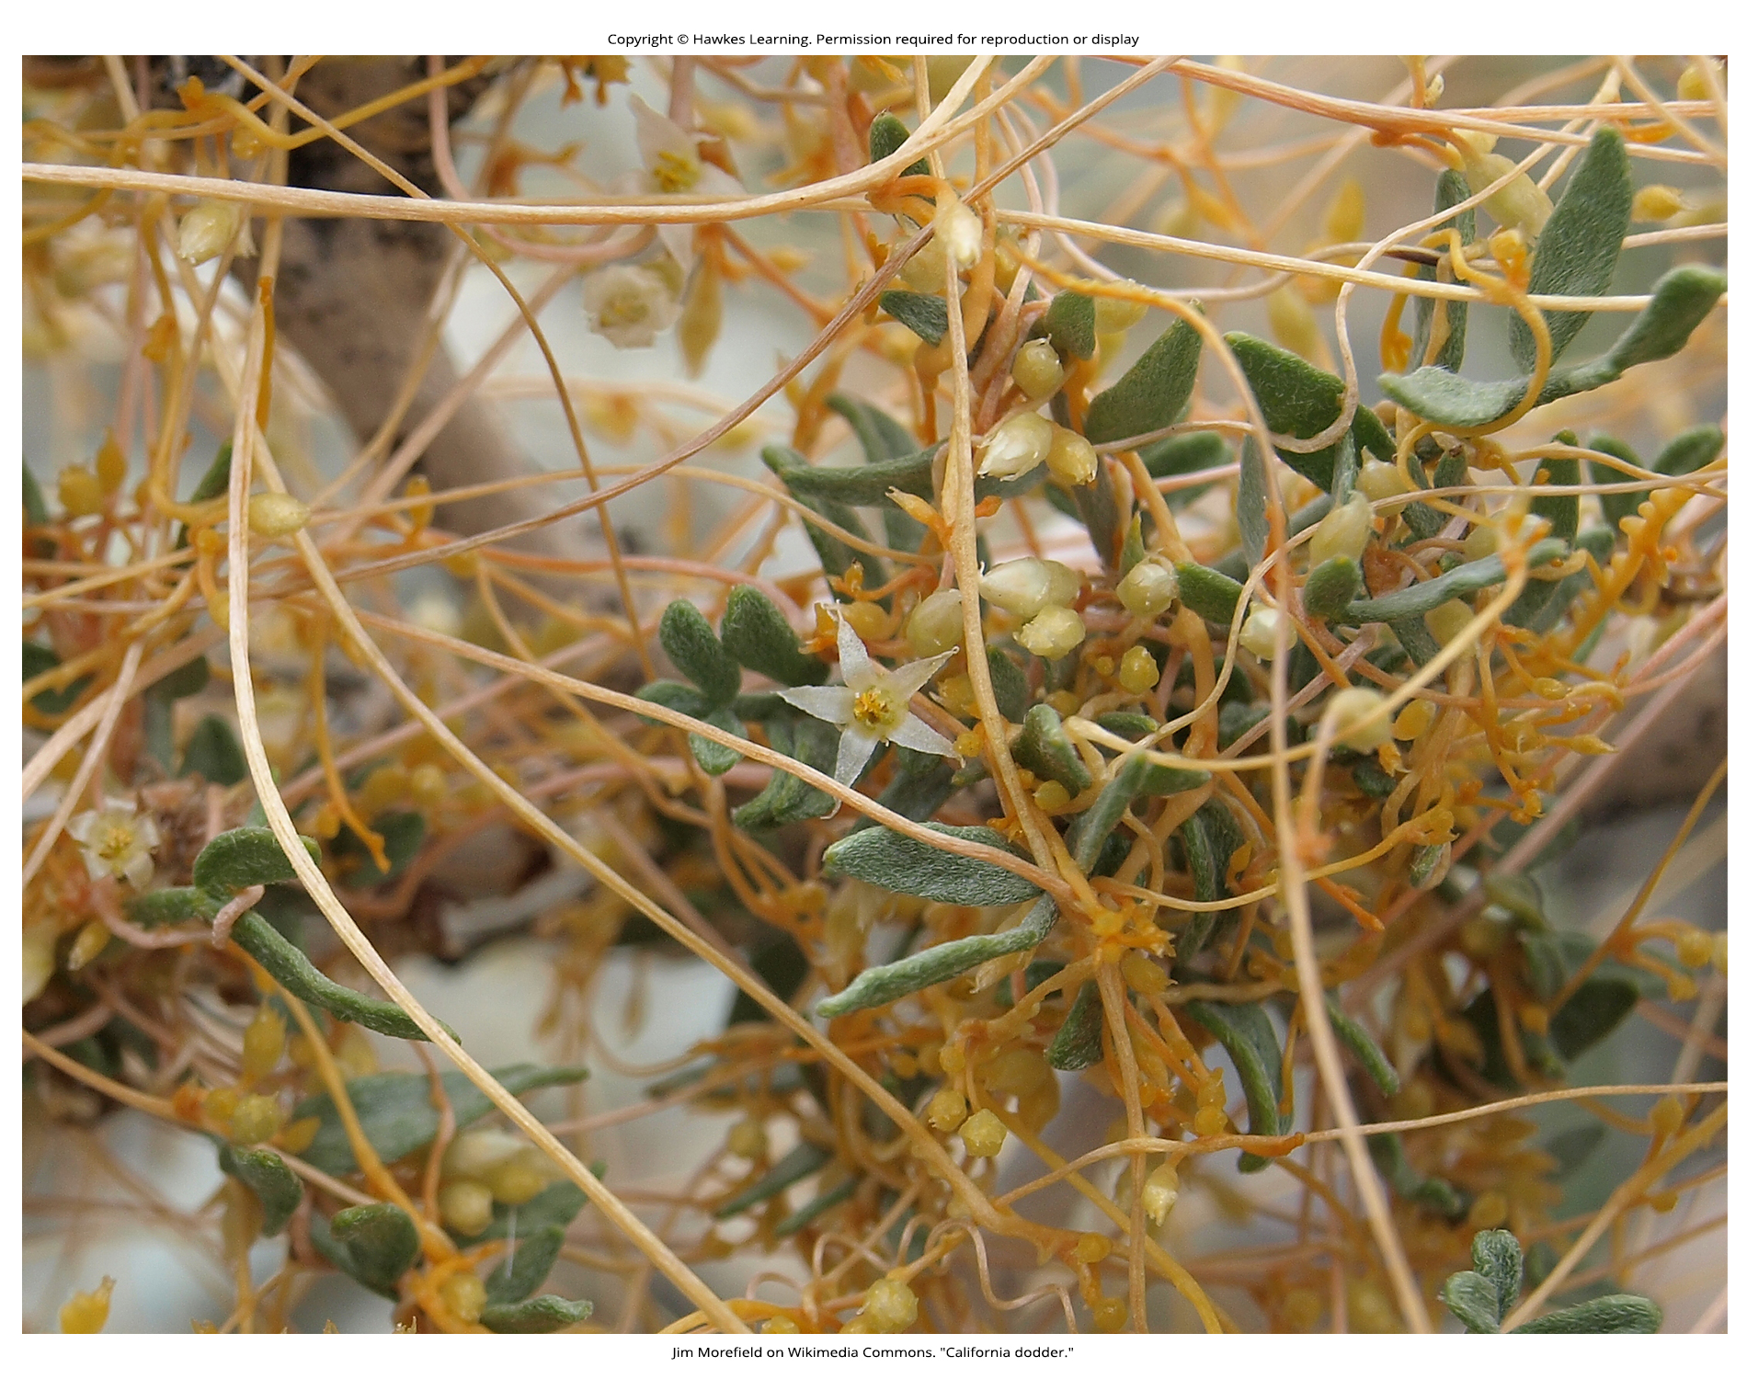
Lesson 31.2 Figure 4

Slide 18
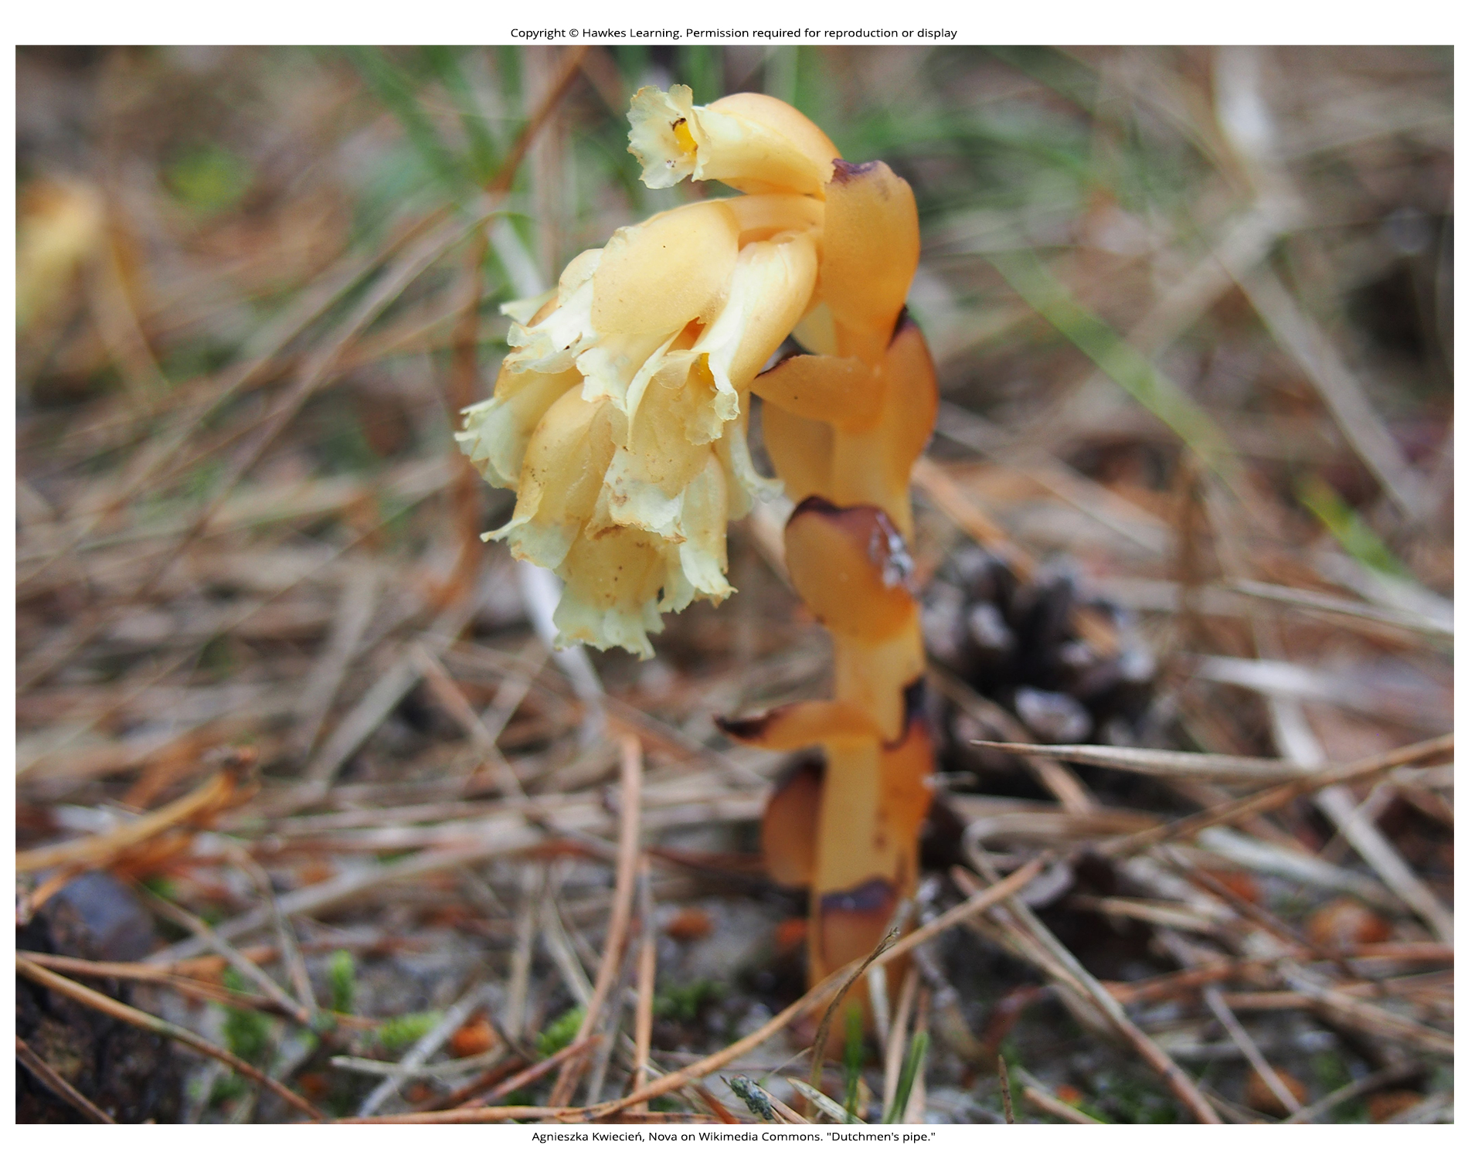
Lesson 31.2 Figure 5

Slide 19
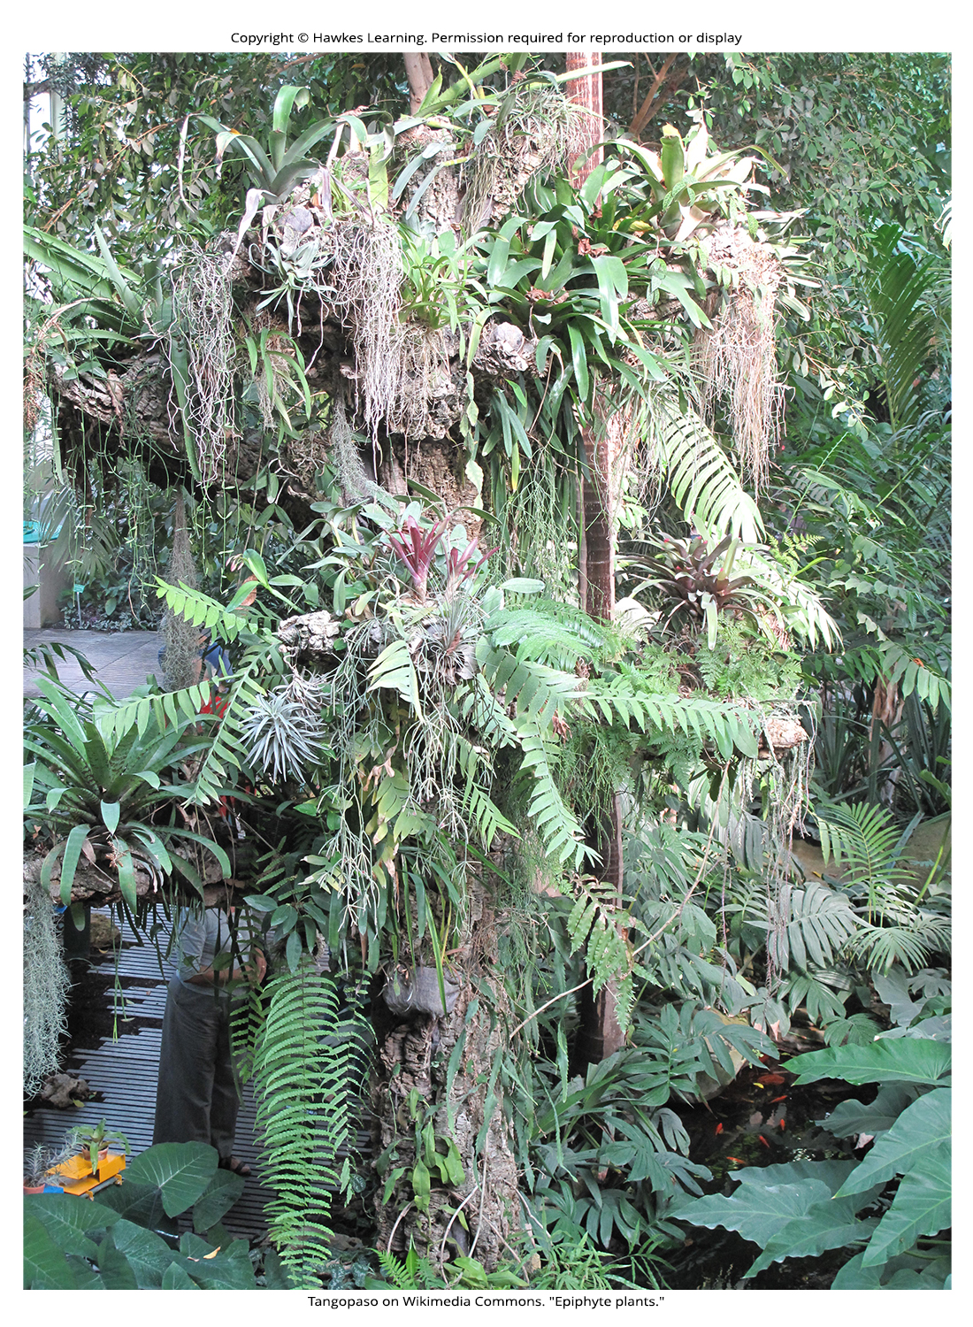
Lesson 31.2 Figure 6

Slide 20
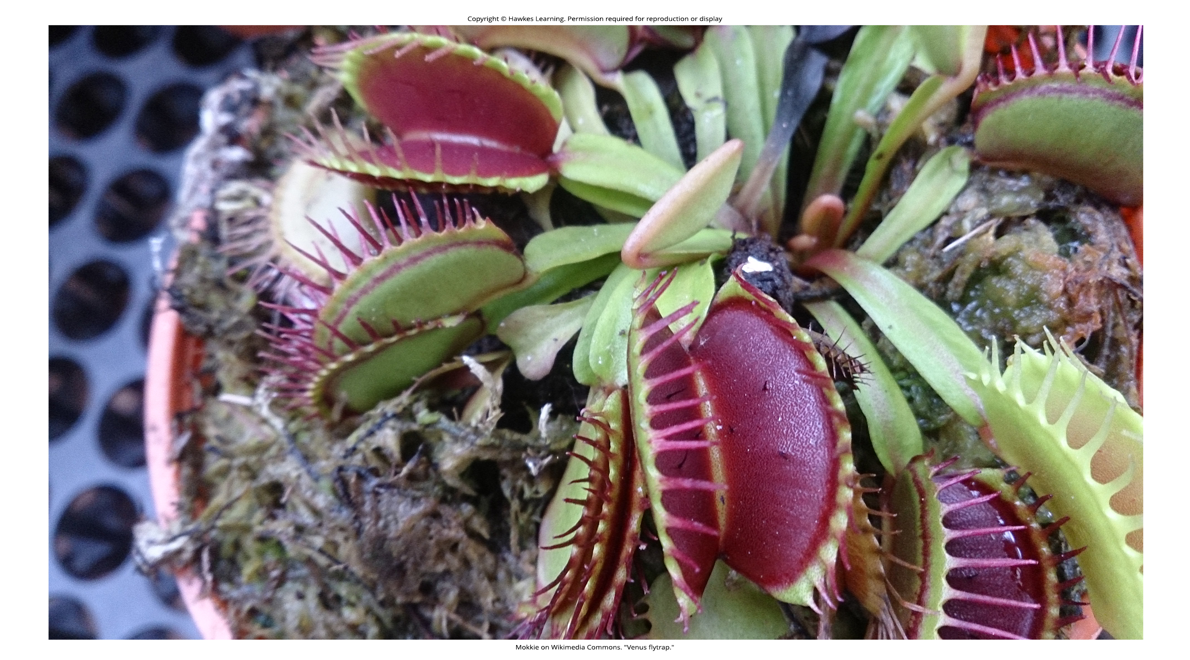
Lesson 31.2 Figure 7

Slide 21
Hawkes Learning – End of PowerPoint

