Slide 1
Chapter 33
The Animal Body

Slide 2
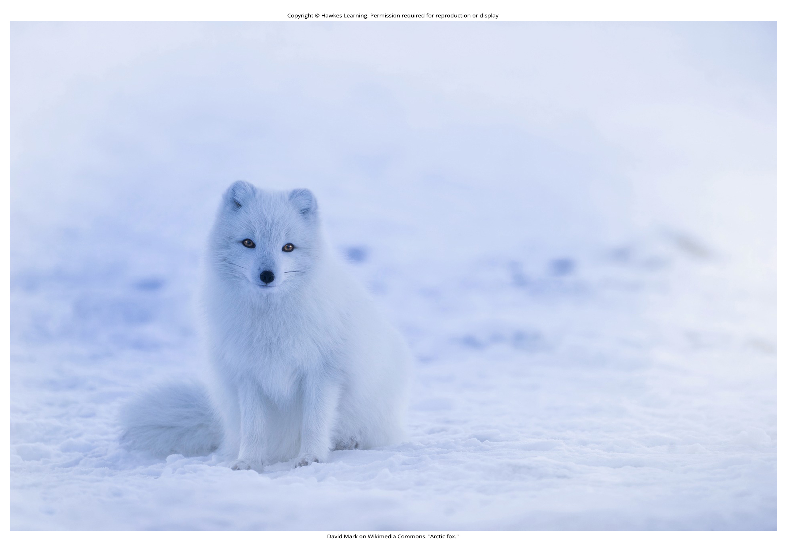
Lesson 33.1 Figure 1

Slide 3
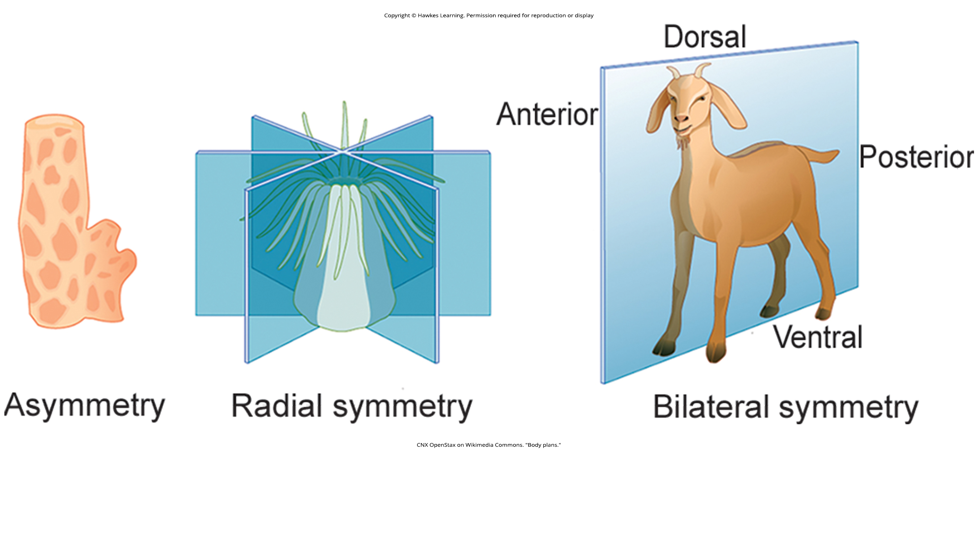
Lesson 33.1 Figure 2

Slide 4
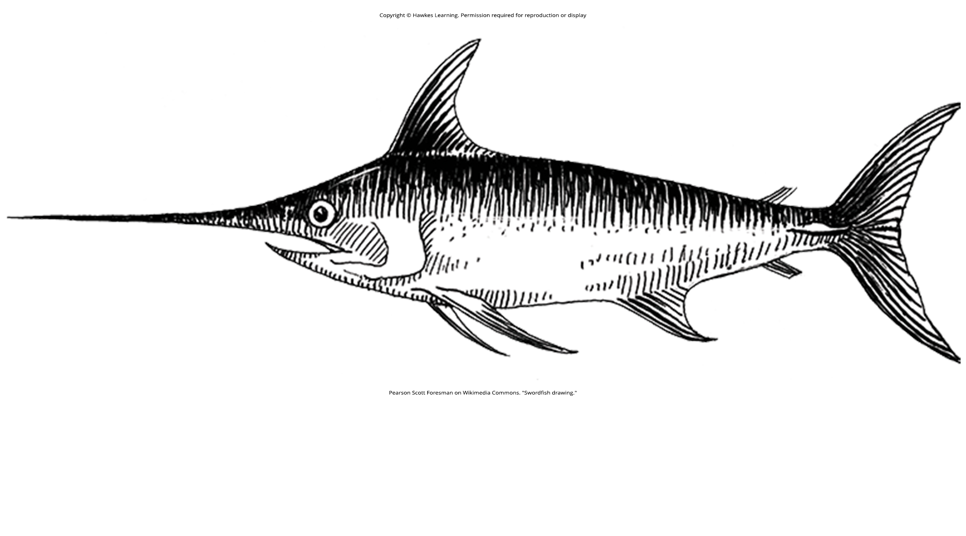
Lesson 33.1 Figure 3

Slide 5
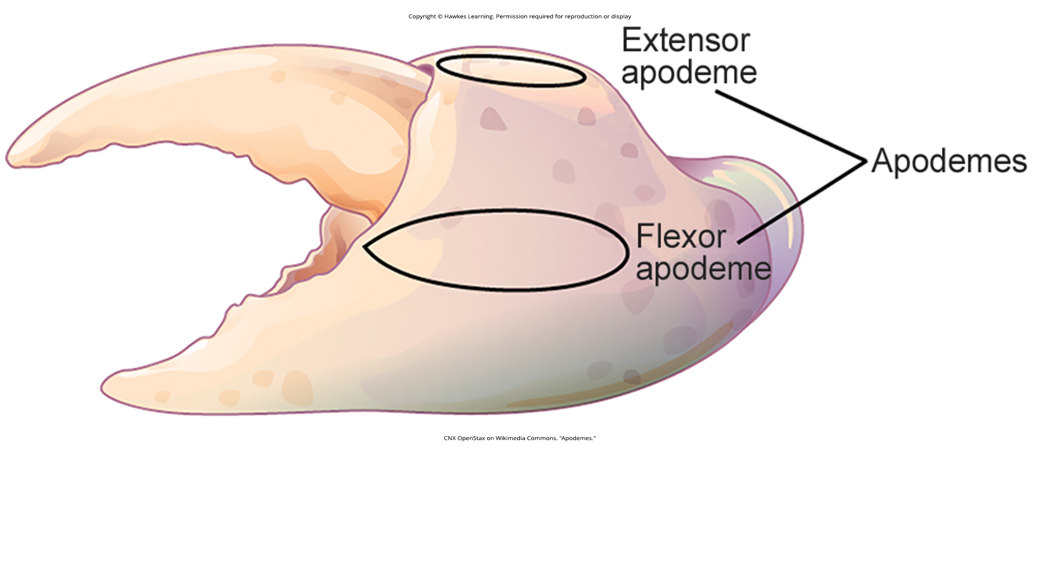
Lesson 33.1 Figure 4

Slide 6
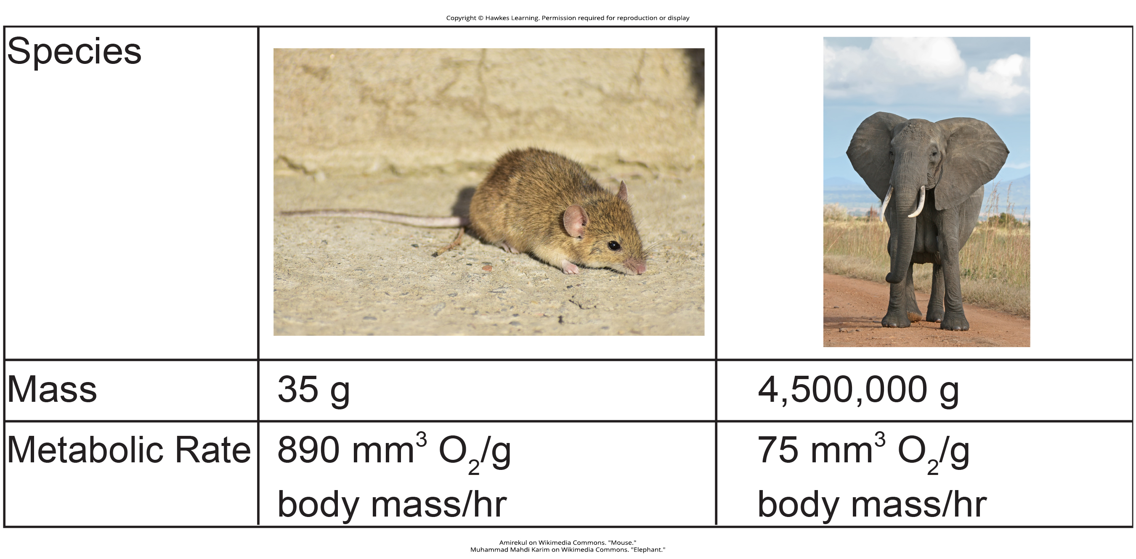
Lesson 33.1 Figure 5

Slide 7
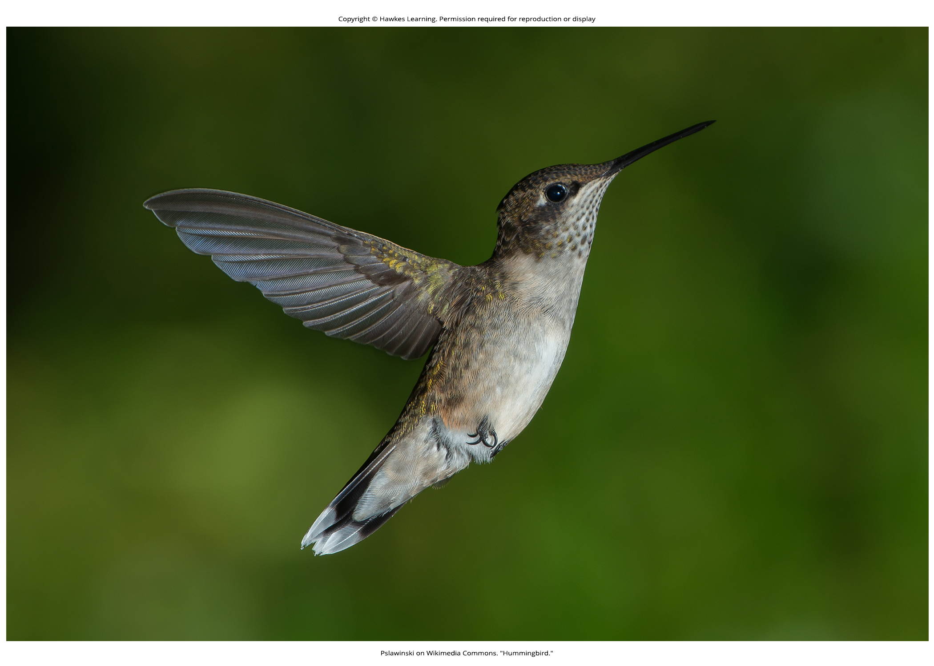
Lesson 33.1 Figure 6

Slide 8
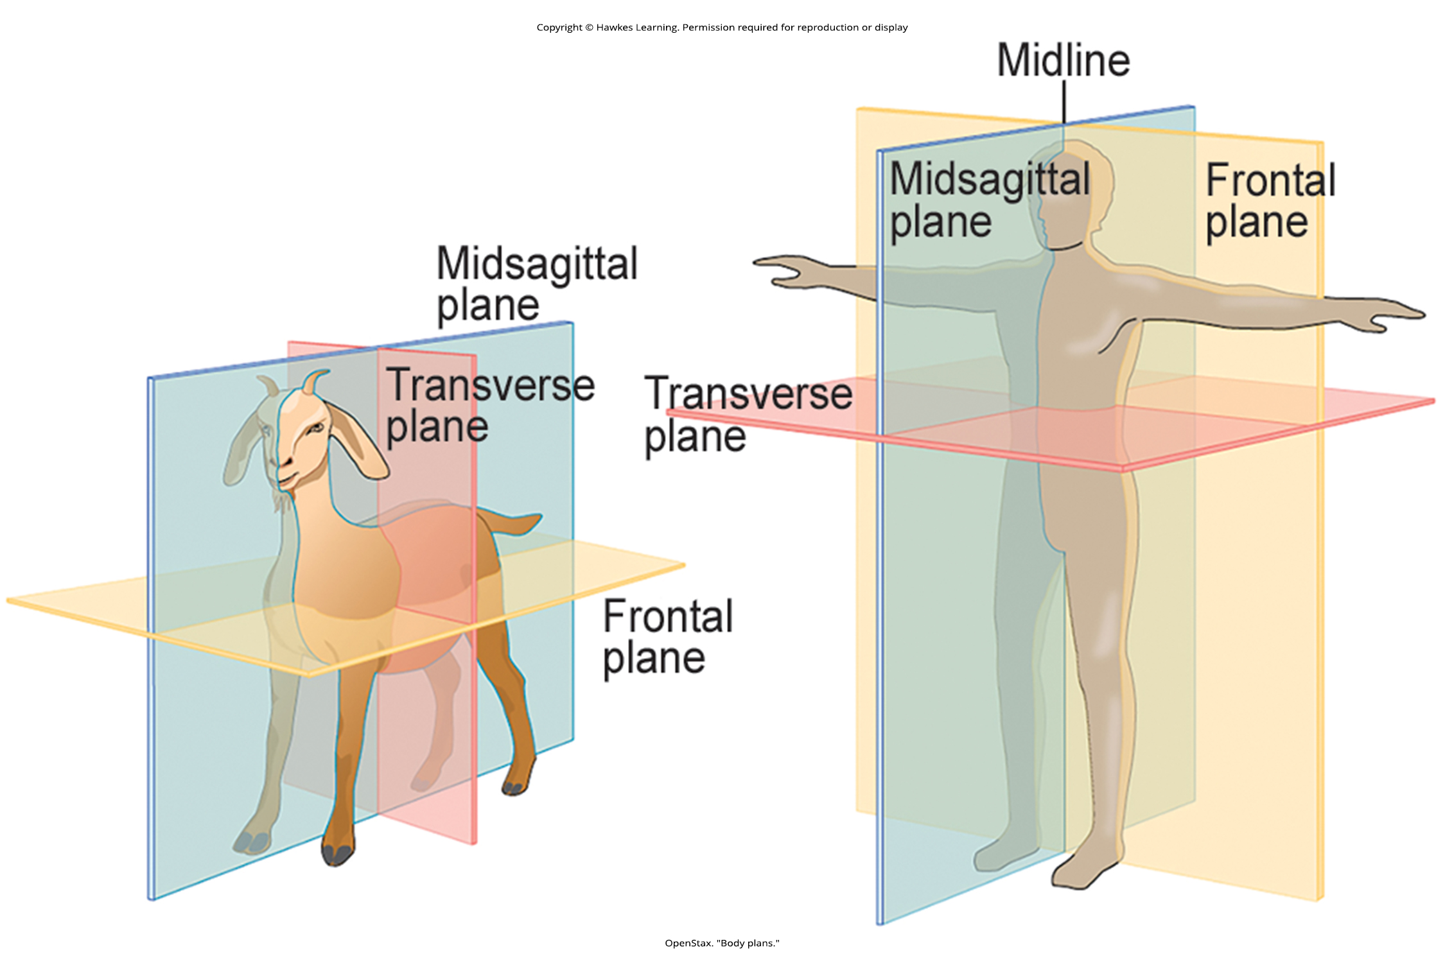
Lesson 33.1 Figure 7

Slide 9
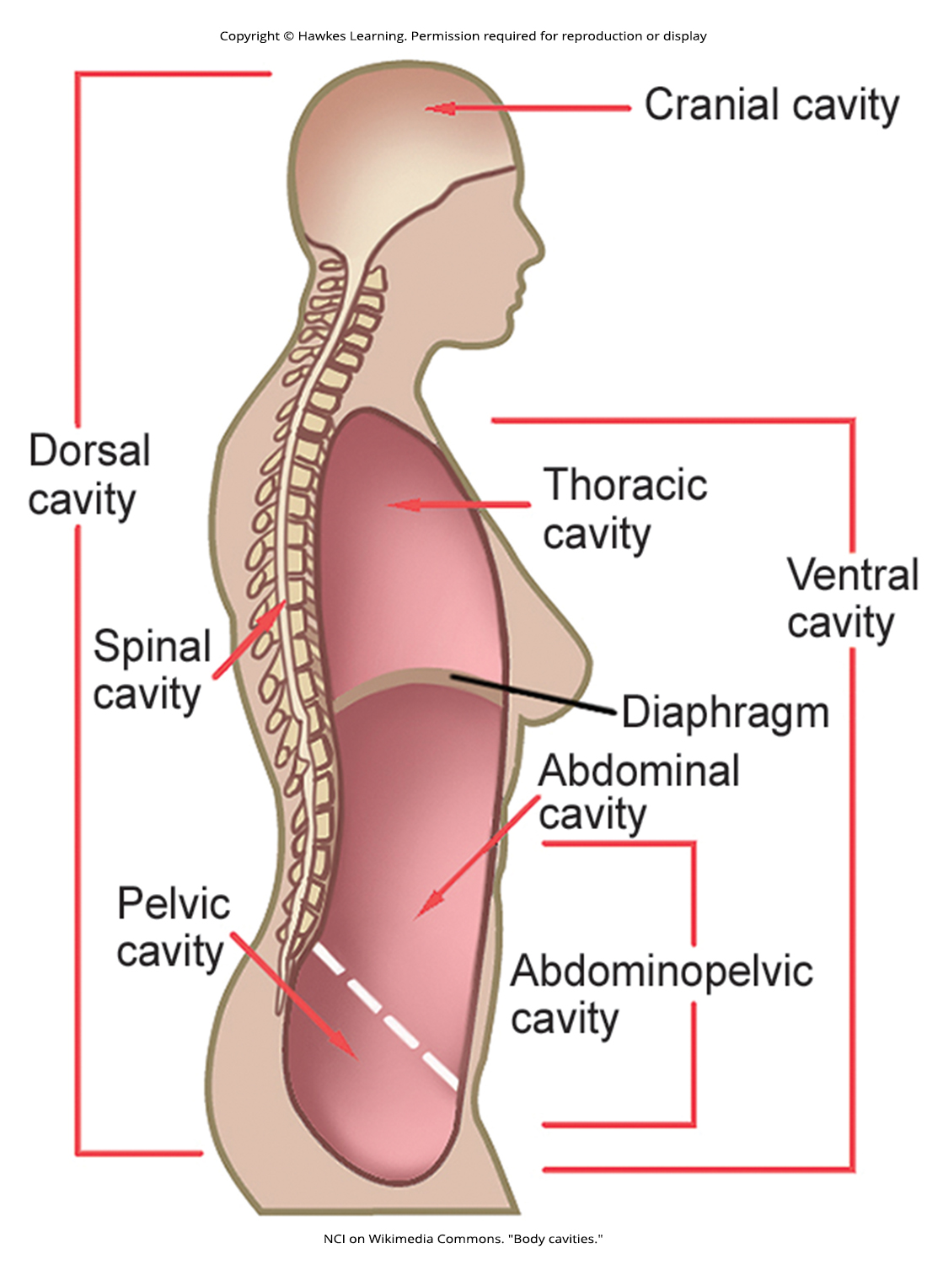
Lesson 33.1 Figure 8

Slide 10
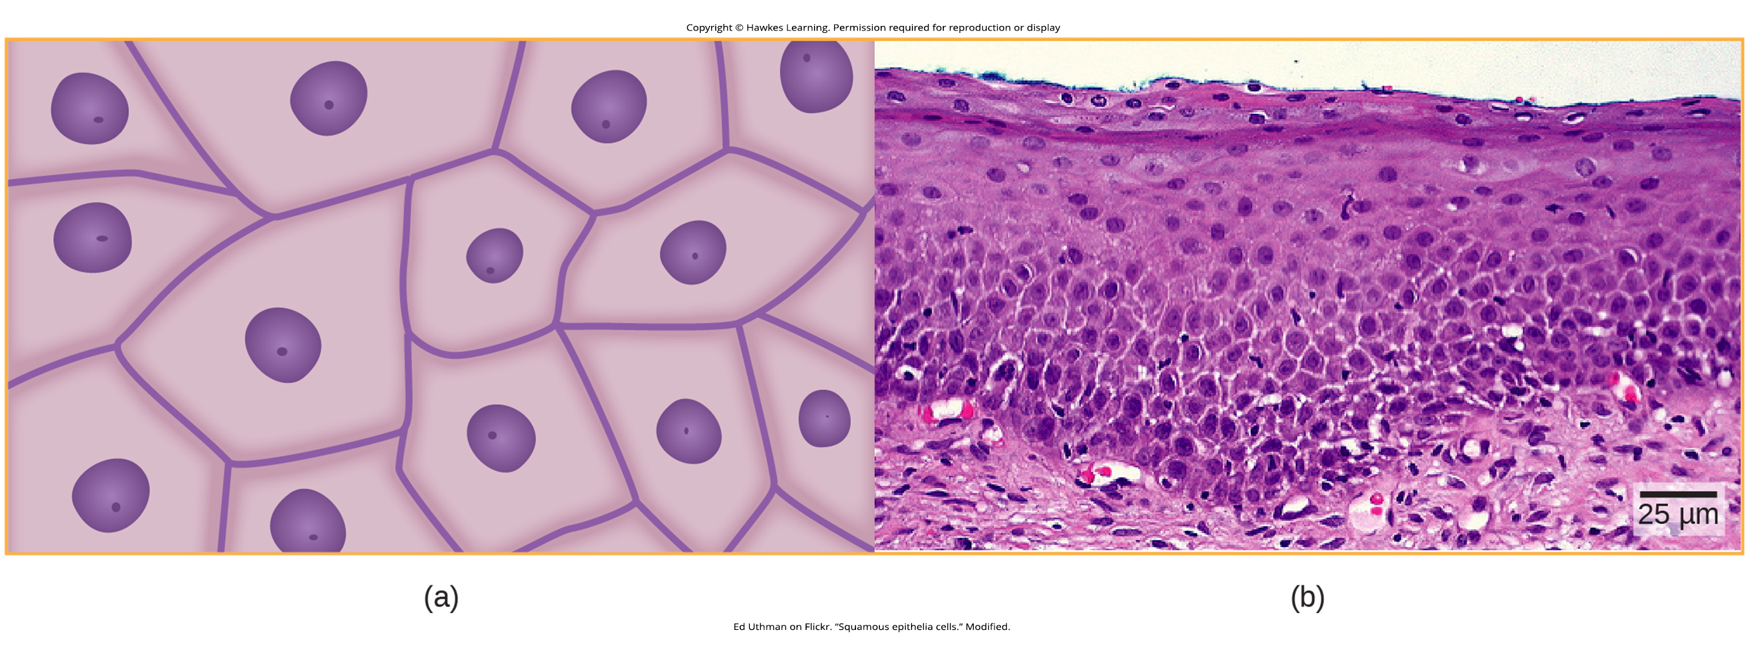
Lesson 33.2 Figure 1

Slide 11
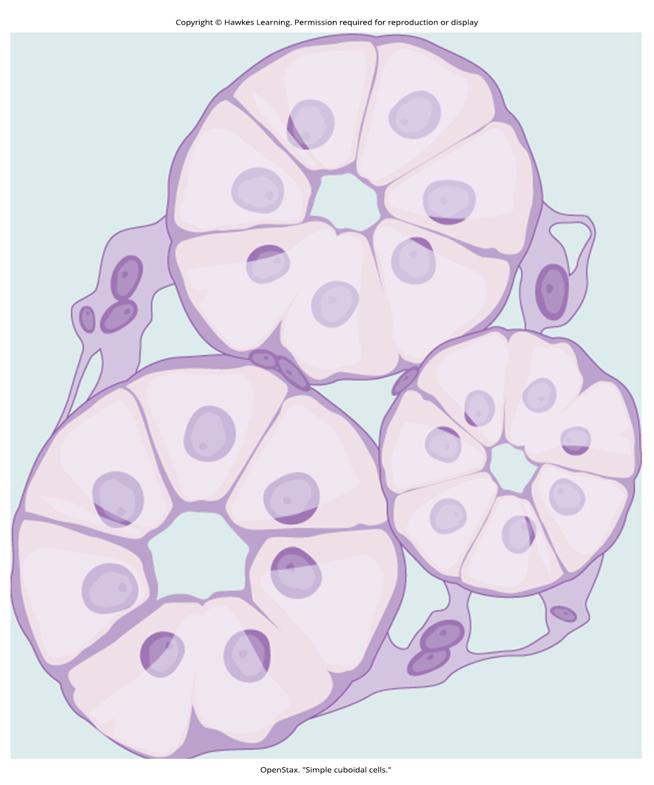
Lesson 33.2 Figure 2

Slide 12
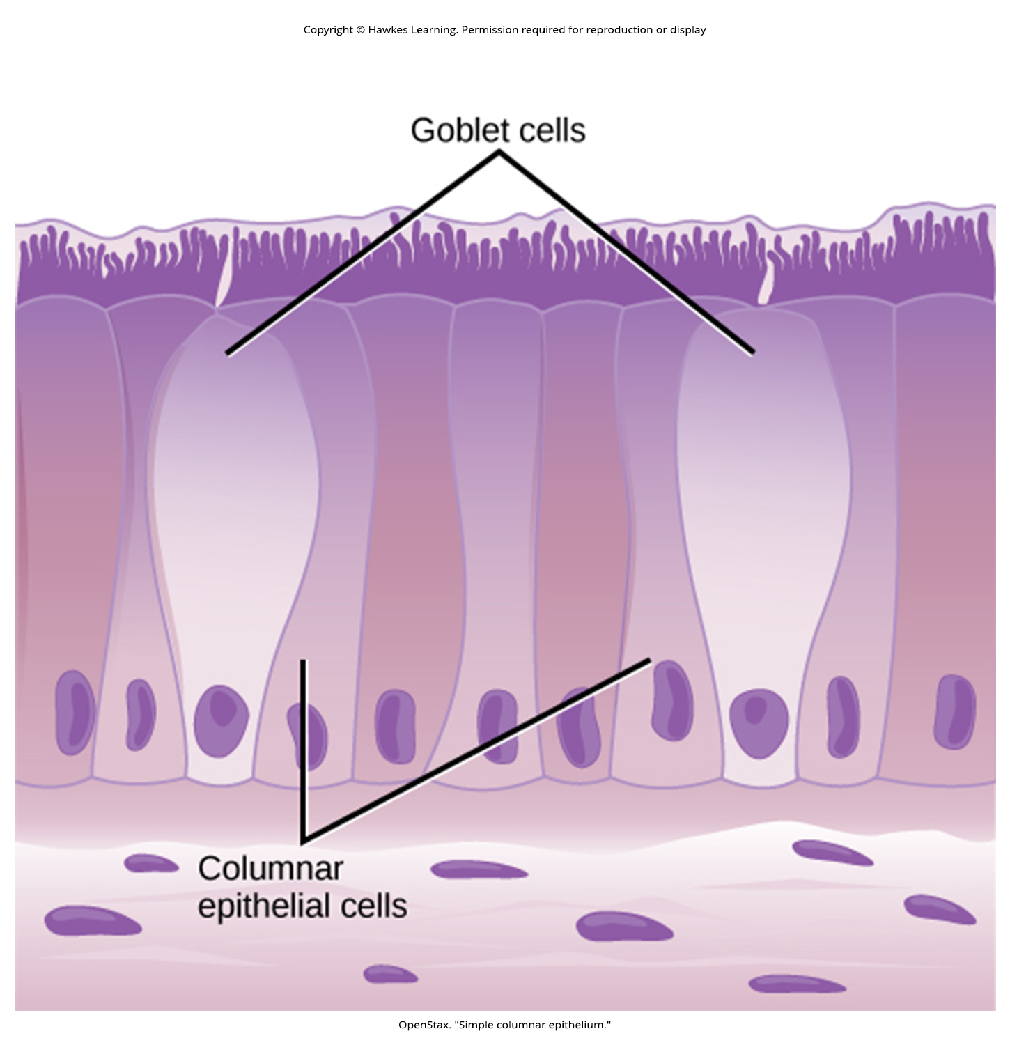
Lesson 33.2 Figure 3

Slide 13
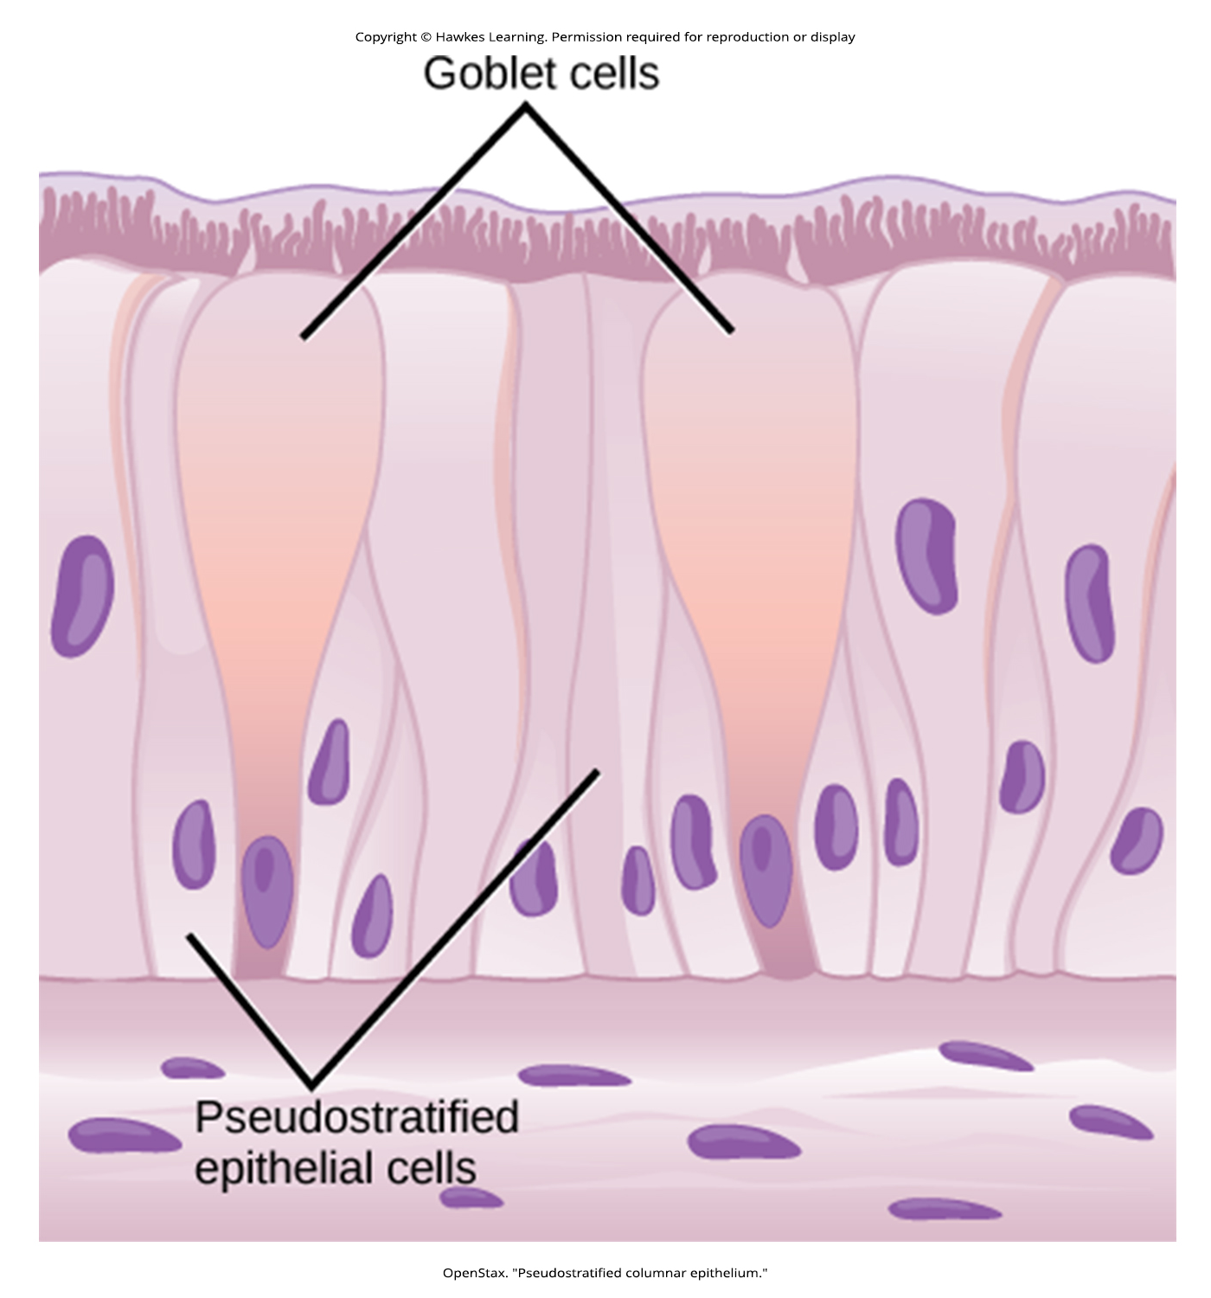
Lesson 33.2 Figure 4

Slide 14
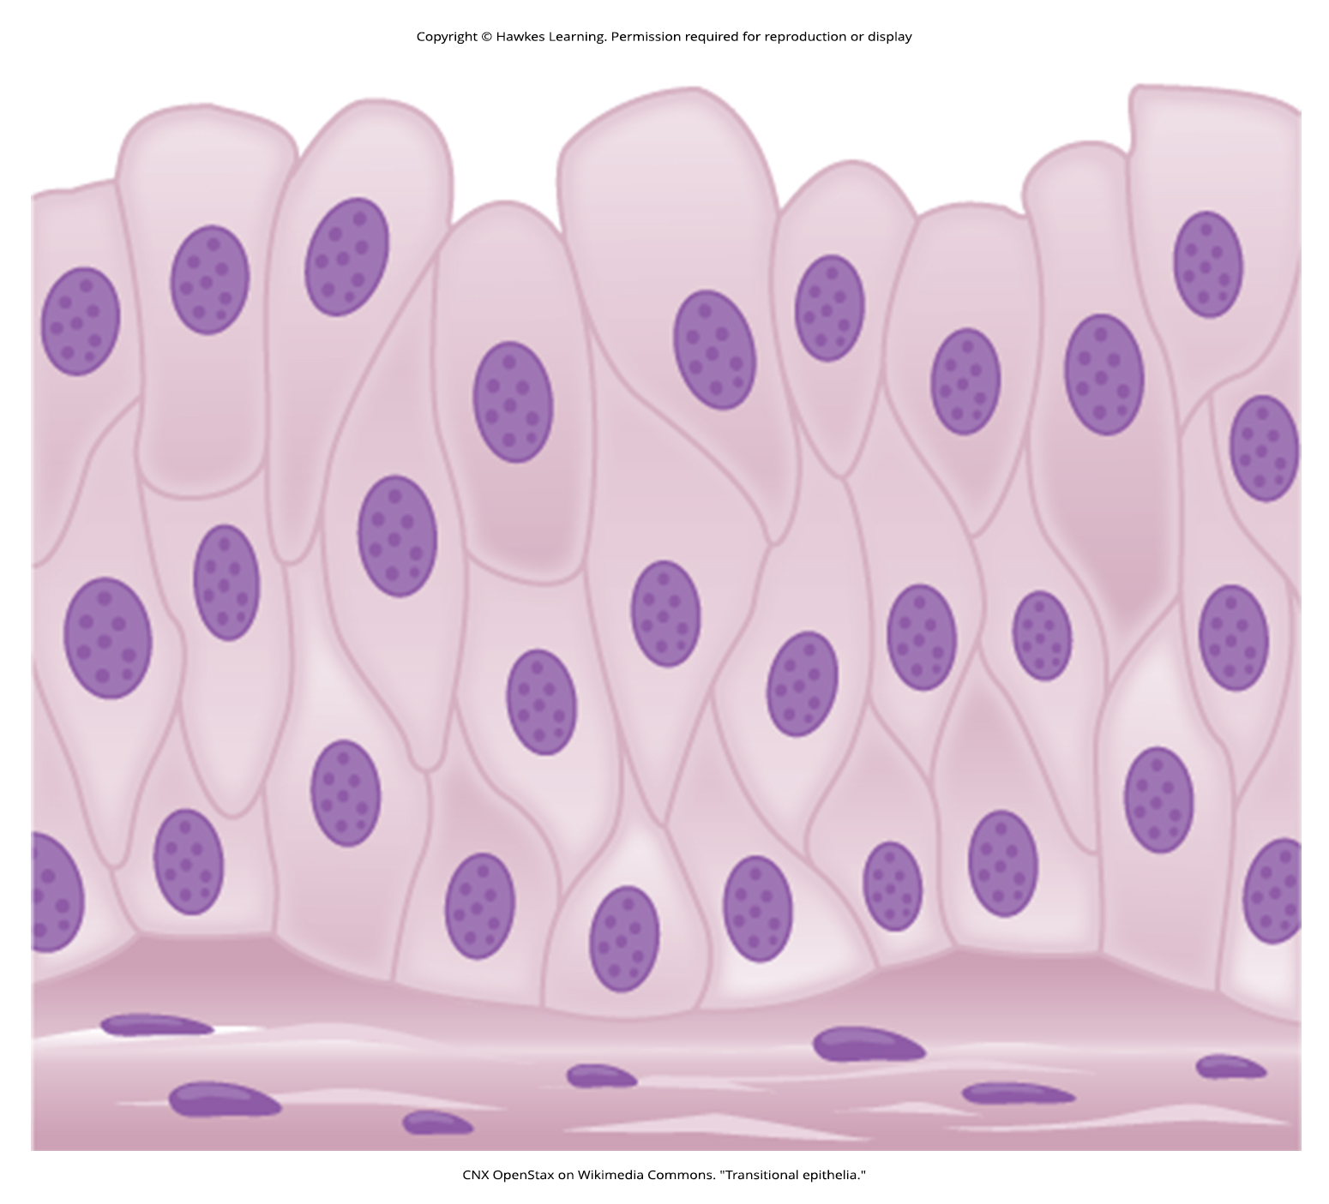
Lesson 33.2 Figure 5

Slide 15
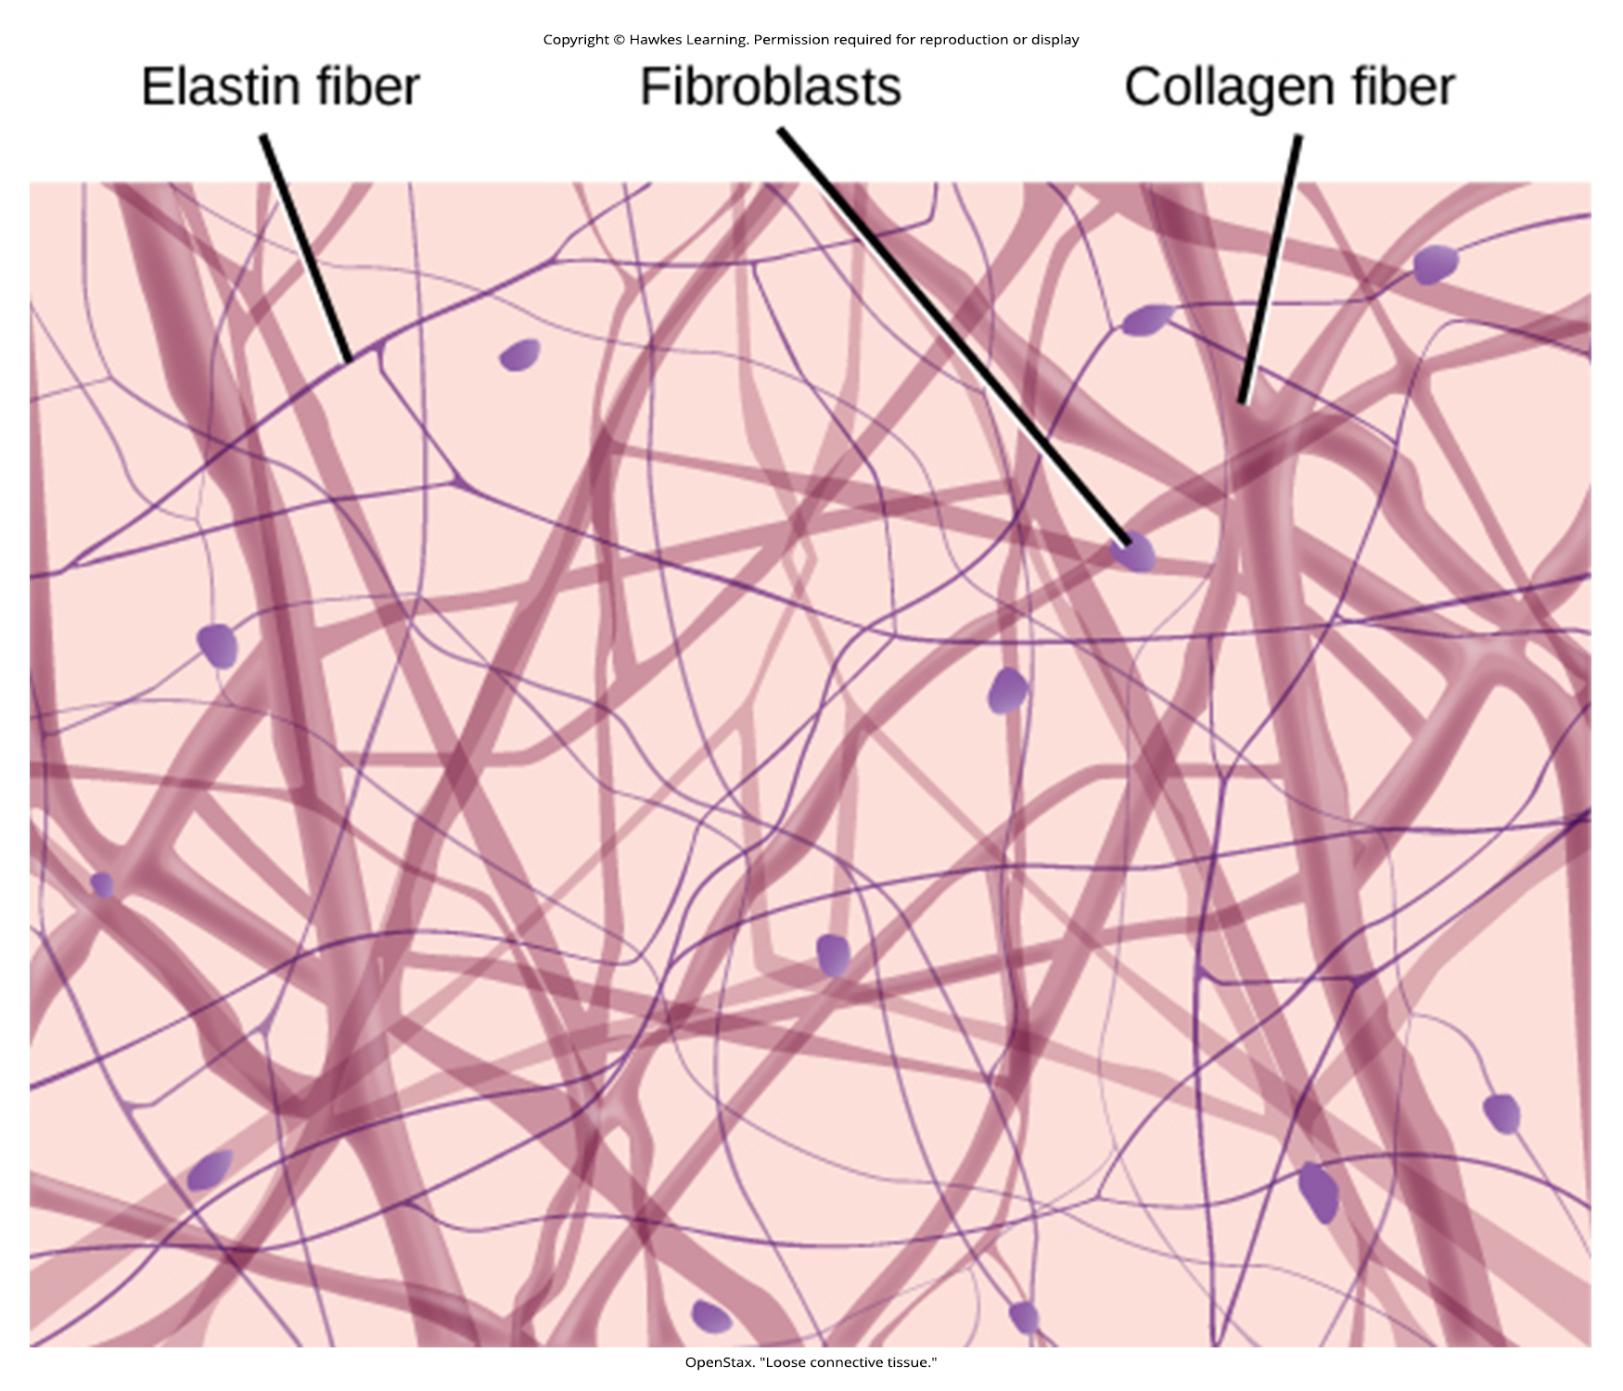
Lesson 33.2 Figure 6

Slide 16
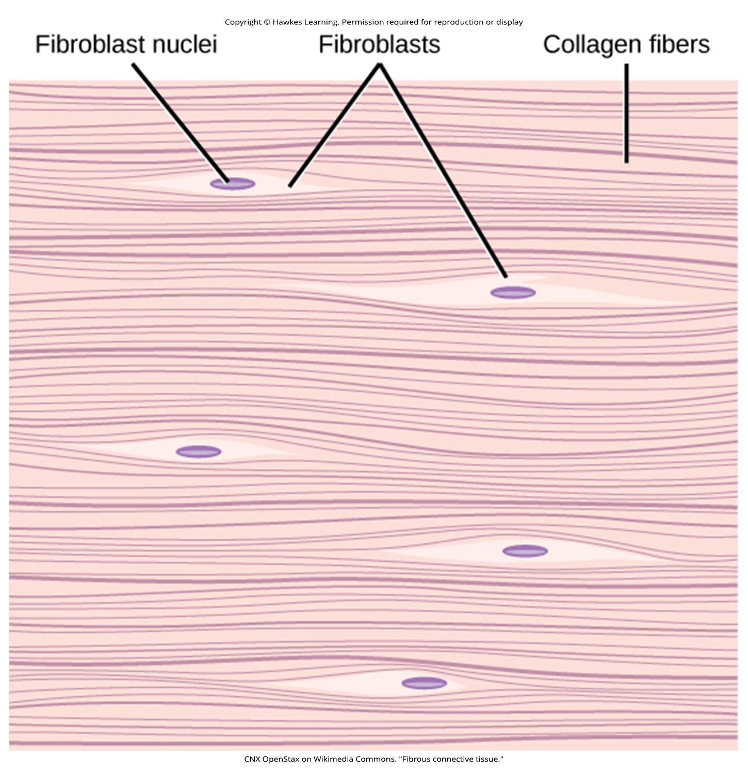
Lesson 33.2 Figure 7

Slide 17
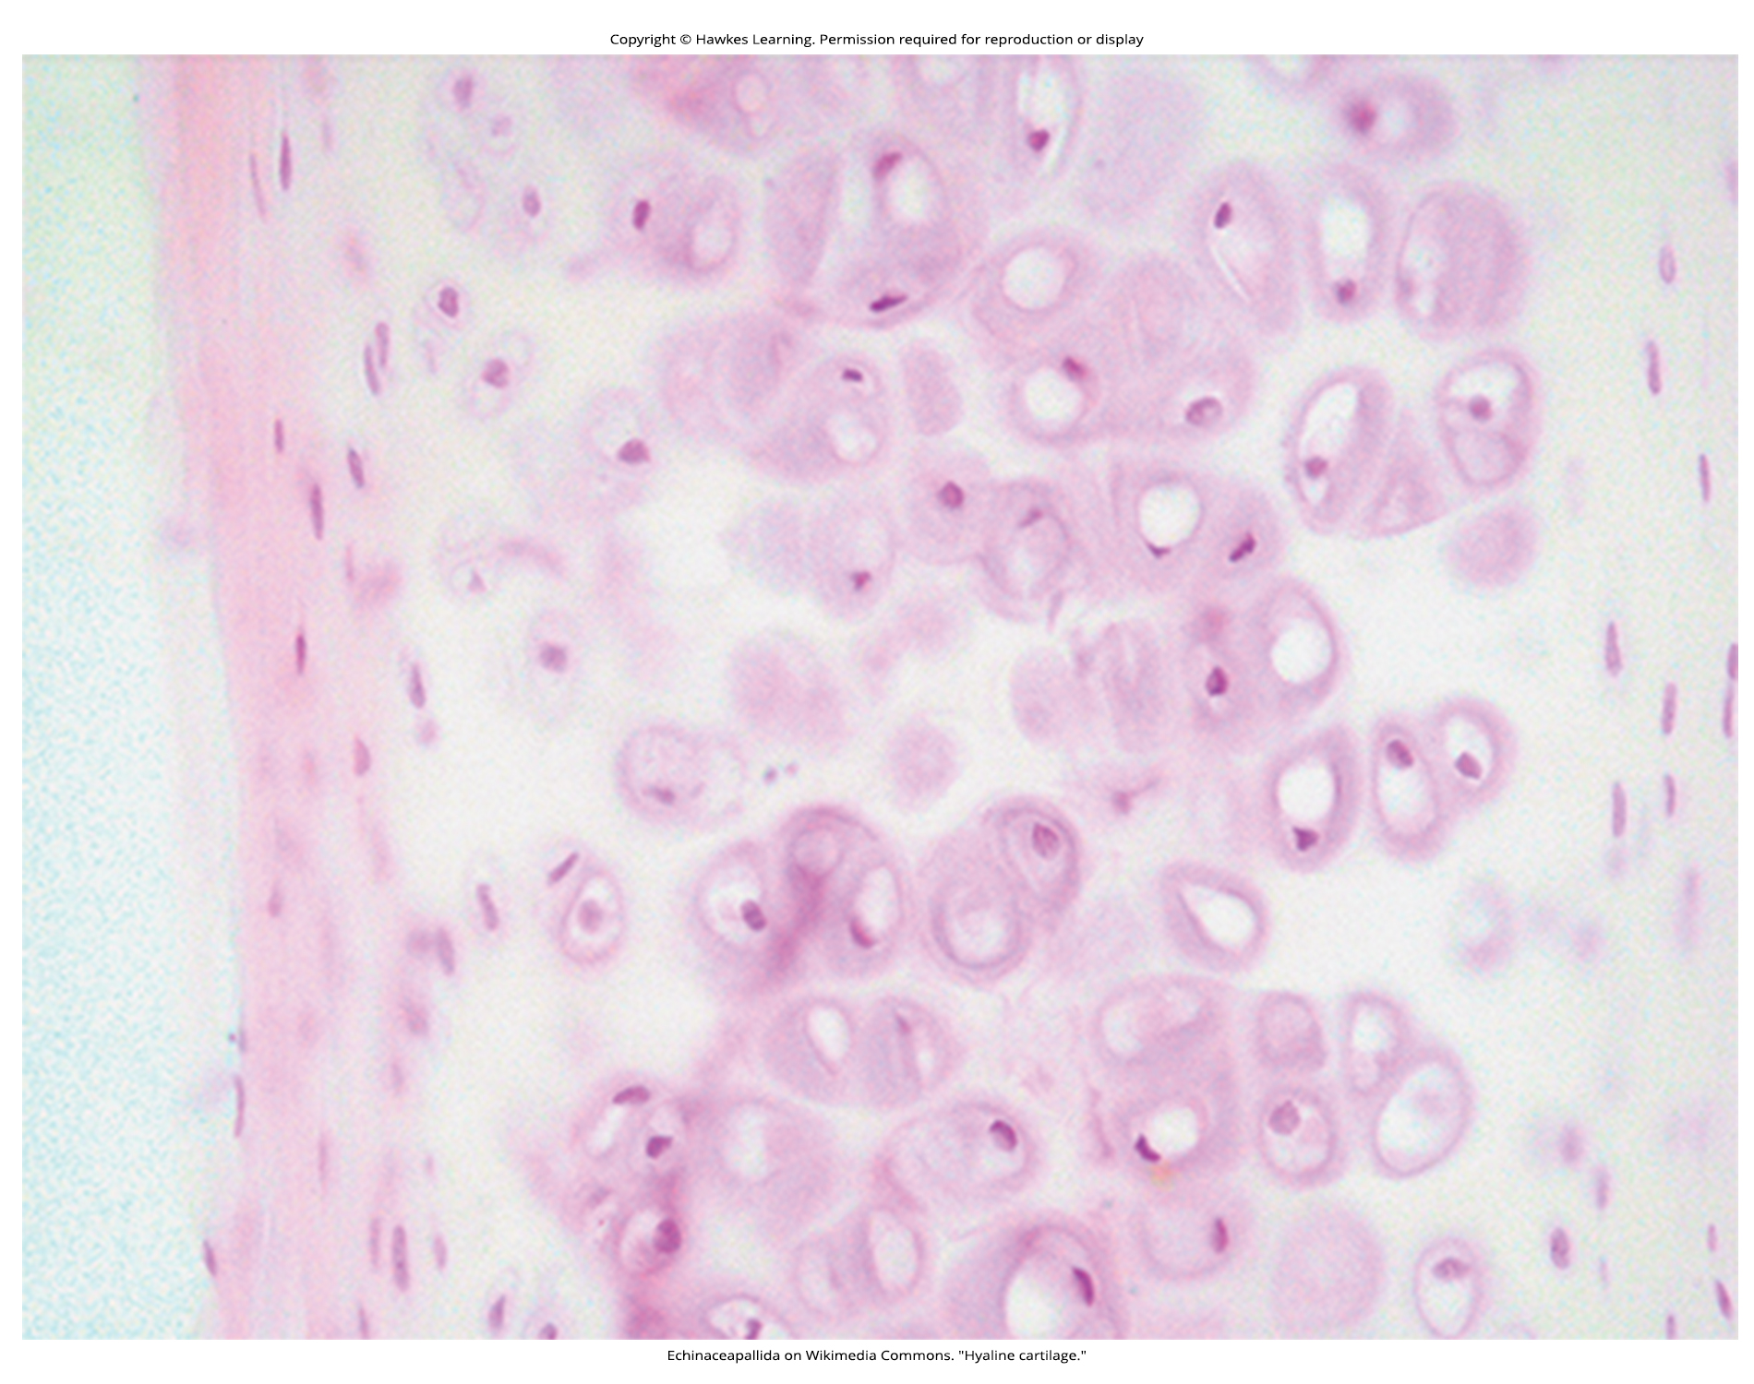
Lesson 33.2 Figure 8

Slide 18
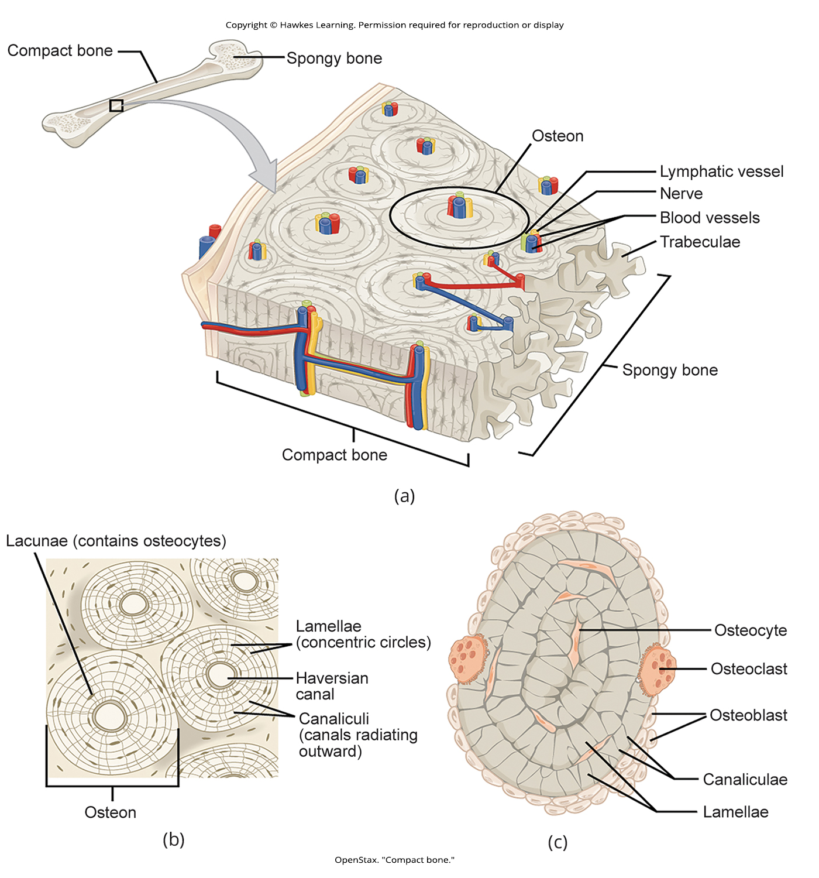
Lesson 33.2 Figure 9

Slide 19
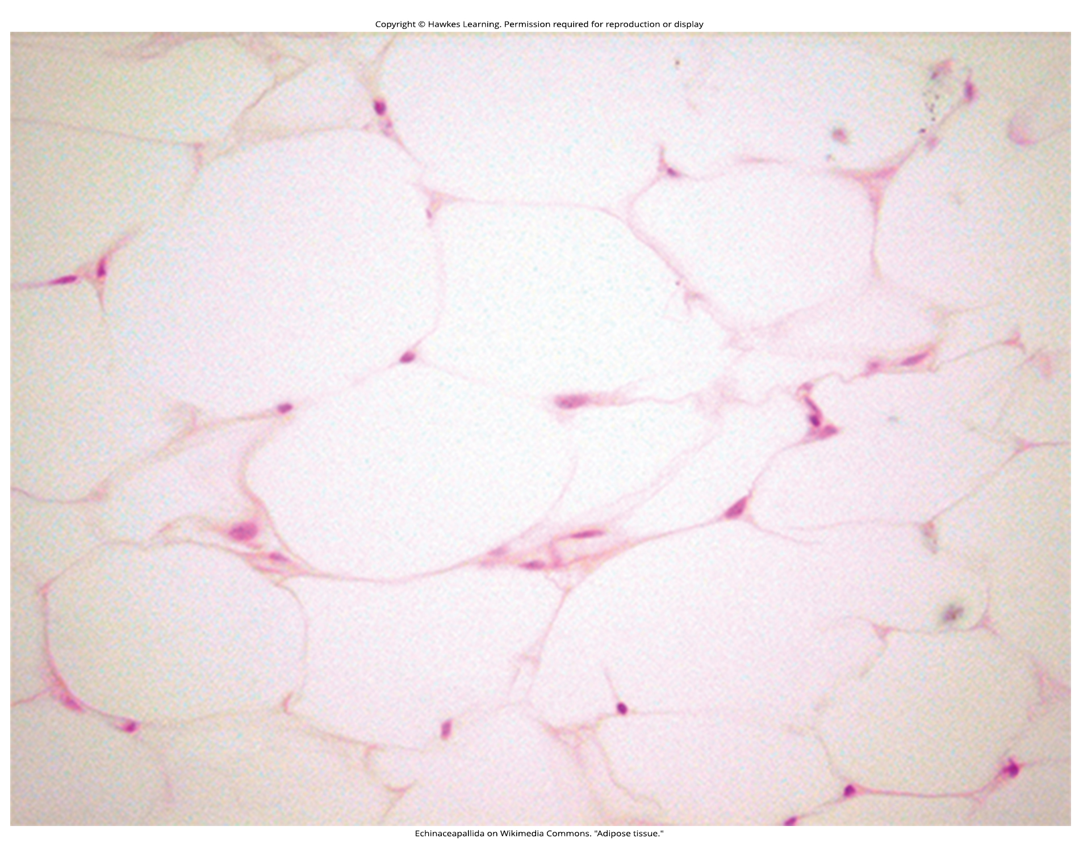
Lesson 33.2 Figure 10

Slide 20
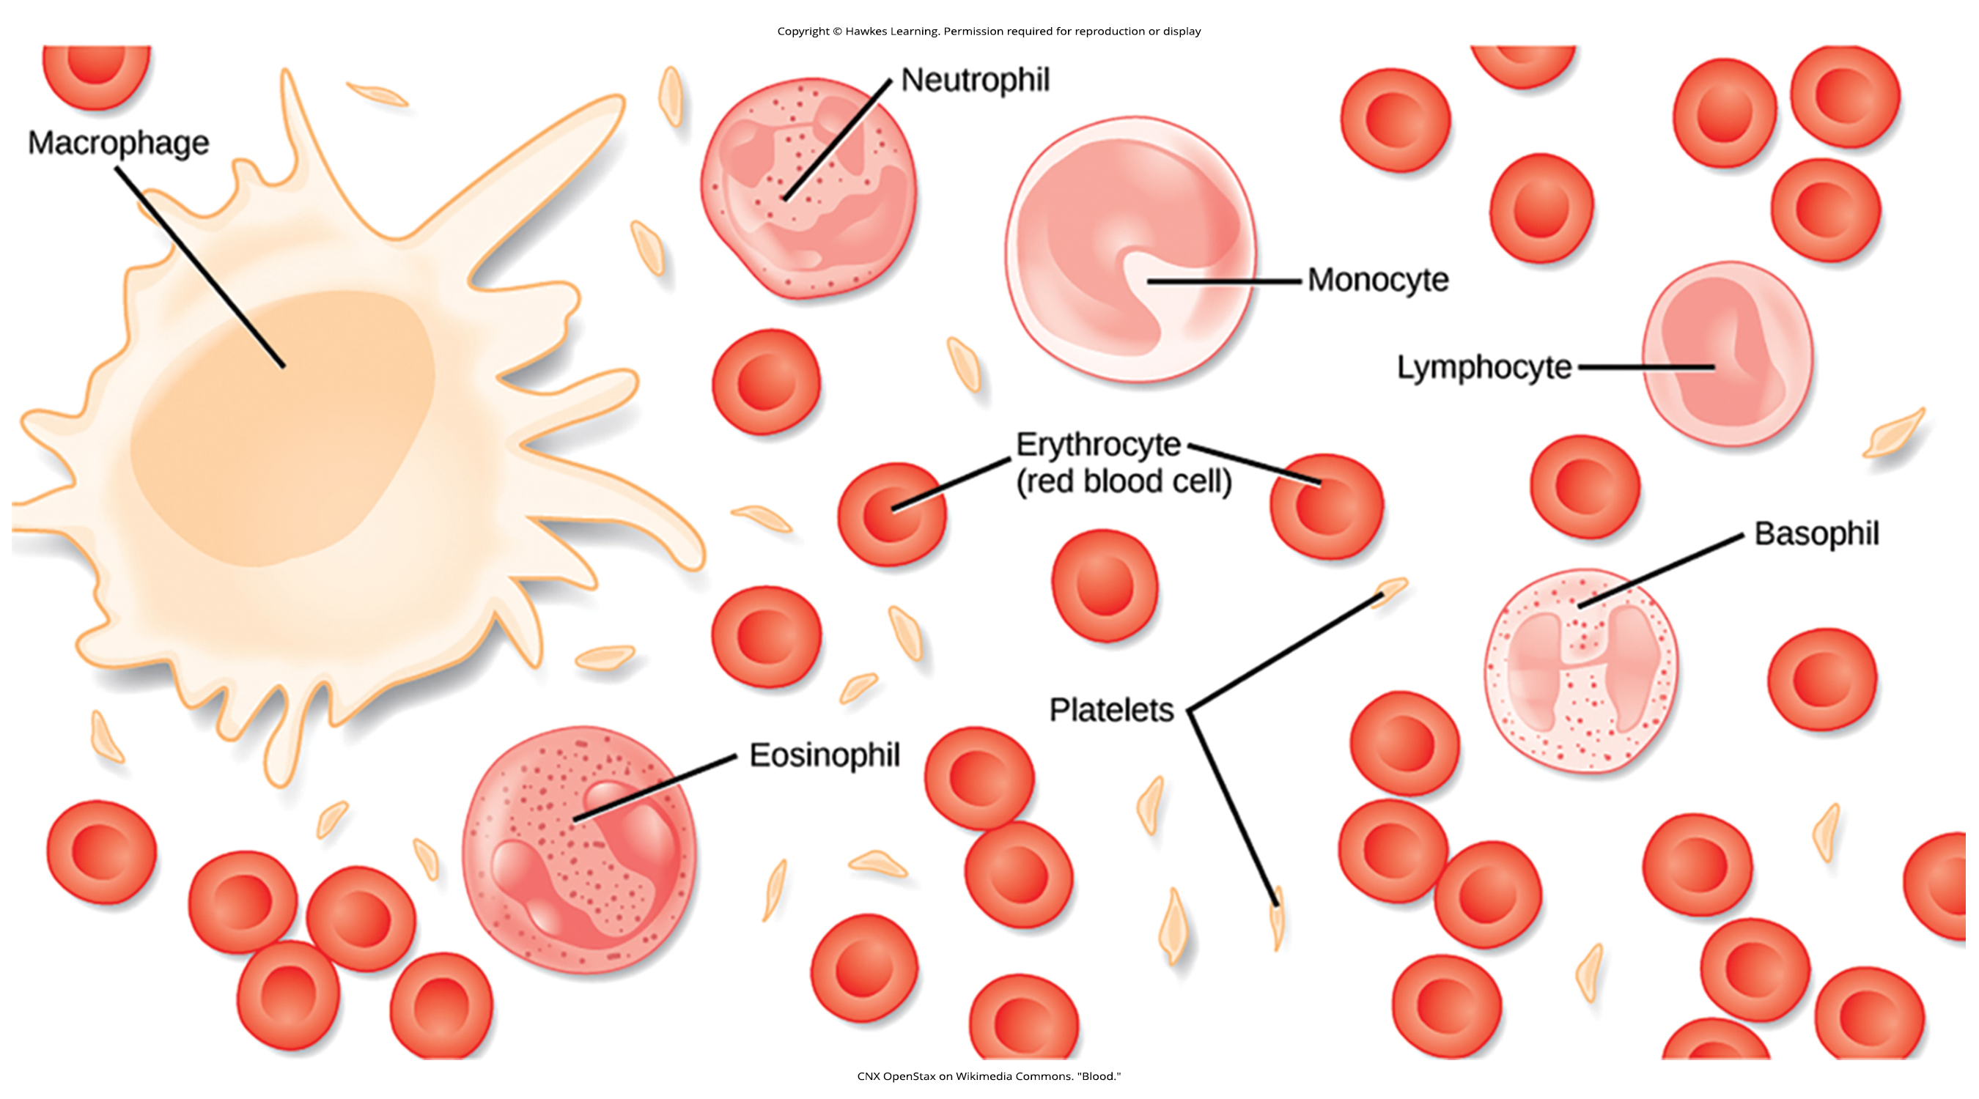
Lesson 33.2 Figure 11

Slide 21
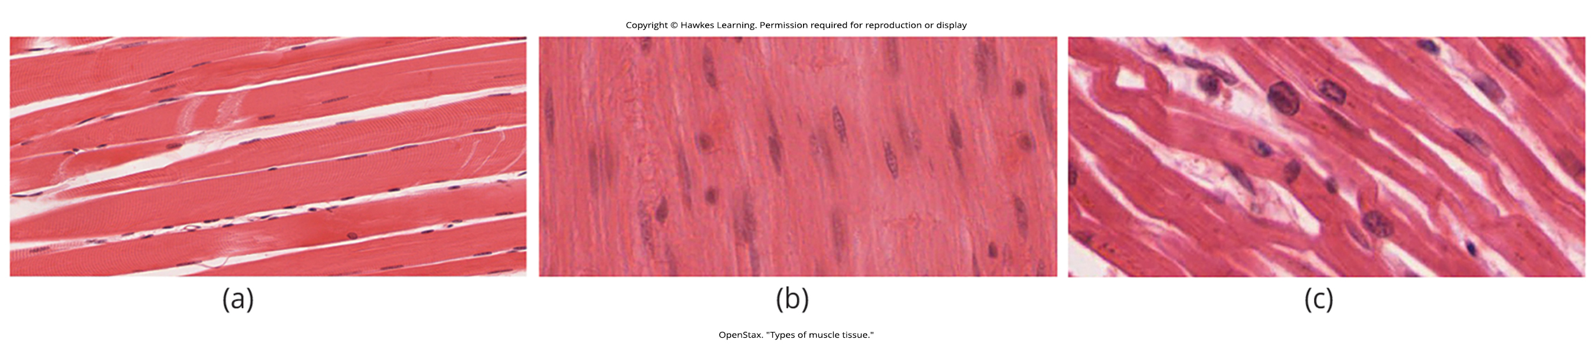
Lesson 33.2 Figure 12

Slide 22
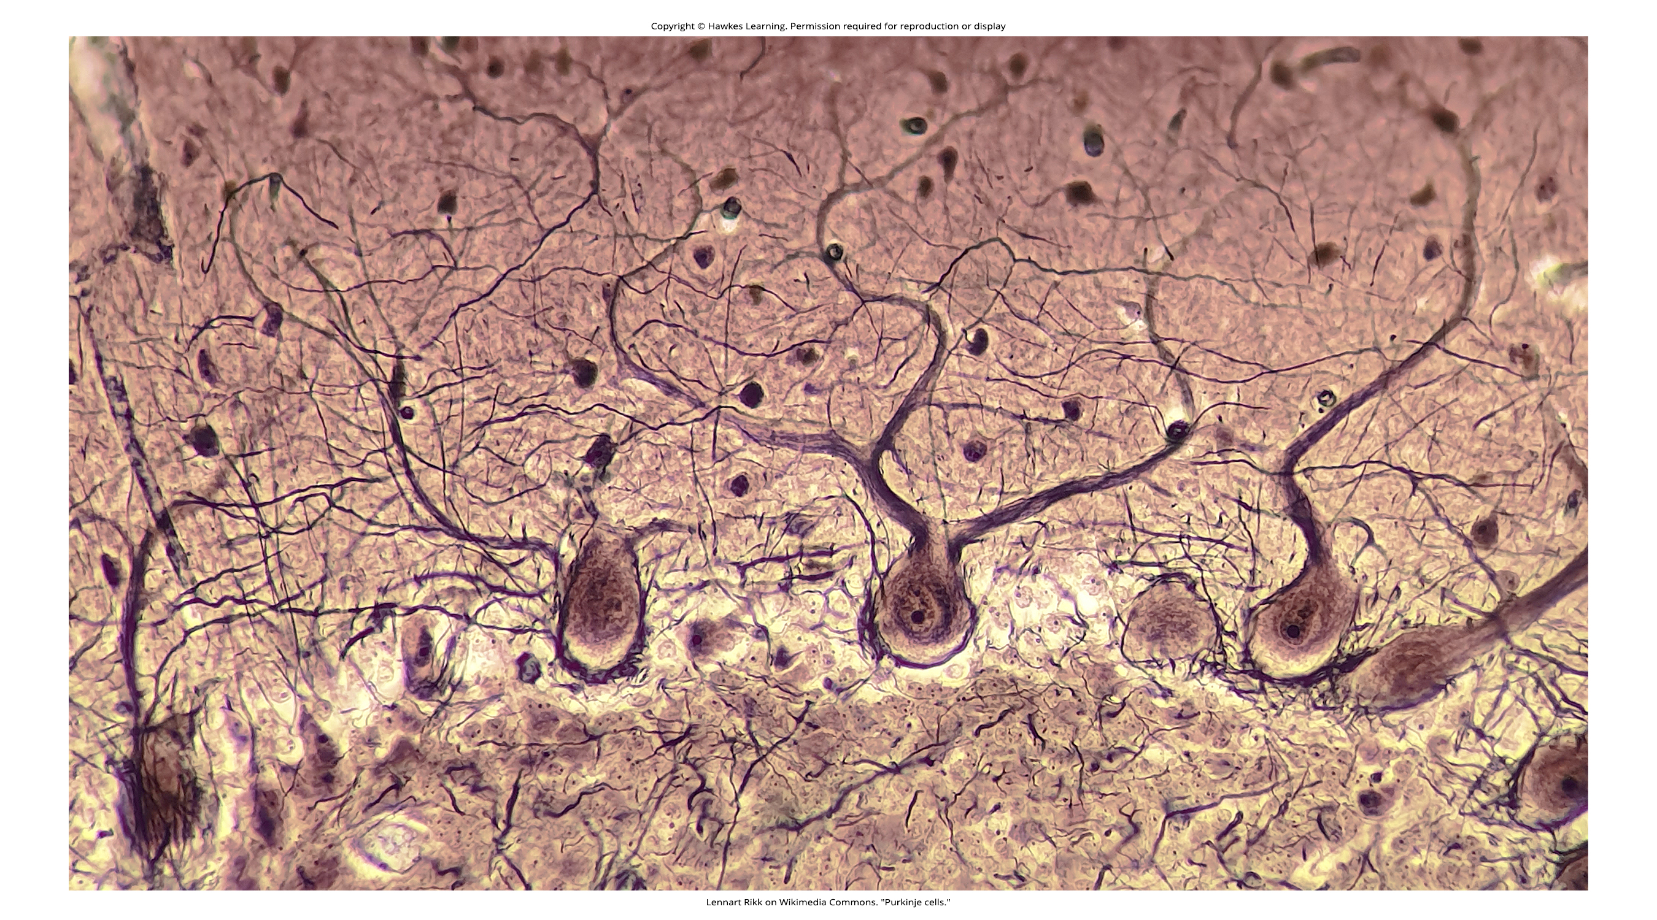
Lesson 33.2 Figure 13

Slide 23
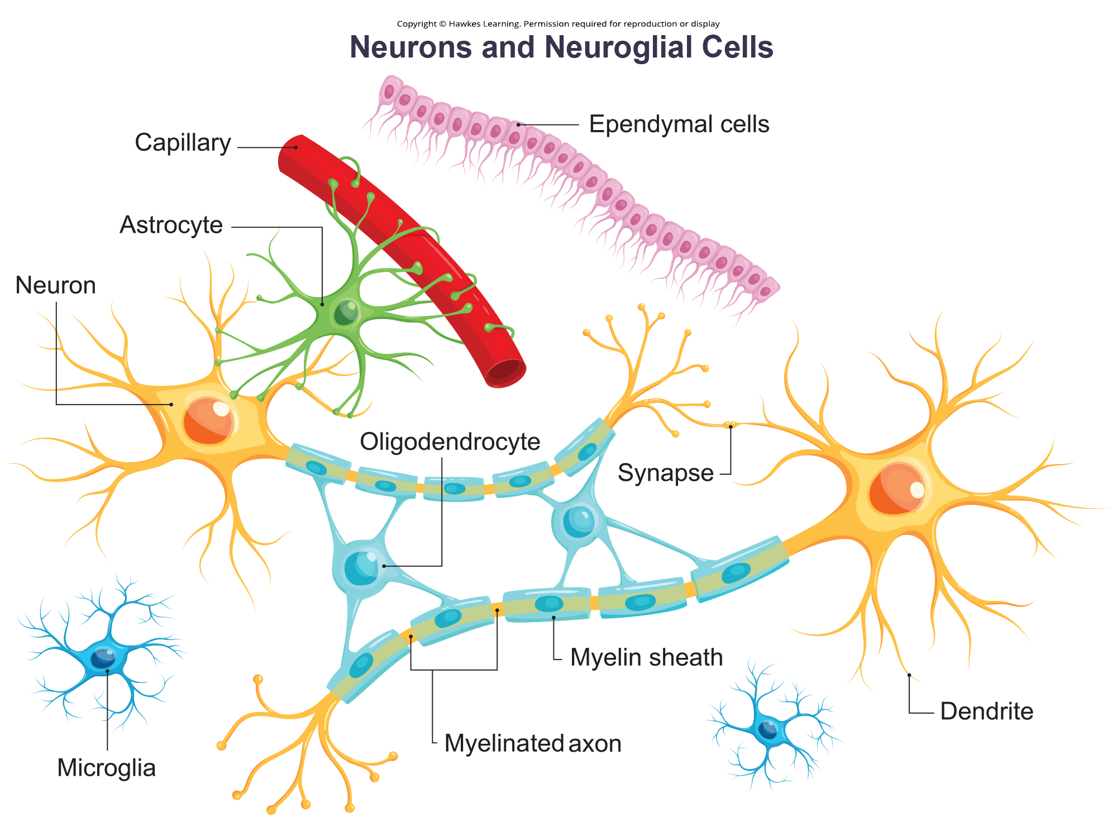
Lesson 33.2 Figure 14

Slide 24
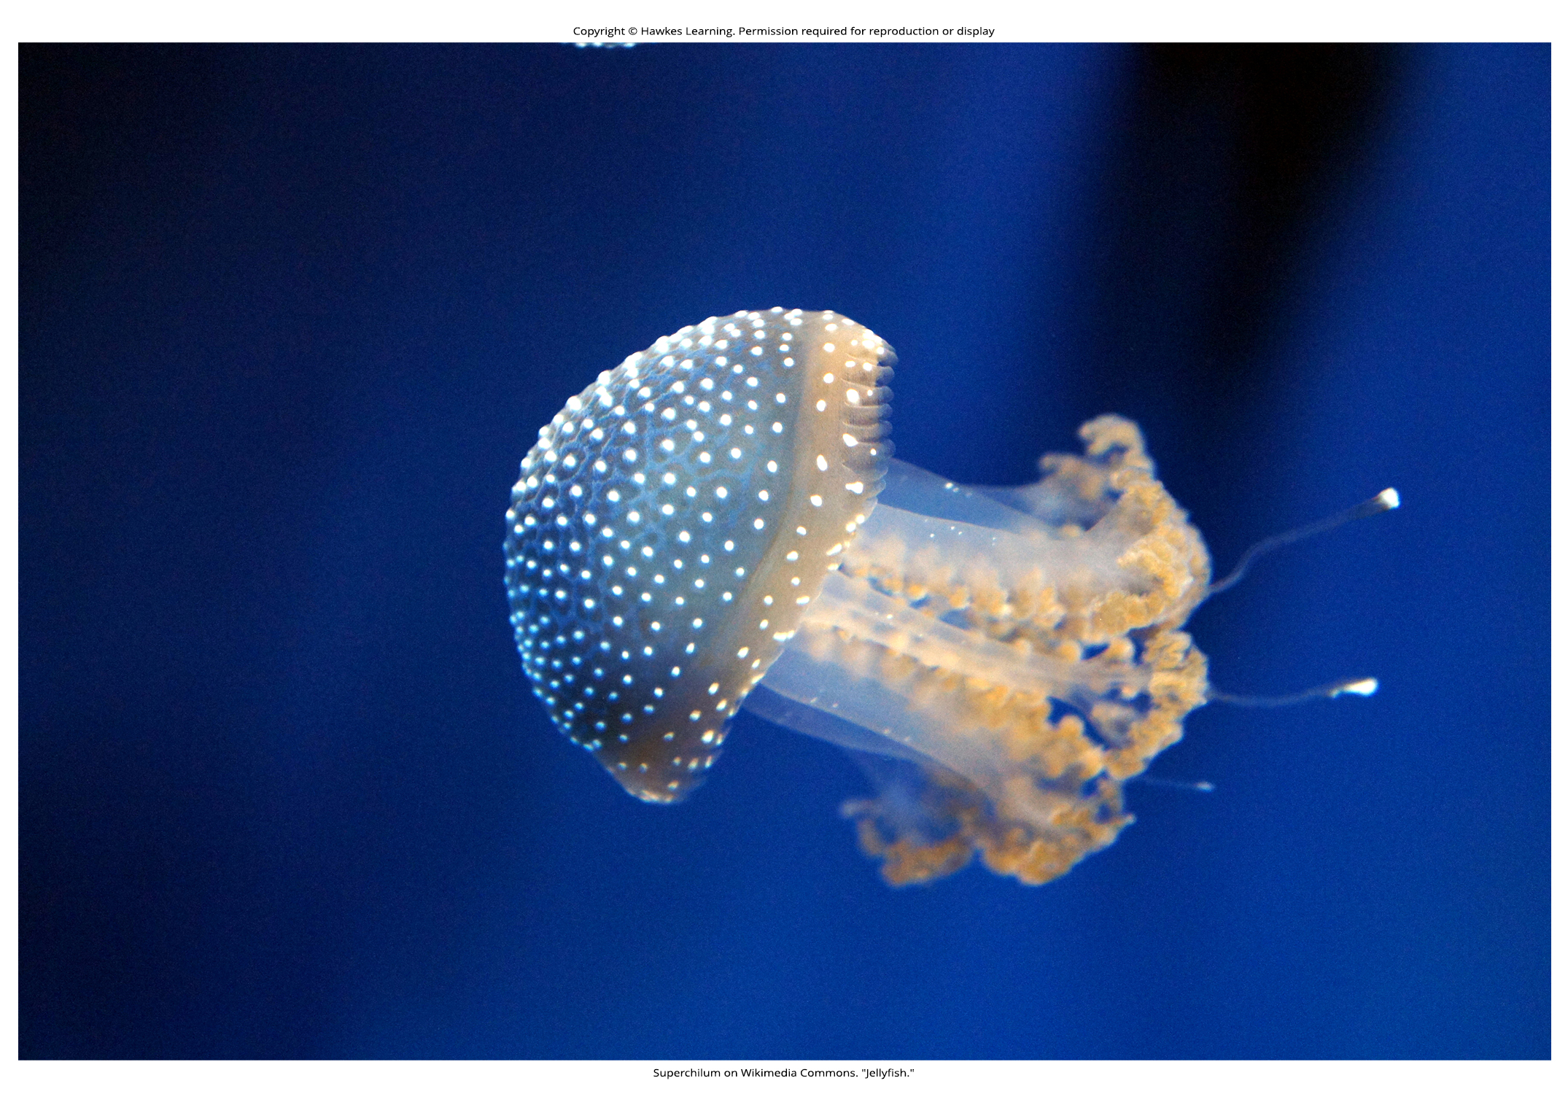
Lesson 33.2 Figure 15

Slide 25
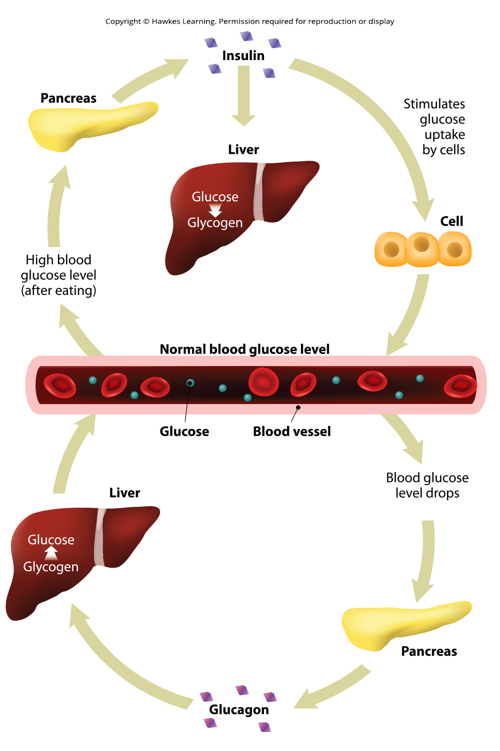
Lesson 33.3 Figure 1

Slide 26
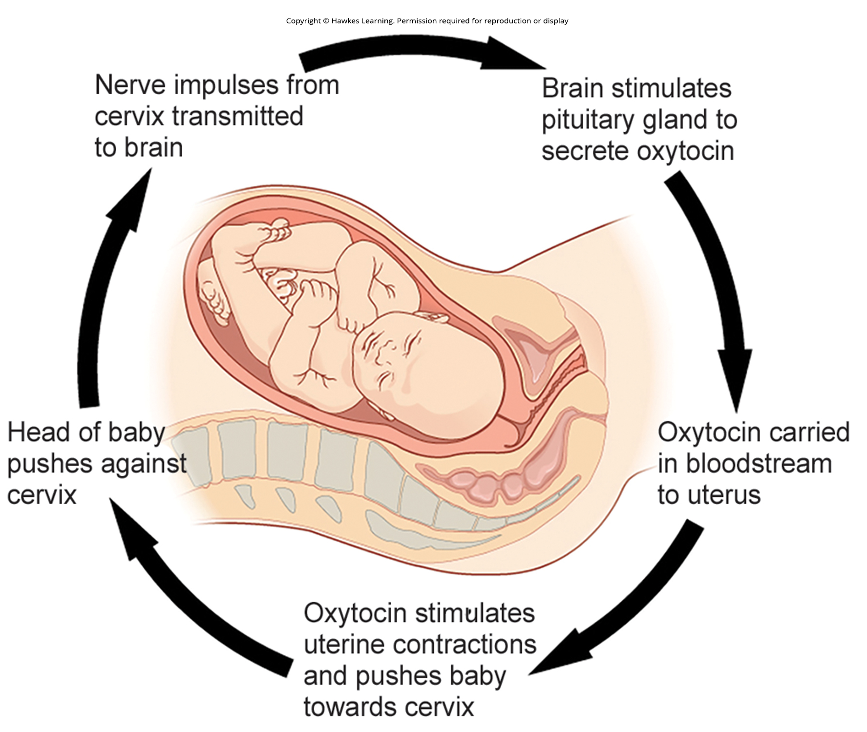
Lesson 33.3 Figure 2

Slide 27
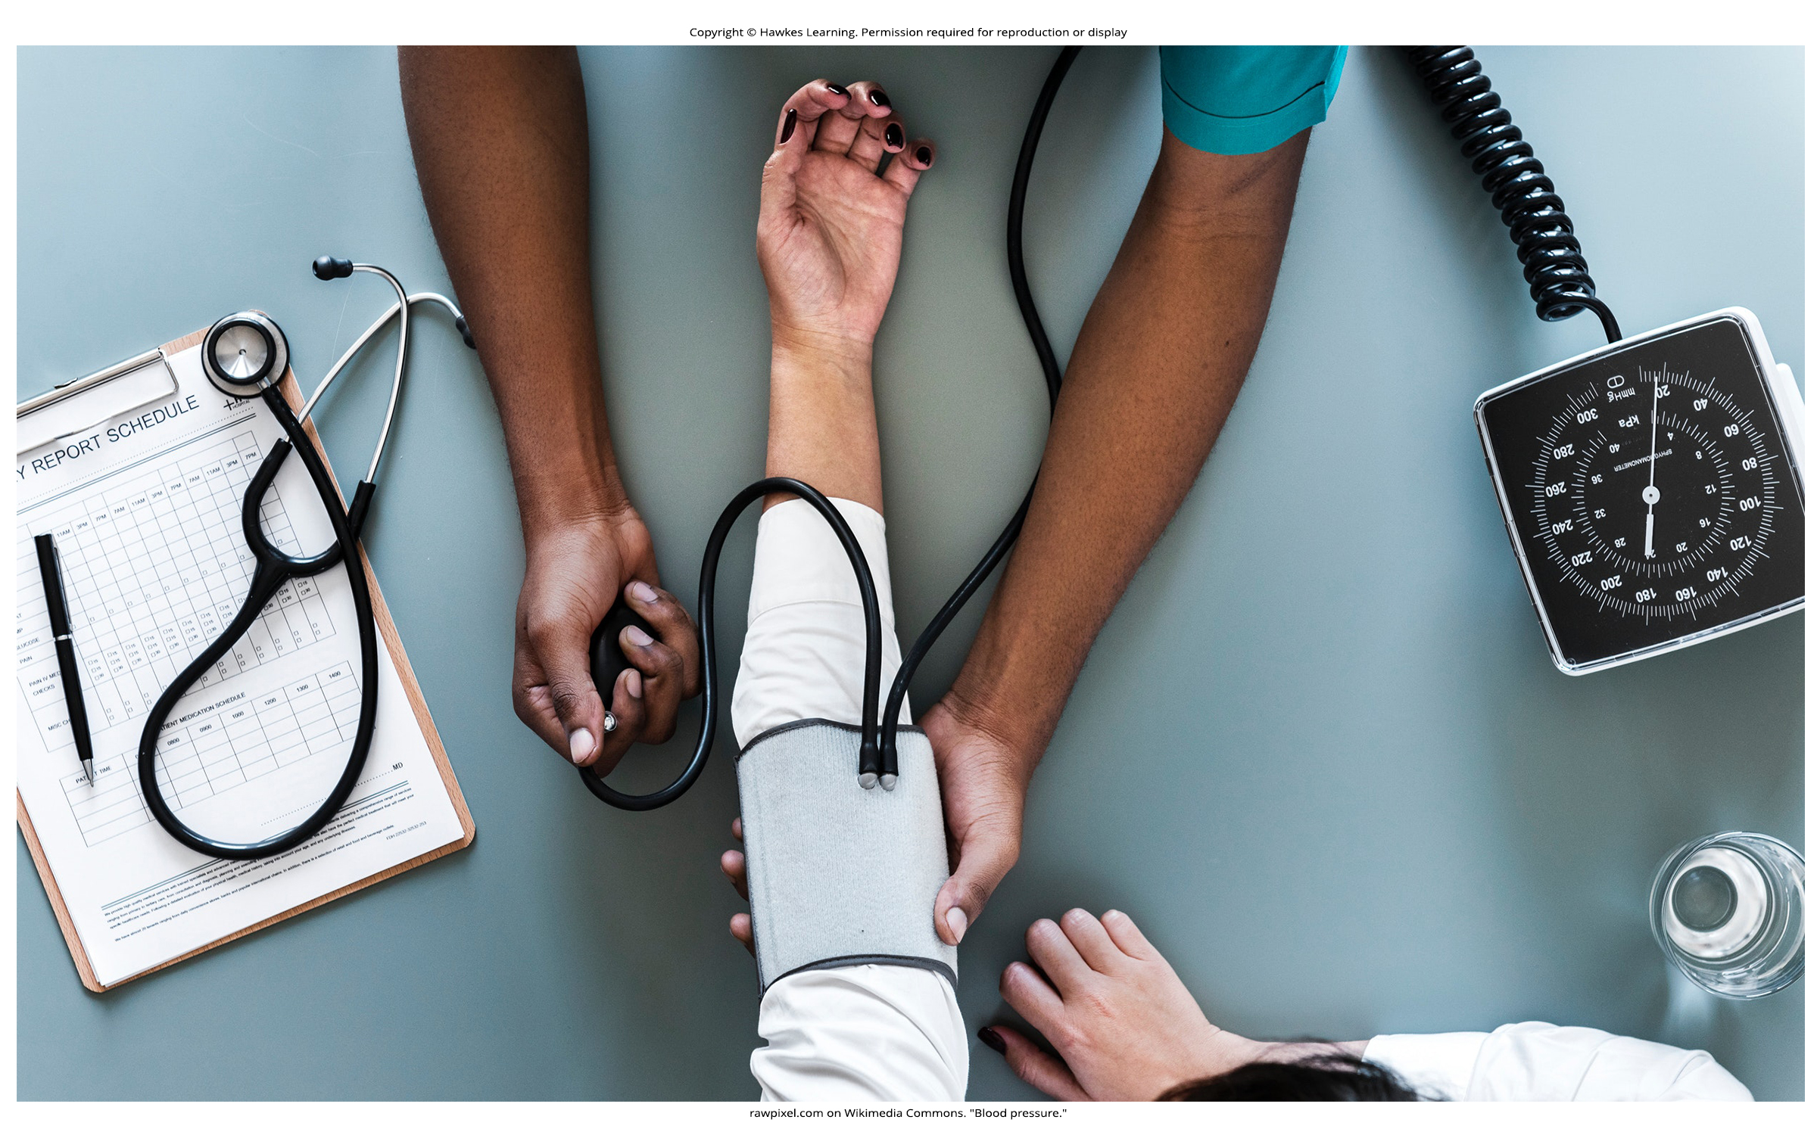
Lesson 33.3 Figure 3

Slide 28
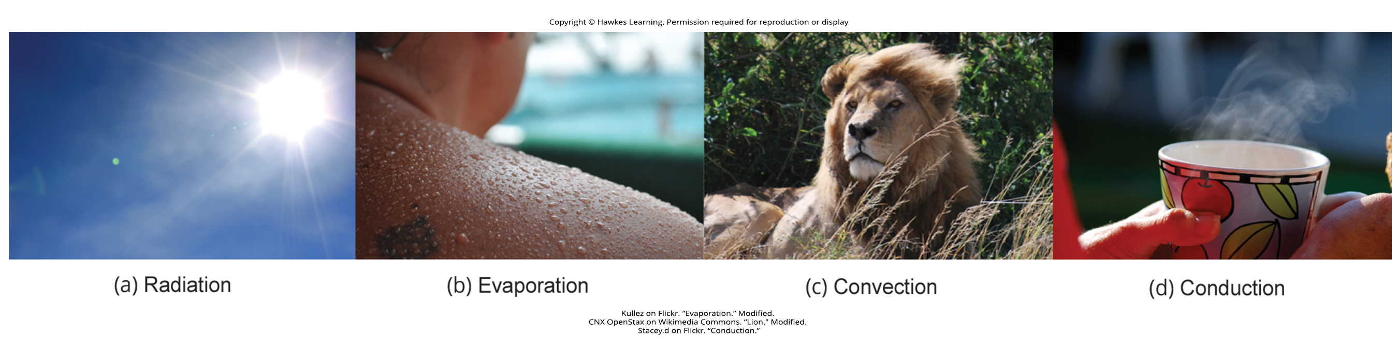
Lesson 33.3 Figure 4

Slide 29
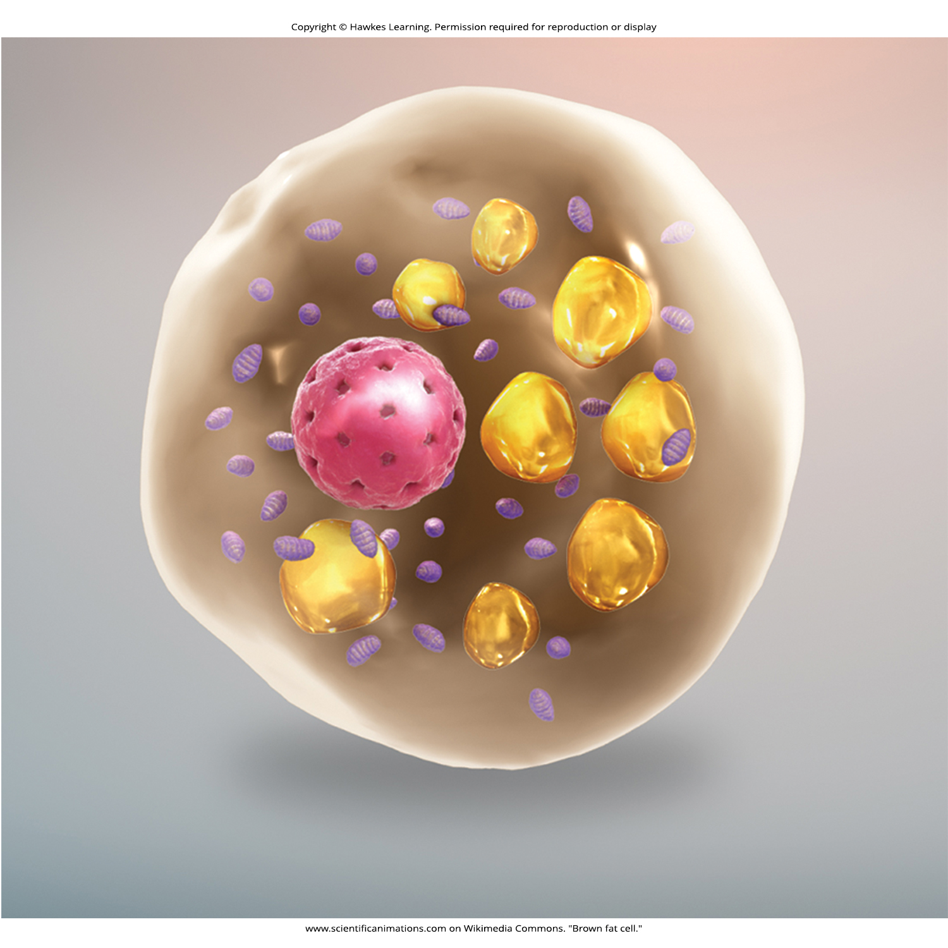
Lesson 33.3 Figure 5

Slide 30
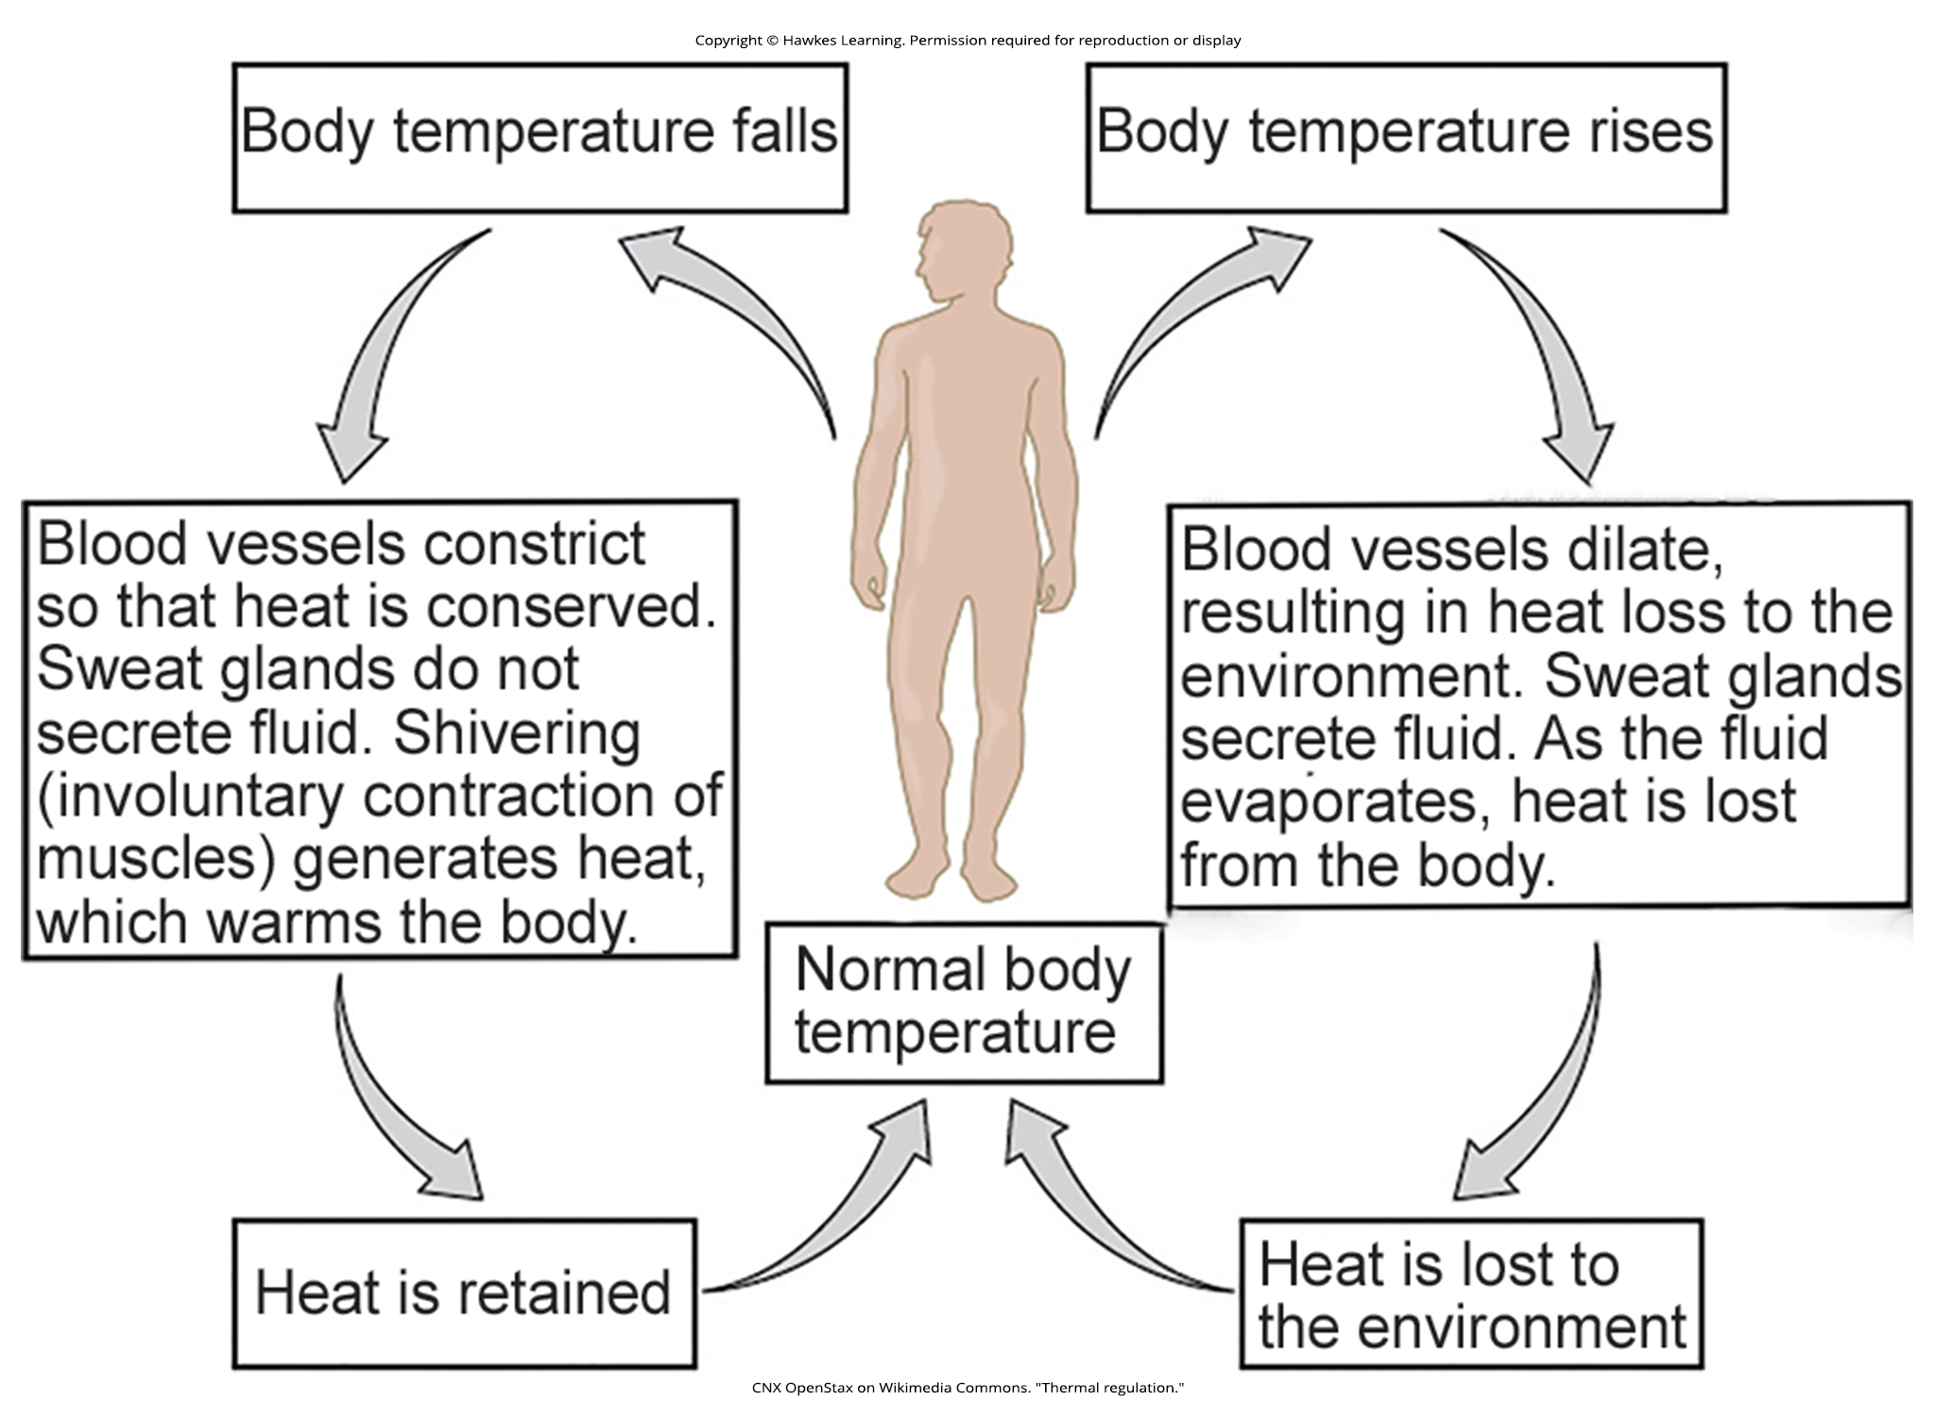
Lesson 33.3 Figure 6

Slide 31
Hawkes Learning – End of PowerPoint

