Slide 1
Chapter 34
The Digestive System

Slide 2
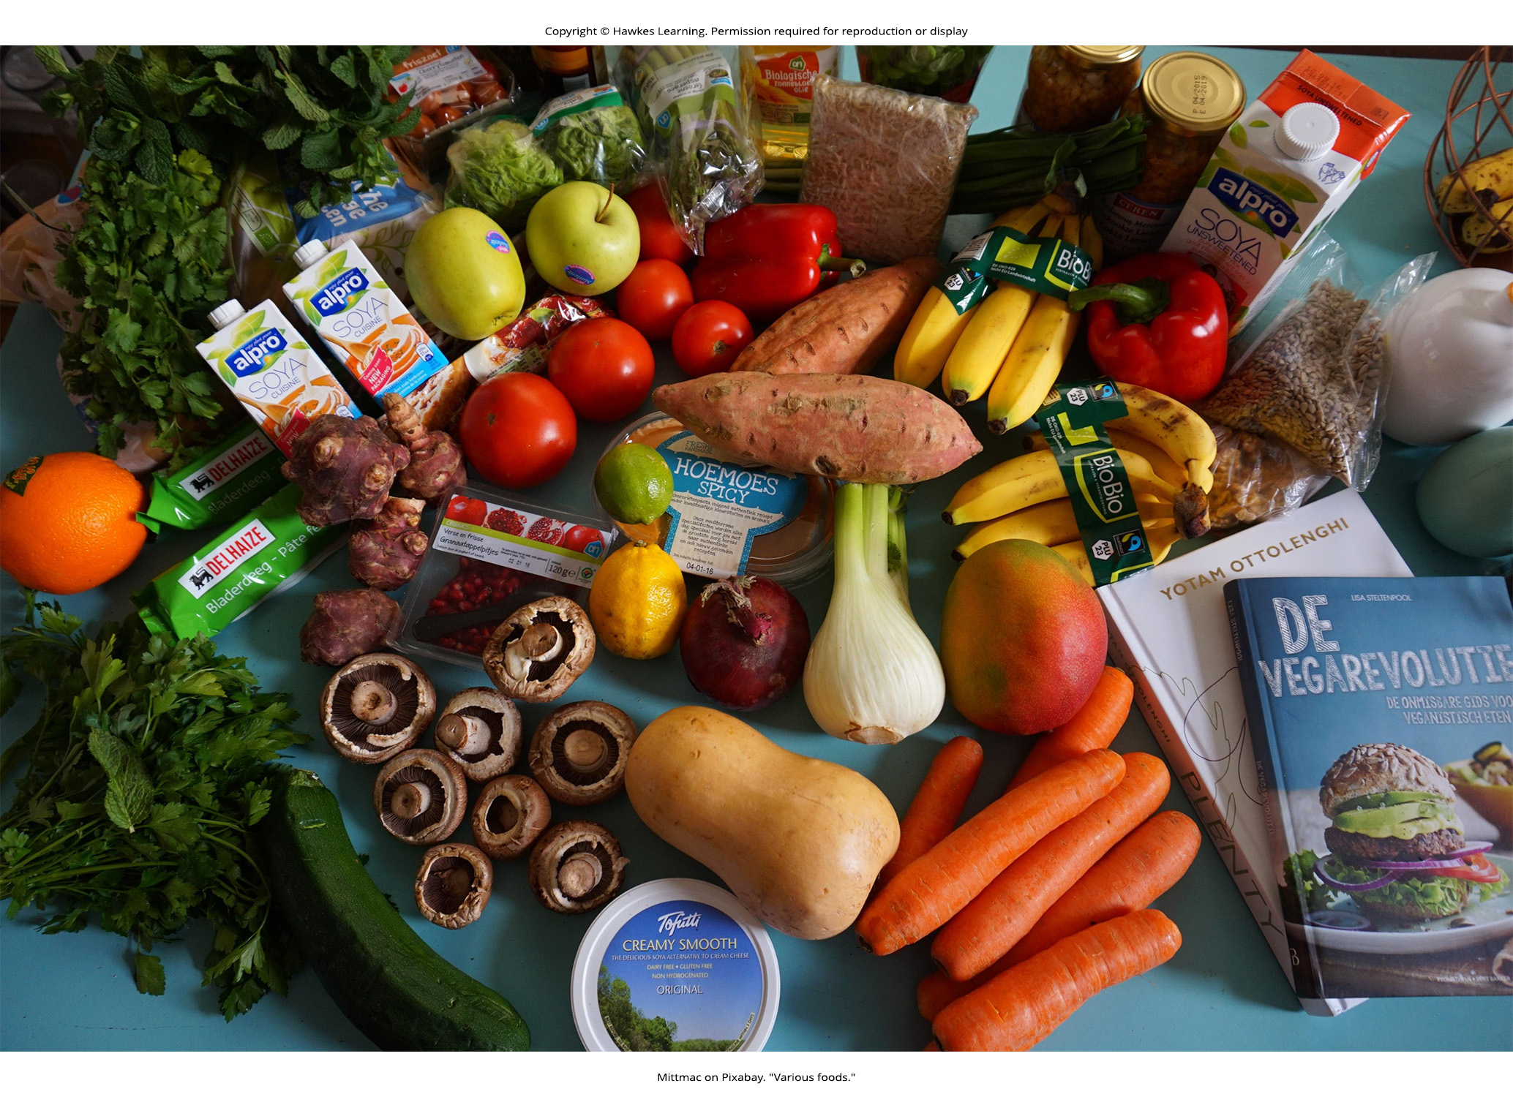
Lesson 34.1 Figure 1

Slide 3
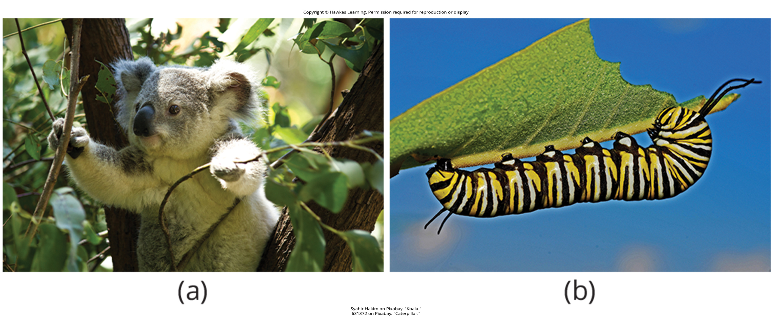
Lesson 34.1 Figure 2

Slide 4
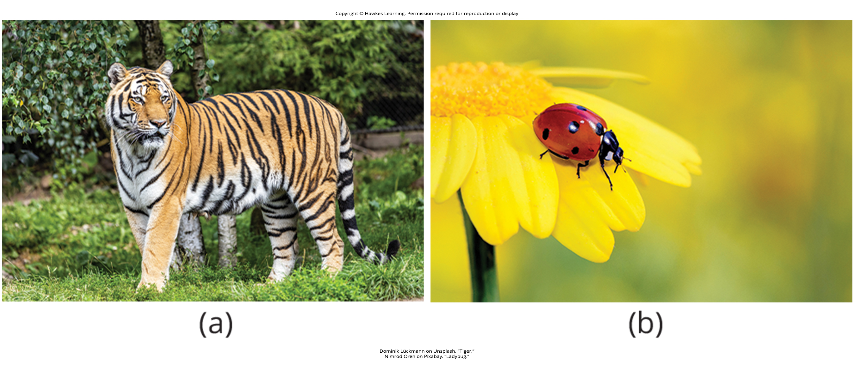
Lesson 34.1 Figure 3

Slide 5
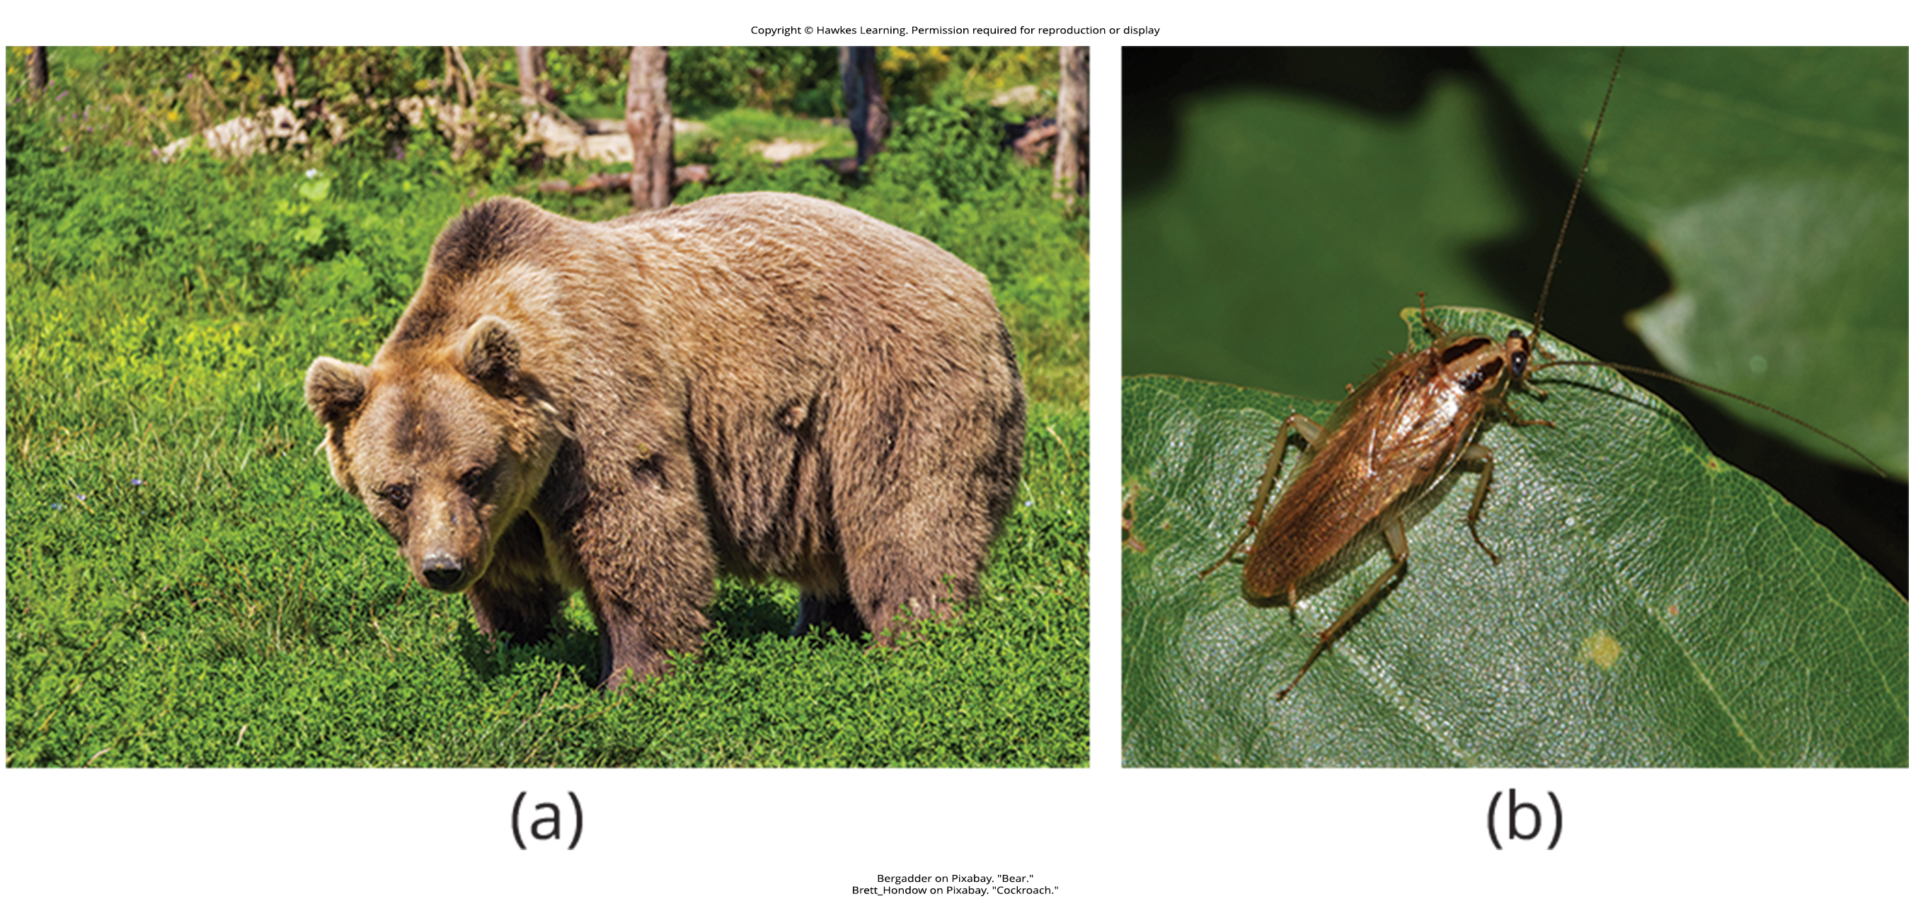
Lesson 34.1 Figure 4

Slide 6
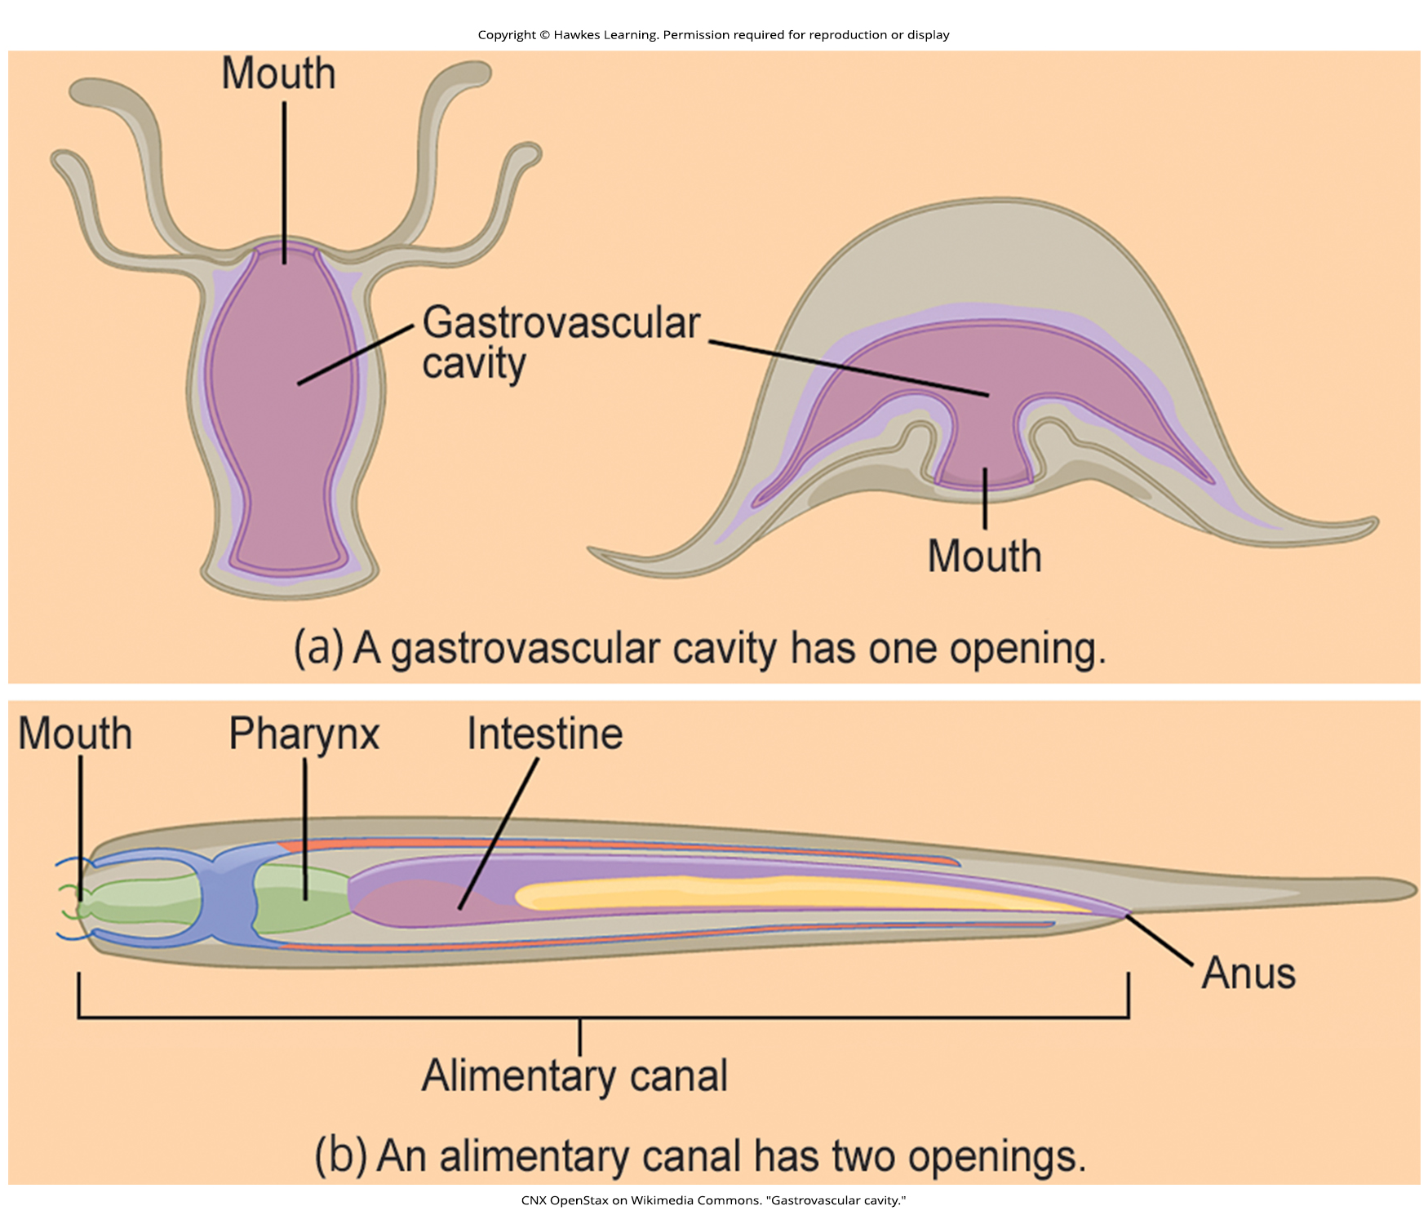
Lesson 34.1 Figure 5

Slide 7
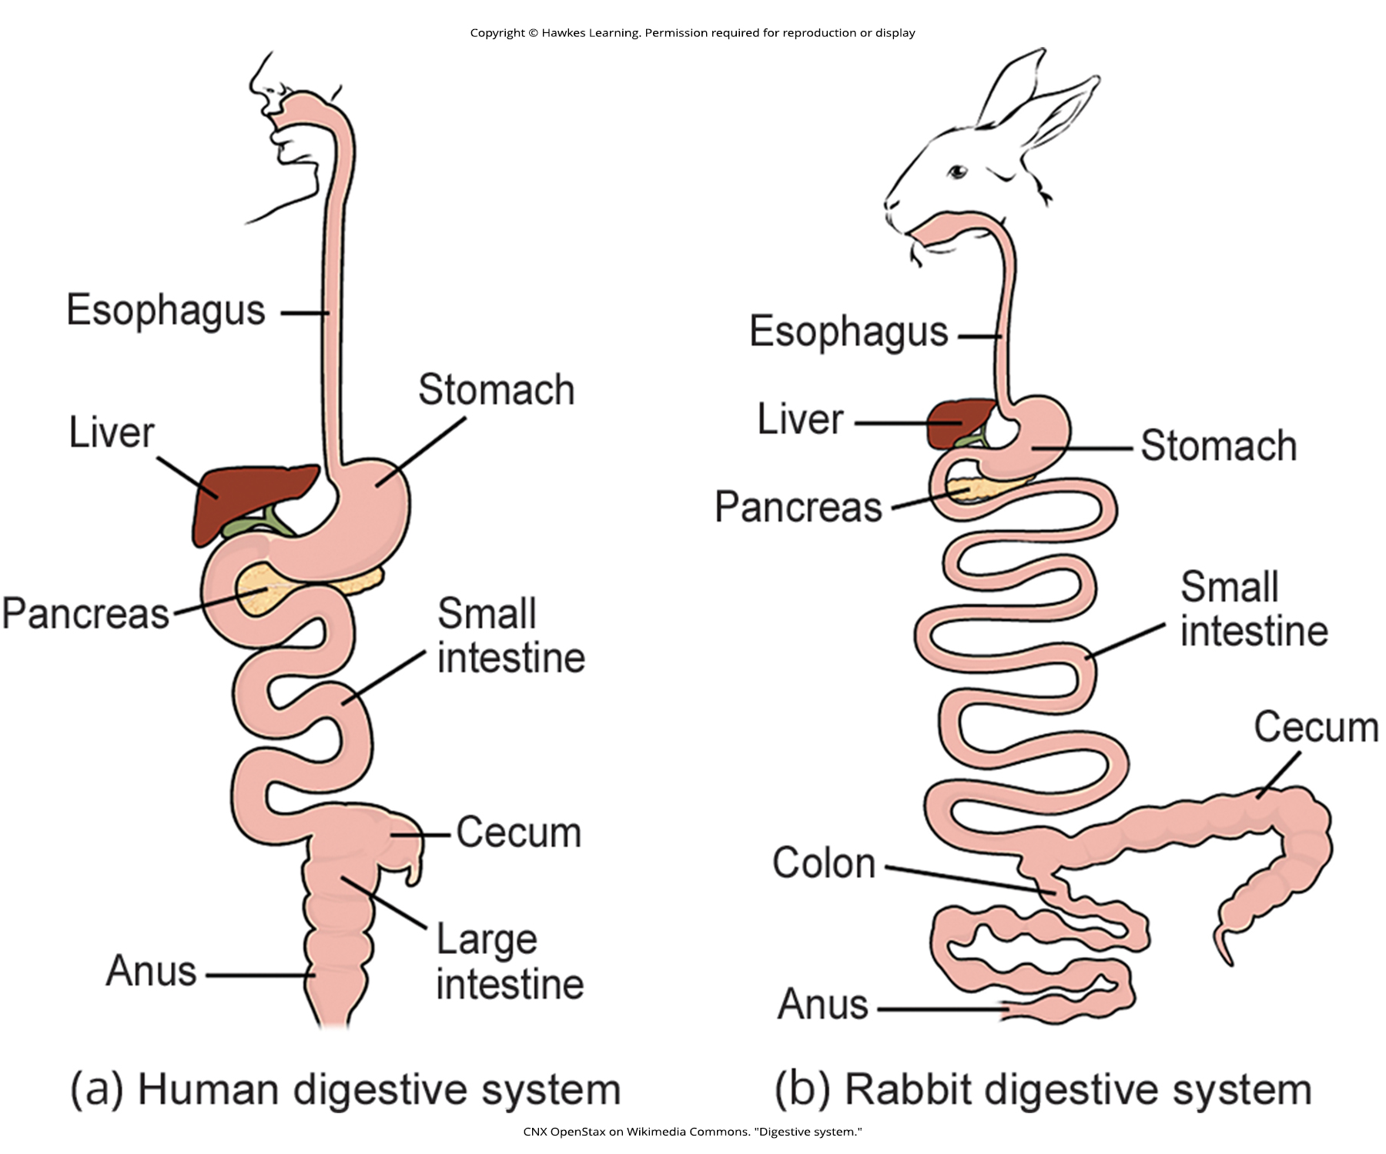
Lesson 34.1 Figure 6

Slide 8
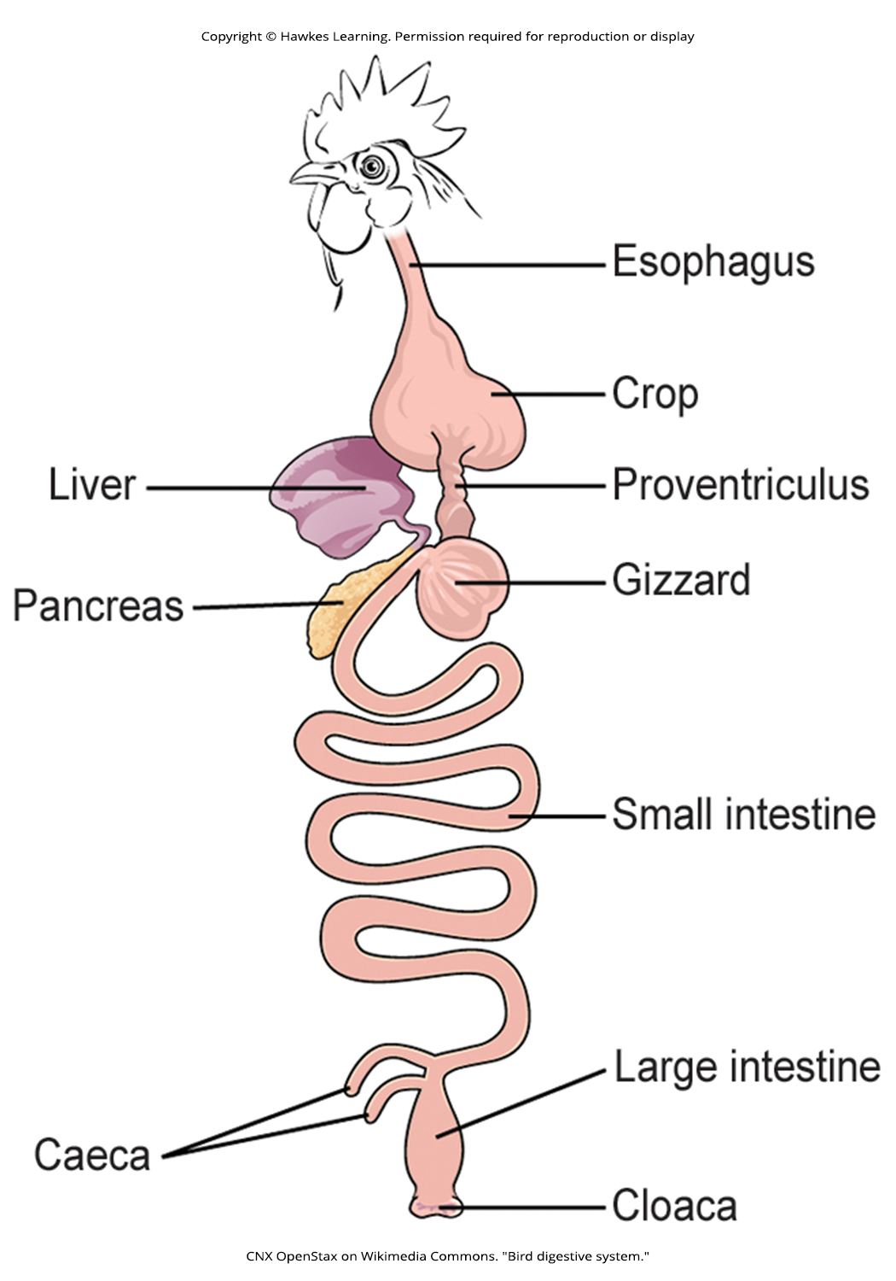
Lesson 34.1 Figure 7

Slide 9
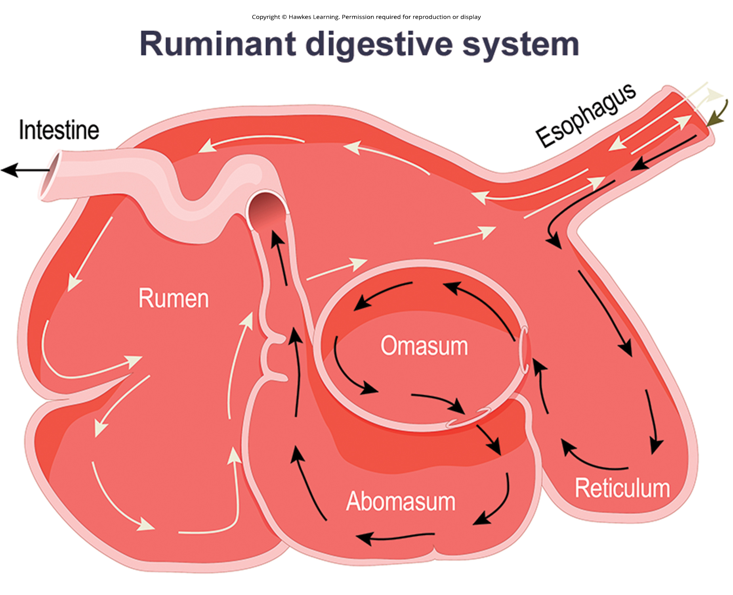
Lesson 34.1 Figure 8

Slide 10
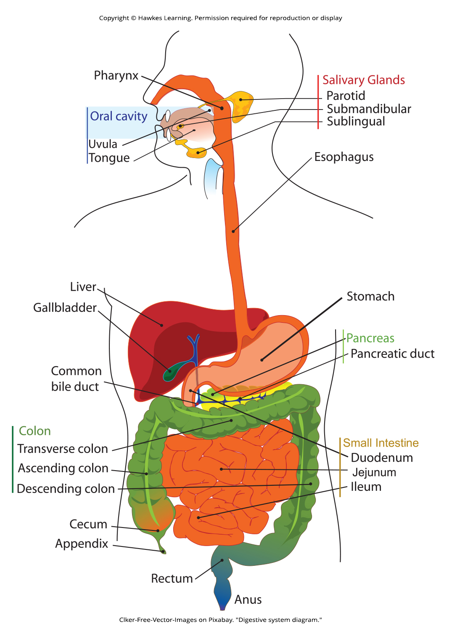
Lesson 34.1 Figure 9

Slide 11
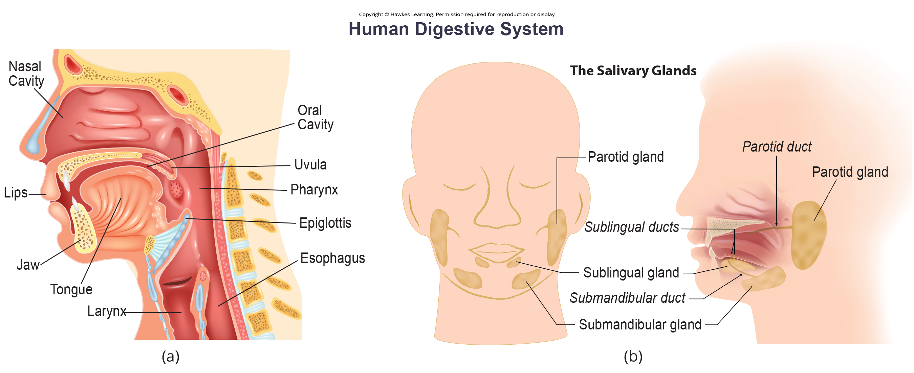
Lesson 34.1 Figure 10

Slide 12
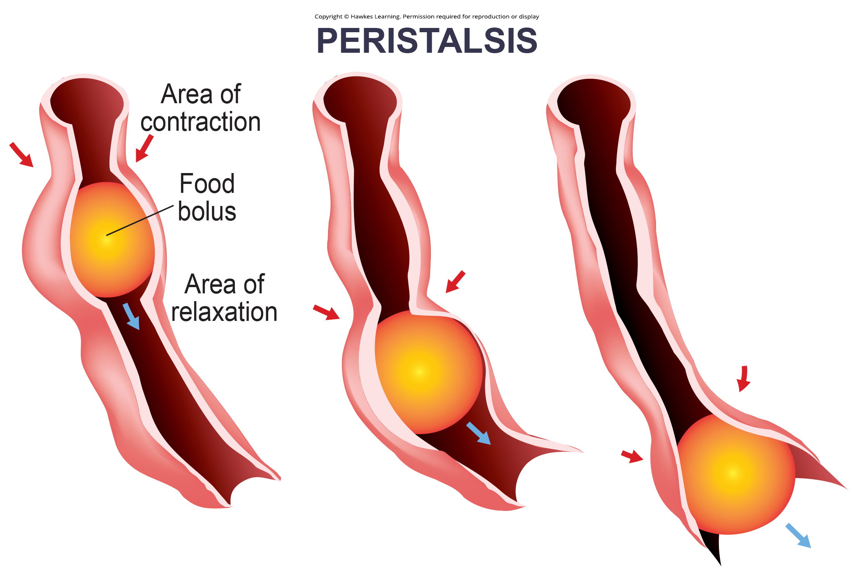
Lesson 34.1 Figure 11

Slide 13
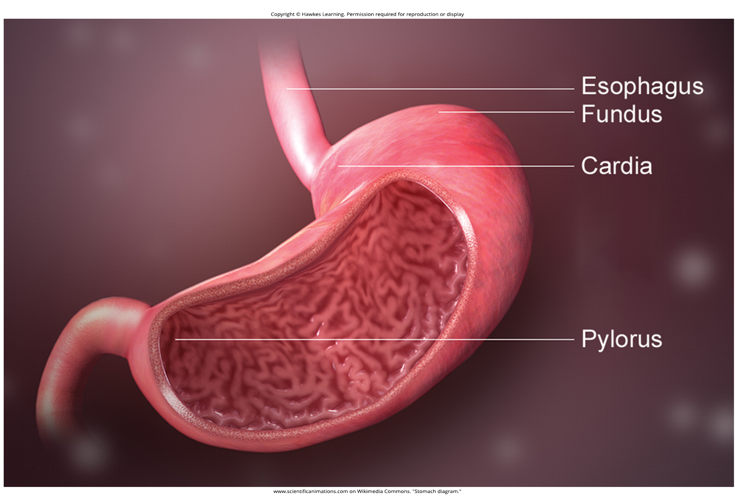
Lesson 34.1 Figure 12

Slide 14
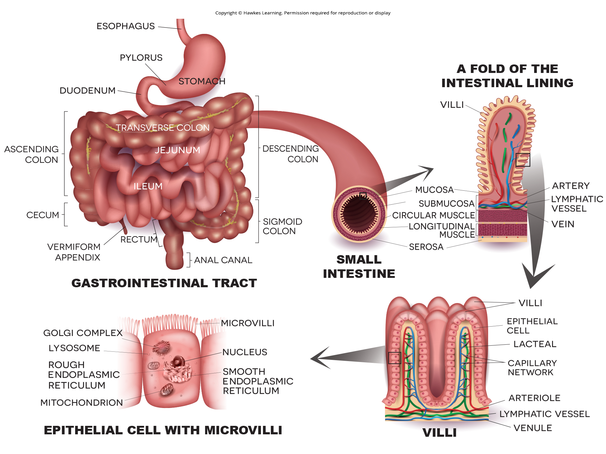
Lesson 34.1 Figure 13

Slide 15
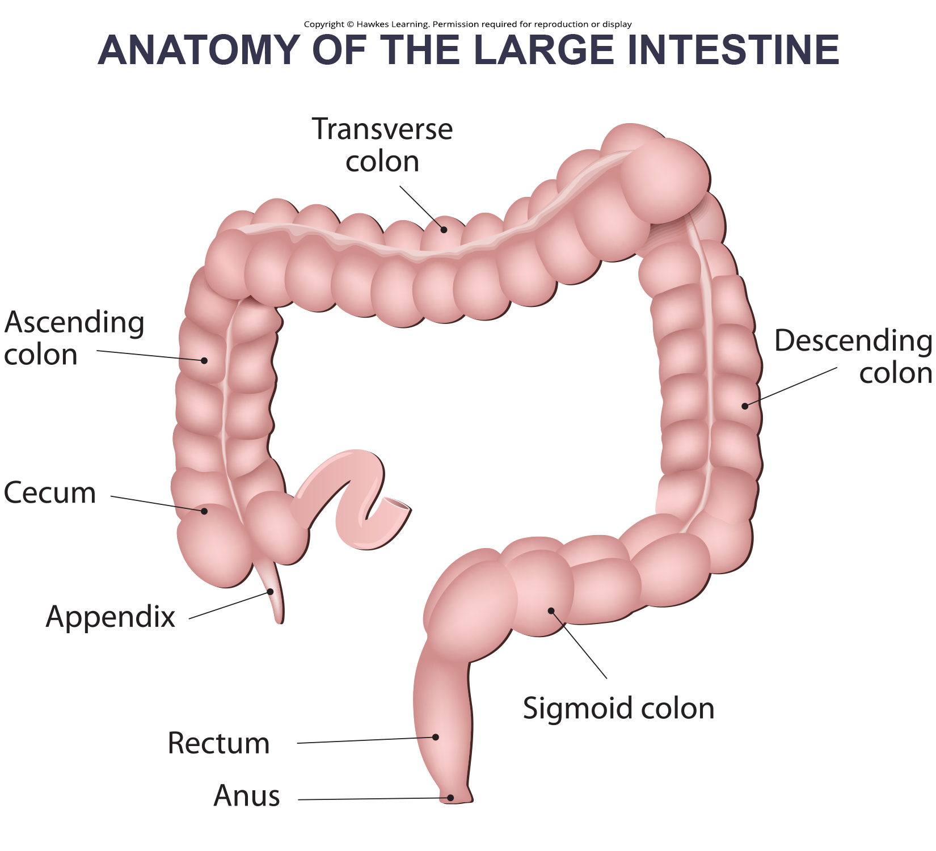
Lesson 34.1 Figure 14

Slide 16
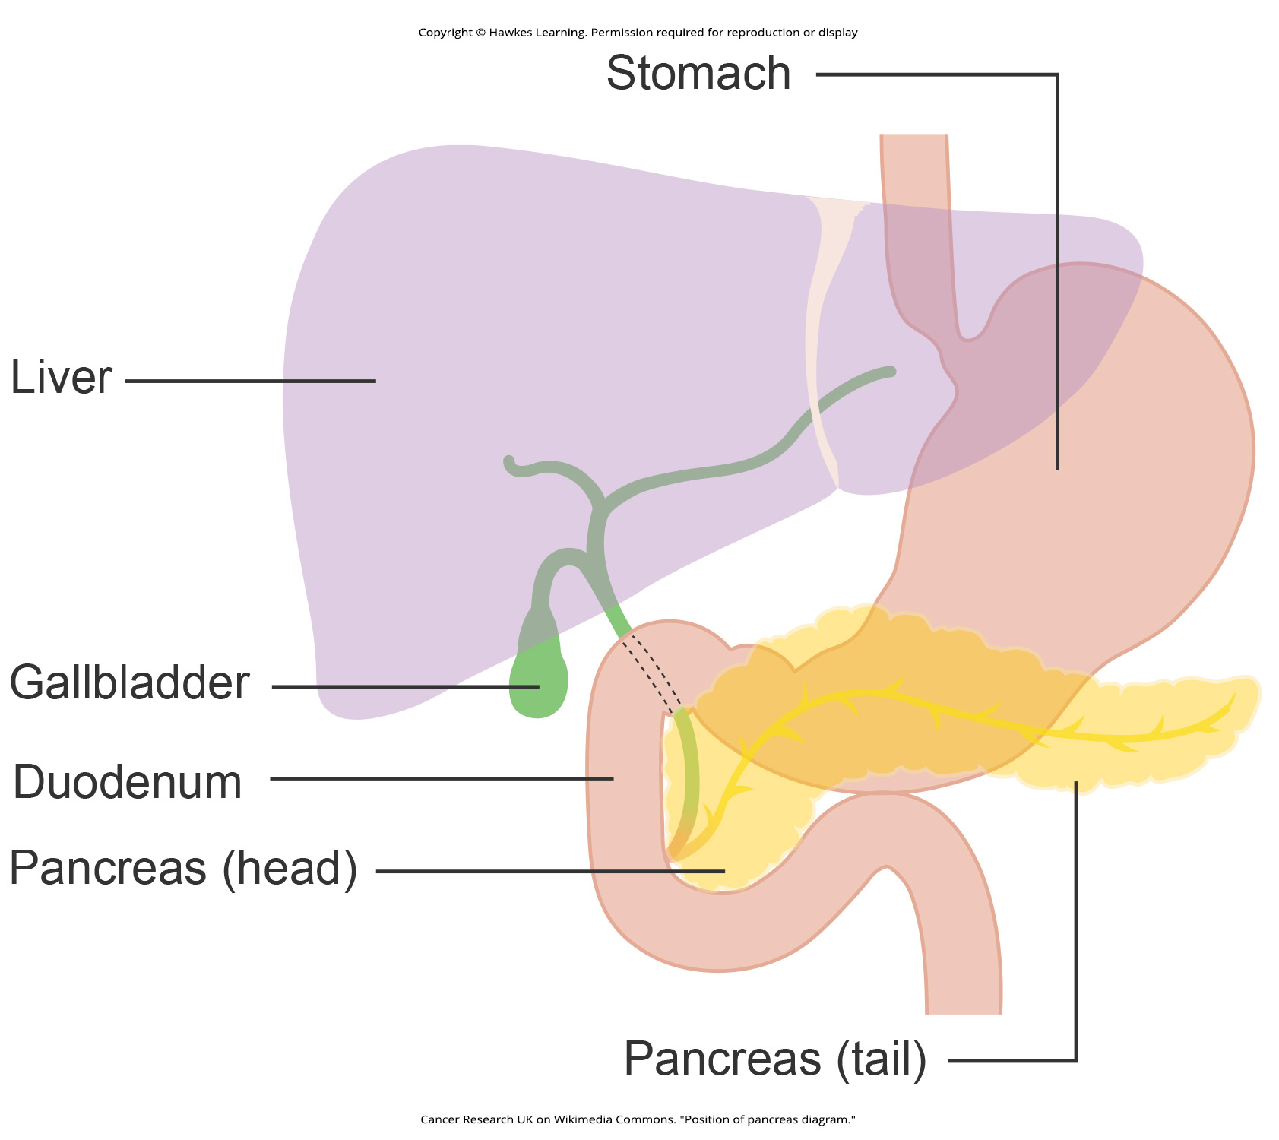
Lesson 34.1 Figure 15

Slide 17
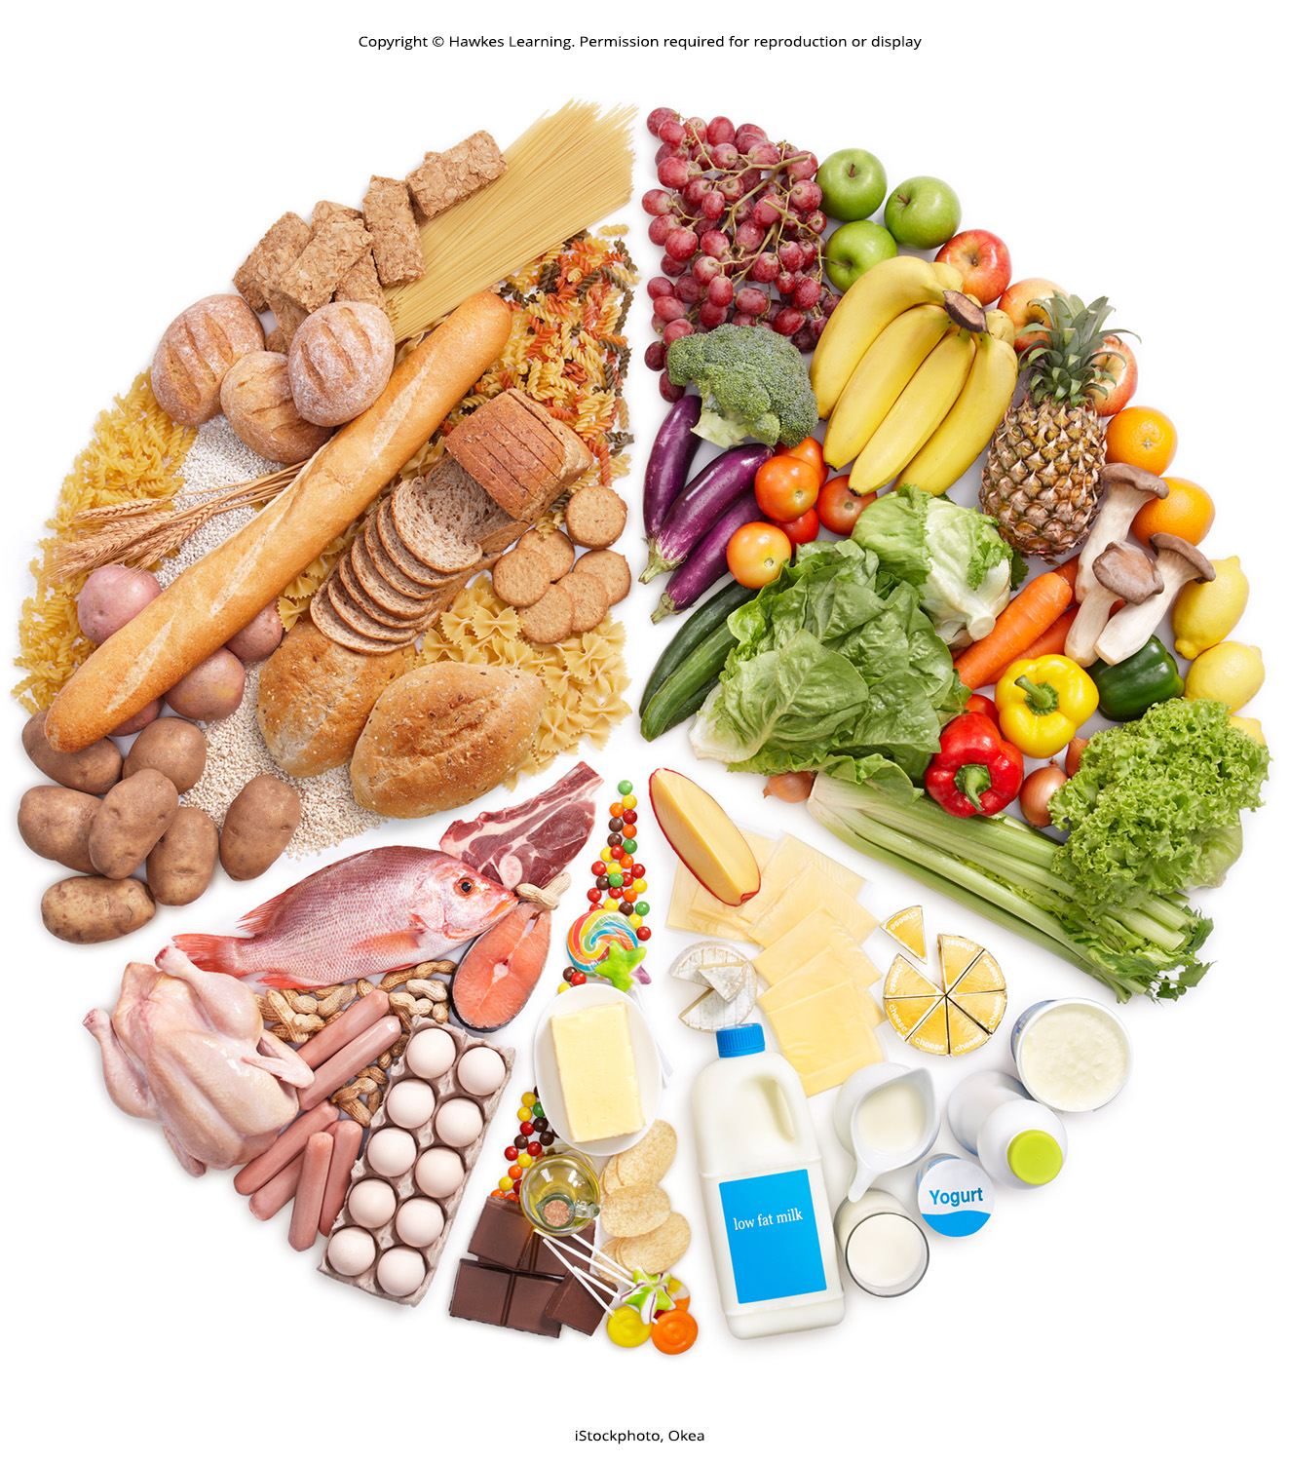
Lesson 34.2 Figure 1

Slide 18

Lesson 34.2 Figure 2

Slide 19
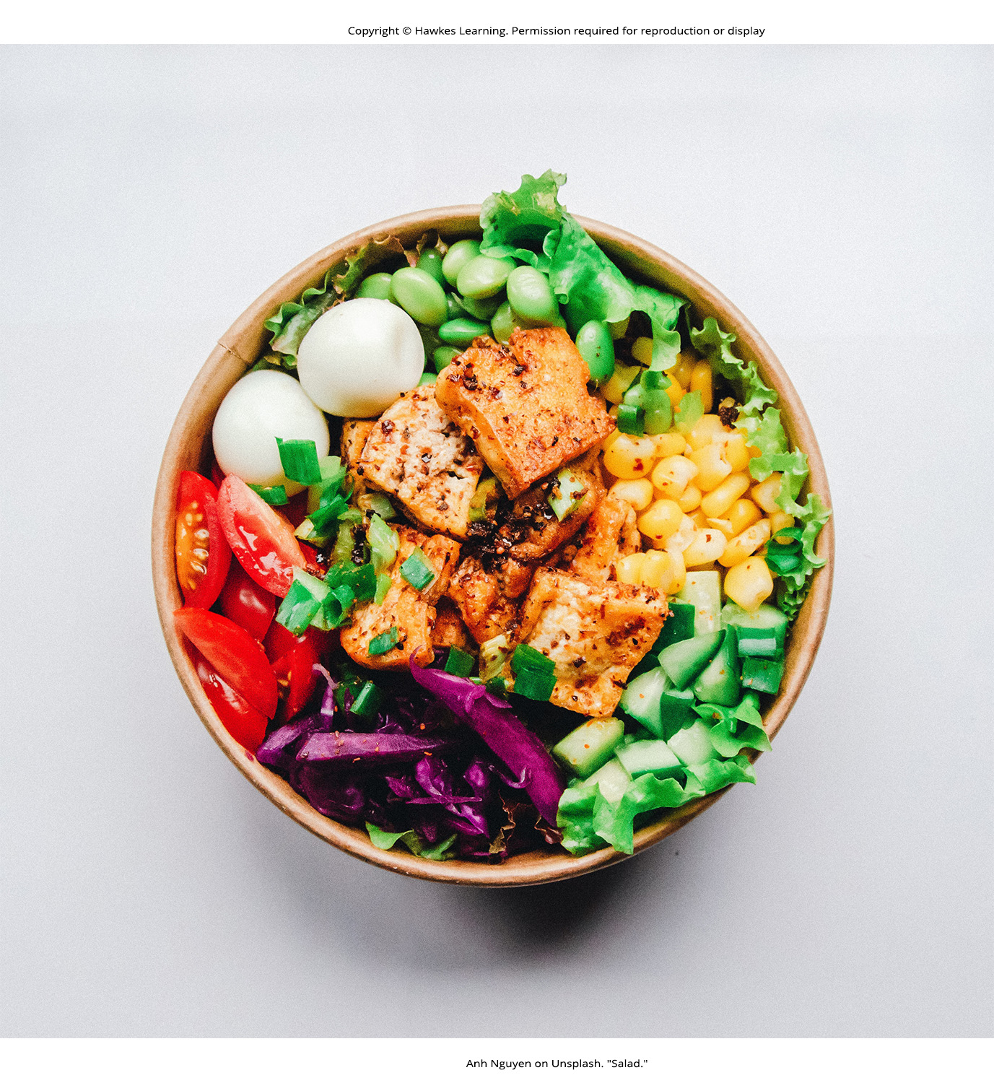
Lesson 34.2 Figure 3

Slide 20
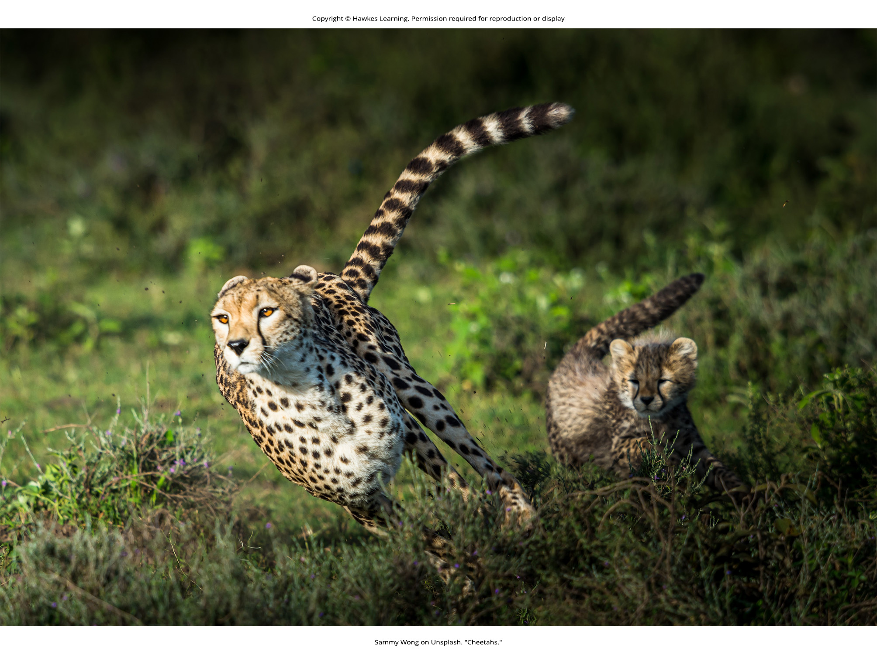
Lesson 34.2 Figure 4

Slide 21
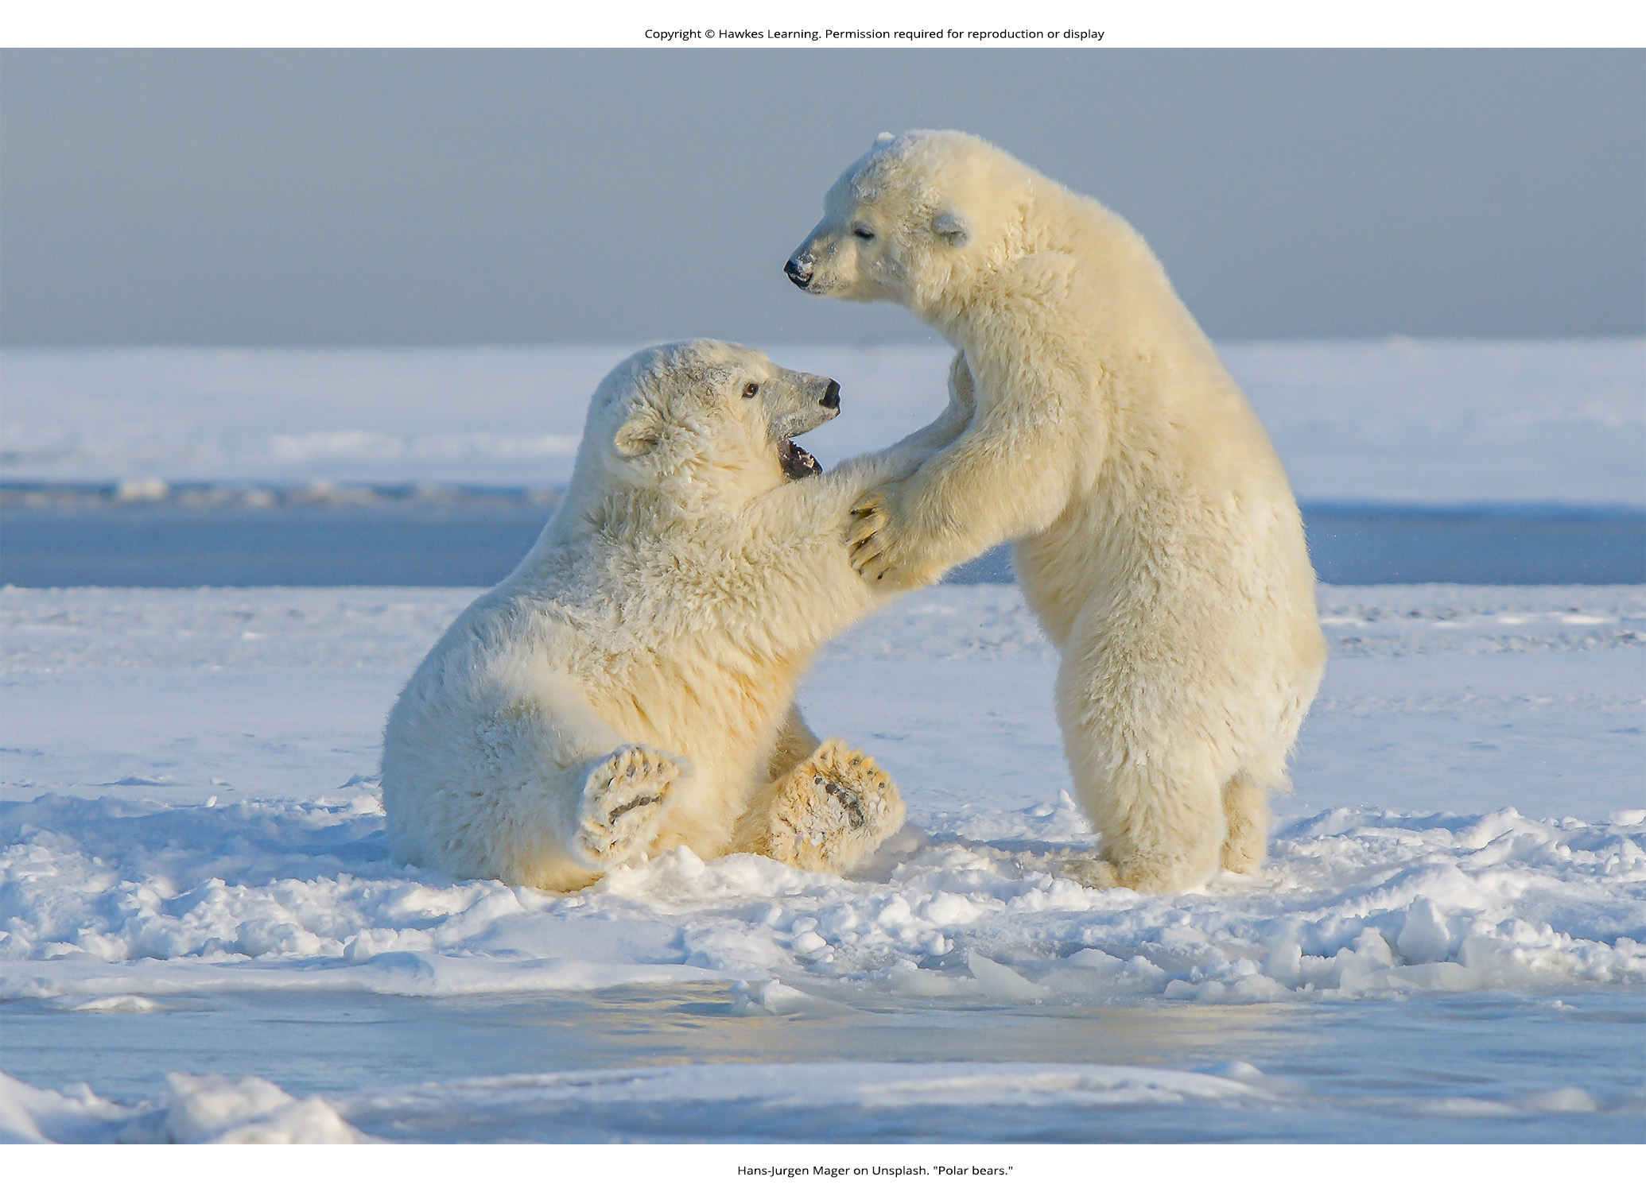
Lesson 34.2 Figure 5

Slide 22
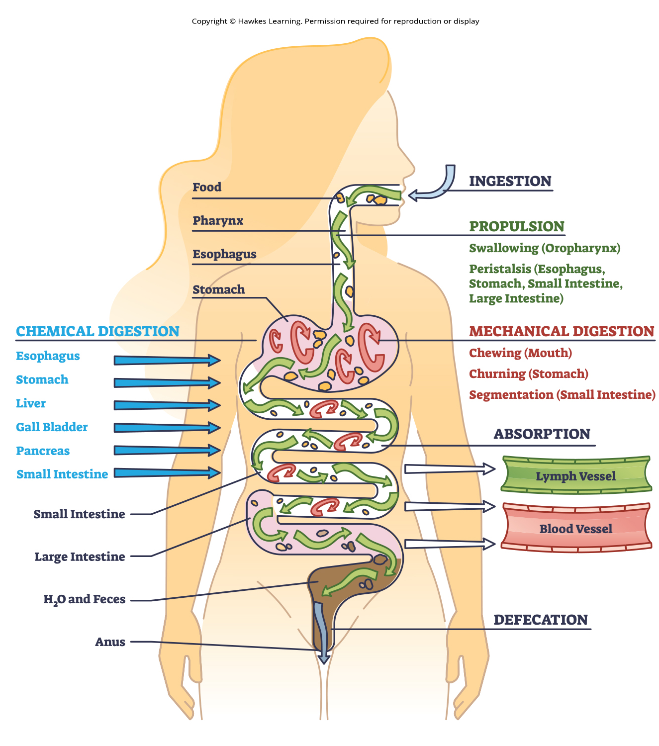
Lesson 34.3 Figure 1

Slide 23
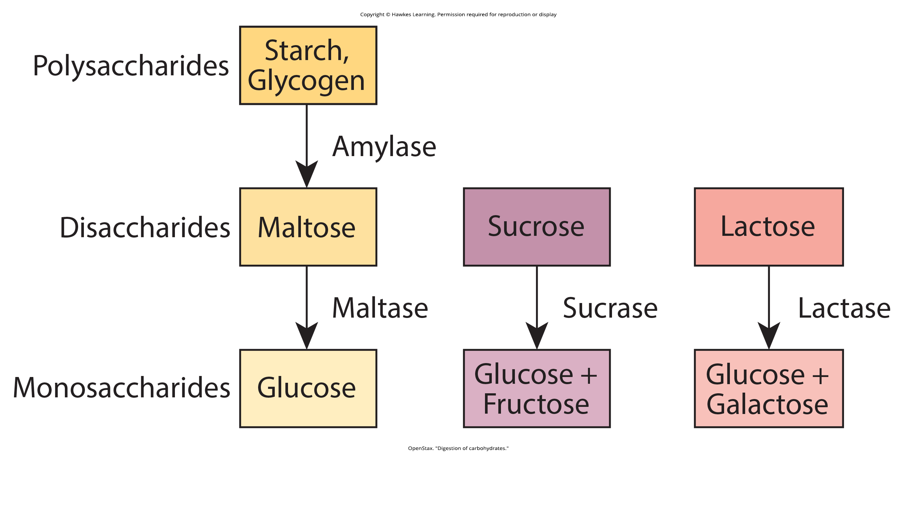
Lesson 34.3 Figure 2

Slide 24
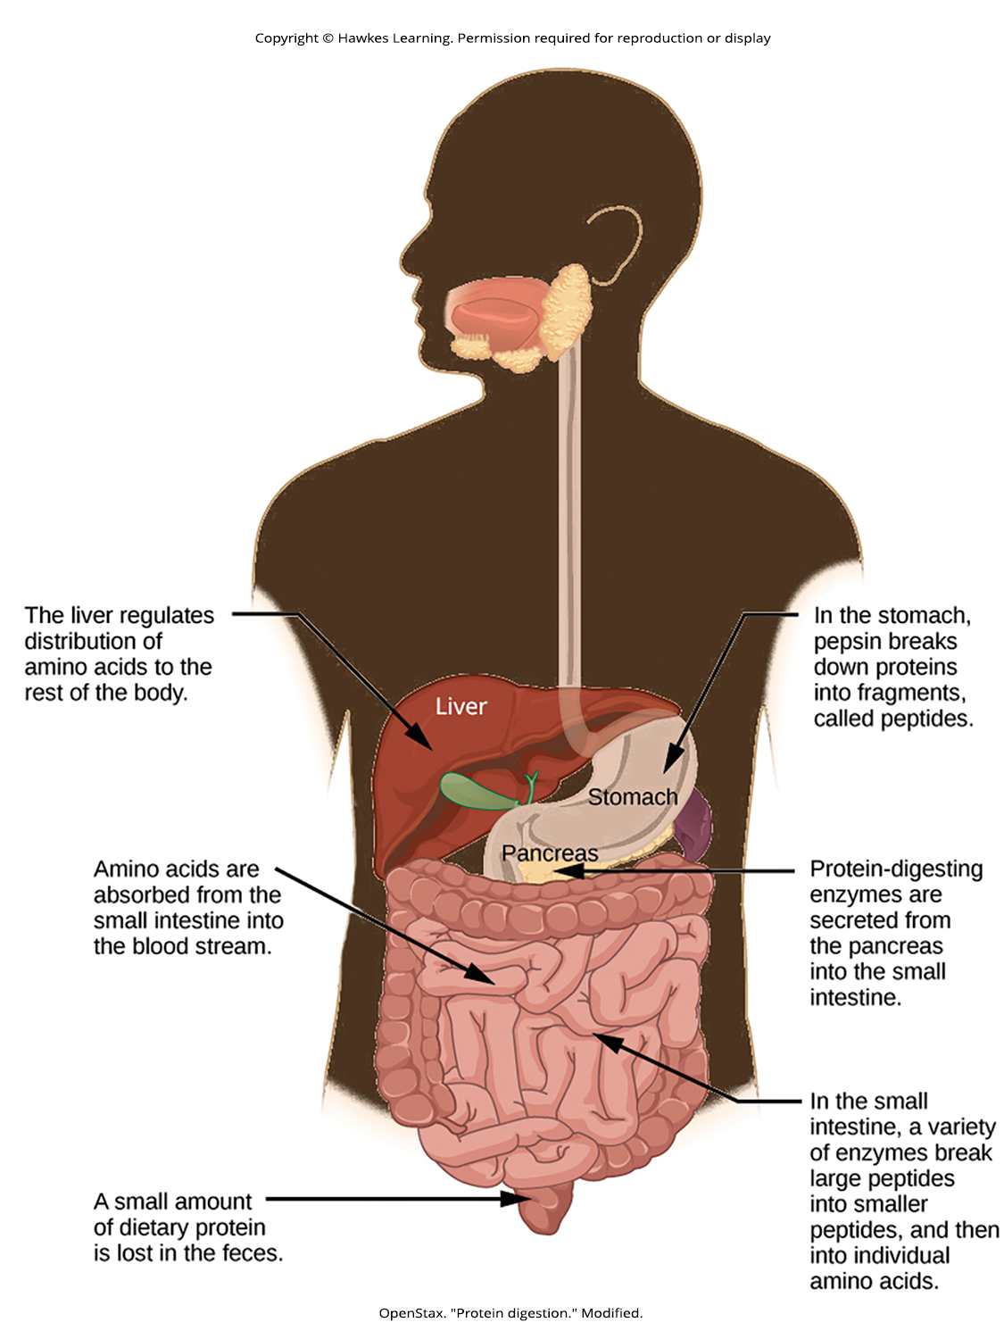
Lesson 34.3 Figure 3

Slide 25
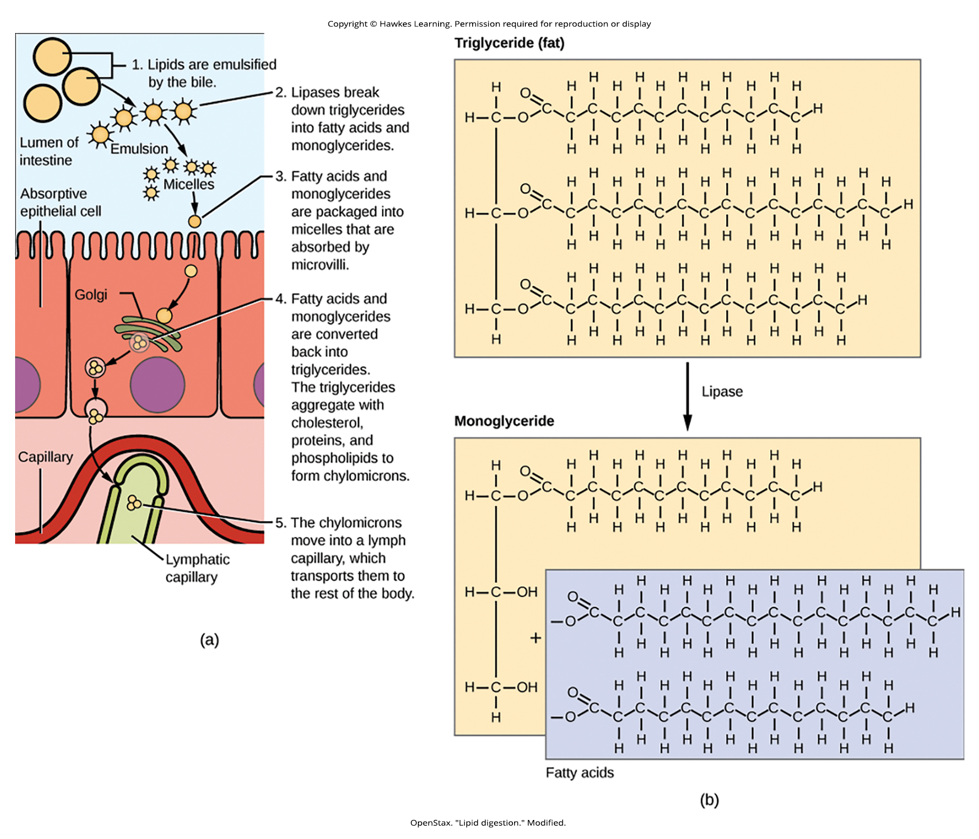
Lesson 34.3 Figure 4

Slide 26
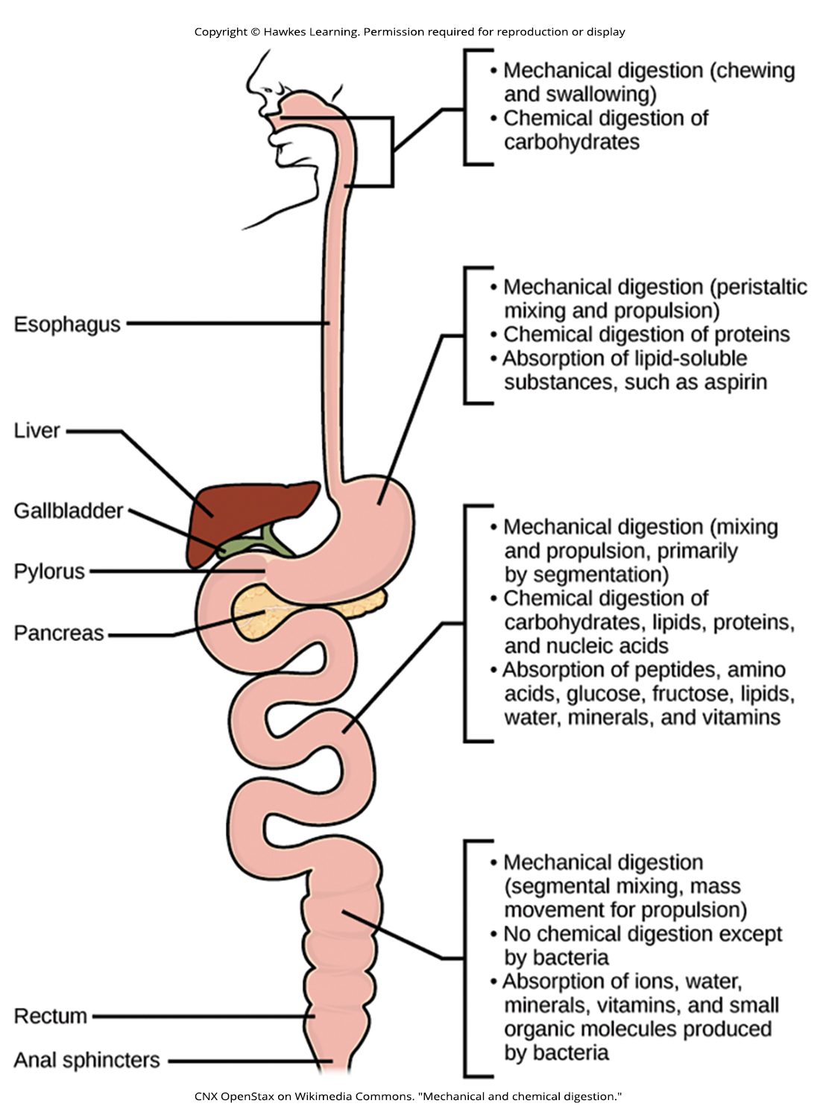
Lesson 34.3 Figure 5

Slide 27

Lesson 34.3 Figure 6

Slide 28

Lesson 34.3 Figure 7

Slide 29
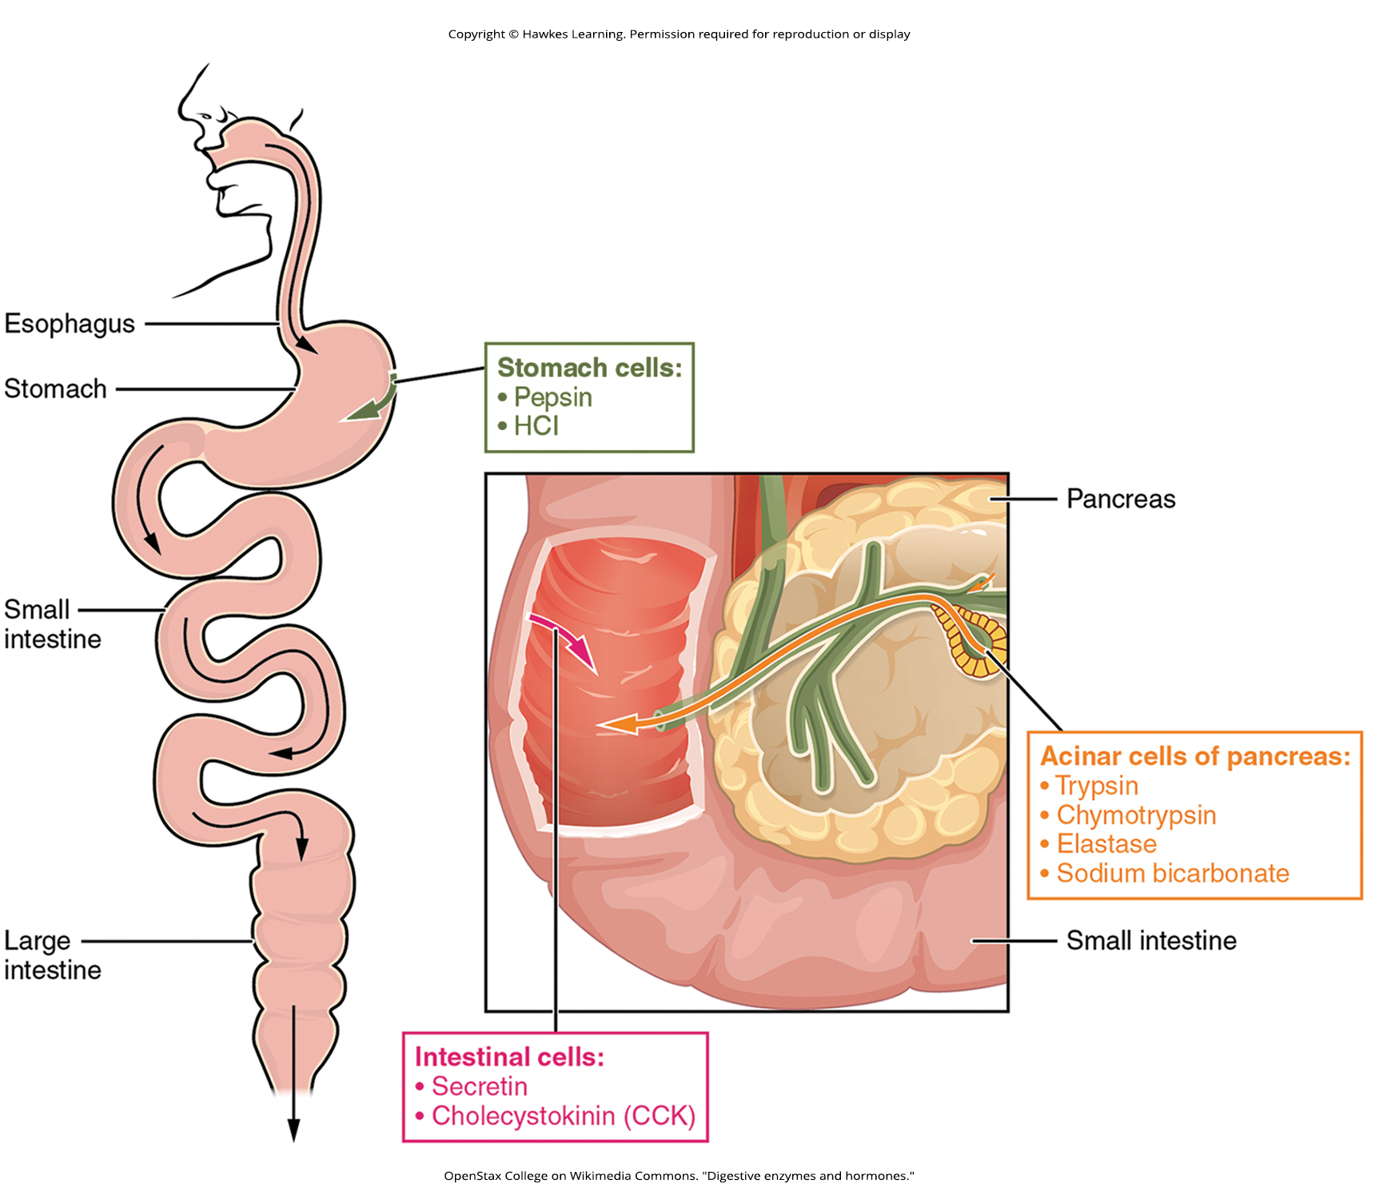
Lesson 34.3 Figure 8

Slide 30
Hawkes Learning – End of PowerPoint

