Slide 1
Chapter 35
The Circulatory System

Slide 2
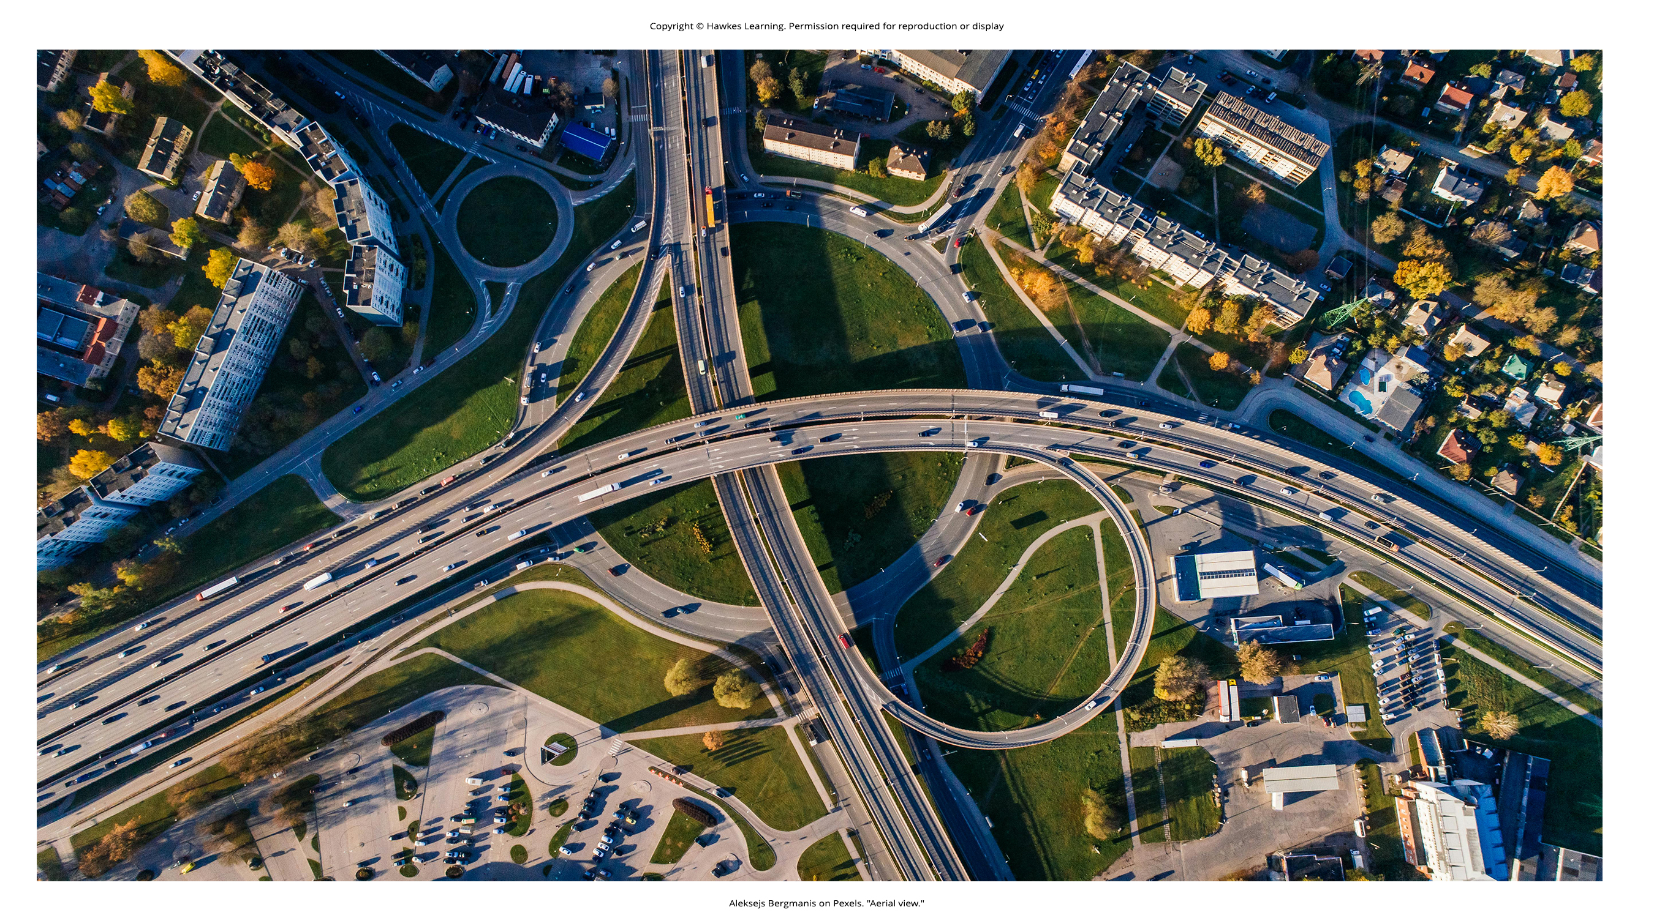
Lesson 35.1 Figure 1

Slide 3

Lesson 35.1 Figure 2

Slide 4
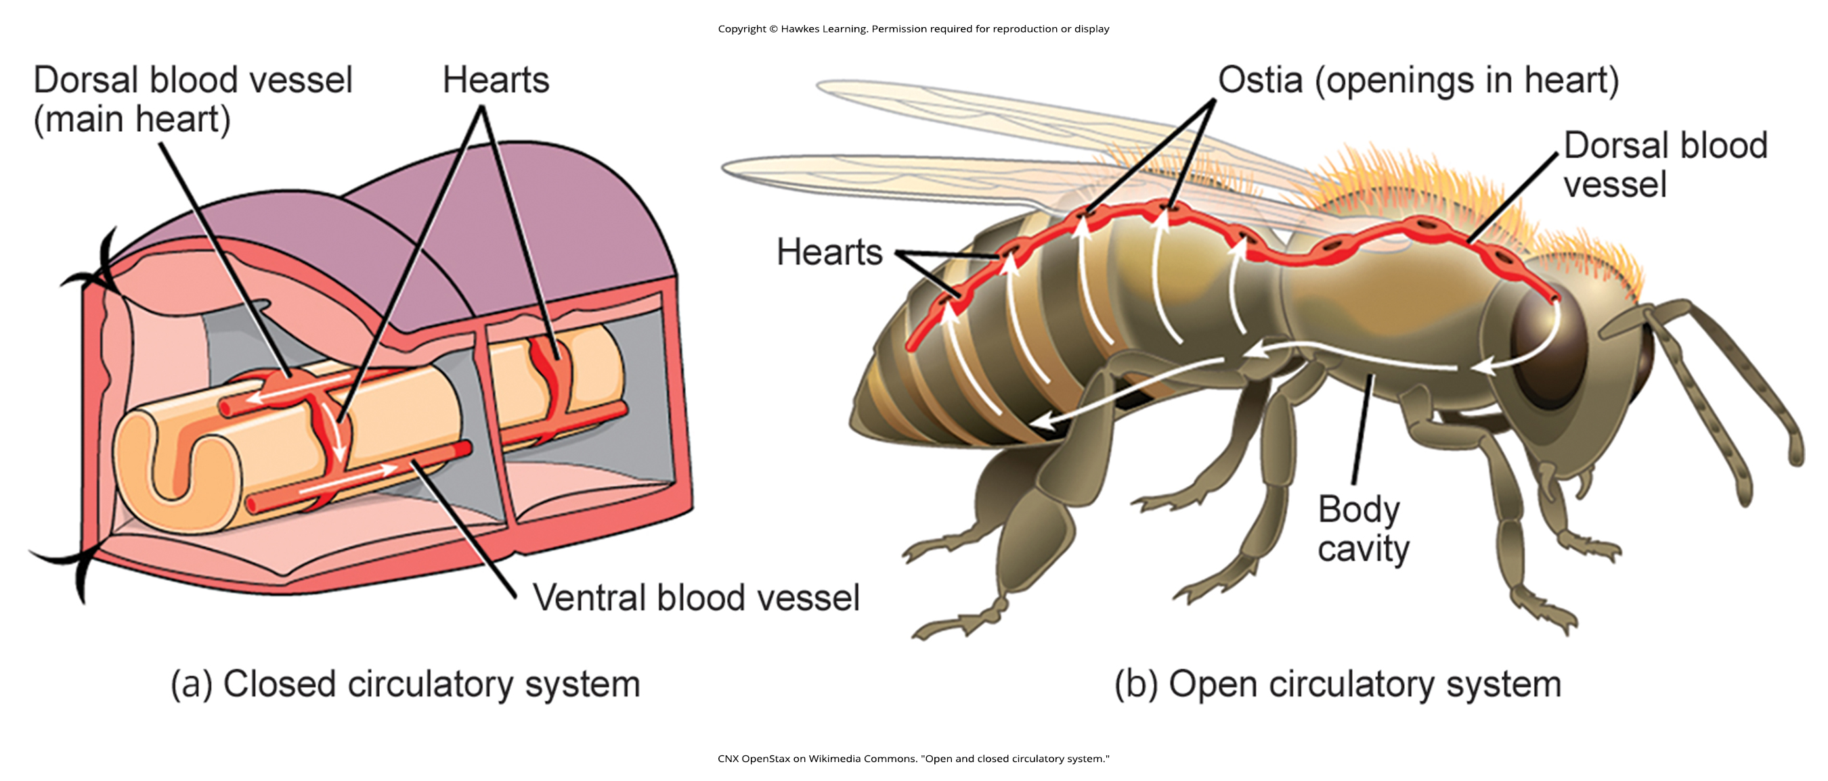
Lesson 35.1 Figure 3

Slide 5
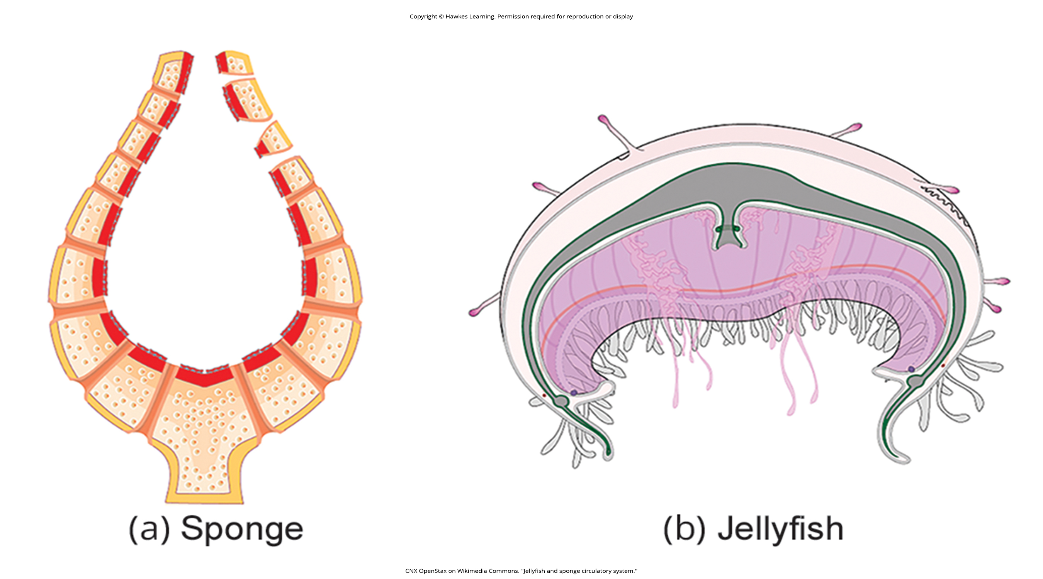
Lesson 35.1 Figure 4

Slide 6
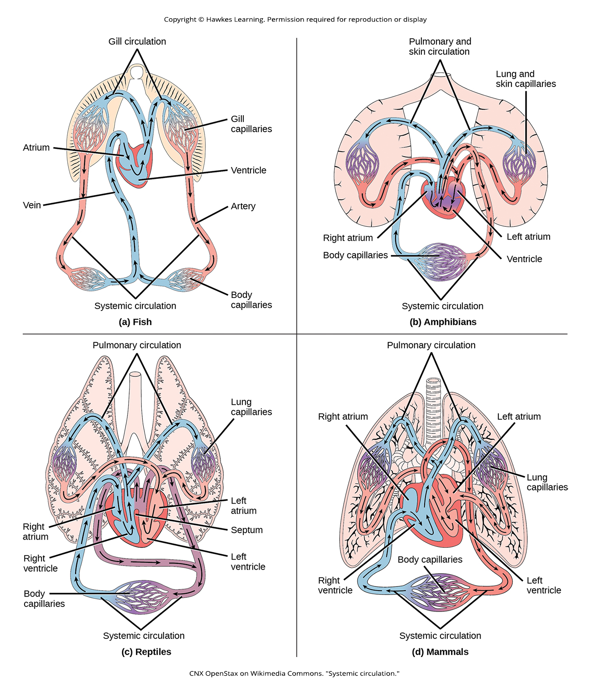
Lesson 35.1 Figure 5

Slide 7
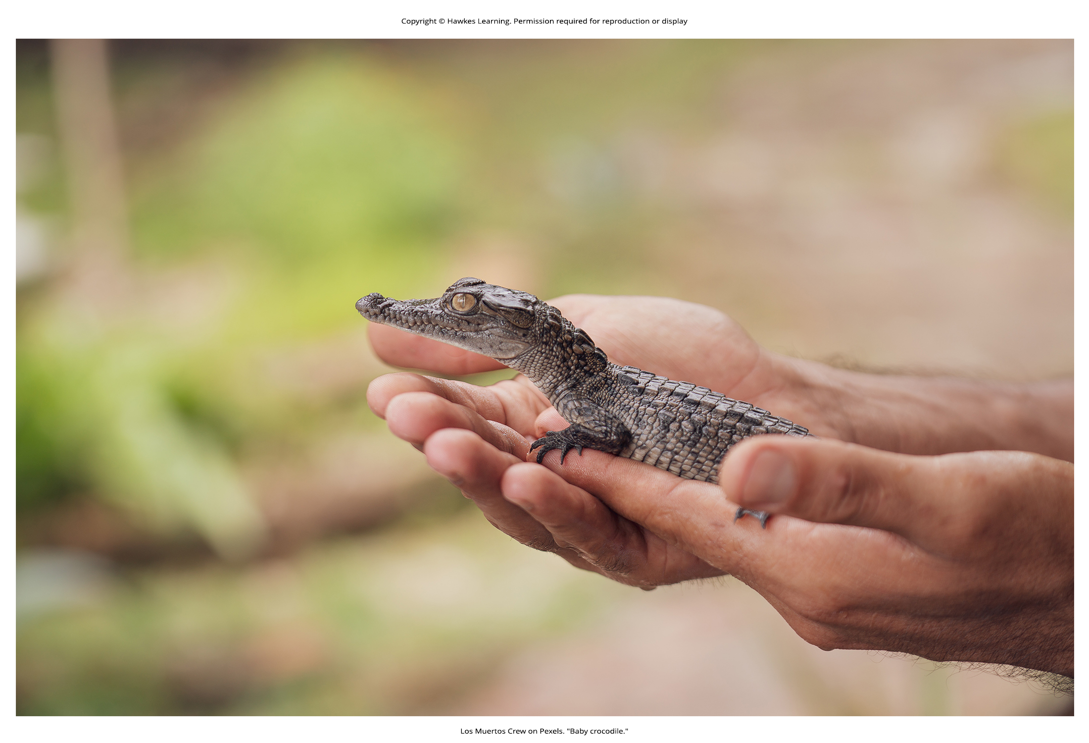
Lesson 35.1 Figure 6

Slide 8
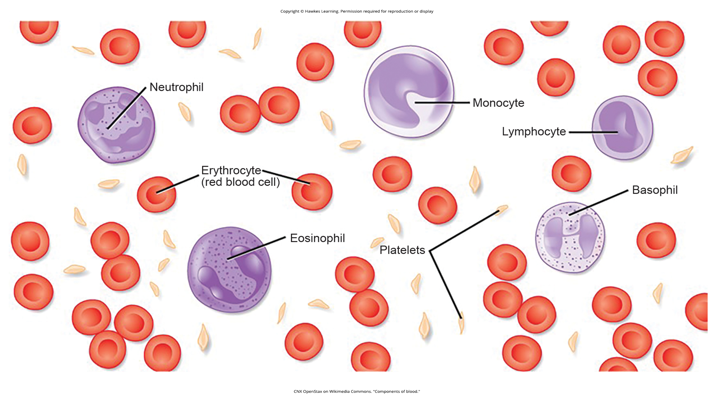
Lesson 35.2 Figure 1

Slide 9
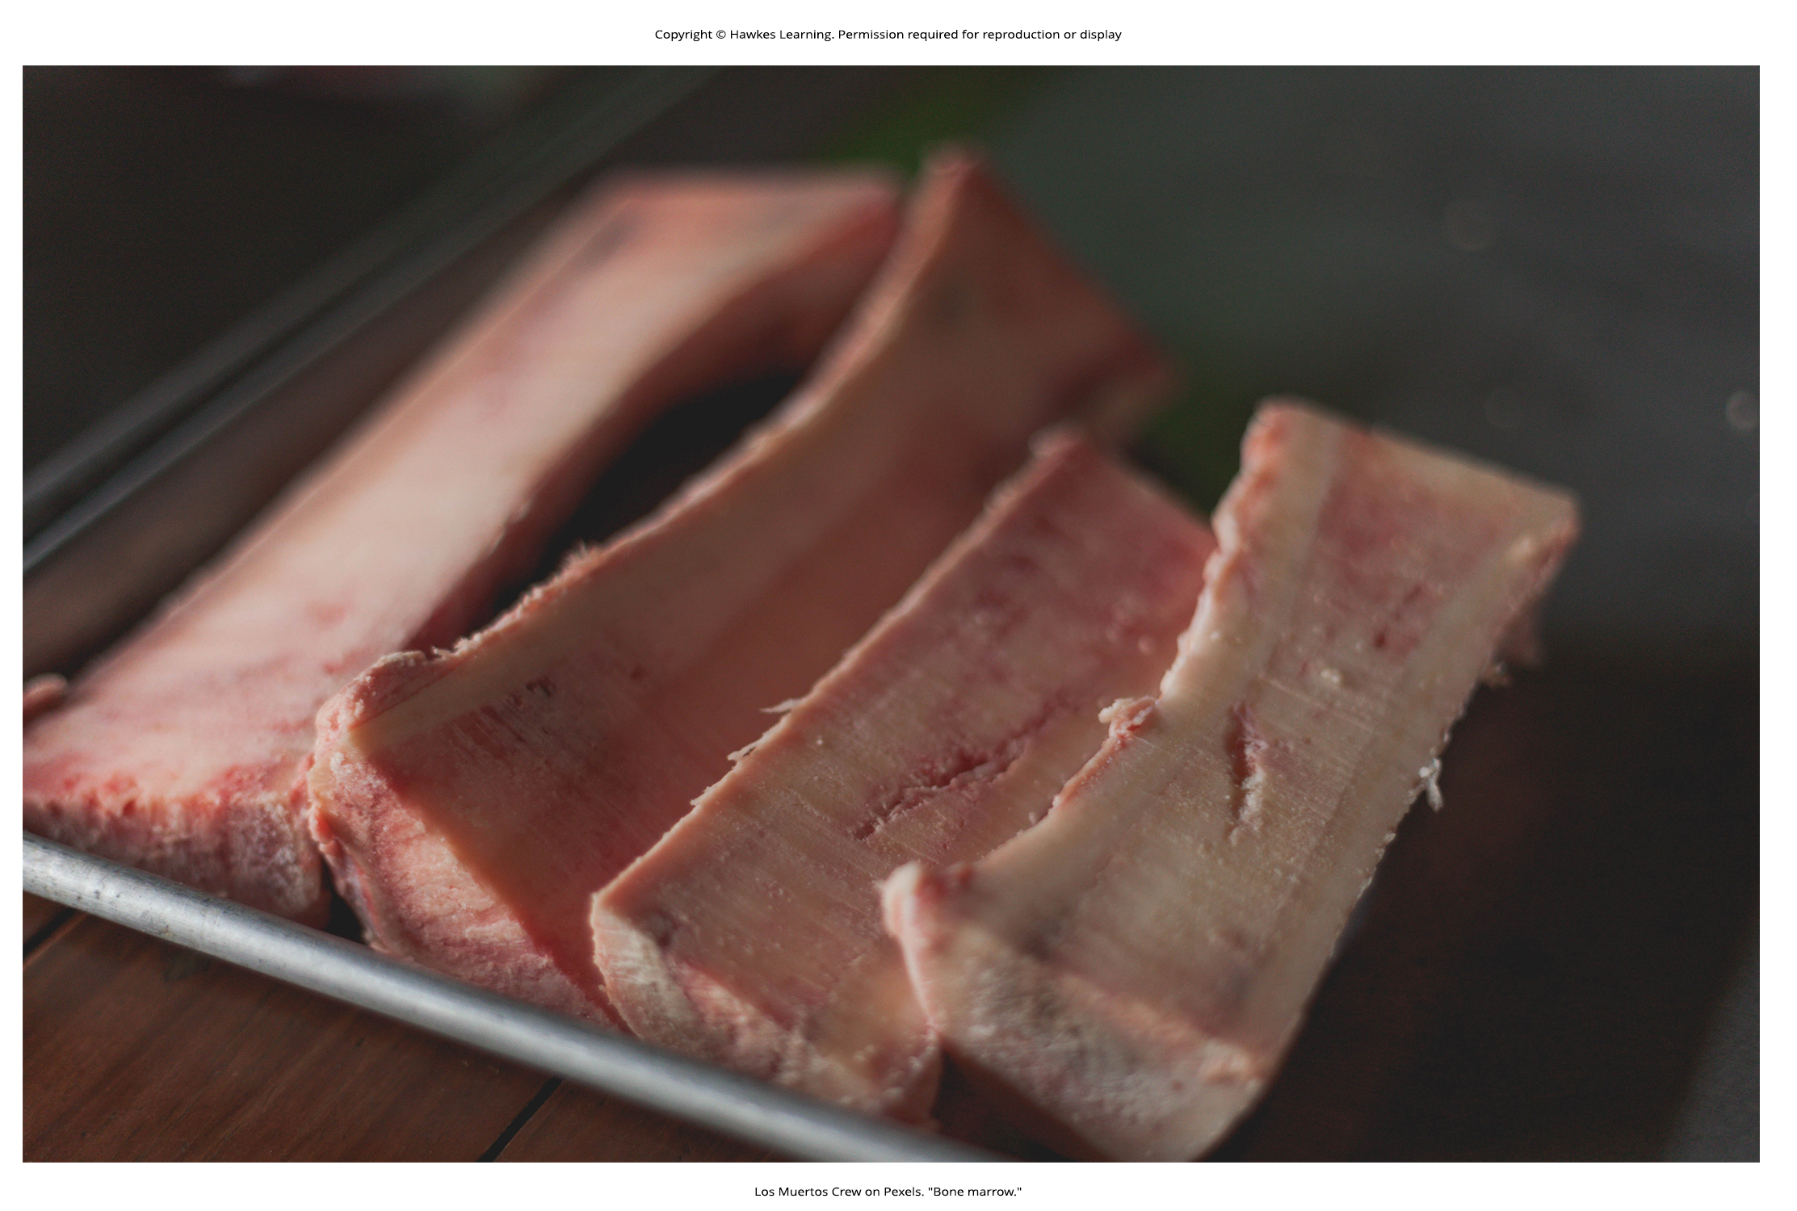
Lesson 35.2 Figure 2

Slide 10
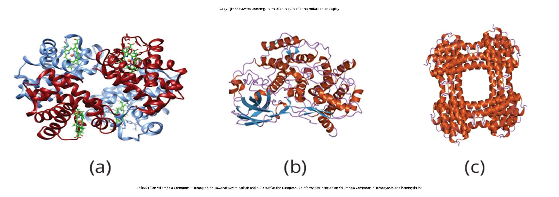
Lesson 35.2 Figure 3

Slide 11
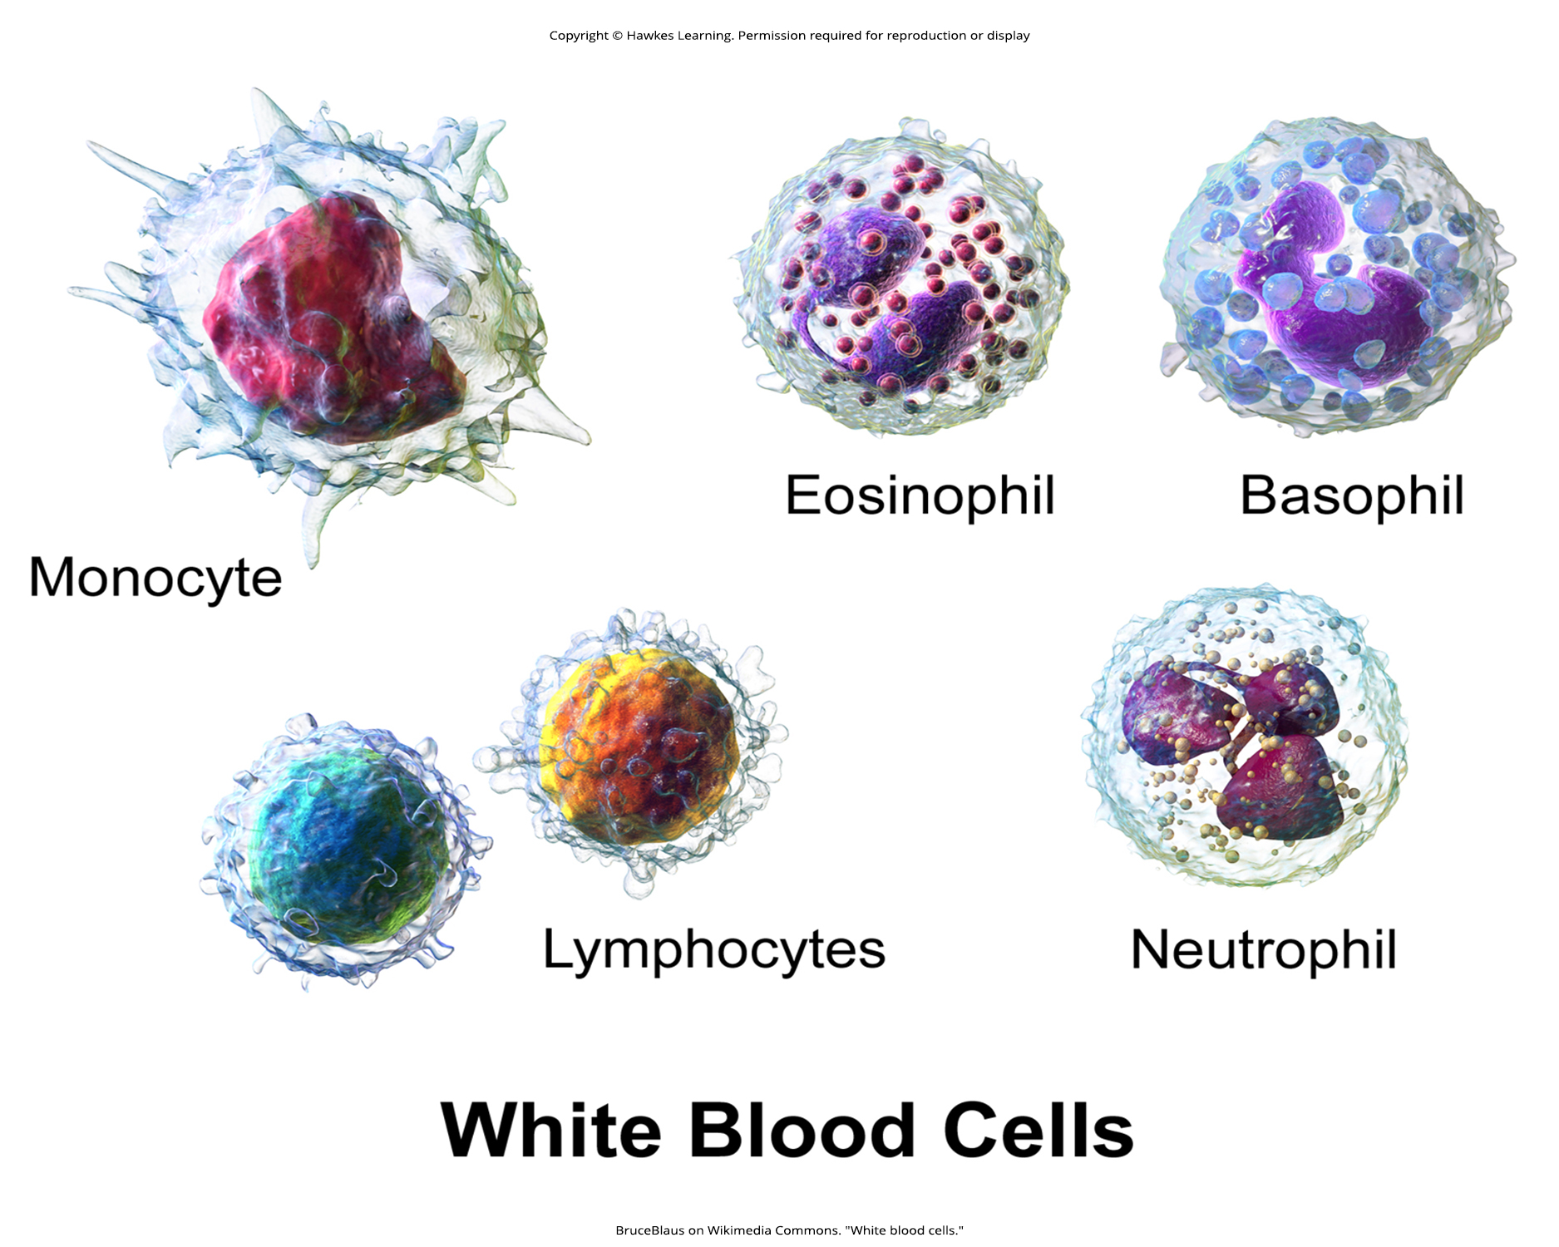
Lesson 35.2 Figure 4

Slide 12
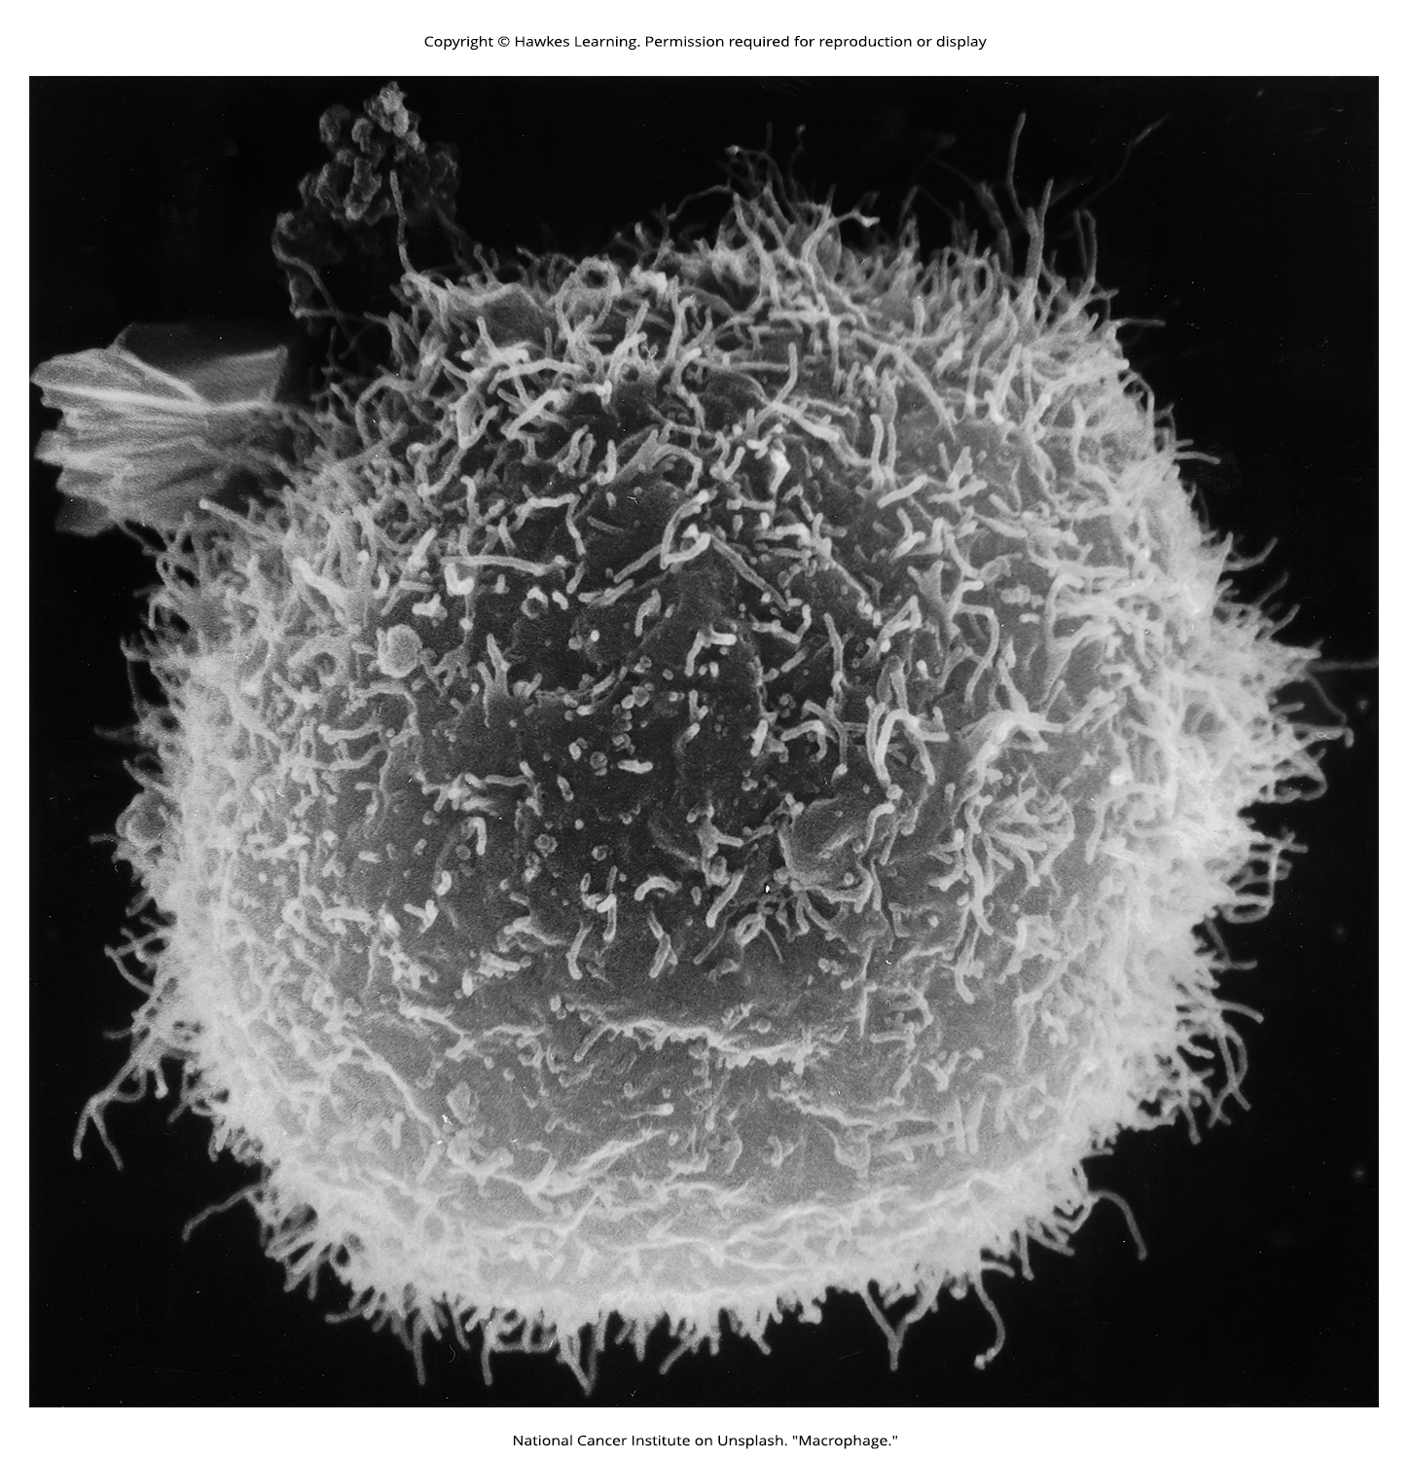
Lesson 35.2 Figure 5

Slide 13
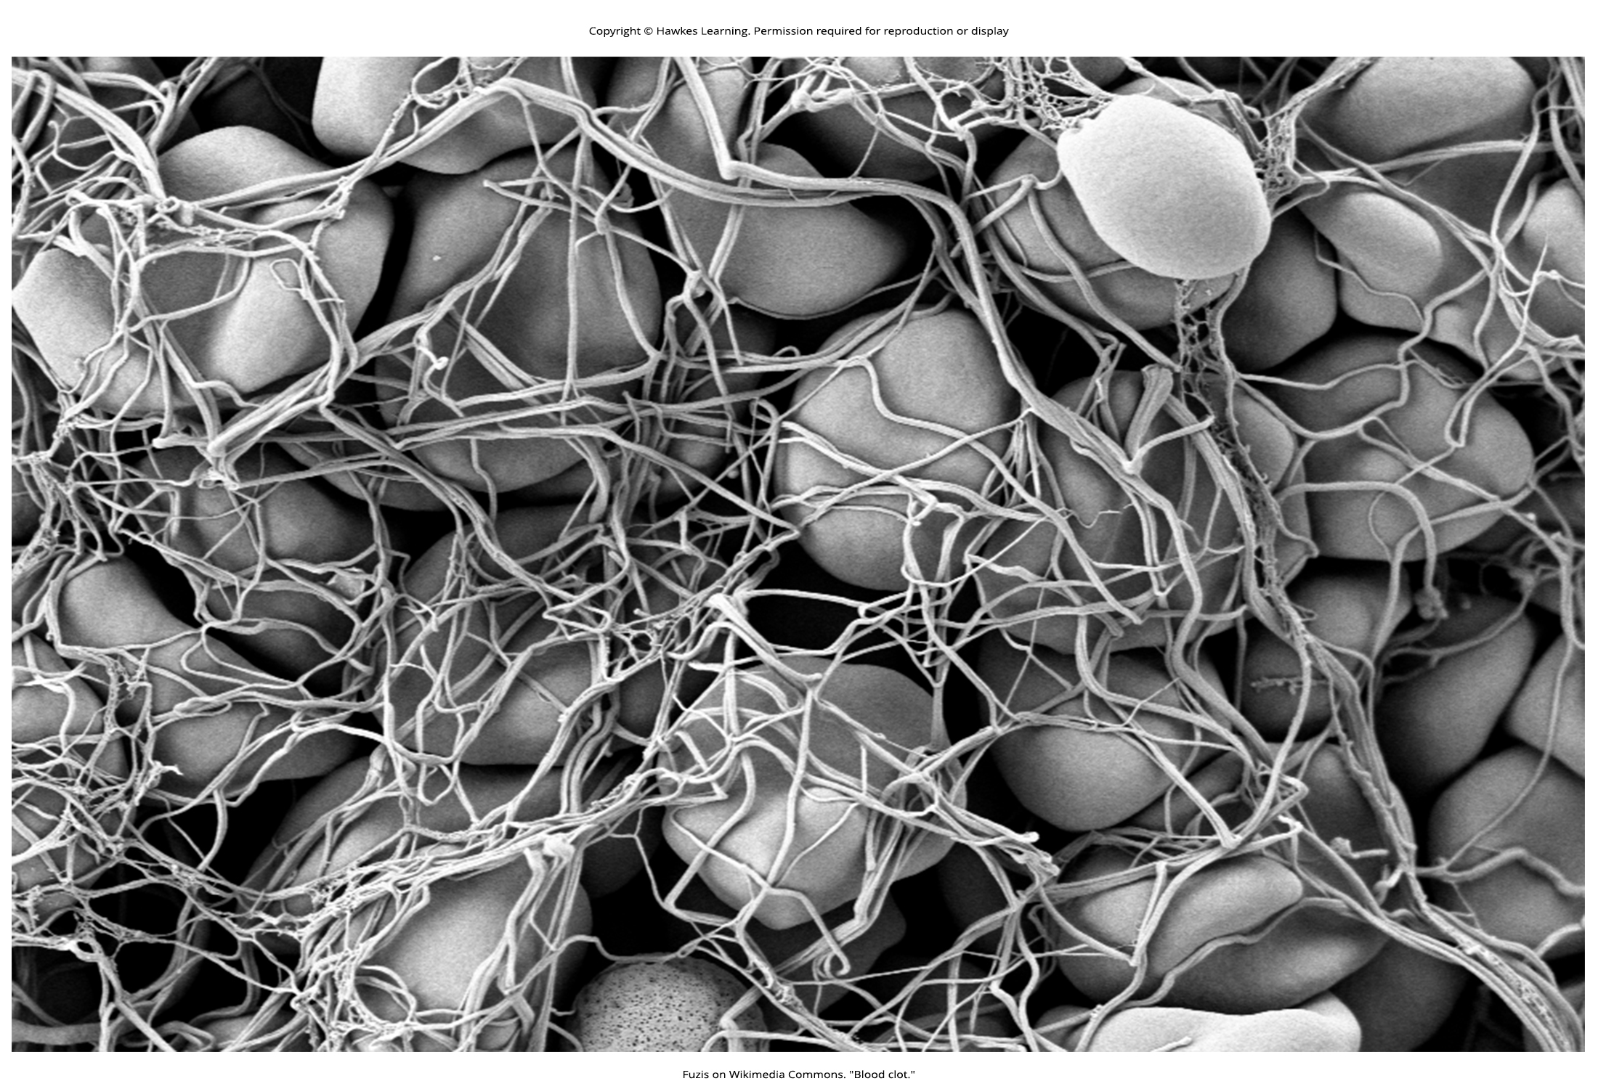
Lesson 35.2 Figure 6

Slide 14
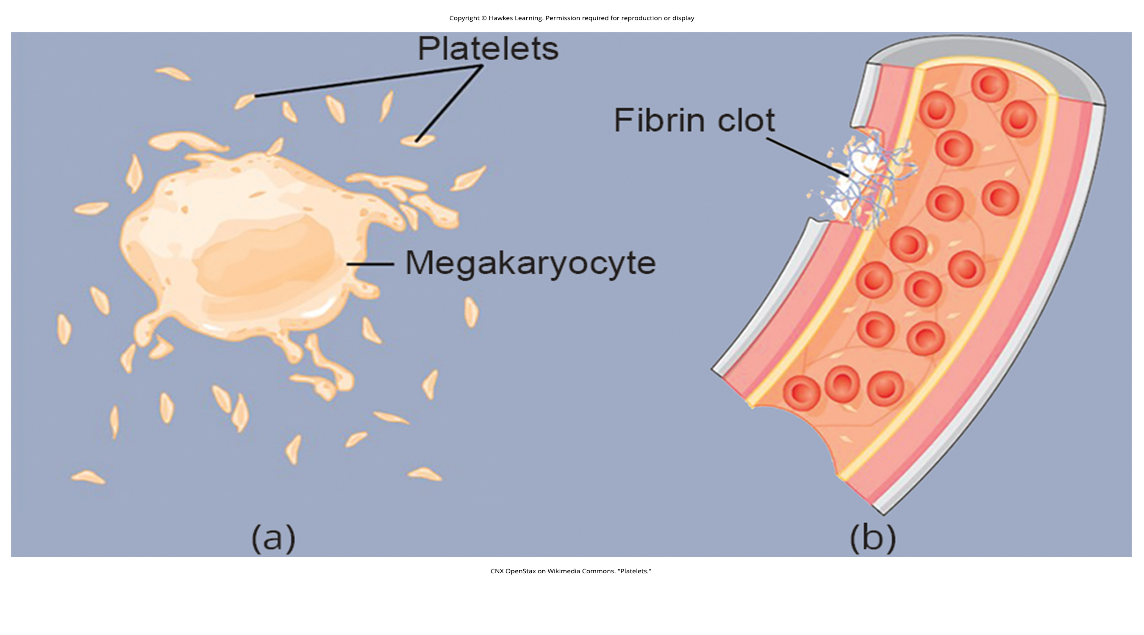
Lesson 35.2 Figure 7

Slide 15
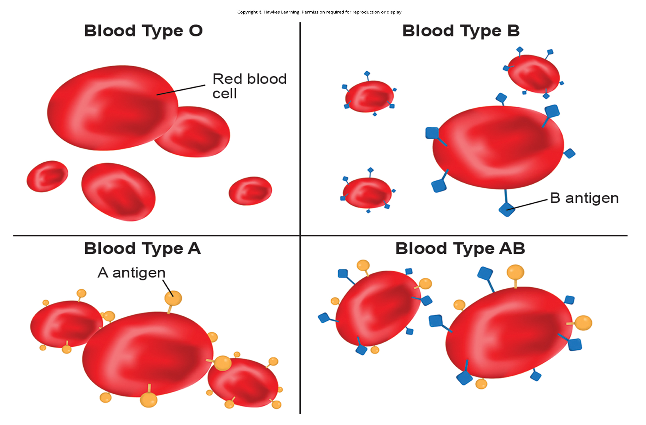
Lesson 35.2 Figure 8

Slide 16
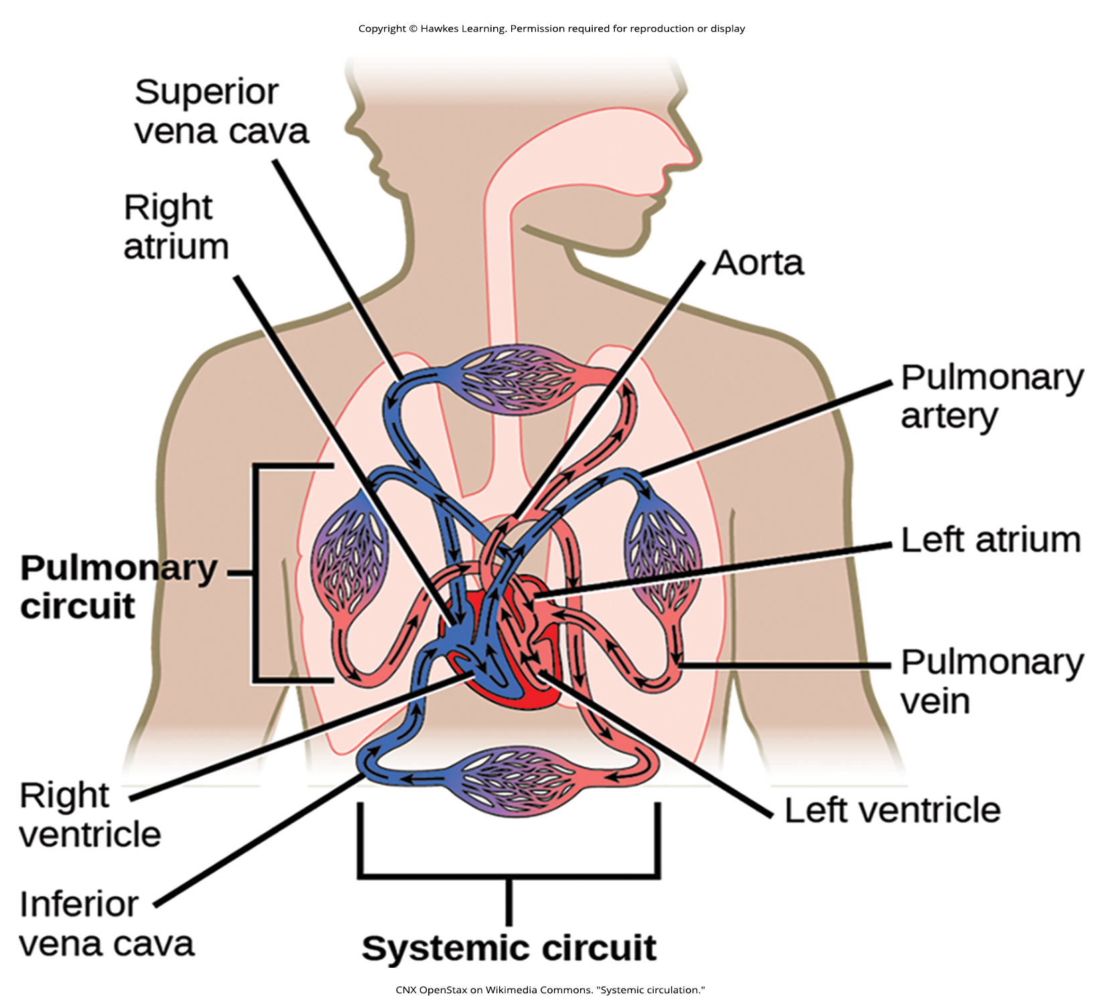
Lesson 35.3 Figure 1

Slide 17
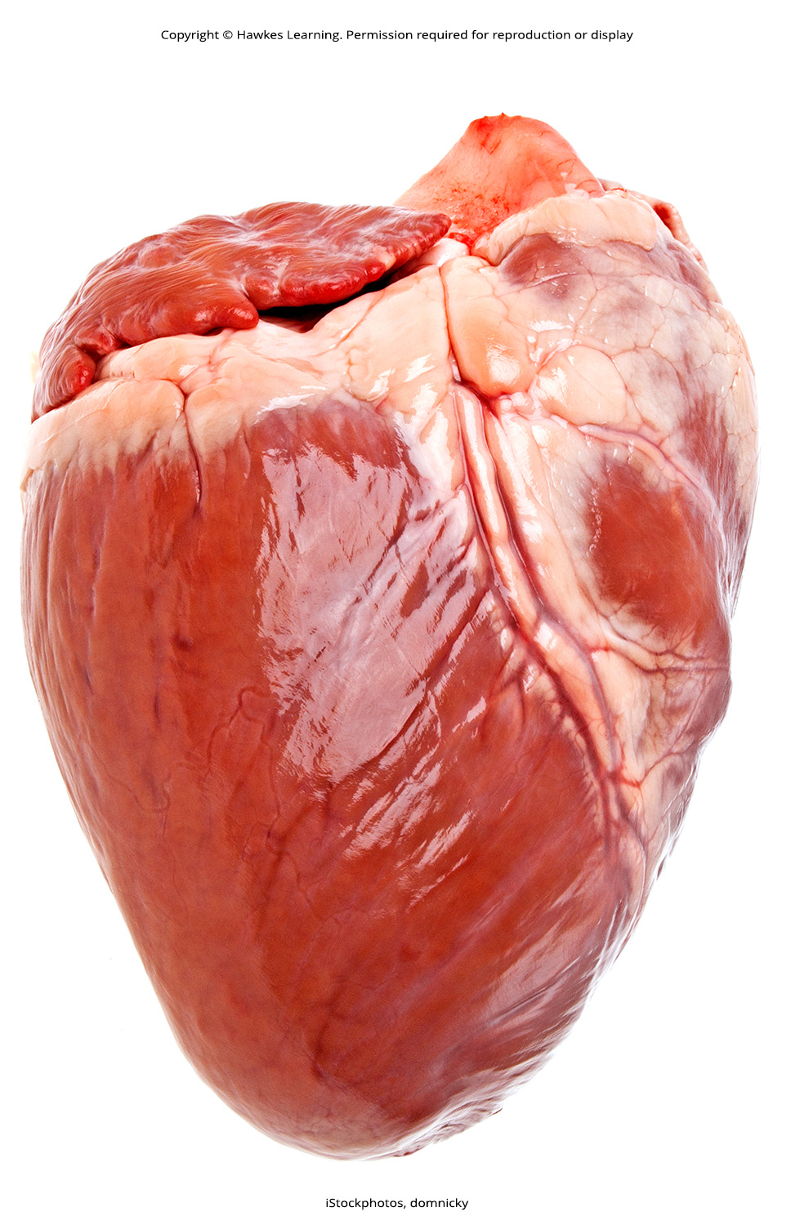
Lesson 35.3 Figure 2

Slide 18
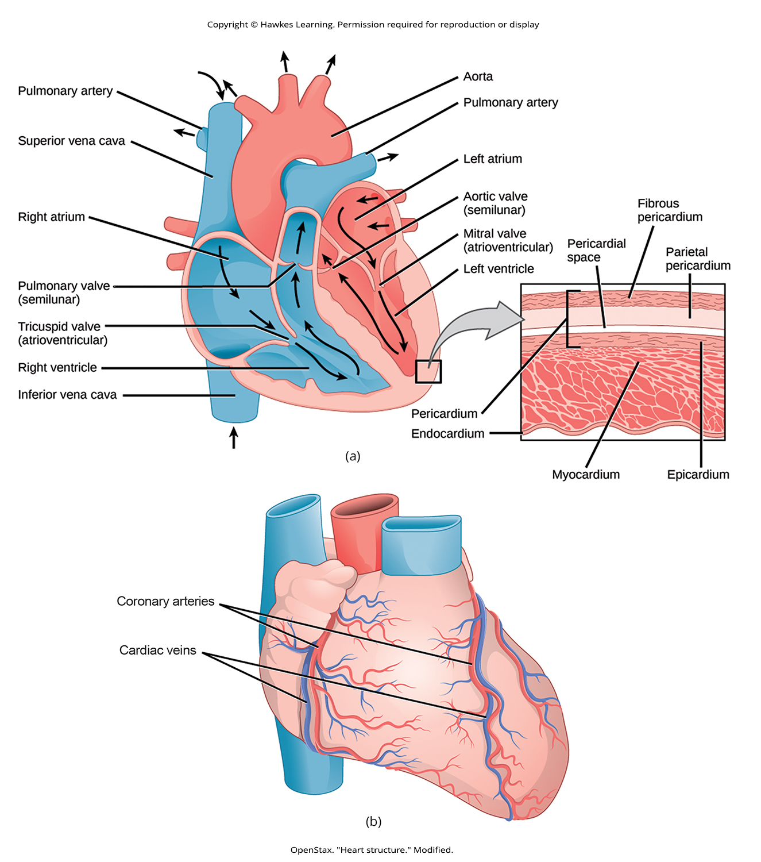
Lesson 35.3 Figure 3

Slide 19
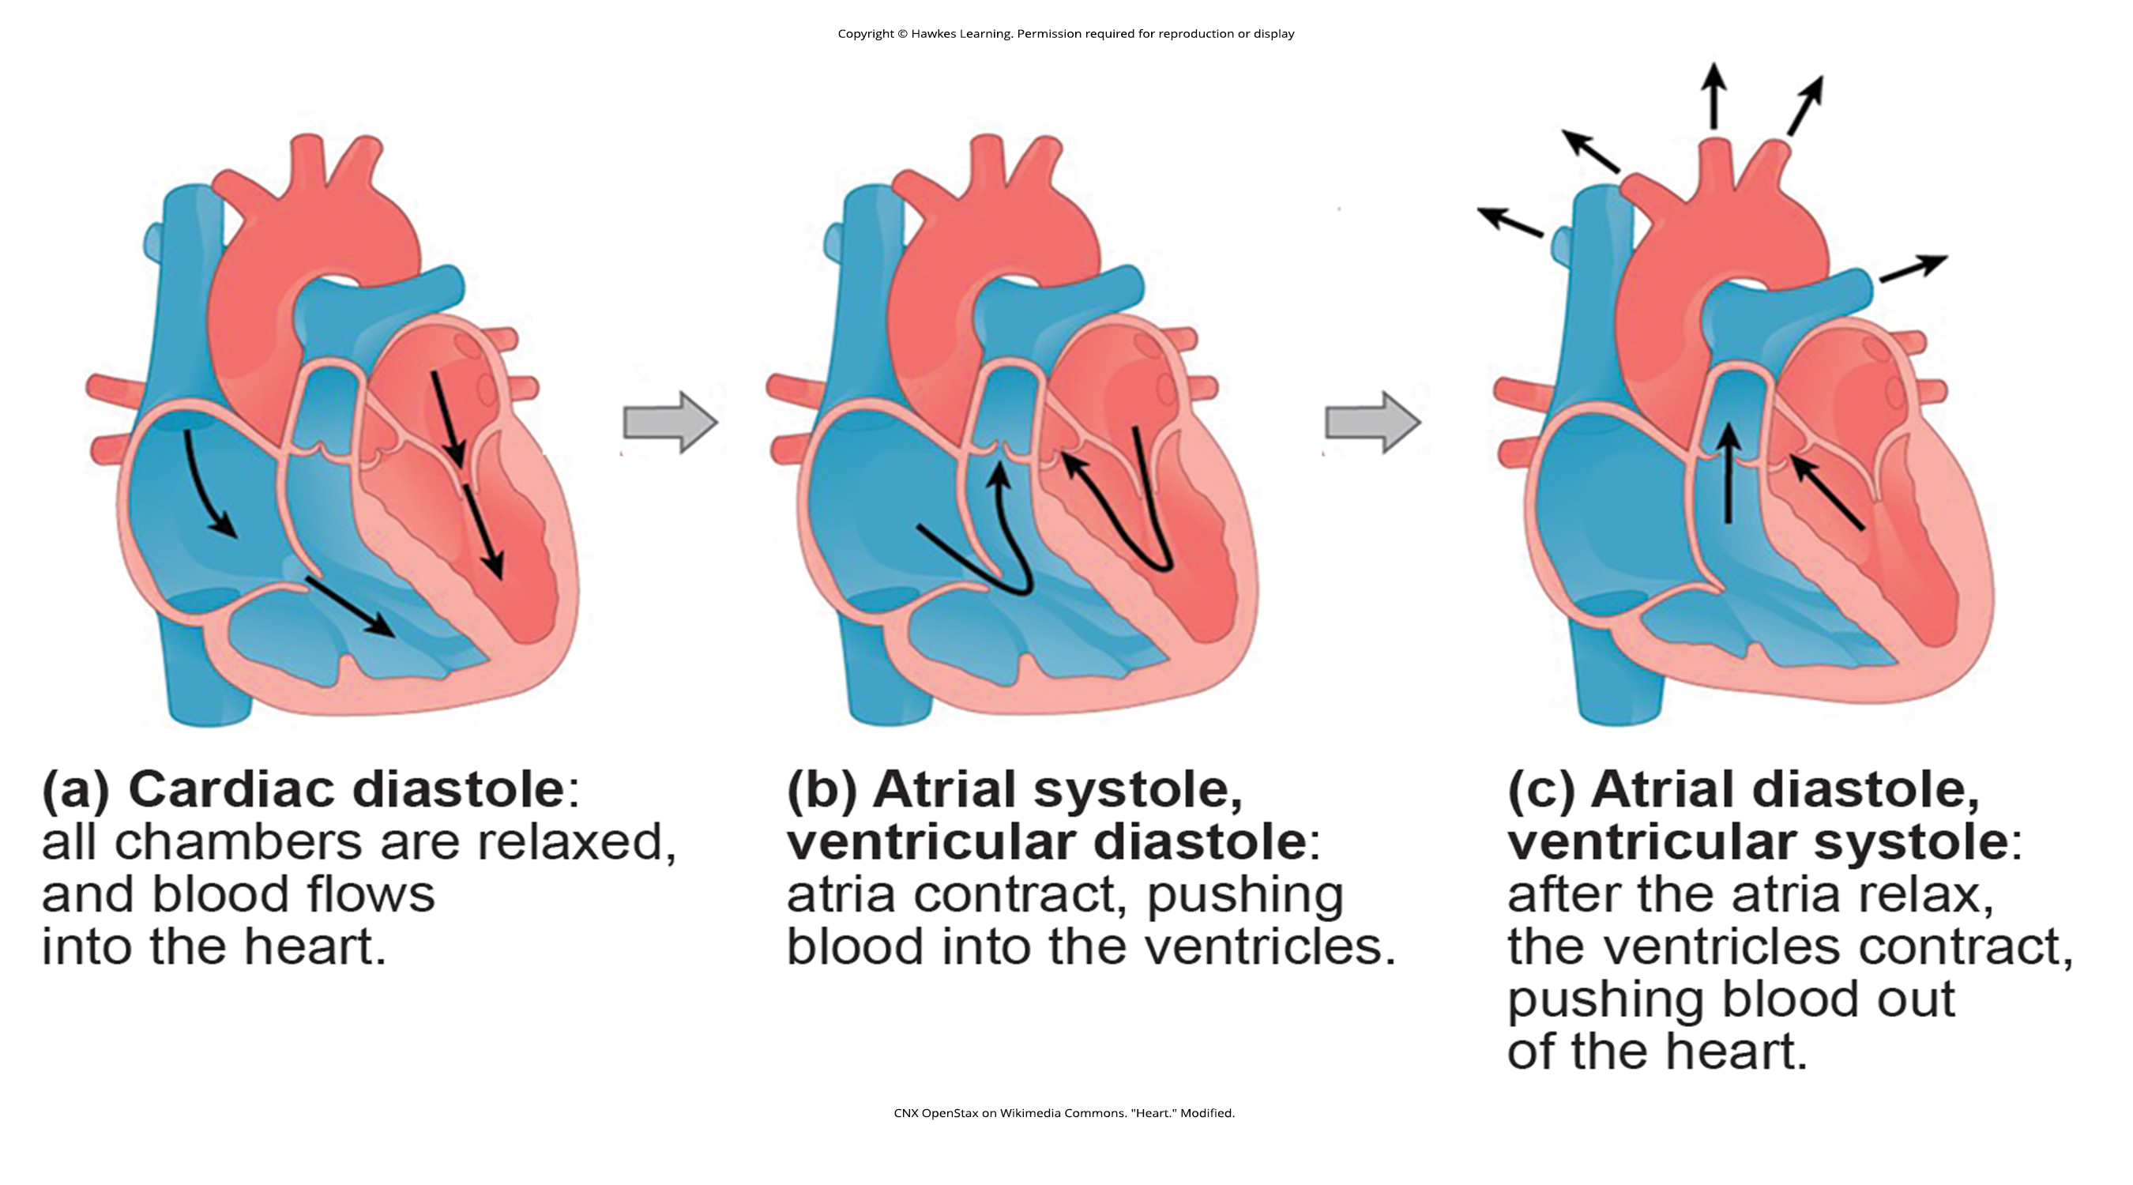
Lesson 35.3 Figure 4

Slide 20
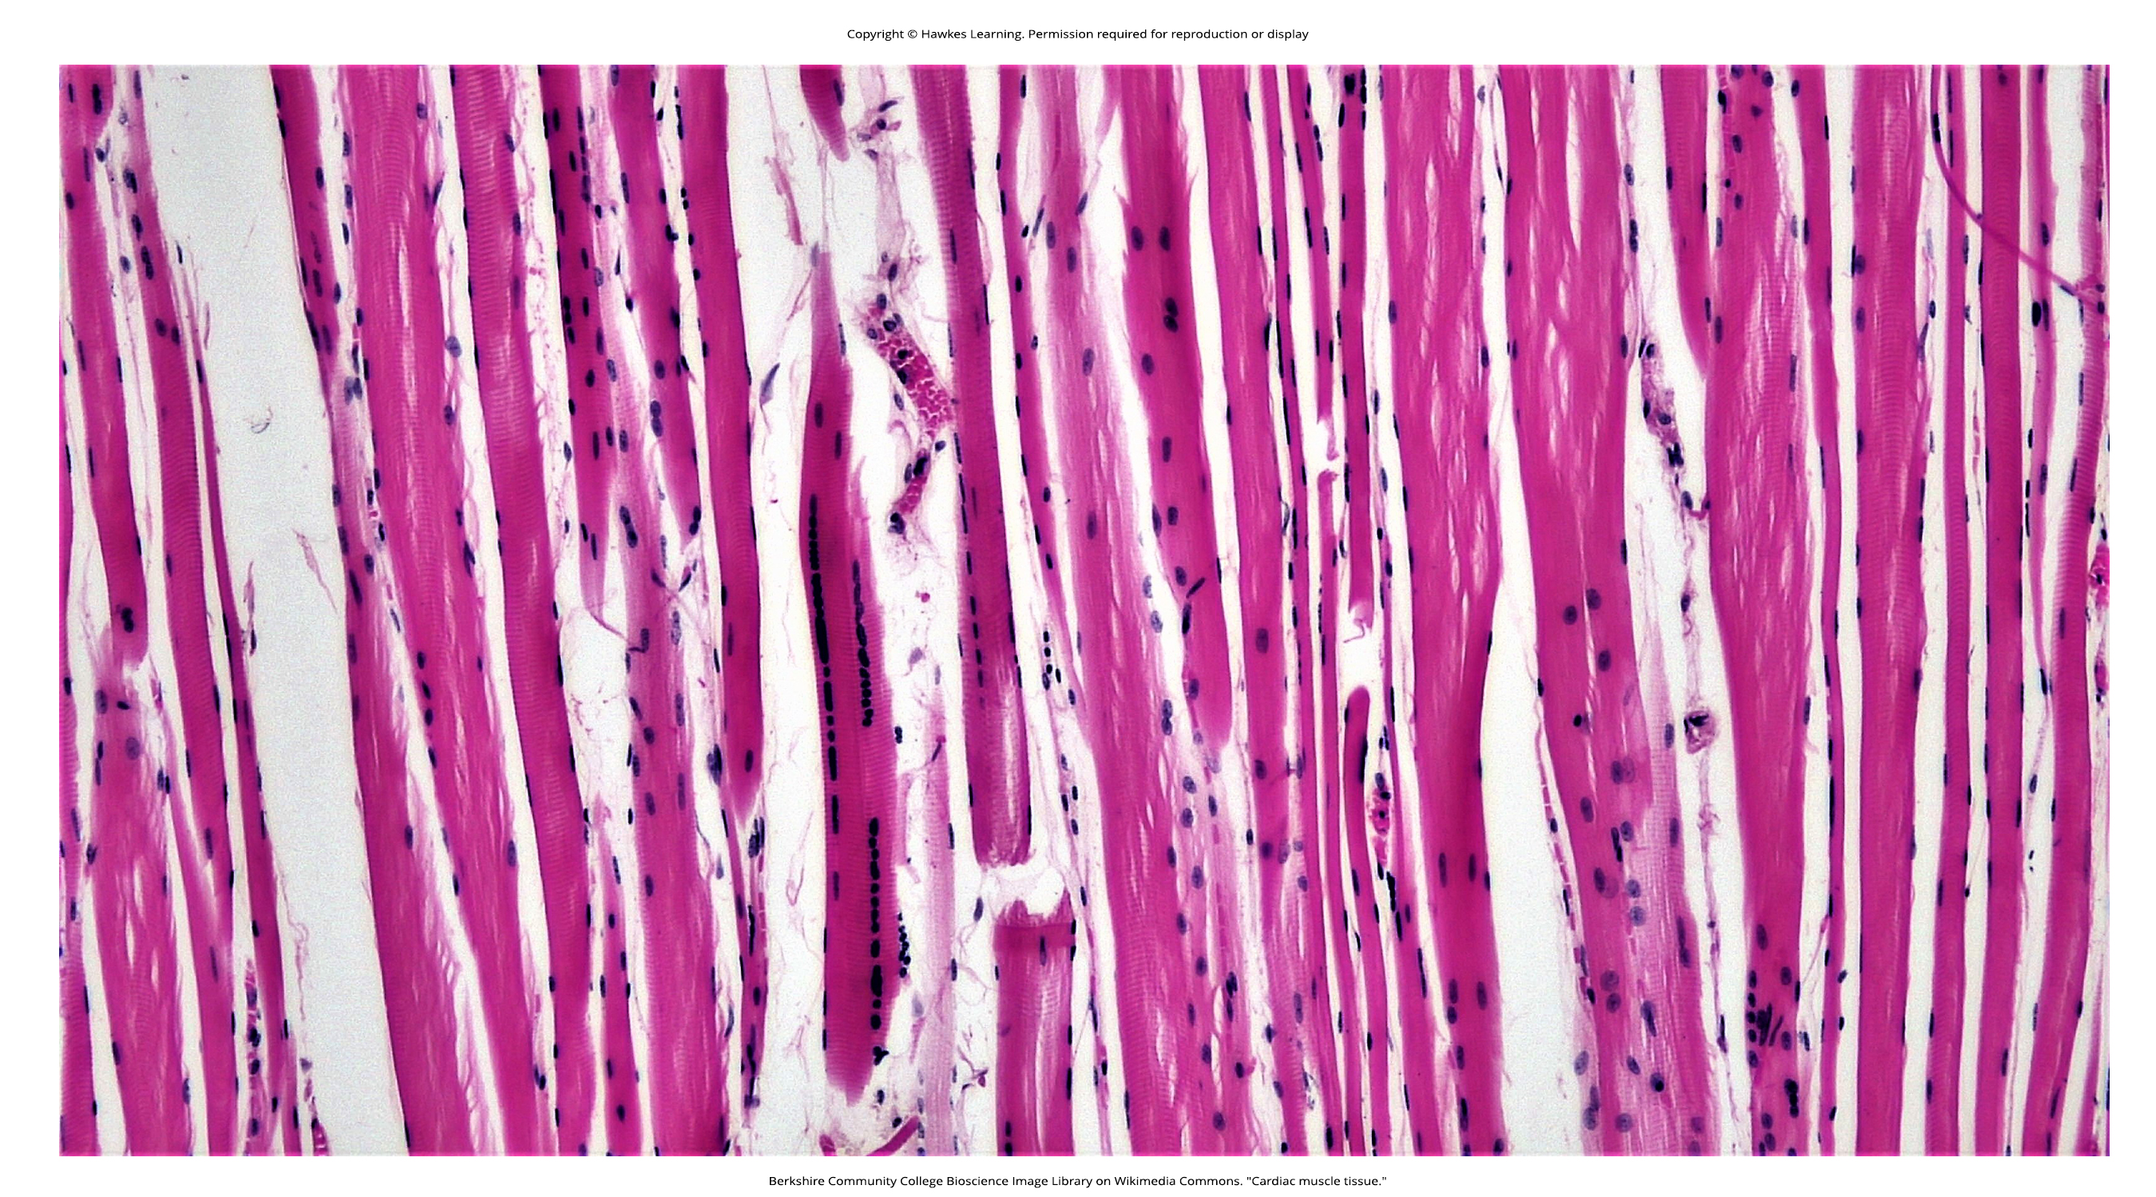
Lesson 35.3 Figure 5

Slide 21
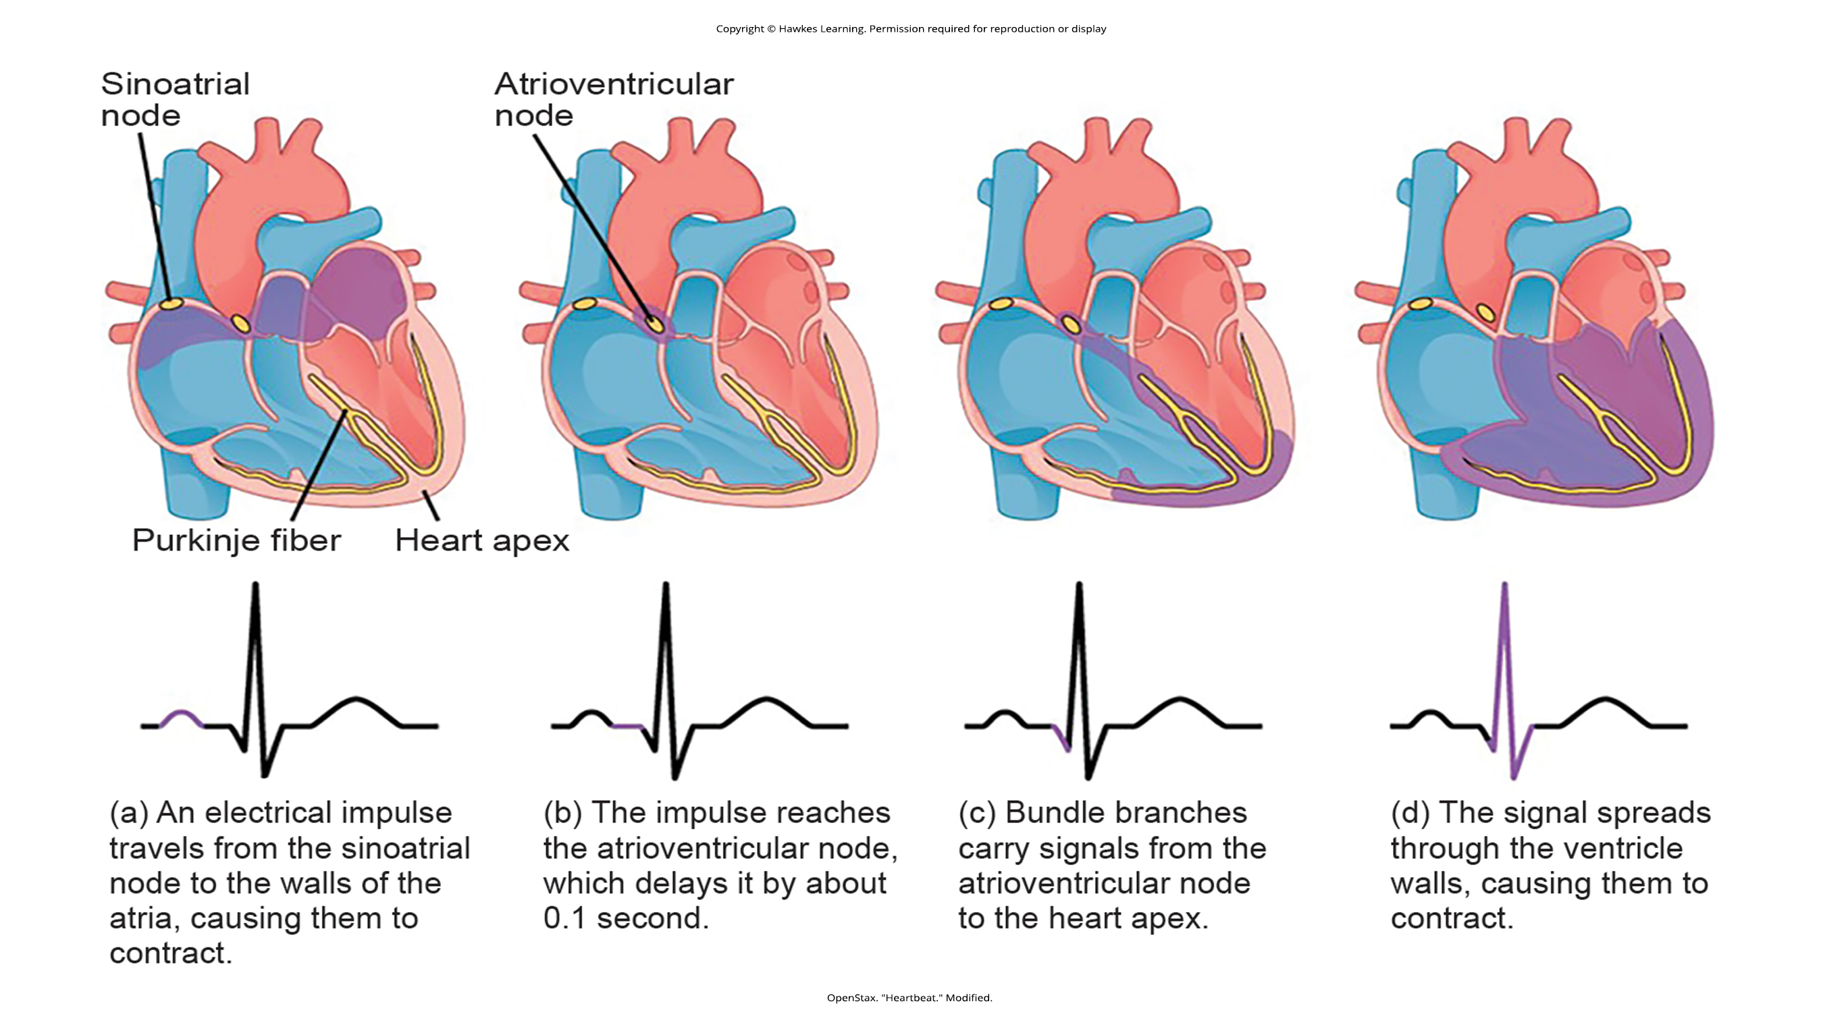
Lesson 35.3 Figure 6

Slide 22
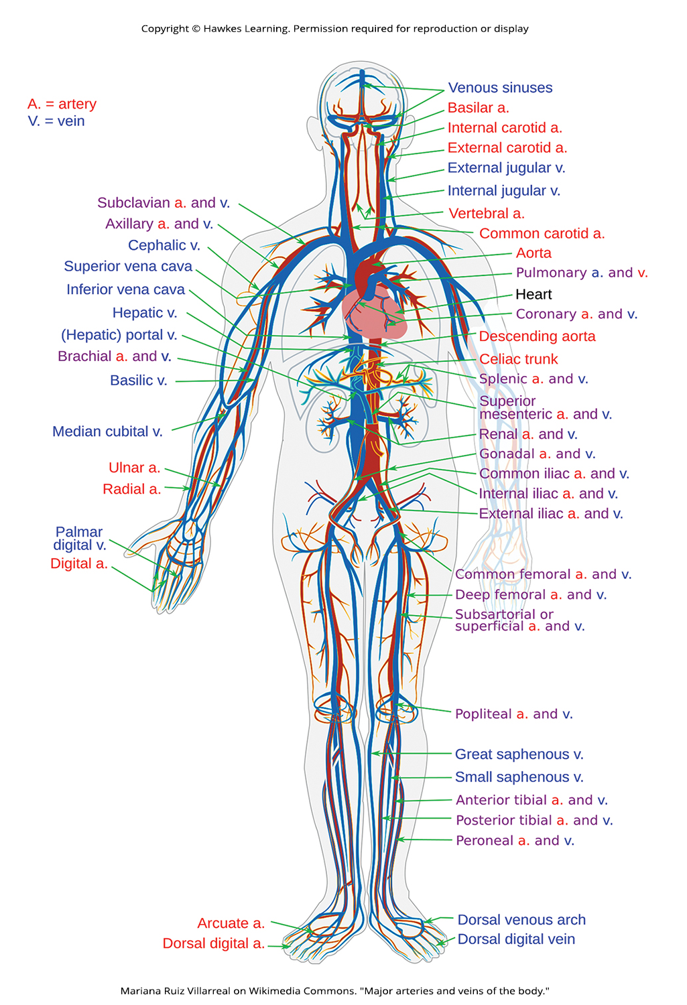
Lesson 35.3 Figure 7

Slide 23
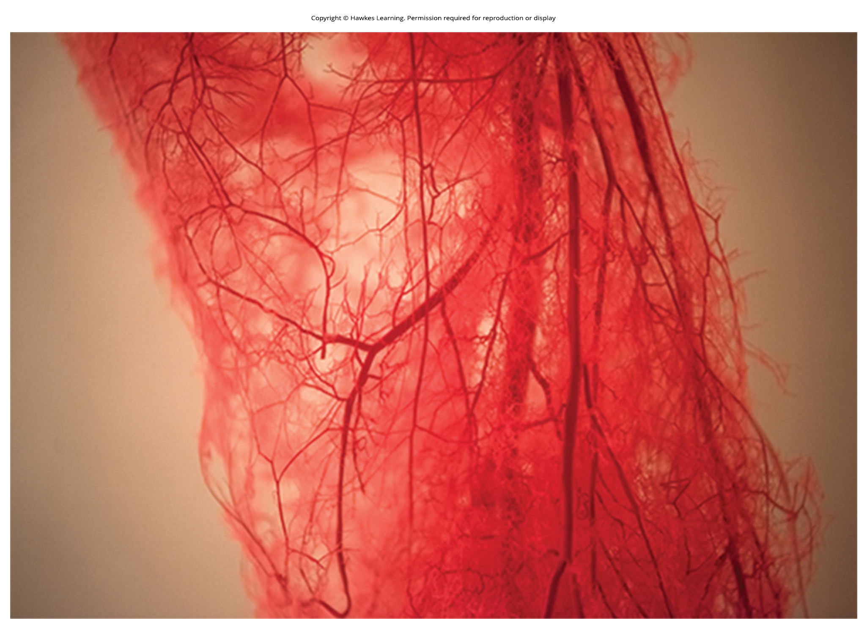
Lesson 35.3 Figure 8

Slide 24
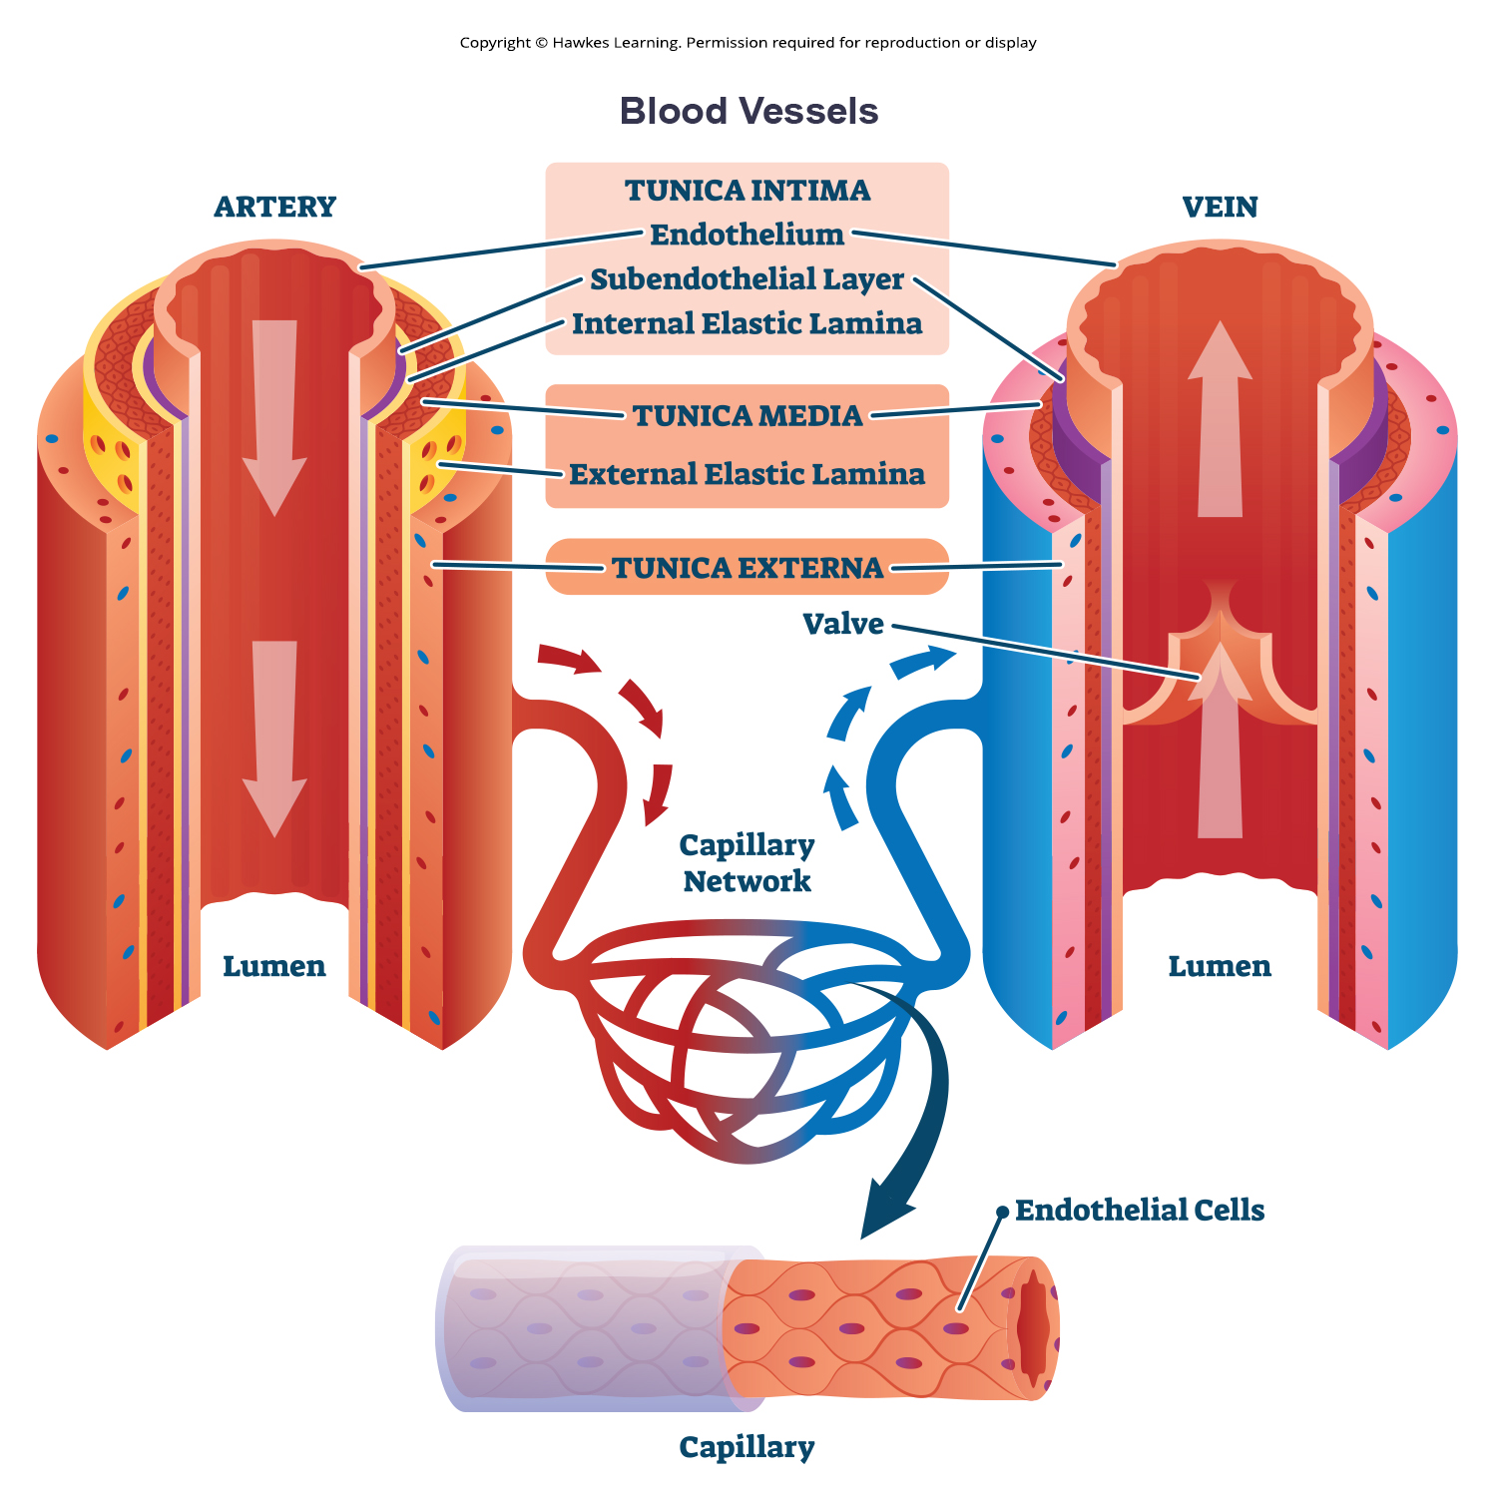
Lesson 35.3 Figure 9

Slide 25
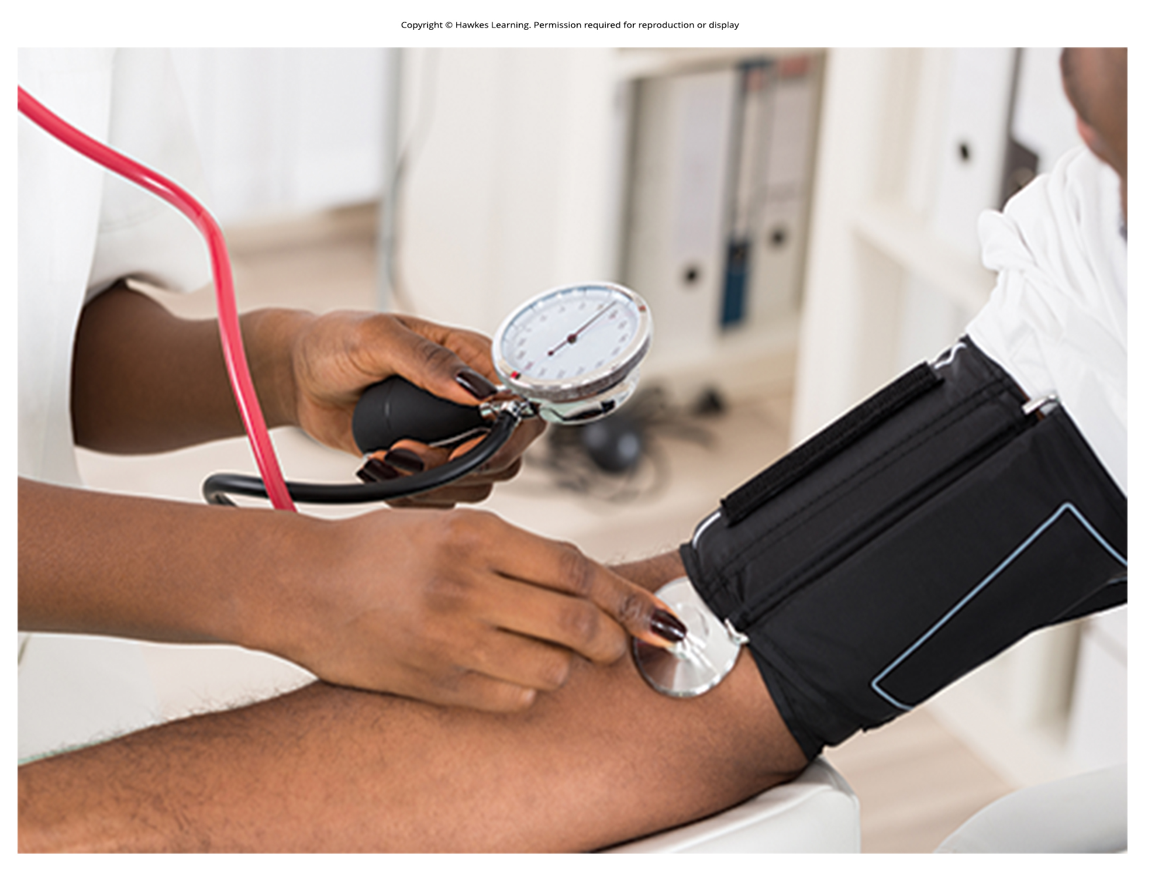
Lesson 35.4 Figure 1

Slide 26
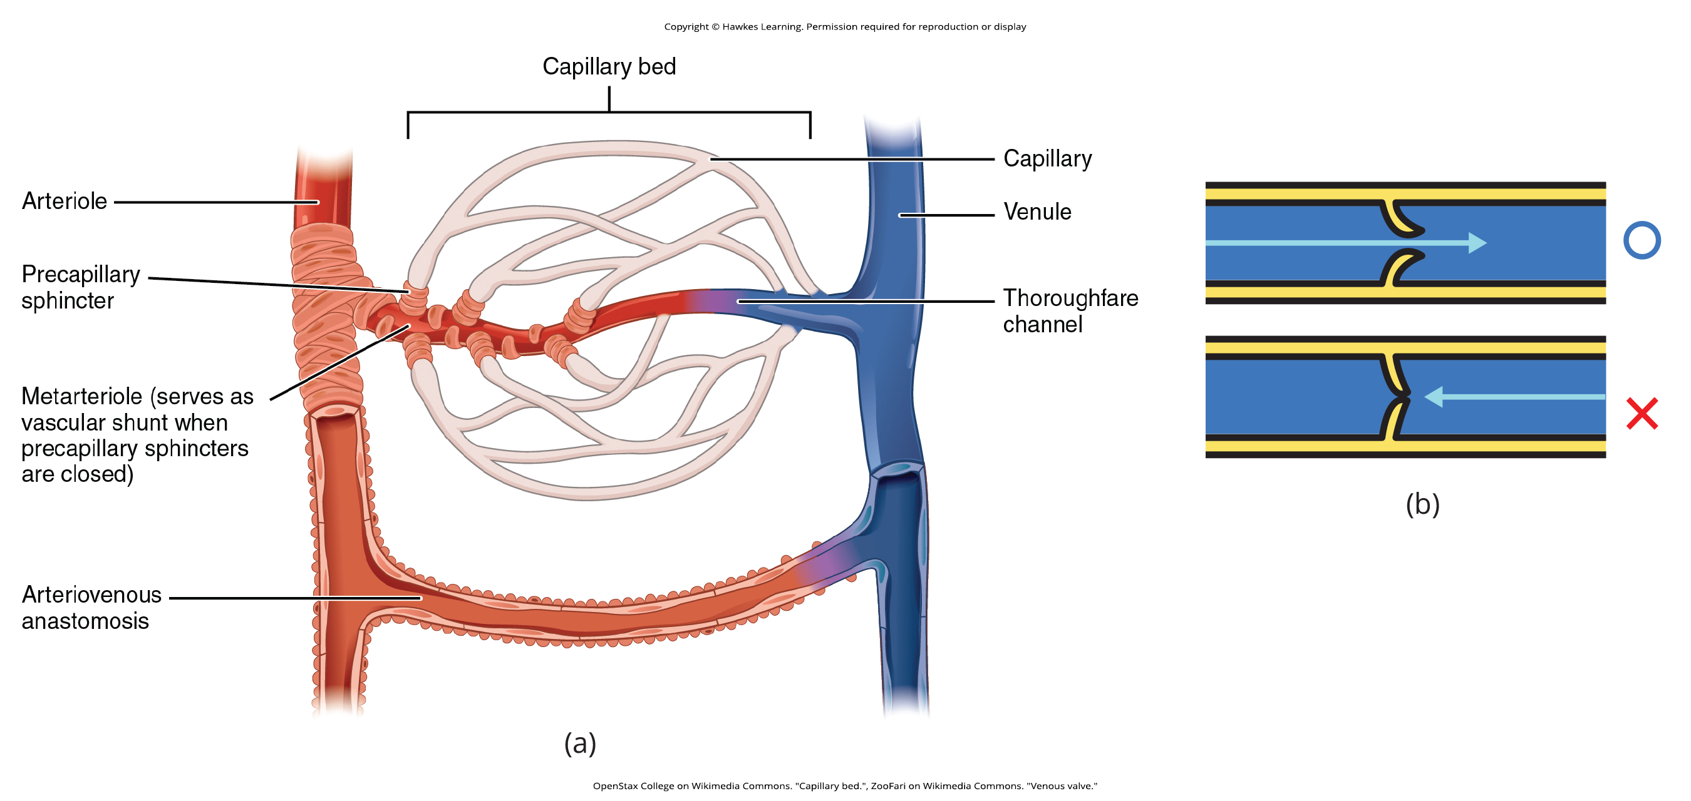
Lesson 35.4 Figure 2

Slide 27
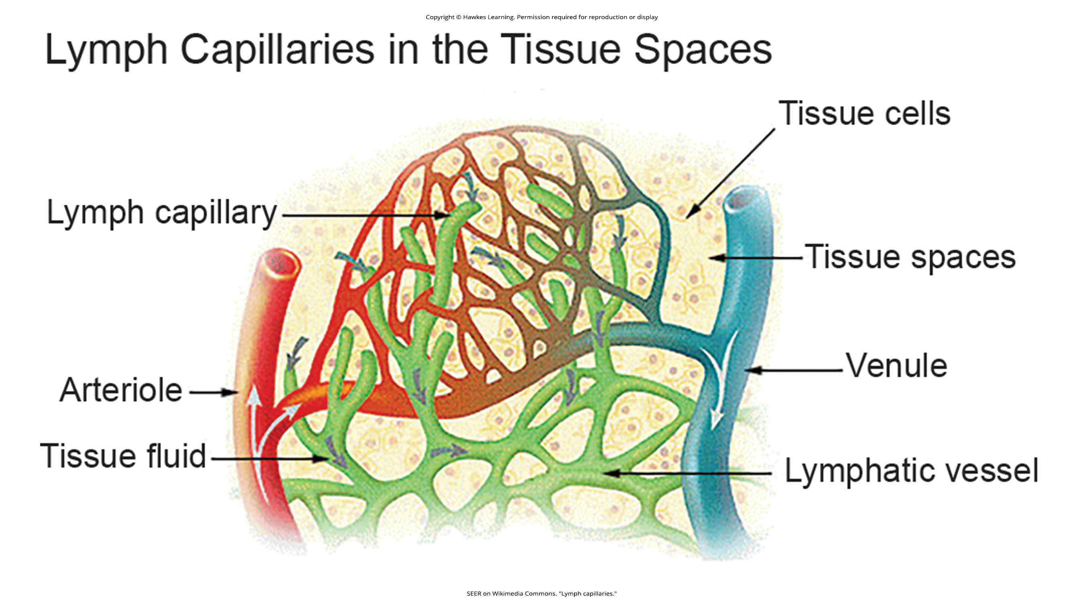
Lesson 35.4 Figure 3

Slide 28
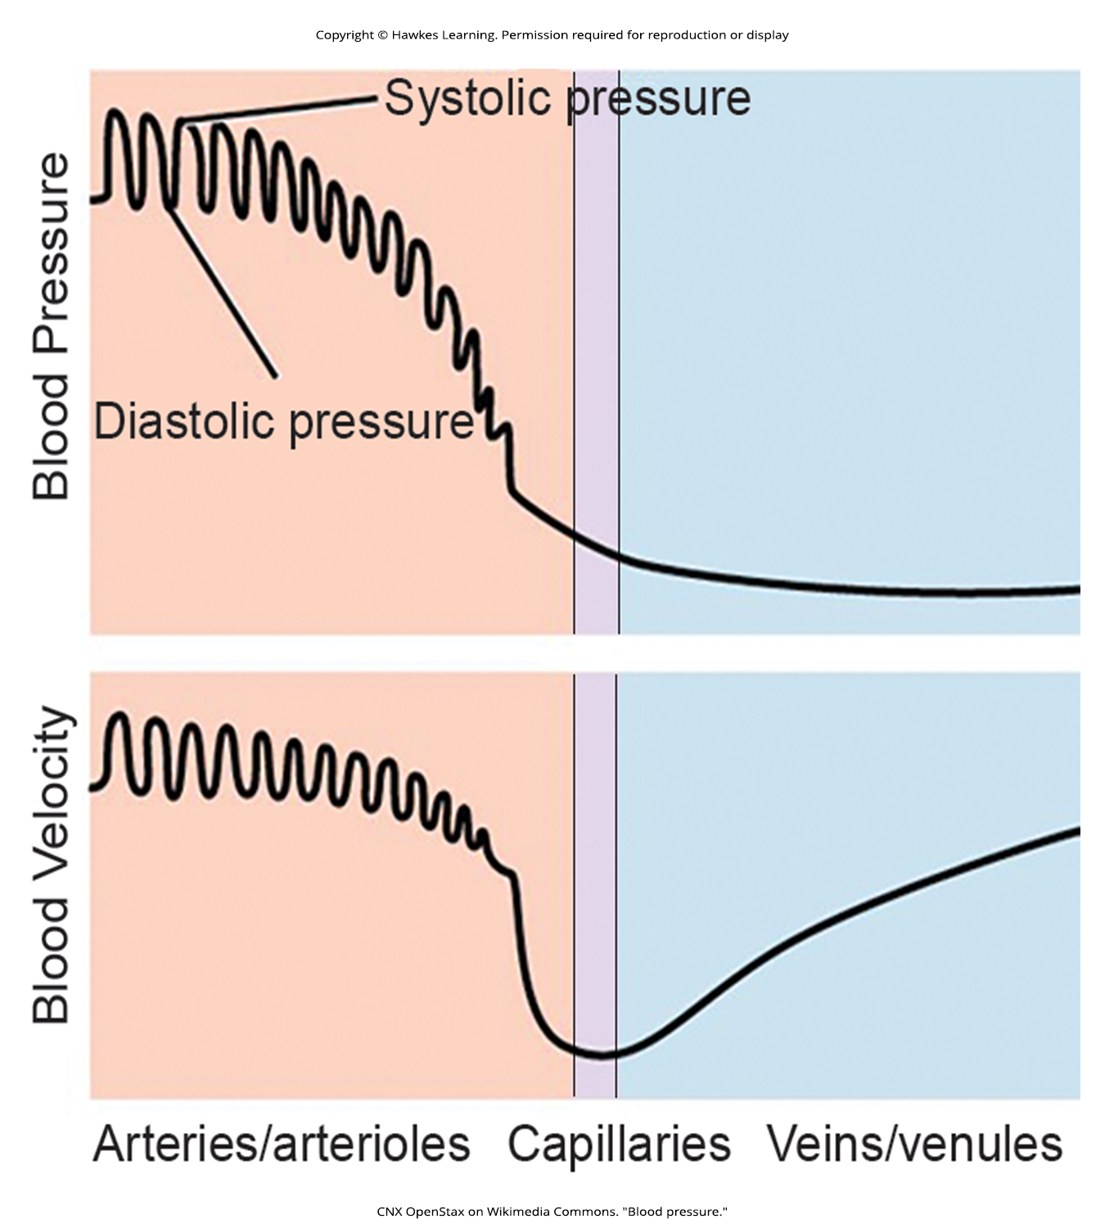
Lesson 35.4 Figure 4

Slide 29
Hawkes Learning – End of PowerPoint

