Slide 1
Chapter 36
The Respiratory System

Slide 2
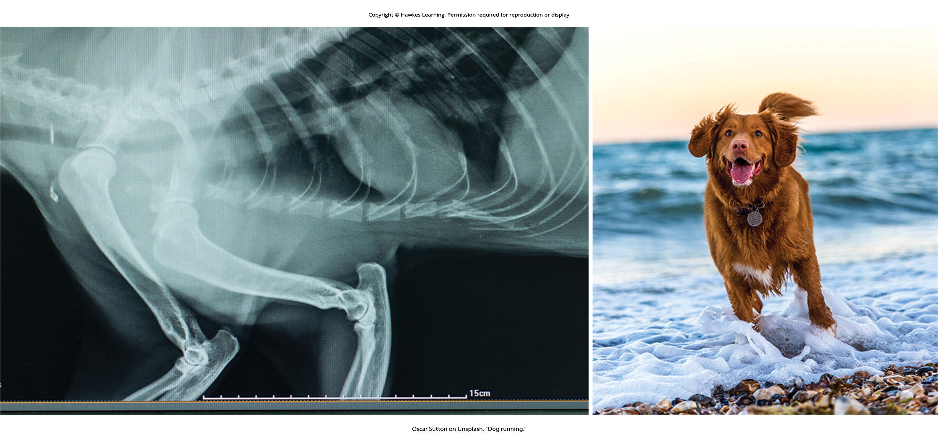
Lesson 36.1 Figure 1

Slide 3
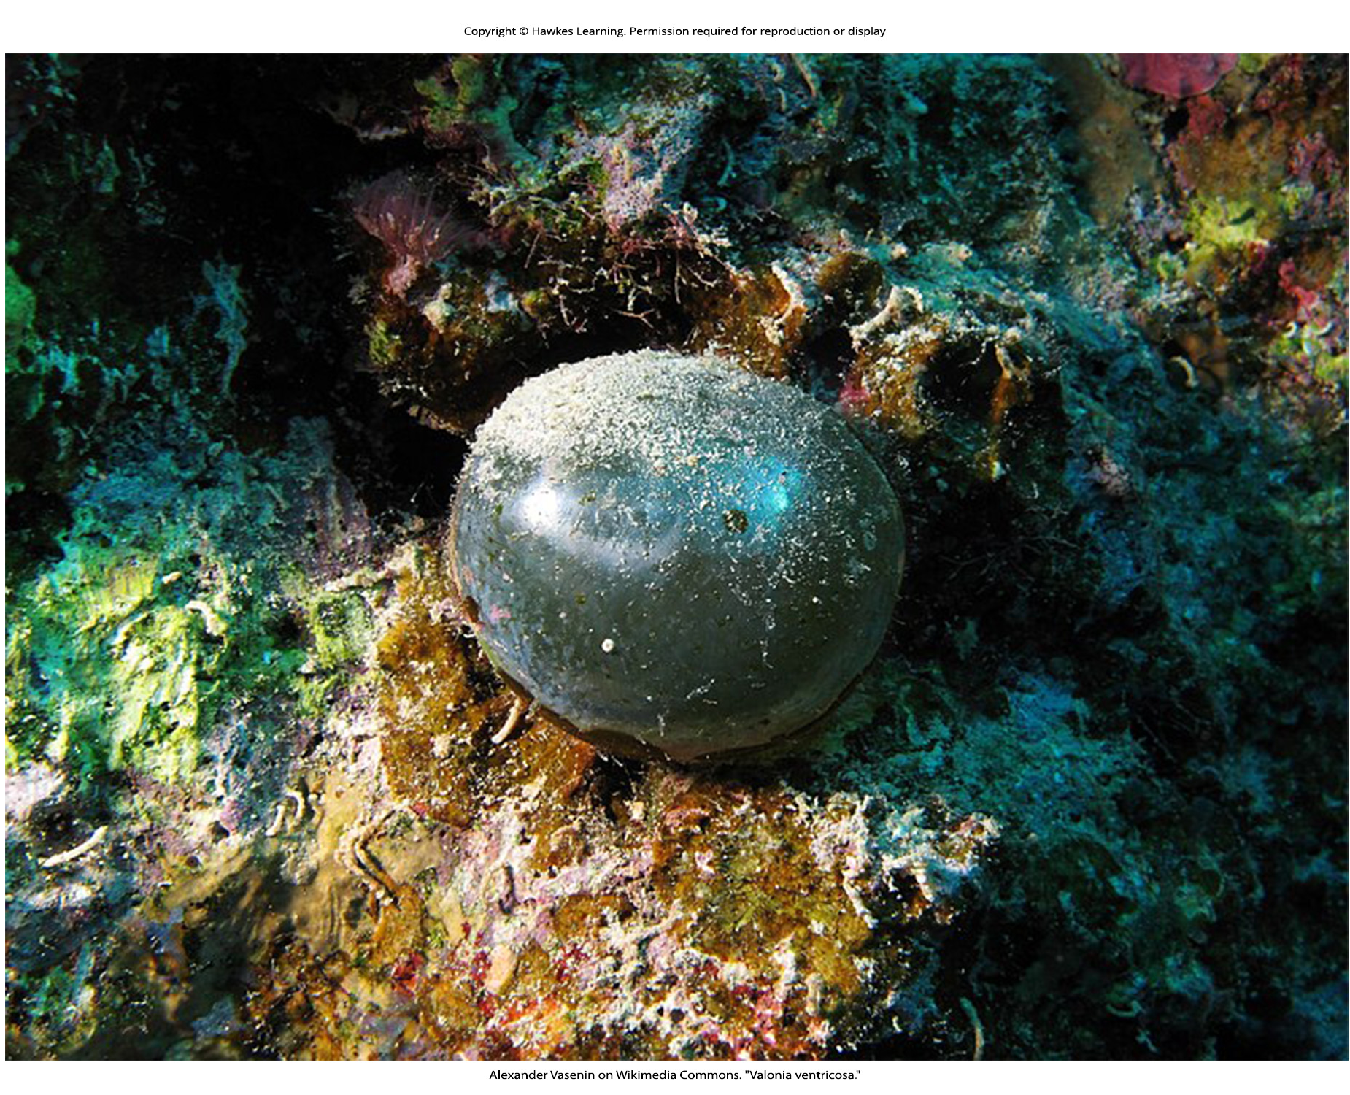
Lesson 36.1 Figure 2

Slide 4
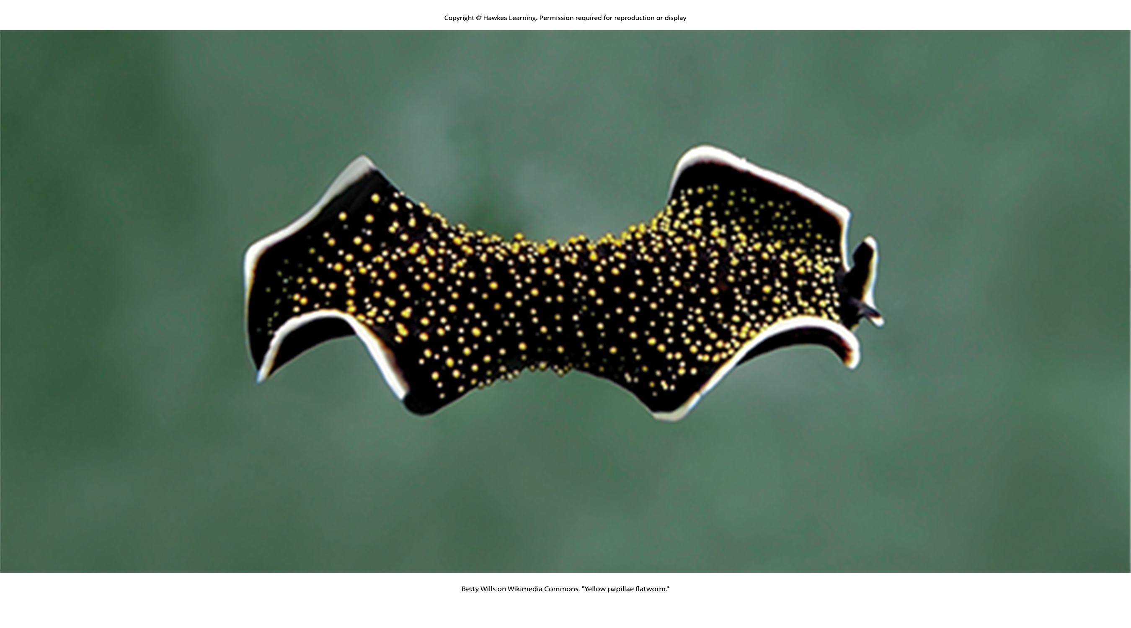
Lesson 36.1 Figure 3

Slide 5
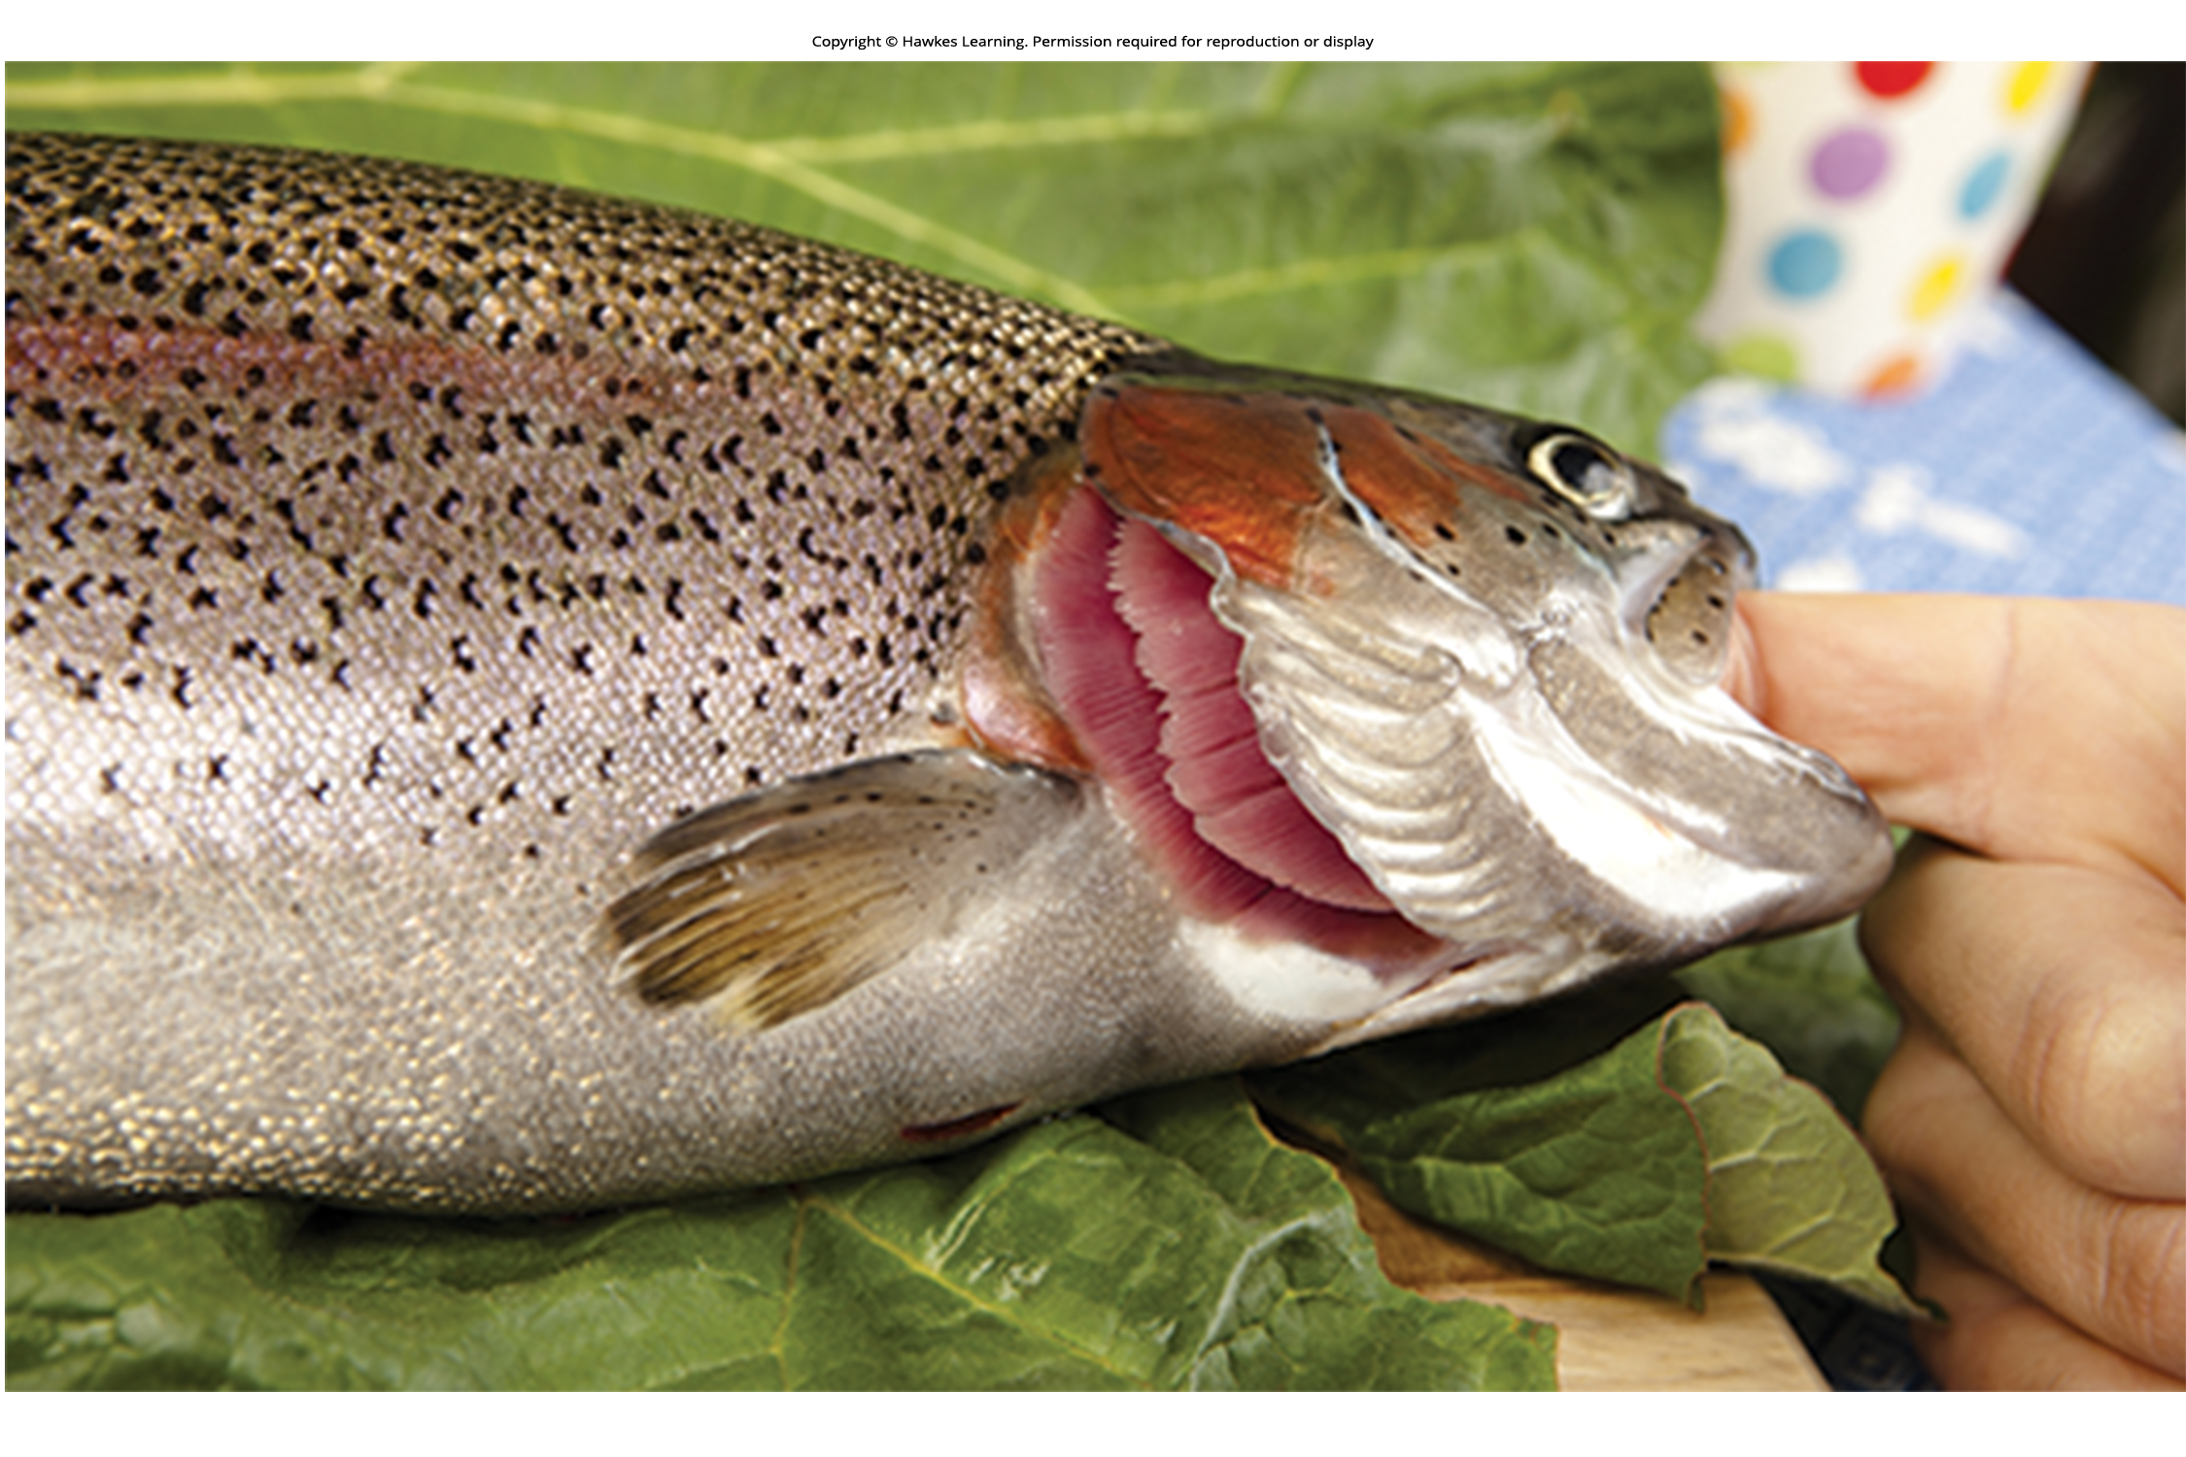
Lesson 36.1 Figure 4

Slide 6
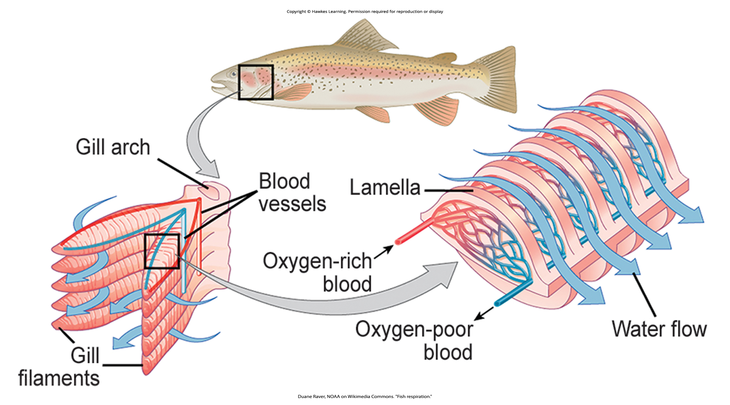
Lesson 36.1 Figure 5

Slide 7
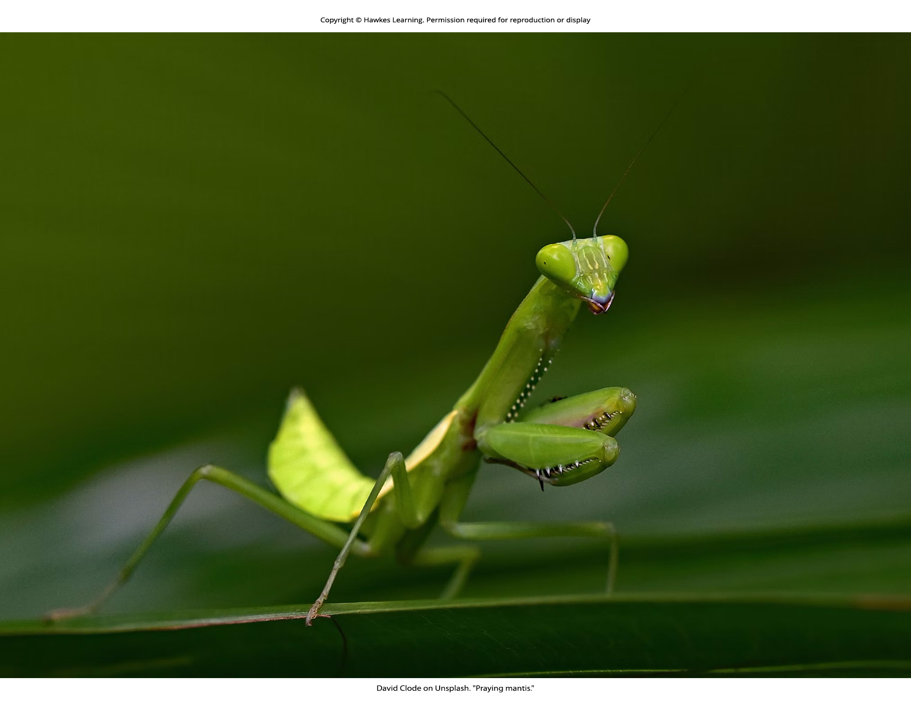
Lesson 36.1 Figure 6

Slide 8
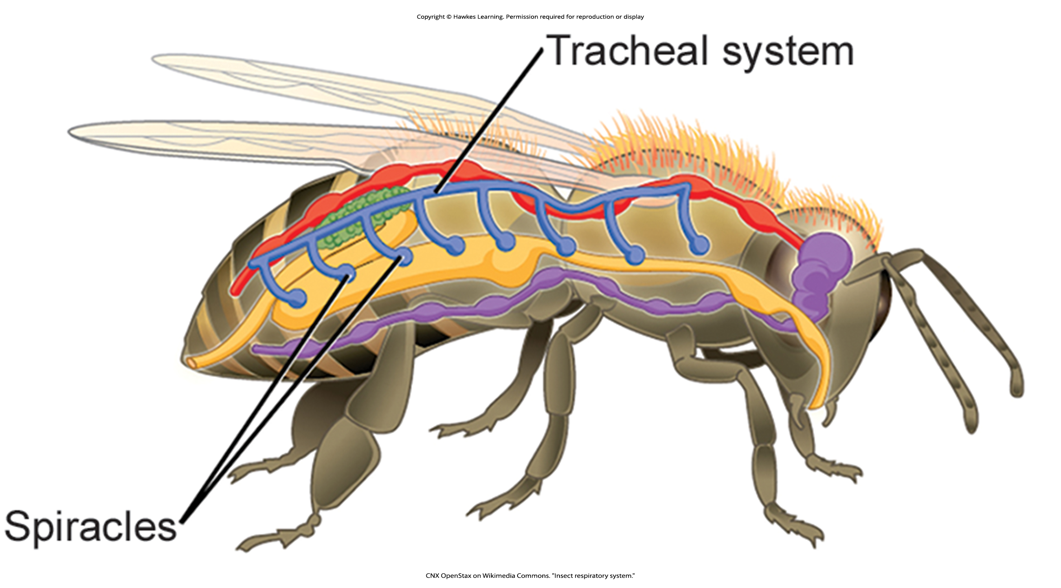
Lesson 36.1 Figure 7

Slide 9
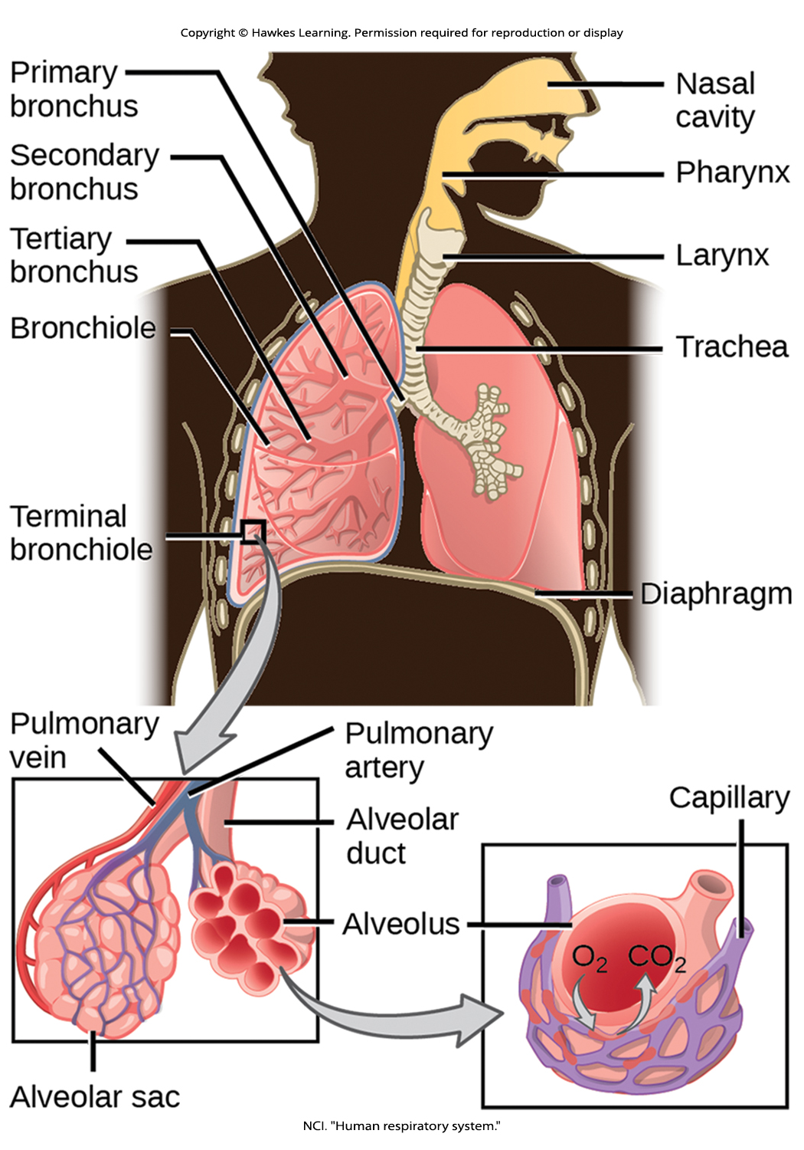
Lesson 36.1 Figure 8

Slide 10
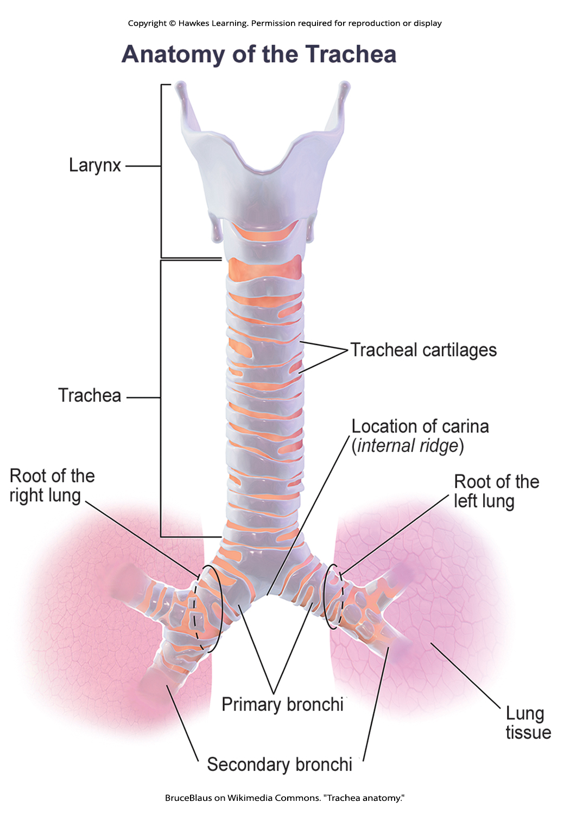
Lesson 36.1 Figure 9

Slide 11
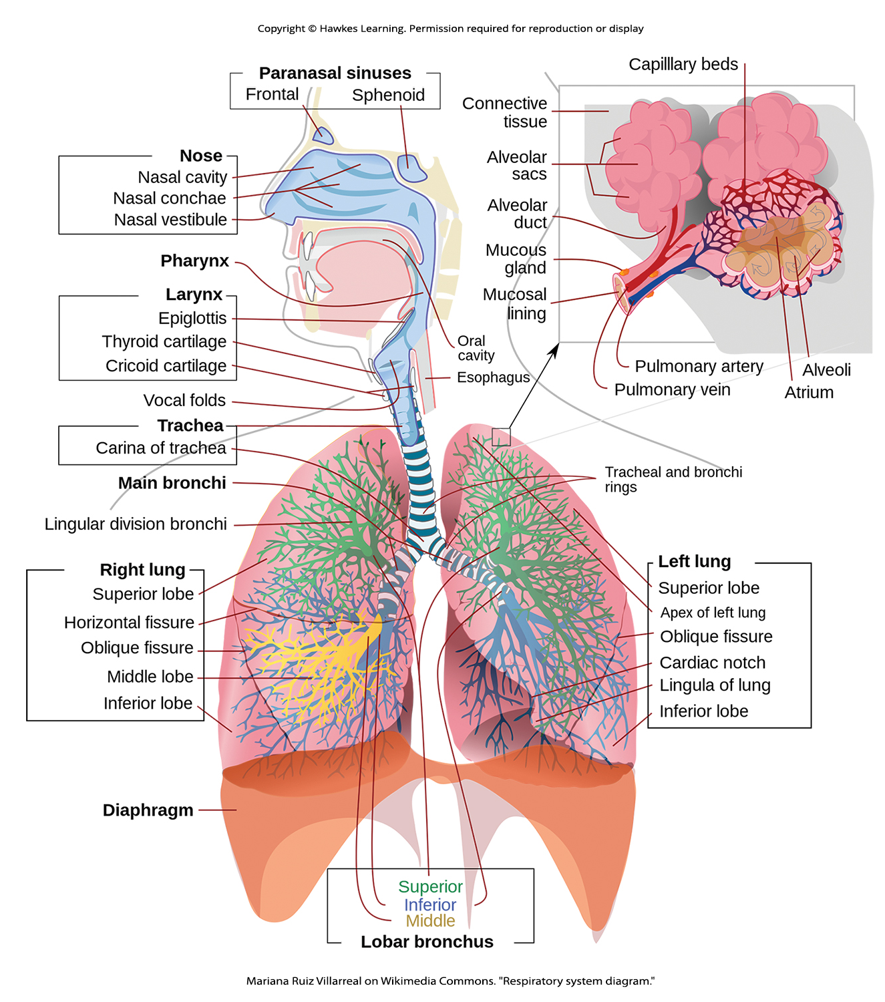
Lesson 36.1 Figure 10

Slide 12
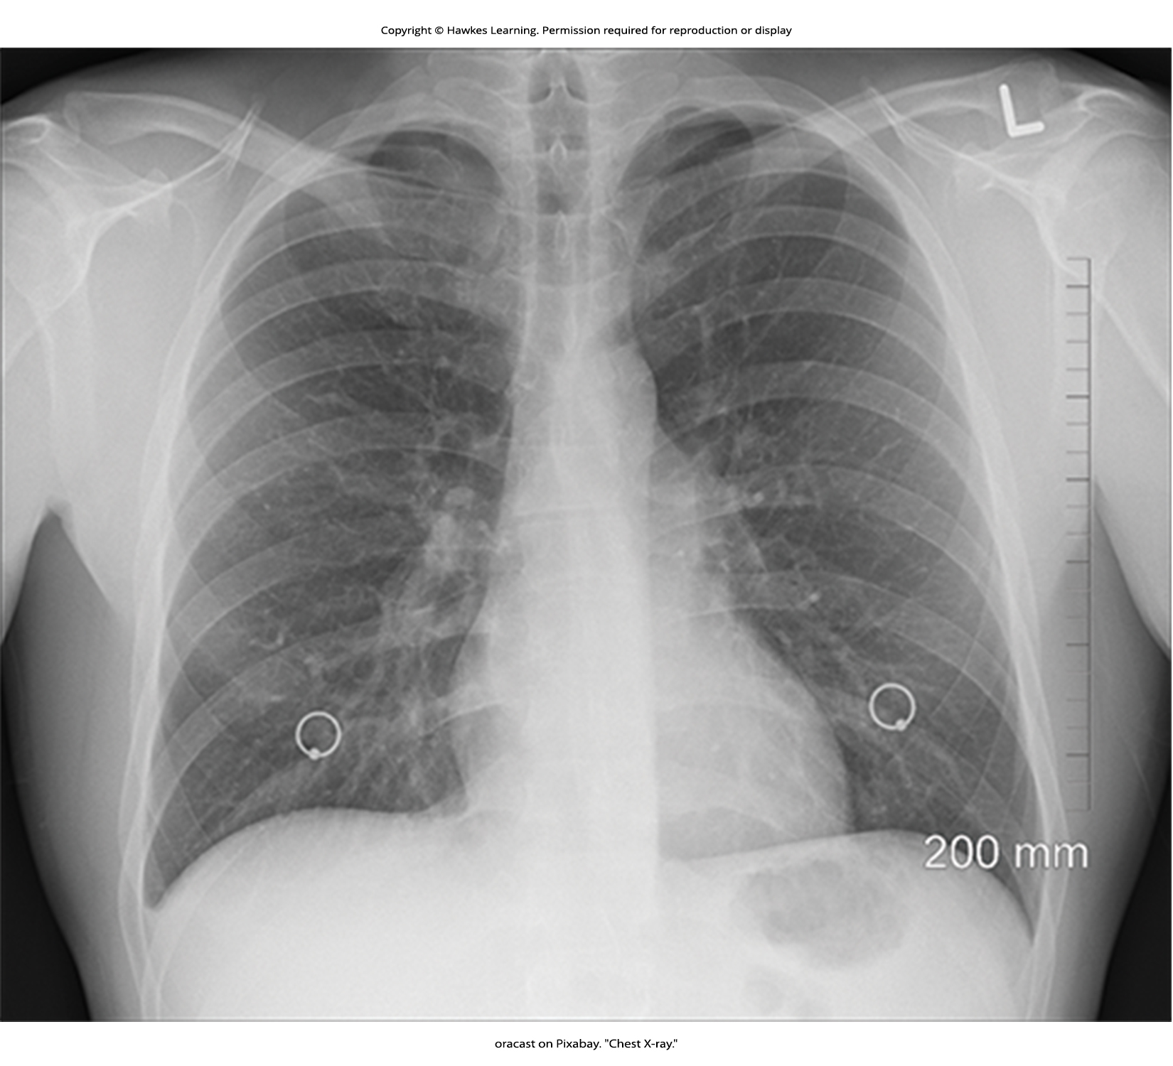
Lesson 36.1 Figure 11

Slide 13
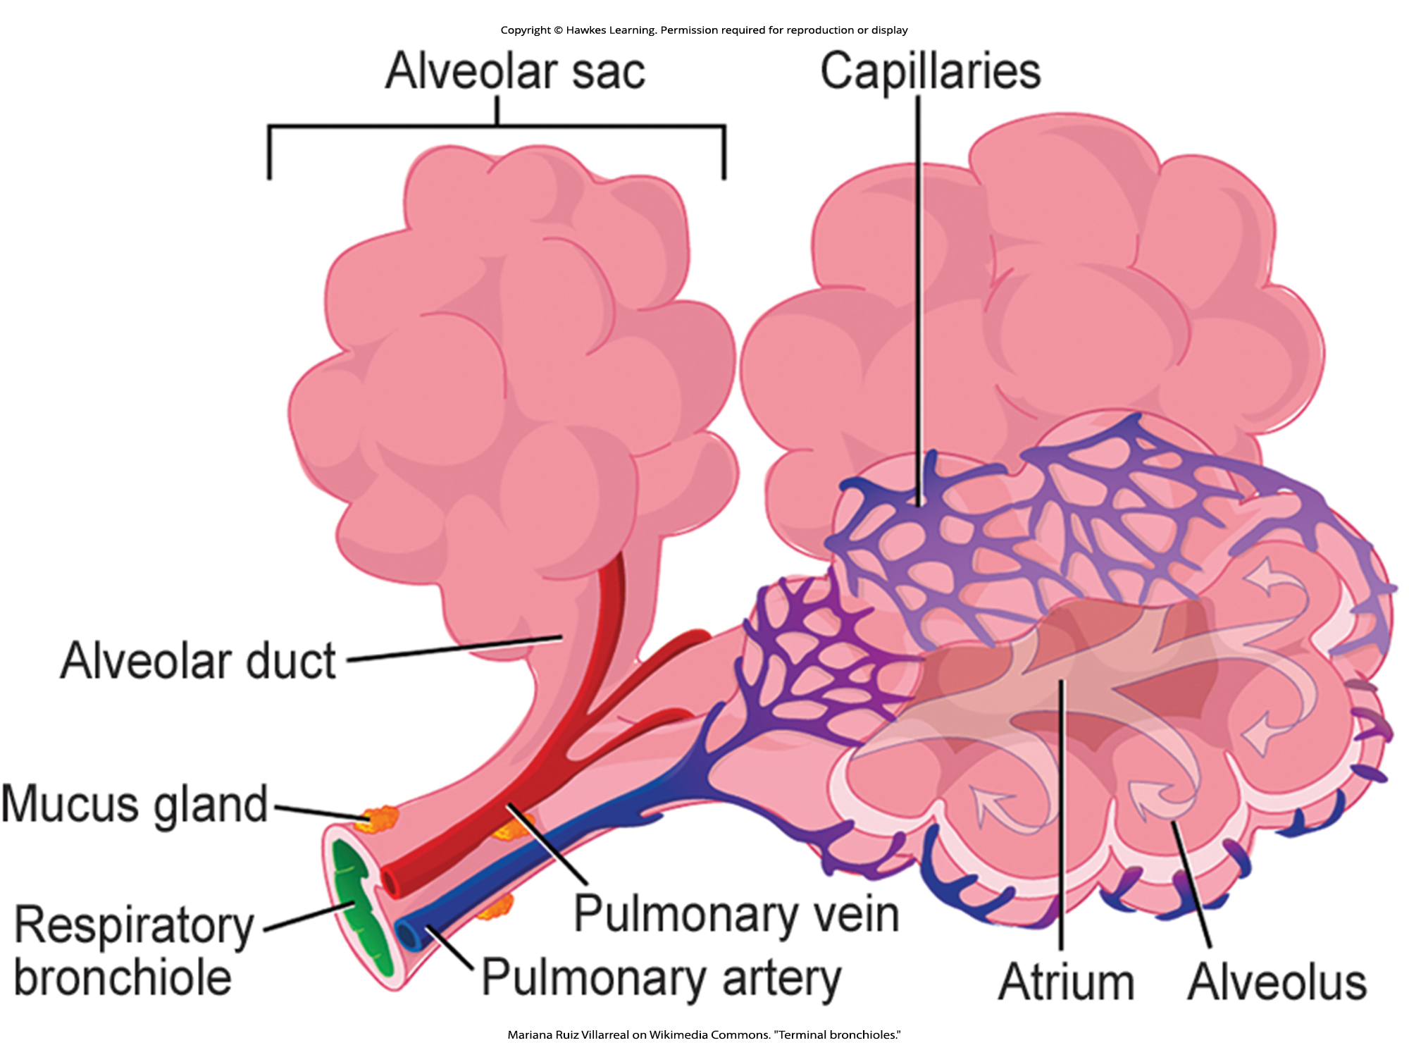
Lesson 36.1 Figure 12

Slide 14
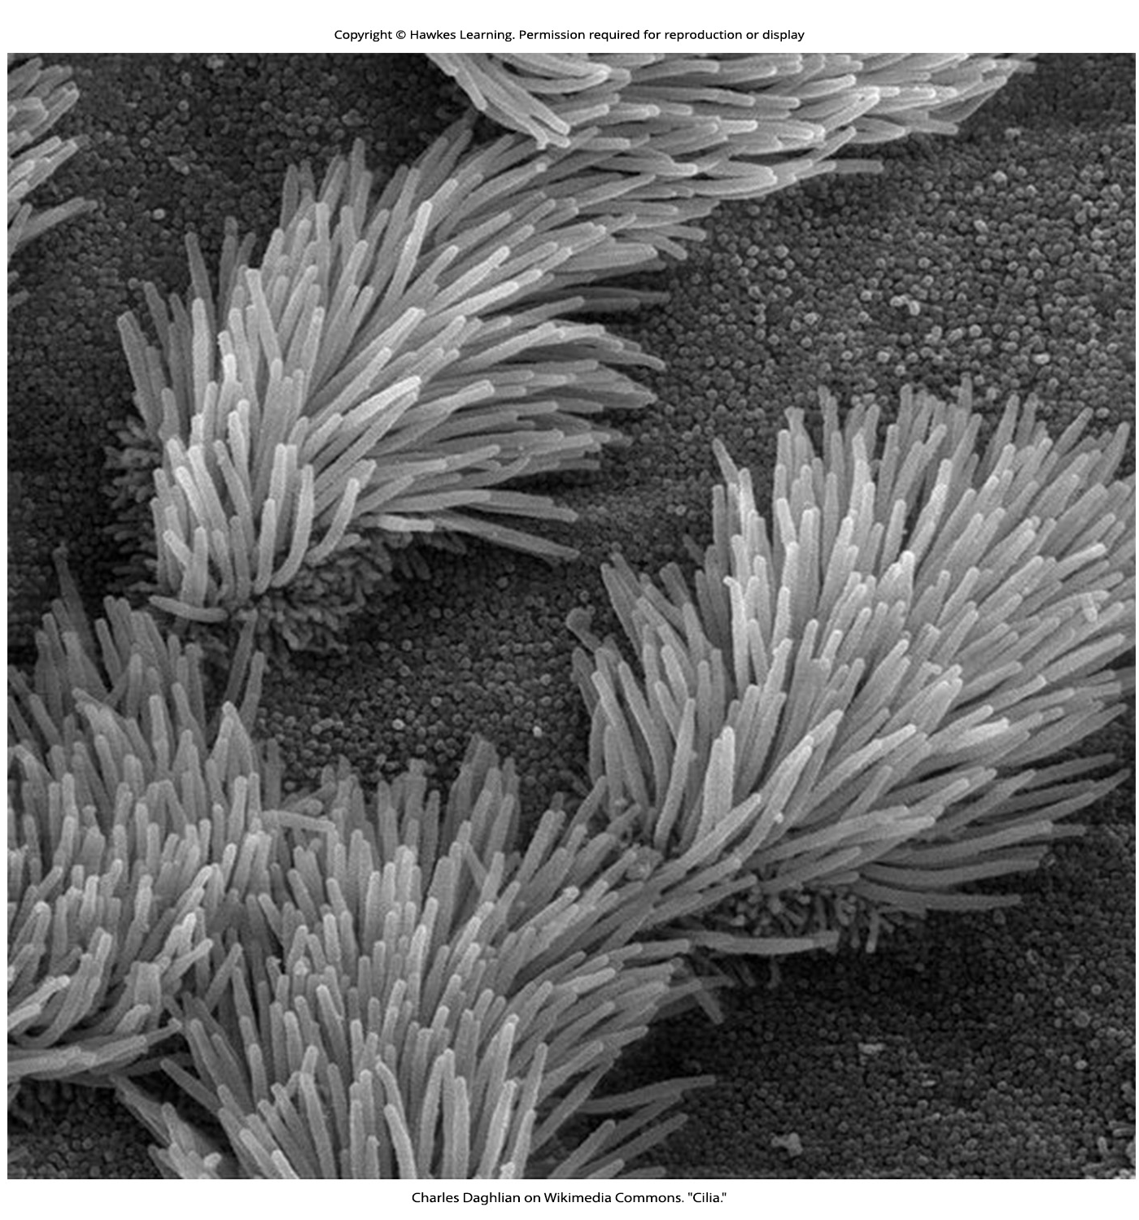
Lesson 36.1 Figure 13

Slide 15
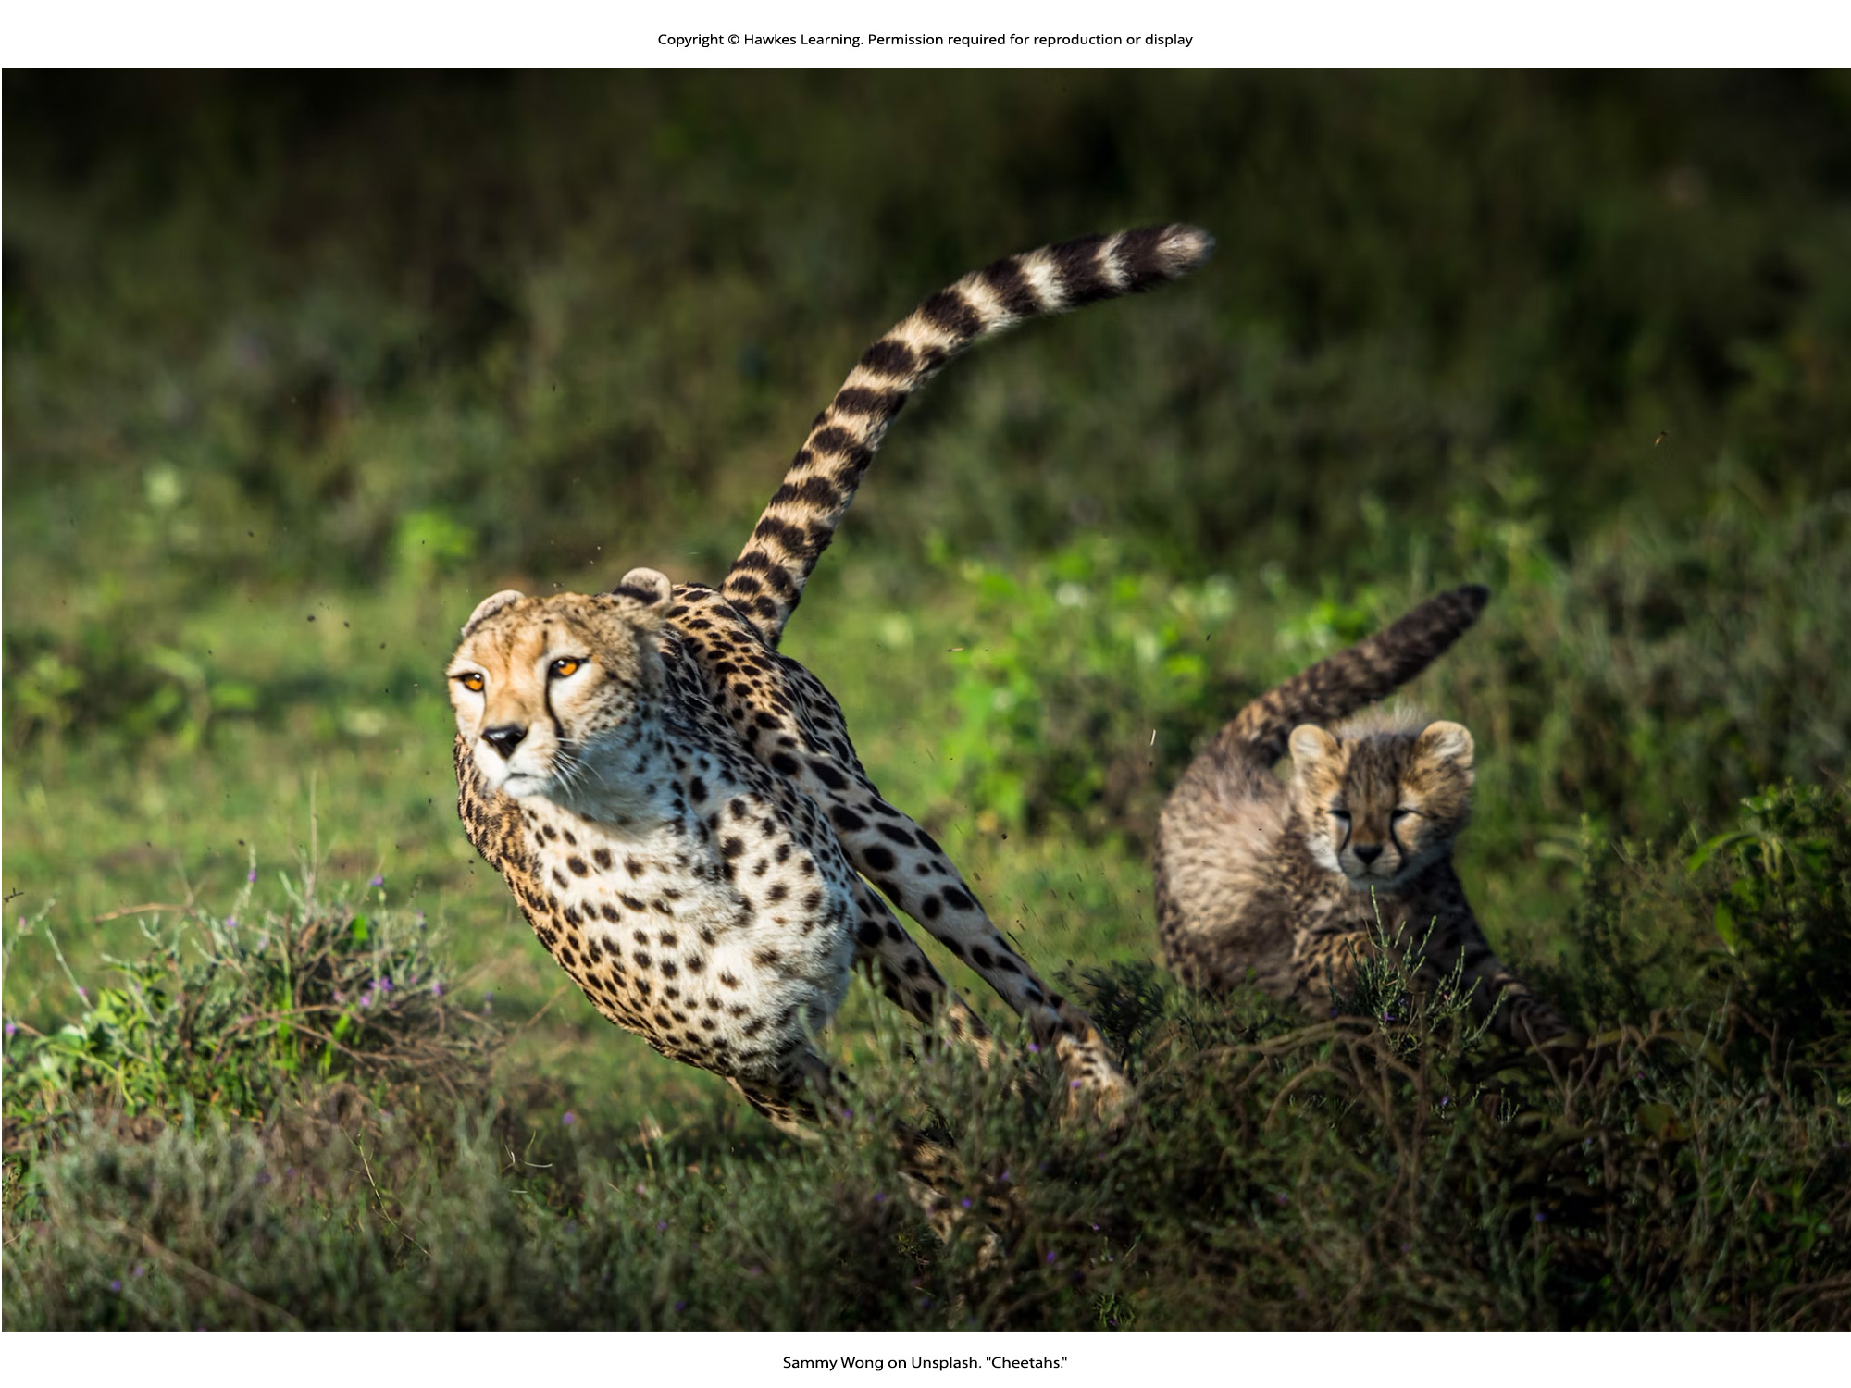
Lesson 36.2 Figure 1

Slide 16
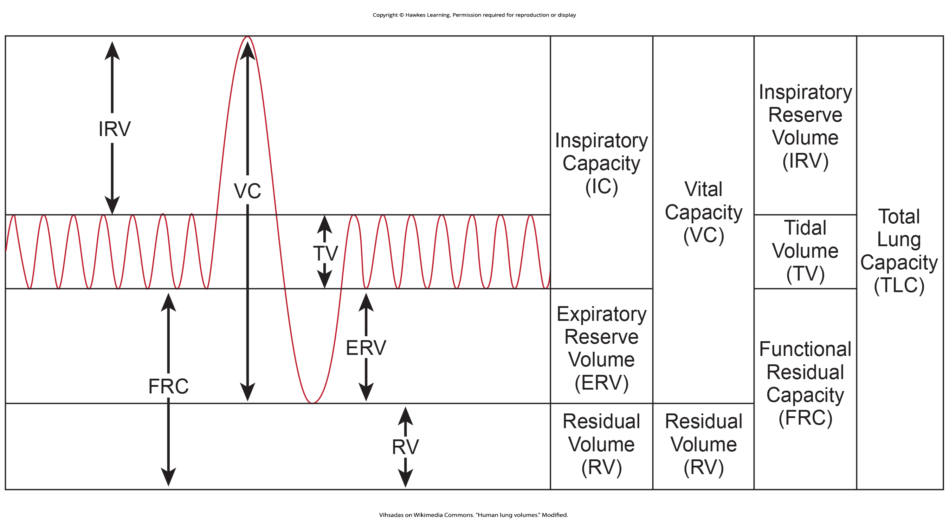
Lesson 36.2 Figure 2

Slide 17
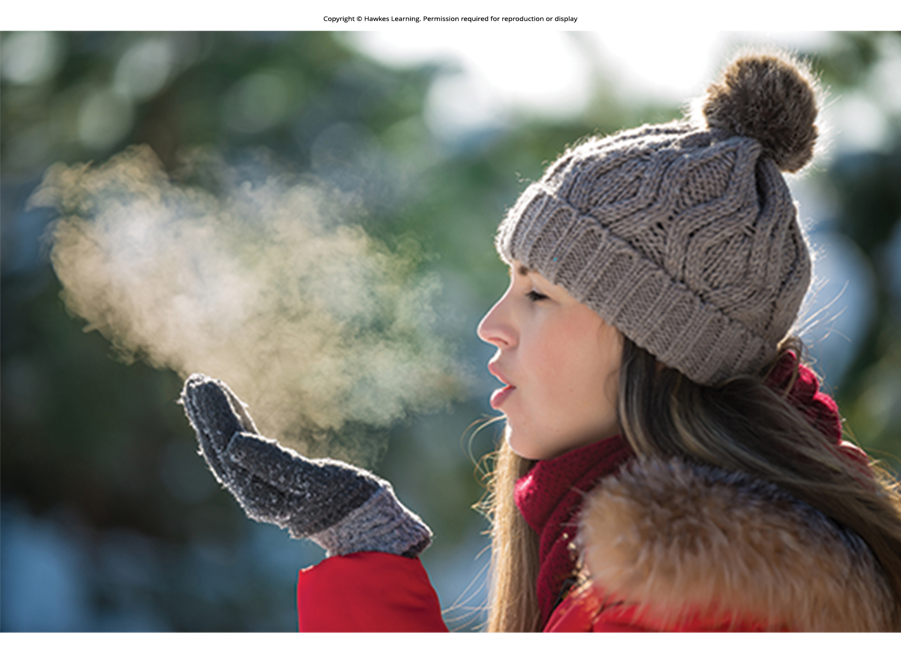
Lesson 36.2 Figure 3

Slide 18

Lesson 36.2 Figure 4

Slide 19
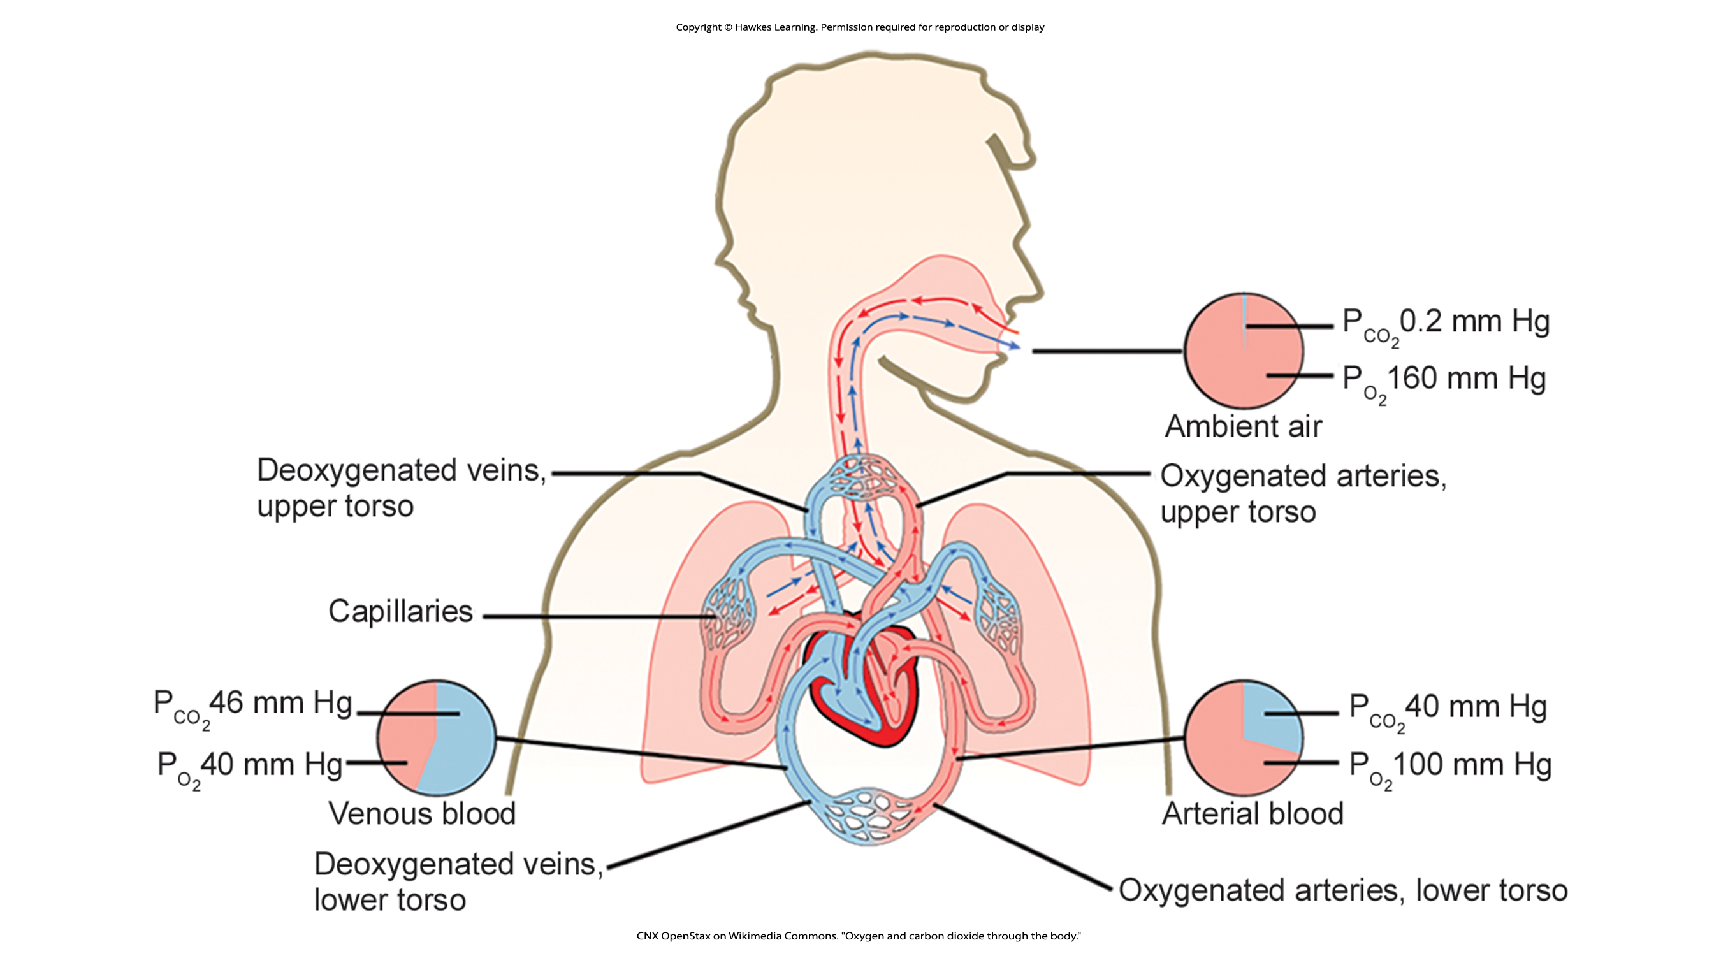
Lesson 36.2 Figure 5

Slide 20
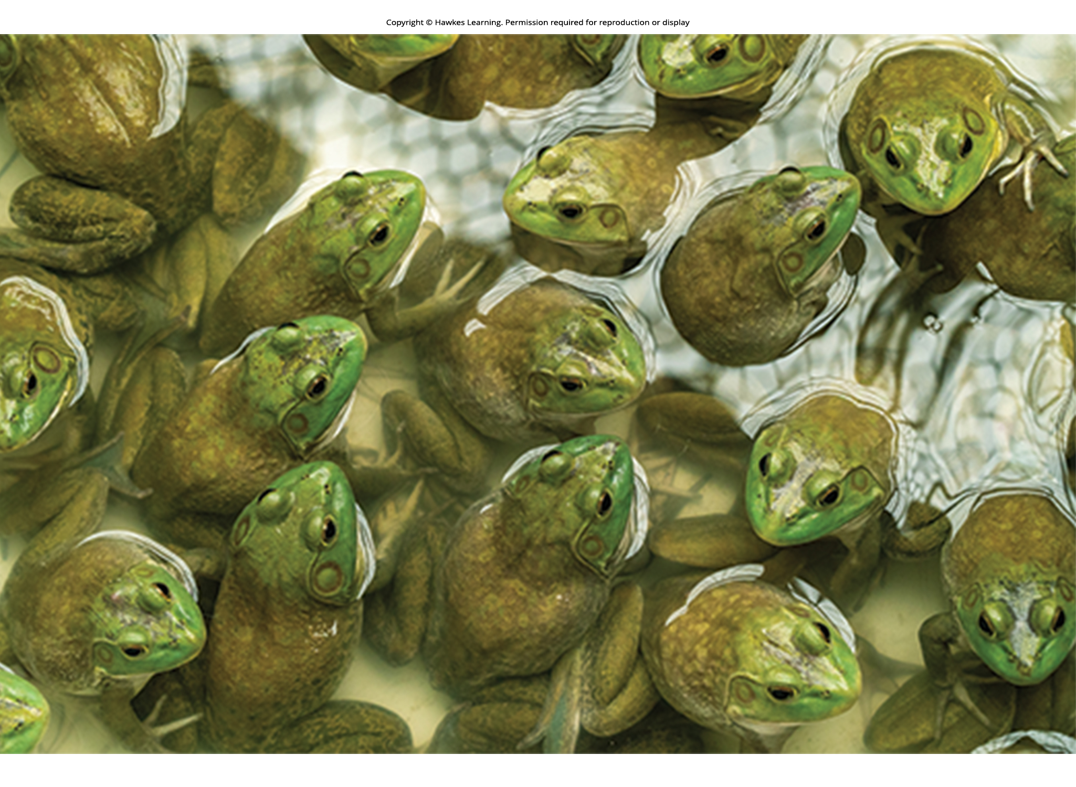
Lesson 36.3 Figure 1

Slide 21

Lesson 36.3 Figure 2

Slide 22
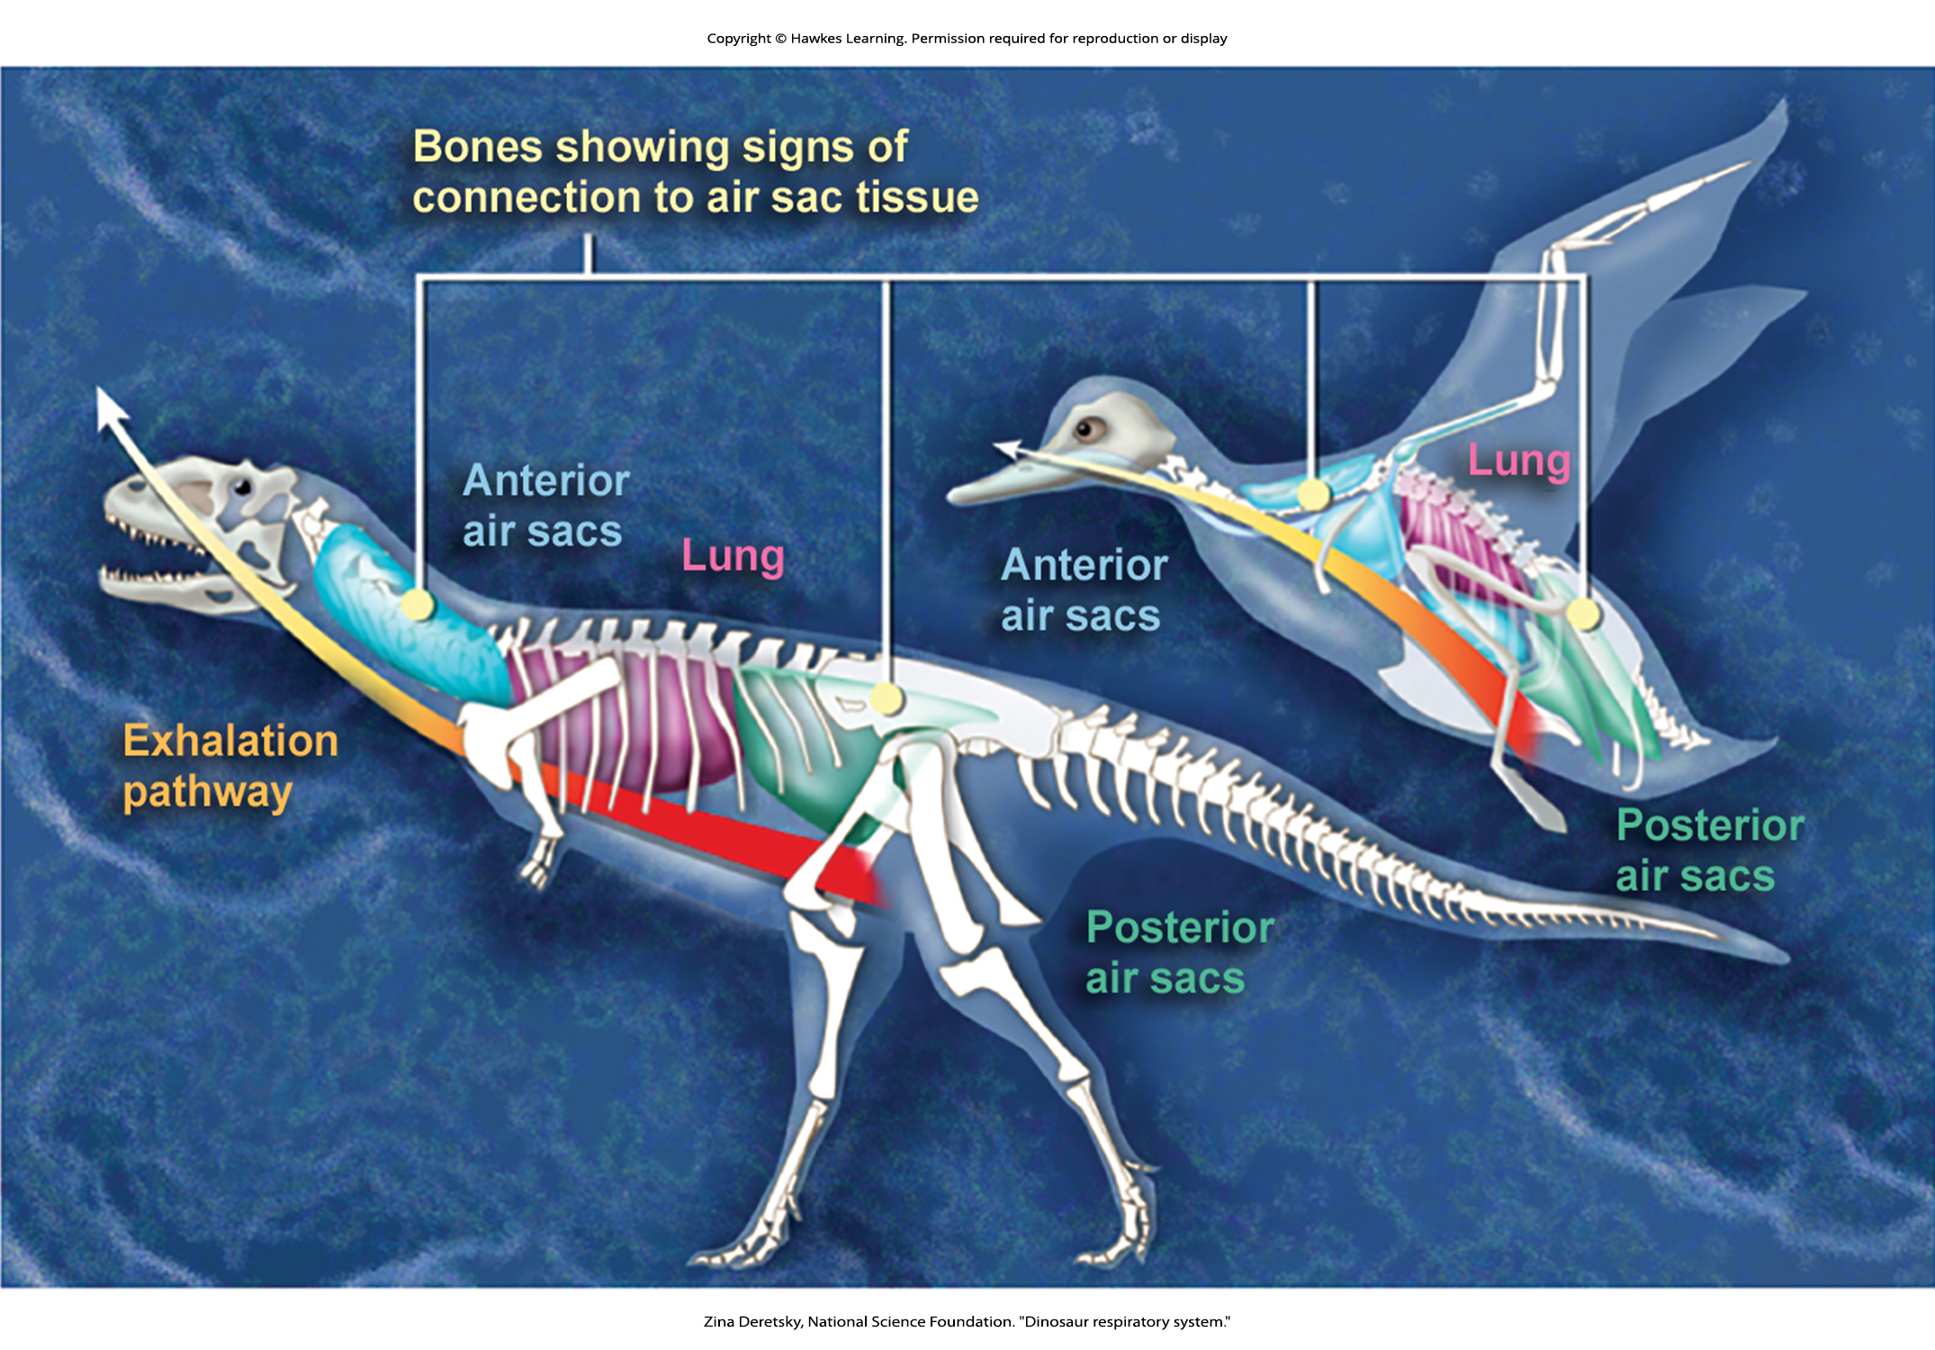
Lesson 36.3 Figure 3

Slide 23
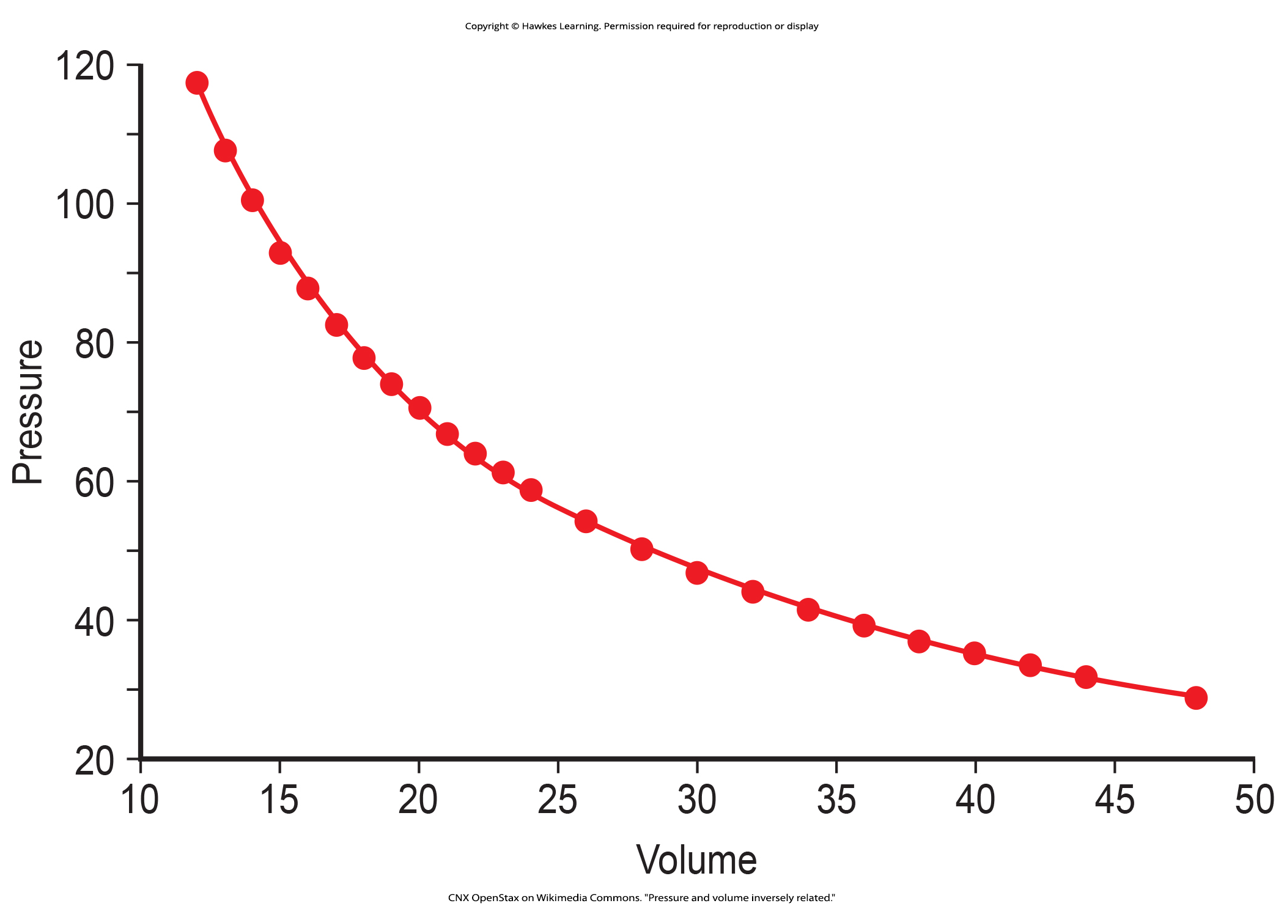
Lesson 36.3 Figure 4

Slide 24
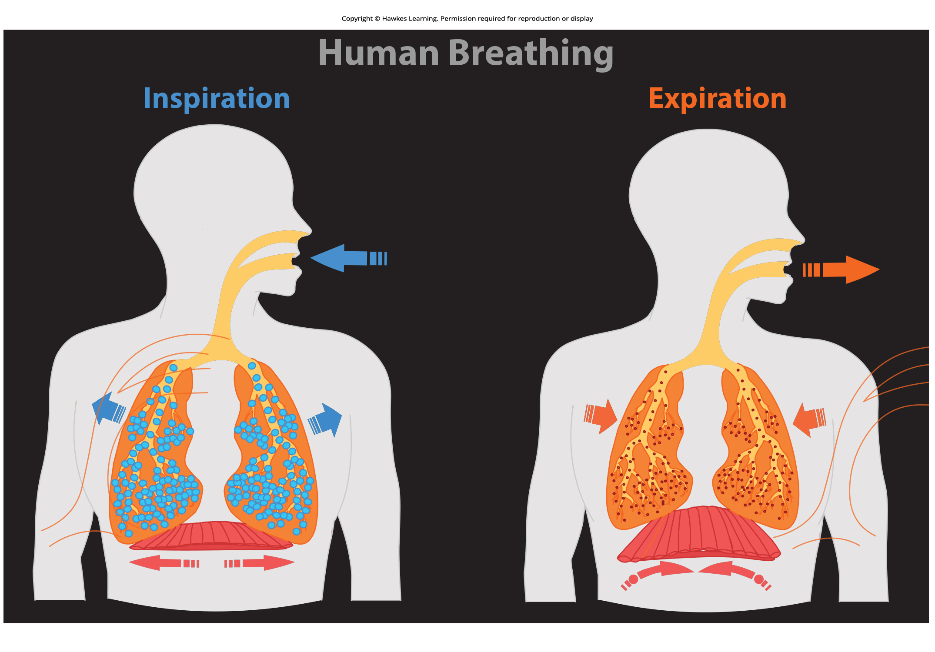
Lesson 36.3 Figure 5

Slide 25
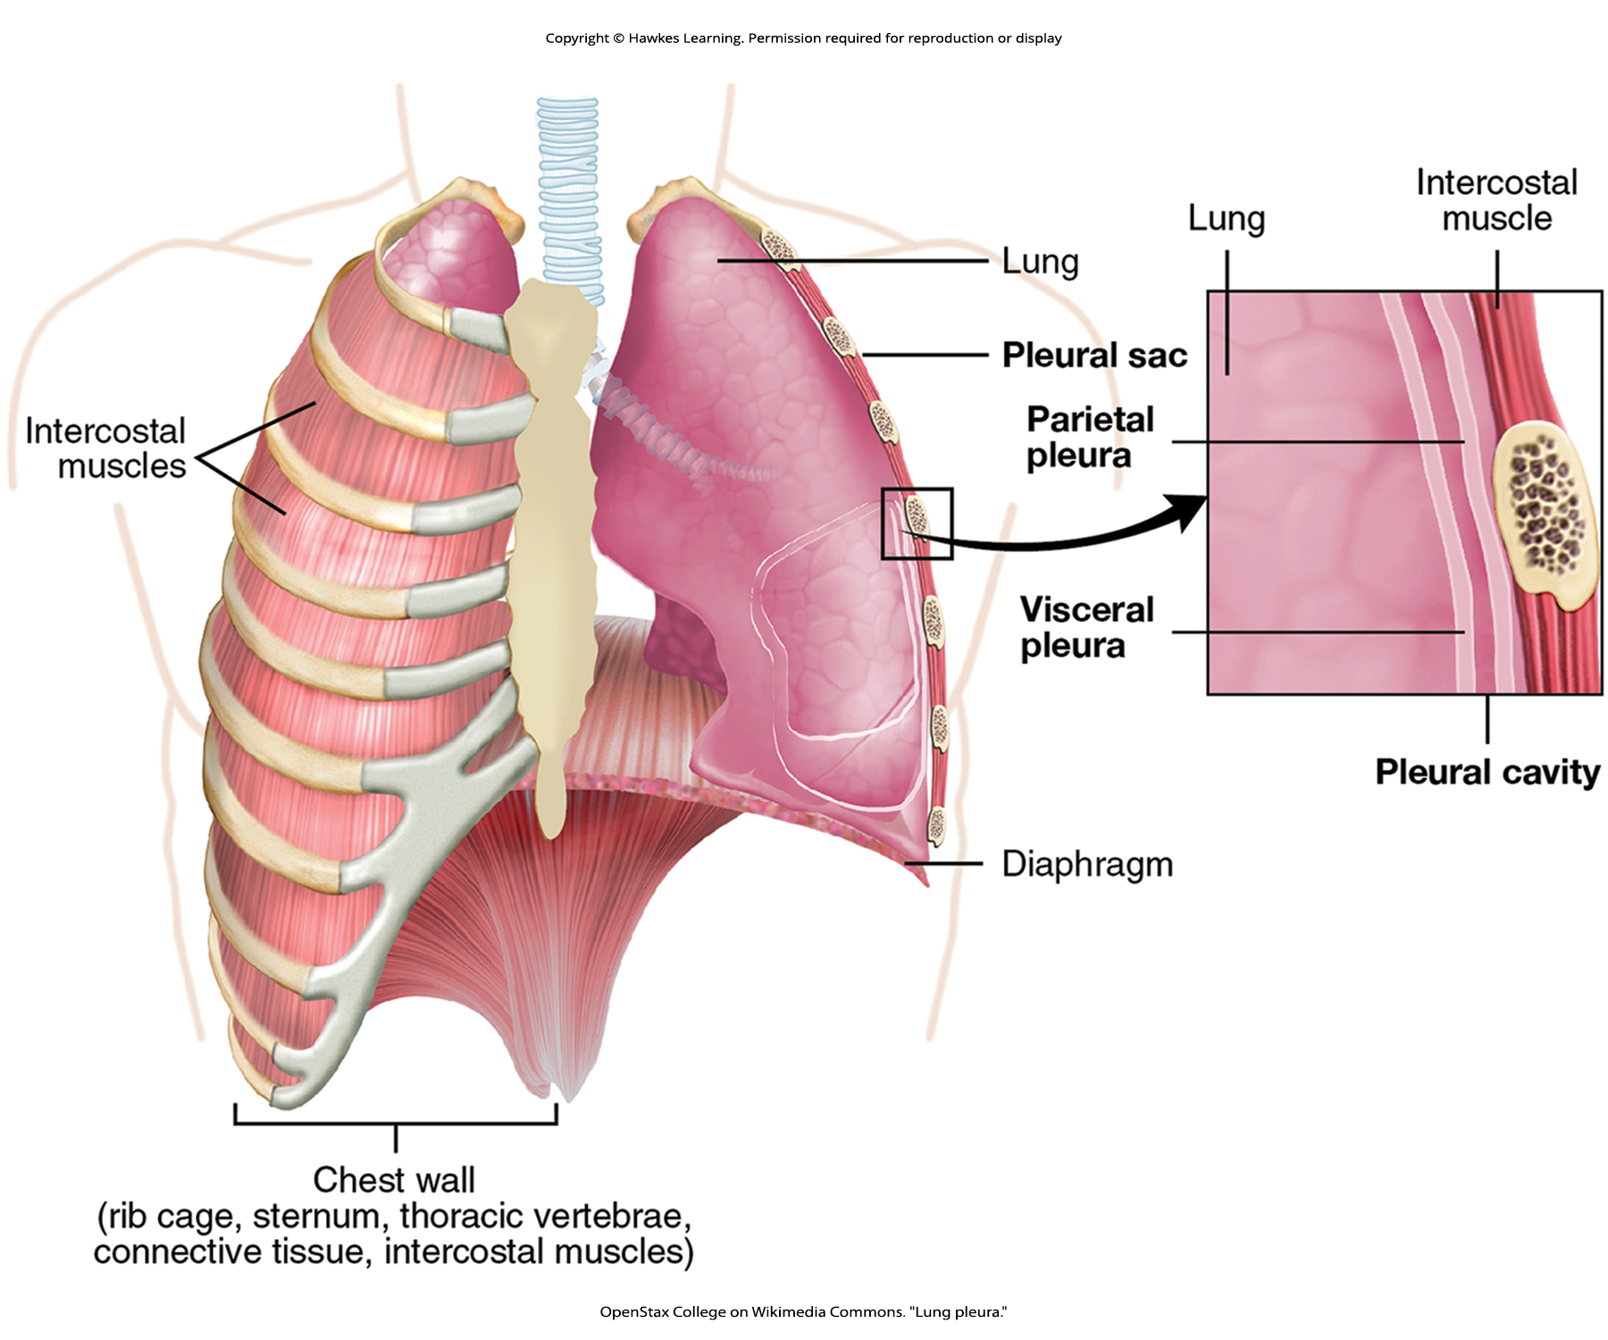
Lesson 36.3 Figure 6

Slide 26

Lesson 36.3 Figure 7

Slide 27
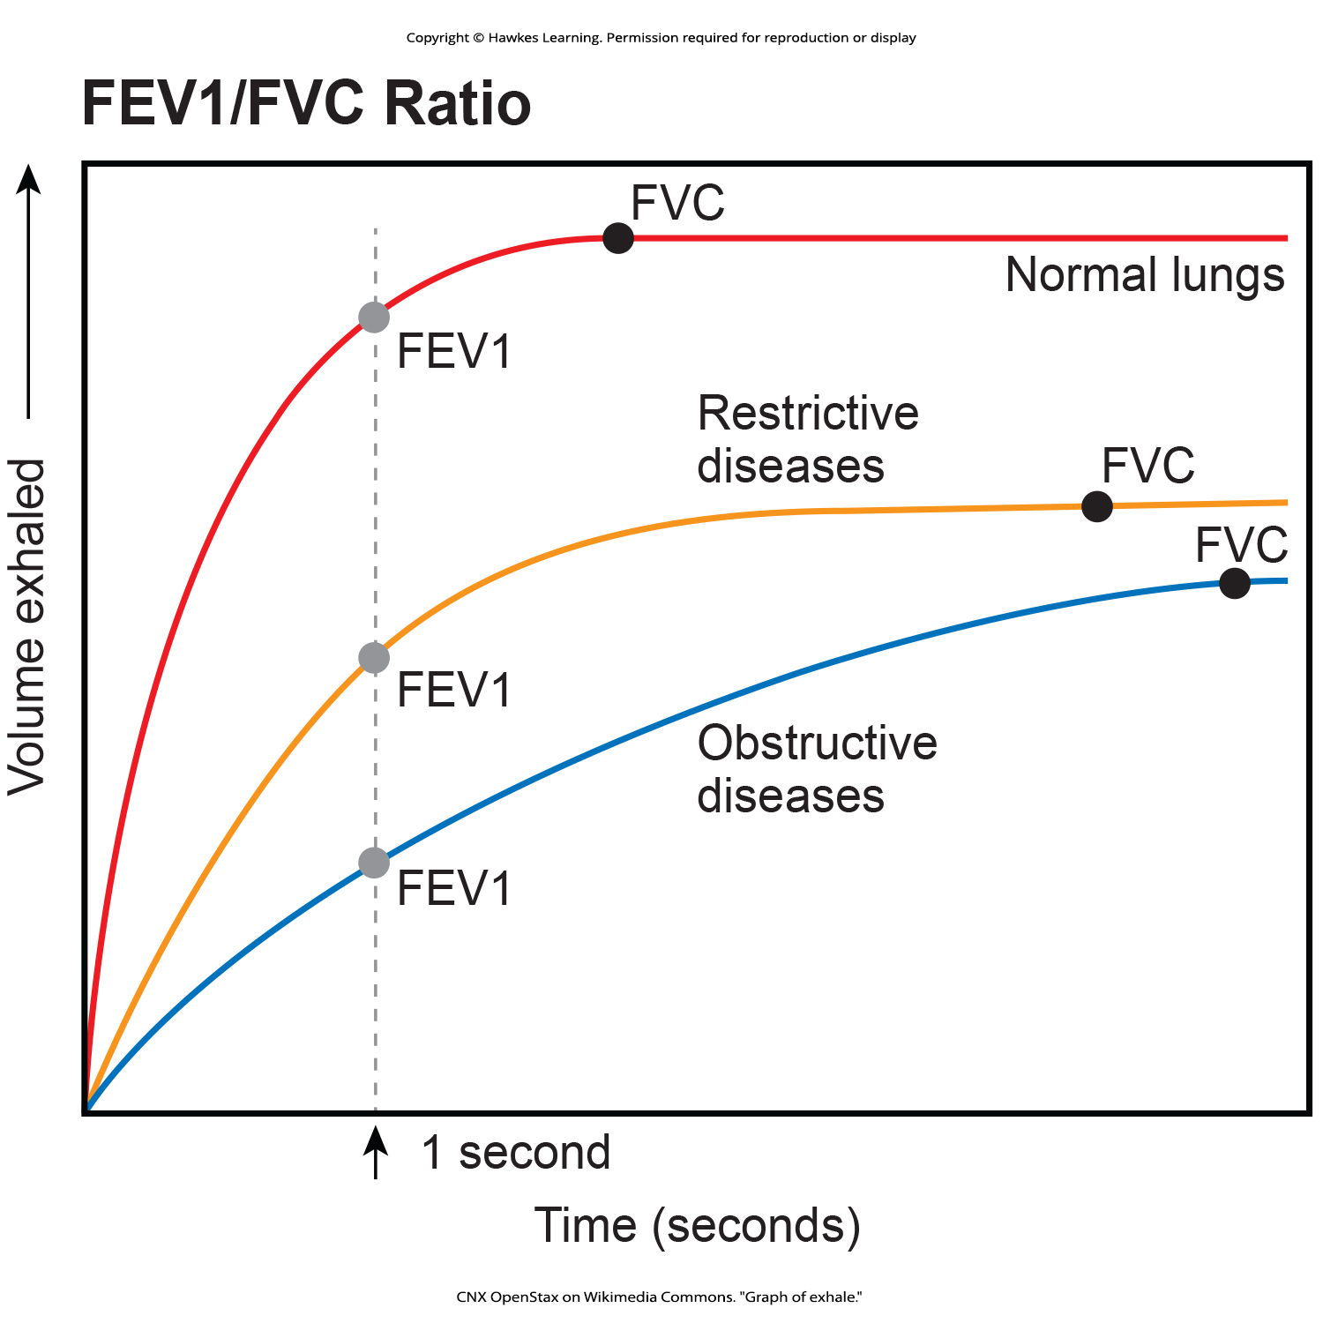
Lesson 36.3 Figure 8

Slide 28
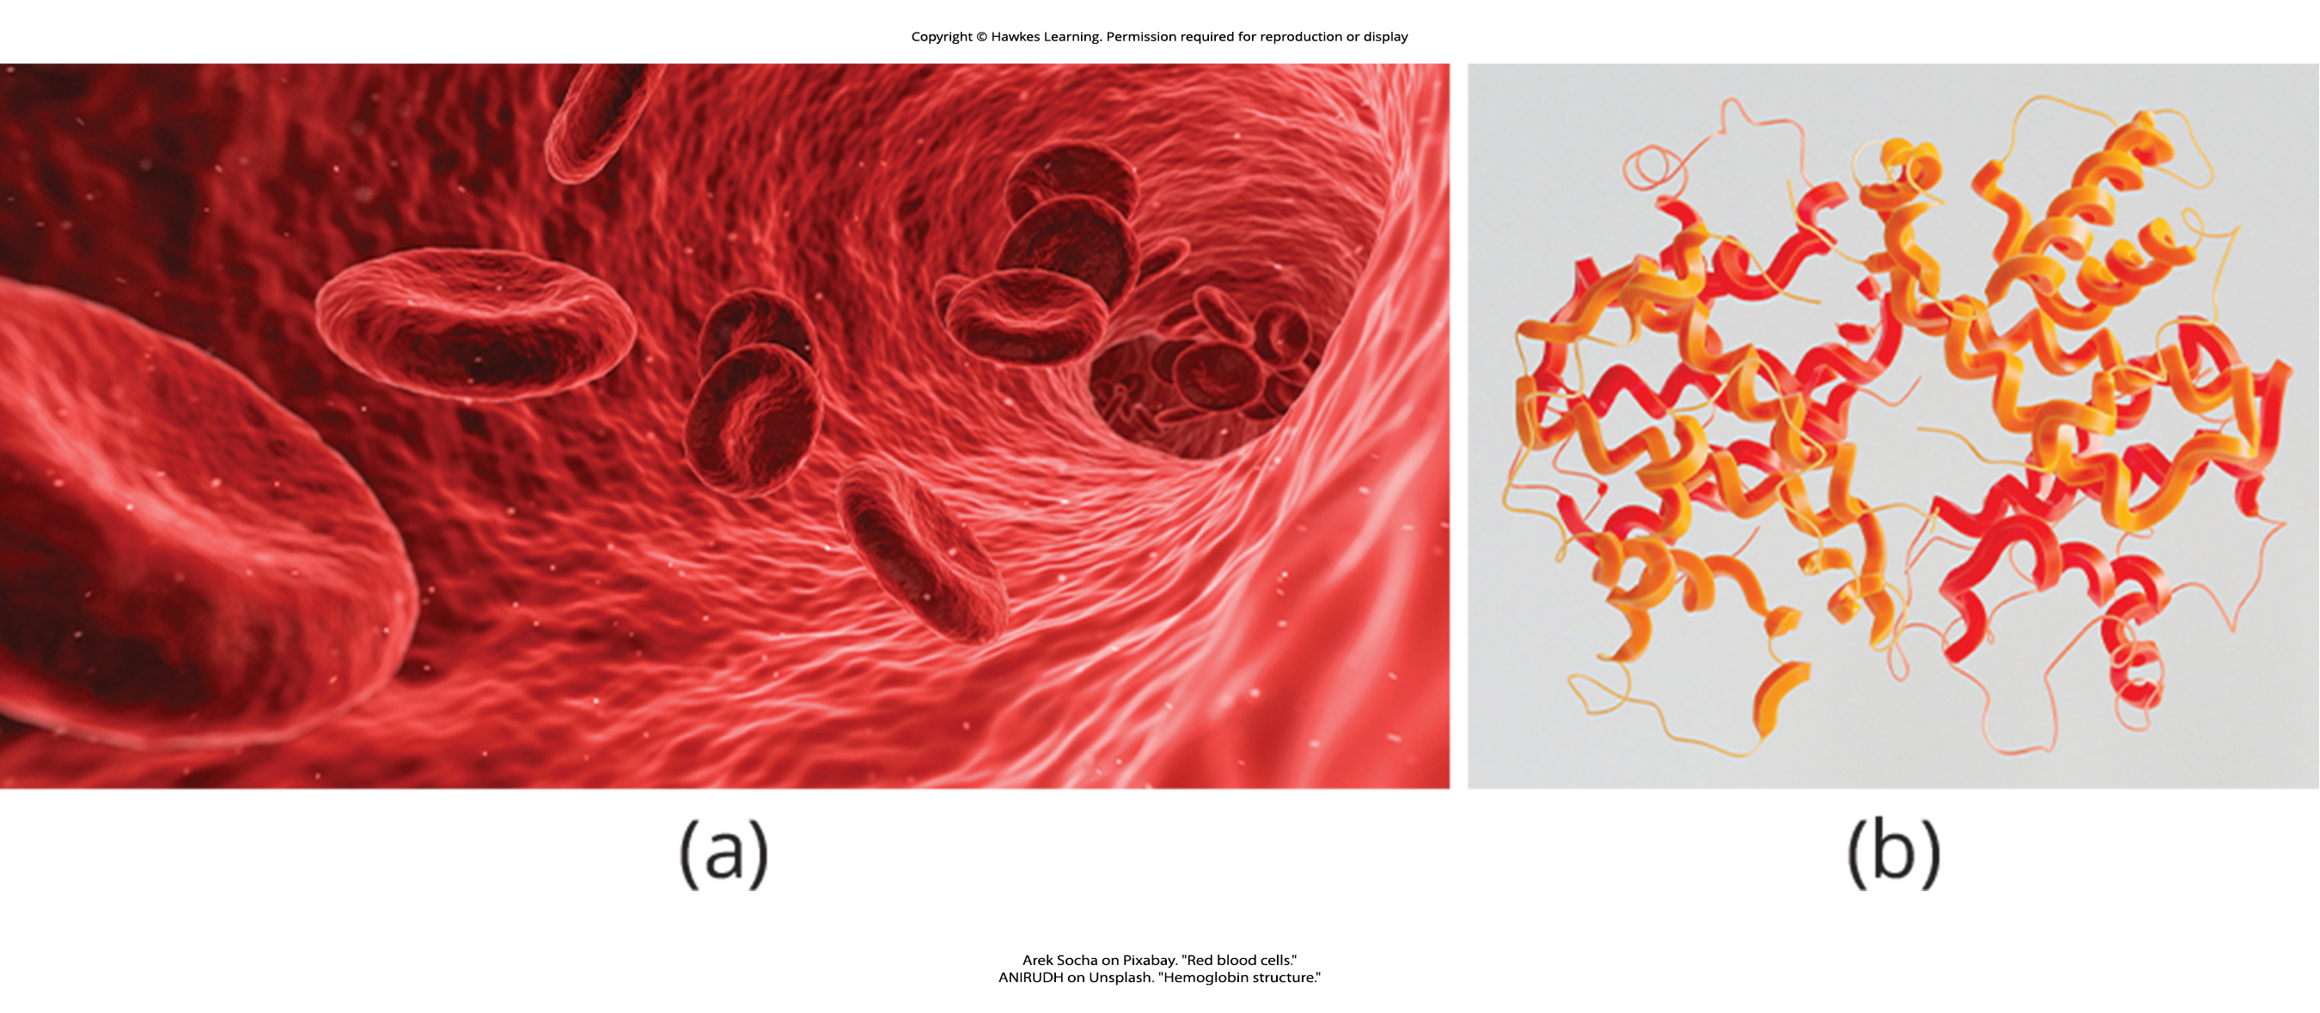
Lesson 36.4 Figure 1

Slide 29
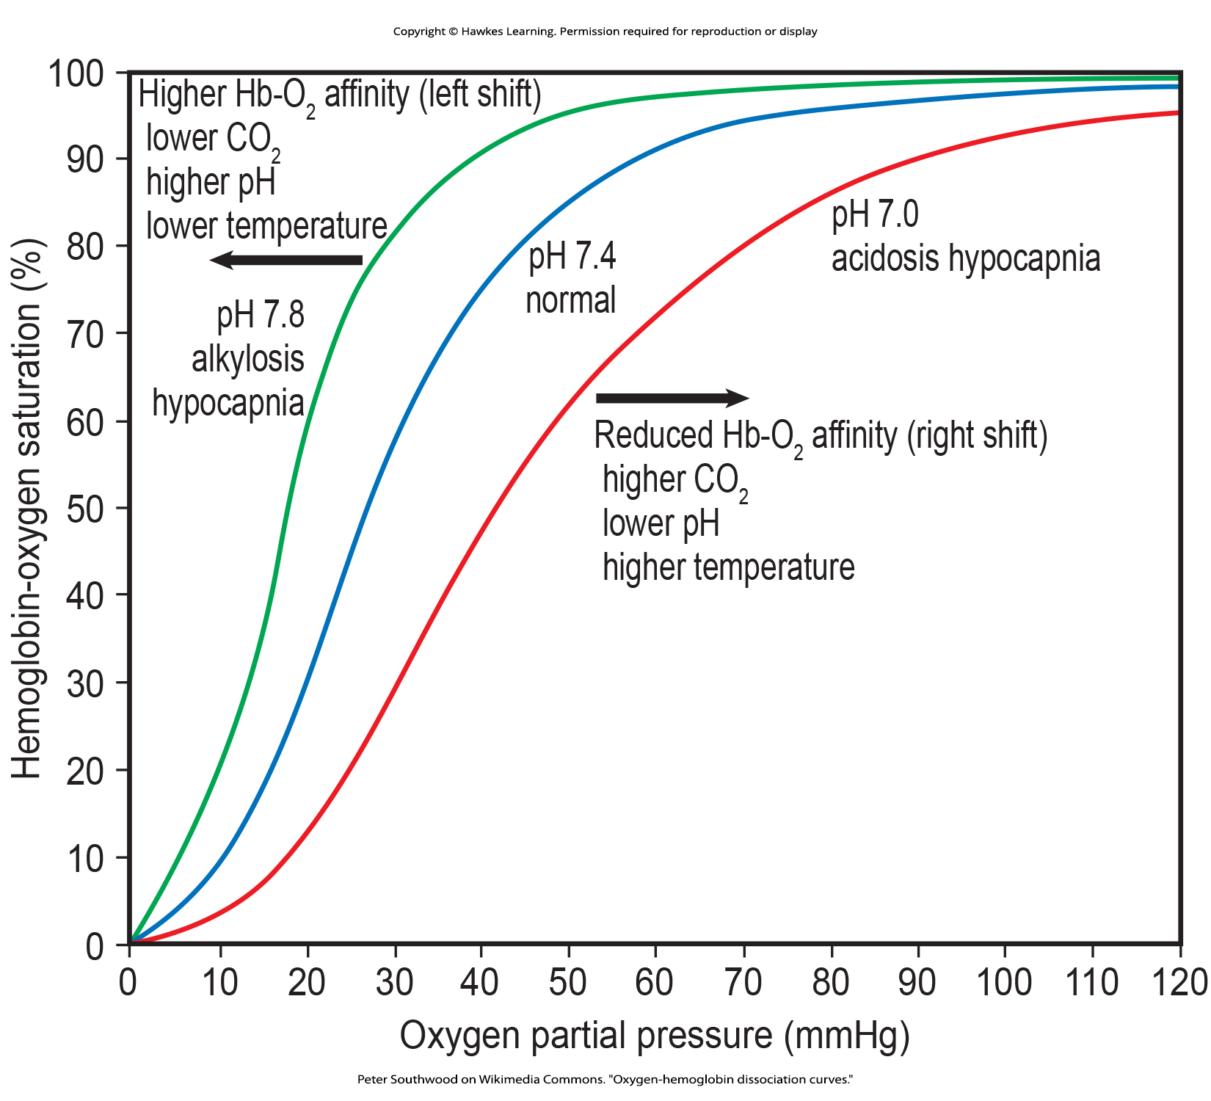
Lesson 36.4 Figure 2

Slide 30
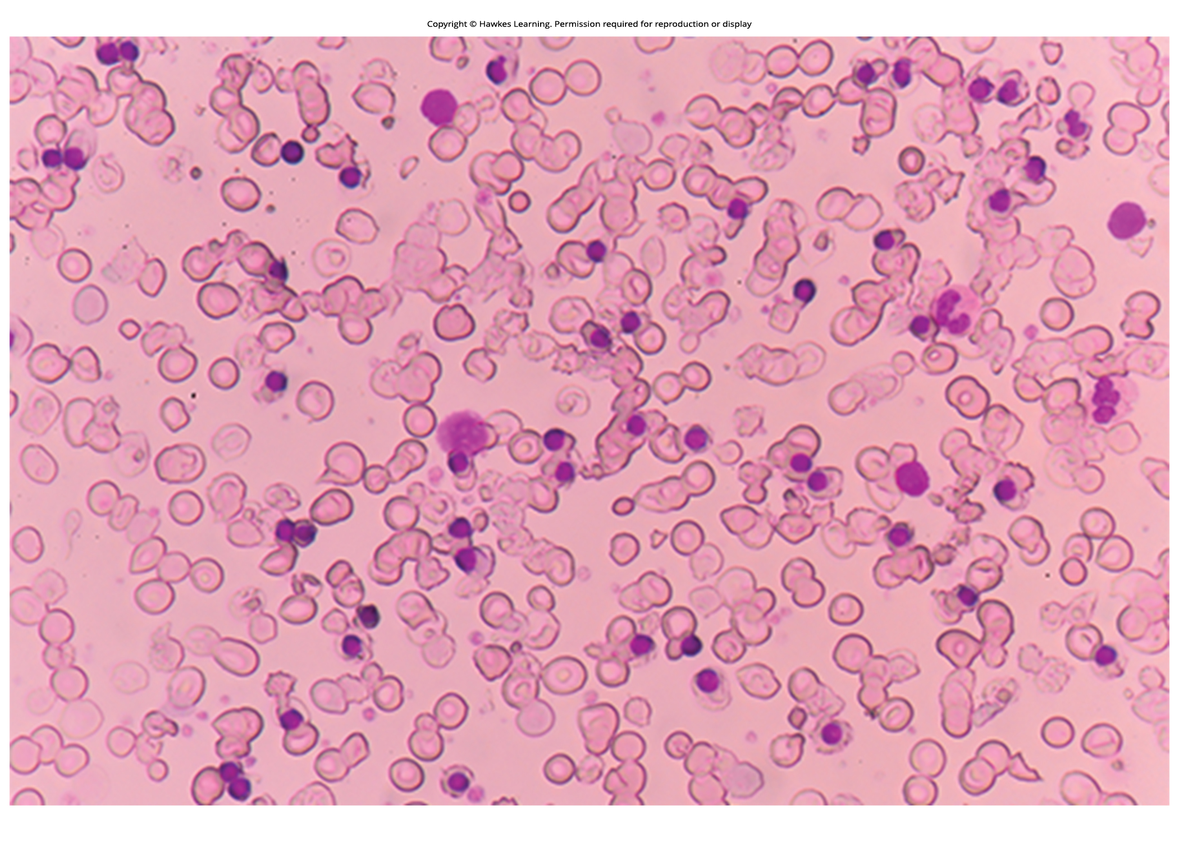
Lesson 36.4 Figure 3

Slide 31
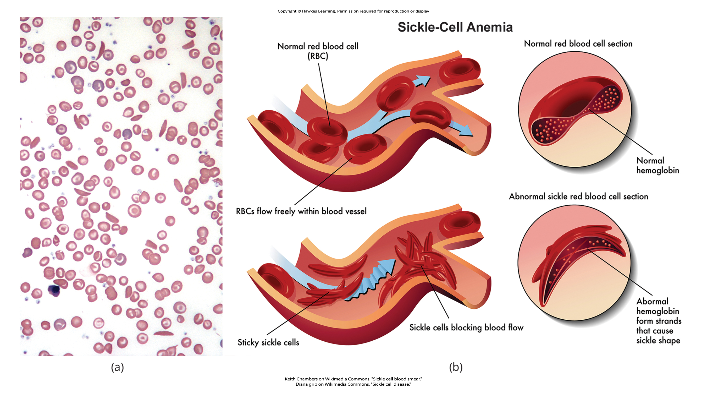
Lesson 36.4 Figure 4

Slide 32
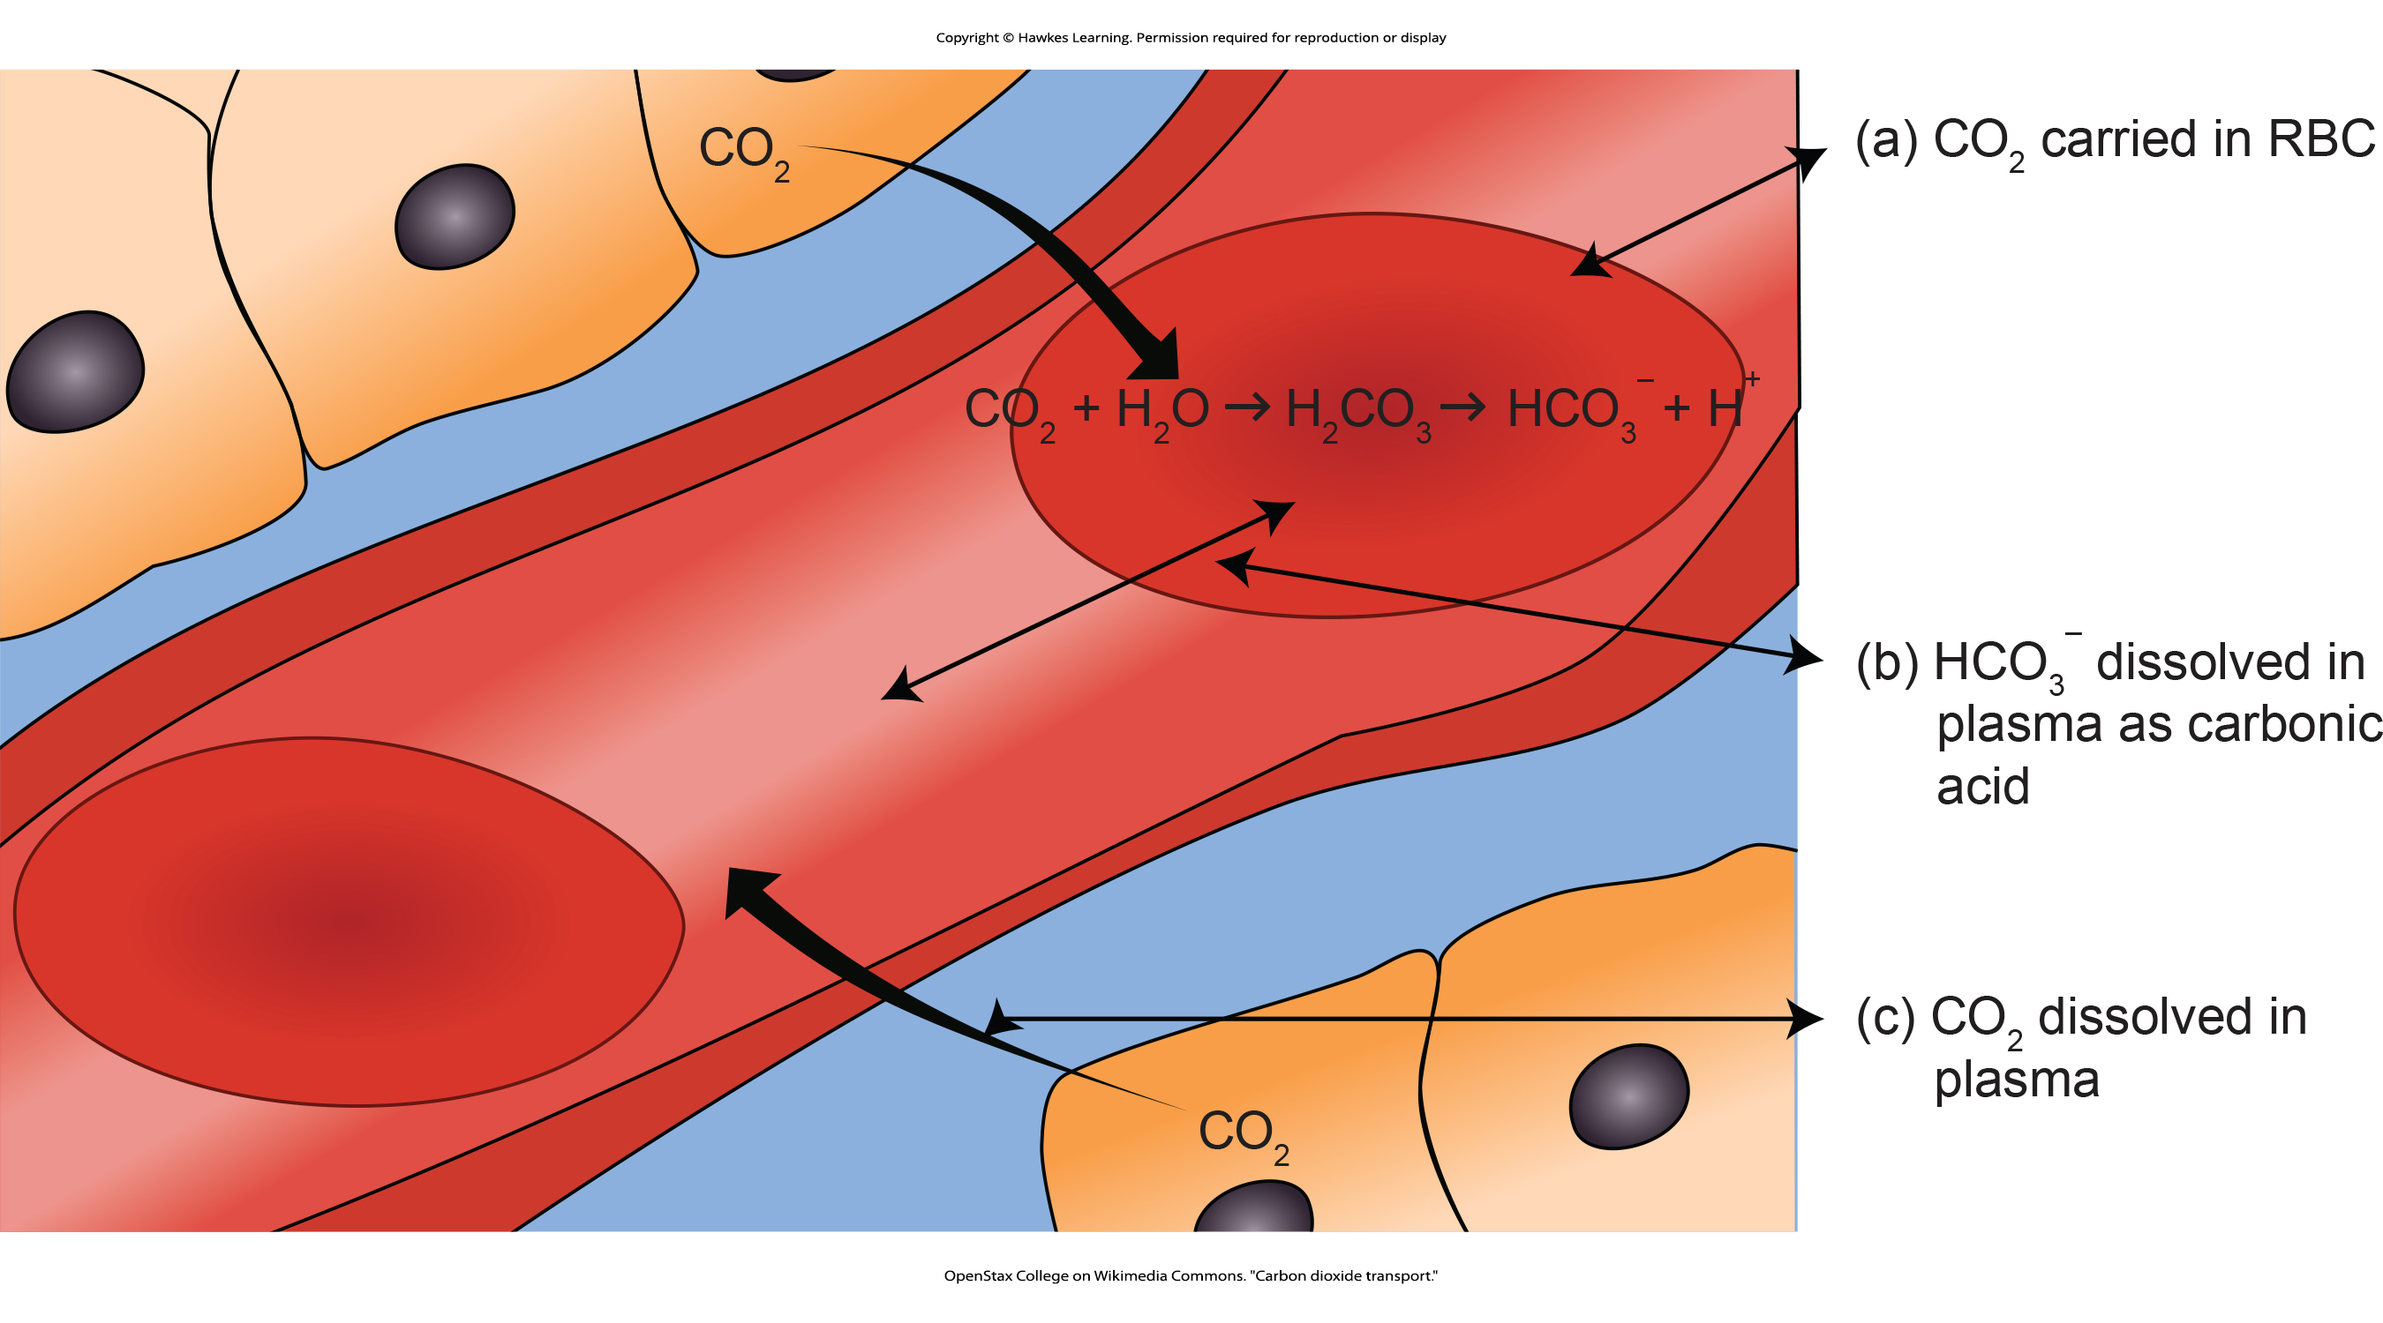
Lesson 36.4 Figure 5

Slide 33
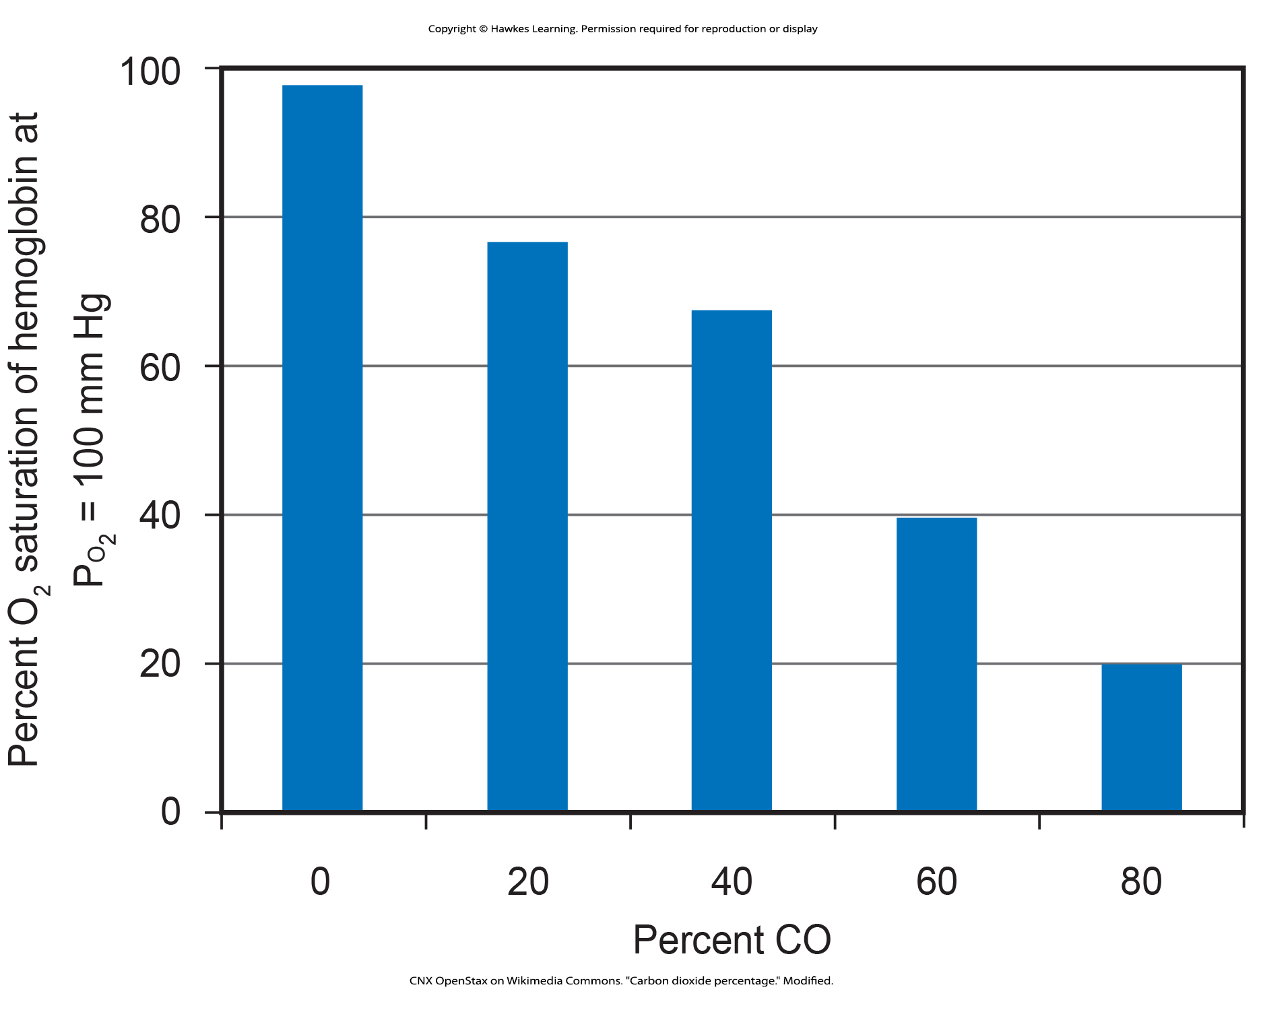
Lesson 36.4 Figure 6

Slide 34
Hawkes Learning – End of PowerPoint

