Slide 1
Chapter 37
The Immune System

Slide 2
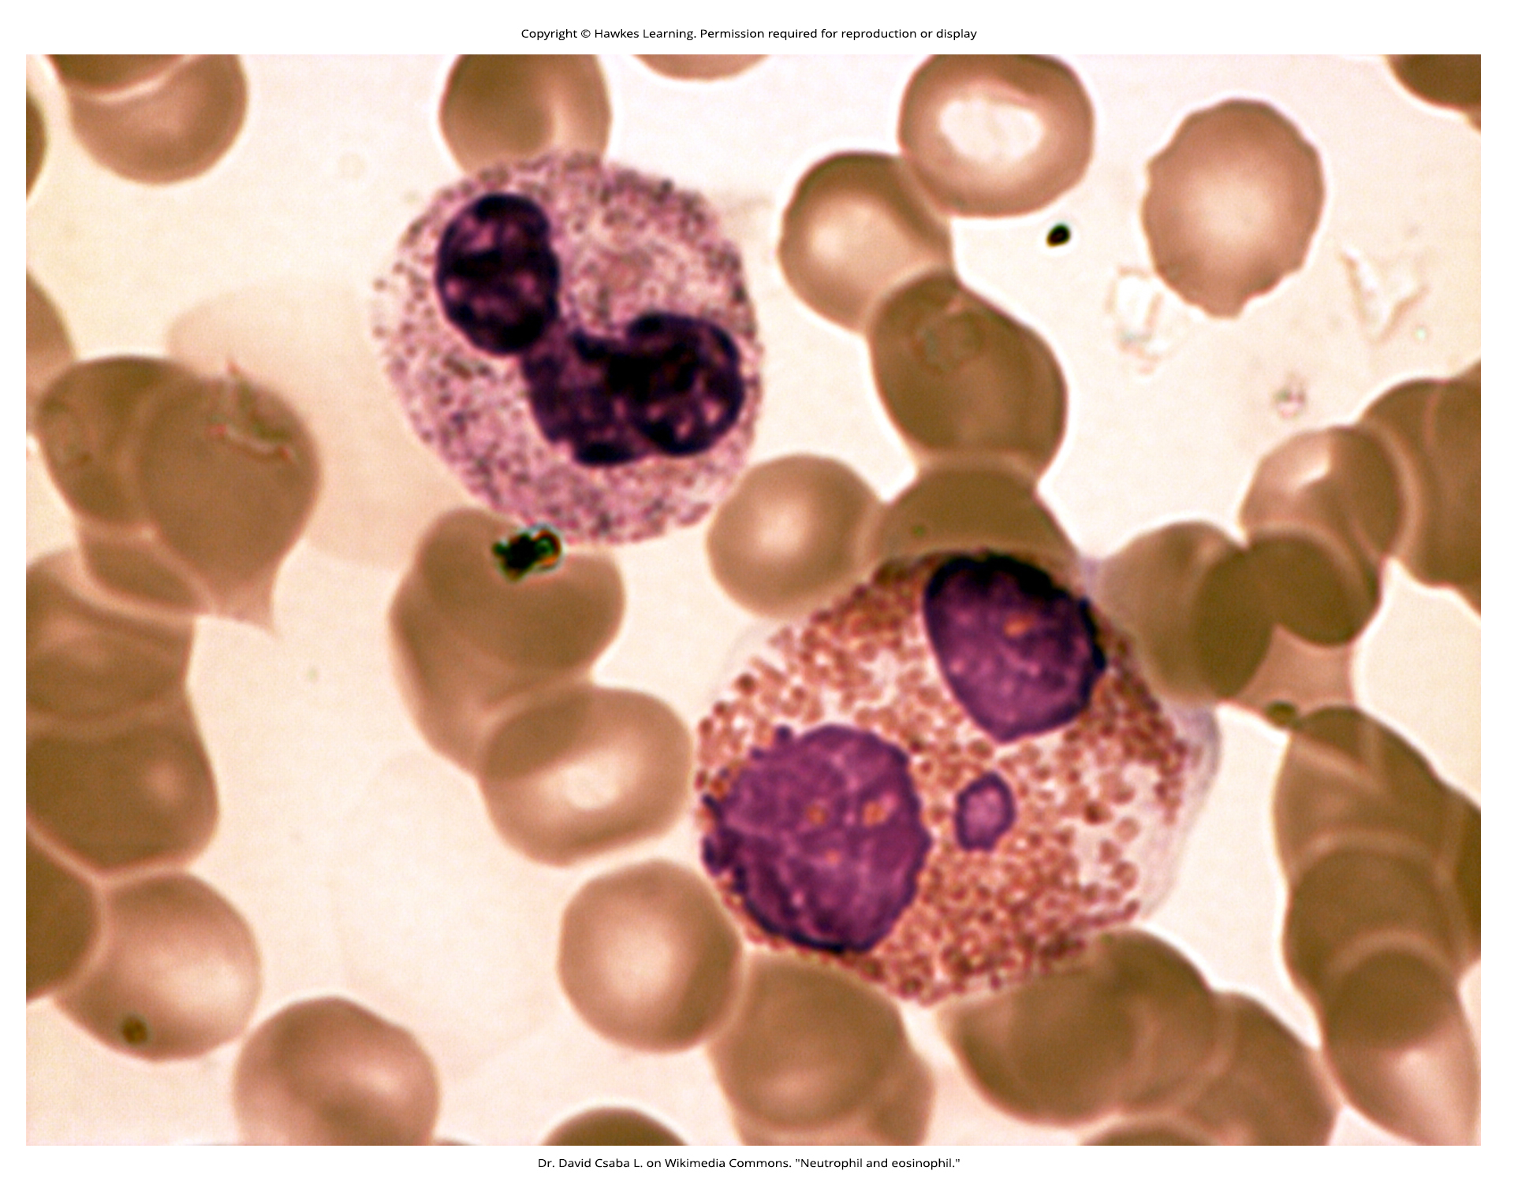
Lesson 37.1 Figure 1

Slide 3
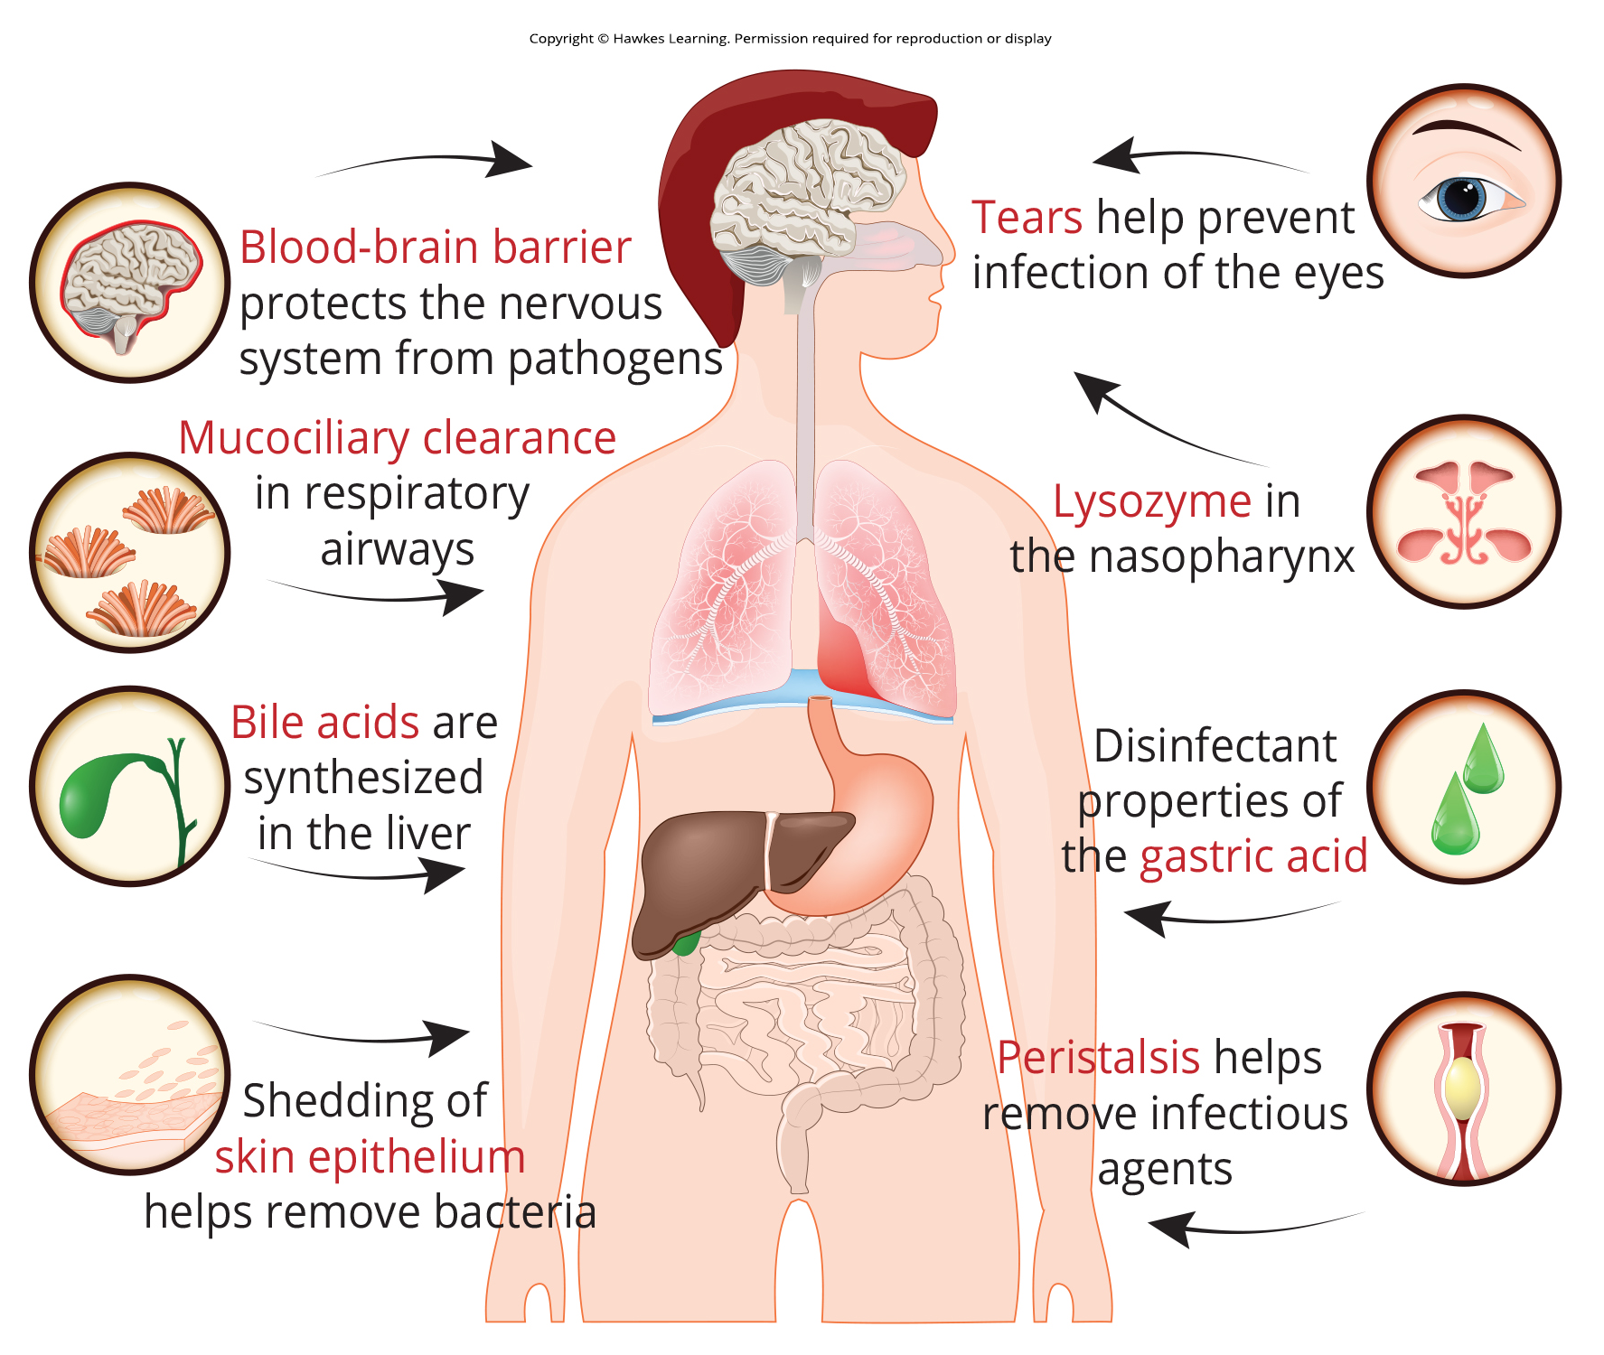
Lesson 37.1 Figure 2

Slide 4
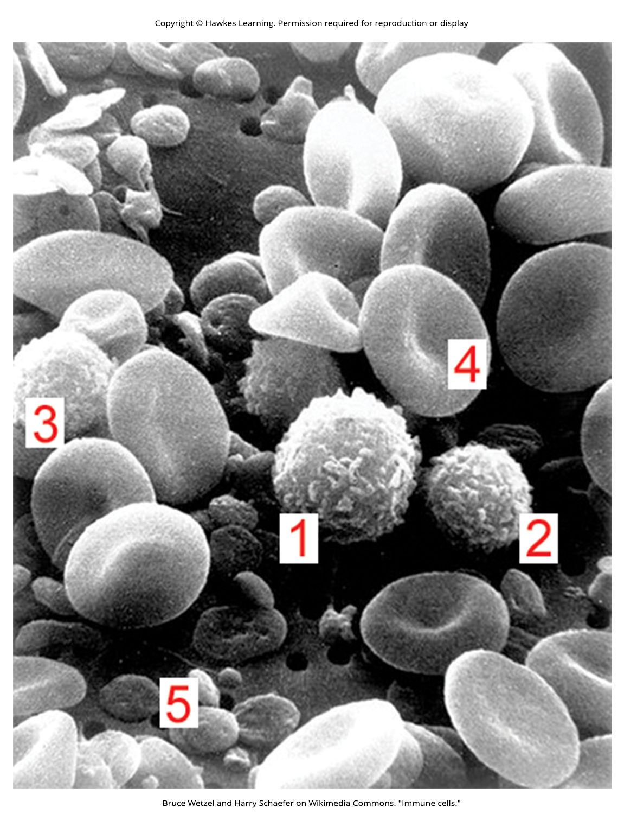
Lesson 37.1 Figure 3

Slide 5
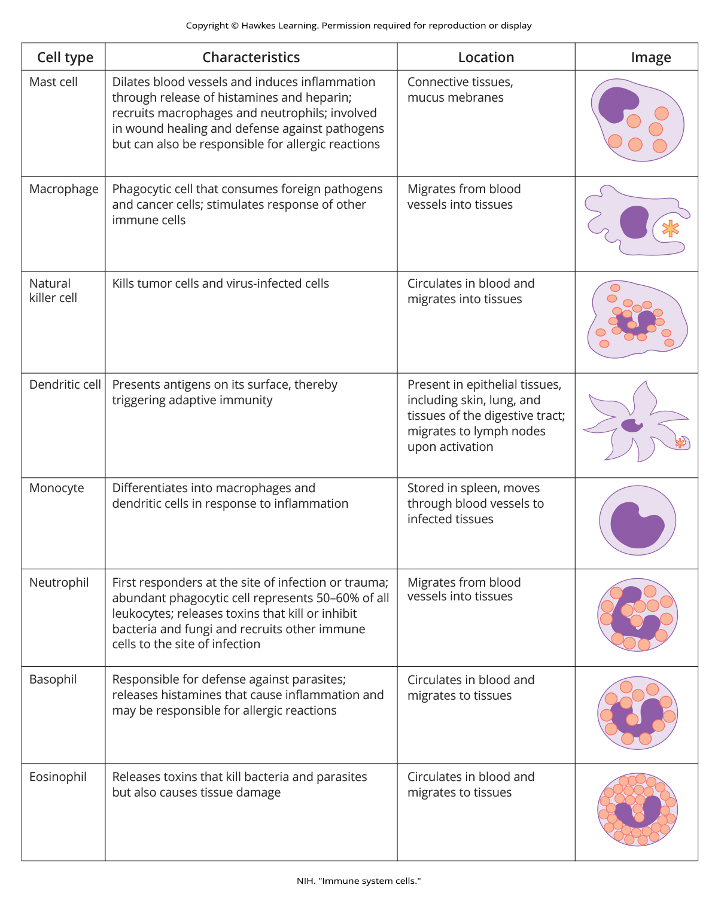
Lesson 37.1 Figure 4

Slide 6
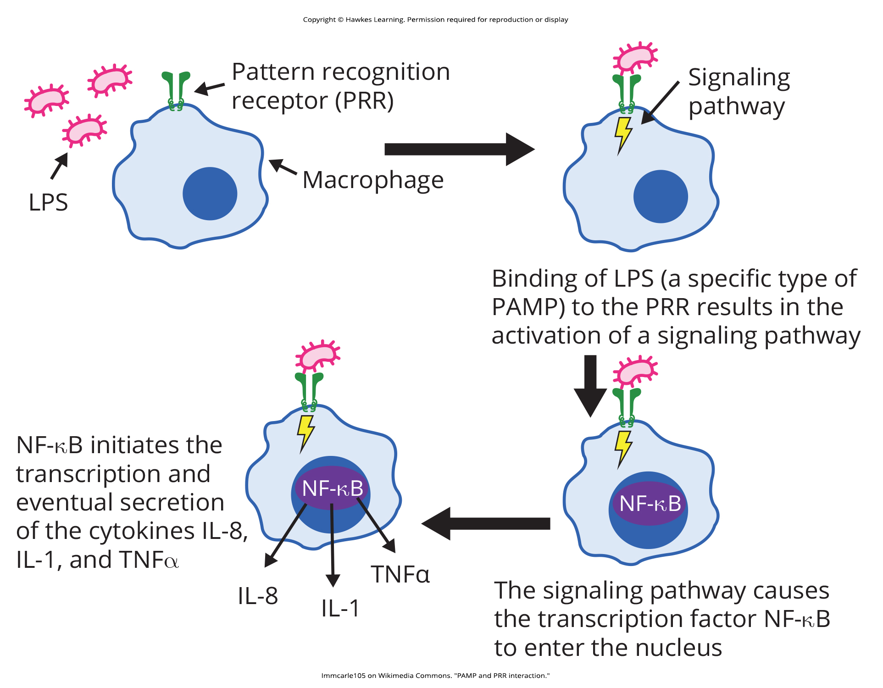
Lesson 37.1 Figure 5

Slide 7
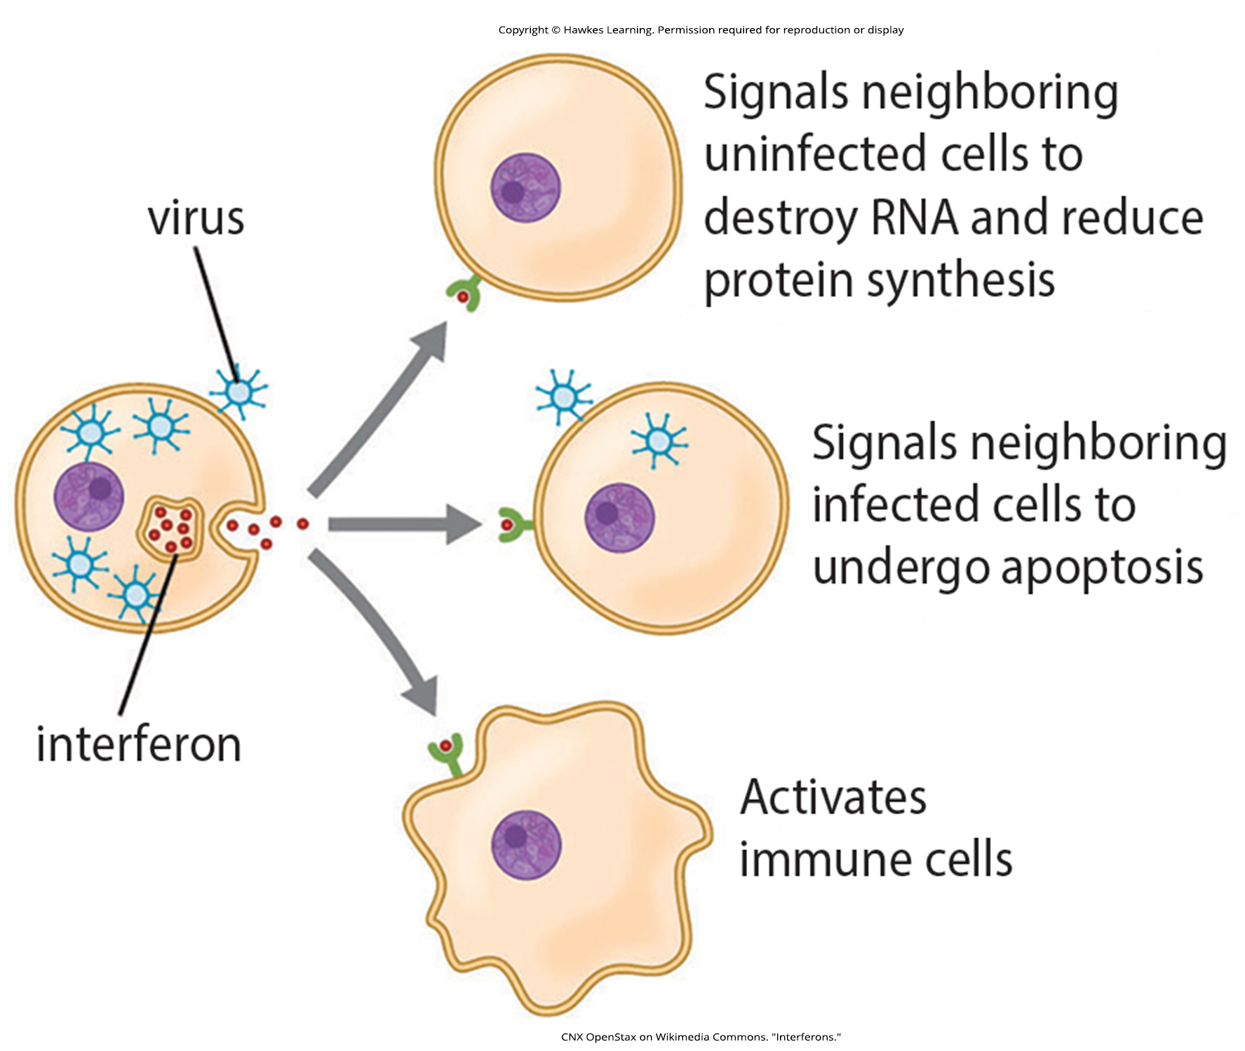
Lesson 37.1 Figure 6

Slide 8
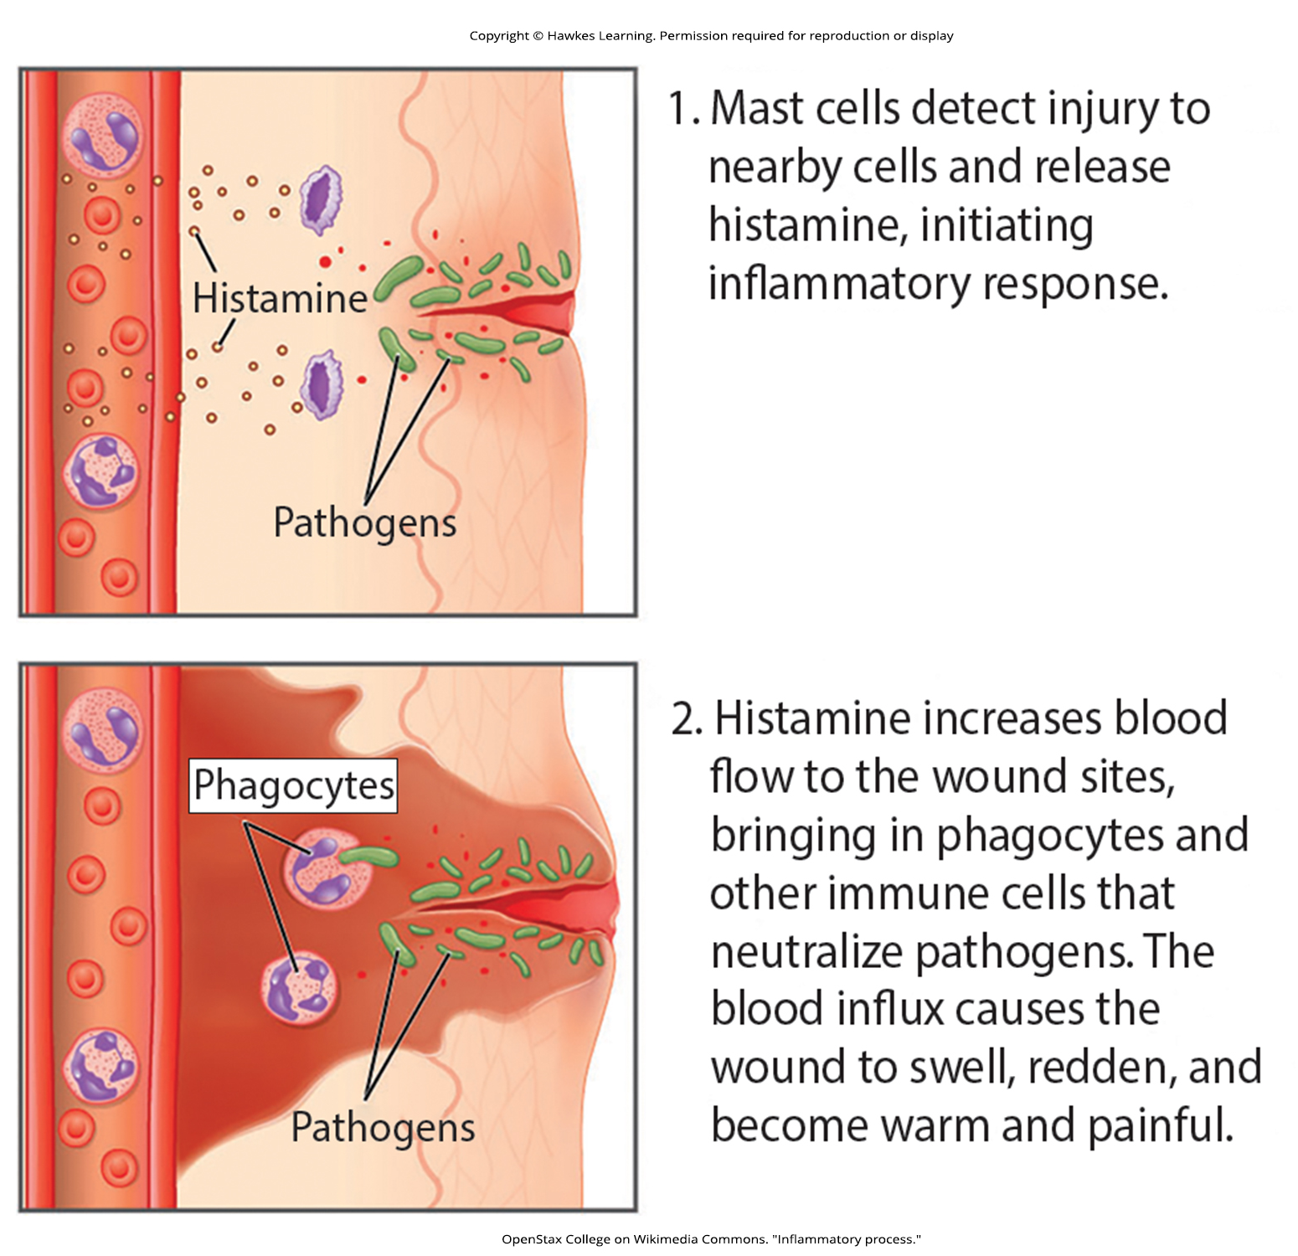
Lesson 37.1 Figure 7

Slide 9
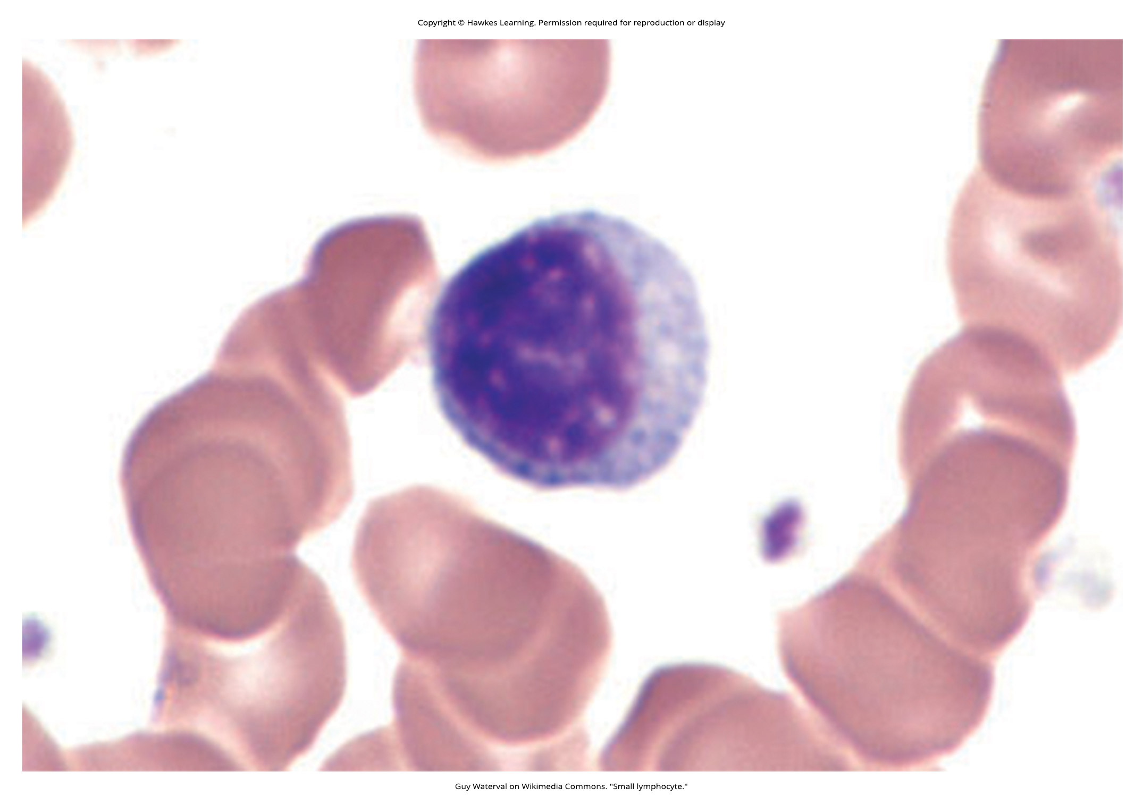
Lesson 37.1 Figure 8

Slide 10
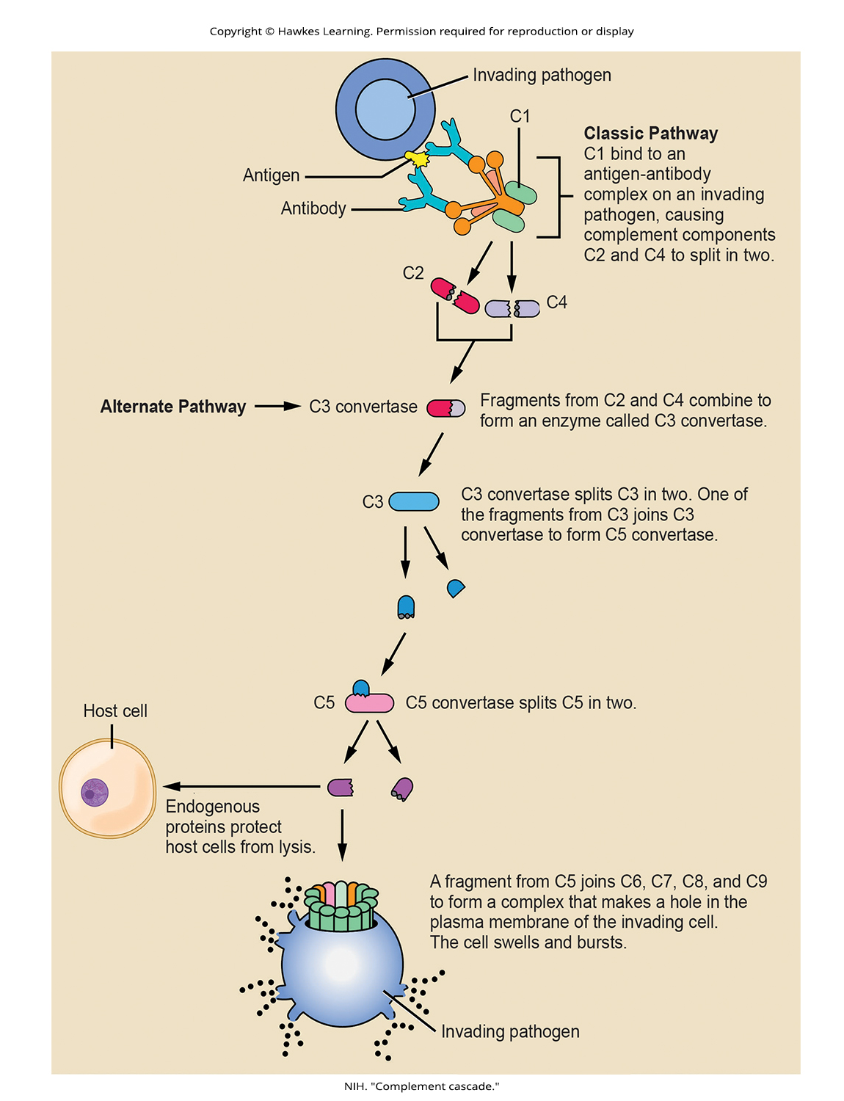
Lesson 37.1 Figure 9

Slide 11
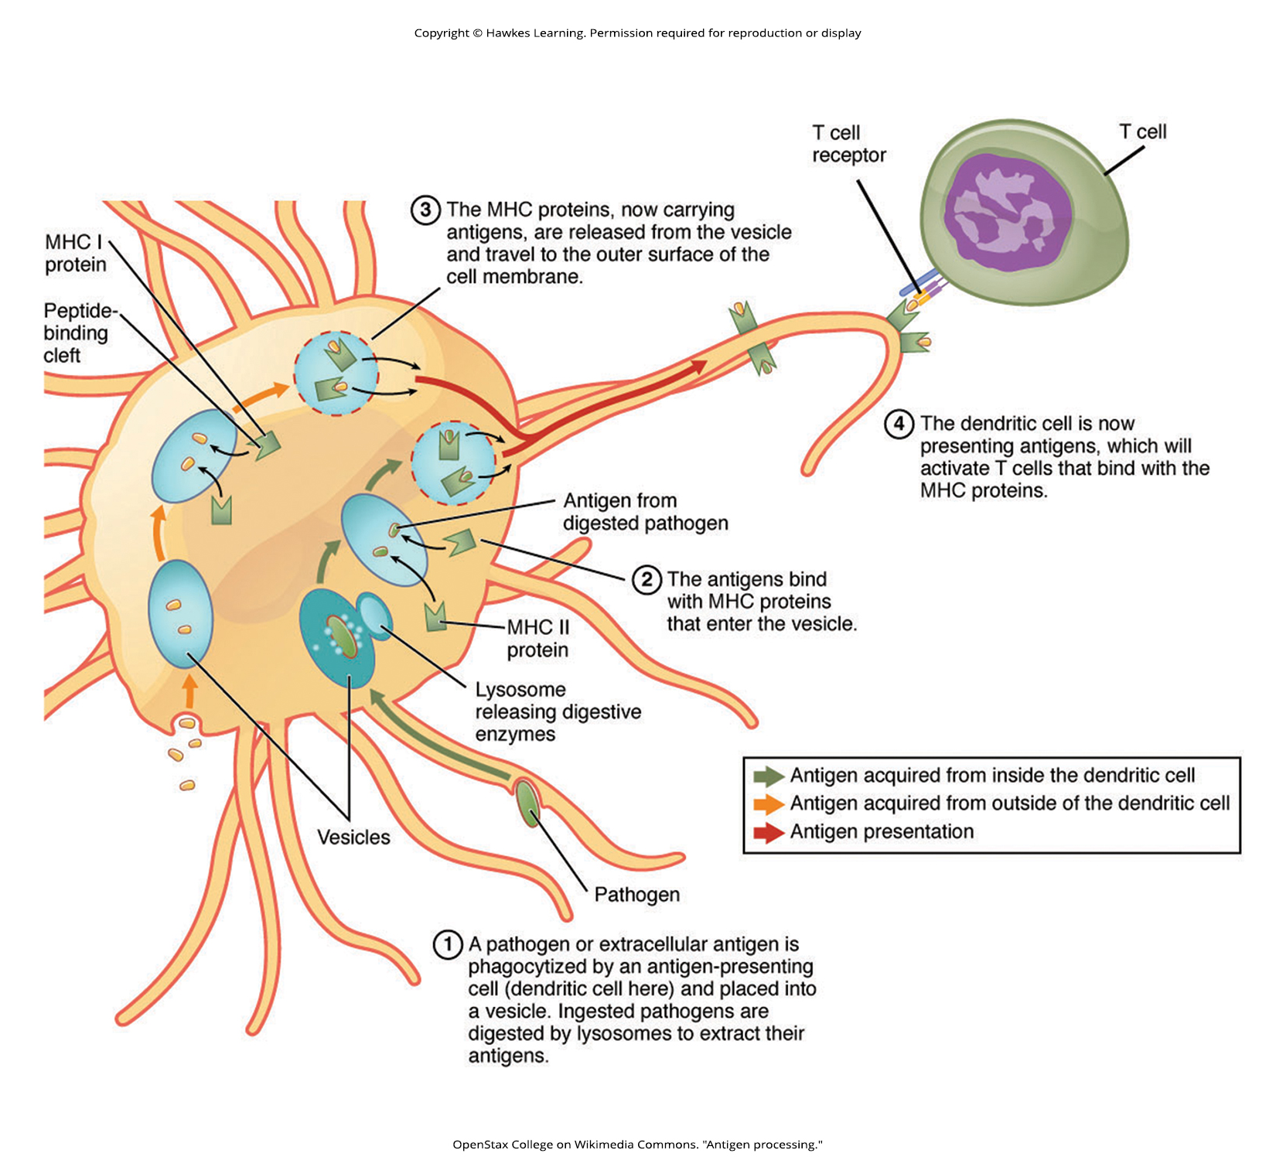
Lesson 37.2 Figure 1

Slide 12
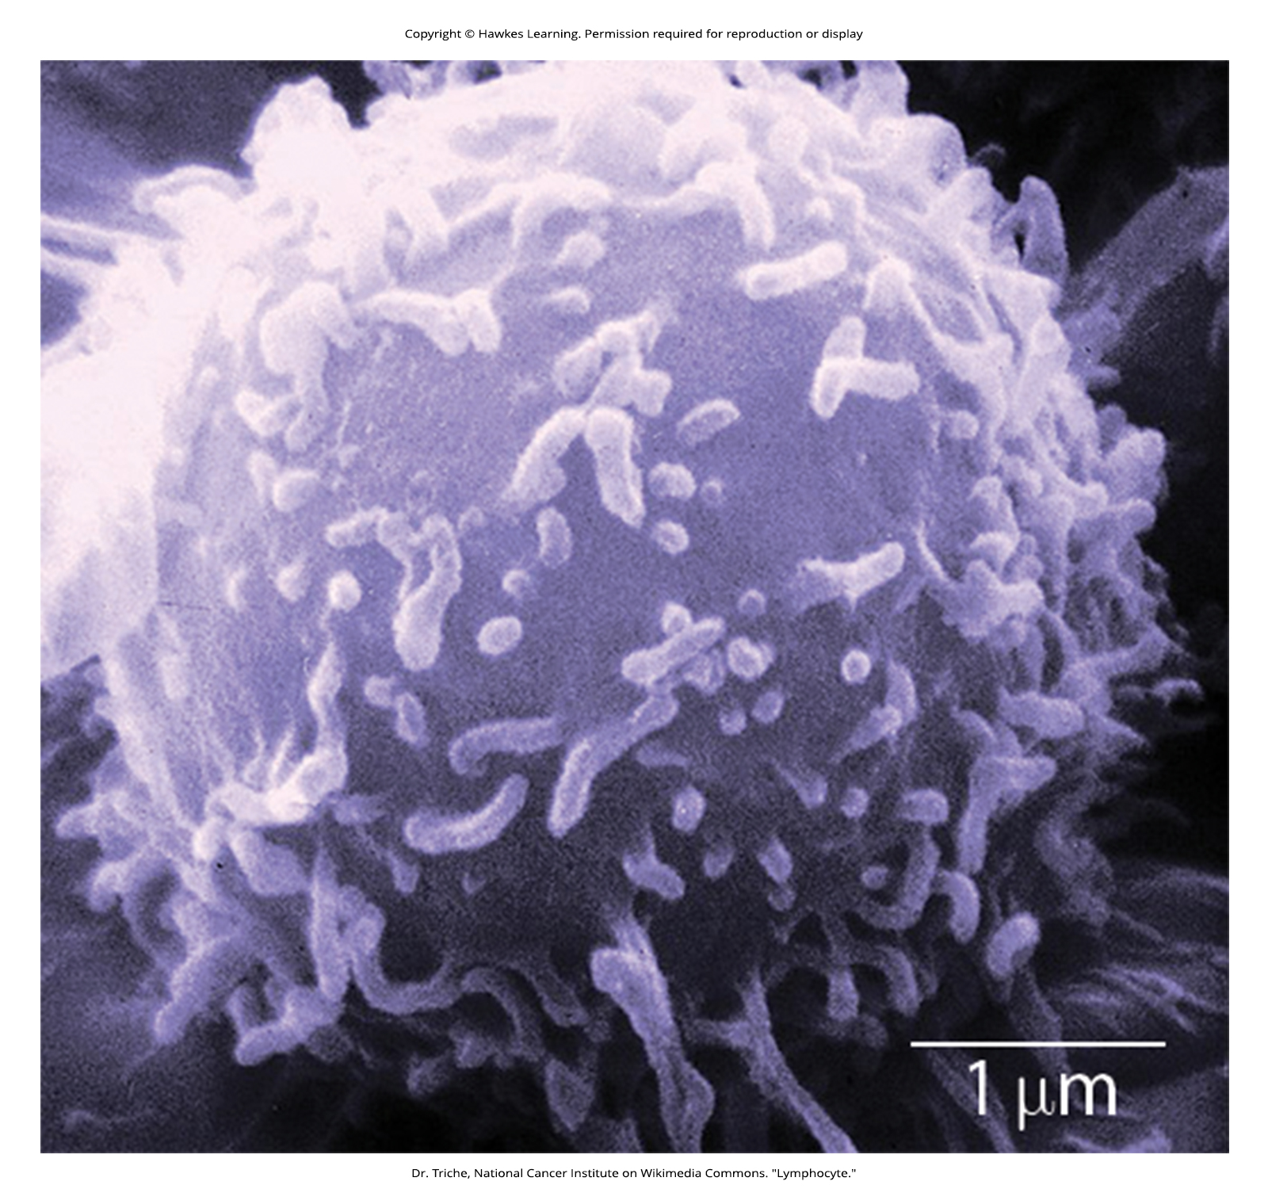
Lesson 37.2 Figure 2

Slide 13
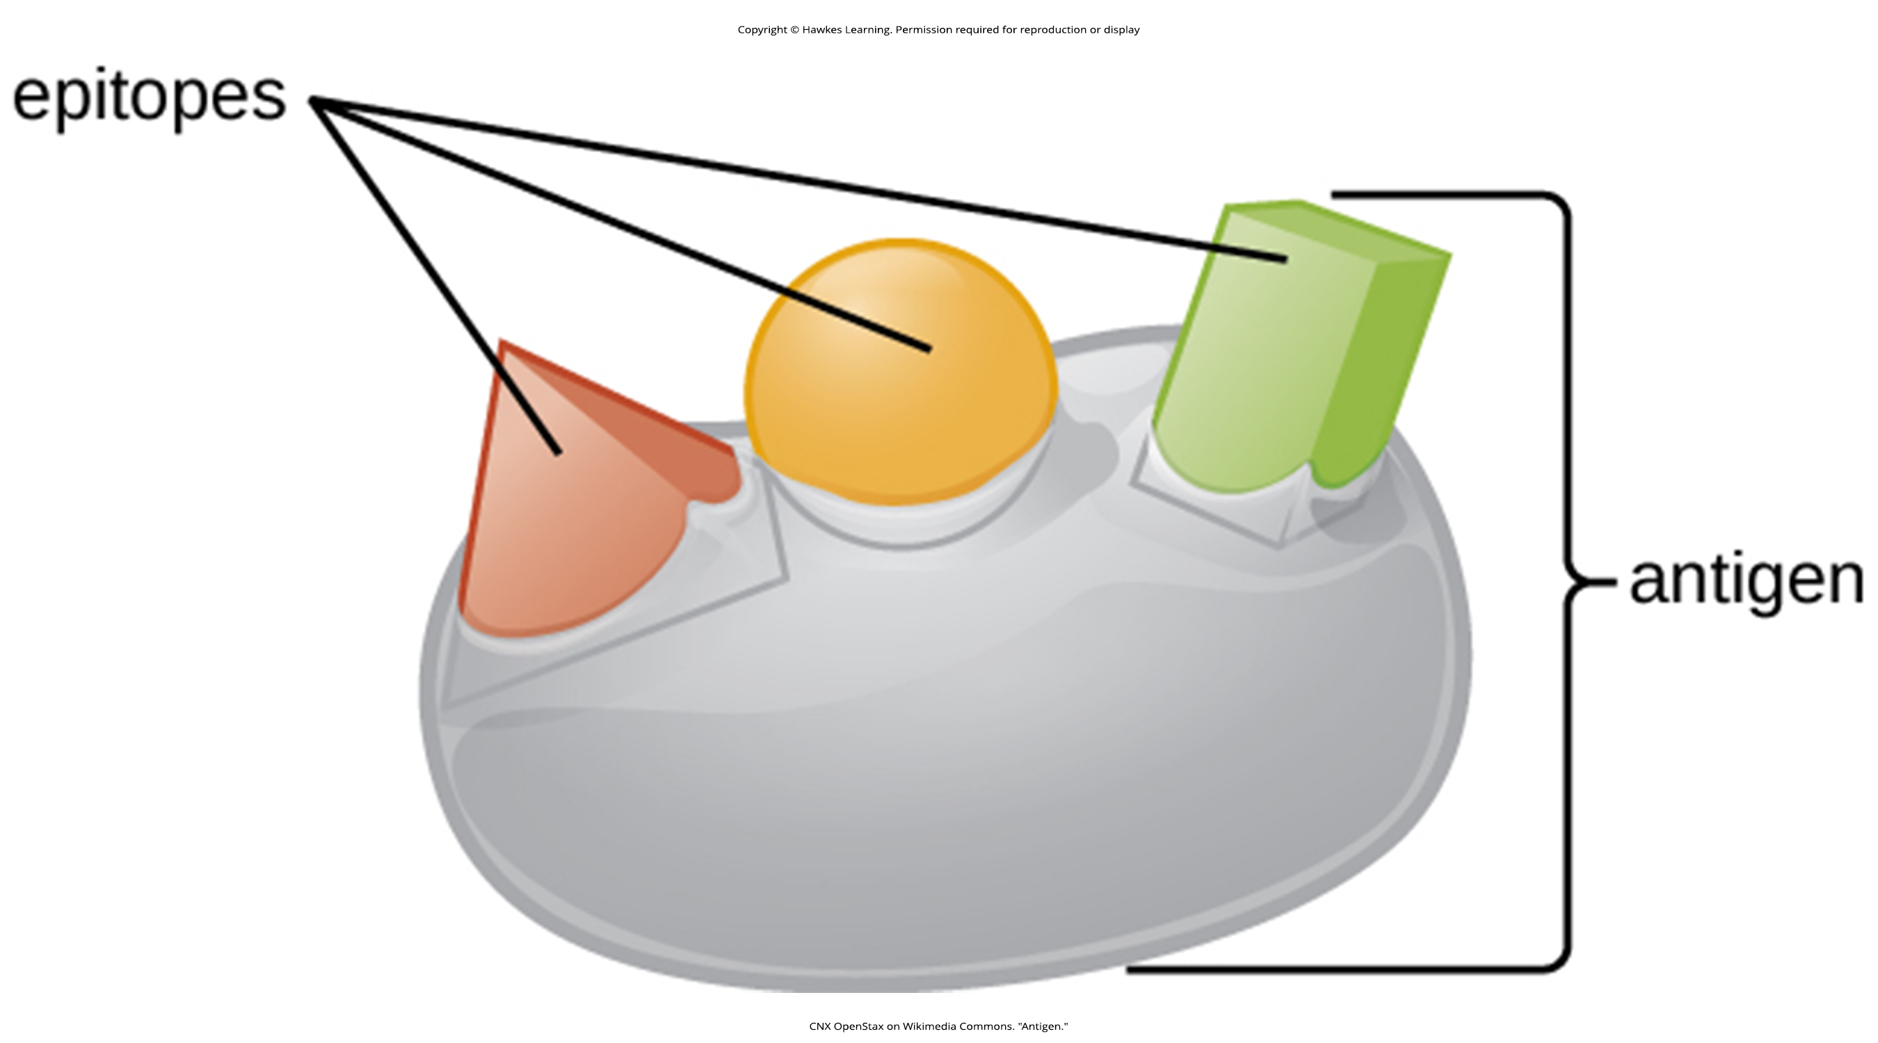
Lesson 37.2 Figure 3

Slide 14
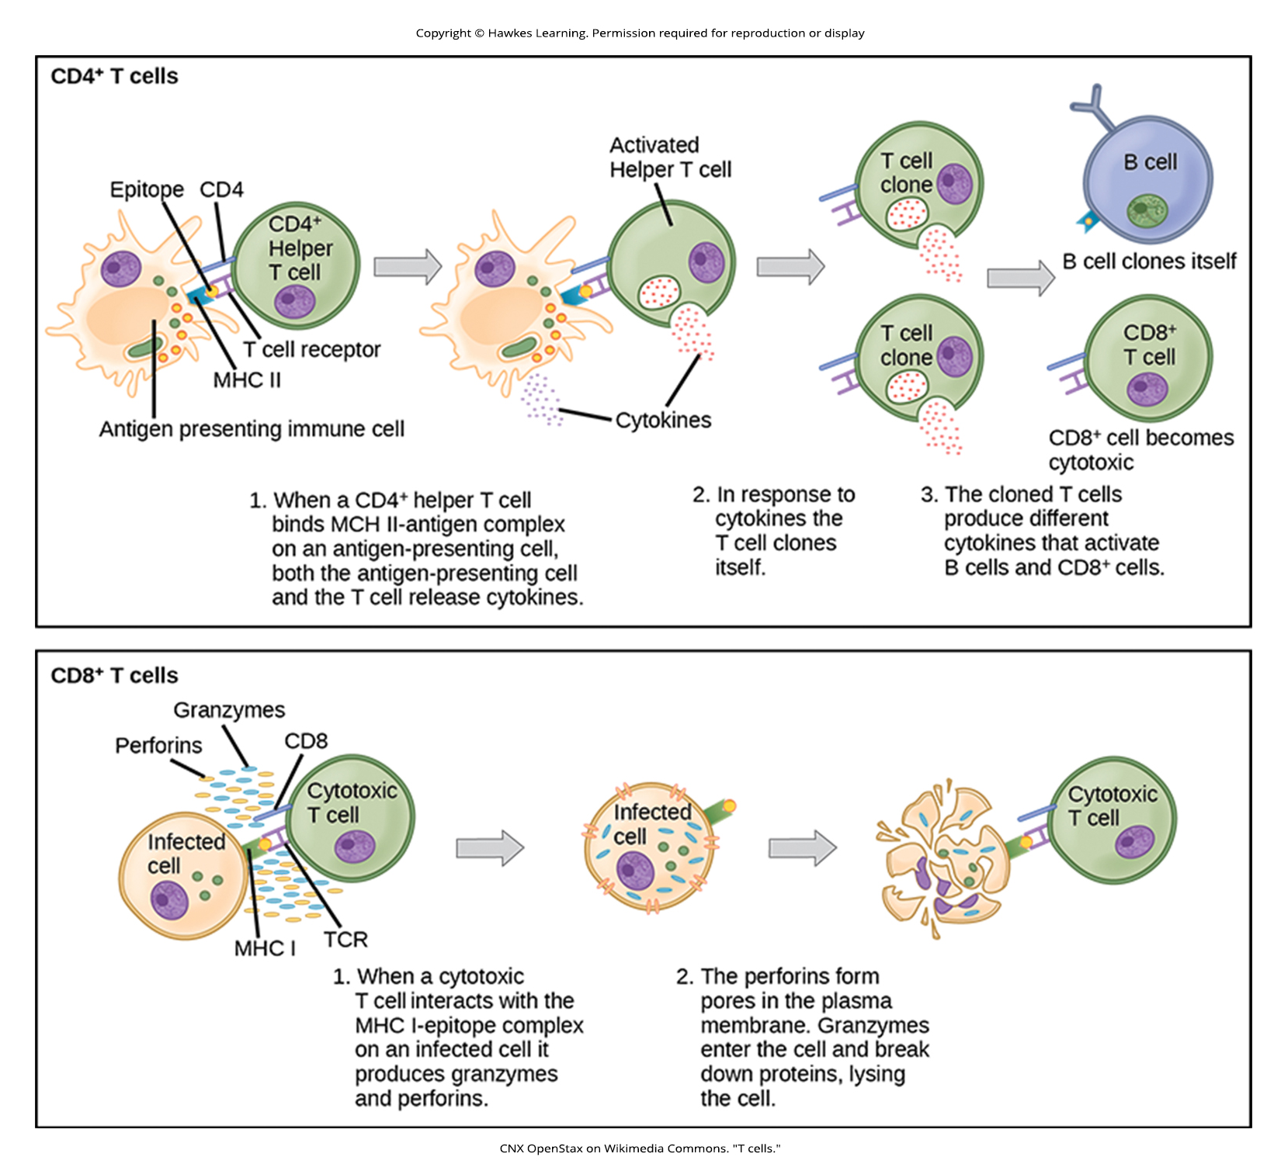
Lesson 37.2 Figure 4

Slide 15
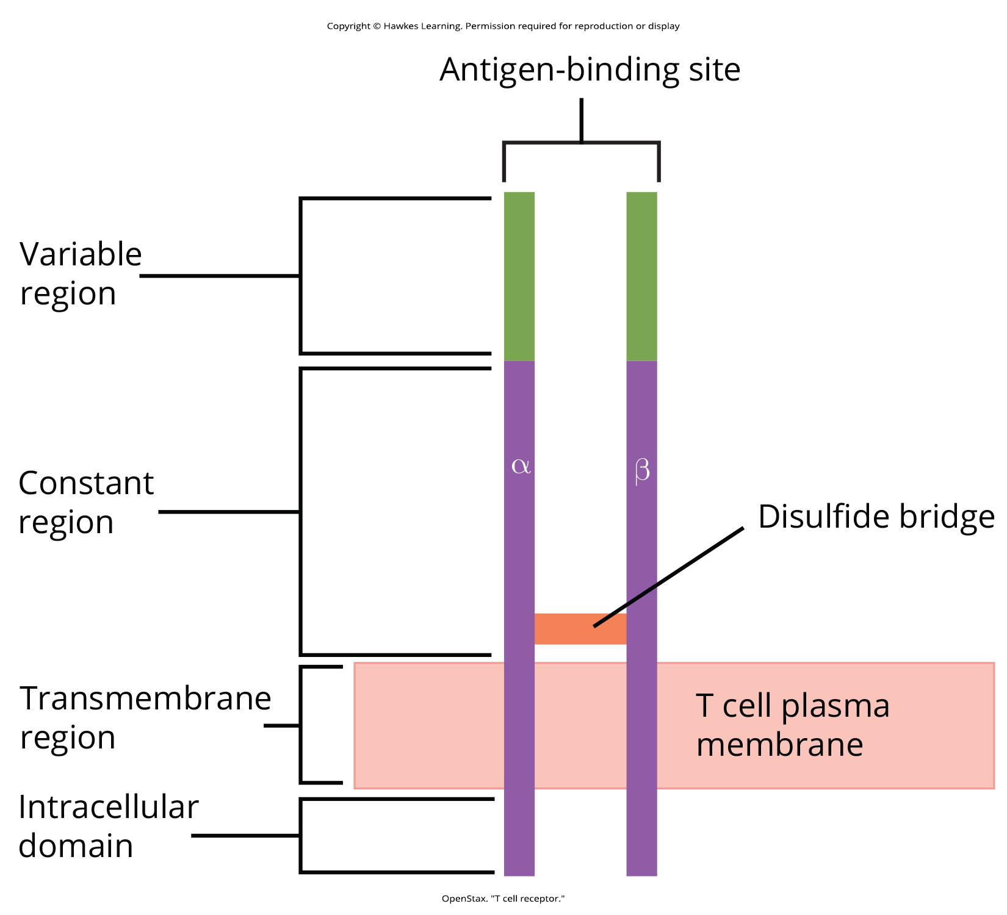
Lesson 37.2 Figure 5

Slide 16
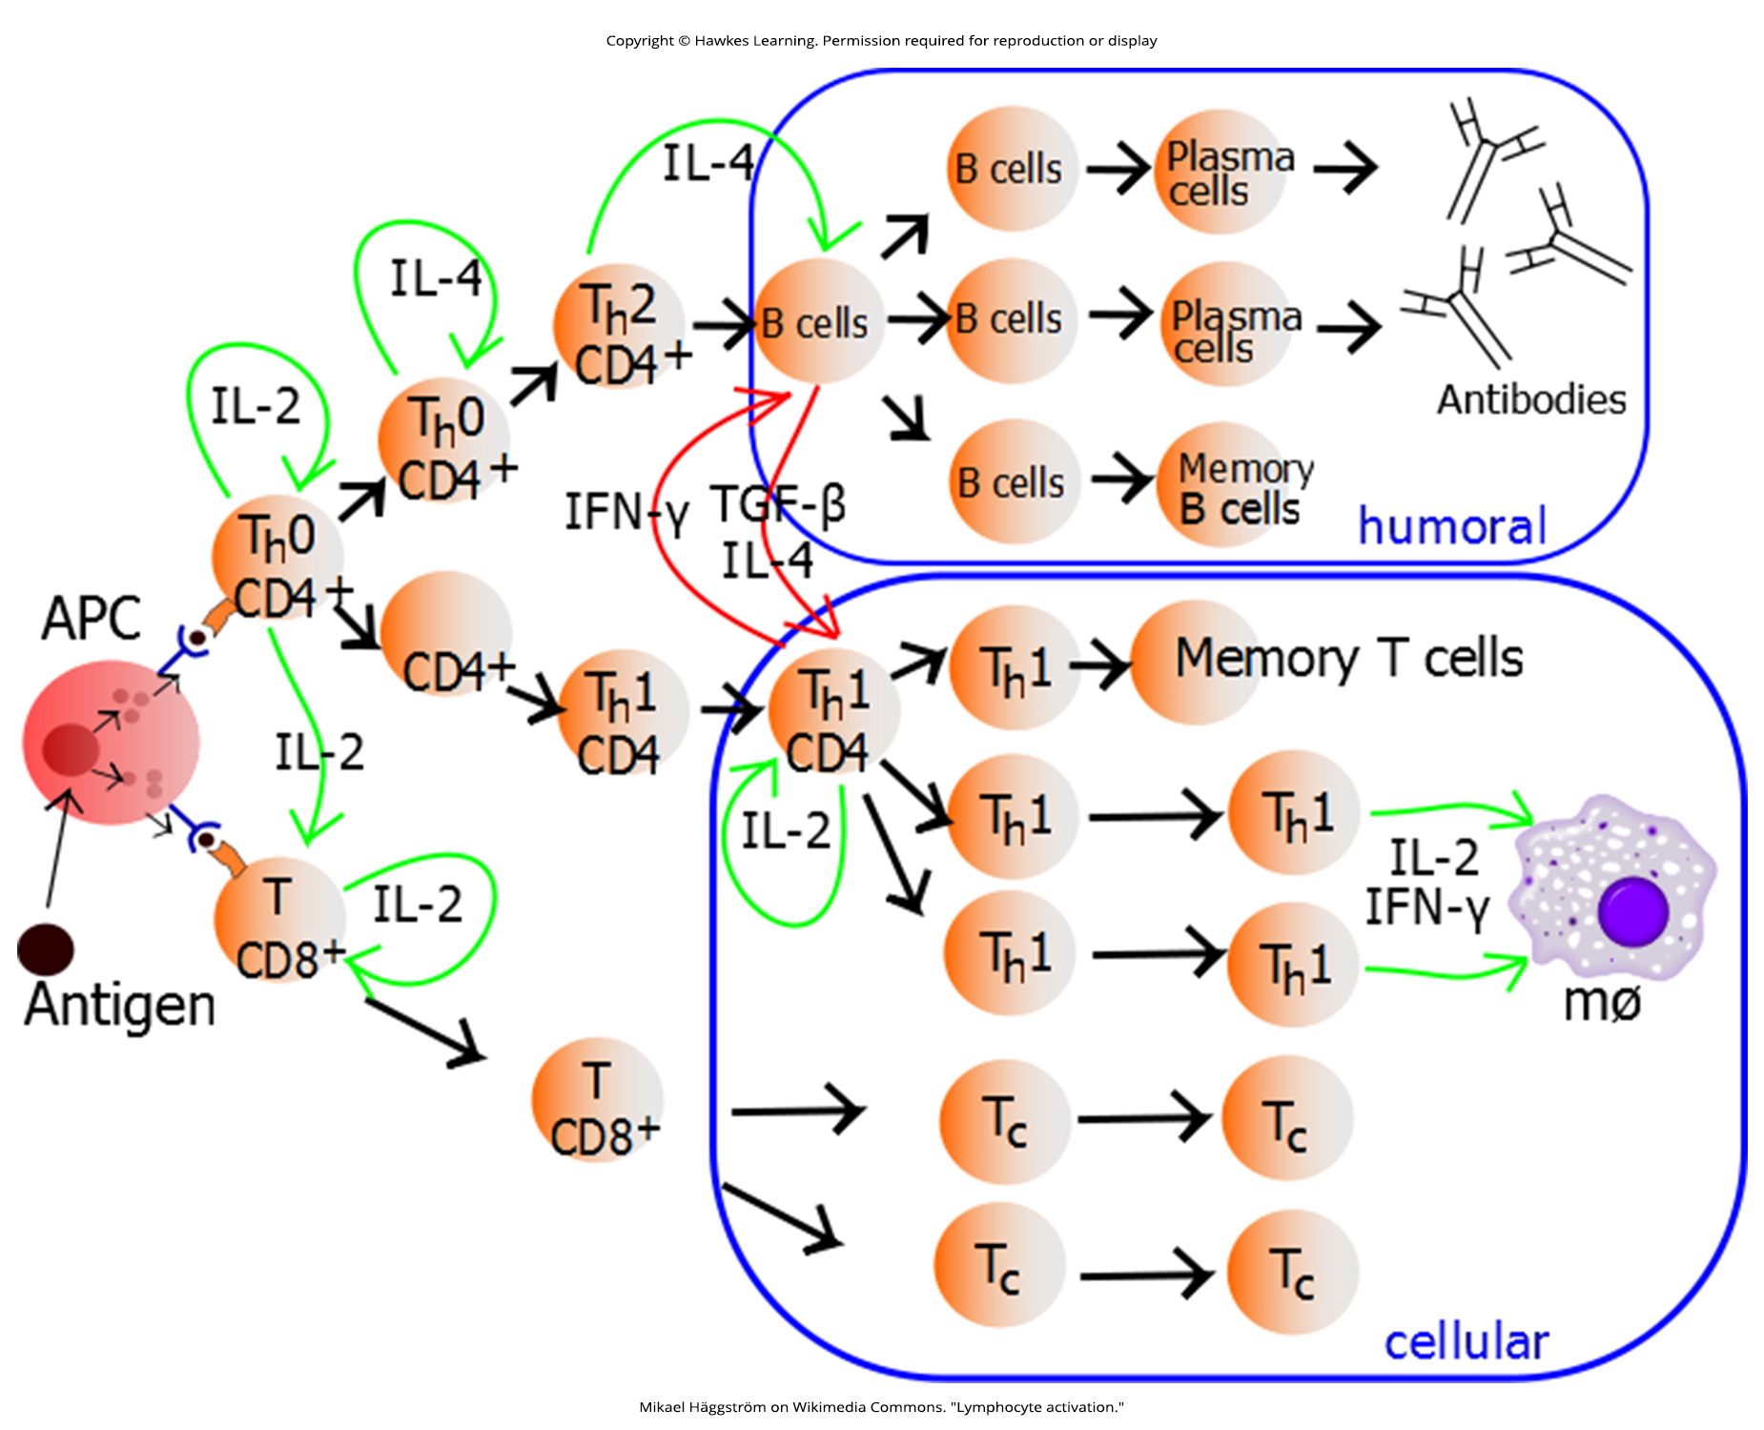
Lesson 37.2 Figure 6

Slide 17
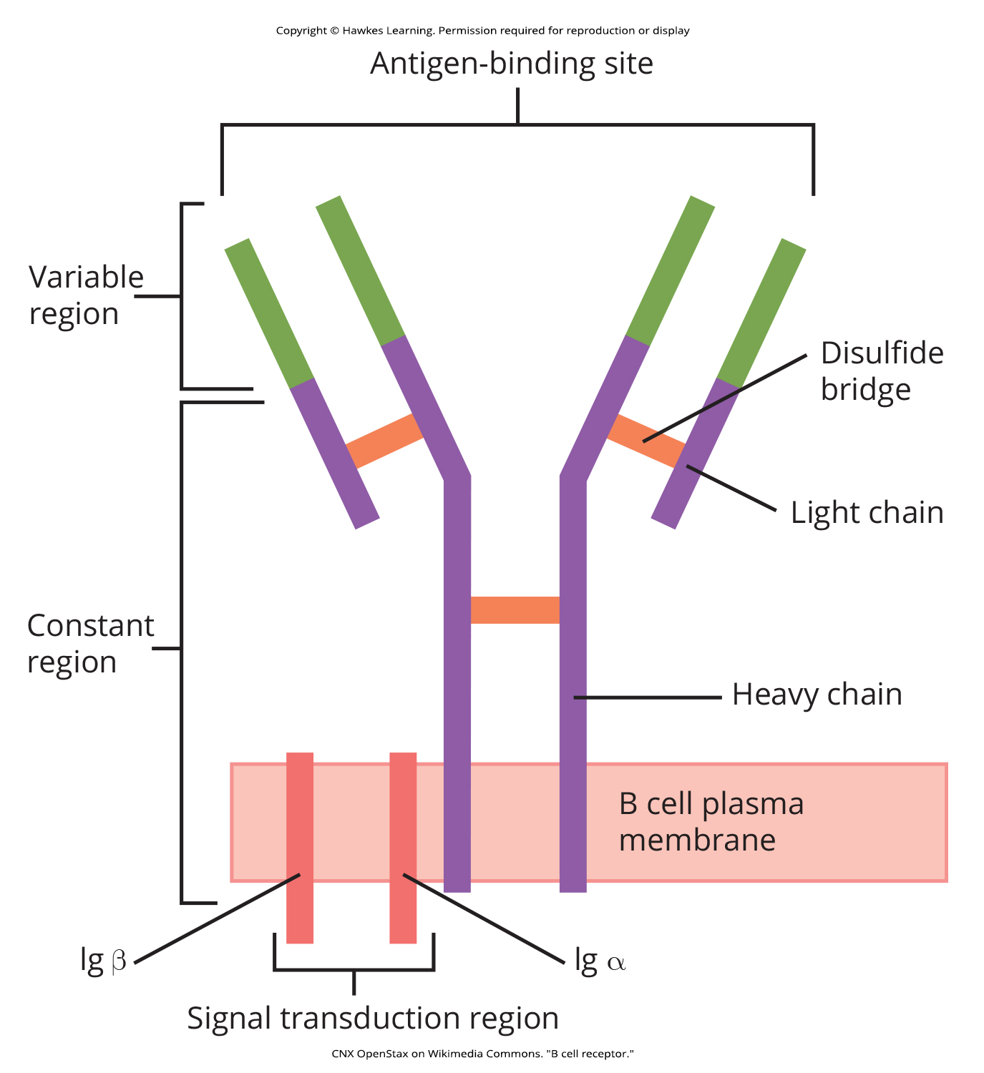
Lesson 37.2 Figure 7

Slide 18
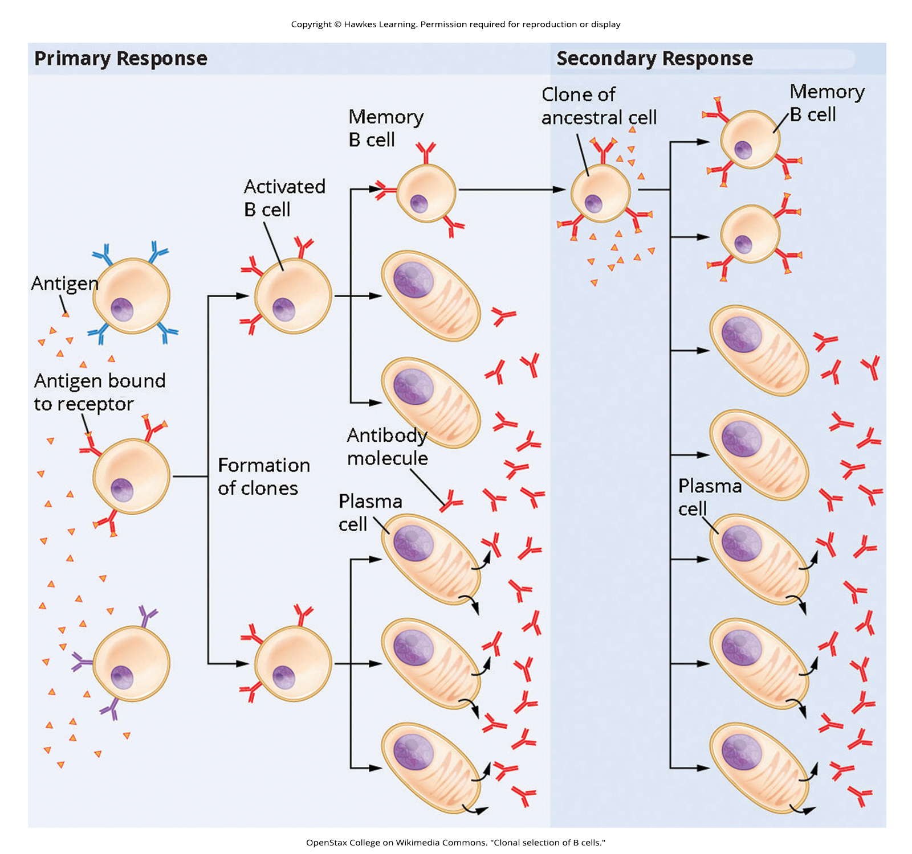
Lesson 37.2 Figure 8

Slide 19
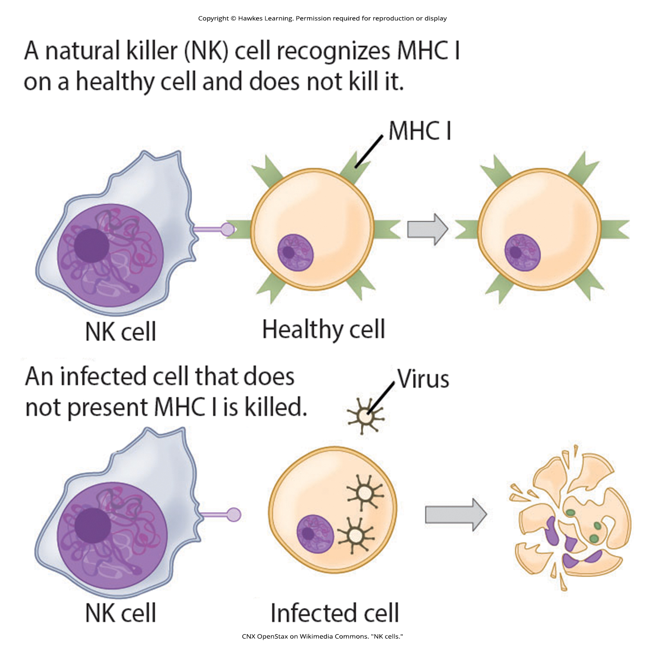
Lesson 37.2 Figure 9

Slide 20
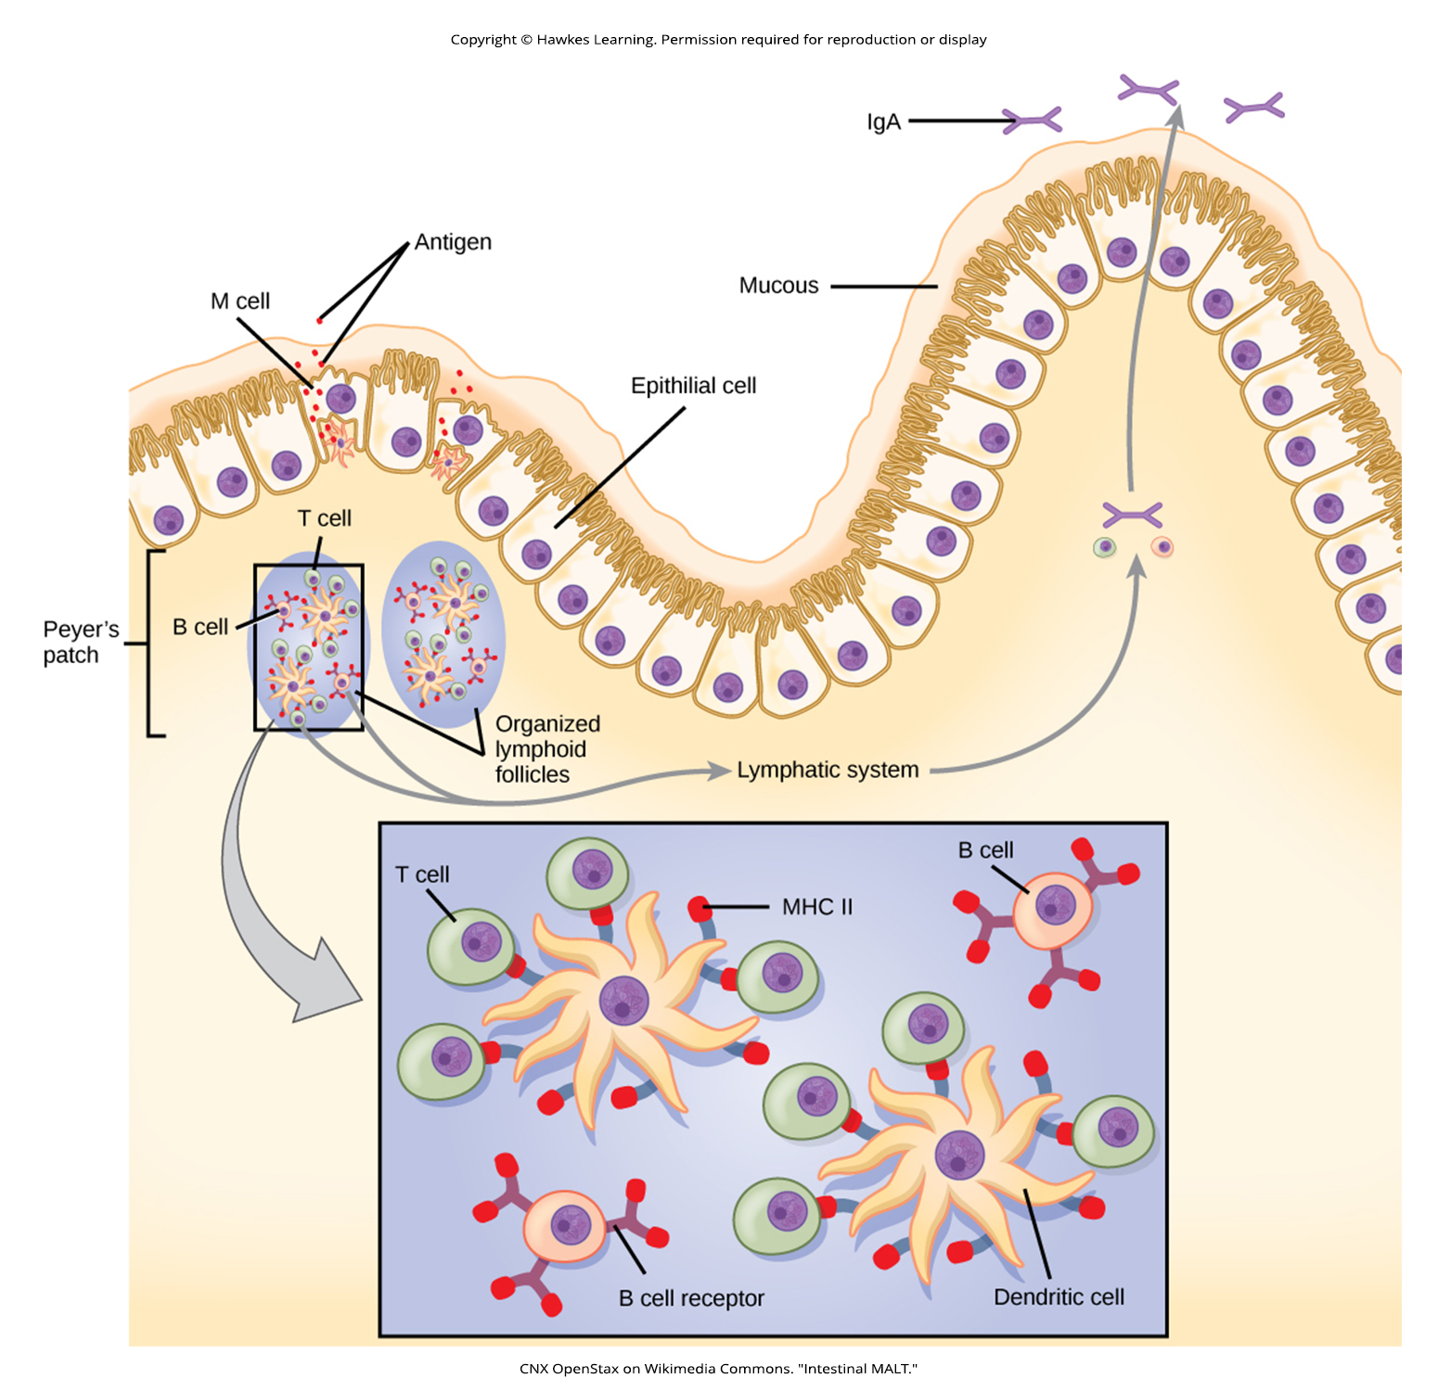
Lesson 37.2 Figure 10

Slide 21
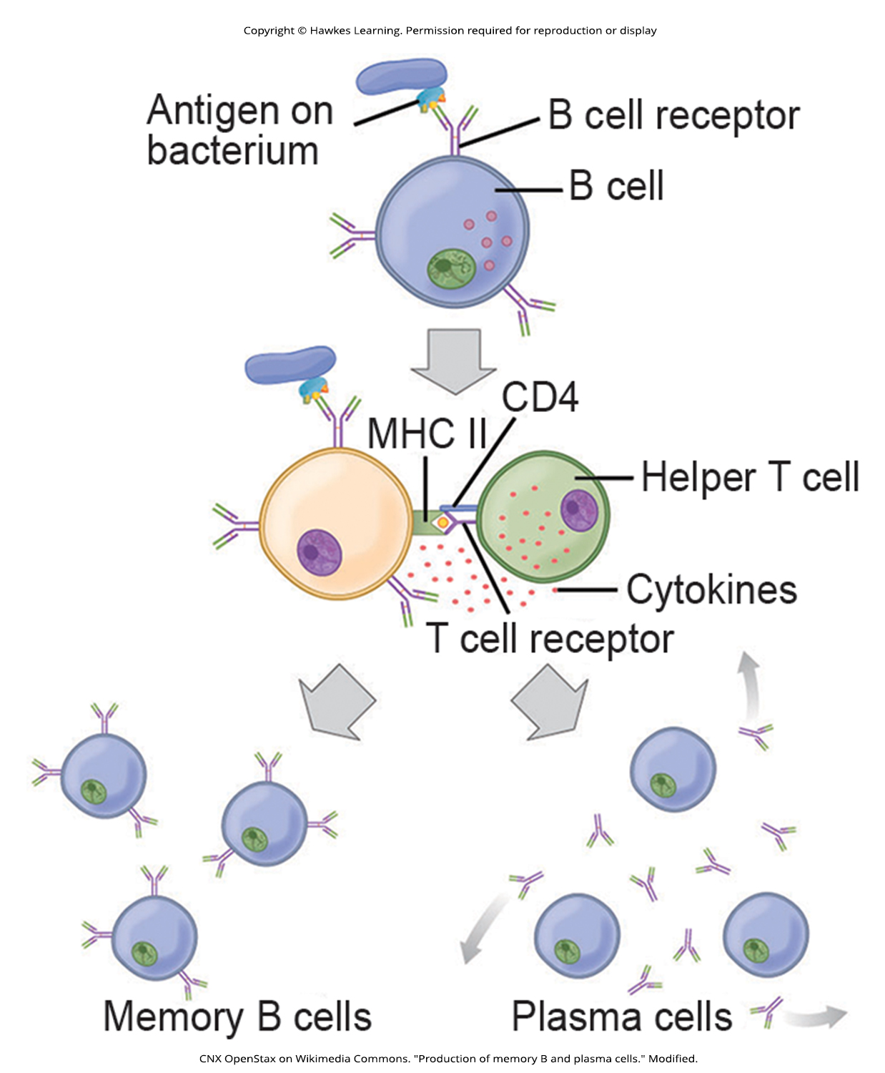
Lesson 37.2 Figure 11

Slide 22
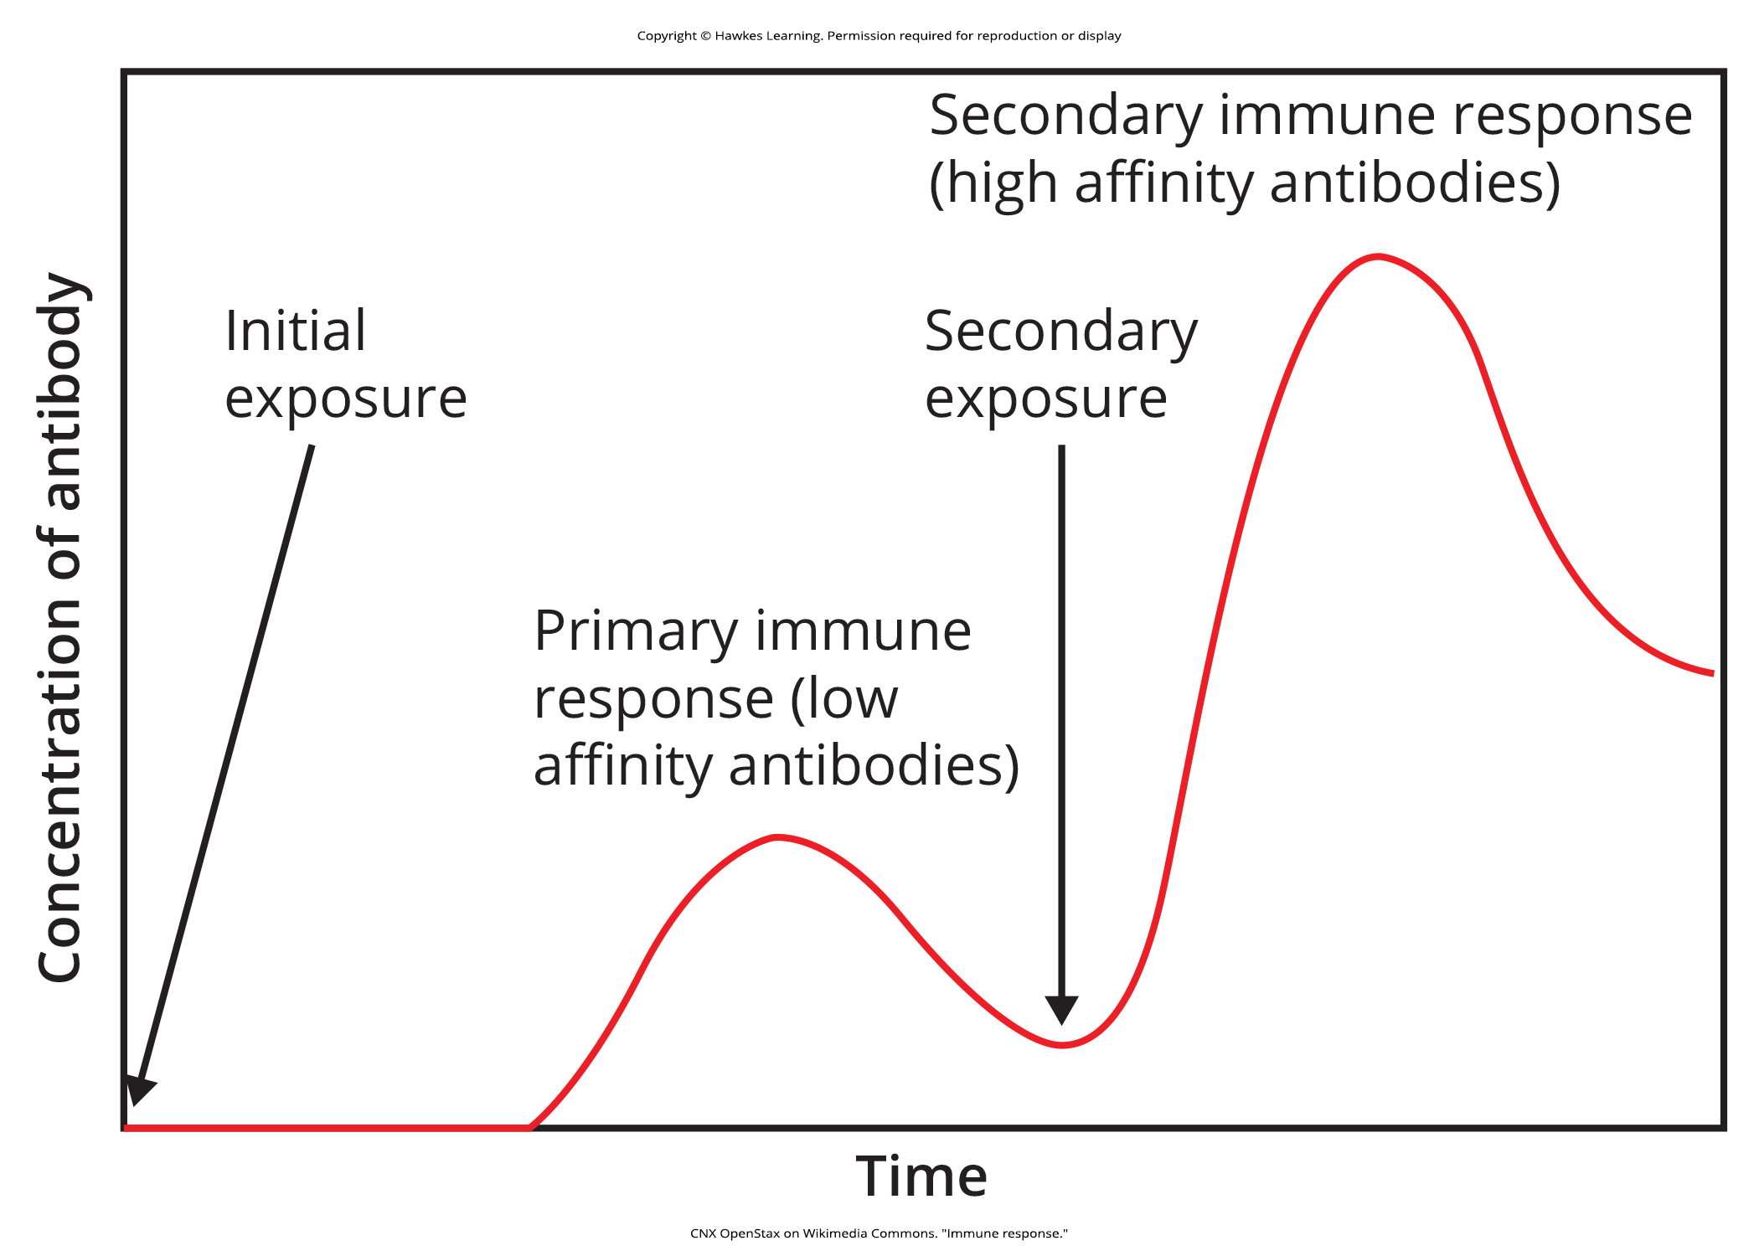
Lesson 37.2 Figure 12

Slide 23
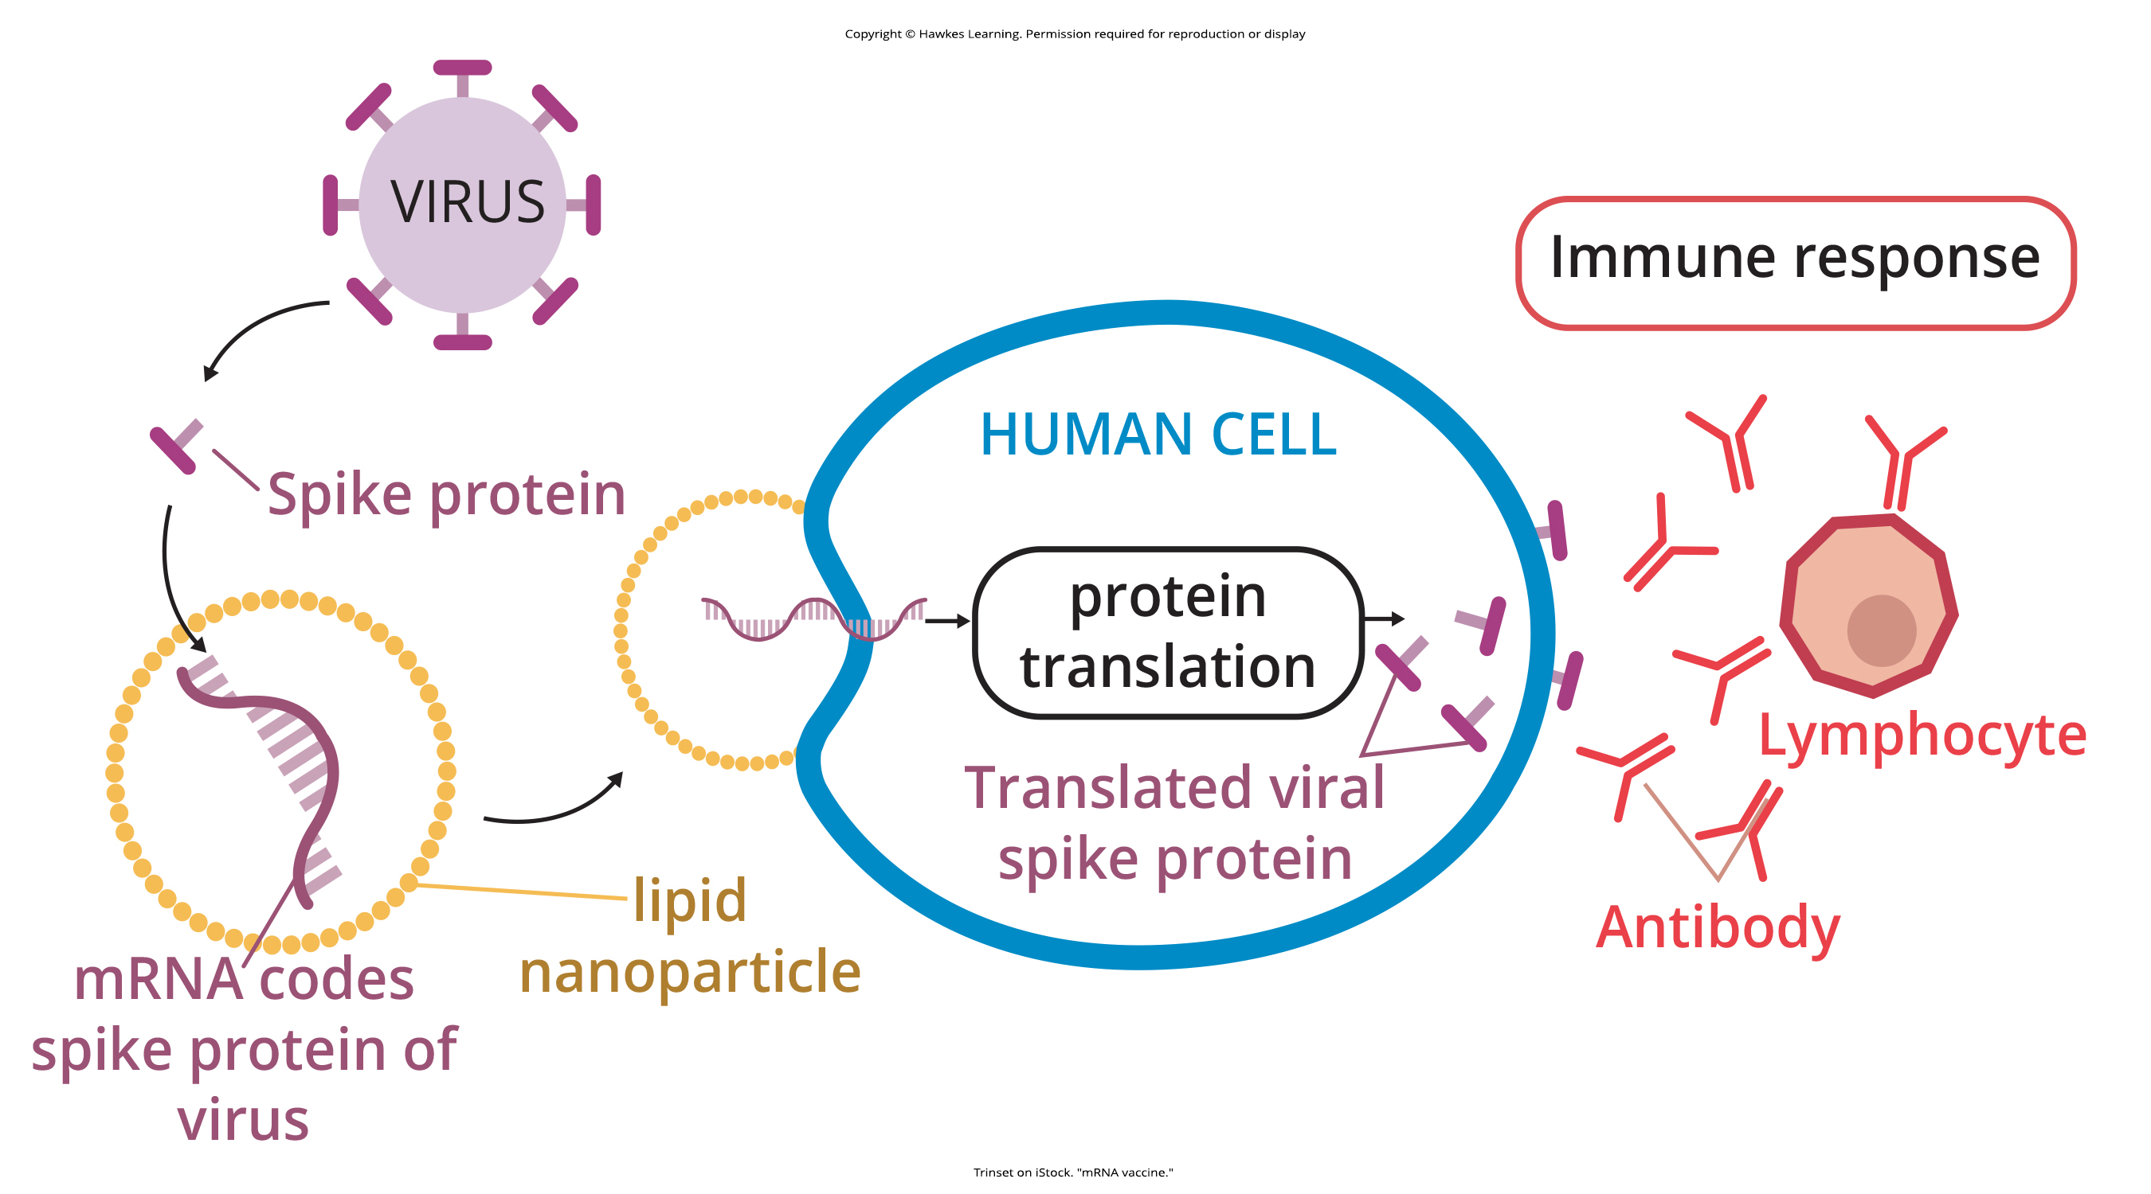
Lesson 37.2 Figure 13

Slide 24
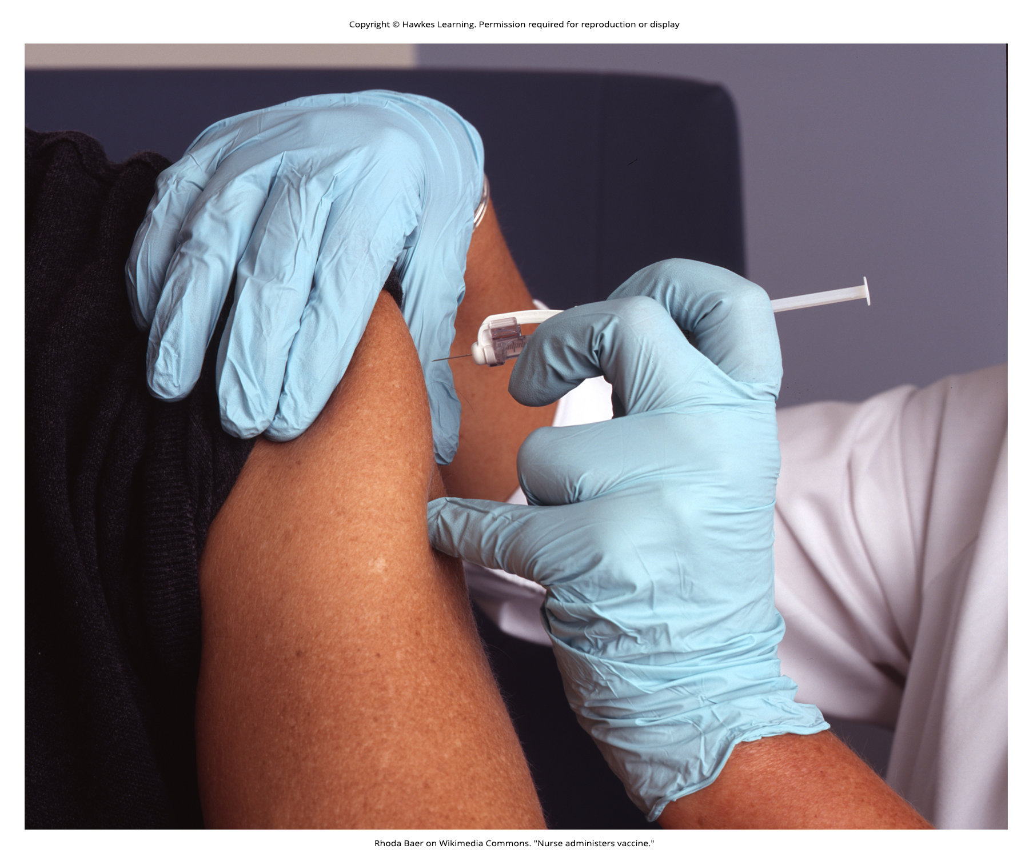
Lesson 37.2 Figure 14

Slide 25
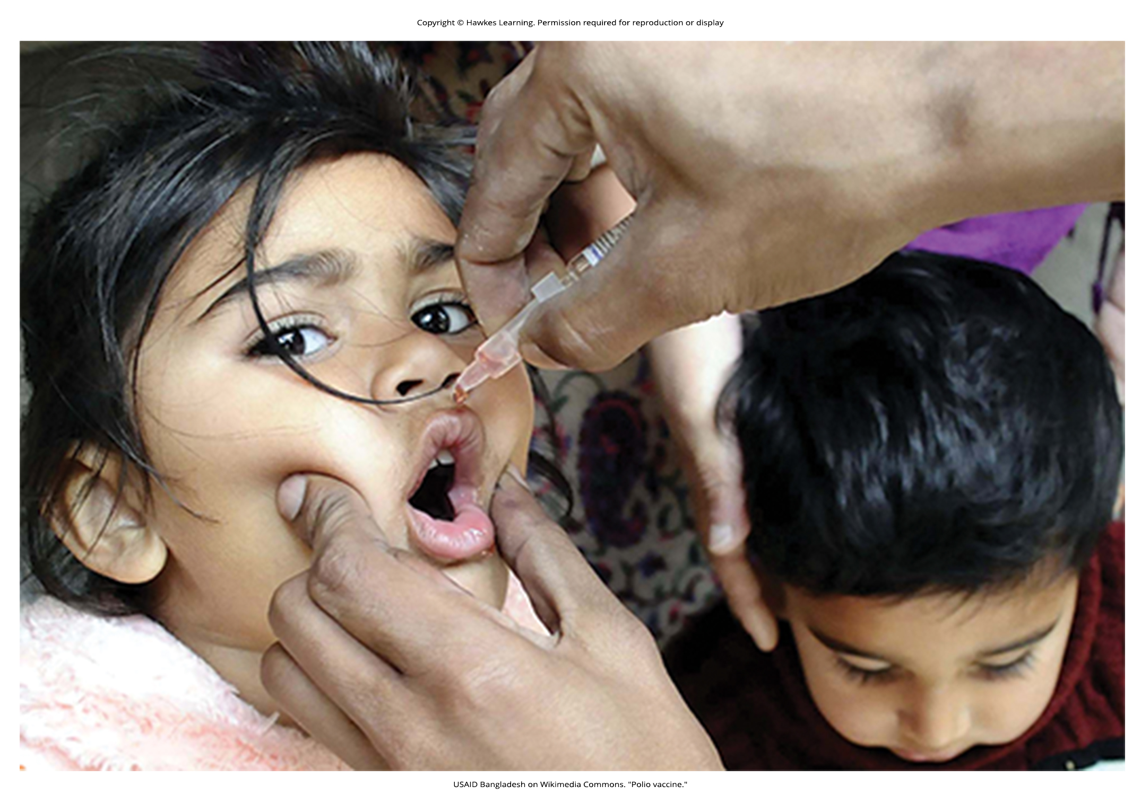
Lesson 37.2 Figure 15

Slide 26
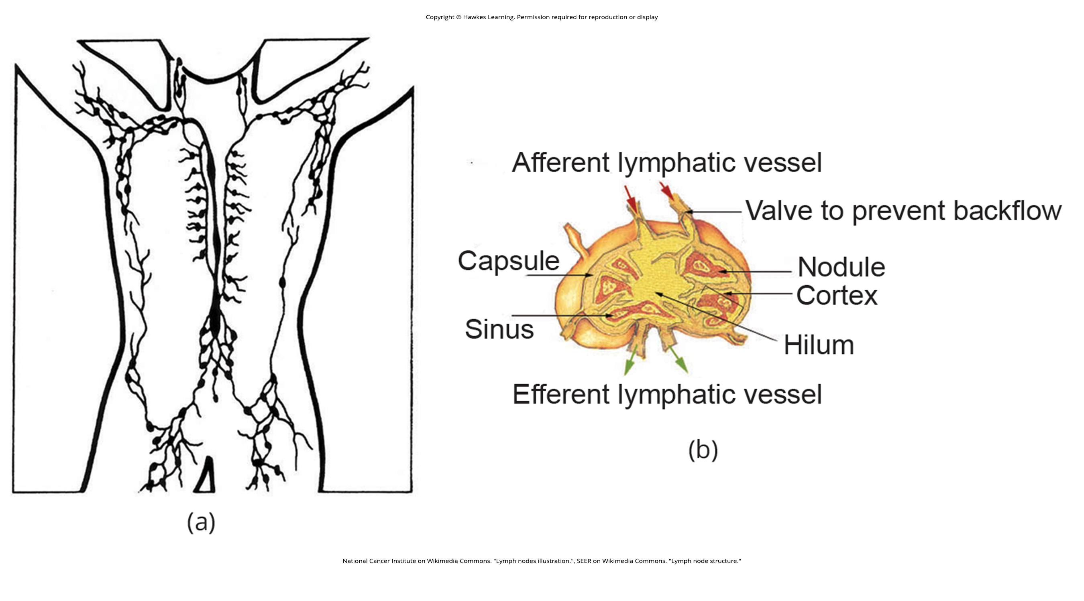
Lesson 37.2 Figure 16

Slide 27
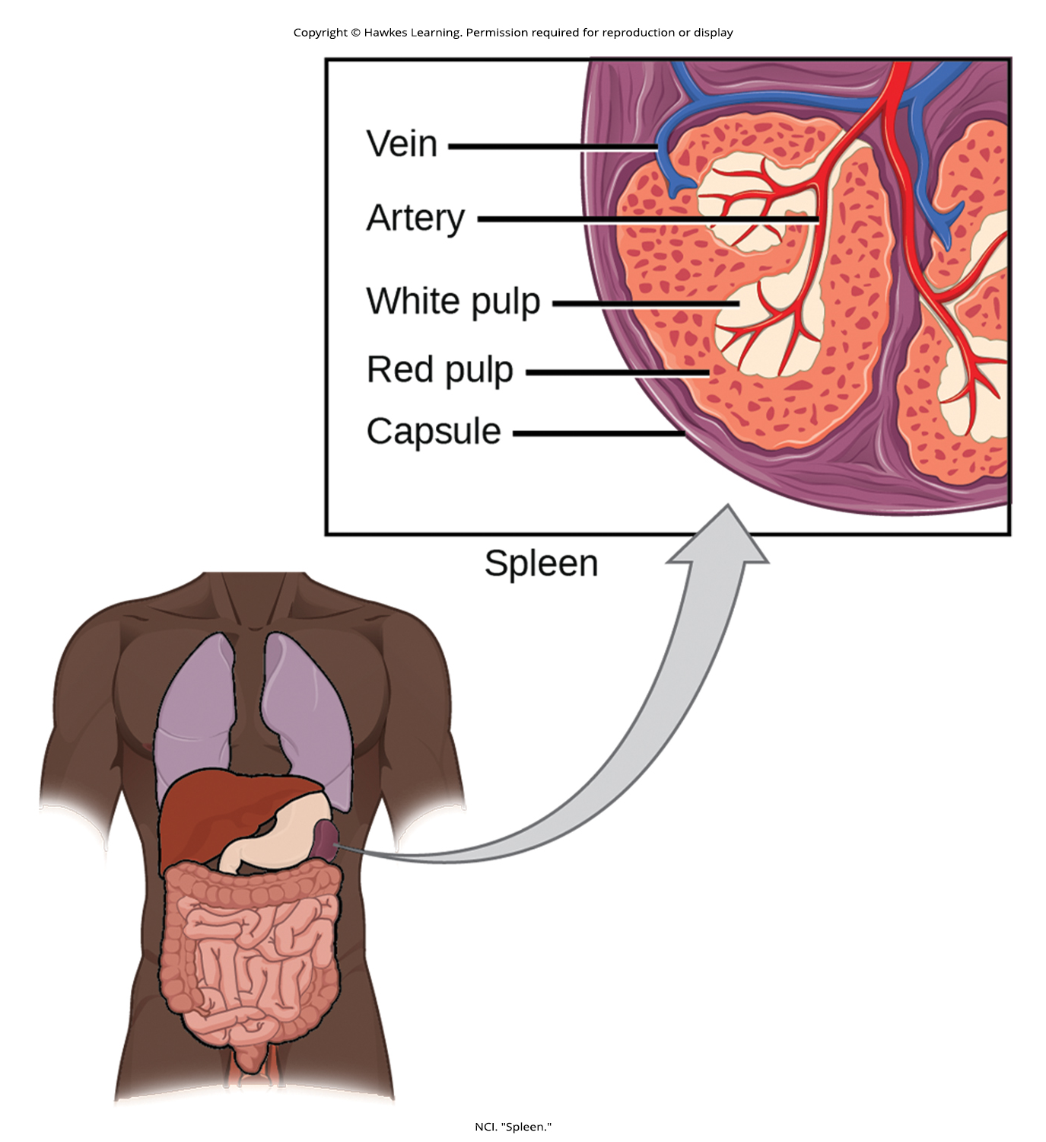
Lesson 37.2 Figure 17

Slide 28
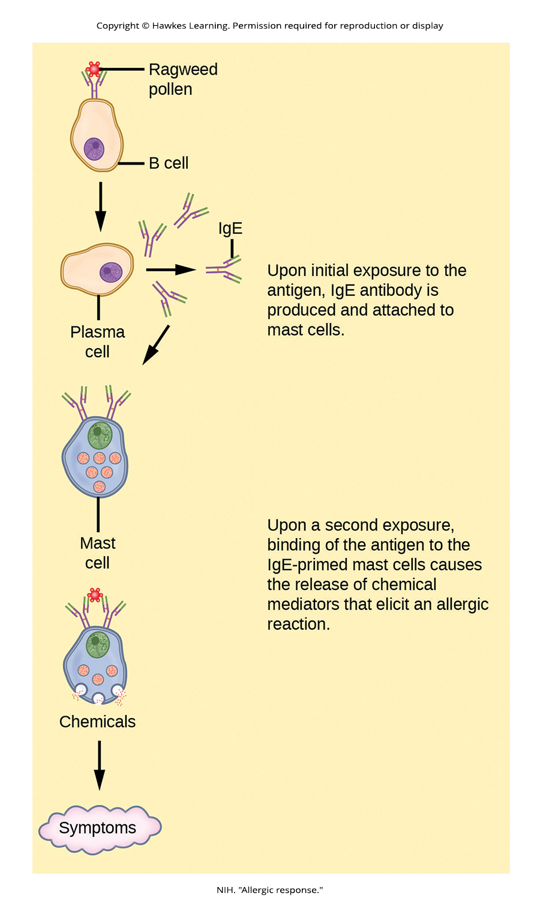
Lesson 37.2 Figure 18

Slide 29
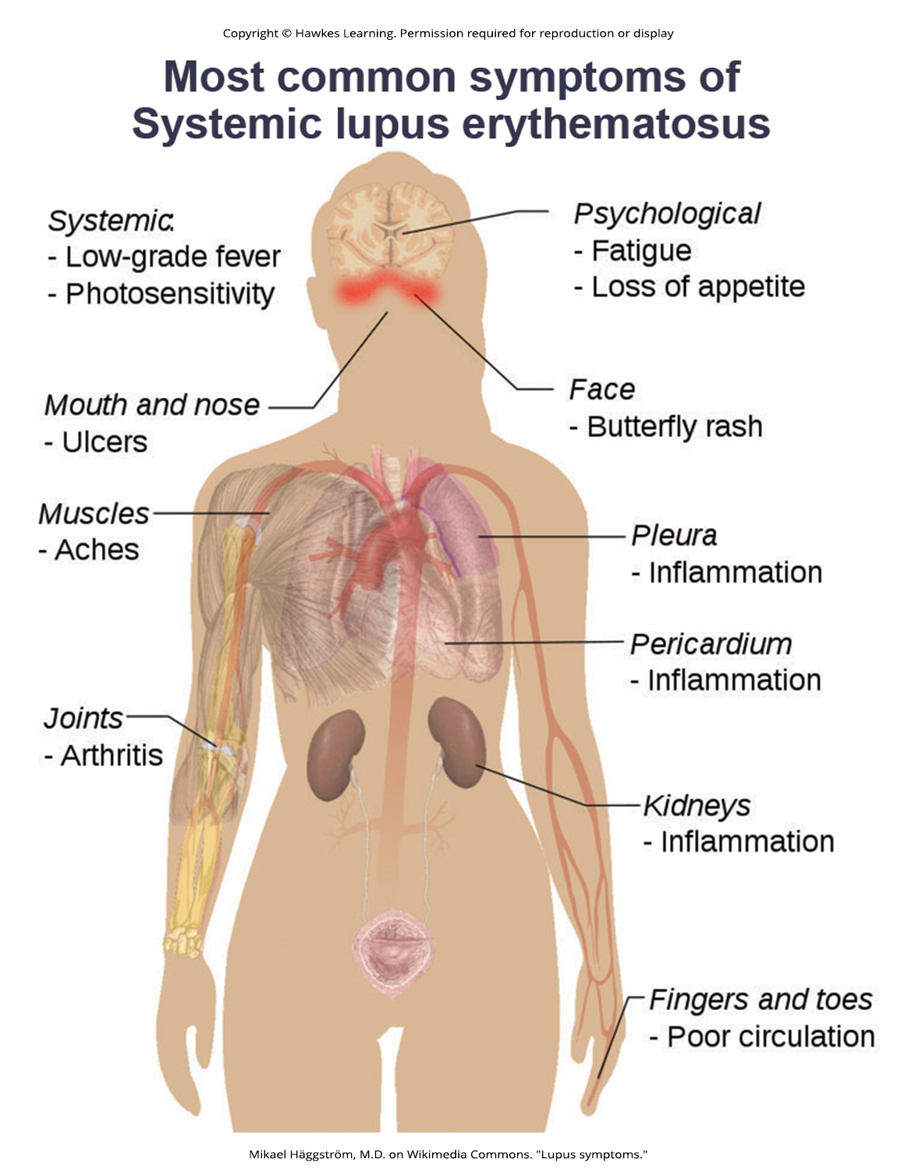
Lesson 37.2 Figure 19

Slide 30
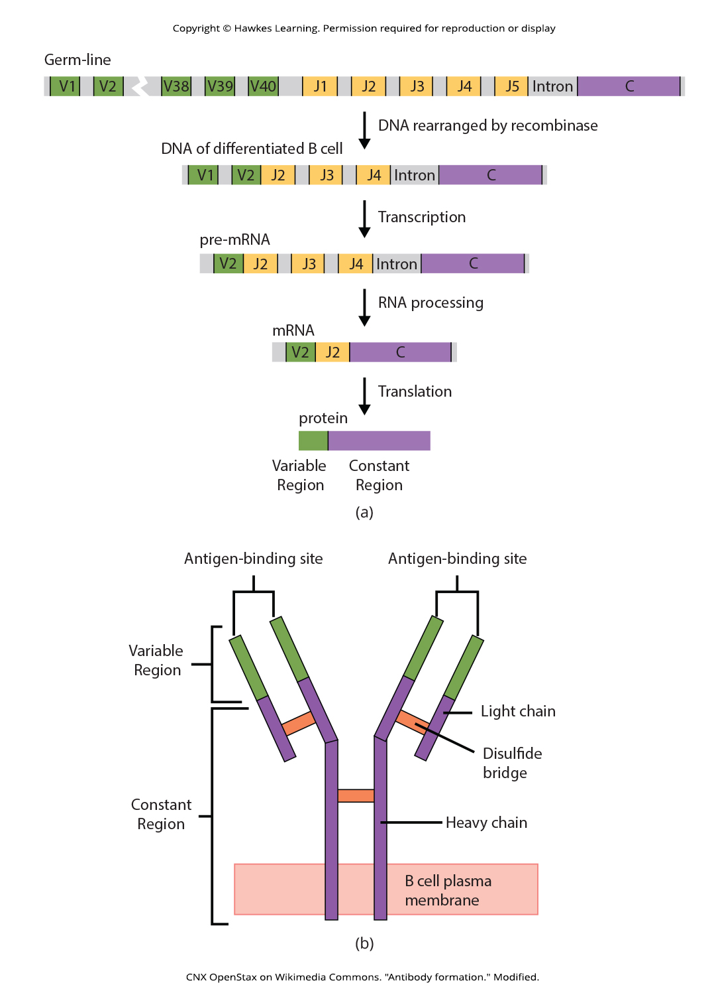
Lesson 37.3 Figure 1

Slide 31
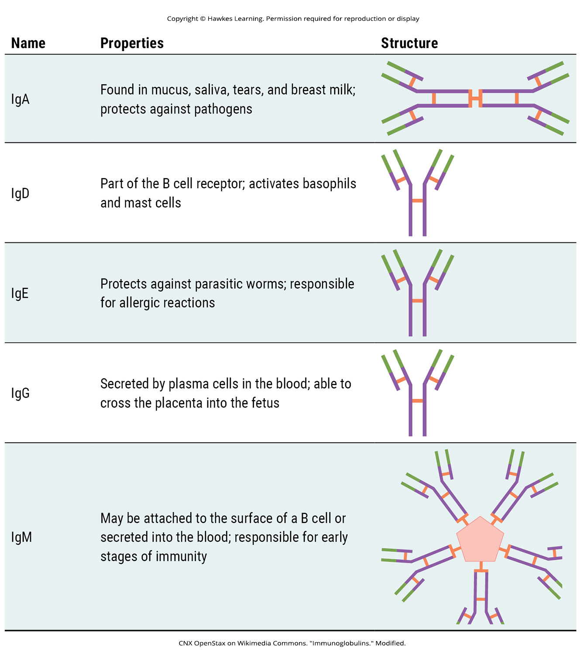
Lesson 37.3 Figure 2

Slide 32
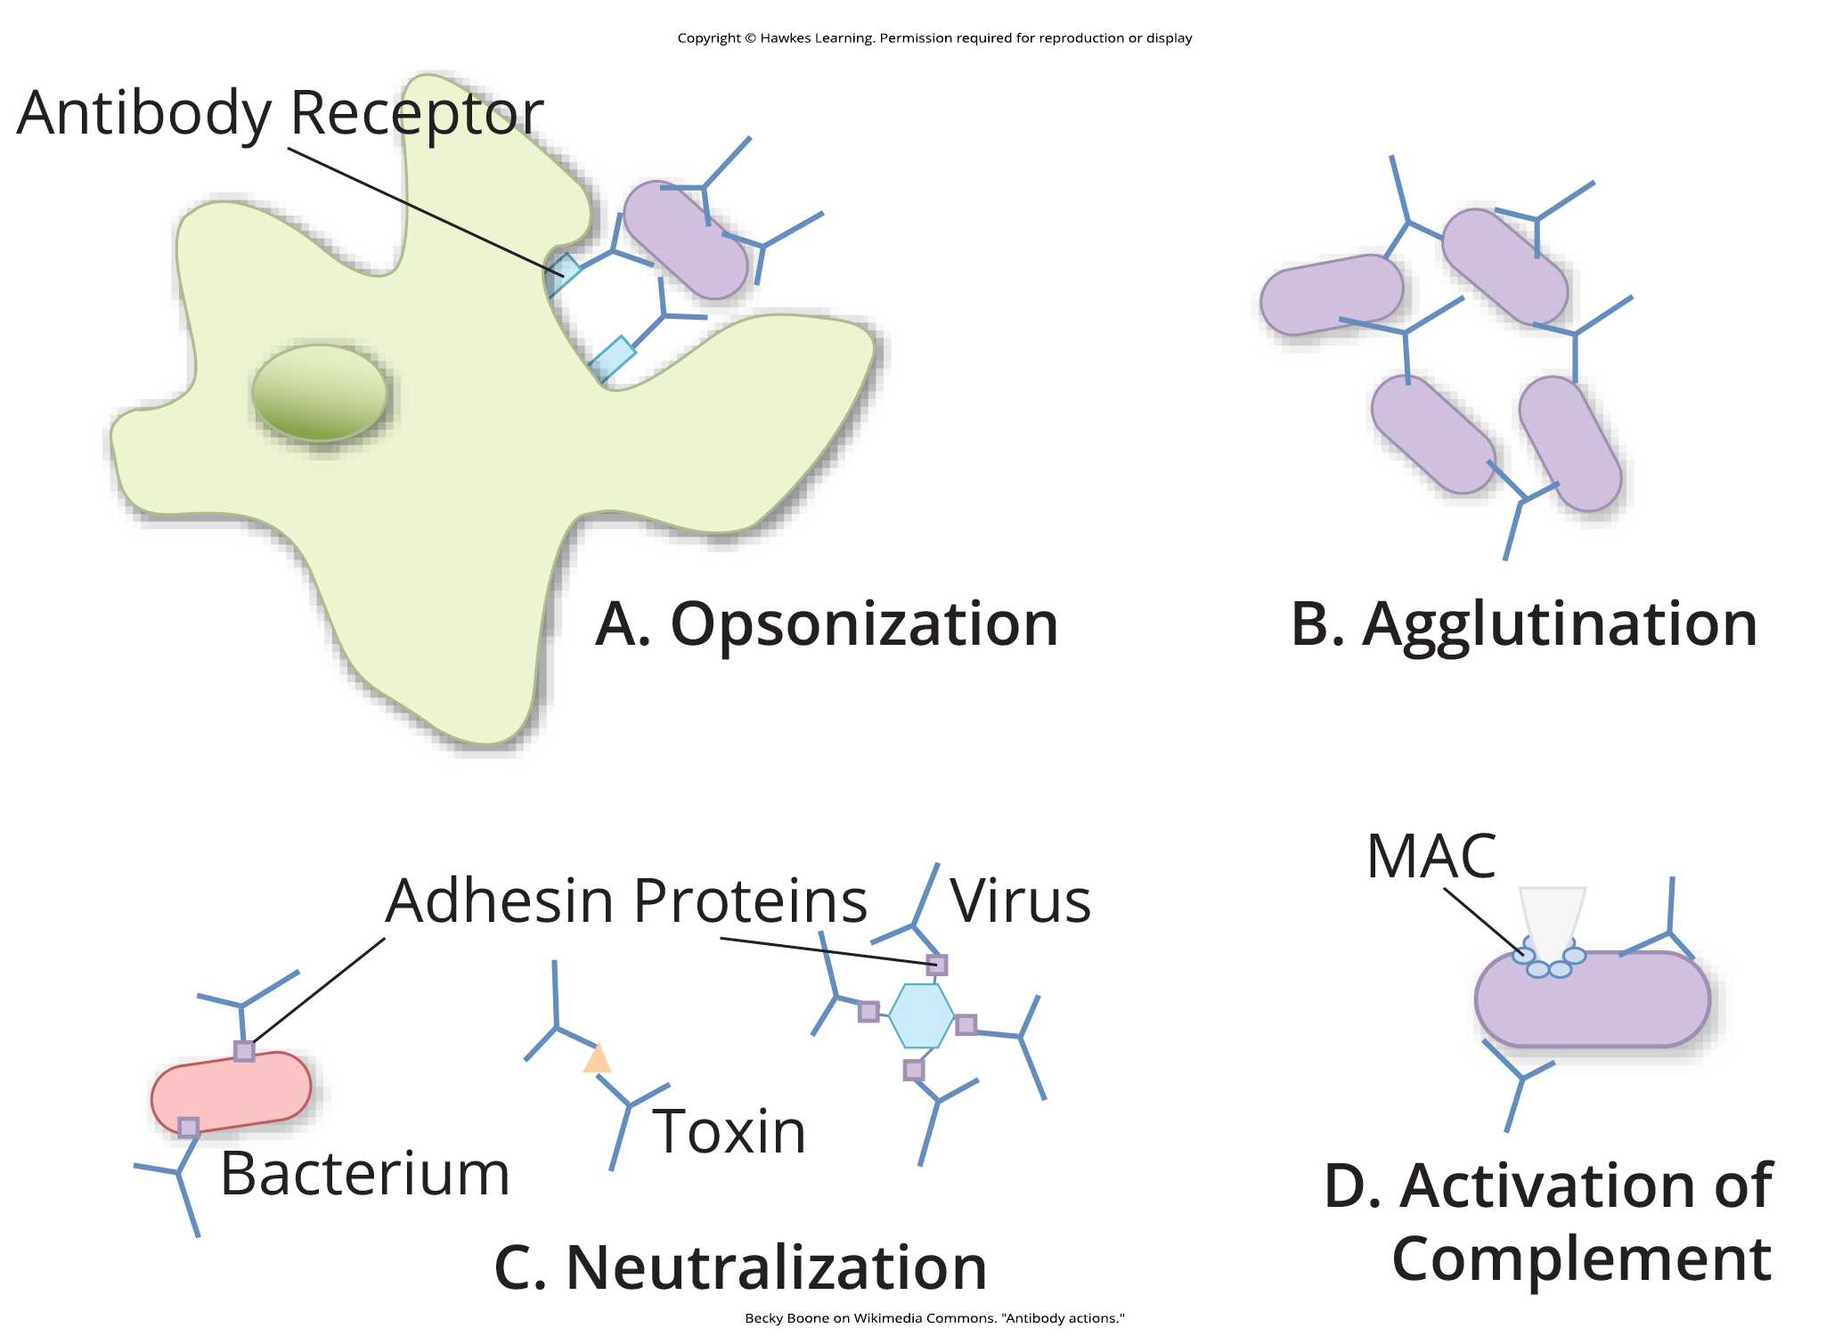
Lesson 37.3 Figure 3

Slide 33
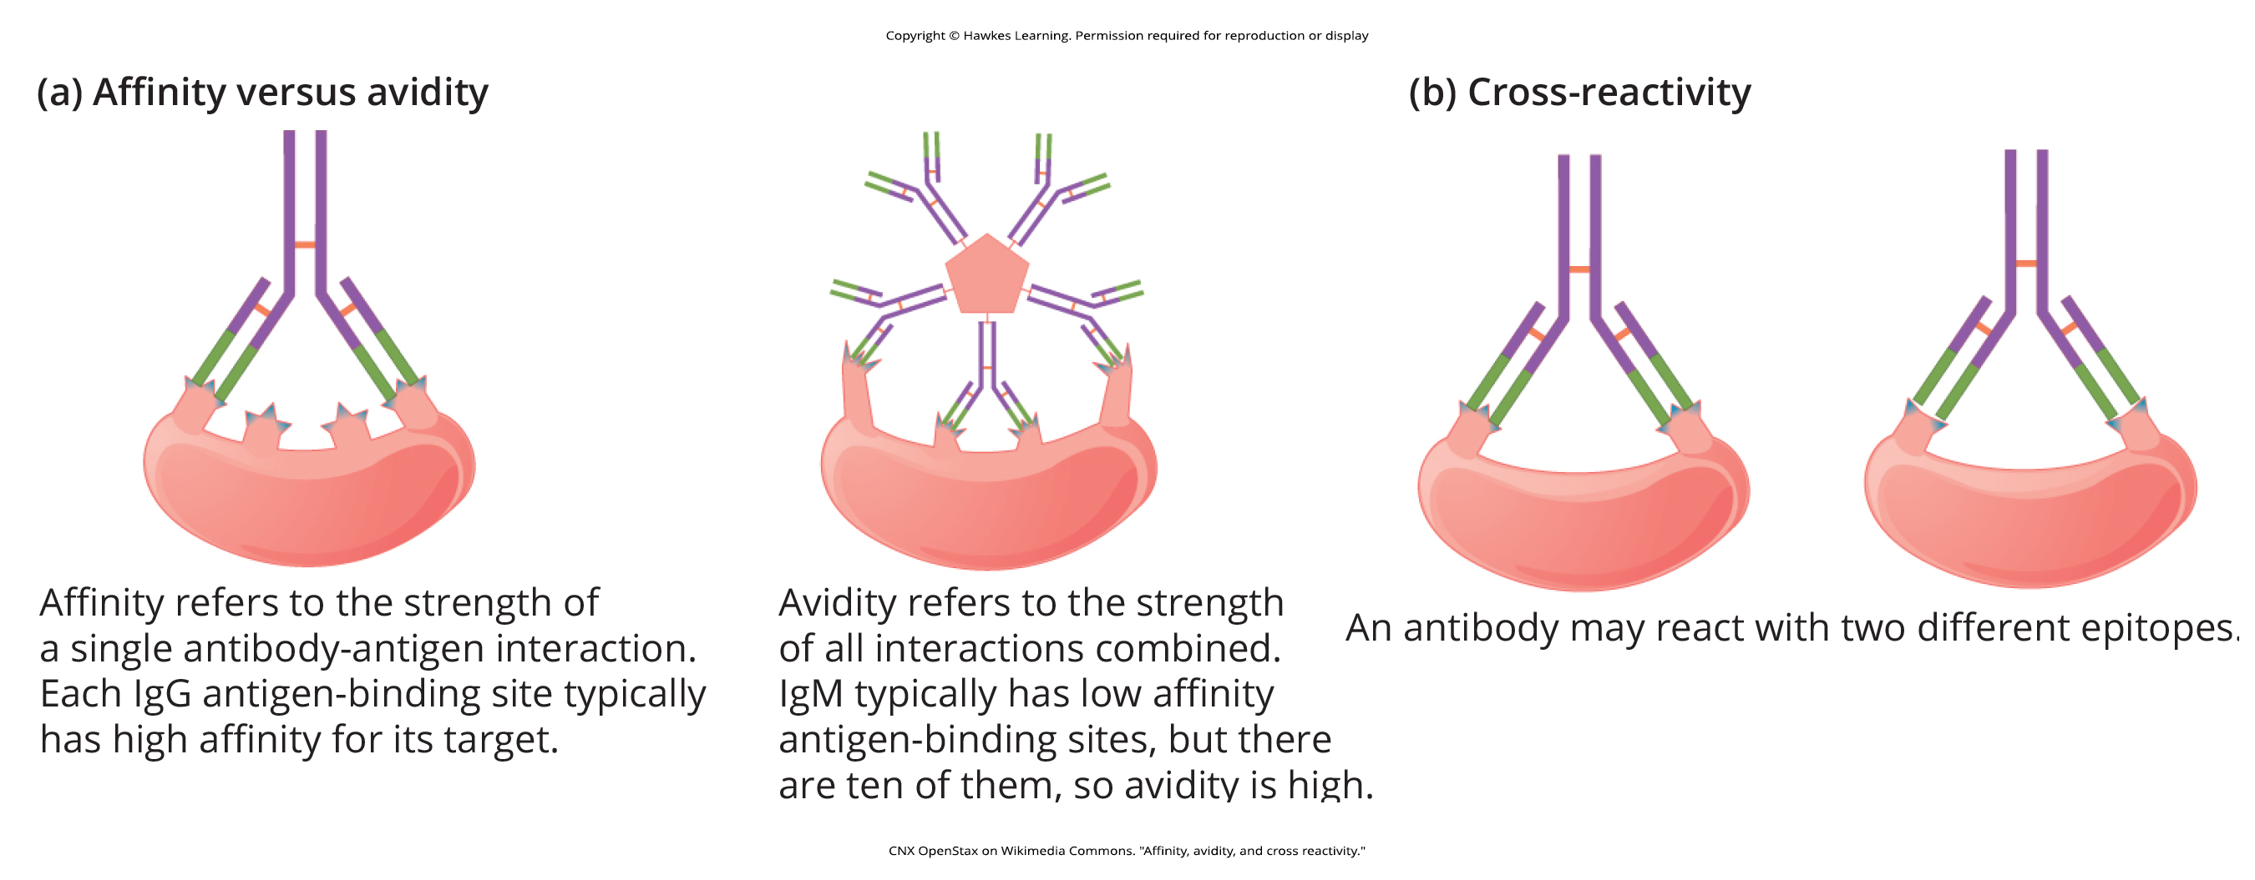
Lesson 37.3 Figure 4

Slide 34
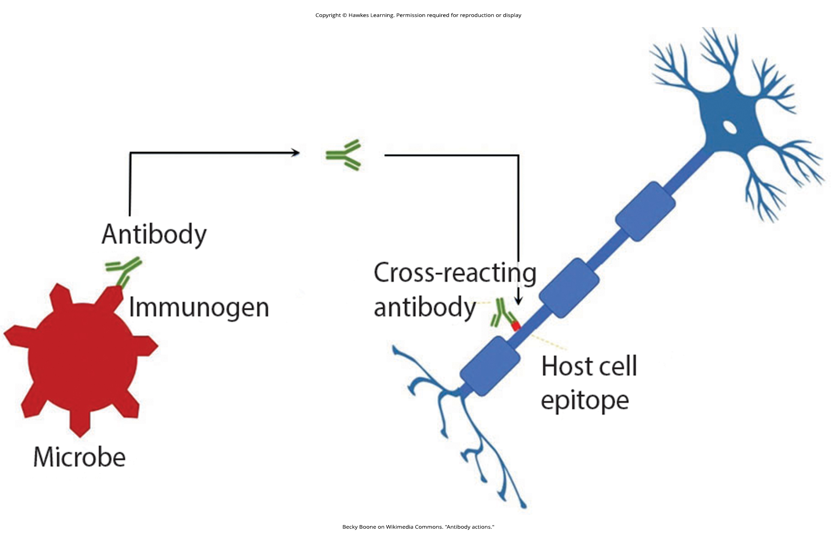
Lesson 37.3 Figure 5

Slide 35
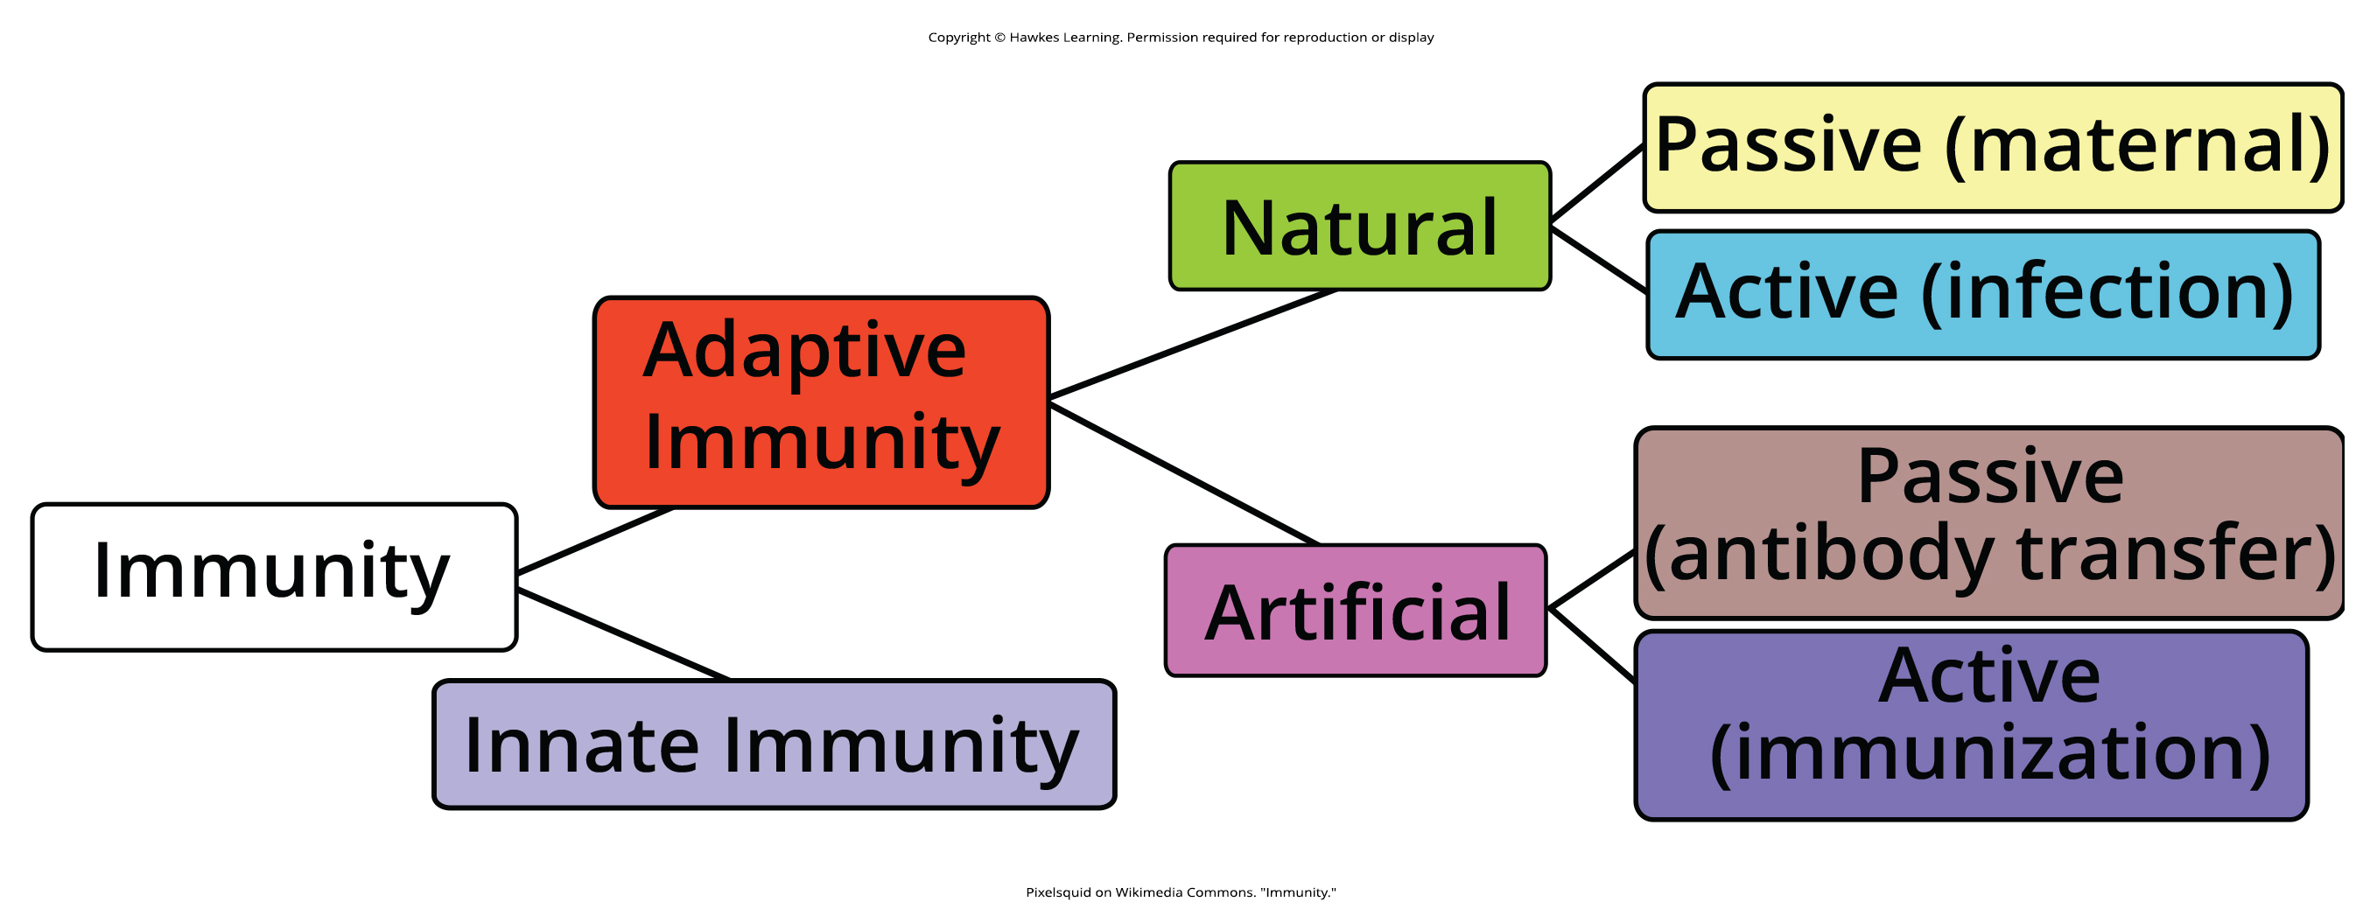
Lesson 37.3 Figure 6

Slide 36
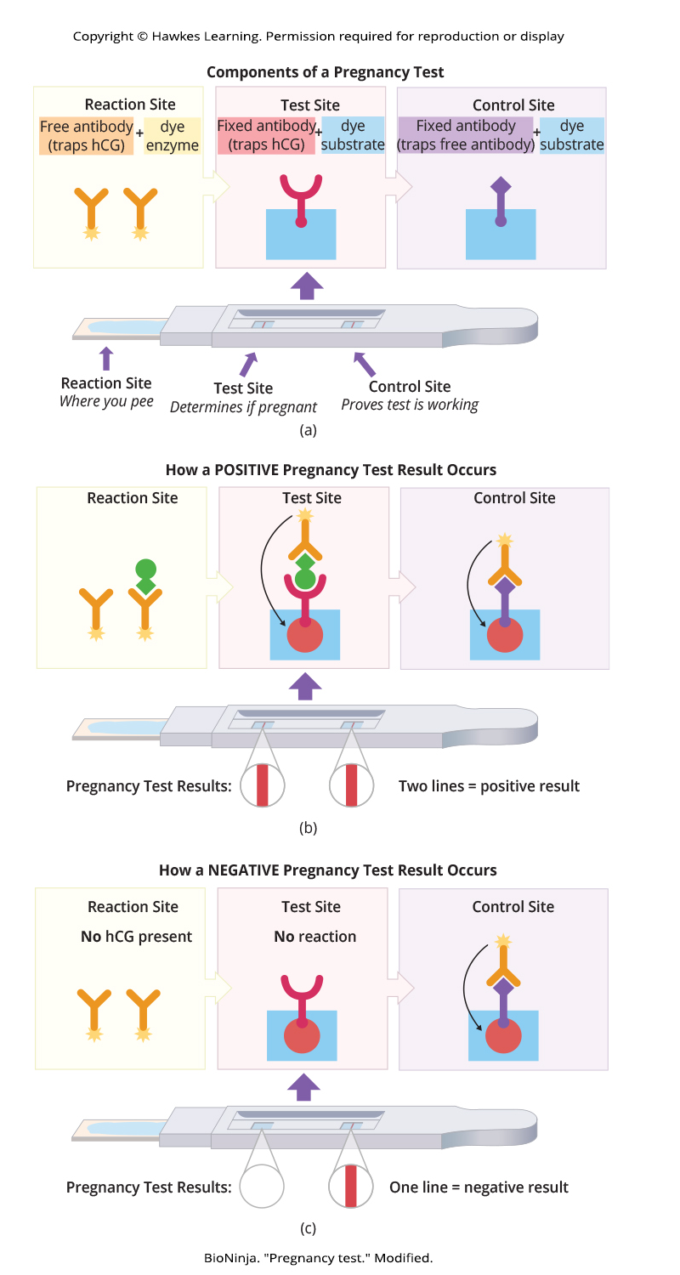
Lesson 37.3 Figure 7

Slide 37
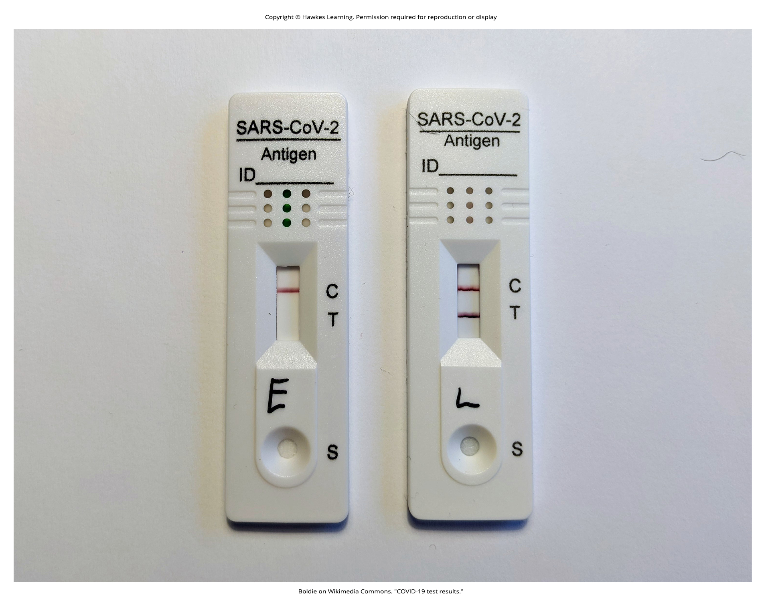
Lesson 37.3 Figure 8

Slide 38
Hawkes Learning – End of PowerPoint

