Slide 1
Chapter 38
The Urinary System

Slide 2
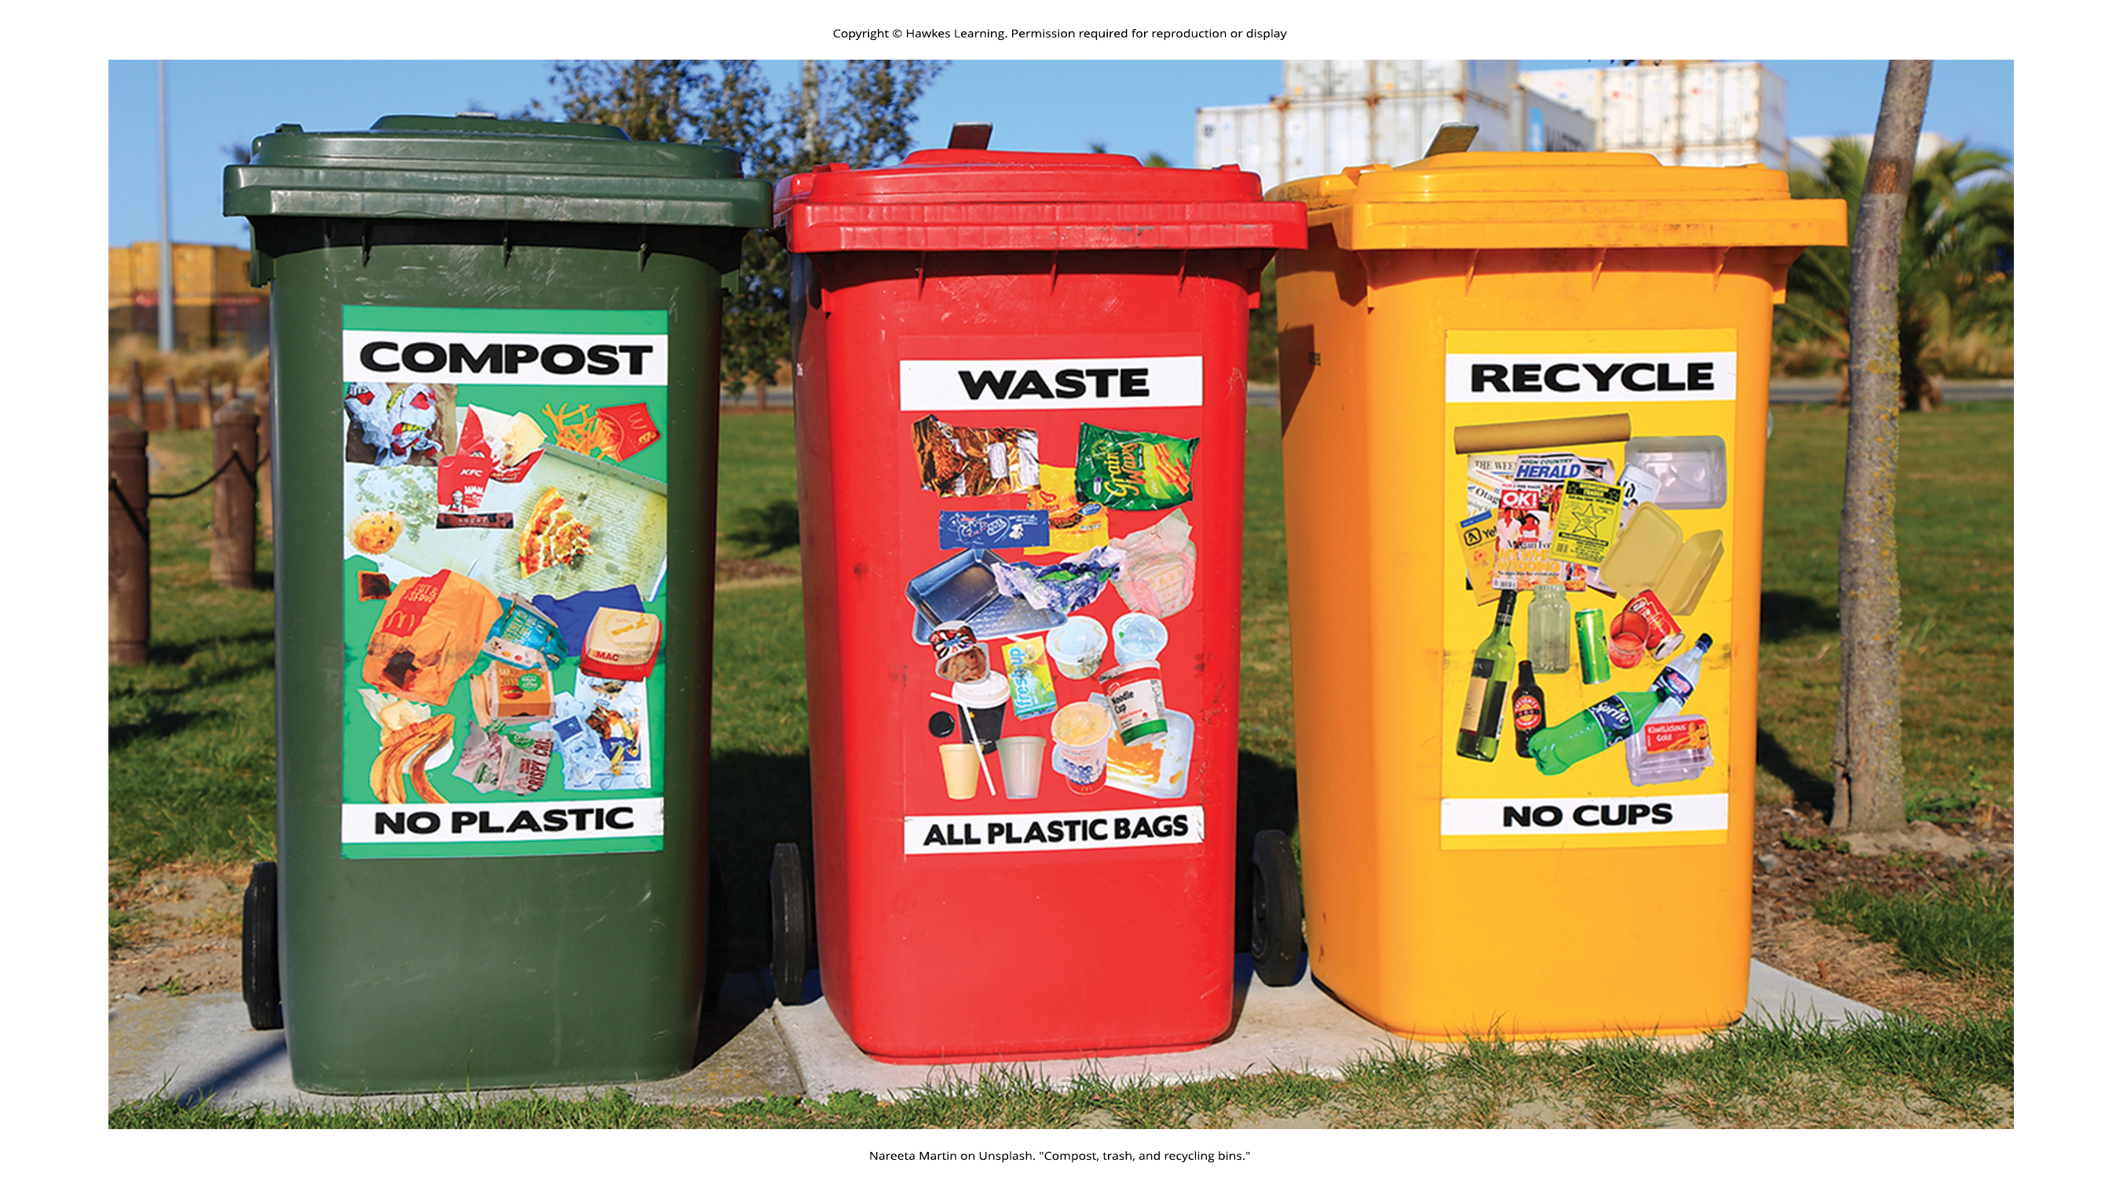
Lesson 38.1 Figure 1

Slide 3
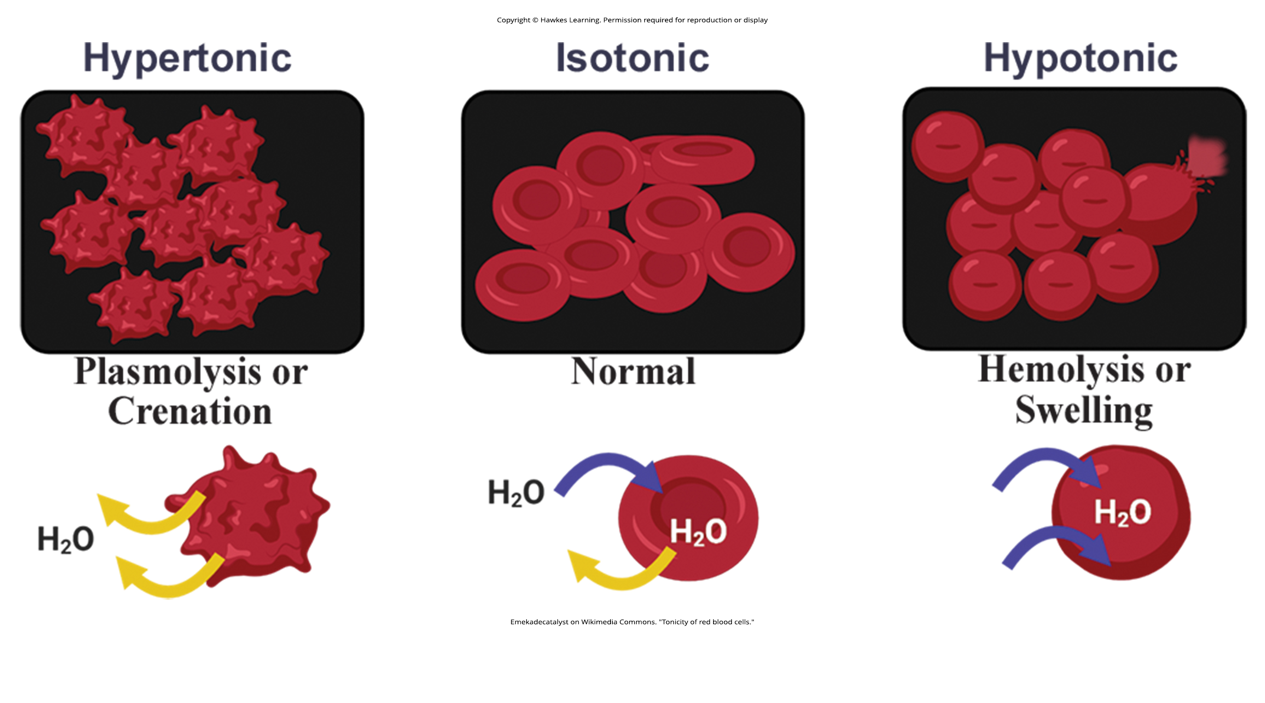
Lesson 38.1 Figure 2

Slide 4
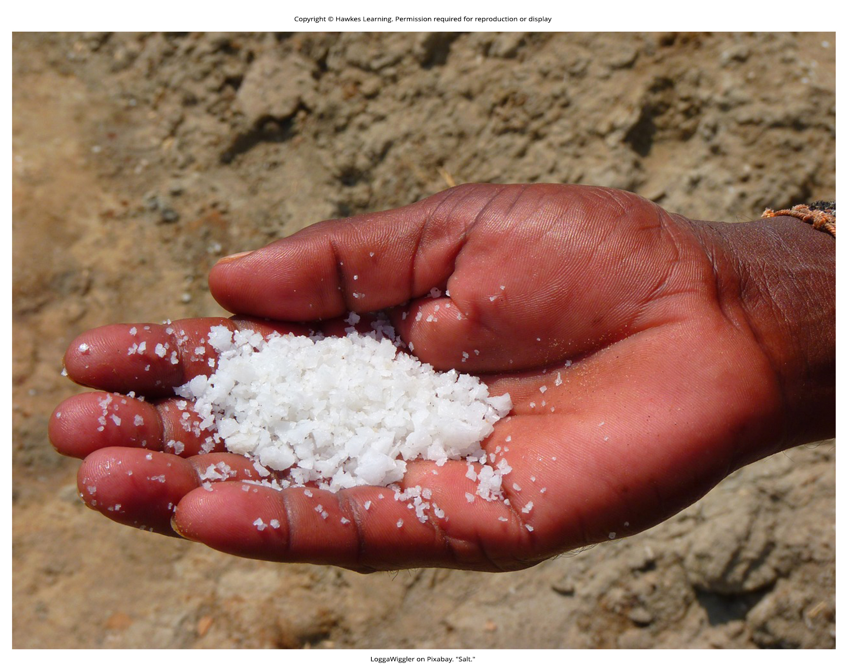
Lesson 38.1 Figure 3

Slide 5

Lesson 38.1 Figure 4

Slide 6
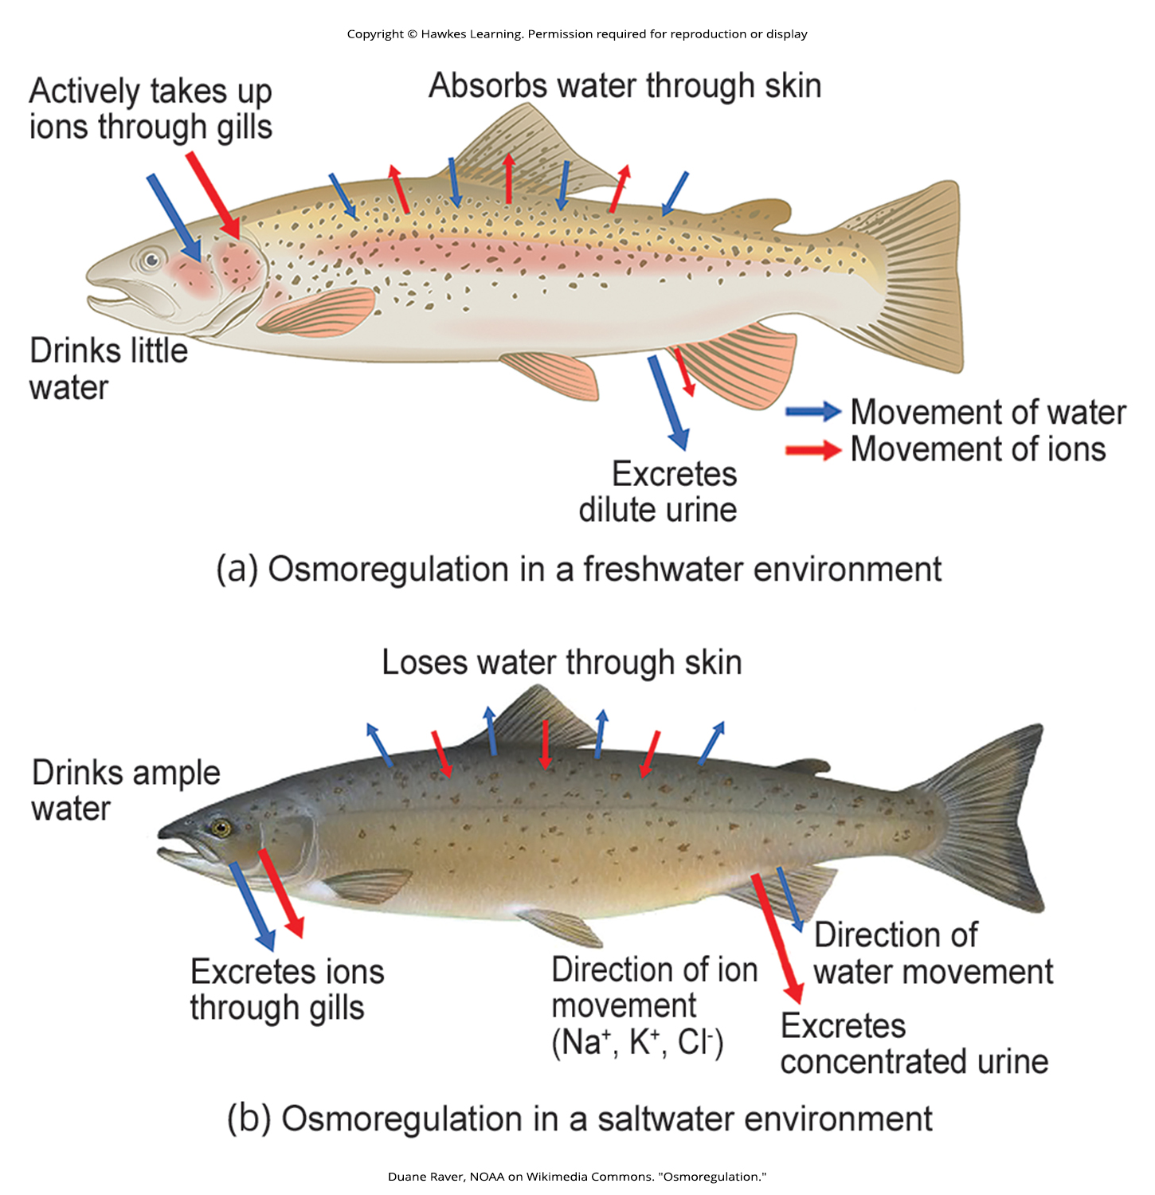
Lesson 38.1 Figure 5

Slide 7
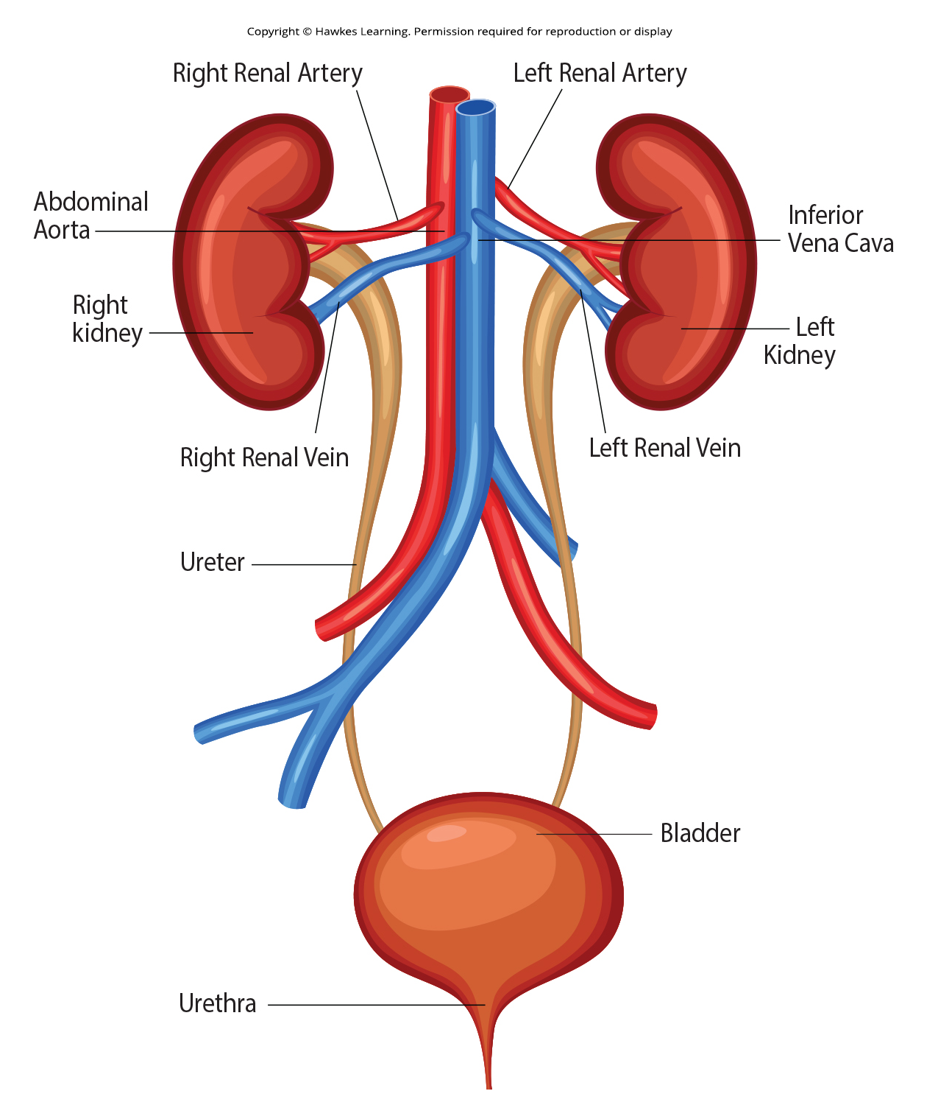
Lesson 38.2 Figure 1

Slide 8
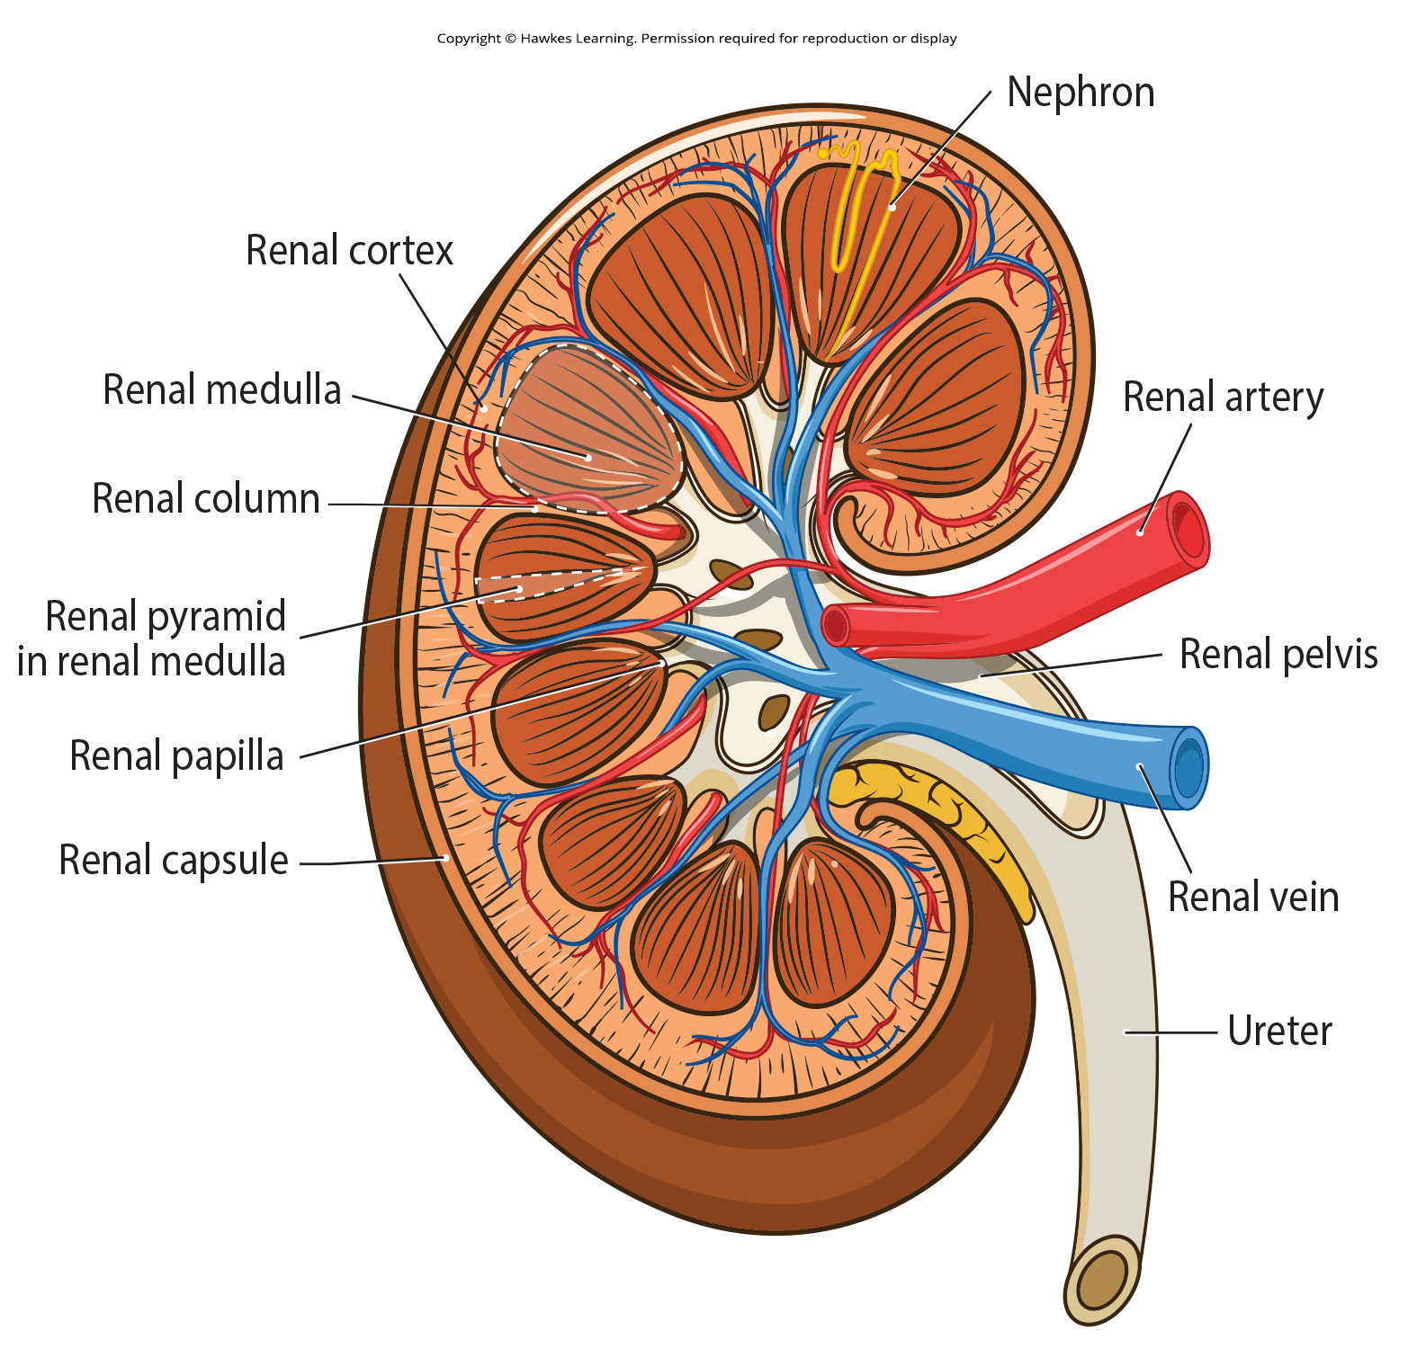
Lesson 38.2 Figure 2

Slide 9
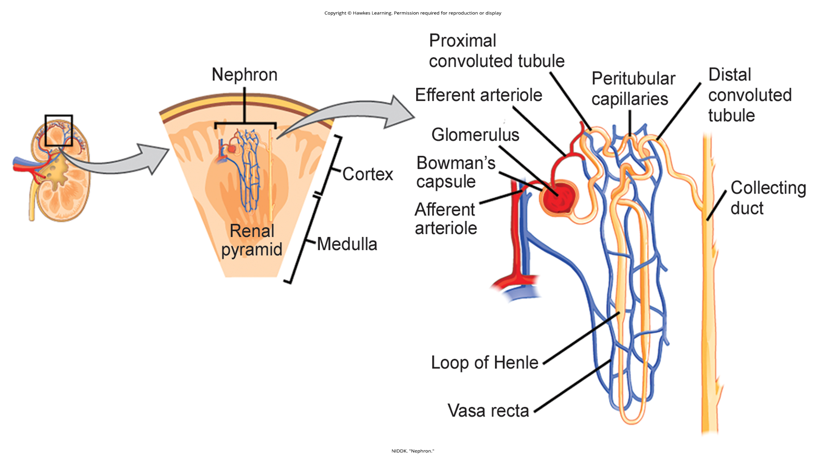
Lesson 38.2 Figure 3

Slide 10
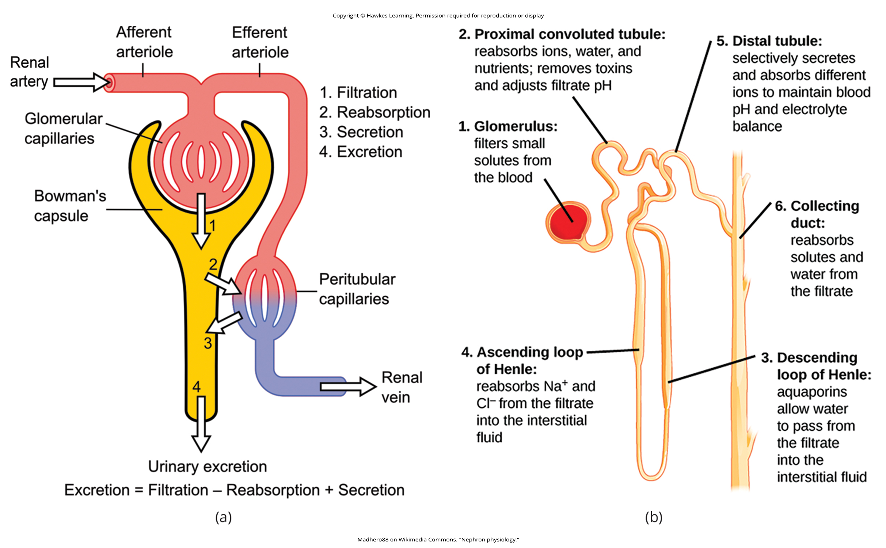
Lesson 38.2 Figure 4

Slide 11
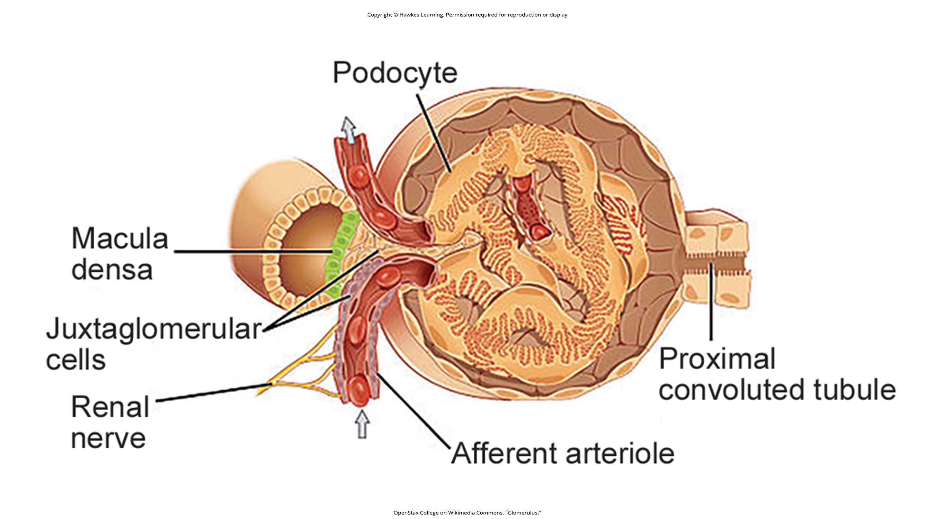
Lesson 38.2 Figure 5

Slide 12
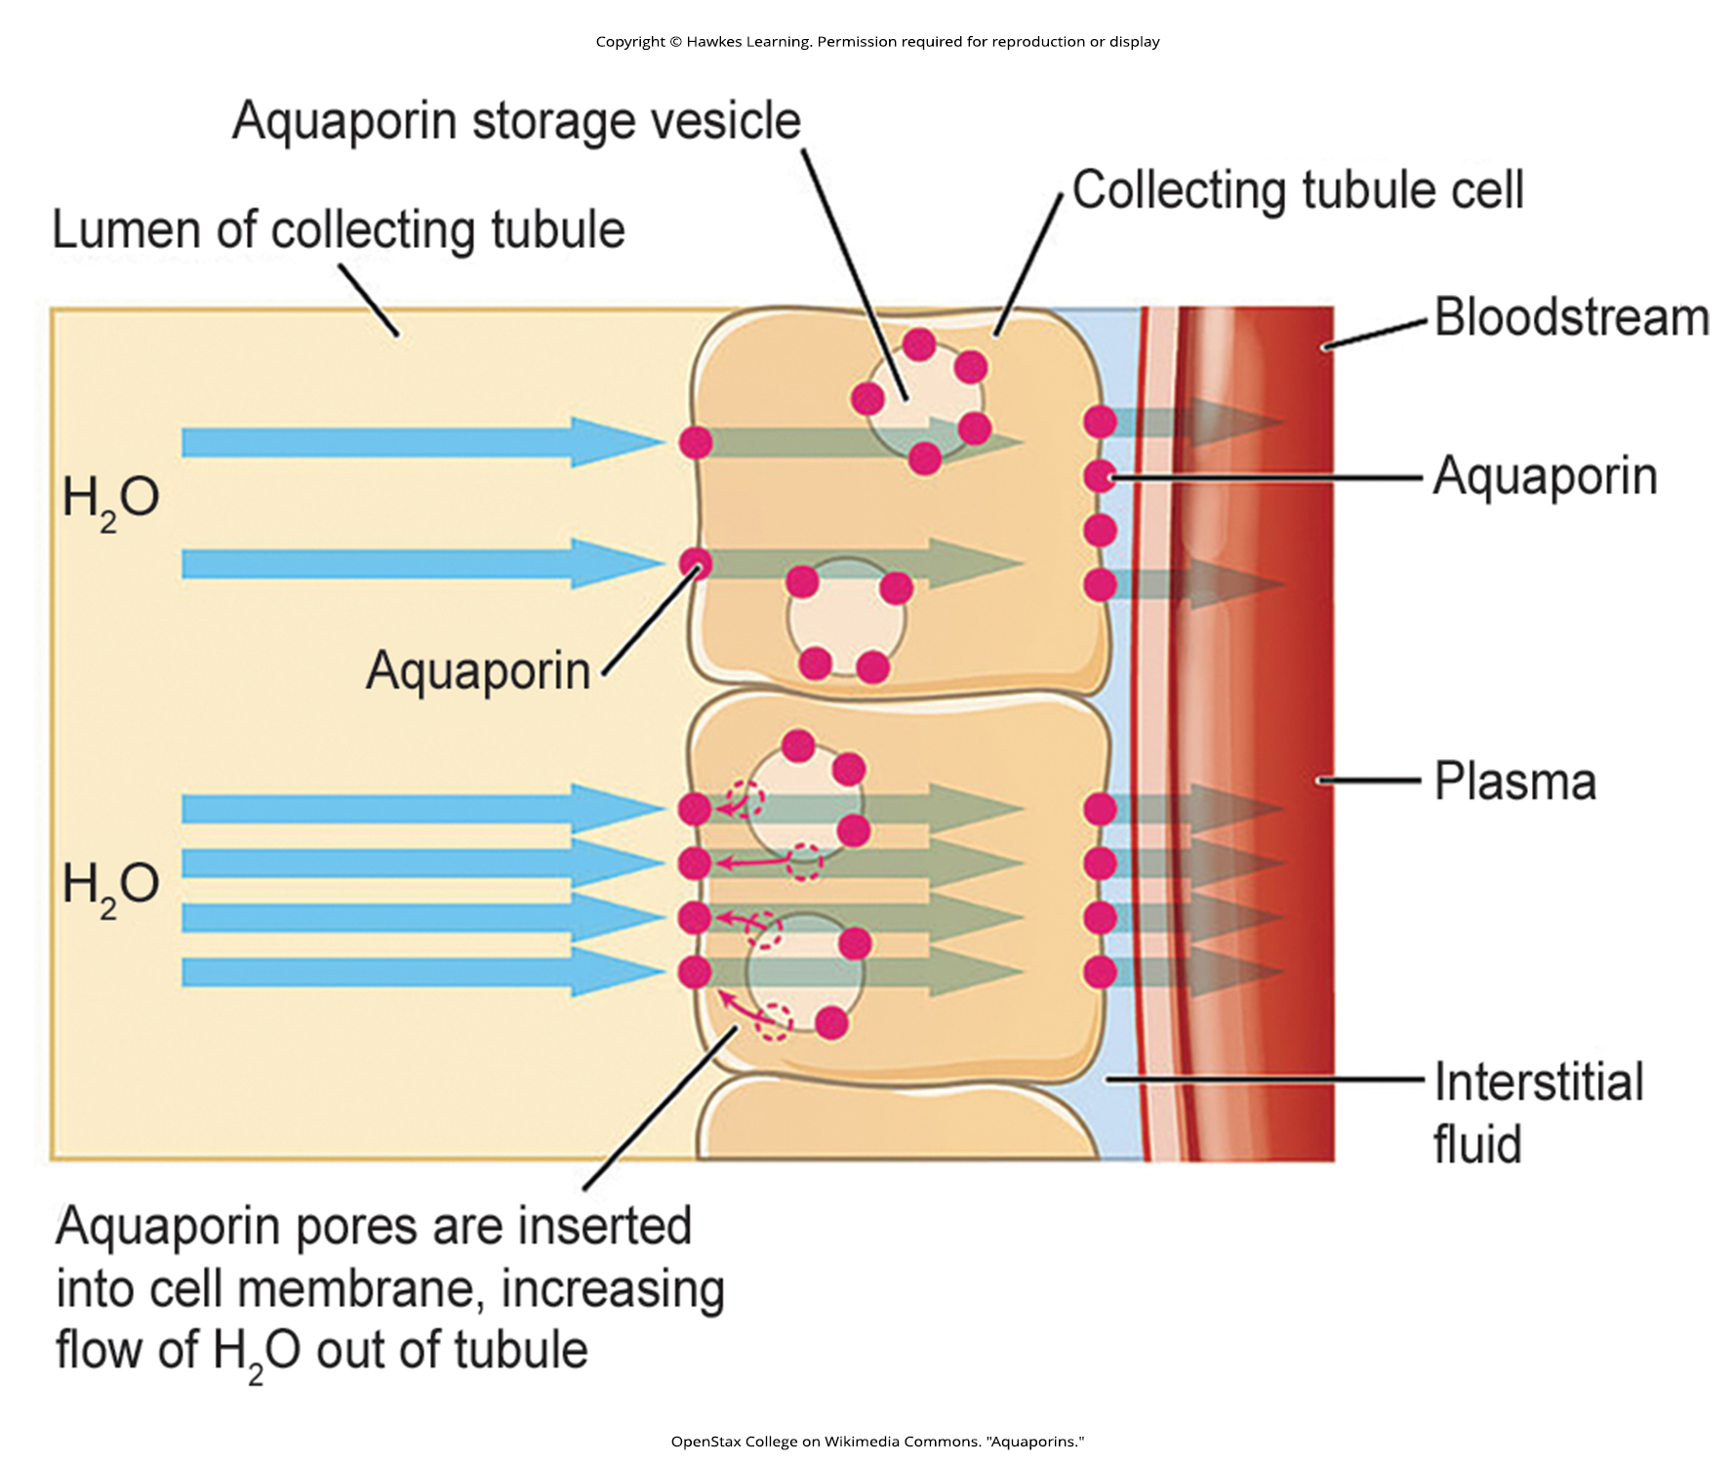
Lesson 38.2 Figure 6

Slide 13
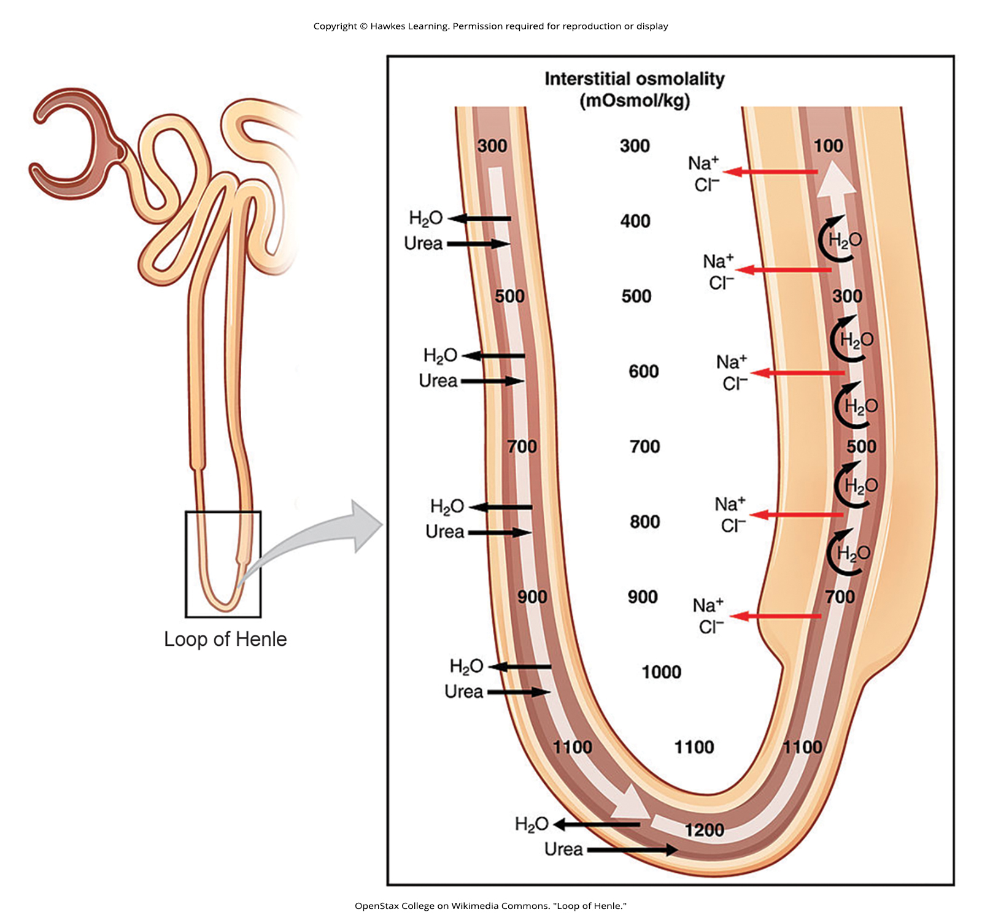
Lesson 38.2 Figure 7

Slide 14
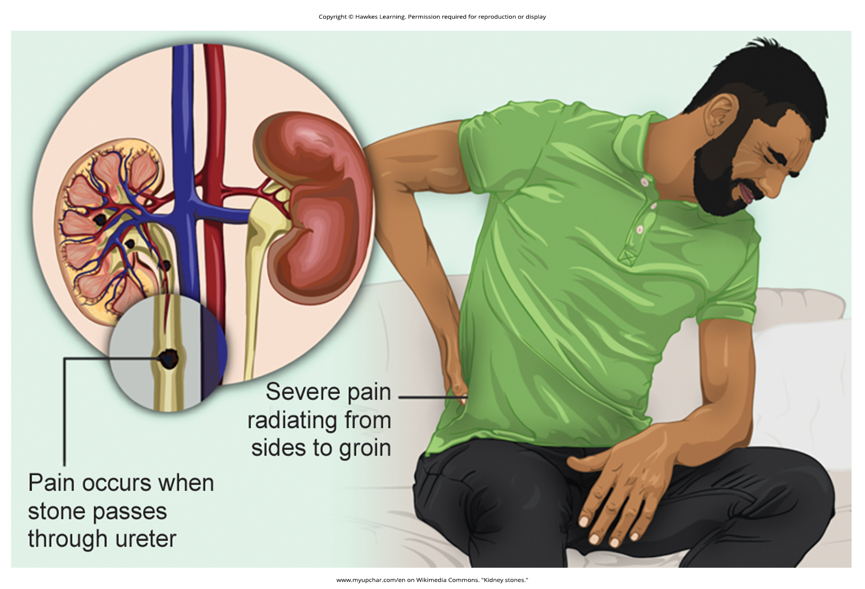
Lesson 38.2 Figure 8

Slide 15
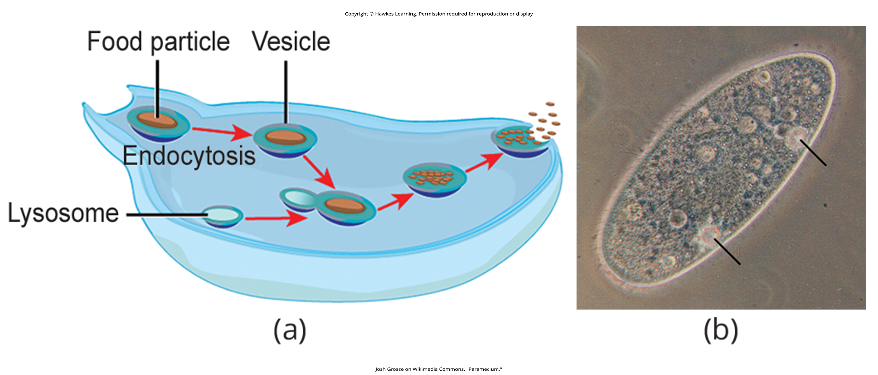
Lesson 38.3 Figure 1

Slide 16
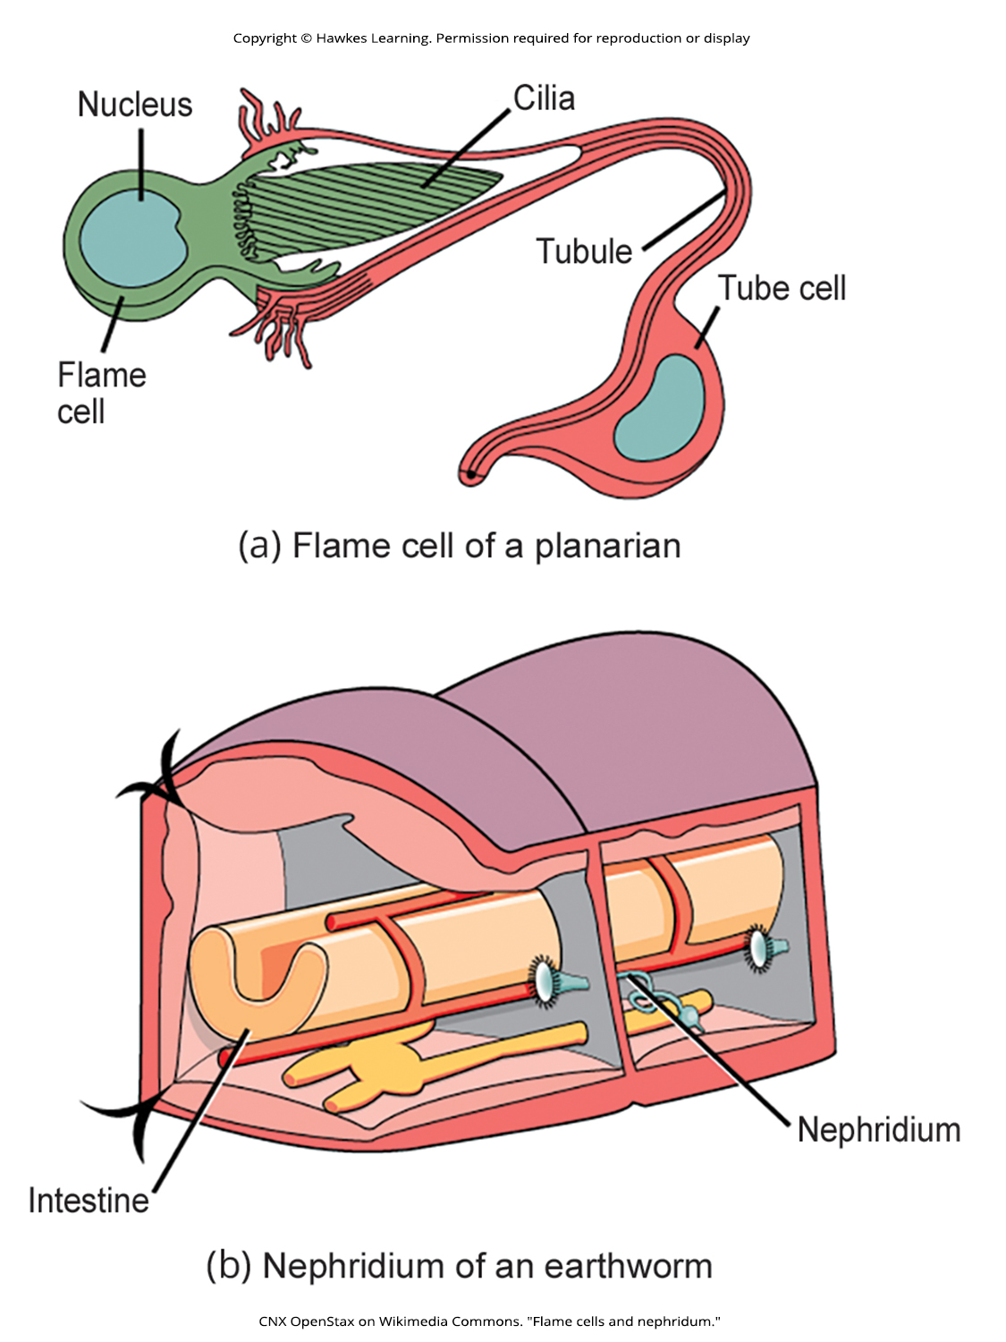
Lesson 38.3 Figure 2

Slide 17
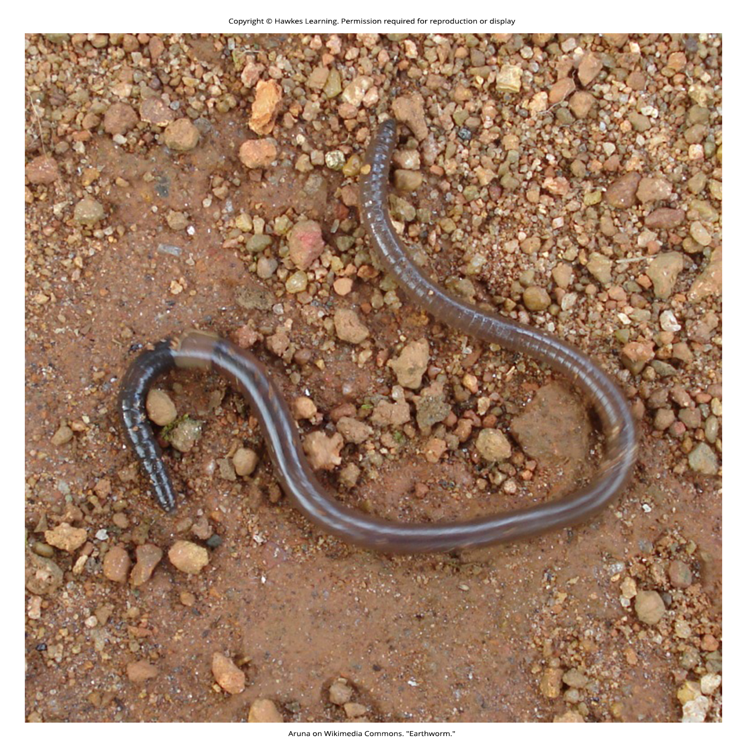
Lesson 38.3 Figure 3

Slide 18
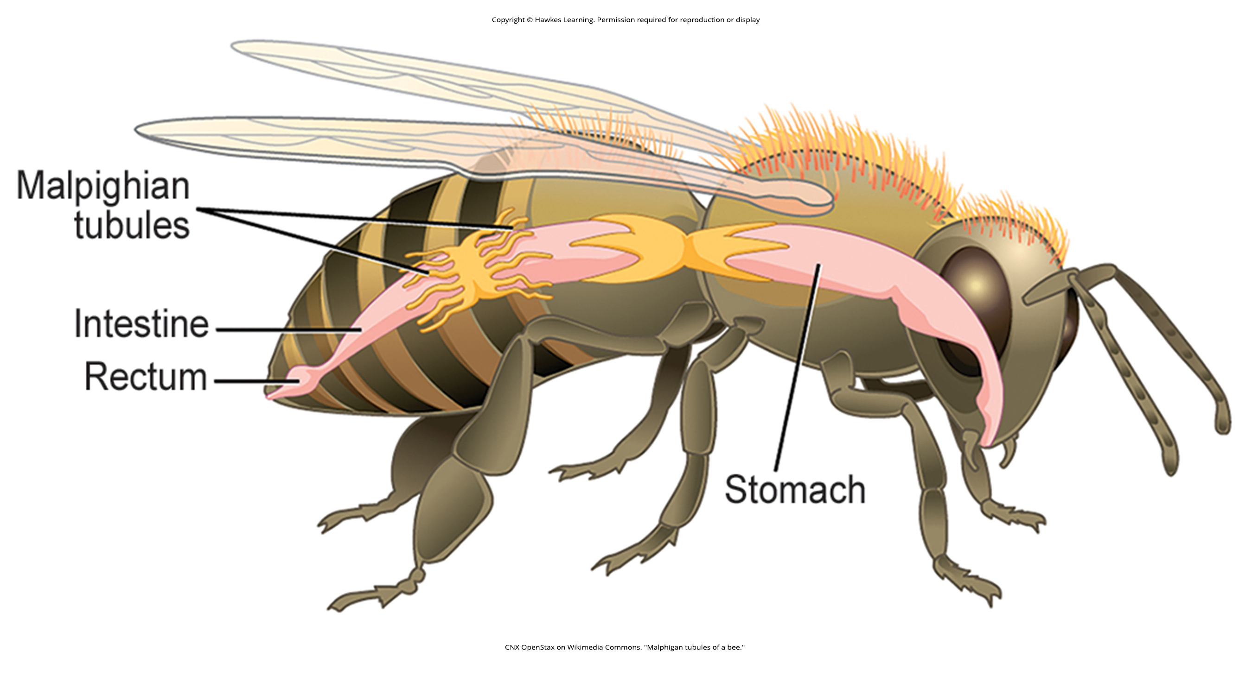
Lesson 38.3 Figure 4

Slide 19
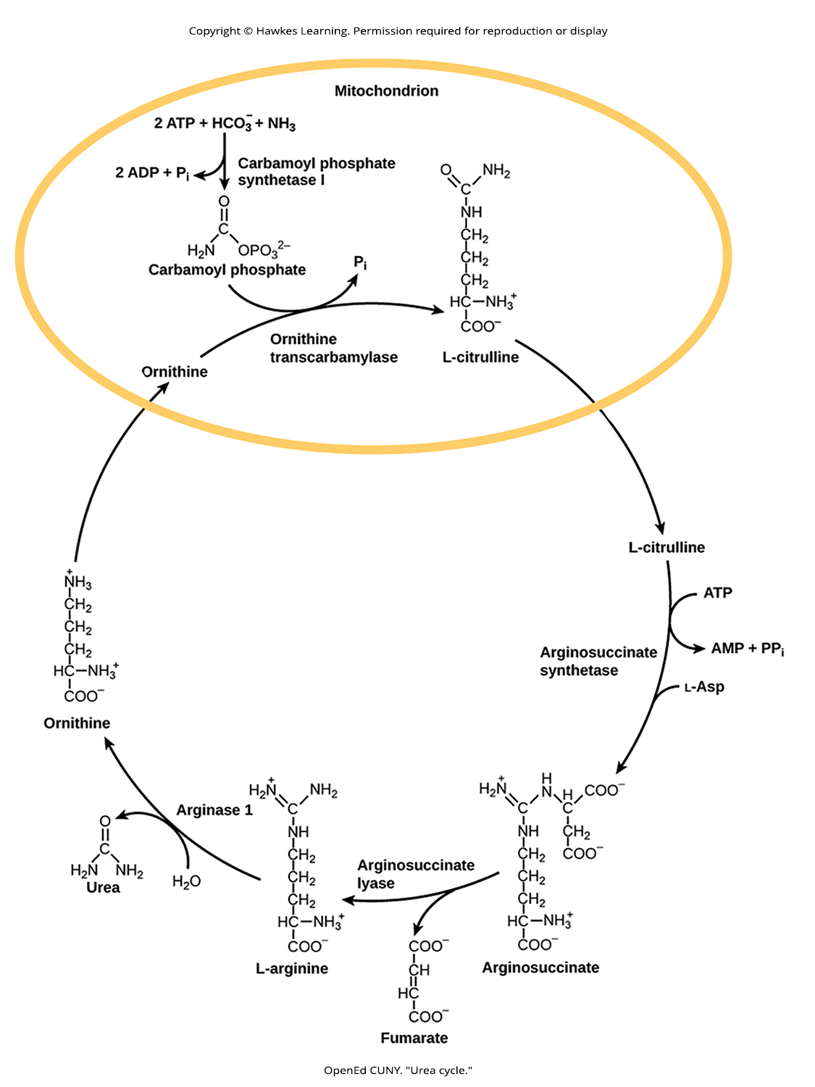
Lesson 38.3 Figure 5

Slide 20
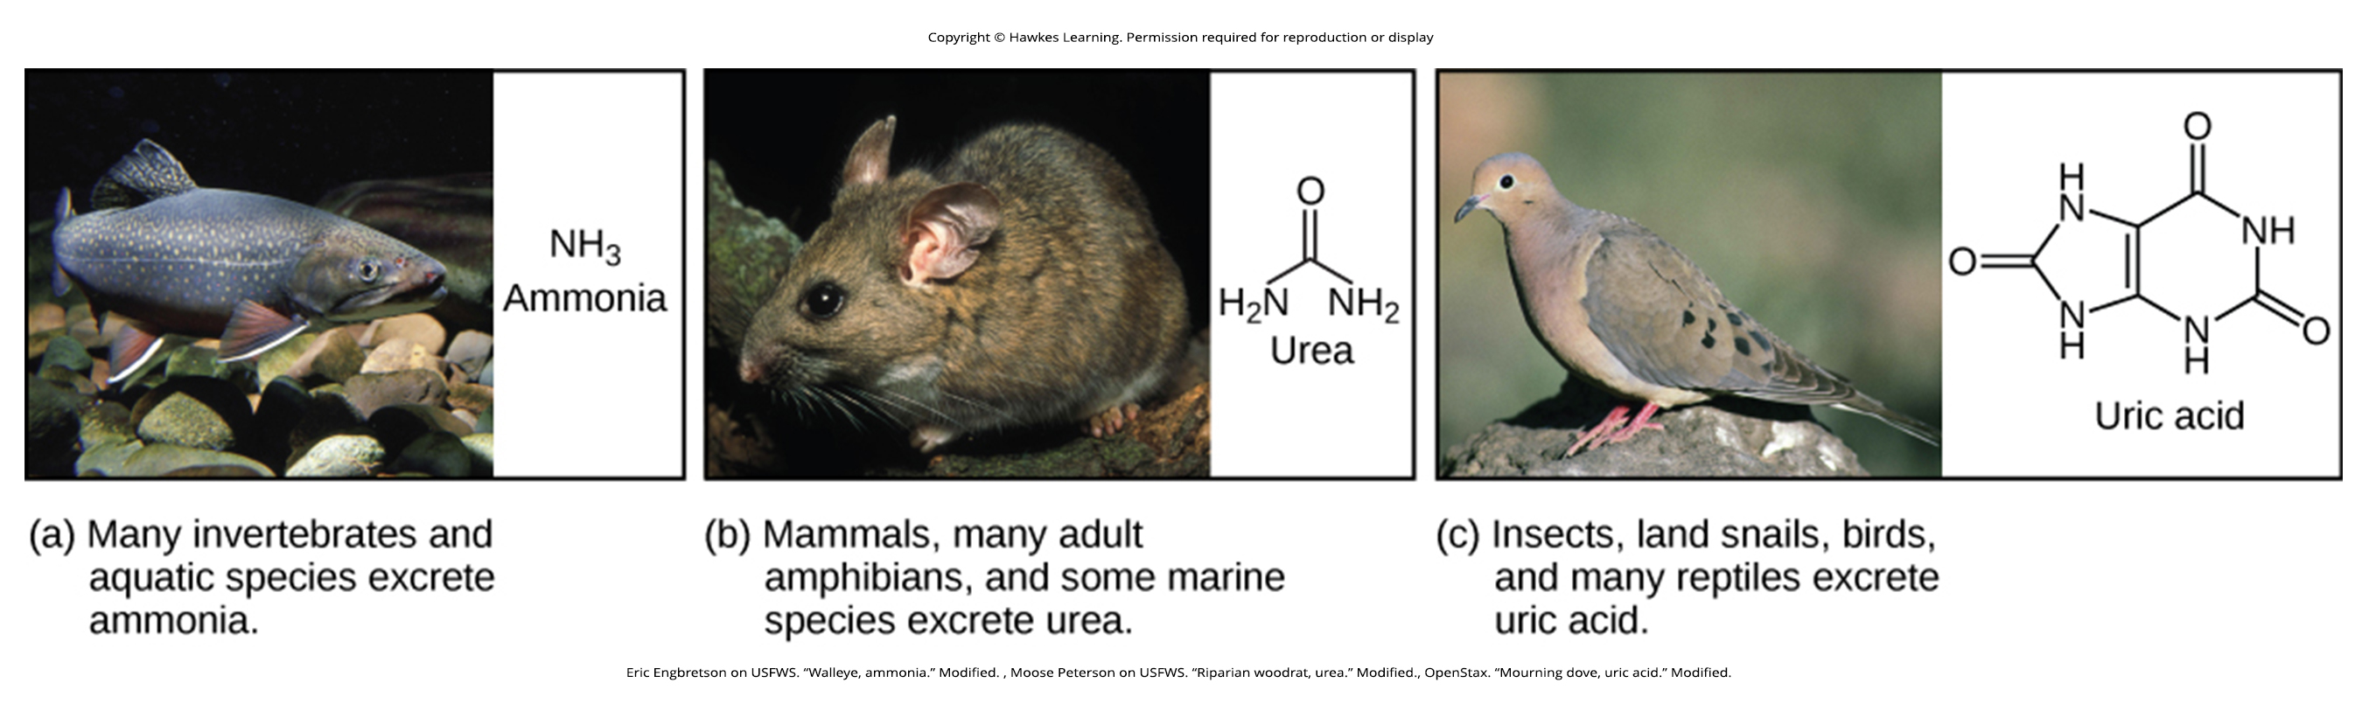
Lesson 38.3 Figure 6

Slide 21
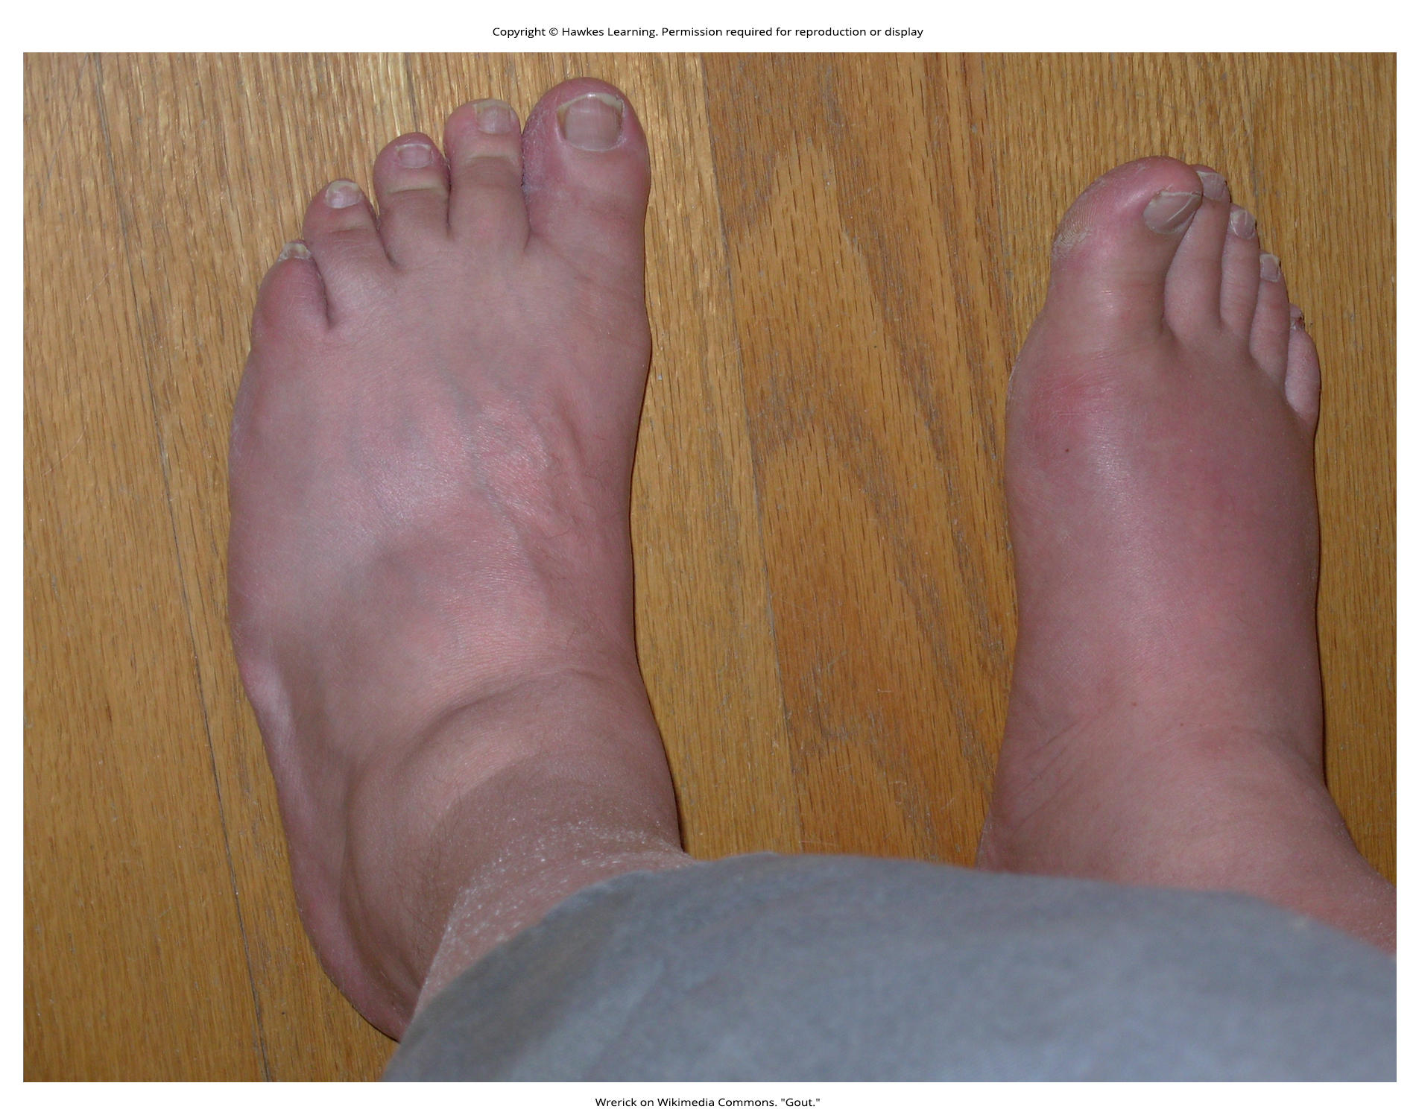
Lesson 38.3 Figure 7

Slide 22
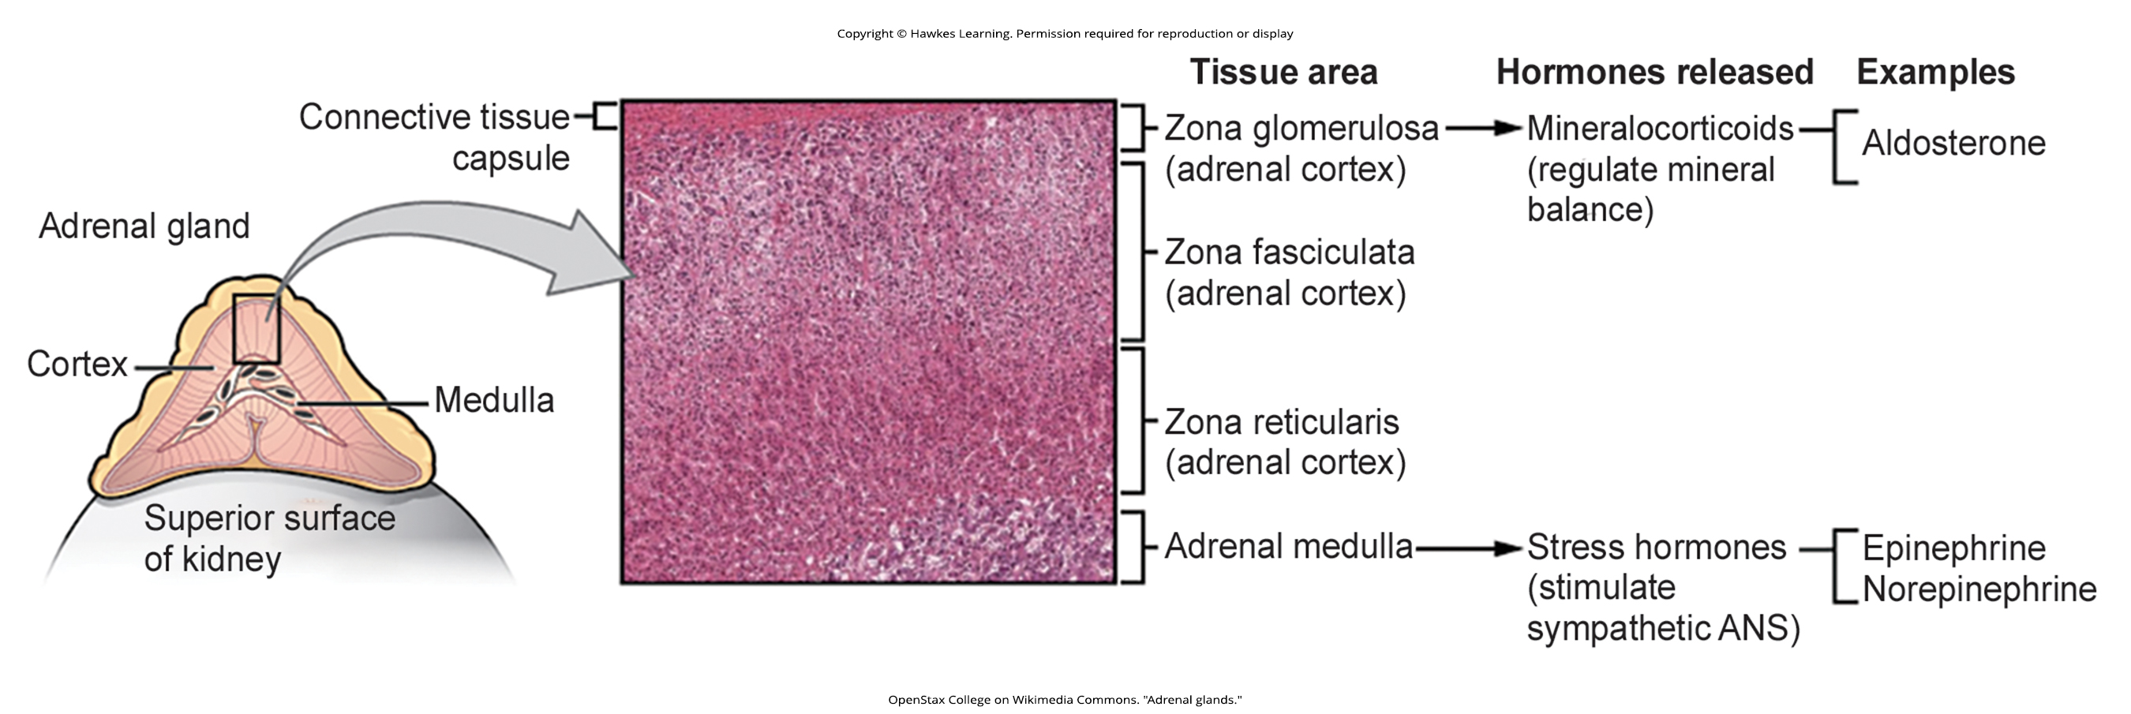
Lesson 38.4 Figure 1

Slide 23
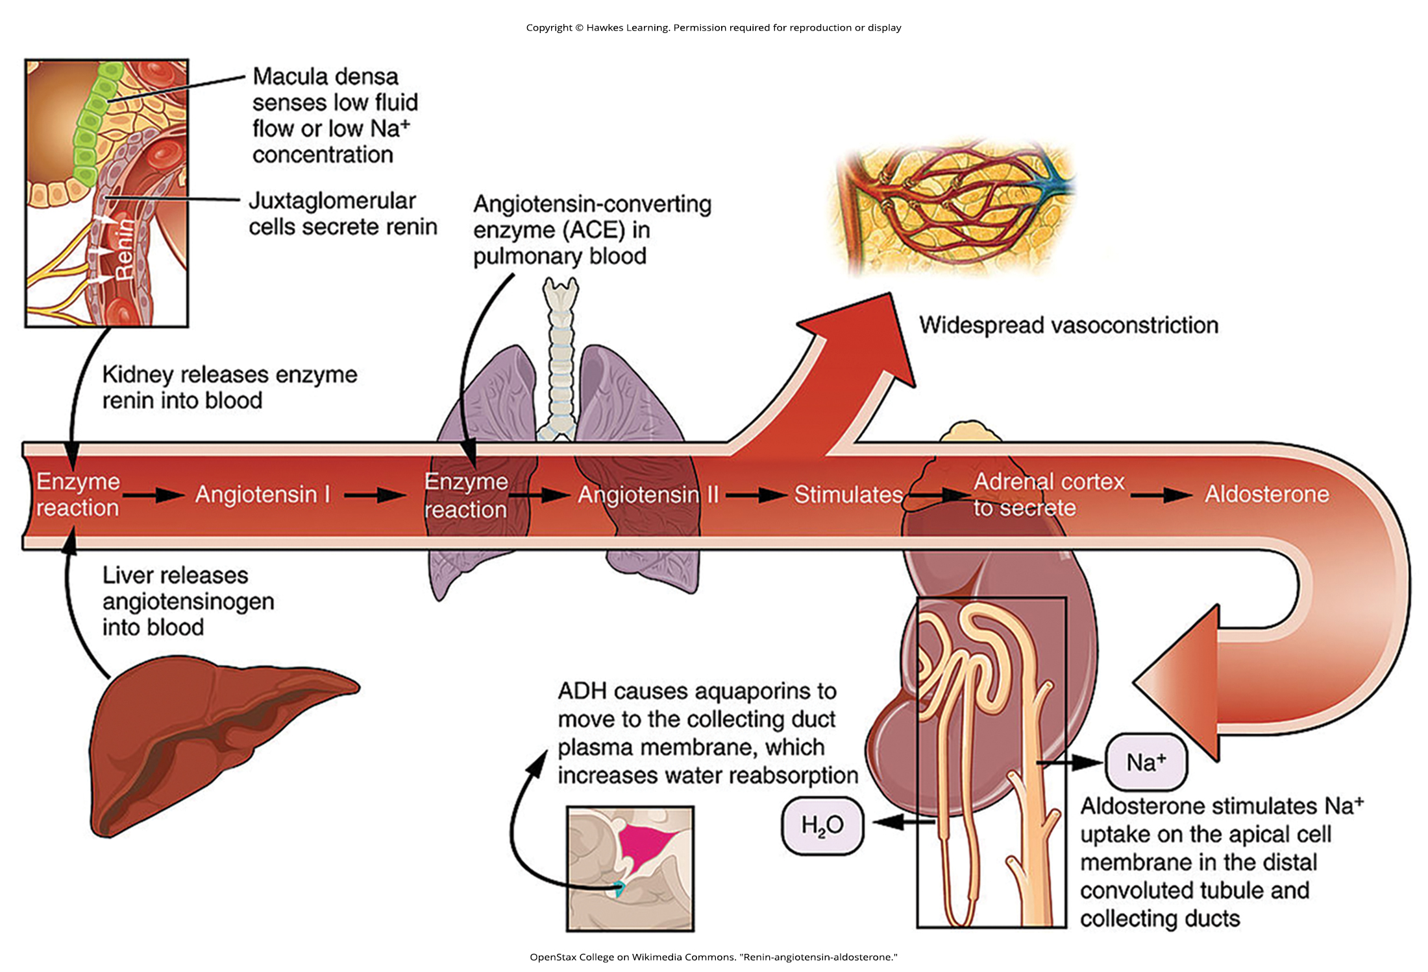
Lesson 38.4 Figure 2

Slide 24
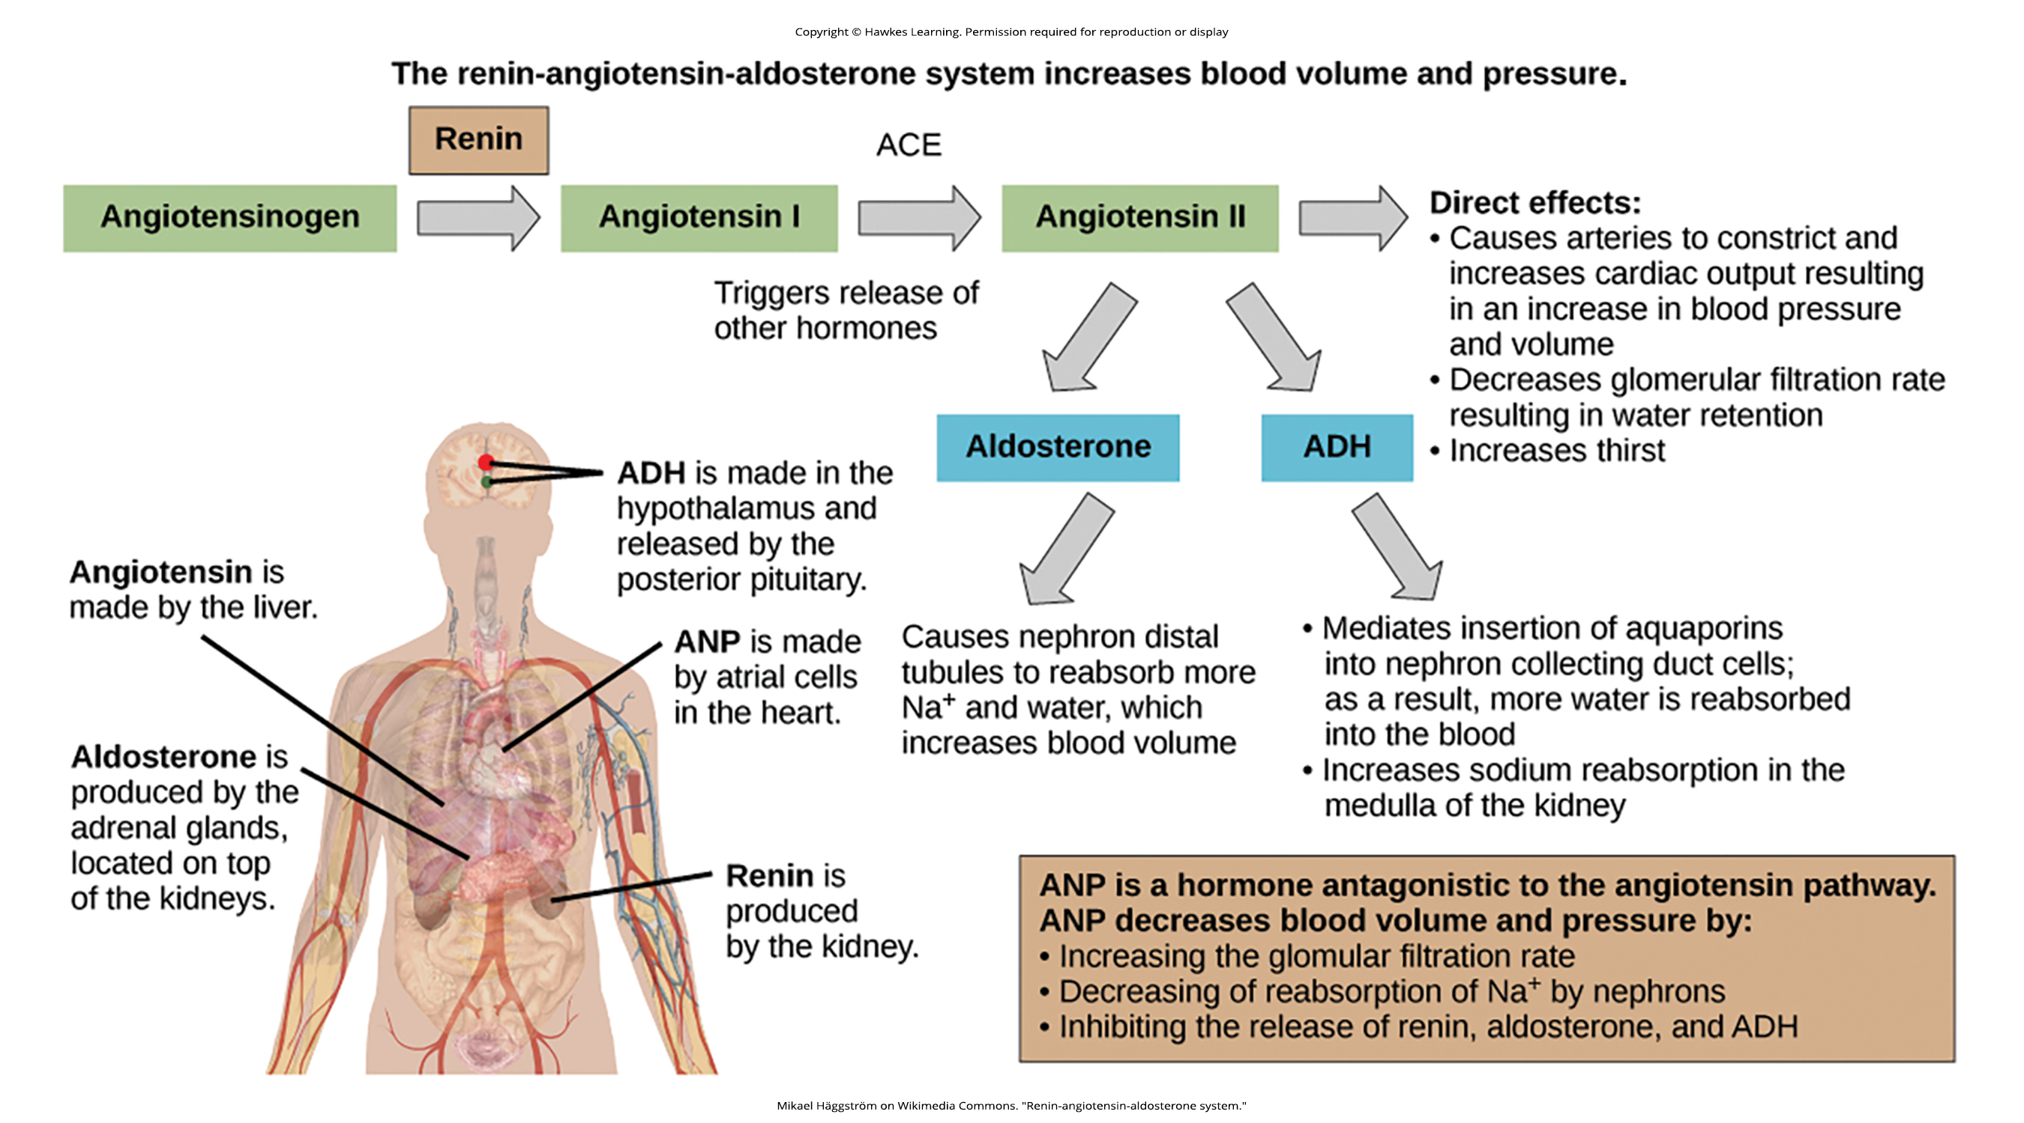
Lesson 38.4 Figure 3

Slide 25
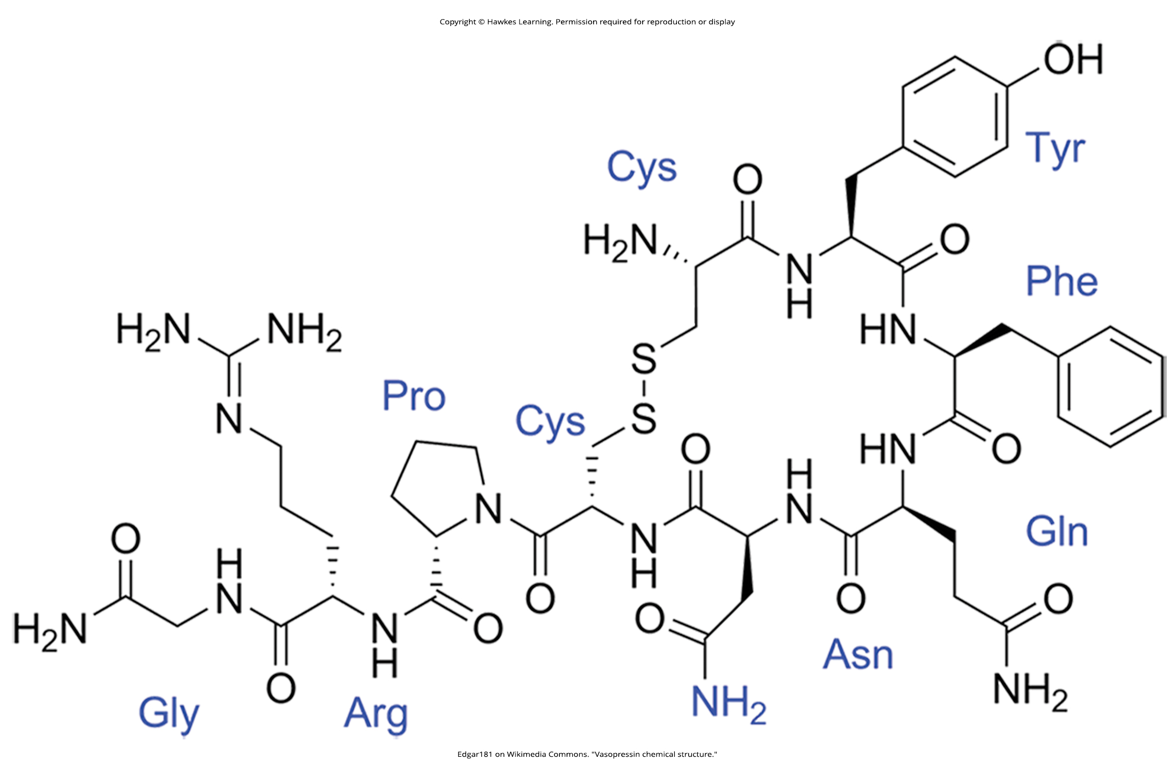
Lesson 38.4 Figure 4

Slide 26
Hawkes Learning – End of PowerPoint

